Slide 1
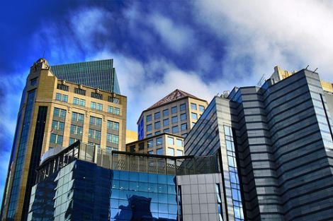
Real Estate Investment Trust
Presented by:
Cathy Wu
Nina Zheng
Kelly Kuo
Sybil Loo

Slide 2
Agenda
REITs Overview
RioCan REITs
H&R REITs
Calloway REITs

Slide 3
What is a REIT?
REIT stands for Real Estate Investment Trust
Founded in the United States in the 1960’s and was introduced in Canada in 1993 as publicly traded securities
Pools capital into real estate that is structured to generate regular distributions of cash
Investors are not directly investing in real estate property, they are investing in REIT units that are publicly traded
Notes:
A tax designation for a corporate entity investing in real estate designed to reduce corporate tax

Slide 4
REIT Structure
Trustee
Trustee Fees
Act on Behalf of Unitholders
REIT
Unitholder
Distributions
Property Income
Properties
Investment
Ownership
Management Services
Management Fees
Management

Slide 5
REIT Characteristics
REITs are income stocks because:
  It is an equity security that distributes at least 90% of its taxable income to investors in the form of regular dividends
  REIT regulations restrict or discourage “merchant building”
    The risky practice of developing properties and selling them immediately enhances earnings by continuously recycling capital on the balance sheet. However, performance assessment becomes difficult.
  Most REITs have limited liability
  In October, 2006, the Canadian government decided that the tax advantages available to SIFT trusts were "not appropriate", and implemented a new tax under the Tax Fairness Plan that made SIFT taxation similar to corporate taxation
Notes:
An equity security that pays regular, often steadily increasing dividends, and offers a high yield that may generate the majority of overall returns. While there is no specific breakpoint for classification, most income stocks have lower levels of volatility than the overall stock market, and offer higher-than-market dividend yields. Income stocks may have limited future growth options, thereby requiring a lower level of ongoing capital investment. The excess cash flow from profits can therefore be directed back toward investors on a regular basis.
REITs have been excluded from the income trust tax legislation passed in the 2007 budget by the Conservative government.
On December 16, 2010, the Department of Finance proposed amendments to the rules defining “Qualifying REITs” for Canadian tax purposes. As a result, “Qualifying REITs” are exempt from the new entity-level, “specified investment flow-through” (SIFT) tax that all publicly traded income trusts and partnerships are paying as of January 1, 2011.
What distinguishes REITs from other real estate companies is that a REIT must acquire and develop its real estate properties primarily to operate them as part of its own investment portfolio, as opposed to reselling those properties after they have been developed.
A tax implemented by the Canadian government on the distributions of a special type of Canadian income trust. SIFT trusts was a common business structure in Canada that provided beneficial tax advantages prior to 2006. They are actively managed and commonly used by businesses that essentially operate like corporations.
(meaning that the government was not collecting as much tax revenue as it wanted to)

Slide 6
REIT Characteristics
Dual market situation where two parallel markets exist for trading real estate
Stock market valuation of property (indirect market), and the private market valuation (direct market) are not always the same
Indirect market (REIT market) tends to lead the private market
When two markets disagree REITs can undertake positive NPV investments either by buying or selling in the private market
When the stock market values property more highly than private property market, REITs can grow merely by buying properties, and thus becoming growth stocks, at least temporarily
Notes:
REITs create a secondary market for trading real estate
Point 4: This causes a REIT to trade at a discount or premium to its Net Asset Value (NAV).

Slide 7
REIT Requirements
Features | U.S REITs | Canadian REITs
Governed By | Requirements of Internal Revenue Code | Self Imposed Trust Declaration and certain requirements of the Income Tax Act
Vehicle | Corporation, Trust, or Association | Open- or closed-ended mutual fund trust
Investors | Min 100 Investors. No more than 50% of units held by 5 or fewer individuals | Min 150 unit holders. Must be listed on a recognized Canadian Exchange
Revenue Rules | Min 75% of Gross Income must be from real estate related sources Min 95% must be from real estate related sources and passive income sources | For closed-end funds: Min 95% of income must be from disposition of, or income earned from qualifying investments.

Slide 8
REIT Requirements
Features | U.S REITs | Canadian REITs
Distributions | At least 90% of Taxable Income, excluding net capital gains | Set individually by the trust declaration. Usually 85-95% of distributable income
Taxation | Income is not taxed as long as it is distributed to investors. Income that is not distributed will be taxed at normal corporate rates. | Income is not taxed within the trust as long as it is distributed to unit holders.
Transfer of real estate to the REIT | Companies can move assets to the REIT on a tax deferred basis. | Limited ability to move assets to REIT on a tax deferred basis

Slide 9
Types of REITs
Equity REITs
  Invest in and own properties
  Revenues come principally from their properties' rents
Mortgage REITs
  deal in investment and ownership of property mortgages
  loan money for mortgages to owners of real estate, or invest in (purchase) existing mortgages or mortgage backed securities
  Revenues are generated primarily by the interest that they earn on the mortgage loans
Hybrid REITs
  combine the investment strategies of Equity REITs and Mortgage REITs by investing in both properties and mortgages
Notes:
Equity REITs
Equity REITS invest in and own properties (thus responsible for the equity or value of their real estate assets). Their revenues come principally from their properties' rents
Mortgage REITs
Mortgage REITs deal in investment and ownership of property mortgages. These REITs loan money for mortgages to owners of real estate, or invest in (purchase) existing mortgages or mortgage backed securities. Their revenues are generated primarily by the interest that they earn on the mortgage loans
Hybrid REITs
Hybrid REITs combine the investment strategies of Equity REITs and Mortgage REITs by investing in both properties and mortgages

Slide 10
REIT Attributes
Diversification
  Create asset portfolio that behave differently across market conditions
Reliable Income
  Consistent run of dividends since required by law
Inflation Protection
  Investing in commercial real estate provides a natural protection against inflation, as rents tend to increase when prices go up
Performance
  Offer strong long-term total returns
Liquidity
  Easily bought and sold on major stock exchanges
Transparency
  Tax transparency: no corporate tax in exchange for consistent dividends.
  Operating transparency: regulated (by SEC in the U.S.) and adheres to high standards of corporate governance, financial reporting and information disclosure.

Slide 11
Substitutes
Mutual funds
Stocks
Bonds
  But due to real estate having limited correlation to most other stocks and bonds, REITs provide one more layer of diversification

Slide 12
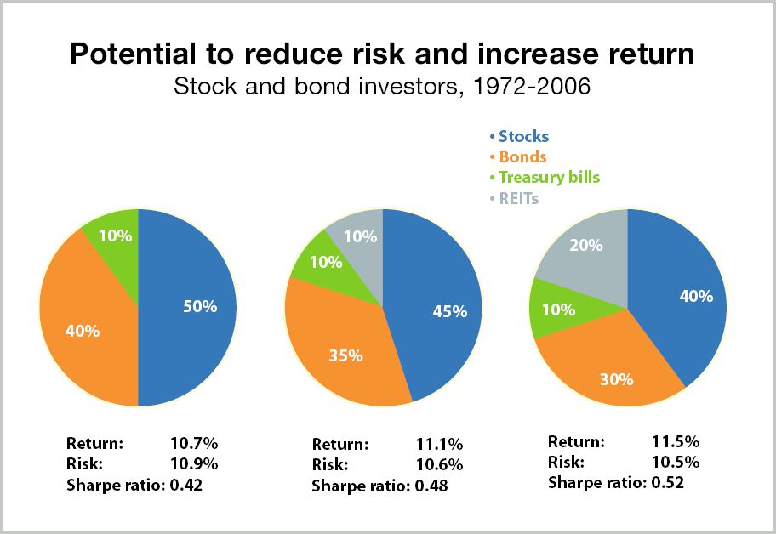
The Benefits of Diversifying

Slide 13
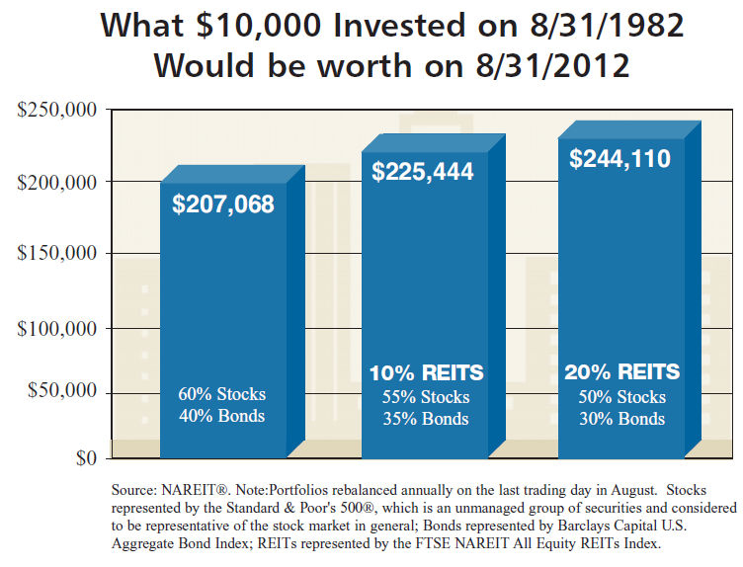
Notes:
For those who like numbers:
I know we weren’t born yet, (well, except for one maybe)… If you chose one of the following 3 avenues for investing your money; this is what it would look like.
Because REITs must pay out almost all of their taxable income to shareholders, investors have historically looked to REITs for reliable and significant dividends (typically four times higher than those of other stocks, on average).

Slide 14
REITs thrive in low-rate, low growth world
After being massacred in the 2008-09 market crash, REITs have been outstandingly good investments. The S&P/TSX Capped REIT Index is up 54 per cent on a cumulative basis over the past three years, roughly three times more than the broader market.
REITs hold portfolios of malls, industrial properties, offices, apartments, hotels or retirement homes. They typically pay out quarterly income to investors, with a significant portion coming from a return of capital. Income received as a return of capital isn’t taxed in the year it’s received, but it does reduce the adjusted cost base for an investment. This, in turn, may give you a larger capital gain when you sell.
The sharp declines in rates that came with the global financial crisis have been a huge help to REITs. The trusts have been able to borrow at historically cheap levels and refinance existing higher-cost debt. Low rates also help their interest coverage ratios, which is a measure of how easily a company can repay its debts.
Source: Garick, R. REITs thrive in low-rate, low growth world. Oct 12, 2012. Globe and Mail. Retrieved from: http://www.theglobeandmail.com/globe-investor/investment-ideas/reits-thrive-in-low-rate-low-growth-world/article4609700/

Slide 15
Structured for Stability
Conservative leverage – the Declaration of Trust sets out a maximum debt capacity for the REIT
Professional management – investors benefit from professional management of the portfolio and the underlying properties – often a hybrid of asset management acumen and industry specific operational expertise
Regulatory requirements – similar to any public company, REITs are required to comply with securities legislation and the rules of the applicable stock exchanges including those of continuous disclosure, insider trading and the sale of units.
Board of Trustees – in keeping with the principles of good corporate governance, the Board of Trustees governs the operations of the REIT, approving key decisions such as change in management, acquisitions and dispositions, the assumption or granting of mortgages and the granting of options under an option plan
Steady distributions – REITs are required to distribute virtually all distributable income to unitholders. Monthly or quarterly distributions are intended to be steady and increasing over time as the REIT and its profitability grow. Yields are typically more attractive than on debt investments

Slide 16
Tax Fairness Plan
  Applicable to all Canadian trusts companies that begin trading after Oct. 31, 2006, except qualified REITs.
  At no time in the year hold any non-portfolio property other than real properties situated in Canada
  Must have at least 95% of its income for the year from properties
  Have more than 75% of its income to be directly or indirectly
  attributable to rents from, mortgages on, or gains from the disposition of real properties situated in Canada
  Hold throughout the year real properties situated in Canada, cash, and debt or other obligations of governments in Canada with a total fair market value that is not less than 75% of its equity value.

Slide 17
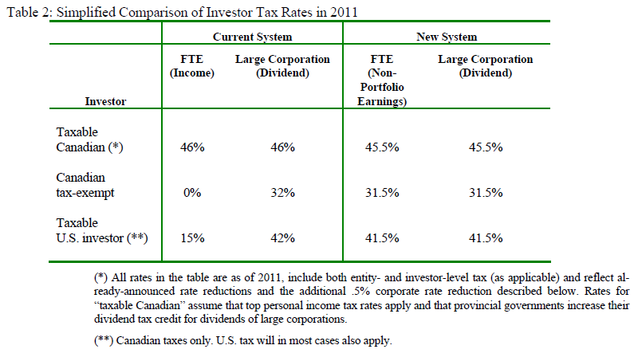
The Government’s solution: continuing the Tax Fairness commitment
  These changes will take effect beginning with the 2007 taxation year for trusts that begin to be publicly- traded after October 2006, but will only apply beginning with the 2011 taxation year for those FTEs that are already publicly-traded.
  Source: Department of Finance, Canada

Slide 18
Market Size
U.S.A
  165 equity REITs listed on major exchanges
  Market capitalization of US $580 billion
Canada
  31 REITs listed on TSX
  Market capitalization of $21.64 billion
Notes:
About 200 billion 3 years ago – extremely high growth

Slide 19
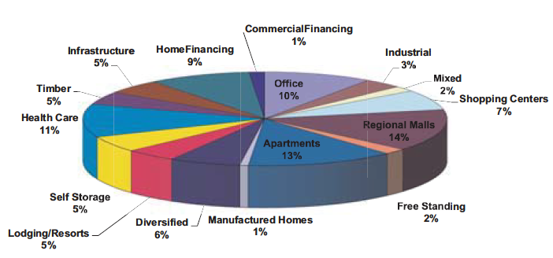
REITs Invest in All Property Types (USA)
Listed REITs as of July 31, 2012
Source: NAREIT

Slide 20
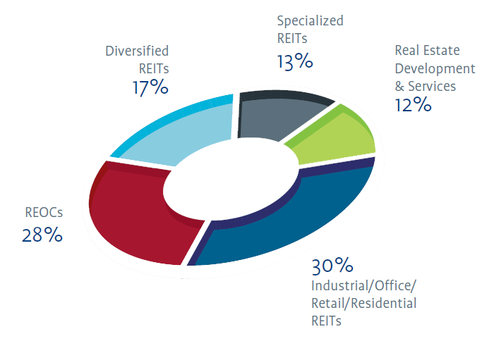
In Canada
Source: Retrieved from: http://www.tmx.com/en/pdf/RealEstate_listing.pdf

Slide 21
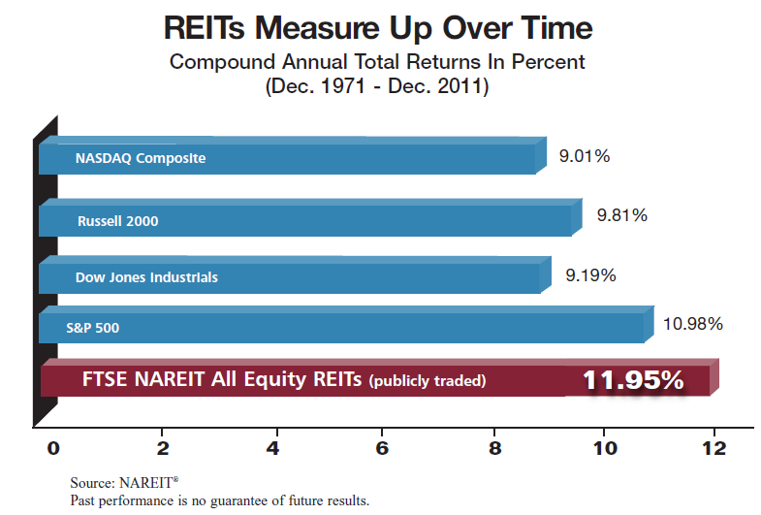

Slide 22
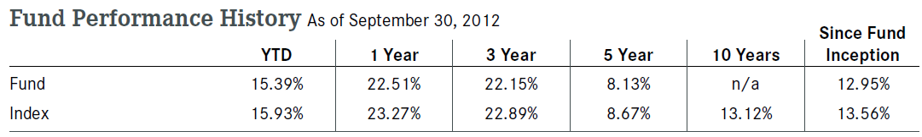
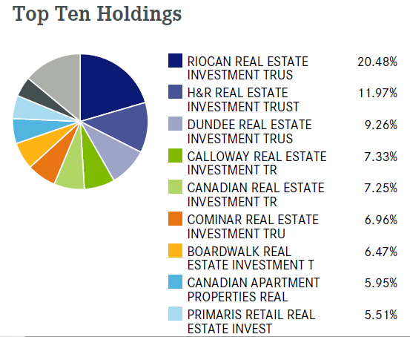
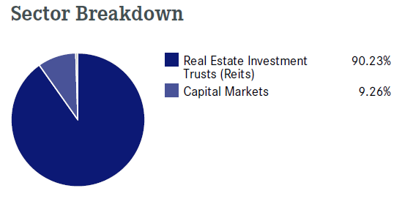
iShares S&P/TSX Capped REIT Index Fund
Notes:
XRE seeks to provide LT capital growth by replicating, to the extent possible, the performance of S&P/TSX Capped REIT Index through investments in the constituent issuers of such index, net of expenses

Slide 23
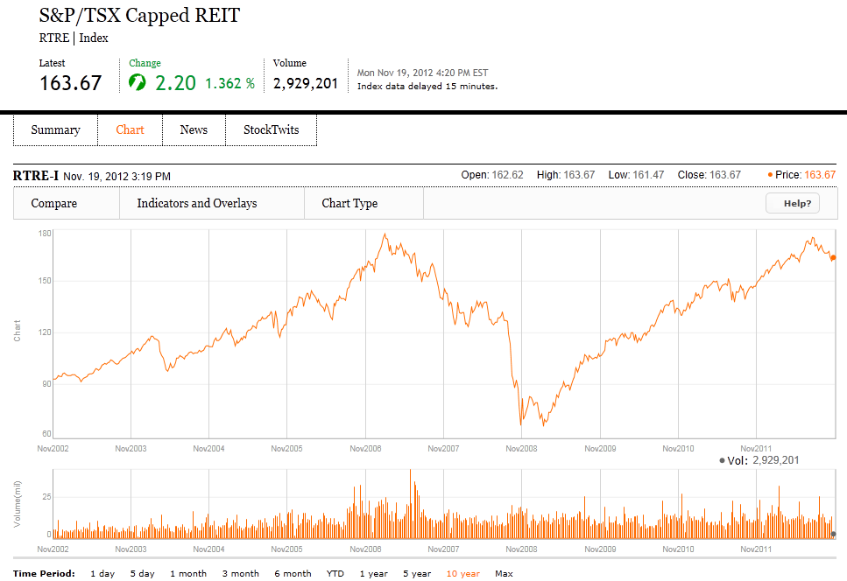
REIT Historical Performance

Slide 24
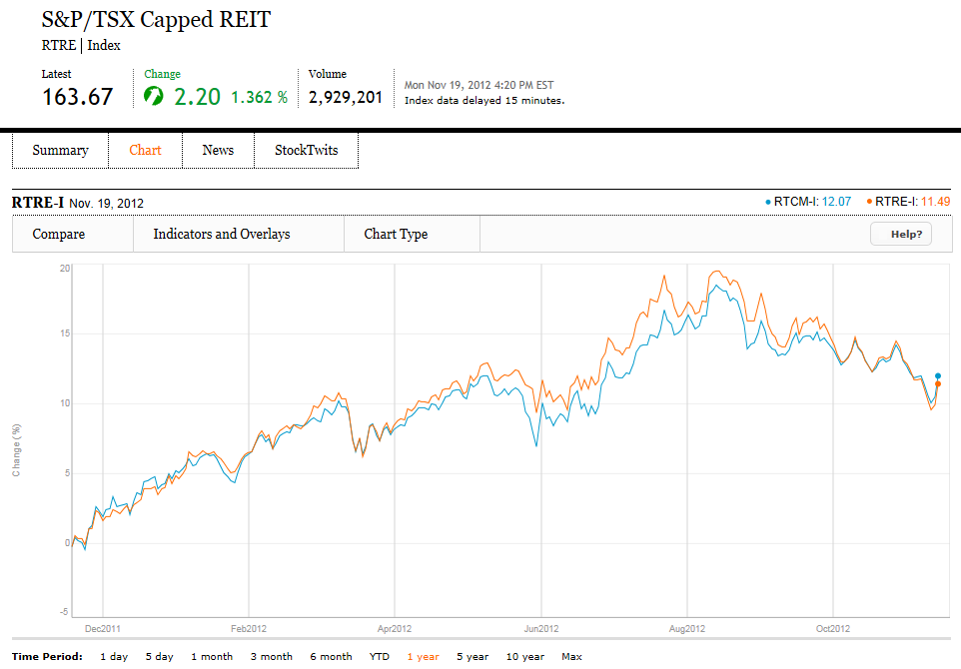
1 Yr REIT Index vs. Income Trust Index

Slide 25
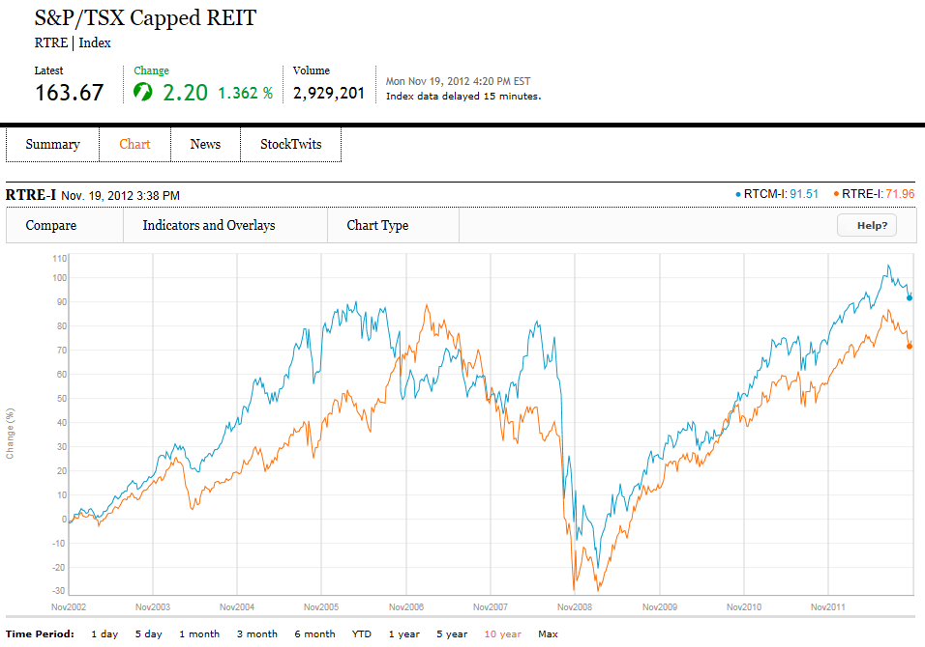
10 Yr REIT Index vs. Income Trust Index

Slide 26
Canadian REITs Market Cap

Slide 27
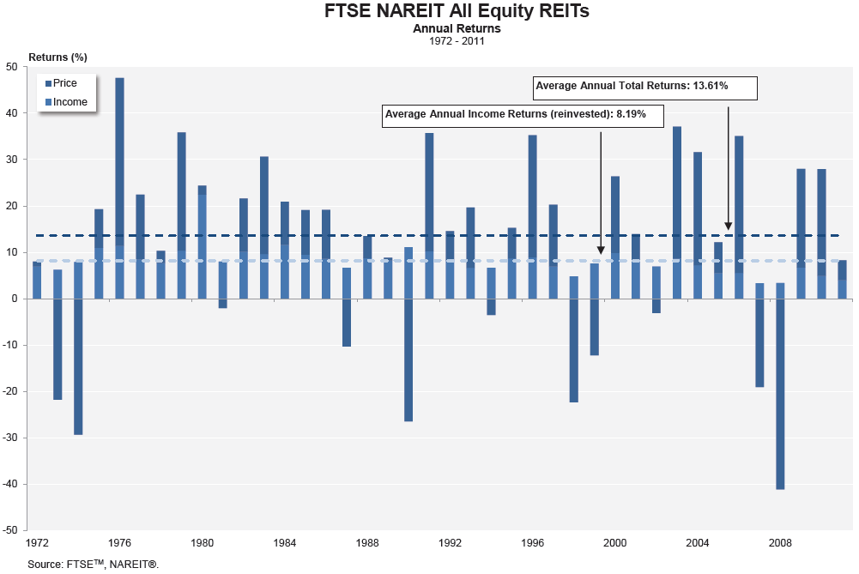

Slide 28
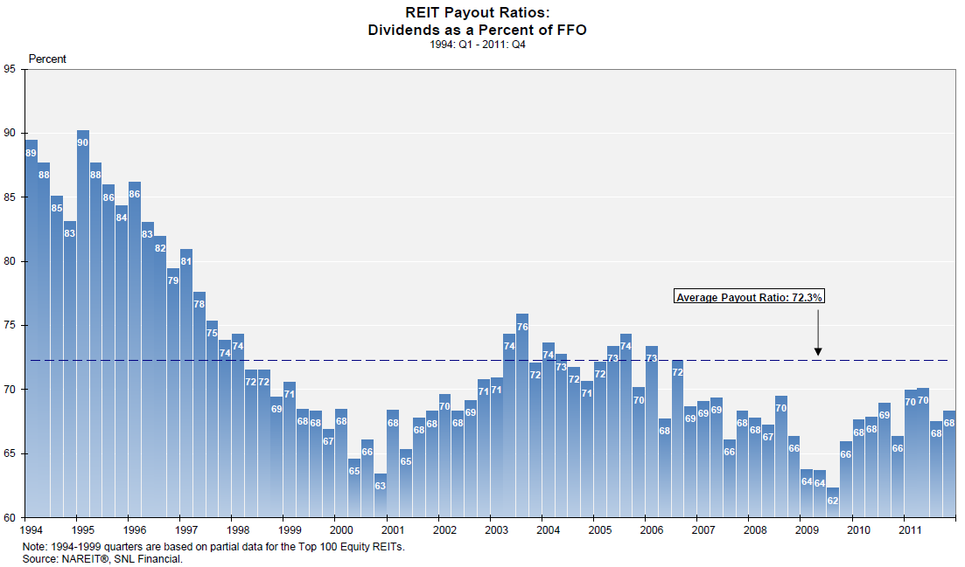

Slide 29
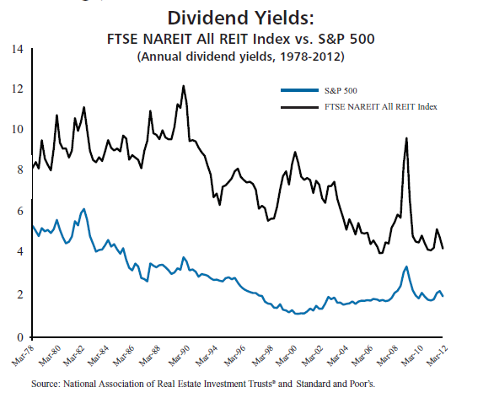

Slide 30
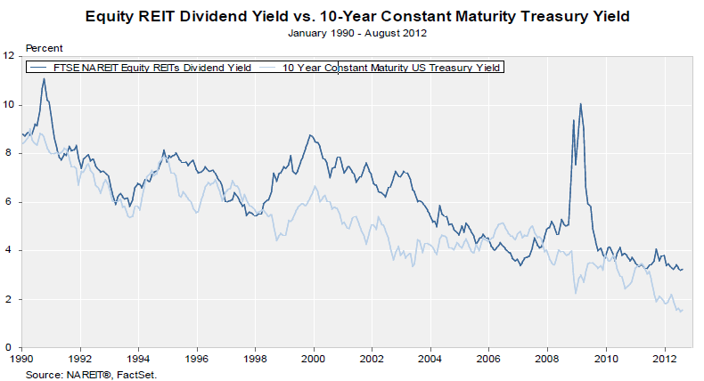

Slide 31
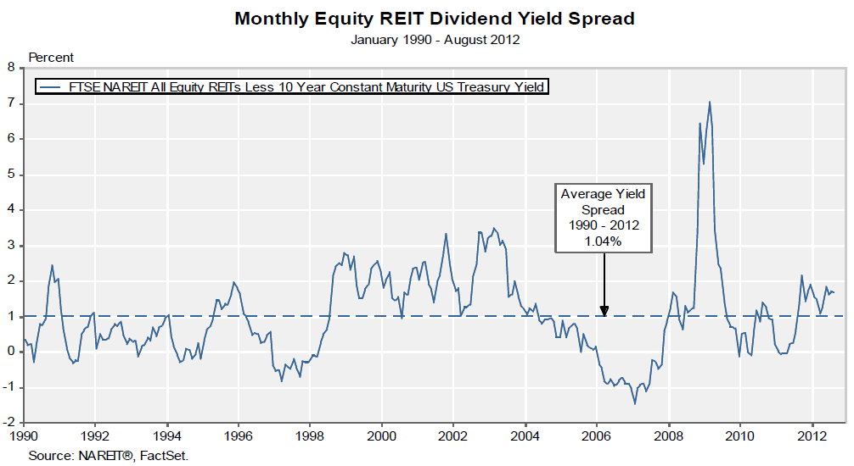

Slide 32
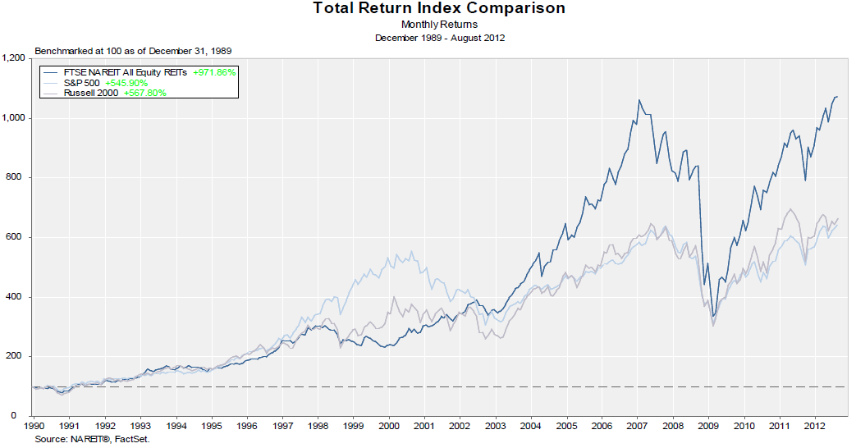

Slide 33
Factors to Consider
Management Expertise
Net Asset Value per Share
Portfolio Diversification
Strong Growth Prospects
  Access to funding
Low Leverage
  Interest Coverage Ratio
  % Long term debt to Capitalization
Earnings available for distribution
  FFO, AFFO (or FAD) instead of Net Income
Cash Distribution to Unitholders
  FFO or AFFO Payout Ratio

Slide 34
Measuring Performance
Net income (NI) – not the best measure largely due to depreciation allowance
Funds from operations (FFO) – closer to economic truth but ignores capital improvements
Funds available for distribution (FAD) – cash flow available to share holders if there is no change in working capital or no new debt
Free cash flow (FCF) – this is REIT’s true operating cash flow

Slide 35
Net Income
Real estate revenue
- Real estate expense
- Depreciation & amortization of real estate
= Income from real estate
+ Other Income
- General and administrative expense
= Net Income per GAAP

Slide 36
Funds from Operation
Net income per GAAP
- Gains from sale of real estate
= Adjusted net income
+ Depreciation and amortization of real estate
= Funds From Operation
A figure used by real estate investment trusts (REITs) to define the cash flow from their operations
Intended to compensate for accounting methods (eg: depreciation) that may distort a real estate investment trust's true performance

Slide 37
Adjusted Funds From Operations
AFFO per unit is calculated by adjusting FFO from straight line and market rent adjustments, non-cash compensation expenses, actual costs incurred for capital expenditures and leasing costs for maintaining infrastructures and current lease revenues
In short, it adjusts for recurring spending the company does to maintain the quality of its underlying real estate assets.

Slide 38
Funds Available for Distribution
Funds from operation
+ Rent adjustments
- Capital improvements
= Funds Available for Distribution
Also called “Cash Available for Distribution (CAD)”, which measures cash that is available to be distributed as dividends to unit holders.

Slide 39
Free Cash Flow
Funds available for distribution
- Real estate acquisitions (new investments)
- Changes in working capital
- Principal payments
+ New debt issue
+ Gain on sale of real estate
+ New equity issue
= Free Cash Flow to Equity

Slide 40
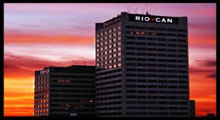

Rio Can Real Estate Investment Trust

Slide 41
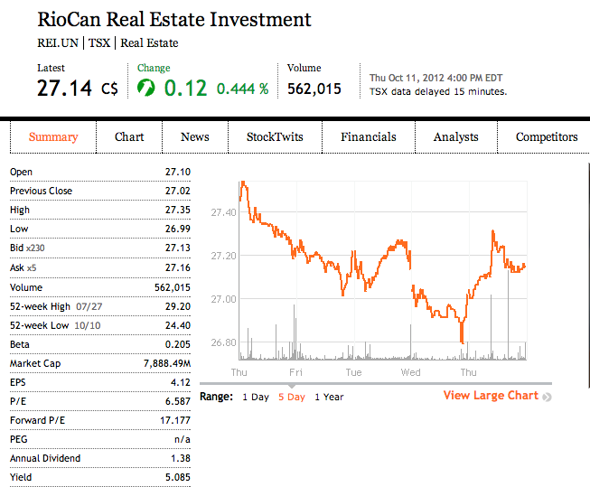
Security Snapshot
Notes:
Two companies could generate the same EPS number, but one could do so with less equity (investment) - that company would be more efficient at using its capital to generate income and, all other things being equal, would be a "better" company. Investors also need to be aware of earnings manipulation that will affect the quality of the earnings number. It is important not to rely on any one financial measure, but to use it in conjunction with statement analysis and other measures.
Find benchmark of yield

Slide 42
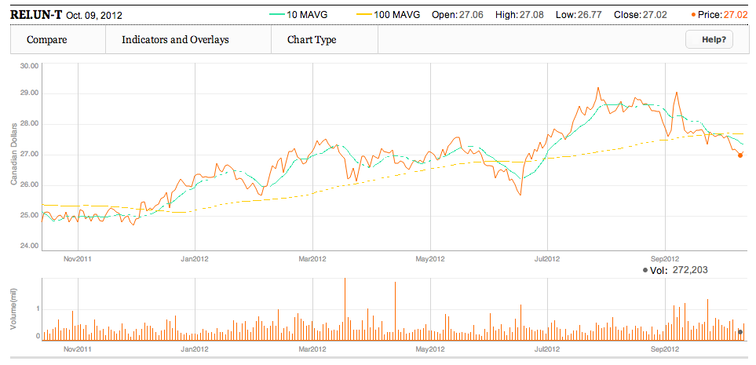
1 Year Chart and Moving Average at
10 & 100
Peak: $29.20
Announcement of the acquisition of Georgian Mall
Notes:
Highest point : 29.20 in july 25 , 2012
July 26: the announcement of the acquisition of Georgian Mall in Barrie, Ontario
Lowest point : 25.72 in June 14, 2012
June 15 :At maturity on June 15, 2012, the Trust redeemed the $100 million Series H debentures with a coupon rate of 4.70%, in accordance
with their terms.

Slide 43
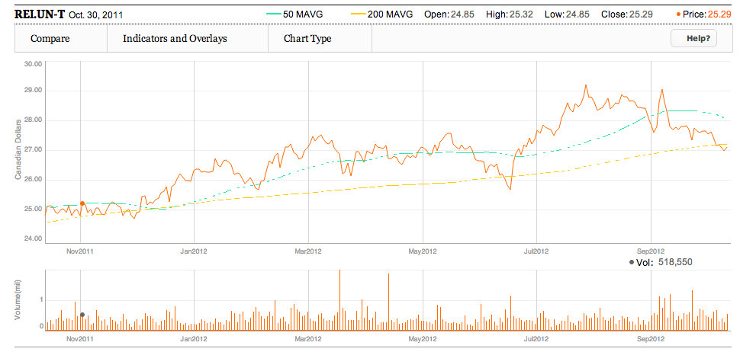
1 Year Chart and Moving Average at
50 & 200

Slide 44
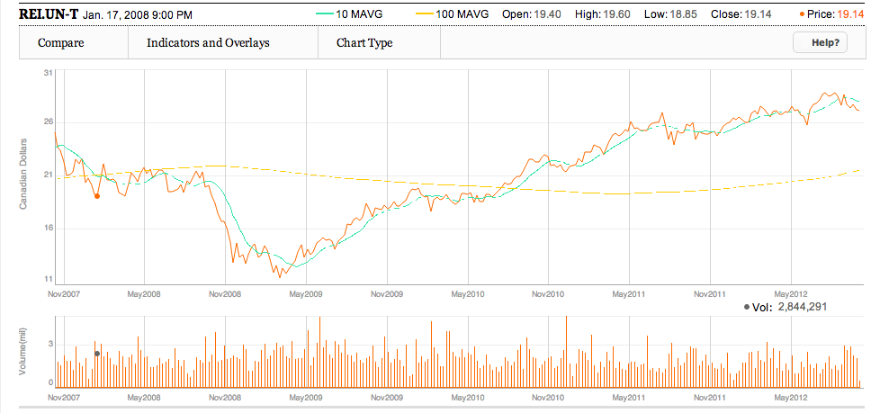
5 Year Chart and Moving Average at
10 & 100
Financial crisis in 2008

Slide 45
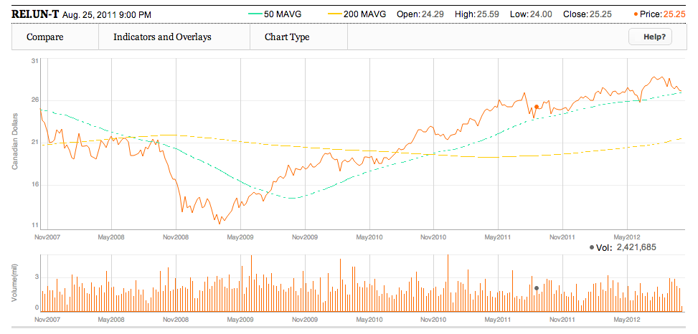
5 Year Chart and Moving Average at
50 & 200
Notes:
DECEMBER 2008: Global financial crisis … subprime
The 2008–2012 global recession, sometimes referred to as the late-2000s recession, the Great Recession,^{[1]} the Lesser Depression,^{[2]}or the Long Recession,^{[3]} is a marked global economic decline that began in December 2007 and took a particularly sharp downward turn in September 2008. The global recession affected the entire world economy, with higher detriment in some countries than others.
The financial crisis of 2007–2008, also known as the global financial crisis and 2008 financial crisis, is considered by many economists to be the worst financial crisis since the Great Depression of the 1930s.^{[1][2]} It resulted in the threat of total collapse of large financial institutions, the bailout of banks by national governments, and downturns in stock markets around the world. In many areas, the housing market also suffered, resulting in evictions, foreclosures and prolonged unemployment. The crisis played a significant role in the failure of key businesses, declines in consumer wealth estimated in trillions of US dollars, and a downturn in economic activity.

Slide 46
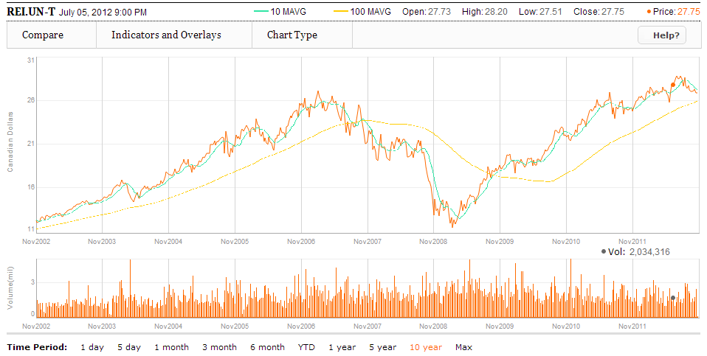
10 Year Chart and Moving Average at
10 & 100

Slide 47
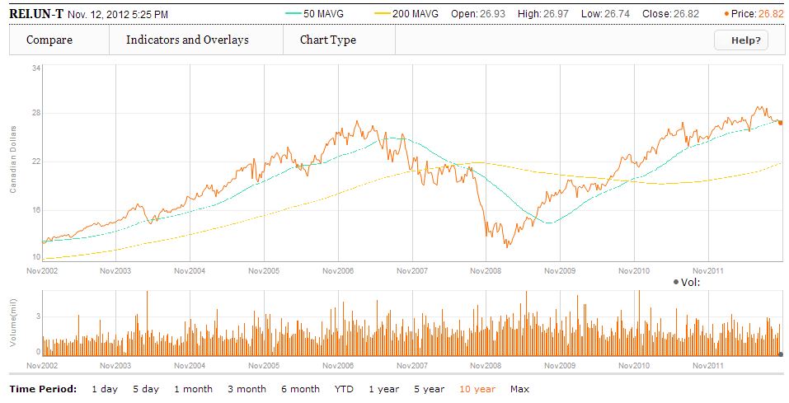
10 Year Chart and Moving Average at
50 & 200

Slide 48
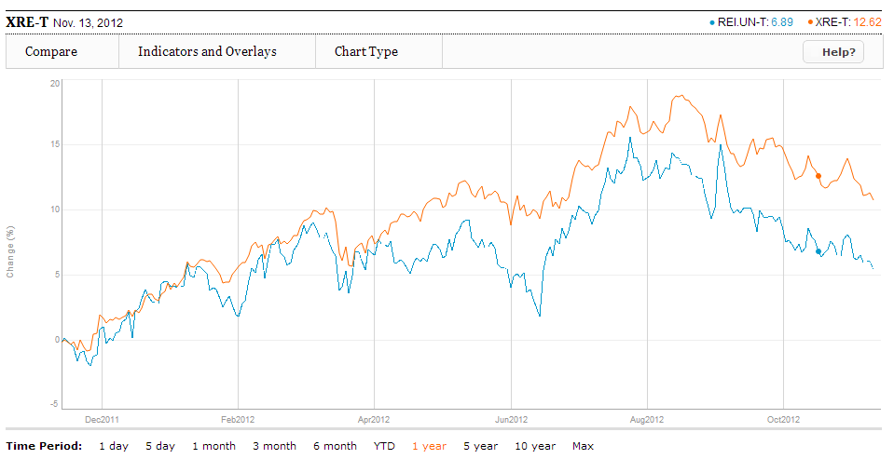
1 Year RIO CAN V.S. iShare S&P TSX Capped REIT
Notes:
June 15 :At maturity on June 15, 2012, the Trust redeemed the $100 million Series H debentures with a coupon rate of 4.70%, in accordance
with their terms.

Slide 49
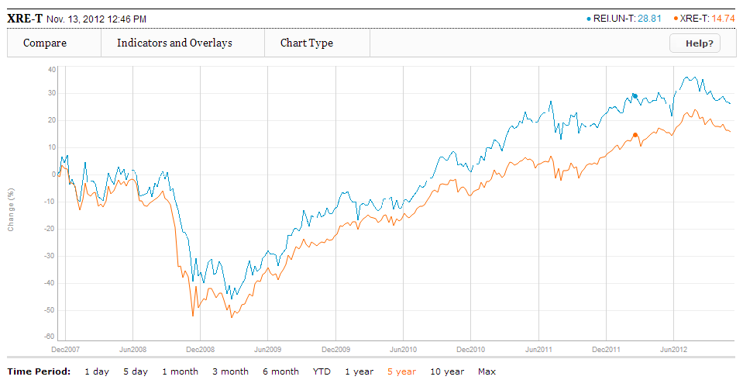
5 Year RIO CAN V.S. iShare S&P TSX Capped REIT
Consistent with the trend of index

Slide 50
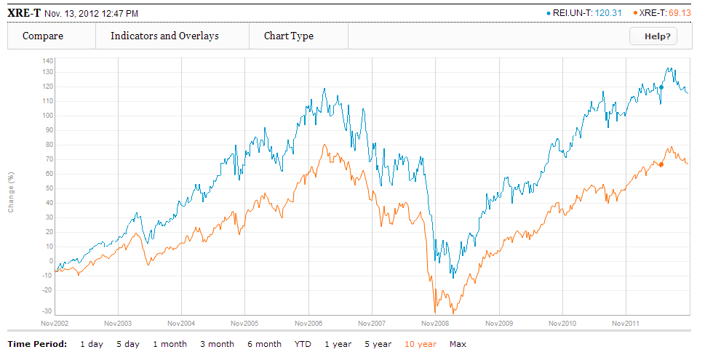
10 Year RIO CAN V.S. iShare S&P TSX Capped REIT
Consistent with the trend of index

Slide 51

Company Overview
Canada’s largest real estate investment trust with approximately $8.5 billion market capitalization and $13.9 billion enterprise value
Approximate 86% revenue generated by national and anchor tenants ; and approximate 7350 tenants
Its portfolio includes in retail and office assets
Manage Canada’s largest portfolio of shopping center
A portfolio of 338 retail properties, including 10 under development, in Canada and U.S.
Notes:
In September 2012, RioCan announced that it had entered into an agreement to dissolve its joint
venture agreement with Cedar, which was dissolved subsequent to the quarter end, on October 10, 2012. As a result, RioCan
acquired Cedar’s 20% interest in 21 of the properties in the venture and sold RioCan’s 80% interest in one property to Cedar

Slide 52
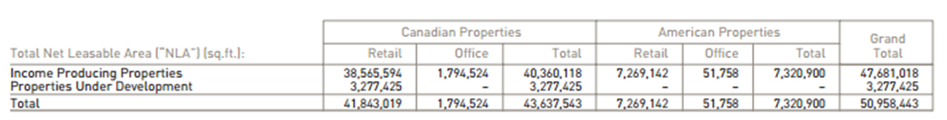
Company overview
The weight of Canadian and U.S. portfolio based on NLA of the total portfolio and annualized rental revenue

Slide 53
Company Overview
Core strategy : ownership and management of retail properties
  New format retail center
    aggregations of dominant retailers grouped together at high traffic and easily accessible locations.
  Neighborhood convenience unenclosed centers
    supermarket and/or junior department store anchored shopping centres
  Enclosed shopping centres
    located close to or in larger population centers
  Urban retail properties
    high-quality, innovative, multi-level format retail centres located in major urban markets ; including office space and/or a residential component as part of the property.
  Outlet shopping centres

Slide 54
Occupancy since 1996
Historical Occupancy Rates 1996 to Q3 2012
Notes:
Stable occupancy rate

Slide 55
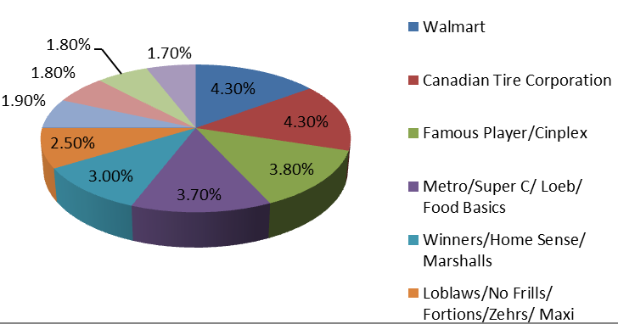
Top 10 RioCan Tenants
Based on annualized rental revenue as at September 30, 2012

Slide 56
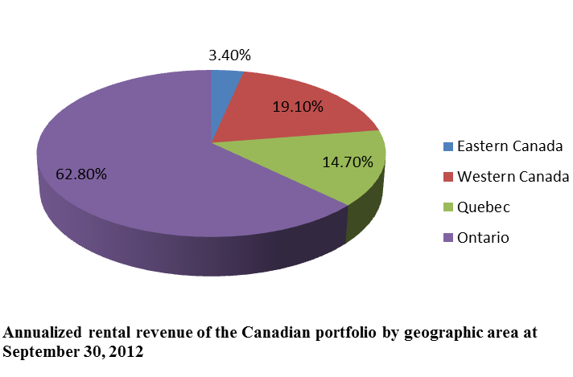
Geographical diversification
Canada Portfolio
US Portfolio

Slide 57
U.S. Portfolio
Portfolio focus on grocery anchored strip retail
Focus portfolio in Northeastern US and Texas
Has gained significant knowledge of local market and assets since its original investment into US in 2009
Aligns with experienced partners
49 shopping centres, predominantly grocery anchored and new format retail centres
44 centere held through five joint venture arrangement
Notes:
Included in RioCan’s portfolio, as of September 30, 2012, are 49 shopping centres, predominantly grocery anchored and new
format retail centres that are located in the US, primarily held through five joint venture arrangements (44 centres), as well as
through outright ownership (5 centres). RioCan’s primary joint venture arrangements are with Retail Properties of America, Inc.
(formerly Inland Western Retail REIT) (“RPAI”), Kimco Realty Corporation (“Kimco”), Dunhill Partners, Inc. (“Dunhill”) and the
Sterling Organization LLC (“Sterling”). In September 2012, RioCan announced that it had entered into an agreement to dissolve its
joint venture agreement with Cedar Realty Trust (“Cedar”), and on October 10, 2012 the joint venture with Cedar was dissolved. As
a result, RioCan acquired Cedar’s 20% interest in 21 of the properties in the joint venture and sold RioCan’s 80% interest in one
property to Cedar. RioCan continues to own an approximately 13% equity interest in Cedar, which is listed on the NYSE (CDR).
RioCan intends to dispose of the shares over time, as market conditions permit

Slide 58
U.S. Portfolio
Main US joint venture:
  Retail Properties of America, Inc.(formerly Inland Western Retail REIT) (“RPAI”),
  Kimco Realty Corporation (“Kimco”),
  Dunhill Partners, Inc. (“Dunhill”)
  Sterling Organization LLC (“Sterling”).
On 0ctober 10, 2012: joint venture with Cedar was dissolved
Notes:
Included in RioCan’s portfolio, as of September 30, 2012, are 49 shopping centres, predominantly grocery anchored and new
format retail centres that are located in the US, primarily held through five joint venture arrangements (44 centres), as well as
through outright ownership (5 centres). RioCan’s primary joint venture arrangements are with Retail Properties of America, Inc.
(formerly Inland Western Retail REIT) (“RPAI”), Kimco Realty Corporation (“Kimco”), Dunhill Partners, Inc. (“Dunhill”) and the
Sterling Organization LLC (“Sterling”). In September 2012, RioCan announced that it had entered into an agreement to dissolve its
joint venture agreement with Cedar Realty Trust (“Cedar”), and on October 10, 2012 the joint venture with Cedar was dissolved. As
a result, RioCan acquired Cedar’s 20% interest in 21 of the properties in the joint venture and sold RioCan’s 80% interest in one
property to Cedar. RioCan continues to own an approximately 13% equity interest in Cedar, which is listed on the NYSE (CDR).
RioCan intends to dispose of the shares over time, as market conditions permit

Slide 59
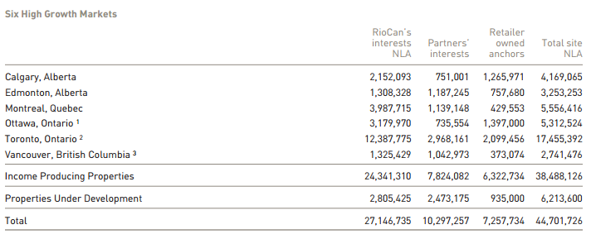
Canadian Portfolio

Slide 60
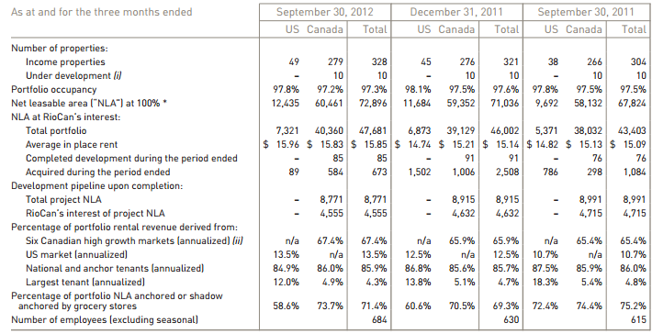
Canadian Portfolio

Slide 61



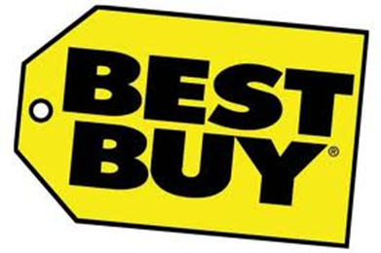

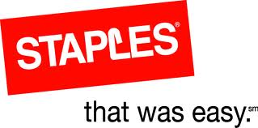

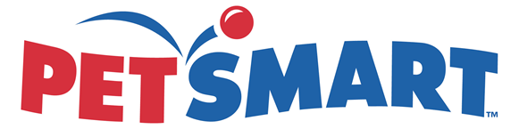


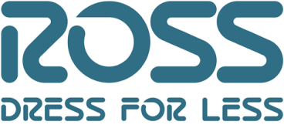
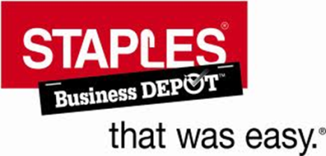


U.S. Tenants Canada Tenants

Slide 62
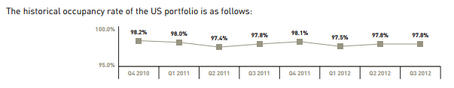
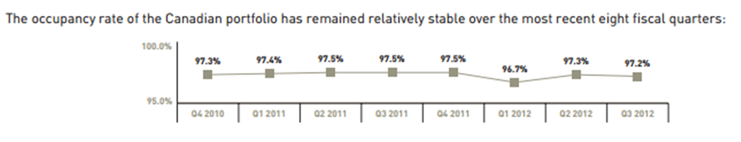
Occupancy Rate

Slide 63
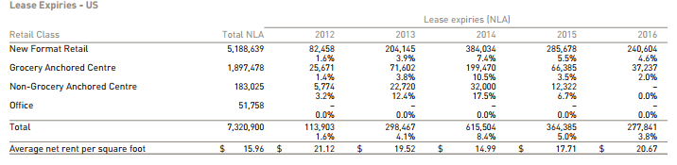
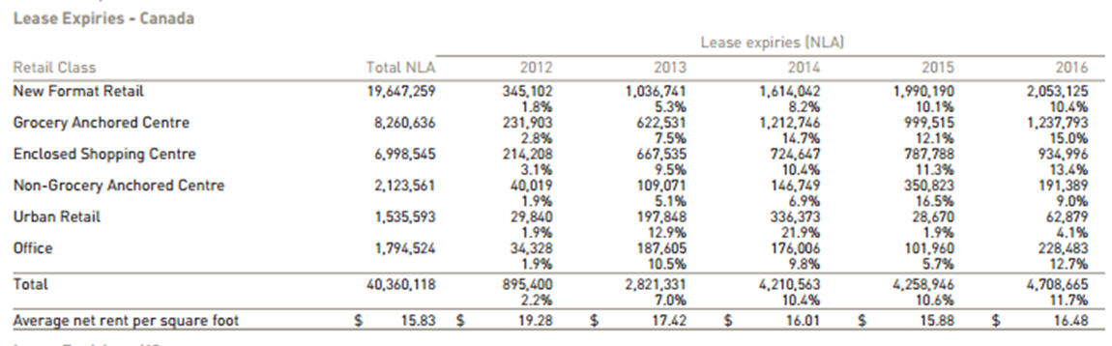
Lease Expiries

Slide 64
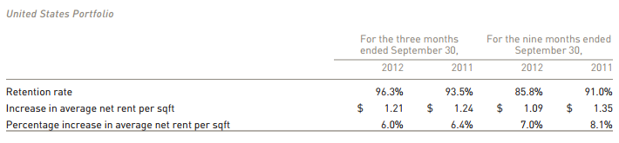
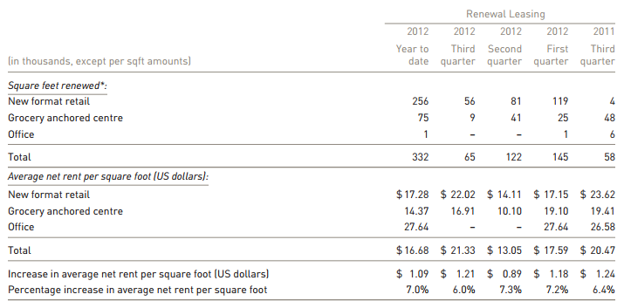
Renewal Leasing – U.S.

Slide 65
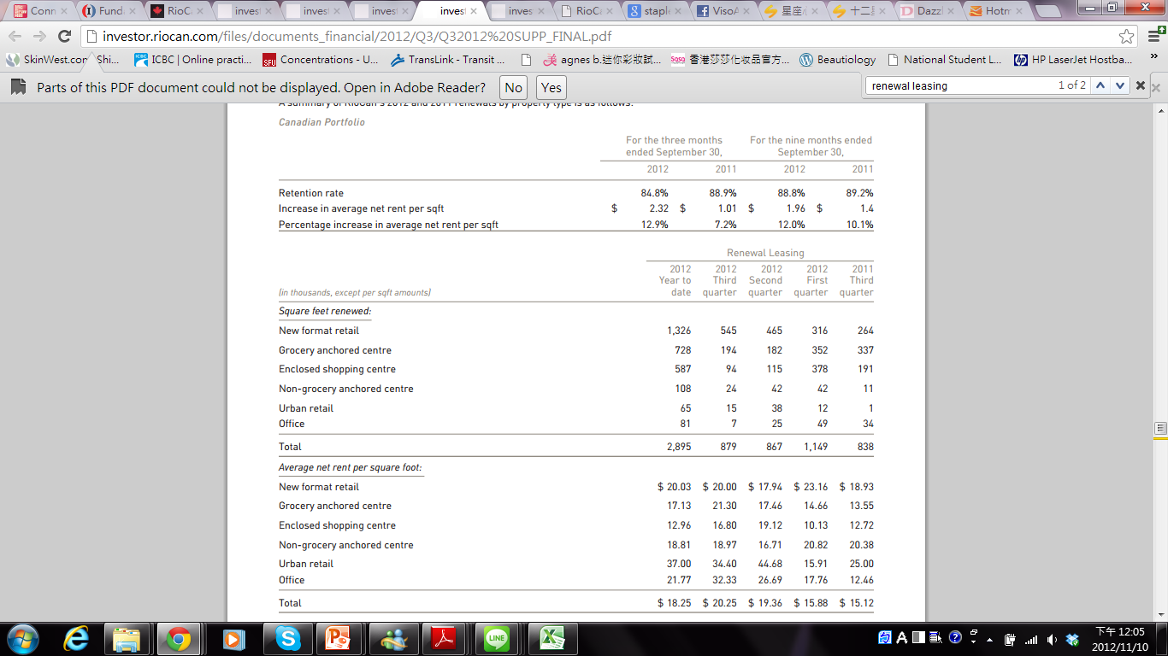
Renewal Leasing - Canada

Slide 66
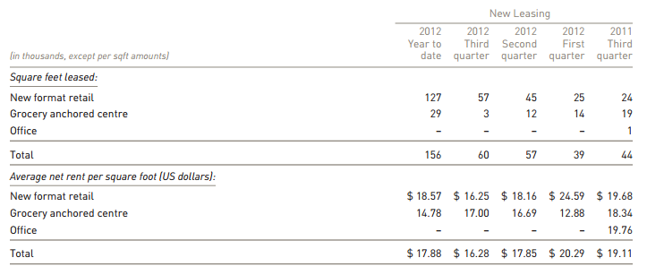
New Leasing on the Existing US Portfolio

Slide 67
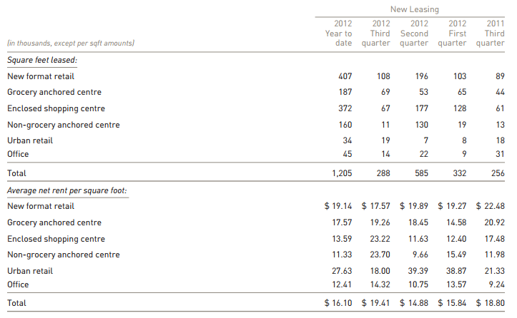
New Leasing on the Existing Canadian Portfolio

Slide 68
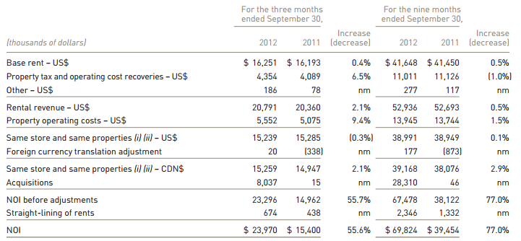
Net Operating Income
U.S. Portfolio
Notes:
(i) Same store refers to those income properties that were owned by RioCan and had consistent leasable area in both periods.
(ii) Same properties refer to those income properties that were owned by RioCan throughout both periods.
Same store and same property NOI decreased slightly during the three months ended September 30, 2012 as compared to the
three months ended September 30, 2011 primarily due to the timing of property tax and operating costs recoveries.
For the US portfolio, same store and same properties NOI remained stable during the nine months ended September 30, 2012 as
compared to the same period in 2011.

Slide 69

Net Operating Income
Canadian Portfolio
Notes:
(i) Same store refers to those income properties that were owned by RioCan and had consistent leasable area in both periods.
(ii) Same properties refer to those income properties that were owned by RioCan throughout both periods.
The change in same store NOI is the result of a combination of factors: contractual rent increases, lease renewals and net
absorption of existing space in the portfolio which is a product of vacancies and the resultant new leasing.
Same store NOI remained stable and same property NOI increased by 0.3% during the three months ended September 30, 2012 as
compared to the three months ended September 30, 2011 primarily due to the following:
• increased NOI as a result of new leasing of approximately $ 3.9 million;
• renewals and rent steps increased NOI by $ 1.5 million;
• re-leasing of space vacated due to bankruptcy or lease cancellations increased NOI by $1.2 million; partially offset by
• reduced NOI due to vacancy caused by normal course turnover of $3.8 million;
• unanticipated vacancies reduced NOI by $1.5 million;
• NOI was reduced by $0.5 million from lease buyouts that have occurred in the last 12 months; and
• adjustments related to tenant recoverable expenses decreased NOI by $0.2 million.
In 2012 on a year to date basis, same store and same property NOI increased by 1.0% and 1.1%, respectively, when compared to
the same period in 2011.
The following items were the major components of same store growth:
• increased NOI as a result of new leasing of approximately $11.7 million;
• renewals and rent steps increased NOI by $4.4 million;
• re-leasing of space vacated due to bankruptcy or lease cancellations increased NOI by $3.9 million;
• adjustments related to tenant recoverable expenses increased NOI by $0.2 million; partially offset by
• reduced NOI due to vacancy caused by normal course turnover of $11.1 million;
• unanticipated vacancies reduced NOI by $3.8 million; and
• NOI was reduced by $1.3 million from lease buyouts that have occurred in the last 12 months.

Slide 70

Development Project

Slide 71

Properties Under Development
Notes:
RioCan has a development program primarily focused on new format and urban retail centres.
An advantage of unenclosed, new format retail is that it lends itself to
phased construction keyed to leasing levels, which avoids the creation of meaningful amounts of vacant space. In addition to
RioCan’s various development projects, the Trust also contributes to portfolio growth through the intensification of existing
properties where RioCan has identified opportunities to increase density or add to an existing asset. This intensification of existing
properties contributes to NOI growth in an efficient manner, leveraging the existing asset base, and can also lead to significant
gains resulting from the sale of residential rights

Slide 72

Current Development Projects

Slide 73


Acquisition during 2012

Slide 74


Acquisition during 2012
Notes:
RioCan currently has one development site in Canada under contract where conditions have been waived that, if completed,
represents $16 million of acquisitions at RioCan’s interest.
• The acquisition of Sage Hill, a 32 acre greenfield site in Northwest Calgary. The purchase price is $32 million ($16 million at
RioCan’s 50% interest) and the land will be acquired with KingSett. The closing of this acquisition is expected to occur in the
fourth quarter of 2012.

Slide 75

Q1 Acquisition

Slide 76

Q2 Acquisition

Slide 77

Q3 Acquisition

Slide 78

Net Operating Income by Joint Venture

Slide 79

Unitholders Summary

Slide 80

Distribution to Unitholders

Slide 81

Distribution to Unitholders
Notes:
(b) Preferred units
The Trust is authorized to issue 50 million preferred units.
(i) Series A
In the first quarter of 2011, the Trust issued a total of 5,000,000 perpetual Cumulative Rate Reset Preferred Trust Units, Series
A (the “Series A Units”) for aggregate gross proceeds of $125 million. The Series A Units will pay a cumulative distribution
yield of 5.25% per annum, payable quarterly, as and when declared by the Board of Trustees of RioCan, for the initial five-year
period ending March 31, 2016. The distribution rate will be reset on March 31, 2016 and every five years thereafter at a rate
equal to the sum of the then five-year Government of Canada bond yield and 2.62%.
The Series A Units are redeemable by RioCan, at its option, on March 31, 2016 and on March 31 of every fifth year
thereafter. Holders of Series A Units will have the right to reclassify all or any part of their units as perpetual Cumulative
Floating Rate Preferred Trust Units, Series B (the “Series B Units”), subject to certain conditions, on March 31, 2016 and on
March 31 of every fifth year thereafter. Holders of Series B Units will be entitled to receive a cumulative quarterly floating
distribution at a rate equal to the sum of the then 90-day Government of Canada Treasury Bill yield plus 2.62%, as and when
declared by the Board of Trustees of RioCan. Holders of Series B Units will have the right to reclassify all or part of their units
as Series A Units on March 31, 2021 and on March 31 of every fifth year thereafter.
(ii) Series C
In the fourth quarter of 2011, the Trust issued an aggregate of 5,980,000 Cumulative Rate Reset Preferred Trust Units, Series
C (the “Series C Units”) for aggregate gross proceeds of $149.5 million. The Series C Units will pay a fixed cumulative
distribution yield of 4.70% per annum, payable quarterly, as and when declared by the Board of Trustees of RioCan, for the
initial approximately five and a half-year period ending June 30, 2017. The distribution rate will be reset on June 30, 2017 and
every five years thereafter at a rate equal to the sum of the then five-year Government of Canada bond yield and 3.18%.
The Series C Units are redeemable by RioCan, at its option, on June 30, 2017 and on June 30 of every fifth year thereafter.
Holders of Series C Units will have the right to reclassify all or any part of their units as Cumulative Floating Rate Preferred
Trust Units, Series D (the “Series D Units”), subject to certain conditions, on June 30, 2017 and on June 30 of every fifth year
thereafter. Holders of Series D Units will be entitled to receive a cumulative quarterly floating distribution at a rate equal to
the sum of the then 90-day Government of Canada Treasury Bill yield plus 3.18%, as and when declared by the Board of
Trustees of RioCan. Holders of Series D Units will have the right to reclassify all or part of their units as Series C Units on
June 30, 2022 and on June 30 of every fifth year thereafter.
The Series C Units and the Series D Units will rank equally with each other and with the outstanding Series A Units and the Series
B Units into which they may be reclassified.

Slide 82

RioCan’s Capital structure and
Debt Maturities

Slide 83


Secured Lines of Credit and
Capital Structure

Slide 84

Capital Structure
Total Assets $12.3 billion
Total Enterprise $13.9 billion
Notes:
Need to change slide
Common Units – market capitalization (xii) 299 million
Preferred units – market capitalization (xiii) $ 284m
Debentures payable (Note 8) $1b
Mortgages payable and lines of credit 7 $ 4.310b
Total enterprise value (iv) $ 13.899 b
Total assets $ 12.249b

Slide 85

Debt and Leverage Metric
Notes:
Coverage ratio: A measure of a company's ability to meet its financial obligations.
(vii) Adjusted to exclude interest capitalized.
Debt service coverage ratio: it is the amount of cash flow available to meet annual interest and principal payments on debt, including sinking fund payments. Greater than 1 which means that the company has positive cash flow and is able to repay debts
Interest coverage ratio: A ratio used to determine how easily a company can pay interest on outstanding debt.
Meet targeted ratios
Need to change the slide

Slide 86


Debt Maturity Schedule
$ Millions
1431
981
852
872
638
477
100
Notes:
Need to change the slide

Slide 87

Aggregate Maturities

Slide 88
Management Team

Slide 89


Edward Sonshine, CEO
CEO of RioCan since 1993
spent the past 15 years developing giant outdoor shopping malls in suburbs across the country
Connected to 71 board members in 7 different organizations across 9 different industries
Law degree from Osgoode Hall Law School and a Bachelor of Arts degree from the University of Toronto
Notes:
Law degree from York University

Slide 90

Raghunath Davloor, CFO and Senior Vice President
CFO and Senior VP since February 2008
Prior to RioCan, he served as VP and Director of Investment Banking at TD Securities Covering the estate sector
Over 25 years of real estate, management, finance and accounting experience
Bachelor of Commerce from the University of Manitoba and holds a CA designation

Slide 91

Frederic A. Waks,
COO & Executive VP
Joined RioCan in 1995 as Senior Vice President and was promoted to COO in 2007
Over 30 years of real estate experience
Prior to RioCan, he worked at Royal LePage, First Plazas, Dominion Trust and Confederation Trust
Active community involvement being on the board of several charities

Slide 92

Financial Review

Slide 93

Balance Sheet (Quarterly)

Slide 94


Balance Sheet (Annual)
Notes:
Investment property: difference is due to Income properties( $10,024 in 2011 and $8185 in 2010)

Slide 95


Statement of Earning (Annual)
Notes:
Difference in Rental revenue is mainly due to an increase in U.S. rental revenue (from 34 to 92).
As at December 31, 45 grocery anchored and new format retail centres (December 31, 2010 – 31) located in the US which the
Trust owns through joint venture agreements with Cedar, Sterling Organization LLC, Inland Western REIT , Kimco Realty
Corporation and Dunhill Partners, Inc.

Slide 96

Statement of Earning ( Quarterly)
Notes:
Of the $1.3 billion increase in RioCan’s investment property since December 31, 2011, the fair value gain was $564 million
composed of $549 million in income properties and $15 million in properties under development.

Slide 97

Cash Flow (Annual)

Slide 98



Cash Flow (Annual)

Slide 99

Cash Flows (Quarterly)
Operating and Investing

Slide 100

Cash Flows (Quarterly)
Financing

Slide 101

Operating FFO (Annual)
Notes:
A figure used by real estate investment trusts (REITs) to define the cash flow from their operations. It is calculated by adding depreciation and amortization expenses to earnings, and sometimes quoted on a per share basis
The $51 million increase in Operating FFO for the year ended December 31, 2011 is primarily due to the following factors:
• increased net operating income from rental properties of $70 million which is due to acquisitions, same store growth of 1.1% for
the Canadian portfolio and 1.9% for the US portfolio and the completion of greenfield developments; and
• increased fee income of $11 million primarily related to leasing and development activities; partially offset by
• increased interest expense of $19 million and higher general and administrative expense of $6 million.

Slide 102

Operating FFO (Quarterly)
Notes:
A figure used by real estate investment trusts (REITs) to define the cash flow from their operations. It is calculated by adding depreciation and amortization expenses to earnings, and sometimes quoted on a per share basis
The $51 million increase in Operating FFO for the year ended December 31, 2011 is primarily due to the following factors:
• increased net operating income from rental properties of $70 million which is due to acquisitions, same store growth of 1.1% for
the Canadian portfolio and 1.9% for the US portfolio and the completion of greenfield developments; and
• increased fee income of $11 million primarily related to leasing and development activities; partially offset by
• increased interest expense of $19 million and higher general and administrative expense of $6 million.

Slide 103


Operating FFO and AFFO (Annual)
Notes:
A figure used by real estate investment trusts (REITs) to define the cash flow from their operations. It is calculated by adding depreciation and amortization expenses to earnings, and sometimes quoted on a per share basis
Read more: http://www.investopedia.com/terms/f/fundsfromoperation.asp#ixzz2AioJ6Hbf

Slide 104


Operating FFO and AFFO (Quarterly- 3 Months)
Notes:
A figure used by real estate investment trusts (REITs) to define the cash flow from their operations. It is calculated by adding depreciation and amortization expenses to earnings, and sometimes quoted on a per share basis
Read more: http://www.investopedia.com/terms/f/fundsfromoperation.asp#ixzz2AioJ6Hbf

Slide 105


Operating FFO and AFFO (Quarterly-9 Months)
Notes:
A figure used by real estate investment trusts (REITs) to define the cash flow from their operations. It is calculated by adding depreciation and amortization expenses to earnings, and sometimes quoted on a per share basis
Read more: http://www.investopedia.com/terms/f/fundsfromoperation.asp#ixzz2AioJ6Hbf

Slide 106
Recommendation
Hold

Slide 107

Calloway Reits
Present by Cathy Wu

Slide 108


SECURITY SNAPSHOT

Slide 109

EARNINGS

Slide 110


ONE YEAR CHART
Moving Average at 10 & 100
Sell
Sell
Buy

Slide 111

FIVE YEAR CHART
Moving Average at 10 & 100
Hold
Buy

Slide 112



TEN YEAR CHART
Hold

Slide 113
COMPARE WITH
S&P/TSX COMPOSITE
What is S&P/TSX Composite?
The S&P/TSX Composite Index is an index of the stock (equity) prices of the largest companies on the Toronto Stock Exchange (TSX) as measured by market capitalization.
The Toronto Stock Exchange listed companies in this index comprise about 70% of market capitalization for all Canadian-based companies listed on the TSX. It replaces the earlier TSE 300 index.
Why Do We Compare with S&P/TSX Composite?
Measures Calloway performance with the largest Canadian-based companies.

Slide 114

COMPARE WITH
S&P/TSX COMPOSITE (1 Year)

Slide 115


COMPARE WITH
S&P/TSX COMPOSITE (5 Year)

Slide 116

COMPARE WITH
S&P/TSX COMPOSITE (10 Year)

Slide 117

COMPARE WITH
S&P/TSX CAPPED REIT (1 Year)
Why Compare with S&P/TSX Capped Reit (Blue) ?
Compare Collaway’s market capitalization with the largest Canadian-based Reit companies
Similar trends but below S&P/TSX Capped Reit

Slide 118


COMPARE WITH
S&P/TSX CAPPED REIT (5 Year)
Due to 2008 Financial Crisis

Slide 119


COMPARE WITH
S&P/TSX CAPPED REIT (10 Year)
Due to 2008 Financial Crisis

Slide 120

One Year Chart Analyze
Announced groundbreaking of 500,000 square foot Toronto Premium Outlets® (Halton Hills)

Slide 121
One Year Chart Analyze
Announced strong Q1 2012 results
Announced JV with Simon Property Group to develop Montreal Premium Outlets® (Mirabel)
Announced conditional deal to acquire up to a 50% interest in a Walmart anchored GTA centre

Slide 122
One Year Chart Analyze
Disposing of 13 non-core assets
Zellers (Penticton, BC) closing June 2012, Loblaws on schedule to open renovated store on November 2012
Announce strategic partner ship with En-Pro

Slide 123
One Year Chart Analyze
July 19,1012 public offering of $125 Million of Series H Senior Unsecured Debentures

Slide 124
One Year Chart Analyze
October 18, 2012 sell three shopping centers

Slide 125

MAX CHART (MAY 1998-2012)
Recovering
Influenced By Financial Crisis
Growing

Slide 126










COMPANY PROFILE
Calloway: We own and manage dominant shopping centres which provide our retailers a platform to reach their customers through convenient locations, intelligent designs, and a desirable tenant mix.

Slide 127
BACKGROUND
Calloway is an unincorporated open-ended mutual fund trust governed by the laws of the Province of Alberta
Mission Statement: Calloway aims to be the landlord of choice for retailers. By selecting convenient locations close to consumers and leasing to strong tenants in well designed centres, Calloway will maximize returns to Unit holders, and retailers will prosper
Objectives:
provide Unit holders with stable and growing tax-deferred cash distributions through the acquisition
development and operation of a portfolio of well located, primarily large format unenclosed retail centres
enhance the value of Calloway's assets and unit value through effective management

Slide 128
BACKGROUND
In 2012, Calloway has:
$6.5 billion in total assets
26.2 million square feet of leasable area
3.8 million square feet of future development potential
131 premium locations across Canada
106 dedicated staff

Slide 129


RECENT DEVELOPMENT
June 12, 2012: Created strategic partnership with En-Pro International Inc. for its Energy Procurement Needs
Reduce energy cost of itself and its tenants
July 19, 2012: issue $125 million principal amount of Series H senior unsecured debentures
Use the net proceeds from the offering for repayment of operating lines, funding of future acquisitions and for general trust purposes

Slide 130


RECENT DEVELOPMENT
Oct 18, 2012: sell three Ontario properties for a total purchase price of approximately $59.8 million
recycle equity from non-core properties to invest in more strategic acquisitions
Oct 31, 2012: 50/50 joint venture with SmartCentres to develop a vast tract of land (53 acres) within the Vaughan Metropolitan Centre (VMC)

Slide 131
INFORMATION ABOUT UNIT HOLDER

Slide 132

UNIT HOLDER SUMMARY

Slide 133

DISTRIBUTION TO UNIT HOLDER

Slide 134


DISTRIBUTION TO UNIT HOLDER
Distributions for 2012
Distributions for 2011

Slide 135
INFORMATION ABOUT PROPERTIES

Slide 136

PROTFOLIO HIGHLIGHTS

Slide 137

TOP 10 LARGEST RETAIL PROPERTIES

Slide 138

10 MOST RECENT ACQUIRED PROPERTIES

Slide 139

INVESTMENT PROPERTIES

Slide 140

TOP 10 TENANTS

Slide 141

TOP 10 TENANTS

Slide 142
TOP 10 TENANTS

Slide 143

GROSS REVENUE
BY PROVINCE

Slide 144

LEASE MATURITY

Slide 145


PORTFOLIO OCCUPANCY AND AGE

Slide 146

LEASE EXPIRATION SCHEDULE

Slide 147
POTENTIAL FUTURE PIPELINE

Slide 148


GROSS LEASABLE AREA

Slide 149

COMMITTED PIPELINE

Slide 150

UNCOMMITTED PIPELINE

Slide 151

PREMIUM OUTLET CENTRES

Slide 152

SUMMARY OF PROPERTIES
Open format shopping centres – value focus
Category leaders – selection and price
Retail focus & Canada focus
Best in class – location, age, strong anchor (mainly Walmart), low CAM / operating costs, tenant quality, design and layout
Generates high traffic
High occupancy level (>99%)

Slide 153

PROPERTY EXAMPLE
OSHAWA S

Slide 154

PROPERTY EXAMPLE
LAVAL (W)

Slide 155
STRATEGIC PARTNERS

Slide 156

STRATEGIC PARTNERS – SMARTCENTRES

Slide 157

STRATEGIC PARTNERS – WALMART

Slide 158

STRATEGIC PARTNERS – SIMON PROPERTY GROUP

Slide 159


ACQUISITIONS AND DEVELOPMENT
During the quarter ended September 30, 2012, $17.7 million of Earnouts and Calloway Developments were completed and transferred to investment properties, compared to $46.6 million for the same period in 2011, summarized as follows:

Slide 160
INFORMATION ABOUT CAPITAL

Slide 161

SUSTAINING CAPITAL EXPENDITURES
Sustaining capital expenditures of $1.0 million and leasing costs of $1.5 million for the three months ended September 30, 2012
Since the Trust's investment properties are relatively new and in good condition, management anticipates only modest increases for the remainder of 2012 and 2013, and thus, they are not expected to have an impact on the Trust's ability to pay distributions at its current level.

Slide 162

CAPITAL STRUCTURE

Slide 163
INFORMATION ABOUT DEBT

Slide 164

DEBT MATURITIES

Slide 165

DEBT

Slide 166

TERM MORTGAGES

Slide 167

FUTURE PRINCIPAL PAYMENTS

Slide 168

UNSECURED DEBENTURES

Slide 169
QUARTERLY FINANCIAL AND OPERATIONAL HIGHLIGHTS
Maintained portfolio occupancy at the 99% level
Completed Developments and Earnouts of 56,414 square feet of leasable area for $17.7 million, providing an unleveraged yield of 8.3%
Issued $150 million in unsecured debentures bearing interest at 4.05% per annum
Renewed and increased revolving operating facility to $70.0 million at an improved rate
Acquired 400,358 square feet in two investment properties for $102.7 million

Slide 170
STRATEGIC FOCUS MOVING FORWARD
Ongoing
1. Maintain 99%+ occupancy and 85%+ retention rates
2. Manage lease renewal rent increases in 5-10% range
3. Enhance asset quality and maximize “same store NOI” growth
4. Harvest 5.8 million square feet development and acquisition option pipeline including first Premium Outlet Mall
5. Deploy capital in selective acquisition opportunities
Opportunistic
1. Capitalize on intensification opportunities in appropriate locations
New subway stations (Vaughan, Westside Mall)
Higher growth markets
2. Re-merchandising opportunities
Hopedale Mall (Target taking over Zellers)

Slide 171
MANAGEMENT TEAM

Slide 172

CHIEF EXECUTIVE OFFICER/ORESIDENT
Al Malwani

Slide 173
CHIEF EXECUTIVE OFFICER/ORESIDENT
Experiences
Abilities
Replaced Simon Nyilassy as CEO on May 2, 2011
Chartered accountant
MBA from the University of Toronto and a Masters of Laws from Osgoode Hall Law School
Previously the President of Exponent Capital Partners, a real estate advisory and private equity firm
Previously the CFO of Oxford Properties Group for over 10 years
2010 compensation for previous CEO Simon Nyilassy: $951,862
Full knowledge about accounting
Able to analyze financial reports
Familiar with law
Plenty management experiences

Slide 174

EXECUTIVE VICE PRESIDENT
Rudy Gobin

Slide 175

EXECUTIVE VICE PRESIDENT
Experiences
Abilities
Familiar with accounting information
Know well about Calloway’s strategy

Slide 176

CHIEF FINANCIAL OFFICER
Bart Munn—Chief Financial Officer
Chartered Accountant
Bachelor of Commerce from Queen’s University
Vice President and CFO of Morguard Corporation (1999-2005)
Vice President and CFO of Morguard Real Estate Investment Trust (1997-1999)
Senior Vice President Finance and Administration for Morguard Investments Limited (1991-2005)
2010 compensation: $617,823

Slide 177
FINANCIAL PERFORMANCE

Slide 178

BALANCE SHEET (Quarterly)

Slide 179

BALANCE SHEET (Annual)
Current Ratio is 0.1658
Notes:
Current ration for 2011 is 0.1658

Slide 180


INCOME STATEMENT (Annual)
Notes:
Huge interest expense and income tax expense

Slide 181

INCOME STATEMENT (Quarterly)

Slide 182

CASH FLOW STATEMENT (Annual)
Notes:
Acquisitions of investment properties in 2011 is 192,900

Slide 183

CASH FLOW STATEMENT (Quarterly)

Slide 184

SUPPLEMENTAL CASH FLOW INFORMATION (Annual)

Slide 185

SUPPLEMENTAL CASH FLOW INFORMATION (Quarterly)

Slide 186

CASH FROM OPERATIONS (Quarterly)

Slide 187

RESULTS FROM OPERATIONS (Quarterly)

Slide 188

FFO & AFFO (Annual)

Slide 189

FFO & AFFO

Slide 190

FFO AND AFFO QUARTERLY INFORMATION

Slide 191
RECOMMENDATION

Slide 192
ANY POTENTIAL RISK?
Real Property Ownership Risk
All real property investments are subject to elements of risk. Such investments are affected by general economic conditions, local real estate markets, supply and demand for leased premises, competition from other available premises and various other factors.
Development Risk
Development risk arises from the possibility that developed space will not be leased or that costs of development will exceed original estimates, resulting in an uneconomic return from the leasing of such developments.

Slide 193
ANY POTENTIAL RISK?
Interest and Financing Risk
In the low interest rate environment that the Canadian economy has experienced in recent years, leverage has enabled the Trust to enhance its return to Unitholders. A reversal of this trend, however, can significantly affect the business's ability to meet its financial obligations.
Environmental Risk
As an owner of real property, the Trust is subject to various federal, provincial, territorial and municipal laws relating to environmental matters. Such laws provide that the Trust could be liable for the costs of removal of certain hazardous substances and remediation of certain hazardous locations.

Slide 194
WHY HOLD?
Stable strategic partners contribute stable income
Best in class assets (high traffic location, high occupancy level)
Stable and growing income
Conservative capital structure
Strong credit profiles
Stable cash flow
Lower Risk Growth
Compelling Valuation

Slide 195
HOLD

Slide 196

Security Snapshot

Slide 197

1 Year Chart and Moving
Average at 10 & 100
August 20, Peak: $26
Reports Solid Q2 Results and With Cenovus’s Occupancy of the Bow Announces Distribution Increases of 12.5%
Notes:
Highest point: $26 August 20,2012
8/14/2012
H&R

Slide 198

1 Year Chart and Moving
Average at 50 & 200

Slide 199

5 Year Chart and Moving
Average at 10 & 100

Slide 200

5 Year Chart and Moving
Average at 50 & 200

Slide 201

1 Year H&R Vs. iShares
S&P TSX Capped REIT

Slide 202

5 Year H&R Vs. iShares
S&P TSX Capped REIT

Slide 203


Company Overview

Slide 204

H&R Profile
An incorporated closed-end trust and trade on theToronto Stock Exchange under the symbol HR.UN.
The largest office REIT and third largest REIT in Canada with approximately $4.44 billion market capitalization
Projects has a fair value totaling approximately $10.0 billion, encompassing 44 million square feet.
The REIT currently pays out approximately 78.4% of its adjusted funds from operations to its Unitholders.

Slide 205

H&R Strategy
focuses its investments and expertise on quality commercial properties
using a very disciplined approach to asset management and acquisitions to generate stable distributable income and maximize return on equity for unitholders
reduce its risk by diversifying the portfolio

Slide 206
Portfolio of Properties
 | Number of Properties | Net Rentable Area (sf) * | Fair Value ($ millions)*
Office | 41 | 12,012,000 | 4,708 | Bell Canada., TCPL, Bell Mobility, City of New York, Royal Bank of Canada, Public Works of Canada, Sony Pictures Entertainment, Ontario Realty Corporation, Hess Corporation, Corus Entertainment, Bank of Nova Scotia, Nestle, Telus Communications, CIBC
Industrial | 116 | 23,495,000 | 1,855 | Canadian Tire, Versacold Logistics Canada Inc., Purolator Courier Limited, Nestle USA, Finning International Inc., Sysco Food Services of Canada
Retail | 139 | 8,894,000 | 1,471 | Rona Inc., Lowe's, Shell Oil Products, Home Depot, Wal-Mart, Marsh Supermarkets Inc, Nike, Canadian Tire, Cineplex, Walgreens, Sobey's, Shoppers Drug Mart
Development | 3 | N/A | 1,869 | EnCana Corporation

Slide 207


Diversified Portfolio
Quebec
Other
Office
Alberta
Ontario
Retail
United States
Industrial
Notes:
income stream is well diversified: income stream is well diversified: by geographic region – spanning across 9 Canadian
provinces and 28 States, and by type of property – office, industrial, and retail,
Retail properties now represent 40% of total portfolio fair properties now represent 57% of total portfolio fair
v

Slide 208

Properties

Slide 209

Top 15 Assets
Notes:
This table lists our Top 15 properties at the end of the second quarter. The $5.9 billion estimated fair market value of these
properties represented 56% of H&R’s enterprise value as at June 31, 2012, while the total mortgage balance
outstanding outstanding of $2.3 billion. These 15 high-quality assets – leased long term to investment grade tenants – represent company’s core portfolio.
The Bow is

Slide 210

The Bow
a world-class, approximately two-million square foot downtown office
It is the largest Canadian office tower west of Toronto andwill be the keystone of their property portfolio
fully leased to EnCana Corporation on a triple-net basis for a term of 25 years
The annualized year-one net income from The Bow is expected to be approximately $93.5 million, and rental rates will increase 0.75% per annum on the office space and 1.5% per annum on the parking space during the lease.

Slide 211

Scotia Plaza
Scotia Plaza comprises approximately 2.0 million sq. ft. of prime office and retail space across four connected buildings
Located in the heart of Toronto’s Financial District, the largest office node in Canada
Acquired a one‐third interest in Scotia Plaza for $422.2 million, closed June 15, 2012
Outstanding anchor tenant: Bank of Nova Scotia will lease approximately 61% of Scotia Plaza for an average lease term of 13.5 years

Slide 212




Top 20 tenants
Notes:
As we can see on this list, the top 20 tenants t include large, creditworthy companies, leased for a weighted average term of
11 years. These public and private companies are brand-name leaders in their sectors, accounting for 58.1% of total rental revenue. The majority of their leases are “triple- net”to the landlord, with tenants being responsible for substantially all property operating expenses and capital expenditures.

Slide 213


Occupancy
Notes:
Consistent high occupancy of 99%

Slide 214

Lease expires

Slide 215
Average remaining lease term
H&R's average remaining lease term is 11.0 years, the highest in the Canadian REIT universe.
Long-term leases are matched with long-term mortgage debt (7.7-year average remaining mortgage term).
Notes:
H&R REIT's operating strategy is to stabilize annual earnings and minimize market risk by leasing and financing its properties on a long-term basis. As a result, the average remaining term to maturity as December 31, 2012 was 11.0 years for leases and 7.7 years for outstanding mortgages. This relatively low turnover protects the property income from cyclical swings in market rents and occupancy
levels, thereby maximizing the stability and predictability of their cash flow.

Slide 216


Acquisitions

Slide 217

Acquisitions
Notes:
Here we can see that HR has accelerated their acquisition program. In 2011, they acquired 11 properties for a total of $1.4
billion, generating a weighted average levered return of 8.3%. in the first three quarter of this year, they purchased additional property for $ 810 million. Included in these acquisitions are four prestigious properties that will provide our unitholders with
reliable reliable and increasing returns and will further and increasing returns and will further enhance the high quality to our portfolio.

Slide 218

Acquisitions
Notes:
Here we can see that HR has accelerated their acquisition program. In 2011, they acquired 11 properties for a total of $1.4
billion, generating a weighted average levered return of 8.3%. in the first and second quarter of this year, they purchased additional property for $ 682 million. Included in these acquisitions are four prestigious properties that will provide our unitholders with
reliable reliable and increasing returns and will further and increasing returns and will further enhance the high quality to our portfolio.

Slide 219

Management Team

Slide 220
Thomas J. Hofstedter
(President and CEO)
1978
attended the University of Toronto
became a member of The Institute of Chartered Accountants
1996
became President and Chief Executive Officer of the REIT at its creation
2008
President and Chief Executive Officer of Finance Trust at its creation in October 2008

Slide 221
Thomas J. Hofstedter
Has more than 30 years of real estate industry experience.
As head of H&R Development's Office Division, Mr. Hofstedter was responsible for building most of the properties that comprised the initial assets of the REIT.
In addition to commercial development, he has considerable experience in high-rise residential and was responsible for building many prominent Toronto condominiums.
Mr. Hofstedter’s academic and professional experience indicates in the areas of executive management, real estate and finance.

Slide 222
Larry Froom
(CFO)
1986-1989
attended the University of the Witwatersrand
1997 – 2006
VP Finance H&R Developments
2006-Present
CFO H&R REIT
Responsible for financial reporting, equity and debt financings, investor relations, and acquisition due diligence.
Majored in accounting
Responsible for securing construction financing on construction projects and financial reporting.

Slide 223
Larry Froom
has over fifteen years of real estate industry experience.
As CFO, Mr. Froom is responsible for overseeing all financial transactions, Unit offerings and investor relations.
Prior to joining H&R, he was manager at Ernst & Young where he serviced clients in the real estate industry.
is a member of Realpac (Canada’s most influential voice in the real property investment industry)

Slide 224

Nathan Uhr
(COO)
has over thirty years of real estate industry experience
was H&R Developments' Director of Leasing and Property Management and held various other positions with H&R over 20 years before becoming Vice-President, Acquisitions of H&R REIT, at its inception, in December 1996.
Mr. Uhr leads the due diligence team on any acquisition or mezzanine financing planned by the REIT and is responsible for management and leasing issues relating to the REIT's properties.

Slide 225
HR’s Capital structure and
Debt Maturities

Slide 226

Capital resource

Slide 227


Distribution to unitholders

Slide 228


Capital resource
Notes:
Liquidity:
Cash on hand at June 30, 2012 was $121M
H&R’s revolving credit facility with CIBC has $136M
available to be drawn
– The remaining Bow operating facility of $300M will fund
the costs to complete the Bow of approximately $70M

Slide 229

Mortgage Maturity Schedule
Notes:
The current low interest environment presents with a fabulous opportunity to reduce the debt service costs with upcoming mortgage rollovers. As at December 31, 2011, mortgages maturing during 2012 had had a weighted average interest rate of a weighted average interest rate of 6.8%. To date in 2012, they have successfully refinanced 13 mortgages.

Slide 230

Capital Structure

Slide 231

Risk Management

Slide 232

Risk Management

Slide 233

Risk Management

Slide 234

Risk Management

Slide 235

Risk Management

Slide 236
Financial Report and
Operating FFO

Slide 237

Financial Statement
Analysis-B/S (2012-Q3)
Notes:
Management has previously stated that, after a period of aggressively growing and
changing its portfolio, it is turning its focus to a thorough portfolio analysis with a view to pruning assets that may no
longer fit within its strategy and redeploying the capital into assets that offer greater potential upside. A variety of assets
have been reclassified as held for sale

Slide 238

Financial Statement
Analysis-B/S (ANNUAL)
Notes:
Note4

Slide 239

Financial Statement
Analysis-I/S (Annual )
Notes:
Property rental income increased by 6%, from 617M to 656M
In March 2011, the REIT was legally released from its mortgages on two Bruno’s Supermarkets LLC properties and two Boscov’s
Department Stores properties upon the lender accepting title to the properties. In July 2011, the REIT was legally released from its
mortgage on the final Boscov Department Store property upon the lender accepting title to the property. As a result, the investment
properties, the mortgages and the accrued interest on the mortgages were all derecognized resulting in a gain on extinguishment of
debt of $0.2 million for the three months and $19.7 million for the year ended December 31, 2011
The Income Tax Act (Canada) contains legislation (the “SIFT Rules”) affecting the tax treatment of “specified investment flowthrough”
(“SIFT”) trusts. The SIFT Rules provide for a transition period until 2011 for
publicly-traded trusts like the REIT which existed prior to November 1, 2006. Under the SIFT Rules, distributions of certain
income by a SIFT are not deductible in computing the SIFT’s taxable income, and a SIFT is subject to tax on such income at a
rate that is substantially equivalent to the general tax rate applicable to a Canadian corporation. The SIFT Rules do not apply to
a publicly-traded trust that qualifies as a real estate investment trust under the Income Tax Act (Canada). The REIT completed
the necessary tax restructuring to qualify as a real estate investment trust effective June 30, 2010. For periods before it
qualified, the REIT recorded deferred tax liabilities in respect of temporary differences expected to reverse after January 1, 2011.
Such deferred tax liability was reversed as an adjustment to deferred income tax expense in income and as an adjustment to
other comprehensive income during the second quarter of 2010, when the REIT became a qualifying REIT.

Slide 240

Financial Statement
Analysis-I/S
Notes:
Net operating income up $52.8 million during this year – Driven by income from acquired properties, NOI increased by 53%
over the prior year comparative period which is driven by occupancy increases in Edmonton, Vancouver, Saskatchewan and Toronto.

Slide 241

Cash flow (2011-Annual)
Notes:
Impairment reversal on investment properties (2011-2,852) (2010-101,165)
During the year ended December 31, 2010, the REIT recorded the reversal of $101,165 in previously recorded impairment
losses on 63 properties (31 properties in the U.S. and 32 in Canada).
These reversals of previously recorded impairment losses were triggered by the significant improvement of the real estate market
during 2010. The economic downturn in 2008 and 2009 had decreased the market value of a number of the REIT’s investment
properties due to weak demand. During 2010, the economy began to rebound and the REIT’s investment properties increased
in value. This change in economic conditions increased the market rent and adjusted discount rates favourably for many of the
REIT’s previously impaired properties.

Slide 242

Cash flow (2012 Q3)

Slide 243

Cash flow
Notes:
Included in restricted cash are bank term deposits of $3,936 (December 31, 2011 - $8,395) at a rate of interest of 1.10% (December 31, 2011 -
0.90% to 1.03%).
general operating facility which is secured by The Bow (the “Bow Facility”) due on November 21, 2013. The total facility
as at June 30, 2012 is $300,000 (December 31, 2011 - $400,000) and can be drawn in either Canadian or U.S. dollars (to a
maximum of $150,000 U.S. dollars). As at June 30, 2012, the REIT has drawn $nil (December 31, 2011 - $233,000) under
the Bow Facility and the undrawn amount available at June 30, 2012 is $300,000 (December 31, 2011 - $167,000).
Included in bank indebtedness at June 30, 2012 are U.S. dollar denominated amounts of $nil (December 31, 2011 - U.S.
$150,000). The Canadian equivalents of these amounts are $nil (December 31, 2011 - $153,000).

Slide 244
Funds From Operations
(Annual)
Notes:
Funds from operations is still increasing – FFO per unit is $1.7, up $0.27 during 2011, reflecting the
impact of accretive acquisitions as well as comparative NOI growth and refinancings completed at lower rates.

Slide 245

Funds From Operations (2012-Q3)

Slide 246

Adjusted Funds From
Operations (2011-Annual)

Slide 247

Adjusted Funds From
Operations (2012-Q3)

Slide 248
Stable balance sheet
Long‐term financing
– Well staggered
– Matched to lease maturity profile
Predictable income
--Creditworthy tenants
– Long‐term leases, with contractual rent escalations
– High, stable occupancy
– Minimal near term lease expiries and debt maturities
Selective developments
-High quality and diversified portfolio

Slide 249
Recommendation
Hold
Notes:
We have consistently executed a disciplined and proven
strategy of building a solid portfolio of incomeproducing
properties that can withstand economic and
real estate cycles.
• Our strategy is focused on locking in predictable
income with fixed costs.
o We lease our premises to highly creditworthy
tenants,
on a long-term basis, with contractual rental
escalations.
o Our properties are diversified by type and by region.
o And we further reduce risk by securing long-term
property financing with fixed-rate mortgages.
• We grow and cull our portfolio pro-actively, with
accretive acquisitions, and selective dispositions.
4
• And we develop quality properties, only on a preleased
basis while at all times maintaining a strong
balance sheet with a conservative capital structure.

