Slide 1
Canadian REITs
Ryan McLaughlin 301137937

Slide 2
Agenda
REIT Overview
RioCan
Calloway
H&R
Conclusion

Slide 3
What is a REIT?
Diversified, liquid means of investing in real estate – analogous to a mutual fund.
Allows the general public and the less affluent to invest in income-generating real estate.
Can be traded on public stock exchanges, or privately held. More than 165 REITs are traded on major stock exchanges in the US, .
Treated by law as a corporation, but they don’t pay corporate tax.
At least 90% of income must be distributed as dividends. In 2012 alone, $29 billion was paid out in dividends to REIT investors.
Owns properties with long-term investment horizon – income comes from operation, not speculation.

Slide 4
REIT Structure
Trustee
Trustee Fees
Act on Behalf of Unitholders
Distributions
Property Income
Unitholder
REIT
Properties
Investment
Ownership
Management Services
Management Fees
Management

Slide 5
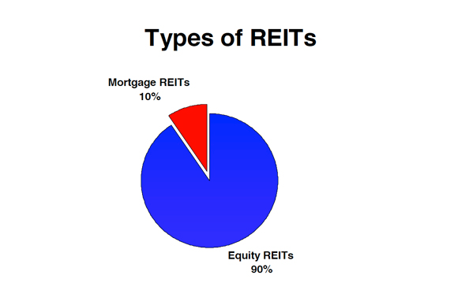
Types of REITs
Equity REITs
Revenue mostly from rent on wide range of property types
Mortgage REITs
Revenue mostly from interest earned on mortgages and MBS’s
Hybrid REITs
Notes:
http://www.reit.com/investing/reit-basics/reit-faqs/basics-reits

Slide 6
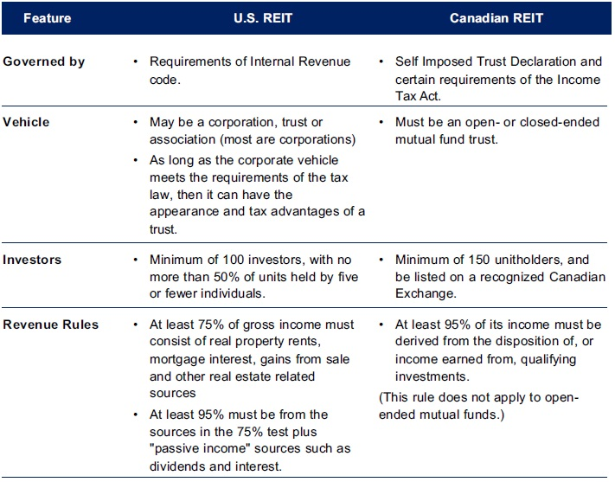
US vs Canadian REIT Rules
Notes:
http://www.deloitte.com/assets/Dcom-Canada/Local%20Assets/Documents/REITGuide2(1).pdf http://www.sec.gov/answers/reits.htm

Slide 7
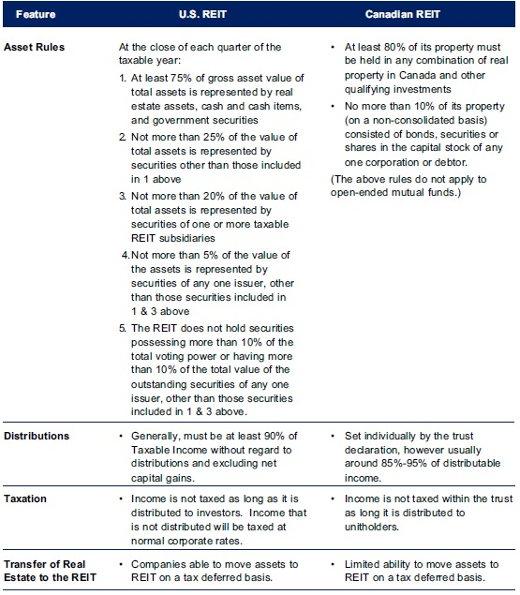

Slide 8
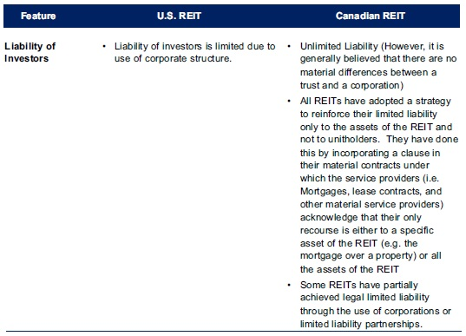

Slide 9
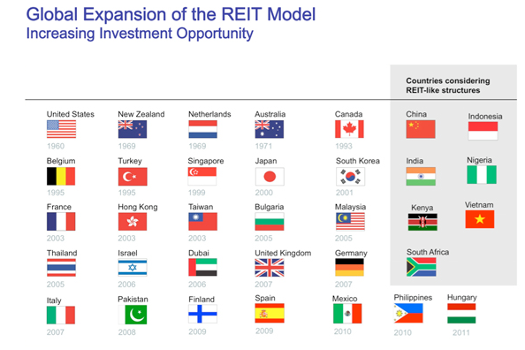
REIT Expansion

Slide 10







REITs Timeline
1972: NAREIT Unveils REIT Index
1960: REITS are Created (USA)
1969: First European REIT (Netherlands)
1993: REITS Introduced in Canada
1960: NAREIT Formed
1989-1991: Dramatic Real Estate Downturn
1965: First NYSE REIT (Continental Mortgage Investors)
1960
2000
1970
1980
1990
2010

Slide 11
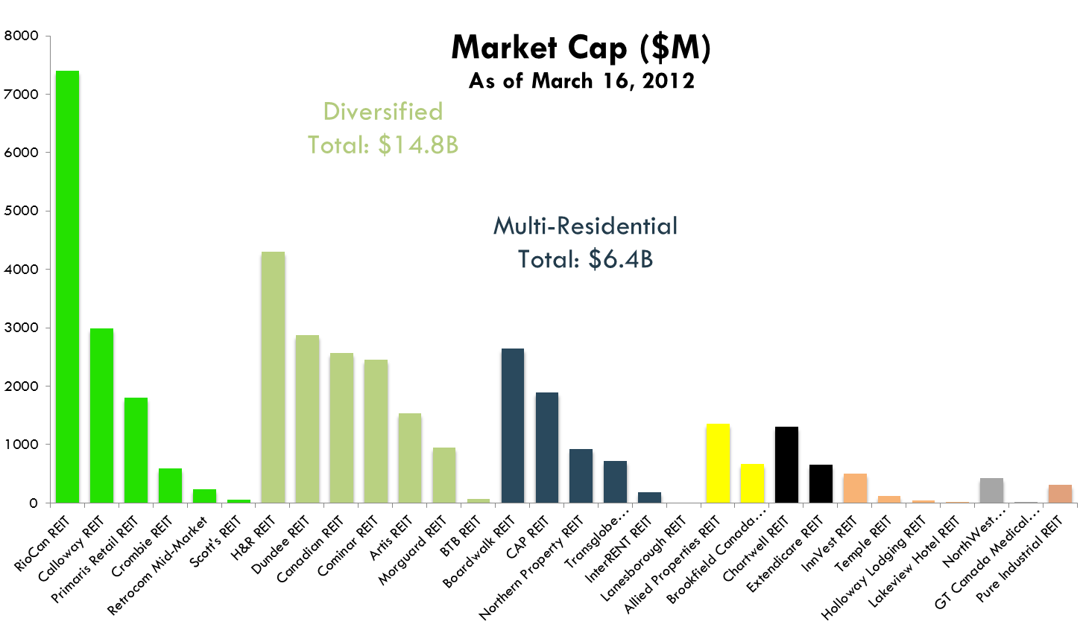
REITs by Market Cap

Slide 12
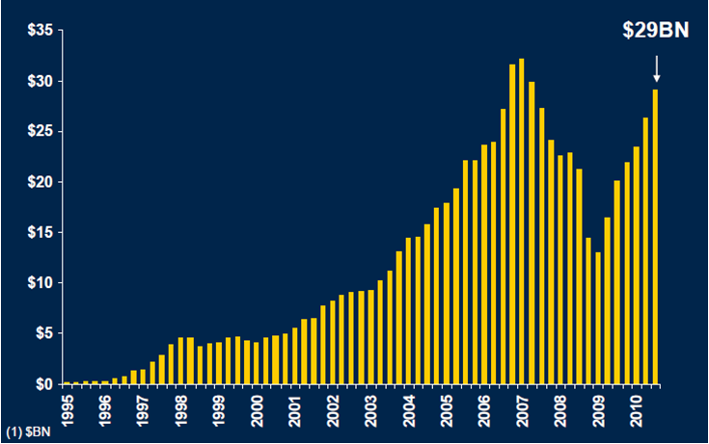
Market Cap Growth

Slide 13
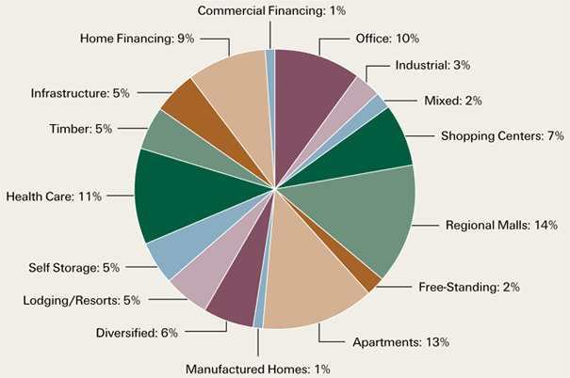
Property Types
REITs own a wide variety of property types. Often REITs focus on a particular property type.
Source: NAREIT. Data based on the FTSE NAREIT All Equity REIT Index, as of October 9, 2012.
Notes:
http://www.advisorperspectives.com/commentaries/abbett_111612.php

Slide 14
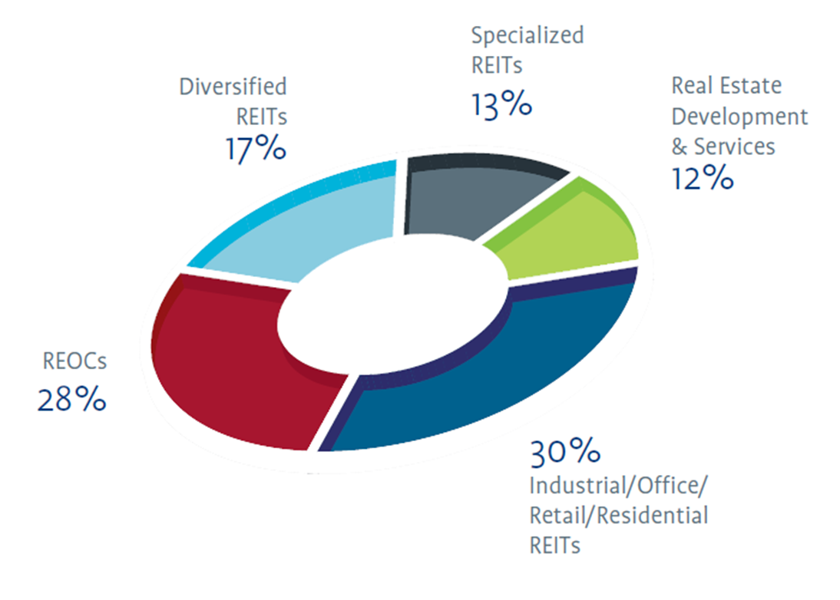
Property types Canada
Notes:
Source: Retrieved from: http://www.tmx.com/en/pdf/RealEstate_listing.pdf

Slide 15
Characteristics
Regulations against “merchant building”
Including one-time sales of property in FFO so as to inflate the apparent performance of the REIT.
Create “secondary market” for real estate.
When primary and secondary markets disagree, REITs can undertake positive NPV projects by buying for selling in primary market. This is why REITs can trade at a discount or premium to their Net Asset Value (NAV).
High interest rate sensitivity.
Income is predictable and steady.
Hedges against inflation as rents rise with inflation.
Adheres to high standards of corporate governance, financial reporting and information disclosure.
Diversified: both in variety of real estate holdings, and due to limited correlation to other securities.
Notes:
http://online.wsj.com/news/articles/SB1012944839582029160

Slide 16
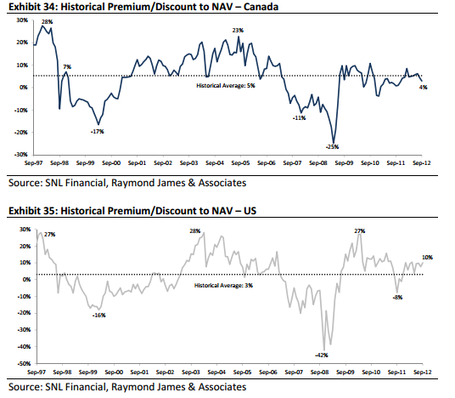
Premium/Discount to NAV
REIT (secondary) market may not align with the real estate (primary market).

Slide 17
Size of the Market
Notes:
http://www.raymondjames.ca/en_ca/equity_capital_markets/equity_research/sample_research/docs/Real%20Estate%20-%20October%204th,%202012.pdf

Slide 18
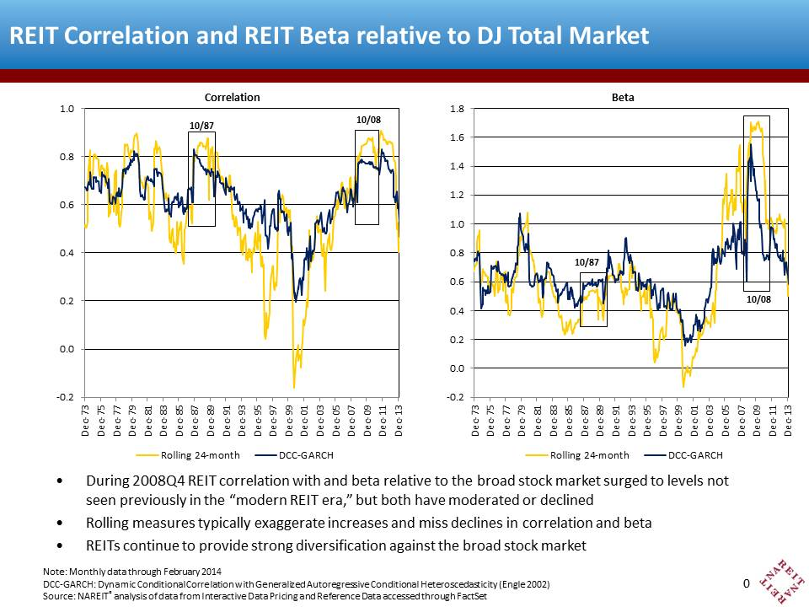
Diversification

Slide 19
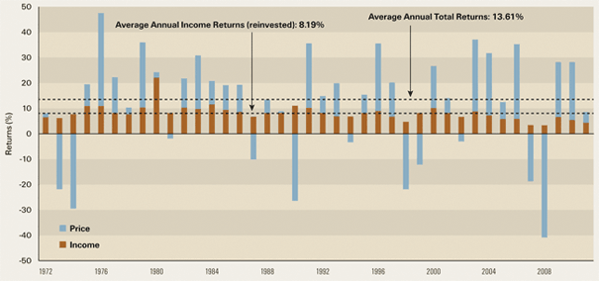
Income
Relatively predictable revenue stream of dividends, but price fluctuations can create volatility
Notes:
http://www.advisorperspectives.com/commentaries/abbett_111612.php

Slide 20
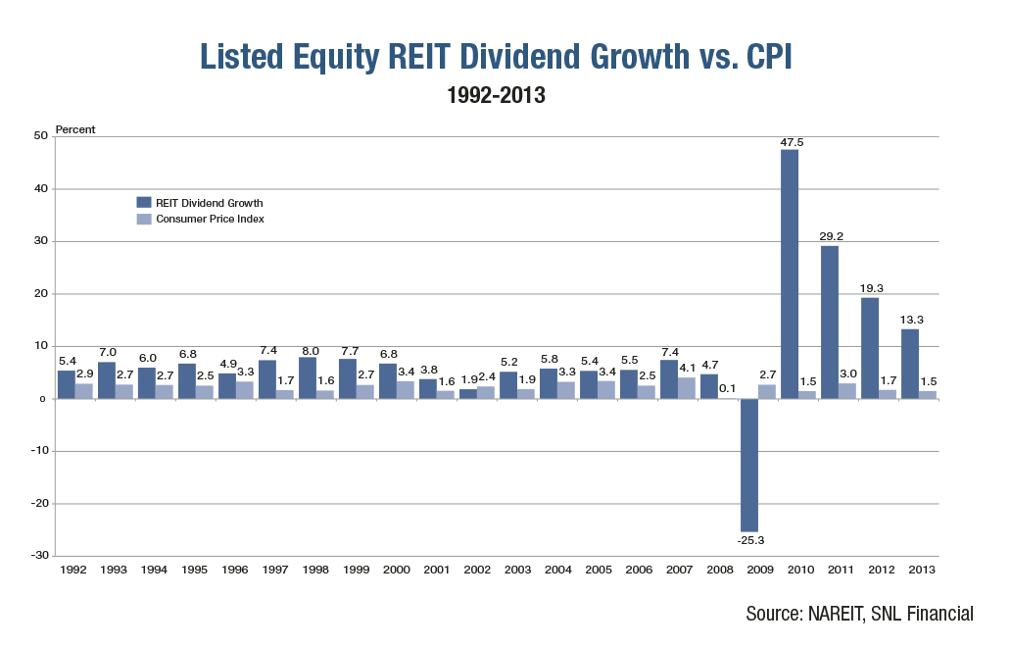
Inflation Resistance
Inflation resistant as rents rise or fall with inflation, as opposed to bonds with predetermined coupons

Slide 21
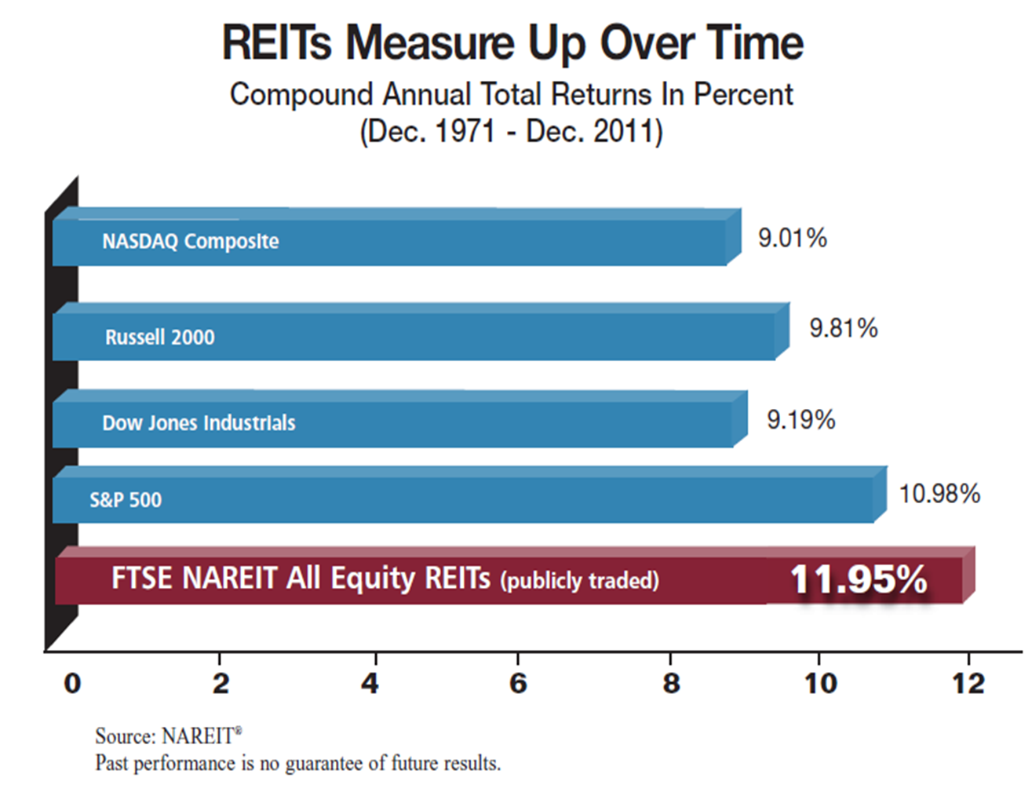
Past Performance

Slide 22
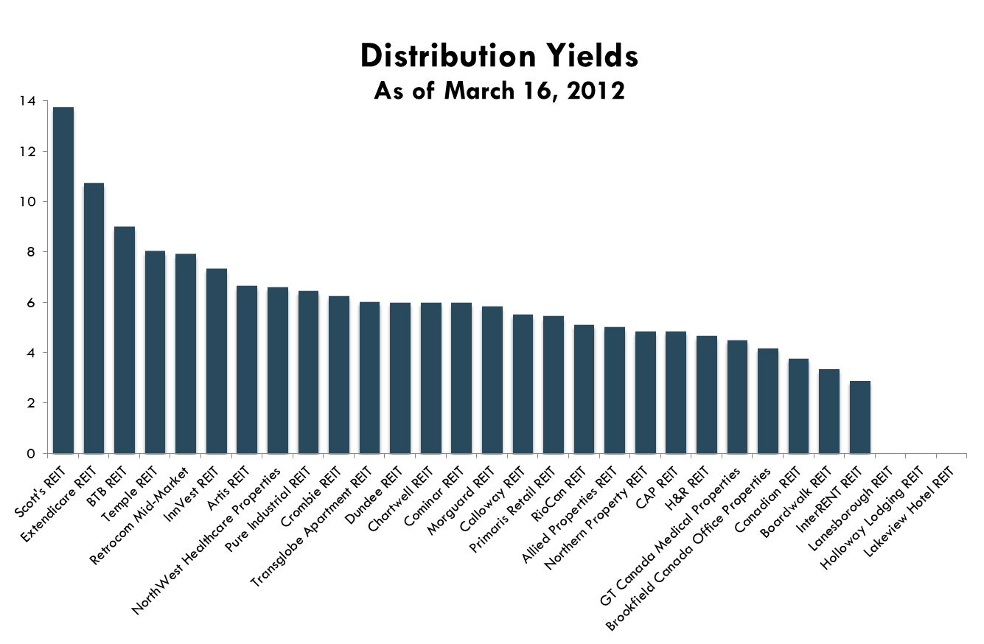
Performance in 2012

Slide 23
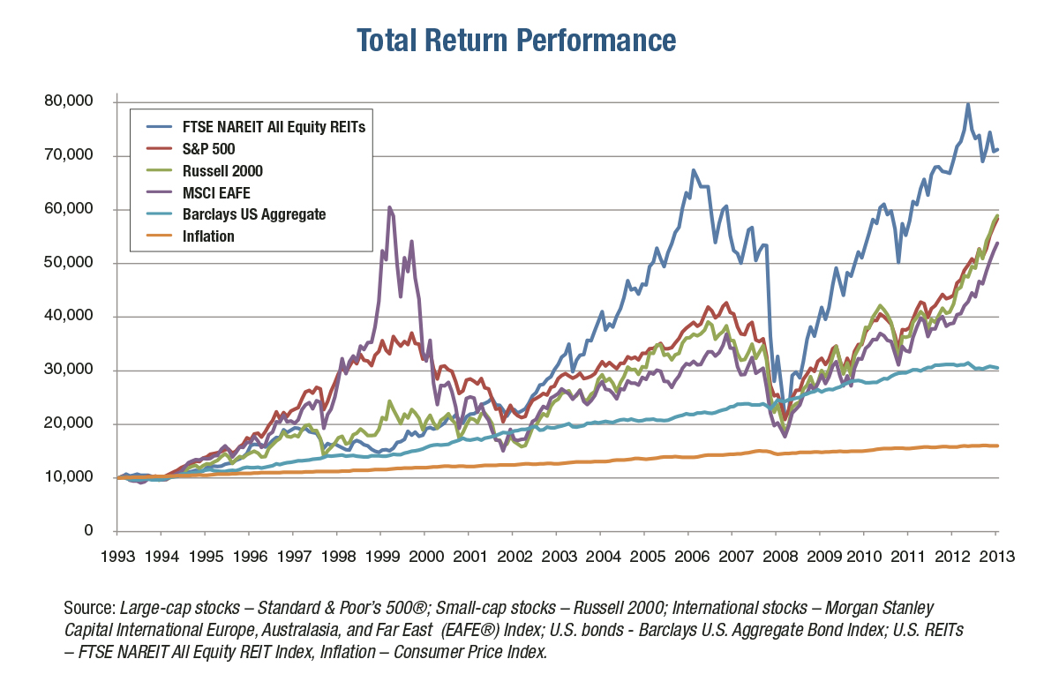
Performance vs Indexes

Slide 24
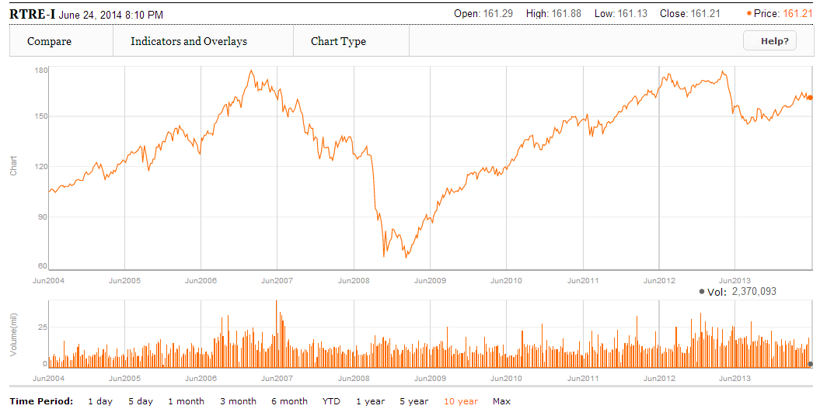
REIT Index 10-Year

Slide 25
S&P/TSX Capped REIT Index Constituents
Allied Properties Real Estate Investment Trust AP.UN:TSX
Artis Real Estate Investment Trust AX.UN:TSX
Boardwalk Real Estate Investment Trust BEI.UN:TSX
Calloway Real Estate Investment Trust CWT.UN:TSX
Canadian Apartment Properties Real Estate Investment Trust CAR.UN:TSX
Canadian Real Estate Investment Trust REF.UN:TSX
Chartwell Retirement Residences CSH.UN:TSX
Cominar Real Estate Investment Trust CUF.UN:TSX
Crombie Real Estate Investment Trust CRR.UN:TSX
Dream Global Real Estate Investment Trust DRG.UN:TSX
Dream Office Real Estate Investment Trust D.UN:TSX
Granite Real Estate Investment Trust GRT.UN:TSX
H&R Real Estate Investment Trust HR.UN:TSX
Northern Property Real Estate Investment Trust NPR.UN:TSX
RioCan Real Estate Investment Trust REI.UN:TSX

Slide 26
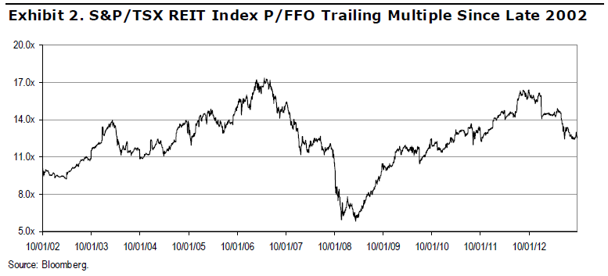
Index Price/FFO Multiple

Slide 27
However…
Interest rates cannot continue to decline as they did over the past 20 years.
Notes:
http://www.reit.com/timeline/timeline.php

Slide 28
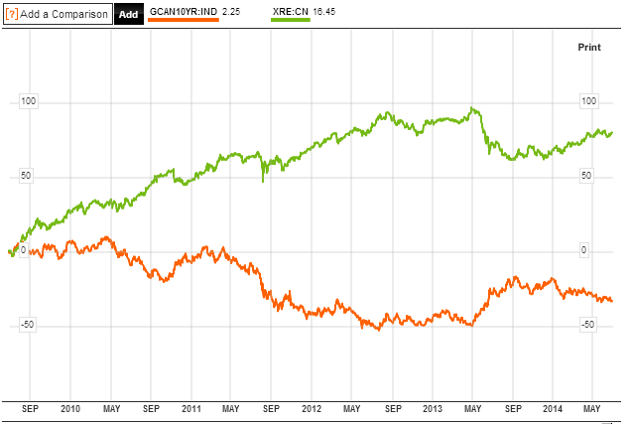
REIT Index vs Bond Index

Slide 29
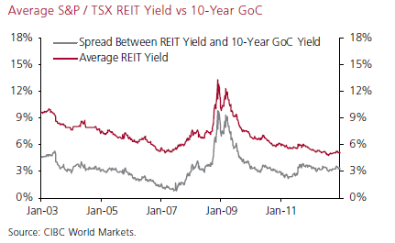
REIT Yield Spread

Slide 30
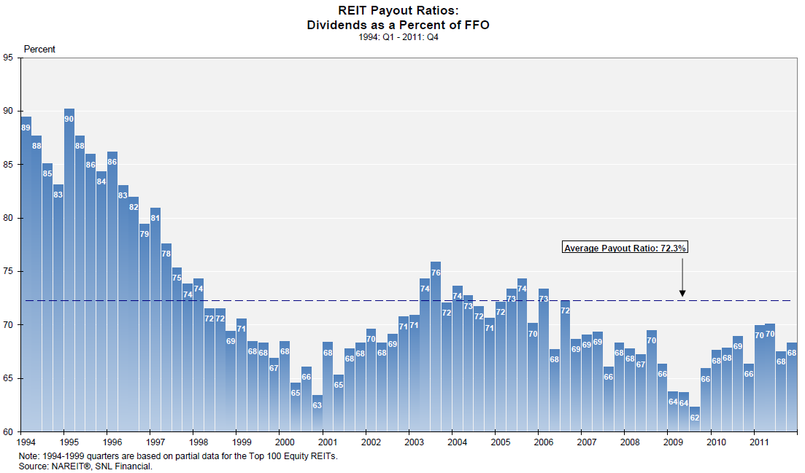
Payout Ratios (USA)

Slide 31
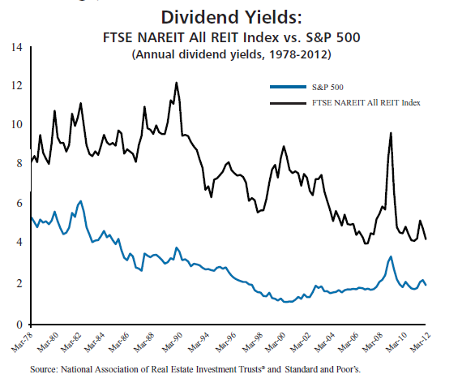
Dividend Yields (USA)

Slide 32
Lease Terms

Slide 33
Debt-Return Correlation

Slide 34
Measuring Performance
Net Income
Real estate revenue
- Real estate expense
- Depreciation & amortization of real estate
= Income from real estate
+ Other Income
- General and administrative expense
= Net Income per GAAP
Net Income is an imperfect measure due to depreciation. Real estate properties rarely depreciate. Instead, they generally appreciate.

Slide 35
Measuring Performance
Funds from Operation (FFO)
Net income per GAAP
- Gains from sale of real estate
= Adjusted net income
+ Depreciation and amortization of real estate
= Funds From Operation
Improved measurement adjusts for misleading depreciation, and non-recurring income from the sale of property.

Slide 36
Measuring Performance
Adjusted Funds From Operations (AFFO) subtracts from FFO the capital expenditures required to maintain the existing portfolio of properties.
It provides an even more precise measure of residual cash flow available to shareholders and is therefore a better number for estimating value.

Slide 37
P/AFFO Multiples Canada

Slide 38
Measuring Performance
Funds from operation
+ Rent adjustments
- Capital improvements
= Funds Available for Distribution
Measures funds that are available to be paid out as dividends.

Slide 39
Measuring Performance
Funds available for distribution
- Real estate acquisitions (new investments)
- Changes in working capital
- Principal payments
+ New debt issue
+ Gain on sale of real estate
+ New equity issue
= Free Cash Flow to Equity

Slide 40
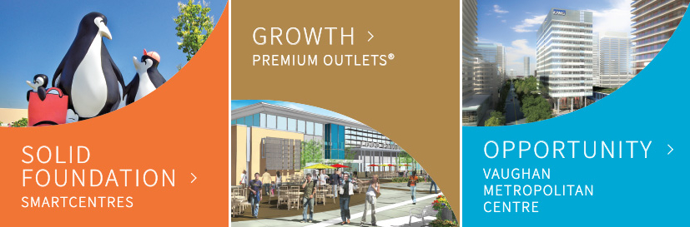
CALLOWAY
Presented by Yuying Liang

Slide 41
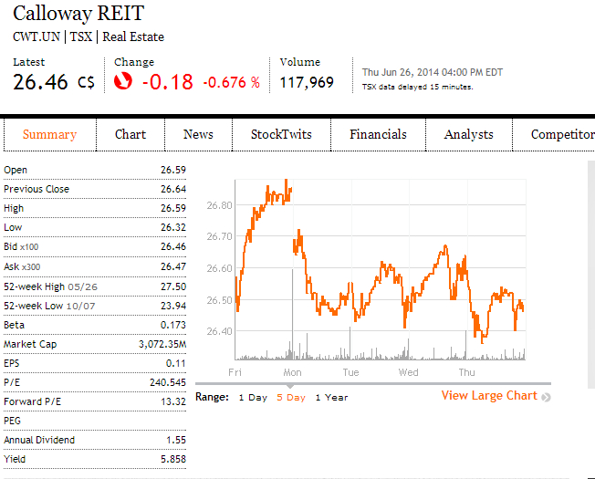
SECURITY SNAPSHOT

Slide 42
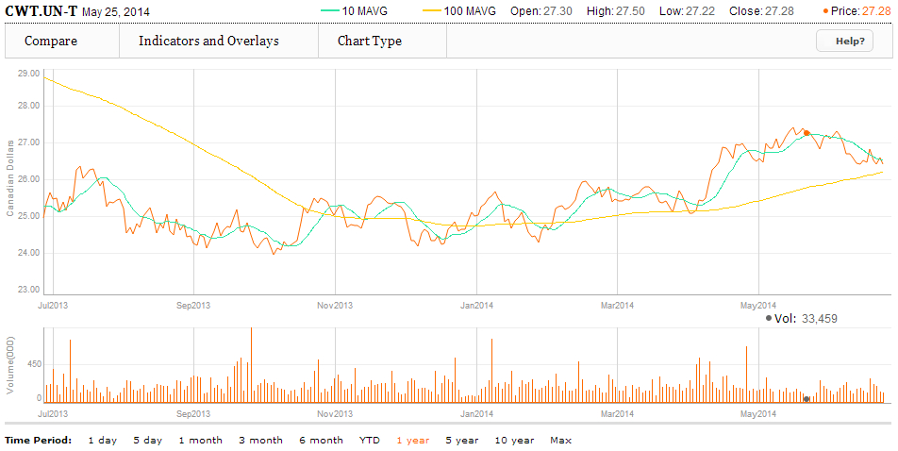
1 YEAR CHART
Moving Average at 10 & 100

Slide 43
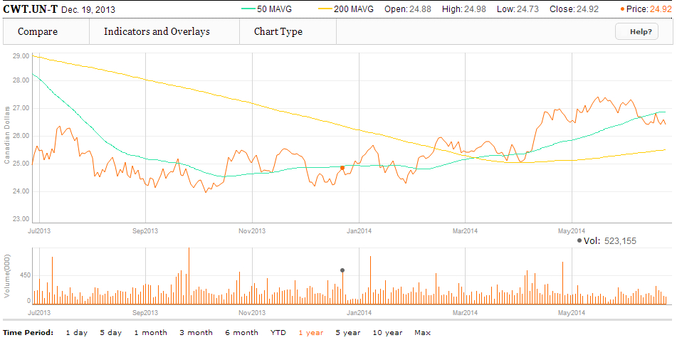
1 YEAR CHART
Moving Average at 50 & 200

Slide 44
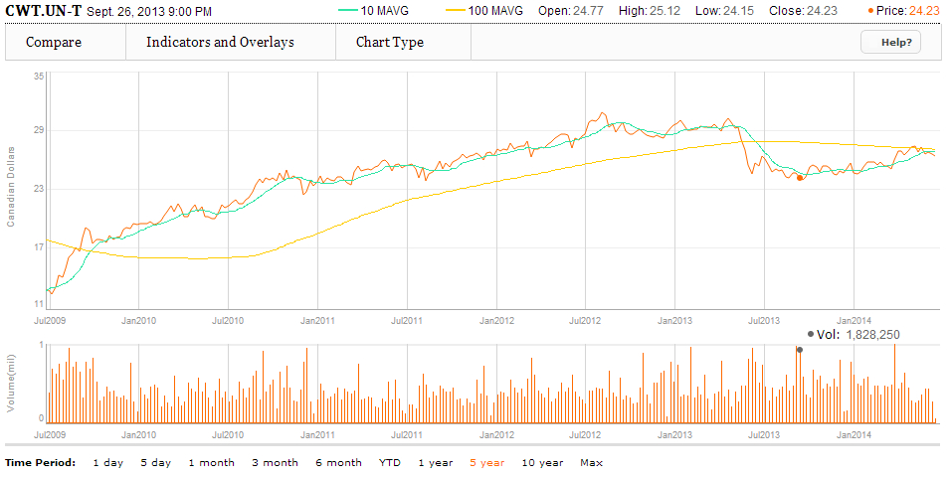
5 YEAR CHART
Moving Average at 10 & 100

Slide 45
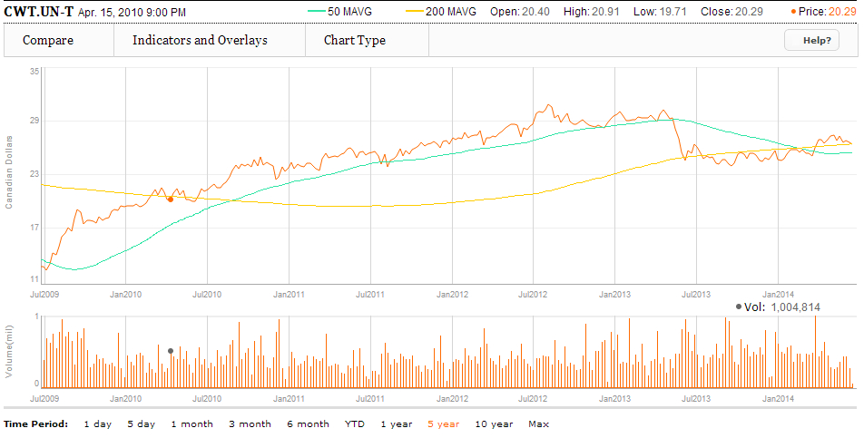
5 YEAR CHART
Moving Average at 50 & 200

Slide 46
COMPARE WITH S&P/TSX COMPOSITE
What is S&P/TSX Composite?
The S&P/TSX Composite Index is an index of the stock (equity) prices of the largest companies on the Toronto Stock Exchange (TSX) as measured by market capitalization.
The Toronto Stock Exchange listed companies in this index comprise about 70% of market capitalization for all Canadian-based companies listed on the TSX. It replaces the earlier TSE 300 index.
Why Do We Compare with S&P/TSX Composite?
Measures Calloway performance with the largest Canadian-based companies.

Slide 47
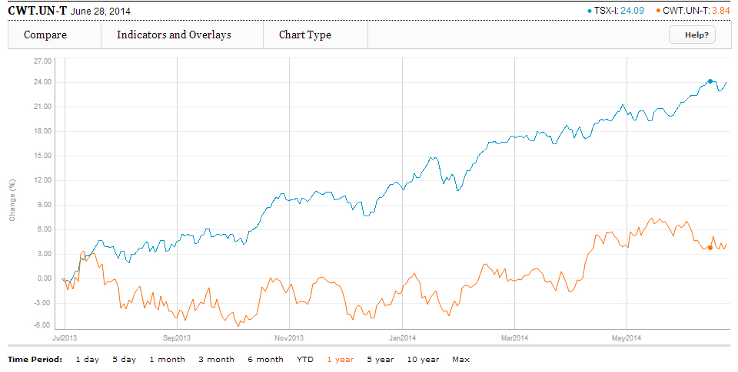
COMPARE WITH S&P/TSX COMPOSITE (1 Year)

Slide 48
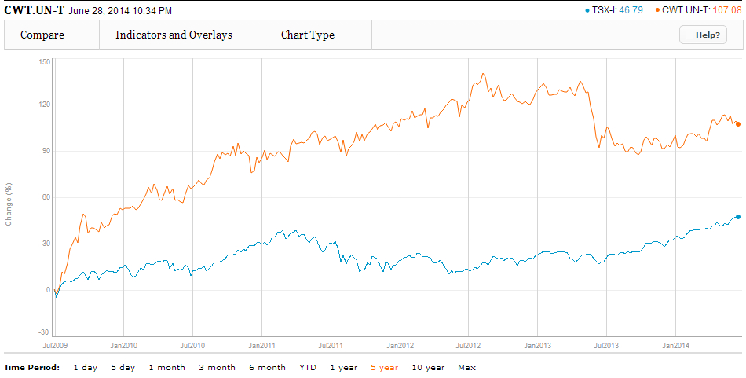
COMPARE WITH S&P/TSX COMPOSITE (5 Year)

Slide 49
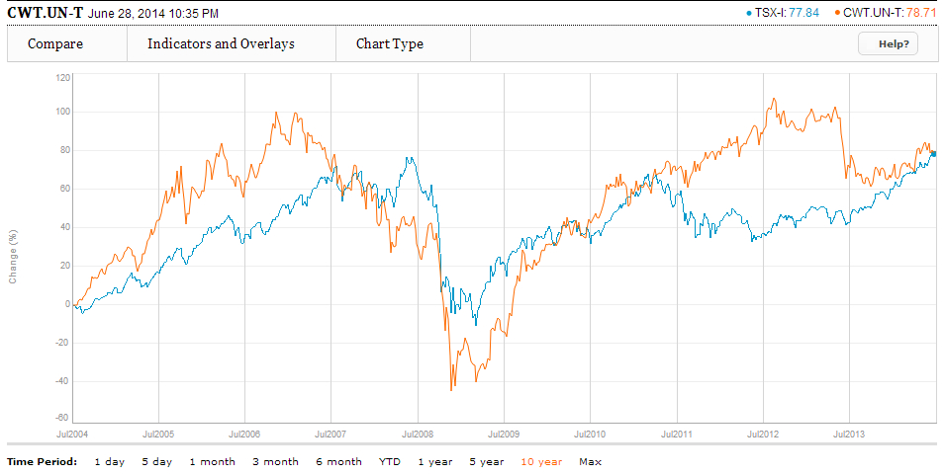
COMPARE WITH S&P/TSX COMPOSITE (10 Year)

Slide 50
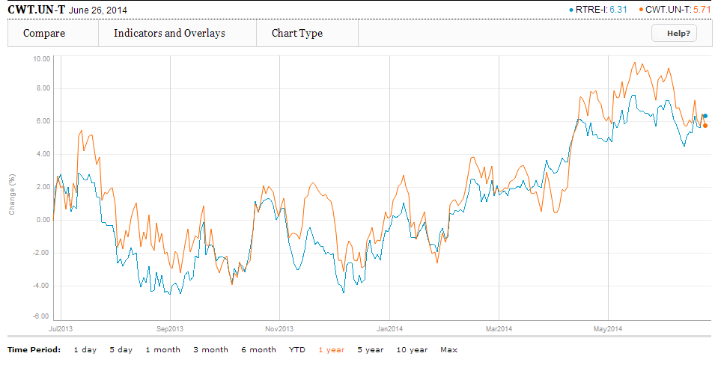
1 Year Calloway vs. iShares S&P/TSX Capped REIT Index (XRE-T)

Slide 51
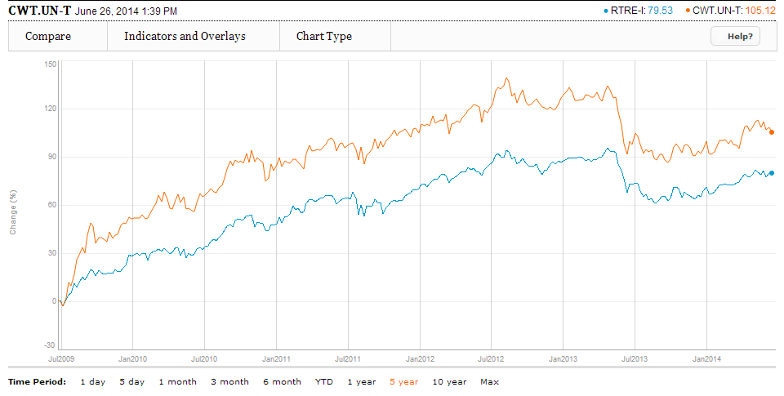
5 Year Calloway vs. iShares S&P/TSX Capped REIT Index (XRE-T)

Slide 52
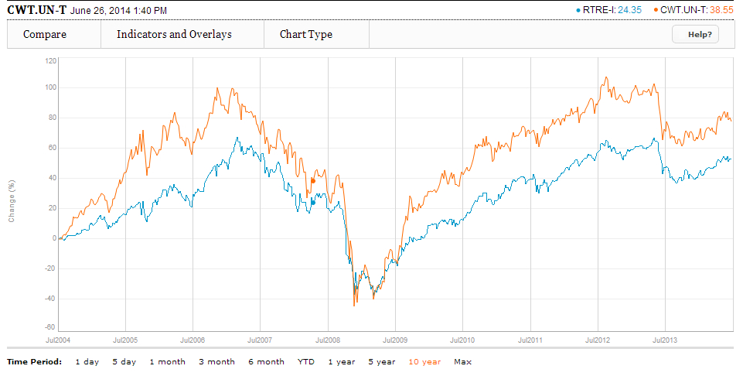
10 Year Calloway vs. iShares S&P/TSX Capped REIT Index (XRE-T)

Slide 53
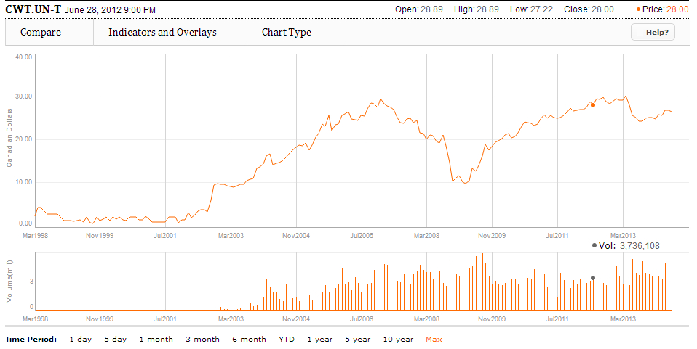
MAX CHART (May 1998 – 2014)

Slide 54
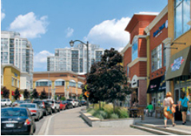
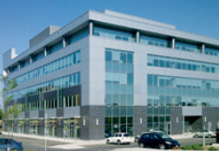

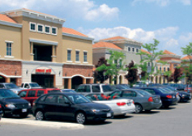
COMPANY OVERVIEW
Vision: To provide a value-oriented shopping experience to Canadian consumers

Slide 55
ABOUT CALLOWAY
Calloway is an unincorporated open-ended mutual fund trust governed by the laws of the Province of Alberta
Mission Statement: Calloway aims to be the landlord of choice for retailers. By selecting convenient locations close to consumers and leasing to strong tenants in well designed centres, Calloway will maximize returns to Unit holders, and retailers will prosper
Objectives:
provide Unit holders with stable and growing tax-deferred cash distributions through the acquisition
development and operation of a portfolio of well located, primarily large format unenclosed retail centres
enhance the value of Calloway's assets and unit value through effective management, leasing and redevelopment of its assets, and through effective control of long-term cost of capital and operating costs.

Slide 56
ABOUT CALLOWAY
Currently in 2014, Calloway has:
$7.0 billion in total assets
27.5 million square feet of leasable area
3.0 million square feet of future development potential
133 premium locations across Canada
109 dedicated staff

Slide 57
INFORMATION ABOUT UNIT HOLDER

Slide 58
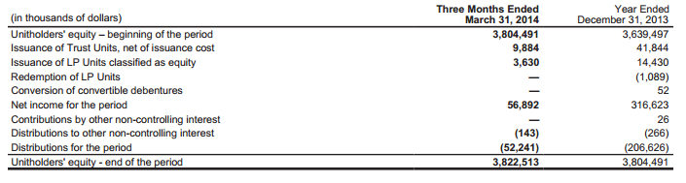
UNITHOLDER SUMMARY

Slide 59
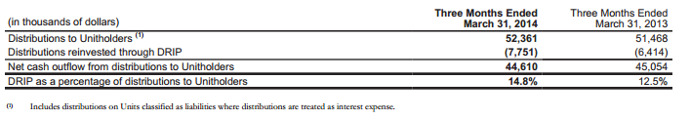
DISTRIBUTION TO UNITHOLDER

Slide 60
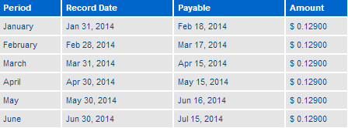
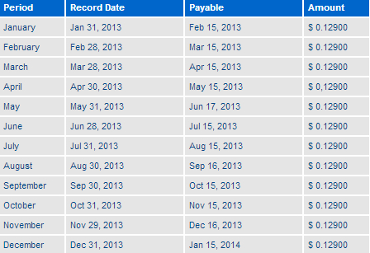
DISTRIBUTION TO UNITHOLDER
Distribution for 2014:
Distribution for 2013:

Slide 61
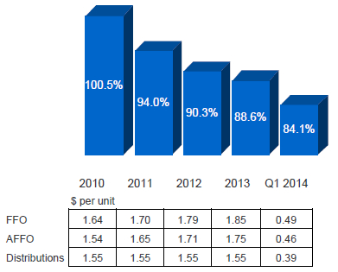
STABLE CASH FLOW
AFFO Payout Ratio
Management and the Board have endorsed a revised target payout range of 82% to 87%
Management expects the overall 2014 payout ratio to trend towards the lower end of the range

Slide 62
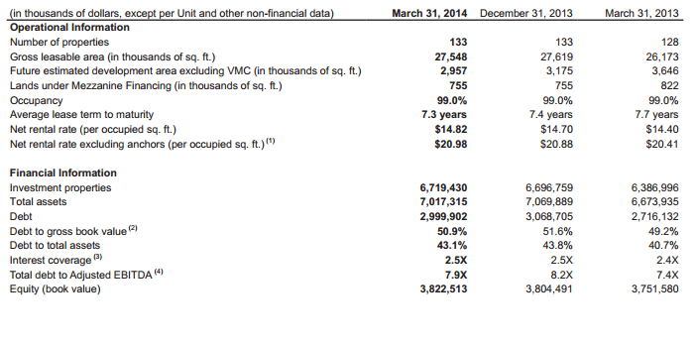
PORTFOLIO HIGHLIGHTS

Slide 63
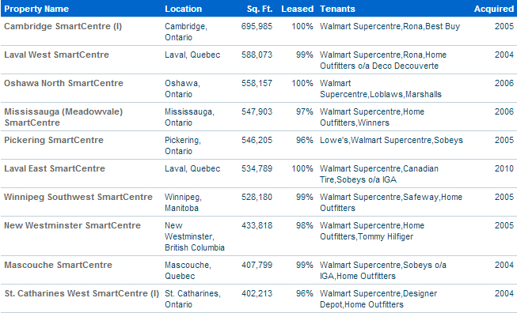
TOP 10 LARGEST PROPERTIES

Slide 64
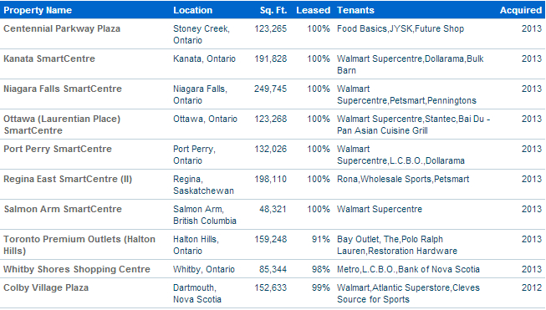
1O MOST RECENT ACQUIRED PROPERTIES

Slide 65
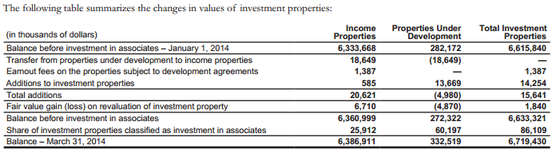
INVESTMENT PROPERTIES

Slide 66
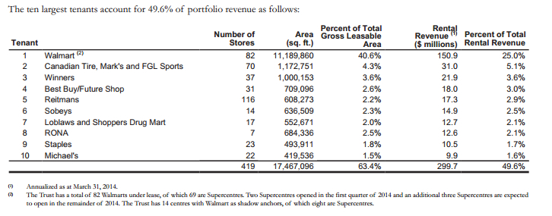
TOP 10 TENANTS

Slide 67
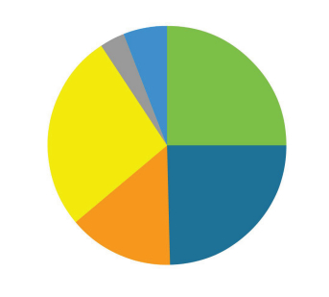
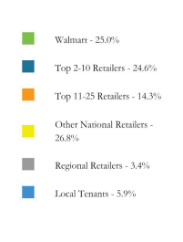
GROSS REVENUE BY TENANT

Slide 68


GROSS REVENUE BY PROVINCE

Slide 69

LEASE MATURITY
Average lease term of 7.3 years
Average remaining lease term of 9.2 years for Walmart
Average remaining lease term excluding Walmart is 5.9 years
Average retention rate of 87% and lifts on renewals of 7.5% for 2013

Slide 70

LEASE MATURITY (Anchor vs. Non-Anchor)

Slide 71

LEASE EXPIRATION SCHEDULE

Slide 72
POTENTIAL FUTURE PIPELINE

Slide 73


GROSS LEASABLE AREA

Slide 74

COMMITTED PIPELINE

Slide 75

UNCOMMITTED PIPELINE

Slide 76
PREMIUM OUTLETS
Toronto Premium Outlets (Halton Hills)
JV with Simon Property Group
500,000 SF when all phases are completed
Phase I opened August 1, 2013
Year 1 yield of 8%+
Montreal Premium Outlets (Mirabel)
JV with Simon Property Group (50%) and SmartCentres (25%)
Phase I – 350,000 SF
Construction on track and on budget
Opening October 2014

Slide 77

PREMIUM OUTLETS

Slide 78
VAUGHAN METROPOLITAN CENTRE (VMC)
A long term build (10 – 15 years)
A 50:50 JV between Calloway and SmartCentres
Potential density of 6 million square feet of residential office and retail development
First development underway – KPMG tower complete with 360,000 SF of LEED Gold space, opening in 2016
Subway also to open in 2016 – fully funded and on schedule
Exceptional opportunity to develop a new city centre for one of Canada’s fastest growing communities

Slide 79

VAUGHAN METROPOLITAN CENTRE (VMC)

Slide 80

VMC: TTC SUBWAY EXTENSION

Slide 81
STRATEGIC RELATIONSHIPS

Slide 82
STRATEGIC RELATIONSHIP – SUPERCENTRES
Largest developer of open format centres in Canada
Largest unitholder (21%)
Relationship provides:
Market intelligence, tenant relationships
Development and leasing infrastructure expertise
Acquisition opportunities and earnout pipeline
Strategic guidance (2 of 7 board seats)

Slide 83

STRATEGIC RELATIONSHIP – WALMART CANADA
Walmart Canada attributes:
Value pricing and fresh food generates huge traffic
Dominant retailer
76% of Canadians live within 10km of a Walmart
An additional 3 Supercentre expansion to open in 2014

Slide 84
STRATEGIC RELATIONSHIP – SIMON PROPERTY GROUP
Largest public real estate company in the U.S.
Engaged primarily in retail real estate properties including regional malls, Premium Outlets and The Mills®
Exceptional relationships with the world’s largest retailers
Canada is part of a continuing global expansion

Slide 85

CAPITAL STRUCTURE

Slide 86
INFORMATION ABOUT DEBT

Slide 87

DEBT

Slide 88

TERM MORTGAGES

Slide 89

FUTURE PRINCIPAL PAYMENTS

Slide 90

UNSECURED DEBENTURES

Slide 91

DEBT MATURITY / LEVERAGE

Slide 92
MANAGEMENT TEAM

Slide 93

CHIEF EXECUTIVE OFFICER/PRESIDENT
Huw Thomas
Appointed President & CEO July 29, 2013
Previously served in various senior financial roles at Canadian Tire Corporation, Limited
Member of the Board of Directors, Audit Committee, and the Nominating and Governance Committee of Dollarama Inc.
Member of the Board of Trustees and member of the Audit Committee of Chartwell Retirement Residences
Chairman and Chair of the Audit Committee of K. P. Tissue Inc.
Plenty of management experience

Slide 94

EXECUTIVE VICE PRESIDENT ASSET MANAGEMENT
Rudy Gobin
Chartered Accountant
Bachelor of Commerce from the University of Toronto
Former Strategy Officer of Calloway
Former Executive Vice President, Finance and Operations of SmartCentres from 2001 to 2006
CFO of Nexacor Realty Management (1998-2001)
Familiar with accounting information

Slide 95

CHIEF FINANCIAL OFFICER
Mario Calabrese
Former Vice President and Controller of Calloway since May 2009
Former Senior Director of Operations Accounting of SmartCentres from 2005 to 2006
Former Corporate Controller of SNC Lavalin Nexacor (2000-2005)
Former Accounting Manager of Oxford Properties Group (1997-1999)
Chartered Accountant
Familiar with Calloway’s strategy

Slide 96
QUARTERLY FINANCIAL AND OPERATIONAL HIGHLIGHTS
Maintained portfolio occupancy at the 99% level
Completed Developments and Earnouts of 104,515 square feet of leasable area for $20.1 million, providing an unleveraged yield of 8.4%
Issued $150.0 million of 3.749% Series L senior unsecured debentures maturing in February 2021
Redeemed $100.0 million of 5.10% Series E senior unsecured debentures and partially redeemed $50.0 million of $250.0 million aggregate principal amount of the 5.37% Series B senior unsecured debentures
Commenced construction of the KPMG Tower in the VMC
Increased the unencumbered asset pool to approximately $1,625.6 million

Slide 97
FINANCIAL PERFORMANCE

Slide 98

BALANCE SHEET (Quarterly)

Slide 99

BALANCE SHEET (Annual)
Current Ratio : 0.2659(2013)
0.1042 (2012)

Slide 100

INCOME STATEMENT (Annual)

Slide 101

INCOME STATEMENT (Quarterly)

Slide 102

CASH FLOW STATEMENT (Annual)

Slide 103

CASH FLOW STATEMENT (Annual) Cont.

Slide 104

CASH FLOW STATEMENT (Quarterly)

Slide 105

CASH FLOW STATEMENT (Quarterly) Cont.

Slide 106

CASH FROM OPERATIONS (Quarterly)

Slide 107

RESULTS FROM OPERATIONS (Quarterly)

Slide 108

FFO & AFFO (Annual)

Slide 109

FFO & AFFO (Quarterly)

Slide 110

FFO AND AFFO QUARTERLY INFORMATION

Slide 111
POTENTIAL RISKS
Development Risk
Possibility that developed space will not be leased or that costs of development will exceed original estimates (mitigated by fixed price contracts)
Interest and Financing Risk
In the low interest rate environment that the Canadian economy has experienced in recent years, leverage has enabled the Trust to enhance its return to Unitholders. A reversal of this trend, however, can significantly affect the business's ability to meet its financial obligations.

Slide 112
POTENTIAL RISKS
Environmental Risk
As an owner of real property, the Trust is subject to various federal, provincial, territorial and municipal laws relating to environmental matters. Such laws provide that the Trust could be liable for the costs of removal of certain hazardous substances and remediation of certain hazardous locations.
Credit Risk
Credit risk arises from cash and cash equivalents, as well as credit exposures with respect to tenant receivables and mortgages and loans receivable. Tenants may experience financial difficulty and become unable to fulfill their lease commitments.

Slide 113
CALLOWAY’S KEY ISSUES
Core platform has great stability, but inherent growth in same properties income is only around 1%
Along with other REITs, cost of capital is expected to climb as interest rates rise
Acquisition supply is slowing with more competitive bidding
Lack of diversification to manage risks

Slide 114
RECOMMENDATION

Slide 115
HOLD

Slide 116
WHY HOLD?
Stable cash flow
Best in class assets (high traffic location, high occupancy level)
Stable and growing income
Strong and improving financial position
Conservative capital structure
Strong credit profiles
Growth prospects increasing

Slide 117




Slide 118


Security Snapshot

Slide 119

Max Chart
23.86
Notes:
Highest point: $23.86 April15,2007 H&R

Slide 120

1 Year Chart and Moving Average at 10 & 100
Notes:
Highest point: $23.86 April15,201 H&R

Slide 121

1 Year Chart and Moving Average at 50 & 200

Slide 122

5 Year Chart and Moving Average at 10 & 100

Slide 123

5 Year Chart and Moving Average at 50 & 200

Slide 124

1 Year H&R Vs S&P TSX Capped REIT

Slide 125

5 Year H&R Vs. S&P TSX Capped REIT

Slide 126

Company Overview

Slide 127

H&R Profile
An incorporated closed-end trust and trade on the Toronto Stock Exchange under the symbol HR.UN.
The largest office REIT and third largest REIT in Canada with approximately $4.44 billion market capitalization
Projects has a fair value totaling approximately $10.0 billion, encompassing 44 million square feet.
The REIT currently pays out approximately 78.4% of its adjusted funds from operations to its Unitholders.

Slide 128

H&R Strategy
focuses its investments and expertise on quality commercial properties
using a very disciplined approach to asset management and acquisitions to generate stable distributable income and maximize return on equity for unitholders
reduce its risk by diversifying the portfolio

Slide 129

Properties under development

Slide 130

Properties under development

Slide 131

Diversified Portfolio
Notes:
income stream is well diversified: income stream is well diversified: by geographic region – spanning across 9 Canadian
provinces and 28 States, and by type of property – office, industrial, and retail,
Retail properties now represent 40% of total portfolio fair properties now represent 57% of total portfolio fair
v

Slide 132


Slide 133


Slide 134

Properties

Slide 135

Notes:
This table lists our Top 15 properties at the end of the second quarter. The $5.9 billion estimated fair market value of these
properties represented 56% of H&R’s enterprise value as at June 31, 2012, while the total mortgage balance
outstanding outstanding of $2.3 billion. These 15 high-quality assets – leased long term to investment grade tenants – represent company’s core portfolio.
The Bow is

Slide 136

The Bow
a world-class, approximately two-million square foot downtown office
It is the largest Canadian office tower west of Toronto andwill be the keystone of their property portfolio
fully leased to EnCana Corporation on a triple-net basis for a term of 25 years
The annualized year-one net income from The Bow is expected to be approximately $93.5 million, and rental rates will increase 0.75% per annum on the office space and 1.5% per annum on the parking space during the lease.
Location: | 5th Avenue at Centre St, Calgary, AB
Tenant: | Encana Corporation
Square Footage: | 2,024,182
Ownership Interest: | 100%

Slide 137


Slide 138

HESS TOWER, HOUSTON
global integrated energy company listed on the New York Stock Exchange.
interconnects 77 of Houston's major downtown office buildings to an abundance of upscale restaurants and retail, first class hotels, and world class sports and entertainment destinations
Location: | 1501 McKinney, Houston, TX
Tenant: | Hess Corporation
Square Footage: | 844,763
Ownership Interest: | 100%

Slide 139

BELL CANADA AND BELL MOBILITY
The site features an 8MW Co-Generation Plant as well as state of the art building automation and lighting systems
the first property of its kind to attain Platinum status in Sustainability by the Recycling Council of Ontario.
Location: | 5025, 5099, 5115 Creekbank Rd., Mississauga, ON
Tenant: | Bell Canada
Square Footage: | 1,123,039
Ownership Interest: | 100%

Slide 140




Top 20 tenants
Notes:
As we can see on this list, the top 20 tenants t include large, creditworthy companies, leased for a weighted average term of
11 years. These public and private companies are brand-name leaders in their sectors, accounting for 58.1% of total rental revenue. The majority of their leases are “triple- net”to the landlord, with tenants being responsible for substantially all property operating expenses and capital expenditures.

Slide 141



Encana Corporation is a North American energy producer of natural gas, oil and natural gas liquids (NGLs).
Total asset US $14.5 billion market capitalization
The corporate headquarters are in Calgary, Alberta. Canada,

Slide 142

Bell Canada (commonly referred to as Bell) is a Canadian telecommunications and media company headquartered in Montreal, Quebec.
Net income 2.159 billion CAD (2010)

Slide 143


The Hess Corporation is a large American-based integrated oil company headquartered in New York City, and a Fortune 100 corporation
Net income: $5.1 billion (2013)

Slide 144


Slide 145


Slide 146

Occupancy
Notes:
Consistent high occupancy of 99%

Slide 147

Lease expires

Slide 148


Average remaining lease term
Notes:
H&R REIT's operating strategy is to stabilize annual earnings and minimize market risk by leasing and financing its properties on a long-term basis. As a result, the average remaining term to maturity as December 31, 2012 was 11.0 years for leases and 7.7 years for outstanding mortgages. This relatively low turnover protects the property income from cyclical swings in market rents and occupancy
levels, thereby maximizing the stability and predictability of their cash flow.

Slide 149

Acquisitions

Slide 150

Acquisitions
Notes:
Here we can see that HR has accelerated their acquisition program. In 2011, they acquired 11 properties for a total of $1.4
billion, generating a weighted average levered return of 8.3%. in the first and second quarter of this year, they purchased additional property for $ 682 million. Included in these acquisitions are four prestigious properties that will provide our unitholders with
reliable reliable and increasing returns and will further and increasing returns and will further enhance the high quality to our portfolio.

Slide 151

Acquisitions
Notes:
Here we can see that HR has accelerated their acquisition program. In 2011, they acquired 11 properties for a total of $1.4
billion, generating a weighted average levered return of 8.3%. in the first three quarter of this year, they purchased additional property for $ 810 million. Included in these acquisitions are four prestigious properties that will provide our unitholders with
reliable reliable and increasing returns and will further and increasing returns and will further enhance the high quality to our portfolio.

Slide 152

Management Team

Slide 153

Thomas J. Hofstedter President and CEO
1978
attended the University of Toronto
became a member of The Institute of Chartered Accountants
1996
became President and Chief Executive Officer of the REIT at its creation
2008
President and Chief Executive Officer of Finance Trust at its creation in October 2008

Slide 154

Thomas J. Hofstedter
Has more than 30 years of real estate industry experience.
As head of H&R Development's Office Division, Mr. Hofstedter was responsible for building most of the properties that comprised the initial assets of the REIT.
In addition to commercial development, he has considerable experience in high-rise residential and was responsible for building many prominent Toronto condominiums.
Mr. Hofstedter’s academic and professional experience indicates in the areas of executive management, real estate and finance.

Slide 155

Larry Froom CFO
1986-1989
attended the University of the Witwatersrand
1997 – 2006
VP Finance H&R Developments
2006-Present
CFO H&R REIT
Responsible for financial reporting, equity and debt financings, investor relations, and acquisition due diligence.
Majored in accounting
Responsible for securing construction financing on construction projects and financial reporting.

Slide 156
Larry Froom
has over fifteen years of real estate industry experience.
As CFO, Mr. Froom is responsible for overseeing all financial transactions, Unit offerings and investor relations.
Prior to joining H&R, he was manager at Ernst & Young where he serviced clients in the real estate industry.
is a member of Realpac (Canada’s most influential voice in the real property investment industry)

Slide 157

Nathan Uhr COO
has over thirty years of real estate industry experience
was H&R Developments' Director of Leasing and Property Management and held various other positions with H&R over 20 years before becoming Vice-President, Acquisitions of H&R REIT, at its inception, in December 1996.
Mr. Uhr leads the due diligence team on any acquisition or mezzanine financing planned by the REIT and is responsible for management and leasing issues relating to the REIT's properties.

Slide 158
HR’s Capital structure and Debt Maturities

Slide 159

Capital resource

Slide 160


Distribution to unitholders

Slide 161

Distribution to unitholders

Slide 162

Capital resource
Notes:
Liquidity:
Cash on hand at June 30, 2012 was $121M
H&R’s revolving credit facility with CIBC has $136M
available to be drawn
– The remaining Bow operating facility of $300M will fund
the costs to complete the Bow of approximately $70M

Slide 163

Mortgage Maturity Schedule
Notes:
The current low interest environment presents with a fabulous opportunity to reduce the debt service costs with upcoming mortgage rollovers. As at December 31, 2011, mortgages maturing during 2012 had had a weighted average interest rate of a weighted average interest rate of 6.8%. To date in 2012, they have successfully refinanced 13 mortgages.

Slide 164

Capital Structure

Slide 165


Risk Management

Slide 166

Risk Management

Slide 167

Risk Management

Slide 168


Risk Management

Slide 169
Financial Report and Operating FFO

Slide 170

Financial Statement Analysis-B/S (ANNUAL)
Notes:
Note4

Slide 171

Financial Statement Analysis-B/S (2014-Q1)
Notes:
Management has previously stated that, after a period of aggressively growing and
changing its portfolio, it is turning its focus to a thorough portfolio analysis with a view to pruning assets that may no
longer fit within its strategy and redeploying the capital into assets that offer greater potential upside. A variety of assets
have been reclassified as held for sale

Slide 172

Financial Statement Analysis-I/S (Annual )
Notes:
Property rental income increased by 6%, from 617M to 656M
In March 2011, the REIT was legally released from its mortgages on two Bruno’s Supermarkets LLC properties and two Boscov’s
Department Stores properties upon the lender accepting title to the properties. In July 2011, the REIT was legally released from its
mortgage on the final Boscov Department Store property upon the lender accepting title to the property. As a result, the investment
properties, the mortgages and the accrued interest on the mortgages were all derecognized resulting in a gain on extinguishment of
debt of $0.2 million for the three months and $19.7 million for the year ended December 31, 2011
The Income Tax Act (Canada) contains legislation (the “SIFT Rules”) affecting the tax treatment of “specified investment flowthrough”
(“SIFT”) trusts. The SIFT Rules provide for a transition period until 2011 for
publicly-traded trusts like the REIT which existed prior to November 1, 2006. Under the SIFT Rules, distributions of certain
income by a SIFT are not deductible in computing the SIFT’s taxable income, and a SIFT is subject to tax on such income at a
rate that is substantially equivalent to the general tax rate applicable to a Canadian corporation. The SIFT Rules do not apply to
a publicly-traded trust that qualifies as a real estate investment trust under the Income Tax Act (Canada). The REIT completed
the necessary tax restructuring to qualify as a real estate investment trust effective June 30, 2010. For periods before it
qualified, the REIT recorded deferred tax liabilities in respect of temporary differences expected to reverse after January 1, 2011.
Such deferred tax liability was reversed as an adjustment to deferred income tax expense in income and as an adjustment to
other comprehensive income during the second quarter of 2010, when the REIT became a qualifying REIT.

Slide 173

Financial Statement Analysis-I/S 2013-Q3
Notes:
Net operating income up $52.8 million during this year – Driven by income from acquired properties, NOI increased by 53%
over the prior year comparative period which is driven by occupancy increases in Edmonton, Vancouver, Saskatchewan and Toronto.

Slide 174

Financial Statement Analysis-I/S 2014-Q1
Notes:
Net operating income up $52.8 million during this year – Driven by income from acquired properties, NOI increased by 53%
over the prior year comparative period which is driven by occupancy increases in Edmonton, Vancouver, Saskatchewan and Toronto.

Slide 175

Cash flow (2013-Annual part1)
Notes:
Impairment reversal on investment properties (2011-2,852) (2010-101,165)
During the year ended December 31, 2010, the REIT recorded the reversal of $101,165 in previously recorded impairment
losses on 63 properties (31 properties in the U.S. and 32 in Canada).
These reversals of previously recorded impairment losses were triggered by the significant improvement of the real estate market
during 2010. The economic downturn in 2008 and 2009 had decreased the market value of a number of the REIT’s investment
properties due to weak demand. During 2010, the economy began to rebound and the REIT’s investment properties increased
in value. This change in economic conditions increased the market rent and adjusted discount rates favourably for many of the
REIT’s previously impaired properties.

Slide 176

Cash flow (2013-Annual part2)
Notes:
Impairment reversal on investment properties (2011-2,852) (2010-101,165)
During the year ended December 31, 2010, the REIT recorded the reversal of $101,165 in previously recorded impairment
losses on 63 properties (31 properties in the U.S. and 32 in Canada).
These reversals of previously recorded impairment losses were triggered by the significant improvement of the real estate market
during 2010. The economic downturn in 2008 and 2009 had decreased the market value of a number of the REIT’s investment
properties due to weak demand. During 2010, the economy began to rebound and the REIT’s investment properties increased
in value. This change in economic conditions increased the market rent and adjusted discount rates favourably for many of the
REIT’s previously impaired properties.

Slide 177

Cash flow (2013 Q3-part1)

Slide 178

Cash flow (2013 Q3 part2)

Slide 179

Cash flow (2014 Q1-part1)

Slide 180

Cash flow (2014 Q1- part2)

Slide 181

Funds From Operations (Annual)
Notes:
Funds from operations is still increasing – FFO per unit is $1.7, up $0.27 during 2011, reflecting the
impact of accretive acquisitions as well as comparative NOI growth and refinancings completed at lower rates.

Slide 182

Funds From Operations (2013-Q3)

Slide 183

Funds From Operations (2014-Q1)

Slide 184

Adjusted Funds From Operations (Annual)

Slide 185

Adjusted Funds From Operations (2013-Q3)

Slide 186

Adjusted Funds From Operations (2014-Q1)

Slide 187
Recommendation HOLD
Notes:
We have consistently executed a disciplined and proven
strategy of building a solid portfolio of incomeproducing
properties that can withstand economic and
real estate cycles.
• Our strategy is focused on locking in predictable
income with fixed costs.
o We lease our premises to highly creditworthy
tenants,
on a long-term basis, with contractual rental
escalations.
o Our properties are diversified by type and by region.
o And we further reduce risk by securing long-term
property financing with fixed-rate mortgages.
• We grow and cull our portfolio pro-actively, with
accretive acquisitions, and selective dispositions.
4
• And we develop quality properties, only on a preleased
basis while at all times maintaining a strong
balance sheet with a conservative capital structure.

Slide 188

RIOCAN
Real Estate Investment

Slide 189

Company Snapshot
Company overview
Management Team
Financial Activities
Recommendation
News

Slide 190

Company Snapshot
1 year with SMA50 and SMA200
Company overview
Management Team
Financial Activities
News
Recommendation

Slide 191

Company Snapshot
5 years with SMA50 and SMA200
Company overview
Management Team
Financial Activities
Recommendation
News

Slide 192

Company Snapshot
1 years compared to S&P/TSX Capped REIT
Company overview
Management Team
Financial Activities
Recommendation
News

Slide 193

Company Snapshot
5 years compared to S&P/TSX Capped REIT
Company overview
Management Team
Financial Activities
Recommendation
News

Slide 194

Company overview
Management Team
Financial Activities
Recommendation
News

Slide 195

Company overview
Management Team
Financial Activities
Recommendation
News
Notes:
As at March 31, 2014 at RioCan’s interest

Slide 196


RioCan Profile
Geographic Diversification
Company overview
Management Team
Financial Activities
Recommendation
News
Notes:
340 in total

Slide 197

Company overview
Management Team
Financial Activities
Recommendation
News

Slide 198

Company overview
Management Team
Financial Activities
Recommendation
News

Slide 199

RioCan Profile
Property Type Mix
Company overview
Management Team
Financial Activities
Recommendation
News

Slide 200

Top Tenants
Company overview
Management Team
Financial Activities
Recommendation
News

Slide 201
RioCan Profile
Top 10 source of revenue by tenants ( including US)
Rank | Tenant | % of annnualized rental revenue | Weighted Avg remaining lease term (yrs)
1 | Loblaws /Nofrills /Fortinos /Zehrs / Maxi | 4.1% | 7.8
2 | Walmart | 3.7% | 12.6
3 | Canadian tire Corp. | 3.4% | 8.5
4 | Metro/Super C/Loeb/Food Basics | 3.2% | 6.9
5 | Cineplex/Galaxy Cinemas | 3.0% | 10.0
6 | Winners/ HomeSense /Marshalls | 2.6% | 7.1
7 | Target Corporation | 2.1% | 8.2
8 | Staples/Business Depot | 1.6% | 5.7
9 | Cara/ Prime Restaurants | 1.6% | 7.1
10 | Sobeys Inc. | 1.6% | 7.7
Company overview
Management Team
Financial Activities
Recommendation
News

Slide 202

RioCan Profile
Lease Rollover Profile
Company overview
Management Team
Financial Activities
Recommendation
News

Slide 203

RioCan Profile
Historical Occupancy Rates
Company overview
Management Team
Financial Activities
Recommendation
News

Slide 204

Portfolio Activity and Acquisition
4-year Annual Acquisitions – Canada & US
( in million dollars)
Company overview
Management Team
Financial Activities
Recommendation
News

Slide 205

Portfolio Activity and Acquisition
4-year Annual Record – Canada & US
Cap rate = NOI/ Value
Company overview
Management Team
Financial Activities
Recommendation
News

Slide 206

Portfolio Activity and Acquisition
Assets Acquired (U.S.) - RPAI
Company overview
News
Management Team
Financial Activities
Recommendation

Slide 207

Portfolio Activity and Acquisition
Assets Acquired (U.S.) -Dunhill
Company overview
News
Management Team
Financial Activities
Recommendation

Slide 208
Portfolio Activity and Acquisition
Cedar Dissolution
In October 2012, RioCan and Cedar Realty Trust entered into an agreement to dissolve their joint venture formed in late 2009.
In January 2013, RioCan opened a regional office in Mount Laurel, New Jersey and effective February 1, 2013 RioCan assumed property and asset management functions for its Northeast portfolio.
In February 2013, RioCan sold its entire position of 9.4 million shares of Cedar for $48 million
Company overview
News
Management Team
Financial Activities
Recommendation

Slide 209
Portfolio Activity and Acquisition
Acquisition Completed (As of December 31, 2013)
Canada: acquired the remaining 40% interest in Whiteshield Plaza.
US: acquired 100% interest in a 64,329 square foot single-tenant building at Riverpark Shopping Center in SugarLand (Houston), Texas.
Company overview
Management Team
Financial Activities
Recommendation
News

Slide 210

Portfolio Activity and Acquisition
Recent Enclosed Acquisition
Company overview
Management Team
Financial Activities
Recommendation
News

Slide 211
Portfolio Activity and Acquisition
Acquisition Under Contract (Firm)
Canada: the acquisition of University Plaza under firm contract at a purchase price of $22 million at a capitalization rate of 6.8%.
Company overview
Management Team
Financial Activities
Recommendation
News

Slide 212
Portfolio Activity and Acquisition
Disposition Pipeline
On January 28, 2014, RioCan sold the Madawaska Centre, located in Edmundston, New Brunswick for $1 million.
On January 31, 2014, RioCan sold the Mega Centre Beauport located in Quebec City for $47 million.
On February 27, 2014, RioCan sold its 26,000 square foot interest (52,000 square feet at 100%) in the Canadian Tire unit at Millcroft Shopping Centre in Millcroft, Ontario for $3 million.
Company overview
Management Team
Financial Activities
Recommendation
News

Slide 213
Portfolio Activity and Acquisition
Development acquisitions completed during the First Quarter
January 10, 2014, acquisition by the joint venture between RioCan and Kimco
January 24, 2014 acquisition of a 100% interest in 1860 Bayview Avenue in Toronto, Ontario.
The March 5, 2014 acquisition of a 50% interest in 31 Roehampton Avenue.
The March 31, 2014 acquisitions of Trinity's interests in three development projects
Subsequent to March 31, 2014, RioCan acquired the remaining 40% interest in the Kromer parcel of the College & Bathurst land.
Company overview
Management Team
Financial Activities
Recommendation
News

Slide 214
Portfolio Activity and Acquisition
Development acquisitions completed during the First Quarter (continued)
Subsequent to March 31, 2014, RioCan acquired the remaining 40% interest in the Kromer parcel of the College & Bathurst land.
On May 9, 2014, RioCan acquired its partner's interests in another development property (100% of the industrial component and 50% of the retail component) at a purchase price of $11 million.
Company overview
Management Team
Financial Statements
Recommendation
News

Slide 215
Portfolio Activity and Acquisition
Development Property Acquisition Under Contract
The acquisition of lands adjacent to Calaway Park, a 35 acre parcel of land located approximately 25 kilometres west of Calgary, Alberta.
The acquisition of a 50% interest in the site where TD Bank is currently located at the North East corner of Yonge and Eglinton in Toronto, Ontario, at a purchase price of $12 million.
Company overview
Management Team
Financial Statements
Recommendation
News

Slide 216

Management Team
Edward Sonshine
CEO/ Founder
Law degree from Osgoode Hall Law School
Was a real estate lawyer
1987-1993: President and Chief Executive Officer of Icarus Realty Corp.
Chief executive of RioCan since 1993
Vice Chairman of Counsel Management Services Inc.
General Partner of Cineplex Entertainment Limited Partnership
Company overview
Management Team
Financial Statements
Recommendation
News
Notes:
Connected to 65 Board members in 6 different organizations across 9 different industries

Slide 217
Management Team
Edward Sonshine
CEO/ Founder
Chairman of the Mount Sinai Hospital Foundation.
Chairman of Chesswood GP Limited.
Independent Director of Royal Bank of Canada
Canada’s Outstanding CEO of the Year for 2013
Company overview
Management Team
Financial Statements
Recommendation
News
Notes:
Connected to 65 Board members in 6 different organizations across 9 different industries

Slide 218

Management Team
Frederic A. Waks
President, COO
Compensation: C$ 2,750,887
President and Chief Officer of RioCan since Jan. 1, 2012
Served as Executive Vice President at RioCan since 2008
Company overview
Management Team
Financial Statements
Recommendation
News

Slide 219

Management Team
Raghunath Davloor
CFO, Executive Vice President
25 years of real estate, management, finance, accounting and tax experience to RioCan
served as a Vice President and Director of Investment Banking at TD Securities prior to join RioCan
Member of the Institute of charted Accoutnants of Ontario.
Company overview
Management Team
Financial Statements
Recommendation
News

Slide 220

Financial Highlights
Five-year Revenues
Company overview
Management Team
Financial Activities
Recommendation
News

Slide 221

Financial Highlights
Five-year Net Operating Income
Company overview
Management Team
Financial Activities
Recommendation
News

Slide 222

Financial Highlights
Five-year Operating FFO
Company overview
Management Team
Financial Activities
Recommendation
News

Slide 223
Financial Highlights
Conservative Debt
Debt-to Assets of 44.2% at March 21, 2014
Total operating lines $707.5 million
Unencumbered pool has a fair value of $2.3 billion
Floating rate debt 8.2% of aggregate debt
Strong coverage ratios in Q1 2014 excluding capitalized interst
- EBITDA interest coverage of 3.20x
- Debt service coverage of 2.34x and
- Fixed charge coverage of 1.12x
Company overview
Management Team
Financial Activities
Recommendation
News

Slide 224

Financial Highlights
Capital Structure
Company overview
Management Team
Financial Activities
Recommendation
News

Slide 225

Financial Highlights
Modest leverage, Strong interest coverage
Company overview
Management Team
Financial Activities
Recommendation
News

Slide 226

Financial Highlights
Debt Maturity Schedule
Company overview
Management Team
Financial Activities
Recommendation
News

Slide 227
Question
Should we hold or sell the stock???
Company overview
Management Team
Financial Activities
Recommendation
News

Slide 228

Quarterly Property Growth
Company overview
Management Team
Financial Activities
Recommendation
News

Slide 229

Organic growth- Canadian Portfolio
Ability to add growth through rental renewals with 51% of lease renewing over the next five years
Company overview
Management Team
Financial Activities
Recommendation
News

Slide 230

Organic growth- U.S. Portfolio
Ability to add growth through rental renewals with 35% of lease renewing over the next five years
Company overview
Management Team
Financial Activities
Recommendation
News

Slide 231

Extracting value by Recycling Capital
Current asset sales plan involves selling centres in lower growth and secondary markets.
Focused in Canada’s high population, high growth markets
Growth in Canada’s 6 Major Markets
Company overview
Management Team
Financial Activities
Recommendation
News

Slide 232


Development Activity
RioCan’s development program consists of 16 projects that are expected to add 10.8 million square feet over the next six years.
Company overview
Management Team
Financial Activities
Recommendation
News

Slide 233

Quarterly Balance Sheet
Company overview
Management Team
Financial Statements
Recommendation
News

Slide 234

Consolidated Annual Balance Sheet
Company overview
Management Team
Financial Statements
Recommendation
News
Notes:
130

Slide 235
Five-Year Blalance Sheet Performance
Company overview
Management Team
Financial Statements
Recommendation
News

Slide 236

Consolidated Annual Income Statement
Company overview
Management Team
Financial Statements
Recommendation
News

Slide 237
Five-Year Income Statement Performance
Company overview
Management Team
Financial Statements
Recommendation
News

Slide 238

Quarterly Income Statement
Company overview
Management Team
Financial Activities
Recommendation
News

Slide 239

Annual Cash Flow Statement

Slide 240
Five-Year Cash Flow Statement Performance
Company overview
Management Team
Financial Activities
Recommendation
News

Slide 241

Quarterly Cash Flow Statement

Slide 242

AFFO and FFO

Slide 243

AFFO and FFO
Company overview
Management Team
Financial Statements
Recommendation
News

Slide 244

Recommendation
Buy
Company overview
Management Team
Financial Activities
Recommendation
News

