Slide 1

REITs
Allan Chan
Sarah Liu
Matthew Tse
Hanwen Xu

Slide 2
Agenda
Introduction to the REIT:
    Characteristics
    Types & Structure
    History
Benefits of REITs
Valuation of REITs
Calloway REIT
H&R REIT
Riocan REIT

Slide 3
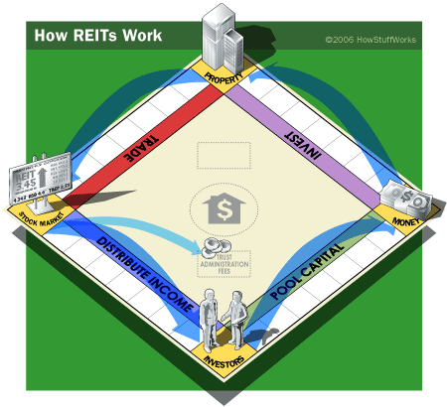
What is a REIT?
Real Estate Investment Trust
Comprised of Trust Units
Tradable
Holds income generating properties
Distributes income to unitholders
Tax efficient
Introduction
Benefits
Valuation
Riocan
H&R
Calloway

Slide 4
Key Characteristics
High yield through regular distributions (monthly)
Capital appreciation
Taxation
Market performance: Contractual cash flows
Focused asset base for stable income
Introduction
Benefits
Valuation
Riocan
H&R
Calloway

Slide 5
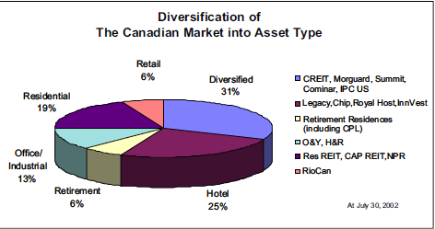
Common Types of Property
Nursing & Retirement
Apartment
Office & Industrial
Retail
Hotels
Introduction
Benefits
Valuation
Riocan
H&R
Calloway

Slide 6
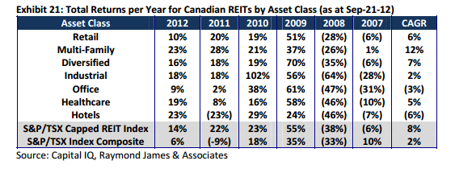
Return by Asset Class (Can. REITs)
Introduction
Benefits
Valuation
Riocan
H&R
Calloway

Slide 7
Canadian REITS Dividends
Introduction
Benefits
Valuation
Riocan
H&R
Calloway

Slide 8
Legal Characteristics
Primarily self-governed through trust declarations & trust indenture
    Defines distributable income
    Minimum distribution
    Amount of borrowing permitted
    Restrictions on issuance
    Board of Trustees (similar to BoD)
Introduction
Benefits
Valuation
Riocan
H&R
Calloway

Slide 9
Transaction Costs
Initial Thought to IPO Completion: 6 months
Underwriters’ fees: 5-6% total dollar value
Legal fees (for REIT’s counsel): $600,000-$1.2 million
Legal fees (underwriters’ counsel): $250,000-600,000
Audit fees: $350,000-$800,000
Appraisals/Environment Engineering: $200,000-$300,000
Printing & Admin: $200,000-$300,000
Rule of Thumb: Total = 7-8% total issue
Introduction
Benefits
Valuation
Riocan
H&R
Calloway

Slide 10
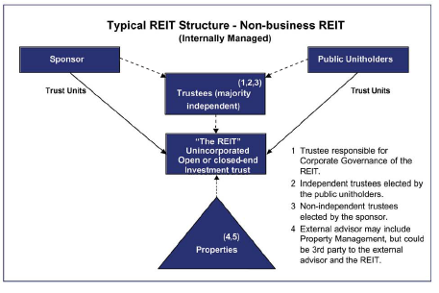
Non-Business REITs
Introduction
Benefits
Valuation
Riocan
H&R
Calloway

Slide 11
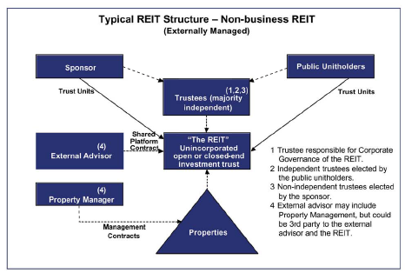
Non-Business REITs
Introduction
Benefits
Valuation
Riocan
H&R
Calloway

Slide 12
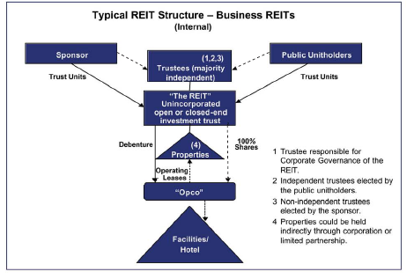
Business REITs
Introduction
Benefits
Valuation
Riocan
H&R
Calloway

Slide 13
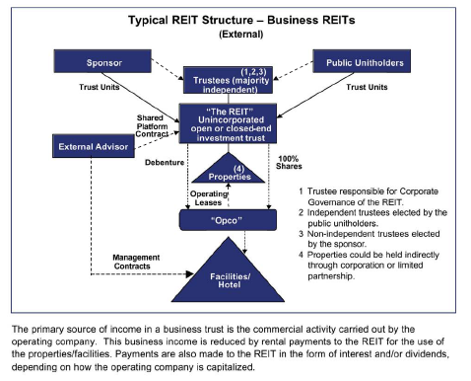
Business REITs
Introduction
Benefits
Valuation
Riocan
H&R
Calloway

Slide 14
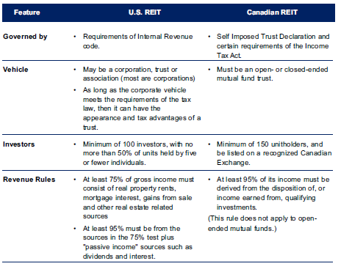
Canadian vs. US REITs
Introduction
Benefits
Valuation
Riocan
H&R
Calloway

Slide 15
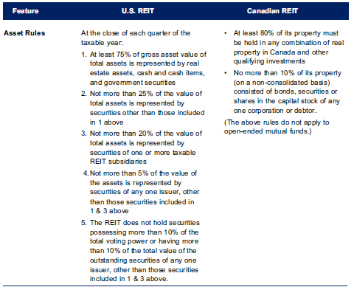
Canadian vs. US REITs
Introduction
Benefits
Valuation
Riocan
H&R
Calloway

Slide 16
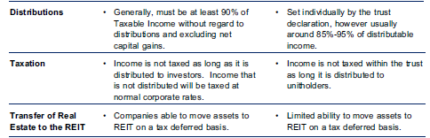
Canadian vs. US REITs
Introduction
Benefits
Valuation
Riocan
H&R
Calloway

Slide 17
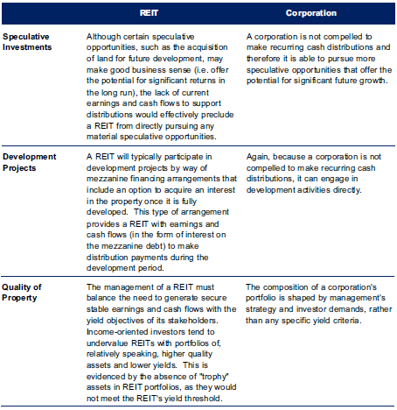
REIT vs. Corporations
Introduction
Benefits
Valuation
Riocan
H&R
Calloway

Slide 18
REIT vs. Corporations
Introduction
Benefits
Valuation
Riocan
H&R
Calloway

Slide 19
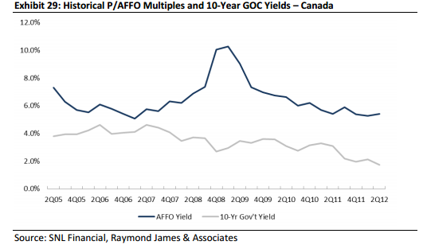
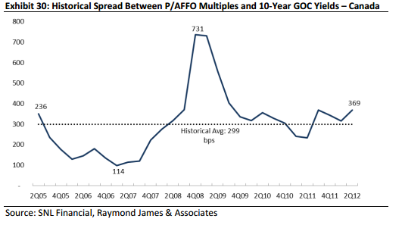
AFFO Yield vs. 10-Year Can. Govt Yield
Introduction
Benefits
Valuation
Riocan
H&R
Calloway

Slide 20
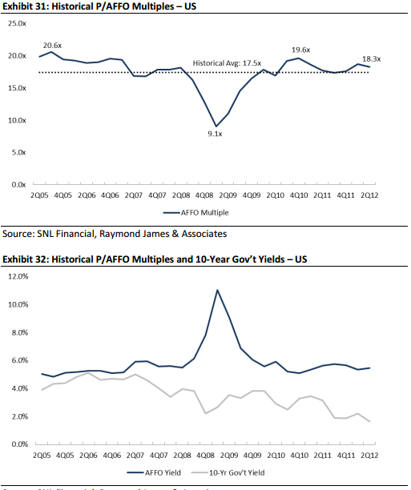
AFFO Yield vs. 10-Year US Govt Yield
Introduction
Benefits
Valuation
Riocan
H&R
Calloway

Slide 21
Tax Fairness Plan (Canada)
Announced on Nov 1st, 2006
Is applicable to all Canadian trusts companies, except REITs given certain conditions
Before the plan, trust companies do not need to pay corporate tax
Federal and Provincial government lose $1 billion annually in tax revenue to trusts
Main purpose is to reduce the growing number of companies converting to trust
Effective for trusts that begin trading after Oct 31, 2006
Four year transition period for existing trusts (2011)
Introduction
Benefits
Valuation
Riocan
H&R
Calloway

Slide 22
New Requirements (SIFT) for REITs
At no time in the year hold any non-portfolio property other than real properties situated in Canada
At least 95% of its income for the year from properties
At least 75% of its income to be directly or indirectly attributable to rents from, mortgages on, or gains from the disposition of real properties situated in Canada
At least 75% of the value of REIT must be attributable to real property situated in Canada, cash and debt and obligations of Canadian governments
Introduction
Benefits
Valuation
Riocan
H&R
Calloway

Slide 23
Origin of the REIT
Came from open-end mutual fund
    Redemption requirement unfitted for real estate
    Collapsed under market downturns (1980s-90s)
Closed-end: unattractive
Modified open-end:
    Indenture prescribed limits
    Honoured by issuing interest-bearing notes
Introduction
Benefits
Valuation
Riocan
H&R
Calloway

Slide 24
History of REITs
1960: Eisenhower signs Cigar Excise Tax Extension Act
1960: NAREIT is formed
1965: First NYSE REIT – Continental
1989-1991: U.S. Real Estate Downturn
1986: US Tax Reform Act: LLPs limited
1972: NARIET introduces REIT Index
1993: First Canadian REIT on TSX
2000: REIT ETFs launched (iShares)
2009: Global Index for REITs with emerging markets
Introduction
Benefits
Valuation
Riocan
H&R
Calloway

Slide 25
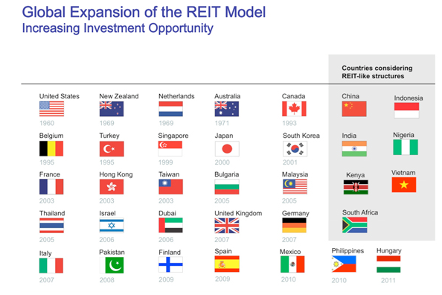
Global Expansion of REITs
Introduction
Benefits
Valuation
Riocan
H&R
Calloway

Slide 26
Future Outlook
Canada lags behind U.S.
REITs allow for real estate securitization
Tax benefits to stay: CCA benefits passed on
Risk diversifying: long-term income
Introduction
Benefits
Valuation
Riocan
H&R
Calloway

Slide 27

Benefits of REITs

Slide 28
Benefits of REITs
Diversification of Portfolio
  Create asset portfolio that behave differently across market conditions
Liquid Asset
  Easily bought and sold on major stock exchanges
High Dividend Yield
Introduction
Benefits
Valuation
Riocan
H&R
Calloway

Slide 29
Benefits of REITs
Transparency
    Tax transparency: no corporate tax in exchange for consistent dividends.
    Operating transparency: regulated (by SEC in the U.S.) and adheres to high standards of corporate governance, financial reporting and information disclosure.
Inflation Protection
    Investing in commercial real estate provides a natural protection against inflation, as rents tend to increase when prices go up
Performance
    Professional and active management Offer strong long-term total returns
Introduction
Benefits
Valuation
Riocan
H&R
Calloway
Notes:
Portfolio diversification
Liquid asset
High yield
Professional and active management
Daily pricing
Stringent regulations on leverage and financial reporting

Slide 30
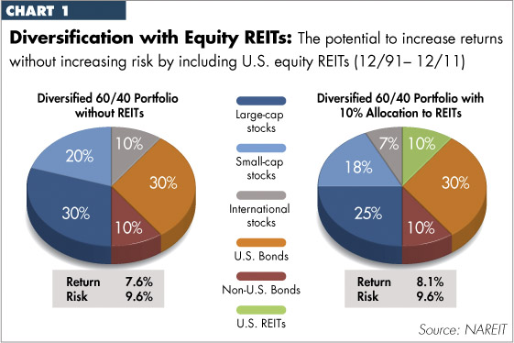
Benefits of Portfolio Diversification
Introduction
Benefits
Valuation
Riocan
H&R
Calloway

Slide 31
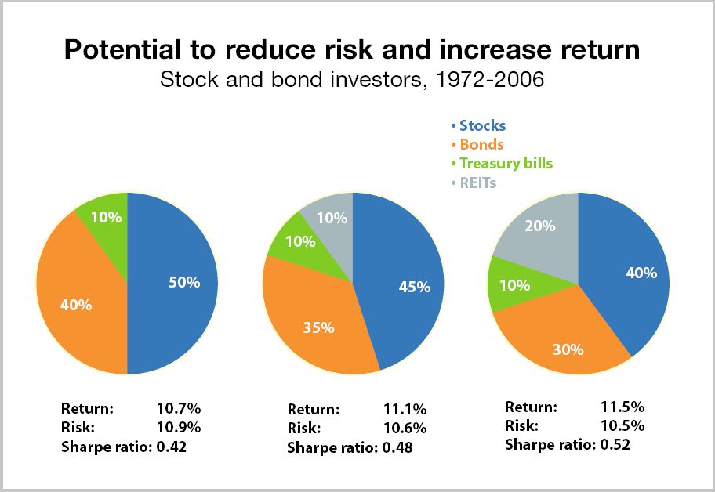
Benefits of Portfolio Diversification
Introduction
Benefits
Valuation
Riocan
H&R
Calloway

Slide 32
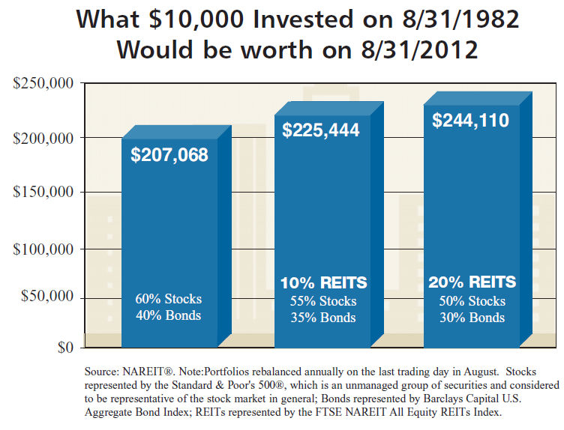
Benefits of Portfolio Diversification
Introduction
Benefits
Valuation
Riocan
H&R
Calloway

Slide 33
Types of REITs
Investment and ownership in properties.
Primary source of revenue from rent incomes.
Equity REITs
Loan money for mortgages
Invest in existing mortgages or MBS
Revenue primarily from interest income
Mortgage REITs
Invest in and own both properties and mortgages
Revenue from both rent and interest income
Hybrid REITs
Introduction
Benefits
Valuation
Riocan
H&R
Calloway

Slide 34
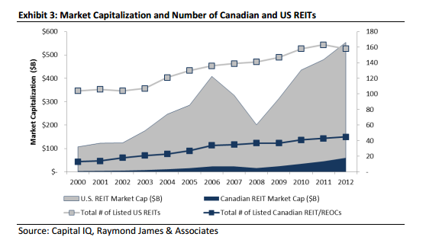
Market Cap. and Number of Can. & US REITs
Introduction
Benefits
Valuation
Riocan
H&R
Calloway

Slide 35
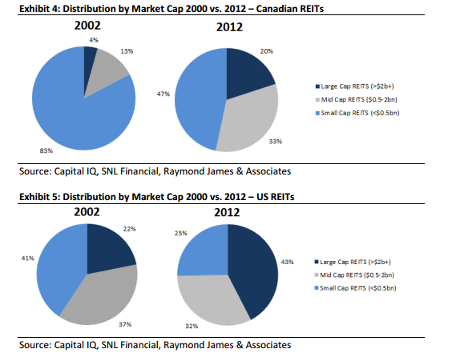
Market Cap. Distribution of Can. & US REITs
Introduction
Benefits
Valuation
Riocan
H&R
Calloway

Slide 36
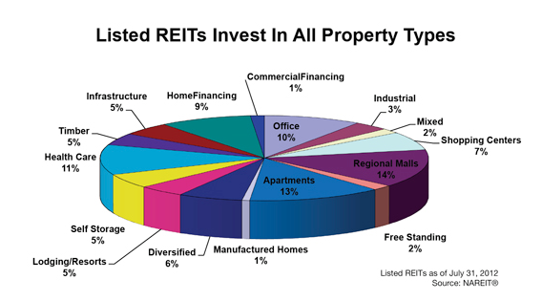
US Equity REITs
Introduction
Benefits
Valuation
Riocan
H&R
Calloway

Slide 37
US Mortgage REITs
Agency vs. Non-Agency MBS
  For Agency MBS the principal and interest payments are guaranteed by a U.S. Government-sponsored entity or agency
Fixed vs. Floating/Adjustable
Leverage
Introduction
Benefits
Valuation
Riocan
H&R
Calloway

Slide 38
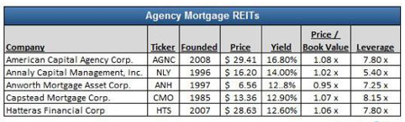
US Mortgage REITs
Introduction
Benefits
Valuation
Riocan
H&R
Calloway

Slide 39
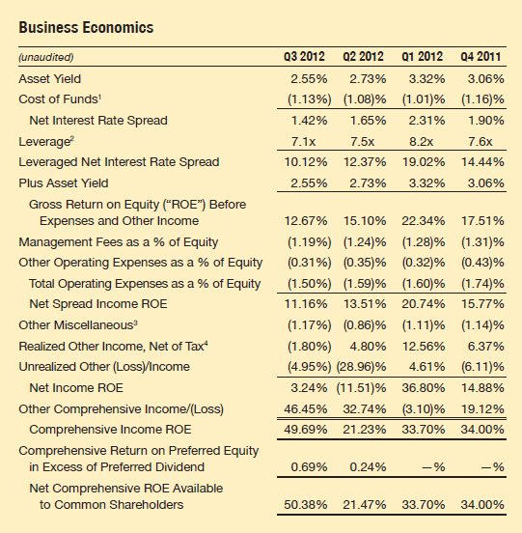
US Mortgage REITs – Business Economics
Introduction
Benefits
Valuation
Riocan
H&R
Calloway

Slide 40
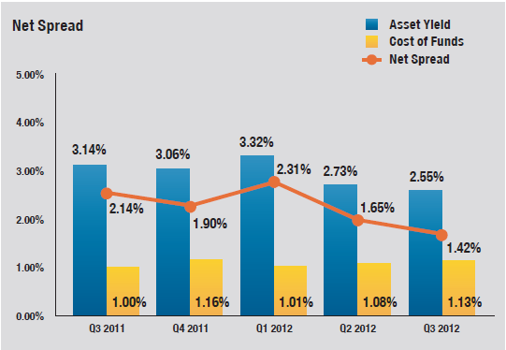
US Mortgage REITs – Net Spread
Introduction
Benefits
Valuation
Riocan
H&R
Calloway

Slide 41
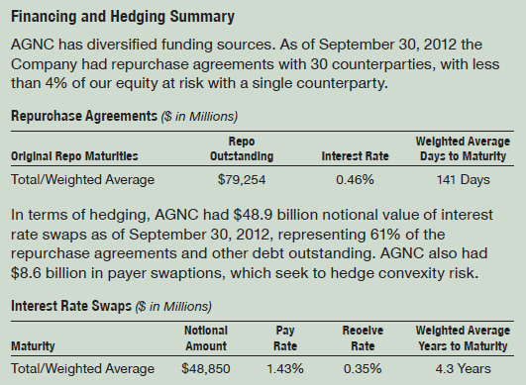
US Mortgage REITs – Financing and Hedging
Introduction
Benefits
Valuation
Riocan
H&R
Calloway

Slide 42
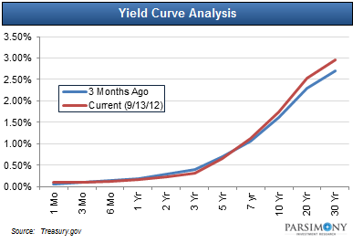
US Mortgage REITs – Yield Curve
steep yield curve ideal for mortgage REITs – borrow short term & invest long term
Introduction
Benefits
Valuation
Riocan
H&R
Calloway

Slide 43
US Mortgage REITs - Risks
Prepayment
  reinvest at lower rates
Interest rate increase
  value of MBS decrease and cost of borrowing increase faster than MBS yield (lower duration)
Changes in yield curve
Default risk
  minimal for REITs that invest in agency MBS
Introduction
Benefits
Valuation
Riocan
H&R
Calloway

Slide 44
Net Asset Value
Value a REIT by valuing its real estate assets then adjusting for its other assets and subtracting liabilities
Current real estate value or equity, net of debt. In common practice, current real estate value is considered to be the most recent appraised value.
Asset's acquisition cost adjusted for capital expenditures and additional contributions or distributions.
Introduction
Benefits
Valuation
Riocan
H&R
Calloway
Notes:
1. Distribution in the range of 80% to 95% of its distribution income. This will allow the REIT to use its retained operating funds to grow its asset size without going to the market for potentially dilutive capital injections.

Slide 45
Net Asset Value
When evaluating public companies, investors generally focus on price-to-book ratios as one valuation measure.
Price-to-book ratios are inappropriate for REITs, as a REIT's book value, which is based on historic cost figures, may not accurately reflect the earnings capacity of otherwise well maintained assets.
Thus, many analysts prefer to use net asset value as a surrogate for book value, which is appropriate insofar as book value is meant to represent an entity's liquidation value.
Introduction
Benefits
Valuation
Riocan
H&R
Calloway

Slide 46
Net Asset Value Per Share
Net asset value = total assets – intangible assets – liabilities
Net asset value mutual fund = total assets – liabilities
Net asset value per share = net asset value/total outstanding shares
Introduction
Benefits
Valuation
Riocan
H&R
Calloway

Slide 47

Valuation of REITs

Slide 48
How to Evaluate a REIT
Strong net operating income, cash flow and sustainable income growth
Limited debt
  Having debt of no more than 60% of market capitalization
Distributions in the range of 80% to 95% of distributable income
  FFO, AFFO & FAD
Cash distribution to unitholders
  FFO or AFFO payout ratio
Introduction
Benefits
Valuation
Riocan
H&R
Calloway
Notes:
1. Distribution in the range of 80% to 95% of its distribution income. This will allow the REIT to use its retained operating funds to grow its asset size without going to the market for potentially dilutive capital injections.

Slide 49
Performance Measures
Net Income
Funds from Operations (FFO)
GAAP Performance Measure
Including depreciation based on historical costs
Incorrectly assuming real estate assets value dimishes predictably over time
Improved under IFRS
Non-GAAP Performance Measure
The cash remaining from net operating income after deduction of debt service and ground lease payments
but not capital expenditures or income taxes
Introduction
Benefits
Valuation
Riocan
H&R
Calloway
Notes:
Since historical real estate values have fluctuated along with market conditions, REIT managers consider the use of historical depreciation inappropriate for REIT firms that invest heavily in investment properties.
This perceived shortfall of GAAP becomes more severe under volatile or inflationary market environments (such that the values of real estate assets exhibit larger fluctuations leading to larger deviations from their book values).
So, the concept of FFO developed
It is generally calculated by adding back to net income the amount of depreciation and amortization related to real estate investment properties and gains and losses on the sale of real estate assets.
The Cnadadian Institute of Public and Private Real Estate Companies (CIPPREC)
CIPPREC attributes the importance of FFO to the following reasons:
• "properties are bought and sold based on projections of their cash flow;
• the ability to finance properties is dependent on the cash flow the properties can generate; and
• the shares of public real estate companies trade on the basis of multiples of cash flow from operations. The relationship between share or unit price and cash flow from operations is particularly strong for those companies or REITs engaged solely in the ownership of income properties".

Slide 50
Performance Measures
Adjusted Funds from Operations (AFFO) is a more precise measure of REIT operating result with true residual cash flows
AFFO is defined in Canada as FFO less ongoing capital expenditures, tenant improvements and other adjustments
Introduction
Benefits
Valuation
Riocan
H&R
Calloway
Notes:
Although FFO is commonly used, professionals tend to focus on Adjusted Funds from Operations AFFO.
Adjusted funds from operations is generally defined in Canada as the funds from operations (FFO) less ongoing capital expenditures, tenant improvements and other adjustments.

Slide 51
Performance Measures
Funds Available for Distribution (FAD), the ability of a REIT to generate a consistent dividend
Useful in analyzing the portion of cash flow available for distribution to shareholders
Introduction
Benefits
Valuation
Riocan
H&R
Calloway
Notes:
Another Non-GAAP measures of a REIT’s operating performance
The FAD is a metric used in evaluating the current and future health of a REIT
IN MOST CASES, THIS DIVIDEND IS WHAT IS LEFT OVER AFTER A REIT ACCOUNTS FOR BOTH REAL ESTATE AND NON-REAL ESTATE RELATED EXPENSES.

Slide 52
REIT Valuation—Net Income
Introduction
Benefits
Valuation
Riocan
H&R
Calloway

Slide 53
REIT Valuation—FFO
Introduction
Benefits
Valuation
Riocan
H&R
Calloway
Notes:
Legitimate add-backs
real property depreciation
amortization of capitalized leasing expenses
amortization of tenant allowances and improvements
Add-backs not allowed
amortization of deferred financing costs
depreciation of computer software
depreciation of company office improvements
FFO is the operating profit, excluding any non-cash accounting charges such as amortization and depreciation

Slide 54
REIT Valuation: AFFO
Introduction
Benefits
Valuation
Riocan
H&R
Calloway
Notes:
Recurring capital expenditures, e.g. painting, carpets, etc.)
AFFO is equal to FFO less any expenditures required to maintain the condition of the rental buildings

Slide 55
REIT Valuation: FAD
Introduction
Benefits
Valuation
Riocan
H&R
Calloway

Slide 56
REIT Valuation: Payout Ratios
FFO Payout Ratio
AFFO Payout Ratio
Introduction
Benefits
Valuation
Riocan
H&R
Calloway
Notes:
Payout ratio—the amount of money a REIT pays its unit-holders, relative to how much it earns. A lower means it is hanging on to its cash; ratios close to 100 percent could mean the distribution is in peril of being reduced.
AFFO is considered the most important financial metric when analyzing a REIT. After AFFO, the payout ratio will be one of the first metrics that an analyst will look at.
This figure represents the percentage of AFFO that an individual REIT pays to its unit holders in the form of income distribution.
It does not take a world class analyst to understand that over-distributing is not a sustainable strategy, it diluting unit holders. The unfortunate reality is that in the Canadian REIT market, payout ratios above 100% is not uncommon.
Generally speaking, low payout ratios (less than 90%) indicate a more sustainable distribution and flexibility of distribution growth in the future.

Slide 57
REIT Valuation: Leverage Ratios
Indicate how much consolidated balance sheet capitalization is related to long term obligations
Introduction
Benefits
Valuation
Riocan
H&R
Calloway
Notes:
Over the past decades, more leveraged REITs have substantially underperformed REITs with less leverage. So, investors should look for a REIT that has a low leverage.
Debt to market capitalization indicate how much of our consolidated balance sheet capitalization is related to long term obligations
Market Cap is equal to a company’s shares outstanding by the current market price of one share

Slide 58
REIT Valuation: Coverage Ratios
Indicate a REIT’s ability to service interest and fixed charges
Introduction
Benefits
Valuation
Riocan
H&R
Calloway
Notes:
Over the past decades, more leveraged REITs have substantially underperformed REITs with less leverage. So, investors should look for a REIT that has a low leverage.
Debt to market capitalization indicat4e how much of our consolidated balance sheet capitalization is related to long term obligations
The coverage ratios indicate our ability to service interest charges

Slide 59
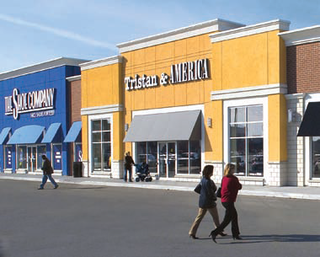




Slide 60

Calloway REIT
TSX: CWT.UN (CWT.DB.A/CWT.DB.B for convertible debentures at 6.65%/5.75%)
Province of Alberta
Market Cap: $3.68B
Retail focused: 127 shopping centers
1 industrial, 1 office
25.5 million square feet
Wal-Mart JV (10yr right 2007-2017 to use SuperCentres brand
99% occupancy level
Introduction
Benefits
Valuation
Riocan
H&R
Calloway

Slide 61
Stock Movement

Slide 62
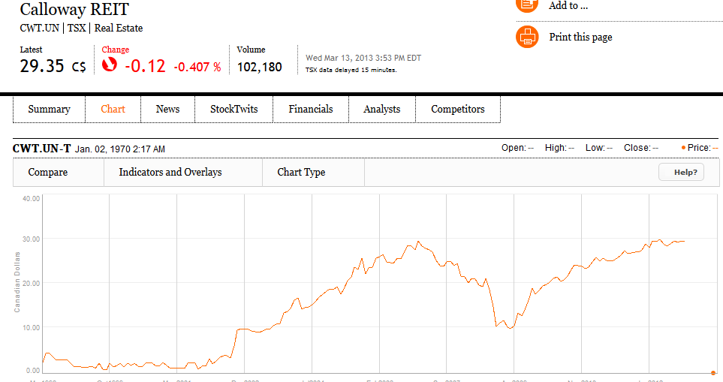
Max Chart
Introduction
Benefits
Valuation
Riocan
H&R
Calloway

Slide 63
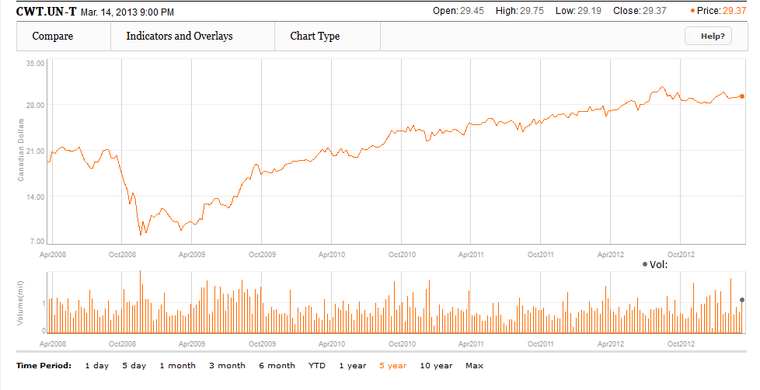
5 Year Chart
Introduction
Benefits
Valuation
Riocan
H&R
Calloway

Slide 64
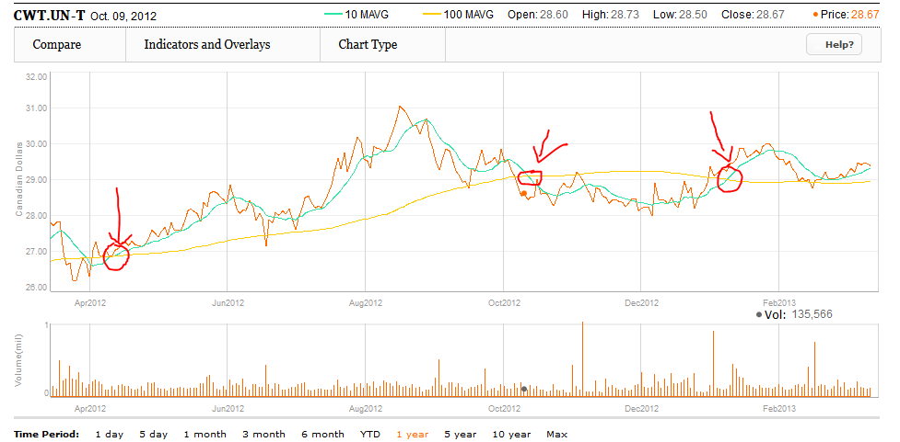
1 Year Chart (MA=10 & 100)
Introduction
Benefits
Valuation
Riocan
H&R
Calloway

Slide 65
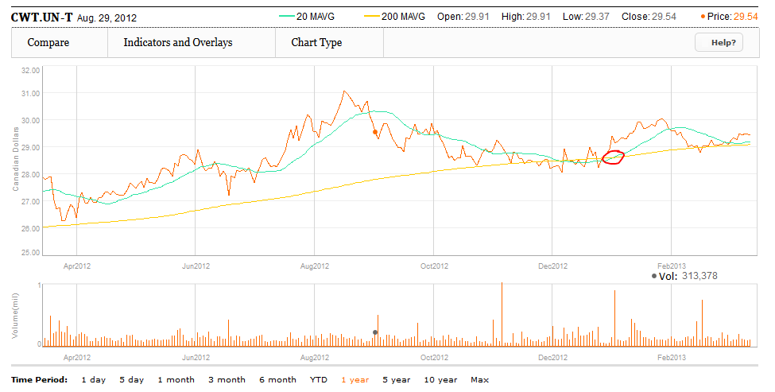
1 Year Chart (MA=20 & 200)
Introduction
Benefits
Valuation
Riocan
H&R
Calloway

Slide 66
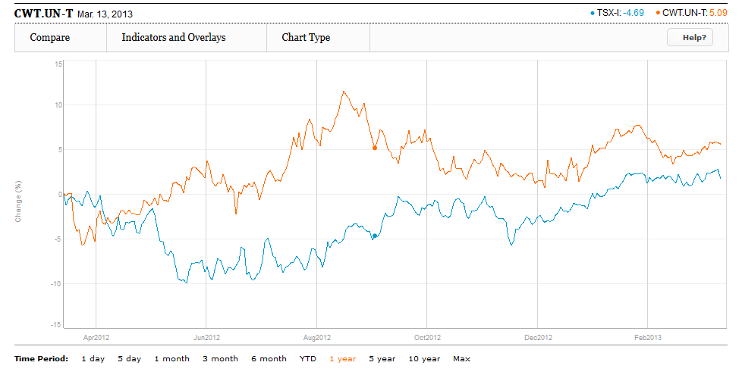
1 Year vs. S&P TSX
Introduction
Benefits
Valuation
Riocan
H&R
Calloway

Slide 67
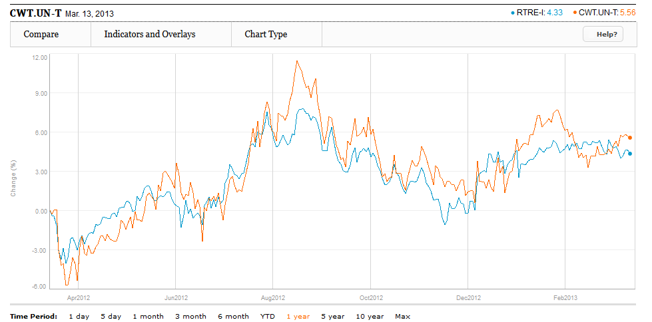
1 Year vs. S&P TSX Capped REIT Index
Introduction
Benefits
Valuation
Riocan
H&R
Calloway

Slide 68
Operations:
Properties & Tenants

Slide 69
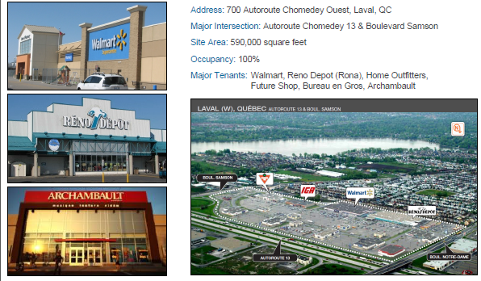
Properties
Introduction
Benefits
Valuation
Riocan
H&R
Calloway

Slide 70
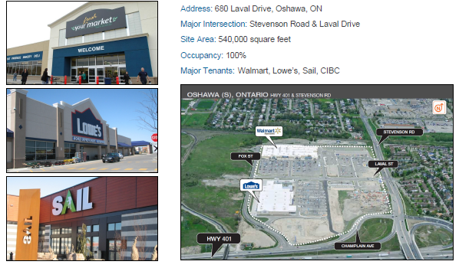
Properties
Introduction
Benefits
Valuation
Riocan
H&R
Calloway

Slide 71
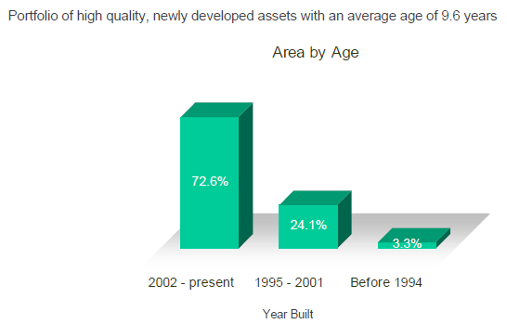
Properties
Introduction
Benefits
Valuation
Riocan
H&R
Calloway

Slide 72
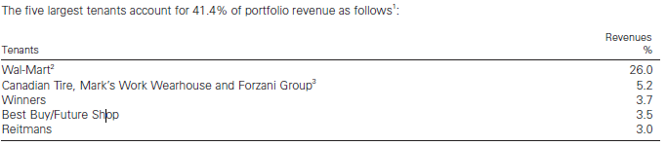
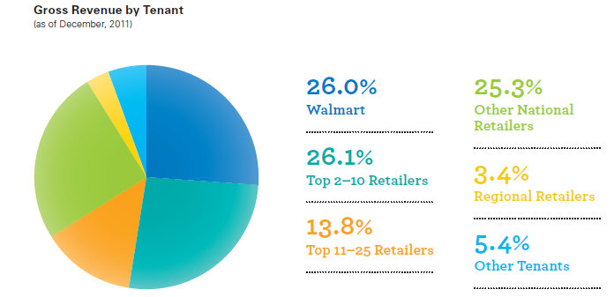
Tenant Distribution
Introduction
Benefits
Valuation
Riocan
H&R
Calloway

Slide 73
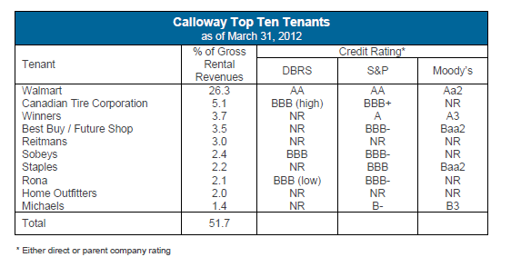
Top 10 Tenants
Introduction
Benefits
Valuation
Riocan
H&R
Calloway

Slide 74
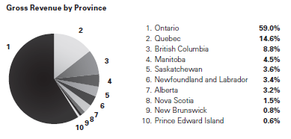
Tenant Distribution
Introduction
Benefits
Valuation
Riocan
H&R
Calloway

Slide 75
Wal-Mart Joint Venture
Largest landlord for WalMart Canada
12 conversions to Supercenters
Operational synergy
Faster execution
Collaboration in site selection
Introduction
Benefits
Valuation
Riocan
H&R
Calloway

Slide 76
Simon Property Group
Largest real estate company in world
50/50 JV in Toronto Premium Outlets
    500,000 sf.
    Opening summer 2013
Monteral Premium Outlets
    25% (Calloway), 25% (SmartCenters), 50% (Simon)
    350,000 sf.
    Opening summer 2014
Introduction
Benefits
Valuation
Riocan
H&R
Calloway

Slide 77
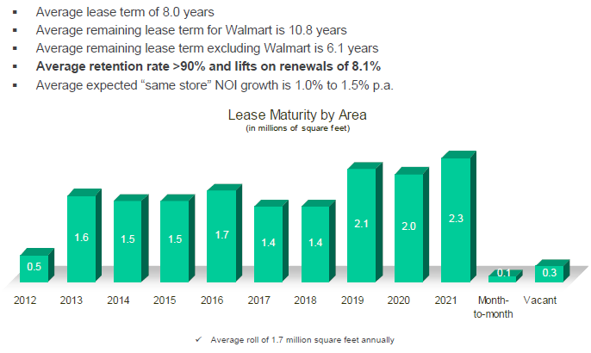
Lease Conditions
Introduction
Benefits
Valuation
Riocan
H&R
Calloway

Slide 78
Financials

Slide 79
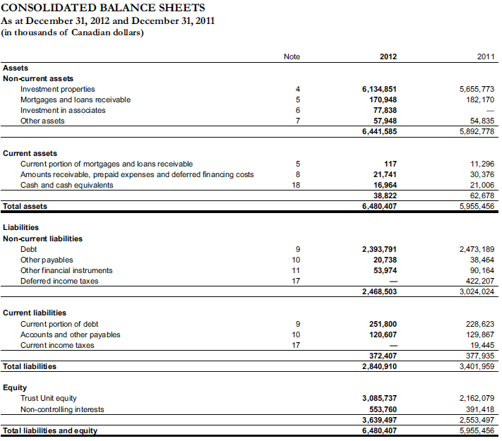
Balance Sheet: Assets

Slide 80
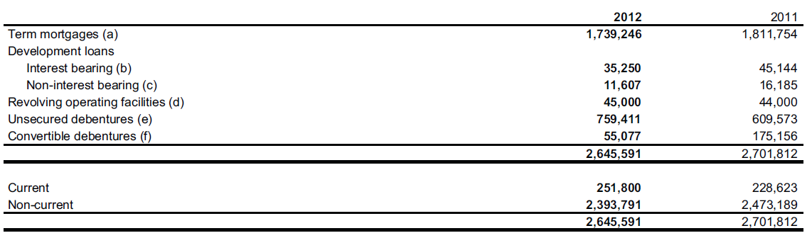
Debt
Declaration of Trust: Max. indebtedness of 60% of Gross Book Value (excluding convertible debentures), or 65% including convertible debentures
December 2011: Excluding Debentures – 49%

Slide 81
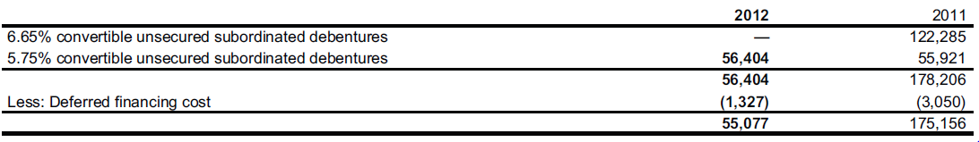
Debt
Convertible Debentures

Slide 82
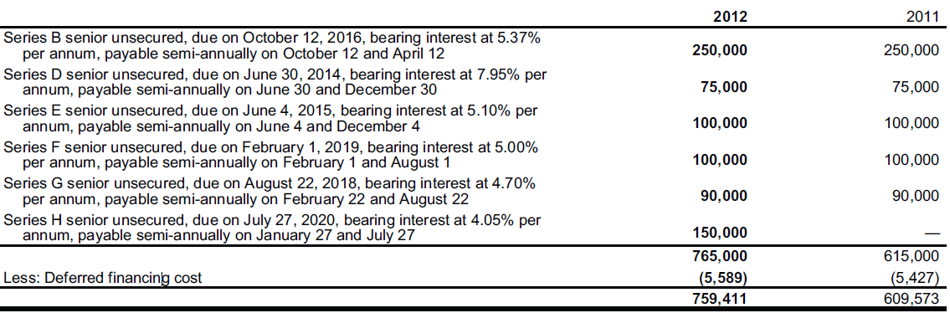
Debt
Unsecured Debentures

Slide 83
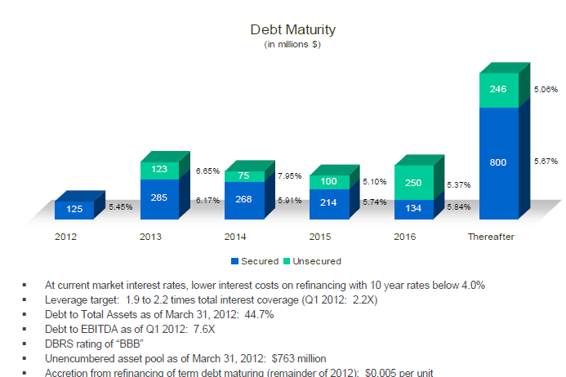
Debt Maturity

Slide 84
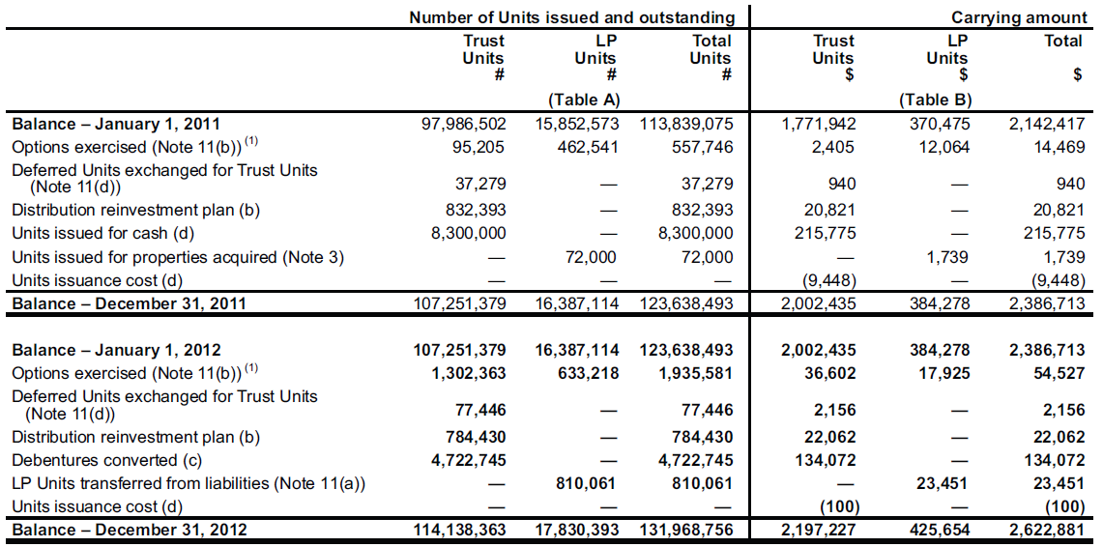
Unitholder Equity

Slide 85
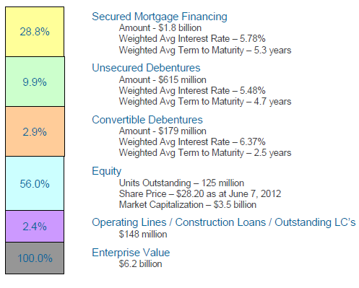
Capital Structure

Slide 86
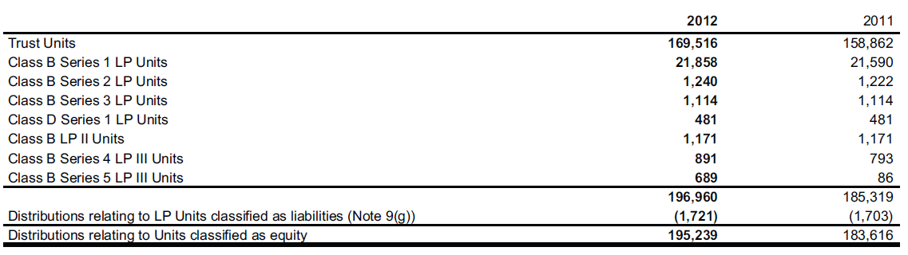
Distributions & Equity Classes

Slide 87
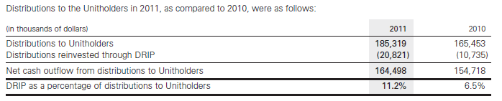
Distributions & DRIP

Slide 88

Income Statement

Slide 89

Cash Flows

Slide 90

Cash Flows:
Note 18

Slide 91

Cash Flows

Slide 92

Distributions Schedule

Slide 93
Key Ratios

Slide 94

Adjusted Funds From Operations
(AFFO)
2012 FFO Payout Ratio = Dividend per unit / FFO per unit = 1.548 / 1.75 = 0.8846
2012 AFFO Payout Ratio = Dividend per unit / AFFO per unit = 1.548/ 1.65 = 0.9382
Introduction
Benefits
Valuation
Riocan
H&R
Calloway

Slide 95
Payout Ratio
From 2012 Report:
    Payout Ratio: 93.7%
    Debt to Gross Book Value: 48.7%
Introduction
Benefits
Valuation
Riocan
H&R
Calloway

Slide 96

Coverage, Debt
Service, & Leverage Ratios
Introduction
Benefits
Valuation
Riocan
H&R
Calloway

Slide 97
Management

Slide 98

Management
Experienced industry professionals
Board Ownership: Over 22%
Introduction
Benefits
Valuation
Riocan
H&R
Calloway

Slide 99

Al Mawani
President, CEO
Since May 2, 2011
Real estate private equity experience for over 15 years
Chartered Accountant
MBA from University of Toronto
LL.M from Osgoode Hall
Introduction
Benefits
Valuation
Riocan
H&R
Calloway

Slide 100

Bart Munn
CFO
At Calloway since Dec. 2005
VP/CFO of other real estate firms, with senior executive experience since 1991
Chartered Accountant
Introduction
Benefits
Valuation
Riocan
H&R
Calloway

Slide 101

Rudy Gobin
EVP Asset Management
Prior: Strategy Officer; EVP Operations
CFO of Nexacor , CFO at Bell’s real estate subsidiary (1998)
CA, B.Comm. (UT)
Introduction
Benefits
Valuation
Riocan
H&R
Calloway

Slide 102
Risks

Slide 103
Risks
Real Property Ownership
Development
Interest & Financing
Credit Risk
Environmental Risk
Capital Requirements
Tax Rules: SIFT & REIT Exemptions
Introduction
Benefits
Valuation
Riocan
H&R
Calloway

Slide 104
Summary

Slide 105
Recommendation
HOLD

Slide 106




Slide 107
Stock Movement

Slide 108

Company snapshot
Introduction
Benefits
Valuation
Riocan
H&R
Calloway

Slide 109

Max Chart
Introduction
Benefits
Valuation
Riocan
H&R
Calloway

Slide 110

1 Year Chart (MA=10 & 100)
Introduction
Benefits
Valuation
Riocan
H&R
Calloway

Slide 111

1 Year Chart (MA=20 & 200)
Introduction
Benefits
Valuation
Riocan
H&R
Calloway

Slide 112

1 Year vs. S&P TSX
Introduction
Benefits
Valuation
Riocan
H&R
Calloway

Slide 113

1 Year vs. S&P TSX Capped REIT Index
Introduction
Benefits
Valuation
Riocan
H&R
Calloway

Slide 114

Company Profile

Slide 115

Portfolio of Properties
Introduction
Benefits
Valuation
Riocan
H&R
Calloway

Slide 116

Diversified Real Estate
Introduction
Benefits
Valuation
Riocan
H&R
Calloway

Slide 117




Introduction
Benefits
Valuation
Riocan
H&R
Calloway

Slide 118

TOP 15 Assets
Introduction
Benefits
Valuation
Riocan
H&R
Calloway

Slide 119

The Bow
The tallest office building in Western Canada
Costs approximately $1.1 billion
The office tower and 700 parking bays will be leased to EnCana Corporation for 25 years with annual rental escalations
Expected annualized first year rent $93.5M
Fair Value: $1,795,000,000
Class: AAA
Introduction
Benefits
Valuation
Riocan
H&R
Calloway

Slide 120

Bell Canada Office Campus
The 1.1million square foot office complex
Leased to Bell Canada and Bell Mobility for a term of 20 years
Ownership interest: 100%
Fair Value: $525,000,000
Introduction
Benefits
Valuation
Riocan
H&R
Calloway

Slide 121

Scotia Plaza Tower
The largest office node in Canada
Comprises approximately 2.0 million sq. ft. of prime office and retail space across four connected buildings
Class “AAA” Property
Outstanding anchor tenant: Bank of Nova Scotia will lease approximately 61% of Scotia Plaza for an average lease term of 13.5 years
Fair Value: $440,000,000
Introduction
Benefits
Valuation
Riocan
H&R
Calloway

Slide 122

2012 Acquisitions
Introduction
Benefits
Valuation
Riocan
H&R
Calloway

Slide 123

2012 Acquisitions
Introduction
Benefits
Valuation
Riocan
H&R
Calloway

Slide 124
Primaris
  Canada's leading enclosed shopping centre real estate investment trust owning 43 properties areas all across the country
  Each property is flexible
  Boasts a high occupancy rate and is always remerchandising its centres to bring new brands to its properties.
Introduction
Benefits
Valuation
Riocan
H&R
Calloway
Notes:
Primaris is Canada's leading enclosed shopping centre real estate investment trust owning 43 properties across the country.
Each property is flexible in order to meet the unique needs of its local customers and the specifications of that community.
Primaris boasts a high occupancy rate and is always remerchandising its centres to bring new and exciting brands to its properties. This combined with its focus on acquiring valuable Canadian properties, makes Primaris a smart, sound investment.

Slide 125

Enhanced Size & Scale
Fair Value (C$ billions, as at 30-Sep-12)
Introduction
Benefits
Valuation
Riocan
H&R
Calloway
Notes:
The combination of H&R and Primaris will help H&R Becomes Canada’s largest REIT by Fair Value and Enterprise Value

Slide 126

Platform for Growth
Introduction
Benefits
Valuation
Riocan
H&R
Calloway
Notes:
this platform growth will diversified the commercial portfolio emulating the real estate investment model adopted by Canadian pension funds

Slide 127

Introduction
Benefits
Valuation
Riocan
H&R
Calloway
Notes:
New H&R REIT
-it is Broader portfolio diversification geographically

Slide 128

Introduction
Benefits
Valuation
Riocan
H&R
Calloway

Slide 129

Benefits
Introduction
Benefits
Valuation
Riocan
H&R
Calloway

Slide 130

Management Team

Slide 131

Thomas J. Hofstedter (President and CEO)
1978: attended the University of Toronto and became a member of The Institute of Chartered Accountants.
1996:became President and Chief Executive Officer of the REIT at its creation
2008:President and Chief Executive Officer of Finance Trust at its creation in October 2008
Introduction
Benefits
Valuation
Riocan
H&R
Calloway

Slide 132
Thomas J. Hofstedter
(President and CEO)
Has more than 30 years of real estate industry experience.
Was responsible for building most of the properties that comprised the initial assets of the REIT (home of such tenants as NCR and the Royal Bank, head office of Nestlé Canada).
In addition to commercial development, Mr. Hofstedter has considerable experience in high-rise residential and was responsible for building many prominent Toronto condominiums such as Wellington Square, the Penrose, and the Metropole.
Introduction
Benefits
Valuation
Riocan
H&R
Calloway

Slide 133

Larry Froom (CFO)
1986-89:attended the University of the Witwatersrand majoring in Accounting .
1997-2006:VP Finance H&R Developments. Responsible for securing construction financing on construction projects and financial reporting.
2006:CFO H&R REIT
Responsible for financial reporting, equity and debt financings, investor relations, and acquisition due diligence.
Introduction
Benefits
Valuation
Riocan
H&R
Calloway

Slide 134
Larry Froom
(CFO)
has over fifteen years of real estate industry experience.
As CFO, Mr. Froom is responsible for overseeing all financial transactions, Unit offerings and investor relations.
Prior to joining H&R, he was manager at Ernst & Young where he serviced clients in the real estate industry.
is a member of Realpac (Canada’s most influential voice in the real property investment industry)
Introduction
Benefits
Valuation
Riocan
H&R
Calloway

Slide 135
Nathan Uhr (COO)
has over thirty years of real estate industry experience
was H&R Developments' Director of Leasing and Property Management and held various other positions with H&R over 20 years before becoming Vice-President, Acquisitions of H&R REIT, at its inception, in December 1996.
Mr. Uhr leads the due diligence team on any acquisition or mezzanine financing planned by the REIT and is responsible for management and leasing issues relating to the REIT's properties.
Introduction
Benefits
Valuation
Riocan
H&R
Calloway

Slide 136
Financial

Slide 137

Convertibles 2012

Slide 138

Risk Management

Slide 139

Risk Management

Slide 140

Risk Management

Slide 141

Risk Management

Slide 142

Risk Management

Slide 143


Distributions to Unitholders

Slide 144

Cash Distributions

Slide 145

Capital Resources

Slide 146

Balance Sheet Q3 2012
Notes:
Management has previously stated that, after a period of aggressively growing and
changing its portfolio, it is turning its focus to a thorough portfolio analysis with a view to pruning assets that may no
longer fit within its strategy and redeploying the capital into assets that offer greater potential upside. A variety of assets
have been reclassified as held for sale

Slide 147

Annual Balance Sheet 2012

Slide 148

Income Statement Q3 2012

Slide 149

Annual Income Statement 2012

Slide 150

Cash Flow Statement Q3 2012

Slide 151

Cash Flow Statement Q3 Cont’d
Notes:
Included in restricted cash are bank term deposits of $3,936 (December 31, 2011 - $8,395) at a rate of interest of 1.10% (December 31, 2011 -
0.90% to 1.03%).
general operating facility which is secured by The Bow (the “Bow Facility”) due on November 21, 2013. The total facility
as at June 30, 2012 is $300,000 (December 31, 2011 - $400,000) and can be drawn in either Canadian or U.S. dollars (to a
maximum of $150,000 U.S. dollars). As at June 30, 2012, the REIT has drawn $nil (December 31, 2011 - $233,000) under
the Bow Facility and the undrawn amount available at June 30, 2012 is $300,000 (December 31, 2011 - $167,000).
Included in bank indebtedness at June 30, 2012 are U.S. dollar denominated amounts of $nil (December 31, 2011 - U.S.
$150,000). The Canadian equivalents of these amounts are $nil (December 31, 2011 - $153,000).

Slide 152

Annual Cash Flow Statement 2012

Slide 153

Annual Cash Flow Statement 2012 Con

Slide 154


Slide 155

Unitholders Equity 2012

Slide 156

Funds From Operations Q3 2012

Slide 157

Annual Funds From Operations 2012

Slide 158

Adjusted Funds From Operations Q3 2012

Slide 159

Annual Adjusted Funds From Operations 2012

Slide 160
Recommendation:
Sell

Slide 161


Stock Price
Overview

Slide 162

Notes:
Earning per share is the portion of a company’s profit allocated to each outstanding share of common stock.
Price-Earnings Ratio is a valuation ratio of a company’s current share price compared to its per-share earnings. In general, a high P/E ratio suggests that investors are expecting higher earnings growth in the future compared to a low P/E ratio.

Slide 163

1-yr Moving Average at 10, 100
Peak: $29.20
Lowest: $25.75
Introduction
Benefits
Valuation
Riocan
H&R
Calloway

Slide 164

5-yr Moving Average at 20, 200
Peak: $28.80
Lowest: $11.58
Introduction
Benefits
Valuation
Riocan
H&R
Calloway

Slide 165

RioCan VS iShares (XRE-T), 5 yr
Consistent with the trend of the Index
Introduction
Benefits
Valuation
Riocan
H&R
Calloway
Notes:
iShares XRE-T: the iShares CDN REIT Index Fund (TSX:XRE) is composed of REITS that are listed on the Toronto Stock Exchange.
iShares: a large provider of exchange-traded funds, managed by the investment management company blackrock.

Slide 166

RioCan VS iShares (XRE-T), TSX Composite, 1yr
Consistent with the trend of the Index
Introduction
Benefits
Valuation
Riocan
H&R
Calloway
Notes:
TSX Capped REIT Index

Slide 167

RioCan Max Chart
Introduction
Benefits
Valuation
Riocan
H&R
Calloway
Notes:
TSX Capped REIT Index

Slide 168
Company
Overview

Slide 169
About RioCan
As at December 31, 2012
Canada’s largest REIT exclusively focused on retail real estate
A total enterprise value of approximately $14.3 billion
Owns Canada’s largest portfolio of shopping centres
Owns a number of grocery anchored shopping centres in US
Focus on major urban markets
A number of 7500 tenancies
No tenant representing more than 4.3% of total rental revenue
Specific retail assets including new format retail centres, neighbourhood convenience unenclosed centres, enclosed shopping centres, urban retail properties, and outlet shopping centres
Introduction
Benefits
Valuation
Riocan
H&R
Calloway
Notes:
RioCan’s tenant portfolio is diverse
Q4Page 6 about RioCan
$14.3 billion as at December 31, 2012
Specific retail assets

Slide 170
2012 Highlights
RioCan completed 43 income property acquisitions totaling $926 million
  An increase of 7.6% in Net Leasable Assets over 2011
RioCan raised $531 million of equity
  $423 million through the issuance of equity in offerings
  $108 million through the common Unit DRIP program
RioCan announced an increase to its monthly distribution to 11.75 cents per unit, starting in January 2013
Occupancy for the portfolio was 97.4% and rental rate increases continued to be positive
Introduction
Benefits
Valuation
Riocan
H&R
Calloway
Notes:
Q4 PAGE11
FFO

Slide 171
Trust Overview-News
02/15/13: announcement of 11.75 cents per unit in distribution for the month of February
02/08/13: sale all of 9.4 million shares of cedar
01/15/13: announcement of 11.75 cents per unit in distribution for the month of January
12/17/12: $0.328125 per preferred unit, Series A and $0.29375 per preferred unit, Series C, for the quarter ending December 31, 2012
12/12/12: announcement of 11.5 cents per unit in distribution for the month of December
12/12/12: completed issuance of $250 million principal amount of Series R senior unsecured debentures
Introduction
Benefits
Valuation
Riocan
H&R
Calloway

Slide 172

Geographic Diversification
As at December 31, 2012
Introduction
Benefits
Valuation
Riocan
H&R
Calloway

Slide 173

Property Ownership by Geographic Area
Introduction
Benefits
Valuation
Riocan
H&R
Calloway

Slide 174

Six High Growth Markets
Introduction
Benefits
Valuation
Riocan
H&R
Calloway

Slide 175

Top Ten Tenants
As at December 31, 2012
Introduction
Benefits
Valuation
Riocan
H&R
Calloway

Slide 176

Property: Canadian Portfolio
Introduction
Benefits
Valuation
Riocan
H&R
Calloway

Slide 177

Property: Canadian Portfolio
Introduction
Benefits
Valuation
Riocan
H&R
Calloway

Slide 178

Property: US Portfolio
Introduction
Benefits
Valuation
Riocan
H&R
Calloway

Slide 179

Capital Structure
Introduction
Benefits
Valuation
Riocan
H&R
Calloway

Slide 180

Capital Structure
December 31, 2012 | December 31, 2011
Introduction
Benefits
Valuation
Riocan
H&R
Calloway
Notes:
Q4 PAGE 42
1.As at December 31, 2012, RioCan had eight series of Debentures outstanding totalling $1.3 billion (December 31, 2011 – six series
totalling $ 822 million).
2. The Debentures have covenants relating to RioCan’s 60% leverage limit to Aggregate Assets as set out in RioCan’s Declaration, the
maintenance of a $1.0 billion Adjusted Book Equity, defined in the indenture, and maintenance of an interest coverage ratio of 1.65
times or better.

Slide 181

Convertible Debentures
RioCan has the right to Convert Series I debentures to mortgage debt, with 60% leverage limit, minimum book equity and interest coverage ratio would be eliminated for those debentures.
Introduction
Benefits
Valuation
Riocan
H&R
Calloway
Notes:
Q4 PAGE 102
1. The debentures have covenants relating to RioCan’s leverage limit of up to 60% of aggregate assets as set out in the Trust’s
Declaration, the maintenance of a $1.0 billion Adjusted Book Equity (as defined in the debenture), and maintenance of an interest
coverage ratio of 1.65 times or greater.

Slide 182
Acquisition During 2012
Property Name & Location | Quarter | NLA (Sq.ft.) | Ownership Interest | Cap Rate | Purchase Price ($M)
Westgate Shopping Centre, Ottawa, ON | Q4 | - | 100% | 5.0% | $9
Elgin Mills Crossing, Richmond Hill, ON | Q4 | 80 | 100% | 5.8% | 20
Les Factoreries, St. Sauveur, PQ | Q4 | 58 | 50% | 5.3% | 27
Les Carrefour Champetre, Bromont, PQ | Q4 | 81 | 50% | 6.9% | 20
Shoppers City East, Ottawa, ON | Q4 | 41 | 27.6% | 6.5% | 8
649 Queen Street West, Toronto, ON | Q4 | 14 | 100% | 4.9% | 14
Dunhill, Arbor Park, San Antonio, TX | Q4 | 119 | 85% | 6.7% | 22
Dunhill, Louetta Central, Spring, TX | Q4 | 153 | 85% | 6.9% | 26
Notes:
Q4 Page 13
During the year ended December 31, 2012, RioCan acquired interests in 43 income properties totaling $926 million, at RioCan’s interest, comprising 14 properties in Canada for $543 million and 29 properties in the US for $383 million, at a weighted average capitalization rate of 6.1%.

Slide 183
Acquisition During 2012
Property Name & Location | Quarter | NLA (Sq.ft.) | Ownership Interest | Cap Rate | Purchase Price ($M)
Acquisitions from Cedar | Q4 | 677 | 100% | 6.5% | 117
Deptford Landing, Deptford, NJ | Q4 | 517 | 100% | 6.6% | 64
The Commons, Martinsburg, WV | Q4 | 277 | 100% | 7.0% | 51
Georgian Mall, Barrie, ON | Q3 | 488 | 100% | 5.4% | $318
Trinity Crossing, Ottawa, ON | Q3 | 96 | 100% | 6.0% | 29
Dunhill, Las Colinas Village, Irving, TX | Q3 | 89 | 85% | 7.8% | 22
2453-2457 Young St & 4-6 Eriskine Ave, Toronto, ON | Q2 | 6 | 50% | 3.9% | $3
Chahko Mika Mall, Nelson, BC | Q2 | 173 | 100% | 6.7% | 31
Notes:
Q4 Page 13
During the year ended December 31, 2012, RioCan acquired interests in 43 income properties totaling $926 million, at RioCan’s interest, comprising 14 properties in Canada for $543 million and 29 properties in the US for $383 million, at a weighted average capitalization rate of 6.1%.
RioCan’s most significant individual acquisition in 2012 was the third quarter acquisition of a 100% interest in Georgian Mall in Barrie, Ontario. The purchase price of the property was $318 million, which equates to a capitalization rate of 5.4% for the income producing components.

Slide 184
Acquisition During 2012
Property Name & Location | Quarter | NLA (Sq.ft.) | Ownership Interest | Cap Rate | Purchase Price ($M)
Kimco, Montgomery Plaza, Fort Worth, TX | Q2 | 233 | 80% | 6.7% | 46
Stering, Ingram Hills, San Antonio, TX | Q2 | 72 | 90% | 8.0% | 7
Trinity Common Brampton, ON | Q1 | 66 | 80% | 6.0% | $19
RioCan Colossus Centre, Vaughan ON | Q1 | 58 | 80% | 6.3% | 17
Silver City Gloucester, Gloucester, ON | Q1 | 23 | 80% | 6.3% | 8
Campus Estates, Guelph, ON | Q1 | 73 | 100% | 6.4% | 20
Southlake Corners, Dallas, TX | Q1 | 107 | 80% | 6.7% | 28
Notes:
Q4 Page 13
Q4 Page 42, 43, 44 acquisition highlights

Slide 185

Acquisition YTD
Capitalization rate | Purchase price | NLA | Weighted average rent
Introduction
Benefits
Valuation
Riocan
H&R
Calloway

Slide 186
Cedar Dissolution
RioCan acquired 21 properties in which Cedar has 20% interest with US$119.5 million
RioCan sold Franklin Village to Cedar for US$60.1 million
RioCan sold all its shares of Cedar for US$48 million
Introduction
Benefits
Valuation
Riocan
H&R
Calloway
Notes:
Q4 PAGE 12
The dissolution was completed on October 10, 2012. Under the terms of the dissolution, Cedar conveyed its 20% interest in 21 properties to RioCan for a gross purchase price of US$119.5 million, representing a capitalization rate of 6.5%.
In turn, RioCan conveyed its 80% interest in Franklin Village (located in Franklin, MA) to Cedar for a gross sale price of US$60.1 million (less debt assumed by Cedar from RioCan in the amount of US$34.7 million).
On February 7, 2013, RioCan sold its 9.4 million shares of Cedar, its entire holding, for proceeds of US$48 million.

Slide 187

Joint Venture Information
Introduction
Benefits
Valuation
Riocan
H&R
Calloway
Notes:
RioCan’s proportionately consolidated co-ownerships, partnerships, and consolidated joint ventures are as follows:

Slide 188

Occupancy Rates
Introduction
Benefits
Valuation
Riocan
H&R
Calloway
Notes:
Q4 PAGE22
During the year committed occupancy decreased from 97.6% to 97.4% and economic occupancy decreased from 96.6% to 95.9%. The net effect of these changes was to increase the annualized rent impact of the difference between economic and committed occupancy from $12 million to $15 million.

Slide 189

Occupancy - Most Recent Eight Quarters
Introduction
Benefits
Valuation
Riocan
H&R
Calloway

Slide 190

Renewal Leasing
Introduction
Benefits
Valuation
Riocan
H&R
Calloway

Slide 191

New Leasing: Canadian Portfolio
Introduction
Benefits
Valuation
Riocan
H&R
Calloway
Notes:
Q4 PAGE17, 25-26

Slide 192

New Leasing: US Portfolio
Introduction
Benefits
Valuation
Riocan
H&R
Calloway

Slide 193

Lease Expires for Canadian Portfolio
Introduction
Benefits
Valuation
Riocan
H&R
Calloway
Notes:
Q4 PAGE26

Slide 194

Lease Expires for US Portfolio
Introduction
Benefits
Valuation
Riocan
H&R
Calloway

Slide 195

Contractual Rental Increases
Periodic increases in rates contribute to growth in same store, NOI.
Introduction
Benefits
Valuation
Riocan
H&R
Calloway
Notes:
Q4 PAGE27
Contractual rent increases, including rent increases at time of renewal, in each year for the next five years are as follows

Slide 196

Greenfield Development Projects

Slide 197

Debt & Leverage Metrics
Introduction
Benefits
Valuation
Riocan
H&R
Calloway
Notes:
Q4 Supplement PAGE16

Slide 198

Revolving Lines of Credit
Introduction
Benefits
Valuation
Riocan
H&R
Calloway
Notes:
Q4 PAGE 61, 100
As at December 31, 2012, RioCan has four revolving lines of credit in place with three Canadian Schedule 1 financial institutions, having an aggregate capacity of $428.5 million

Slide 199

Aggregate Maturities
Introduction
Benefits
Valuation
Riocan
H&R
Calloway
Notes:
Q4 PAGE64
On a combined basis, RioCan’s mortgages and debentures payable bear a weighted average contractual interest rate of 4.7% with a weighted average term to maturity of 4.7% years. RioCan’s debt matruity profile and future repayments are as outlined below

Slide 200

Principals Maturities by Lender
Introduction
Benefits
Valuation
Riocan
H&R
Calloway

Slide 201

Distribution History
Introduction
Benefits
Valuation
Riocan
H&R
Calloway

Slide 202

Net Earnings Attributable to Unitholders
Three months ended December 31, | Year ended December 31,
(thousands of dollars, except for Unit amounts) | 2012 | 2011 | Increase/decrease | 2012 | 2011 | Increas/decrease
Introduction
Benefits
Valuation
Riocan
H&R
Calloway

Slide 203
Outlook & Strategy
RioCan as a leading North American REIT with a retail focus
RioCan expects to continue to see growth in NOI in 2013 through as follows:
  Property rental income growth
  Acquisitions
  Greenfield development, and
  Asset intensification by JV partnerships
Introduction
Benefits
Valuation
Riocan
H&R
Calloway

Slide 204
In 2013
Fundamentals in retail real estate in Canada
The trend of selected US retailers
Target’s acquisition of Zellers stores
$18 million investment on upgrading Target occupied centres
The completed acquisitions and developments’ contribution to operating FFO growth
Continue to focus on the enclosed mall segment
Interest expense savings
A property management platform established in US
Introduction
Benefits
Valuation
Riocan
H&R
Calloway
Notes:
Q4 PAGE16

Slide 205

Management Team

Slide 206

Board of Trustees
Introduction
Benefits
Valuation
Riocan
H&R
Calloway

Slide 207

Senior Management
Introduction
Benefits
Valuation
Riocan
H&R
Calloway

Slide 208

Senior Management
Introduction
Benefits
Valuation
Riocan
H&R
Calloway

Slide 209


Chief Executive Officer
Edward Sonshine
CEO since 1993
Law degree from Osgoode Hall Law School and a Bachelor of Arts degree from the University of Toronto
.
Introduction
Benefits
Valuation
Riocan
H&R
Calloway

Slide 210


President & Chief Operating Officer
Frederic A. Waks
President since January 1, 2012
Joined RioCan in 1995 as Senior Vice President and was promoted to COO in 2007
Introduction
Benefits
Valuation
Riocan
H&R
Calloway

Slide 211


Executive Vice President, Chief Financial officer & Corporate Secretary
Raghunath Davloor
Chief Financial Officer, Executive Vice President (Since January 2012)
Senior Vice President and Chief Financial Officer of the Trust (2008 - 2011)
Introduction
Benefits
Valuation
Riocan
H&R
Calloway

Slide 212

Financial Highlights

Slide 213

Condensed Consolidated Balance Sheets

Slide 214

Condensed Consolidated Statements of Earnings

Slide 215

Operating FFO & AFFO

Slide 216
Operating FFO & AFFO
2011 FFO Payout Ratio = Dividend per unit / FFO per unit = 1.38 / 1.43 = 0.97
2012 FFO Payout Ratio = Dividend per unit / FFO per unit = 1.38 / 1.52 = 0.91
2011 AFFO Payout Ratio = Dividend per unit / AFFO per unit = 1.38 / 1.29 = 1.07
2012 AFFO Payout Ratio = Dividend per unit / AFFO per unit = 1.38 / 1.39 = 0.99

Slide 217

Financial Information

Slide 218

Financial Information

Slide 219
Recommendation: Hold

