Slide 1
Real Estate Investment Trusts
BUS 417 CANADIAN REITS SECURITY ANALYSIS
PRESENTED BY Alex, Josh, Keng, Winston, Yvonne

Slide 2
Agenda
REITs Overview
H&R REITs
RioCan REITs
Boardwalk REITs

Slide 3
What are REITs?
REIT: Real Estate Investment Trusts
Can be publically or privately held
Similar to Mutual Funds
  Pool capital into real estate that is structured to generate regular distributions of cash
Provide opportunities to invest in real estate which in portfolios of large-scale properties - through purchase of stocks often traded on major exchanges
Typically pay-out a majority of their taxable income as dividend
Investors receive high dividend yield

Slide 4
Evolution of REITs
  REIT was created when President Eisenhower signs Cigar Excise Tax Extension on Sept 14
  The National Association of Real Estate Investment Funds (NAREIT’s predecessor) incorporated on Sept 15
1960
  Continental Mortgage Investors becomes the first REIT to be listed on the New York Stock Exchange.
1965
  NAREIT REIT Index debuts as the first REIT Index available to investors
1972

Slide 5
Evolution of REITs Cont.
  President Ford signs first package of REIT simplification amendments, allowing REITs to be established as corporations in addition to business trusts
1976
  President Reagan signs the Tax Reform Act
    Prevent taxpayers from using partnerships to shelter earnings from other sources
    REITs to be internally advised and managed
1986
  NAREIT adopts FFO
1991

Slide 6
Evolution of REITs Cont.
  First Canadian REIT, Real Fund, emerged
1993
  The iShares Dow Jones U.S Real Estate Index Fund lauches, becoming the 1st real estate traded fund
2000
  Standard and Poor’s open its indexes to REITs
  Launched Global Real Estate Index
2001
  FTSE, NAREIT, EPRA announced the addition of REITs and listed property companies in emerging markets to the FTSE EPRA/NAREIT Global Real Estate Index
2009

Slide 7
How REITs Operate
Rely upon external funding as key source of capital
Funds use to buy, develop and manage real estate assets
Income is generated through renting, leasing or selling of property
Required to distribute 90% of their taxable income to investor. Distributes among shareholders as percentage of paid-out taxable income on a regular basis
Investors purchase shares in REITs
REIT acquires properties
Income is generated
REIT pays distribution

Slide 8
Types of REITs
Equity REITs
(EREITs)
  Purchase, own, and manage income producing properties
  Differ from typical real estate developers because they purchase property to operate instead of for resale
  Considering superior for long-term investing
  90% are EREITs
Mortgage REITs
(MREITs)
  Loan money for mortgages
  Purchase existing mortgages or mortgages backed securities
  Revenue primarily from interest earned on mortgage loans
  React more quickly to interest rate changes because dividends come from interest payments
  10% are MREITs
Hybrid REITs
  Combination of both EREITs and MREITs
  Own properties and make loans
  Earn money through combination of rents and interests

Slide 9
How to Purchase REITs
Publicly Traded
  Registered with Security and Exchange Commission (SEC) and traded in major stock exchanges
  Simple for investors to buy and sell
  Great liquidity
Non-Exchange Trade
  Registered with SEC but not traded on any public exchanges
  They have private sponsors who market them to invesstors
  Relative stability
Private
  Not registered or traded on SEC
  Raise equity from individuals, trusts, or other entities that are accredited under federal securities law
  Less regulations – only guidelines to maintain REIT status

Slide 10
Factors Driving REIT Earnings
Economic Growth
Job Market
Demographics
Occupancy Rates and Rents
Mortgage Rates
Interest Rates

Slide 11
REITs: Investment Advantage
Over the long term, Equity REIT return have
followed a path that is different than the
returns of other stocks
Over long holding periods, EREIT
return have tended to outpace
rates of inflation, helping
investors hedge
Also, as inflation increases,
rent increases too
Diversification
Growth / Protection
Dividends
REIT must pay out 75 – 95 %
of Their income on a regular
basis
Benefits
Publicly traded REITs operate under same
rules As other public companies for
securities regulatory and financial reporting
purposes
Publicly traded EREITs outperformed
leading stock market indexed including
S&P 500, Dow Jones Industrial and
NASDAQ over the past 30 years
Transparency
Performance
Liquidity
Publicly traded REIT can be easily bought and sold
Over 200 REITs on the US stock exchange and 40 on TSX

Slide 12
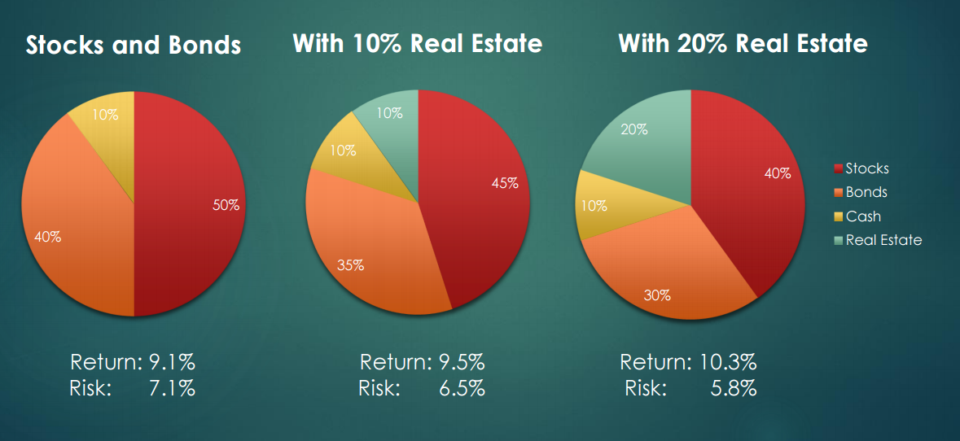
Benefits of Diversification

Slide 13
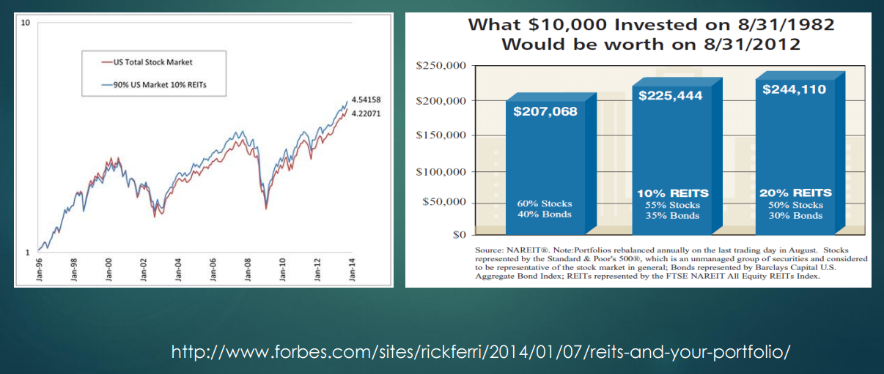
Benefits of Diversification

Slide 14
Risks of Investing in REITs
Slower Growth
May Rely on Debt
Risks
Risk of Property Tax Increase
Real Estate is a cyclical business
Tax Treatment

Slide 15
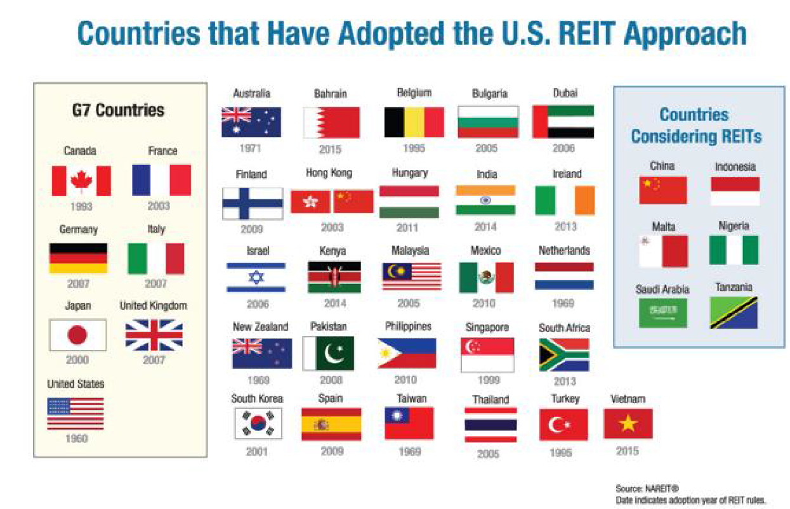
Globalization

Slide 16
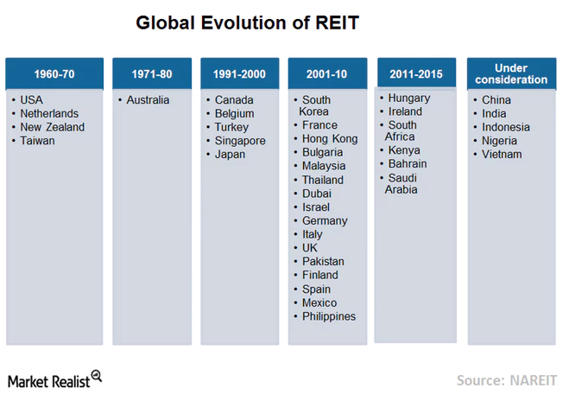
Global REIT Industry
The major growth of REITs happened only after 2000
With the introduction of REITs in most of the countries, the global listed real estate witnessed astonishing growth

Slide 17
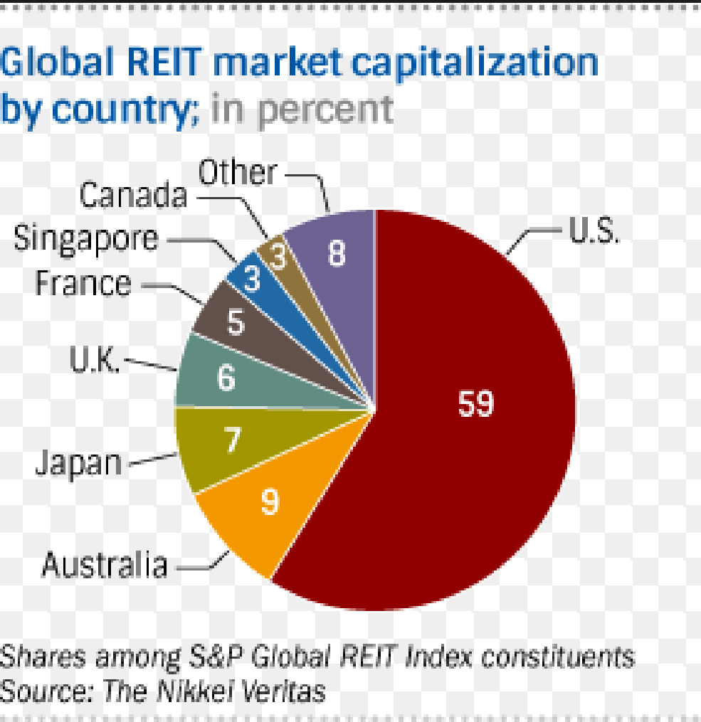
Global – Market Cap

Slide 18
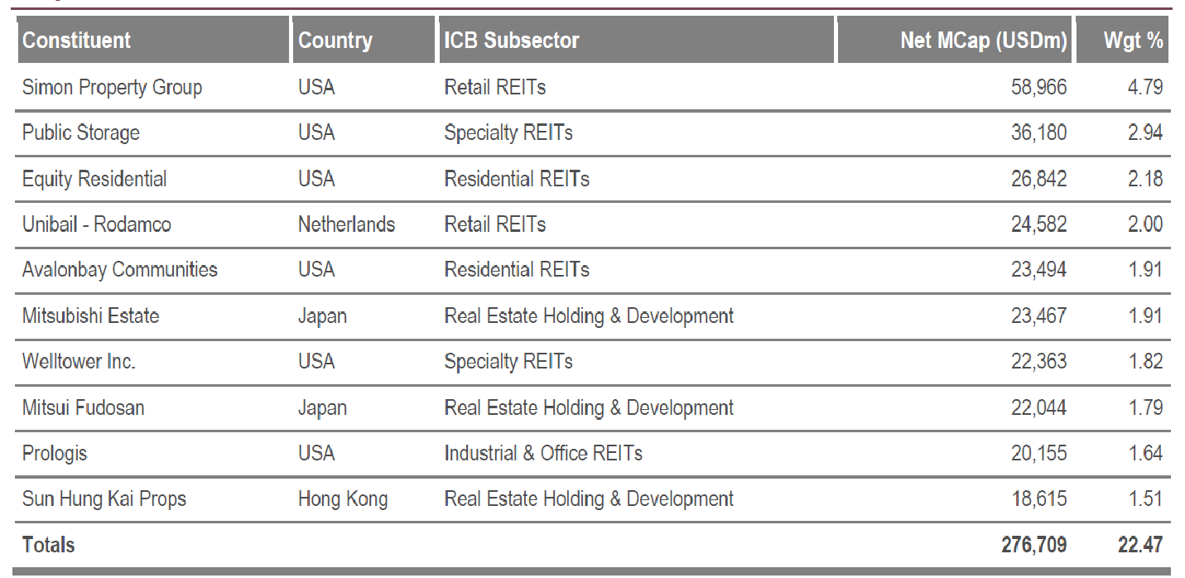
Global – Top 10 REITs

Slide 19
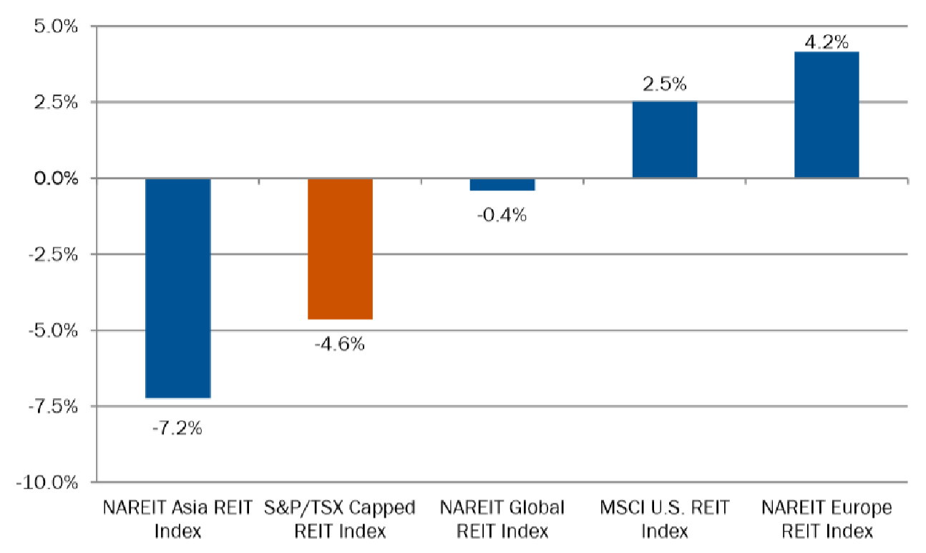
Global – Total Return on REIT Index 2016

Slide 20
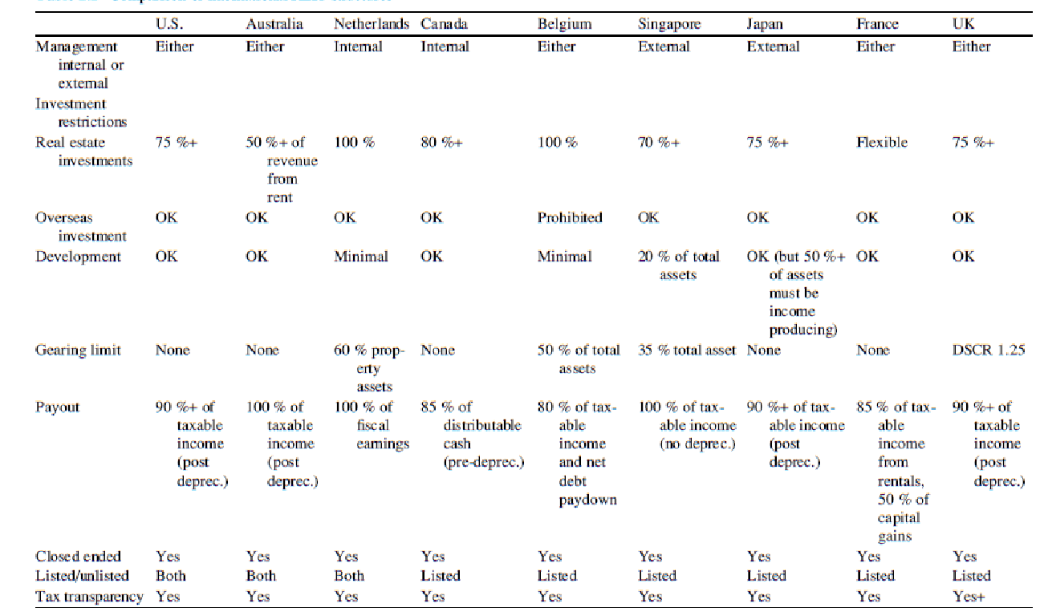
Comparison of REIT Rules

Slide 21
REITs Rules & Regulations
Canada vs US

Slide 22
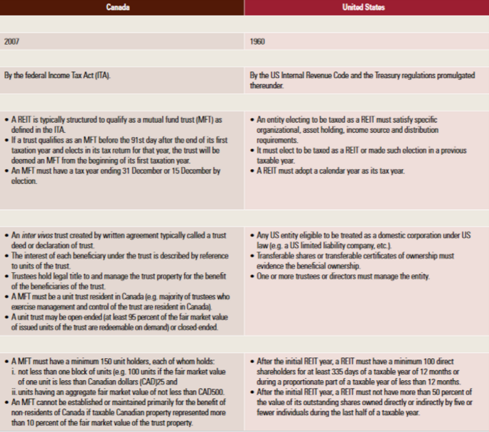
Rules & Regulations
Year
Governed Under
Formalities and Procedures
Legal Form and Share Capital
Restrictions on Shareholdings

Slide 23
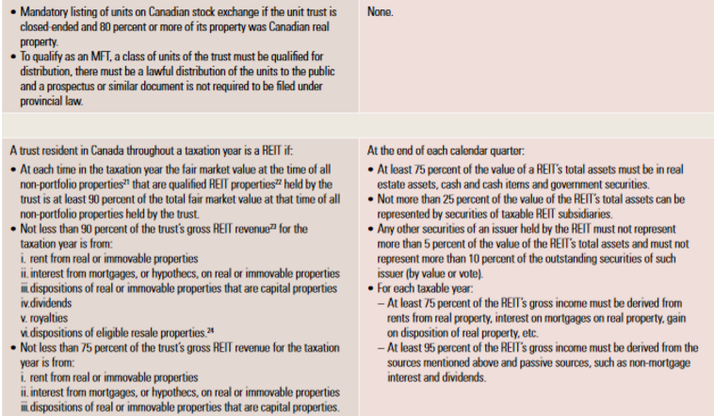
Rules & Regulations
Mandatory Listings on Stock Exchanges
Restrictions on Activities and Investments

Slide 24
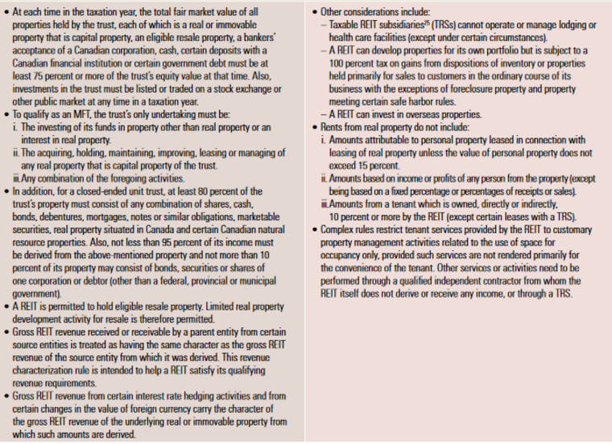
Rules & Regulations
More Restriction on Activities and Investments

Slide 25
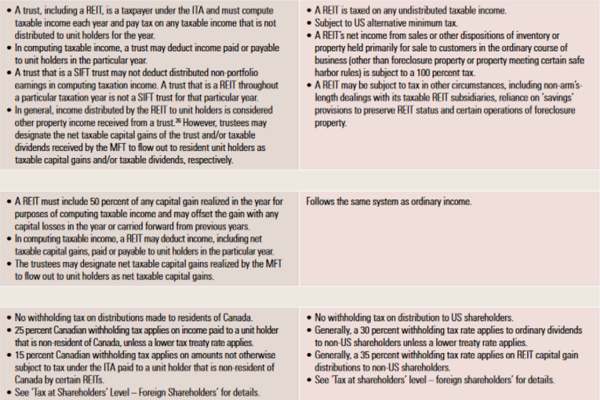
Rules & Regulations
REIT Level Income Tax
REIT Level Capital Gain Tax
Withholding Tax

Slide 26
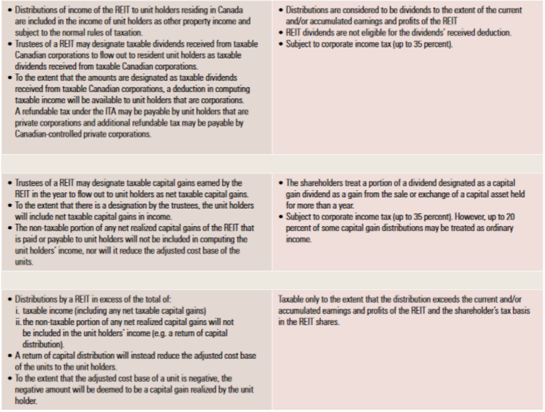
Rules & Regulations
Ordinary Dividends
Capital Gains and Distributions
Return of Capital Distributions

Slide 27
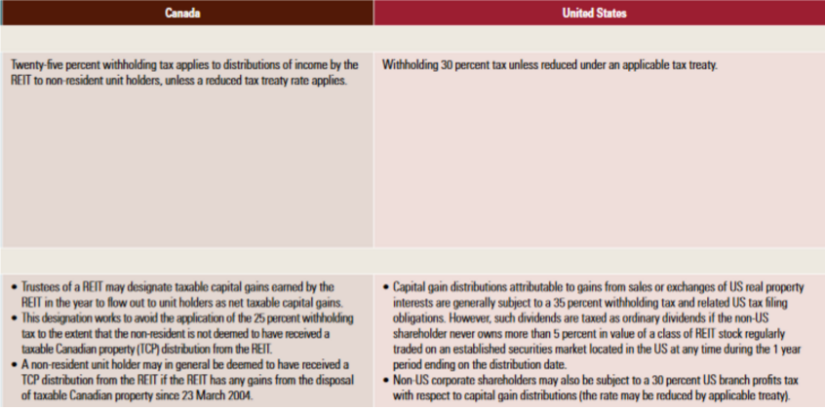
Rules & Regulations
Ordinary Dividends
Capital Gains Distribution

Slide 28
Protecting American from Tax Hikes Acts of 2015
Highlights of provision affecting REITs and foreign investments in real estate:
- Restriction on tax-free spinoffs
- Reduction in % limitation on assets of REIT which may be taxable REIT subsidiaries
- Prohibited transaction safe harbors
- Repeal of preferential dividend rule for publicly offered REITs
- Authority for alternative remedies to address certain REIT distribution failures
- Limitation on designation of dividend REITs
- Debt instruments of publicly offered REITs and mortgages treated as real estate assets
- Asset and income test clarification regarding ancillary personal property
- Hedging provision
- Exception for interests held by foreign retirement or pension funds
- Increase in rate of withholding of tax on disposition of US real property interest
- Increase to the FIRPTA publicly traded stock exception for publicly traded REITs

Slide 29
Market Cap
US vs Canada

Slide 30
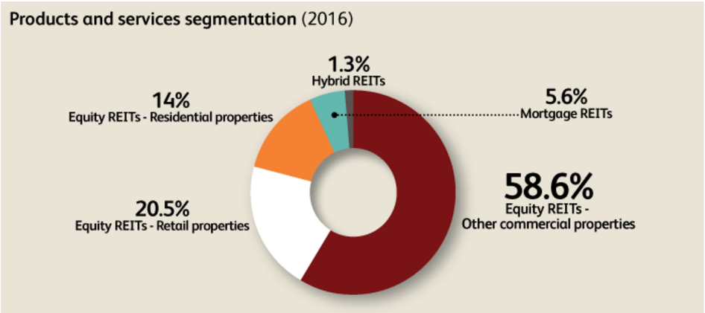
US: Product & Service Segmentation
Notes:
3 main classification of REITs: equity, mortgage, hybrid that are publicly or privately traded.
equity are pooled capital from investors to purchase/manage income property

Slide 31
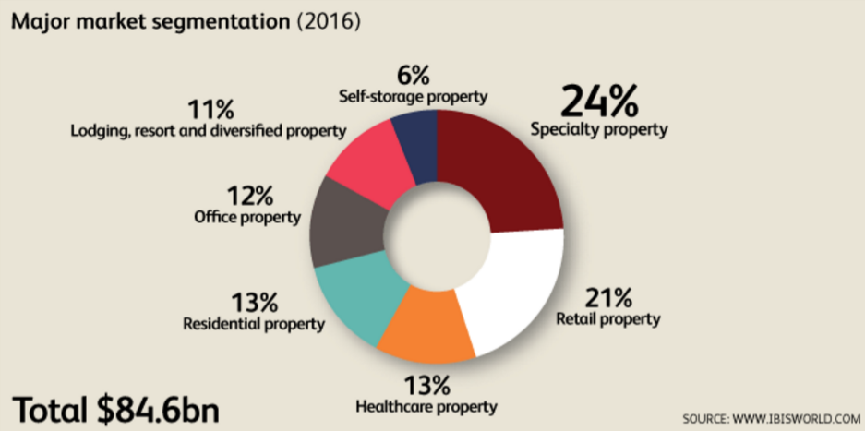

US: Major Market Segmentation
Notes:
7 market segments
Reits investment in a variety of property types: shopping malls, apartment, warehours, office building, storage facilities, hotel etc.
specialized property include infrastructure and timberlands, industrial
retail property: shopping centers, malls, freestanding retail developments

Slide 32
Canadian REITs
First Canadian REIT was listed in 1993
Added into S&P/TSX Composite Index on January 26, 2005
Canadian REIT sector has 7 industries: Diversified, Retail, Office, Residential, Healthcare, Industrial, and Hotel
On January 1 2011, relaxed conditions that REITs must satisfy to be exempted from specified investment flow through trust tax (SIFT)

Slide 33
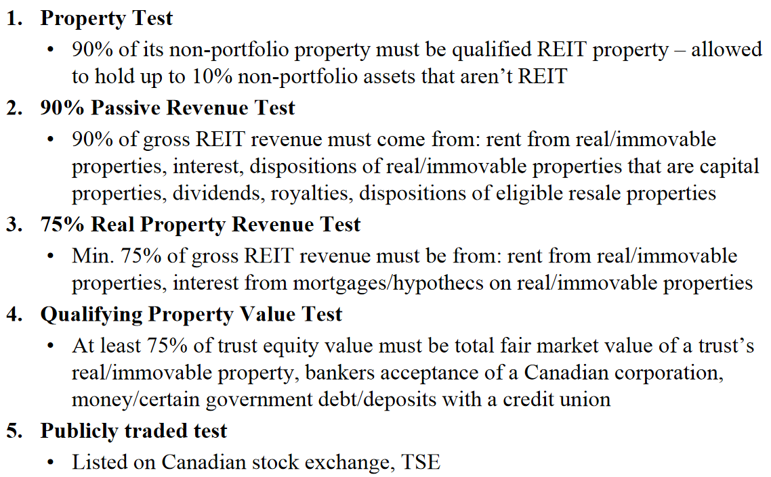
Proposed Changes to REIT Exemption

Slide 34
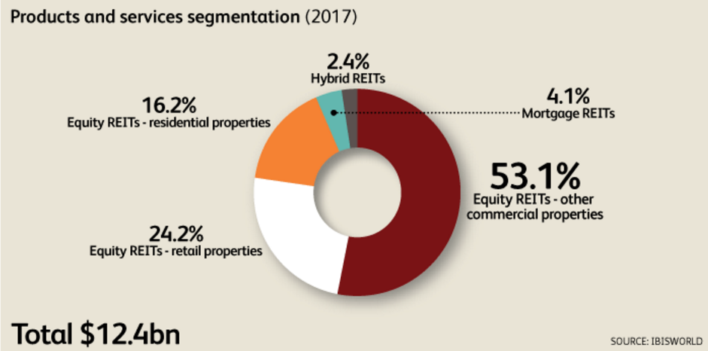
Canada: Product & Service Segmentation
Notes:
similar to US product and service segmentation

Slide 35
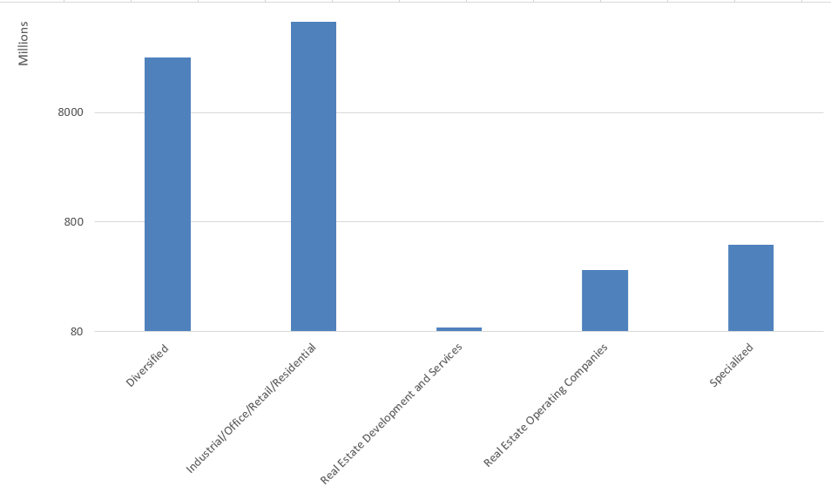
Canada: REITs by Market Segmentation
Notes:
67% industrial, office, retail and residential in the same subsector
32%
1% - specialized
0
0

Slide 36
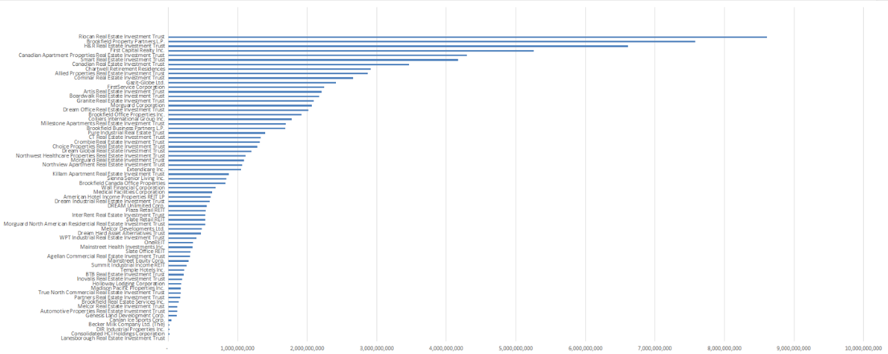
Canada: Canadian REITs

Slide 37
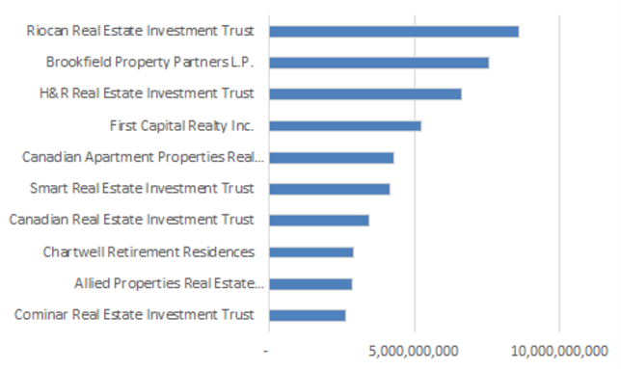
Canada: Top 10 Market Cap

Slide 38
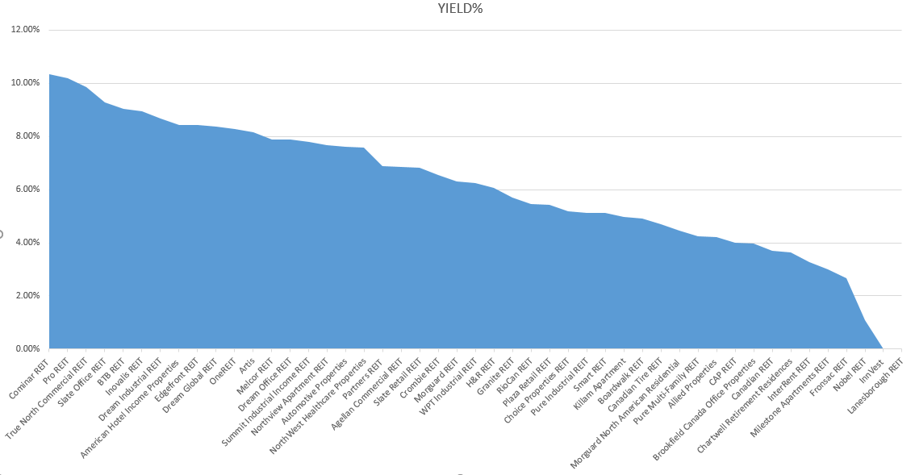
Canadian REITs Dividend Yield

Slide 39
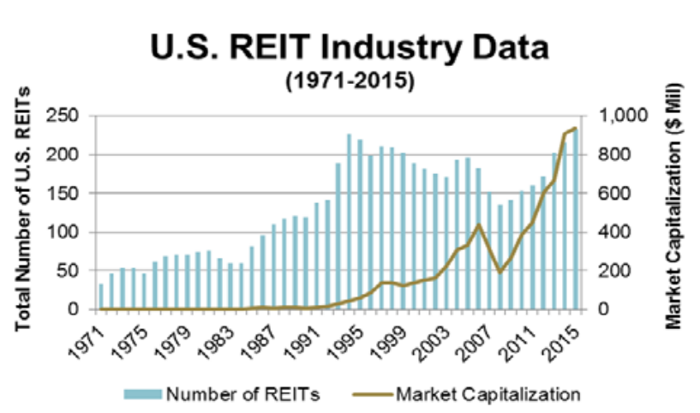
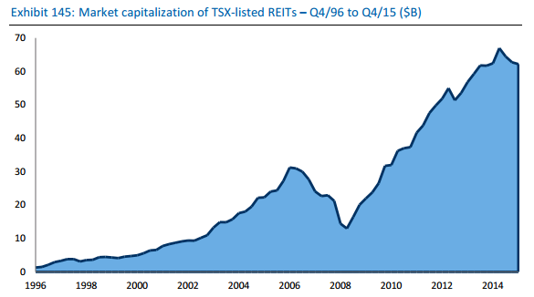
Market Capitalization Growth
Canada REIT Industry Data
Market Capitalization ($Bill)
VS
Notes:
Total Number of Reits in 2015 =41
current 94b and 67 companies listed on tsx

Slide 40
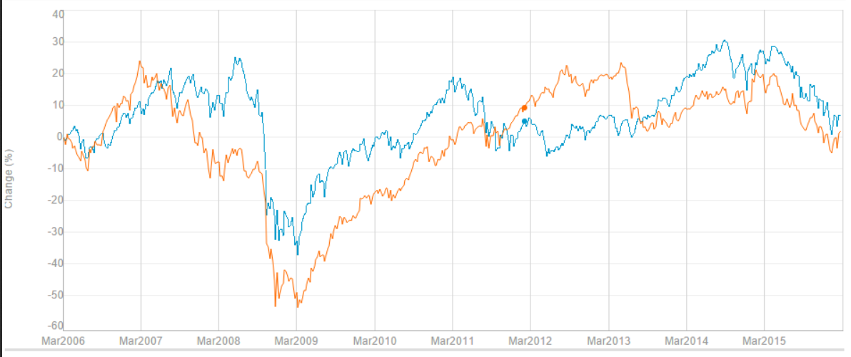
S&P/TSX Capped Reit Index vs S&P/TSX Composite

Slide 41
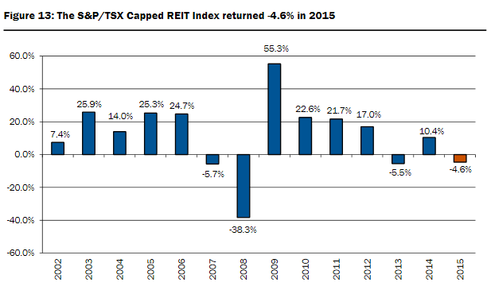
S&P/ TSX Capped Reit Index Return 2015
Notes:
sub index of S&P/TSX Income Trust Index.

Slide 42
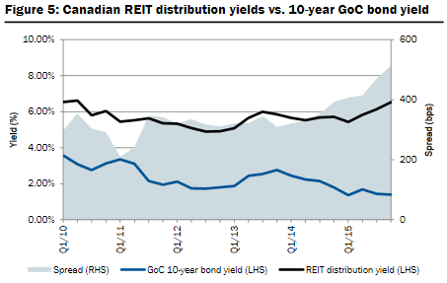
Canadian Reit Yield vs 10-year GOC

Slide 43
How to Evaluate a REIT

Slide 44
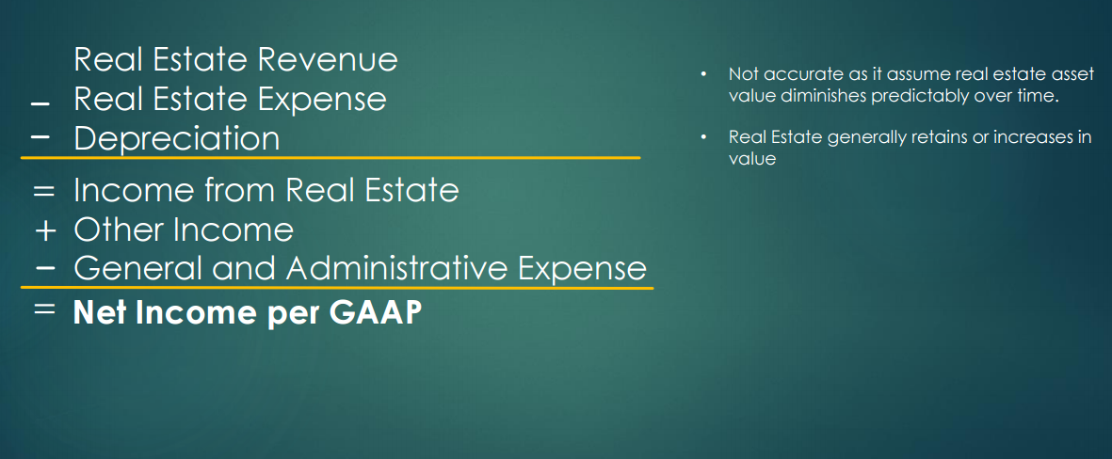
Net Income

Slide 45

Net Asset Value (NAV)
Total Assets
Intangible Assets
Liabilities
NAV per share = NAV / Total Outstanding Shares
Tries to determine the underlying value of a REIT
A high NAV indicates a strong earning potential and good management
Net Asset Value

Slide 46
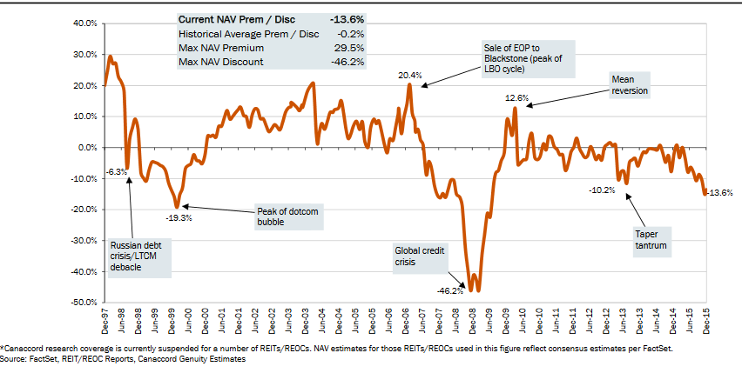
Historical Price to NAV to REIT

Slide 47
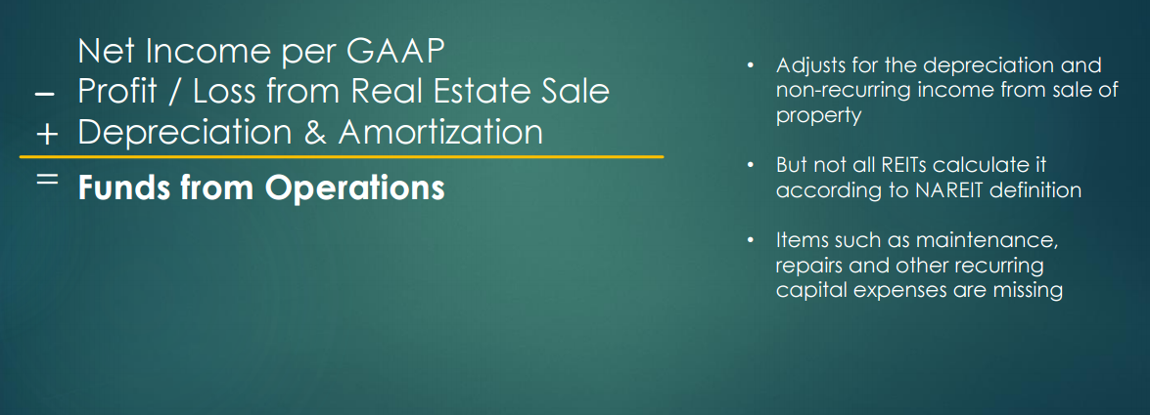
Funds From Operations (FFO)
Notes:
similar to eps
guage profitability per unit of shareholder ownership

Slide 48
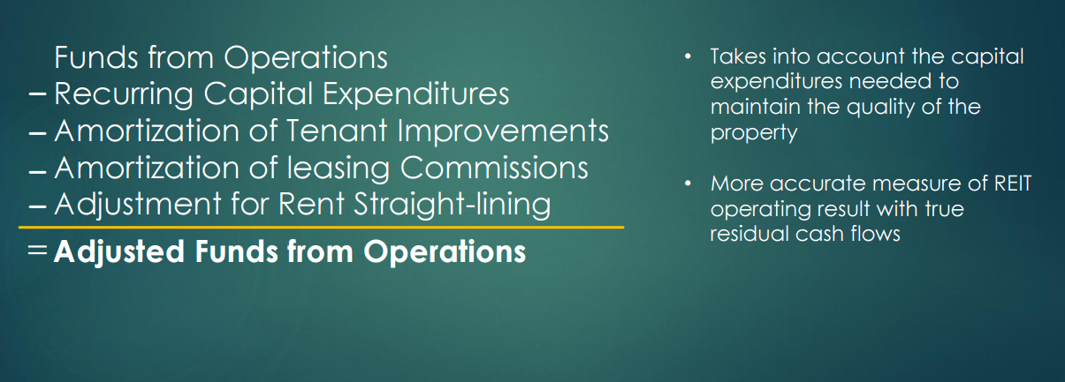
Adjusted Funds From Operations (AFFO)
Notes:
ffo overstate profitability

Slide 49
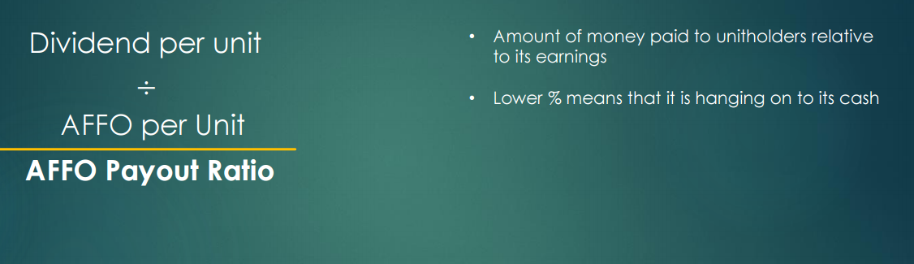
AFFO Payout Ratios

Slide 50
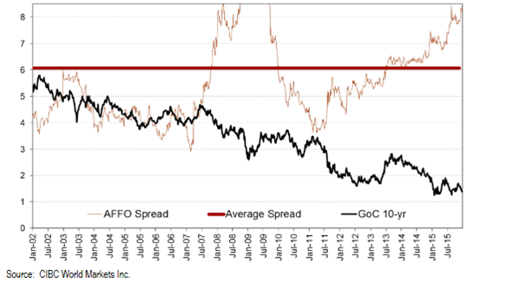
REIT AFFO Yield Spread History

Slide 51
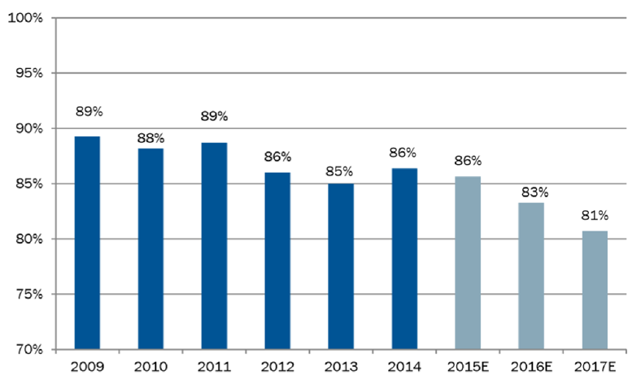
Weighted Average AFFO Payout Ratio

Slide 52
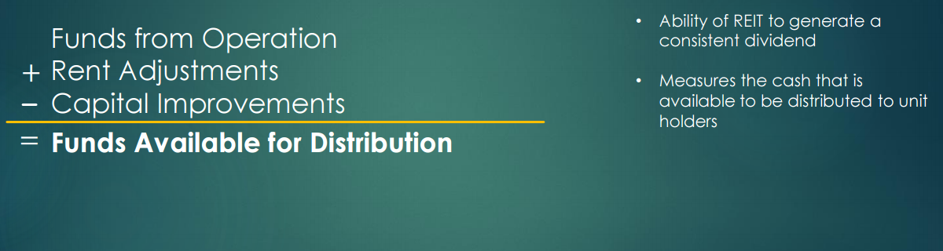
Funds Available for Distribution (FAD)

Slide 53

Capitalization Rate (Cap Rate)
Annual Net Operating Income from Property
Acquisition Cost of Property
Rise in Cap Rate indicate a rise in income from the property relative to its price

Slide 54

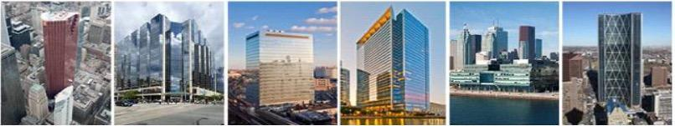

Slide 55
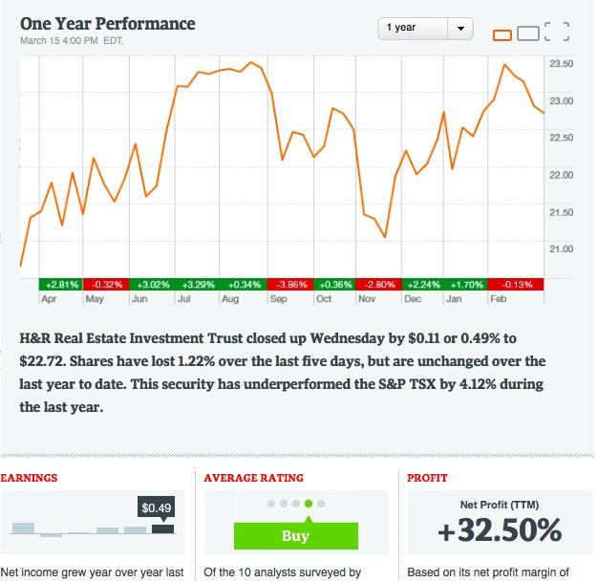
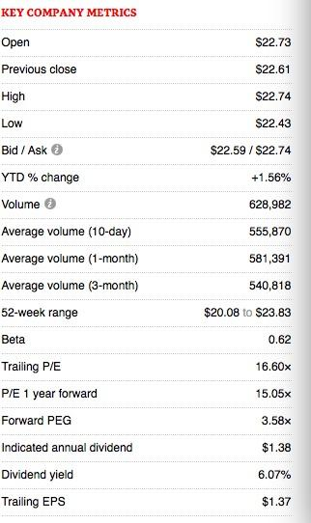
HR (HR.UN) Security Snapshot

Slide 56
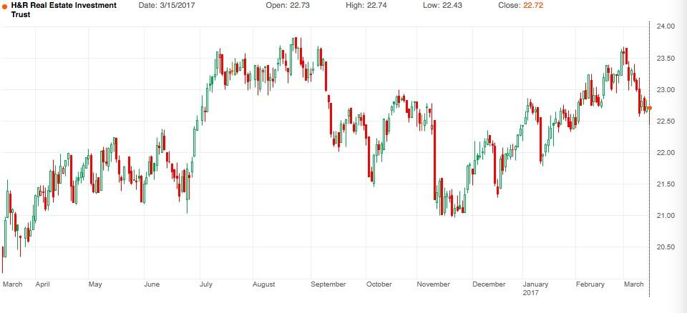
1 Year Chart

Slide 57
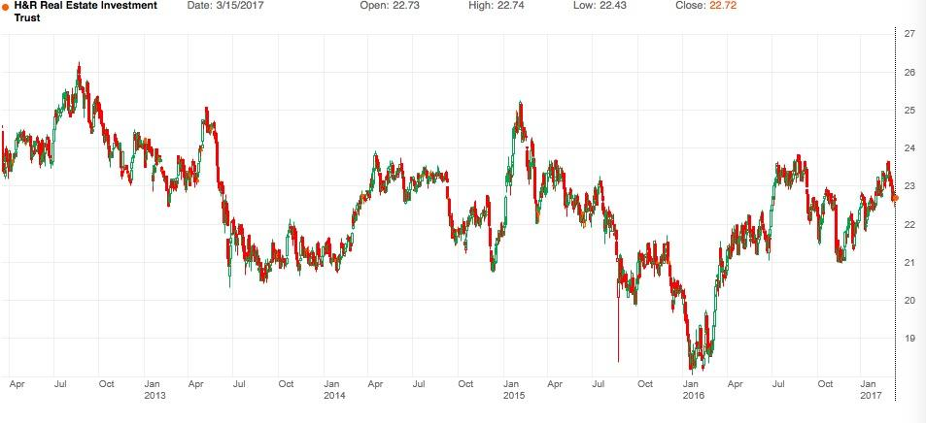
5 Years Chart

Slide 58
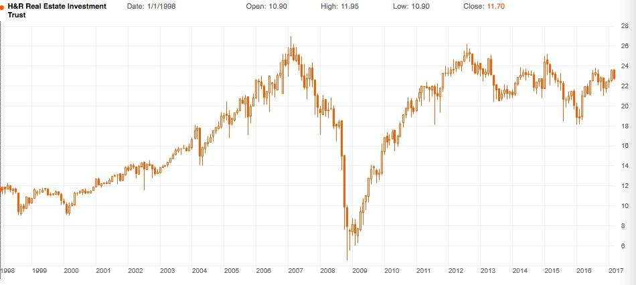
Max Chart

Slide 59
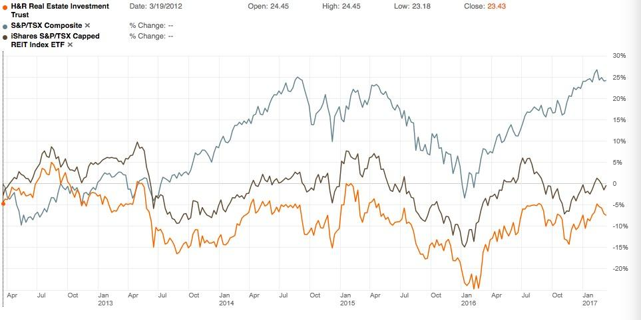
5 Years vs S&P/TSX Composite vs iShare S&P/TSX Capped REIT

Slide 60
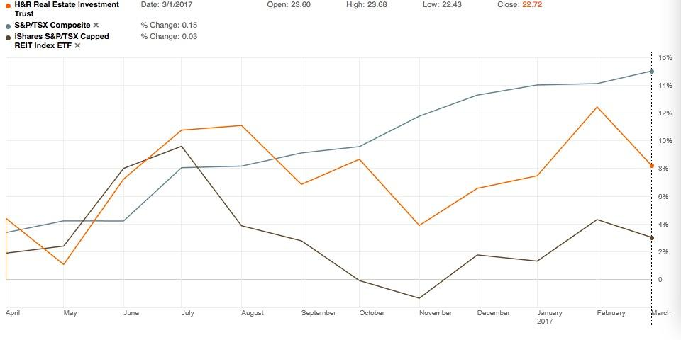
1 Year vs S&P/TSX Composite vs iShare S&P/TSX Capped REIT

Slide 61
Company Overview
H&R REIT (TSX: HR.UN) is an open-ended real estate investment trust
H&R is the second largest REIT and the largest diversified REIT in Canada
IPO was in December of 1996
Investment in US & Canada
Main Investment: Office Complex
Company owns the H&R Finance Trust subsidiary, which invests in US Corporate notes

Slide 62
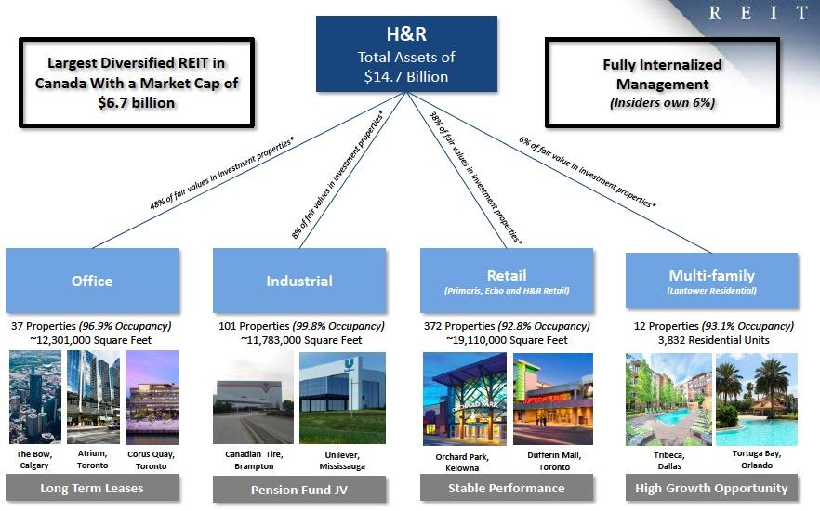
Property Segments

Slide 63
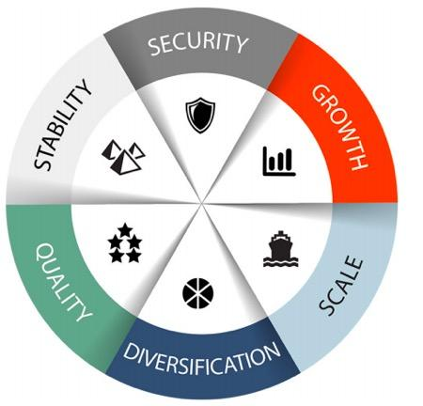
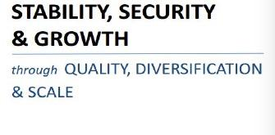
Company Strategy

Slide 64
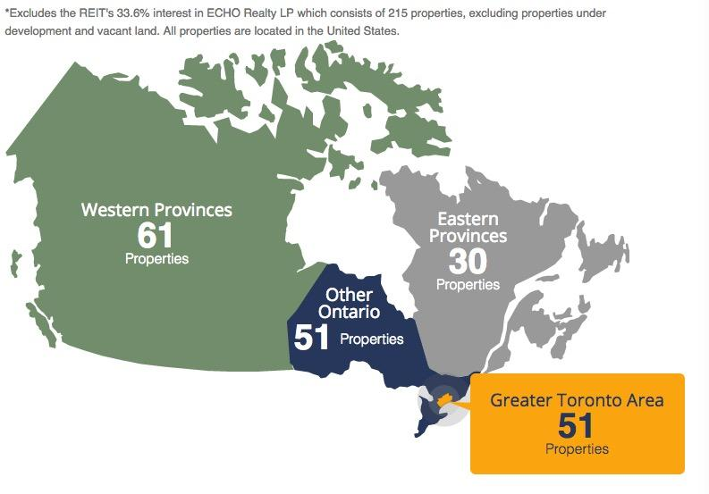
Canadian Properties Owned

Slide 65
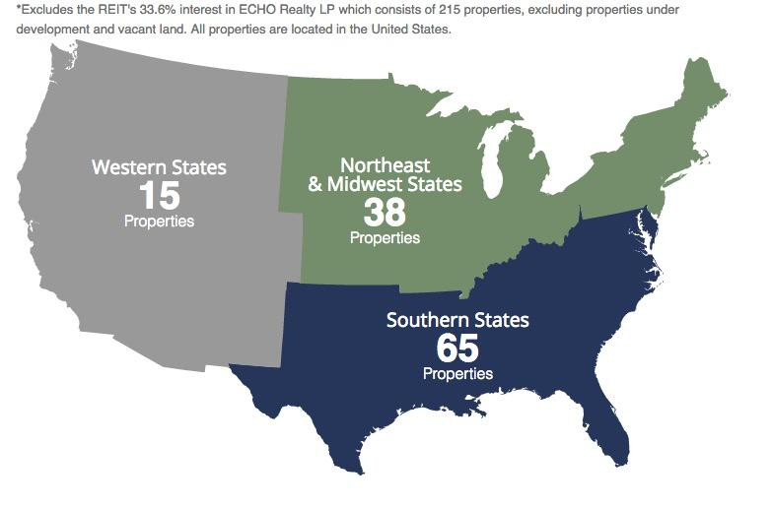
US Properties Owned

Slide 66
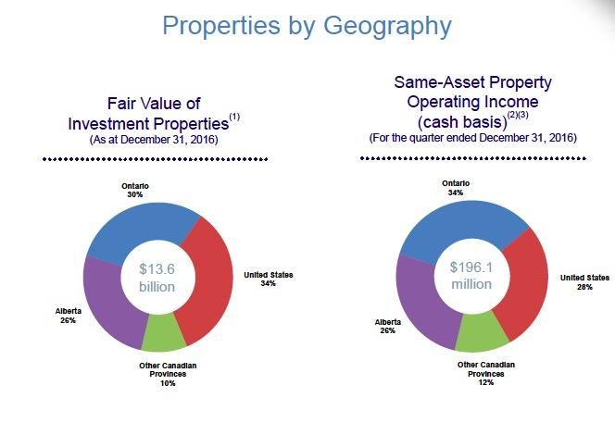
Properties Diversification

Slide 67
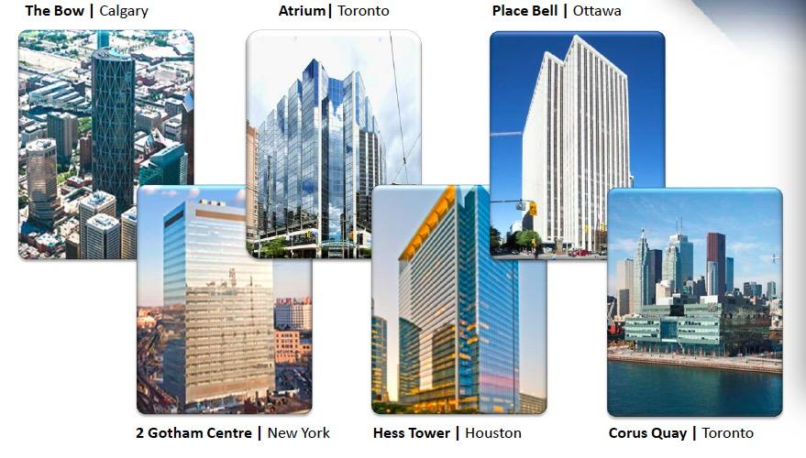

Slide 68


Slide 69
Pramaris Portfolio
Primaris portfolio which operates enclosed shopping centres and multi-tenant retail plazas throughout Canada with shorter-term leases
Subsequent acquisitions of enclosed shopping centres and multi-tenant plazas in Canada will be included in this segment.

Slide 70

H&R Post Pramaris Acquisition

Slide 71


Slide 72

Lantower Residential
Chief Operating Officer: Philippe Lapointe
12 properties, 3,832 residential units
Average property age of 13 years, average monthly rent U.S. $1,081
Texas, Florida & North Carolina
Fair value: U.S. $564 million
Mortgage payable: U.S. $215 million
Strategy: to build a portfolio of class A properties in submarkets of Texas, Florida and North Carolina where there is strong job growth

Slide 73


Slide 74


Slide 75

Long Island City Construction Update
H&R has a 50% interest in a landmark luxury residential rental development in Long Island City, NY
Total cost of the project of all three phases at the 100% level is expected to be approximately U.S. $1.2 billion
H&R’s total cash investment in the LIC Project is $260.7 million
As at December 31, 2016, total costs incurred amounted to $655.3 million. The remaining costs are expected to be funded through the construction financing facility.
Upon completion and stabilized occupancy, the contribution to FFO from the LIC Project at H&R’s interest is projected to be U.S. $23.0 million

Slide 76

Top 15 tenants by Revenue

Slide 77

Other Strong Tenants

Slide 78

20 Years of Stable Occupancy

Slide 79

Limited Lease Rollover
Low-risk rollover schedule
Well diversified by property and geography
Average remaining lease term of 9.5 years, one of the longest in the industry

Slide 80

Management Team

Slide 81

Thomas J. Hofstedter, President and Chief Executive Officer
30 years of North American real estate experience
CEO & President since creation, IPO in 1996
Head of Development’s Office Division
Responsible for building most of the initial assets of the REIT
Bachelor of Arts from University of Toronto

Slide 82

Larry Froom, CPA, CA, Chief Financial Officer
Been with H&R since 1997
Became CFO in September of 2006
Oversees transactions, corporate finance, financial reporting, and investor relations
Manager at E&Y – Real Estate clients
Bachelor in Accounting at University of Witwatersrand in South Africa

Slide 83

Nathan Uhr, Chief Operating Officer
Over 30 years of real estate industry experience
Has worked at H&R for over 20 years
Previously Director of Leasing and Property Management and Vice President at H&R
Responsible for management and leasing issues related to properties

Slide 84

Patrick Sullivan, Chief Operating Officer, Primaris Management Inc.
Leads senior management group at Primaris
Responsible for strategic and operational aspects of Primaris
Previously was Senior Vice President at Primaris
Bachelor degree in Commerce from UBC

Slide 85

Philippe Lapointe, Chief Operating Officer, Lantower Residential
Oversees acquisition, financing and operations of all Lantower investments
Previously, Vice President of Matthews Multifamily and ran the US acquisition and asset management platforms
Law degree and MBA
Member of NMHC and TREC

Slide 86

Balance Sheet

Slide 87

Income Statement

Slide 88

Cash Flow Statement

Slide 89

Cash Flow Statement – Continued

Slide 90

Funds From Operations

Slide 91

Funds From Operations - Continued

Slide 92

Adj. Funds From Operations

Slide 93
RECOMMENDATION:
BUY

Slide 94



Slide 95








Company Snapshot

Slide 96

Company Snapshot
— Max Timeframe Performance

Slide 97

Company Snapshot
— 1 years compared to S&P/TSX Capped REIT

Slide 98

Company Snapshot
— 5 years compared to S&P/TSX Capped REIT

Slide 99

Company Snapshot
— 10 years compared to S&P/TSX Capped REIT

Slide 100

Company History Overview
1993, in the wake of the worst real estate recession since the Great Depression, RioCan was built as one of Canada's earliest REITs companies.
January 1994, RioCan was first listed on the Toronto Stock Exchange
2009, RioCan made a significant move into the American market, strengthening their portfolio and keeping their revenue sources diverse.
Today, RioCan is Canada’s largest REIT and one of North America’s larger retail REITs

Slide 101


Slide 102


Geographic Diversification

Slide 103

Six Canadian Major Markets
Notes:
As at December 31, 2016, the percentage of gross revenue derived from the six major markets increased to 75.5% compared to
74.8% at December 31, 2015. The increase during 2016 is in line with management's strategy to acquire and develop properties
located in our six major markets and dispose of non-core lower growth assets.
As at December 31, 2016, the committed occupancy for our six major markets is 96.5% compared to 95.1% at December 31,
2015.

Slide 104



TOP 10
Retailers

Slide 105

Top Ten Sources of Revenue by Property Tenant

Slide 106

REAL ESTATE PORTFOLIO KEY FACTS

Slide 107






Income Property Acquisitions During 2016

Slide 108
Company 2016 Q4 Overview
Largest REIT in Canada with a total enterprise value of about $14.6 billion as at December 31,201
On May 24, 2016, RioCan completed the sale of its U.S. portfolio of 49 wholly owned investment properties to Blackstone Real Estate Partners VIII ("Blackstone") for gross sales proceeds of US$1.9 billion, and received cash proceeds of approximately US$1.0 billion.
Reduced its weighted average contractual interest rate to 3.54% which is 3.65% in 2015, 4,04% in 2014.
Notes:
RioCan Real Estate Investment Trust is an unincorporated "closed-end" trust governed by the laws of the Province of Ontario and constituted pursuant to a Declaration of Trust. RioCan is publicly traded and is listed on the Toronto Stock Exchange under the symbol REI.UN.
RioCan is Canada's largest real estate investment trust with a total enterprise value of approximately $16 billion as at March 31, 2015. It owns and manages Canada's largest portfolio of shopping centres with ownership interests in a portfolio of 353 retail properties, including 15 under development, containing more than 79 million square feet including 48 grocery anchored and new format retail centres containing 13 million square feet in the United States at March 31, 2015.
RioCan's purpose is to deliver to its unitholders stable and reliable cash distributions that will increase over the long term. It seeks to do so by following a strategy of owning, developing, managing and operating Canadian retail real estate. RioCan's management, in measuring the Trust's performance, does not distinguish or group its operations on a geographical or any other basis. Accordingly, the Trust has a single reportable segment for disclosure purposes in accordance with Canadian generally accepted accounting principles.

Slide 109

Capital Structure
Notes:
As at December 31, 2016, RioCan's ratio of floating rate debt to total debt remained relatively flat at 13.8% (14.0% as at
December 31, 2015), as a result of the Trust repaying a portion of floating rate debt with the net sales proceeds generated from
the U.S. asset sale, largely offset by higher operating credit facility draws associated with property acquisitions and development
costs. Also in connection with the Trust repaying debt during 2016, our overall debt leverage has been reduced from 46.3% as at
December 31, 2015 to 40.0% as at December 31, 2016, as determined on a RioCan proportionate share basis.
We expect our total debt to total asset ratio to fluctuate going forward between 38% to approximately 42%. Over the next 12 to 18
months, we expect this ratio to rise toward the higher end of the range, primarily as a result of funding of our development
program.
RioCan continues to utilize floating interest rate debt for the purpose of interest rate risk management and for the flexibility it
offers in the execution of investment transactions.

Slide 110

Liquidity
$1 billion unsecured operating facility
Canada’s six largest banks all participated in this facility

Slide 111
Company Core Strength
Stable, diversified portfolio of national retail tenants
  Invest in grocery chain anchored shopping centers, mixed-use developments and urban opportunities in both US and Canadian markets
  Follow a strategy of owning, developing, managing and operating Canadian retail real estate
Strong relationship with large tenants
With a purpose to deliver its unitholders stable and reliable cash distributions that will increase over the long term

Slide 112

Management Team
Edward Sonshine
Chief Executive Officer/ Founder
A member of the Boards of the Royal Bank of Canada and Cineplex Inc.
Vice Chair of Mount Sinai Hospital in Toronto
Chair of the Israel Bonds Organization of Canada.
Canada’s Outstanding CEO of the Year for 2013

Slide 113

Management Team
Raghunath Davloor
President, Chief Operating Officer
Compensation: C$ 2,750,887
President and Chief Operating Officer at since 2014.
Chief Financial Officer of Riocan from 2015 to 2018.

Slide 114

Management Team
Cynthia Devine
Chief Financial Officer, Executive Vice President
Currently serving on the Board of Directors of Empire Company Limited (Sobey’s).
On the Board of Directors for Canada’s Walk of Fame, a non-profit organization.
Served on the Board of Directors of ING Direct Canada from 2009 until its sale to Scotiabank in December 2012

Slide 115

Current Trends
Rise of e-commerce
Urbanization
Aging population, low growth
economy and gridlock

Slide 116
Canadian Focus
Achieving organic growth by leveraging our existing strengths.
An investment strategy that promotes growth and learning by bringing in additional partners with expertise when needed and an acquisitions/divestitures program.
A disciplined development strategy for both commercial and mixed use, including a residential intensification program seeking to capitalize on development capabilities and the high quality locational attributes of our land holdings.
Financial strength through prudent balance sheet management ensuring continued access to cost effective capital in support of our investment and development strategies.

Slide 117


Slide 118


Slide 119


Slide 120
Residential Focus
Leverage Riocan’s ownership of land in key urban locations, often those along mass transit lines - provide a competitive cost advantage.
Allow a steady income stream with a growth profile that will serve as a partial hedge against inflation.
Drive long term efficiencies going forward.
Attract favorable financing terms based on the availability of Canadian Mortgage and Housing Corporation (CMHC) insurance.

Slide 121
Capital Management
Optimize the risk-adjusted cost of capital through an appropriate mix of debt and equity;
Raise debt from a variety of sources and maintain a well-staggered maturity schedule and a large pool of unencumbered assets;
Maintain and expand as necessary significant committed undrawn loan facilities to support current and future business requirements;
Actively manage financial risks, including interest rate, foreign exchange, liquidity and counterparty risks;
Selectively sell assets as part of actively managing the portfolio and to increase the portfolio weighting to the six urban markets in Canada as a means to strategically recycle capital.

Slide 122
Sustainability Governance
Assembled a Sustainability Steering Committee comprised of cross functional Executive and Leadership team members to oversee the sustainability strategy implementation and to drive performance improvements.
Steering Committee members will sponsor and provide guidance on sustainability initiatives within the organization and enable performance measurement.
Committed to hiring a full time resource to manage day-to-day sustainability strategy implementation.

Slide 123

Financial performance

Slide 124

2016 Financial Highlights

Slide 125

Operating Income
( in thousands of Canadian dollars)

Slide 126

Net Operating Income
( in thousands of Canadian dollars)

Slide 127

Canadian Portfolio
( in thousands of Canadian dollars)

Slide 128

Balance
Sheet
Statement
2016 – Q4
( in thousands of Canadian dollars)

Slide 129

Income
Statement
2016 – Q4
( in thousands of Canadian dollars)

Slide 130

Comprehensive Income Statement 2016 – Q4
( in thousands of Canadian dollars)

Slide 131

Cash Flow Statement2016 – Q4
( in thousands of Canadian dollars)

Slide 132

Cash Flow Statement2016 – Q4
( in thousands of Canadian dollars)

Slide 133

Statements of Changes in Unitholder’s Equity

Slide 134

Funds from Operation & Operating Funds from Operation
2016 – Q4
( in thousands of Canadian dollars)

Slide 135

Funds from Operation & Operating Funds from Operation
2016 – Q4 ( in thousands of Canadian dollars)

Slide 136

FFO and OFFO Summary
2016 – Q4
( in thousands of Canadian dollars)

Slide 137

Adjusted Funds from Operations
2016 – Q4
( in thousands of Canadian dollars)

Slide 138

AFFO Summary
2016 – Q4
( in thousands of Canadian dollars)
*AFFO for the fourth quarter of 2016 is $119 million compared to $129 million during the same period in 2015, representing a decrease of $9.2 million or approximately 7.2%.
*The decrease in AFFO was primarily due to a $30 million reduction caused by the sale of our U.S. property portfolio, lower property and asset management fees of $1.4 million and less investment income from marketable securities of $1.3 million. =

Slide 139
RECOMMENDATION:
BUY

Slide 140

BOARDWALK

Slide 141


Slide 142

BEI 1 Year

Slide 143

BEI 5 Year

Slide 144

BEI Max

Slide 145
Company Overview
→ Canadian Real Estate Investment Trust
→ owns and operates more than 200 communities
→ over 33,000 residential units
→ 28 million net rentable square feet
→ sustainable monthly cash distributions
→ increase the value of its trust units through:
→ selective acquisitions
→ dispositions
→ development
→ effective management of its residential multi-family communities
→ Canada’s leading owner/operator of multi-family communities
→ located in Alberta, Saskatchewan, Ontario, and Quebec.

Slide 146

The History of Boardwalk

Slide 147

Company Core Initiatives

Slide 148



Major Press Releases 2016

Slide 149



Major Press Releases 2016

Slide 150

Unit Distribution

Slide 151

Distribution and NOI

Slide 152

Growth

Slide 153


Slide 154


Boardwalk Tenancy

Slide 155


Slide 156


Slide 157


Slide 158


Slide 159


Slide 160


Slide 161


Slide 162
Management Team

Slide 163

Chief Executive Officer of Boardwalk REIT and served as its President until May 2007.
Co-founder and served as President of Boardwalk Properties Co. Ltd
Chairman since May 10, 2007
Director since July 14,1993
Affiliate of the Real Estate Institute of Canada since 1985.
Brother is Van Kolias (Senior VP of Quality Control)
Together they own about 23% of Boardwalk
Bachelor of Science in Civil Engineering in 1983 from the University of Calgary
Certified Property Manager from the Real Estate Institute of Canada in 1995

Slide 164

President since May 10, 2007
Senior Vice President of Finance at Boardwalk REIT since 1993 until March 30, 2007
Chief Financial Officer until March 30, 2007.
14 years of multi-family real estate experience.
University of Calgary - Commerce in 1990
Chartered Accountant designation in 1993
Awarded his Fellowship Chartered Accountant (FCA) by the Institute of Chartered Accountants of Alberta.

Slide 165

Chief Financial Officer of Boardwalk Real Estate Investment Trust since May 10, 2007
Vice President of Boardwalk Real Estate Investment Trust until March 30, 2007, Senior Vice President since March 30, 2007
Accountant at Deloitte in Toronto from 1987 to 1990
Trust's controller since December 2004.
Boardwalk's Director of Taxation and Financial Reporting, from October 2002 to December 2004.
Chartered Accountant, Chartered Financial Analyst and Certified Management Accountant

Slide 166

Van Kolias
Senior Vice President, Quality Control
Brother of CEO Sam Kolias
Been Senior VP since 2004
Named top 100 richest people in Canada with brother
Together they own about 24% of Boardwalk

Slide 167

Financial Performance

Slide 168

Balance Sheet Q4
2016

Slide 169


Slide 170

Cash Flow Statement

Slide 171


Slide 172


Slide 173


