Slide 1
U.S. Retailers
Mengxia Wang
Jiaying He
Shu Wei, Lee
Yeung Tim Ching
Liting Wang
Presented by:

Slide 2



Industrial Analysis
Notes:
https://www.askfood.eu/tools/forecast/wp-content/uploads/2019/06/global-powers-of-retailing-2018.pdf
https://www2.deloitte.com/us/en/pages/consumer-business/articles/retail-distribution-industry-outlook.html
https://home.kpmg/xx/en/home/insights/2019/02/retail-trends-2019.html
https://assets.kpmg/content/dam/kpmg/xx/pdf/2018/03/global-retail-trends-2018.pdf
https://on.emarketer.com/rs/867-SLG-901/images/eMarketer_Future_of_Retail_Report_Braze_2019.pdf

Slide 3
Definition of retail
The Retail Trade sector comprises establishments engaged in retailing merchandise, generally without transformation, and rendering services incidental to the sale of merchandise.
The retailing process is the final step in the distribution of merchandise; retailers are, therefore, organized to sell merchandise in small quantities to the general public. This sector comprises two main types of retailers: store and nonstore retailers.
Notes:
https://www.census.gov/cgi-bin/sssd/naics/naicsrch?code=44&search=2017%20NAICS%20Search

Slide 4
Examples of Retail Stores
Grocery Stores
This industry group comprises establishments primarily engaged in retailing a general line of food products.
Department Stores
This industry comprises establishments known as department stores that have separate departments for general lines of new merchandise, such as apparel, jewelry, home furnishings, and toys, with no one merchandise line predominating. Department stores may sell perishable groceries, such as fresh fruits, vegetables, and dairy products, but such sales are insignificant. Department stores may have separate customer checkout areas in each department, central customer checkout areas, or both.
Notes:
https://www.census.gov/cgi-bin/sssd/naics/naicsrch?code=4451&search=2017%20NAICS%20Search
https://www.census.gov/cgi-bin/sssd/naics/naicsrch?code=4522&search=2017%20NAICS%20Search

Slide 5
Examples of retail stores
Furniture and Home Furnishings Stores
Industries in the Furniture and Home Furnishings Stores subsector retail new furniture and home furnishings from fixed point-of-sale locations. Establishments in this subsector usually operate from showrooms and have substantial areas for the presentation of their products. Many offer interior decorating services in addition to the sale of products.
General Merchandise Stores, including Warehouse Clubs and Supercenters
This industry comprises establishments primarily engaged in retailing new goods in general merchandise stores (except department stores). These establishments retail a general line of new merchandise, such as apparel, automotive parts, dry goods, hardware, groceries, housewares, and home furnishings, with no one merchandise line predominating. Establishments known as warehouse clubs, superstores, or supercenters are included in this industry.

Slide 6
Global Retail Industry Analysis
The scope of study is geographically limited to North America, Europe, Asia Pacific
Valued at $23.956 trillion in 2018 and estimated to reach $25.038 trillion in 2019
The growth rate between 5.7% to 7.5% each year
Notes:
https://www.emarketer.com/content/global-ecommerce-2019

Slide 7
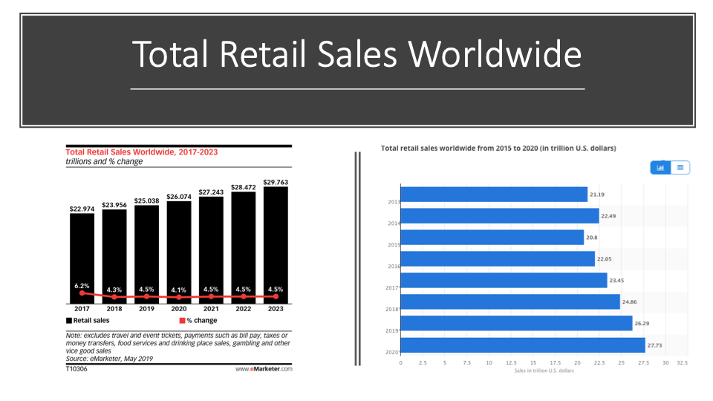
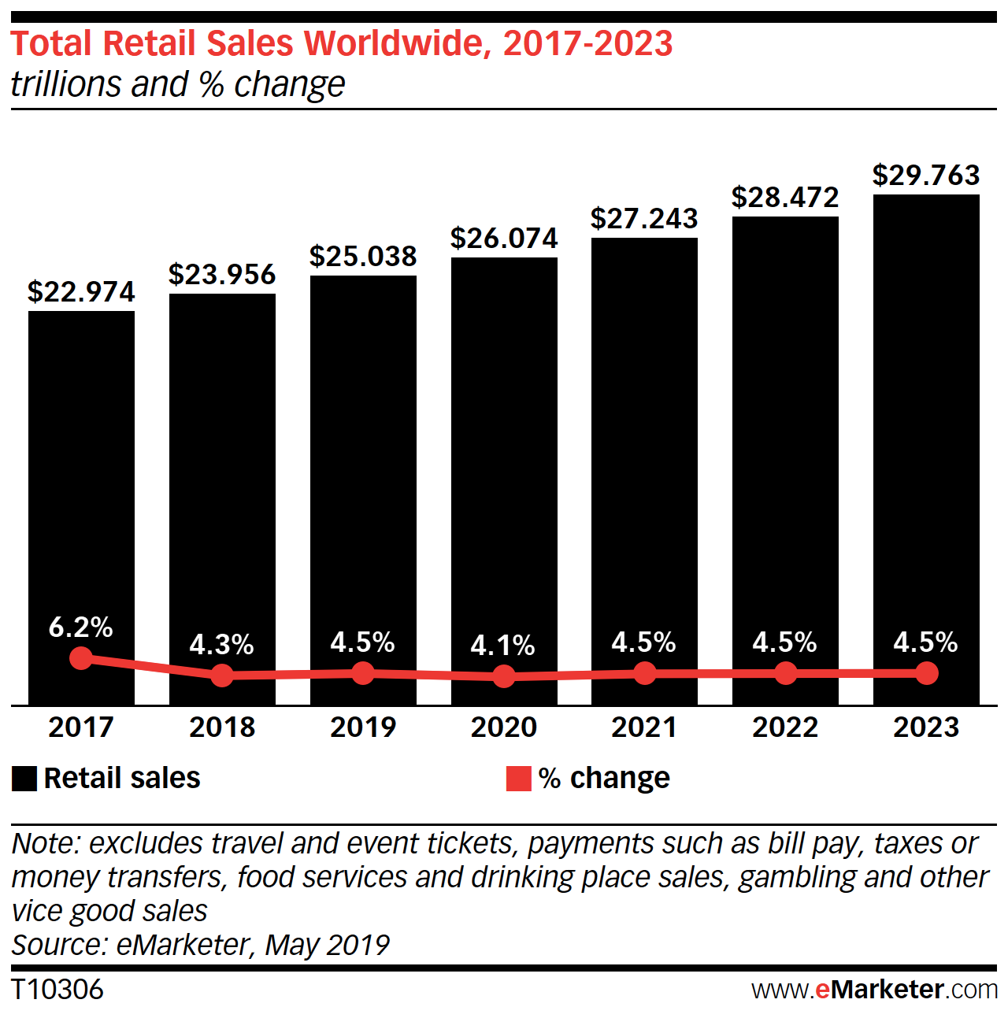
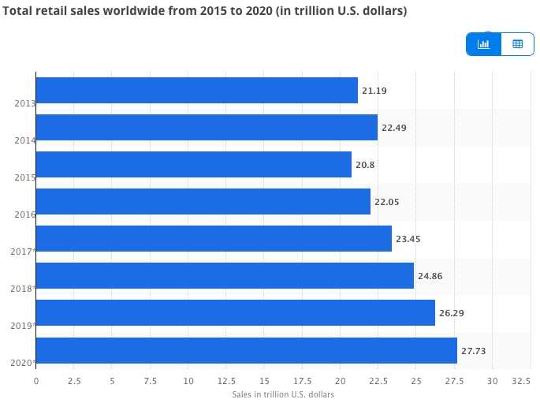
Total Retail Sales Worldwide

Slide 8
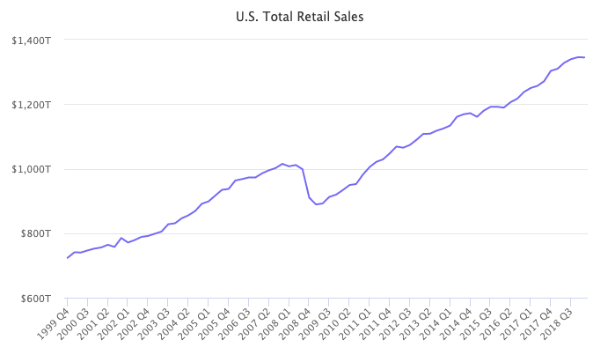
Retail Sales in U.S.
Notes:
https://www.marketplacepulse.com/stats/us-ecommerce/us-total-retail-sales-113

Slide 9
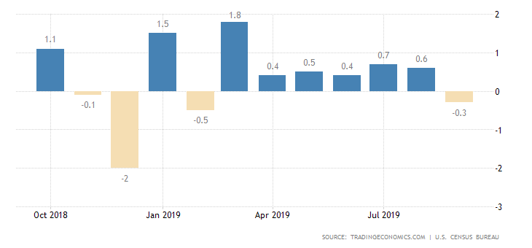
Current U.S. Retail Industry Analysis
Notes:
https://tradingeconomics.com/united-states/retail-sales

Slide 10
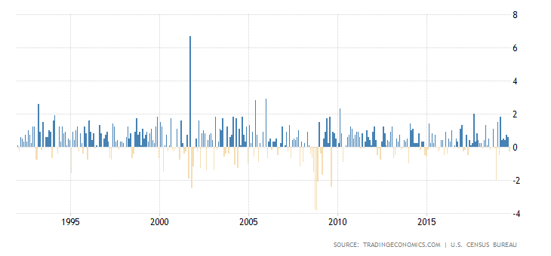
U.S. Retail Industry History Data

Slide 11
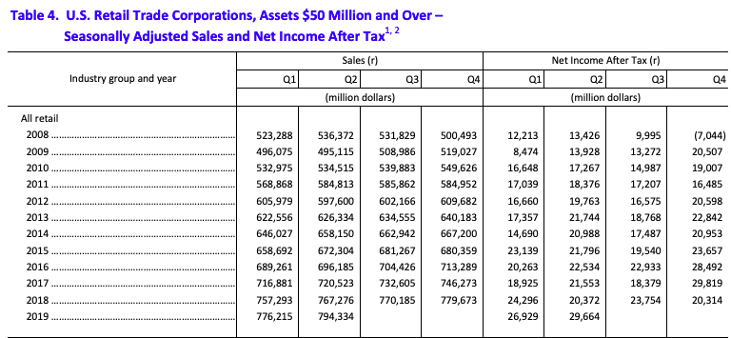
Quarterly Financial Report
Notes:
https://www.census.gov/econ/qfr/retail/current/qfr_rt.pdf

Slide 12
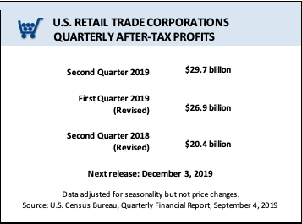
Quarterly Financial Report

Slide 13
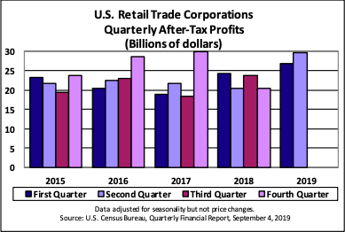
Quarterly Financial Report

Slide 14
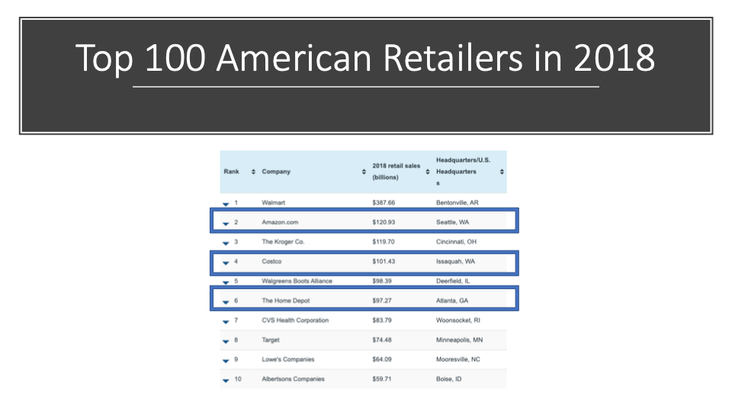
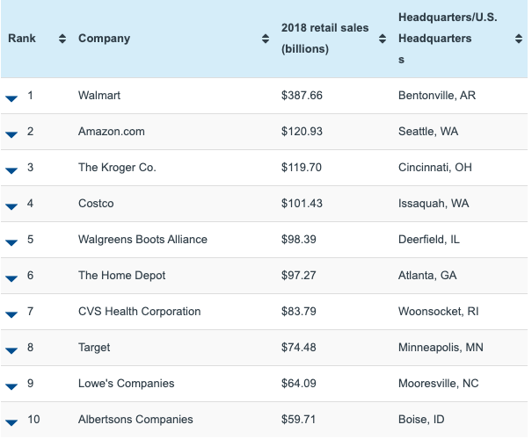
Top 100 American Retailers in 2018
Notes:
https://www.statista.com/statistics/195992/usa-retail-sales-of-the-top-50-retailers/

Slide 15
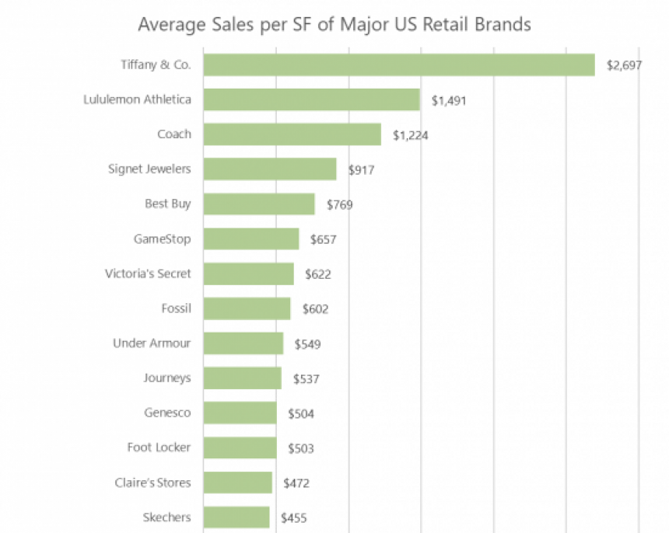
U.S. Retailer sales per square foot
Notes:
https://www.camoinassociates.com/average-square-footage-and-retail-sales-square-foot-across-major-brands

Slide 16
Current Global Trend-challenge
The advanced technology of internet and consumer enjoy multichannel buying experience
Consumer tend to have online shopping which lower the profit of physical retail stores
Price difference between online stores and traditional brick & mortar stores

Slide 17
Threats for retailer
Price war among rivalries
Economic recession
Decrease in demand
Change in consumers’ purchase behavior

Slide 18



Retail Store Closures in 2019
Forever 21 went bankruptcy close 200 stores
GAP closed 230 stores
H&M closed 160 stores
Notes:
Part of its restructuring after filing for bankruptcy in Sept 2019
https://ritholtz.com/2019/09/retail-bankruptcies-closures-2019/

Slide 19
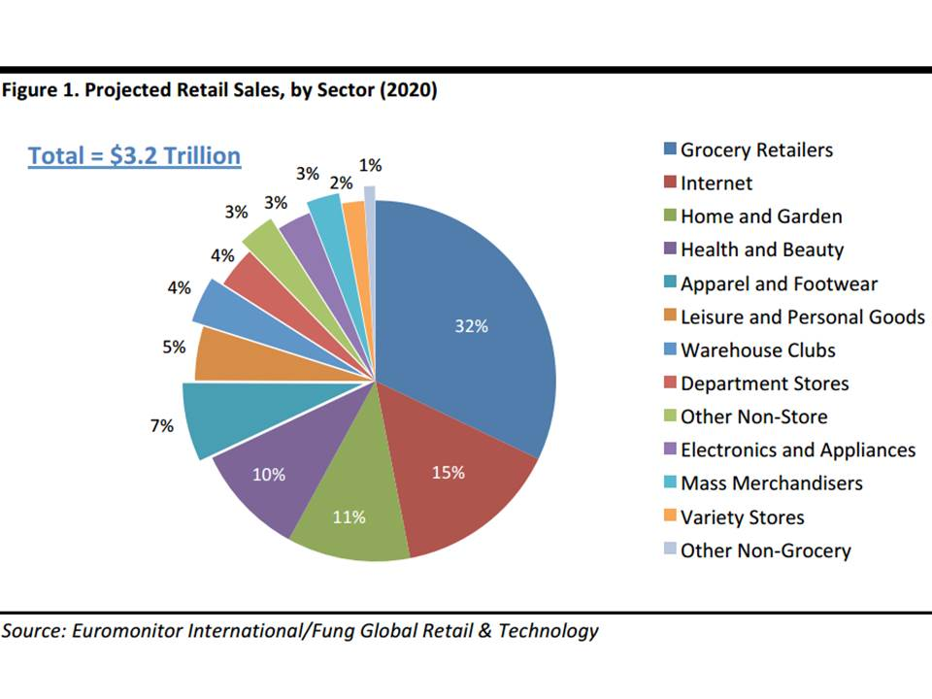
Trend of retail industry by sector
Notes:
https://www.deborahweinswig.com/uncategorized/what-will-the-retail-industry-look-like-in-2020/

Slide 20
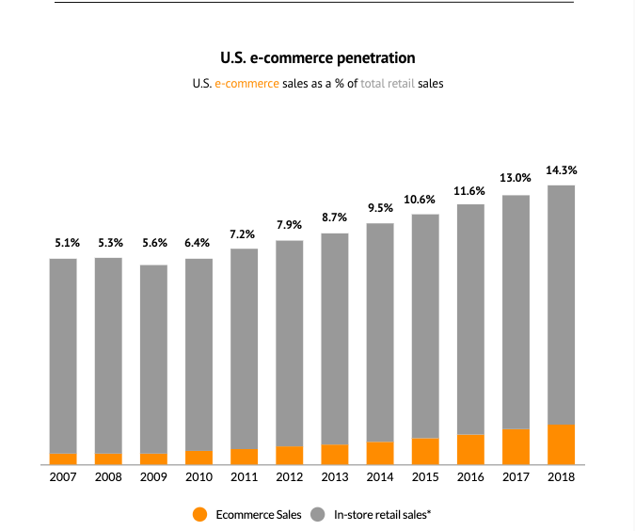
U.S. Sales Variation between Online and Offline
Notes:
https://www.digitalcommerce360.com/article/e-commerce-sales-retail-sales-ten-year-review/

Slide 21
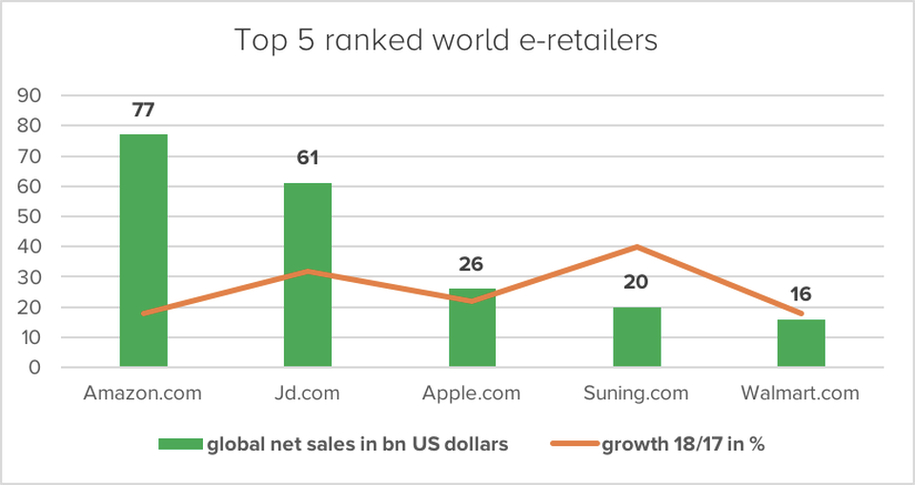
Notes:
https://www.forbes.com/sites/ninaangelovska/2019/05/20/top-5-online-retailers-electronics-and-media-is-the-star-of-e-commerce-worldwide/#b6aca9a1cd9f

Slide 22
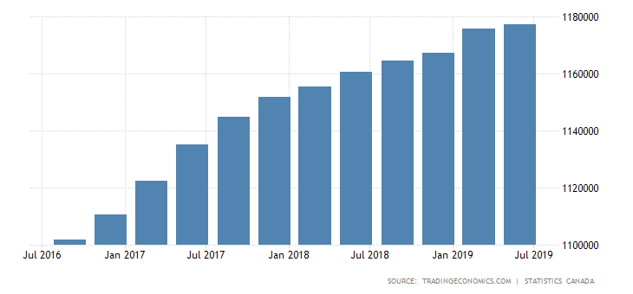
Consumer Spending
Notes:
https://tradingeconomics.com/canada/consumer-spending

Slide 23
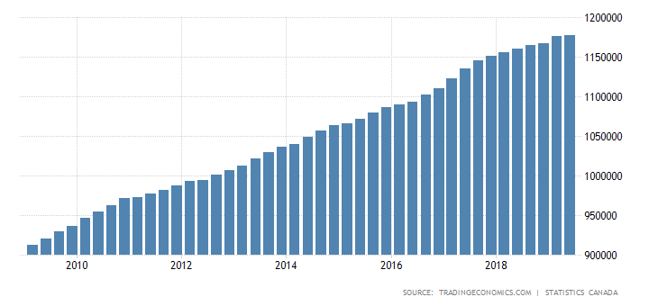
Customer Spending Development over 10 Years
Notes:
https://tradingeconomics.com/canada/consumer-spending

Slide 24
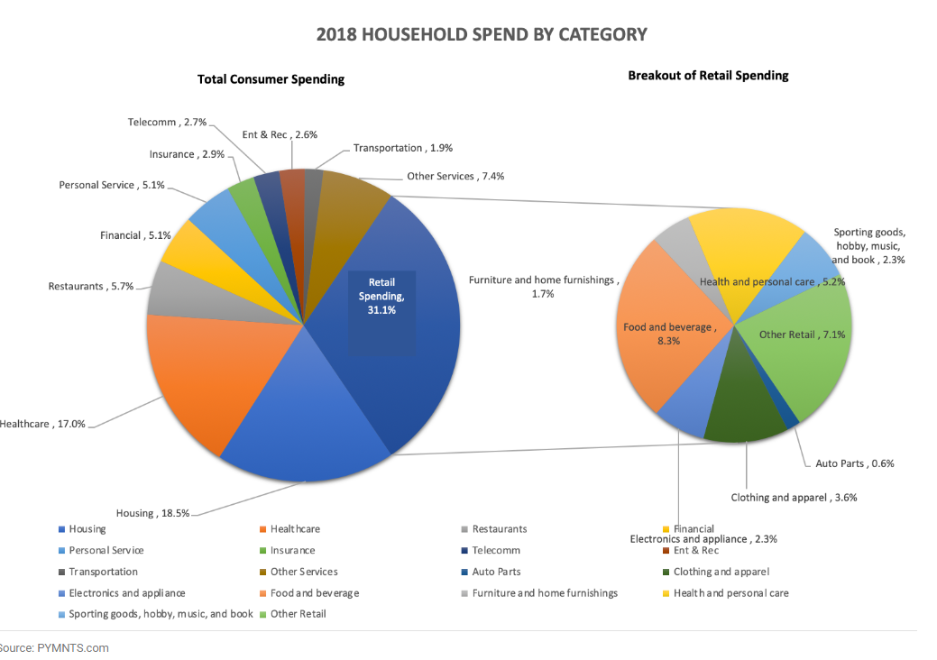
Breakdown of Consumer Expenditure

Slide 25
Retail Index
S&P Retail Index – RLX
Exchange Traded Funds(ETFs)
RTH – VanEck Vectors Retail
XLY – Dow Jones Consumer

Slide 26
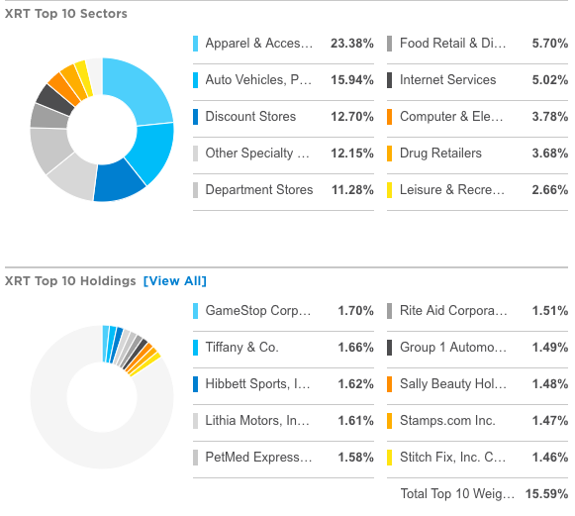
S&P Retail Index - RLX
Notes:
https://www.etf.com/XRT#overview

Slide 27
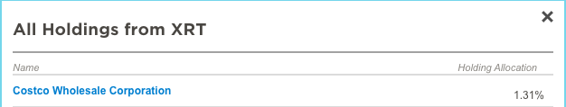
S&P Retail Index - RLX

Slide 28
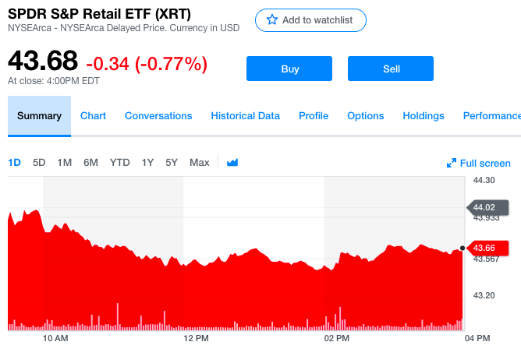
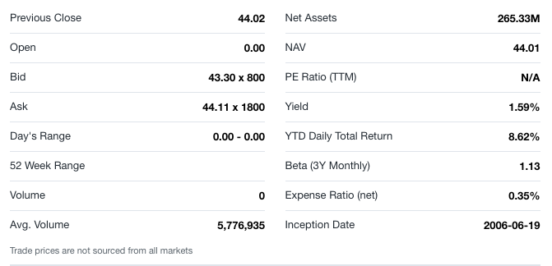
S&P Retail Index - RLX
Notes:
https://finance.yahoo.com/quote/XRT?ltr=1

Slide 29
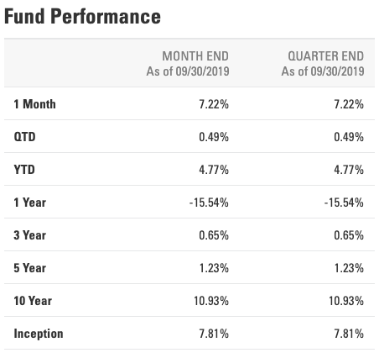
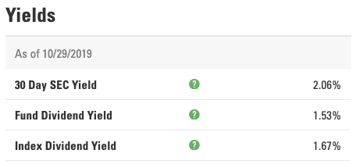
Dividend Yield and Return
Notes:
https://us.spdrs.com/etf/spdr-sp-retail-etf-XRT

Slide 30
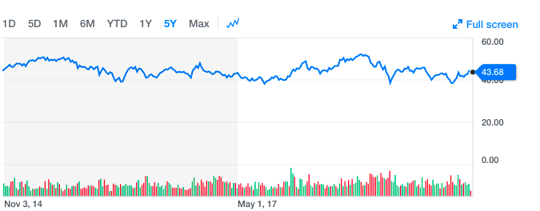
S&P Retail Index – RLX within 5 years

Slide 31
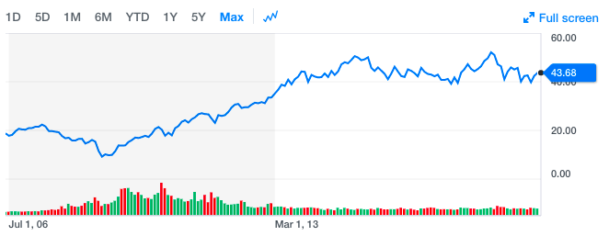
S&P Retail Index – RLX within 13 years

Slide 32
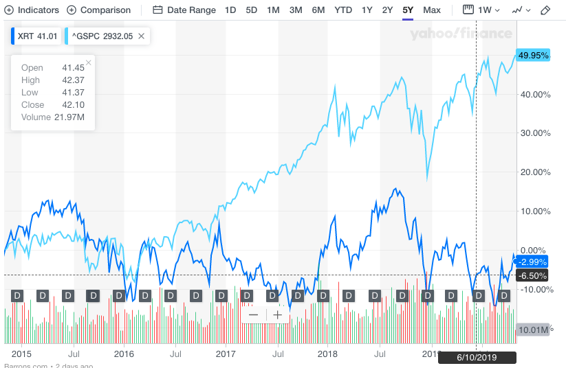
Comparison with S&P 500

Slide 33
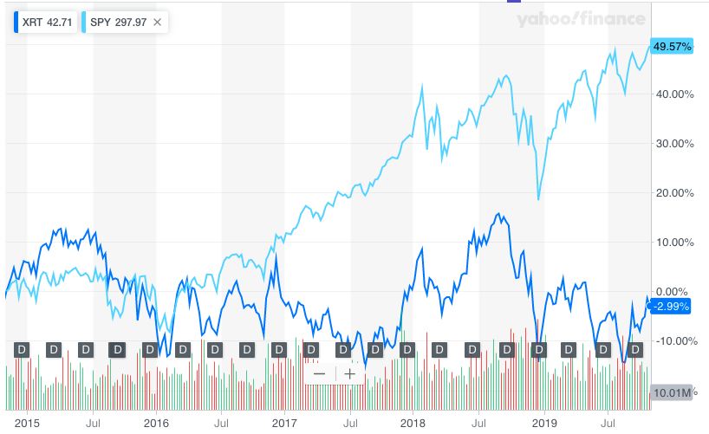
Comparison with SPDR S&P 500

Slide 34
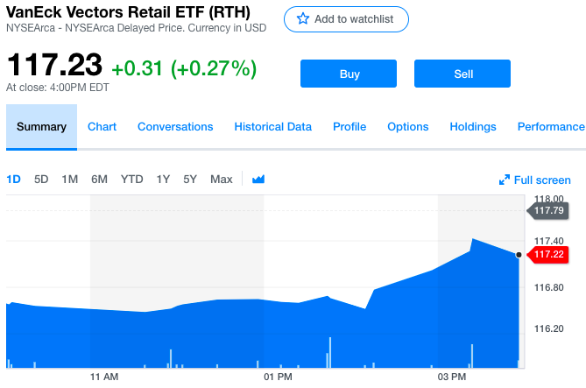
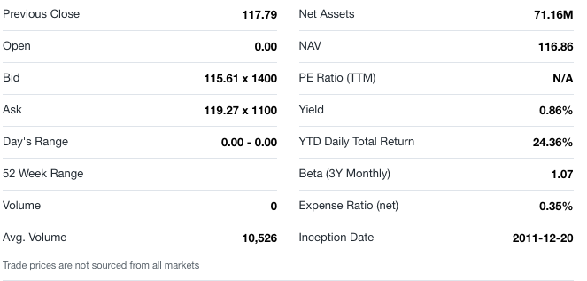
RTH – VanEck Vectors Retail ETF
Notes:
https://finance.yahoo.com/quote/RTH/performance?p=RTH

Slide 35
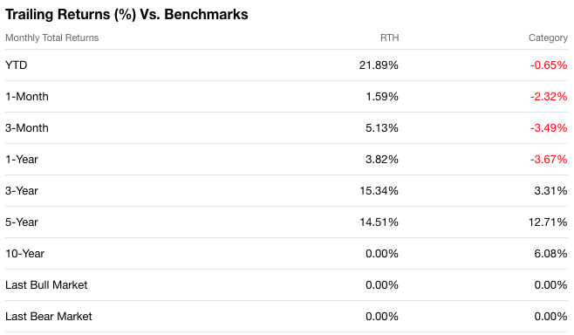
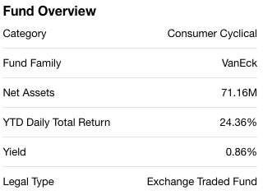
Dividend Yield and Return

Slide 36
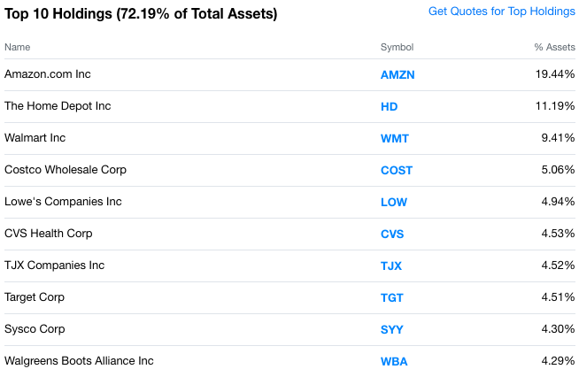

Slide 37
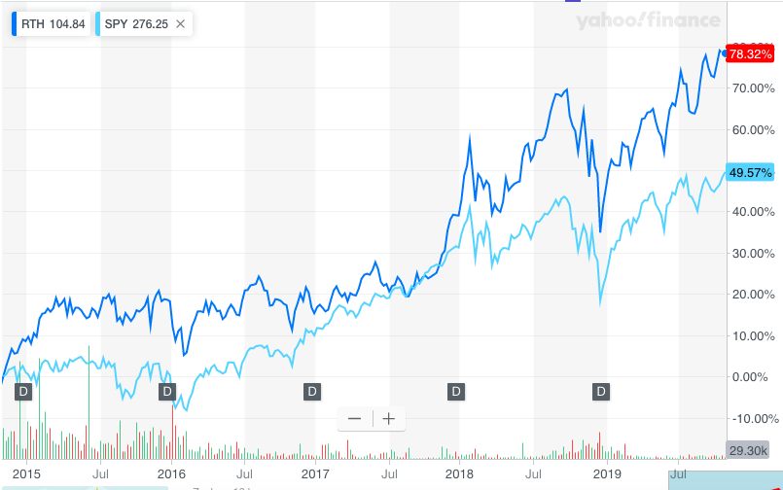
RTH – VanEck Vectors Retail ETF

Slide 39
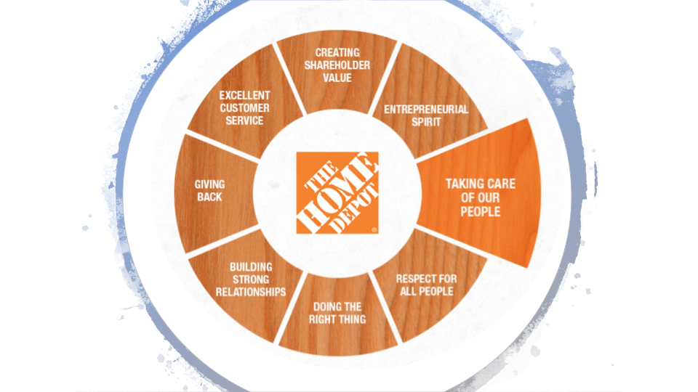

Slide 40
Stock
Price

Slide 41
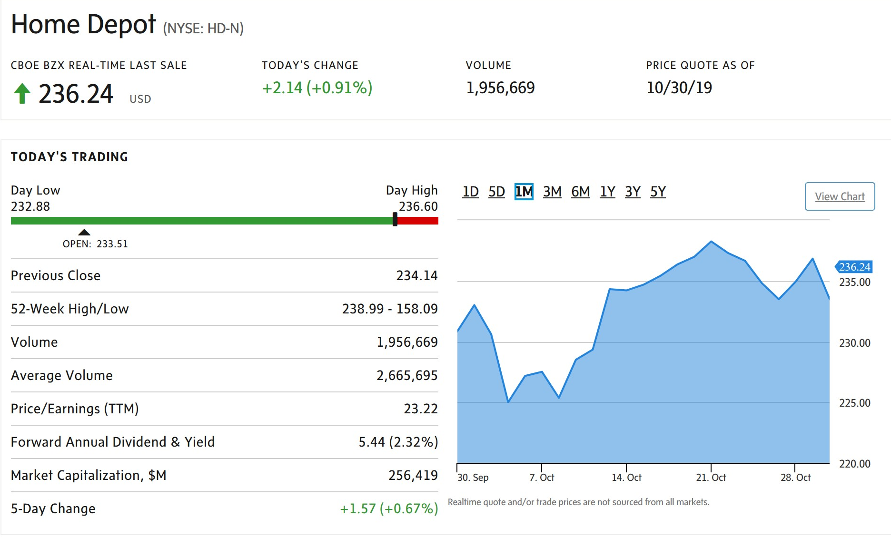

Slide 42
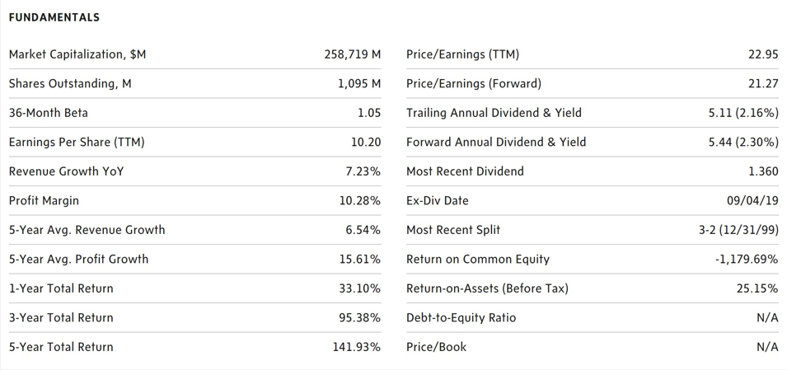

Slide 43
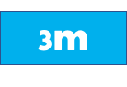
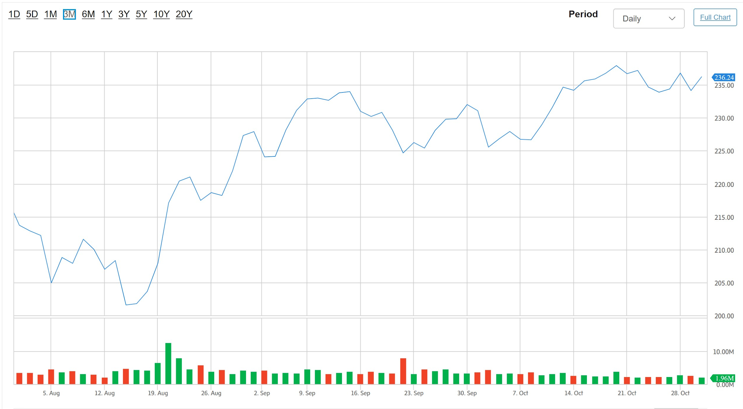

Slide 44

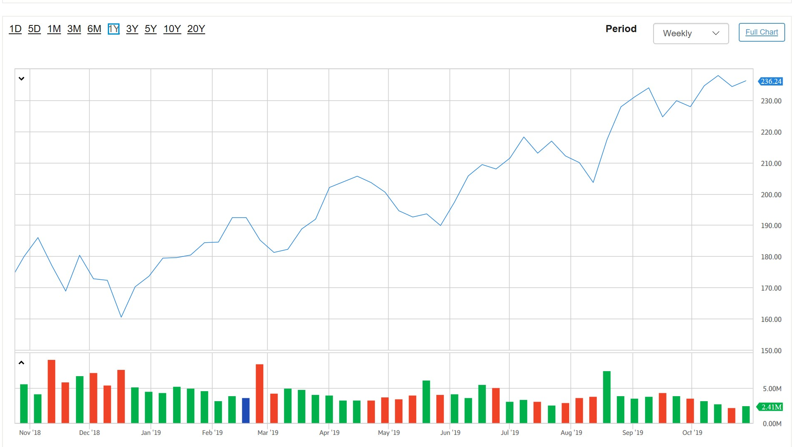

Slide 45

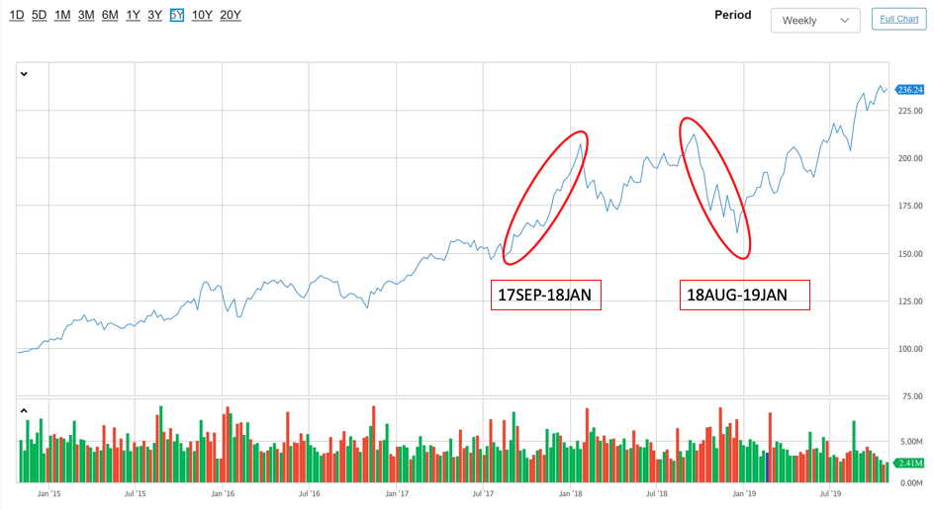

Slide 46
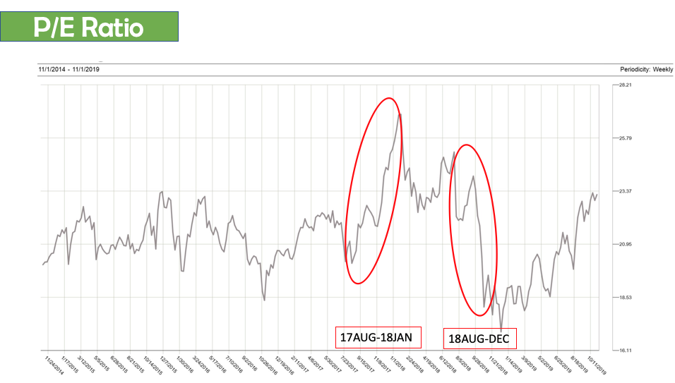

Slide 47
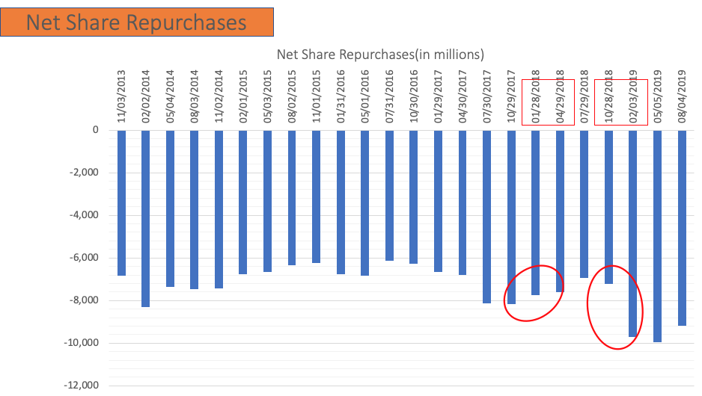

Slide 48

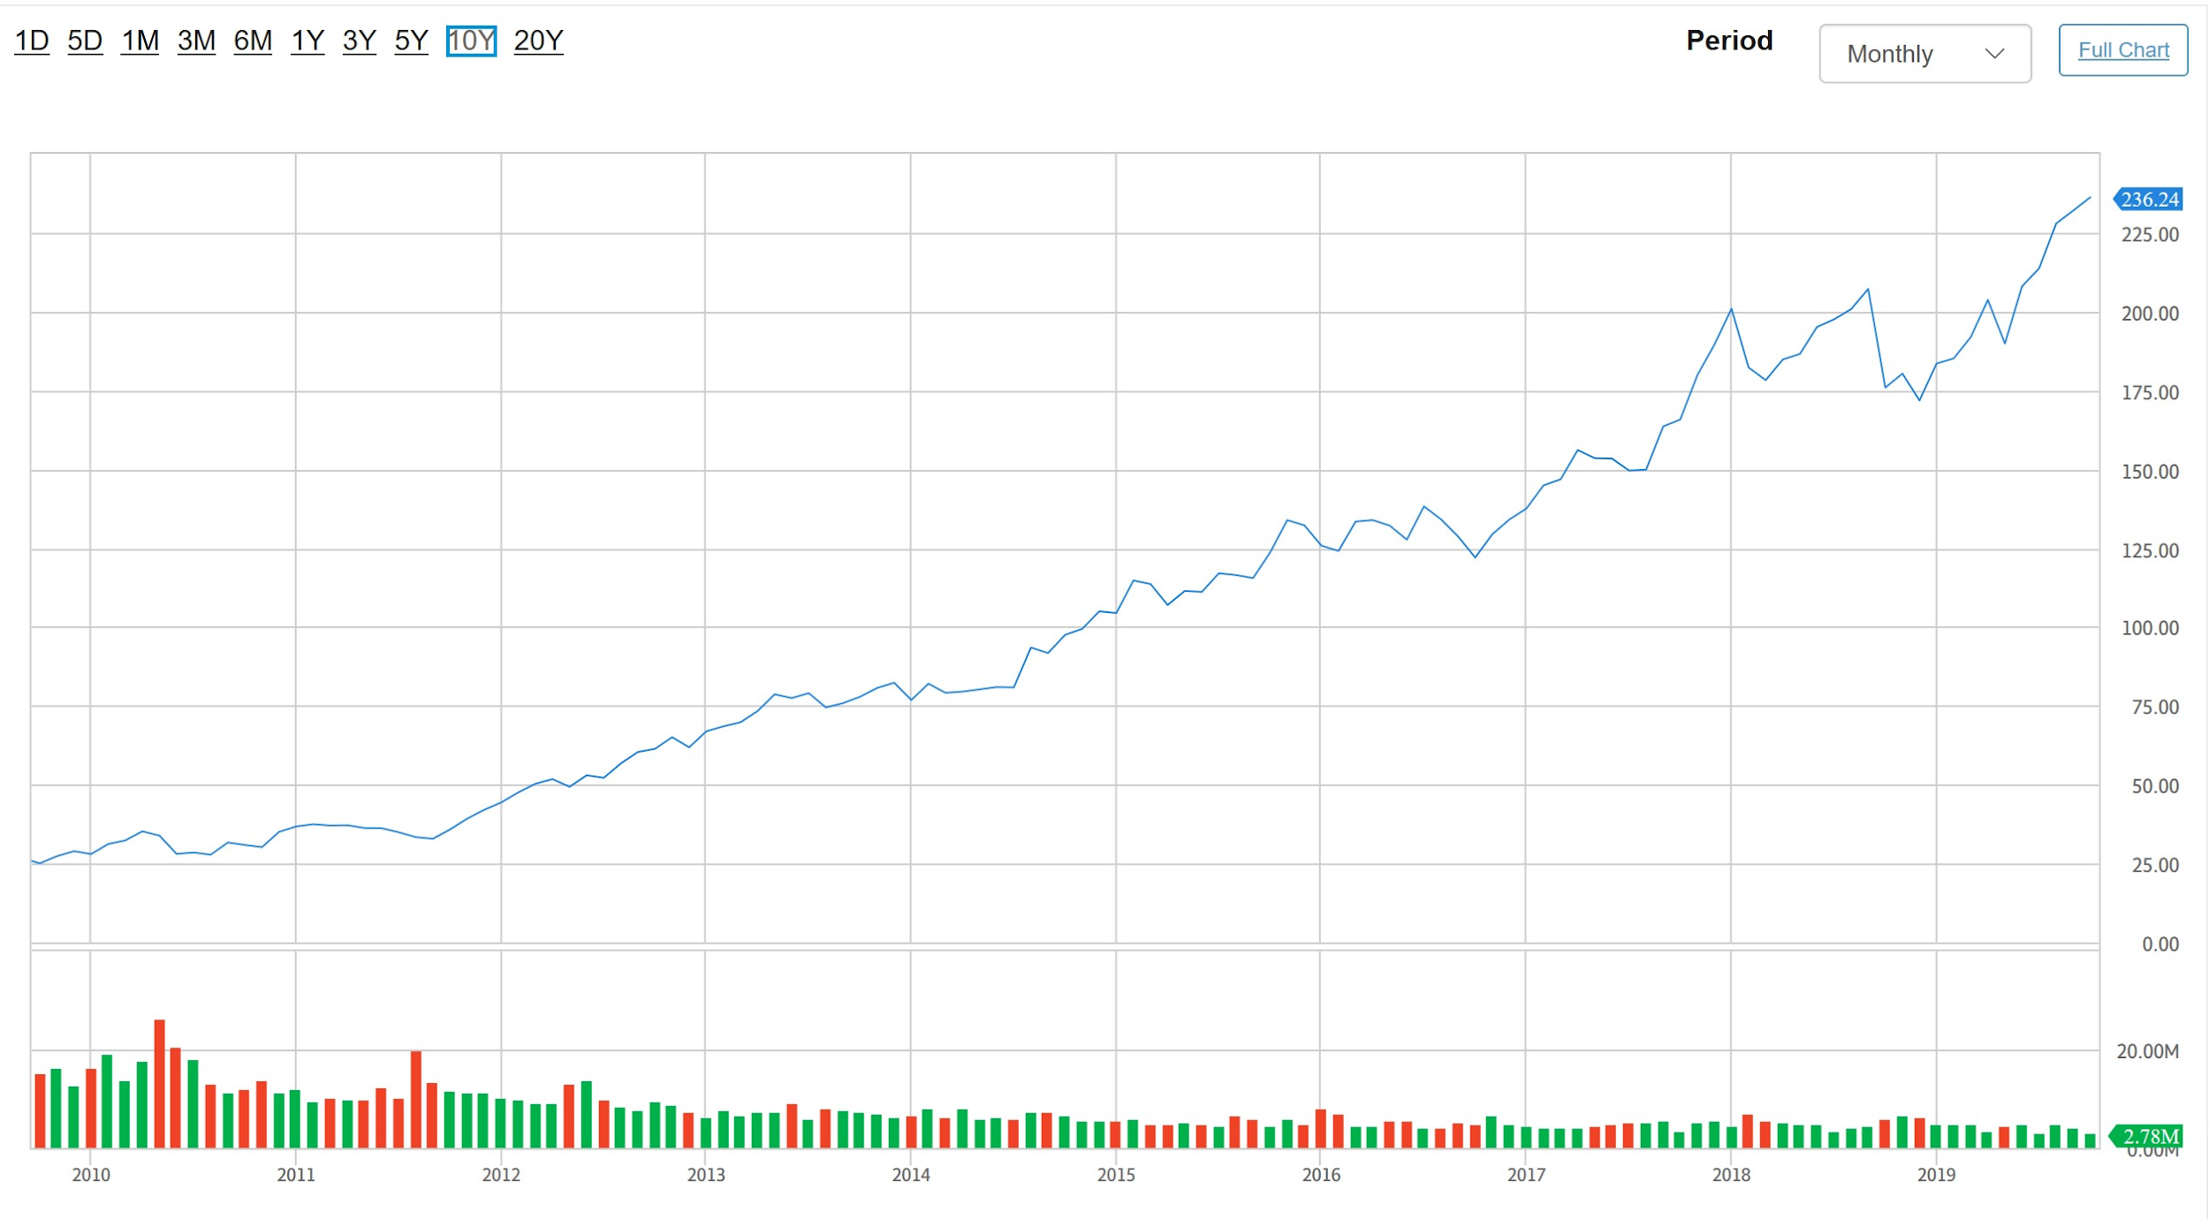

Slide 49

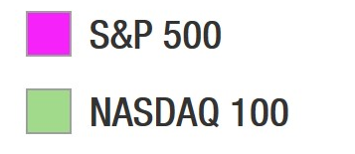
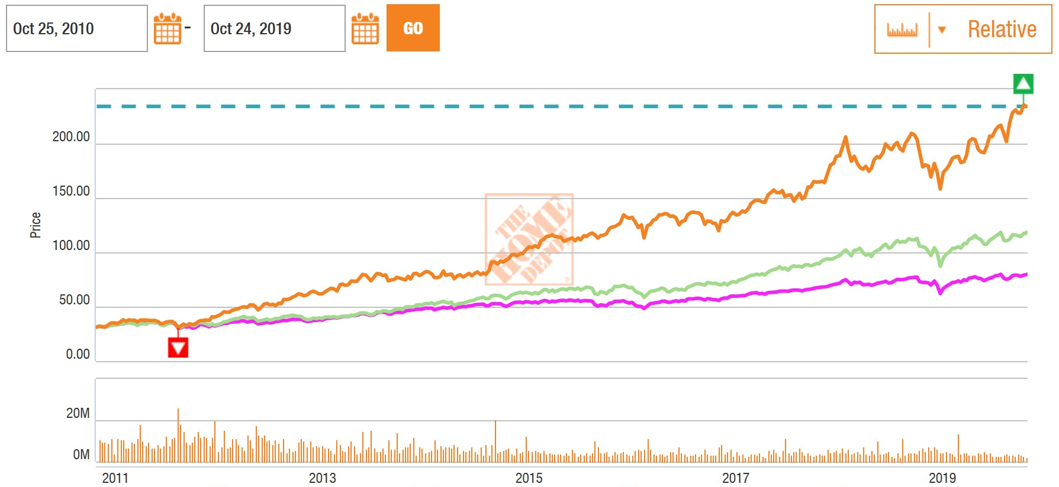

Slide 50

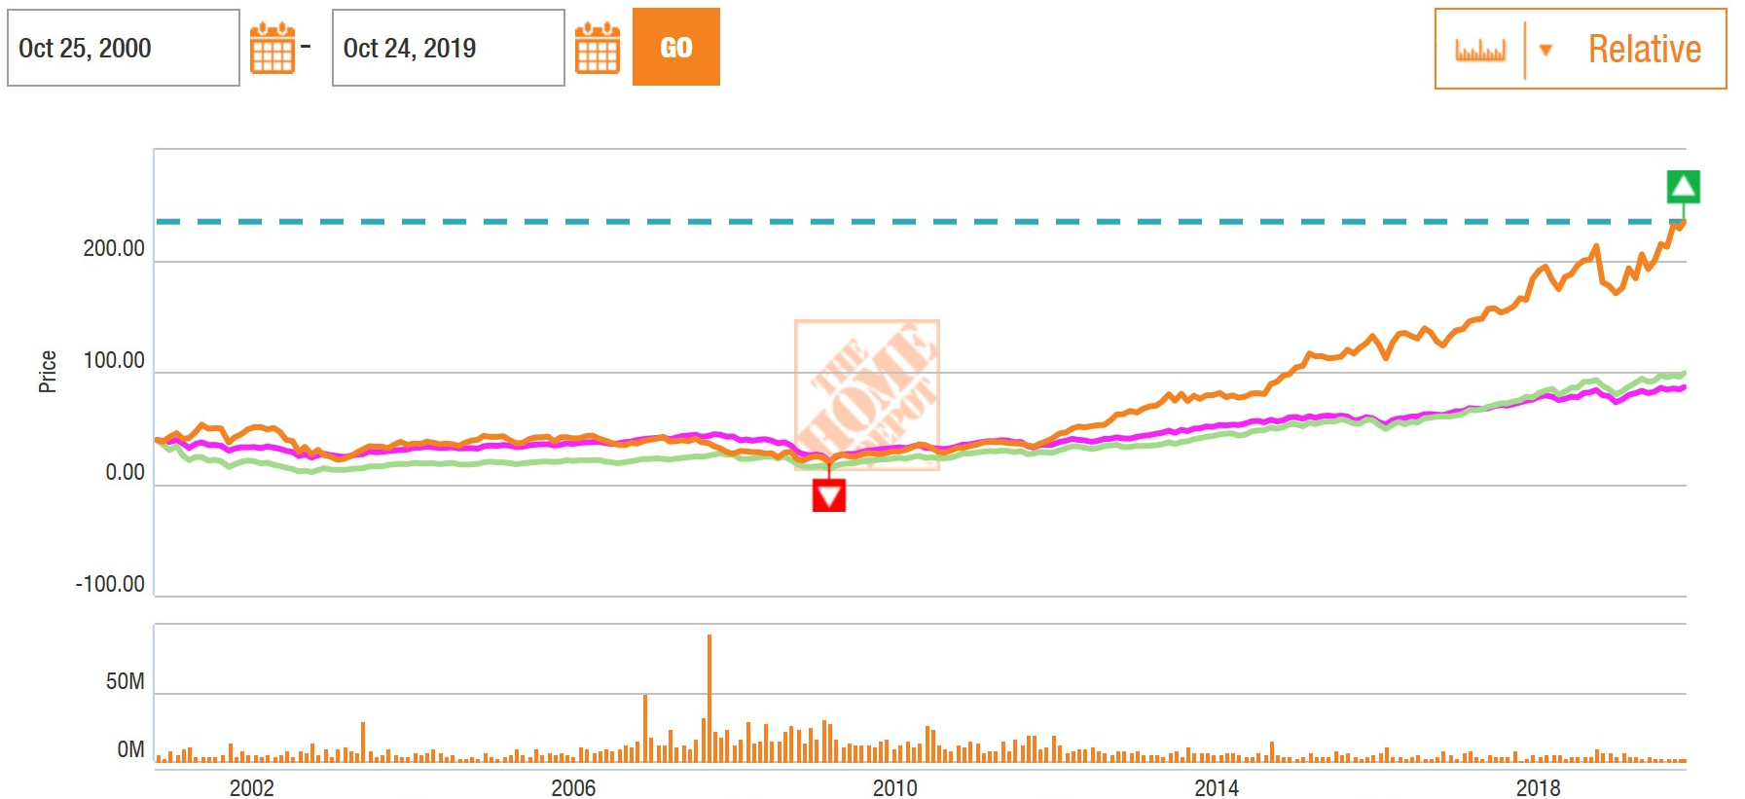

Slide 51
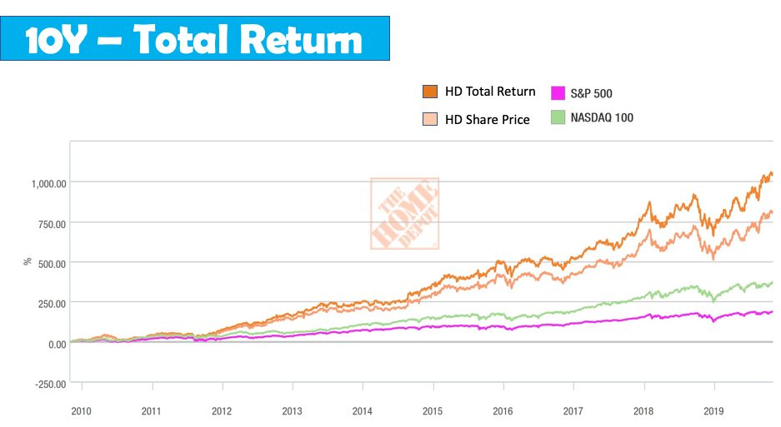
Notes:
The shareholders´ return can be measured as total return that includes dividend. The measure "total return" consists of re-invested dividends added to the share price value.

Slide 52
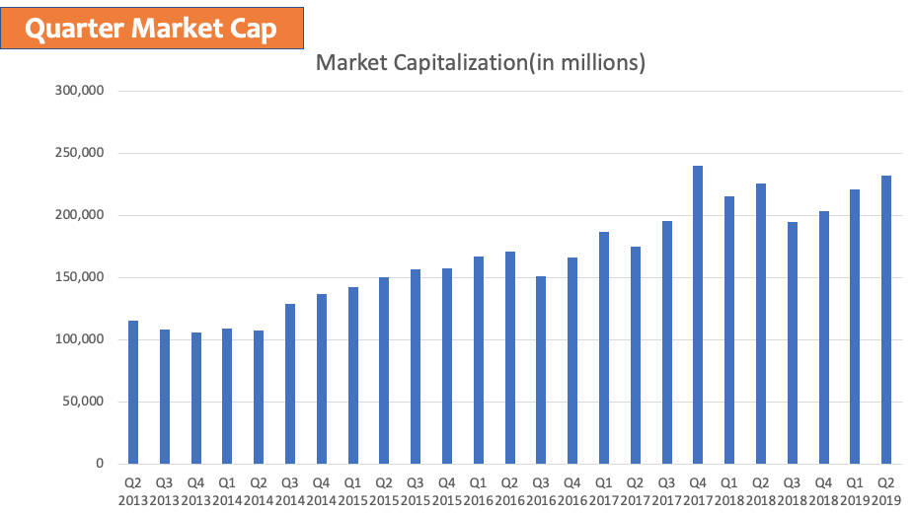

Slide 53
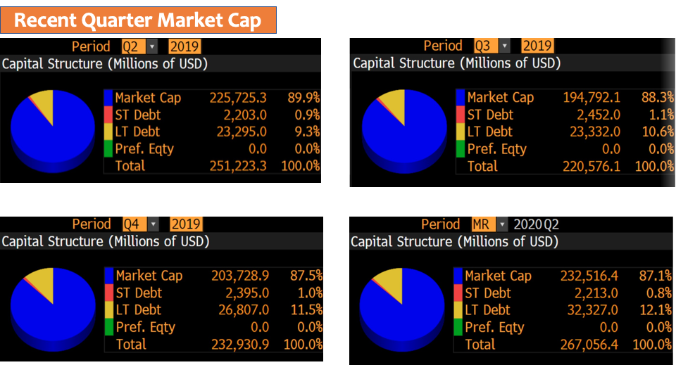

Slide 54


Slide 55


Slide 56


Slide 57


Slide 58

Notes:
Div/ Share

Slide 59


Slide 60


Slide 61


Slide 62


Slide 63


Slide 64


Slide 65


Slide 66


Slide 67


Slide 68


Slide 69

Discontinued on growing revenues through new store construction, closing 15 U.S. big box stores and canceling approximately 50 future store openings.
Established e-commerce site with test market in Las Vegas, NV.
The acquisition of Compact Power Equipment, Inc and The Company Store
2000
2008
2017
2005
2015
2019
The 2,000th store opened and acquired 21 companies for its Home Depot Supply and Home Services businesses.
The acquisition of Interline Brands, Inc.
#rank 21, FORTUNE THE WORLD”S MOST ADMIRED COMPANIES.

Slide 70
“One Home Depot” shopping experience
“The front door of our store is no longer at the front door of our stores. It's in the customer's pocket. It's on the job site. It's in their home. Developing the One Home Depot experience by bringing the physical and digital worlds together, with ability to handle the scale of Home Depot, required us to complete a re-platform of our website. This re-platform gives us the ability to create differentiated experiences for the customers going forward.”
---- said CEO Craig Menear
Notes:
Each "allows customers to pinpoint the aisle and bay location of an item they are looking for in the store.

Slide 71


Improvement in 2019
Apps
mobile store-specific maps available to customers to improve product search experience
+
Store
piloting a redesign of the front end of some stores and introducing self-service lockers for online orders being picked up.
+

Slide 72


Slide 73


Slide 74


Slide 75

Segment Revenue FY2018

Slide 76


Slide 77

M&A (sort from largest)
Notes:
in millions

Slide 78

Numbers of M&A

Slide 79


Slide 80


Slide 81


Slide 82


Slide 83


Slide 84


Slide 85


Slide 86


Slide 87


Slide 88

Notes:
Just recently assigned this title, however, have been with HD since 2005
Carol is main insiders of HD

Slide 89


Slide 90

Notes:
Cashier - VP

Slide 91

Notes:
hold certain amount of shares

Slide 92


Slide 93


Slide 94


Slide 95

Notes:
Booking incorporation

Slide 96

Notes:
talent accountant

Slide 97

Notes:
retail experience

Slide 98


Slide 99


Slide 100


Slide 101


Slide 102


Slide 103


Slide 104


Slide 105


Slide 106


Slide 107


Slide 108


Slide 109


Slide 110


Slide 111


Slide 112


Slide 113

Notes:
by blended P/E ratio, we mean a weighted average of the most recent actual reported earnings plus the closest quarterly forecast earnings.
the blended P/E ratio calculation will be using a moderately higher denominator than trailing twelve months

Slide 114


Slide 115

Home Depot =

Slide 116


Personal Suggestion : Hold and wait until next price falls
Notes:
**

Slide 117
PRESENTED BY MENGXIA WANG
Notes:
Costco Wholesale Corporation operates an international chain of membership warehouses, mainly under the `Costco Wholesale` name, that carry quality, brand name merchandise at substantially lower prices than are typically found at conventional wholesale or retail sources. The warehouses are designed to help small-to-medium-sized businesses reduce costs in purchasing for resale and for everyday business use. Individuals may also purchase for their personal needs. Costco's warehouses present one of the largest and most exclusive product category selections to be found under a single roof. Categories include groceries, candy, appliances, television and media, automotive supplies, tires, toys, hardware, sporting goods, jewelry, watches, cameras, books, housewares, apparel, health and beauty aids, tobacco, furniture, and office equipment. Costco is known for carrying top quality national and regional brands, with 100% satisfaction guaranteed, at prices consistently below traditional wholesale or retail outlets.

Slide 118

Stock Overview

Slide 119


Slide 120

P/E Ratios

Slide 121

Institutional ownership

Slide 122


Slide 123

Top institutional holders

Slide 124
Stock Performance

Slide 125

5-Day Performance

Slide 126

1-month Performance

Slide 127

6-month Performance

Slide 128

1-Year Performance

Slide 129

5-Year Performance

Slide 130

10-Year Performance (Max)

Slide 131

Stock Performance Comparison (Peers)

Slide 132

Competitor Industry: Department/Specialty Retail Stores

Slide 133
Company Overview
Opened in 1976 under the Price Club name in San Diego
In 1983, the first Costco warehouse location was opened in Seattle, WA
Costco and Price Club merged in 1993, operating under the name PriceCostco
Changed name from PriceCostco to Costco in 1997, and Executive Membership was introduced at the same time
In 1998,E-Commerce at Costco.com brought Costco prices and services to the Internet
Changed name to Costco Wholesale Corporation in 1999

Slide 134
Company Overview
•Merchandise offered at Costco:
➢ Food (dry foods, packaged foods, and groceries)
➢ Sundries (snacks, candy, alcohol and non-alcohol beverages, and cleaning
supplies)
➢ Hardlines (major appliances, electronics, health and beauty aids, hardware,
and garden and patio)
➢ Fresh Foods (meat, produce, deli, and bakery)
➢ Softlines (apprarel and small appliances)
➢ Others (gas stations and pharmacy)

Slide 135
Costco’s Code of Ethics
1. Obey the law
2. Take care of our members
3. Take care of our employees
4. Respect our suppliers
if we do these four things throughout our organization, then we will
achieve our ultimate goal, which is to:
5. Reward our shareholders

Slide 136
Management

Slide 137

Executive Officers of the Registrant

Slide 138

Co-founder (James Sinegal)
• In Costco:
➢ Inception - now: Co-founder and Director
➢ Until Feb 2010: President
➢ Until Dec 2011: CEO
➢ Jan 2012 - Apr 2013: non-officer employee
• He is now on the Board of Directors at Costco Wholesale
Corp., United Negro College Fund, Inc., Fred Hutchinson
Cancer Research Center, and The National Mentoring
Partnership, Inc.
• Business Administration graduate of San Diego State
University with extensive career in the retail industry

Slide 139

Co-founder (Jeffrey Brotman)
Age 74, died in 2017
Graduated from the University of Washington in 1964
With a degree in Political Science
Co-founded Costco with James Sinegal in 1982
Served as Chairman from the company’s inception until his death
Expert in scouting the most profitable locations for Costco’s warehouse stores

Slide 140

President, CEO and Director
(W. Craig Jelinek)
Age 66
Started career working for FedMart
Joined Costco in 1984
Became the CEO in 2012
Worked with the warehouse chain since its birth

Slide 141

Chairman of the Board (Hamilton E. James)
Hamilton E. James has been a director of the Company since August 1988.
He is the Executive Vice Chairman of The Blackstone Group.
Prior to February 2018, he was the President and Chief Operating Officer of The Blackstone Group.
Until October 2002, Mr. James served as an executive board member and Chairman of Global Investment Banking and Private Equity for Credit Suisse First Boston Corporation.
Prior thereto, he was Chairman of The Banking Group at Donaldson, Lufkin & Jenrette Securities Corporation.

Slide 142

Executive Vice President, Chief Financial Officer and Director
(Richard A. Galanti)
Richard A. Galanti has been a director of the Company since January 1995, and Executive Vice President and Chief Financial Officer of the Company since October 1993.
He was Senior Vice President, Chief Financial Officer and Treasurer of the Company from January 1985 to October 1993, having joined as Vice President-Finance in March 1984.
From 1978 to February 1984, Mr. Galanti was an Associate with Donaldson Lufkin & Jenrette Securities Corporation.

Slide 143

Director (Susan Decker)
Susan Decker has been a director of the company since October 2004.
She was President of Yahoo! Inc. from 2007 to 2009, responsible for all global business operations. From 2000 to 2006, she was the Chief Financial Officer of Yahoo!
Prior to joining Yahoo! in June 2000, Decker was with Donaldson, Lufkin & Jenrette for 14 years, serving as global director of equity research from 1998 to 2000 and twelve years as a publishing and advertising equity research analyst.
She was appointed to the board of Pixar Animation Studios in June 2004 and the Stanford Institute of Economic and Policy Research in February 2005. Ms. Decker's nomination was recommended by a non-management director.

Slide 144

Director (Kenneth D. Denman)
Ken Denman was President and Chief Executive Officer of Emotient, Inc., a start-up that built an artificial-intelligence based platform for measuring facial expressions to predict emotions, until it was acquired by Apple in January 2016.
Previously, Ken was the CEO of Openwave (now known as Unwired Planet) and iPass and a Senior Vice President for MediaOne.
He is a member of the boards of directors of Mitek and Motorola Solutions, Inc.

Slide 145

Director Emeritus (Richard M. Libenson)
Richard M. Libenson has been a director of the Company since October 1993.
He was a director of The Price Company from its formation in 1976 until October 1993 and was an executive officer of The Price Company from 1976 until October 1989, when he retired from active involvement as an officer of The Price Company.
He served as Chief Operating Officer of The Price Company from August 1986 through October 1988, and Vice Chairman of its Board from October 1988 through September 1989.

Slide 146

Director (John W. Meisenbach)
•Inception - now: Director
• Other experiences:
➢ 1962 - now : President of MCM, a financial services company
➢ Now: Director of M Financial Holdings
➢ Before: Director and Chair of Compensation Committee of
Expeditors International
• He graduated in pre-law from Seattle University, but
have broad-ranging experiences in the insurance
industry

Slide 147

Director (John W. Stanton)
• Oct 2015: entered the Board as a Director
• Now: Chairman of Trilogy International Partners Inc., Trilogy
Equity Partners, and First Avenue Entertainment LLLP, and
Director of Microsoft and Columbia Sportswear Company
• He has extensive background as a CEO and Director of public and private companies and his insights into global operations, strategic planning and financial matters

Slide 148
Costco Overview

Slide 149
Historical Highlights
1976 - Sol and Robert Price raise $2.5 million from friends and family to open Price Club on July 12, the first warehouse club for business shoppers only. The warehouse was located in a remodeled airplane hangar on Morena Boulevard in San Diego, California.
1983 - The first Costco warehouse opens in September in Seattle, Washington. By the end of the second year, additional locations had opened in Portland, Oregon, and Spokane, Washington.
1985 - Costco offers public stock on December 5. Costco's first hot dog cart opens. The price for a hot dog and a soda is $1.50. Costco opens its first Canadian warehouse in Burnaby, British Columbia.
1993 - Costco celebrates its 10th anniversary in September. Shareholders approve the merger of Price Company and Costco. PriceCostco is formed and opens its first warehouse in the United Kingdom in West Thurrock, Essex, England.
2000 - The 2% reward program is initiated, increasing Executive Member value even more. Costco opens its travel business, Costco Travel. Costco stock splits 2-for-1 on January 14. Costco opens two locations in Texas.

Slide 150
Historical Highlights
2004 - The True Earnings® credit card from Costco and American Express is introduced. Costco is the 5th largest retailer in the U.S. and 11th largest in the world. Fortune Magazine lists Costco 29th on the Fortune 500. Costco enters Iowa bringing the total number of states with operations to 37.
2008- Costco is the 5th largest retailer in the U.S., 8th largest in the world. Costco is listed 29th on the Fortune 500. Currently has 53.5 Million cardholders worldwide. 2.1 billion gallons of gasoline were sold during fiscal 2008. Expansion in Asia continued adding with a fifth location in Taiwan, sixth location in Korea, and eighth location in Japan.
2010- Costco is listed 25th on the Fortune 500. Costco is the 3rd largest retailer in the U.S. and 8th largest in the world. 84,000 carats of diamonds were sold in fiscal year 2010. Currently processes more than 1.7M transactions per day.
2013- Costco's average sales per unit increased to $160 million. The company returned $3.6 billion to shareholders, primarily in the form of dividends including a special cash dividend of $7.00 per share. Twenty-six new Costco locations were opened in seven countries. On September 15, 2013, Costco celebrated the 30th anniversary of its first Costco Wholesale location in Seattle on September 15, 1983.

Slide 151
Historical Highlights
2015- Costco is the 2nd largest global retailer. On average, Costco processed 2.3 million sales transactions per day. Over 80 million people have a Costco membership card. Costco is one of the largest sellers of organic foods in the U.S… approximately $4 billion in 2015. Costco paid a special cash dividend of $5.00 per share to its shareholders in February 2015.
2017- Sales topped $126 billion (53-week Fiscal Year).Costco Travel added hotel-only booking reservations. Costco appointed a new Chairman of the Board, Hamilton (Tony) James. Mr. James replaces the co-founder and chairman of 33 years, Jeff Brotman, who died this year.
2018- Costco reached the 750 location milestone (762 at year-end) Costco.com achieves 20th anniversary, site was launched in 1998. Costco Grocery launched on Costco.com; 2-day and same-day delivery via instacart October 2017. Buy online and pick up in warehouse commences on select product categories. Executive Member 2% Reward extended to include Costco Travel. Costco was ranked as one of the top five best workplaces in 2018 among Fortune 500 companies by Indeed. Co-founder and former CEO Jim Sinegal retires from the Board of Directors.

Slide 152
Costco Today
• 3 rd Largest Global retailer
• 14th Largest in Fortune 500
• $129 Billion market cap
Sales $149.4B – FY’19
• 113.7M Sq. Ft. (145K / whse.)
• 254K employees worldwide

Slide 153
Costco Today
783 Warehouses Worldwide
544 locations in 44 U.S. States & Puerto Rico; 100 locations in nine Canadian provinces; 29 locations in the United Kingdom; 13 locations in Taiwan; 16 locations in Korea; 26 locations in Japan; 11 locations in Australia; 39 locations in Mexico; 2 locations in Spain 1 location in Iceland 1 location in France 1 location in China

Slide 154

Strategies
•Cost leadership
• Private label
•Membership
•Expansion

Slide 155

Membership
The member renewal rate was 90% in the U.S. and Canada and 88% on a worldwide basis at the end of 2018. The majority of members renew within six months following their renewal date. Therefore, our renewal rate is a trailing calculation that captures renewals during the period seven to eighteen months prior to the reporting date.

Slide 156
Financial Statements

Slide 157

Balance Sheet Assets (10-Q)

Slide 158

Balance Sheet Liabilities and Equity (10-Q)

Slide 159

Balance Sheet Assets (10-K)

Slide 160

Balance Sheet Liabilities and Equity (10-Q)

Slide 161

Income Statement (10-Q)
Income Statement (10-Q)

Slide 162

Income Statement (10-K)

Slide 163

Cash Flow (10-Q)

Slide 164

Cash Flow (10-Q)

Slide 165

Cash Flow (10-K)

Slide 166

Cash Flow (10-K)

Slide 167

RECOMMENDATION: BUY

Slide 169
Stock Overview

Slide 170


Slide 171

Key Statistics

Slide 172

Shares Outstanding

Slide 173

5-Day Performance

Slide 174

3-Month Performance

Slide 175

6-Month Performance

Slide 176

1-year Performance

Slide 177

5-year Performance

Slide 178

Max Time Frame Performance

Slide 179

Stock Performance Comparison with S&P 500

Slide 180

Dividend
Walmart has increased its annual cash dividend every year since first declaring a $0.05 per share annual dividend in March 1974.

Slide 181

Dividend Schedule

Slide 182

Stock Split
Wal-Mart Stores, Inc. was incorporated on Oct. 31, 1969. On Oct. 1, 1970, Walmart offered 300,000 shares of its common stock to the public at a price of $16.50 per share. Since that time, we have had 11 two-for-one (2:1) stock splits. On a purchase of 100 shares at $16.50 per share on our first offering, the number of shares has grown as follows:

Slide 183
Walmart Overview

Slide 184

Notes:
We’re building an ecosystem on a global scale. Our unique set of assets and strong financial position mean we can grow our business and expand our capabilities to deliver solutions for customers.

Slide 185

Walmart Value

Slide 186



Four Segments
Sam’s Club
Walmart U.S
Walmart International
Walmart E-commerce

Slide 187
Walmart Overview
●Walmart U.S. is the largest segment and operates retail stores in all 50 states in the U.S. Walmart U.S. generated approximately 65% of total net sales in fiscal 2019; Walmart U.S. has historically contributed the greatest amount to the Company's net sales and operating income
●Wal-Mart International is the second largest segment and consists of operations in 27 countries outside of the U.S. and includes numerous formats as well as digital retail; Wal-Mart International generated approximately 24% of fiscal 2019 net sales
●Sam's Club consists of membership-only warehouse clubs and operates in 48 states in the U.S., as well as digital retail. Sam's Club accounted for approximately 11% of fiscal 2019 net sales; As a membership-only warehouse club, membership income is a significant component of the segment's operating income
Notes:
Walmart U.S. is our largest segment and operates in the U.S., including in all 50 states, Washington D.C. and Puerto Rico. Walmart U.S. is a mass merchandiser of consumer products, operating under the "Walmart" and "Walmart Neighborhood Market" brands, as well as walmart.com, jet.com and other eCommerce brands. Walmart U.S. had net sales of $331.7 billion for fiscal 2019, representing 65% of our fiscal 2019 consolidated net sales, and had net sales of $318.5 billion and $307.8 billion for fiscal 2018 and 2017, respectively. Of our three segments, Walmart U.S. has historically had the highest gross profit as a percentage of net sales ("gross profit rate"). In addition, Walmart U.S. has historically contributed the greatest amount to the Company's net sales and operating income.

Slide 188
Walmart Timeline
●1962: Sam Walton opened the first Walmart in Rogers, Arkansas
●1969: Officially incorporated as Wal-Mart Stores, Inc.
●1970: Became a publicly traded company
●1972: Listed on NYSE, 51 stores and sales of $78 million
●1980: Walmart reaches $1 billion in annual sales, faster than any other company at that time.
●1983: The first Sam’s Club opened in Midwest City, Oklahoma
●1990: Walmart became the nation's number-one retailer
●1991: Walmart goes global, opened a Sam’s Club in Mexico City
●1992: Employed 371,000 associates in 1,928 stores and clubs.
●1996: Walmart opened its first stores in China

Slide 189
Walmart Timeline
●2002: Walmart topped the Fortune 500 ranking of America's largest companies
●2009: Walmart exceeded $400 billion in annual sales
●2011: With the acquisition of MassMart in South Africa, Walmart surpassed 10,000 retail units around the world.
●2014: Doug McMillon succeeded Mike Duke as CEO
●2015: Walmart announces a $2.7 billion investment over two years in its U.S workforce
●2016: Walmart and JD.com, China’s largest e-commerce company by revenue, form a strategic alliance to better serve consumers across China
●2017: Walmart aqcuired Shoebuy.com, which was later renamed Shoes.com
●2017: Walmart launches free two-day shipping on more than 2 million items, no membership required.
●2018: The company changes its legal name from Wal-Mart Stores, Inc. to Walmart Inc.
●2019: John Furner named President and CEO of Walmart U.S.

Slide 190

Total Number of Walmart Stores Worldwide

Slide 191

Walmart Gross Profit Margin Worldwide

Slide 192

Strategy

Slide 193

Strategy

Slide 194

Financial Accomplishment

Slide 195



The Walton Family
●Executive; Strategic Planning &Finance
●Son of Wal-Mart founder, Sam Walton, Rob Walton served as Wal-Mart’s chairman of the board of directors from 1992 to 2015
●Rob joined the company in 1969. Prior to becoming chairman, he held a variety of positions with Walmart, including senior vice president, corporate secretary, general counsel and vice chairman
●Before joining Walmart, Rob was a partner with the law firm of Conner & Winters in Tulsa, Okla
●Graduated from the University of Arkansas in 1966 with a bachelor of science degree in business administration
●Net worth: 48.1 billion USD
●Graduated from Trinity University with a B.A. in economics and finance
●Net worth: 48.4 billion USD
●Walton received a bachelor's degree in Business Administration (BA) Marketing
●Jim Walton’s retirement from the board and the nomination of Steuart Walton, his son, mark a leadership transition to the next generation of Walton family representation.
●Jim Walton served on the board for over 10 years and was a member of the Technology and eCommerce Committee, as well as the Strategic Planning and Finance Committee during his tenure

Slide 196

Effective Management
Doug McMillon is president and CEO of Walmart Inc.
Under Doug’s leadership, Walmart is making life easier for busy families and building trust with customers. It is investing heavily in associate wages, benefits and education—including a debt-free, dollar-a-day college program and an expanded parental leave policy. And, it launched an ambitious program, Project Gigaton, to combat climate change and work with suppliers to avoid 1 billion metric tons of emissions worldwide.
Doug is a longtime champion of Walmart’s customers, its associates and the company’s culture. He was named president and CEO in 2014. From 2009 to 2014 he was president and CEO of Walmart International, and from 2005 to 2009 he served as president and CEO of Sam’s Club. He has worked at Walmart for nearly 30 years, starting as a teenager unloading trucks for an hourly wage. He went on to serve in senior leadership roles in all of Walmart’s business segments. He remains a merchant at heart.

Slide 197

Effective Management
Greg Foran is president and chief executive officer of Walmart U.S.
He is responsible for the strategic direction and performance of Walmart’s 4,600 stores and more than 1 million associates. Last year Walmart U.S. served more than 140 million customers a week and had revenues of $307 billion.
Since assuming the role in 2014, Greg’s team has led a transformation of the U.S. business. The cornerstone of their approach has been developing and executing a strategy around Walmart’s business principles of Every Day Low Costs and Every Day Low Price. As a result, Walmart U.S. has achieved multiple, consecutive quarters of comp sales growth over the past several years.

Slide 198

Effective Management
Judith McKenna is president and chief executive officer of Walmart International, a growing segment of Walmart’s overall operations that is focused on making life easier for its customers and associates. She leads more than 6,000 retail stores and 700,000 associates across 26 countries.
Prior to being named president and CEO of Walmart International, Judith served as executive vice president and chief operating officer for Walmart U.S. She led the company’s 1.5 million associates and operations for its 4,600 U.S. stores. Her passion for teaching and training led to the development of the Walmart U.S. Academy Stores program, which trained a quarter of a million people in its first year. Under her tenure, Judith launched Online Grocery Pickup in more than 1,100 U.S. stores and oversaw the integration of technology and processes in the business.

Slide 199

Effective Management
John Furner serves as president and chief executive officer of Sam’s Club, a members-only warehouse club. A division of Walmart Inc., Sam’s Club had revenues of $59 billion for fiscal year 2018, 100,000 associates and nearly 600 clubs. John started with Walmart as an hourly associate in 1993 and has held important roles in Walmart U.S., Sam’s Club and Walmart International as an expatriate in China.
John most recently served as executive vice president and chief merchandising officer at Sam’s Club. In this position, John oversaw all of merchandising, including global sourcing and packaging, and worked to elevate our assortment, develop our talent and seize the opportunity in private brands. Prior to that, John served as chief merchandising and chief marketing officer of Walmart China, where he was over merchandising, procurement, marketing, supply chain, financial services and mobile commerce for the Hypermarket division.

Slide 200

Effective Management
Marc Lore is president and chief executive officer of Walmart U.S. eCommerce. He was appointed in September 2016 to lead U.S. e-commerce when his company Jet.com was acquired by Walmart Inc. In his role, he accelerates Walmart’s U.S. e-commerce growth and customer reach, leading Walmart.com and Jet.com. Walmart.com offers customers everyday low prices and a seamless shopping experience across Walmart.com and Walmart’s stores and apps, while Jet.com delivers premium brands and a premium experience with emphasis on millennial and urban shoppers. He also oversees @WalmartLabs, Walmart’s technology arm for e-commerce.
Prior to Walmart, Marc founded and served as CEO of Jet.com, growing to a $1 billion gross merchandise value run rate in its first year before being acquired by Walmart. Jet introduced radical price innovation in e-commerce by optimizing the underlying economics of online shopping and unbundling the embedded retail costs that drive up price, creating an entirely new business model that works better for both customers and merchants.

Slide 201

Board of Directors
Gregory B. Penner
Joined the Board: 2008
Committees: Executive
Greg Penner is founder and general partner of Madrone Capital Partners, an investment management firm located in Menlo Park, California. Elected as chairman of the Walmart Board of Directors in 2015, Greg is only the third person to serve in the position, following his father-in-law, Rob Walton, and company founder Sam Walton.Over a 20-year period, Greg has worked with Walmart in a number of capacities, including as senior vice president and chief financial officer- Japan and senior vice president of finance and strategy for Walmart.com. He was first elected to the Walmart Board in 2008 and has served as a member on the Strategic Planning and Finance Committee and as chairman of the Technology and eCommerce Committee.
Previously, Greg worked as a financial analyst at Goldman Sachs & Co. and as a general partner of Peninsula Capital. He also served as a member of the board of directors of Baidu, Inc., from 2004 to 2017 and on the board of directors of Hyatt Hotels Corporation from 2007 to 2014.
Greg earned a bachelor of science degree in international economics from Georgetown University in 1992 and a master’s in business administration from the Stanford Graduate School of Business in 1997.

Slide 202

Board of Directors
Timothy P. Flynn
Joined the Board: 2012
Committee: Audit (Chairman); Technology and eCommerce
Tim was chairman of KPMG International from 2007 until his retirement in October 2011. He also served as chairman from 2005 to 2010 and chief executive officer from 2005 to 2008 of KPMG LLP in the U.S., the largest member firm of KPMG International.
Tim has served as a member of the board of directors of JPMorgan Chase & Co. since 2012, Alcoa Corporation since September 2016 and UnitedHealth Group, Inc., since January 2017. He is also a member of the board of trustees of the University of St. Thomas, St. Paul, Minn. He has previously served as a member of the board of directors of The Chubb Corporation from 2013 until its acquisition by ACE Limited in January 2016. He also served as a trustee of the Financial Accounting Standards Board, a member of the World Economic Forum’s International Business Council and a director of the International Integrated Reporting Council.

Slide 203

Board of Directors
Cesar Conde
Joined the Board: 2019
Committee: Audit; Technology and eCommerce
Cesar Conde is the Chairman of NBCUniversal International Group and NBCUniversal Telemundo Enterprises. He also serves on the Executive Committee of NBCUniversal. As Chairman of NBCUniversal International Group, he is responsible for the operations and international expansion of NBCUniversal businesses outside of North America. As Chairman of Telemundo Enterprises, he oversees the leading media properties serving Hispanics across broadcast, cable and digital platforms.Conde joined NBCUniversal in October 2013 as Executive Vice President of NBCUniversal to oversee NBCU International and NBCU Digital Enterprises and assumed his current role in 2015. Prior to NBCUniversal, he was the President of Univision Networks and for 10 years served in a variety of senior executive capacities.
Conde serves on the board of directors of PepsiCo. He is a Trustee of the Aspen Institute and the Paley Center for Media, and Full Member at the Council on Foreign Relations and a Young Global Leader for the World Economic Forum.
Conde holds a B.A. with honors from Harvard University and an M.B.A. from the Wharton School at the University of Pennsylvania.

Slide 204

Board of Directors
Stephen J. Easterbrook
Joined the Board: 2018
Committees: Compensation and Management Development; Strategic Planning and Finance
Steve has been president, chief executive officer and a member of the board of directors of McDonald’s Corporation since March 2015. Prior to this appointment, he served in various senior leadership positions with McDonald’s, including as senior executive vice president and global chief brand officer from June 2013 to February 2015.
From September 2012 through May 2013, Steve served as CEO of wagamama limited, a Japanese-inspired restaurant chain, and from September 2011 to September 2012, he served as CEO of PizzaExpress Limited, a casual dining company in the United Kingdom. From December 2010 to September 2011, he held the position of president of McDonald’s Europe. Prior to that, Steve served in a number of roles with McDonald’s over the course of 18 years, having joined the company as a financial reporting manager in London in 1993.
He is a chartered accountant and serves as a Visiting Fellow at Oxford University Centre for Corporate Reputation. He also serves on the board of directors of Catalyst Inc., a global nonprofit organization that promotes inclusive workplaces for women, and on the board of trustees for Ronald McDonald House Charities.

Slide 205

Board of Directors
Sarah Friar
Joined the Board: 2018
Committees: Audit; Strategic Planning and Finance (Chairman)
Sarah Friar is Chief Executive Officer of Nextdoor, the world’s largest private social network for neighborhoods.
Prior to Nextdoor, Sarah served as Chief Financial Officer at Square. Under Sarah’s leadership, the company launched its initial public offering in 2015 and added $30Bn in market cap.
Before her tenure at Square, Sarah served as Senior Vice President of Finance & Strategy at Salesforce. Sarah also held executive roles at Goldman Sachs, as well as leadership positions at McKinsey in both London and South Africa. Sarah sits on the boards of Walmart and Slack. Sarah is a Fellow of the inaugural class of the Finance Leaders Fellowship Program, a member of the Aspen Global Leadership Network, and co-founder of Ladies Who Launch, a network that mentors and inspires women entrepreneurs and business owners.
Sarah grew up in Northern Ireland and earned her MEng in Metallurgy, Economics, and Management from the University of Oxford and her MBA from the Stanford University Graduate School of Business, where she graduated as an Arjay Miller scholar.

Slide 206

Board of Directors
Carla A. Harris
Joined the Board: 2017
Committees: Compensation and Management Development; Strategic Planning and Finance; Nominating and Governance
Carla has served as vice chair of Wealth Management and head of Multicultural Client Strategy for Morgan Stanley since August 2013 and as managing director and senior client advisor since June 2012. In these roles, she is responsible for increasing client connectivity and penetration to enhance revenue generation across the firm. Carla joined the mergers and acquisitions team at Morgan Stanley in 1987 and since then has held a number of positions during her tenure. Her experiences at Morgan Stanley range from investment banking, equity capital markets, equity private placements and initial public offerings in a number of industries such as technology, media, retail, telecommunications, transportation, health care and biotechnology.
In August 2013, President Barack Obama appointed Carla to serve as chair of the National Women’s Business Council. She currently serves on the boards of several nonprofit organizations, including St. Vincent's Health Care and the Morgan Stanley Foundation.

Slide 207

Board of Directors
Marissa A. Mayer
Joined the Board: 2012
Committees: Compensation and Management Development; Technology and eCommerce
Marissa A. Mayer is the co-founder of Lumi Labs, Inc., a technology incubator focused on consumer internet technologies. From July 2012 through June 2017, she served as president, chief executive officer and a member of the board of directors of Yahoo!, Inc. ("Yahoo," now Altaba, Inc.). At Yahoo, she led the internet giant's push to reinvent itself for the mobile era. With a renewed focus on user experience, Marissa grew Yahoo to serve over 1 billion people worldwide – with more than 600 million mobile users – and transformed its advertising approach.
Prior to her role at Yahoo, Marissa spent 13 years at Google, Inc., ("Google") where she led various initiatives, including Google Search, for more than a decade and other products such as Google Maps, Gmail and Google News.
She holds a bachelor's degree in symbolic systems and a master's degree in computer science from Stanford University. From March 2013 until October 2016, she served on the board of directors for AliphCom, which operates as Jawbone. She also serves on the boards of the Stanford Children's Hospital, the San Francisco Museum of Modern Art, the San Francisco Ballet and the foundation board for the Forum of Young Global Leaders at the World Economic Forum.

Slide 208

Transition to E-Commerce

Slide 209

Acquisition - Jet.com
Walmart acquired Jet.com in August 2016 for $3 billion in cash and $300 million worth of Walmart shares, gaining the brand's smartcart technology.
Jet brings in its grounded technology specifically, the powerful AI software which Jet’s online platform is built on.
Unique to Jet, the proprietary algorithm pulls data from their vast marketplace of third party sellers, serving their customers with the best products, at the best price, by the best possible means of delivery.
The purchase of Jet.com opened up an opportunity for Walmart to grow in the world of E-commerce.

Slide 210

Acquisition - Jet.com
In 2019, Walmart decided to fully merge majority of Jet.com employees within Walmart Inc. and shrink the unit’s management team.
As Walmart’s main website has grown, reaching about $20 billion in sales last year, Jet has weakened, suffering declines in traffic and sales.

Slide 211


Acquisitions - Flipkart
In August 2018, Walmart acquired a 77% stake in India’s largest online retailer Flipkart for $16 billion.

Slide 212

Leading U.S. companies ranked by retail e-commerce sales from 2017 to 2019 (in billion U.S. dollars)
Notes:
Walmart growth:
19: 32.7%
18: 39.29%
Avg: 35.99%
Amazon:
19: 20.4%
18: 23.15%
Avg: 21.77%
Ebay:
19: 2%
18: 3.4%
Avg: 2.7%

Slide 213

Walmart and Omnichannel
32% of consumers agree that the biggest improvement retailers need to make is to integrate the mobile, website and in-store shopping experience.
Wal-Mart is leading the omni-channel charge. Numerous improvements to the tune of $1.2 billion have recently been made to its e-commerce program, as the discount compartment store focuses its efforts on the omni-channel shopper.
“We will be the first to deliver a seamless shopping experience at scale,” said Wal-Mart CEO Doug McMillon. “No matter how you choose to shop with us, through your mobile device, online, in a store, or a combination, it will be fast and easy.”
In its third quarter, Wal-Mart has rolled out its online grocery pickup services to 85 locations, bringing the total to 140 stores in 25 metropolitan markets that allow store pickup of online grocery orders.

Slide 214
Financial Snapshot

Slide 215

Balance Sheet (10-Q)

Slide 216

Balance Sheet (10-Q)

Slide 217

Balance Sheet (10-K)

Slide 218

Balance Sheet (10-K)

Slide 219

Statements of Income (10-K)

Slide 220

Statements of Income (10-Q)

Slide 221

Statement of Cash Flow (10-K)

Slide 222

Statement of Cash Flow (10-K)

Slide 223

Statement of Cash Flow (10-Q)

Slide 224

Statement of Cash Flow (10-Q)

Slide 225

Net Income Per Common Share (10-Q)

Slide 226

Net Income Per Common Share (10-K)

Slide 227


Slide 228


Slide 229

FCF

Slide 230

5-year Financial Summary (Financial Position) from 2015-2019
Debt to equity ratio:
2015: 53.43%
2016: 54.66%
2017: 54%
2018: 47.29%
2019: 69.25%
Industry average: 0.8 to 1.1
Notes:
Risk relatively low compared with its peers

Slide 231

Geographic Market

Slide 232


Slide 233


Slide 234

Share Repurchase

Slide 235

Segment and Disaggregated Revenue

Slide 236

Commitments

Slide 237

Recommendation:
Walmart =

