Slide 1
Software as a Service (SaaS)
BUS417 Group 3
Presented by:
Tyler Gunara , Gaurav Kakwani ,
Eaint Kyawt Hmue (Joan),
Jingqi Cheng (Barbara)
Presented on: July 12, 2024

Slide 2
Research Coverage
Analyst | Company | Recommendation
Tyler Gunara | Industry Analysis | -
Gaurav Kakwani | Synopsys (SNPS) | Buy
Eaint Kyawt Hmue (Joan) | Salesforce (CRM) | Hold
Jingqi Cheng (Barbara) | Crowdstrike Holdings (CRWD) | Buy

Slide 3
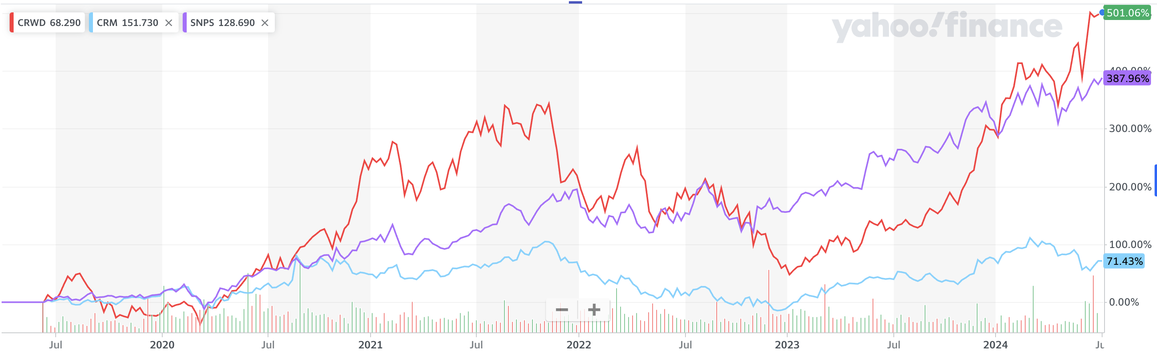
5 Year Trend Comparison (SNPS, CRWD, CRM)

Slide 4

Industry Analysis: Defining the Sector

Slide 5
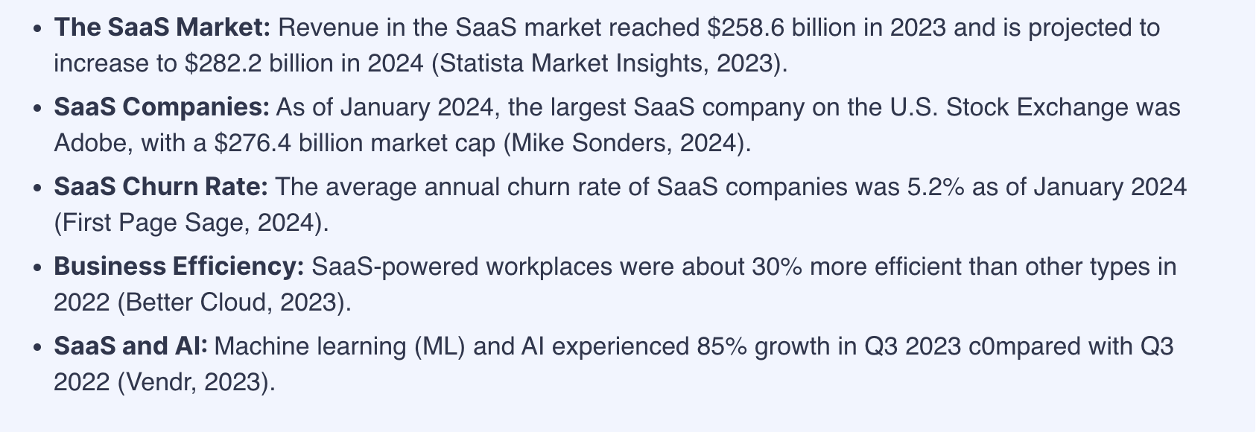
Market Highlights
Source: Technopedia, SaaS Statistics Highlights
Notes:
https://www.techopedia.com/saas-statistics

Slide 6
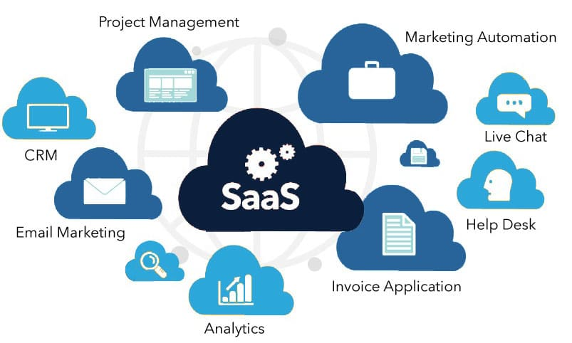
What is SaaS?
Software as a Service (SaaS):
A cloud-based subscription service model that provides companies with multi-faceted applications without purchasing new systems.
2 Types:
Enterprise Software (ERP)
Productivity Software

Slide 7

Enterprise Software
Enterprise Software is designed to meet the needs of an organization to manage and automate operations efficiently.
Projected to have revenue CAGR (2022-2028) of 11.1% due to the shift into cloud computing and Artificial Intelligence.
Notes:
https://www.kbvresearch.com/enterprise-software-market/

Slide 8
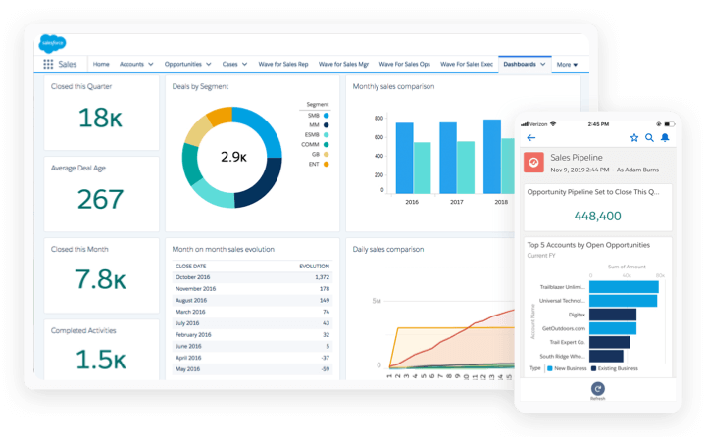
ENTERPRISE SOFTWARE:
Customer Relationship Management
Customer Relationship Management (CRM) is a specialized software designed to help organizations manage and optimize their interactions and relationships with customers.
Notes:
https://whatagraph.com/blog/articles/enterprise-software

Slide 9
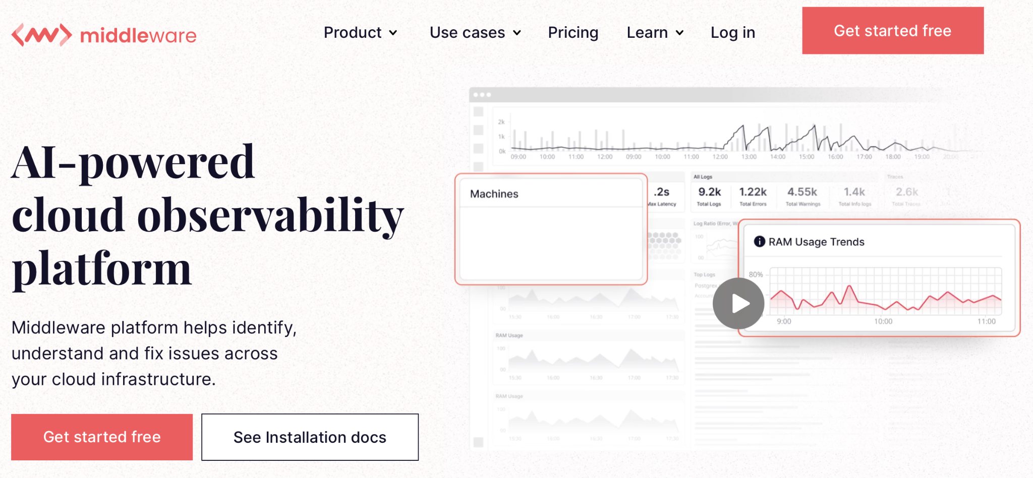
ENTERPRISE SOFTWARE:
Observability and Monitoring Software
Observability and Monitoring Software is designed to furnish an all-encompassing perspective on the functioning and conduct of intricate distributed systems.
Notes:
https://whatagraph.com/blog/articles/enterprise-software

Slide 10
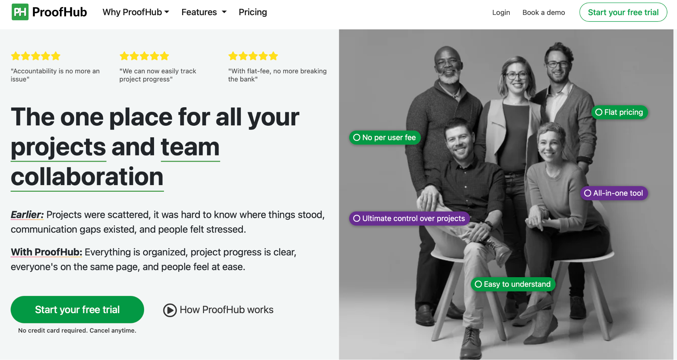
ENTERPRISE SOFTWARE:
Project Management Software
Project Management Software is a specialized tool that helps individuals and teams plan, execute, and oversee various aspects of projects to achieve project goals efficiently.
Notes:
https://whatagraph.com/blog/articles/enterprise-software

Slide 11
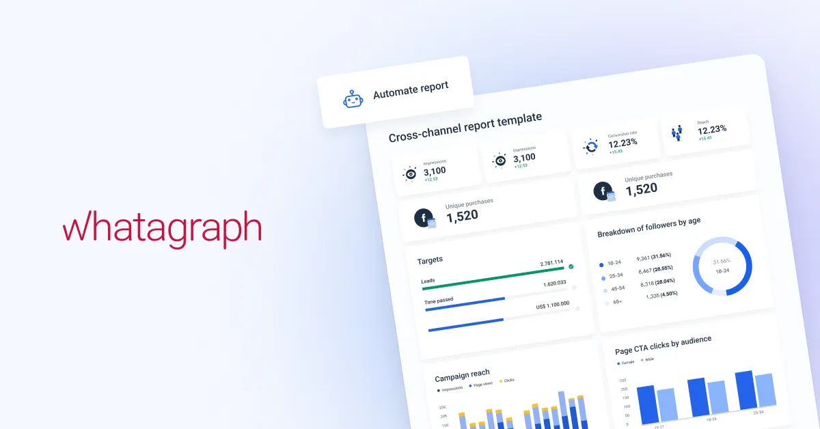
ENTERPRISE SOFTWARE:
Marketing Automation Software
Marketing Automation Software is designed to streamline and automate various marketing tasks, improving customer engagement and boosting marketing efficiency.
Notes:
https://whatagraph.com/blog/articles/enterprise-software

Slide 12
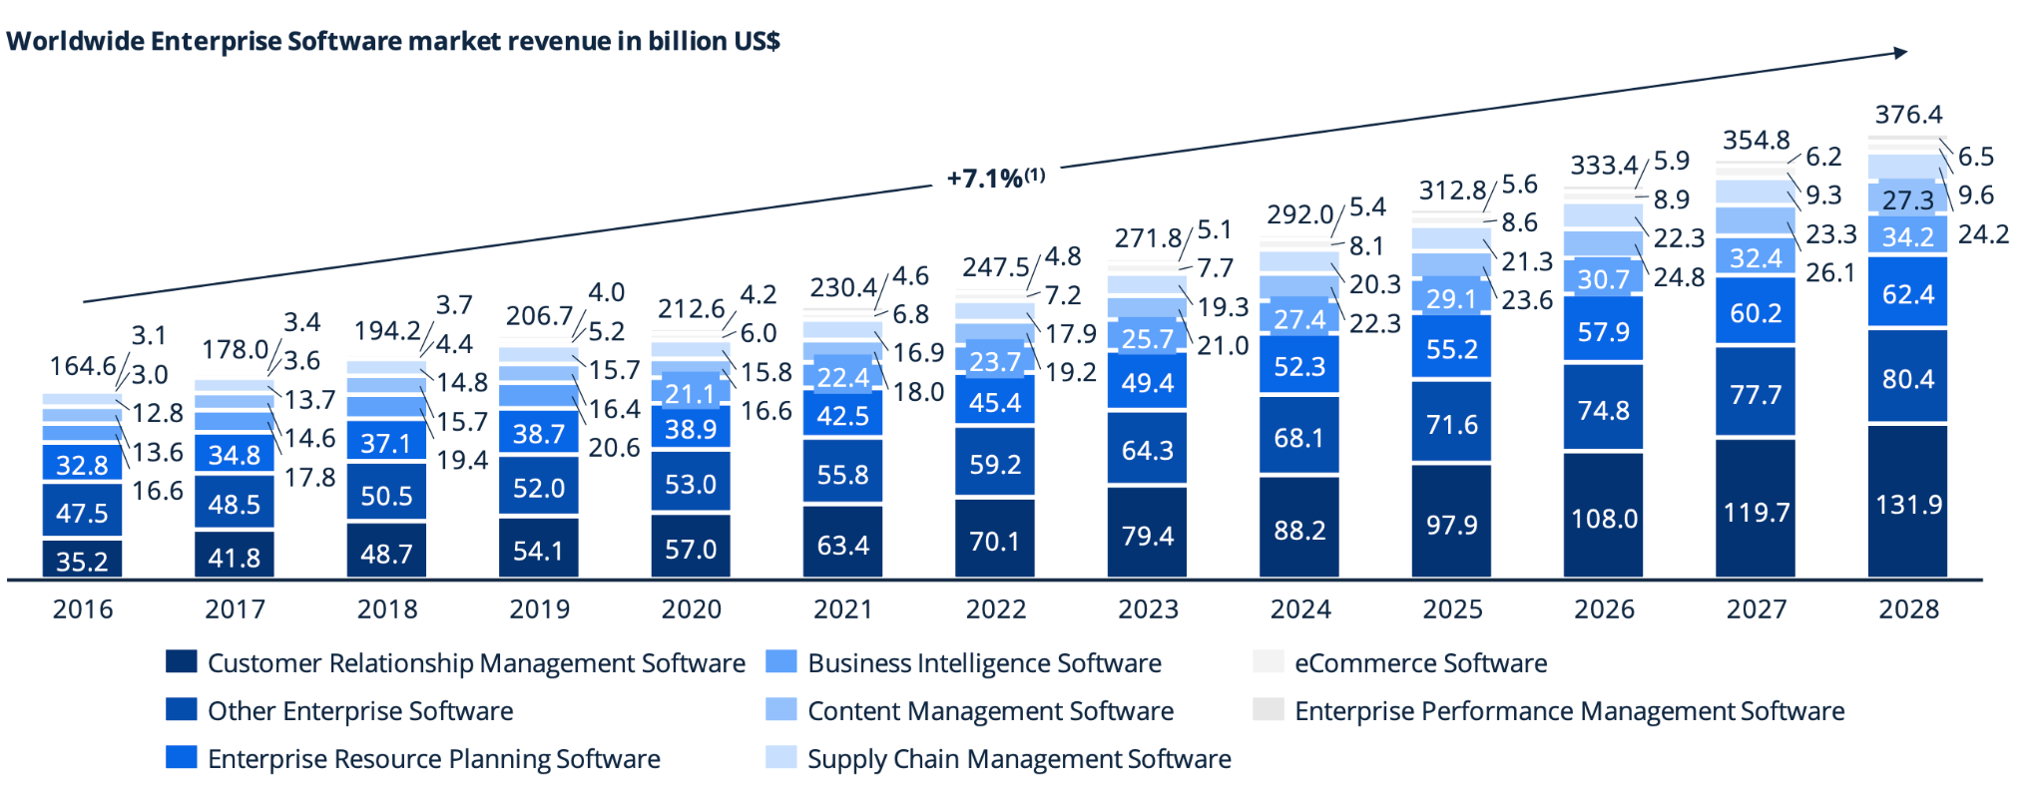
Expected Revenue Growth in Enterprise Software
Notes:
https://www-statista-com.proxy.lib.sfu.ca/study/84966/enterprise-software-report/

Slide 13
Productivity Software
Productivity Software assists users in producing and managing information to streamline communication and workflows.
Revenue is expected to reach US$ 79.07 bn in 2024 due to companies are prioritizing streamlining operations and optimizing resources with cloud systems and AI.
Notes:
https://www.kbvresearch.com/enterprise-software-market/

Slide 14

PRODUCTIVITY SOFTWARE:
Word Processing
Word Processing Software is an application designed for creating, editing, formatting, and printing textual documents, allowing users to input, manipulate, and organize text.
Notes:
https://www.encyclopedia.com/computing/news-wires-white-papers-and-books/productivity-software

Slide 15
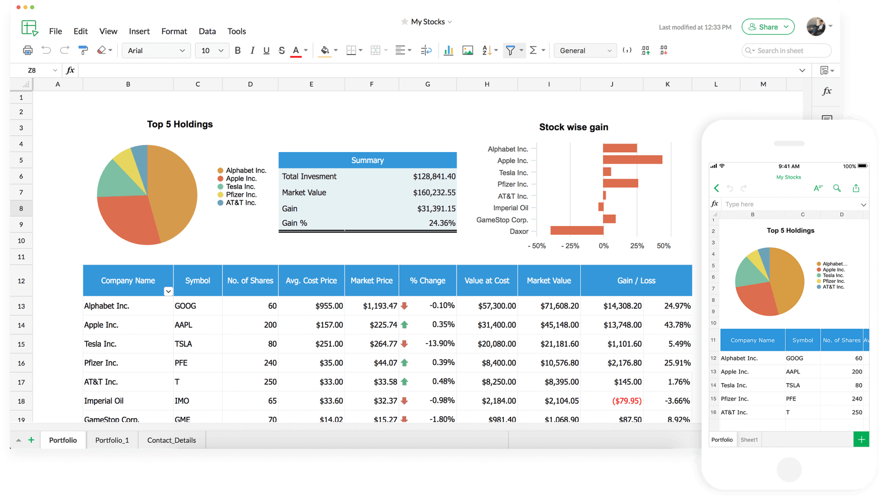
PRODUCTIVITY SOFTWARE:
Spreadsheet
Spreadsheet is a tool for performing numerical calculations based on user-entered numbers and formulas, typically organized in rows and columns, enabling data analysis and visualization.
Notes:
https://www.encyclopedia.com/computing/news-wires-white-papers-and-books/productivity-software

Slide 16
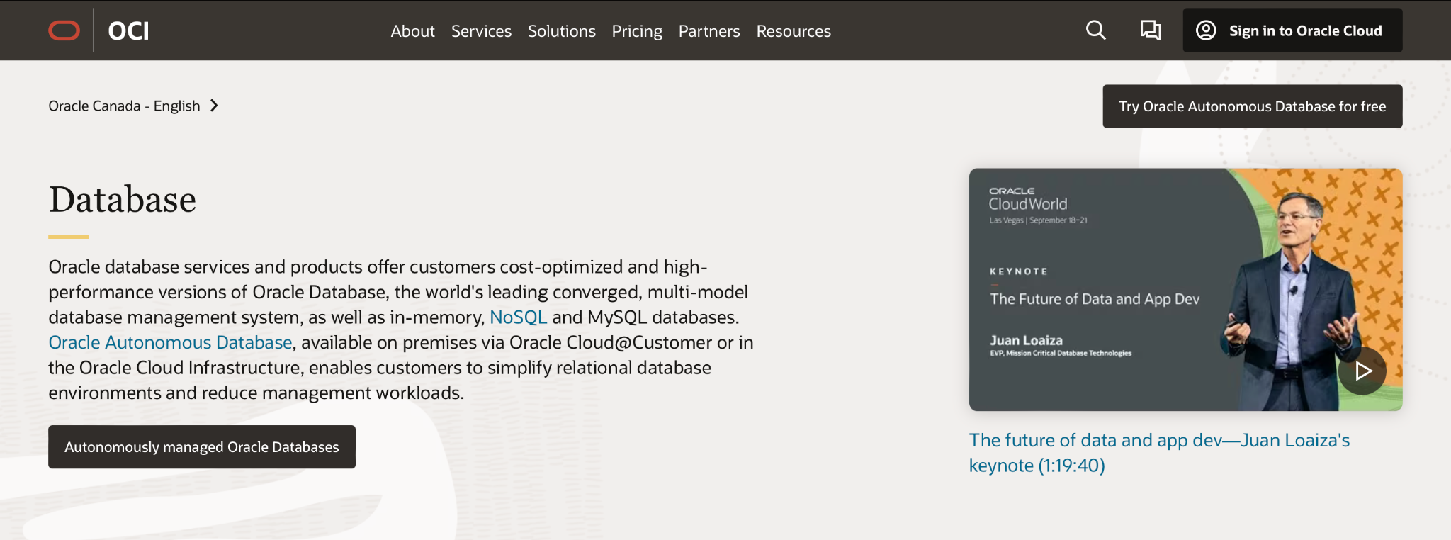
PRODUCTIVITY SOFTWARE:
Database Management System
Database Management Software is a specialized application that facilitates the effective storage, organization, and management of extensive data, designed to provide flexible data repositories with customizable access and administration.
Notes:
https://www.encyclopedia.com/computing/news-wires-white-papers-and-books/productivity-software

Slide 17
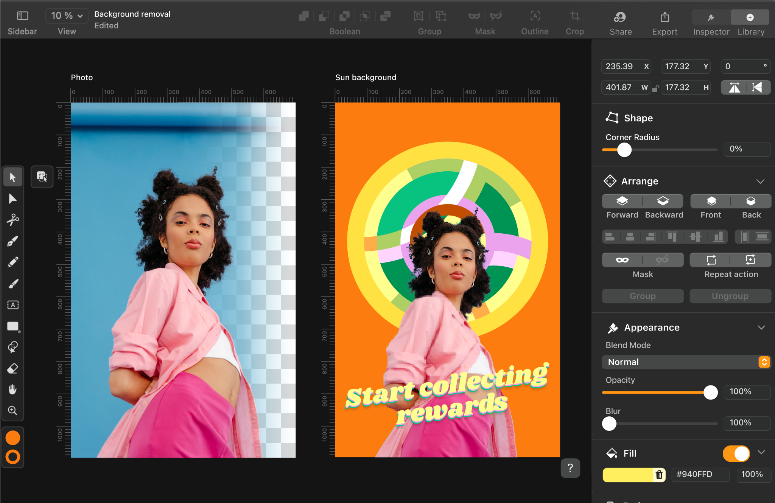
PRODUCTIVITY SOFTWARE:
Desktop Publishing
Desktop Publishing is a specialized software tool that enhances the visual appearance of documents, enabling users to create professional-quality materials like newspapers and magazines.
Notes:
https://www.encyclopedia.com/computing/news-wires-white-papers-and-books/productivity-software

Slide 18
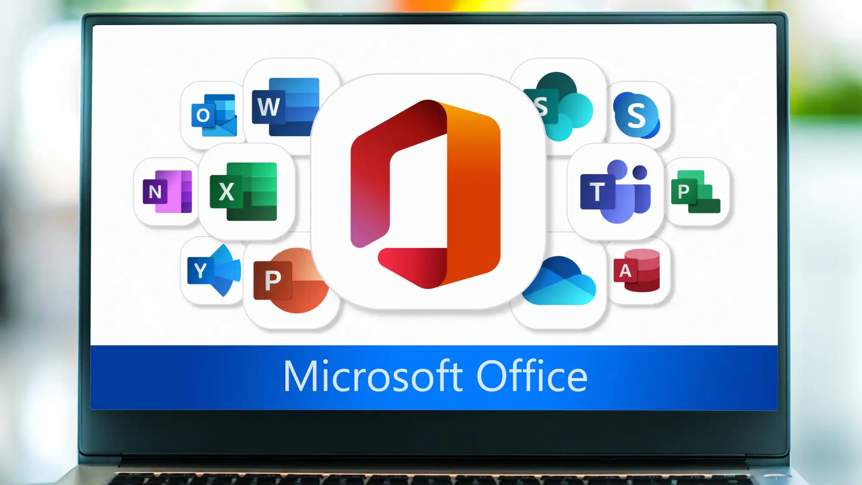
PRODUCTIVITY SOFTWARE:
Integrated Productivity Software
Integrated Productivity Software refers to a software package that combines the functionalities of multiple individual application programs into a single unit.
Notes:
https://www.encyclopedia.com/computing/news-wires-white-papers-and-books/productivity-software

Slide 19
Types of SaaS Cloud Functions
Public
Hybrid
Private
Computing service provided by third party
Available to anyone who wants to purchase them
Can transition between public and private
Cost effective
Computing Env. for a single organization for:
Customization
Security
Compliance
Control
E.g. AWS
E.g. Salesforce (CRM)
E.g. IBM

Slide 20
SaaS Revenue Models: Subscription Model
Subscription Basis:
Revenue earned when a consumer subscribes on a monthly or yearly basis.
Recurring revenue compounds over time with each returning user.
Usage Basis
Deferred Revenue*
Deferring subscription revenue for cash received but not yet fulfilling all performance obligations.
Hybrid Model

Slide 21
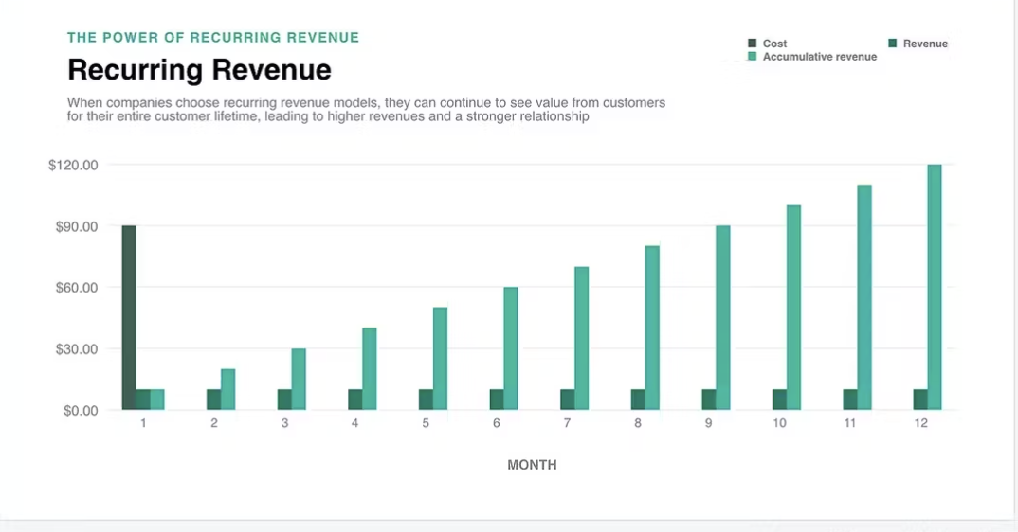
Recurring Revenue
Source: Paddle

Slide 22
SaaS Revenue Models: Usage Basis
Usage Basis:
Prices will vary depending on the usage of the user, revenue for SaaS company will be variable based.
Common Items:
1) CPU usage
2) Memory
3) Data Transfers
Hybrid Model
Accrued Revenue*
Employ technology to track usage rates that directly input into Cash account.
Freemium / Upsell Model

Slide 23
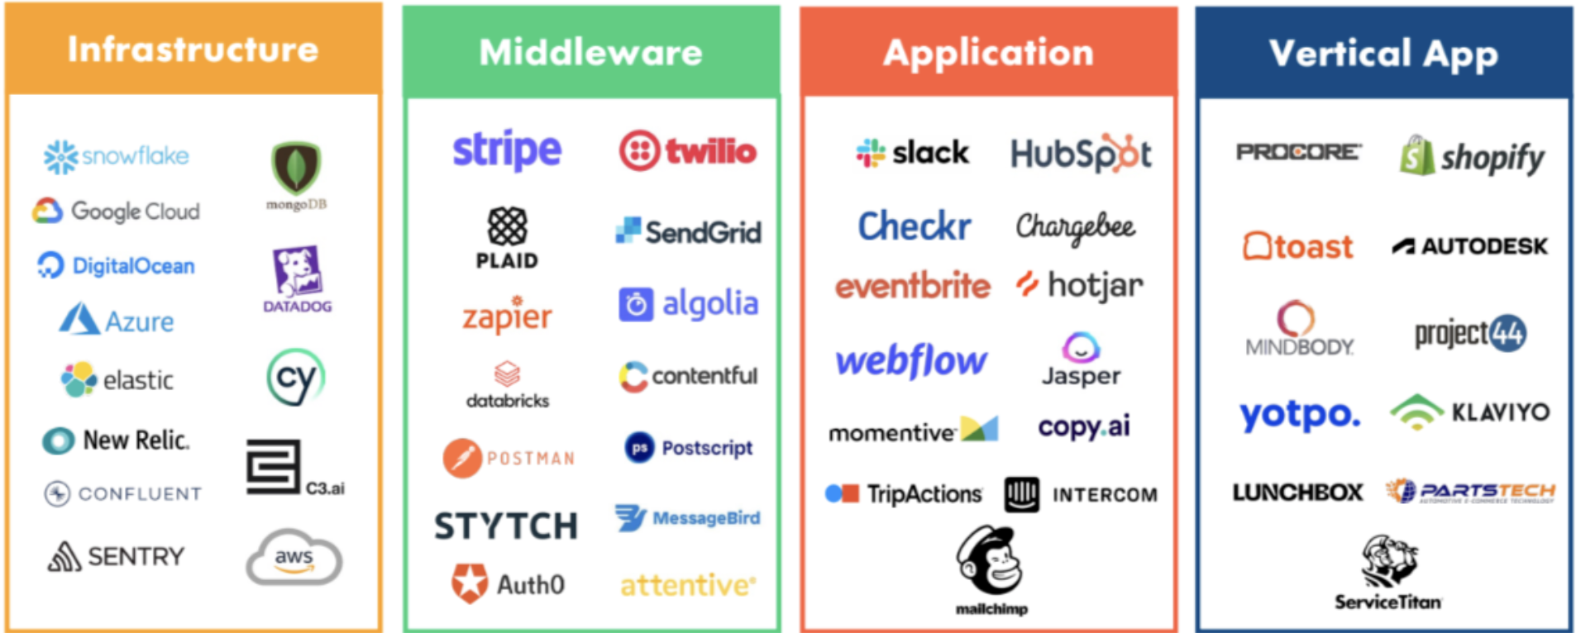
Usage Basis Pricing

Slide 24
SaaS Revenue Models: Hybrid Model
Hybrid Model:
Different renditions of pricing metric plans to suit the client for optimal performance. Combines flat fees with low user monthly fees.
Accrued Revenue*
Revenue is recognized at the beginning of the payment schedule and is not amortized over time.
Freemium / Upsell Model
Application Programming Interface

Slide 25
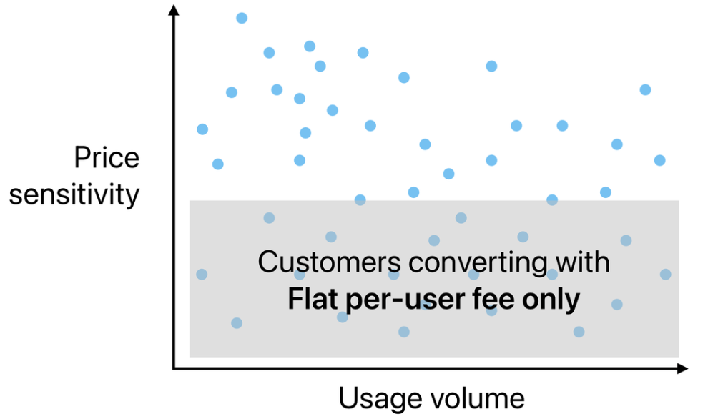
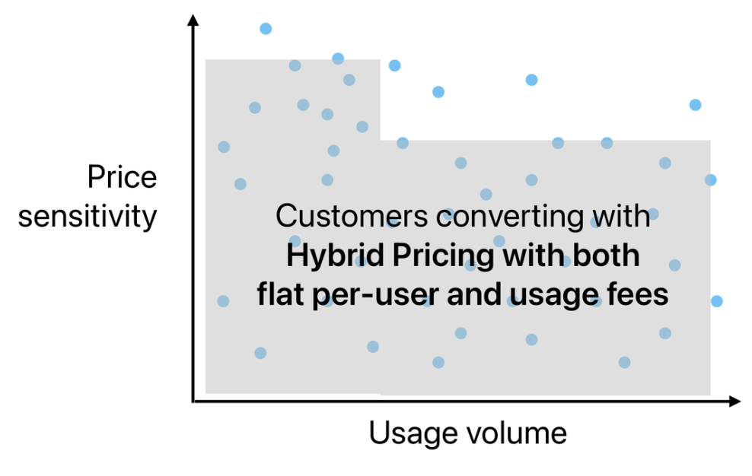
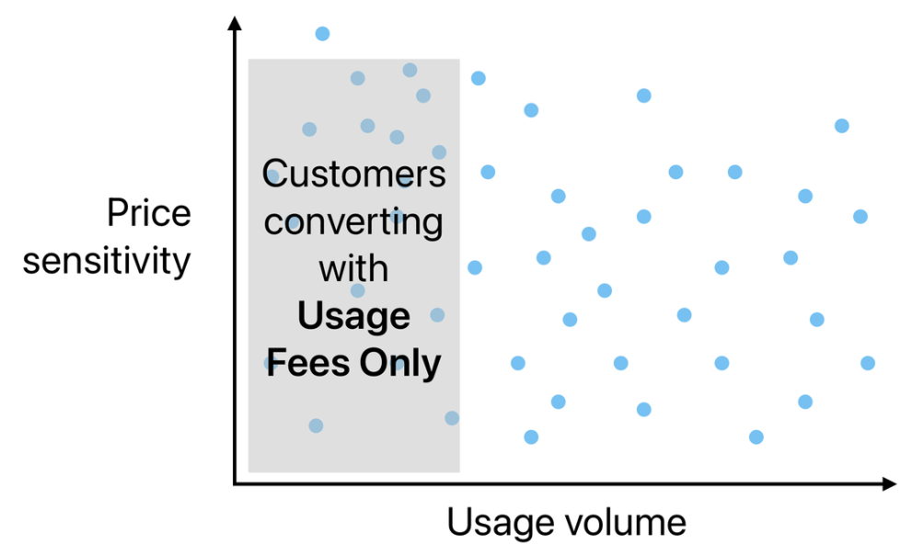
Hybrid Pricing Retention

Slide 26
SaaS Revenue Models: Freemium Model
Freemium / Upsell Model:
The user is provided with a free-trial period, at the end of the period they are then charged for the monthly/yearly subscription basis.
Deferred Revenue*
Revenue is recognized at the beginning of the payment schedule and is not amortized over time.
Application Programming Interface
Advertising

Slide 27
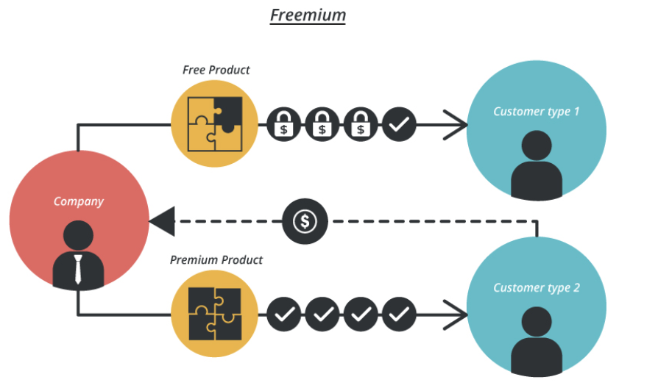
Freemium Model Returns
Source: Business Model Toolbox

Slide 28
SaaS Revenue Models: API’s
Application Programming Interface (API’s):
Creating linkages between SaaS and other softwares for multi-faceted usage.
Accrued Revenue*
Revenue is recognized at the beginning of the payment schedule associated with the cost of the subscription.
Advertising
Subscription Basis

Slide 29
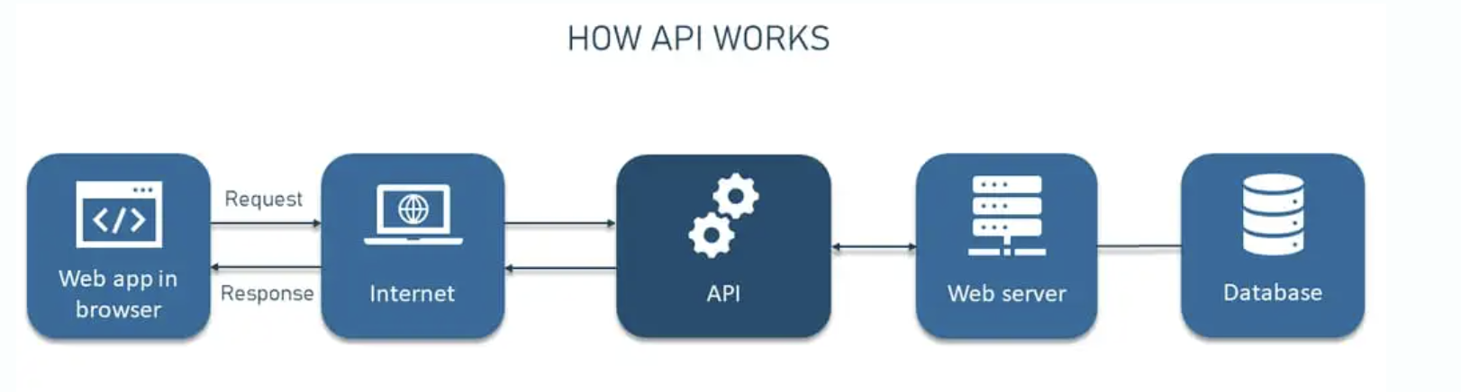
API Functions
Source: AltexSoft
Notes:
Can be considered a contract following an “If …Then…” clause

Slide 30
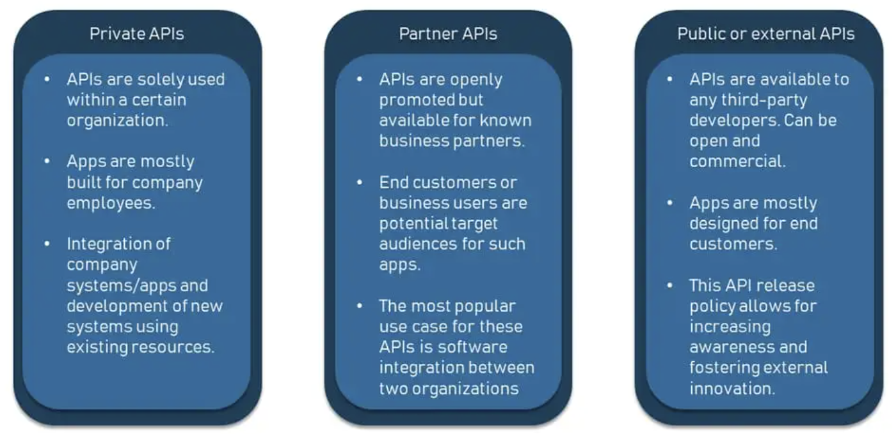
Types of APIs
Source: AltexSoft

Slide 31
SaaS Revenue Models
Advertising:
Opening space up on the SaaS framework to allow for advertisements
Accrued Revenue*
Revenue is recognized as the company wishing to advertise proceeds with payment.
Subscription Basis
Usage Basis

Slide 32
Industry Analysis: Trends

Slide 33
Trends: Artificial Intelligence Optimization
Personalization
Software becomes easier to use and better addresses client needs
Speed
AI enables SaaS speed up internal processes and operations
Security
AI-automation, and machine learning to recognize patterns
Data Intelligence
Enhanced consumer insights via data optimization

Slide 34
Trends: Machine Learning
Training Software
Deper Data
Gaining a greater level of intelligence and efficiency in the process
The kind that can help business gain a competitive edge
Communication
Consumer Service
Improved internal collaboration and operations
Practical functions in line with client needs and demands

Slide 35
Trend: Vertical SaaS for Specific Solutions
Customer Intelligence
Pre-defined Metrics
Enable businesses to obtain industry-specific customer data
Businesses can assess daily and long-term performance
New Niches
Higher Standard
Niche products will enter the market to address very specific industry pain points
Higher quality service will emerge to be distinguished from the ever-increasing crowd

Slide 36





Trend: Cybersecurity
Encryption:
Keeps user information confidential using algorithms.
Identity Theft:
Protects internal data from pirated attacks.
Ransom-ware:
Locks sensitive data regarding cash in perpetual password alteration.
Bugs:
Identifies bugs packaged within data received.

Slide 37
Industry Analysis: Performance and Multiples

Slide 38
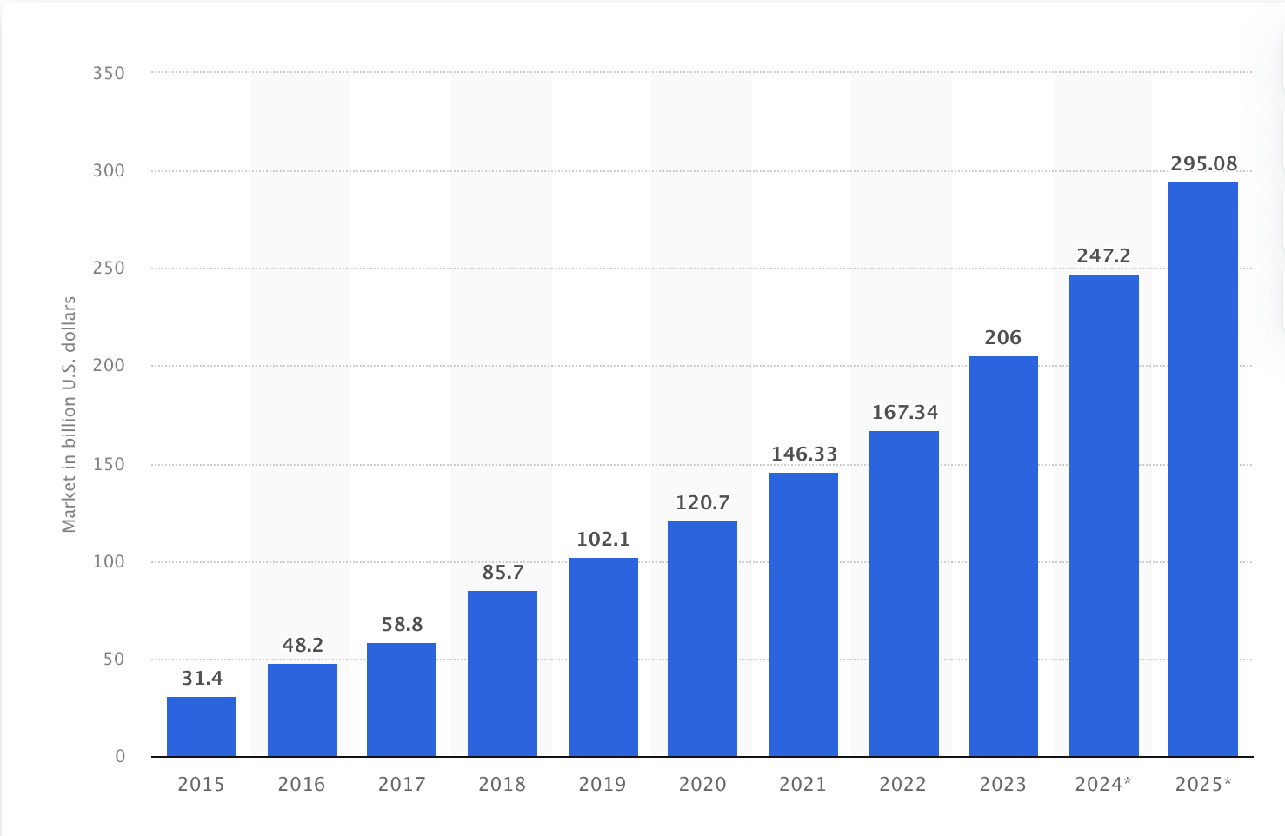
SaaS Industry Revenue (2015 -2025)
Statista

Slide 39
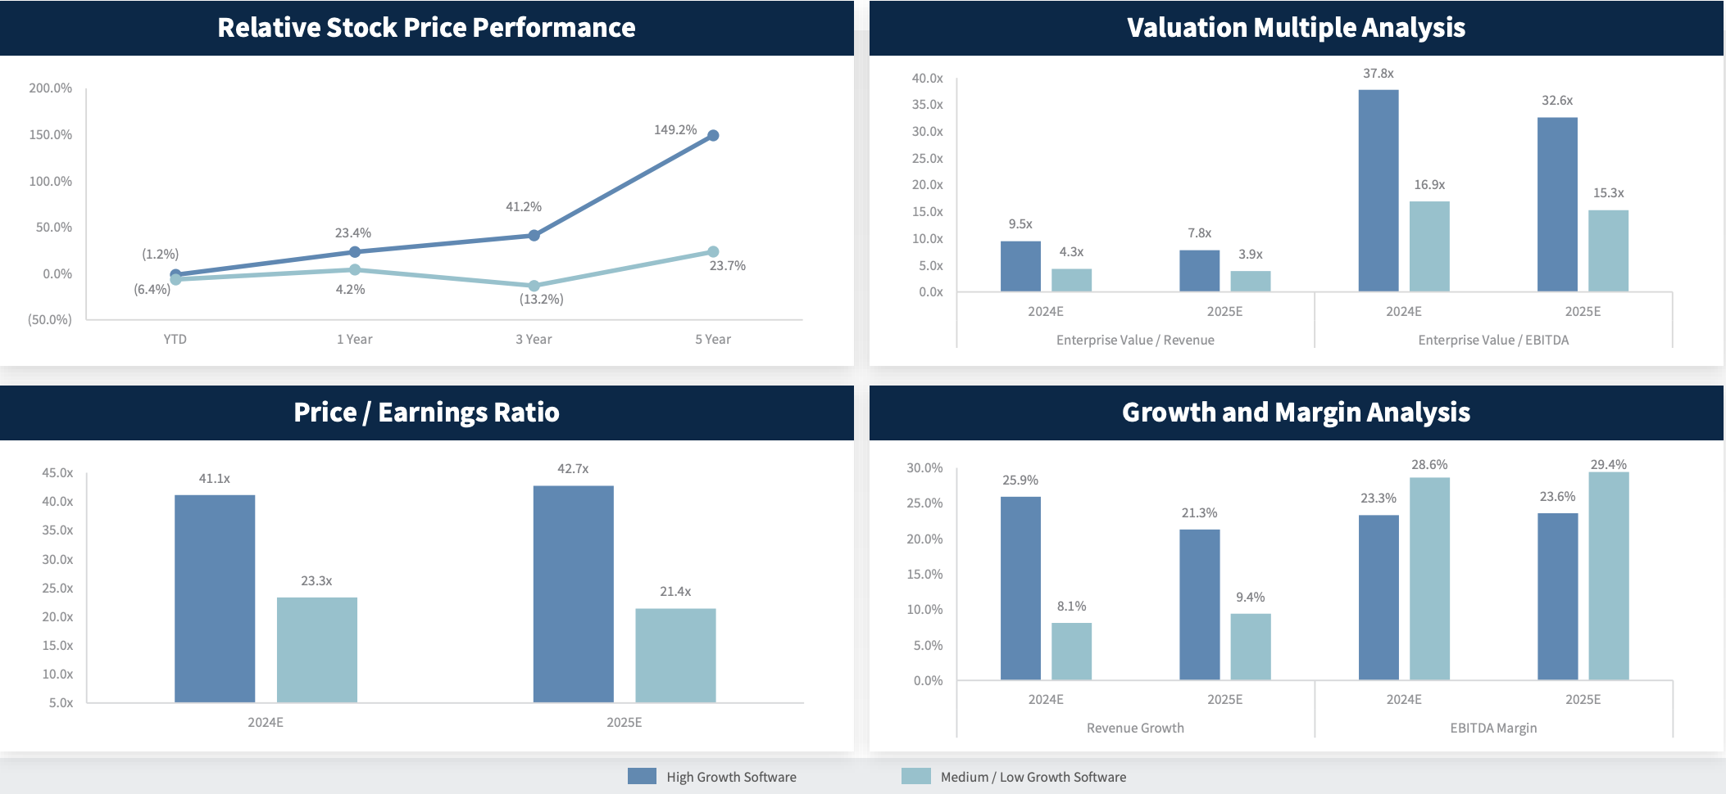
High Growth and Medium/Low Growth Software
Source: Raymond James (2024)
Notes:
https://www.raymondjames.com/-/media/rj/dotcom/files/corporations-and-institutions/investment-banking/industry-insight/software_monthly_market_insights.pdf

Slide 40
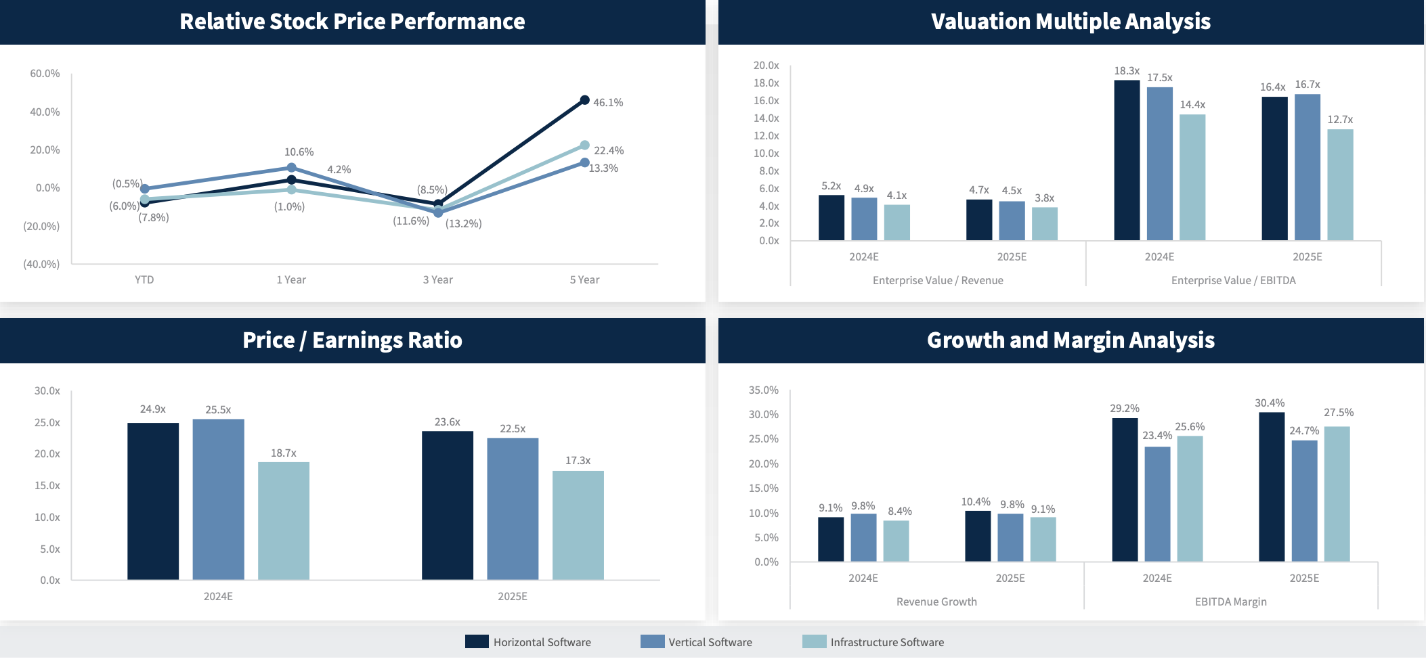
Horizontal/ Vertical/ Infrastructure Software
Source: Raymond James (2024)
Notes:
https://www.raymondjames.com/-/media/rj/dotcom/files/corporations-and-institutions/investment-banking/industry-insight/software_monthly_market_insights.pdf

Slide 41
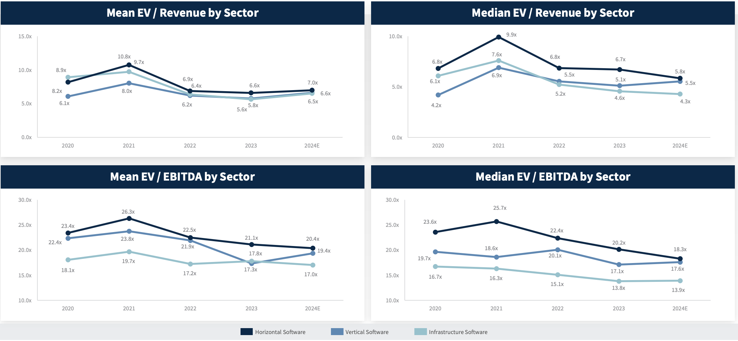
Equity Trading Multiples by Sector
Source: Raymond James (2024)
Notes:
https://www.raymondjames.com/-/media/rj/dotcom/files/corporations-and-institutions/investment-banking/industry-insight/software_monthly_market_insights.pdf

Slide 42

“The Rule of 40”
40%
Revenue Growth
Profit Margin or Free Cash Flow Rate
≥
= Monthly or Annual Recurring Revenue
= EBTIDA Margin (%) = EBIDTA / Revenue

Slide 43
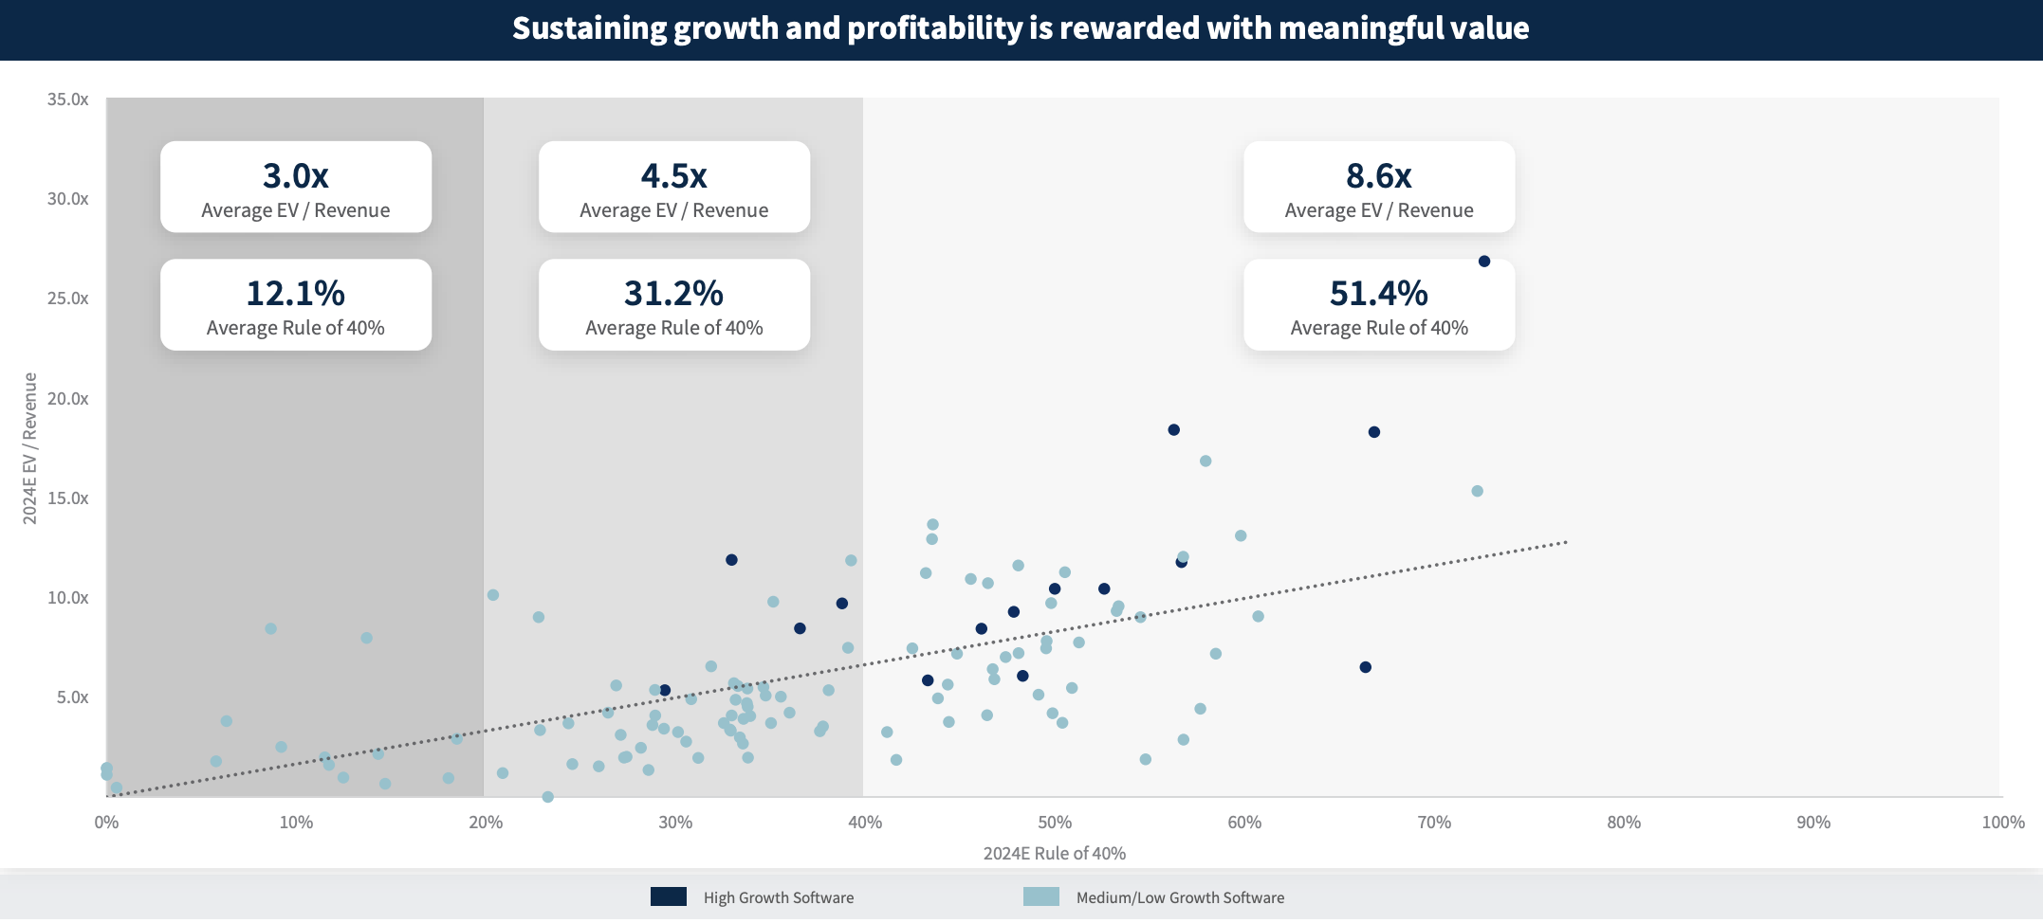
Software Valuation Using “The Rule of 40”
Source: Raymond James (2024)

Slide 44
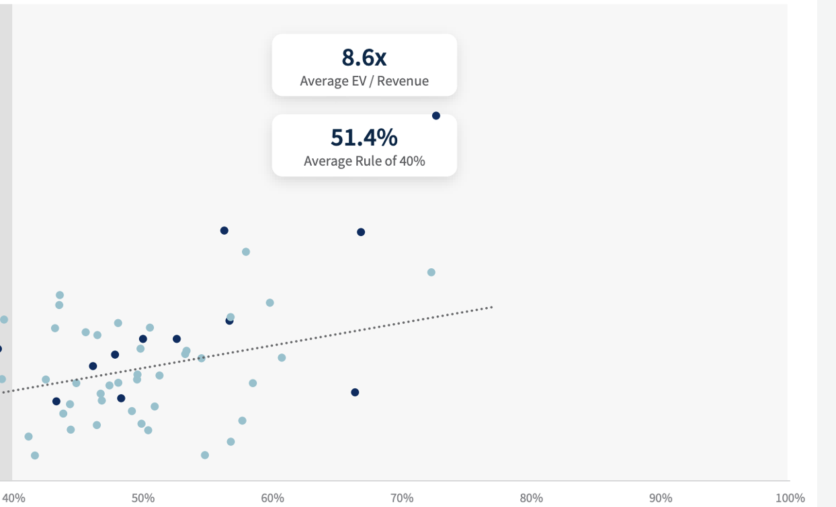
Software Valuation Using “The Rule of 40”
1/3
Only one third of companies surpass and sustain levels more than 40%
Source: Raymond James (2024)

Slide 45
How to Sustain “The Rule of 40”
Adjust Revenue Growth and Free Cash Flow by:
Set realistic growth targets
Priority on net retention
Optimize go-to-market spend
Build new business fast
Set revenue growth targets based on what is organic growth
Invest in customer success and care
Optimize sales and marketing performance
Starting or acquiring new businesses
Notes:
https://www.mckinsey.com/industries/technology-media-and-telecommunications/our-insights/saas-and-the-rule-of-40-keys-to-the-critical-value-creation-metric

Slide 46
How to Sustain “The Rule of 40”
Adjust Revenue Growth and Free Cash Flow by:
Set realistic growth targets
Priority on net retention
Optimize go-to-market spend
Build new business fast
Set revenue growth targets based on what is organic growth
Invest in customer success and care
Optimize sales and marketing performance
Starting or acquiring new businesses
Notes:
https://www.mckinsey.com/industries/technology-media-and-telecommunications/our-insights/saas-and-the-rule-of-40-keys-to-the-critical-value-creation-metric

Slide 47
How to Sustain “The Rule of 40”
Adjust Revenue Growth and Free Cash Flow by:
Set realistic growth targets
Priority on net retention
Optimize go-to-market spend
Build new business fast
Set revenue growth targets based on what is organic growth
Invest in customer success and care
Optimize sales and marketing performance
Starting or acquiring new businesses
Notes:
https://www.mckinsey.com/industries/technology-media-and-telecommunications/our-insights/saas-and-the-rule-of-40-keys-to-the-critical-value-creation-metric

Slide 48
How to Sustain “The Rule of 40”
Adjust Revenue Growth and Free Cash Flow by:
Set realistic growth targets
Priority on net retention
Optimize go-to-market spend
Build new business fast
Set revenue growth targets based on what is organic growth
Invest in customer success and care
Optimize sales and marketing performance
Starting or acquiring new businesses
Notes:
https://www.mckinsey.com/industries/technology-media-and-telecommunications/our-insights/saas-and-the-rule-of-40-keys-to-the-critical-value-creation-metric

Slide 49
Industry Analysis: Arising Challenges

Slide 50
SaaS Challenges
1
Emerging competitors with reduced switching costs pressure SaaS companies to retain clients.
Profitability Pressures
2
Multiple data pools need to be considered alongside different SaaS.
AI Adoption
3
Consumers are looking for a one-stop shop with the ability to personalize to their needs
Consumer Expectations
4
SaaS companies must prioritize data protection and maintain compliance with security regulations and filings.
Cybersecurity
5
Sustainable Global Scaling
Adopt localized strategies while investing in FDI to grow on international scale

Slide 51
Challenges
1
Emerging competitors with reduced switching costs pressure SaaS companies to retain clients.
Profitability Pressures
2
Multiple data pools need to be considered alongside different SaaS.
AI Adoption
3
Consumers are looking for a one-stop shop with the ability to personalize to their needs
Consumer Expectations
4
SaaS companies must prioritize data protection and maintain compliance with security regulations and filings.
Cybersecurity
5
Sustainable Global Scaling
Adopt localized strategies while investing in FDI to grow on international scale

Slide 52

SEC Filings Item 1.05 and 1.06 (8-K / 10-K)
Regarding disclosure of Cybersecurity, Risk, Management, Governance, and Incident Disclosure (July 26, 2023)

Slide 53
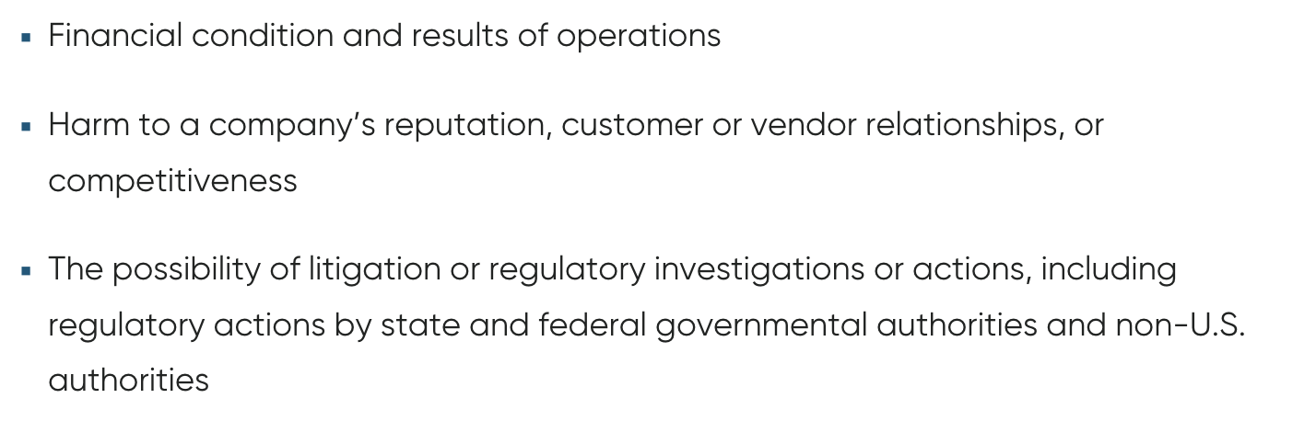
Contents of Item 1.05
“To be selectively disclosed upon the voluntary realization of a cybersecurity scenario deemed to be material by the company.”

Slide 54
Contents of Item 1.06
Item 1.06 Disclosure:
Companies need to disclose material cybersecurity risks that could impact clients or investors.
1) Risk Management
2) 3rd Party Oversight
3) Incident Response Plan
Must implement cybersecurity risk management practices in briefing
SaaS companies are required to assess cybersecurity practices of their vendors
SaaS companies must develop comprehensive incident response plans

Slide 55
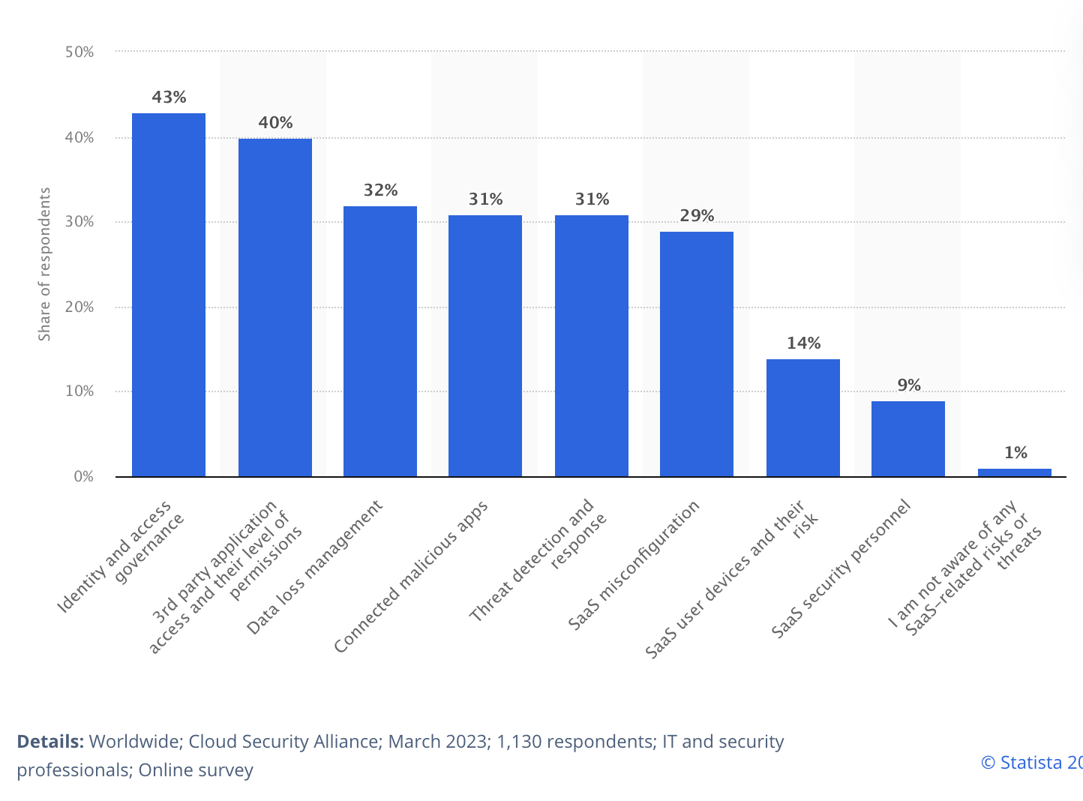
Arising Security Concerns
The impact of cyber-related issues on our operations hinges on executives' understanding. An issue deemed to be small may have larger effects on shareholders and the company.
HOWEVER:
CrowdStrike (CRWD) has developed software to immediately report and identify breaches within systems

Slide 56
Industry Analysis: Revenue Breakdowns

Slide 57
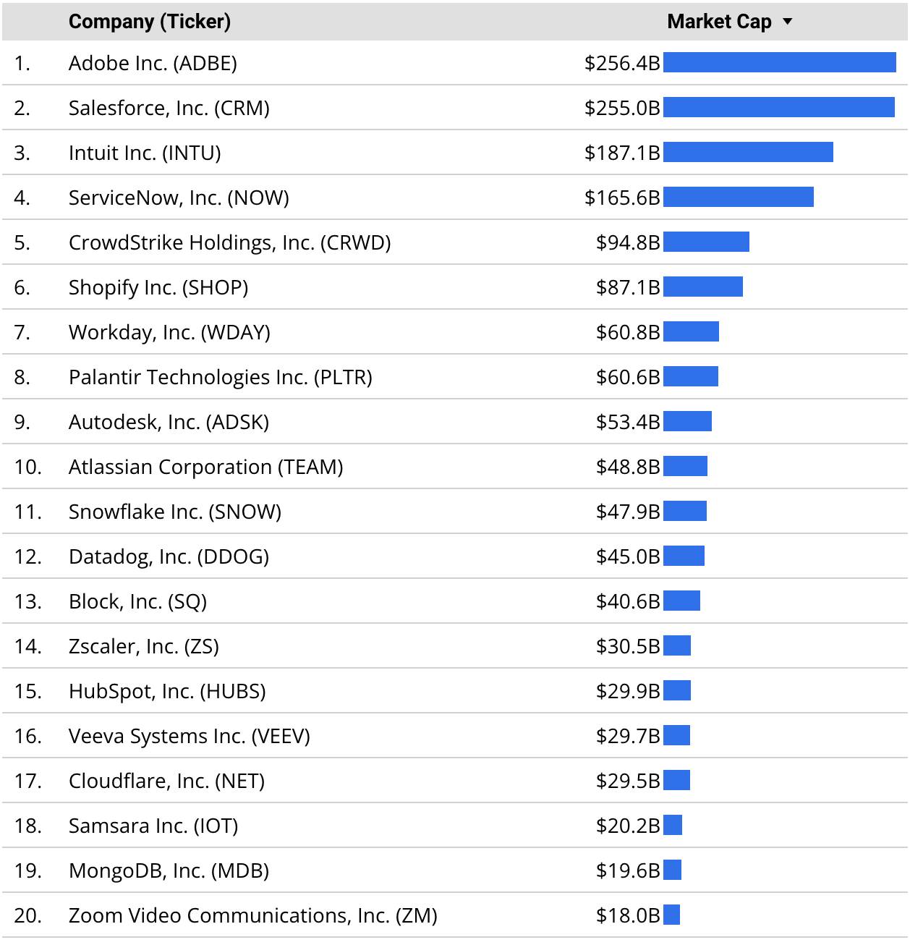
Industry Segment by Market Cap
Source: MikeSonders
Notes:
https://www.mikesonders.com/largest-saas-companies/

Slide 58
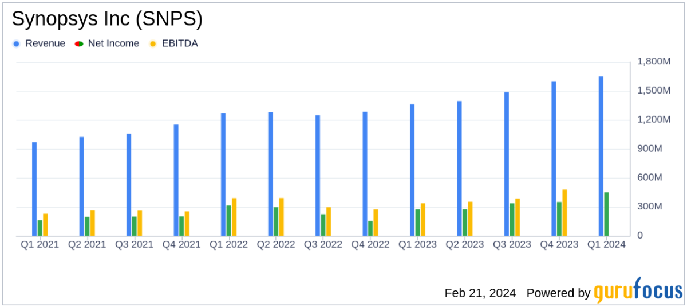
Synopsys Revenue

Slide 59
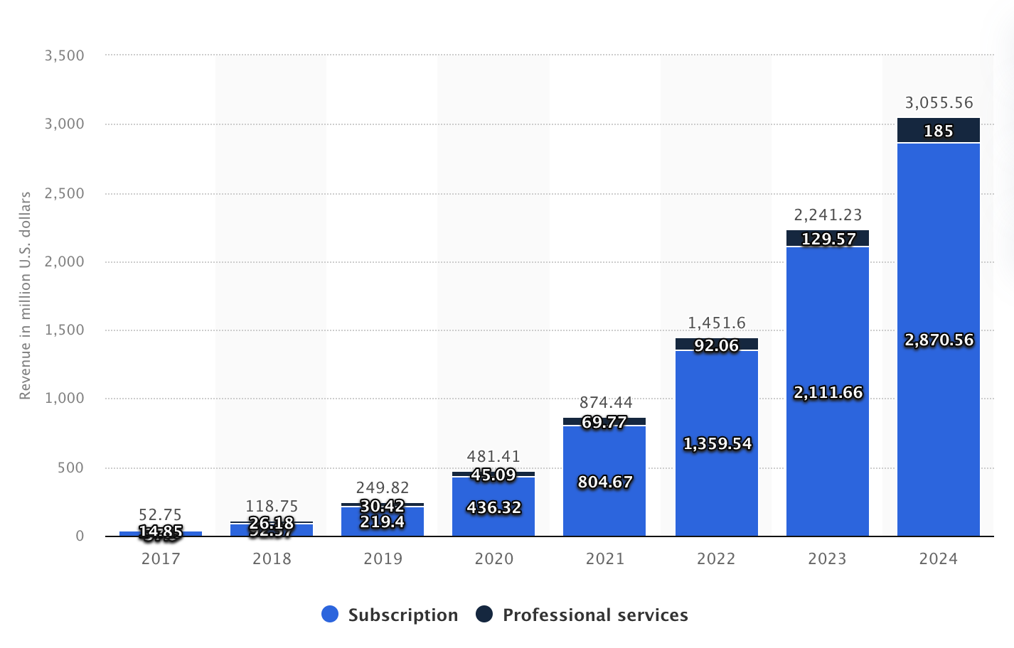
CrowdStrike Revenue Break down
Source: Statista
Notes:
https://www.statista.com/statistics/1178000/crowdstrike-revenue-segment-breakdown/

Slide 60

01
Synopsys

Slide 61
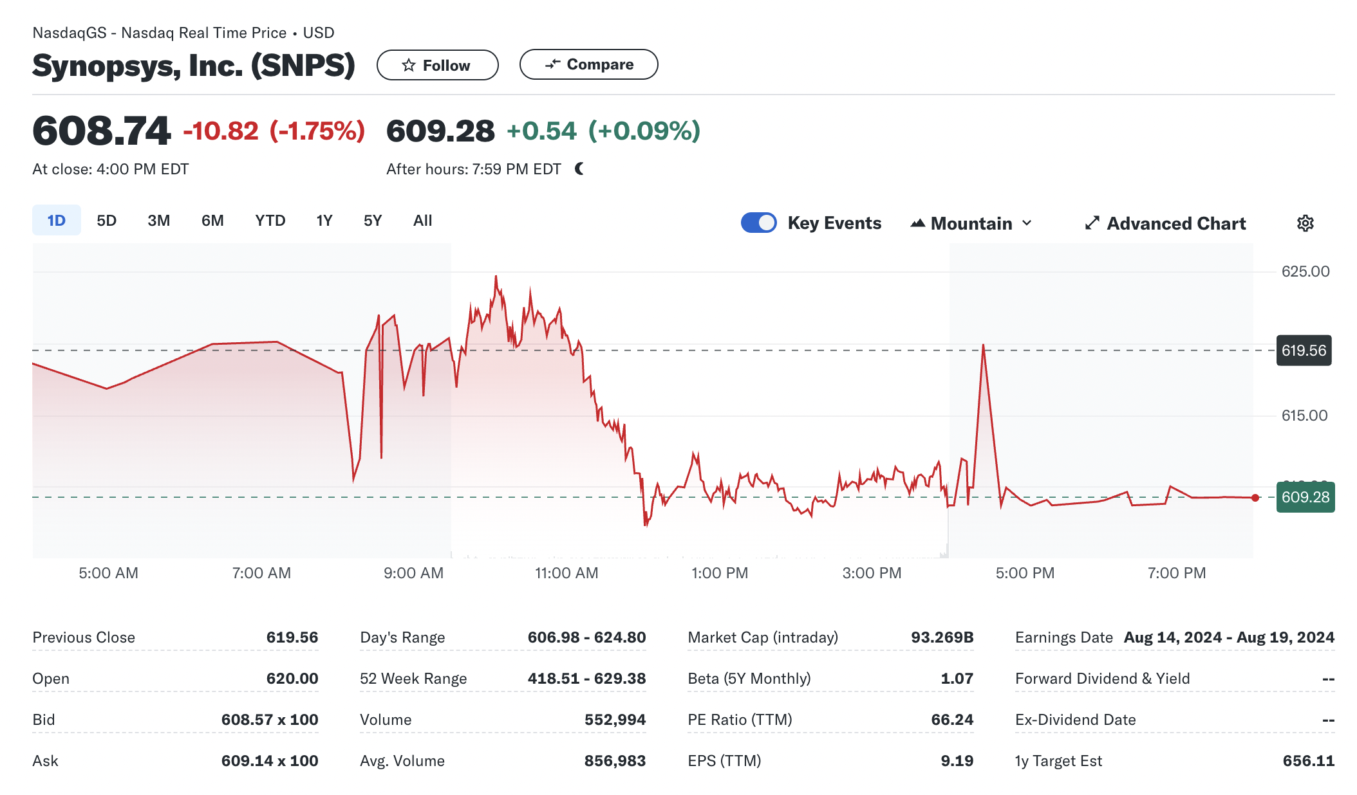
Synopsys Overview and Summary
Founded as a synthesis company in 1986, Synopsys is now the leader in electronic design automation (EDA) and semiconductor IP, and we are growing our leadership in software security solutions.

Slide 62
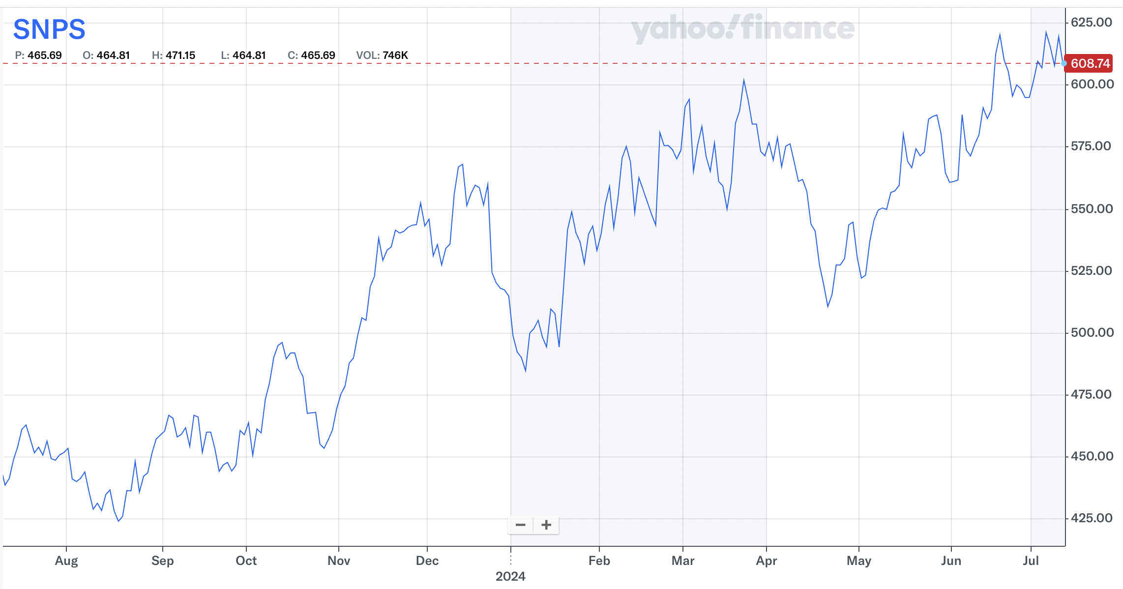
SNPS 1 Year Chart

Slide 63
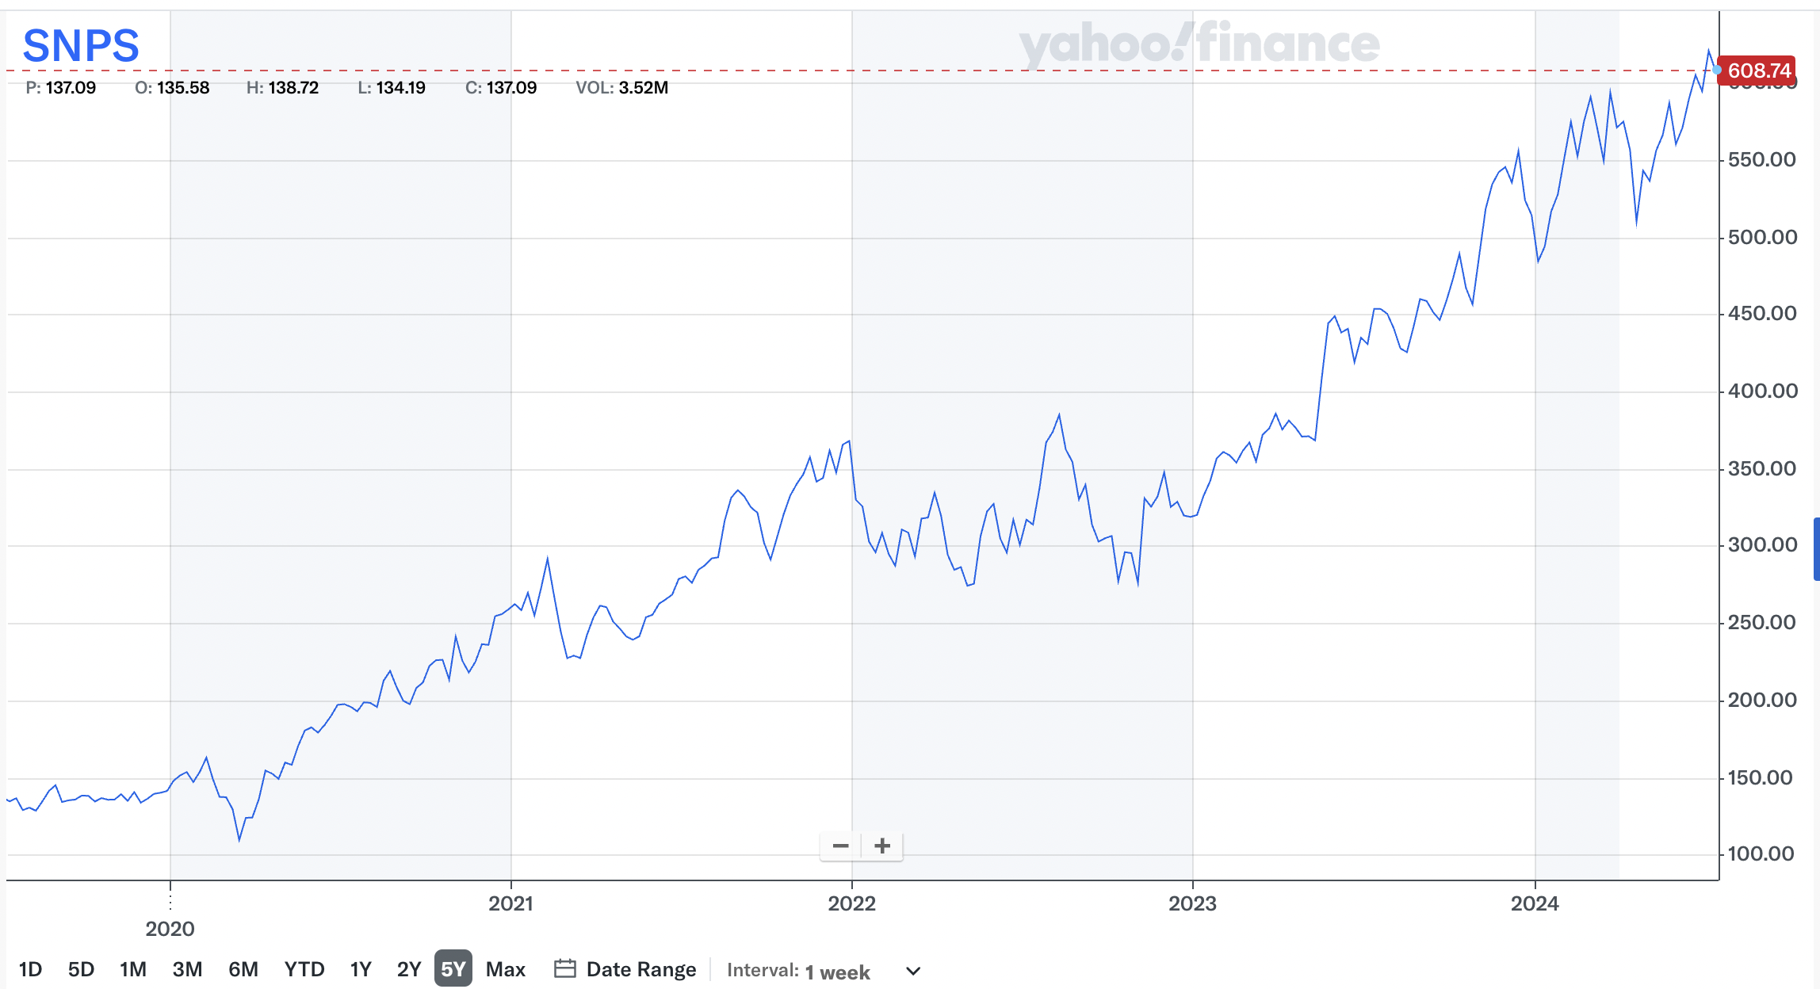
SNPS 5 Year Chart

Slide 64
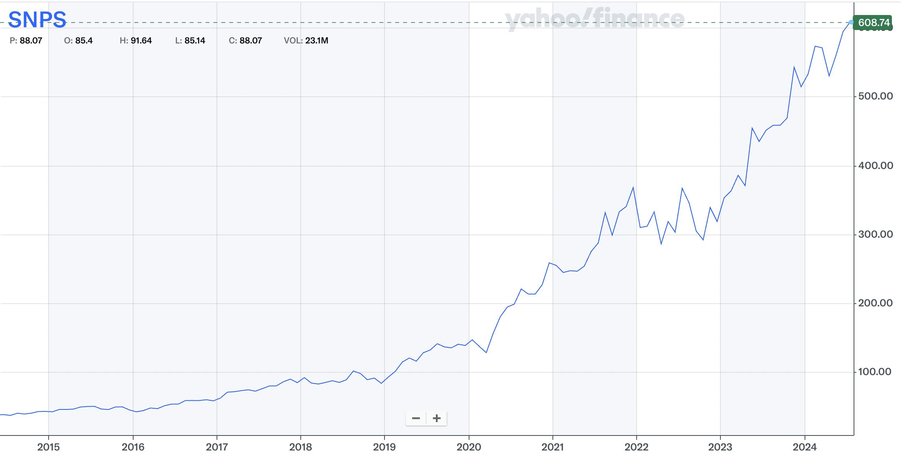
SNPS 10 Year Chart

Slide 65
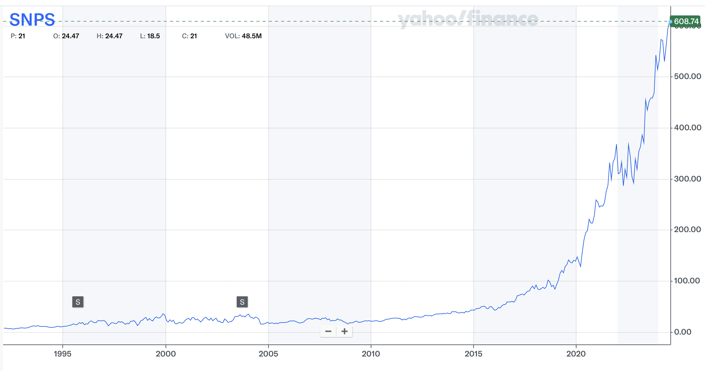
SNPS Max Chart

Slide 66
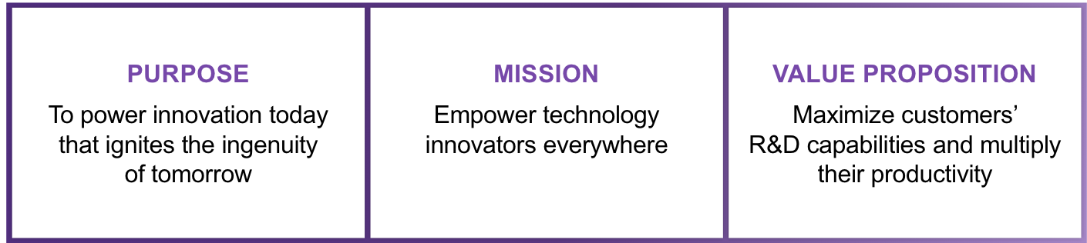
Company Description
Synopsys, Inc. (SNPS) is a leading provider of electronic design automation (EDA) software, intellectual property, and software integrity products. As will be highlighted below, SNPS’s products are essential towards the design and manufacture of semiconductor chips, a role which is significant given the prevalence of AI chips and ever increasing complexity of semiconductor chips.

Slide 67
Company Description
SNPS classifies its business model as being a time-based, recurring revenue model, with a non-cancellable backlog of $7.1 billion. SNPS typically sells EDA products and services through Technology Subscription License (TSL) agreements. Lasts 3 years and includes the use of all licensed products and maintenance. This helps add stability in revenue even despite challenging economic conditions, which is favorable during uncertain economic periods.
Notes:
Recurring revenue models, where customers are charged at regular intervals for access to a product or service
designed to create predictable and stable income streams
ustomers to make regular payments for continued access to a product or service.
The recurring revenue model inherently emphasises customer retention
keeping churn rates low and increasing customer lifetime value (CLV).

Slide 68
Company Description
These time-based products make up ~60% of SNPS in total revenue, which has fallen from 74% since 2018, given the increased demand for chip design IP, with revenues generally recognized upfront. We do not view this change as a significant threat for SNPS, given the robust nature of EDA industry (as it is required to design semiconductors) and the high expected growth arising from Design IP.

Slide 69
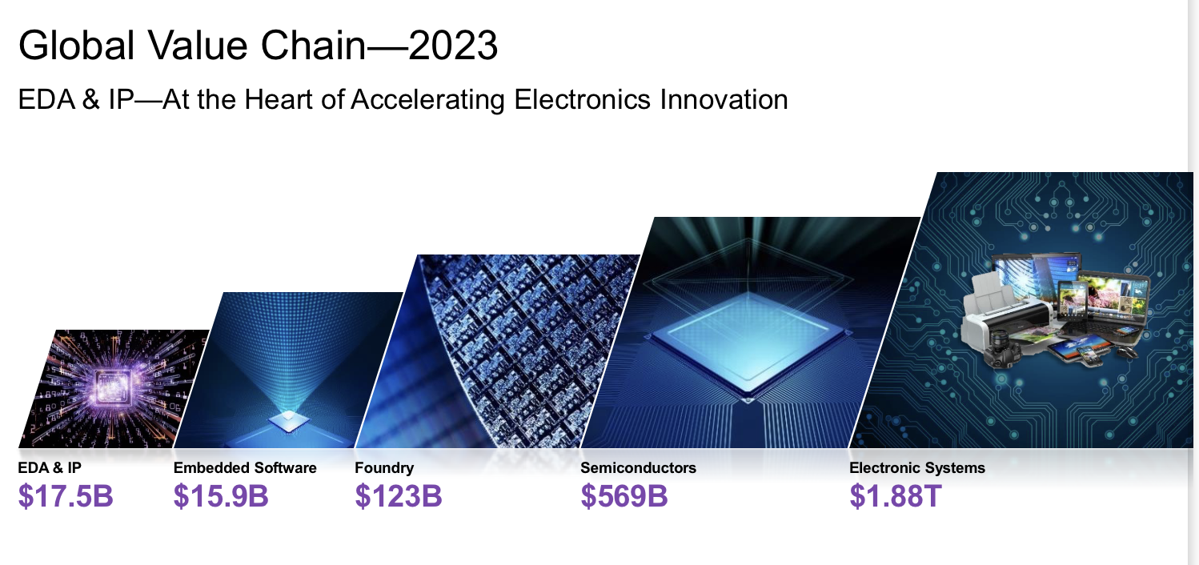
Global Value Chain

Slide 70
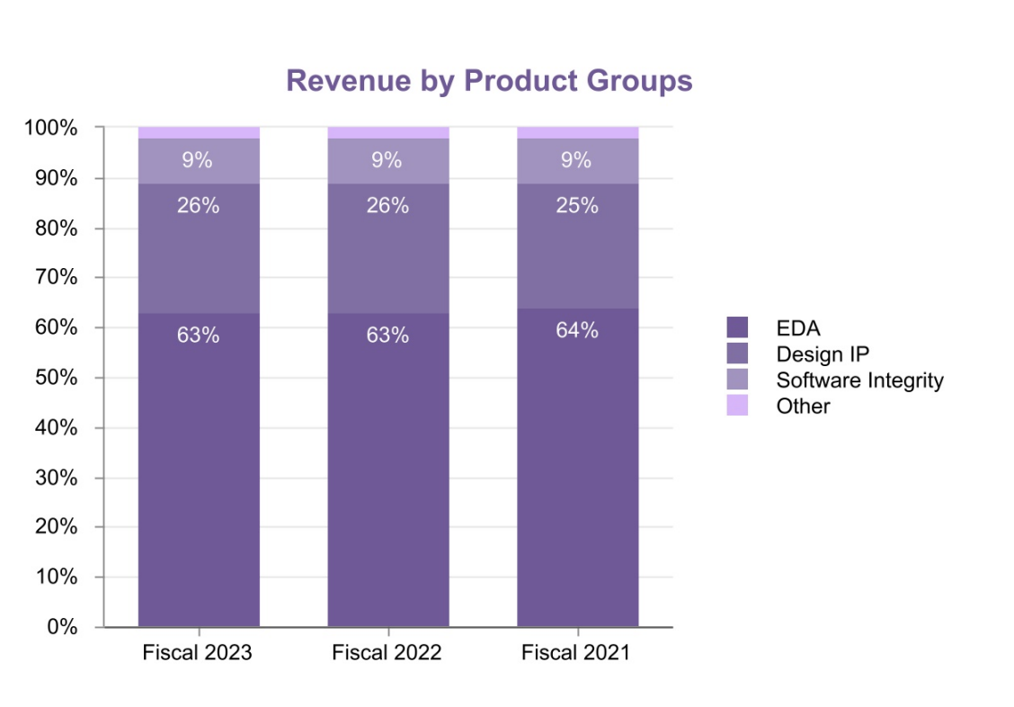
SNPS Business Segments
Segments:
Design Automation: EDA Software which includes digital and custom IC design software, verification hardware and software products, manufacturing-related design products, FPGA design software, AI driven EDA solutions, and professional services.
Design IP: Semiconductor Intellectual Property (IP) Products
Software Integrity: which includes solutions that test software code for security vulnerabilities and quality defects, as well as professional and managed services
1. Electronic Design Automation (EDA) Software
•Fusion Design Platform: Digital design implementation solutions.
•Verification Continuum Platform: Virtual prototyping, static and formal verification, simulation, emulation, FPGA-based prototyping, and debug solutions.
•FPGA Design Products: Programmed to perform specific functions.
2. Semiconductor Intellectual Property (IP) Products
•Interfaces for Connectivity: USB, PCI Express, DDR, Ethernet, SATA, MIPI, HDMI, Bluetooth low energy applications.
•Analog IP: Data converters and audio codecs.
•System-on-Chip (SoC) Infrastructure IP: Datapath and building block IP, verification IP products, mathematical and floating-point components, and Arm AMBA interconnect fabric and peripherals.
•Logic Libraries and Embedded Memories: Standard cells and memory components.
•Processor Solutions: Configurable ARC processors, neural network processors, and DSP cores.
•Security IP Solutions: Cryptography, security subsystems, and secured interfaces.
•Automotive IP: Optimized for functional safety and reliability standards.
3. Software Integrity Solutions
•Static Analysis: Identifies security vulnerabilities in the software development lifecycle.
•Software Composition Analysis: Ensures compliance and security of open-source components.
•Dynamic Application Security Testing: Identifies vulnerabilities in running applications.
•Fuzz Testing Tools: Detects unknown vulnerabilities.
•Managed Services: Mobile app security testing and dynamic application security testing.
•Consulting Services: Software security and quality initiatives.
•Training: For developers and security professionals.
Notes:
EDA) software that engineers use to design and test integrated circuits (ICs), also known as chips or silicon. We provide software and hardware used to validate the electronic systems that incorporate chips and the software that runs on them, including cloud-based digital design flow to boost chip-design development productivity. We also provide technical services and support to help our customers develop advanced chips and electronic systems. These products and services are part of our Design Automation segment.
We also offer a broad and comprehensive portfolio of semiconductor intellectual property (IP) products, which are pre-designed circuits that engineers use as components of larger chip designs rather than designing those circuits themselves. These products and services are part of our Design IP segment.
We are also a leading provider of software tools and services that improve the security, quality and compliance of software in a wide variety of industries, including electronics, financial services, automotive, medicine, energy and industrials. These tools and services are part of our Software Integrity segment

Slide 71
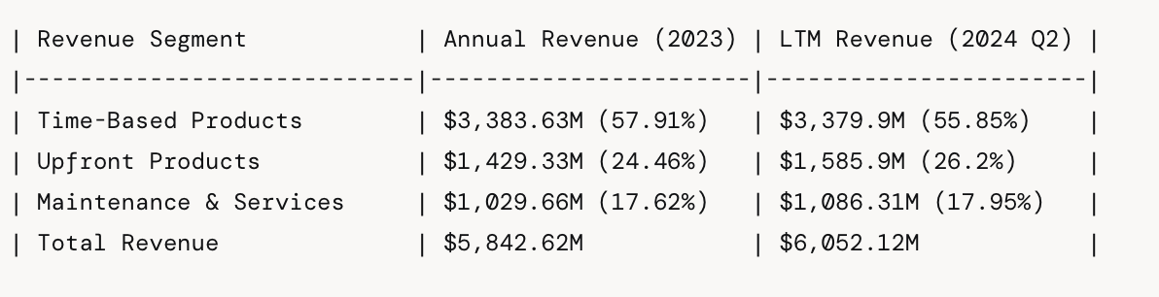
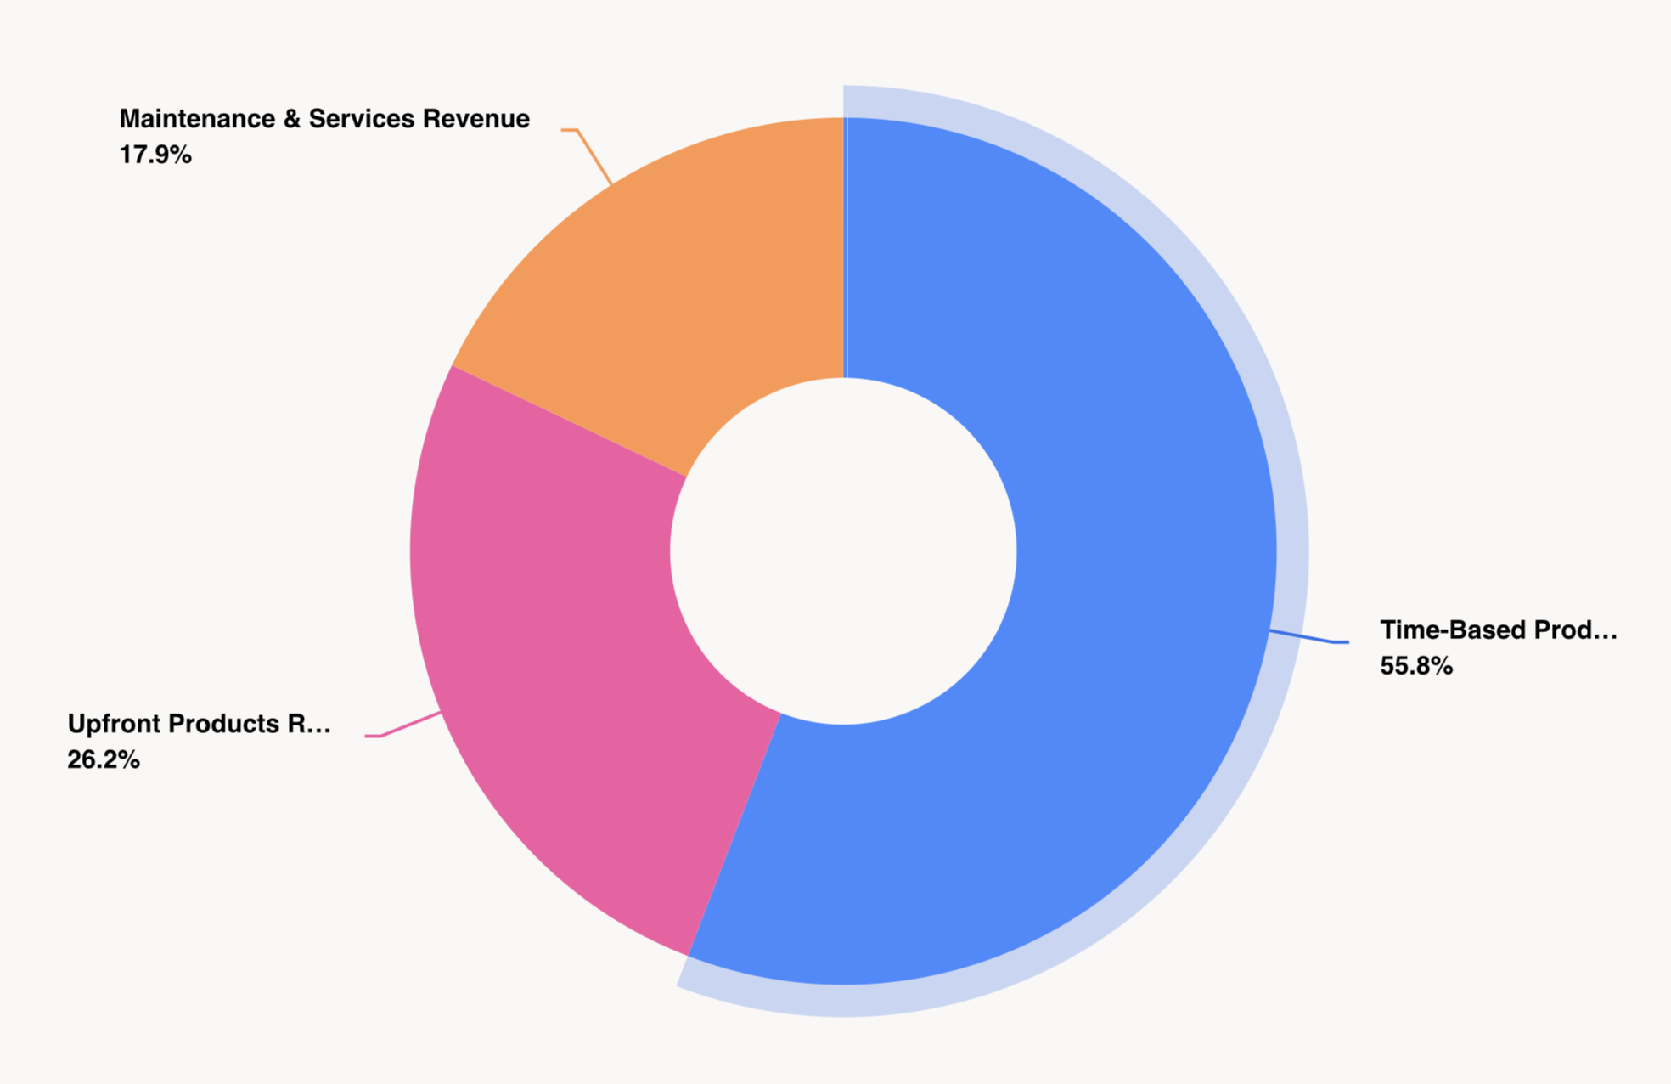
Business segments
1. Time-Based Products Revenue: Revenue from products that are licensed on a time-based model, where customers pay for the right to use the software for a specific period.
2. Upfront Products Revenue: Revenue from products sold with an upfront payment, typically for perpetual licenses.
3. Maintenance & Services Revenue: Revenue from ongoing maintenance and support services provided to customers.

Slide 72
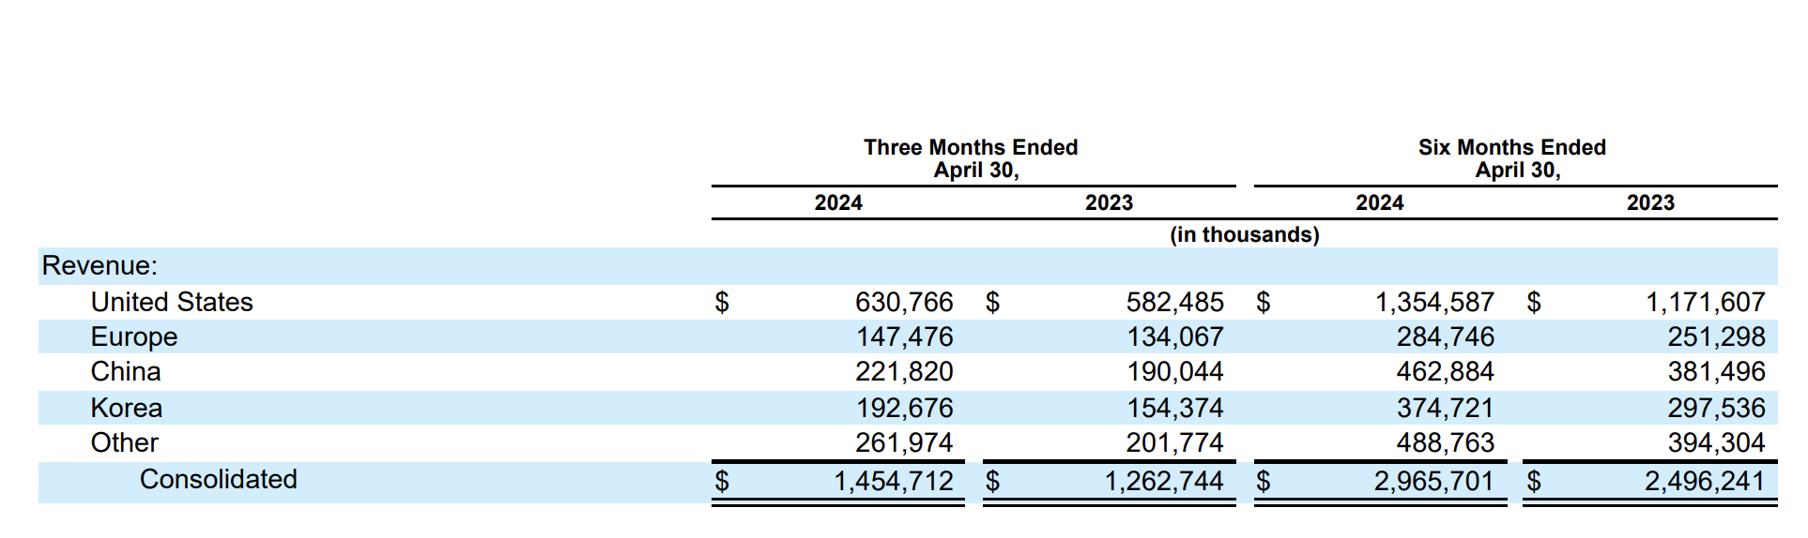
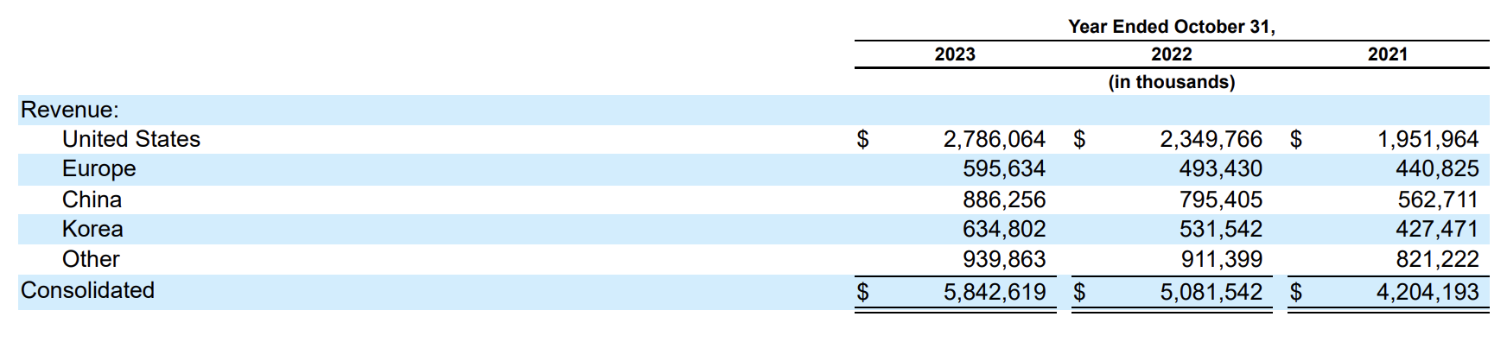
Revenue by Geography
Notes:
Synopsys revenue tends to be very stable, but the cyclicality comes in with the profit margin side. You can see that the free cash flow has fallen a bit this year. And Nick, maybe you can explain a little bit more about why that is. Yeah, you can see, obviously the first half of the year free cash flow is pretty, pretty meager. Not so good. It is expected to rebound the second half of the year. A lot of this just tends to be timing of when they renew their long term agreements with customers, and that tends to skew towards the 2nd, half of every fiscal year. And then there's also timing of of revenue, especially with the hardware side of the business as well. And then also, because it's manufacturing based, we go through these cycles where Synopsys will realize revenue and thus profit, especially on a free cash flow metric based on when their customers projects ramp up to full production. So second half of the year, we are expected to get a nice little rebound in free cash flow margins. Roughly $1. 1 billion is the guidance in dollar terms. But as Synopsys continues to mature along with the industry, and then also factoring in that Ansys acquisition a bit. they announced that they were selling the software integrity group, which we had covered in previous videos, that's going away, Ansys now coming into play. Long term, there's certainly a lot of upside for Synopsys, if they can get those operating margins out of the high 30 percent range on an adjusted basis up into the mid 40 percent range, and then on a free cash flow basis, obviously, fiscal 2024 expected to be a down year for free cash flow. But even at a pretty decent year, 20%, 25%, historically, the free cash flow margin profile for Synopsys. They're looking at a low to mid 30 percent over the next, let's say, 3 to 5 years. So not just a growth story as the business matures, we should see fantastic profit margin expansion along the way as well, which is exactly what we would expect from a tightly integrated hardware and software business like Synopsys.

Slide 73
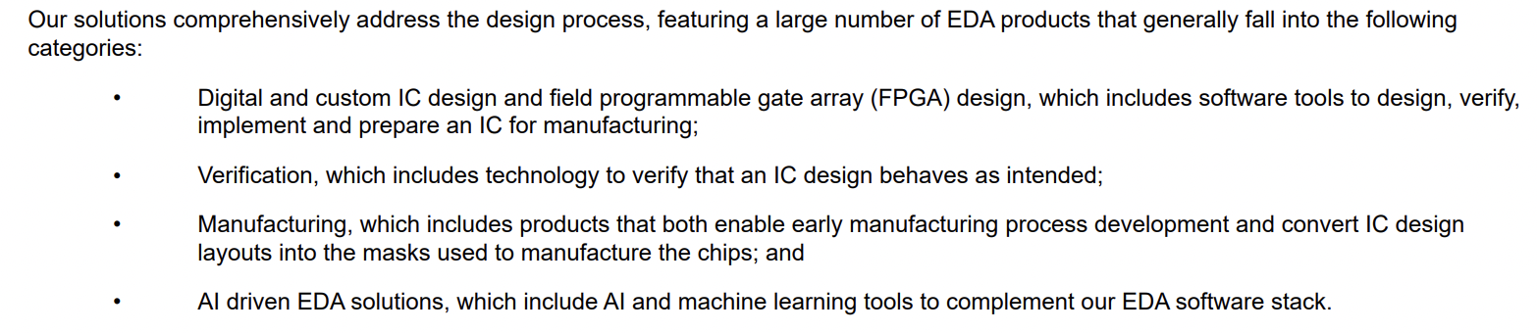
Design Automation Segment
Design Automation Segment: EDA -> INDUSTRY LEADER
EDA refers to the collection of software, hardware, and services essential for designing and manufacturing semiconductor chips. While EDA is not involved directly with manufacturing chips, it does have three important applications, per Synopsys:

Slide 74
Key Products and Service
Technology computer-aided design (TCAD): Used to design and validate semiconductor manufacturing processes to ensure it delivers the required performance and density .
Design for Manufacturability (DFM): Used to verify that a design will meet all requirements of a manufacturing process. This is done to ensure that the chip will function and not operate at a reduced capacity
Silicon Lifecycle Management (SLM): Performance of a chip is monitored after it is manufactured, to ensure that it continues to perform as expected and that tampering has not occurred.
35 Years
65% revenue
Notes:
With increasing cloud-based data storage, Synopsys offers scalable and flexible cloud solutions, including the industry’s first EDA Software-as-a-Service with Microsoft Azure, enabling designers to efficiently utilize cloud environments for their workflows.

Slide 75
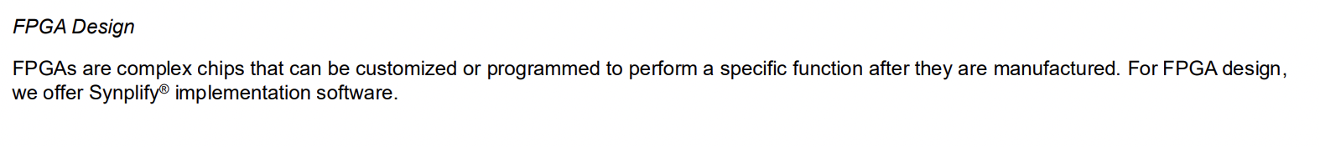
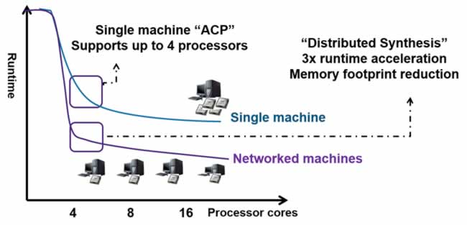
FPGA: Synplify

Slide 76
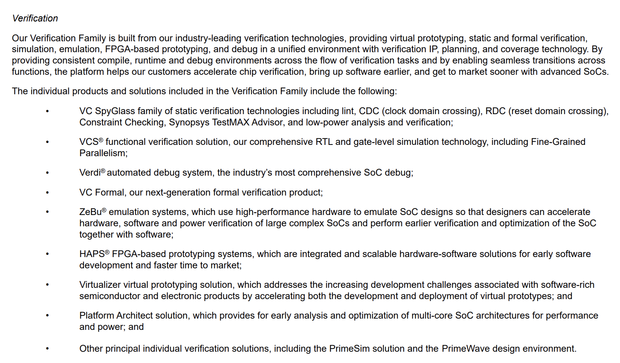
Verification Family

Slide 77
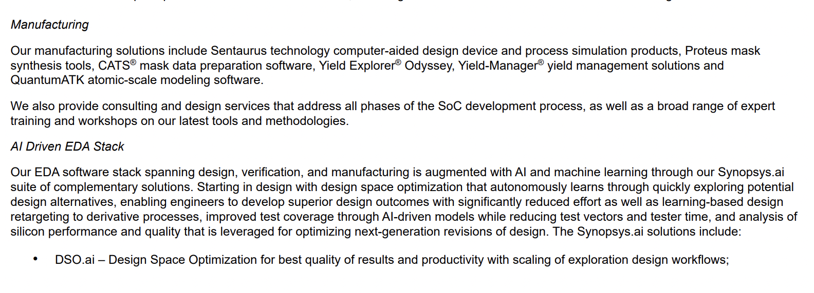
Manufacturing Ecosystem

Slide 78
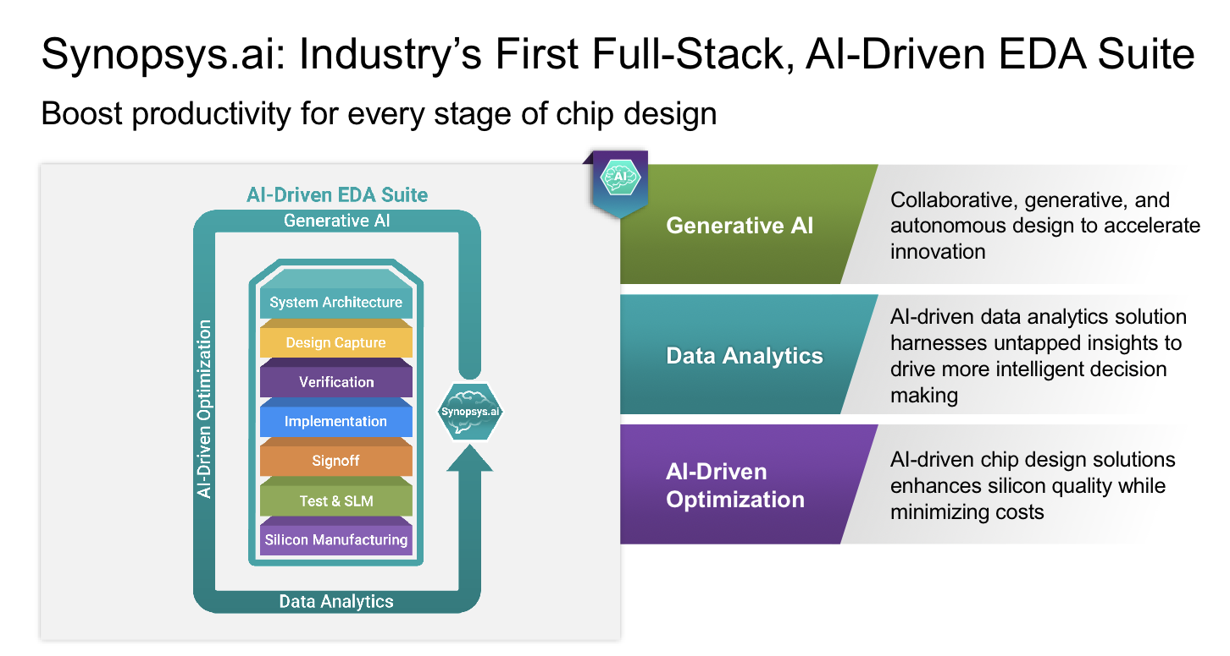
EDA AI Suite
Synopsys.ai is the industry’s first full-stack, AI driven EDA-suite, used for the verification, testing, and manufacturing of digital and analog chips.

Slide 79
Key Changes
Strong Adoption
Future outlook
CoPilot
In February, SNPS reported that customers have reached 100 commercial tape-outs (the stage where a design is sent to be manufactured, a critical step in chip development) using their AI and is up to 270 as of their most recent earnings call. In addition, 9 out of the top 10 semiconductor vendors are using Synopsys.ai in production, with the tenth already in test phases
SNPS has stated that Synopsys.ai revenue is just starting to ramp up, with customers now increasingly adding Synopsys.ai subscriptions. In addition, the firm saw multiple full-flow switches to Synopsys.ai from competitors, driven by 10 times productivity differentiation compared to competitors
On November 15, 2023, SNPS announced Synopsys.ai Copilot, resulting from a strategic collaboration with Microsoft to integrate Azure OpenAI service for use in semiconductor design This will allow engineers to make natural language requests/queries for chip design, helping to increase productivity and address the issue of a workforce shortage 6,3. As of this report, Synopsys.ai Copilot is available for early access customers.

Slide 80
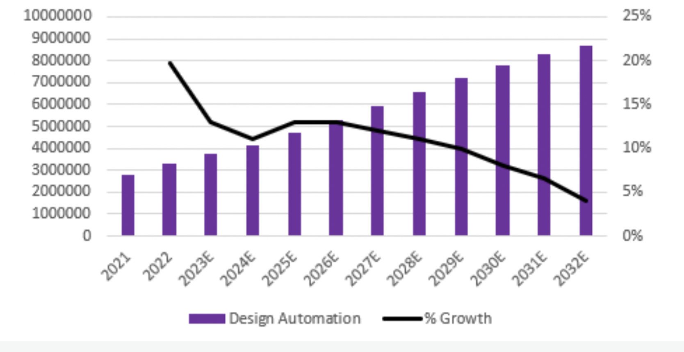
Design Automation Segment
This segment serves primarily companies in the semiconductor and electronics industries, in growing markets such as Internet-of-Things (IoT), automotive, security, and cloud computing, all of which are expected to see high growth over our forecast horizon. This segment is set to strongly benefit from tailwinds in technologies such as AI/ML, IoT, 5G, automotive, and more, which IP blocks cater to and are driving demand.

Slide 81
Design IP Segment – Products
Design IP (Intellectual Property) - #2 IP Vendor
Offers pre-designed, high-quality, silicon-proven components that companies in the semiconductor and electronics industry can incorporate into their System on Chips (SoCs).
These IP blocks include interfaces like USB and Bluetooth, logic libraries, embedded memories, processors, and security solutions.
Design IP is widely used in applications such as mobile devices, automotive systems, digital home products, IoT devices, and cloud computing.
The benefits include faster development times, reduced risk, and improved performance, allowing designers to quickly integrate complex functionalities into their products.

Slide 82


Slide 83
Design IP Segment
Design IP is SNPS’s second-largest segment by revenue, totaling ~25%, consisting of pre-designed circuits used by engineers as components of larger chip designs, rather than having to design it themselves. This helps to reduce chip design costs, lowers risks, and lowers the chips’ time to market. Specific products include foundation IP, analog, interfaces, processors, and subsystems3 .
This segment serves primarily companies in the semiconductor and electronics industries, in growing markets such as Internet-of-Things (IoT), automotive, security, and cloud computing, all of which are expected to see high growth over our forecast horizon. This segment is set to strongly benefit from tailwinds in technologies such as AI/ML, IoT, 5G, automotive, and more, which IP blocks cater to and are driving demand.
SNPS has the second-largest market share in Design IP, a $6.7 billion market which has grown by a CAGR of 11.8%. SNPS is behind ARM and ahead of competitor Cadence Design in terms of market share, with values of 19.7%, 41.1%, and 5.4%. We expect growth for this segment to continue in-line with SNPS’s mid-teens guidance through 2030, as it is benefitted through customers’ move to outsourcing increasingly complex IP

Slide 84
Key offerings
Key offerings include:
In addition, semiconductor intellectual property (IP) is closely associated with EDA, which allows highly complex chips to be designed in far less, as existing design work can be reused:
Simulation: Can predict circuit behavior pre implementation from proposed circuit descriptions.
Design: Assemble circuit elements to implement proposed circuit functions from a given description.
Verification: Confirms if the resulting design is connected correctly and will deliver the required performance.
Semiconductors are very complex, oftentimes containing billions of transistors on a very small chip, which must work flawlessly. For instance, the Nvidia H100 GPU contains 80 billion transistors on a single chip. If there is an error in a manufactured chip, the entire chip needs to be re-designed and re-manufactured, incurring very high costs, and potential project failure.
Without EDA tools, achieving this and successfully managing semiconductor complexity is impossible

Slide 85
Software Integrity Segment
Software Integrity Segment Overview:
Our Software Integrity segment helps organizations manage software risks throughout the entire application lifecycle. We provide tools and services for security and quality testing, license compliance, and vulnerability management.
Key Offerings:
Polaris Software Integrity Platform
Integrates security and development tools to build secure, high-quality software quickly.
Intelligent Orchestration
Automates testing pipelines based on specific policy guidelines.
Coverity
Identifies bugs, security vulnerabilities, and performance issues in software code.

Slide 86
Software Integrity Segment
Software Integrity Segment Overview:
Our Software Integrity segment helps organizations manage software risks throughout the entire application lifecycle. We provide tools and services for security and quality testing, license compliance, and vulnerability management.
Key Offerings (Cont.):
Black Duck
Scans for license compliance and known vulnerabilities in third-party and open-source code.
White-Hat Dynamic
Rapidly finds vulnerabilities in web applications.
Seeker IAST
Detects exploitable vulnerabilities during application runtime.

Slide 87
AI Monetization Trends
1
Participation in design and very strong growth in demand for AI chips: With more companies designing AI chips, solutions are needed for their specific applications, with SNPS being the leading EDA provider to AI chip designers . SNPS cites estimates that the current $20-30 billion market for AI chips will exceed $100 billion by 2030 (CAGR of ~22%).
2
Embedding their AI solutions across Synopsys.ai: Used by customers for the automation of entire design sub flows, reduced time to market, and to increase performance of chips. Due to the significance of this offering, we highlight this in a dedicated section.
AI-driven efficiency transformation: We expect future cost savings and continued economies of scale as SNPS optimizes and automates their internal workflows. Generative AI in particular is a significant tailwind here, with an expected CAGR of 42% over the next 10 years
3
Notes:
Synopsys revenue tends to be very stable, but the cyclicality comes in with the profit margin side. You can see that the free cash flow has fallen a bit this year. And Nick, maybe you can explain a little bit more about why that is. Yeah, you can see, obviously the first half of the year free cash flow is pretty, pretty meager. Not so good. It is expected to rebound the second half of the year. A lot of this just tends to be timing of when they renew their long term agreements with customers, and that tends to skew towards the 2nd, half of every fiscal year. And then there's also timing of of revenue, especially with the hardware side of the business as well. And then also, because it's manufacturing based, we go through these cycles where Synopsys will realize revenue and thus profit, especially on a free cash flow metric based on when their customers projects ramp up to full production. So second half of the year, we are expected to get a nice little rebound in free cash flow margins. Roughly $1. 1 billion is the guidance in dollar terms. But as Synopsys continues to mature along with the industry, and then also factoring in that Ansys acquisition a bit. they announced that they were selling the software integrity group, which we had covered in previous videos, that's going away, Ansys now coming into play. Long term, there's certainly a lot of upside for Synopsys, if they can get those operating margins out of the high 30 percent range on an adjusted basis up into the mid 40 percent range, and then on a free cash flow basis, obviously, fiscal 2024 expected to be a down year for free cash flow. But even at a pretty decent year, 20%, 25%, historically, the free cash flow margin profile for Synopsys. They're looking at a low to mid 30 percent over the next, let's say, 3 to 5 years. So not just a growth story as the business matures, we should see fantastic profit margin expansion along the way as well, which is exactly what we would expect from a tightly integrated hardware and software business like Synopsys.

Slide 88

Revenue Growth (Timeline)

Slide 89



Acquisition Timeline
Bold font indicates a major acquisition. An asterisk indicates a technology acquisition only, not a company acquisition.

Slide 90



Acquisition Timeline
Bold font indicates a major acquisition. An asterisk indicates a technology acquisition only, not a company acquisition.

Slide 91


Acquisition
Expanding core business focus
Global leader in engineering simulation software. The company develops and markets simulation software that enables engineers to simulate designs across a wide range of applications
Transaction Value
$ 35 bn deal (Pending) - Ansys shareholders will receive $197.00 in cash and 0.3450 shares of Synopsys common stock for each Ansys share.
Synopsys intends to fund the $19 billion of cash consideration through a combination of its cash on hand and debt financing. Synopsys has obtained $16 billion of fully committed debt financing. Expected to close in the first half of 2025.
Notes:
Synopsys makes tools to design the chips themselves, a complement to offerings from Anysys, which makes software for evaluating larger electronic systems where those chips end up.

Slide 92


Acquisition Synergies
Expands Synopsys’ TAM by ~1.5x to ~$28B, forecasted to grow at ~11% CAGR1

Slide 93

Acquisition Synergies

Slide 94


Strategy – Selloff of Software Integrity Business
Buyer
Seller
Software Integrity business is ~9% of the total revenue
Private Equity Company
Deal Value: $2.1bn
Synopsys will get $1.5 billion upon the close of the transaction, another $125 million over the next five quarters and $475 million in cash payable upon achieving a specified rate of return. The transaction is anticipated to close in the second half of 2024, subject to customary closing conditions.

Slide 95

About Clear lake Capital
Founded in 2006, Clearlake Capital Group, L.P. is an investment firm operating integrated businesses across private equity, credit and other related strategies.
Clearlake currently has over $80 billion of assets under management, and its senior investment principals have led or co-led over 400 investments.
The firm is headquartered in Santa Monica, CA with affiliates in Dallas, TX, London, UK, Dublin, Ireland and Singapore.

Slide 96

Other Recent Acquisitions
Deal Value: ~200mm
On August 23, 2023, SNPS acquired PikeTec GmbH, a German leader in solutions for the testing and verification of automotive software for control unit systems, which is important given the increasing complexity of software defined vehicle (SDV). SDVs, or vehicles whose features and functions are primarily enabled through software (APTIV), have been emerging, expected to create more than $650 billion in value for the automotive industry, and make up 15-20% of industry value by 2030 (BCG).

Slide 97




Partnerships
To run Synopsys Optical Proximity Correction (OPC) software on Nvidia’s computational lithography platform, accelerating performance from weeks to days.
In May 2023, SNPS expanded their agreement with ARM to join ARM Total Design, providing IP and design services using Synopsys.ai.. We view this as beneficial towards SNPS, given the increased adoption of Synopsys.ai among partners, benefiting the potential for strong long-term growth prospects
In April 2023, SNPS announced a collaboration with Taiwan Semiconductor (TSMC) to deliver digital and custom design EDA flows on TSMC’s most advanced N2 process, referring to the new generation of chips with increased performance and chip density. We view this as a beneficial for SNPS.
Strategic collaboration with SNPS to integrate Azure OpenAI service for use in Synopsys.ai offering

Slide 98


ESG
We find SNPS to be very well-positioned among its peers, having an ESG risk rating of 14.42, the lowest among its peer group. In the table below, a lower ESG risk rating is considered better:
• 25% power reduction for customer systems-on-chip (SoCs) through SNPS’s low power EDA solutions.
• Achieved CarbonNeutral company certification for fourth consecutive year.
• Mitigated approximately 50% of their North America energy demand.

Slide 99

Total Return %
Notes:
Synopsys has traded at a premium for as long as we've been covering it. And currently the shares are right around $588, $89 billion market cap. I would not call this a value stock. Let's talk about the expectations that the market has to get us to that $588 per share using our reverse DCF DCF calculation. We're taking a blended per share profit of $8. 18, and that's just taking the trillion 12 month earnings per share on a GAAP basis, averaged with the free cash flow per share over the last 12 months. And to get us to fair value at this particular stock price, we think the market is basically expecting about 30 percent growth on a per share basis for the next five years. And then a six to 7 percent terminal growth rate thereafter. Discount rate of 10%. That gets us to approximately 580, 590, 600 per share as a fair value. This is definitely not a low bar for Synopsys to clear, but as you stated, Kasey, this thing has really never traded for a value, not for as long as we've covered it for the last 3, 4 years.

Slide 100

Total Return %
Notes:
Synopsys has traded at a premium for as long as we've been covering it. And currently the shares are right around $588, $89 billion market cap. I would not call this a value stock. Let's talk about the expectations that the market has to get us to that $588 per share using our reverse DCF DCF calculation. We're taking a blended per share profit of $8. 18, and that's just taking the trillion 12 month earnings per share on a GAAP basis, averaged with the free cash flow per share over the last 12 months. And to get us to fair value at this particular stock price, we think the market is basically expecting about 30 percent growth on a per share basis for the next five years. And then a six to 7 percent terminal growth rate thereafter. Discount rate of 10%. That gets us to approximately 580, 590, 600 per share as a fair value. This is definitely not a low bar for Synopsys to clear, but as you stated, Kasey, this thing has really never traded for a value, not for as long as we've covered it for the last 3, 4 years.

Slide 101

Total Return %

Slide 102

New Institutional Buyers
Notes:
Synopsys has traded at a premium for as long as we've been covering it. And currently the shares are right around $588, $89 billion market cap. I would not call this a value stock. Let's talk about the expectations that the market has to get us to that $588 per share using our reverse DCF DCF calculation. We're taking a blended per share profit of $8. 18, and that's just taking the trillion 12 month earnings per share on a GAAP basis, averaged with the free cash flow per share over the last 12 months. And to get us to fair value at this particular stock price, we think the market is basically expecting about 30 percent growth on a per share basis for the next five years. And then a six to 7 percent terminal growth rate thereafter. Discount rate of 10%. That gets us to approximately 580, 590, 600 per share as a fair value. This is definitely not a low bar for Synopsys to clear, but as you stated, Kasey, this thing has really never traded for a value, not for as long as we've covered it for the last 3, 4 years.

Slide 103


Management Team
It was announced that Sassine Ghazi, the current president and COO, will succeed the current CEO and co-founder of SNPS Aart de Geus effective January 2024. We view this as favorable, given Ghazi’s 25-year history with the company.

Slide 104

Executive Compensation
3 Core Elements to the compensation package depicted in the graph below:
Base salary, Annual cash incentive opportunity and Annual equity awards

Slide 105



Executive Compensation - Definitions
Breakdown
Annual performance-based restricted stock units (PRSUs), which are eligible to vest only upon the achievement of pre-established performance criteria over a two-year performance period. Following the completion of the performance period, 50% of the PRSUs will vest and the remaining PRSUs are subject to vesting for an additional year
Annual time-based restricted stock units (RSUs), which vest in four equal annual installments and contribute to retention. Annual RSUs also promote long-term performance as they are directly subject to increases and decreases in our stock price, further aligning NEO and stockholder interests.
Stock options with time-based vesting, which vest over four years with 25% of the shares vesting on the one-year anniversary of the grant date, and the remaining shares vesting quarterly thereafter. Encourage long term performance.

Slide 106

Executive Compensation
Cash Compensation Table Summary (Not Inclusive)
Annual performance-based restricted stock units (PRSUs), which are eligible to vest only upon the achievement of pre-established performance criteria over a two-year performance period. Following the completion of the performance period, 50% of the PRSUs will vest and the remaining PRSUs are subject to vesting for an additional year
Annual time-based restricted stock units (RSUs), which vest in four equal annual installments and contribute to retention. Annual RSUs also promote long-term performance as they are directly subject to increases and decreases in our stock price, further aligning NEO and stockholder interests.
Stock options with time-based vesting, which vest over four years with 25% of the shares vesting on the one-year anniversary of the grant date, and the remaining shares vesting quarterly thereafter. Encourage long term performance.
Notes:
Under our Employee Stock Purchase Plan (ESPP), participating employees are granted the right to purchase shares of common stock at a price per share that is 85% of the lesser of the fair market value of the shares at (1) the beginning of an offering period (generally, a rolling two year period) or (2) the purchase date (generally occurring at the end of each semi-annual purchase period), subject to the terms of ESPP, including a limit on the number of shares that may be purchased in a purchase period. On April 12, 2022, our stockholders approved amendments to the ESPP to increase the number of shares of common stock authorized for issuance under the plan by 2.0 million shares. During fiscal 2023, 2022 and 2021, we issued 0.6 million, 0.7 million, and 1.0 million shares, respectively, under the ESPP at average per share prices of $266.82, $195.48 and $134.26, respectively. As of October 31, 2023, 13.5 million shares of common stock were reserved for future issuance under the ESPP.
Sna o diancial – lose money on net income but make cash – what are statements actually telling us what is deferred equity compensation a lot of value being captured by insiders with compensation scheme
Its <10% dissipate profitability by buying new things
Compare cash flow vs income statement
Not profitbale on earnings basis only cash

Slide 107

Compensation Rewards

Slide 108

Management Team
He holds a bachelor's degree in business administration from the Lebanese American University, a B.S. in Electrical Engineering from the Georgia Institute of Technology, and an M.S. in Electrical Engineering from the University of Tennessee.
Ghazi began his career as a design engineer at Intel before he joined Synopsys in 1998 as Systems Engineer and was recently named CEO in 2024.
Holds 212,109 shares
Sassine Ghazi
President and CEO

Slide 109

Shelagh Glaser CFO
Management Team
Glaser holds a BA in economics from the University of Michigan and an MBA from Carnegie Mellon University
Glaser began her career as a finance manager at Intel working her way up to CFO and COO before she joined Zendesk as the CFO from 2021- 2022. Later joined Synopsys in 2022 as CFO.
Holds 17,384 shares

Slide 110

Antonio Varas CSO
Management Team
He holds a BSC and MSC degree in business and managerial economics from the University of Duesto. He also has an MBA from Stanford University
Varas began his career as an IB analyst before moving to BCG where he worked for 17 years -Senior Partner and Managing Director, Global Co-Lead of Semiconductor Sector Practice. He was appointed as the CSO at Synopsys in 2021
Holds ~$xxmm in shares

Slide 111

Shankar Krishnamoorthy GM EDA
Management Team
He holds a B.Tech in Computer Science from IIT Bombay and a Masters degree in Computer Science from the University of Texas at Austin
Shankar began his career in R&D at Synopsys before founding his own company - Sierra Design Automation Inc. which was acquired by Mentor Graphics. He served as the Chief Scientist of R&D before moving to Synopsys as the Sr. VP of Digital Implementation in 2017. HE currently is the GM of the EDA software line of business for Synopsys.

Slide 112

Rick Mahoney CRO
Management Team
He holds a degree in Computer Science from San Diego State, Penn State University and an International Business degree from Santa Clara.
Mahoney was also previously Senior Vice President, Design Enablement and International Sales at GlobalFoundries. While there, he led a global engineering team. Prior to that, he had a long, successful career at Cadence Design Systems, starting as a Software Developer and Architect then eventually advancing to Senior Vice President of Worldwide Field Operations with responsibility for worldwide sales, field application engineering, customer support, and sales operations.

Slide 113

Joachim Kunkel GM Solutions Group
Management Team
Joachim holds an M.S.E.E. degree, the Dipl.-Ing. der Nachrichtentechnik, from the Aachen University of Technology.
He joined Synopsys in 2006 as the VP/GM of the Solutions Group and has worked in the same role for the last 18 years.

Slide 114

Ravi Subramanian GM Systems Design Group
Management Team
He received his B.Sc. degree in EE (with honors) from the California Institute of Technology. Ravi holds a Ph.D. degree in EECS from the University of California, Berkeley, where he was a recipient of the prestigious UC Regent's Fellowship. He completed the Kellogg School of Management Leadership Program.
Ravi began his career as the Dept Head Radio Systems Research at AT&T Bell Labs where he developed the all-digital radio transceiver designs for cellular radio applications/GSM. He then worked at Synopsys as the group director before moving to Infineon Tech where he served as the CEO and VP. He then worked at Mentor Graphics for 7 years as Senior VP before doing a short stint at Siemens in the same role for 2 years. He joined Synopsys in 2022.
Holds $38.18mm in shares

Slide 115

Balance Sheet (10Q Assets)

Slide 116

Balance Sheet (10Q Liabilities and SE)

Slide 117

Balance Sheet (10K Assets)
Notes:
Insiders capturing profitability, growing by acquisitions

Slide 118

Balance Sheet (10K Liabilities and SE)
Follow the link in the graph to modify its data and then paste the new one here. For more info, click here

Slide 119

Consolidated Statement of Operations 10K
Notes:
Cost of products revenue. Cost of products revenue includes costs related to products sold and software licensed, hardware-related costs including inventory provisions, allocated operating costs related to product support and distribution, royalties paid to third-party vendors, and the amortization of capitalized software development costs.
Cost of maintenance and service revenue includes costs to deliver our maintenance services, such as hotline and on-site support, production services and documentation of maintenance updates. Amortization of acquired intangible assets.
Amortization of acquired intangible assets, included in cost of revenue, consists of the amortization of core/developed technology and certain contract rights intangible assets related to acquisitions
Net income per share on a different slide , tlk about what diluted is , then 10 k cash fow then 10 q
Look at operating lsease iability – stock absed compensation
Payments of taxed for netshare settlements

Slide 120

Consolidated Statement of Operations 10K

Slide 121

Consolidated Statement of Operations 10Q
Notes:
Revenue was up 15% primarily due to revenue growth across all products and geographies. • Total cost of revenue and operating expenses was $1.1 billion, an increase of $152.3 million or 16%, primarily due to an increase of $50.3 million in employee-related costs resulting from headcount increases through organic growth and acquisitions.
The increase in cost of revenue for the three months ended April 30, 2024 compared to the same period in fiscal 2023 was primarily due to increases of $25.1 million in hardware-related costs including inventory provisions, $12.4 million in costs to fulfill IP consulting arrangements, $5.1 million in employee-related costs as a result of headcount increases from hiring, and $3.0 million in amortization of acquired technologyrelated intangible assets

Slide 122


Consolidated Statement of Operations 10Q

Slide 123

Consolidated Statement of Cashflows 10K - Operating
Notes:
Cash basis – options, compensation insiders exchange options way in the money, insiders capturing prfotiability

Slide 124

Consolidated Statement of Cashflows 10K - Investing

Slide 125

Consolidated Statement of Cashflows 10K - Financing

Slide 126

Consolidated Statement of Cashflows 10Q - Operating

Slide 127

Consolidated Statement of Cashflows 10Q - Investing

Slide 128

Consolidated Statement of Cashflows 10Q - Financing

Slide 129
Recommendation
Drivers of Thesis:
1
EDA tools are essential towards designing semiconductor chips in many end markets, especially given the increasing complexity of these chips.
2
Synopsys is well-positioned in the EDA industry, being the current market leader, with ~5% market share lead over Cadence Design Systems, its closest competitor. The firm has a time-based, recurring revenue model, offering resilience through uncertain economic conditions.
3
Growth in technologies such as AI, machine learning, IoT, 5G, and automotive are expected to spur demand for Synopsys’s solutions.

Slide 130
Recommendation
Drivers of Thesis
Recommendation: BUY
1
EDA tools are essential towards designing semiconductor chips in many end markets, especially given the increasing complexity of these chips.
2
Synopsys is well-positioned in the EDA industry, being the current market leader, with ~5% market share lead over Cadence Design Systems, its closest competitor. The firm has a time-based, recurring revenue model, offering resilience through uncertain economic conditions.
3
Growth in technologies such as AI, machine learning, IoT, 5G, and automotive are expected to spur demand for Synopsys’s solutions.

Slide 131
Recommendation
Drivers of Thesis
Recommendation: BUY
1
EDA tools are essential towards designing semiconductor chips in many end markets, especially given the increasing complexity of these chips.
2
Synopsys is well-positioned in the EDA industry, being the current market leader, with ~5% market share lead over Cadence Design Systems, its closest competitor. The firm has a time-based, recurring revenue model, offering resilience through uncertain economic conditions.
3
Growth in technologies such as AI, machine learning, IoT, 5G, and automotive are expected to spur demand for Synopsys’s solutions.

Slide 132

02
Salesforce

Slide 133


Stock Performance
Current Price:
$257.10
Recommendation: HOLD

Slide 134

CRM 1 Year Chart
Current Price:
$257.10
Recommendation: HOLD

Slide 135

CRM 5 Year Chart
Current Price:
$257.10
Recommendation: HOLD

Slide 136

CRM 10 Year Chart
Current Price:
$257.10
Recommendation: HOLD

Slide 137

CRM Max Chart
Current Price:
$257.10
Recommendation: HOLD

Slide 138

Company Overview
Current Price:
$257.10
Recommendation: HOLD
Company History
Salesforce was founded in February 1999 by Marc Benioff, Parker Harris, Frank Dominguez and Dave Moellenhoff. Their vision was to be "A World-Class Internet Company for Sales Force Automation. Salesforce is currently the global leader in Consumer Relationship Management and was ranked 491st on the 2023 edition of Fortune 500.
Key Statistics
Founded in 1999
Founder & CEO: Marc Benioff
72,000+ employees in 99 offices around the world
$31.35B revenue in FY23
$290B+ total addressable market for 2026

Slide 139

Timeline
Current Price:
$257.10
Recommendation: HOLD

Slide 140

Timeline
Current Price:
$257.10
Recommendation: HOLD

Slide 141

Timeline
Current Price:
$257.10
Recommendation: HOLD

Slide 142

Service Offerings
Current Price:
$257.10
Recommendation: HOLD
Saleforce’s Integrated Customer 360 offerings

Slide 143
Business Breakdown
Current Price:
$257.10
Recommendation: HOLD
2024 Q1 Financials
CRM’s business segments
Subscription & support (94% of total revenue) - $8.59B [12.3% YOY increase]
Sales Cloud - $2B [10.4% YOY increase]
Service Cloud - $2.18B [11.1% YOY increase]
Marketing & commerce cloud - $1.28B [9.6% YOY increase]
Platform & other revenues - $1.72B [9.6% YOY increase]
Integration & Analytics division - $1.41B [24.2% YOY increase]
Professional services & other (6% of total revenue) - $548M [9.4% YOY decrease]
Revenues by geography
America - $6.06B (66% of total revenue) [10.6% YOY increase]
EMEA - $$2.15B (23% of total revenue) [9.9% YOY increase]
Asia Pacific - $926M (11% of total revenue) [13.8% YOY increase]
Non-GAAP gross profit - $7.33B [13.2% YOY increase]
Non-GAAP operating income - $2.93B [28.8% YOY increase]

Slide 144

Growth Strategy
Current Price: ​
$257.10​
Recommendation: HOLD
Expand relationships with existing customers
Salesforce seek opportunities to deepen existing customer relationships through cross-selling and upselling. It engages in direct discussions and strategic engagements with customers to focus on relevant innovations and enhancements that fulfill their requirements.
Increase geographic reach
Salesforce aim to grow our business by selling to new customers in new regions through its direct sales force. It also plans to continue developing distribution channels for its global solutions and new go-to-market strategies.
Focus on industries and new products
Salesforce delivers innovative solutions in new categories driven by existing and potential customer needs, including analytics, ecommerce, collaboration, integration, and workforce management.
Notes:
After Customer slide Pg. 144.

Slide 145
Growth Strategy
Current Price:
$257.10
Recommendation: HOLD
Expand and strengthen the partner ecosystem
The Customer 360 Platform enables customers, independent software vendors, and third-party developers to create, test and deliver cloud-based apps. These apps can be marketed and sold on AppExchange, Salesforce’s enterprise cloud marketplace, or directly by software vendors.
Promote customer adoption and reduce customer attrition
Salesforce is well known for its accessible, curated resources, such as Trailhead, to help companies learn its systems. This community of Trailblazers drives innovation and customer success programs.
Notes:
After customers slide Pg. 144.

Slide 146

Customers
Current Price: ​
$257.10​
Recommendation: HOLD
Salesforce has over 150,000 paying clients. Most of CRM’s software is targeted towards mid-large companies, however they do offer products for small businesses. Salesforce has a well-established customer base, with 90% of Fortune 500 companies using Salesforce solutions.

Slide 147

Innovations
Current Price: ​
$257.10​
Recommendation: HOLD

Slide 148

Acquisitions
Current Price:
$257.10
Recommendation: HOLD

Slide 149

Competitors
Current Price: ​
$257.10​
Recommendation: HOLD
For 9 years in a row, Salesforce has been ranked #1 CRM worldwide, offering its products to biggest companies in the world.
As of 2022, Salesforce occupies a significant market share of 23% in the worldwide software market, according to the latest Worldwide Semi-annual Software Tracker by IDC.
Salesforce competes with 163 competitors in the sphere of CRM-providing services.

Slide 150

Revenue Growth
Current Price: ​
$257.10​
Recommendation: HOLD
Salesforce had revenue of $35.74B in the twelve months ending April 30, 2024, with 11.04% growth year-over-year. Revenue in the quarter ending April 30, 2024, was $9.13B with 10.74% year-over-year growth. In the fiscal year ending January 31, 2024, Salesforce had annual revenue of $34.86B with 11.18% growth.

Slide 151

Revenue Growth
Current Price:
$257.10
Recommendation: HOLD
Over the past years, four of the five revenue segments experienced decelerating growth.
Notes:
To replace Revenue Growth slide that have a table of percentages. Pg. 149

Slide 152

Revenue Growth
Recommendation: HOLD
Price: $257.10
Salesforce splits its cloud ecosystem into five main segments: sales, service, platform and other, marketing and commerce, and integration and analytics. But over the past two years, four of those five segments experienced decelerating growth.

Slide 153

Growth Estimates
Current Price:
$257.10
Recommendation: HOLD

Slide 154

Profitability Goals
Current Price:
$257.10
Recommendation: HOLD
Having disciplined operating framework will drive accelerating margin expansion

Slide 155

Driving Leverage
Current Price:
$257.10
Recommendation: HOLD
Operating Leverage across the business drives margin expansion
Notes:
Sales 1) Chanel diversification, 2) sales rep productivity
G&A 1) automation and optimization of workflow & process, 2) Hybrid workforce strategy

Slide 156


Salesforce’s Positioning
Current Price:
$257.10
Recommendation: HOLD
Salesforce being a leader in Multichannel Marketing Hub
Salesforce being a leader in Customer Data Platforms
Notes:
https://ascendix.com/blog/how-many-companies-use-salesforce/#:~:text=Companies%20who%20use%20Salesforce%20most,%E2%80%93%203.1%25%2C%20and%20others.

Slide 157

AI Pioneer in CRM
Current Price:
$257.10
Recommendation: HOLD
Built on the top of Einstein GPT, AI Cloud brings together multiple systems under one roof:
Sales GPT – Email auto-generation, automatic meeting scheduling, etc. Here, we should also mention the Sales AI feature. Built as an extension of Sales Cloud, Sales AI drives better sales results, helping users automate and personalize sales-related tasks with Einstein GPT;
Service GPT – Coming as an add-on feature in the Service Cloud, Service GPT auto-generates personalized replies in customer service chats;
Marketing GPT – Personalized web and advertising content generation;
Slack GPT – Collaboration tools come to a new level with AI Slack GPT summarizes conversations for users, offers AI-driven research, and auto-generates message drafts.
Einstein GPT for Developers – Development teams can use the AI chat assistant for smart code generation or ask the digital assistant questions related to Salesforce large language models.
Notes:
https://ascendix.com/blog/how-many-companies-use-salesforce/#:~:text=Companies%20who%20use%20Salesforce%20most,%E2%80%93%203.1%25%2C%20and%20others.

Slide 158

Executive Compensation
Current Price:
$257.10
Recommendation: HOLD
Notes:
https://ascendix.com/blog/how-many-companies-use-salesforce/#:~:text=Companies%20who%20use%20Salesforce%20most,%E2%80%93%203.1%25%2C%20and%20others.

Slide 159


Executive Compensation
Current Price:
$257.10
Recommendation: HOLD
Notes:
https://ascendix.com/blog/how-many-companies-use-salesforce/#:~:text=Companies%20who%20use%20Salesforce%20most,%E2%80%93%203.1%25%2C%20and%20others.

Slide 160

Management Team
Marc Benioff is the Chair, Chief Executive Officer and Co-Founder of Salesforce and a pioneer of cloud computing.
Under Benioff’s leadership, Salesforce has become the third-largest enterprise software company and the largest enterprise applications company in the world.
Benioff received a Bachelor of Science in business administration from the University of Southern California.
Before launching Salesforce, Benioff spent 13 years at Oracle Corporation, where he was the youngest vice president in company history.
Benioff was named “Innovator of the Decade” by Forbes and is recognized as one of the World’s 25 Greatest Leaders by Fortune, one of the 10 Best-Performing CEOs by Harvard Business Review.
Marc Benioff
Chair, CEO & Co-Founder of Salesforce

Slide 161

Management Team
Parker Harris is the CTO of Slack and the Co-Founder of Salesforce. He oversees Slack’s world-class engineering team and sets the technical vision for the company.
Parker has spearheaded many technology initiatives at Salesforce that deliver productivity, reliability and exceptional user experiences to companies at scale – notably, Hyperforce, the Salesforce Platform, and Lightning Experience.
Before Salesforce, Parker co-founded cloud computing company Left Coast Software and worked at Metropolis Software, a pioneer in field sales force automation.
Parker has a B.A. in English Literature from Middlebury College.
Parker Harris
Co-Founder, Salesforce & Chief Technology Officer, Slack

Slide 162

Management Team
Amy Weaver is President and CFO at Salesforce, responsible for leading Salesforce’s global finance organization.
Before her appointment in 2021, Amy was Chief Legal Officer building the global legal and corporate affairs organizations at Salesforce.
Her previous roles before Salesforce include being General counsel at Univar and SVP, Deputy General Counsel at Expedia Group, practicing law at Cravath, Swaine & Moore and at Perkins Coie.
Amy currently serves on the board of directors of McDonald’s and Habitat for Humanity International. She is a member of the Council on Foreign Relations.
Amy holds a J.D degree from Harvard Law School and a B.A. in Political Science from Wellesley College.
Amy Weaver
President and Chief Financial Officer

Slide 163

Management Team
Brian Millham is President and COO at Salesforce, where he leads Global Sales, Customer Success, Professional Services, Alliances and Channels, Marketing, Employee Success, and Business Technology.
Brian has been at Salesforce for more than 23 years and has held a variety of executive leadership roles. He mostly served as Chief Customer Success Officer and COO of Global Distribution.
He began his career at Oracle and after that, he worked at Remedy Corporation leading the global alliances team.
Brian holds a B.A. from the University of California, Berkeley.
Brian Millham
President and Chief Operating Officer

Slide 164

Balance Sheet (10Q)
AR to AP Ratio for Apr 30, 2024 = 0.77
AR to AP Ratio for Jan 31, 2024 = 1.87

Slide 165

Balance Sheet (10Q)

Slide 166

Balance Sheet (10K)
rice: $257.10
AR to AP Ratio for Jan 31, 2024 = 1.87
AR to AP Ratio for Jan 31, 2024 = 1.59

Slide 167

Balance Sheet (10K)

Slide 168

Income Statement (10K)

Slide 169

Income Statement (10Q)

Slide 170

Cash Flow Statement (10K)

Slide 171

Cash Flow Statement (10K)
Notes:
Break up the investing and financing activities

Slide 172

Cash Flow Statement (10Q)

Slide 173

Cash Flow Statement (10Q)
Notes:
Break up the investing and financing activities

Slide 174

Recommendation
Price: $257.10
Recommendation: HOLD
Thesis: CRM has been having decelerating growth on its major top revenue segments for the past two years. The company’s latest earnings rose 11% year over year to $9.13 billion but missed analysts’ estimates by $40 million. This marked its first top-line miss over the past 20 years. Management’s guidance of FY2025 growth of 8.6% makes it seem improbable to achieve its own $50 Billion revenue targe by FY2026.
On the other hand, the company has an established customer base in several industries, a dominant market share in CRM, a track record of innovation and a reputation of trust. Salesforce has incorporated AI in all its service platforms since 2023 and the benefits of it is still yet to see.
Notes:
The last slide for Salesforce.

Slide 175

03
CrowdStrike Holding Inc.

Slide 176

Stock Performance

Slide 177

1 Month Chart

Slide 178

6 Month Chart

Slide 179

1 Year Chart

Slide 180

5 Year & Max Chart

Slide 181

Stock Performance
Earnings Beats Guidance
Q1 CY2024 Highlights:
Revenue: $921 million vs analyst estimates of $904.8 million (1.8% beat)
EPS (non-GAAP): $0.93 vs analyst estimates of $0.89
(4.4% beat)
Revenue Guidance for Q2 CY2024 is $959.8 million at the midpoint, roughly in line with what analysts were expecting

Slide 182

Stock Performance

Slide 183

Stock Performance

Slide 184

Company Overview
Founders: George Kurtz and Dmitri Petrovitch (quit at 2020) .
Founded at 2011
Initial IPO at 2019 June
Offering Complete Cybersecurity protection of endpoint and cloud workload protection solution
Support and Deploy Services: ensure that security solutions are properly implemented and maintained.

Slide 185

Subsector Brief

Slide 186


Subsector Brief

Slide 187


Revenue Breakdown
93%
Subscription revenue

Slide 188



Falcon Platform
CNAPP : Cloud-native application protection platform
Cloud Native
Deploy highly integrated modules
Unified set

Slide 189

Falcon Platform
Recommendation: BUY
Price: $389.68
CNAPP : Cloud-native application protection platform
Cloud Native
Deploy highly integrated modules
Unified set
“The Falcon platform also encompasses recently acquired technologies where integration may be ongoing.”

Slide 190


Slide 191

Acquisition Timeline
Oct. 2020
Preempt Security Focused on identity protection and threat prevention.
Dec. 2021
Secure Circle Specialized in data security.
Oct. 2022
Reposify Enhanced CrowdStrike's external attack surface management capabilities.
Oct. 2023
Bionic Expanded capabilities in protecting applications and managing security risks in real-time.
Mar. 2024
Flow Security Added cloud data runtime security solutions to bolster cloud security leadership.
Initial IPO
2019

Slide 192


Slide 193


Slide 194








Marketplace: Database Compilation

Slide 195

Strategy
Low-friction land-and-expand sales strategy.
When customers deploy the Falcon platform, they can start with any number of cloud modules and easily add additional cloud modules. Once customers experience the benefits of the Falcon platform, they often expand their adoption over time by adding more endpoints or purchasing additional modules.

Slide 196


Example: SEC

Slide 197
Example: SEC
Recommendation: BUY
Price: $389.68
Driving market awareness

Slide 198

Partnership Drive

Slide 199

Industry Opportunity

Slide 200


Slide 201


Slide 202


Slide 203

Company Opportunity

Slide 204

Company Opportunity

Slide 205

Company Performance

Slide 206


Slide 207





Valuation
EV/Sales/Growth

Slide 208

Management Team
George Kurtz is the CEO and founder of CrowdStrike. He has more than 30 years of experience in the security space, including extensive experience driving revenue growth and scaling organizations across the globe.
Mr. Kurtz started FoundStone in October 1999 as the founder and CEO. FoundStone, one of the first dedicated security consulting companies which focused on vulnerability management software and services and developed incident response practices, and was acquired by McAfee in October of 2004.
EXPERIENCE
Worldwide CTO, General Manager, and EVP at McAfee
Founder, CEO, Foundstone
Senior positions in security at Ernst & Young and PricewaterhouseCoopers
C.P.A., State of New Jersey, inactive status
EDUCATION
B.S., Accounting from Seton Hall University
OTHER Co-writer of Hacking Exposed - a book about cybersecurity for network administrators,
George Kurtz
Founder and Chief Executive Officer

Slide 209

Management Team
Michael Sentonas is President, who is responsible for CrowdStrike’s product and go-to-market functions, including its sales, marketing, product & engineering, threat intelligence, privacy & policy, corporate development, corporate strategy and CTO teams.
A 20-plus year cybersecurity veteran, Mr. Sentonas is an active public authority on security issues and the evolving threat landscape and is regularly featured as a speaker at key industry events and a trusted advisor to governments and company boards.
EXPERIENCE
CTO – CrowdStrike
Vice President, Technology Strategy – CrowdStrike (Joined in 2016)
Chief Technology Officer – Security Connected – McAfee (formerly Intel Security)
Chief Technology Officer Asia-Pacific – McAfee (formerly Intel Security)
Director, Sales Engineering & Professionals Services Asia-Pacific – McAfee (formerly Intel Security)
Professional Services and Enterprise Support – Network Associates
EDUCATION
B.Sc., Computer Science, Edith Cowan University, Western Australia
Michael Sentonas
President

Slide 210

Management Team
Elia Zaitsev leads CrowdStrike technology vision and strategy, notably driving the company’s data science, artificial intelligence, machine learning and malware research functions. Zaitsev was promoted to CrowdStrike’s Global Chief Technology Officer (CTO) in 2023.
He joined CrowdStrike in 2013 as the company’s first sales engineer. Throughout his tenure, he has worked closely as a trusted advisor to CrowdStrike’s largest customers while collaborating with the product and R&D teams to ensure continued customer success and safety through innovation and evolution of the Falcon platform. Prior to CrowdStrike, Zaitsev was at IBM, i2 Inc. and Northrop Grumman.
EXPERIENCE
Chief Technology Officer of the Americas – CrowdStrike
VP Americas, Sales Engineering – CrowdStrike
Director of Sales Engineering, Americas – CrowdStrike
Sales Engineer – IBM
Sales Engineer – i2
Systems Engineer – Northrop Grumman
EDUCATION
Masters in Engineering, Cornell University
B.S. in Operations Research & Industrial Engineering, Cornell University
Elia Zaitsev Chief Technology Officer

Slide 211

Management Team
Burt Podbere is Chief Financial Officer (CFO) of CrowdStrike. Since joining the company, Mr. Podbere has been instrumental in establishing the company’s long-term financial management strategy and developing the company’s global expansion strategy.
Since joining CrowdStrike in 2015, he has helped secure approximately $1B in equity financing through several funding rounds, including the company’s 2019 IPO, and approximately $1.5B in secured and unsecured debt.
Mr. Podbere has worked in Canada, Europe, and the U.S., garnering extensive knowledge of domestic and international finance, SaaS businesses, and international operations.
EXPERIENCE
CFO, OpenDNS, Inc.
CFO, Net Optics, Inc.
EDUCATION
B.A., McGill University
C.P.A., Canadian Institute of Chartered Accountants
Burt Podbere
Chief Financial Officer

Slide 212

Management Team
Shawn Henry is the chief security officer. He founded CrowdStrike’s security practice incident response and professional services practice.
Mr. Henry oversees all security aspects, including the company’s information security, business continuity and resiliency, and risk reduction programs, as well as the physical security of CrowdStrike’s global facilities.
Prior to joining CrowdStrike, Mr. Henry oversaw half of the FBI’s investigative operations as Executive Assistant Director, including all FBI criminal and cyber investigations worldwide, international operations, and the FBI’s critical incident response to major investigations and disasters.
EXPERIENCE
President of Services at CrowdStrike (Joined in 2012)
Executive Assistant Director, FBI’s Criminal, Cyber, Response and Services Branch
EDUCATION
B.B.A., Hofstra University
M.S., Criminal Justice Administration, Virginia Commonwealth University
Graduate, Homeland Security Executive Leadership Program of the Naval Postgraduate School
Shawn Henry
Chief Security Officer

Slide 213

Management Team
Daniel Bernard is CrowdStrike’s chief business officer, he leads the company’s channel, alliances and partnership efforts, while driving growth initiatives and go-to-market strategy for the company’s small and medium business (SMB) customer segment.
Bernard has a strong track record of disrupting markets and accelerating revenue growth through direct and indirect channels. Prior to CrowdStrike, he led channel partnerships and business development at several high-growth SaaS, cloud, and cybersecurity companies, including Dropbox and Cylance.
EXPERIENCE
CMO and VP, Business & Corporate Development – SentinelOne
Director, Global Business Development – Cylance
Channel Partnerships Lead – Dropbox
Investment Banking – Credit Suisse
Investment Banking – Barclays
EDUCATION
BSBA, Marketing, International Business, & Chinese (Mandarin), Washington University in St. Louis
Daniel Bernard Chief Business Officer

Slide 214

Management Team
Jennifer Johnson is the Chief Marketing Officer, and she is responsible for leading CrowdStrike’s global marketing strategy and execution.
Johnson is a seasoned CMO who has earned a reputation as a bold storyteller well known for helping companies define and dominate market categories.
EXPERIENCE
CMO -Tenable (Nasdaq: TENB)
CMO- Amplitude (Nasdaq: AMPL)
(both of which she helped lead through successful public offerings)
CMO - Coverity (now Synopsys)
CMO - Tanium
CMO – Illumio
OTHER
Partner - Andreessen Horowitz (currently she serves on the Board of Directors at Immersive Labs)
Jennifer Johnson
Chief Marketing Officer

Slide 215

Management Team
J.C. Herrera is the Chief Human Resources Officer for CrowdStrike and he is responsible for establishing the global people strategy that drives business and employee performance and sustains CrowdStrike’s special culture.
With 20 years of experience in Human Resources with leading technology companies, Herrera brings deep expertise in building effective global HR organizations and systems.
EXPERIENCE
Chief Human Resources Officer – Imperva
SVP & CHRO – Lithium Technologies
SVP, Global HR & Learning – McAfee
EDUCATION
BS in Business Administration, San Francisco State University
J.C. Herrera Chief Human Resources Office

Slide 216

Management Team
Brett Shirk leads CrowdStrike’s global sales, go-to-market operations and customer success organizations. He joined CrowdStrike in 2023 , with 25 years experience driving high-performance sales organizations for some of the world’s leading security, cloud and IT brands,
Prior to CrowdStrike, he was Executive Vice President and Chief Revenue Officer (CRO) at Fastly (NYSE: FSLY) where he led the edge cloud platform leader’s global sales and customer relationship strategies. Prior to Fastly, Shirk was CRO at Rubrik, the cloud data security company, running worldwide sales, and was previously Senior Vice President (SVP) and General Manager, Americas at VMware, Executive Vice President of Worldwide Sales for Veritas Technologies, and SVP, North America at Symantec.
EXPERIENCE
EVP and CRO – Fastly
CRO – Rubrik
SVP and GM, Americas – VMware
EVP, Worldwide Sales – Veritas Technologies
SVP, North America – Symantec
EDUCATION
BBA, Sales and Marketing Operations, Texas A&M University
Brett Shirk
Chief Sales Officer

Slide 217

Management Team
Cathleen Anderson serves as the Chief Legal Officer of CrowdStrike, bringing more than a decade of wide-ranging legal experience to find creative solutions to support our rapidly growing, cloud-native organization. She led the legal efforts supporting CrowdStrike’s successful IPO. Anderson leads a team responsible for commercial, compliance, corporate, employment, intellectual property and litigation. She is passionate about supporting our employees in their mission to stop breaches.
EXPERIENCE
VP, Legal at CrowdStrike
Associate General Counsel at MobileIron, Inc.
Intellectual Property Litigator at Farella, Braun + Martel
Admitted to practice in California
EDUCATION
J.D., University of Pennsylvania Law School, cum laude
B.S. in Biology from Penn State University, summa cum laude
Cathleen Anderson Chief Legal Officer

Slide 218

Management Team
As Chief Global Professional Services Officer, Thomas Etheridge oversees CrowdStrike’s entire Professional and Managed Services portfolio, including Incident Response and Forensics Investigative Services, Technical Assessment Services, Cyber Advisory Services, Training.
Etheridge brings to this role more than 30 years of management consulting and software services leadership expertise in cybersecurity with industry-leading companies.
EXPERIENCE
Services Leadership – CrowdStrike
VP Global Services – Imperva
VP Global Security Services – Hewlett-Packard (ArcSight acquisition)
VP Global Services & Support – Aveksa (acquired by RSA)
VP Global Security Services – Broadcom (Netegrity acquisition)
KPMG Consulting
EDUCATION
Bachelor of Science, Northeastern University
Thomas Etheridge
Chief Global Professional Service Officer

Slide 219

Balance Sheet – 10Q

Slide 220

Balance Sheet – 10Q
Notes:
SPLIT INTO 2

Slide 221

Balance Sheet – 10Q
Notes:
SPLIT INTO 2

Slide 222


Balance Sheet – 10K

Slide 223

Balance Sheet – 10K
Notes:
SPLIT INTO 2

Slide 224

Balance Sheet – 10K
Notes:
SPLIT INTO 2

Slide 225

Income Statement – 10K
Notes:
SPLIT INTO 3

Slide 226

Income Statement – 10K
Notes:
SPLIT INTO 3

Slide 227

Income Statement – 10K
Notes:
SPLIT INTO 3

Slide 228

Income Statement – 10Q
Notes:
SPLIT INTO 3

Slide 229

Income Statement – 10Q
Notes:
SPLIT INTO 3

Slide 230

Income Statement – 10Q
Notes:
SPLIT INTO 3

Slide 231

Cash Flow Statement – 10K

Slide 232

Cash Flow Statement – 10K
Notes:
SPLIT INTO 3

Slide 233

Cash Flow Statement – 10K
Notes:
SPLIT INTO 3

Slide 234

Cash Flow Statement – 10Q
Notes:
Stock based compensation
Need to watch about the shell game

Slide 235

Cash Flow Statement – 10Q
Notes:
SPLIT INTO 3

Slide 236

Cash Flow Statement – 10Q
Notes:
SPLIT INTO 3

Slide 237
Recommendation
Recommendation:
BUY
Notes:
CrowdStrike has the ability to capture industry trends and opportunities. Based on the revenue guidance, it is expected to maintain a high growth rate and may align with market expectations for earnings. The 52-week range is broad, from 140.52 to 398.33. The price increase began at the beginning of 2024, as FY24 marked the first time CRWD reported positive net income (even post-acquisition). Since then, the price has been steadily increasing.As a SaaS company, both customer count and sales are crucial indicators. There is no reason for these metrics to weaken if the company executes well. Recently, the CRWD price reached its historical highest position. Although there have been several "historical highs" in the last six months, the range was around 330. The market is still digesting the Q1 release, which may cause some short-term modifications.However, in the long run, if there are no negative catalysts affecting CRWD, the stock price should continue to increase.

