Slide 1
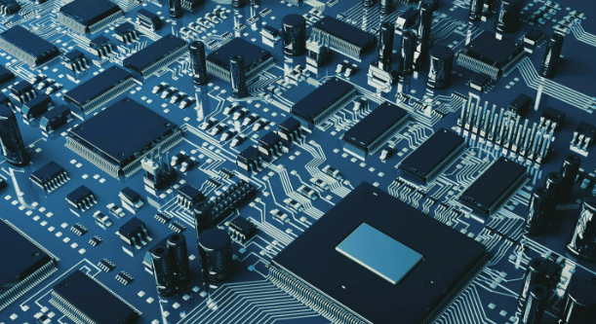
Semiconductors
Prepared by Group 2
Hamza Saqib (301432934)
Taryn Myddleton (301359363)
Mohammadali Guivehchian (301399976)
Christopher Regalado (301416431)
Prepared For BUS 417 D100 (Fall 2023)
Course Title: Equity Security Analysis
Section Number: D100
Lecturer: Geoffrey Poitras
Date of Submission: November 3, 2023

Slide 2
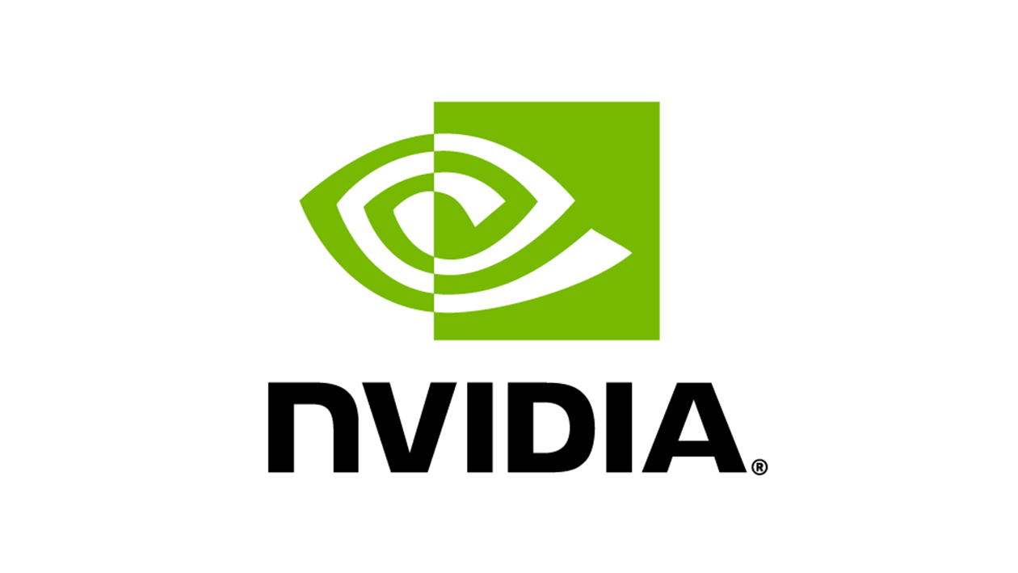

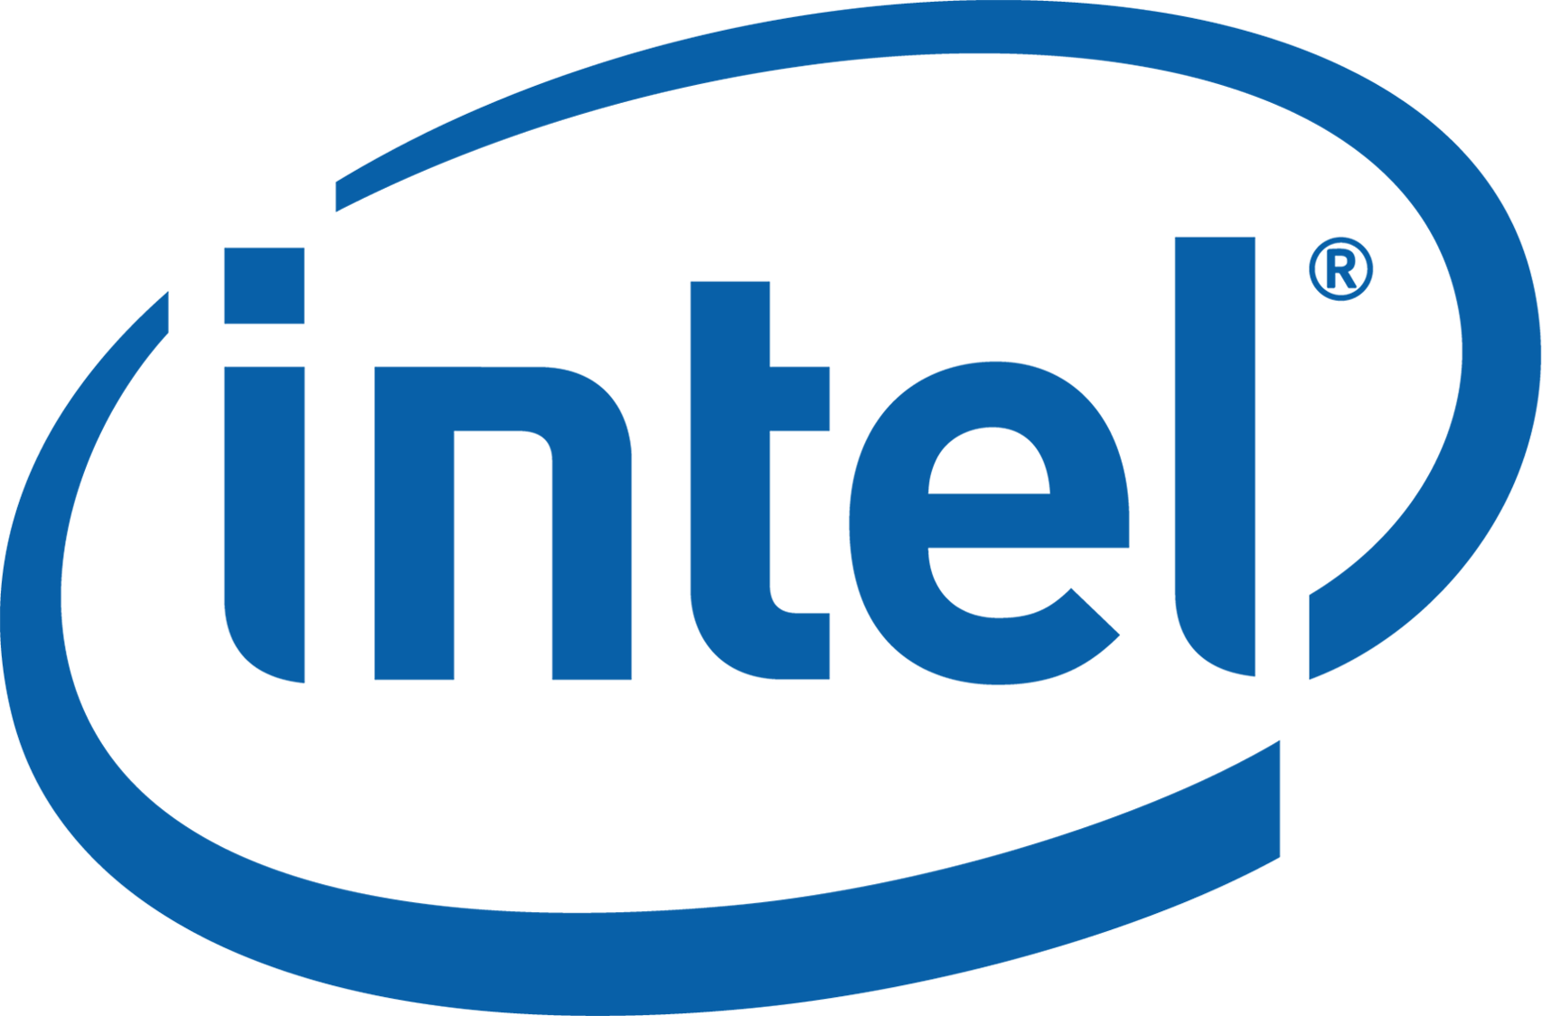
Overview
Analyst | Company / Sector | Rating
Hamza Saqib | Sector Overview | N/A
Taryn Myddleton |  | HOLD
Mohammadali Guivehchian |  | BUY
Christopher Regalado |  | SELL

Slide 3
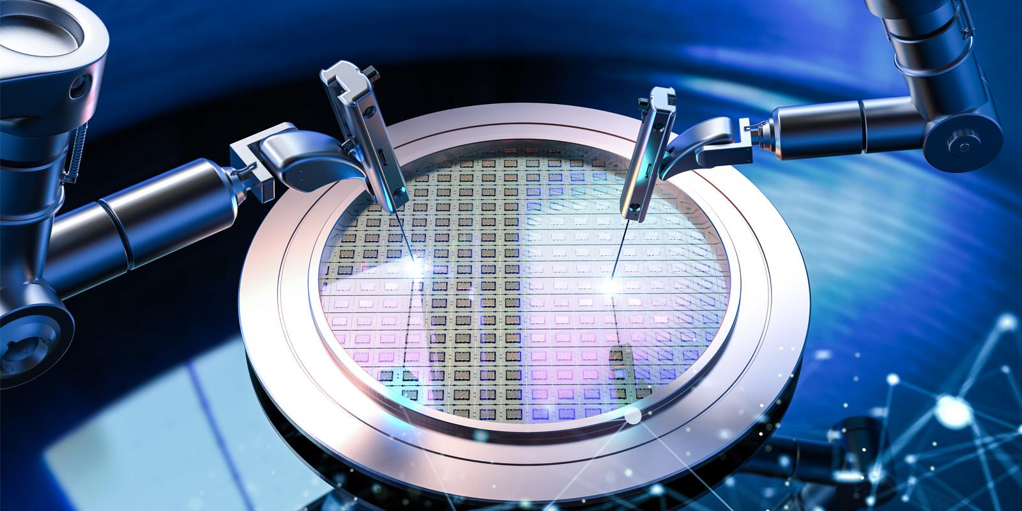
Sector Overview

Slide 4
What is a Semiconductor?
Materials used in electrical circuits that partially conduct electricity
Conducts electricity more than an insulator but less than a conductor
Brains of modern electronics
What is Wafer?
  Thin slice of semiconductor substance used in electronics for the making of integrated circuits
Examples of Semiconductor materials
Silicon (most commonly used)
Germanium
Gallium arsenide
Source: Investopedia (2023)

Slide 5
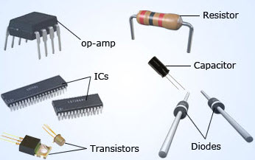
Semiconductor Products
Semiconductors can be categorized by the circuit board components that use them
Discretes
  Diodes, transistors, resistors, capacitors
Optoelectronics
  Displays, lamps
Sensors and actuators
Integrated circuits (ICs), “computer chips”
Source: WSTS (2018) Elprocus

Slide 6
Uses of Semiconductors
Memory chips
  Temporary storehouses of data
  RAM, ROM, NAND flash
Microprocessors
  Processing units that contain the basic logic to perform tasks
  CPU, GPU
Commodity integrated circuit (CIC) / Standard chips
  Chips used for performing repetitive processing routines
  Produced in large batches
  ASIC (application specific integrated chip), FPGA chips
Complex systems-on-a-chip (SOC)
  Single chip with an entire system's capability on it
Artificial intelligence (AI) chip
  Performs computations specifically for AI tasks
  Include CPUs, GPUs, FPGAs, ASICs specialized for AI
Source: Investopedia (2023)

Slide 7
Semiconductor Materials
Group IV of Periodic Table
  Made from a single element
  Carbon
  Silicon
  Germanium tin
Compound semiconductors
  Designed by chemical combination of two different elements
    Using groups III and V of periodic table
  Gallium Arsenide, Silicone Carbine
Organic semiconductors
  Contain polymer structures composed of carbon or hydrogen
Liquid Semiconductors
  Lack of structure
  Hydrogenated amorphous silicon
Source: TheEngineeringProject (2020)

Slide 8
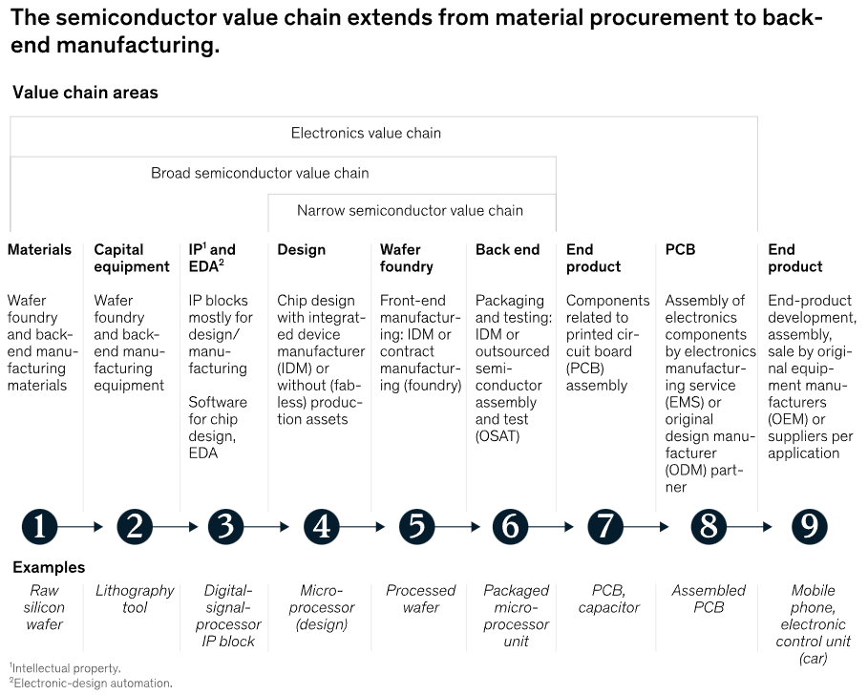
Semiconductor Value Chain
When all production phases are considered, entire process extends from material procurement to back end manufacturing
For each product segment, companies specialize in three or fewer steps
  The other activities are outsourced
Source: Mckinsey (2022)

Slide 9
Design and Manufacturing Methods
Photolithography
  Process where light is used to create a pattern on a surface, like a silicon wafer or chip
    Light is used to transfer a pattern onto a material
Electronic design automation
  Specialized software for designing electronic circuits
  AI/ML can be applied in EDA
Extreme Ultraviolet lithography
  State of the art lithography technique
Computational lithography
  Uses computers to help improve process of lithography
    Used to create more perfect images on microchips
Next generation lithography - lithography techniques that will replace current techniques
  X-ray techniques
  Electron beam lithography
Source: ASML (2023) Wikipedia (2023)

Slide 10
Design and Manufacturing Methods
Key Players
ASML HOLDING NV
  Largest supplier and sole supplier in the world of EUV machines required to manufacture the most advanced chips
  Used by TSMC, Samsung, Intel
Synopsys
  Leader in EDA software
Nvidia
  “Hopper architecture GPUs”
    Major development in computational lithography
    cuLitho is an AI based software library
    Enable semiconductor leaders (TSMC, Synopsys) to speed up manufacturing process
    Using NVIDIA Hopper Architecture GPUs
    cuLitho provides performance leap up to 40x beyond current lithography
    Enables 500 NVIDIA DGX H100 systems to achieve work of 40,000 CPU systems
    Speeds up production times and increases yield
Source: Guru3D (2023)

Slide 11
Chip Size
Key players:
5nm technology
Samsung began production in 2018
TSMC began production in 2019
3nm technology
TSMC and Samsung began production in 2022
2nm technology
TSMC, Samsung, and Intel announced they would start production in 2024-2025
Rapidus set target for production in 2027
Semiconductor size indicated in nanometers (nm)
14 and 10 nm are in mass production
Source: Versus (2023), Wikipedia (2023), Wikipedia (2023)

Slide 12
TSMC reportedly delay 2nm Production
Global demand for semiconductors continues to decelerate
TSMC delays its 2nm mass production schedule
  Originally planned to begin in 2025. It could now be postponed to 2026
TSMC currently building 3 new fabs in Taiwan to support its leap into 2nm production
Delay occurred due to slowdown and the result of decreasing orders as buyers are more cautious
Other chip makers may swoop in to capture TSMCs market share
Samsung starting 2nm mass production in 2025
Source: SourceEngine(2023)

Slide 13
Business Models
Foundry / Fab
Fabless
Integrated Device Manufacturer (IDM)
Manufacture and sell to other companies
Semiconductor devices like microchips or IC’s are manufactured on large scale
TSMC, Globalfoundries
Focus on marketing and product development
Outsource some or all of manufacturing
AMD, NVIDIA
60% of market
Manufacture, design and marketing
Both fab and fabless
Intel, Samsung
Source: Investopedia (2023)

Slide 14
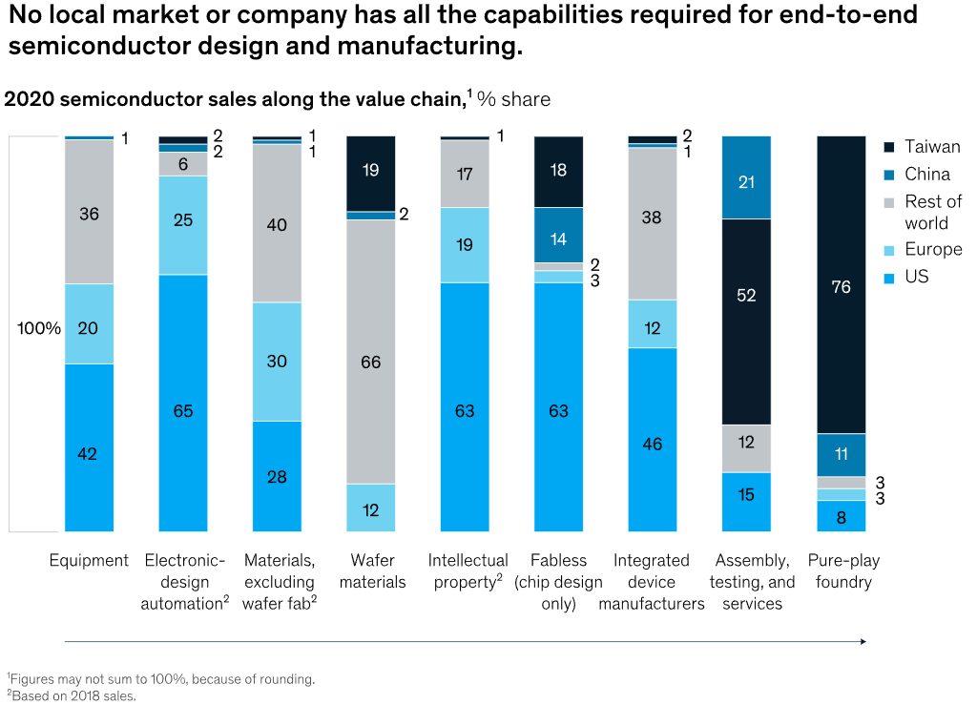
Business Models
Expertise is often concentrated in certain markets (for example, the United States has the highest presence of fabless players - chip design only)
No local market has all capabilities required for end to end design and manufacturing
Since semiconductor value chain is complex and specialized, the industry will remain highly interdependent
Source: McKinsey (2022)

Slide 15
Industry Characteristics
Moore's law
  Named after Gordon Moore, co founder of Intel
  States that number of transistors on microchip doubles every 2 years while cost per transistor decreases
  Computers more powerful, smaller and cheaper over time
Recurrent cycle
  Short product life
  Newer and faster applications are constantly being developed
Fierce competition in industry
Continuous technological innovations drive demand
Semiconductors are critical components of economy
Source: McKinsey (2022)

Slide 16
Global chip shortage
Causes
  COVID-19 pandemic
    Disruptions in supply chain
    Shift to stay at home economy increased demand for personal electronics
    Due to lockdown, chip production facilities were shut down leading to depletion of inventory
  China-United States Trade war
    U.S imposed restrictions on Chinese computer chips
    These restrictions forced companies to use other manufacturing plants like TSMC and Samsung, however, these companies were already producing at maximum capacity
  Severe weather
    Fires, droughts, storms forcing factory closures
    Severe winter storm forced closure of three plants in Austin, Texas owned by Samsung, Infineon and NXP due to loss of electricity
  Russe-Ukraine War
    Supply of neon and palladium severely constrained by Russian invasion of Ukraine
Source: TechRepublic (2023)

Slide 17
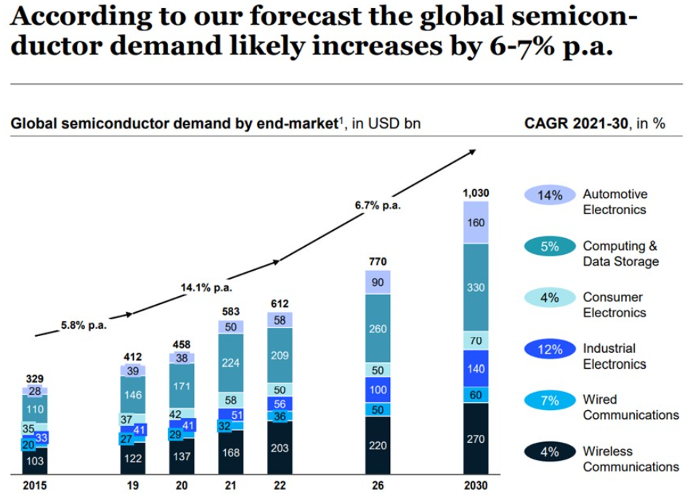
Market Analysis
Global semiconductor demand likely increases by 6-7% per annum
Automotive industry- Increased penetration on electric mobility
Second strongest growth: computing and data storage
Source: McKinsey (2022)

Slide 18
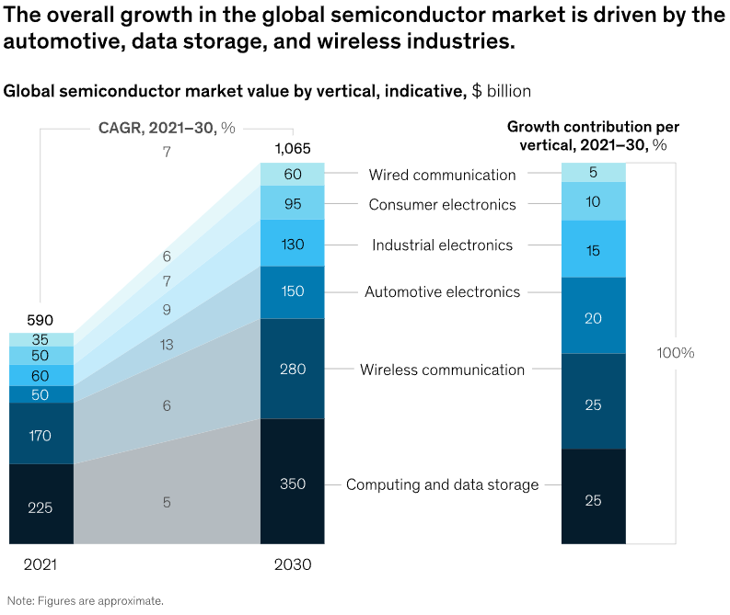
Market Analysis
Global semiconductor industry poised for a decade of growth. Projected to become a trillion dollar industry by 2030
70% of growth is predicted to be driven by 3 industries:
  Automotive, computation and data storage, and wireless
Automotive industry is strong. We could see tripling of demand fueled by applications such as autonomous driving and e-mobility
Growth of 4%-6% in computation and data storage due to demand for servers to support applications such as AI and cloud computing
Finally, wireless segment could account for majority expansion. Backed by growth in 5G
Source: McKinsey (2022)

Slide 19
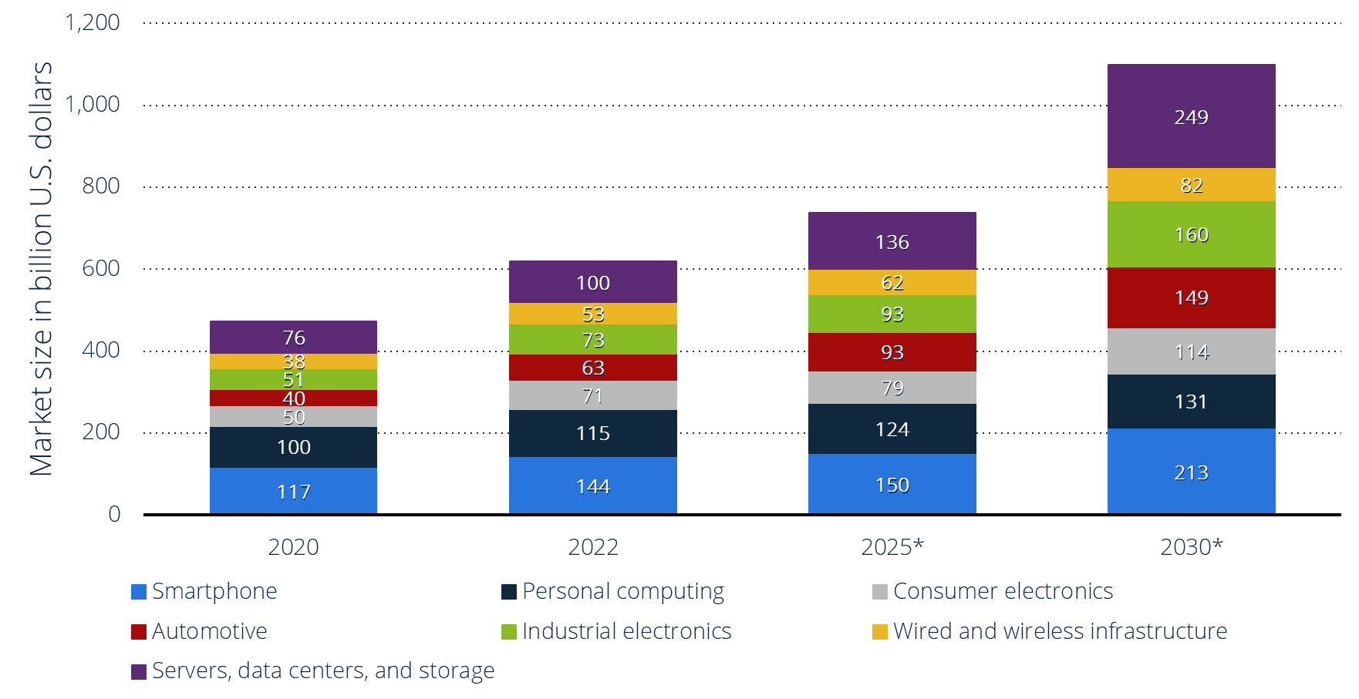
Market Analysis
Semiconductor market size worldwide 2020-2030, by application
By 2025, one of the leading application within global semiconductor is expected to be smartphones
  Due to development of image sensors
  Able to support technologies such as augmented reality (AR) and virtual reality (VR)
Source: Statista (2023)

Slide 20
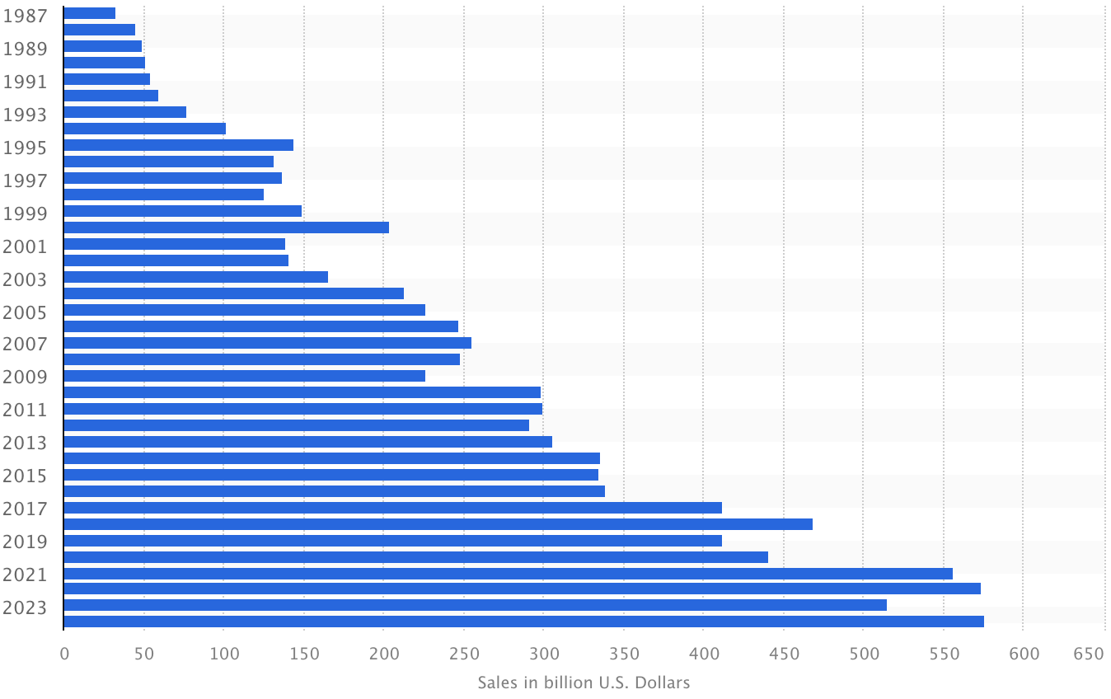
Market Analysis
Semiconductor industry sales worldwide 1987-2024
Global semiconductor revenue decline 10.3% in 2023
In 2023, sales were expected to reach $515.1 billion U.S. dollars
Source: Statista (2023)

Slide 21
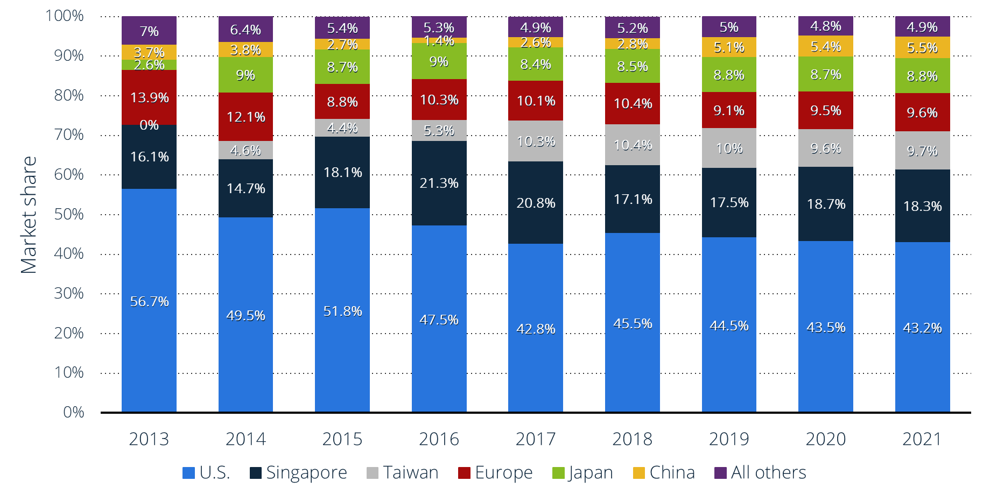
Market Analysis
Semiconductor manufacturing capacity worldwide 2013-2021, by region
In 2021, about 43% of U.S headquartered firms front end semiconductor capacity was located in the U.S.
Other locations that take up market share in the manufacturing capacity is Singapore, Taiwan, Europe, Japan and China
Source: Statista (2022)

Slide 22
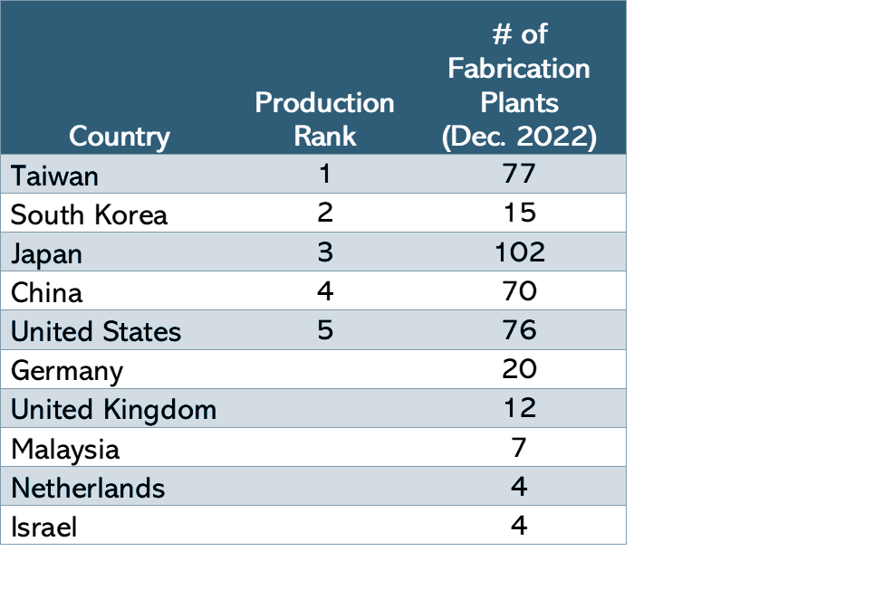
Manufacturing Capacity
Taiwan
  50% of global market - TSMC
  Manufactures for many companies like Apple, AMD, Nvidia, Qualcomm etc
  Foundry model
South Korea
  South Korea’s multinational Samsung Electronics corporation is one of largest technology companies in terms of revenue
  ID manufacturer (making semiconductors for use in its own products) and foundry
  17% global foundry market
Japan
  Home to more than 100 semiconductor fabrication plants
China
  Expected to produce up to 25% of world’s semiconductors
United States
  Possessed approximately 12% of global manufacturing capacity in 2021
  More than 46% of total semiconductor sales market
Source: World Population Review (2023)

Slide 23
Manufacturing Capacity
Foundry segment is expected to lead the semiconductor expansion
  $48.8 billion in investments
Memory is forecast to place second
  $28.2 billion in investments
Analog and power
  $9.7 billion in investments
BasBasi | Investments | YoY Increase
Taiwan | $24.9 billion | 4.2%
Korea | $21 billion | 41.5%
China | $16 billion
Americas | $11 billion | 23.9%
Europe & Mideast | $8.2 billion | 36%
Japan | $7.0 billion
Southeast Asia | $3.0 billion
Source: Semi (2023)

Slide 24
Industry Leaders
Intel - Dominated market for desktop and laptop CPUs
Qualcomm - Leader in smartphone system on a chip market
TSMC - Top manufacturer for chips at 10nm or below
ASML - Produces most lithography equipment
Samsung - Worlds biggest memory chip maker
SK Hynix - Second biggest memory chip maker
AMD - Known for gaming hardware
NVIDIA - Dominates market for graphic cards
Source: CNBC (2023) , McKinsey (2020)

Slide 25
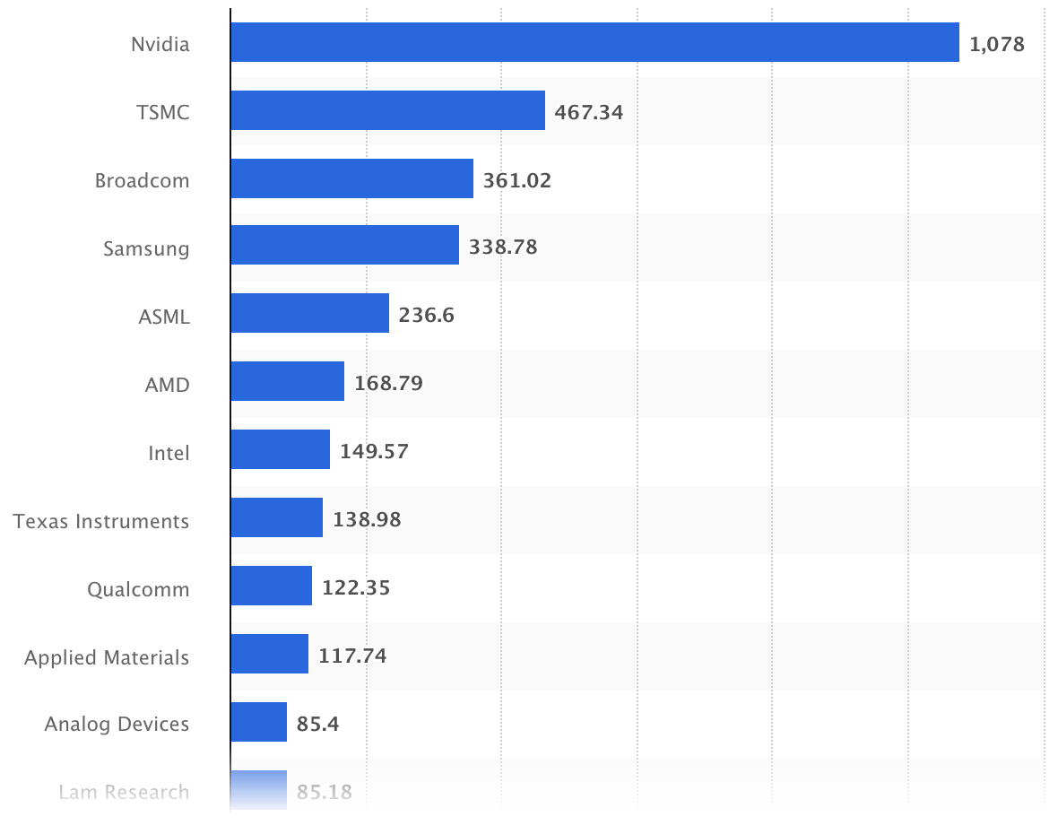
Industry Leaders
Leading semiconductor companies worldwide 2023, by market cap
NVIDIA ranked as one of leading semiconductor companies in terms of market cap
NVIDIA hit $1trillion market cap
Source: Statista (2023)

Slide 26
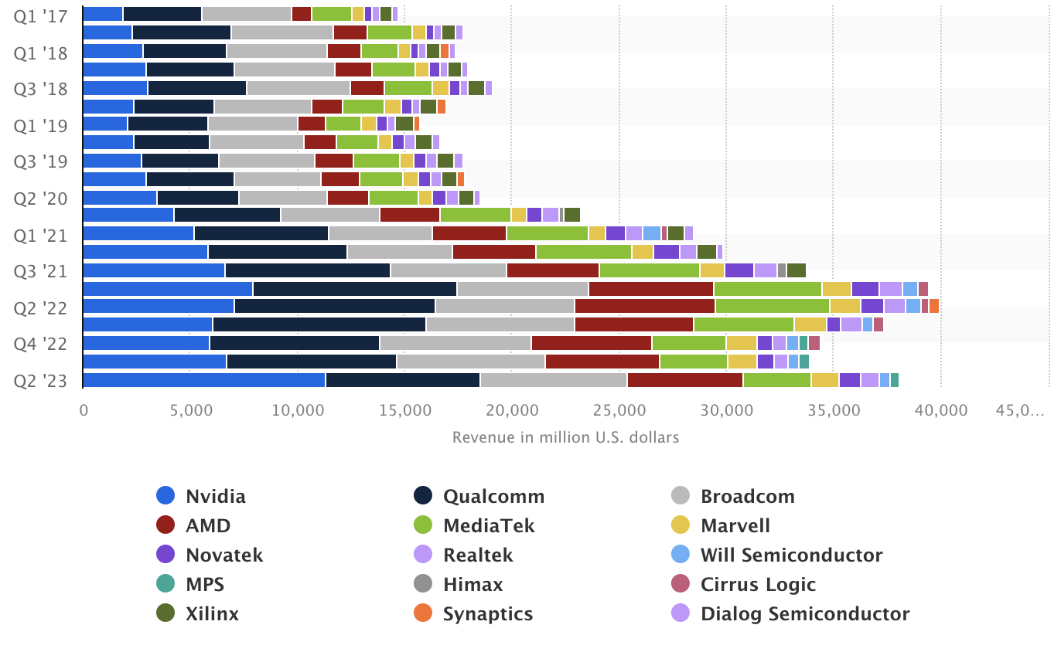
Industry Leaders
IC design companies revenue worldwide 2017-2023, by quarter
In second quarter of 2023, the leading IC design companies worldwide is Nvidia with a revenue of about 11.3 billion U.S. dollars
  NVIDIA solutions are being deployed for accelerated computing and generative AI applications like ChatGPT
Qualcomm ranked second with revenue of 7.2 billion U.S. dollars
Specifically to fabless companies
Source: Statista (2023)

Slide 27
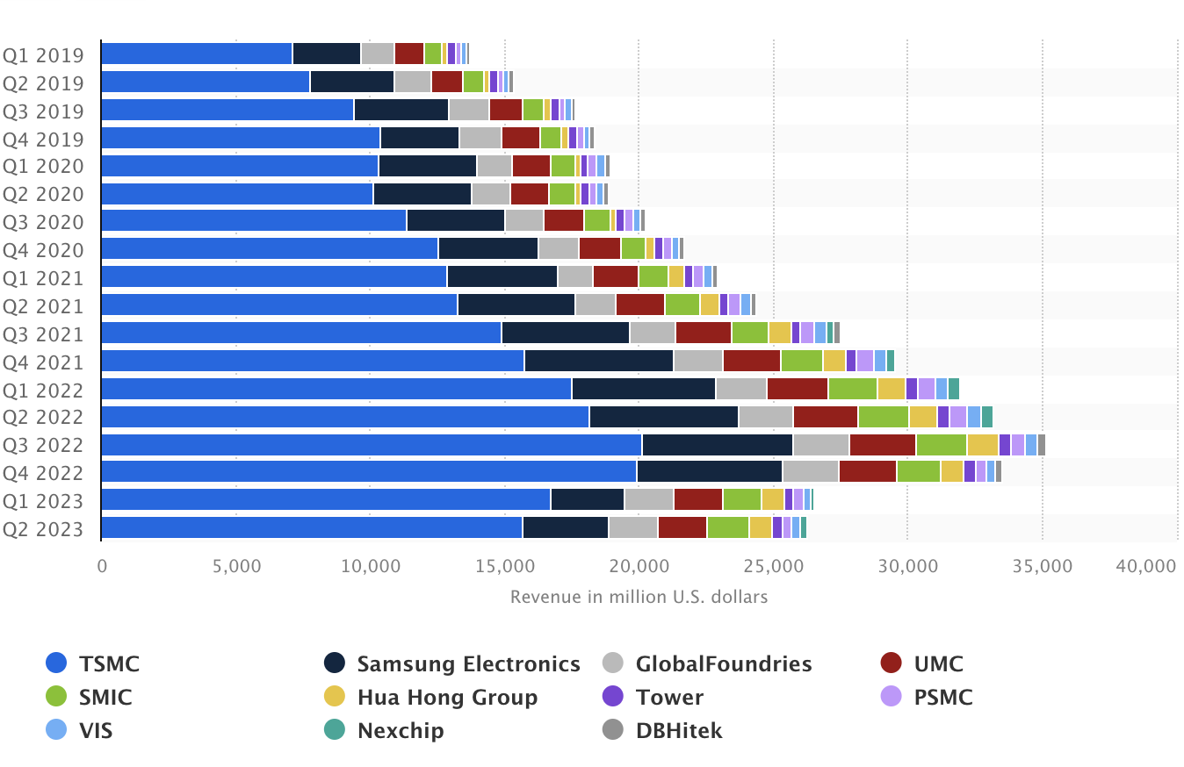
Industry Leaders
Leading semiconductor foundries revenue worldwide 2019-2023, by quarter
In second quarter of 2023, Taiwan Semiconductor generated about 15.66 billion U.S. dollars in revenue
Samsung made 3.23 billion U.S. dollars
Source: Statista (2023)

Slide 28
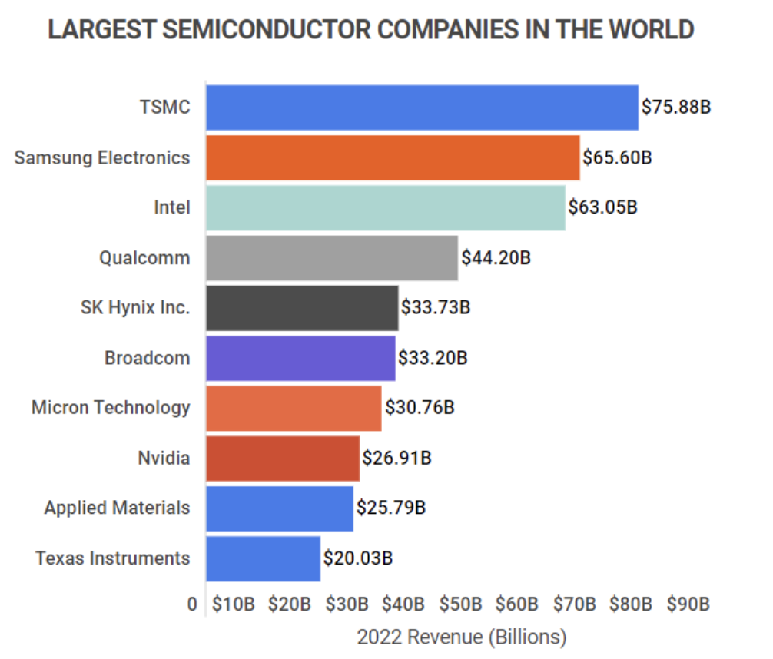
Industry Leaders
Leading semiconductor companies in the world 2022, by revenue
TSMC has grown rapidly since 1994, with compound annual growth rate (CAPG) of 17.4%
The runner up is Samsung Electronics with a revenue of $65.6 billion
Source: Zippia (2023)

Slide 29
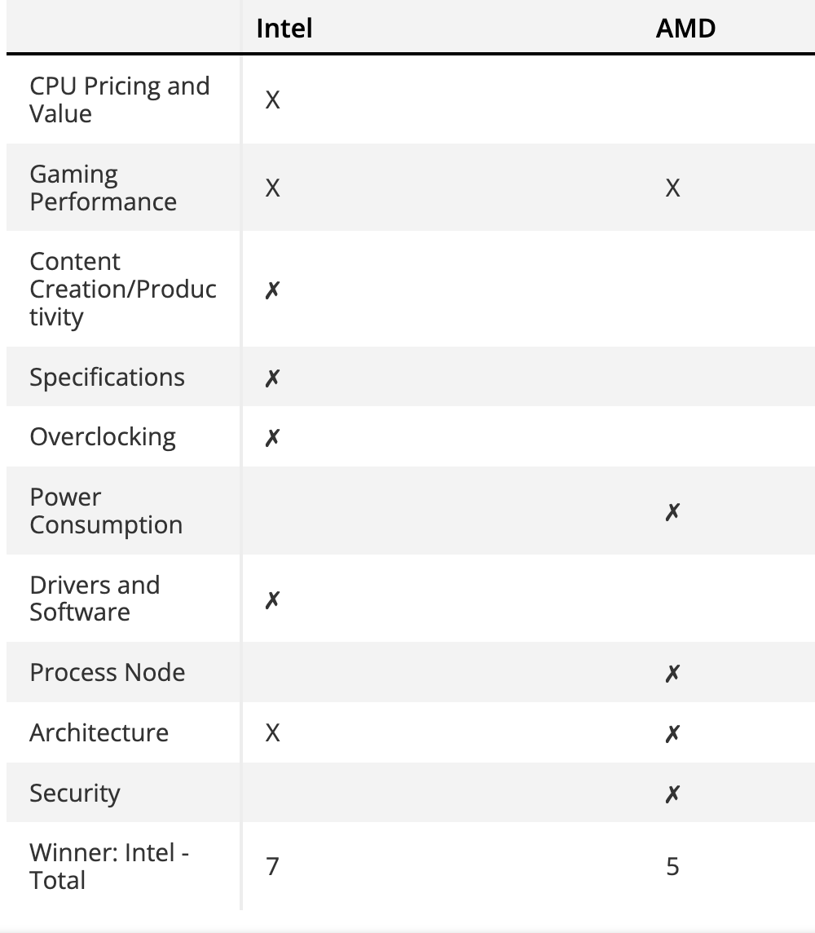
Chip Comparison (CPUs)
Intel
  Leads market for CPUs
  Raptor Lake, Core i9, i7, i5, Celeron, Atom, Pentium, Xeon
AMD
  Specialized X3D CPUs wins for PCs focused on gaming
  Ryzen 7000 series
Intel has the fastest overall chips in the market at an accessible price point
Source: Tomshardware (2023)

Slide 30
Chip Comparison (GPUs)
Dedicated GPU
  Wholly separate from the CPU and has its own dedicated memory
  Deliver better performance but uses more power and costs more
  Commonly found in desktops than laptops
Integrated GPU
  Does not come on its own separate card
  Embedded alongside CPU
  Perfect for handling most everyday tasks
Dedicated GPU
  NVIDIA leads the market
  AMD is top competitor
Integrated GPU
  Intel leads the market
Source: GPUCheck(2023)

Slide 31
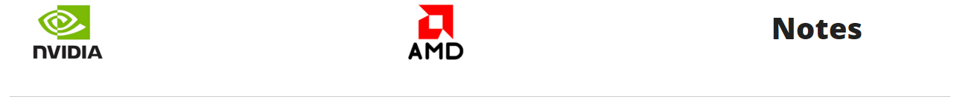
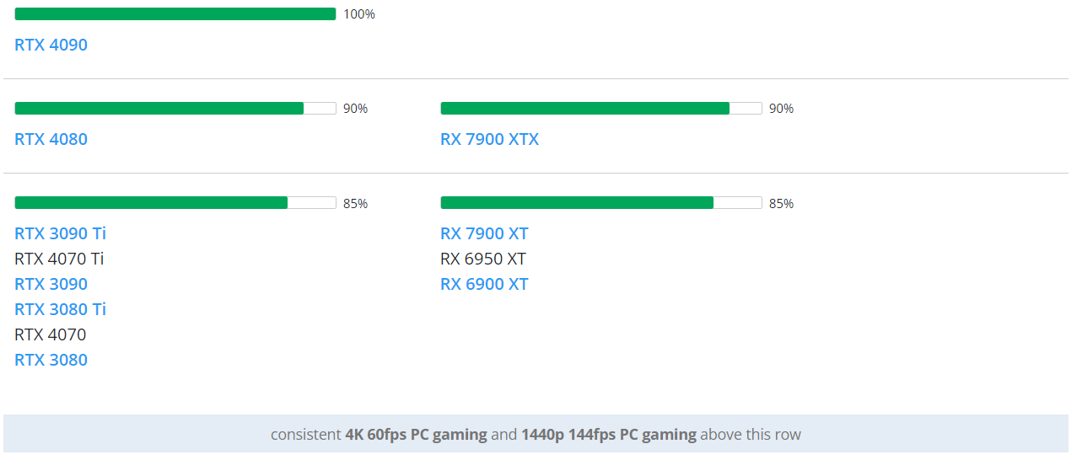
Chip Comparison
Best GPU is NVIDIA’s RTX 4090
Next best is AMD's RX 7900 XTX (90% compared to RTX 4090)
Source: LogicalIncrements (2023)

Slide 32
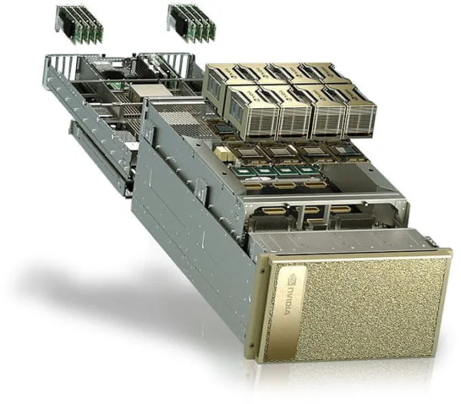
Chip Comparison (AI Chips)
NVIDIA
  Dominated market for AI GPUs
  DGX systems, H100 GPUs, Hopper chips
AMD
  Instinct MI300, expected to launch this year
Intel
  Falcon Shores GPU expected to release in 2025
NVIDIA DGX Systems
Source: CNBC (2023), Barrons (2023)

Slide 33
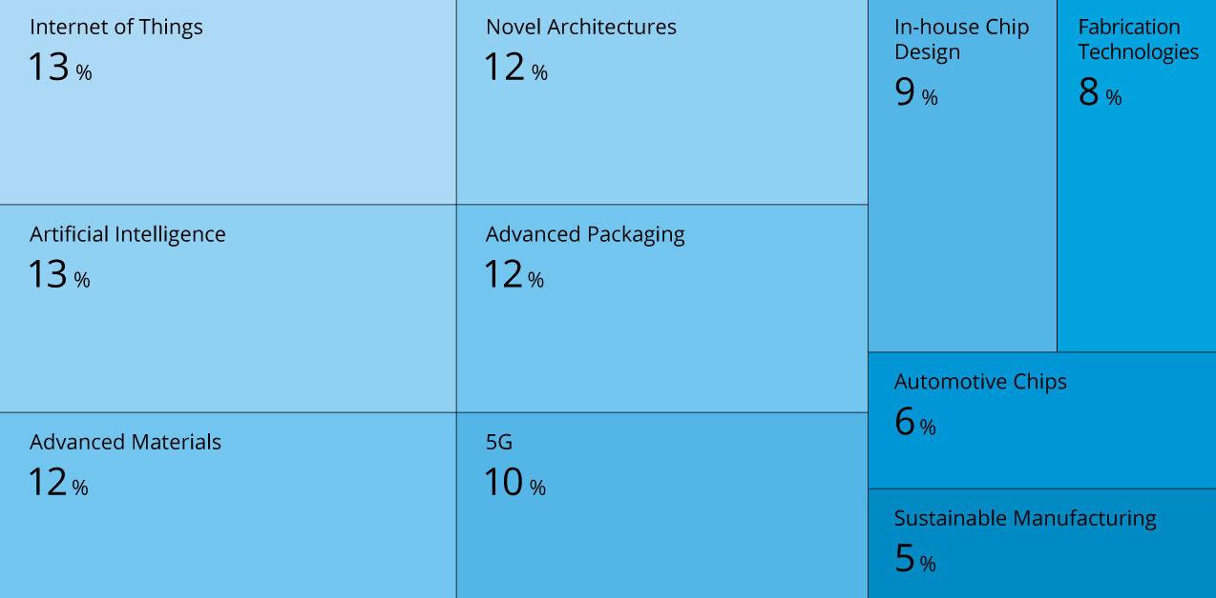
Semiconductor Trends
Tree map illustrates the top 10 innovation trends and their impact on semiconductors
Key Trends
Connectivity and mobility
  5G mobile networks, autonomous vehicles, energy efficiency
Computing accelerators
  GPUs which were in demand among video game enthusiasts and cryptocurrency miners are now needed for data centers as AI is adopted across the economy
Artificial Intelligence
  Application of AI and ML has become fundamental semiconductor industry driver
Advancements in areas such as nanotechnology, advanced packaging and materials science will drive the industry’s future growth and competitiveness
Source: StartUs Insights (2023) , The Motley Fool (2023)

Slide 34
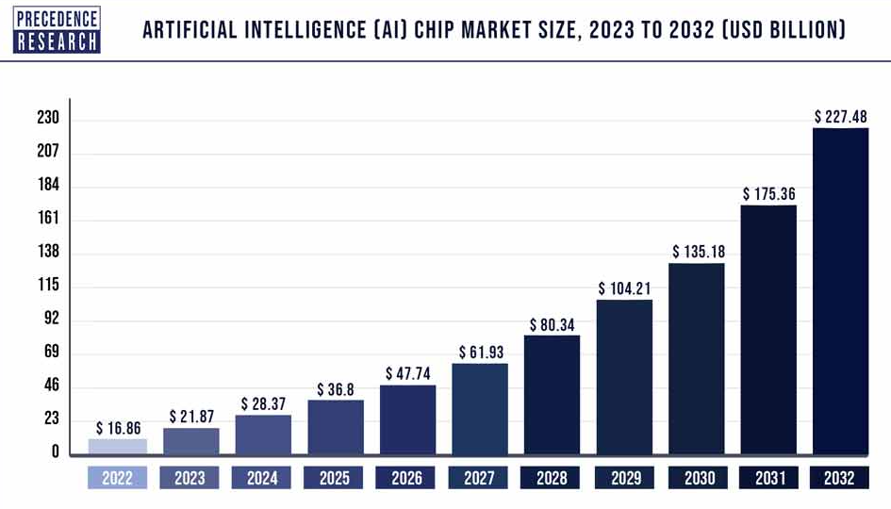
Semiconductor Trends
Compound annual growth rate (CAGR) of 29.72% from 2023 to 2032
North America will lead the global AI chip market during the forecast period 2023 to 2032
Key Players
NVIDIA
General Vision
Amazon
Google
Microsoft
AMD
Apple
Source: Precedence Research (2023)

Slide 35
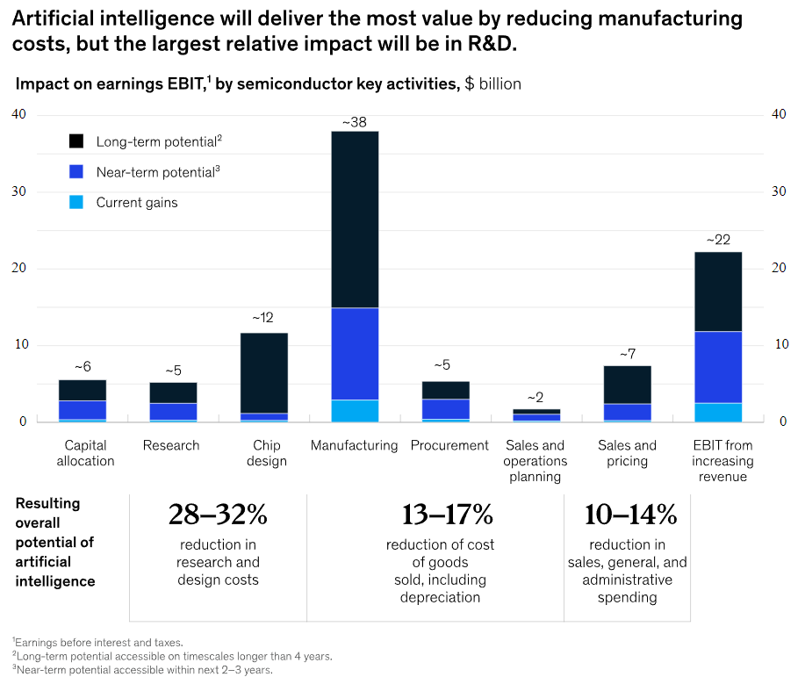
Semiconductor Trends
As companies attempt to increase productivity within research, chip design, and manufacturing while simultaneously accelerating time to market, AI/ML is becoming an important tool along the value chain
Industry wide, manufacturing will accrue the most value from AI/ML
Greatest relative spend reduction will occur in research and design, primarily resulting from automation of chip design and verification
Source: McKinsey (2021)

Slide 36
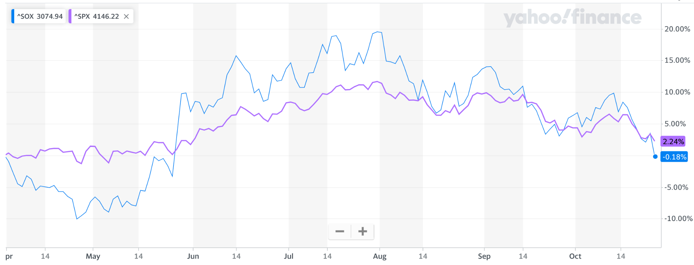
Stock Performance
SOX is in blue and SPX is in purple
In the past couple months, the semiconductor industry has done fairly well compared to the S&P 500
Source: Yahoo Finance (2023)

Slide 37
Nvidia Corp.
NASDAQ: NVDA

Slide 38
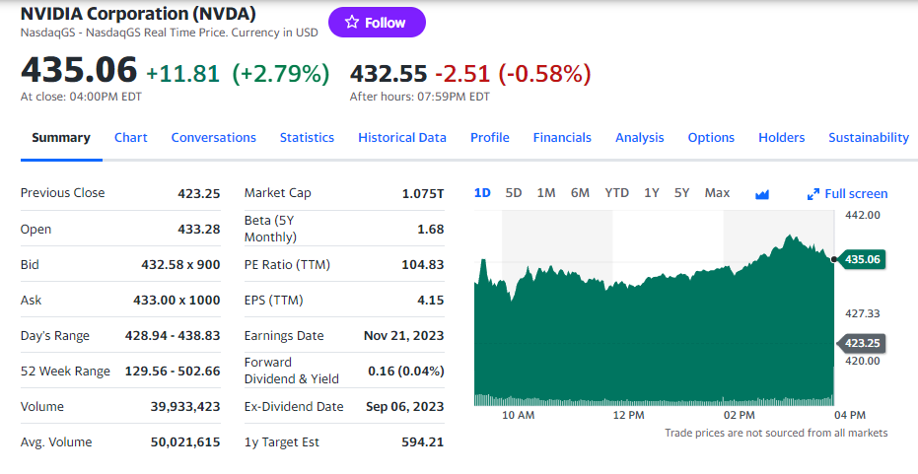
Key Metrics - Nvidia Corp.

Slide 39
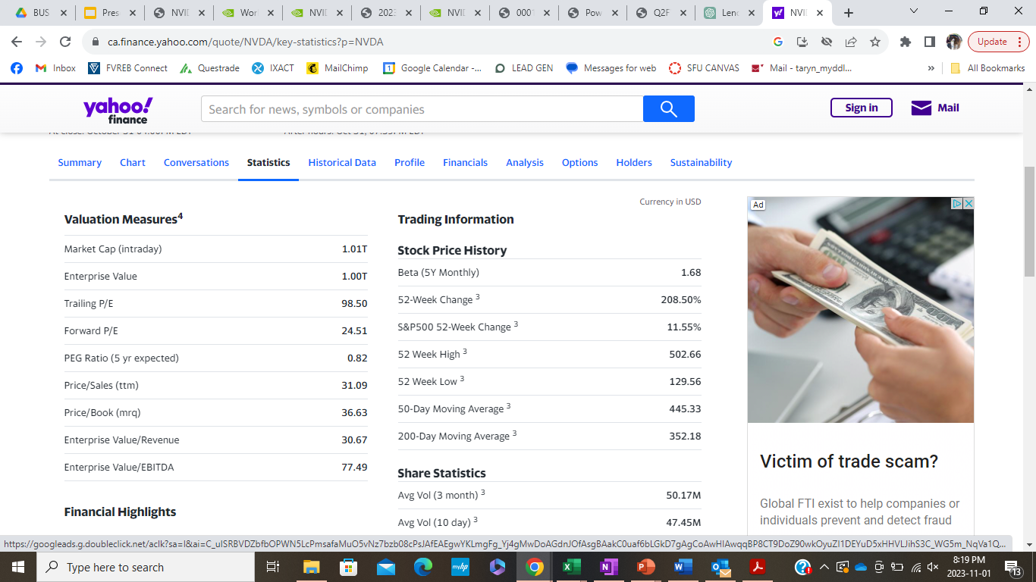
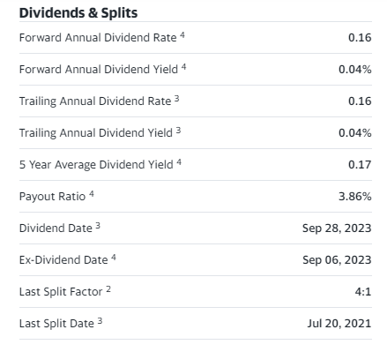
Key Metrics - Nvidia Corp.

Slide 40
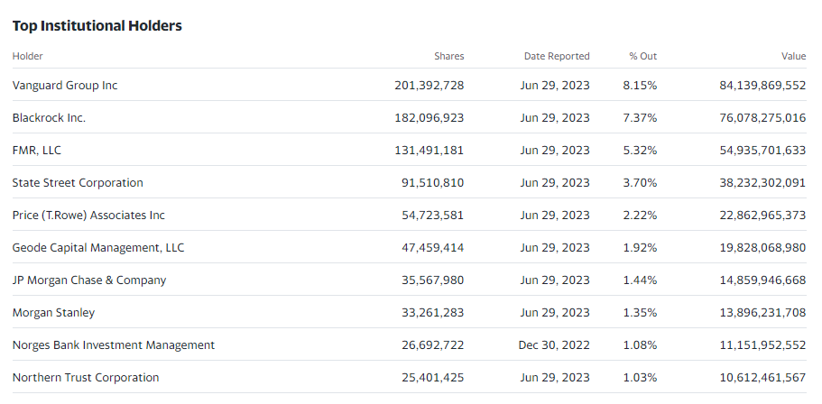
Institutional Shareholders

Slide 41
Price Charts

Slide 42
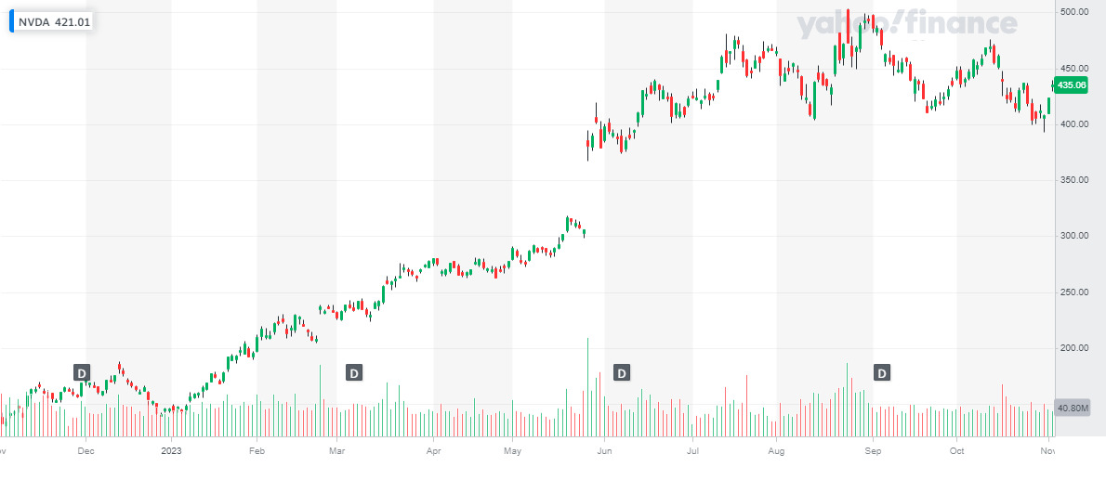
1 Year Stock Performance
Notes:
https://finance.yahoo.com/video/nvidia-faces-5b-hit-u-145503328.html
$5Billion Hit, US china restrictions

Slide 43
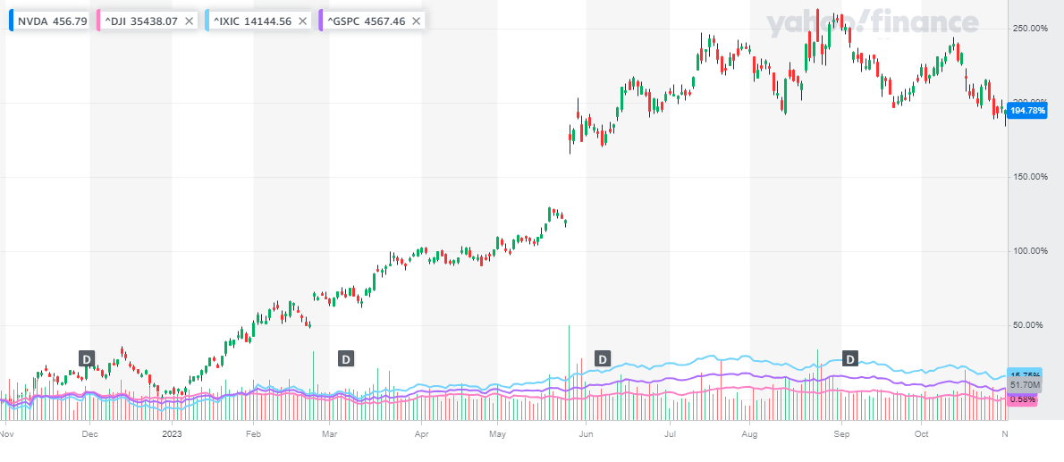
1 Year Stock Performance Against Indices

Slide 44
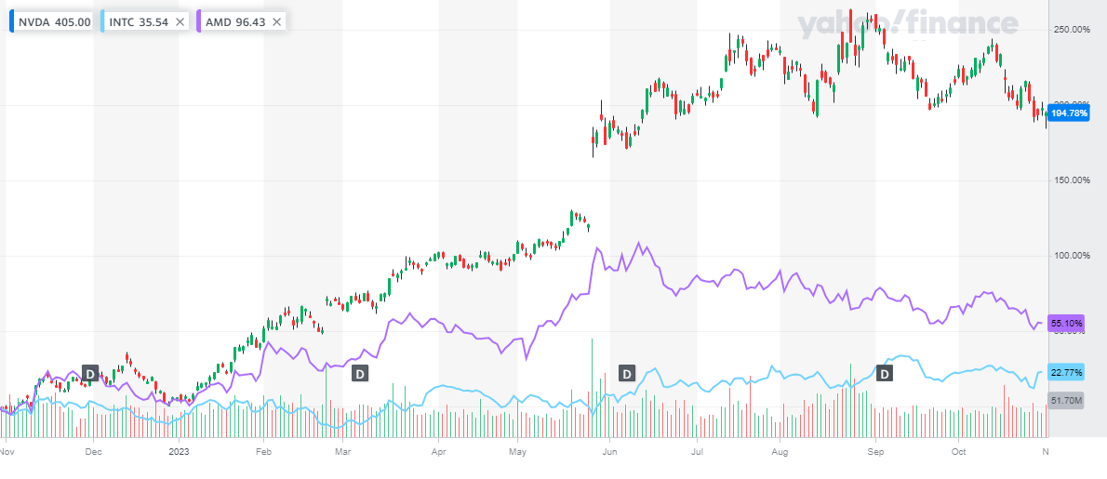
1 Year Stock Performance Against Competitors

Slide 45
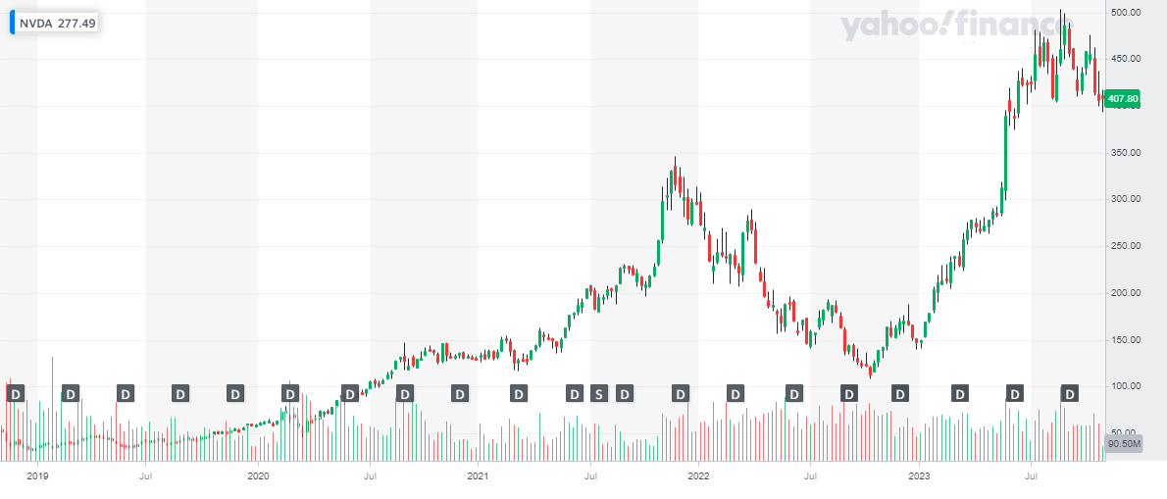
5 Year Stock Performance

Slide 46
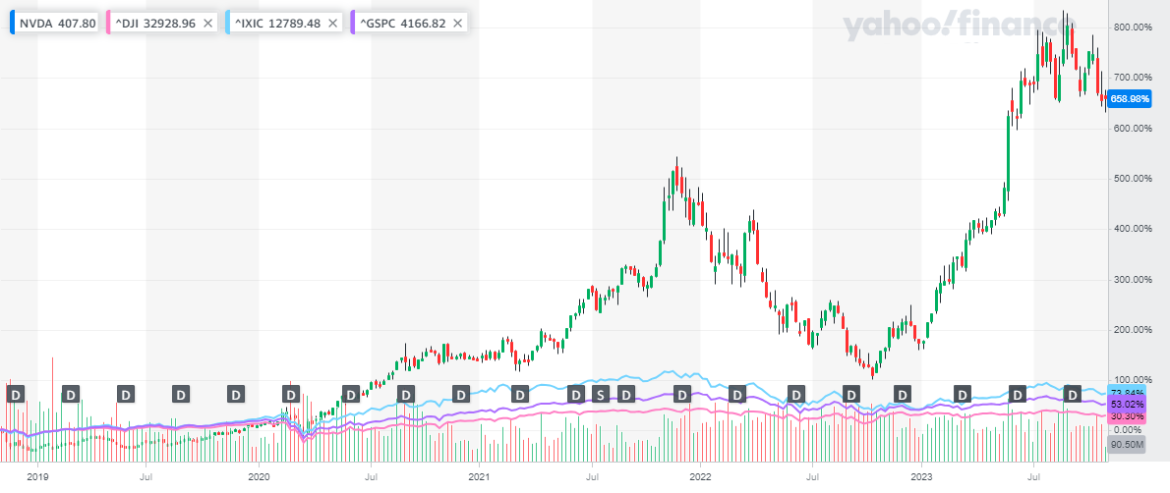
5 Year Stock Performance Against Indices

Slide 47
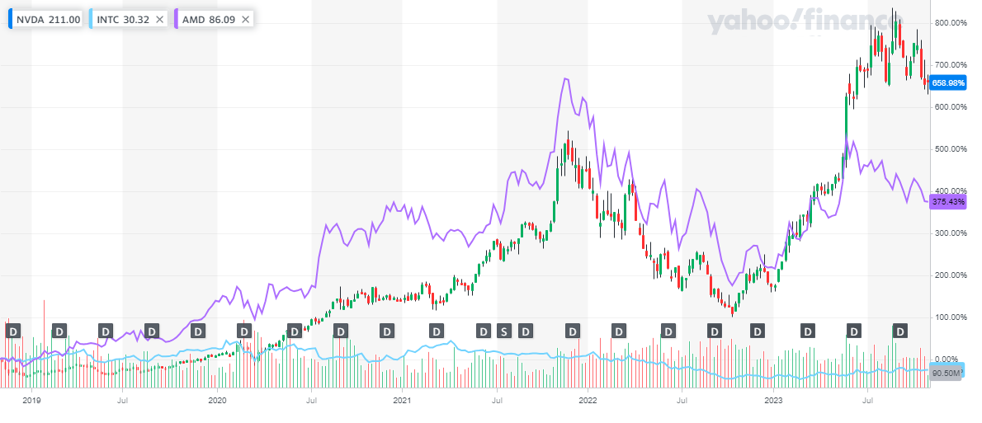
5 Year Stock Performance Against Competitors

Slide 48
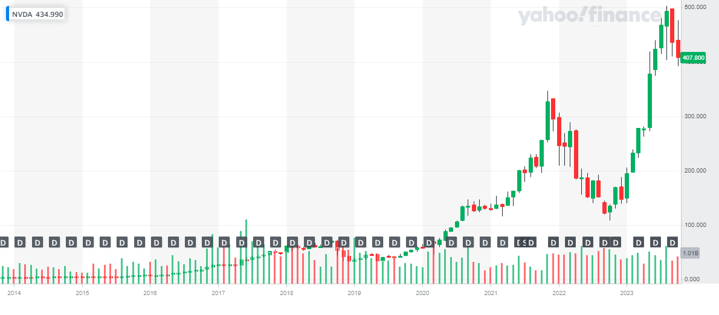
10 Year Stock Performance

Slide 49
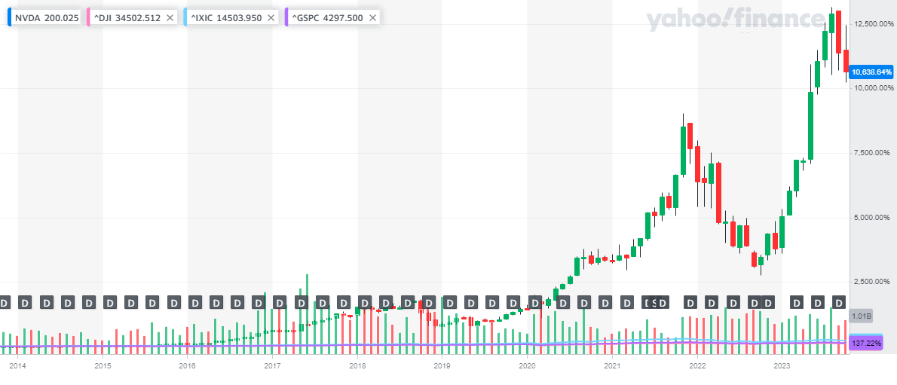
10 Year Stock Performance Against Indices

Slide 50
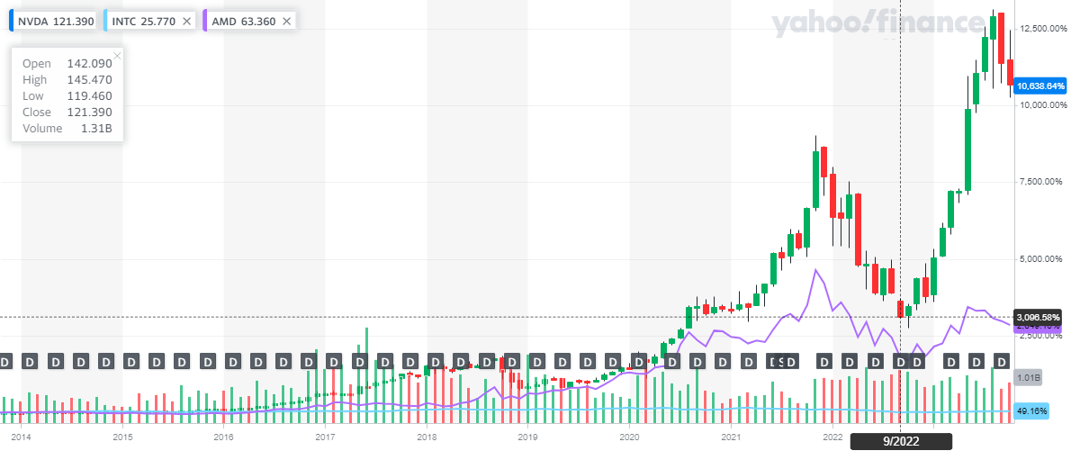
10 Year Stock Performance Against Competitors

Slide 51
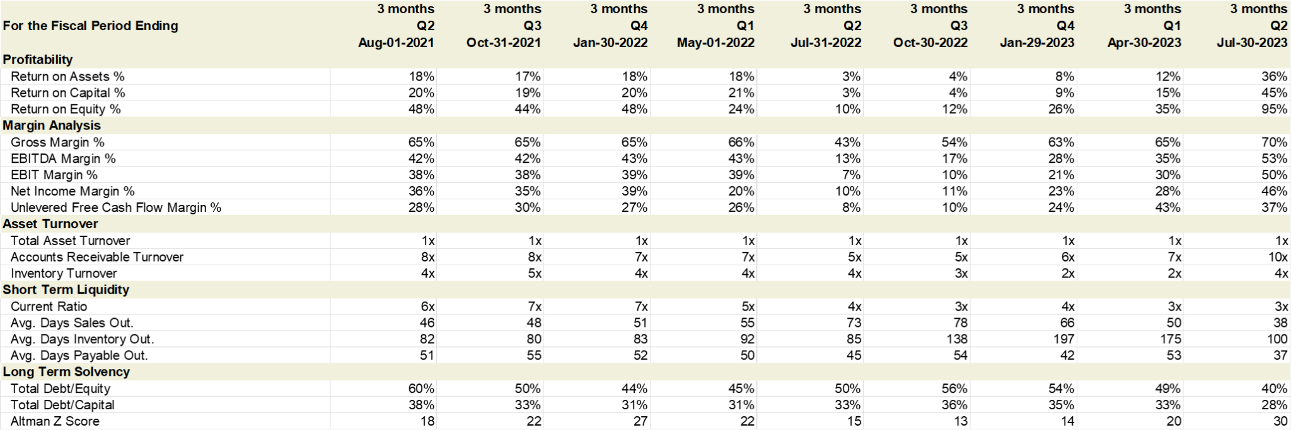
Ratios
Source: S&P Capital IQ

Slide 52
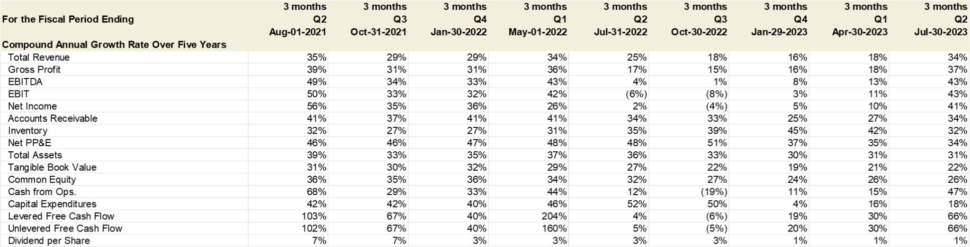
CAGR Over Five Years
Source: S&P Capital IQ

Slide 53
Company Overview

Slide 54
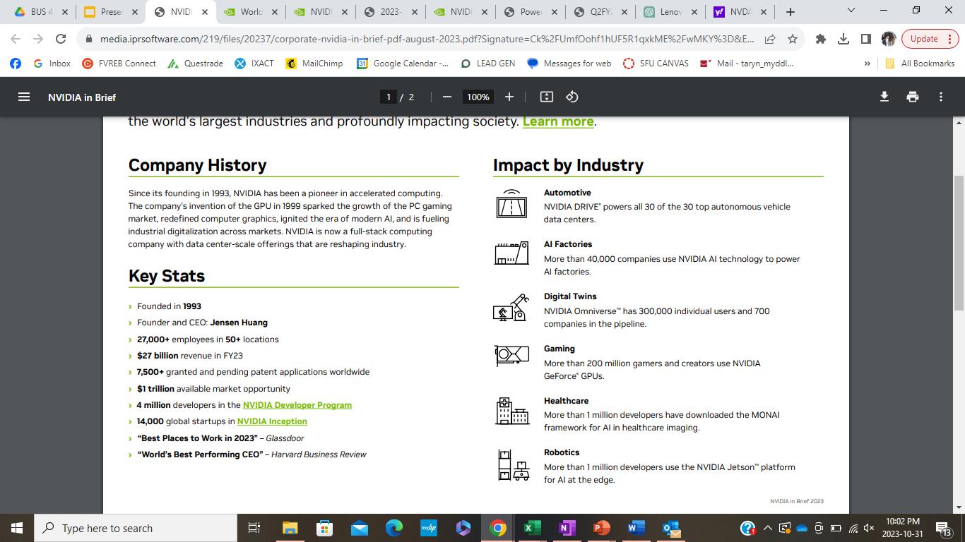
Company Overview - Nvidia Corp.
Notes:
NVIDIA is a technology company primarily known for its Graphics Processing Units (GPUs) for gaming and professional visualization tools. Founded in 1993, the company has expanded its focus beyond GPUs to include AI computing, data center solutions, and automotive market technologies. NVIDIA's GPUs are essential for a range of applications, from video games to machine learning and data science. The company has been a key player in the rise of artificial intelligence, offering specialized hardware and software solutions for AI applications. NVIDIA has been strengthening and building partnerships with various industries and companies, like Lenovo, google cloud and Foxconn to provide end-to-end AI solutions. Their technology is ubiquitous, powering everything from accelerated computing to self-driving cars, and they continue to be at the forefront of technological innovation.

Slide 55
Timeline
Nvidia acquired Exluna for an undisclosed sum. Exluna made software-rendering tools and the personnel were merged into the Cg project.
Nvidia's first chip, the NV1, and cost $10 million to develop--money was raised from Sequoia Capital and Sutter Hill Ventures.
1995
2002
1993
1999
Founded by Jensen Huang, Chris Malachowsky, and Curtis Priem, with a vision to bring 3D graphics to the gaming and multimedia markets.
Invents the GPU, the graphics processing unit, which sets the stage to reshape the computing industry.
IPO Offering
Notes:
Founded in 1993, the first chip was produced in 1995 for $10 Million.
1999: Nvidia made its IPO

Slide 56
Timeline
Opens parallel processing capabilities of GPUs to science and research with unveiling of CUDA® architecture.
Sparks the era of modern AI by powering the breakthrough AlexNet neural network.
2006
2012
2003
2007
Nvidia acquired MediaQ for approximately US$70 million.
NVIDIA was honoured as Company of the Year by Forbes magazine for its rapid growth and success.

Slide 57
Timeline
Honoured as Company of the Year by Forbes magazine for its rapid growth and success.
Reinvents computer graphics with NVIDIA RTX™, the first GPU capable of real-time ray tracing.
Plays a foundational role in the building of the metaverse, the next stage of the internet, with the NVIDIA Omniverse™ platform.
2018
2022
2014
2019
Nvidia has diversified its business focusing on three markets: gaming, automotive electronics, and mobile devices.
Nvidia announced new RTX Studio laptops.

Slide 58
Notable Acquisitions
Mellanox Technologies
Main Business: Cloud Computing and Networking
Acquisition Price: $6.9 billion
Date Acquired: March 11, 2019
Hybrid Graphics
Main Business: Graphics Software
Acquisition Price: Undisclosed
Date Acquired: March 22, 2006
3dfx Interactive
Main Business: Graphics Chips
Acquisition Price: $70 million cash and one million shares of common stock
Date Acquired: April 2002
MediaQ
Main Business: Graphics Chips
Acquisition Price: $70 million
Date Acquired: Aug. 4, 2003
Notes:
Growth through acquisitions

Slide 59

Failed Acquisitions
ARM Limited
Main Business: IP Solutions for CPU, GPU, & NPUs
Acquisition Price: $40 billion
U.K. Based Company, to be acquired from SoftBank
Failed due to regulatory concerns and pushback in: USA, U.K., E.U, and China.
Nvidia did not secure regulatory approval.
Deal was terminated February 2022. Nvidia had to pay $1.25 Billion to SoftBank to break the agreement.
Notes:
Initial Announcement: Nvidia announced plans to acquire ARM from SoftBank for $40 billion in September 2020.
Regulatory Concerns: Authorities in the U.S., U.K., EU, and China raised antitrust concerns about the deal, fearing it would stifle competition in the semiconductor industry.
Industry Opposition: Companies like Google, Microsoft, and Qualcomm opposed the acquisition, citing concerns over fair access to ARM's chip designs.
National Security: The U.K. government intervened, citing national security concerns, as ARM is a U.K.-based company.
Extended Review Periods: Regulatory bodies extended their review periods multiple times, delaying the acquisition process.
Failed to Gain Approval: By 2022, Nvidia was unable to secure the necessary regulatory approvals to proceed with the acquisition.
Deal Termination: Nvidia and SoftBank officially announced the termination of the acquisition deal in February 2022.
Break-up Fee: Nvidia had to pay SoftBank a $1.25 billion break-up fee as per the initial agreement.
ARM's Future: Post-termination, SoftBank announced plans to take ARM public.

Slide 60
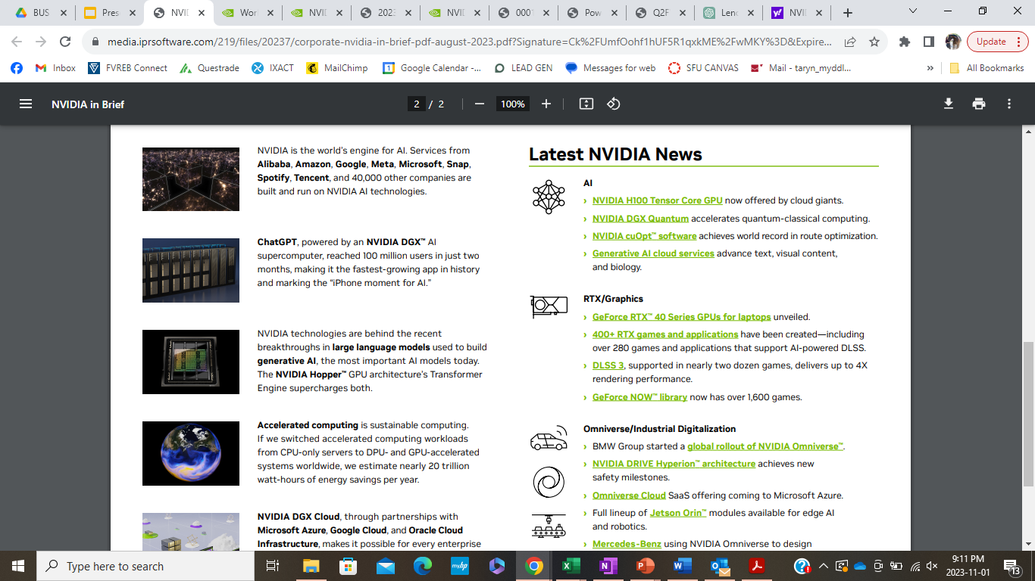
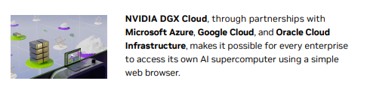
Business Segments & Applications
Notes:
Source: https://s201.q4cdn.com/141608511/files/doc_financials/2024/q2/nvda-f2q24-investor-presentation-final-1.pdf

Slide 61
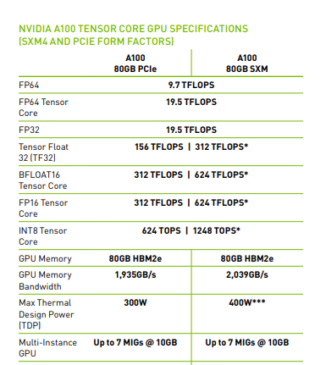
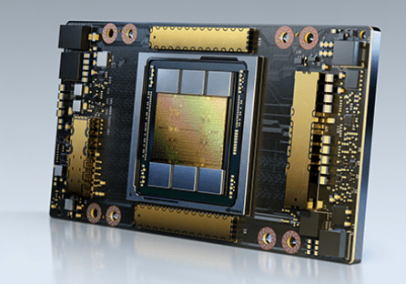
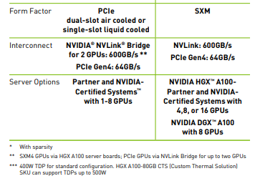
AI Products: A100 Tensor Core GPU
Notes:
Ideal for giant AI and HPC applications like Gen AI,
deep recommenders, and vector databases. Utilized in google cloud partnership for accelerated computing.

Slide 62
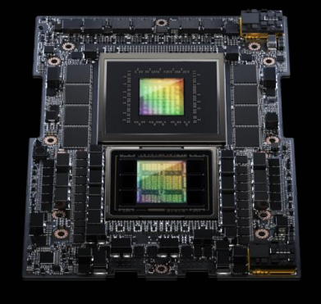
AI Products: Grace Hopper CPU & H100 GPU
GH200 Grace Hopper Superchip combines our first
Arm-based Grace CPU with an H100 GPU
Using NVIDIA NVLink-C2C interconnect at 900GB/s
(7X faster than PCIe Gen5), it delivers a CPU+GPU
coherent access to over 600GB of memory
GH200 delivers order-of-magnitude speed-ups
compared to x86 CPUs
  • 9X for vector databases
  12X for deep recommender inference
  284X for LLM (65B parameter) inference
Available now from leading server manufacturers
NVIDIA and SoftBank are collaborating on a platform
based on GH200 for Gen AI and 5G/6G
The NVIDIA H100 is an integral
part of the NVIDIA data center
platform. Built for AI, HPC, and data
analytics, the platform accelerates
over 3,000 applications, and is
available everywhere from data
center to edge, delivering both
dramatic performance gains and
cost-saving opportunities.
Notes:
SOurce: https://www.nvidia.com/content/dam/en-zz/Solutions/Data-Center/a100/pdf/nvidia-a100-datasheet-nvidia-us-2188504-web.pdf

Slide 63
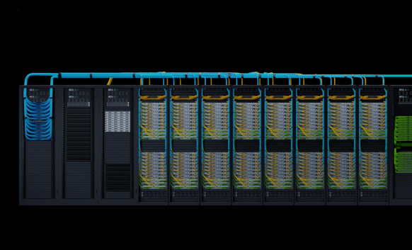
AI Products: DGX GH200 AI Supercomputer AI
DGX GH200 AI Supercomputer
DGX GH200 is a new class of large-memory AI
supercomputer powered by 256 NVIDIA GH200 Grace
Hopper Superchips and the NVIDIA NVLink Switch System,
with massive, shared memory space.
1 exaflop of performance and 144TB of shared memory
for giant next-gen Gen AI language models, recommender
systems and data analytics workloads
The NVIDIA NVLink Switch System enables all 256 GPUs
in a DGX GH200 to work together as one
Google Cloud, Meta and Microsoft are among the first
to gain access to the DGX GH200
DGX GH200 supercomputers are expected to be available
by the end of calendar 2023
Notes:
Ideal for giant AI and HPC applications like Gen AI,
deep recommenders, and vector databases. Utilized in google cloud partnership for accelerated computing.

Slide 64
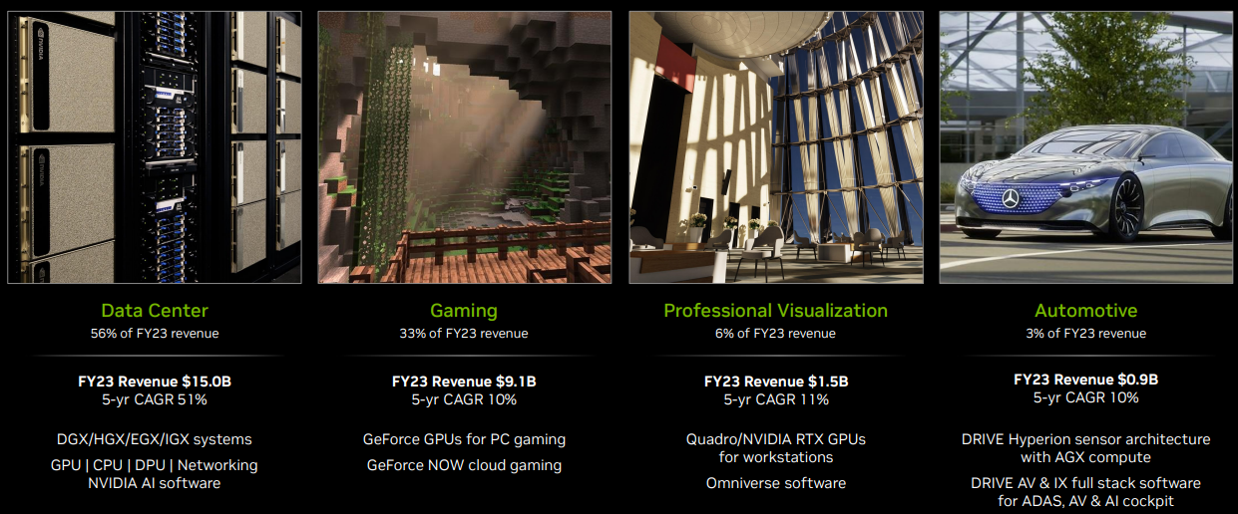
Revenue by Business Segment
Notes:
Source: https://s201.q4cdn.com/141608511/files/doc_financials/2024/q2/nvda-f2q24-investor-presentation-final-1.pdf
NVIDIA's flagship products primarily fall into the following categories:
GeForce GPUs: These are designed for gaming and are among the most popular GPUs in the consumer market. The latest in this line as of my last update is the GeForce RTX 30 series, which includes models like the RTX 3090, RTX 3080, and RTX 3070.
Quadro GPUs: Aimed at professionals in design, content creation, and scientific research, these GPUs offer high performance and reliability.
Tesla GPUs: These are designed for data centers and for use in high-performance computing environments. They are not for gaming but are used in supercomputers and servers.
NVIDIA DGX Systems: These are AI supercomputers featuring NVIDIA's most advanced data center GPUs, designed for machine learning and AI research.
Tegra Processors: These are mobile processors used in smartphones, tablets, automotive applications, and the Nintendo Switch gaming console.
NVIDIA Drive: This is an AI platform designed for self-driving cars, featuring both hardware and software components.
NVIDIA Jetson: This platform is designed for edge computing in devices like drones and industrial robots.
NVIDIA Shield: This is a range of streaming devices for home entertainment, including Shield TV and Shield Tablet.
NVIDIA AI Enterprise Software: This is a comprehensive software suite designed to enable AI workloads in enterprise environments.
NVIDIA Omniverse: This is a platform for collaborative and simulated 3D content creation.

Slide 65
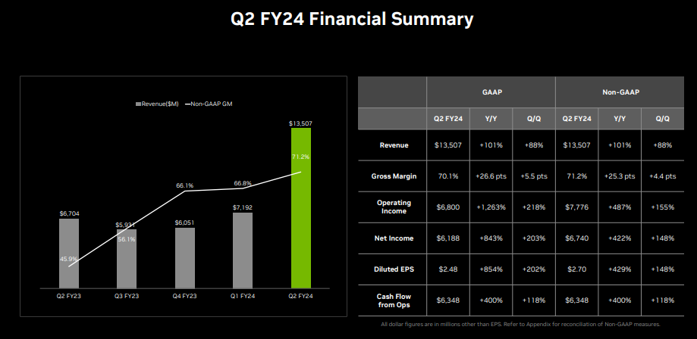
Financial Summary Q2
Notes:
Ideal for giant AI and HPC applications like Gen AI,
deep recommenders, and vector databases. Utilized in google cloud partnership for accelerated computing.

Slide 66

Financial Summary Q2 - Data Centers
Notes:
Ideal for giant AI and HPC applications like Gen AI,
deep recommenders, and vector databases. Utilized in google cloud partnership for accelerated computing.

Slide 67

Financial Summary Q2 - Gaming
Notes:
Ideal for giant AI and HPC applications like Gen AI,
deep recommenders, and vector databases. Utilized in google cloud partnership for accelerated computing.

Slide 68

Financial Summary Q2 - Professional Visualization
Notes:
Ideal for giant AI and HPC applications like Gen AI,
deep recommenders, and vector databases. Utilized in google cloud partnership for accelerated computing.

Slide 69

Financial Summary Q2 - Automotive
Notes:
Ideal for giant AI and HPC applications like Gen AI,
deep recommenders, and vector databases. Utilized in google cloud partnership for accelerated computing.

Slide 70

Financial Summary Q2 - Cash Source & Uses
Notes:
Ideal for giant AI and HPC applications like Gen AI,
deep recommenders, and vector databases. Utilized in google cloud partnership for accelerated computing.

Slide 71

Financial Summary Q2 - Q3 Outlook
Notes:
Ideal for giant AI and HPC applications like Gen AI,
deep recommenders, and vector databases. Utilized in google cloud partnership for accelerated computing.

Slide 72

Financial Summary Q2
Notes:
Ideal for giant AI and HPC applications like Gen AI,
deep recommenders, and vector databases. Utilized in google cloud partnership for accelerated computing.

Slide 73
Notable Partnerships - Recent Announcements
Google Cloud
Google Cloud will be one of the first companies in the world to have access to the Nvidia DGX GH200 AI supercomputer—powered by the Nvidia Grace Hopper Superchip—to explore its capabilities for generative AI workloads.
Foxconn
NVIDIA and Foxconn are partnering to accelerate the AI industrial revolution by creating AI factories, developing smart platforms for electric vehicles, manufacturing, and cities, and enabling Foxconn's global customer base to build their own AI-optimized systems.
Lenovo
Lenovo and NVIDIA have expanded their partnership to offer enterprises end-to-end, hybrid AI solutions that combine accelerated hardware, AI software, and expert services for quick, scalable, and secure AI deployment across various industries.
Notes:
https://www.crn.com/news/cloud/nvidia-ceo-on-joining-forces-with-google-to-reinvent-cloud-for-ai
https://nvidianews.nvidia.com/news/lenovo-nvidia-hybrid-ai
FOXconn
5 Key Points:
Strategic Collaboration: NVIDIA is partnering with Foxconn to accelerate the AI industrial revolution. The collaboration aims to integrate NVIDIA's advanced technologies into Foxconn's systems.
AI Factories: The partnership will result in the creation of AI factories, which will utilize NVIDIA's GPU computing infrastructure, including the latest NVIDIA GH200 Grace Hopper Superchip and NVIDIA AI Enterprise software, for data processing and AI model development.
Smart Solutions: Foxconn plans to develop various smart platforms based on NVIDIA technologies, including Smart EV (Electric Vehicles) built on NVIDIA DRIVE Hyperion 9, Smart Manufacturing robotic systems on NVIDIA Isaac, and Smart City solutions incorporating NVIDIA Metropolis.
Customer Enablement: Foxconn will build systems based on NVIDIA CPUs, GPUs, and networking for its global customer base, allowing them to create and operate their own AI factories optimized with NVIDIA AI Enterprise software.
Future Developments: Foxconn is considering building its own AI factory using NVIDIA's Omniverse platform and other frameworks. They will also offer AI-powered EV solutions to global automakers, featuring NVIDIA DRIVE technologies.
What is Generative AI: Generative artificial intelligence (AI) describes algorithms (such as ChatGPT) that can be used to create new content, including audio, code, images, text, simulations, and videos.
Strategic Partnership for Hybrid AI: Lenovo and NVIDIA have expanded their partnership to offer new hybrid AI solutions. These solutions aim to make generative AI accessible to enterprises, from the edge to the cloud, across various industries.
End-to-End AI Solutions: The collaboration will provide fully integrated systems that include accelerated hardware, AI software, and expert services. Businesses can build custom AI models using NVIDIA's cloud service and run them on Lenovo's on-prem systems.
Flexible and Scalable Deployment: Supported by Lenovo AI Professional Services Practice, the solutions offer a hybrid cloud approach and a pay-as-you-go model. They are optimized for secure, stable production AI and are designed to help businesses implement AI quickly and at scale.

Slide 74
Executive Team

Slide 75

Jensen Huang
Founder, President, and CEO
Jensen Huang founded NVIDIA in 1993 and has served since its inception as president, chief executive officer, and a member of the board of directors.
Since its founding, NVIDIA has pioneered accelerated computing. The company’s invention of the GPU in 1999 sparked the growth of the PC gaming market, redefined computer graphics, and ignited the era of modern AI. NVIDIA is now driving the platform shift of accelerated computing and generative AI, transforming the world's largest industries, and profoundly impacting society.
Huang is a recipient of the Semiconductor Industry Association’s highest honor, the Robert N. Noyce Award; IEEE Founder’s Medal; the Dr. Morris Chang Exemplary Leadership Award; and honorary doctorate degrees from Taiwan’s National Chiao Tung University, National Taiwan University, and Oregon State University. He has been named the world’s best CEO by Harvard Business Review and Brand Finance, as well as Fortune’s Businessperson of the Year and one of TIME magazine’s 100 most influential people.
Prior to founding NVIDIA, Huang worked at LSI Logic and Advanced Micro Devices. He holds a BSEE degree from Oregon State University and an MSEE degree from Stanford University.

Slide 76

Chris A. Malachowsky
Founder and NVIDIA Fellow
Chris Malachowsky founded NVIDIA in 1993 and has more than 40 years of industry experience. He serves as a member of the executive staff and a senior technology executive for the company.
Malachowsky has been instrumental in managing, defining and driving the company’s core technologies as it has grown from a startup to the global leader in visual and parallel computing. As an executive at NVIDIA, he has led numerous functions, including IT, operations and all facets of the company’s product engineering. Most recently, he was responsible for NVIDIA’s world-class research organization, which is chartered with developing the strategic technologies that will help drive the company’s future growth and success.
Prior to NVIDIA, Malachowsky held engineering and technical leadership positions at HP and Sun Microsystems.
A recognized authority on integrated-circuit design and methodology, he has authored close to 40 patents. He holds a BSEE degree from the University of Florida and an MSCS degree from Santa Clara University. Both schools have honored Malachowsky with Distinguished Alumnus awards. He also received an honorary doctorate in technology from the University of Silicon Valley in 2022.
Beyond his technical accomplishments, Malachowsky has also received an Emmy for a film he helped produce, Inheritance, that won Best Documentary in 2009. He was also inducted into the Florida Inventors Hall of Fame in 2019.

Slide 77

Colette Kress
EVP and Chief Financial Officer
Colette Kress is executive vice president and chief financial officer of NVIDIA. She joined the company in September 2013, after serving nearly 25 years in a range of finance roles at major technology companies.
She previously served for three years as senior vice president and chief financial officer at Cisco’s Business Technology and Operations Finance organization, where she was responsible for financial strategy, planning, reporting and business development for all business segments, engineering and operations.
Previously, she spent 13 years at Microsoft, including four years as chief financial officer of the Server and Tools division, and held senior roles in corporate planning and finance. Prior to that, she served at Texas Instruments in a variety of finance positions.
Kress holds a B.Sc. degree in finance from University of Arizona and an MBA from Southern Methodist University.

Slide 78

Jay Puri
EVP, Worldwide Field Operations
Jay Puri serves as executive vice president of worldwide field operations at NVIDIA, with responsibility for global sales and regional marketing of all NVIDIA products and services.
Puri joined NVIDIA in 2005 in his current role after a 22-year career at Sun Microsystems, where he held positions in sales, marketing and general management. Most recently, he served as senior vice president of Sun’s Asia-Pacific Group. Prior to that, he was vice president of worldwide sales for software and technology, president of Nihon Sun KK and vice president of worldwide product marketing. During his tenure, Sun grew from 25 employees and no revenue to 35,000 employees and $12 billion in revenue.
Previously, Puri held marketing, management consulting and product development positions at Hewlett-Packard Company, Booz Allen & Hamilton and Texas Instruments.
Puri holds a BSEE degree with high distinction from the University of Minnesota, an MSEE degree from the California Institute of Technology and an MBA degree from Harvard Business School.

Slide 79

Debora Shoquist
EVP, Operations
Debora Shoquist is executive vice president of operations at NVIDIA. She is responsible for the company’s operations and supply chain functions. These include manufacturing product and test engineering, foundry operations, supplier management and contract-manufacturing management, supply planning, logistics, and the company’s quality management system. She was also responsible for overseeing construction of the company's new 1.25 million-square-foot corporate headquarters in Santa Clara, Calif.
Shoquist joined NVIDIA in 2007 as senior vice president of operations and was named to her current role two years later. She has more than 20 years of executive experience in general management, manufacturing and operations, including plant management, engineering, information services, finance and human resources.
Previously, Shoquist was executive vice president of operations at JDS Uniphase and senior vice president and general manager of the electro-optics business at Coherent, a manufacturer of commercial and scientific laser equipment. She also spent 11 years in key executive roles at Quantum, including president of the Personal Computer Hard Disk Drive division, and 10 years at HP in various engineering and manufacturing management roles.
Shoquist holds a Bachelor of Science in electrical engineering from Kansas State University and a Bachelor of Science in biology from Santa Clara University.

Slide 80

Tim Teter
EVP, General Counsel and Secretary
Tim Teter is executive vice president, general counsel and secretary of NVIDIA. He joined the company in January 2017, after more than two decades at the law firm of Cooley LLP.
He was most recently partner at Cooley, where he focused on litigating patent and technology related matters. Previous to attending law school, he worked as an engineer at Lockheed Missiles and Space Company.
Teter holds a J.D. from Stanford Law School and a B.S. in mechanical engineering from the University of California at Davis.

Slide 81
Sec Filings & Financials

Slide 82
Overview of MD&A (10Q)
Recent Developments, Future Objectives and Challenges:
Demand and Supply, Product Transitions, and New Products and Business Models
Demand for our data center systems and products has surged over the last two quarters and our demand visibility extends into next year. In order to meet this demand, we have increased our purchase obligations with existing suppliers, added new suppliers and entered into prepaid supply and capacity agreements. These increased purchase volumes and number of suppliers may create more supply chain complexity and execution risk. We expect our supply to increase each quarter through next year. We have entered and expect to continue to enter into supplier and capacity arrangements. Product transitions are complex as we often ship both new and prior architecture products simultaneously and we and our channel partners prepare to ship and support new products. We are in various stages of transitioning the architecture of our Data Center, Professional Visualization, and Gaming products. Qualification time for new products, customers anticipating product transitions and channel partners

Slide 83
Overview of MD&A (10Q)
reducing channel inventory of prior architectures ahead of new product introductions can create reductions or volatility in our revenue. In addition, the bring up of new product architectures is complex due to functionality challenges and quality concerns not identified in manufacturing testing. These product quality issues may incur costs, increase our warranty costs, and delay further production of our architecture. While we have managed prior product transitions and have previously sold multiple product architectures at the same time, these transitions are difficult, may impair our ability to predict demand and impact our supply mix, and we may incur additional costs. We build technology and products for use cases and applications that may be new or may not yet exist such as our Omniverse platform, third party large language models, and generative AI models. We have recently begun offering enterprise customers NVIDIA DGX cloud services directly and through our network of partners, which includes cloud-based infrastructure and software and services for training and deploying AI models, and NVIDIA AI Foundations for customizable pretrained AI models. Our demand estimates for new use cases, applications, and services can be incorrect and create volatility in our revenue or supply levels, and we may not be able to generate significant revenue from these use cases, applications, and services. New technologies such as generative AI models have emerged, and while they have driven increased demand for Data Center compute infrastructure, the long-term trajectory is unknown.

Slide 84

Overview of MD&A (10Q)

Slide 85

Overview of MD&A (10K) - Executive Compensation
Notes:
DROP??

Slide 86

Overview of MD&A (10K)

Slide 87

Share Repurchases (10Q)

Slide 88

Overview of (10Q) - R&D Costs

Slide 89

Overview of (10Q) - Revenue & Op. Income by Segment

Slide 90

Revenue by Location (10Q)

Slide 91

Revenue (10K)
Notes:
Reflects YOY downward trend.

Slide 92


Revenue by Segment (10K)
Notes:
REVISE

Slide 93

Revenue Quarterly Trend
Notes:
Revenue Revenue was $13.51 billion, up 101% from a year ago and up 88% sequentially. Data Center revenue was a record, up 171% from a year ago and up 141% sequentially, led by cloud service providers and large consumer internet companies. Strong demand for the NVIDIA HGX platform based on our Hopper and Ampere GPU architectures was primarily driven by the development of large language models and generative AI. Data Center Compute grew 195% from a year ago and 157% sequentially, largely reflecting the strong ramp of our Hopper-based HGX platform. Networking was up 94% from a year ago and up 85% sequentially, primarily on strong growth in InfiniBand infrastructure to support our HGX platform. Gaming revenue was up 22% from a year ago and up 11% sequentially, primarily reflecting demand for our GeForce RTX 40 Series GPUs based on the NVIDIA Ada Lovelace architecture following normalization of channel inventory levels. Professional Visualization revenue was down 24% from a year ago and up 28% sequentially. The yearon-year decrease primarily reflects lower sell-in to partners following normalization of channel inventory levels. The sequential increase was primarily due to stronger enterprise workstation demand and the ramp of NVIDIA RTX products based on the Ada Lovelace Architecture. Automotive revenue was up 15% from a year ago and down 15% sequentially. The year-on-year increase was primarily driven by sales of self-driving platforms. The sequential decrease primarily reflects lower overall auto demand, particularly in China.
https://s201.q4cdn.com/141608511/files/doc_financials/2024/Q2FY24/Q2FY24-CFO-Commentary.pdf

Slide 94

Balance Sheet Analysis (10Q)

Slide 95

Balance Sheet Analysis (10Q)

Slide 96

Balance Sheet Analysis (10K)

Slide 97

Balance Sheet Analysis (10K)

Slide 98

Income Statement Analysis (10K)

Slide 99

Income Statement Analysis (10Q)

Slide 100

Cash Flow Statement Analysis (10K)

Slide 101

Cash Flow Statement Analysis (10K)

Slide 102

Cash Flow Statement Analysis (10Q)

Slide 103
Cash Flow Statement Analysis (10Q)

Slide 104

Cash Flow Statement Analysis (10Q)

Slide 105

Cash Flow Statement Analysis (10Q)

Slide 106
Recommendation
Financial outlooks, involve increasing leverage, heavy reliance on 3rd parties.
Recommendation: Based on the comprehensive financial analysis, NVIDIA could be considered a Hold at the current price, with a potential to Buy if the company's strategic investments start to pay off and it continues to demonstrate strong cash flow generation. Potential investors should be cautious about the increasing debt levels and ensure that the company's growth prospects justify the current valuation.
HOLD
Notes:
Defects in our products have caused and could cause us to incur significant expenses to remediate, which can damage our reputation and cause us to lose market share. Our hardware and software product offerings are complex and they have in the past and may in the future contain defects or security vulnerabilities, or experience failures or unsatisfactory performance due to any number of issues in design, fabrication, packaging, materials and/or use within a system. These risks may increase as our products are introduced into new devices, markets, technologies and applications or as new versions are released. These risks further increase when we rely on partners to supply and manufacture components that are used in our products, as these arrangements reduce our direct control over production. Although arrangements with component providers may contain provisions for product defect expense reimbursement, we generally remain responsible to the customer for warranty product defects that may occur from time to time. Some failures in our products or services have been in the past and may in the future be only discovered after a product or service has been shipped or used. Undiscovered vulnerabilities in our products or services could result in loss of data or intangible property, or expose our end customers to unscrupulous third parties who develop and deploy malicious software programs that could attack our products or services. Defects or failure of our products to perform to specifications could lead to substantial damage to the products or the product in which our device has been integrated by OEMs, ODMs, AIBs and automotive manufacturers and tier 1 automotive suppliers, and to the user of such end product. Any such defect may cause us to incur significant warranty, support and repair or replacement costs as part of a product recall or otherwise, write-off the value of related inventory, and divert the attention of our engineering and management personnel from our product development efforts to find and correct the issue. Our efforts to remedy these issues may not be timely or satisfactory to our customers. An error or defect in new products, releases, or related software drivers after commencement of commercial shipments could result in failure to achieve market acceptance, loss of design wins, temporary or permanent withdrawal from a product or market, and harm to our relationships with existing and prospective customers and partners and consumers’ perceptions of our brand, which would in turn negatively impact our business operations, gross margin, revenue and/or financial results. We may be required to reimburse our customers, partners or consumers, including for costs to repair or replace products in the field or in connection with indemnification obligations, or pay fines imposed by regulatory agencies.

Slide 107
Advanced Micro Devices, Inc.
NASDAQ: AMD
Mohammadali Guivehchian

Slide 108



Summary
Source: https://www.theglobeandmail.com/investing/markets/stocks/AMD-Q/

Slide 109





Key Statistics (Currency in USD)
Source: https://www.theglobeandmail.com/investing/markets/stocks/AMD-Q/statistics/

Slide 110

Stock Performance 1-Year
Source: https://ca.finance.yahoo.com/quote/AMD/chart?p=AMD

Slide 111

Stock Performance 1-Year vs S&P 500, NASDAQ, and DJIA
Source: https://ca.finance.yahoo.com/quote/AMD/chart?p=AMD

Slide 112

Stock Performance 1-Year vs NVIDIA & INTEL
Source: https://ca.finance.yahoo.com/quote/AMD/chart?p=AMD

Slide 113

Stock Performance 5-Year
Source: https://ca.finance.yahoo.com/quote/AMD/chart?p=AMD

Slide 114

Stock Performance 5-Year vs S&P 500, NASDAQ, and DJIA
Source: https://ca.finance.yahoo.com/quote/AMD/chart?p=AMD

Slide 115

Stock Performance 5-Year vs NVIDIA & INTEL
Source: https://ca.finance.yahoo.com/quote/AMD/chart?p=AMD

Slide 116

Stock Performance 10-Year
Source: https://ca.finance.yahoo.com/quote/AMD/chart?p=AMD

Slide 117

Stock Performance 10-Year vs S&P 500, NASDAQ, and DJIA
Source: https://ca.finance.yahoo.com/quote/AMD/chart?p=AMD

Slide 118

Stock Performance 10-Year vs NVIDIA & INTEL
Source: https://ca.finance.yahoo.com/quote/AMD/chart?p=AMD

Slide 119
Major Shareholders (June 29, 2023)
Breakdown
Shares Held by All Insider 0.48%
Shares Held by Institutions 74.47%
Float Held by Institutions 74.82%
Number of Institutions Holding Shares 2,617
Top 3 Institutional Holders %Out
Vanguard Group Inc 8.60%
Blackrock Inc. 7.46%
State Street Corporation 4.03%
Top 3 Mutual Fund Holders
Vanguard Total Stock Market Index Fund 3.11%
Vanguard 500 Index Fund 2.37%
Invesco ETF Tr-Invesco QQQ Tr, Series 1 ETF 1.69%
Source: https://ca.finance.yahoo.com/quote/AMD/holders?p=AMD

Slide 120

Shares Outstanding
Source: https://ir.amd.com/sec-filings/content/0000002488-23-000195/0000002488-23-000195.pdf

Slide 121

Financial Outlook (Non-GAAP)
Source: https://ir.amd.com/sec-filings/content/0000002488-23-000192/0000002488-23-000192.pdf

Slide 122

Ratios
Source: S&P Capital IQ

Slide 123

CAGR Over Five Years
Source: S&P Capital IQ

Slide 124
Company Overview
Company Profile
Products
Artificial Intelligence
Timeline
Mergers & Acquisitions/Spin Offs
Equity Joint Ventures

Slide 125





Company Profile
Since its founding in 1969 (May 1, Delaware, IPO 1972), Advanced Micro Devices is among leading global suppliers of microprocessors and graphics semiconductors that are used in computers and related products. AMD is company primarily offering:
Server microprocessors (CPUs) and graphics processing units (GPUs), data processing units (DPUs), Field Programmable Gate Arrays (FPGAs), and Adaptive System-on-Chip (SoC) products for data centers;
CPUs, accelerated processing units (APUs) that integrate CPUs and GPUs, and chipsets for desktop and notebook personal computers;
Discrete GPUs, and semi-custom SoC products and development services;
Embedded CPUs, GPUs, APUs, FPGAs, and Adaptive SoC products.
From time to time, they may also sell or license portions of their intellectual property (IP) portfolio.
Source: https://ir.amd.com/sec-filings/filter/annual-filings/content/0000002488-22-000016/0000002488-22-000016.pdf

Slide 126
Products
Processors
Servers
Business Systems
Workstations
Embedded
Personal Laptops
Personal Desktops
Handheld
Accelerators, SOMs, and SmartNICs
DPU (Data Processing Unit) Accelerators
  Optimized to execute a software stack delivering cloud, compute, network, storage, and security services at cloud scale – with minimal latency, jitter, and power requirements
Adaptive Accelerators
  Video, big data, compute, networking, and storage acceleration
SmartNICs & Ethernet Adapters
  Helps data centers CPU for infrastructure tasks
Systems on Modules (SOMs)
  Small embedded boards about the size of a credit card that include an SoC (such as a microprocessor, GPU, or FPGA), memory, power management, and other supporting circuitry. SOMs abstract the hardware so developers can accelerate a streamlined design process at the board level instead of the chip level
GPU Accelerators
  Data center computing supercharging HPC (High-Performance Computing) and AI workloads
Graphics
Workstations
Desktops
Laptops
Adaptive SOCs (System-on-Chips) & FPGAs (Field-Programmable Gate Arrays)
  Automotive, Defence
Software, Tools, and Apps
Source: https://www.amd.com

Slide 127

Artificial Intelligence (AI)
Source: https://ir.amd.com/sec-filings/content/0000002488-23-000192/0000002488-23-000192.pdf

Slide 128

Upcoming AI Flagship
Source: https://www.amd.com/en/newsroom/press-releases/2023-6-13-amd-expands-leadership-data-center-portfolio-with-.html

Slide 129
Timeline
Founded by Walter Jeremiah Sanders (+7 others), initially as a second source supplier of microchips.
Entered the RAM chip market, Am3101, a 64-bit bipolar RAM.
Entered the microprocessor market with Am9080, a reverse-engineered clone of the Intel 8080.
Introduced INT.STD.1000, the highest manufacturing quality standard in the industry.
1970
1972
1980
1969
1971
1975
1983
Produced its first proprietary product, the Am2501 logic counter.
IPO at $15.50.
Began supplying semiconductor products for telecommunications.
Source: Partially from https://en.wikipedia.org/wiki/AMD

Slide 130
Timeline
Began volume-producing its own Am286 clone of Intel 80286 processor, for the rapidly growing market of IBM PCs.
AMD offers its own microprocessor, the Am386. This chip was similar to Intel’s own 386 chip.
AMD spun off its flash memory business and manufacturing into Spansion, a joint venture with Fujitsu.
Acquisition of the Canadian 3D graphics card company ATI Technologies.
1986
2000
2005
1984
1991
2003
2006
Embraced the perceived shift toward RISC with their own AMD Am29000 (29k) processor; the 29k survived as an embedded processor.
AMD beats Intel to the 1 Ghz processor, Athlon 1000.
AMD divested itself of Spansion to focus on the microprocessor market, and Spansion went public in an IPO.
Source: Partially from https://en.wikipedia.org/wiki/AMD

Slide 131
Timeline
AMD announced plans to spin off manufacturing operations in the form of GlobalFoundries Inc., a multibillion-dollar joint venture with Advanced Technology Investment Co.
The AMD Jaguar microarchitecture releases, being used in both the PS4 and Xbox One, securing the position in the gaming console market.
2012
2014
2008
2013
Restructured into two segments:
Computing and Graphics
Enterprise, Embedded, and Semi-Custom.
AMD acquired the low-power server manufacturer SeaMicro.
Source: Partially from https://en.wikipedia.org/wiki/AMD

Slide 132
Timeline
Release of Ryzen 7 1700, was very popular among PC gamers.
Release of Ryzen 9 4900HS, established the company as having the clear technological edge over Intel.
2019
2022
2017
2020
Release of AMD's Ryzen 7 5800X3D, currently best-selling processor.
Acquisition of Xilinx in an all-stock transaction of approx $50B.
Release of Ryzen 9 3950X, highest threaded CPU at the time.
Source: Partially from https://en.wikipedia.org/wiki/AMD

Slide 133
Mergers & Acquisitions/Spin Offs
1977 - AMC (Advanced Micro Computers) a collaboration with Siemens to enter the microcomputer development and manufacturing field
1996 - NexGen $857M, to move away from Intel.
2003 - Spanion A joint venture with Fujitsu. AMD spins off its flash memory business (Steps away in 2005)
2006 - ATI Technologies $5.4B. Canadian 3D graphics card company.
2008 - GlobalFoundries Inc. a joint venture with Advanced Technology Investment Co. AMD spins off of its manufacturing operations
2012 - SeaMicro $334M. Ultra-dense, low-power server manufacturer.
2016 - HiAlgo Developer of unique PC gaming technologies designed to help Radeon RX Series GPUs.
2017 - Nitero Develops and manufactures wireless chips for streaming virtual reality (VR) content.
2022 - Xilinx $50B. Programmable logic devices supplier.
2022 - Pensando $1.9B. Data center optimization startup.
2023 - Nod.ai Open-source AI software provider to improve its AI software capabilities.
Source: https://en.wikipedia.org/wiki/AMD

Slide 134

Recent Mergers & Acquisitions
Source: https://ir.amd.com/sec-filings/content/0000002488-23-000195/0000002488-23-000195.pdf

Slide 135

Equity Joint Ventures
Source: https://ir.amd.com/sec-filings/content/0000002488-23-000195/0000002488-23-000195.pdf

Slide 136
MD&A
Income
  Gross Margin
  R&D
  Geography
Segments
Cash Flow
Strategy

Slide 137

Financial Overview - Q3, 2023
Source: https://ir.amd.com/financial-information

Slide 138

MD&A - Income - Q3, 2023
Source: https://ir.amd.com/sec-filings/content/0000002488-23-000195/0000002488-23-000195.pdf

Slide 139

MD&A - Income - Q3, 2023
Source: https://ir.amd.com/sec-filings/content/0000002488-23-000195/0000002488-23-000195.pdf

Slide 140

MD&A - Gross Margin - Q3, 2023
Source: https://ir.amd.com/sec-filings/content/0000002488-23-000195/0000002488-23-000195.pdf

Slide 141


Gross Margin - Q3, 2023
Source: https://ir.amd.com/sec-filings/content/0000002488-23-000192/0000002488-23-000192.pdf

Slide 142

MD&A - R&D - Q3, 2023
Source: https://ir.amd.com/sec-filings/content/0000002488-23-000195/0000002488-23-000195.pdf

Slide 143

Sales by Geography - 2022
Source: https://ir.amd.com/sec-filings/filter/annual-filings/content/0000002488-22-000016/0000002488-22-000016.pdf

Slide 144

Business Segments - Overview
Source: https://ir.amd.com/sec-filings/content/0000002488-23-000192/0000002488-23-000192.pdf

Slide 145

Business Segments - Operating Income
Source: https://ir.amd.com/sec-filings/content/0000002488-23-000195/0000002488-23-000195.pdf

Slide 146
Business Segments - Data Center
Server CPUs
FPGAs and Adaptive SoCs
AMD EPYCTM Series processors
AMD EPYC 9004 Series
AMD EPYC 7003 Series
AMD EPYC 7002 Series
Devices include the VirtexTM and KintexTM FPGA products, as well as ZynqTM, Zynq MPSoC, and VersalTM Adaptive SoC products.
AlveoTM accelerator cards provide a platform for accelerating workloads in the data center, at the edge or the cloud
DPUs
Data Center GPUs
P4 programmable AMD Pensando DPUs
  Designed to help offload data center infrastructure services from the CPU, and help enable cloud and enterprise customers to optimize performance
DPUs
  Helps large Infrastructure as a service (IaaS) cloud providers improve hosted virtualized and bare-metal workload performance
Specifically designed to address the growing demand for compute-accelerated data center workloads
Includes AI training and a range of supercomputing applications where the compute capabilities of GPUs provide additional performance

Slide 147


Business Segments - Data Center
Strategic Highlights
Almost 100 new AMD processor-powered cloud instances launched from Amazon, Google, Microsoft, Oracle, Tencent and others
Enterprise wins in automotive, aerospace, financial services, pharmaceutical and technology
Launched 4th Gen EPYC “Siena” processors for intelligent edge and telco applications
Announced acquisitions of Mipsology and Nod.ai to support expanding AI software capabilities
AMD Instinct™ MI300A and MI300X GPU production shipments expected during Q4’23
Source: https://ir.amd.com/sec-filings/content/0000002488-23-000192/0000002488-23-000192.pdf

Slide 148

MD&A - Data Center
Source: https://ir.amd.com/sec-filings/content/0000002488-23-000195/0000002488-23-000195.pdf

Slide 149
Business Segments - Client
Desktop CPUs
Notebook CPUs
AMD RyzenTM
AMD AthlonTM series processors.
  Based on “Zen 4” architecture and deliver Leadership performance for gamers and content creators
AMD Ryzen and
AMD Athlon mobile processors
  For the commercial and consumer markets
  Combine both high levels of performance and efficiency for notebook PCs
Commercial CPUs
Chipsets
Enterprise-class desktop and mobile PC solutions
AMD PRO Mobile
AMD PRO desktop processors
RadeonTM graphics for the commercial market.
  Designed to provide enterprise customers with the performance, security capabilities and business features such as enhanced security and manageability, platform longevity and extended image stability.
Chipset products to support AMD Ryzen and Threadripper platforms.
End Desktop (HEDT) and Workstation segments
  WRX80 chipsets to support the 3rd Gen Ryzen Threadripper PRO platforms offering high speed I/O and platform bandwidth

Slide 150
Business Segments - Client
Strategic Highlights
Growth driven by strong demand for RyzenTM 7000 series desktop and notebook processors
More than 50 notebook designs powered by Ryzen AI in market
Launched first ThreadripperTM PRO workstation CPUs based on “Zen 4” core with Dell, HP and Lenovo announcing workstations powered by new Threadripper PRO processors
Source: https://ir.amd.com/sec-filings/content/0000002488-23-000192/0000002488-23-000192.pdf

Slide 151

MD&A - Client
Source: https://ir.amd.com/sec-filings/content/0000002488-23-000195/0000002488-23-000195.pdf

Slide 152

Business Segments - Gaming
Semi-Custom Products
Discrete Desktop and Notebook GPUs
Semi-custom products are tailored, co-developed, high-performance, customer-specific solutions based on our CPU, GPU and multimedia technologies
Work closely with customers to define solutions to precisely match the requirements of the device or application
SoC products that power both the Sony PlayStation 5 as well as the Microsoft Xbox Series S and X game consoles
Partnered with Valve to create a semi-custom APU optimized for handheld gaming to power the Steam Deck
AMD Radeon series discrete GPU processors for desktop and notebook PCs
  Designed to support VR in PC platforms.
AMD Radeon RX 7900 XTX and Radeon RX 7900 XT graphics cards
Professional GPUs
Multi-view graphics cards and GPUs
  Designed for integration in mobile and desktop workstations
  Demanding use cases such as design and manufacturing for CAD, and media and entertainment for broadcast and animation pipelines
GPU accelerated visualization for construction, architecture and mechanical design through gaming and visualization engines on high resolution displays

Slide 153
Business Segments - Gaming
Strategic Highlights
Launched new RadeonTM RX 7000 enthusiast desktop GPUs offering leadership price/performance for 1440P gamers
Launched first AMD RDNA 3 architecture based mobile GPU enabling desktop-level performance in Alienware’s newest m18 gaming laptop
Source: https://ir.amd.com/sec-filings/content/0000002488-23-000192/0000002488-23-000192.pdf

Slide 154

MD&A - Gaming
Source: https://ir.amd.com/sec-filings/content/0000002488-23-000195/0000002488-23-000195.pdf

Slide 155
Business Segments - Embedded
Price at uly 3
Embedded CPUs, APUs and GPUs
FPGAs and Adaptive SoCs
Embedded processors and GPUs designed to support:
High performance and bandwidth network connectivity and security
Storage requirements for enterprise and cloud infrastructure, 3D graphics performance and 4K multimedia requirements of automotive infotainment systems
Hardware-customizable devices that can be tailored to meet the specific needs of each customer
  Enables them to differentiate their products and accelerate time-to-market.
FPGA in a wide variety of markets, including data center, wired network, 5G wireless, automotive, industrial, scientific, medical, aerospace and defense.
Development Boards, Kits and Configuration Products
Legacy Product Families
Development kits for all our FPGA and Adaptive SoC products
  Hardware
  Development tools
  IP and reference designs
Complex Programmable Logic Devices (CPLDs)
  Operate on the lowest end of the programmable logic density spectrum.
CPLDs are single-chip, nonvolatile solutions characterized by instant-on and universal interconnect

Slide 156
Business Segments - Embedded
Strategic Highlights
Launched first AMD adaptive SoCs with on chip HBM memory delivering significant performance and efficiency for data center, network, test and aerospace applications
Announced next-generation space-grade Versal SoC integrating an enhanced AI Engine
Launched Alveo accelerator card for fintech market delivering 7x improvement in latency compared to prior generation
Source: https://ir.amd.com/sec-filings/content/0000002488-23-000192/0000002488-23-000192.pdf

Slide 157

MD&A - Embedded
Source: https://ir.amd.com/sec-filings/content/0000002488-23-000195/0000002488-23-000195.pdf

Slide 158

MD&A - All Other
Source: https://ir.amd.com/sec-filings/content/0000002488-23-000195/0000002488-23-000195.pdf

Slide 159

MD&A - Cash Flow
Source: https://ir.amd.com/sec-filings/content/0000002488-23-000195/0000002488-23-000195.pdf

Slide 160

MD&A - CFO
Source: https://ir.amd.com/sec-filings/content/0000002488-23-000195/0000002488-23-000195.pdf

Slide 161

MD&A - CFI
Source: https://ir.amd.com/sec-filings/content/0000002488-23-000195/0000002488-23-000195.pdf

Slide 162

MD&A - CFF
Source: https://ir.amd.com/sec-filings/content/0000002488-23-000195/0000002488-23-000195.pdf

Slide 163

Strategy
Source: https://ir.amd.com/sec-filings/filter/annual-filings/content/0000002488-22-000016/0000002488-22-000016.pdf

Slide 164
BOD and Executives
Board of Directors
Executive Leadership Team

Slide 165









Board of Directors
Nora M. Denzel Lead Independent Director
Mark Durcan
Mike P. Gregoire
Joseph A. Householder
Dr. Lisa Su Chair and Chief Executive Officer
John Marren
Jon A. Olson
Abhi Talwalkar
Elizabeth (Beth) Vanderslice
Source: https://ir.amd.com/leadership-governance/board-of-directors

Slide 166
Executive Leadership Team
Chair and Chief Executive Officer | Dr. Lisa Su
President, AMD | Victor Peng
Executive Vice President, Strategic Partnerships, President EMEA | Darren Grasby
Executive Vice President and Chief Commercial Officer | Phil Guido
Executive Vice President, Chief Financial Officer and Treasurer |Jean Hu
Executive Vice President and General Manager, Data Center Solutions Business Unit |Forrest Norrod
Executive Vice President and Chief Technology Officer, Technology and Engineering |Mark Papermaster
Source: https://www.amd.com/en/corporate/leadership.html

Slide 167

Dr. Lisa Su
Chair and Chief Executive Officer
Since February 2022 (1 Year): Named Chair
Since October 2014 (9 Year): President, CEO, and Board of Directors
Jul 2014-Oct 2014: Chief Operating Officer (3 Months)
Jan 2012-Jul 2014: Senior Vice President and General Manager, Global Business Units (2.5 Years)
In 2007, Joined Freescale Semiconductor, Inc. as Chief Technology Officer and left Freescale as Senior Vice President & General Manager, Networking and Multimedia. Prior to that she had Various leadership roles at IBM for 13 years and left IBM as Vice President, Semiconductor R&D Center. From 1994-1995 she was Technical Staff Member at Texas Instruments Inc.
Affiliations:
Board of Directors at Cisco Systems, Inc. (since January 2020)
Board of Directors for the Semiconductor Industry Association
Education:
B.S., M.S., and Ph.D. in Electrical Engineering from the Massachusetts Institute of Technology (MIT)
Notable Achievements & Honors:
Published 40+ technical articles
Fellow, Institute of Electronics and Electrical Engineers (2009)
Elected, National Academy of Engineering (2018)
Received, Global Semiconductor Association’s Dr. Morris Chang Leadership Award (2018)
#2 on Fortune's "Business Person of the Year” (2020)
Elected, American Academy of Arts & Science (2020)
Recipient, IEEE's Robert N. Noyce Medal (2021)
Appointed, President’s Council of Advisors on Science & Technology (2021)
Source: https://ir.amd.com/leadership-governance/board-of-directors

Slide 168

Victor Peng
President, AMD
Peng rejoined AMD in 2022 after 14 years at Xilinx, most recently serving as president, CEO and member of the Board of Directors. Peng has over 40 years of experience defining and delivering leadership technologies across FPGAs, SoCs, GPUs and high-performance CPUs.
Responsible for AMD’s adaptive and embedded products including FPGAs, adaptive SoCs and embedded processors and the company’s AI strategy, including the AI roadmap across client, edge and cloud, datacenter GPUs and AI software efforts.
Xilinx: During his tenure as CEO of Xilinx, Peng accelerated the company’s growth by increasing its market share, expanding into the data center market, and transforming the company from a chip supplier to an adaptable platform provider with products like the Versal ACAP and the Alveo family of acceleration cards, as well as delivering key technologies like the AI Engine and the Vitis software stack.
Prior to joining Xilinx, Peng worked at AMD as corporate vice president of silicon engineering for the graphics products group (GPG) and led the central silicon engineering team supporting graphics, game console products, and CPU chipsets. Prior to that, Peng held executive and engineering leadership roles at MIPS Technologies, SGI, and Digital Equipment Corp.
Education:
Bachelor’s in Electrical Engineering from Rensselaer Polytechnic Institute
Master’s in Electrical Engineering from Cornell University
Patents:
Holds four U.S. patents
Source: https://www.amd.com/en/corporate/leadership/victor-peng.html

Slide 169

Darren Grasby
Executive Vice President, Strategic Partnerships, President EMEA
Since joining AMD in 2007 (16 Years), Grasby has been instrumental in driving profitable growth across AMD’s different routes to market and increasing the company’s global sales footprint.
For the last five years, Grasby served as chief sales officer. In that role, he united the global sales teams and significantly strengthened customer relationships, growing AMD share. Prior to that, he held several leadership roles within AMD focused on sales and marketing, and the EMEA region.
Based in the UK, Grasby has nearly three decades of high-tech industry expertise focused on PCs, graphics and peripheral product sales.
Before joining AMD, he founded and led several successful regional computer manufacturing companies.
Source: https://www.amd.com/en/corporate/leadership/darren-grasby.html

Slide 170

Phil Guido
Executive Vice President and Chief Commercial Officer
Leading the Worldwide Sales Organization for AMD.
Phil was previously general manager, global managing partner of Strategic Sales at IBM Consulting, responsible for expanding IBM’s deep partnerships with enterprise customers. He held multiple leadership roles at IBM during his more than 30-year tenure with the company, including the general manager of IBM North America driving over $40B in revenue and general manager, Infrastructure Services Business.
Education:
Economics Degree from Magna Cum Laude and Phi Kappa Phi from Montclair State University
Certificate in International Business from the University of Copenhagen
Source: https://www.amd.com/en/corporate/leadership/phil-guido.html

Slide 171

Jean Hu
Executive Vice President, Chief Financial Officer and Treasurer
Responsible for the company’s financial planning and strategy. In this role, Hu leads the global finance organization, global corporate services, facilities, and indirect procurement.
Prior to AMD, Hu served as CFO of Marvell where she led all aspects of financial planning, accounting, reporting, treasury, tax and investor relations. She has more than 20 years of financial leadership experience in the semiconductor industry, including previous CFO roles at Qlogic and Conexant.
Education:
B.S. in Chemical Engineering from Beijing University of Chemical Technology
Ph.D. in Economics from Claremont Graduate University
Source: https://www.amd.com/en/corporate/leadership/jean-hu.html

Slide 172

Forrest Norrod
Executive Vice President and General Manager, Data Center Solutions Business Unit
Responsible for managing all aspects of strategy, business management and engineering for AMD data center products. Norrod has more than 30 years of technology industry experience across a number of engineering and business management roles at both the chip and system level.
Dec 2009-Oct 2014: Dell, VP and GM of the Server Business
Aug 2000-Dec 2009: Dell, CTO of Client Products in August 2000, and held multiple engineering and management roles during his tenure
1997-2000: National Semiconductor, led the integrated x86 CPU businesses
1993-1997: Cyrix Corp
Education:
Bachelor of Science in Electrical Engineering from Virginia Tech
Master of Science in Electrical Engineering from Virginia Tech
Patents:
Holds 11 US patents in computer architecture, graphics, and system design.
Source: https://www.amd.com/en/corporate/leadership/forrest-norrod.html

Slide 173

Mark Papermaster
Executive Vice President and Chief Technology Officer, Technology and Engineering
Responsible for AMD's technical direction and product development including microprocessor design, I/O and memory, system-on-chip (SOC) methodology, and advanced research. He led the re-design of engineering processes at AMD and the development of the award-winning “Zen” high-performance x86 CPU family, high-performance GPUs and the company’s modular design approach, Infinity Architecture. He also oversees Information Technology (IT) that delivers AMD’s compute infrastructure and services.
More than 40 years of engineering experience includes significant leadership roles
Before joining AMD in October 2011 (12 Years) as senior vice president and CTO:
Leader of Cisco’s Silicon Engineering Group
Apple Senior VP of Devices Hardware Engineering for iPod and iPhone
held multiple IBM roles in technology and server development.
Affiliations:
Global Semiconductor Alliance Board of Directors
IEEE Industry Advisory Board
University of Texas Cockrell School of Engineering Advisory Board
Purdue University Semiconductor Degrees Leadership Board.
Education:
Bachelor's in Electrical Engineering from the University of Texas at Austin
Master's in Electrical Engineering from the University of Vermont
Source: https://www.amd.com/en/corporate/leadership/mark-papermaster.html

Slide 174
Financial Questions
What do they do with their money? (CapEx, Div, Share buybacks, etc.)
How is the cash to accrual relation?
How they spend their cash from operation?

Slide 175

1. What do they do with their money? (CapEx, Div, Share buybacks, etc.)
Source: https://ir.amd.com/sec-filings/content/0000002488-23-000195/0000002488-23-000195.pdf

Slide 176

What do they do with their money? (CapEx, Div, Share buybacks, etc.)
Source: S&P Capital IQ

Slide 177
2. How is the cash to accrual relation?
Source: S&P Capital IQ

Slide 178
3. How they spend their cash from operation?
Source: S&P Capital IQ

Slide 179
Financial Statements & Recommendation
Balance Sheet - 10Q
Balance Sheet - 10K
Income Statement - 10K
Income Statement - 10Q
Cash Flow Statement - 10K
Cash Flow Statement - 10Q
Recommendation

Slide 180

Balance Sheet - 10Q
Source: https://ir.amd.com/sec-filings/content/0000002488-23-000195/0000002488-23-000195.pdf

Slide 181

Balance Sheet - 10Q
Source: https://ir.amd.com/sec-filings/content/0000002488-23-000195/0000002488-23-000195.pdf

Slide 182

Balance Sheet - 10K
Source: https://ir.amd.com/sec-filings/filter/annual-filings/content/0000002488-22-000016/0000002488-22-000016.pdf

Slide 183

Balance Sheet - 10K
Source: https://ir.amd.com/sec-filings/filter/annual-filings/content/0000002488-22-000016/0000002488-22-000016.pdf

Slide 184

Income Statement - 10K
Source: https://ir.amd.com/sec-filings/filter/annual-filings/content/0000002488-22-000016/0000002488-22-000016.pdf

Slide 185

Income Statement - 10Q
Source: https://ir.amd.com/sec-filings/content/0000002488-23-000195/0000002488-23-000195.pdf

Slide 186

Cash Flow Statement - 10K
Source: https://ir.amd.com/sec-filings/filter/annual-filings/content/0000002488-22-000016/0000002488-22-000016.pdf

Slide 187


Cash Flow Statement - 10K
Source: https://ir.amd.com/sec-filings/filter/annual-filings/content/0000002488-22-000016/0000002488-22-000016.pdf

Slide 188

Cash Flow Statement - 10Q
Source: https://ir.amd.com/sec-filings/content/0000002488-23-000195/0000002488-23-000195.pdf

Slide 189

Cash Flow Statement - 10Q
Source: https://ir.amd.com/sec-filings/content/0000002488-23-000195/0000002488-23-000195.pdf

Slide 190
Recommendation for AMD
Business
Higher Potentials and More Diversity Because of Their Involvement in Both CPU and GPU Market
Growth by Strategic Acquisitions
Involvement in Emerging AI Market
Proven Innovation and Ability to Compete Big Rivals
Financials
Increasing Gross Margin and Effective Cost Management
Strong Balance Sheet and Current Assets Position
Compensating Shareholders Through Sharebuybacks
Value
Cheap Compared to Intel and Nvidia (Lower P/E)
BUY

Slide 191
Intel Corp.
NASDAQ: INTC

Slide 192




Key Information Metrics
Source: https://www.theglobeandmail.com/investing/markets/stocks/INTC-Q/

Slide 193






Key Statistics (Currency in USD)
Source: https://www.theglobeandmail.com/investing/markets/stocks/INTC-Q/

Slide 194

1 Year Stock Performance
Source: https://finance.yahoo.com/quote/INTC/

Slide 195

1 Year Stock Performance vs S&P 500, NASDAQ, and DJIA
Source: https://finance.yahoo.com/quote/INTC/

Slide 196

1 Year Stock Performance vs NVDA, AMD, and TSMC
Source: https://finance.yahoo.com/quote/INTC/

Slide 197

5 Year Stock Performance
Source: https://finance.yahoo.com/quote/INTC/

Slide 198

5 Year Stock Performance vs S&P 500, NASDAQ, and DJIA
Source: https://finance.yahoo.com/quote/INTC/

Slide 199

5 Year Stock Performance vs NVDA, AMD, and TSMC
Source: https://finance.yahoo.com/quote/INTC/

Slide 200

10 Year Stock Performance
Source: https://finance.yahoo.com/quote/INTC/

Slide 201

10 Year Stock Performance vs S&P 500, NASDAQ, and DJIA
Source: https://finance.yahoo.com/quote/INTC/

Slide 202

10 Year Stock Performance vs NVDA, AMD, and TSMC
Source: https://finance.yahoo.com/quote/INTC/

Slide 203

Ratios
Source: S&P Capital IQ

Slide 204

CAGR Over Five Years
Source: S&P Capital IQ

Slide 205

Ratios
Source: https://www.intc.com/filings-reports/all-sec-filings/content/0000050863-23-000006/0000050863-23-000006.pdf

Slide 206

Ratios
Source: https://www.intc.com/filings-reports/all-sec-filings/content/0000050863-23-000006/0000050863-23-000006.pdf

Slide 207

Ratios
Source: https://www.intc.com/filings-reports/all-sec-filings/content/0000050863-23-000006/0000050863-23-000006.pdf

Slide 208
Top Shareholders
Breakdown
Shares Held by All Insider 00.06%
Shares Held by Institutions 64.66%
Float Held by Institutions 64.70%
Number of Institutions Holding Shares 3119
Top 3 Institutional Holders %Out
Vanguard Group Inc 9.06%
Blackrock Inc. 7.96%
State Street Corporation 4.34%
Top 3 Mutual Fund Holders
Vanguard Total Stock Market Index Fund 3.11%
Vanguard 500 Index Fund 2.37%
Invesco ETF Tr-Invesco QQQ Tr, Series 1 ETF 1.69%
Source:https://finance.yahoo.com/quote/INTC/holders/

Slide 209
Company Overview
Company overview
Timeline
Notable acquisitions
Business Segments & application
Artificial Intelligence
Graphic card

Slide 210
Company Overview
Founded in 1968, Intel’s technology has been at the heart of computing breakthroughs. We are an industry leader, creating world-changing technology that enables global progress and enriches lives. We stand at the brink of several technology inflections—artificial intelligence (AI), 5G network transformation, and the rise of the intelligent edge—that together will shape the future of technology. Silicon and software drive these inflections, and Intel is at the heart of it all.
“The company that put silicon in silicon valley”

Slide 211

Company Overview
We are a global IDM of CPUs and related solutions that we design, develop, manufacture, market, sell, support and service. Our CPUs and related solutions are incorporated in computing and related end products and services, and utilized globally by consumers, enterprises, governments, and educational organizations. Our customers primarily include OEMs, ODMs, cloud service providers, and other equipment manufacturers that we market and sell to directly through our global sales and marketing organizations and indirectly through channel partners. We manufacture our products at our fabrication and assembly and test facilities located throughout the world. Our CPU and related product offerings provide end-to-end solutions, scaling from edge computing to 5G networks, the cloud, and the emerging fields of AI and autonomous driving. Products, such as our gaming CPUs, may be sold directly to end consumers, or they may be further integrated by our customers into end products such as notebooks and storage servers. Combining some of these products—for example, integrating FPGAs with Intel Xeon processors in a data center solution—enables incremental synergistic value and performance. We launched new products in 2022, such as the 12th Gen Intel Core HXprocessors, the final products in our Alder Lake family; Raptor Lake, our 13th Gen Intel 7 client product; and Sapphire Rapids, the first of our 4th Gen Intel Xeon Scalable processors. We also added to our graphics offerings with the introduction of Ponte Vecchio and Alchemist.

Slide 212
Timeline
Introduced the 80486 chip which included 1.2 million transistors and allows for the first built-in math coprocessor
Released the 1103 DRAM
Created the first general purpose microprocessor, 8080.
Founded by Gordon Moore and Bob Noyce
1969
1971
1980
1968
1970
1974
1989
Introduced semiconductor and silicon gate technologies
Introduced the EPROM and became a public company
IBM selects Intel microprocessor for the first personal computer

Slide 213
Timeline
Introduced Itanium, the company’s first 64-bit processor, which was designed to meet the needs of powerful internet servers
Made up 40 % of PC market by selling 10 million motherboards
Merger with Mobileye that greatly advanced the company’s position in autonomous driving
Intel spun off key assets of a solar startup business to form an independent company, SpectraWatt Inc
1997
2006
2011
1995
2000
2008
2017
Launched the Celeron processor
Pioneers SRAM chip using nanometer logic technology
Introduced the first Thunderbolt technology

Slide 214
Timeline
Introduced Project Amber, which provides organizations with remote verification of trustworthiness in cloud, edge and on-premises environments.
Introduced foldable screen computer
Achieved $70 billion in revenue
2019
2021
2018
2020
2022
Bob Swan became permanent CEO
Launches new 11th gen core designed for mobile gaming

Slide 215
Mergers & Acquisitions
2006 - ATI Technologies ($5.4B. Canadian 3D graphics card company specializing in GPUs and chipsets. Brand name retired in 2010.)
2012 - SeaMicro ($334M. Specialized in the ultra-dense computer server industry. Ceased operations in 2015.)
2016 - HiAlgo (Developer of unique PC gaming technologies designed to help Radeon RX Series GPUs
2017 - Nitero (Develops and manufactures wireless chips for streaming virtual reality (VR) content.)
2022 - Xilinx ($50B. Semiconductor company that primarily supplies programmable logic devices.)
2022 - Pensando ($1.9B. Data center optimization startup. Programmable packet processor that manages how workloads move through the hardware infrastructure.
Notes:
Reshape and reword

Slide 216
Operating segment
Client Computing Group: CCG creates platforms designed for end-user form factors, focusing on higher growth segments of 2-in-1, thin-and-light, commercial and gaming, and growing opportunities in areas such as connectivity.
Accelerated Computing Systems and Graphics Group: AXG is chartered with delivering high performance computing and graphics solutions across client, enterprise and data center.
CCG
AXG
DCAI
Data Center and AI Group : DCAI focuses on developing leadership data center products, including Intel® Xeon® server and field programmable gate array (FPGA) products, as well as driving the company’s overall artificial intelligence (AI) strategy.
IFS
Intel Foundry Service: IFS is a fully vertical, standalone foundry business that offers a wide range of manufacturing services to meet unique product needs, including our industry-leading sort and test capabilities.
NEX
Network and Edge group: NEX is chartered with driving technology and product leadership throughout the network to the intelligent edge.
MOB
Mobileye: Mobileye is a global leader in driving assistance and self-driving solutions. Our product portfolio covers the entire stack required for assisted and autonomous driving.
Source: https://www.intc.com/filings-reports/all-sec-filings/content/0000050863-23-000006/0000050863-23-000006.pdf
Notes:
At Intel, we have evolved alongside data. We have transformed beyond a PC-centric company to have a stronger focus on data, allowing us to address the needs of a new data-centric world. Our main businesses include:
Our segment reporting aligns with our organizational structure and business strategy. Beginning with our Q1’22 results, we will report results under six business units: Client Computing Group (CCG), Datacenter and AI Group (DCAI), Network and Edge Group (NEX), Accelerated Computing Systems and Graphics Group (AXG), Intel Foundry Services (IFS), and Mobileye (MBLY). This reporting structure enables transparent accountability relative to how well we are managing and executing against the six business units.

Slide 217

Data Center and AI Group
The Intel portfolio for AI hardware covers everything from data science workstations to data preprocessing, machine learning/deep learning (ML/DL) modeling, and deployment in the data center and at the intelligent edge.
Source: https://www.intc.com/filings-reports/all-sec-filings/content/0000050863-23-000006/0000050863-23-000006.pdf

Slide 218


Data Center and AI Group
Source: https://www.intc.com/filings-reports/all-sec-filings/content/0000050863-23-000006/0000050863-23-000006.pdf

Slide 219

Data Center and AI Group
Source:https://www.youtube.com/@LinusTechTips

Slide 220

Data Center and AI Group
Source:https://www.intel.com/content/www/us/en/products/details/discrete-gpus/arc.html

Slide 221

Client Computing Group:
Source:https://www.intel.com/content/www/us/en/products/details/discrete-gpus/arc.html

Slide 222

Client Computing Group:
Source:https://www.intel.com/content/www/us/en/products/details/discrete-gpus/arc.html

Slide 223

Client Computing Group:
Source:https://www.intel.com/content/www/us/en/products/details/discrete-gpus/arc.html

Slide 224

Client Computing Group:
Source:https://www.intel.com/content/www/us/en/products/details/discrete-gpus/arc.html

Slide 225

Intel Foundry Service:
Source: https://www.intc.com/filings-reports/all-sec-filings/content/0000050863-23-000006/0000050863-23-000006.pdf

Slide 226
MD&A
Income
  Gross Margin
  R&D
Strategy

Slide 227

A year in review
Notes:
Source: https://s201.q4cdn.com/141608511/files/doc_financials/2024/q2/nvda-f2q24-investor-presentation-final-1.pdf

Slide 228

A quarter in review
Source: https://www.intc.com/filings-reports/all-sec-filings/content/0000050863-23-000006/0000050863-23-000006.pdf

Slide 229

Income - Client Computing
Source: https://www.intc.com/filings-reports/all-sec-filings/content/0000050863-23-000006/0000050863-23-000006.pdf

Slide 230

Income - Client Computing
Source: https://www.intc.com/filings-reports/all-sec-filings/content/0000050863-23-000006/0000050863-23-000006.pdf

Slide 231

Income - Data Center and AI
Source: https://www.intc.com/filings-reports/all-sec-filings/content/0000050863-23-000006/0000050863-23-000006.pdf

Slide 232

Income - Data Center and AI
Source: https://www.intc.com/filings-reports/all-sec-filings/content/0000050863-23-000006/0000050863-23-000006.pdf

Slide 233

Income - Network Edge
Source: https://www.intc.com/filings-reports/all-sec-filings/content/0000050863-23-000006/0000050863-23-000006.pdf

Slide 234

Income - Network Edge
Source: https://www.intc.com/filings-reports/all-sec-filings/content/0000050863-23-000006/0000050863-23-000006.pdf

Slide 235

Income - Mobileye
Source: https://www.intc.com/filings-reports/all-sec-filings/content/0000050863-23-000006/0000050863-23-000006.pdf

Slide 236

Income - Foundry service
Source: https://www.intc.com/filings-reports/all-sec-filings/content/0000050863-23-000006/0000050863-23-000006.pdf

Slide 237

Gross Margin
Source: https://www.intc.com/filings-reports/all-sec-filings/content/0000050863-23-000006/0000050863-23-000006.pdf

Slide 238

Operating Expense
Source: https://www.intc.com/filings-reports/all-sec-filings/content/0000050863-23-000006/0000050863-23-000006.pdf

Slide 239
Strategy
Compute: Everything we interact with involves computer technology
Product leadership
Open Platform
Lead and democratize compute with Intel x86 and xPU
We aim to deliver open software and hardware platforms with industry- defining standards
Pervasive Connectivity: Everything and everyone is connected
Cloud-to-Edge Infrastructure: Unlimited scale and capacity combined with unlimited reach- while simultaneously addressing the need for lower latency and higher bandwidth
Manufacturing at Scale
Our people
Our IDM 2.0 strategy combines three capabilities: our internal factory network, strategic use of foundry capacity, and our systems foundry
Our world-class talent is at the heart of everything we do. Together, we strive to have a positive effect on business, society, and the planet
Artificial Intelligence: Intelligence everything- turning infinite data into actionable insight
Sensing: Through advancements in AI, telemetry, photonics, mapping, and more, machine are adopting human- centric abilities for smarter, more useful data
Source: https://www.intc.com/filings-reports/all-sec-filings/content/0000050863-23-000006/0000050863-23-000006.pdf

Slide 240

Strategy
Manufacturing at Scale
Product leadership
New fabs:
New mexico
Arizona
Ohia
Oregon
Germany

Slide 241


Concerns
Source: https://www.intc.com/filings-reports/all-sec-filings/content/0000050863-23-000006/0000050863-23-000006.pdf

Slide 242
BOD and Executives
Board of Directors
Executive Leadership Team

Slide 243






Board Members
Patrick Gelsinger
James J. Goetz
Andrea Goldsmith
Alyssa Henry
Omar Ishrak
Risa Lavizzo-Mourey
Source: https://www.intc.com/board-and-governance/board-of-directors

Slide 244






Board Members
Tsu-Jae King Liu
Barbara G. Novick
Gregory D. Smith
Lip-Bu Tan
Dion Weisler
Frank D. Yeary
Source: https://www.intc.com/board-and-governance/board-of-directors

Slide 245

Patrick Gelsinger
Chief Executive Officer
CEO of Intel Corporation and board member since February 15, 2021.
Previously served at Intel for 30 years at various positions, including the first Chief Technology Officer and Senior Vice President.
Managed the creation of industry technologies like USB and Wi-Fi.
Architect of the original 80486 processor and led multiple microprocessor programs.
Served as CEO of VMware, where he transformed the company into a global leader in cloud infrastructure, enterprise mobility, and cyber security.
Under his leadership, VMware gained recognition as a top player in the industry.
Ranked as the best CEO in America in 2019, according to a Glassdoor annual survey.
Source: https://www.intc.com/about-intel/management-team

Slide 246

Dan Zinsner
Chief Financial Officer
Executive Vice President and Chief Financial Officer (CFO) at Intel Corporation.
Leads Intel's global finance organization, including finance, accounting and reporting, tax, treasury, internal audit, and investor relations.
Joined Intel in January 2022.
Former Executive Vice President and CFO at Micron Technology Inc.
Served as President and Chief Operating Officer at Affirmed Networks.
Held positions as Senior Vice President of Finance and CFO at Analog Devices.
Also served as Senior Vice President and CFO at Intersil Corp.
Source: https://www.intc.com/about-intel/management-team

Slide 247

Keyvan Esfarjani
Executive Vice President; Chief Global Operations Officer
Executive Vice President, Chief Global Operations Officer, and General Manager of Manufacturing, Supply Chain, and Operations at Intel Corporation.
Responsible for worldwide manufacturing operations, including Fab Sort Manufacturing, Assembly Test Manufacturing, and strategic planning.
Oversees corporate quality assurance, corporate services, and supply chain.
Joined Intel in 1996 as an industrial engineer.
Has held various roles and responsibilities within the company over the years.
Worked in the automotive industry for four years before joining Intel.
Source: https://www.intc.com/about-intel/management-team

Slide 248

Michelle J Holthaus
Executive Vice President; General Manager, Client Computing Group
Executive Vice President and General Manager of the Client Computing Group at Intel Corporation.
Responsible for strategy, financial performance, and product development of the client business.
Manages the full portfolio of client technologies and platforms for exceptional personal computing experiences.
Joined Intel in 1996.
Previously held the role of Chief Revenue Officer and General Manager of the Sales, Marketing, and Communications Group.
Source: https://www.intc.com/about-intel/management-team

Slide 249

Sachin Katti
Senior Vice President; General Manager, Network and Edge Group
Senior Vice President and General Manager of the Network and Edge Group (NEX) at Intel Corporation.
Responsible for driving technology and product leadership from the network to the intelligent edge.
Former Vice President and Chief Technology Officer for NEX, responsible for technical strategy and vision.
Previously served as Vice President of Telco & Edge Strategy at VMware, defining product and technology vision for cloudification of the network and edge.
Professor of Electrical Engineering and Computer Science at Stanford University.
Co-chair of the Technical Steering Committee for the O-RAN Alliance.
Founding director of the xRAN Foundation (merged with O-RAN Alliance).
Source: https://www.intc.com/about-intel/management-team

Slide 250

Dr. Ann B. Kelleher
Executive Vice President; General Manager, Technology Development
Executive Vice President and General Manager of Technology Development at Intel Corporation.
Responsible for research, development, and deployment of next-generation silicon logic, packaging, and test technologies.
Joined Intel in 1996 as a process engineer.
Held various positions managing technology transfers and factory ramp-ups for 200mm and 300mm technologies.
Source: https://www.intc.com/about-intel/management-team

Slide 251

Greg Lavender
Chief Technology Officer
Senior Vice President, Chief Technology Officer (CTO), and General Manager of the Software and Advanced Technology Group (SATG) at Intel Corporation.
Responsible for driving Intel's future technical innovation and research programs.
Also responsible for defining an artificial intelligence software stack to support Intel's business and hardware offerings.
Joined Intel in June 2021 from VMware, where he served as Senior Vice President and CTO.
Held positions at Citigroup, Cisco, and Sun Microsystems.
Source: https://www.intc.com/about-intel/management-team

Slide 252

April Miller Boise
Executive Vice President, Chief Legal Officer and Corporate Secretary
Executive Vice President and Chief Legal Officer at Intel Corporation since July 2022.
Also serves as Corporate Secretary since August 2022.
Leads Intel's global legal, trade, and government affairs team.
Member of Intel's Executive Leadership Team and strategic advisor to the Company and the Board of Directors.
Former Executive Vice President and Chief Legal Officer at Eaton Corp.
Prior role was Senior Vice President, Chief Legal Officer, and Corporate Secretary at Meritor Inc.
Has more than 25 years of experience in executive leadership roles, including Chief Legal Officer, General Counsel, and Head of Global Mergers and Acquisitions.
Source: https://www.intc.com/about-intel/management-team

Slide 253

Christy Pambianchi
Executive Vice President and Chief People Officer
Executive Vice President and Chief People Officer (CPO) at Intel Corporation.
Responsible for driving Intel's people strategy and fostering a culture of innovation, execution, development, and learning.
Former Executive Vice President and Chief Human Resources Officer at Verizon.
Former Executive Vice President of People & Digital at Corning Inc.
Worked as a Director of Human Resources at PepsiCo Inc.
Serves on the boards of the Center for Advanced Human Resource Studies at Cornell University for the School of Industrial and Labor Relations.
Source: https://www.intc.com/about-intel/management-team

Slide 254

Stu Pann
Senior Vice President, General Manager, Intel Foundry Services
Senior Vice President and General Manager of Intel Foundry Services (IFS).
Drives growth for IFS and its differentiated systems foundry offering.
Previous role as Chief Business Transformation Officer and General Manager of Intel's Corporate Planning Group.
Established the IDM 2.0 Acceleration Office (IAO) for implementing an internal foundry model.
Returned to Intel in June 2021 after serving as Chief Supply Chain Officer and Chief Information Officer at HP.
Held various management positions within Intel, including Corporate Vice President and General Manager of the Business Management Group.
Bachelor's degree in Electrical Engineering from Michigan Technological University.
Source: https://www.intc.com/about-intel/management-team

Slide 255

Matt Poirier
Senior Vice President, Corporate Development
Matt Poirier is the Senior Vice President of Corporate Development at Intel Corporation.
Responsible for advancing and accelerating Intel's business through strategic corporate development, including mergers and acquisitions, divestitures, and integration activities.
Previously served as Senior Vice President of Strategy and Corporate Development at Advanced Micro Devices Inc. (AMD), leading teams responsible for corporate strategy, AMD Ventures, and mergers and acquisition execution and integration.
Was Senior Vice President of Corporate Development and Investor Relations at Xilinx before AMD's acquisition, also serving as interim treasurer of Xilinx.
Has extensive experience in technology investment banking, specifically covering the semiconductor industry.
Source: https://www.intc.com/about-intel/management-team

Slide 256

Sandra L. Rivera
Executive Vice President; General Manager, Datacenter and AI, Chief Executive Officer of Programmable Solutions Group
Sandra L. Rivera is the Executive Vice President and General Manager of the Datacenter and AI Group at Intel Corporation.
Leads Intel's development of data center products, including Intel Xeon and field programmable gate array (FPGA) products, for cloud-based applications.
Drives Intel's overall artificial intelligence (AI) strategy and product roadmap.
Co-founded and served as President of The CTI Authority.
Previously served as President of the computer telephony division at Catalyst Telecom.
Sits on the Equinix board of directors.
Source: https://www.intc.com/about-intel/management-team

Slide 257

Christoph Schell
Executive Vice President; Chief Commercial Officer
Christoph Schell is the Executive Vice President, Chief Commercial Officer, and General Manager of Sales, Marketing, and Communications at Intel Corporation.
Oversees Intel's global sales, marketing, and communications teams, driving innovative approaches to broaden business opportunities and enhance customer relationships.
Joined Intel in March 2022 from HP Inc., where he served as Chief Commercial Officer, leading customer and partner success, category management, and global customer support.
Has 25 years of experience at HP, holding various senior management roles, including President of 3D Printing & Digital Manufacturing.
Source: https://www.intc.com/about-intel/management-team

Slide 258

Shlomit Weiss
Senior Vice President; Co-General Manager of the Design Engineering Group
Shlomit Weiss is the Senior Vice President and Co-General Manager of the Design Engineering Group at Intel Corporation.
Responsible for leading the design, development, validation, and manufacturing support of intellectual properties (IPs) and system-on-chips (SoCs).
Has over 30 years of experience in the semiconductor industry.
Has 28 years of experience at Intel in engineering and leadership roles, including leading cross-site teams for IP and discrete data center products and serving as General Manager of Data Center Group silicon development.
Previously served as Senior Vice President of Silicon Engineering at Mellanox, which is now part of Nvidia.
Source: https://www.intc.com/about-intel/management-team

Slide 259

Safroadu Yeboah-Amankwah
Senior Vice President; Chief Strategy Officer
Safroadu (Saf) Yeboah-Amankwah is the Senior Vice President and Chief Strategy Officer (CSO) at Intel Corporation.
Leads Intel's Global Strategy Office, which focuses on driving growth-oriented strategies, including mergers and acquisitions, strategic partnerships, Intel Capital, and incubation initiatives.
Joined Intel in 2020 from McKinsey & Company, where he served as a Senior Partner and the Global Head of the Transformation Practice for the Telecom, Media, and Technology (TMT) practice.
Source: https://www.intc.com/about-intel/management-team

Slide 260

Balance Sheet - 10Q
Intel Corporation
Consolidated Balance Sheets
Source: https://www.intc.com/filings-reports/all-sec-filings/content/0000050863-23-000006/0000050863-23-000006.pdf

Slide 261

Balance Sheet - 10Q
Intel Corporation
Consolidated Balance Sheets
Source: https://www.intc.com/filings-reports/all-sec-filings/content/0000050863-23-000006/0000050863-23-000006.pdf

Slide 262

Balance Sheet - 10K
Intel Corporation
Consolidated Balance Sheets
Source: https://www.intc.com/filings-reports/all-sec-filings/content/0000050863-23-000006/0000050863-23-000006.pdf

Slide 263

Balance Sheet - 10K
Intel Corporation
Consolidated Balance Sheets
Source: https://www.intc.com/filings-reports/all-sec-filings/content/0000050863-23-000006/0000050863-23-000006.pdf

Slide 264

Income Statement - 10K
Intel Corporation
Consolidated Statements of
Income
Source: https://www.intc.com/filings-reports/all-sec-filings/content/0000050863-23-000006/0000050863-23-000006.pdf

Slide 265

Income Statement - 10Q
Intel Corporation
Consolidated Statements of
Income
Source: https://www.intc.com/filings-reports/all-sec-filings/content/0000050863-23-000006/0000050863-23-000006.pdf

Slide 266

Cash flow Statement - 10K
Intel Corporation
Consolidated Statements of
Cash Flows
Source: https://www.intc.com/filings-reports/all-sec-filings/content/0000050863-23-000006/0000050863-23-000006.pdf

Slide 267
Cash flow Statement - 10K
Intel Corporation
Consolidated Statements of
Cash Flows
Source: https://www.intc.com/filings-reports/all-sec-filings/content/0000050863-23-000006/0000050863-23-000006.pdf

Slide 268

Cash flow Statement - 10Q
Intel Corporation
Consolidated Statements of
Cash Flows
Source: https://www.intc.com/filings-reports/all-sec-filings/content/0000050863-23-000006/0000050863-23-000006.pdf

Slide 269

Cash flow Statement - 10Q
Intel Corporation
Consolidated Statements of
Cash Flows
Source: https://www.intc.com/filings-reports/all-sec-filings/content/0000050863-23-000006/0000050863-23-000006.pdf

Slide 270
Cash flow Statement - 10Q
Intel Corporation
Consolidated Statements of
Cash Flows
Source: https://www.intc.com/filings-reports/all-sec-filings/content/0000050863-23-000006/0000050863-23-000006.pdf

Slide 271
Recommendation for INTC
Financial reasons:
Shrinking short term liquidity
Shrinking long term liquidity
Unstable profitability
Build up in inventory
SELL

