Slide 1




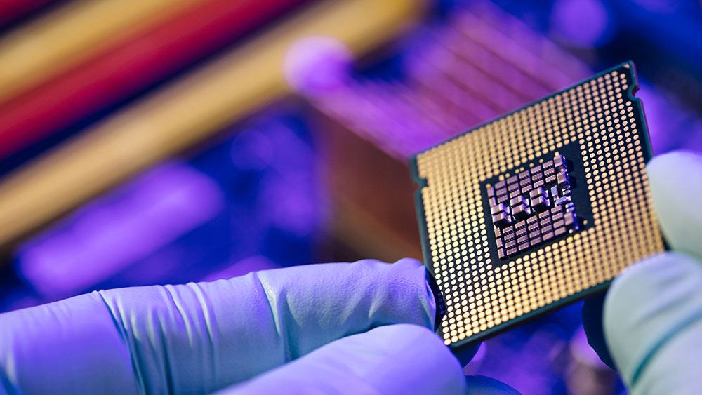
Equity Security Analysis
SEMI-
CONDUCTORS
EQUITY SECURITY ANALYSIS
Presented by:
Ansh Batla (301432732)
Benjamin Prout (301424034),
Brandon Rexhepi (301376196)
Justin Roadhouse (301473665)
Presented to:
Geoffrey Poitras (BUS417 D100)
Presented on:
October 31, 2024
Notes:
https://in.mitsubishielectric.com/en/feature/partneringindia/images/stories/siic-c1.jpg

Slide 2




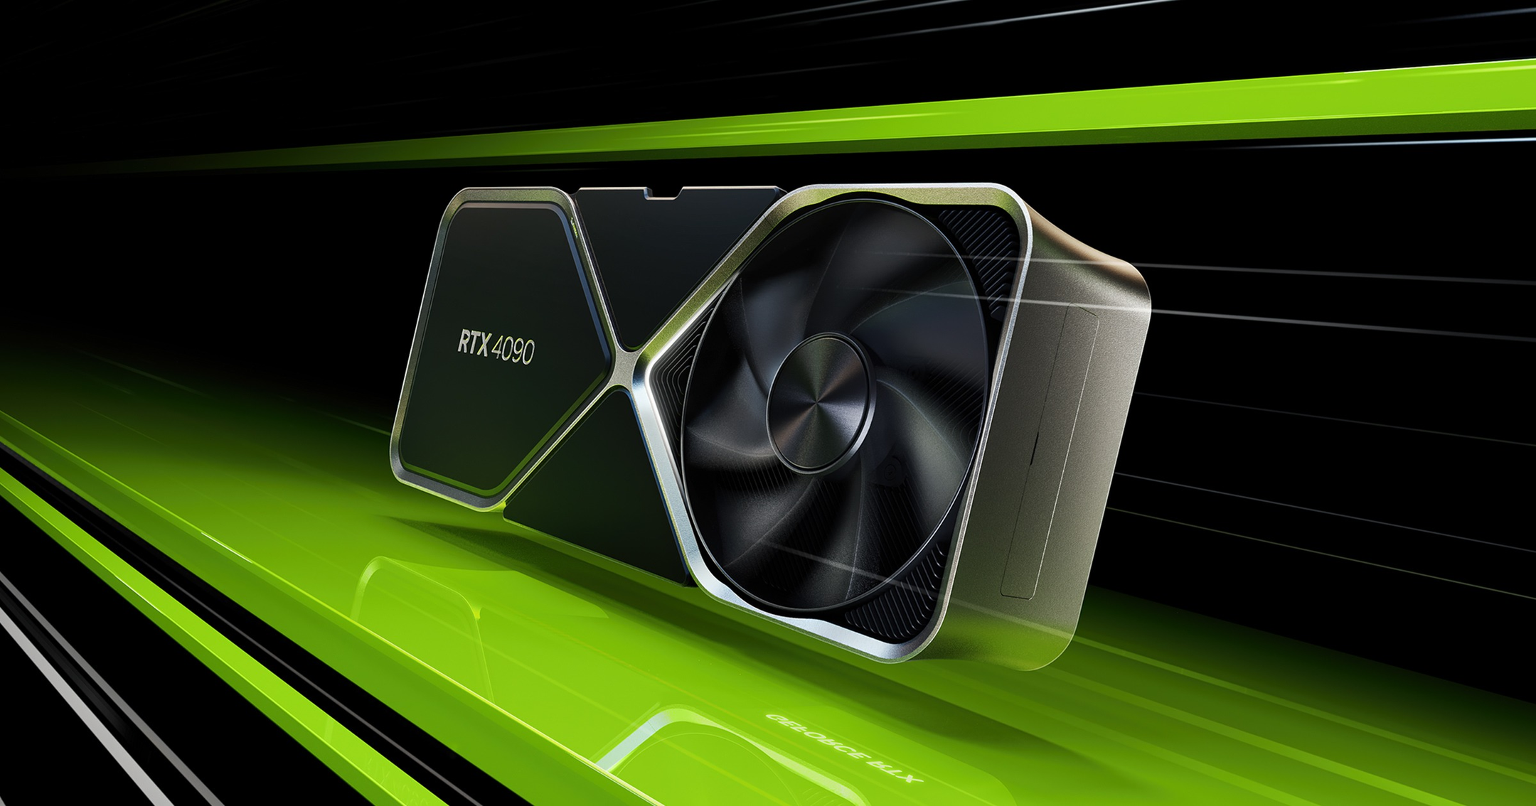
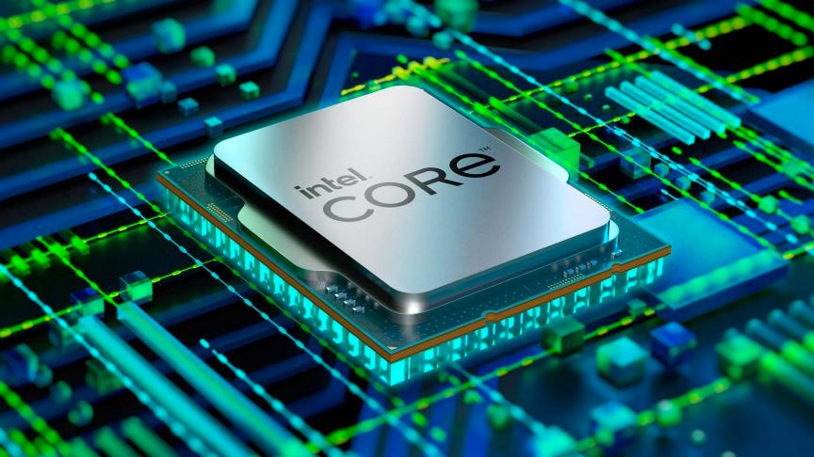

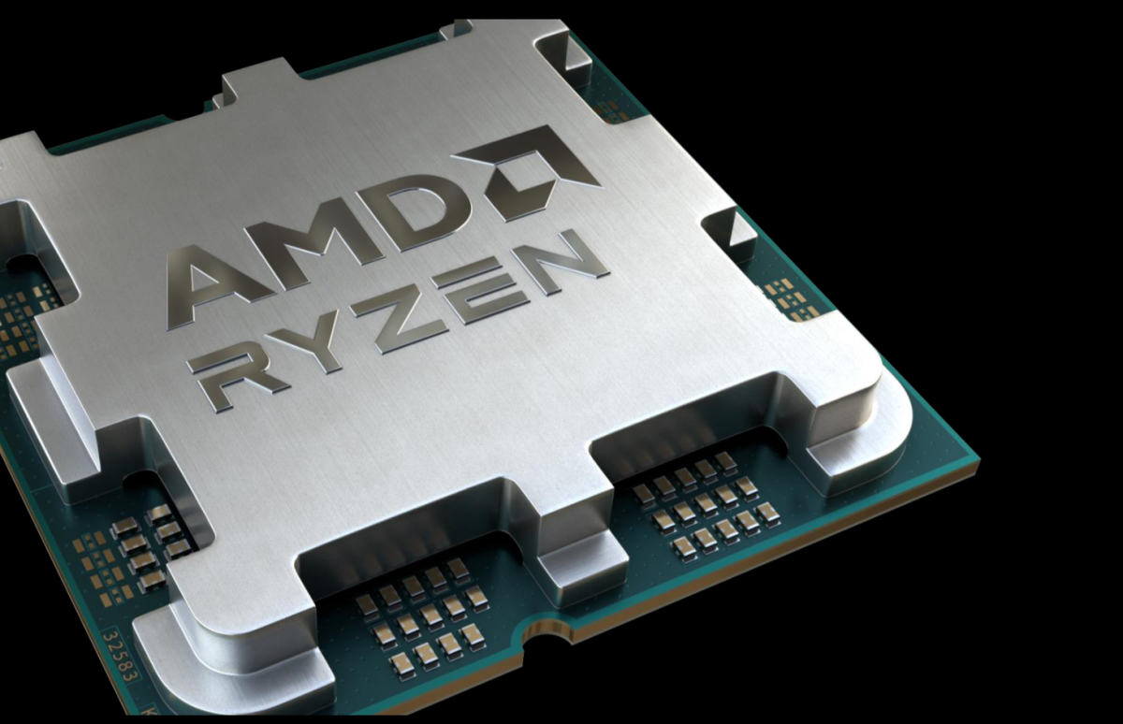
Sector Overview
Intel Inc.
Nvidia Inc.
AMD Inc.
AGENDA
SLIDE 2
Introduction to Semiconductors

Slide 3
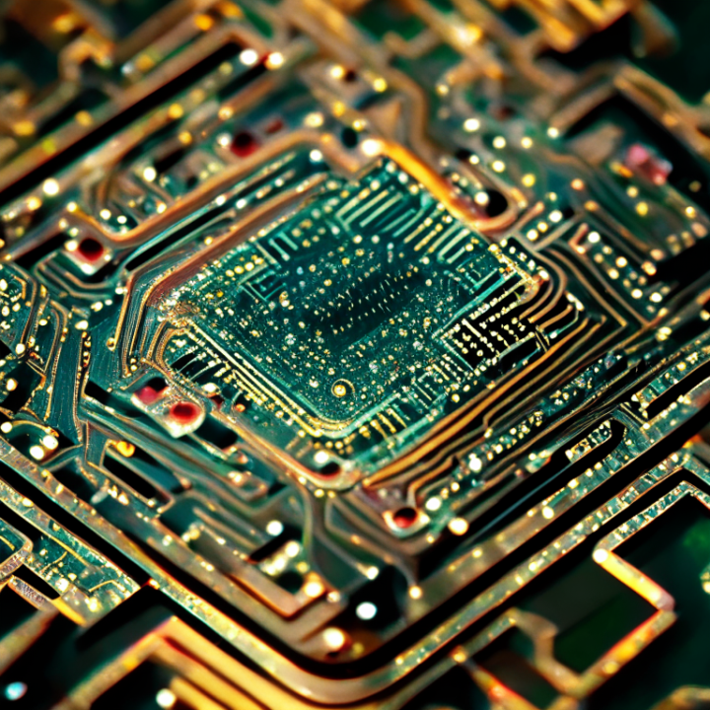
INTRODUCTION TO SEMICONDUCTORS
What are Semiconductors?
Components that act as both insulators and conductors:
Semiconductors like silicon and aluminum have properties that allow them to conduct electricity under specific conditions while also acting as insulators.
This dual functionality makes them essential in regulating electrical currents.
Used in transistors, diodes, and integrated circuits (ICs):
Transistors: Used for amplifying and switching electronic signals.
Diodes: Allow current to flow in one direction, critical in rectifiers and voltage regulators.
Integrated Circuits (ICs): Miniaturized circuits used in all modern electronics, from computers to smartphones.
Introduction to Semiconductors
Notes:
https://www.ineteconomics.org/uploads/featured/iStock-1210738055.jpg
https://otofacto.tech/otofacto2022/wp-content/uploads/2023/08/istockphoto-1373244125-170667a.webp

Slide 4
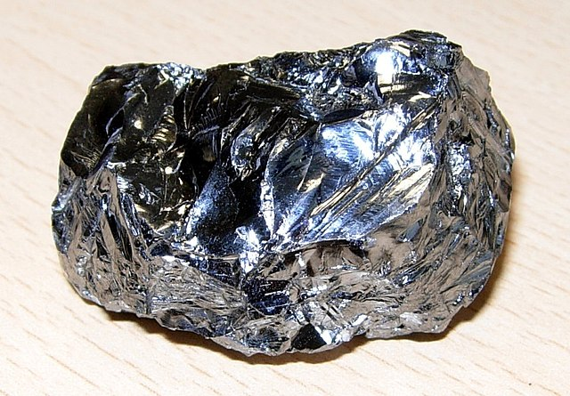
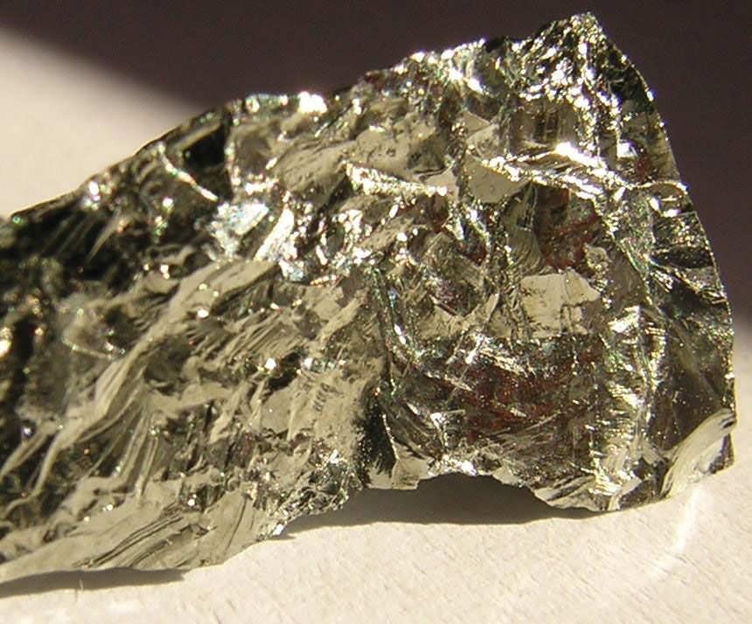
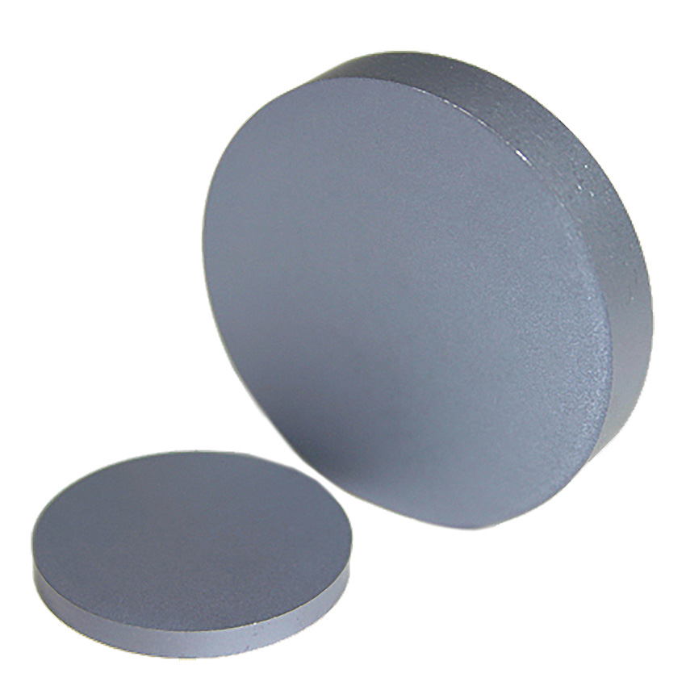
SEMICONDUCTOR MATERIALS
1
2
Silicon
Germanium
The most commonly used material in the production of semiconductor devices due to its favorable electrical properties and abundance.
An earlier material used, now often mixed with silicon for certain applications..
5
Gallium Arsenide
Used in high-speed applications like mobile phones and satellites.
SLIDE 6
Introduction to Semiconductors

Slide 5
COMMON APPLICATIONS OF SEMICONDUCTORS
1
2
Artificial Intelligence
Automotive
Drive GPUs for AI tasks, enabling real-time processing in advanced computing applications.
Critical for electric vehicles (EVs) and autonomous driving systems, managing sensors and AI processing.
3
4
Consumer Electronics
Telecommunications
Power smartphones, laptops, and gaming consoles, enabling essential digital tasks.
Support high-speed data transmission in 5G networks and mobile devices.
Introduction to Semiconductors

Slide 6

KEY TYPES OF SEMICONDUCTORS
Types of Semiconductor chips:
Memory Chips
Microprocessors
System on Chip (SoC)
Core functions of Semiconductor chips:
Amplification: Amplifying voltage or power for various electronic circuits.
Switching: Semiconductor components (transistors) control the flow of electricity, enabling
binary signaling (on/off states).
Energy Conversion: Converting alternating current (AC) to direct current (DC), which is necessary
for powering most electronic devices.
Introduction to Semiconductors

Slide 7

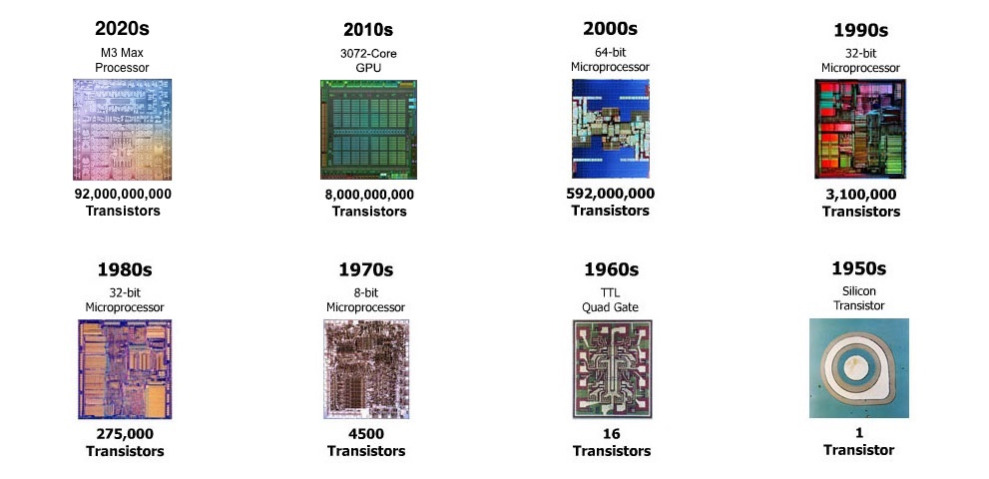
HISTORICAL INDUSTRY EVOLUTION
1947
1960
2020s
First transistor invented, marking the birth of the semiconductor industry.
Introduction of integrated circuits (ICs), enabling the miniaturization of electronics.
Industry valued at over $775 billion, with exponential growth in AI, IoT, and computing.
Industry Progress

Slide 8
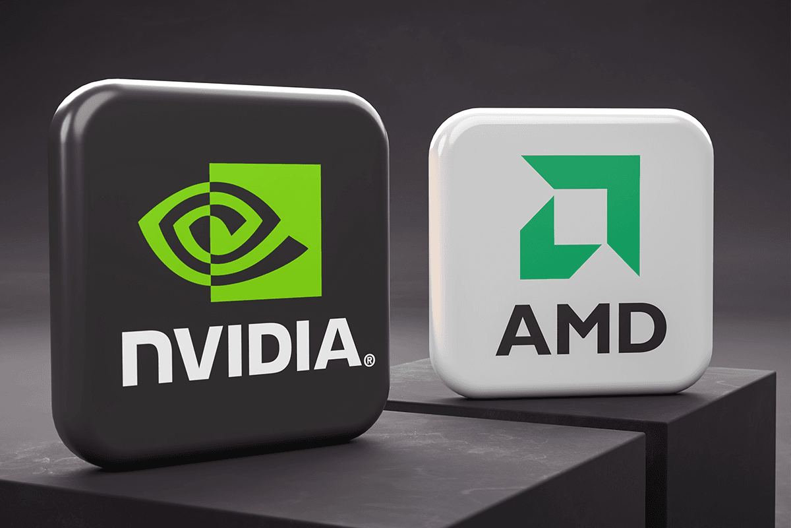
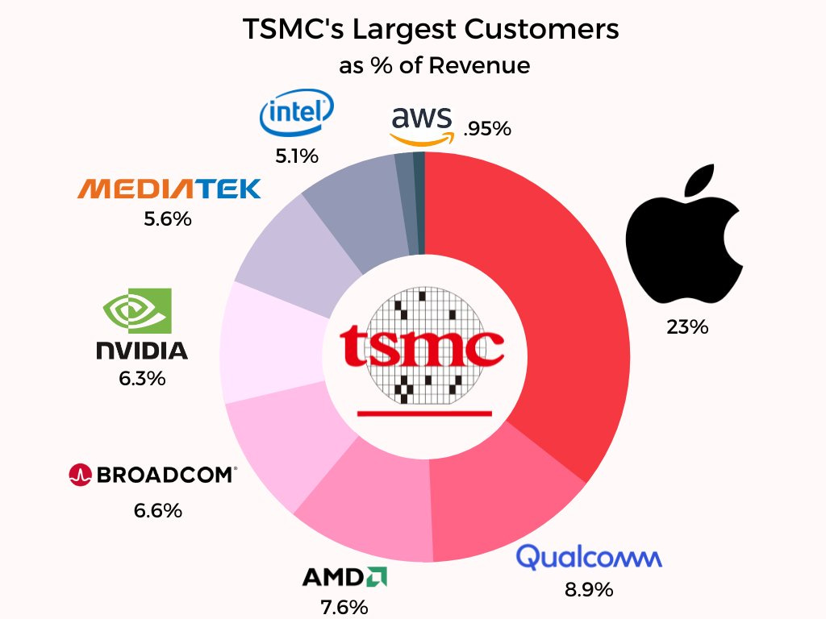

BUSINESS MODELS
Fabless Companies (e.g., Nvidia, AMD): Design chips but outsource manufacturing to foundries like TSMC.
Foundries (e.g., TSMC, GlobalFoundries): Specialize in manufacturing chips designed by other companies.
Integrated Device Manufacturers (IDMs) (e.g., Intel, Samsung): Design and manufacture their own chips.
Industry Progress

Slide 9
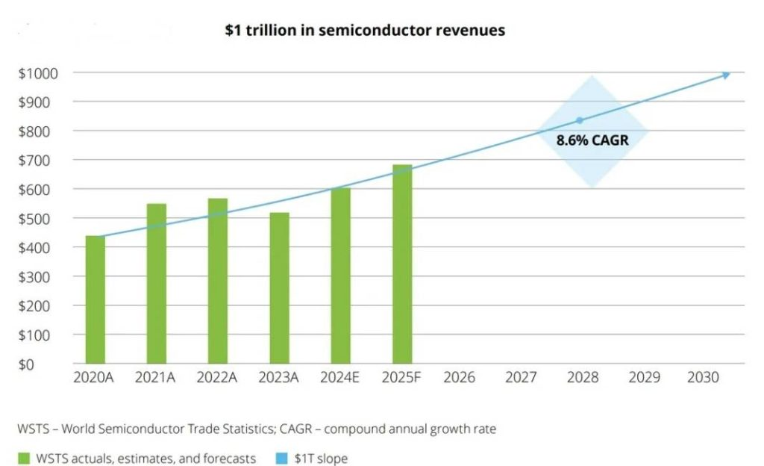
Semiconductor Market Growth Forecast
CAGR of 8.6% from 2020 to 2030.
Market revenues are expected to approach $1 trillion by 2030
Notes:
The image shows a bar graph representing the global semiconductor market's actuals, estimates, and forecasts from 2020 to 2030, along with a compound annual growth rate (CAGR) of 8.6%. The y-axis represents revenue in billions of dollars, while the x-axis shows the years from 2020 to 2030.
Key observations:
2020 to 2025: The market grows from about $450 billion in 2020 to nearly $600 billion in 2025 (forecasted).
CAGR of 8.6%: This represents the average annual growth rate over this period, indicating robust growth for the semiconductor market.
Future Projection: The graph extrapolates the growth trend, suggesting that the market could approach $1 trillion by 2030.

Slide 10
MAJOR MARKET SEGMENTS
CPUs, GPUs, and other chips for personal and enterprise computing.
Chips for EVs, autonomous driving systems, and connected vehicles.
Computing
AUTOMOTIVE
Smartphones, tablets, gaming consoles, and smart home devices.
Consumer Electronics
Production Process

Slide 11
VALUE CHAIN
Overview of the Semiconductor Value Chain
Use of Electronic Design Automation (EDA) software to design semiconductor chips.
Design
Silicon, photomasks, and other materials used in manufacturing.
Process carried out by foundries using advanced lithography techniques.
Raw Materials
Manufacturing
Production Process

Slide 12
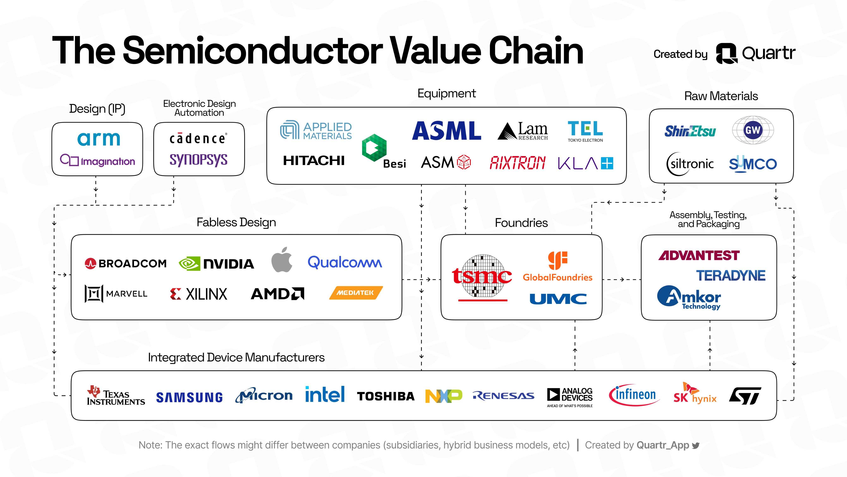
Production Process

Slide 13
MANUFACTURING PROCESS
How Are Semiconductors Made?
The manufacturing process involves photolithography, etching, doping, and packaging.
The process begins with a silicon wafer, which is processed to create microchips.

Slide 14
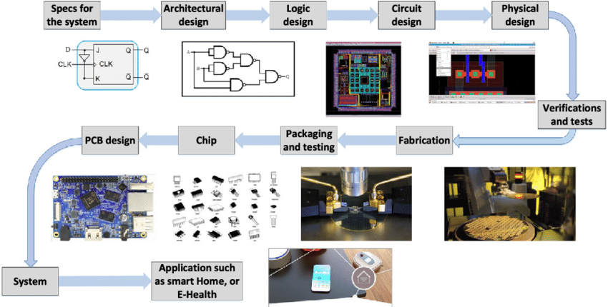
DESIGN AND MANUFACTURING METHODS
Industry Progress

Slide 15
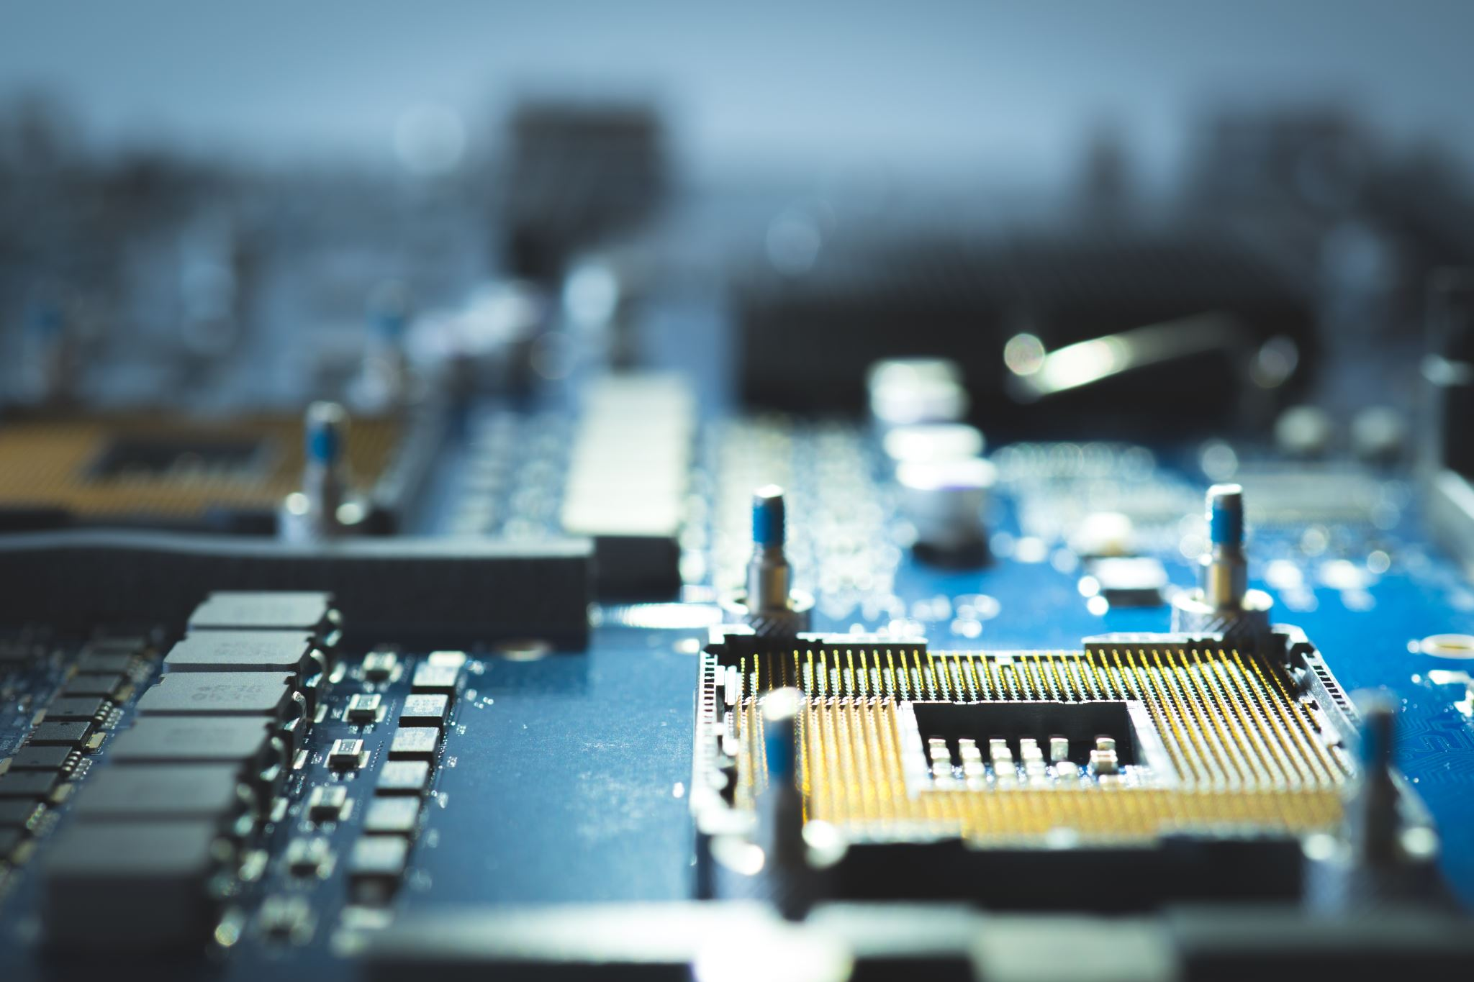
INDUSTRY PLAYERS OVERVIEW
Intel: Leading IDM, strong in CPU production and moving into AI and autonomous driving.
Nvidia: Fabless leader in GPU production, dominant in AI and high-performance computing.
AMD: Fabless company competing with Intel in CPUs and Nvidia in GPUs.
Industry Progress

Slide 16
Industry Trends: Shrinking Chip Sizes
Shrinking chip sizes (e.g., moving from 7nm to 3nm technology) allows for more transistors on a chip, improving performance and reducing energy consumption.
These advancements make chips faster and more efficient.

Slide 17
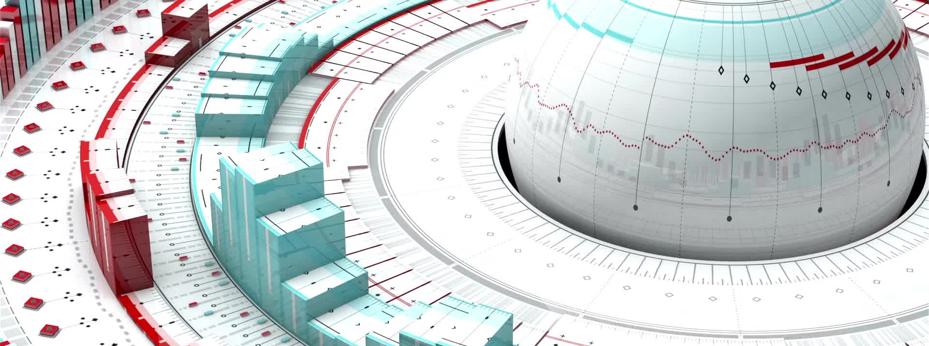
Geopolitics and Semiconductor Manufacturing
Taiwan is the global hub for semiconductor manufacturing, producing over 60% of the world’s chips (mainly through TSMC).
US-China tensions over Taiwan’s status pose risks to the global supply chain.

Slide 18
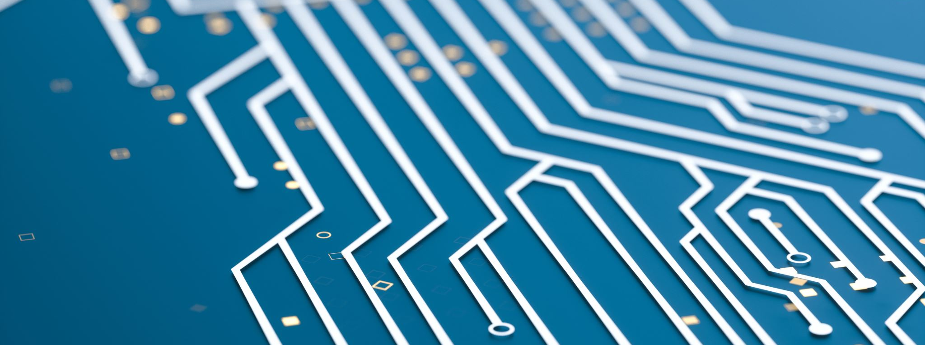
Global Industry Forecast
The industry is expected to grow by 6-7% annually, driven by the adoption of AI, 5G, and IoT.
Automotive and industrial electronics will be key drivers of growth.

Slide 19

Key Challenges Facing the Semiconductor Industry
Supply chain disruptions due to geopolitical tensions, natural disasters, and COVID-19.
Rising costs of domestic production due to government regulations and the CHIPS Act.
Additional Info

Slide 20

Supply Chain Vulnerabilities
COVID-19 revealed vulnerabilities in global supply chains, leading to shortages in key industries like automotive.
Companies are diversifying their supply chains to mitigate future risks.

Slide 21
CHIPS Act and Government Initiatives
Impact of the CHIPS Act:
The US government has introduced the CHIPS Act to boost domestic semiconductor production, offering $52.7 billion in subsidies.
Major players like Intel and TSMC are expanding their US operations as a result.

Slide 22
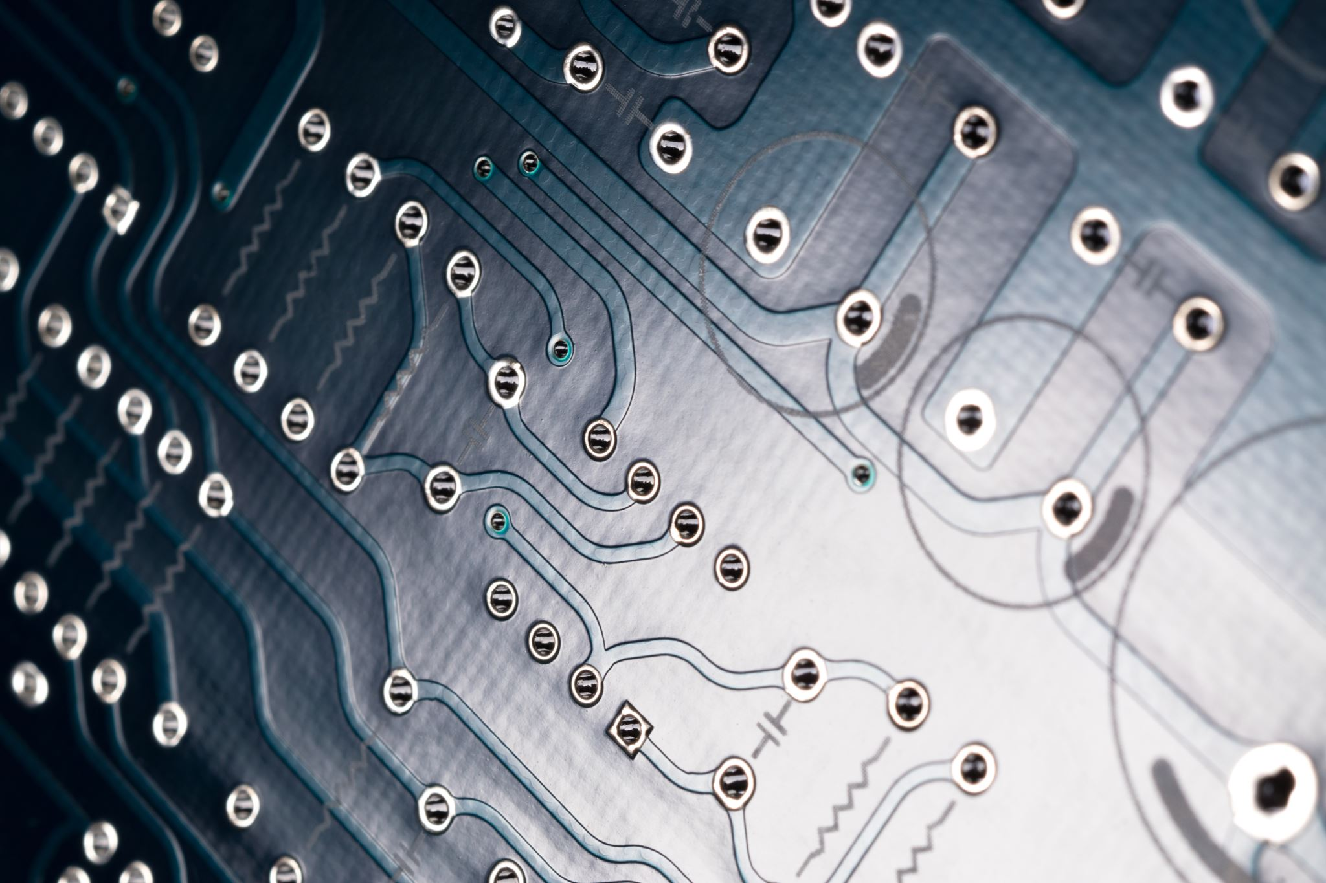
Risks Facing the Semiconductor Sector
Geopolitical risks (e.g., Taiwan and China).
Supply-demand mismatches leading to shortages in key industries, particularly the automotive sector.

Slide 23
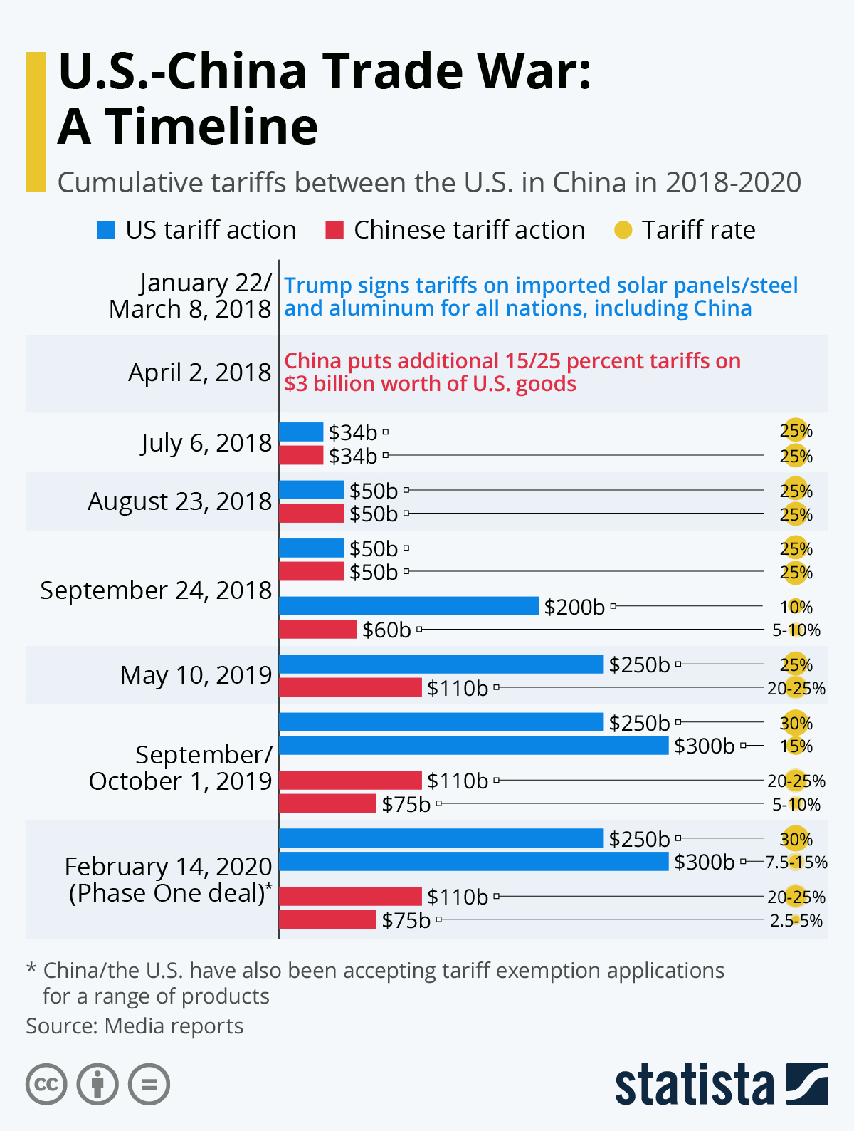
US-China Trade War Impact on Semiconductors
Trade tensions led to export restrictions and tariffs, affecting global semiconductor supply chains.
China ramped up efforts to develop its own semiconductor manufacturing capabilities.

Slide 24
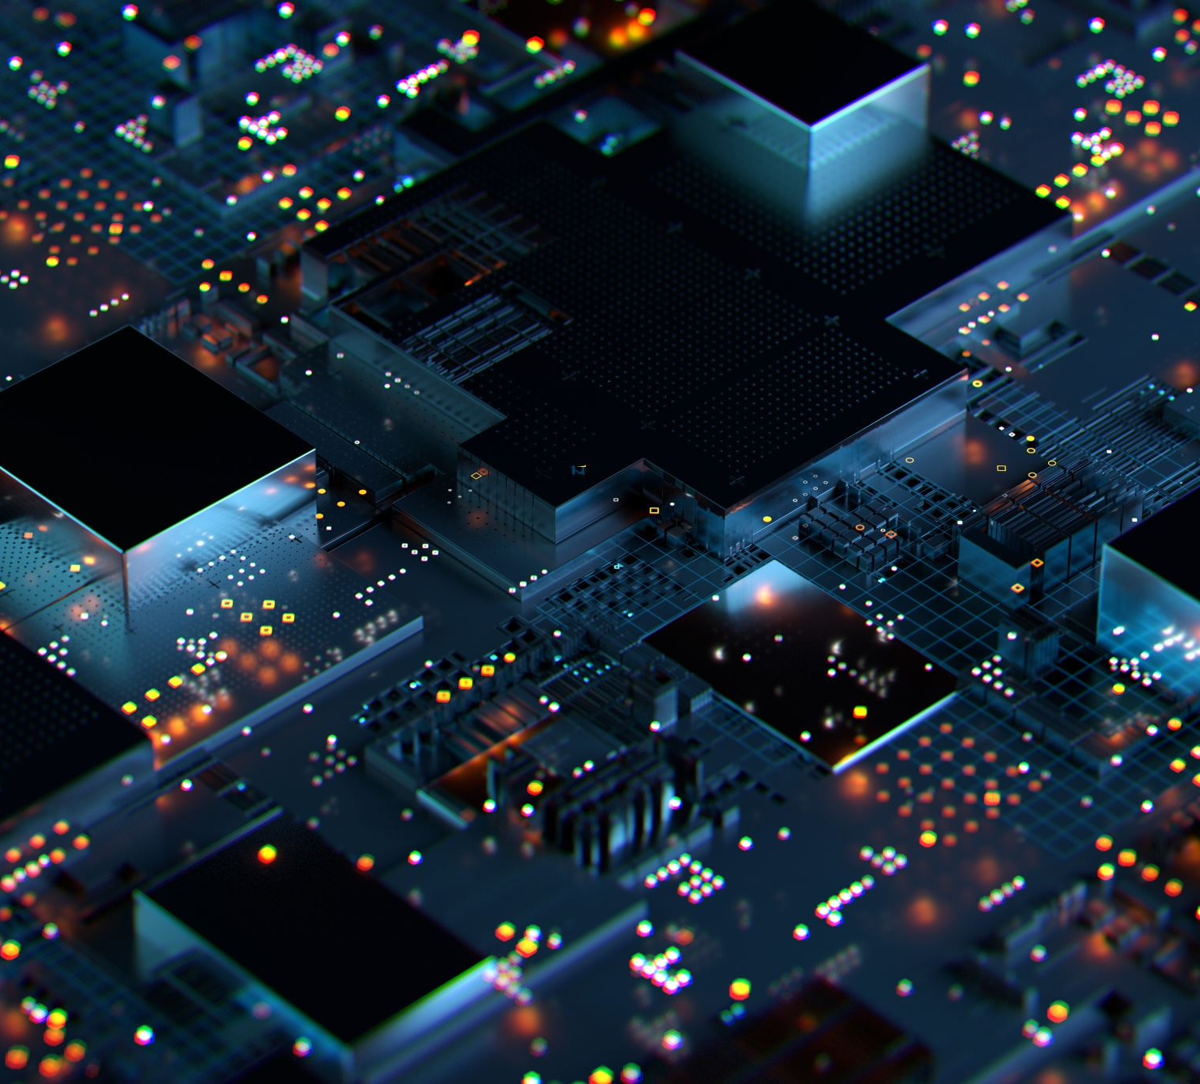
Intel vs Nvidia vs AMD: Competitive Landscape
Intel: Leading IDM with a strong focus on CPUs and AI.
Nvidia: Dominates in GPUs and AI chips.
AMD: Competes closely with Intel in CPUs and Nvidia in GPUs.

Slide 25
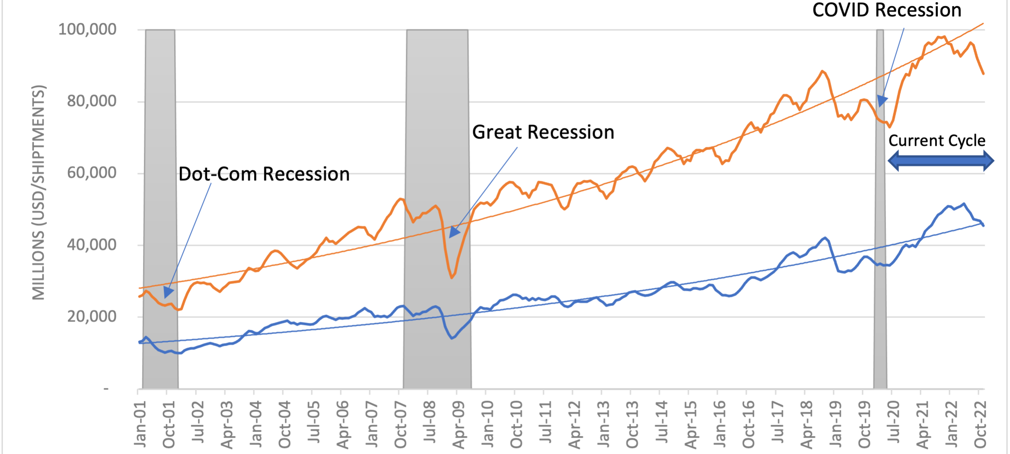
SALES AND UNIT SHIPMENTS

Slide 26
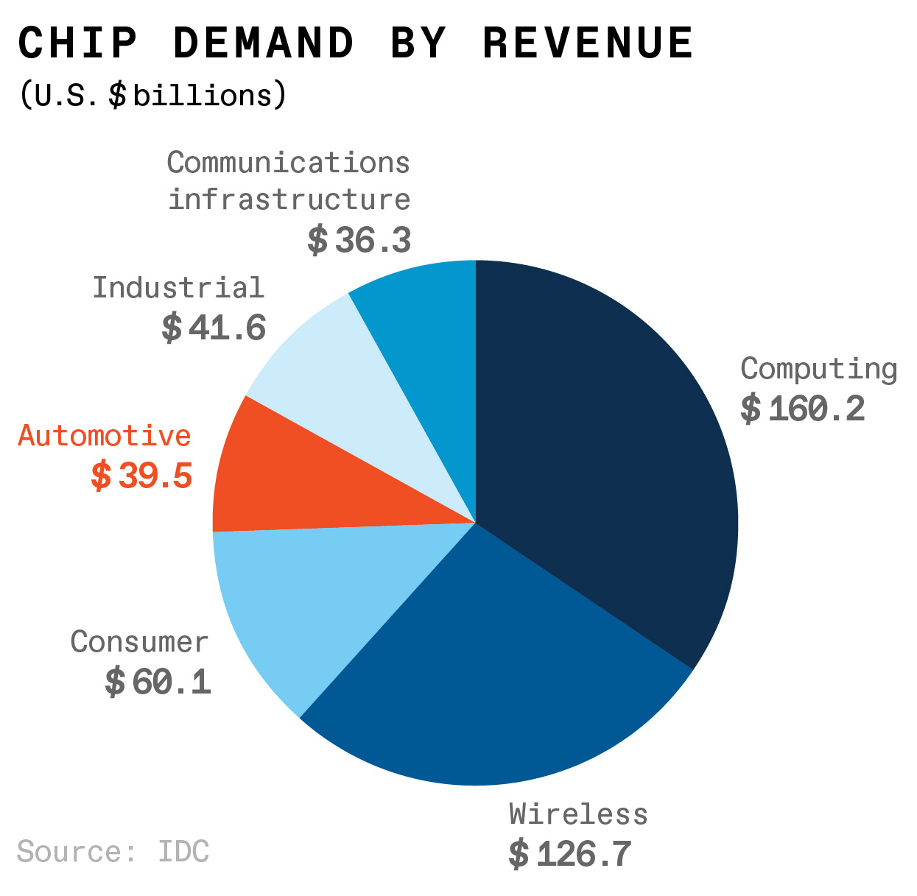

Slide 27
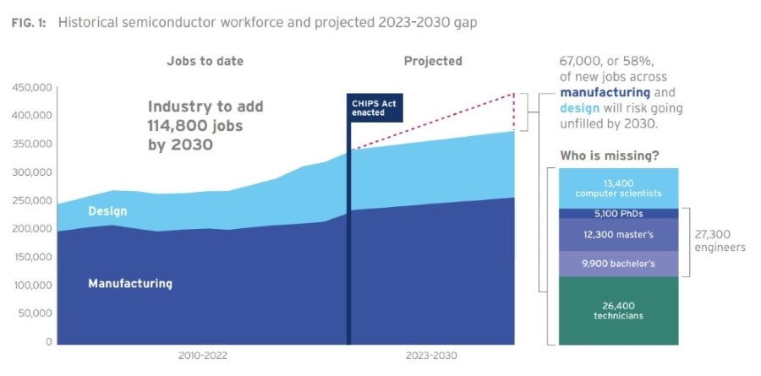

Slide 28
Future Trends in Semiconductor Technology
Quantum computing could revolutionize the industry, enabling exponential processing power.
AI and machine learning chips are advancing rapidly, driving innovation in various sectors.

Slide 29

INTEL
MORE INFORMATION
https://www.intel.com/content/www/us/en/homepage.html

Slide 30

KEY METRICS

Slide 31
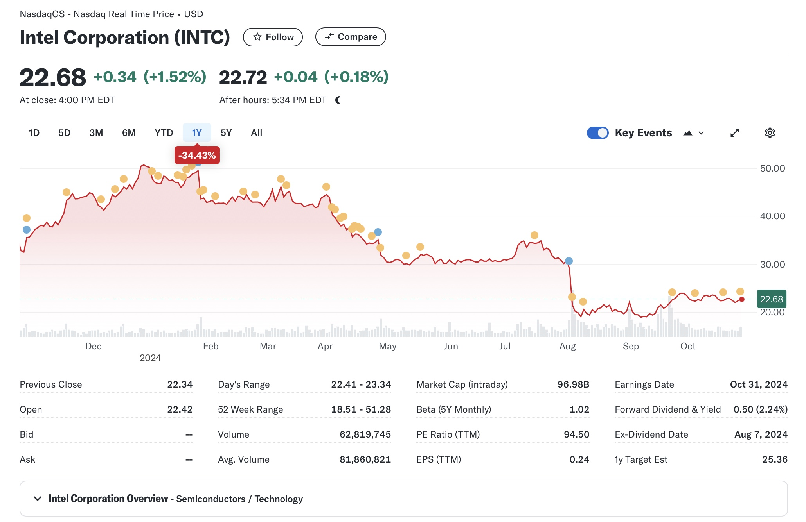
KEY METRICS - INTEL CORP.
Notes:
Intel's stock is currently priced at 31.23USD
Market cap 133 billion
Price/Earnings of 56.49, essentially indicating a high valuation and suggesting investors have high expectations for future growth

Slide 32
PRICE CHARTS

Slide 33
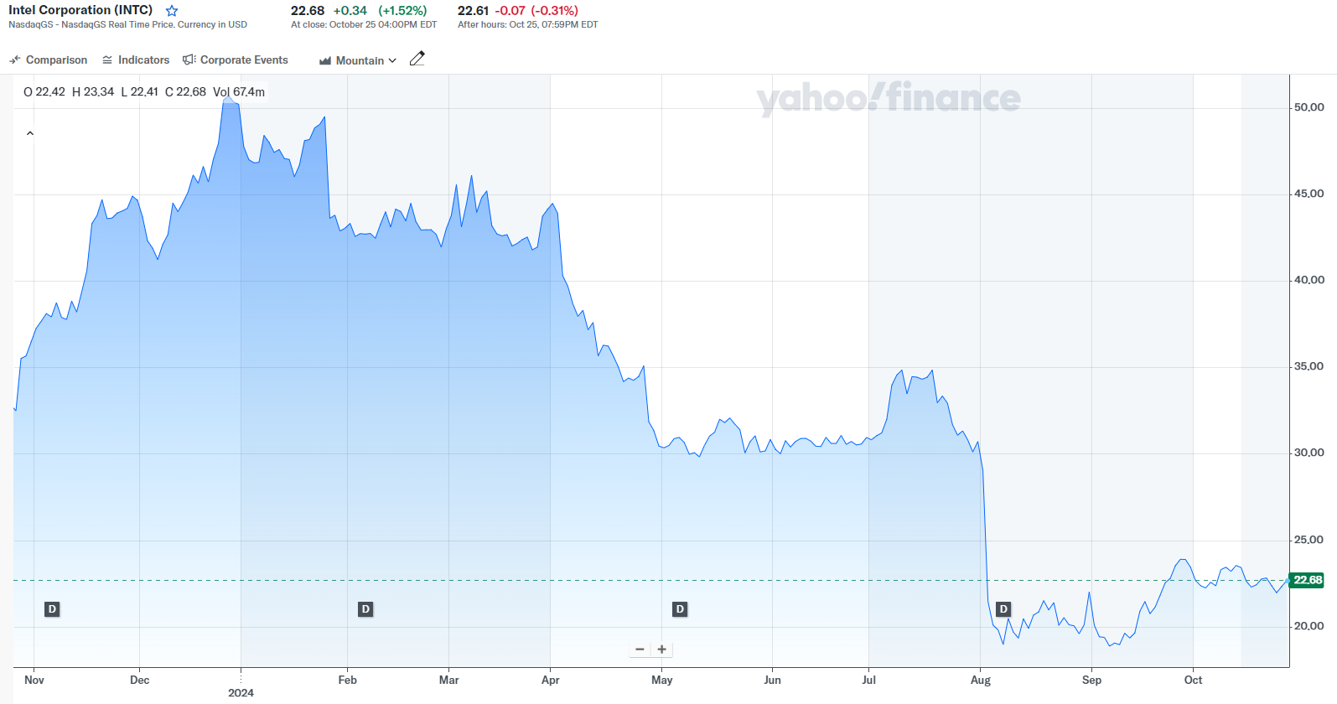
1 YEAR STOCK PERFORMANCE
Notes:
As you can see, Intel spiked up at the end of 2023 which was due to a couple of factors
Israel's government awarded Intel a $3.2 billion grant for a $25 billion chip plant it intends to construct in southern Israel. The investment is reportedly the largest ever by a company in Israel.
Intel also showcased a range of AI-focused products and services which included an artificial intelligence chip for generative AI software. The chip will officially launch next year. Intel also showed off its Core Ultra processor, which will target the emerging AI PC market.
Then, Intel drastically fell in 2024 after reporting first quarter sales that missed Wall Street’s estimates and issuing an uninspiring outlook for the current quarter.

Slide 34
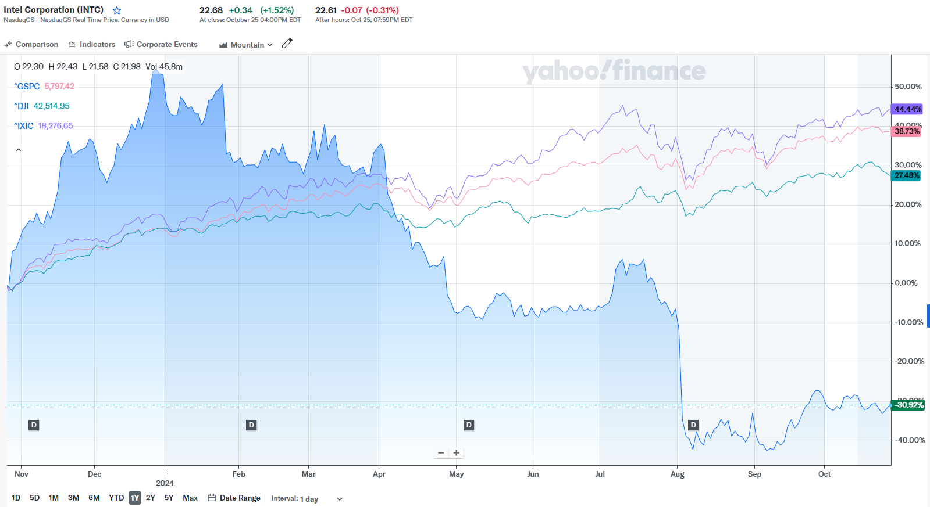
1 YEAR STOCK PERFORMANCE AGAINST INDICES
Notes:
Comparing against indices like S&P 500, NASDAQ, and Dow Jones Industrial Average, the indices have all been pretty much steadily increasing while Intel took the drastic dip in April

Slide 35
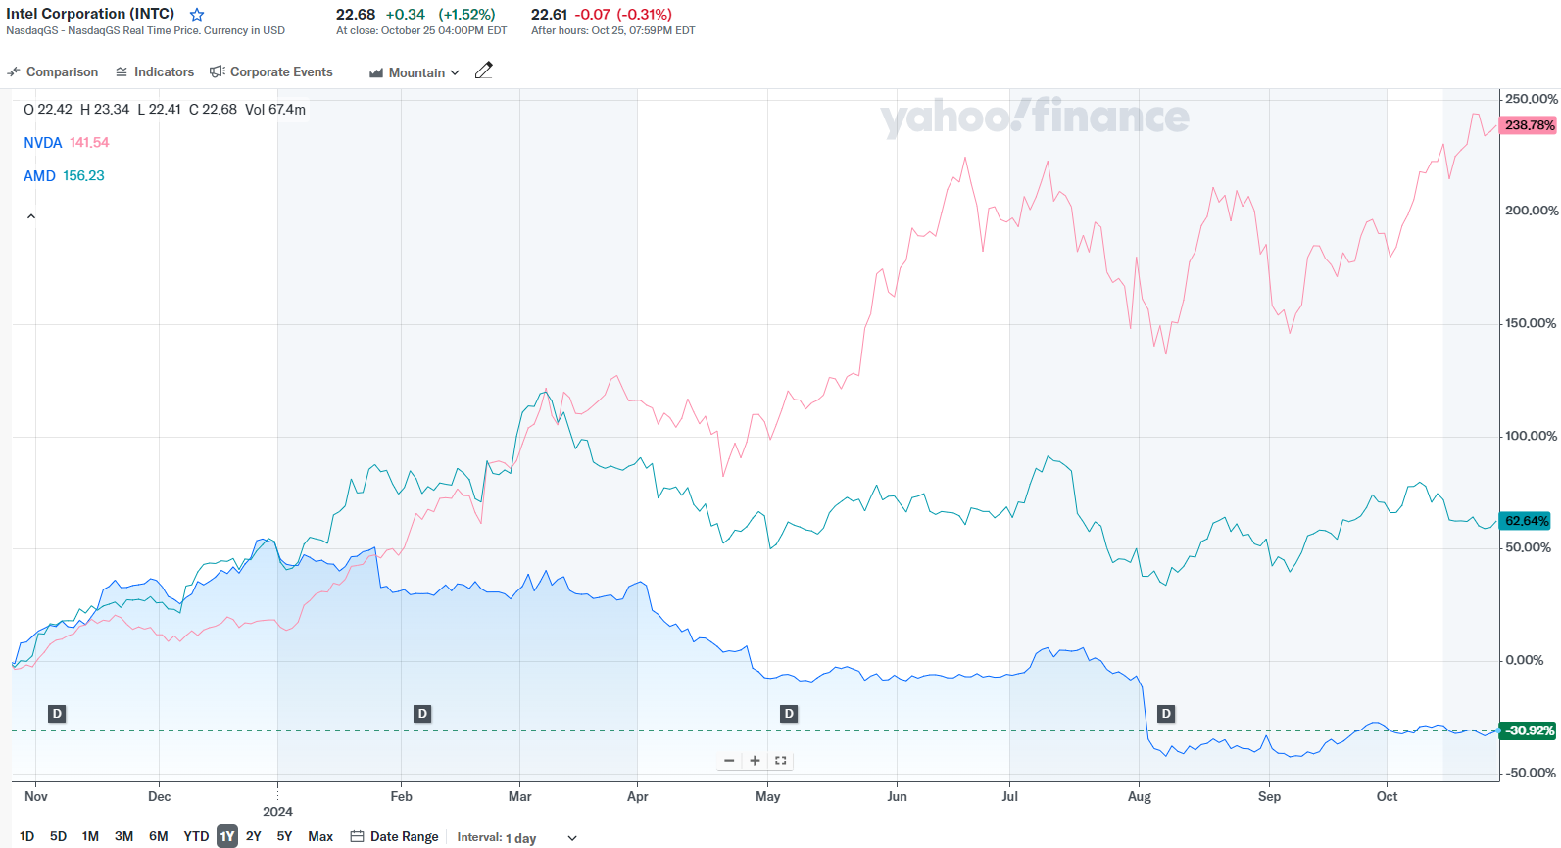
1 YEAR STOCK PERFORMANCE AGAINST NVDA & AMD
Notes:
Now comparing to some of its competitors in Nvidia and Qualcomm, Nvidia has been increasing like crazy this year while Qualcomm has seen a more steady increase

Slide 36
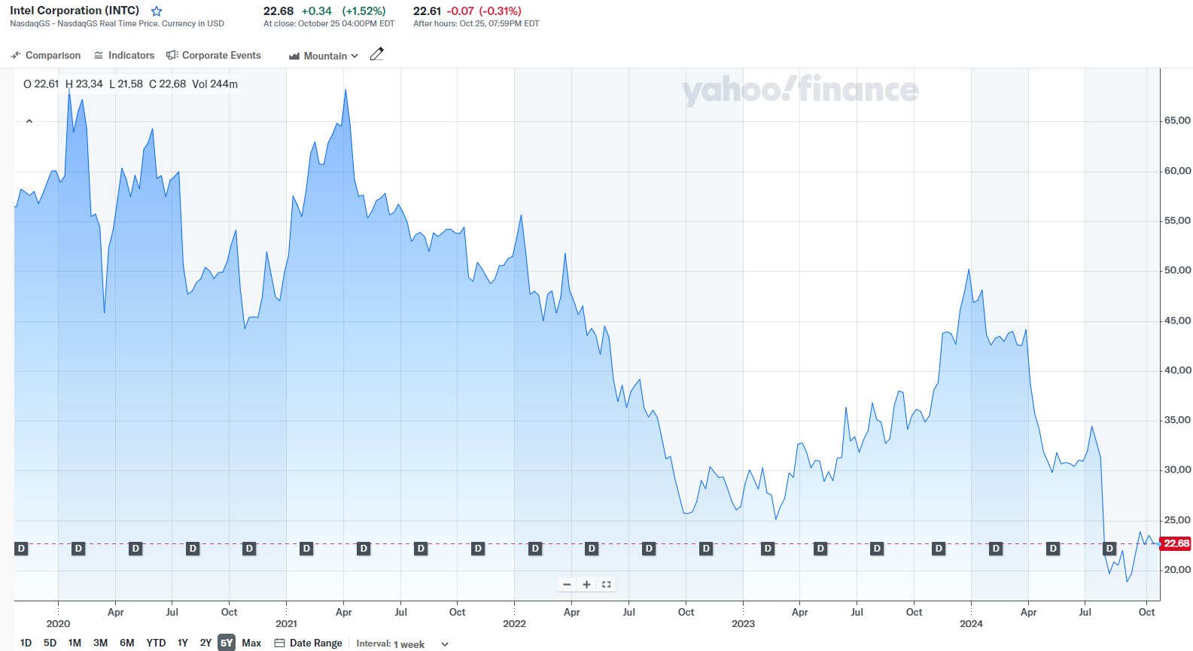
5 YEAR STOCK PERFORMANCE
Notes:
Looking at Intel over last 5 years
It's not doing well right now. It is at one of its lowest points since the end of 2022-early 2023

Slide 37
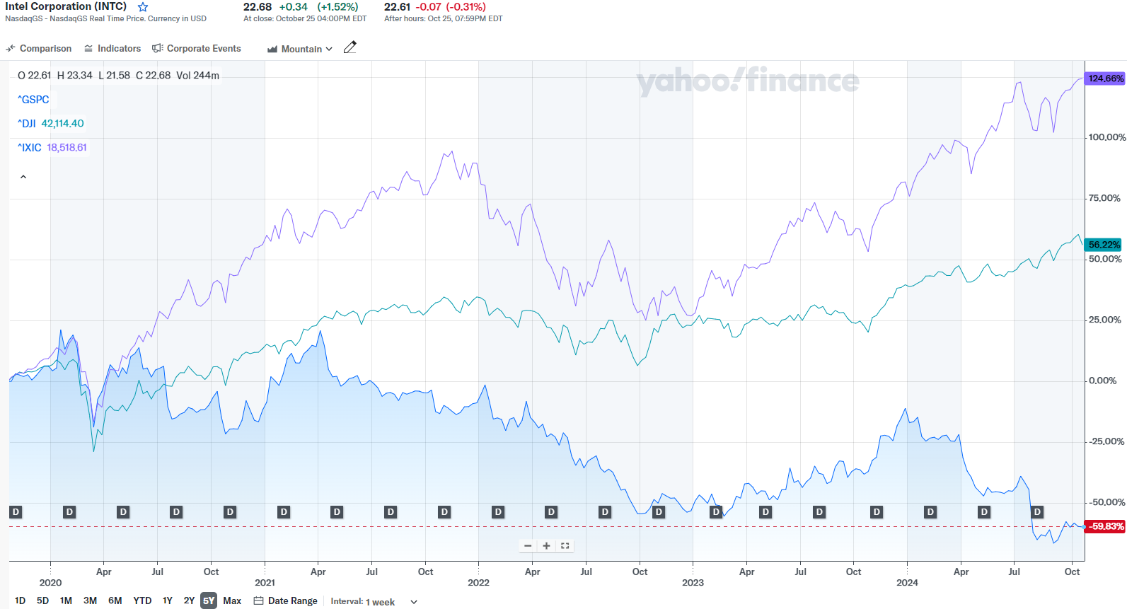
5 YEAR STOCK PERFORMANCE AGAINST INDICES
Notes:
Comparing again against the indices but from last 5 years
Again the indices have seen a steady climb but Intel has taken a dip and sits below them

Slide 38
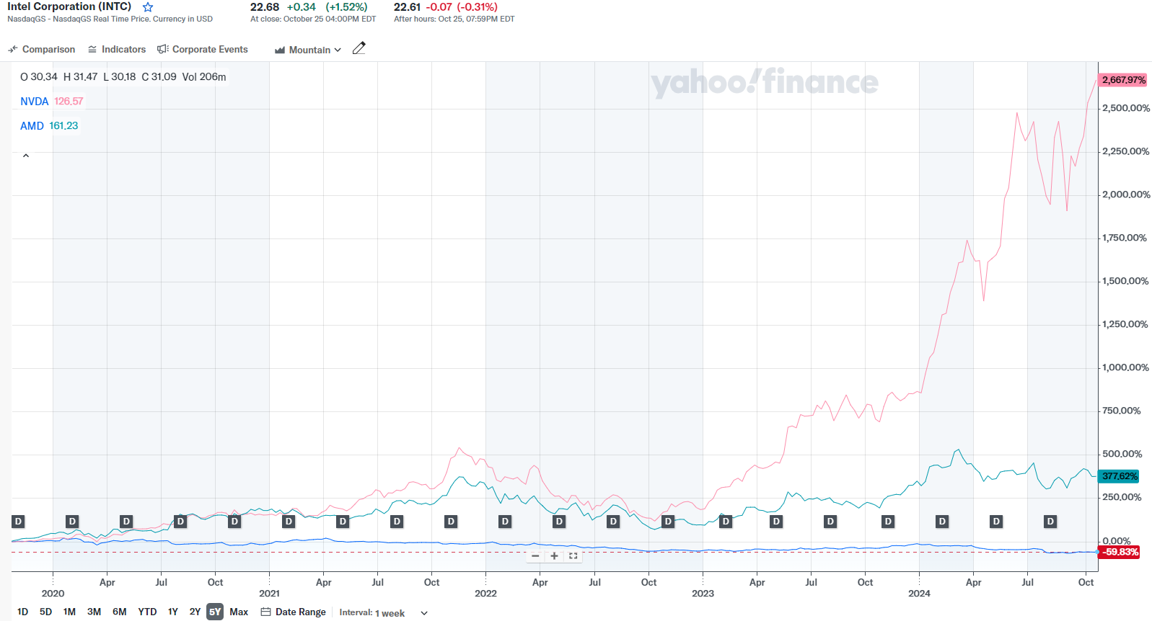
5 YEAR STOCK PERFORMANCE AGAINST NVDA & AMD
Notes:
Now for the past 5 years against Nvidia & Qualcomm, Nvidia is doing very well compared to Intel & Qualcomm right now, as it started to climb in 2023 and increased drastically in 2024
Intel & Qualcomm on the other hand, have not performed to the same level as Nvidia which is reflected here

Slide 39
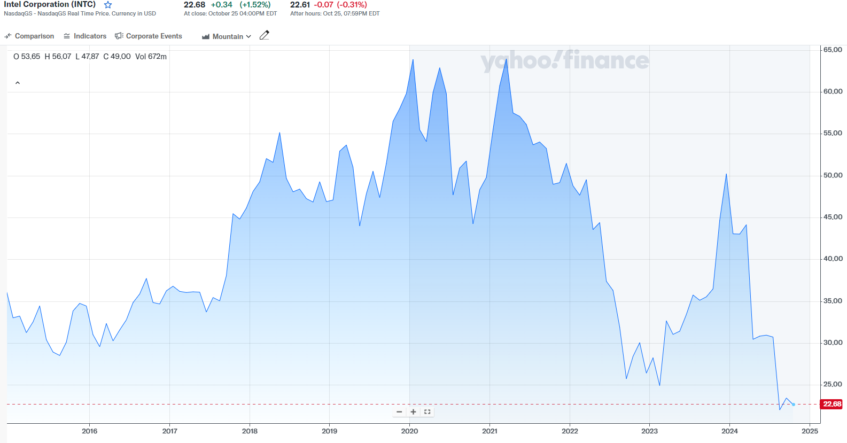
10 YEAR STOCK PERFORMANCE
Notes:
Over the last 10 years, Intel has really fluctuated, being a lot higher between 2018-2022 than it is now
Again, this is a really low point for Intel looking at the last 10 years

Slide 40
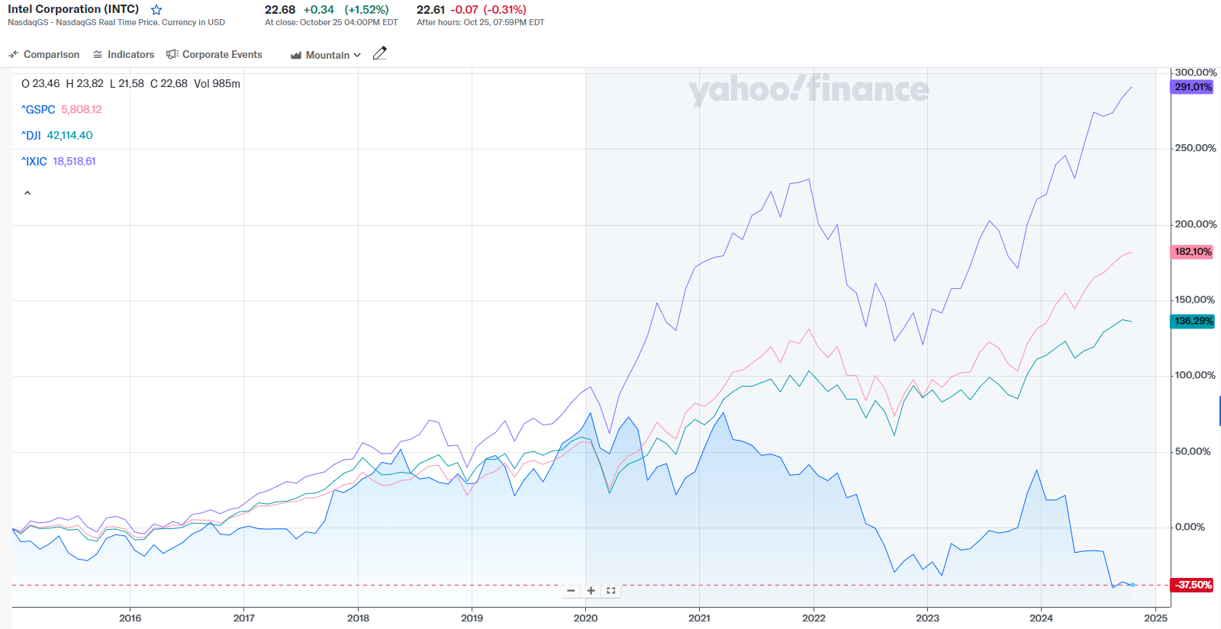
10 YEAR STOCK PERFORMANCE AGAINST INDICES
Notes:
Comparing to the indices in last 10 years

Slide 41
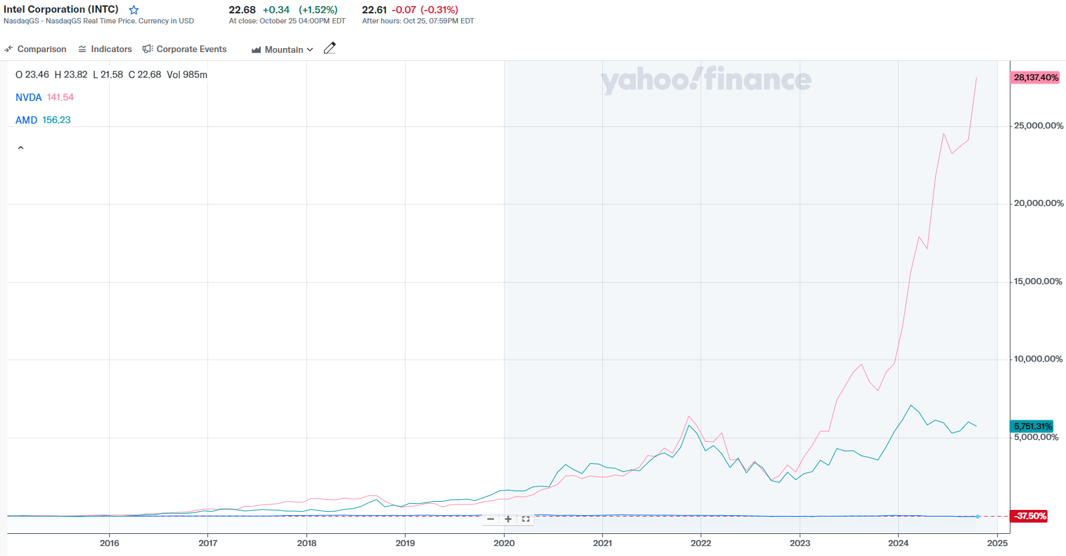
10 YEAR STOCK PERFORMANCE AGAINST NVDA & AMD
Notes:
And comparing to Nvidia & Qualcomm over last 10 years

Slide 42
INSTITUTIONAL HOLDERS

Slide 43
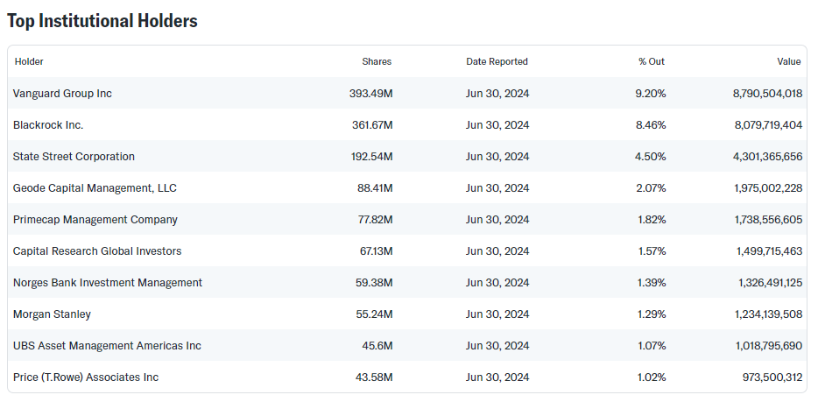
Notes:
Now onto the top institutional holders for Intel
Like Vanguard Group, Blackrock Inc., and State Street Corporation

Slide 44
Financial Summary

Slide 45
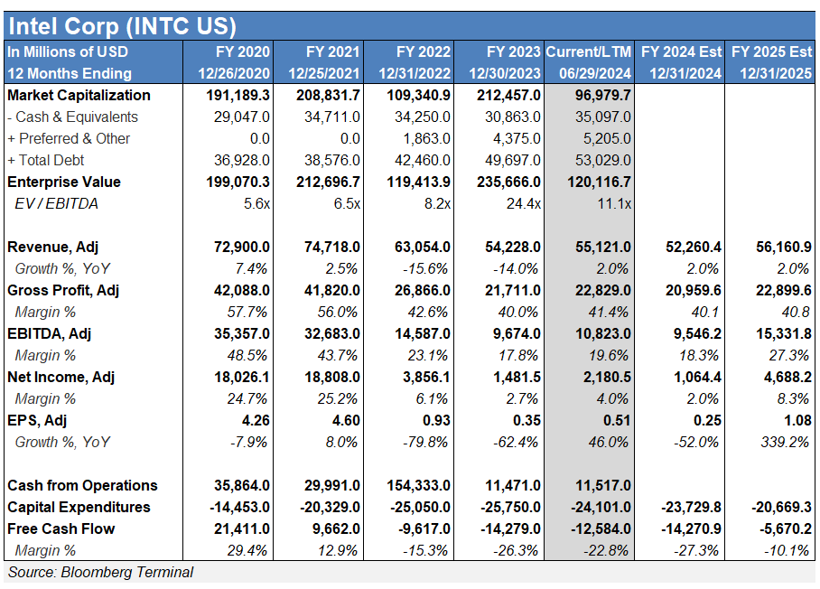
Financial Summary
Notes:
Now onto ratios, which ill point out some for trailing 12 months which refers to last 12 months
Gross margin 41.49%
Operating margin 1.29% - quite low
Net profit margin 7.36%

Slide 46
Valuation

Slide 47
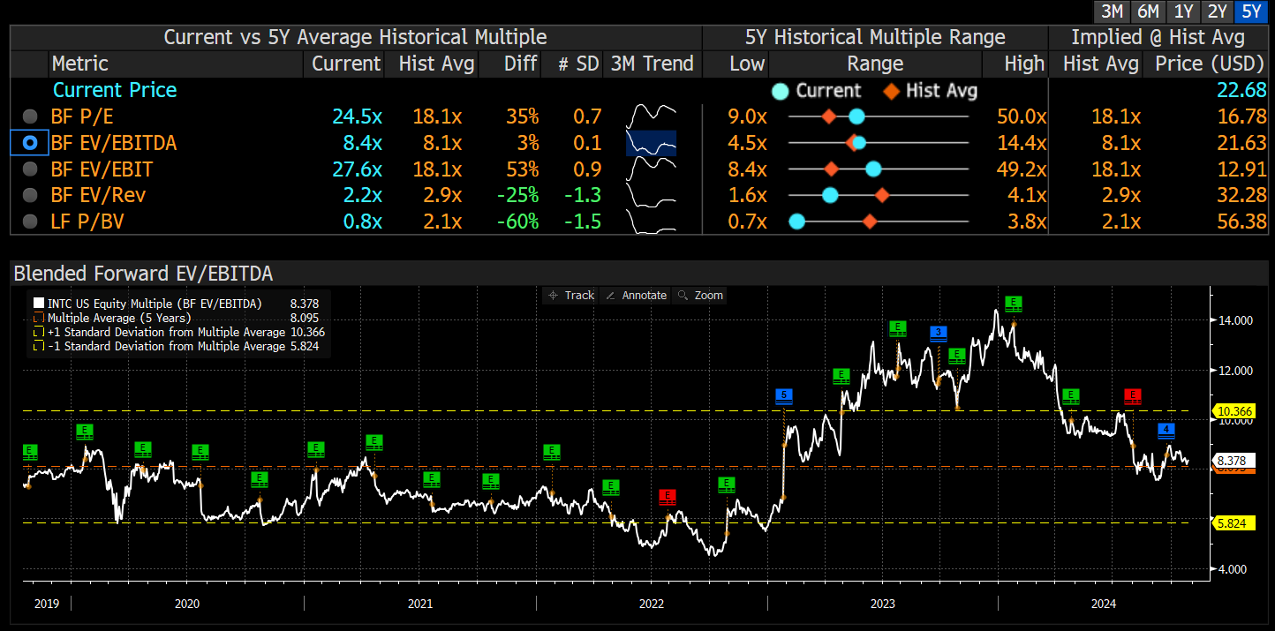
Historical EV / EBITDA
Notes:
Now onto ratios, which ill point out some for trailing 12 months which refers to last 12 months
Gross margin 41.49%
Operating margin 1.29% - quite low
Net profit margin 7.36%

Slide 48
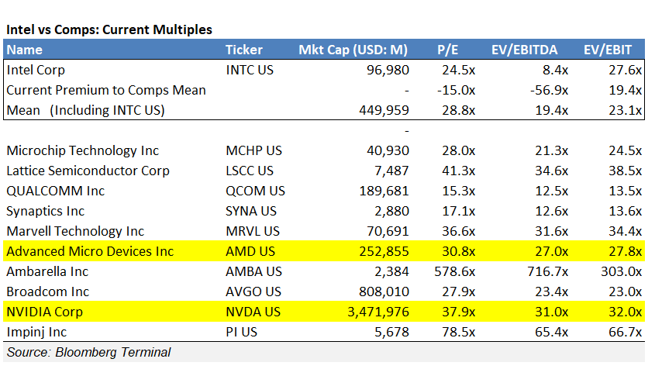
Intel vs Comps
Notes:
Now onto ratios, which ill point out some for trailing 12 months which refers to last 12 months
Gross margin 41.49%
Operating margin 1.29% - quite low
Net profit margin 7.36%

Slide 49
COMPANY OVERVIEW

Slide 50
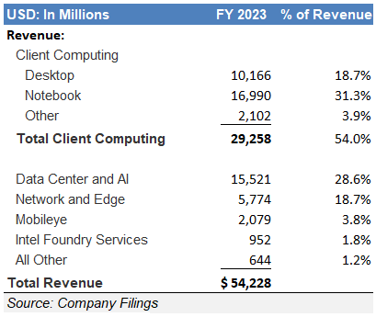
COMPANY OVERVIEW
Intel designs, manufactures, and sells computer components and related products. The company's major products include microprocessors, chipsets, embedded processors and microcontrollers, flash memory, graphic, network and communication, systems management software, conferencing, and digital imaging products.
Notes:
The company is a leading global Integrated Device Manufacturer (IDM) specializing in CPUs and related solutions. They handle all aspects of the product life cycle, from design and development to manufacturing, marketing, sales, support, and service. Their CPUs and solutions are widely used in computing and related end products and services globally, serving consumers, enterprises, governments, and educational organizations. The primary customer base comprises Original Equipment Manufacturers (OEMs), Original Design Manufacturers (ODMs), cloud service providers, and other equipment manufacturers. They reach these customers directly through their global sales and marketing organizations and indirectly through channel partners. The company's diverse product offerings are integrated into various computing applications, covering everything from edge computing to 5G networks, cloud services, AI, and autonomous driving. These solutions cater to a broad range of industries and applications. Manufacturing takes place at multiple fabrication, assembly, and testing facilities worldwide, ensuring a global supply chain to meet market demands.
Intel’s business is broken into six segments: client computing group, data center and ai, network and edge, mobileye, accelerated computing systems and graphics, intel foundry services

Slide 51
1968 Founded by Gordon Moore and Bob Noyce | 1969 Introduced semiconductor and silicon gate technologies | 1970 Released the 1103 DRAM | 1971 Introduced the EPROM and became a public company | 1974 Created the first general purpose microprocessor, 8080. | 1980 IBM selects Intel microprocessor for the first personal computer
TIMELINE
6
5
4
3
2
1
Notes:
DRAM - dynamic random access memory
EPROM - erasable programmable read-only memory

Slide 52
1989 Introduced the 80486 chip which included 1.2 million transistors and allows for the first built-in math coprocessor | 1995 Made up 40 % of PC market by selling 10 million motherboards | 1997 Launched the Celeron processor | 2000 Introduced Itanium, the company’s first 64-bit processor, which was designed to meet the needs of powerful internet servers | 2006 Pioneers SRAM chip using nanometer logic technology | 2008 Intel spun off key assets of a solar startup business to form an independent company, SpectraWatt Inc
TIMELINE
12
11
10
9
8
7
Notes:
SRAM - Static random-access memory (static RAM or SRAM) is a type of random-access memory (RAM) that uses latching circuitry (flip-flop) to store each bit

Slide 53
2011 Introduced the first Thunderbolt technology | 2017 Merger with Mobileye that greatly advanced the company’s position in autonomous driving | 2018 Achieved $70 billion in revenue | 2019 Bob Swan became permanent CEO | 2020 Introduced foldable screen computer | 2021 Launches new 11th gen core designed for mobile gaming 2022 Introduced Project Amber, which provides organizations with remote verification of trustworthiness in cloud, edge and on-premises environments.
TIMELINE
18
17
16
15
14
13

Slide 54

NOTABLE ACQUISITIONS
2000: GIGA - $1.25 BILLION - SPECIALIZES IN ADVANCED HIGH-SPEED COMMUNICATIONS CHIPS USED IN OPTICAL NETWORKING
2010: MCAFEE - $7.68 BILLION - COMPUTER SECURITY SOFTWARE
2010: INFINEON TECHNOLOGIES - $1.4 BILLION - GERMANY’S LARGEST SEMICONDUCTOR MANUFACTURER
2015: ALTERA - $16.75 BILLION - MANUFACTURER OF PROGRAMMABLE LOGIC DEVICES
2017: MOBILEYE - $15.3 BILLION - DEVELOPS AUTONOMOUS DRIVING TECHNOLOGIES
Notes:
Giga - specializes in advanced high-speed communications chips used in optical networking. Its products are targeted for a range of applications that speed transmission over the Internet backbone.
McAfee - Online protection for your identity, privacy, and devices. Includes antivirus, VPN, and Protection Score
Infineon - Infineon semiconductor solutions - MCUs, sensors, automotive & power management ICs, memories, USB, Bluetooth, WiFi, LED drivers
Altera - specializes in configurable field programmable gate arrays (FPGAs), which are basically chips that can be programmed for different uses after manufacturing.
Mobileye - It is developing self-driving technologies and advanced driver-assistance systems including cameras, computer chips, and software

Slide 55
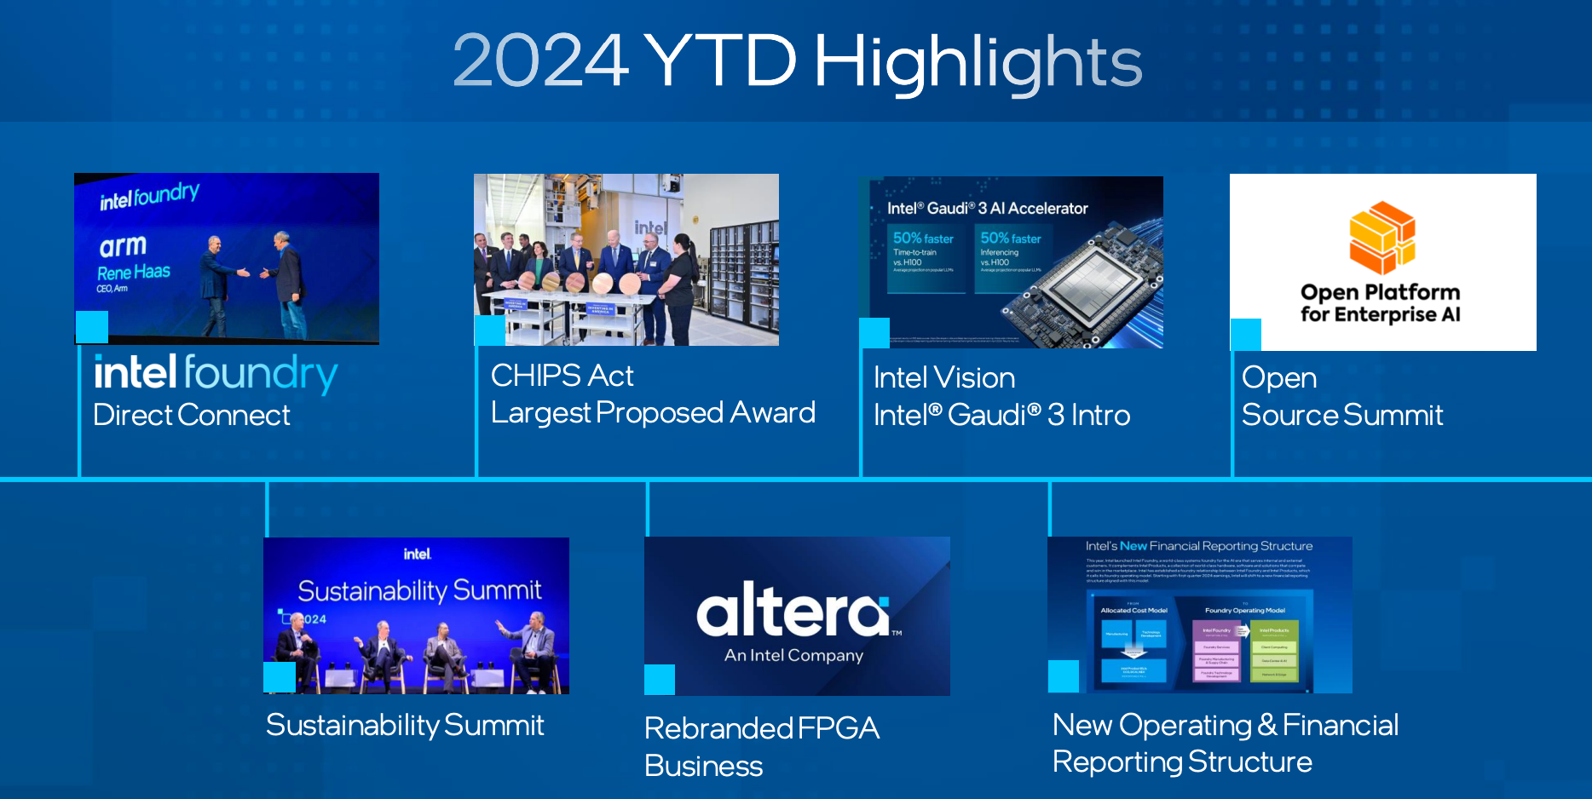
Notes:
CHIPS Act:
U.S. Department of Commerce has proposed up to $8.5 billion in direct funding through the CHIPS and Science Act to advance Intel’s commercial semiconductor projects in Arizona, New Mexico, Ohio and Oregon.
Intel also expects to benefit from a U.S. Treasury Department Investment Tax Credit (ITC) of up to 25% on more than $100 billion in qualified investments and eligibility for federal loans up to $11 billion.

Slide 56
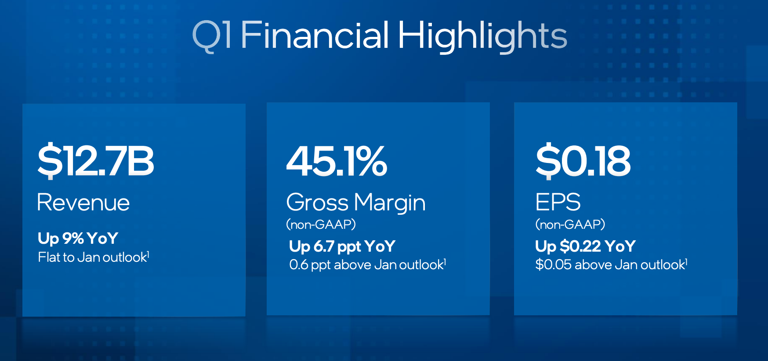

Slide 57
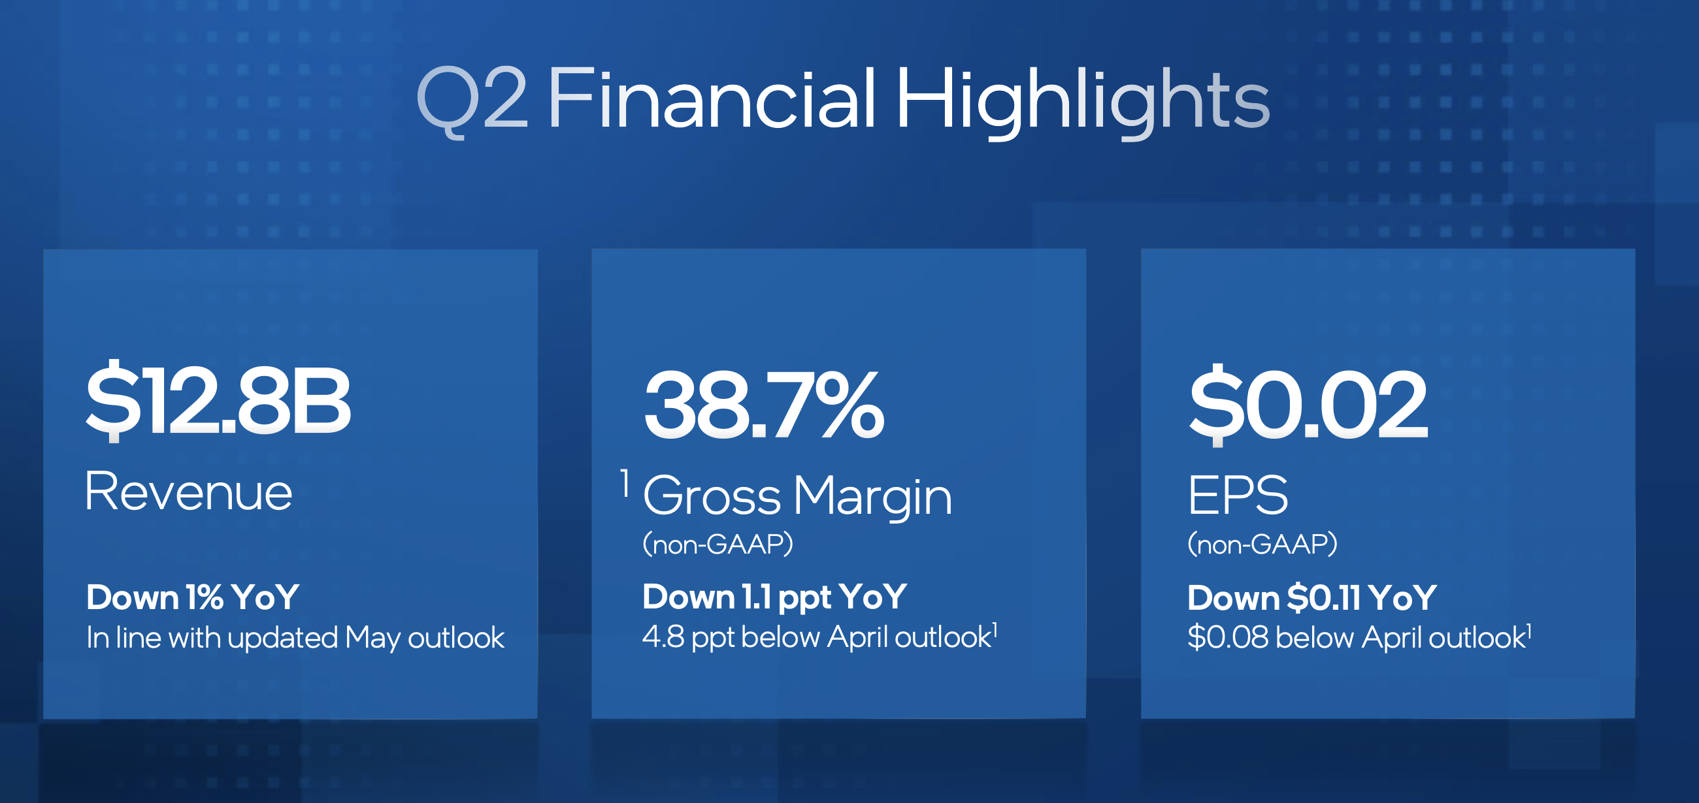

Slide 58
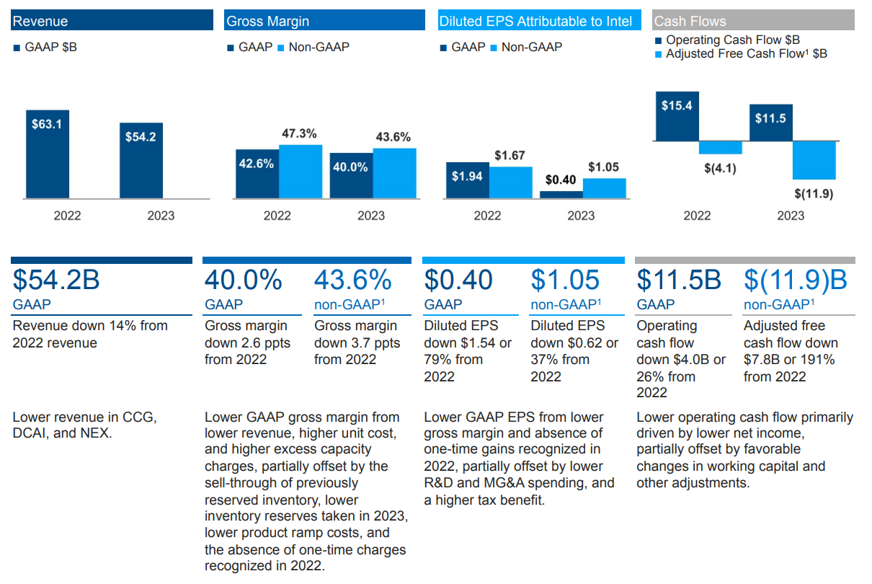
A YEAR IN REVIEW (10K)
Notes:
Everything down from 2022
Revenue down
Gross margin down
Diluted EPS down
Operating cash flow down

Slide 59
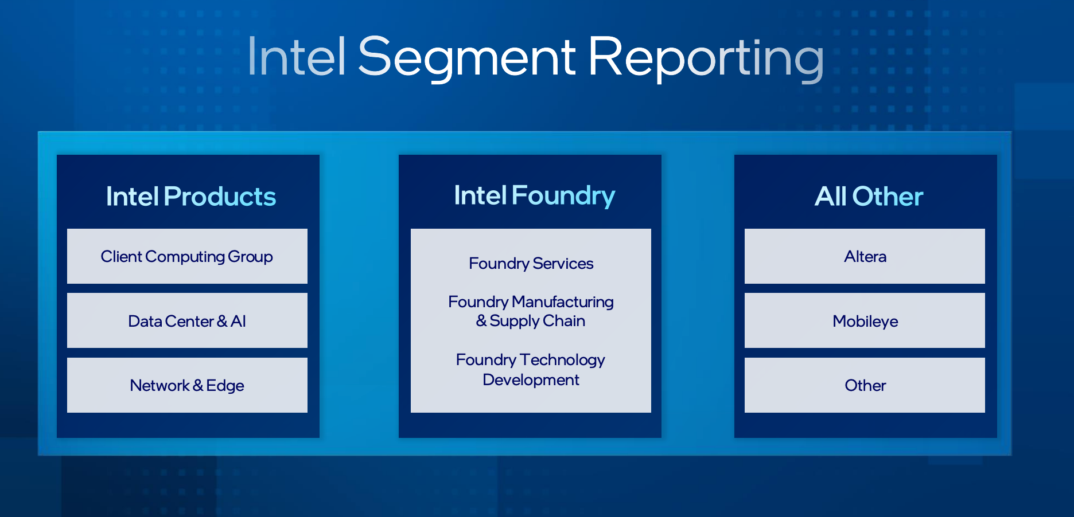
Notes:
Intel's 3 product lines
- Client Computing Group: CCG creates platforms designed for end-user form factors, focusing on higher growth segments of 2-in-1, thin-and-light, commercial and gaming, and growing opportunities in areas such as connectivity.
- Data Center and AI Group : DCAI focuses on developing leadership data center products, including Intel® Xeon® server and field programmable gate array (FPGA) products, as well as driving the company’s overall artificial intelligence (AI) strategy.
- Network and Edge group: NEX is chartered with driving technology and product leadership throughout the network to the intelligent edge.
Intel Foundry:
- a fully vertical, standalone foundry business that offers a wide range of manufacturing services to meet unique product needs, including our industry-leading sort and test capabilities.

Slide 60
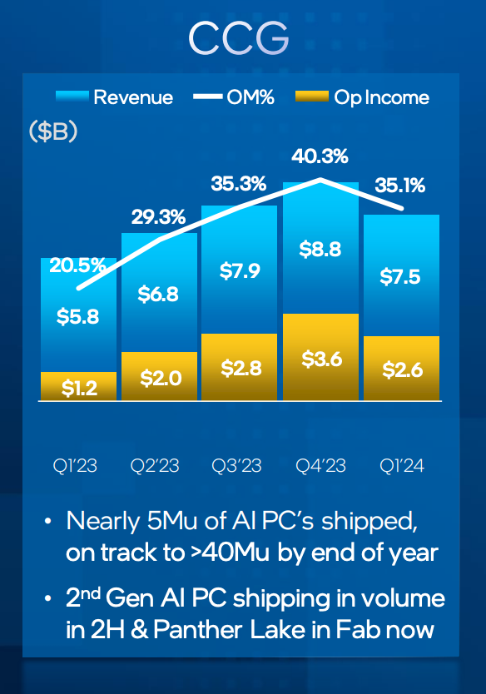
INCOME - CLIENT COMPUTING

Slide 61
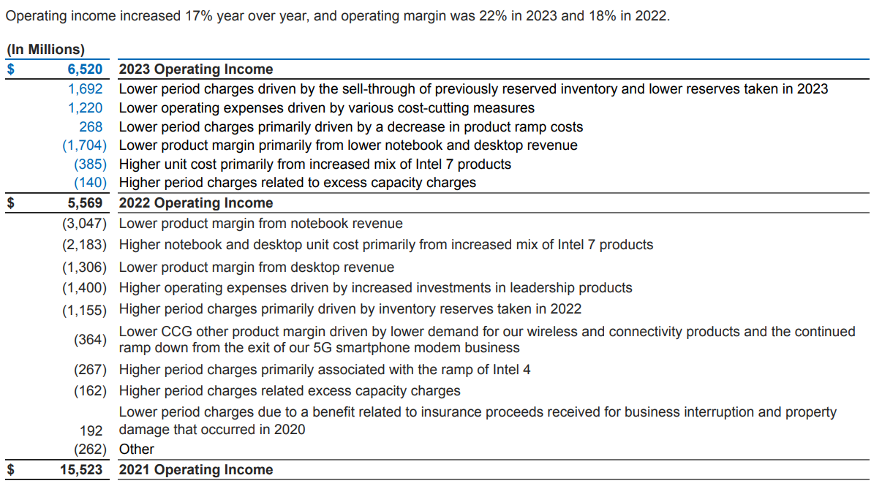
INCOME - CLIENT COMPUTING (10K)
Notes:
Operating income up in 2023 from 2022

Slide 62
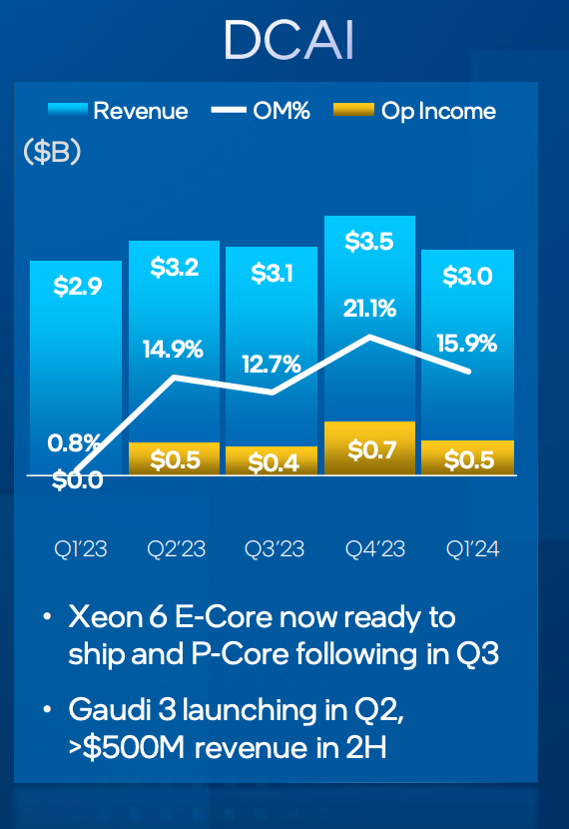
INCOME - DATA CENTER AND AI

Slide 63
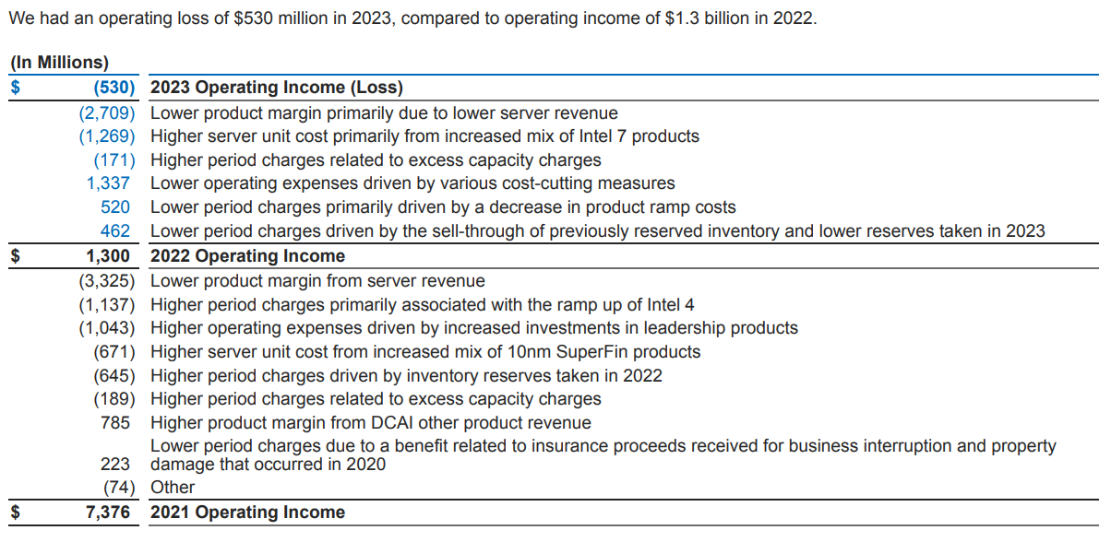
INCOME - DATA CENTER AND AI (10K)
Notes:
Data Center and AI at a loss in 2023

Slide 64
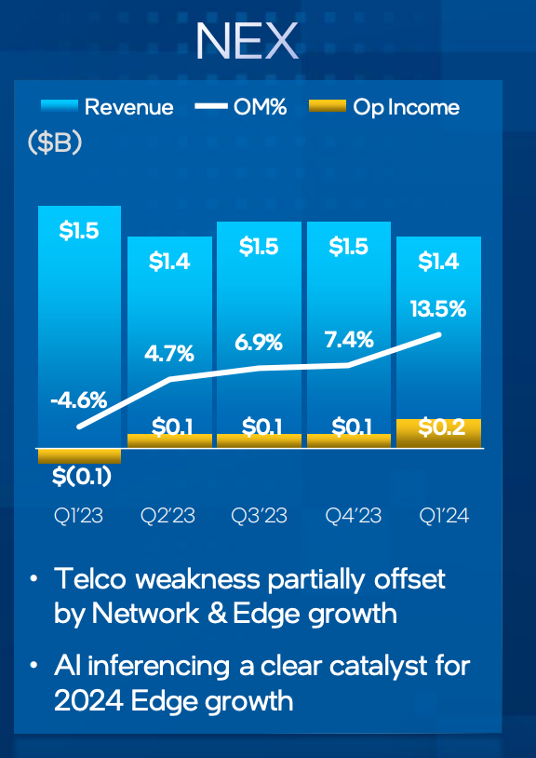
INCOME - NETWORK AND EDGE

Slide 65
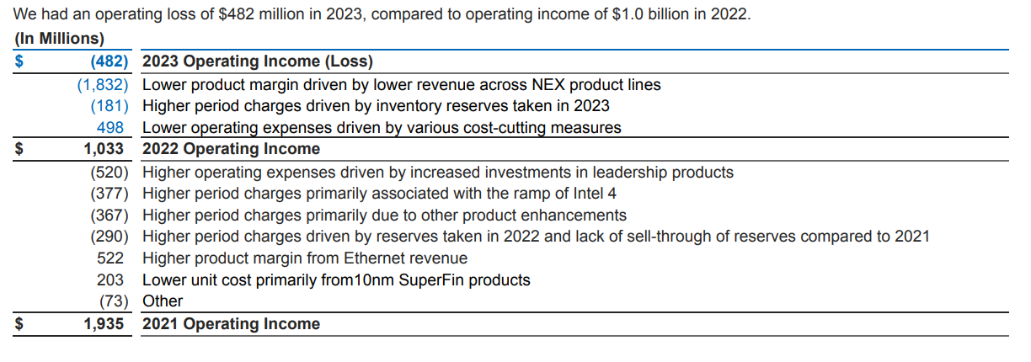
INCOME - NETWORK AND EDGE (10K)
Notes:
Loss in 2023

Slide 66
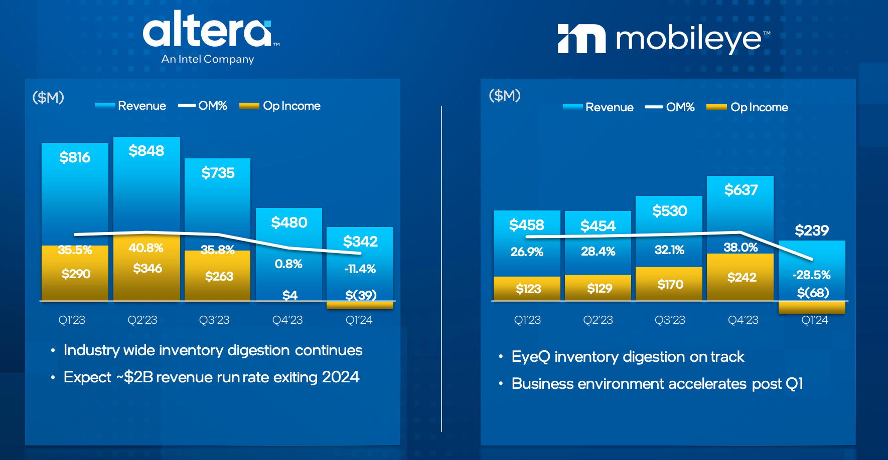

Slide 67

INCOME - MOBILEYE (10K)
Notes:
Revenue up in 2023 for Mobileye, driven by higher demand for EyeQ products

Slide 68


Slide 69

INCOME - FOUNDRY SERVICE (10K)
Notes:
Revenue up driven by higher packaging revenue
Increased operating loss however due to increased spending to drive strategic growth

Slide 70
BOD & EXECUTIVES

Slide 71

BOARD OF DIRECTORS

Slide 72

BOARD OF DIRECTORS

Slide 73

CEO and Board Member, Intel Corporation since February 15, 2021.
Over 40 years of technology leadership
Transformed VMware as CEO, tripling revenues
Former President & COO at EMC
Chair of Mobileye Global Inc. board since 2022
First CTO at Intel, led key innovations like USB and Wi-Fi
Architect of the original 80486 processor
Significant contributions to Intel® Core™ and Intel® Xeon® families
Electrical Engineering degrees from Santa Clara University (Bachelors) and Stanford University (masters)
Elected member of National Academy of Engineering in 2023
Holds 8 patents and is an IEEE Fellow
Married for over 30 years with 4 children and 8 grandchildren
Published author and speaker on faith, work, and philanthropy
Notes:
With intel since Feb 15, 2021
Electricial engineering bachelor degree from Santa Clara Uni and masters degree at Stanford

Slide 74

EXecutive Vice President and CHIEF Financial Officer (CFO), Intel Corporation
Leads Intel’s global finance organization, including finance, accounting, reportING, tax, treasury, internal audit, and investor relations
JOINED INTEL IN JANUARY 2022
Former EVP and CFO at Micron Technology Inc., responsible for global finance and investor relations
Over 20 years of financial and operational experience in semiconductors and technology
PRESIDEnt and COO at Affirmed Networks
SVP of Finance and CFO at Analog Devices
SVP and CFO at Intersil Corp.
MBA in Finance and Accounting from Vanderbilt University
Bachelor’s degree in Industrial Management from Carnegie Mellon University
Notes:
joined intel jan 2022
mba in finance and accounting from vanderbilt uni
bachelors in industrial management from carnegie mellon university

Slide 75

Executive Vice President, Chief Global Operations Officer, and GM of Foundry Manufacturing and Supply Chain, Intel Corporation
Responsible for worldwide manufacturing operations, strategic planning, corporate quality assurance, corporate services, and supply chain
LED INTel’s non-volatile memory worldwide manufacturing
Managed strategy and operations for memory fabs, component assembly/test, 3D NAND, and Optane SSD manufacturing
Held various leadership roles in process engineering, yield and manufacturing
Joined Intel in 1996 as an industrial engineer
Former co-CEO of IM Flash Technologies joint venture with Micron
Led Dalian fab conversion and expansion projects
Bachelor’s and Master’s degrees in Industrial Engineering and Operations Research from Purdue University
Notes:
Joined intel in 1996
Bachelor and masters degrees in industrial engineering and operations research from purdue university

Slide 76

EXecutive Vice President, Chief Technology Officer (CTO), and General Manager, Software and Advanced Technology Group (SATG), Intel Corporation
JOINED INTEL IN JUNE 2021 FROM VMWARE, WHERE HE SERVED AS SENIOR VICE PRESIDENT AND CTO
Responsible for driving Intel’s technical innovation, leading Intel Labs, Intel Federal LLC, and Intel IT
Former SVP and CTO at VMware, specializing in software and hardware prODUCt engineering, cloud-scale systems architecture, and R&D
Leadership roles at Citigroup, Cisco Systems, and Sun Microsystems
OVer 40 years of experience in software and hardware engineering
Focus on AI, confidential computing, and open accelerated computing
Bachelor of Science in Computer Science from University of Georgia
Master of Science and Ph.D. in Computer Science from Virginia Tech
Notes:
joined intel june 2021
bachelor of science in comp sci uni of georgia
master of science and phd in comp sci virginia tech

Slide 77

Executive Vice President and Chief Legal Officer, Intel Corporation since July 2022
Leads Intel’s global legal, trade, and government affairs team
Strategic adviser to company and board of directors
Previously EVP and CLO at Eaton Corp. and Meritor Inc.
Over 25 years of executive leadership in legal roles
Managed mergers and acquisitions across various industries
Juris Doctor from University of Chicago Law School
Bachelor of Business Administration from University of Michigan Business School
Board Membership
Member of the board of directors of Trane Technologies
Notes:
With intel since July 2022
Bachelor of business admin from uni of michigan business school

Slide 78

Executive Vice President, Chief Commercial Officer, and GENeral Manager of Sales, Marketing, and Communications, Intel Corporation
JOINED INTEL IN MARCH 2022
Responsible for global sales, marketing, communications, corporate planning, customer support, and customer success
Former CHIEF COMMERCIAl Officer at HP Inc., led global customer and partner success
Over 25 years at HP Inc., held senior management roles including president of 3D Printing & Digital Manufacturing
Executive Vice President of Growth Markets at Philips, overseeing lighting business across multiple regions
Member of the SupervisORY Board of KUKA AG
BACHELORS DEGREE NEOMA BUSINESS SCHOOL
Notes:
joined intel march 2022
bachelor degree neoma business school

Slide 79

Senior Vice President and CHIEF Strategy Officer (CSO), Intel Corporation
Leads Intel’s Corporate Strategy & Ventures Group, focusing on growth-oriented stratEGIES, partnerships, Intel Capital, and incubation initiatives
JOINED INTEL IN 2020
Former senior partner at McKinsey & Company, global head of Transformation Practice (Telecom, Media, and Technology)
Managed partner for South Africa, led TMT and Digital practice for Africa
Bachelor’s and Master’s degrees in Electrical Engineering and Computer Science from Massachusetts Institute of Technology (MIT)
Current board member of United Negro College Fund, Department of Defense Business Board, and Mobileye
Notes:
joined intel 2020
bachelor and masters degrees in electrical engineering and computer science from massachuetts institute of technology

Slide 80

EXecutive Vice President and Chief People Officer (CPO), Intel Corporation
JOINED INTEL IN AUGUST 2021
Responsible for Intel’s people strategy, fostering a culture of innovation, execution, and continuous learning
Former EVP and CHRO at Verizon, led strategic HR transformation and COVID-19 response
EVP OF PEople & Digital at Corning Inc., integrated HR and IT for digital transformation
Senior leadership roles at Corning, including 12 years as CHRO
10 YEArs at PepsiCo Inc., spanning labor relations, organization capability, and IT transformation
Bachelor’s degree from Cornell University's School of Industrial and Labor Relations
Boards include National Academy of Human Resources Foundation, HR Policy Association, Health Transformation Alliance, and others
BOard member of Lumina Foundation, supporting post-secondary education initiatives
Notes:
joined intel aug 2021
bachelors degree cornell university school of industrial and labor relations

Slide 81

Executive Vice President and General Manager, Data Center and AI Group (DCAI), Intel Corporation since February 2024
Responsible for growing DCAI business and executing Intel’s data center product roadmap
Former EVP and GM of High-Performance Computing, AI, and Labs at Hewlett PackarD ENTerprise (HPE)
Led teams delivering AI capabilities and world's first exascale supercomputer, Frontier
Senior leadership roles at HPE including president of HPE Japan and SVP of compute global business unit
OVer 20 years in global technology companies driving product development and revenue growth
Former president of NCR Small Business
Bachelor of Science in Electrical Engineering from University of Illinois Urbana-Champaign
Master of Business Administration from MIT Sloan School of Management
Notes:
Joined Feb 2024
Bachelor of science in electrical engineering from uni of illinois urbana champaign
masters business admin mit sloan school of management

Slide 82

Executive Vice President and General Manager, Client Computing Group, Intel Corporation
Responsible for strategy, financial performance, and product development of client technologies
Former Chief Revenue Officer and GM of Sales, Marketing and Communications Group at Intel
Led global sales anD REVENUe efforts, focused on innovative sales and marketing approaches
OVer 25 years at Intel, various management roles since 1996
Managed global Client Computing Group sales, overseeing strategy and customer relationships for client computing products
Named three times by CRN magazine as one of the Top 100 Women of the Channel
Bachelor’s degree in Finance from Linfield College
Notes:
joined intel 1996
bachelor degree in finance from linfield college

Slide 83

Senior Vice President and General Manager, Network and Edge Group (NEX), Intel Corporation
JOINED INTEL IN NOVEMBER 2021
Responsible for driving technology and product leadership from network to intelligent edge
Former VP and CTO for NEX at Intel, overseeing technical strategy anD VISION
PREVIOUSLY VP of Telco & Edge Strategy at VMware, defining product and technology vision
Professor of Electrical Engineering and Computer Science at Stanford University
Co-chair of Technical Steering Committee for O-RAN Alliance
Co-founder of Uhana (now part of VMware) and Kumu Networks
PhD in Electrical Engineering/Computer Science from MIT in 2009
Notes:
Joined intel Nov 2021
Phd in electrial engineering / computer science from mit

Slide 84

EXecutive Vice President and General Manager, Foundry Technology Development, Intel Corporation
Responsible for research, development, and deployment of next-generation silicon logic, packaging, and test technologies
Former GM of Manufacturing and Operations at Intel, overseeing worldwide manufacturing operations and strategic plannING
CO-GM of the Technology and Manufacturing Group
Joined Intel in 1996 as a process engineer, managed technology transfers and factory ramp-ups
Led Intel's Fab 24 in Ireland, Fab 12 in Arizona, and Fab 11X in New Mexico
General Manager of Fab Sort Manufacturing
Bachelor’s, Master’s, and Ph.D. in Electrical Engineering from University College Cork, Ireland
Notes:
Joined intel 1996
bachelor , masters, and phd in electrical engineering from uni college cork in ireland

Slide 85

Senior Vice President and General Manager, Foundry Services, Intel Corporation
JOINED INTEL IN MAY 2024
Responsible for driving growth of Intel Foundry, focusing on differentiated systems foundry offerings
Former SVP at Marvell, leading Compute and Custom SOLUtions Engineering teams
Managed ASIC business and served on board at Marvell Government Solutions
CEO AT AVera Semiconductor before its acquisition by Marvell
Executive roles at Global Foundries and IBM, specializing in technology development and manufacturing
Bachelor of Science in Electrical Engineering from Alfred University
Master of Science in Electrical Engineering from University of Vermont
Notes:
joined intel may 2024
bachelor of science in electrical engineering from alfred uni
master of science in electrical engineering from uni of vermont

Slide 86

Senior Vice President, Corporate Development, Intel Corporation
JOINED INTEL IN MAY 2022
Responsible for strategic corporate development, mergers and acquisitions, divestitures, and integration activities
Former SVP of Strategy and Corporate Development at AMD, led corporate strategy and AMD Ventures
Senior VP OF Corporate Development and Investor Relations at Xilinx before its acquisition by AMD
Nearly a decade in technology investment banking at Morgan STANLEY and BofA Merrill Lynch
Led semiconductor team at Morgan Stanley and co-led automotive technology practice
Served over six years as an officer in the U.S. Navy
Bachelor of Science from U.S. Naval Academy
Master of Business Administration from UCLA AndersON School of Management
Notes:
joined intel may 2022
bachelor of science from us naval academy
master of business admin ucla anderson school of management

Slide 87

Executive Vice President, Intel Corporation
CEO of the Programmable Solutions Group (PSG), focusing on FPGA development
Former head of Intel’s Data Center and AI Group, overseeing development of data center products and AI strategy
Named one of TIME Magazine’s most influential people in AI in 2023
CHIEF PEople Officer at Intel from 2019 to 2021, led global HR organization
Led Intel’s Network Platforms Group, transforming network infrastructure
Joined Intel in 2000 after acquisition of Dialogic Corp., started as marketing director
Co-fouNDED and served as president of The CTI Authority
Bachelor’s degree in Electrical Engineering from Pennsylvania State University
Board member at Equinix, member of UC Berkeley’s engineering advisORY board
Notes:
joined intel 2000
bachelor degree electrical engineering from pennyslvania state uni

Slide 88
FINANCIALS& RECO

Slide 89

BALANCE SHEET - 1OQ
Notes:
total current assets are about the same, same as total assets

Slide 90

BALANCE SHEET - 1OQ
Notes:
same as liabilites and shareholders equity ,same

Slide 91

BALANCE SHEET - 1OK
Notes:
for 10k, total current assets are down in 2023 from 2022
total assets however increased
inventories have decreased

Slide 92

BALANCE SHEET - 1OK
Notes:
current liabilities have slightly decreased, accounts payable slightly decreasing and short term debt decreasing
total liabilities and shareholdrs equity is up

Slide 93

INCOME STATEMENT - 10K
Notes:
net revenue down, decreased in 2022 then again 2023
gross margin down
operating income down
net income down quite a bit

Slide 94

INCOME STATEMENT - 10Q
Notes:
however, when looking at 10Q, net revenue is looking better as well as operating income
currently at a loss in net income

Slide 95

CASH FLOW STATEMENT - 10K
Notes:
net cash provided by operating activities down again

Slide 96

CASH FLOW STATEMENT - 10K
Notes:
more cashed used for investing activities as well than 2022
no repurchases of common stock again in 2023

Slide 97

CASH FLOW STATEMENT - 10Q
Notes:
net cash used for operating activities similar

Slide 98

CASH FLOW STATEMENT - 10Q
Notes:
less cash used for investing this quarter
less cash provided by financing activites as well, less issuance of debt

Slide 99

RECOMMENDATION FOR INTC
Higher EV/EBITDA compared to previous years even though financials are deteriorating
Company is losing money on a free cash flow basis
SHARE REPURCHASES WERE DECLINING AND NO REPURCHASES MADE THIS YEAR, WHICH MAY INDICATE THAT INTEL MANAGEMENT DO NOT SEE THEIR STOCK AS UNDERVALUED

Slide 100
NVIDIA

Slide 101

ABOUT NVIDIA
Powering the Future of AI and Graphics Innovation
Leading Tech Company: Known for pioneering graphics processing and AI advancements.
High-Performance GPUs: Initially focused on GPUs for gaming, now essential across various industries.
Broad Industry Impact: Powers AI applications, data centers, self-driving tech, and cloud computing.
Wide Application: Supports fields like scientific research, data analytics, and autonomous robotics.
Innovative Edge: Drives digital transformation with cutting-edge technology and AI solutions.
Key Industry Player: Critical role in shaping the future of tech and computational power.

Slide 102


KEY METRICS

Slide 103





KEY METRICS – Current Price, Metrics
Notes:
A stock price of $143 for NVIDIA suggests a strong market valuation, driven by its leading role in AI and data center technologies NVIDIA's growth is largely attributed to the rising demand for its GPUs, essential for AI and machine learning, which has fueled its recent stock surge by nearly 177% over the past year as you can see with the 52 week range NVIDIA’s high PE ratio suggests that the market has high expectations for nvidias growth a high P/E ratio can also imply risk, as it leaves less room for error. If NVIDIA's growth rate or profitability were to slow down, the stock could face downward pressure, as the valuation might no longer appear justified to investor An earnings per share (EPS) of $2.13 means that NVIDIA has earned $2.13 in profit for each outstanding share over the past 12 months
However, when viewed with NVIDIA's high P/E ratio, this EPS indicates that the stock’s price is high relative to its current earnings, suggesting investors are expecting significant future earnings growth

Slide 104







KEY METRICS - Valuations
Notes:
NVIDIAs high market cap infers their large impact in globalization of different tech trends.
The high trailing P/E of 65.83 suggests high growth expectations, while a lower forward P/E of 35.97 indicates anticipated earnings growth.
When a PEG (Price/Earnings to Growth) ratio decreases from 1.33 to 1.08, it suggests that the stock's valuation has become more aligned with its expected growth rate

Slide 105








KEY METRICS - Valuations
Notes:
Beta: With a beta of 1.67, NVIDIA's stock is more volatile than the market, implying higher potential returns and risks.
Profit Margin: A profit margin of 48.85% demonstrates efficient operations and strong profitability relative to revenue.

Slide 106






KEY METRICS - Valuations
Notes:
Dividend Yield and Rate: NVIDIA's dividend yield is low (0.03% forward yield), reflecting its focus on reinvesting profits into growth rather than high dividend payouts.
Stock Split: The recent 10:1 stock split (on 6/10/2024) makes NVIDIA shares more accessible to individual investors, potentially increasing liquidity and demand.

Slide 107









KEY METRICS - Valuations
Notes:
Financial Health: The current and quick ratios (3.53 and 3.14) indicate strong liquidity, meaning NVIDIA has ample assets to cover short-term liabilities. Low debt-to-equity (0.15) suggests limited reliance on debt.
Operating Performance: Strong operating (63.47%) and net margins (55.04%) highlight profitability, while high returns on assets, equity, and investments (73.83%, 113.5%, 95.83%) show efficient use of resources.

Slide 108

PRICE CHARTS

Slide 109

1 YEAR STOCK PERFORMANCE
Notes:
Shows nvidias growth over the last year

Slide 110

1 YEAR STOCK PERFORMANCE AGAINST INDICES
Notes:
Shows nvidia outperforming indices over the past year
The dow, the s&p, the nasdaq

Slide 111

1 YEAR STOCK PERFORMANCE AGAINST COMPETITORS
Notes:
Nvidia vs intel and amd

Slide 112

5 YEAR STOCK PERFORMANCE

Slide 113

5 YEAR STOCK PERFORMANCE AGAINST INDICES

Slide 114

5 YEAR STOCK PERFORMANCE AGAINST COMPETITORS

Slide 115

10 YEAR STOCK PERFORMANCE

Slide 116

10 YEAR STOCK PERFORMANCE AGAINST INDICES

Slide 117

10 YEAR STOCK PERFORMANCE AGAINST COMPETITORS

Slide 118
Institutional Holders

Slide 119

INSTITUTIONAL SHAREHOLDERS
Notes:
Again nvidia is institutional owned by 65.27%

Slide 120
Company Overview

Slide 121


COMPANY OVERVIEW

Slide 122
TIMELINE
NVIDIA is founded by Jensen Huang, Chris Malachowsky, and Curtis Priem with a focus on graphics processing technologies.
Launch of the GeForce 256 GPU, marketed as the world's first GPU, revolutionizing computer graphics for gaming and visual applications.
First stock split (2-for-1) as NVIDIA’s stock gains traction, driven by demand for its high-performance graphics technology.
Launch of CUDA, allowing GPUs to process general-purpose data, pivotal for NVIDIA’s growth into high-performance computing and AI applications.
1995
1999
2001
1993
1999
2000
2006
NVIDIA produces it’s first chip, the NV1, by raising capital from Sutter Hill Ventures and Sequoia Capital (Cost $10Mil)
Second stock split (2-for-1), reflecting significant growth as the GeForce GPU line gains popularity.
NVIDIA goes public on NASDAQ under the ticker NVDA, marking its IPO and entry into the stock market..
Notes:
CUDA = Compute Unified Device Architecture
From 2001- 2006: graphics for xbox, new gpu chips, some more minor stock splits, partnership with sony, introduced SLI.
Ipo date was jan 22 1999 for $12, hit $23, closed at $20

Slide 123
TIMELINE
Third stock split (3-for-2), as NVIDIA’s influence expands beyond gaming into scientific and enterprise computing.
NVIDIA enters automotive with Tegra processors, powering Tesla’s infotainment systems and marking its foray into autonomous driving tech.
Fourth stock split (4-for-1) as NVIDIA’s value continues to climb, driven by its dominance in AI and data center markets.
Announces a $40 billion acquisition of Arm Ltd. from SoftBank, aiming to integrate Arm’s IP for expanded AI, mobile, and IoT reach (the acquisition was later abandoned in 2022 due to regulatory challenges).
2011
2016
2018
2007
2012
2017
2020
Acquisition of Icera, a baseband processor company, expanding NVIDIA’s capabilities in mobile processing (NVIDIA exited this business in 2015).
Launch of the Pascal GPU architecture, pivotal for AI, gaming, and virtual reality applications. NVIDIA’s stock price surges, cementing its status in AI and deep learning.
Launch of the Turing architecture with real-time ray tracing capabilities, pushing visual realism in gaming and simulations to new heights..
Notes:
ARM Ltd., a British semiconductor and software design company, became highly influential by licensing its low-power, energy-efficient chip designs

Slide 124
TIMELINE
Launch of the Hopper architecture designed specifically for AI model training and inference, further strengthening NVIDIA’s role in AI infrastructure.
Release of the Grace CPU Superchip, NVIDIA’s first CPU built specifically for AI and high-performance computing workloads, marking its expansion beyond GPUs.
NVIDIA remains a leader in GPU innovation, AI infrastructure, cloud services, and autonomous vehicle technologies, consistently expanding its hardware, software, and service offerings across multiple industries.
Fifth stock split (4-for-1) as NVIDIA’s market cap grows with high demand for its products across gaming, AI, and data centers.
2022
2023
May-June 2024
2021
2022
2023
Present
Unveils Grace CPU Superchip for AI and high-performance computing, marking its first CPU designed for intensive workloads and broadening its hardware portfolio.
NVIDIA’s stock reaches new highs as AI demand skyrockets, spurred by NVIDIA’s GPUs powering AI models like ChatGPT. NVIDIA’s influence solidifies across AI, autonomous tech, and cloud infrastructure.
NVIDIA announced a 10-for-1 stock split. This move aimed to make NVIDIA's stock more accessible to investors amid a significant increase in its stock price, driven largely by growing demand for its AI-focused products.​

Slide 125




NOTABLE ACQUISITIONS
Notes:
Regulatory Challenges Prevent Arm Acquisition
The company also tried to expand into the smartphone market with a proposal to acquire Arm Ltd. for $40 billion. The company is a U.K.-based phone chips developer owned by Japan's SoftBank and its chips are found in 95% of the world's smartphones. The announcement was made in September 2020 and Softbank agreed to retain a stake in ARM of no more than 10%.
The announcement didn't come without challenges. The U.S. Federal Trade Commission (FTC) filed suit to block the acquisition to "preserve competition" in the computer chip market. The agency called it the "largest transaction in the history of the semiconductor industry." The proposed deal also drew increased regulatory scrutiny in the U.K.2021
On Feb. 7, 2022, Nvidia and SoftBank canceled the transaction. Arm is working its way toward an IPO by March 31, 2023, which is the end of its fiscal year. The stock may be listed in the U.S. on the Nasdaq rather than in the U.K.The termination was a notable setback for Nvidia, a company that has used past acquisitions to fuel its rapid growth.

Slide 126

PRODUCTS - HARDWARE

Slide 127

PRODUCTS - SOFTWARE

Slide 128
Notable
Announcements

Slide 129


NVIDIA: US TECH GIANT UNVEILS LATEST ARTIFICIAL INTELLIGENCE CHIP
Nvidia introduced the B200 "Blackwell" AI chip, 30 times faster than its predecessor.
The company holds an 80% market share and aims to cement its dominance.
CEO Jensen Huang unveiled microservices software to enhance AI integration.
Nvidia, the third-most valuable US company, saw a 240% share surge, reaching a $2 trillion market value.
Major customers like Amazon, Google, Microsoft, and OpenAI plan to use the new chip for cloud computing and AI services.
New chips for cars will be used by Chinese EV makers BYD and Xpeng.
Nvidia also revealed chips for humanoid robots at the conference.
Early investments in machine learning features helped Nvidia gain market share.
Despite competition from AMD and Intel, rapid market growth offers opportunities for all players.
Notes:
Nvidia introduced the B200 "Blackwell" AI chip, performing some tasks 30 times faster than its predecessor.
The company holds an 80% market share and aims to cement its dominance.
CEO Jensen Huang unveiled new software tools called microservices to enhance system efficiency for AI integration.
Nvidia is the third-most valuable US company, with a 240% share surge in the past year, reaching a $2 trillion market value.
Major customers like Amazon, Google, Microsoft, and OpenAI plan to use the new chip for cloud-computing and AI services.
Nvidia announced new chips for cars, with Chinese EV makers BYD and Xpeng set to use them.
The company also revealed new chips for humanoid robots, showcased on stage during the conference.
Originally known for graphics processing chips, Nvidia's early investment in machine learning features helped gain market share.
Despite competition from AMD and Intel, the market's rapid expansion offers growth opportunities for all players.

Slide 130

NVIDIA BLACKWELL ARCHITECTURAL INNOVATIONS
Notes:
A New Class of AI Superchip
Blackwell-architecture GPUs pack 208 billion transistors and are manufactured using a custom-built TSMC 4NP process. All Blackwell products feature two reticle-limited dies connected by a 10 terabytes per second (TB/s) chip-to-chip interconnect in a unified single GPU.
The second-generation Transformer Engine uses custom Blackwell Tensor Core technology combined with NVIDIA® TensorRT™-LLM and NeMo™ Framework innovations to accelerate inference and training for large language models (LLMs) and Mixture-of-Experts (MoE) models.
To supercharge inference of MoE models, Blackwell Tensor Cores add new precisions, including new community-defined microscaling formats, giving high accuracy and ease of replacement for larger precisions. The Blackwell Transformer Engine utilizes fine-grain scaling techniques called micro-tensor scaling, to optimize performance and accuracy enabling 4-bit floating point (FP4) AI. This doubles the performance and size of next-generation models that memory can support while maintaining high accuracy.
https://www.nvidia.com/en-us/data-center/technologies/blackwell-architecture/?ncid=so-link-252431-vt04

Slide 131


Slide 132


Slide 133


Slide 134


Slide 135


Slide 136


Slide 137


Slide 138


Slide 139


Slide 140


Slide 141


Slide 142


Slide 143




Slide 144
Q2FY25
Presentation

Slide 145

NVIDIA Q2 FY25 Investor Presentation

Slide 146

Q2 FY25 FINANCIAL SUMMARY

Slide 147

Q2 FY25 DATA CENTER

Slide 148

Q2 FY25 GAMING

Slide 149

Q2 FY25 PROFESSIONAL VISUALIZATION

Slide 150

Q2 FY25 AUTOMOTIVE

Slide 151

Q2 FY25 SOURCES AND USES OF CASH

Slide 152

Q3 FY 25 OUTLOOK

Slide 153

QUARTERLY REVENUE TREND Q2 FY25 to Q3 FY23

Slide 154
Notable
Extra Information

Slide 155






OVERVIEW OF R&D COSTS
Notes:
Research and Development (R&D): A significant portion of stock-based compensation (e.g., $832 million for three months ending July 28, 2024) goes towards R&D, showing NVIDIA's commitment to incentivizing innovation.

Slide 156

REVENUE BY LOCATION

Slide 157








REVENUE BY SEGMENTS

Slide 158

SHARES OUTSTANDING
Notes:
shares outstanding 2.46 m
Stock Repurchases: NVIDIA repurchased 63 million shares during the three months ending July 28, 2024, totaling $7,028 million. This reduces the number of outstanding shares, often done to return value to shareholders or consolidate ownership.
Dividends: A small cash dividend of $0.01 per share was declared, totaling $246 million, which reduces retained earnings.
Shareholders' Equity Movement: The total shareholders' equity increased from $49,142 million at the start of the period to $58,157 million by the end of the quarter, indicating an overall growth in equity driven by net income and comprehensive income despite share repurchases and dividend payments.

Slide 159

BUSINESS OVERVIEW (10K) -2024 MARKET PLATFORMS

Slide 160

BUSINESS OVERVIEW (10K) - 2024 RESULTS

Slide 161
Executive Team

Slide 162



Slide 163



Slide 164



Slide 165



Slide 166



Slide 167



Slide 168

BOARD OF DIRECTORS

Slide 169

BOARD OF DIRECTORS

Slide 170

BOARD OF DIRECTORS

Slide 171
Financial Statements

Slide 172





CONDENSED CONSOLIDATED BALANCE SHEETS - 10Q
Notes:
Buildup of AR over time is a red flag, suggesting higher sales, though this could also increase the risk of uncollected payments.
Need to look at annual balance sheet
8 billion in cash

Slide 173





CONDENSED CONSOLIDATED BALANCE SHEETS - 10Q
Notes:
25 m common stock
Retained earnings: This reflects NVIDIA’s profitability and reinvestment of earnings back into the company rather than distributing them all as dividends.
Long term debt is stable
Other current liabilities: which could include accrued expenses related to operating costs or compensation.

Slide 174








CONDENSED CONSOLIDATED BALANCE SHEETS - 10K
Notes:
Cash and Cash Equivalents: Increased from $3,389 million to $7,280 million, indicating improved liquidity. This larger cash reserve provides NVIDIA with more flexibility for investments, acquisitions, or to cushion against market volatility.
Marketable Securities: Grew from $9,907 million to $18,704 million. This increase in short-term investments reflects NVIDIA’s strategy to optimize returns on cash reserves without compromising liquidity.
Accounts Receivable: Jumped from $3,827 million to $9,999 million, possibly indicating higher sales volumes. This increase can reflect strong demand but may also require careful monitoring for potential collection risks.
Inventories: Remained relatively stable, with a slight increase from $5,159 million to $5,282 million. This indicates NVIDIA is managing inventory levels well, balancing production and demand.
Deferred Income Tax Assets: Increased from $3,396 million to $6,081 million, possibly reflecting future tax benefits, which can improve cash flow over time.
Total Assets: Overall, total assets grew from $41,182 million to $65,728 million, showing significant expansion. This growth in asset base reflects NVIDIA's scaling operations, investment in liquid assets, and rising accounts receivable from higher sales.
Important to note about inventories, raw materials = 1.895, work in process = 2.111, finished goods = 2.669

Slide 175








CONDENSED CONSOLIDATED BALANCE SHEETS - 10K

Slide 176











CONSOLIDATED STATEMENTS OF INCOME - 10K
Notes:
Huge increases in revenue and gross profit as mentioned earlier

Slide 177





CONSOLIDATED STATEMENTS OF INCOME - 10Q

Slide 178













Cash Flows from Operating/Investing – 10K
Notes:
Increase in Accounts Receivable: Accounts receivable grew significantly by $6,172 million, indicating that NVIDIA has more outstanding payments due from customers.
Stock Base Comp: This shows NVIDIA’s reliance on stock options to attract and retain talent, which does not impact cash directly but affects shareholder equity.

Slide 179







Cash Flows from Financing– 10K

Slide 180











Cash Flows from Operating/Investing - 10Q

Slide 181




Cash Flows from Financing - 10Q

Slide 182

RECOMMENDATION
Increases in Revenue, and Gross Margin
Strong AI Market Position: NVIDIA is an industry leader in AI and data center technology, especially with its latest Blackwell architecture, which enhances performance and efficiency in AI applications​.
Sustained Demand through Partnerships: Ongoing partnerships with major cloud providers like AWS and Google Cloud secure NVIDIA’s position in the AI infrastructure market.
​High Valuation and Market Volatility: NVIDIA’s stock is currently trading at high multiples, reflecting its strong market position but also exposing it to price volatility and risk from high-growth expectations.

Slide 183

AMD
Advanced Micro Devices, Inc.
MORE INFORMATION
https://www.amd.com/en.html
Notes:
Picture from AMD website.

Slide 184
KEY METRICS

Slide 185


KEY METRICS – AMD, Inc.
Notes:
AMD’s stock price was 156.23 as of Oct 25, 2024 EOD.
Market cap 252.52 billion
Price/Earnings of 74.85, indicating a high valuation and suggesting investors have high expectations for future growth. Could be overvalued, or that earnings are very low. Above 20-25 would be high.

Slide 186




KEY METRICS – AMD, Inc.
Notes:
Returns are extremely high, could indicate very strong growth in the firm, the return is in-line with the earnings growth, which implies that the P/E ratio should be consistent.
EPS on significant rise.
Some more key metrics, like
Shares outstanding
Annual Sales
Earnings per share
Profit margin
https://www.theglobeandmail.com/investing/markets/stocks/AMD-Q/statistics/

Slide 187


KEY METRICS – AMD, Inc.
Notes:
Some more key metrics like
Can assist in assessing AMD's financial health, valuation, and operating performance
which we will look at more
Very low leverage (little assets?)

Slide 188
PRICE CHARTS

Slide 189


1Y STOCK PERFORMANCE
Notes:
As you can see, AMD stock started to rise significantly at the beginning of 2024.
This mainly stems from continued interest in the firm’s AI efforts, which is a strongly growing industry.
The announcement of the MI300X AI Chips, at the end of 2023, which promised AMD’s most powerful datacenter GPU yet fueled strong sales in Q1 and Q2 of 2024.
The chip boasted similar or better results than the Nvidia counterpart.
Earnings were higher than expected for Q4 2023, which may have also contributed to the rise
Subsequent rises in the stock in Q2 and Q3 have coincided with beating earnings expectations.

Slide 190

1 YEAR STOCK PERFORMANCE AGAINST INDICES
Notes:
Comparing against indices like S&P 500, NASDAQ, and Dow Jones Industrial Average, the indices have all been pretty much steadily increasing while AMD surpassed this growth significantly after the release of the new MI300X AI chips in Q1 2024, eventually moving back toward the general market trends later in the year. GSPC is S&P, NASDAQ is IXIC

Slide 191

1Y STOCK PERFORMANCE: AGAINST NVDA & INTC
Notes:
AMD has not experienced the long-term growth that NVIDIA has after the release of the new chips but has steadily been above that on Intel.
Middle of the pack.

Slide 192

5Y STOCK PERFORMANCE
Notes:
AMD has seen a roughly 500% growth in the last five years, with the highest prices being the most recent.

Slide 193

5Y STOCK PERFORMANCE: AGAINST INDICES
Notes:
When comparing with the DOW, NASDAQ, and S&P 500, we can see that AMD has consistently performed higher, but much more sporadically.
GSPC is S&P, NASDAQ is IXIC

Slide 194

5Y STOCK PERFORMANCE: AGAINST NVDA & INTC
Notes:
AMD has seen growth over than of competitors like intel, but has been significantly outpaced by Nvidia more recently.

Slide 195

10Y STOCK PERFORMANCE
Notes:
Stock has risen from $2-3 to ~$156 in 10 yrs.

Slide 196

10Y STOCK PERFORMANCE AGAINST INDICES
Notes:
Much higher return compared to indices over the past 10 yrs.
GSPC is S&P, NASDAQ is IXIC

Slide 197

10Y STOCK PERFORMANCE AGAINST NVDA & INTC
Notes:
Nvidias growth was similar to that of AMDs until the 2020’s and it skyrocketed. AMD has been consistently above Intel stock returns.

Slide 198
INSTITUTIONAL HOLDERS

Slide 199

Notes:
Seems to be the usual suspects, which may indicate belief in long-term share value growth.

Slide 200
RATIOS

Slide 201


RATIOS
Notes:
Now onto ratios, which ill point out some for trailing 12 months which refers to last 12 months
Gross margin 51.42%
Operating margin3.74% - low?
Net profit margin 5.82%
https://ca.investing.com/equities/adv-micro-device-ratios

Slide 202


RATIOS
Notes:
Looking at 5 yr average
Return on equity – 25.47% - good
Return on assets – 8.51% - good
Return on investment – 12.93% - good
most recent quarter:
Quick ratio - measures the ability of a business to pay its short-term liabilities by having assets that are readily convertible into cash
1.79 which is pretty good, want to be over 1.
Current ratio of 2.82 - good

Slide 203

RATIOS
Notes:
for last 12 months
Asset turnover - efficiency of a company's use of its assets in generating sales revenue
- so, higher the ratio the better
Inventory turnover - measures how efficiently a company uses its inventory
- inventory turnover ratio of 2.37 means that the company sells and replaces its inventory approximately 2.37 times within a specific period, usually a year.

Slide 204

RATIOS

Slide 205

COMPANY OVERVIEW

Slide 206

ABOUT AMD
AMD, Founded in 1969 (May 1, Delaware, IPO 1972), is a global industry leader in innovating and supplying consumer and commercial microprocessor and graphical semi-conductor technology. The main offerings of AMD are:
Server microprocessors (CPUs) and graphics processing units (GPUs), data processing units (DPUs), Field Programmable Gate Arrays (FPGAs), and Adaptive System-on-Chip (SoC) products for data centers;
CPUs, accelerated processing units (APUs) that integrate CPUs and GPUs, and chipsets for desktop and notebook personal computers;
Discrete GPUs, and semi-custom SoC products and development services;
Embedded CPUs, GPUs, APUs, FPGAs, and Adaptive SoC products.
On top of this, AI hardware and software capabilities are used to support commercial clients with a low barrier to enter. AMD has also partnered with other firms to create semi-custom products to mass-product powerful personal machines.
Notes:
INFO from SEC filings and https://www.amd.com/en/corporate.html
Helped build steam deck.

Slide 207
TIMELINE
Founded by Walter Jeremiah Sanders (+7 others), initially as a second source supplier of microchips.
Entered the microprocessor market with Am9080, a reverse-engineered clone of the Intel 8080.
Introduced INT.STD.1000, the highest manufacturing quality standard in the industry.
Entered the RAM chip market, Am3101, a 64-bit bipolar RAM.
1970
1972
1980
1969
1971
1975
1983
Produced its first proprietary product, the Am2501 logic counter.
IPO at $15.50.
Began supplying semiconductor products for telecommunications.
Source: Partially from https://en.wikipedia.org/wiki/AMD

Slide 208
TIMELINE
Began volume-producing its own Am286 clone of Intel 80286 processor, for the rapidly growing market of IBM PCs.
AMD offers its own microprocessor, the Am386. This chip was similar to Intel’s own 386 chip.
AMD spun off its flash memory business and manufacturing into Spansion, a joint venture with Fujitsu.
Acquisition of the Canadian 3D graphics card company ATI Technologies.
1986
2000
2005
1984
1991
2003
2006
Embraced the perceived shift toward RISC with their own AMD Am29000 (29k) processor; the 29k survived as an embedded processor.
AMD beats Intel to the 1 Ghz processor, Athlon 1000.
AMD divested itself of Spansion to focus on the microprocessor market, and Spansion went public in an IPO.
Source: Partially from https://en.wikipedia.org/wiki/AMD
Notes:
Start here Monday.
Timeline -> Acquisitions -> Equity joint ventures? -> Talk about AI, then MD&A (year in review onwards). -> BOD -> Financials.

Slide 209
TIMELINE
AMD announced plans to spin off manufacturing operations in the form of GlobalFoundries Inc., a multibillion-dollar joint venture with Advanced Technology Investment Co.
The AMD Jaguar microarchitecture releases, being used in both the PS4 and Xbox One, securing the position in the gaming console market.
2012
2014
2008
2013
AMD acquired the low-power server manufacturer SeaMicro.
Restructured into two segments:
Computing and Graphics
Enterprise, Embedded, and Semi-Custom.
Source: Partially from https://en.wikipedia.org/wiki/AMD

Slide 210
TIMELINE
Release of the MI300 AI Chip, gaining $1 billion revenue.
Announced Acquisition of Silo AI startup & ZT Systems.
Stock valuation surpasses $300Billion.
Release of Ryzen 9 4900HS, established the company as having the clear technological edge over Intel.
Release of Ryzen 7 1700, was very popular among PC gamers.
2019
2022
2017
2020
2024
Release of Ryzen 9 3950X, highest threaded CPU at the time.
Release of AMD's Ryzen 7 5800X3D, currently best-selling processor.
Acquisition of Xilinx in an all-stock transaction of approx $50B.
Source: Partially from https://en.wikipedia.org/wiki/AMD
Notes:
1 billion revenue was in the first quarter of release.

Slide 211
NOTABLE AQUISTIONS
1977 - AMC (Advanced Micro Computers) a collaboration with Siemens to enter the microcomputer development and manufacturing field
1996 - NexGen $857M, to move away from Intel.
2003 - Spanion A joint venture with Fujitsu. AMD spins off its flash memory business (Steps away in 2005)
2006 - ATI Technologies $5.4B. Canadian 3D graphics card company.
2008 - GlobalFoundries Inc. a joint venture with Advanced Technology Investment Co. AMD spins off of its manufacturing operations
2012 - SeaMicro $334M. Ultra-dense, low-power server manufacturer.
2016 - HiAlgo Developer of unique PC gaming technologies designed to help Radeon RX Series GPUs.
2017 - Nitero Develops and manufactures wireless chips for streaming virtual reality (VR) content.
2022 - Xilinx $50B. Programmable logic devices supplier.
2022 - Pensando $1.9B. Data center optimization startup.
2023 - Nod.ai Open-source AI software provider to improve its AI software capabilities.
2024 – Silo AI $665M. AI startup acquired to help keep up with Nvidia. (“Europe’s largest private AI Lab”)
2024 – ZT Systems $4.9B. Aiming to acquire the server maker. To further competition with Nvidia in the AI infrastructure segment.
Source: https://en.wikipedia.org/wiki/AMD
https://www.silo.ai/
Notes:
Notable acquisition was SILO AI, to compete with Nvidia. Shows how big of a market AI is moving forward for the firm and industry.
Also, ZT systems, it should be noted that AMD will likely sell the pre-existing server-manufacturing segment of the firm.

Slide 212




Recent Notable Acquisitions
Source: https://ir.amd.com/sec-filings/content/0000002488-23-000195/0000002488-23-000195.pdf
Source: https://ir.amd.com/sec-filings/content/0000002488-24-000163/0000002488-24-000163.pdf
Notes:
Notable acquisition was SILO AI, to compete with Nvidia. Shows how big of a market AI is moving forward for the firm and industry.

Slide 213






Equity Joint Ventures
Source: https://ir.amd.com/sec-filings/filter/quarterly-filings/content/0000002488-24-000123/0000002488-24-000123.pdf
Notes:
Notable acquisition was SILO AI, to compete with Nvidia. Shows how big of a market AI is moving forward for the firm and industry.

Slide 214

Artificial Intelligence
Source: https://d1io3yog0oux5.cloudfront.net/_f6de27f278081f738f70348fd51b7b40/amd/db/778/6973/file/AMD+Q2%2724+Earnings+Slides.pdf
Notes:
AMD has aligned itself to develop and integrate AI and AI products into the different customer bases it serves.

Slide 215

Artificial Intelligence
Source: https://d1io3yog0oux5.cloudfront.net/_f6de27f278081f738f70348fd51b7b40/amd/db/778/6973/file/AMD+Q2%2724+Earnings+Slides.pdf
Notes:
AMD has aligned itself to develop and integrate AI and AI products into the different customer bases it serves.
Further shown through the implementation into consumer and commercial offerings.

Slide 216


Artificial Intelligence
Source: https://d1io3yog0oux5.cloudfront.net/_d6b2c8efb6b3f42dcdf76650b6cd0573/amd/db/778/6984/file/AMD+Q3%2724+Earnings+Slides.pdf https://ir.amd.com/sec-filings/content/0000002488-24-000163/0000002488-24-000163.pdf
Notes:
AMD has aligned itself to develop and integrate AI and AI products into the different customer bases it serves.
Further shown through the implementation into consumer and commercial offerings.

Slide 217

IP + Leadership in Technology
Source: https://d1io3yog0oux5.cloudfront.net/_f6de27f278081f738f70348fd51b7b40/amd/db/778/6973/file/AMD+Q2%2724+Earnings+Slides.pdf
Notes:
A major part of AMD is the recognizable IP it holds, and the standard setting in key areas such as Data Center infrastructure, and AI implementation.

Slide 218

Corporate Social Responsibility
Source: https://d1io3yog0oux5.cloudfront.net/_f6de27f278081f738f70348fd51b7b40/amd/db/778/6973/file/AMD+Q2%2724+Earnings+Slides.pdf

Slide 219

Release of the MI300 & MI300X Chip (Mid 2024)
Commercial AI chips were released late 2023
MI300 became a top-seller, with $1Billion in sales in the first to quarters of 2024.
Caused increase in revenue predictions
MI300X is said to exceed Nvidia counterpart’s performance
MI300X Chosen by Oracle Cloud in late Sept. 2024
https://www.forbes.com/sites/greatspeculations/2024/05/29/with-mi300x-does-amd-really-have-what-it-takes-to-challenge-nvidia-in-ai/
https://ir.amd.com/news-events/press-releases/
Notes:
Seems like AI chips used for commercial server and infrastructure purposes is the future of the firm. It is required to compete with NVidia, and it seems that AMD is continuing to compete.

Slide 220
Income
Gross Margin
R&D
Geography
Segments
Cash Flow
Strategy
MD&A

Slide 221



Financial Overview –Q3, 2024
Source: https://ir.amd.com/financial-information
Notes:
Revenue is up, mainly from Increases in Data Center Revenues (increase in AI usage). This is also true for Client revenue, like Ryzen chips used in gaming computers, perhaps this is in response to Intel’s recent disappointments in performance.

Slide 222









MD&A - Income –Q3, 2024
Source: https://ir.amd.com/sec-filings/content/0000002488-24-000163/0000002488-24-000163.pdf
Notes:
AMD:
Essentially, operating income has improved much better in the past year on a quarter-by-quarter comparison. It was negative last year.
The other areas see good growth, but no major changes like this.

Slide 223







MD&A - Income –Q3, 2024
Source: https://ir.amd.com/sec-filings/content/0000002488-24-000163/0000002488-24-000163.pdf
Notes:
AMD:
Essentially, operating income has improved much better in the past year on a quarter-by-quarter comparison. The other areas see good growth, but no major changes like this.
Growth in data centre and client displacing the losses on gaming and embedded are seen here.

Slide 224

MD&A – Gross Margin –Q3, 2024
Source: https://ir.amd.com/sec-filings/content/0000002488-24-000163/0000002488-24-000163.pdf https://d1io3yog0oux5.cloudfront.net/_d6b2c8efb6b3f42dcdf76650b6cd0573/amd/db/778/6984/file/AMD+Q3%2724+Earnings+Slides.pdf
Notes:
Gross margin up 3% in both GAAP and Non-GAAP metrics in the year on a quarter-to-quarter analysis with Q3 2023.

Slide 225







MD&A – R&D –Q3, 2024
Source: https://ir.amd.com/sec-filings/content/0000002488-24-000163/0000002488-24-000163.pdf
Notes:
R&D costs up about 9%, AI requiring more employees and likely higher skilled workers to blame. Quarter-by-quarter.

Slide 226



MD&A – Marketing –Q3, 2024
Source: https://ir.amd.com/sec-filings/content/0000002488-24-000163/0000002488-24-000163.pdf
Notes:
Marketing costs up 25% on a quarter-by-quarter basis on the year.

Slide 227

Geographical Sales - 2023
Source https://ir.amd.com/sec-filings/filter/annual-filings/content/0000002488-24-000012/0000002488-24-000012.pdf
Notes:
As seen, the majority of Sales for AMD come from the US. Japan is an area of strong growth as well, and China is slowing down compared to other areas.

Slide 228

MD&A – Segmentation of Business
Source: https://ir.amd.com/sec-filings/filter/quarterly-filings/content/0000002488-24-000123/0000002488-24-000123.pdf https://d1io3yog0oux5.cloudfront.net/_3e1a81abf1ceccc3173d906316e9e933/amd/db/778/6973/file/AMD+Q2%2724+Earnings+Slides.pdf
Notes:
Explanation of the different segments of AMD. Describe as on the slide.
Data center is more AI.

Slide 229





Operating Income by Segment–Q3, 2024
Source: https://ir.amd.com/sec-filings/content/0000002488-24-000163/0000002488-24-000163.pdf
Notes:
Overall revenue up, mainly from large growth in Data center and client segments, with drops in gaming/embedded.
OI up.

Slide 230


Segment – Data Centers
Server CPUs
FPGAs and Adaptive SoCs
AMD EPYC™ Series processors
AMD EPYC 9005/4 Series
AMD EPYC 8004 Series
AMD EPYC 7003 Series
Devices include the Virtex™ and Kintex™ FPGA products, as well as Zynq™, Zynq MPSoC, and Versal™ Adaptive SoC products.
Alveo™ accelerator cards provide a platform for accelerating workloads in the data center, at the edge or the cloud
Data Processing Units (DPUs)
GPUs (for Data Centers)
P4 programmable AMD Pensando DPUs
Designed to help offload data center infrastructure services from the CPU, and help enable cloud and enterprise customers to optimize performance
DPUs
Helps large Infrastructure as a service (IaaS) cloud providers improve hosted virtualized and bare-metal workload performance
Specifically designed to address the growing demand for compute-accelerated data center workloads
Includes AI training and a range of supercomputing applications where the compute capabilities of GPUs provide additional performance
Notes:
The key here is the new MI300 and MI300X chips that are used in data centers, these have seen huge sales since their release. In fact, AMD has had to adjust expected revenues.

Slide 231


Segment – Data Centers
Source: https://ir.amd.com/sec-filings/content/0000002488-24-000161/0000002488-24-000161.pdf https://d1io3yog0oux5.cloudfront.net/_d6b2c8efb6b3f42dcdf76650b6cd0573/amd/db/778/6984/file/AMD+Q3%2724+Earnings+Slides.pdf
Notes:
Up massively year over year, and quarter over quarter.
Up even more looking at six months ended.

Slide 232







Segment – Data Centers
Source: https://ir.amd.com/sec-filings/content/0000002488-24-000163/0000002488-24-000163.pdf https://d1io3yog0oux5.cloudfront.net/_d6b2c8efb6b3f42dcdf76650b6cd0573/amd/db/778/6984/file/AMD+Q3%2724+Earnings+Slides.pdf
Notes:
Up massively year over year, and quarter over quarter. 122%
Up a lot looking at nine months ended.

Slide 233

Segment – Client
Desktop CPUs
Notebook (Laptop) CPUs
AMD Ryzen™
AMD Athlon™ series processors.
Based on “Zen 4” architecture and deliver Leadership performance for gamers
Zen 5 architecture released Q3.
AMD Ryzen™ and
AMD Athlon™ mobile processors
For the commercial and consumer markets
Combine both high levels of performance and efficiency for notebook PCs
Commerical CPUs
Chipsets
Enterprise-class desktop and mobile PC solutions
AMD PRO Mobile
AMD PRO desktop processors
Radeon™ graphics for the commercial market.
Designed to provide enterprise customers with the performance, security capabilities and business features such as enhanced security and manageability, platform longevity and extended image stability.
Chipset products to support AMD ‘Ryzen’ and ‘Threadripper’ platforms
Notes:
AMD:
The key here is the new MI300 chips that are used in data centers, these have seen huge sales since their release. In fact, AMD has had to adjust expected revenues.

Slide 234


Segment – Client
Source: https://ir.amd.com/sec-filings/content/0000002488-24-000161/0000002488-24-000161.pdf https://d1io3yog0oux5.cloudfront.net/_d6b2c8efb6b3f42dcdf76650b6cd0573/amd/db/778/6984/file/AMD+Q3%2724+Earnings+Slides.pdf
Notes:
Up massively year over year, and quarter over quarter.
Up even more looking at six months ended.
OI is even more up.

Slide 235










Segment – Client
Source: https://ir.amd.com/sec-filings/content/0000002488-24-000163/0000002488-24-000163.pdf https://d1io3yog0oux5.cloudfront.net/_d6b2c8efb6b3f42dcdf76650b6cd0573/amd/db/778/6984/file/AMD+Q3%2724+Earnings+Slides.pdf
Notes:
Increase is even higher if you look at the first 9 months y/y
So not only are prices up, but sales are up.

Slide 236


Segment – Gaming
Desktop CPUs
PC GPUs (Gaming)
Semi-custom products are tailored, co-developed, high-performance, customer-specific solutions based on our CPU, GPU and multimedia technologies
Work closely with customers to define solutions to precisely match the requirements of the device or application
SoC products that power both the Sony PlayStation 5 as well as the Microsoft Xbox Series S and X game consoles
Partnered with Valve to create a semi-custom APU optimized for handheld gaming to power the Steam Deck
AMD Radeon series discrete GPU processors for desktop and notebook PCs
RX 7000 Series GPUs
Professional GPUs
Multi-view graphics cards and GPUs
Designed for integration in mobile and desktop workstations
Demanding use cases such as design and manufacturing for CAD
PRO W7000 Series

Slide 237

Segment – Gaming
Source: https://ir.amd.com/sec-filings/content/0000002488-24-000161/0000002488-24-000161.pdf https://d1io3yog0oux5.cloudfront.net/_d6b2c8efb6b3f42dcdf76650b6cd0573/amd/db/778/6984/file/AMD+Q3%2724+Earnings+Slides.pdf
Notes:
Down massively year over year, and quarter over quarter.
Down even more looking at six months ended.
OI is even more up.

Slide 238






Segment – Gaming
Source: https://ir.amd.com/sec-filings/content/0000002488-24-000163/0000002488-24-000163.pdf https://d1io3yog0oux5.cloudfront.net/_d6b2c8efb6b3f42dcdf76650b6cd0573/amd/db/778/6984/file/AMD+Q3%2724+Earnings+Slides.pdf
Notes:
Hardware sales in the market are slowing, leading to this decrease. New PS5 Pro may help.
Seems to be moving efforts towards more profitable ventures (like data-center hardware).

Slide 239
Segment – Embedded
Embedded CPU, APU, GPU Units
FPGAs / Adaptive SoCs
Embedded processors and GPUs designed to support:
High performance and bandwidth network connectivity and security
Storage requirements for enterprise and cloud infrastructure, 3D graphics performance and 4K multimedia requirements of automotive infotainment systems
Hardware-customizable devices that can be tailored to meet the specific needs of each customer
Enables differentiation between products and accelerate time-to-market.
FPGA in a wide variety of markets, including data center, wired network, 5G wireless, automotive, industrial, scientific, medical, aerospace and defense.
Dev Boards, Kits, Configuration Offerings
Legacy Products
Development kits for all FPGA and Adaptive SoC products
Prior Gen Virtex FPGA families
Virtex-6,5,4, & II Pro.
Spartan FPGA families
Spartan 6, 3, 3E, 3A, IIE, II, XL
CPLDs (Complex Programmable Logic Devices). Single-chip, nonvolatile solutions characterized by instant-on and universal interconnect
FPGA: Field-programmable gate array
Notes:
AMD makes many chips that a lot of manufacturers don’t.
FPGA is more for defense and that sort of thing?

Slide 240

Segment – Embedded
Source: https://ir.amd.com/sec-filings/content/0000002488-24-000161/0000002488-24-000161.pdf https://d1io3yog0oux5.cloudfront.net/_d6b2c8efb6b3f42dcdf76650b6cd0573/amd/db/778/6984/file/AMD+Q3%2724+Earnings+Slides.pdf

Slide 241





MD&A – Embedded
Source: https://ir.amd.com/sec-filings/content/0000002488-24-000163/0000002488-24-000163.pdf https://d1io3yog0oux5.cloudfront.net/_d6b2c8efb6b3f42dcdf76650b6cd0573/amd/db/778/6984/file/AMD+Q3%2724+Earnings+Slides.pdf
Notes:
Revenue down 25% y/y. Lowering operating margin as well.

Slide 242


MD&A – Other
Source: https://ir.amd.com/sec-filings/content/0000002488-24-000163/0000002488-24-000163.pdf
Notes:
Seems to meet amortization and stock-based comp.

Slide 243








MD&A – Cash Flow
Source: https://ir.amd.com/sec-filings/content/0000002488-24-000163/0000002488-24-000163.pdf
Notes:
Cash mainly going out for big acquisitions but should be enough in the long run.

Slide 244




MD&A – Operating Cash Flow
Source: https://ir.amd.com/sec-filings/content/0000002488-24-000163/0000002488-24-000163.pdf
Notes:
Payments, data center inventory, and tax.

Slide 245




MD&A – Investing Cash Flow
Source: https://ir.amd.com/sec-filings/content/0000002488-24-000163/0000002488-24-000163.pdf
Notes:
Large amounts of short-term investments maturing, and the purchase of more. Decent amount of equipment as well.

Slide 246



MD&A – Financing Cash Flow
Source: https://ir.amd.com/sec-filings/content/0000002488-24-000163/0000002488-24-000163.pdf
Notes:
Repurchases could be key here. What does this say about stock value?

Slide 247

MD&A – Strategy
Source: https://ir.amd.com/sec-filings/content/0000002488-24-000012/0000002488-24-000012.pdf

Slide 248
BOD + Execs

Slide 249









Board of Directors
Dr. Lisa T. Su
CEO + President + Chair
Nora M. Denzel
Lead Independent Director
Mark Durcan
32-years Semiconductor Industry Experience
Mike P. Gregoire
Founding Partner – Brighton Park Capital
Joseph A. Householder Former CFO of Sempra Energy / PWC Partner
John Marren
Former Senior Managing Director – Morgan Stanley & Temasek (Sovereign Wealth Fund) Currently.
Jon A. Olson
Prior Xilinix CFO & Board Member (Acquired by AMD)
Elizabeth Vanderslice
Partner of Trewstar Corporate Board Services
Abhi Talwalkar Former CEO – LSI Corp. (Semiconductor Firm)
Source: https://ir.amd.com/leadership-governance/board-of-directors
Notes:
Same as last presentation.

Slide 250

Executive Leadership
In 2007, Joined Freescale Semiconductor, Inc. as Chief Technology Officer and left Freescale as Senior Vice President & General Manager, Networking and Multimedia. Prior to that she had Various leadership roles at IBM for 13 years and left IBM as Vice President, Semiconductor R&D Center. From 1994-1995 she was Technical Staff Member at Texas Instruments Inc.
Affiliations:
Board of Directors at Cisco Systems, Inc. (since January 2020)
Board of Directors for the Semiconductor Industry Association
Department of Homeland Security – AI Safety and Security Board
Education:
B.S., M.S., and Ph.D. in Electrical Engineering from MIT
Notable Achievements & Honors:
Published 40+ technical articles
Fellow, Institute of Electronics and Electrical Engineers (2009)
Elected, National Academy of Engineering (2018)
Received, Global Semiconductor Association’s Dr. Morris Chang Leadership Award (2018)
#2 on Fortune's "Business Person of the Year” (2020)
Elected, American Academy of Arts & Science (2020)
Recipient, IEEE's Robert N. Noyce Medal (2021)
Appointed, President’s Council of Advisors on Science & Technology (2021)
2024, 2023, 2022 & 2021 Barron's World's Best CEOs
Recipient, 2023 World Innovation, Technology and Services Alliance (WITSA) Eminent Person Award
Recipient, 2023 JEDEC Distinguished Executive Leadership Award, for Commitment to Open Standards Development
Dr. Lisa Su
Chair and Chief Executive Officer
Since February 2022 (2 Years+): Named Chair
Since October 2014 (10 Years): President, CEO, and Board of Directors
Jul 2014-Oct 2014: Chief Operating Officer (3 Months)
Jan 2012-Jul 2014: Senior Vice President and General Manager, Global Business Units (2.5 Years)
Source: https://www.amd.com/en/corporate/leadership/lisa-su.html

Slide 251

Executive Leadership
Since joining AMD in 2007 (16 Years), Grasby has been instrumental in driving profitable growth across AMD’s different routes to market and increasing the company’s global sales footprint.
For the last five years, Grasby served as chief sales officer. In that role, he united the global sales teams and significantly strengthened customer relationships, growing AMD share. Prior to that, he held several leadership roles within AMD focused on sales and marketing, and the EMEA region.
Based in the UK, Grasby has nearly three decades of high-tech industry expertise focused on PCs, graphics and peripheral product sales.
Before joining AMD, he founded and led several successful regional computer manufacturing companies.
Darren Grasby Executive Vice President, Strategic Partnerships, President EMEA
Source: https://www.amd.com/en/corporate/leadership/darren-grasby.html

Slide 252

Executive Leadership
Phil Guido is executive vice president and chief commercial officer leading the Worldwide Sales Organization for AMD.
Phil was previously general manager, global managing partner of Strategic Sales at IBM Consulting, responsible for expanding IBM’s deep partnerships with enterprise customers. He held multiple leadership roles at IBM during his more than 30-year tenure with the company, including the general manager of IBM North America driving over $40B in revenue and general manager, Infrastructure Services Business.
Phil graduated Magna Cum Laude and Phi Kappa Phi from Montclair State University with a degree in economics and has a certificate in International Business from the University of Copenhagen.
He is a senior advisor board member of Brighton Park Capital Group, senior member of The David Rockefeller Fellows Programs in New York City, and on the board of the NPower Gala Committee.
Phil Guido Executive Vice President and Chief Commercial Officer
Source: https://www.amd.com/en/corporate/leadership/phil-guido.html

Slide 253

Executive Leadership
Jean Hu is executive vice president, chief financial officer and treasurer of AMD, responsible for the company’s financial planning and strategy. In this role, Hu leads the global finance organization, global corporate services, facilities, and investor relations.
Prior to AMD, Hu served as CFO of Marvell where she led all aspects of financial planning, accounting, reporting, treasury, tax and investor relations. She has more than 20 years of financial leadership experience in the semiconductor industry, including previous CFO roles at Qlogic and Conexant.
Hu earned a B.S. in chemical engineering from Beijing University of Chemical Technology and holds a Ph.D. in economics from Claremont Graduate University. She serves on the board of directors at cybersecurity company Fortinet.
Jean Hu Executive Vice President, Chief Financial Officer and Treasurer
Source: https://www.amd.com/en/corporate/leadership/jean-hu.html

Slide 254

Executive Leadership
He is responsible for managing all aspects of strategy, business management and engineering for AMD data center products. Norrod has more than 30 years of technology industry experience across a number of engineering and business management roles at both the chip and system level.
Norrod was previously vice president and general manager of the Server Business at Dell from December 2009 to October 2014. He joined Dell as CTO of Client Products in August 2000, and held multiple engineering and management roles during his tenure.
Prior to Dell, Norrod worked at Cyrix Corp from 1993 to 1997 and led the integrated x86 CPU businesses at National Semiconductor from 1997 to 2000.
Norrod earned his Bachelor of Science and Master of Science degrees in electrical engineering from Virginia Tech and holds 11 US patents in computer architecture, graphics and system design.
Forrest Norrod Executive Vice President and General Manager, Data Center Solutions Business Unit
Source: https://www.amd.com/en/corporate/leadership/forrest-norrod.html

Slide 255

Executive Leadership
Led the re-design of engineering processes at AMD and the development of the award-winning “Zen” high-performance x86 CPU family, high-performance GPUs and the company’s modular design approach, Infinity Architecture.
40+ years of engineering experience includes significant leadership roles managing the development of a wide range of products, from microprocessors to mobile devices and high-performance servers. Before joining AMD in October 2011, he was the leader of Cisco’s Silicon Engineering Group, Apple Senior Vice President of Devices Hardware Engineering for iPod and iPhone and held multiple IBM roles in technology development including blade server and the microprocessor technology in mainframe, server, and storage products.
He is an active member of several boards and committees, including the US Department of Commerce Industrial Advisory Committee (IAC) for the CHIPS for America program, Global Semiconductor Alliance Board of Directors, IEEE Industry Advisory Board, The University of Texas at Austin Cockrell School of Engineering Advisory Board, The University of Texas President’s Austin Innovation Board, and Purdue University Semiconductor Degrees Leadership Board.
Received his bachelor’s degree from the University of Texas at Austin and master’s degree from the University of Vermont, both in Electrical Engineering.
Mark Papermaster Executive Vice President (2019) and Chief Technology Officer
Source: https://www.amd.com/en/corporate/leadership/mark-papermaster.html

Slide 256
Balance Sheet - 10Q
Balance Sheet - 10K
Income Statement - 10K
Income Statement - 10Q
Cash Flow Statement - 10K
Cash Flow Statement - 10Q
Recommendation
Statements

Slide 257




Balance Sheet – 10Q
Source: https://ir.amd.com/sec-filings/content/0000002488-24-000163/0000002488-24-000163.pdf
Notes:
Assets mainly coming from the Goodwill and Intangibles that are related.
It seems that AMD is paying well for the usage of IP, patents, and/or branding of acquired products.

Slide 258







Balance Sheet – 10Q
Source: https://ir.amd.com/sec-filings/content/0000002488-24-000163/0000002488-24-000163.pdf
Notes:
Buyback important to note here.
Liabilities pretty low. Going up a bit.
Additional Paid-In seems to be quite high, showing that investors are investing more into the firm than the stock is supposed to represent. Lenders see this as a good thing. It also allows the firm pay debts.

Slide 259





Balance Sheet – 10K
Source: https://ir.amd.com/sec-filings/filter/annual-filings/content/0000002488-24-000012/0000002488-24-000012.pdf
Notes:
Assets mainly coming from the Goodwill and Intangibles that are related.
It seems that AMD is paying well for the usage of IP, patents, and/or branding of acquired products.

Slide 260








Balance Sheet – 10K
Source: https://ir.amd.com/sec-filings/filter/annual-filings/content/0000002488-24-000012/0000002488-24-000012.pdf
Notes:
Buyback important to note here.

Slide 261











Income Statement – 10K
Source: https://ir.amd.com/sec-filings/filter/annual-filings/content/0000002488-24-000012/0000002488-24-000012.pdf
Notes:
Highlight that sales have been down a bit. NI Dropping.
OI dropping significantly.

Slide 262







Income Statement – 10Q
Source: https://ir.amd.com/sec-filings/content/0000002488-24-000163/0000002488-24-000163.pdf
Notes:
Net Income up a decent amount. Revenues up over a billion.

Slide 263










Cash Flow Statement – 10K
Source: https://ir.amd.com/sec-filings/filter/annual-filings/content/0000002488-24-000012/0000002488-24-000012.pdf
Notes:
Revenue was down heavily before 2024. Stock price?
AR accounts down, AP accounts down.
Seems like Net income is to blame here.

Slide 264




Cash Flow Statement – 10K
Source: https://ir.amd.com/sec-filings/filter/annual-filings/content/0000002488-24-000012/0000002488-24-000012.pdf

Slide 265








Cash Flow Statement – 10Q
Source: https://ir.amd.com/sec-filings/content/0000002488-24-000163/0000002488-24-000163.pdf

Slide 266










Cash Flow Statement – 10Q
Source: https://ir.amd.com/sec-filings/content/0000002488-24-000163/0000002488-24-000163.pdf
Notes:
Debt, repurchases. Note taxes for equity plans.
Short term investments seem to bring in a lot. Acquisitions are up, as we saw earlier.
Cash is up compared to last year, but down from year end.

Slide 267
RECOMMENDATION FOR AMD
High Price-to-Earnings Ratio indicates potential for strong growth.
Strong innovation compared to peers in high-revenue areas (PC CPUs & Data Center chips) while having strong integration with AI.
With Intel lagging, AMD can use its pedigree and acquisition power to assert its position in the marketplace, while remaining competitive with Nvidia.
Great earnings results for new product releases.
Gross Margin and Net Income on the rise.
Firm is buying back shares (sign of underpricing)
BUY

Slide 268

THANK YOU

