Slide 1



SOCIAL MEDIA
Jeffrey - Assel - Kelvin - Yasmin - Angela
Notes:
(Facebook)
https://www.google.ca/search?q=facebook+logo&espv=2&biw=1745&bih=900&tbm=isch&imgil=mPeGAGNnyBu0iM%253A%253B6fmzY3uw3Mb87M%253Bhttps%25253A%25252F%25252Fen.facebookbrand.com%25252F&source=iu&pf=m&fir=mPeGAGNnyBu0iM%253A%252C6fmzY3uw3Mb87M%252C_&usg=__BL0hKNhEsltQvL9NoKqqJ83LegI%3D&ved=0ahUKEwjxx4uJgrDSAhUB-mMKHekpAeUQyjcIQA&ei=aPizWPHzB4H0jwPp04SoDg#imgrc=Ex2M67Kcq3iHEM:
(Twitter)
https://www.google.ca/search?q=twitter+logo&source=lnms&tbm=isch&sa=X&ved=0ahUKEwiGlPWUgrDSAhUIz2MKHbVPCGMQ_AUICCgB&biw=1745&bih=900#imgrc=glwcI1QRB1nMNM:
(Citrix)
https://www.google.ca/search?q=citrix+logo&espv=2&biw=1745&bih=900&source=lnms&tbm=isch&sa=X&ved=0ahUKEwjz_NfBgrDSAhUP2GMKHevAAScQ_AUIBigB#imgrc=wKbW5--L0zsr8M:
Twitter

Slide 2
•The collective of online communications channels dedicated to community-based input, interaction, content-sharing and collaboration.
What is Social Media?
Notes:
http://whatis.techtarget.com/definition/social-media
Facebook is a popular free social networking website that allows registered users to create profiles, upload photos and video, send messages and keep in touch with friends, family and colleagues. According to statistics from the Nielsen Group, Internet users within the United States spend more time on Facebook than any other website.
Twitter is a free microblogging service that allows registered members to broadcast short posts called tweets. Twitter members can broadcast tweets and follow other users' tweets by using multiple platforms and devices.

Slide 3
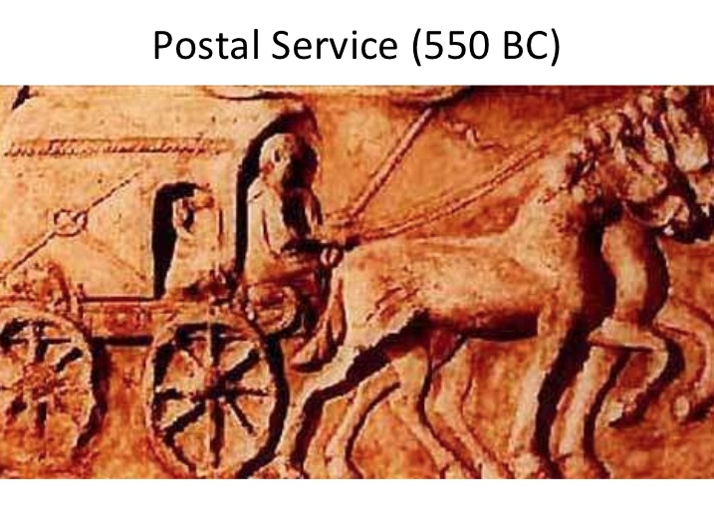

Slide 4
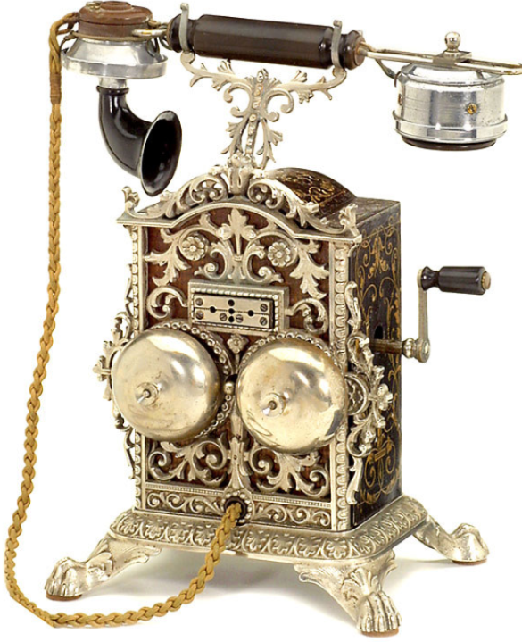

1890
The Telephone
Notes:
The telephone at that time

Slide 5


Slide 6

1966
Email
Notes:
provided a message service at

Slide 7

1972
The Telegraph
-Transmitting and receiving message over long distance
Notes:
The telegraph office

Slide 8
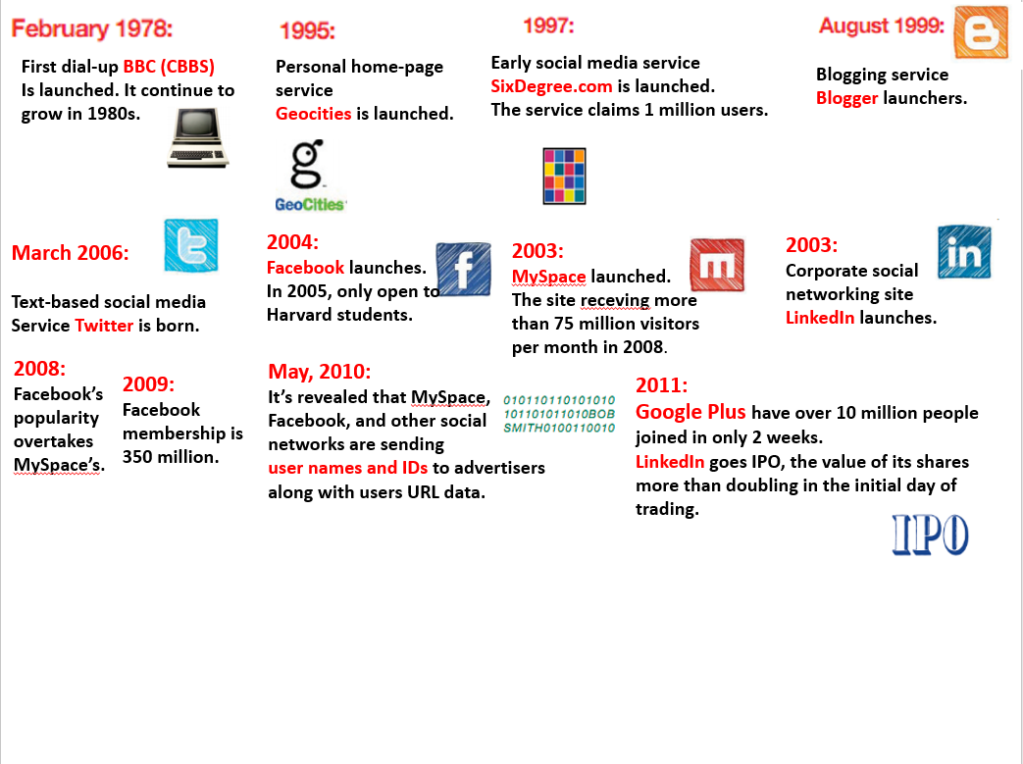
Notes:
Privicy

Slide 9
More than half the world uses a smartphone.
More than half of the world’s web traffic now comes from mobile phones.
U.S. users spend more than 216 weeks on social media via smartphone, opposed to the 53 weeks via PC.
Popularity of the Mobile Platform
Notes:
U.S. users spend more than 216 weeks minutes on social media via smartphone, 53 weekly minutes via PC, and 50 minutes per week on social networks via tablet devices.

Slide 10

A Unique User
An individual that has visited a Web site or received specific content, such as ads, email, or newsletters.
Specified period of time such as a day or month.
Active monthly user
Calculated by taking the number of unique users for a thirty day period.
Notes:
30

Slide 11
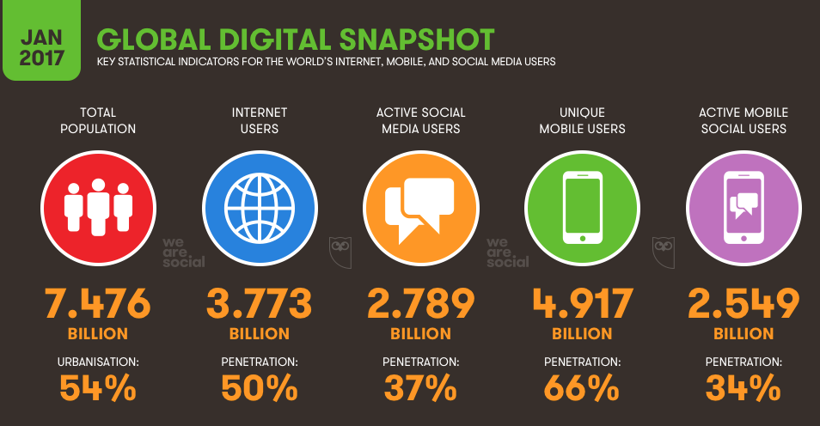
Notes:
http://wearesocial.com/uk/blog/2017/01/digital-in-2017-global-overview
They have a huge demand base.

Slide 12
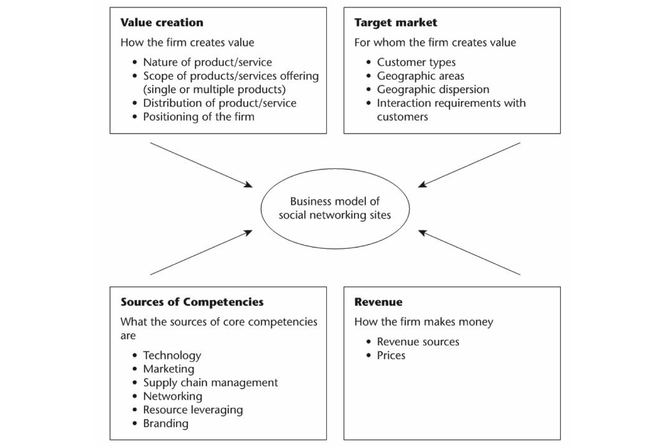
The Business Model of Social Media

Slide 13
Social Networking Sites (Revenue Models)
The Advertising model
The Subscription based model
The transaction based model
Notes:
1.The key is to attract large and highly differentiated users.
2.It charges its users for access to some or all of its servicrs, the key is to create high level of unquie custermer value, increase customer willingness to pay
3.Charging a fee for transaction, ebay taobao

Slide 14
Social media product market
Market | Types of products
Business to Business B2B | Advertising in different formats/ platforms. | Built on audience impressions.
Business to Consumer B2C | Attract users/ followers. | Premium services, add-ons, subscriptions, other payments.
Consumer to Consumer C2C | Various types of products and services. | Direct transactions among consumers.
Notes:
B2C the target market can be divided futher into subgroups in terms of demographics or other characteristics of customers.

Slide 15
Cost structure
Traditional media> social media firms
Fixed cost | Variable cost
Headquarters for operation | Salaries for employees (engineers, programmers)
Severs | Branding cost
Other hardwares | Marketing cost

Slide 16
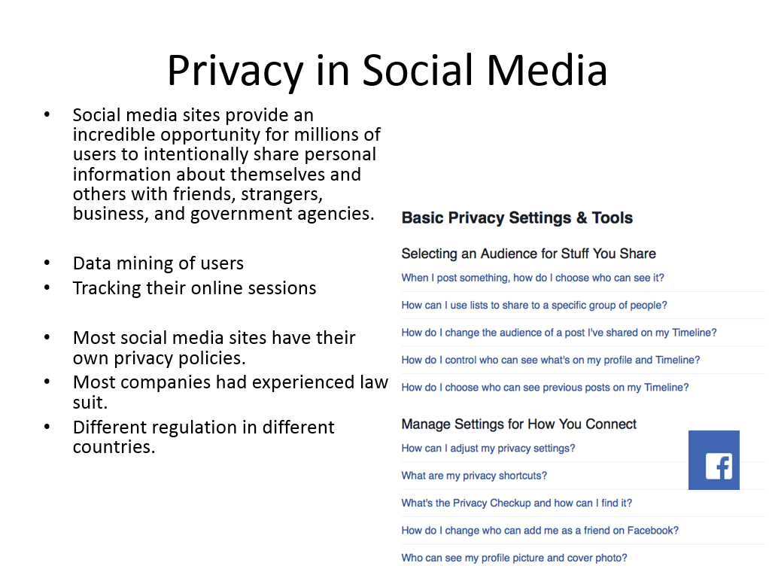
Notes:
In different countries they different regulation.

Slide 17
Competition analysis
Highly competitive.
Starting new firms is simple.
Few barriers to entry.
No switching cost.
To be successful and profitable is difficult.
Economies of scale
Notes:
The social media industry is unique but possesses a few barriers to entry. The social media industry is highly competitive. And dominate by few large companies.
It requires economies of scale, you have to invest large capital.

Slide 18

Use of Social Media Marketing
Why are so many marketers using social media to grow their businesses?
Reduced marketing expenses
Improved search rankings
The popular platform for B2C and B2B
Increased exposure
Grew business partnerships
Notes:
Marketer
With as little as 6 hours per week, the vast majority of marketers (92%+) indicated their social media efforts
increased exposure
The more time marketers invest in social media, the more they gain business partnerships.
Social media marketing is relatively low cost compared with traditional marketing.
Also using social media marketing improve search engine rankings. It is efficient for their target customer to visit their website.

Slide 19
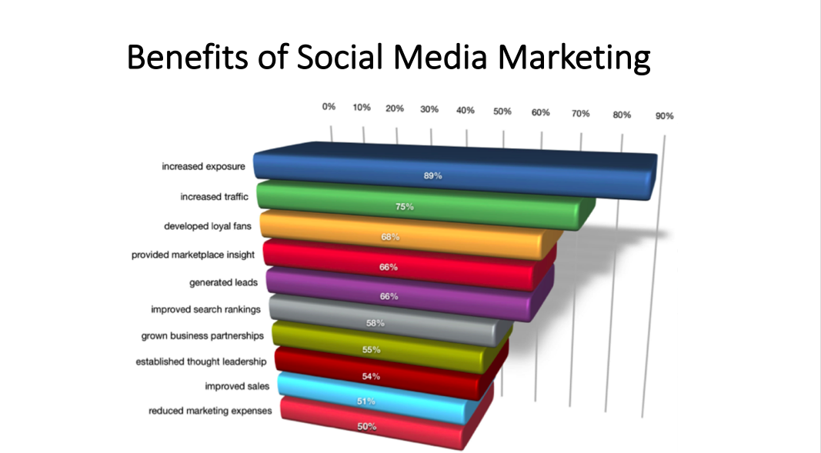
Notes:
http://www.socialmediaexaminer.com/wp-content/uploads/2016/05/SocialMediaMarketingIndustryReport2016.pdf

Slide 20
Data & Analysis

Slide 21
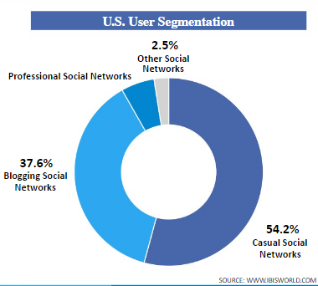
Industry Segmentation
Casual Social Networks
Companies include Facebook, MySpace, Google Plus, Yahoo Pulse, and Microsoft So.cl.
Responsible for majority of revenue in the industry.
Advertising is the main source of revenue.
Notes:
These companies include Facebook, MySpace, Google Plus, Yahoo Pulse, and Microsoft So.cl. (Socl = is a social networking service and social search engine - So.cl appears similar to Google+)
This segment is responsible for majority of revenue in the industry, even if it only account for a bit over half of the users.
Advertising is the main source of revenue for this segment, as platforms utilize user data to target specific customers

Slide 22
Industry Segmentation Cont’d
Blogging Social Networks
Consists of two formats: Traditional Blogging Networks like Blogger and Wordpress, and microblogging such as Twitter and Tumblr
Limited revenue potential due to content limitations.
Professional Social Networks
Majority of revenue comes from products offered to job seekers and employers.
Projected to grow.
Notes:
Professional Social networks: This segment is projected to grow as other social networks seek to incorporate similar career features

Slide 23
Key Success Factors
The ability to compete effectively depends on:
Ability to innovate.
Security, updates, and support are critical factors
Reputation and Brand Strength relative to competitors
Offer a user-friendly interface to consumers.
Compatibility and ubiquity are important.
Notes:
Offer a user-friendly interface to consumers, which important for networks with broad audiences as it doesn’t frustrate novice users.
Compatibility and ubiquity - People want to access these networks however and whenever they want.

Slide 24
Key Success Factors Ctd.
The frequency, size, format, quality and prominence of advertisements.
Ability to attract, retain, and motivate talented employees.
Ability to keep costs low and maintain gross/operating margins.
Ability to comply with complex and evolving laws and regulations.
Notes:
The frequency and prominence of advertisements relative to competitors
Ability to attract and retain talented employees, especially software engineers, designers, and upper management
Ability to comply with complex and evolving laws and regulations regarding privacy and data protection

Slide 25
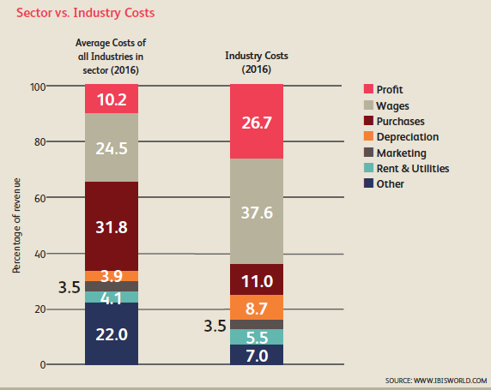
Key Operating Factors
Profit (26.7% of Revenue)
Many large and small companies in this industry either have low profit margins or are deeply in the red. Facebook’s high profit margin pushes up the average industry profit margin
Wages (37.6% of Revenue)
High wage costs reflect R&D spend and wages for skilled employees such as coders
Specialized workers are absolutely essential in this industry.
Purchases (11.0% of Revenue)
Primarily Patents and costs related to generating website traffic
Notes:
Profit: Average Industry profit margin 26.7% of revenue. While smaller and sometimes larger companies lke Twitter and LinkedIn operates at a loss, Facebook’s high profit margin pushes up the average industry profit margin.
Wages: Most significant industry cost - 37.6% of revenue. High wage costs reflect R&D spend, and Wages for skilled employees such as coders.
Lastly, Purchasing costs are approximately 11.0% of revenue. One of the major costs are patent costs. These are key for companies protecting their intellectual property in this industry. The more patents a company has, the greater chance it has to prevent other companies from using the same technology to gain a competitive advantage. Another significant purchasing cost is related to generating website traffic.

Slide 26
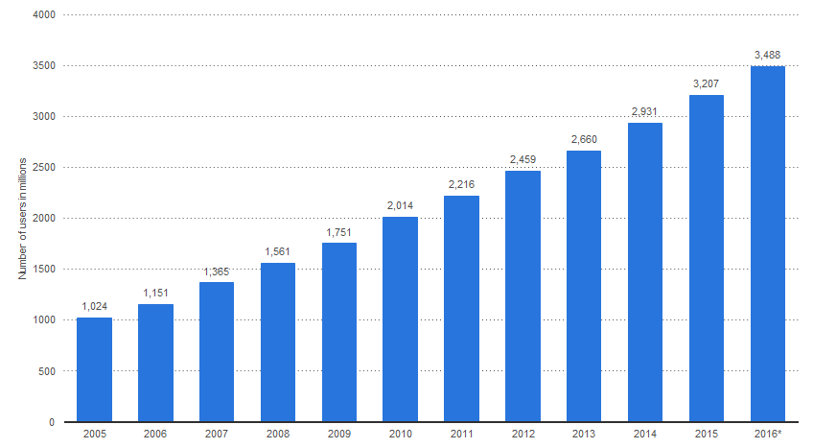
Number of Internet Users Worldwide
(2005-2016)
Notes:
This shows total number of internet users worldwide from 2005 to 2016.
There are 3.5 billion internet users worldwide as of 2016.
SOURCE: STATISTICA

Slide 27
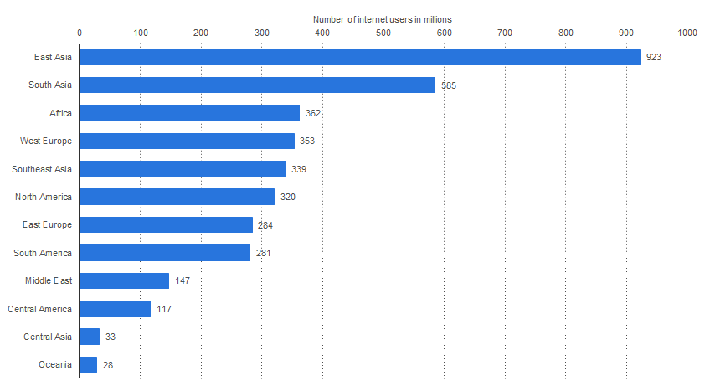
Number of Internet Users Worldwide (Region, 2017)
Notes:
The shows the number of worldwide internet users, sorted by region. As of January 2017, East Asia accounted for 923 million internet users, followed by South Asia with 585 million internet users.
SOURCE: STATISTICA

Slide 28
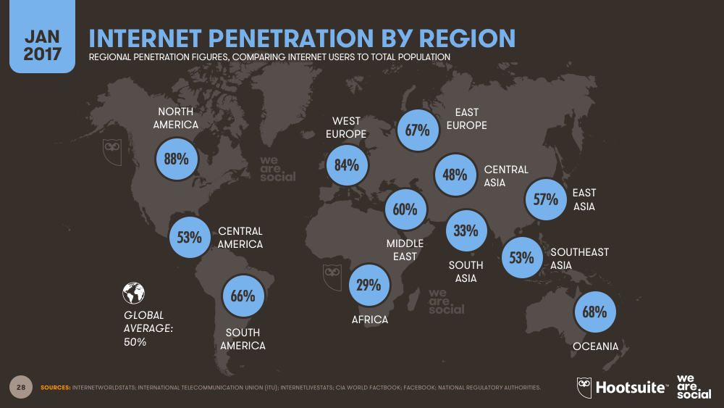
Notes:
This graph shows Internet penetration which shows what % of the population in each of these areas uses the internet.
Internet penetration remain low in South Asia which is the world’s most populous region.
It is also low in Africa, where fewer than 1 in 3 people access the internet today.

Slide 29
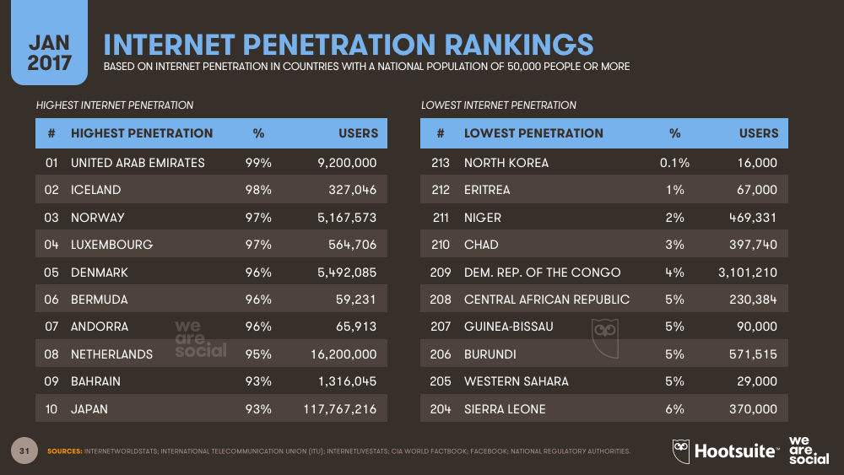
Notes:
With the exception of North Korea - where the internet is almost completely inaccessible - the countries with the lowest levels of internet penetration are all in Africa. At the other end of the scale, internet penetration rates are approaching 100% in a number of countries, with the United Arab Emirates taking top spot

Slide 30
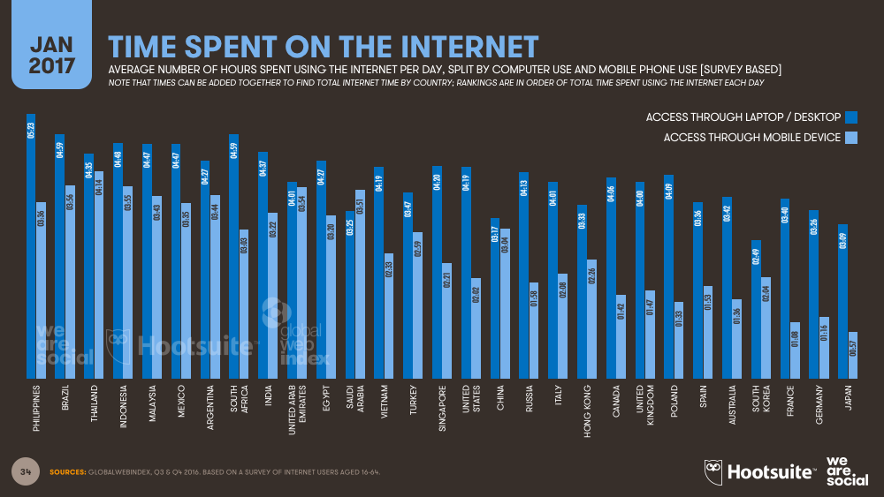
Notes:
Average number of hours spent using the internet per day, split by computer use and mobile phone use
Where time spent on the computer is in dark blue and time spent on mobile devies is in light blue.
The average canadian internet user spends about 6 hours of internet per day
The average Filipino internet user spends 9 hours online each day, with mobile access accounting for more than three and a half of those hours.

Slide 31
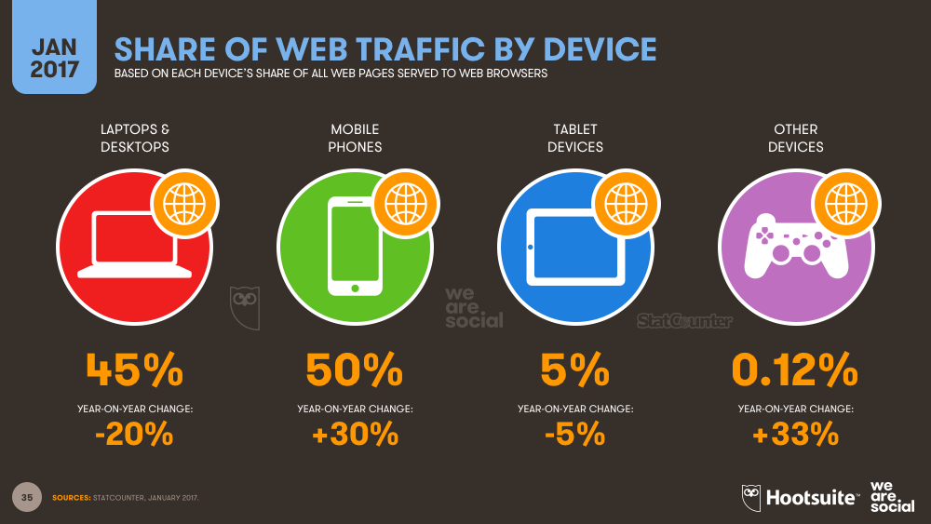
Notes:
This shows the share of web traffic by device. Which means it shows the total number of web pages served to each device.
Mobile Phone’s share of web traffic is up 30% year-on-year, with the majority of this increase coming from developing economies.
The reason why there is a negative year-over-year change of laptops and desktops is because there was an increase in the number of people accessing the web through mobile devices in the past year, and as a result, other devices’ respective share of the total number of web pages served has dropped.

Slide 32
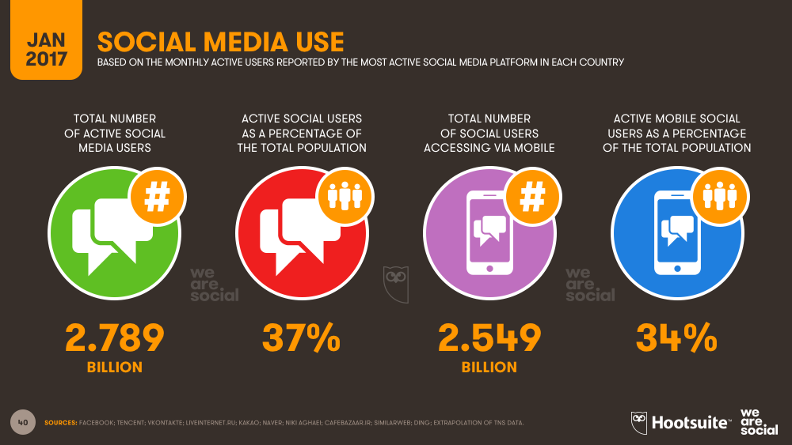
Notes:
Total number of Active social media users globally is 2.789 billion people.
This means that 2.789 billion people around the world use social media at least once a month.
Of those, 2.549 billion people access social media through their mobile devices or 91%.

Slide 33
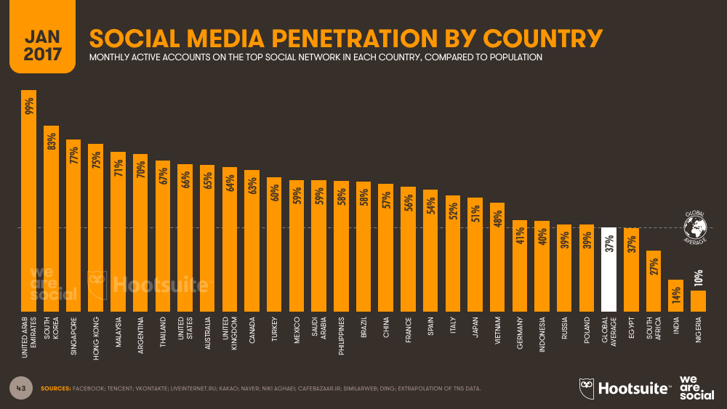
Notes:
This graph shows the social media penetration by country.
IF we look to the very left of the screen, 99% of the population of the united arab emirates uses some kind of social media account at least once a month.
United States has 66% penetration and CAnada has 63% penetration while the gloabl average is 37%

Slide 34
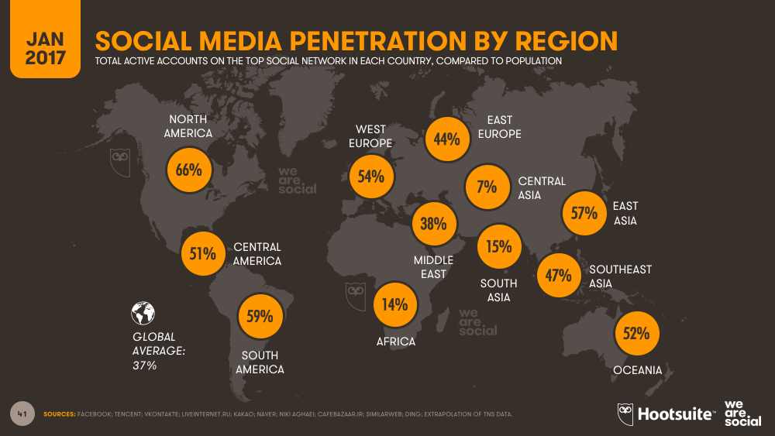
Notes:
Social Media penetration by region.
Two-thirds of North Americans are active social media users.
and Social media penetration in South America is approaching 60%.

Slide 35
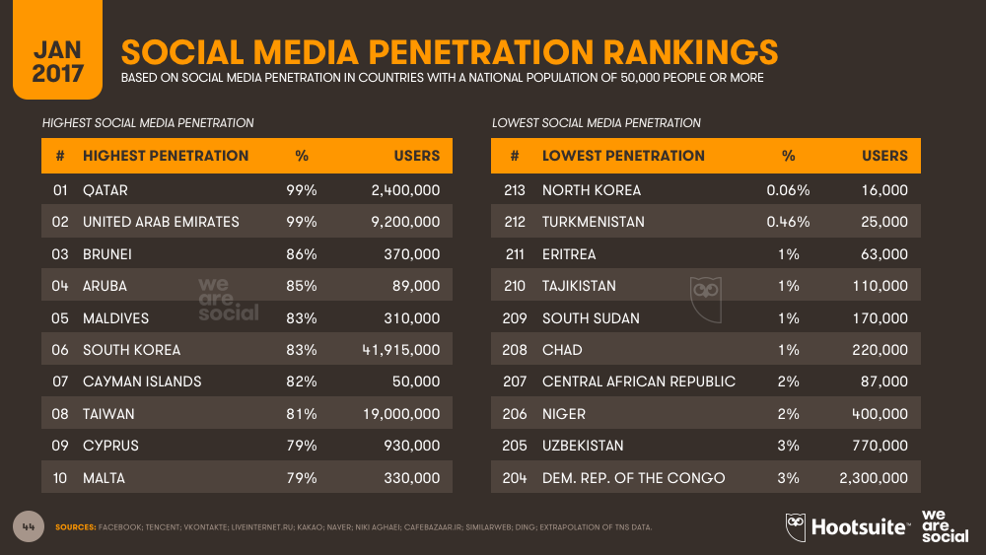
Notes:
8 countries around the world now have social media penetration levels in excess of 80%: Qater, United Arab Emirates, Brunei, Aruba, Maldives, South Korea, Cayman Islands and Taiwan.

Slide 36
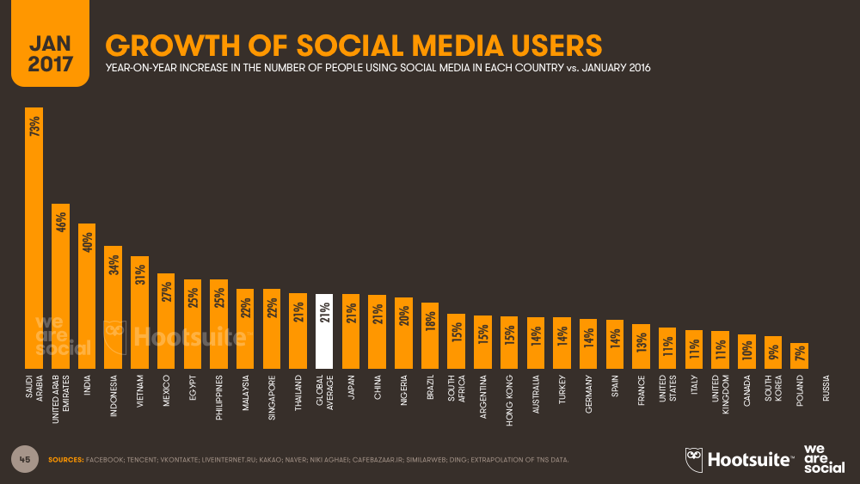
Notes:
Here is where the growth of social media users is coming from
Here is the year-on-year increase in the number of people using social media in each country.

Slide 37
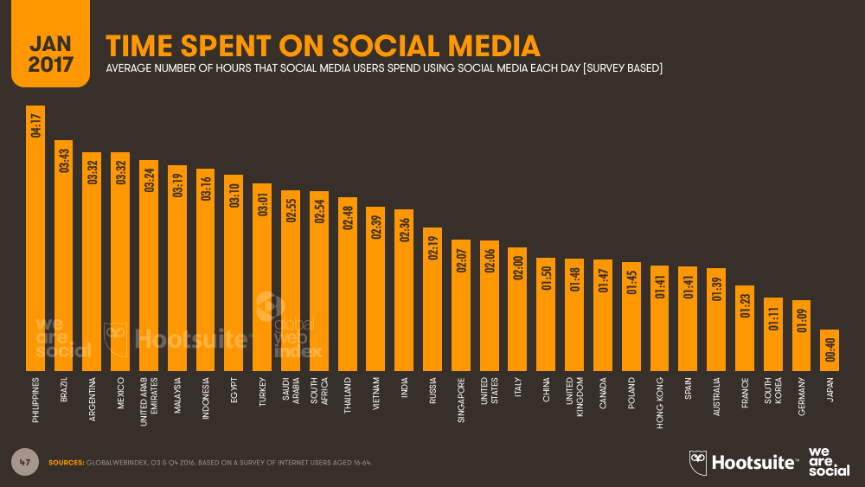
Notes:
The average number of hours that each person spends on social media platforms each day.
The global average is average is 2 hours and 19 minutes - US is just at average of 2.06 hours, Canada 1.47 hours
The Philippines tops the ranking for time spent on social media amongst those countries. They spent about 4 hours on social media on average each day.

Slide 38
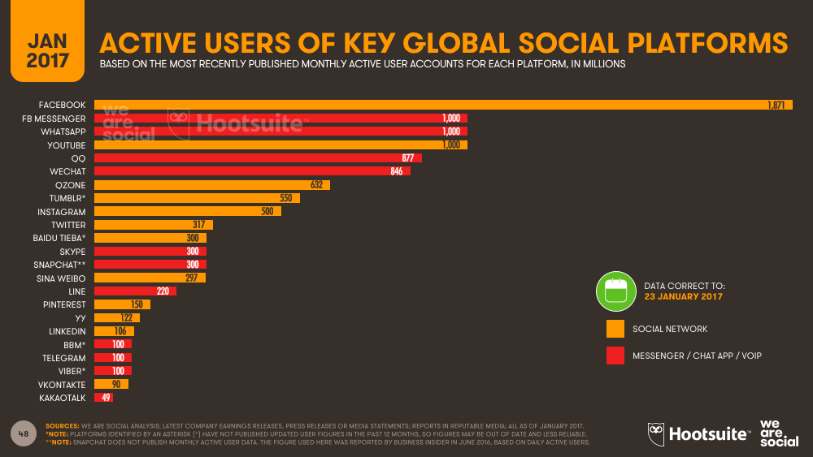
Notes:
This graph shows the Active Users of Key Global Social Platforms.
Facebook increased its global footprint by 363 million monthly active accounts in 2016. More than one billion people use Facebook every day. If we taken into account Facebook’s combined audiences and include whatasapp, facebook messagener and instagram, the number of active users is 4 billion.

Slide 39
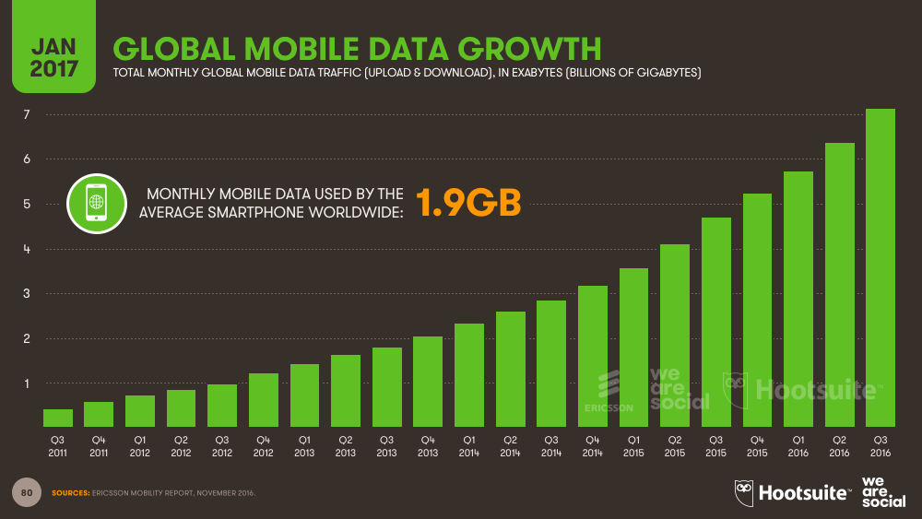
Notes:
GLobal Mobile Data growth.
50% year-on-year increase in data traffic volumes.
Total data traffic around the world now exceeds 7 billion gigabytes each month and
the average smartphone accesses nearly 2GB of data every month.

Slide 40
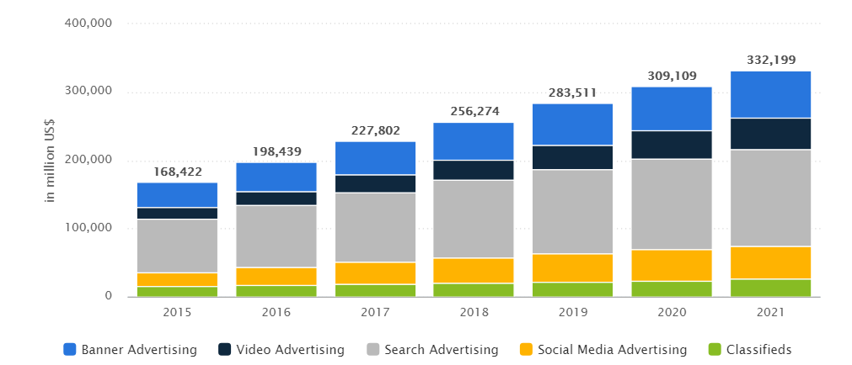
Revenue in the Digital Advertising Market
Notes:
Revenue in the "Digital Advertising" market was $198,439 million USD, is expected to increase by 15% next year.
Highhligted in yellow is the portion os Social Media Advertising, which made up $27 million USD of the total digital advertising market in 2016.

Slide 41
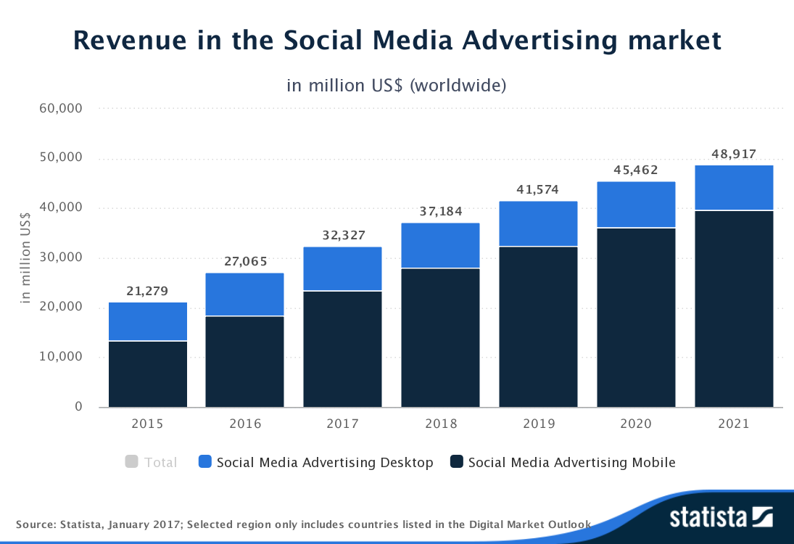
Notes:
Same thing, total social media advertising revenue was $27 million, where advertising through mobile devices is expected to increase the most year over year.

Slide 42
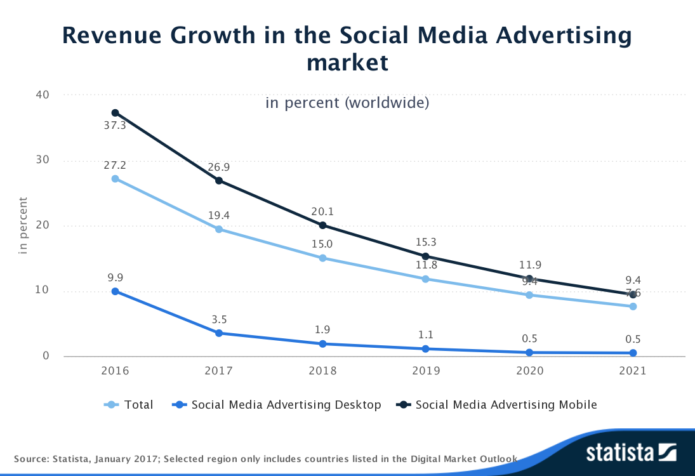
Notes:
The "Social Media Advertising" segment is expected to show a revenue growth of 19.4% this year.

Slide 43
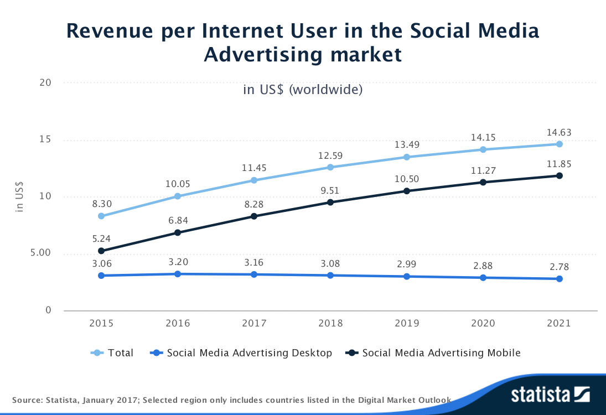
Notes:
The average revenue per Internet user in the "Social Media Advertising" segment is US$10.05 in 2016
https://www.statista.com/outlook/220/100/social-media-advertising/worldwide#market-revenue

Slide 44
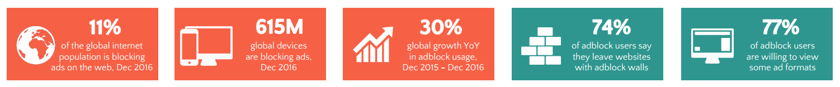
Ad blocking - Quick Facts
11% of the global internet population is blocking ads on the web.
+600 million devices running adblock software globally, 62% of which were on mobile devices.
Adblock usage grew by 30% globally in 2016 .
Adblock adoption on desktop and laptop computers continues to grow despite user migration towards the mobile web.
Notes:
https://pagefair.com/downloads/2017/01/PageFair-2017-Adblock-Report.pdf

Slide 45
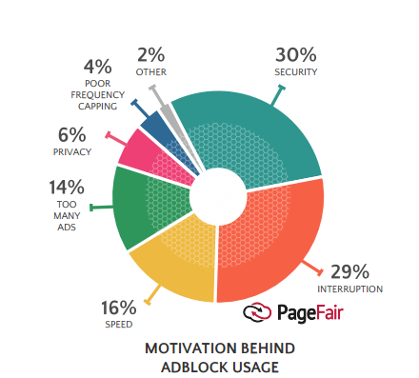
Adblock User Motivations
Security exposures to viruses and malware
Interruption
Slow website loading time
Too many ads on webpages
Privacy and tracking by unknown parties

Slide 46
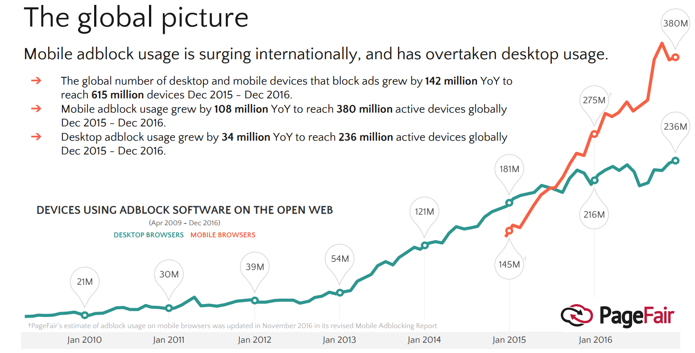
Adblock Usage
Notes:
The global number of devices that block ads in December 2016 was 615 million. Of this, 380 million was from mobile adblock usage, and 236 million was from desktop adblock usage.

Slide 47
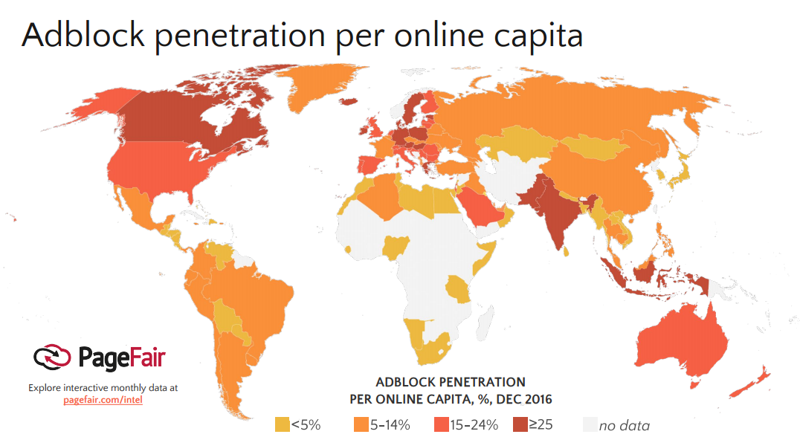
Notes:
https://pagefair.com/downloads/2017/01/PageFair-2017-Adblock-Report.pdf
Areas in dark red = most adblock penetration of greater than 25%
The maximum penetration of ad blocking software in the US is 17%

Slide 48
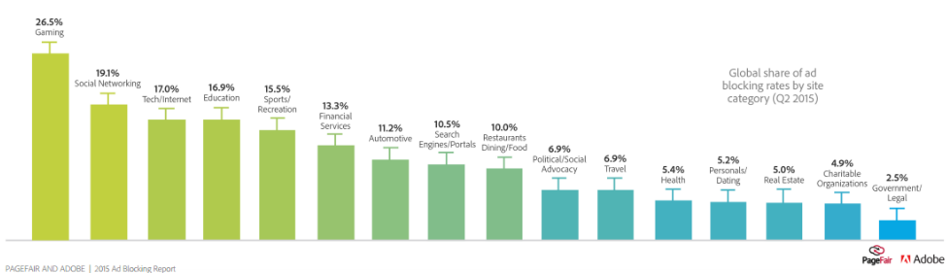
Types of websites affected most by Adblocking
Notes:
Gaming, social media and other tech related websites are most affected by ad-blocking software.
http://www.socialmediatoday.com/marketing/adhutchinson/2015-08-11/ad-blocking-software-next-major-challenge-digital-marketers-need

Slide 49



Slide 50
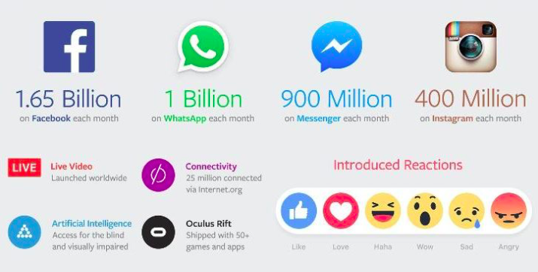
Facebook Overview
Notes:
http://lighthouseinsights.in/facebook-q12016-earnings-report.html/

Slide 51
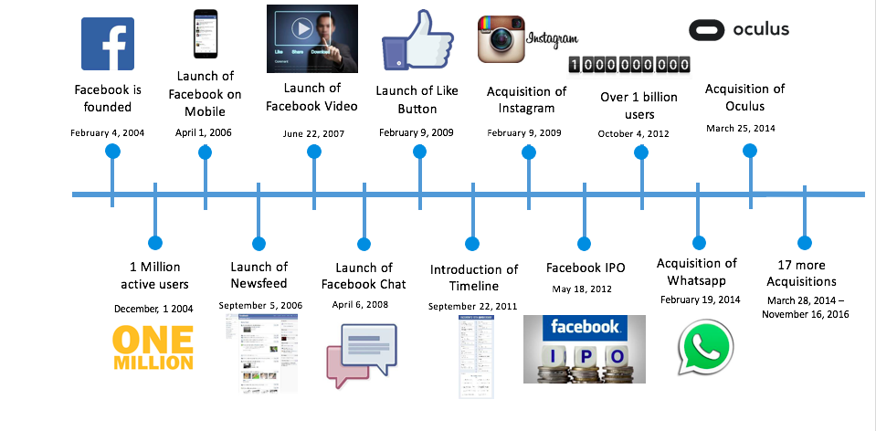
Timeline

Slide 52
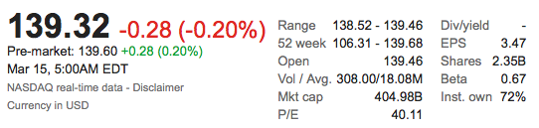
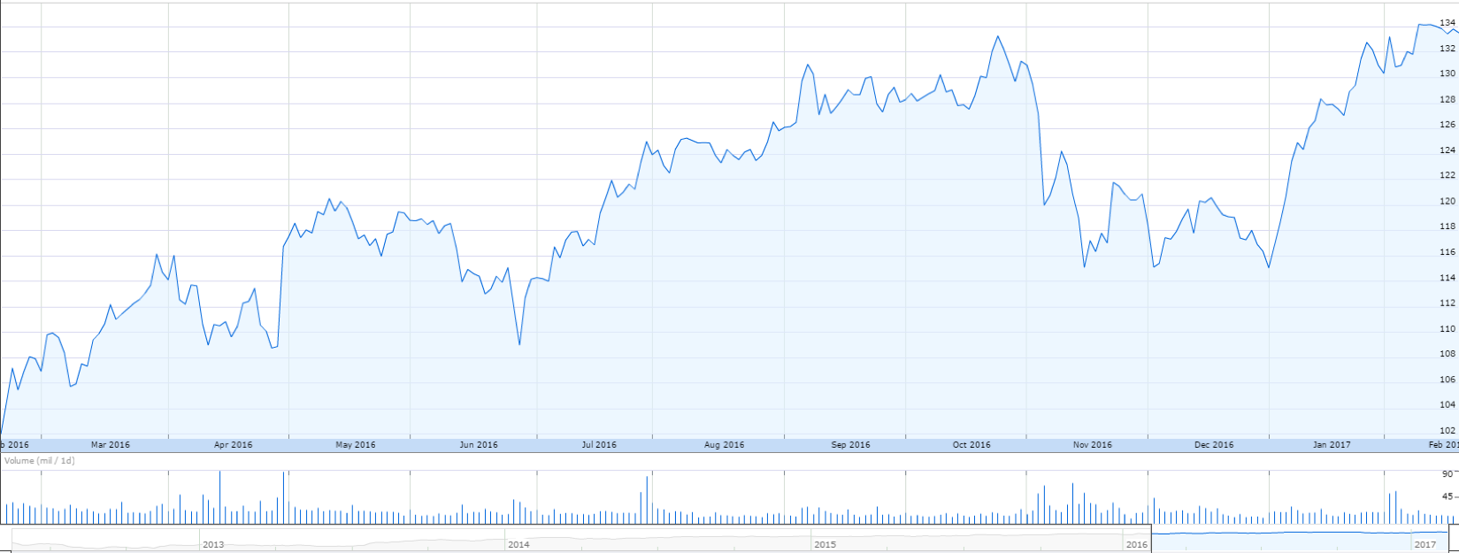
Stock Overview 1 year

Slide 53
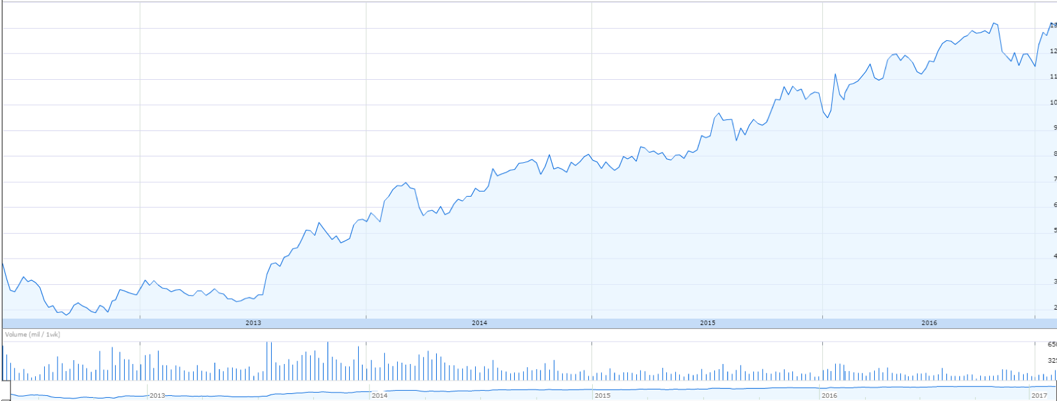
IPO to Present

Slide 54
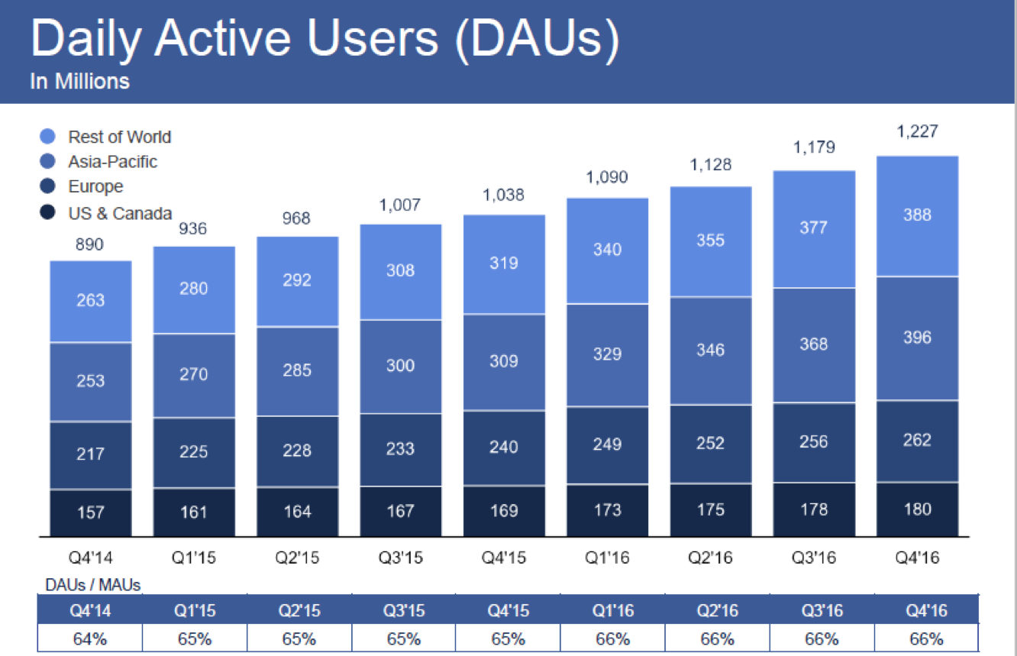
Daily Active Users

Slide 55
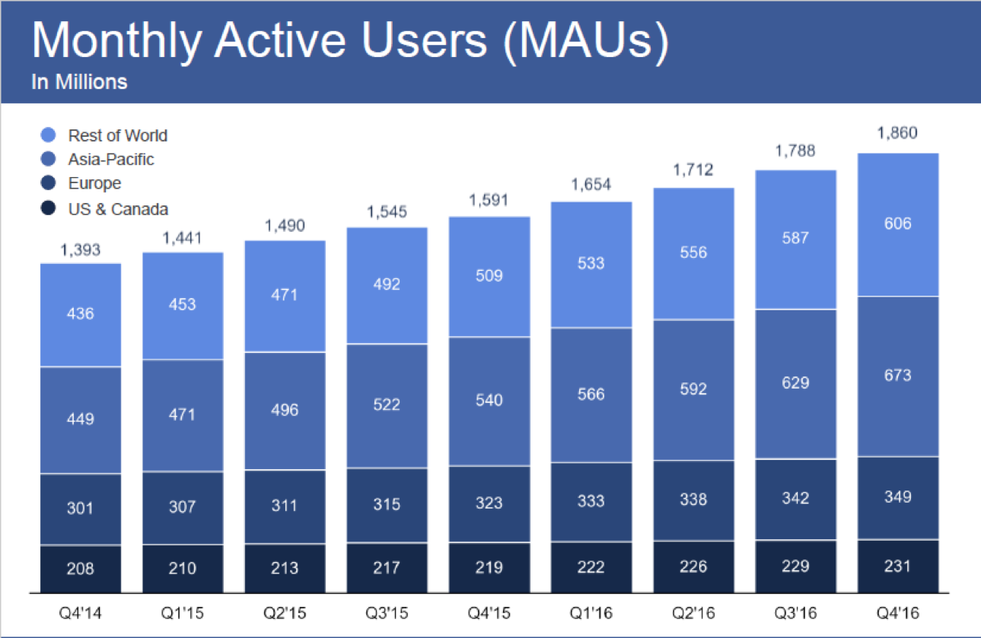
Monthly Active Users

Slide 56
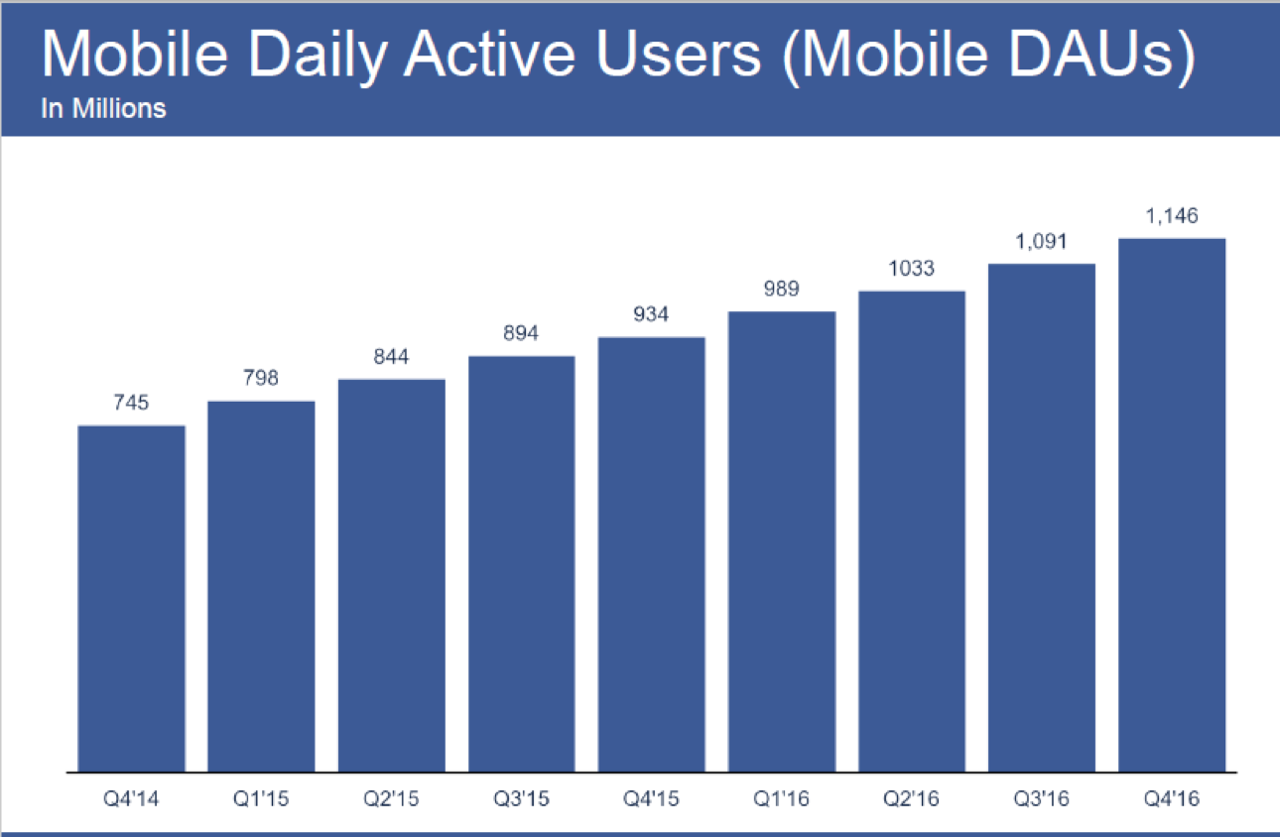
Mobile Daily Active Users

Slide 57
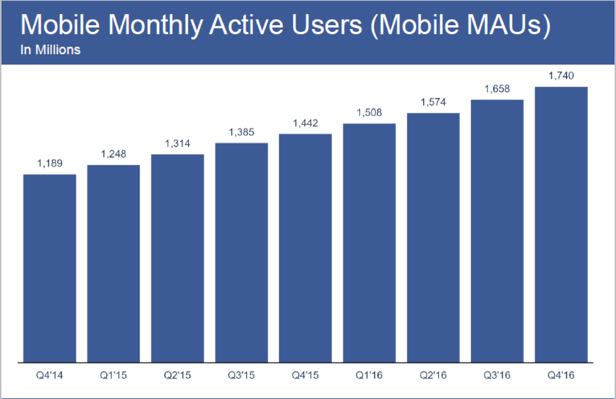
Mobile Monthly Active Users

Slide 58
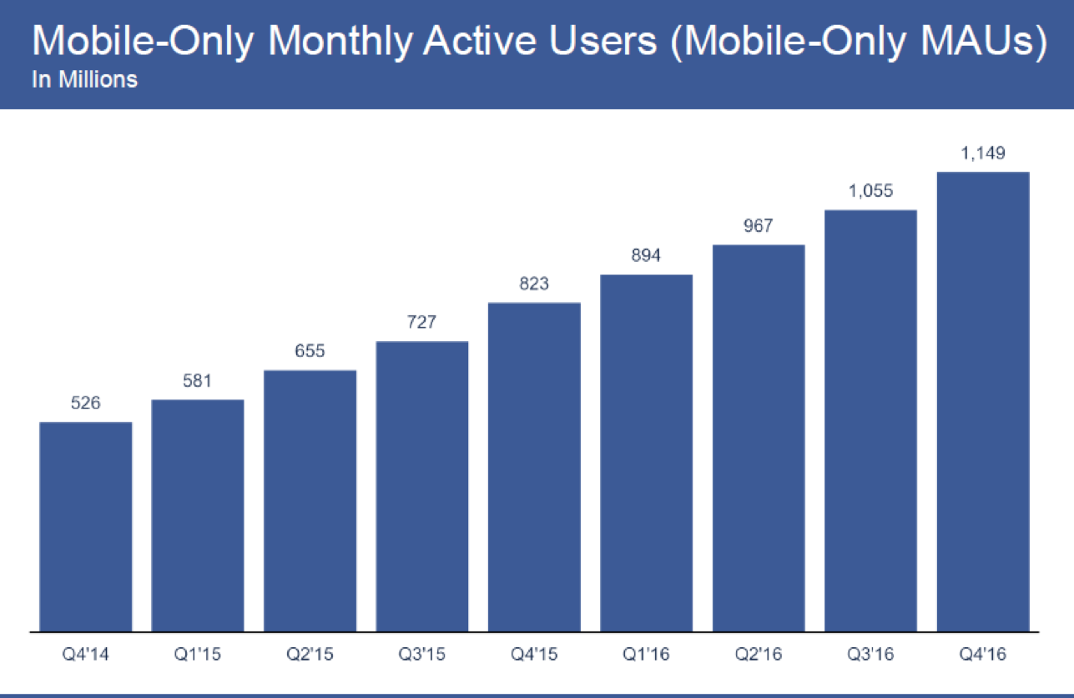
Mobile Only Monthly Active Users

Slide 59
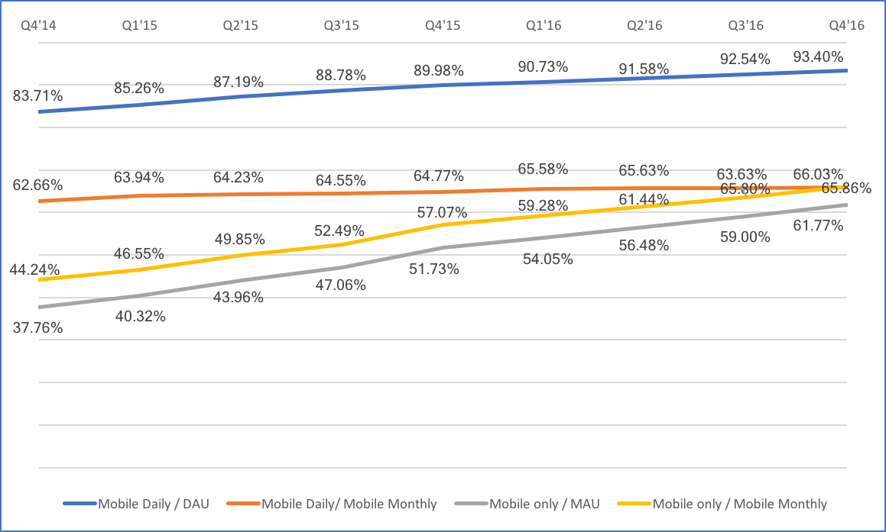
Mobile Ratios

Slide 60
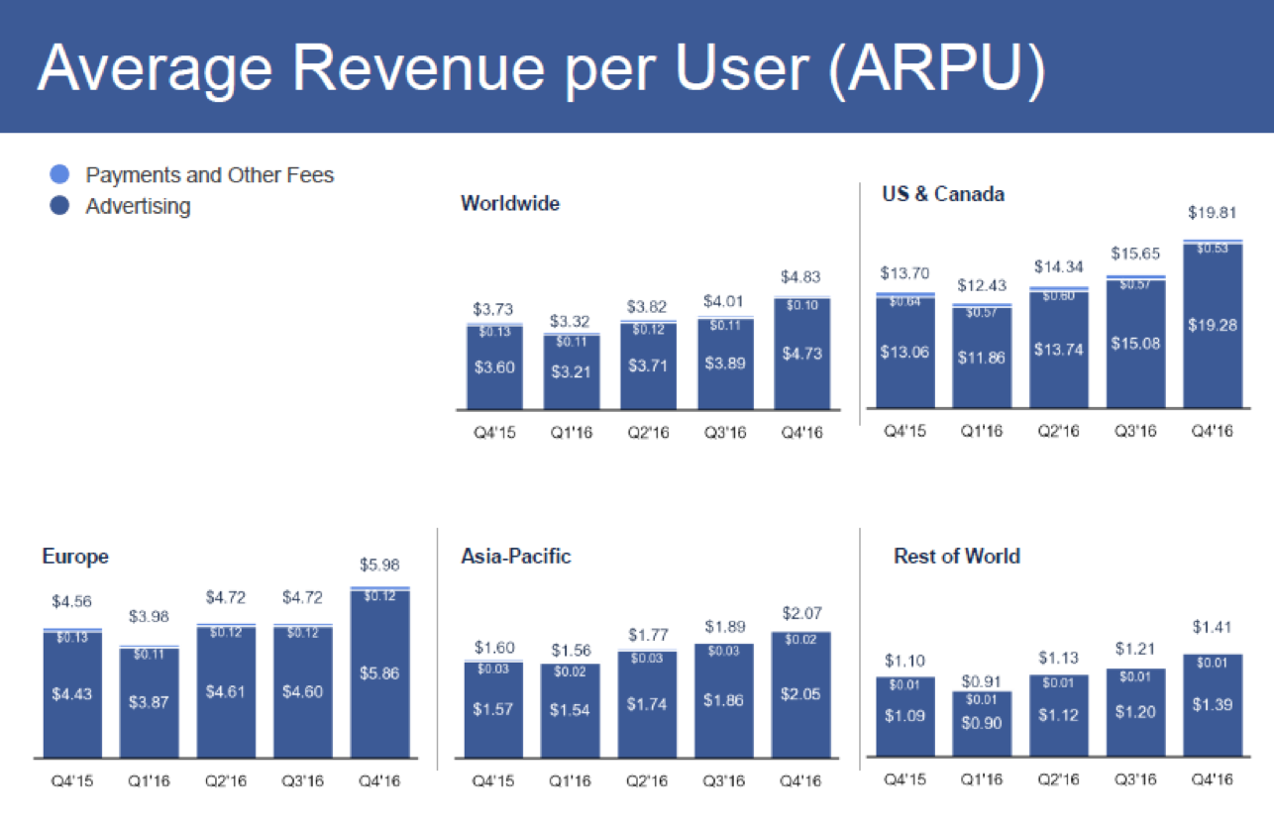
Average Revenue Per User Q4’15-Q4’16

Slide 61
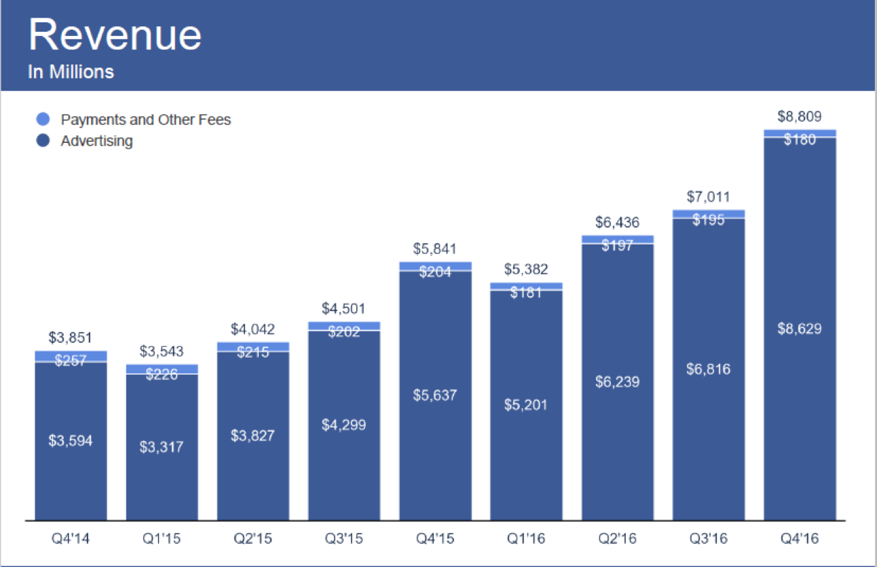
Revenue

Slide 62
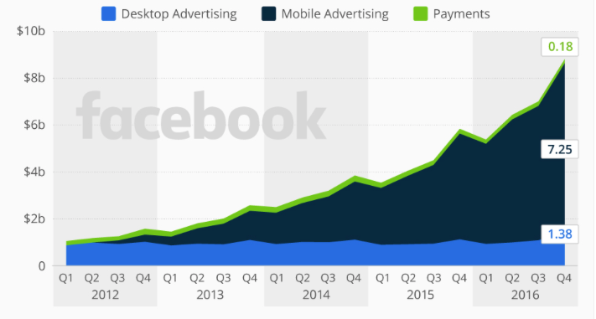
Revenue Segmentation
Notes:
Ad Blockers concern- http://www.businessinsider.com/facebook-revenue-breakdown-by-segment-2015-11
Is fueled by mobile ads: https://www.statista.com/chart/2496/facebook-revenue-by-segment/

Slide 63
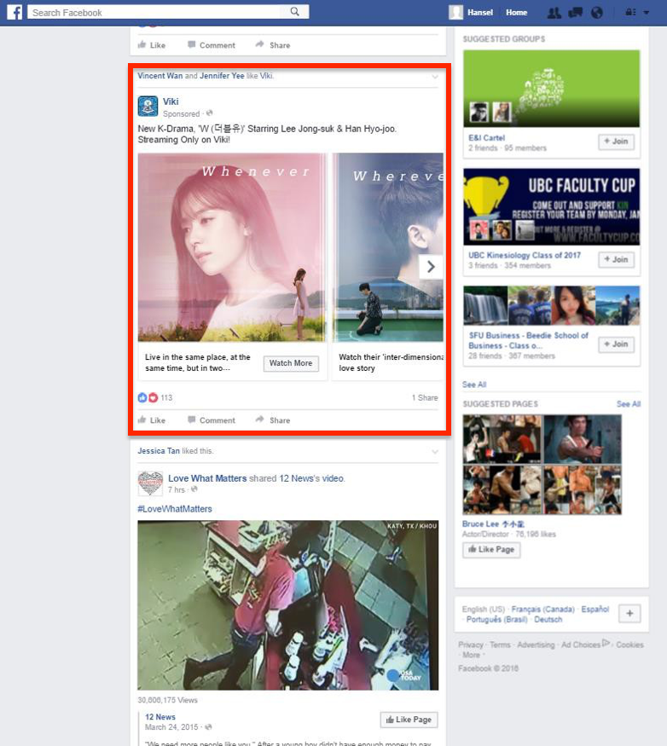
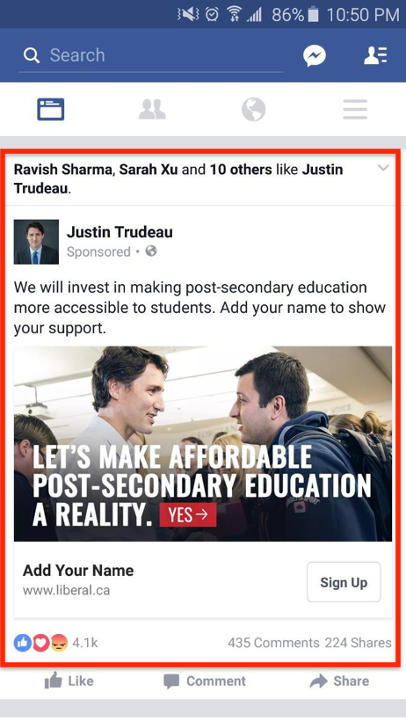
Newsfeed Ad on:
Desktop Mobile

Slide 64
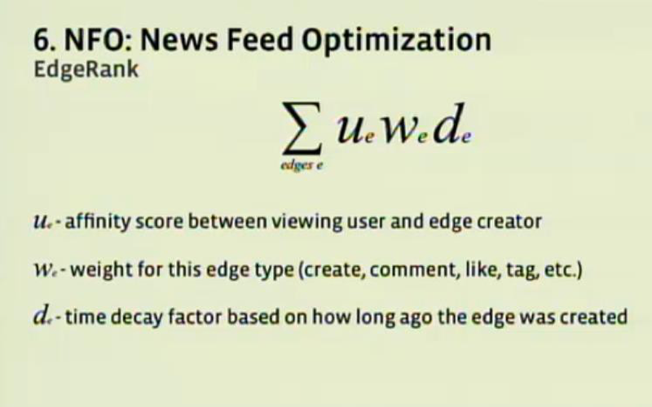
Newsfeed Algorithm
Newsfeed allows users to see friends’ recent posts easily.
However, not all posts are shown, Facebook uses an algorithm to determine which would be most important to the user.
Newsfeed allows for seamless integration of advertisements.
Changes: raw number of visitors -> how long user spends with a piece.

Slide 65
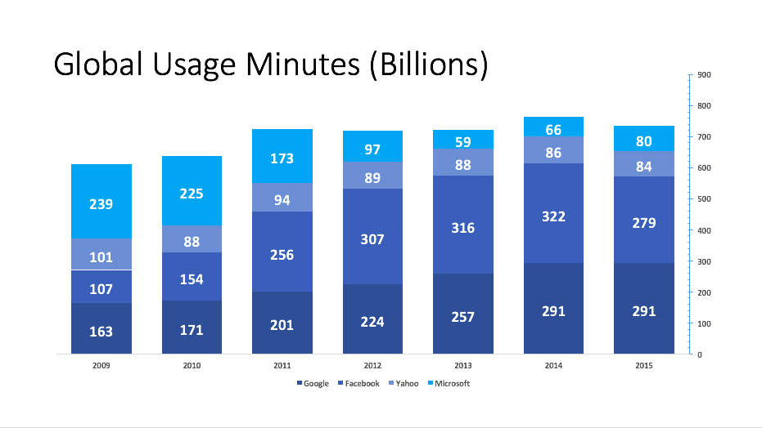

Slide 66


Slide 67

Facebook dominates the social landscape
Notes:
The size of each circle represents the number of days each site was accessed monthly on avg.
The color intensity and accompanying number represents the number of sessions.

Slide 68


Slide 69

Ad Products
Mobile is no longer “nice to do” but a “must do”
Facebook recognizes the different behaviours of mobile and desktop browsing
Creating ads that catch attention within seconds of viewing without sound
Facebook is creating an easier experience for small and medium-sized businesses to create a web presence, instead of a traditional website, they can create a Facebook profile
Simple and inexpensive ad buying experience and impression tracking for businesses

Slide 70

Live video and 360 Photos
Live Video is a new focus of Facebook, it is changing the way people consume news
Live video can present important moments as they happen

Slide 71

Audience network
Audience Network is Facebook’s ad serving platform.
Over 1 billion people see an ad through Audience Network every month.
On average, 12% increase in conversions for website campaigns, and a 17% increase in installs for mobile app campaigns.
Launched support for video views in May, 2016.
Notes:
Facebook is planning to expand Audience Network to serve ads to third-party sites

Slide 72

Advanced Measurement
March 7, 2017: relaunched the current version of Atlas with a focus on “people- based marketing”.
Allows users to measure the effectiveness of their campaigns across the social network and other platforms.
Notes:
namely, the ability for advertisers to track users across devices.
Allows users to measure the effectiveness of their campaigns across Facebook’s properties versus how they performed on competitors sites and apps.
Facebook says Advanced Measurement is currently in testing, with plans to refine the interface and introduce more data as it rolls out

Slide 73

Workplace
More than 1000 organizations around the world use Workplace:
Danone, Starbucks, Booking.com
The best of Facebook plus new features: Dashboard with analytics and integrations
Notes:
Groups, chats, newsfeed, live video, etc
You can: chat with a colleague across the world in real time, host a virtual brainstorm in a Group, or follow along with your CEO’s presentation on Facebook Live.
We’ve also built unique, Workplace-only features that companies can benefit from such as a dashboard with analytics and integrations
Danone, Starbucks and Booking.com, etc have all embraced “Workplace”
http://newsroom.fb.com/news/2016/10/introducing-workplace-by-facebook/

Slide 74

Free Basics
Free Basics by Facebook provides free basic services in markets where internet access may be less affordable.
It allows people to browse selected health, employment and local information websites without data charges.
The app is currently available in parts of Africa, Latin America and Asia, and will continue to expand to more countries around the world.

Slide 75

Facebook Lite
Facebook Lite is a version of Facebook for Android that uses less data and works well across all network conditions.
It includes Facebook’s core experiences like News Feed, status updates, photos, notifications and more.

Slide 76

Oculus
Oculus is a virtual reality technology company.
Oculus produces the virtual reality products: Oculus Rift and Gear VR.
Oculus is creating a virtual reality platform for all consumer media.
More than 1 million people are using Oculus software through Gear VR partnership with Samsung.

Slide 77

Instagram
Instagram is a photo and video sharing platform.
Instagram now has more than 500 million monthly active users.
Over 300 million daily active users.
It is only beginning to monetize this platform, but the ads are visually simple and non-intrusive.

Slide 78

Instagram Advertisement
Notes:
In addition, stories ads

Slide 79


Whastapp
Whatsapp is a free, cross- platform messaging application.
It has over 1 billion monthly active users.
It has committed to not selling advertising on this platform.

Slide 80


Messenger
Messenger is also a free messaging application with the ability to send text messages, videos, and calls
Over 1 billion monthly active users

Slide 81


Monetizing Whatsapp and Messenger
Build a great consumer experience and get it to scale.
Give people a way to “organically” communicate with businesses.
Give businesses “tools to reach those people”.
Notes:
Messenger is in the 2nd stage with the thousands of chat bots businesses have already built to communicate with people. There are now 33,000 bots. Facebook is also experimenting with different types of revenue-generating ads that connect users with bots and businesses.
Whatsapp is moving to the 2nd stage. And it has yet to introduce chatbots for businesses like messenger.

Slide 82

Diluted Shares Outstanding and YoY % Change
Notes:
To be updated

Slide 83

Notes:
To be updated

Slide 84

Mark Zuckerberg
Founded Facebook on February 4, 2004, and became CEO in July 2004.
Responsible for overall direction and product strategy for the company.
Leads the design of Facebook’s service and development of its core technology and infrastructure.

Slide 85

Sheryl Sandberg
COO, since March 24, 2008
Responsible for helping Facebook scale its operations and expand its presence globally and also managed sales, marketing, business development, legal, human resources, public policy, privacy and communications.
Previously VP of Global Online Sales and Operations at Google
Served on the board of Facebook since June 25, 2012.
Named one of the "50 Most Powerful Women in Business" by Fortune and one of the "50 Women to Watch" by The Wall Street Journal.
Holds a B.A. in Economics from Harvard University, and was a Baker and Ford Scholar at Harvard Business School, where she earned an MBA with highest distinction.

Slide 86

David Wehner
CFO, since June 1, 2014
Leads the finance, facilities and info tech teams. Before being CFO in June 2014, he was Facebook’s VP, Corporate Finance and Business Planning since 2012.
Between 2010 and 2012, he was CFO of Zynga.
Before Zynga, he served as Managing Director of Allen & Company LLC. He led corporate finance teams responsible for capital raises and M&A transactions with a focus on Allen & Co.'s Silicon Valley clients.
B.S. in Chemistry from Georgetown University and M.S. from Stanford University.

Slide 87

Mike Schroepfer
CTO (since March 15, 2013), and VP of Engineering (since September 2008)
Responsible for Facebook’s products, services and infrastructure.
Before joining Facebook in 2008, he was the VP of Engineering at Mozilla. He led the global, collaborative, open and participatory product development process behind Firefox web browser.
Prior to Mozilla, he served in various positions of Sun Microsystems, Inc and served as its Chief Technology Officer of data center automation division
Mr. Schroepfer holds a B.S. and an M.S. in Computer Science from Stanford University.

Slide 88

Chris Cox
CPO (Chief Product Officer)
Leads Facebook’s product management, design and marketing functions globally.
Responsible for the core products and features that shape the social experience for Facebook.
Joined Facebook in 2005 as a Software Engineer and was instrumental in implementing first versions of key Facebook features, including News Feed and Inbox.
Holds a bachelor’s degree in symbolic systems with a concentration in artificial intelligence from Stanford University

Slide 89


Shareholder ownership

Slide 90

10 year roadmap

Slide 91

Balance Sheet 10K

Slide 92

Income Statement 10K

Slide 93

Cash Flow Statement 10K (I)

Slide 94

Cash Flow Statement 10K (II)

Slide 95

Recommendation:
BUY

Slide 96


Slide 97


Slide 98


Slide 99

Twitter 1 year (NYSE)

Slide 100

Twitter 5 years (NYSE)

Slide 101

Twitter vs Dow Jones vs S&P 500

Slide 102

Company overview

Slide 103


Slide 104

Monetization
Primarily through advertisement
Promoted tweets, accounts and trends accounts; generate the majority of their advertising revenues
Data licensing and other: (i)allow data partners to access, search and analyze data on Twitter; (ii) provide mobile advertising services through MoPub exchange
Notes:
Monetization occurs through advertisement

Slide 105

Notes:
Total ad engagements grew 151% yr over yr, driven by video ads, and higher clickthrough rates
Average cost per engagement fell 60% yr over yr

Slide 106



Slide 107


Slide 108


Other product - Periscope
6.6 million hours through Periscope in Q4, 2016
Implement technology into Twitter
Create 360 video, Tweet live
https://www.periscope.tv/
Notes:
Acquire Periscope to implement live-streaming technology into Twitter

Slide 109

Increasing Revenue through live streaming(Q4)
News & Politics
Live Sports
E-Sports
Notes:
Live streaming content focuses on Twitter’s key areas of strength: News and politics, live sports and e-sports

Slide 110


Living streaming on Twitter (Q4)
Signed a 10 million deal with NFL#TNF
  Generated more than 3.5 million viewers on average per game
Presidential debates, 4.2 million views
Election night, 7.5 million views
Inauguration, 8.6 million views

Slide 111


Slide 112
Management team

Slide 113

Jack Dorsey
Chief Executive Officer and Co-founder of Twitter and Square
Serves on the Board of the Walt Disney Company
Became CEO of Twitter on June 10, 2015
Officially named permanent CEO of Twitter on October 5, 2015

Slide 114

Anthony Noto
COO, Nov 9, 2016.
CFO, since July 2014.
Oversees revenue generating organizations.
Prior to joining Twitter, he was a partner and the Head of the Technology, Media and Telecom Investment Banking Group at Goldman Sachs & Co, 2010-2014.
He was CFO of the National Football League, 2008 to 2010.
Holds a B.S. in Mechanical Engineering from the US Military Academy and MBA from the Wharton School of the University of Pennsylvania.

Slide 115

Leslie Berland
CMO, February 2016
Prior to joining Twitter, she was the EVP, Global Advertising, Marketing & Digital Partnerships at American Express.
Holds a BS from Boston University’s College of Communications.

Slide 116

Robert Kaiden
CAO, June 1, 2015
Prior to joining Twitter, he was a Partner at Deloitte & Touche LLP, with 25 years of service; also served as the Chief of Staff.
Holds an MBA from the Wharton School, MS in Accounting from the University of Hartford, and a BA from Hamilton College.

Slide 117

Vijaya Gadde
General Counsel
Leading Twitter’s legal, trust and safety, and public policy teams.
Previously served as Legal Director, managing international, and corporate legal teams only.
Prior to joining Twitter in 2011, she was Senior Director, Legal at Juniper Networks.
Had a JD from New York University School of Law, and a BS in Industrial and Labor Relations from Cornell University.

Slide 118

Operational goal of 2016
Cost restructure
Increase in free cash flow
Increase in DAU growth

Slide 119


Stock-based compensation

Slide 120

Notes:
http://www.cnbc.com/2016/10/17/why-twitters-stock-plunge-is-especially-bad-for-its-employees.html
Twitter employee sentiment

Slide 121

Stock-based compensation
Notes:
Reducing stock based compensatino expense
SBC expenses decreased 10% yr over yr
Decreased 7% as percent of revenue, reaching 24% from 31% in 2015
Goal is to reduce SBC to high single digits as a percentage of revenue

Slide 122

Management Ownership

Slide 123

Share structure and net loss
Notes:
Although there is a decrease in stock based compensation and increase in FCF, there is still a net loss of 0.65 per share. But as you can see in the table, they are trying to reduce their net loss

Slide 124

Free cash flow 2016 vs 2015
Notes:
Generated more FCF comparing to 2015

Slide 125
Financial Statements 10K

Slide 126


Slide 127


Slide 128

Consolidated statements of cash flows (I)

Slide 129
Consolidated Statements of Cash flow (II)

Slide 130
RECOMMENDATION:
SELL

Slide 131


Slide 132
Company Overview
Founded in 1989 in Richardson, Texas by Ed Lacobucci.
Began by developing remote access products for Microsoft Operating Systems.
Citrix's software creates work spaces that provide access over networks and in the cloud.
Currently based in Fort Lauderdale, Florida and Santa Clara
IPO: 1995
Notes:
Citrix's software creates work spaces that provide access to desktops, apps, data and communications on any device, over networks and in the cloud.

Slide 133
Company overview
#1
IT Professionals have chosen Citrix Networking as the Best Application Delivery Controller 3 years in a row
20M
Users across 60,000 Enterprises Worldwide who use Citric File Sync and Sharing
750K
Cloud-Delivered Seats of Citrix Technologies
300K
End Users who rely on Xendesktop at the Leading U.S Banking and Healthcare Institutions
Notes:
Citrix is growing increasingly popular…

Slide 134
Major Acquisitions
First acquisition: DataPac (1997)
Sequoia Software Corp.: 2001
ExpertCity: 2004
NetScaler: 2005
XenSource: 2007
ShareFile: 2011
*As of 2015, Citrix has acquired nearly 50 companies.
Notes:
Major acquisistions since its inception include

Slide 135

Company Main Process
Notes:
https://www.citrix.com/about/what-does-citrix-do.html
Here is a diagram from Citru’s webiste of the main process of their company’s operations.

Slide 136

Current Stock Performance

Slide 137

Stock Overview 1 year (CTXS)
Notes:
n mid-2015 activist investment outfit Elliot Management bought a stake in Citrix, gained a board seat and started agitating for change that culminated in the $1.8bn sale of Citrix's GoTo business to LogMeIn. Citrix has also returned to decent profits and started doing decidedly long-range things like committing to ten years of support for its XenServer products

Slide 138

Stock Overview 5 years (CTXS)
Notes:
https://www.google.ca/finance?cid=659701

Slide 139

Stock Overview 10 years (CTXS)

Slide 140

Citrix vs. Industry Averages

Slide 141

Notes:
Citrix is able to tap into the social media market thorugh some of its products such its webinars, which is an Applications for web conferencing include meetings, training events, lectures, or presentations from a web-connected computer to other web-connected computers

Slide 142


Management Team
Notes:
https://www.google.ca/search?q=funny+office+people&espv=2&source=lnms&tbm=isch&sa=X&ved=0ahUKEwjFmqaixdTSAhUG4GMKHTDUDQkQ_AUIBigB&biw=935&bih=910#tbm=isch&q=office+workers+in+conga+line&*&imgrc=M_DeT2wv2ExY3M:

Slide 143

Kirill Tatarinov
President and CEO (as of Jan 2016)
Led the Management and Solutions Division at Microsoft, was in charge of the Microsoft
Before joining Microsoft in 2002, Tatarinov was Senior Vice President and Chief Technology Officer for BMC
Was co-founder, chief architect, and head of R&D for Patrol Software
Notes:
https://www.citrix.com/about/executives/kirill-tatarinov.html

Slide 144

Bob Calderoni
Executive Chairman, appointed in July 2015
Served as member of the Board since June 2014
Previously served as Chairman and CEO if Ariba Inc.
Served as CFO at Avery Dennison Corporation, Senior Vice PResident at Finance at Apple, and Vice President of Finance at IBM.
Notes:
https://www.citrix.com/about/executives/bob-calderoni.html

Slide 145

Mark M. Coyle
Senior Vice President of Finance
30 years experience in the technology industry
Previously senior vice president and CFO for CA Technologies
Holds an undergraduate degree from Northeastern University and an MBA from Duke University
Notes:
https://www.citrix.com/about/executives/mark-coyle.html (find better picture)

Slide 146

Tony Gomes
Senior vice president
Responsible for corporate governance
Was a partner in the corporate practice of Goodwin Procter LLP
Associate at Testa
Received his undergraduate degree from Northeastern University and his Law degree from Boston University School of Law

Slide 147

David J. Henshall
Chief Operating Officer and Chief Financial Officer
Oversees worldwide finance, operations and administration organizations.
Focuses on building a balanced portfolio
25 years of management experience in the technology sector
Previously served as CFO of Rational Software Corporation

Slide 148

PJ Hough
Senior Vice President (as of Jan 2016)
Responsible for driving product alignment and innovation
25 years of industry experience
Spent over 17 years in the Microsoft Office Division.
Earned a bachelor’s degree in Computer Applications with honors from the National Institute for Higher Education in Dublin.

Slide 149

Donna Kimmel
Senior Vice President and Chief people officer
30 years of experience in global talent programs
Previously, senior vice president in HR of International Game Technology
Earned a Master’s of Science in Organizational Development from Pepperdine University.

Slide 150

Tim Minahan
Senior vice president and Chief Marketing Officer
Lead global marketing strategy and operations for the company’s vision.
Served a broad range of business leadership roles at leading enterprise software, cloud, and services firms.
Holds a bachelor’s degree from Boston College

Slide 151

Carlos Sartorius
Executive Vice President, Worldwide Sales and Services.
Joined Citrix as managing director and VP of the Europe, Middle East, and Africa organization.
Holds a bachelor’s degree in electrical engineering from the Universidad Iberoamericana in Mexico.
Notes:
https://www.citrix.com/about/executives/

Slide 152

Jeroen Van Rotterdam
Senior Vice President of engineering
Responsible for the development and delivery of flagship products for secure delivery of apps and data.
Leads R&D across all hardware and software products.
Holds a bachelor’s degree in mechanical engineering from Rotterdam University

Slide 153


Balance Sheet 10K
Notes:
The key thing to take away from this slide is the ssubstantial increase in the cash account in 2016

Slide 154

Balance Sheet 10K con’t

Slide 155

Income Statement 10K
Notes:
As of December 31, 2016… the company had 302,851,000 shars in common stock

Slide 156

Income Statement 10K con’t
Notes:
"This was a strong quarter, demonstrating that our commitment to improved focus and streamlined execution is resonating in the marketplace," said Kirill Tatarinov, CEO at Citrix, in a statement. "We made significant strides in advancing our vision, strategy and culture, while at the same time rapidly expanding profitability and growth in our core business.

Slide 157

Cash Flows Operating Activities 10K

Slide 158

Cash Flows Investing Activities 10K

Slide 159

Cash Flows Financing Activities 10K
Notes:
They dont pay divdiends… stock repurchases.. Big stock buybacks… increase in stock price could be from huge buyback… building up cash like crazy

Slide 160

Goodwill: 2016
Notes:
On Jan 31, 2017, Citrix completed the seapration of the: Go To Business. As a result, the company is reevaluating its operating segments in the first quarter

Slide 161
4Q 2016 Financial Highlights
Net revenue was $908 million
- FY 2016 total revenue up 4% from FY 2015
Non-GAAP operating margin was 35%
Non-GAAP earnings per share was $1.61
- FY2016 earnings per share of $5.32 up 23%
Deferred revenue was up over %190 million sequentially, up 8% from 4Q15

Slide 162

4Q16 Geo Net Revenue Highlights
Notes:
Europe Middle East and Africa.

Slide 163

Expectations

Slide 164
RECOMMENDATION:
BUY

Slide 165
Thanks for Listening!

