Slide 1



Canadian TelecommunicationS
Rogers Communications• Manitoba Telecom • Bell Canada
Ellard Chua • Lulu Lin • Peng Tang • Leki Tao

Slide 2


Agenda
Industry Overview
Rogers Communications [RCI.A • RCI.B ]
Manitoba Telecom Services [MBT]
Bell Canada [BCE]

Slide 3

Industry
What is Telecommunication?

Slide 4
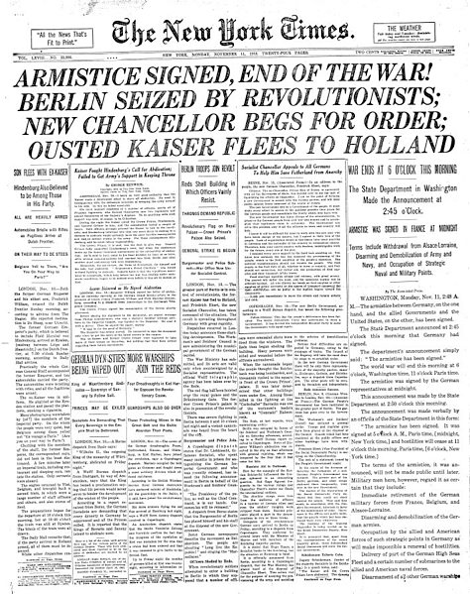



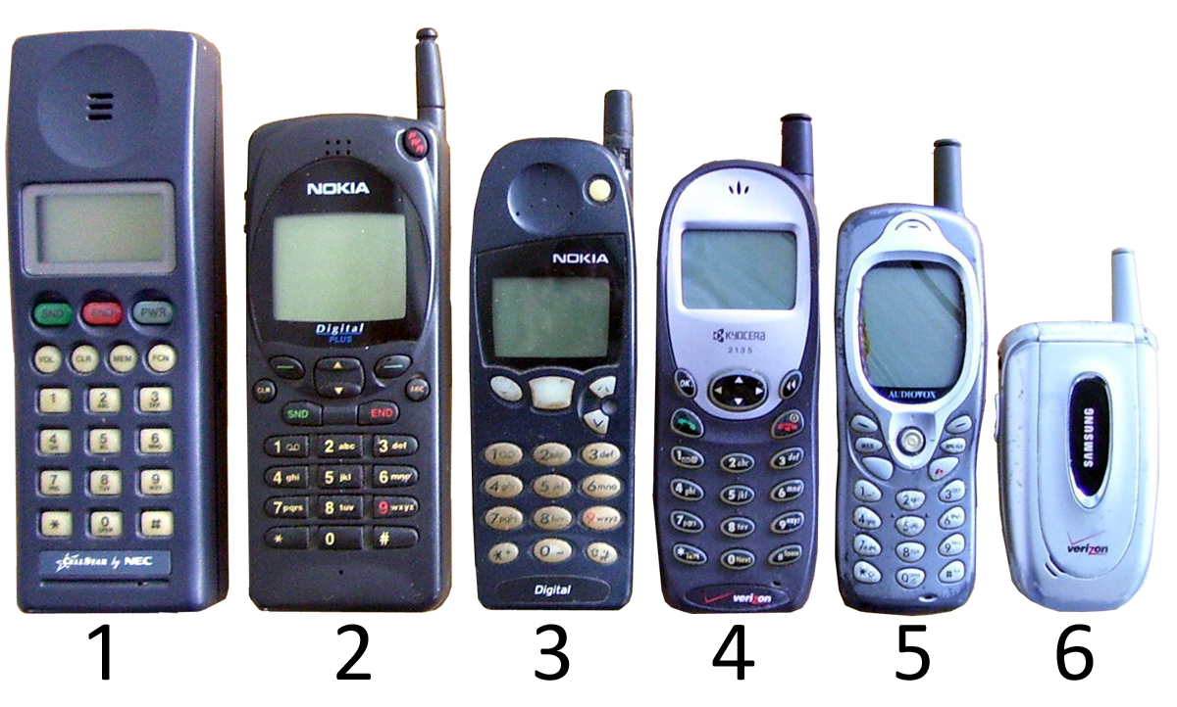
Industry
Timeline of Communication Tools
3000 BC | papyrus
3000 BC 0 | communication drums, horns
2400 BC 4 | couriers, postal systems
490 BC | heliograph
59 BC | first newspaper
100 AD | paper
1000 AD | pens
1400 AD | first European printing press
1500 AD | pencils
16th Century | maritime flags
1790 AD | semaphore lines
1800s | typewriter
1838 | telegraph
1848 | telephone
1896 | radio
1897 | computer
19th Century | signal lamps
1927 | television
1960s | computers and text editors
1969 | computer networking
1983 | Internet
early 1990s | Mobile ; 1G networks
late 1990s | Mobile ; 2G & 2.5G networks
2000s | Mobile ; 3G networks
2012
4G | LTE

Slide 5


INDUSTRY
Classification of Canadian Telecommunications Services Providers (TSP)
Incumbent TSPs
Alternative TSPs
-Facilities based alternative
Cable BDUs
Utility telcos and other carriers
-Non-facilities based

Slide 6
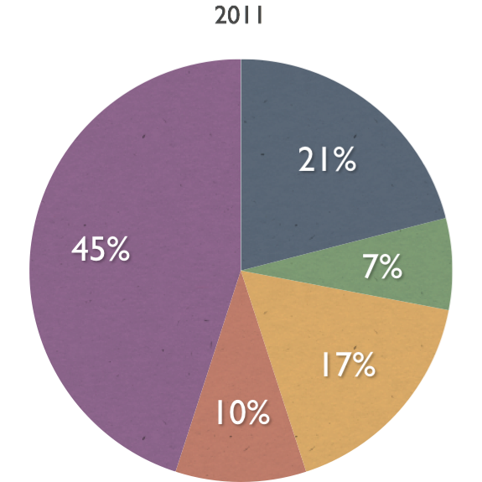
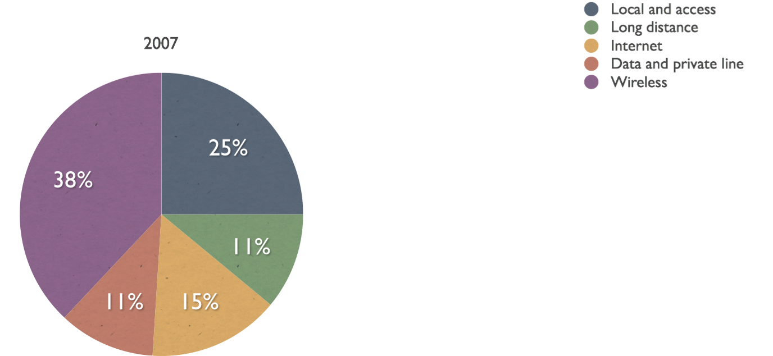
Industry
Revenue Mix in Canada

Slide 7
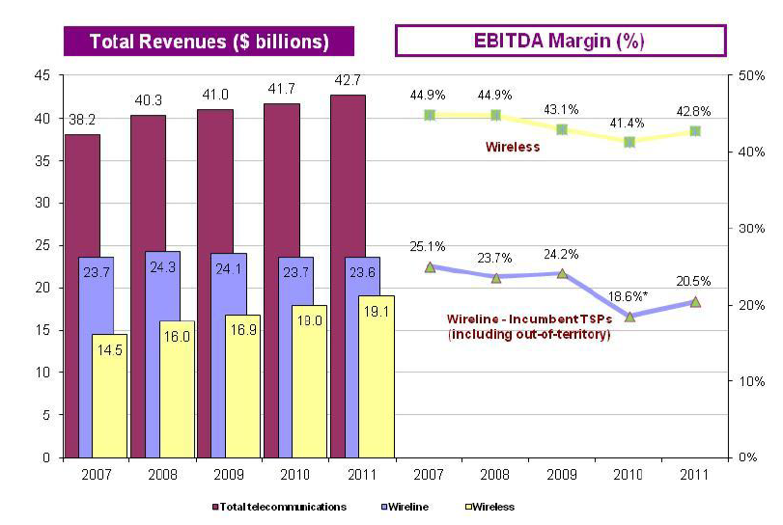
INDUSTRY
Telecommunications Revenues and EBITDA Margins

Slide 8
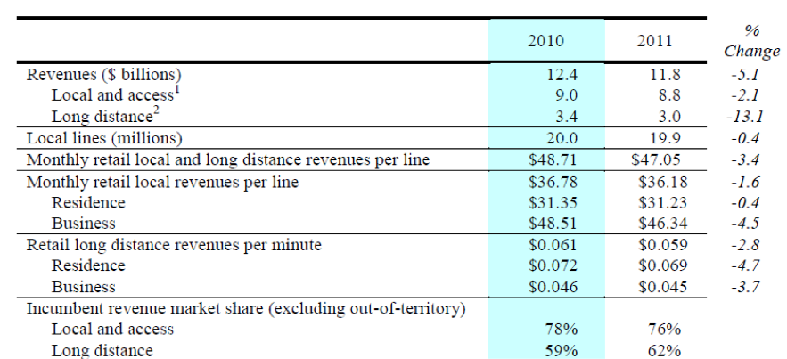
Industry
Local Revenue and Access Line Erosion

Slide 9


Industry
Local and Access Line
Wires & cables connecting to central offices maintained
All transmissions routed through switching equipment
Oldest & once largest sector of the industry
Reason for declination:
Technology innovation : disconnection of second lines for DSL and using switched technology platforms
Cable telephony and VoIP (Voice over Internet Protocol) : causing acceleration of access line losses

Slide 10


Industry
Long Distance
Traffic moves onto competitive networks (the cable infrastructure or VoIP operators )
Discount pre-pay voice
Dial-around LD providers that offer cheap rate across North America
Substitution of VoIP, wireless and email, online long distance call (Skype)
CLEC offerings

Slide 11
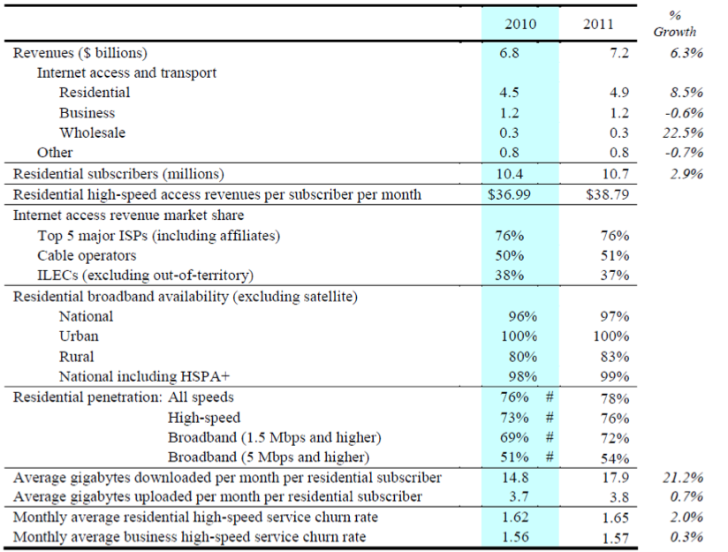
Industry
Internet Revenue

Slide 12

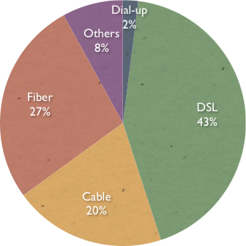
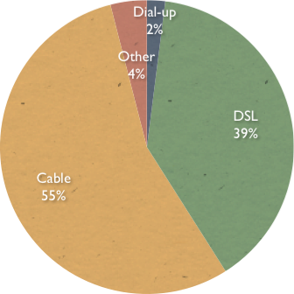
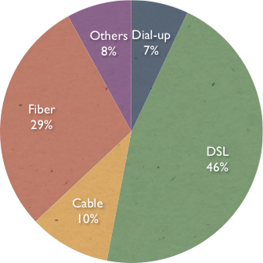
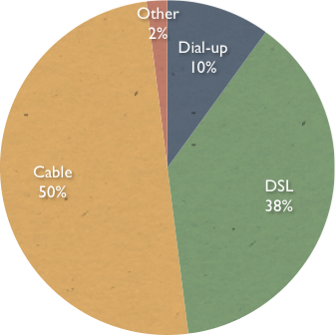
INDUSTRY
Internet Access Revenue
Business
2007-2011
Residential
2007-2011

Slide 13
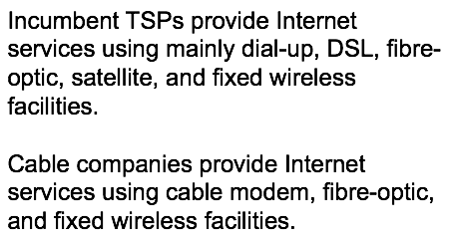

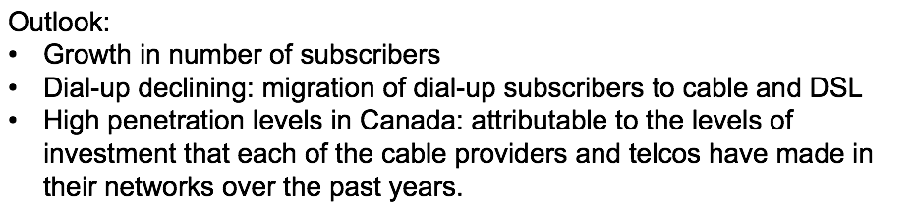
Industry
The Internet

Slide 14
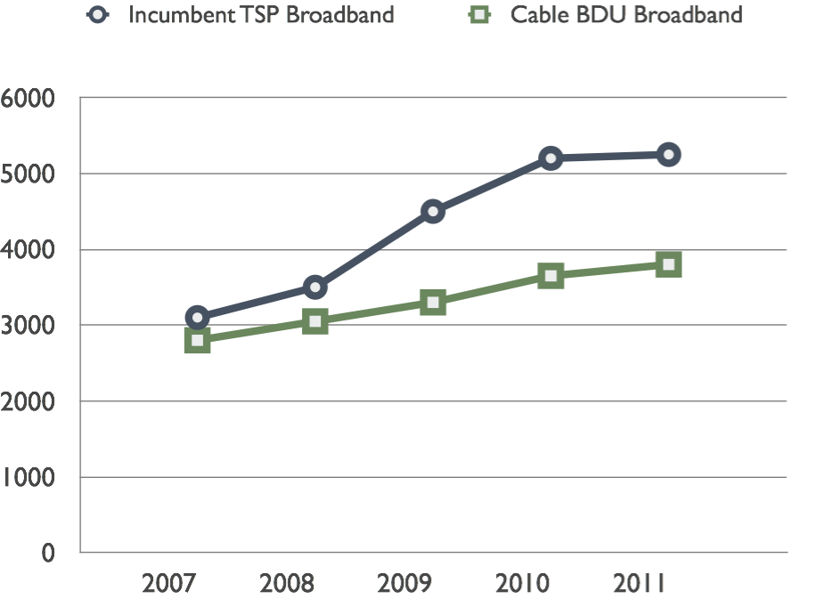
Industry
Broadband
DSL broadband,
Cable broadband,
Wireless broadband,
Satellite broadband,
Power line broadband.

Slide 15
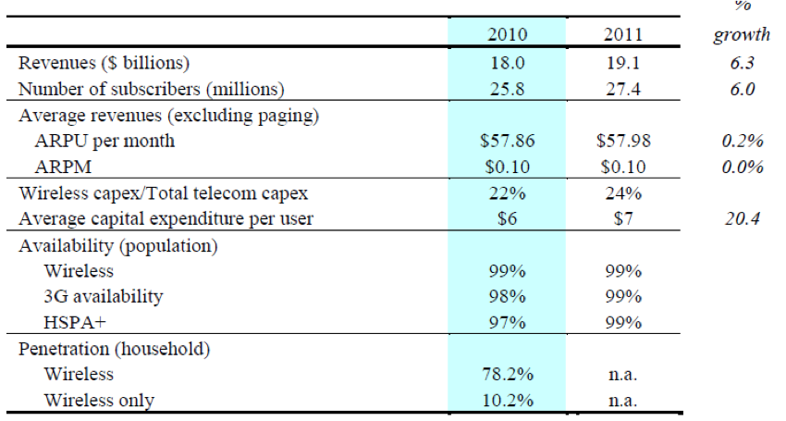
Industry
Wireless Revenue

Slide 16
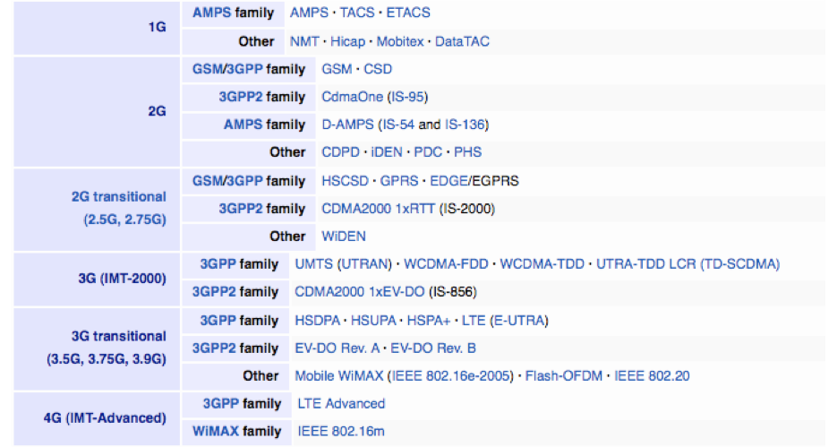
Industry
Technology

Slide 17
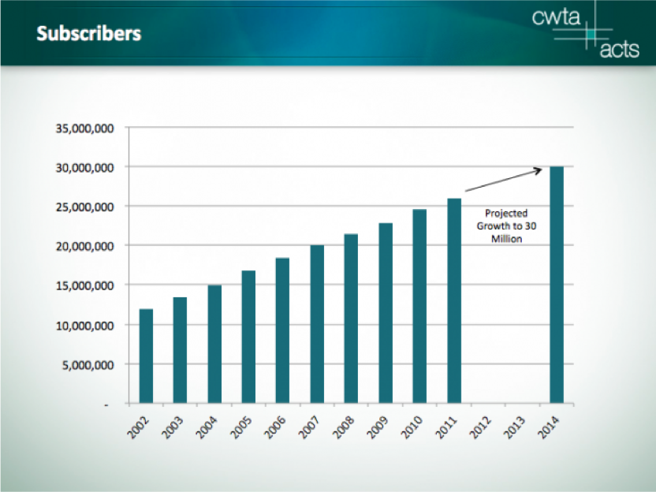
Industry
Subscribers Projection

Slide 18
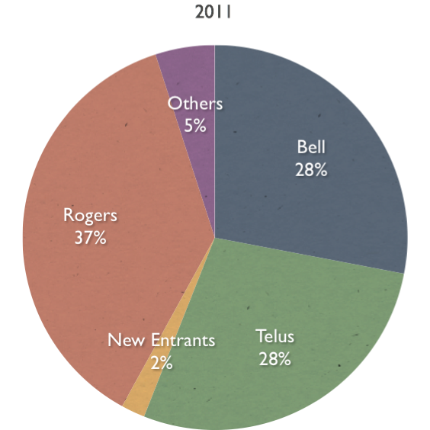
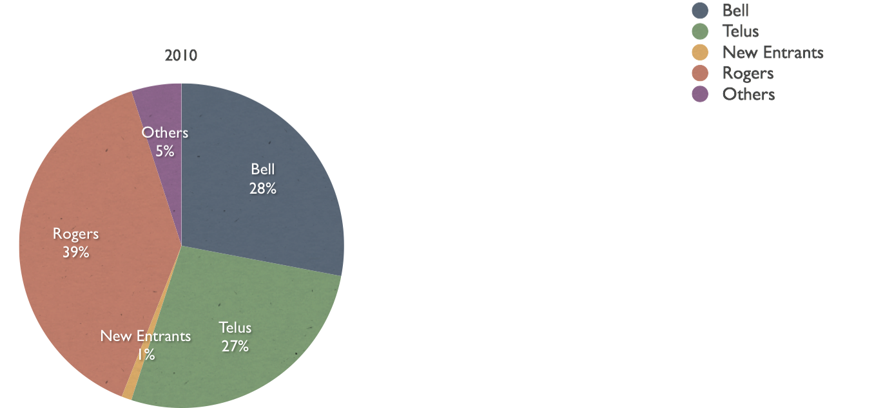
Industry
Wireless Market Share

Slide 19
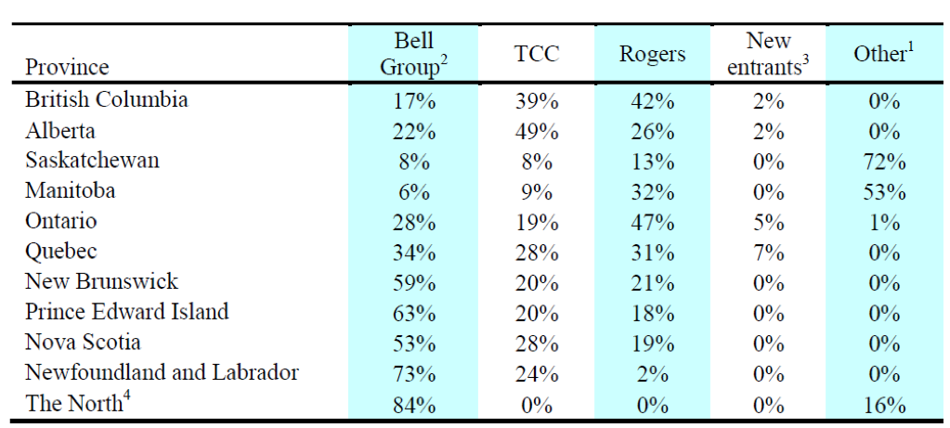
Industry
Wireless Subscriber Market Share by Province

Slide 20
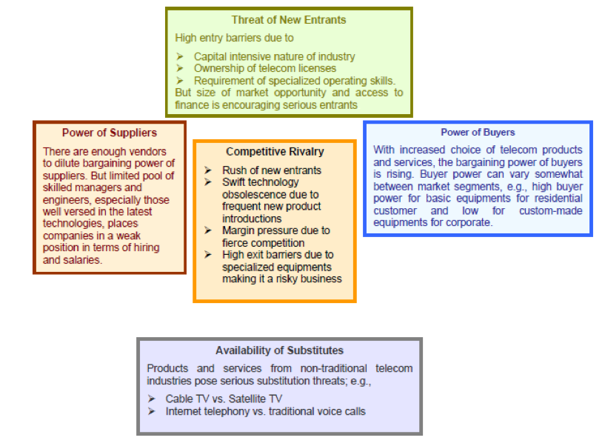
Industry
Porter’s Five Forces

Slide 21
Industry
Industry Characteristics
High capital investment and innovation cost
High customer churn rate
Economies of scale between OEM and Contract Manufacturers
Complex supply chain from contract manufacturer to end consumer
Skilled human capital requirement
Globalization of services – global operations in localized environments
Bundling of services
Frequent new product, services and tariff introductions
Shortening of product life cycles

Slide 22
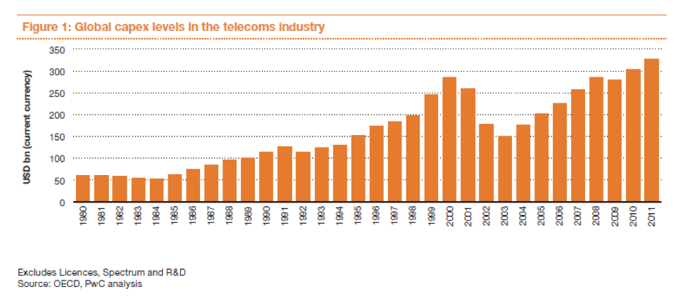
Industry
Global CAPEX Levels in the Telecommunications Industry

Slide 23
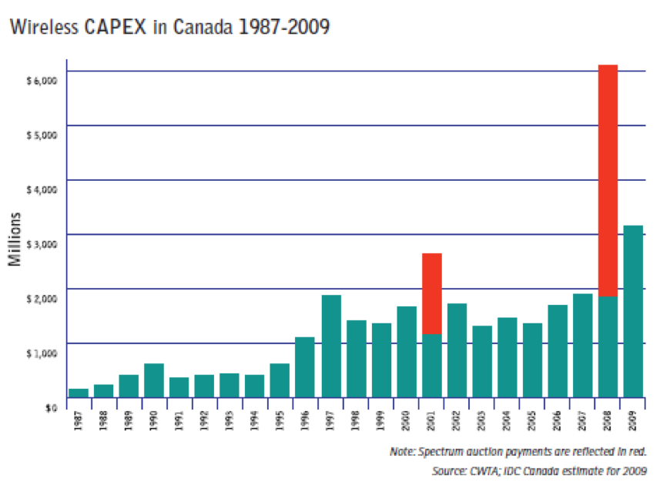
Industry
CAPEX in Canada

Slide 24
Industry
Telecommunication CAPEX
Business-as-usual Capex: RAN consolidation, core upgrades, additional carriers or anything needed to support an increase in traffic, network coverage and network performance, and purchase of spectrum rights (mobile spectrum licenses via auction)
Project Capex: innovation cost, growth capex

Slide 25
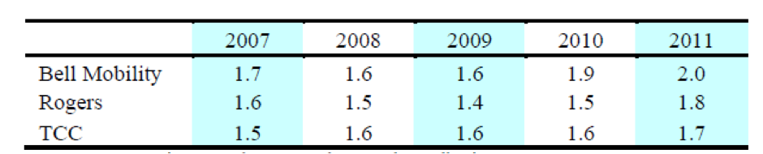
Industry
Churn Rate
Churn rate (sometimes called attrition rate), in its broadest sense, is a measure of the number of individuals or items moving out of a collective over a specific period of time.

Slide 26
Industry
Valuation Drivers in the Telecommunication Industry
Telecom-specific Ratios and Performance Indicators
ARPU
EV/Number of Subscribers
EV/Line Installed
SAC
SRC
Churn Rate
Broadband
Common Valuation Criteria
EV/Sales
EV/EBITDA
P/E
P/B
BETA

Slide 27
Industry
Component of Assets in the Telecommunication Industry
Intangible Assets
Customer relationships and contracts
Licenses for mobile operators or technology-related assets
Trade names/brand
Agreements, such as distribution, supplier or
interconnect arrangements.
Goodwill components
Tangible Assets
Radio communication equipment
Fibre optics (CCA rate is 12%)
Data network infrastructure
Equipment and systems software

Slide 28
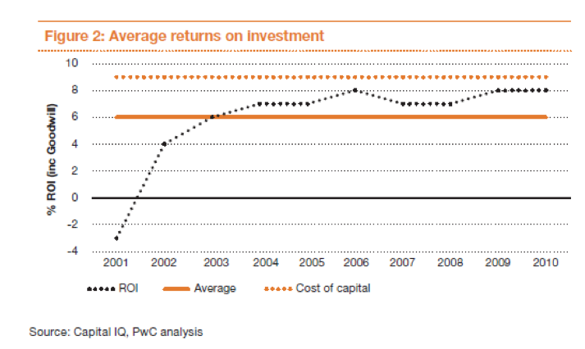
Industry
Return on Investment

Slide 29
Industry
Leading Indicators of an Impending Squeeze on ROI
Slow broadband speeds, where LTE is a viable substitute
Adoption of smartphones as a precursor to use of WhatsApp, iMessage, etc., and thus the destruction of SMS business
Rising levels of mobile VoIP take-up
Increased competition
The release of analogue spectrum, paving the way for new entrants
with better mobile data economics as a result of lower frequency
A business model based on subscribers, average revenue per user
(ARPU), revenues and earnings before interest, taxes, depreciation
and amortization (EBITDA), with a network configured to service
these metrics
High levels of CAPEX

Slide 30
Industry
Regulation Environment
The Canadian Radio-television and Telecommunications Commission (CRTC)
Industry Canada
The Telecommunication Act
The Broadcasting Act

Slide 31

Industry
CRTC
Under the Broadcasting Act;
Power to grant or revoke license;
Foreign ownership restrictions in broadcasting and telecommunication market
Telecommunications common carriers must be Canadian owned and controlled;
There can be 100% foreign ownership of entities such as resellers of telecommunication services
Regulations on transfers of ownership of broadcasting license
CRTC nixes Bell’s Astral $3.38 Billion Takeover as convergence of media companies were severely reduce the competition in broadcast market. This deal would have created a company with large size and scale to exert its market power unfairly.

Slide 32
Industry
Industry Canada
Spectrum Auction: a process whereby government uses an auction system to sell the licenses to transmit signals over specific bands
Advanced Wireless Services and Other Spectrum in the 2 GHz Range (2008)
Switch from analog to digital television (2011)
Licenses for Mobile Broadband Services in the 700 MHz band (2013)
Licenses for Broadband Radio Services in the 2500-2690 MHz (2014)
Transition from 2G to 3G and now 4G

Slide 33
Industry
2008 Spectrum Auction
Administrative Spectrum License Fees

Slide 34
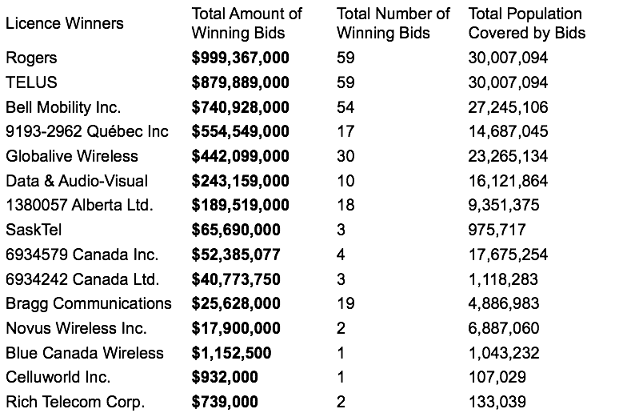
Industry
2GHz Range: Sum of Winning Bids: $4,254,710,327

Slide 35
Industry
Regulation Update
Local contribution subsidy for service in high-cost serving areas
The CRTC telecom fees assessed on wireline and wireless carriers to cover the cost of CRTC operations.
Terrestrial commercial mobile spectrum licensees in Canada typically carry a condition of license (COL) requiring them to dedicate 2% of adjusted annual revenues to a narrow range of pre-defined R&D activities.

Slide 36
Industry
Regulation Update
On March 14, 2012, Industry Canada proposed two major regulatory changes:
Liberalization of the current foreign ownership rules for small operators under the Telecommunications Act
Setting specific rules for future wireless spectrum auctions, including the highly anticipated 700 MHz spectrum auction in 2013 and the 2.5 GHz auction.

Slide 37
Industry
Foreign Policy Changes on the way:
This included lifting foreign ownership restrictions for companies under this act that have less than 10% of the total Canadian communications market.
Targeted toward small and new-entrant communications providers
M&A activity is permitted if the combined share is less than 10% of the telecommunication market in Canada.
Further growth potential indicated by low penetration rates and new entrants market share

Slide 38
Industry
New Spectrum: Hats off but caps on
More rational bidding for spectrum in the upcoming auctions (which would benefit incumbents and new entrants alike), while enabling new entrants to continue to offer roaming beyond their current and future wireless networks
700 MHz spectrum auction will be held in the first half of 2013, the 2.5 GHz spectrum auction will be held up to a year thereafter
Limit the amount of prime spectrum that incumbent carriers

Slide 39
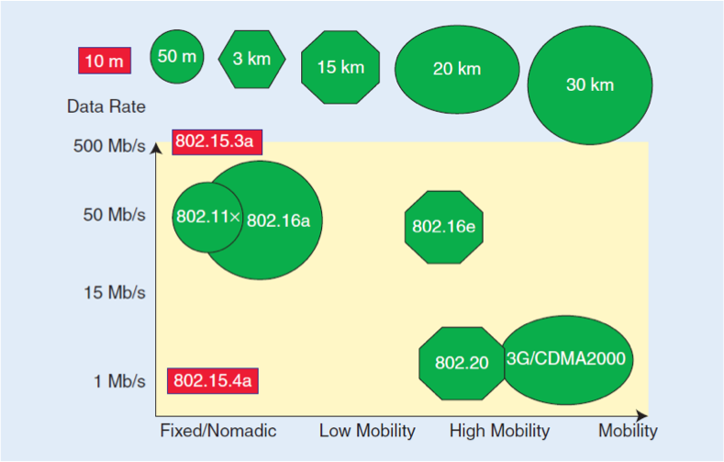
Industry
Telecommunication Standards

Slide 40
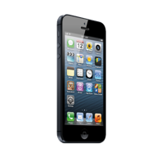
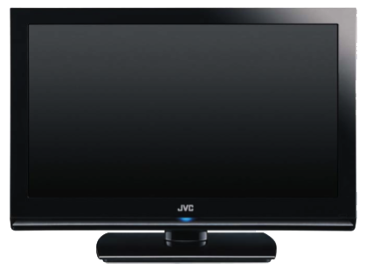
Rogers Communications
Wireless
Media
Cable

Slide 41
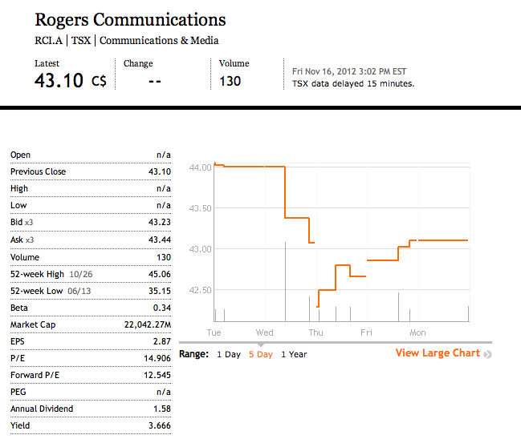
ROGERS
RCI.A - TSX

Slide 42
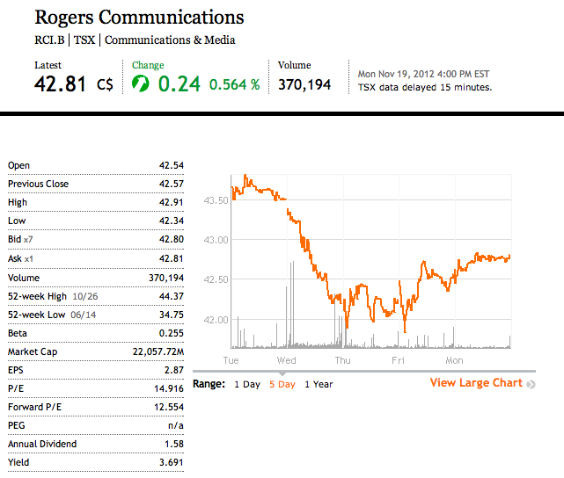
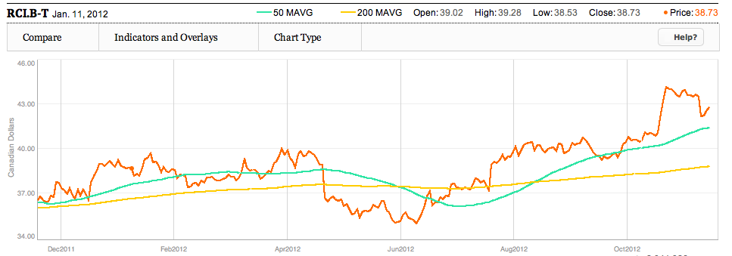
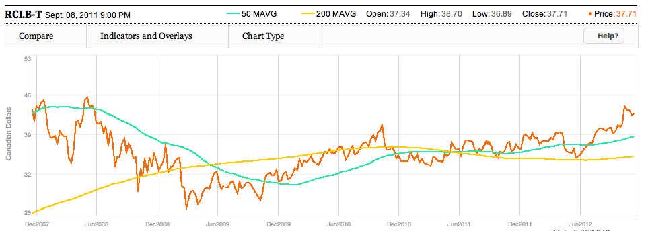
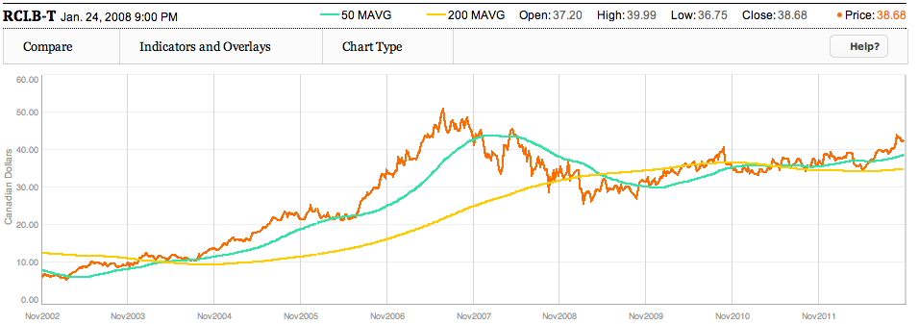
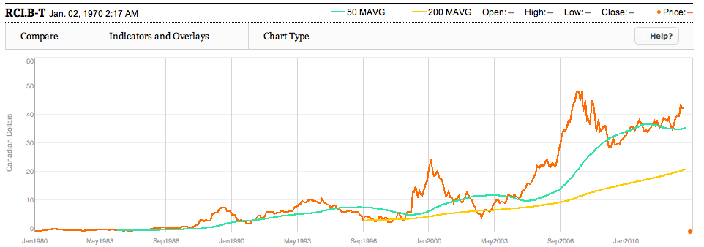
ROGERS
RCI.B - TSX

Slide 43
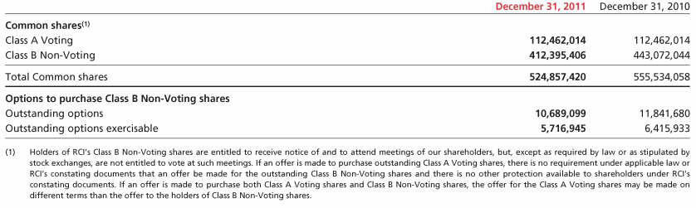
ROGERS
Common Shares Outstanding

Slide 44
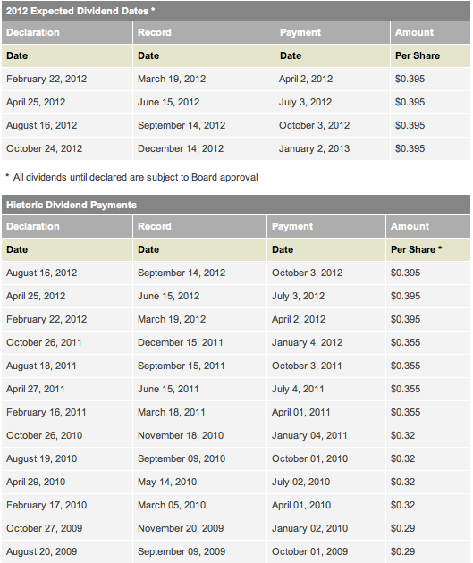
ROGERS
Dividend History

Slide 45
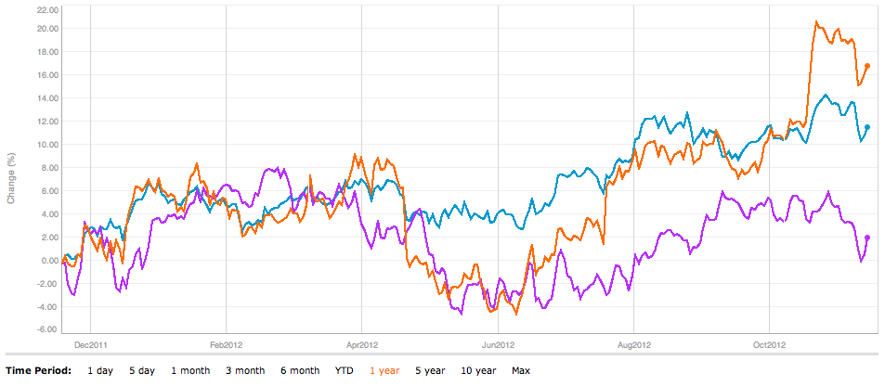
Rogers
1 Year vs. TSC Comp / TSX Telecom

Slide 46
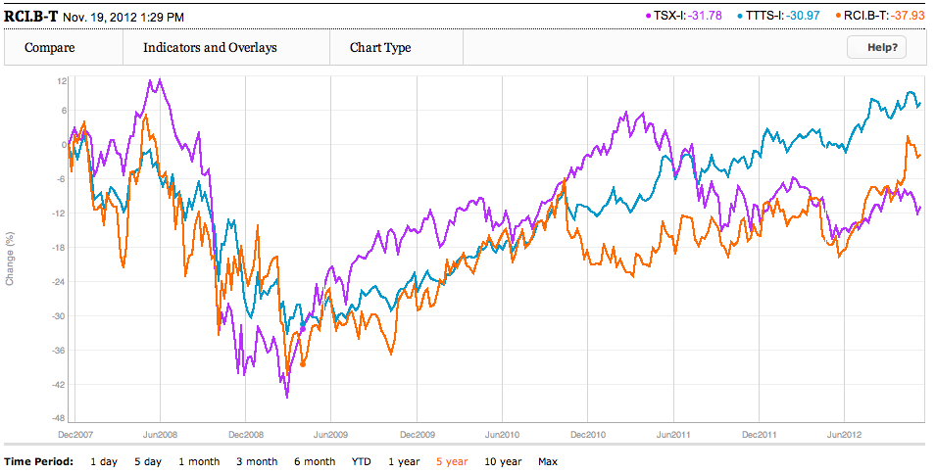
Rogers
5 Year vs. TSC Comp / TSX Telecom

Slide 47
Rogers
History
1960 | While in School Ted Rogers buys CHFI and makes it successful
1967 | Ted Rogers founds Rogers Cable TV, and enters into the cable business
1979 | Rogers becomes a public company after acquiring Canadian Cablesystems and becomes biggest cable company in Canada
1981 | Rogers enters the America market
1985 | Rogers enters the cellular market under the brand Cantel
1994 | Rogers media is created after the $3.1 billion hostile bid for Maclean Hunter
2000 | Rogers acquires the Toronto Blue Jays
2007 | Acquires 5 CityTV stations
2009 | Nadir Mohamed becomes President & CEO of Rogers Communications Inc

Slide 48
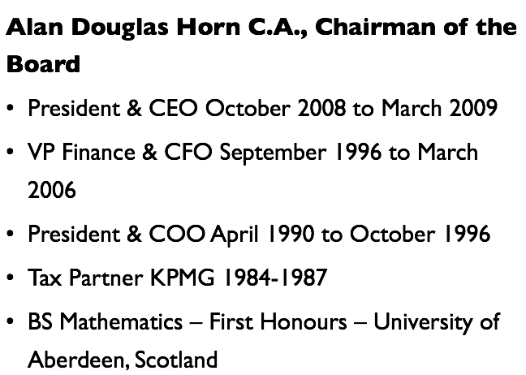
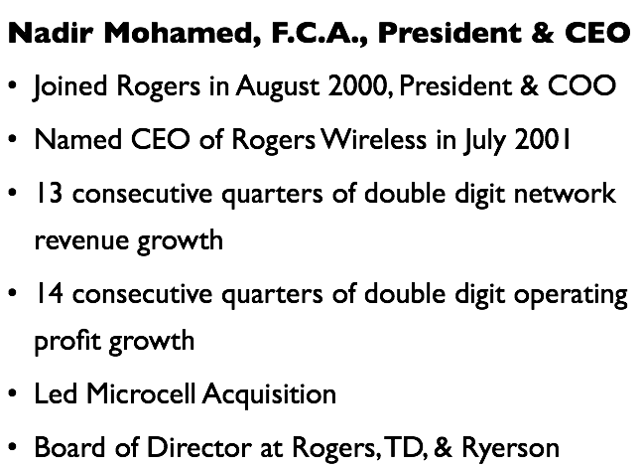
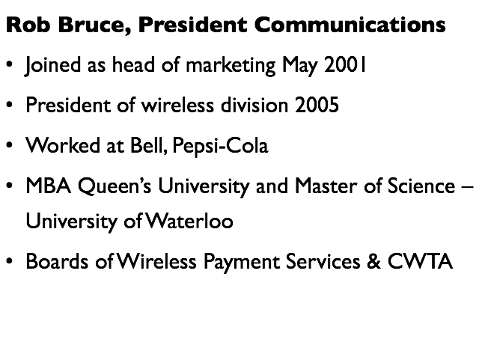
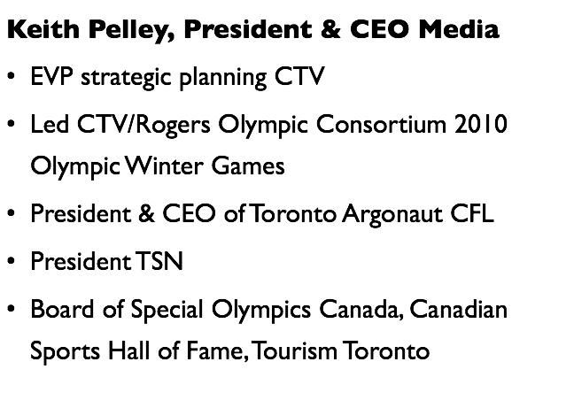

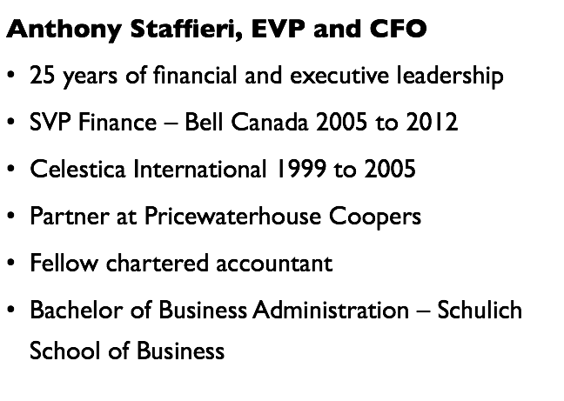




Rogers
Management Team
Notes:
Keith Pelley joined in September 2010

Slide 49
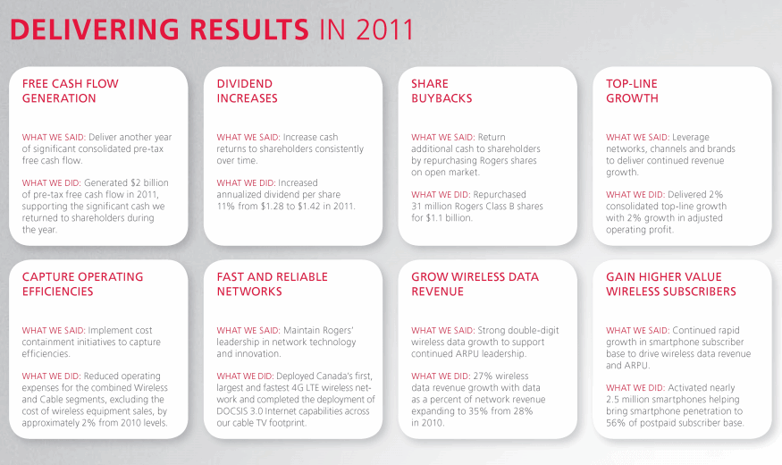
Rogers
Financial Overview

Slide 50
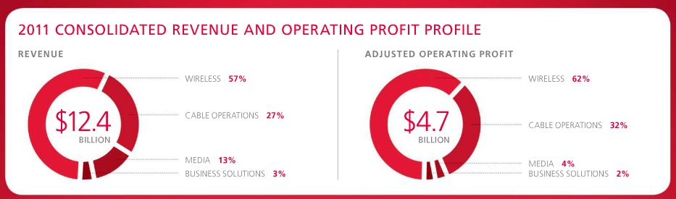
Rogers
Revenue and Profit Breakdown

Slide 51


Rogers
Wireless
Rogers Wireless is Canada's largest wireless communications services provider, under the Rogers, Fido, Chatr Wireless and Cityfone brand names, with 9.3 million voice and data subscribers.

Slide 52
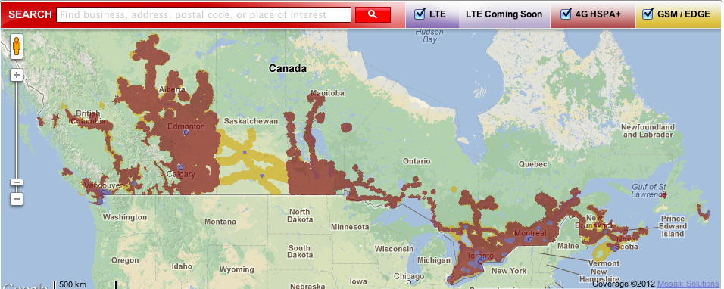
Rogers
Wireless Coverage

Slide 53
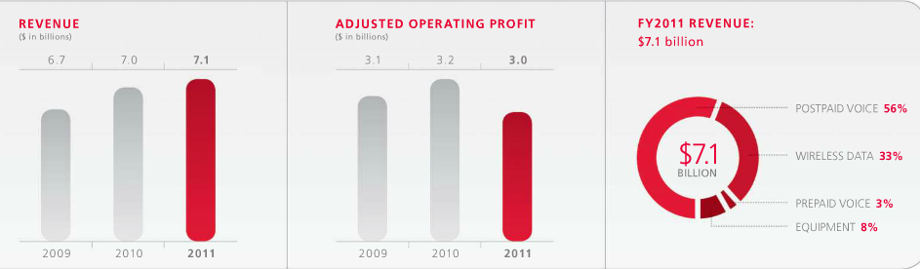
Rogers
Wireless Revenue Breakdown

Slide 54
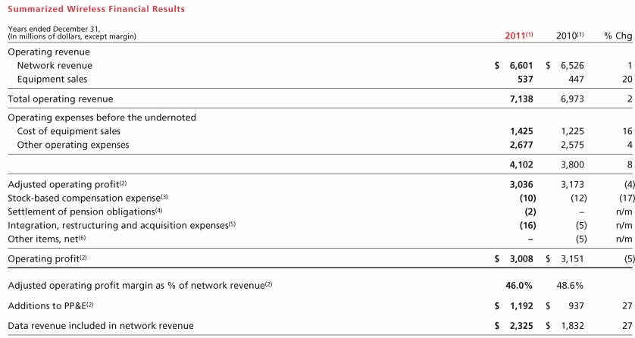
Rogers
Wireless Operating and Financial Results

Slide 55
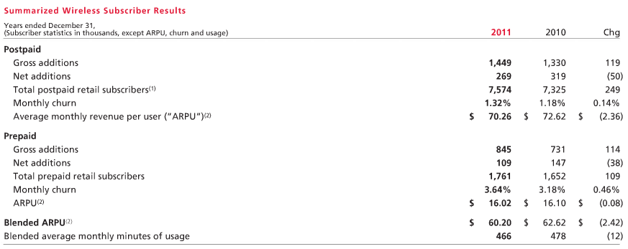
Rogers
Summarized Wireless Subscriber Results

Slide 56


Rogers
Wireless Operating and Financial Results

Slide 57



Rogers
Media
Rogers Media owns Canada's largest publishing company, Rogers Publishing Limited, which has more than 70 consumer and business publications, 55 radio stations, television broadcasting with Omni Television, CityTV, Sportsnet, Sportsnet One, Sportsnet World, OLN, G4 Canada and The Shopping Channel which is Canada's home shopping service.

Slide 58

Rogers
Acquisition of Score Media

Slide 59


Rogers
Media Revenue Breakdown

Slide 60

Rogers
Media Operating and Financial Results

Slide 61
Rogers
Cable
Rogers Cable
Canada’s largest cable television service provider
2.3 million customers in southern Ontario (90% share), NB, NL
HDTV, video on demand, interactive television and enhanced television
Broadband internet access (Rogers Hi-Speed Internet)
Home phone

Slide 62

Rogers
Cable Revenue Breakdown

Slide 63

Rogers
Cable Financial Results

Slide 64

Rogers
Cable Subscriber Financial Results

Slide 65

Rogers
Cable Financial Results

Slide 66

Rogers
Financials : Q3-12, Balance Sheet

Slide 67

Rogers
Financials : Q3-12, Balance Sheet
Sept 2012
Dec 2011

Slide 68

Rogers
Financials : Annual 2011, Balance Sheet

Slide 69


Rogers
Financials : Annual 2011, Balance Sheet

Slide 70

Rogers
Financials : Annual 2011, Income Statement

Slide 71

Rogers
Financials : Q3-12, Income Statement

Slide 72

Rogers
Financials : Annual 2011, Cash Flow

Slide 73

Rogers
Financials : Annual 2011, Cash Flow

Slide 74

Rogers
Financials : Q3-12, Cash Flow

Slide 75

Rogers
Financials : Q3-12, Cash Flow

Slide 76

Rogers
Financials : Q3-12

Slide 77

ROGERS
Recommendation
BUY

Slide 78

Manitoba Telecom Services INC.

Slide 79

Manitoba Telecom
MBT - TSX

Slide 80

Manitoba Telecom
Dividend History

Slide 81

Manitoba Telecom
Number of Shares Outstanding

Slide 82

Manitoba Telecom
1 Year with 50/200 MAVG

Slide 83

Manitoba Telecom
5 Year with 50/200 MAVG

Slide 84

Manitoba Telecom
1 Year vs. TSC Comp / TSX Telecom

Slide 85

Manitoba Telecom
5 Year vs. TSC Comp / TSX Telecom

Slide 86

Manitoba Telecom
10 Year vs. TSC Comp / TSX Telecom

Slide 87
Manitoba Telecom
Company Overview
Fourth largest national communications provider in Canada
MTS, operating in Manitoba
Allstream, operating nationally
Strengths
Dominant market share in Manitoba
Quadruple-play services of voice, wireless, video and data on its own network
Challenges
High business risk of Allstream

Slide 88
Manitoba Telecom
History
1908: Manitoba Government purchased the Bell Telephone operations to create “Manitoba Government Telephones”
1921: changes its name to Manitoba Telephone System (MTS)
1988: MTS entered the wireless business
1997: MTS went public on Toronto Stock Exchange, “MBT”
2004: Acquired Allstream ($1.7 billion) and become the 3rd largest national telecom provider in Canada
2004: Allstream became the first communication solutions provider in Canada to market a network resident IP telephony service on a national basis
2011: Launched 4G wireless network across Manitoba by sharing costing with Rogers Wireless

Slide 89
Manitoba Telecom
Structure
Leading full-service communications provider
Operated more than 100 years
More than 500K residential customers
Heart of Manitoba’s economic growth
Industry innovator, digital television, electronic commerce
Works with businesses of all size
Drive workforce and partner productivity
More than 65K business customers
2388 fibre-red buildings

Slide 90
Manitoba Telecom
Operation
•4G Wireless
•High-speed Internet
•Television
•Home phone
•Home security
•IP communications
•Managed IP network services
•Unified communications
•Cloud enablement
•Data and security management

Slide 91

Manitoba Telecom
Overall Performance
▼1.0%
▲5.2%
▲17.0%

Slide 92

Manitoba Telecom
Revenue Breakdown

Slide 93



Manitoba Telecom
MTS Yearly Revenue
Accounts 54% of whole revenue

Slide 94



Manitoba Telecom
Allstream Yearly Revenue
Accounts 46% of whole revenue

Slide 95


Slide 96

Manitoba Telecom
Wireless Coverage

Slide 97








Manitoba Telecom
Management Team

Slide 98

Manitoba Telecom
Financials : Q3-12, Balance Sheet

Slide 99

Manitoba Telecom
Financials : Q3-12, Balance Sheet
Sept 2011
Dec 2012

Slide 100

Manitoba Telecom
Financials : Annual 2011, Balance Sheet

Slide 101

Manitoba Telecom
Financials : Annual 2011, Balance Sheet

Slide 102

Manitoba Telecom
Financials : Annual 2011, Income Statement

Slide 103

Manitoba Telecom
Financials : Q3-12, Income Statement

Slide 104

Manitoba Telecom
Financials : Annual 2011, Cash Flow

Slide 105

Manitoba Telecom
Financials : Q3-12, Cash Flow

Slide 106

Manitoba Telecom
Financials : Q3-12

Slide 107


Manitoba Telecom
Financials : Q3-12

Slide 108
Manitoba Telecom
Key Developments
Changes in foreign investment rules for telecommunications companies
Allowed increased foreign investment into Allstream division
Launch of 4G LTE wireless network and iPhone5
Launched on Aug. 28, 2012
First to offer Manitobans LTE wireless technology
Spectrum auction
Continue to evaluate their option
Await the Gov’s announcement regarding the auction’s framework

Slide 109


Manitoba Telecom
Recommendation
Hold / Sell

Slide 110
BELL CANADA

Slide 111

BELL
BCE - TSX

Slide 112

BELL
Dividend History

Slide 113

BELL
1 Year with 50/200 MAVG

Slide 114

BELL
5 Year with 50/200 MAVG

Slide 115

BELL
Max Year with 50/200 MAVG

Slide 116

BELL
1 Year vs. TSC Comp / TSX Telecom

Slide 117

BELL
5 Year vs. TSC Comp / TSX Telecom

Slide 118



BELL
Company History

Slide 119
BELL
Communication Services
Wireless through Bell Mobility, SOLO and Virgin Mobile Canada
High-speed Internet and Bell Fibe Internet
Bell Satellite TV and Bell Fibe TV
Bell Home Phone, local and long distance
Connectivity, Internet Protocol broad services and information and communications technology(ICT)solutions through Bell Business Market
Bell Media offers radio, digital media and television (CTV)

Slide 120

BELL
Acquisition of CTV
Acquisition cost $165 millionIncreasing operating cost 9.8% in 2011Acquired the remaining 85% of CTV common sharesCanada’s #1 television networkCTV2 Provides local news and community programming in 7 regions across Canada

Slide 121
BELL
BCE 6 Strategic Imperatives
Accelerate wirelessLeverage wireline momentumExpand media leadershipInvest in broadband networks and servicesAchieve a competitive cost structureImprove customer service

Slide 122

BELL
Organizational Chart

Slide 123


BELL
Revenue Breakdown: Q3-12

Slide 124

BELL
Financial & Operational Highlights: Q3-12

Slide 125
BELL
Bell Wireline
ServiceMost extensive local access networkLocal and long distance callingFast and secure internet servicesDigital televisionHD PVRsOn-demand moviesTV onlineFlexible programming

Slide 126


BELL
Bell Wireline Revenue

Slide 127

BELL
Bell Wireline Voice
Residential NAS lost 11.3% y/yBusiness NAS increase 9.3 K y/yVoice revenue decline 9.3% in Q3’12Should improve residential NAS

Slide 129

BELL
Wireline FIBE TV
Fibe TV net additions in Q3’12 is more than double compare with Q3’11 ---Fibe TV customer base over 200k

Slide 130

BELL
Wireline TV

Slide 131

BELL
Wireline TV : TV Revenue 2011

Slide 132

BELL
Market Share in TV Revenue

Slide 133

BELL
Wireline Data Revenue
Data includes TV and Internet

Slide 134
BELL
Equipment & Others
Revenue decreased 8.0% in Q3’12 and 10.5% y/yReason of decreasing revenue: lower year over year legacy wireline equipment salesPromotion at Bell TV->reduced average retail price (TV set-top box)Higher proportion of STB rentals for Fibe TVLower consumer electronic equipment sales at The Source

Slide 135

BELL
Wireline Data
InternetInternet access and information and communication technology (ICT) solutions

Slide 136
BELL
Bell Wireless
Provide integrated digital wireless voice and dataOffer over technologically advanced wireless network, available to all of Canadian populationIncludes Bell Mobility, Virgin Mobile CanadaProducts sales from The Source and the wireless operations of Northwestel

Slide 137

BELL
Bell Wireless Market Share

Slide 138


BELL
Wireless TSPs’ Subscriber Market Share

Slide 139
BELL
Wireless TSPs’ Revenue Market Share

Slide 140

BELL
Wireless Market Share by Province

Slide 141

BELL
Wireless Coverage

Slide 142

BELL
Wireless Connections : Q3-12

Slide 143


BELL
Wireless Revenue : Q3-12

Slide 144


BELL
Wireless Performance

Slide 145
BELL
Bell Media
Created on April 1, 2011Acquisition of CTV Inc. and all CTV propertiesOwns 28 conventional television stationCTV, Canada’s leading television network based on viewershipOwns 30 specialty television channelsTSN, Canada’s leading specialty channel and RDS, Canada’ leading French-language specialty channelOwns 33 radio stations, and several websitesSympatico.ca portal, Dome productions partnership, etc.

Slide 146

BELL
Bell Media Financials

Slide 147

BELL
Segmented Data

Slide 148






BELL
Management Team

Slide 149

BELL
Financials : 2011, Balance Sheet - Assets

Slide 150

BELL
Financials : 2011, Balance Sheet - Liabilities

Slide 151

BELL
Financials : Q3-12, Balance Sheet - Assets

Slide 152

BELL
Financials : Q3-12, Balance Sheet - Liabilities

Slide 153

BELL
Financials : Annual 2011, Income Statement

Slide 154

BELL
Financials : Q3-12, Income Statement

Slide 155

Bell
Financials : Annual 2011, Cash Flow

Slide 156

Bell
Financials : Q3-12, Cash Flow

Slide 157
BeLL
Recommendation
Hold

Slide 158
The End

