Slide 1
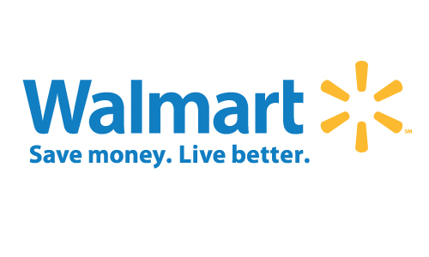
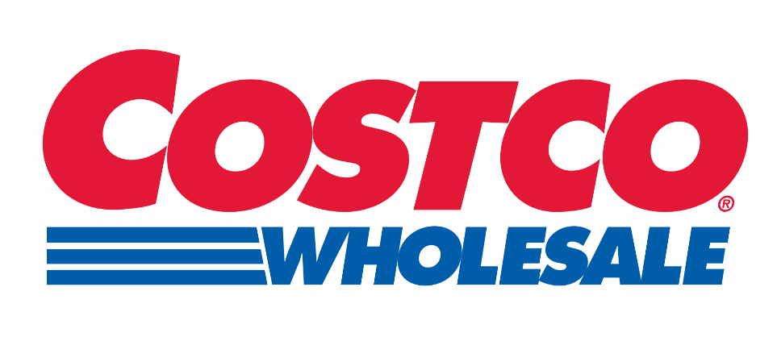
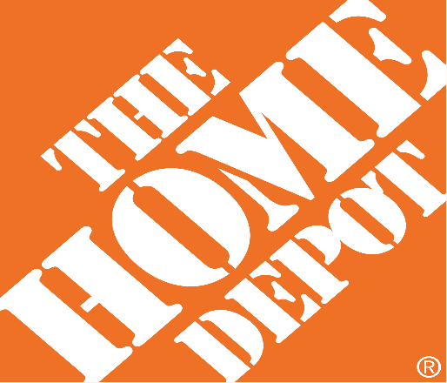
U.S. Retail Industry
Presented by:
Chen Li 301187267
Li Shi 301211226
Juan Fanjani 301215216
Qianying Zhang 301176311

Slide 2
Today’s Agenda
Retail Market Analysis
Walmart
Costco
Home Depot

Slide 3
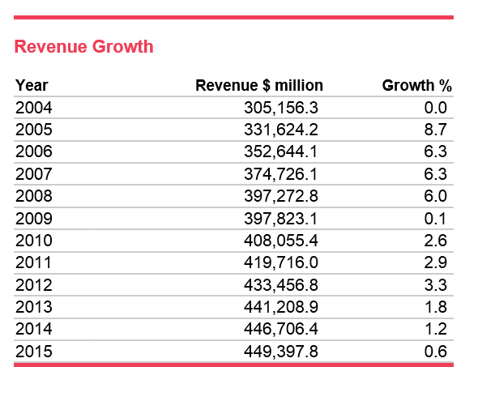
Retail Industry Overview
Retail is the process of selling consumer goods and/or services to customers through multiple channels of distribution to earn a profit.
According to IBISWorld, retail sales in the U.S. reached $4.49 trillion in 2015. Globally, retail sales surpassed $24 trillion in 2015.

Slide 4
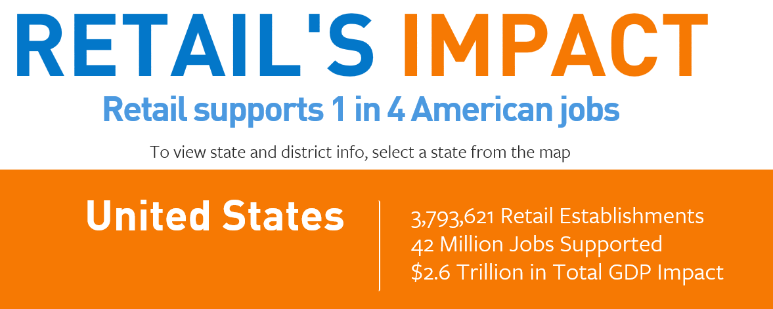
U.S. retail industry overview

Slide 5
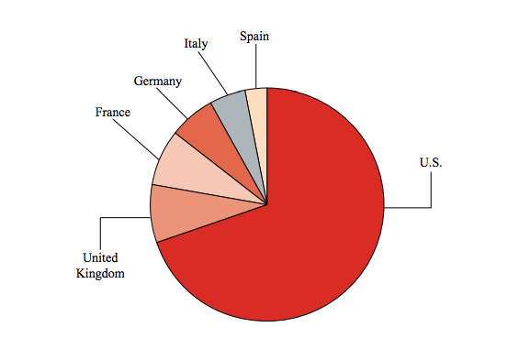
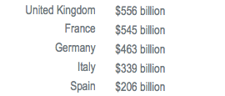
U.S. retail industry overview

Slide 6
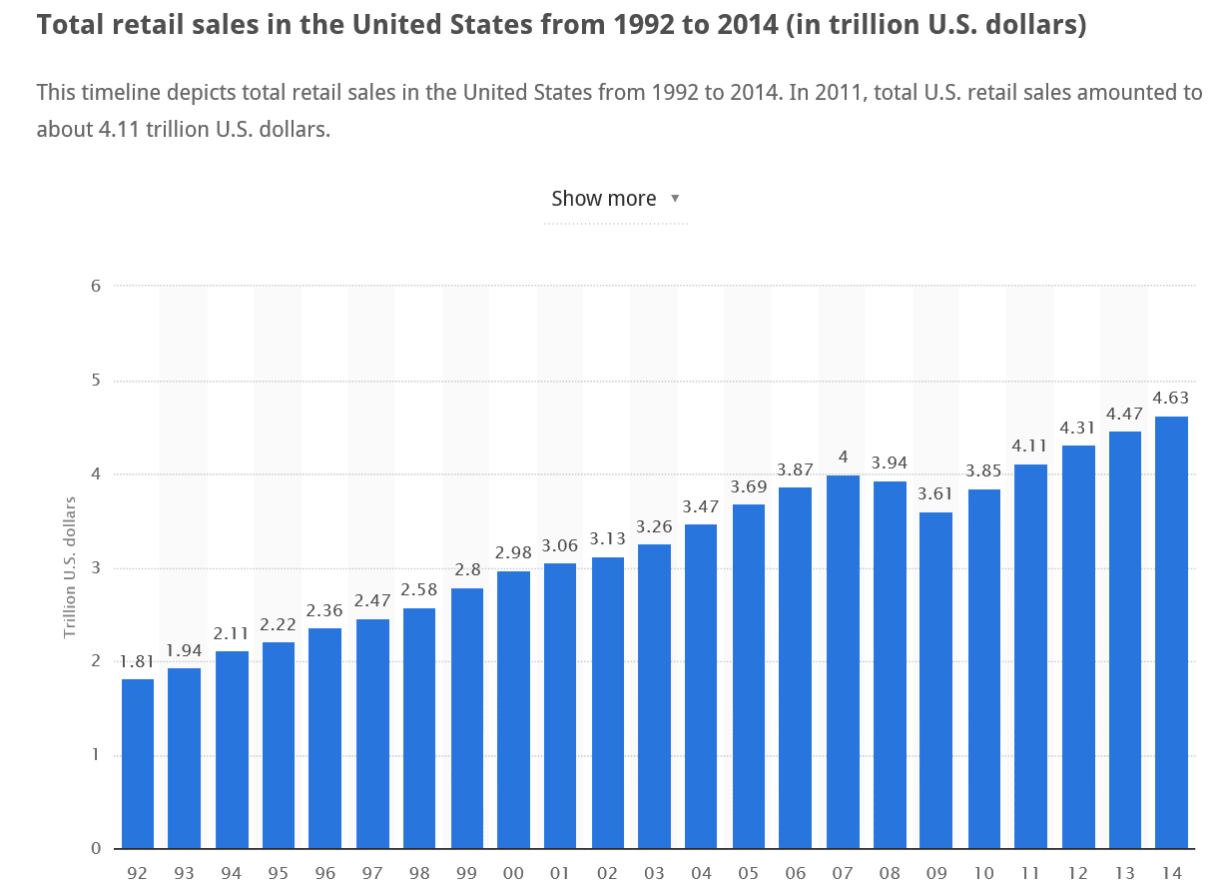
U.S. retail industry overview

Slide 7
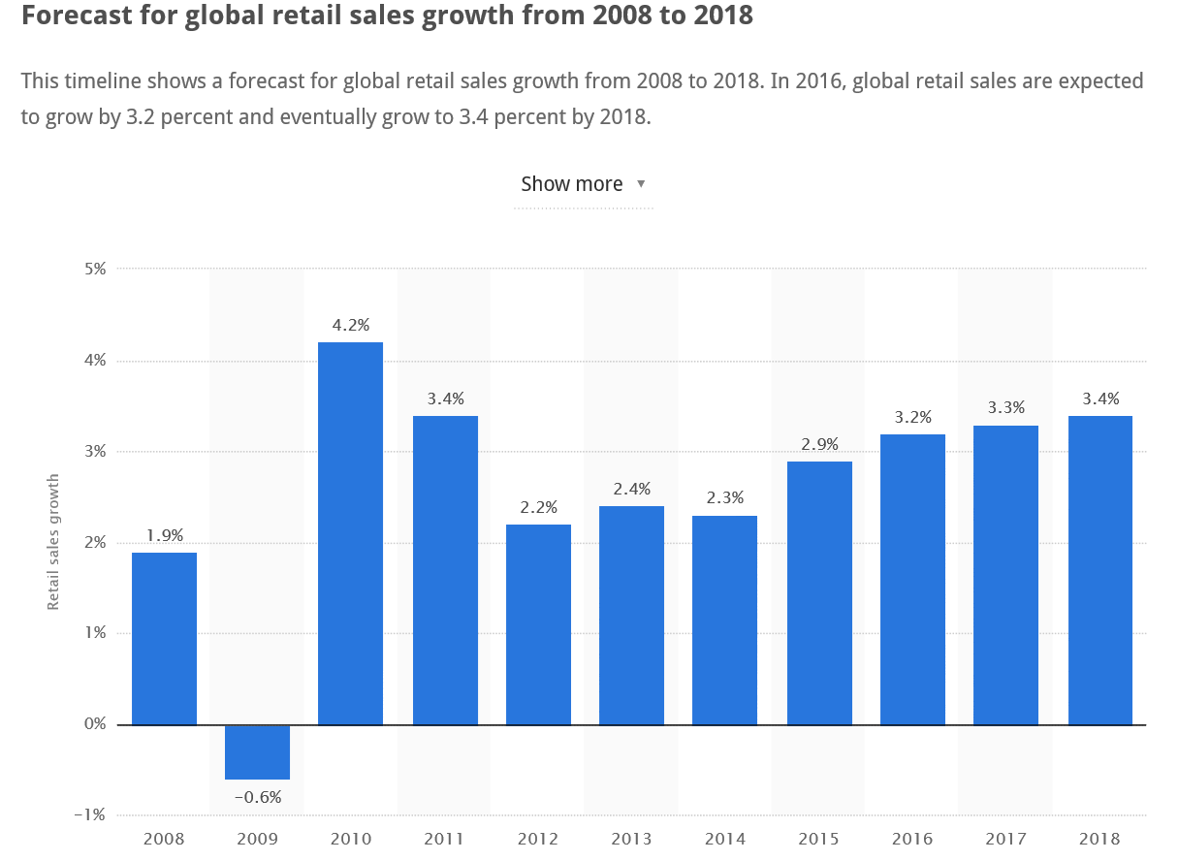
U.S. retail industry overview

Slide 8
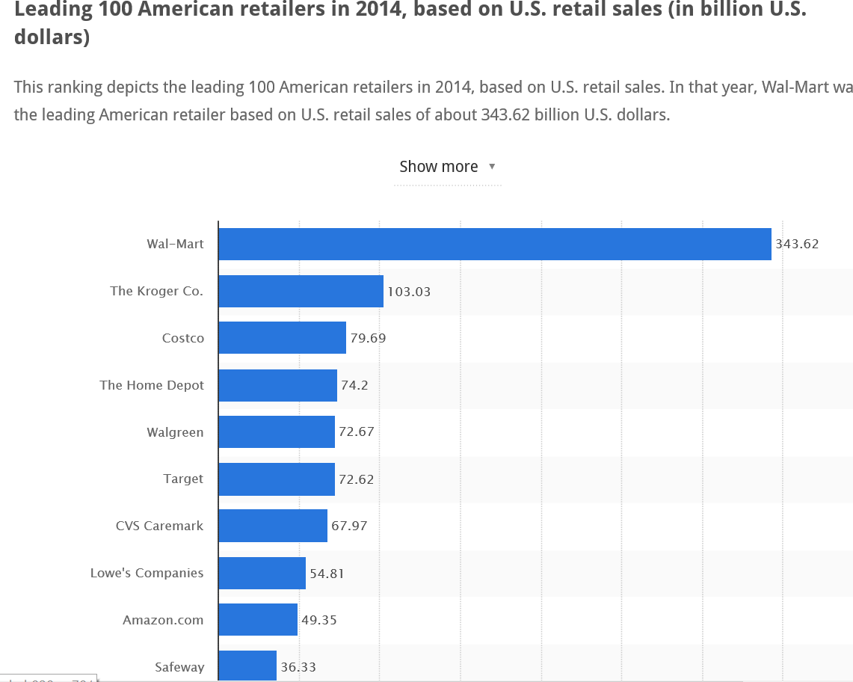
U.S. retail industry overview

Slide 9
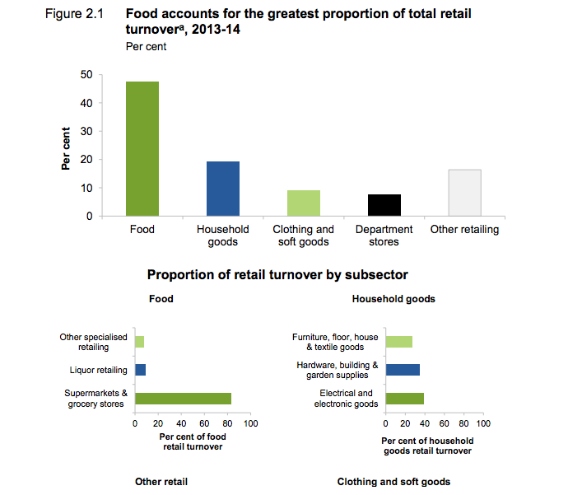
U.S. retail industry overview

Slide 10
U.S. retail industry overview
Sales per square foot is a popular sales metric used in the retailing industry. Sales per square foot is simply the average revenue a retail business creates for every square foot of sales space.
Retail sales per square foot is a popular way for retailers to determine how successful store sales have been.
The average regional mall sales per square foot is $341 and most big box retailers average between $250 to $350.
According to RetailSails, sales per square foot for Nordstrom is $400, compared with just $173 for Macy’s.

Slide 11

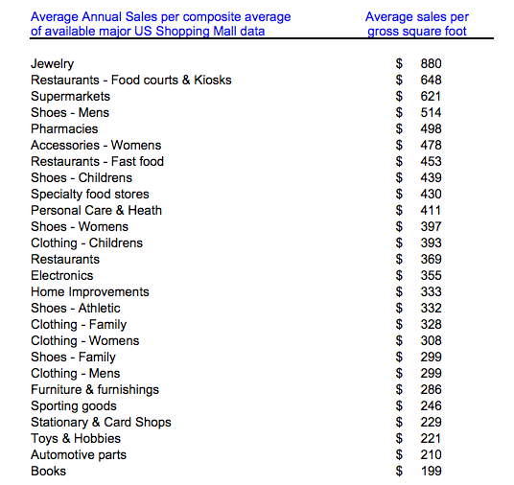
Retail sales per foot

Slide 12
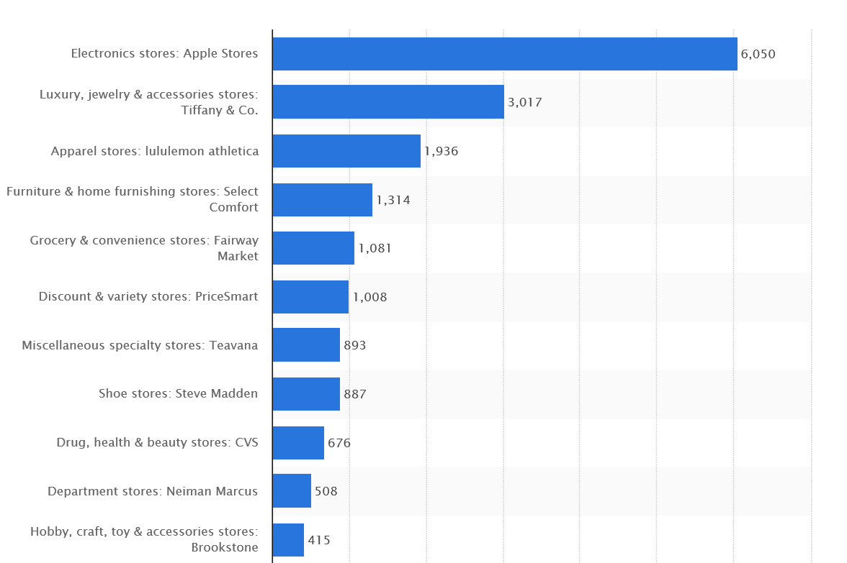
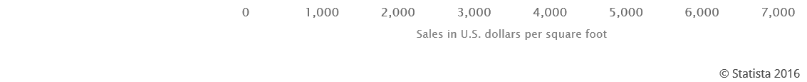
Retail sales per foot

Slide 13
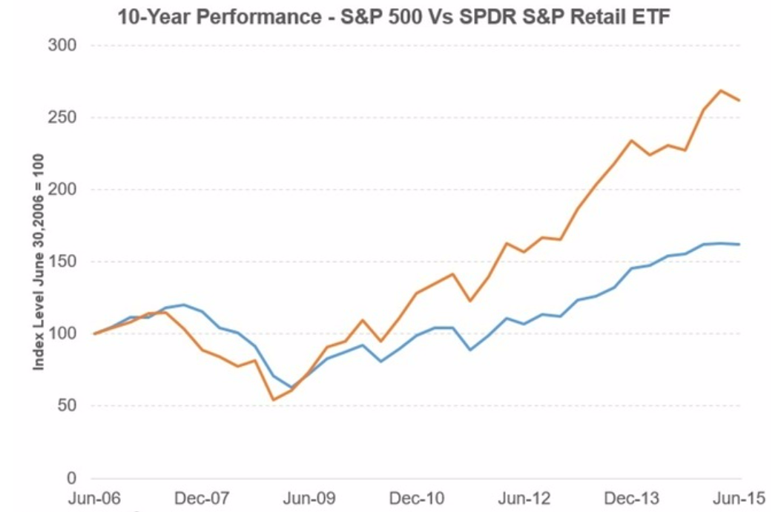
Relationship between the Retail Industry and the US Economy
The correlation between the S&P 500 (SPX) Broad Market Index and the SPDR S&P Retail ETF (XRT) is 0.91.
The US GDP (gross domestic product) has a correlation of 0.94 with the retail ETF.

Slide 14
Structure of the Industry: competition and market dynamics
Big-Box & Department Store Retailers: broad range of general merchandise, such as apparel, jewelry, cosmetics, home furnishings, general household products, toys, appliances and sporting goods
Warehouse Club & Supercenter Retailers: general line of grocery products, along with merchandise items. Warehouse clubs offer customers a wide selection of goods (often in bulk) at discounted prices, in exchange for a membership fee paid by each customer.

Slide 15
Structure of the Industry: competition and market dynamics
Supermarkets & Grocery Stores: general lines of food products, including fresh and prepared meats, poultry and seafood, canned and frozen foods, fresh fruits and vegetables and various dairy products.
E-tailers: sell retail goods on the Internet.

Slide 16
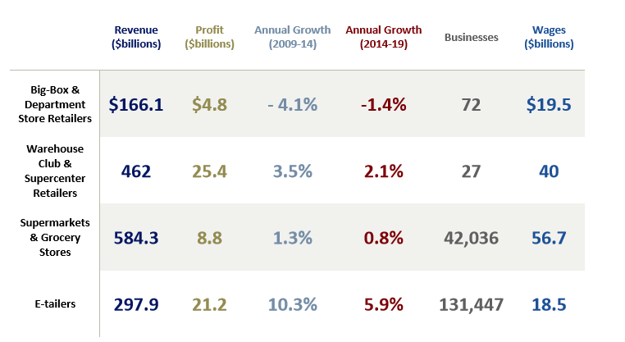
Structure of the Industry

Slide 17
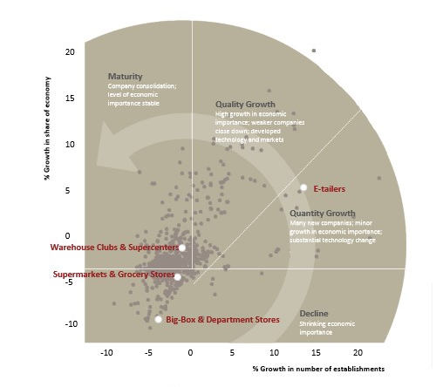
Retail Industry Mature Life Cycle
Decline phase: IVA falls below GDP
Growth phase: IVA outpaces GDP
Mature phase: IVA mirrors GDP
U.S. GDP is anticipated to rise an at
annualized rate of 2.5% in the 10
years to 2020.

Slide 18
Retail Industry Mature Life Cycle
The Big-Box & Department Store Retailer: Decline. In the 10 years to 2020, IVA is expected to decline at an annualized rate of about 4.6%.
The Warehouse Club & Supercenter Retailer: Mature. In the 10 years to 2020, IVA is forecast to increase at a rate of 2.5% per year on average, mirroring U.S. GDP.

Slide 19
Retail Industry Mature Life Cycle
The Supermarkets and Grocery Stores: Mature. The Supermarkets and Grocery Stores industry is in the mature stage of its life cycle. However, in the 10 years to 2020, IVA is expected to increase at a relatively slow rate of 0.6% per year on average.
The E-tailer: Growing. In the 10 years to 2020, IVA is expected to increase at an average annual rate of 12.8%. High IVA growth relative to the economy as a whole is highly indicative of a growing life cycle stage.

Slide 20
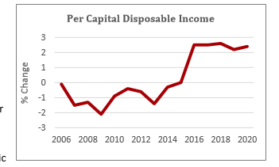
Key External Factors of Growth
Internal Industry Competition.
Disposable Income
Consumer Confidence Index
Population

Slide 21
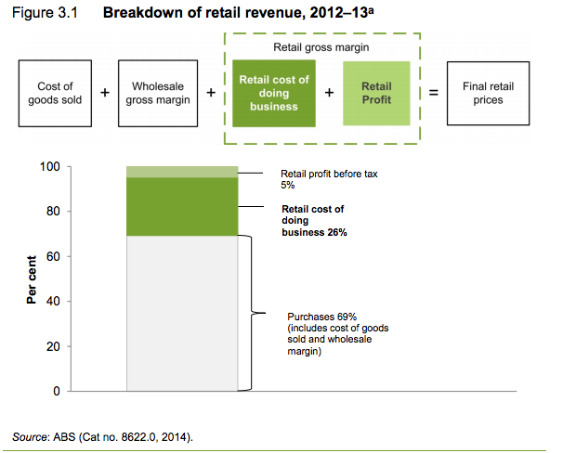
Cost Structure and Revenue Composition
Revenue= Manufacturing+ Wholesaling+ Retail income
Retail income= Retail profit margin+ Costs

Slide 22
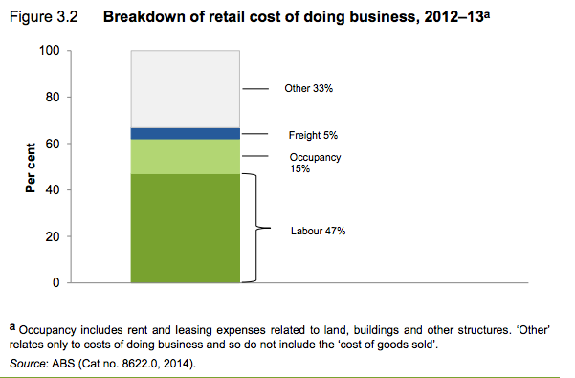
Retail cost of doing business
Main cost= labor cost+ occupancy cost
Other costs of doing business include utilities, professional and financial services, and distribution

Slide 23
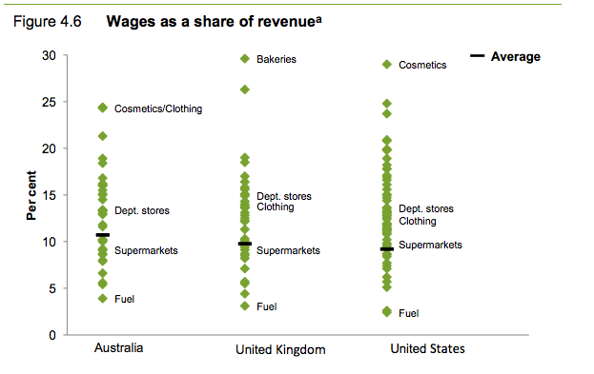
Retail cost of doing business
Labor costs include wages, other workers’ compensation and payroll taxes.

Slide 24
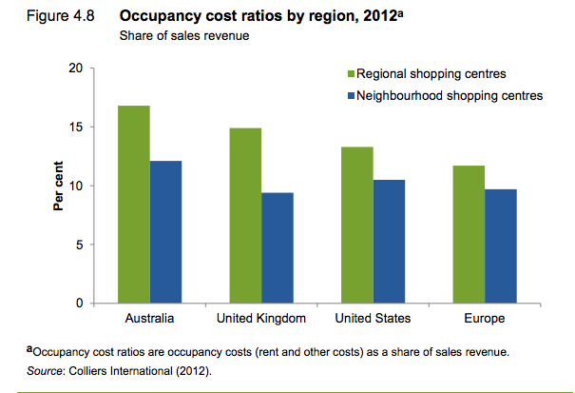
Retail cost of doing business
Occupancy costs include those costs associated with maintaining a shop, office or warehouse space.
Occupancy costs generally include rent and other fees paid to landlords for shared services and facilities such as security, air conditioning, lighting, marketing, and the operation of car parks.

Slide 25
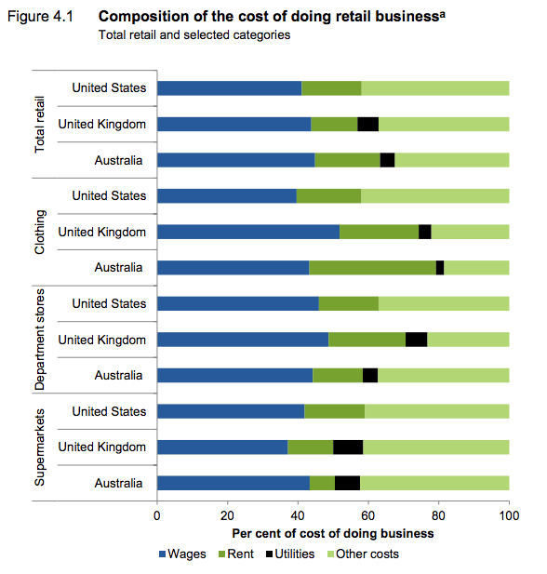
Compare Cost of retail industry

Slide 26
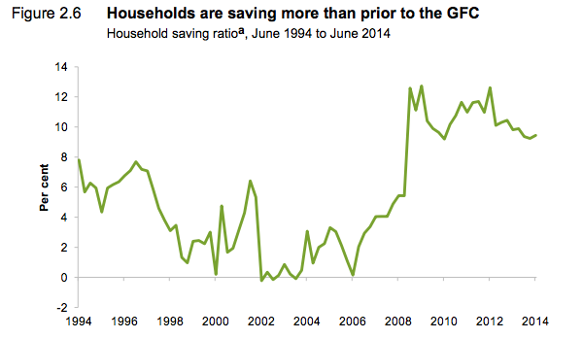
Retail industry is evolving
Changes in consumer behavior

Slide 27
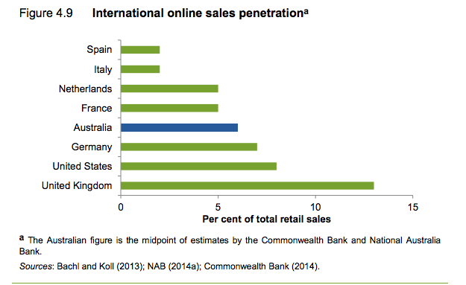
Retail industry is evolving
Technological change

Slide 28
U.S. Retail_ Walmart

Slide 29
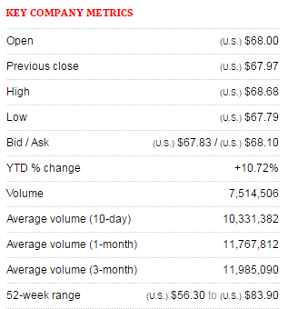
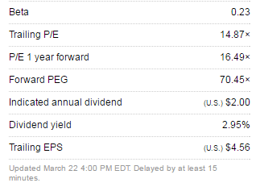

Slide 30
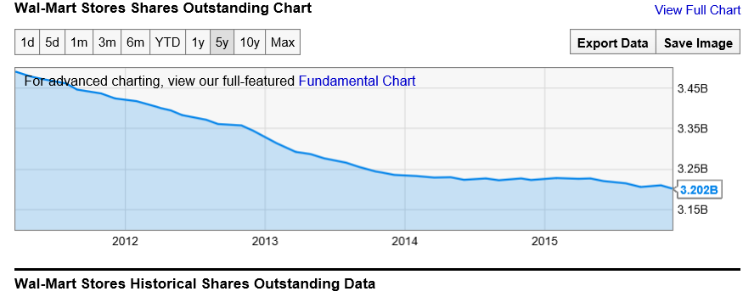
Wal-Mart Stores Shares Outstanding

Slide 31
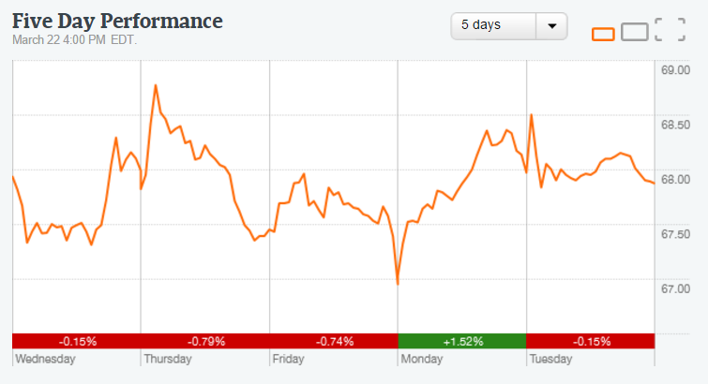
5 days Performance

Slide 32
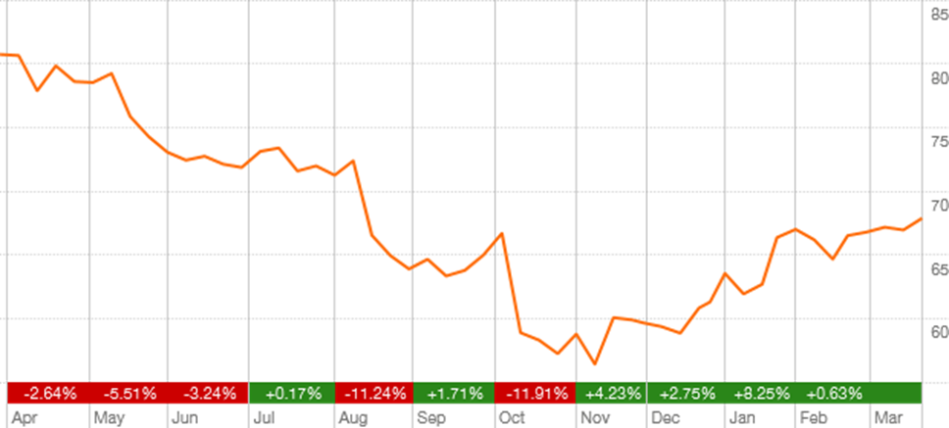
1 Year Performance

Slide 33
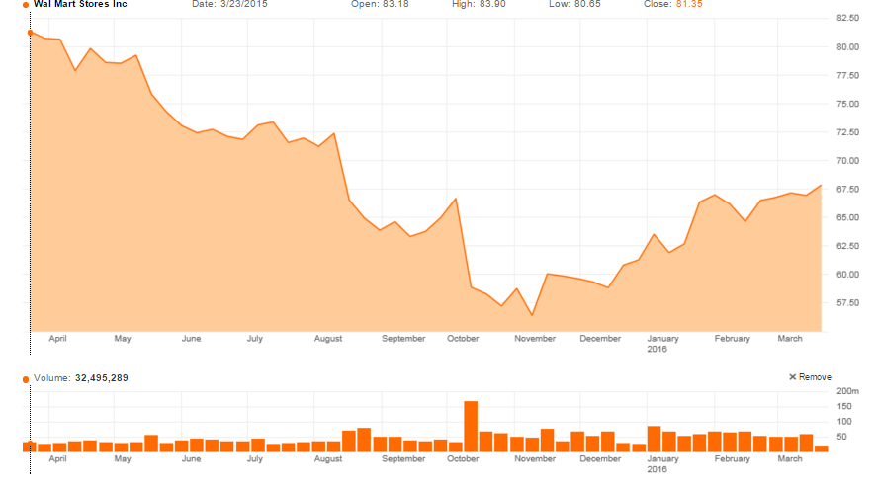
1 Year Trading Range

Slide 34
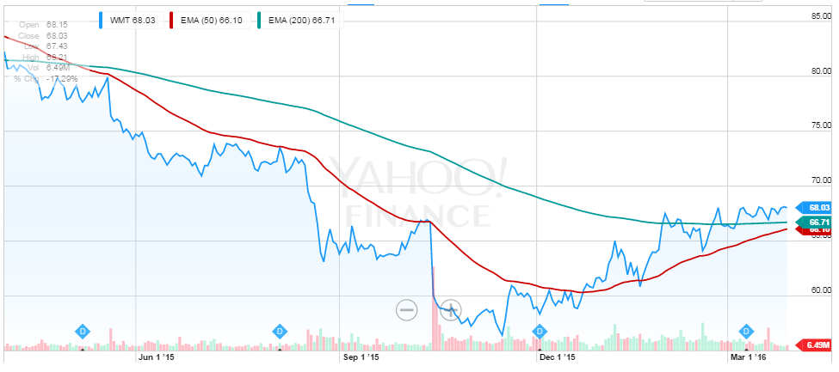
1 Year Exponential Moving Average (50 days & 200 days)

Slide 35
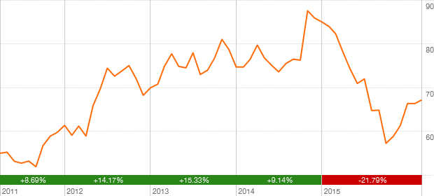
5 Year performance

Slide 36
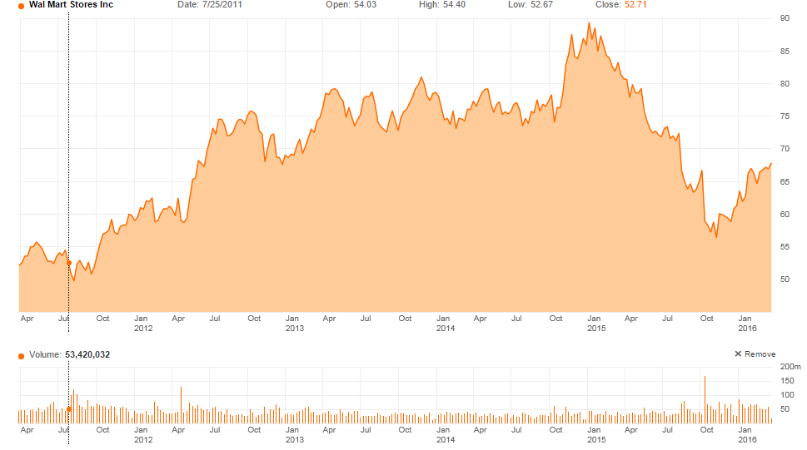
5 Year Trading Range

Slide 37
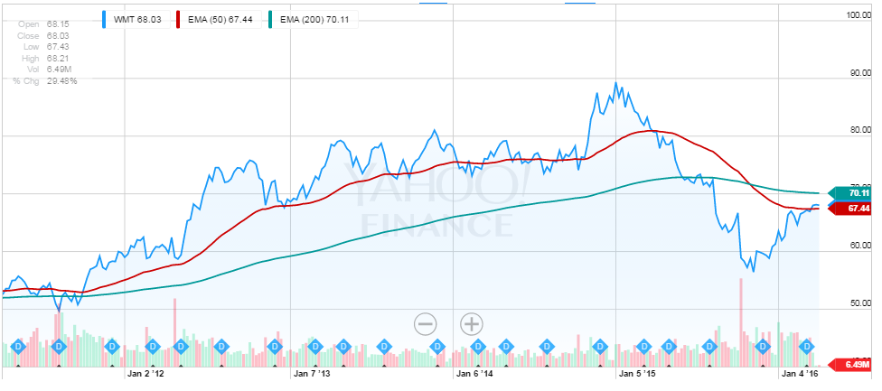
5 Year Exponential Moving Average (50 days & 200 days)

Slide 38
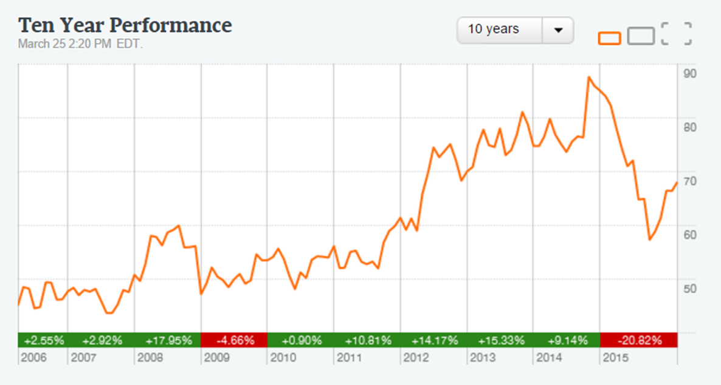
10 Year Performance

Slide 39
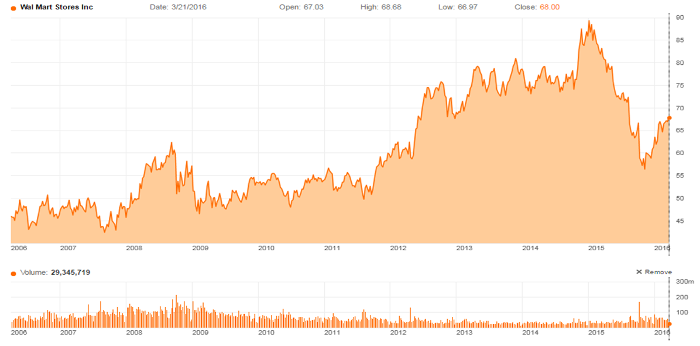
10 Year Trading Range

Slide 40
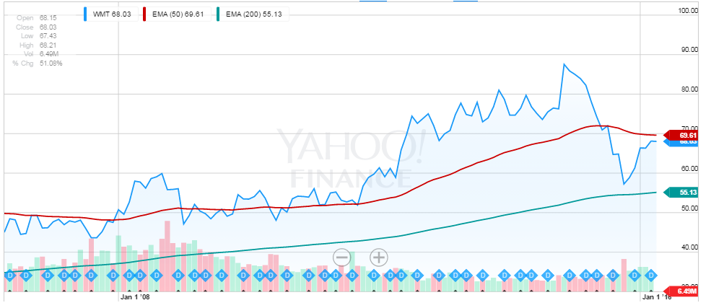
10 Year Exponential Moving Average (50 days & 200 days)

Slide 41
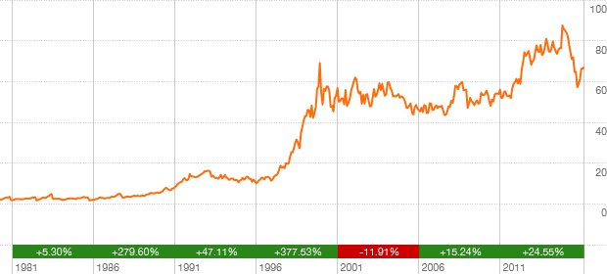
Max Timeframe Performance

Slide 42
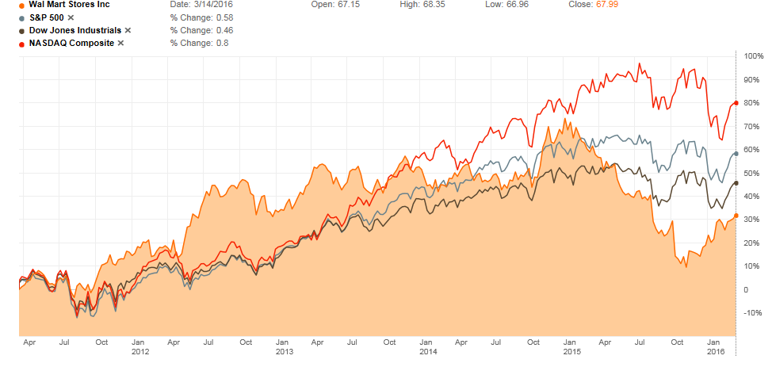
Walmart vs S&P 500, DJIA, NASDAQ

Slide 43
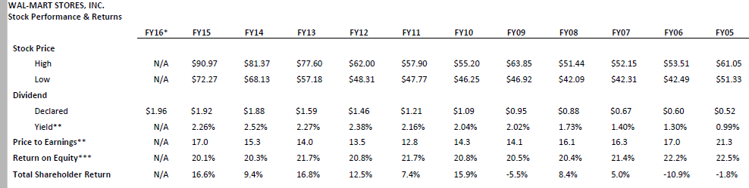
WMT Stock Performance & Return

Slide 44
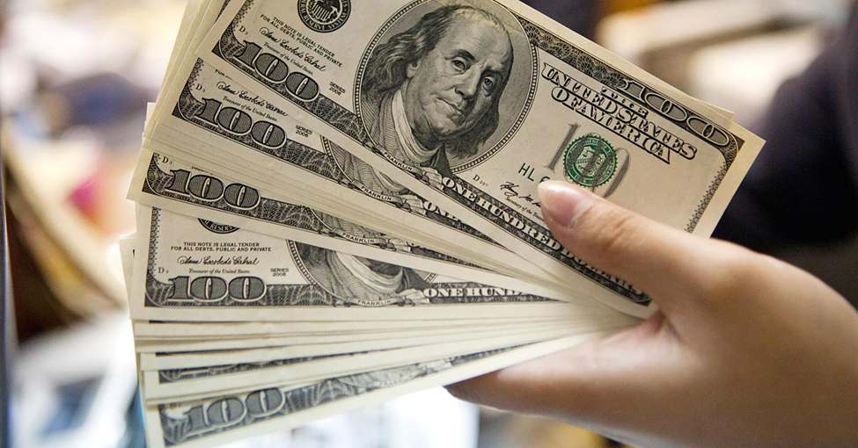
Dividends
Walmart total dividend payments were $6.2 billion , $6.1 billion and $5.4 billion for fiscal 2015 , 2014 and 2013 , respectively.
On February 19, 2015 , the Board of Directors approved the fiscal 2016 annual dividend of $ 1.96 per share, an increase compared to the fiscal 2015 annual dividend of $1.92 per share.

Slide 45
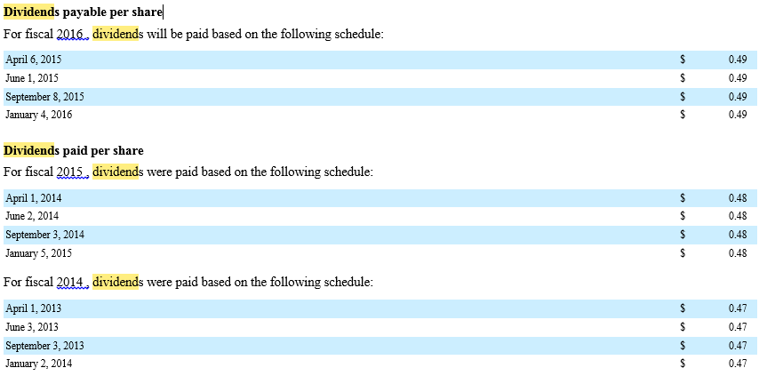
Dividend Schedule

Slide 46
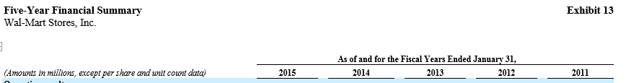
5 Year Dividends Declared Summary

Slide 47
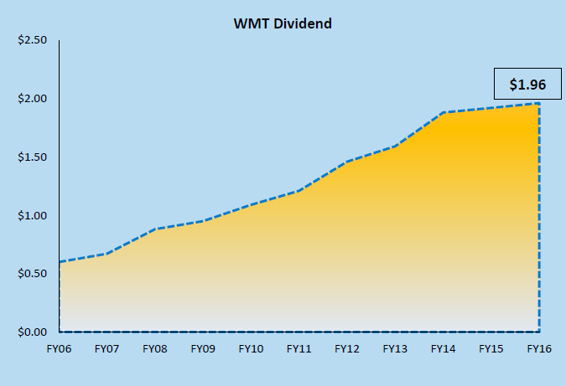
Dividend History

Slide 48
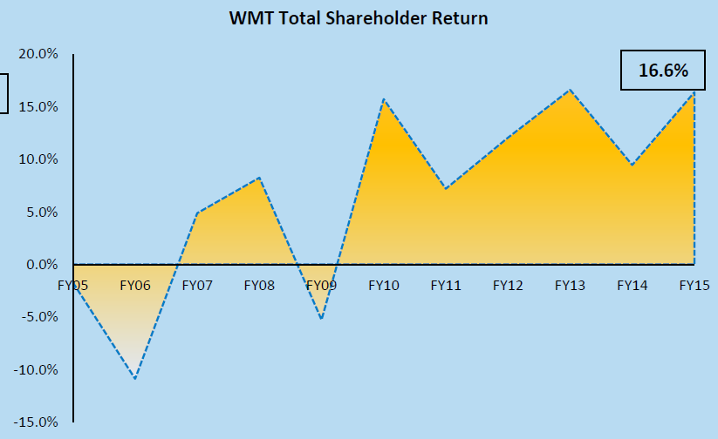
Total Shareholder Return

Slide 49

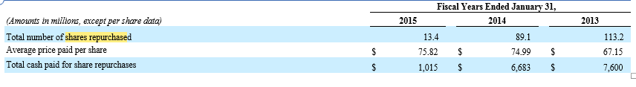
Shares Repurchase
The Company considers several factors in determining when to execute share repurchases, including, among other things, current cash needs, capacity for leverage, cost of borrowings, its results of operations and the market price of its common stock.

Slide 50
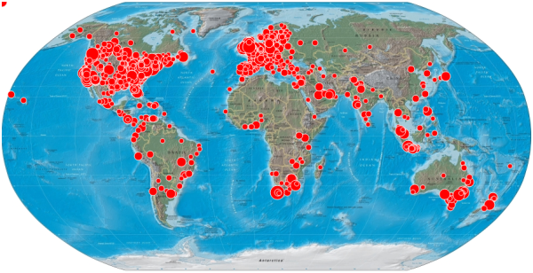
Walmart Stores Worldwide Map

Slide 51
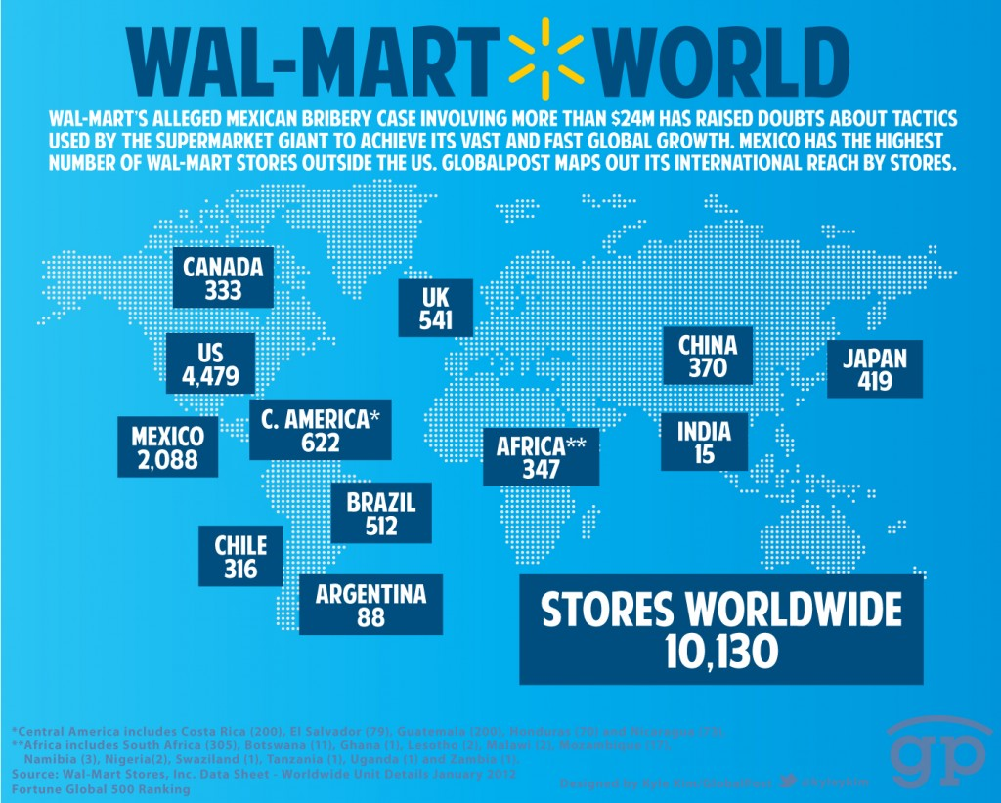
Walmart Stores Worldwide Map

Slide 52
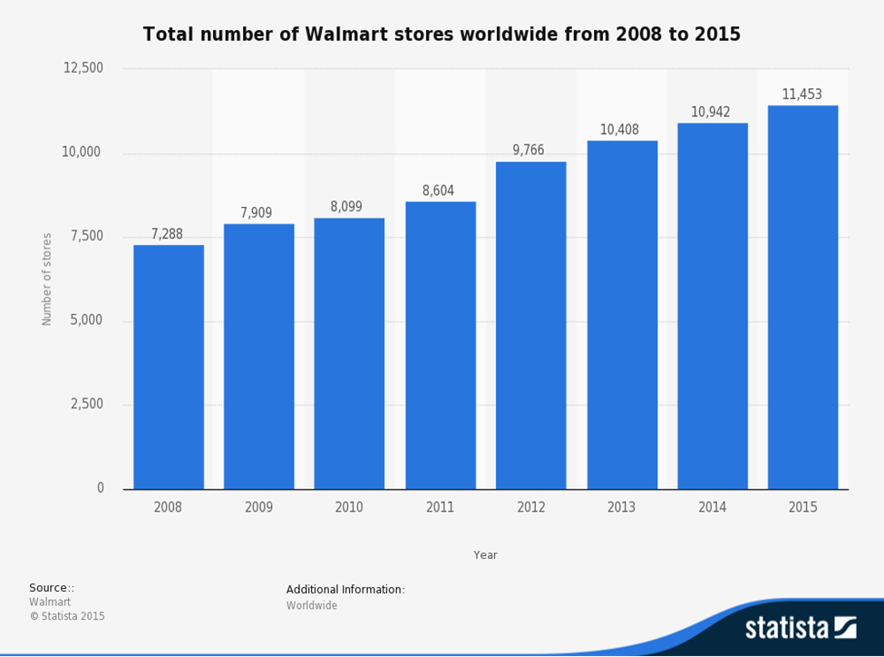
Walmart Store Count

Slide 53

Walmart History
1962: Sam Walton opened the first Walmart in Rogers, Arkansas
1970: Walmart went public, the first stock price $16.50/share
1972: Listed on NYSE, recorded sales of $78 million
1980: The fastest company reached $1 billion in annual sales
1983: The first Sam’s Club opened in Midwest City, Oklahoma
1988: The first Walmart Supercenter opened in Washington, Missouri
1990: Walmart was the nation's number-one retailer
1991: Walmart went global, opened a Sam’s Club in Mexico City
1994: Walmart expanded into Canada with the purchase of 122 Woolco stores

Slide 54

Walmart History
1996: Walmart opened its first stores in China
1998: The Neighborhood Market format was introduced with three stores in Arkansas
2000: Walmart.com was founded
2002: Walmart topped the Fortune 500 ranking of America's largest companies
2007: Walmart.com launched Site to Store service
2009: Walmart exceeded $400 billion in annual sales
2011: With the acquisition of MassMart in South Africa, Walmart surpassed 10,000 retail units around the world.
2014: Doug McMillon succeeded Mike Duke as CEO

Slide 55


Walmart Operating Division
1 Walmart U.S. :
Walmart U.S. is the company's largest division, It consists of three retail formats that have become commonplace in the United States: Discount Stores, Supercenters, Neighborhood Markets, and Walmart online site.
1) Walmart Discount Store
They carry general merchandise and a selection of groceries. Many of these stores also feature a garden center, pharmacy, tire & Lube Express, optical center, one-hour photo processing lab, portrait studio, a bank branch, a cell phone store and a fast food outlet.
2) Walmart Supercenter
Walmart Supercenters, branded as simply "Walmart", are hypermarkets. Carry everything a discount store does, as well as a full-line supermarket. Including garden centre, pet shop, pharmacy, Tire & Lube Express, optical centre, one-hour photo, fast food outlet, ect.
3) Walmart Neighborhood Market
Walmart Neighborhood Market is a chain of grocery stores, they are used to fill the gap between discount store and supercenters

Slide 56


Walmart Operating Division
4) Walmart online site
Walmart U.S. division also includes Walmart's online site, walmart.com which allows consumers to directly buy goods or services from Walmart over the Internet using a web browse.
2 Sam’s club
Sam's Club is a chain of warehouse clubs that sell groceries and general merchandise, often in bulk. Sam's Club stores are "membership" stores where most customers buy annual memberships.
3 Walmart International
As of January 31, 2016, Walmart's international operations comprised 6,306 stores and 800,000 workers in 26 countries outside the United States. There are wholly owned operations in Argentina, Brazil, Canada, and the UK.
.

Slide 57

Walmart Net Sales By Segment

Slide 58

Walmart Net Sales By Segment FY15

Slide 59

Walmart U.S. Merchandise Category - % of Net Sales

Slide 60

Employee
Walmart employs 2.2 million associates around the world -- 1.4 million in the U.S. alone at more than 5,000 stores and clubs nationwide.
Average Retail Sales Associates in the United States make around $9.79 per hour.
After wage increased in February 2016, the full-time hourly wage of Walmart becomes $13.38.
About 75% of the store management teams started as hourly associates, and they earn between $50,000 and $170,000 a year
Last year, Walmart promoted about 170,000 people to jobs with more responsibility and higher pay.

Slide 61


Employee

Slide 62

Unit Count and Square Footage

Slide 63

Square Footage & Employee Growth

Slide 64

Sales per square foot

Slide 65

Efficiency Ratios

Slide 66

Efficiency Ratios

Slide 67

Efficiency Ratios

Slide 68

Strategy
Wal-Mart Stores, Inc. Enterprise Strategy
Price, access, assortment & experience drive a customer’s choice of retailer.
Historically, Walmart led on price and assortment. Retail environments are more competitive today, especially with e-commerce.
To win, Walmart will lead on price, invest to differentiate on access, be competitive on assortment & deliver a great experience.

Slide 69

Strategy

Slide 70

Risk of Investing In Walmart Stock
1 Americans for Tax Fairness Study
A June 2015 report by the Americans for Tax Fairness indicated that Wal-Mart may be in violation of U.S. Securities and Exchange Commission (SEC) and Internal Revenue Service (IRS) rules for the use of tax havens.
2 Market Risks
One of the challenges of any business chain with locations in many different countries is the cost of regulatory compliance, which is different from region to region. business cycle risk, interest rate risk, exchange rate risk, and intense competition from companies such as Target and Amazon.
3 Minimum Wage Laws
Business costs have to be absorbed somewhere; Wal-Mart's profit margin is typically below 3% (2.89% in the third quarter of 2015). Labor costs are a significant part of this equation.
4 Lawsuits
Wal-Mart is always in litigation over some problem – it's one of the side effects of being in every market and selling just about every kind of product.

Slide 71

Recent Events
Walmart raises annual dividend to $2.00 per share, representing the 43rd consecutive year of dividend increases (February 18, 2016)
The Board of Directors of Wal-Mart Stores, Inc. (NYSE: WMT) approved an annual cash dividend for fiscal year 2017 of $2.00 per share, an increase of two percent from the $1.96 per share paid for the last fiscal year. The fiscal year 2017 annual dividend of $2.00 per share will be paid in four quarterly installments of $0.50 per share.
More Than One Million Walmart Associates to Receive Pay Increase in 2016 (Jan. 20, 2016)
2016 action lifts average hourly full-time rate to $13.38; New paid time off plan gives full- and part-time associates greater control. More than 1.2 million Walmart U.S. and Sam’s Club associates will receive a pay increase under the second phase of the company’s two-year, $2.7 billion investment in workers. Walmart is also implementing new short-term disability and simplified paid time off (PTO) programs. The combined changes will expand support for associates dealing with extended health issues and provide associates greater control over their paid time away from work.

Slide 72


Recent Events
Mystery surrounds Wal-Mart's bizarre cover story of closing five stores for six months due to "plumbing problems (April 15, 2015)
Wal-Mart has suddenly announced it is shuttering five stores from Florida to California for a six-month period due to what the company claims are "plumbing problems." Nobody except the ultra-gullible really believes the Wal-Mart cover story, however. "The retail chain announced Monday that five stores are shutting down - one in Brandon, two in Texas, one in Oklahoma and one in California - due to clogging and drainage problems,"

Slide 73


Slide 74

Key Management Compensation

Slide 75

Key Management Compensation

Slide 76

Gregory B. Penner, Chairman Walmart Board of Directors
Since 2008: joined the board, elected as chairman Walmart Board of Directors in 2015, following his father-in-law. Founder and general partner of Madrone Capital Partners.
Over 20-year period: worked with Walmart in many capacities, including senior vice president and chief financial officer (Japan), senior vice president of finance and strategy (walmart.com).
Previously: worked as a financial analyst at Goldman, Sachs & Co., Inc., and as a general partner of Peninsula Capital.
2007-2014: The board of directors of Hyatt Hotels Corporation and the board of director of Baidu, Inc., since 2004.
Education: MBA from the Stanford Graduate School of Business in 1997 B.S. in International Economics from Georgetown University in 1992

Slide 77

James I. Cash, Jr. Lead Independent Director
2009 - current: provides management development and consulting services through The Cash Catalyst, LLC
2006-- current: Lead Independent Director of Walmart
2003 – 2009: the director of Phase Forward Incorporation
2001 -- 2009: the director of Microsoft Corporation
1997--current: the director of General Electric Company
1996-current: the director of Chubb Limited (formerly The Chubb Corporation)
1976 -- 2003: the senior associate dean and chairman of Harvard Business School, the chairman of the MBA Program

Slide 78

Doug McMillon, President and CEO
2009-current: the board of director, the chair of the Executive and Global Compensation committees (Walmart), and the president and chief executive officer
the Consumer Goods Forum, the U.S.-China Business Council and Crystal Bridges Museum of American Art, the advisory board of the Tsinghua University School of Economics and Management in Beijing, China; the executive committee of Business Roundtable; and the Dean’s Advisory Board for the Walton College of Business at the University of Arkansas
2009-2014: president and chief executive officer of Walmart International
2006 -- 2009: president and chief executive officer of Sam’s Club
1990: an assistant manager, then moved to merchandising as a buyer trainee, then senior leadership roles, then a merchant at heart.
1984: an hourly summer associate in a Walmart distribution center
Education: MBA in finance from the University of Tulsa; bachelor of science in business administration from the University of Arkansas,

Slide 79

Greg Foran, President and CEO
Currently: president and CEO of Walmart U.S., recently served as president and CEO of Walmart Asia. Previously, served as president and CEO of Walmart China
2011: senior vice president of Walmart International
Prior to Walmart: the managing director of supermarkets in Woolworths
Earlier in his career: general manager of Big W, Woolworths’ industry leading discount store business and as general manager of Dick Smith Electronics
Education: 2 advanced management programs at Harvard University and the University of Virginia
Diploma in management from the New Zealand Institute of Management in Auckland

Slide 80

David Cheesewright, President and CEO
Current: president and chief executive officer of Walmart International
--the board of director of Walmex and Queens Business School, Ontario, Canada, --Previously, was chairman of the board of Gazeley Holdings and of Walmart Canada Bank
2011-before current role: president and CEO for Walmart’s EMEA (Europe, the Middle East and Africa) and Canada region
2008: president and CEO of Walmart Canada
2004-2005: chief operating officer of Walmart Canada, following a term as chief operating officer of Asda in the U.K.
1999: leadership positions in operations, merchandising, logistics, strategy and format development of Asda
Prior to 1999: held a range of key positions with Mars Confectionary in the U.K. in sales, marketing, supply chain and manufacturing
Education: holds a first-class honors degree in sports science and mathematics from Loughborough University, U.K.

Slide 81

Claire Babineaux-Fontenot, Executive Vice President and Treasurer
Current: Executive Vice President and Treasurer for Wal-Mart Stores, Inc., and chief tax officer for investor relations, capital markets and treasury operations
2007: senior vice president and chief tax officer of Walmart
2004: vice president of audits and tax policy of Walmart
Prior to Walmart: partner at the law firm of Adams & Reese, and partner-in-charge of the Baton Rouge office
Previously: dispute resolution practice group leader for PricewaterhouseCoopers,
Beginning of career: tax attorney for the Louisiana Department of Revenue, then assistant secretary of the office of legal affairs, then administrative law judge for the Louisiana Department of Civil Service
Education: master of laws degree in taxation from Southern Methodist University’s Dedman School of Law in Dallas, law degree from Southern University Law Center in Baton Rouge, graduate of the University of Louisiana at Lafayette

Slide 82

Andy Barron,Executive Vice President, Softlines and General Merchandise
Current: executive vice president of the softlines and general merchandise divisions for Walmart U.S.
Joined Walmart in 1993: served in many merchandising roles, including menswear and intimate apparel, automotive, toys, home entertainment and hardlines
2004: senior vice president and general merchandise manager, and later became senior vice president and general manager of hardlines merchandising
2009: named senior vice president over merchandise execution, reporting to both the chief marketing officer and chief operating officer in Walmart U.S.
--received the General Merchandise Manager of the Year Award and was the recipient of the Students in Free Enterprise (SIFE) Good Fellow Award
Prior to Walmart career: worked in various management roles at Joske’s department stores and County Seat stores.
Education: bachelor’s degree from Texas Tech University

Slide 83

Dan Bartlett, Executive Vice President, Corporate Affairs
Current: executive vice president of corporate affairs for Walmart
Before joining Walmart: was president and CEO of the U.S. division of Hill+Knowlton Strategies, a strategic advisor to business leaders
Prior to Hill+Knowlton Strategies: president and CEO of Public Strategies, Inc
2007: counselor to President George W. Bush, responsible for all aspects of communications for the president and his administration
Other Positions: the advisory board of UT Austin’s College of Communication, an adjunct faculty member at the University of Texas LBJ School of Public Affairs and a fellow of the school’s Center for Politics and Governance
Education: graduate of the University of Texas at Austin

Slide 84

Michael J. Bender, Chief Operating Officer, Global ECommerce
Current: chief operating officer of Global eCommerce for Wal-Mart Stores, Inc.,
Previously: serving as senior vice president of the mountain division, then promoted to executive vice president and president of the Walmart West business unit of Walmart U.S.,
2009: joined Walmart as vice president and regional general manager for the West division
2003-2007: president/general manager of the retail and alternate care business of Cardinal Health, Inc.,
Prior to Cardinal Health: vice president of store operations for Victoria’s Secret Stores in Columbus, Ohio
Earlier in his career: 14 years at Pepsi-Cola North America and held several executive-level positions in strategic planning, finance, operations, sales and marketing. Also the board of director for Ryman Hospitality Properties and is chairman of the board’s audit committee
Education: 1988 master’s of management in finance, marketing and management policy from the J.L. Kellogg Graduate School of Management at Northwestern University , 1984 bachelor’s degree in economics from Stanford University

Slide 85

Brett Biggs, Executive Vice President and Chief Financial Officer
Current: executive vice president and chief financial officer for Walmart
Before current role: executive vice president and chief financial officer for Walmart U.S., ,then became executive vice president and chief financial officer for Walmart International
Joined Walmart in 2000: senior vice president, International Strategy and Mergers & Acquisitions of Walmart, then promoted to chief financial officer, Sam’s Club, then senior vice president of operations for Sam’s Club
Before Walmart: held various M&A and corporate finance positions with Leggett & Platt, Phillips Petroleum Co. and Price Waterhouse
Civic functions involvement: the Board of Director for MANA, and serves on the Cancer Challenge Board and is the former Board of the First Tee of Northwest Arkansas
Education: MBA with Honors from Oklahoma State University, Summa Cum Laude from Harding University with a bachelor’s degree in accounting, serves in various advisory roles at Harding University

Slide 86

Financial

Slide 87

Walmart Financial Summary 2006-2015 Key Ratios

Slide 88


Financial Overview

Slide 89

Financial Overview

Slide 90

Financial Overview

Slide 91

Consolidated Balance Sheets 2016 Q4 (Asset)

Slide 92


Consolidated Balance Sheets 2016 Q4 (Liabilities &Equity)

Slide 93

Consolidated Balance Sheet 2015-2014 10K (Asset)

Slide 94

Consolidated Balance Sheet 2015-2014 10K (Liabilities &Equity)

Slide 95

Consolidated Statements of Income 2015-2013 10K

Slide 96

Consolidated Statements of Income 2015-2013 10K (continued)

Slide 97

Consolidated Statements of Income 2016 Q4

Slide 98


Consolidated Statements of Income 2016 Q4 (continued)

Slide 99

Consolidated statements of Cash flows 2015-2013 10K (Operating)

Slide 100


Consolidated statements of Cash flows 2015-2013 10K (Financing)

Slide 101


Consolidated statements of Cash flows 2015-2013 10K (Investing)

Slide 102

Free Cash Flow Summary 2015-2013 10K

Slide 103

Consolidated statements of Cash flows 2016 Q4 (Operating)

Slide 104


Consolidated statements of Cash flows 2016 Q4 (Investing)

Slide 105


Consolidated statements of Cash flows 2016 Q4 (Financing)

Slide 106

Consolidated Statement of Shareholders' Equity and Redeemable Non-controlling Interest 2015 10K

Slide 107


Consolidated Statement of Shareholders' Equity and Redeemable Non-controlling Interest 2015 10K (continued)

Slide 108


Consolidated Statement of Shareholders' Equity and Redeemable Non-controlling Interest 2015 10K (continued)

Slide 109

Recommendation

Slide 110
U.S. Retail_ Costco

Slide 111
Corporate Overview
NYSE Symbol: COST
Part of NASDAQ Industrial
GICS Sector: Consumer Staples
Market Cap: 66.83 Billion
Shares Outstanding: 1,643,242

Slide 112

Stock Price
Notes:
Market capital: 66.83 billion. Number of shares outstanding:1,643,242. P/E=28.51 which is high, dividend yield is 1.04%.

Slide 113

5 Days Stock Performance

Slide 114

5 Days Trading Range

Slide 115

1 Year Stock Performance

Slide 116

1 year stock performance
Notes:
From March to September, Costco underperformed all three major indexes. However, Costco’s stock price increased and outperformed Dow, Nasdap and S&P 500 from October 2015 until now.

Slide 117

1 Year Trading Range
167
138
Notes:
1 year Costco’s stock price varies from 132 to 169 dollars.

Slide 118

5 Year Stock Performance
Notes:
1 year Costco’s stock price varies from 71 to 169 dollars. Its stock piece has a overall increasing trend.

Slide 119

5 Year Stock Performance
Notes:
From 5 year horizon, Costco has outperformed all three major indexes

Slide 120

5 Year Trading Range
70

Slide 121

10 Year Stock Performance
Notes:
Stock price ranges from 40 to 170, having an overall increasing trend since 2009 April.

Slide 122

10 Year Trading Range
40

Slide 123

MAX Timeframe Performance
162.5
12
0

Slide 124
Dividend/$ First dividend of $0.1 on April 28th, 2004 Has increased its dividend payment every year.In 2013 and 2015, the company paid a special cash dividend respectively. Until February this year, Costco has paid $0.8 dividend.
Notes:
First dividend of $0.1 on April 28th 2004.
Dividends paid have an overall increasing trend since 2011. In 2013, Costco had significant increase in dividend payout, and in 2014 it dropped. But in 2015 the dividend payout recovered to $6.51. Until February this year, Costco has paid $0.8 dividend.

Slide 125

Key Stats
☹Invent. Turnover(TTM) 11.67 – lower than average
Liquidity
- Current ratio(MRQ) 1.01
- Quick ratio(MRQ) .43
- ☺Cash conversion cycle
Profitability
☹ Gross Margin(TTM) 13.13%
- ☹ Operating Margin(TTM) 3.07%
- ☺ROE 21.78%
Notes:
Costco has lower than average inventory turnover, which shows it has not strong enough sales.
Costco has lower gross margin and operating margin than industry average.
But Costco has higher ROE.
Cash Conversion Cycle: has been stable around 2.6 since 2013, but fluctuates between quarters: every quarter that end February has high CCC.
The lower CCC, the better. Costco has a low CCC which is much lower than walmart.

Slide 126
History of Company
1976 - Sol & Robert Price opened Price Club on July 12, the first warehouse club for business shoppers only. The warehouse was located in San Diego, California.
1983 - The first Costco warehouse opens in September in Seattle, Washington.
1985 - Costco offers public stock on December 5th. Costco opens it's first Canadian warehouse in Burnaby, British Columbia.
1993 -Shareholders approve the merger of Price Company and Costco. PriceCostco is formed and opens its first warehouse in the United Kingdom in West Thurrock, Essex, England.
1995 - Kirkland Signature, Costco's exclusive private label, is introduced.

Slide 127
History of Company
1997 - The company officially changes it's name from PriceCostco to Costco Companies, Inc. Executive Membership is introduced.
1998 - E-Commerce at Costco.com brings Costco prices and services to the internet.
1999 - The Costco American Express co-branded membership credit card is introduced. The Company changes it's name to Costco Wholesale Corporation on August 30th.
2004 - Fortune Magazine lists Costco 29th on the Fortune 500.
2006 - Costco was named one of the "most admired" companies by Fortune magazine.
2014 - Costco is listed 19th on the Fortune 500.
2015- Costco is the 2nd largest Global retailer.

Slide 128
Recent events (2015)
03/02/15--Costco entered into a new co-brand credit card program agreement with Citi Group and an acceptance and co-brand incentive agreement with Visa. Citi would become the exclusive issuer of Costco's co-brand credit cards and Visa will replace American Express as the credit card network for Costco in the US and Puerto Rico beginning April 1, 2016. Once issued, Costco's co-brand Visa credit card would serve as the Costco membership card, and would be accepted at Costco locations and all merchants that accept Visa credit cards.
04/17/15 -- Costco Wholesale Corporation today announced that its Board of Directors has reauthorized a common stock repurchase program of up to $4 billion. This program will expire in April 2019 and replaces the current $4 billion program (expiring this month), which has unused authorization of approximately $2.5 billion.

Slide 129
Recent events (2016)
Costco prepares for Apex opening on March 16 in US
Northeast Houston store in US will open on March 18th
2016/03/21--The Mooresville Board of Commissioners rejected plans for a Costco-anchored retail center off Interstate 77, Exit 35, saying the project doesn’t fit primarily residential Talbert Road.

Slide 130
Stock Repurchase
07/18/06 Announces Plan to Purchase Up to an Additional $2 Billion of Costco Common Stock
07/23/08 Announces an Additional $1 Billion Stock Repurchase Authorization
04/26/11 Announces Expansion of Its Stock Repurchase Program
04/17/15 Announces Reauthorization of Its Stock Repurchase Program

Slide 131
Number of Shares Outstanding (2006 - 2015)
RSU is Restricted stock units (RSUs) granted to employees from Stock-based compensation.

Slide 132
Stock Compensation for Executives
James D. Sinegal: president and CEO (retired from management from 2012)
W. Craig Jelinek: President, CEO and Director
Richard A. Galanti: Executive Vice President, CFO and Director
Jeffrey H. Brotman: Chairman of the Board
Joseph P. Portera: Executive Vice President, COO – Eastern & Canadian Divisions and Chief Diversity Officer
Dennis R. Zook: Executive Vice President, COO – Southwest Division &Mexico

Slide 133
Codes of Ethics
1. Obey the law.
2. Take care of our members.
3. Take care of our employees.
4. Respect our suppliers.
If we do these four things throughout our organization, then we will achieve our ultimate goal, which is to:
5. Reward our shareholders.

Slide 134
Employees
From 2013 to 2015, the number of the company’s employees has kept increasing.
Higher average wage for full-time workers
Costco's generous pay won the company effusive praise from President Obama in his 2014 State of the Union address.
Average pay in 2016:
Costco = $20/hour before overtime and benefits & It raised minimum wage by $1.5/hour
Walmart = $13.38/hour after recent wage increase
Higher wage leads to more employee satisfaction and better performance
Glassdoor.com: allows workers to rate their employers
- Costco: 3.9 out of five stars Wal-Mart 3.1 out of five stars
Costco executives believe that keeping employees happy is worth the cost, as it leads to lower turnover, higher productivity, and better customer service.

Slide 135
News: Even Costco Has Union Problems! Mar 19, 2016
The Teamsters union, which represents about 16,000 Costco employees, recently recommended that its members reject Costco's "last, best and final" contract offer. (Most of Costco's 200,000-plus employees are not unionized.)
Today, the bulk of the union's members work at Costco locations in California. These workers have a union-administered defined benefit pension plan, and they want the company to make a higher contribution to the plan.
Meanwhile, the 3,500 East Coast union members currently have a 401(k) defined contribution plan. However, the Teamsters want Costco to allow the East Coast union members to join the California workers' defined benefit plan.
There's a reason why employers have shifted en masse over the past few decades from offering defined benefit plans to relying on 401(k) plans. Defined benefit plans give employees more security in retirement, but are very risky for the companies that sponsor them. If investment results are worse than expected, or retirees live longer than expected, a defined benefit plan sponsor can find itself on the hook for billions of dollars of unplanned contributions
Members will vote on the contract later this month. The contract will be approved if a majority of votes are cast in favor of it. But if a majority vote against the contract the union will seek to reopen negotiations.
It is possible there could be a strike if the company refuses to renegotiate but it ‘s unlikely, since there had not been a strike since the Teamsters started representing Costco workers in the 1970s.
Notes:
[The news: Costco’s union recommended Costco changes the defined contribution plan(401(k)) to defined benefit plan for the east cost union members. Defined benefit plan is currently offered to California workers. However, giving more defined benefit plan brings the company more risks.]
Comment: Costco’s markets are heavily relied on US market, and despite California contributed to 1/3 of US net sales in 2015, Costco has to find a solution to satisfy needs of employees in other districts. Otherwise, the problem may affect Costco’s operations and stock performance.

Slide 136
Strategies Overview
Low Cost And High Quality Strategy
Brand And Private Label Strategy
Expansion Strategy
Multi-channel Strategy
Notes:
Costco has 4 major strategies. READ

Slide 137
Low Cost Differentiation Strategy

Slide 138
Mission statement: To continually provide our members with quality goods and services at the lowest possible prices.
Products
Food: low price from Kirkland in general, while also build high quality image by providing some goods with matching price.
Non-food products: target at higher-end customers
e.g. formal dressing in apparel and co-brand in alcohol and drinks

Slide 139
Ancillary businesses
Costco’s ancillary businesses contributed to 16% sales in 2015.
There are 5 sections of ancillary business:
Gasoline Stations
Pharmacies
Optical And Hearing Aid Centers
Food Courts
Travel
Sales increased in all of sections of ancillary business, excepts gasoline business, where the average sales price per gallon was lower by 22% year-over-year.
Profits in these ancillary businesses were also up.
Gasoline: To attract more memberships, Costco continued to expand gasoline operations globally, with almost all new U.S. and Canadian warehouses opening with gasoline stations; and other international locations adding stations where regulations allow and space permits. As of calendar 2015 year-end, 490 gasoline stations were in operation. Gasoline business generally has a significantly lower gross margin percentage relative to non-gasoline business and is very sensitive to gas price change. When gas price goes down, the profit margin narrows.
Notes:
Costco’s ancillary businesses contributed to 16% sales in 2015.
Sales increased in all of sections of ancillary business, excepts gasoline business, where the average sales price per gallon was lower by 22% year-over-year.
Profits in these ancillary businesses were also up.
Gasoline: To attract more memberships, Costco continued to expand gasoline operations globally, with almost all new U.S. and Canadian warehouses opening with gasoline stations; and other international locations adding stations where regulations allow and space permits. As of calendar 2015 year-end, 490 gasoline stations were in operation. Gasoline business generally has a significantly lower gross margin percentage relative to non-gasoline business and is very sensitive to gas price change. When gas price goes down, the profit margin narrows.

Slide 140
Private Label Strategy

Slide 141

Kirkland Signature - high quality with lower price
Costco has a private label- Kirkland signature. Kirkland’s products are Costco's signature products that offer high quality with generally 10% - 15% lower price than other brands.
Costco continuously adds new products to the brand line. Costco offers more items under the private label in US than in international market.
These products occupy 20% of products in Costco’s warehouses. It contributes to 25% global sales.
The Kirkland Signature name is used across a wide range of product areas, which enables the company to build strong consumer awareness of the name and make it a main reason to visit its outlets, by being perceived as a label offering an assurance of quality.
Notes:
Costco has a private label- Kirkland signature. READ

Slide 142
Why Costco invests in its own line of private label products?
Jim Sinegal, Costco president and CEO. With Kirkland Signature, Costco can:
Develop popular items with wide appeal to expand sales volume
Control the quality of the product
Drive down prices on national brands
Control the packaging
Achieve pallet efficiencies
To obtain “pallet efficiencies” by shipping more product in the same amount of space. Most shipping costs are driven by volume of shipments so any dead air in the shipments (via truck/rail/etc.) is wasted. Costco realized this and changed the shape of their packaging from round to square to turn the dead freight into a cost savings.

Slide 143
Costco expanded Kirkland Signature product offering
In 2015, Costco expanded Kirkland Signature product offering:
Food: organic 2% milk, organic liquid eggs, organic coconut water, artisan breads, and light beer. Sales of all organic products at Costco continued to grow, topping $4 billion in 2015.
Non-food: new apparel and cookware

Slide 144
Membership Strategy
Notes:
Costco’s membership revenue is a important component of its operating income.

Slide 145



Membership Policy
Costco’s membership revenue is a important component of its operating income.
There are two types of membership cards available to individuals and businesses respectively: gold star membership and business membership. Either of the membership can be upgraded to executive membership by paying $55 upgrade fees. Executive membership is advised for annual spending higher than $2,750 in Costco.
Notes:
There are two types of membership cards available to individuals and businesses respectively: gold star membership and business membership. Either of the membership can be upgraded to executive membership by paying $55 upgrade fees. Executive membership is advised for annual spending higher than $2,750 in Costco.

Slide 146
Membership
Membership Data (as of 8/30/15):
Total: 81.3 million cardholders
44.6 million households card holders
Paid memberships
34.0 million Gold Star
7.1 million Business
3.5 million Business add on
Around 23.77% of paid membership cardholders of Costco are business holders and business add - ons. Costco takes steps to target small business customers through the trial of opening Business center, which provides “earlier hours, larger merchandise portions, next-day delivery and copying/printing services.”

Slide 147
2015 Membership Facts
Had more than 81 million cardholders worldwide
Membership base grew by more than six percent
Member loyalty in 2015:
91% of members in the U.S. and Canada and 88% worldwide renewed their memberships
Shopping frequency increased 4 percent
Executive Members, an increasing percentage of total membership base, now represent over 1/3of members and nearly 2/3 of sales

Slide 148
Expansion Strategy

Slide 149
Domestic market - Competition
US sales contributes to 50% to 70% of total sales.
Costco consistently outperformed Wal-Mart’s Sam’s Club chain in the US over 2010-2015, which helped Costco’s share in warehouse clubs to reach 55% in 2015, up from 51% in 2010.
Costco thrived due to internal and external factors:
- Costco has high member renewal rates, steady expansion of its store network, competitive pricing and its Kirkland Signature brand. Moreover, Costco targets more affluent customers than Sam’s Club, Costco sees 41% of domestic stores in the top 10 wealthiest states in terms of median household income in 2014 according to The Motley Fool.
- Sam’s Club continues to suffer competition from its parent company’s Wal-Mart stores, as the price gap between the two chains narrows in favour of Wal-Mart. Therefore, Sam’s Club’s appeal has become more centred around bulk buyers, by targeting small business owners rather than private consumers, which has reduced its appeal among the latter group.

Slide 150
Domestic - Expansion moves away from West Coast
The Costco chain is relatively over-represented on the Pacific Coast, particularly in California, which had 25% of all its US outlets and generated 31% of sales in 2015.
In financial year 2015, the company added outlets throughout the US, but largely away from the coasts, where most of its outlets are currently concentrated. These states include Indiana, Colorado, Michigan, Kansas, Alabama and Ohio, which saw two new outlets in the financial year. New York state also saw the development of two outlets. The company expects to open 19 locations across the US in financial year 2016. By the end of financial year 2016 Q1, nine locations had already been added.

Slide 151

International market
Number of ware houses by FY 2016 Q2: 698, with 210 in 8 international market.
Competitor: Sam’s club
Costco’s global reach is stronger than for Wal-Mart’s Sam’s Club chain, which operates in only four markets (Brazil, China, Mexico and the US).
However, Sam’s Club’s current operations in two large emerging markets, Brazil and China, and Wal-Mart’s presence in warehouse clubs in several markets in Africa, under the aegis of its South African division Massmart, bring expansion potential.

Slide 152
North America Asia Pacific
Sales in North America accounted for89% of Costco's global retailing sales in 2015, down from 93% in 2009. The majority of the company’s non-domestic sales are generated by the Canadian market, which accounted for 10% of its global sales in US dollar terms in 2015, lower than the 13% seen in 2010. Canada’s share of total sales fell in 2015 largely as a result of currency fluctuations.
Canada’s revenue success: differentiates itself from retailers that target low-income consumers
Asia Pacific is the second contributor of sales growth after US domestic market.
- Korea: maintains dominance over domestic rivals- Shinsegae and Lotte
- China: enter T-mall in 2014
- Japan: added 3 new outlets in FY2015.
- Taiwan: added 1 new outlet in FY2015.
Costco's international presence remains geared towards Asia Pacific, which accounted for 9% of total retail sales in 2015, up from 6% in 2009.
However, Costco continues to derive 77% of its Asia Pacific sales from Japan and South Korea, both of which saw total retailing value sales growth in local currency terms of less than 2% in 2015.

Slide 153
Other markets
Australia: Costco recovers from sales cannibalization in 2014 to see revenue had grown by 50%
UK: strong sales growth in 2015 of 5% in local currency terms. Obtaining permission from planning departments remains a major obstacle for its expansion.
Mexico: Costco’s only market in Latin America and its performance was relatively modest.
Spain: Costco entered market in May 2014, with a new warehouse in Seville, and opened a new outlet in October 2015 near Madrid; Costco plans to open an additional outlet in FY2016.

Slide 154
Sales through Expansion
Since 2006, Costco has kept opening new warehouses. Sales per ware house has an overall increasing trend from expansion of warehouses.
Costco current plan is to open up to 32 new warehouses in 2016: 22 in the U.S., three in Canada, two each in Japan and Australia, and one each in the U.K., Taiwan, and Spain. By December 17, 2015, twelve new Costco warehouses have already been opened.

Slide 155
Comparable Warehouse Sales by Aug. 2015
In fiscal year 2015, warehouse sales in US increased at a lower rate, while other international warehouses sales dropped. The overall decrease of sales in 2015 is caused by changes in foreign currency and gasoline prices. High US dollar value and low gasoline price declined its sales.
Financial statements translate the results of operations of international operations from local currencies into U.S. dollars using exchange rates for the current period. Fluctuations in currency exchange rates over time may adversely affect the financial performance of International operating segments. As Costco continue to expand international operations, its exposure to fluctuations in foreign exchange rates may increase. Costco manages these fluctuations, in part, by using forward foreign-exchange contracts.
Low gasoline price decreased the revenue, since Costco offers discounted gasoline in its store.
On the other hand, Costco is exposed to fluctuations in prices of energy that stores consume, including gas. So Costco partially mitigate commodity price risks through fixed-price contracts for certain of warehouses and facilities, predominately in the U.S. and Canada.

Slide 156
Comparable Warehouse Operating Income
 | 2013 | 2014 | 2015 | 2016.2 | 2016 estimated(2016.2*2)
US | 1,810 | 1,880(+3.867%) | 2,308(+22.766%) | 1,003 | 2,006(-)
Canada | 756 | 796(+5.291%) | 771(-3.141%) | 339 | 678(-)
Other International | 487 | 544(+11.704%) | 545(+0.184%) | 281 | 562(+)
Total | 3,053 | 3,220(+5.47%) | 3,624(+12.547%) | 1,623 | 3,246(-)
US and Canada remain to be the major contributors to the company’s operating income. From the segment market performance from 2013 to 2016, Canada has a decrease of operating income in 2015, and this trend may last 2016 based on its performance until February. The performance of other international market is flat in 2015. If the US and Canadian markets cannot perform better in the following months this year, they may become contributors of an overall decrease of operating income this year.

Slide 157
Expansion Drives Square Footage sales growth
International markets hold a strong potential for square footage growth since warehouse clubs penetration is lower in these markets compared to the U.S. Costco Wholesale’s net warehouse count increased by 27 in fiscal 2Q16 to 698, compared to 2Q15. Its gross square footage rose to 100.7 million square feet in 2Q16, up 4.5% compared to 96.4 million in fiscal 2Q15.
In 2015, Costco has highest square footage sales among club and department store retailers selling food.
In US: $1,032/ sq.ft
In Canada: $1,490/sq.ft

Slide 158
Laws and regulations
Costco competes with other retailers and businesses for suitable locations. The following factors restrict the construction and operation of warehouses.
Local land use and other regulations
local laws
Environmental regulations
local community actions

Slide 159
As an international operator, Costco has to obey various laws and regulations from different countries.
Currency regulations
Foreign trade policies laws and regulations of governments, agencies and organizations
Monetary and fiscal policies
Accounting rules
Intellectual property rights
Tax provisions
Environmental laws and regulations on material disposal

Slide 160
Example: France market 2016 may see the first Costco in France
Warehouse clubs currently are not present in the French market due to the dominance of hypermarkets, which carry a considerable variety of grocery and non-grocery items. Carrefour, E Leclerc and ITM Enterprises, all of which are active in both supermarkets and hypermarkets, are key players in retailing. In total, the three companies accounted for almost 24% of retailing value sales in France in 2015.
In August 2015, the Seattle Times reported that after four years of stops and starts, Costco received final approval to enter the French retailing market. Regulators had previously argued that the outlets “wouldn't be harmonious with its environment”, and would look “low quality”, but eventually approved a new 13,500 sq m warehouse in May 2014. However, opposition from key rivals, including Carrefour, Auchan and Casino, pushed the opening date back to spring 2016, when Costco plans to open its first warehouse in Villebon-sur-Yvette, a suburb of Paris.
Comment:
Opposition of French government and retail competitors delayed entrance of Costco’s warehouse in France.

Slide 161
Example: Attempt to open warehouse in Exit 35 failed
2016/03/21--The Mooresville Board of Commissioners rejected plans for a Costco-anchored retail center off Interstate 77, Exit 35, saying the project doesn’t fit primarily residential Talbert Road. Those assurances didn’t appease most of the crowd of about 160 people packed into Mooresville Town Hall. Numerous speakers cited traffic and safety concerns and said the project would disrupt the residential character of their area.

Slide 162
Multi-Channel Strategy

Slide 163
Retailing Approaches
Two retailing approaches are used by Costco- warehouse and e-commerce. Costco's global sales are almost exclusively generated from warehouse clubs, which accounted for approximately 97% of sales in 2015.
Warehouse
In all the markets where it operates, except Mexico, Costco is the largest warehouse club operator. Wal-Mart is the largest player in Mexico. Wal-Mart is the only player in three major emerging markets in which Costco has no presence: Brazil, China and South Africa.
The five markets in which Costco has a 100% share, Australia, Japan, Taiwan, UK and Spain, despite being mature retailing markets with little room for network expansion in large store formats, still have moderate to high growth forecasts, as they offer strong growth opportunities for warehouse clubs due to Costco's strong differentiating elements compared to other retail formats.

Slide 164

Trend of E-commerce in Retail
The E-commerce is becoming increasingly important for the retail industry. The contribution of e-commerce to retail sales reaches 7.5% in US, which is higher than the percentage of sales driven by e-commerce in Costco-3%.
So Costco needs to follow the internet retail trend to increase its sales.

Slide 165

Benefits to develop e-commerce for Costco
In March 2016, Costco‘s management stated that the company’s e-commerce operating margins are higher than its in-store margins and these high margins are sustainable given substantially low selling, general and administrative expenses (SG&A) for this segment.
From graph, when gas price fluctuates, more customers switch to online shopping instead of going to stores. Therefore, providing alternatives to online shopping could help Costco to hedge negative impacts of oil price changes on sales growth in recent years.

Slide 166
Retailing Approaches
E- commerce 3% of sales
2015 performance - Competitions:
Walmart 3% internet retailing
Target 4% internet retailing
Both Wal-Mart and Target continue to benefit from offering click-and-collect services
Costco 3% internet retailing, &17% sales growth; only offers home delivery
Costco is not pursuing an aggressive e-commerce growth strategy.
The company is slowly expanding the categories its sells online and does not plan to focus on omni-channel initiatives to drive store traffic.
The company is not looking to provide store pick up option for its online sales in the near future since it believes that it has enough traffic in its stores and it would look at other strategies to drive store traffic
While Costco is expecting to expand internet retailing to more countries in the future, CFO Richard Galanti, notes, “…ultimately it's about value. We recognize that convenience is value and we are not [as good as some on the] convenience side –so we're not going to be the company that delivers two different cereals to your doorstep at 7am as long as you order by 10pm the night before. But we will sell to some of those people, and more importantly there are a lot of reasons to come into Costco. We don't have our head in the sand, but we know there are certain things we can't do as well.”
Notes:
3% of Costco's global sales are from internet retailing in 2015. Online sales were largely confined to the US market, with only a modest presence in Canada, Mexico and the UK.
Competition: In 2015, the proportion of internet retailing for Wal-Mart rose from 1% to 3%, helped by the 2012 acquisition of Chinese pure play internet retailer Yihaodian, which saw 70% value growth in 2014.
The proportion was significantly higher for Target, rising from 3% in 2010 to 4% in 2015.
Both Wal-Mart and Target continue to benefit from offering click-and-collect services. Costco only offers home delivery. However, Costco’s total business sales through the internet accelerated through 2014 when it reached 19% annual growth as the company increased its online product selection and expanded online shopping to private consumers in the UK. Sales growth decelerated slightly in 2015 to 17% as its internet presence in the US matured.

Slide 167
Internet Retail
 | Date | Form of trade | Customers | Service and Products
Canada | 2013
US | 2009 |  |  | No click-and-collect delivery 80%-90% online exclusive items
UK | Nov.2012. |  | Members, non-Costco members and private consumers (5% surcharge or a £15 annual online-only subscription fee) | a wider variety of products, including consumer electronics, furniture and homewares
Mexico | Oct. 2013, |  | Businesses and private consumer members
China | Nov. 2014, | Setting up a store on Alibaba’s Tmall Global e-commerce site |  | 200 Costco items, including many Kirkland Signature™ products
 | in mid-2015 | partnerships with Chinese e-commerce retailers JD.com and Ymatou.com
Korea | 2015
Costco has moderate internet market in US, while UK, Canada and Mexico have infancy markets. Costco just entered markets in east Asia recently. Costco provides extra access for non-members in UK by charging a surcharge or subscription fees. It also provides online exclusive items in US and UK, which attract people to shop online rather than visit physical stores.

Slide 168
2015 Internet Retail
Internet sales growth is 17% in 2015.
Major Contributors: US, Canada, UK and Mexico
New operation: Korea
Costco took 5 actions to develop its e-commerce:
- Add new depot distribution points: faster delivery and lower shipping costs
- Leverage inline vendor relationships: better online offerings and prices
- Leverage in location traffic: drive online sales of jewelry and larger-sized products
- Include additional products in infant care, apparel, health and beauty aids, and cosmetics: expanded merchandise mix
- Develop e-commerce delivery businesses: Google Express, Instacart, Boxed, and Jet.com offer Costco online delivery service

Slide 169

Mobile commerce
Customers’ need for mobile:
From the graph, people from different generations all use mobile in store, the major use of mobile for all of them is to read product review and check-in discounts. Therefore, Costco can develop mobile apps to fulfill customers demand
Consumers live in a multichannel world. Retailers that integrate their online with their offline, and their mobile with their in-store, have a major advantage.
Costco
First mobile phone app: Launched in the US in mid-2012, and in Canada in 2014.
In 2013, it formed a partnership with Google, whereby the company’s products are available through the Google Shopping Express portal to Costco members.

Slide 170
Risks of Investing in Costco’s Stock
High P/E ratio :
SPDR S&P Retail ETF has a P/E ratio of 20, and the average for the S&P 500 as a whole is closer to 21.
E-commerce
Costco is not pursuing an aggressive e-commerce growth strategy, which may be unable to satisfy customers’ needs. Developing e-commerce requires cost of shipping, shipping infrastructure and maintaining a website. This may narrow Costco’s profits from high-volume selling and membership fees.
Expansion
Lower profit margin in new stores and cannibalization, which seems to have small effect now.
Private Label
If there is a quality issue of Kirkland Signature brand, and the company is no longer able to command loyalty to the brand, Costco's profits will suffer.

Slide 171
Board of Directors

Slide 172

James D. Sinegal Co-Founder and Director
In Costco
1885- now: co-founder and a director
Until February 2010: President of Costco
Until December 31, 2011: CEO of Costco
January 2012-April 2013: served as a non-officer employee of Costco
Now: He is on the Board of Directors at Costco Wholesale Corp., United Negro College Fund, Inc., Fred Hutchinson Cancer Research Center, and The National Mentoring Partnership, Inc.
Business Administration graduate of San Diego State University
Notes:
He is a co-founder, but he is not directly manage the company.

Slide 173

Richard A. Galanti Executive Vice President, CFO and Director
In Costco:
March 1984: Vice President-Finance
January 1985 - October 1993: Senior Vice President, Chief Financial Officer and Treasurer
October 1993 - now: Executive Vice President and Chief Financial Officer
January 1995 – now: director
Before Costco: an Associate with Donaldson Lufkin & Jenrette Securities Corporation
Now: He is also on board of directors at Federal Reserve Bank of San Francisco.
MBA Stanford University
Notes:
Finance guy: worked in finance industry before and administer financial service after entering Costco.

Slide 174

Jeffrey H. Brotman Chairman of the Board
In Costco
1885 – Oct. 1993: co-founder and Chairman of the Board
Oct. 1993: the Vice Chairman
Dec. 1994 – now: Chairman
He is on the Board of Directors at United Way of King County.
Undergraduate degree in Political Science and law degree from University of Washington
Notes:
Note: United way of king county is a org. that provides help to people in need in a community.

Slide 175

Richard M. Libenson Director
October 1993 – now: a director of Costco
Before joining Costco:
1976 - October 1993: director of The Price Company
1976 - October 1989: executive officer of The Price Company
1986 - 1988: Chief Operating Officer of The Price Company
1988 - 1989: Vice Chairman of Board of The Price Company
Notes:
He comes from Price Co. after Price was merged with Costco. He has experience in managing operations and board.

Slide 176

W. Craig Jelinek President, CEO and Director
In Costco
February 2010 – now: President, Chief Operating Officer and Director
2004 - February 2010: various senior management positions in Operations and Merchandising, including the position of Executive Vice President and COO of Merchandising.
Before joining Costco in 1984: various management positions with Fed-Mart and Gemco.
Notes:
Experience in retail in Fed-mart before.
Fed mart is a discount department store for Government employees who paid two dollars to become a member. It was founded by Sol Price which later founded Price.
Price sold Fedmart corp in 1976 after losing leadership of the company. Gemco is a construction company? So he might have experience in spot selection for Costco stores.

Slide 177

John W. Meisenbach Director
1885 – now: a director of Costco
Other experience:
In 1962: he founded MCM, a financial service company.
1962 – now : President of MCM.
Now: a director of Expeditors International and M Financial Holdings. , and a trustee of the Elite Fund, an investment company registered in 1940.
He graduated in pre-law from Seattle University .
Notes:
He is a finance guy. His education is about law. He might be helpful in dealing with laws and rules and corporate financing.

Slide 178

John W. Stanton Director
October, 2015: entered the board of Costco
Other experience
1992 – 2005: founded and served as Chairman and CEO of Western Wireless Corporation, a wireless telecommunications company
1994 – 2004: Chairman and a director of T-Mobile USA, a mobile telecommunications company
1998 – 2003: CEO of T-Mobile USA
2008 – 2013: a director of Clearwire Corporation
2011 – 2013: chairman of Clearwire Corporation
Now：Chairman of Trilogy International Partners, Inc., and Trilogy Equity Partners, and a director of Microsoft and Columbia Sportswear.
Notes:
Trilogy is a telecom company.
He is wireless and tech guy.

Slide 179

Maggie Wilderotter Director
She entered the board in October, 2015.
Other experience:
She is the Executive Chairman of Frontier Communications. Previously, she was the Chairman and Chief Executive Officer of Frontier for ten and one-half years. She formerly served in a number of executive roles at technology and telecommunications companies, including Microsoft, Wink Communications, AT&T, and McCaw Cellular. She is a member of the boards of directors of DreamWorks Animation and Juno Therapeutics, among other organizations.
She received her undergraduate degree from the College of the Holy Cross (Massachusetts).
Notes:
She is familiar with technology and telecommunication industry.
Frontier Communications is a phone company in US.

Slide 180
Management

Slide 181

Mauricio Talayero Gonzalez Vice President & CFO of COSTCO Wholesale Mexico
Mauricio Talayero currently is Vice President and CFO of Costco Wholesale Mexico, as well as a Board member of MGI Capital Investment Group and of the Papalote Children´s Museum in Cuernavaca. Additionally he is part of a CFO Executive Circle which gathers Mexico’s 20 foremost CFOs who come together to share ideas and experiences and communicate them to the corresponding authorities. He has been with Costco for 22 years.
A CPA with an Accounting Degree from La Salle University, and a Diploma from MIT in Information Technology for Executives.

Slide 182

Paul G. Moulton Chief Information Officer and Executive Vice President
Mr. Paul G. Moulton serves as Chief Information Officer and Executive Vice President of Costco.
Oct. 1999 – now: has been responsible for Marketing, E-commerce and Member Services of Costco
Feb. 2001 – now: Executive Vice President of Information Systems at Costco Wholesale Corp. Executive Vice President of Real Estate Development of Costco
1995-1997: Senior Vice President, Chief Operating Officer of Costco Asia;
1992 – 1995: Senior Vice President, Chief Operating Officer of Costco Europe, and Executive Vice President of Information Systems at Costco Wholesale Corp.
1990 - 1992, Vice President of Finance and Corporate Treasurer
July 1985 – 1990: various management positions since joining Costco
Notes:
He is responsile for marketing and E-commerce. He has had various management positions in Costco since 1985, Finance, operation, real estate, information system.

Slide 183

Franz E. Lazarus Executive Vice President, Chief Operating Officer
September 1995 – now: Executive Vice President, Chief Operating Officer--International Operations of Costco
Aug. 2000 – now: additional responsibilities over Manufacturing and Ancillary Businesses for Costco
August 1994 - September 1995, Executive Vice President, Chief Operating Officer--Northern Division of Costco
1993 -1994: Executive Vice President, Chief Operating Officer--Eastern Division of Costco
August 1992: Executive Vice President, Chief Operating Officer--East Coast Operations of Costco Wholesale Corporation
November 1983: joined Costco
Notes:
He is responsible for international operations, manufacturing and ancillary business. He has worked various positions in Costco since 1983, including VP, COO, EVP.

Slide 184
Financial highlights by 2015. 8
Net Sales
Net income
Gross margin
Membership
In 2015, net sales , net income and number of paid membership-holders have kept increasing since 2011. Gross margin decreased a little in 2012 and then kept increasing later.

Slide 185
Financials

Slide 186

Financial highlights Aug.2015- Feb.14 2016
Net Sales
Net income
Gross margin
Membership(in 000s)
*2 = estimated:
net sales by Aug. 2016=108,388
Net income by Aug. 2016=2,052
During the latest half year, the sales performance is consistent if we estimate its performance until August by multiplying half year net sales and net income by 2.
The gross margin also favorably increased. Besides, the membership keeps increasing trend.
However, one concern is that the membership fee growth slowed down since beginning of 2015, which may indicate a narrower profit margin from membership fees.

Slide 187

Balance Sheet 10-Q
Notes:
Amount of cash decreased from 2015-16. This might be because it paid some AP at that time.( Since AP decreased). PPE expense was 1,038 during the half year.

Slide 188

Balance Sheet 10-Q
Notes:
D/E=4,886/11,234=0.435, so it remains conservative financial structure in 2016. AR<AP, Costco has many credits from its suppliers.

Slide 189

Balance Sheet 10-K
Notes:
Amount of cash decreased from 2014-15. This might be because it increased its AR during 2015. PPE was 989 during 2015, which is the same number as CAPX.

Slide 190

Balance Sheet 10-K
Notes:
D/E=4,864/10,843=0.4486, so it has conservative financial structure in 2015. AR<AP, so Costco has high credits from its suppliers.

Slide 191

Income Statement 10-K
Notes:
Since operating expense is close to net sales, the major source of operating income and net income is membership fees. Membership fees is the major source of profit for Costco.
Net income has kept increasing.

Slide 192

Income Statement 10-K
Notes:
Foreign currency exchange rate has a significant negative impact on Costco’s comprehensive income.

Slide 193

Income Statement 10-Q

Slide 194


Income Statement 10-Q

Slide 195

Cash Flow Statement 10- K
Notes:
CFO increased by 301 million in 2015, which is primarily due to stronger net income in 2015.

Slide 196

Cash Flow Statement 10- K
Notes:
CF from financing is majorly used to finance PPE. PPE increased by 400 during 2015 from 2014.
Costco increased LT debt and repurchase of common stocks. So issuing LT debt is the major source of financing: it increase more than 1,000 LT debt. CF used to pay dividends is very high , so CFF=-2,324 which cannot cover CFI. So it wil use CFO to finance CAPX, repurchase and dividend payout. Change of Cashflow= CFO+CFI+CFF=4,285-2,480-2,324=-519. So Costco cash decrease by 519 mi in 2015.

Slide 197

Cash Flow Statement 10- Q

Slide 198

Cash Flow Statement 10- Q
Notes:
Change of cash flow=1,602-952-1,767=-1,117. So the cash flow decreased by 1,117 from Aug. 2015 to Feb. 2016

Slide 199
Recommendation:
Hold

Slide 200

U.S. Retail Home Depot

Slide 201


Stock

Slide 202

Shares Outstanding (in Millions)

Slide 203

Dividend History

Slide 204

5 Days Performance

Slide 205

1 Year Performance

Slide 206

1 Year Moving Average

Slide 207

1 Year Trading Volume

Slide 208

5 Year Performance

Slide 209

5 Year Moving Average

Slide 210

5 Year Trading Volume

Slide 211

10 Year Performance

Slide 212

10 Year Moving Average

Slide 213

10 Year Trading Volume

Slide 214

Max Timeframe Performance

Slide 215

Home Depot vs. Nasdaq & S&P 500 (5 Years)

Slide 216


Stock Price & Sales per Square Foot
HD : Home Depot
LOW : Lowe’s
BBBY: Bed Bath & Beyond Inc.
PIR : Pier 1 Imports Inc.

Slide 217

Home Depot Profitability

Slide 218

Efficiency Ratios

Slide 219
Cash Conversion Cycle

Slide 220

Inventory Turnover

Slide 221

History
1979- In Atlanta, Georgia, founded by Bernie Marcus and Arthur Blank when they opened their first two one-stop do-it-yourself warehouse-style stores
1981- The Home Depot went public on NASDAQ
1984- They moved to the New York Stock Exchange

Slide 222

1994- The company arrived in Canada with the acquisition of Aikenhead's home improvement centers
2001- They opened in Mexico through the acquisition of Total HOME
2003- The Home Depot had grown from three stores employing 200 people to more than 1,700 stores employing 300,000 people
2006- The company extended its reach to China by acquiring The Home Way, a 12 store chain

Slide 223
Home Depot Mission
1. Taking care of our people:
The key to our success is treating people well. We do this by encouraging associates to speak up and take risks, by recognizing and rewarding good performance and by leading and developing people so they may grow.
2. Giving back to our communities:
An important part of the fabric of The Home Depot is giving our time, talents, energy and resources to worthwhile causes in our communities and society.
3. Doing the right thing:
We exercise good judgment by "doing the right thing" instead of just "doing things right". We strive to understand the impact of our decisions, and we accept responsibility for our actions.
4. Excellent customer service:
Along with our quality products, service, price and selection, we must go the extra mile to give customers knowledgeable advice about merchandise and to help them use those products to their maximum benefit.

Slide 224
Home Depot Mission cont.
5. Creating shareholder value:
The investors who provide the capital necessary to allow our company to grow need and expect a return on their investment. We are committed to providing it.
6. Building strong relationships:
Strong relationships are built on trust, honesty and integrity. We listen and respond to the needs of customers, associates, communities and vendors, treating them as partners.
7. Entrepreneurial spirit:
The Home Depot associates are encouraged to initiate creative and innovative ways of serving our customers and improving the business and to spread best practices throughout the company.
8. Respect for all people:
In order to remain successful, our associates must work in an environment of mutual respect, free of discrimination and harassment where each associate is regarded as part of The Home Depot team.

Slide 225


Slide 226


Slide 227

Home Depot
2,269 The Home Depot stores located throughout the United States, including the Commonwealth of Puerto Rico and the territories of the U.S. Virgin Islands and Guam, Canada and Mexico

Slide 228

Number of Stores in US

Slide 229

Number of Stores in Canada

Slide 230


Number of Stores in Mexico

Slide 231


Strategy : Marketing Designed for Consumer Base
Catch them young :
Home Depot regularly organizes clinics and workshop.
They provide learning experience and emotional connections for customers.

Slide 232


Strategy : Marketing Designed for Consumer Base
Loyalty Programs :
In 2013 Home Depot introduced a new loyalty program called PRO XTRA. This is exclusively for professional customers. It’s benefit includes product discounts, exclusive product offers, and a tool to track purchases and receipts online.

Slide 233

Strategy : Marketing Designed for Consumer Base
Private Credit Card:
Co-branded credit card with Citibank (C). Nearly 2.8 million new customers applied for a card in fiscal 2014. At the end of the year, the number of private label credit accounts numbered ~11 million. These accounted for ~23% of total sales in the year, up from 22% in fiscal 2012.

Slide 234

Management Team

Slide 235

Craig Menear: Chairman, CEO and President
Previously: -Executive vice president of merchandising
-Senior vice president of merchandising for hardlines
-Vice president of merchandising for hardware
-Vice president of merchandising for the Southwest Division
2013 : under Craig’s leadership, sales grew 50 percent
Accounted for $900 million of the company’s total sales growth of $5 billion
30+ years experience in Retail Industry (half of it with Home Depot
Education :Bachelor of Arts, Michigan State University’s Eli Broad College of Business

Slide 236

Carol B. Tome Executive Vice President - Corporate Services & Chief Financial Officer
1995 : Joined The Home Depot
Chief financial officer since 2001
2003 : joined the UPS board of directors and currently serves as chair of the audit committee
2007 : Executive vice president of corporate services at The Home Depot
2008 – 2013 : Served as a board member for the Federal Reserve Bank of Atlanta
2012: The Wall Street Journal ranked Carol No. 2 on its list of the best chief financial officers in corporate America
2013 :Fortune magazine listed her among the top 50 Most Powerful Women in Business, for the second consecutive year.
Education : Bachelor’s degree in communication from the University of Wyoming.
Master of Business Administration in finance from the University of Denver.

Slide 237

Mark Holifield ​Executive Vice President, Supply Chain and Product Development
2006: Joined home depot as senior vice president of supply chain
He has engineered The Home Depot’s supply chain transformation, adding the company’s network of 18 Rapid Deployment Centers to supply stores more quickly.
Prior to Office Depot, Mark worked in supply chain roles at Dallas Systems Corporation, Frito-Lay North America Inc., and H.E. Butt Grocery Company.
Education : bachelor’s degree in business administration with honors from the University of Texas master’s degree in business administration from Baylor University

Slide 238

Matt Carey Executive Vice President & Chief Information Officer
2008 : Joined The Home Depot
Responsible for all aspect in IT infrastructure and software development, approximately 90 supply chain distribution centers, more than 2000 store support centers.
Before 2006 : Spent more than 20 years with Wal-Mart, where he was senior vice president and chief technology officer
2006-2008 : Served as senior vice president and chief technology officer at eBay.
Responsible for implementing Goodlinks, which provided wireless real-time email and calendaring functions.

Slide 239

Timothy Crow ​Executive Vice President - Human Resources
Bachelor’s degree from California State University at Northridge.
Joined Home Depot in 2002
Tim served as senior vice president of human resources at Kmart before joined Home Depot
Spent almost 20 years with Sears, Roebuck & Co.
director of the Human Resources Policy Association and serves on its Health Care Policy Committee
member of the American Health Policy Institute Board of Governors and serves on the board of directors of Make-A-Wish Georgia.

Slide 240

Compensations (2010-2014)

Slide 241

Balance Sheet (Assets 10K)

Slide 242

Balance Sheet (Liabilities & Shareholder’s Equity 10K)

Slide 243

Statements of Earnings 10K

Slide 244

Statement of Comprehensive Income 10K

Slide 245

Statements of Cash Flows 10K

Slide 246

Recommendation

