Slide 1

US Retail
BUS 417-3
Team 4
By: Sandeep Chahil, Yuvraj Singh, Timothy Wong, Dilkamal Phull

Slide 2

Industry Overview

Slide 3

Definition of US Retail
The retail industry is a sector of the economy that is comprised of individuals and companies engaged in the selling of finished products to end user consumers.

Slide 4
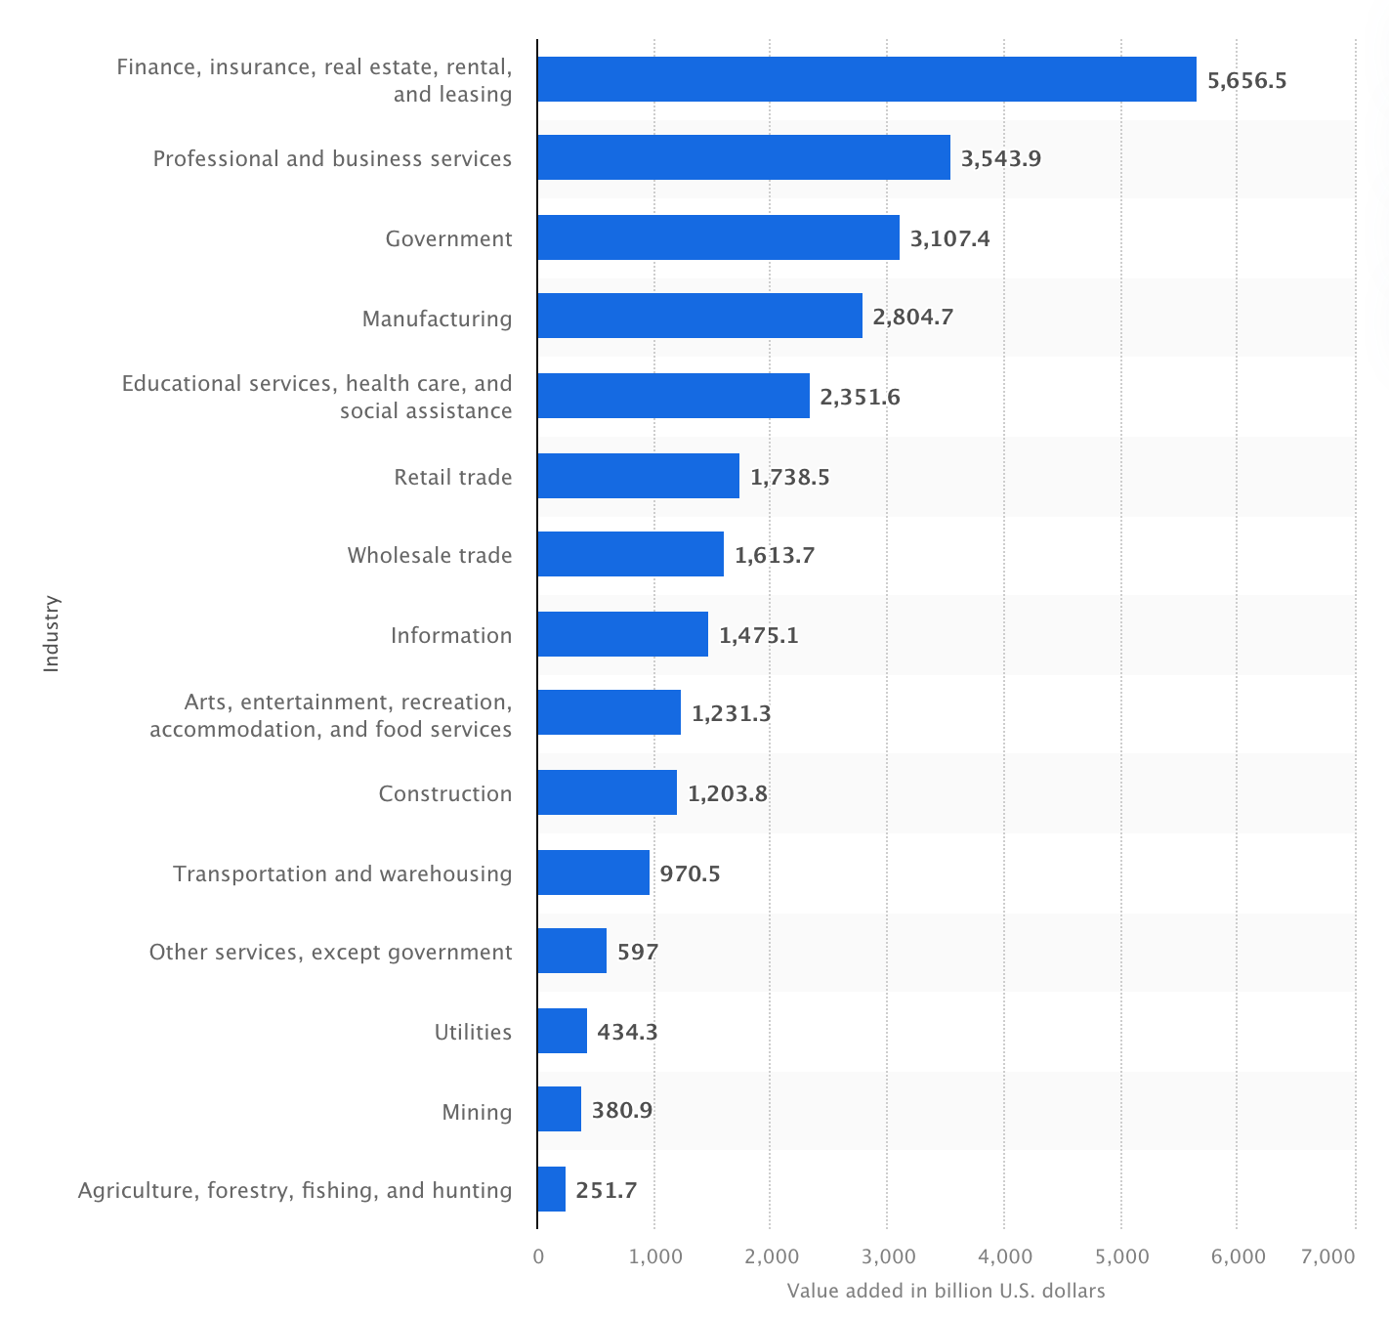
Value added to the GDP of United States in 2023

Slide 5
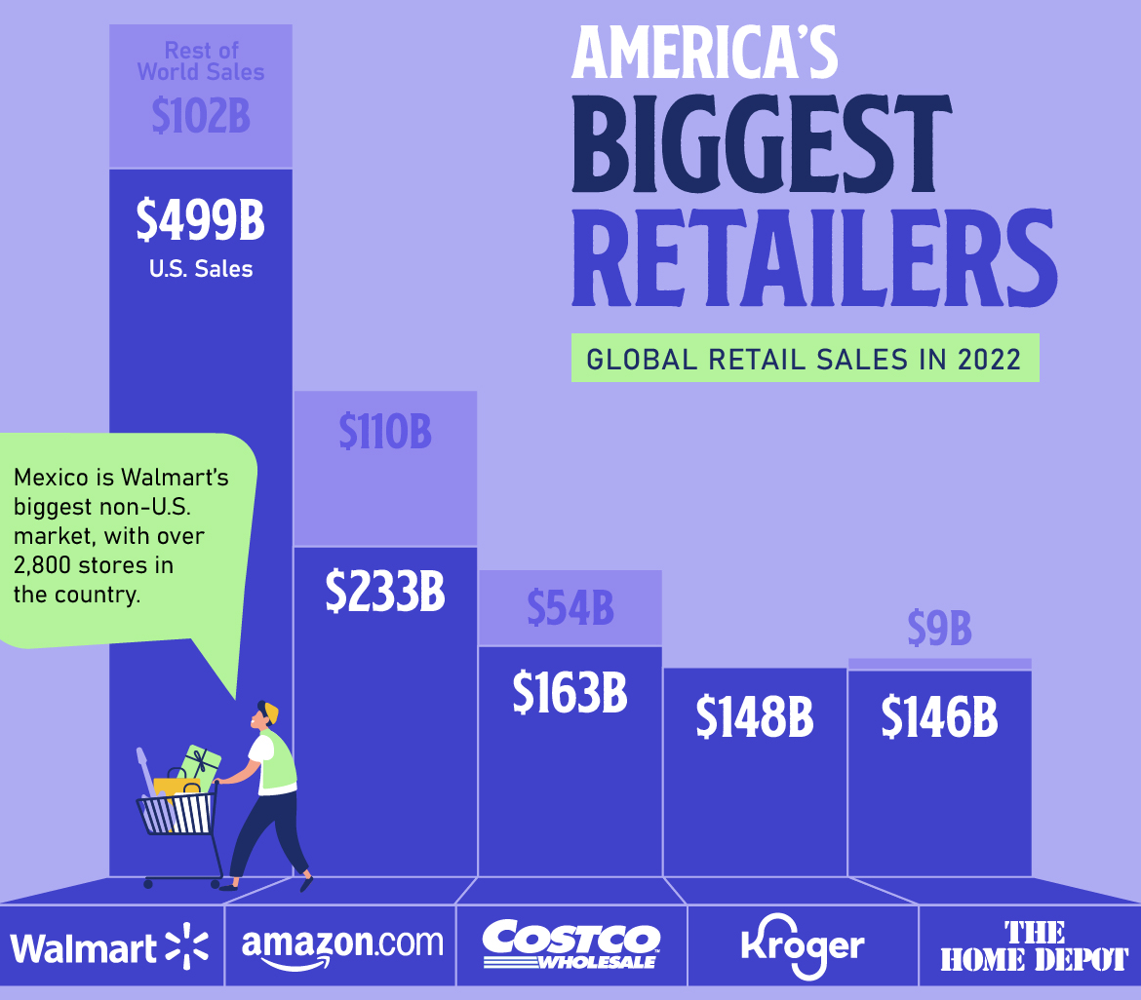


Dominance in the Retail Market
Notes:
America's largest retailers, like Walmart and Amazon, dominate the market with massive sales and extensive reach. They continually innovate, using advanced technology and logistics to meet customer demands and stay ahead of the competition.

Slide 6
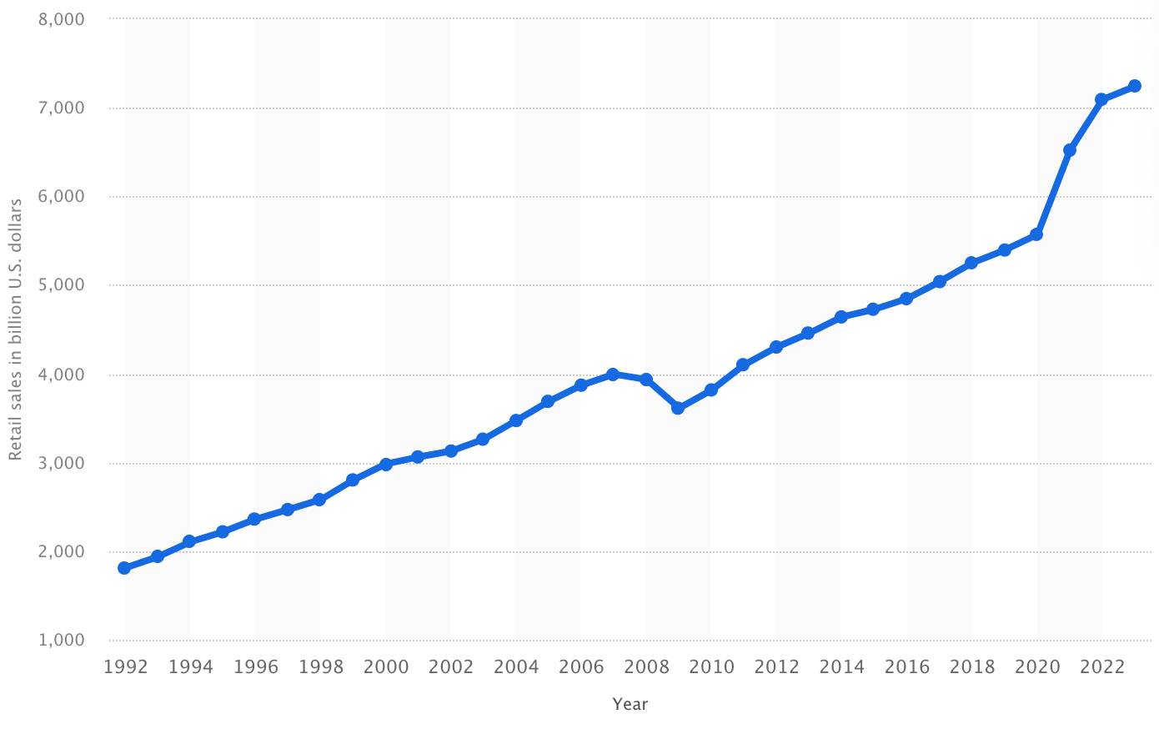
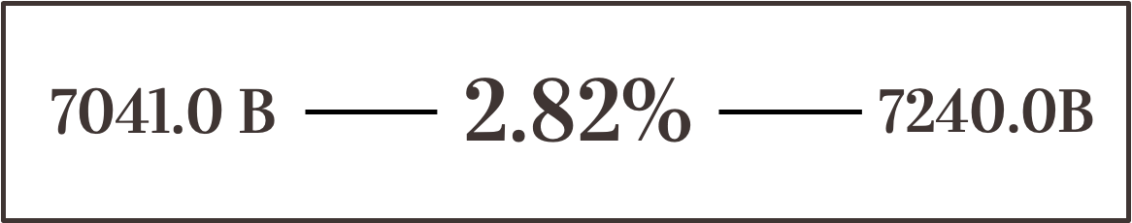
US Retail Sales
Previous Year Sales Growth 7.78%
2022 Revenue
Growth
2023 Revenue

Slide 7
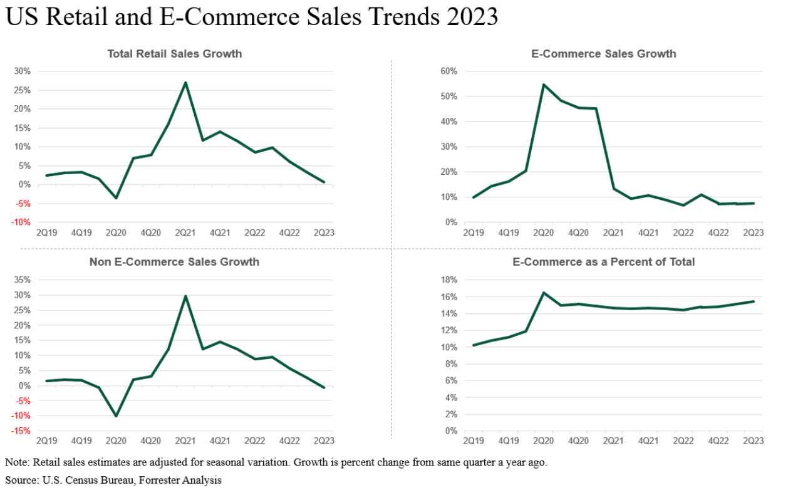
US Retail and E-Commerce Sales Growth: 2023
Notes:
E-commerce sales grew quickly from Q2 2020 to Q1 2021 but have slowed down since. For six out of the last eight quarters, including the last three, growth has been slow. This is much weaker compared to the usual fast growth in US e-commerce from 2009 to 2021, except for Q1 2019.

Slide 8

Type of Retailers
Department Stores: Offer a wide range of consumer goods in different areas of the store, each area ("department") specializing in a product category.
Speciality Stores: Focus on one or two specific categories of products.
Supermarkets: Big self-service retail market that generally sells foods and household items.
Convenience Store: Offer a limited range of products at premium prices due to the added value of convenience. Usually are small and located in residential area.

Slide 9

Type of Retailers
Discount Stores: Compete on the basis of low prices, high turnover, and high volume.
E-Commerce Retailers: Sells from an Internet shopping website and ship the purchases directly to customers at their homes or workplaces and without all the expenses of a traditional brick-and-mortar retailer, usually sell merchandise for a lower-than-retail price.
Warehouse Retailers: Selling large quantities of goods at discounts deeper than those provided in conventional supermarkets or wholesalers. They offer very low prices and little or no customer service at all

Slide 10

Retail Industry Analysis

Slide 11
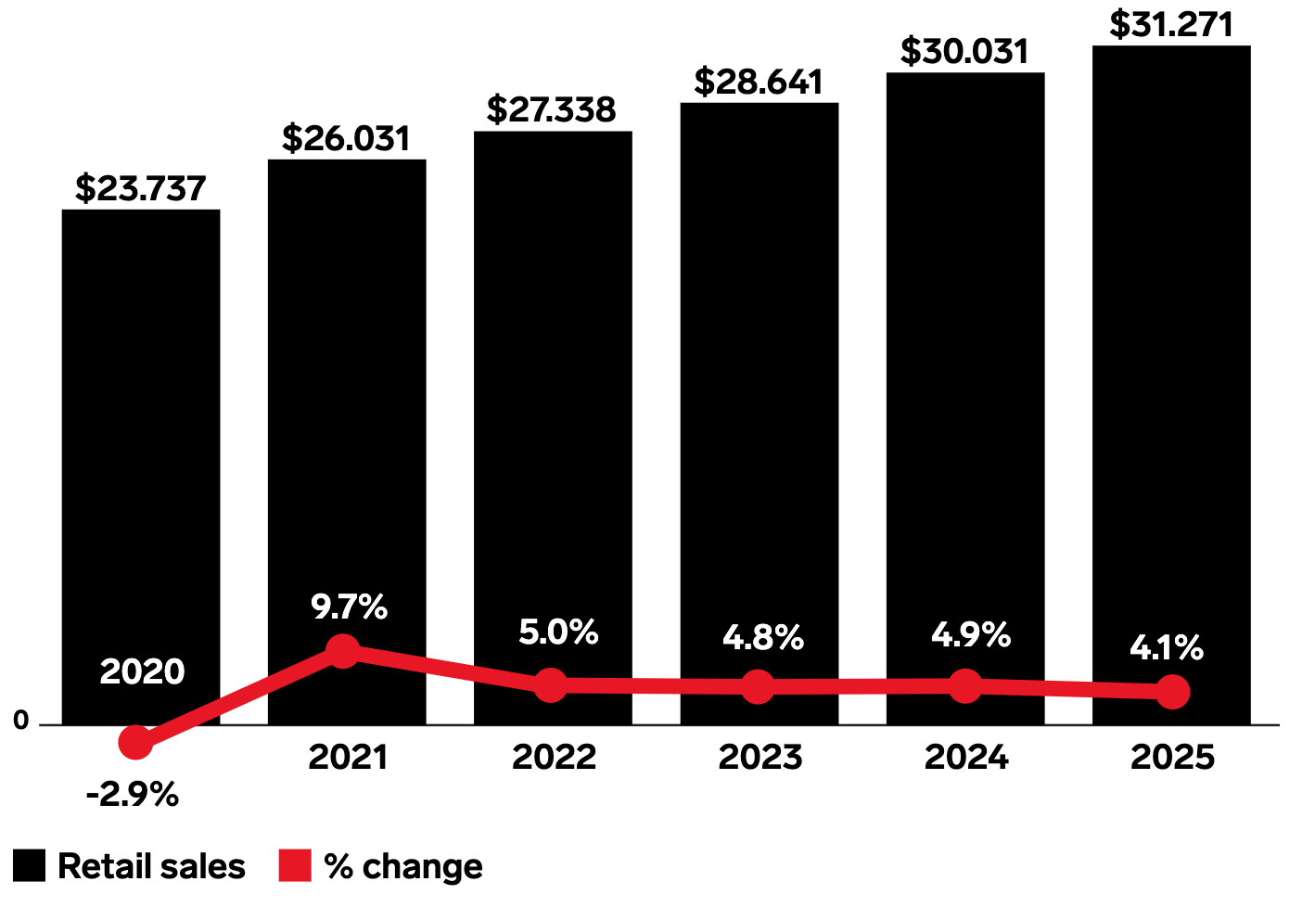
Retail Sales Worldwide
Total retail sales are expected to increase by $1.24 trillion, an overall increase of 31.7 percent and an average annual increase of 4.3 percent.
In Trillions

Slide 12
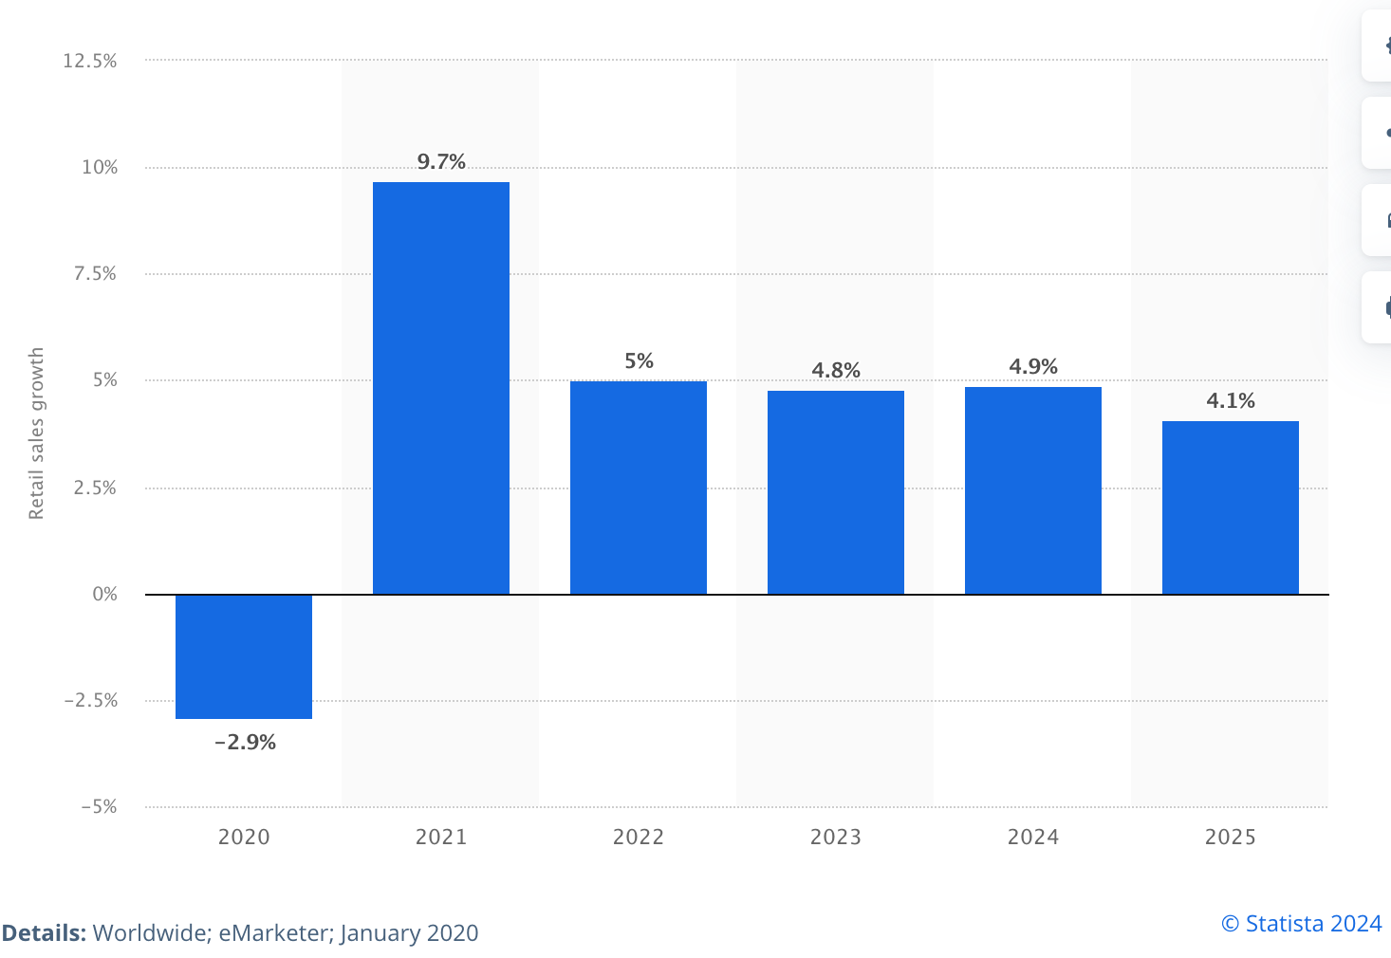
Projected Retail Sales Growth Worldwide
Notes:
In 2020, global retail sales fell by 2.9 percent as a result of the COVID-19 pandemic, bouncing back in 2021 with a growth of 9.7 percent Global retail sales were projected to amount to around 27.3 trillion U.S. dollars by 2022, up from approximately 23.7 trillion U.S. dollars in 2020.

Slide 13
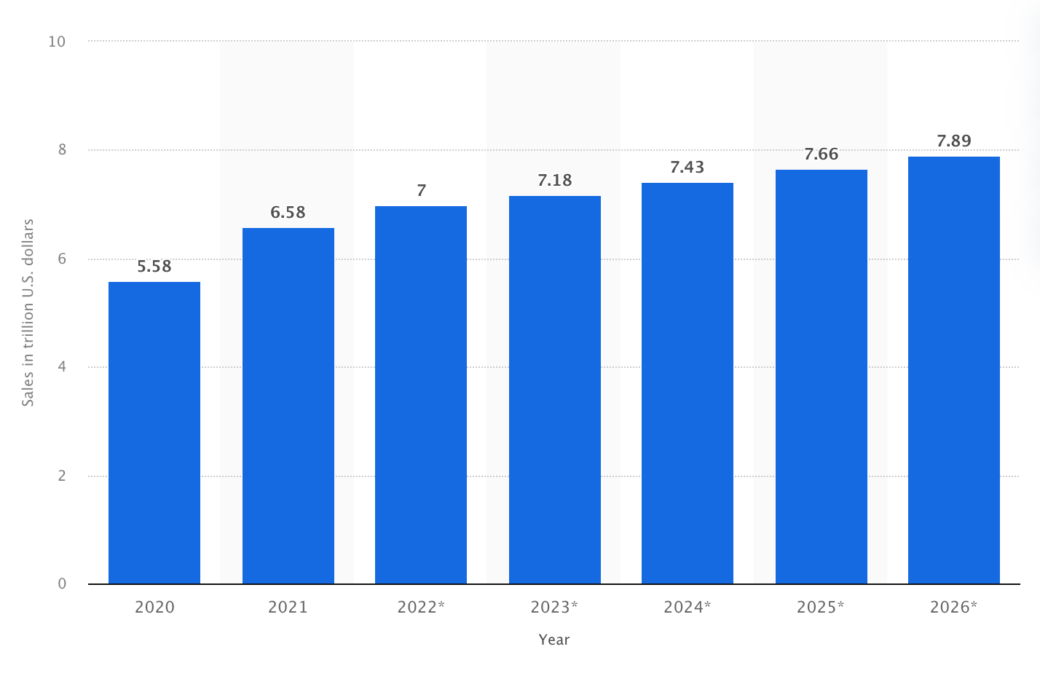
US Retail Sales 2020-2026
Similar Slide: Incorporate in other

Slide 14
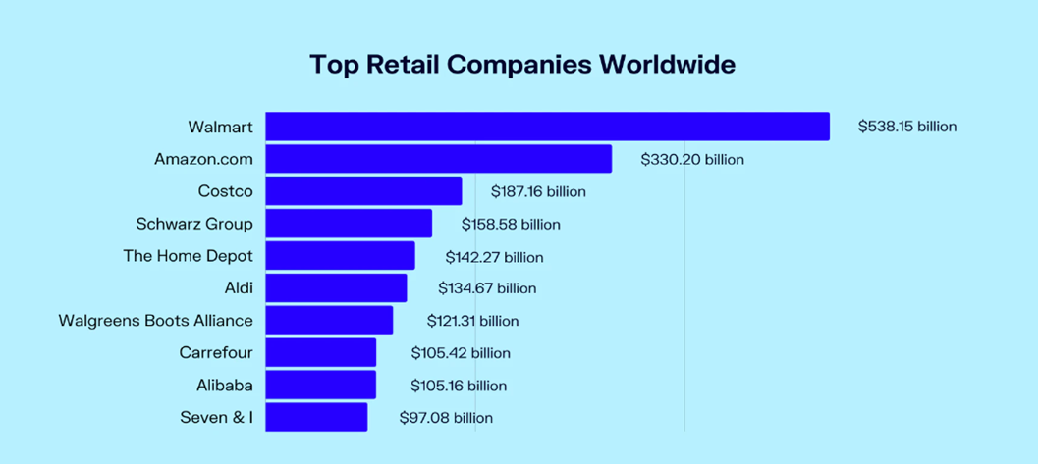
Top Retail Companies: Worldwide
Notes:
When discussing the top retail companies worldwide, it's essential to highlight a few key players dominating the market. Walmart leads the pack as the world's largest retailer, known for its vast network of stores and significant market share. Amazon follows closely, revolutionizing the retail landscape with its e-commerce dominance and rapid delivery services. Other major players include Costco, with its membership-based model and bulk sales, and Alibaba, which rules the Asian market with its online shopping platforms. These companies are not just leaders in sales but also in innovation, continuously setting trends and shaping the future of retail.

Slide 15
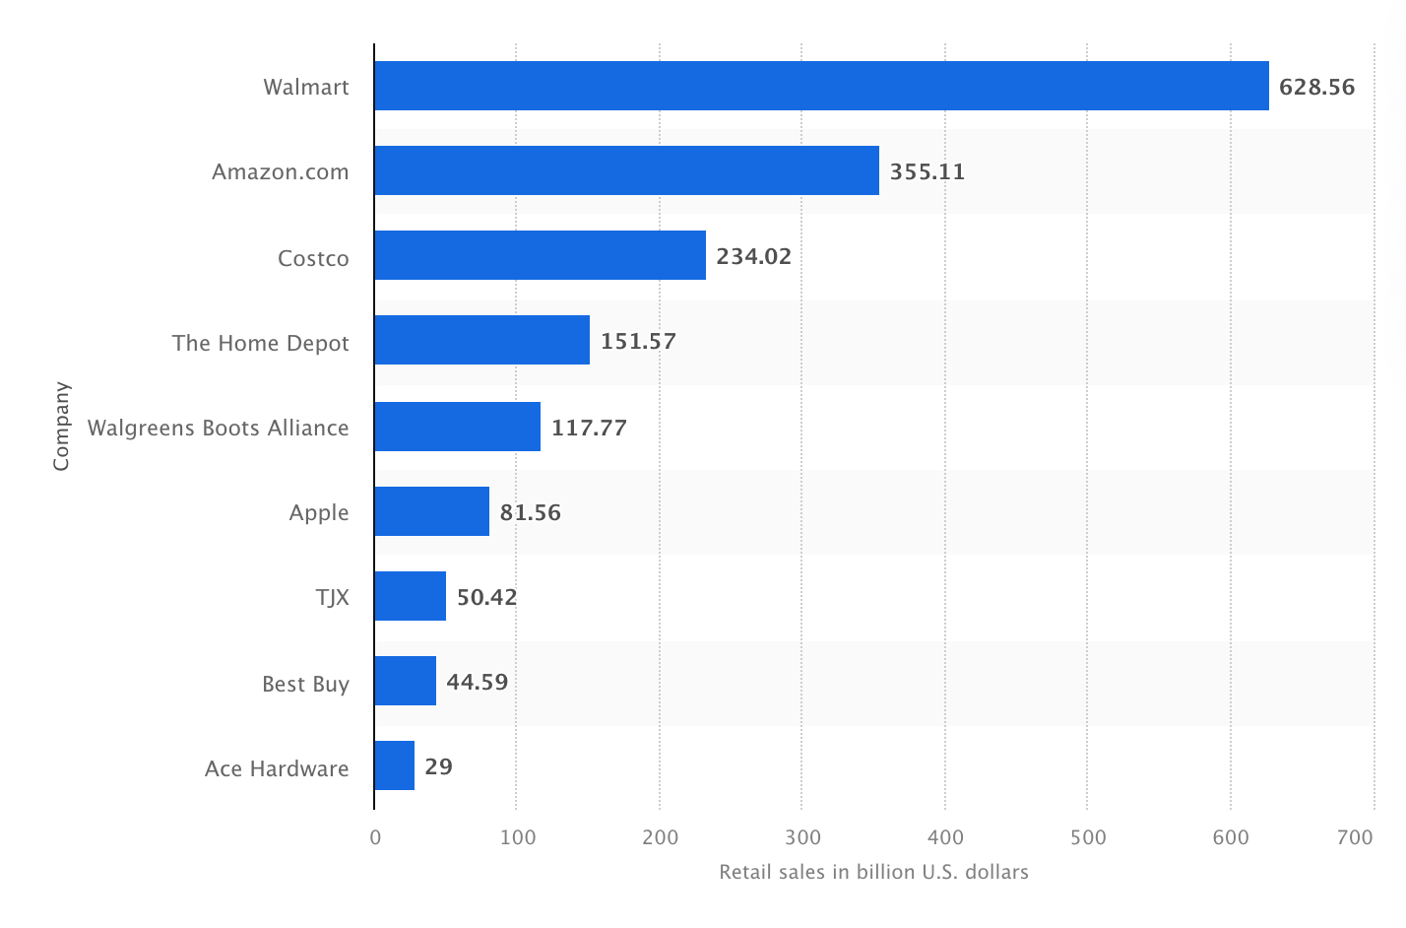
Retail sales of leading U.S. retailers in 2023

Slide 16
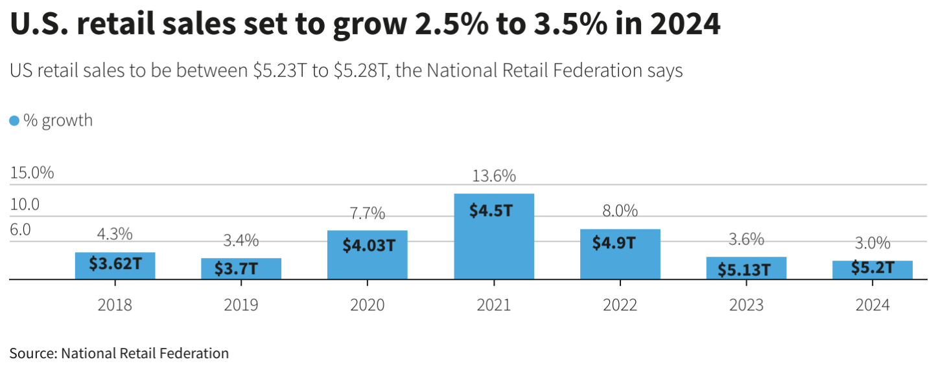
U.S. retail sales set to grow 2.5% to 3.5% in 2024

Slide 17

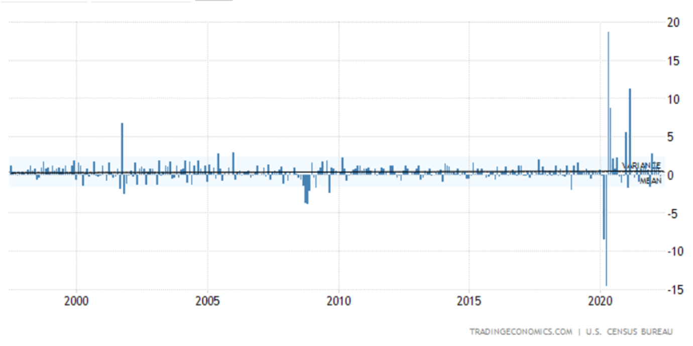
US Retail Historical Data
Average: 0.41%
Max 18.7% in May of 2020
Min: -14.7% in April of 2020

Slide 18
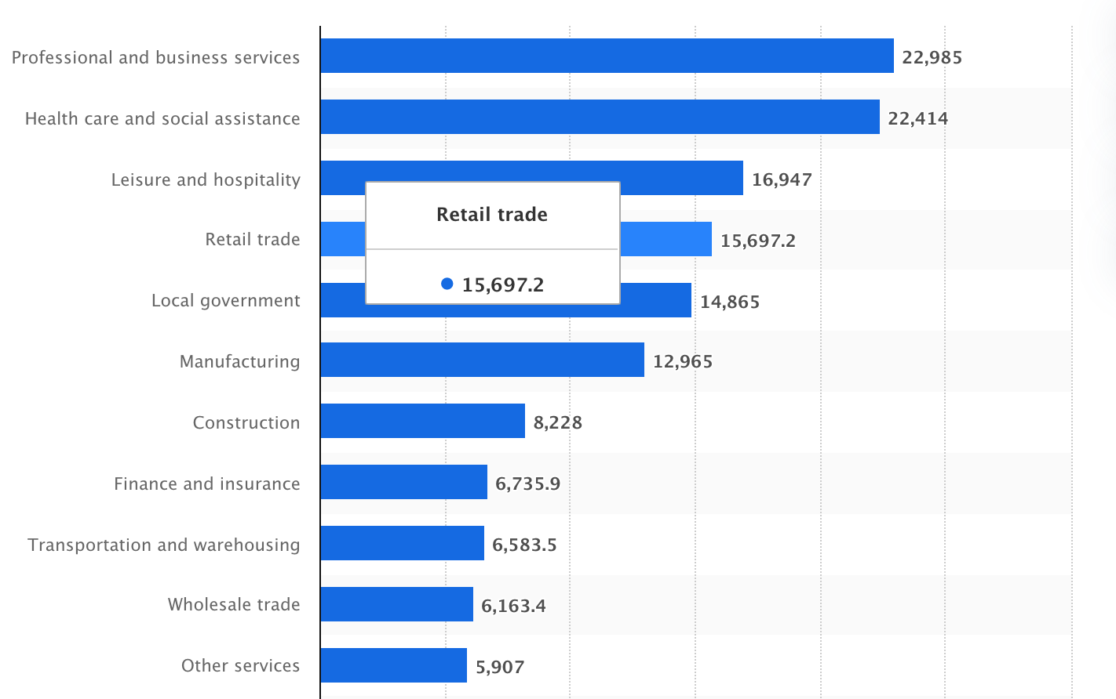
Employment in the US Industries
As of May 2024, There were approximately 15.7 Million employees employed by the Retail Industry.

Slide 19
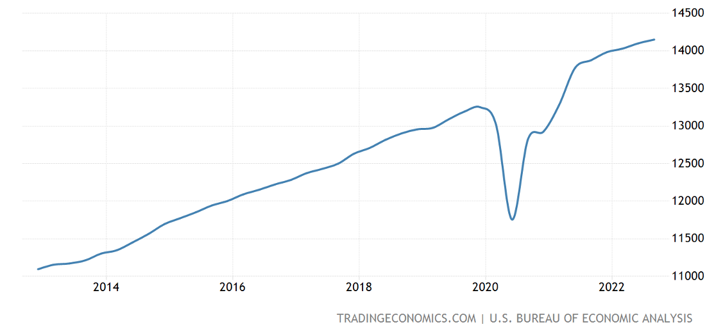
US Consumer Spending: Past 10 Years
Notes:
Over the past few years, US consumer spending has shown resilience, bouncing back strongly after the COVID-19 pandemic due to government stimulus and pent-up demand. The pandemic accelerated the shift to online shopping, significantly boosting e-commerce sales. Rising inflation in 2022 and 2023 affected spending habits, with consumers prioritizing essentials over discretionary items. Despite fluctuations in consumer confidence, retail sales continued to grow, particularly in sectors like electronics, home goods, and health and personal care.

Slide 20
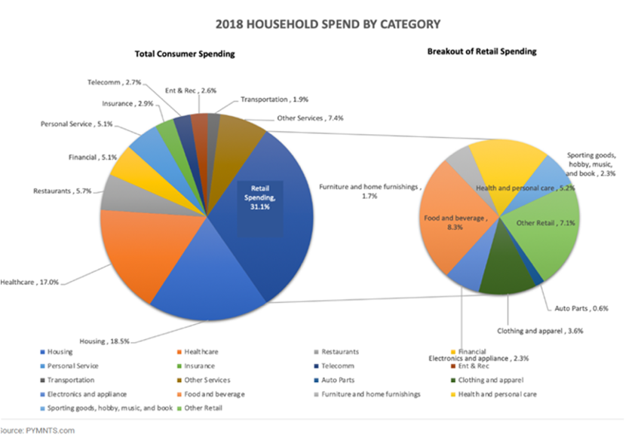
Consumer Expenditure
Overall Spending: $6.6 Trillion in 2022
Ecommerce: Rapid Growth in online sales, 1 trillion in 2022 (Boosted by pandemic)

Slide 21
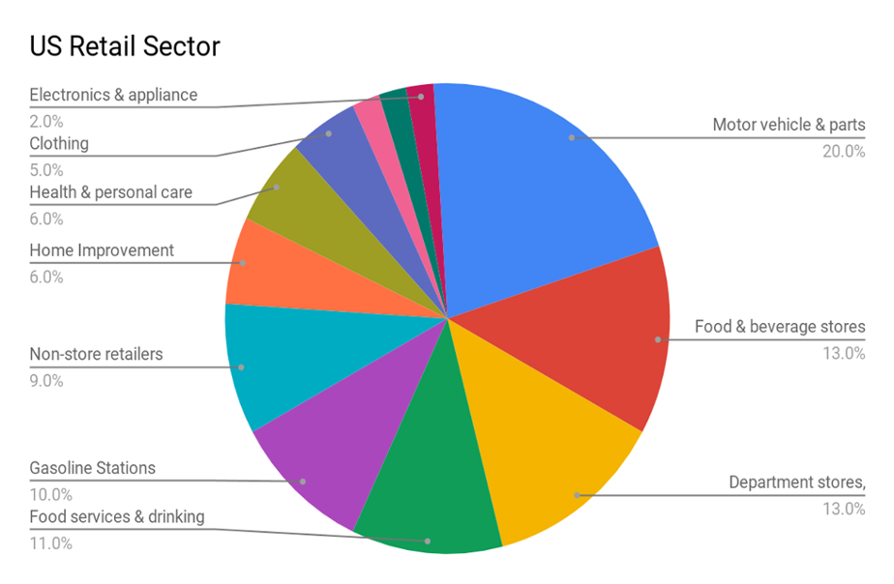
Retail Industry by Sector
Top 10 Sectors
1)Apparel
2)Automotive
3)Internet
4)Specialty
5)Food
6)Other
7)Hypermarkets
8)Department stores
9)Computer
Drug

Slide 22
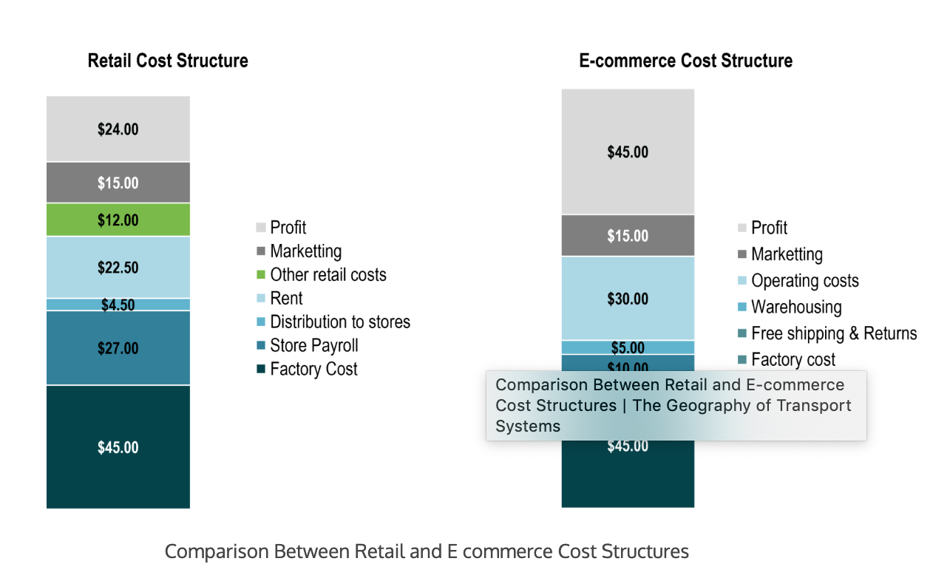
Cost Structure: Retail Vs E-Commerce
Retail
Physical Stores
Staff
Inventory
Marketing
E-commerce
Technology
Shipping/Logistics
Customer Service
Marketing

Slide 23


Slide 24
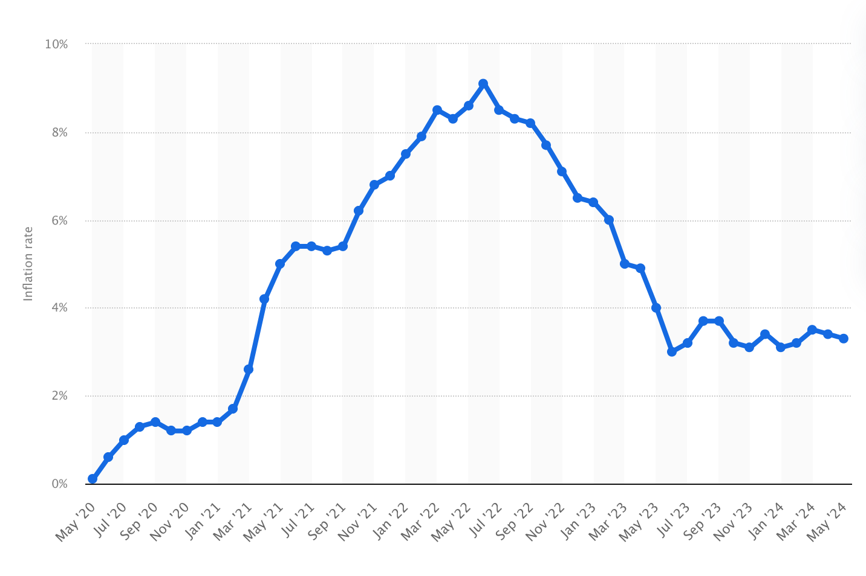
Threat : Economic Recession
As inflation rates rise, the possibility of a recession increases, impacting consumer spending habits.

Slide 25
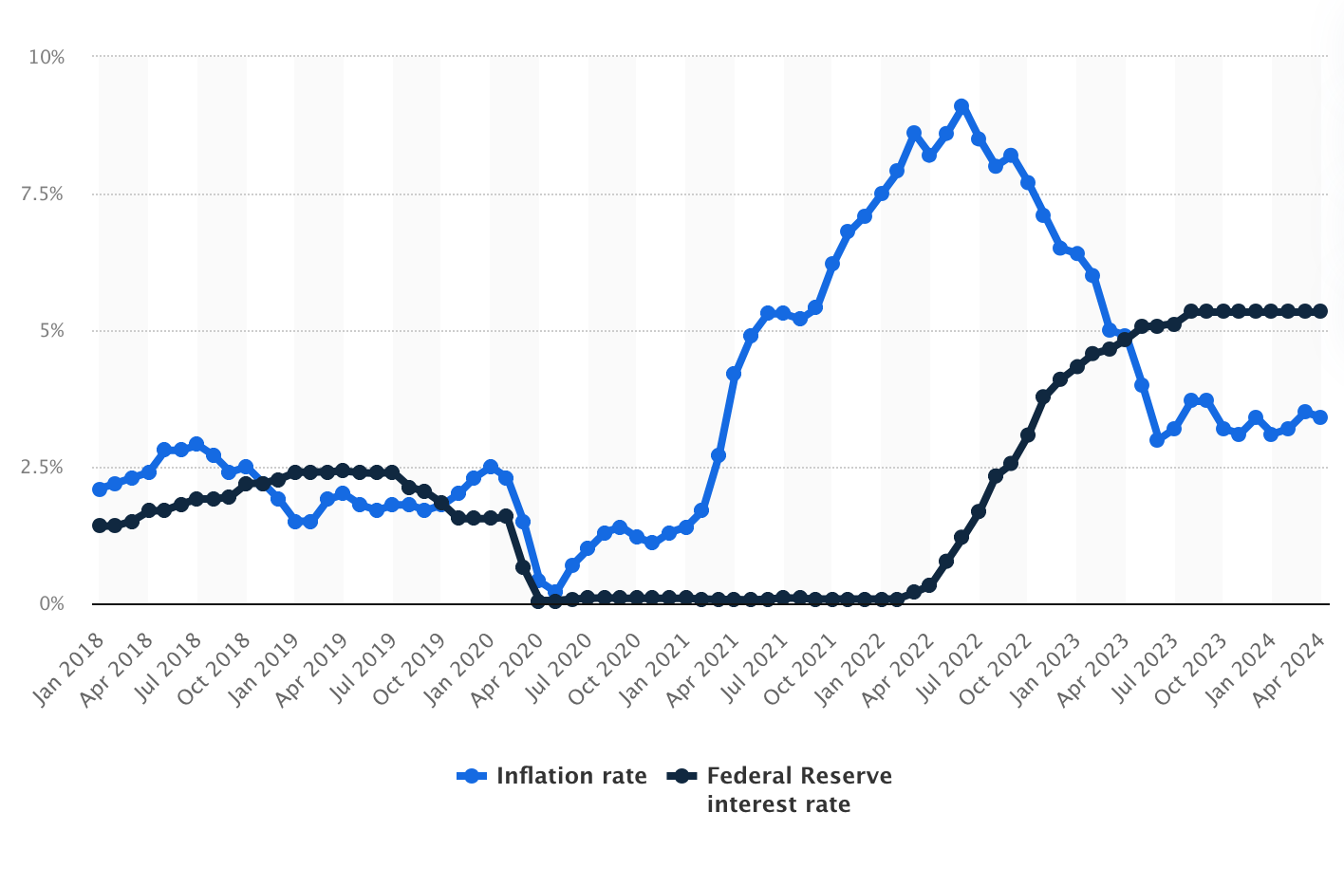
Threat : Interest Rates
Interest rates significantly impact consumer spending on retail goods. High interest rates discourage borrowing and reduce discretionary spending, while low interest rates encourage borrowing and increase retail purchases.

Slide 26
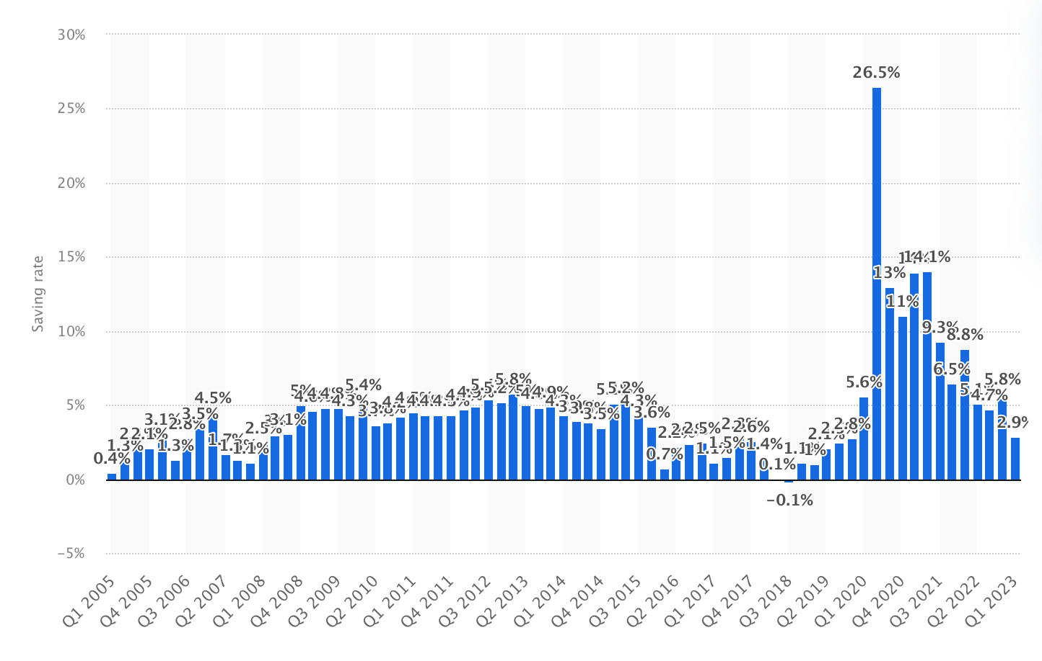
Threat : Change in Consumer Behaviour
The saving rate of U.S. households surged during the early stages of the COVID-19 pandemic, peaking at 26.5 percent in the second quarter of 2020. By the second quarter of 2022, this rate had decreased to an average of 6.2 percent of disposable income

Slide 27
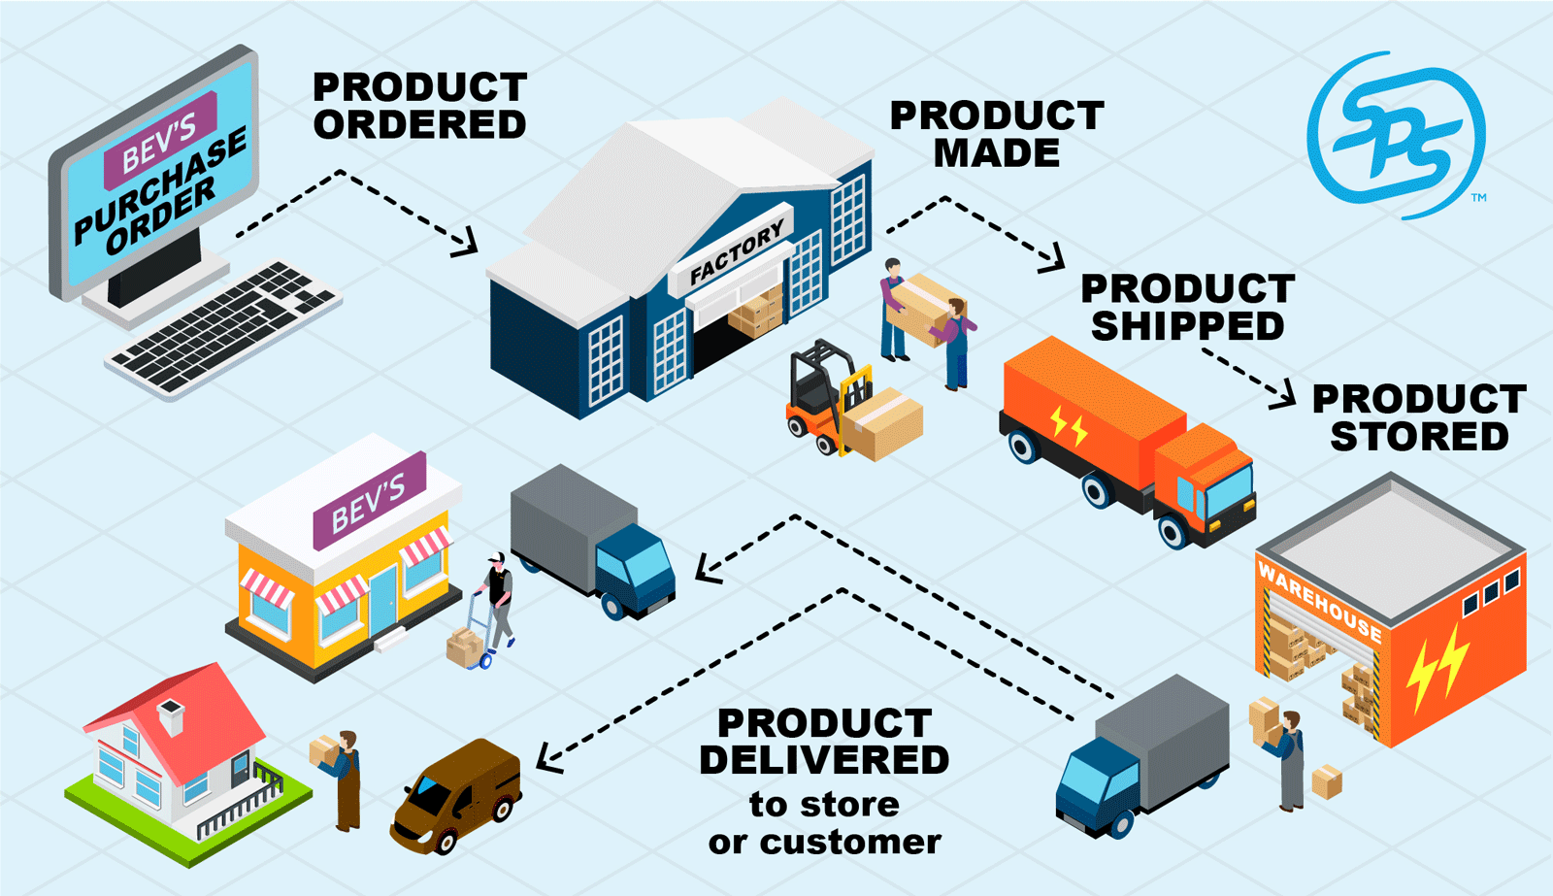
Threat : Supply Chain Issues
Disruptions in supply chain can lead to inventory shortages, increased costs, delays in product availability which can all negatively impact sales and customer satisfaction.
Retailers may struggle to meet consumer demand, leading to lost revenue opportunities and damage to reputation.

Slide 28
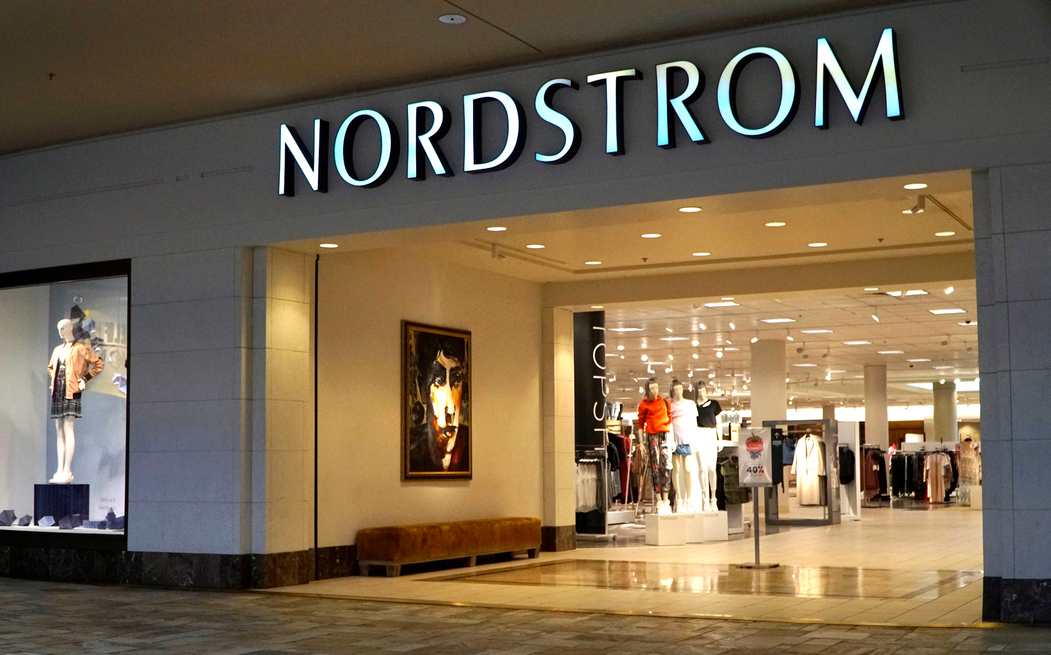
Changes in Retail
Decline of brick and mortar stores: the covid-19 pandemic has shifted the view of consumers from in person shopping to that of convenience and safety. Brick and mortar stores are expected to decline by 60%, and convert to an online format
AR/VR: Through the metaverse, we could see stores shifting their entire platform into AR/VR, to provide consumers with the shopping experience from the comfort of their own homes.
Integration of Technology: Stores are choosing to go about a more technological route, we see this in the forms of curbside pick up or self check out. Ultimately reducing the human element of the shopping experience.

Slide 29
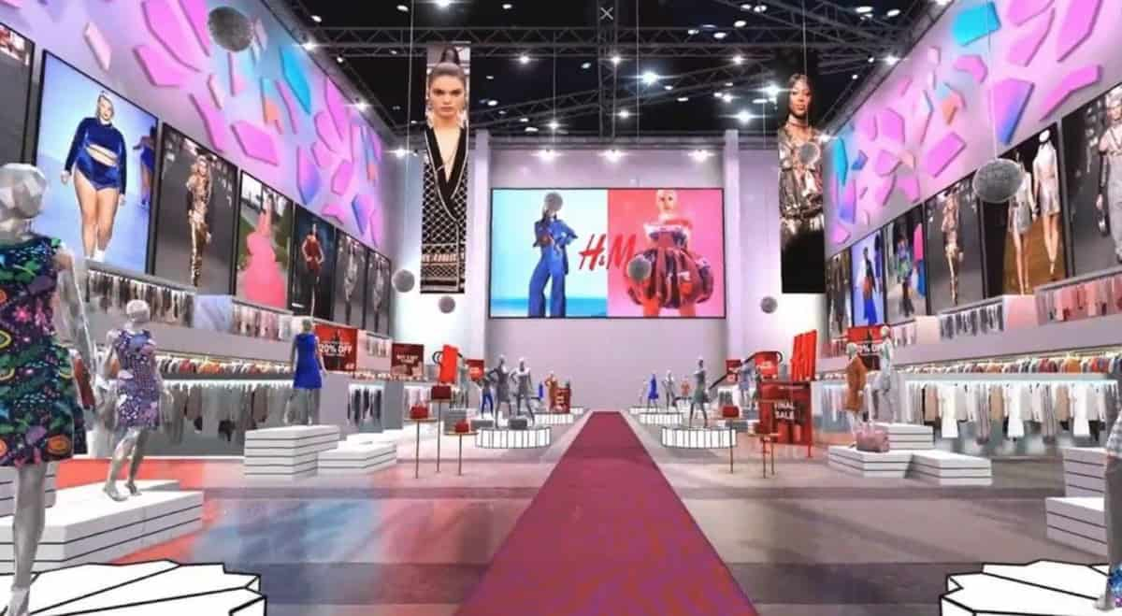
Metaverse Shopping?

Slide 30

E-Commerce Retail
Buying and selling of goods and services over the internet, offering convenience and a wide range of products to consumers globally

Slide 31
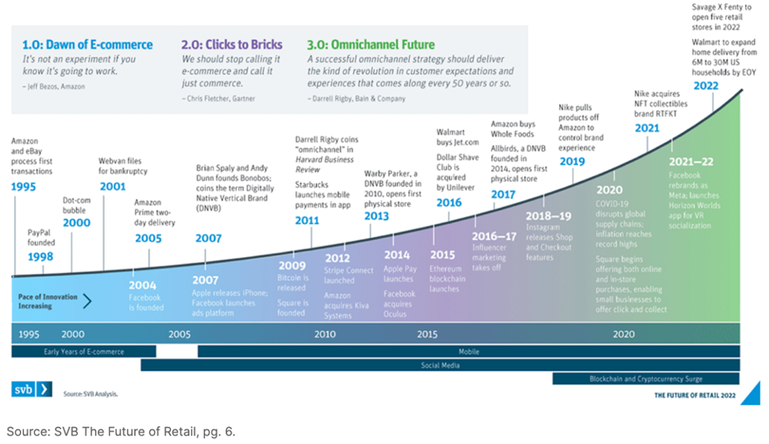
Timeline: E-commerce

Slide 32
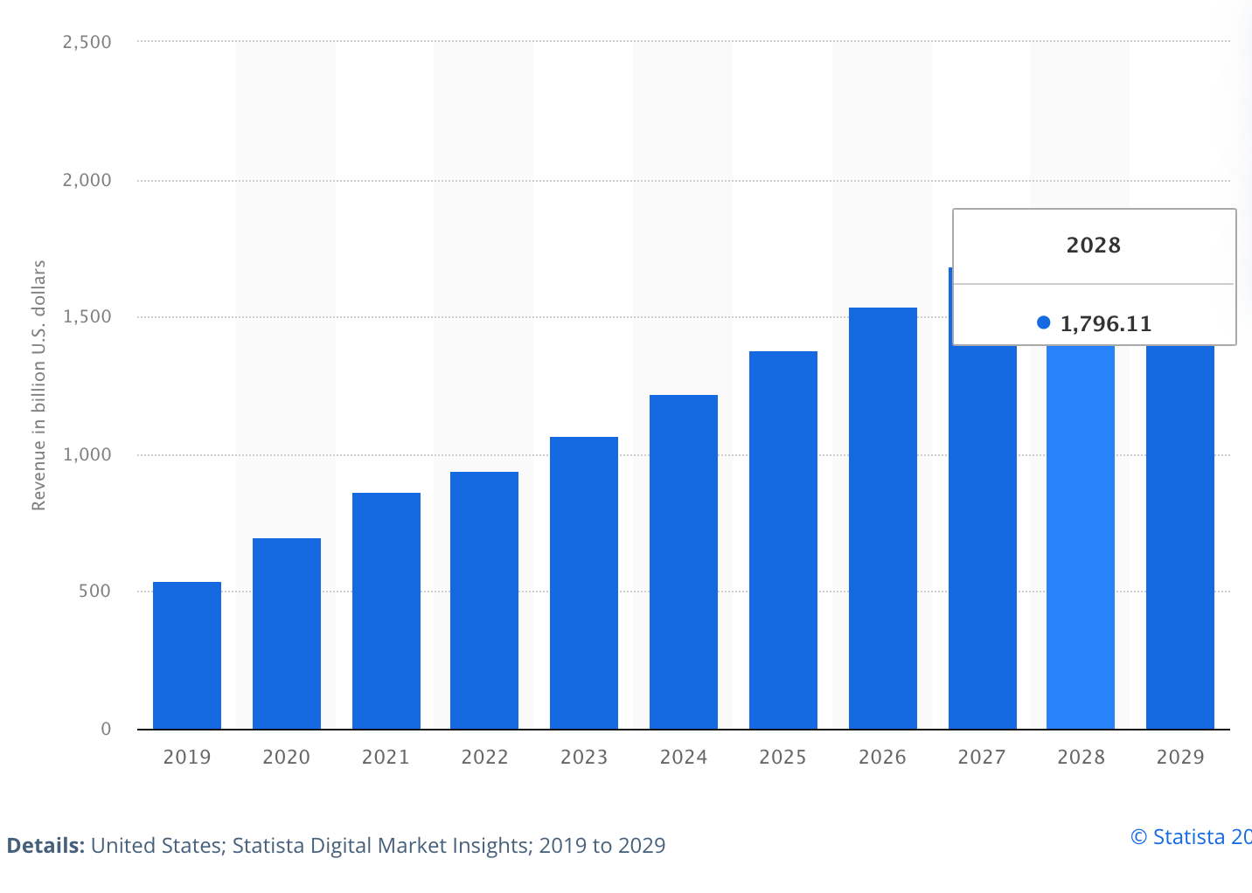
Revenue of E-commerce Industry in US

Slide 33
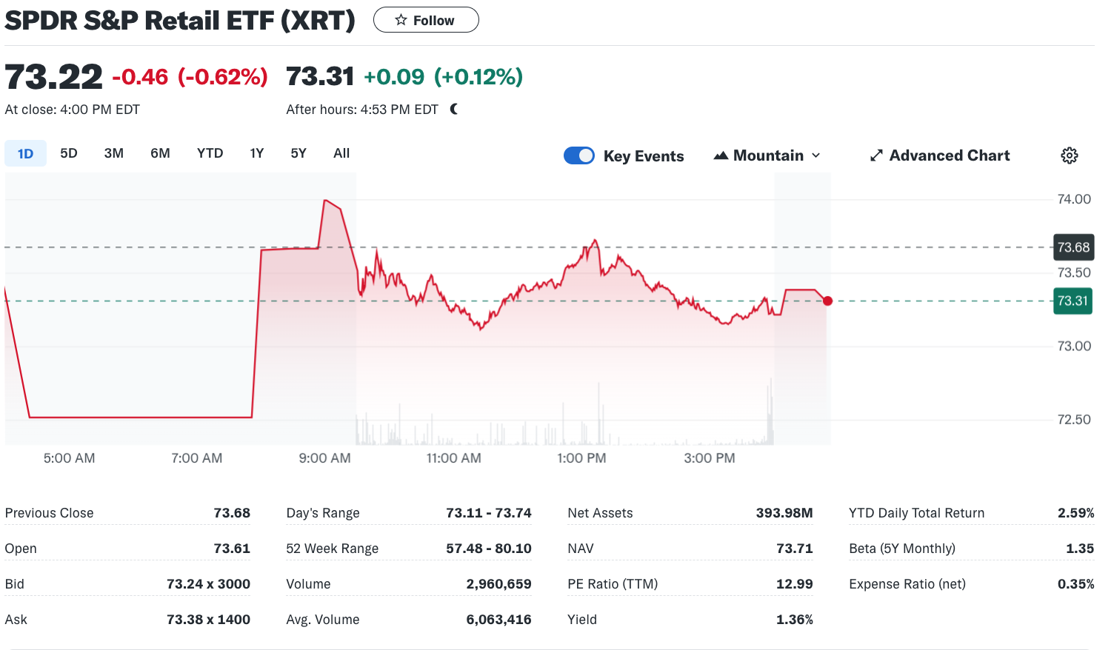
S&P Retail ETF (XRT)

Slide 34
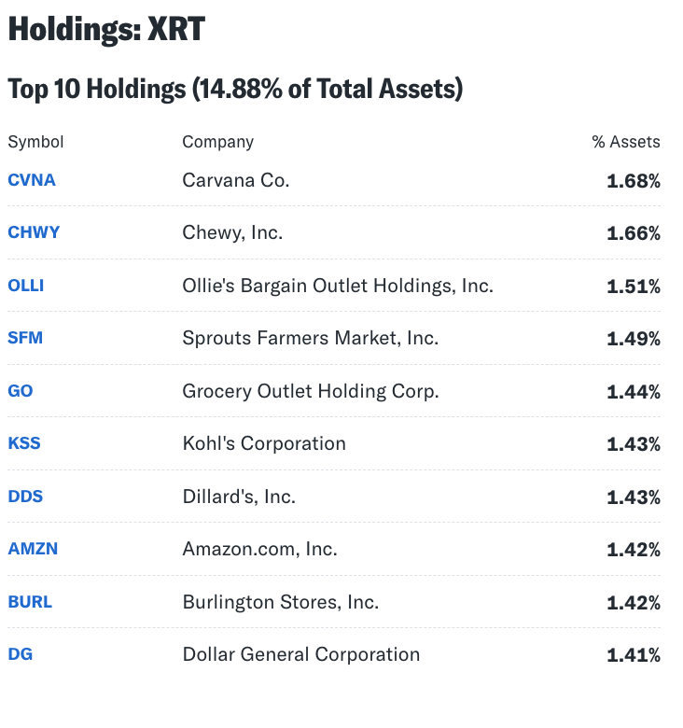
S&P Top Holdings

Slide 35
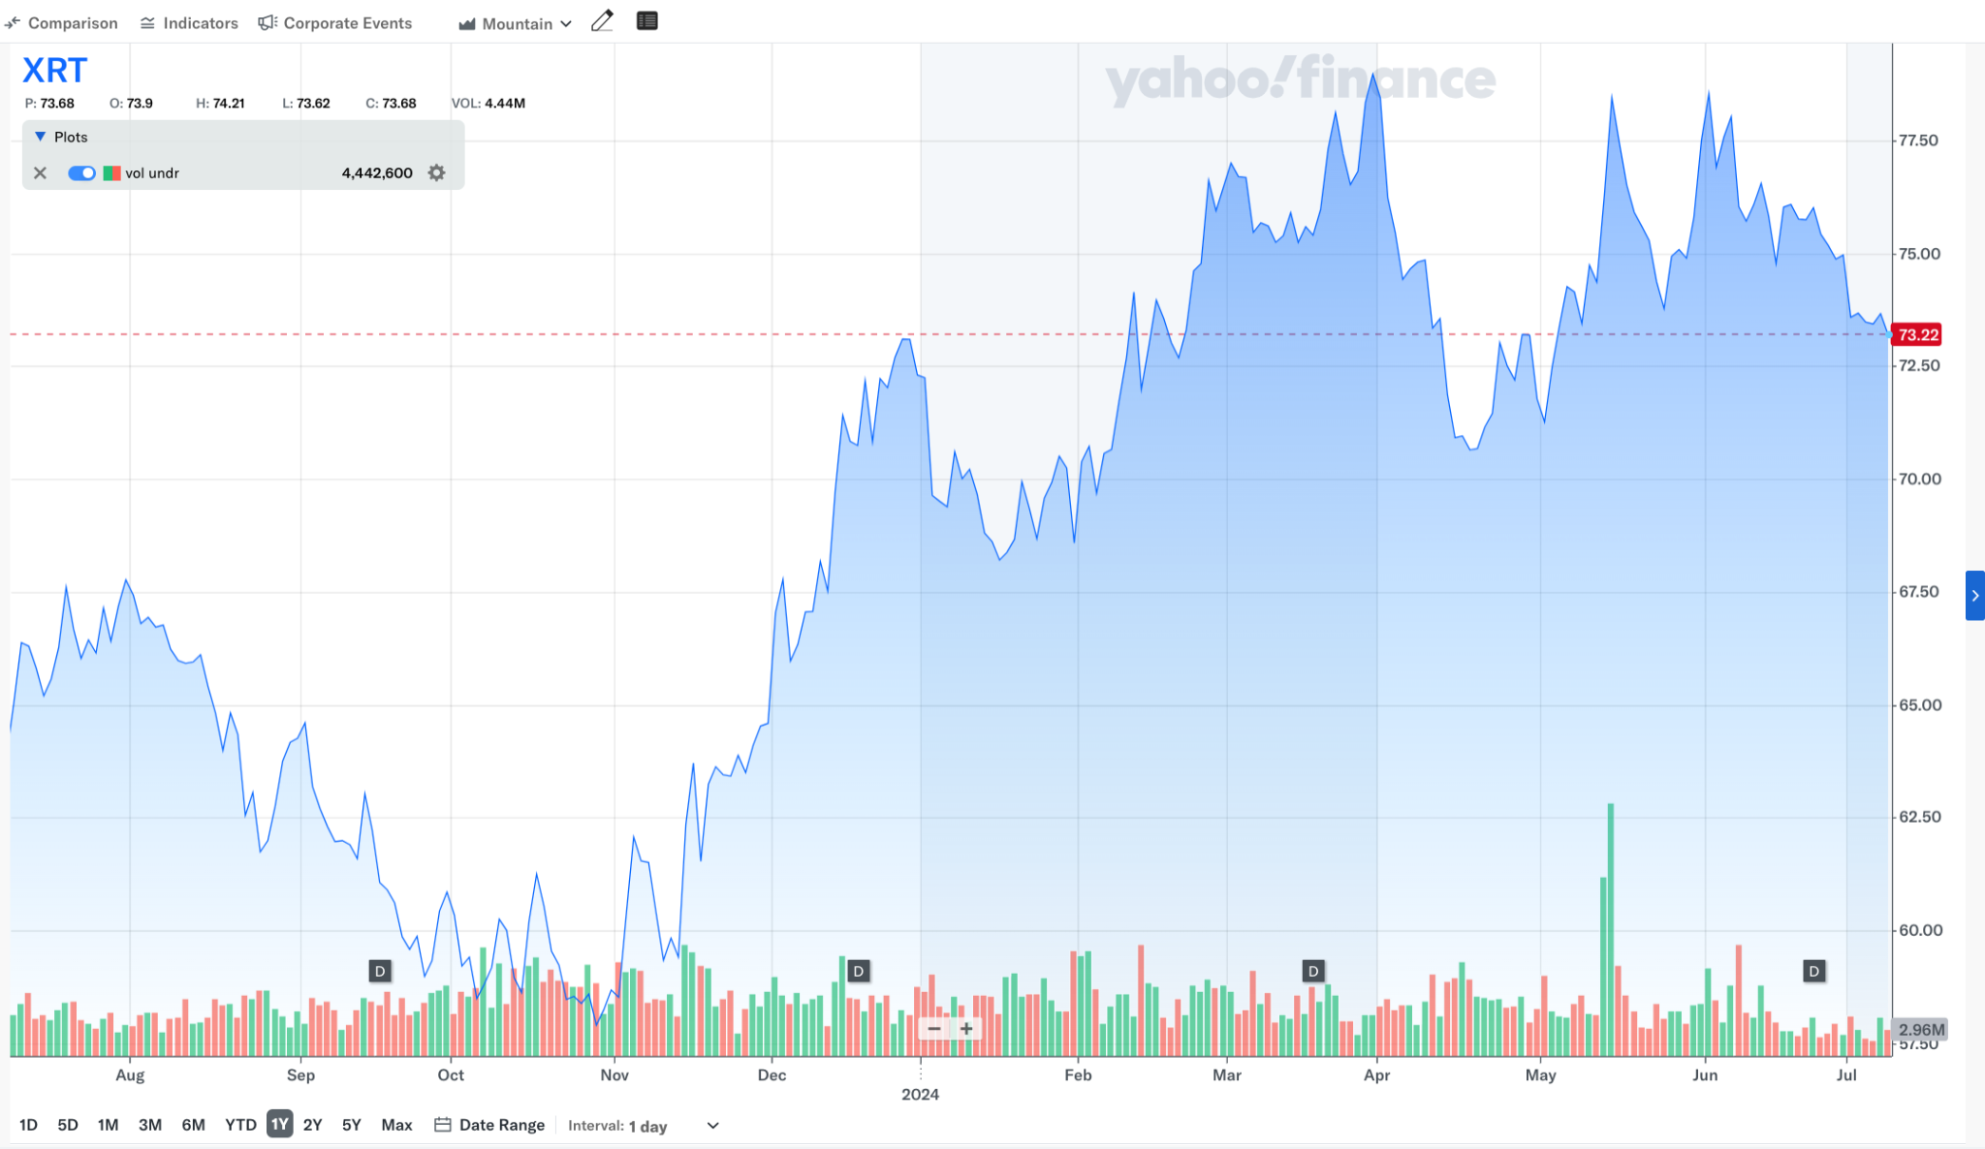
S&P Retail Index Comparison (1 Year)

Slide 36
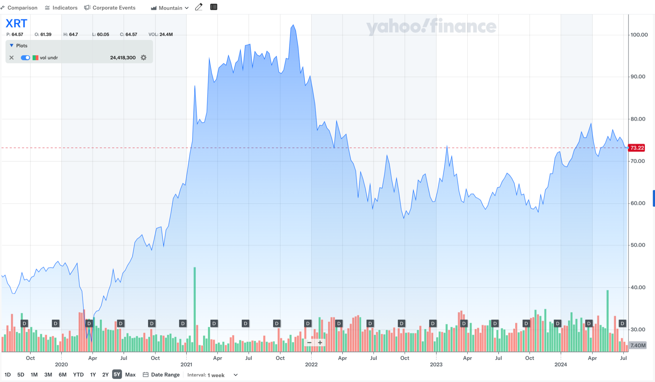
S&P Retail Index Comparison (5 Year)

Slide 37
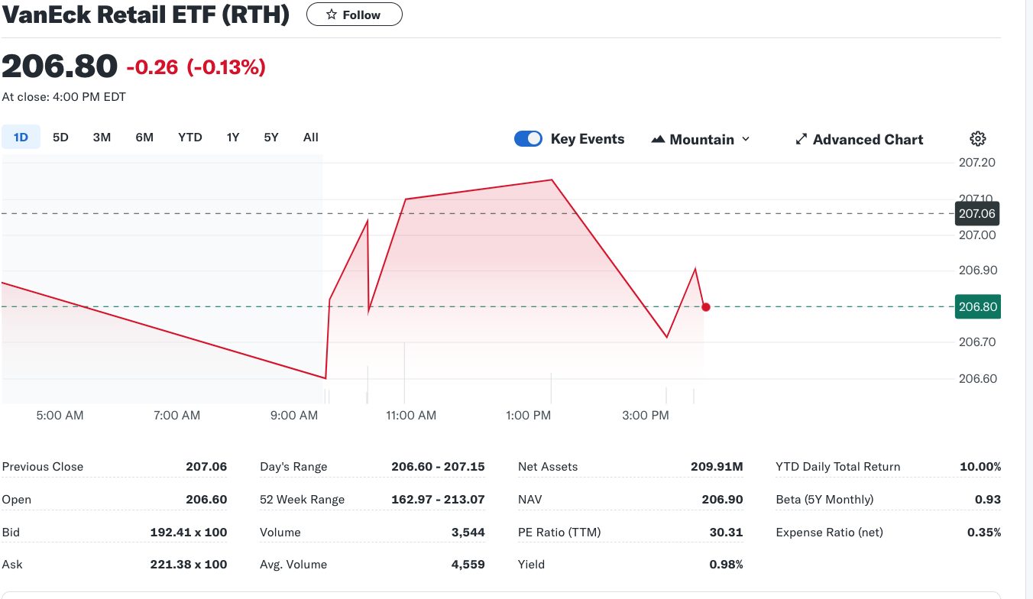
VanEck Retail ETF (RTH)

Slide 38
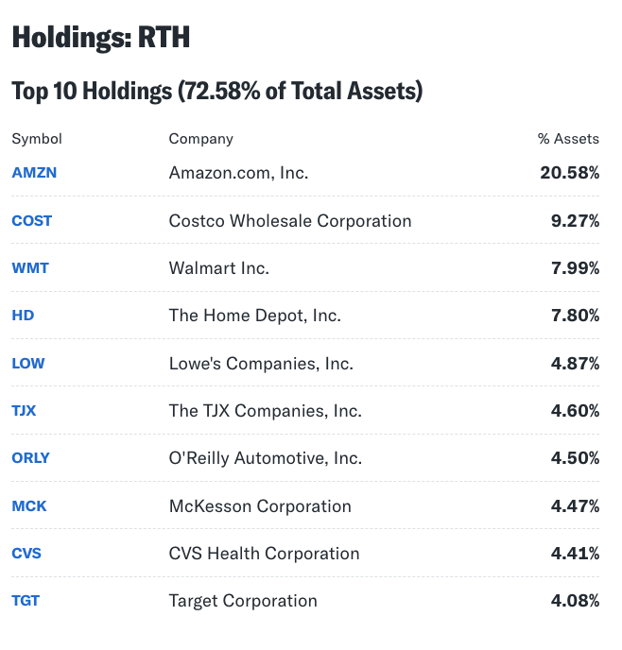
VanEck Retail ETF (RTH) Top Holdings

Slide 39
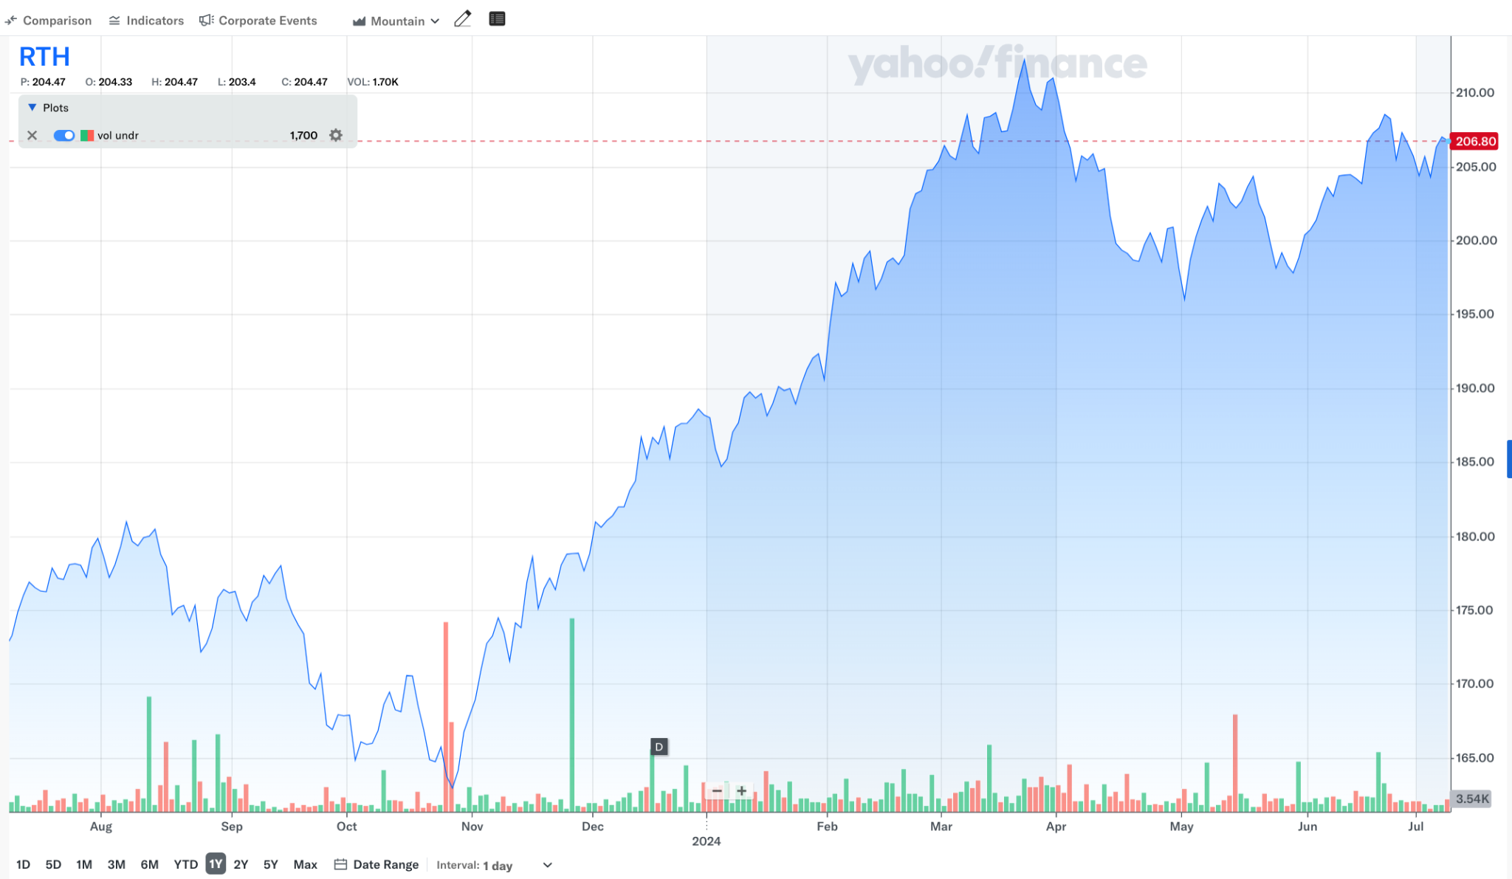
VanEck Retail ETF Comparison (1 Year)

Slide 40
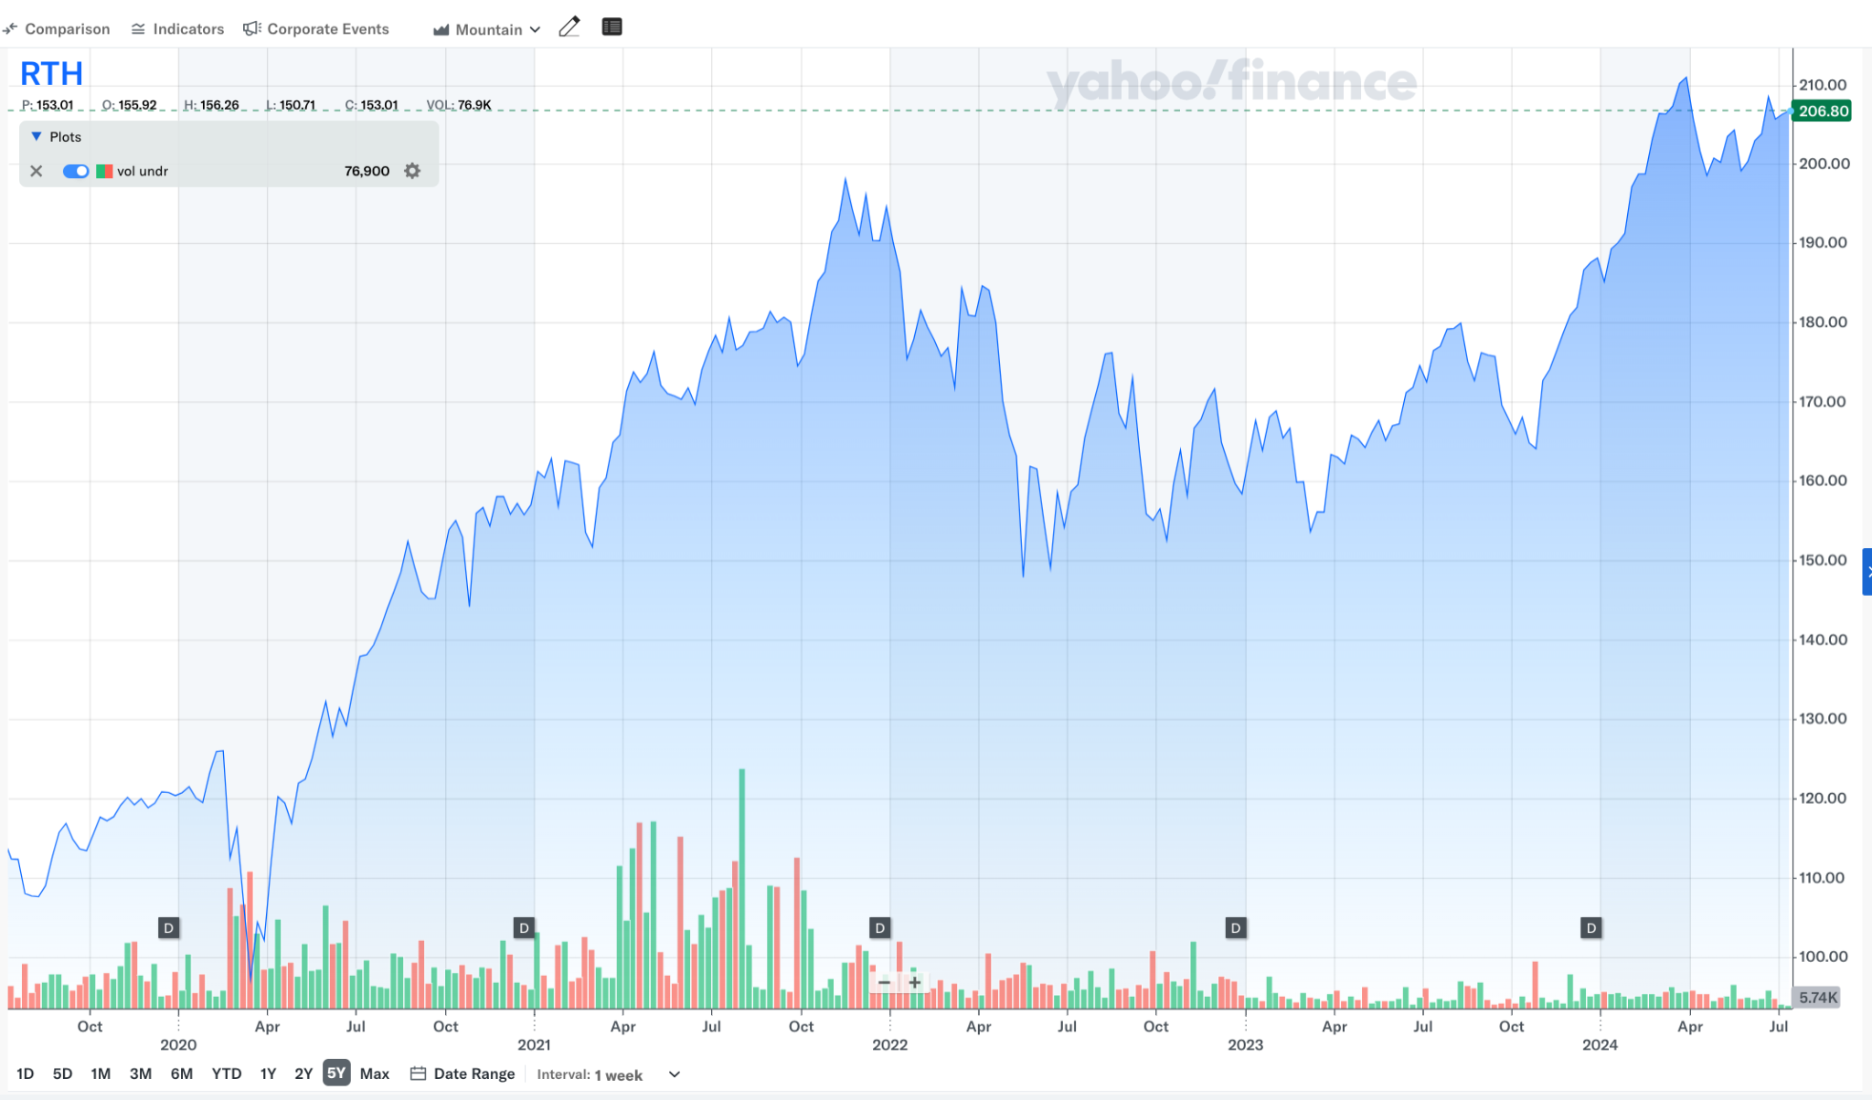
VanEck Retail ETF Comparison (5 Year)

Slide 41


Slide 42
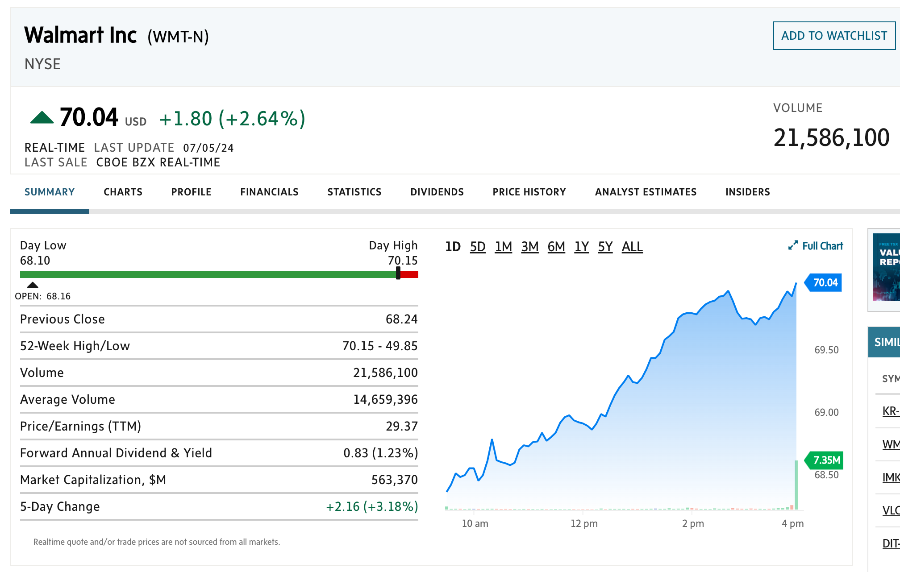
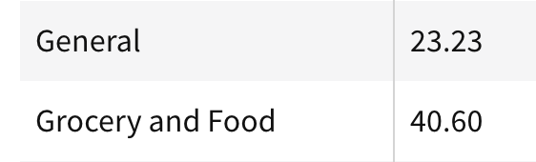
Basic Company Information

Slide 43
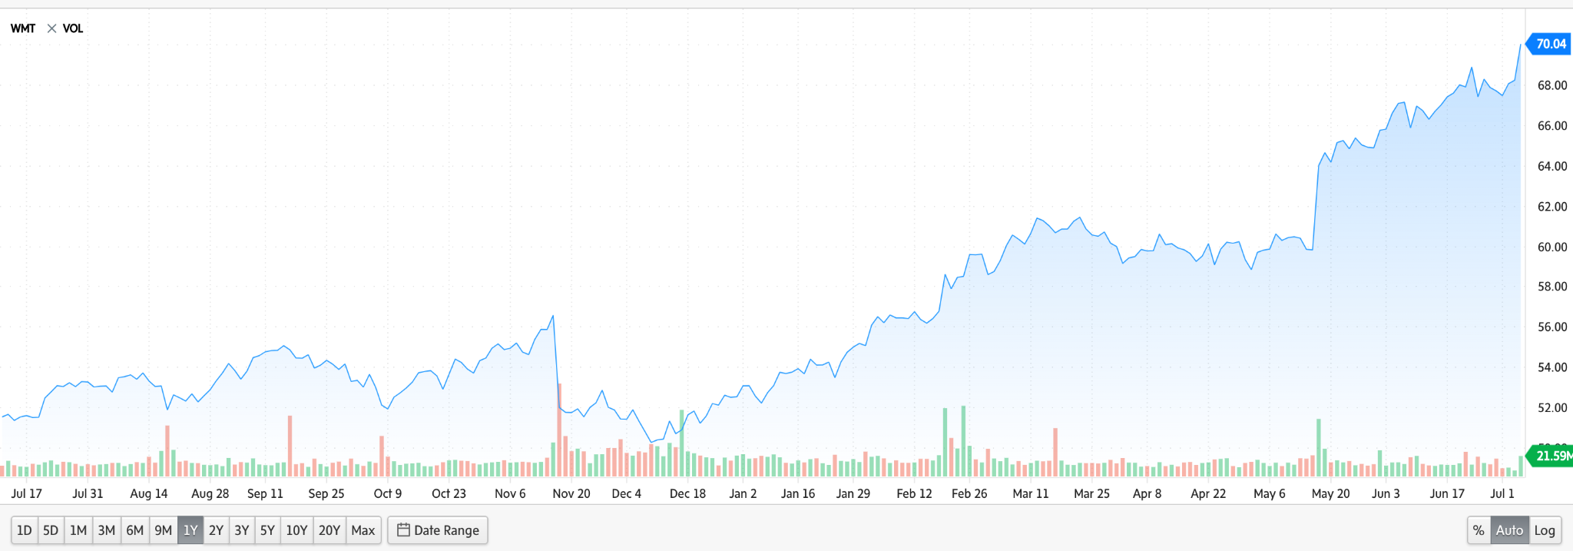
Price Chart - 1 Year

Slide 44
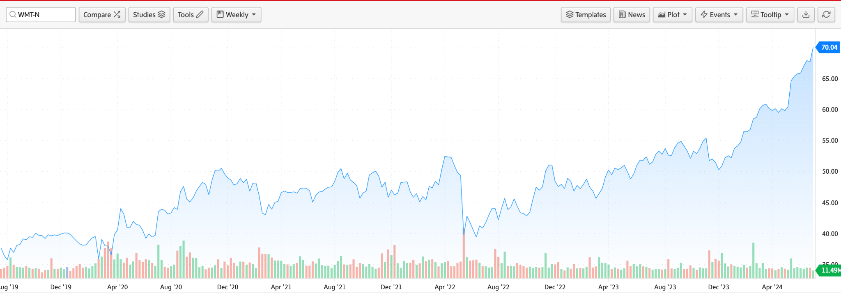
Price Chart - 5 Year

Slide 45
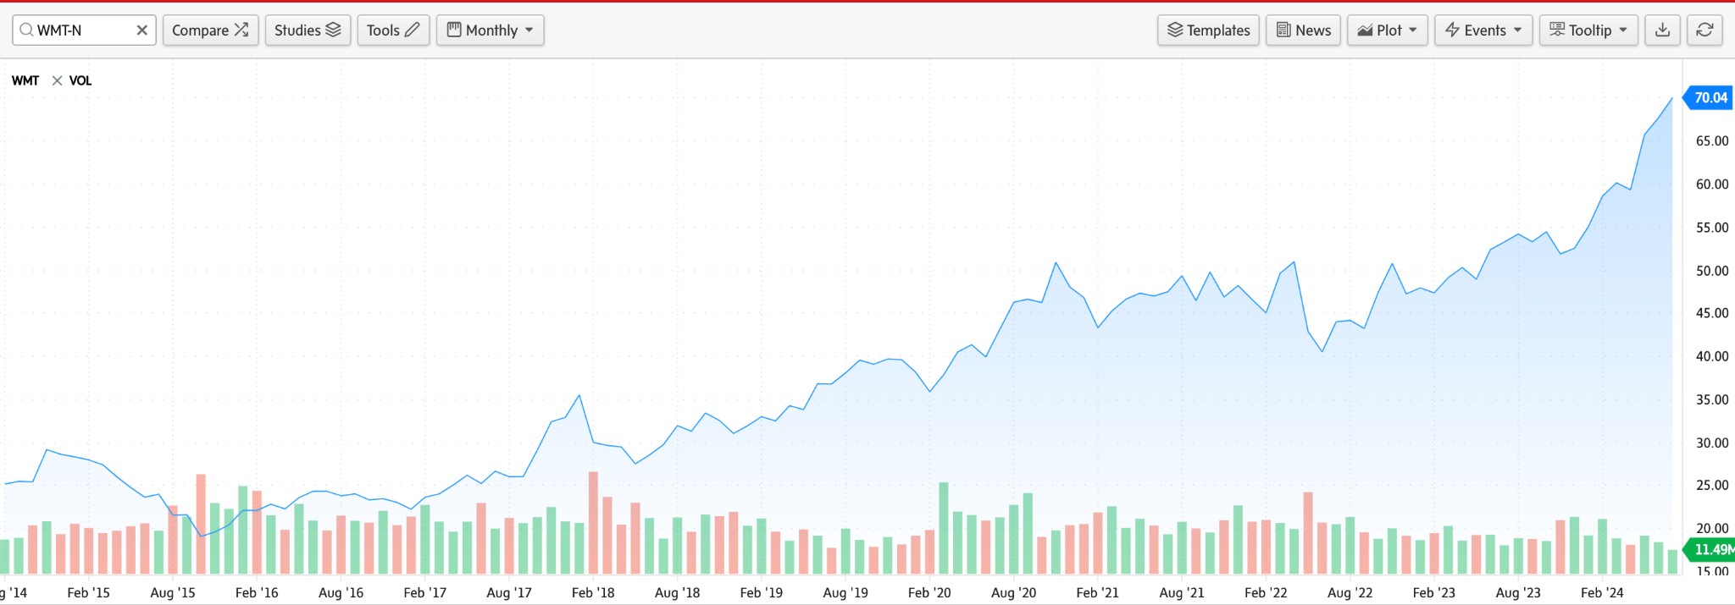
Price Chart - 10 Year

Slide 46
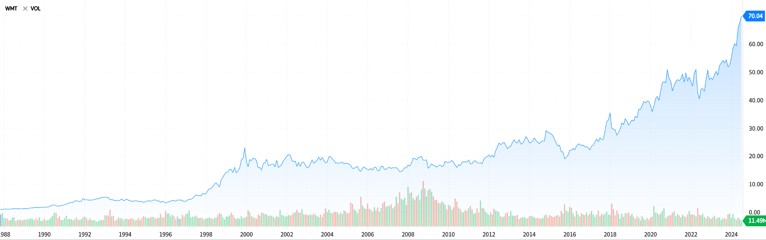
Price Chart - Max

Slide 47
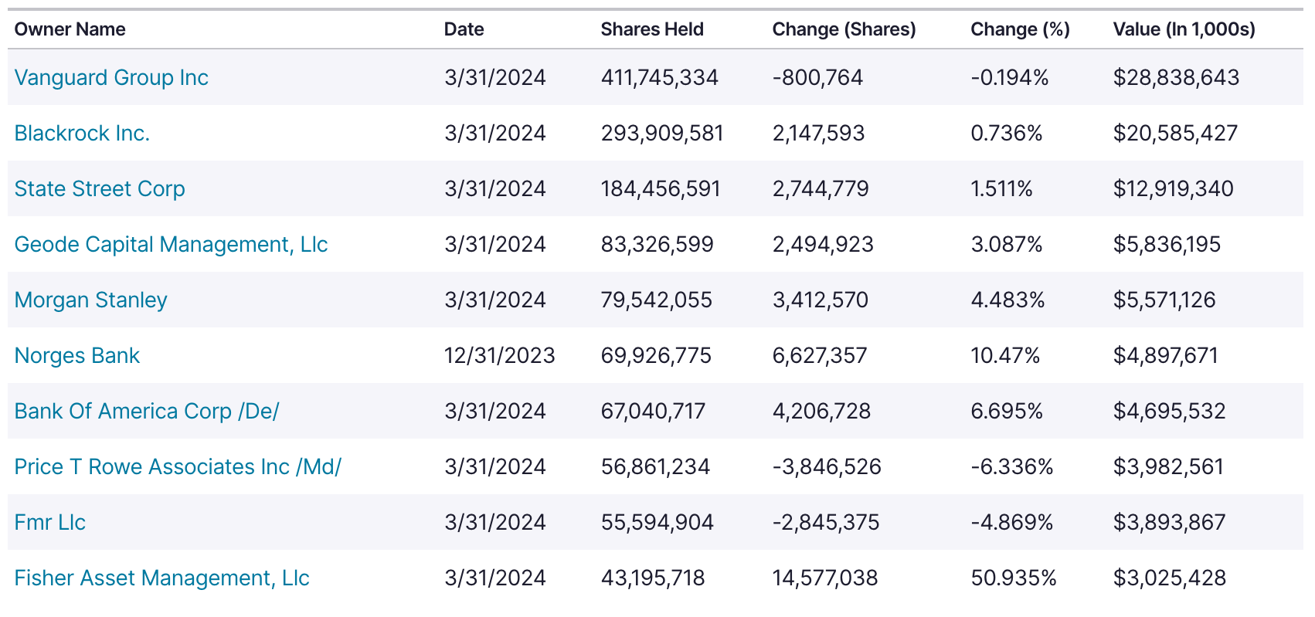
Institutional Holders

Slide 48
Company Overview

Slide 49
Timeline
1962
● Sam Walton opens first Walmart in Rogers, Arkansas
1969
● Official incorporation as Wal-Mart Stores, Inc.
1970
● Walmart becomes publicly traded
1971
● The first distribution center and Home Office opens in Bentonville, Arkansas
1972
● Walmart is listed on the NYSE
1978
● First pharmacy opens
1980
● Walmart becomes fastest company to reach $1 billions annual sales

Slide 50
Timeline
1983
● Walmart’s First Sam’s Club opens in Midwest City, Oklahoma
● Walmart replaces cash registers with computerized POS systems
1988
● The first Walmart Supercenter opens in Washington, Missouri
● David Glass becomes CEO
1991
● Walmart goes global, opening a Sam’s Club in Mexico City
1992
● Sam Walton passes away at age 74
1993
● Walmart achieves $1 billion sales in a week
1994
● Walmart expands into Canada through purchase of 122 Woolco stores

Slide 51
Timeline
1996
● Walmart opens first stores in China
1997
● Walmart achieves first $100 billion sales year
1998
● Walmart enters the UK with acquisition of Asda
2000
● H. Lee Scott, Jr becomes CEO
● Walmart.com is founded
2002
● Walmart enters the Japanese market through investment in Seiyu
2007
● Walmart.com launches Site to Store service (order online and pick up in store)

Slide 52
Timeline
2009
● Mike Duke becomes CEO
● Walmart enters Chile with acquisition of majority stake in D&S S.A.
2010
● Walmart enters India with a joint venture
2011
● Walmart enters South Africa with acquisition of 51% of Massmart Holdings Limited
2014
● Doug McMillon becomes CEO
2019
● First Walmart Health Center opens
● Walmart insources its advertising business, Walmart Connect
2020
● Walmart launches Walmart+ membership program

Slide 53
Mission and Strategy
Mission
“Walmart Inc. helps people around the world save money and live better - anytime and anywhere - by providing the opportunity to shop in both retail stores and through eCommerce, and to access other service offerings”
Strategy
“Our strategy is to make every day easier for busy families, operate with discipline, sharpen our cultures and became more digital, and make trust a competitive advantage.”
Core Values
●Price leadership (Pay Less. Live Better)
●Trust consumers are getting the best price (Everyday low prices)
●Making life easier by increasing convenience (eCommerce, pick-up instore)

Slide 54
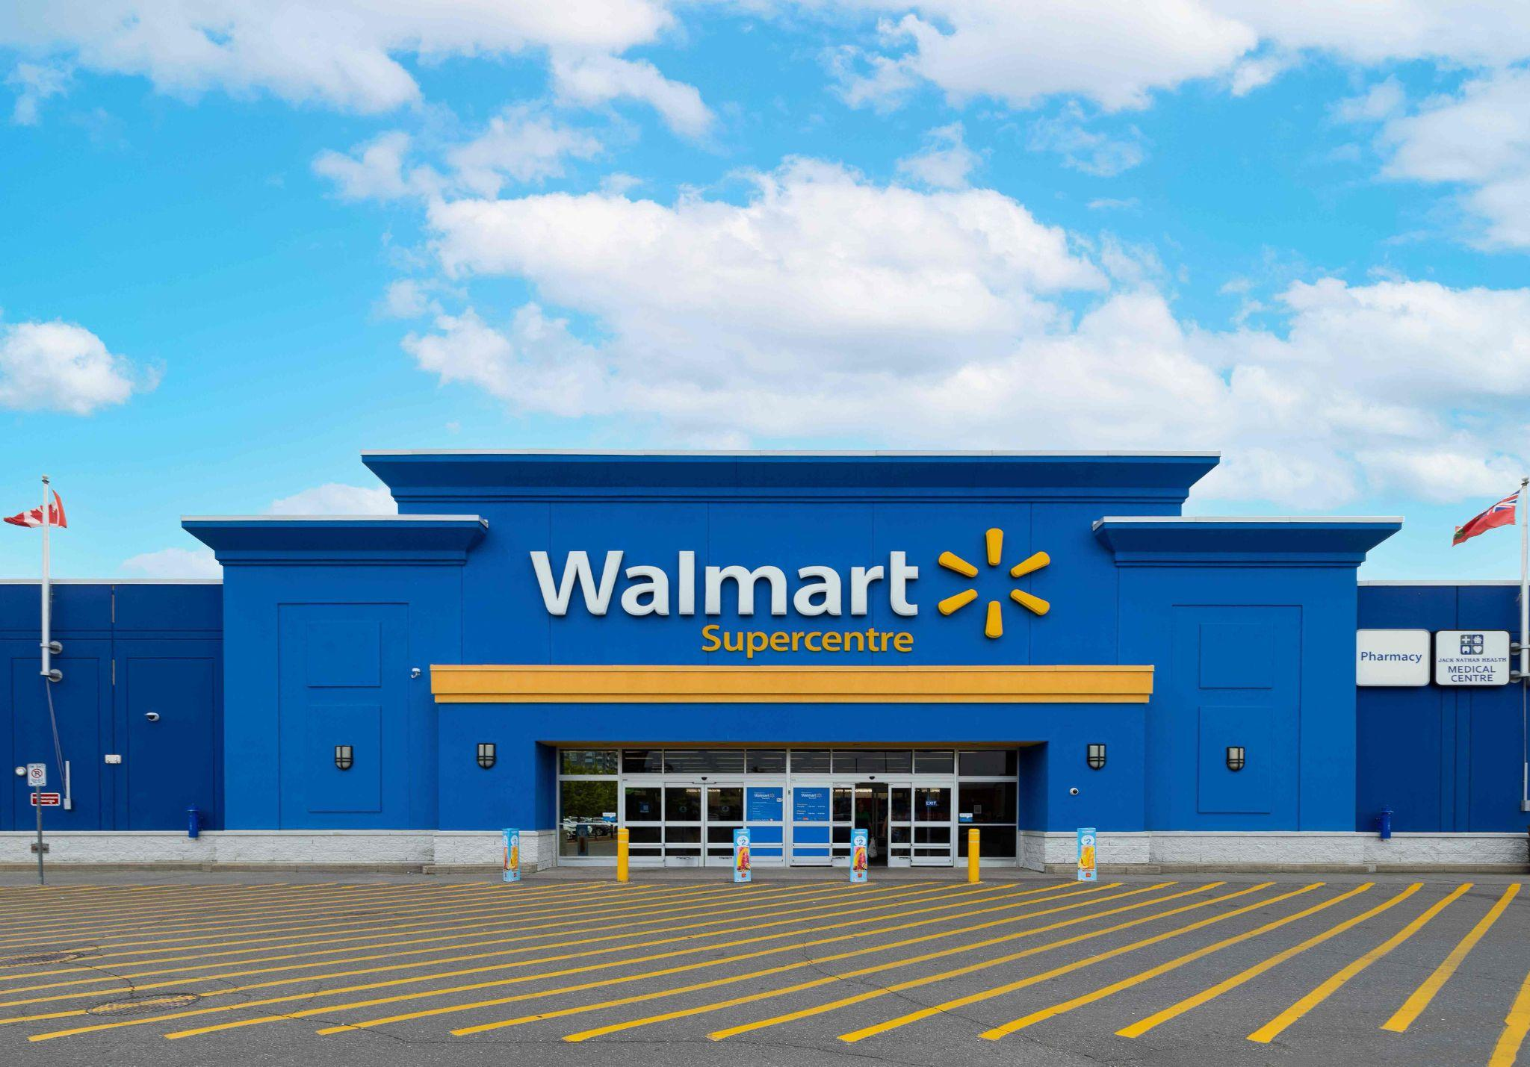
Company Introduction
• At revenue over $600 billion, Walmart is the largest company by revenue since 2014
• 95% of Americans visit Walmart at least twice every year

Slide 55
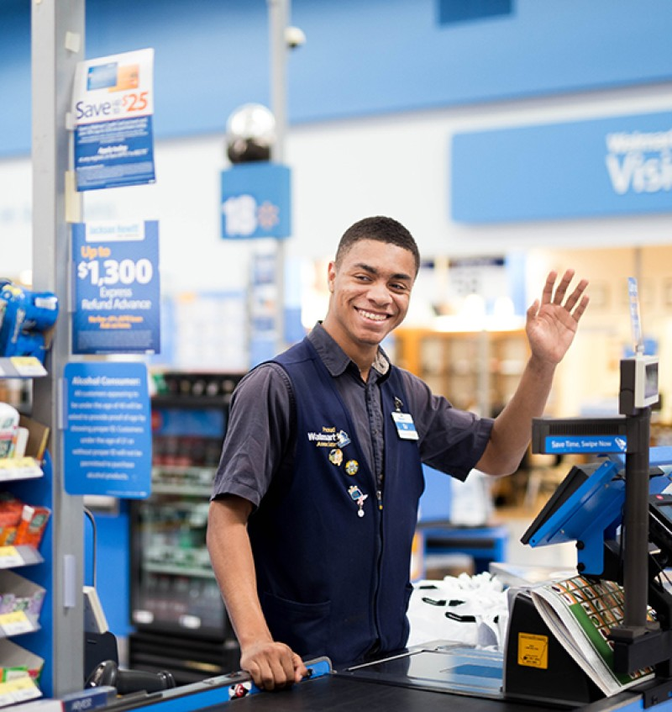
Employees
As of 2023:
1.6 million employee in US, 600,000 worldwide
75% of U.S. Walmart managers started as hourly employees
Women represent 57% of Walmart’s workforce, slightly above the natural male/female split of 51.1% in the U.S
There are around 14,500 U.S. Walmart employees who are currently on welfare programs like SNAP food stamps.
Notes:
https://www.zippia.com/advice/walmart-statistics/#:~:text=every%20single%20day.-,In%20fact%2C%20just%20one%20Walmart%20Supercenter%20in%20the%20U.S.%20serves,items%20available%20on%20the%20shelves.
https://www.enterpriseappstoday.com/stats/walmart-statistics.html

Slide 56
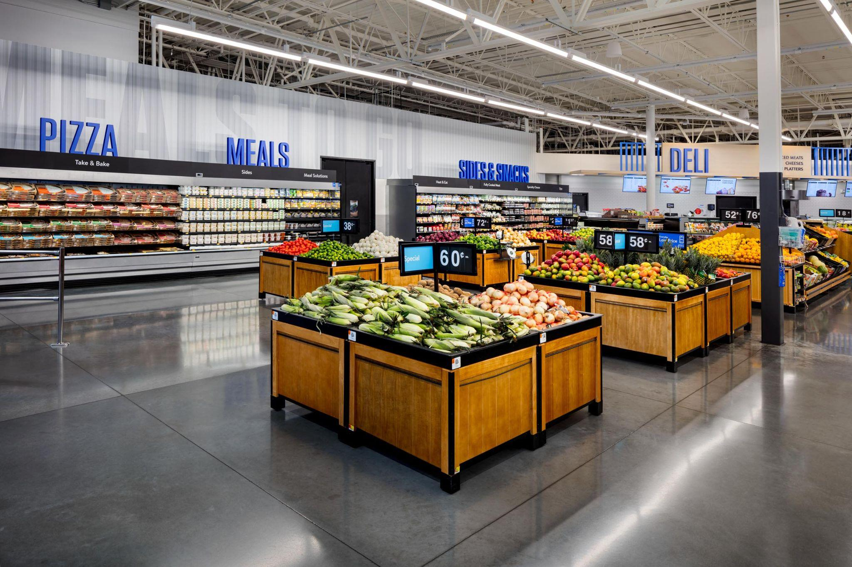
Merchandise
On Average, Walmart supercenters contains ~142,000 items
Bananas are the Walmart’s most popular product, however the margin is likely close to 0%
Other popular items include slow cookers, pillows, flushable wipes, paper towels, television etc

Slide 57
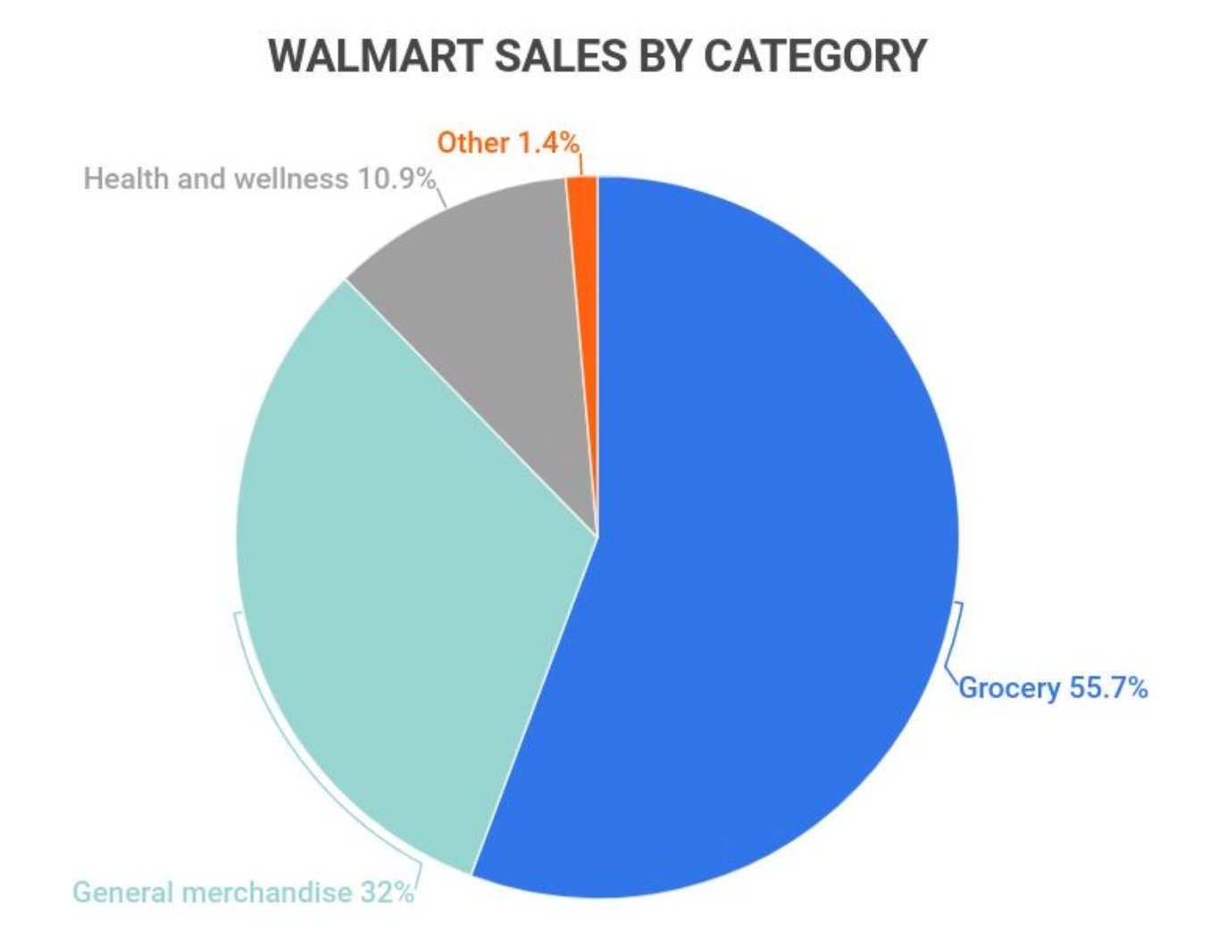
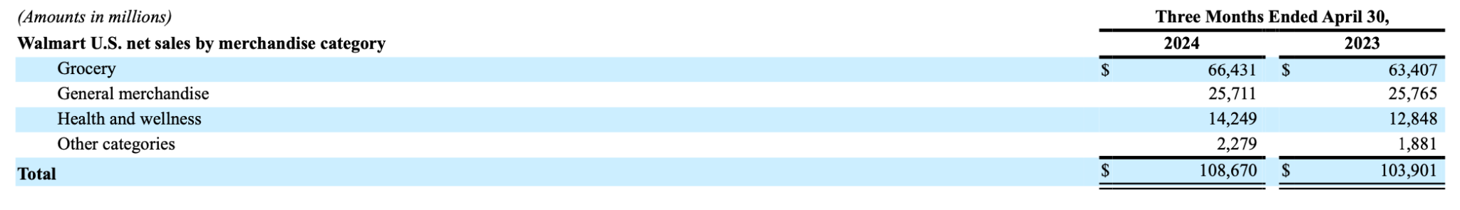
Merchandise
Largest revenue source by merchandise:
Grocery
General Merchandise
Health and wellness
Other categories
Walmart Margins
Gross Margin (24.1%)
Net Margin (4.3%)

Slide 58
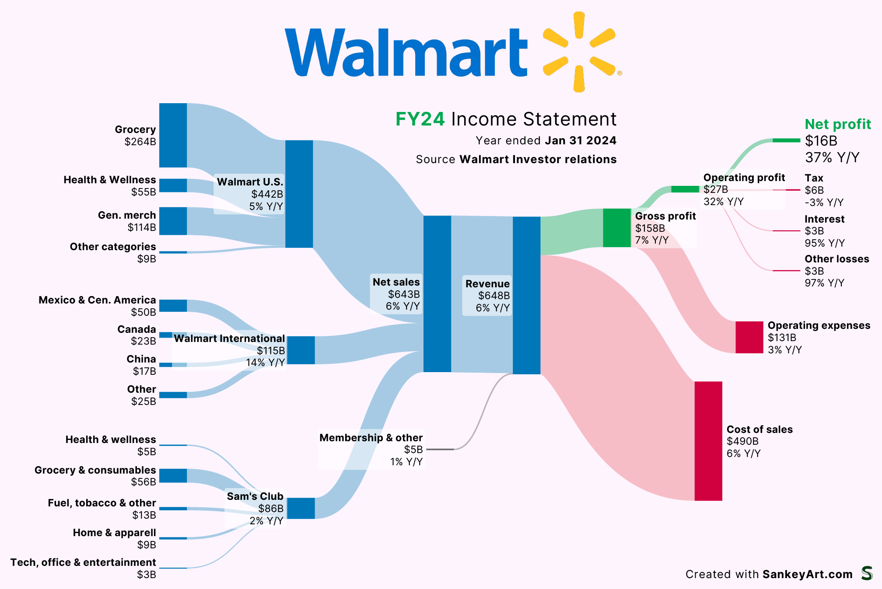

Slide 59



Three Walmart Segments

Slide 60
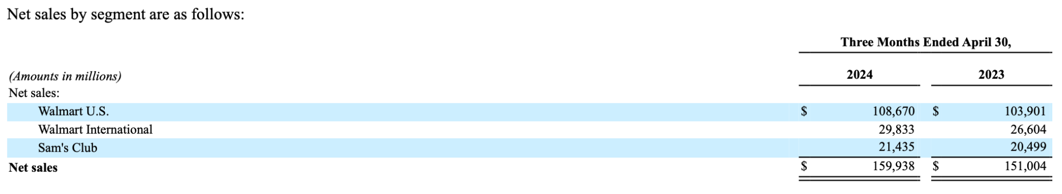
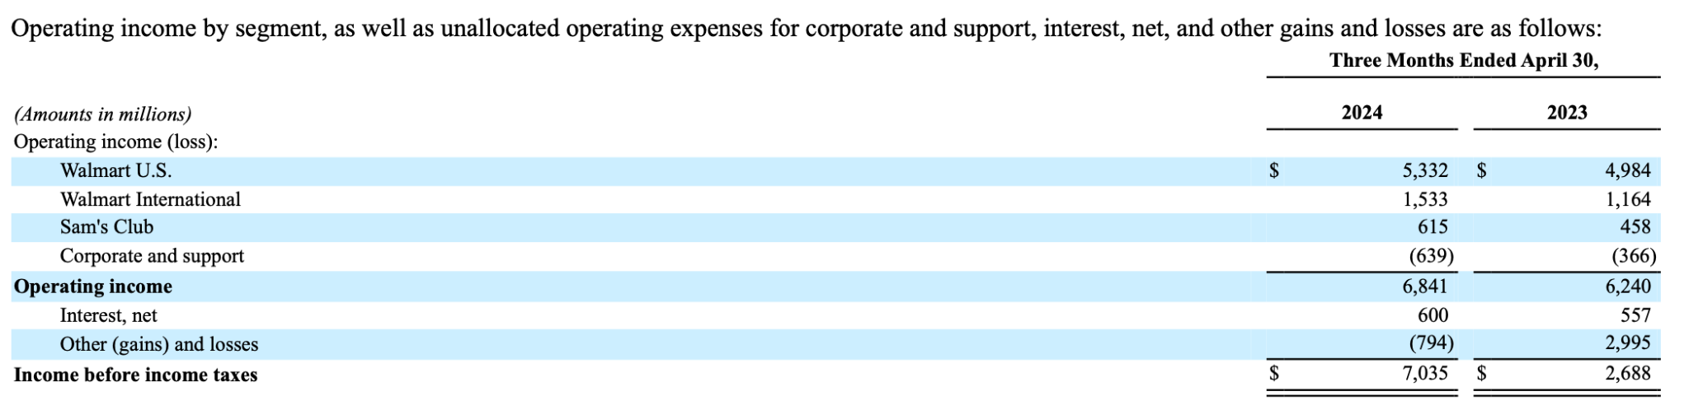
Revenue & Income

Slide 61
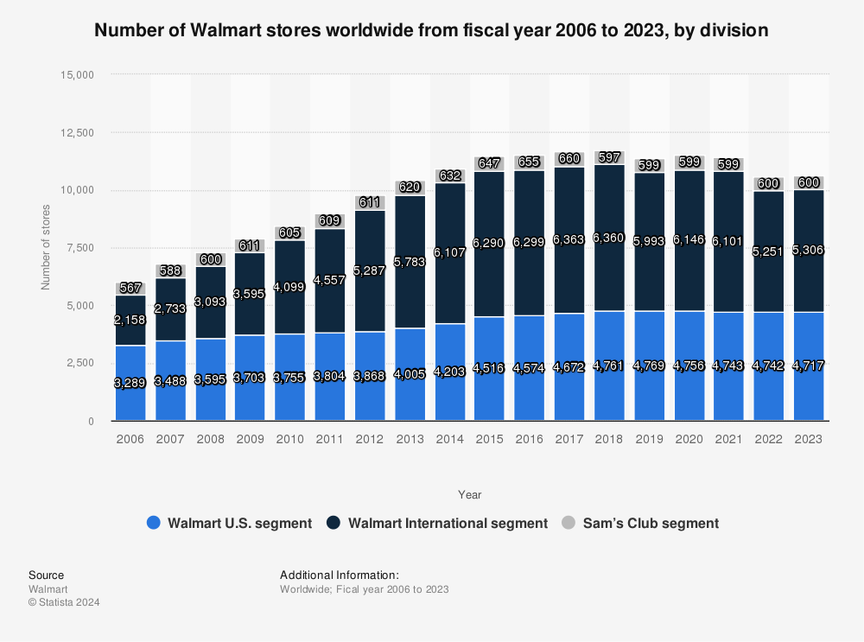
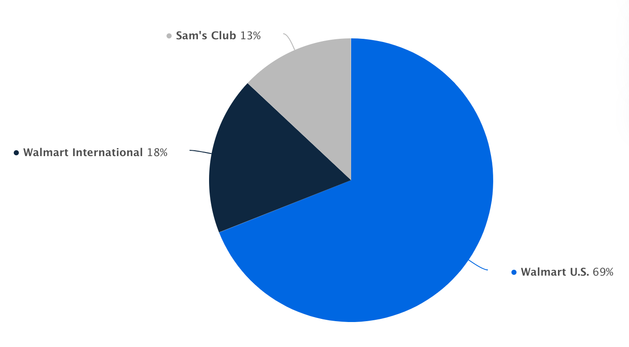
Sources of Revenue
Percentage of Net sales in FY2024

Slide 62

Walmart US
Gross Profit Rate
+46bps
Strong competitive price gaps to retail market
Lower markdowns as a result of disciplined inventory management
Advertising and data analytics & insights businesses aided business mix
Operating expenses as a percentage of net sales
+48bps
Operating income
$5.3Billion, +7.0%
Reflects gross margin expansion and higher Walmart+ membership income
Inventory
-4.2%
Disciplined inventory management while sustaining strong sales and higher in-stock levels

Slide 63


Revenue Details - International
Largest Market outside of US:
Mexico and Central America (44%)
China (18%)
Canada (18%)

Slide 64

Walmart International
Gross Profit Rate
+32bps
Improved eCommerce margins and growth in higher-margin services
Operating expenses as a percentage of net sales
-47bps
Strong sales growth combined with disciplined expense management driving leverage
Benefited by ongoing format mix changes
Operating income
$1.5Billion, +31.7%
Inventory
+3.7%
Driven by over 170 new stores in the past 12 months and currency rate fluctuations

Slide 65

Walmart International Sales
Sales growth led by Mexico, China, Philippines
eCommerce sales grew 19% led by store-fulfilled pickup and delivery and marketplace
Currency rate fluctuations positively affected sales by $0.4 billion

Slide 66

Walmex
Mexico and Central America
Opened 162 new stores in the past 12 months, including 12 new stores in the quarter
Gross profit rate increase
Lower supply chain costs and growth of higher-margin services
Operating expense rate increase
Primarily due to planned investments in associates and strategic priorities
Operating income increase

Slide 67

Canada
Sales
Continued strength in food and consumables
Strong eCommerce growth led by store-fulfilled pickup and delivery and marketplace
Gross profit rate relatively flat
Lower supply chain costs and shrink offset by investments in price gaps
Operating expense rate relatively flat
Operating income increase

Slide 68

China
Sales
Continued strength in Sam’s Club and eCommerce
eCommerce penetration at 43%, up over 200 bps vs Q1 last year
Gross profit rate decrease
Due to format and channel mix changes, partially offset by lower delivery costs
Operating expense rate decrease
Driven by strong sales growth and format mix changes
Operating income increase

Slide 69

Sam’s Club
Operates in 44 states in the U.S. and in Puerto Rico, Membership-only warehouse club
Operates in 45 states in the U.S. and in Puerto Rico, Membership-only warehouse club
Also operates 168 locations in Mexico and 45 locations in China
Revenue is behind its main rival Costco
In 2009, Walmart Canada announced that it would be closing all six of its Canadian Sam's Club locations due to competition with Costco. Only 1 Sam’s Club remains in Canada in Ontario.

Slide 70

Sam’s Club - Performance
Compared to sales of $108,670 million and $5,332 million of operating income from Walmart US. 2.9% operating income as a percentage of net sale compared to 4.9% from Walmart US
Walmart US Units counts: 4,609
Retail square feet: 698

Slide 71

Sam’s Club US
Gross Profit Rate
+58bps
Benefited from lower markdowns as a result of disciplined inventory management
Continued focus on cost and price to increase value for the member
Operating expenses as a percentage of net sales
+17bps
Membership income
+13.3%
Record highs for total and Plus membership
Operating income
$615M, +34.3%,
Inventory
-4.9%
Disciplined inventory management

Slide 72


eCommerce
For reference, Amazon’s revenue 7 year CAGR is 22.9%
Notes:
https://finbox.com/NASDAQGS:AMZN/explorer/total_rev_cagr_7y/

Slide 73

eCommerce

Slide 74

Acquisition of Jet.com
Jet.com was a E-commerce business, a competitor to Amazon
Walmart acquired Jet.com in 2016 for $3.3billion, this started Walmart’s E-commerce business
Walmart winded up Jet.com in 2020 when Walmart’s main website outgrew Jet.com
Majority of Jet.com employees were merged into Walmart
Despite the wind up, Walmart credited Jet.com as the stepping stone to the E-commerce business

Slide 75


Strategic Alliance with JD.com
Largest E-commerce companies in China
In 2016, Walmart and JD.com, China’s largest e-commerce company by revenue, form a strategic alliance to better serve consumers across China, covering both online and offline retail
Wal-Mart is putting faith in JD.com to remain one of the top players in China’s e-commerce space, where consumers are projected to spend nearly $6.4 trillion a year by 2025
On the innovation front, the company is expanding its drone delivery routes to cut transportation costs and increase focus on rural areas of China, which will ultimately help it compete against Chinese e-commerce market leader Alibaba

Slide 76

Partnership with Shopify
In 2020, Walmart partnered with e-commerce firm Shopify as it looks to expand its online marketplace business and cash in on the coronavirus-driven jump in online shopping.
The partnership was focused on adding small- and medium-sized U.S. businesses to its platform, Walmart.com
Shopify Walmart Integration: Allows Shopify sellers to easily register and sell on Walmart Marketplace

Slide 77


Other E-Commerce Acquisitions
●Type of business: Online apparel brand
●Acquisition price: $310 million
●Date purchased: June 16, 2017
●Sold in May 2023 for $75 million
●Type of business: Online outdoor retailer
●Acquisition price: $51 million
●Date purchased: February 13, 2017
●Sold in February 2023

Slide 78


Other E-Commerce Acquisitions
●Type of Business: E-commerce
●Acquisition price: $70 million
●Date purchased: December 30, 2016
●Sold in October 2020
●Type of business: Online specialty retailer
●Acquisition price: N/A (between $50 million and $75 million)
●Date purchased: March 17, 2017
●Sold in October 2019

Slide 79

eCommerce
Walmart App: Walmart Pay, Mobile Express Returns, prescription refills and grocery orders with same-day pickup
Mobile Scan & Go: Shop and checkout with your phone in-store.
Curbside Pickup: Order online, pickup in store
NextDay Delivery: Free shipping on eligible orders over $35

Slide 80

eCommerce
Walmart+: Membership program with various in-store and online benefits
Walmart GoLocal: Walmart’s delivery as a service business that provides delivery to customers from businesses of all sizes.
Built for Better: Promoting personal well-being and reducing our impact on the environment

Slide 81
Walmart+
Launched in 2020, a Prime competitor
Annual/monthly membership ($12.95/mo or $98/an), cheaper than Prime ($139/$15)
Benefits
Free shipping on goods (no order minimum) and free delivery on groceries ($35 order minimum)
Free next day and two-day shipping on items from Walmart.com
Paramount+ subscription (video streaming service)
Returns from home
Scan-and-Go
Walmart Rewards
Other limited-time offers
Estimated ~59 million members, compared to Amazon prime ~230 million
Probably not accurate as Walmart doesn’t report its member count

Slide 82

Automated Distribution Centres
On July 10, 2024, Walmart said it will open 5 automated distribution centres for fresh foods across the US
Will be roughly 700,000 square feet, with chilled and frozen areas with products later sold at stores or online
Walmart said by early 2026,
Two-thirds of its stores will be serviced by some kind of automation
Roughly 55% of fulfillment center volume will move through automated facilities.
Unit cost averages could improve by about 20%

Slide 83
Other
Information

Slide 84

Gross Profit Rate
Gross profit rate +42bps to 24.1%
Due to improvements across segments, led by Walmart U.S.
Improvement from continuing to manage pricing aligned to competitive price gaps, lower markdowns as a result of disciplined inventory management, and favorable business mix

Slide 85

Return to Shareholders
Share repurchases during the quarter totaled $1.1 billion representing 18.0 million shares, at an average price of $59.05 per share
Remaining share repurchase authorization is $15.5 billion

Slide 86

Strategic Capital Expenditure

Slide 87
Board of Directors

Slide 88






Board of Directors
Gregory B. Penner
Chairman of the Board. General Partner of Madrone Capital Partners
Cesar Conde
Chairman of NBC Universal News Group
Timothy P. Flynn
Retired Chairman and CEO of KPMG International
Sarah Friar
CEO of Nextdoor holdings, Inc.
Carla A. Harris
Senior Client Advisor Morgan Stanley
Tom Horton
Lead Independent Director. Retired Chairman and CEO of American Airlines

Slide 89





Board of Directors
Marissa A. Mayer
Co-founder and CEO of Sunshine Products, Inc. Former President and CEO of Yahoo!, Inc.
Doug McMillon
President and CEO, Walmart Inc.
Brian Niccol
Chairman and CEO, Chipotle Mexican Grill, Inc.
Randall Stephenson
Retired Executive Chairman and CEO of AT&T Inc.
Steuart Walton
Founder and Chairman, RZC Investments, LLC

Slide 90
Executive Management

Slide 91

Doug McMillon:
President and CEO, Walmart Inc (2014-present)
●2009-2014 President and CEO, Walmart International
●2005-2009 President and CEO, Sam’s Club
●Started in 1984 as a teenager unloading trucks
●MBA from University of ​​Tulsa
John Furner:
President and CEO, Walmart U.S. (2019-present)
●2017-2019, President and CEO of Sam’s Club
●Started Walmart career as an associate in 1993
●Held positions including: assistant store manager, store manager, district manager, buyer, regional general manager, divisional merchandising manager, VP of global sources, general merchandise manager, head of marketing and merchandising for Walmart China, and chief merchant for Sam’s Club
●Bachelor of Science in Marketing Management from the University of Arkansas.

Slide 92


Chris Nicolas: President and CEO, Sam’s Club (2018-present)
●More than 20 years of broad retail experience working in nine countries and serving in leadership roles with companies such as Tesco, and The Salling Group
●Graduated at the Manchester Institute of Science and Technology with a Bachelor of Science in Management Science and is a chartered accountant (ACMA)
Kathryn McLay: President and CEO, Walmart International (2023-present)
●Joined Walmart in 2015 as Vice President Strategy
●Was CEO and president of Sam’s Club from 2019 to 2023
●Prior to joining Walmart, worked various managerial positions at Woolworths (U.K. supermarket) over 12 years
●Bachelor’s in accounting and finance from the University of Technology Sydney

Slide 93


Dan Bartlett: Executive Vice President, Corporate Affairs (2013-present)
●Responsible for government relations and public policy, corporate communications, philanthropy, and social responsibility
●Also worked as President and CEO of Public Strategies, Inc. and several high-ranking positions at the White House
●Graduated at the University of Texas at Austin with a arts degree in political science
Rachel Brand: Executive Vice President of Global Governance, Chief Legal Office and Corporate Secretary (2018-present)
●Also held positions including Assistant Attorney General for the Office of Legal Policy at the U.S. Depart of Justice during President George W. Bush’s administration
●Bachelor of Arts degree from the University of Minnesota-Morris and her J.D. from Harvard Law School.

Slide 94


Suresh Kumar: Executive Vice President, Global Chief Technology Officer and Chief Development Officer (2019-present)
●Responsible for setting technical strategy, which includes combining advances in computing with Walmart’s strengths to deliver the best customer experiences
●Prior to joining Walmart, worked various executive positions in technology companies including at Google, Microsoft, Amazon, and IBM
●PhD in engineering from Princeton University
Donna Morris: Executive Vice President, Chief People Officer (2020-present)
●Responsible for attracting, retaining and developing talent
●Prior to joining Walmart, worked various people-related executive positions at Adobe for 17 years including Chief Human Resources Office
●Bachelor of Arts degree in political science from the Carleton University

Slide 95

John Rainey: Executive Vice President and Chief Financial Officer (2022-present)
●Responsible for accounting and controls, corporate strategy and development, business planning and analysis, global procurement, internal audit, treasury, tax and investor relations
●Prior to joining Walmart, worked at PayPal’s CFO
●Also worked other executive positions including CFO at United Airlines
●MBA and Bachelor of Business Administration from Baylor University.

Slide 96
Financial
Statements

Slide 97

10-Q Balance Sheet (Assets)

Slide 98

10-Q Balance Sheet (Liabilities)

Slide 99

10-Q Balance Sheet (Equity)

Slide 100

10-K Balance Sheet (Assets)

Slide 101

10-K Balance Sheet (Liabilities)

Slide 102

10-K Balance Sheet (Equity)

Slide 103

10-K Income Statement

Slide 104

10-K Income Statement - cont.

Slide 105

10-Q Income Statement

Slide 106

10-Q Income Statement - cont.

Slide 107

10-K Cash Flow Statement (Operating)

Slide 108

10-K Cash Flow Statement (Investing)

Slide 109

10-K Cash Flow Statement (Financing)

Slide 110

10-Q Cash Flow Statement (Operating)

Slide 111


10-Q Cash Flow Statement (Investing and Financing)

Slide 112
Buy
Recommendation
Large Potential for Growth:
Economies of scale and economies of scope
Continued growth across all markets (+13.7% Y/Y in income)
Continued E-commerce growth
(+31.8% 6 year CAGR)
Continued growth in international markets (+10.7% Y/Y)

Slide 113


Slide 114

Basic Company Information
Notes:
High P/E ratio indicates a high valuation, high growth expectations.
The dividend is attractive indicating that costco returns a large portion of its earnings to its shareholders

Slide 115

Price Chart - 1 Year
Notes:
There is an overall positive trend because the stock price has been rising from $500 to $800 in this past year.
The positive increase in December was because of a 6.1% increase in net sales and the announcement of a special cash dividend of $15 which was payable on Jan 12, 2024
There was a steep increase in the second half of the year perhaps cause of positive news or positive earnings reports.
There is some volatility around early march (increase maybe due to a positive sales report indicating that net sales for the quarter increased by 5.7%. Fluctuations may be due to Garry Millerchip being appointed an Executive Vice President position)

Slide 116

Price Chart - 5 Year
Notes:
There is still an upward trend but a lot more volatility can be seen in the 5 year price chart. 2020 and 2021 stock prices were impacted by COVID-19.
Volatility in Late December of 2021 was due to net income being down. Fluctuations from April until Late June due to Costco acquiring a minority interest in Costco-Taiwan

Slide 117

Price Chart - 10 Year
Notes:
As for the 10 year it is still a positive trend and some fluctuations due to covid, news, and announcements

Slide 118

Price Chart - Max
Notes:
Again same thing can be seen for the max with the stock price being fairly consistent until Covid-19 hit and then so on due to changes in sales, news about new management, and dividends.

Slide 119

Institutional Holders

Slide 120
Timeline
1976: Costco traces its history back to 1976, when Sol Price, opened the first Price Club in San Diego
1978: Price Club was able to rebound from its rocky start and opened a second store in Arizona
1980: Price Club was operating four stores in California and Arizona, generating $150 million in annual sales, and offered public stock on July 12th
1983: The first Costco location opened in September in Seattle, Washington
1984: Price Club sales exceeded USD $1 billion, and there were nine Costco’s in five states
1985: Costco offers public stock on December 5th
1993: Costco and Price Club merge, forming “PriceCostco”
1995: Kirkland Signature, Costco’s exclusive private label was introduced
1997: The company changed its name from Price Costco to Costco Companies, Inc
The Executive Membership is introduced

Slide 121
Timeline
1998: E-commerce at Costco.com brings Costco prices and services to the internet
1999: The company changes its name to Costco Wholesale Corporation on August 30th
2000: The 2% reward program is initiated, increasing Executive member value even more
2004: Costco is now the 5th largest retailer in the U.S. and the 11th largest in the world
Fortune Magazine lists Costco 29th on the Fortune 500
2005: Costco.ca is launched for Canadian members in February 2005
2014: With less than 2 million employees on its payroll, Costco becomes the Fortune - 2014 list of Top Revenue generating companies
Costco becomes the third-largest retailer in the U.S.
2018: Jim Sinegal, Co-founder and former CEO of Costco retires from Board of Directors
2019: Costco opens its first Chinese location in Shanghai
2022: Costco has 842 locations across the globe and has surpassed over USD $200 Billion in sales
2024: Costco has 876 locations worldwide

Slide 122

How Costco Makes Money
Notes:
More memberships: The primary revenue source for costco is actually their membership fees. In order to shop at costco customers need to pay an annual fee to become members. This allows them to have a stable income creat and they also offer different membership types such as gold-star, business, executive and each membership has different benefits and fees.
Higher Sales Volume: Costco sells most of their products in bulk at lower prices than competing stores which influences customers to purchase more items when they visit regardless of if they need the large quantity. The idea of having a wholesale store in a warehouse also is aimed at attracting more customers while maintaining low costs
Better Negotiating Leverage: Costco is a company that has strong relationships and negotiating power with their suppliers which allows them to secure lower prices and favourable items. Their private label, Kirkland also allows the company to offer high-quality products at lower prices which increases their margins on these products
Low Prices: Costco is known for offering lower prices than their competitors which drives high customer traffic and loyalty. Also by maintaining low operational costs and efficient inventory management, costco also helps customers save
E-commerce and In-store: Many of their stores are Brick-and-Mortar stores so most of their revenue comes from physical stores. Their E-commerce platform is also growing which gives customers convenience and accessibility to purchase a wider range of products

Slide 123

Membership Layout
Gold Star Membership
Annual Membership fee of $60
Executive Membership
Annual Membership fee of $120
2% cash back on eligible purchased, up to $1000
Totaled 32.3 Million and represented 45.4% of paid members (excluding affiliates) in the U.S. & Canada.
Represented approximately 72.8% of worldwide net sales in 2023
Notes:
Most popular membership option is the Gold star due to its cheaper annual membership fee and benefits

Slide 124

Membership Growth
Membership Growth has been considerably strong amid inflationary pressures, growing at a 10-year CAGR of 5.72%
International Membership retention has been maintained at 90%
U.S. and Canada Membership retention has averaged roughly 93%
As of yesterday, Costco plans their first membership fee increase since 2017
$5 increase on basic memberships and $10 increase on executive memberships
Notes:
Costco's membership has continued to grow at a steady pace. The membership fees for Q3 2023 amounted to over $1.4 billion, indicating a healthy increase from the previous year's $984 million. This growth aligns with a 10-year compound annual growth rate (CAGR) of approximately 5.72%​
The membership retention rates have been maintained at high levels. As of the latest reports, the U.S. and Canada retention rate is about 92.6%, and the international retention rate is around 90.5%, both at all-time highs​

Slide 125

Costco Inc. Strategy
Costco purposely sells a few items at a loss to drive customers into their stores, with the focus on making money strictly from their annual memberships
Costco provides its members with a “thrilling shopping experience,” with cheap meals at its cafeteria and a treasure-hunting-like experience, with a strategically designed warehouse designed to maximize restocking
The company carries an average of roughly 4000 active stock-keeping units (SKUs) per warehouse, significantly less than other retailers

Slide 126


Segment Reporting
2023 Revenue Mix
2023 Geographical Mix
Food and Sundries
861 Warehouses
$237.7B
Notes:
This visual shows that costco’s revenue primarily comes from food and sundries which amounts to 40.5%. In terms of geographical mix, US and Puerto Rico are said to make up 69% of their warehouses.

Slide 127

Disaggregated Revenue
Notes:
This again just shows which one of their products bring in the most revenue for Costco and it’s clear that is has been Food and Sundries for 3 consecutive years now

Slide 128

Locations
Notes:
This visual kind of just shows all the locations in which Costco operates. This shows that a bulk of the locations are in the US followed by Canada and so on.

Slide 129

Global Success
Costco membership sign ups in the first 8 to 12 weeks of a new store opening overseas are generally 10 times greater than Costco store openings in the US.
Costco’s unorthodox strategies create two outcomes:
Average ticket total for Costco customers is high because customers firmly believe they are saving more money by spending more money
“More - is - better mindset,” customers tend to make impulse purchases when they spot products that they did not expect to be available at a discount warehouse
Notes:
When Costco opens up its international stores, they see membership sign-ups are 10 times higher in the first 8-12 weeks compared to US stores. This is said to be driven by two strategies: high average ticket totals from customers who believe they are saving by spending more and a “more-is-better” mindset leading to impulse purchases of things that are not needed.

Slide 130

Employee Productivity
Costco pays its employees way above the average minimum hourly pay (US $18.50 vs. US $12)
76% of Costco’s warehouse managers started at entry-level and worked their way up
Strong employee perks have allowed Costco to have high employee engagement
90% employees have been with Costco for at least one year in 2023 in the U.S.
Walmart faces an estimated employee turnover rate of 70% per year
Notes:
In 2024 Costco increased their minimum employee wage by 50 cents bringing it up to 18.50. They pay their employees above the minimum wage with 76% of warehouse managers who are rising from entry-level positions. Strong benefits and high engagement leads to 90% employee retention for over a year in 2023.

Slide 131

Kirkland
Kirkland is Costco’s in-house brand that sells products for up to 20% less than their national brand name counterparts
Kirkland is America’s biggest consumer packaged goods brand measured by sales
As Costco is a high-volume driven business, national brand names compete for shelf space which is why Kirkland products tend to be high quality
Notes:
Kirkland is Costco’s private label brand that sells products for up to 20% less than their competing brands.

Slide 132

Average Sales Per Warehouse
Notes:
This chart shoes the average sales per Costco warehouse from 2014 to 2023. It shows a steady increase in sales, with a noticeable jump in recent years. The newer warehouses, especially the ones opened from 2020 onwards have higher sales figures which shows Costco’s growing market presence and efficiency in generating revenue.

Slide 133
Board of Directors

Slide 134

Board of Directors
Age: 71
Director of Costco since 1988
Lead Independent Director from 2005 until becoming the non-executive Chairman of the Board, in August 2017
Chairman of Jefferson River Capital
Precious Executive Vice Chairman, President and COO of The Blackstone Group
Co-chair of the board of the Metropolitan Museum of Art, of which he has been a member of the board since 2010
Board member of several environmental nonprofits and in 2016 co-authored Rescuing Retirement, a book on solutions to the retirement crisis
Hamilton E. James
Chairman of the Board
Notes:
These are positions they do not currently all hold but are notable positions they had
Based on the Costco’s Websites board of directors and executive management the chairman of the board is Hamilton E. James. “Talk about his past experiences and education”

Slide 135





Board of Directors
Maggie Wilderotter
Director
Susan Decker
Director
Kenneth D. Denman
Director
Helena Buonanno Foulkes
Director
Richard A. Galanti
Director

Slide 136





Board of Directors
W. Craig Jelinek
Company Advisor and Director
Sally Jewell
Director
Jeff Raikes
Director
John W. Stanton
Director
Ron Vachris
President, CEO and Director

Slide 137
Executive Management

Slide 138

President & CEO
Ron Vachris
President, CEO and Director
Age: 58
Experience:
Elected to President and CEO effective January 1, 2024
Most previously served as Director and President of the company from February 2022-January 2024 and Executive Vice President of Merchandising from June 2016-January 2022
Began Retail Career as a forklift driver with the Price Club in 1982
Education:
Graduated from Glendale Community College of California

Slide 139


Richard A. Galanti: Previous Executive Vice President, CFO and Director
Age: 67
Been director since January 1995, and Executive Vice President and CFO of the Company since October 1993
Stepped down on March 15 but staying on until January 2025 to assist in the transition
One of the longest-serving finance chiefs in the US
Raised in the grocery store business as the son and nephew of grocery store operators in the south
Earlier in his career, Galanti held previous roles in Investment Banking
Earned his B.S. in economics from the Wharton School of Business and his MBA from the Stanford University Graduate School of Business
Garry Millerchip: Executive Vice President and Chief Financial Officer
Age: 48
Has had multiple leadership positions at Kroger
Previously a CFO at Kroger from April 2019-February 2024
In March 2024, was named the CFO of Costco, taking over from long-serving Costco CFO Richard Galanti
Held positions as a CFO and CEO at Kroger
Earned his Bachelor of Arts in Financial Services from Birmingham City University and went on to the Warwick Business School to get his MBA

Slide 140


Russ Miller: Senior Executive Vice President, COO - Warehouse Operations
Age: 66
Appointed Senior VP of U.S. operations on May 4, 2022
Previously served as Senior Vice President, of Western Canada Region, from 2001 to January 2018
From 1977-1982, worked at the U.S. Air Force in a Instrumentation and Navigation role
Undergraduate degree from Northwestern University and an MBA from the university of Denver
Patrick Callans: : Executive Vice President, Administration
Age: 61
Has had multiple leadership positions across finance, HR, operations
Worked as an Attorney at Winston & Strawn LP
Joined Foster Pepper & Shefelman in 1989 as an Attorney
In 1994, began his career as Corporate Counsel at Costco
Has been with the company for nearly 28 years
Went to Northwest University, Pritzker School of Law from 1984-1987

Slide 141


Pierre Riel: Executive Vice President, COO - International Division
Age: 60
Appointed to executive vice president, COO - international in 2022 after overseeing the company’s Eastern Canada operations for more than 20 years and most recently serving as a senior vice president and country manager of Canada
Joined the Price Club in 1986 as a forklift operator
In the past he was a store manager at Costco
Jim C. Klauer: Executive Vice President; COO, Northern Division.
Age: 61
Graduated from University of Notre Dame, majoring in MIS
Previously was Senior VP, Non-Foods and E-commerce Merchandise (2013-2018)
Started career at Ernst & Young as a consultant
Spent 28 years at Fidelity Investments. Before joining in Costco in 2018, he was VP, Planning and Re-Engineering Leader at Fidelity

Slide 142
Financial Statements

Slide 143

10-Q Balance Sheet (Assets)
Notes:
So, between May 2024 and September 2023 we can see a slight decrease in total assets from roughly 69 million to approximately 68 billion. Changes are from the reduction from cash and cash equivalents from 13.7 billion to 10.4 billion and also a decrease in short-term investments and operating lease right-of-use assets.
The decrease in short-term investments could suggest that Costco is relocating these funds into a more long-term strategic investments or operational needs
The decrease in operating lease right-of-use assets can reflect the end of certain lease agreements and maybe a shift towards instead owning properties instead which is supported by the property and equipment
Increase in property and equipment can show that Costco is investing in its physical infrastructure to maybe improve and expand their warehouses.

Slide 144

10-Q Balance Sheet (Liabilities)

Slide 145

10-Q Balance Sheet (Equity)

Slide 146

10-K Balance Sheet (Assets)

Slide 147

10-K Balance Sheet (Liabilities)

Slide 148

10-K Balance Sheet (Equity)

Slide 149

10-K Income Statement

Slide 150

10-Q Income Statement

Slide 151

10-K Cash Flow Statement

Slide 152

10-K Cash Flow Statement Con’t

Slide 153

10-Q Cash Flow Statement

Slide 154

10-Q Cash Flow Statement Con’t

Slide 155
HOLD
Recommendation
Potential for Growth:
In FY 2023, Costco reported revenue went up ~$17 billion, indicating growth
Despite economic uncertainties, they have maintained strong performance indicating stability
Strong brand reputation, customer loyalty, and promoting from within

Slide 156


Slide 157

Company Information

Slide 158

Price Chart - 1 Year

Slide 159

Price Chart - 5 Year

Slide 160

Price Chart - 10 Year

Slide 161

Price Chart - Max

Slide 162

Home Depot
VanEck Retail
SPDR S&P Retail
Price Compared with Benchmark (10 Y)

Slide 163

Institutional Holders

Slide 164

Statistics

Slide 165

Statistics

Slide 166

Dividends

Slide 167

Dividends

Slide 168
Company Overview

Slide 169

Value Proposition
Mission Statement
“To provide the highest level of service, the broadest selection of products, and the most competitive prices.”

Slide 170

Strategy

Slide 171

Locations
Total# of Retail Stores as of 2024 Q1: 2,337
US & Territories: 2,017
Canada: 182
Mexico: 138

Slide 172


Sources of Revenue / Segments

Slide 173

Sales/ Segment

Slide 174
Timeline
1978: The Home Depot was founded by Bernie Marcus and Arthur Blank in Atlanta, Georgia.
1979: The first two Home Depot stores opened in Atlanta on June 22.
1981: The Home Depot goes public on September 22, trading on the NASDAQ.
1984: The Home Depot is listed on the New York Stock Exchange (NYSE).
1989: The Home Depot opens its 100th store.
1994: The Home Depot expands internationally, opening its first store in Canada.
1997: The Home Depot celebrates the opening of its 500th store.
1999: The Home Depot launches its online home improvement store, homedepot.com.
2001: The Home Depot begins the installation services business.

Slide 175
Timeline
2006: The Home Depot surpasses 2,000 stores across the United States, Canada, and Mexico.
2011: The Home Depot announces a goal to reduce its energy use by 20% by 2015.
2014: The Home Depot announces a data breach affecting 56 million credit and debit cards, leading to enhanced security measures.
2019: Craig Menear, CEO of The Home Depot, announces a $1.2 billion investment to enhance supply chain efficiency.
2020: The Home Depot reaches over 2,300 stores and expands its online presence.
2022: The Home Depot achieves over $150 billion in annual sales for the first time.
2023: Home depot acquires Temco, Redi Carpet & construction resources.
2024: Home depot acquires SRS Distribution in March for $18.25 Billion.

Slide 176


Notable Acquisitions

Slide 177

Notable Acquisitions

Slide 178

Performance Review 2023

Slide 179

Cash Flow Summary

Slide 180

Q1 Performance Review

Slide 181

Return on Investment Capital

Slide 182

Performance Review 2023

Slide 183
Board of Directors

Slide 184






Slide 185




Slide 186
Executive Management

Slide 187


Career Path
2020-2022: President and COO, led global operations and integrated online and in-store shopping.
Chief Merchant: Managed merchandising, marketing, and vendor relations.
Joined in 2000: Held various strategic roles, including business valuation and retail finance.
Previous Experience
Kimberly-Clark and Scott Paper: Worked in strategic planning and finance.
PNC Bank: Roles in corporate finance and credit.
International: Worked in England and Australia.
Education
Degrees: Bachelor's in English (College of William and Mary), MBA (Carnegie Mellon University).

Slide 188


Ann-Marie Campbell: Executive Vice President of U.S. Stores and International Operations at The Home Depot
Started career with The Home Depot in 1985 as a cashier in South Florida
Held various positions, including store manager, district manager, and regional vice president
Leads more than 2,300 stores and over 400,000 associates
Overseas supply chain, merchandising, sourcing, and strategy for The Home Depot Canada and The Home Depot Mexico
Bachelors in Philosophy and Masters from Georgia State University.
Billy Bastek: Executive Vice President of Merchandising at The Home Depot
Over 30-year veteran of The Home Depot
Started career in 1989 at HD Supply (formerly known as Maintenance Warehouse)
Oversees all store merchandising departments
Develops merchandising strategy
Manages services and vendor management

Slide 189


Matt Carey:Executive Vice President (EVP) of Customer Experience at The Home Depot
Started career in 2008 with HD
Leads the vision, design, and development of new and innovative solutions for a seamless customer experience
Focuses on in-store, online, and mobile experiences
John Deaton: Executive Vice President of Supply Chain & Product Development at The Home Depot
Joined The Home Depot in 2007 as Vice President of Supply Chain Development
Leads strategic efforts to build a fast, efficient, and reliable supply chain in home improvement
Overseas logistics, distribution, delivery, transportation, and inventory management
Responsible for product development of the company's private brands

Slide 190


Richard McPhail:Executive Vice President and Chief Financial Officer (CFO) of The Home Depot
Joined The Home Depot in 2005
Oversees financial operations and functions of the company
Drives company growth and strategy for a seamless, interconnected retail experience
Bachelors in Economics and Business Management from North Carolina State University.
Tim Hourigan:Executive Vice President – Human Resources
President of the Southern Division
Leads all aspects of human resource management at The Home Depot
Focuses on creating a best-in-class environment for over 400,000 associates
Upholds the company's inverted pyramid leadership model and core values
Led a team of over 100,000 associates
Led Human Resources function for U.S. stores and operations:

Slide 191


Hector Padilla:Executive Vice President of Outside Sales & Service for The Home Depot
Over 26 years with The Home Depot
Started in store aisles and progressed through various positions
Positions held include department supervisor, store manager, district manager, general manager of home services, divisional director of field services, regional vice president, and senior vice president of operations
Teresa Wynn Roseborough:Executive Vice President of General Counsel & Corporate Secretary for The Home Depot
Oversees legal functions, government relations, and external communications
Serves as corporate secretary and liaison between the board of directors and the company
Responsible for corporate governance matters

Slide 192


Fahim Siddiqui:Executive Vice President and Chief Information Officer (CIO) of The Home Depot
Senior Vice President of Information Technology at The Home Depot before becoming CIO
Led software development in the retail, energy, and telecom sectors for over three decades
Oversees the company's technology strategy, infrastructure, and software development
Manages technology for retail stores, supply chain facilities, store support centers, and online systems
Paul Antony: Senior VP of Technology
Senior Vice President of Technology at The Home Depot
Develops solutions for enterprise-wide functions including stores, supply chain, finance, human resources, and legal
Over a decade at NCR Corporation in software development and integration
Bachelors in Electrical Engineering from Christian Brothers University
Master's in Engineering from the University of South Carolina

Slide 193

CEO Compensation

Slide 194
Financial Statements

Slide 195

10-Q Balance Sheet: Assets

Slide 196

10-Q Balance Sheet: Liabilities

Slide 197

10-Q Balance Sheet: Equity

Slide 198

10-K Balance Sheets: Assets

Slide 199

10-K Balance Sheets: Liabilities

Slide 200

10-K Balance Sheets: Equity

Slide 201

10-K Income Statement

Slide 202

10-Q Income Statement

Slide 203

10-K Cash Flow Statement

Slide 204

10-K Cash Flow Statement Cont.

Slide 205

10-Q Cash Flow Statement

Slide 206

10-Q Cash Flow Statement Cont.

Slide 207
Recommendation
BUY
Large Potential for Growth:
Cost Advantage: Economies of scale.
Superior Growth: Sales growth outpaces industry by 1.7% annually.
Recent Debt Activity: Raised nearly $2 billion in 2023, repaid $1.3 billion.
Robust Coverage: EBIT forecast to cover net interest expense 12 times by end of 2024.

Slide 208
Thank You

