Slide 1

US Retail
Presented by:
Hansika Chawla | 301269804
Manraj Sanghera| 301318077
Suruchi Singal | 301294798
Raunaq Singh | 301291564
Joven Toor | 301343707

Slide 2





Our Team:
Raunaq Singh
Suruchi Singal
Manraj Sanghera
Hansika Chawla
Joven Toor

Slide 3
Presentation Overview
Industry Overview
-US Retail
-Retail Trends
-Effects of the Pandemic
Stock Analysis
-Home Depot
-Costco Wholesale
-Walmart

Slide 4
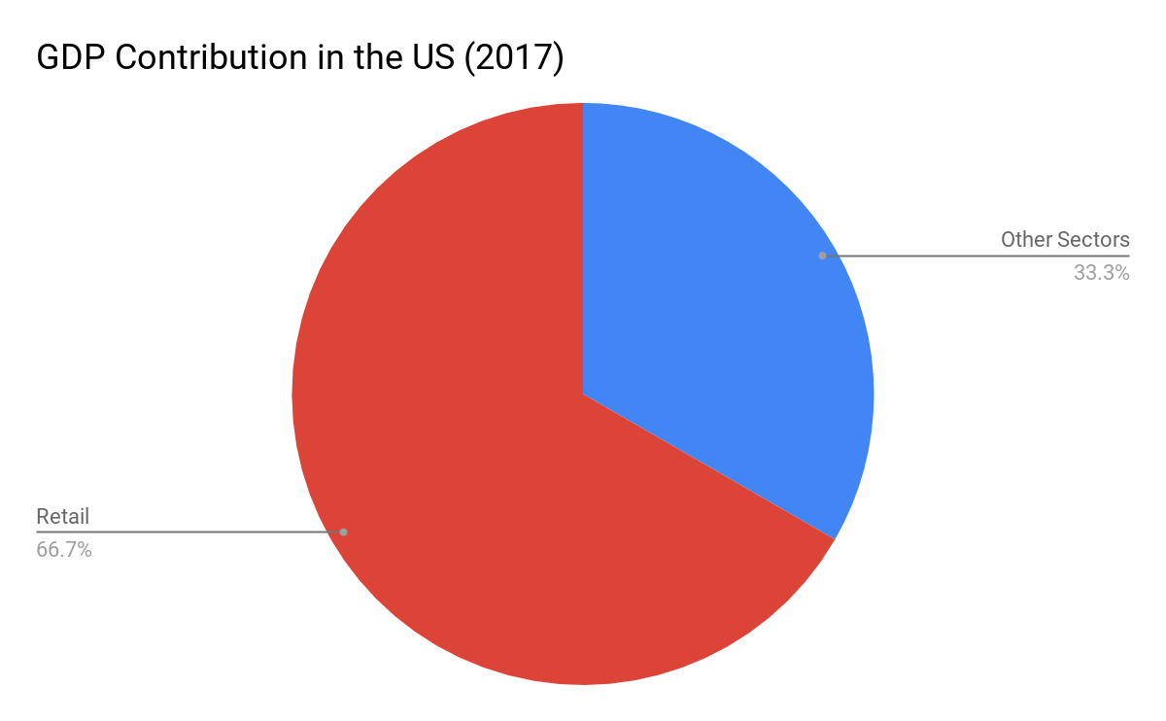
How is Retail defined?
The retail industry is a sector of the economy that is comprised of individuals and companies engaged in the selling of finished products to end user consumers.
-76 of the largest retailing companies in the world are based in the U.S.
-Changes in retail sector significant indicator of strength of US economy.

Slide 5
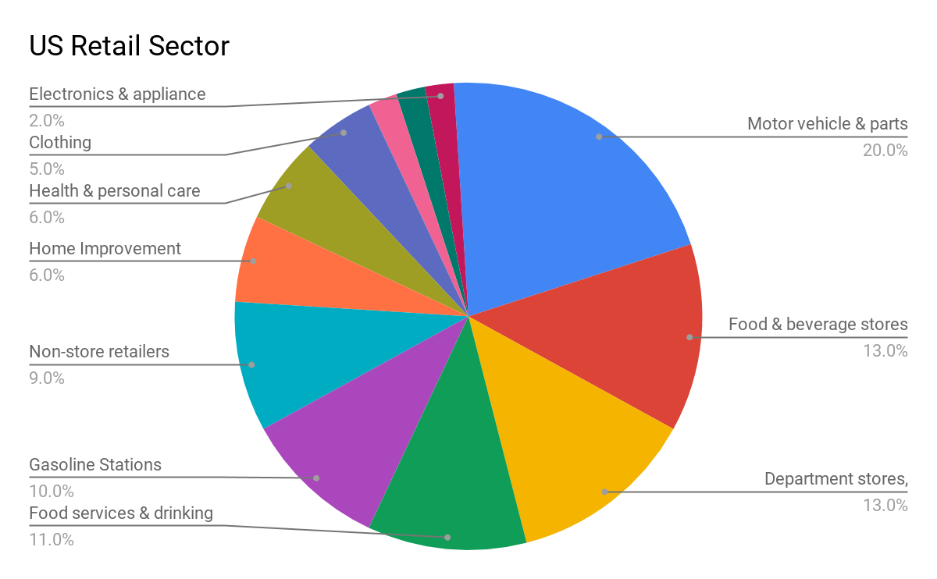
Retail in Detail
16.5 million people were employed in the U.S. Retail Industry in 2018.
Global retail sales amount for upwards of $25 Trillion.
US Retail sales surpassed $5 Trillion in 2018.
US largest retail market in the world.
Top 10 of the largest retailers based in US

Slide 6
Types of Retail Stores
●Furniture and Home Furnishings Stores
○Industries in the Furniture and Home Furnishings Stores subsector retail new furniture and home furnishings from fixed point-of-sale locations. Establishments in this sub-sector usually operate from showrooms and have substantial areas for the presentation of their products.
●General Merchandise Stores and Supercenters
○This industry comprises establishments primarily engaged in retailing new goods in general merchandise stores (except department stores). These establishments retail a general line of new merchandise, such as apparel, automotive parts, dry goods, hardware, groceries, housewares, and home furnishings, with no one merchandise line predominating.
Notes:
Raunaq

Slide 7
Types of Retail Stores
●Grocery Stores
○This industry group comprises establishments primarily engaged in retailing a general line of food products.
●Department Stores
○This industry comprises establishments known as department stores that have separate departments for general lines of new merchandise, such as apparel, jewelry, home furnishings, and toys, with no one merchandise line predominating. Department stores may sell perishable groceries, such as fresh fruits, vegetables, and dairy products, but such sales are insignificant.
Notes:
Raunaq

Slide 8
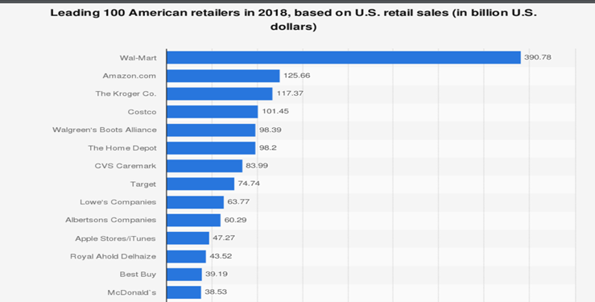
Top American Retailers
Notes:
Joven

Slide 9
Retail Metrics
●Retailer sales per square foot: The sales per square foot data are most commonly used in the retailing industry to determine how successful store sales have been.
●When measuring sales per square foot, keep in mind that selling space does not include the stock room or any area where products are not displayed.
●Total Net Sales ÷ Square Feet of Selling Space = Sales per Square Foot of Selling Space
Notes:
Raunaq

Slide 10
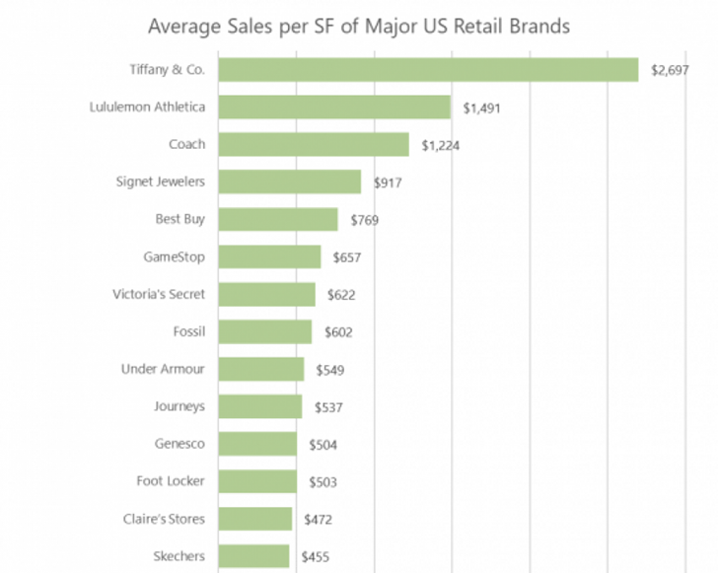
Retail Metrics
Notes:
Raunaq

Slide 11
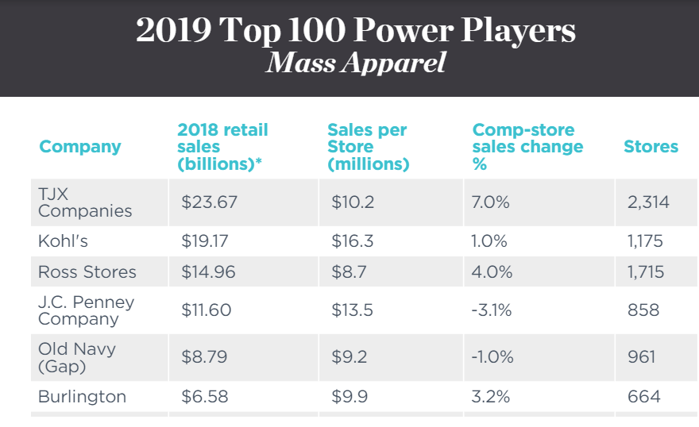
Retail Rankings
Notes:
Raunaq

Slide 12
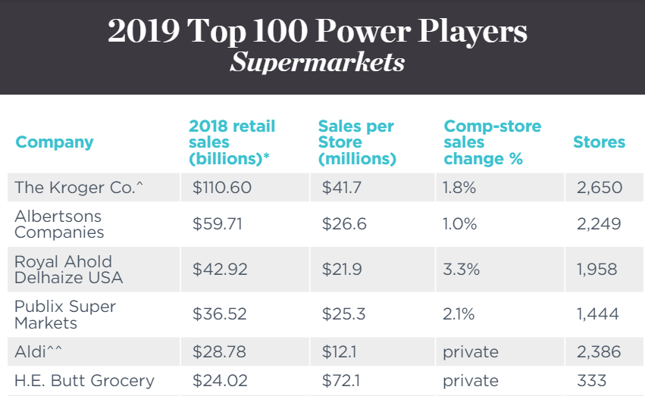
Retail Rankings
Notes:
Raunaq

Slide 13
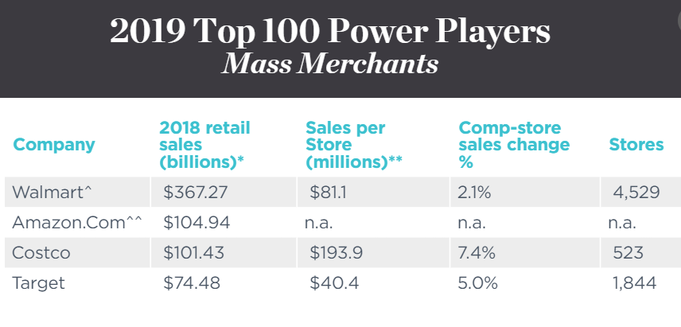
Retail Rankings
Notes:
Raunaq

Slide 14

Retail Industry
Analysis

Slide 15
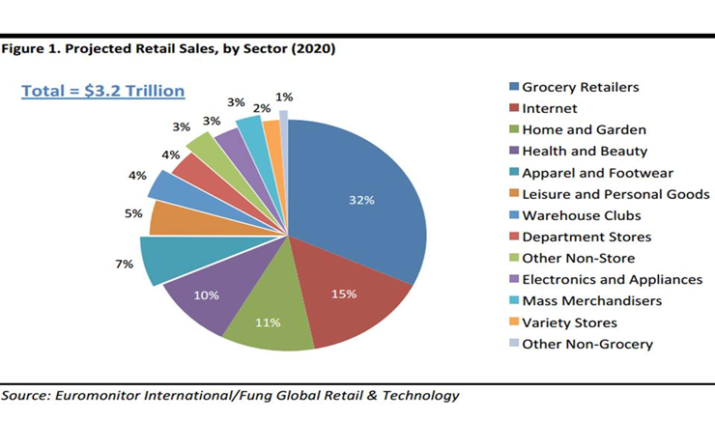
Retail Metrics
Notes:
Raunaq

Slide 16
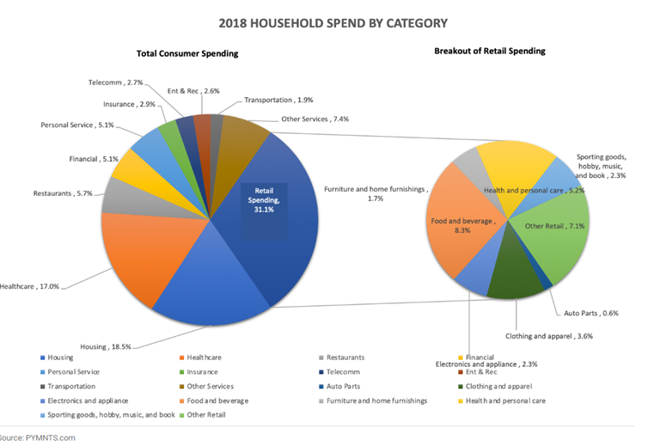
Breakdown of Consumer Expenditure
Notes:
Raunaq

Slide 17
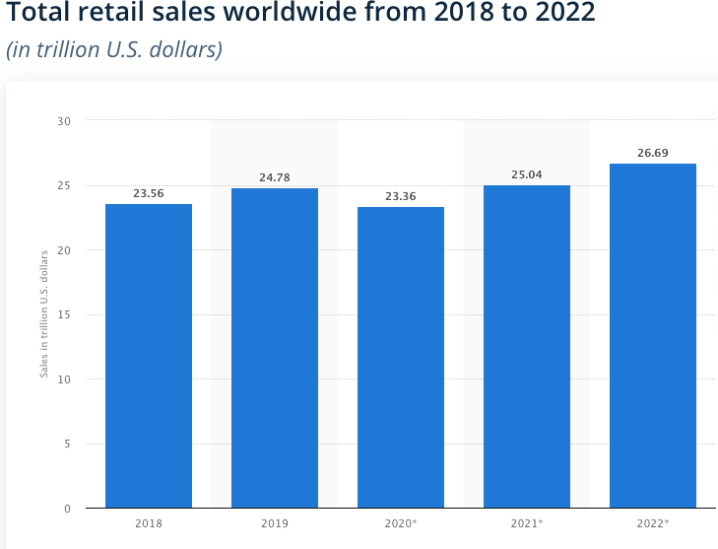
Worldwide Retail Sales Trend
Notes:
Joven

Slide 18
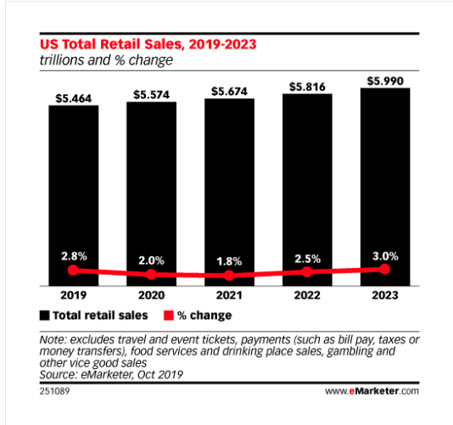
US Retail Sales Trend
Notes:
Joven

Slide 19
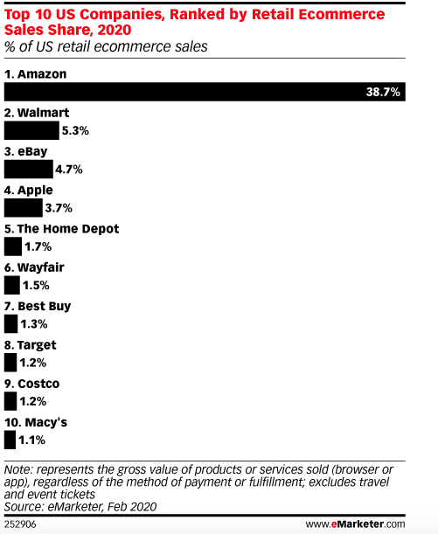
Retail Sales Worldwide
Notes:
Joven

Slide 20
Retail Index
SPDR S&P Retail (XRT)
SPDR S&P 500 (SPY)
RTH: VanEck Vectors Retail
XLY: Dow Jones Consumer

Slide 21
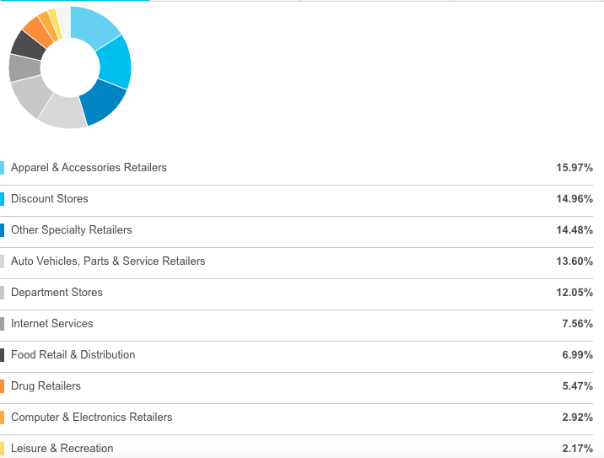
XRT Retail Index Fund
Top 10 Sectors
Notes:
Joven

Slide 22
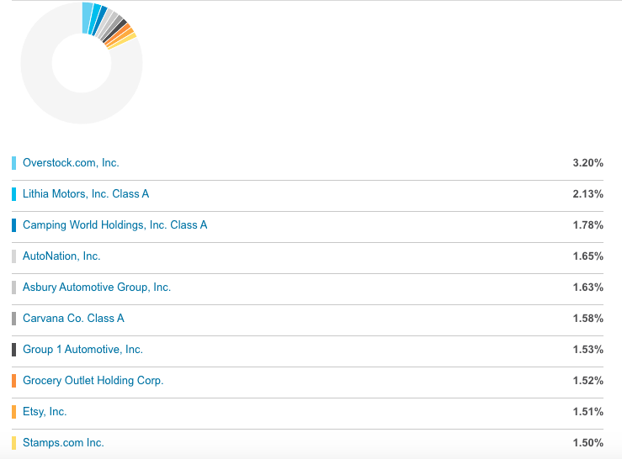
Top 10 Holdings

Slide 23
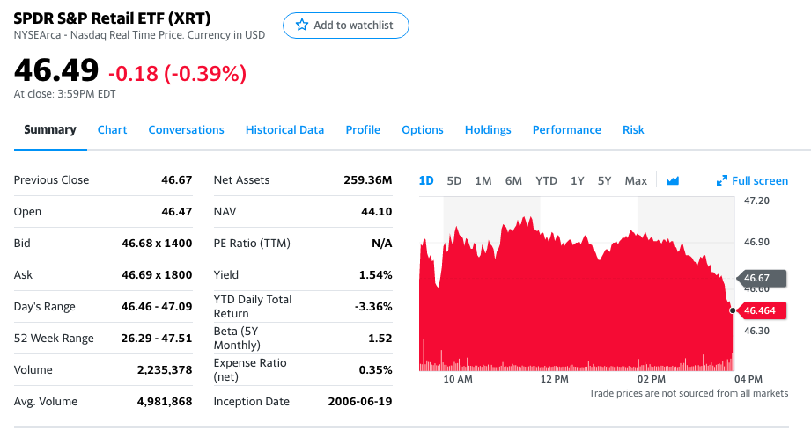

S&P Retail Index - RLX

Slide 24
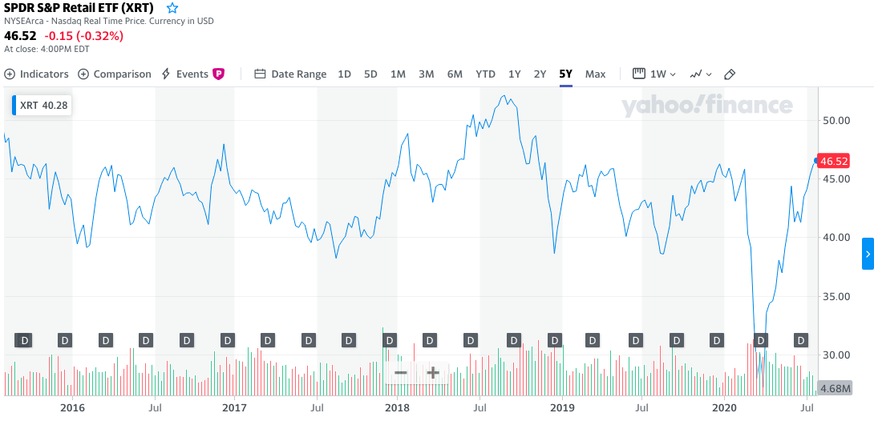
S&P Retail Index - XRT (5 Year)

Slide 25
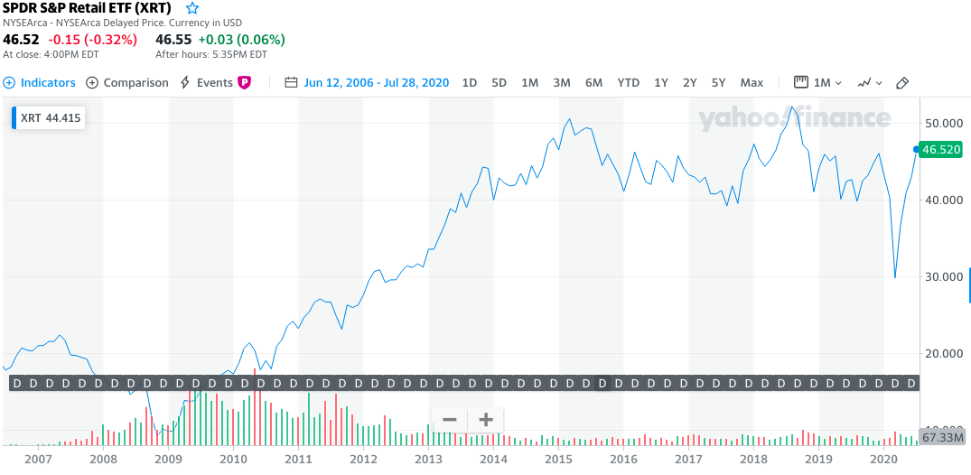
S&P Retail Index - XRT (14 Year)

Slide 26
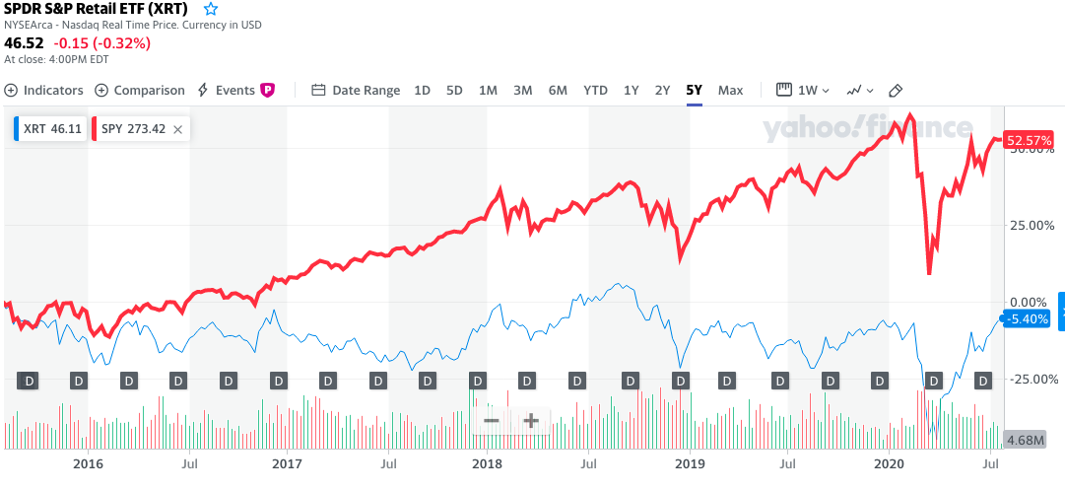
S&P Retail Index Comparison (5 Year)

Slide 27
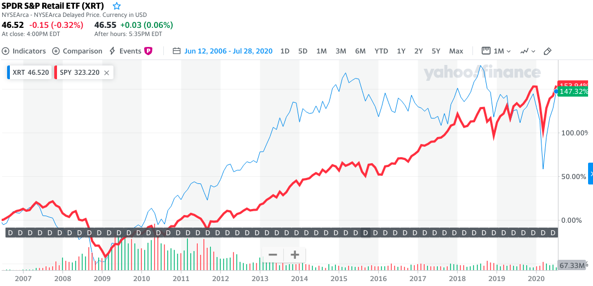
S&P Retail Index Comparison (14 Year)

Slide 28
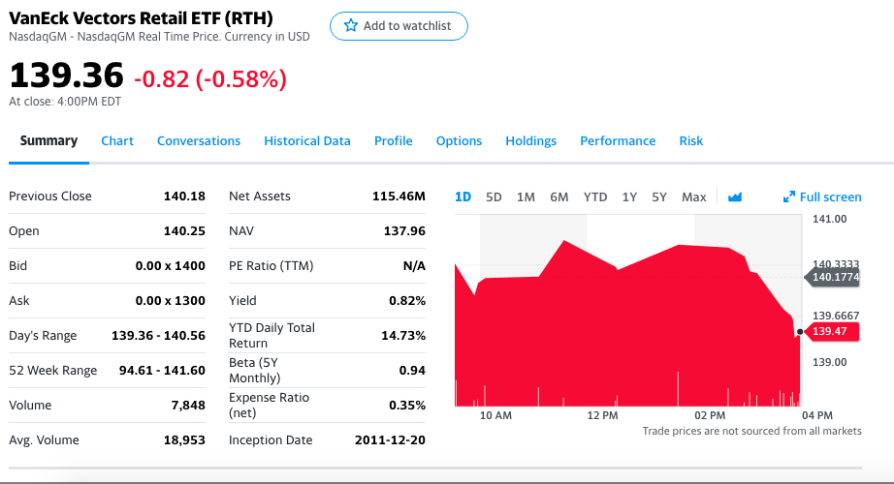

RTH: VanEck Vector Retail ETF

Slide 29
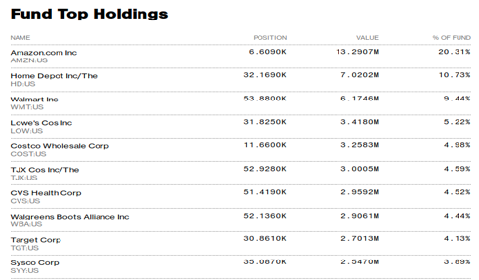
RTH: VanEck Vector Retail ETF

Slide 30
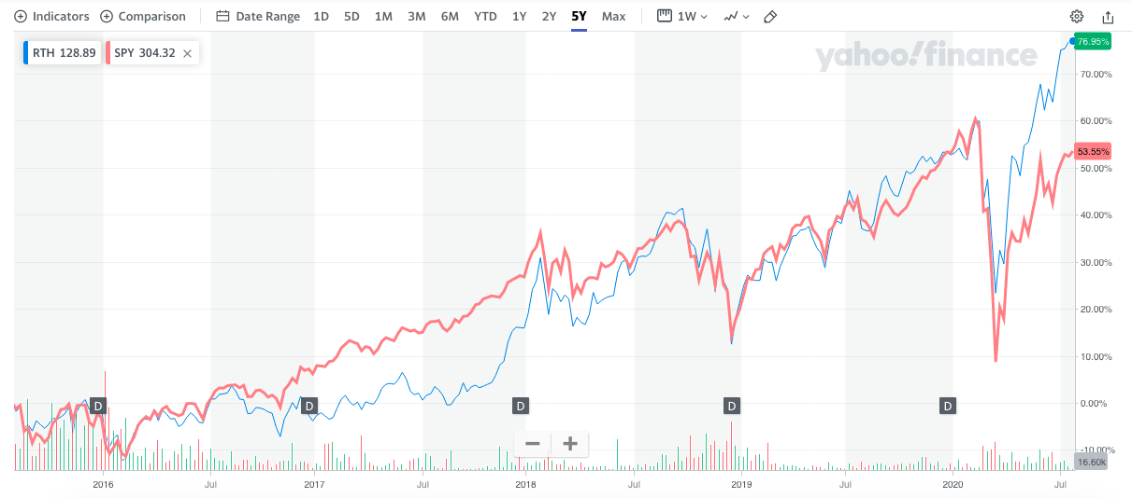
VanEck Vector Retail Comparison (5 Year)

Slide 31


Cyclical and Defensive Stocks
Cyclical stocks
  Apparel stores
Defensive stocks
  Grocery stores

Slide 32

The Retailpocalypse

Slide 33
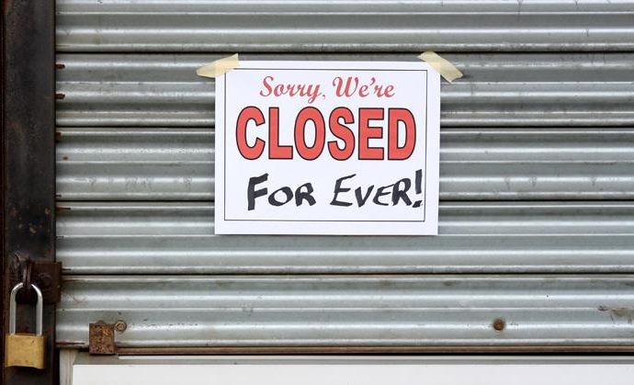
Is Retail dying?
Increasing retail store closures in a booming US economy.
Part of the explanation for retail chains' difficulties since 2017—what some have called the "retail apocalypse"—is the continuing trend of Americans making purchases online
Furthered by the Covid-19 Pandemic.

Slide 34
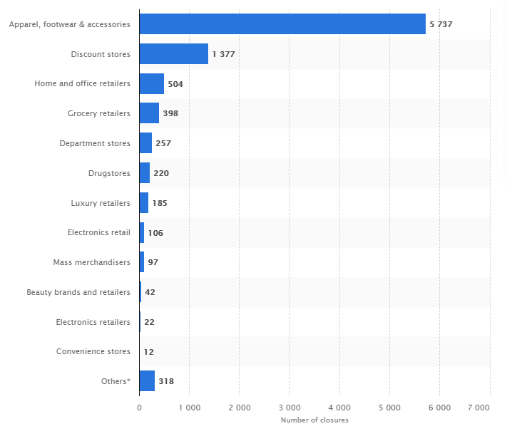
Is Retail dying?

Slide 35




In Memoriam
Major Retailers that closed doors permanently in recent years:
In 2019, nearly 9,100 US Retail Stores closed doors, 55% higher than total closures in 2018.

Slide 36




In Memoriam
Examples of major retailers that are closing stores in 2020:
Notes:
152 JC penney

Slide 37
Challenges in the Retail Sector
Shift in Consumer Expectations
All about Convenience. “Saves me time”
Digitalization
Focus on how to increase sales by adapting to mobile.
Facebook Shops
Escalation of trade tensions
Increased Pricing Pressure and the race to go global

Slide 38
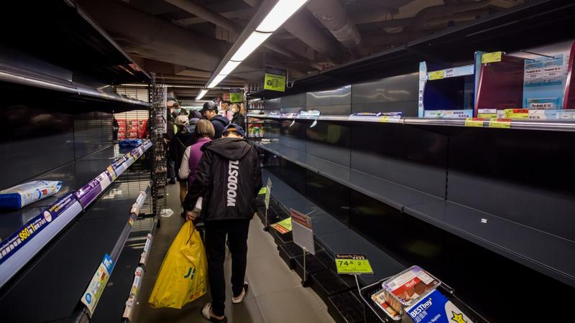
US Retail Post Covid-19

Slide 39
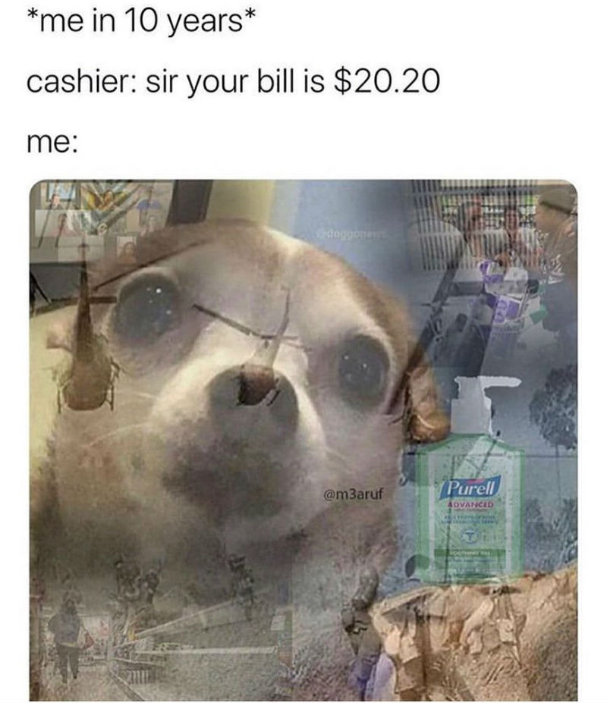
Effect on US Retail

Slide 40
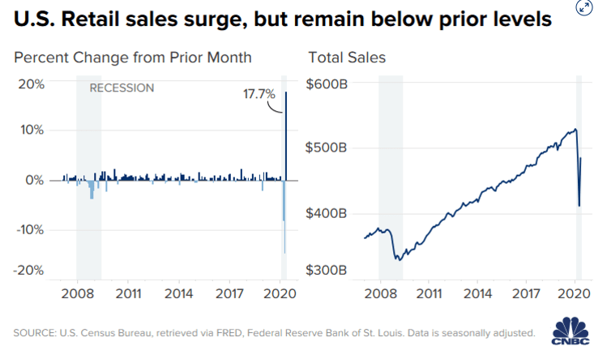
Effect on US Retail

Slide 41
Covid-19 Challenges in the Retail Sector (Forbes)
Retailers will follow safety guidelines for a long time.
Limited visitor numbers will lead to different experiences.
Employee relations will become essential.
Low-touch environments will become the norm.
Notes:
Contactless pay, mention war on cash and shopify

Slide 42
Renaissance for Retail
-A recent survey by ICSC of 9,000 consumers found that slightly more than half of online shoppers said a nearby physical store is “important when buying online.”
-Another ICSC survey found that the newest customer cohort, Gen Z, believes by three-to-one that physical stores provide a better shopping experience.
-71 percent of consumers under 30 years old said they shop for clothing mostly in stores.
-Trend in physical retail reflecting a generational shift. “Millennials are into experiences”.

Slide 43
Shifting Trends
The Shift to Online
In 2019, digital natives turned to physical store pilots, and traditional retailers rolled out digitally powered physical stores.
Retailers are still contemplating plans for fulfillment centers, stores serve as showrooms.
Increased focus on the consumer shopping experience.

Slide 44
Shifting Trends
2. Data Driven Shopping Experiences
Brick-and-mortar accounted for nearly 90 percent of all retail sales in the third quarter of 2019, according to the US Census Bureau
Socially conscious shoppers use their purchasing power as a demonstration of support, and with research showing that shoppers still rely primarily on stores for product discovery and inspiration.
Entire supply chains are being revamped to improve access by having same day delivery etc.

Slide 45
Renaissance for Retail
Consumerization of Technology
Internet use
Smartphones
2. Increased Competitiveness
Price Advantage
Convenience
Large product assortment
3. Major cost savings
A. Showrooming
B. Inventory Savings
C. Real Estate Effect

Slide 46
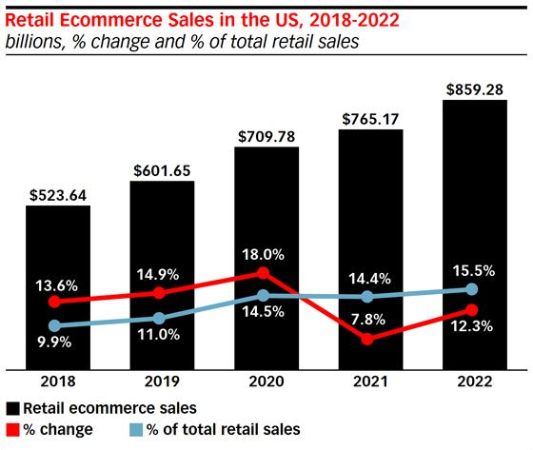
The Rise of Ecommerce
Notes:
Talk about bezos at senate hearing

Slide 47
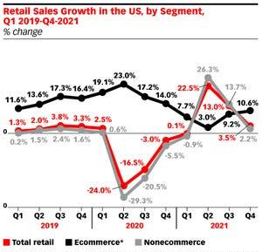
The Rise of Ecommerce

Slide 48

Retail Companies’ Analysis

Slide 49


Slide 50
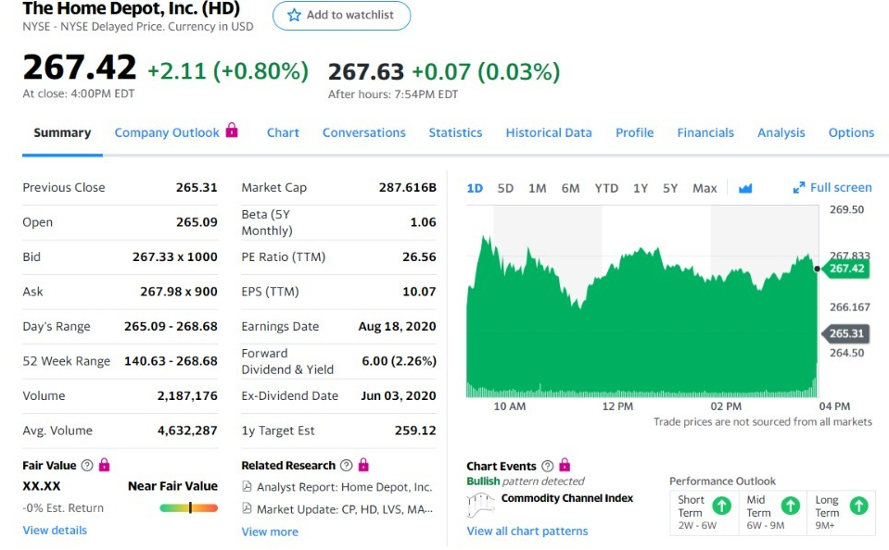

Slide 51
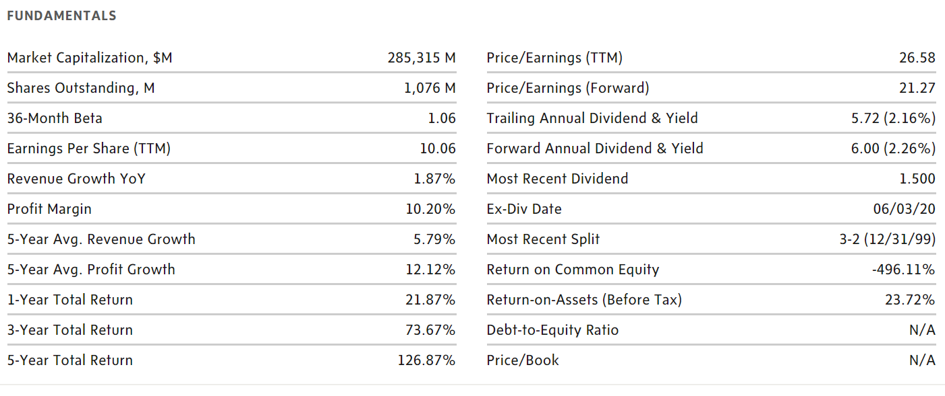

Slide 52
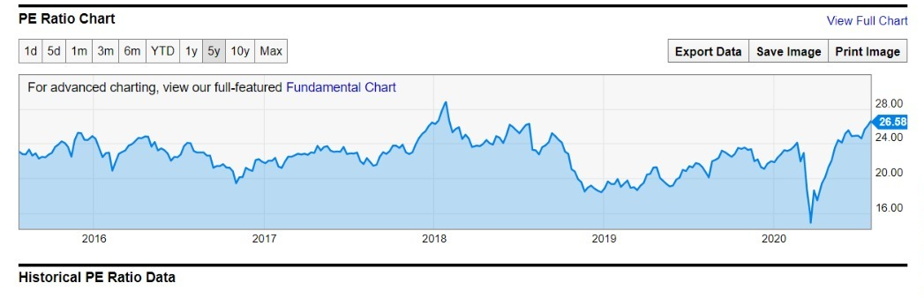
PE Ratio

Slide 53
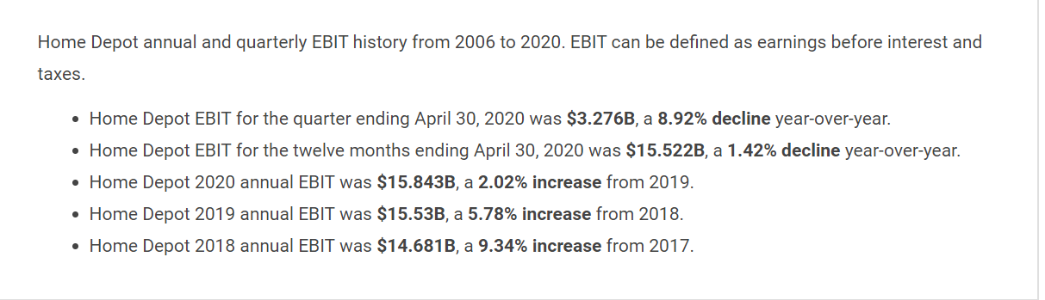

Slide 54
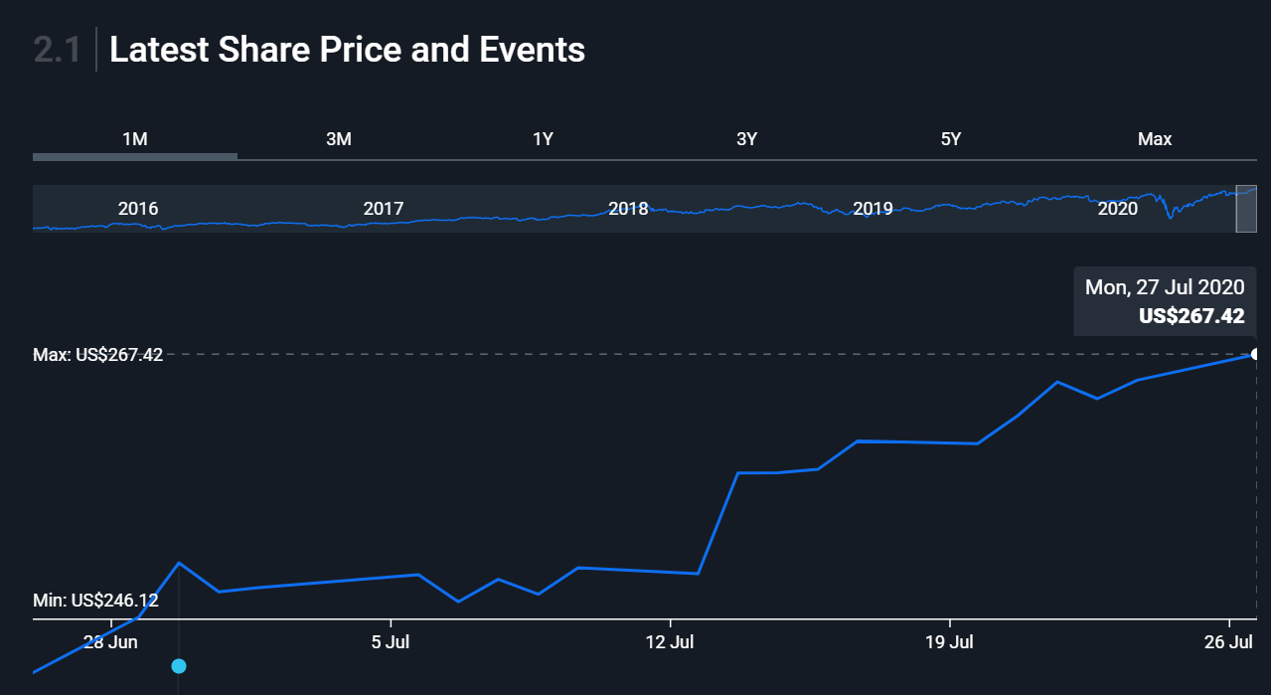

Slide 55
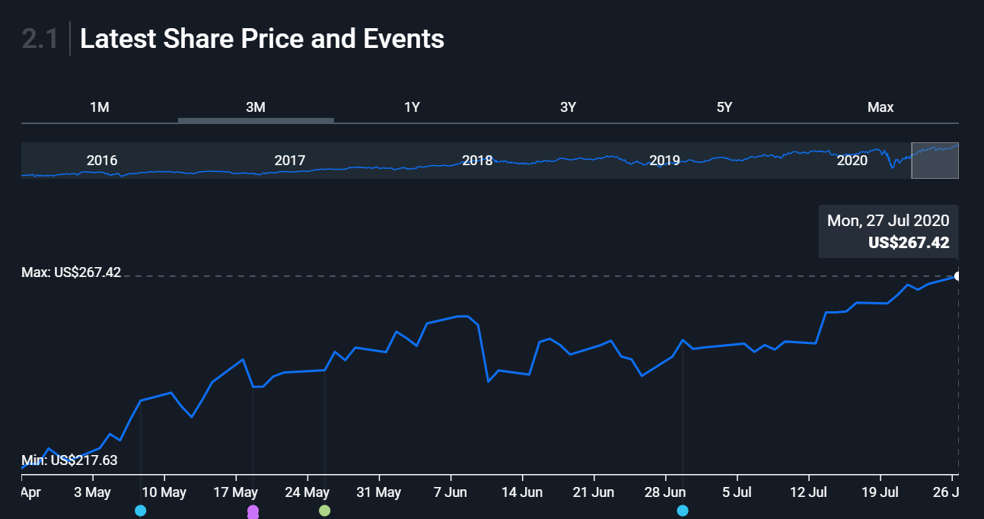

Slide 56
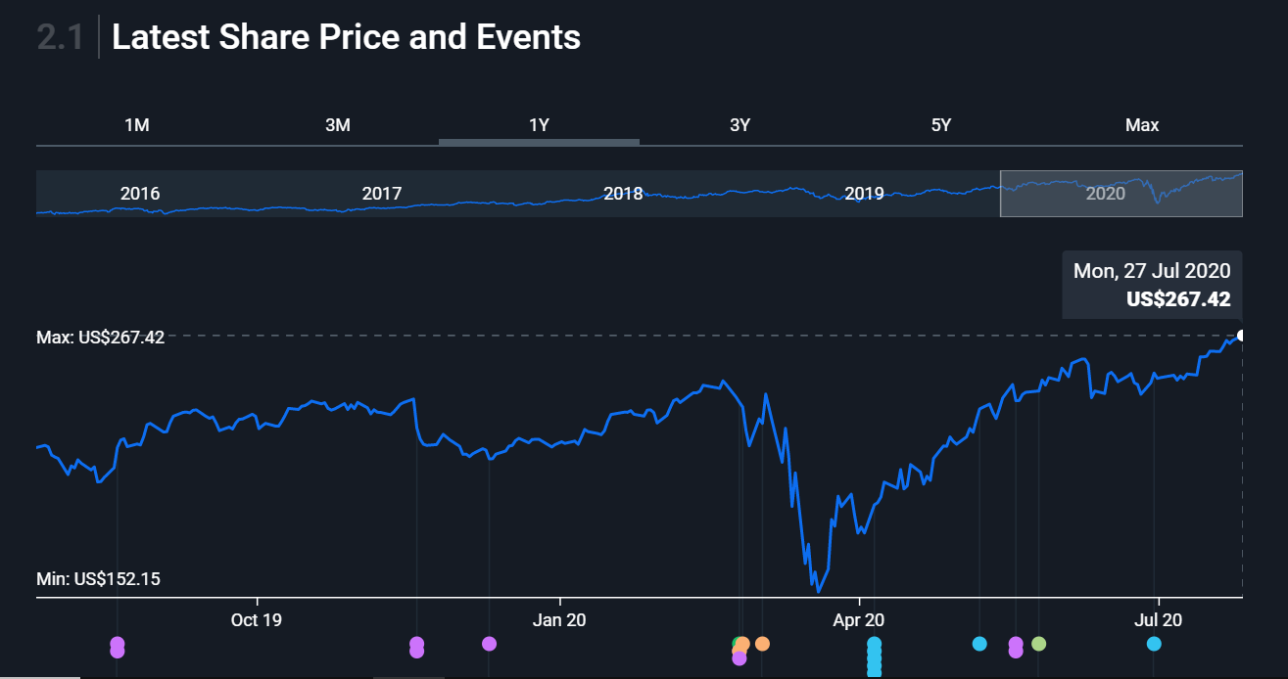

Slide 57
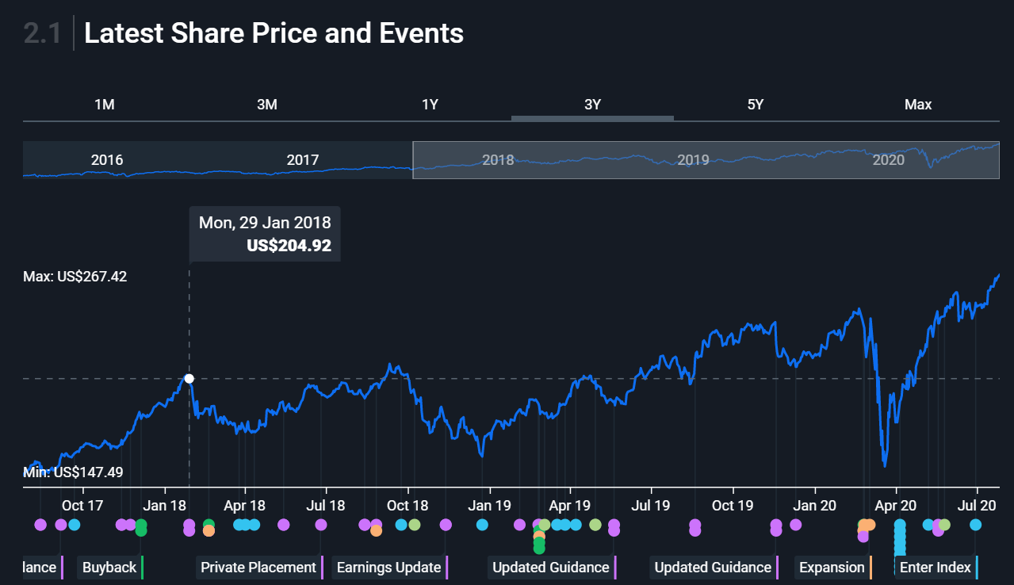

Slide 58
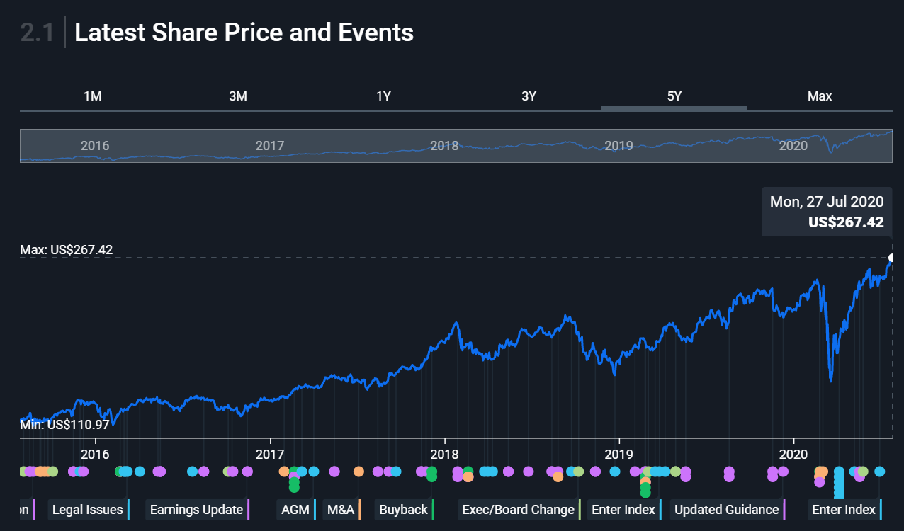

Slide 59
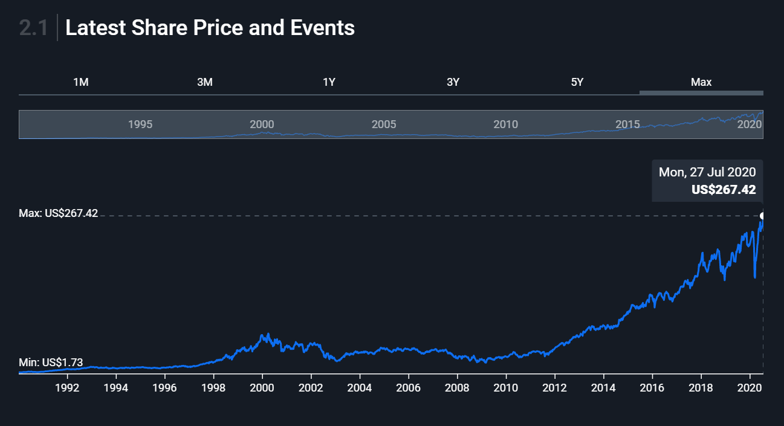

Slide 60
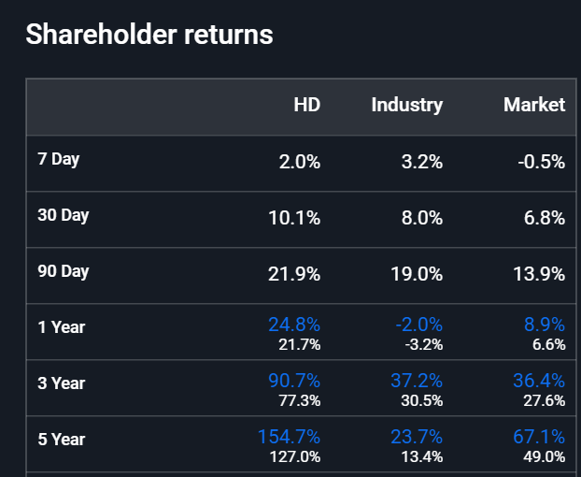

Slide 61
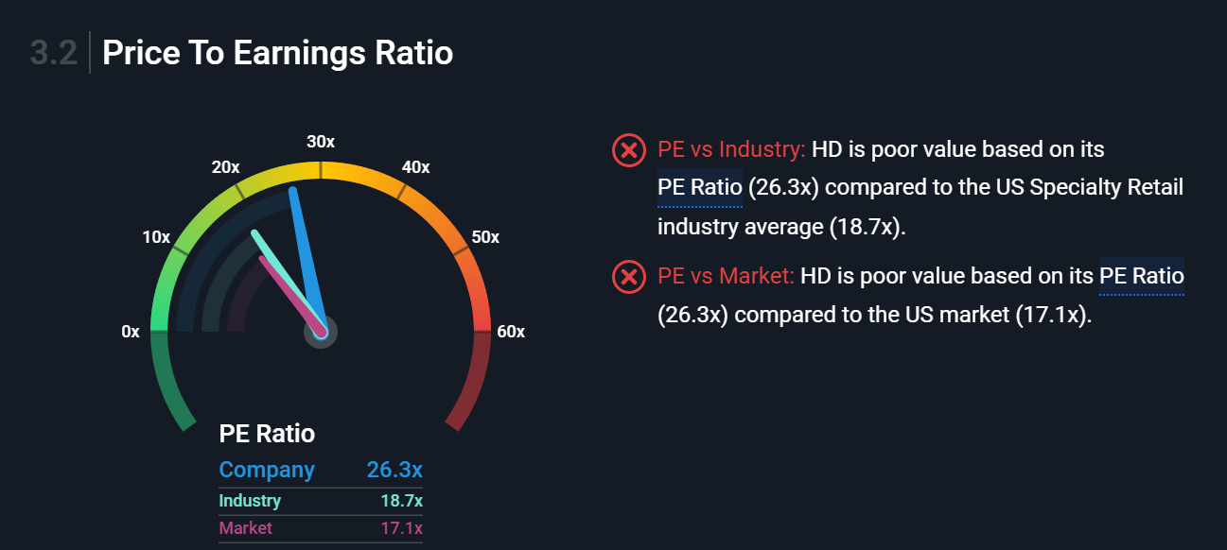

Slide 62
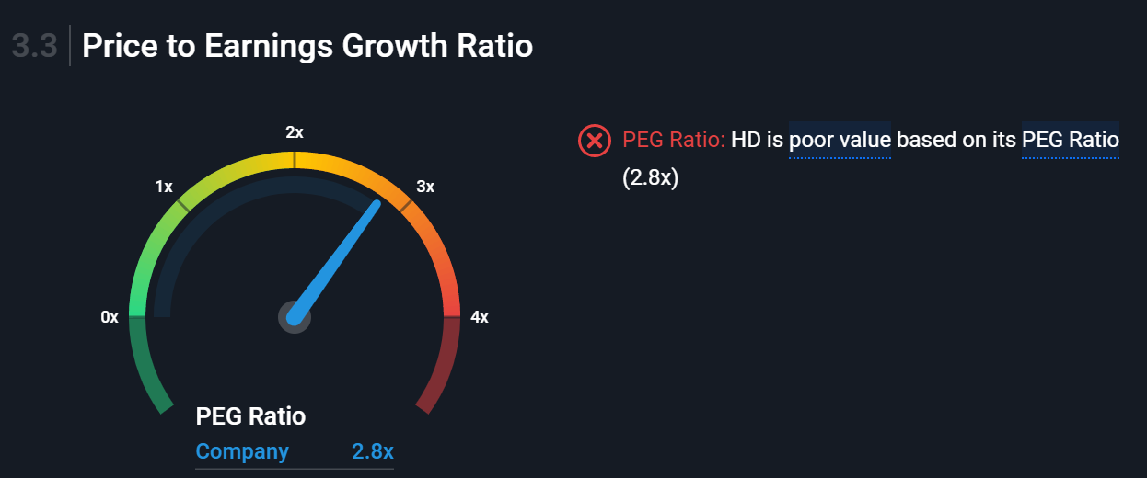

Slide 63
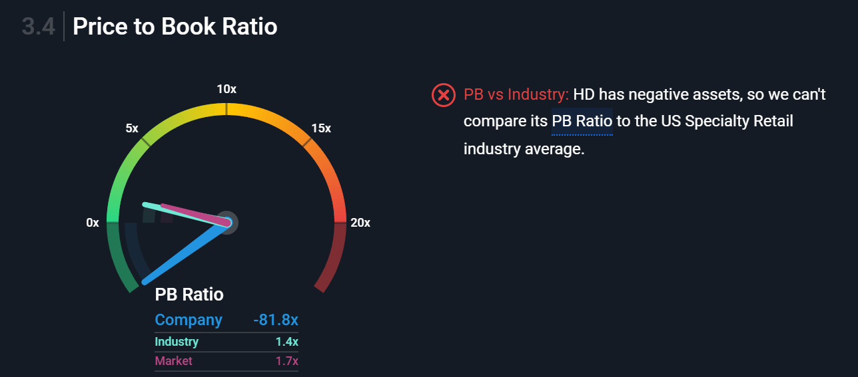

Slide 64
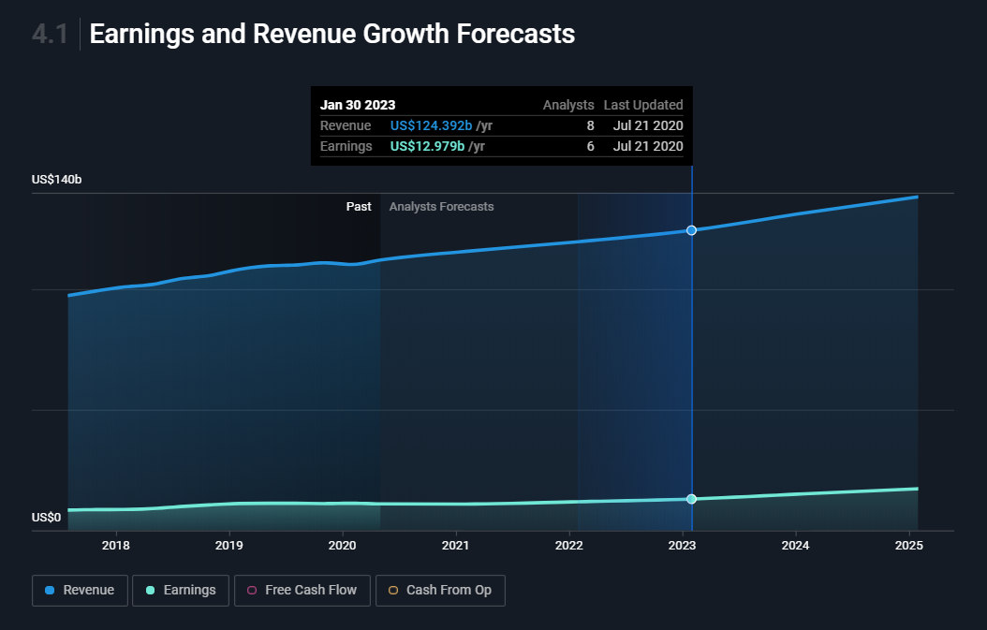

Slide 65
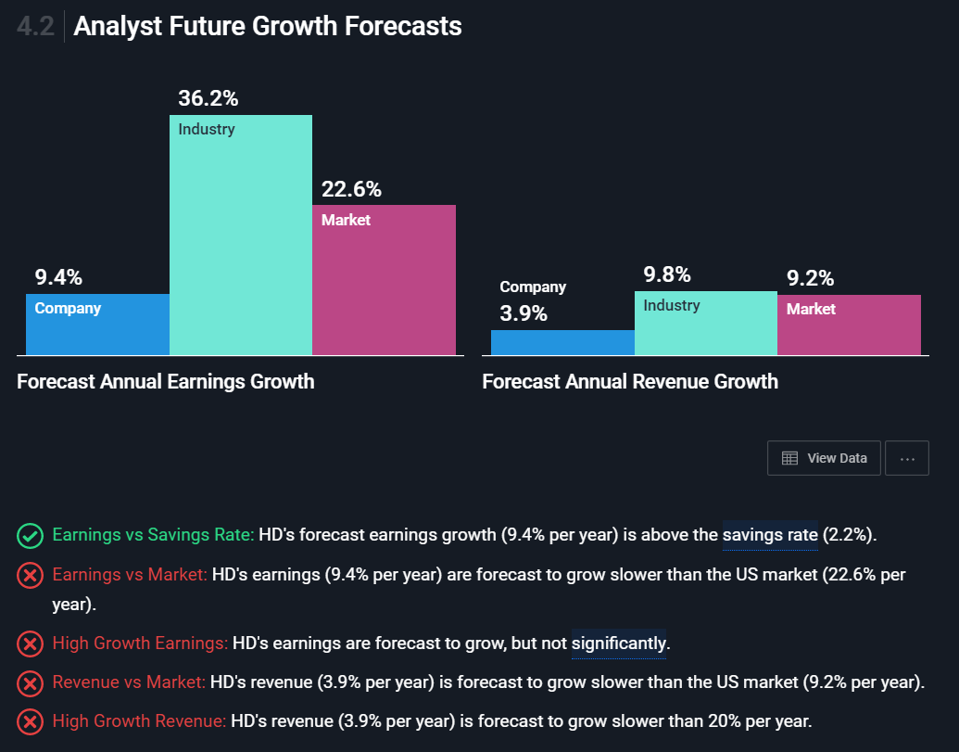

Slide 66
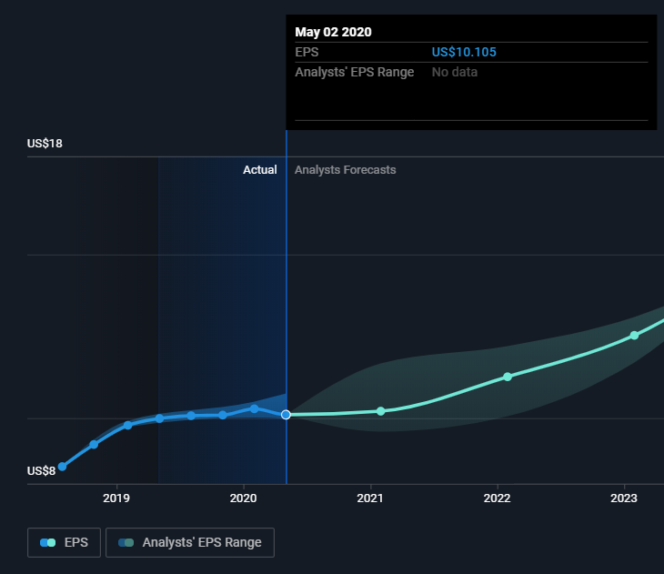
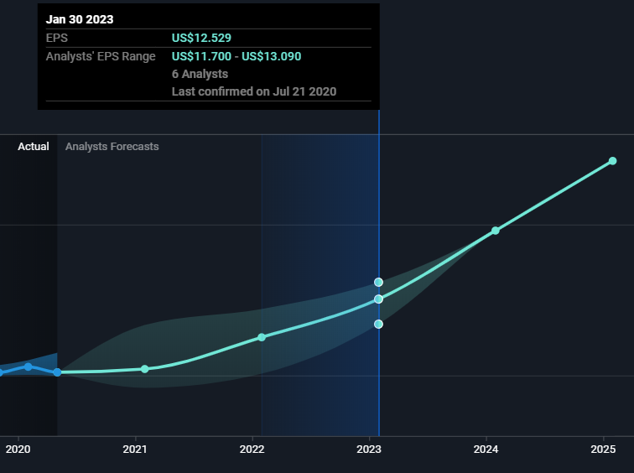
Earnings per Share Growth Forecasts

Slide 67
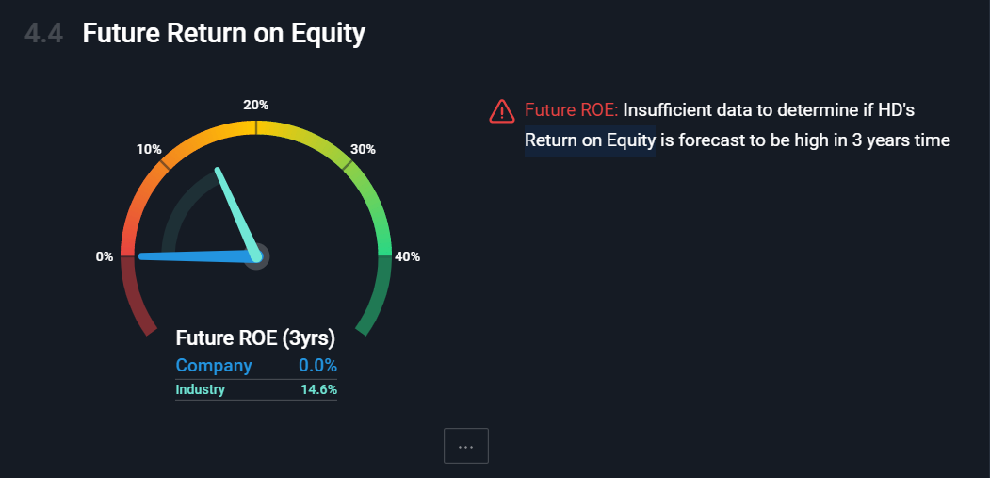

Slide 68
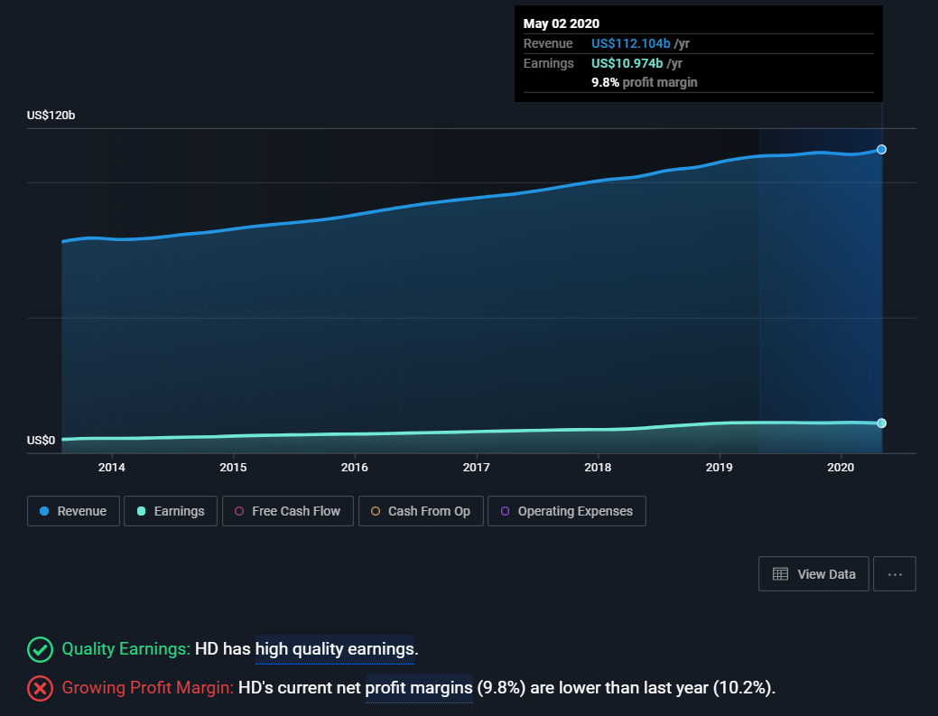
Earnings and Revenue History

Slide 69
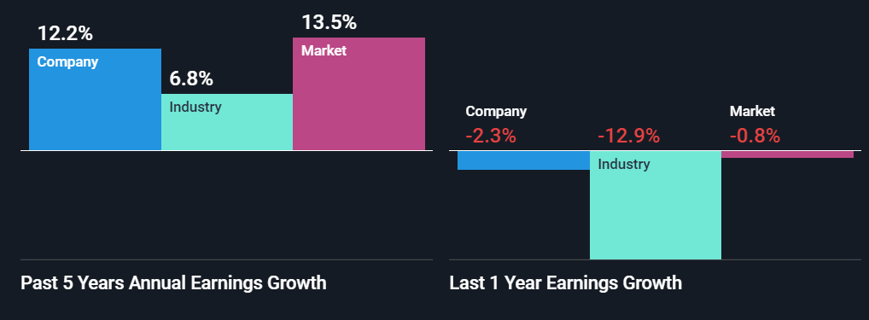
Earnings Trend: HD's earnings have grown by 12.2% per year over the past 5 years.
Accelerating Growth: HD's has had negative earnings growth over the past year, so it can't be compared to its 5-year average.
Earnings vs Industry: HD had negative earnings growth (-2.3%) over the past year, making it difficult to compare to the Specialty Retail industry average (-12.9%).

Slide 70


Slide 71


Slide 72

Short Term Liabilities: HD has negative shareholder equity, which is a more serious situation than short term assets not covering short term liabilities.
Long Term Liabilities: HD has negative shareholder equity, which is a more serious situation than short term assets not covering long term liabilities.

Slide 73

Debt to Equity History and Analysis
Debt Level: HD has negative shareholder equity, which is a more serious situation than a high debt level.
Reducing Debt: HD's has negative shareholder equity, so we do not need to check if its debt has reduced over time.
Debt Coverage: HD's debt is well covered by operating cash flow (42.9%).
Interest Coverage: HD's interest payments on its debt are well covered by EBIT (13.4x coverage)

Slide 74

Balance Sheet

Slide 75

Dividend Yield vs Market

Slide 76

Stability and Growth of Payments
Stable Dividend: HD's dividends per share have been stable in the past 10 years.
Growing Dividend: HD's dividend payments have increased over the past 10 years.

Slide 77


Slide 78


Slide 79

Net Share Repurchases

Slide 80

r U.S. store locations

Slide 81

Home Depot stores in Canada

Slide 82

Company Profile

Slide 83


Slide 84

Cash Flow Summary

Slide 85

Balance Sheet (10Q)

Slide 86

Balance Sheet (10Q)

Slide 87

Balance Sheet (10K)

Slide 88

Balance Sheet (10K)

Slide 89

Income Statement (10K)

Slide 90

Income statement (10Q)

Slide 91

Cash Flow Statement (10K)

Slide 92


Slide 93

Cash Flow Statement (10Q)

Slide 94


Slide 95

Craig Menear
Chairman, CEO & President
Chief Executive Officer and President since November 2014 and our Chairman since February 2015
Roles: spanning merchandising, supply chain, store operations, sourcing, marketing and online
Education: Bachelor of Arts degree from Michigan State University’s Eli Broad College of Business. In 2017, he was honored with MSU’s Distinguished Alumni Award for his business accomplishments and commitment to philanthropic initiatives.

Slide 96

ANN-MARIE CAMPBELL
Executive Vice President
Began her career with The Home Depot in 1985 as a cashier in South Florida
Role: leads the company’s three U.S. operating divisions comprised of nearly 2,000 U.S. stores and the bulk of the company’s nearly 400,000 associates.
Education: graduate of Georgia State University, where she earned a bachelor’s degree in philosophy and a master’s degree in business administration.

Slide 97

MATT CAREY
Executive Vice President & Chief Information Officer
Role: responsible for all aspects of our IT infrastructure and software development, including communication networks and IT Strategy
Matt’s team designed and launched an industry-first proprietary mobile device we call the “First Phone,” which functions as a phone and walkie-talkie with the added functionality of mobile checkout, inventory management, product search and business analytics.
Education: associate’s degree in information systems from Oklahoma State University – Okmulgee.

Slide 98

TED DECKER
Executive Vice President – Merchandising
Role: responsible for all aspects of merchandising, marketing, store environment, pricing and assortment planning.
Has extensive international experience, having lived and worked in London, England, and Sydney, Australia.
Education: bachelor’s degree in English from The College of William and Mary and a master’s degree in business administration from Carnegie Mellon University

Slide 99

MARK HOLIFIELD
Executive Vice President - Supply Chain & Product Development
Role: responsible for The Home Depot’s logistics, distribution, delivery, transportation, and inventory planning and replenishment operations, as well as product development
Mark and his team are now expanding the RDC network to Canada, and recently opened three new Direct Fulfillment Centers to support our expanding e-commerce business and interconnected retail strategy.
Education: bachelor’s degree in business administration with honors from the University of Texas and his master’s degree in business administration from Baylor University.

Slide 100

JEFF KINNAIRD
President - Canada
Role: responsible for the sales and operations of 182 stores and approximately 28,000 associates
Jeff has over 25 years of Home Improvement retail experience. Prior to joining The Home Depot, he worked at Windsor Plywood.
Education: Executive MBA from Queen’s University.

Slide 101


Slide 102


Slide 103


Slide 104


Slide 105


Slide 106


Slide 107


Slide 108


Slide 109

Number of employees

Slide 110

COVID-19 UPDATE: HOW HOME DEPOT IS RESPONDING
As the situation around the 2019 Novel Coronavirus (COVID-19) continues to develop, our paramount concern has been for the health and safety of our customers and associates.
The Home Depot is an essential retailer to the communities we serve, and we’re committed to keeping stores open just as we always do during times of crisis and natural disaster. Homeowners and businesses depend on us for urgent needs such as hot water heaters, refrigerators, electrical and plumbing repairs, and harsh weather items like tarps, propane and batteries.

Slide 111

2020 RESPONSIBILITY REPORT

Slide 112


2020 RESPONSIBILITY REPORT

Slide 113
Recommendation
Hold

Slide 114


Slide 115

Stock Overview

Slide 116

P/E Ratio
Notes:
https://ycharts.com/companies/COST/pe_ratio
http://pages.stern.nyu.edu/~adamodar/New_Home_Page/datafile/pedata.html

Slide 117

P/E Ratio vs Industry

Slide 118

Dividend Yield Chart

Slide 119

Institutional Ownership

Slide 120

Stock Performance

Slide 121

5 Day Performance

Slide 122

1 Month Performance

Slide 123

6 Month Performance

Slide 124

1 Year Performance

Slide 125

5 Year Performance

Slide 126

10 Year Performance

Slide 127

5 Year Peer Comparison
Notes:
Costco and home depot at 126%
Wmt 82
Target at 50

Slide 128

Market & Industry Index Comparison
Notes:
Cost at 126
S&p at 54%
Xrt at -5%

Slide 129


Company Overview
Notes:
785 warehouses, 666 in Canada and u.s , with more internationally
53.9 million memerships

Slide 130

Company Overview
Notes:
785 warehouses, 666 in Canada and u.s , with more internationally
53.9 million memerships

Slide 131

Company Overview
Notes:
785 warehouses, 666 in Canada and u.s , with more internationally
53.9 million memerships

Slide 132


Slide 133
Costco Timeline
1983-Costco opens its first warehouse after founder James Sinegal acquired experience working at Price Club
1993- Merger between Costco and Price Club and Price Club locations rebranded as Costco Wholesale in 1997
1994- First Asia Costco opens in Seoul
1995- 200th location is opened in Washington
1998- Costco.com is established
2000- 2 for 1 stock split on January 14th
2005- 25 warehouses pass $200 million in annual sales
2019- 785 warehouses to date have been opened across the world

Slide 134

Business Model

Slide 135

Business Model - Memberships

Slide 136


Business Model - Memberships
Notes:
Membership fees allow for products to be sold lower and along with bulk selling makes it very attractive for consumers, membership fees higher percentage of net income
Our member renewal rate was 91% in the U.S. and Canada and 88% on a worldwide basis at the end of 2019
Paid cardholders (except affiliates) are eligible to upgrade to an Executive membership in the U.S. and Canada, for an additional annual fee of $60

Slide 137

Business Model - Memberships
Notes:
https://seekingalpha.com/article/4319008-costco-strong-u-s-base-allowing-for-expansion-east
Using strong base to expand internationally
Merchandise revenue per member up

Slide 138

Notes:
https://www.forbes.com/sites/niallmccarthy/2019/04/18/americas-best-large-employers-2019-infographic/#54b4a0ff1b4a

Slide 139

Notes:
https://www.forbes.com/canada-best-employers/#73104d08241f

Slide 140

Covid-19 Impact

Slide 141

Largest Retailers U.S ($M)

Slide 142
Management Overview

Slide 143

James Sinegal (Co-Founder)
Co founder, CEO from 1983- Dec 2011
On the Board of Directors until retirement in 2018
Implemented Costco culture of paying employees well and providing benefits resulting in lowest turnover in retail
Led the company successfully and stock price increased 5000% under his tenure

Slide 144

Jeffrey Brotman (Co-Founder)
Co founded Costco with Sinegal in 1982
Was Chairman on Board of Directors until his death in 2017
Previously a lawyer before founding Costco
Shared philosophy of Sinegal to “do the right thing” and take care of employees

Slide 145

Hamilton James (Chairman of the Board)
Became Chairman of the board in 2017 following Brotman’s death
Served as President and COO at Blackstone Group until 2018
Has extensive experience in private equity and on other boards of directors
Graduated with a BA from Harvard in 1973

Slide 146

Craig Jelinek (President, CEO, Director)
President since 2010 and CEO since 2012
Previously VP of Merchandising since 2004
Joined Costco in 1984 after previously working in retail in the 1970s
Has built on Sinegal’s success by continuing to add new stores and increase revenues

Slide 147

Richard Galanti (Executive VP, CFO, Director)
Executive VP and CFO since 1993
Director since 1995
Previously worked at Donaldson Lufkin & Jenrette Securities prior to joining Costco in 1984
Graduated from Stanford University Graduate School of Business in 1982 with an MBA

Slide 148

Paul Moulton (Executive VP & Chief Information Officer)
Joined Costco in July 1985
Has been responsible for Marketing, E-commerce and Member Services since 1999
Has served as COO for Costco in Asia and Europe
Received Bachelors degree from University of San Diego

Slide 149
Financial Statements

Slide 150

Balance Sheet Assets – 10Q

Slide 151

Balance Sheet Liabilities & Equity – 10Q

Slide 152

Balance Sheet Assets – 10K

Slide 153

Balance Sheet Liabilities & Equity – 10K

Slide 154

Income Statement – 10K

Slide 155

Income Statement – 10Q

Slide 156

Cash Flow – 10K

Slide 157

Cash Flow – 10K

Slide 158

Cash Flow – 10Q

Slide 159

Cash Flow – 10Q

Slide 160

P/E Analyst Estimates

Slide 161

Analysts Outlook on Costco

Slide 162
Recommendation
Buy

Slide 163


Slide 164


Slide 165

Key Statistics

Slide 166

5-Day Performance

Slide 167

1- Month Performance

Slide 168

6 - Month Performance

Slide 169

1 - Year Performance

Slide 170

5 - Year Performance

Slide 171

10 -Year Performance

Slide 172

Stock Performance Comparison with S&P 500

Slide 173

Dividend
Walmart has increased its annual cash dividend every year since first declaring a $0.05 per share annual dividend in March 1974.

Slide 174

Stock Splits
Walmart has offered 2:1 stock splits and the number of shares has grown as shown

Slide 175

Company Overview

Slide 176

Walmart Values

Slide 177



Four Segments
Sam’s Club
Walmart U.S
Walmart International
Walmart U.S E-commerce

Slide 178
Facts
●Walmart U.S. is the largest segment and operates retail stores in all 50 states in the U.S. Walmart U.S. generated approximately 66% of total net sales in fiscal 2020; Walmart U.S. has historically contributed the greatest amount to the Company's net sales and operating income
●Wal-Mart International is the second largest segment and consists of operations in 27 countries outside of the U.S. and includes numerous formats as well as digital retail; Wal-Mart International generated approximately 23% of fiscal 2020 net sales
●Sam's Club consists of membership-only warehouse clubs and operates in 44 states in the U.S., as well as digital retail. Sam's Club accounted for approximately 11% of fiscal 2020 net sales; As a membership-only warehouse club, membership income is a significant component of the segment's operating income

Slide 179
Walmart Timeline
●1962: Sam Walton opened the first Walmart in Rogers, Arkansas
●1969: Officially incorporated as Wal-Mart Stores, Inc.
●1970: Became a publicly traded company
●1972: Listed on NYSE, 51 stores and sales of $78 million
●1980: Walmart reaches $1 billion in annual sales, faster than any other company at that time.
●1983: The first Sam’s Club opened in Midwest City, Oklahoma
●1990: Walmart became the nation's number-one retailer
●1991: Walmart goes global, opened a Sam’s Club in Mexico City
●1992: Employed 371,000 associates in 1,928 stores and clubs.
●1996: Walmart opened its first stores in China

Slide 180
Walmart Timeline
●2002: Walmart topped the Fortune 500 ranking of America's largest companies
●2009: Walmart exceeded $400 billion in annual sales
●2011: With the acquisition of MassMart in South Africa, Walmart surpassed 10,000 retail units around the world.
●2014: Doug McMillon succeeded Mike Duke as CEO
●2015: Walmart announces a $2.7 billion investment over two years in its U.S workforce
●2016: Walmart and JD.com, China’s largest e-commerce company by revenue, form a strategic alliance to better serve consumers across China
●2017: Walmart acquires Shoebuy.com, which was later renamed Shoes.com
●2017: Walmart launches free two-day shipping on more than 2 million items, no membership required.
●2018: The company changes its legal name from Wal-Mart Stores, Inc. to Walmart Inc.
●2019: John Furner named President and CEO of Walmart U.S.

Slide 181

Walmart net sales worldwide from 2006 to 2020

Slide 182

Total Number of Walmart Stores Worldwide

Slide 183

Walmart’s gross profit margin worldwide form fiscal year 2006 to 2020

Slide 184

Transition to E-Commerce

Slide 185

Acquisition of Jet.com
Walmart acquired Jet.com in August 2016 for $3 billion in cash and $300 million worth of Walmart shares, gaining the brand’s smartcart technology
Jet brings in its grounded technology specifically, the powerful AI software which Jet’s online platform is built on
Unique to Jet, the proprietary algorithm pulls data from their vast marketplace of third party sellers, serving their customers with the best products, at the best price, by the best possible means of delivery
The purchase of Jet.com opened up an opportunity for Walmart to grow in the world of E-commerce

Slide 186

Acquisition of Jet.com
In 2019, Walmart decided to fully merge majority of Jet.com employees within
Walmart Inc. and shrink the unit’s management team
In 2020, Walmart announced that it will discontinue Jet.com and phase out the brand. This is because as Walmart’s main website grew, reaching about 20 billion in sales, Jet weakened, suffering declines in traffic and sales

Slide 187

Other E-Commerce Acquisitions
In 2016, Walmart and JD.com, China’s largest e-commerce company by revenue, form a strategic alliance to better serve consumers across China, covering both online and offline retail
Wal-Mart is putting faith in JD.com to remain one of the top players in China’s e-commerce space, where consumers are projected to spend nearly $6.4 trillion a year by 2025
On the innovation front, the company is expanding its drone delivery routes to cut transportation costs and increase focus on rural areas of China, which will ultimately help it compete against Chinese e-commerce market leader Alibaba

Slide 188


Other E-Commerce Acquisitions
In August 2018, Walmart acquired a 77% stake in India’s largest online retailer Flipkart for $16 billion.

Slide 189

Other E-Commerce Acquisitions

Slide 190

Growth of Walmart’s E-commerce Sales in the U.S

Slide 191

Top 10 E-Commerce Retailers in the US in 2020 by % share of US retail e-commerce sales

Slide 192
Management Overview

Slide 193



The Walton Family
Rob Walton
Alice Walton
Jim Walton
Executive; Strategic Planning & Finance
Son of Walmart founder, Sam Walton, Rob Walton served as Walmart’s chairman of the board of directors from 1992 to 2015
Rob joined the company in 1969. Prior to becoming chairman, he held a variety of positions with Walmart, including senior vice president, corporate secretary, general counsel and vice chairman
Before joining Walmart, Rob was a partner with the law firm of Conner & Winters in Tulsa, Okla
Graduated from the University of Arkansas in 1966 with a bachelor of science degree in business administration
Net worth: 48.1 billion USD
Graduated from Trinity University with a B.A, in economics and finance
Net worth: 48.4 billion USD
Walton received a bachelor’s degree in Business Administration Marketing
Jim walton’s retirement from the board and the nomination of Steuart Walton, his son, mark a leadership transition to the next generation of Walton family representatives
Jim Walton served on the board for over 10 years and was a member of the Technology and eCommerce Committee, as well as the Strategic Planning and Finance Committee during his tenure

Slide 194

Management
Doug McMillon: CEO and President, Walmart
As CEO, Doug leads a strong management team that is working to deliver Walmart’s mission of “saving people money so they can live a better life.”
Mr. McMillon has more than 25 years of experience in the retail industry and at our company.
From February 2009 to February 2014, Doug served as president and chief executive officer of Walmart
International, a fast-growing segment of Walmart’s overall operations
Originally from Jonesboro, Ark., Doug graduated from the University of Arkansas with a bachelor of science in business administration. He earned his MBA in finance from the University of Tulsa.

Slide 195

Management
John Furner: CEO and President, Walmart U.S.
John Furner is responsible for the strategic direction and performance of more than 4,700 stores and more than 1 million associates
From 2017-2019, John served as president and CEO of Sam’s Club
John started with Walmart as an hourly associate in 1993, at Store 100 in Bentonville, Arkansas. He has held important roles throughout the company, including assistant store manager, store manager, district manager, buyer with the prominent ones including head of marketing and merchandising for Walmart China, and chief merchant for Sam’s Club
John has a bachelor of science in marketing from the University of Arkansas

Slide 196

Management
Judith Mckenna: CEO and President, Walmart International
She leads more than 5,900 retail units and 700,000 associates across 26 countries.
Prior to being named president and CEO of Walmart International, Judith served as executive vice president and chief operating officer for Walmart U.S. She led the company’s 1.5 million associates and operations for its 4,600 U.S. stores.
Judith has been named to Fortune’s 50 Most Powerful Women list every year since 2015.
Judith graduated with a law degree from Hull University in England before earning her Institute of Chartered Accountants in England and Wales accounting qualification at KPMG.

Slide 197

Management
Marc Lore: CEO and President, Walmart eCommerce U.S.
He was appointed in September 2016 to lead U.S. ecommerce when his company Jet.com was acquired
In his role, he accelerates Walmart’s U.S. e-commerce growth and customer reach, leading Walmart.com and Jet.com.
Prior to Jet, Marc was the co-founder and CEO of Quidsi, the parent company of e-commerce websites Diapers.com, Soap.com, Wag.com and more.
Marc’s industry accolades include E&Y’s Entrepreneur of the Year regional winner and Fortune’s “smartest people in technology.”
He graduated from Bucknell University, where he received a B.A. in Business Management and Economics.

Slide 198

Management
Brett Biggs: Executive Vice President and CFO, Walmart
Brett is responsible for accounting and control, corporate strategy and development, business planning and analysis, internal auditing, treasury, tax, global shared services and several other key areas of the company.
Before being appointed to his current role, he was executive vice president and chief financial officer for Walmart International, where he was responsible for all global finance activities.
Prior to joining Walmart in 2000, Brett held various M&A and corporate finance positions with Leggett & Platt, Phillips Petroleum Co. and Price Waterhouse.
Brett graduated Summa Cum Laude from Harding University with a bachelor’s degree in accounting and later received a MBA with Honors from Oklahoma State University. He serves in various advisory roles at Harding University

Slide 199

Management
Kathryn McLay: President and CEO, Sam’s Club
Kathryn has held a number of leadership roles at Walmart since joining in 2015 as vice president at U.S. Finance & Strategy
Kathryn began her career in 1992 at Deloitte as an undergraduate and worked in both internal and external audit and later at Qantas Airlines. In 2007, she was selected as the general manager for business development and subsequently held executive leadership roles throughout Woolworths’ retail and supply chain
She has a bachelor’s degree in accounting and finance from the University of Technology in Sydney

Slide 200
Financial Snapshot

Slide 201

Balance Sheet - Assets (10-Q)

Slide 202

Balance - Liabilities & Equity (10-Q)

Slide 203

Balance Sheet (10 - K)

Slide 204

Balance Sheet (10 - K)

Slide 205

Statement of Income (10 - K)

Slide 206

Statement of Income (10 - Q)

Slide 207

Statement of Cash Flows (10 - K)

Slide 208

Statement of Cash Flows (10 - K)

Slide 209

Statement of Cash Flows (10 - Q)

Slide 210

Statement of Cash Flows (10 - Q)

Slide 211

Share Repurchase - for quarter year ended Jan 31, 2020

Slide 212

Recommendation

