Slide 1

US Retail
Presented by:
Tri Nguyen| 301323790
Harrison Wang | 301326922
Abraham Ali | 301277633

Slide 2
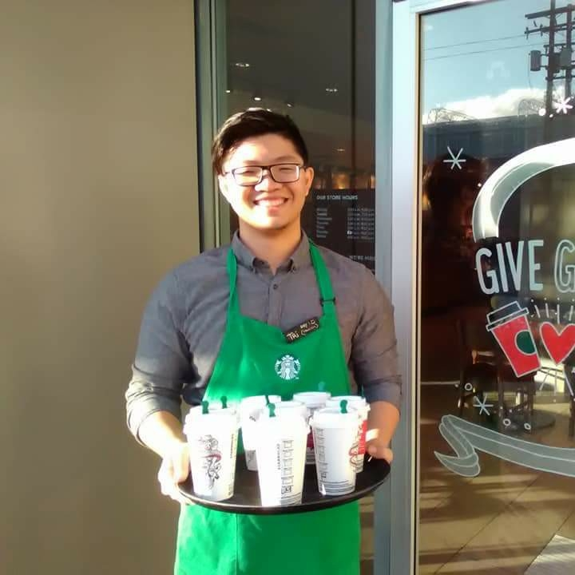


Team Member
Tri Nguyen
Harrison Wang
Abraham Ali

Slide 3
Presentation Overview
Industry Overview
-US Retail
-Retail Trends
-Effects of the Pandemic
Stock Analysis
-Costco Wholesale
-Walmart

Slide 4
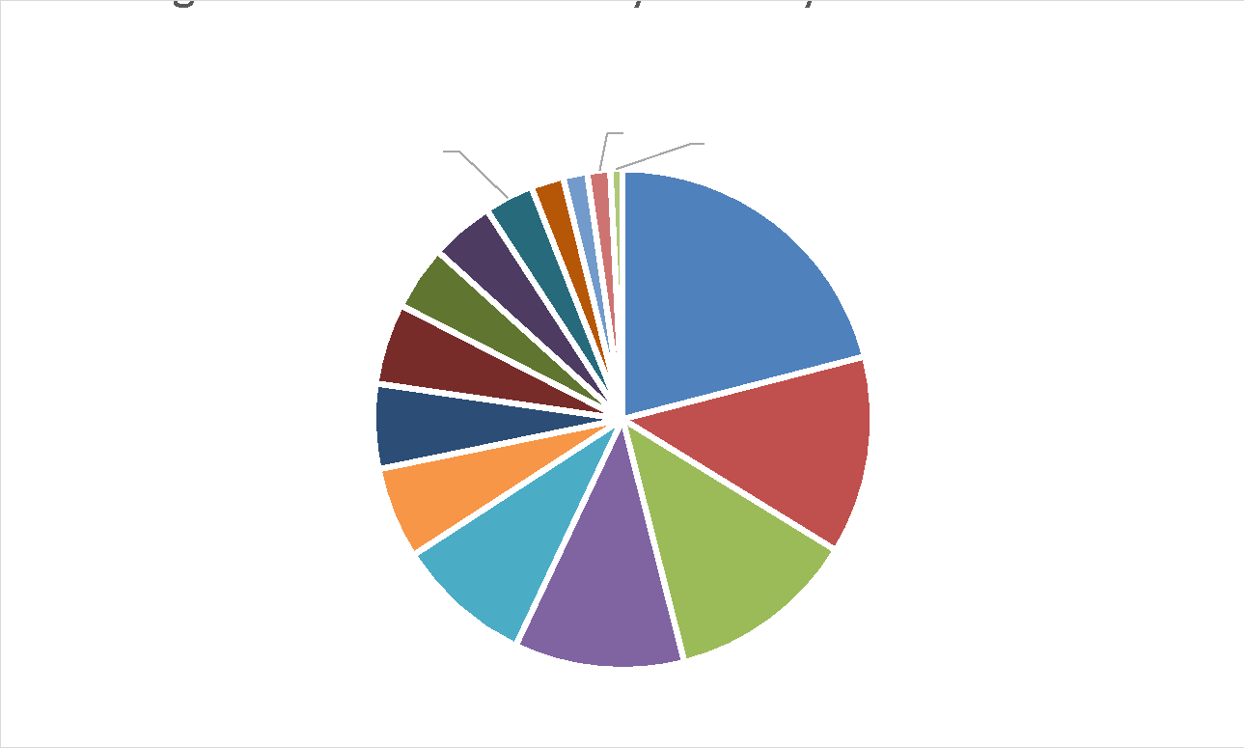
How is Retail defined?
The retail industry is a sector of the economy that is comprised of individuals and companies engaged in the selling of finished products to end user consumers.
    Added $1,172.9B to U.S. GDP (2019).
    Highly dependent on the number of households and their disposable income level.
Retail

Slide 5
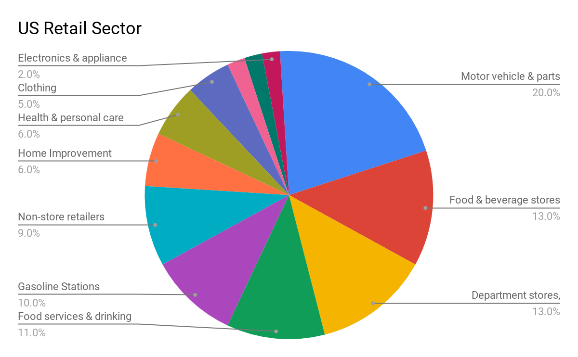
Retail in Detail
16 million people were employed in the U.S. Retail Industry in 2020.
US Retail sales comes close to $5 Trillion in 2020.
US largest retail market in the world.
Top 10 of the largest retailers based in US

Slide 6
Types of Retail Stores
Department stores: offer products at different pricing levels and have a variety of different products. Exp: Macy’s, Kohls, etc.
Specialty stores: focus on one or two specific categories of products.
Supermarkets: large, departmentalized, self-service stores that specialize in food and non-food items.
Convenience stores: offer a limited range of products at premium prices due to the added value of convenience. Usually are small and located in residential area.
Discount stores: compete on the basis of low prices, high turnover, and high volume. Exp: Walmart, Winners, etc.
Hypermarkets or Superstores: the next level of supermarkets. Usually are the size of malls. Exp: Tesco, Costco, etc.

Slide 7
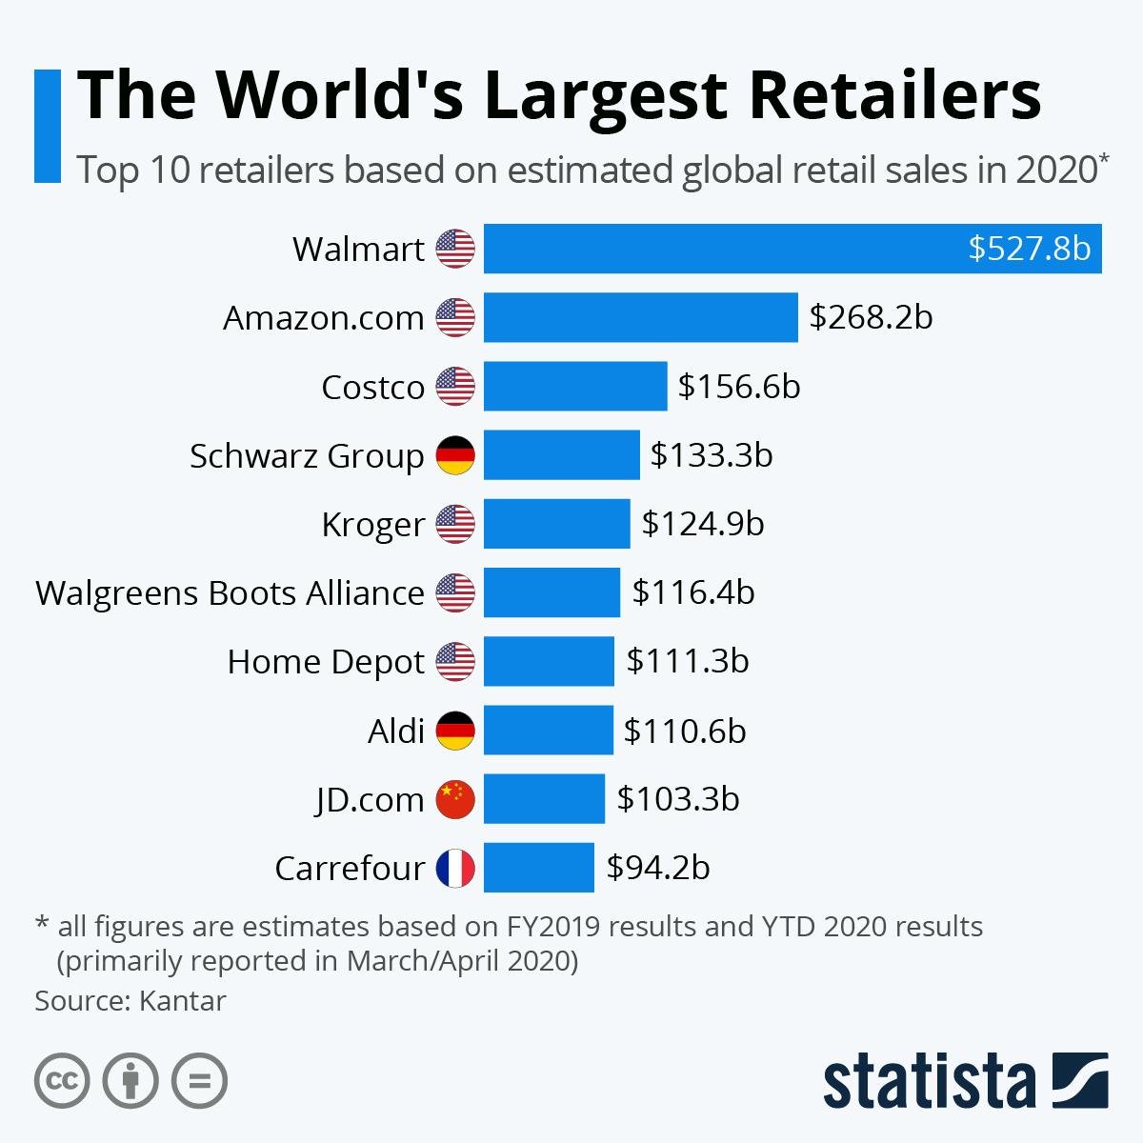
World Largest Retailers

Slide 8
Retail Metrics
●Retailer sales per square foot: The sales per square foot data are most commonly used in the retailing industry to determine how successful store sales have been.
●When measuring sales per square foot, keep in mind that selling space does not include the stock room or any area where products are not displayed.
●Total Net Sales ÷ Square Feet of Selling Space = Sales per Square Foot of Selling Space

Slide 9
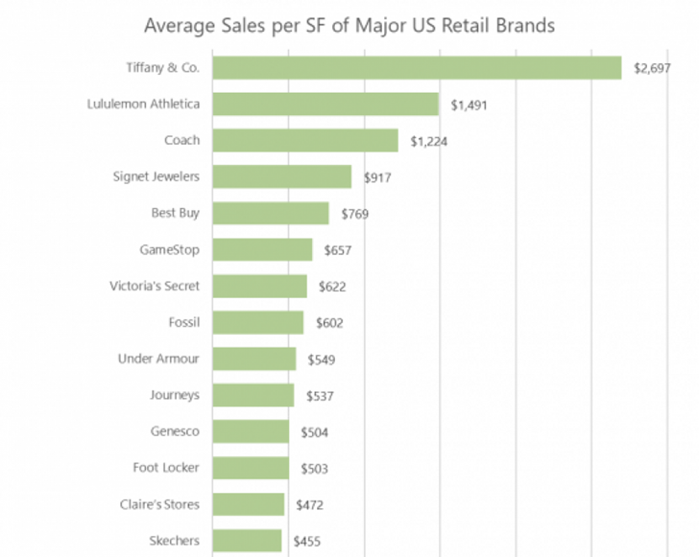
Retail Metrics

Slide 10
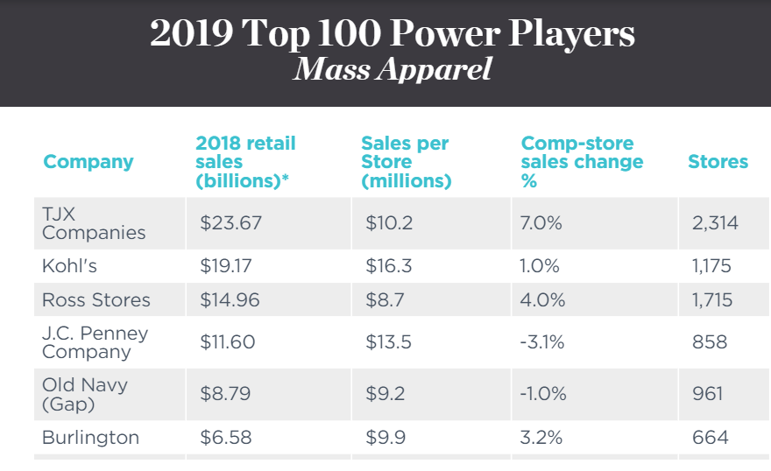
Retail Rankings

Slide 11
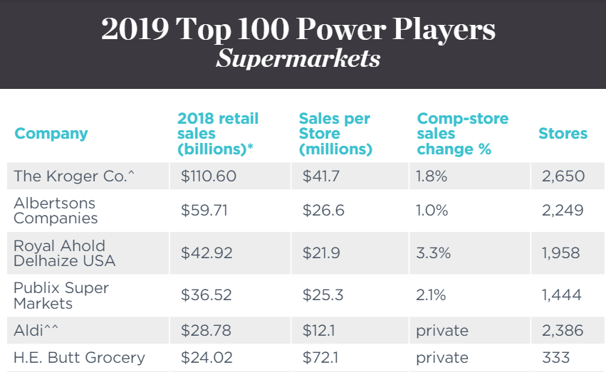
Retail Rankings

Slide 12
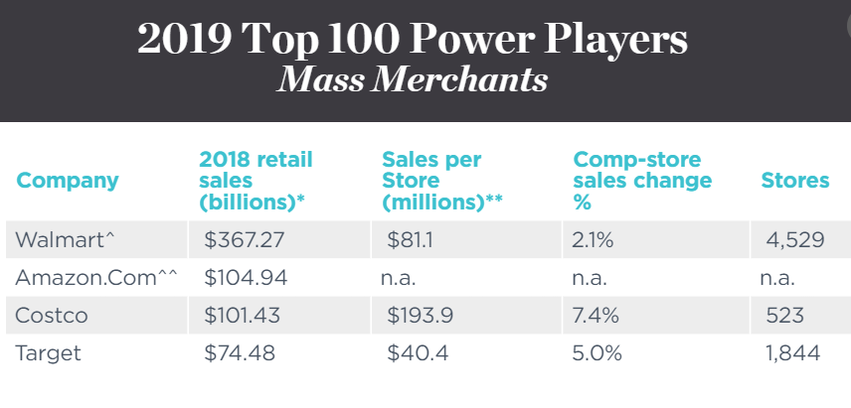
Retail Rankings

Slide 13

Retail Industry
Analysis

Slide 14
SWOT Analysis
Strengths: Diverse customer classes Low product/service concentration Low capital requirements Brand loyalty Flexibility in workforce Weaknesses: | Weaknesses: Low Profit: 2.6% of revenue Many small companies lacking resources Too much flexibility in workforce → less motivated workers, poor service quality.
Opportunities: E-commerce Emerging markets Increasing income per capita Supplier/Customer relationship-based business | Threats: International competition E-commerce rules over traditional retailers E-commerce presents many problems: fraud, payment systems, delivery quality. Emerging markets are difficult to penetrate.

Slide 15
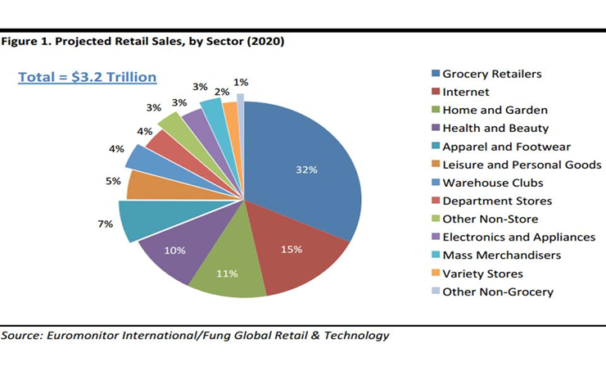
Retail Metrics
Notes:
Raunaq

Slide 16
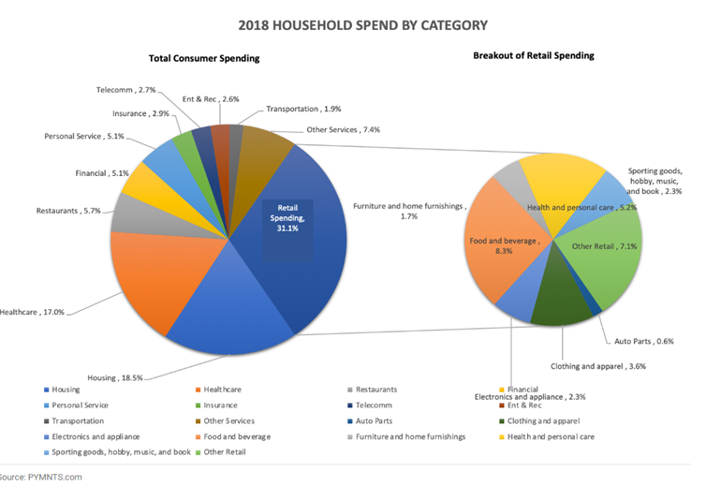
Breakdown of Consumer Expenditure
Notes:
Raunaq

Slide 17
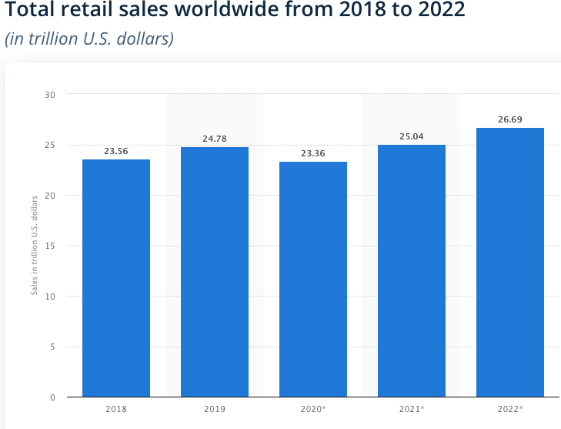
Worldwide Retail Sales Trend
Notes:
Joven

Slide 18
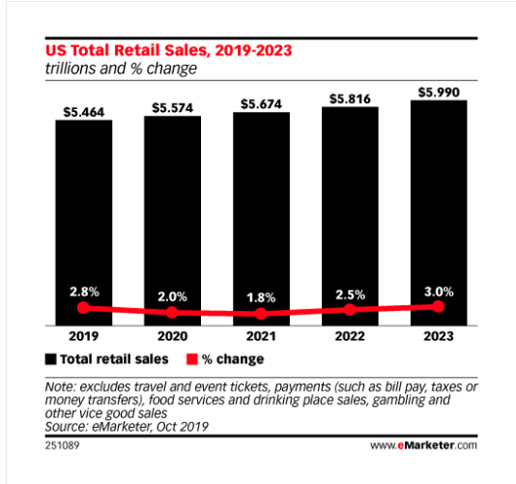
US Retail Sales Trend
Notes:
Joven

Slide 19
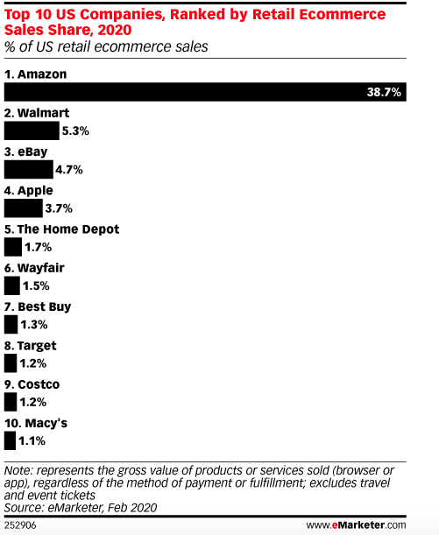
Retail Sales Worldwide
Notes:
Joven

Slide 20
Retail Index
SPDR S&P Retail (XRT)
SPDR S&P 500 (SPY)
RTH: VanEck Vectors Retail
XLY: Dow Jones Consumer

Slide 21
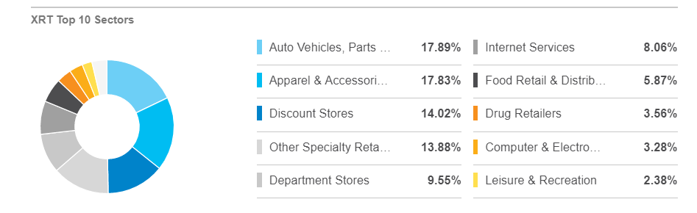
XRT Retail Index Fund
Notes:
Joven

Slide 22
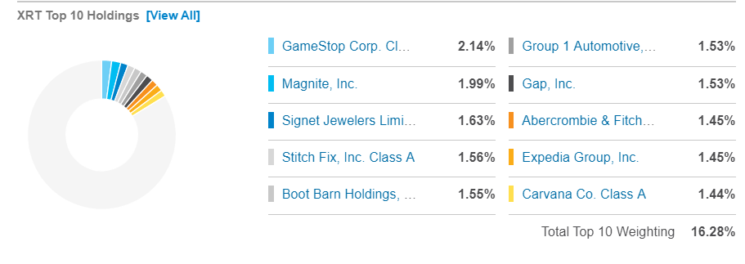
Top 10 Holdings

Slide 23
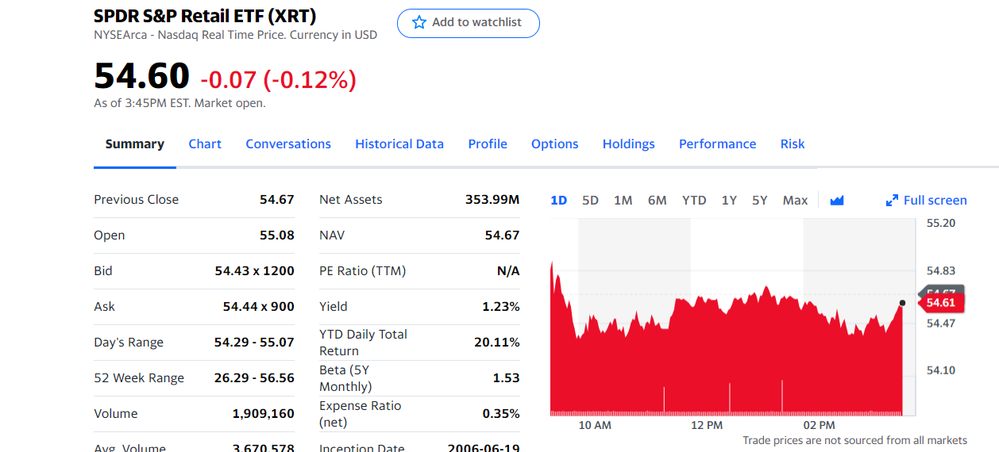
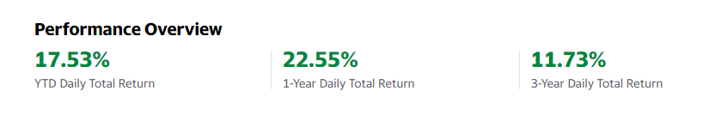
S&P Retail ETF - XRT

Slide 24
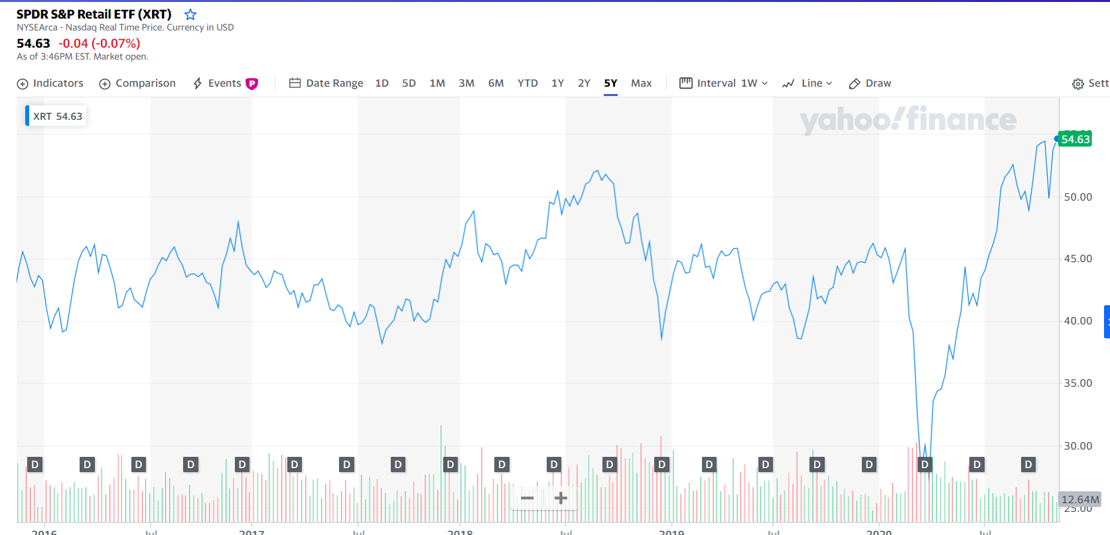
S&P Retail Index - XRT (5 Year)

Slide 25
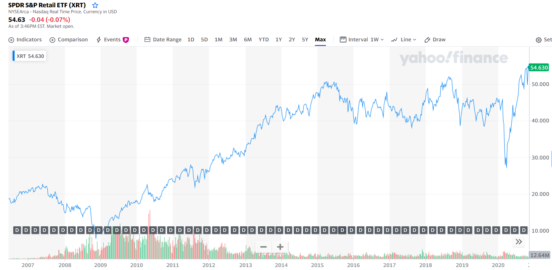
S&P Retail Index - XRT (14 Year)

Slide 26
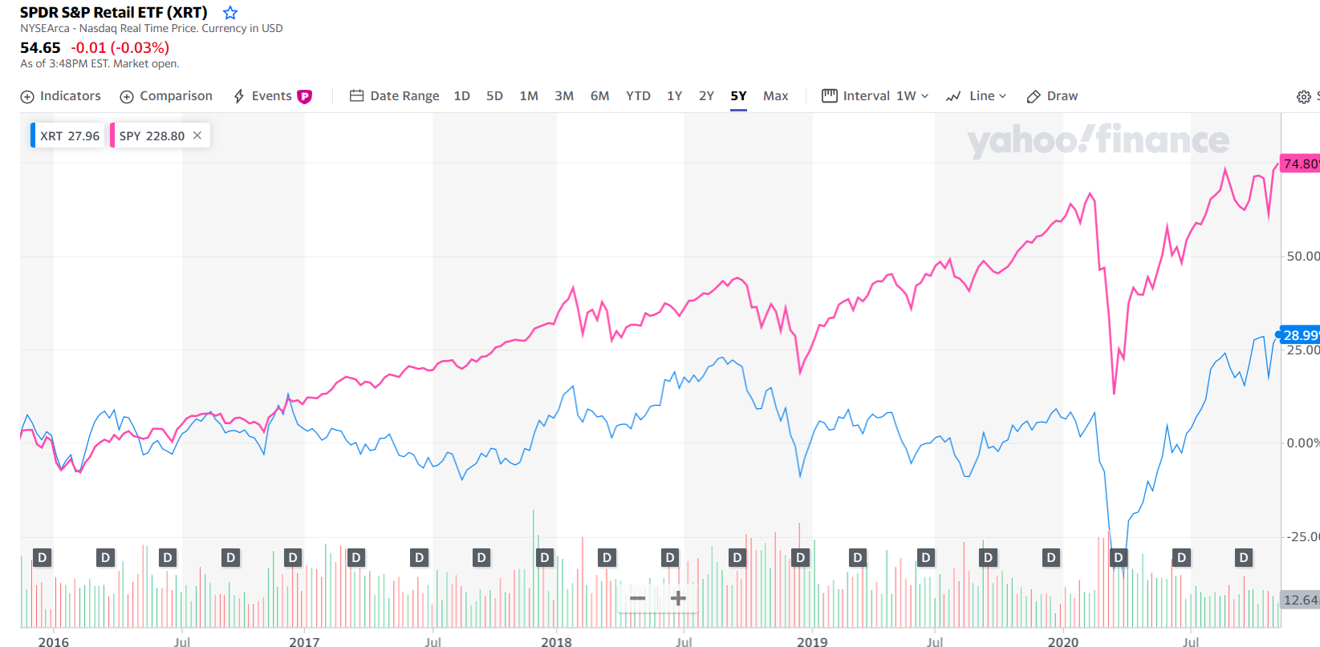
S&P Retail Index Comparison (5 Years)

Slide 27
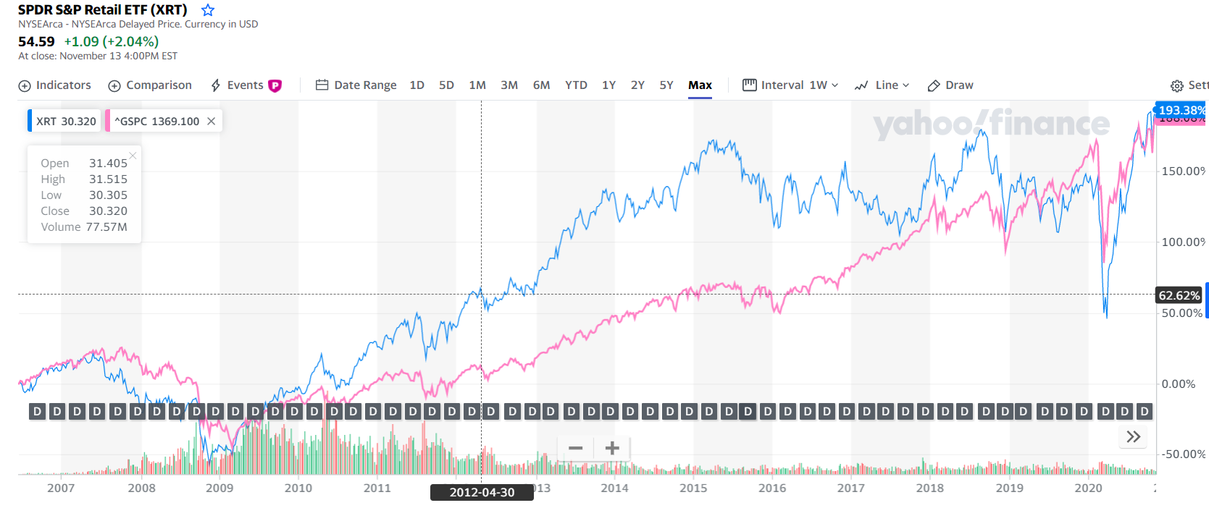
S&P Retail Index Comparison (14 Years)

Slide 28
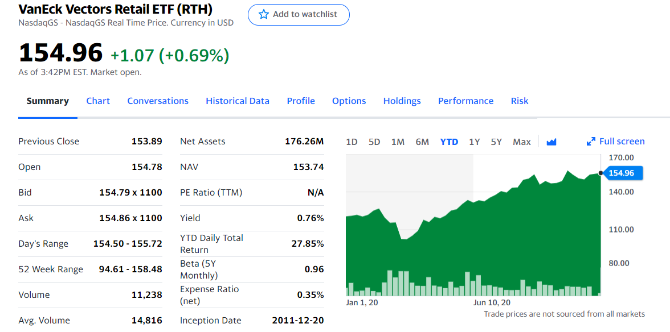

RTH: VanEck Vector Retail ETF

Slide 29
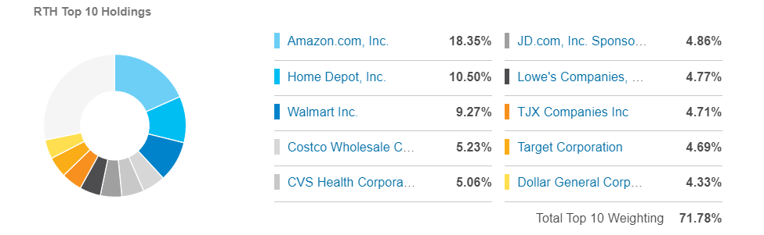
RTH: VanEck Vector Retail ETF

Slide 30
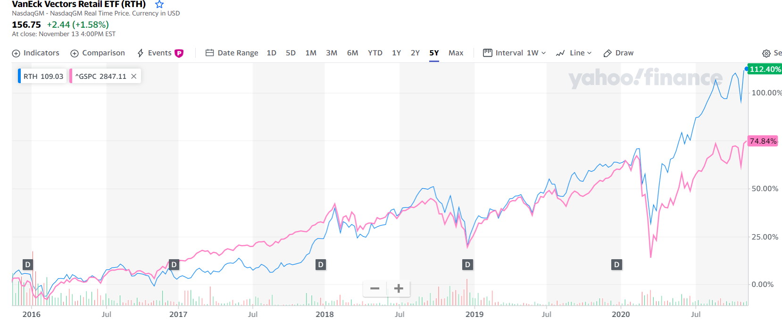
VanEck Vector Retail Comparison (5 Years)

Slide 31
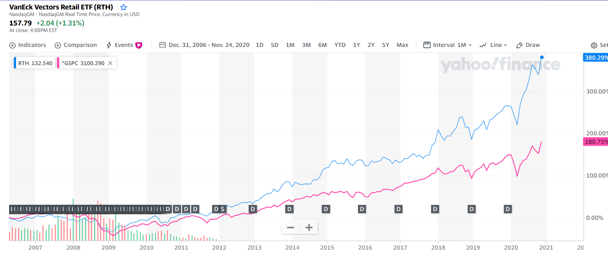
VanEck Vector Retail Comparison (14 Years)

Slide 32


Cyclical and Defensive Stocks
Cyclical stocks
  Apparel stores
Defensive stocks
  Grocery stores

Slide 33

The Retailpocalypse

Slide 34
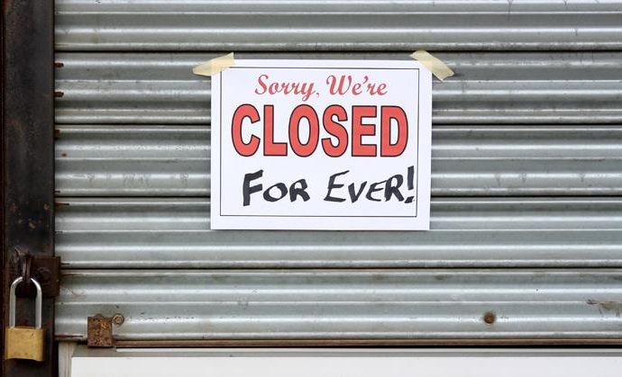
Is Retail dying?
Increasing retail store closures in a booming US economy.
Part of the explanation for retail chains' difficulties since 2017—what some have called the "retail apocalypse"—is the continuing trend of Americans making purchases online
Furthered by the Covid-19 Pandemic.

Slide 35
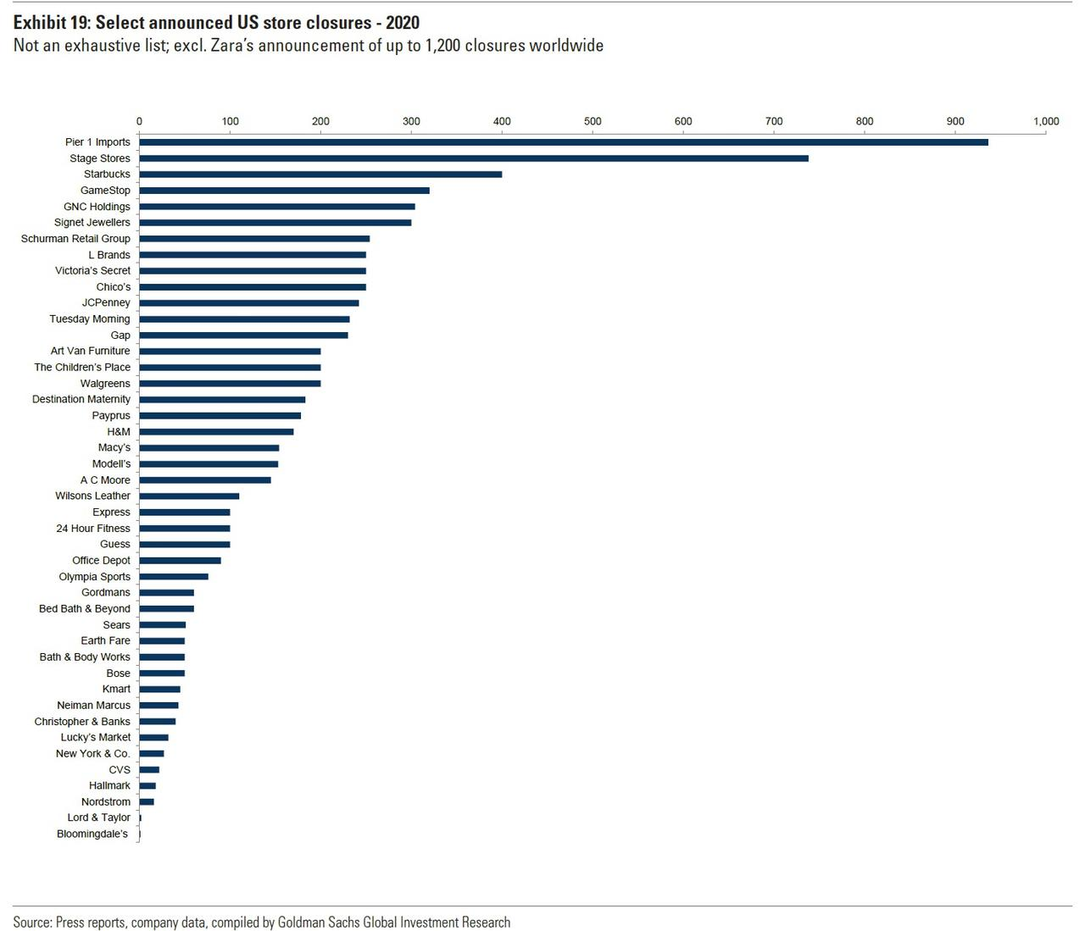
Is Retail dying?

Slide 36




In Memoriam
Major Retailers that closed doors permanently in recent years:
In 2019, nearly 9,100 US Retail Stores closed doors, 55% higher than total closures in 2018.

Slide 37




In Memoriam
Examples of major retailers that are closing stores in 2020:
Notes:
152 JC penney

Slide 38
Challenges in the Retail Sector
Shift in Consumer Expectations
All about Convenience. “Saves me time”
Digitalization
Focus on how to increase sales by adapting to mobile.
Facebook Shops
Escalation of trade tensions
Increased Pricing Pressure and the race to go global

Slide 39
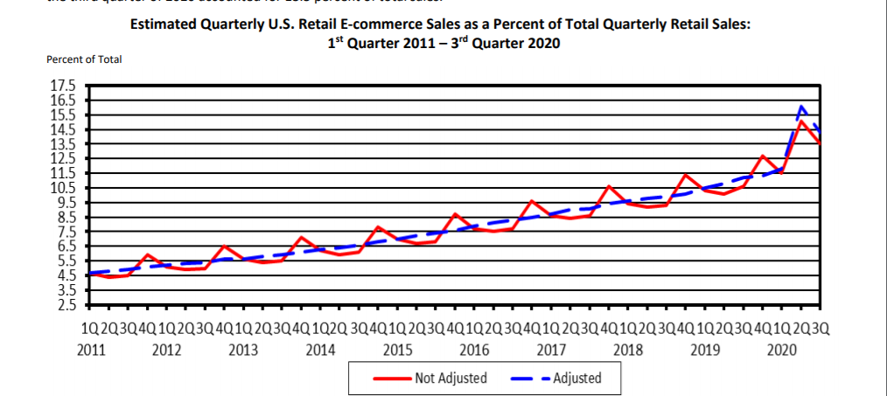
E-commerce is taking over

Slide 40
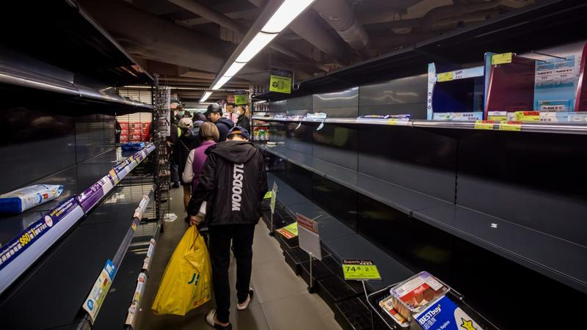
US Retail Post Covid-19

Slide 41
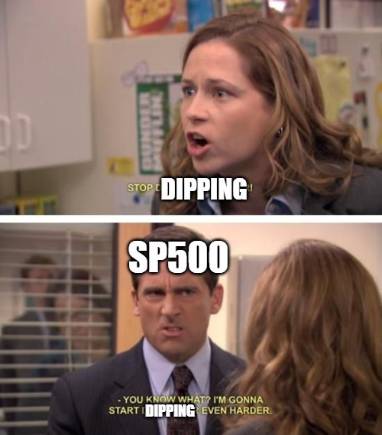
Effect on US Retail

Slide 42
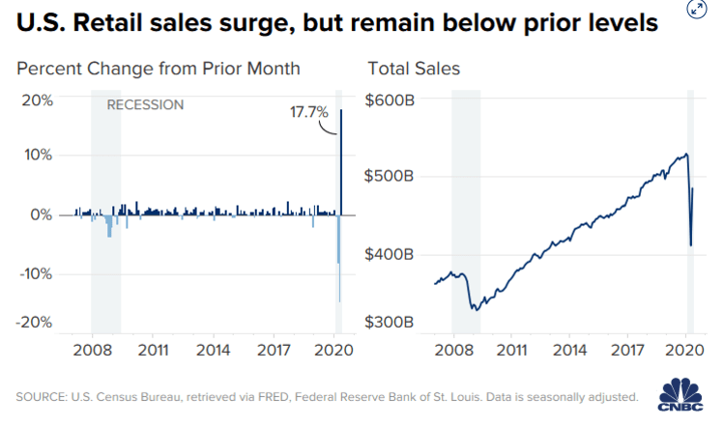
Effect on US Retail

Slide 43
Covid-19 Challenges in the Retail Sector (Forbes)
Retailers will follow safety guidelines for a long time.
Limited visitor numbers will lead to different experiences.
Employee relations will become essential.
Low-touch environments will become the norm.
Notes:
Contactless pay, mention war on cash and shopify

Slide 44
Renaissance for Retail
-A recent survey by ICSC of 9,000 consumers found that slightly more than half of online shoppers said a nearby physical store is “important when buying online.”
-Another ICSC survey found that the newest customer cohort, Gen Z, believes by three-to-one that physical stores provide a better shopping experience.
-71 percent of consumers under 30 years old said they shop for clothing mostly in stores.
-Trend in physical retail reflecting a generational shift. “Millennials are into experiences”.

Slide 45
Shifting Trends
The Shift to Online
In 2019, digital natives turned to physical store pilots, and traditional retailers rolled out digitally powered physical stores.
Retailers are still contemplating plans for fulfillment centers, stores serve as showrooms.
Increased focus on the consumer shopping experience.

Slide 46
Shifting Trends
2. Data Driven Shopping Experiences
Brick-and-mortar accounted for nearly 90 percent of all retail sales in the third quarter of 2019, according to the US Census Bureau
Socially conscious shoppers use their purchasing power as a demonstration of support, and with research showing that shoppers still rely primarily on stores for product discovery and inspiration.
Entire supply chains are being revamped to improve access by having same day delivery etc.

Slide 47
Renaissance for Retail
Consumerization of Technology
Internet use
Smartphones
2. Increased Competitiveness
Price Advantage
Convenience
Large product assortment
3. Major cost savings
A. Showrooming
B. Inventory Savings
C. Real Estate Effect

Slide 48
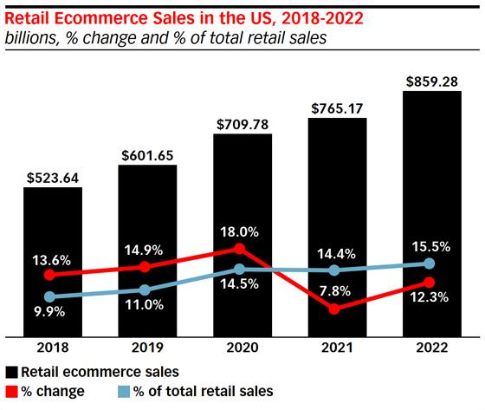
The Rise of Ecommerce
Notes:
Talk about bezos at senate hearing

Slide 49
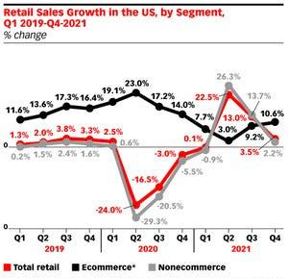
The Rise of Ecommerce

Slide 50


Slide 51
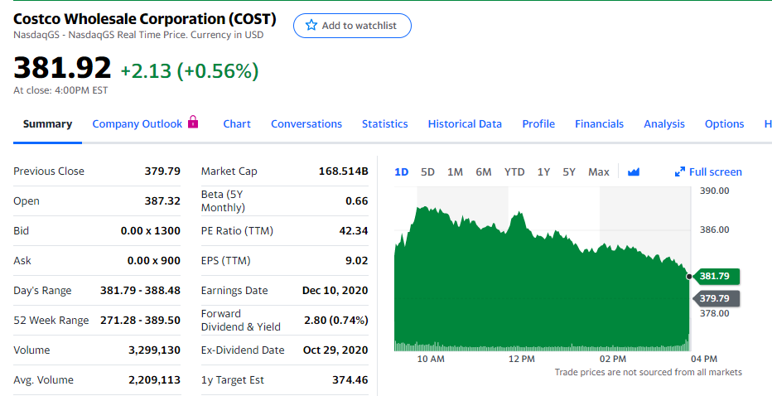
Stock Overview

Slide 52
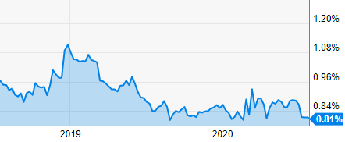
Dividend Yield Chart

Slide 53
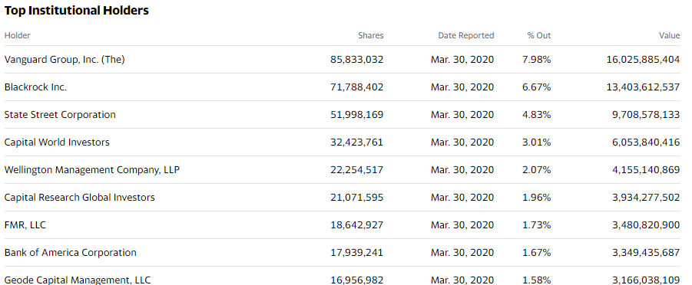
Institutional Ownership

Slide 54

Stock Performance

Slide 55
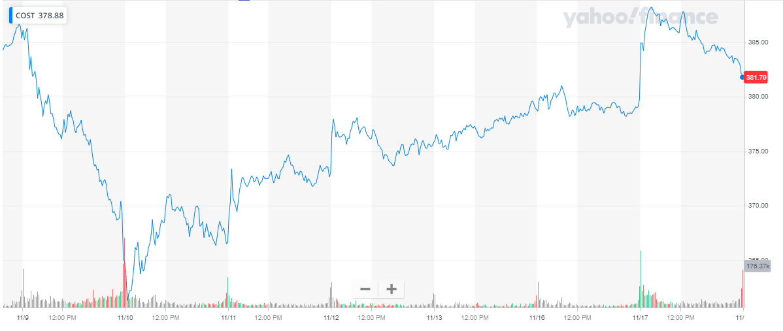
5 Day Performance

Slide 56
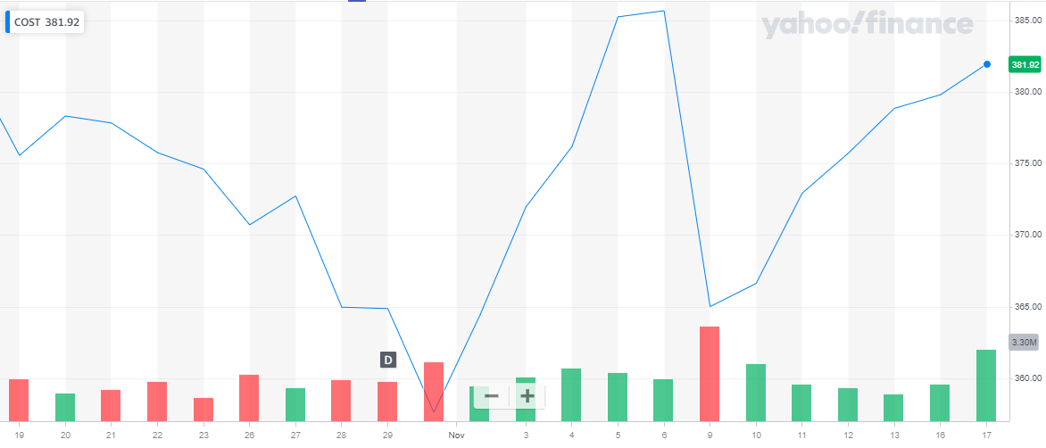
1 Month Performance

Slide 57
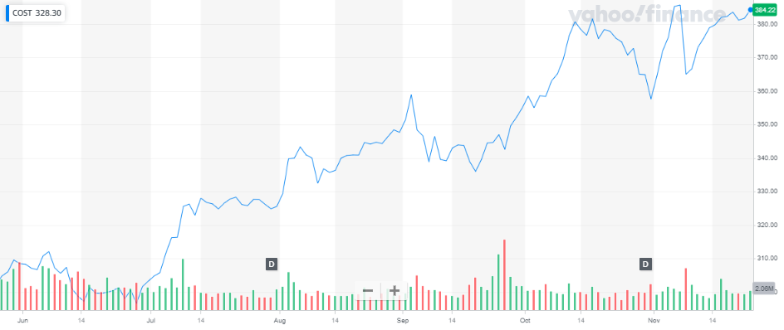
6 Month Performance

Slide 58
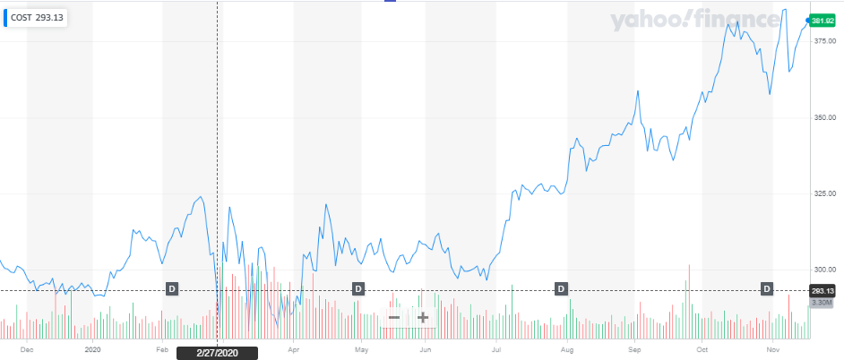
1 Year Performance

Slide 59
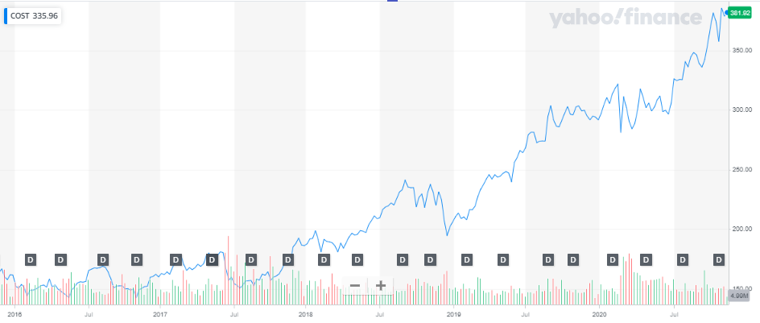
5 Year Performance

Slide 60
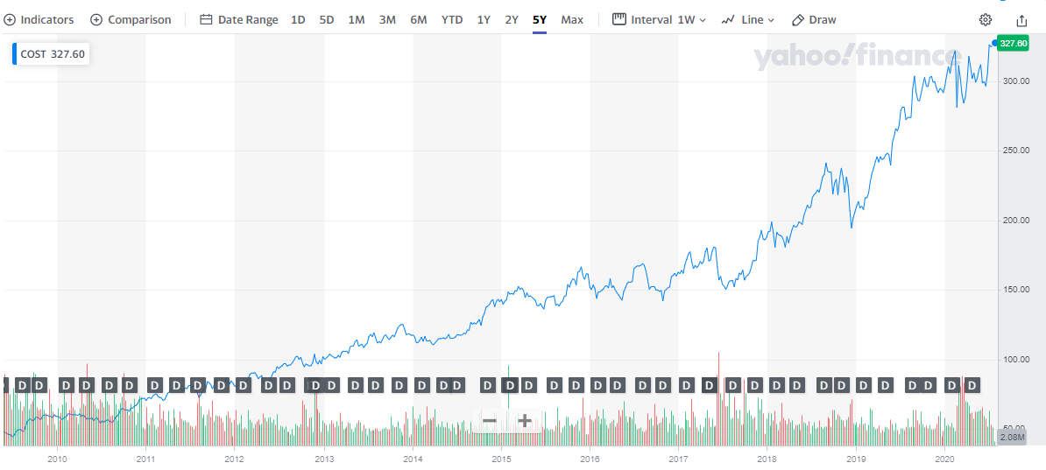
10 Year Performance

Slide 61
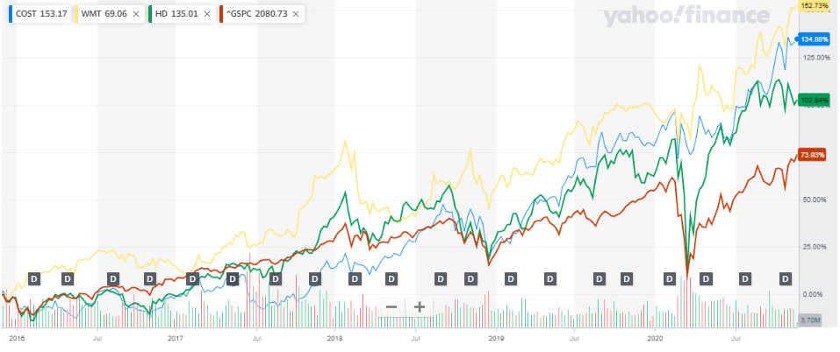
Peer Comparison
Notes:
Costco and home depot at 126%
Wmt 82
Target at 50

Slide 62
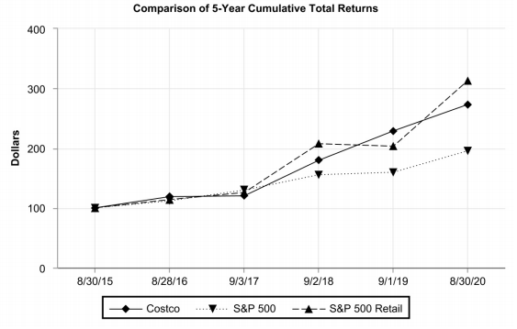
Market & Industry Index Comparison
Notes:
Cost at 126
S&p at 54%
Xrt at -5%

Slide 63
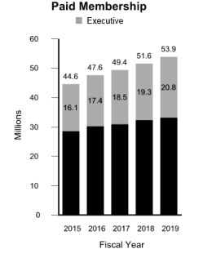
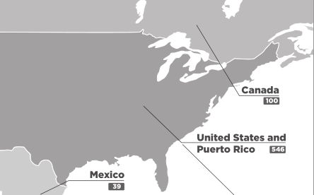
Company Overview
Notes:
785 warehouses, 666 in Canada and u.s , with more internationally
53.9 million memerships

Slide 64
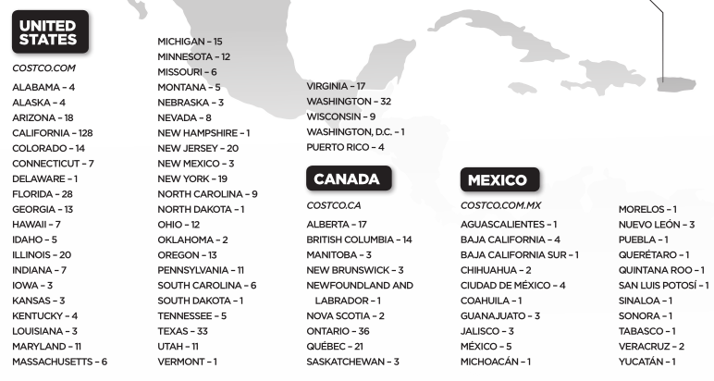
Company Overview
Notes:
785 warehouses, 666 in Canada and u.s , with more internationally
53.9 million memerships

Slide 65
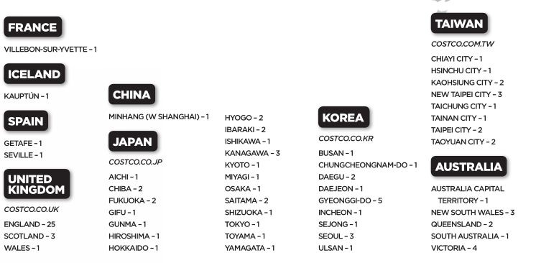
Company Overview
Notes:
785 warehouses, 666 in Canada and u.s , with more internationally
53.9 million memerships

Slide 66
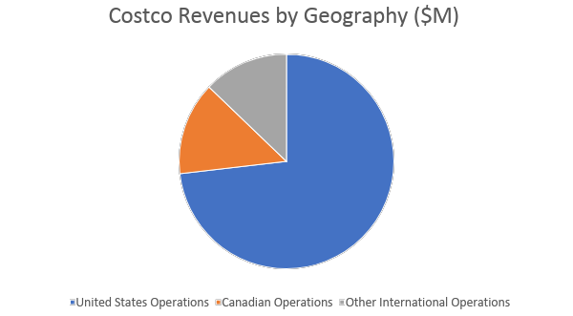

Slide 67
Costco Timeline
1983-Costco opens its first warehouse after founder James Sinegal acquired experience working at Price Club
1993- Merger between Costco and Price Club and Price Club locations rebranded as Costco Wholesale in 1997
1994- First Asia Costco opens in Seoul
1995- 200th location is opened in Washington
1998- Costco.com is established
2000- 2 for 1 stock split on January 14th
2005- 25 warehouses pass $200 million in annual sales
2019- 785 warehouses to date have been opened across the world

Slide 68
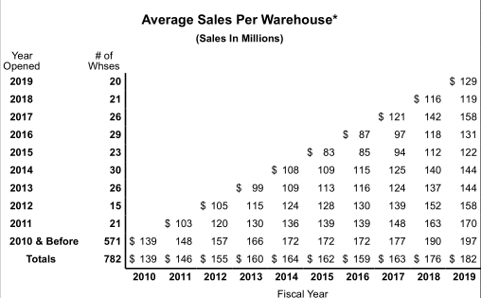
Business Model

Slide 69

Business Model - Memberships

Slide 70


Business Model - Memberships
Notes:
Membership fees allow for products to be sold lower and along with bulk selling makes it very attractive for consumers, membership fees higher percentage of net income
Our member renewal rate was 91% in the U.S. and Canada and 88% on a worldwide basis at the end of 2019
Paid cardholders (except affiliates) are eligible to upgrade to an Executive membership in the U.S. and Canada, for an additional annual fee of $60

Slide 71

Business Model - Memberships
Notes:
https://seekingalpha.com/article/4319008-costco-strong-u-s-base-allowing-for-expansion-east
Using strong base to expand internationally
Merchandise revenue per member up

Slide 72

Notes:
https://www.forbes.com/sites/niallmccarthy/2019/04/18/americas-best-large-employers-2019-infographic/#54b4a0ff1b4a

Slide 73

Notes:
https://www.forbes.com/canada-best-employers/#73104d08241f

Slide 74

Covid-19 Impact

Slide 75

Largest Retailers U.S ($M)

Slide 76
Management Overview

Slide 77

James Sinegal (Co-Founder)
Co founder, CEO from 1983- Dec 2011
On the Board of Directors until retirement in 2018
Implemented Costco culture of paying employees well and providing benefits resulting in lowest turnover in retail
Led the company successfully and stock price increased 5000% under his tenure

Slide 78

Jeffrey Brotman (Co-Founder)
Co founded Costco with Sinegal in 1982
Was Chairman on Board of Directors until his death in 2017
Previously a lawyer before founding Costco
Shared philosophy of Sinegal to “do the right thing” and take care of employees

Slide 79

Hamilton James (Chairman of the Board)
Became Chairman of the board in 2017 following Brotman’s death
Served as President and COO at Blackstone Group until 2018
Has extensive experience in private equity and on other boards of directors
Graduated with a BA from Harvard in 1973

Slide 80

Craig Jelinek (President, CEO, Director)
President since 2010 and CEO since 2012
Previously VP of Merchandising since 2004
Joined Costco in 1984 after previously working in retail in the 1970s
Has built on Sinegal’s success by continuing to add new stores and increase revenues

Slide 81

Richard Galanti (Executive VP, CFO, Director)
Executive VP and CFO since 1993
Director since 1995
Previously worked at Donaldson Lufkin & Jenrette Securities prior to joining Costco in 1984
Graduated from Stanford University Graduate School of Business in 1982 with an MBA

Slide 82

Paul Moulton (Executive VP & Chief Information Officer)
Joined Costco in July 1985
Has been responsible for Marketing, E-commerce and Member Services since 1999
Has served as COO for Costco in Asia and Europe
Received Bachelors degree from University of San Diego

Slide 83
Financial Statements

Slide 84

Balance Sheet Assets – 10Q

Slide 85

Balance Sheet Liabilities & Equity – 10Q

Slide 86

Balance Sheet Assets – 10K

Slide 87

Balance Sheet Liabilities & Equity – 10K

Slide 88

Income Statement – 10K

Slide 89

Income Statement – 10Q

Slide 90

Cash Flow – 10K

Slide 91

Cash Flow – 10K

Slide 92

Cash Flow – 10Q

Slide 93

Cash Flow – 10Q

Slide 94

P/E Analyst Estimates

Slide 95

Analysts Outlook on Costco

Slide 96
Recommendation
Buy

Slide 97


Slide 98



Slide 99

Key Statistics

Slide 100

5-Day Performance

Slide 101

1-Month Performance

Slide 102

3-Month Performance

Slide 103

6-Month Performance

Slide 104

1-Year Performance

Slide 105

5-Year Performance

Slide 106

10-Year Performance

Slide 107

10- year Stock Performance Comparison With S&P 500 and SPDR S&P Retail ETF

Slide 108


Walmart Dividend Schedule

Slide 109

Wal-Mart Stores, Inc. was incorporated on Oct. 31, 1969. On Oct. 1, 1970, Walmart offered 300,000 shares of its common stock to the public at a price of $16.50 per share. Since that time, there have been 11 two-for-one (2:1) stock splits. On a purchase of 100 shares at $16.50 per share on their first offering, the number of shares has grown as follows:
Stock Splits

Slide 110

Walmart Top Institutional Holders

Slide 111
Walmart Overview

Slide 112


Slide 113

Walmart Values

Slide 114

Strategy

Slide 115

Strategy

Slide 116



Walmart Four Segments
Sam’s Club
Walmart E-commerce
Walmart U.S
Walmart International

Slide 117
Facts
●Walmart U.S. is the largest segment and operates retail stores in all 50 states in the U.S. Walmart U.S. generated approximately 66% of total net sales in fiscal 2020; Walmart U.S. has historically contributed the greatest amount to the Company's net sales and operating income
●Wal-Mart International is the second largest segment and consists of operations in 27 countries outside of the U.S. and includes numerous formats as well as digital retail; Wal-Mart International generated approximately 23% of fiscal 2020 net sales
●Sam's Club consists of membership-only warehouse clubs and operates in 44 states in the U.S., as well as digital retail. Sam's Club accounted for approximately 11% of fiscal 2020 net sales; As a membership-only warehouse club, membership income is a significant component of the segment's operating income

Slide 118
Timeline
●1962: Sam Walton opened the first Walmart in Rogers, Arkansas
●1969: Officially incorporated as Wal-Mart Stores, Inc.
●1970: Became a publicly traded company
●1972: Listed on NYSE, 51 stores and sales of $78 million
●1980: Walmart reaches $1 billion in annual sales, faster than any other company at that time.
●1983: The first Sam’s Club opened in Midwest City, Oklahoma
●1990: Walmart became the nation's number-one retailer
●1991: Walmart goes global, opened a Sam’s Club in Mexico City
●1992: Employed 371,000 associates in 1,928 stores and clubs.
●1996: Walmart opened its first stores in China

Slide 119
Timeline
●2002: Walmart topped the Fortune 500 ranking of America's largest companies
●2009: Walmart exceeded $400 billion in annual sales
●2011: With the acquisition of MassMart in South Africa, Walmart surpassed 10,000 retail units around the world.
●2014: Doug McMillon succeeded Mike Duke as CEO
●2015: Walmart announces a $2.7 billion investment over two years in its U.S workforce
●2016: Walmart and JD.com, China’s largest e-commerce company by revenue, form a strategic alliance to better serve consumers across China
●2017: Walmart acquires Shoebuy.com, which was later renamed Shoes.com
●2017: Walmart launches free two-day shipping on more than 2 million items, no membership required.
●2018: The company changes its legal name from Wal-Mart Stores, Inc. to Walmart Inc.
●2019: John Furner named President and CEO of Walmart U.S.

Slide 120

Total Number of Walmart Stores Worldwide

Slide 121

Walmart’s gross profit margin worldwide form fiscal year 2006 to 2020

Slide 122

Walmart net sales worldwide from 2006 to 2020

Slide 123


Walmart and the Competition

Slide 124

Jet.com
Walmart acquired Jet.com in August 2016 for $3 billion in cash and $300 million worth of Walmart shares, gaining the brand’s smartcart technology
Jet brings in its grounded technology specifically, the powerful AI software which Jet’s online platform is built on
Unique to Jet, the proprietary algorithm pulls data from their vast marketplace of third party sellers, serving their customers with the best products, at the best price, by the best possible means of delivery
The purchase of Jet.com opened up an opportunity for Walmart to grow in the world of E-commerce

Slide 125

Jet.Com
In 2019, Walmart decided to fully merge majority of Jet.com employees within
Walmart Inc. and shrink the unit’s management team
In 2020, Walmart announced that it will discontinue Jet.com and phase out the brand. This is because as Walmart’s main website grew, reaching about 20 billion in sales, Jet weakened, suffering declines in traffic and sales

Slide 126

E-Commerce Acquisitions

Slide 127

JD.COM
In 2016, Walmart and JD.com, China’s largest e-commerce company by revenue, form a strategic alliance to better serve consumers across China, covering both online and offline retail
Wal-Mart is putting faith in JD.com to remain one of the top players in China’s e-commerce space, where consumers are projected to spend nearly $6.4 trillion a year by 2025
On the innovation front, the company is expanding its drone delivery routes to cut transportation costs and increase focus on rural areas of China, which will ultimately help it compete against Chinese e-commerce market leader Alibaba

Slide 128


Flipkart
In August 2018, Walmart acquired a 77% stake in India’s largest online retailer Flipkart for $16 billion.

Slide 129

Flipkart

Slide 130

Growth of Walmart’s E-commerce Sales in the U.S

Slide 131

Top 10 E-Commerce Retailers in the US in 2020 by % share of US retail e-commerce sales

Slide 132
Management

Slide 133



The Walton Family
Alice Walton
Jim Walton
Rob Walton
Executive; Strategic Planning & Finance
Son of Walmart founder, Sam Walton, Rob Walton served as Walmart’s chairman of the board of directors from 1992 to 2015
Rob joined the company in 1969. Prior to becoming chairman, he held a variety of positions with Walmart, including senior vice president, corporate secretary, general counsel and vice chairman
Before joining Walmart, Rob was a partner with the law firm of Conner & Winters in Tulsa, Okla
Graduated from the University of Arkansas in 1966 with a bachelor of science degree in business administration
Net worth: 48.4 billion USD
Walton received a bachelor’s degree in Business Administration Marketing
Jim walton’s retirement from the board and the nomination of Steuart Walton, his son, mark a leadership transition to the next generation of Walton family representatives
Jim Walton served on the board for over 10 years and was a member of the Technology and eCommerce Committee, as well as the Strategic Planning and Finance Committee during his tenure
Net worth: 48.1 billion USD
Graduated from Trinity University with a B.A, in economics and finance

Slide 134

Management
Doug McMillon: CEO and President, Walmart
As CEO, Doug leads a strong management team that is working to deliver Walmart’s mission of “saving people money so they can live a better life.”
Mr. McMillon has more than 25 years of experience in the retail industry and at our company.
From February 2009 to February 2014, Doug served as president and chief executive officer of Walmart
International, a fast-growing segment of Walmart’s overall operations
Originally from Jonesboro, Ark., Doug graduated from the University of Arkansas with a bachelor of science in business administration. He earned his MBA in finance from the University of Tulsa.

Slide 135

Management
John Furner: CEO and President, Walmart U.S.
John Furner is responsible for the strategic direction and performance of more than 4,700 stores and more than 1 million associates
From 2017-2019, John served as president and CEO of Sam’s Club
John started with Walmart as an hourly associate in 1993, at Store 100 in Bentonville, Arkansas. He has held important roles throughout the company, including assistant store manager, store manager, district manager, buyer with the prominent ones including head of marketing and merchandising for Walmart China, and chief merchant for Sam’s Club
John has a bachelor of science in marketing from the University of Arkansas

Slide 136

Management
Judith Mckenna: CEO and President, Walmart International
She leads more than 5,900 retail units and 700,000 associates across 26 countries.
Prior to being named president and CEO of Walmart International, Judith served as executive vice president and chief operating officer for Walmart U.S. She led the company’s 1.5 million associates and operations for its 4,600 U.S. stores.
Judith has been named to Fortune’s 50 Most Powerful Women list every year since 2015.
Judith graduated with a law degree from Hull University in England before earning her Institute of Chartered Accountants in England and Wales accounting qualification at KPMG.

Slide 137

Management
Marc Lore: CEO and President, Walmart eCommerce U.S.
He was appointed in September 2016 to lead U.S. ecommerce when his company Jet.com was acquired
In his role, he accelerates Walmart’s U.S. e-commerce growth and customer reach, leading Walmart.com and Jet.com.
Prior to Jet, Marc was the co-founder and CEO of Quidsi, the parent company of e-commerce websites Diapers.com, Soap.com, Wag.com and more.
Marc’s industry accolades include E&Y’s Entrepreneur of the Year regional winner and Fortune’s “smartest people in technology.”
He graduated from Bucknell University, where he received a B.A. in Business Management and Economics.

Slide 138

Management
Brett Biggs: Executive Vice President and CFO, Walmart
Brett is responsible for accounting and control, corporate strategy and development, business planning and analysis, internal auditing, treasury, tax, global shared services and several other key areas of the company.
Before being appointed to his current role, he was executive vice president and chief financial officer for Walmart International, where he was responsible for all global finance activities.
Prior to joining Walmart in 2000, Brett held various M&A and corporate finance positions with Leggett & Platt, Phillips Petroleum Co. and Price Waterhouse.
Brett graduated Summa Cum Laude from Harding University with a bachelor’s degree in accounting and later received a MBA with Honors from Oklahoma State University. He serves in various advisory roles at Harding University

Slide 139

Management
Kathryn McLay: President and CEO, Sam’s Club
Kathryn has held a number of leadership roles at Walmart since joining in 2015 as vice president at U.S. Finance & Strategy
Kathryn began her career in 1992 at Deloitte as an undergraduate and worked in both internal and external audit and later at Qantas Airlines. In 2007, she was selected as the general manager for business development and subsequently held executive leadership roles throughout Woolworths’ retail and supply chain
She has a bachelor’s degree in accounting and finance from the University of Technology in Sydney

Slide 140
Financial Snapshot

Slide 141

Balance Sheet - Assets (10-Q)

Slide 142

Balance - Liabilities & Equity (10-Q)

Slide 143

Balance Sheet (10 - K)

Slide 144

Balance - Liabilities & Equity (10 - K)

Slide 145

Statement of Income (10 - K)

Slide 146

Statement of Income (10 - Q)

Slide 147

Statement of Cash Flows (10 - K)

Slide 148

Statement of Cash Flows (10 - K)

Slide 149

Statement of Cash Flows (10 - Q)

Slide 150

Statement of Cash Flows (10 - Q)

Slide 151

Recommendation

