Slide 1
U.S. RETAILS Summer 2022
Team Members: Laurel Dao, Annie Lee, Zoya Ahmad, John Gong

Slide 2
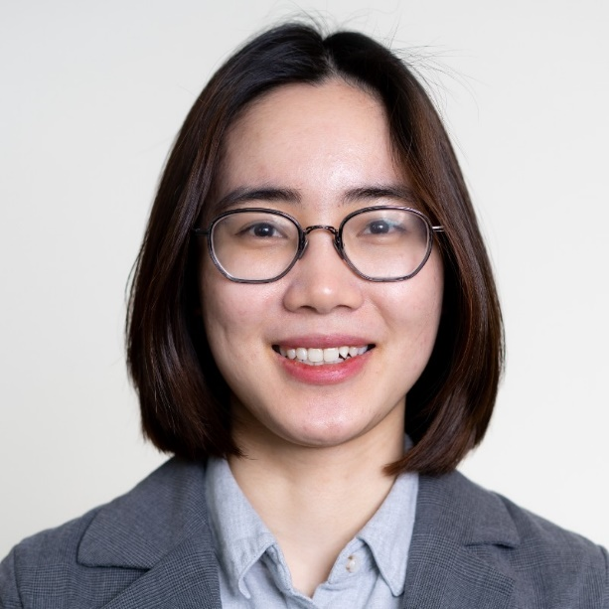
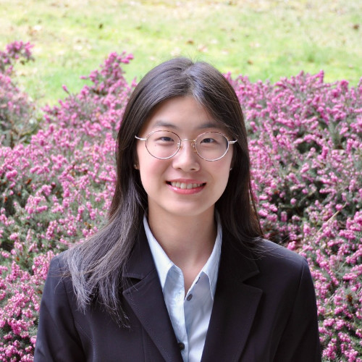





U.S. RETAILS
Presenters
Laurel Dao
Annie Lee
Zoya Ahmad
John Gong

Slide 3
Table of Contents
TABLE OF CONTENTS
Industry Overview
Walmart Inc.
The Kroger Company
Costco Wholesale Corporation

Slide 4
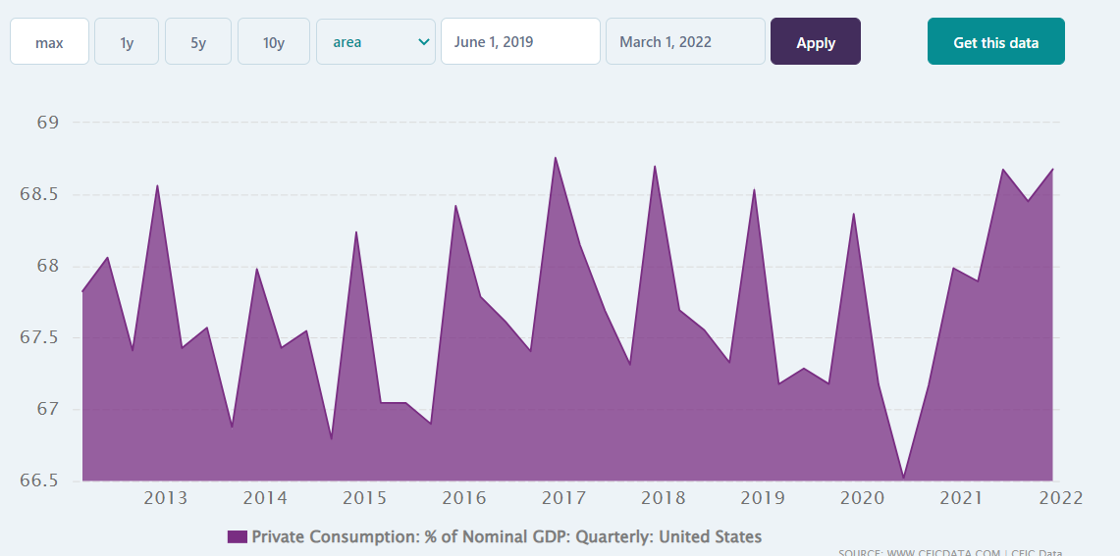
Definition of Retail
INDUSTRY OVERVIEW
The retail industry is a sector of the economy that is comprised of individuals and companies engaged in the selling of finished products to end user consumers.
Changes in retail sector significant indicator of strength of US economy.

Slide 5
INDUSTRY OVERVIEW
Types of Retail Stores
Department stores: offer a wide range of consumer goods in different areas of the store, each area ("department") specializing in a product category. Exp: Macy’s, Dillard’s
Specialty stores: focus on one or two specific categories of products. Exp: Furniture stores, bookstores
Supermarkets: big self-service retail market that generally sells foods and household items Exp: Safeway, Nesters
Convenience stores: offer a limited range of products at premium prices due to the added value of convenience. Usually are small and located in residential area.
Discount stores: compete on the basis of low prices, high turnover, and high volume. Exp: Walmart, Winners

Slide 6
Types of Retail Stores
INDUSTRY OVERVIEW
Hypermarkets or Superstores: the next level of supermarkets. Usually are the size of malls. Exp: Tesco, Walmart Supercenter
Warehouse Retailers: selling large quantities of goods at discounts deeper than those provided in conventional supermarkets or wholesalers. They offer very low prices and little or no customer service at all. Exp: Costco
E-commerce Stores: Sells from an Internet shopping website and ship the purchases directly to customers at their homes or workplaces and without all the expenses of a traditional brick-and-mortar retailer, usually sell merchandise for a lower-than-retail price. Exp: Amazon, eBay

Slide 7

Retail Industry Analysis

Slide 8
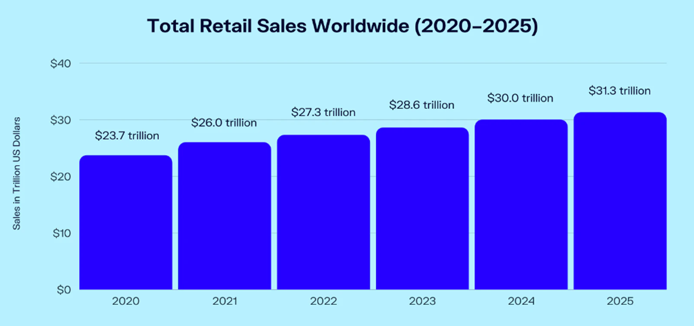
Retail Sales Worldwide
From 2020 to 2025, total retail sales are expected to increase by $7.6 trillion, an overall increase of 31.7 percent and an average annual increase of 4.3 percent.

Slide 9
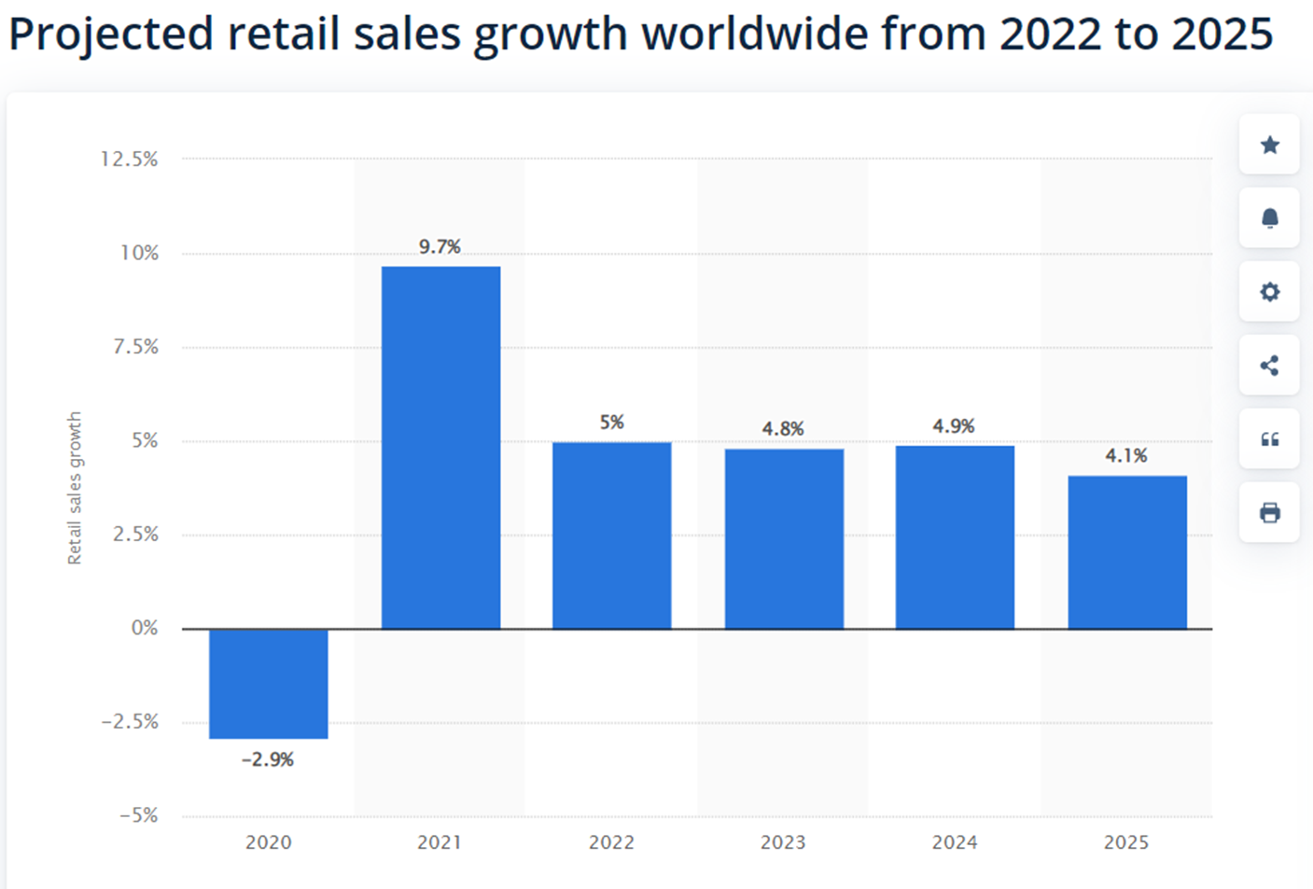

Slide 10
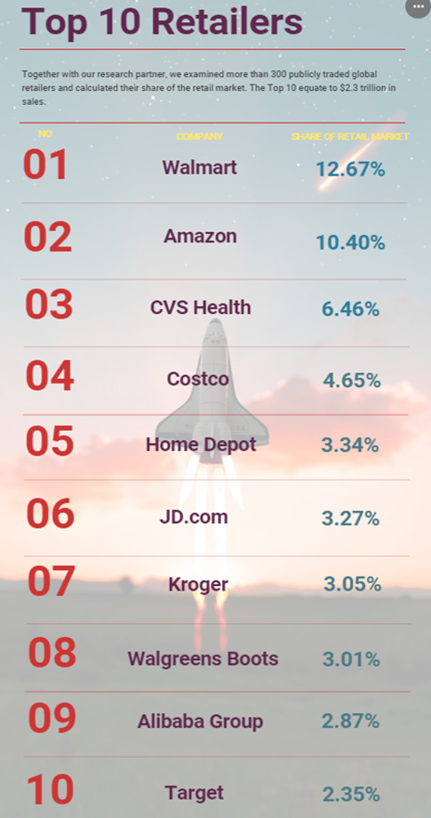
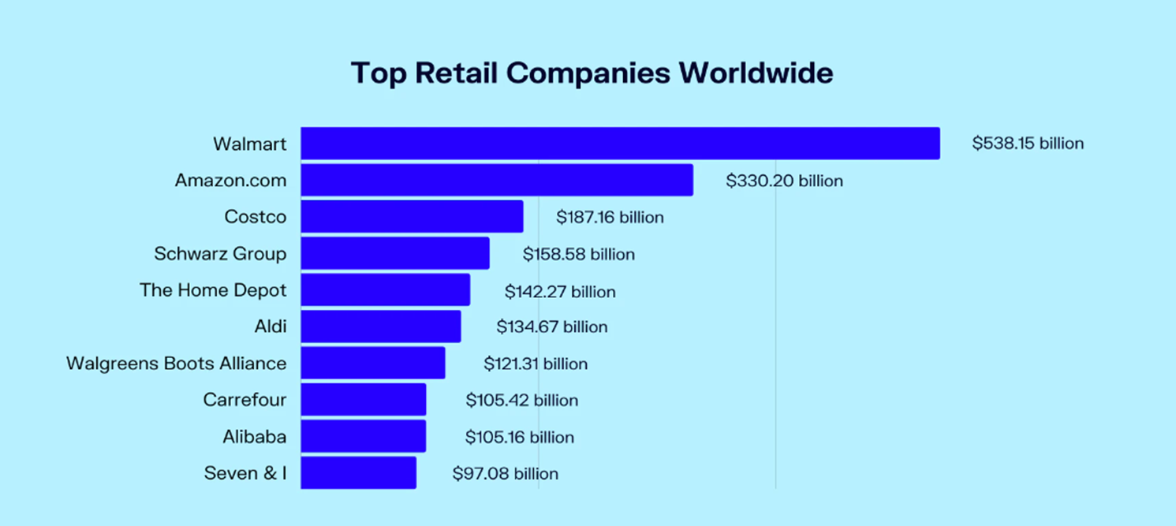
Top Retail Companies Worldwide in 2021

Slide 11
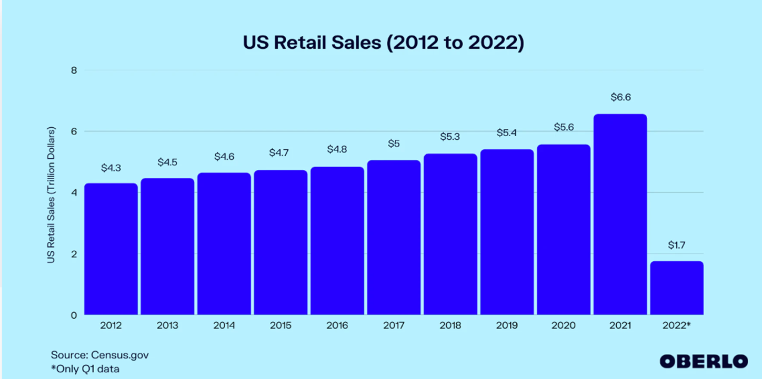
US Retail Sales

Slide 12
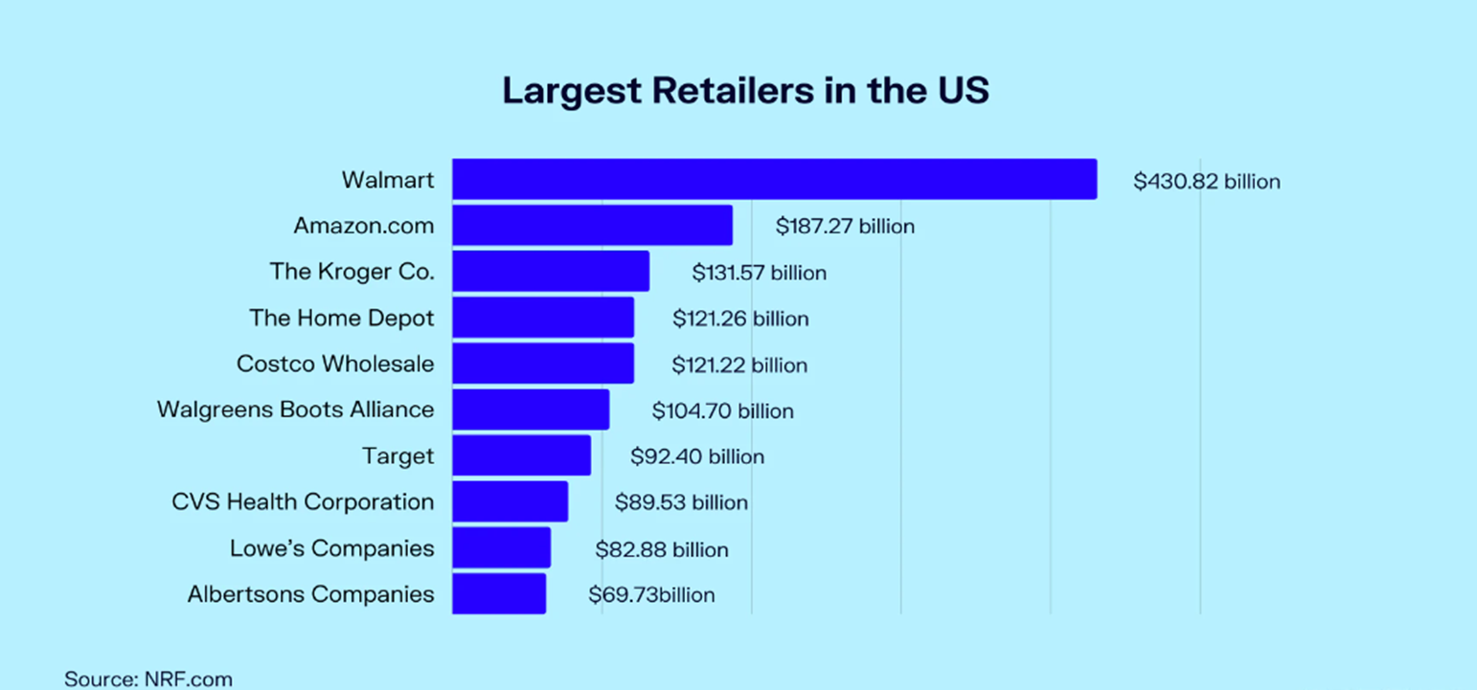
Largest Retailers’ Sales in US

Slide 13
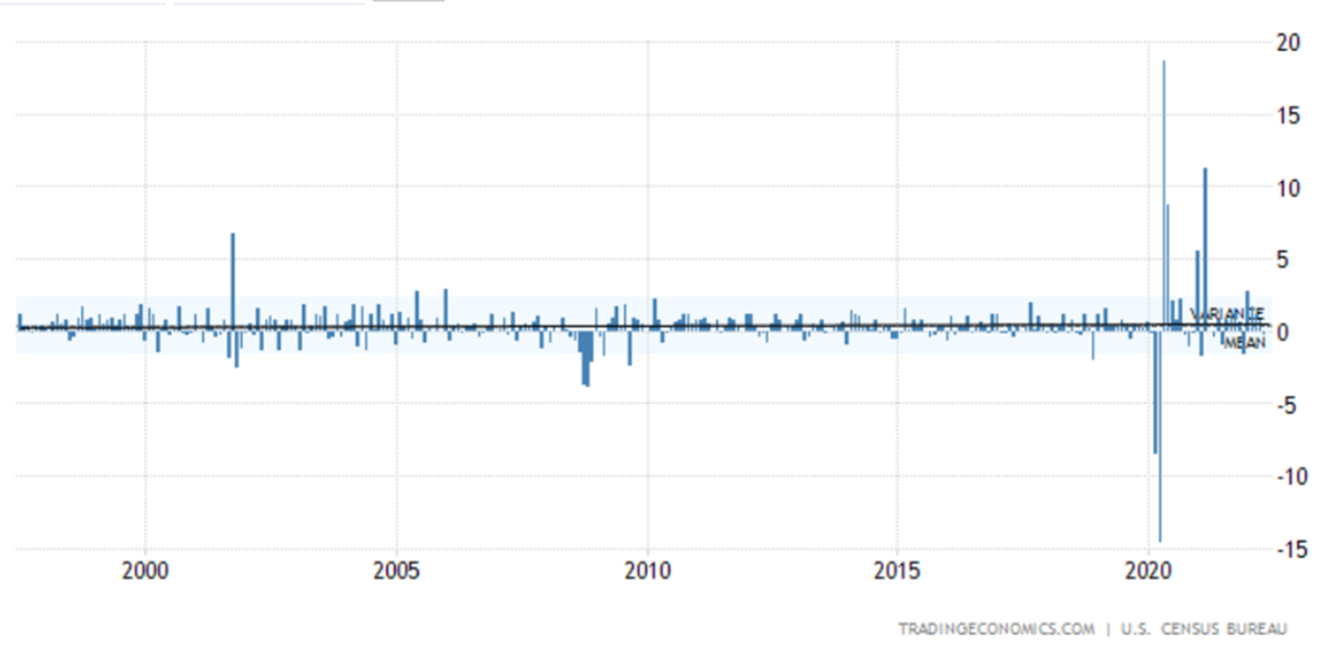
U.S. Retail Industry Historical Data
Average: 0.41%
Max 18.7% in May of 2020
Min: -14.7% in April of 2020

Slide 14
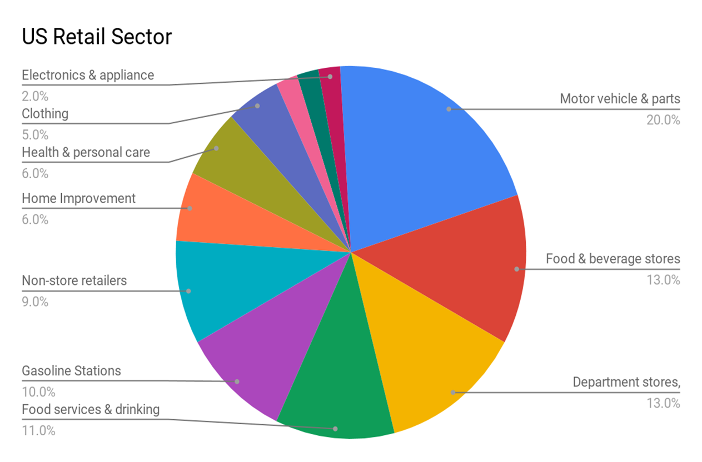
US Retail
In February 2021, there were approximately 15.7 million people employed in the retail industry in the United States
Top Three:
Motor vehicle & parts dealers (20%)
Food & beverage stores (13%)
Department stores (13%)

Slide 15
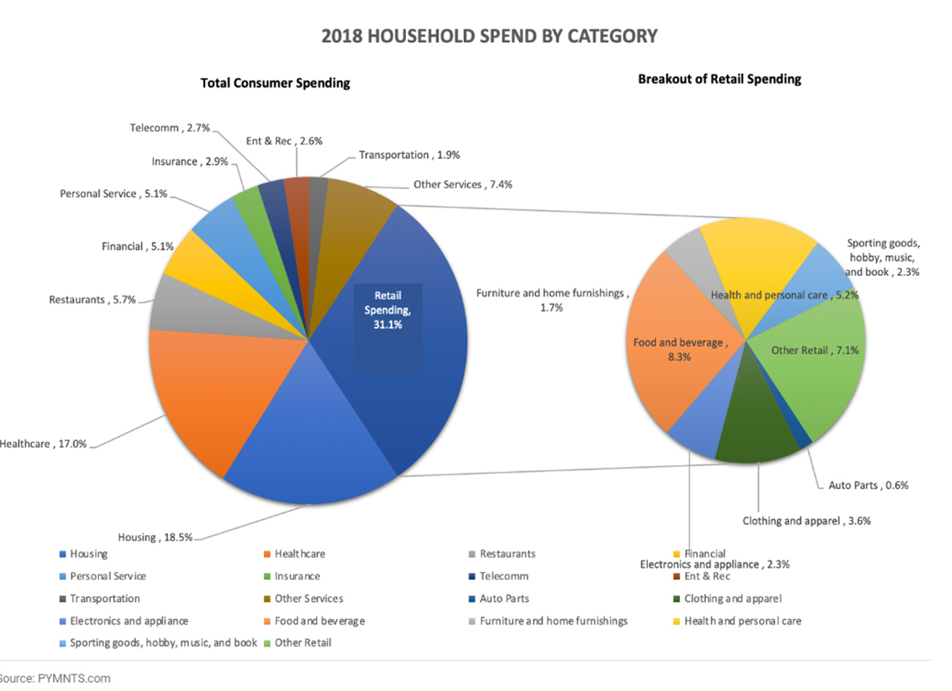
Composition of Consumer Expenditure

Slide 16
Openings and Closings in 2021
U.S. retailers announced twice as many store openings as closings in 2021
more than 8,100 new store openings
roughly 3,950 store closings
Openings remained skewed toward dollar, discount, off-price and warehouse clubs
These sectors accounted for 47 percent of all opening announcements last year, or 3,840-plus stores
CVS and specialty apparel/footwear retailers announced the most closings
CVS announced the planned closing of about 900 stores over the next three years

Slide 17
Retail Index
SPDR S&P Retail (XRT)
VanEck Retail ETF (RTH)
SPDR S&P 500 (SPY)

Slide 18
In seeking to track the performance of the S&P Retail Select Industry Index (the "index").
It generally invests substantially all, but at least 80%, of its total assets in the securities comprising the index.
The index represents the retail segment of the S&P Total Market Index ("S&P TMI").
SPDR S&P Retail (XRT)

Slide 19
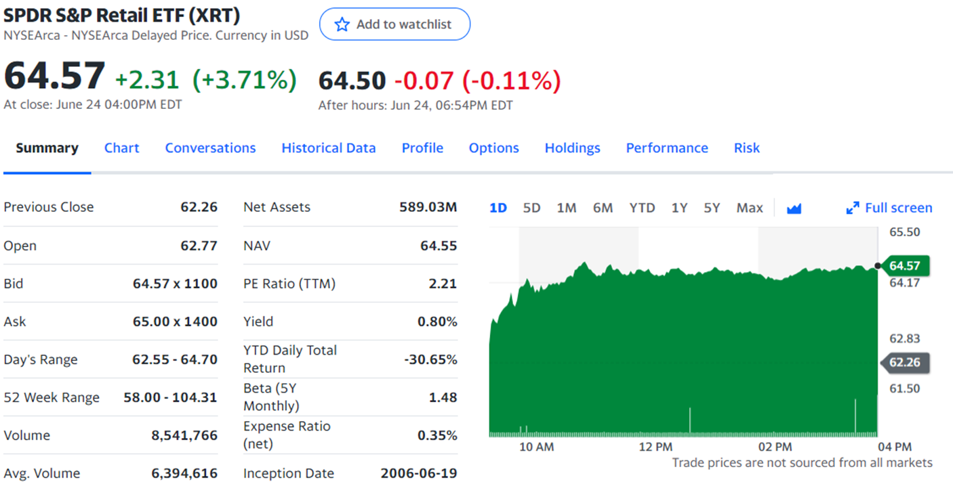
S&P Retail ETF - XRT

Slide 20
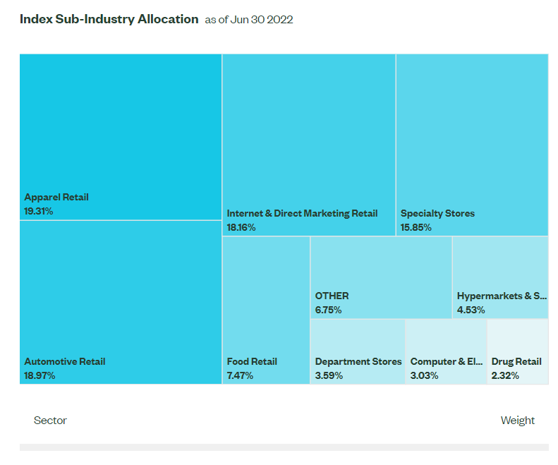
Top 10 Sectors

Slide 21
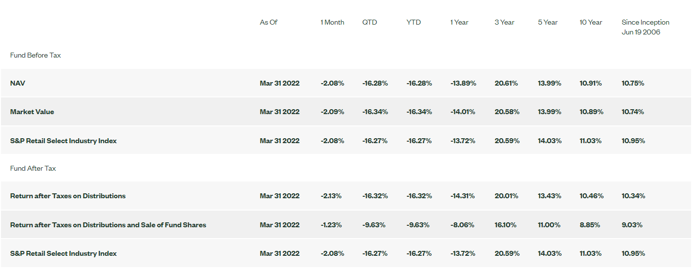
Performance

Slide 22
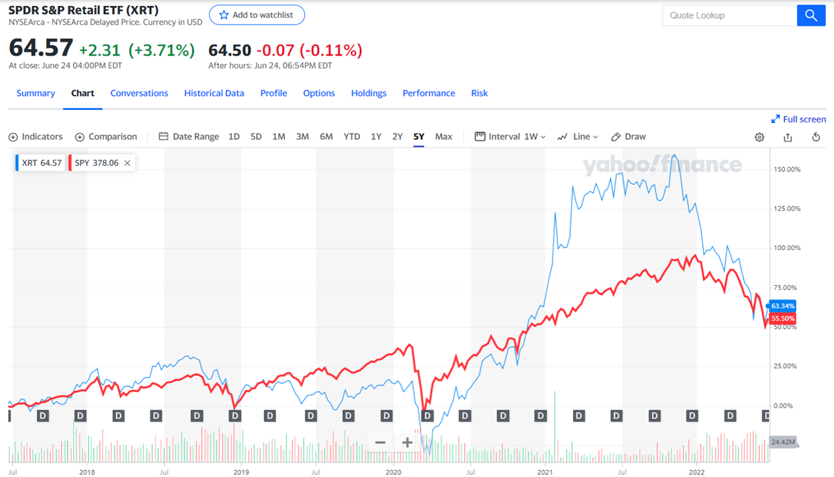
S&P Retail Index Comparison (5 Years)

Slide 23
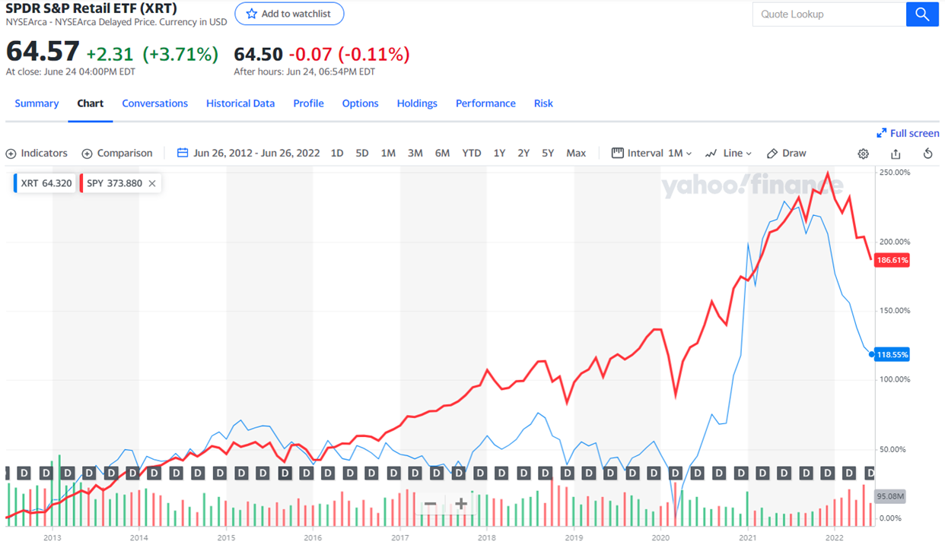
S&P Retail Index Comparison (10 Years)

Slide 24
VanEck Retail ETF (RTH) seeks to replicate as closely as possible, before fees and expenses, the price and yield performance of the MVIS US Listed Retail 25 Index (MVRTHTR).
Retail includes companies engaged primarily in retail distribution; wholesalers; online, direct mail, and TV retailers; multi-line retailers; specialty retailers; and food and other staples retailers. The fund is non-diversified.
VanEck Retail ETF (RTH)

Slide 25
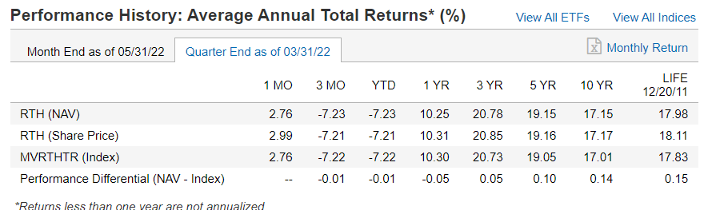
Performance

Slide 26
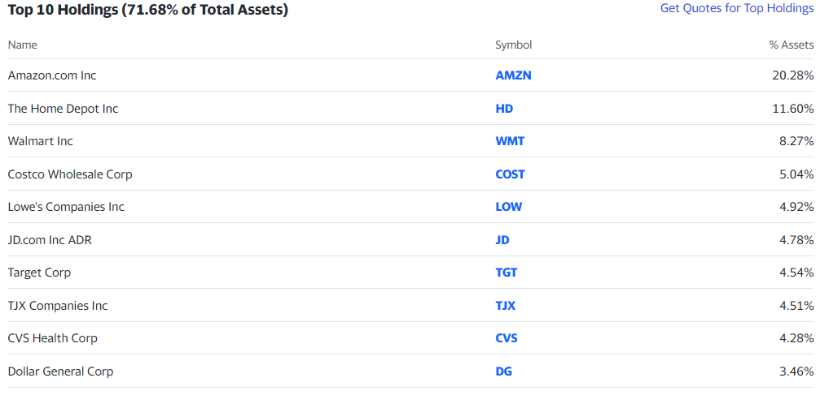
Top 10 Holdings

Slide 27
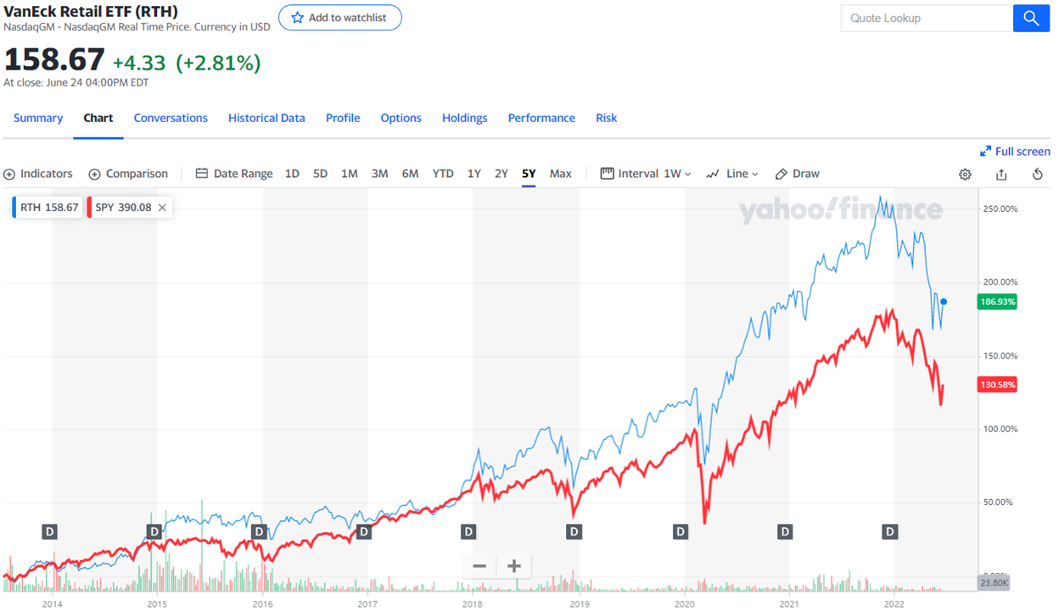
VanEck Retail Comparison (5 Years)

Slide 28
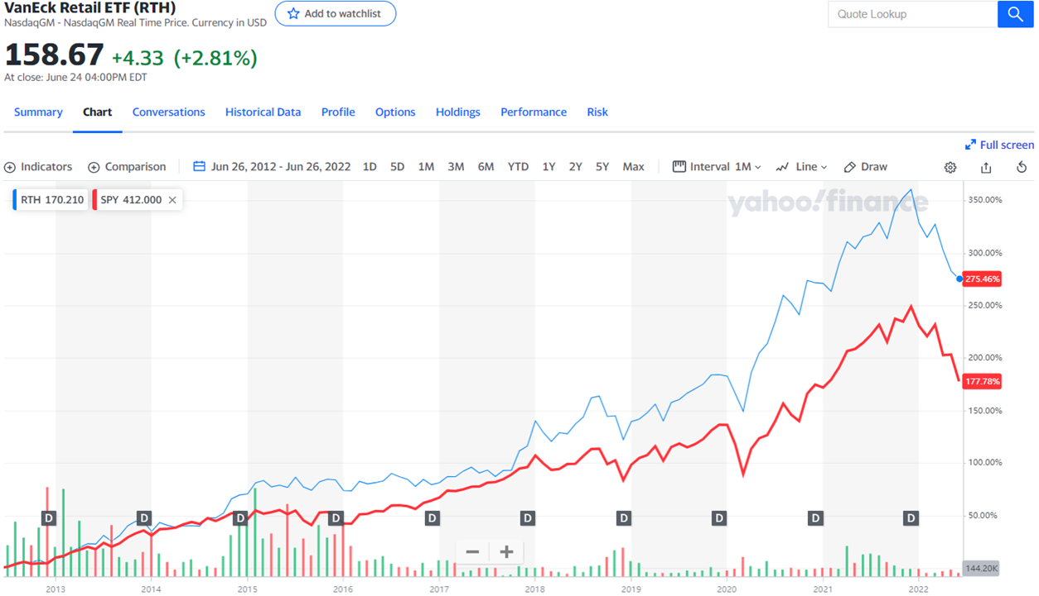
VanEck Retail Comparison (10 Years)

Slide 29
The Future of Retail

Slide 30
Shifting Trends
1. Emloyee Retension
The great resignation brings workforce issues to the forefront
In 2021, over 47 million Americans voluntarily quit their jobs
Many retailers are now in a tough spot—83% are investing most heavily in employee recruitment and retention.
With executives noting that labor issues are top retail concerns, retailers should reset the way they think about their employees as they consider the future.
The issues go far deeper than merely salaries. Priorities have shifted for employees, especially around flexibility, culture, and diversity, equity, and inclusion (DEI).

Slide 31
Shifting Trends
2. Supply Chain Resiliency
Overcoming persistent issues with the manufacture and movement of goods
Shifting priorities from the pandemic have altered the way consumers shop. Where and when customers make their purchases are far less predictable these days.
Many current supply chain capabilities—including demand planning, inventory management, and fulfillment forecasting—aren’t set up to handle such scenarios. Organizations need more credible information and technology upgrades to develop agile systems that can handle the new consumer scenarios.

Slide 32
Shifting Trends
3. Digital Revolution
The fusion of digital and physical experiences will only accelerate
Retailers should make significant investments that not only meet the e-commerce needs of the present, but also those of the future. A key takeaway from the pandemic has been that consumers have reset their level of reliance on technology and digital platforms.
Over the next five years, leaders are buying into the prospects of digitization of the physical world, such as voice commerce, staff-free cashier-less stores, and the selling of digital goods.

Slide 33
Challenges in the Retail Sector
High Inflations
lower purchasing power, higher input cost
High Interest rate
higher borrowing costs, higher saving rates
Shift in Shopping Habits
Switch from in-store to online shopping

Slide 34
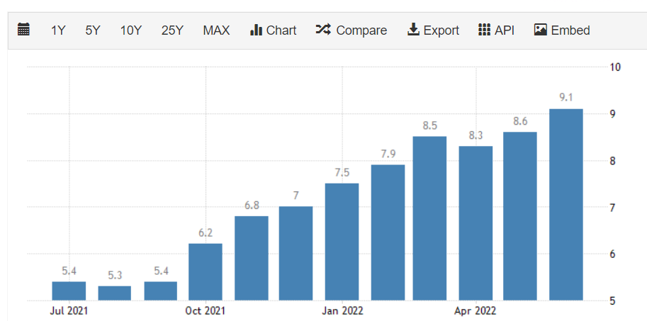
US Inflation Rate
The annual inflation rate in the US accelerated to 9.1% in June of 2022,
the highest since November of 1981, from 8.6% in May and above market forecasts of 8.8%

Slide 35
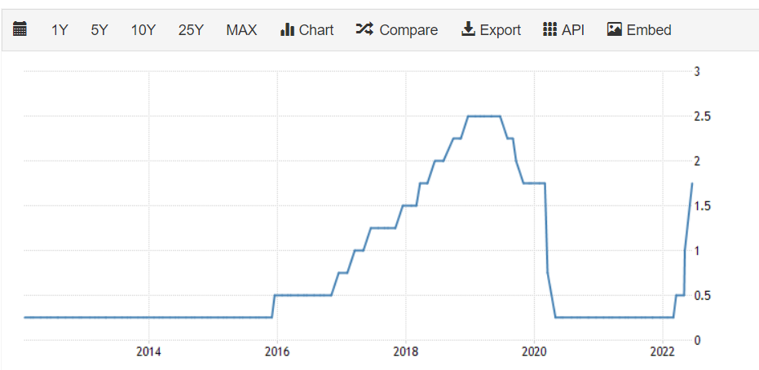
US Interest Rate

Slide 36

The Rise of Ecommerce

Slide 37
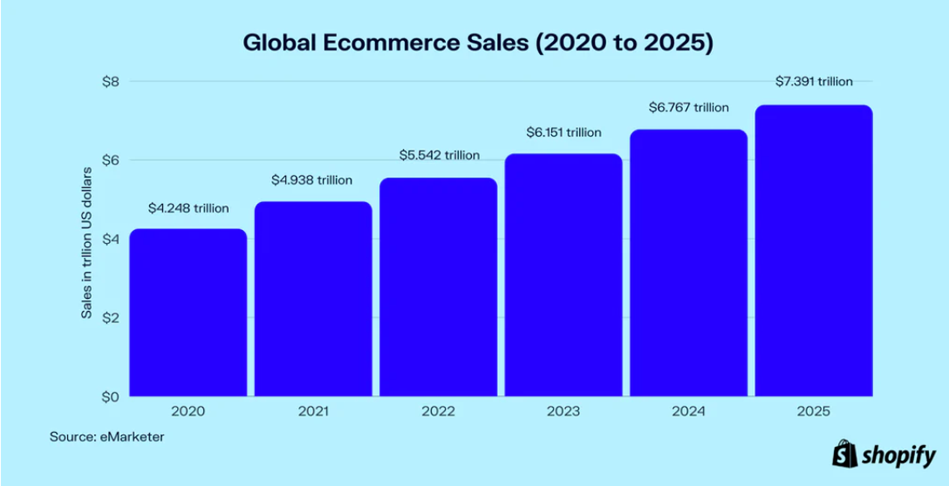
Global Ecommerce Sales

Slide 38
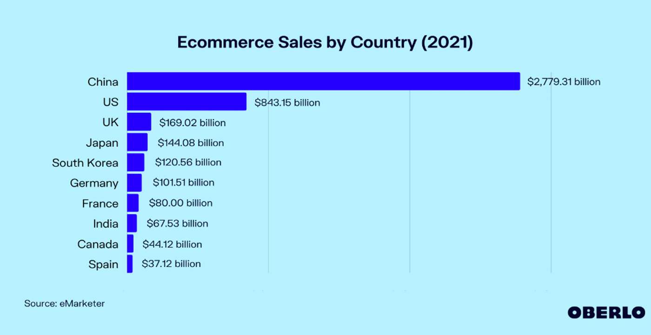
Ecommerce Sales by Country in 2021

Slide 39
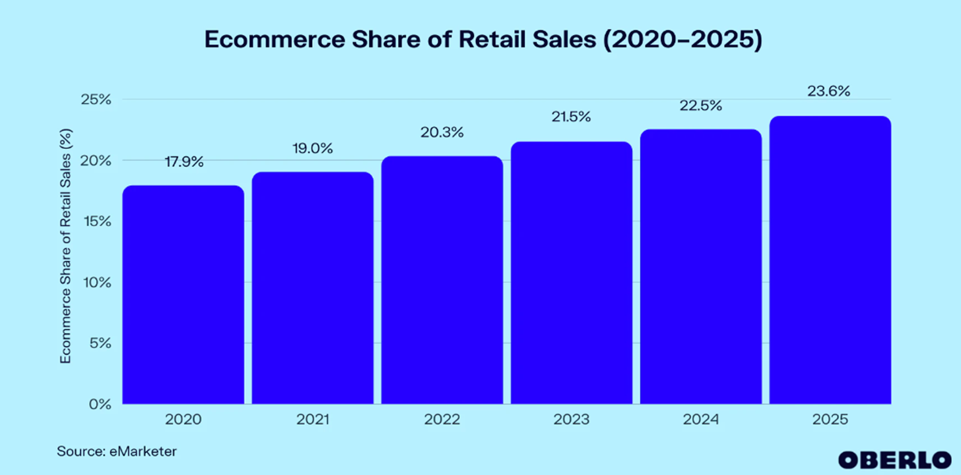
Global Ecommerce Shares

Slide 40
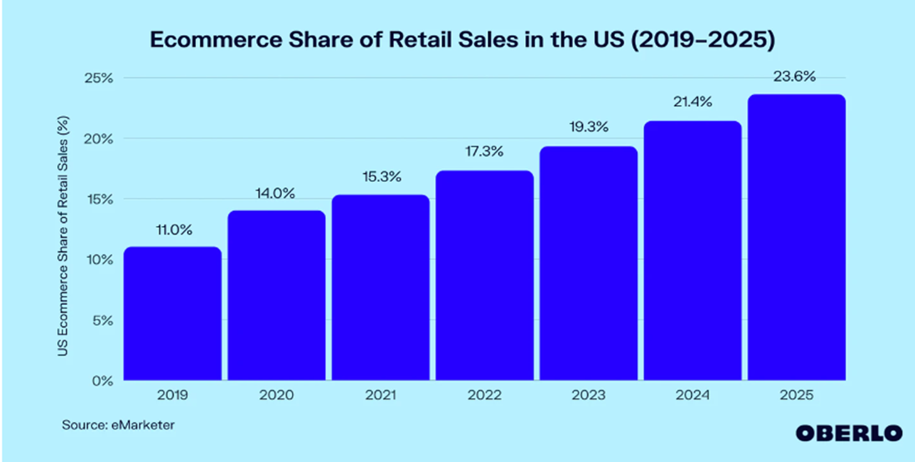
U.S. Ecommerce Shares

Slide 41


Slide 42
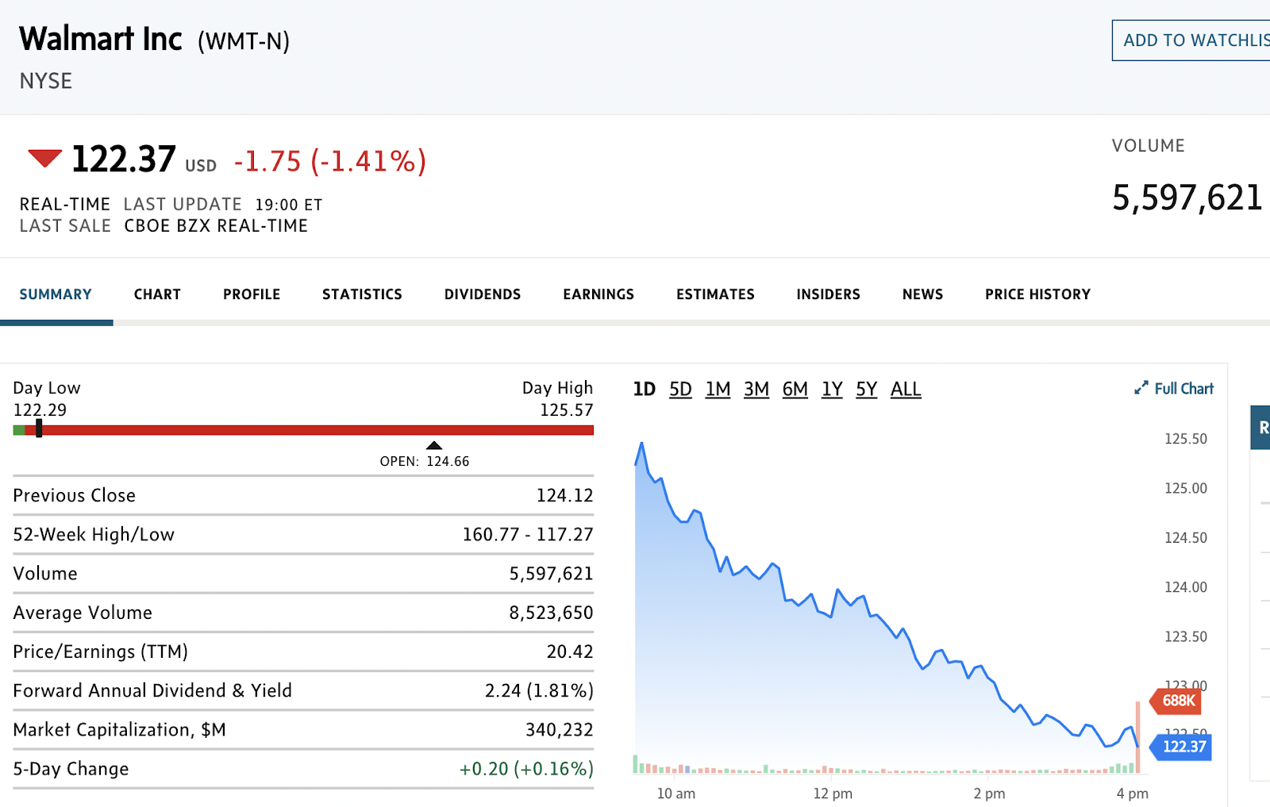
Stock Information
COMPANY OVERVIEW
Company Snapshot

Slide 43
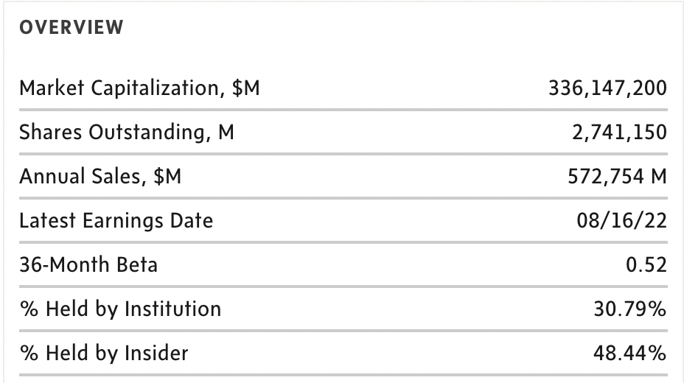
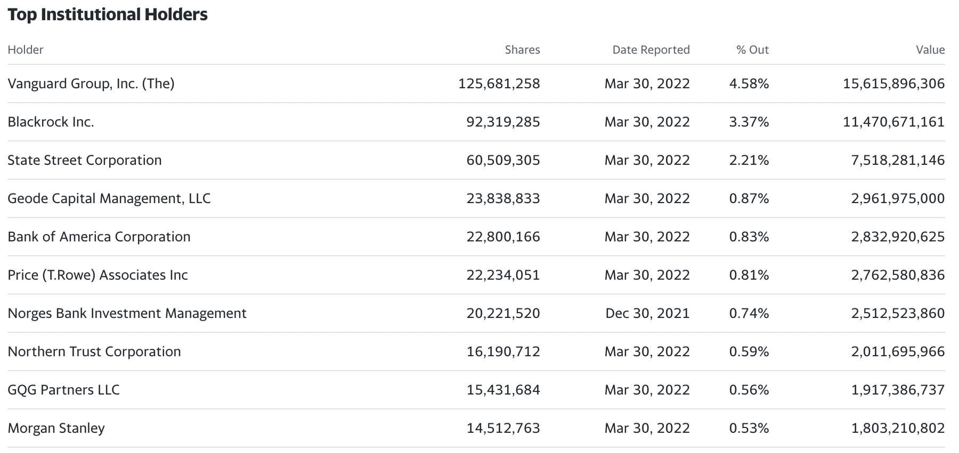
Ownership Structure
COMPANY OVERVIEW

Slide 44
Key Ratios
ratios
Ratio | Fiscal 2022 | Fiscal 2021
Current Ratio | 0.93 | 0.97
Quick Ratio | 0.28 | 0.49
Inventory turnover | 7.59 | 9.35
EPS | 4.87 | 4.75
P/E ratio | 28.44 | 29.02
Price/book ratio | 4.17 | 4.42
Return on Equity | 15.43% | 16.36%
Debt/Equity | 1.67 | 1.89

Slide 45
Stock Performance

Slide 46
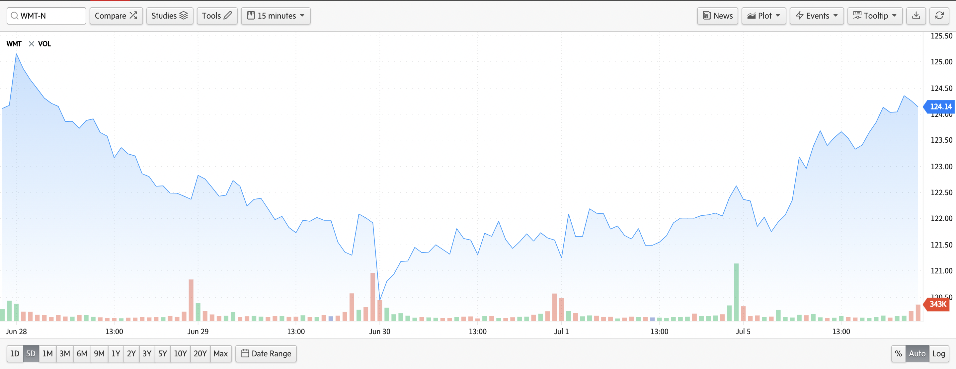
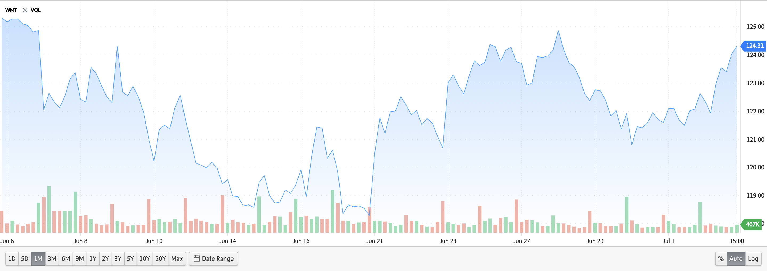
Stock Performance
STOCK PERFORMANCE
5-Day Stock Performance
1-Month Stock Performance

Slide 47
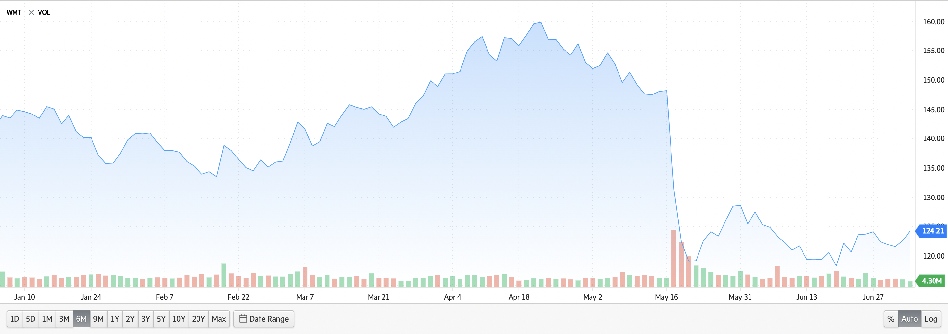
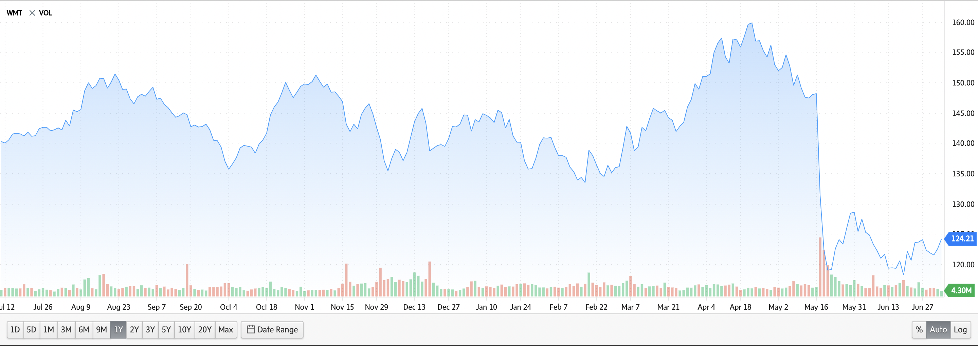
Stock Performance
STOCK PERFORMANCE
6-Month Stock Performance
1-Year Stock Performance

Slide 48
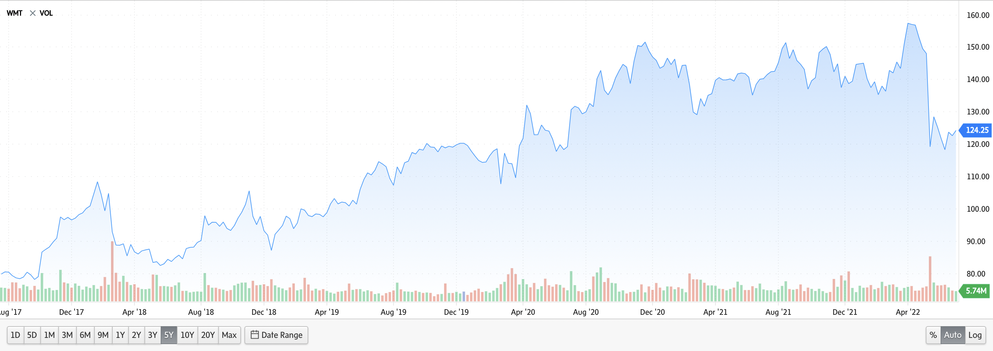
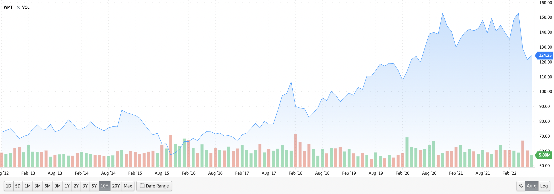
Stock Performance
STOCK PERFORMANCE
5-Year Stock Performance
10-Year Stock Performance

Slide 49
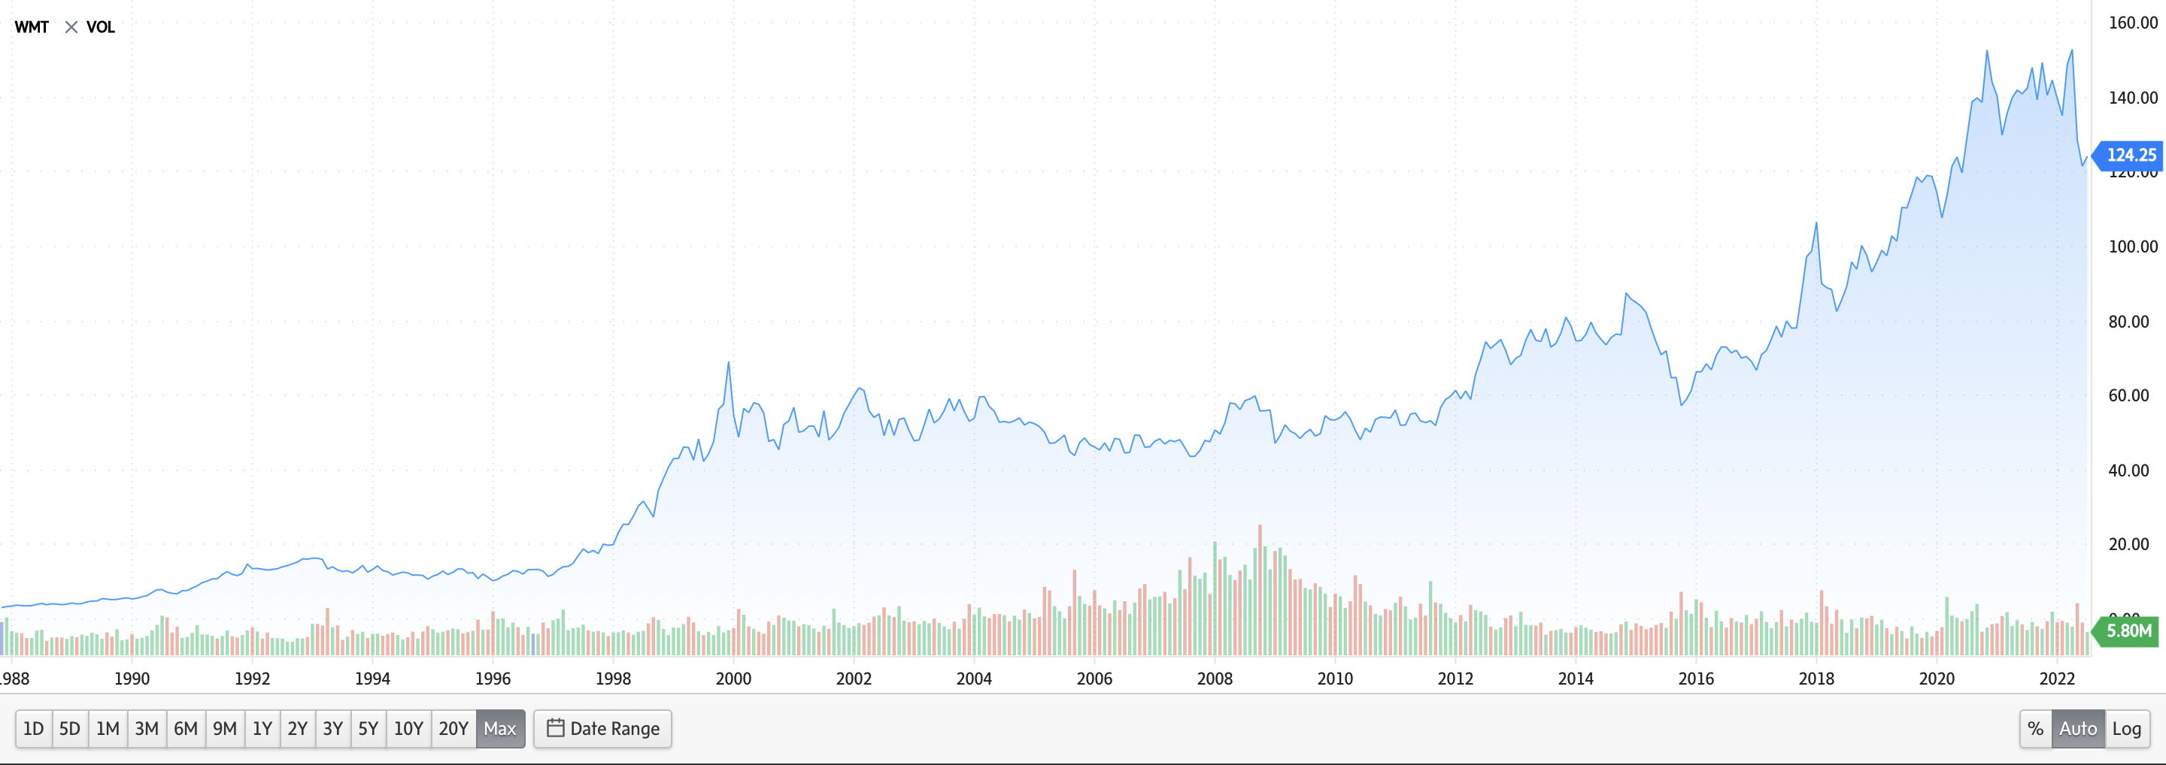
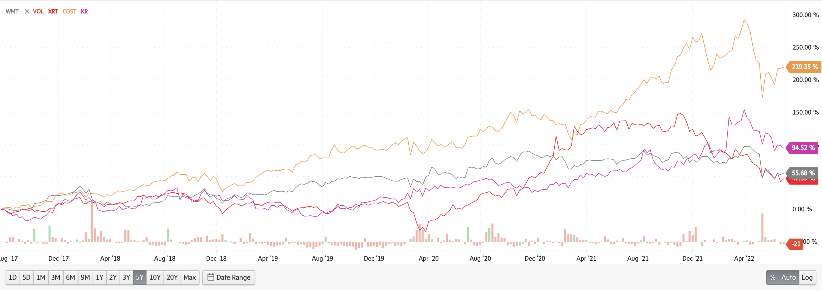
Stock Performance
STOCK PERFORMANCE
Max Stock Performance
Comparison Performance

Slide 50
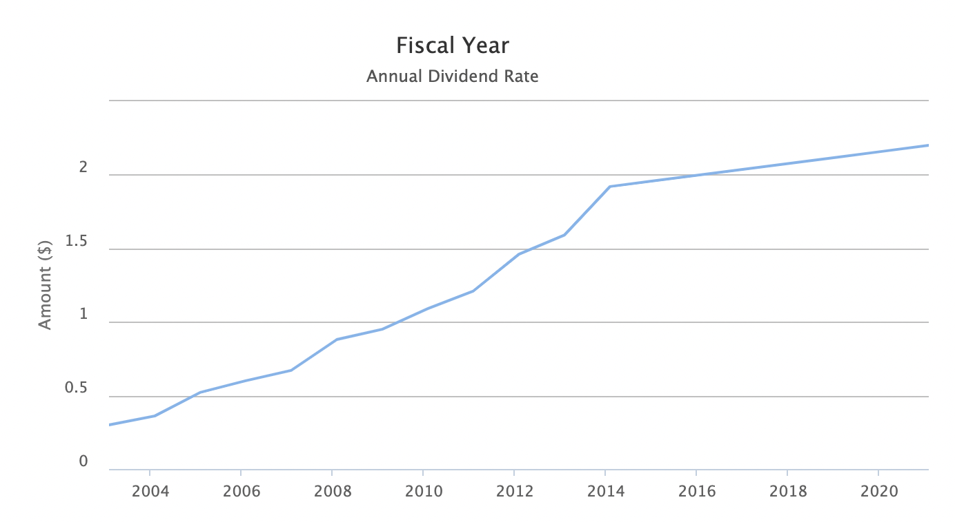
Dividend History
Stock performance
Annual Dividend Rate 2003-2022:
Walmart has increased its annual cash dividend every year since first declaring a $0.05 per share annual dividend in March 1974

Slide 51
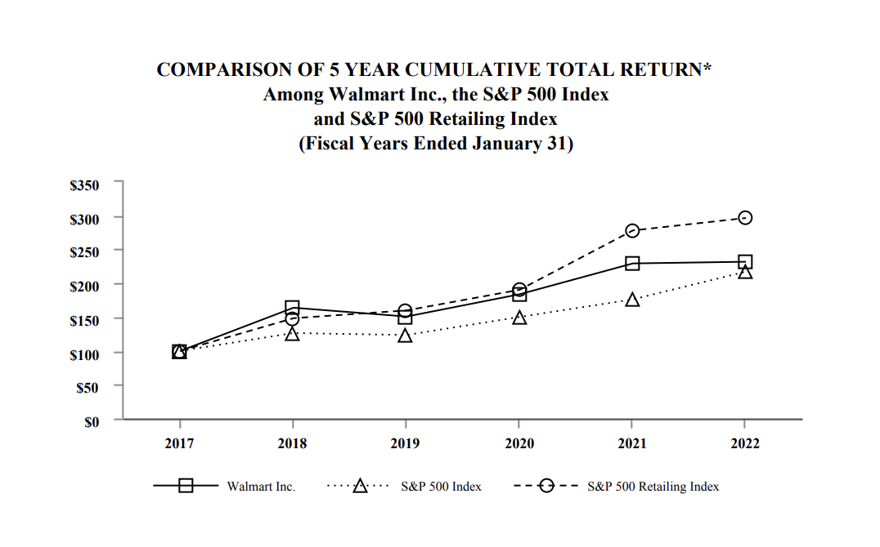
Stock Performance
Stock performance
Comparison of 5-Year Cumulative Return

Slide 52
Company Overview

Slide 53
Business Timeline
COMPANY OVERVIEW
1962 On July 2, 1962, Sam Walton opens the first Walmart store in Rogers, Arkansas.
1969 The company officially incorporates as Wal-Mart Stores, Inc.
1970 Walmart becomes a publicly traded company. The first stock is sold at $16.50 per share.
1971 The first distribution center and Home Office open in Bentonville, Arkansas.
1978 First pharmacy opens.
1979 The Walmart Foundation is established.
1980 Walmart reaches $1 billion in annual sales, faster than any other company at that time.
1983 The first Sam's Club opens in Midwest City, Oklahoma.

Slide 54
Business Timeline (cont)
COMPANY OVERVIEW
1988 The first Walmart Supercenter opens in Washington, Missouri David Glass is named chief executive officer.
1991 Through a joint venture with Cifra, a Mexican retail company, Walmart goes global, opening a Sam's Club in Mexico City.
1994 Walmart expands into Canada with the purchase of 122 Woolco stores.
1996 Walmart opens its first stores in China.
1998 Walmart enters the United Kingdom with the acquisition of Asda.
2000 Walmart.com is founded, allowing U.S. customers to shop online.
2002 Walmart enters the Japanese market through its investment in Seiyu.

Slide 55
Business Timeline (cont)
COMPANY OVERVIEW
2007 Walmart.com launches its Site to Store service, enabling customers to make a purchase online and pick up merchandise in stores.
2009 Walmart enters Chile with the acquisition of a majority stake in D&S S.A.
2010 Bharti Walmart, a joint venture, opens its first store in India.
2011 Walmart expands its business into South Africa by acquiring 51% of Massmart Holdings Limited.
2013 Walmart opens its first store in the District of Columbia.
2015 Walmart acquires 100% stake in Yihaodian, an e-commerce business in China, up from the 51% stake since 2012.
2020 Walmart launches Walmart+ membership program

Slide 56
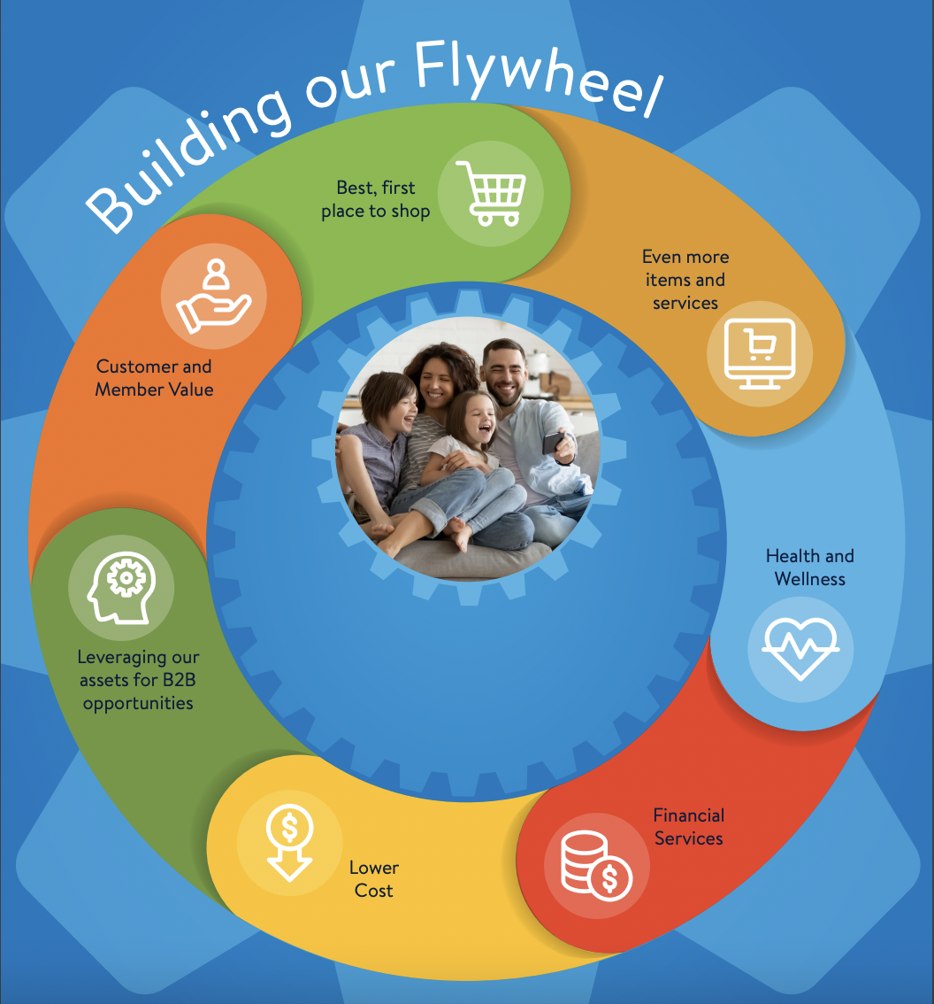
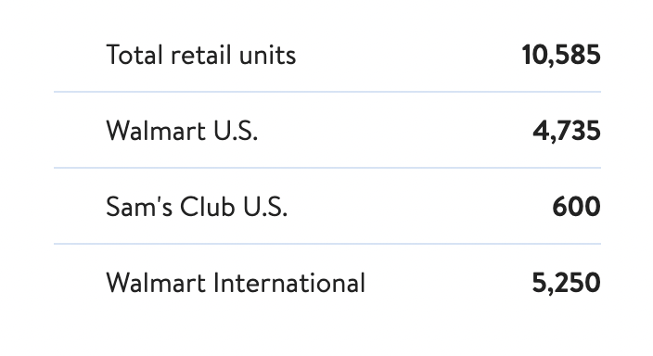
Wal-Mart Company Facts
COMPANY OVERVIEW
Walmart Flywheel Strategy:
Mission statement:
help people save money and live better (low prices)
on a broad assortment (wide range of products and services)
anytime, anywhere (online or in physical stores
Competes and is differentiated against competitors on price
Operates in 24 countries
Operates approximately 10,500 stores around the world
Employs 2.3 million associates around the world (1.6 million in US)
Has recently expanded its goals and purpose to include social values such as ESG reporting, Sustainability, Diversity etc.
2021 key events:
Sells majority stake in Seiyu
Completes sale of ASDA
3 segments:
Walmart US
Sam's Club
Walmart International

Slide 57
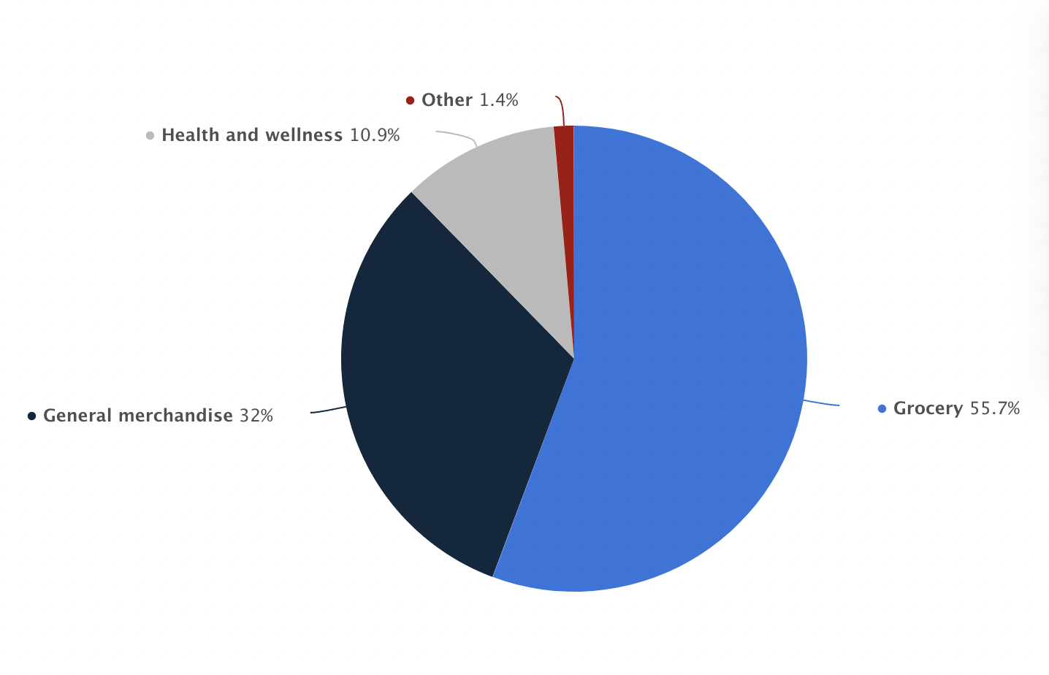
Net sales share of Walmart US in 2022, by merchandise category
COMPANY OVERVIEW

Slide 58
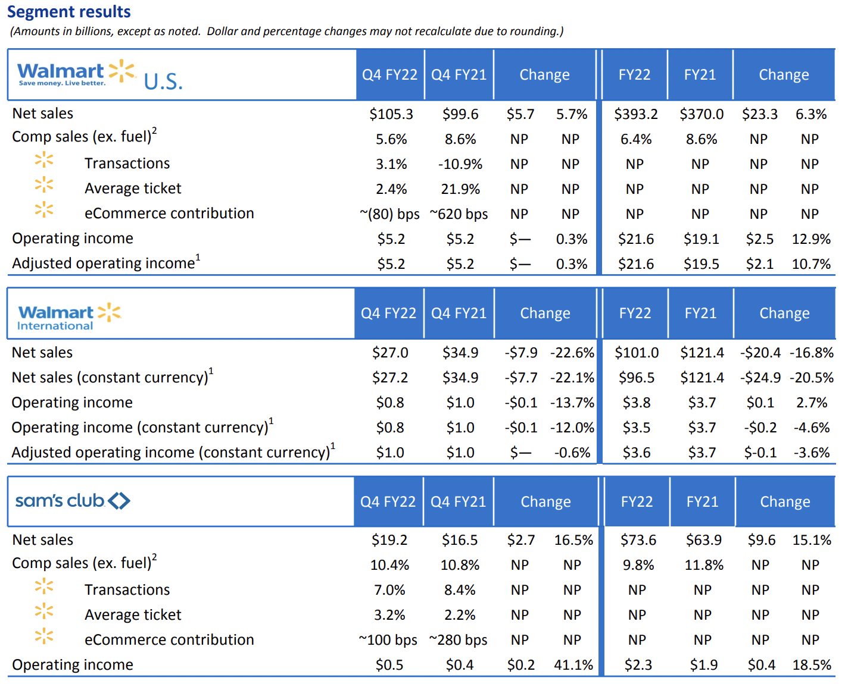
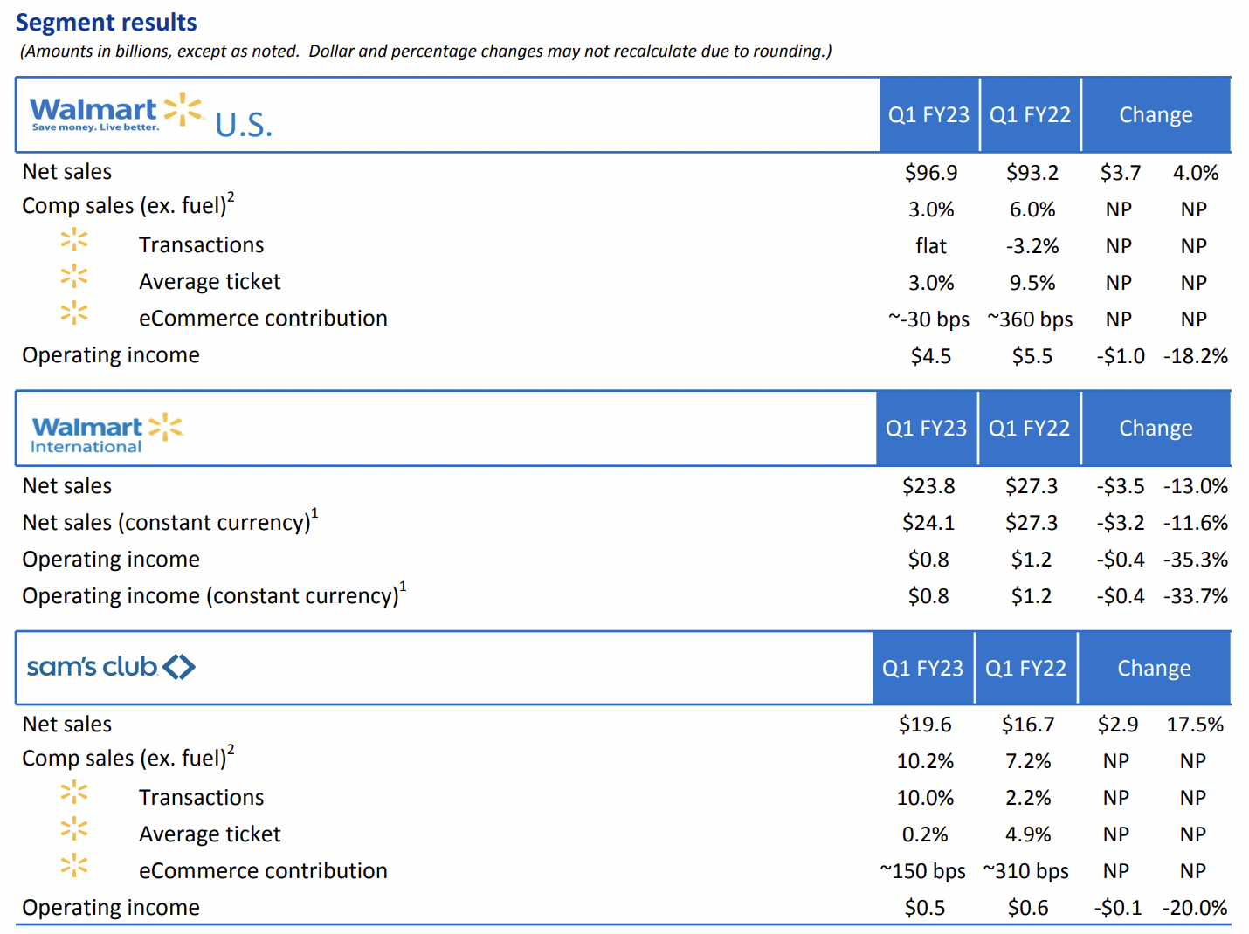
Segment Performance
COMPANY OVERVIEW

Slide 59
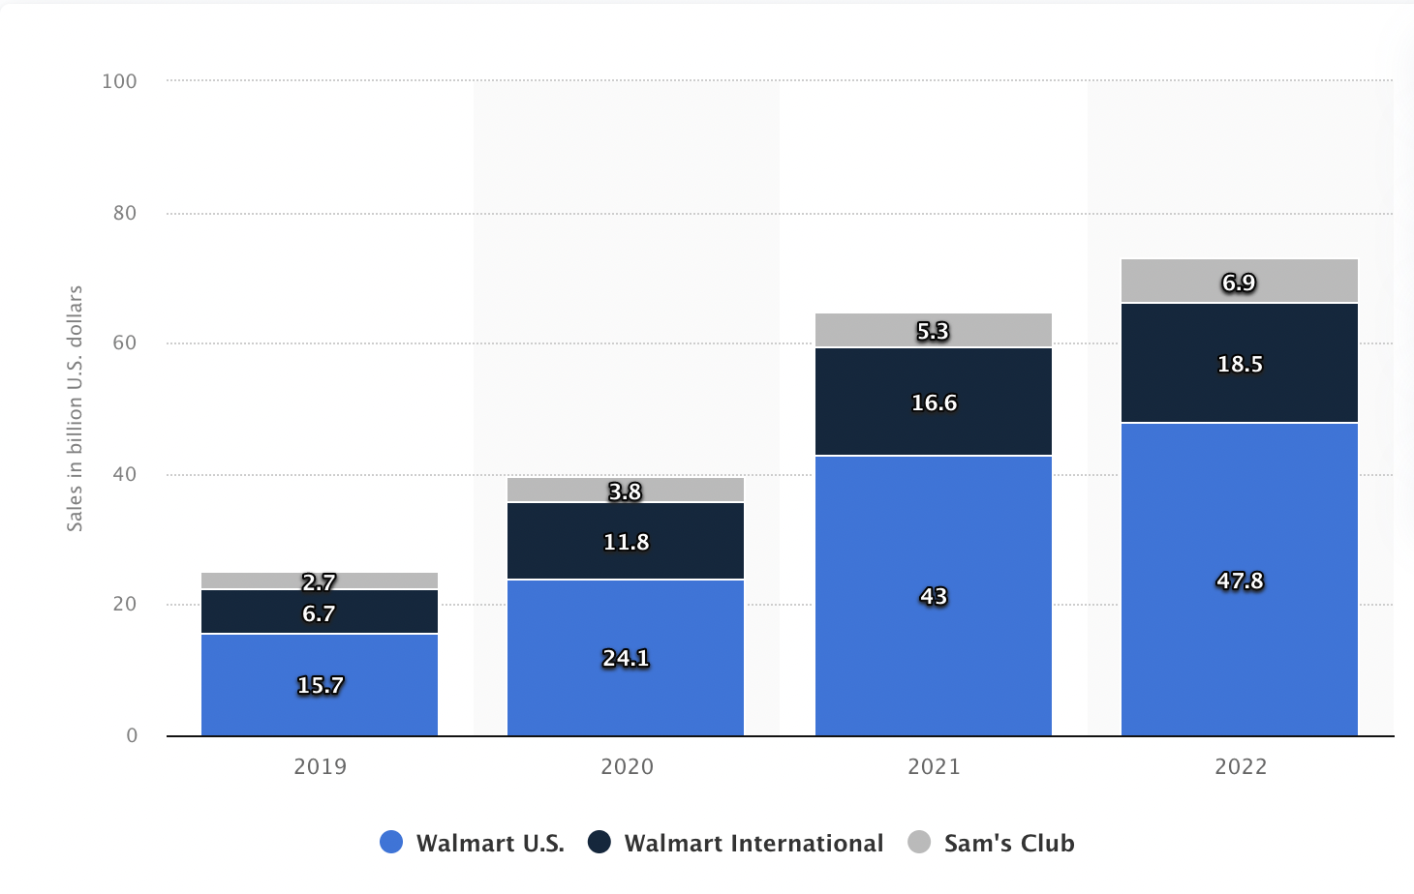
Global Walmart Ecommerce Sales 2019- 2022, by segment
COMPANY OVERVIEW

Slide 60
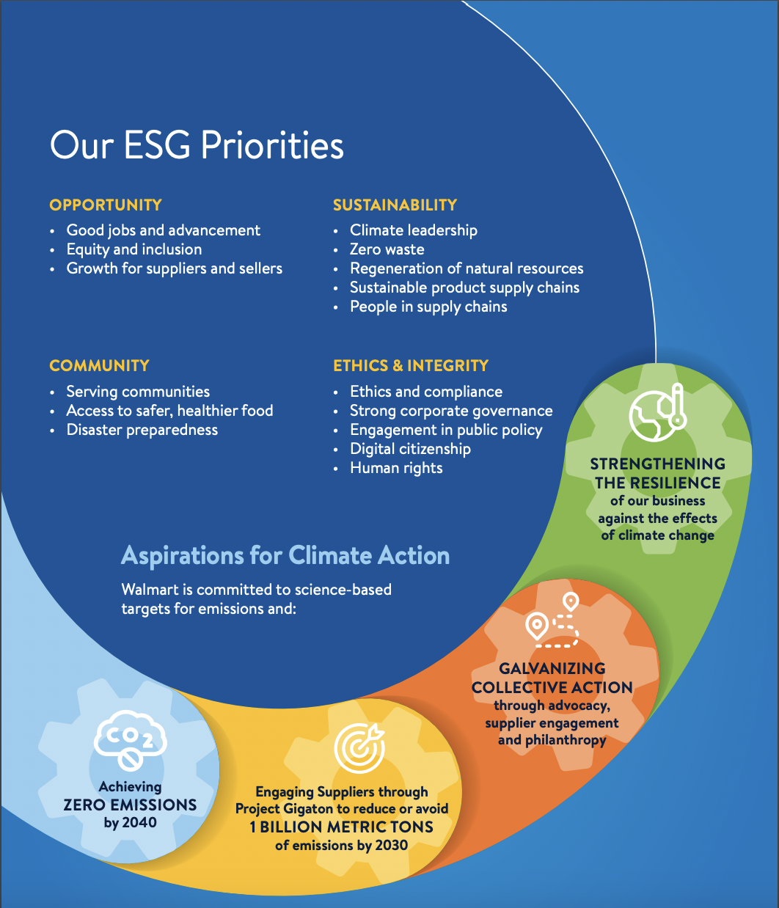
ESG Commitment
COMPANY OVERVIEW
Fiscal Year 2021 Highlights
Opportunity:
Over 300,000 US associates promoted to jobs of higher pay
Over $2.8 billion dollars in bonuses paid to US hourly associates
US management promotions went to 46% women and 39% people of colour
Sustainability:
Target zero emissions globally by 2040
19% decrease in carbon intensity per revenue
Community:
Over 745 million pounds of food donated globally
Supported over 500 COVID-19 testing sites in US
Ethics and Integrity:
Over 942,000 associates received ethics training
98% overall attendance rate at Board and Board Committee meetings

Slide 61
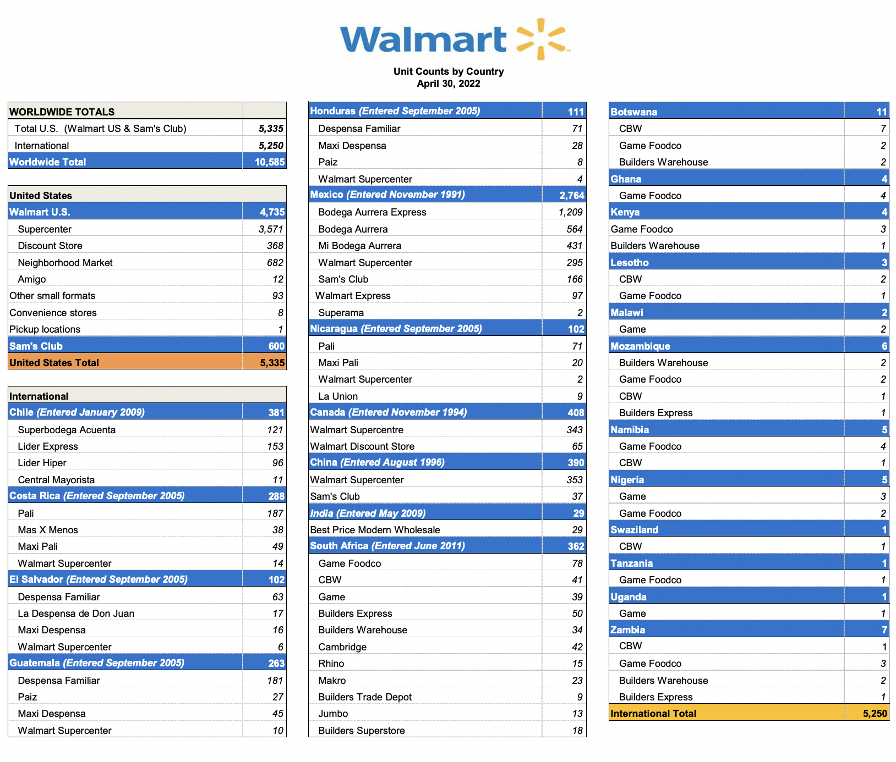
Global Exposure
Company overview

Slide 62
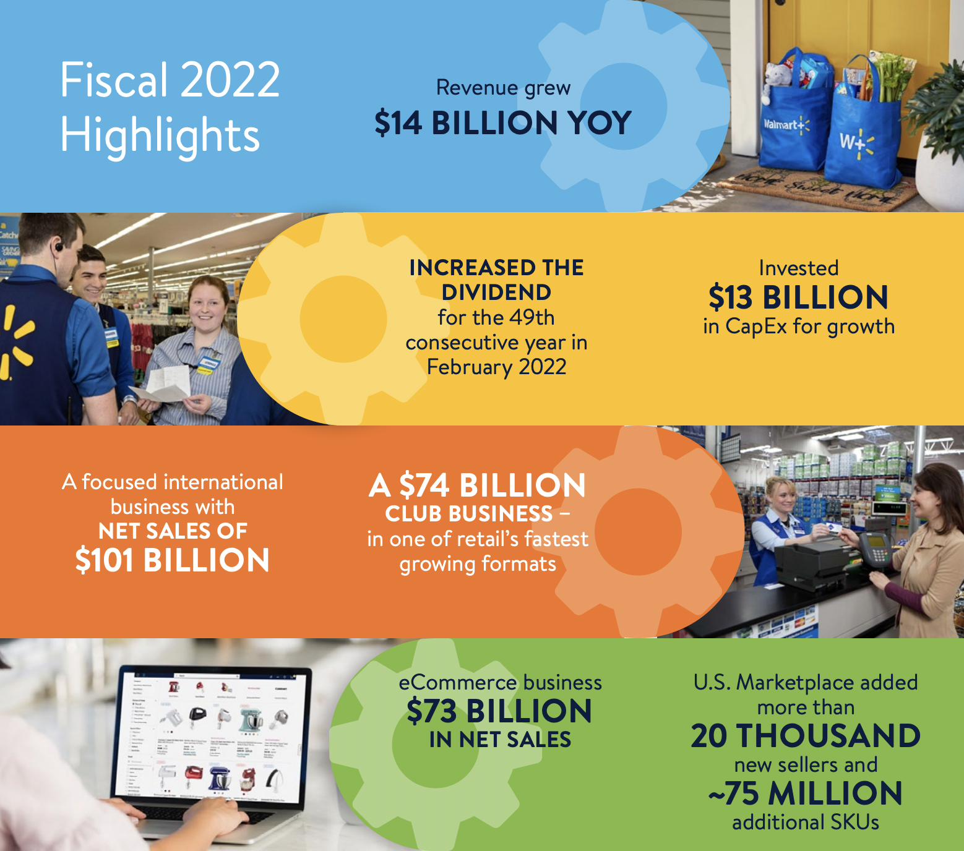
2022 Performance Highlights
Company overview

Slide 63
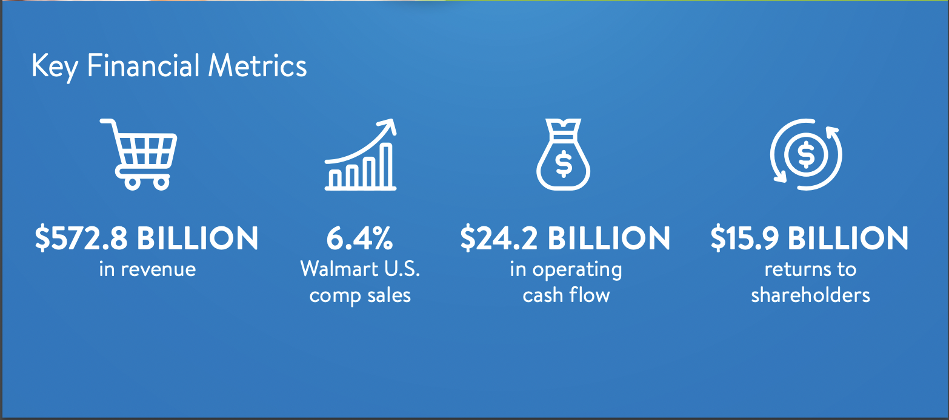
2022 Performance Highlights (continued)
Company overview

Slide 64
Management Team

Slide 65


Management Team
Company overview
Doug McMillon: President and CEO, Walmart Inc. (2014-present)
2009-2014: President and CEO, Walmart International
2005-2009: President and CEO, Sam's Club
Has worked at Walmart for more than 30 years, starting as a teenager
Has served in senior leadership roles in all of Walmart's business segments
Has Bachelor's and Master's degrees in Business Administration
Has served on the Board of many businesses
Dan Bartlett: Executive Vice President, Corporate Affairs (2013-present)
Responsible for: government relations and public policy, corporate communications, philanthropy and the company’s social responsibility and sustainability initiatives
Was President and CEO at Hill+Knowlton Strategies prior to joining Walmart
Served as an advisor to US President George W. Bush in 2007

Slide 66


Management Team
Company overview
Rachel Brand: Executive Vice President of Global Governance, Chief Legal Officer and Corporate Secretary (2018-present)
Oversees global legal, compliance, ethics, corporate governance, digital citizenship, aviation, investigative, and corporate security functions
Was first woman to serve as United States Associate Attorney General prior to joining Walmart
Serves on the board of directors for the Walmart Foundation
Executive sponsor for Walmart’s Tribal Voices Associate Resource Group
John Furner: President and CEO, Walmart U.S. (2019-present)
2017-2019: President and CEO, Sam's Club
Had 11 consecutive quarters of positive sales comps, while increasing memberships during his tenure at Sam's Club
Responsible for the strategic direction and performance of Walmart’s 4,700 stores, as well as its website, app and supply chain
Started working in Walmart in 1993 as an hourly associate
Has had several senior leadership roles throughout the company

Slide 67


Management Team
Company overview
Suresh Kumar: Executive Vice President, Global Chief Technology Officer and Chief Development Officer, Walmart Inc. (2019-present)
Responsible for setting technical strategy, combining advances in computing with Walmart’s strengths to deliver the best customer experiences
Leads the team in building tools and systems to digitally transform business operations
Oversees company's global shared services, data, cloud, infrastructure, and information security organizations
Has 25 years of technology leadership experience including at Google, Microsoft, and Amazon
Judith McKenna: President and CEO, Walmart International (2018-present)
2015-2018: Chief Operating Officer, Walmart US
2013-2015: Executive VP of Strategy and Development, Walmart International
Worked as COO at ASDA in the UK prior to joining Walmart
Was the architect behind the introduction of Walmart Academies to the US
Has appeared in Fortunes and Forbes lists of world's most powerful women in business

Slide 68


Management Team
Company overview
Kathryn McLay: President and CEO, Sam’s Club (2019-present)
Has held a number of leadership roles at Walmart since joining in 2015
In 2016 she redesigned the way product moved from supplier to shelf, created an integrated end-to-end Walmart U.S. supply chain
Has served as a board member of ECRA, an industry board comprised of retailers and suppliers.
Worked for Australian retailer Woolworth's from 2001-2015
Donna Morris: Executive Vice President, Chief People Officer, Walmart Inc. (2020-present)
Responsible for attracting, retaining and developing talent
Has nearly 20 years of leadership experience in delivering innovative people solutions, developing and managing teams that operate in an agile way, and helping to build a high-performance culture that promotes diversity and inclusion.
Served as chief human resources officer and executive vice president of employee experience at Adobe prior to joining Walmart

Slide 69

Management Team
Company overview
John David Rainey: Executive Vice President and Chief Financial Officer, Walmart (2022-present)
Responsible for accounting and controls, corporate strategy and development, business planning and analysis, global procurement, internal audit, treasury, tax and investor relations
Worked as Paypal's CFO and executive VP, global customer operations, prior to joining Walmart
Has worked as CFO and executive VP at United Airlines
Has over 20 years of financial management experience
Serves on the NASDAQ Board of Directors

Slide 70
Financial Statements

Slide 71

Balance Sheet Assets – 10Q
Financial statements

Slide 72

Balance Sheet Liabilities & Shareholders’ Equity – 10Q
Financial statements

Slide 73

Balance Sheet Assets – 10K
Financial statements

Slide 74

Balance Sheet Liabilities & Shareholders’ Equity – 10K
Financial statements

Slide 75

Income Statement – 10Q
Financial statements

Slide 76

Income Statement – 10K
Financial statements

Slide 77

Cash Flow Statement – 10Q
Financial statements

Slide 78

Cash Flow Statement – 10K
Financial statements

Slide 79
Recommendation:
HOLD

Slide 81


Stock Information
COMPANY OVERVIEW
Company Snapshot

Slide 82

Ownership Structure
COMPANY OVERVIEW

Slide 83
Stock Performance

Slide 84


Stock Performance
STOCK PERFORMANCE
5-Day Stock Performance
1-Month Stock Performance

Slide 85


Stock Performance
STOCK PERFORMANCE
6-Month Stock Performance
1-Year Stock Performance

Slide 86


Stock Performance
STOCK PERFORMANCE
5-Year Stock Performance
10-Year Stock Performance

Slide 87


Stock Performance
STOCK PERFORMANCE
Max Stock Performance
Comparison Performance

Slide 88
Dividend History
Stock performance

Slide 89

Stock Performance
Stock performance
Comparison of 5-Year Cumulative Return

Slide 90





The Kroger Co. (NYSE: KR) – Top World Grocery Chain
COMPANY OVERVIEW
Founded in 1883, The Kroger Cp. (“Kroger”) is one of the world’s largest retailers in terms of revenue with ~$138 billion FY2021
Kroger operates 2,726 supermarkets (Ralphs, Kroger, Owen's, Bakers, Harris Teeter, etc.), of which 2,252 are pharmacies and 1,613 are fuel centers
This segment represents +90% of total sales, of which ~11% come from supermarket fuel
Business is built to strengthen the market position in food retail that includes the added convenience of retail pharmacies and fuel centers
Kroger’s supermarkets are operated under 4 formats
Combo store: primary food store format that draw customers from a 2-2.5 mile and offer one-stop shopping for customers
Multi-department stores: significantly larger in size than combo ones and sell a wide selection of general merchandise, home fashion and furnishings
Marketplace stores: smaller in size than multi-department stores and offer full-service grocery, pharmacy, health and beauty care
Price impact warehouse: similar in size to combo store and offer everyday low prices

Slide 91
Business Timeline
COMPANY OVERVIEW
1883: Founded by Bernard Kroger in Cincinnati, Ohio
1916: Began self-service shopping
1998-2000s: Merged with the then 5th largest grocery company along with others
1955: Began acquiring supermarket chains, expanding into new markets
1983: The U.S. severe economic recession impacted Kroger’s business, leading to its stores withdrawal
2016: Named the 2nd largest grocer in the nation with $110 billion in sales
1977: Kroger announced IPO
2017-nowadays: Invested into organic foods supermarket chain and opened convenience store

Slide 92

Geographical Exposure
Company overview

Slide 93

Kroger’s Value Creation Model
Company overview

Slide 94

Kroger’s Financial Metrics
Company overview
Identical Supermarket Sales
Identical supermarket sales are a key measure of health in retail food industry
A supermarket is identical when it has been in operation without expansion or relocation for five full quarters
Sales from all acquired businesses are treated as identical as if they were part of company in the prior year

Slide 95
Kroger’s Value Creation
Company overview
Capital Investment Plan
Intend for the investments portfolio to drive after tax returns above internal hurdle rate of 11.3%
Allocate capital spending priorities across 4 major buckets of investments: (i) sales growth, (ii) digital ecosystem, (iii) margin expansion and (iv) maintain business
Sales Growth
Capital Investments
Drive incremental sales through brick-and-mortar retail locations
Linked to annual ID sales growth of 2%-4%
Digital Ecosystem
Include Digital, Ocado and supply chain investments that are required to build e-commerce business
Margin Expansion
Include projects focused on reducing cost
Allocate to invest in technologies and new processes driving cost of business lower
Maintain Business
2019
Total Spending: $3.0B
2020
Total Spending: $3.2B
Represents maintenance, repairs and assets required to support day to day business

Slide 96
Management Team

Slide 97


Management Team
Company overview
W. Rodney McMullen (61), Chairman and Chief Executive Officer (2014 – present)
Mr. McMullen joined Kroger in 1978 as a part-time stock clerk
Previously served as President and Chief Operating Officer from 2009 to 2013 and held numerous leadership roles, including Vice Chairman, Executive Vice President of Strategy, Vice President of Planning and Capital Management
He is a member of the Board of Directors of Cincinnati Financial Corp., VF Corporation, Cincinnati Business Committee and Consumer Goods Forum
Hold a Bachelor’s and a Master’s degree in Accounting from the University of Kentucky
Gary Millerchip (49), Senior Vice President and Chief Financial Officer (2019 – present)
Mr. Millerchip served as Chief Executive Officer for Kroger Personal Finance since joining Kroger in 2008
He was responsible for several retail grocery divisions and led the integration of Kroger’s corporate strategic initiatives
Before coming to Kroger, he was in charge of Royal bank of Scotland in the United Kingdom and held leadership positions in Sales, Finance, Change Management, Strategy and Branch Operations
Earned a Bachelor’s degree in Financial Services from the University of Central England

Slide 98


Management Team
Company overview
Yael Cosset (48), Senior Vice President and Chief Information Officer (2019 – present)
Mr. Cosset is responsible for leading Kroger’s digital strategy, focused on building Kroger’s presence in the marketplace in digital channels, personalization and e-commerce
He also assumed responsibility for Kroger’s alternative profit business including Kroger Personal Finance and Kroger’s data analytics subsidiary
Previously he served as Chief Commercial Officer, Group Vice President and Chief Digital Officer and several leadership roles at dunnhumby USA
Stuart W. Aitken (50), Senior Vice President and Chief Merchant and Marketing Officer (2020 – present)
Mr. Aitken is in charge of sales, pricing, promotional and category planning for fresh foods, center store and general merchandise categories as well as analytics & execution, e-commerce and Our Brands
He has over 15 years of marketing, academic and technical experience across a variety of industries, and held various leadership roles with other companies including Safeway Inc.

Slide 99


Management Team
Company overview
Mary Ellen Adcock (46), Senior Vice President (1999 – present)
Ms. Adcock was elected Senior Vice President in 2019 and is in charge of retail operations as well as the oversight of all Kroger retail divisions
Previously served as Group Vice President of Retail Operations and held leadership roles in Kroger’s Columbus Division
Graduated magna cum laude from Vanderbilt University and earned a Bachelor’s degree in human and organizational development
Earned a MBA from the University of Colorado
Valerie L. Jabbar (53), Senior Vice President (2021 – present)
Ms. Jabbar was elected Senior Vice President in 2021 and is responsible for the oversight of several Kroger retail divisions
Served as Group Vice President of Center Store Merchandising from 2018 to 2020 and held several leadership roles including assistant store director, Drug/GM coordinator, district manager
Joined Kroger in 1987 as a clerk in the Fry’s Division

Slide 100
Financial Statements

Slide 101

Balance Sheet Assets – 10Q
Financial statements

Slide 102

Balance Sheet Liabilities & Shareholders’ Equity – 10Q
Financial statements

Slide 103

Balance Sheet Assets – 10K
Financial statements

Slide 104

Balance Sheet Liabilities & Shareholders’ Equity – 10K
Financial statements

Slide 105

Income Statement – 10Q
Financial statements

Slide 106

Income Statement – 10K
Financial statements

Slide 107

Cash Flow Statement – 10Q
Financial statements

Slide 108

Cash Flow Statement – 10K
Financial statements

Slide 109
Recommendation
HOLD

Slide 111

Stock Information

Slide 112

Stock Overview

Slide 113

Institutional Ownership

Slide 114


Slide 115
Stock Performance

Slide 116

5 Day Performance

Slide 117

1 Month Performance

Slide 118

6 Month Performance

Slide 119

1 Year Performance

Slide 120

5 Year Performance

Slide 121

10 Year Performance

Slide 122

Max Performance All-Time

Slide 123

Peer Comparison

Slide 124

Market & Industry Index Comparison

Slide 125
Company Overview

Slide 126
Business Timeline
1983 – Costco was founded by James Sinegal and Jeffery Brotman and opened its first
warehouse at Seattle.
1985 – Profits had grown to $45M on sales of $1.9B. Costco becomes a publicly owned.
1993 - Costco merged with Price Club under the name PriceCostco, had 206 locations
generating $16B in annual sales.
1994 - First Asia Costco opens in Seoul.
1998 - The Costco.com Web site is launched.
2000 - The 2% reward program is initiated. 2 for 1 stock split on January 14th
2019 - 785 warehouses, 98.5M members, and #14 Fortune 500 rankings of largest United
States corporations by total revenue.
2020 - Acquisition of Innovel (now Costco Logistics) to improve last mile delivery
offerings.
2021 - 815 warehouses, Kirkland Signature represented $59B total sales, and over 106M
rotisserie chickens were sold company-wide.

Slide 127
Highlight for 2021
Opened 22 new warehouses, including 2 relocations: 12 net new in the U.S., 4 net new in our Canadian segment, and 4 new in our Other International segment, compared to 16 new warehouses, including 3 relocations in 2020;
Net sales increased 18% to $192,052 driven by a 16% increase in comparable sales and sales at new warehouses opened in 2020 and 2021;
Membership fee revenue increased 9% to $3,877, driven by sign-ups and upgrades to Executive membership;
Net income increased 25% to $5,007, or $11.27 per diluted share compared to $4,002, or $9.02 per diluted share in 2020;
We paid a special cash dividend of $10.00 per share in December 2020 and in April 2021, increased the quarterly cash dividend from $0.70 to $0.79 per share totaling $5,748.

Slide 128
Core Business
Costco operates membership warehouses and e-commerce websites based on the concept that offering their members low prices on a limited selection of nationally-branded and private-label products in a wide range of categories will produce high sales volumes and rapid inventory turnover.
Foods and Sundries (Ex: dry grocery, cooler, liquor, tobacco)
Non-Foods (Ex: tickets, apparel, health and beauty aids)
Warehouse Ancillary (Ex: gasoline, pharmacy)
Other Business (Ex: e-commerce, business centers, travel)

Slide 129

Net sales of Costco worldwide in 2019 and 2021, by merchandise category (in million U.S. dollars)

Slide 130

Business Model - Membership

Slide 131


Business Model - Membership

Slide 132

Number of paid Costco members worldwide from 2014 to 2021 (in millions)

Slide 133

828 Locations on December 31, 2021

Slide 134


Slide 135

Number of Costco warehouses worldwide from 2011 to 2021

Slide 136
Management Team

Slide 137

Co-Founder / Jim Sinegal
1983 - 2011: President and CEO
2012 - 2018: Advisor and Board of Director
During his 35-year career at Costco, Sinegal was known for being frugal and going out of his way to help his employees.
Despite Costco's immense success, Sinegal earned only a third of what his fellow CEOs did while leading the company.

Slide 138

Co-Founder / Jeff Brotman
Co-founded Costco with Sinegal in 1982
Was Chairman on Board of Directors until his death in 2017
Previously a lawyer before founding Costco
Shared philosophy of Sinegal to “do the right thing” and take care of employees

Slide 139

President and CEO / W. Craig Jelinek
Age: 69
1984: Join Costco
1995 – 2010: Executive VP and COO
2010 – 2011: President and COO
2012 – Now: President and CEO
The company has experienced steady growth during his tenure. In August 2019, Costco opened its first-ever Chinese store, in Shanghai.
a key role in Costco’s expansion into Nevada and California
overseeing E-commerce, Fresh Foods, Meat, Bakery, Deli, Produce, Foods, Non-Foods, Pharmacy, Home/Business Centers and Purchasing
Craig Jelinek Saves the $1.50 Hot Dog, built their own hot dog manufacturing plant, ditch Coca-Cola for Pepsi

Slide 140

Executive VP and CFO/ Richard A. Galanti
Age: 65
1978 – 1984: Associate with Donaldson Lufkin & Jenrette Securities Corporation
1984: Join Costco Vice President, Finance
1985 – 1993: Senior VP, CFO and Treasurer
1993 – Now: Executive VP and CFO
Board Memberships: Seattle Academy of Arts & Sciences, Federal Reserve Bank San Fran, Costco Wholesale Corp, Foster School of Business
President of Jewish Day School of Metropolitan Seattle
Education: MBA from Stanford University

Slide 141

Chairman of the Board / Hamilton E. James
Age: 70
Director of Costco since 1988
Lead Independent Director from 2005 until becoming the non-executive Chairman of the Board, in August 2017.
Chairman of Jefferson River Capital.
Precious Executive Vice Chairman, President and COO of The Blackstone Group
Co-chair of the board of the Metropolitan Museum of Art, of which he has been a member of the board of directors since 2010.
Board member of several environmental nonprofits and in 2016 co-authored Rescuing Retirement, a book on solutions to the retirement crisis.

Slide 142
Financial Statement

Slide 143

Balance Sheet Assets - 10Q
Financial statements

Slide 144

Balance Sheet Liabilities and Equity - 10Q
Financial statements

Slide 145

Balance Sheet Assets - 10K
Financial statements

Slide 146

Balance Sheet Liabilities and Equity - 10K
Financial statements

Slide 147

Income Statement - 10Q
Financial statements

Slide 148

Income Statement - 10K
Financial statements

Slide 149

Cash Flow Statement - 10Q
Financial statements

Slide 150

Cash Flow Statement - 10Q
Financial statements

Slide 151

Cash Flow Statement - 10K
Financial statements

Slide 152

Cash Flow Statement - 10K
Financial statements

Slide 153
Recommendation
BUY

