Slide 1
BUS 417 - Group 2: E-Commerce
Industry: Paul Atwal
Industry: Hector Chen
Amazon: Gary Sidhu
Shopify: Naman Katyal
Ebay: WooHee Kim

Slide 2

E-Commerce
The purchase or sale of goods or services through the internet

Slide 3
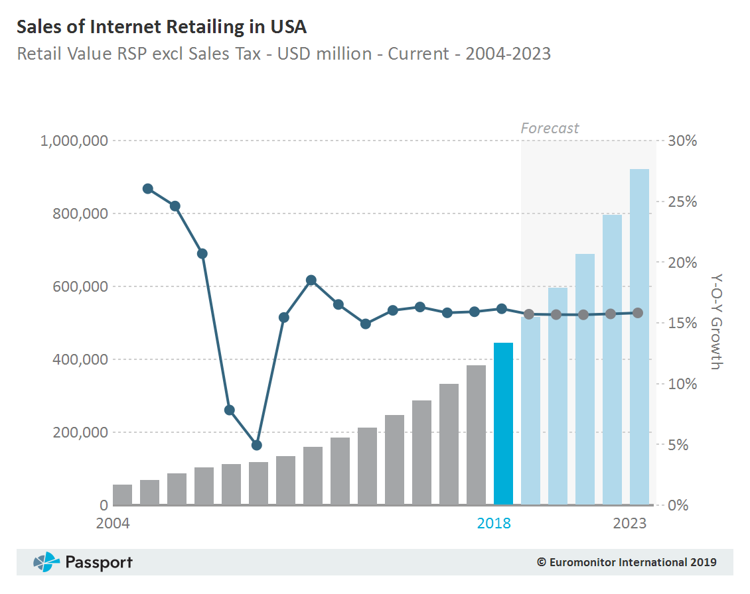

Slide 4
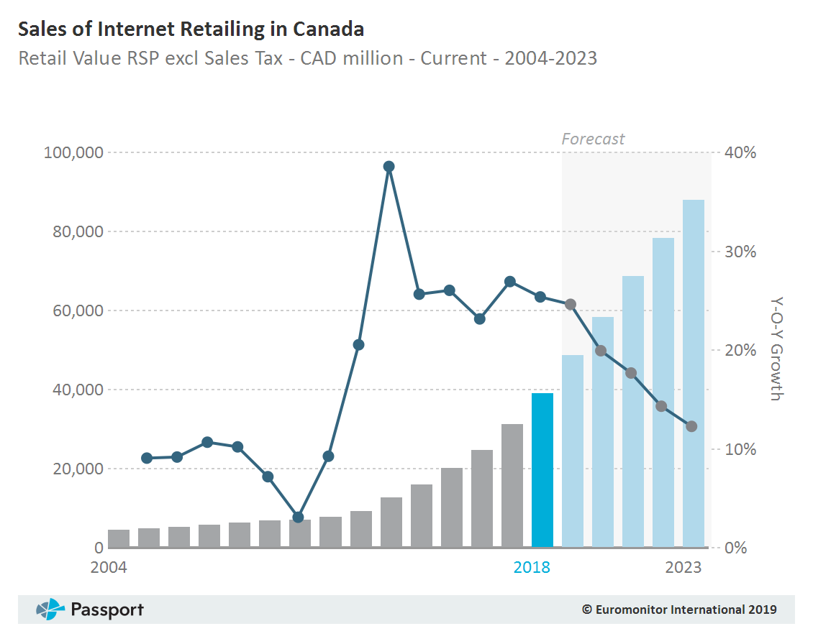

Slide 5
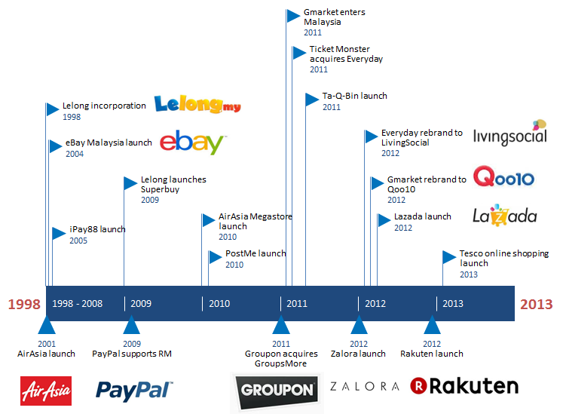

Slide 6

Types of E-Commerce
1. Business-to-Consumer (B2C)
2. Business-to-Business (B2B)
3. Consumer-to-Consumer (C2C)
4. Consumer-to-Business (C2B)
5. Business-to-Administration (B2A)
6. Consumer-to-Administration (C2A)

Slide 7


Business-to-Consumer (B2C)
The sale of a product or service in which the end-user is the customer

Slide 8

Business-to-Business
The exchange of products, services or information between businesses, rather than between businesses and consumers.

Slide 9
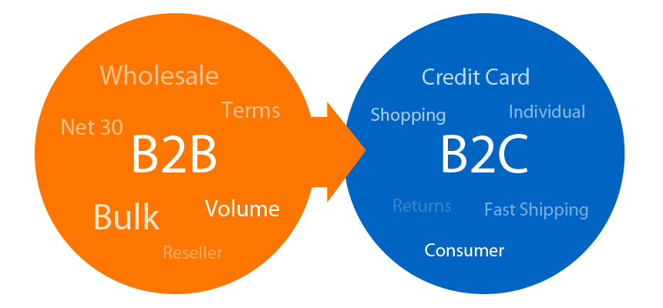
B2B vs B2C

Slide 10
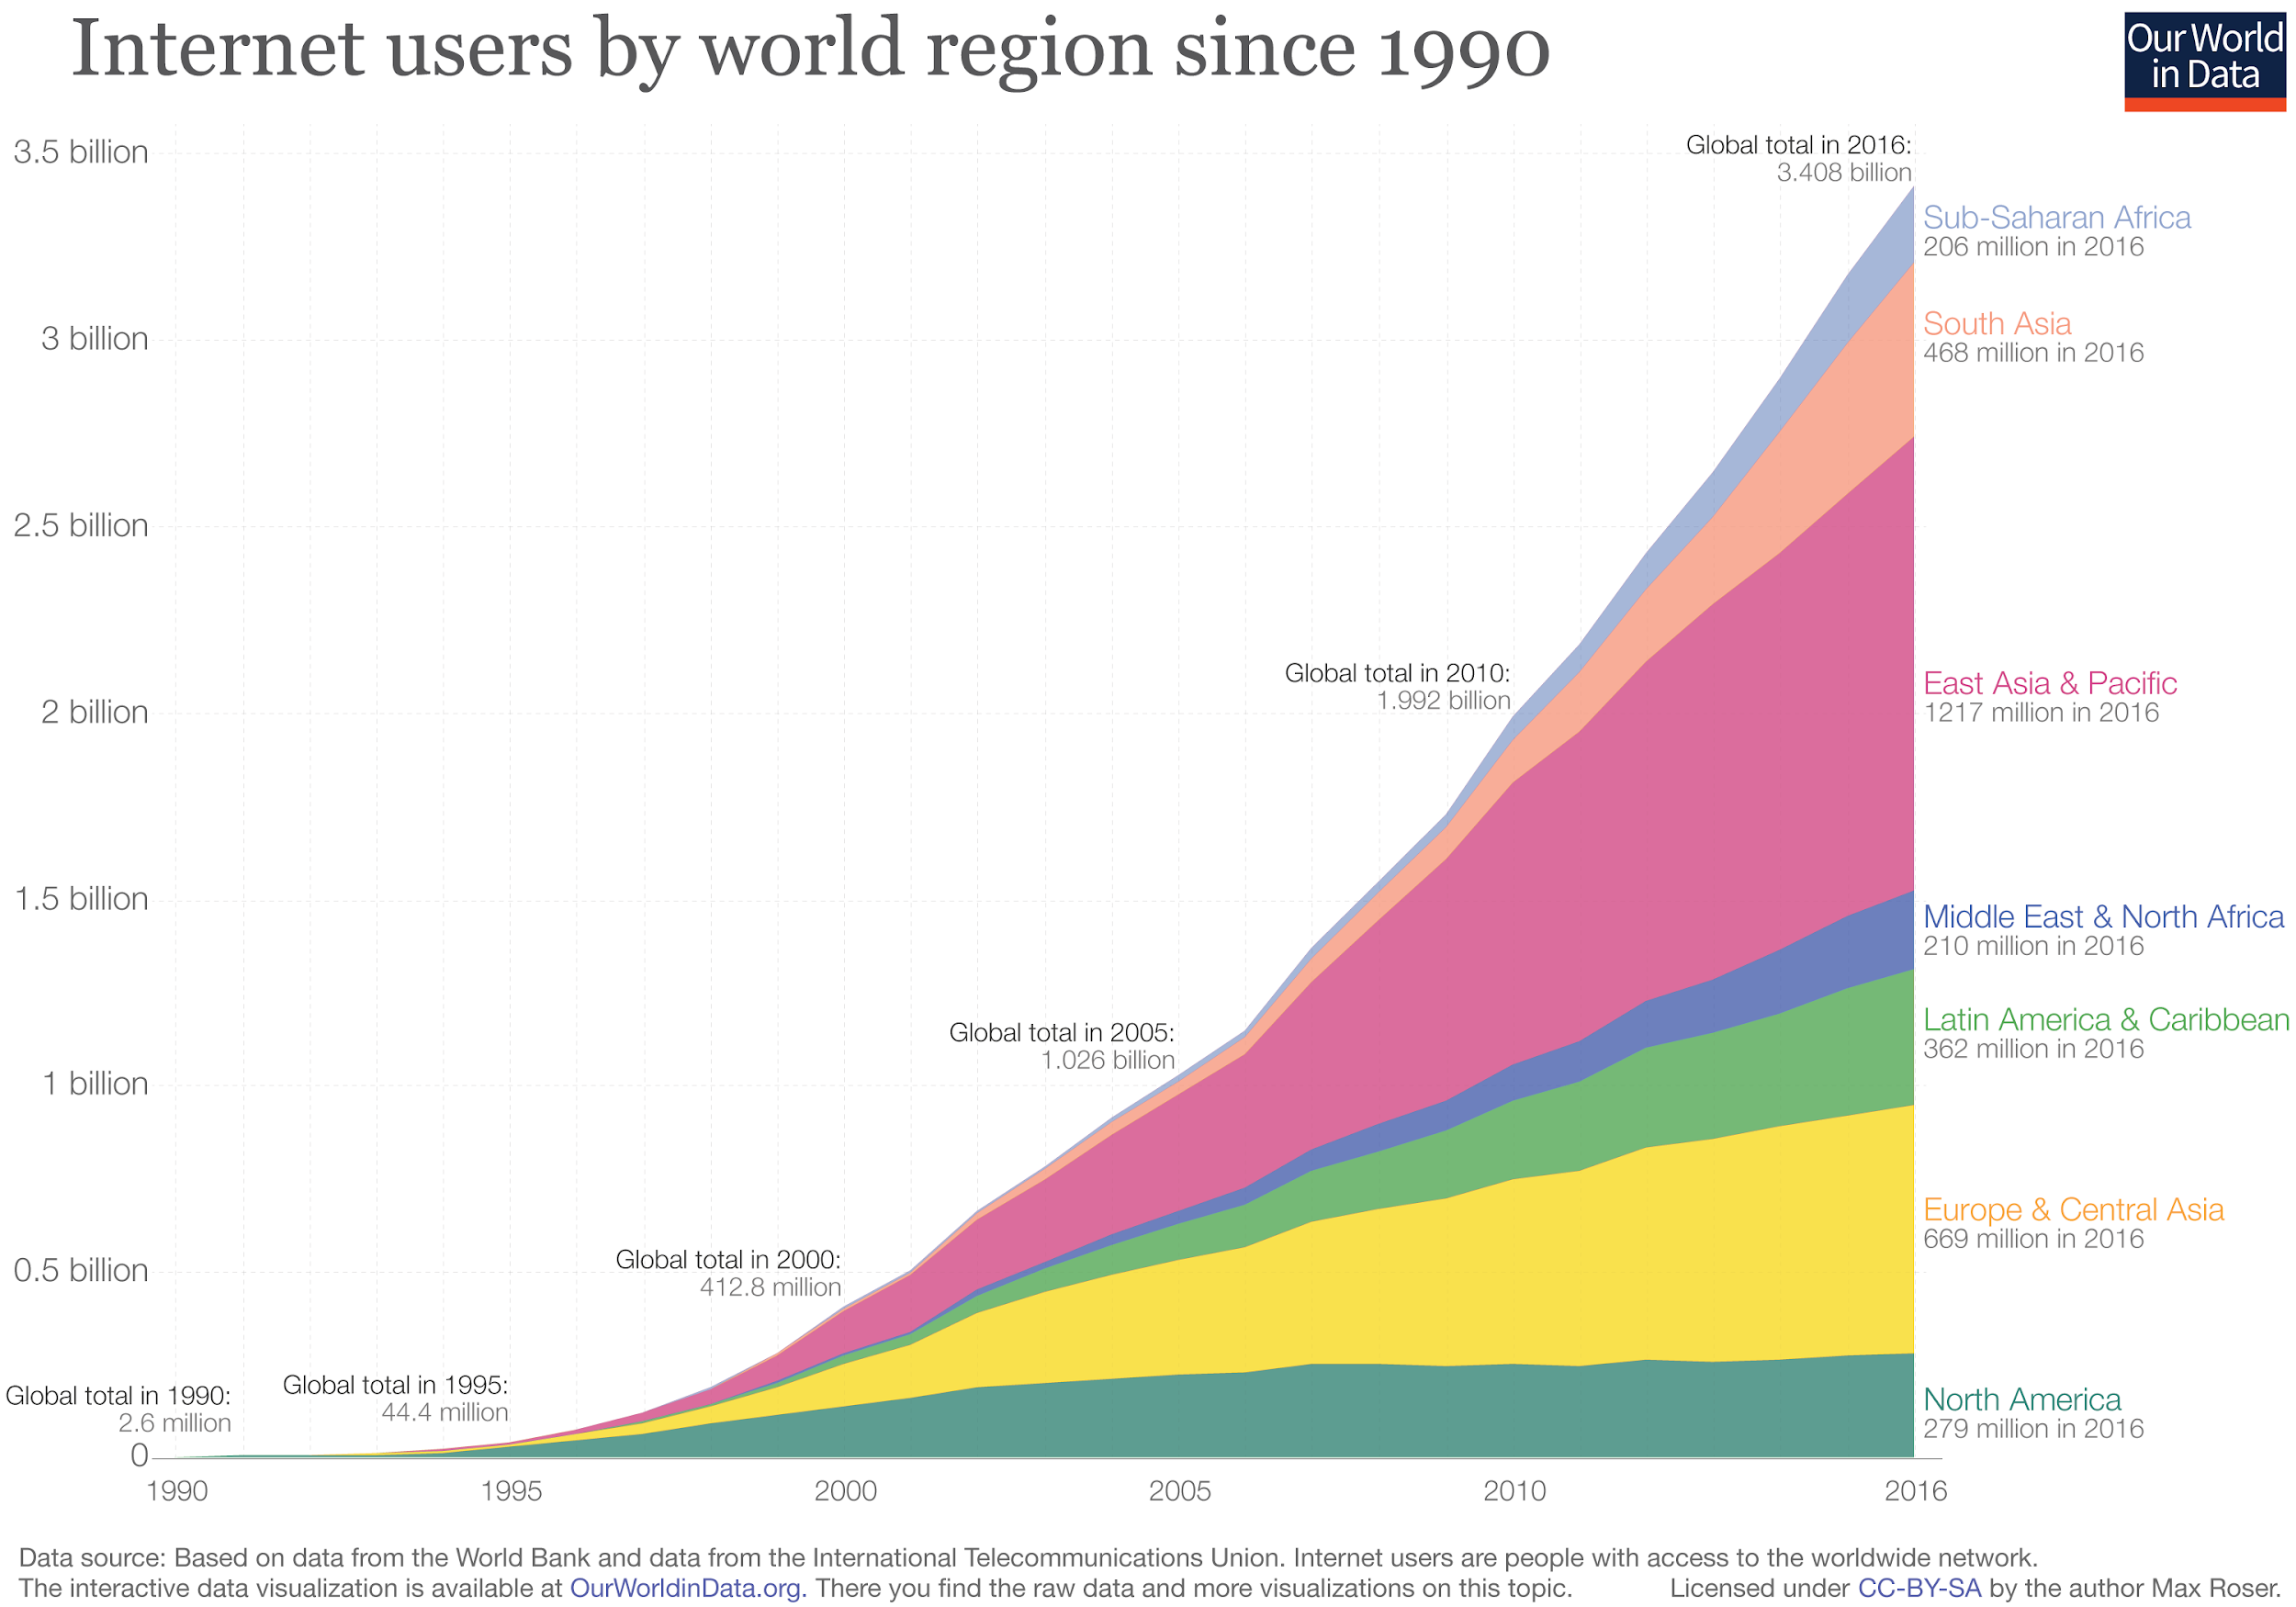

Slide 11
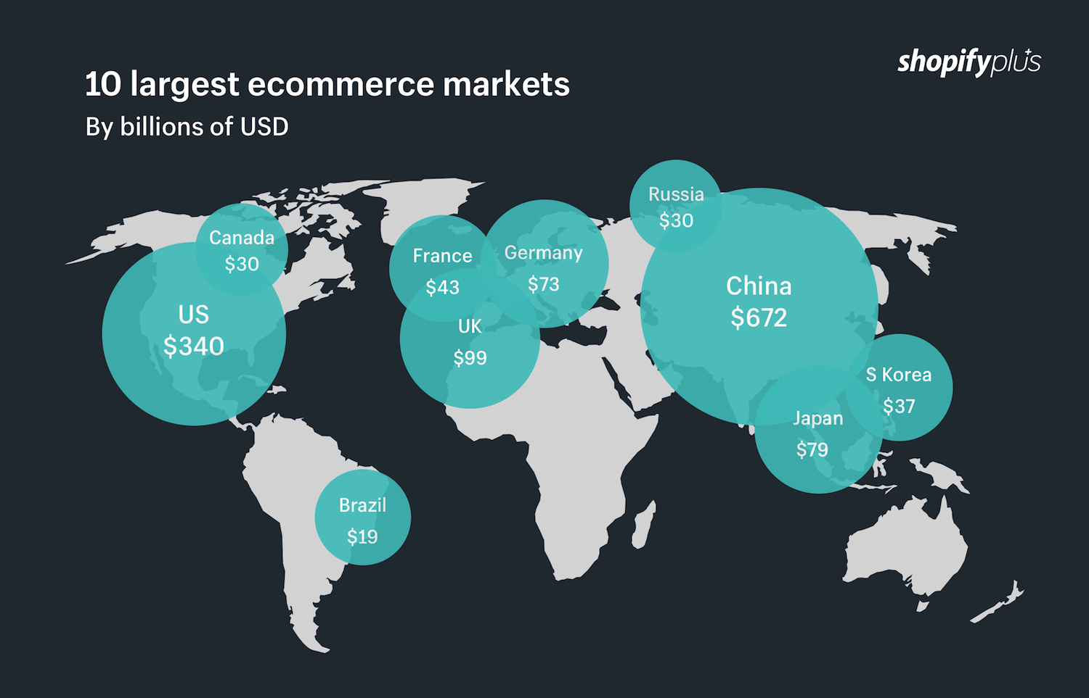

Slide 12
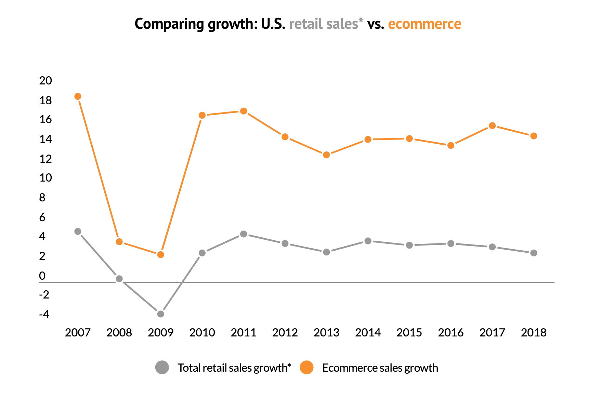

Slide 13
Comparing growth: US retail sales vs e-commerce
E-commerce accounted for over 50% of the overall retail growth (51.9%) in the United States
This is the largest percentage of growth accounted by e-commerce since 2008 (63.8%)

Slide 14
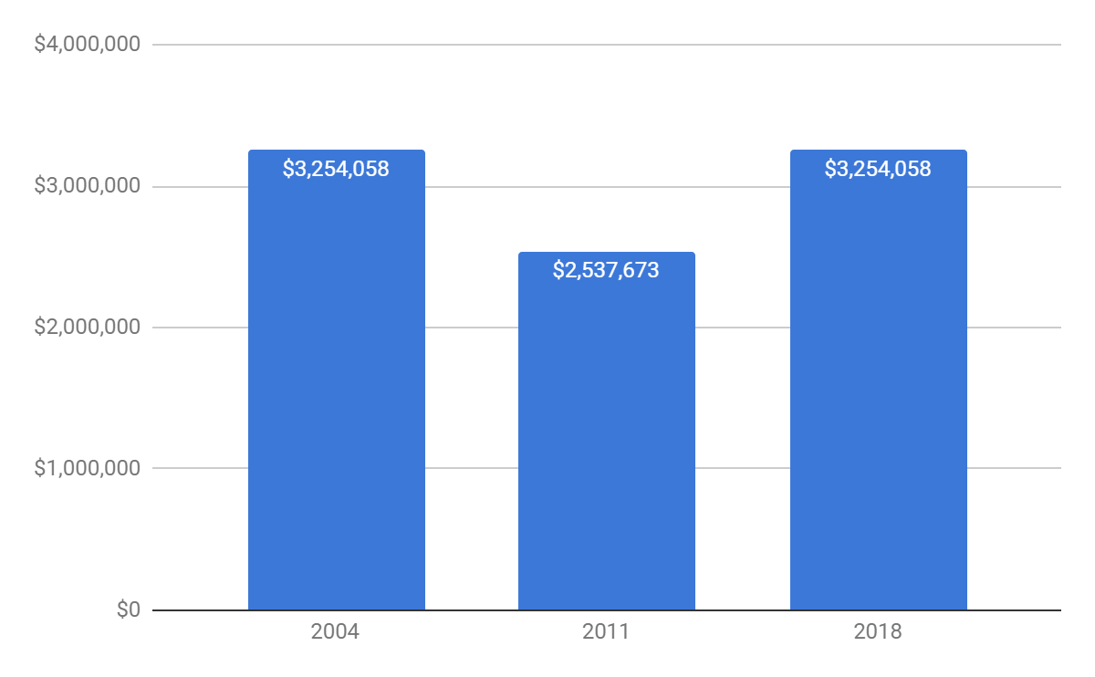
Overall Retailing Sales (USA)

Slide 15
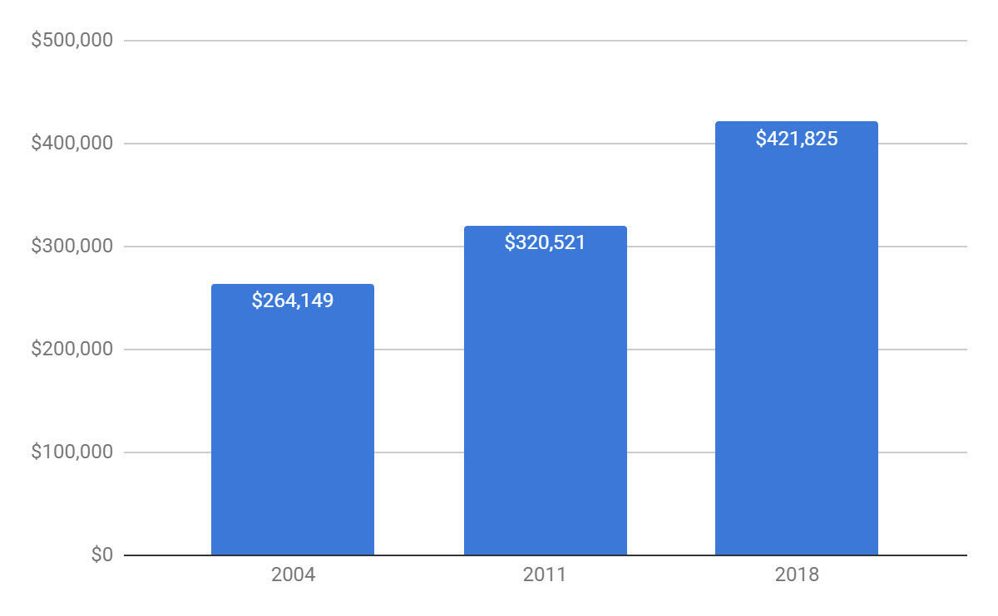
Overall Retailing Sales (Canada)

Slide 16
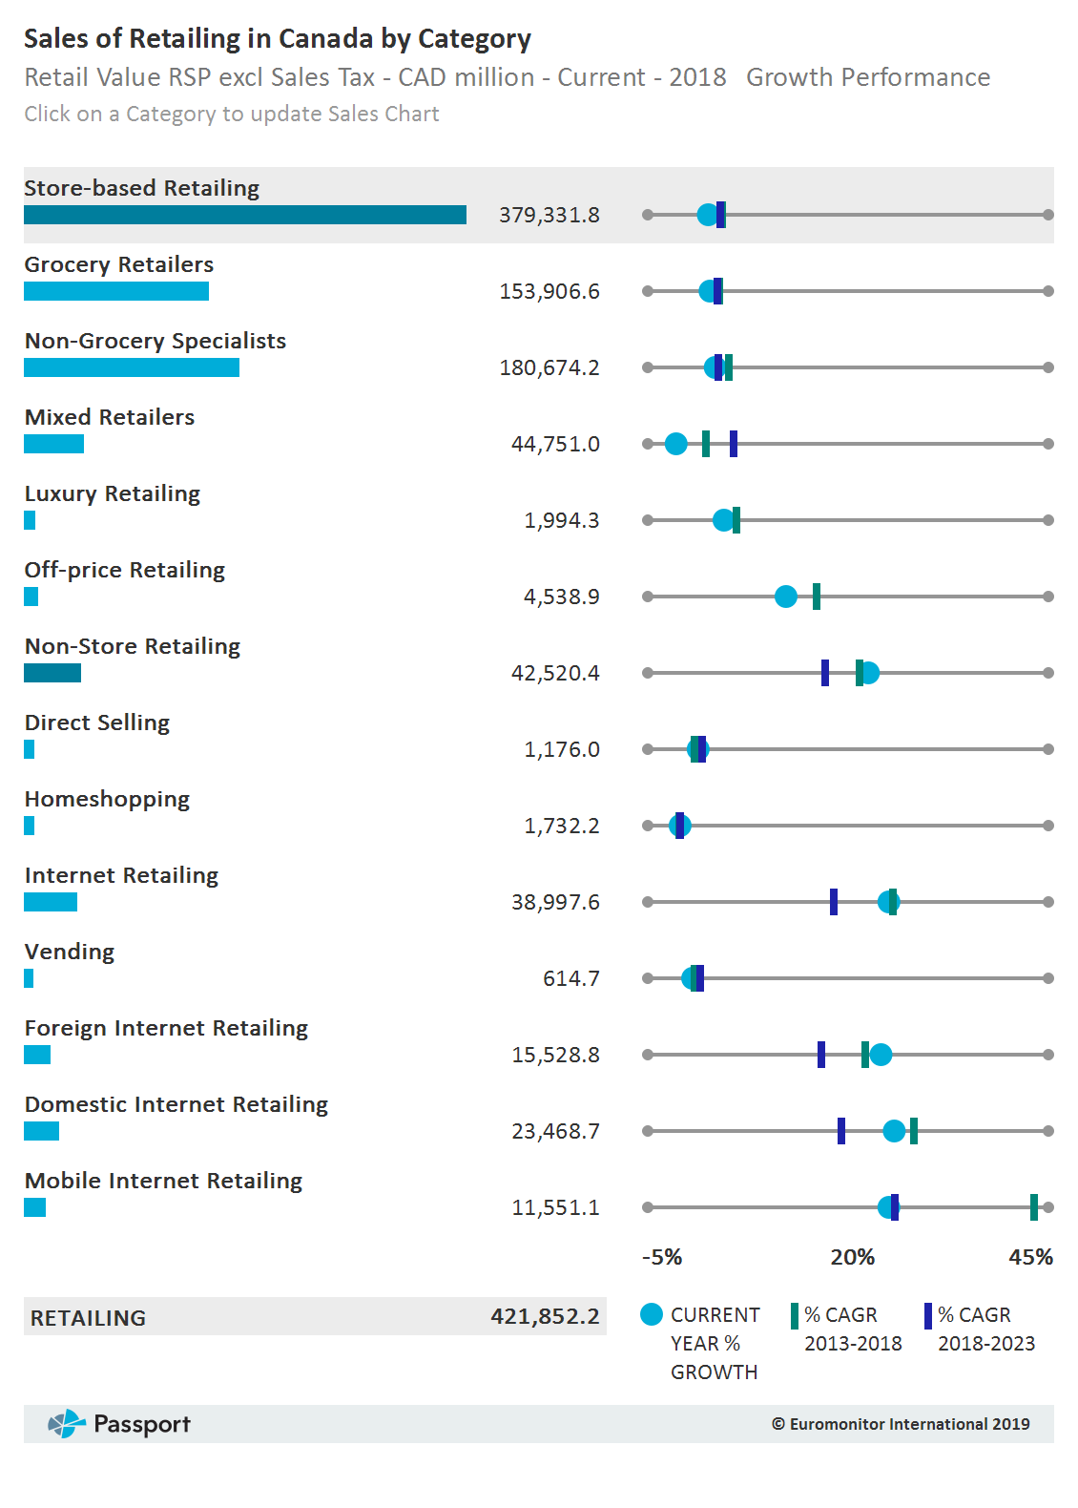

Slide 17
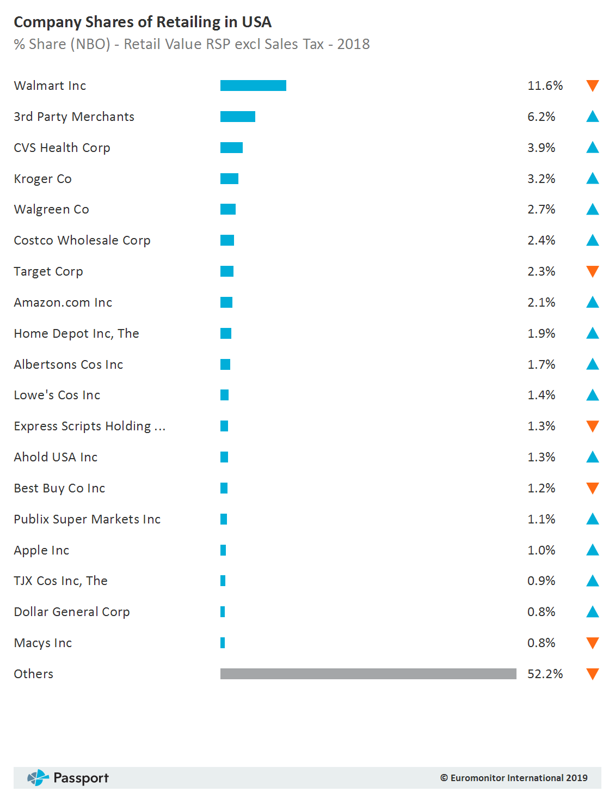

Slide 18
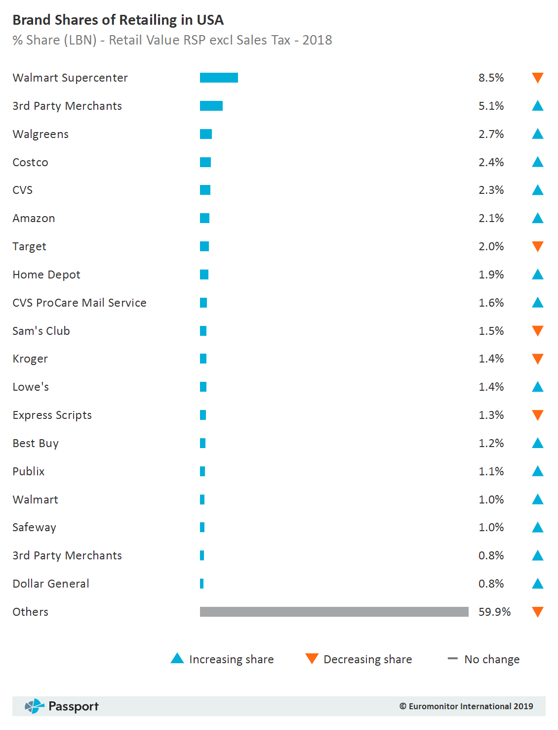

Slide 19
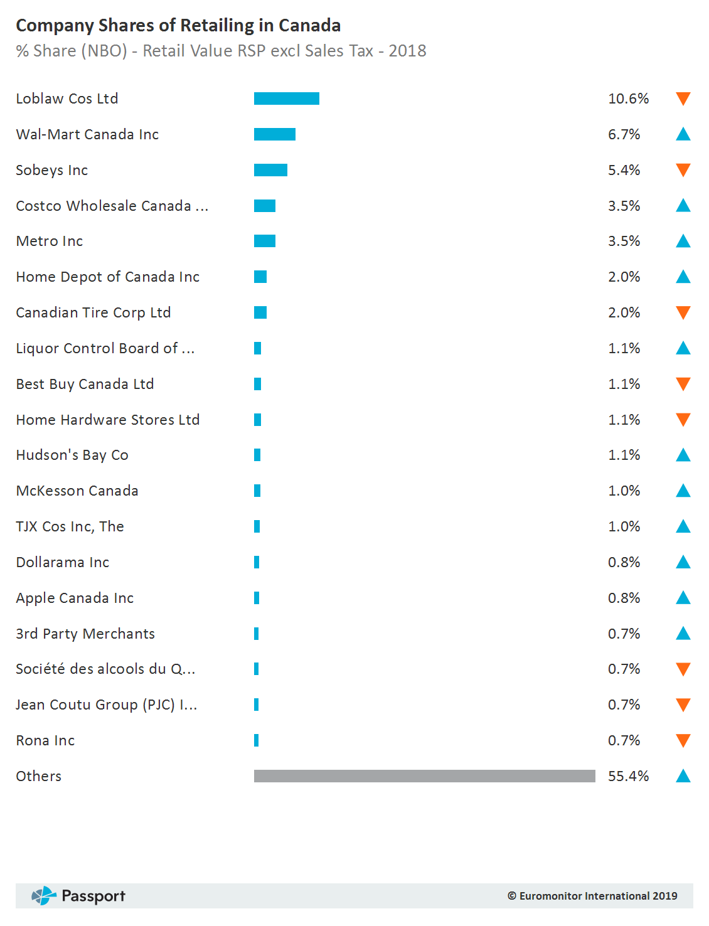

Slide 20
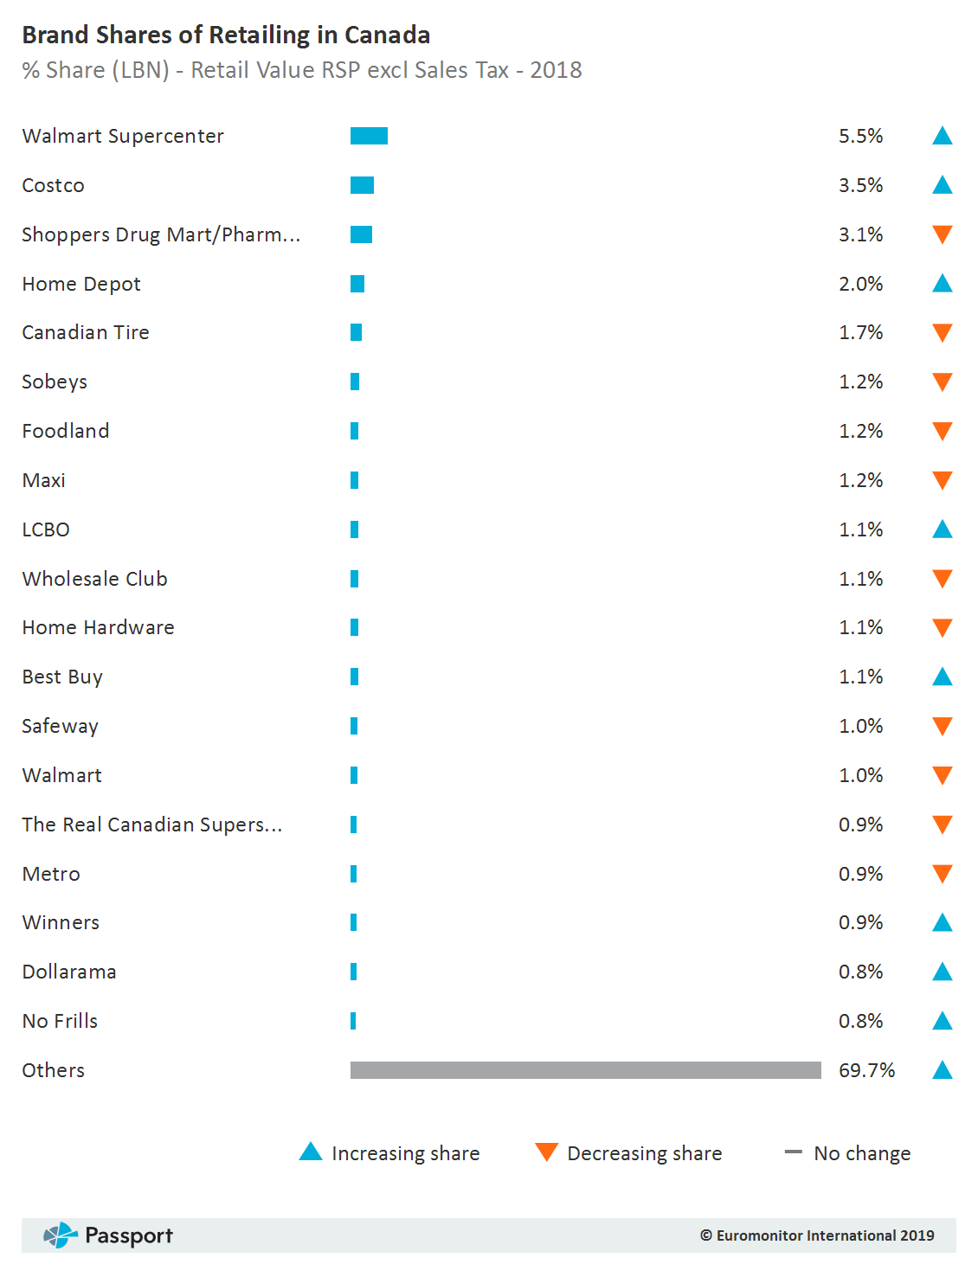

Slide 21
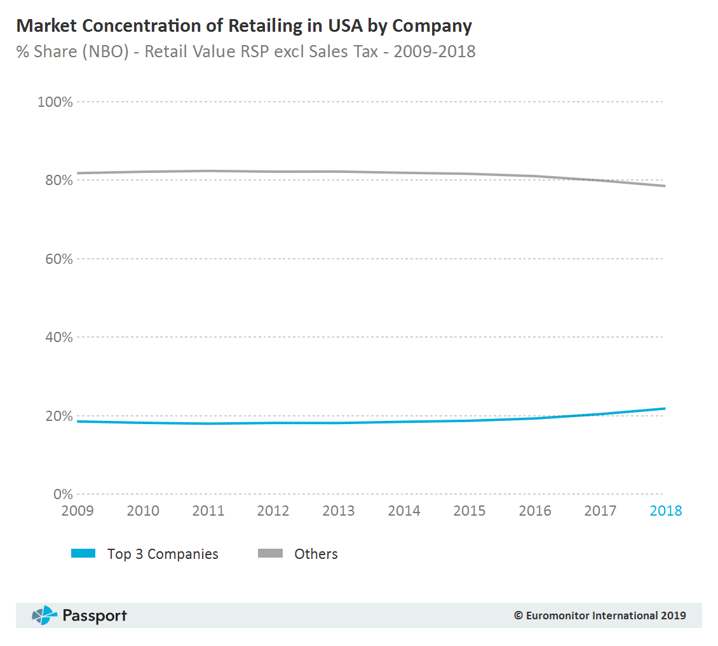

Slide 22
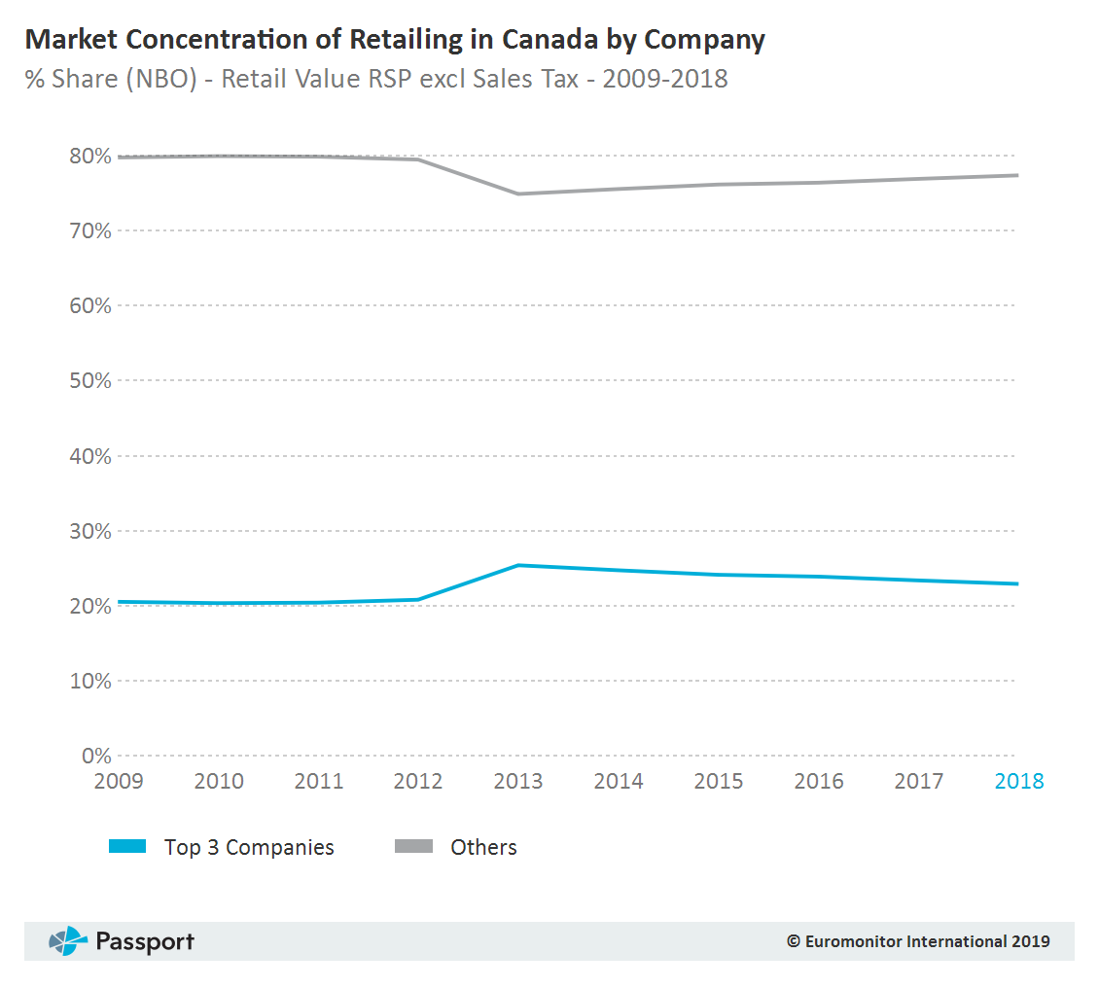

Slide 23
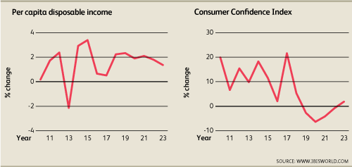
Per capita disposable income - spending power of consumers.
Consumer Confidence Index - the optimism of consumers with regards to the economy. This affects spending habits.

Slide 24
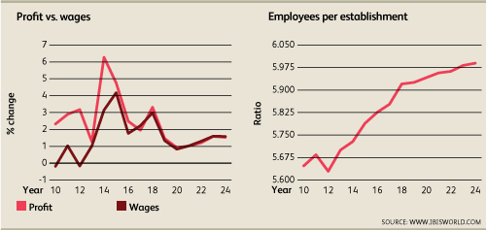
The shift to online retail is increasing price competition
easier for consumers to compare prices quickly
Minimum wage laws will continue to increase costs for companies while they work to increase automation

Slide 25
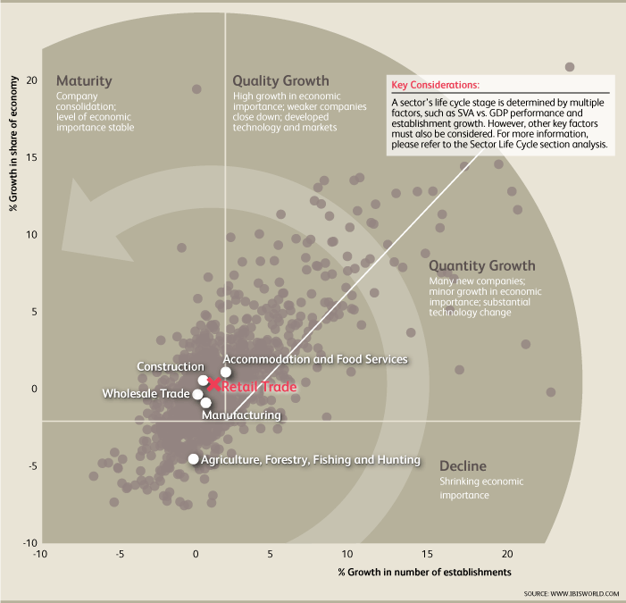

Slide 26
Competitive Landscape
Low concentration
The top four players in the retail sector in the USA are projected to generate around 14% of the total industry revenue
Walmart is expected to account for 5%
High competition
Many companies with small share

Slide 27
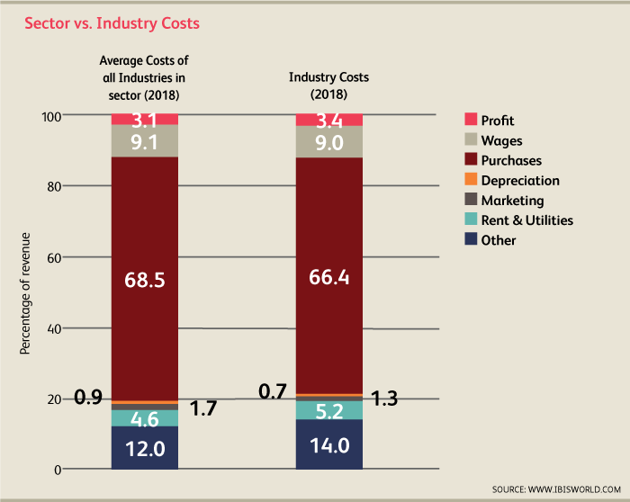
Competitive Landscape
Relatively low profit from array of costs
Profit ratios vary greatly between subsectors
e.g. Art dealers = 9.0%, convenience stores = 2.0%

Slide 28
Competitive Landscape
Barrier to entry is low
However, potential entrants may struggle to compete with large incumbents who benefit from economies of scale
Capital costs are high up front for brick and mortar locations. However, these are generally lower for online retailers
Product differentiation is generally low

Slide 29
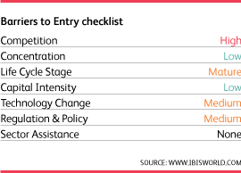
Competitive Landscape

Slide 30
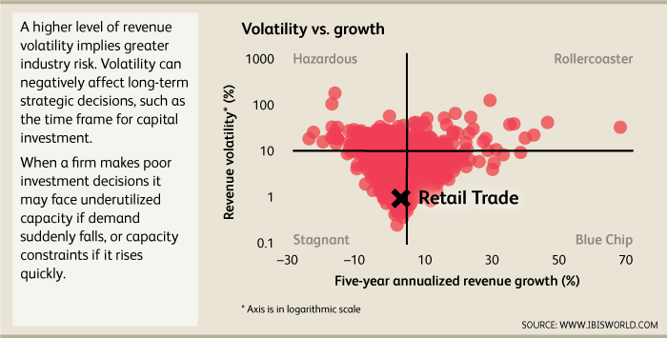

Slide 31
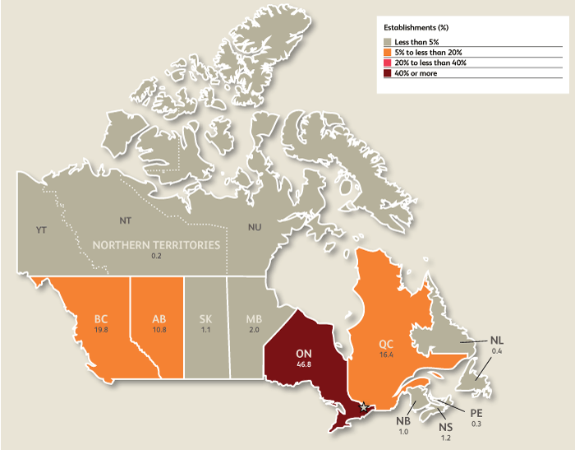
E-Commerce in Canada

Slide 32
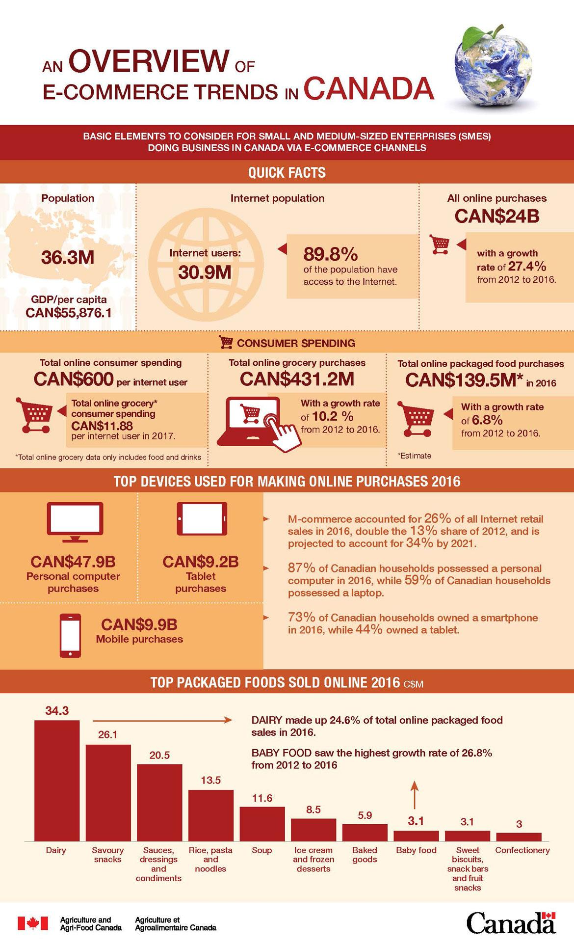

Slide 33
Current Performance in Canada
Over the five years to 2018, industry revenue is increasing at an annualized rate of 20.5% to $8.0 billion, including a 17.5% growth in 2018 alone
Online sales accounted for 1.5% of retail sales in 2013, which represents a marginal increase from 1.3% in 2003
Online sales accounting for an estimated 2.7% of total retail sales in 2018

Slide 34
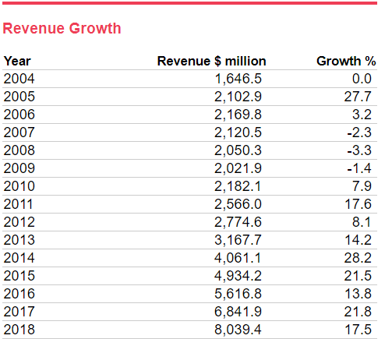

Slide 36
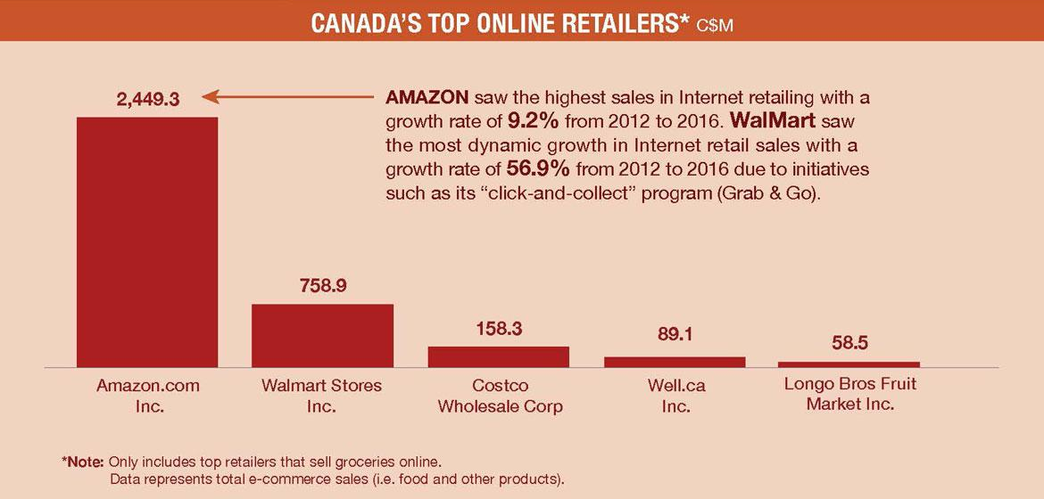

Slide 37
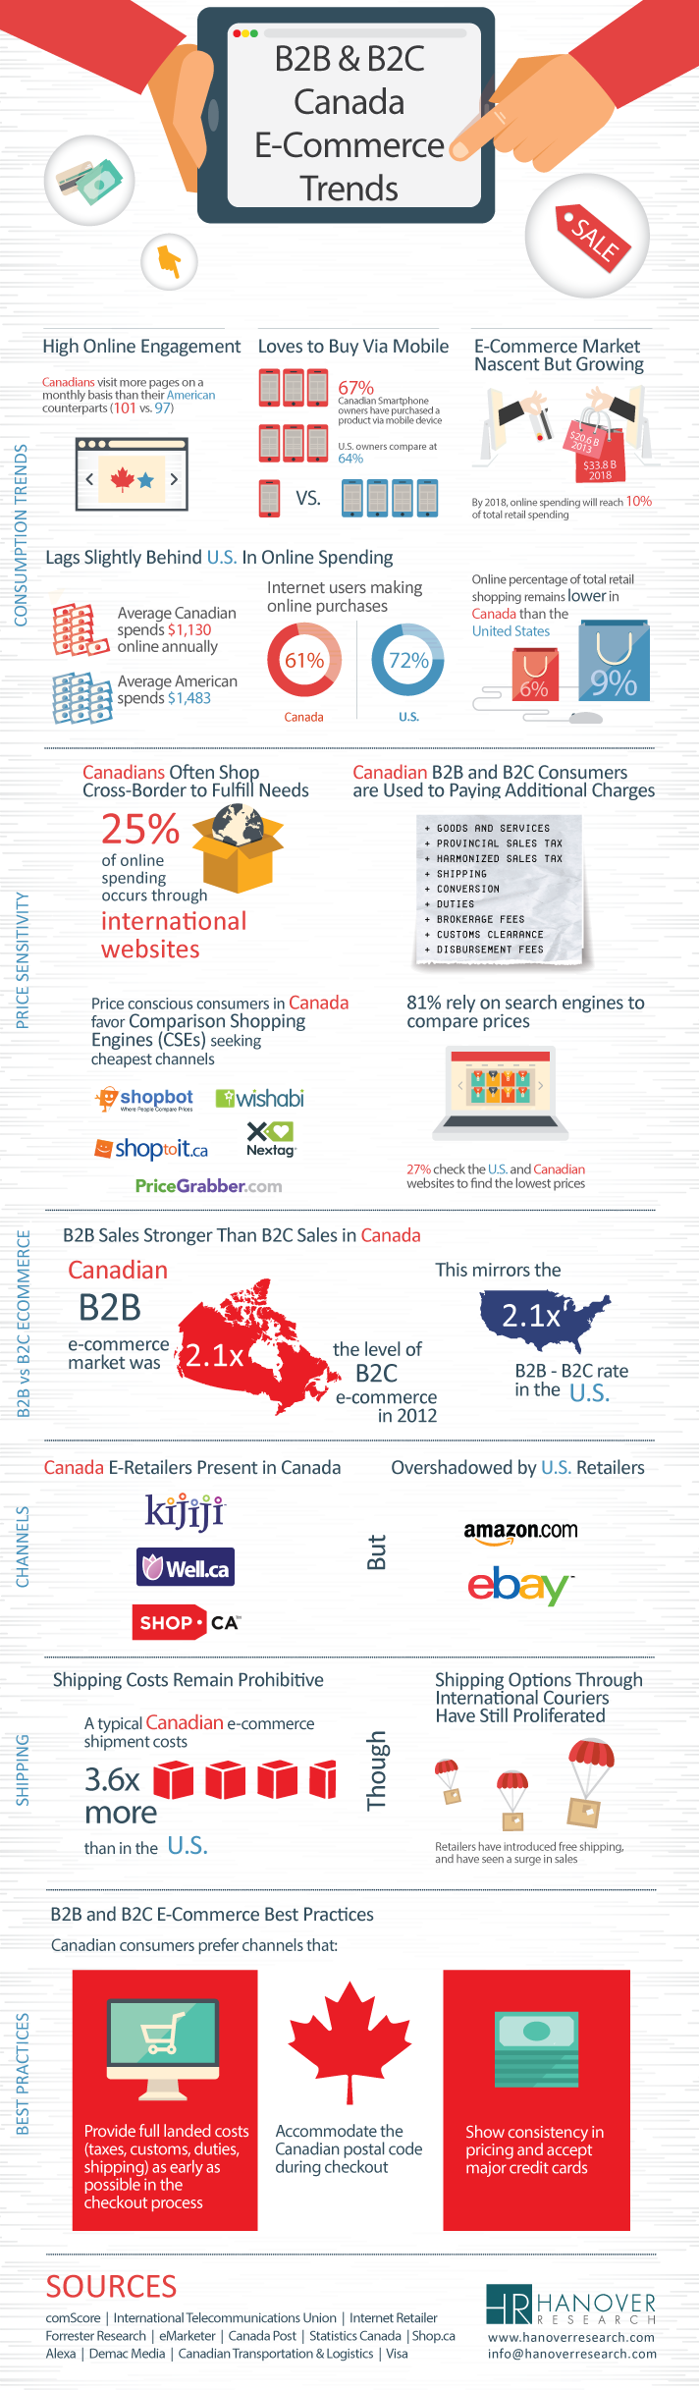

Slide 42

Regulation & Policy in Canada
The level of regulation is medium and the trend is increasing
As a relatively new industry, there is little regulation affecting the E-commerce and Online Auctions industry in Canada
A significant retail law that limits credit card transaction fees has not yet been extended to include online retailers

Slide 43
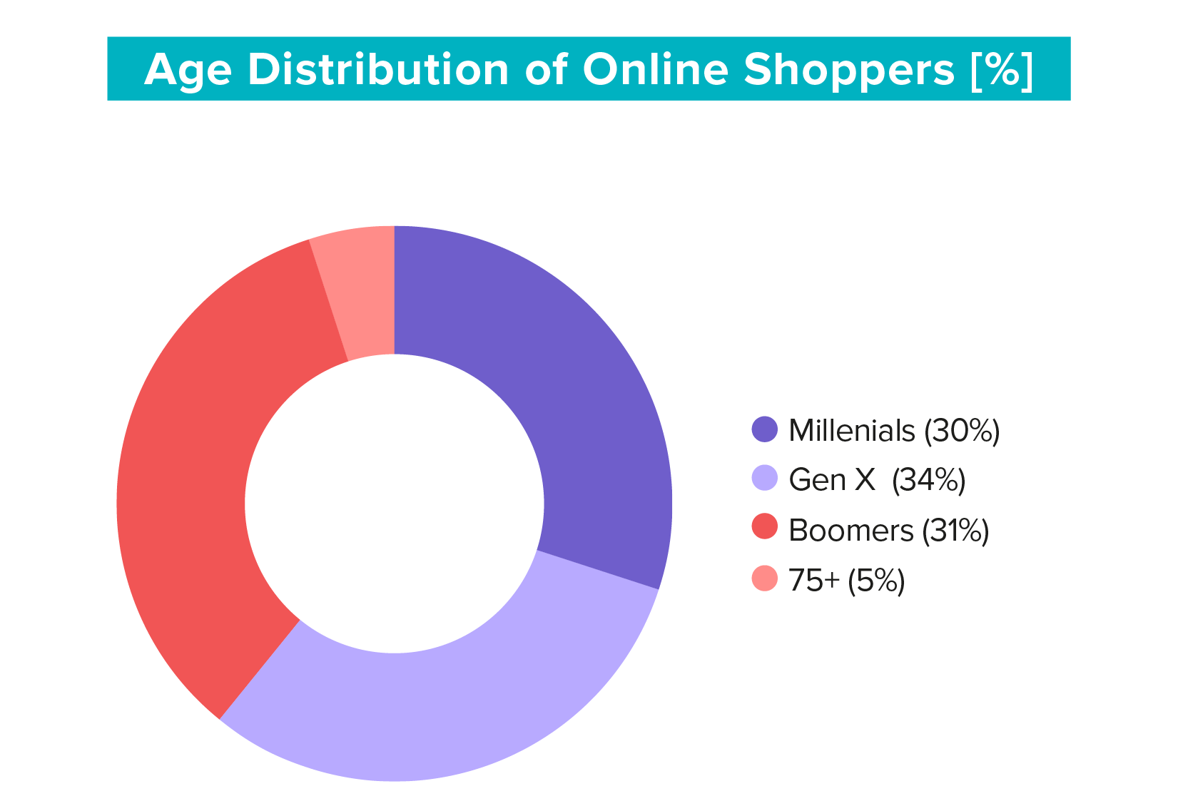
Who Shops Online?

Slide 44
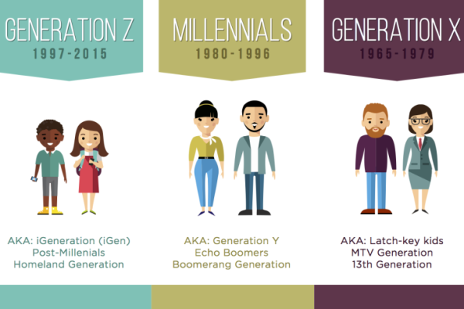
Who Shops Online?
Generation Z
People born after the early 2000s
Won't directly make online purchases
They have a major influence on the parents
Possesses the technological proficiency to browse for products online

Slide 45
Who Shops Online?
Millennials (Generation Y)
Age from roughly 25 to 39 years old
A lower disposable income
Optimistic about their future economic status
Lower levels of traditional brand loyalty
Like to compare products and prices

Slide 46
Who Shops Online?
Generation X
Age from roughly 40 to 54 years old
A significant majority grew up without home computers
Can afford higher-priced goods
Often busy with work or family
Attracted by the convenience of e-commerce and the ability to ship directly to their homes

Slide 47
Who Shops Online?
Boomers
Age from roughly 55 to 74 years old
Generate the largest amount of revenue
Slowly but surely adapted to internet trends
Favouring convenience over tradition
Increased disposable income due to the emancipation of children

Slide 48

Who Shops Online?
Age 75+
Tend to have a lot of leisure time
Little trust of or familiarity with the internet

Slide 49
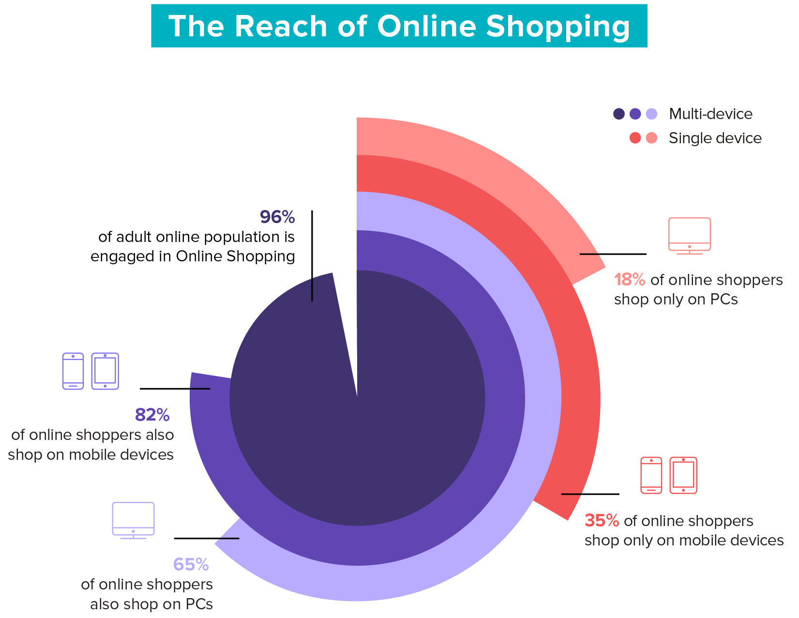
Which Devices Do Shoppers Use?

Slide 50
Which Devices Do Shoppers Use?
The number of fixed broadband connections
Grow an annualized 3.4% over the five years to 2023
The number of mobile telephone subscriptions
Grow at an annualized rate of 3.6% during the outlook period

Slide 51
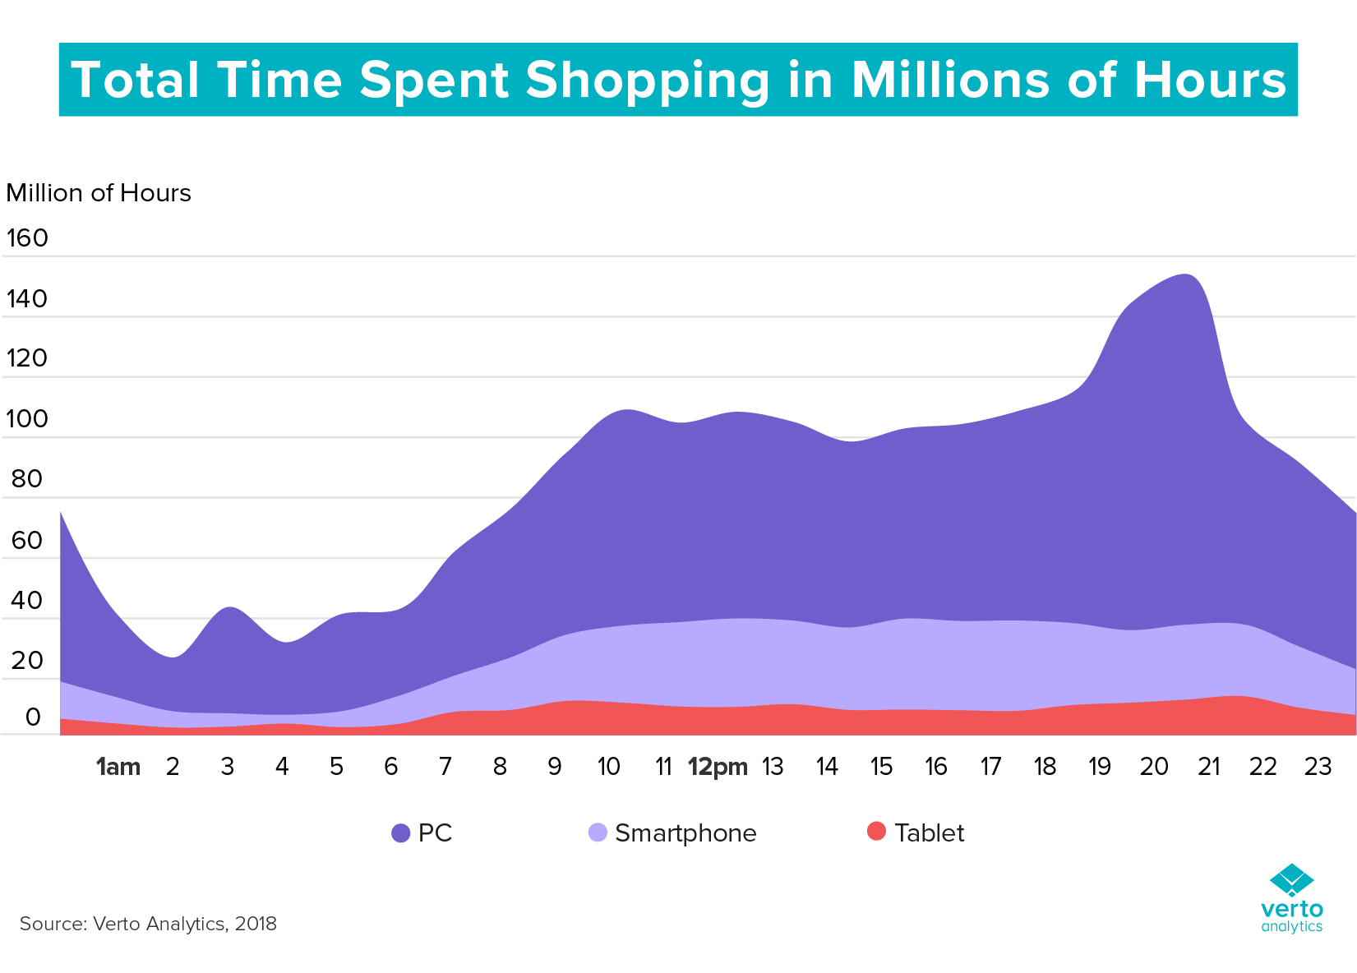

Slide 52
The Three Categories Of Online Shoppers
Based on the amount of time they spend per month with online shopping brands
Heavy shoppers
Top 20% of all online shoppers
Medium shoppers
Between 40% and 80% of all online shoppers
Light shoppers
Bottom 40% of all online shoppers

Slide 53
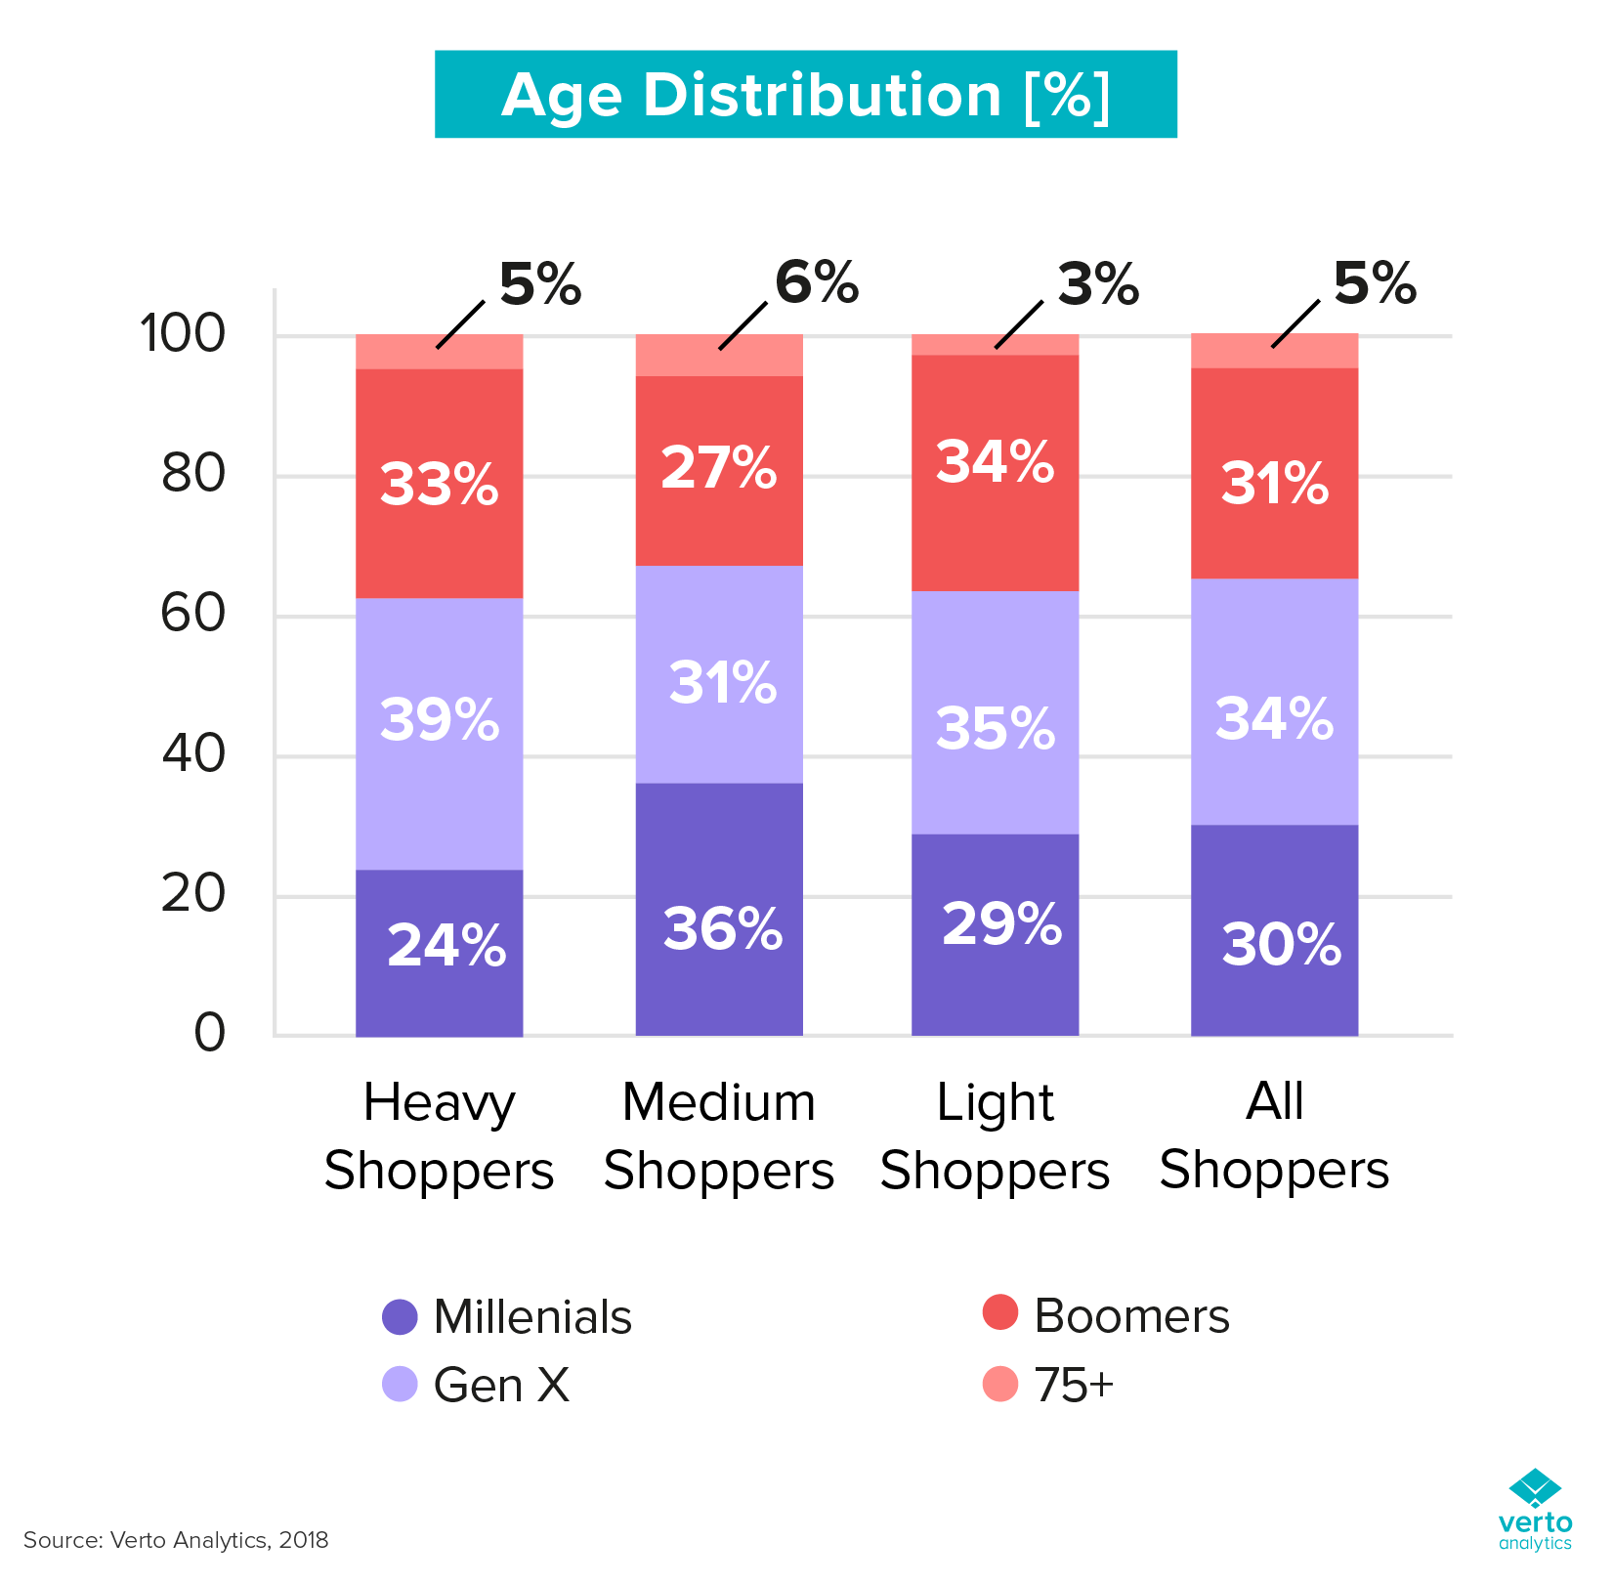

Slide 54
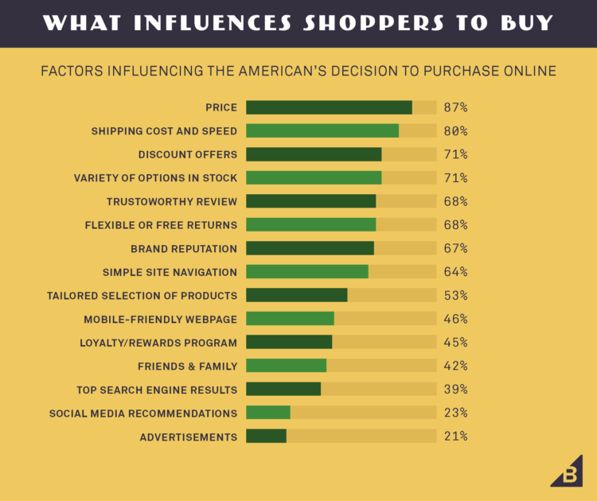

Slide 55
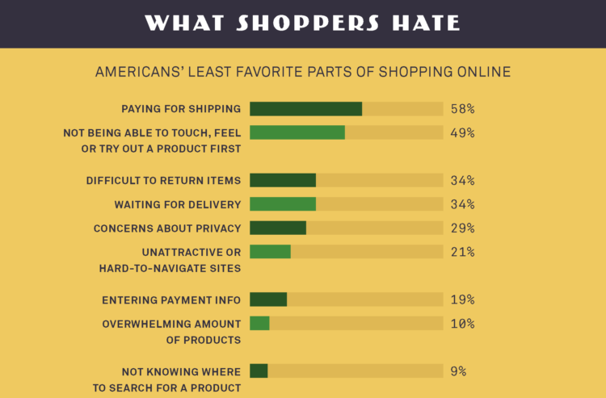

Slide 56
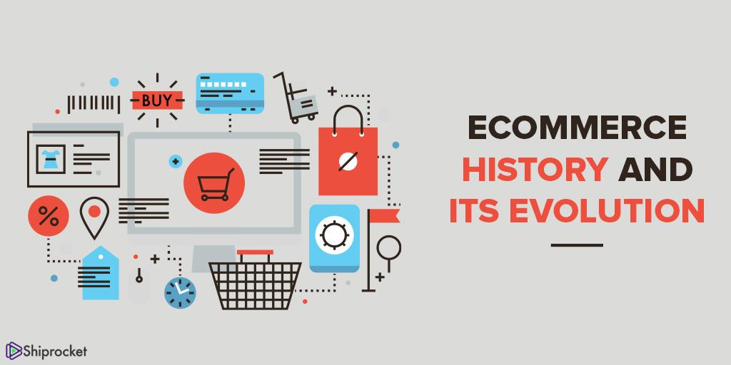

Slide 57
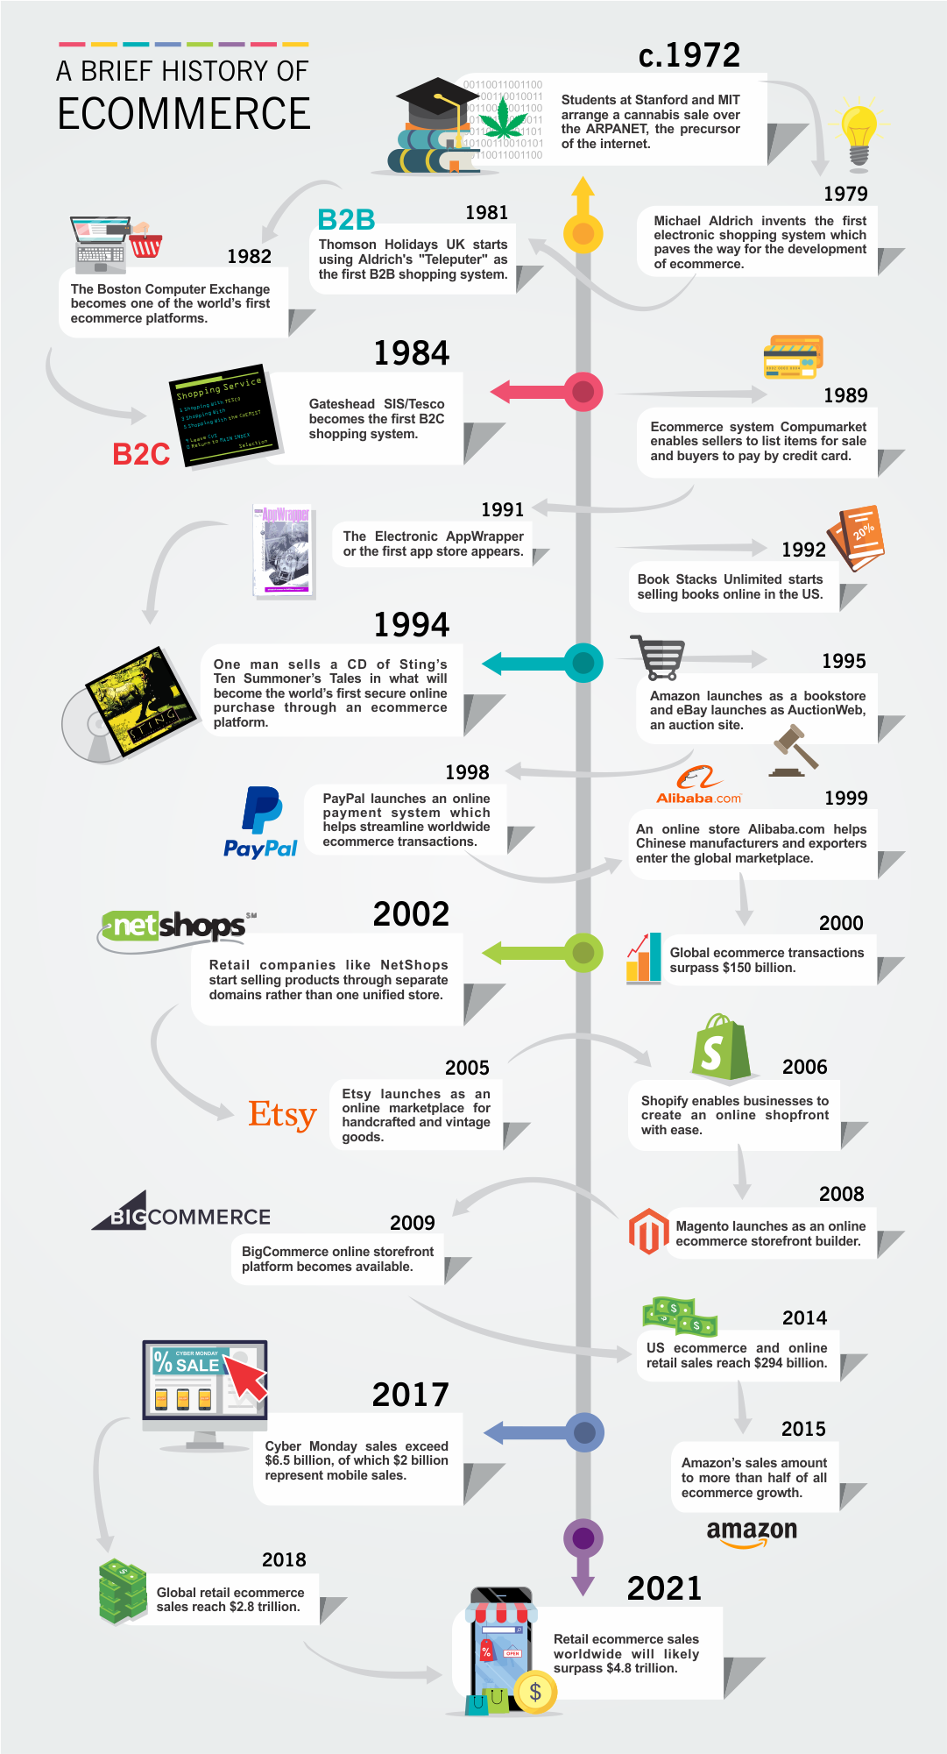

Slide 61


Slide 62
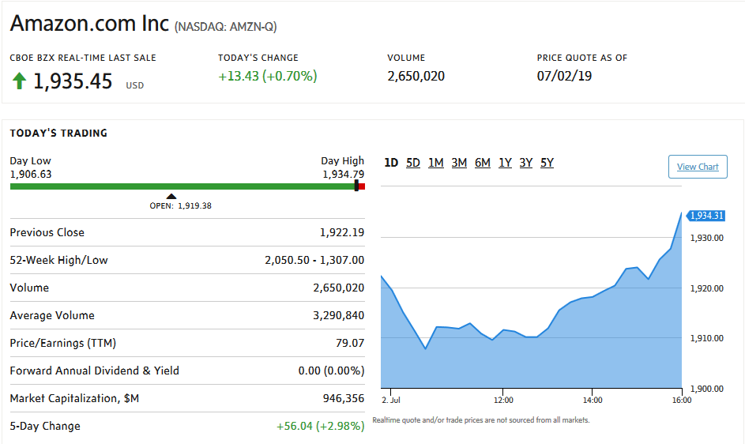

Slide 63
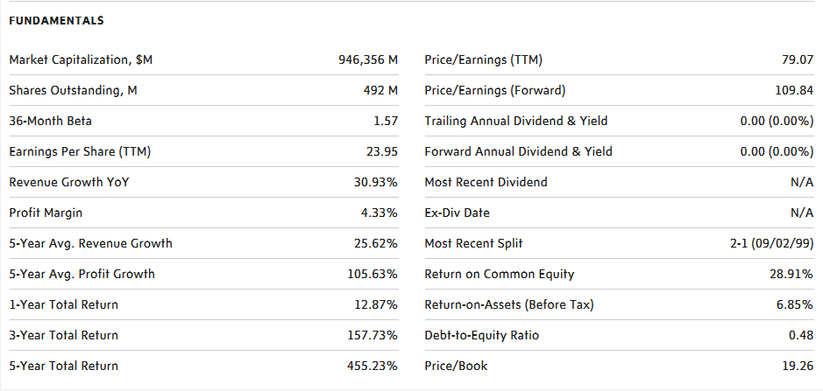
Key Statistics - Screenshots

Slide 64
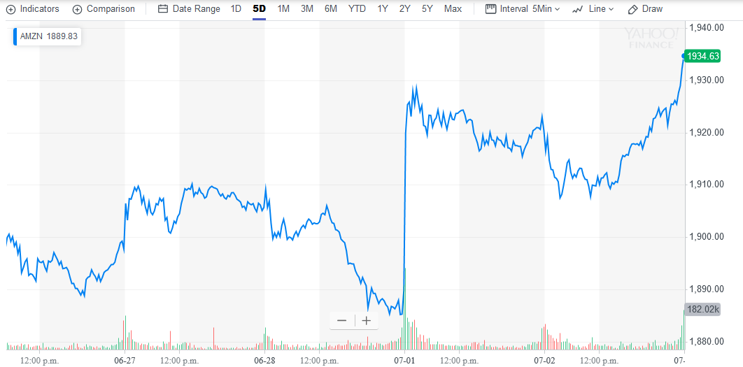
5 - Day Performance

Slide 65
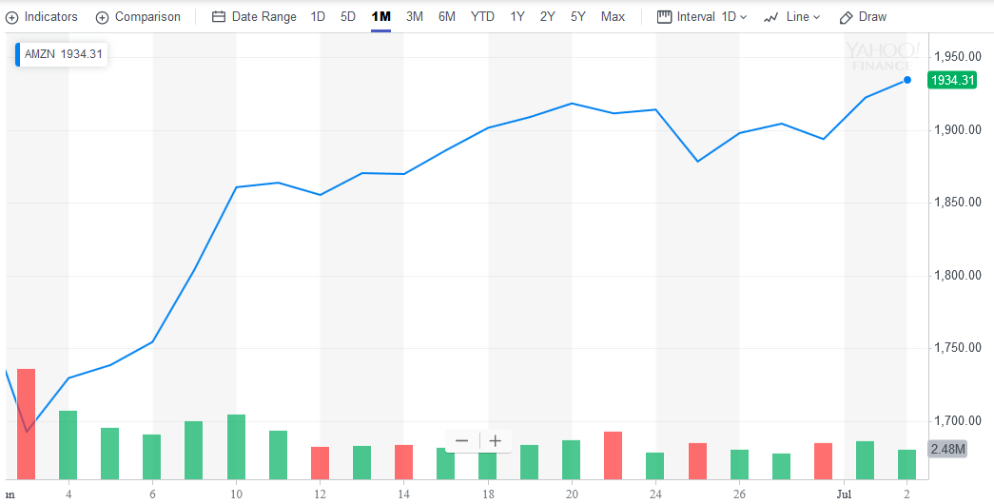
1 - Month Performance

Slide 66
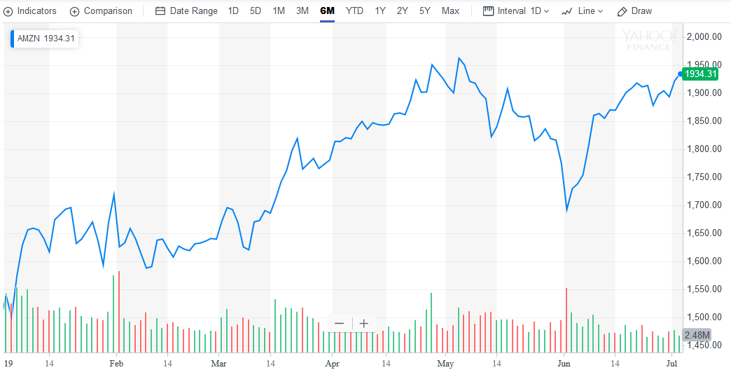
6 - Month Performance

Slide 67
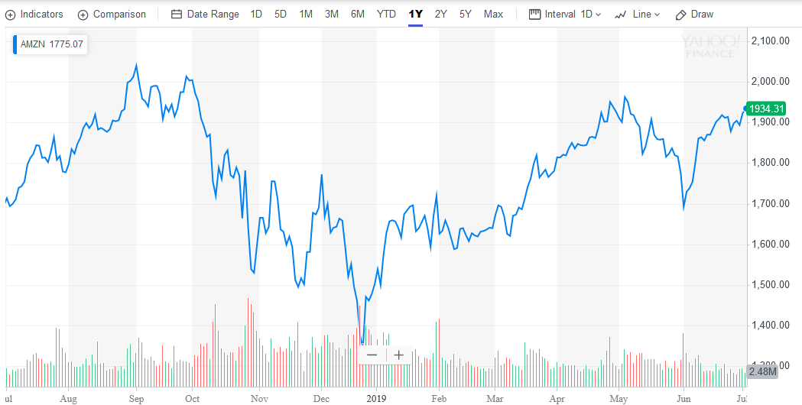
1 - Year Performance

Slide 68
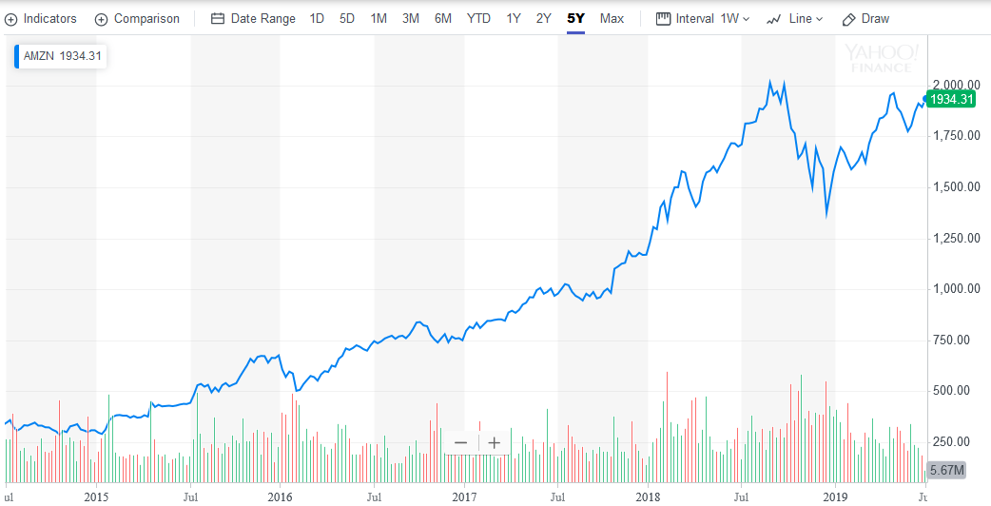
5 - Year Performance

Slide 69
Company Overview
AMAZON.COM, INC. (NASDAQ: AMZN)
An American multinational technology company that focuses on e-commerce, cloud computing, digital streaming and artificial intelligence
Founded: July 5, 1994
Headquarters: Seattle, Washington
Employees: ~647,500
Initial Public Offering: May 15, 1997
Amazon Marketplace is the largest online retailer in the US
Each second, Amazon records $4,722 in sales

Slide 70
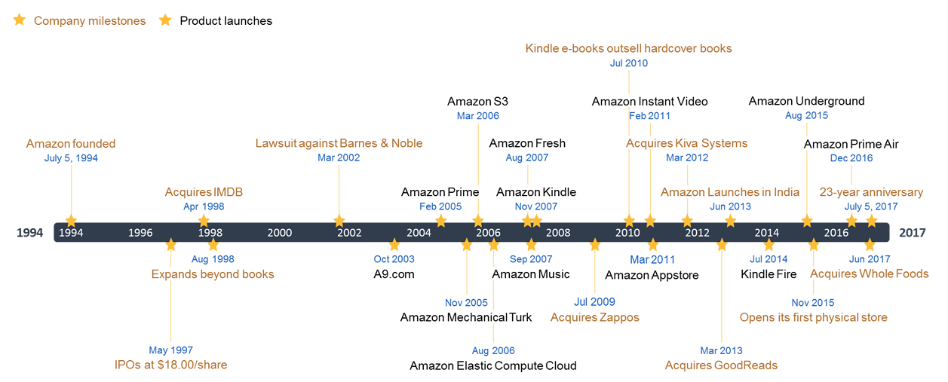
Company History

Slide 71
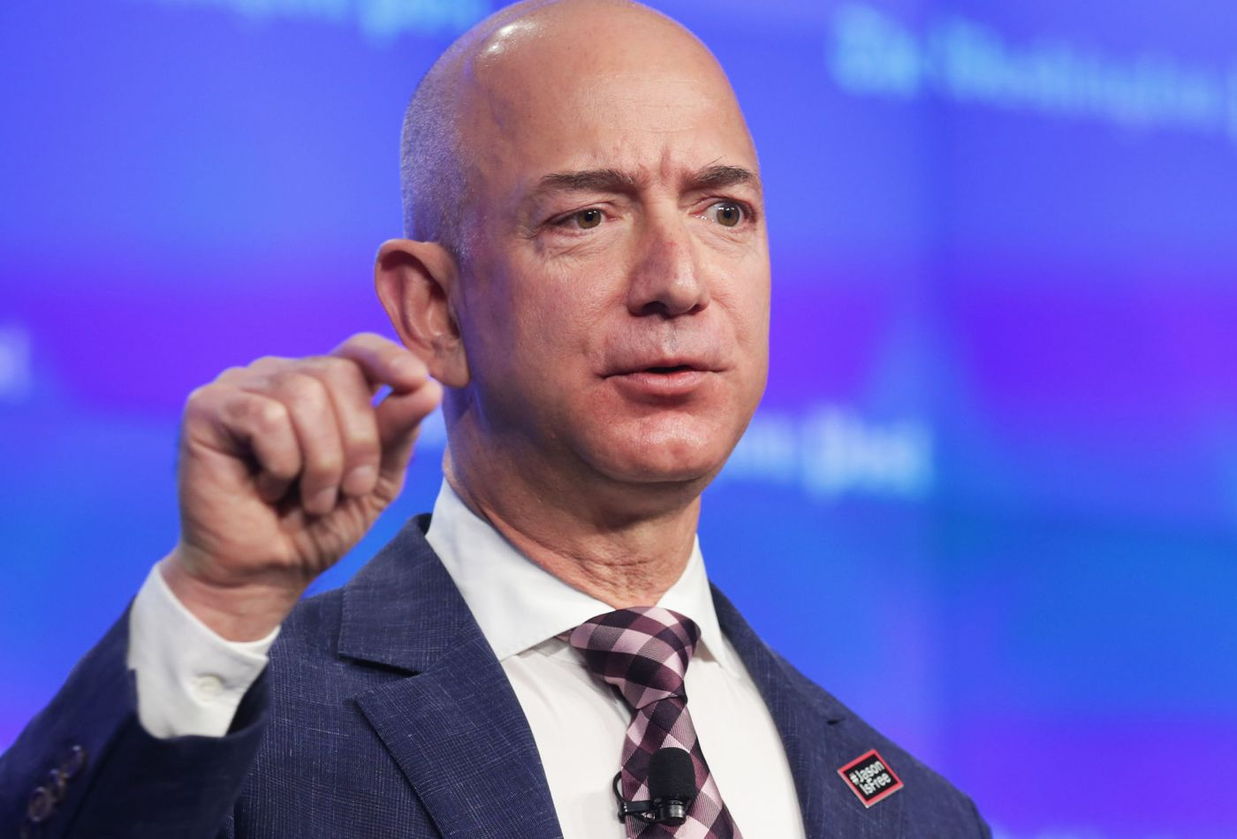
Jeff Bezos
Graduated from Princeton with degree in electrical engineering and computer science
Worked on Wall Street from 1986-1994
Early investor in Google
Founded Blue Origin in 2000
Aerospace manufacturer and sub-orbital spaceflight services
Purchased The Washington Post in 2013

Slide 72

Jeff Bezos
After graduating:
Worked at Fitel
Telecommunications start-up
Promoted to head of development and director of customer services
Transitioned to banking industry at Bankers Trust
Joined D.E. Shaw & Co hedge fund
Became senior vice president at age 30

Slide 73
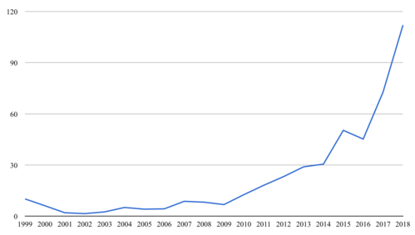
Jeff Bezos Estimated Net Worth (Billions)

Slide 74
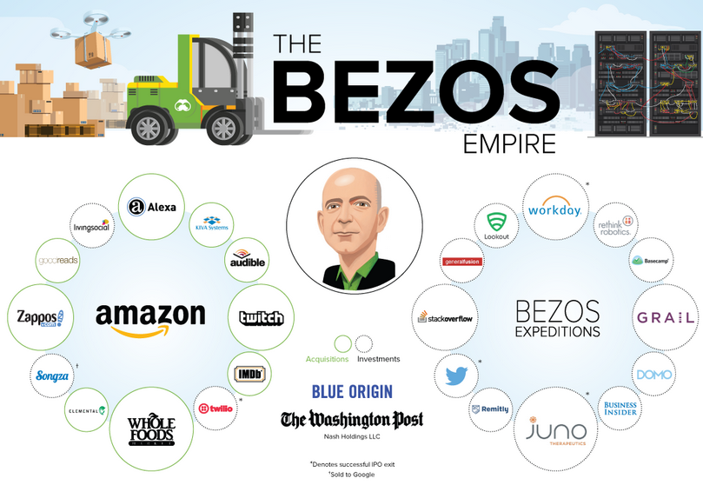
Jeff Bezos

Slide 75
Recent news - Jeff Bezos Pays Divorce Settlement
Jeff Bezos hands over a 4% stake in the online shopping giant to his soon-to-be ex-wife MacKenzie Bezos
A judge is expected to sign legal papers transferring the Amazon shares – worth $38bn (£29bn) – into MacKenzie Bezos’ name
In a statement, MacKenzie Bezos said she was granting Jeff Bezos all of her interests in The Washington Post and Blue Origin, and 75% of the Amazon stock co-owned by the pair and voting control over the shares she's retaining

Slide 76










Notable Acquisitions
Amazon has completed ~100 acquisitions since it was founded in 1994. The following are some of the more recent larger transactions:
$13.7B, 2017
$1.2B, 2018
$1.2B, 2009
$1B, 2018
$970M, 2014
$775M, 2012
$312M, 2011
$580M, 2017
$500M, 2011
$370M, 2015

Slide 77
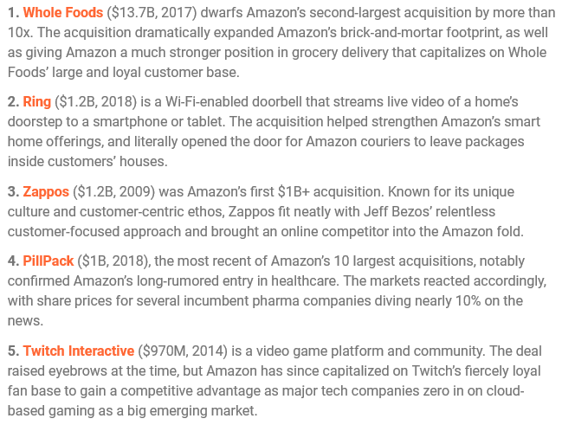
Acquisitions Description

Slide 78
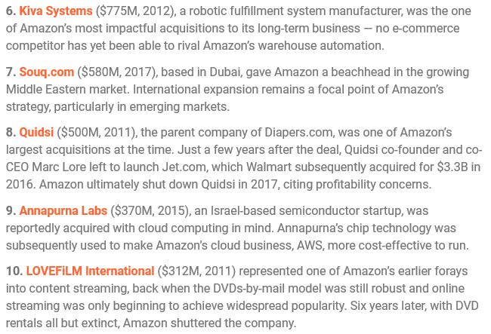
Acquisitions Description

Slide 79

Technology Acquisitions

Slide 80
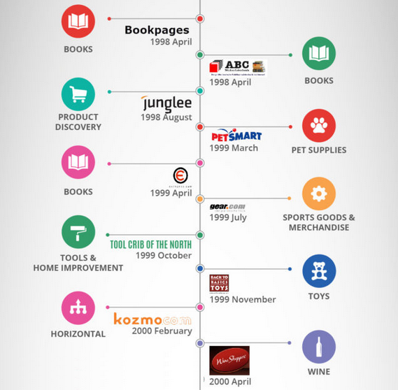

Retail Acquisitions

Slide 81
Products & Services

Slide 82

Amazon Prime
Amazon Prime is a paid subscription service offered by Amazon that gives users access to services that would otherwise be unavailable, or cost extra, to the typical Amazon customer.

Slide 83




Amazon Prime - Shopping Benefits

Slide 84




Amazon Prime - Entertainment Benefits

Slide 85

Amazon Prime - Other Benefits

Slide 86

Amazon Prime - Pricing

Slide 87

Amazon Prime - Student Pricing

Slide 88

Amazon Prime - Membership

Slide 89

Amazon Prime - Membership

Slide 90

Amazon Prime - Membership

Slide 91

Amazon Prime - Usage

Slide 92

Amazon Prime - Spending

Slide 93

Amazon Prime - Prime Day Spending

Slide 94

Amazon Web Services (AWS)
Amazon Web Services provides on-demand cloud computing platforms to individuals, companies and governments, on a metered pay-as-you-go basis.

Slide 95


Amazon Web Services - Solutions

Slide 96

Amazon Web Services - Pricing
Offers pay-as-you-go pricing for 160+ cloud services. You pay only for the services you need and for as long as you use them. Once you stop using them, there are no additional costs or termination fees.

Slide 97

Amazon Web Services - Notable Customers

Slide 98

Amazon Web Services - Revenue

Slide 99

Amazon Web Services - Revenue

Slide 100

Amazon Web Services - Market Share

Slide 101

Amazon Web Services - Market Share

Slide 102

Whole Foods Market
The company offers a selection of natural and organic products with emphasis on perishable foods. Its stores also feature various non-GMO, vegan, gluten-free, dairy-free and other special diet foods.

Slide 103


Whole Foods Market - Products

Slide 104


Whole Foods Market - Products

Slide 105


Whole Foods Market - Prime Member Perks

Slide 106

Whole Foods Market - Net Sales

Slide 107

Whole Foods Market - Sales By Category

Slide 108

Whole Foods Market - Market Share

Slide 109

Other Products & Services

Slide 110

Products & Services - Usage

Slide 111
Analysis of Business Segments

Slide 112


Business Segment Overview

Slide 113

North America Segment
North America
Retail sales of consumer products (including from sellers) and subscriptions through North America-focused online and physical stores. This segment includes export sales from these online stores.

Slide 114

International Segment
International
Retail sales of consumer products (including from sellers) and subscriptions through internationally-focused online stores. This segment includes export sales from these internationally-focused online stores (including export sales from these online stores to customers in the U.S., Mexico, and Canada), but excludes export sales from our North America-focused online stores.

Slide 115

Amazon Web Services (AWS) Segment
AWS
Global sales of compute, storage, database, and other service offerings for start-ups, enterprises government agencies, and academic institutions.

Slide 116

Sales Growth Analysis By Segment

Slide 117

Operating Margin Analysis By Segment

Slide 118


Geographical Breakdown

Slide 119


Revenue By Groupings

Slide 120
Description of Groupings
Online stores
Includes product sales and digital media content. Includes media products available in both a physical and digital format
Physical stores
Includes product sales where customers physically select items in a store.
Third-party seller services
Includes commissions and any related fulfillment and shipping fees, and other third-party seller services
Subscription services
Includes annual and monthly fees associated with Amazon Prime memberships, as well as audiobook, digital video, e-book, digital music, and other non-AWS subscription services.
Other
Sales of advertising services, as well as sales related to our other service offerings

Slide 121
Management Team
Jeffrey P. Bezos - President, Chief Executive Officer and Chairman of the Board
Brian T. Olsavsky - Senior Vice President and Chief Financial Officer
Jeffrey M. Blackburn - Senior Vice President, Business Development
Andrew R. Jassy - Chief Executive Officer, Amazon Web Services
Shelley L. Reynolds - Vice President, Worldwide Controller
Jeffrey A. Wilke - CEO Worldwide Consumer
David A. Zapolsky - Senior Vice President, General Counsel and Secretary

Slide 122

Jeffrey P. Bezos
Founded Amazon.com in 1994
Founder of Blue Origin, an aerospace company looking to lower the cost and increase the safety of spaceflight
Owner of the Washington Post
Named TIME Magazine’s Person of the Year in 1999
Graduated summa cum laude, Phi Beta Kappa in electrical engineering and computer science from Princeton University in 1986

Slide 123

Brian T. Olsavsky
Oversees financial activities, including controllership, tax, treasury, analysis, investor relations, internal audit and financial operations
(2012-Present) - CFO
(2002-2012) - VP Finance
(1995-2002) - VP Finance at Fisher Scientific
(1987-1989) - MBA, Finance from Tepper School of Business
(1981-1985) - B.S., Mechanical Engineering from Penn State University

Slide 124

Jeffrey M. Blackburn
(2004-Present) - SVP, Business Development
(1998-2004) - Product Development & Operations
(1996-1998) - Associate at Deutsche Bank
(1995-1996) - Associate at Morgan Stanley
MBA from Stanford Business School
B.A., Economics from Dartmouth College

Slide 125

Andrew R. Jassy
Managed team that delivered 90+ cloud infrastructure & application services
(1997-Present) - CEO of Amazon Web Services (AWS)
Has led Amazon Web Services since its inception
MBA from Harvard Business School
AB from Harvard University

Slide 126

Shelley L. Reynolds
Oversees Amazon’s accounting function
(2007-Present) - VP, Worldwide Controller & Principal Accounting Officer
(2006-2007) - VP, Finance & Controller
(1998-2006) - Partner at Deloitte & Touche LLP
Undergraduate degree from University of Washington Foster School of Business

Slide 127

Jeffrey A. Wilke
(2016-Present) - CEO Worldwide Consumer
(2012-2016) - Senior Vice President, Consumer Business
(2007-2012) - Senior Vice President, North American Retail
(2002-2006) - Senior Vice President, Worldwide Operations
(1999-2002) - Vice President & General Manager
Former Vice President & General Manager, Pharmaceutical Fine Chemicals at AlliedSignal (now Honeywell)
MBA & MS in Chemical Engineering from MIT's Leaders for Global Operations
BSE degree in Chemical Engineering, Summa Cum Laude, from Princeton University

Slide 128

David A. Zapolsky
(2014-Present) - SVP, General Counsel and Secretary
(2002-2014) - VP, General Counsel and Secretary
(1999-2002) - Associate General Counsel
(1999) - Partner at Dorsey & Whitney LLP
(1994-1999) - Partner at Bogle & Gates
(1991-1994) - Associate at Wachtell, Lipton, Rosen & Katz
(1998-1991) - Assistant District Attorney at Kings County District Attorney's Office
(1985-1988) - J.D., Law from Berkeley School of Law
(1981-1985) - A.B., Music from Columbia University

Slide 129

Management Compensation

Slide 130

CEO Compensation

Slide 131


Ownership Summary

Slide 132


Institutional Ownership

Slide 133


Top Holders

Slide 134
Financial Statements

Slide 135

Balance Sheet: 10-Q (Assets)

Slide 136

Balance Sheet: 10-Q (Liabilities and Shareholders’ Equity)

Slide 137

Balance Sheet: 10-K (Assets)

Slide 138

Balance Sheet: 10-K (Liabilities and Shareholders’ Equity)

Slide 139

Income Statement: 10-K

Slide 140

Income Statement: 10-Q

Slide 141

Cash Flows Statement: 10-K
Notes:
Include Heading?
Supplemental Info?

Slide 142

Cash Flows Statement: 10-Q
Notes:
Include Heading?
Supplemental Info?

Slide 143
Financial Statement Analysis

Slide 144

No Dividend

Slide 145

Top Line Growth

Slide 146

Explosive Bottom Line Growth

Slide 147

Diluted EPS Growth Over Time

Slide 148

Tremendous Cash Generation

Slide 149

Cash Stockpile Over Time

Slide 150

Overall Low Margin Business ...

Slide 151

... Due To High Operating Expenses

Slide 152

Revenue vs Expense Growth

Slide 153

Difference Between Revenue & Expense Growth

Slide 154

Recommendation
Innovative leader with Jeff Bezos at the helm
Continued growth potential with Amazon Prime & Amazon Web Services
Complementary acquistions, Whole Foods in particular
Tremendous cash generation ability (CFO - 46% CAGR)
Increasing operating margin and income

Slide 155


Slide 156


Slide 157

Key Statistics

Slide 158

5 - Day Performance

Slide 159

1 - Month Performance

Slide 160

6 - Month Performance

Slide 161

1 - Year Performance

Slide 162

5 - Year Performance

Slide 163
Company Overview
Shopify Inc. (TSE: SHOP)
A Canadian which offers retailers a suite of services including payments, marketing, shipping and customer engagement tools to simplify the process of running an online store for small merchants.
Founded: 2004
Headquarters: Ottawa, Ontario
Employees: ~4000
Initial Public Offering: May 21, 2015
Started as an online store for snowboarding equipment called Snowdevil
The platform was launched as Spotify in June, 2006

Slide 164



Slide 165


Slide 166


Slide 167


Slide 168



Slide 169



Slide 170
Revenue Streams
Two main revenue streams -
A recurring subscription component called Subscription solutions
~44% of the total revenue
A merchant success-based component called Merchant Solutions
~56% of the total revenue
Notes:
Merchant Solutions that enhance the subscription with payment services (Shopify Payments), shipping (Shopify Shipping), and working capital (Shopify Capital). More than two-thirds of Shopify’s merchants have enabled Shopify Payments, which eliminates the need for a third-party payment gateway.

Slide 171
Subscription Solutions
Shopify principally generates Subscription Solutions revenues through the sale of subscriptions for its platform.
Offer different plans for different prices
Basic Shopify
Advanced Shopify
Shopify Plus
Subscription terms automatically renew and subscription fee are non-refundable.
Company also generates associated subscription revenue from the sale of custom themes, apps and registration of domain names.

Slide 172
Merchant Solutions
Merchant Solutions enhance the subscription with payment services (Shopify Payments), shipping (Shopify Shipping), and working capital (Shopify Capital). More than two-thirds of Shopify’s merchants have enabled Shopify Payments, which eliminates the need for a third-party payment gateway.
Shopify now generates more revenue from Merchant Solutions than Subscription model

Slide 173









Acquisitions
Shopify has completed 9 acquisitions since it was founded

Slide 174
The terms of acquisitions were not disclosed, However, it is estimated to be around $100 million.
Will provide Shopify with a stronger mobile business-to-business software through its mobile app - Handshake Rep
The app allows sales reps through their mobiles to
Access their company’s product catalog
Check inventory
Enter orders for customers
Check order history
Notes:
The two vendors should complement each other with ecommerce technology platforms designed for flexibility in helping online buyers and sellers interact online.

Slide 175
Tictail is an e-commerce platform based in Sweden which lets users shop for various goods such as clothing or art from small business owners around the world.
TicTail is engaged in providing a online marketplace enabling shoppers to discover products of around 80,000 - 125,000 brands.
Shopify continues to work on its goal of international expansion
Tic Tac also has set up pop up shops in North America which will help Shopify’s goal of setting up Brick-and mortar locations

Slide 176
Return Magic is a Montreal based e-commerce return solution.
Return Magic supports buyers and merchants in three key ways -
By enhancing the buyer experience
enhances post shopping experience which is becoming a differentiation factor such as faster shipping and free and easy returns.
By helping merchants save time
It automates several core, repetitive tasks such as issuing refund or gift card etc
By making it easy for retailers to set up a return system
It understands retailers have different needs when it comes to return and aims to address as many as possible.
Notes:
By enhancing the buyer experience: With online buyers expecting an ever-more-convenient online shopping experience, whether it’s wider selection or faster shipping, free and easy returns have also become a given. “We believe that the post-purchase shopping experience (of which returns are a part of) is increasingly becoming a differentiation factor for shoppers to decide to convert and become loyal customers over time,” Racine says, pointing ITBusiness.ca readers to an infographic published by Return Magic that reveals, among other things, that more than 80 per cent of customers read an online retailer’s return policy before making a purchase, and more than 70 per cent say they’re more likely to return to merchants that make the return experience simple.
By helping merchants save time: By automating several core, repetitive tasks such as issuing a refund or gift card, sending a return label, or providing email notifications, Return Magic helps retailers both streamline the return process and increase its effectiveness.
By making it easy for retailers to set up a return system: Retailers have different needs when it comes to returns, and Return Magic aims to address as many of them as possible, including payments, inventory management, fulfilment, shipping, customer service, and user experience. “We allow merchants to combine it all in a seamless way for the buyer, while providing them with the flexibility they want to handle returns that works best for them,” Racine says. And like the core Shopify playform, Return Magic’s interface can be personalized to reflect the business using it.

Slide 177
Oberlo is an Lithuanian company which was founded in 2015. It is a marketplace for entrepreneurs to search and find products to sell online. It allows the user to export products from Aliexpress and import directly to your Shopify store.
Acquired for 15 million
Acquisition is consistent with the goal of international expansion.

Slide 178
Shopify Cannabis Play
Shopify’s platform was widely adopted for online sales of recreational marijuana, which Canada legalized on Oct 17, 2018.
Government run websites in several provinces including Ontario and British Columbia use Shopify’s platform.
Most of the big licensed producers in the Cannabis market, Canopy Growth Corp, Aurora Cannabis Inc and HExo Corp. all use Shopify’s point of sale system.
Notes:
Shopify is in a unique space that puts it in the perfect position to capture part of the value from cannabis legalization. North America is the largest market for the substance. The black market here is estimated to be worth $45 billion right now. Medical marijuana could be worth nearly as much if not more.
Canada is the only G7 country where recreational marijuana is legal. The way this legalization is structured gives companies like Aphria, Canopy Growth, and Aurora an edge. These companies have managed to get their provincial sales agreements based on their track record of medical research. Canopy has nearly $4.5 billion in cash after its deal with Constellation Brands, while the other two are on track to dramatically increase sales and launch branded consumer products soon. All these companies use Shopifys point of sale system.

Slide 179
Shopify Cannabis Play
Shopify can capture the part of the Cannabis legalization due to its perfect position.
In Canada, government is giving out licenses to only a handful of players and billions pouring into this market likely means that Canada’s cannabis industry will evolve into an oligopoly like Big Tobacco.
Canada’s market is dwarfed in comparison to North American market which is estimated $45 billion today and expected to be worth $200 billion by 2030.
Already has a market presence in US with ~7200 US ecommerce business using Shopify.
Notes:
With the government giving out licenses to only a handful of players and billions pouring into this market at the top-end, it’s likely that Canada’s cannabis industry will evolve into an oligopoly like Big Tobacco.
However, Canada’s market isn’t where the action is. The domestic market is worth just over $4.5 to $5 billion, which is barely bigger than the potential market in the state of Colorado. Meanwhile the global market for medical and recreational marijuana is estimated to be worth $200 billion by 2030.
Half of that will be recreational and half of recreational will be concentrated in North America. So assuming the market is worth $50 billion, and a mere 10% of that is online sales, Shopify has access to upside worth nearly one-third of its current market cap.
The potential size of the market doesn’t tell you the full story. Shopify’s business model gives it access to all of the upside from this wave of legalization without any of the downside. It doesn’t need to invest in production facilities, seek out medical research licenses, pay hefty sin taxes, or spend a ton on marketing brands. Instead, the company just needs to apply the same magic that helped it get these online sales deals with Canadian provinces and large private producers.
Also it has already established itself in US as ~72000 us businesses use Shopify. This is just North America. Shopify also has a presence in other markets where legalization is a possibility such as UK, South Africa and Germany.

Slide 180
Management Team
Management
Tobi Lütke, Founder, Chief Executive Officer
Harley Finkelstein, Chief Operating Officer
Craig Miller, Chief Product Officer
Amy Shapero, Chief Financial Office
Jeff Weiser, Chief Marketing Officer
Joe Frasca, Chief Legal Officer
Jean-Michel Lemieux, Chief Technology Officer

Slide 181

Tobi Lutke
Tobi Lutke founded and CEO of Shopify, a Canadian e commerce firm that helps companies set up and run online stores.
Lutke grew up in Germany, where he learned to code by age 12 and left school at 16 to enter a computer programming apprenticeship.
He moved to Canada in 2003 after meeting his now-wife, an Ottawa native, on a snowboarding trip to Whistler.
He began working on an ecommerce platform after he and a friend tried to open an online snowboard shop but couldn't find decent software.
They soon realized their software would make a good product to sell, so they raised about $200,000 from friends and family to launch Shopify.
Notes:
Tobi is an active advocate for computer literacy and education, and serves as a board member of Canada Learning Code, an organization working to give all Canadians access to digital skills. In 2014, Tobi was named the Globe and Mail’s CEO of the Year. He served as Chair of the Digital Industries Table, an advisory board commissioned by the federal government to provide recommendations on how to turn Canada into a digital leader.

Slide 182

Harley Finkelstein
Harley Finkelstein is the Chief Operating Officer at Shopify and has been with the company since 2010. Prior to his current role, Harley founded numerous startups and ecommerce companies.
(2010-Present) - COO
(2017-Present) - Board Member at CBC
(2015-Present) - Advisory Board Member at OMERS Ventures
(2005-2009) - JD/MBA, University of Ottawa
(2001-2005) - B.A., Economics from Concordia University
Notes:
Harley holds a Bachelor degree in Economics from Concordia University and a J.D./M.B.A. joint degree in Law and Business from the University of Ottawa.

Slide 183

Craig Miller
Oversees product and UX teams, in addition to growth, marketing, and communications. Completed his Bachelors in Electrical Engineering from McGill University.
(2017-Present) - Chief Product Officer at Shopify
(2011-2018) - Chief Marketing Officer at Shopify
(2009-2011) - Head of Product at Kijiji
(2006-2009) - Global Internet Marketing Lead at Kijiji
Notes:
Craig Miller is the Chief Product Officer at Shopify and has been with the company since September 2011. Prior to this, Craig was Chief Marketing Officer and VP Marketing. In his current role, he oversees the Product and User Experience teams at the Company. Previously, Craig held several product and marketing roles at Kijiji, an eBay Company, between 2006 and 2011.
Craig holds a Bachelor’s degree in Electrical Engineering from McGill University.

Slide 184

Amy Shapero
Amy began her career as a CPA at Ernst & Young, followed by investment banking positions at Credit Suisse and Goldman Sachs serving emerging growth companies. She holds an MBA from the University of Chicago Booth School of Business.
(2018-Present) - CFO at Shopify
(2016-2018) - CFO at Betterment
(2015-2016) - CFO at Sailthru
Notes:
Amy Shapero is the Chief Financial Officer at Shopify and joined in April 2018. Prior to joining Shopify, Amy was the Chief Financial Officer at Betterment, an online wealth-management service, since 2016. Previously, Amy was Chief Financial Officer at Sailthru, and Senior Vice President of Strategy, Corporate Development and Corporate Communications at DigitalGlobe.
Amy began her career as a CPA at Ernst & Young, followed by investment banking positions at Credit Suisse and Goldman Sachs serving emerging growth companies. She holds an MBA from the University of Chicago Booth School of Business.

Slide 185

Jeff Weiser
Oversees the Marketing function globally, including Growth, Brand and Communications, Product Marketing, Strategy and Operations, and Creative teams. He holds an MBA in Decision, Risk and optimization from Columbia University
(2018-Present) - Chief Marketing Officer at Shopify
(2016-2017) - Chief Marketing Officer at Shutterstock
(2013-2016) - Senior VP at Beachbody, Strategic Analysis and Database Marketing
(2010-2013) - Vice President, Strategic Analysis
Notes:
Jeff Weiser is the Chief Marketing Officer at Shopify and has been with the company since February 2018. He oversees the Marketing function globally, including Growth, Brand and Communications, Product Marketing, Strategy and Operations, and Creative teams. Prior to joining Shopify, he served as Chief Marketing Officer at Shutterstock, Inc. (NYSE). Prior to that, Jeff held multiple senior level positions with Beachbody LLC (creators of P90X and Shakeology), and Strategy and Analytics roles at SGN (Social Gaming Network), MySpace and Yahoo!.
Jeff holds a B.A. in English from Yale University and an M.B.A from Columbia Business School.

Slide 186

Jean-Michel Lemieux
Jean-Michel holds a Bachelor’s degree in Computer Science from the University of Ottawa. Wants to spend rest of his career at Shopify.
(2019-Present) - CTO
(2015-Present) - SVP of Engineering for the long term
(2011-2015) - VP of Engineering
(2008-2011) - Chief Architect for Rational Team Concert at IBM
(2005-2008) - Chief Architect for Jazz Source Control at IBM
Notes:
Jean-Michel Lemieux is the Chief Technology Officer at Shopify and joined the company in 2015. Prior to joining Shopify, he served as the Vice President of Engineering at Atlassian and as the Chief Architect for Rational Team Concert, a division of IBM. Jean-Michel co-authored the book, Eclipse Rich Client Platform and has filed two U.S. patents on software configuration management.
Jean-Michel holds a Bachelor’s degree in Computer Science from the University of Ottawa.

Slide 187

Management Compensation

Slide 188

CEO Compensation

Slide 189


Share Ownership Summary

Slide 190

Institutional Ownership Details

Slide 191

Balance Sheet: 10-Q (Assets)

Slide 192

Balance Sheet: 10-Q (Liabilities and Shareholders Equity)

Slide 193

Balance Sheet: 10-K (Assets)

Slide 194

Balance Sheet: 10-K (Liabilities and Shareholder’s Equity)
)

Slide 195

Income Statement: 10-K

Slide 196

Income Statement: 10-Q

Slide 197

Cash Flows Statement: 10-K (Operating activities)

Slide 198

Cash Flows Statement: 10-K (Investing and Financing activities)

Slide 199

Cash Flows Statement: 10-Q (Operating activities)

Slide 200

Cash Flows Statement: 10-Q (Investing and Financing activities)

Slide 201
Financial Statement Analysis

Slide 202


Slide 203


Slide 204


Slide 205


Slide 206


Slide 207


Slide 208


Slide 209


Slide 210


Slide 211

Recommendation
Several lifers at the helm
Continued growth potential with Cannabis legalization
Recurring subscription and revenue growth
Smart acquisitions
Notes:
Shopify was the preferred vendor to set up those storefronts, ultimately becoming the platform of choice for B.C., Newfoundland and Labrador, Ontario and P.E.I.
This will offer two waves of growth for the company, the first of which we should begin to see over the course of the next two quarterly updates as revenue stemming from legalization clients begins to add to Shopify’s bottom line.
That will be followed by a slew of new business opportunities as other nations and regulatory bodies, with their own security and privacy concerns, turn to Shopify’s legalization success as a model for their own needs.
Finally, we come to Shopify’s growth itself. Shopify has provided handsome returns over the course of the past few years since its IPO, but the two numbers that I’m most excited about from Shopify’s most recent update are the numbers for revenue growth and recurring subscription revenue.
Specifically, revenue growth registered an impressive 58% improvement over the same quarter last year, while recurring subscription revenue saw a 46% year-over-year improvement. As long as Shopify keeps seeing double-digit growth across both those segments, investors can expect the stock to continue its upward trajectory and a flurry of new business and investment opportunities to materialize.

Slide 212


Slide 213


Slide 214

Key Statistics - Screenshots
Notes:
*Note that the stock is cheaper relative to the previous competitors that we have talked about today in terms of P/E, P/forward E, Price/Book
*Higher ROE and Profit margin than the two
*Provides a dividend
*Negative 5-yr avg revenue and profit growth, unlike the other companies

Slide 215

5 - Day Performance

Slide 216

1 - Month Performance

Slide 217

6 - Month Performance

Slide 218

1 - Year Performance

Slide 219

5 - Year Performance

Slide 220

Company Overview
A global ecommerce leader
Platforms are designed to connect sellers to buyers
Generates revenue with listing and selling fees (80%) and advertising (20%)
180+ Million users and 1+ Billion listings globally
2018: $95 Billion in Gross Merchandise Volume
2019 Q1: $2.6B Revenue
2019 Q1: $12.9B Sales volume involved mobile devices
60% of eBay Inc’s revenue is International
Notes:
eBay Inc. (NASDAQ: EBAY) is a global commerce leader including the Marketplace, StubHub and Classifieds platforms.
Collectively, it connects millions of buyers and sellers around the world, empowering people and creating opportunity for all.
In 2018, eBay enabled $95 billion of gross merchandise volume.

Slide 221

Strategy
Transaction based business model
Revenue generation through:
Ecommerce platforms
Marketing services, classified and advertising
Enhances experiences for buyers and sellers
Product searching by image using AI
Authentication program for luxury goods
Cost reduction
Focus on high margin activities
Notes:
The company is primarily a transaction-based business model that generates revenue through its e-commerce platforms. The company also generates revenue through marketing services, classifieds, and advertising.
eBay has made changes to enhance experiences for buyers and sellers. It allows users to search for products by image, using artificial intelligence technology. For buyers of high-end goods, the company introduced an authentication program to increase consumer confidence. Another new service has been guaranteed delivery in three days or less for tens of millions of items.
The company activated a global branding campaign to drive more traffic and new buyers to its sites. It rolled out local campaigns to increase brand awareness of eBay in North America, Europe, and Australia using television, digital, and social media channels.

Slide 222










eBay Timeline
Meg Whitman Joins as CEO
John Donahoe is appointed as new CEO
Devin Wenig becomes new CEO
Notes:
*Acquisition of Paypal in 2002, acquired stubhub in 2007, rolled out its mobile app in 2008. Spun off paypal in 2014.

Slide 223

eBay Marketplaces
One of the biggest online marketplaces globally
Marketplace platforms include:
www.ebay.com marketplace
Localized counterparts (eg: ebay.ca)
eBay mobile apps
Key Values
$2.2B Marketplace Revenue (Q1 2019)
$21.6B eBay Marketplace GMV (Q1 2019)
62% of GMV involved mobile
1.2B Live Marketplace Listings

Slide 224








eBay Classifieds
Helps people find what they are looking for in their local communities
Classifieds platforms include:
Collection of Brands, examples include
Mobile.de
Kijiji
Gumtree
Key Values
Offers online classifieds in 1500+ cities
$256M Classifieds Revenue (2019 Q1)
62% of GMv involved mobile
1.2B Live Marketplace Listings

Slide 225

Stubhub
The largest secondary marketplace for online tickets
Stubhub platforms include:
Online ticket platform
Localized counterparts
Mobile apps
Key Values (Q1 2019)
$230M Stubhub Revenue
$1.0B Stubhub GMV
Notes:
*some cities are focusing down on ticket scalpers, this may provide stubhub with better market share

Slide 226


Recent Acquisition/Expansion Efforts
Southeast Asian e-commerce platform
eBay purchased Giosis Japan Business of Giosis Pte. Ltd in 2018
A leading UK-based classifieds site
Offers 620,000+ car listings across UK platforms
Acquired by eBay late 2018
Analytics company
Provides data analytics for sellers
Acquired by eBay in late 2017
Notes:
In 2018, eBay acquired Motors.co.uk, a leading UK-based classifieds site that makes the car buying and selling process intuitive and simple.
The Motors.co.uk team has joined Gumtree UK, an eBay Classifieds business, and, together with eBay Motors UK, will offer more than 620,000 car listings seamlessly across these platforms creating a leading alternative to the current UK motors classifieds market leader. This will enable car dealers in the UK to easily reach customers and give buyers access to more choice. In addition, the combination provides opportunities for cross-platform synergies with the eBay UK marketplace and an improved transaction experience for consumers.
Japanese consumers more inventory and grow our international presence,
Terapeaks aims to empower merchants to discover what to sell on eBay and how to optimize their listings for maximum performance. Over time Terapeak’s capabilities will become naturally integrated with eBay’s Seller Hub, therefore becoming more robust and providing merchants with a single place to manage and elevate their ecommerce business.”

Slide 227

Geographic Reach
Country | Percentage
USA | 40.03%
International (other) | 20.70%
Germany | 14.53%
UK | 13.47%
South Korea | 11.28%
Total | 100.00%
Notes:
About 60% of eBay's revenue is generated outside the US. The company has a strong focus on Europe with Germany and the UK each providing about 15% of revenue. The company's classified websites are available in more than 1,000 cities around the world.
The company has offices, data centers, product development offices, fulfillment centers, and customer service offices in about 35 countries.
Since 2011, eBay’s international revenues have outpaced its domestic ones. Last year the company generated $8.5 billion in the United States, $9.4 billion elsewhere. eBay’s second-largest market is the United Kingdom, where revenues topped $2.6 billion last year. That’s followed by Germany at $2.1 billion. Curiously, the rest of the world is pacing growth in the Big Three markets almost note-for-note, accounting for 26% of revenue every year since 2011.

Slide 228

Trailing 12-Month Active Buyers (Millions)

Slide 229

Gross Merchandising Volume ($ Millions)
Notes:
Note there has been little to no growth on $ of items sold year on year

Slide 230

Revenue Streams
Revenue Streams | Percentage
Marketplaces | 71.32%
Stubhub | 8.44%
Marketplaces | 10.48%
Classified | 9.69%
Total | 100.00%
Notes:
eBay generates revenue from net transactions, about 80% of the total, and from marketing services and other, about 20%. Net transaction revenue consists of final value fees (fees payable on transactions closed in the Marketplace and StubHub platforms), listing fees, and other service fees. Marketing services and other revenue consists of sales from Marketplace, StubHub, and Classified, principally from the sale of advertisements, revenue sharing arrangements, classifieds fees, marketing service fees, and lead referral fees.

Slide 231

Revenues ($ Millions)

Slide 232

Marketplace GMV and Revenue (Millions)
Notes:
Q1 segment margin is up 3% year over year because of a reduced cost base and FX
The Take rate has slowly increased as time goes on.

Slide 233


Classifieds Revenue (Millions)
Notes:
Segment Margin up 1% year over year was driven by volume leverage from larger platforms.
Q1 FX neutral revenue up 12% year over year, up 1%Q/Q driven by ongoing strength in Germany and UK.

Slide 234


Stubhub GMV and Revenue (Millions)
Notes:
No Q1 revenue growth
Segment Margin down 2% year on year was driven by increased marketing spending
Outside investors are recommending that Stubhub should be divested off.

Slide 235


External Pressures From Shareholders
“Despite its remarkable history as one of the world’s largest e-commerce platforms, EBay as a public-company investment has underperformed both its peers and the market for a prolonged period of time,” Elliott Management, (Jan, 2019).
Emphasize the core business of eBay Marketplace
Focus on Operational Improvements and Margin Expansion
Spin off its Classifieds and Stubhub divisions
With restructuring and improvements in efficiencies, shares are predicted to be worth between $55 to $63 by the end of 2020
Notes:
The company has been overshadowed by Amazon, which has lured merchants who used to flock to eBay to its own platform. Ebay has far fewer customers and slower growth than its rival and Amazon’s third-party sales have ballooned in recent years so that it is now capturing half of the online retail market in the US.

Slide 236


Share Ownership Summary

Slide 237


Institutional Ownership Details

Slide 238


Top Holders

Slide 239
Key Management - Ebay
Devin Wenig: CEO, President
Scott Schenkel: CFO, SVP
Kris Miller: Chief Strategy Officer, SVP
Alessandro Coppo: General Manager, eBay Classifieds Group
Jae Hyun Lee: General Manager of Ebay Markets, SVP
Wendy Jones: Global Operations, SVP

Slide 240

Devin Wenig
(2015-Present) CEO of eBay
(2011-2015) President of eBay Marketplaces
Grew eBay’s annual Gross Merchandise Volume from $60.3B in 2011 to $95B in 2018
Grew Bay’s customer base of active buyers by 81%.
(2003-2011) Various leadership roles at Thomson Reuters Markets
JD (Columbia), B.A
Notes:
Devin Wenig is eBay’s President & CEO. He is the 3rd CEO in the Company’s history. A purpose-driven global technology leader, Devin became CEO in July 2015, after overseeing eBay's Marketplaces business as its President.
Under his leadership, eBay’s annual Gross Merchandise Volume grew from $60.3 billion in 2011 to $95 billion in 2018. During the same period, eBay’s customer base of active buyers worldwide grew by 81 percent.
During his tenure at eBay, Devin has led a transformation of the business, including a technology and data-led replatforming using structured data to catalog eBay’s vast inventory; investing in artificial intelligence capabilities; activating a sharpened and more clearly differentiated brand; redesigning eBay’s mobile experiences; and expanding global reach both geographically and by category.
Devin joined eBay in September 2011 after more than 18 years at global technology/media company Thomson Reuters, where he was CEO of Thomson Reuters Markets. In that role, he led the global media and financial services businesses—which provide technology, news, and data to corporations, media, and consumers.

Slide 241

Scott Schenkel
(2015-Present): SVP, CFO of eBay
Oversees all aspects of eBay’s finance, analytics, and information technology functions
(2008-2015): SVP and CFO of eBay Marketplaces
(2007-2008): VP FP&A eBay
16 years of various finance roles with General Electric
B.S Finance
Notes:
Scott Schenkel oversees all aspects of eBay’s finance, analytics, and information technology functions – including controllership, financial planning and analysis, tax, treasury, audit, mergers and acquisitions, and investor relations. Scott also works closely with the classifieds business unit reporting to him, via Alessandro Coppo and his team.
Before becoming CFO of eBay, Scott had been Senior Vice President and CFO of eBay Marketplaces for over six years. Scott joined eBay in March 2007 as Vice President FP&A, and was appointed the following year to lead the finance function across the Marketplaces business.
Prior to that, Scott spent over 16 years in finance with General Electric, in a variety of roles around the world. His last position at GE was CFO of GE Healthcare Clinical Systems – a global manufacturer, distributor, and servicer of monitoring, cardiology, and ultrasound equipment and clinical information technology solutions. Previously, Scott was the CFO for GE Medical Information Technologies (Milwaukee, WI); GE Plastics Europe (Holland); and GE Lighting Europe (London and Budapest). Scott spent more than six years with GE’s Corporate Audit Staff working globally within GE on a variety of strategic, M&A integration, financial, and compliance-oriented auditing and consulting engagements. Scott started his career on GE’s Financial Management Program.
He has a B.S. in Finance from Virginia Polytechnic Institute and State University’s Pamplin College of Business.

Slide 242

Kris Miller
(2014-Present): SVP, Global Strategy Leader
(1990-2014): Partner and Director of Bain & Company
Immense business strategy background
MBA (Stanford), B.S Chemical Engineering
Notes:
Kris Miller is eBay’s global strategy leader, responsible for setting the future direction of eBay: our ambition, where we play, and how we win in the market. Her teams are responsible for deeply understanding the needs of our core buyers and sellers, and creating the strategies that will differentiate eBay relative to our competitors. She and her team work very closely with product, technology, and regional business teams to ensure the strategy is translated into action across the end-to-end customer experience.
Kris came to eBay in September 2014 from Bain & Company, where she was a Partner and Director of the global management consulting firm. Kris has extensive experience working with retail and consumer products clients to create and implement digital and omnichannel strategies. This experience includes new concept development, customer targeting and marketing strategies, operational improvement programs, organizational effectiveness, and M&A due diligence.
Her work with clients has spanned numerous sectors, including many of eBay’s priority segments: fashion, consumer electronics, and home goods. In addition, she has worked with clients across numerous geographies, from established to emerging markets.

Slide 243

Alessandro Coppo
Led eCG into being a global classifieds leader
Responsible for overall business performance
(2004 to Present) SVP, Various VP and General Manager positions at eBay
(1996-2004) Partner at The Boston Consulting Group
M.Phil. Econ. (Oxford), Bachelor’s (Econ and Business)
Notes:
As Senior Vice President and General Manager, Alessandro is responsible for the world-leading classifieds portfolio available in ten different classifieds brands across the globe, including eBay Kleinanzeigen and Mobile.de in Germany, Gumtree in the UK, Australia and South Africa, and Kijiji in Canada and Italy. He is driving the Group’s vision to shape the future of local commerce by bringing people together through an enriched online experience that allows them reach out to the community around them. Overseeing a global team of more than 1,000 people who are passionate for local trade, Alessandro is focused on maintaining the customer-centric nature of the Group, while exploring growth opportunities in both the countries where eBay Classifieds Group already has a presence and in prospective markets.
In his previous role as VP and General Manager of eBay Classifieds Group, Northern Europe, Alessandro was responsible for Marktplaats, the largest Dutch ecommerce and horizontal classifieds site, and DBA and BilBasen, the top horizontal classifieds and autos sites in Denmark. He put a strong focus on innovation and leveraging the potential of new technologies to reduce current market or industry inefficiencies and therefore bring sustainable benefits to consumers.
Alessandro joined eBay Italy in 2004 as head of category management and became country manager in October 2005. In his role as country manager, he led the Italian business from break-even to high profitability. In addition, he is a true revolutionary, seeing the potential of classifieds and adopting an innovative approach that resulted in eBay Italia building successful real estate and motors businesses.

Slide 244

Jay Lee
Oversees eBay’s geographic regions, of the Americas, APAC, UK, Central and Southern Europe, and Cross-Border Trade.
(2019-Present) SVP, General Manager Markets
(2017-2019): SVP, EMEA
(2007-2017): Regional VP, Asia Pacific
(2002-2007): GM of eBay Asian Pacific
(1992-1999): Partner at Boston Consulting Group
Notes:
Jay Lee oversees eBay’s geographic regions, including The Americas, APAC, UK, Central and Southern Europe, as well as Cross-Border Trade. He is passionate about connecting buyers and sellers around the world, and creating opportunities through commerce and technology.
Prior to taking on the leadership role across all regions, Jay was head of eBay’s business in EMEA. He was responsible for eBay’s operations in major European markets -- UK, Germany, France, Italy, Spain -- as well as driving growth in emerging markets such as Turkey.
He joined eBay in 2002 and guided the growth of eBay’s portfolio of assets in Asia Pacific. He built market-leading positions in Korea, via our Gmarket and Auction marketplaces, and in Australia via eBay.com.au. He pioneered online cross border exports from China-based sellers to eBay’s global consumer base. This has evolved into a significant channel for entrepreneurs and businesses across Asia.

Slide 245

Wendy Jones
Led eBay’s geological expansion, cross-border trade initiatives, marketing, operations efforts
(2016-Present): SVP, Chair of Global Operations
(2003-2016): VP of Customer Service for North America and Australia
MBA (Loyola), B.S Econ
Notes:
Wendy Jones, eBay’s SVP, Global Operations, is the Chair of eBay’s Operating Committee, responsible for managing the intersection of our product and business teams and overseeing the development and execution of the company’s annual business roadmap. A long-tenured leader at eBay, with extensive experience of our marketplace, she also runs our Global Customer Service (GCX), Global Trust, and Global Security and Resiliency organizations and our Workplace Resources (WPR) function – responsible for eBay’s facilities around the world.
In everything she does, Wendy ensures that eBay’s customers are front-and-center in all our strategic decisions, and that we execute our plans with our customers as our most important priority.
Wendy began her career at eBay in 2003 as VP Customer Service for North America and Australia. She’s held various other leadership roles in marketing, advertising, and operations. And has focused much of her career on growing eBay’s global presence. She has worked in Europe, Canada and the US, led geographical expansion efforts, launching eBay in markets like Brazil, Russia, and Mexico, and spearheaded eBay’s cross border trade efforts. During her time in Europe, she was responsible for leading marketing, operations, and advertising for eBay’s European portfolio of sites. More recently, she managed the overall separation process with PayPal and continues to oversee all elements of the operating agreements between the two companies.

Slide 246

Sukhinder Singh Cassidy
(2018-Present): SVP and President of StubHub
(1999-2003 & 2009-2010): CEO of various tech start-ups that were acquired
(2003-2009): Google: President of Asia Pacific and Latin American operations
BA in Business
Notes:
Sukhinder Singh Cassidy has founded and successfully built and scaled technology companies at the intersection of media and commerce throughout her career. As SVP and President of StubHub, she is advancing expansion into international markets and championing technology innovation to deliver a superior fan experience. Sukhinder and the StubHub team advocate for fans in search of the best choice, providing open access to live events and connecting fans with their favorite teams, shows and artists around the world.
Prior to StubHub, Sukhinder was the founder and chairman of theBoardlist, a talent marketplace that matches women leaders with board opportunities, and Joyus, the first online video commerce marketplace, where she also served as CEO. She was also the CEO of Polyvore and co-founded financial data services platform Yodlee.
Sukhinder also held senior leadership positions at Google, including serving as President of its Asia Pacific and Latin America business, where she scaled the business to a multi-billion dollar operation across 103 different countries serving users, advertisers and partners. She started her career at Amazon, BskyB and Merrill Lynch.
Sukhinder is currently on the board of Urban Outfitters and Chairman of the theBoardlist.
Sukhinder graduated with a BA in Business from the Ivey School of Business Administration at the University of Western Ontario, Canada.

Slide 247

Management Compensation

Slide 248

CEO Compensation

Slide 249
Financial Statement Analysis

Slide 250

Balance Sheet: 10-Q Assets
Notes:
cash decrease

Slide 251

Balance Sheet: 10-Q Liabilities and Equities
Notes:
operating lease liabilities

Slide 252

Balance Sheet: 10-K Assets
Notes:
Decrease in ST and LT investments

Slide 253

Balance Sheet: 10-K Liabilities and Equities
Notes:
increase in st debt, lt debt
SHE decrease
Deferred tax liabilities decrease

Slide 254

Income Statement: 10-K
Notes:
Income tax benefit provision
Change in NI

Slide 255

Income Statement: 10-Q

Slide 256

Cash Flows Statement: 10-K Operations

Slide 257


Cash Flows Statement: 10-K
Investing and Financing

Slide 258

Cash Flows Statement: 10-Q
Operations

Slide 259
Cash Flows Statement: 10-Q Investing and Financing

Slide 260
Recommendation
HOLD
Potential Short-term growth in stock price with divestitures and operational efficiencies
Slowing Short-term growth
Unclear opportunities for Long-term growth

