Slide 1
E-Commerce
Bus417-D100
Group#4

Slide 2

项目分析幻灯片 4
About the Industry
The E-Commerce Industry comprises establishment that sell goods and services online. The Internet is the main selling platform via a retailer’s online store or an auction site.

Slide 3

项目分析幻灯片 4
Industry Overview
The Primary Activities of his Industry are:
Retailing clothing and footwear online
Retailing other merchandise online
Retailing electronics online
Operating internet auction sites
The Major Merchandises in this Industry are:
Clothing, footwear and accessories
Electronics
Home and Office
Food and Groceries
Medication and Health Aids
Sporting Goods, Toys, Hobby Items and Games
Media

Slide 4
项目分析幻灯片 10
Major Players Worldwide
Global e-commerce market share of leading e-retailers 2017

Slide 5
项目分析幻灯片 10
Major Players U.S.
U.S. leading e-retailers 2019, by market share

Slide 6
项目分析幻灯片 5
Products and Services Segmentation (2019)

Slide 7
项目分析幻灯片 5
Industry Overview 2019
Revenue
Annual Growth 14-19
Annual Growth 19-24
$546.1 bn
14.1%
10%

Slide 8
项目分析幻灯片 5
Industry Overview 2019
Enterprises
Employment
Wages (millions)
229,554
577,452
$21,234.6

Slide 9

项目分析幻灯片 6
Key External Drives
Percentage of Services Conducted Online
It reflects consumer preferences towards items and conducting services online.
Internet Traffic Volume
Internet traffic reflects the popularity of the Internet.
Number of Mobile Internet Connections
As more consumers are connected online through their phones, companies will increasingly invest in smartphone e-commerce applications and mobile-responsive websites to boost sales.
Per Capita Disposable Income
Per capita disposable income is a deciding factor in determining the quantity and quality of online purchases.

Slide 10
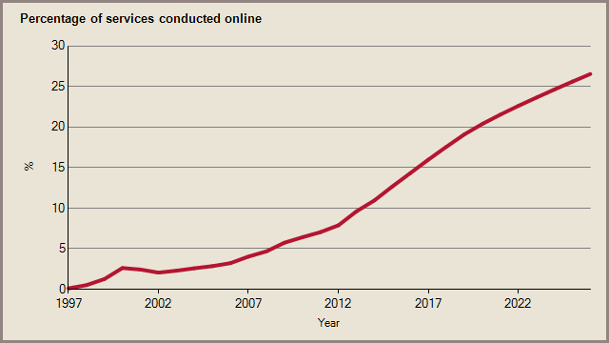
项目分析幻灯片 6
Key External Drives
Percentage of Services Conducted Online
Estimated value in 2020: 20.39%
2015-2020 Average Annual Growth: 9.96 percentage points
Forecast value in 2025: 25.59%
2020-2025 Average Annual Growth: 4.65 percentage points

Slide 11
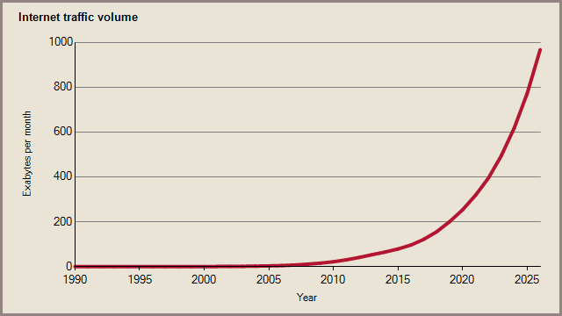
项目分析幻灯片 6
Key External Drives
2. Internet Traffic Volume:
Estimated value in 2020: 253.4 Exabyte per month
2015-2020 Compound Growth: 26.40%
Forecast value in 2025: 773.0 Exabyte per month
2020-2025 Compound Growth: 24.99%

Slide 12
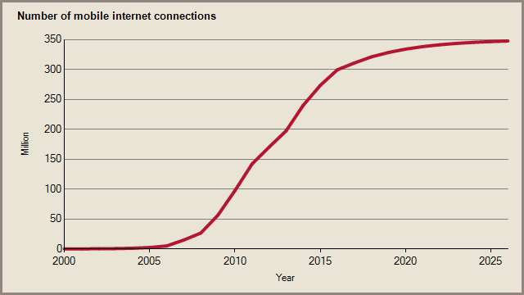
项目分析幻灯片 6
Key External Drives
3. Number of Mobile Internet Connections:
Estimated value in 2020: 333.9 Million
2015-2020 Compound Growth: 4.08%
Forecast value in 2025: 346.5 Million
2020-2025 Compound Growth: 0.75%

Slide 13
Per capita disposable personal income in the United States from 2000 to 2018 (in billion chained 2012 U.S. dollars)
Per capita disposable personal income in the U.S. 2000-2018
6

Slide 14
Distribution of online shoppers in the United States as of December 2017, by household income (in U.S. dollars)
Distribution of U.S. online shoppers 2017, by household income

Slide 15
项目分析幻灯片 6
Current Performance
Mobile drives growth

Slide 16
项目分析幻灯片 6
Current Performance
Rising competition

Slide 17

项目分析幻灯片 6
Demand Determinants
Clicks over bricks
The internet makes it easy for customers to research different products, read reviews from other customers and find the best price for a product they are interested in.
Product availability
Operators should ensure that their product range is as extensive, if not more extensive, as those found in traditional brick and mortar stores.

Slide 18
项目分析幻灯片 6
Major Markets

Slide 19
Per capita disposable personal income in the United States from 2000 to 2018 (in billion chained 2012 U.S. dollars)
Per capita disposable personal income in the U.S. 2000-2018
6

Slide 20

项目分析幻灯片 6
Key Success Factors
Ability to Control Stock on Hand.
Ability to Quickly Adopt New Technology.
E.g. software systems, warehouse technology and personal info security, etc.
Provision of Superior After-Sales Service.
Shipment tracking, and offering refunds and exchange etc.
Having a loyal customer base.
To attract repeat buyers and ensure continued sales.

Slide 21
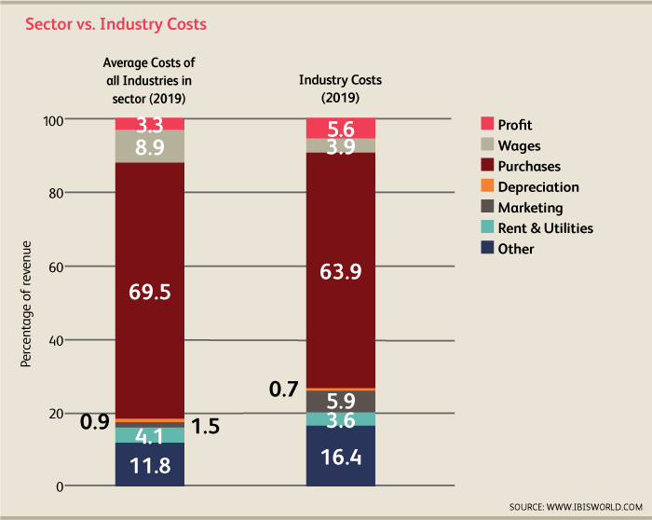
项目分析幻灯片 6
Cost Structure Benchmarks

Slide 22
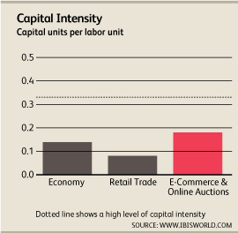
项目分析幻灯片 10
Operating Conditions Capital Intensity is Medium
For every dollar spent on wages, industry operators will spend $0.18 in capital investment.
Labor costs are mainly incurred through hiring staff to fulfill orders and corporate workers for larger companies.

Slide 23
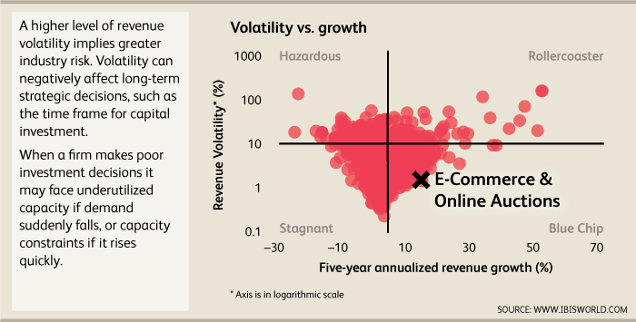
项目分析幻灯片 10
Operating Conditions Revenue Volatility

Slide 24

项目分析幻灯片 10
Basis of Competition
Competition is High and the trend is Increasing
Internal Competition:
Price
Product Selection
Promotional Activities
Website Features or Navigability
Valued-added Services
External Competition:
Convenience
Price
Product Availability

Slide 25
项目分析幻灯片 10
Barriers to Entry
Competition is Low and the trend is Decreasing

Slide 26
项目分析幻灯片 10
Tech & Systems
The level of tech change is High
Global mobile retail commerce revenue 2016-2021

Slide 27
项目分析幻灯片 10
Tech & Systems
The level of tech change is High
Global payment methods online transaction volume share 2018, by region

Slide 28
项目分析幻灯片 10
Regulations & Policy
The level of regulation is Medium and the trend is Increasing
E-commerce law impact expectations by cross-border online shoppers in China Q3 2018

Slide 29

AMAZON

Slide 30
Stock Performance

Slide 31
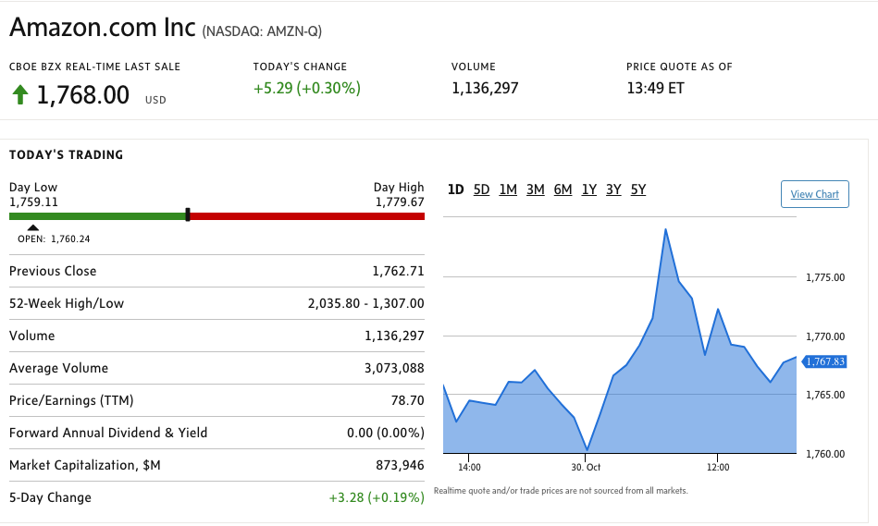

Slide 32
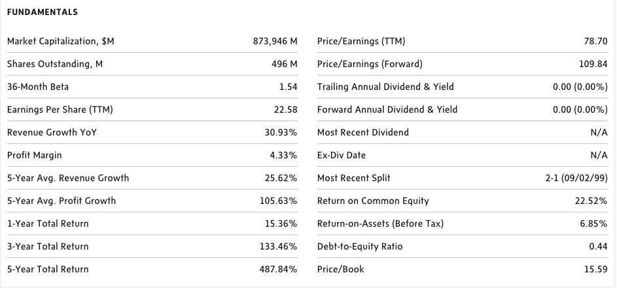
Key statistics

Slide 33
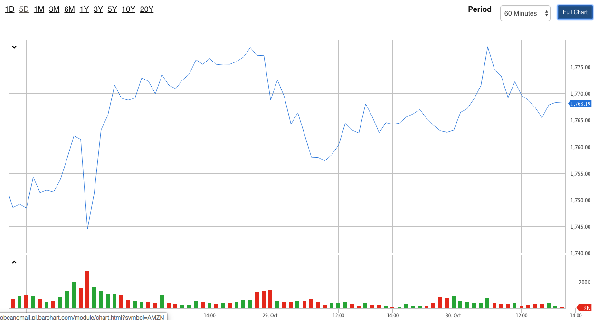
5-Day Performance

Slide 34
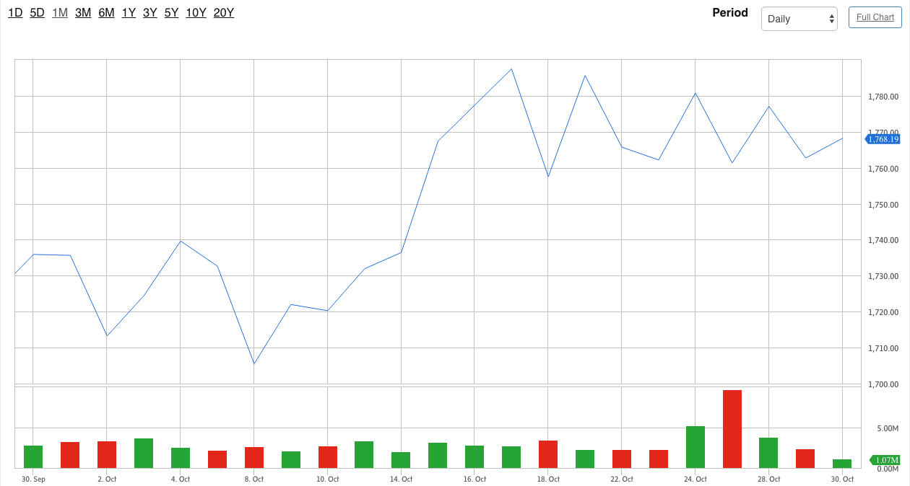
1-M Performance

Slide 35
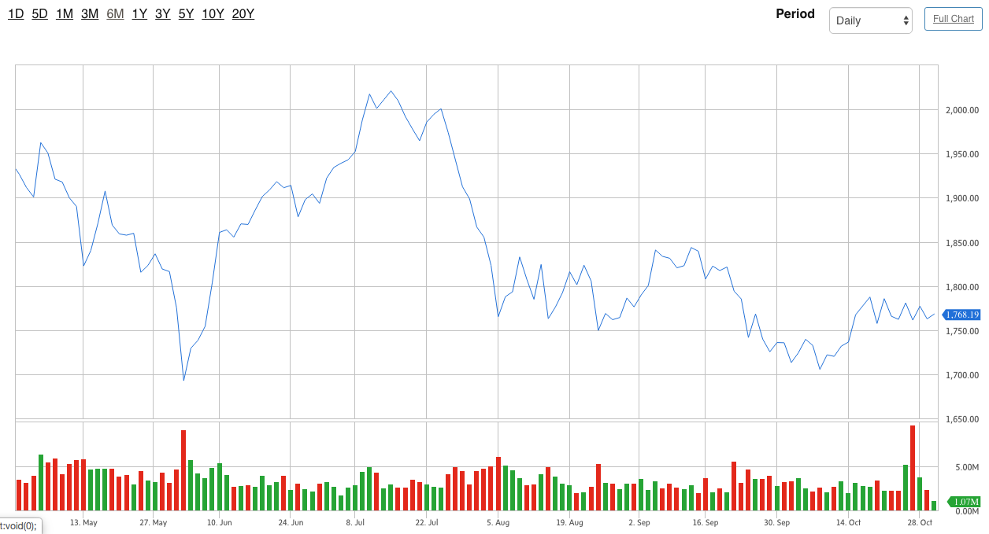
6-M Performance

Slide 36
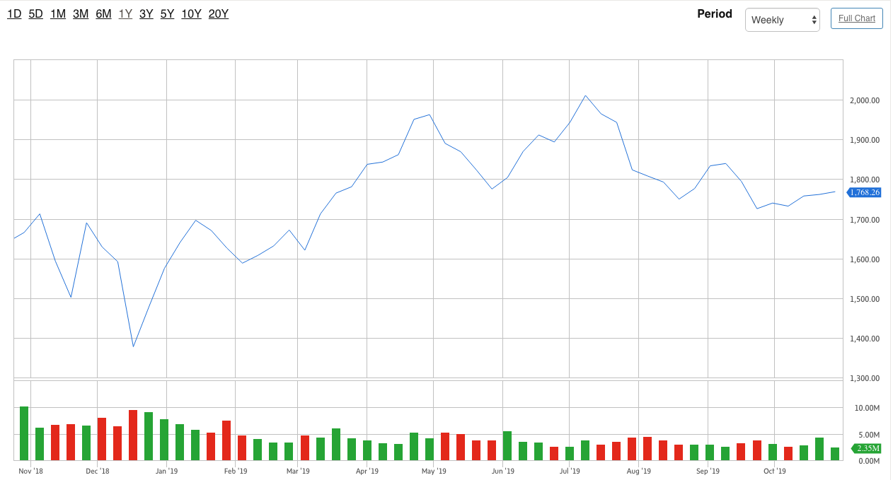
1-Y Performance

Slide 37
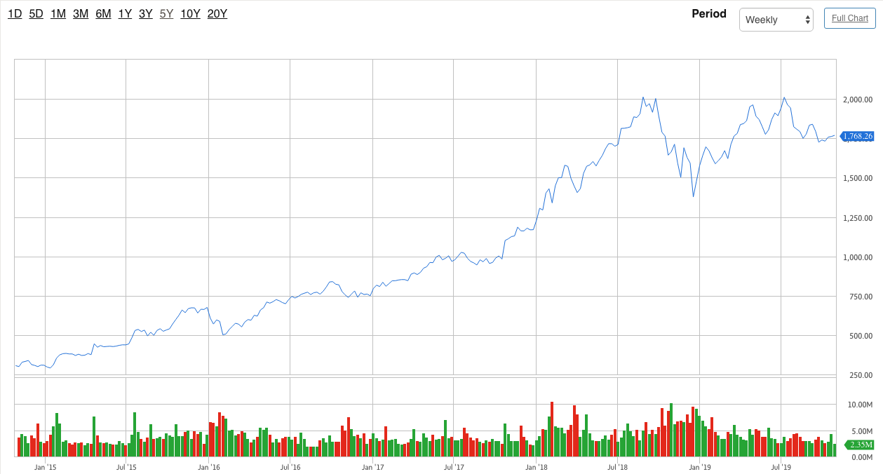
5-Y Performance

Slide 38
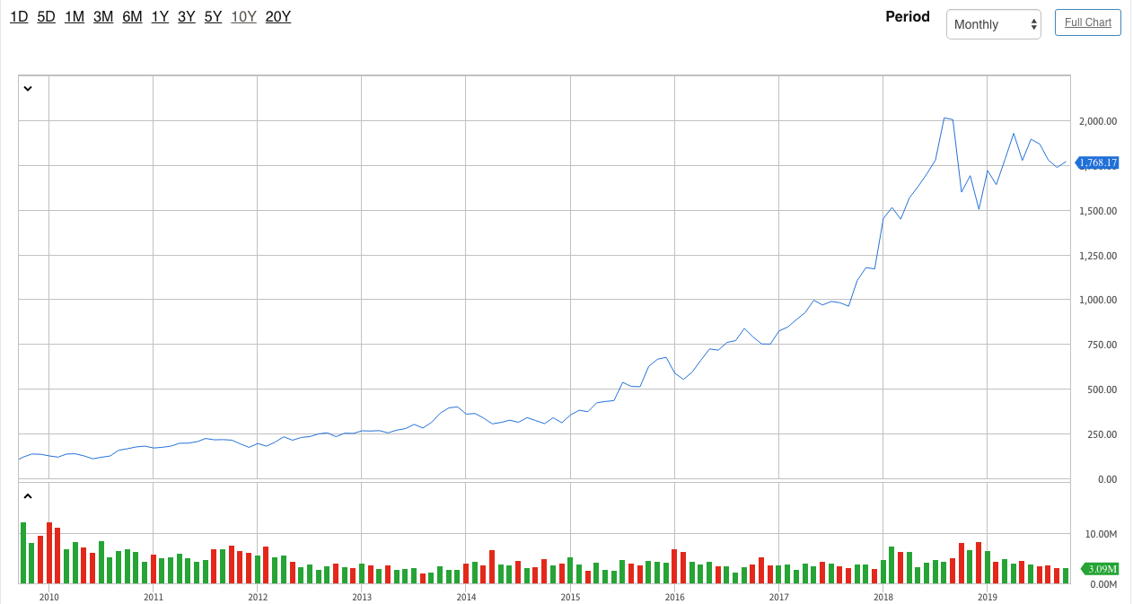
10-Y Performance

Slide 39
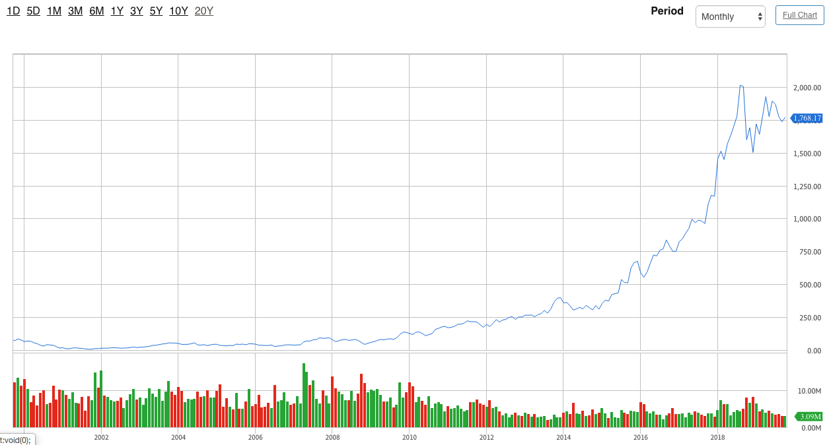
20-Y Performance

Slide 40
Company Overview
AMAZON.COM, INC. (NASDAQ: AMZN)
An American technology company with a focus on:
E-commerce
Cloud computing
Digital streaming
Artificial intelligence
Grocery stores

Slide 41
Company Overview
World’s biggest online retailer
Founded: July 5, 1994 in Bellevue, Washington, US
Founder: Jeff Bezos
Headquarters: Seattle, Washington and Crystal City, Arlington, Virginia
IPO: May 15, 1997
Employees: 647,500 people in 2018

Slide 42
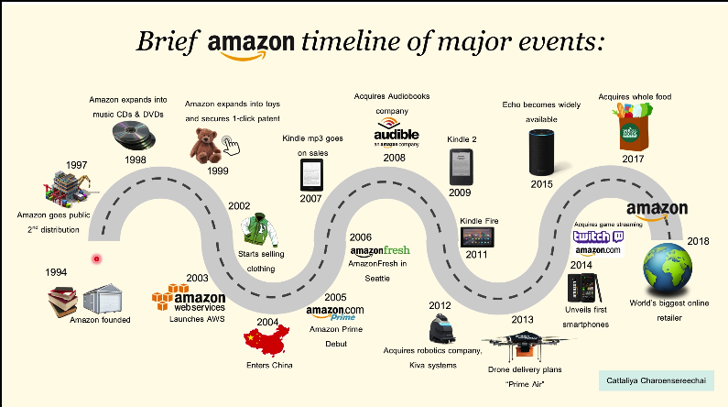

Slide 43
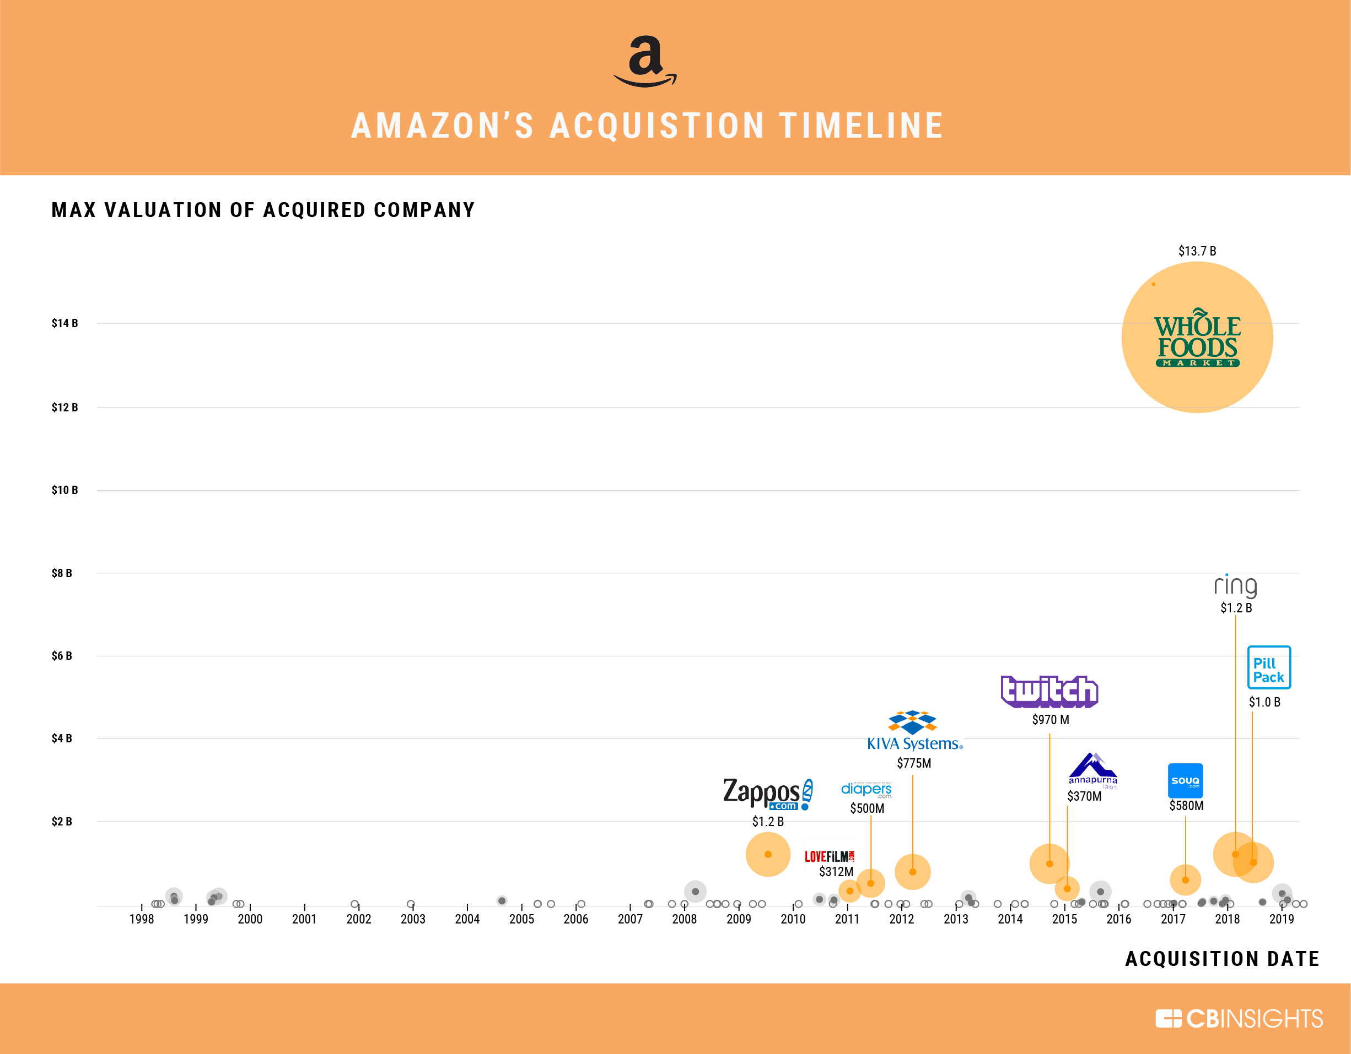

Slide 44
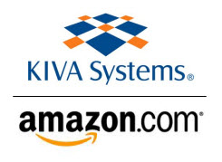
Amazon’s Top Acquisitions
Kiva Systems
Acquired in March 2012 for $775 million
Rebranded as Amazon Robotics
The company develops and manufactures robotic systems for a variety of uses.
One of Amazon’s most impactful acquisitions to its long-term business — no e-commerce competitor has yet been able to rival Amazon’s warehouse automation.

Slide 45

Amazon’s Top Acquisitions
Twitch Interactive
Acquired in August 2014 for $970 million in cash
The most popular video game streaming platform in the world, outpacing YouTube's equivalen
More than 15 million daily active users.
Earns revenue both through subscription fees as well as through advertisements which can be embedded within videos.

Slide 46

Amazon’s Top Acquisitions
PillPack, Inc.
Acquired in June 2018 for $1 billion in cash
An online pharmacy company
Move into the online prescription business
Shipping prescription medications overnight to locations across the country
Generates an estimated $100 million in annual revenue

Slide 47

Amazon’s Top Acquisitions
Zappos
Leading footwear and apparel website in the world
Acquired in July 2009 for $1.2 billion
Known for its unique culture and customer-centric approach

Slide 48

Amazon’s Top Acquisitions
Ring
Acquired in February of 2018 for $1.8 billion
Home security company that specializes in smart home security devices
Popular product: Ring Video Doorbell allows users to monitor entry points to their home from a remote location
The acquisition helped strengthen Amazon’s smart home offerings
Opened the door for Amazon couriers to leave packages inside customers’ houses
Generated Revenue of $415 million in 2017

Slide 49

Amazon’s Top Acquisitions
Whole Foods Market
Acquired in August 2017 for $13.7 billion in cash
A prominent grocery store chain with the distinction of being the only USDA Certified Organic grocer in the U.S
Amazon integrated aspects of its Prime service into the Whole Foods customer experience
In 2017 Q-4, immediately following Amazon's acquisition of Whole Foods, Amazon reported revenue of approximately $4.5 billion from physical stores
This figure is primarily a reflection of Whole Foods' revenue

Slide 50
Products & Services

Slide 51


Slide 52




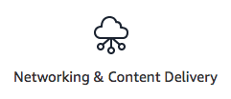



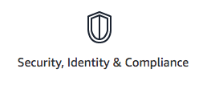

Amazon Web Services
Amazon Web Services offers a broad set of global cloud-based products including:

Slide 53
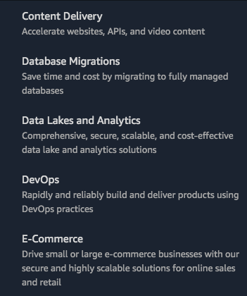
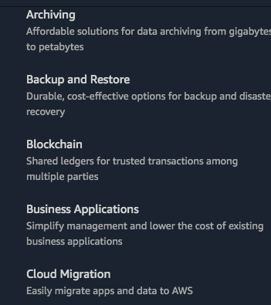
Amazon Web Services - Solutions

Slide 54
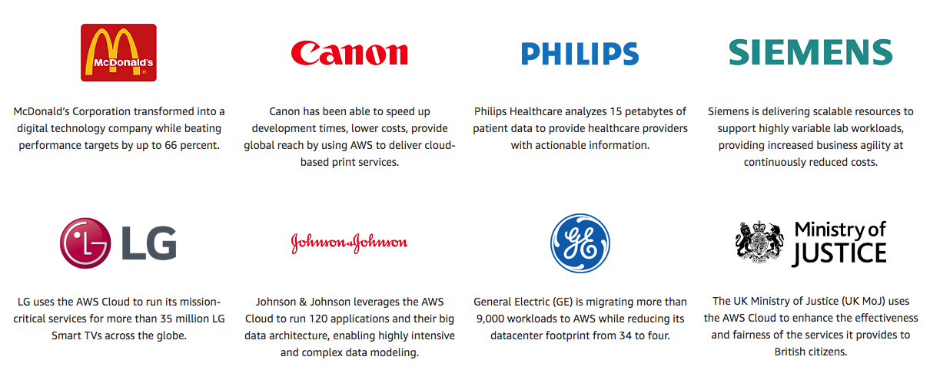
Amazon Web Services - Customers

Slide 55
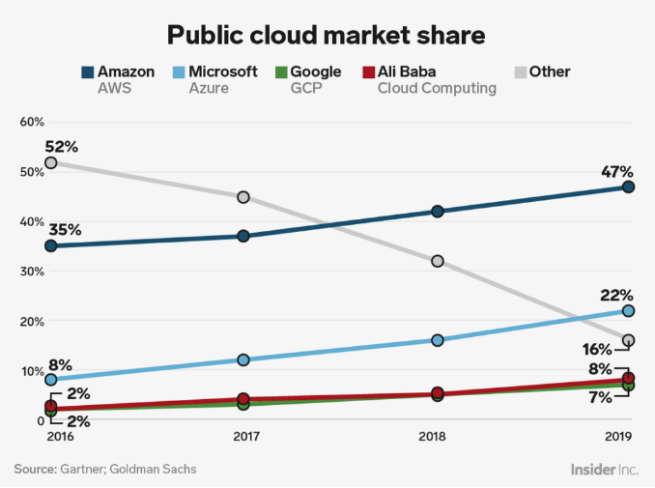
Amazon Web Services - Market Share

Slide 56
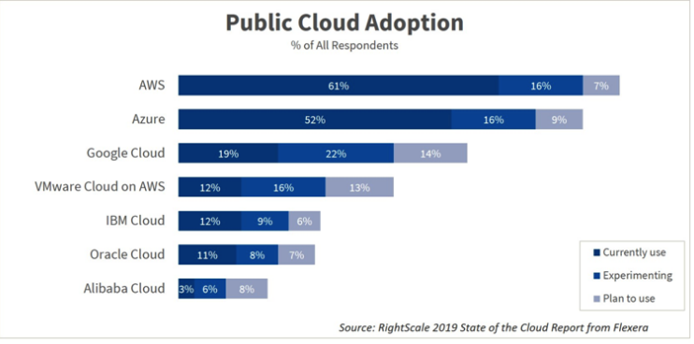

Slide 57
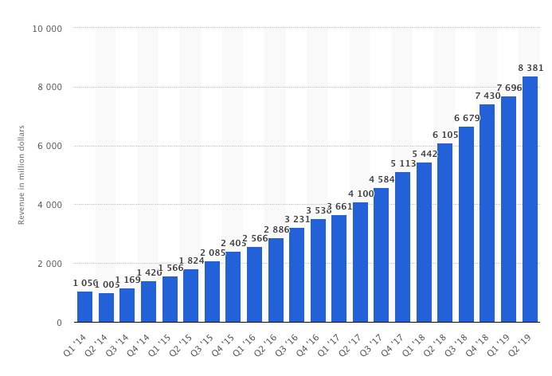
Quarterly revenue of Amazon Web Services (in million U.S. dollars)

Slide 58
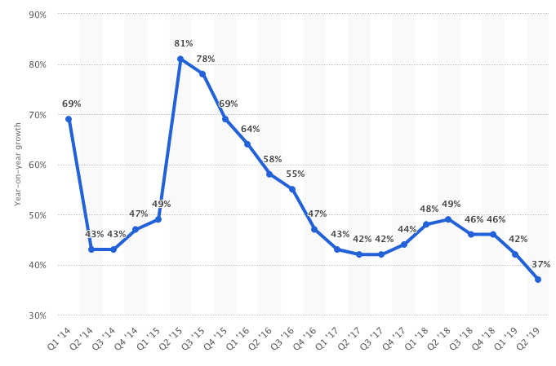
Amazon Web Service Quarterly Revenue Growth

Slide 59

A subscription service that gives members access to a variety of Amazon perks

Slide 60
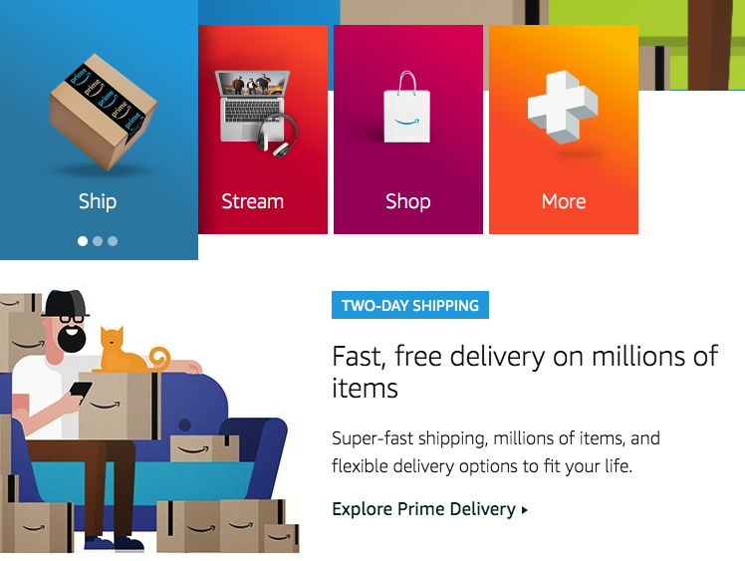
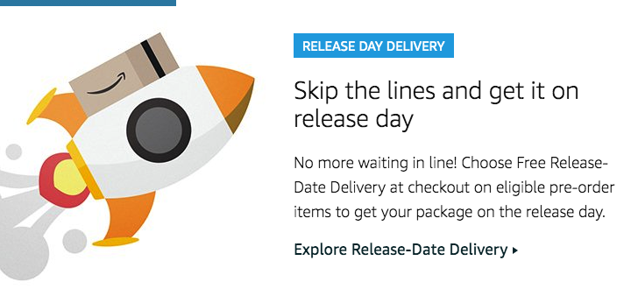
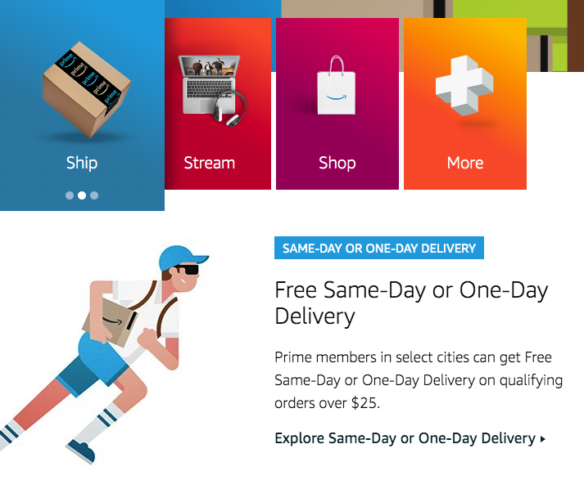
Amazon Prime Shipping Benefits

Slide 61
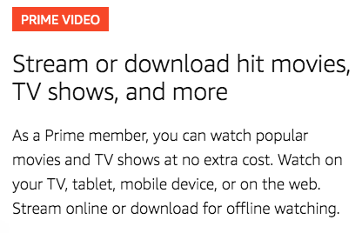
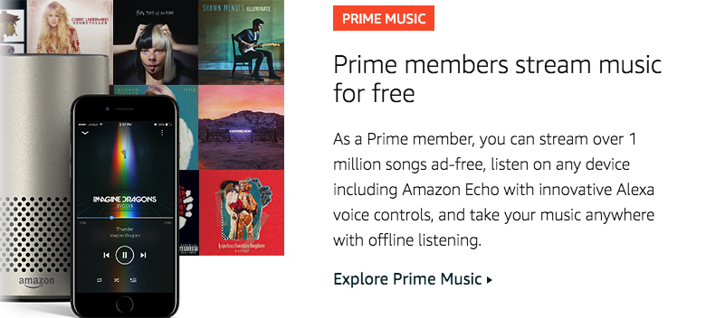

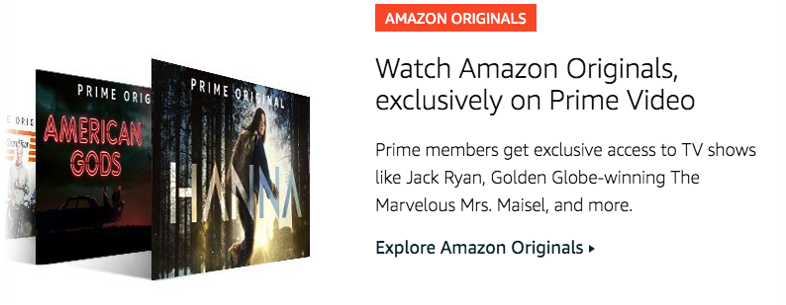
Amazon Prime Steam Benefits

Slide 62
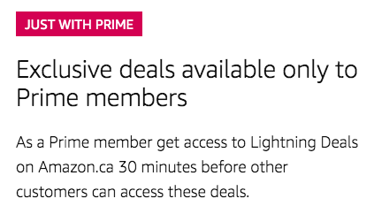
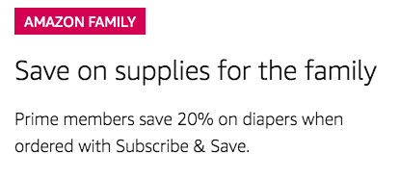
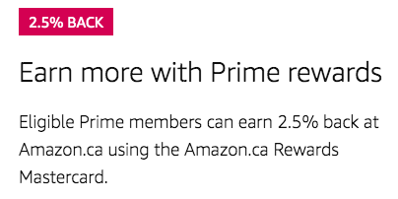
Amazon Prime Shopping Benefits

Slide 63
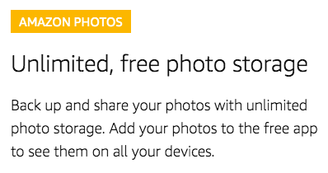
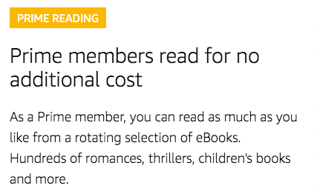
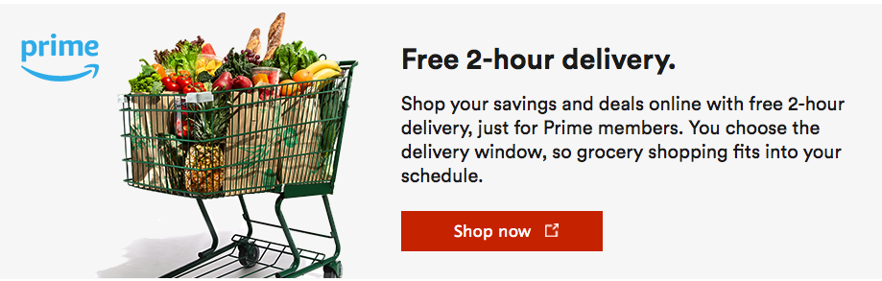
Amazon Prime Other Benefits

Slide 64
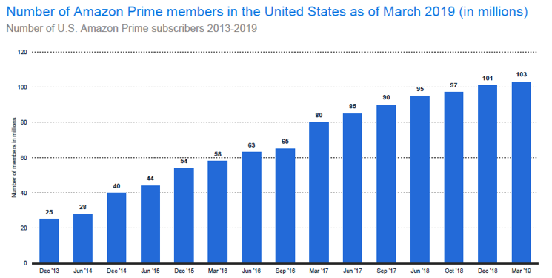
Amazon Prime - Membership

Slide 65
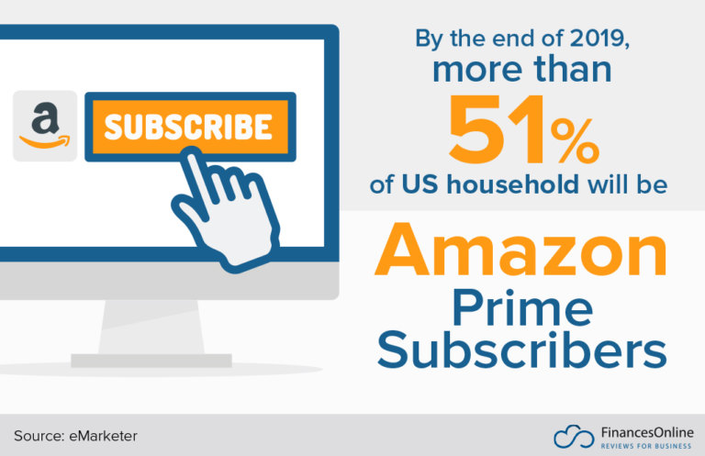
Amazon Prime
In 2018, the firm gained $14.17 million in revenue from the subscription services category.
Notes:
As Amazon statistics have shown, there is an influx of consumers into Amazon Prime. The service has caught the attention of many consumers, and its popularity is set to continue to snowball. What’s intriguing is that Amazon Prime has quashed one of the most prevalent e-commerce challenges, shipping, besides its other inimitable benefits.
The Prime subscription program is a supreme example of Amazon’s innovation prowess. It signifies Amazon’s relentless endeavor to extend its reach and command all facets of the customer purchase journey.

Slide 66
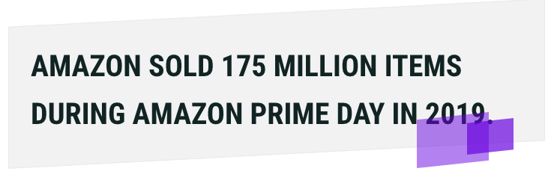
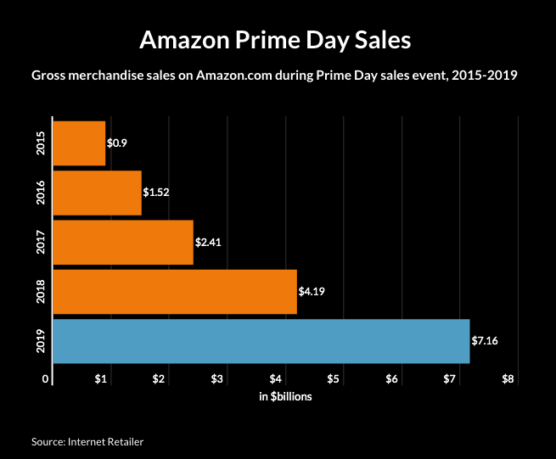
Amazon Prime Day
Notes:
https://10under100.com/amazon-statistics-facts/
Amazon said that Prime Day 2019 shoppers purchased 175 million items between Monday and Tuesday, making it the largest shopping event in the company's history

Slide 67
Management team

Slide 68
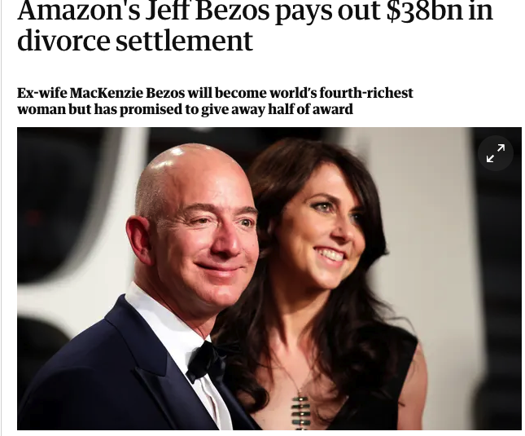
Bezos’ Divorce Settlement
Largest divorce settlement in history
Over a 4% of Amazon’s stock - worth $38 billion - is transferred into MacKenzie Bezos’s name
MacKenzie Bezos granted Jeff Bezos voting control and financial interests in The Washington Post and Blue Origin
Jeff Bezos remains richest individual in the world with an estimated net worth of $110 billion

Slide 69
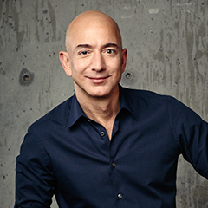
Jeffrey P. Bezos
President, Chief Executive Officer and Chairman of the Board
Founder of Amazon.com, 1994
Founder of Blue Origin, a human spaceflight company
Founder of Bezos Day One Fund (2018), non-profit organization
Owner of Washington Post
Ranked the best CEO on Harvard Business Review in 2014
Degree: Bachelors of Science in Electrical Engineering and Computer Science (Princeton University, 1986)

Slide 70
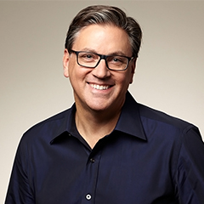
Brian T. Olsavsky
Senior Vice President and Chief Financial Officer
Joined Amazon.com in April 2002 as a VP in Finance
Oversees the company's overall financial activities, including controllership, tax, treasury, analysis, investor relations, internal audit and financial operations
2002 - 2007: Led the finance departments for Amazon's Worldwide Operations organization
2007 - 2010: Vice President, Finance for Amazon's North America retail business unit and acquisitions
Prior to 2015: Vice President, Finance and CFO for the Global Consumer Business
Degree: Bachelor of Science in Mechanical Engineering, Penn State MBA in Finance, Carnegie Mellon University

Slide 71
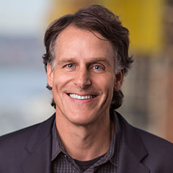
Jeffrey M. Blackburn
Senior Vice President, Business Development
Joined Amazon.com in 1998, Mr. Blackburn
2002 - 2003: Vice President, Operations Integration
2003 - 2004: Vice President, European Customer Service
2004 - 2006: Vice President, Business Development
2006 - Now: Senior Vice President, Business Development
Degree: BA, Dartmouth College
MBA, Stanford’s Graduate School of Business.

Slide 72

Andrew R. Jassy
Chief Executive Officer, Amazon Web Services
Joined Amazon in 1997
Led AWS since its inception
Delivered more than 90 cloud infrastructure and application services that are used by millions of startup, enterprise, and government customers around the world
Degree: AB from Harvard University
MBA from Harvard Business School.

Slide 73

Shelley L. Reynolds
Vice President, Worldwide Controller
Joined Amazon in February 2006 as Vice President of Finance and Controller
Oversees Amazon’s accounting function, leading the team that touches every geography in which the company operates
1998 - 2006: worked at Deloitte & Touche LLP, specialized mergers & acquisitions and the Securities and Exchange Commission
2007 - Now: Vice President, Worldwide Controller and Principle Accounting Officer
Degree: University of Washington Foster School of Business

Slide 74
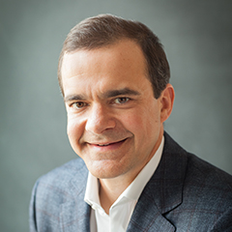
Jeffrey A. Wilke
CEO Worldwide Consumer
Joined Amazon.com as a Vice President and General Manager, Operations in September 1999
Prior to joining Amazon: Vice-President and General Manager, Pharmaceutical Fine Chemicals at AlliedSignal (honeywell)
2002 - 2006: Senior Vice President, Worldwide Operations
2007 - 2012: Senior Vice President, North American Retail
2012 - 2016: Senior Vice President, Consumer Business
Degree: BSE degree in Chemical Engineering, Summa Cum Laude, Princeton University

Slide 75

David A. Zapolsky
Senior Vice President, General Counsel and Secretary
Joined Amazon.com in November 1999 as Associate General Counsel for Litigation and Regulatory matters
2002 - promoted to Vice President
September 2012 - Vice President, General Counsel and Secretary, overseeing the company’s legal, policy, compliance, and regulatory affairs
May 2014 - Senior Vice President, General Counsel and Secretary
Degree: UDin music from Columbia University
J.D. with honors from the University of California, Berkeley

Slide 76
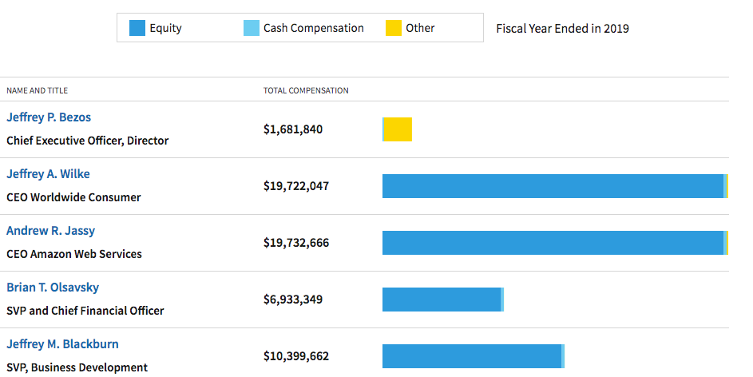
Management Compensation

Slide 77
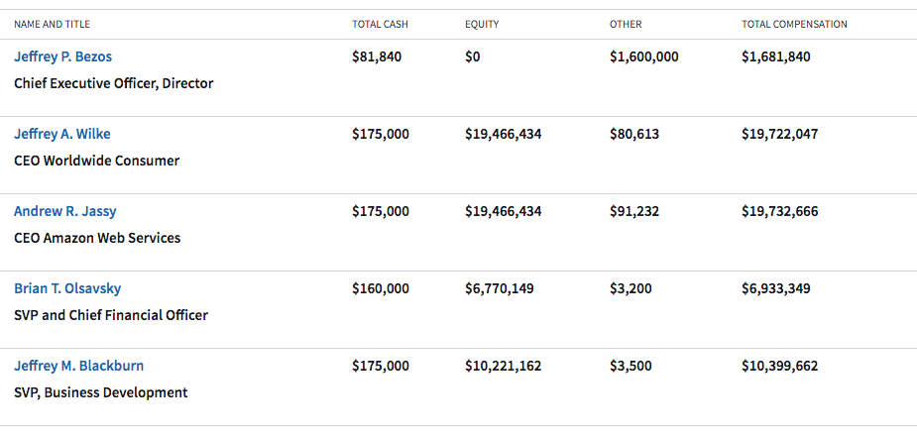
Management Compensation
Notes:
Total Cash Compensation information is comprised of yearly Base Pay and Bonuses. AMAZON.COM INC income statements for executive base pay and bonus are filed yearly with the SEC in the edgar filing system. AMAZON.COM INC annual reports of executive compensation and pay are most commonly found in the Def 14a documents.
Total Equity aggregates grant date fair value of stock and option awards and long term incentives granted during the fiscal year.
Other Compensation covers all compensation-like awards that don't fit in any of these other standard categories. Numbers reported do not include change in pension value and non-qualified deferred compensation earnings.

Slide 78

Ownership

Slide 79


Top Institutional Owners
Notes:
https://www.msn.com/en-us/money/stockdetails/ownership/nas-amzn/fi-a1nhlh?ownershipType=institutional

Slide 80
Financial statements

Slide 81

10-Q Balance Sheet (Assets)

Slide 82

10-Q Balance Sheet (Liability and Shareholder’s Equity)

Slide 83

10-K Balance Sheet (Assets)

Slide 84

10-K Balance Sheet (Liabilities and Shareholder’s Equity)

Slide 85

10-K Income Statement

Slide 86

10-Q Income Statement

Slide 87

Decomposition of Sales by Segments

Slide 88

Decomposition of Sales by Segments

Slide 89

10-Q Cash Flow Statement

Slide 90

10-K Cash Flows Statement

Slide 92



Slide 94


Slide 95

Key Statistics

Slide 96


Slide 97

1 Day Performance

Slide 98

5 Day Performance

Slide 99

1 Month Performance

Slide 100

3 Month Performance

Slide 101

6 Month Performance

Slide 102

1 Year Performance

Slide 103

3 Year Performance

Slide 104

10 Year Performance

Slide 105


Slide 106
Shopify Inc. (NYSE: SHOP)
Shopify was founded in 2004, and started with selling snowboards online
A Canadian multinational e-commerce company headquartered in Ottawa, Ontario
Merchants use Shopify to design, set up, and manage their stores
A powerful back-office and a single view of their business, from payments to shipping
Powers over 800,000 businesses in around 175 countries
Number of employees: 4000+
Over $100 billion in sales
The initial public offering (IPO) on New York Stock Exchange and Toronto Stock Exchange with “SHOP” and “SH” on April 14, 2015
Mission -- Making commerce better for everyone

Slide 107
Shopify History
2004
Shopify was founded in 2004, after they attempting to open Snowdevil, an online store for snowboarding equipment.
Tobi Lütke was dissatisfied with the existing e-commerce, so he built his own website.
2006
Tobi Lütkw, Daniel Weinand, and Scott Lake launched the platform as Shopify.

Slide 108
Shopify History
2009
Shopify launched an application programming interface (API) platform and APP store. The developers can create applications for Shopify online stores and sell them on the Shopify APP Store.
2010
Shopify launched a free mobile app on the Apple Store.
The company received $7 million from an initial series A round of venture capital financing.

Slide 109
Shopify History
2011
Later year, Shopify raised another $15 million from a Series B round of venture capital financing.
By the end of year, 15,000 active stores across 80 countries.
2012
Profit Magazine named Shopify “Canada’s Smartest Company”. By the end of the year, Shopify had grown to 40,000 stores across 90 countries selling $740 million worth of product.

Slide 110
Shopify History
2013
Shopify Payments allowed merchants to accept credit cards without a third party payment gateway, and point of sale system was launched. The point of sale system can use iPad to accept payments from debit and credit.
Shopify acquired Jet Cooper, a designer and user experience agency based in Toronto.
Shopify received $100 million in Series C funding.

Slide 111
Shopify History
2014
Shopify platform hosted around 120,000 online retailers, and it was listed as #3 in Deloitte’s Fast 50 in Canada.
Shopify earned $105 million, twice as much as it raised the previous year.
2015
Shopify ‘s initial public offering filled for in April on NYSE and TSX, and it went public in May, raising more than $131 million.
Shopify generated $45 million during the first quarter as a public offering, doubled from the year-ago quarter.

Slide 112
Two Main Revenue Streams
Subscription Solutions
A recurring subscription component
Merchant Solutions
A merchant success-based component

Slide 113
Subscription Solutions Revenue
Principally through the sale of subscriptions to the platform
Offer different plans for different prices
Basic Shopify
Advanced Shopify
Shopify Plus
Subscription terms automatically renew and subscription fee are non-refundable
Additional subscription solutions revenue from the sale of themes and apps, the registration of domain names, and the collection of variable platform fees

Slide 114
Merchant Solutions Revenue
Providing additional services to merchants to increase their use of the platform
Majority of revenue is from fees earned from merchants based on their customer orders processed through Shopify Payments
Generates revenue which relating to Shopify Shipping, Shopify Capital, other transaction services and referral fees, as well as from the sale of Point-of-Sale (POS) hardware

Slide 115










Acquisitions
Acquisitions occur when one company buys another company friendly or hostile, depending on the company is better off as an operating unit.

Slide 116
6 River Systems
Shopify completes acquisition of 6 River Systems in October 2019.
6 River Systems is flexible and scalable warehouse automation powered by collaborative robots and artificial intelligence. The solution engages associates, keeps them on task and boosts productivity by 2-3x.
Tobi Lütke, CEO of Shopify, said “With 6 River Systems, we will bring technology and operational efficiencies to companies of all sizes around the world.”

Slide 117


Slide 118
Solutions Alveo Inc.
Shopify completed the acquisition of Solutions Alveo Inc. on June 22, 2018, accounted for as a business combination.
Solutions Alveo Inc. provides a platform for commerce return solution, and it was founded in 2016 in Montreal.
The operations of Solutions Alveo Inc. have been consolidated into Shopify.

Slide 119
Tictail, Inc.
Shopify completed the acquisition of Tictail, Inc. and all of its subsidiaries (Tictail) on November 19, 2018.
Tictail is a social shopping website for shoppers to discover emerging designers around world.
Th operations of Tictail also have been consolidated into the Shopify.

Slide 120

Final purchase price 2018

Slide 121

Oberlo UAB
Shopify completed the acquisition of Oberlo UAB (Oberlo) on April 28, 2017.
Oberlo helps make starting a dropshipping business, suppliers ship products directly to your customers
No inventory, No risk!

Slide 122

Final purchase price 2017

Slide 123
Management Team

Slide 124
Tobi Lütke, Founder & Chief Executive Officer
In 2004, built software to launch an online snowboard store called Snowdevil.
He and his founding team launched the Shopify platform in 2006.
He is proficient in computer literacy, and an advisory board commissioned by the federal government to provide recommendations on how to turn Canada into a digital leader.
Notes:
P71

Slide 125
Harley Finkelstein, Chief Operating Officer
He has been with Shopify since 2010.
He founded numerous startups and ecommerce companies.
He serves on the board of the CBC and is an advisor to Felicis Ventures.
He holds a Bachelor degree in Economics from Concordia University and a J.D./M.B.A. joint degree in Law and Business from the University of Ottawa.

Slide 126
Amy Shapero, Chief Financial Officer
She joined Shopify in April 2018.
Before that, she was a Chief Financial Officer at Betterment, an online wealth-management service.
She was also a Chief Financial Officer at Sailthru.
She began her career as a CPA at Ernst & Young.
She holds an MBA from the University of Chicago Booth School of Business.

Slide 127
Craig Miller, Chief Product Officer
He has been with the company from September 2011.
Prior to this, he was Chief Marketing Officer and VP Marketing.
He held several product and marketing roles at Kijiji and eBay company between 2006 and 2011.
He oversees the Product and User Experience Teams at current position
He holds a Bachelor’s degree in Electrical Engineering from McGill University.

Slide 128
Brittany Forsyth, Chief Talent Officer
She has been this position from 2014.
She has been with the company from 2010, she was a director of HR.
She involves a number of HR organizations across North America.
She holds a Bachelor of Commerce degree at Carleton University.

Slide 129

Ownership Summary
30.23%
62.75%
7.02%

Slide 130

Institutional Ownership
6.24%
11.54%
77.74%

Slide 131

Current Top Holders

Slide 132
Financial Statements

Slide 133

Balance Sheet: Asset (10-Q)

Slide 134

Balance Sheet: Liabilities & Equity (10-Q)

Slide 135

Balance Sheet: Assets (10-K)

Slide 136

Balance Sheet: Liabilities & Equity (10-K)

Slide 137

Income Statement (10-K)

Slide 138

Income Statement (10-Q)

Slide 139

Breakdown of revenue

Slide 140

Breakdown of revenue

Slide 141

Cash Flow: Operating (10-K)

Slide 142

Cash Flow: Investing & Financing (10-K)

Slide 143

Cash Flow: Operating (10-Q)

Slide 144

Cash Flow: Financing & Investing (10-Q)

Slide 145
Financial Statement Analysis

Slide 146
Shopify Total Revenue (million)

Slide 147
Shopify Gross Margin

Slide 148
Shopify Diluted EPS (million)

Slide 149
Shopify Return on Equity

Slide 150
Shopify Return on Asset

Slide 151


BUY

Slide 152

Wayfair Inc.

Slide 153

Stock Performance

Slide 154

Statistics

Slide 155

5 Days

Slide 156

1 Month

Slide 157

3 Month

Slide 158

6 Month

Slide 159

1 Year

Slide 160

5 Year

Slide 161

IPO
Wayfair IPO Prices at $29 a Share

Slide 162
Price History
The all-time high Wayfair stock closing price was 171.57 on March 12, 2019.
The Wayfair 52-week high stock price is 173.72, which is 111.3% above the current share price.
The Wayfair 52-week low stock price is 76.60, which is 6.8% below the current share price.
The average Wayfair stock price for the last 52 weeks is 127.35.

Slide 163

Index
Russell 1000

Slide 164
Company Overview
Founded : 2002
--- formerly “CSN Stores” (2002-2011)
Founders : Niraj Shah, Steve Conine
Headquarters : Boston, Massachusetts, U.S.
Number of employee : ~ 16,000

Slide 165
Company Overview
Wayfair Inc. engages in the e-commerce business. It offers bedroom, living room, kitchen and dining, home entertainment, home office, game room and bar, patio, hallway and entryway, and bathroom furniture.
The Company operates under the Wayfair.com, Joss & Main, AllModern, DwellStudio, and Birch Lane brands. It offers products and services primarily in the United States. Wayfair LLC is headquartered in Boston, Massachusetts.

Slide 166
Company Mission
“At Wayfair, we believe that strong communities and good business are inextricably linked. We established our first charitable giving program in 2004 and have expanded our efforts every year since.”
“We partner with organizations that play a meaningful role in creating safe and comfortable living spaces because we believe that a secure home is not only a basic human need but also the foundation for well-being.”
“Our mission is to make home a reality for more of the many people in need of safe shelter and basic household items that help make a home.”

Slide 167
Subsidiaries
Wayfair LLC
Online Home Store for Furniture, Decor, Outdoors & More.Their inventory includes more than 10 mln products from millions of suppliers, making Wayfair a top destination for interior design shopping.
Joss & Main
Online store for interior design products.
AllModern
Online store for furniture, decorations and decor with minimalism designs and themes.
Birch Lane
Online store for furniture, decorations and decor with traditional and classic designs and themes.
Perigold
Premium store for high-end home furnishings.

Slide 168

Recent News
Employees Walkout June 2019.
“Wayfair employees protest company's bed sales to migrant camps”
--- CNN

Slide 169

Annual revenue of Wayfair from 2012 to 2018 (in million U.S. dollars)
Wayfair annual revenue 2012-2018
Revenue
Wayfair revenue for the quarter ending June 30, 2019 was $2.343B, a 41.56% increase year-over-year.
Wayfair revenue for the twelve months ending June 30, 2019 was $8.008B, a 40.57% increase year-over-year.
Wayfair annual revenue for 2018 was $6.779B, a 43.6% increase from 2017.
Wayfair annual revenue for 2017 was $4.721B, a 39.66% increase from 2016.
Wayfair annual revenue for 2016 was $3.38B, a 50.25% increase from 2015
Note: Worldwide; 2012 to 2018
Further information regarding this statistic can be found on page 8.
Source(s): Wayfair; ID 660726

Slide 170
Gross Profit
Wayfair gross profit for the quarter ending June 30, 2019 was $0.560B, a 45.35% increase year-over-year.
Wayfair gross profit for the twelve months ending June 30, 2019 was $1.908B, a 44.4% increase year-over-year.
Wayfair annual gross profit for 2018 was $1.587B, a 41.82% increase from 2017.
Wayfair annual gross profit for 2017 was $1.119B, a 38.5% increase from 2016.
Wayfair annual gross profit for 2016 was $0.808B, a 49.39% increase from 2015.

Slide 171
Operating expenses of Wayfair from 2012 to 2018, by type (in million U.S. dollars)
Wayfair operating expenditure 2012-2018, by type
Operating Income
Wayfair operating income for the quarter ending June 30, 2019 was $-0.171B, a 79.55% increase year-over-year.
Wayfair operating income for the twelve months ending June 30, 2019 was $-0.640B, a 88.08% increase year-over-year.
Wayfair annual operating income for 2018 was $-0.473B, a 101.01% increase from 2017.
Wayfair annual operating income for 2017 was $-0.235B, a 20% increase from 2016.
Wayfair annual operating income for 2016 was $-0.196B, a 141.2% increase from 2015.
3

Slide 172
Annual net loss of Wayfair from 2012 to 2018 (in million U.S. dollars)
Wayfair annual loss 2012-2018
Net Income (Loss)
Wayfair net income for the quarter ending June 30, 2019 was $-0.182B, a 80.61% increase year-over-year.
Wayfair net income for the twelve months ending June 30, 2019 was $-0.678B, a 89.51% increase year-over-year.
Wayfair annual net income for 2018 was $-0.504B, a 106.07% increase from 2017.
Wayfair annual net income for 2017 was $-0.245B, a 25.85% increase from 2016.
Wayfair annual net income for 2016 was $-0.194B, a 150.99% increase from 2015.

Slide 173


Company Strategy
MyWay “Counterstrategy”

Slide 174

MyWay

Slide 175


Slide 176


Slide 177


Slide 178


Slide 179

Acquisition
Buyster Acquisition announced date: September 20, 2011
Wayfair acquired buyster for an undisclosed amount
buyster is an Australian online retail company based in Sydney. Their aim is to offer you an unparalleled selection of great value products and excellent customer service and making your shopping experience easier, quicker and hassle free.

Slide 180

Acquisition
DwellStudio Acquisition announced date: August 2, 2013
DwellStudio is the design house for modern home and family furnishings. With graphic prints and bold colors, the company’s designs find excitement in the unexpected.
New York, New York, United States

Slide 181

Acquisition
CustomMade Acquisition announced date: May 21, 2015
CustomMade is an online marketplace connecting Buyers who want one-of-a-kind creations with professional and passionate Makers of those goods. Born in 1996 with the vision to help people find the unique gifts, objects and goods they cannot find through traditional retail channels, CustomMade has grown from a community of 350 carpenters to more than 12,000 Makers of all trades since its acquisition in 2009.
Cambridge, Massachusetts, United States

Slide 182

Acquisition
Trumplt Acquisition announced date: August 30, 2016
“Trumpit is conversations with PHOTOS! Trumpit is the only Augmented Reality app that allows you to REACT to photos your friends send YOU!”
Boston, Massachusetts, United States

Slide 183


Management

Slide 184
Management Team
Niraj Shah --- Chief Executive Officer, Co-Chairman and Co-Founder
Steve Conine --- Co-Chairman and Co-Founder
Michael Fleisher --- Chief Financial Officer
Allan Lyall --- Chief Global Supply Chain Officer
Ed Macri --- Chief Product and Marketing Officer
Jim Miller --- Interim Chief Technology Officer
Steve Oblak --- Chief Merchandising Officer
Thomas Netzer --- Chief Operating Officer

Slide 185

Chief Executive Officer, Co-Chairman and Co-Founder
Niraj Shah
Co-founded the company with Steve Conine in 2002.
CEO and co-founder of Simplify Mobile.
Entrepreneur-in-Residence at Greylock Partners.
COO and a member of the Board of iXL, CEO and co-founder of Spinners.
Included in Fortune Magazine's 40 Under 40.
Won the Ernst and Young's Entrepreneur of the Year award.
Serves on the board of Massachusetts Competitive Partnership, the Greater Boston Chamber of Commerce, and the Federal Reserve Bank of Boston.
Holds a B.S. in engineering from Cornell University.

Slide 186

Co-Chairman and Co-Founder
Steve Conine
Co-founder and co-chairman of Wayfair.
Co-founded Spinners Incorporated.
Chief operating officer for the London office of iXL.
Founder, chief technology officer and board member of Simplify Mobile.
Member of the Board of Directors at CarGurus.
Holds a B.S. from Cornell University.

Slide 187

Chief Financial Officer
Michael Fleisher
Chief Financial Officer of Wayfair.
Trustee and Vice Chair of the Chewonki Foundation.
Vice Chairman, Strategy and Operations of Warner Music Group’s.
Executive Vice President and Chief Financial Officer of WMG.
Chairman and CEO of Gartner, Inc.
On the board of Squarespace, Inc.
As an associate at Bain Capital.
Holds a bachelor's degree in economics from the Wharton School of Business.

Slide 188

Chief Global Supply Chain Officer
Allan Lyall
Global Vice President of Fulfillment at Wayfair.
Customer Fulfilment Director of Tesco.
Vice President of European Operations of Amazon,
Senior operations logistics of Apple.
Director of European Fulfilment for Apple Computers.

Slide 189

Chief Product and Marketing Officer
Ed Macri
Chief Product and Marketing Officer of Wayfair.
Marketing positions at IBM-Emptoris.
Holds a B.A. from Dartmouth College and M.B.A. from MIT Sloan School of Management

Slide 190

Interim Chief Technology Officer
Jim Miller
Member of board of directors of Wayfair.
Interim Chief Technology Officer of Wayfair.
Strategic Advisor of AREVO Inc.
Chief Executive Officer of AREVO.
Vice President of Worldwide Operations at Google Inc.
Executive Vice President of Sanmina-SCI Corporation
Holds B.S. from Purdue University, an M.S. from MIT and an MBA from the Sloan School of Management at MIT.

Slide 191

Chief Merchandising Officer
Steve Oblak
Chief Merchandising Officer of Wayfair.
Member of the management team of River West Brands,
Senior Director at FutureBrand Worldwide.
Holds B.A. from Hamilton College and an M.B.A. from Northwestern University.

Slide 192

Chief Operating Officer
Thomas Netzer
Chief Operating Officer of Wayfair.
Partner at McKinsey.
Holds PhD in business and a diploma in business administration from the University of Cologne.

Slide 193

Vice President of Lifestyle Brands and Canada
Paul Toms
Vice President of Lifestyle Brands and Canada of Wayfair.
General Manager of Joss & Main.
Hold B.A. in Economics from Boston University and lives in Boston with his wife and their two sons

Slide 194

Institutional Holders
Institutional investors purchased a net $3.4 million shares of W during the quarter ended June 2019, and now own 108.71% of the total float, a percentage that is typical for companies in the Internet Retail industry.

Slide 195



Slide 196
Dividend
$0

Slide 197
Financial statements
“The following slides are using inserted files, double click the statements to open PDF”

Slide 198
Balance Sheet
10-Q3 2019

Slide 199
Balance Sheet
10-Q2 2019

Slide 200
Balance Sheet
10-Q1 2019

Slide 201
Balance Sheet
10-k 2018

Slide 202
Income Statement
10-k 2018

Slide 203
Income Statement
10-Q3 2019

Slide 204
Income Statement
10-Q2 2019

Slide 205
Income Statement
10-Q1 2019

Slide 206
Breakdown of Revenue

Slide 207
Cash Flow
10-K 2018

Slide 208
Cash Flow
10-Q3 2019

Slide 209
Cash Flow
10-Q2 2019

Slide 210
Cash Flow
10-Q1 2019

Slide 211

Recommendation
Buy

Slide 212

Thank you for listening

