Slide 1
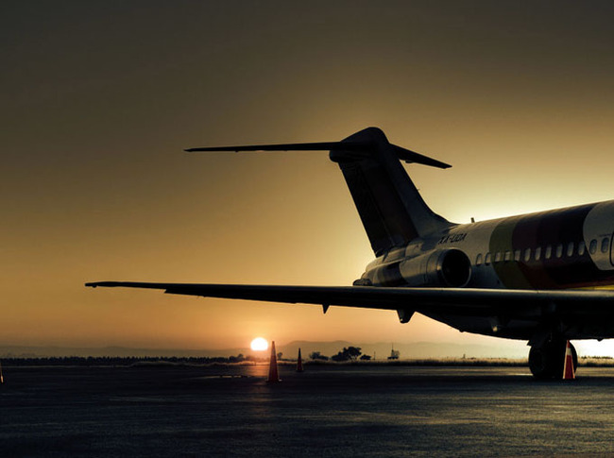
GLOBAL AIRLINES
BUS 417
Presented By:
Haomin Chen
Joey Hong
Lim Li
Presksha Simoniha
Jiayi Wang (Joy)

Slide 2

AGENDA
Terminology
History and Regulations
Industry Overview
Market Performance and Outlook
Company Profiles
Southwest
Singapore
Cathay Pacific

Slide 3
TERMINOLOGY
ATK: Available Tonne Kilometer (Capacity)
= Passenger and cargo capacity
ASK: Available Seat Kilometer (Capacity)
= [Number of seats] * [kilometers flown]
RPK: Revenue Passenger Kilometer (Traffic)
= [Number of paying passengers] * [kilometers flown]
FTK: Freight Tonne Kilometer (Traffic)
= [Freight tonnes carried] * [kilometers flown]

Slide 4
TERMINOLOGY
YIELD
= [Revenue] / [RPK]
LF: Load Factor (Capacity Utilization)
= [RPK] / [ASK]
= [number of passengers]/[number of seats]
Break Even LF: Unit cost / Yield
i.e. Operating cost = Operating Revenue

Slide 5
HISTORY & REGULATIONS

Slide 6
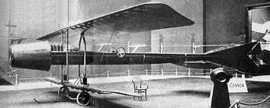
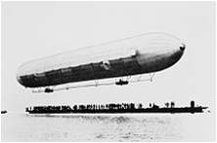
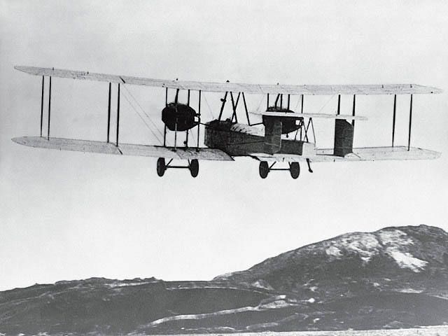

HISTORY & REGULATION
1909
First Zeppelin - DELAG (Deutsche Luftschiffahrts-Aktiengesellschaft)
1910
1919
First jet-propelled aircraft (Coanda 1910)
First non-stop transatlantic flight (Alcock and Brown)
1925
Airmail Act—transferring operations to private companies
1926
Air Commerce Act—safer flying routes needed

Slide 7
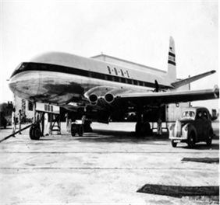
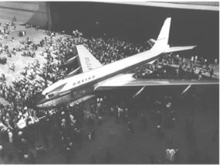
HISTORY & REGULATIONS
1934
Federal Aviation Administration was formed due to another Airmail Act – Bureau of Air Commerce
1938
Civil Aeronautics Act: delegating federal responsibilities to Civil Aeronautics Authority
1940
Civil Aeronautics Administration (CAA)
Air traffic control
Civil Aeronautics Board (CAB)
Adequate air service
Regulate fees/schedules
1949
First commercial aircraft (de Havilland DH 106)
1957
Boeing 707 was created

Slide 8
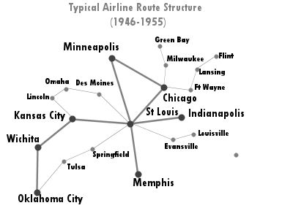
AFTER WORLD WAR II
Open skies allowed competition for international routes
Open skies refers to the Air Transport Agreement between two or more nations which:
Liberalizes the rules for international aviation markets and minimizes government intervention
Military and other state-based flights may be permitted

Slide 9
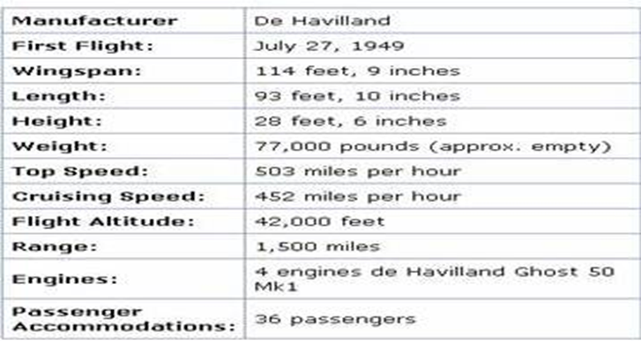
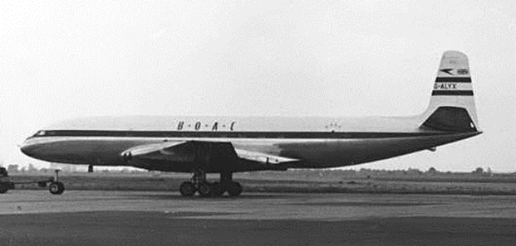
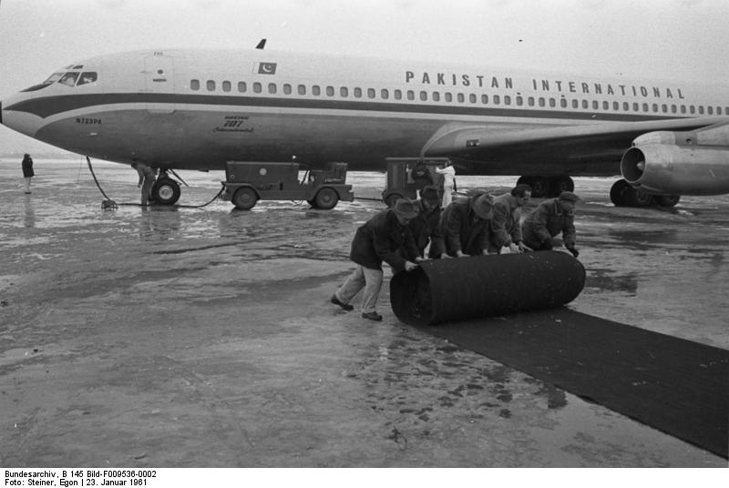
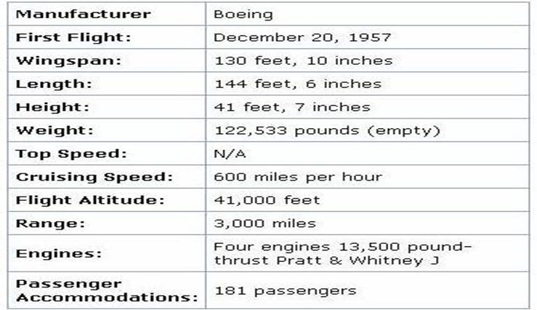
Jet Airliners-1950’s-1960’s (Narrow-body)
First production commercial airliner
DH 106 Comet
Boeing 707

Slide 10
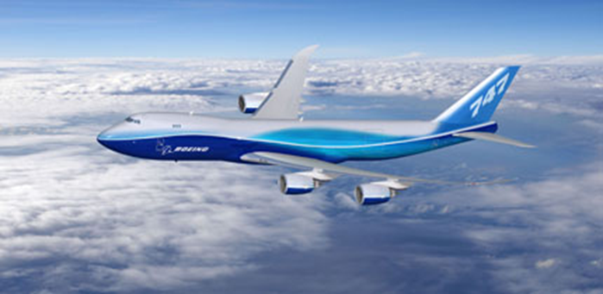
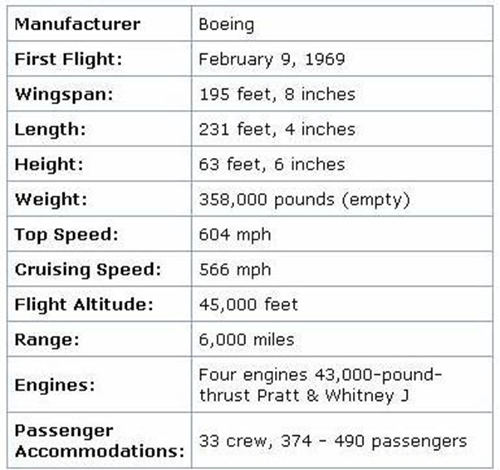
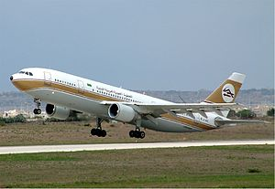
Jumbo Jets - 1960’s-1970’s (Wide-Body)
first wide-body airliner (four engine)
Boeing 747-8
world's first twin-engined widebody
Airbus A300

Slide 11
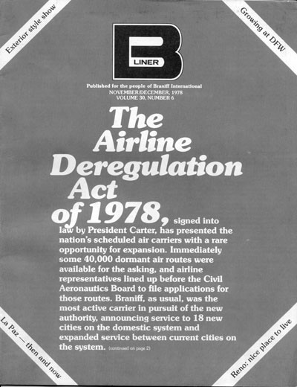
Deregulation Act of 1978
American federal law created to remove government control over fares, routes, and market entry
The Civil Aeronautics Board (CAB), had previously controlled entry, exit, and the pricing of airline services, as well as intercarrier agreements, mergers, and consumer issues
CAB eliminated
Underserved airports opened to major carriers
Mergers between local carriers were allowed
Implementation of “Hub-and- Spoke” system

Slide 12
INDUSTRY OVERVIEW

Slide 13
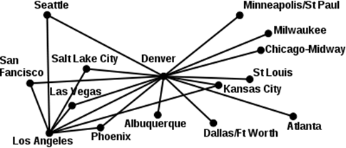

BUSINESS MODEL
Hub-and-Spoke System
Used by legacy carriers
Allowed for more distant and international routes
Utilize main airports as hubs
Lead to more efficient use of transportation resource
Centralized model result in inflexible operation (domino effect)
e.g. Cathay Pacific, American Airline

Slide 14
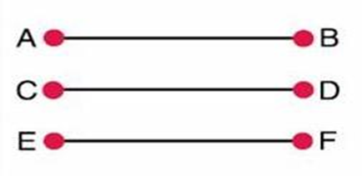
POINT TO POINT SYSTEM
Point to Point System
Used by low-cost carrier
Shorter routes, usually regional/domestic
↓ Connection & travel time
↑ Utilization leads to lower unit cost
Avoid domino effect
Require more routes
Less flexibility in destination
e.g. Southwest Airline (hybrid)

Slide 15
BUSINESS MODEL – TYPES OF AIRLINES
Network-Legacy Airlines
New competition after deregulation
More Luxury aircrafts
Economic/Business/First Class
Higher level of services: airport lounges, frequent-flyer program, premium in-flight services
Price discrimination
‘sell the right seat, to the right customer, at the right time, for the right prices.’
Frills
Airline Alliances
Low-Cost Airlines
Fewer types of aircrafts
Lower maintenance expenses
Economic class
Less services
Fly early/late
Lower landing fees
Simpler fare schedules
Lower fares
No alliance
No-frills

Slide 16
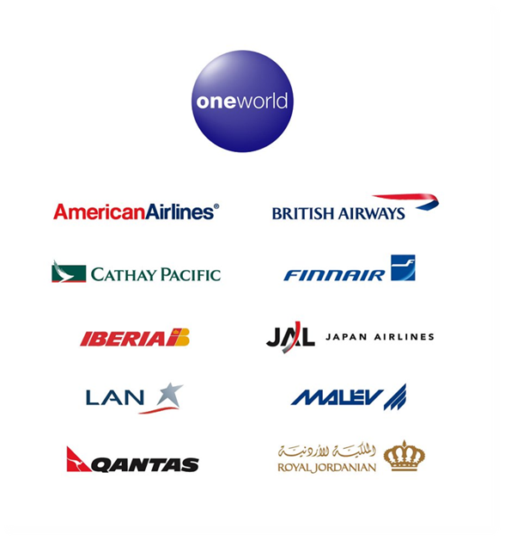
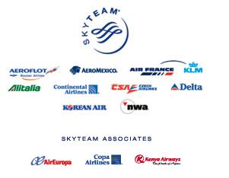
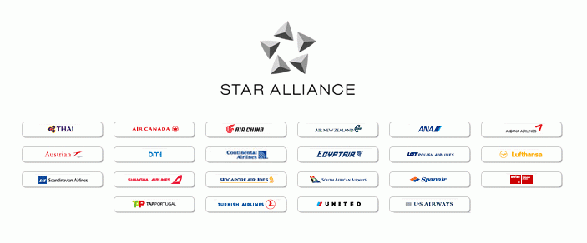
AIRLINE ALLIANCE
An agreement between two or more airlines to cooperate on a substantial level

Slide 17

BENEFITS OF ALLIANCE
Lower fares for interlining passenger
Lower fares resulting from economies of traffic density
Passengers can more easily combine fares in an itinerary
Airlines can offer passengers a much wider range of schedule
The passenger experience benefits from more seamless service and similar product

Slide 18

GENERAL ENVIRONMENTAL FACTORS
Key factors affecting the business:
Airport capacity
Route structure
Technology
Costs to lease/buy the aircrafts
Weather
Cost of fuel
Cost of labour

Slide 19
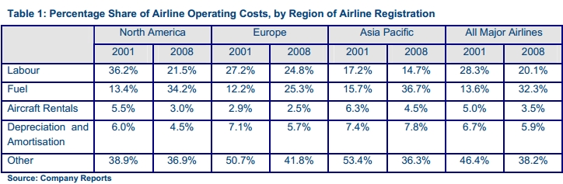
COST STRUCTURE

Slide 20
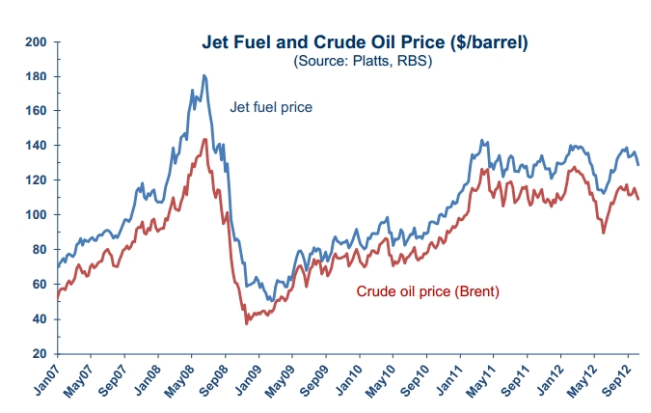
COSTS - FUEL
Notes:
http://www.iata.org/whatwedo/Documents/economics/AirlinesFinancialMonitorOct12.pdf
Jet fuel prices fall moderately from September highs
The surge in jet fuel prices after the
June low has now stopped, with prices
easing slightly throughout September
and October. Jet fuel prices are also
down but still remain high at close to
$130/bbl. The cost of fuel has been
within a range of +/-$15/bbl around
$130/bbl for the past 20 months.
 The main influence on price at the
moment seems to be a view that stocks
will trend higher with higher crude oil
output in North America and Saudi
Arabia, coupled with subdued demand.

Slide 21
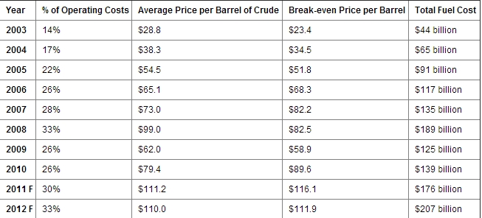
FUEL IMPACTS ON OPERATING COSTS
31
Notes:
http://www.iata.org/pressroom/facts_figures/fact_sheets/pages/fuel.aspx

Slide 22
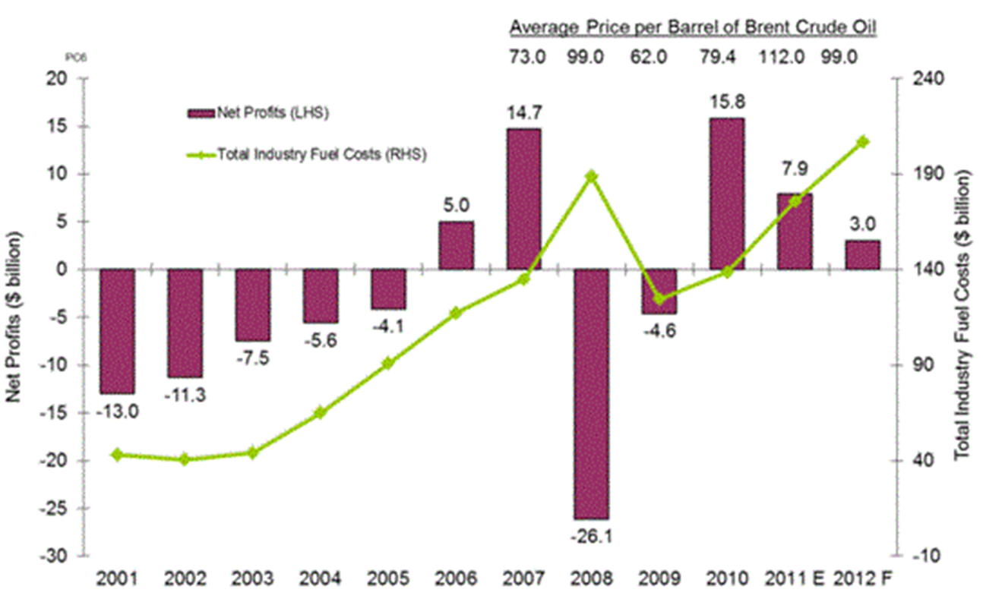
FUEL COSTS AND NET PROFIT
Notes:
http://www.iata.org/pressroom/facts_figures/fact_sheets/pages/fuel.aspx
Fact Sheet: Fuel
The global airline industry’s fuel bill is forecast to total $207 billion in 2012 (accounting for 33% of operating expenses at $110.0/barrel Brent of oil).
This is an increase of $31 billion over 2011 and is almost 5 times 2003’s fuel bill of $44 billion (that accounted for 14% of operating expenses at $28.8/barrel Brent).
In 2011 the fuel bill is estimated at $176 billion (accounting for 30% of operating expenses at $111.2 per barrel Brent).
Industry profits of $3.0 billion are forecast for 2012 and following profits of $7.9 billion in 2011.
Industry Fuel Costs and Net Profits

Slide 23
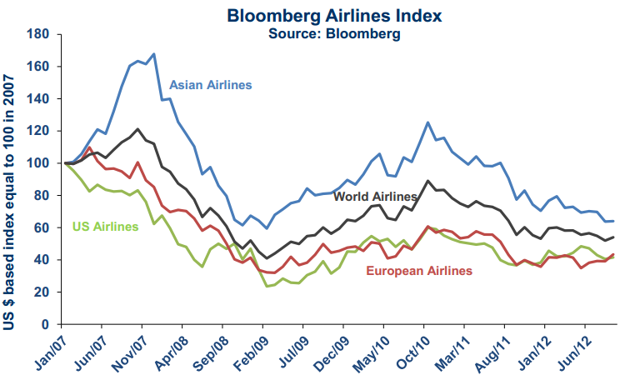
MARKET INDEX
Notes:
Airline share prices increased for a second consecutive month in October, with the Bloomberg Worldwide Airlines Index gaining 4% on September. Moreover, airline shares outperformed
the broader market, with the FTSE Global All-Cap staying flat over the month. Airline shares in all regions experienced a rise. Investors have seen improved performance in Q2 and Q3. The strongest performance was in Europe, where improved Q3 financial results helped generate a 7% increase in that region’s airline share values

Slide 24
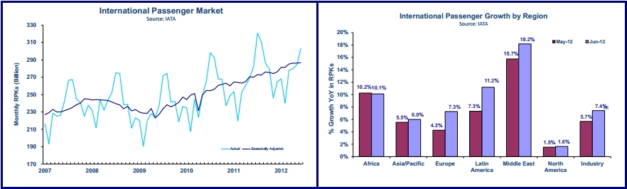
REVENUE - PASSENGER
Notes:
http://www.iata.org/pressroom/pr/pages/2012-08-02-01.aspx
http://www.iata.org/whatwedo/Documents/economics/MIS_Note_Jun12.pdf
The trend in international passenger travel made little progress in June, increasing only 0.2% on the previous month. Compared to a year ago, however, the market grew by a strong 7.4% in June, up on May, with all regionsexcept Africa strengthening.
European airlines experienced strong growth in June, increasing by 7.3% compared to the same month last year, well above the May result. Furthermore, the seasonally adjusted trend also shows a rebound in growth, with the market increasing by 1.7% in June compared to May. The growth trend started to flatten in recent months, which is consistent with the persisting economic weakness throughout much of the continent, so the improved performance in June could be a result of volatility, rather than a legitimate reacceleration in international traffic in Europe.
International passenger travel on Latin American airlines increased significantly in June compared to a year ago, by 11.2%. However, the trend in international travel had slowed in 2012, increasing at a 2% annualized rate from early 2012 through to May. In June, the growth was solid compared to May, 1.3%, but once again this month’s performance may not be reflecting more than volatility, with Latin America’s economies expanding at a lower rate in light of the persisting European crisis.
Asia/Pacific airlines experienced an increase in international travel in June compared to a year ago, by 6%. This result was only slightly up on May, and in fact the month-on-month trend indicates a small decline in the market, by 0.1%. This is now the second month of negative trend, putting on hold the upward momentum in growth which had commenced at the end of 2011.

Slide 25
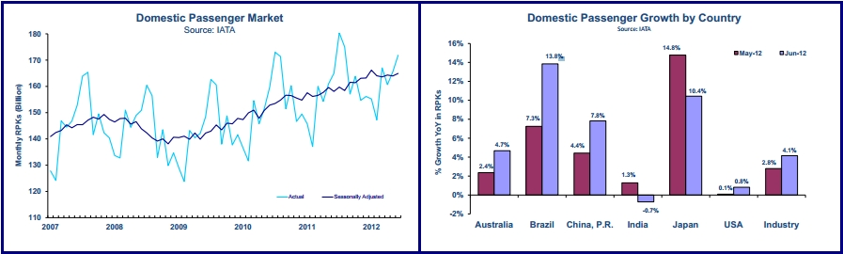
REVENUE - PASSENGER
Notes:
http://www.iata.org/pressroom/pr/pages/2012-08-02-01.aspx
http://www.iata.org/whatwedo/Documents/economics/MIS_Note_Jun12.pdf
On domestic passenger markets, India’s domestic travel fell sharply in June compared to May, contracting by 0.7% year-on-year. This is the second month of weak year-on-year growth, and the trend in growth continues to be flat since the start of 2012. 
Japan’s domestic market continues to show no growth. There were signs of post-earthquake recovery toward the end of 2011, but that expansion lost steam in 2012 and the market remains more than 8% smaller than prior to the disaster. The 10.4% year-on-year growth result for June is entirely due to growth in the second half of 2011.
The downward trend in domestic load factors persists, despite some pickup in June compared to May, where an improvement in demand helped load factors gain slightly, by 0.1%. Weakness in domestic travel demand since the start of 2012 has been placing downward pressure on load factors for several months.

Slide 26
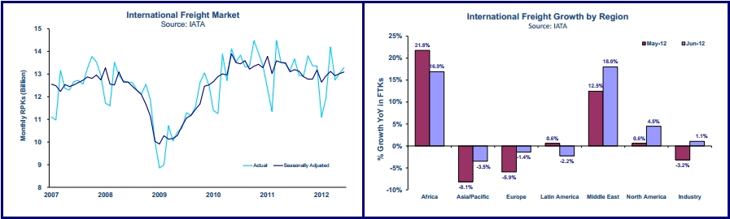
REVENUE - CARGO
Notes:
http://www.iata.org/whatwedo/Documents/economics/MIS_Note_Jun12.pdf
The trend for international air freight was positive in June, improving further on the lows of Q4 2011. The positive trend has been consistent with improvements in business and consumer confidence seen earlier in the year. In
the most recent months, however, business confidence has started to soften as has growth in world trade, and a
continuation in this trend could threaten the recovery in demand for air freight in coming months. The international
air freight market was 1.1% larger in June than the same month last year, and the month-on-month trend was
also positive, increasing 0.6% in June compared to May

Slide 27
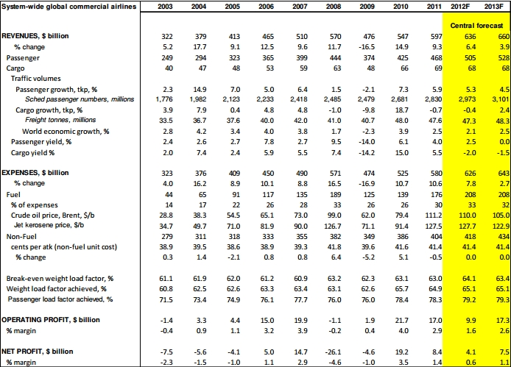
INDUSTRY STATISTICS
Updated: 09/2012 Next Update: 12/2012 Source: Industry Financial Forecast Table (IATA Economics)
Notes:
http://www.iata.org/pressroom/facts_figures/fact_sheets/Documents/industry-facts.pdf
http://www.iata.org/events/agm/2012/Documents/2012-agm-industry-outlook-media-briefing.pdf

Slide 28
MARKET PERFORMANCE AND OUTLOOK

Slide 29
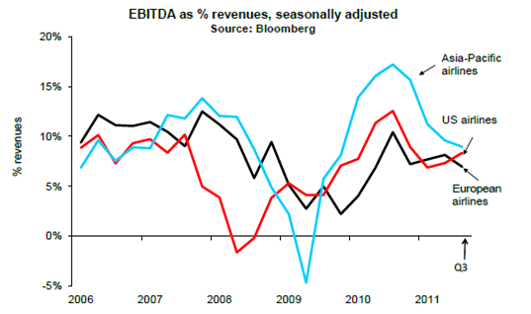
EARNINGS (% OF REVENUES)
Notes:
EBITDA as a percentage of revenues: graph clearly shows that margins are being squeezed. Airlines across all three regions took a big hit due to the financial crisis. Looks like U.S. went down first. Asia-Pacific experienced the biggest loss in 2009, but recovered much better than its US and Euro counterparts

Slide 30
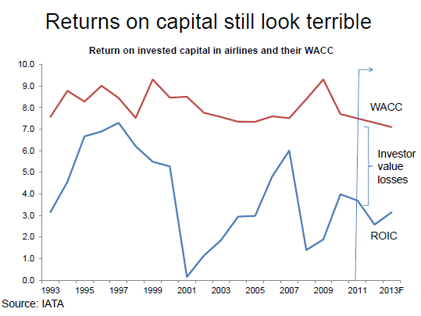
RETURNS VERSUS WACC
Notes:
The weighted average cost of capital for airlines is significantly higher than the return on invested capital. The graph shows that the airline industry is not friendly to investors.

Slide 31
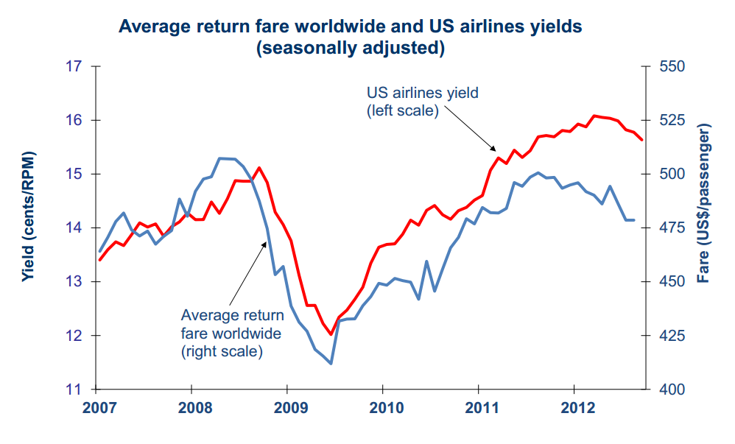
YIELDS
Notes:
The graph shows yields of US airlines with the average worldwide return fare. We can observe that yields have been trending upwards since 2009. The strong rise seen in yields has stalled through 2012. The most recent quarter has seen yields starting to decline.

Slide 32
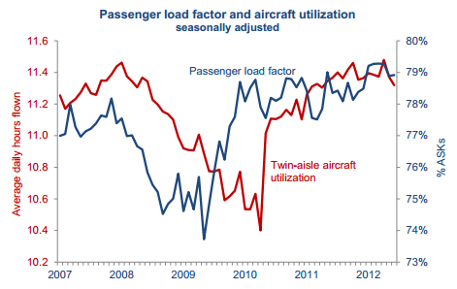
LOAD FACTOR & ASSET UTILIZATION
Notes:
According to the IATA, asset utilization across many markets is looking good. In the past, in the face of slowing demand and increasing airline deliveries, passenger load factors and aircraft utilization would have fallen by this stage. Both measure have stabilized in the last few years.

Slide 33
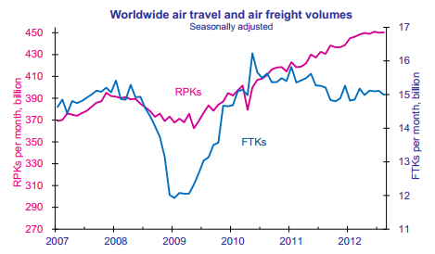
FREIGHT AND PASSENGER VOLUMES
Notes:
Global air travel continued to expand in Sept, but at a slower rate than during the first half of the year. There were improvements in the levels of air travel in September compared to the month before. However, the current weak business environment implies that this is merely erratic movement rather than an upturn in the trend.

Slide 34
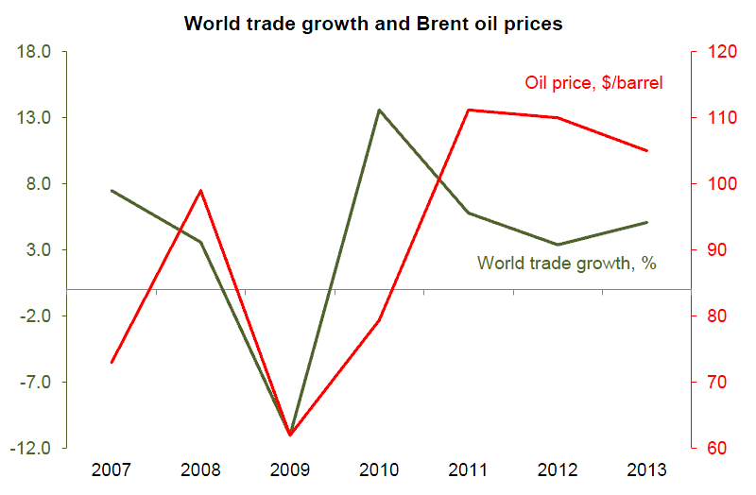
BRENT OIL PRICES AND WORLD TRADE GROWTH
Notes:
Airline profitability has seen significant downward pressure since the industry peaked in 2010. The two main contributing factors is oil prices and faltering world trade growth. We can observe that oil prices have risen from about $79 a barrel to nearly $110; a rise of 40% since 2010. During that same time, world trade growth slowed from 14% to about 3%.
These two adverse factors will the point of maximum damage in 2012. By 2013, forecasters expect oil prices to drop and world trade growth is expected to rise at a faster pace. Reasons: recent monetary actions by central banks and lower energy prices.

Slide 35
PORTER’S FIVE FORCES MODEL
Risk of Entry
Moderate
Supplier power
High
Industry Rivalry
High
Buyer power
High
Substitutes
Moderate

Slide 36
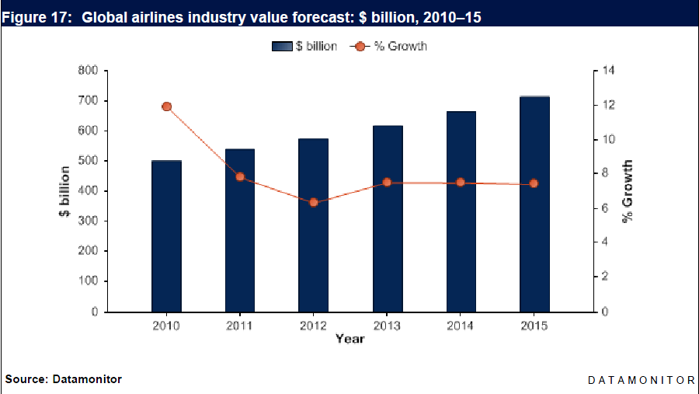
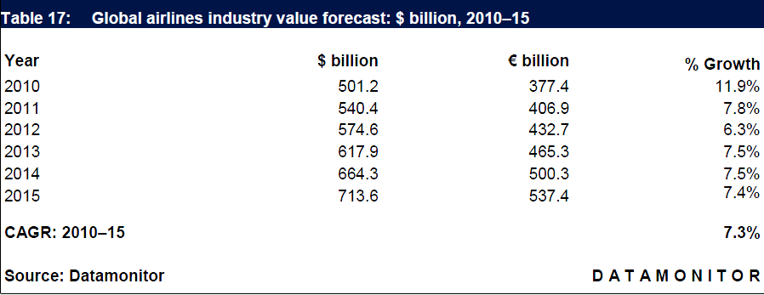
MARKET FORECASTS (VALUE)

Slide 37
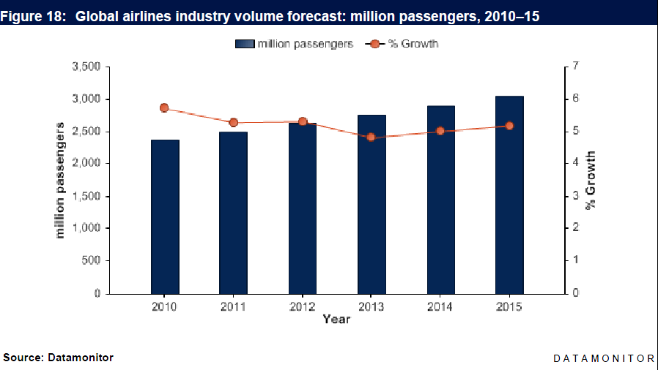
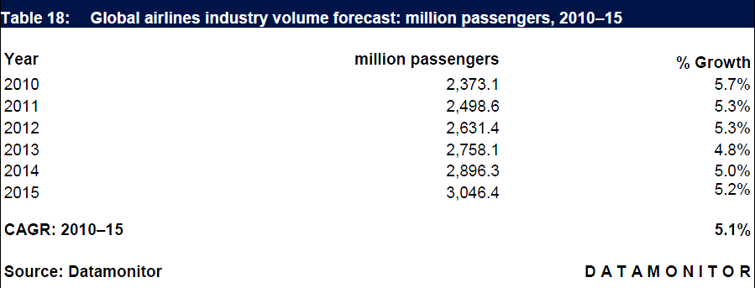
MARKET FORECASTS (VOLUME)

Slide 38
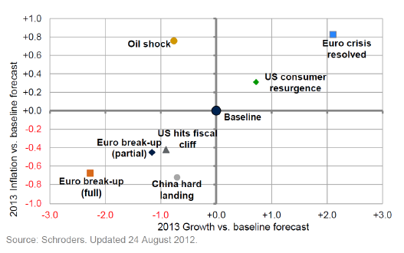
SUBSTANTIAL DOWNSIDE
Notes:
Graph shows 2013 inflation vs. baseline forecast. Best case scenarios will land on the top right of the origin.

Slide 39
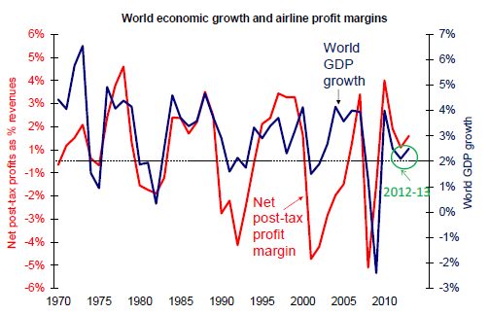
PROFIT MARGINS VS ECONOMIC GROWTH
Notes:
Both global economic growth and airline profit margins starting to show an upward climb starting in 2012. The current economic growth environment is weak. Industry profitability is closely correlated with economic growth. When economic growth is robust, global airlines can still make profits despite high fuel prices. Growth is now close to the point where profits turns into losses.

Slide 40
COMPANY PROFILES

Slide 41
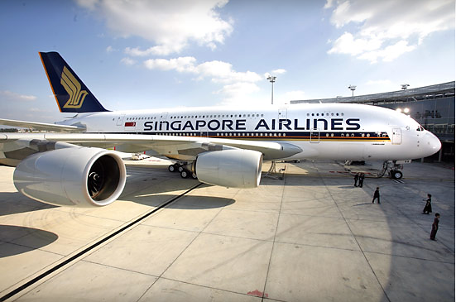
Singapore Airlines

Slide 42

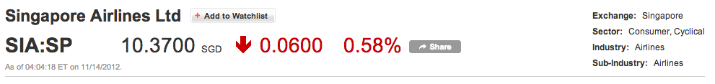
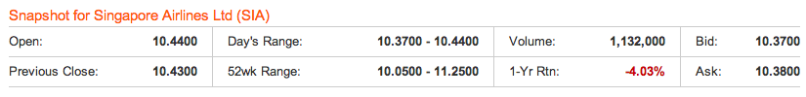
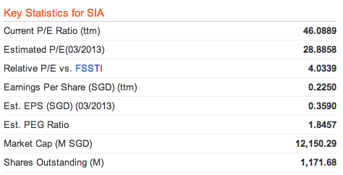
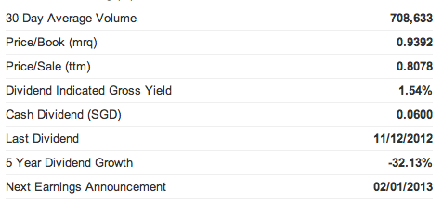
STOCK INFORMATION (SIA:SP)
Exchange Rate: $1 USD = 1.23059 SGD

Slide 43
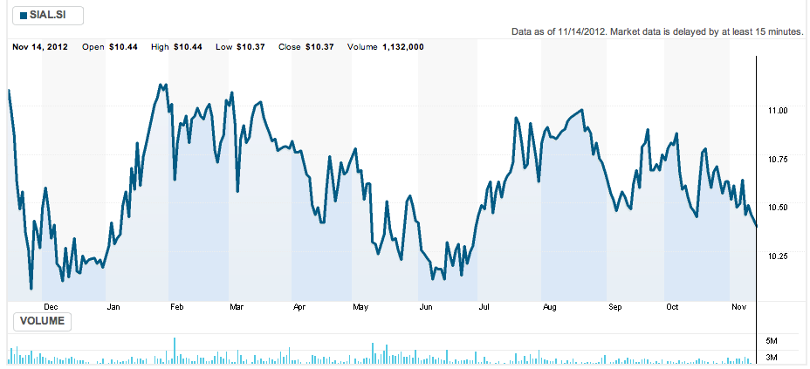
1 YEAR STOCK PRICE MOVEMENTS
All prices are in local currency

Slide 44
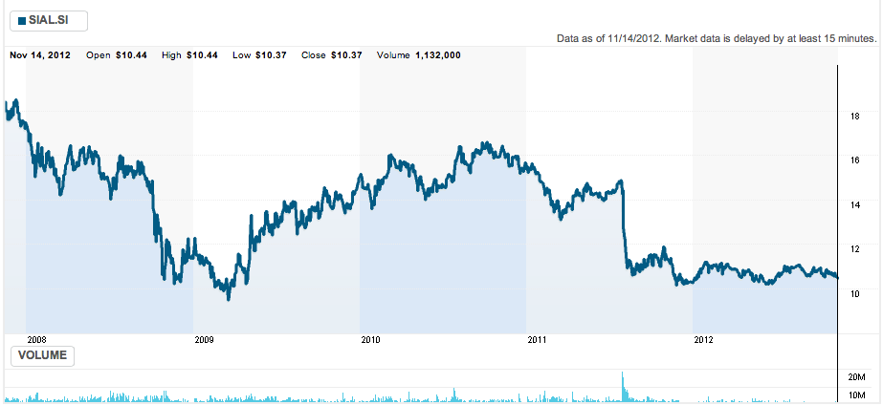
5 YEAR STOCK PRICE MOVEMENTS
All prices are in local currency

Slide 45
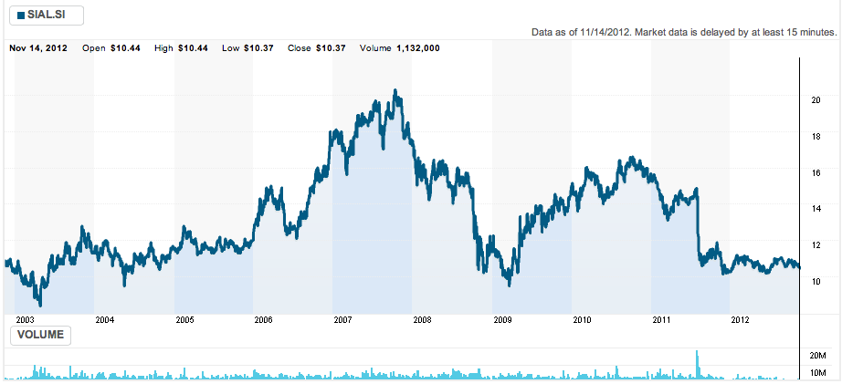
10 YEAR STOCK PRICE MOVEMENTS
All prices are in local currency

Slide 46
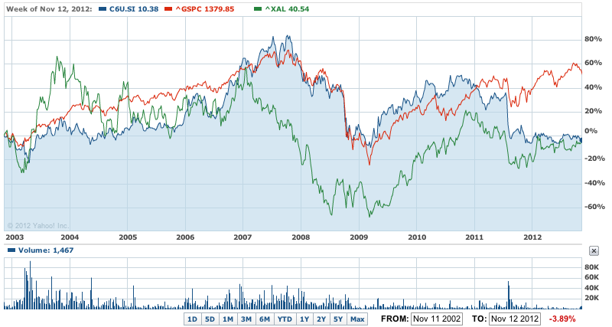
10-Year VS S&P 500 VS Airlines INDEX
All prices are in local currency

Slide 47



COMPANY PROFILE
Founded in 1972
A regional airline => One of the most respected travel brands around the world
Based at Singapore Changi Airport
The national carrier of Singapore
Use a fleet of wide-body Boeing and Airbus aircraft including A380
Operate an extensive network across Asia, North America, Australasia, Europe, Africa and the Middle East
Join the Star Alliance on April 1, 2000

Slide 48





HISTORY OF SIA
May 1, 1947:
Began with a Malayan Airways Limited (MAL)
1963:
The Federation of Malaysia was born and was known as Malaysian Airways Limited
1966:
Renamed as Malaysia-Singapore Airlines (MSA)
1972:
MSA split up to form Malaysian Airlines System and Singapore Airlines
1990s:
Set new standards; KrisFlyer
2004
The first non-stop air service between Singapore and USA with A340-500
2007
The first Airbus A380

Slide 49
SUBSIDIARIES
Has over 20 subsidiaries covering a range of airline-related services
Main Subsidiaries
SIA Cargo
SIA Engineering Company
SilkAir
Tradewinds Tours and Travel

Slide 50



SIA – OBJECTIVES FOR THE FUTURE
A Great Way To Fly
Mission Statement: “Singapore Airlines is a global company dedicated to providing air transportation services of the highest quality and to maximizing returns for the benefit of its shareholders and employees.”
Commitment to the Environment
Embrace new technology and green initiative on the ground
Reduce fuel consumption

Slide 51


CURRENT STRATEGY
Excellent service process (especially the experience at the airplane cabin) presented by the entire cabin crew; the service is personified in the Singapore Girl figure
Innovation particularly about the in-flight services
e.g. The first airlines to introduce personal system of the entertainment system and video on-demand for every seat
e.g. The first one to have suite class designed exactly as the five star hotel room in airlines
Always use the new airplanes
Two purposes: Cost efficiency & Build a reputation as the superior airlines company

Slide 52
FUEL HEDGING
Has hedged about a quarter of its jet fuel requirements near US$126 a barrel in 2012
The airline bought 37 million barrels of jet fuel in the fiscal year that started on April 1
Suffered US$225 million in hedging losses from Oct. to Dec., 2009

Slide 53

GLOBAL ROUTE MAP

Slide 54

INFORMATION OF SHAREHOLDINGS

Slide 55

THE GROUP FLEET PROFILE

Slide 56

MANAGEMENT TEAM

Slide 57

Stephen Lee Ching Yen (BOD Chairman)
Chairman of BOD since January 2006
Managing Director of Shanghai Commercial and Savings Bank Ltd. (Taiwan) and Great Malaysia Textile Investments Pte Ltd.
President of the Singapore National Employers Federation since 1988 and is a Council Member of the Singapore National Wages Council
Nominated Member of Parliament from 1994-1997
Awarded the Distinguished Service Order Award in 2006 and the Public Service Star Award in 1998
Chairman of the Singapore Business Federation from 2002 to 2008 and International Enterprise Singapore from 1995 to 2002
Education: MBA in Northwestern University, Illinois, US (1973)

Slide 58

Goh Choon Phong (CEO)
CEO since January 1, 2011 and Appointed Director on October 1, 2010
Joined SIA in 1990 and served in various key positions
Divisional Vice President Commercial Technology of SIA in 1999 and Senior Vice President for Commercial Technology in 2000
Cjhairman of SilkAir (Singapore) Private Limted and a Member of the Board of Governors at IATA
Executive Vice President of Marketing and the Sales Regions from March 2010 to January 1, 2011
President of Singapore Airlines Cargo Pte Ltd. since June 1, 2006
Education: a MS degree in Computer Science & Electrical Engineering and three BS degrees in Computer Science & Engineering, Management Science and Cognitive Science, all from the Massachusetts Institute of Technology.

Slide 59

OPERATIONS PERFORMANCE

Slide 60

REVENUE

Slide 61

REVENUE COMPOSITION

Slide 62

OPERATING PROFITS

Slide 63

EXPENDITURE

Slide 64

EXPENDITURE CONT.

Slide 65

TRENDS IN FUEL PRICE AND COST

Slide 66

CASH EXPENDITURE AND CASH FLOW

Slide 67

FINANCIAL REVIEW

Slide 68

BALANCE SHEET

Slide 69

BALANCE SHEET Q2, 2012

Slide 70

BALANCE SHEET Q2, 2012 (CONTINUED)

Slide 71

DIVIDEND

Slide 72

INCOME STATEMENT 2010/2011

Slide 73

INCOME STATEMENT Q2 2012

Slide 74

INCOME STATEMENT Q2 2012

Slide 75

CASH FLOW STATEMENT

Slide 76

CASH FLOW STATEMENT (CONTINUED)

Slide 77

CASH FLOW STATEMENT Q2

Slide 78

CASH FLOW STATEMENT Q2 (CONT.)

Slide 79

RECOMMENDATION
HOLD!

Slide 80



Slide 81


STOCK INFORMATION (LUV:NYSE)
Notes:
8.76 latest closing price

Slide 82

1 YEAR STOCK PRICE MOVEMENT

Slide 83

5 YEAR STOCK PRICE MOVEMENT

Slide 84

10 YEAR STOCK PRICE MOVEMENT

Slide 85

LUV VS. AIRLINE INDEX (AMEX)

Slide 86

HISTORY
1971
Air Southwest Co. changes its name to Southwest Airlines Co.
Begins service to Dallas, San Antonio and Houston with three Boeing 737s
1975
Common stock listed on
American Stock Exchange under the ticker “LUV”
1973
Ends the year with first yearly profit
1974
Carries one-millionth customer
1978
Flies to New Orleans, first flight
destination outside of Texas
1967
Air Southwest was incorporated by Rollin King and Her Kelleher

Slide 87

HISTORY
1994
Acquires 2 airline companies: Morris Air and Arizona One
1996
Online booking site launched
2005
Enters first code-share agreement with American Trans Air
2009
Becomes largest carrier in the US with 545 Boeing 737 aircrafts servicing 68 airports in 35 states and able to offer more than 3,300 flights a day
2011
Integration of AirTran
2012
Began service at Des Moines International Airport (DSM)

Slide 88
COMPANY PROFILE
Southwest Airlines Co. (NYSE: LUV), operating as Southwest Airlines, is the largest low-cost carrier in the United States, and is headquartered in Dallas, Texas.
Southwest Airlines operates more than 3,200 flights a day. AirTran Airways operates nearly 600 flights a day.
Has among the lowest cost structures in domestic airline industry and consistently offers the lowest and simplest fares
In first nine months of 2012, Southwest’s average passenger airfare was $146.56 one-way, and the average passenger trip length is approximately 943 miles
Adopted the first profit-sharing plan in U.S. airline industry in 1973 where employees own about 8% of the company stock

Slide 89

SOUTHWEST’S ROUTES

Slide 90


1 YEAR STOCK PRICE MOVEMENT

Slide 91

AIRCRAFTS

Slide 92

BUSINESS STRATEGY
Differentiates itself from other low-fare carriers by providing exemplary Customer Service
short haul passenger and providing rates as low as one third of their competitors
Fly directly to destination
Lower unit cost
putting the employee first, Southwest has found the key to success in the airline business

Slide 93

1 YEAR STOCK PRICE MOVEMENT

Slide 94

MANAGEMENT TEAM

Slide 95

MANAGEMENT TEAM
Gary C Kelly: Chairman of the Board, President & CEO
Before 1986: He was a CPA for Arthur Young & Company in Dallas and Controller for Systems Center, Inc.
1986: joined the company as Controller
1989: Kelly became CFO
2004: promoted to CEO and Vice Chairman
2008: He assumed the role of Chairman and President
Education: Gary received a B.B.A. in Accounting from the University of Texas at Austin and is a Certified Public Accountant. He is a member of the Texas Society of CPAs

Slide 96

MANAGEMENT TEAM
Michael G Van De Ven "Mike”: Executive Vice President & Chief Operating Officer
1993: Joined Southwest
positions at Southwest: Executive Vice President of Aircraft Operations, Senior Vice President of Planning, Vice President Financial Planning & Analysis, Senior Director of Financial Planning & Analysis, Director of Financial Planning, and Director of Internal Audit
Education: Mike received a B.B.A. from the University of Texas at Austin. He is also a Certified Public Accountant

Slide 97

MANAGEMENT TEAM
Ron Ricks : Executive Vice President—Chief Legal and Regulatory Officer
Before 1981: Ron was a partner in the San Antonio law firm founded by Herb Kelleher, where Ron worked extensively on the Southwest Airlines' account.
1981: Ron has represented Southwest since 1981
Education: Ron has an undergraduate degree from the University of Texas at Austin, and, earned a law degree from George Washington University, in Washington, D.C

Slide 98

MANAGEMENT TEAM
1981 to 1993: Prior to joining Southwest Airlines, Jeff worked 12 years at Mesa Petroleum, under the leadership of Boone Pickens
1993 to 2000: served as Vice President of Administration at Belo Corporation
2000: Jeff joined The Staubach Company as their Executive Vice President Corporate Operations and was also President of Staubach Lease Administration Company
2004: he came to Southwest Airlines.
Education: Jeff completed his undergraduate work at West Texas State University - Canyon, Texas (now West Texas A&M) in 1986
Jeff Lamb: Executive Vice President & Chief People & Administrative Officer.

Slide 99


OPERATIONS PERFORMANCE

Slide 100
AirTran Acquisition
Southwest Airline bought Airtrain for $1.42 billion on May 2nd, 2011
Based on the average of Southwest Airlines' closing prices for the 20 trading days ending three trading days prior to May 2, 2011, of $11.90
The transaction valued AirTran Holdings common stock at approximately $7.57 per share
Southwest Airlines operates more than 3,400 flights a day. AirTran Airways operates nearly 700 flights a day.

Slide 101

AirTran Acquisition
The following table summarizes the assets acquired and liabilities assumed as of the acquisition date at estimated fair value:

Slide 102

FUEL HEDGING STRATEGY
Southwest Hedged their fuel needs to protect themselves against price higher fuel prices.
Southwest was able to save about $3.5 billion between 1999-2008
Although, There is risk associated with this: sometimes the cross hedge does not accurately track jet fuel prices
Southwest owns long-term contracts to buy most of its fuel through 2009 for what it would cost if oil were $51 a barrel. The value of those hedges soared as oil raced above $90 a barrel

Slide 103

FUEL HEDGING STRATEGY

Slide 104

FUEL HEDGING STRATEGY
In 2011, the Company experienced a significant increase in its Fuel and oil expense as a result of higher market prices.
For the 7th consecutive year, fuel costs have represented the first or second largest expense for Southwest

Slide 105

FUEL HEDGING STRATEGY
The following table presents the location of all assets and liabilities associated with the Company’s hedging instruments within the Consolidated Balance Sheet:

Slide 106

DOWNSIDE OF FUEL HEDGING
In 2011, the Company experienced a significant increase in its Fuel and oil expense as a result of higher market prices When airlines like Southwest heavily lock in high prices, they lose money when prices drop
Southwest Airlines lost $140 million in third quarter 2011 after it was recorded a $239 million charge related to its fuel hedging contracts

Slide 107

IMPACT OF FUEL HEDGING STRATEGY

Slide 108


OPERATING DATA

Slide 109

FINANCIAL DATA
Consolidated operating expenses for 2011 increased 34.6 percent, compared to 2010, while capacity increased 22.5 percent compared to 2010. The increase in consolidated operating expenses was primarily due to the inclusion of AirTran’s 2011 operating expenses following the acquisition
On a dollar basis, excluding the results for AirTran following the acquisition, operating expenses increased by $1.9 billion for 2011 compared to 2010, approximately 64 percent of which was due to a higher average jet fuel cost per gallon

Slide 110

OPERATING REVENUE
The Company’s consolidated net income of $178 million ($.23 per share, diluted) in 2011 decreased by $281 million, or 61.2 percent, compared to its 2010 net income of $459 million ($.61 per share, diluted)

Slide 111


OPERATING EXPENSE

Slide 112

FINANCIAL REVIEW

Slide 113

BALANCE SHEET

Slide 114

BALANCE SHEET (QUARTERLY)

Slide 115

INCOME STATEMENT

Slide 116

INCOME STATEMENT (QUARTERLY)

Slide 117

CASH FLOW STATEMENT

Slide 118

CASH FLOW STATEMENT (QUARTERLY)

Slide 119

Recommendation
HOLD!

Slide 120



Slide 121



STOCK INFORMATION
Notes:
13.56 closing HKD

Slide 122

STOCK INFORMATION

Slide 123

1 YEAR STOCK PRICE MOVEMENTS

Slide 124

5 YEAR STOCK PRICE MOVEMENTS

Slide 125

5 YEAR VS. AIRLINE INDEX

Slide 126

5 YEAR VS. HANGSENG INDEX

Slide 127

5 YEAR VS. OIL & GAS

Slide 128

10 YEAR SUMMARY

Slide 129

KEY STATISTICS

Slide 130

KEY STATISTICS

Slide 131

Destinations served: 167 in 42 countries and territories (2012 June)

Slide 132

COMPANY PROFILE
Registered and based in Hong Kong
Offering scheduled passenger and cargo services to 145 destinations in 40 countries and territories around the world
Founded in 1946 and remains deeply committed to its home base, making substantial investments to develop Hong Kong as one of the world’s leading international aviation hubs
In addition to its current fleet of 128 wide-bodied aircraft, Cathay Pacific continues to invest heavily in its home city and has another 97 new aircraft due for delivery up to 2019
Cathay Pacific and its subsidiaries employ some 28,100 people worldwide (more than 21,000 of them in Hong Kong)
Cathay Pacific is listed on The Stock Exchange of Hong Kong Limited, as are its substantial shareholders Swire Pacific Limited (“Swire Pacific”) and Air China

Slide 133


COMPANY HISTORY
1946:
Founded by Farrell and Kantzow
Initially based in Shanghai
1948:
Began to operate the passenger flights;
Swire trading house buys into Cathay Pacific
1980s:
Expanded the international network to include London, Brisbane, Frankfurt, Vancouver, Amsterdam, Rome, San Francisco, Paris, Zurich and Manchester
1960:
Business grew at 20% a year; initiated international services
1970s:
Started to make use of the latest technology with our computerized reservation system and flight simulators;
The first Boeing 747-200 arrived in Hong Kong in mid-1979

Slide 134


COMPANY HISTORY
1990:
Used US$9 billion to assemble a fleet of aircraft that was among the youngest in the world
2002:
Became joint venture partners in Air Hong Kong with DHL
2006:
Closer relationship with Air China by taking 20% shareholding
2003:
Resume passenger services to Beijing & undertook a range of e-business initiatives
2005:
The "Airline of the Year & Airline of the Year 2006

Slide 135

ANNUAL RESULT

Slide 136
FACT SHEET
Major shareholders
Major subsidiaries and associates
Swire Pacific Limited | 44.97%
Air China Limited | 29.99%
Hong Kong Dragon Airlines Limited | 100%
Cathay Pacific Catering Services (HK) Limited | 100%
Cathay Holidays Limited | 100%
Vogue Laundry Services Limited | 100%
Hong Kong Airport Services Limited | 100%
Cathay Pacific Services Limited | 100%
AHK Air Hong Kong Limited | 60%
Air China Limited | 19.53%

Slide 137

FLEET PROFILE

Slide 138

MANAGEMENT TEAM

Slide 139

MANAGEMENT TEAM
Chris Pratt
CBE, Chairman
Honors degree in modern history from the University of Oxford
Joined John Swire & Sons Limited ("Swire") group in 1978 and has worked with the group in Hong Kong, Australia and Papua New Guinea
Chairman of Swire Pacific Limited and John Swire & Sons (H.K.) Limited, and a director of Swire Properties Limited
Served as Executive Director of Swire Pacific’s Trading and Industrial Division from 2000 to 2005

Slide 140

MANAGEMENT TEAM
John Slosar
Chief Executive since March 2011
Holds degrees in Economics from Columbia University and Cambridge University.
Joined the Swire group in 1980 and has worked with the group in Hong Kong, the United States and Thailand.
Appointed Managing Director of Hong Kong Aircraft Engineering Company Limited in 1996, Managing Director of Swire Pacific's Beverages Division in July 1998 and Chief Operating Officer of Cathay Pacific in July 2007
Director of Cathay Pacific, John Swire & Sons (H.K.) Limited, Swire Pacific Limited, and Chairman of Hong Kong Dragon Airlines Limited and Swire Beverages Limited

Slide 141

MANAGEMENT TEAM
Ivan Chu
Chief Operating Officer since March 2011
Joined Cathay Pacific in 1984 and has worked with the Company in Hong Kong, Mainland China, Taiwan, Thailand and Australia
Was General Manager Southwest Pacific based in Sydney, Australia
Director of Cathay Pacific and Hong Kong Dragon Airlines Limited, and Chairman of AHK Air Hong Kong Limited and Cathay Pacific Catering Services (H.K.) Limited

Slide 142

MANAGEMENT TEAM
Martin Murray
Finance Director of the Company since November 2011.
Director of Hong Kong Dragon Airlines Limited. He was previously Deputy Finance Director of Swire Pacific Limited
Joined the Swire group in 1995 and has worked with the group in Hong Kong, the United States, Singapore and Australia

Slide 143

OPERATIONS

Slide 144

OPERATING PROFITS

Slide 145

OPERATING RESULTS ANALYSIS

Slide 146

HIGHLIGHTS OF PERFORMANCE

Slide 147

PASSENGER SERVICES

Slide 148

PASSENGER SERVICES – KEY NUMBERS

Slide 149

PASSENGER YIELD

Slide 150


CARGO SERVICES

Slide 151

TURNOVER
Group passenger turnover increased 9.2% against a 6.9% increase in capacity. The increased turnover principally reflected an increase in capacity.
• Group cargo turnover decreased by 7.6%. Combined Cathay Pacific and Dragonair cargo turnover decreased by 0.2% against a 4.3% decrease in capacity.
• Group turnover from catering, recoveries and other services increased by 4.8%.

Slide 152

TURNOVER

Slide 153

OPERATING EXPENSES

Slide 154
FUEL FACTORS

Slide 155

FUEL EXPENDITURE AND HEDGING

Slide 156

FUEL HEDGING AS AT MARCH 14 2012

Slide 157

FINANCIAL REVIEW

Slide 158

BALANCE SHEET

Slide 159


BALANCE SHEET (QUARTERLY)

Slide 160

INCOME STATEMENT

Slide 161

INCOME STATEMENT (QUARTERLY)

Slide 162

CASH FLOW STATEMENT

Slide 163

CASH FLOW STATEMENT (QUARTERLY)

Slide 164

RECOMMENDATION
HOLD!

