Slide 1
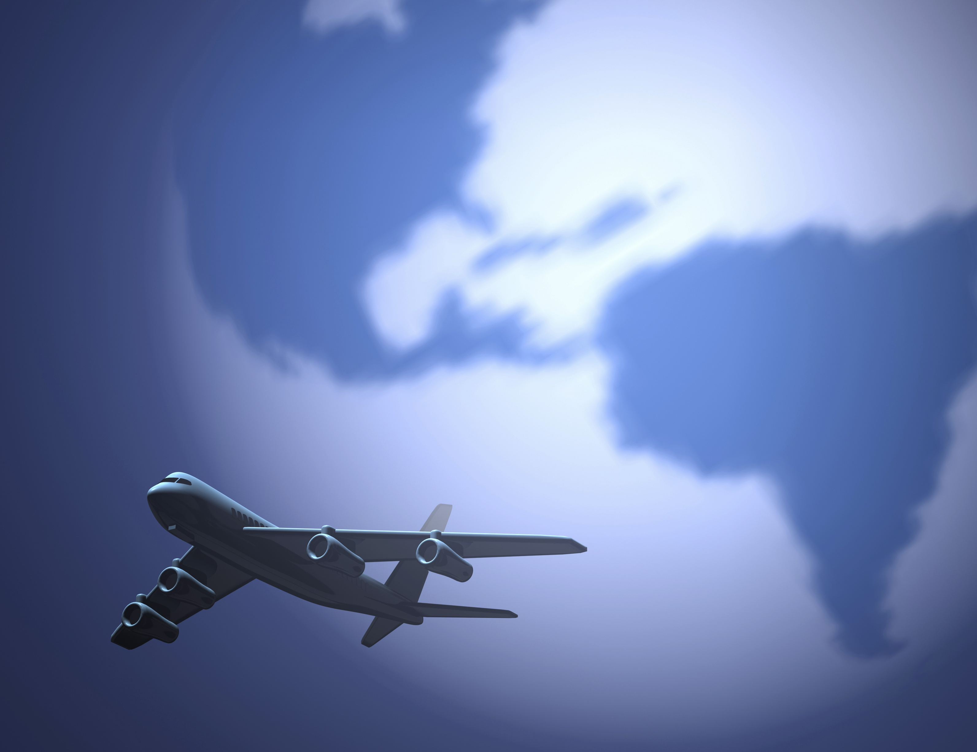
BUS 417 Security Analysis
Global Airlines
Present by: Lucy Qian
April Zeng
WenHui Shi
Jeffrey Zeng

Slide 2

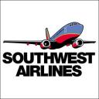

AGENDA
Industry Overview
Terminology
Industry Background
Profitability
Business Model
Alliances
Market Facts and outlook
American Airline
Southwest Airline
Singapore Airline

Slide 3

Industry Overview
Industry Overview
American Airline
Southwest Airline
Singapore Airline

Slide 4
Terminology
ATK: Available Tonne Kilometer (Capacity)
= Passenger and cargo capacity
ASK: Available Seat Kilometer (Capacity)
= [Number of seats] * [kilometers flown]
RPK: Revenue Passenger Kilometer (Traffic)
= [Number of paying passengers] * [kilometers flown]
FTK: Freight Tonne Kilometer (Traffic)
= [Freight tonnes carried] * [kilometers flown]
YIELD
= [Revenue] / [RPK]
LF: Load Factor (Capacity Utilization)
= [RPK] / [ASK]
= [number of passengers]/[number of seats]
Break Even LF: Unit cost / Yield
i.e. Operating cost = Operating Revenue
Industry Overview
American Airline
Southwest Airline
Singapore Airline

Slide 5
History
1909
DELAG, Deutsche Luftschiffahrts-Aktiengesellschaft was the world's first airline. It was founded on November 16, 1909.
Tony Jannus conducted the United States' first scheduled commercial airline flight on 1 January 1914 for the St. Petersburg-Tampa Airboat Line
1913
May 15, the first air mail route in the United States was established between New York, N. Y., and Washington, D. C.
1918
Passenger service is established on the mail routes through the development of the Ford Trimotor, the first successful American airliner with a 12-passenger capacity.
1925
Industry Overview
American Airline
Southwest Airline
Singapore Airline

Slide 6
History
After 1945
World War II, like World War I, brought new life to the airline industry. Many airlines in the Allied countries were flush from lease contracts to the military, and foresaw a future explosive demand for civil air transport, for both passengers and cargo.
1970s
A big boost for the airlines comes in 1970s, large multi-aisle, wide body planes introduced (Boeing 747, Douglas DC-10, and Lockheed L-1011)
Almost half of the total flying in the world took place in the U.S., and today the domestic industry operates over 10,000 daily departures nationwide.
1980s
Southwest launches - Era of low-cost airlines
1930s
1940s
Intercontinental jets and pressurization improve air travel experience (Boeing 247 and Douglas DC-3). The airline industry was generally profitable until the World War II.
Industry Overview
American Airline
Southwest Airline
Singapore Airline

Slide 7
Industry Background - Regulations
1925
Contract Air Mail Act → Air mail went to private ownership
Air mail carriers were soon carrying passengers
TWA, American and United
1926
Air Commerce Act for Safety improvements
Ensure safety standards
1934
Bureau of Air Commerce for Air traffic Control
New Deal Legislation by Franklin Roosevelt
Improved and built additional airfields with paved all-weather runways
1940
Two Regulatory Bodies
Civil Aeronautics Administration (CAA) → Air traffic control, safety regulations
Civil Aeronautics Board (CAB) → Economic regulation:
Ensure adequate Service (Regulate entry and exit of carriers)
Regulate fares
Regulate schedules
Industry Overview
American Airline
Southwest Airline
Singapore Airline

Slide 8
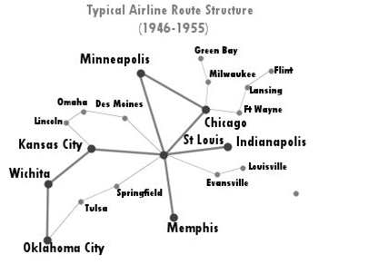
Industry Background - Regulations
Regulation Shaping the Industry after World War II
Open skies competition for international routes
Internally, rates and routes were assigned by the CAB to:
Certified trunk carriers (Long Haul parallel routes)
Local Service carriers (Specific geographic regions
Industry Overview
American Airline
Southwest Airline
Singapore Airline

Slide 9
Industry Background - Regulations
Airline Deregulation Act (1978)
To remove government control over fares, routes, and market entry => CAB eliminated
Underserved airports opened to major carriers
Mergers between local carriers were allowed
Implementation of “Hub and Spoke” system
Industry Overview
American Airline
Southwest Airline
Singapore Airline

Slide 10
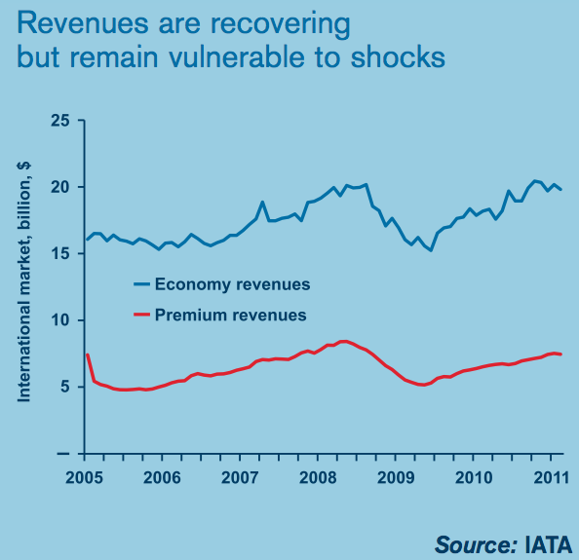
Profitability – Revenue
Global airline revenues grew an estimated 15% in 2010
strong rise from the recession-depressed, but was not yet a recovery to 2008 levels
Passenger revenue
passenger revenues lagged when yields failed to recover to prerecession levels.
Cargo revenue
recover to 2008 levels in 2010, rising more than one-third over the 2009 figure, to $66 billion
Industry Overview
American Airline
Southwest Airline
Singapore Airline

Slide 11
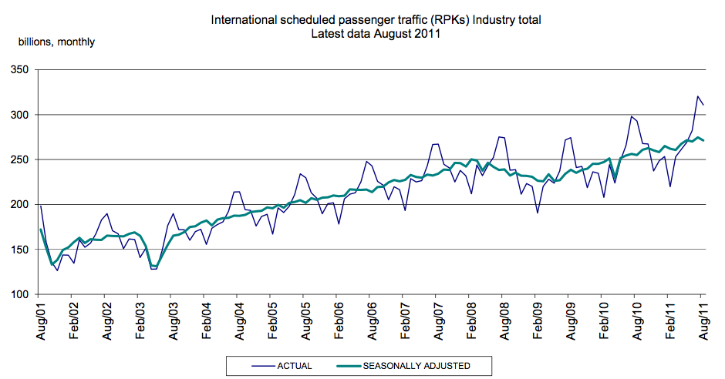
Revenue –Seasonal and Cyclical Demand
Industry Overview
American Airline
Southwest Airline
Singapore Airline

Slide 12
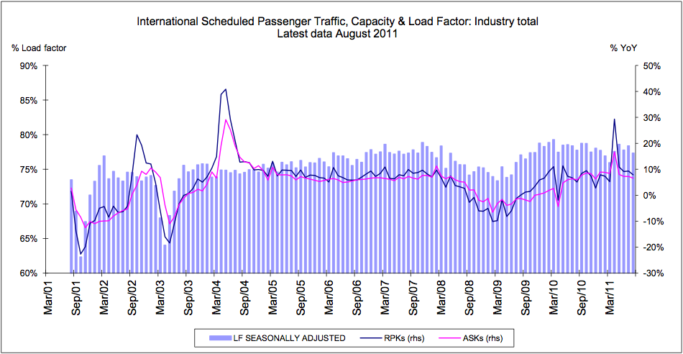
Revenue– Passenger
Industry Overview
American Airline
Southwest Airline
Singapore Airline

Slide 13
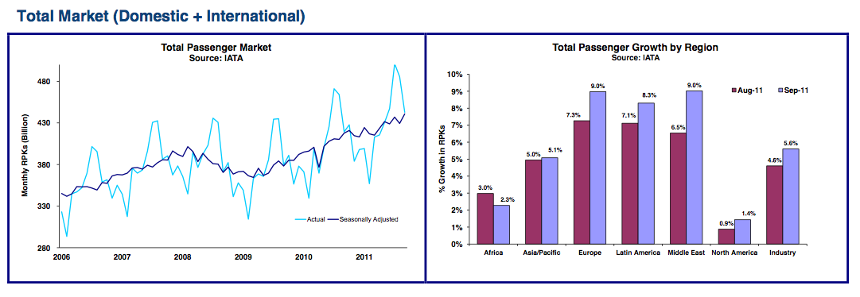
Revenue– Passenger
Industry Overview
American Airline
Southwest Airline
Singapore Airline

Slide 14
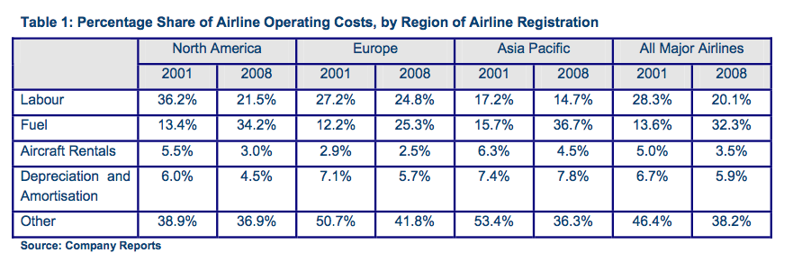
Profitability – Cost Structure
Industry Overview
American Airline
Southwest Airline
Singapore Airline

Slide 15
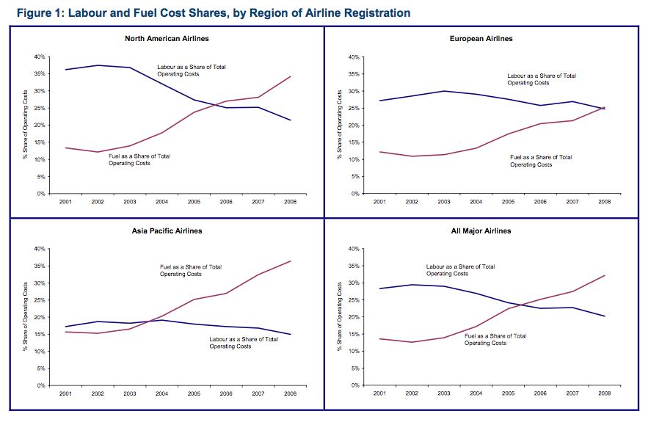
Profitability – Cost Structure
Industry Overview
American Airline
Southwest Airline
Singapore Airline

Slide 16
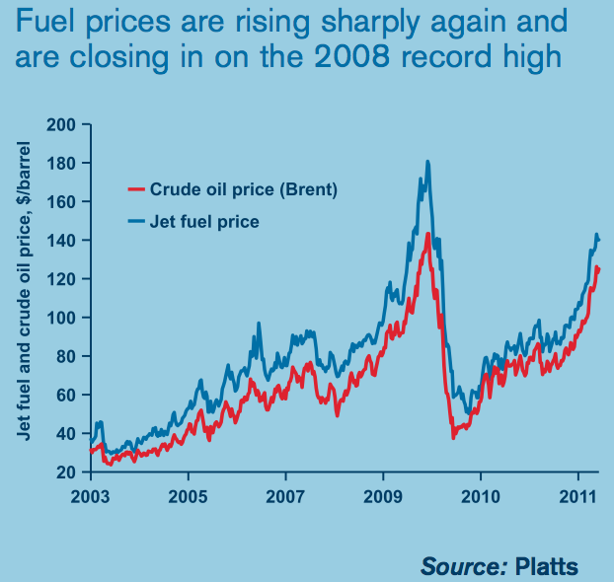
Profitability – Influence of Fuel
The cost of fuel is once more threatening the economics of air transport.
Hedging and fuel-efficiency gains offered airlines some protection from rising fuel prices, and reduce volatility
Even so, the airline industry’s fuel bill in 2010 rose more than 11%, to $139 billion. Fuel represented 26% of the industry’s 2010 operating expenses.
Industry Overview
American Airline
Southwest Airline
Singapore Airline

Slide 17
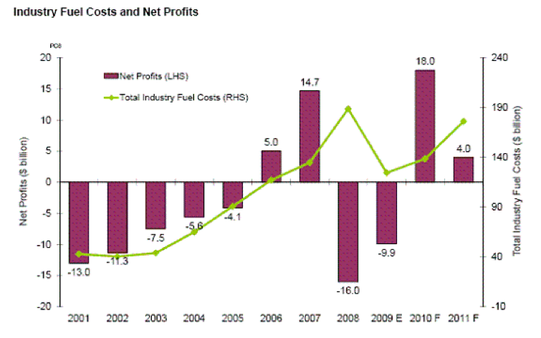
Profitability – Influence of Fuel
Industry Overview
American Airline
Southwest Airline
Singapore Airline

Slide 18
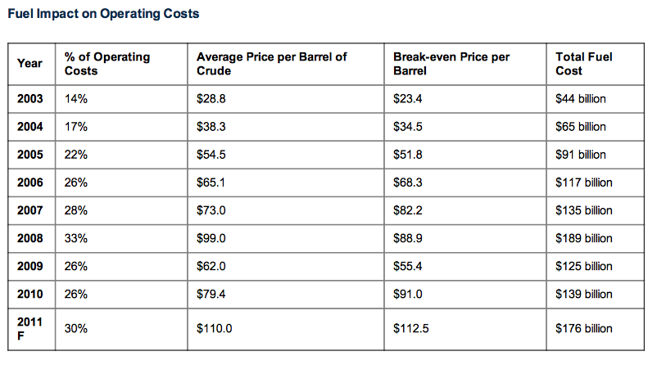
Profitability – Influence of Fuel
Industry Overview
American Airline
Southwest Airline
Singapore Airline

Slide 19
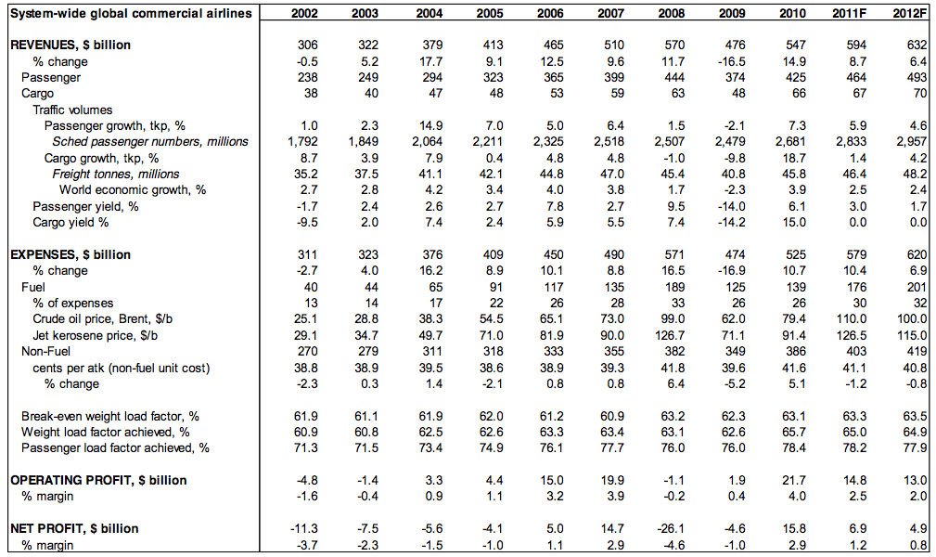
Overall Profitability
Industry Overview
American Airline
Southwest Airline
Singapore Airline

Slide 20
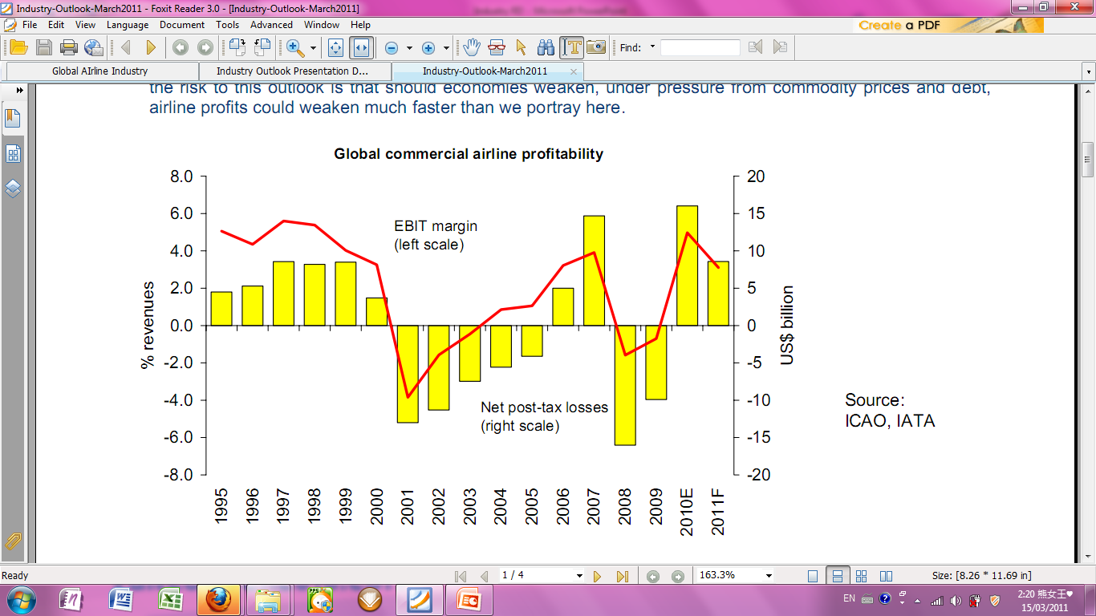
Overall Profitability
Airline profitability in 2010 saw its largest improvement in more than 60 years.
went from net posttax losses of $9.9 billion in 2009 to net posttax profits of $18 billion in 2010.
EBIT or operating profit margin improved more than 5 percentage points.
However, the profit margin in 2010 were still insufficient to allow the industry to meet its cost of capital.
Industry Overview
American Airline
Southwest Airline
Singapore Airline

Slide 21




Airline’s Supplier
Boeing is an American multinational aerospace and defense corporation, founded in 1916 by William E. Boeing in Seattle, Washington. Boeing has expanded over the years, merging with McDonnell Douglas in 1997. Boeing is made up of multiple business units, including Boeing Commercial Airplanes (BCA).
Airbus is a European aerospace company, based in Blagnac, France with significant activity across Europe. The company produces around half of the world's jet airliners. Airbus began as a consortium of aerospace manufacturers, Airbus Industrie. The company produced and markets the first commercially viable fly-by-wire airliner, the Airbus A320 and the world's largest airliner, the A380.
A300
A330
A340
A350
A380
Boeing 737
Boeing 747
Boeing 767
Boeing 777
Boeing 787
Industry Overview
American Airline
Southwest Airline
Singapore Airline

Slide 22
Airplane History
1903
First sustained flight with a powered, controlled airplane
1910s
Dramatic improvements in structures and control and propulsion systems
During World War I
First electromechanical flight simulator
1930s-
1940s
Douglas introduces the 12-passenger twin-engine DC-1 powered commercial aircraft in 1949
1920s
1960s
First small jet aircraft to enter mass production
Boeing 727 737 and 747 are launched
1970s
Airbus launched A300,A310
Concorde SST introduced into commercial airline service
1980s
Airbus launched A320
1990s
Airbus launched A330 A340 A321 A319
2000s
Airbus launched A380 350
Boeing launched 757 767
Boeing merged with Douglas and launched 717 777
Boeing launched 787
First nonstop solo flight across the Atlantic
Boeing introduces the 247, first modern commercial airliner with twin-engine and 10-passenger seats.
World War II spurs innovation: First jet
Industry Overview
American Airline
Southwest Airline
Singapore Airline

Slide 23
Importance of Airplane
Most important asset of airline
Influence the efficiency and profitability of airline
Capacity of airplane
Level of fuel consumptions
Comfort level
Industry Overview
American Airline
Southwest Airline
Singapore Airline

Slide 24
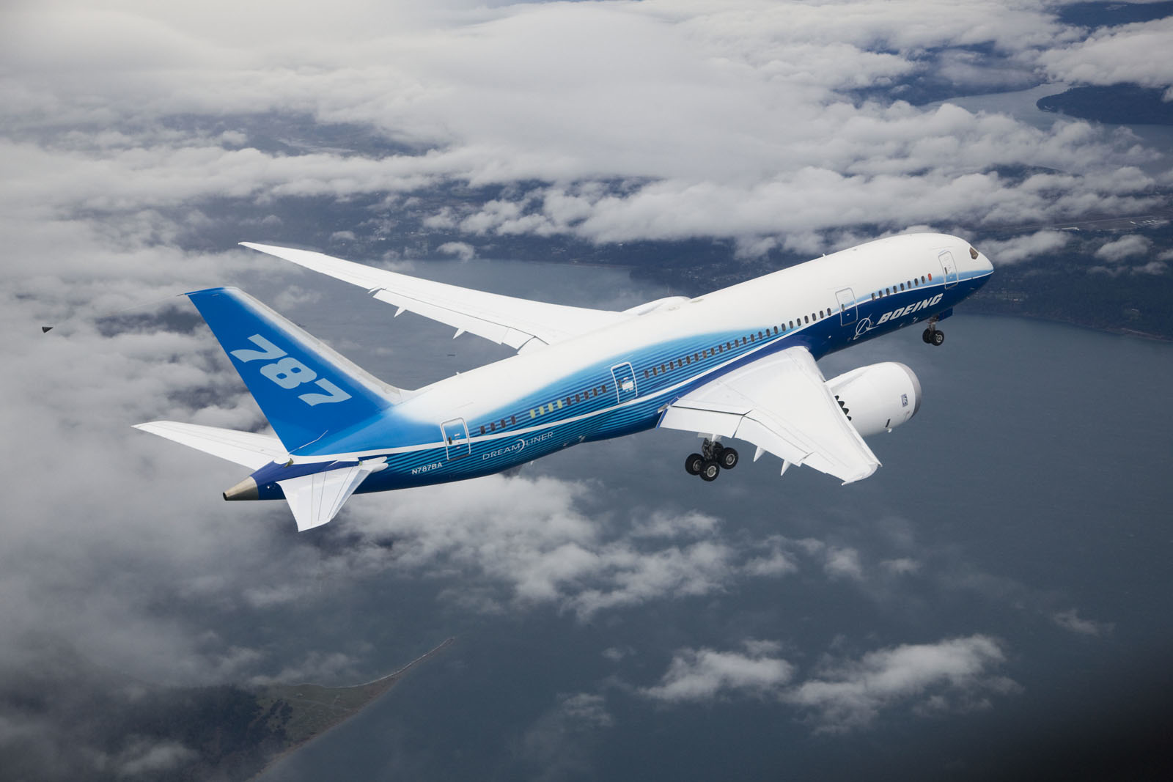
Latest Aircraft
Boeing 787 – The dreamliner
fastest-selling plane in commercial aircraft history)
Advanced composite materials, systems, engines
Allow Long-range nonstop service
Lower maintenance cost
Higher fuel efficiency, save 20% fuel
Higher customer comfort
Airline enjoy more cargo revenue capacity
Drawbacks: serious delay due to technical problem, delay result huge losses of airlines. Some airlines cancel order
In Oct 26, 2011, the Dreamliner completes its first commercial flight with All Nippon Airlines (ANA) from Tokyo to Hong Kong.
Industry Overview
American Airline
Southwest Airline
Singapore Airline

Slide 25
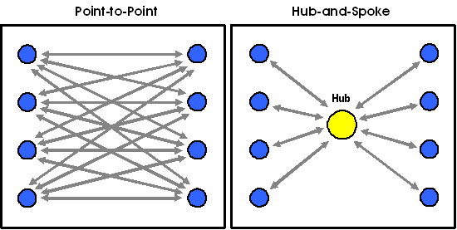
Business Model - Structure
Hub-and-Spoke System
Used by legacy carriers
Allowed for more distant and international routes
Utilize main airports as hubs
Lead to more efficient use of transportation resource
Centralized model result in inflexible operation (domino effect)
American Airline; Singapore Airline
Point to Point System
Used by low-cost carrier
Shorter routes, usually regional/domestic
↓connection & travel time
↑utilization leads to lower unit cost
Avoid domino effect
Require more routes
Less flexibility in destination
Southwest Airline (hybrid)
Industry Overview
American Airline
Southwest Airline
Singapore Airline

Slide 26
Business Model – Types of Airline
1. Network Legacy Airlines: Hub and spoke system
Long-haul routes, including international flights, using main airports
Higher product quality
Price discriminate: ‘sell the right seat, to the right customer, at the right time, for the right prices.’
Yield management system
A model that works for international carriers
Monopoly power in hub airports
Economies of scale in maintenance, ground services and flight frequency.
Industry Overview
American Airline
Southwest Airline
Singapore Airline

Slide 27
Business Model – Types of Airline
2. Low Cost Airlines (LCCs):Point to point system
Short-haul routes, usually regional flights, using secondary airports
Limited passenger services, charge for add-ons, one service class.
Price discrimination through time
Uniform fleet to reduce maintenance, personnel training costs and increase efficiency/flexibility of staff.
High aircraft/staff utilization with high seat density and short turnaround times between operations
COST REDUCTIONS LEADING TO LOWER FARE PRICES
Industry Overview
American Airline
Southwest Airline
Singapore Airline

Slide 28
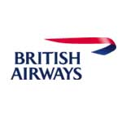

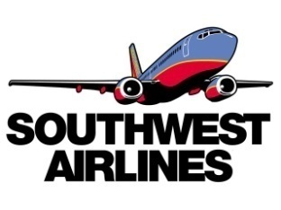



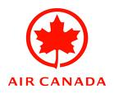
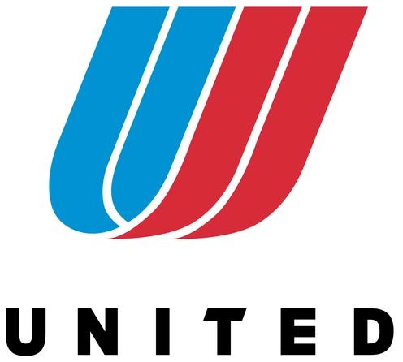




Business Model: Types of Airlines
Network/Legacy Carriers: NATIONAL / INTERNATIONAL
Low Cost Carriers (LCC): NATIONAL / REGIONAL
Cargo Airlines: INTERNATIONAL / NATIONAL / REGIONAL
Industry Overview
American Airline
Southwest Airline
Singapore Airline

Slide 29
IATA-International Air Transport Association
An international trade body that comprises 230 airlines and represents 93% of scheduled international air traffic
Developed the commercial standards
Help airlines by simplifying processes and increasing passenger convenience while reducing costs and improving efficiency.
Provides essential professional support to all industry stakeholders with a wide range of products and expert services.
Industry Overview
American Airline
Southwest Airline
Singapore Airline

Slide 30







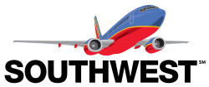


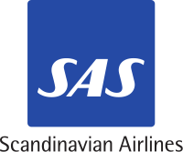





Alliances – Passenger Alliances
Star Alliance
Sky Team
Oneworld
Industry Overview
American Airline
Southwest Airline
Singapore Airline

Slide 31

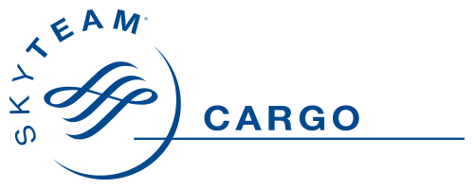


Alliances – Cargo Alliances
WOW Alliance
Sky Team Cargo
ANA/UPS Alliance
Industry Overview
American Airline
Southwest Airline
Singapore Airline

Slide 32
Alliances - Benefits
An extended and optimized network
Cost reduction from sharing of
Sales offices
Maintenance/operational facilities
Operational staff
Investment and purchases
Benefits Traveler
Lower Price
More choice of departure and destination
Faster mileage reward
Industry Overview
American Airline
Southwest Airline
Singapore Airline

Slide 33
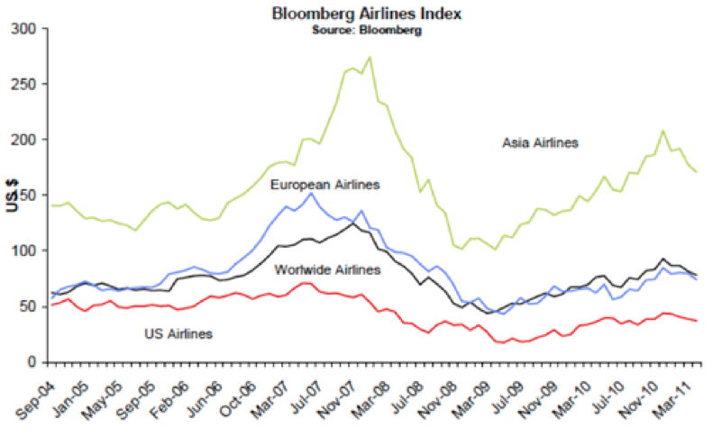
Market Index
Industry Overview
American Airline
Southwest Airline
Singapore Airline

Slide 34
Terrorist Events Of 9-11
Prior to September 2001, industry demand has been steadily trending upwards.
Fig. 1 demonstrates:
The seasonal component of airline demand (RPMs tend to peak in the sum- mer and bottom during the winter);
The cyclical component of airline demand
A number of notable events that have impacted the U.S. airline industry since 1980, such as the air traffic controller’s strike in August 1981 and the Gulf War in 1991
Industry Overview
American Airline
Southwest Airline
Singapore Airline

Slide 35
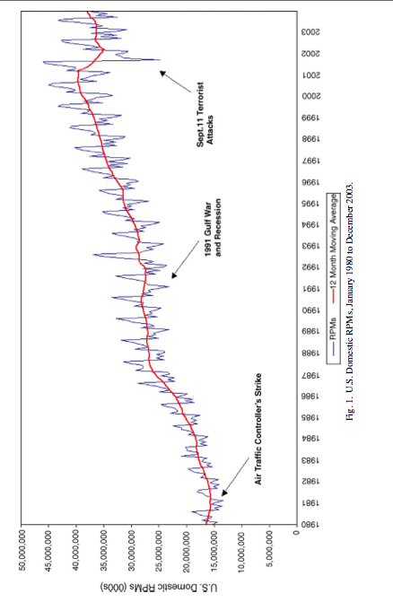
Terrorist Events Of 9-11: Fig 1
Industry Overview
American Airline
Southwest Airline
Singapore Airline

Slide 36
Terrorist Events Of 9-11
After September 11
Both a transitory, negative demand shock of more than 30%
An ongoing negative demand shift of approximately 7.4% that cannot be explained by cyclical, seasonal or other factors.
Travelers reduce or avoid air travel due to increased fear of a newly-perceived risk associated with flying.
The increased security measures that have made traveling by air post-September 11 more time-consuming and far less convenient. This “hassle factor” has been especially noticeable on the demand for short-haul trips.
The industry faced increasing consolidation and key bankruptcies as the sector struggled to regain its financial footing.
reduce operating cost and charge higher fares
United, Delta and Northwest
Industry Overview
American Airline
Southwest Airline
Singapore Airline

Slide 37
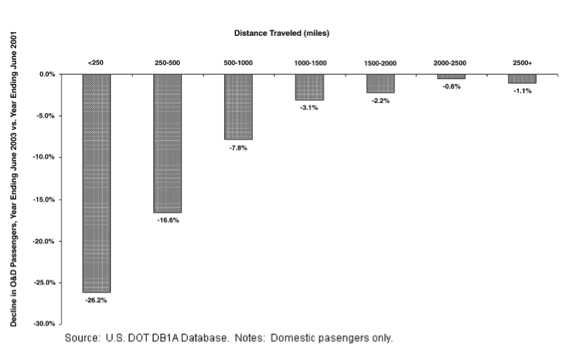
Terrorist Events Of 9-11: Fig 2
Industry Overview
American Airline
Southwest Airline
Singapore Airline

Slide 38
Terrorist Events Of 9-11
Figure 2 illustrate the percentage decline in the number of domestic origin and destination (O&D) passengers for the year ending June 2003 compared to the year ending June 2001
The drop in demand for domestic air service has been most pronounced in short-haul (less than 500 mile) markets, where increased elapsed travel times due to tighter security have made travel by alternative means.
driving or taking the train relatively more attractive following September 11.
Industry Overview
American Airline
Southwest Airline
Singapore Airline

Slide 39
Market Facts and Outlook
Industry Overview
American Airline
Southwest Airline
Singapore Airline

Slide 40
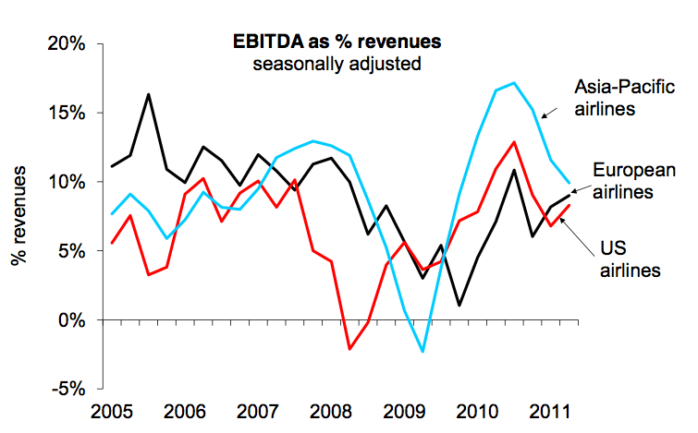
Cash Flows Are Being Squeezed
Industry Overview
American Airline
Southwest Airline
Singapore Airline

Slide 41
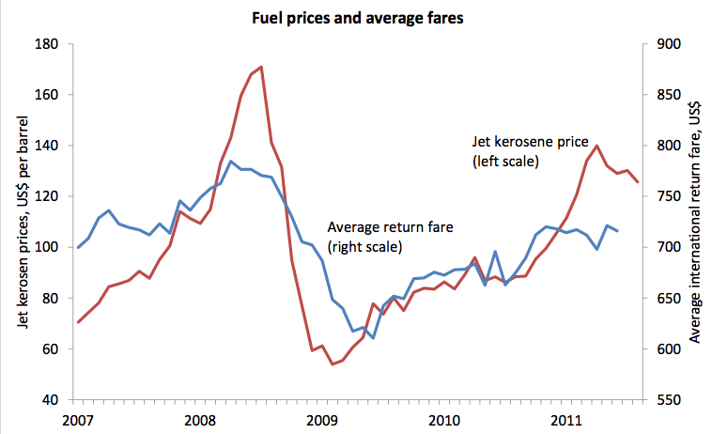
Mainly By The Rise In Fuel Costs
Industry Overview
American Airline
Southwest Airline
Singapore Airline

Slide 42
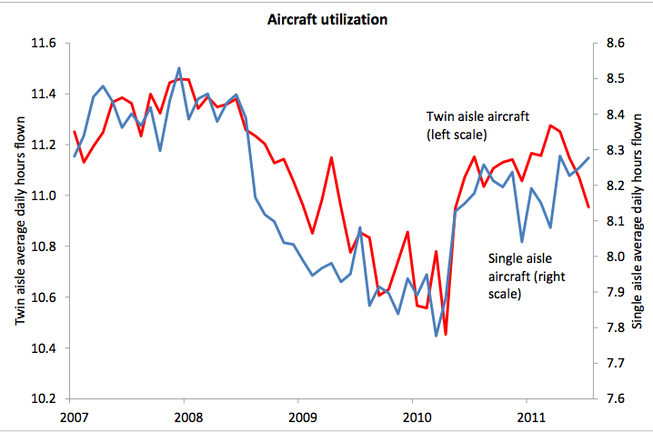
Also Due To Faltering Asset Utilization
Industry Overview
American Airline
Southwest Airline
Singapore Airline

Slide 43
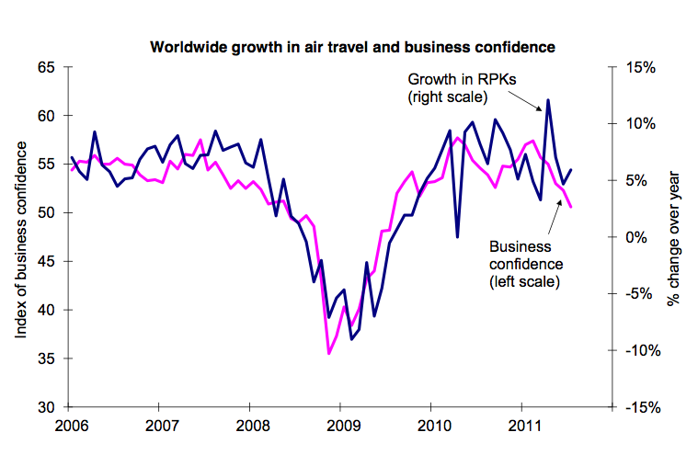
Travel Has Held Up But Outlook Is Weaker
Industry Overview
American Airline
Southwest Airline
Singapore Airline

Slide 44
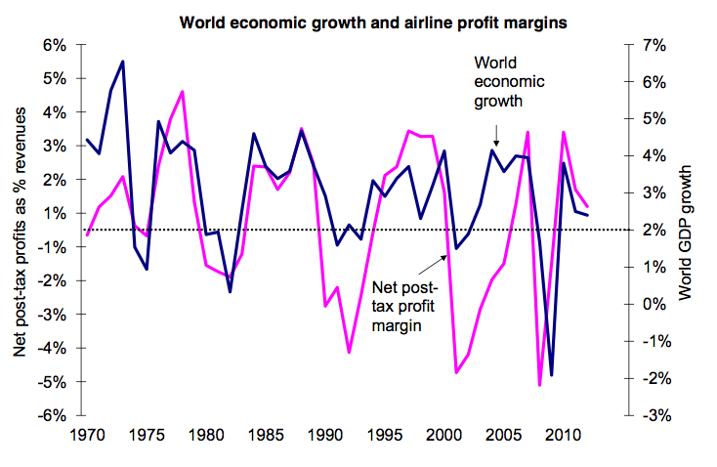
Global Growth Slowing Towards Critical Level
Industry Overview
American Airline
Southwest Airline
Singapore Airline

Slide 45
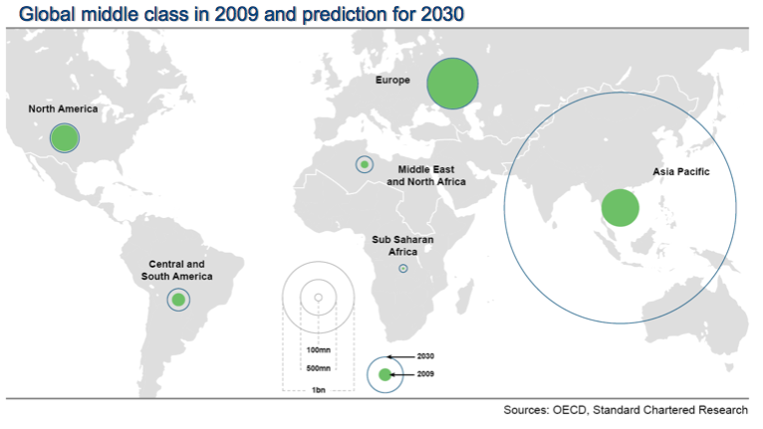
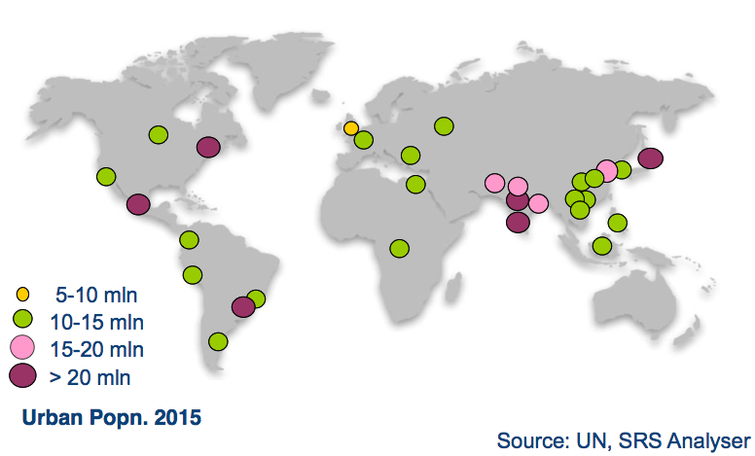
Will Reinforce Medium-term Geographical Shifts -Driven By Growth Of Middle Incomes And Large Cities, Particularly In ASPAC And LATAM
Industry Overview
American Airline
Southwest Airline
Singapore Airline

Slide 46
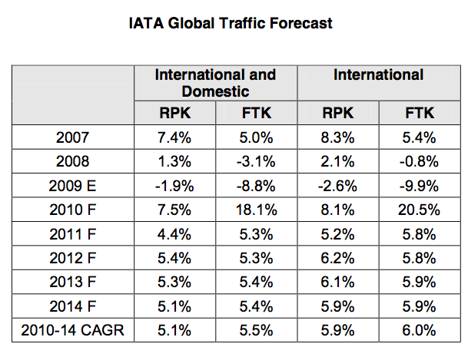
Traffic Is Expected to Increase
Industry Overview
American Airline
Southwest Airline
Singapore Airline

Slide 47
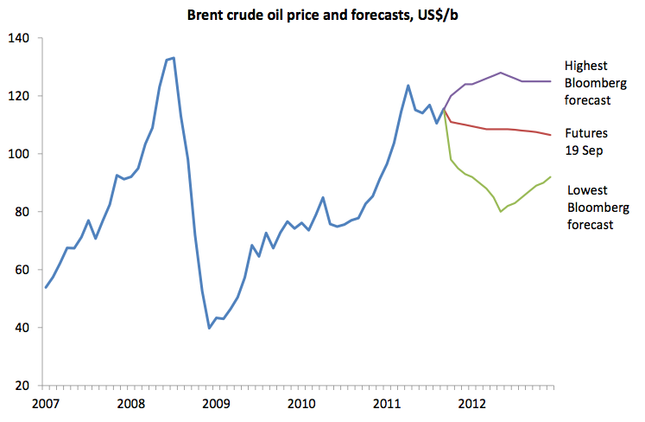
Fuel Costs Expected To Stay Relatively High
Industry Overview
American Airline
Southwest Airline
Singapore Airline

Slide 48
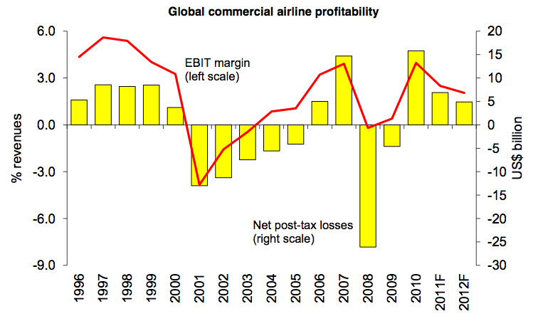
Profits Is Expected To Be Positive But Not Strong
Industry Overview
American Airline
Southwest Airline
Singapore Airline

Slide 49
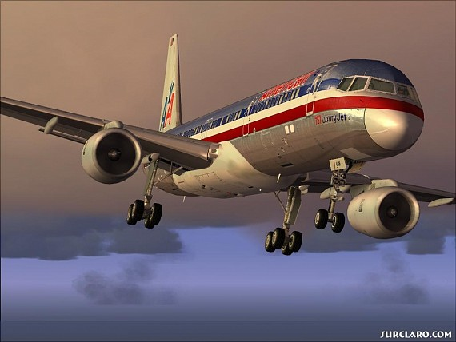
American Corporation
Industry Overview
American Airline
Southwest Airline
Singapore Airline

Slide 50
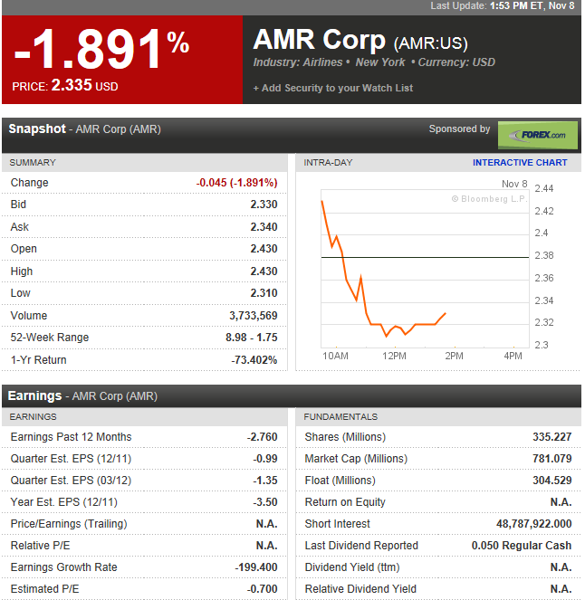
Current Stock Price
Industry Overview
American Airline
Southwest Airline
Singapore Airline

Slide 51
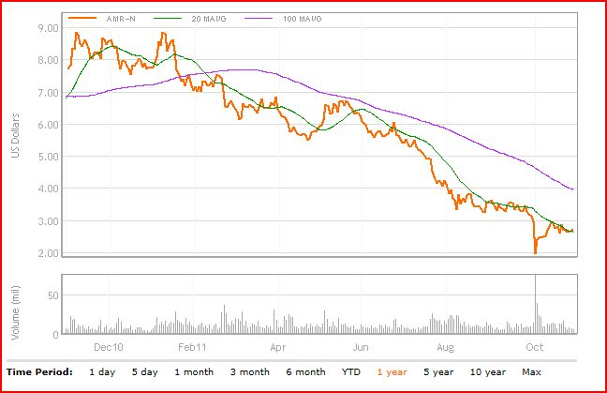
1 Year Stock Price
Industry Overview
American Airline
Southwest Airline
Singapore Airline

Slide 52
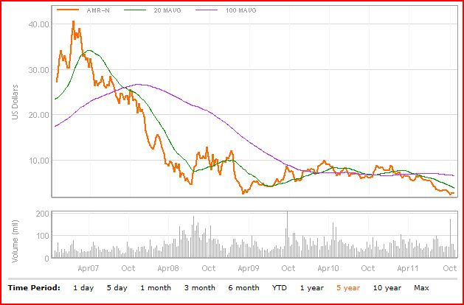
5 Year Stock Price
Industry Overview
American Airline
Southwest Airline
Singapore Airline

Slide 53
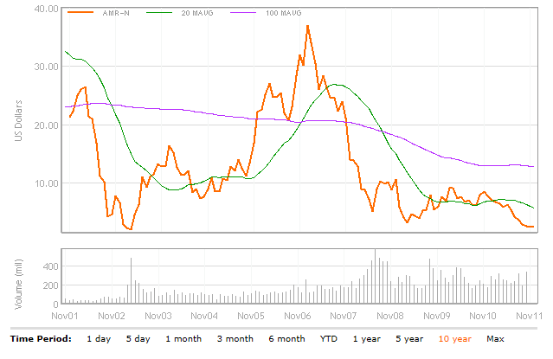
10 Year Stock Price
Industry Overview
American Airline
Southwest Airline
Singapore Airline

Slide 54
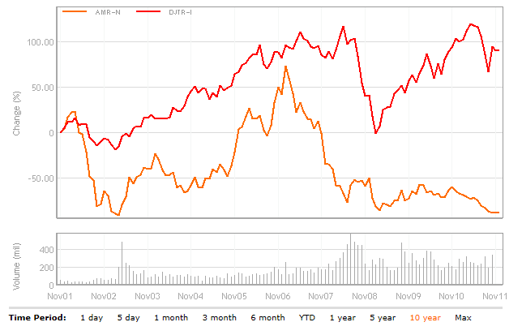
AMR Corp Vs Dow Jones Transportation (10 Years)
Industry Overview
American Airline
Southwest Airline
Singapore Airline

Slide 55
Company Background
AMR Corporation is headquartered in Fort Worth, Texas.
AMR is the parent company of both American Airlines, Inc. and American Eagle Airlines, Inc
Serve 250 cities in 50 countries with, on average, more than 3,600 daily flights
American’s network covers points throughout North America, the Caribbean, Latin America, Europe and the Pacific.
Main operating hubs: Dallas/Fort Worth, Chicago, Miami, and New York
Uses Hub and Spoke system
Industry Overview
American Airline
Southwest Airline
Singapore Airline

Slide 56
Brief History of AMR
In 1934, American Airways became American Airlines, Inc.
In 1979, American moved its headquarters from New York City to Dallas/Fort Worth, Texas.
In 1981, American introduced the AADVANTAGE travel awards program.
On May 19, 1982, stockholders approved a plan of reorganization and a new holding company was formed, AMR Corporation.
In 1984, American introduced the American Eagle system
On January 16, 1992, American opened the first state-of-the-art airline maintenance facility
Industry Overview
American Airline
Southwest Airline
Singapore Airline

Slide 57
History Continued
On Feb. 1, 1999 global alliance – oneworld was formed.
On April 2, 2002, Gerard J. Arpey was elected President and Chief Operating Officer of American Airlines.
On April 2, 2006, American launched its first-ever service to China
On March 31, 2009, American announced the expansion of Gogo® Inflight Internet on more than 300 domestic aircraft.
In October 2009, American launched a first-of-its-kind social networking site, BlackAtlas.com
On July 21, 2010, American Airlines announced an order for 35 additional Next-Generation Boeing 737-800s, to be delivered in 2011 and 2012
Industry Overview
American Airline
Southwest Airline
Singapore Airline

Slide 58
Recent Event
On July 20, 2011 American entered into agreement to acquire 460 narrowbody, single-aisle aircraft from the Boeing 737 and Airbus A320 families beginning in 2013 through 2022
Agreement includes options and purchase rights for 465 additional aircraft through 2025
Starting in 2017 American will become the first network U.S. airline to begin taking delivery of "next generation" narrowbody aircraft that will further accelerate fuel-efficiency gains.
Industry Overview
American Airline
Southwest Airline
Singapore Airline

Slide 59
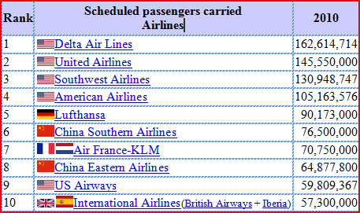
World Ranking of Airlines in Terms of Passengers Carried
Industry Overview
American Airline
Southwest Airline
Singapore Airline

Slide 60
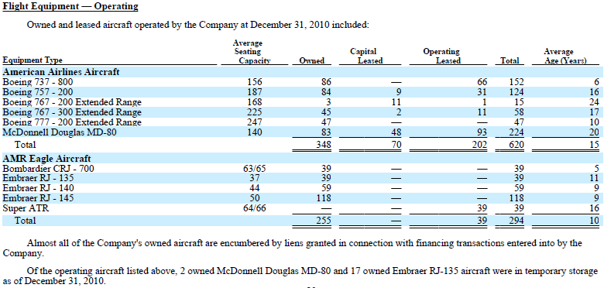
Operating Fleets
Industry Overview
American Airline
Southwest Airline
Singapore Airline

Slide 61
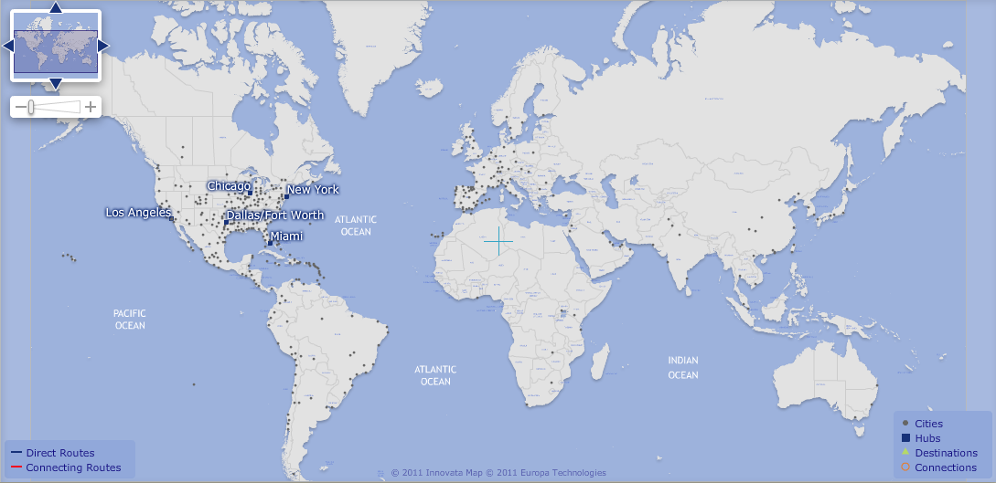
AMR’s Hubs and Destinations
Industry Overview
American Airline
Southwest Airline
Singapore Airline

Slide 62
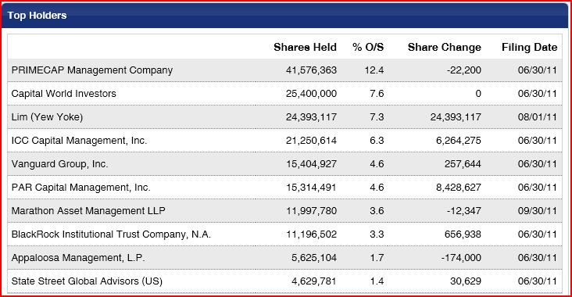
Major Shareholders
Industry Overview
American Airline
Southwest Airline
Singapore Airline

Slide 63
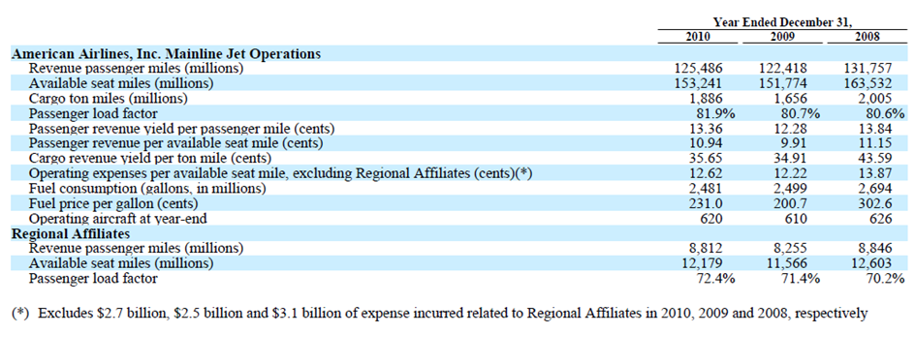
Operation Statistics
Industry Overview
American Airline
Southwest Airline
Singapore Airline

Slide 64
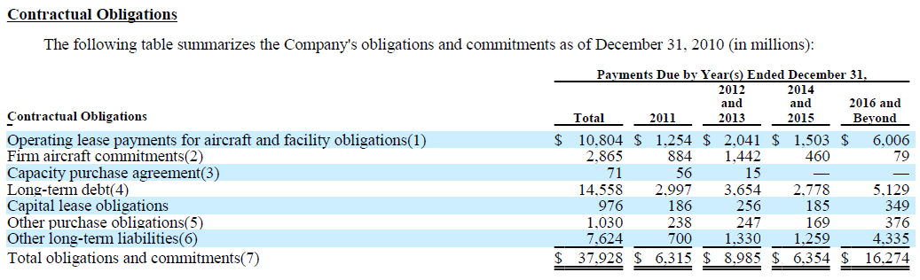
Contractual Obligations
Industry Overview
American Airline
Southwest Airline
Singapore Airline

Slide 65
Average Fuel Cost
Industry Overview
American Airline
Southwest Airline
Singapore Airline

Slide 66
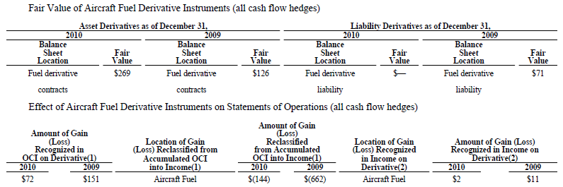
Fuel Hedging Strategy
The company uses variety of financial instruments, primarily heating oil option and collar contracts to hedge the price risk of jet fuels.
Industry Overview
American Airline
Southwest Airline
Singapore Airline
Notes:
Fuel Price Risk Management As part of the Company's risk management program, it uses a variety of financial instruments,
primarily heating oil option and collar contracts, as cash flow hedges to mitigate commodity
The fair value of the
Company's fuel hedging agreements at December 31, 2010 and 2009, representing the amount the Company would receive upon
termination of the agreements, totaled $257 million and $57 million, respectively, which excludes a payable for both years related to
contracts that settled in December of each year.

Slide 67
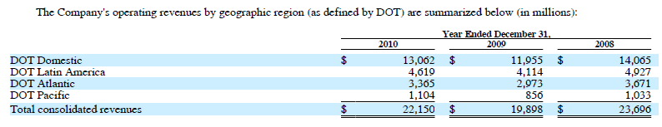
Revenue By Geographic Region
Industry Overview
American Airline
Southwest Airline
Singapore Airline

Slide 68
American Corporation
Management Team

Slide 69

Management Team
Gerard J. Arpey - Chairman and CEO, AMR Corp. and American Airlines since 2004
Joined American Airlines in 1982 as a Financial Analyst
Executive Vice President of Operations of American (2000-2002)
President and Chief Operating Officer of AMR and American (2002-2003)
Holds a Bachelor of Business Administration Degree and an MBA from the University of Texas at Austin.
Industry Overview
American Airline
Southwest Airline
Singapore Airline

Slide 70

Management Team
Thomas W. Horton — President, AMR Corp. and American Airlines
Joined AMR in 1985 and held a range of senior financial positions with AMR
Senior Vice President and Chief Financial Officer of AMR and American (2000-2002)
Executive Vice President of Finance and Planning and Chief Financial Officer of AMR and American(2006-2010)
Holds a BBA degree from Baylor University and an MBA degree from the Cox School of Business at Southern Methodist University
Industry Overview
American Airline
Southwest Airline
Singapore Airline

Slide 71

Management Team
Isabella D. Goren - SVP and Chief Financial Officer, AMR Corp. and American Airlines
Joined American in 1986 as a Financial Analyst
Vice President of Interactive Marketing and Reservations (2003-2006)
Senior VP of Customer Relationship Marketing(2006-2010)
Holds a B.S. in Chemical Engineering from the University of Texas and an MBA from Southern Methodist University.
Industry Overview
American Airline
Southwest Airline
Singapore Airline

Slide 72

Financial Analysis

Slide 73

Balance Sheet (3rd Quarter)
Industry Overview
American Airline
Southwest Airline
Singapore Airline

Slide 74

Balance Sheet(3rd Quarter)
Industry Overview
American Airline
Southwest Airline
Singapore Airline

Slide 75

Balance Sheet (Annual)
Industry Overview
American Airline
Southwest Airline
Singapore Airline

Slide 76

Short-term Investments
Industry Overview
American Airline
Southwest Airline
Singapore Airline

Slide 77

Balance Sheet (Annual)
Industry Overview
American Airline
Southwest Airline
Singapore Airline

Slide 78

Long Term Debts
Industry Overview
American Airline
Southwest Airline
Singapore Airline

Slide 79

Statement of Operations (Annual)
Industry Overview
American Airline
Southwest Airline
Singapore Airline

Slide 80

Statement of Operations (3rd Quarter)
Industry Overview
American Airline
Southwest Airline
Singapore Airline

Slide 81

5 year Operating Income
Industry Overview
American Airline
Southwest Airline
Singapore Airline

Slide 82

Statement of Cash Flows (Annual)
Industry Overview
American Airline
Southwest Airline
Singapore Airline

Slide 83

Statement of Cash Flows (3rd Quarter)
Industry Overview
American Airline
Southwest Airline
Singapore Airline

Slide 84

RECOMMENDATION
SELL

Slide 85


Southwest Airlines
Industry Overview
American Airline
Southwest Airlines
Singapore Airline

Slide 86

Stock Information
Industry Overview
American Airline
Southwest Airlines
Singapore Airline

Slide 87
1 Year Price Chart
Industry Overview
American Airline
Southwest Airlines
Singapore Airline

Slide 88
5 Year Price Chart
Industry Overview
American Airline
Southwest Airlines
Singapore Airline

Slide 89

10 Year Price Chart
Industry Overview
American Airline
Southwest Airlines
Singapore Airline

Slide 90

10 Year Comparison: LUV, Dow Jones Transportation and S&P500
Industry Overview
American Airline
Southwest Airlines
Singapore Airline

Slide 91











History
March 15, 1967
Southwest incorporated
1980s~1990s
Fast expanding
2011
Acquisition of AirTran
Industry Overview
American Airline
Southwest Airlines
Singapore Airline

Slide 92
Timeline: 1960 - 1980
1967: Incorporated as Air Southwest Co.
1971: Launches first route with 3 Boeing 737 aircrafts serving only Dallas, Houston and San Antonio
1973: Southwest posts first profit
1976: Renamed to Southwest Airlines Co. (SWA)
1977: SWA carries its 5 millionth passenger and is listed on the NYSE
1978: SWA flies outside Texas to New Orleans
Industry Overview
American Airline
Southwest Airlines
Singapore Airline

Slide 93
Timeline: 1980 - Present
1982: SWA begins flights to the West Coast
1990: Revenues exceed $1 billion
1994: Morris Air and Arizona One are acquired
1996: Online booking site is launched
2005: SWA enters first ever codeshare arrangement, with ATA Airlines
2011:Southwest Airlines acquired AirTran
Industry Overview
American Airline
Southwest Airlines
Singapore Airline

Slide 94
Company Today
The highest quality of Customer Service
Mission of Southwest Airlines is dedication to the highest quality of Customer Service delivered with a sense of warmth, friendliness, individual pride, and Company Spirit.
The largest low cost carrier in the US
Total 699 aircrafts
611 Boeing-737 and 88 Boeing-717
136 destinations in 45 states in the US
5 destinations in Caribbean and Mexico
Best cumulative Customer Satisfaction record among airlines for the last 18 years
As year end of 2010, SWA has been profitable for 38th consecutive years and declares 138th consecutive Quarterly Dividend
Industry Overview
American Airline
Southwest Airlines
Singapore Airline

Slide 95
Current Event
On May 2, 2011, Southwest acquired all of the outstanding equity of AirTran.
Each share of AirTran was exchanged for $3.75 in cash and 0.321 shares of Southwest stock at $11.90/share
AirTran was valued at approximately $7.57/share, or $1.0 billion in the aggregate.
For the three and nine month periods ended September 30, 2011, Southwest had incurred consolidated acquisition-related costs of $22 million and $97 million, respectively.
Southwest is expected to continue to incur substantial integration and transition expenses for the AirTran acquisition.
Industry Overview
American Airline
Southwest Airlines
Singapore Airline

Slide 96
Business Model
Point-to-Point
Flying multiple short quick trips
Factors that allow low operating costs
Employees: Empowerment and Respect
Higher productivity
Flying into the secondary airports of major markets
Reduces costs associated with landing fees, etc.
Less congestion → Increase turnaround
One Aircraft Type: Boeing 737
Reduce costs associated with maintenance, training and ground operations
These factors allow Southwest to provide ‘low-cost’ flights
Industry Overview
American Airline
Southwest Airlines
Singapore Airline

Slide 97

Aircrafts Purchasing Plan
Industry Overview
American Airline
Southwest Airlines
Singapore Airline

Slide 98

Hedging for Jet Fuel
Using West Texas Intermediate crude oil, Brent crude oil, and refined products, such as heating oil and unleaded gasoline, to decreasing its exposure to jet fuel price volatility
Industry Overview
American Airline
Southwest Airlines
Singapore Airline

Slide 99

Servicing Map of Southwest
Industry Overview
American Airline
Southwest Airlines
Singapore Airline

Slide 100

Servicing Map of AirTran
Industry Overview
American Airline
Southwest Airlines
Singapore Airline

Slide 101
Management Team
Gary C. Kelly | Chairman of the Board, President, Chief Executive Officer
Laura H. Wright | Chief Financial Officer, Senior Vice President - Finance
Michael G. Van de Ven | Chief Operating Officer, Executive Vice President
Jeff Lamb | Executive Vice President, Chief People and Administrative Officer
Ron Ricks | Executive Vice President - Corporate Services, Corporate Secretary
Robert R. Jordan | Executive Vice President, Chief Commercial Officer, President - AirTran Airways
Davis S. Ridley | Chief Marketing Officer, Senior Vice President
Ellen Torbert | Vice President - Diversity & Inclusion
J. Veronica Biggins | Director
William H. Cunningham Ph.D. | Independent Presiding Director
Industry Overview
American Airline
Southwest Airlines
Singapore Airline

Slide 102

Gary C. Kelly
- Chairman, President (since 1994), CEO
Age: 55
1986: Joined the company as Controller
1989: CFO and VP of Finance
1991: Executive Vice President
2004: CEO
2008: Chairman of the Board of Directors
Education:
Earned B.B.A. in Accounting from University of Texas
Certified Public Accountant
Industry Overview
American Airline
Southwest Airlines
Singapore Airline

Slide 103


Industry Overview
American Airline
Southwest Airlines
Singapore Airline

Slide 104

Industry Overview
American Airline
Southwest Airlines
Singapore Airline

Slide 105

Industry Overview
American Airline
Southwest Airlines
Singapore Airline

Slide 106

Five-Year Summary Selected Consolidated Financial Data (GAAP)
Source: Annual Report, Southwest
Industry Overview
American Airline
Southwest Airlines
Singapore Airline

Slide 107
Income & Expense Figure
Industry Overview
American Airline
Southwest Airlines
Singapore Airline

Slide 108


Industry Overview
American Airline
Southwest Airlines
Singapore Airline

Slide 109

Industry Overview
American Airline
Southwest Airlines
Singapore Airline

Slide 110
Operating Margin Comparison
2010 vs. 2011
Industry Overview
American Airline
Southwest Airlines
Singapore Airline

Slide 111


Five-Year Summary Selected Consolidated Operating Data (GAAP)
Source: Annual Report, Southwest
Industry Overview
American Airline
Southwest Airlines
Singapore Airline

Slide 112
Performance
Industry Overview
American Airline
Southwest Airlines
Singapore Airline

Slide 113
Operating Expenses
Industry Overview
American Airline
Southwest Airlines
Singapore Airline

Slide 114

Operating Performance
Industry Overview
American Airline
Southwest Airlines
Singapore Airline

Slide 115


Operating Performance
Industry Overview
American Airline
Southwest Airlines
Singapore Airline

Slide 116

Industry Overview
American Airline
Southwest Airlines
Singapore Airline

Slide 117


Industry Overview
American Airline
Southwest Airlines
Singapore Airline

Slide 118
Evaluation
Positive
Alleviate the competition from AirTran
Extend Southwest’s network and expand its market
Generate more revenue
Negative
Economy down pressure
Increasing fuel cost
Operating margin decline
Uncertainty in the integration of AirTran
More difficult in controlling expenses
Potential disputes or law suits in the acquisition
Industry Overview
American Airline
Southwest Airlines
Singapore Airline

Slide 119


Recommendation
HOLD
Industry Overview
American Airline
Southwest Airlines
Singapore Airline

Slide 120

Singapore Airline
Industry Overview
American Airline
Southwest Airline
Singapore Airline

Slide 121


Singapore Airlines (SGX: C6L)
Exchange Rate: $1 USD = 1.266 SGD
Industry Overview
American Airline
Southwest Airline
Singapore Airline
Notes:
Current stock price (updated )
Total share outstanding
Currency exchange rate
Listed on Singapore Stock Ex change

Slide 122

1-Year Stock Price Movement
Industry Overview
American Airline
Southwest Airline
Singapore Airline
Notes:
July 29, the market was caught with its pants down last week when Singapore Airlines (SIA) shocked with first-quarter core net profit of just $6 million, versus a consensus bottomline profit estimate of $130-180 million.

Slide 123

5-Year Stock Price Movement
Industry Overview
American Airline
Southwest Airline
Singapore Airline
Notes:
50 100

Slide 124

10-Year Stock Price Movement
Industry Overview
American Airline
Southwest Airline
Singapore Airline
Notes:
50 100

Slide 125
Price Comparison
Industry Overview
American Airline
Southwest Airline
Singapore Airline

Slide 126
SIA - Timeline
May 1, 1947: Began with the incorporation of Malayan Airways Limited.
1963: Federation of Malaysia was formed and the airline changed name to Malaysian Airways.
1966: Singapore separated from the federation and the airline changed name to Malaysia-Singapore Airlines (MSA).
1972: MSA split up to form Malaysian Airlines System and Singapore Airlines.
February 2004: World’s longest non-stop flight from Singapore to LA.
October 25, 2007: First to fly the A380 from Singapore to Sydney.
Industry Overview
American Airline
Southwest Airline
Singapore Airline
Notes:
First flight: using an airspeed consul twin engined aeroplane
From 1980s – 1990s, adding more cities and expand its services to india, asia, north ameria, european countries

Slide 127

SIA – Current Events
Aug 4, problems in Tiger safety documents disrupt Australia return
Oct 20, The Competition Commission of Singapore has approved the alliance between Singapore Airlines and Virgin Australia
Oct 21, SIA will fly to Addis Ababa, Ethiopia’s capital city, under a code share agreement with Ethiopian Airlines from Nov 1.
Aug 10, will order eight more Boeing 777-300ERs to support growth plans for the coming year.
Nov 1, SIA targets mid-2012 take off for new budget carrier Scoot
Industry Overview
American Airline
Southwest Airline
Singapore Airline
Notes:
August 4, Australia's aviation safety authority has identified problems in documentation provided by Tiger Airways Holdings Ltd. (J7X.SG) related to safety practices, delaying the airline's possible return to Australian skies.

Slide 128



SIA – the Group and Alliance
World’s second-largest carrier
Major subsidiaries
SilkAir – regional wing
SIA Engineering Company
SIA Cargo
Scoot – long-haul, low-cost
Important Investments
Tiger Airways – low-cost carrier, own 34.4%, listed on SGX
Virgin Atlantic Airways – own 49%
Alliance
Star Alliance
Industry Overview
American Airline
Southwest Airline
Singapore Airline
Notes:
Silkair: operates scheduled passenger services from Singapore to 31 cities in Southeast Asia, South Asia and China

Slide 129

SIA – Management Team
BOD Chairman Stephen Lee Ching Yen
Became chairman of BOD in 2006
Managing Director of Shanghai Commercial & Savings Bank (Taiwan) and Great Malaysia Textile Investments Pte Ltd
President of the Singapore National Employers’ Federation since 1988 and is a Council Member of the Singapore National Wages Council
Nominated Member of Parliament from 1994-1997
Graduated from Northwestern University, Illinois, USA in 1973, MBA
Industry Overview
American Airline
Southwest Airline
Singapore Airline

Slide 130
SIA – Management Team
Director and CEO – Goh Choon Phong
Appointed Director in 2010 and CEO On 1 January 2011
Join SIA since 1990 and held senior management positions in various divisions in Singapore and overseas
President of the Singapore Airlines Cargo Pte Lid from 2006 to 2010 and was EVP for Marketing and the Regions
Received undergraduate degree and a graduate degree from the Massachusetts Institute of Technology.
Industry Overview
American Airline
Southwest Airline
Singapore Airline
Notes:
Various position: ranging from
Marketing to Information Technology to Finance and Cargo.

Slide 131


SIA – Fleet Profile
Industry Overview
American Airline
Southwest Airline
Singapore Airline
Notes:
As at 31 March 2011, Singapore Airlines Group operating fleet consisted of 137 aircraft - 126 passenger aircraft and
11 freighters. 108 and 18 of the passenger aircraft were operated by Singapore Airlines and SilkAir respectively.

Slide 132

SIA – Global Route Map
Industry Overview
American Airline
Southwest Airline
Singapore Airline
Notes:
62 destinations
Singapore Airlines operates a hub at Changi Airport and has a strong presence in the Southeast Asia, East Asia, South Asia, and "Kangaroo Route" markets. The company also operates trans-Pacific flights, including the world's two longest non-stop commercial flights from Singapore to Newark and Los Angeles on the Airbus A340-500.[

Slide 133


SIA – Regional Route Map
Industry Overview
American Airline
Southwest Airline
Singapore Airline
Notes:
Singapore Airlines operates a hub at Changi Airport and has a strong presence in the Southeast Asia, East Asia, South Asia, and "Kangaroo Route" markets.
Also point to point service: from the U.S. to other cities such as tokyo and hong kong

Slide 134


SIA – Major Shareholders
Industry Overview
American Airline
Southwest Airline
Singapore Airline
Notes:
Total share outstanding 1,198,246,165
Government owned

Slide 135
SIA – A Great Way To Fly
A Great Way To Fly
“Singapore Airlines is a global company dedicated to providing air transportation services of the highest quality and to maximizing returns for the benefit of its shareholders and employees.”
----Singapore Airlines' Mission Statement
Commitment to the Environment
Embrace new technology and green initiative on the ground
Reduce fuel consumption
Industry Overview
American Airline
Southwest Airline
Singapore Airline
Notes:
Flight Operation Procedures that Reduces Fuel Burn
Participation in the Asia and Pacific Initiative to Reduce Emissions (ASPIRE) Programme
Commitment to Achieving Carbon-Neutral Growth
Harapan Rainforest Initiative

Slide 136

SIA - Branding
Singapore Girl
Represent the Asian value and hospitality
caring, warm, gentle, elegant and serene
Sarong Kebaya uniform
Industry Trendsetter
Industry – leading innovations
The list of “First”
Industry Overview
American Airline
Southwest Airline
Singapore Airline
Notes:
First to offer free headsets, a choice of meals and free drinks in Economy Class, in the 1970s
First to introduce satellite-based inflight telephones in 1991
First to involve a comprehensive panel of world-renowned chefs, the International Culinary Panel, in developing inflight meals in 1998
First to offer audio and video on demand (AVOD) capabilities on KrisWorld in all classes in October 2001

Slide 137



SIA - Branding
The World’s most awarded airline
Awarded second place in the Skytrax world’s best airlines awards 2011
Industry Overview
American Airline
Southwest Airline
Singapore Airline
Notes:
New design of cabin, seats and services to provide more high quality service

Slide 138
SIA – Hedging
Fuel
hedges its jet fuel requirements in Mean of Platts Singapore Jet Kerosene (“MOPS”)
hedging up to 15 months forward using jet fuel swap and option contracts.
Existing gasoil swap contracts will be rolled up into jet fuel equivalents by hedging in the gasoil-jet fuel regrade closer to maturity
Currency
largest exposures are from USD, Euro, UK Sterling Pound, Swiss Franc, Australian Dollar, New Zealand Dollar, Japanese Yen, Indian Rupee, Hong Kong Dollar, Chinese Yuan, Korean Won and Malaysian Ringgit.
As at 31 March 2011, the Company holds USD460.9 million (2010: USD158.3 million) in short-term deposits to hedge against foreign currency risk for a portion of the forecast USD capital expenditure in the next 10 months.
Industry Overview
American Airline
Southwest Airline
Singapore Airline

Slide 139
SIA – Financial Highlights
FY 2010/2011
Industry Overview
American Airline
Southwest Airline
Singapore Airline

Slide 140
SIA – 10 Year Record
Industry Overview
American Airline
Southwest Airline
Singapore Airline

Slide 141
SIA – Balance Sheet Q2 2011
Industry Overview
American Airline
Southwest Airline
Singapore Airline

Slide 142
SIA – Balance Sheet Q2 2011
Industry Overview
American Airline
Southwest Airline
Singapore Airline

Slide 143
SIA – Balance Sheet FY 2010/2011
Industry Overview
American Airline
Southwest Airline
Singapore Airline

Slide 144
SIA – Balance Sheet FY 2010/2011
Industry Overview
American Airline
Southwest Airline
Singapore Airline

Slide 145
SIA - Performance
Equity attributable to owners of increased by 5.5% to $14,204 million resulting from the profit for the year. The Group assets increased by 9.2% because of increased in cash and bank balance.
Industry Overview
American Airline
Southwest Airline
Singapore Airline

Slide 146
SIA - Performance
The Group’s net liquid assets increased by 130% to $2519 million, resulting from cash generated from operations. Total debt to equity ratio at 0.14 times.
Industry Overview
American Airline
Southwest Airline
Singapore Airline

Slide 147
SIA – Income Statement FY 2010/2011
Industry Overview
American Airline
Southwest Airline
Singapore Airline

Slide 148
SIA – Income Statement Q2 2011
Industry Overview
American Airline
Southwest Airline
Singapore Airline

Slide 149
SIA – Revenue by Region
Industry Overview
American Airline
Southwest Airline
Singapore Airline
Notes:
SATS Ltd Group (“SATS Group”) was deconsolidated from the Group with effect from 1 September 2009, after completion of the dividend
in specie distribution.

Slide 150
SIA – Group Earnings
Industry Overview
American Airline
Southwest Airline
Singapore Airline
Notes:
SATS Ltd Group (“SATS Group”) was deconsolidated from the Group with effect from 1 September 2009, after completion of the dividend
in specie distribution.

Slide 151
SIA – Top 5 Expenditure FY 2010/2011
Industry Overview
American Airline
Southwest Airline
Singapore Airline

Slide 152
SIA Expenditure
Industry Overview
American Airline
Southwest Airline
Singapore Airline

Slide 153
SIA – Fuel Expenditure FY 10/11
Parent Airline Company
Industry Overview
American Airline
Southwest Airline
Singapore Airline

Slide 154
SIA - Operation Statistics 10/11
Industry Overview
American Airline
Southwest Airline
Singapore Airline

Slide 155
SIA – Cash Flow Statement FY 10/11
Industry Overview
American Airline
Southwest Airline
Singapore Airline

Slide 156
SIA – Cash Flow Statement FY 10/11
Industry Overview
American Airline
Southwest Airline
Singapore Airline

Slide 157
SIA – Cash Flow Statement Q2 2011
Industry Overview
American Airline
Southwest Airline
Singapore Airline

Slide 158
SIA – Cash Flow Statement Q2 2011
Industry Overview
American Airline
Southwest Airline
Singapore Airline

Slide 159
SIA – Capital Expenditure
Capital expenditure was 21.6% lower than in the fiscal year 2009/2010. About 91% of the capital spending was on aircraft, spares and spare engines.
Industry Overview
American Airline
Southwest Airline
Singapore Airline

Slide 160

SIA - Recommendation
Buy!
Industry Overview
American Airline
Southwest Airline
Singapore Airline

