Slide 1
Global Airlines
November 2019
Team members: Alwin, Jens, Daniel, Katherine and Maria

Slide 2
Introduction
Industry overview
Southwest
Singapore Airlines
EasyJet

Slide 3
Some industry facts
The industry supports 65 million jobs.
Create a global economic impact of $2.7 trillion (3.6% Global GDP, if a country, ranked 20th based on GDP)
4.1 billion passengers carried by airlines, 7.75 trillion passenger km (2017), 18 million passengers per day (2018)
There are over 1300 airlines worldwide
Notes:
https://aviationbenefits.org/media/166344/abbb18_full-report_web.pdf

Slide 4
Terminology
ATK: Available Tonne Kilometres
[number of tonnes of capacity available (passenger & cargo)] x [number of kilometers flown]
ASK: Available Seat Kilometers
[number of seats available] x [number of kilometers flown]
RPK: Revenue Passenger Kilometers
[number of passengers] x [number of kilometers flown]
FTK: Freight Tonne Kilometers
[Freight tonnes carried] x [kilometers flown]
YIELD: [Revenue] / [RPK]
Represents an aggregate of all the airfare and airline charges and measured on a per kilometer basis
LOAD FACTOR: Capacity Utilization
[RPK] / [ASK]
[number of passengers] / [number of seats available]
BREAK-EVEN LOAD FACTOR:
[Unit Cost] / [Yield]
Operating cost = operating revenue

Slide 5
HISTORY
1908
First passenger flight: Wilbur Wright takes an employee along for a ride
1922
First permanent airport & commercial terminal used solely for commercial flights opens at Flughaven Devau
1909
World’s first airline, DELAG, founded
College Park Airport established by Wilbur Wright, making it the longest continuously operating airport in the world
1923
First transcontinental non-stop flight
1911
Burgess Co. becomes the first licensed commercial aircraft manufacturer
1935
Boeing designs the 307 Stratoliner, the first commercial aircraft with pressurized cabin
1914
The world's first scheduled passenger airline service took off, operating between St. Petersburg and Tampa, Fla. T
1936
Pan American inaugurates passenger flights across the Pacific Ocean
1918
National Airmail Service inaugurated
1939
Pan American begins transatlantic passenger service
1919
KLM begins operation, making it the oldest carrier in the world still operating under its original name
1979
First frequent flyer program introduced
Notes:
[Cyrille]
https://www.burnsmcd.com/insightsnews/publications/aviation-special-report/2011/timeline-of-commercial-aviation
1914: https://www.space.com/16657-worlds-first-commercial-airline-the-greatest-moments-in-flight.html

Slide 6


Types of Route Structure
Point-to-Point:
Used by low cost carriers (e.g., Southwest Airlines)
Shorter routes, usually regional/domestic
Decreased connection and travel times
Increased utilization leads to lower unit cost
Avoid domino effect
Require more routes, less flexibility in destination
Hub and Spoke:
Used by legacy carriers (e.g., Delta Air Lines)
Allows more distant and international routes
Utilize main airports as hubs
Lead to more efficient use of transportation resource
Centralized model result in inflexible operation

Slide 7
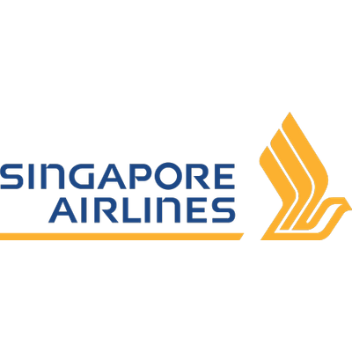
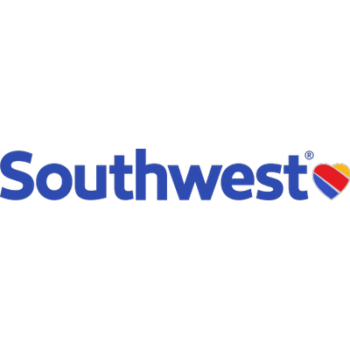

Types of Airlines
Network Carriers
Low Cost Carriers
Ultra Low-Cost Carriers
Focus on service differentiation
Price discrimination
Different aircraft types
Hub and Spoke: major airports, connecting flights
Alliance member
Focus on cost reduction
Simpler fare schemes
Homogenous fleet of aircraft
Point-to-Point: smaller airports
Very low cost by offering seats only, no food or luggage
Point to Point, focus on short, domestic flights

Slide 8
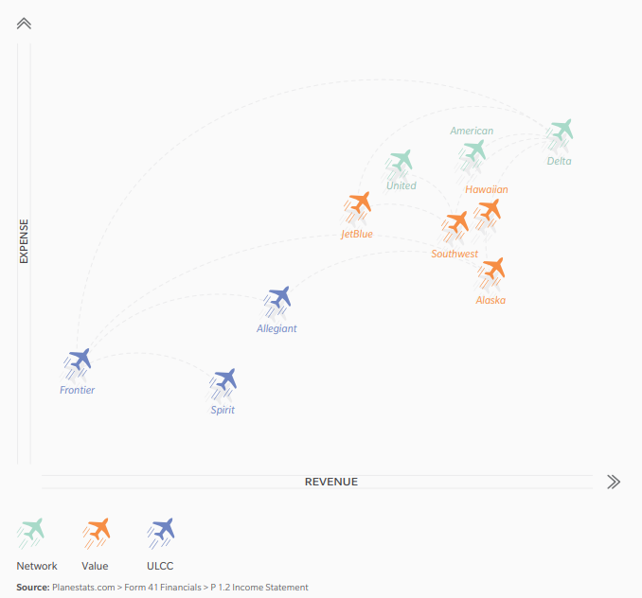
Airlines Positioning
Positioned based on RPK and Costs
Notes:
https://www.oliverwyman.com/content/dam/oliver-wyman/v2/publications/2019/apr/APRIL262019_Airline_Economic_Analysis_2018-2019vFweb.pdf

Slide 9
Segmentation
Notes:
Source: IBISWorld

Slide 10
Industry Characteristics
Highly competitive due to deregulation
Low concentration
Capital & Labour Intensive
Sensitive to business cycle
Subject to risk and uncertainty
Slim profit margin

Slide 11
Key Success Factors
Operational resilience (minimize delays)
Competitive pricing policy
Effective cost controls
Well-developed internal processes
Access to latest available and efficient technology and techniques
Ability to expand operations in line with market demand

Slide 12
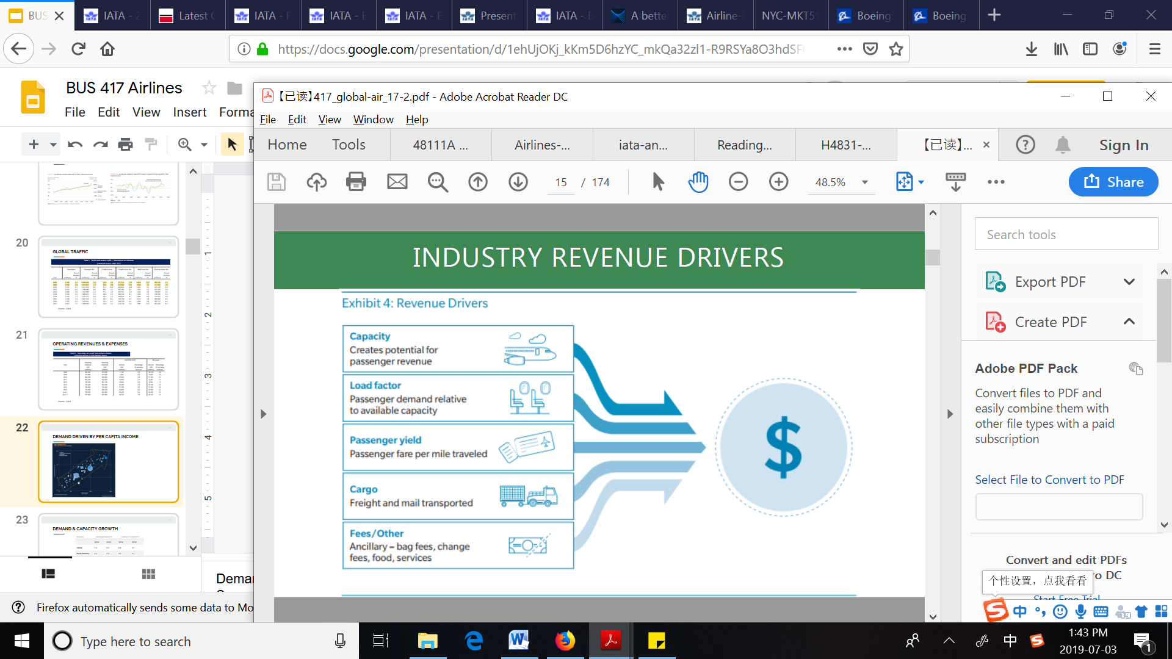
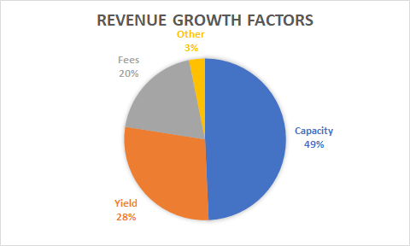
Revenue Drivers
Notes:
Yield: average fare per passenger per mile
https://www.oliverwyman.com/content/dam/oliver-wyman/v2/publications/2019/apr/APRIL262019_Airline_Economic_Analysis_2018-2019vFweb.pdf

Slide 13
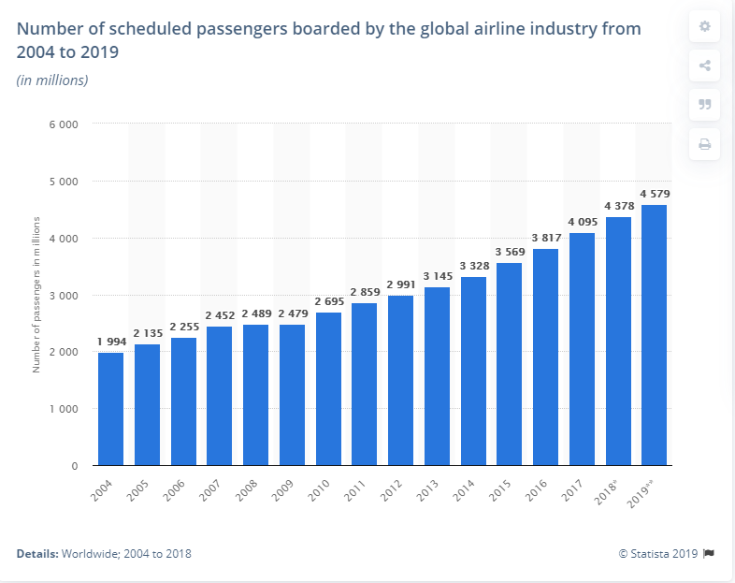
Global demand

Slide 14
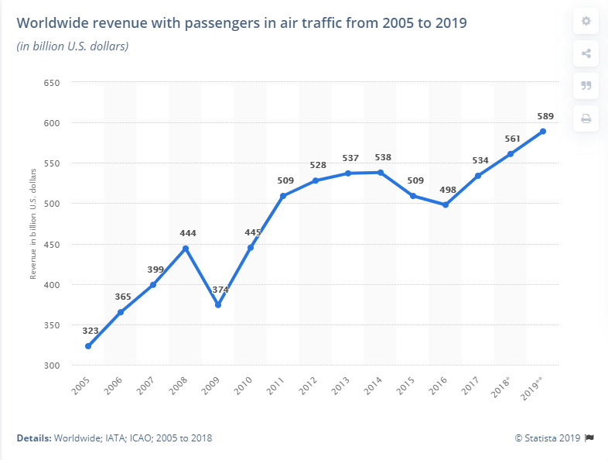
Global revenue

Slide 15
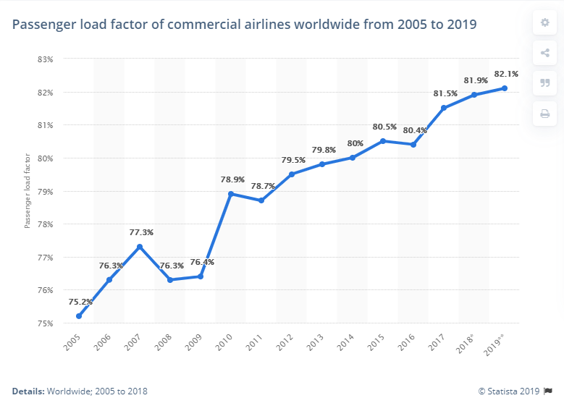
Load factor

Slide 16
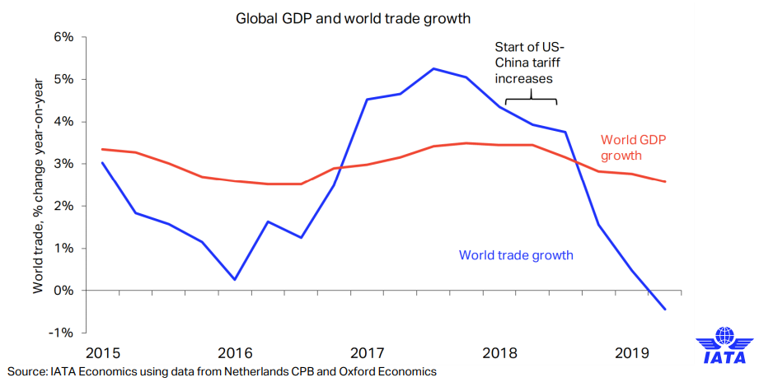
Effect of Trade War
Notes:
US and China are negotiating a deal, expect world trade to get better but not till next year
https://www.cnbc.com/2019/10/28/us-china-trade-analysts-dont-expect-more-than-phase-one-deal-in-2019.html
https://www.iata.org/publications/economics/Reports/Presentations/World-Financial-Symposium-Plenary-Session-25-Sep-2019.pdf

Slide 17
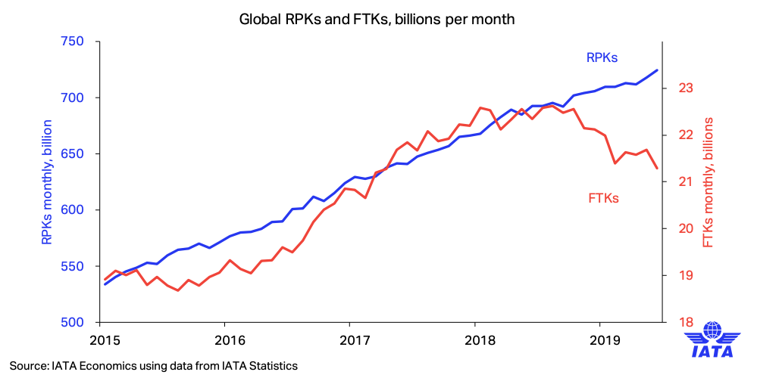
Industry Performance: RKP increasing but FTK stalling
Notes:
Affected by the us-china trade war
https://www.iata.org/publications/economics/Reports/freight-monthly-analysis/freight-analysis-aug-2019.pdf

Slide 18
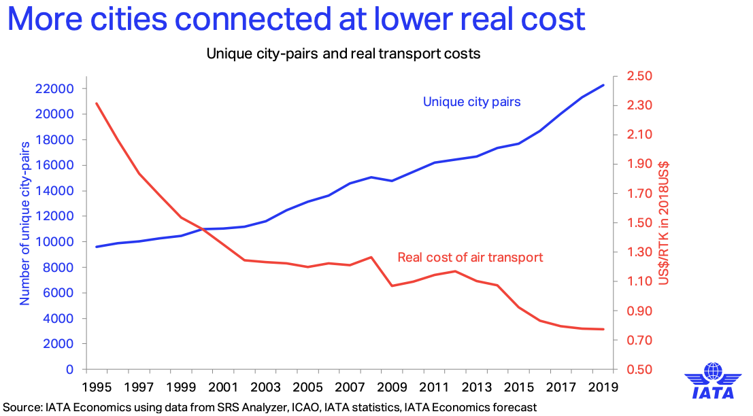

Slide 19
Alliances
Designed to achieve fleet rationalisation, expansion and rationalisation of network structure, greater exploitation of cost-side economies of scale and reduction of costs through joint purchasing, joint marketing
Alliances enable airlines to obtain the efficiencies and benefits normally linked with mergers and acquisitions
But:
Deemed as anti-competition practice
Might be subject to the competition rules of different constituencies
Unstable Alliances - Alliances tend to change quickly
Notes:
https://ec.europa.eu/competition/speeches/text/sp1999678_en.html

Slide 20
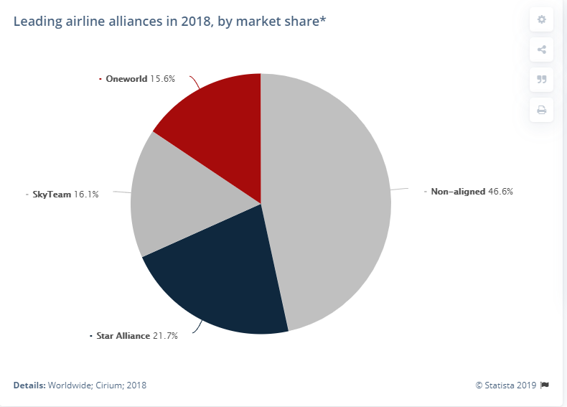

Slide 21
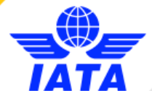
International Air Transport Association
IATA is a trade association for the world’s airlines, representing 290 airline or 82% of total air traffic.
Funded in 1945 in Havana, Cuba, IATA is the successor to the International Air Traffic Association.
Headquartered in Montreal. Over 50 offices over the world, supporting members in 120 countries.
Supports many areas of aviation activity and help formulate industry policy on critical aviation issues.
Provides industry stakeholders (e.g., airlines, airports, travel agents, etc) with a wide range of products and expert services such as financial advice, business intelligence, safety & flight operations solutions.

Slide 22
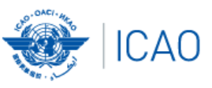
International Civil Aviation Organisation
ICAO a UN specialized agency, established by 52 nations in 1944 to manage the administration and governance of the Convention on International Civil Aviation.
It works with 193 Member States and industry groups to reach consensus on international civil aviation Standards and Recommended Practices (SARPs) in support of a safe, efficient, and sustainable civil aviation sector.
Policies are used by ICAO Member States to ensure that their local civil aviation operations and regulations conform to global norms.

Slide 23
EXternal Factors Affecting Global Airlines Industry
Political
Economic
Social
Technological
Environmental
Legal / Regulations

Slide 24
INternal Factors Affecting Global Airlines Industry
Airline capacity
Ticket prices
Route structures
Cost structures
Safety concerns
Weather, natural disasters, disease outbreaks, terrorism

Slide 25
Regulations
Air Mail Act - 1925: allowed air mail routes to be independent of the U.S. post office for up to four years.
Air Commerce Act -1926: organized federal regulations of aircraft, airmen, navigational facilities, air traffic, and more.
Civil Aeronautics Act - 1938: the Civil Aeronautics Board (CAB) was formed to increase regulations on airlines. The CAB regulated most of what the consumer saw regarding airlines.
The Chicago Convention on International Civil Aviation - 1944: establishment of the International Civil Aviation Organization (ICAO) as a unit of the United Nations devoted to overseeing civil aviation.
Federal Aviation Act - 1958: The act empowered the FAA to oversee and regulate safety in the airline industry and the use of American airspace by both military aircraft and civilian aircraft.
The Tokyo Convention - 1963: enacted new international standards for the treatment of criminal offenses on or involving aircraft
Airline Deregulation Act - 1978: United States federal law that deregulated the airline industry in the United States, removing the federal government control over such areas as fares, routes, and market entry of new airlines.
The Montreal Convention of 1999: updated the carrier liability provisions of the Warsaw Convention, while the Cape Town Treaty of 2001 created an international regime for the registration of security interests in aircraft and certain other large movable assets.
EU-US Open-skies Agreement – 2007: The agreement allows any airline of the European Union and any airline of the United States to fly between any point in the European Union and any point in the United States.

Slide 26
Open-skies agreements
Bilateral agreements signed by two parties (e.g., countries, regions) to liberalize international air transportation.
Minimize government restrictions and roles in industry operation
Significantly increased passenger and cargo traffic among countries/regions involved.
Promoted the international and long-haul markets, stimulating mutual economic benefits.

Slide 27
Environmental Factors
The industry has increasingly come under greater pressure due to stricter environmental regulations
IATA’s main policy areas: Climate Change, Carbon Offsetting, Aircraft Noise, Local Air Quality, Illegal Wildlife Trafficking

Slide 28
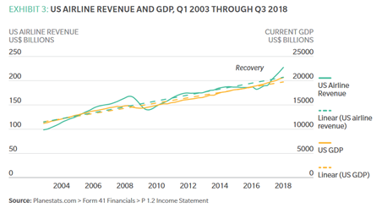
Economic factors: GDP

Slide 29
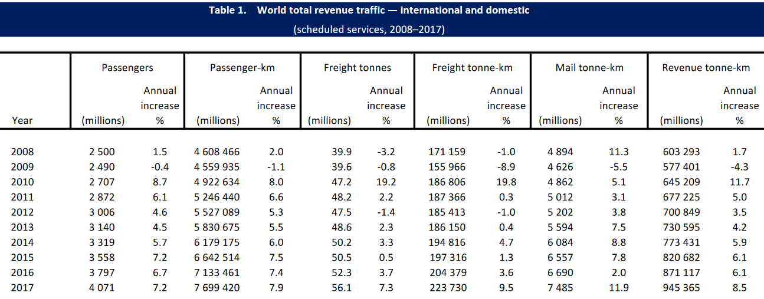
Global Statistics
Source: ICAO
Notes:
Macroeconomic factors tied to industry performance
https://www.icao.int/annual-report-2017/Documents/Annual.Report.2017_Air%20Transport%20Statistics.pdf

Slide 30
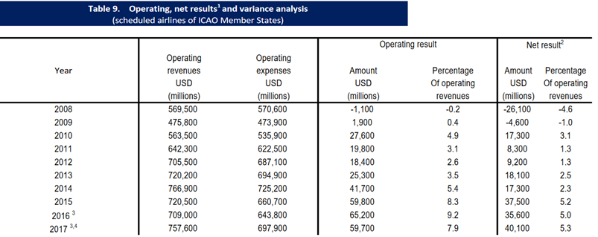
Financial market performance

Slide 31
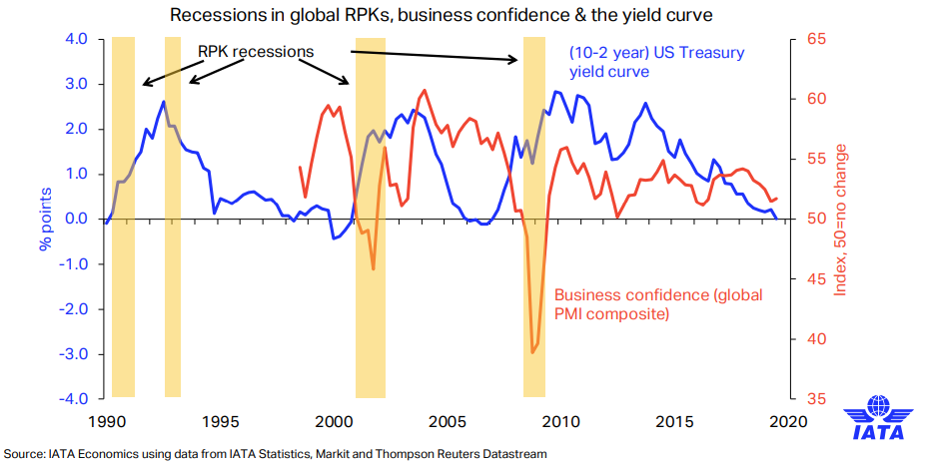
Financial crisis coming?

Slide 32
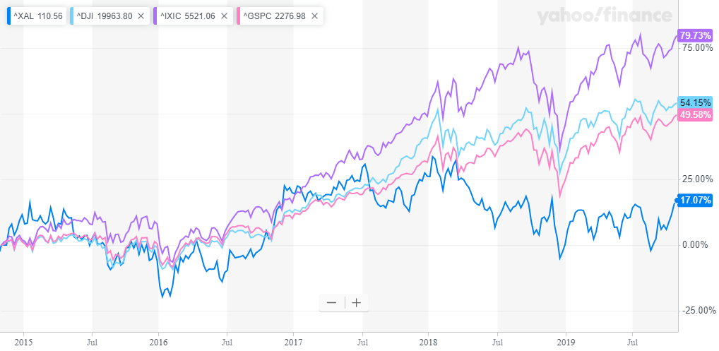
Index has outperformed Airlines as compared to S&P 500, NAsdaq and DJI
Notes:
Arca Airlines Index in comparison with Dow, S&P 500 and Nasdaq (Oct 28) → correlated but underperforming, compared to the past. → why?

Slide 33
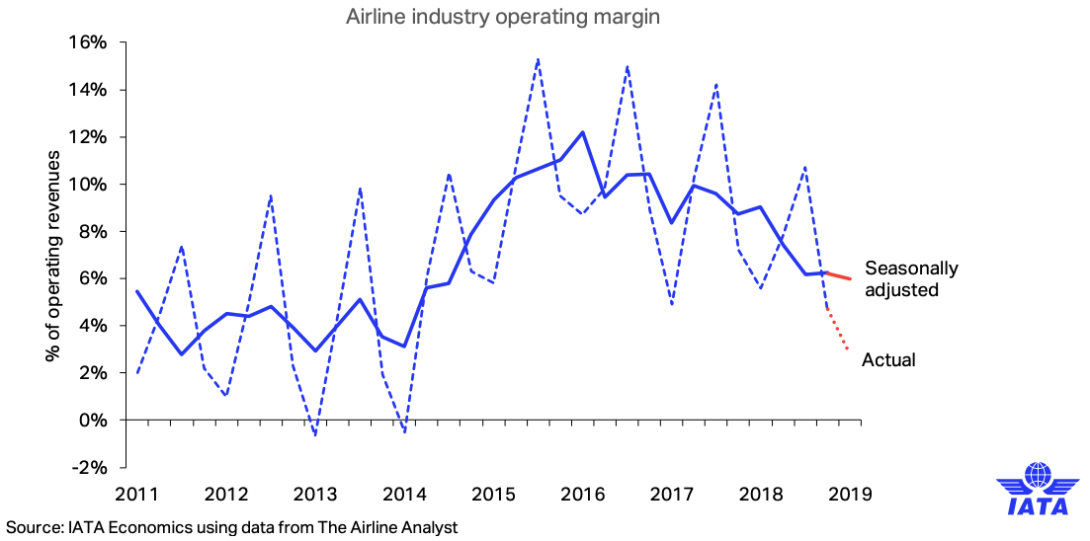
Slimming profit

Slide 34
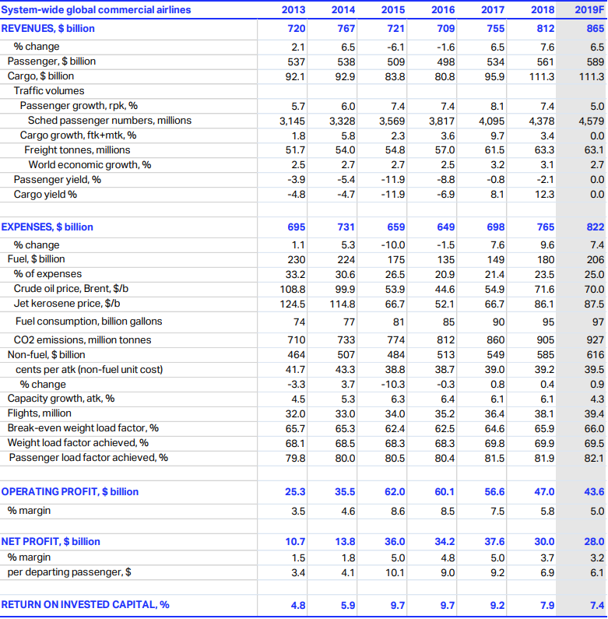
Expenses increasing faster than revenue

Slide 35
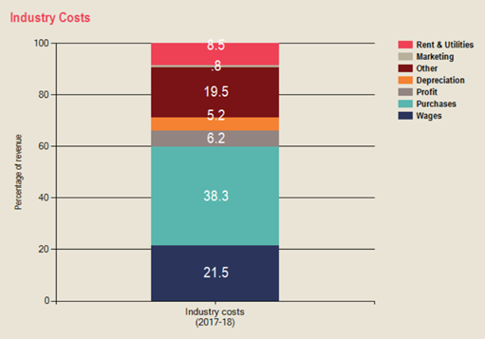
Cost structure
Purchases account for 38.3% of the cost structure.
  Includes: Fuel, Airplanes, Food, Uniform, etc.
Slim profit → Optimization Game

Slide 36
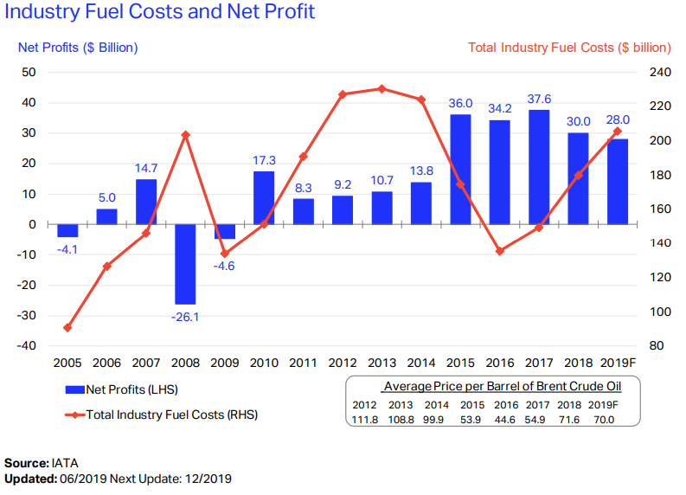
As fuel costs have gone up, profitability has come down, but this was not always the case?
Notes:
Profit is dependent on fuel costs (decreases as Brent Crude Oil prices rise)

Slide 37
Fuel Hedging
Purchasing Current Oil Contracts
Purchasing Call Options
Implementing a Collar Hedge
Requires a company to purchase both a call option and a put option.
Purchasing Swap Contracts
Like a call option, but with more stringent guidelines.
Locks in the purchase of oil at a future price at a specified date.
If fuel prices decline instead, the airline company has the potential to lose much more than it would with a call option strategy.
Notes:
Jet fuel is one of the most sigificant expenses for an airine, accountign for b/w 25% - 40% of total operating expenses. Thus airliens are vulnerable to oil price fluctuations.
https://www.investopedia.com/articles/investing/081415/4-ways-airlines-hedge-against-oil.asp
-Purchasing Current Oil Contracts: In this hedging scenario, an airline would have to believe that prices will rise in the future. To mitigate these rising prices, the airline purchases large amounts of current oil contracts for its future needs.
-Purchasing Call Options: When a company purchases a call option, it allows the company to purchase a stock or commodity at a specific price within a certain date range. This means that airline companies are able to hedge against rising fuel prices by buying the right to purchase oil in the future at a price that is agreed on today.
-Implementing a Collar Hedge: Requires a company to purchase both a call option and a put option. Where a call option allows an investor to purchase a stock or commodity at a future date for a price that's agreed upon today, a put option allows an investor to do the opposite: sell a stock or commodity at a future date for a price that's agreed on today.
-Purchasing Swap Contracts: A swap is similar to a call option, but with more stringent guidelines. While a call option gives an airline the right to purchase oil in the future at a certain price, it doesn't require the company to do so. A swap, on the other hand, locks in the purchase of oil at a future price at a specified date. If fuel prices decline instead, the airline company has the potential to lose much more than it would with a call option strategy.

Slide 38
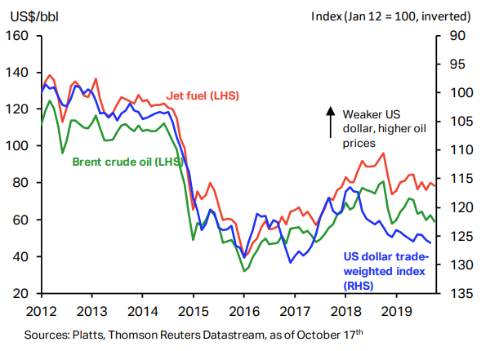
Fuel cost stabilizing?
Oil prices decreased after 2018 hike.
Attacks on Saudi’s oil fields hiked up prices but have returned to pre-attack level.
Is the Fuel price stabilizing?

Slide 39
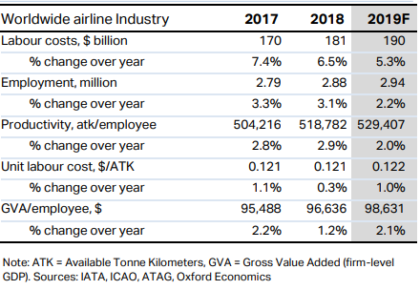
Labour cost
Labour account for 21.5% of total cost
Unit Labour Cost expected to increase by 1%.
GVA (measure for productivity) expected to increase 2.1%

Slide 40
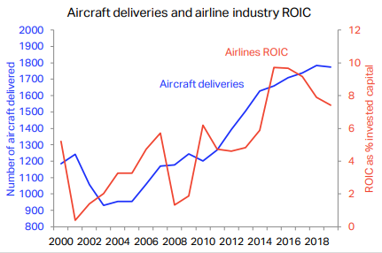
Aircraft purchases
Why is ROIC going down?
This year commercial airlines are expected to take delivery of over 1,750 new aircraft, an investment of around $80 billion by the industry.
  The improvement in ROIC gave the industry the confidence to invest on this scale.
~50% of this year’s deliveries will replace existing fleet, making a significant contribution to increasing fleet fuel efficiency.

Slide 41
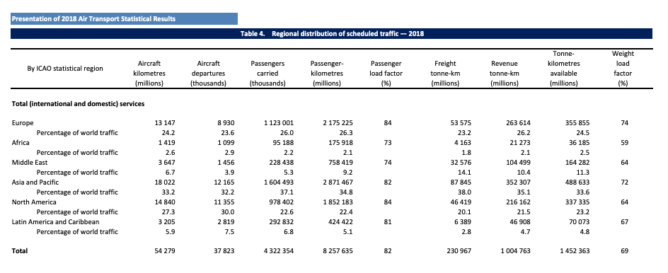
Industry Statistics
Notes:
6 main markets. Asia has RPKs, followed by NA then EU.

Slide 42
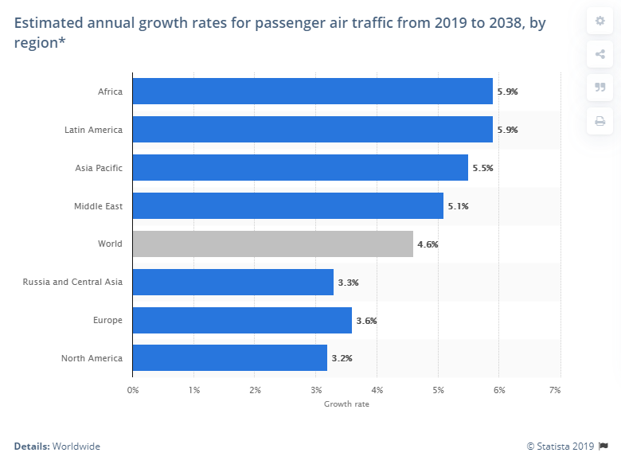
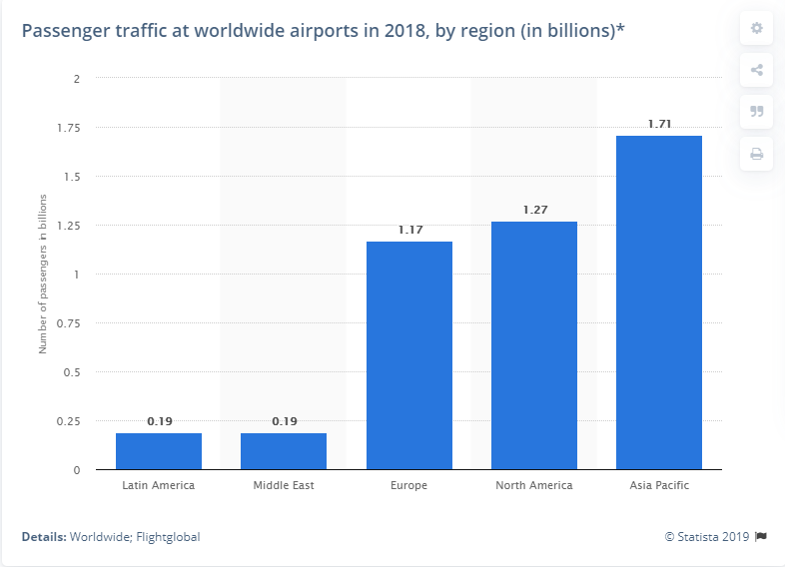
Growth by Region
Asia pacific domintates both traffic and growth

Slide 43
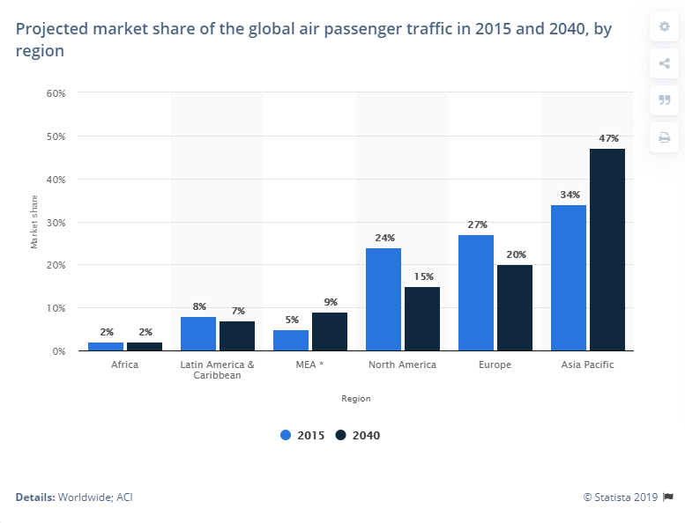
Market Share

Slide 44
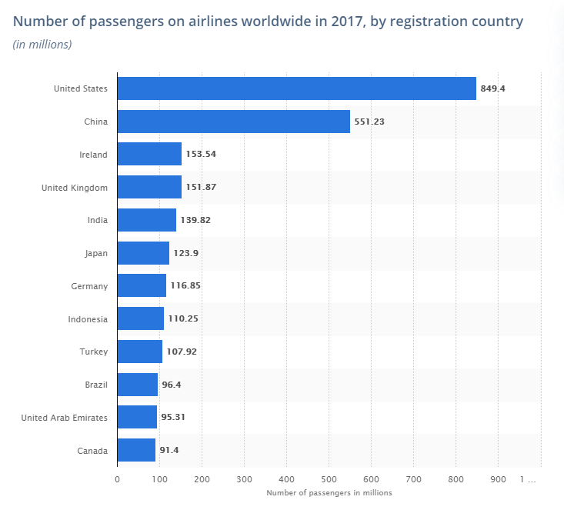
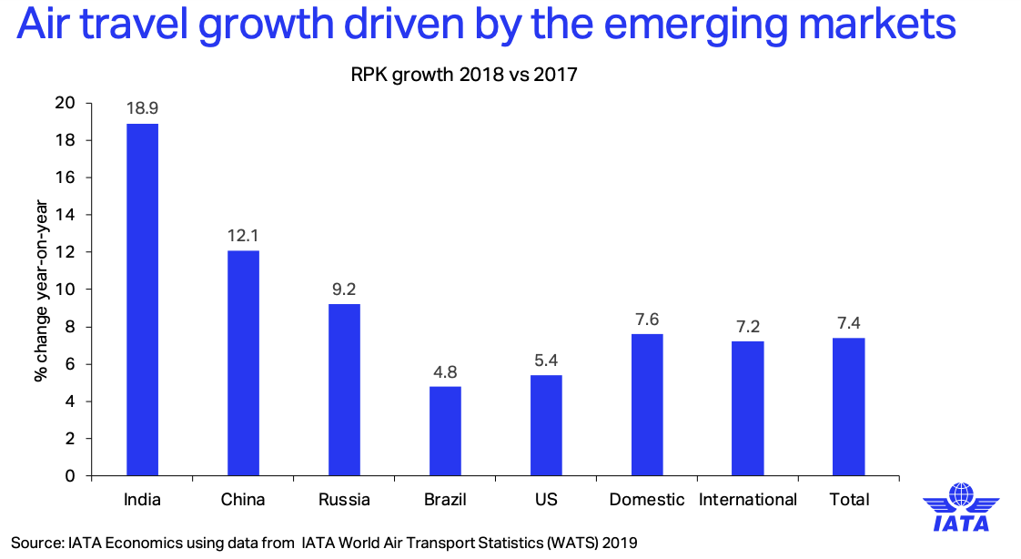

Slide 45
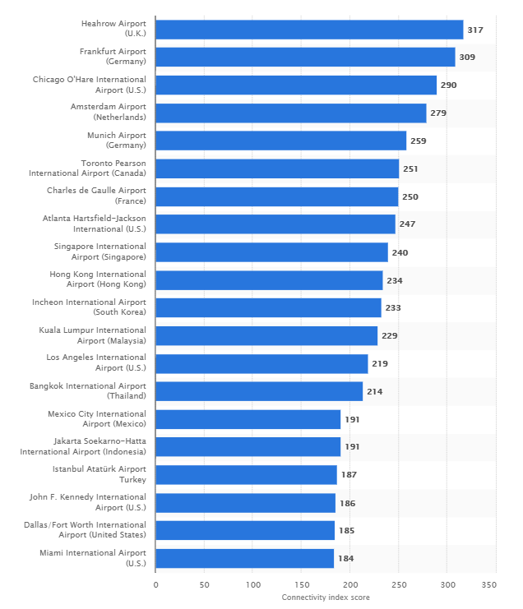
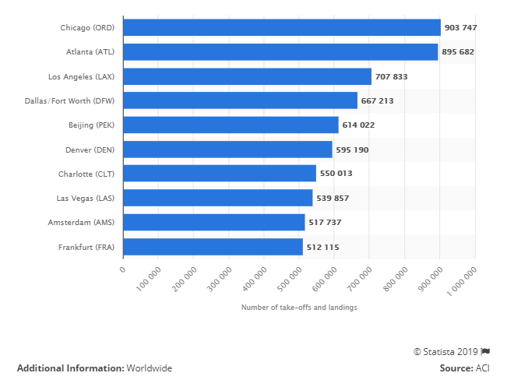
Leading airports
(2019)
(2018)

Slide 46
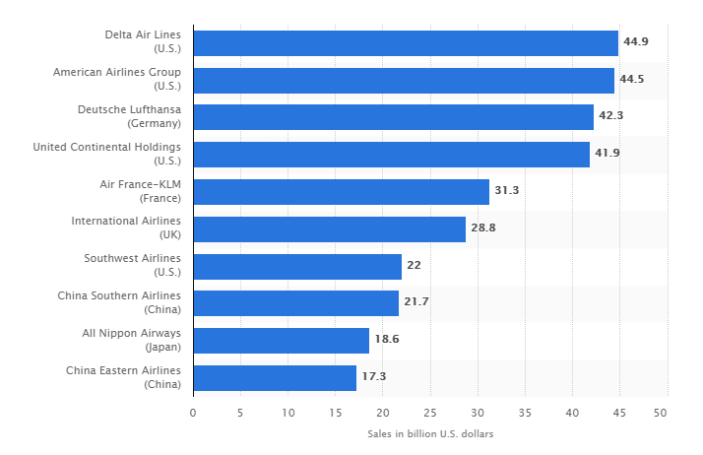
Largest Airlines based on sales
(2018)

Slide 47
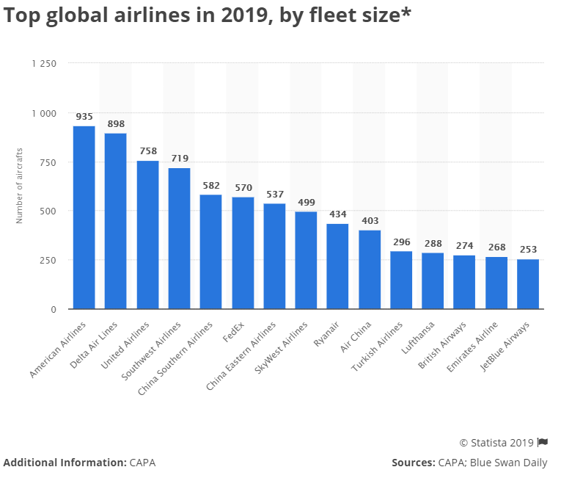

Slide 48
Southwest Airlines

Slide 49
Stock information

Slide 50
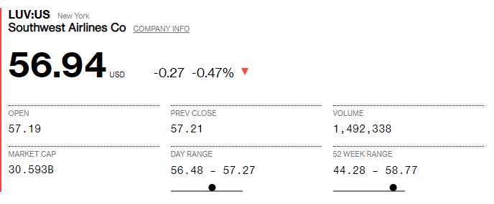
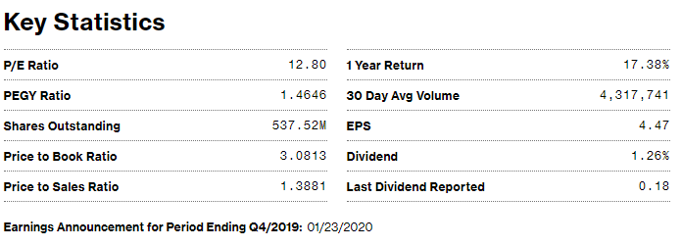
Company Snapshot

Slide 51
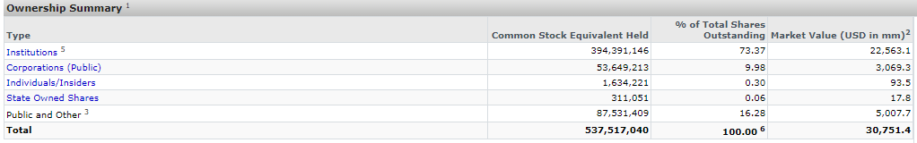
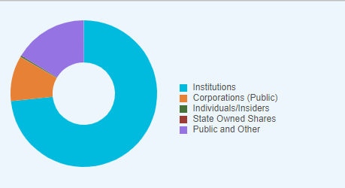
HOLDERS

Slide 52
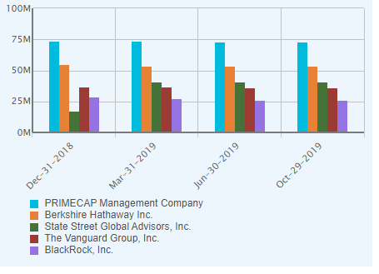
HOLDERS

Slide 53
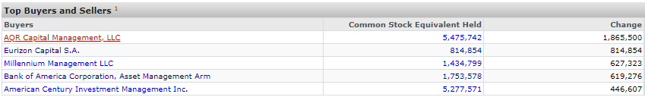
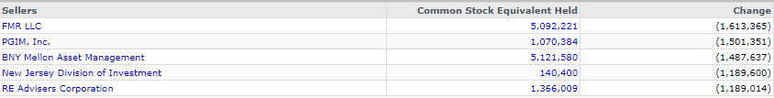
Top Buyers and sellers

Slide 54
SHARE STRUCTURE

Slide 55
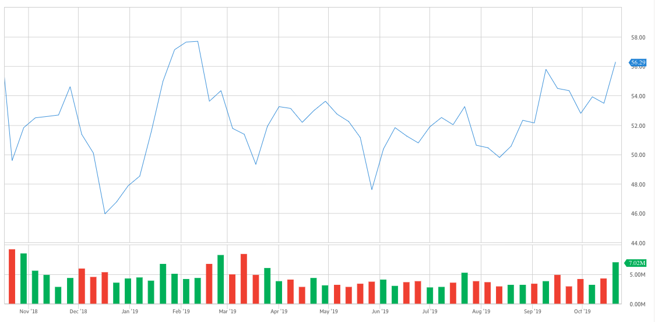
1 year return

Slide 56
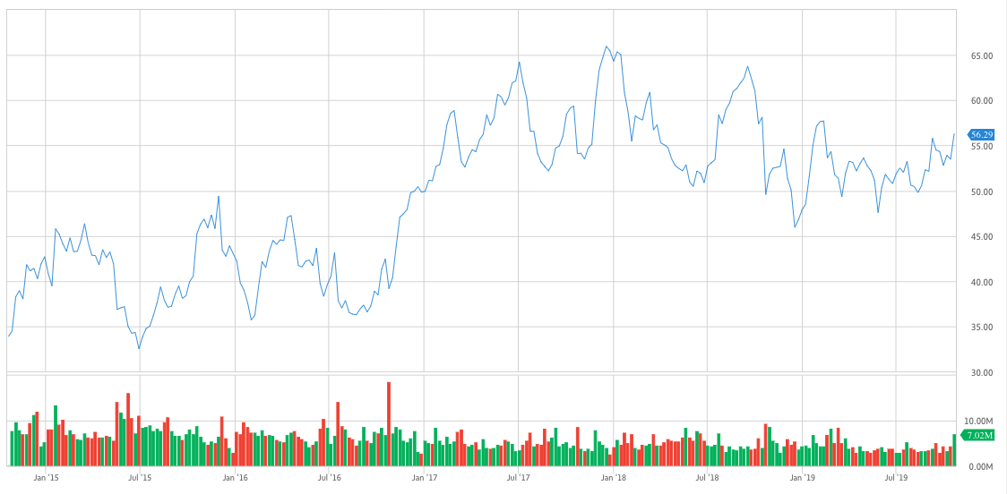
5 year return

Slide 57
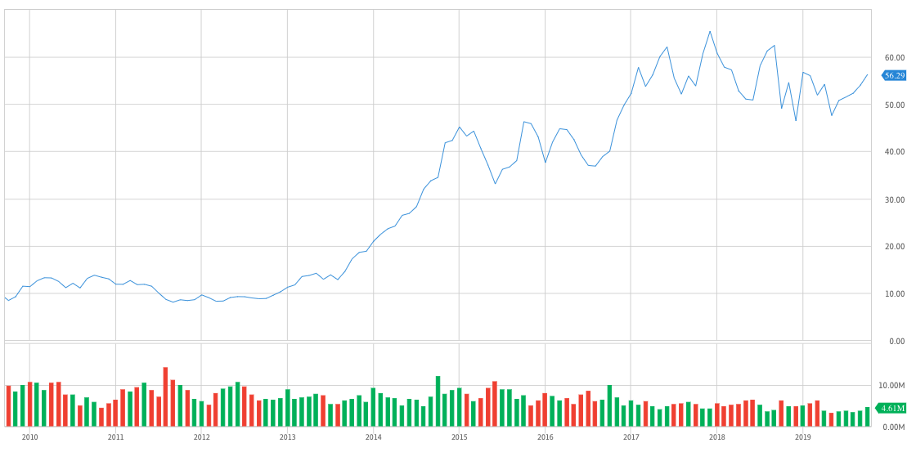
10 year return

Slide 58
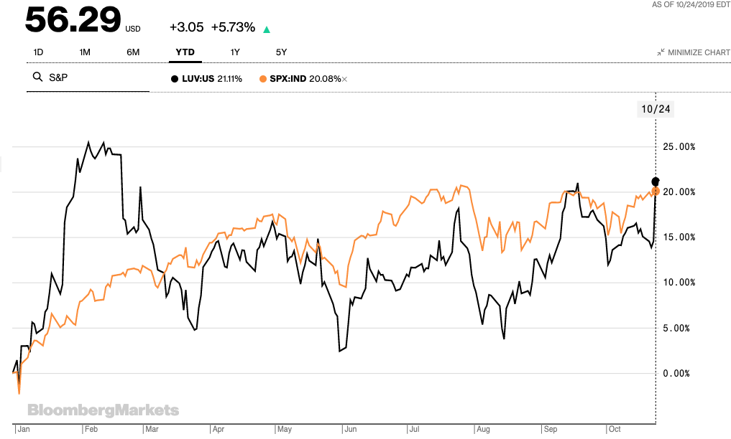
Comparison of Southwest to S&P 500 (YTD)

Slide 59
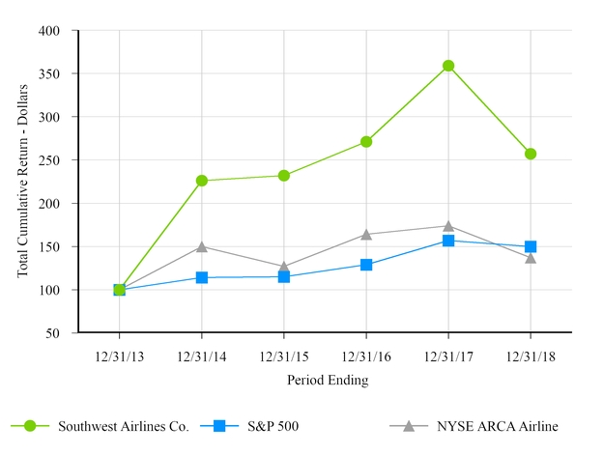
Comparison of 5 year Cumulative Return

Slide 60
Company information

Slide 61
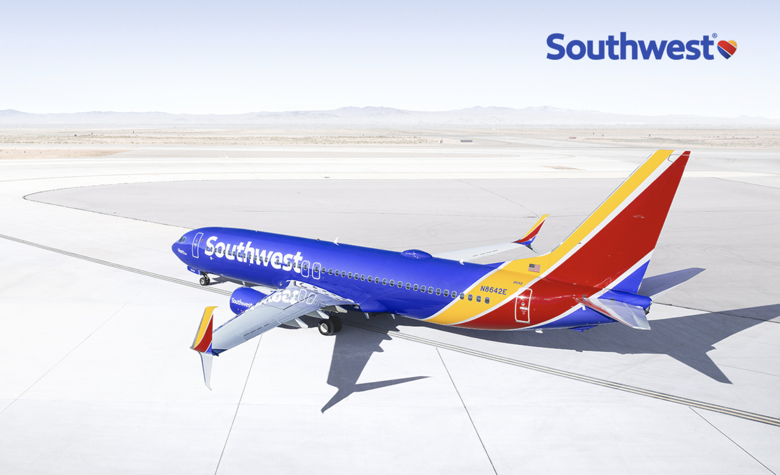
Profile
Founded in 1967 by Herb Kelleher (1931 - 2019)
Headquarters in Dallas, Texas
Largest US domestic airline by passenger
Short haul, high frequency, point to point flights
Flies only Boeing 737s
Utilizes secondary airports
101 US destinations and 10 additional countries

Slide 62
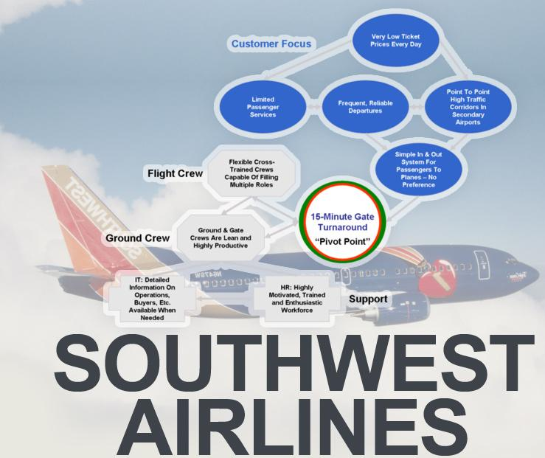
Business Strategy
Differentiates itself from other low-fare carriers by providing exemplary customer service
Short haul passenger and providing rates as low as one third of their competitors
Fly directly to destination
Lower unit cost
Puts the employee first, Southwest has found the key to success in the airline business

Slide 63
History
1971 – Air Southwest Co. changes its name to Southwest Airlines Co. Begins its service to Dallas, San Antonio and Houston.
1975 – Southwest Airlines common stock is listed for trading on the American Stock Exchange under the ticker symbol "LUV".
1979 – Begins its service to New Orleans. That is the first destination outside the State of Texas.

Slide 64


Culture in the 70’s
Southwest marketed itself on the 70’s culture
●Promoted theme of love (Ticker Symbol: LUV)
●Love potions & love bites → drinks and peanuts
●Flight attendants in hot pants and go-go boots
●Targeted male businessmen

Slide 65
History
1993 – Acquires Morris Air and Arizona One
1995 – Becomes one of the first airlines to have a website
1996 – Launched online booking
2009 – Becomes largest carrier in the US
      545 Boeing 737 aircrafts
      Servicing 68 airports in 35 states
      offer more than 3,300 flights a day

Slide 66
History
2011 – Began integration of AirTran
2014 – Integration with AirTran completed. Southwest introduces new branding
2015 – Added 16 additional flight destinations
2016 – Southwest begins service from Los Angeles to Liberia, Costa Rica
2018 – Southwest unveils its newest on-board entertainment product: iHeartRadio.

Slide 67

Despite the tragic incident the culture of the Best Loved Airline ensured that the accident did not tarnish its reputation.
HISTORY
7 April 2018- One person was killed and seven others sustained injuries on a flight from New York to Dallas when an engine exploded in midair.

Slide 68


Air Tran Integration
Southwest and AirTran shared a low-cost philosophy, but AirTran delivered a significantly different product.
AirTran’s most notable contribution has been accelerating Southwest’s entry in to international markets.
Geographically, AirTran added 21 cities to Southwest’s network and 7 of these cities lie in the international market.
International presence has positioned Southwest to expand to Central America and northern parts of South America – regions that are seeing fast growth in demand for air travel.
The integration of AirTran has made Southwest the largest domestic airline, based on the number of passengers flown.
In addition AirTran provided several synergies which led to improved financial performance in the years of the integration (2011 – 2014).
All in all, AirTran has accelerated Southwest’s expansion in the continental U.S. and also positioned it well for long term growth in the international market.

Slide 69

Boeing 737 MAX Groundings
Oct 29, 2018 – Lion Air Flight 610 crash
Mar 10, 2019 – Ethiopian Airlines Flight 302 crash
Southwest was hardest hit as it is the largest operator of Boeing 737
Cut 2019 Q2 operating income by 175 million and 2019 Q3 operating income by 210 million
Currently 34 grounded Boeing 737 Max aircrafts
To take 44 in 2019 and 38 in 2020

Slide 70

Company Culture
"Our people are our single greatest strength and most enduring long-term competitive advantage.„ Gary Kelly, CEO Southwest Airlines
„Competitors can buy tangible assets, but they cannot buy culture.“ Herb Kelleher, founder Southwest Airlines
Creation of “Culture Committee,” which works to preserve the company’s strong culture.

Slide 71

Company mission
“Dedication to the highest quality of customer service delivered with a sense of warmth, friendliness, individual pride, and company spirit.”
“… to provide our employees a stable work environment with equal opportunity for learning and personal growth.”

Slide 72
Management team

Slide 73

MANAGEMENT PROFILE
Herb Kelleher, Founder and ex-CEO
Passed this year, age 87
Bachelor of Law from New York University
Founded Southwest in 1960’s
Stepped down from CEO in 2001; resign from board in 2008
Revolutionized low cost air travel
Notes:
Braniff, Trans Texas, and Continental Airlines fought to keep his startup out of the skies with a temporary restraining order
Fought the ban personally up to Supreme Court of Texas
Use fuel efficient, low cost planes
No frills service
Pay employees well with no layoffs; reputation for good customer service

Slide 74

Management Profile
Gary C. Kelly, Chairman and CEO
Age: 64
33 years with Southwest
Past positions include: Controller and Chief Financial Officer
Named one of America’s best CEOs by Institutional Investor magazine 3 times
BBA in Accounting from University of Texas & acquired CPA designation with Arthur Young & Company

Slide 75

Management Profile
Tom Nealon, President
Age: 58
Became President in January 2017
Previous roles include: Senior VP and Chief Information Officer, Director of the Board
Held leadership positions in JCPenny and Frito-Lay
Bachelor of Science from Villanova Business School and MBA from University of Dallas

Slide 76

Management Profile
Mike Van de Ven, Chief Operating Officer
Age: 57
Joined Southwest in 1993
Previous roles include: Director of Internal Audit, VP Financial Planning & Analysis, Senior VP of Planning, Executive VP of Aircraft Operations
BBA from University of Texas and CPA

Slide 77

Management Profile
Tammy Romo, Executive VP and CFO
Age: 56
Started career at Southwest in 1991 & held this position since 2012
Previous roles include: Senior VP Planning, VP Financial Planning, VP Controller, VP Treasurer
BBA in Accounting at University of Texas and CPA

Slide 78
Routes

Slide 79

Top 10 Airports by Departures

Slide 80
Comparables
 | Price (USD) | Market cap ($M) | Revenue (mm) | EPS | DIV
Southwest | $57.21 | 30,751 | 22,402 | 4.45 | 1.26%
Delta | $55.38 | 35,683 | 46,310 | 7.07 | 2.9%
American | $30.92 | 13,544 | 45,393 | 3.53 | 1.3%
Alaska | $69.76 | 8,599 | 3,724 | 5.06 | 2%
Jetblue | $19.47 | 5,620 | 8,617 | 4.92 | None
Notes:
All data from Globe Investor as at July 3
Based on comparable US airlines; Southwest stock price is slightly higher, reflected in higher market cap
High P/E ratio indicates higher expectation of growth opportunities, lower div reflects this
Lower levels of debt compared to its competitors

Slide 81

Comparables: Southwest has led in recent years in the US

Slide 82

Comparables

Slide 83


Fleet:
753 Aircraft
As of June 30, 2019
Fleet is mainly owned
Notes:
Company is investing in Max 8’s and ended 2018 with 31 Max 8s based on their FS
Has placed orders for additional 37 Max 8s

Slide 84

Fleet Projections

Slide 85

Operations Analysis

Slide 86

Sales by Region

Slide 87


Revenues
Notes:
As compared with 2013, operating revenues increased 5.1 percent, driven by strong demand for air travel and successful execution of the strategic initiatives. Passenger revenues in 2014 increased 5.6 percent, compared with 2013, driven by record load factors and record passenger revenue yield per revenue passenger mile. Freight revenues benefited from new and maturing markets as a result of the AirTran acquisition, while other revenues in 2014 decreased 5.2 percent, compared with 2013.

Slide 88

OPERATING INCOME

Slide 89
Operating Data
Operating Data | 2018 | 2017 | 2016 | 2015 | 2014
ASM (000s) | 159,795,153 | 153,811,072 | 148,522,051 | 140,501,409 | 131,003,957
RPM (000s) | 133,322,322 | 129,041,420 | 124,797,986 | 117,499,879 | 108,035,133
Load Factor | 83.4% | 83.9% | 84% | 83.6% | 82.5%
Average Passenger Fare | $151.64 | 151.73 | 152.89 | 154.85 | 159.80
Full-time Employees | 58,803 | 56,110 | 53,536 | 49,583 | 46,278
Size of Fleet | 750 | 706 | 723 | 704 | 665

Slide 90
Liquidity - Current Ratio
 | 2018 | 2017 | 2016 | 2015 | 2014
Current Ratio | 0.636 | 0.702 | 0.657 | 0.543 | 0.663

Slide 91

DIVIDEND

Slide 92

Per Share Data

Slide 93

Satisfaction Index

Slide 94

Operating expense

Slide 95


Operating Expenses
Notes:
Fuel and oil expense remains one of the Company's largest operating costs. Salaries and wages

Slide 96


Operating Expense Excluding Fuel

Slide 97

Cost of Jet FUel
Notes:
The Company attempts to manage its risk associated with changing jet fuel prices by utilizing over-the-counter fuel derivative instruments to hedge a portion of its future jet fuel purchases, The Company's average economic jet fuel price per gallon decreased 6.4 percent year-over-year, from $3.12 for 2013 to $2.92 for 2014. In addition, fuel efficiency improved slightly due to the Company's fleet modernization efforts, as fuel gallons consumed decreased 1 percent, compared with 2013, while year-over-year capacity increased 0.5 percent. Southwest purchases jet fuel at prevailing market prices, but seeks to protect against significant increases in fuel costs by entering into OTC fuel derivative contracts.

Slide 98


Fuel Hedging Strategy
Notes:
In response to the dramatic drop in fuel prices in fourth quarter 2014, Southest effectively unwound portions of our fuel hedge portfolio to participate in the collapse of fuel prices. As of Jan. 16, 2015, none of our fuel consumption was hedged in 2015, 10 percent was hedged in 2016, and 30 percent in 2017. We will continue to actively manage our portfolio to protect against fuel price volatility. Southwest cross-hedges their jet fuel risks using similar commodities such as heating oil, crude oil (WTI) and gasoline
There is risk associated with this: sometimes the cross hedge does not accurately track jet fuel prices

Slide 99

Minimal Fuel Impact
Notes:
Small change

Slide 100
Fuel Hedging
Use of derivative contracts to mitigate risk of increase in fuel prices
Hedging close to 70% of its fuel needs by 2019
Derivatives used: purchased call options, collar structures, call spreads, put spreads, and fixed price swap agreements
General decrease in jet fuel prices may reduce benefit of fuel hedging

Slide 101

Fuel Hedging Strategy
The Company enters into fuel derivative contracts to manage its risk associated with significant increases in fuel prices
The more volatile the market the higher the cost of hedging
The cost of hedging has increased in recent years with current high volatility in jet fuel prices and at the same time cost of fuel has decreased substantially what out weighted the increase in cost of hedging
The Company holds a net position of fuel derivative instruments that represent a hedge for a portion of its anticipated jet fuel purchases and the Balance of this position has been decreasing from March 31, 2019, but increasing from December 31, 2018

Slide 102
Performance Data
 | 2018 | 2017 | 2016 | 2015 | 2014
Effective Tax Rates | 22.1 | -2.8 | 36.7 | 37.3 | 37.4
Net Income (millions) | 2,465 | 3,357 | 2,183 | 2,181 | 1,136
% Return on Assets | 7.71 | 8.66 | 10.74 | 12.05 | 7.64
% Return on Equity | 25.3 | 37.1 | 27.6 | 30.9 | 16.1

Slide 103

Profitability

Slide 104


Return on Invested Capital
Notes:
Decreasing ROIC mainly due to increase in invested capital, which is not necessarily bad

Slide 105

financials

Slide 106

Balance Sheet 10-Q

Slide 107

Balance Sheet 10-Q

Slide 108

Balance Sheet 10-K

Slide 109

Balance Sheet 10-K 2018

Slide 110

Income Statement 10-K

Slide 111

Income Statement 10-K

Slide 112

Income Statement 10-Q

Slide 113

Income Statement 10-Q

Slide 114

Cash Flow Statement 10-k

Slide 115

Cash Flow Statement 10-K

Slide 116

Cash Flow Statement 10-Q

Slide 117

Cash Flow Statement 10-Q

Slide 118

Statement of Changes in Equity 10-K

Slide 119
Recommendation
HOLD

Slide 120
Singapore Airlines

Slide 121

Stock information

Slide 122


Key Statistics
Singapore Airlines trades on two exchanges. On the Singapore Exchange and in the US as an ADR.
SIA
SINGY (ADR)

Slide 123

KEY Statistics (Cont)
SINGY (ADR)

Slide 124

Stock price

Slide 125

Stock price 1yr (SIA)

Slide 126

Stock price 1yr (SINGY)

Slide 127

Stock price 5yr (SIA)

Slide 128

Stock price 5yr (SINGY)

Slide 129

Dividend Yield

Slide 130
Company information

Slide 131
Company History
SIA began in May 1947, when Malaysian Airways first operated a twin-engined Airspeed Consul between Singapore, Kuala Lumpur, Ipoh and Penang.
1963 – Changed to Malaysian Airlines with formation of federation of Malaysia
1966 – Became Malaysian-Singapore Airlines
1972 – Restructured itself into 2 airlines (Malaysian & Singapore Airlines)
1981 – Moved to the new Singapore Changi Airport from Paya Lebar

Slide 132
Company History
1989 – Became the first airline to operate a 747-400 on a commercial flight across the Pacific
1990 – Became the first global sky telephone service, extended to African destinations
1990 – Became the first non-stop air service between Singapore and the USA
2007 – Became the first airline to operate the A380 superjumbo, the largest passenger plane in the world
Today – Serves over 280 destinations in 70 countries, including services by Singapore Airlines Cargo, SilkAIR and codeshare partners

Slide 133
Company profile
Singapore Airlines Ltd (SIA) founded on January 28, 1972 is the flag carrier airline of Singapore with its hub at Singapore Changi Airport. The airline uses the Singapore Girl as its central figure in corporate branding.
The airline is frequently ranked as one of the best global airlines and it has a number of subsidiaries engaging in passenger and cargo air transportation, as well as engineering.
Singapore Airlines was the launch customer for the Airbus A380 aircraft.
The airline won the 2nd and 4th position as the World's Best Airlines[9] and World's Cleanest Airlines respectively for 2019.

Slide 134
Company Profile (cont)
First to involve a comprehensive panel of world-renowned chefs, the International Culinary Panel, in developing inflight meals in 1998
First to offer audio and video on demand (AVOD) capabilities on KrisWorld in all classes in October 2001
First to operate the world’s longest non-stop commercial flight between Singapore and Los Angeles in February 2004 on the A340-500, and then surpassing the record (in terms of distance) later that year with the non-stop service to New York (Newark), in June 2004
First to fly the A380 from Singapore to Sydney on 25 October 2007
First to offer free headsets, a choice of meals and free drinks in Economy Class, in the 1970s
First to introduce satellite-based inflight telephones in 1991

Slide 135
SWOT Analysis
Strengths
service quality, unmatched environment, clean and sanitized food and unparalleled security
legitimate quality, paramount technology and brand strategy
It stood first to soar Airbus Super jumbo A-380 IN 2006 and is also known for its sub-branded aircrafts like 777 jubilee and 747 mega top
Weakness
It is too expensive to travel for middle class people
Huge decline in the financial performance in year 2010 as compared to year 2010
The relation between labor union and management has been not good at times due to cut in wages and downsizing in bad economic conditions.

Slide 136
SWOT Analysis
Opportunities
Innovation” is an important trait of Singapore Airlines
It has vigilantly developed a financial plus rigid cost in order to support their brand name to overcome the competition on costs. .
It can increase revenue by increasing the total number of destinations and fleet size.
Threats
Increasing price of oil may result in high cost per passenger
Rapid growth of low cost airways in the recent past

Slide 137

news
At the beginning of October 2019 Singapore Airlines began partnering with AeroFarms to have a fresh produce supply for its business class meals out of Newark Liberty International
The concept of farm to plane is to be more sustainable and reduce the carbon footprint by using hyper-local produce, and SIA wanted the in-flight food to taste as vibrant as possible.
This farm-to-plane concept has been in development internally at Singapore Airlines for nearly two years. This adoption has two aims: enhanced passenger experience and a lower carbon footprint.
Exclusive to passengers with a business class ticket from Newark to Singapore, guests will enjoy extremely fresh produce that is grown just a few miles from the airport.
According to CNN, Singapore Airlines says that the airline aims to introduce AeroFarms’ produce to premium economy class riders eventually

Slide 138

news
Singapore Airlines and Malaysia Airlines plan to code-share on more routes, including Europe and South Africa
The agreement signed on October 30 2018 also includes SIA subsidiaries SilkAir and Scoot, as well as Firefly, the sister airline of MAB.
As part of the agreement, which is still subject to approval from competition authorities, the carriers will expand their code-share routes to include more destinations on each other’s networks, and participate in joint marketing activities to develop tourism in each other’s home countries.
With the expansion, SIA and SilkAir plan to code-share on MAB’s domestic flights so that the two Singapore carriers will serve a total of 16 destinations in Malaysia, the companies said in a joint statement.
If approved, the airlines intend to coordinate flight schedules to provide customers with more flight choices and increased frequency.

Slide 139



NEWS
Singapore Airlines' new suites are more like hotel rooms in the sky than airplane seats
The suite's dining table pulls out from one of its side consoles and can double as a work desk.
The first two suites in each row, including their beds, can even be combined into double suites for passengers traveling with a companion
Luxurious leather armchairs, separate beds dressed in Lalique linens, and gourmet meal service on Wedgwood china are just a few of the treats in store for passengers.

Slide 140



New A380 Airbus
Source: SIA annual report FY18/19

Slide 141
Company Mission
Mission Statement
Singapore Airlines is a global company dedicated to providing air transportation of the highest quality and to maximizing returns for the benefit of its shareholders of employees

Slide 142
Corporate Strategy
Portfolio approach
  The SIA Group is committed to a portfolio approach in which it has investments in both full-service and low-cost airlines.
Multi-hub strategy
  Investments in Vistara in India and NokScoot in Thailand enable the SIA Group to expand in new hubs across growth markets.
New business initiatives
  SIA continues to tap into new revenue and business opportunities to complement its traditional focus on ticket sales. During the year in review, the Airline announced new joint ventures, including strategic collaborations with partners such as:
    Travel Retail Joint Venture with 3Sixty and SATS
    SIA-CAE Pilot Training Joint Venture
    Commences Operations
Strengthening premium positioning
  SIA remains steadfast in its commitment to the constant enhancement of the three main pillars of its brand promise: Service Excellence, Product Leadership and Network Connectivity.

Slide 143


Business Segments and Subsidiaries
Singapore Airlines has three subsidiaries:
  SilkAir
  Scoot
  Singapore Airlines Engineering
Singapore Airlines Engineering handles maintenance, repair, and overhaul (MRO) business across nine countries, with a portfolio of 27 joint ventures, including with Boeing and Rolls-Royce.

Slide 144

SINGAPORE GLOBAL ROUTE MAP
Together, Singapore Airlines, SilkAir and Scoot fly to over 130 destinations around the globe.

Slide 145


SIA – Regional Route Map
Notes:
Singapore Airlines operates a hub at Changi Airport and has a strong presence in the Southeast Asia, East Asia, South Asia, and "Kangaroo Route" markets.
Also point to point service: from the U.S. to other cities such as tokyo and hong kong

Slide 146

Fleet chart As of 30 September, 2019

Slide 147

Major Shareholders Information

Slide 148
Management team

Slide 149

Management team

Slide 150

management profile
Mr Goh Choon Phong
Chief Executive Officer
Mr Goh joined Singapore Airlines in 1990 and has held senior management positions in Singapore as well as overseas. Mr Goh joined the Airline’s Board on 1 October 2010 and was appointed CEO on 1 January 2011.
Mr Goh became Executive Vice President Marketing and the Regions in June 2010. Prior to that he was President of Singapore Airlines Cargo for four years. Previous senior positions with Singapore Airlines included Senior Vice President Finance, Senior Vice President Information Technology and Senior Vice President Commercial Technology. His overseas assignments were in China and Scandinavia.

Slide 151

management profile
Mr Mak Swee Wah
Executive Vice President Commercia
Mr Mak graduated from the London School of Economics with a Masters Degree in Science, majoring in Operational Research, and a Bachelor of Science (First Class Honours) in Accounting and Finance.
He joined Singapore Airlines in 1983 and worked in a number of management positions in Singapore as well as overseas.
Mr Mak was promoted to Executive Vice President for Operations and Services on 1 January 2008 and was appointed Executive Vice President Commercial on 1 February 2011.
Mr Mak is currently Chairman of SilkAir. He is also a Non-Executive Director of TATA SIA Airlines Limited.

Slide 152

management profile
Mr Ng Chin Hwee
Executive Vice President Human Resources & Operations
Mr Ng, a Singapore Airlines Scholar, graduated from the National University of Singapore with a First Class Honours degree in Engineering and holds a Master of Science in Management degree from the Massachusetts Institute of Technology, USA
Mr Ng, a Singapore Airlines Scholar, graduated from the National University of Singapore with a First Class Honours degree in Engineering and holds a Master of Science in Management degree from the Massachusetts Institute of Technology, USA

Slide 153

management profile
Mr Stephen Barnes
Senior Vice President Finance
Mr Barnes joined Singapore Airlines in January 2014 as Senior Vice President Finance.
He also had an earlier stint at SIA, from June 2001 to October 2008, where he last held the position of Divisional Vice President Treasury & Structured Finance.
After Mr Barnes left SIA in 2008, he joined an aircraft leasing company, holding a senior leadership role.
Mr Barnes has over 35 years’ experience as a finance professional, having held key leadership positions in industries ranging from banking to fund management.

Slide 154

management profile
Mr Chin Yau Seng
Senior Vice President Cargo
Mr Chin assumed the post of Senior Vice President Cargo following the re-integration of SIA Cargo as a Division of Singapore Airlines from 1 April 2018. Prior to that, he had been President SIA Cargo since May 2014.
Mr Chin began his career with SIA in 1995 as a Cadet Administrative Officer and has held various executive positions across the SIA Group.
He was Chief Executive SilkAir from 2007 to 2010 and Chief Executive Officer of Tiger Airways Holdings from 2011 to 2012. Prior to his move to SIA Cargo, he held the position of Senior Vice President Sales & Marketing in SIA.

Slide 155

management profile
Mr Lau Hwa Peng
Senior Vice President Engineering
Mr Lau joined Singapore Airlines in February 1992 as a Technical Services Engineer. He held positions in Engineering Planning, Engineering Supplies and Technical Projects before being appointed Manager Projects in 2000 and subsequently Senior Manager Technical Services in 2001. He was promoted to Vice President Technical Services in 2004.
Mr Lau became Vice President Company Planning & Fuel in July 2009. He was seconded to SIA Engineering Company as Vice President Line Maintenance (Services & Projects) and Vice President Heavy Maintenance & Planning in 2011. He returned to Head Office as Vice President Technical Services in December 2012.

Slide 156
competitors

Slide 157






Top competitors

Slide 158

5 year Stock price comparison
Singapore Airline Vs China Southern Vs Quantas

Slide 159

financial Comparison

Slide 160


financial Comparison (CONT)

Slide 161
Financial analysis

Slide 162

Operating Statistics

Slide 163

Operating Statistics (cont)

Slide 164

KEY Financial Highlights

Slide 165

Group Earnings

Slide 166

Group Expenditure

Slide 167

Group Expenditure Breakdown

Slide 168


Revenue by region
Passenger statistics
Cargo and mail statistics

Slide 169

Parent Airline Company FY18 Revenue Breakdown

Slide 170

Parent Airline Company Cost Composition FY18 ($M)

Slide 171

Overall unit cost analysis

Slide 172

Group operating Revenues

Slide 173

Net profits

Slide 174

Company operating profits

Slide 175
Liquidity - Current Ratio
 | 2019 | 2018 | 2017 | 2016 | 2015
Current Ratio | 0.7454 | 0.7565 | 0.9039 | 1.0473 | 1.0922
Net Working Capital | (1,878.7) | (1,598.7) | (606.2) | 306.8 | 612.5

Slide 176
Capital Structure Analysis
 | 2019 | 2018 | 2017 | 2016 | 2015
Debt /Equity | 0.6810 | 0.6603 | 0.6124 | 0.6284 | 0.6157

Slide 177
Capital Market Analysis
 | 2019 | 2018 | 2017 | 2016 | 2015
Price/ Earnings | 15.41 | 10.17 | 16.30 | 22.17 | 36.92
Price to Book | 0.95 | 0.93 | 0.89 | 1.10 | 1.10
Dividend Yield | 3.84% | 1.87% | 4.48% | 2.27% | 1.42%

Slide 178
Profitability Analysis
 | 2018 | 2017 | 2016 | 2015 | 2014
ROA | 0.13 | 0.24 | 0.07 | 0.12 | 0.06
ROE | 0.05 | 0.12 | 0.02 | 0.05 | 0.03
Profit Margin | 0.07 | 0.10 | 0.04 | 0.04 | 0.03
EPS(cents) | 57.7 | 110.1 | 30.5 | 69.0 | 31.4
Diluted EPS | 57.4 | 109.7 | 30.3 | 68.7 | 31.2

Slide 179

Dividends payout
For the financial year ended 31 march 2019, the Board recommends a final dividend of 22 cents per share. including the interim dividend of 8 cents per share paid
On 4 December 2018, the total dividend for the 2018/19 financial year will be 30 cents per share. This amounts to a payout of approximately $355 million based on the number of issued shares as at 31 march 2019.

Slide 180

Capital expenditure
capital expenditure was $5,562 million, 6.8 per cent higher than last year. Approximately 98 per cent of the capital spending was on aircraft, spares and spare engines. internally generated cash flow of $3,116 million (+5.3 per cent) was approximately 56 per cent of capital expenditure.

Slide 181

Fuel Hedging

Slide 182

Group fuel hedging position

Slide 183



Financial Overview

Slide 184
Financial Statements

Slide 185

Balance Sheet 10q

Slide 186

Balance Sheet 10q(Cont)

Slide 187

Balance Sheet 10q(Cont)

Slide 188

Balance Sheet 1ok

Slide 189

Balance Sheet 10k (Cont)

Slide 190

Balance Sheet 10k (Cont)

Slide 191

Income Statement10k

Slide 192

InCome Statement 10k(Cont)

Slide 193

Income Statement 10q

Slide 194

InCome Statement 10q(Cont)
OTHER COMPREHENSIVE INCOME:

Slide 195

Cash Flow Statement 10k

Slide 196

Cash Flow Statement 10k (CONT)

Slide 197

Cash Flow Statement 10k (CONT)

Slide 198

Cash Flow Statement 10k (CONT)

Slide 199

Cash Flow Statement 10q

Slide 200

Cash Flow Statement 10Q(CONT)

Slide 201

Cash Flow Statement 10q(CONT)

Slide 202

Cash Flow Statement 10q (CONT)

Slide 203
Recommendation sell

Slide 204
EASYJET

Slide 205
Stock information

Slide 206

Key Statistics

Slide 207

Share price 1 yr

Slide 208

Share price 5 year

Slide 209

Share price 10 year

Slide 210

EASYJET vs FTSE 100

Slide 211

Dividend YielD history

Slide 212
History
1995
EasyJet is established by Greek-Cypriot Stelios
1996
Receives its first aircraft opening up international travel
2000
EasyJet is listed on the London Stock Exchange
2002
Makes London Gatwick Airport its main operational base
2004
FL Group purchases an 8.4% stake in the business
2006
FL Group sells its stake after speculation of takeover bid
2007
EasyJet purchases GB Airways
2013
EasyJet is promoted to the FTSE 100
2017
EasyJet announces that it will open a new HQ in Austria
2010
EasyJet becomes the UK's largest airline

Slide 213
Company Information
Headquarters in Luton, UK
Low cost European point-to-point airline
Operates an Airbus fleet using the A320 family of craft
Employs over 10,000 people
Operates more than 1,000 routes in more than 30 countries
Inspired by the SouthWest model
EasyJet has been voted the best low-cost airline in Europe on several occasions

Slide 214

Low COST Structure
Similar to Southwest
Low ticket prices
  Extra fees
Low cost airports
Higher load factor and aircraft utilization in its point-to-point model
Younger fleet and advantaged fleet deals
Increasing number of seats per aircraft
  No Business Class

Slide 215

Corporate Strategy

Slide 216

EasyJet Routes

Slide 217

ACQUISITIONS
Go Fly Limited
GB Airways
Air Berlin

Slide 218

ACQUISITIONS
  Go Fly Limited
  Acquired low-cost rival in 2002
    374 million GBP
    Increases management strength
    Larger platform to exploit growth opportunities
  Operates from Stanstead Airport and Bristol International Airport in England
    Prior to acquisition, Go operated 10 destinations from Bristol Airport
    EasyJet now offers 44 destinations from Bristol

Slide 219

acquisitions
GB Airways
  Acquired on 2008 for 103.5 million GBP
  Operates airlines in Southern Europe and Africa
  Passengers, cargo, courier items, mail, and household pets
  Strengthen base and take over slots at Gatwick
    Allows EasyJet to operate 24% of Gatwick Airport’s slots
  Establish a base at Manchester Airport
  Acquire GB airways fleets

Slide 220

ACQUISITIONS
Air Berlin
  2017 - Acquisition of a part of Air Berlin for 40m Euros
    Included Air Berlin’s operations at Tegel airport
    Leases for 25 A320 aircraft
    1000 of Air Berlin’s pilot and cabin crew
  Made EasyJet the largest carrier in the German capital
  Focus on corporate travelers
    Fly from Tegel to business cities (Ex: Vienna and Zurich) for up to 5x a day

Slide 221

Air Berlin Acquisition
Finding underserved markets
  Does not compete everywhere
  Air Berlin had significantly higher prices
  Main low-cost competitor at Tegel Airport was Lufthansa
  “Purposeful investments in strong number one positions in Europe’s leading airports” – Johan Lundgren, Chief Executive of EasyJet
  Airbus 320
  Targeting on Business Travelers

Slide 222


Corporate travelers
Flexi-fares
Expanding their network to airports closer to business centers
Distribution channels dedicated for corporate bookings
Flight Club
  Free ticket alterations

Slide 223

Innovation
Strategic investment in Founders Factory
Sharing expertise and information
  WeTrip – online platform for group bookings
  Car and Away – airbnb for cars
  FlightSayer – using algorithms to predict flight delays weeks in advance

Slide 224

Fleet profile
315 total aircraft

Slide 225


Airbus A320
Lower training costs
  pilots and flight crew
Skywise Predictive Maintenance Agreement
  Prevents delays
30% of fleet are leased
  Greater flexibility for demand fluctuations
  Off balance sheet
  Finance lease = 1%

Slide 226
Macroeconomic impacts
EasyJet heavily impacted by Brexit
Pound Sterling has significantly fallen in value against both US dollar and Euro, which has had an ongoing negative impact on profit and capital expenditure.
A strong US dollar increases the price of fuel, one of easyJet’s biggest costs; a strong Euro typically has a net translational benefit for easyJet’s European operations, although it may impact Eurozone inbound demand.

Slide 227

BREXIT
Uncertainty regarding ability to fly between UK and Europe post-Brexit
Must have license and air operator’s certificate in an EU member
Pushing to negotiate a deal that would keep aviation market as open as possible

Slide 228


Post-Brexit
Announced that a headquarter would open in Austria
  Strict implementation of European safety regulations
Enables the company to continuing operating flights in the EU
Reregistering aircrafts under Austrian jurisdiction (at least 10m)

Slide 229


Fuel Hedging

Slide 230


Slide 231


Slide 232
Corporate Structure and shareholders
Part of the EasyGroup brands
Stelios Haji-Ioannou is major shareholder with 35% ownership
The rest of the business is owned by institutional investors

Slide 233

Major Shareholders

Slide 234
Company Founders and Directors

Slide 235

Founder
Stelios Haji-Ioannou
Son of rich Greek shipping family
Received start up funds from his father to create EasyJet and shipping line Stelmar
Founded EasyJet in 1995

Slide 236

Chairman
John Barton
Name: John Barton
Born in UK, age 75
Appointed May 2013
Holds various other executive board positions
Previously CEO of insurance broker JIB Group from 1984 to 1987
ACA chartered accountant

Slide 237

CEO
Johan Lundgren
Name: Johan Lundgren
Born in Sweden, age 53
Joined EasyJet in December 2017
Over 30 years experience in the travel industry
Former Deputy CEO of German travel company TUI AG

Slide 238

CFO
Andrew Findlay
Name: Andrew Findlay
Joined EasyJet on October 2015
Previously CFO at Halfords plc and at Marks & Spencer
As well as senior finance roles at the London Stock Exchange
ACA Chartered Accountant

Slide 239
Financial and Operational Highlights

Slide 240



Slide 241


Slide 242


Slide 243


Slide 244


Slide 245

5 Year Summary

Slide 246

5 Year Summary

Slide 247

Half year key performance indicators

Slide 248

Financial Statements

Slide 249

Half year balance sheet

Slide 250

Balance sheet FY 18

Slide 251

Balance sheet FY 18 (cont)

Slide 252

Income Statement FY 18

Slide 253

Income statement FY 18 (CONT)

Slide 254

Half year income statement

Slide 255

Cash Flow FY 18

Slide 256

Cash flow FY 18 (CONT)

Slide 257

Cash flow Half year

Slide 258

CASH FLOW HALF YEAR

Slide 259

Statement of Changes in Equity FY 18

Slide 260


Recommendation
Hold
Notes:
Good outlook for EasyJet as expanding operations, however given uncertainty of Brexit, best to hold the stock

