Slide 1



Global Gadgets
Antony Sulentic
Jeff Chen
Julian Katz
Yiyang Lin
Pear Lok
Antony Sulentic
Jeff Chen
Julian Katz
Pearl Lok
Yiyang (Leon) Lin

Slide 2
Agenda
Industry Overview
Industry
Main aspects of the Industry
Apple
Google
Microsoft

Slide 3
What are Gadgets?
Gadgets are often small mechanical or electronic devices that have a practical use.
Gadgets are supported by software, services, other applications
Benefits of gadgets are often through the hardware, applications, or software.
Gadgets are used for convenience, entertainment, to increase productivity, or even for style.
Gadgets are used almost everywhere, at work or during at home.
Widgets are software gadgets.

Slide 4
How Do Companies Earn Profit?
Profits are made from the sale of hardware, service fees, and supporting software.

Slide 5
Gadget: Hardware
Novelty Gadgets
- Smart watches
- Google glasses
- Smart wristbands
- Game consoles
- Virtual reality (VR) headsets
- Smart home devices (examples: Nest learning thermostat)
- Smart jewelry and fashion
- Drones
- 3-D printers
- Digital Pianos
Common Daily Gadgets
- Smart Phones
- Personal computers (PC)
- Laptops
- Tablets
- Global position systems (GPS)
- E-book readers
- Electronic dictionaries

Slide 6
Gadget: Software & Service
Software and Apps:
- Operating systems (OS), such as IOS and android.
- App Stores, such as Google Play, and Apple’s app store
- Apps (third party apps), such as Instagram and Facebook
- Computer software, such as excel and word
- Online payment, paypal
Services:
- Advertisements
- Telecommunication fees
- Internet
- Wireless connectivity/ cellular data/ mobile networking
- Open source/ closed environment

Slide 7
Gadget Industry Overview: Structure
The industry employs software and electronics engineers, IT professionals, designers, marketers, salespeople, customer service representatives, finance gurus.
Employees are responsible for coming up and selling the next must have product.
Manufacturing usually takes place in low labour-cost locations, such as Asia.
Involves multi-players in industry’s value chain, such as supplies for parts and
materials, tech integration and developing, manufacturing, marketing, etc.

Slide 8
Gadget Industry Overview: Trend
Convergence:
- Blurring of traditional categorization: telecommunications, computer hardware, and consumer electronics.
- Hard to categorize products and service in the industry.
Players in consumer electronics, computer hardware, and telecom sectors are competing directly to become leader in brand-new product categories, such as internet- connect cell phones.
Falling prices:
Consumers rely on semiconductors for functionality.
- Moore’s law: semiconductor speed doubles every 18 months.
- As a result, players in this industry need to develop new and improved products making prices fall.
- Only costly for consumers who are tech trendy.

Slide 9
Gadget Industry Today
Part of the consumer electronics industry.
Rapidly changing and growing
constant new developments
Explosion of new wearable products for private consumer market

Slide 10
Gadget Industry Today and in Future
Worldwide Data for Consumer Electronics:
Revenue amounts to US $245, 160 million
Revenue is expected to have a growth rate of 11.6% from 2017-2021
Forecast a market volume of US $379,790 million in 2021
User penetration in 2017 is 23.3% and expected to grow to 29.1% in 2021
Most revenue is generated by China (US $81,1696 million in 2017)
Global wearable technology market may value $19 billion by 2018.

Slide 11
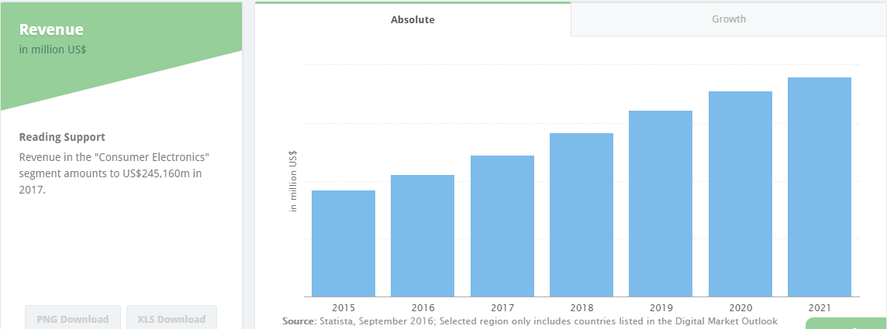
Worldwide Consumer Electronics-Revenue

Slide 12
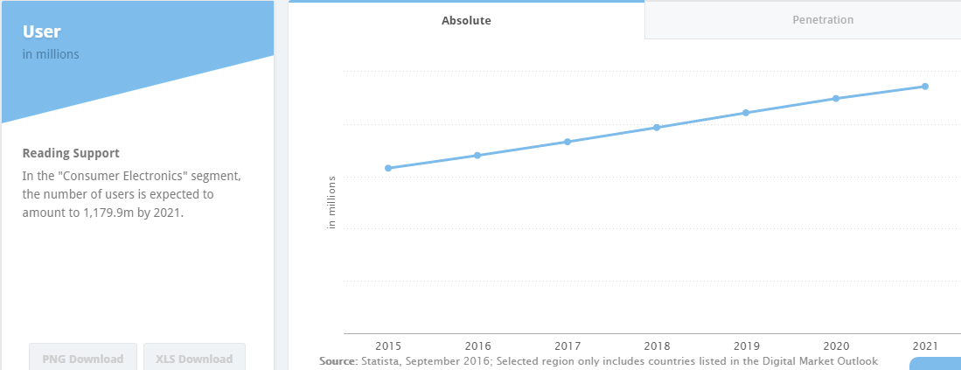
Worldwide Consumer Electronics-Users

Slide 13
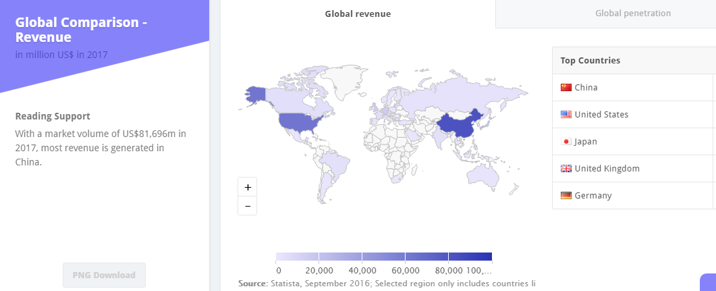
Worldwide Consumer Electronics-Global Comparison

Slide 14
Challenges
Slim operating margins
High capital expenditure
Shortening product life cycle
Managing a global supply chain
Volatile Industry that is rapidly changing
Constant changes in trends

Slide 15
Competition
Oligopoly, dominated by a handful of large competitors
Rapid changes in market shares
High competition encourages innovation and ways to reduce cost
Competitors can earn high profit margins

Slide 16
Main Aspects of the Industry
Internet
Computers
Smartphones
Tablets
Smart watches
Operating Systems
Cloud Computing
App Store
Virtual Reality
Smart Cars

Slide 17
The Internet
Massive network of networks, which connects billions of people online through which communication and other various activities may occur

Slide 18
The Internet
1969: The original internet
1971: First email sent
1990: Archie, the first search engine
1991: Internet available for commercial use
1996: More email than post mail in the USA
1996: BackRub search engine (Stanford)
1997: Google

Slide 19
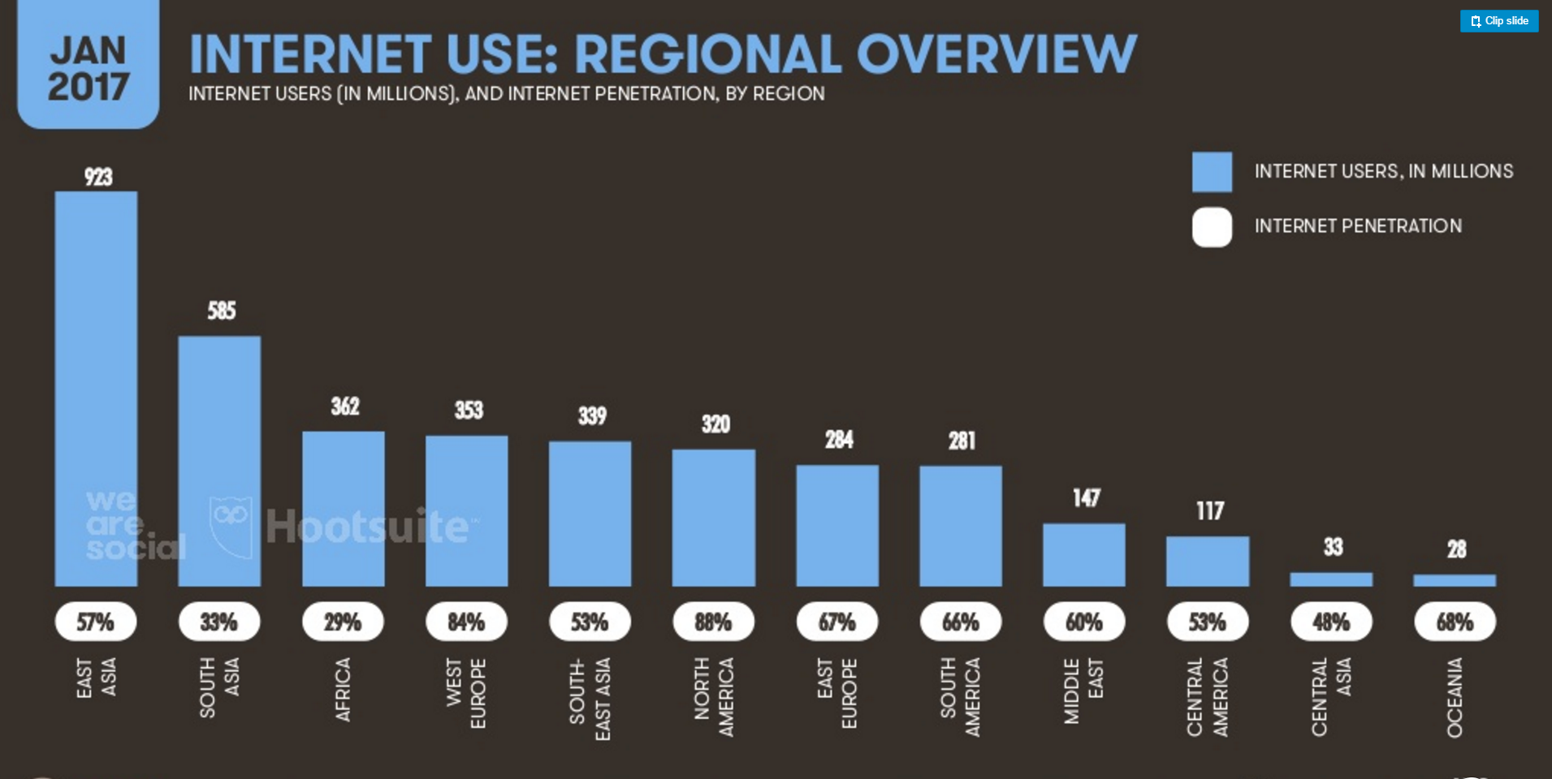

Slide 20
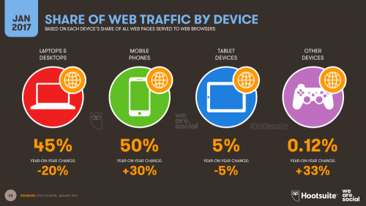

Slide 21
Computers
A device which can do a multitude of tasks ranging from processing and storing data to, doing set tasks based on the software it is operating on.

Slide 22
Computer History
1936: First freely programmable computer
1951: First commercial computer released
1974: First consumer computers (IBM)
1976: Apple I,II
1984: Apple Macintosh
1985: Microsoft Windows

Slide 23
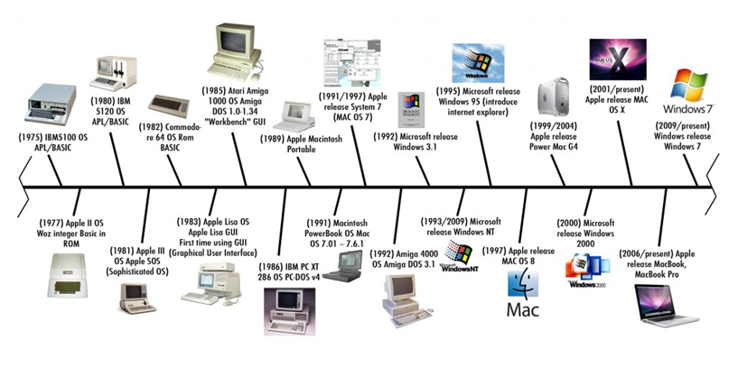
Computer Timeline

Slide 24
Smartphones
What is a Smartphone?
All in one device that can be used as a cell phone and has computing, PDA functions
Variety of applications available
High Speed Data Access
Multimedia

Slide 25
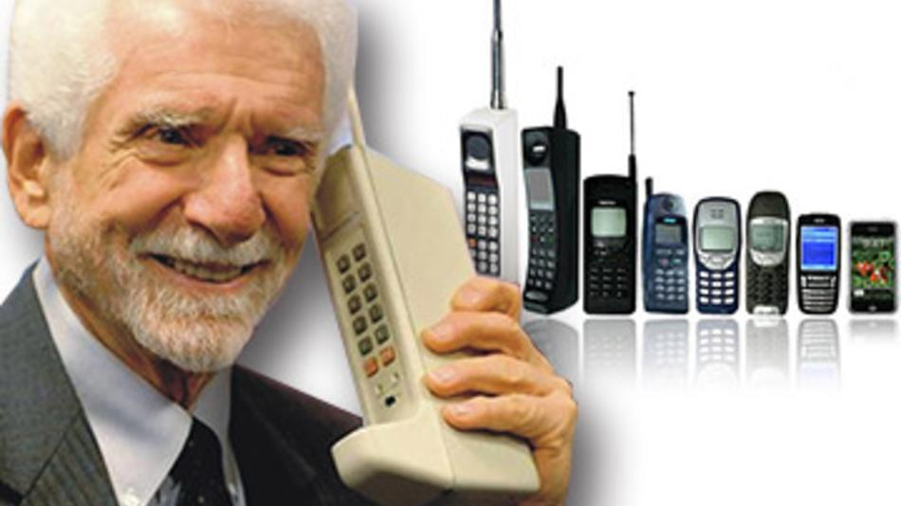
Mobile Phone History
1973: Motorola cell phone created
April 3, 1973: first cell phone call made by Martin Cooper
1983: first cell phone available to consumers
1994: First smartphone
1999: First mobile watch phone
2001: First Commercial 3g Network
2007: First Iphone Released
2008: First Android phone released
2010: First LTE Network

Slide 26
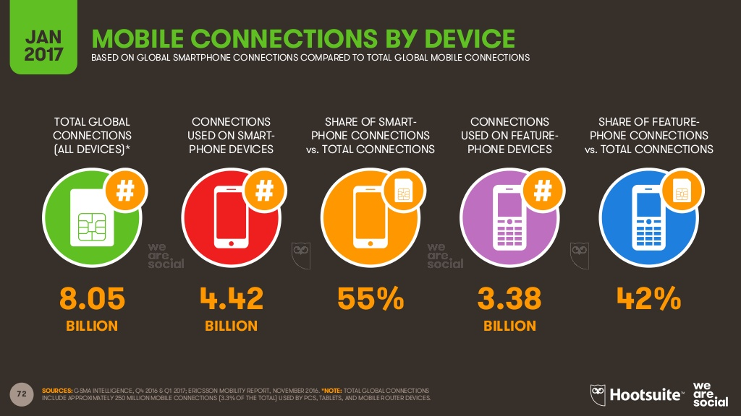

Slide 27
4G/LTE Networks
Speeds of 1Gbs when stationary
100Mbps when mobile
However this standard is so high that no commercialized standard actually meets them hence why we have LTE networks
LTE is part of this generation

Slide 28
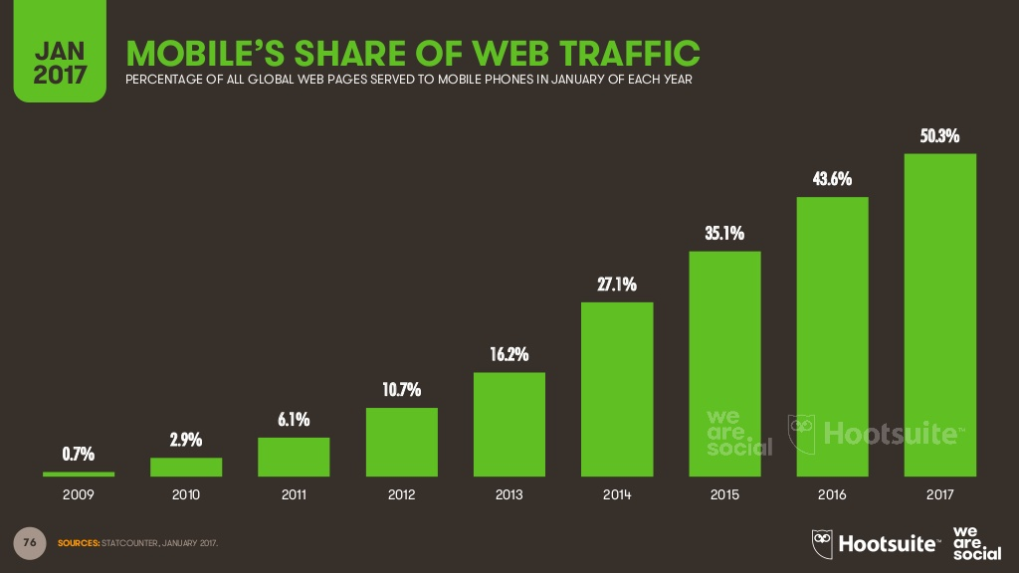

Slide 29
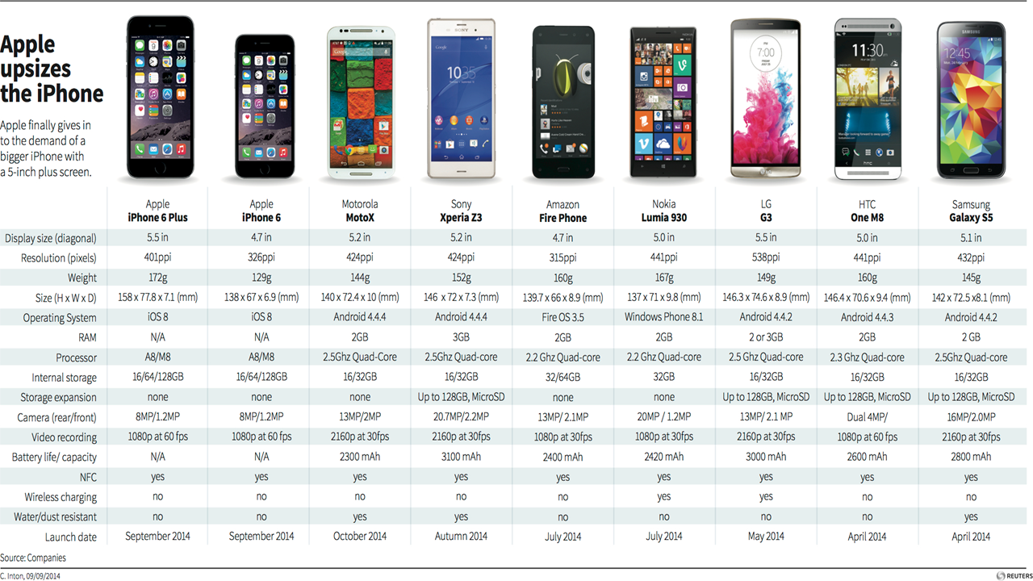

Slide 30
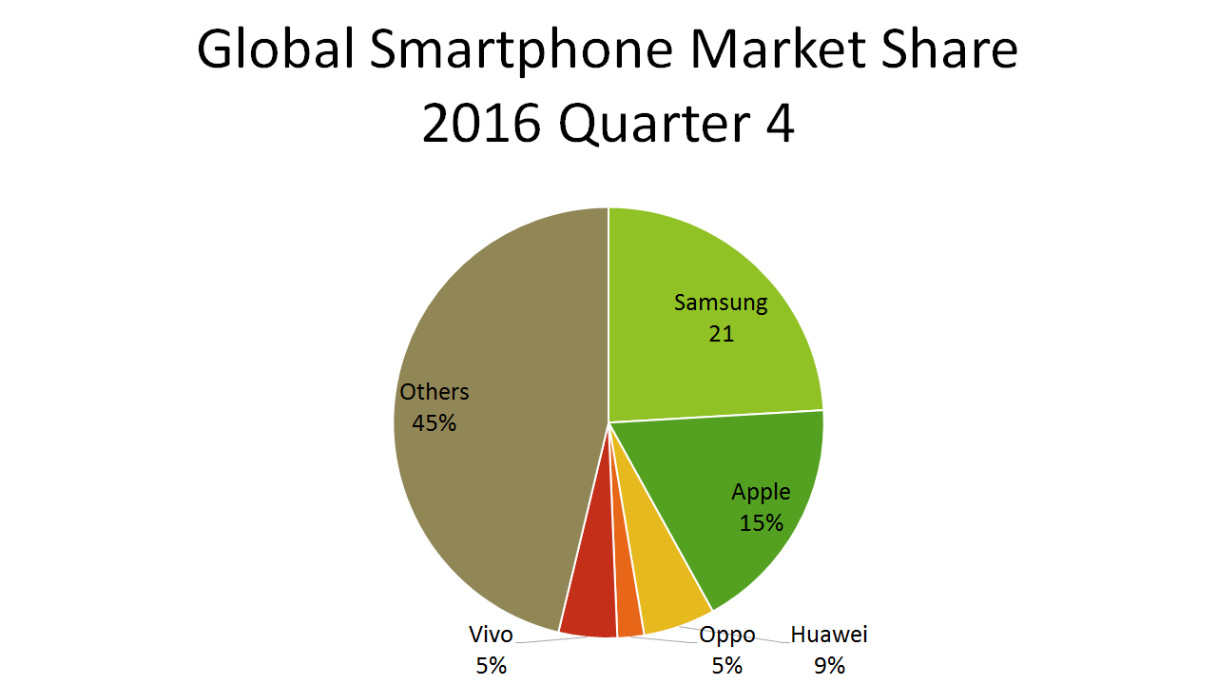

Slide 31
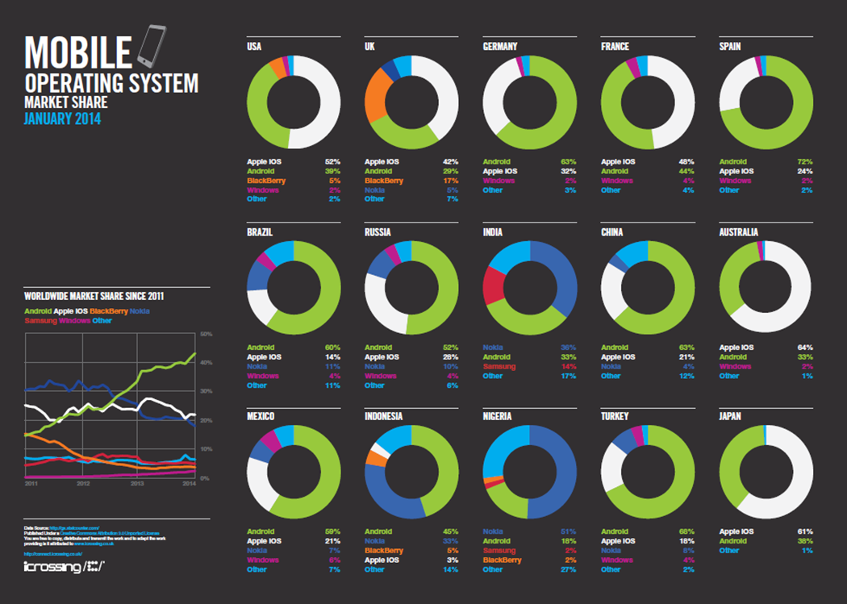

Slide 32
Tablets
What is a Tablet?
Larger than a Smartphone
Touchscreen used as primary method of input
Some typical functions are:
Mobile Browsing
Portable Media Player
Camera
Downloadable Apps

Slide 33
Tablet History
1971: Allan Kay describges a tablet computer at Xerox PARC
1983: Apple and AT&T work on a tablet prototype
1991: IBM markets a tablet computer but fails
1993: Apple Newton launched, also fails
1996: NewsPad debuts; considered one of the first serious prototypes
2009: Various computer manufacturers release tablets to market
2010: Apple iPad launched

Slide 34
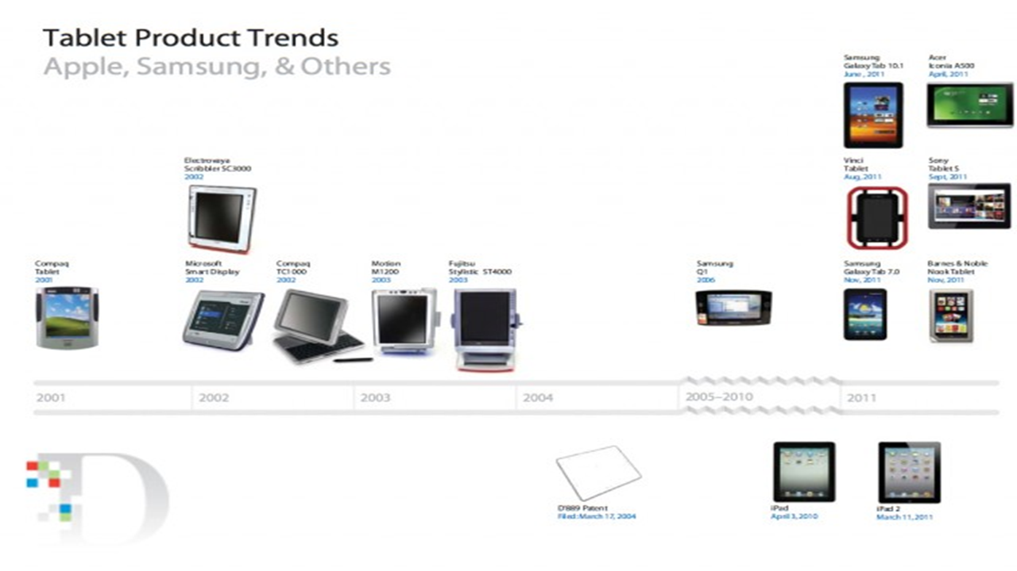

Slide 35
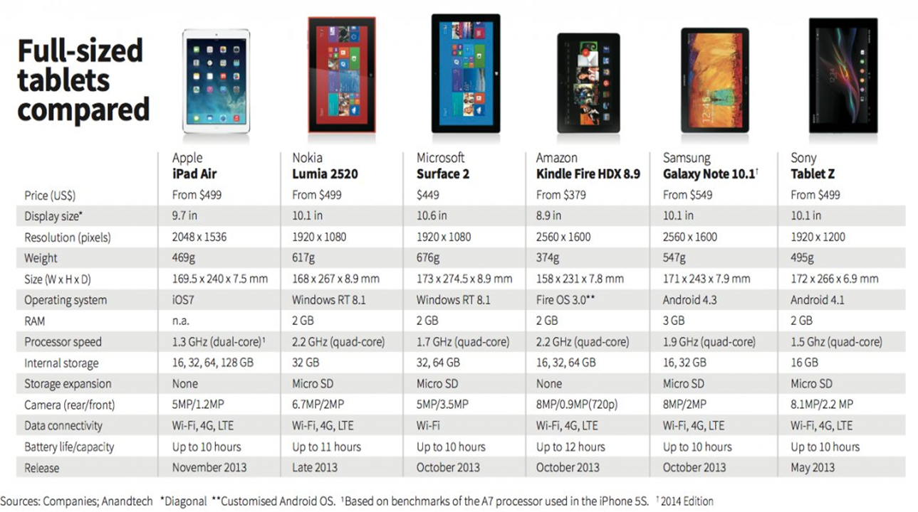

Slide 36
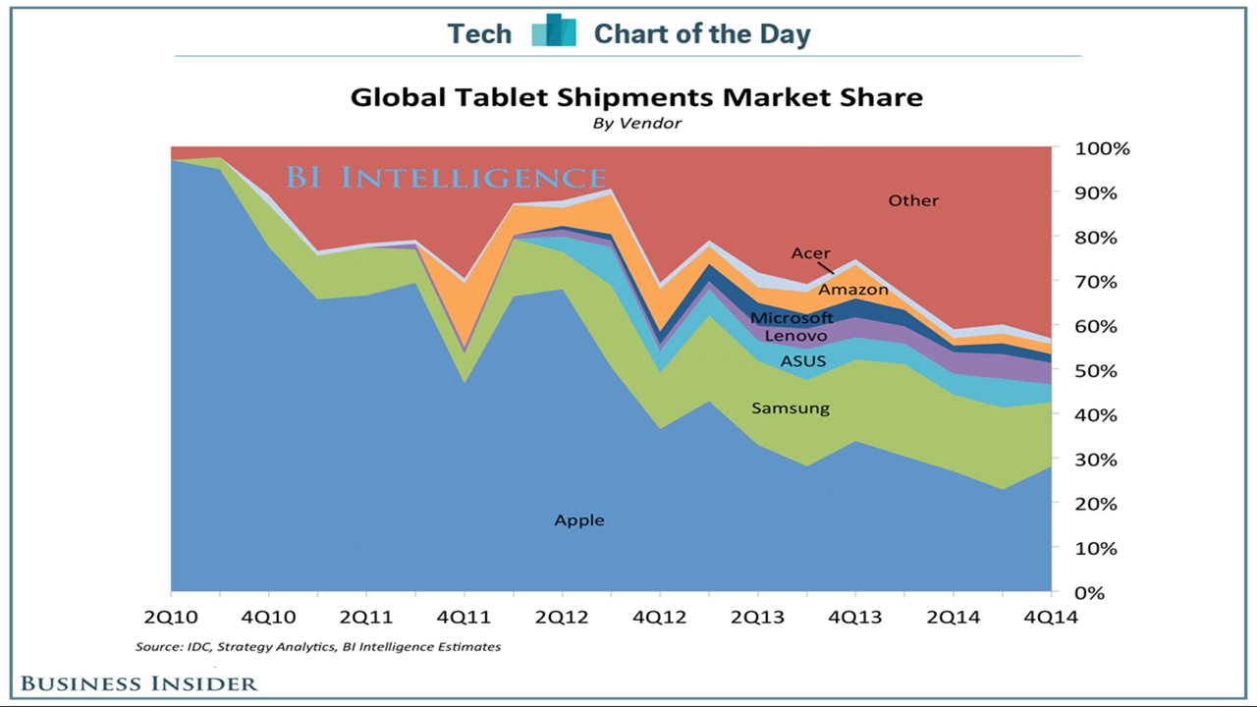

Slide 37
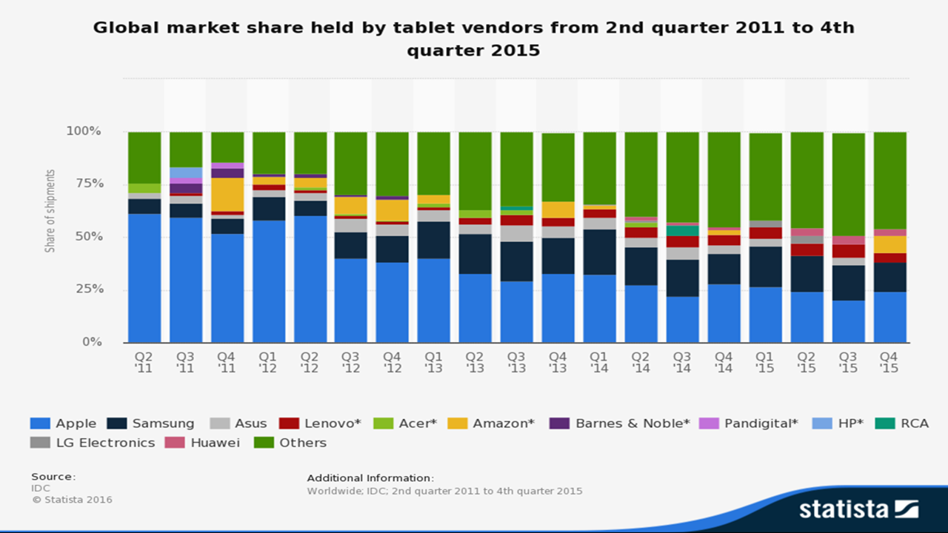

Slide 38
Smart Watch
What is a Smart watch?
A computerized wristwatch with functionality that is enhanced beyond timekeeping, and is often comparable to a personal digital assistant device

Slide 39
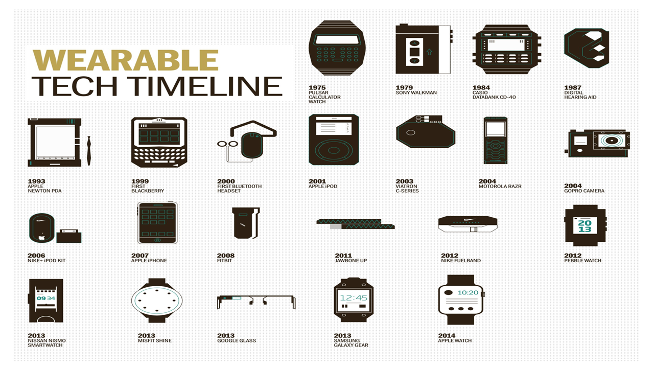

Slide 40
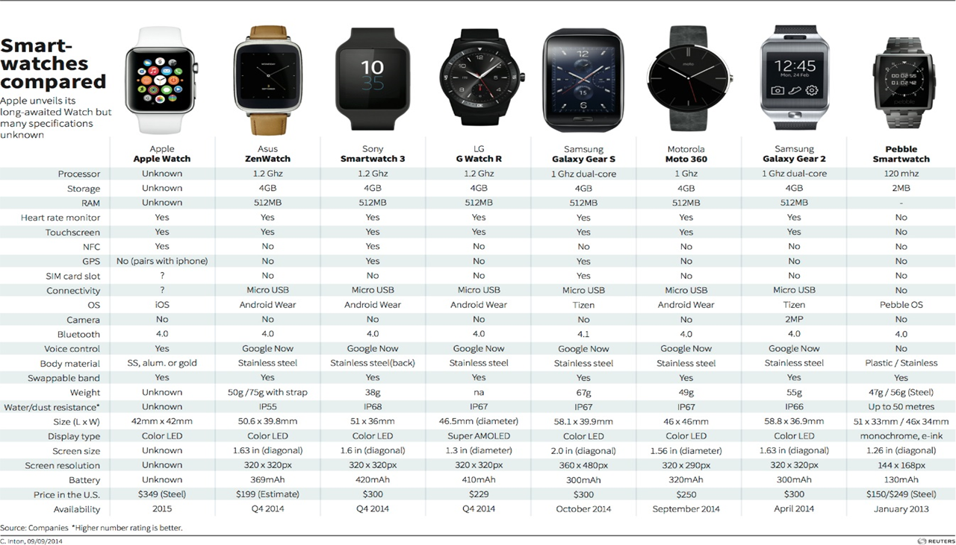

Slide 41
Operating System (OS)
What is an Operating System?
An operating system (OS) is software that manages computer hardware resources and provides services for computer programs.

Slide 42
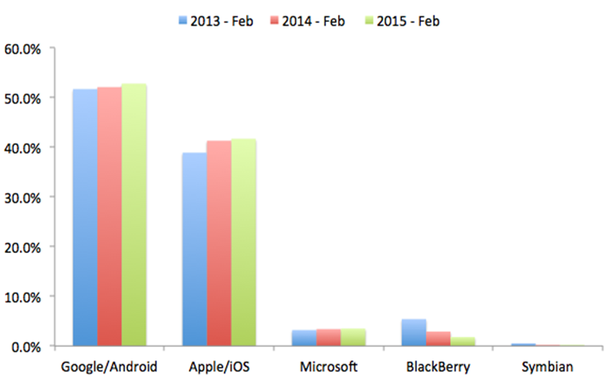
Global Mobile Operating System Share

Slide 43
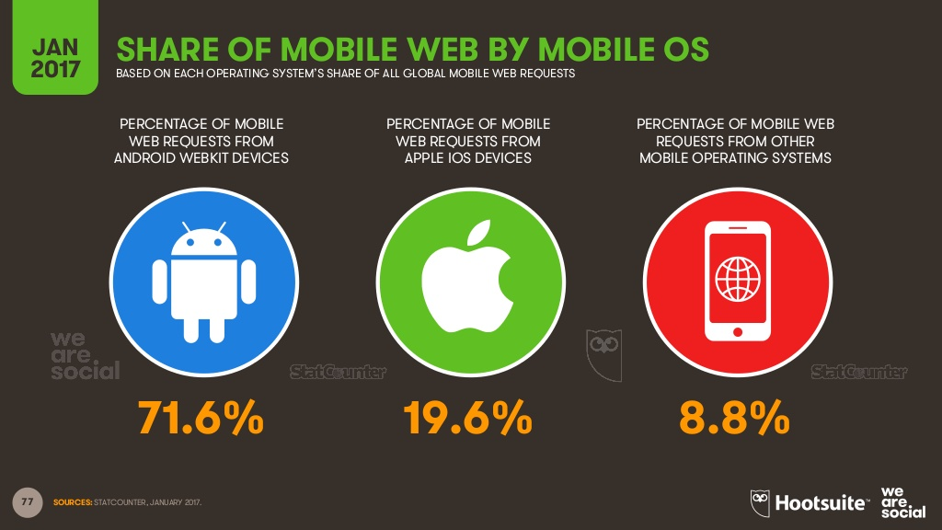

Slide 44
Cloud Computing
A model of network computing where a program or application runs on a connected server or servers rather than on a local computing device.

Slide 45
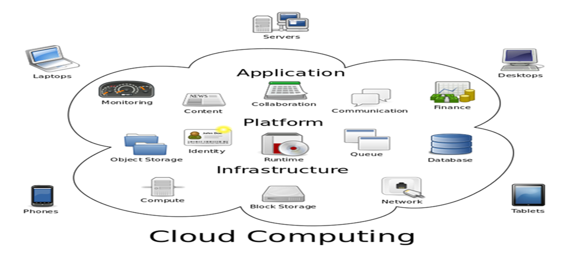
Cloud Computing

Slide 46
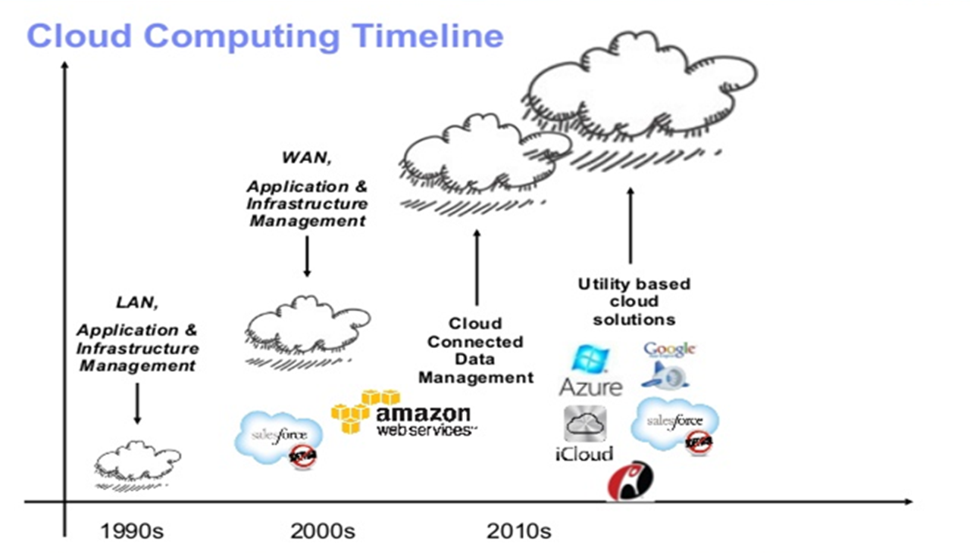

Slide 47
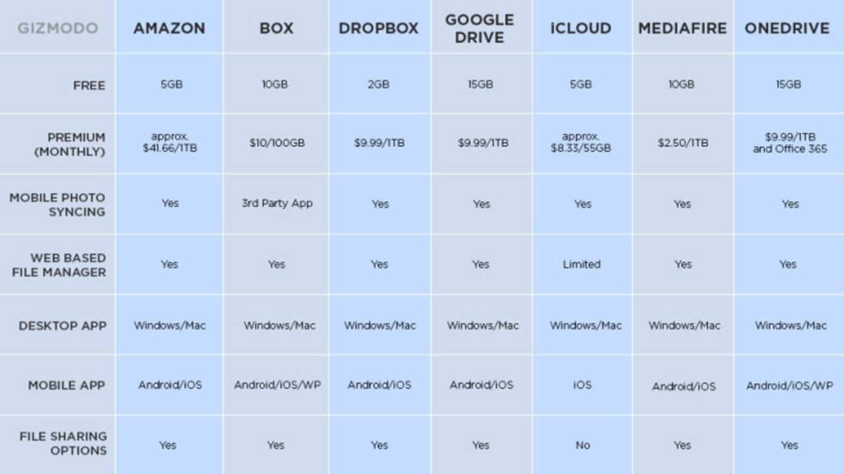

Slide 48
App Store
A place where applications can be downloaded directly to a device to supplement the experience of the device, for recreational use, etc. Some apps are free some have to be bought

Slide 49
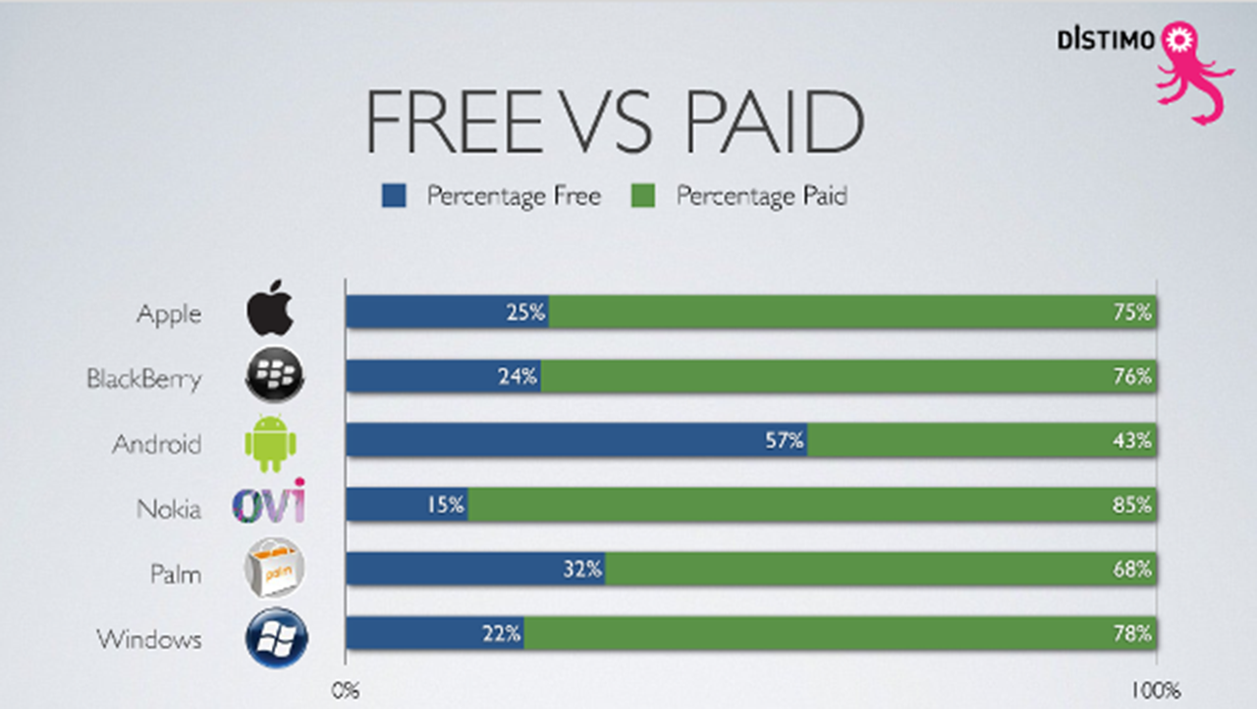

Slide 50
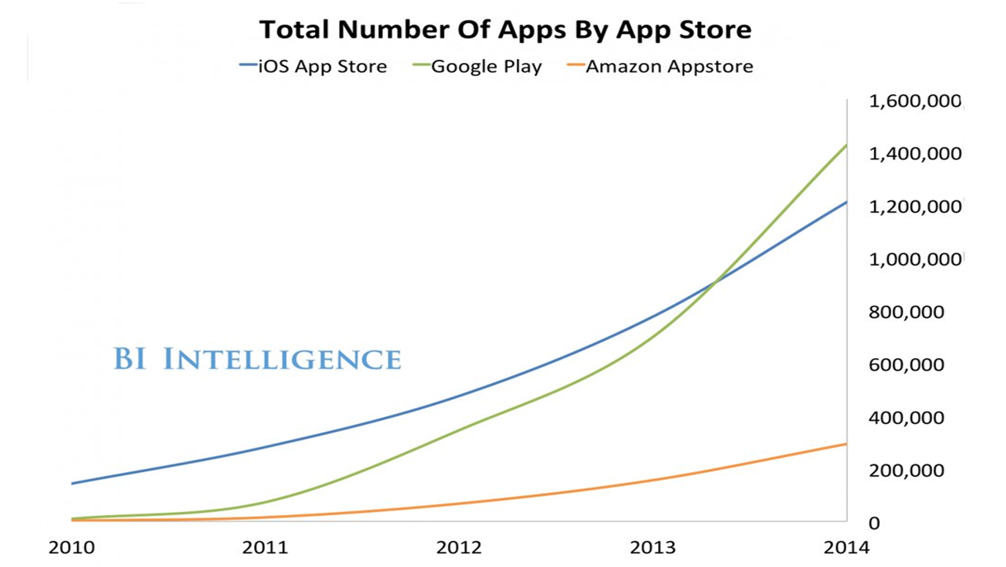

Slide 51
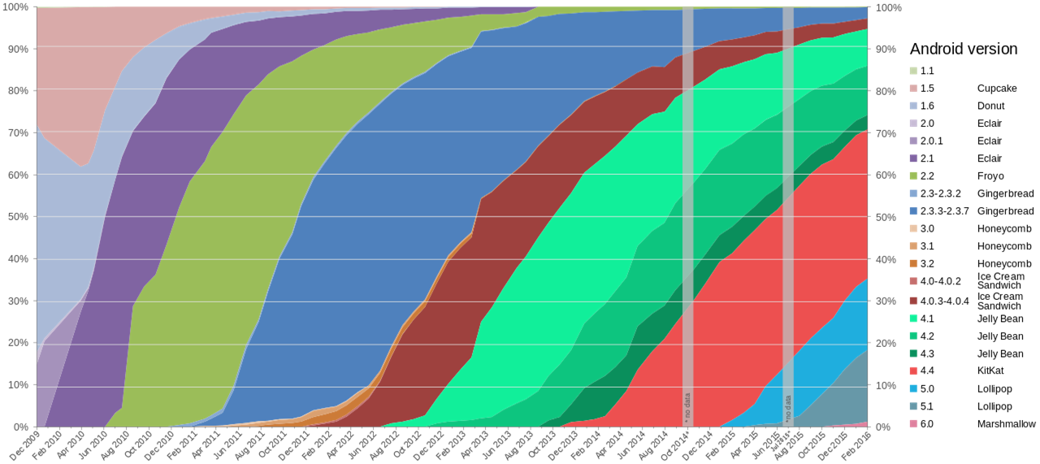

Slide 52
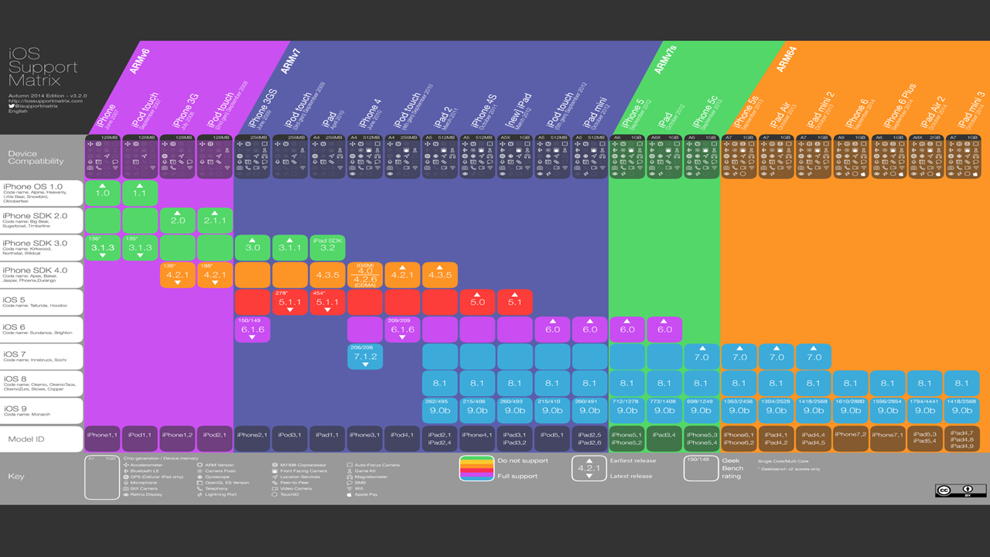

Slide 53
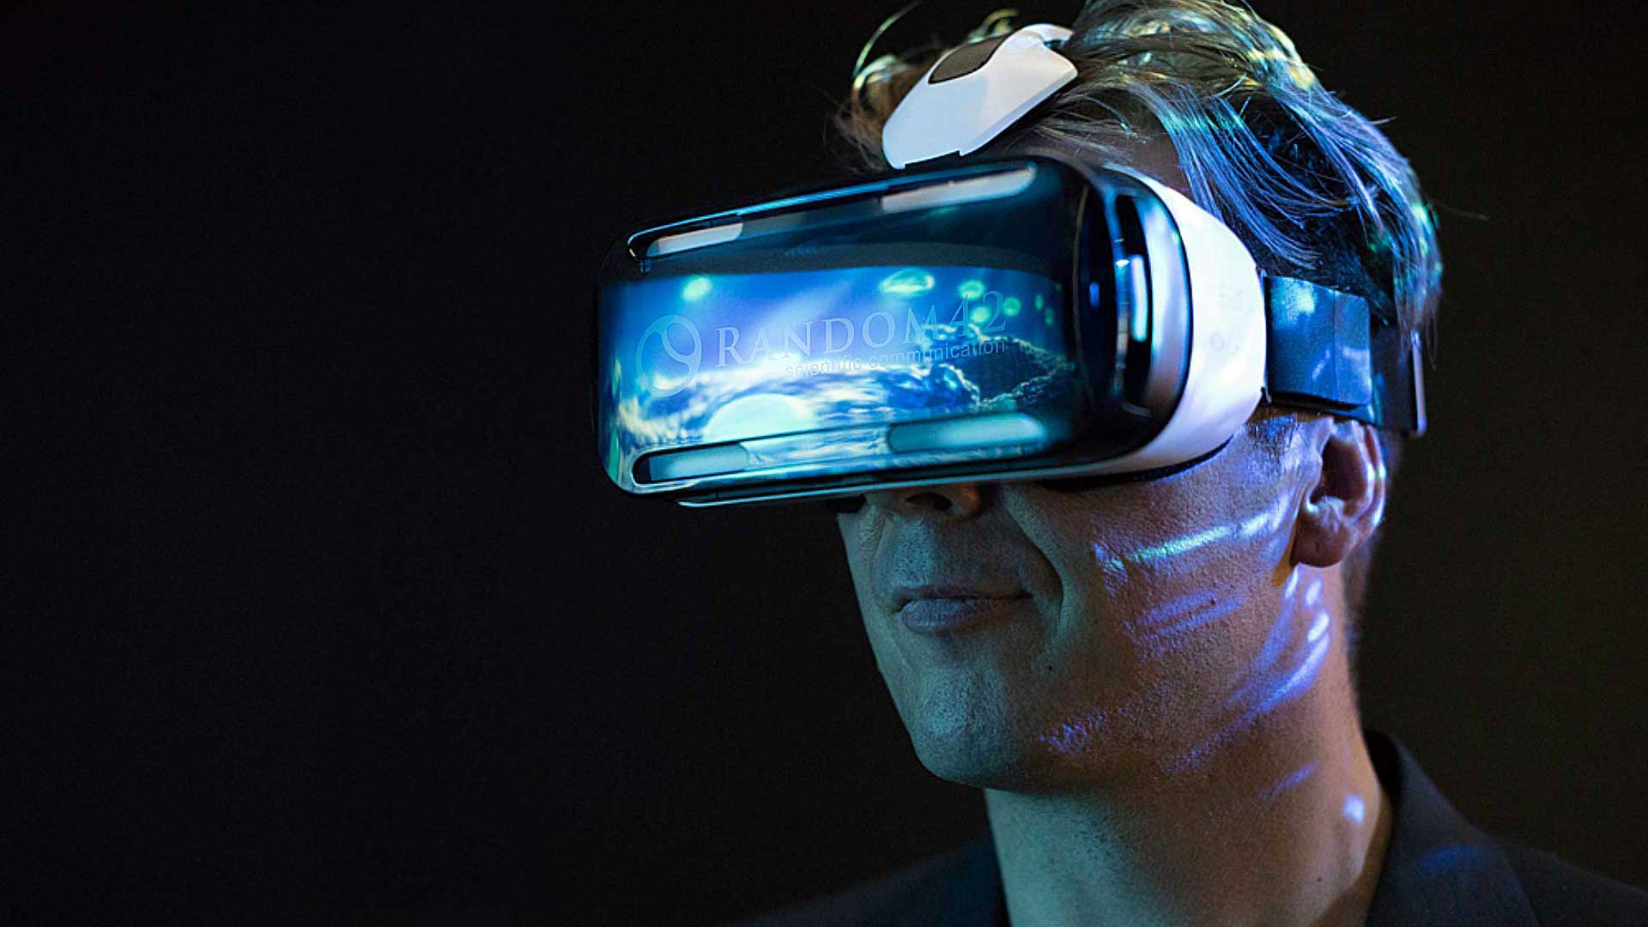
Virtual Reality
Virtual reality (VR) typically refers to computer technologies that use software to generate the realistic images, sounds and other sensations that replicate a real environment

Slide 54
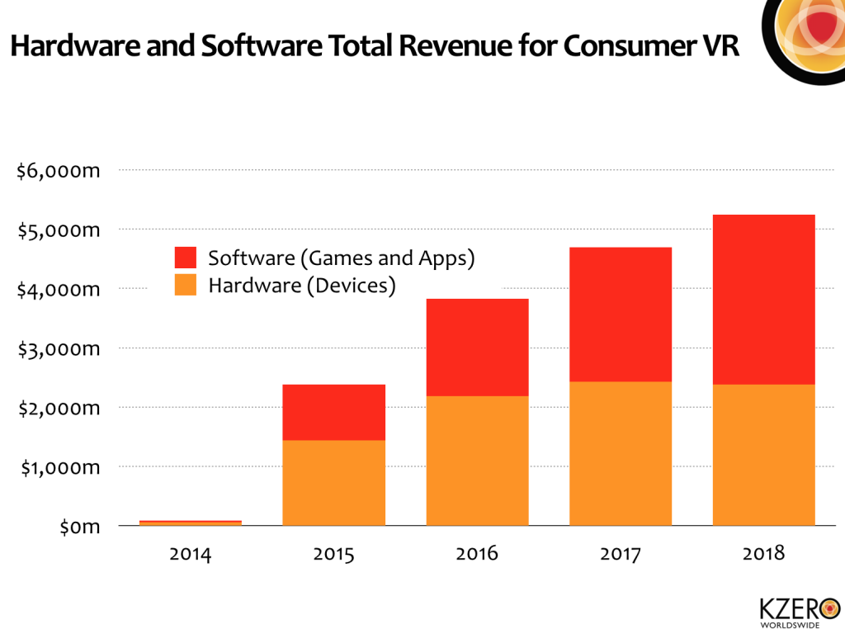

Slide 55
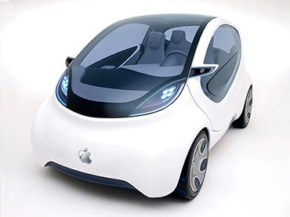
Smart Car
Self Driving

Slide 56
Apple

Slide 57
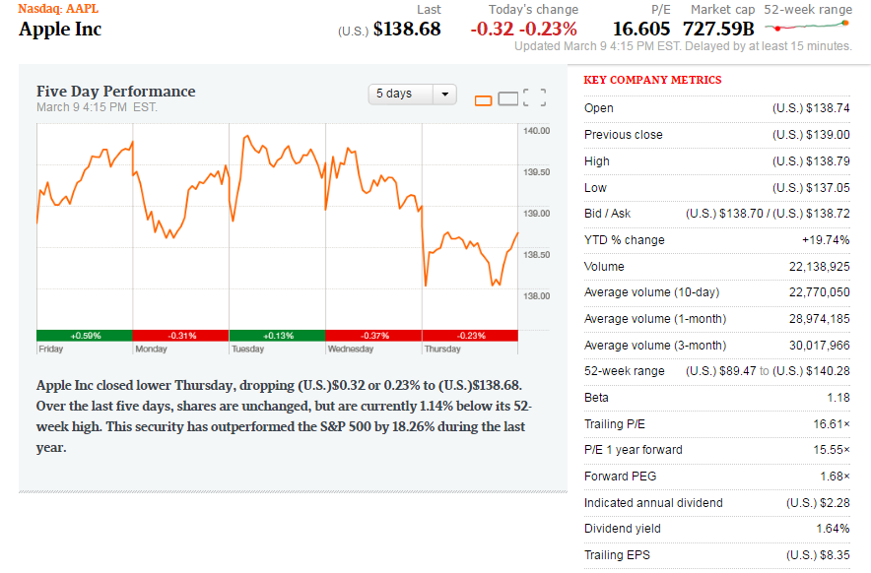
Financial Snapshot

Slide 58
Share Structure
Weighted Average Shares Outstanding (in Millions)
2013 | 2014 | 2015 | Mar 9 2017
6.477 | 6.085 | 5.753 | 5.247
Annual Diluted Earnings Per Share
2013 | 2014 | 2015 | 2016
5.68 | 6.45 | 9.22 | 8.31

Slide 59
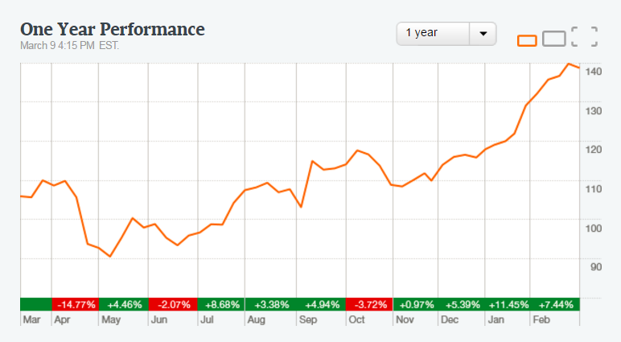
1 Year

Slide 60
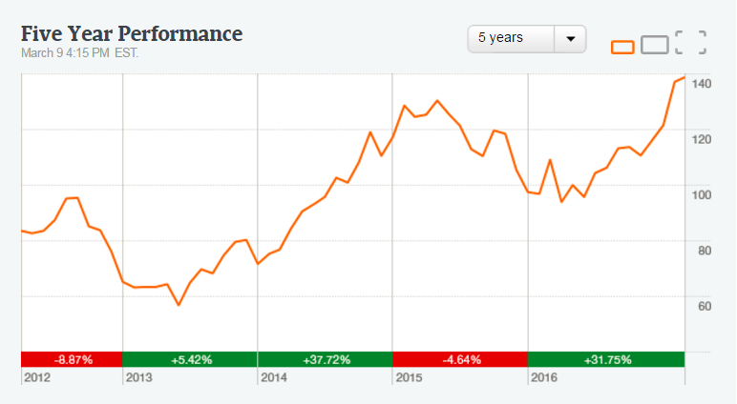
5 Year
Notes:
3.28 EPS 3 months ending December 2015 translates to about $75.9 Billion revenue
60

Slide 61
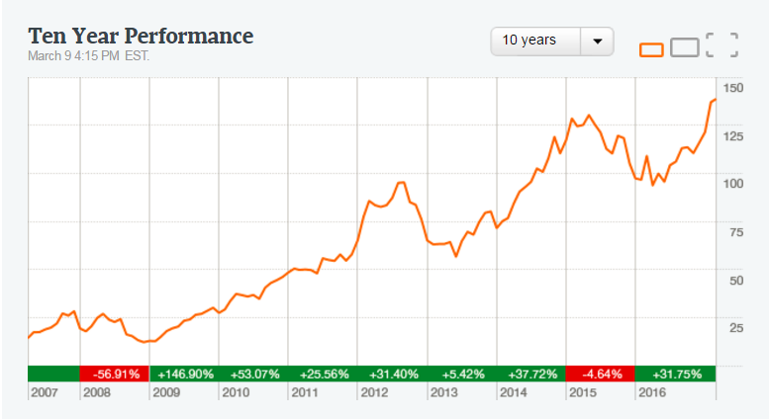
10 Year

Slide 62
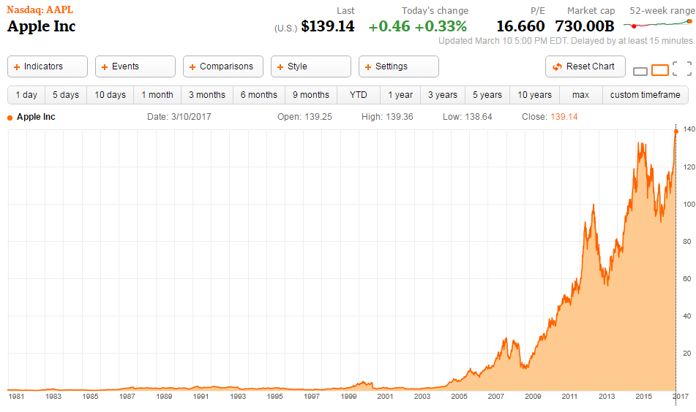
Max

Slide 63
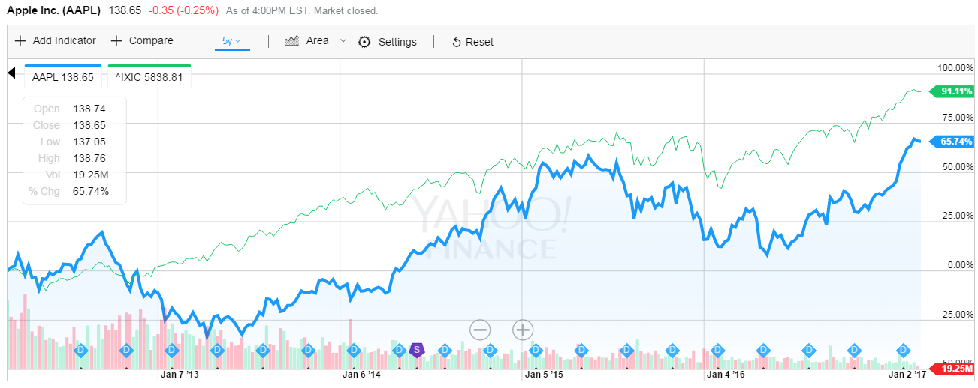
APPL v. NASDAQ

Slide 64
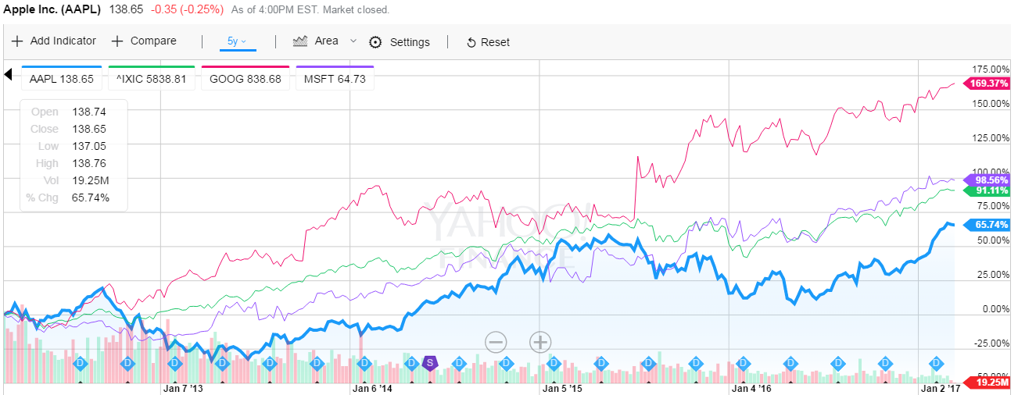
APPL v. MSFT & GOOGL

Slide 65
Apple’s Mission
“Apple designs Macs, the best personal computers in the world, along with OS X, iLife, iWork and professional software. Apple leads the digital music revolution with its iPods and iTunes online store. Apple has reinvented the mobile phone with its revolutionary iPhone and App store, and is defining the future of mobile media and computing devices with iPad.”

Slide 66
Company Profile
•HQ: Cupertino, California
•The Company designs, manufactures and markets mobile communication and media devices, personal computers and portable digital music players, and sells a variety of related software, services, accessories, networking solutions and third-party digital content and applications
•116,000 permanent full-time employees
•490 retail stores in 20 countries
•Most products are designed in the US but manufactured abroad

Slide 67
Strategy
“The Company believes ongoing investment in research and development (“R&D”), marketing and advertising is critical to the development and sale of innovative products and technologies”
•Bring the best user experience to its customers through its innovative hardware, software and services
•Expand its platform for the discovery and delivery of digital content and applications through its internet services
•Build and expand retail and online stores and its third-party distribution network to effectively reach more customers and provide them with a high-quality sales and post-sales support experience
•Support a community for the development of third-party software and hardware products and digital content that complement the Company’s offerings

Slide 68
History of Apple
Notes:
DO: APPLE vs. S&P 500 Index, the S&P Information Tech Index and Dow Jones US Tech Index
68

Slide 69
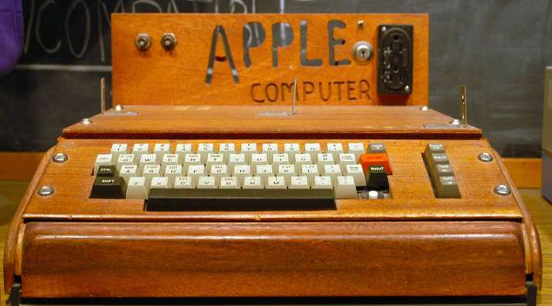
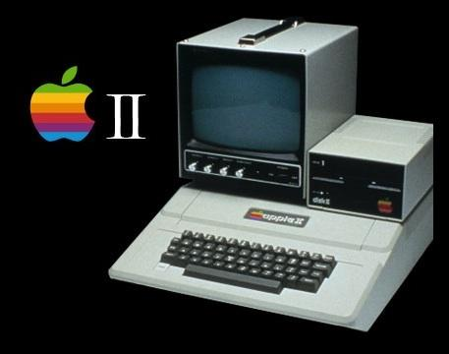
Early Years
1976: Founded in Cupertino, California by Steve Jobs, Ronald Wayne and Steve Wozniak
Apple I sells for $666.66 (200 units)
1977
Apple II released at $1300
Apple incorporated in California
1979: First app unveiled: VisiCalc

Slide 70
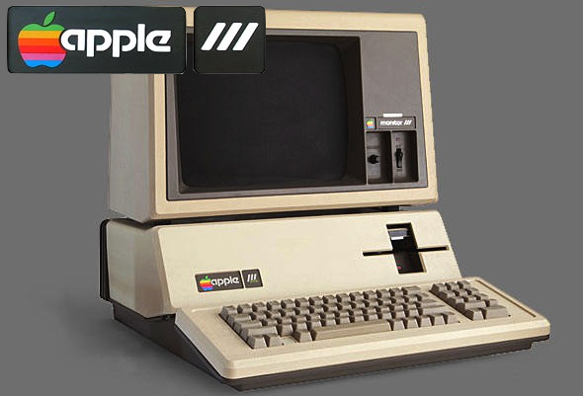
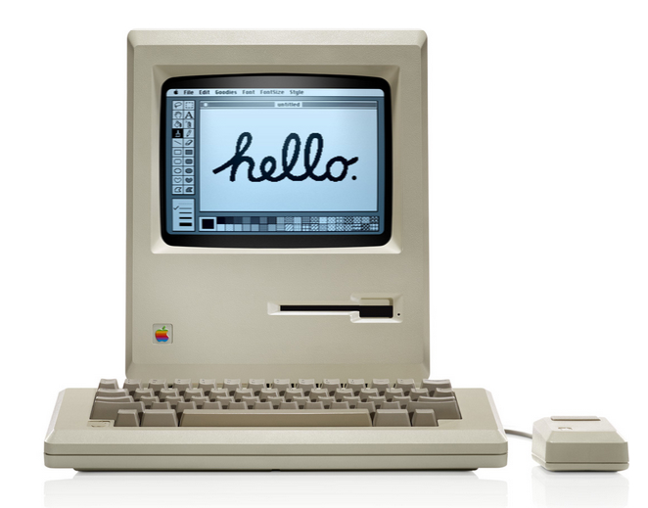
The ’80s
1980:
IPO launched at $22, selling 4.2 million shares
Apple III released
1983: LISA released for 9,995
1984 : Macintosh 1 launched for $2,495
1985: Jobs leaves Apple and starts NeXT

Slide 71
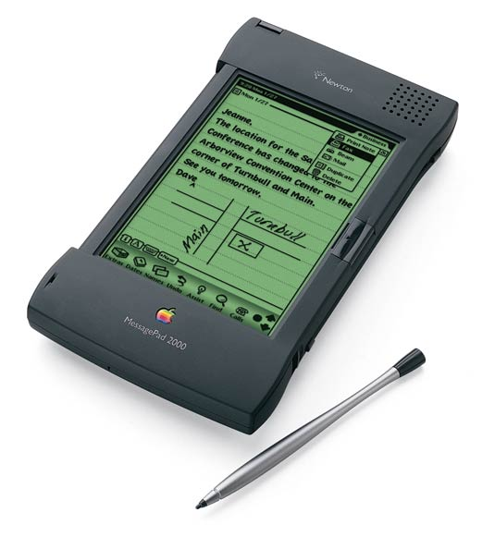
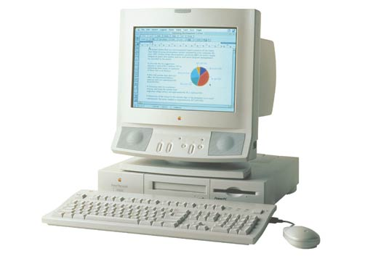
The ‘90s
1993: The Newton released (early PDA model)
1994 - Apple releases its first PowerPC-based desktop computers and notebooks.
1997:
Apple acquires NeXT and its OS, NeXTstep
In 1997, Steve Jobs back to the company he co-founded as an advisor.
Apple is in financial trouble, with its stock reaching a 12-year low
Steve Jobs appointed interim CEO
Apple Online Store Launched
Notes:
http://www.macworld.co.uk/feature/apple/history-of-apple-steve-jobs-what-happened-mac-computer-feb-16-3606104/
the Apple II ‘was the first of its type to provide usable colo[u]r graphics... contained expansion slots for which other hardware manufacturers could design devices that could be installed into the computer to perform functions that Apple has never even considered.’
71

Slide 72
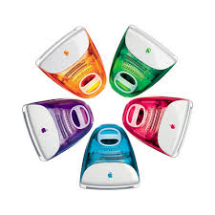
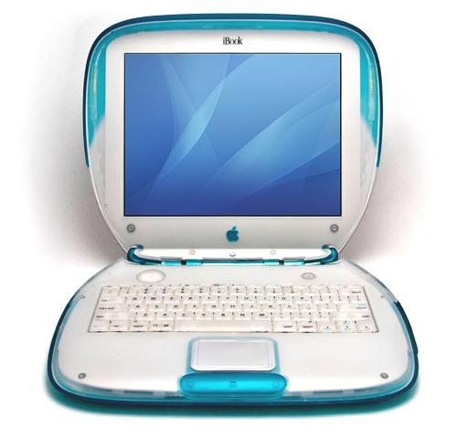
The ‘90s
1998: iMac launched
1999: iBook launched

Slide 73
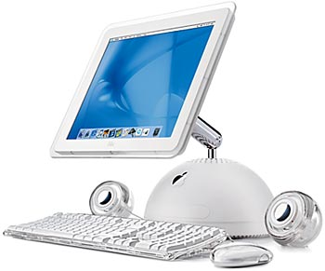
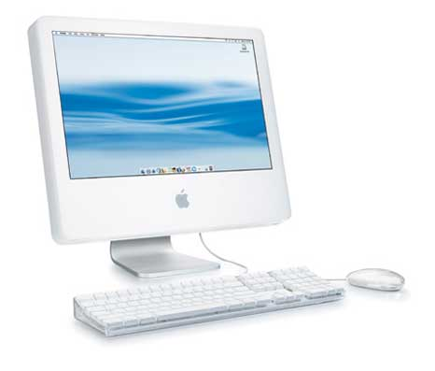
2000s
2001
Mac OS X
Opening of Apple retail stores
First iPod
2002: iMac G4
2003: iTunes music store
2004
iMac G5
iPod mini

Slide 74
2000s
2005:
iPod shuffle iPod nano
2006: MacBook Pro
2007
iPhone and iPhone 3G
iPod Touch
Apple TV
2008: MacBook Air

Slide 75
2010s
2010:
iPad
iPhone 4
2011
iCloud announced
Steve Jobs resigns as CEO, replaced by Tim Cook
becomes the world's most valuable publicly traded company on august 9
iPhone 4S
Steve Jobs passes away
2012
- iPhone 5 and iPad Mini released
- Apple Maps launches

Slide 76
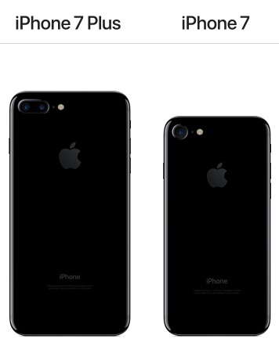
2013: iPhone 5S/5C launched
2014: Apple Pay launched
2015:
iPhone 6S and 6S Plus released
iPad Pro
Apple Watch
Apple Music launched
March 2016: iPhone SE
September 2016:iPhone 7 and 7Plus

Slide 77
Key Acquisitions
1997: NeXT (computer programming services)
Derived Products: OS X and iOS
$404 million
2000: SoundJam MP (Software)
Derived Products: iTunes
2005: Fingerworks
Derivied Product: Multi-touchscreen
2008: P.A. Semi (semiconductors)
Derived Products: Apple A4 and A5 chips
$278 million
2009: Lala.com (music streaming)
Derived Products: iCloud, iTunes Match
$80 million
Notes:
NEXTstep OS brought Steve Jobs back into Apple and was the precursor for the Mac OS X operating system
77

Slide 78
Key Acquisitions
2010: Siri (Voice control software)
Derived Products: Siri
$200 million
February 23, 2012: Chomp (App search engine)
Derived Products: App store
$50 million
July 27, 2012: AuthenTec (PC and mobile security)
Derived Products: Touch ID
$356 million

Slide 79
Key Acquisitions
2014: Beats Electronics
Derived Products: iPhone, iTunes
$3 billion
2015: IinX (camera)
Derived Products: iPod, iPhone, iPad
$20 million
2016:
Flyby Media (Augmented reality software)
iPhone, iPod, iPad
Shares in Didi Chuxing $1,000,000,000
Turi (Machine Learining Company) $200,000,000

Slide 80
APPLE MANAGEMENT TEAM

Slide 81
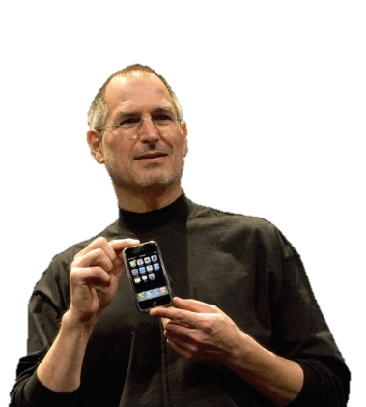
Steve Jobs
Co-Founder and former CEO
Education:
Reed College – Dropped Out
-Left in 1985, came back in 1997
▪ NeXT: computer company
▪ Pixar: computer animation film studio
Oversaw development of iMac, iTunes, iPhone, and iPad on the services side as well as Apple’s retail stores
Demanding perfectionist
belief in premium design and craftsmanship
Passed away in 2011

Slide 82
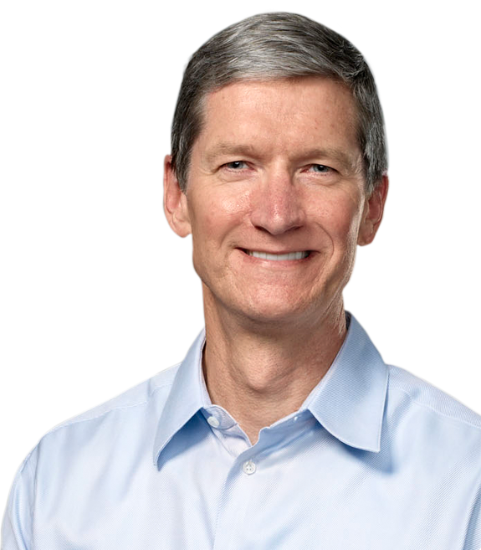
Tim Cook
Chief Executive Officer
Since 08/12/2011
Chief Finance Officer (2005-2011)
Executive VP, Worldwide Sales and Operations (2002-2005)
Senior VP, Worldwide Operations, Sales, Service, and Support (2000-2002)
Senior VP, Worldwide Sales and Operations (1998-2000)
Education:
Auburn University – (B) Industrial Engineering
Duke University – MBA
Notes:
Next: Computer programming services
Soundjam
APPLE SOC: Apple Inc. has developed a range of APPLE SOC: Apple Inc. has developed a range of "System on Chip" (SoC) as well as APPLE SOC: Apple Inc. has developed a range of "System on Chip" (SoC) as well as "System in Package" (SiP) mobile application processors to power their to power their mobile consumer devices. In order to meet the stringent power and space constraints common to mobile devices, these chips combine a to power their mobile consumer devices. In order to meet the stringent power and space constraints common to mobile devices, these chips combine a central processing unit (CPU) with other components into a single compact physical package.
82

Slide 83

Angela Ahrendts
Senior VP, Retail and Online Stores
Joined Apple in 2014
Formerly, Burberry, CEO
Plan for the future of Apple Retail: China emphasis, mobile payments, revamped experience.
A member of the UK’s Prime Minister’s Business Advisory Council; named honorary dame commander of the British Empire
Marketing and Merchandising degree from Ball state University in Indiana, where she was awarded an honorary doctorate
Notes:
Beats: Headphones, music streaming (Beats music)
83

Slide 84

Eddy Cue
Senior VP, Internet, Software and Services
•Joined Apple in 1989
Oversees Apple's content stores including the iTunes Store, the revolutionary App Store and the iBookstore, as well as Siri, Maps, iAd and Apple's innovative iCloud services.
Earned a Bachelor Degree in Computer Science and Economics from Duke University

Slide 85

Craig Federighi
▪Senior VP of Software Engineering
▪A former NeXT employee
▪Joined Apple in 2009
▪Oversees the development of iOS, OS X and Apple's common operating system engineering teams
▪Education: University of California
▪Computer Science (B)
▪Electrical Engineering and Computer Science (M)

Slide 86

Jonathan Ive
Senior VP, Design
Since 07/2010
Senior VP, Industrial Design (1997-2010)
Oversees the designs of Apple hardware, user interface, packaging, major architectural projects such as Apple Campus 2 and Apple's retail stores, as well as new ideas and future initiatives
▪Notable honors and awards:
▪2007: National Design Award (US)
▪2012: Knight Commander of the British Empire
▪Education: Newcastle Polytechnic
▪ Bachelor of Arts degree

Slide 87

Dan Riccio
Senior VP, Hardware Engineering
Since 06/28/2012
Joined Apple in 1998
Leads the Mac, iPhone, iPad and iPod engineering teams
•Prior to Apple:
•Compaq: Senior Manager of Mechanical Engineering
Education:
University of Massachusetts – (B) Engineering

Slide 88

Philip W. Schiller
Senior VP, Worldwide Marketing
Since 04/1997
At Apple, Schiller worked in the formation and marketing of iMac, iBook, PowerBook G4, iPod, Mac OS X, and subsequent products. Schiller is credited with coming up with the idea for the original iPod's click wheel interface.
Education:
Boston College – (B) Biology

Slide 89

Jeff Williams
Senior VP, Operations
Since 07/2010
Joined Apple in 1998
Oversees Apple’s supply chain, service and support, and the social responsibility initiatives which protect more than one million workers worldwide
▪2013: leads the Apple Watch project
Education:
North Carolina University – (M) Mechanical Engineering
Duke University - MFA

Slide 90

Luca Maestri
Senior VP and Chief Financial Officer
Joined Apple in 2013 as vice president of Finance and corporate controller,
Oversees the accounting, business support, financial planning and analysis, treasury, M&A, investor relations, internal audit and tax functions at Apple
•Prior to Apple:
CFO at Xerox, Nokia Siemens Networks, and GM
•Education:
Luiss University in Rome: Economics (B)
Boston University: Management (M)

Slide 91

Bruce Sewell
•Senior VP and General Counsel
•Joined Apple in 2009
•Oversees legal matters:
•Prior to Apple
Intel: VP and deputy general counsel
Education:
•University of Lancaster: Science (B)
•George Washington University: JD

Slide 92

Johny Srouji
Senior VP of Hardware Technologies
Joined Apple in 2008
Oversees Apple’s custom silicon and hardwaretechnologies:
Prior to Apple:
Intel and IBM: processor development and design
Education:
Technion, Israel’s Institute of Technology: Computer Science (B and M)

Slide 93
Apple Products
iPod
iPhone
iPad
Apple Watch
iMac
MacBook
MacBook Pro
MacBook Air
Apple TV
iTunes
iCloud
Apple Music
Productivity App
iBooks

Slide 94

iPod
October 2001: 1st release
Latest: iPod Touch 6th gen
Portable digital music and media players
Lines:
Classic
Nano
Mini
Shuffle
Touch
Global Apple iPod sales Q1 2006 –Q4 2014 (in million units)

Slide 95


iPhone
2007: iPhone 1
March 2016: iPhone SE
September 2016: iPhone 7 and 7 Plus
• Dual-camera setting, removal of the 3.5mm headphone jack and its replacement by airpods, a higher base storage capacity, a new home button and a better A10 processor
In September 2016, the Company released iOS 10, which introduces the ability for Siri to do more by working with apps

Slide 96



iPad
April 2010: 1stiPad
•Multi-purpose tablets based on Apple’s iOS Multi-Touch operating system
•Lines:
•iPad Air (9.4”)
•iPad mini (8”)
•iPad Pro (12.9”)

Slide 97


Apple Watch
April 2015: 1st release
•Incorporates fitness tracking and health-oriented capabilities with integration with iOS and other Apple products and services
•Need an iPhone nearby to pair to
•iPhone 5 and up
In September 2016, Apple introduced Apple Watch Series 2
Featuring new fitness and health capabilities, built-in GPS and a 50-meter water resistance rating for swimming.

Slide 98


iMac
Apple’s line of desktop and portable personal computers
▪Desktops: iMac. Mac Mini, Mac Pro
▪Portables: MacBook, MacBook Air, MacBook Pro
▪Runs on Mac OS X
▪Intel processors
iMac 21.5 - 27 inch

Slide 99

Apple TV
•January 2007: 1strelease
•2015: 4thgen
•tvOS: enables App Store
•Connects to HD TVs
•Streams digital contents from iTunes Store:
•Photos, videos, music
•Movies
On September 13, 2016, Apple released the tvOS 10 software update for the Apple TV, incorporates new Siri capabilities that allow searching across more apps
and services.

Slide 100

iTunes
Released 2001
Store allows for digital purchase of various entertainment media
iTunes U for downloading free material from top universities, museums, and other institutions
Media player and library to play and download digital audio and video including radio (iTunes Radio)

Slide 101

iCloud
•October 2011: release date
•Stores data such as photos, applications, contacts, calendars, and documents
•5GB of free storage
•Keep data up-to-date
•Wireless backups

Slide 102

Apple Music
Launched June 30, 2015
On demand music streaming service with 3-month free trial, $9.99 per month
As of December 2016, Apple Music has more than 20 million paying subscribers.

Slide 103

iBooks
E-book app for iOS
Installation of books and text books from the iTunes store
Millions of titles available, in different languages
Reading of content using VoiceOver

Slide 104

Apple Retail Store
Founded in May 2001 by Ron Johnson
Primarily sells computers and consumer electronics
Genius Bar for technical support and repairs
Over 490 Retail locations in 20 countries

Slide 105

App Store
Launched June 2008
Digital platform for mobile apps, available directly for download through iOS devices
Over 1.5 million apps and 100 billion downloads since 2008
At the end of 2013, App Store users spent over $10 billion
The average US iPhone user spent $40 on apps throughout the year, up from $35 in 2015.

Slide 106

Apple Pay
Mobile payment service that offers an easy, secure and private way to pay.
Pay accepts credit and debit cards, reward programs and store-issued credit and debit
Available in US, UK, Canada, Australia, China, Singapore, Switzerland, France, Russia, New Zealand, Japan, Spain, Ireland, Italy, Germany and Belgium.

Slide 107

Net Sales by Product

Slide 108

Net Sales by Product

Slide 109

Net Sales by Operating Segment Segment

Slide 110


Net Sales by Operating Segment

Slide 111
Contingencies
Possible legal proceeding in the future regarding access to private information
Apple Inc. v. Samsung Electronics Co., Ltd., et al. On October 11, 2016, the United States Supreme Court heard arguments in Samsung’s request for appeal related to the $548 million in damages.
Competition in current and future markets

Slide 112

Balance Sheet [Assets] 10-Q

Slide 113

Balance Sheet [Liabilities and Shareholder’s EQ] 10-Q

Slide 114

Balance Sheet [Assets] 10-K

Slide 115

Balance Sheet [Liabilities and Shareholder’s EQ] 10-K
Notes:
http://www.economist.com/blogs/graphicdetail/2016/01/daily-chart-20
115

Slide 116

Income Statement 10-K

Slide 117

Income Statement 10-Q

Slide 118

CF Statement [Operating] 10-K
Notes:
http://www.marketwatch.com/story/apple-vs-the-fbi-a-complete-guide-2016-02-20
118

Slide 119

CF [Investing and Financing] 10-K

Slide 120

CF Statement [Operating] 10-Q

Slide 121

CF [Investing and Financing] 10-Q

Slide 122




Slide 123

Financial Forecast

Slide 124

Recommendation
HOLD

Slide 125
Google

Slide 126

Financial Snapshot

Slide 127

1 Year

Slide 128

5 Year

Slide 129

Max

Slide 130

Google Vs. Nasdaq

Slide 131
Common Share Structure
Class A
294 Million - 1 vote per share
Class B
49 Million – 10 votes per share
Class C
344 Million – 0 votes per share
Designed to concentrate voting power

Slide 132

Share Ownership

Slide 133
Common Share Trend
Minor increase in total number of shares
Decrease in insider shares (Class B)
Share Class | 2014 | 2015 | 2016
Class A | 283M | 290M | 294M
Class B | 55M | 52M | 49M
Class C | 338M | 343M | 345M
Total | 676M | 685M | 688M

Slide 134
Business Strategy
Revenue
Advertising! More users online longer, more revenue
88% of revenue from advertising
80% of that from Google owned sites
Rest of Alphabet holdings < 1%

Slide 135
Mission
The Internet is one of the world’s most powerful equalizers, and we see it as our job to make it available to as many people as possible.

Slide 136
Philosophy
Technology is a democratizing force
Google is not a conventional company. We do not intend to become one.
Incrementalism leads to irrelevance over time
In technology, where change tends to be revolutionary, not evolutionary

Slide 137
History
1996: Larry and Sergey create a search engine called BackRub (Operating on Stanford servers). It featured an efficient algorithm named “PageRank”
1997: Google.com is registered as a domain
1998: Andy Bechtolsheim becomes first investor ($100,000), and Google files for incorporation in California
1999: Venture capital firms Kleiner Perkins Caufield & Byers and Sequoia Capital provide $25 million; Website officially launched
2000: Google AdWords launched (Paid web links with associated searches)
2001: Eric Schmidt becomes CEO and Chairman of the Board of Directors; “PageRank” granted a patent
2002: Google labs, Google Scholar released,.. AdWords becomes cost-per-click
2003: Re-incorporated in Delaware

Slide 138
History (cont.)
2004: Google Local released (became Google Maps), Gmail released, IPO raised $1.67 billion for 20 million shares at $85
2005: Google Maps, Google Earth launched
2007: Share prices hit $700
2011: Android exceeds 10 billion app downloads, growth rate of 1 billion downloads per month, Google Drive launched
2012: Google is the dominant search engine globally with 88.8% market share, Most visited website in the world
2013: 1 billion android devices , Calico founded, focused on health and well being
2014: Prototypes of self driving cars revealed
2015: In October, Alphabet Inc. was founded as the parent company of Google and several other companies

Slide 139
Key Acquisitions
Apr 2003: Applied Semantics - Launch of Google AdSense
Jul 2004: Picasa Inc. - Digital photo management
Oct 2004: Keyhole Corp. - Launch of Google Maps/Google Earth
Aug 2005: Android
Oct 2006: YouTube ($1.65 Billion)
Apr 2007: Double clicks ($3.1 Billion)
Mar 2008: Ad Mob ($750 Million) - Enhances advertising revenue
Aug 2011: Motorola ($12.5 Billion) Sold in 2013/2014

Slide 140
Key Acquisitions (Cont.)
2012:
Meebo: Web-based instant messaging service ($100M)
Sparrow: Email client for iOS and OSX devices ($25M)
Wildfire: Social marketing software developer ($450M)
Quickoffice: Productivity suite for Google Docs and smart devices.
2014:
Nest: makes various products for the home such as thermostats and smoke alarms ($3.2B)
Dropcam Inc: ($517M) Help Nest improve smart home products
Skybox Imaging: satellite imaging company ($478M)
2015 Bebop Technologies Inc: ($272M) Cloud based platform for enterprise applications
2016: pigee: ($571M) API company to be used with Google Cloud

Slide 141
Alphabet Inc.
Alphabet is the parent company of Google (introduced in 2015)
Same founders as Google
Includes other companies:
Access, Calico, CapitalG, GV, Nest, Verily, Waymo, X

Slide 142

Larry Page
CEO of Alphabet Inc.
CEO of Google (2011-2015)
President, Products (2001-2011)
Co-Founder (1998)
Education:
Michigan University – (B) Engineering
Stanford – (M) Computer Science
Stanford – (PhD) Dropped Out
Met Sergey at Stanford during the PhD program

Slide 143

Sundar Pichai
CEO of Google – August 2015
Born in Chennai, Tamil Nadu, India
Joined Google in 2004
Wharton School of the University of Pennsylvania
Stanford University
Indian Institute of Technology Kharagpur

Slide 144

Sergey Brin
President of Alphabet Inc
President of Technology at Google
2001 to 2011
Co-Founder (1998)
Education:
University of Maryland – (B) Math and Comp Sci
Stanford – (M) Computer Science
Stanford – (PhD) Dropped Out
Met Larry at Stanford during the PhD program

Slide 145

Eric Schmidt
Executive Chairman of Alphabet Inc.
Executive Chairman, Board of Directors
Since 2011
CEO, Google (2001-2011)
CEO, Novell (1997-2001)
CTO, Sun Microsystems (1983-1997)
Education:
Princeton– (B) Engineering
University of California – (M) Computer Science
University of California – (PhD) Computer Science
Member of Obama’s Council of Science and Technology

Slide 146

David C. Drummond
Senior VP, Corporate Development and Chief Legal officer
Since 2002
Helped incoroporate
Helped secure initial financing
Responsible for business development
Investments, M&A
Education:
Santa Clara University– (B) History
Stanford– (JD) Law
University of California – (PhD) Computer Science
Serves on Board of Directors of Uber Technologies

Slide 147

Urs Hölzle
Senior VP Technical Infrastructure
–Since 1999
–Head of Cloud
–Created there system of servers
–Professor at UCSB
–Member of National Academy of Engineering
Education
–ETH Zurich – (B, Msc) – Computing Science
–Standford – (PhD) - Computing Science

Slide 148
Products and Services
Android mobile OS
Blogger
Chrome Browser
Chrome OS
Chromecast
Flight Explorer
Gmail
Google Ads
Google Blog Search
Google Books
Google Calendar
Google Docs
Google Drive
Google Earth
Google Finance
Google Image
Google Maps
Google News
Google Photos
Google Play
Google Scholar
Google TV
Google Ventures
Google Wallet
Google+
Hangouts
Patent Search
Translate
Web Search
YouTube

Slide 149

Revenue Growth

Slide 150

FCFF Growth

Slide 151

Revenue by Geography

Slide 152

Revenue by Source

Slide 153

Market Share

Slide 154
Company Overview
Focused on improving the ways people connect with information
Organize the world’s information and make it universally accessible and useful.
Innovations in web search and advertising have made their website a top internet property and their brand one of the most recognized in the world.
Revenues primarily by delivering relevant, cost-effective online advertising.
Google’s AdWords program and AdSense program to promote their products and services with advertising

Slide 155
AdWords
Advertisers create ads to show alongside Google search results
Advertisers “bid” in an auction to have their ads displayed alongside certain specific keywords
Pay per click
Cost-per-thousand
Advertisers create ads to show alongside Google search results
Consists of 1 headline, 25 characters
2 text lines, 35 characters each
Advertisers may bid on certain specific keywords to have their ads displayed alongside
Cost-per-impression (CPM)
Cost-per-click (CPC)

Slide 156

AdWords

Slide 157

Google Map Ads

Slide 158

Gmail Ads

Slide 159

Google Finance Ads

Slide 160
Adsense
Google partnerships with publishers within Google Network Members, who sell the ad space of their websites
Ads are shown on publishers’ websites in terms of relevancy to their products
Google shares profits with the website publishers
Per click
Per impression

Slide 161
YouTube
Largest video sharing site in the world
Large user base
Google aims to monetize video content by leveraging partnerships in the mobile space

Slide 162


YouTube

Slide 163
Google Glass
The beginning of wearable technology
Searches the web
Records videos
GPS navigation
MP3

Slide 164
Google+
Social Network like Facebook
Integrated to Google owned platforms such as YouTube
Google Hangout
An OS designed for touch screen devices
Nexus, HTC One, Galaxy, Xperia Z
Opened sourced
300 Million users worldwide

Slide 165
Google Chrome and Chrome OS
Chrome web browser
200 million users
Chrome OS
Open Source Software(Free)
Profits come from:
Partnership with carriers (Rogers) and producers ( Samsung)
Free Google apps (supported by ads)
Google Play (70% developers; 30% Operation cost to Google and carriers)

Slide 166
Chromecast
Plays HD audio or videos by directly streaming it on the internet
Controlled with mobile app or webapps
Use Google Chrome

Slide 167
Andriod
1 Billion Android Devices around the world
51.8% of global smartphone market share
Over 1.5 million Android Apps (1.4 in Apple)
Promotes more searching
Using keyboard
Voice
Camera

Slide 168
Google Play
Used to be Android Market
Digital Distribution of music, books etc. (iOS)
Apps for Android and Chromecast

Slide 169
Financial Strategy
Become the primary interface of the world
Improve quality and reach of the Internet
Own the home
Control more of the purchase cycle
Extend and improve life and cure diseases

Slide 170
Future Outlooks
Android M (update to Android)
Chrome integration, battery life, offline maps in Google for developing world (poor connectivity)
Improvements to “Smart Home” applications
Android Pay (similar to Apple Pay)
Virtual Reality (partner with GoPro)
Fi Wireless (Wifi Hotspot service)
Android Auto (Phone display through Dashboard)
Bringing the Next 5 Billion People Online

Slide 171
SpaceX
Google invested $900M into The US space company for 10% ownership
Many others have done this: Amazon, Virgin Group, and Facebook
Space imaging satellite
SpaceX sets out to build the world’s largest global communication system with hundreds of satellites

Slide 172
Potential Risks
Google has a lot of competition, must continually innovate
Apple, Microsoft
New investments are inherently risky
Social networks, such as Facebook and Twitter
Users rely on social networks for product or service referrals, rather than seeking information through traditional search engines.
Most revenue is from advertisements
Growth can decline over time

Slide 173

Balance Sheet (Assets)

Slide 174

Balance Sheet (Liabilities + Equity)

Slide 175

Income Statement

Slide 176

Income Statement (Cont.)

Slide 177

Cash Flow (Operating)

Slide 178

Cash Flow (Investing + Financing)

Slide 179

Stock Forecast

Slide 180
BUY

Slide 181
Microsoft

Slide 182

Financial Snapshot

Slide 183

Shareholders Equity

Slide 184

Common Stock

Slide 185

Share Repurchase Program

Slide 186

1 Year

Slide 187

5 Year

Slide 188

10 Year

Slide 189

MSFT v Nasdaq

Slide 190

200 MA v 50 MA

Slide 191
Mission and Strategy
Mission Empower every person and every organization on the planet to achieve more
Strategy Build best-in-class platforms and productivity services for a mobile-first, cloud-first world
Notes:
191

Slide 192
History and Milestones
1975
Microsoft founded
1981
Microsoft incorporates
IBM introduces its personal computer MS-DOS 1.0
1986
Microsoft stock goes public
1990
launches Windows 3.0
1995
launches Windows 95
1998
launches Windows 98
2000
launches Windows 2000

Slide 193
History and Milestones
2001
launches Office XP and Xbox
2005
launches Xbox 360
2007
launches Windows Vista
2009
launches Windows 7
2010
launches general availability of Office
launches Kinect for Xbox 360
launches Windows Phone 7
2011
launches Office 365
Microsoft closes its acquisition of Skype

Slide 194
History and Milestones
2012
Microsoft launches Windows 8 and Microsoft Surface
2013
launches Office 2013, Outlook.com, Windows 8.1
launches Surface 2 and Surface Pro 2, and launches Xbox One
Microsoft announces decision to acquire Nokia
2014
Satya Nadella named chief executive officer for Microsoft
Microsoft launches Office for iPad, Surface Pro 3
Minecraft to join Microsoft announcement
Microsoft announces Office apps for Android tablets
2015
Microsoft reveals Windows 10
2016
Microsoft announces decision to acquire LinkedIn

Slide 195
Key Acquisitions
1987 – Forethought
Forethought was founded in 1983, later known as Microsoft PowerPoint
1997 – Hotmail
Acquired Hotmail for $500 million
2000 – Visio Corporation
Acquired Visio for $1.375 billion
2002 – Navision
Purchased Navision for $1.33 billion; turned into a new division as Microsoft Business Solutions (now Microsoft Dynamics)
2011 – Skype Technologies
Purchased for $8.5 billion; 32 times larger than its value
2013 – Nokia (Hardware Division)
Formerly developed phones for Microsoft; highlights Microsoft’s move into hardware

Slide 196
Other Acquisition 2015-2016
Company | Industry
Xamarin | Software- Mobile Application
SwiftKey | Mobile Productivity
Metanautix | Data Analytics
Secure Islands | Data Protection Technology
Mobile Data Labs | Mobile
Linkedin | Professional Networking

Slide 197

Management Team
John W. Thompson
Chairman
John W. Thompson joined the Microsoft Board in February 2012 and became independent chairman of Microsoft Corporation on Feb. 4, 2014.
Education:
Thompson received a bachelor’s degree in Business Administration from Florida A&M, and a master’s degree in Management from the Sloan Fellows program of the MIT Sloan School of Management.

Slide 198

Management Team
Bill Gates
Founder and Technology Advisor
William (Bill) H. Gates is founder, technology advisor and board member of Microsoft Corporation. He served as chairman of the board until Feb. 4, 2014.
Education:
In 1973, Gates entered Harvard University as a freshman. In his junior year, Gates left Harvard to devote his energies to Microsoft, a company he had begun in 1975 with his childhood friend Paul Allen.

Slide 199

Management Team
Satya Nadella
Chief Executive Officer
Satya Nadella is Chief Executive Officer of Microsoft. Before being named CEO in February 2014, Nadella held leadership roles in both enterprise and consumer businesses across the company.
Education:
He earned a bachelor’s degree in electrical engineering from Mangalore University, a master’s degree in computer science from the University of Wisconsin – Milwaukee and a master’s degree in business administration from the University of Chicago.

Slide 200

Management Team
Chris Capossela
Executive Vice President and Chief Marketing Officer
As chief marketing officer, Chris Capossela leads Microsoft’s global product marketing, advertising, brand, research and communications functions for businesses and consumers.
He oversaw the creation of new business opportunities with partners to deliver new consumer experiences through Windows, Windows Phone, Office and Xbox.
Education:
Capossela holds a bachelor’s degree in computer science and economics from Harvard University.

Slide 201


Revenue by Segment

Slide 202

Revenue by segment: FY15-FY16

Slide 203

Revenue by segment: FY17Q2

Slide 204

Personal Computing

Slide 205
Personal Computing
Devices
Phone
The principal products provided by the Phone Hardware segment are Lumia phones and other non-Lumia phones, which were begun manufacturing and selling with the acquisition of NDS on April 25, 2014. Other Lumia phones run Windows and are designed to enable people and organizations to connect to people and content that matter most, using integrated Microsoft services such as Outlook, OneDrive, Skype and Office
Surface & Surface Studio
Surface is designed to help organizations, students, and consumers to be more productive. The latest Surface devices, the Surface Pro 4 and Surface Book, were released in October 2015
Microsoft HoloLens
Microsoft HoloLens is the first fully untethered holographic computer running Windows 10. It is completely untethered–no wires, phones, or connection to a PC needed. MicrosoftHoloLens allows you to place holograms in your physical environment and provides a new way to see yourworld.
Microsoft Band
A product helps you reach your health and fitness goals by tracking your heart rate, exercise, calorie burn and sleep quality, and be productive with email, text and calendar alerts on your wrist.
Microsoft PC Accessories

Slide 206
Personal Computing
Gaming
Xbox
is a video gaming brand created and owned by Microsoft.
Gaming Console
Xbox Live, Comprising Transactions, Subscriptions, and Advertising

Slide 207

Personal Computing

Slide 208



Personal Computing
Search Advertising
Search and display advertising includes Bing, Bing Ads, MSN. Microsoft has a partnership with Yahoo! in which Microsoft provides algorithmic and paid search platform for Yahoo! websites worldwide. In June 2015, Microsoft entered into agreements with AOL outsource our display sales efforts.

Slide 209
Strategy
Reinvent productivity and business processes
Build the intelligent cloud platform
Create more personal computing

Slide 210

Balance Sheet Q2 (Assets)

Slide 211

Balance Sheet Q2 (Liabilities & Sh.Eq)

Slide 212

Balance Sheet Annual (Assets)

Slide 213

Balance Sheet Annual (Liabilities & Sh.Eq)
2016
2015

Slide 214

IS.FY16

Slide 215

IS.FY17Q2

Slide 216

Cash Flow Annual Operations

Slide 217


Cash Flow Annual Financing & Investing

Slide 218

Cash Flow Q2 Operations

Slide 219

Cash Flow Q2 Financing & Investing

Slide 220

Intrinsic Value - FCFE

Slide 221

Intrinsic Value - DDM

Slide 222
Recommendation
BUY
Strong Management team
Improving Brand
Surface Pro series doing well
Share repurchasing is improving stock price
The story: lots of cash on hand, taking on ST & LT debt
Questions to be answered:
How will LinkedIn be monetized? Will it be a success?
Tech services offer a smaller margin than gadgets, is it worth it?
How to compete with IBM and Intel on this front?

Slide 223
THANK YOU!

