Slide 1
Global Gadgets
AAPL, GOOG, MSFT
Raymon Chauhan
Vintek Gill
Muhammad Ismail
Goharik Shahinian
Tianxiang Zheng

Slide 2
Global Gadgets
Industry Overview
Apple
Google
Microsoft
Conclusion

Slide 3
What are Gadgets?
Gadgets are small technological objects such as devices and tools that have particular functions
Increase of productivity and convenience in daily life
“Smart”: multi-purpose, multi-tasking
For work, entertainment, or sense of style
Benefits that gadgets provide are through hardware, software, and service

Slide 4
How Do Companies Make Money?
Profit is derived from physical sales and service fees

Slide 5


Gadget as a Product
Profit relies on gadget sales and service, with the support of software, including OS and apps
Hardware
Software
Service

Slide 6
Gadgets: Hardware
Normal Consumer Electronics
Novelty
Devices that have proven to be useful and have substantially embedded into daily life
  PCs
  Smart phones
  Tablets
  GPS’s
  E-book readers
Tools with features that change or will change the way users conduct daily activities
  Smart watch
  Smart wristbands
  Google glasses
  Portable camcorders
  Others

Slide 7
Gadgets: Software & Service
Software & Apps
Service
Operation System
App Stores
  Apple’s App Store, Google Play
Third-party contents
  Apps
Online payment
  PayPal, Alipay
E-commerce
Advertising
Telecommunication service
Open source/Closed Environment
Internet
Wireless connection/Mobile networking

Slide 8
Gadget Industry Overview: Structure
The industry employs a host of engineers, designers, marketers, salespeople, customer service reps, and finance personnel to continually improve familiar products as well as come up with the next big must-have gadget.
Much of the actual manufacturing of the products is done in low labor-cost locations
Involves multi-players in industry’s value chain, such as supplies for parts and materials, tech integration and developing, manufacturing, marketing, etc.
Blurring of traditional categorization: telecommunications, computer hardware, and consumer electronics

Slide 9
Gadget Industry Overview: Trend
Convergence
  players in the consumer electronics, computer hardware, and telecom sectors are increasingly finding themselves competing head-to-head
  Turmoil, in the form of mergers and acquisitions and fluctuations in profitability, is likely to result in each of these industries as time passes.
Falling price
  Technology improves all the time
  Products go by fast
  Only cutting-edge products cost more for developers and consumers

Slide 10
Today’s Gadget Industry
Part of the consumer electronics industry.
Has seen exciting new developments in recent years and at a rapid pace.
It is continually growing and evolving
Anticipating $606 billion of revenue globally

Slide 11
Challenges
Slim operating margins
High capital expenditure
Shortening product lifecycle
Managing a global supply chain
Volatile Industry that is rapidly changing

Slide 12
Competition
Market dominated by small number of very large companies
Profits are extremely high
Rapid change in Market Shares

Slide 13
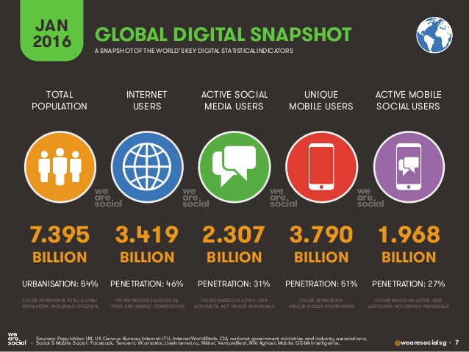
Global Digital Snapshot

Slide 14
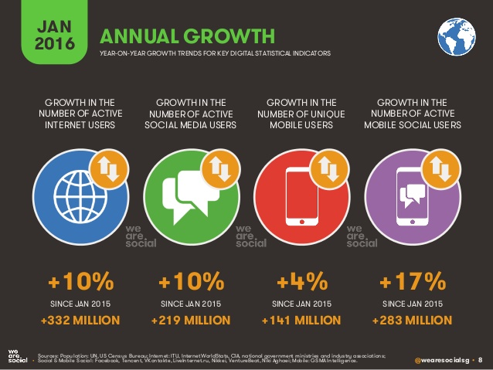
Annual Growth

Slide 15
Main Aspects of the Industry
Internet
Computers
Smartphones
Tablets
Smart watches
Operating Systems
Cloud Computing
App Store

Slide 16
The Internet
Massive network of networks, which connects billions of people online through which communication and other various activities may occur

Slide 17
Internet History
1969: The original internet
1971: First email sent
1990: Archie, the first search engine
1991: Internet available for commercial use
1996: More email than post mail in the USA
: BackRub search engine (Stanford)
1997: Google (googol)

Slide 18
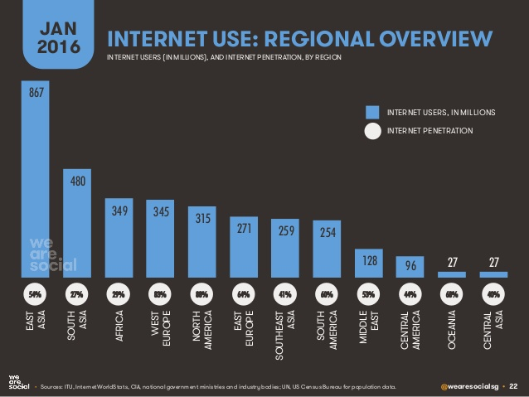
Internet Use: Regional Overview

Slide 19
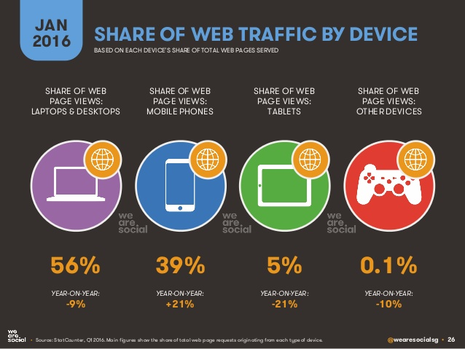
Share of Web Traffic by Device

Slide 20
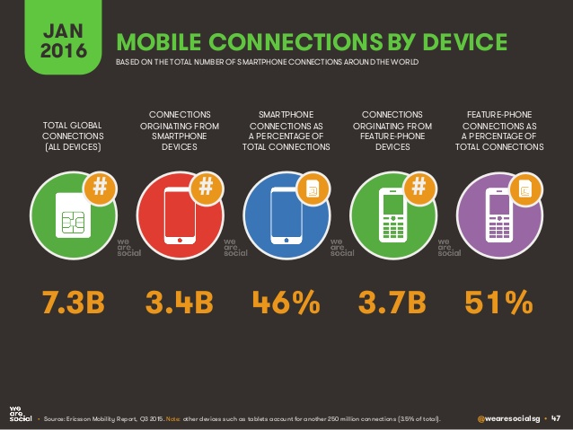
Mobile Connections by Device

Slide 21
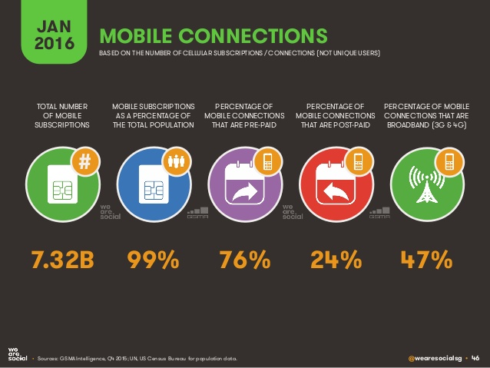
Mobile Connections

Slide 22
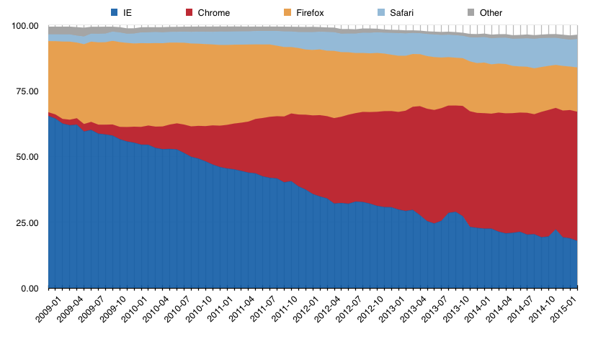
Share of Users on Internet Platforms
Safari
Firefox
Chrome
Internet Explorer

Slide 23
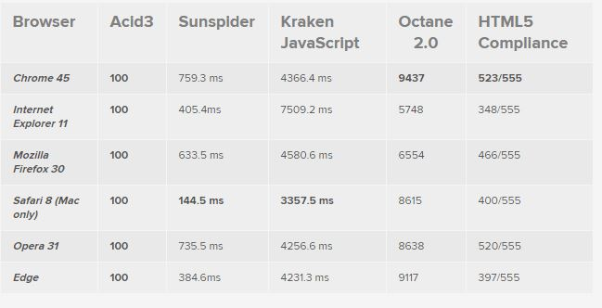
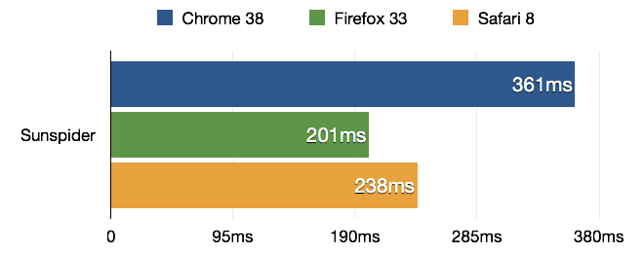
Browsers Speed Test

Slide 24
Computers
A device which can do a multitude of tasks ranging from processing and storing data to, doing set tasks based on the software it is operating on.

Slide 25
Computer History
1936: First freely programmable computer
1951: First commercial computer released
1974: First consumer computers (IBM)
1976: Apple I,II
1984: Apple Macintosh
1985: Microsoft Windows

Slide 26
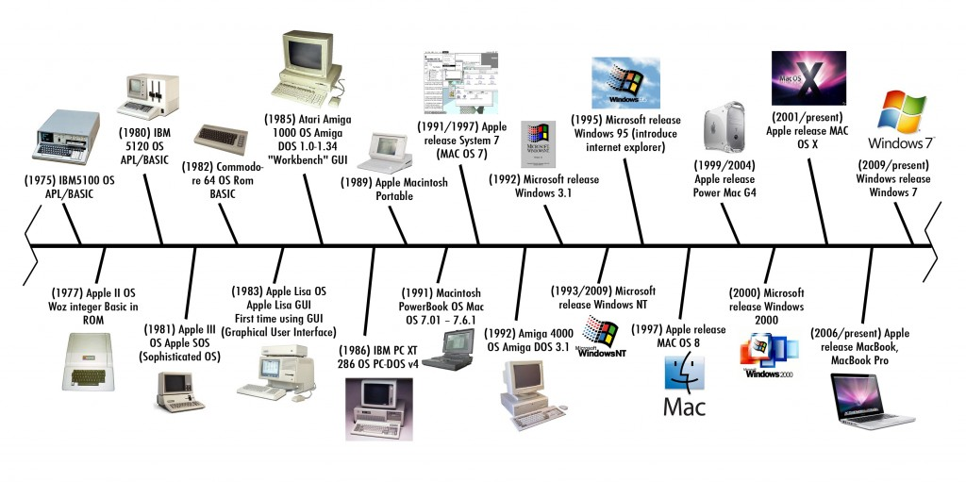
Computers

Slide 27
Smartphones
What is a Smartphone?
  All in one device that can be used as a cell phone and has computing, PDA functions
  Variety of applications available
  High Speed Data Access
  Multimedia

Slide 28
Mobile Phone History
1973: Motorola cell phone created
April 3, 1973: first cell phone call made by Martin Cooper
1983: first cell phone available to consumers
1994: First smartphone
1999: First mobile watch phone
2001: First Commercial 3g Network
2007: First Iphone Released
2008: First Android phone released
2010: First LTE Network
2013: First smart watch

Slide 29
4G/LTE Networks
Speeds of 1Gbs when stationary
100Mbps when mobile
However this standard is so high that no commercialized standard actually meets them hence why we have LTE networks
  LTE is part of this generation

Slide 30
Broadband vs Regular Phone Connection
Broadband
Regular internet connection
Wireless internet access
  Nearly all 2G and 3G phones are broadband
Wired internet access
  More common in underdeveloped countries

Slide 31
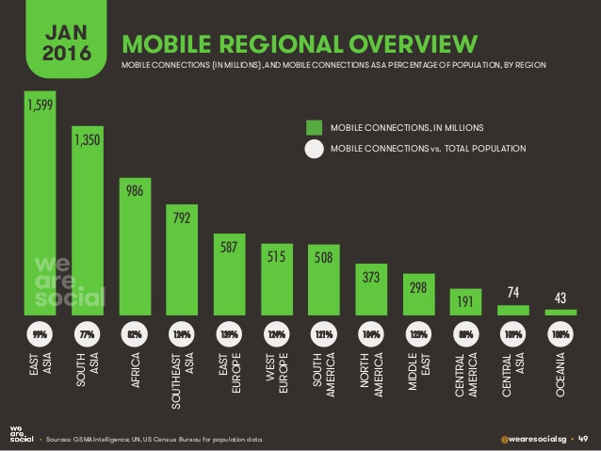
Mobile Regional Overview

Slide 32
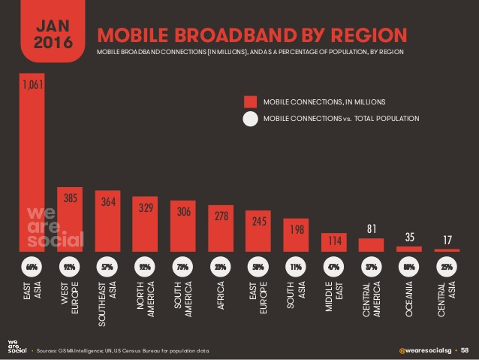
Mobile Broadband by Region

Slide 33
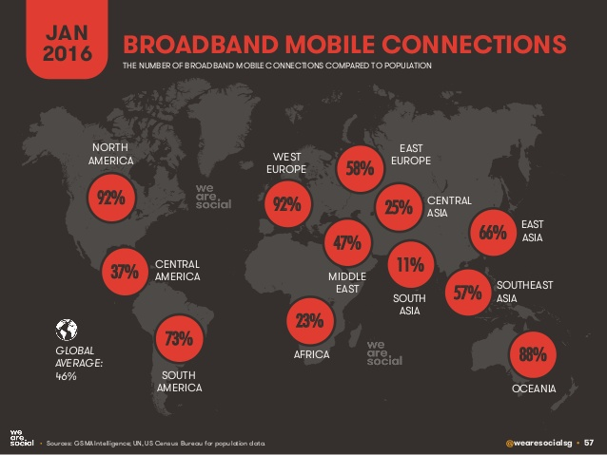
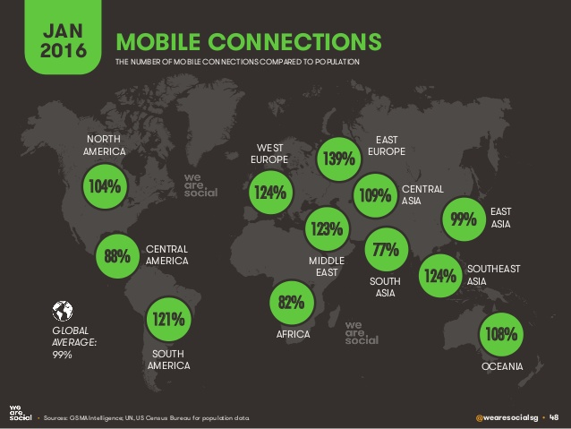
Broadband vs Normal Connections

Slide 34
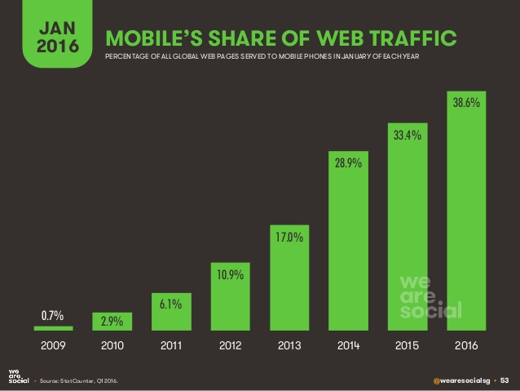
Mobile Share of Web Traffic

Slide 35
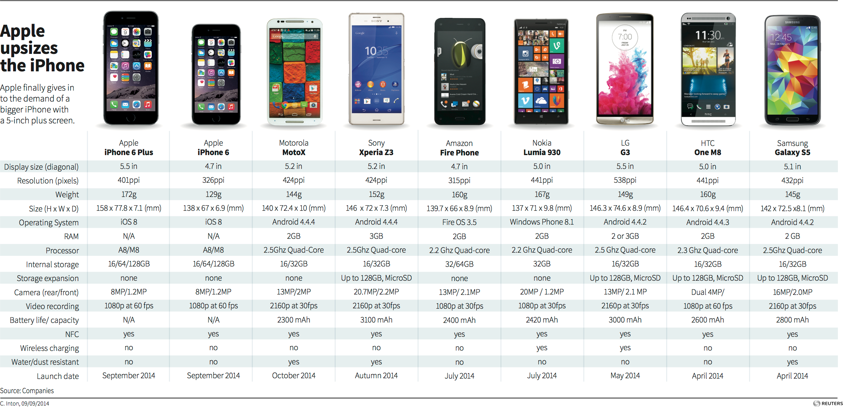
Current Smartphones on the Market

Slide 36
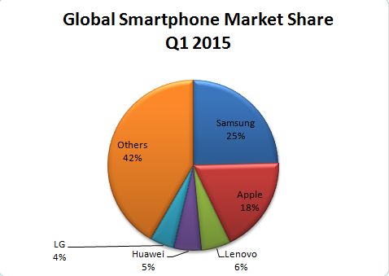

Slide 37
Tablets
What is a Tablet?
  Larger than a Smartphone
  Touchscreen used as primary method of input
  Some typical functions are:
  Mobile Browsing
  Portable Media Player
  Camera
  Downloadable Apps

Slide 38
Tablets History
1971: Allan Kay describges a tablet computer at Xerox PARC
1983: Apple and AT&T work on a tablet prototype
1991: IBM markets a tablet computer but fails
1993: Apple Newton launched, also fails
1996: NewsPad debuts; considered one of the first serious prototypes
2009: Various computer manufacturers release tablets to market
2010: Apple iPad launched

Slide 39
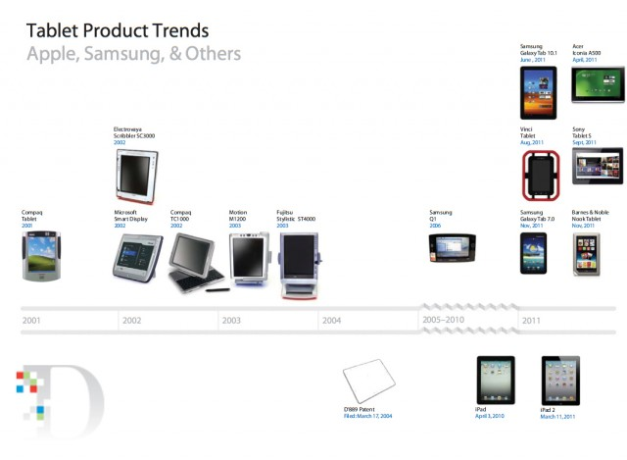

Slide 40
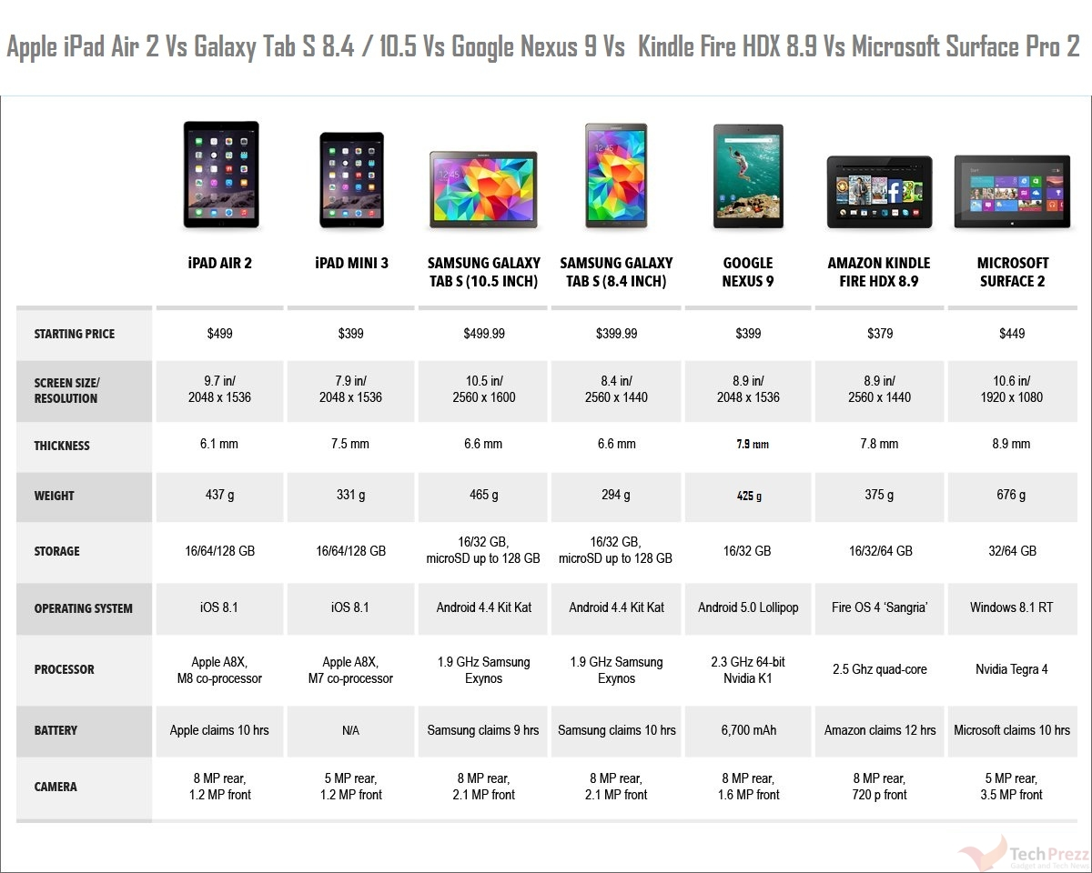
Current Tablets on the Market

Slide 41
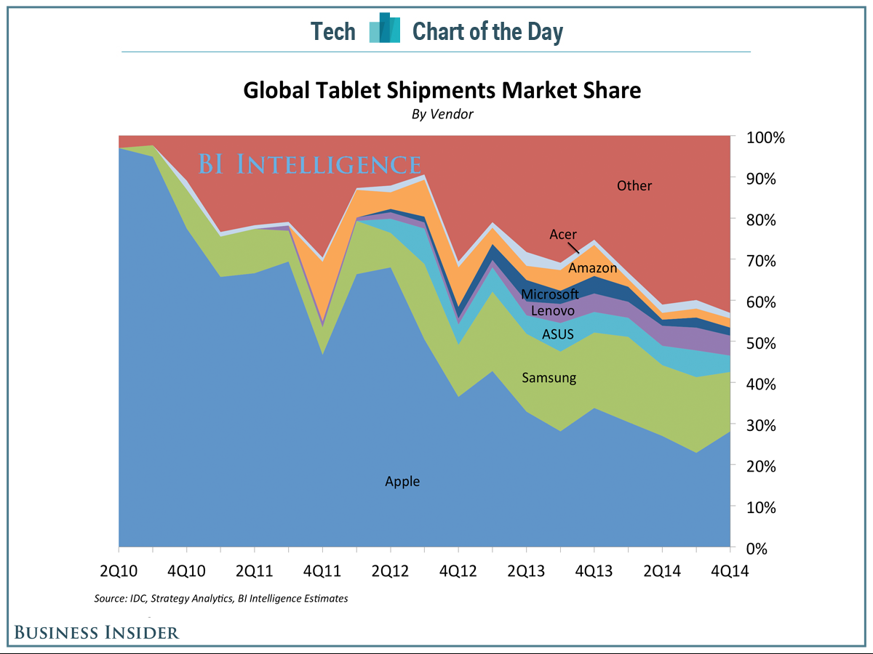
Tablet Shipments Market Share

Slide 42
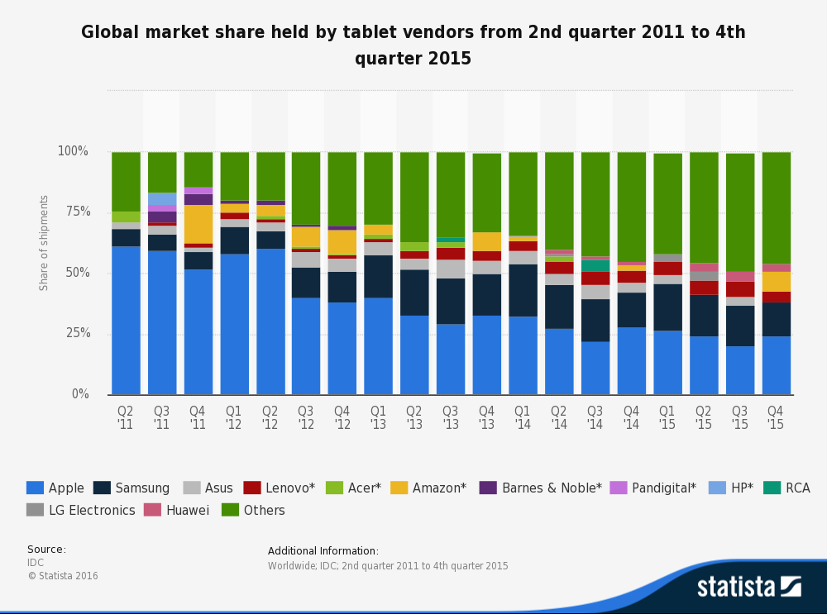
Market Share by Vendor

Slide 43
Smart Watch
What is a Smart watch?
  A computerized wristwatch with functionality that is enhanced beyond timekeeping, and is often comparable to a personal digital assistant device

Slide 44
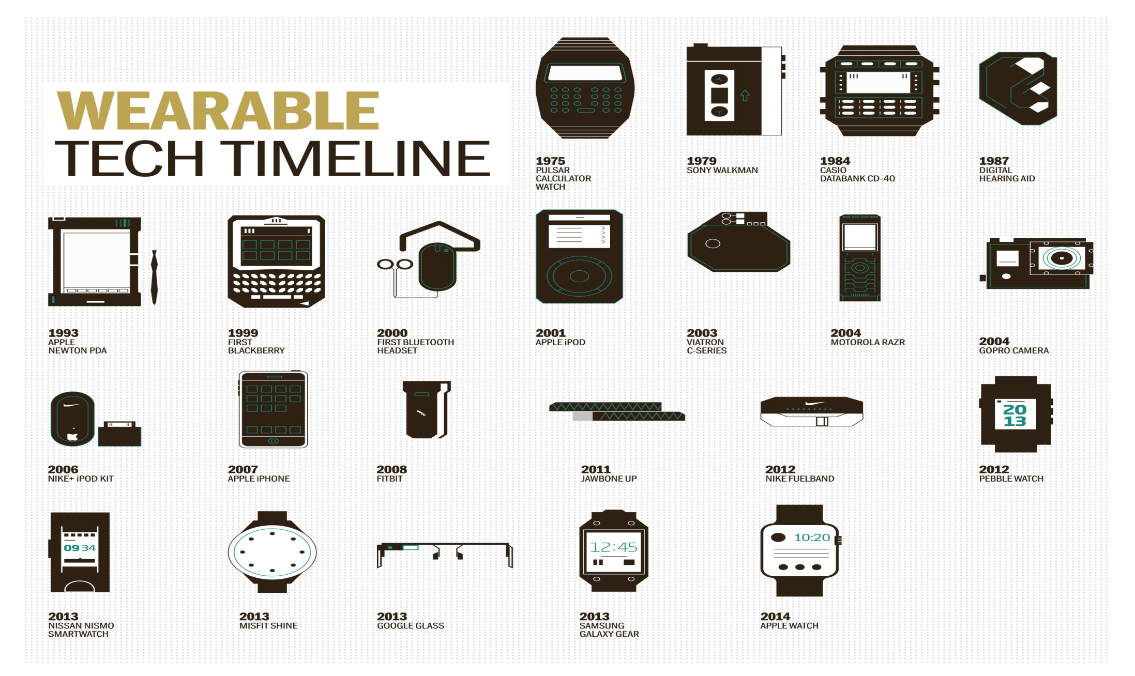

Slide 45
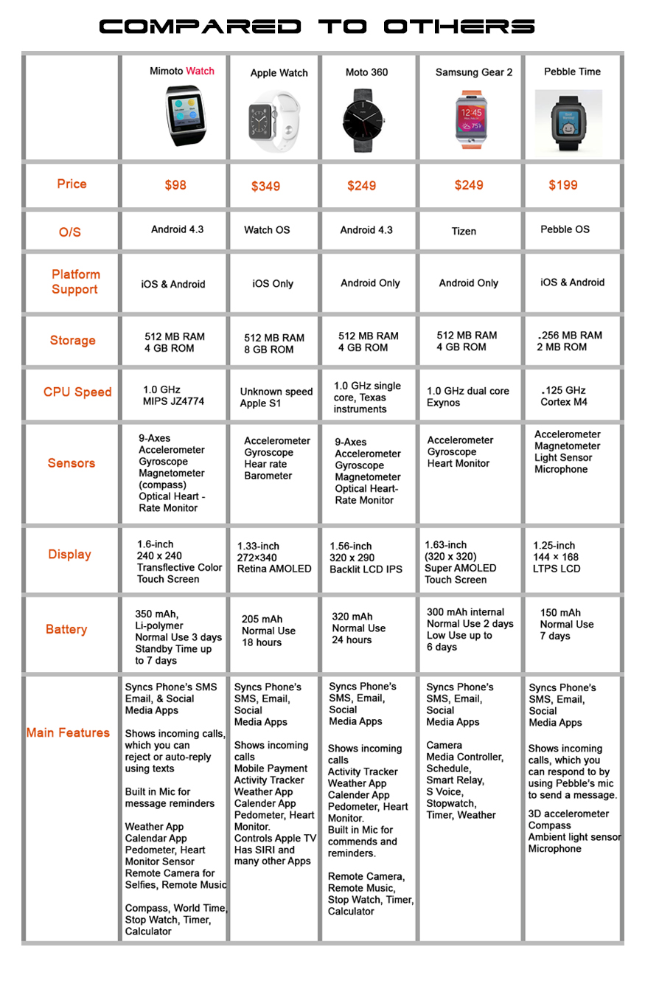
Current Smartwatches on the Market

Slide 46
Operating System (OS)
What is an Operating System?
  An operating system (OS) is software that manages computer hardware resources and provides services for computer programs.

Slide 47
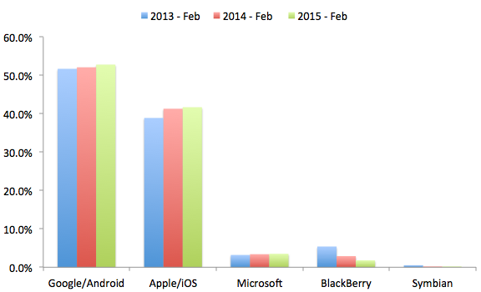
Operating Global System Share

Slide 48
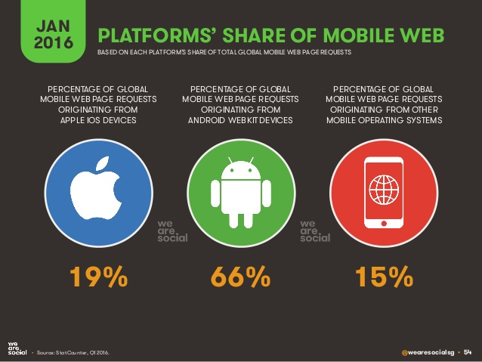
Platforms Share of Mobile Web

Slide 49
Cloud Computing
A model of network computing where a program or application runs on a connected server or servers rather than on a local computing device.

Slide 50
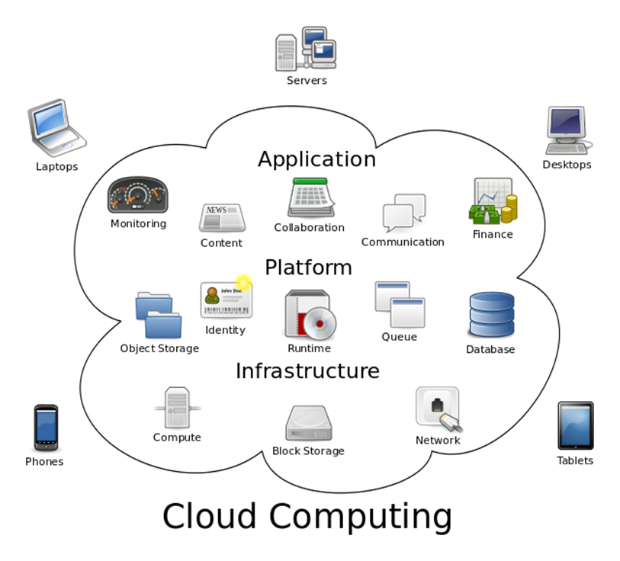
Cloud Computing

Slide 51
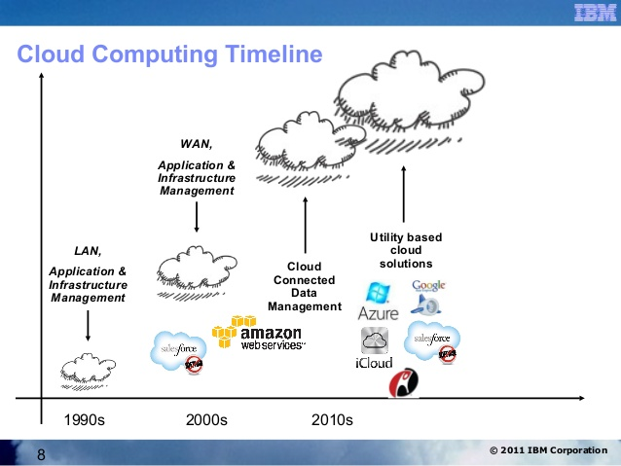
Cloud Computing Timeline

Slide 52
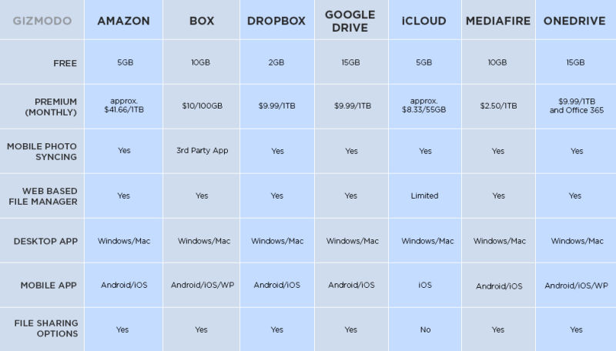

Slide 53
App Store
A place where applications can be downloaded directly to a device to supplement the experience of the device, for recreational use, etc. Some apps are free some have to be bought

Slide 54
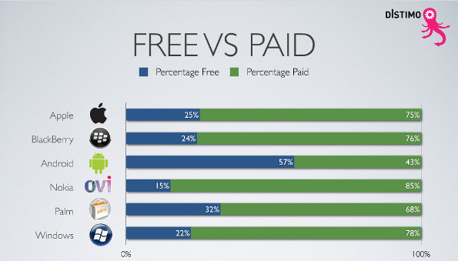

Slide 55
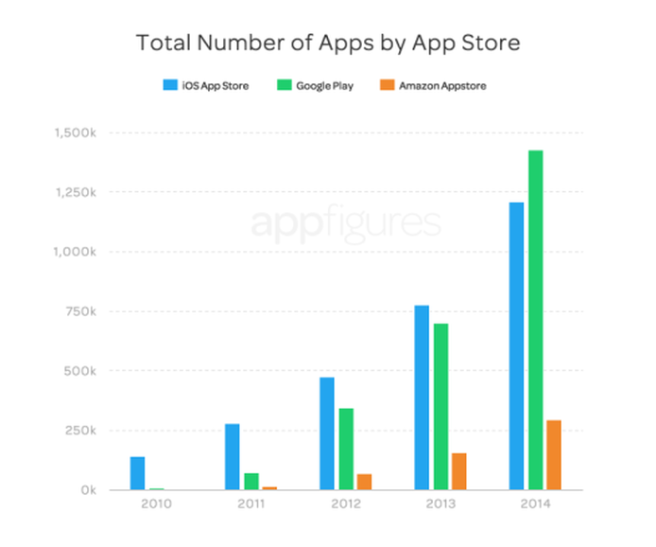

Slide 56
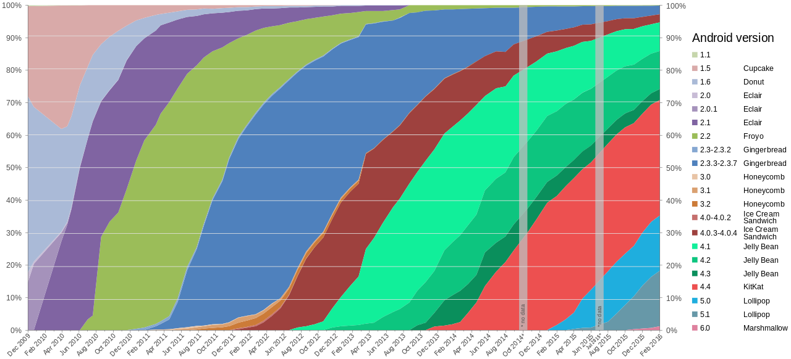
Android Versions

Slide 57
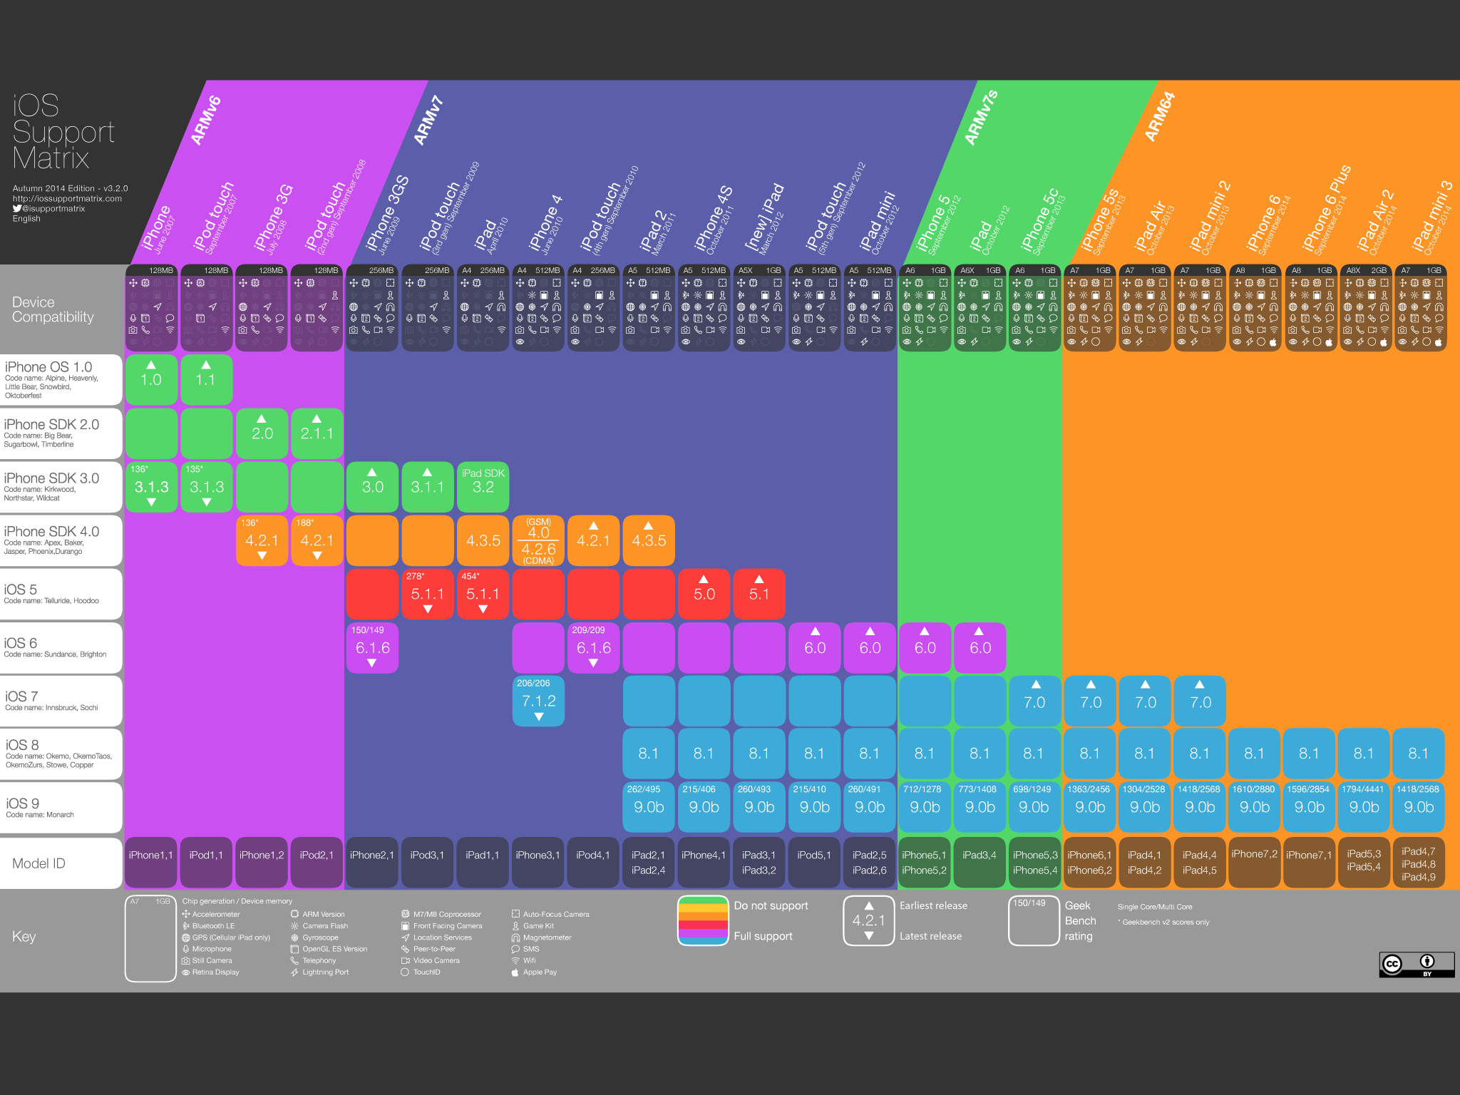
IOS Support Matrix

Slide 58


Slide 59
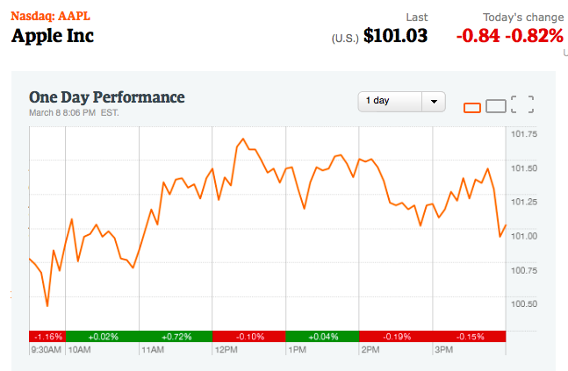
Financial Snapshot

Slide 60
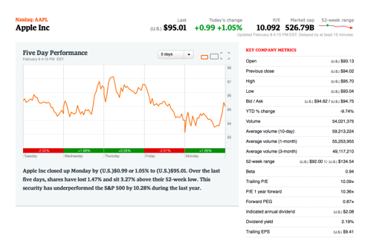
Financial Snapshot

Slide 61
Share Structure
Weighted Average Shares Outstanding (in Millions)
2013 | 2014 | 2015 | Jan- 2016
6.477 | 6.085 | 5.753 | 5.544
Annual Diluted Earnings Per Share
2013 | 2014 | 2015 | Last Quarterly
5.68 | 6.45 | 9.22 | 3.28

Slide 62
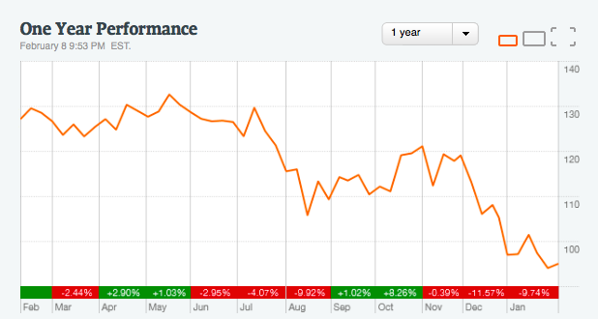
1 Year

Slide 63
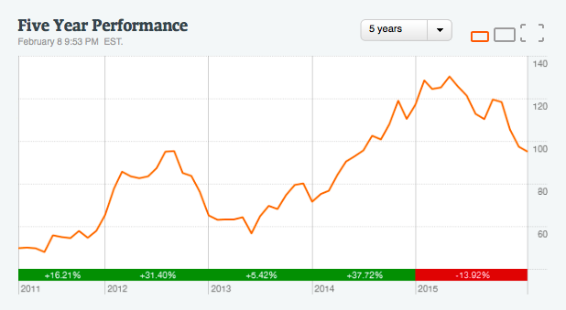
5 Year
Notes:
3.28 EPS 3 months ending December 2015 translates to about $75.9 Billion revenue
63

Slide 64
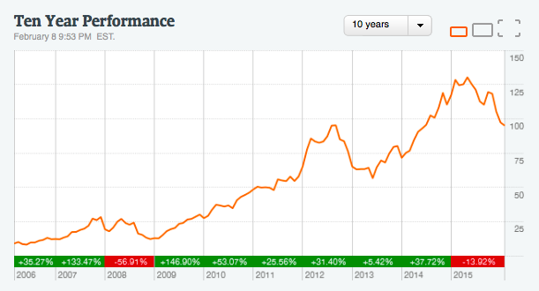
10 Year

Slide 65
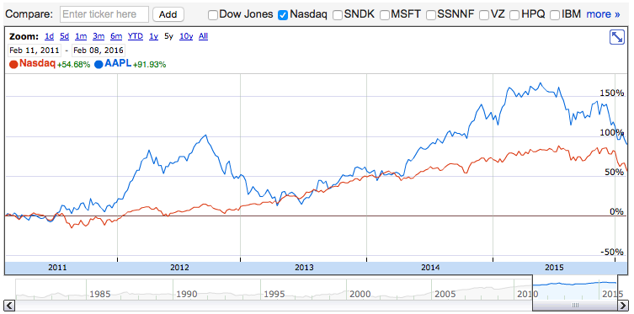
APPL v. NASDAQ

Slide 66
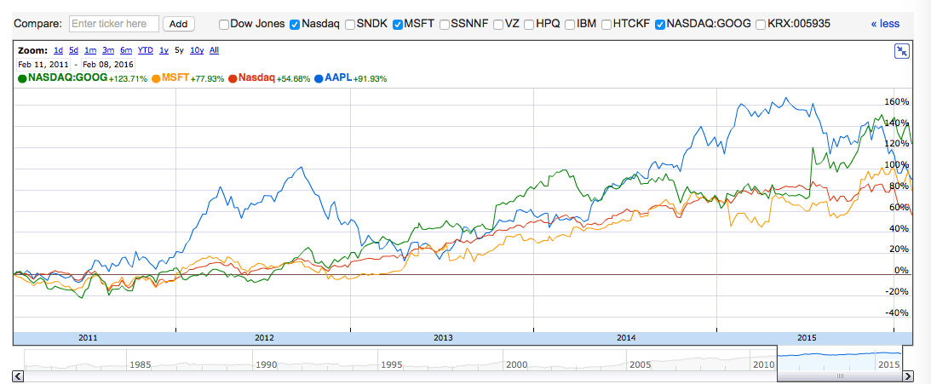
APPL v. MSFT & GOOGL

Slide 67
Apple’s Mission
“Apple designs Macs, the best personal computers in the world, along with OS X, iLife, iWork and professional software. Apple leads the digital music revolution with its iPods and iTunes online store. Apple has reinvented the mobile phone with its revolutionary iPhone and App store, and is defining the future of mobile media and computing devices with iPad.”

Slide 68
History of Apple
Notes:
DO: APPLE vs. S&P 500 Index, the S&P Information Tech Index and Dow Jones US Tech Index
68

Slide 69
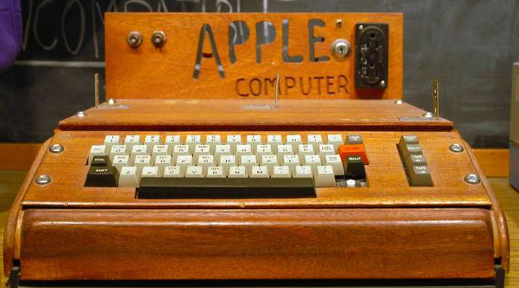
Early Years
April 1, 1976: Founded in Cupertino, California by Steve Jobs, Ronald Wayne and Steve Wozniak
1976: Apple I released (200 units)
1977
  Apple II released at $1300
  Apple incorporates in California
1979: First app unveiled: VisiCalc

Slide 70
The ’80s
1980:
  Dec 12, IPO launched at $22, selling 4.6 million shares
  Apple III released
1983: LISA (Local Integrated System Architecture) released, selling for $10,000
1984: Debut of the Macintosh
1985: Jobs leaves Apple and acquires NeXT
1987: Apple registered the Apple.com domain name (one of the first companies to use .com)

Slide 71
The ‘90s
1993: The Newton released (early PDA model)
1996: Apple purchases NeXT and its OS, NeXTstep
1997
  Jobs steps in as interim CEO of Apple
  Apple Store introduced
  Deal with Microsoft for Microsoft Office
1998: iMac G3 launched
1999
  Power Mac G4
  iBook unveiled
Notes:
http://www.macworld.co.uk/feature/apple/history-of-apple-steve-jobs-what-happened-mac-computer-feb-16-3606104/
the Apple II ‘was the first of its type to provide usable colo[u]r graphics... contained expansion slots for which other hardware manufacturers could design devices that could be installed into the computer to perform functions that Apple has never even considered.’
71

Slide 72
2000s
2001
  Mac OS X launched
  Opening of Apple retail stores announced
  First iPod released
2002: iMac G4 design
2003: iTunes music store (2mil download in 16 days)
2004
  iMac G5
  iPod mini launched
2006: MacBook Pro launched
2007
  The iPhone and iPhone 3G
  iPod Touch
  Apple TV
2008: MacBook Air announced

Slide 73
2010s
2010:
  Apple iPad announced
  iPhone 4
2011
  iCloud announced
  Steve Jobs resigns as CEO, replaced by Tim Cook
  iPhone 4S and iPad 4th gen
2012: iPhone 5 and iPad Mini released
2013: iPhone 5S/5C launched
2014: Apple Watch announced
2015
  iPhone 6S and 6S Plus released
  iPad Pro
  4th Gen Apple TV and 4th Gen iPad Mini

Slide 74
Key Acquisitions
February 17, 1997: NeXT (computer programming services)
  Derived Products: OS X and iOS
  $404 million
2000: SoundJam MP (Software)
  Derived Products: iTunes
April 24, 2008: P.A. Semi (semiconductors)
  Derived Products: Apple SOC
  $278 million
December 6, 2009: Lala.com (music streaming)
  Derived Products: iCloud, iTunes Match
  $17 million
April 27, 2010: Siri (Voice control software)
  Derived Products: Siri
Notes:
NEXTstep OS brought Steve Jobs back into Apple and was the precursor for the Mac OS X operating system
74

Slide 75
Key Acquisitions
February 23, 2012: Chomp (App search engine)
  Derived Products: App store
  $50 million
July 27, 2012: AuthenTec (PC and mobile security)
  Derived Products: Touch ID
  $356 million
August 1, 2014: Beats Electronics
  Derived Products: iPhone, iTunes
  $3 billion
April 14, 2015: LinX (camera)
  Derived Products: iPod, iPhone, iPad
  $20 million
January 29, 2016: Flyby Media (Augmented reality software)
  iPhone, iPod, iPad

Slide 76
APPLE MANAGEMENT TEAM

Slide 77
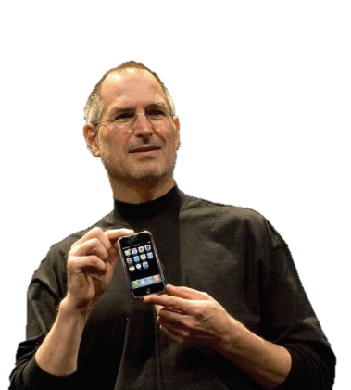
Steve Jobs
Co-Founder and former CEO
Education:
  Reed College – Dropped Out
Oversaw development of iMac, iTunes, iPhone, and iPad on the services side as well as Apple’s retail stores
Demanding perfectionist
Always aimed to position Apple at the forefront of IT
Design influenced by modernist architectural styles of Joseph Eichler and industrial designs of Braun’s Dieter Rams
Passed away in 2011

Slide 78
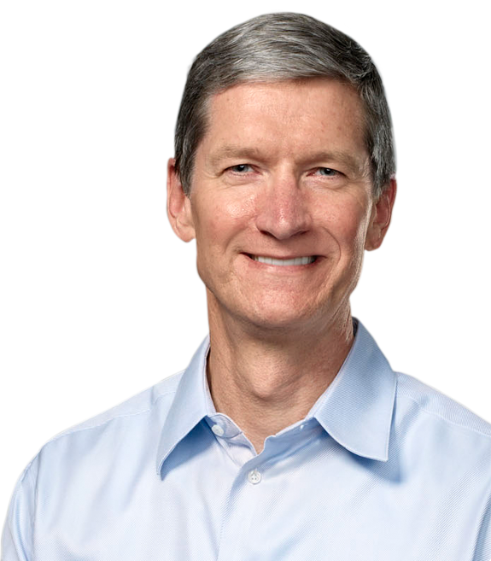
Tim Cook
Chief Executive Officer
  Since 08/12/2011
Chief Finance Officer (2005-2011)
Executive VP, Worldwide Sales and Operations (2002-2005)
Senior VP, Worldwide Operations, Sales, Service, and Support (2000-2002)
Senior VP, Worldwide Sales and Operations (1998-200)
Education:
  Auburn University – (B) Industrial Engineering
  Duke University - MBA
Prior to joining Apple, has worked with IE, IBM, and Compaq
Notes:
Next: Computer programming services
Soundjam
APPLE SOC: Apple Inc. has developed a range of APPLE SOC: Apple Inc. has developed a range of "System on Chip" (SoC) as well as APPLE SOC: Apple Inc. has developed a range of "System on Chip" (SoC) as well as "System in Package" (SiP) mobile application processors to power their to power their mobile consumer devices. In order to meet the stringent power and space constraints common to mobile devices, these chips combine a to power their mobile consumer devices. In order to meet the stringent power and space constraints common to mobile devices, these chips combine a central processing unit (CPU) with other components into a single compact physical package.
78

Slide 79
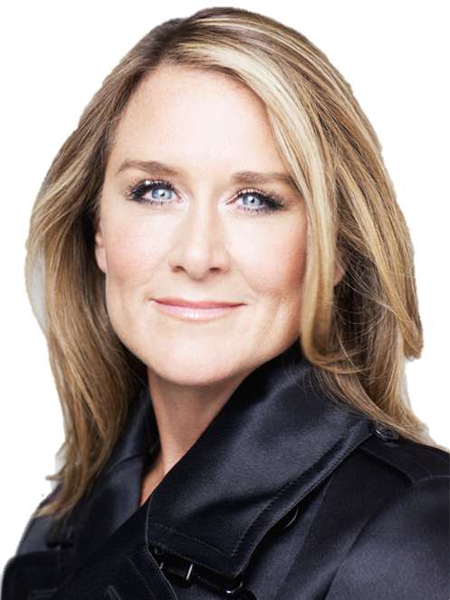
Angela Ahrendts
Senior VP, Retail and Online Stores
Joined Apple from Burberry, where she served as CEO and led the company through a period of outstanding global growth.
Joined the company on may 1, 2014
Plan for the future of Apple Retail: China emphasis, mobile payments, revamped experience
A member of the UK’s Prime Minister’s Business Advisory Council; named honorary dame commander of the British Empire
Marketing and Merchandising degree from
Ball state University in Indiana, where she
was awarded an honorary doctorate
Notes:
Beats: Headphones, music streaming (Beats music)
79

Slide 80

Eddy Cue
Senior VP, Internet, Software and Services
Oversees Apple's content stores including the iTunes Store, the revolutionary App Store and the iBookstore, as well as Siri, Maps, iAd and Apple's innovative iCloud services.
26-year Apple veteran
Earned a Bachelor Degree in Computer Science and Economics from Duke University

Slide 81
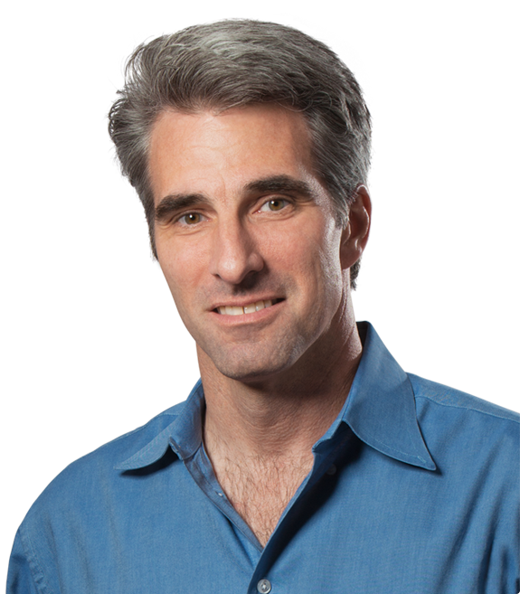
Craig Federighi
Senior VP, Software Engineering
  Since 08/27/2012
Joined Apple in 1996 after acquisition of NeXT
Rejoined Apple in 2009
Education:
  University of California – (B) Computer Science
  University of California - (M) Electrical Engineering and Computer Science

Slide 82
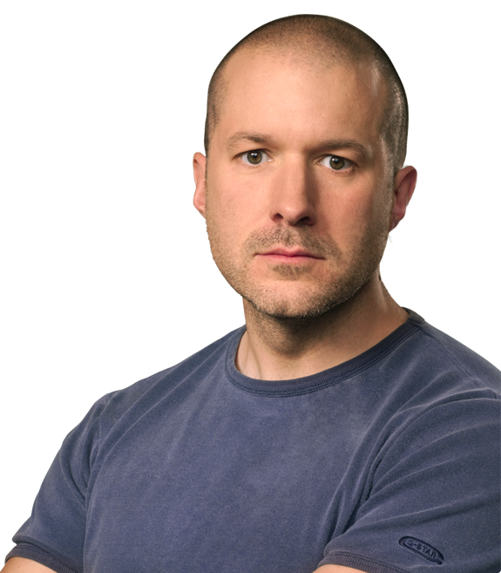
Jonathan Ive
Senior VP, Design
  Since 07/2010
Senior VP, Industrial Design (1997-2010)
Designed MacBook Pro, iMac, MacBook Air, iPod, iPod Touch, iPhone, iPad, iPad Mini, the new Macbook.
Education:
  North Carolina University – (M) Mechanical Engineering
  Duke University - MFA

Slide 83

Dan Riccio
Senior VP, Hardware Engineering
  Since 06/28/2012
Joined Apple in 1998
Education:
  University of Massachusetts – (B) Engineering
Teams responsible for delivering multiple product breakthroughs such as Mac, iPhone and iPad.

Slide 84

Philip W. Schiller
Senior VP, Worldwide Marketing
  Since 04/1997
Rejoined Apple in 1997
Always involved in marketing roles
Education:
  Boston College – (B) Biology

Slide 85

Jeff Williams
Senior VP, Operations
  Since 07/2010
Joined Apple in 1998
Worked a variety of operational roles
Education:
  North Carolina University – (M) Mechanical Engineering
  Duke University - MFA

Slide 86
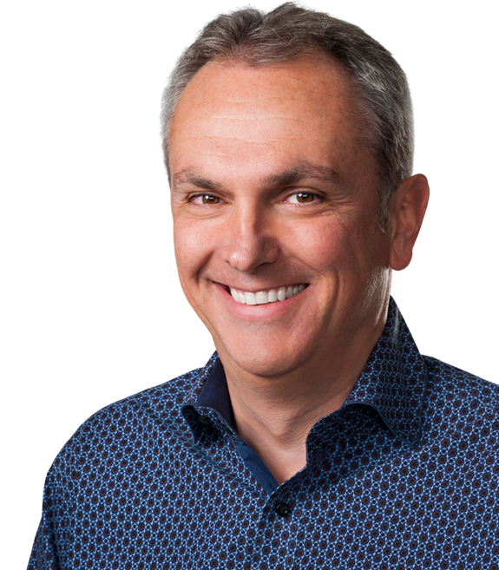
Luca Maestri
Senior VP and Chief Financial Officer
Joined Apple in 2013 as vice president of Finance and corporate controller, previously worked as CFO at Xerox, Nokia Siemens Networks and GM
Master’s degree in Science of Management from Boston University; B.A in Economics from Luiss University

Slide 87
Apple Inc. Products
iPod
iPhone
iPad
Apple Watch
iMac
MacBook
  MacBook Pro
  MacBook Air
Apple TV
iTunes
iCloud
Apple Music
Productivity App
iBooks

Slide 88
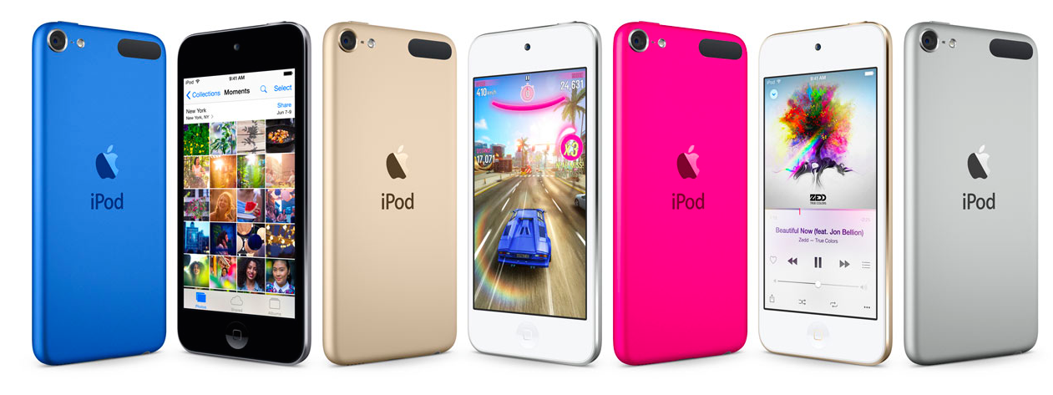
iPod
Line of portable media players, first released 2001
Integrated with iTunes
iOS Multi-Touch operating system
Current versions include
  iPod Touch
  iPod Nano
  iPod Shuffle

Slide 89
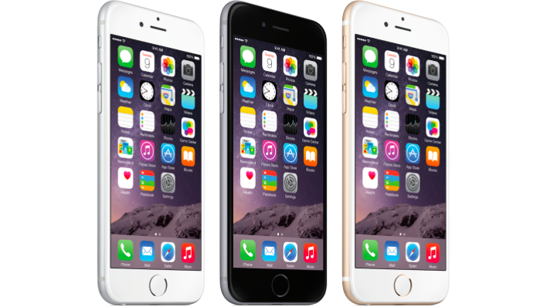
iPhone
Line of smartphones running on iOS mobile operating system
Access to App Store and iTunes
Most recent models
  iPhone 6
  iPhone 6S

Slide 90
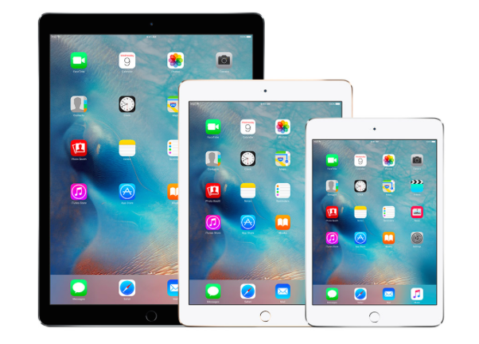
iPad
iOS based tablet computers
Most recent models:
  iPad Pro
  iPad Air 2
  iPad Mini 4

Slide 91
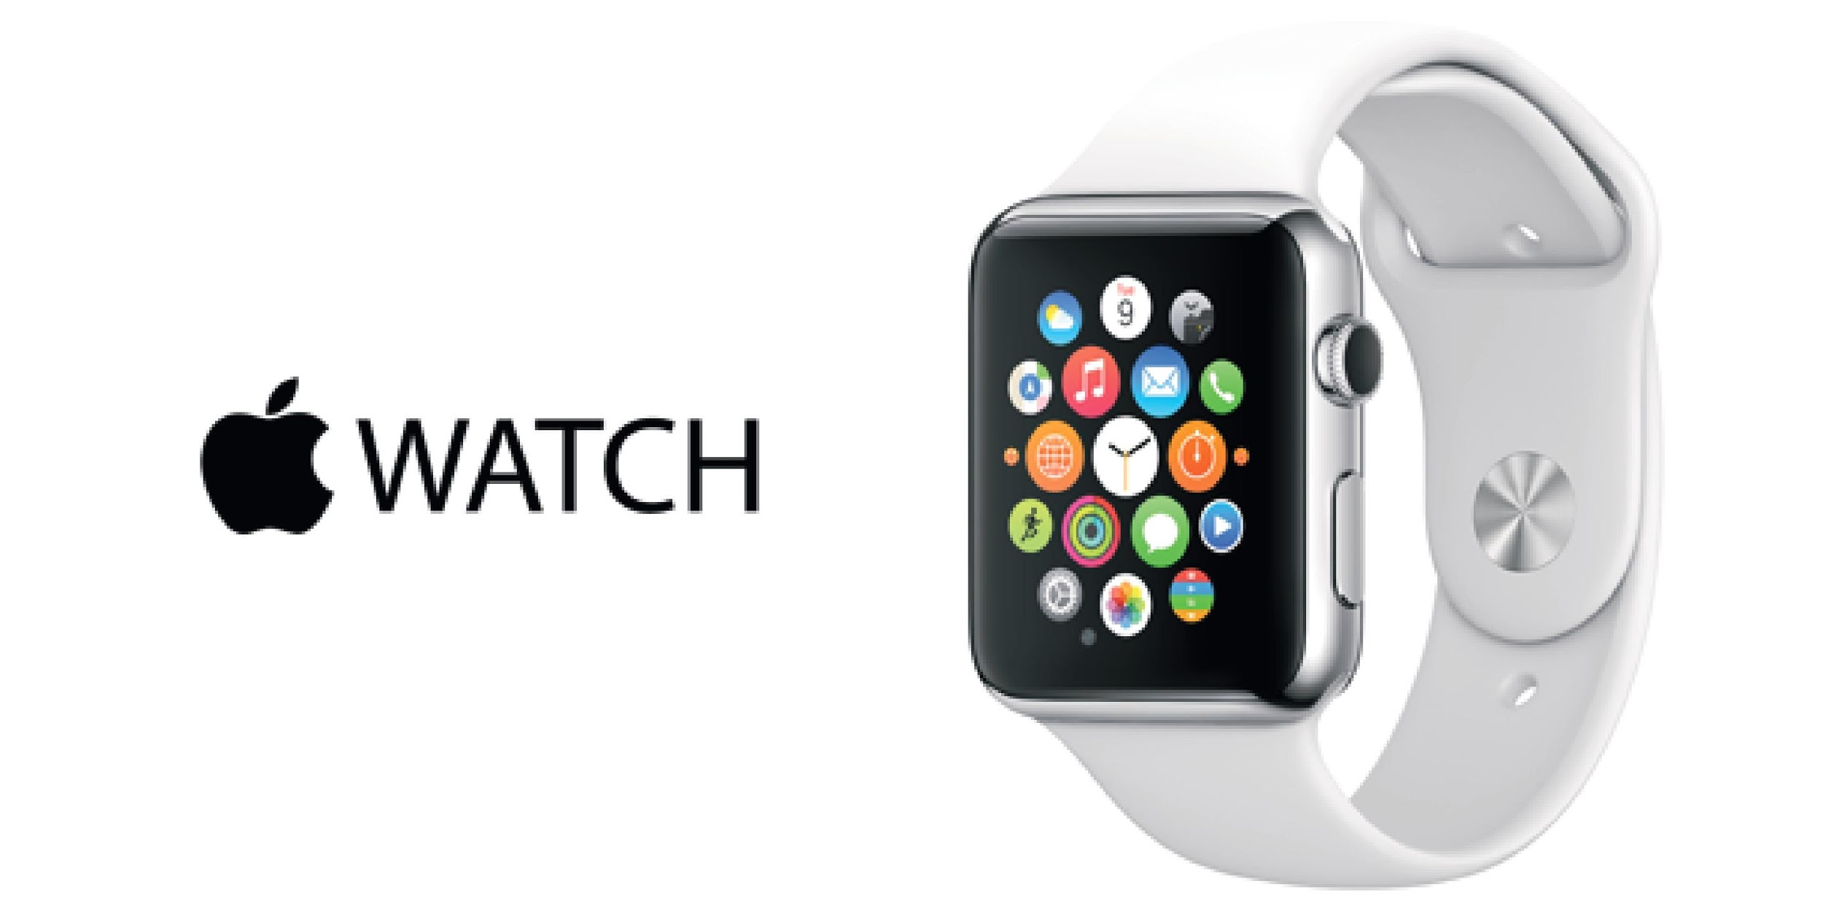
Apple Watch
Smart watch incorporating fitness tracking with iOS and other Apple product integration
Wireless connection with iPhone
Four variations:
  Apple Watch
  Apple Watch Sport
  Apple Watch Hermes
  Apple Watch Edition

Slide 92

iMac
Line of desktop computers
Intel microprocessors
Current Model runs on OS X
iMac 21.5 - 27 inch

Slide 93

MacBook
Line on notebook computers
MacBook redesigned in 2015
  Thinner than the MacBook air
  Three color options
MacBook Air and Pro

Slide 94

Apple TV
Small entertainment device
Network connection
Streaming of data from a number of devices to TV screens
iTunes connectivity

Slide 95

iTunes
Released January 9, 2001
Store allows for digital purchase of various entertainment media
iTunes U for downloading free material from top universities, museums, and other institutions
Media player and library to play and download digital audio and video including radio (iTunes Radio)

Slide 96

iCloud
Launched October 12, 2011
Cloud storage and computing service
Data storage on remote servers to share data with other users and manage Apple devices
Wireless backup of iOS devices directly to iCloud

Slide 97

Apple Music
Launched June 30, 2015
On demand music streaming service with 3-month free trial
In excess of 11 million subscribers as of February 2016

Slide 98

iBooks
E-book app for iOS
Installation of books and text books from the iTunes store
Millions of titles available, in different languages
Reading of content using VoiceOver

Slide 99

Apple Retail Store
Founded in May 2001 by Ron Johnson
Primarily sells computers and consumer electronics
Genius Bar for technical support and repairs
Over 450 Retail locations worldwide

Slide 100

App Store
Launched June 2008
Digital platform for mobile apps, available directly for download through iOS devices
Over 1.5 million apps and 100 billion downloads since 2008
At the end of 2013, App Store users spent over $10 billion

Slide 101

App Store

Slide 102

App Store

Slide 103

Net Sales by Product

Slide 104

Net Sales by Product

Slide 105

Net Sales by Operating Segment

Slide 106

Net Sales by Operating Segment

Slide 107
Litigation and Contingencies
Apple Inc. v. FBI
Following San Bernardino shooting, FBI asking a judge for a court order, demanding Apple Inc. build a new OS, allowing the Department of Justice to access iPhone data more efficiently
Tim Cook concerned with the “backdoor” that can be created when building an OS that can allow for any security bypass, compromising the security of personal information
Apple Inc. objects, worrying about the FBI setting a precedent for other countries
Apple given until February 26th to respond

Slide 108

Balance Sheet [Assets] 10-Q

Slide 109


Balance Sheet [Liabilities and Shareholder’s EQ] 10-Q

Slide 110

Balance Sheet [Assets] 10-K

Slide 111

Balance Sheet [Liabilities and Shareholder’s EQ] 10-K
Notes:
http://www.economist.com/blogs/graphicdetail/2016/01/daily-chart-20
111

Slide 112

Income Statement 10-Q

Slide 113

Income Statement 10-K

Slide 114

CF Statement [Operating] 10-Q

Slide 115


CF [Investing and Financing] 10-Q

Slide 116

CF Statement [Operating] 10-K
Notes:
http://www.marketwatch.com/story/apple-vs-the-fbi-a-complete-guide-2016-02-20
116

Slide 117


CF [Investing and Financing] 10-K

Slide 118

Financial Forecast

Slide 119

Recommendation
BUY

Slide 120


Slide 121

Financial Snapshot
Notes:
In millions
Number of shares in thousands
121

Slide 122

Share Holders Equity

Slide 123

Common Stock

Slide 124

Share Repurchase Program

Slide 125

1 Year

Slide 126

5 Year

Slide 127

10 Year

Slide 128

MSFT Vs NASDAQ
Notes:
http://markets.ft.com/research/Markets/Tearsheets/Forecasts?s=AAPL:NSQ
128

Slide 129
Goals
At Microsoft, our goal is to enable people and businesses throughout the world to realize their full potential
We deliver on that commitment by striving to create technology that is accessible to everyone—of all ages and abilities.
Notes:
129

Slide 130
History and Milestones
1975
Microsoft founded
1981
Microsoft incorporates
IBM introduces its personal computer MS-DOS 1.0
1986
Microsoft stock goes public
1990
launches Windows 3.0
1995
launches Windows 95
1998
launches Windows 98
2000
launches Windows 2000

Slide 131
History and Milestones
2001
launches Office XP and Xbox
2005
launches Xbox 360
2007
launches Windows Vista
2009
launches Windows 7
2010
launches general availability of Office
launches Kinect for Xbox 360
launches Windows Phone 7
2011
launches Office 365
Microsoft closes its acquisition of Skype

Slide 132
History and Milestones
2012
Microsoft launches Windows 8 and Microsoft Surface
2013
launches Office 2013, Outlook.com, Windows 8.1
launches Surface 2 and Surface Pro 2, and launches Xbox One
Microsoft announces decision to acquire Nokia
2014
Satya Nadella named chief executive officer for Microsoft
Microsoft launches Office for iPad, Surface Pro 3
Minecraft to join Microsoft announcement
Microsoft announces Office apps for Android tablets
2015
Microsoft reveals Windows 10

Slide 133
Key Acquisitions
1987 – Forethought
  Forethought was founded in 1983 tat later be know as Microsoft PowerPoint
1997 – Hotmail
  Acquired Hotmail for $500 million
2000 – Visio Corporation
  Acquired Visio for $1.375 billion
2002 – Navision
  Purchased Navision for $1.33 billion; turned into a new division as Microsoft Business Solutions (now Microsoft Dynamics)
2011 – Skype Technologies
  Purchased for $8.5 billion; 32 times larger than its value
2013 – Nokia (Hardware Division)
  Formerly developed phones for Microsoft; highlights Microsoft’s move into hardware

Slide 134
Other Aquisition- 2015 and 2016
Comany | Industry
Xamarin | Software- Mobile Application
SwiftKey | Mobile Productivity
Metanautix | Data Analytics
Secure Islands | Data Protection Technology
Mobile Data Labs | Mobile

Slide 135

Management Team
John W. Thompson
Chairman
John W. Thompson joined the Microsoft Board in February 2012 and became independent chairman of Microsoft Corporation on Feb. 4, 2014.
Education:
Thompson received a bachelor’s degree in Business Administration from Florida A&M, and a master’s degree in Management from the Sloan Fellows program of the MIT Sloan School of Management.

Slide 136

Management Team
Bill Gates
Founder and Technology Advisor
William (Bill) H. Gates is founder, technology advisor and board member of Microsoft Corporation. He served as chairman of the board until Feb. 4, 2014.
Education:
In 1973, Gates entered Harvard University as a freshman. In his junior year, Gates left Harvard to devote his energies to Microsoft, a company he had begun in 1975 with his childhood friend Paul Allen.

Slide 137

Management Team
Satya Nadella
Chief Executive Officer
Satya Nadella is Chief Executive Officer of Microsoft. Before being named CEO in February 2014, Nadella held leadership roles in both enterprise and consumer businesses across the company.
Education:
He earned a bachelor’s degree in electrical engineering from Mangalore University, a master’s degree in computer science from the University of Wisconsin – Milwaukee and a master’s degree in business administration from the University of Chicago.

Slide 138

Management Team
Chris Capossela
Executive Vice President and Chief Marketing Officer
As chief marketing officer, Chris Capossela leads Microsoft’s global product marketing, advertising, brand, research and communications functions for businesses and consumers.
He oversaw the creation of new business opportunities with partners to deliver new consumer experiences through Windows, Windows Phone, Office and Xbox.
Education:
Capossela holds a bachelor’s degree in computer science and economics from Harvard University.

Slide 139
Products and Services
Windows
Office
Internet Explorer
Bing and MSN
Xbox and PC Games
Email and Communications
One Drive
Solution Business
Servers
Hardware and Multimedia

Slide 140
Microsoft Stores
The first store was opened in 2009.
It has 106 stores worldwide.
The main goal is to reach final customers directly and understand their needs.
All their products and services are offered at the store.
The most direct competitor is Apple Store.

Slide 141
Wearable Bands
Wearable Fitness Bands Launched in late 2014.
After the success, they have launched the latest Version of it with more features and can be connected to more than one software.
The most direct competition is Samsung.

Slide 142

Revenue by Geography

Slide 143

Revenue by Product

Slide 144

Microsoft Operating Segments

Slide 145

Windows
Windows 8.1
Easier access to the apps and key controls
More familiar mouse and keyboard options
Simpler to find new apps
More PCs and devices to choose from
Benefits for businesses
Windows 10
Released on July 29, 2015, more then 100 million devices are running on it.

Slide 146


Microsoft Applications

Slide 147

Surface
Tablet computer created and sold by Microsoft.
Windows 8-based tablets was introduced on June 18, 2012.
The most recent models, the Surface Pro 3 and the Surface 3, were released on June 20, 2014, and May 5, 2015, respectively.
The latest Surface Pro 4 was launched in October, 2015.

Slide 148

XBOX
XBOX is a video gaming brand created and owned by Microsoft.
Xbox 360, was released in 2005 and has sold over 77.2 million consoles worldwide as of April 18, 2013.
Xbox One, was revealed in 21 markets in total on May 21, 2013. Approximately sold 20 million units.

Slide 149
Business Strategy
“One Microsoft, One Strategy”- Alignment Strategy
To reach run rate of $20 billion
One billion active devices of Windows 10

Slide 150

Balance Sheet 10-Q (Assets)

Slide 151

Balance Sheet 10-Q (Liabilities and S/E)

Slide 152

Balance Sheet 10-K (Assets)

Slide 153

Balance Sheet 10-K (Liabilities and S/E)

Slide 154

Income Statement 10-Q
Notes:
http://windows.microsoft.com/en-ca/windows-8/whats-new
154

Slide 155

Income Statement 10-K

Slide 156

Cash Flow 10-Q

Slide 157

Cash Flow 10-K

Slide 158


Stock Forecast

Slide 159


Recommendation

Slide 160


Slide 161

Financial Snapshot

Slide 162

1 Year

Slide 163

5 Year

Slide 164

10 Year

Slide 165

Google Vs. NASDAQ

Slide 166
Common Share Structure
Class A (GOOGL)
  1 vote per share
  As of Q3 2015: 291.3 Million shares outstanding
Class B
  10 votes per share
  Only available to Google Insiders and executives
  As of Q3 2015: 50.9 Million shares outstanding
Class C (GOOG)
  Issued on January 30, 2014
    Shareholders gained 1 class C share for each class A share they previously held, similar to a stock-split.
  0 votes: Maintain control of Google’s direction
  As of Q3 2015: 345.5 Million shares outstanding

Slide 167
Common Share Structure
Annual Data (in millions of shares)
 | Dec-11 | Dec-12 | Dec-13 | Dec-14 | Dec-15
Shares Outstanding | 649 | 659 | 671 | 681 | Class A: 293 Class C: 346

Slide 168
Strategy
Revenue = Amount of time on the Web
Generate 90% of revenues primarily by delivering online advertising that consumers find relevant and that advertisers find cost-effective.

Slide 169
Mission
“To organize the world’s information and make it universally accessible and useful”
  Unofficial motto “Don’t be evil”

Slide 170
Philosophy
Focus on the user and all else will follow.
It’s best to do one thing really, really well.
Fast is better than slow.
Democracy on the web works.
You don’t need to be at your desk to need an answer.
You can make money without doing evil.
There’s always more information out there.
The need for information crosses all borders.
You can be serious without a suit.
Great just isn’t good enough.

Slide 171
History
1996: Larry and Sergey create a search engine called BackRub (Operating on Stanford servers). It featured an efficient algorithm named “PageRank”
1997: Google.com is registered as a domain
1998: Andy Bechtolsheim becomes first investor ($100,000), and Google files for incorporation in California
1999: Venture capital firms Kleiner Perkins Caufield & Byers and Sequoia Capital provide $25 million; Website officially launched
2000: Google AdWords launched (Paid web links with associated searches)
2001: Eric Schmidt becomes CEO and Chairman of the Board of Directors; “PageRank” granted a patent
2002: Google labs, Google Scholar released,.. AdWords becomes cost-per-click

Slide 172
History
  2003: Re-incorporated in Delaware
  2004: Google Local released (became Google Maps), Gmail released, IPO raised $1.67 billion for 20 million shares at $85
2005: Google Maps, Google Earth launched
2007: Share prices hit $700
2011: Android exceeds 10 billion app downloads, growth rate of 1 billion downloads per month, Google Drive launched
2012: Google is the dominant search engine globally with 88.8% market share, Most visited website in the world
2013: 1 billion android devices activated, Calico founded, a company focused on health and well being

Slide 173


History
  2014: Prototypes of self driving cars revealed
  2015: In October, Alphabet Inc. was founded as the parent company of Google and several other companies

Slide 174
Key Acquisitions
Apr 2003: Applied Semantics - Launch of Google AdSense
Jul 2004: Picasa Inc. - Digital photo management
Oct 2004: Keyhole Corp. - Launch of Google Maps/Google Earth
Aug 2005: Android
Oct 2006: YouTube ($1.65 Billion)
Apr 2007: Double clicks ($3.1 Billion)
Mar 2008: Ad Mob ($750 Million) - Enhances advertising revenue
Aug 2011: Motorola ($12.5 Billion) Sold in 2013/2014

Slide 175



Key Acquisitions
2012:
  Meebo: Web-based instant messaging service ($100M)
  Sparrow: Email client for iOS and OSX devices ($25M)
  Wildfire: Social marketing software developer ($450M)
  Quickoffice: Productivity suite for Google Docs and smart devices.

Slide 176

Key Acquisitions
2014:
  Nest: makes various products for the home such as thermostats and smoke alarms ($3.2B)
  Dropcam Inc: ($517M) Help Nest improve smart home products
  Skybox Imaging: satellite imaging company ($478M)
2015
  Bebop Technologies Inc: ($272M) Cloud based platform for enterprise applications

Slide 177
Alphabet Inc. and Google
American multinational conglomerate created in 2015 as the parent company of Google and several other companies
Headed by Google's co-founders, Larry Page and Sergey Brin

Slide 178

Larry Page
CEO of Alphabet Inc.
CEO of Google (2011-2015)
President, Products (2001-2011)
Co-Founder (1998)
Education:
  Michigan University – (B) Engineering
  Stanford – (M) Computer Science
  Stanford – (PhD) Dropped Out
Met Sergey at Stanford during the PhD program

Slide 179

New CEO Sundar Pichai
CEO of Google – August 2015
Born in Chennai, Tamil Nadu, India
Joined Google in 2004
Wharton School of the University of Pennsylvania
Stanford University
Indian Institute of Technology Kharagpur

Slide 180

Sergey Brin
President of Alphabet Inc
President of Technology at Google
  2001 to 2011
Co-Founder (1998)
Education:
  University of Maryland – (B) Mathematics and Computer Sciences
  Stanford – (M) Computer Science
  Stanford – (PhD) Dropped Out
Met Larry at Stanford during the PhD program

Slide 181

Eric Schmidt
Executive Chairman of Alphabet Inc.
Executive Chairman, Board of Directors
  Since 2011
CEO, Google (2001-2011)
CEO, Novell (1997-2001)
CTO, Sun Microsystems (1983-1997)
Education:
  Princeton– (B) Engineering
  University of California – (M) Computer Science
  University of California – (PhD) Computer Science
Member of Obama’s Council of Science and Technology

Slide 182

David C. Drummond
Senior VP, Corporate Development and Chief Legal officer
  Since 2002
Helped Larry Page and Sergey Brin incorporate the company, and secure its initial rounds of financing
  Responsible for company’s business development (Investments and M&A)
Education:
  Santa Clara University– (B) History
  Stanford– (JD) Law
  University of California – (PhD) Computer Science
Serves on Board of Directors of Uber Technologies

Slide 183
Products and Services
Android mobile OS
Blogger
Chrome Browser
Chrome OS
Chromecast
Flight Explorer
Gmail
Google Ads
Google Blog Search
Google Books
Google Calendar
Google Docs
Google Drive
Google Earth
Google Finance
Google Image
Google Maps
Google News
Google Photos
Google Play
Google Scholar
Google TV
Google Ventures
Google Wallet
Google+
Hangouts
Patent Search
Translate
Web Search
YouTube

Slide 184

Revenue Growth

Slide 185

Revenue by Geography- 10K

Slide 186

Revenue by Source- 10K

Slide 187

Market Share

Slide 188
Company Overview
Focused on improving the ways people connect with information
Their mission is to organize the world’s information and make it universally accessible and useful.
Innovations in web search and advertising have made their website a top internet property and their brand one of the most recognized in the world.
Revenues primarily by delivering relevant, cost-effective online advertising.
Google’s AdWords program and AdSense program to promote their products and services with advertising

Slide 189
AdWords
Advertisers create ads to show alongside Google search results
Advertisers “bid” in an auction to have their ads displayed alongside certain specific keywords
  Pay per click
  Cost-per-thousand
Advertisers create ads to show alongside Google search results
  Consists of 1 headline, 25 characters
  2 text lines, 35 characters each
Advertisers may bid on certain specific keywords to have their ads displayed alongside
  Cost-per-impression (CPM)
  Cost-per-click (CPC)

Slide 190

AdWords

Slide 191

Google Maps Ads

Slide 192
Adsense
Google partnerships with publishers within Google Network Members, who sell the ad space of their websites
Ads are shown on publishers’ websites in terms of relevancy to their products
Google shares profits with the website publishers
  Per click
  Per impression

Slide 193
Gmail
Features:
First online email service with one gigabyte of storage
First to keep emails from the same conversation together in one thread, similar to an Internet forum.
Interactive webpages without having to refresh browser

Slide 194

Gmail Ads

Slide 195

Google Finance Ads

Slide 196

YouTube
The biggest video site in the world
Increasing mobile user base
Google has established partnerships with content companies to aid in monetizing video in the mobile space

Slide 197

Usage Penetration of YouTube

Slide 198
Google Glass
  The beginning of wearable technology
  Searches the web
  Records videos
  GPS navigation
  MP3

Slide 199

Google+
Social Network like Facebook
Integrated to Google owned platforms such as YouTube
Google Hangout
An OS designed for touch screen devices
  Nexus, HTC One, Galaxy, Xperia Z
Opened sourced
300 Million users worldwide

Slide 200
Google Chrome and Chrome OS
Chrome web browser
  200 million users
  Chrome Web Store
Chrome OS
  Open Source Software(Free)
  Profits come from:
  Partnership with carriers (Rogers) and mobile phone producers (HTC, Samsung)
  Free Google apps (supported by ads)
  Google Play (70% developers; 30% Operation cost to Google and carriers)

Slide 201

Chromecast
Plays HD audio or videos by directly streaming it on the internet
Controlled with mobile app or webapps
Use Google Chrome

Slide 202

Android
1 Billion Android Devices around the world
  51.8% of global smartphone market share
Over 1.5 million Android Apps (1.4 in Apple)
Promotes more searching
  Using keyboard
  Voice
  Camera

Slide 203

Google Play
Used to be Android Market
Digital Distribution of music, books etc. (iOS)
Apps for Android and Chromecast

Slide 204

Google Play Internet Users Worldwide by Region

Slide 205
Financial Strategy
Become the primary interface of the world
Improve quality and reach of the Internet
Own the home
Control more of the purchase cycle
Extend and improve life and cure diseases

Slide 206
Future Outlooks
Android M (update to Android)
  Chrome integration, battery life, offline maps in Google for developing world (poor connectivity)
Improvements to “Smart Home” applications
Android Pay (similar to Apple Pay)
Virtual Reality (partner with GoPro)
Fi Wireless (Wifi Hotspot service)
Android Auto (Phone display through Dashboard)
Bringing the Next 5 Billion People Online

Slide 207
Future Outlook into SpaceX
Last year Google invested $ 1 Billion into The US space company for 10% ownership
Many others have done this before, Amazon, Virgin Group, and Facebook
Space imaging satellite
SpaceX sets out to build the world’s largest global communication system with hundreds of satellites

Slide 208
Potential Risks UPDATE
Google has a lot of competition, must continually innovate
  Apple, Microsoft
New investments are inherently risky
Social networks, such as Facebook and Twitter
Users rely on social networks for product or service referrals, rather than seeking information through traditional search engines.
Most revenue is from advertisements
Growth can decline over time

Slide 209

Balance Sheets (Assets) 10-K

Slide 210

Balance Sheet (Liabilities) 10-K

Slide 211

Income Statement 10-K

Slide 212

Cash Flow (Operating) 10-K

Slide 213

Cash Flow (Investing & Finance) 10-K

Slide 214

Retained Earnings

Slide 215

Stock Forecast

Slide 216
Recommendation
BUY

Slide 217
Q&A

