Slide 1
Green Tech
Group 4
Yuxuan Wang / Yalin Feng / Yun Tian / Karan Thakur

Slide 2
Agenda
Industry Analysis
Brookfield Renewable Energy Partners LP. Analysis
Canadian Solar Analysis
First Solar Analysis

Slide 3
What is Green Tech / Clean Tech?

Slide 4
Green Tech/ Clean Tech is….
According to Leonard Anderson’s For investors, a heads-up on clean tech, green tech/ clean tech is:
Any product, service, or process that delivers value using limited or zero non-renewable resources and/or creates significantly less waste than conventional offerings

Slide 5
Key Industry Sectors
Solar Power
Wind Power
Biofuels
Green Buildings
Hydro Power
Geothermal
** not considering nuclear power(not cost-effective) & clean fuel(triggers lots of diseases and environment pollution).

Slide 6
Revolution of Green Tech

Slide 7
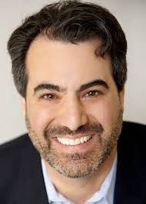
In the 1970s
Ron Pernick (on the right) explained that green tech was considered “alternative”
Expensive
No political support
Large, established companies were not embracing the sector.

Slide 8
In the 2000s
At the start of the 21st century, the term green tech was not yet in the financial or business community’s vocabulary.
Now, there is "the beginning of a revolution that is changing the places where we live and work, the products we manufacture and purchase, and the development plans of cities, regional governments, and nations around the globe."

Slide 9
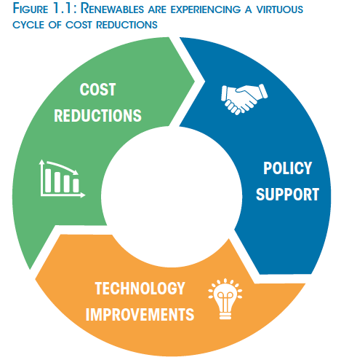
Nowadays..
Major forces to push clean technology into the mainstream and driving rapid growth and expansion
Source: IRENA

Slide 10
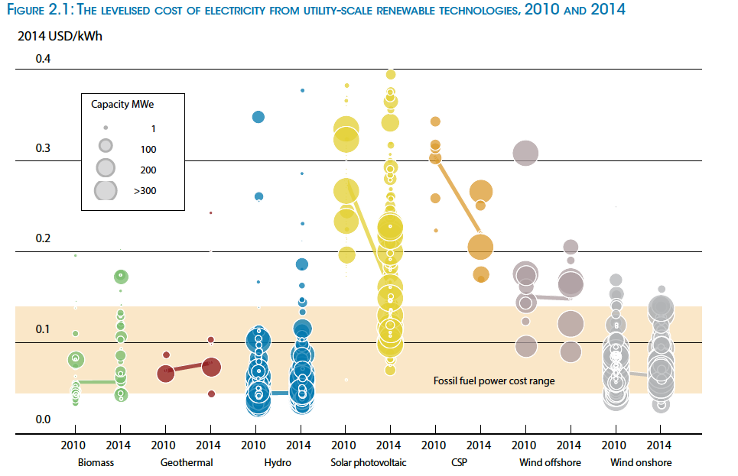
Renewable Power Generation Costs (2014)
Source: IRENA

Slide 11
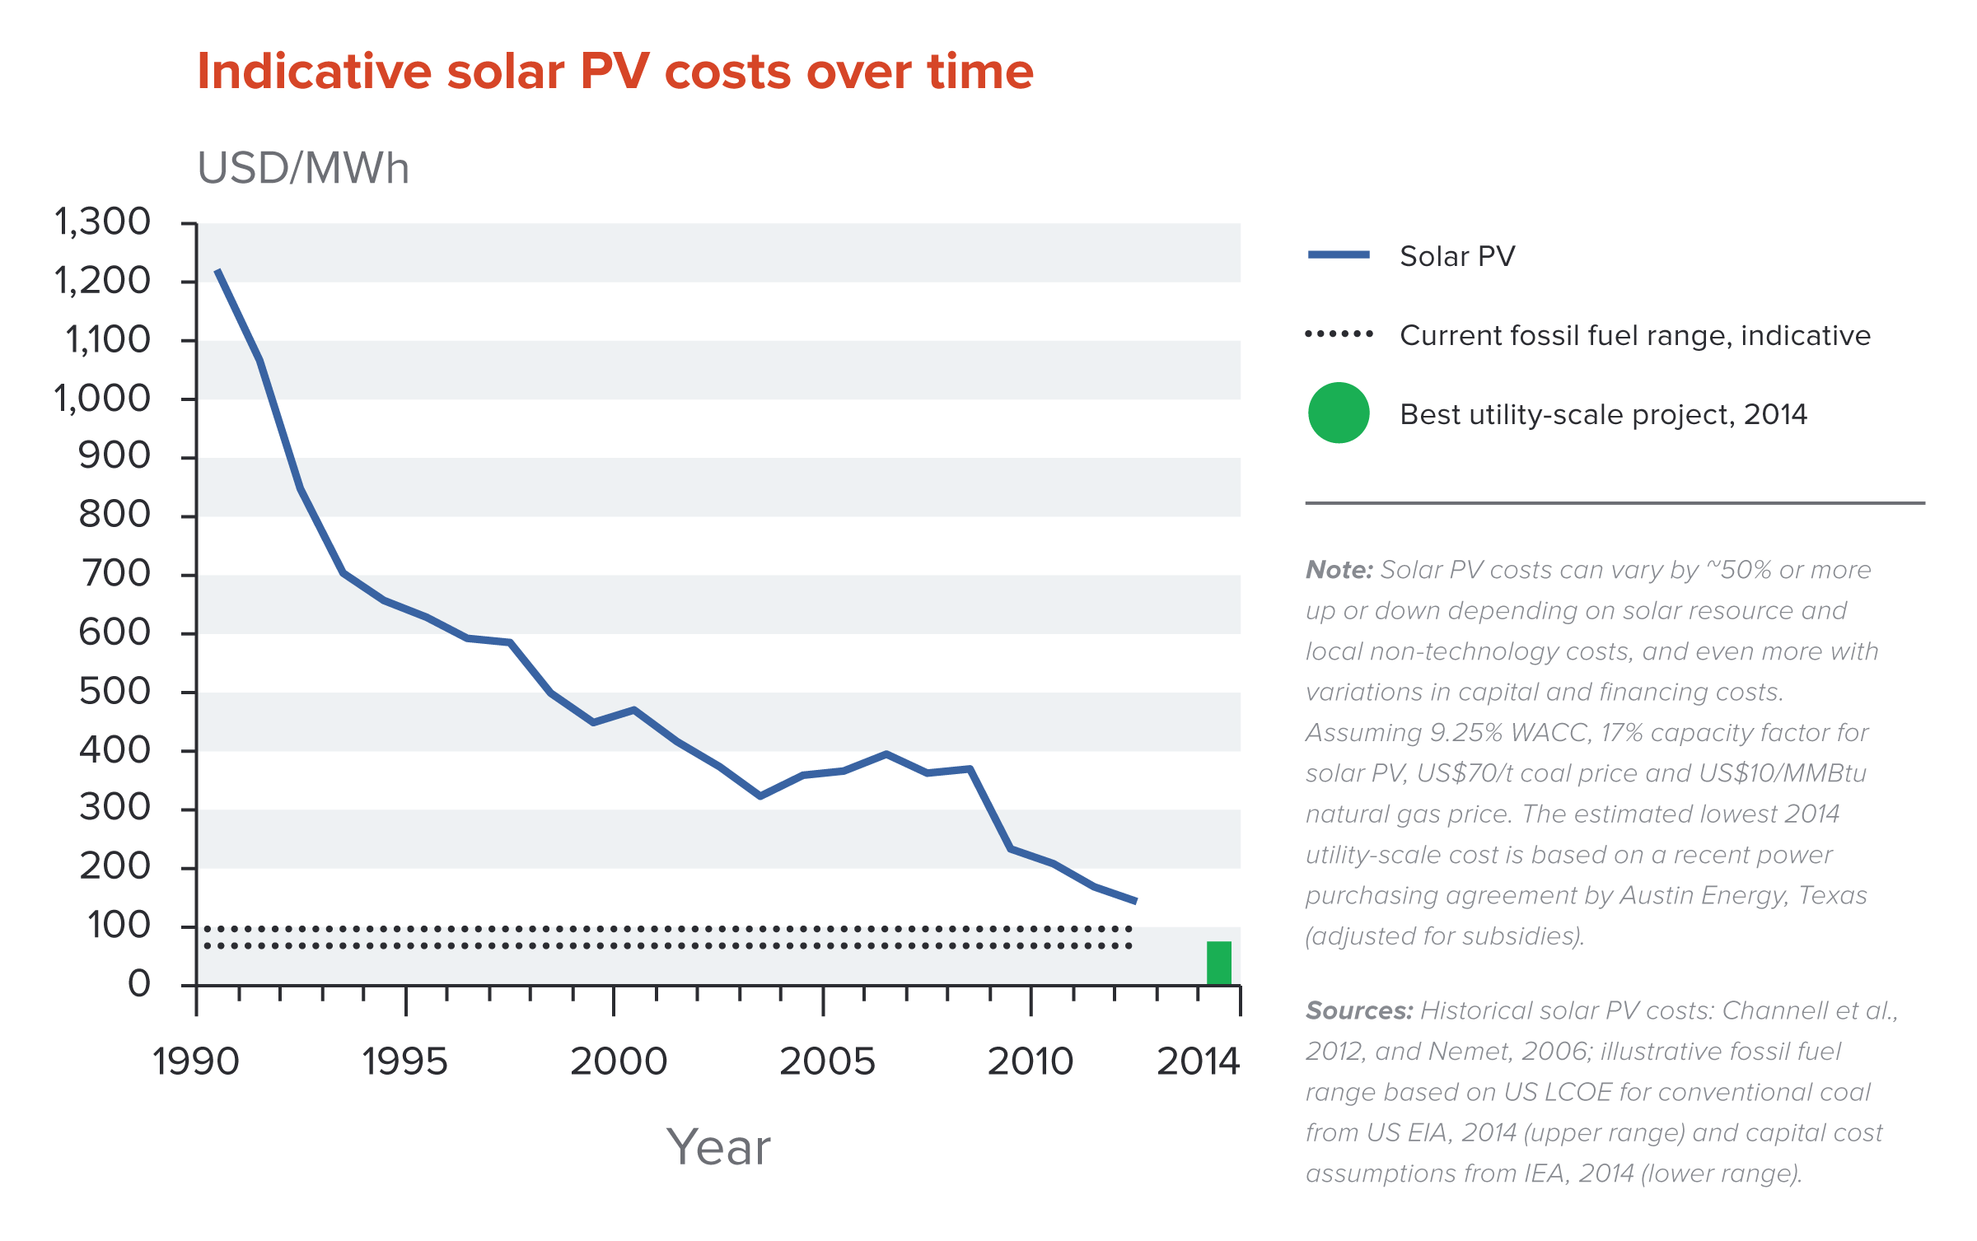
Solar Power Generation Costs (2014)
Source: IRENA

Slide 12
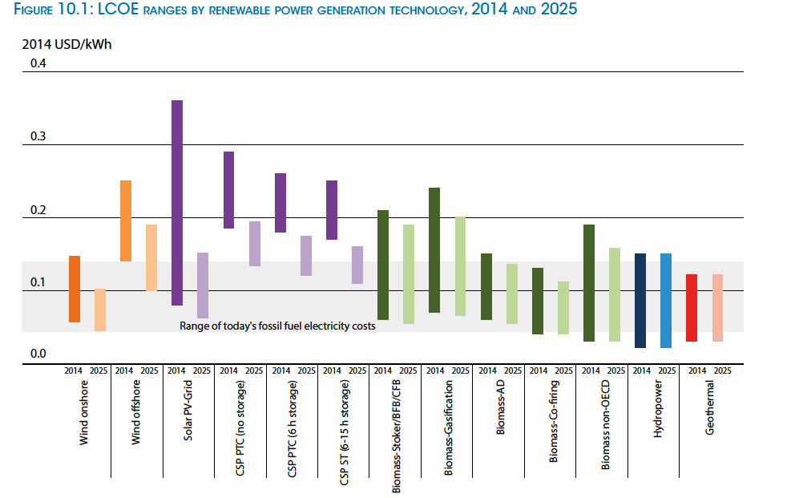
Renewable Power Generation Costs, 2014 and 2025
Source: IRENA

Slide 13
Policy Support
Subsidies
Direct Expenditures. These are Federal programs that directly affect the energy industry and for which the Federal government provides funds that ultimately result in a direct payment to producers or consumers of energy.
Tax Expenditures. Tax expenditures are provisions in the Federal tax code that reduce the tax liability of firms or individuals who take specified actions that affect energy production, consumption, or conservation in ways deemed to be in the public interest.

Slide 14
Policy Support
Subsidies
Research and Development (R&D). Federal R&D spending focuses on a variety of goals, such as increasing U.S. energy supplies, or improving the efficiency of various energy production, transformation, and end-use technologies. R&D expenditures do not directly affect current energy production and prices, but, if successful, they could affect future production and prices.

Slide 15
Policy Support
Subsidies
Electricity programs serving targeted categories of electricity consumers in several regions of the country. Through the Tennessee Valley Authority (TVA) and the Power Marketing Administrations (PMAs), the Federal government brings to market large amounts of electricity. The Federal government also indirectly supports portions of the electricity industry through loans and loan guarantees made by the U.S. Department of Agriculture’s Rural Utilities Service (RUS).

Slide 16
Policy Support
Feed-in Tariff (FiT)
First implemented in US in 1978 by president Jimmy Carter
As a reaction to 1970’s energy crisis
As of 2009, FiT enacted in 63 jurisdictions around the world
Denmark, Spain, and Germany

Slide 17
Policy Support
Feed-in Tariff (FiT)
A feed-in tariff is a rate of money paid by the government to homeowners, business and organizations such as schools and community groups to generate their own electricity through small-scale green energy installations such as solar panels.
As a government mandate, utility companies pay the homeowners, business and organizations to generate their own electricity.

Slide 18
Energy Generation

Slide 19
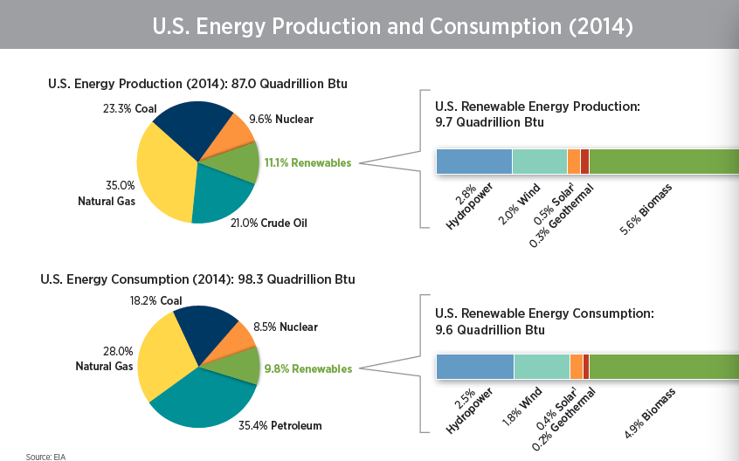

Slide 20
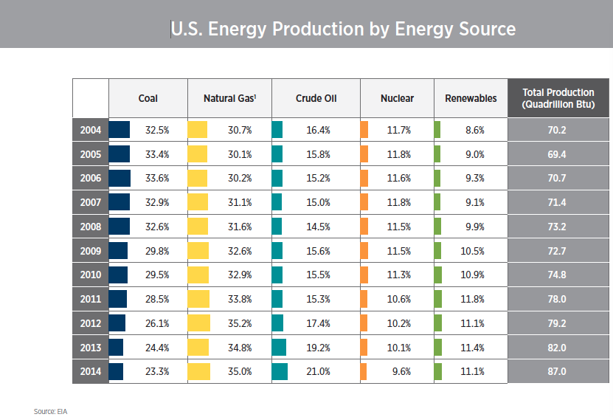

Slide 21
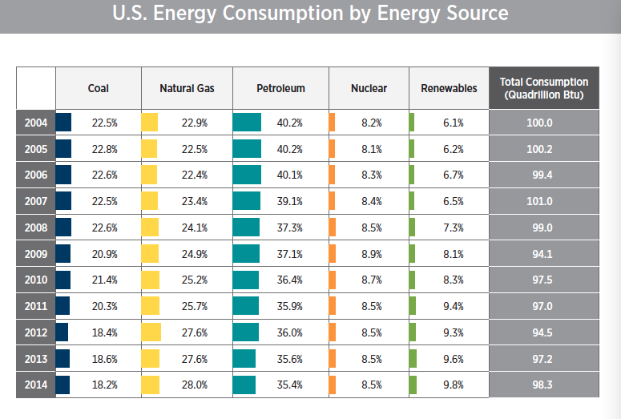

Slide 22
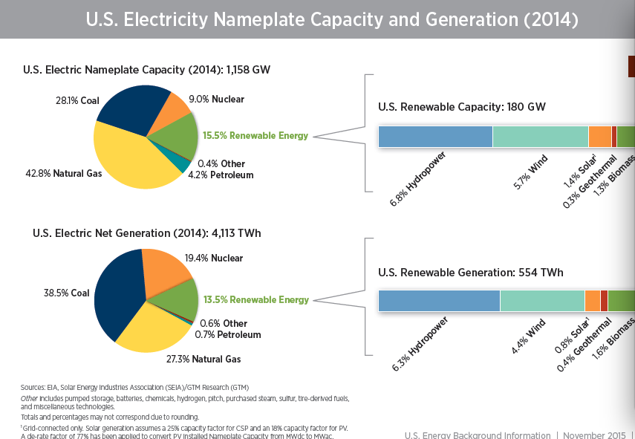

Slide 23
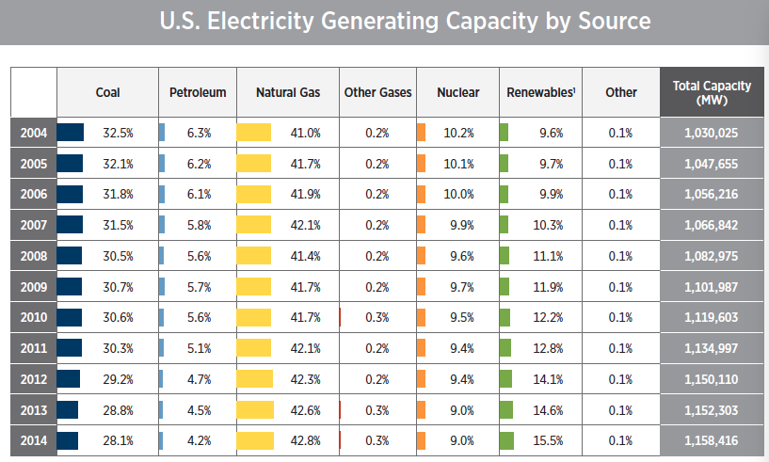

Slide 24
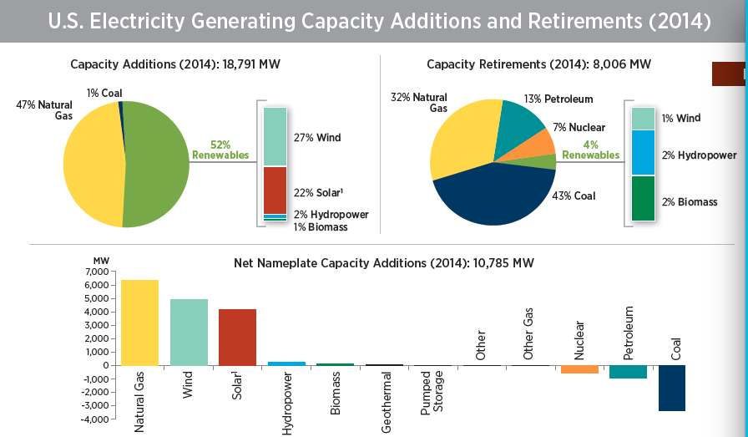

Slide 25
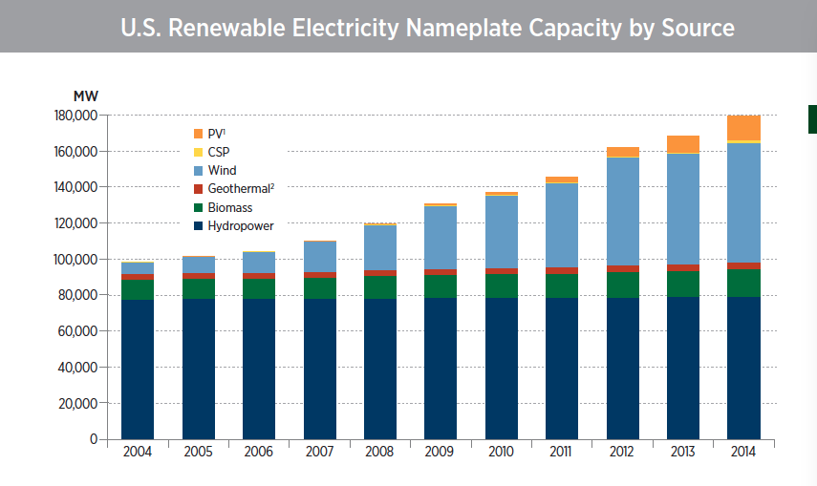

Slide 26
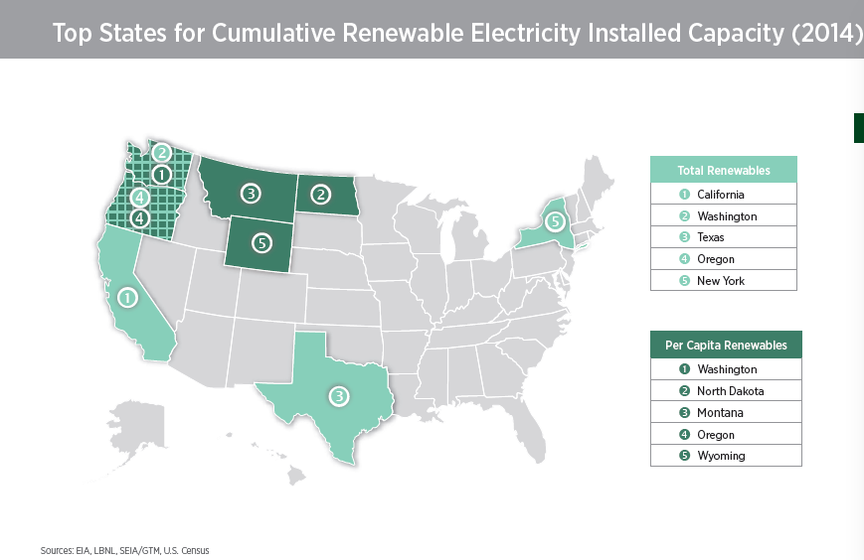

Slide 27
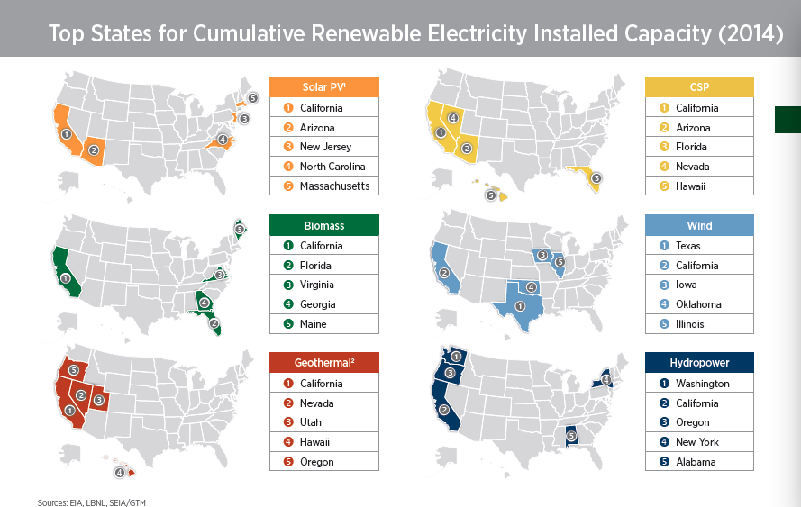

Slide 28
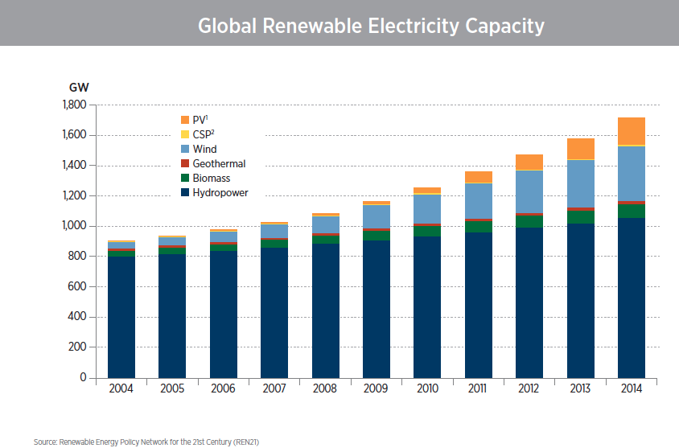

Slide 29
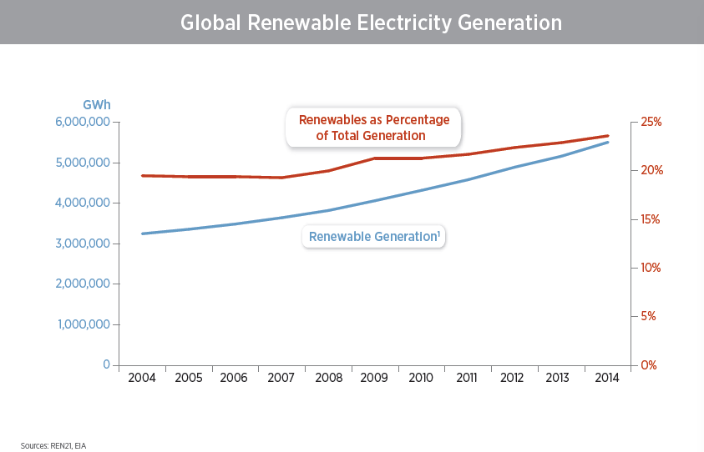

Slide 30
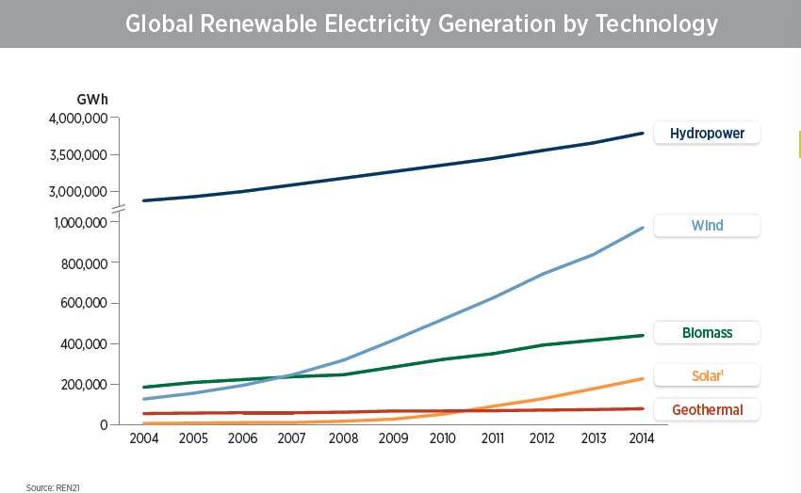

Slide 31
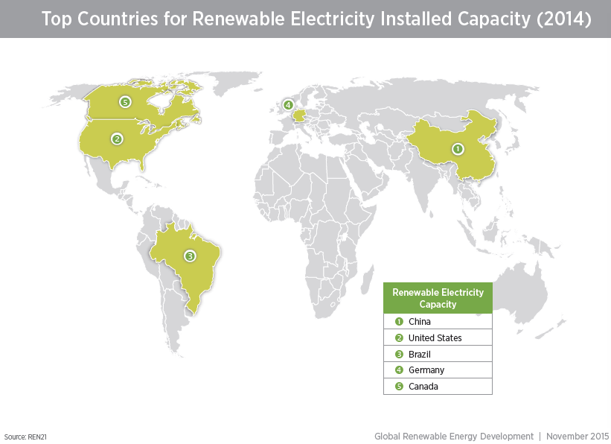

Slide 32
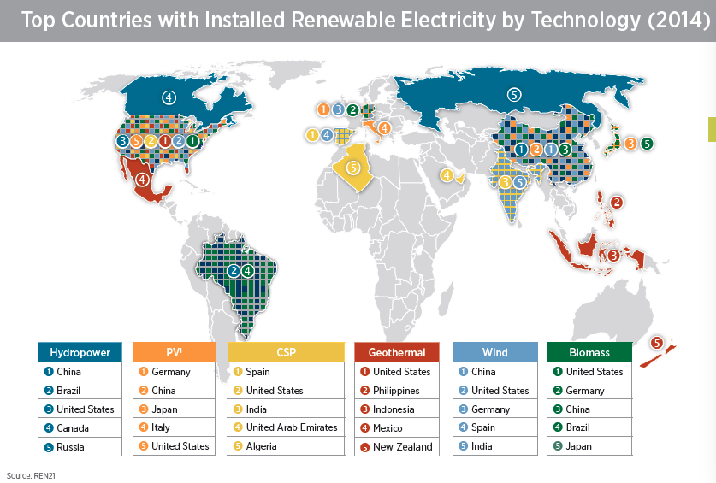

Slide 33
Wind Power

Slide 34


Turbines
Horizontal
Vertical

Slide 35
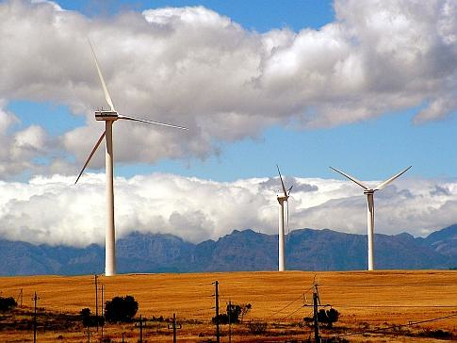
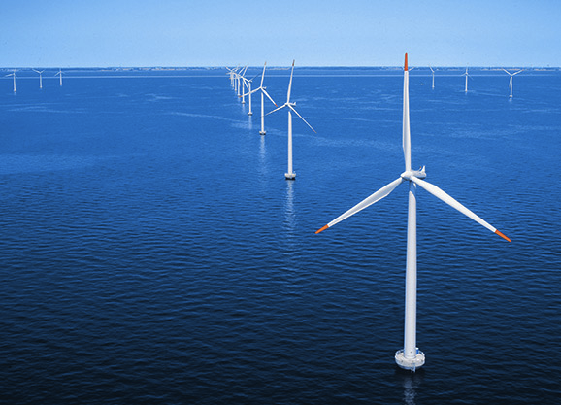
Wind Farms
Onshore Wind Farm
Offshore Wind Farm

Slide 36
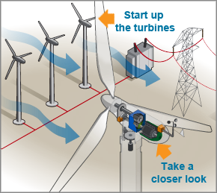
How does it work?
This picture shows how energy in the wind turns two or three propeller-like blades around a rotor. The rotor is connected to the main shaft, which spins a generator to create electricity. Wind turbines are mounted on a tower to capture the most energy. At 100 feet (30 meters) or more above ground, they can take advantage of faster and less turbulent wind. Wind turbines can be used to produce electricity for a single home or building, or they can be connected to an electricity grid (shown here) for more widespread electricity distribution.

Slide 37
Industry Development
US installed wind energy capacity increased almost 14x between 2000 and 2009.
In the United States, wind installed capacity grew 7.8% in 2014 compared to 1.8% in 2013. Nearly 4.8GW of additional wind capacity was installed in 2014, leading to a total cumulative capacity of nearly 66GW.
Some states with the highest cumulative wind installed capacity also experienced the most growth in capacity in 2014, including Texas (1.8 GW).

Slide 38
Industry Development
China continued to lead the world in cumulative installed wind capacity with over 114 GW.
Global cumulative installed offshore wind capacity reached nearly 8.8 GW in 2014, largely driven by projects in Europe. A total of 21 U.S. offshore wind projects, comprising more than 15.6 GW, are at various stages of development.

Slide 39
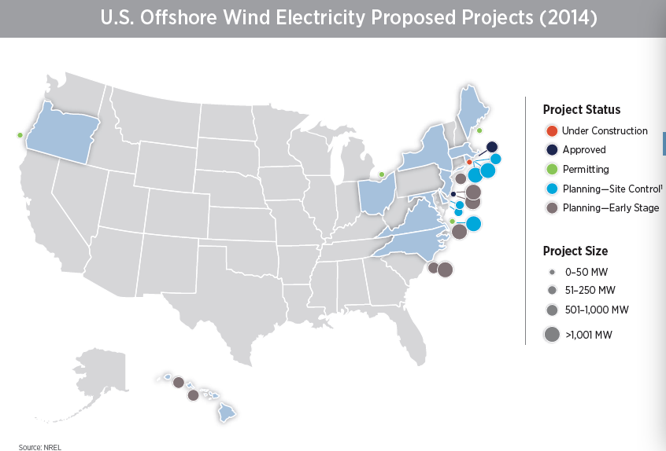

Slide 40
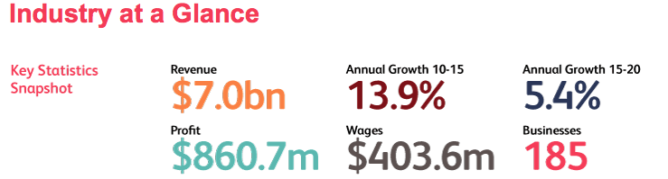
Industry Performance
$7.0 billion in revenues in 2015*
Annual Growth of 13.9% annually since 2010
Source: IBIS World

Slide 41
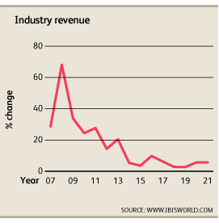
Industry Performance
Recession and competition from other alternative energy sources
Source: IBIS World

Slide 42
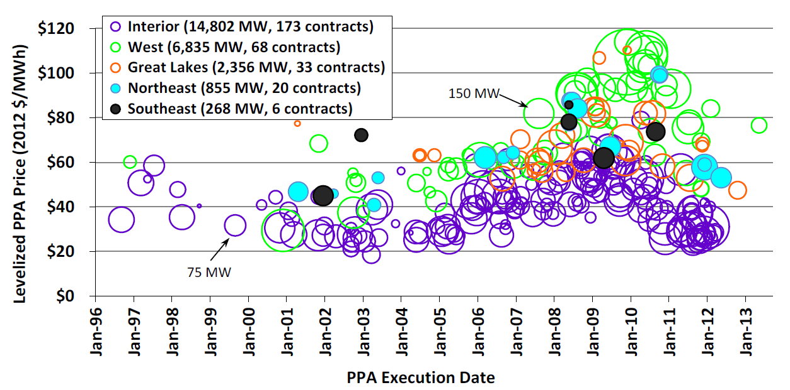
US Wind Power Sales Price
Price started rising after 2005 as the resulting supply-demand imbalance in wind turbines, along with the rising cost of materials and weakness in the US dollar, has put upward pressure on wind turbine costs, and ultimately, wind power prices.

Slide 43
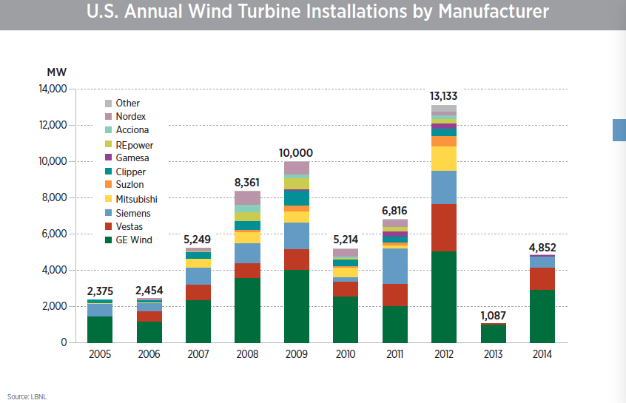

Slide 44

GE Renewable Energy is one of the world‘s leading wind turbine suppliers, with over 30,000 across the globe. Their portfolio includes a suite of onshore and offshore turbines, flexible support services ranging from development assistance to operations and maintenance, and cutting edge technology to upgrade customers’ fleet.
￼
Source: GE Renewable Energy

Slide 45
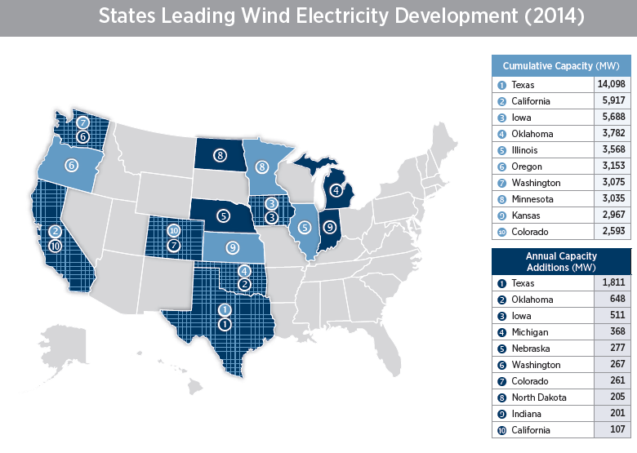

Slide 46
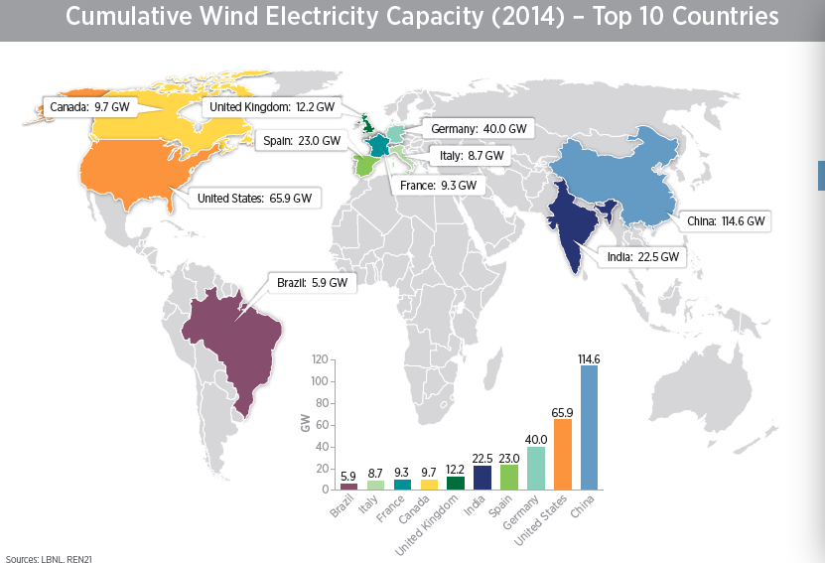

Slide 47
Limited Partnership

Slide 48
Limited Partnership
A limited partnership (LP) is a form of partnership similar to a general partnership, except that where a general partnership must have at least two general partners (GPs), a limited partnership must have at least one GP and at least one limited partner.

Slide 49
Limited Partnership
The GPs are, in all major respects, in the same legal position as partners in a conventional firm.
E.g. have management control, and share the right to use partnership property.
Limited partners have limited liability.
E.g. have no management authority, and (unless they obligate themselves by a separate contract such as a guaranty) are not liable for the debts of the partnership.

Slide 50



Slide 51
Stock Performance

Slide 52
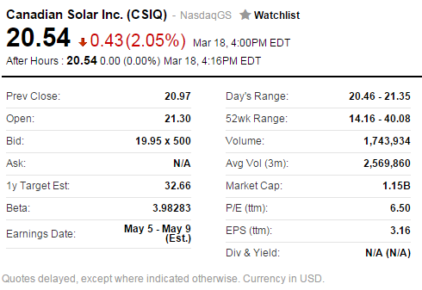

Slide 53
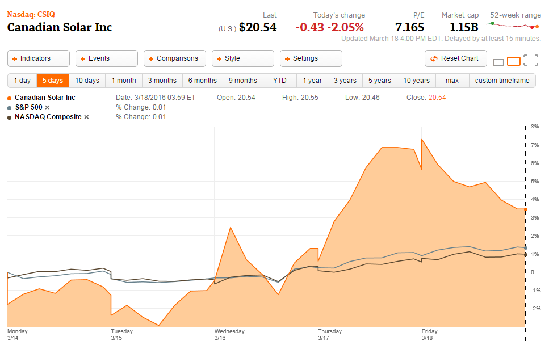
5 Day Stock Performance

Slide 54
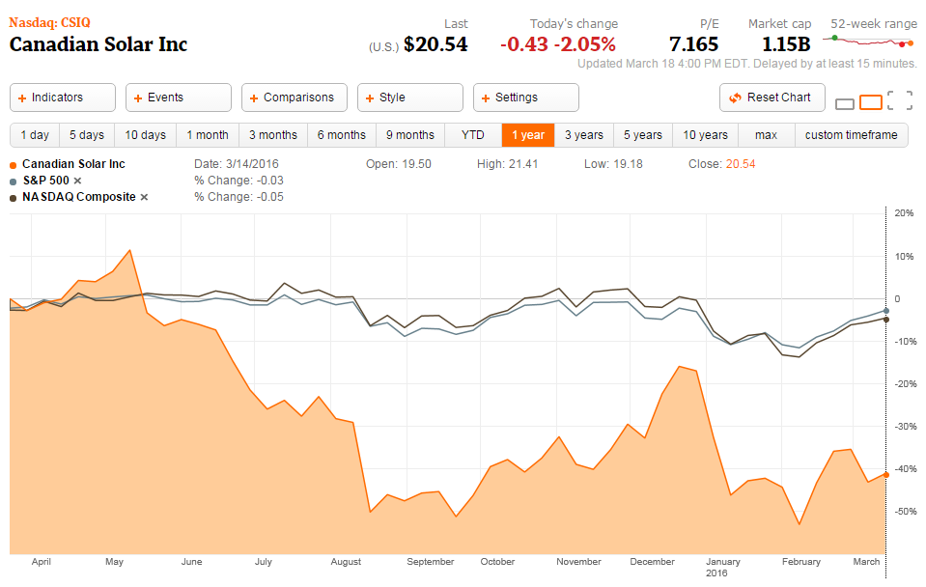
1 Year Stock Performance

Slide 55
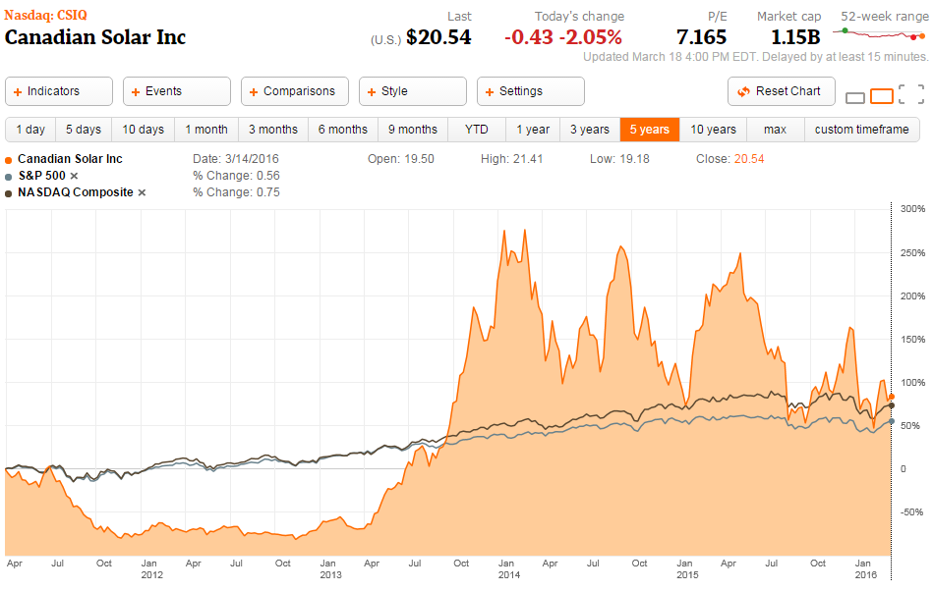
5 Year Stock Performance

Slide 56
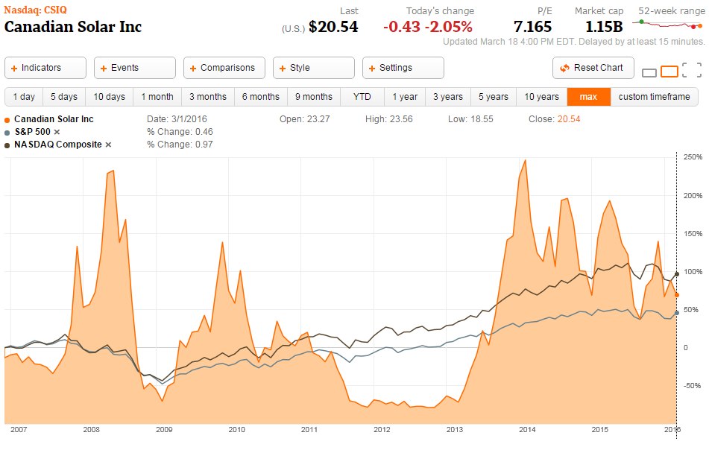
Max Stock Performance

Slide 57
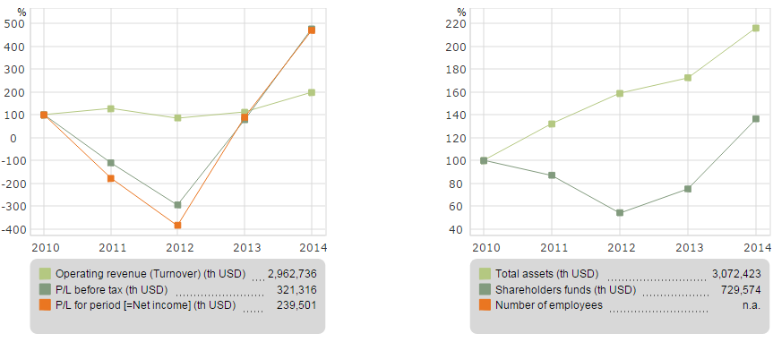
Key Data Trend

Slide 58
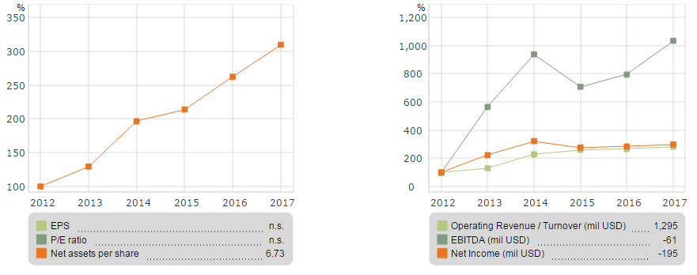
Financial Forecast

Slide 59
Company Overview

Slide 60
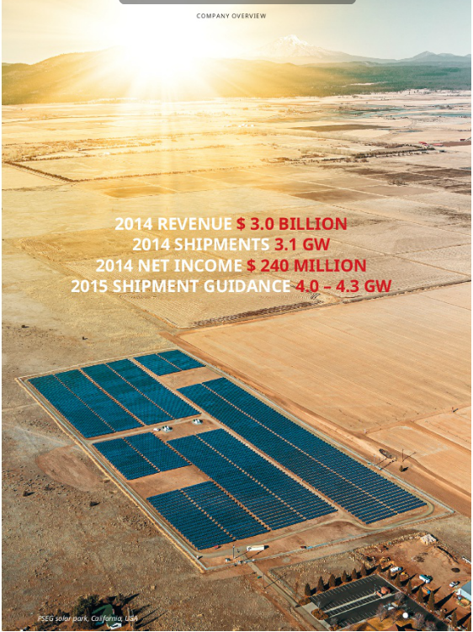
Company Profile
Founded in 2001 in Ontario, Canada
Over 8,600 employees
Listed in NASDAQ(CSIQ) in 2006
Top 3 solar company by revenue and profits in 2014
9GW project pipeline, 10GW of solar modules shipped

Slide 61
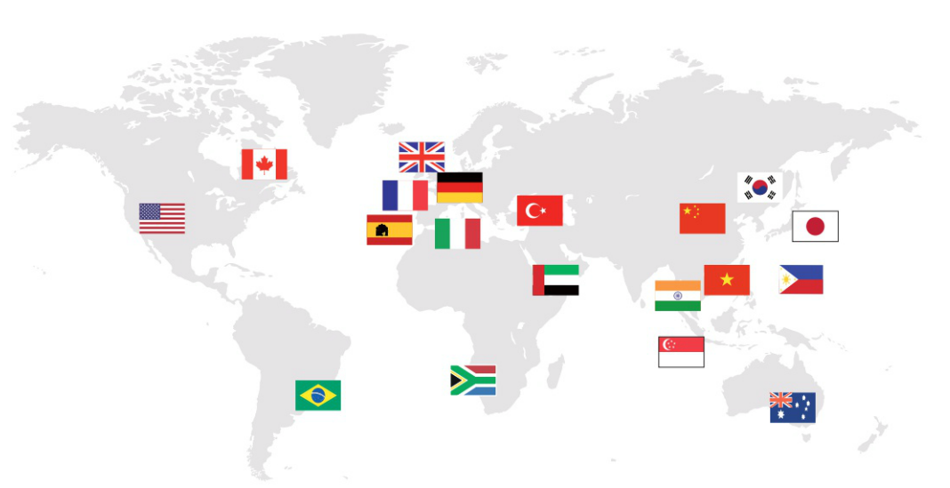
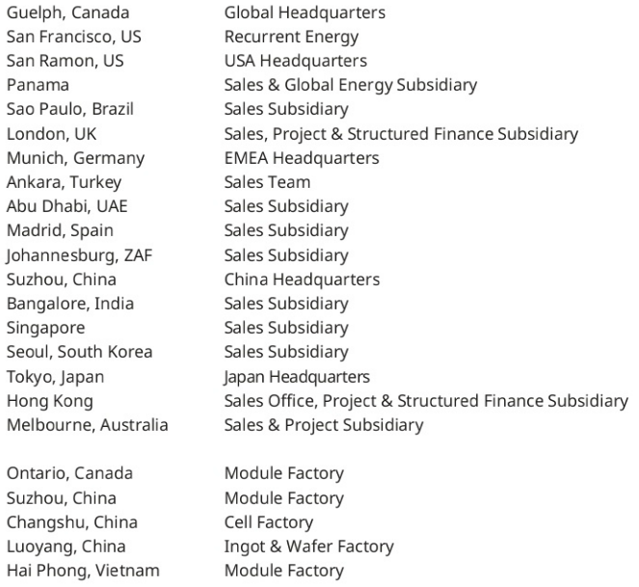
Global Footprint

Slide 62
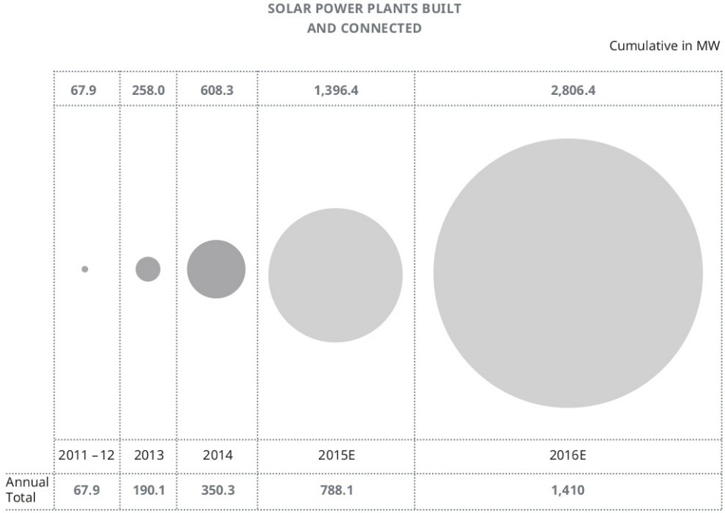
Growth Perspective

Slide 63
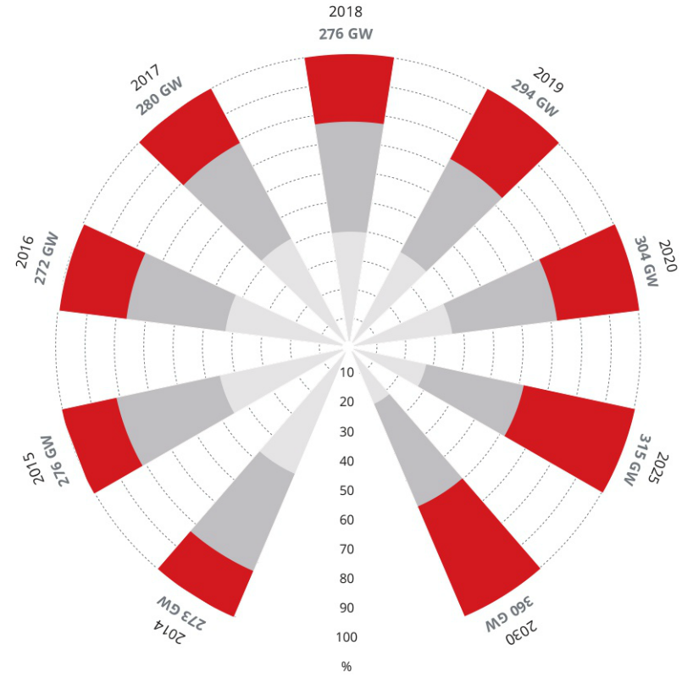

Global Capacity Additions

Slide 64
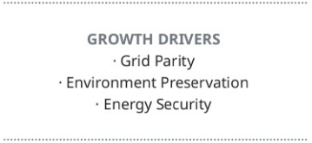
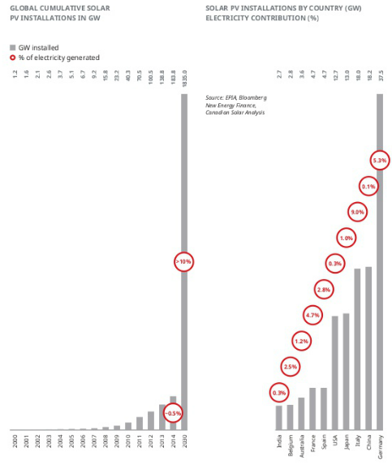
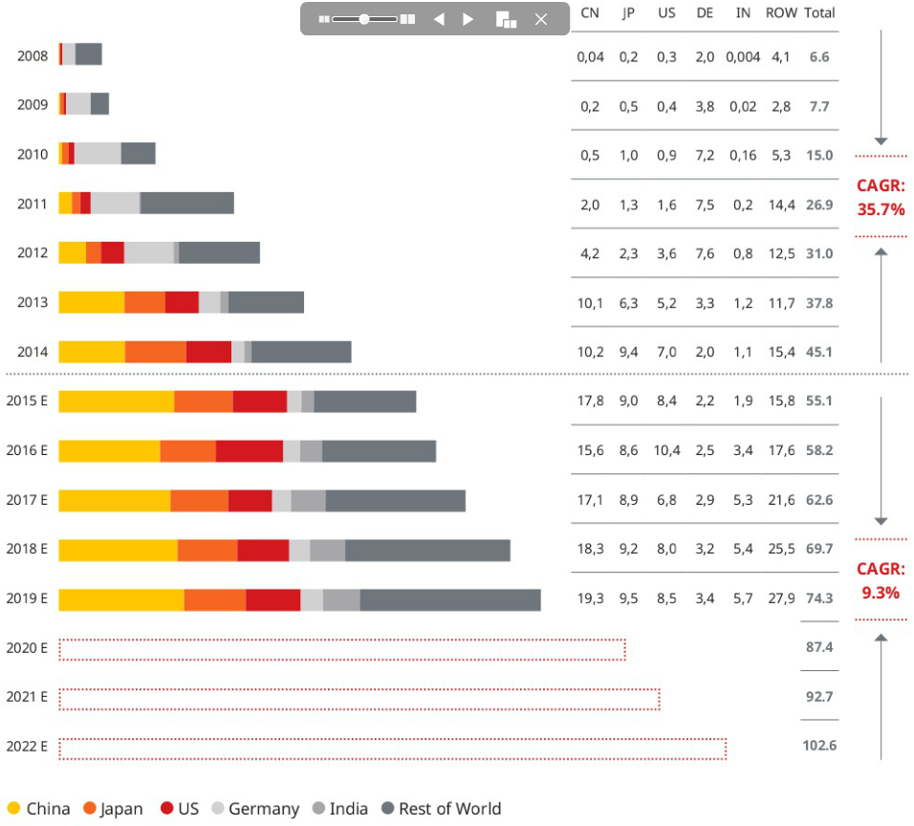

Slide 65
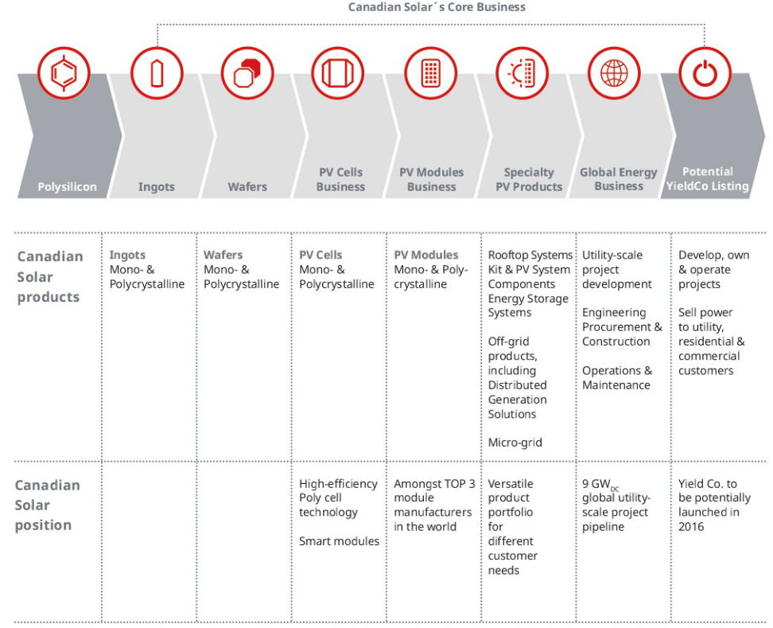
Business Model

Slide 66
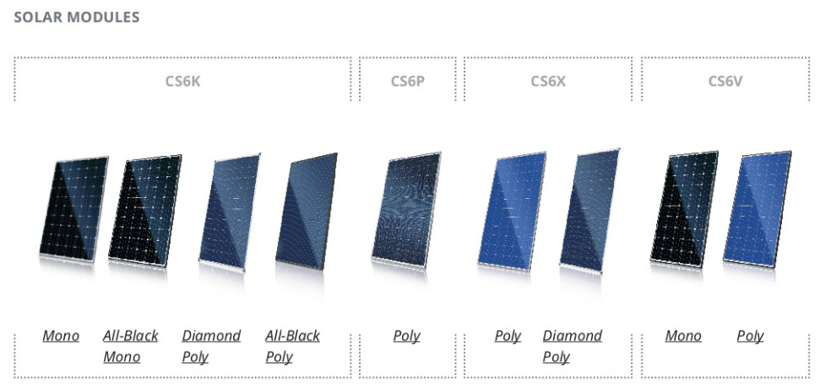
Product Overview

Slide 67
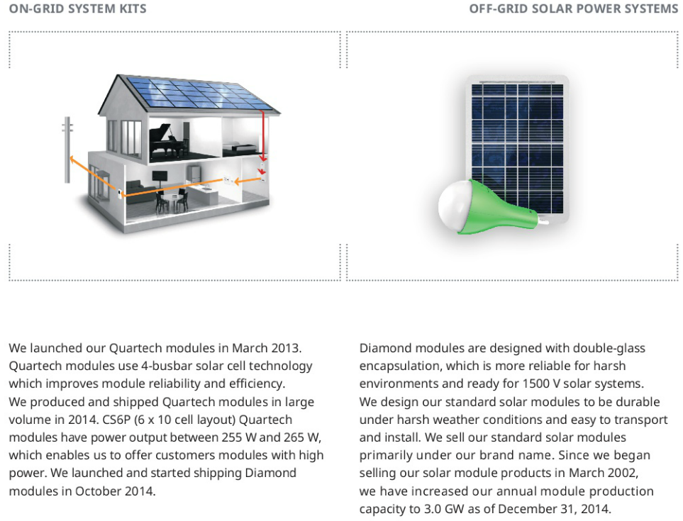
Product Overview

Slide 68
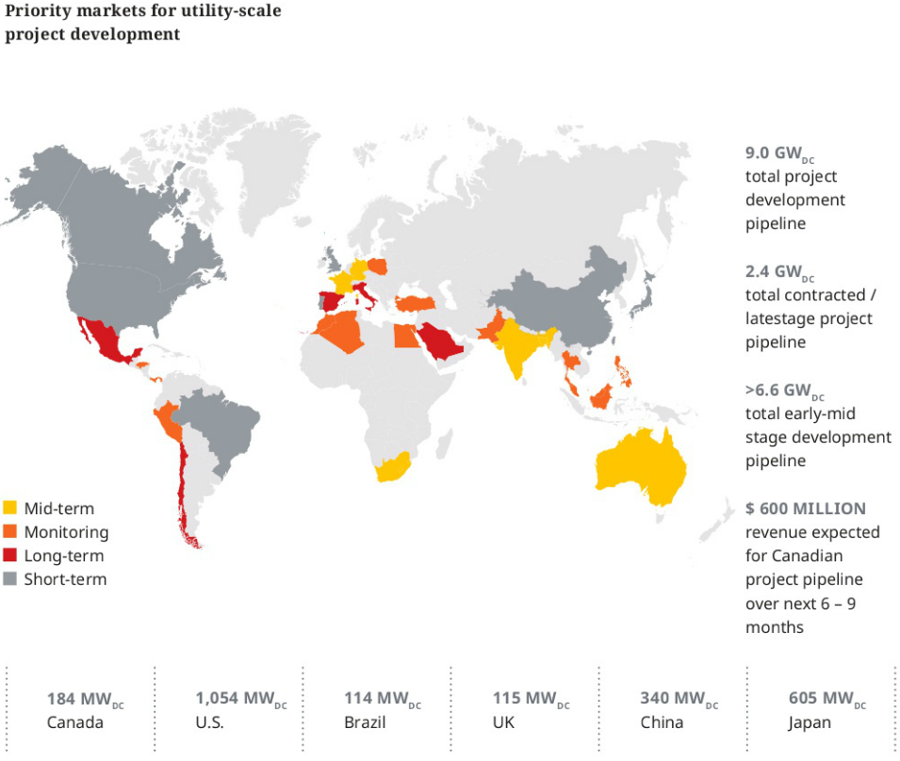
Industry Leading Globally Diversified Project Pipelines

Slide 69
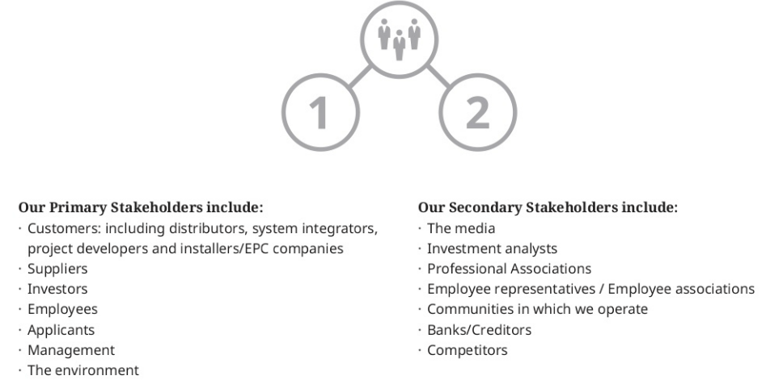
Shareholder Engagement

Slide 70
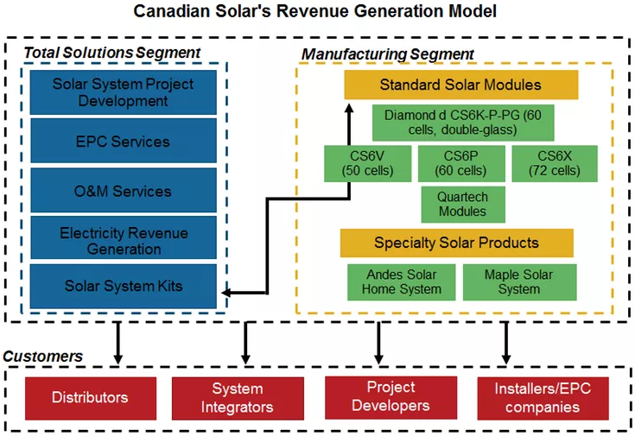
Revenue generation model
Canadian Solar derives its revenues from two segments:
the manufacturing segment, which is vertically integrated across the solar panel manufacturing value chain
the total solutions segment, which is involved in downstream operations

Slide 71


Key customers

Slide 72

Key customers
A significant proportion of Canadian Solar’s revenue comes from its top five customers, a structure that’s not uncommon in the industry. In 2014 this figure was 33.6%. It was 38.3% and 25.5% in 2013 and 2012, respectively.
The company’s notable customers in Canada include PennEnergy, Samsung (KRX), BlackRock (BLK), TransCanada (TRP-D), and BluEarth Renewables. Its customers in the United States include Duke Energy (DUK), Strata Energy Services, and Dominion (D). A key customer in Australia is Ikea.

Slide 73
Geographic spread of shipments
Canadian Solar has developed its geographic footprint and targets its products and services to customers across the globe. Whereas almost 90% of its revenue used to come from Europe until 2008, the company has shifted its focus to the Canadian and US markets while also expanding into emerging Asian markets.
Close competitors have also expanded their geographic footprints across the globe. Trina Solar (TSL) has the highest proportion of its sales in China (33%) and the United States (29%), SunPower (SPWR) the highest sales proportion in the Americas (77%), and JA Solar (JASO) in China (33%) and Japan (34%).
So how has Canadian Solar differentiated its business model? Read on to the next part of this series to learn more about the company’s manufacturing and downstream businesses.

Slide 74

Manufacturing business
Canadian Solar (CSIQ) designs its standard modules for residential, commercial, and utility markets. The company offers modules of various power outputs and design patterns. Its specialty solar products cater to users without access to grid electricity as well as users who require a mobile power source.

Slide 75

Manufacturing capacity
From 2014 to 2017, the company’s manufacturing capacity for solar cells and modules is estimated to increase at a compound annual growth rate of 15% and 16%, respectively. Trina Solar (TSL) reached a manufacturing capacity of 3,100 MW for cells and 4,000 MW for modules at the end of 2014. ReneSola (SOL) has a module capacity of 1,200 MW and SunPower (SPWR) has a combined cell and module manufacturing capacity of 1,700 MW. Yingli (YGE), on the other hand, has a capacity of 3,200 MW and 4,000 MW for cells and modules, respectively.
So far, Canadian Solar doesn’t have higher manufacturing capacity than its peers. But taking a look at the company’s photovoltaic module market share, you can see that it has consistently improved over the last five years.

Slide 76

Competition in technology
Improving module output and cell efficiency (the ratio of electrical output to energy produced) has been a major focus for solar power industry operators and R&D.
Standard modules are composed of mono-crystalline and multi-crystalline silicon cells, which have a conversion efficiency of 19.2% and 17.8%, respectively. For standard modules, Canadian Solar’s (CSIQ) cells have achieved a similar output to other industry operators and a conversion efficiency in line with industry averages.

Slide 77
Product quality
Canadian Solar has seen strong and steady year-over-year growth in its shipments of solar modules. Plus, Canadian Solar offers a broad range of solar cells and modules that goes beyond the standard products offered by most industry operators.
According to industry standard metrics set by the California Energy Commission for measuring cell quality, Canadian Solar is ranked first for multiple cell types. Based on the PTC Rating (a preferred measure of module performance), Canadian Solar’s cells rank number one for five different module types.
The PTC rating ranks cells after testing them in more realistic as well as harsh conditions. For one of the most commonly used multi-crystalline modules—with a 260 watt output composed of 60 cells—tests yielded a conversion efficiency of 16.1% for Canadian Solar, whereas Trina Solar’s (TSL) modules yielded an efficiency of 15.9%.

Slide 78
Research and development
Since 2012, Canadian Solar’s close peers have dedicated between 0.5% and 4.5% of their net revenues to R&D. Of the firms with the largest market share, the percentage of sales dedicated to R&D is at the lower end of the spectrum and has been decreasing for the past few years. Trina Solar, for example, spent 2.04%, 1.12%, and 0.97% on R&D in 2012. 2013, and 2014, respectively. Over the same period, Canadian Solar spent 1%, 0.7%, and 0.4% on R&D.
Industry operators have indicated that they intend to increase their R&D expenditures into the double digits. With consistently increasing market share already, the additional focus on research and development could mean further and faster breakthroughs.

Slide 79

Downstream expansion
Historically a solar power equipment manufacturer, Canadian Solar (CSIQ) has since expanded into the downstream market with its total solutions business. With the solar panel manufacturing industry facing headwinds from an oversupply of panels and a decrease in panels’ selling price, many industry operators have diversified across the solar value chain. Beginning in 2011, Canadian Solar has seen steady integration of its total solutions business.

Slide 80

The Total Solutions business
In 2010, Canadian Solar started providing EPC services primarily in Canada and China. These services consist of contracted engineering, procurement, and construction work performed on projects owned by other developers. Also in 2010, the company started selling solar system kits primarily in Canada and Japan. These kits consist of internally produced solar modules and other components, such as inverters, supplied by third parties.
In 2012, Canadian Solar started providing O&M services—miscellaneous operations and maintenance services. In 2014, Canadian Solar expanded its total solutions business to electricity revenue generation and added build-to-own projects to its pipeline.
As of May 2015, Canadian Solar has installed 822 MW of power, a number that’s grown at a compound annual growth rate of 112% since 2011.

Slide 81
Pipeline of assets
Canadian Solar has various projects in operation across its geographic segments: 6.6 GW worth of early-mid stage and 2.4 GW of late-stage projects, which are either in development or EPC¹. The graph above shows a breakdown by geography for these late-stage projects.
Going forward, much of the company’s pipeline will comprise projects from the acquisition of Recurrent Energy. For more information regarding the acquisition, read on to the next part of this series.
Management has indicated its intentions to increase its attention to and investment in downstream expansion. The proportion of revenues from the company’s total solutions business has increased rapidly. In 2014, the total solutions business accounted for 44.5% of Canadian Solar’s revenues, whereas it accounted for 28.6% of revenues in 2013 and only 11.5% in 2012.
The total solutions business allows higher margins. The company’s overall gross margin increased from 16.7% in 2013 to 19.6% from 2014, whereas its operating margin increased from 7.9% to 12.4% over the same period.

Slide 82

History of Recurrent Energy
Incorporated in 2006, Recurrent Energy is a California-based developer of solar projects in North America. It has 4.3 GW of energy in its pipeline, 1 GW of which is in late stages. In March 2015, the company was acquired by Canadian Solar (CSIQ) from Sharp Corporation (TYO) for $265 million in cash.

Slide 83

Sources of competitive advantage
Canadian Solar (CSIQ) derives its competitive advantage from its strategic positioning in the downstream market, its broad range of crystalline silicon solar power products, and its technology.

Slide 84
Main performance drivers
The factors that have the greatest impact on Canadian Solar’s (CSIQ) financial performance include government subsidies and economic incentives, industry and seasonal demand, and the cost of inputs.
Government subsidies are critical to financing for solar projects and the installation of solar systems. Third-party financing also depends on economic incentives from the government, such as Renewable Portfolio Standards or feed-in tariffs. Any revision, reduction, or removal of subsidies or economic incentives affects demand.
Demand is also affected by other factors:
Seasonality: Winter months cause harsh conditions for installation.
Price of solar modules: Due to oversupply, market prices have been decreasing since 2008 and are only just showing signs of stabilization.
In addition to industry-wide demand, company-specific demand is also affected:
Prices of silicon and other inputs affect product pricing and therefore the price that Canadian Solar can offer for its modules relative to competitors.
Due to existence of long-term agreements with suppliers, it can be hard for Canadian Solar to adjust the cost of raw materials with market prices.
Polysilicon prices have been on a steady downward trend. They decreased 70% over the last five years. They fluctuated in 2013 and rose for most of 2014 until the third quarter. Over the last 12 months prices have decreased 27%. But with long-term purchase agreements, Canadian Solar may not be able to decrease product costs along with such decreases.

Slide 85

Main performance drivers

Slide 86
Collective impact
In 2012, changes in government subsidies and economic incentives led to a decrease in demand and an oversupply of photovoltaic modules and module components. As a result, the selling price of solar modules decreased to $0.77 per watt from $1.34 per watt in 2011. This decrease caused manufacturing segment revenues to decrease 32.3%.
Close competitors faced similar results over that period. Trina Solar’s (TSL) selling price for modules decreased from $1.33 per watt to $0.78 per watt, resulting in a 37.7% decrease in revenues from its module business.
JA Solar’s (JASO) revenues were similarly affected. With a 48% decrease in modules’ selling price, JASO’s revenues decreased by 43.6% in China and 30.8% outside China. SunPower (SPWR) also saw a 27.0% decrease in revenues from its solar power components business.
Canadian Solar has recovered. Its manufacturing revenues increased by 3.1% in 2013 and 39.1% in 2014.

Slide 87

Debt profile
With outstanding total debt of $1,010 million at the end of 2014, First Solar (CSIQ) has maintained its debt levels at around the same amount since 2010. Short-term debt makes up the most significant proportion of the company’s debt (72%) as well as its total liabilities (43%). This line item mostly consists of borrowings from Chinese banks to fund operations—that is, working capital expenditures and capital expenditures. The company’s dependence on Chinese banks’ lending policies would pose a significant risk if these policies became less favorable towards solar companies in the future.

Slide 88
The debt-to-equity ratio and its implications
Canadian Solar has a trailing-12-month debt-to-equity ratio of 0.37, which is similar to close peers Trina Solar (TSL) and ReneSola (SOL). In contrast, First Solar has a very low debt-to-equity ratio of 0.04. Canadian Solar has maintained a ratio of around 0.4 since 2013. In 2012, its ratio reached 0.74. The 2012 result was due to a deficit in retained earnings resulting from an industry-wide weak year. In 2010 and 2011, the company had a debt-to-equity ratio below 0.2.
More than 50% of all Canadian Solar’s short-term bank borrowings are secured by restricted cash, inventories, prepaid land use rights, property, plant, and equipment (PP&E), project assets, and bank notes. Most notably. they’re guaranteed by the company’s president and CEO, Dr. Shawn Qu. About 60% of the company’s long-term borrowings mature within the next two years. These long-term borrowings are secured by restricted cash, prepaid land use rights, PP&E, and project assets.

Slide 89
Liquidity
Taking a look at Canadian Solar’s quick ratio, at 0.38, we see that the company has a low ratio compared to its close peers. The quick ratio measures the company’s ability to pay off current liabilities with current assets limited to cash, cash equivalents, short-term investments, and accounts receivable.
The quick ratio is regarded as a refined measure of liquidity, as opposed to the current ratio. But in Canadian Solar’s case, the current ratio may be an appropriate measure of liquidity. In addition to cash, since the company’s short-term debt is secured by other assets, its debt situation may not be too big of a concern for investors. With a current ratio of 1.13, the company’s balance sheet looks stronger than Trina Solar’s and ReneSola’s, are currently 1 and 0.59, respectively.

Slide 90

Comparing profitability to industry peers
To measure Canadian Solar’s (CSIQ) operating profitability, we took a look at its earnings before interest, tax, depreciation and amortization, or EBITDA. This number indicates how efficiently the company operates and how much revenue is left over after paying major operating expenses.

Slide 91

Opportunities for growth
Future demand for solar power should be driven by government legislation and other initiatives pushing for clean energy. The higher-margin downstream business will drive most of the growth and expansion in the industry.
Looking at the five-year performance against a value-weighted index of close industry peers as well as the MAC Global Solar Energy Index, you can see that Canadian Solar (CSIQ) has outperformed significantly. You can attribute this outperformance to the competitive advantage the company has built through its downstream expansion, product technology, and quality.
As solar power grew its share of global energy, one-third of all electric generation capacity added in 2014 came from solar power. Solar energy is forecast to fuel more than 10% of global electricity generation from less than 1% today. In the emerging solar markets where there’s extensive room for growth, solar currently only makes up a small proportion of electricity generation capacity:
0.1% in China
1% in Japan
0.3% in India
Canadian Solar is well positioned to penetrate these emerging markets. The company has enjoyed marked success in creating a strong brand within established as well as emerging markets. It has achieved fast expansion and integration of its downstream business.

Slide 92
Management Team

Slide 93

Dr. Shawn Qu, President & Chief Executive Officer
Dr. Shawn Qu founded Canadian Solar in 2001
He has a Ph.D. in material sciences from the University of Toronto and various other degrees
Dr. Qu held various positions at ATS Automation Systems and was a research scientist at Ontario Power Generation

Slide 94

Michael G. Potter, Senior Vice President and Chief Financial Officer
Joined Canadian Solar in July 2011
Worked in finance, controlling and audit positions for a variety of multinational companies over a 20-year period
Chartered Accountant with a Bachelor of Commerce degree from Concordia University, Canada and a Diploma of Public Accountancy from McGill University, Canada

Slide 95

Yan Zhuang, Senior Vice President and Chief Commercial Officer
Joined Canadian Solar in June 2009
Led corporate branding, sales and marketing initiatives in multinational companies across the Asia Region
Holds a Master in Applied Statistics from the University of Alberta, Canada and a Master in Marketing Management from the University of Guelph, Canada

Slide 96

Guangchun Zhang, Chief Operation Officer
Over 18 years of experience in the photovoltaic industry
Used to be the Vice Director of China state PV standards Committee
Chairman of SEMI China PV Standards Committee and the expert of IEC/TC82 PV Standards
Associate Professor at Shandong Technology University and received his Bachelor’s degree in 1982 from the School of Electronic Engineering at Shandong Industrial Institute

Slide 97

Dr. Huifeng Chang, Senior Vice President Corporate Strategy
Joined Canadian Solar early 2016
More than 17 years of experience in capital markets, financial investment and risk management
Used to be the Co-Head of Sales and Trading at CICC USA and CEO of CSOP Asset Management
Ph.D. in soil physics and MBA from the University of Hawaii

Slide 98

Robert McDermott, Independent Director
Joined the board in 2006
Partner with McMillan Binch Mendelsohn LLP, a business and commercial law firm based in Canada
Member of the Canadian Bar Association, Canada Tax Foundation, International Bar Association and Rocky Mountain Mineral Law Institute
Law degree from the University of Toronto and a Bachelor's of Arts degree from the University of Western Ontario

Slide 99

Lars-Eric Johansson, Independent Director
Joined the board in 2006
Worked in finance and controller positions in Canada and Sweden for more than thirty years also serves on he boards and audit committees of several other corporations listed on the New York, NASDAQ and Toronto Stock Exchanges
MBA in Finance and Accounting from Gothenburg School of Economics in Sweden

Slide 100

Dr. Harry E. Ruda, Independent Director
Joined the board in 2011
Director of the Centre for Advanced Nanotechnology, the Stanley Meek Chair in Nanotechnology and professor of Applied Science and Engineering at the University of Toronto, Canada
Has extensive knowledge, experience and qualifications in material sciences, photonics and semiconductors
PhD in semiconductor physics from MIT in 1982

Slide 101

Andrew Wong, Independent Director
Joined the board in August 2014
Director of Ace Life Insurances, China CITIC Bank, Intime Retail Group and Shenzhen Yantian Port Group
Senior positions at Royal Bank of Canada, Union Bank of Switzerland, China Citicorp, Hang Seng Bank and DBS Bank
Board member of the Tsinghua University Education Foundation
Awarded by the Shanghai Stock Exchange 2010 and received Hong Kong's Medal of Honour in 2011

Slide 102
Financial Performance

Slide 103

Selected Financial Data

Slide 104

Selected Financial Data

Slide 105

Balance Sheet (Assets)

Slide 106

Balance Sheet
(Liabilities&Equities)

Slide 107

Income Statement

Slide 108

Cash Flow Statement

Slide 109

Cash Flow Statement(continued)

Slide 110

Cash Flow Statement(continued)

Slide 111

Competitor

Slide 112
Recommendation
BUY

Slide 113


Slide 114

Stock Price
Notes:
The stock price is about $70 per share, and market cap is about 7 billion, the P/E ratio is 13.2 . First Solar has no dividends.

Slide 115

Stock Performance-1 Year
Notes:
This is the first year stock performance:
We can see that from June to July, there was a big drop in the stock price. Because there was a limited partnership formed by First Solar and SunPower Corporation (“SunPower”), completed its IPO in Jun.
Its called “8point3 Energy Partners ”, is a joint venture, First Solar and SunPower each contributed a portfolio of selected solar generation assets.
They launched the “8point3 Energy Partners ” to enable a competitive cost of capital and greater optionality in the project sales process for a portion of future project sales. So the stock price may be impacted by changes in the price of ‘8point3 Energy Partners’ shares and market perceptions about the value of interest.

Slide 116

Stock Performance-5 Year
Notes:
This is the five year stock performance

Slide 117

Stock Performance-Max
Notes:
This is a ten year stock performance,
There was a big drop in 2008 to 2009, most of the reason because the financial crisis.
The decline of government subsidies['sʌbsɪdɪ] in large markets like Germany and Spain, the world's largest and second largest solar markets,.
(In 2008, Germany approved a law cutting its solar subsidies by 10%. Under the law subsidies will fall another 8%-10% each year for the next three years.)
(And the Spanish Government cut its solar subsidies by 30%)
From 2011 to 2012, shares in First Solar have been dropped a lots this year, as a huge oversupply and less demand caused the price of silicon solar panels to decrease. First Solar shares are down over 70% since January.
Because the cut in German subsidies; first solar restructures its operations to align with the sustainable market opportunities.
in 2012, First Solar announced it would close one factory in Germany, shut down four other production lines, and lay off 30 percent of its workers. There was a massive loss of $450 million for the first quarter of 2012.
In addition, solar-panel manufacturers in China have built new factories and provided the market with inexpensive solar panels, driving down prices, which fell by 50% in 2011. That has reduced or eliminated profit margins and forced some solar-panel companies out of business.

Slide 118


Slide 119

Company History
Founded in 1999 (17years) by Harold Master, as Solar Cells, Inc.
1999, was purchased by True North Partners, LLC.
Went public in 2006, changed name to First Solar, Inc.
American Photovoltaic (PV) manufacturer of thin film solar modules
Provide solar energy solutions and services that include finance, construction, maintenance and end of life panel recycling.
Headquartered in Tempe, Arizona
The world’s largest thin-film PV solar module manufacturer
History of leadership…

Slide 120

History of Leadership
History of leadership
1999 – 2015 Scaled Advanced Thin Film Module Technology
1st solar company to:
Produce 1GW in a single year
Break the $1/watt manufacturing cost barrier
Implement a global PV module recycling program
Multiple world records for CdTe (Cadmium Telluride) thin film solar module (17%) and cell (21.5%) efficiency
Notes:
Break the $1/watt manufacturing cost barrier:
On February 24, 2009, First Solar's cost per watt broke the $1 barrier, reaching $0.98. Production cost has continued to fall and in February 2013, reached $0.68 per watt.

Slide 121

History of Leadership
2007 – 2015 Demonstrated Leadership across Entire Solar Value Chain
Developed world’s largest contracted solar project pipeline
( 3GW+)
Facilitated the financing for ~2GW (representing ~$9 billion)
Developed advanced grid integration, plant control, forecasting, and energy scheduling capabilities
Engineered and constructed over 2GW (AC) of PV power plants
Currently operate more than 2GW (DC) with fleet system availability of over 99%
Constructed two of the largest PV power plants in the world, both are fully operational

Slide 122

History of Leadership
2012 – 2015 Introducing Solutions to Contemporary Energy Problems
Integrating utility-scale solar into the global energy mix
Reducing fuel consumption and costs with PV/diesel hybrid system solutions
Delivering off-grid and energy access solutions to underserved energy markets
Providing solutions for restricted spaces and distributed solar generation

Slide 123


Ownership
Notes:
84% shares owned by institutions
30.64% shares owned by mutual funds
0.29% shares owned by insiders

Slide 124

Subsidiaries of First Solar
Notes:
Its subsidiaries of first solar, most of them located in United Stated, Germany,

Slide 125

Properties
Notes:
Most of properties are leased.

Slide 126
Executive Management

Slide 127

Chief Executive Officer& Director
James A. Hughes (Age: 52)
-was appointed in 2012
-2007-2011, CEO and Director of AEI Services LLC
-2004-2007, engaged in principal investing with a privately held company
-2002-2004, President& COO of Prisma Energy International
-President & COO of Enron Global Assets
-Director of TPI Composites, Inc.
-Chairman of the board of directors of the Los Angeles branch of the Federal Reserve Bank of San Francisco
-Hold Juries doctor degree, University of Texas
-Certificate of Completion in international business law, Queen Mary’s College
-Bachelor’s degree in business administration, Southern Methodist University
Notes:
James A. Hughes
Chief Executive Officer
James A. Hughes joined First Solar in March 2012 as Chief Commercial Officer and was appointed Chief Executive Officer in May 2012. Prior to joining First Solar, Mr. Hughes served, from October 2007 until April 2011, as Chief Executive Officer and Director of AEI Services LLC, which owned and operated power distribution, power generation (both thermal and renewable), natural gas transportation and services, and natural gas distribution businesses in emerging markets worldwide. From 2004 to 2007, he engaged in principal investing with a privately held company based in Houston, Texas that focused on micro-cap investments in North American distressed manufacturing assets. Previously, he served, from 2002 until March 2004, as President and Chief Operating Officer of Prisma Energy International, which was formed out of former Enron interests in international electric and natural gas utilities. Prior to that role, Mr. Hughes spent almost a decade with Enron Corporation in positions that included President and Chief Operating Officer of Enron Global Assets, President and Chief Operating Officer of Enron Asia Pacific, Africa, and China, and as Assistant General Counsel of Enron International. Mr. Hughes is a Director of TPI Composites, Inc., a leading manufacturer of composite wind blades for the wind energy market. He is Chairman of the board of directors of the Los Angeles branch of the Federal Reserve Bank of San Francisco. Mr. Hughes holds a juris doctor degree from the University of Texas at Austin School of Law, a Certificate of Completion in international business law from Queen Mary’s College, University of London, and a bachelor’s degree in business administration from Southern Methodist University.

Slide 128

Chief Financial Officer
Mark R. Widmar (49)
-Joined 2011
-2012-2015, Chief Accounting Officier
-CFO&Director, board of 8point3 Energy Partners LP
-2006-2011, CFO of GrafTech International Ltd.
-2005-2006, Corporate Controller of NCR Inc.
-2000-2002, Division Controller at Dell, Inc.
-Also held various financial and managerial positions with Lucent Technologies Inc., Allied Signal, Inc., and Bristol Myers/Squibb, Inc.
-Bachelor of Science in Business Accounting and a Masters of Business Administration from Indiana University
Notes:
Mark R. Widmar
Chief Financial Officer
Mark R. Widmar joined First Solar in April 2011 as Chief Financial Officer and served as First Solar’s Chief Accounting Officer from February 2012 through June 2015. Mr. Widmar also serves as CFO and as a director on the board of 8point3 Energy Partners LP, the joint yieldco formed by First Solar and SunPower Corporation in 2015 to own and operate a portfolio of selected solar generation assets. Prior to joining First Solar, Mr. Widmar served as Chief Financial Officer of GrafTech International Ltd., a leading global manufacturer of advanced carbon and graphite materials, from May 2006 through March 2011, as well as President, Engineered Solutions from January 2011 through March 2011. Prior to joining GrafTech, Mr. Widmar served as Corporate Controller of NCR Inc. from 2005 to 2006, and was a Business Unit Chief Financial Officer for NCR from November 2002 to his appointment as Controller. He also served as a Division Controller at Dell, Inc. from August 2000 to November 2002 prior to joining NCR. Mr. Widmar also held various financial and managerial positions with Lucent Technologies Inc., Allied Signal, Inc., and Bristol Myers/Squibb, Inc. He began his career in 1987 as an accountant with Ernst & Young. Mr. Widmar holds a Bachelor of Science in Business Accounting and a Masters of Business Administration from Indiana University.

Slide 129

President, U.S. &COO
Georges J. Antoun (52)
-He was appointed President, U.S. in July 2015.
-He has leadership responsibility for the identification, development, and execution of all projects in the United States
-2012, COO of First Solar
-2011, as Venture Partner at Technology Crossover Ventures (“TCV”)
-2007, was the Head of Product Area IP & Broadband Networks for Ericsson
-Served as Vice President of Worldwide Systems Engineering and Field Marketing, Vice President of Worldwide Optical Operations, and Vice President of Carrier Sales.
-Held senior management positions at Newbridge Networks
-As a member of the board of directors of Ruckus Wireless, Inc. & Violin Memory, Inc., both publicly-traded companies.
-Bachelor of Science degree in Engineering , University of Louisiana at Lafayette
-Master’s degree in Information Systems Engineering NYU Poly.
Notes:
George Antoun
President, U.S.
Georges Antoun was appointed President, U.S. in July 2015. Mr. Antoun has leadership responsibility for the identification, development, and execution of all projects in the United States. Prior to this appointment, Mr. Antoun served as Chief Operating Officer since joining First Solar in July 2012. Mr. Antoun has over 20 years of operational and technical experience, including leadership positions at several global technology companies. Prior to joining First Solar, Mr. Antoun served as Venture Partner at Technology Crossover Ventures (“TCV”), a private equity and venture firm that he joined in July 2011. Prior to joining TCV, Mr. Antoun was the Head of Product Area IP & Broadband Networks for Ericsson, based in San Jose, California. Mr. Antoun joined Ericsson in 2007, when Ericsson acquired Redback Networks, a telecommunications equipment company, where Mr. Antoun served as the Senior Vice President of World Wide Sales & Operations. After the acquisition, Mr. Antoun was promoted to Chief Executive Officer of the Redback Networks subsidiary. Prior to Redback Networks, Mr. Antoun spent five years at Cisco Systems, where he served as Vice President of Worldwide Systems Engineering and Field Marketing, Vice President of Worldwide Optical Operations, and Vice President of Carrier Sales. He has also held senior management positions at Newbridge Networks, a data and voice networking company, and Nynex (now Verizon Communications), where he was part of its Science and Technology Division. Mr. Antoun is a member of the board of directors of Ruckus Wireless, Inc. and Violin Memory, Inc., both publicly-traded companies. Mr. Antoun earned a Bachelor of Science degree in Engineering from the University of Louisiana at Lafayette and a Master’s degree in Information Systems Engineering from NYU Poly.

Slide 130

President, International
Joseph G. Kishkill (50)
-Was appointed President, International, in July 2015
-Joined First Solar in 2013, Chief Commercial Officer
-serves as a director on the board of 8point3 Energy Partners LP.
-President, Eastern Hemisphere Operations, for Exterran Energy Solutions, LP
-2002, Senior Vice President of Exterran Holdings, Inc.
-Enron Corporation from 1990 to 2001, advancing to Chief Executive Officer for South America
-Enron Corporation from 1990 to 2001, advancing to Chief Executive Officer for South America
-Master in Business Administration degree from the Harvard Graduate School of Business Administration
-Bachelor of Science degree in Electrical Engineering from Brown University.
Notes:
Joseph G. Kishkill
President, International
Joseph G. Kishkill was appointed President, International, in July 2015. Mr. Kishkill has leadership responsibility for global business development, sales, and international public affairs, with a primary focus on sustainable growth in emerging markets. Mr. Kishkill joined First Solar in September 2013 as Chief Commercial Officer and is a proven leader in business development and growth in global markets, and thrives in an environment of cultural diversity. He also serves as a director on the board of 8point3 Energy Partners LP. Prior to joining First Solar, Mr. Kishkill was President, Eastern Hemisphere Operations, for Exterran Energy Solutions, LP and Senior Vice President of Exterran Holdings, Inc., a global provider of natural gas, petroleum, and water treatment production services. He previously led Exterran’s business in the Latin America region. Prior to joining Exterran’s predecessor company in 2002, Mr. Kishkill held positions of increasing responsibility with Enron Corporation from 1990 to 2001, advancing to Chief Executive Officer for South America. During his career, Mr. Kishkill has been based in Dubai, Brazil, and Argentina and has provided management services for energy projects and pipelines throughout South America. Mr. Kishkill holds a Master in Business Administration degree from the Harvard Graduate School of Business Administration and holds a Bachelor of Science degree in Electrical Engineering from Brown University.

Slide 131

Chairman of the Board
Michael J. Ahearn (58)
- Co-founded First Solar in 1999
- Served as the Company's CEO from August 2000 to September 2009
- Interim chief executive officer from October 2011 to May 2012
- Executive Chairman from October 2009 to December 2010 and May 2012 to July 2012; and non-executive chairman from January 2011 to October 2011 and July 2012 to present.
-Co-Founder at True North Management Partners LLC, and an Advisor at Black Coral Capital LLC.
- Board of Directors at Cox Enterprises, Inc., The German Marshall Fund of United States, and Endeavor Global, Inc.
- a Member of the Board of Trustees of Thunderbird School of Global Management, Member of the Global Advisory Board of Beijing Climate Policy Initiative, and Member of the Advisory Board at BDT Capital Partners.
-Holds Bachelor of Science and Doctor of Law degrees from Arizona State University
Notes:
Michael J. Ahearn, 58
Non-Executive Chairman, First Solar, Inc.
Mr. Michael J. Ahearn is Co-Founder at True North Management Partners LLC, Chairman at First Solar, Inc., and an Advisor at Black Coral Capital LLC. He is on the Board of Directors at Cox Enterprises, Inc., The German Marshall Fund of United States, and Endeavor Global, Inc. He is also a Member of the Board of Trustees of Thunderbird School of Global Management, Member of the Global Advisory Board of Beijing Climate Policy Initiative, and Member of the Advisory Board at BDT Capital Partners. Prior to co-founding True North in February 2011, Mr. Ahearn co-founded First Solar in 1999. Previously, he was President of True North Partners LLC, Partner at Gallagher & Kennedy, PA, and President at Equity Investment Corp. He also served on the board at Arizona Science Center, Arizona State University Research Park, Arizona Technology Enterprises LLC, and Homeward Bound.
Mr. Ahearn holds B.S. and J.D. degrees from Arizona State University.

Slide 132
Products and Services

Slide 133

Products and Services

Slide 134

PV Module and Manufacturing Technology

Slide 135

First Solar ‘Series 4’ Features
Outperforms conventional crystalline silicon solar modules with equal power rating Proven energy yield advantage in humid climates due to superior spectral response and in hot climates due to superior temperature coefficient (-0.34%/°C) Robust against shading in landscape orientation Industry-leading long-term reliability and durability Higher voltage, lower current, increases power density and reduces BOS cost Compatible with newer 1500V system architecture for operational and capital benefits Anti-reflective coated glass (Series 4A™) enhances energy production
Notes:
First Solar ‘series 4’, outperforms conventional crystalline ['krɪstə'laɪn] silicon solar modules with equal power rating. The Series 4™ Modules are good in quality and long-term reliability and durability.

Slide 136

PV Plant with First Solar’s Control System
Notes:
First Solar’s plant control system receives real-time data from the plant ‘Supervisory Control and Data Acquisition (SCADA) system’ and analyzes the performance of each inverter[ɪn'vɜːtə] .
It checks the ‘grid requirements’ and ‘set points’ by [‘the grid operator’ or ‘remote operations center’ ]and sends individual instructions to each inverter[ɪn'vɜːtə] ten times per second based on its location within the plant, losses, and historical data to ensure the plant stay to its voltage, frequency, and power output requirements. A large utility-scale PV plant can be composed of hundreds of inverters, each one being managed by the control system and receiving individual instructions every 100 milliseconds.

Slide 137

Notes:
First Solar’s plant control system can actually reduce the impact of cloud passage and increase overall energy yield.

Slide 138


The First Solar Tracker Features
Notes:
Tracker systems follow the sun throughout the day to maximize energy output. The First Solar Tracker is a proven single-axis tracking technology that has been designed to integrate with First Solar modules and reduce system costs. The First Solar Tracker generates up to 25% more energy than fixed mounting systems .

Slide 139

Construction Process
Notes:
First Solar has made improvements to construction processes in order to increase installation speed, reduce labor costs and environmental impact, and maximize energy output over the life of the plant.

Slide 140

Notes:
Here is the fixed-tilt[tɪlt] installation process

Slide 141

Notes:
Fixed-tilt mounting system, can provide low cost of products and lower cost of labor.

Slide 142

Site Preparation and Environmental Mitigation
Notes:
Site Preparation and Environmental Mitigation
The site preparation processes can minimize land disturbance.
And the disk-and-roll technique, which contours the land without changing the macro-level topo-graphy[tə'pɒgrəfɪ] and existing drainage['dreɪ-nɪ-dʒ] patterns in order to minimize impact,
resulting in less earth movement, air emissions, and water use during construction.

Slide 143

End-of-Life Management
Notes:
First Solar’s long-standing leadership in PV lifecycle management and recycling program.
High volume recycling as more modules reach the end of their 25+ year life.
Experience in recycling has allowed them to continuously improve processes, technology, and reduce operational costs.
Recycling process achieves high recovery rates; up to 90% of the semiconductor material can be reused in new modules and 90% of the glass can be reused in new glass products.

Slide 144

Sales Channels
Sell modules to developers and IPPs under multi‐year agreements----Project developers design and develop turnkey commercial solar power plants
Develop solar PV project sites in transition markets
Provide EPC and operating monitoring services to create and maintain PV power plants
Notes:
independent power producers (IPPs)

Slide 145

Representative Projects-Rooftop

Slide 146

Representative Projects-Ground Mount

Slide 147

First Solar Utility Systems Channel Strategy

Slide 148

Notes:
Cell efficiency of 21.5%， module efficiency of 18.6%, full fleet module cost per watt decrease of 15%, and installed 1.8 gigawatt of module.

Slide 149

Notes:
World record CdTe solar cell: improve to 22.1% efficiency.

Slide 150

Notes:
The above table presents the actual module shipments for 2015 through Dec 31, 2015.
New module volume bookings through Feb 23, 2016.
And the expected module shipments beyond Dec 31, 2015.

Slide 151


Slide 152

Notes:
The potential bookings opportunities by geography shows a significant increase in US opportunities, as previously indicated.
The portion of US opportunities is now over 40%.
Besides the US, we also saw an increase of potential opportunities in India.

Slide 153

Global PV Manufacturing Attractiveness Index 2015 (PVMAX) Global PVMAX Top 10 Country Rankings
Notes:
This report provides a PV manufacturing attractiveness index (PVMAX) for countries around the world,
It helps manufacturers select their next site and enable countries to improve their standing. The index focuses on a shortlist of 50 countries selected on the basis of demand availability and experience with high-tech manufacturing.
These 50 countries have been assessed for PV manufacturing attractiveness based on their business environment, access to demand, PV manufacturing, and all-in costs.

Slide 154

Notes:
First Solar had installed 1,505 MW (megawatt) of solar capacity from 2012.^{[9]} Below are some of First Solar’s solar installations and development projects:
North America[edit]
290 MW Agua Caliente Solar Project in Yuma County, AZ, being constructed for NRG Energy and MidAmerican Renewables.^{[42]}
550 MW Topaz Solar Farm in San Luis Obispo County, CA, under construction and acquired by MidAmerican Energy Holdings.^{[43]}
550 MW Desert Sunlight Solar Farm in Riverside County, CA, under construction and acquired by NextEra Energy and GE Energy Financial Services.^{[44]}
230 MW AV Solar Ranch One in Los Angeles, CA, under construction and acquired by Exelon Corp.^{[45]}
80 MW Sarnia Solar Farm in Ontario, Canada, completed, owned by Enbridge.^{[46]}
50 MW Silver State North, in Boulder County, NV, completed, acquired by Enbridge.^{[47]}
Europe, Middle East and North Africa[edit]
Mohammed bin Rashid Al Maktoum Solar Park in Seih Al-Dahal, UAE, includes a 13 MW_{DC} solar power plant built by First Solar for the Dubai Electricity & Water Authority (DEWA).^{[48]}
Stadtwerke Trier (SWT) in Trier, Germany, is one of the world’s largest thin-film solar plants. As of February 2009, it was estimated the facility would produce over 9 GWh per year, which would supply power to more than 2,400 homes each year. Additionally, it is estimated the facility will conserve 100,000 tons of CO₂ over 20 years.^{[49]}
The Ramat Hovav solar field is the largest PV power plant built so far in Israel's solar power sector. Constructed by Belectric over a previous evaporation pond, it has a nominal capacity of 37.5 MW. The facility became fully operational in December 2014.^{[50]}
Waldpolenz Solar Park near Leipzig, Germany, is the largest thin-film PV power system in the world. Built and developed by Juwi Group, it has a capacity of 40 MW. The facility became fully operational in 2008.
In December 2009, the Lieberose Photovoltaic Park, Germany’s biggest conversion land project (126 hectares) on a former military training area, was opened with an output of 53 MW. The solar park uses 700,000 solar modules.^{[51]}
For the Sports Stadium Bentegodi in Verona, Italy, First Solar supplied more than 13,000 thin film modules for a rooftop installation.^{[52]}
Asia and Australia[edit]
10 MW Greenough River Solar Farm in Western Australia, completed for Verve Energy and GE Energy Financial Services.^{[53]}
159 MW AGL Energy projects, to be constructed in Nyngan and Broken Hill, New South Wales.^{[54]}

Slide 155

Long Term Growth Opportunities

Slide 156
Risk Factors
In 10-K Annual Report, 20 pages about Risk Factors:
Risks related to markets and customers
Risks related to regulations
Risks related to operations, manufacturing and technology
Risks related to systems business
Other risks

Slide 157
Risks related to markets and customers
‘The reduction, elimination, or expiration of government subsidies, economic incentives, renewable energy targets, and other support for on-grid solar electricity applications, or an increase in protectionist or other adverse public policies, could reduce demand and/or price levels for solar modules and limit growth or lead to a reduction in net sales, thereby adversely impacting operating results.’

Slide 158
Risks related to regulations
‘Existing regulations and policies, changes thereto, and new regulations and policies may present technical, regulatory, and economic barriers to the purchase and use of PV products or systems, which may significantly reduce demand for solar modules, systems, or services.’

Slide 159
Risks related to operations, manufacturing and technology
‘We face intense competition from manufacturers of crystalline silicon solar modules, as well as other thin-film solar modules; if global supply exceeds global demand, it could lead to a reduction in the average selling price for PV modules , which could reduce our net sales and adversely affect our results of operations.’

Slide 160
Risks related to systems business
‘We may not be able to obtain long-term contracts for the sale of power produced by our projects at prices and on other terms favorable to attract financing and other investments ; with regard to projects for which electricity is or will be sold on an open-contract basis rather than under a PPA, our results of operations could be adversely affected to the extent prevailing spot electricity prices decline in an unexpected manner.’
Notes:
A solar power purchase agreement (PPA) is a financial agreement where a developer arranges for the design, permitting, financing and installation of a solar energy system on a customer's property at little to no cost.

Slide 161
Other risks
Currency translation and transaction risk may negatively affect our results of operations.
Our largest stockholder has significant influence over us and its interests may conflict with or differ from interests of other stockholders.
Unanticipated changes in our tax provisions, the adoption of a new tax legislation, or exposure to additional income tax liabilities could affect our profitability.

Slide 162
Financial Statements
Balance Sheet
Income Statement
Cash Flow Statement

Slide 163
Five Year Financial Data Comparison

Slide 164

Balance Sheet
Notes:
This is the 5 year annual financial data comparison.
There was a large negative number in accumulated depreciation.

Slide 165


Slide 166

Statement of Cash Flow
See 2015 Cash Flow Statement
Notes:
Account receivable, it was negative.
Other working capital, it was a huge negative number in 2015. about -$866million
Purchase of investment, increased about $ 200million compare with 2014.
Total Free Cash Flow was negative -$527million
There was lots of negative number in 2015 financial data.

Slide 167

Financial Ratios Comparison

Slide 168
Quarterly Report

Slide 169

Retrieved from https://ycharts.com/financials/FSLR/balance_sheet/quarterly

Slide 170


Slide 171


Slide 172

Notes:
Net sales decreased

Slide 173


Slide 174

Notes:
2015-03, the net income is negative -$62million.
Because the
account receivable: -125.07millon
Change in working capital: project assets and deferred project costs, -$302.29million.

Slide 175


Slide 176

2015-03 Quarterly
Cash Flows

Slide 177


Slide 178
2015 Annual Report

Slide 179

2015 Annual Report
Balance Sheet (Assets)
Notes:
Current assets:
Marketable securities, increased by 38.2%.
Account receivable trade, its 3.69 times larger than 2014.

Slide 180

2015 Annual Report Balance Sheet (Liabilities and Equity)

Slide 181

2015 Annual Report
Income Statement
Notes:
Operating expenses:
Foreign currency loss about $7 million
production start-up, excess $10 million
During 2015 and 2014 , our production start-up expense related to the commencement of our TetraSun operations at our manufacturing facility in Kulim,
Malaysia. Our TetraSun operations involve the manufacturing of crystalline silicon solar modules with proprietary high-power density, mono-crystalline
technology. These production start-up activities commenced during the third quarter of 2014 .

Slide 182


Slide 183

2015 Annual Report
Cash Flows
Notes:
We expense project assets and deferred project costs to cost of sales after each respective project is sold to a customer and all revenue recognition criteria have been met (matching the expensing of costs to the underlying revenue recognition method). In addition, we present all expenditures related to the development and construction of project assets or deferred project costs, whether fully or partially owned, as a component of cash flows from operating activities.
Deferred Project Costs. Deferred project costs represent (i) costs that we capitalize as project assets for arrangements that we account for as real estate transactions after we have entered into a definitive sales arrangement, but before the sale is completed or before we have met all criteria to recognize the sale as revenue, (ii) recoverable pre-contract costs that we capitalize for arrangements accounted for as long-term construction contracts prior to entering into a definitive sales agreement, or (iii) costs that we capitalize for arrangements accounted for as long-term construction contracts after we have signed a definitive sales agreement, but before all revenue recognition criteria have been met. We classify deferred project costs as current if completion of the sale and the meeting of all revenue recognition criteria are expected within the next 12 months.

Slide 184

Notes:
Marketable securities:
Foreign debt, time deposits, US debt, US government obligations.

Slide 185
Hold

Slide 186


Slide 187
Brookfield Renewable Energy Partners
Brookfield Renewable Energy Partners operates one of the world’s largest publicly traded, pure-play renewable power platforms. Our portfolio consists of hydroelectric and wind facilities in North America, Latin America and Europe and totals more than 10,000 megawatts of installed capacity, generating enough renewable energy to power four million homes. Brookfield Renewable is listed on the New York and Toronto stock exchanges.

Slide 188


http://www.theglobeandmail.com/globe-investor/markets/stocks/summary/?q=bep.un-t

Slide 189



Slide 190


Investment Highlights

Slide 191

Stock Performance – 1 Year

Slide 192


Slide 193


Slide 194


Slide 195



Slide 196


Slide 197


Slide 198


Slide 199


Slide 200

Brookfield Operations

Slide 201

Brookfield Operations

Slide 202

Operations and Financial Strength

Slide 203


Growth

Slide 204

Competitive Strengths

Slide 205

Management’s Discussion and Analysis

Slide 206

Historical Operations and Financial Information

Slide 207

Historical Operations and Financial Information

Slide 208

Generation and Financial Review
Year Ended Dec 31, 2015

Slide 209

Segmented Disclosures

Slide 210

Segmented Disclosures

Slide 211

Contract Profile

Slide 212

Contract Profile

Slide 213

Shares and Units Outstanding

Slide 214

Dividends and Distributions

Slide 215

Operational and Financial Review
3 Months Ended Dec 31, 2015

Slide 216

Operational and Financial Review

Slide 217

Summary of Historical Quarterly Results

Slide 218

Risk Management

Slide 219


Risk Management

Slide 220

Risk Management

Slide 221


Risk Management

Slide 222
Risk Factors
may be subject to the risks commonly associated with a separation of economic interest from control or the incurrence of debt at multiple levels within an organizational structure.
failure to maintain effective internal controls could have a material adverse effect on our business in the future and the price of our Units.
Changes to hydrology at hydroelectric stations, wind conditions at our wind facilities or to crop supply or weather conditions generally at biomass cogeneration facilities could materially adversely affect the volume of electricity generated.

Slide 223
Risk Factors
Counterparties to contracts may not fulfill their obligations and, as contracts expire, may not be able to replace them with agreements on similar terms.
Increases in water rental costs (or similar fees) or changes to the regulation of water supply may impose additional obligations on Brookfield Renewable.
Supply and demand in the energy market, including the non-renewable energy market, is volatile and such volatility could have an adverse impact on electricity prices and a material adverse effect on Brookfield Renewable’s assets, liabilities, business, financial condition, results of operations and cash flow.

Slide 224
Risk Factors
Operations are highly regulated and may be exposed to increased regulation which could result in additional costs to Brookfield Renewable.
Risk that concessions and licenses will not be renewed.
Cost of operating plants could increase for reasons beyond our control.
May fail to comply with the conditions in, or may not be able to maintain, governmental permits.
may experience equipment failure.

Slide 225
Risk Factors
The occurrence of dam failures could result in a loss of generating capacity and repairing such failures could require to expend significant amounts of capital and other resources.
subject to foreign currency risk which may adversely affect the performance of operations and ability to manage such risk depends, in part, on our ability to implement an effective hedging strategy.
Ability to deliver electricity to various counterparties requires the availability of and access to interconnection facilities and transmission systems
operations are exposed to health, safety, security and environmental risks.

Slide 226
Risk Factors
May suffer a significant loss resulting from fraud, bribery, corruption other illegal acts, inadequate or failed internal processes or systems, or from external events.
Rely on computerized business systems.
Advances in technology could impair or eliminate the competitive advantage of projects.

Slide 227

2015 Balance Sheet

Slide 228

2015 Income Statement

Slide 229

2015 Cash flow Statement

Slide 230

2015 Balance Sheet

Slide 231


Slide 232

Management

Slide 233

Board of Directors

Slide 234

Board of Directors

Slide 235

Buy Recommendation

