Slide 1



Social Media
Presented by Mandy Man, Yibi Liang,
Dino Zhao

Slide 2

Agenda
Industry Overveiw
Facebook
Twitter
Snap
Notes:
https://wearesocial.com/uk/special-reports/digital-in-2017-global-overview;
http://www.smartinsights.com/social-media-marketing/social-media-strategy/new-global-social-media-research/
http://www.socialmediaexaminer.com/wp-content/uploads/2016/05/SocialMediaMarketingIndustryReport2016.pdf

Slide 3
Industry Overview

Slide 4
What is social media?
collective of online communications channels
dedicated to community-based input, interaction, content-sharing and collaboration

Slide 5
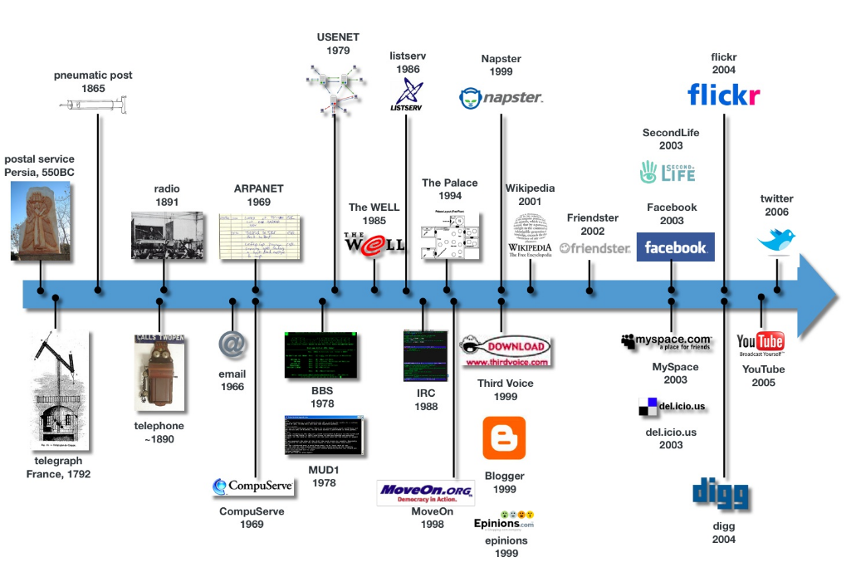
Evolution of social media

Slide 6
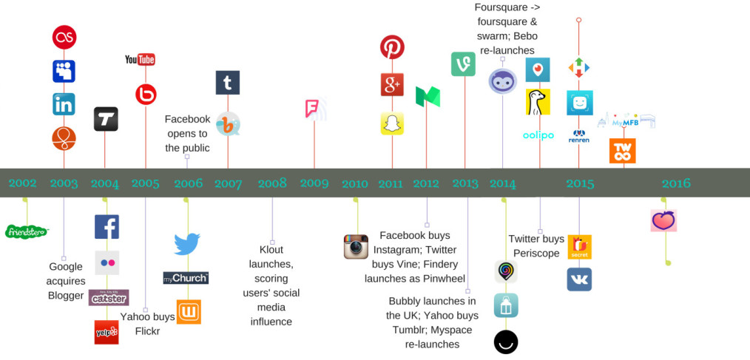
Evolution of social media Cont’d

Slide 7
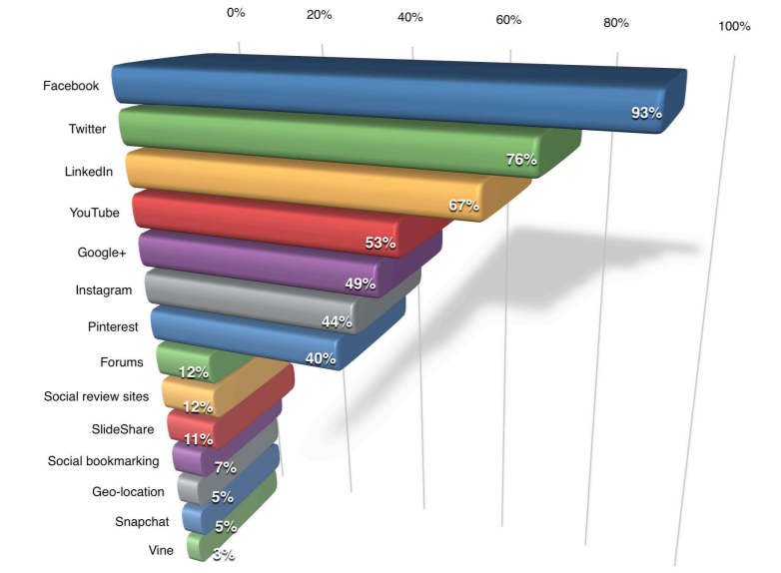
Prominent examples of social media

Slide 8
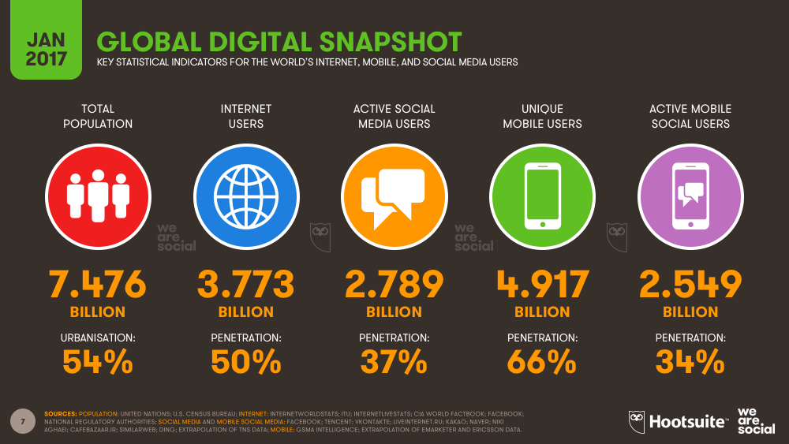
Why you should care?

Slide 9
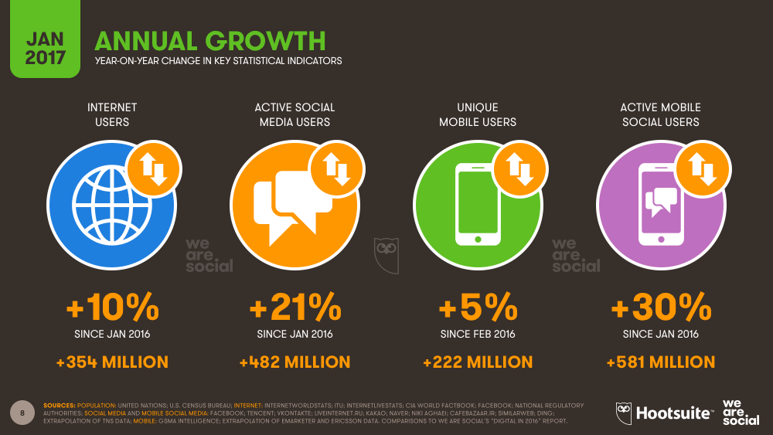
Why you should care? Cont’d

Slide 10
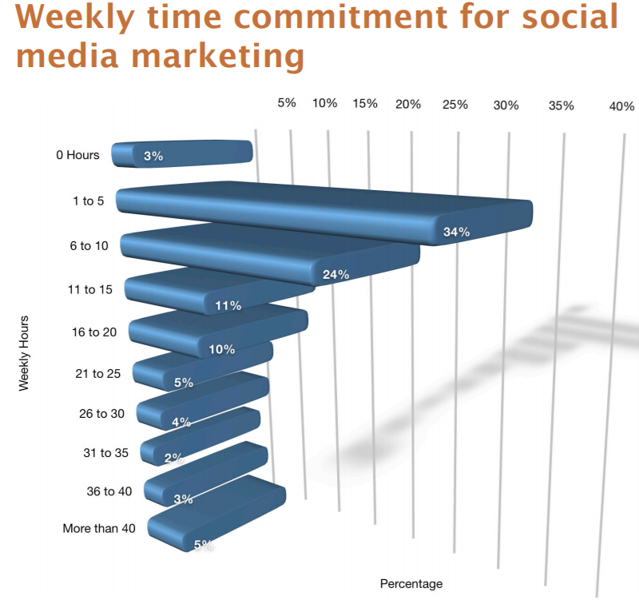
Weekly Active Users (WAU):
one of the ways to measure the success rate of online social games and social networking services.
measured by counting the number of unique users during a specific measurement period, such as within the previous 7 days.
Unique Users (UU):
An individual that has visited a Web site or received specific content, such as ads, email, or newsletters.

Slide 11
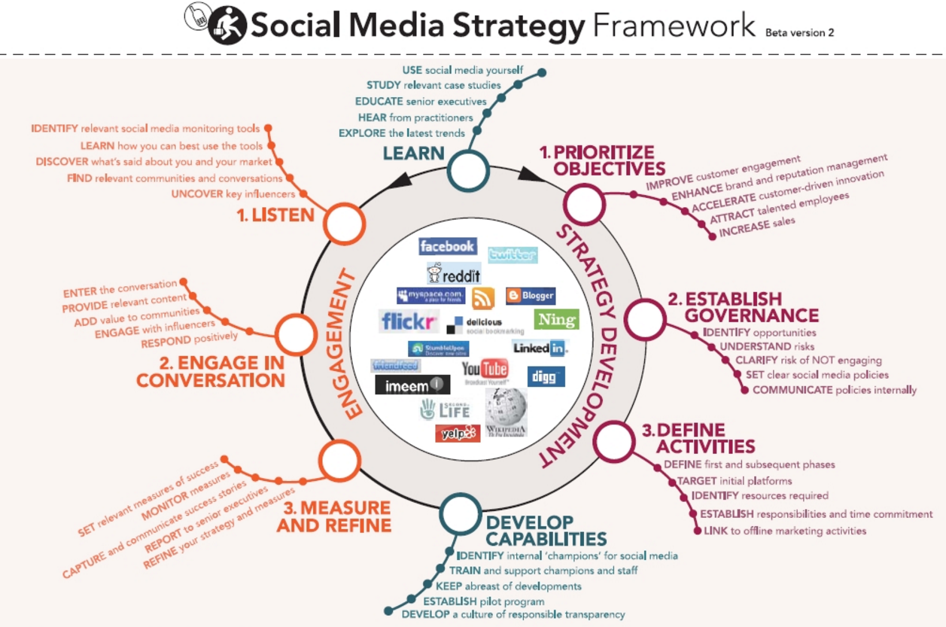

Slide 12
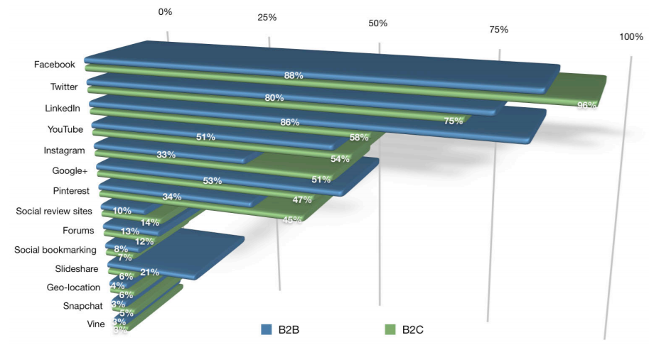
Social Media Product Market
Platforms used by B2B versus B2C

Slide 13
Primary Revenue Model
Advertising (Yahoo.com)
Subscription (WSJ.com)
Transaction fee (e-bay.com)
Sales (Amazon.com)
Affiliate (Mypoints.com)

Slide 14
Cost Structure
Fixed Cost:
Headquarters for operation
Severs
Other hardwares
Variable Cost :
Salaries for employees
Branding cost
Marketing cost

Slide 15
Competition Landscape
Dominated by few large companies.
To be profitable is difficult
Starting new firm is simple
few barriers to entry
switching cost is low
So Social media industry is highly competitive

Slide 16
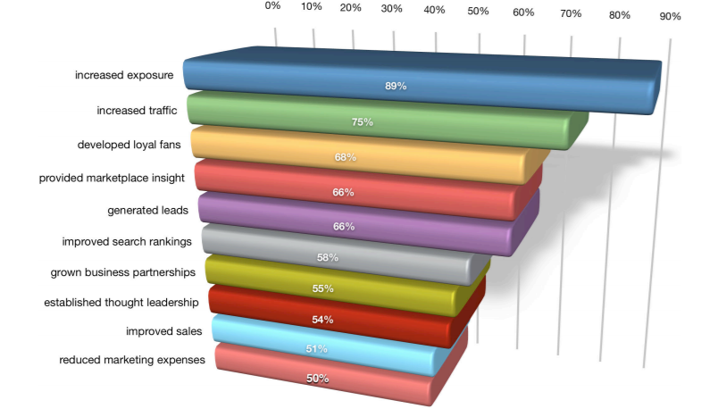
Benefits of social media marketing

Slide 17
Data & Analysis

Slide 18
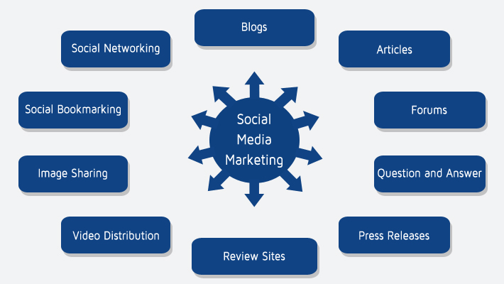
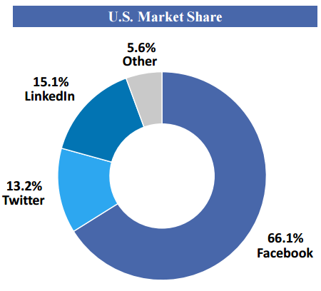
Industry Segmentation

Slide 19
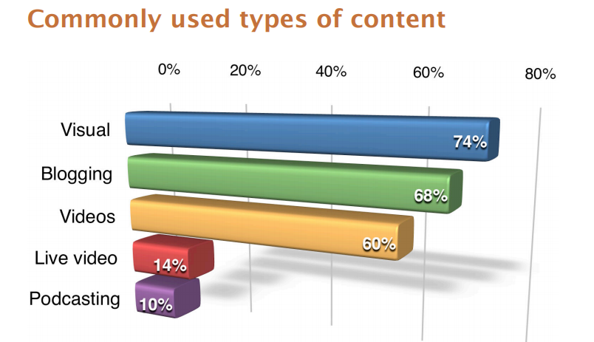

Slide 20
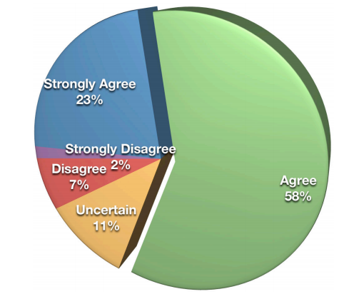

Social media marketing gives new options for segmentation
Notes:
more than 80 % of marketers agreed that they have integrated their social media and traditional marketing activities

Slide 21




Casual Social Networks
•Companies include Facebook, MySpace, Google Plus, Yahoo Pulse, and Microsoft So.cl.
•Responsible for majority of revenue in the industry.
•Advertising is the main source of revenue.

Slide 22


Blogging Social Networks
Wordpress, Blogger, ect.
Traditional
Blogging
Networks
Microblogging
Limited revenue potential due to content limitations.
Professional Social Networks
Majority of revenue comes from products offered to job seekers and employers.
Projected to grow.

Slide 23
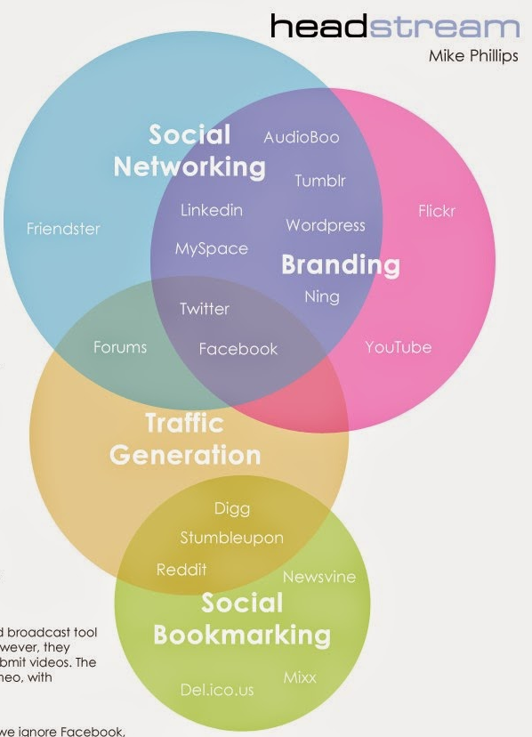
Key Success Factors
The ability to compete effectively depends on:
Ability to innovate.
Security, updates, and support are critical factors
Reputation and Brand Strength relative to competitors
Offer a user-friendly interface to consumers.
Compatibility and ubiquity are important.

Slide 24

Key Success Factors Ctd.
The frequency, size, format, quality and prominence of advertisements.
Ability to attract, retain, and motivate talented employees.
Ability to keep costs low and maintain gross/operating margins.
Ability to comply with complex and evolving laws and regulations.

Slide 25

Key Operating Factors
Profit (26.7% of Revenue)
Many large and small companies in this industry either have low profit margins or are deeply in the red. Facebook’s high profit margin pushes up the average industry profit margin.
Wages (37.6% of Revenue)
High wage costs reflect R&D spend and wages for skilled employees such as coders
Specialized workers are absolutely essential in this industry.
Purchases (11.0% of Revenue)
Primarily Patents and costs related to generating website traffic

Slide 26
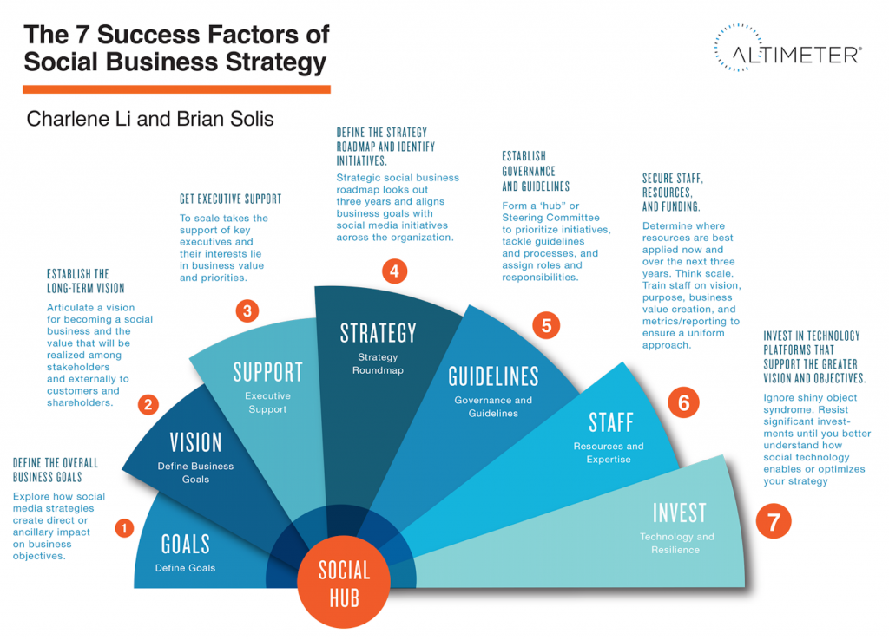

Slide 27
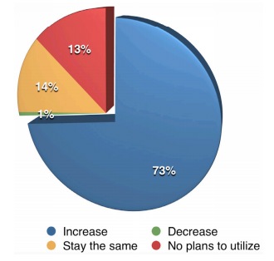
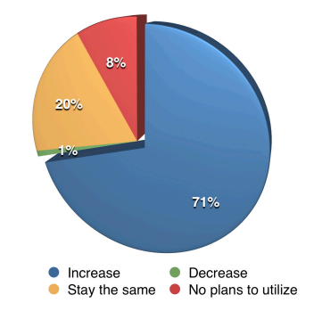
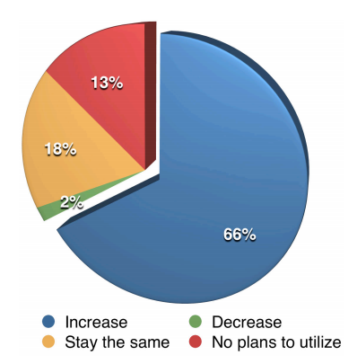
How will marketers change their future content activities in the FUTURE?
#1: Video
#2: Visuals
#3: Blogging

Slide 28
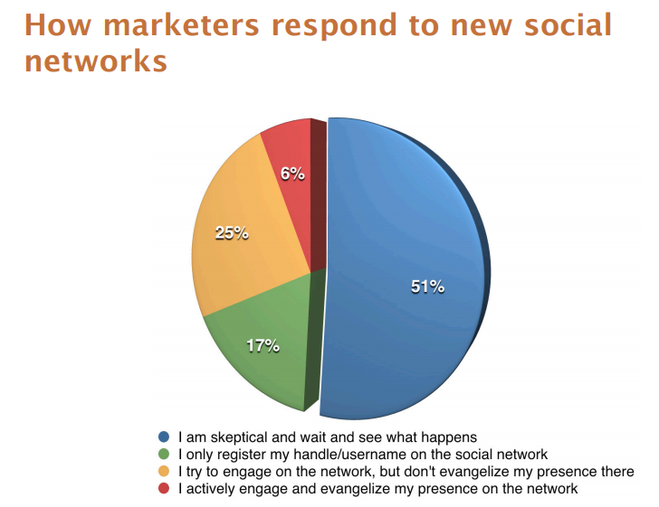

Slide 29
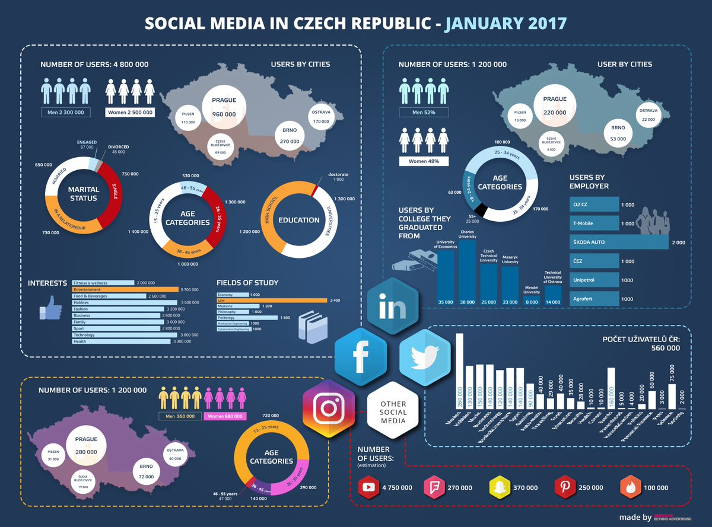

Slide 30
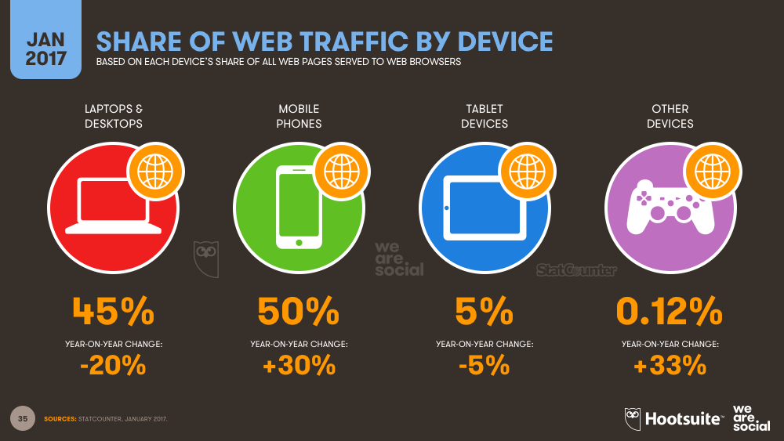
SHARE OF WEB TRAFFIC BY DEVICE

Slide 31
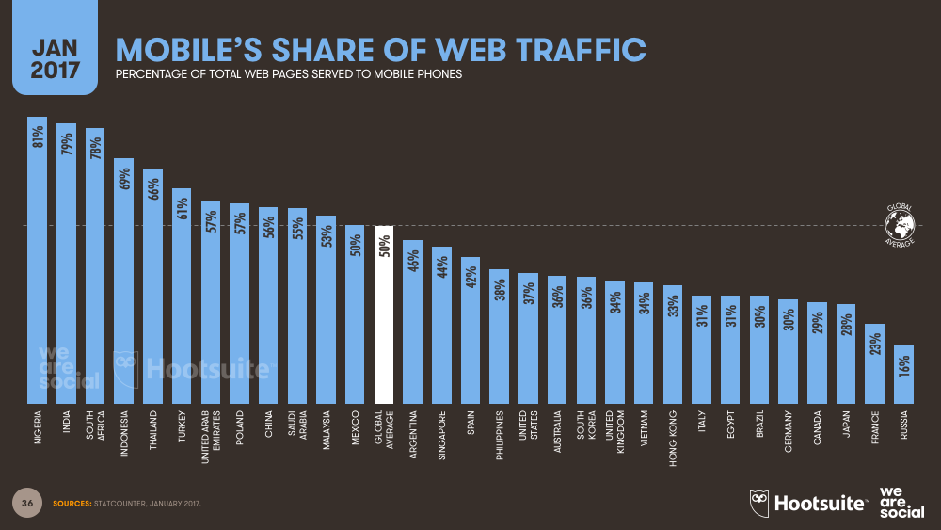
MOBILE’S SHARE OF WEB TRAFFIC

Slide 32
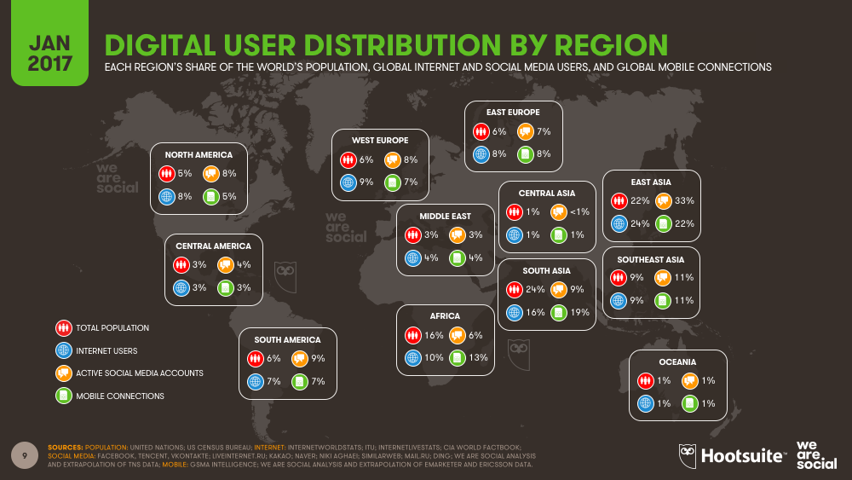
GLOBAL USAGE

Slide 33
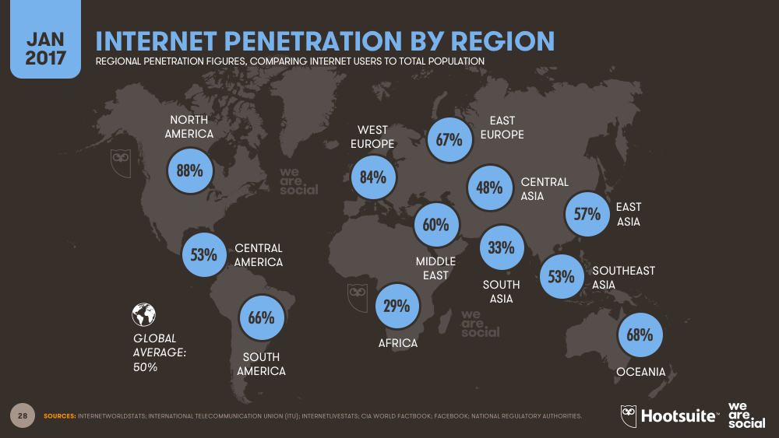
INTERENT PENETRATION BY REGION

Slide 34
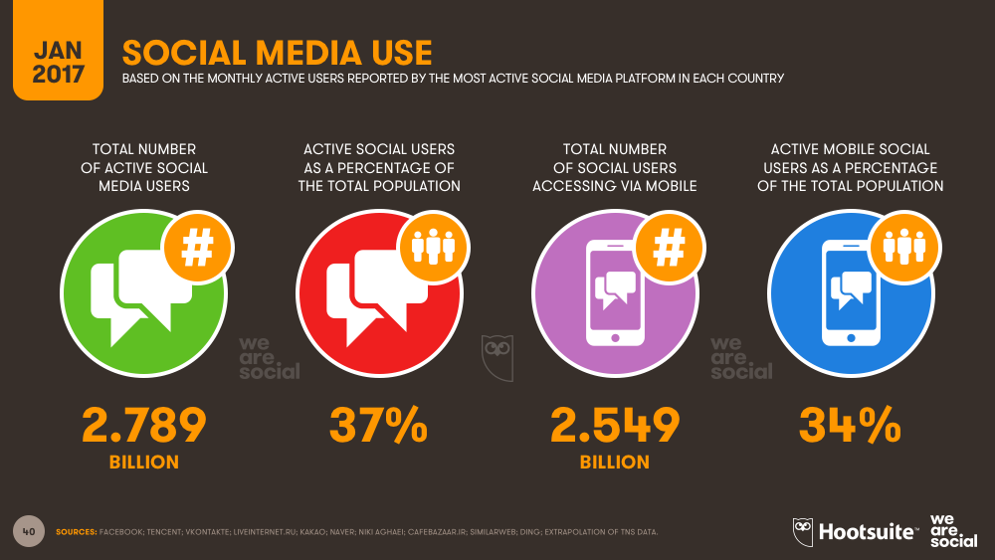
SOCIAL MEDIA USE

Slide 35
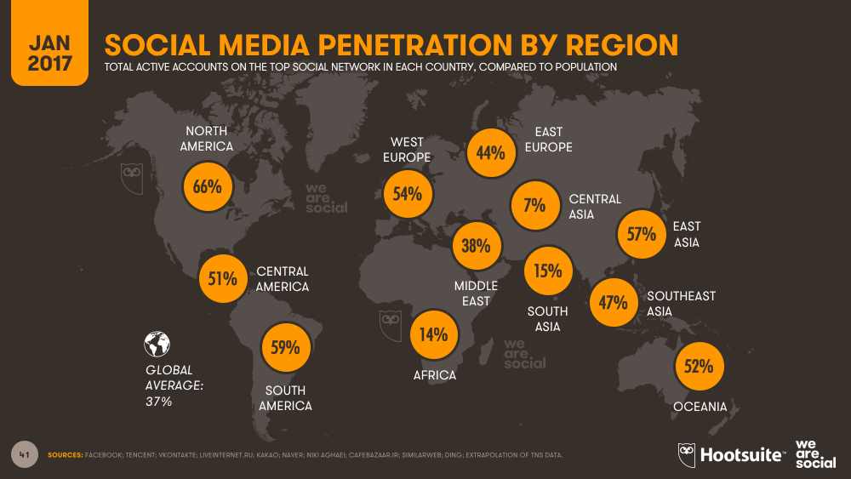
SOCIAL MEDIA PENETRATION BY REGION

Slide 36
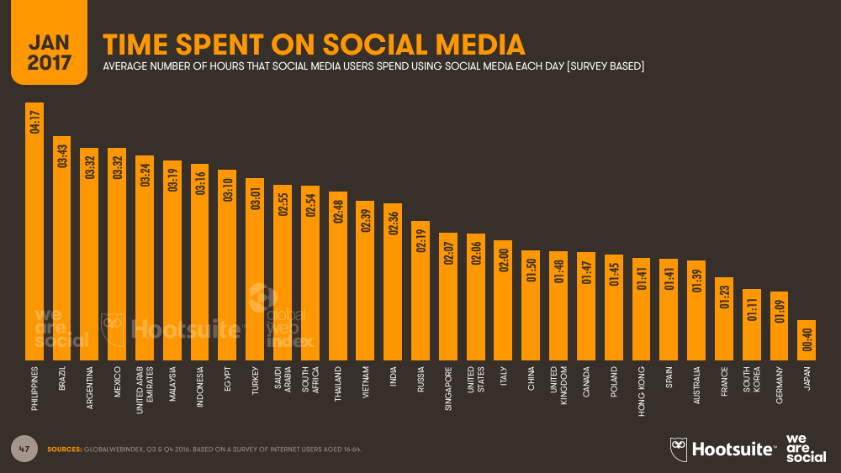
TIME SPENT ON SOCIAL MEDIA

Slide 37
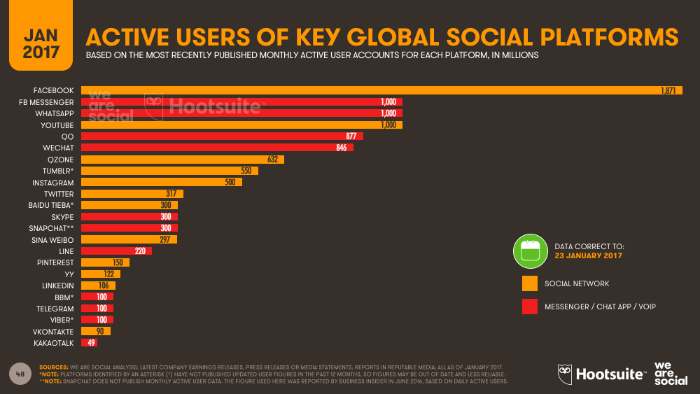
ACTIVE USERS OF KEY GLOBAL SOCIAL PLATFORMS

Slide 38
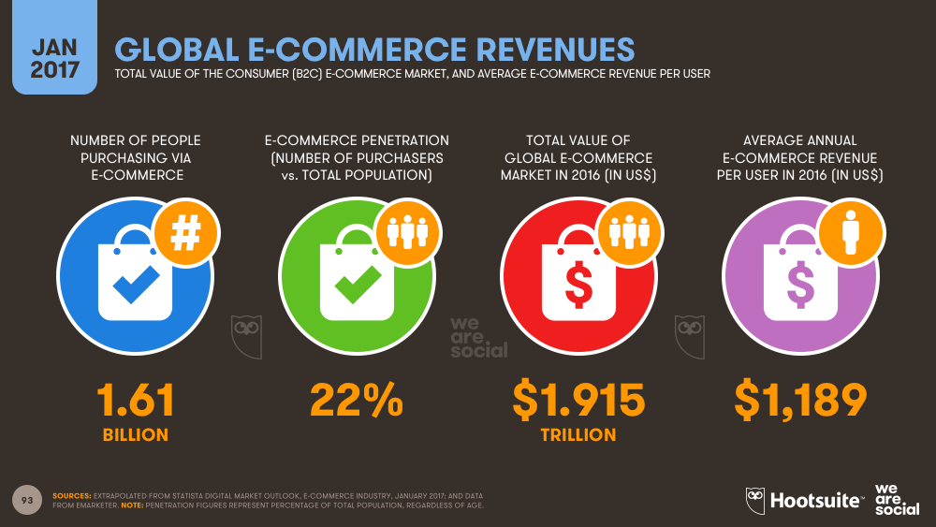
GLOBAL E-COMMERCE REVENUES

Slide 39
AdBlock is a content filtering and ad blocking extension for the Google Chrome, Apple Safari (desktop and mobile), Firefox, Opera and Microsoft Edge web browsers. AdBlock allows users to prevent page elements, such as advertisements, from being displayed.
AD BLCOKS

Slide 40
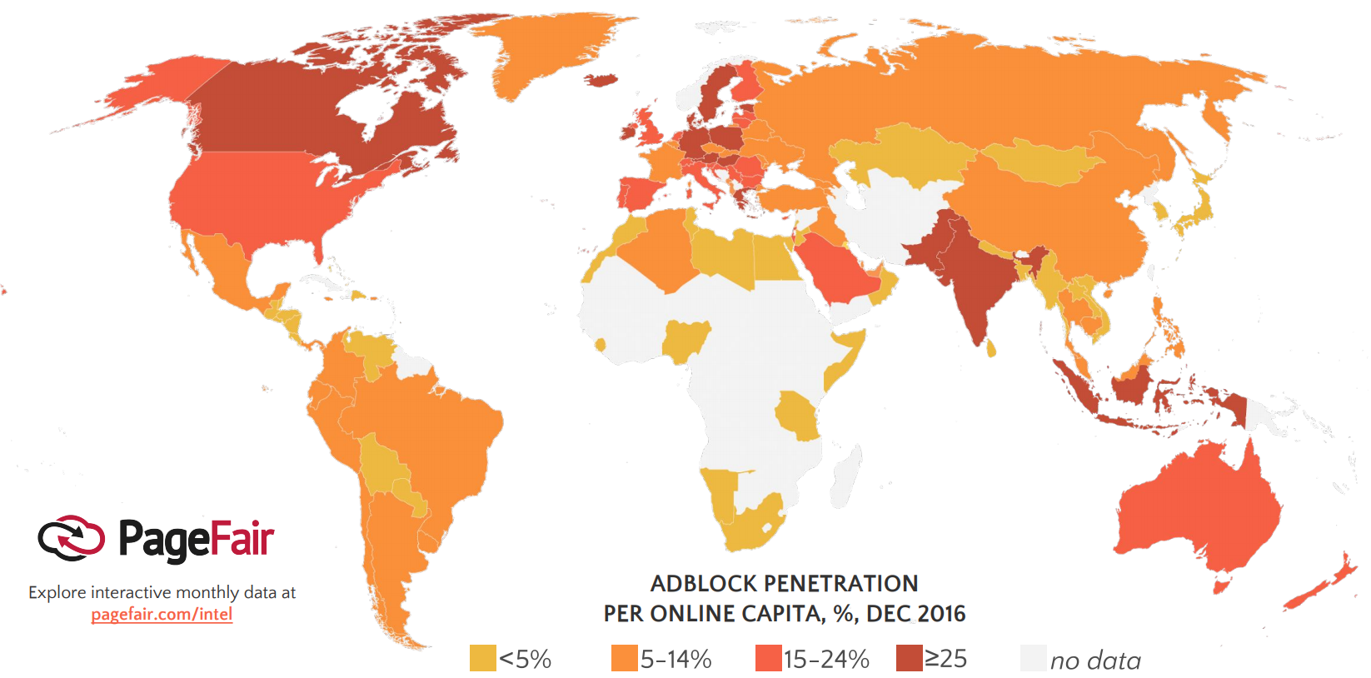
AD BLOCK PENETRATION PER ONLINE CAPITAL

Slide 41
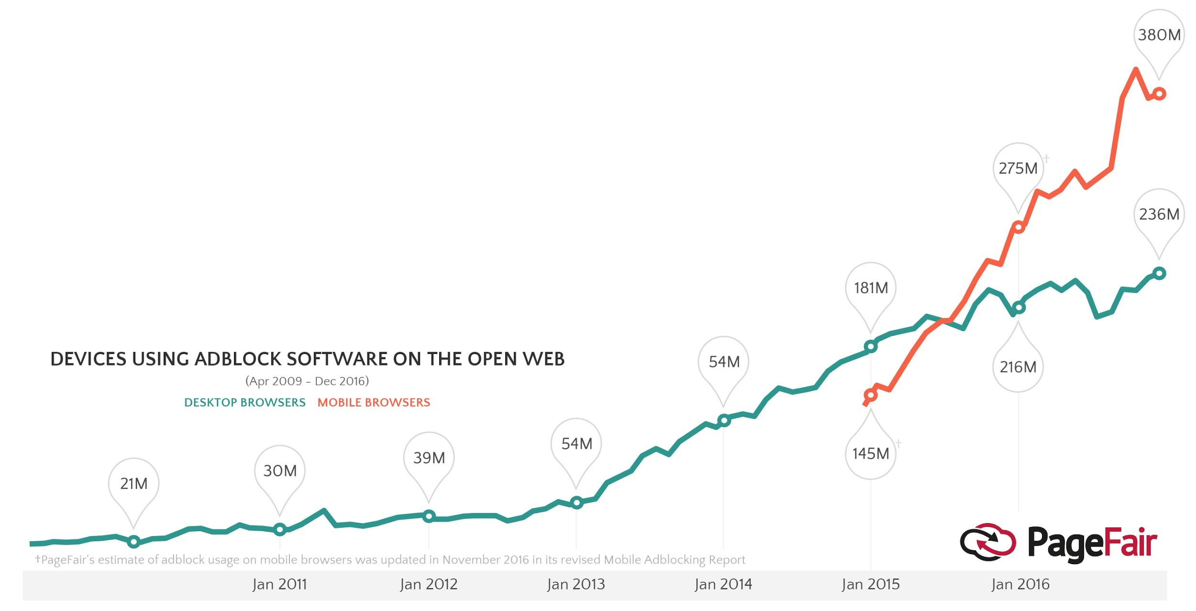
THE GLOBAL PICTURE

Slide 42
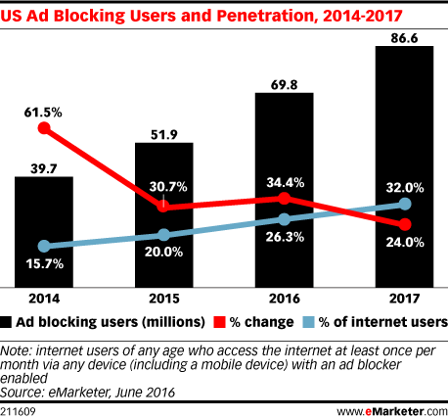
AD BLCOKS

Slide 43
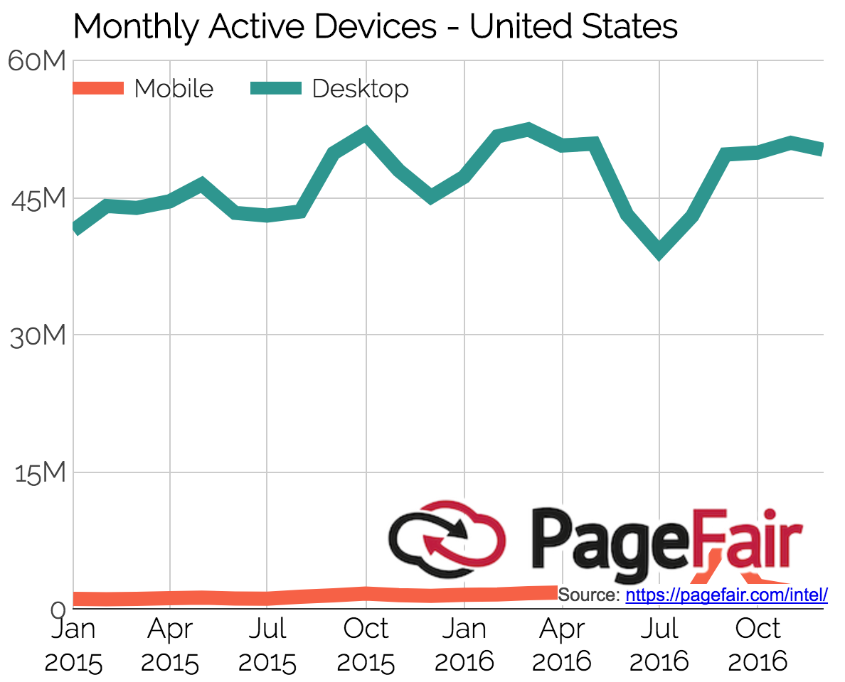
AD BLCOKS US MONTHLY ACTIVE DEVICES

Slide 44
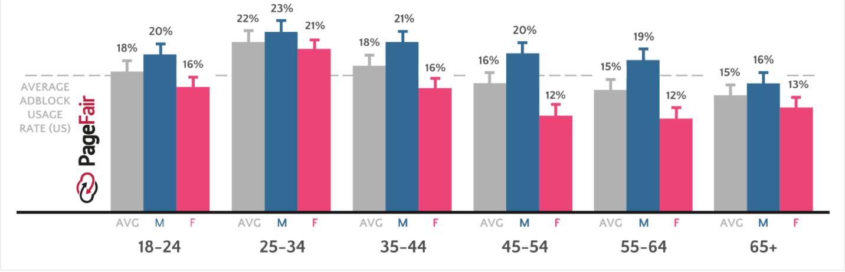
AD BLOCK USER DEMOGRAPHICS (US)

Slide 45
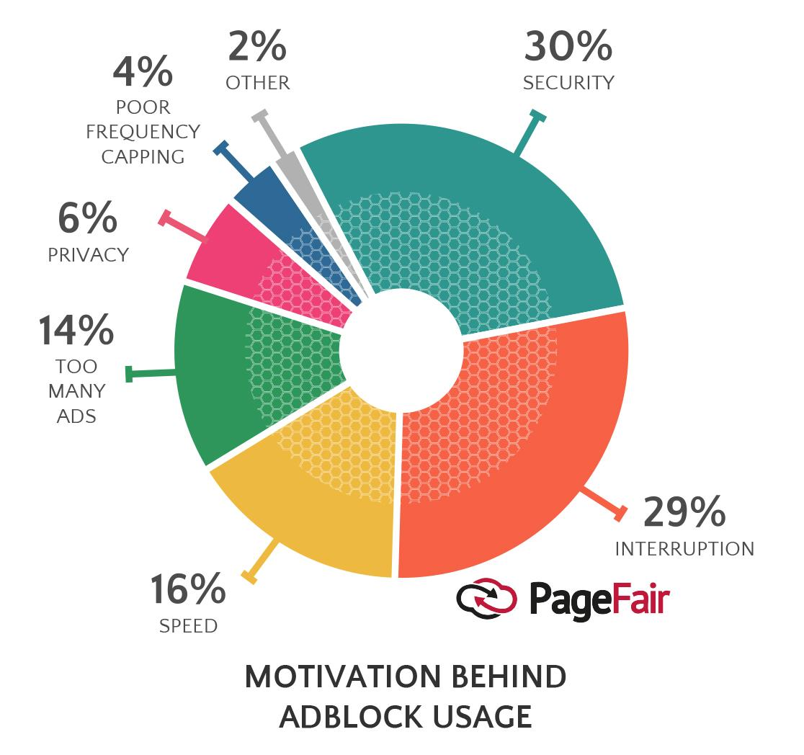
12
WHY AD BLOCK?

Slide 46

facebook

Slide 47

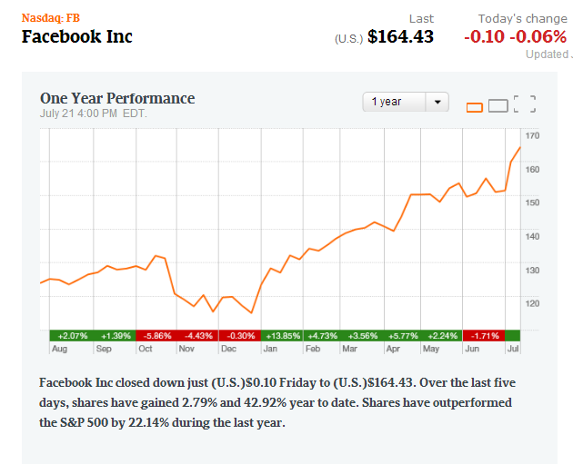

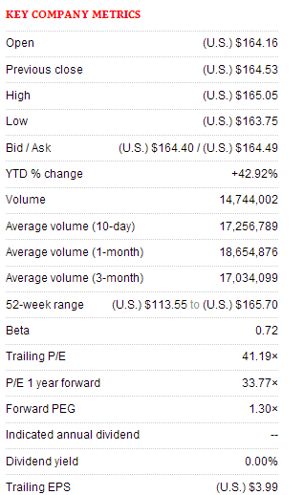
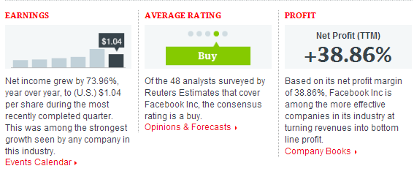
Stock Overview 1 year

Slide 48
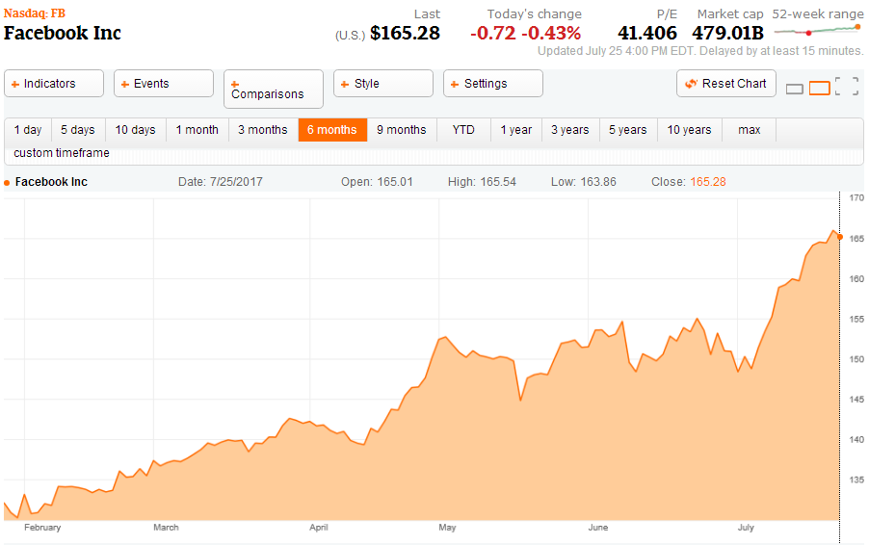
Facebook 6 months

Slide 49
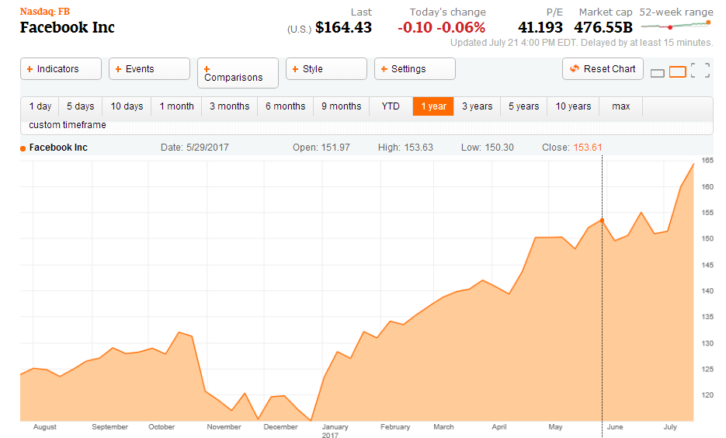
Facebook 1 year

Slide 50
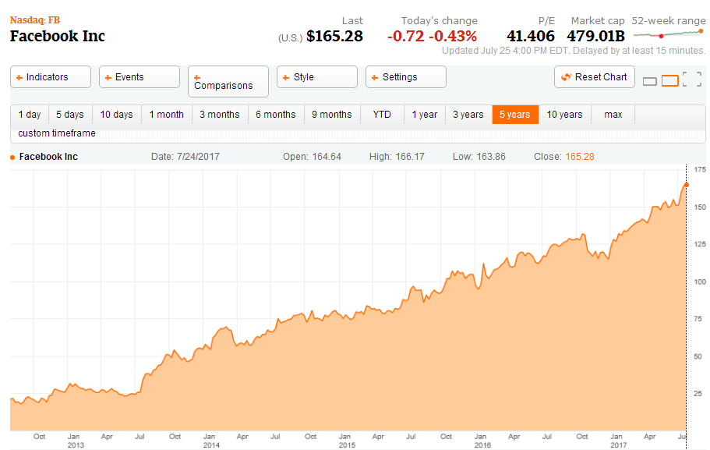
Facebook 5 year

Slide 51
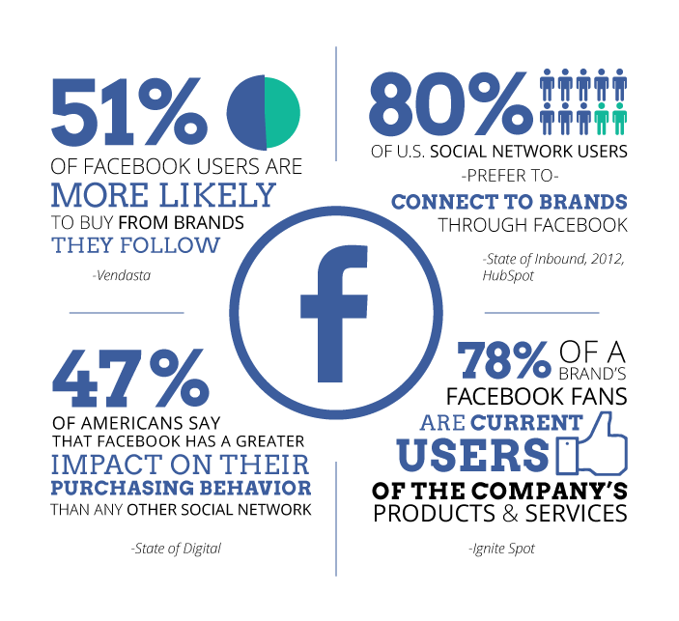
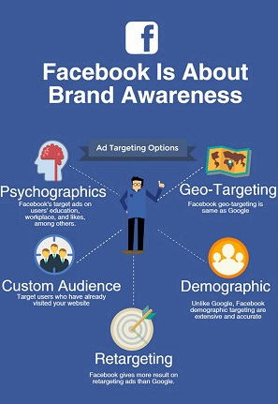
Facebook Stats Overview

Slide 52
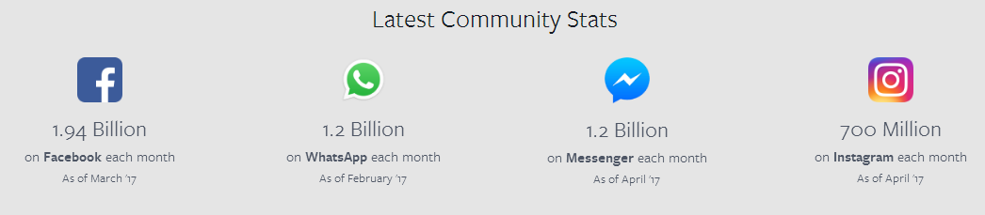
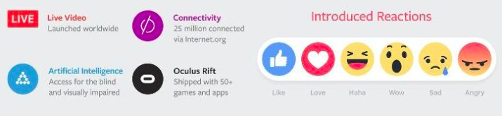
Facebook Stat Overview (Cnt’n)

Slide 53
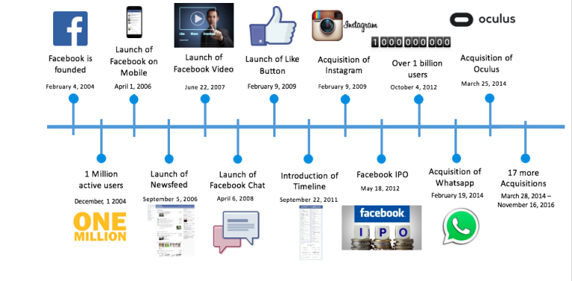
Facebook Timeline

Slide 54
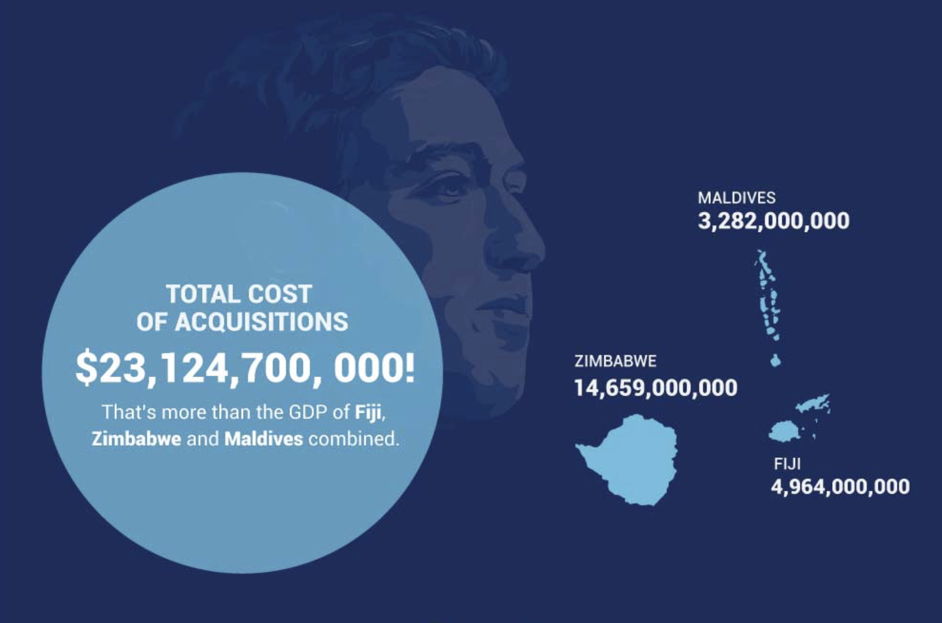
Notes:
The total cost of Facebook’s acquisitions to date is over 2 billion dollars. And that’s just from the acquisition costs they disclosed!

Slide 55
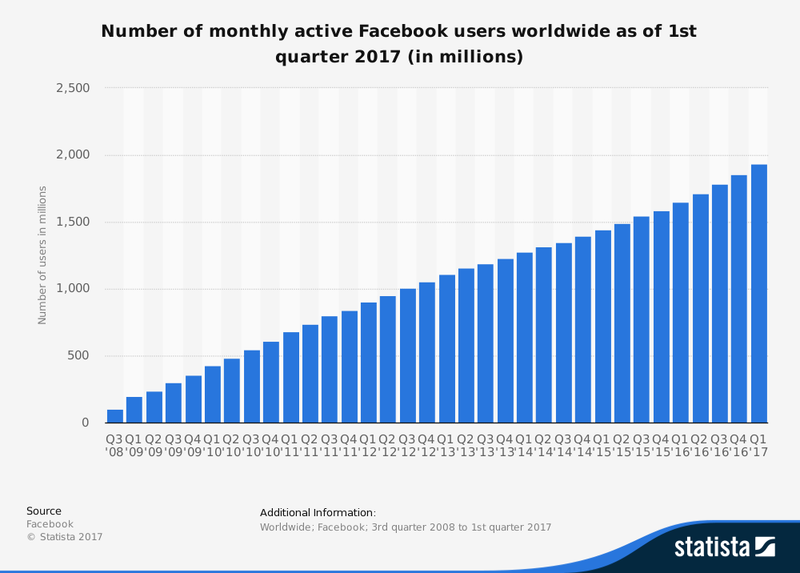
Notes:
This statistic shows a timeline with the worldwide number of monthly active Facebook users from 2008 to 2017. As of the first quarter of 2017, Facebook had 1.94 billion monthly active users. In the third quarter of 2012, the number of active Facebook users had surpassed 1 billion, making it the first social network ever to do so. Active users are those which have logged in to Facebook during the last 30 days. Furthermore, as of that quarter the social network had 1.74 billion mobile monthly active users. The platform is also the most popular social network worldwide.

Slide 56
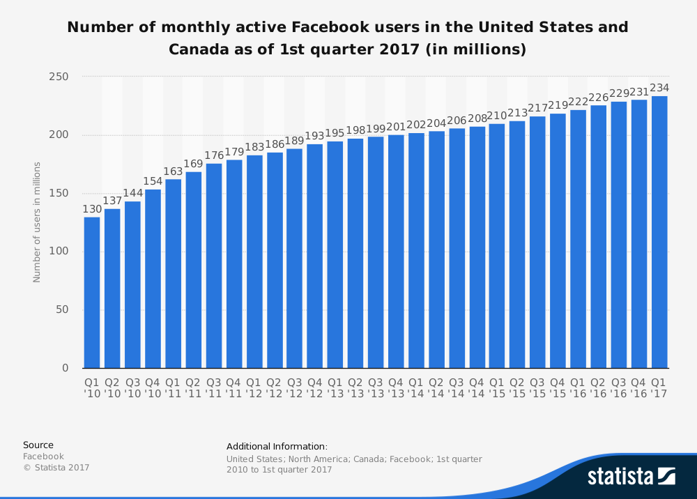
Notes:
This statistic gives information on the number of monthly active Facebook users in the United States and Canada as of the first quarter of 2017. During the most recently reported period, the social network had 234 million monthly active users in the two North American markets.

Slide 57
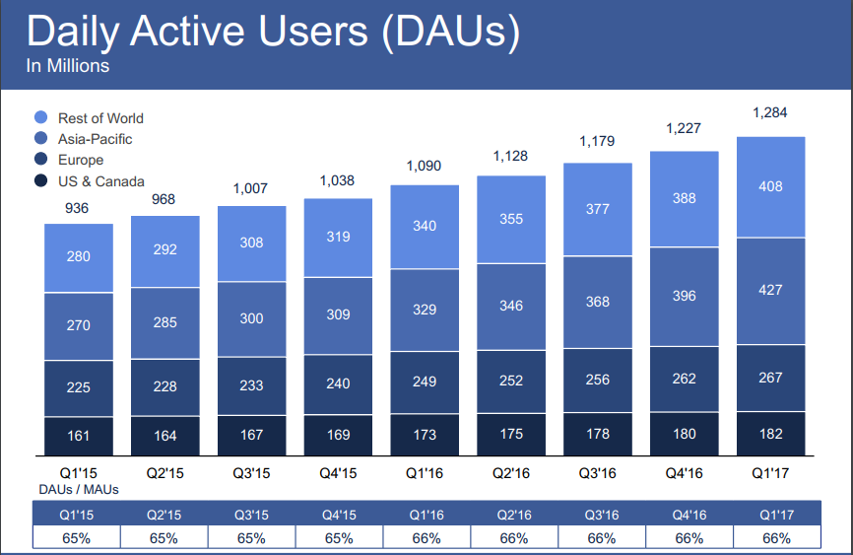
Notes:
by 2017, the US& canada market grow steadly
while the asia-pacific group rapidly gais a huge amount of users throught these yrs

Slide 58


Slide 59

Notes:
Revenue by user geography is geographically apportioned based on our estimation of the geographic location of our users when they perform a revenue generating activity. This allocation differs from our revenue by geography disclosure in our condensed consolidated financial statements where revenue is geographically apportioned based on the location of the marketer or developer.

Slide 60

Notes:
an error in the algorithm we used to attribute our revenue by user geography in late 2015. While this issue did not affect our overall worldwide revenue, it did affect our attribution of revenue to different geographic regions. The fourth quarter of 2015 revenue by user geography for all regions was adjusted to reflect this reclassification.

Slide 61

Notes:
Revenue by user geography is geographically apportioned based on our estimation of the geographic location of our users when they perform a revenuegenerating activity. This allocation differs from our revenue by geography disclosure in our condensed consolidated financial statements where revenue is geographically apportioned based on the location of the marketer or developer. We discovered an error in the algorithm we used to attribute our revenue by user geography in late 2015. While this issue did not affect our overall worldwide revenue, it did affect our attribution of revenue to different geographic regions. The fourth quarter of 2015 revenue by user geography for all regions was adjusted to reflect this reclassification.

Slide 62

Notes:
Revenue by user geography is geographically apportioned based on our estimation of the geographic location of our users when they perform a revenuegenerating activity. This allocation differs from our revenue by geography disclosure in our condensed consolidated financial statements where revenue is geographically apportioned based on the location of the marketer or developer. We discovered an error in the algorithm we used to attribute our revenue by user geography in late 2015. While this issue did not affect our overall worldwide revenue, it did affect our attribution of revenue to different geographic regions. The fourth quarter of 2015 revenue by user geography was adjusted to reflect this reclassification.

Slide 63


Slide 64

Notes:
In the fourth quarter of 2016, we elected to early adopt the Financial Accounting Standards Board (FASB)'s Accounting Standards Update No. 2016-09, Compensation Stock Compensation (Topic 718): Improvement to Employee Share-based Payment Accounting (ASU 2016-09). As such, quarterly expenses for and following 2016 include the impact of ASU 2016-09 adoption. See ASU 2016-09 Adoption in the Appendix for additional information.

Slide 65

Notes:
In the fourth quarter of 2016, we elected to early adopt ASU 2016-09. As such, quarterly income from operations for and following 2016 includes the impact of ASU 2016-09 adoption. See ASU 2016-09 Adoption in the Appendix for additional information.

Slide 66

Notes:
In the fourth quarter of 2016, we elected to early adopt ASU 2016-09. As such, quarterly operating margin for and following 2016 includes the impact of ASU 2016-09 adoption. See ASU 2016-09 Adoption in the Appendix for additional information.

Slide 67

Notes:
In the fourth quarter of 2016, we elected to early adopt ASU 2016-09. As such, quarterly net income for and following 2016 includes the impact of ASU 2016-09 adoption. See ASU 2016-09 Adoption in the Appendix for additional information.

Slide 68

Notes:
In the fourth quarter of 2016, we elected to early adopt ASU 2016-09. As such, quarterly diluted earnings per share for and following 2016 include the impact of ASU 2016-09 adoption. See ASU 2016-09 Adoption in the Appendix for additional information.

Slide 69


Slide 70

Notes:
Capital investments for periods presented were related to purchases of property and equipment.

Slide 71

Notes:
The statistic illustrates Facebook's quarterly revenue in the United States and Canada as of the first quarter of 2017, sorted by segment. In the most recently reported period, the social network's consolidated advertising revenue in the two North American markets amounted to 3.85 billion U.S. dollars.

Slide 72

Notes:
The statistic shows the revenue of Facebook from 2009 to 2016, by segment. The social network's advertising revenue in 2015 amounted to 17.1 billion U.S. dollars and grew to 26.9 billion U.S. dollars in 2016.

Slide 73

Notes:
The timeline shows Facebook's quarterly revenues, sorted by segment. In the first quarter of 2017, the social network's total advertising revenue amounted to 7.86 billion U.S. dollars. Payments and other fees generated 175 million U.S. dollars in revenues.

Slide 74

Newsfeed Ad on:
Desktop Mobile

Slide 75

Newsfeed Algorithm

Slide 76

Facebook dominates the social landscape

Slide 77


Facebook
Used in
Regions
Average Time
Spent

Slide 78

Ad Products

Slide 79


Slide 80


Slide 81


Slide 82


Slide 83


Slide 84


Slide 85


Slide 86


Slide 87


Slide 88


Slide 89


Slide 90


Slide 91


Slide 92


Slide 93


Slide 94


Slide 95


Slide 96
Financial Statement

Slide 97

2017 Q1 Financial Highlights
Notes:
Facebook is no longer reporting non-GAAP expenses, income, tax rate, and earnings per share (EPS)

Slide 98

Balance Sheet 10Q

Slide 99

Balance Sheet 10K

Slide 100

Income Statement 10K

Slide 101

Income Statement 10Q

Slide 102

Cash Flow Statement 10K

Slide 103


Cash Flow Statement 10K(I)

Slide 104

Cash Flow Statement 10Q

Slide 105

Cash Flow Statement 10Q(I)

Slide 106
RECOMMENDATION:
BUY

Slide 107


Slide 108




Slide 109

Twitter 1 year (NYSE)

Slide 110

Twitter 5 year (NYSE)

Slide 111

Twitter vs Dow Jones vs S&P 500

Slide 112

Company Overview

Slide 113

Monetization
•Primarily through advertisement
•Promoted tweets, accounts and trends accounts for generating the majority of their advertising revenues
•Data licensing and other revenue by:
(i) Offering “Gnip” branded products and data licenses that allow data partners to access, search and analyze historical and real-time data on Twitter;
(ii) Providing mobile advertising services through MoPub exchange
Notes:
MoPub (a twitter company, provides monetization solutions for mobile app publishers and developers around the globe)

Slide 114

Monetization Metrics
ad engagement : a user interaction with one of our pay-for-performance advertising products
Notes:
In the three months ended March 31, 2017, ad engagements increased 139%. The increase was driven mainly by a continuing mix shift toward video ad impressions and higher video view rates from product improvements such as video quality optimization and latency improvement. In the three months ended March 31, 2017, average cost per ad engagement decreased 63% from the three months ended March 31, 2016. The decrease in cost per ad engagement reflects a higher mix of video engagements and, to a lesser extent, lower cost per engagement across most ad formats in the first quarter of 2017 compared to the first quarter of 2016.

Slide 115

Declining revenue
Notes:
the quarterly revenue in 2017 is decreasing. That means the twitter Failture to attract advertisers.

Slide 116

Declining revenue
Notes:
the quarterly revenue in U.S. and international are decreasing

Slide 117

Reason of declining revenue
Notes:
MAU is declining

Slide 118

Reason of declining revenue
Notes:
Reason： flat & declining MAU( Monthly active users)

Slide 119

Twitter Other Products
Periscope: a new app that lets you share and experience live video from your mobile phone.
Implement technology into Twitter
Create 360 video, Tweet live
Advertisers and data partners need a broad audience
Twitter other products provide a depth of experience for users

Slide 120

Live streaming (New Strategy?)
Signed a $10 million deal with the NFL to live stream 10 TNF games
Generated more than 3.5 million viewers on average per game

Slide 121

Live streaming (New Strategy?)

Slide 122

Management Team
CEO and co-founder of Twitter and Square
•Serves on Board for The Walt Disney Company
•Became chairman of the board for Twitter on October 16, 2008
•On June 10, 2015, Costoloannounced that he was resigning as CEO of Twitter
•Dorsey became interim CEO
•Named permanent CEO of Twitter on October 5, 2015
Jack Dorsey CEO

Slide 123

Management Team
Prior to joining Twitter in July 2014, Anthony was a partner and the Head of the Technology, Media and Telecom Investment Banking Group at Goldman, Sachs & Co. from 2010 to 2014
•From 2008 to 2010, Anthony was Chief Financial Officer of the National Football League
•From 1999 to 2007, he served in various roles at Goldman Sachs
•Holds a B.S. in Mechanical Engineering from the United States Military Academy and an M.B.A. from the Wharton School
Anthony Noto
COO & CFO

Slide 124

Management Team
•Joined Twitter in February 2016
•Prior to joining the company in 2016, she was Executive Vice President, Global Advertising, Marketing & Digital Partnerships at American Express
•Worked with AE since 2005
•Earned a B.S. from Boston University’s College of Communications
Leslie Berland
CMO

Slide 125

Management Team
•CAO, June 1, 2015
•Prior to joining Twitter, he was a Partner at Deloitte & Touche LLP, with 25 years of service; also served as the Chief of Staff.
•Holds an MBA from the Wharton School, MS in Accounting from the University of Hartford, and a BA from Hamilton College.
Robert Kaiden
CAO

Slide 126

Management Team
•Leading Twitter’s legal, trust and safety, and public policy teams.
•Previously served as Legal Director, managing international, and corporate legal teams only.
•Prior to joining Twitter in 2011, she was Senior Director, Legal at Juniper Networks.
•Had a JD from New York University School of Law, and a BS in Industrial and Labor Relations from Cornell University.
Vijaya Gadde
General Counsel

Slide 127


Stock-based compensation

Slide 128

Stock-based compensation
Notes:
Reducing stock based compensatino expense
Goal is to reduce SBC to high single digits as a percentage of revenue

Slide 129


Slide 130

Management Ownership

Slide 131

Free cash flow
Notes:
Generated more FCF comparing to 2015

Slide 132

Share structure and net loss
Notes:
Although there is a decrease in stock based compensation and increase in FCF, there is still a net loss of 0.65 per share. But as you can see in the table, they are trying to reduce their net loss

Slide 133
Financial Statements

Slide 134

Balance Sheet 10Q

Slide 135

Balance Sheet 10K

Slide 136

Income Statement 10K

Slide 137

Income Statement 10Q

Slide 138

Cash Flow Statement 10K(I)

Slide 139

Cash Flow Statement 10K(II)

Slide 140

Cash Flow Statement 10Q(I)

Slide 141

Cash Flow Statement 10Q(II)

Slide 142
RECOMMENDATION:
SELL

Slide 143

SNAP INC.

Slide 144


Slide 145

SNAP INC. 6 MONTH (NYSE)

Slide 146

SNAP INC vs DOW JONES vs S&P 500 vs S&P/TSX

Slide 147




COMPANY OVERVIEW
Snap Inc., formerly Snapchat, Inc., is a camera company incorporated in May 24, 2012
Initial Public Offering was on Mar 2, 2017
Offers three ways for people to make Snaps: the Snapchat application, Publishers Tools that help its partners to create Publisher Stories, and Spectacles, its sunglasses that make Snaps.

Slide 148


CHALLENGES
Snap Inc. turnt down 3 billion cash acquisition offer from Facebook in 2014
Shortly after Snap Inc.’s IPO, Facebook released three features that they duplicated from Snapchat : Facebook Camera Effects, Facebook Direct and Facebook stories.
With these three features available to Facebook’s nearly 2 billion users, Snapchat will have a harder expanding to other countries, or even keeping its current position.

Slide 149

PROSPECTUS

Slide 150

PROSPECTUS

Slide 151

PROSPECTUS

Slide 152


USER METRICS
Quarterly average daily users (in millions)

Slide 153

MONETIZATION
Primarily through advertising, includes Snap Ads and sponsored Creative Tools
advertising business is in early stage and growing rapidly

Slide 154

Management Team
Studied Product Design at Stanford University while building Snapchat with classmates Reggie Brown and Bobby Murphy
Co-Founder of Snapchat Inc. and served as Chief Executive Officer and a member of board of directors since May 2012
Evan Spiegel
CEO

Slide 155

Management Team
Co-Founder of Snapchat Inc. and has served as Chief Technology Officer and a member of board of directors since May 2012
Holds a B.S. in Mathematical and Computational Science from Stanford University
Oversees the company’s engineering and product developmen
Robert Murphy
CTO

Slide 156

Management Team
Jumped from the banking world to the tech world in 2015 when he joined Snap as Chief Strategy Officer
Holds a B.S.B.A. in Finance and Economics from the University of Denver
Served as Equity Analyst at J.P. Morgan Securities Inc. between 2004 and 2011
Served as a Managing Director in the Investment Banking Division at Credit Suisse from 2011 to 2015
Leader of Snap Inc.’s business strategy
Imran Khan
CSO

Slide 157

Management Team
Served as Chief Financial Officer since February 2016 and previously served as Vice President, Finance since August 2015
Holds a B.A. in Mathematics and Economics from Yale University and a Master of Science in Management from Oxford University.
Andrew vollero
CFO

Slide 158

Management Team
Served as General Counsel since May 2014
Partner in the Supreme Court and Appellate Litigation group at Hogan Lovells LLP in Washington, D.C
Holds a J.D. from Yale Law School and a B.A. in both Political Science and International Relations from American University
Chris Handman
General Concel

Slide 159

Management Team
Served as Senior Vice President of Engineering since September 2013
Prior to joining Snap Inc., he worked at Amazon.com Inc. from 2003 to 2013 holding various positions, including as Director of Software Development from 2010 to 2013
holds a B.A.Sc. from the University of Waterloo
Timothy Sehn
Senior Vice President of Engineering

Slide 160

Management Team
Joined Snap Inc. in January 2015 and currently serves as our Vice President of Hardware
Served as Senior Vice President of Software Engineer at Motorola Mobility, LLC, formerly a Google company, from December 2012 to january 2015
From January 2009 through November 2012, Horowitz served as Chief Technology Officer for Quotient Technology, Inc., a consumer technologies company
Holds a B.A. from the University of Michigan, Ann Arbor. Horowitz is also a member of the board of directors of Quotient Technology, Inc.
Steven Horowitz
Vice President of Hardware

Slide 161

PRINCIPAL AND SELLING STOCKHOLDERS

Slide 162

OWNERSHIP STRUCTURE

Slide 163
FINANCIAL STATEMENTS

Slide 164

FINANCIAL HIGHLIGHTS FRIST QUARTER 2017

Slide 165

CONSOLIDATED BALANCE SHEET 10Q

Slide 166

CONSOLIDATED STATEMENT OF OPERATIONS 10Q

Slide 167

RESULTS OF OPERATIONS 10Q(CONTINUED)

Slide 168

CONSOLIDATED STATEMENT OF CASH FLOW 10Q

Slide 169

FREE CASH FLOW

Slide 170
RECOMMENDATION:
SELL

