Slide 1

Goldman
Sachs
BUS 419 Group Presentation Group 2 Goldman Sachs

Slide 2




Presenters
Shuoyao He
Yuan Yao
Yuchen Feng
Mengyao Li

Slide 3
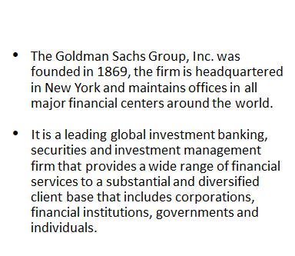

Company Overview

Slide 4
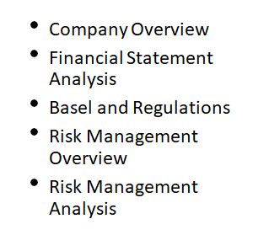
Agenda

Slide 5
Financial Statement Analysis

Slide 6
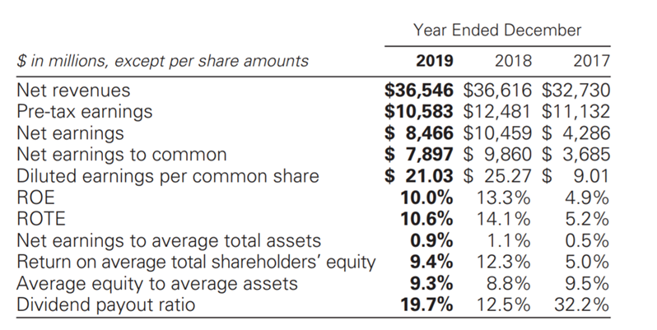
Financial Overview (Page 50 in Financial Report)

Slide 7
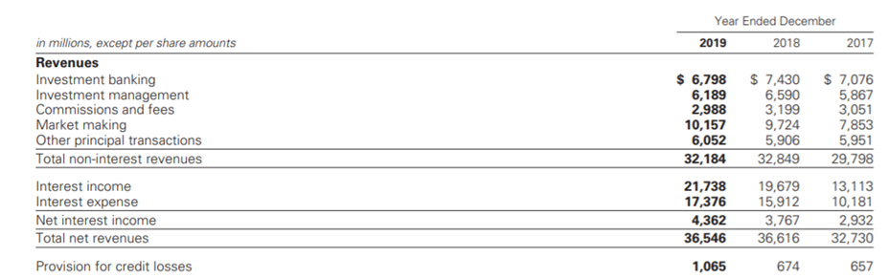
Income Statement (Page 105 in Financial Report)

Slide 8
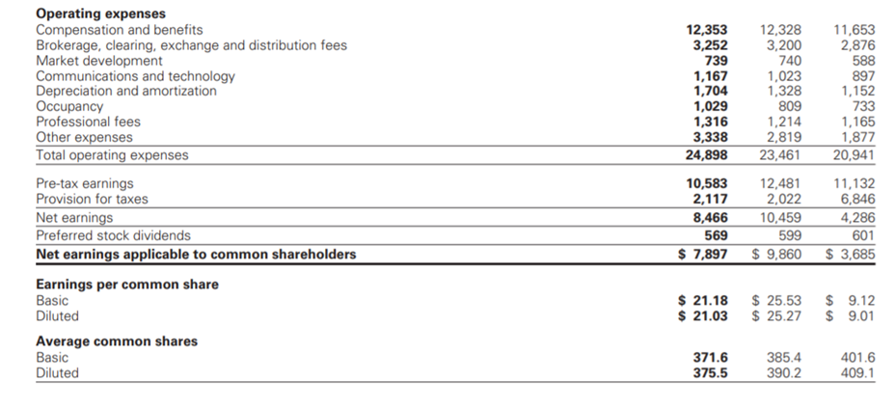
Income Statement (Page 105 in Financial Report)

Slide 9
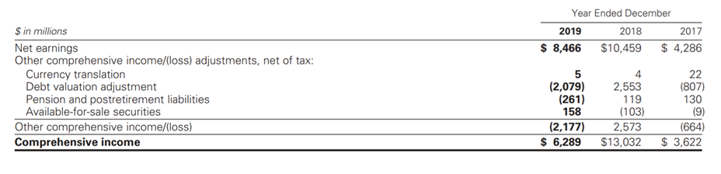
Consolidated Statements (Page 105 in Financial Report)

Slide 10
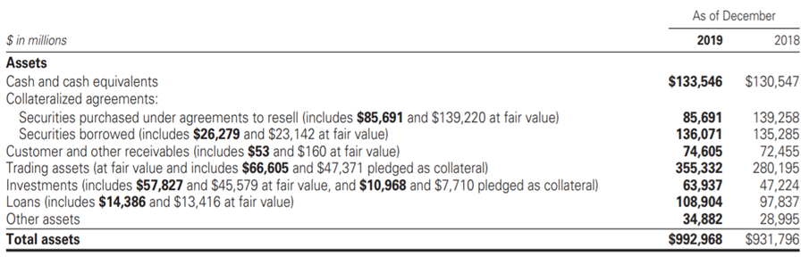
Balance Sheet (Page 106 in Financial Report)

Slide 11
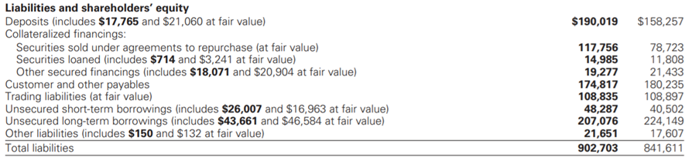
Balance Sheet (Page 106 in Financial Report)

Slide 12
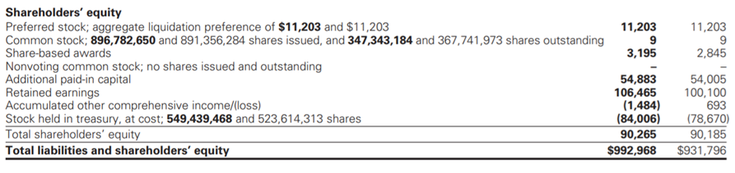
Balance Sheet (Page 106 in Financial Report)

Slide 13
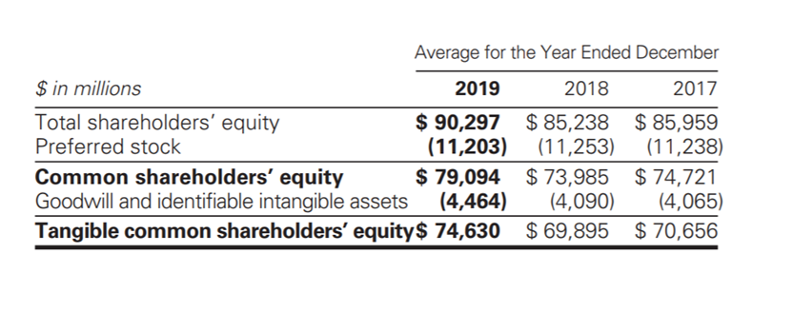
Average Equity (Page 50 in Financial Report)

Slide 14
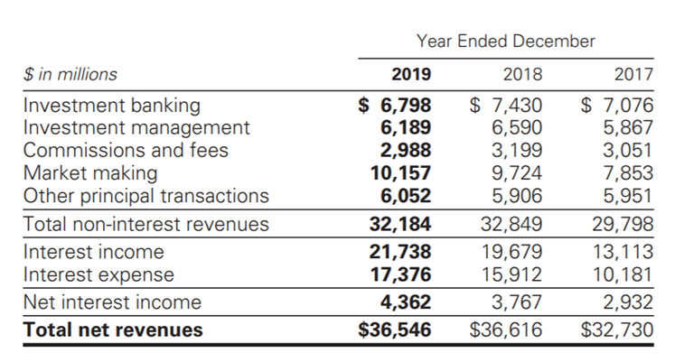
Net Revenue (Page 51 in Financial Report)

Slide 15
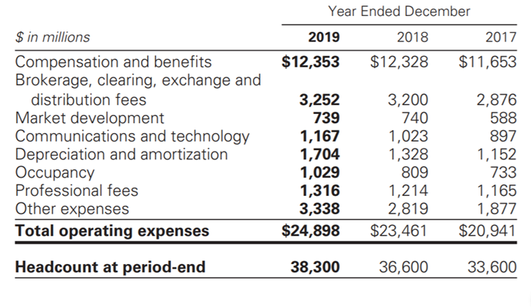
Operating Expense (Page 53 in Financial Report)

Slide 16
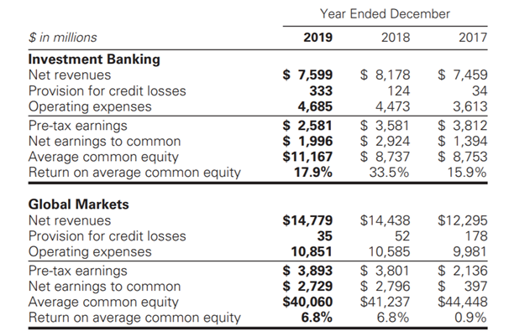
Segment Operating Result (Page 55 in Financial Report)

Slide 17
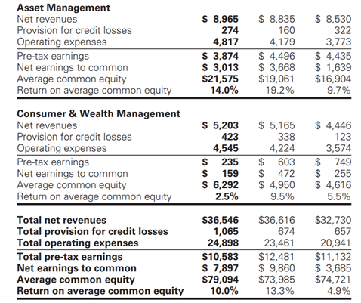
Segment Operating Result (Page 55 in Financial Report)

Slide 18
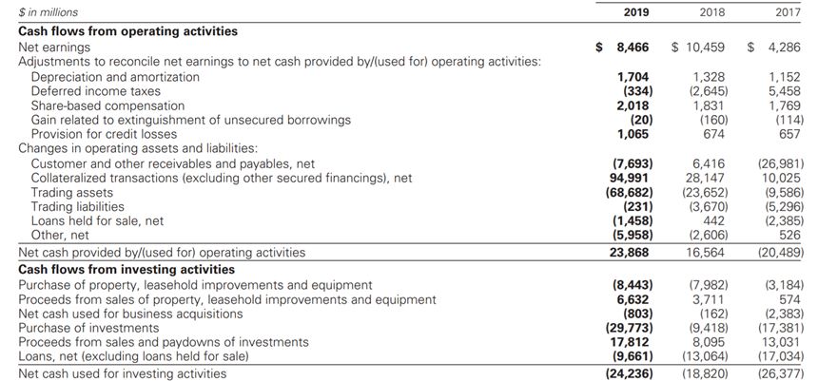
Cash Flow Statement (Page 108 in Financial Report)

Slide 19
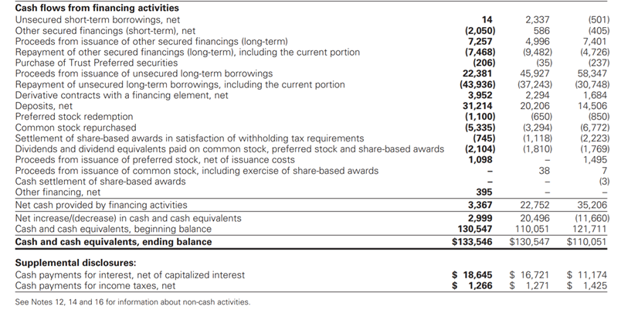
Cash Flow Statement (Page 108 in Financial Report)

Slide 20
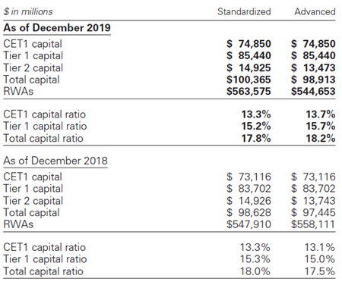
Risk-based Capital Ratios

Slide 21
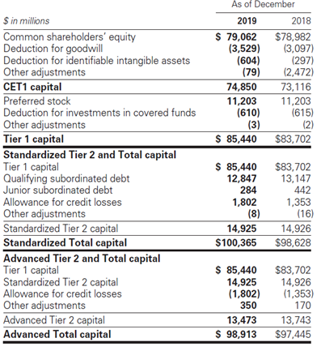
Risk-based Capital

Slide 22
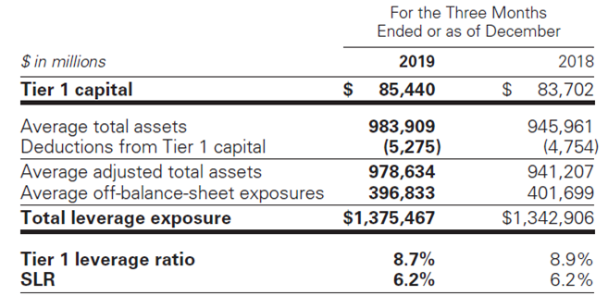
Leverage Ratios

Slide 23
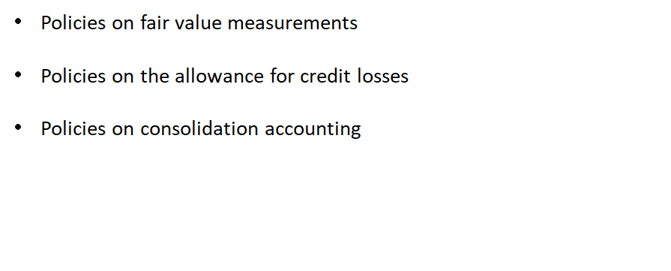
Significant Accounting Policies (Page 110 in Financial Report)

Slide 24
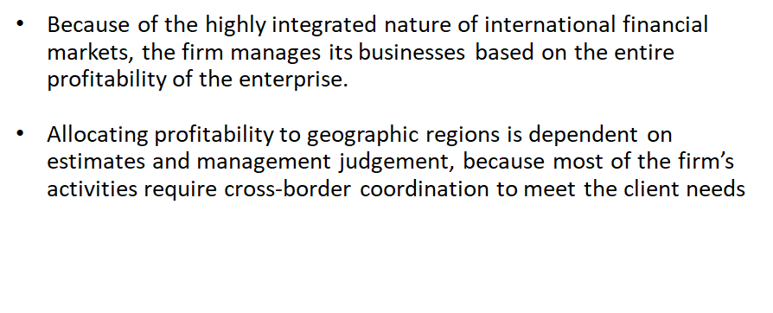
Geographic Info

Slide 25
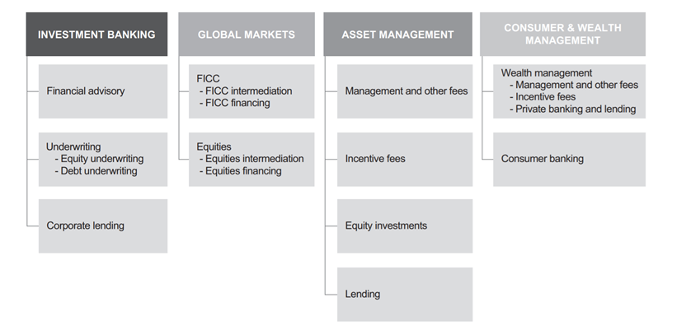
Business Segments (Page 1 in Financial Report)

Slide 26
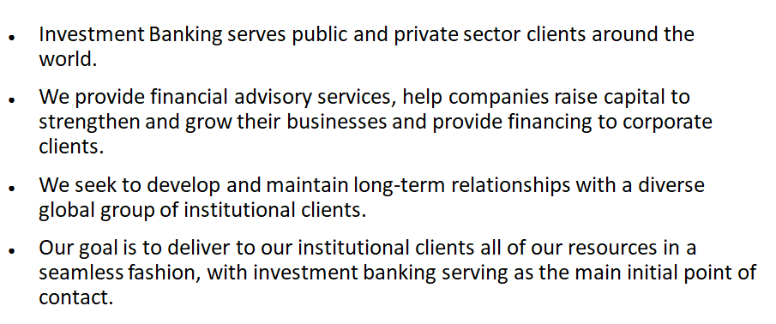
Investment Banking (Page 2 in Financial Report)

Slide 27
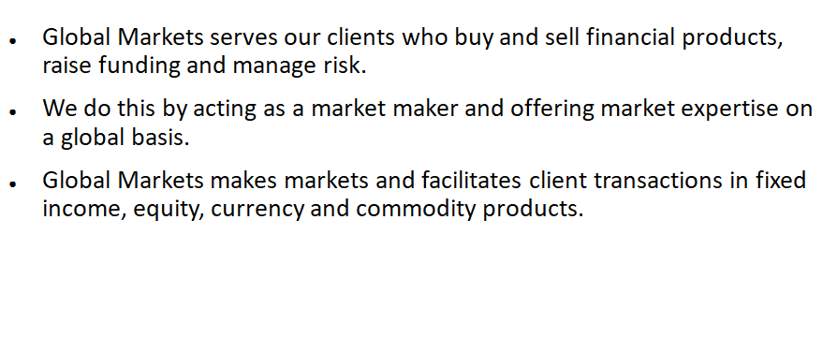
Global Markets (FICC and Equities) (Page 3 in Financial Report)

Slide 28
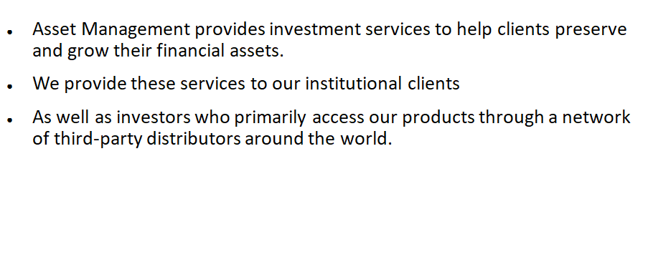
Asset Management (Page 4 in Financial Report)

Slide 29
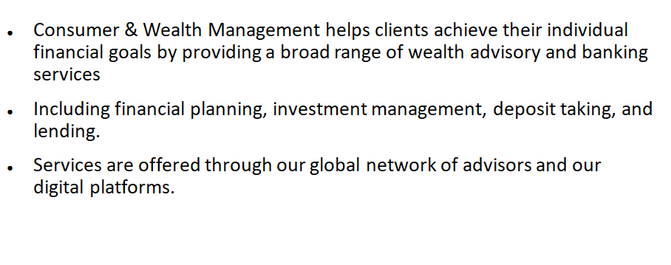
Consumer & Wealth Management

Slide 30
Regulations

Slide 31
Regulations
Dodd-Frank Act: Enacted in July 2010, provides extension on the rules adopted by the Federal Reserve Board
The Volcker Rule - prohibits “proprietary trading”, sponsorship of “covered funds” and investment in hedge funds
Federal Reserve Board:
Primary regulator of bank holding company (BHC) under BHC Act
BHC Act restricts bank holding companies from engaging in business activities
Fed board has the authority to limit the ability to conduct activities and it is necessary its approval before engaging in financial activities

Slide 32
Regulations
•The Dodd-Frank Act significantly altered the financial regulatory regime within GS operates
• The capital, liquidity and leverage ratios based on the Basel III implemented by the Federal Reserve, the PRA and FCA and other national regulators also had a significant impact on GS businesses
• The implications of regulations for our businesses continue to depend largely on their implementation by the relevant regulators globally, as well as the development of market practices and structures under the regime established by such regulations
• Other reforms have been adopted or are being considered by regulators and policy makers worldwide
•The Basel Committee is the primary global standard setter for prudential bank regulation

Slide 33
The Volcker Rule
The provision of the ‘’Dodd-Frank Act’’ referred to as “Volcker Rule’’ became effective in year 2015
Prohibits proprietary trading but permits other activities with extensive compliance requirements.
The Volcker Rule limitation on investments in hedge funds and private equity funds required to reduce investments to 3% or less of Tier 1 Capital
FRB, OCC, FDIC, CFTC and SEC finalized amendments in October 2019
These amendments became effective on January 1, 2020 but with a required compliance date of January 1, 2021

Slide 34
Basel Capital Accord
The Basel Accords are three series of banking regulations (Basel I, II, and III)
Set by the Basel Committee on Bank Supervision (BCBS).
Provides recommendations on banking regulations specifically, concerning capital risk, market risk, and operational risk.
Ensure that financial institutions have enough capital on account to absorb unexpected losses.

Slide 35
Basel I
Basel I was the first accord. Issued in 1988
Purpose: Published a set of minimum capital requirements for banks.mainly focused on credit risk by creating a bank asset classification system and appropriate risk-weighting of assets.
Capital Adequacy Risk (0%, 10%, 20%, 50% and 100%)
Banks operate internationally are required to keep capital of at least 8% of their determined risk profile on hand
Enforced by law in the Group of Ten (G-10) countries in 1992

Slide 36
Basel I A
Basel I A was proposed as an intermediate between the current Basel I accord and the Basel II accord that is being implemented. Basel I A would have been more risk sensitive than Basel I but would not be as complex as the advanced approach under Basel II.
It was decided to drop the proposed Basel 1A and allow Basel II standardized in its place.

Slide 37
Basel II
-Published in 2004
-Purpose: “three pillars concepts, more risk sensitive
-Refining the definition of risk-weighted assets, used as a denominator in regulatory capital ratios
-Intended to amend international standards that controlled how much capital banks need to hold to guard against the financial and operational risks banks face.
-Requires companies to publish both the details of risky investments and risk management practices
-Aimed at rewarding and encouraging continued improvements in risk measurement and control
Difference:
-Incorporates credit risk of assets held by financial institutions to determine regulatory capital ratios.

Slide 38
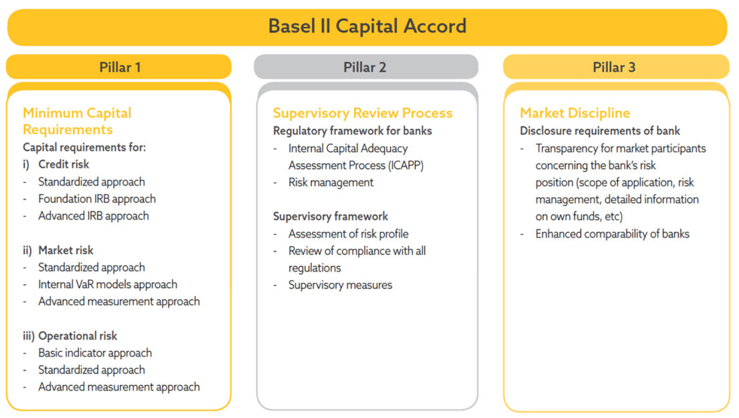

Slide 39
Basel III
Purpose: response to the deficiencies in financial regulation revealed by the financial crisis of 2007-08
Intended to strengthen bank capital requirements
Promote greater resilience at an individual bank level to reduce the risk of system-wide shocks

Slide 40
Key principles of Basel III
Minimum capital requirements
Raised the minimum capital requirements for banks from 2% in Basel II to 4.5% of common equity.
Tier 1 capital requirements increased from 4% to 6%
Leverage ratio
In July 2014, the U.S. Federal Reserve announced that the minimum Basel III leverage ratio would be 6% for 8 systemically important financial institution (SIFI) banks and 5% for their uninsured bank holding companies
Liquidity requirements
Introduce the usage of two liquidity ratios - the Liquidity Coverage Ratio and the Net Stable Funding ratio

Slide 41
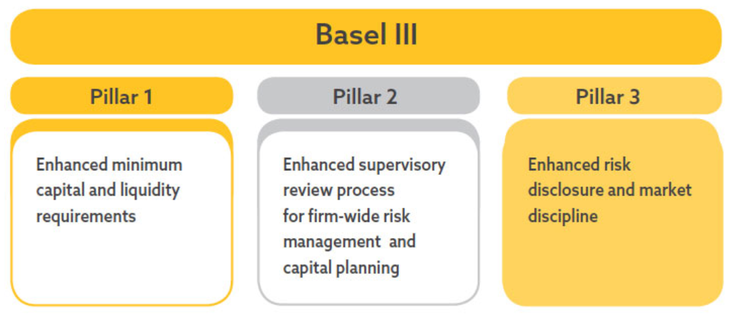
Basel III Pillar

Slide 42
Basel III
Regulatory Elements
Higher Tier 1 and Tier 2 capital requirement
Capital Conservation Buffer
Counter Critical Measures
Liquidity Standards
Capital Leverage ratio

Slide 43
Capital Requirements for Banks
Tier 1 Capital is a bank's core capital related to common stocks non-cumulative perpetual preferred stocks and disclosed reserves. Appears on the bank's financial statements. intended to ensure that each bank remains a going concern
Tier 2 Capital is a bank's supplementary capital protects the bank’s depositors.represents debts with fixed or cumulative costs
Tier 3 Capital represents short-dated subordinated debentures retained to support the trading desk and market risks associated with derivatives transactions

Slide 44
Capital and Liquidity Requirements
As a bank holding company, Goldman Sachs is subject to consolidated regulatory capital requirements
In January 2019, the Basel Committee finalized a revised framework for calculating minimum capital requirements for market risk

Slide 45
Changes in Capital Requirements (1)
Changes to the market risk capital rules effective on January 1, 2013
Basel II revises the regulatory capital framework for credit risk and equity investments and will be adopted once the regulators will approve GS to do so
Under the tailoring rules adopted by the U.S. federal bank regulatory agencies in October 2019, we and GS Bank USA subject to “Category I” standards because they have been designated as a global systemically important bank (G-SIB).

Slide 46
Changes in Capital Requirements (2)
“The Collins Amendment” of the Dodd-Frank Act defines
generally applicable risk-based capital requirements
generally applicable leverage capital requirements

Slide 47
Changes in Capital Requirements (3)
More stringent capital standards:
Basel III provide additional capital ratio requirements include
The capital conservation buffer
Countercyclical capital buffer
G-SIB surcharge
All of these must consist entirely of capital that qualifies as Common Equity Tier 1 (CET1) capital.

Slide 48
Broker-Dealer & Securities Regulation
In the United States, the SEC is the federal agency responsible for the administration of the federal securities laws.
Goldman Sachs’ broker-dealer subsidiaries are subject to regulations that cover all aspects of the securities business.
GS&Co. is registered as a broker-dealer, a municipal advisor and an investment adviser with the SEC and as a broker-dealer in all 50 states and the District of Columbia.
U.S.Self-regulatory organizations, such as FINRA and the NYSE, adopt rules that apply to, and examine, broker-dealers such as GS&Co.
According to the Dodd-Frank Act, any person who organizes an asset-backed security transaction to retain a portion of any credit risk that the person conveys with a third party.

Slide 49
Payment of Dividends and Stock Repurchases
Subject to the oversight of the fed board based on capital plans and stress tests to judge the capital planning processes
The applicable U.S. banking regulators have authority to prohibit or limit the payment of dividends if, in the banking regulator’s opinion, payment of a dividend would constitute an unsafe or unsound practice in light of the financial condition of the banking organization

Slide 50
Compensation Practices
Oversight by the fed board
The guidance sets forth the following three key principles:
(i) provide employees with incentives that balance risk and financial results
(ii) compatible with effective controls and risk management
(iii) supported by strong corporate governance
Review of the incentive compensation policies will affect its ability to make acquisitions or perform other actions.
Enforcement actions taken against the risk of the organization's safety caused by related risk management
If the regulations are adopted the flexibility will be restricted

Slide 51
Regulation of GS Bank USA
Undertake stress test is required, according to Dodd-frank act and submit them to the fed board
“Derivative push-out” will prevent GS from conducting certain swaps-related activities
Transactions between GS bank USA and its subsidiaries are regulated by the Fed Board

Slide 52
Prompt Corrective Actions and Capital Ratios
The US Federal Deposit Insurance Corporation Improvement Act of 1991 (FDCIA) establishes 5 capital categories:
Well-capitalized depositary institution
Adequately capitalized
Undercapitalized
Significantly undercapitalized
Critically undercapitalized

Slide 53
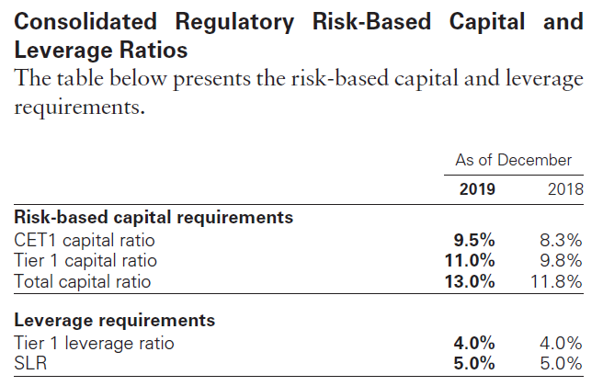

Slide 54
Insolvency of an Insured Depository Institution
Transfer the depository institution's assets and liabilities to a new obligor without approval of the creditors
Enforce the terms of the depository institution's contracts
Repudiation of any contracts to which the institution is a Party
Resolution plan: submitted to the regulators on June 29, 2012, which established GS bank USA is protected from risks

Slide 55
Swap, Derivatives and Commodities Regulations
Subject to regulation of U.S. Commodity Exchange Act
The Dodd-frank act provides increased regulation, imposing the following requirements:
Real time public and regulatory reporting of trade information for swaps
Registration of swap dealers
Position limits the cap exposure to derivatives on certain physical commodities
Mandated clearing through central counterparties for certain swaps
New business conduct standards for swap dealers
Margin requirements for trades that are not cleared
Entity level capital requirements for swap dealers

Slide 56
Brexit and Future Regulations
GS expects considerable change in the regulatory framework that will govern transactions and business undertaken by their U.K. subsidiaries.
Withdrawal agreement became effective on January 31, 2020 when the U.K. ceased to be an E.U. member state.
After the end of the transition period, the U.K. will not be required to continue to apply E.U. financial services legislation and may not adopt rules that correspond to E.U. legislation not already operative in the U.K.

Slide 57
Other Regulations
Insurance subsidiaries: subject to state insurance regulation in the states in which they are domiciled
Investment management: subject to significant regulation in numerous jurisdictions around the world

Slide 58
Risk Management

Slide 59
Components of Risk Management
Governance: review and approve by the board, followed by a risk-oriented committees run by senior managers. This structure provides the protocol for decision-making.
Processes: discipline the inventory to current market level to provide transparency. Apply a framework of limits to control risk. Using active management to ensure high quality information.
People: by proper training and rewarding experienced professionals to ensure their high risk management and reputational performance.
risk identification and assessment
risk appetite, limit and threshold setting
risk reporting and monitoring
risk decision-making

Slide 60
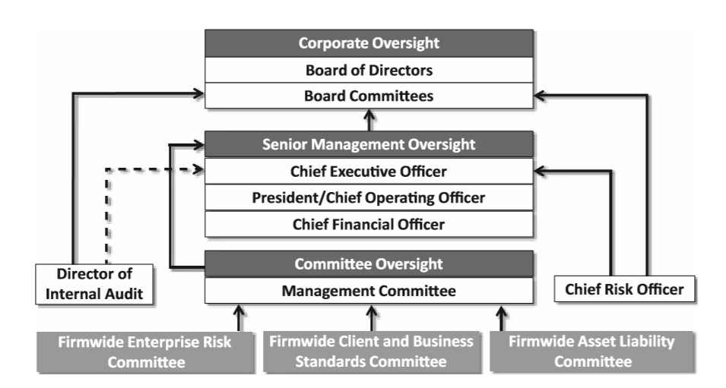
Structure of Risk Management
The chart below presents an overview of the risk management governance structure.

Slide 61
Risk Management Governance Structure
1. Start with the Risk Committee to oversee the risk management policy and practice implemented through the enterprise risk management framework.
The Board Risk Committee is also responsible for the annual review and approval of risk appetite statement
The risk appetite describes the level and and types of risk, which are willing to accept or avoid.
2. Independent risk oversight and control function by management team are second line of defense.
Include Compliance, Enterprise Risk, Legal, Liquidity Risk, Market Risk, Model Risk, Operational Risk and Tax
3. The third lane of defense is Internal Audit, which is accountable to the Audit Committee of the Board.
Internal Audit is responsible for the independently assessing and validating the effectiveness of key controls.
Providing timely reporting to the Audit Committee, senior management and regulators.

Slide 62
Risk Factors
Goldman Sachs may have been and may continue to be adversely affected by conditions in the global financial markets and economic conditions
GS may be adversely affected by declining asset values, especially for those businesses in which the company has net long positions, or in businesses where Goldman Sachs receives fees based on value of assets manage
Goldman Sachs may be adversely affected by disruptions in the credit markets, including reduced access to credit and higher costs of servicing debt
Market-making activities may have been and may be affected by changes in levels of market volatility
May be adversely affected by market uncertainty or lack of confidence among investors and CEOs due to general declines in economic activity and other unfavorable market conditions
GS may incur losses as a result of ineffective risk management processes and strategies.
Liquidity and profitability may be adversely affected by inability to access debt capital markets or to sell assets by a reduction in credit ratings or an increase in credit spreads

Slide 63
Major Risk of GS
Market Risk
Operational Risk
Liquidity Risk
Credit RIsk
Model Risk

Slide 64
GS’s Market Risk Management

Slide 65

Market Risk
Definition: Market risk is the risk of loss in the value of the inventory, investments, loans and other financial assets and liabilities accounted for at fair value due to changes in market conditions.
Source of Market Risk: It include recessions, political turmoil, changes in interest rates, natural disasters and terrorist attacks. Systematic, or market risk tends to influence the entire market at the same time.

Slide 66
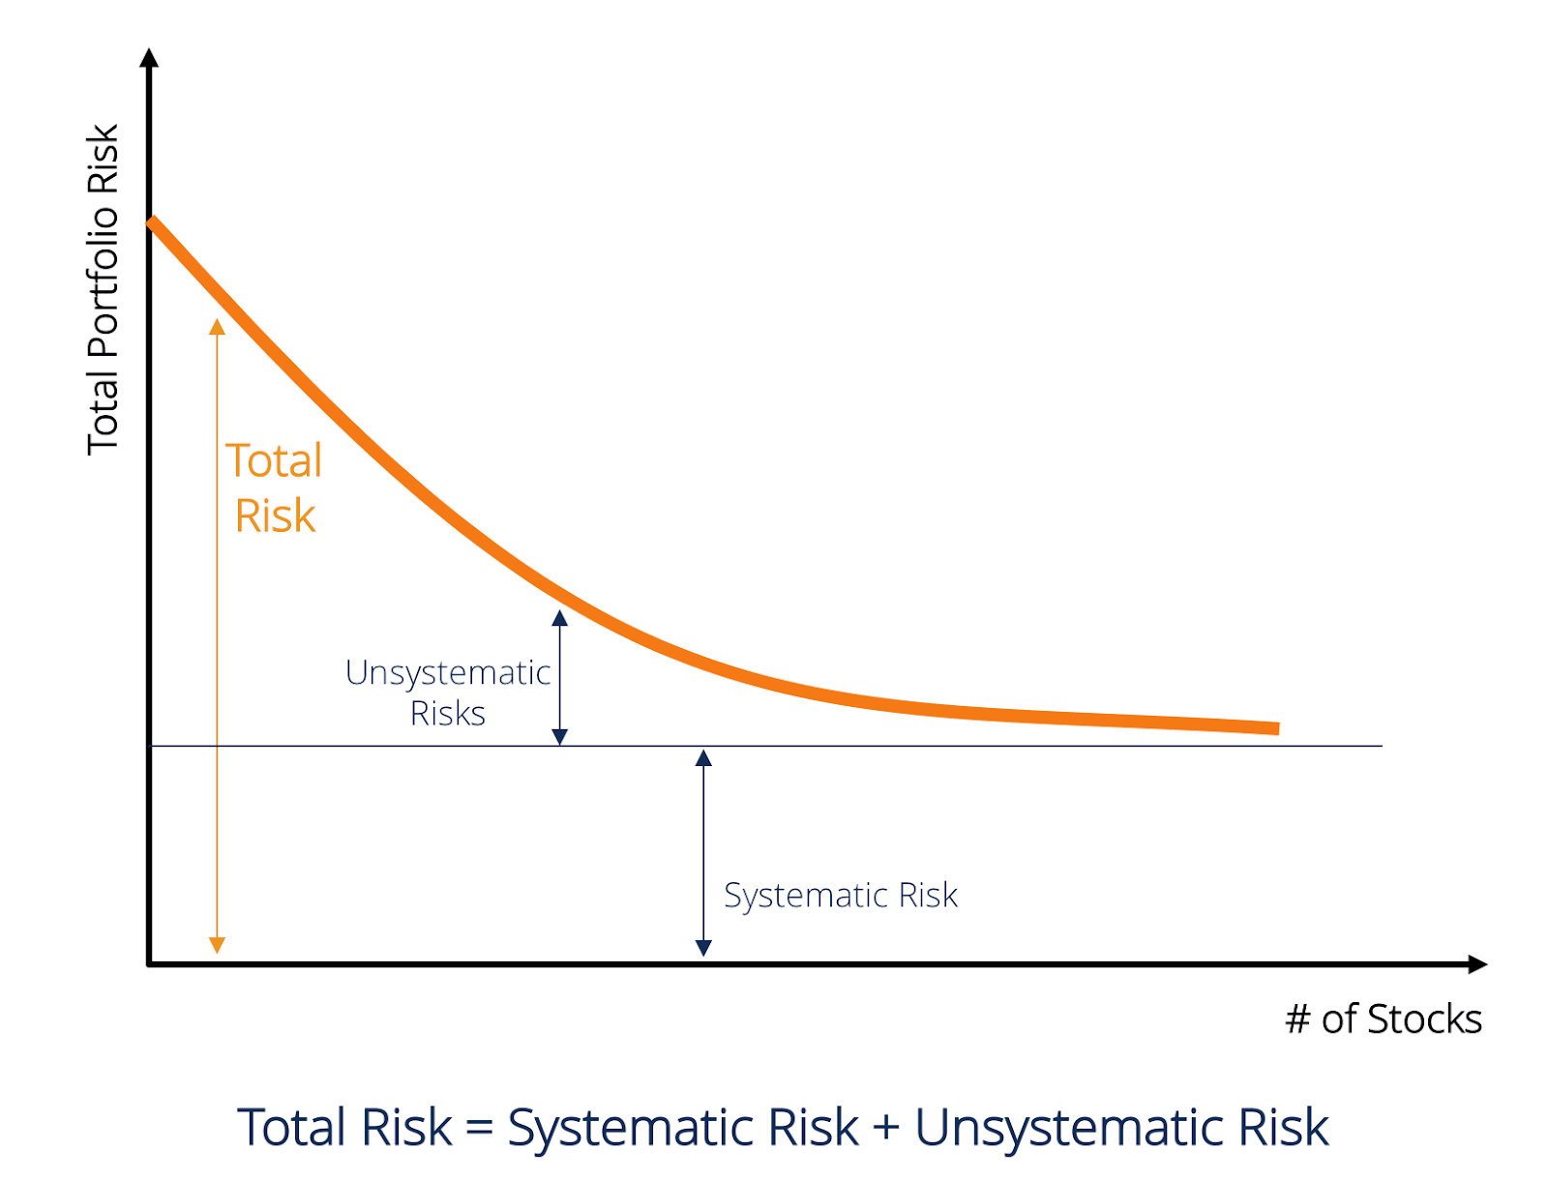
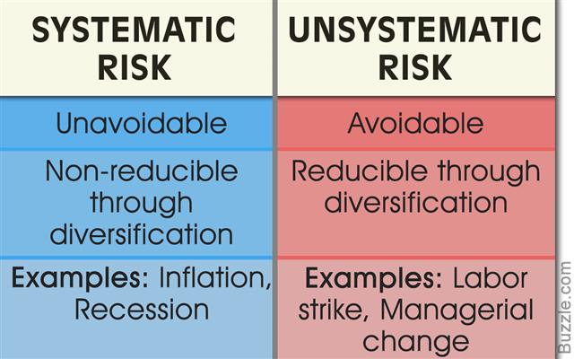
Market risk, also called "systematic risk," cannot be eliminated through diversification, though it can be hedged against in other ways.
Market Risk

Slide 67
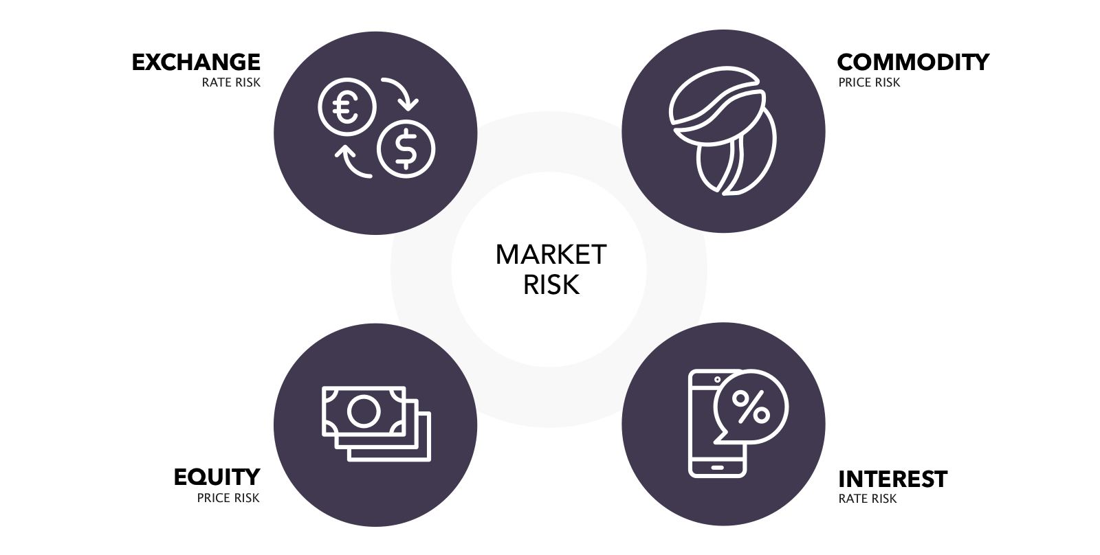
Market Risk-Source
Interest rate risk: results from exposures to changes in the level, slope and curvature of yield curves, the volatilities of interest rates, prepayment speeds and credit spreads;
Equity price risk: results from exposures to changes in prices and volatilities of individual equities, baskets of equities and equity indices;
Currency rate risk: results from exposures to changes in spot prices, forward prices and volatilities of currency rates; and
Commodity price risk: results from exposures to changes in spot prices, forward prices and volatilities of commodities, such as crude oil, petroleum products, natural gas, electricity, and precious and base metals.
Notes:
Market risk depends on the type of security being traded, as well as the geographical boundaries of the trade.

Slide 68
Market Risk Management Process
Monitoring compliance with established market risk limits and reporting their exposures;
Diversifying exposures;
Controlling position sizes; and
Evaluating mitigants, such as economic hedges in related securities or derivatives

Slide 69
Risk Measures
Value-at-Risk
VaR is the potential loss in value due to adverse market movements over a defined time horizon with a specified confidence level.
Assumption:
1. Stationarity. A 1% fluctuation in returns is equally likely to occur at any point in time.
2. Random walk of intertemporal unpredictability. Day-to-day fluctuations in returns are independent.
3. Nonnegativity. Financial assets with limited liability cannot attain negative values.
4. Time consistency. All single-period assumptions hold over the multiperiod time horizon.
5. Distributional. Daily return fluctuations follow a normal distribution with a mean of zero and a standard deviation of 100 bp

Slide 70
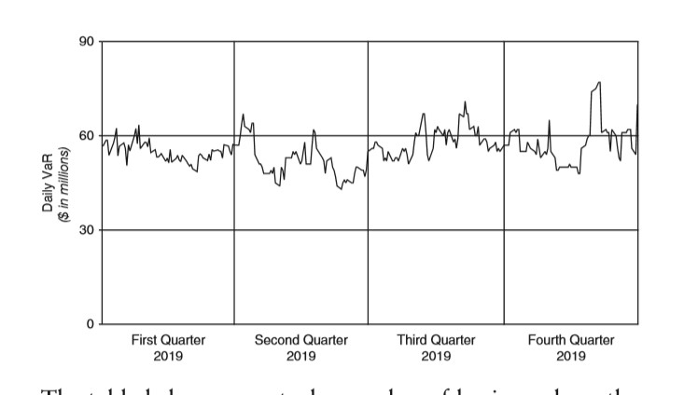
Risk Measures-VaR
Example to Explain Var: If a portfolio of stocks has a one-day 5% VaR of $1 million, that means that there is a 0.05 probability that the portfolio will fall in value by more than $1 million over a one-day period if there is no trading. Informally, a loss of $1 million or more on this portfolio is expected on 1 day out of 20 days (because of 5% probability).More formally, p VaR is defined such that the probability of a loss greater than VaR is (at most) p while the probability of a loss less than VaR is (at least) 1−p. A loss which exceeds the VaR threshold is termed a "VaR breach".
Daily VaR for 2019

Slide 71
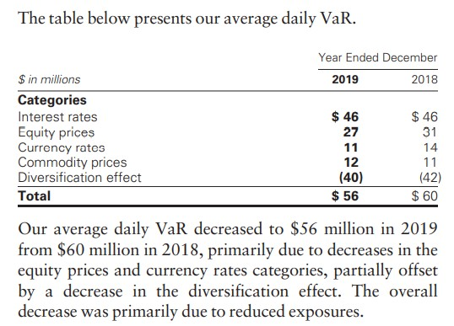
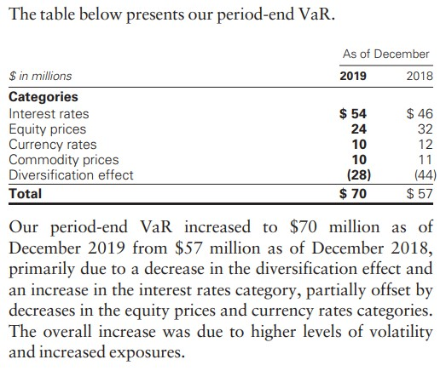
Risk Measures-VaR

Slide 72
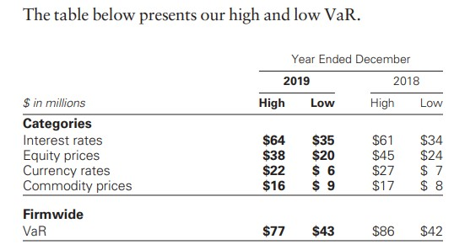
Risk Measures-VaR
During 2019 and 2018, the firmwide VaR risk limit was not exceeded, raised or reduced.

Slide 73
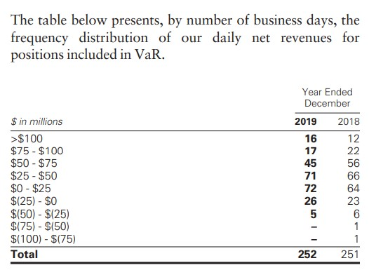
Risk Measures-VaR
Notes:
Daily net revenues for positions included in VaR are compared with VaR calculated as of the end of the prior business day. Net losses incurred on a single day for such positions did not exceed our 95% one-day VaR (i.e., a VaR exception) during 2019 and exceeded our 95% one-day VaR on two occasions during 2018

Slide 74
Limits of VaR
VaR does not estimate potential losses over longer time horizons where moves may be extreme;
VaR does not take account of the relative liquidity of different risk positions; and
Previous moves in market risk factors may not produce accurate predictions of all future market moves

Slide 75
Risk Measure-Other Tools
Other Measurements (rarely use than VaR):
*Certain portfolios and individual positions are not included in VaR because VaR is not the most appropriate risk measure.
Stress Testing
Designed to ensure a comprehensive analysis of our vulnerabilities and idiosyncratic risks combining financial and nonfinancial risks
Including, but not limited to, market, credit, liquidity and funding, operational and compliance, strategic, systemic and emerging risks into a single combined scenario
Sensitivity analysis
10% sensitivity measure
Credit spread sensitivity on derivatives and financial liabilities
Interest rate sensitivity
Scenario analysis
Comprehensive Capital Analysis and Review (CCAR)
Dodd-Frank Act Stress Tests (DFAST)

Slide 76
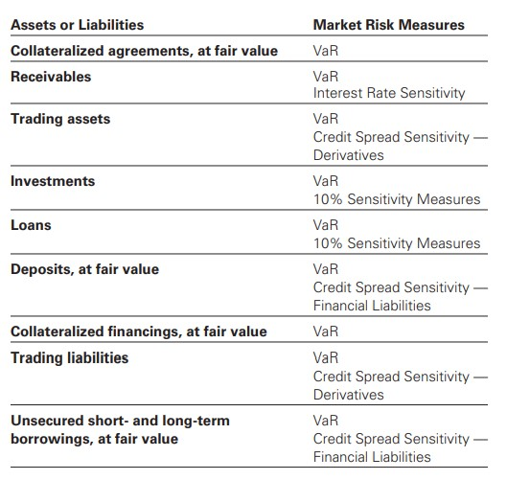
Measurement Tool & Balance Sheet

Slide 77
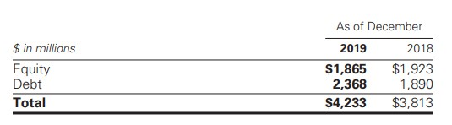
Sensitivity Measures
10% Sensitivity Measures.
The table below presents their market risk by asset category for positions accounted for at fair value, that are not included in VaR.
The market risk of these positions is determined by estimating the potential reduction in net revenues of a 10% decline in the value of these positions.

Slide 78
GS’s Operational Risk Management

Slide 79
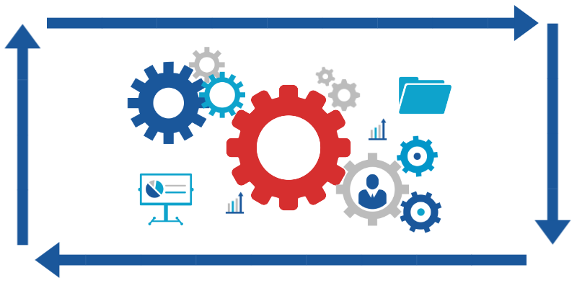
Operational Risk
Overview:
Operational risk is the risk of an adverse outcome resulting from inadequate or failed internal processes, people, systems or from external events. Our exposure to operational risk arises from routine processing errors, as well as extraordinary incidents, such as major systems failures or legal and regulatory matters.

Slide 80
Operational Risk
Potential types of loss events related to internal and external operational risk include:
Clients, products and business practices;
Execution, delivery and process management;
Business disruption and system failures;
Employment practices and workplace safety;
Damage to physical assets;
Internal fraud; and
External fraud.

Slide 81
Operational Risk Measurement
GS measure their operational risk exposure using both statistical modeling and scenario analyses, which involve qualitative and quantitative assessments of internal and external operational risk event data and internal control factors for each of our businesses. Operational risk measurement also incorporates an assessment of business environment factors, including:
Evaluations of the complexity of our business activities;
The degree of automation in our processes;
New activity information;
The legal and regulatory environment; and
Changes in the markets for our products and services, including the diversity and sophistication of our customers and counterparties.

Slide 82
Operational Risk Management Process
Combine top-down and bottom-up approaches to manage and measure operational risk.
Maintain a comprehensive control framework designed to provide a well-controlled environment to minimize operational risks.
Established policies that require all employees to report and escalate operational risk events.
Use operational risk management applications to capture and organize operational risk event data and key metrics.

Slide 83
Different Type of Operational Risk and Management Method
Information and Cyber Security Risk.
minimize the occurrence and impact of unauthorized access, disruption or use of information and/or information systems.
Third Party Risk
identify, manage and report key third-party risks and conduct due diligence across multiple risk domains, including information security and cyber security, resilience and additional third- party dependencies.
Business Resilience Risk.
monitor threats and assess risks and seek to ensure our state of readiness in the event of a significant operational disruption to the normal operations of our critical functions or their dependencies, such as, critical facilities, systems, third parties, data and/or personnel.

Slide 84
GS’s Liquidity Risk Management(LRM）

Slide 85
Liquidity Risk Management
Liquidity risk: to be unable to fund the firm or meet the liquidity needs in the event of firm-specific, broader industry or market liquidity stress events.
The objective: to be able to offer fund and to enable core businesses to continue to serve clients and generate revenues, even under adverse circumstances.
GS’s liquidity risk management is independent of revenue producing units and Treasury, and reports to the chief risk officer, has primary responsibility for assessing, monitoring and managing the liquidity risk through firmwide oversight across global businesses and the establishment of stress testing and limits frameworks.

Slide 86



Liquidity Risk Management Principles
Hold sufficient excess liquidity in the form of GCLA to cover outflows during a stressed period
Maintain appropriate Asset-Liability Management
Maintain a viable Contingency Funding Plan

Slide 87
Liquidity Risk Management — “GCLA”
GCLA — Global Core Liquid Assets, is the liquidity maintained to meet a broad range of potential cash outflows and collateral needs in a stressed environment
GCLA consists of cash, high quality and narrowly defined unencumbered assets, including U.S. Treasuries and German, French, Japanese and United Kingdom government obligations

Slide 88
Liquidity Risk Management — “GCLA”
A primary principle is to pre-fund the estimated potential cash and collateral needs during a liquidity crisis and hold this liquidity in the form of unencumbered, highly liquid securities and cash.
During a liquidity crisis, credit-sensitive funding may change or be unavailable, and certain deposits may be withdrawn. As a result, GS pre-fund the liquidity that larger than the businesses would otherwise require including unencumbered securities and funding.

Slide 89
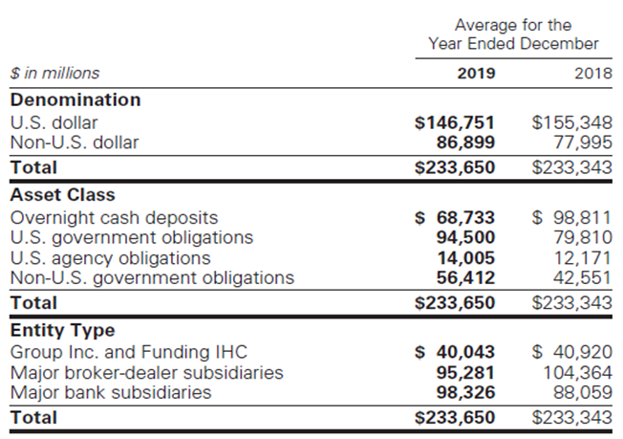
Liquidity Risk Management — “GCLA”
During 2018 and 2019, GCLA averaged $233 billion
Average GCLA increased to $290 billion during 2020

Slide 90
Liquidity Risk Management —— Asset-Liability Management
Goal: to maintain sufficient liquidity to fund assets and meet contractual and contingent obligations.
Conservatively managing the overall funding book, with a focus on maintaining long-term, diversified sources of funding in excess of the current requirements;
Actively managing and monitoring the asset base, with particular focus on the liquidity, holding period and ability to fund assets on a secured basis;
Raising secured or unsecured financing with longer tenure than the liquidity profile of assets.

Slide 91
Liquidity Risk Management —— Contingency Funding Plan
Aim: to provide framework for analyzing liquidity risks and responding market stress:
Outline a list of risk factors, key reports and metrics
Describe details of responses in potential risk crisis
Identifies key groups of individuals to foster effective coordination control and distribution of information

Slide 92
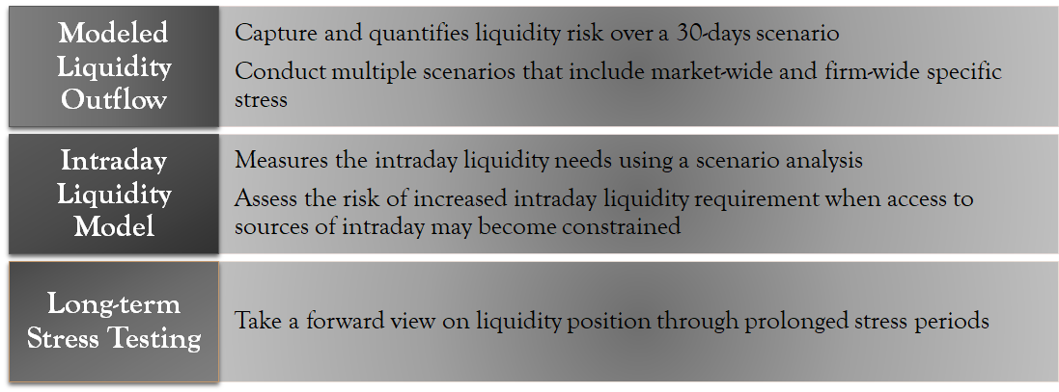
Liquidity Risk Management —— Stress Test

Slide 93
Liquidity Risk Management —— Limits
Liquidity risk limits at various levels and across liquidity risk types to manage the size of the liquidity exposures.
Measured relative to acceptable levels of risk given our liquidity risk tolerance
Monitored by Treasury and Liquidity Risk Management
Liquidity Risk is responsible for identifying and escalating to senior management or the appropriate risk committee, on a timely basis, instances where limits have been exceeded.

Slide 94
GS’s Credit Risk Management(CRM)

Slide 95
Credit Risk — Exposures
Credit risk: potential for loss due to the default or deterioration in credit quality of a counterparty (e.g., an OTC derivatives counterparty or a borrower) or an issuer of securities or other instruments we hold.
Client transactions in OTC derivatives
Loans and lending commitments
Securities financing transactions (e.g. resale and repurchase agreements and securities borrowing and lending activities.)
Cash placed with banks

Slide 96
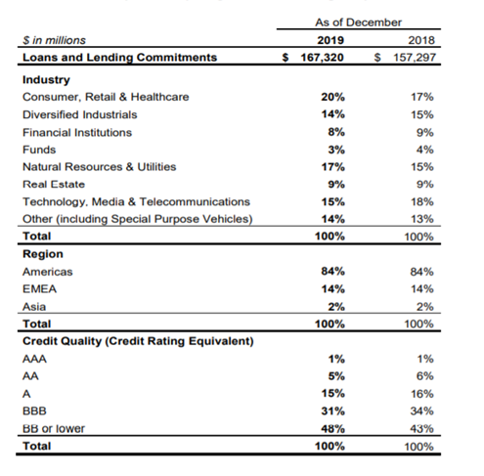
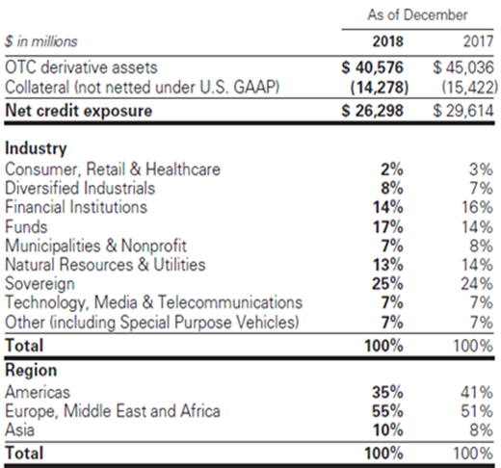
Tables represent GS credit exposures from loans and lending commitments and OTC derivatives, concentrating by industry and region during 2017 – 2019.

Slide 97
Credit Risk Management —— Process
Perform credit reviews, which include initial and ongoing analyses of our counterparties
A credit review is an independent analysis of the capacity and willingness of a counterparty to meet its financial obligations, resulting in an internal credit rating
The determination of internal credit ratings also incorporates assumptions with respect to the nature of and outlook for the counterparty’s industry, and the economic environment
Risk assessment process may also include reviewing certain key metrics, which includes delinquency status, collateral values, Fair Isaac Corporation credit scores and other risk factors

Slide 98
Credit Risk Measures And Limits
Measure the credit risk based on potential loss in the event of non-payment by a counterparty using current and potential exposure
For derivatives and securities financing transactions, the potential exposure represents the estimate of the future exposure that could arise over the life of a transaction based on market movements within a specified confidence level
For loans and lending commitments, the primary measure is a function of the notional amount of the position
Use credit risk limits at various levels as well as underwriting standards, to manage the size and nature of credit exposures

Slide 99
Mitigating Credit Risk — 4 Exposures
For securities financing transactions:
Enter into netting agreements with counterparties that allow to offset receivables and payables
Obtain collateral or contingent basis
Ability to terminate transactions if counterparty credit rating falls below a specified level
For loans and lending commitments:
Collateral provisions, guarantees, covenants, structural seniority of the bank loan claims
For certain lending commitments, provisions in the legal documentation that allow us to adjust loan amounts, pricing, structure and other terms as market conditions change
Third party as guarantor for the counterparties’ obligations

Slide 100
Mitigating Credit Risk — 4 Exposures
For OTC Derivatives:
Transfer credit risk through hedging with available derivatives
Enter into OTC derivatives transactions under bilateral collateral arrangements that require the daily exchange of collateral
GS includes a credit value adjustment (CVA) in the fair value of derivatives to reflect the counterparty credit risk. CVA is a function of the present value of expected exposure, the probability of the counterparty default and the assumed recovery upon default
For cash and cash equivalents
All deposits with highly rated banks and central banks

