Slide 1
American International Group
Tom Olson
Tommy Yip
Gordon Tang
Michael Chiu
Paul’s Sugiarto
Notes:
Gordon

Slide 2
Agenda
Industry Overview
Regulations
Company Overview
Financial Statement
Risk Factors and Management
Notes:
Gordon

Slide 3
Industry Overview
Notes:
Gordon

Slide 4
The Insurance Industry
Insurance companies generally have two branches of business
Life & Health Insurance
Individual’s well being
Property and Casualty Insurance
Protection against losses of a physical property, or its ability to generate income
Notes:
Gordon
AIG is an insurance company; in fact, it is one of the largest in the world.
The insurance industry is general broken down into 2 major branches of business.
The first is life and health insurance.
- Life
- Accidental Death and Dismemberment
- STD, LTD
- Vision, Drugs, Medicine, Dental
- Pensions
Then there’s property and casualty, often abbreviated as P&C
- equipment breakdown
- general liability
- kidnap & ransom
- homeowners
- auto

Slide 5
Global Insurance Market
$3,671.7 billion in gross premiums in 2009
Life insurance makes up approximately 57% of the insurance industry
Growth rate of 2.7% per year
Notes:
Gordon
Insurance is often categorized within the financial industry, along with other such as investment and commercial banks, mortgages, investment services.
For our purposes though, we will focus just on the insurance sector.
In 2009, the global insurance market collected $3.7 trillion in gross premiums (essentially, their revenue).
The life insurance business makes up the biggest part of the industry, representing 57% of the collected premiums
Over the last year, the industry has experienced an average growth rate of 2.7%. However this number is largely affect by recession.

Slide 6

Global Insurance Market
Year | $bn | Growth (%)
2005 | 3,301.4 | -
2006 | 3,517.8 | 6.6
2007 | 3,676.1 | 4.5
2008 | 3,701.8 | 0.7
2009 | 3,671.8 | (0.8)
CAGR, 2005–09 | 2.7
Notes:
Gordon
This is a chart and graph of the total gross premium collected in the insurance industry. As you can see, prior to the recession, the industry has growth rate of 6.6 and 4.5. Then the recession came, and the industry didn’t experience growth in that period.

Slide 7
Global Insurance Market
Projected to have gross premiums of $5,082.7 billion in 2014
Average growth rate of 6.7% per year, 38.4% up from 2009
Notes:
Gordon
It is expected that the industry will recover quite quickly from the recession. Projections indicate that total gross premiums will be at $5 trillion by 2014, representing an average growth rate of 6.7% per year from 2009

Slide 8
Global Insurance Market
Year | $bn | Growth (%)
2009 | 3,671.1 | (0.8)
2010 | 3,751.8 | 2.2
2011 | 3,989.5 | 6.3
2012 | 4,276.8 | 7.2
2013 | 4,654.2 | 8.8
2014 | 5,082.7 | 9.2
CAGR, 2009–14 |  | 6.7
Notes:
Gordon
This is the graph and chart indicating the projected gross premium and the implied growth rate. Out of the recession, the industry will recover slowly, at 2.2%, then picks up and exhibits growth of 6.3% and upwards. Again, by 2014, the gross premium is expected to hit $5 trillion

Slide 9
Top 10 Global Insurance Companies
Company | Share (%)
AXA | 3.2
Assicurazioni Generali | 2.4
Allianz Group | 2.3
American International Group | 1.8
Munich Re Group | 1.5
Aviva Plc | 1.4
Zurich Financial Services | 1.3
CNP Assurances | 1.2
ING Group | 1.1
Prudential plc | 0.9
Others | 83.0
TOTAL | 100.0
Notes:
Gordon
This chart shows the top 10 global insurance companies. Again, this indicates any firm that operates in the insurance industry, regardless of which line of business it does.
On top of the list is AXA group. They have business in both life insurance and p&c
And then lower down the list is AIG, at 1.8%. AIG mainly does P&C
Munich, 5th from the list, operates primarily as a reinsurer.
The top 10 firms makes up 17% of the entire industry.

Slide 10
Performance for Top 5 Insurance Companies, 2009
Notes:
Gordon
This is a quick comparison in performance for the top 5 firms in the industry, in 2009. Let’s ignore AIG for now: they had a pretty bad year and we’ll talk about what actually happened to them later in our presentation.
In green is operating margin, orange is return on assets, and blue is return on equity. We can see that for the top 5, minus one, the margin is around 13%, ROA 0.5%, ROE around 10%
In 2010,
ROA = 0.87%
ROE = 9.92%
Operating Margin = 13.62%
By quick comparison, AIG isn’t doing particular bad anymore, but not doing outstanding either

Slide 11
US Insurance Market, 2010
$1.0 trillion of gross premiums
58% in Life & Health ($581 billion)
42% in Property and Casualty ($426 billion)
2,689 Property and Casualty insurance companies
1,061 Life & Health insurance companies
The U.S. insurance industry employs 2.2 million people, including insurers, brokers, agents, etc
Notes:
Gordon
AIG is based primarily in the US, so I’ll also briefly talk about the market situation in the US.
In 2010, $1.0 trillion of premiums were collected, 58% from L&H, 42% from P&C
There is a lot of competition in the insurance market in the US. There were 2689 P&C and 1061 L&H firms in the US. While some companies operate in both lines of business, it doesn’t happen very often, so you can see that there is quite a bit of competition in the market.
In 2010, the US insurance market employs 2.2 million people. This includes insurers, brokers, agents, etc.

Slide 12
Top 5 US Property and Casualty Insurance Companies, 2010
Group | Revenues | Assets
Berkshire Hathaway | $136,185 | $372,229
American International Group | $104,417 | $683,443
State Farm Insurance Cos. | $63,177 | $192,794
Liberty Mutual Insurance Group | $33,193 | $112,350
Allstate | $31,400 | $130,874
Notes:
Gordon
This is the table of the top 5 US P&C insurance companies in 2010, ranked by revenues. Berkshire Hathaway is at the top, and AIG is second.
In terms of assets, AIG is at the top.

Slide 13
Regulations
Notes:
Tommy

Slide 14
Regulations
The scope of regulation extends beyond the prudential oversight of insurance companies and their capital adequacy
Ensures policy holders (person buying the insurance) are protected against
bad faith claims
premiums are not unduly high
policies issued meet a minimum standard
Notes:
Tommy
A bad faith action may constitute several possibilities; the insurer:
-denies a claim that seems valid in the contract or policy
-refuses to pay out for an unreasonable amount of time
-lays the burden of proof on the insured - often in the case where the claim is unprovable
-price fixing between insurers, creating an unfair competitive environment for
If an insurer is found to be guilty of fraud or deception, they can be fined either by regulatory bodies, or in a lawsuit by the insured or surrounding party. In more severe cases, or if the party has had a series of complaints or rulings, the insurer's license may be revoked or suspended.

Slide 15
Regulations
Insurance companies (in US) are not subject to federal regulation and only state level regulation exists for insurance companies
Therefore, regulation is different from state to state
State agencies usually called Department of Insurance with their head officials named Insurance Commissioner
Insurance commissioners are members of NAIC
Notes:
Tommy
Who set the rules for insurance companies and make sure they are doing their jobs?

Slide 16
What is NAIC
National Association of Insurance Commissioners
Formed in 1871
Non-profit organization which seeks to organize the regulatory and supervisory efforts of the various state insurance commissioners from around the United States
Forum for the creation of model laws and regulations
Is NOT a regulator!
Notes:
Tommy
The NAIC is not a regulator; while its members are the insurance commissioners (i.e., the chief insurance regulators) of each state and territory, the NAIC is a non-governmental organization that concerns itself with insurance regulatory matters but does not actually regulate. The states have not delegated their regulatory authority to the NAIC.
Each state decides whether to pass each NAIC model law or regulation, and each state may make changes in the enactment process, but the models are widely, albeit somewhat irregularly, adopted. The NAIC also acts at the national level to advance laws and policies supported by state insurance regulators. The NAIC also is responsible for creating the statutory accounting principles (SAP) upon which insurance accounting is based. SAP is often contrasted with Generally Accepted Accounting Principles (GAAP) and is notable for its very conservative valuation methods. Additionally the NAIC promulgates the NAIC annual statement which incorporates SAP and must be filed with the department of insurance in every state in which an insurance company writes business.

Slide 17
NAIC
Acts at the national level to advance laws and policies supported by state insurance regulators
Responsible for creating the Statutory Accounting Principles (SAP), which is required accounting for insurance companies, in addition to the state GAAP
SAP is notable for its very conservative valuation methods—aiming to keep reserve high in order and keeping the insurance companies solvent
Notes:
Tommy
The Statutory Accounting Principles (SAP) forms the basis for preparing the financial statements of insurance companies. GAAP is the set of accounting rules required to be followed by all companies, irrespective of the industry. Broadly, SAP differs from GAAP in terms of the accounting principles used to prepare the financial statements, governing agencies, the purpose for which the financial statements are used, and valuation methods.
Difference 1
SAP is specific to the insurance industry, while all companies must follow GAAP rules.
Statutory Accounting Principles are accounting rules that are specific to insurance companies as outlined by the National Association of Insurance Commissioners (NAIC). They provide the framework to prepare the financial statements of insurance companies. Because the insurance industry falls under state regulation, actual rules vary by state. The SAP filings are used to determine the health of the insurance company.
Generally Accepted Accounting Principles (GAAP), on the other hand, are a set of accounting rules and standards that are required to be followed by all companies. The GAAP rules are set and monitored by the Financial Accounting Standards Board (FASB). The U.S. Securities and Exchange Commission (SEC) requires all companies to follow GAAP rules when filing their financial reports. GAAP rules are the same nationwide, allowing investors to compare companies using the same set of standards.
Insurance companies have to file their financial statements using SAP for state filings, and GAAP for SEC filings.
Difference 2
SAP and GAAP operate on different accounting principles to provide information that is used for different purposes.
SAP guidelines are used to prepare financial statements that allow investors to determine the ability of the insurance company to pay its future claims. In other words, if all customers of the insurance company had a claim at present, SAP helps to determine if the company would be able to pay those insurance claims. It allows investors to know the worth of the company if it ceased operations immediately.
GAAP guidelines, however, treat a business as a going concern--as if the business would remain in operation indefinitely. Therefore, the focus is on preparing the financial statements by matching revenues with expenses, so an investor can gauge the underlying profitability of the business. This allows investors to answer the question about the worth of a company in its future versus its actual present value.
Difference 3
The value of assets using SAP is lower than when using GAAP.
This difference stems from the fundamental difference in the purpose of creating financial statements under SAP and GAAP. Because SAP statements are used to find the value of the company at the immediate present, the statements don't include many intangible and non-liquid assets. This includes items such as furniture, supplies, tax credit and goodwill. GAAP, on the other hand, allows companies to list these items under the assets category, which translates to a higher value in terms of assets.
Difference 4
The matching principle used by GAAP that matches revenues and expenses isn't followed in SAP filings. Thus, the net income ratios as calculated by using the data from SAP and GAAP filings are different for the same company and the same financial year.
So when a product is sold apart from recording the sales revenue, the company has to also record the cost of making the product as an expense. Though in actuality the expense may have occurred before the sale of the product, the matching principle allows a company to record this expense only when the sale is made. In the case of insurance, an insurance company can record the expense over the life of the policy using GAAP. So if the premium is due quarterly, the expense related to the sale of the policy is divided to match the quarterly earned premiums.
In the case of SAP, this principle is broken. So the insurance company has to record its expenses as they occur, irrespective of when the revenue is earned. So the entire expense related to the policy is recorded when the sale is made, even though the premium may still be unearned. For a growing company, the initial statements may thus show more expenses than revenue, thus lowering its net income.
Difference 5
The equity values for the same company differ, using data from SAP and GAAP filing for the same financial year.
The value of an enterprise is recorded differently using GAAP and SAP. GAAP records it as stockholder equity; SAP records this under statutory policyholder surplus. Because SAP records assets more conservatively and also has different standards for calculating the net income of an insurance company than GAAP, it naturally follows that the values recorded under statutory policyholder surplus aren't the same as stockholder equity. Generally, the valuation under SAP will tend to be lower than that of GAAP because of the more conservative method of accounting used.

Slide 18
Company Overview
Notes:
Paul

Slide 19
AIG
American International Group, Inc. (AIG) is a leading American multinational insurance organization serving customers in more than 130 countries
In 2000, AIG was the 29th-largest public company in the world; listed on the DOWJONES (2004-2008)
AIG common stock is listed on the New York Stock Exchange, as well as the stock exchanges in Ireland and Tokyo
Notes:
Paul

Slide 20
Businesses
Chartis Insurance
International Lease Finance Corporation
AIG Bank
AIG Direct
SunAmerica Financial Group
United Guaranty Corporation
Notes:
Paul

Slide 21
Chartis Insurance
World leading property-casualty and general insurance organization
Provides the following insurances:
Executive Liability
Environmental
Alternative Risk and Collateral
Travelling
Workers' Compensation
Property
Global Marine and Energy
Casualty
Accident and Health
Specialty
Notes:
Paul

Slide 22
International Lease Finance Corporation
The world's largest aircraft lessor by value
Leases Boeing and Airbus aircraft to major airlines worldwide such as American Airlines, Alaska Airlines, Emirates Airlines, Air Canada, Cathay Pacific, Lufthansa and other airlines
September 2, 2011 - AIG filled with the SEC to make an IPO
Notes:
Paul

Slide 23
AIG Bank
Offers service on mortgages for refinance and purchase, home equity lines of credit, money market savings, & certificates of deposit
Provides specialized Federal Deposit Insurance Corporation insured deposit products, loan products, and banking services to the core customer groups nationwide
Serving consumers, small businesses, AIG policyholders and AIG employees
Notes:
Paul

Slide 24
AIG Direct
Marketing name: Matrix Direct
Provides reliable and affordable term life insurance
Offers customized, personalized life insurance
Notes:
Paul

Slide 25
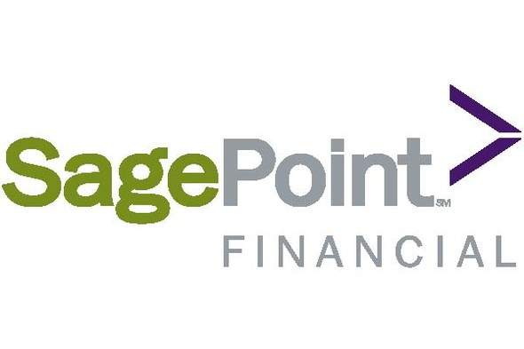


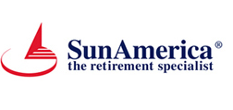





SunAmerica Financial Group
A group of companies that consist of financial advisors and insurance agents
The members:
Notes:
Paul

Slide 26
United Guaranty Corporation
Provides mortgage insurance products and services to mortgage lenders and credit unions of all sizes.
United Guaranty Residential Insurance Company
United Guaranty Residential Insurance Company of North Carolina and United Guaranty Credit Insurance Company
United Guaranty Commercial Insurance Company of North Carolina
United Guaranty Services, Inc.
United Guaranty Mortgage Indemnity Company
Notes:
Paul

Slide 27
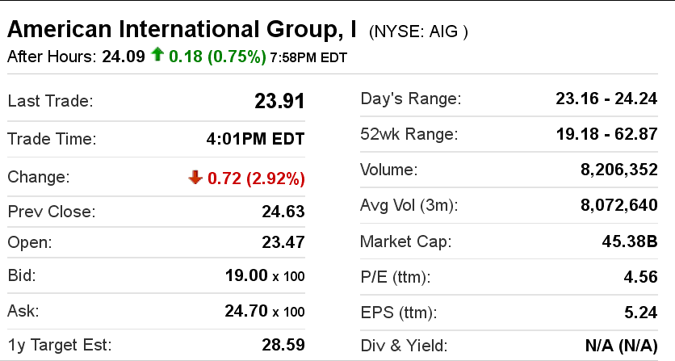
AIG Stock Info as of November 4, 2011
Notes:
Paul

Slide 28
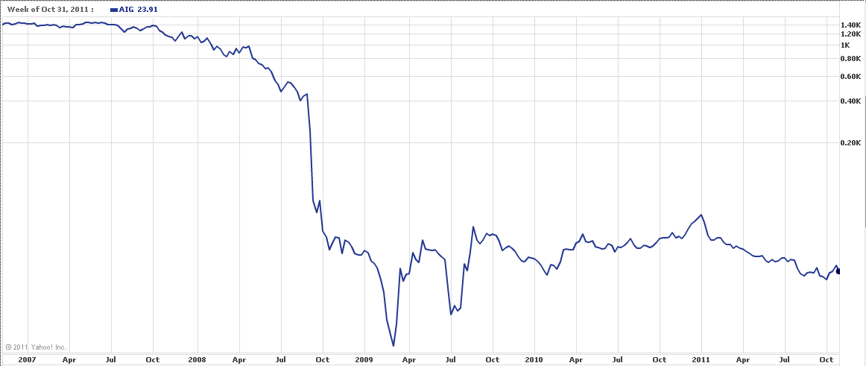
AIG Stock Info – Last 5 years.
Notes:
Paul

Slide 29
The AIG Crisis and Bailout
AIG Financial Products Corp. (AIGFP)
September 2008: Credit ratings downgraded below "AA" levels
The US Federal Reserve Bank created an $85 billion credit facility
The US Government would be entitled to 79.9% equity ownership of AIG (preferred stock)
Notes:
Paul

Slide 30
The AIG Crisis and Bailout – Cont.
November 2008, came up with :
Maiden Lane II (Lending Division)
Maiden Lane III (Credit default swap Division)
The US Treasury purchased $40 billion of newly issued AIG perpetual preferred shares through TARP
By 2009: $182.5 billion available financial support
Sold a few subsidiaries and assets
Notes:
Paul

Slide 31
Financial Statements
Notes:
Michael

Slide 32
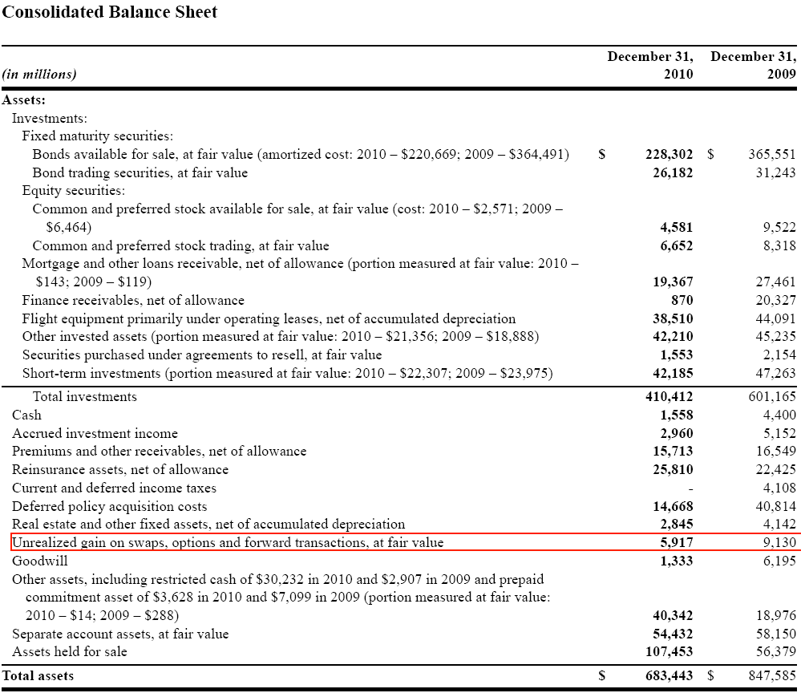
Balance Sheet
Notes:
Michael

Slide 33
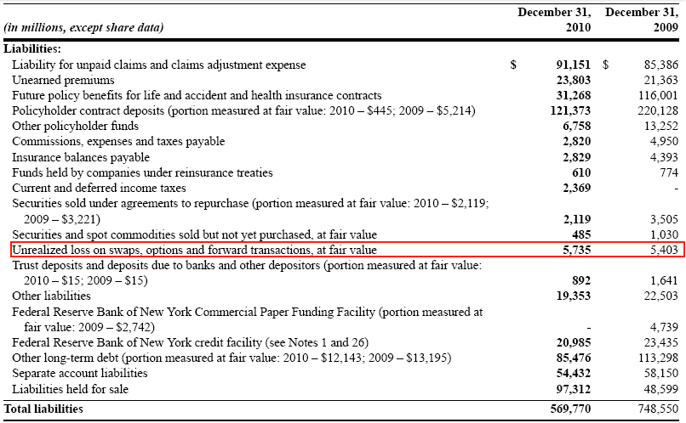
Balance Sheet
Notes:
Michael

Slide 34
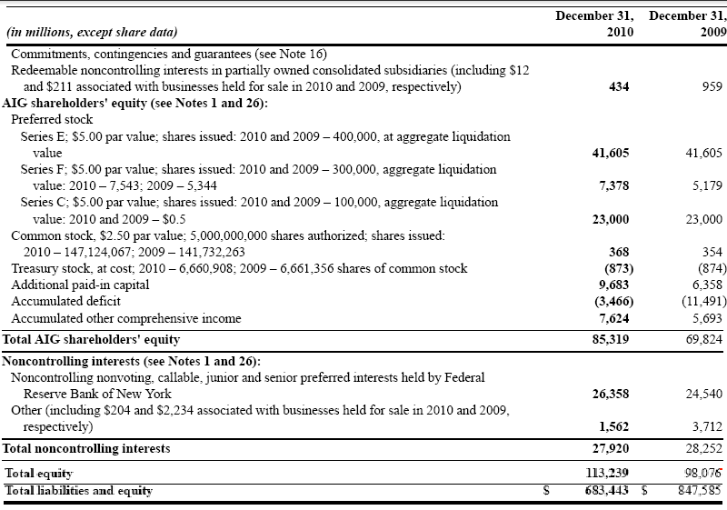
Balance Sheet
Notes:
Michael

Slide 35
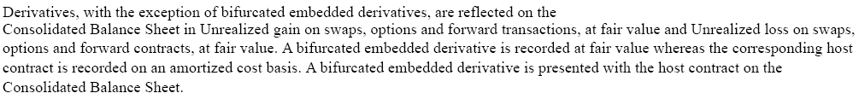
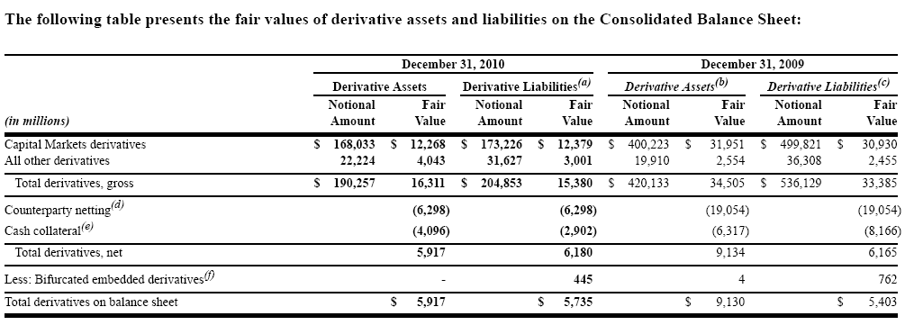
Balance Sheet Derivatives
Notes:
Michael

Slide 36
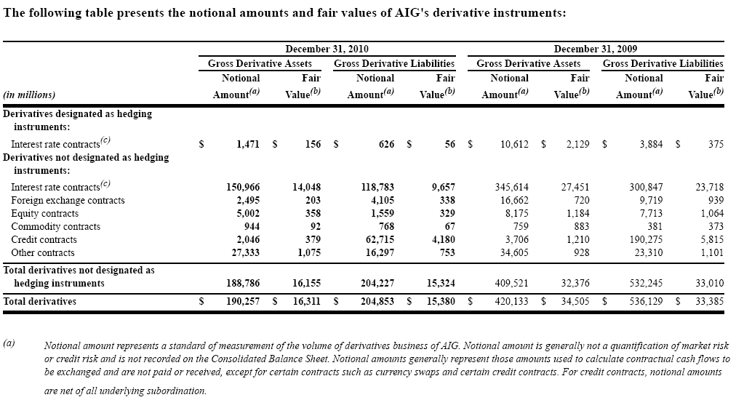
Balance Sheet Derivatives
Notes:
Michael

Slide 37
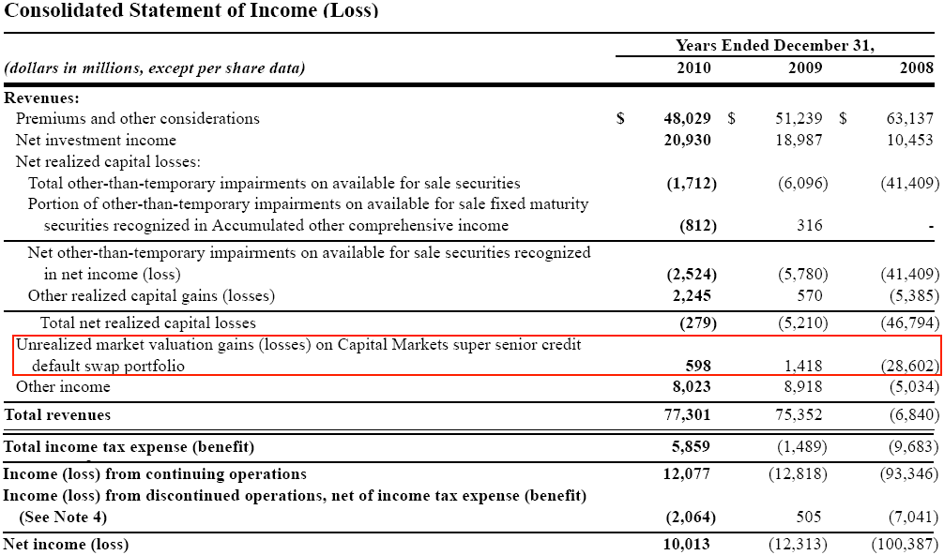
Income Statement
Notes:
Michael

Slide 38
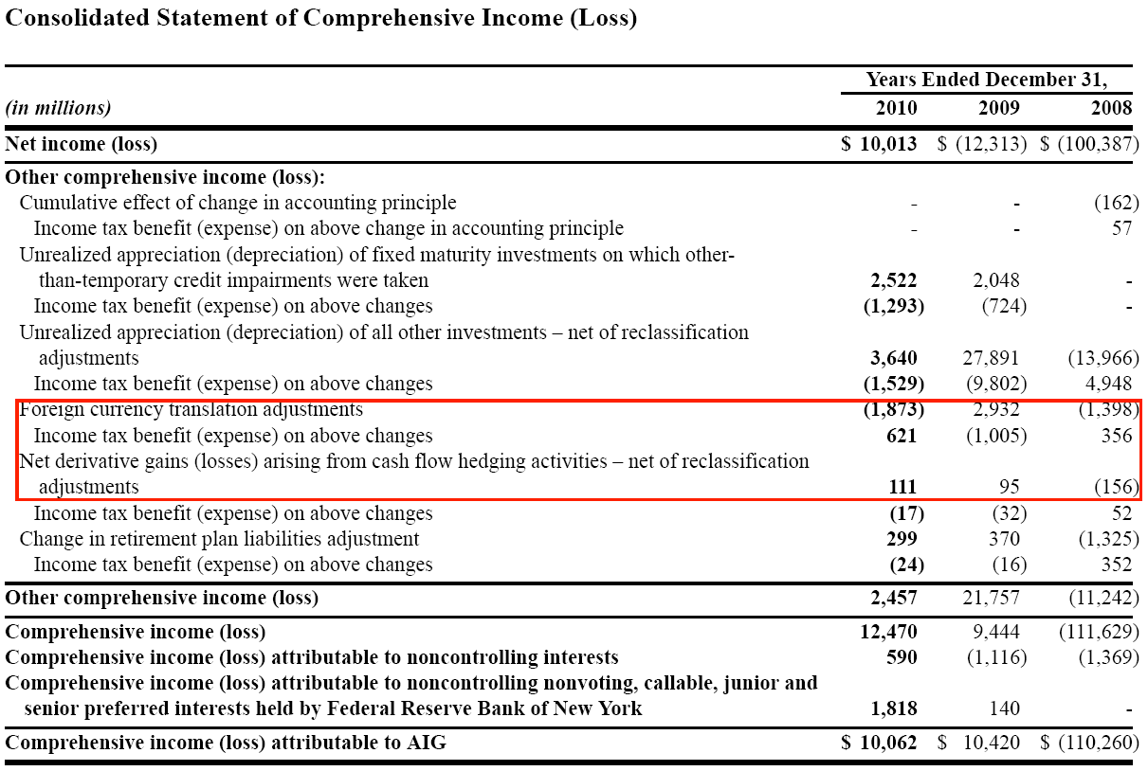
Income Statement
Notes:
Michael

Slide 39
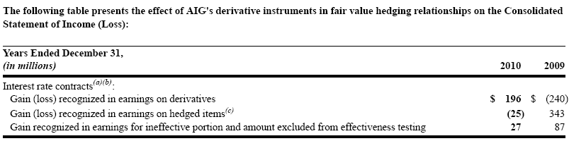
Income Statement Derivatives
Notes:
Michael

Slide 40
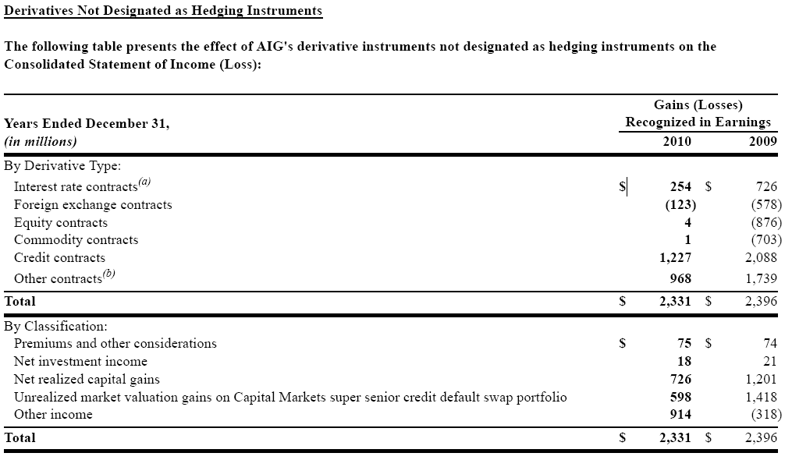
Non Hedging Derivatives
Notes:
Michael

Slide 41
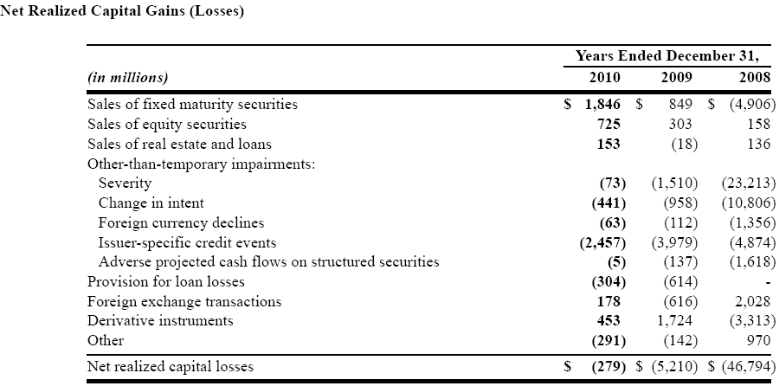
Net Realized Capital Gains
Notes:
Michael

Slide 42
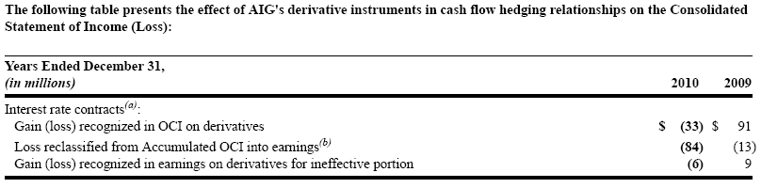
Cash Flow Hedging
Notes:
Michael

Slide 43
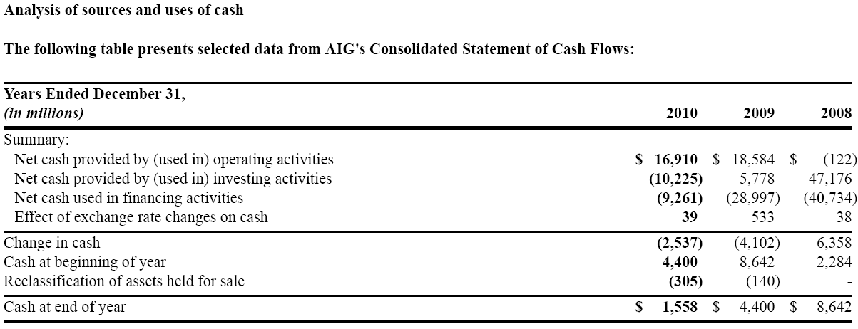
Cash Flows Condensed
Notes:
Michael

Slide 44
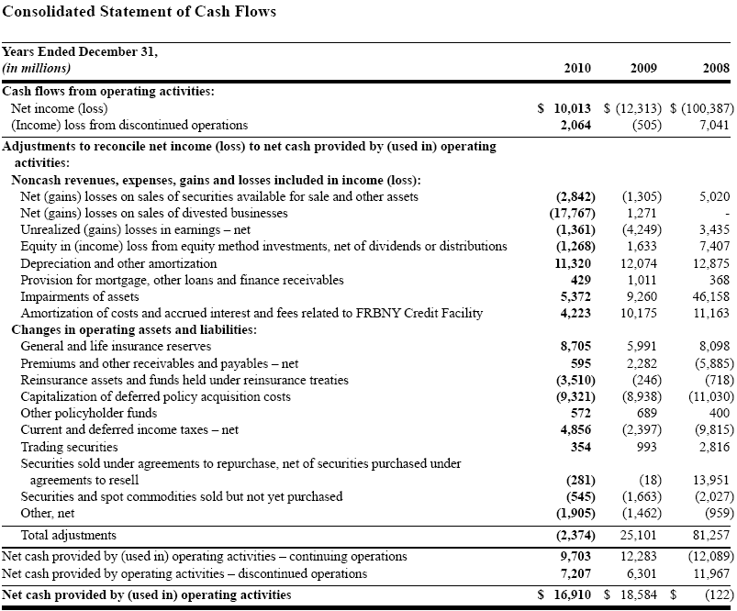
Cash Flows Operating
Notes:
Michael

Slide 45
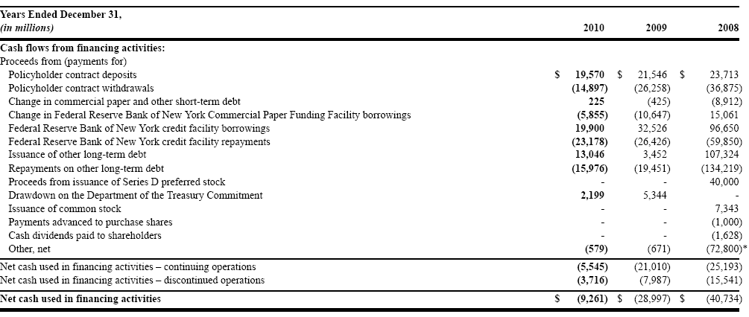
Cash Flows Financing
Notes:
Michael

Slide 46
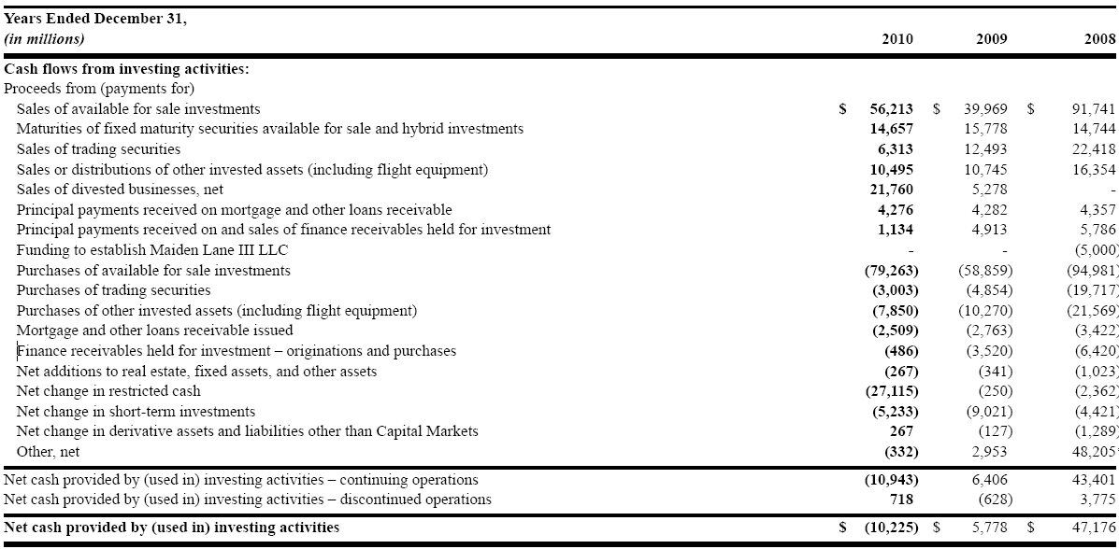
Cash Flow Investing
Notes:
Michael

Slide 47
Risk Factors
Notes:
Thomas

Slide 48
Risk Factors
Credit & Financial Strength Ratings
Market Conditions
Investment Portfolio & Concentration of Investments
Casualty Insurance
Competition
Guarantees with Variable Annuities
Notes:
Thomas

Slide 49
Risk Factors Cont.
Adjustments of Deferred Policy Acquisition Cost
Catastrophe Exposure
Reinsurance
Indemnity Obligations
Regulation
Change in Control
Notes:
Thomas

Slide 50
Risk Factors Cont.
Foreign Operations
Legal Proceedings
Use of Estimates
Aircraft Leasing Business
Liquidity
Notes:
Thomas

Slide 51
Risk Factors Cont.
Special Purpose Vehicle Intercompany Loans
Controlling Shareholder
Employees
Electronic Data Systems
Regulatory Capital Credit Default Swap Portfolios
Notes:
Thomas

Slide 52
Credit & Financial Strength Ratings
Credit and Financial Strength ratings measure the ability of the company to meet contract obligations
Establishes the company’s position relative to other companies
If ratings drop
Could limit new business
Lose current customers/business
Could require AIG to post additional collateral
Notes:
Thomas

Slide 53
Market Conditions
Insurance business is highly dependent on the business environment
If markets return to what they were a few years ago AIG could be affected by:
Decline in value of investment portfolio
Unrealized market valuation losses on investments
Impairments of good-will and other long lived assets
Increased liability from interest rate guarantees
Increase in policy surrenders and cancellations
Notes:
Thomas

Slide 54
Investment Portfolios & Concentration of Investments
Investment portfolio’s value affected by interest rates:
Can change from monetary policy changes, domestic and international political issues, and other factors
Concentration of investments:
Ability to sell may be limited because of others trying to sell in the same concentration
Ex. AIG has a large exposure to residential mortgage-backed securities, commercial mortgage-backed securities, and commercial mortgage loans
Notes:
Thomas

Slide 55
Casualty Insurance
Liabilities are difficult to predict
could exceed current reserves
Historical loss factors used to project future loss development
No guarantee that the future loss will follow the same pattern
Notes:
Thomas

Slide 56
Competition
Highly competitive market both domestically and overseas
Competing with insurance companies, banks, investment banks
1800 US life insurance co.
3300 other stock co. (competing with Chartis subsidiaries)
Position affected by credit ratings
Competing through: risk acceptance criteria, product pricing, and terms and conditions
Notes:
Thomas

Slide 57
Guarantees with Variable Annuities
Certain policies offered guarantee customers:
Guaranteed minimum death benefits, guaranteed minimum income benefits, guaranteed minimum withdrawal benefits, and guaranteed minimum account benefits
AIG uses derivatives and reinsurance to hedge some of this risk, not fully hedged
Notes:
Thomas

Slide 58
Adjustments of Deferred Policy Acquisition Cost
Interest rate changes, increased cancellations, increased investment returns may lead to accelerated amortization of deferred policy acquisition costs
Higher interest rates and investment returns cause an increase in the number of contracts surrendered
Forcing subsidiaries to accelerate the amortization of DACs
If this cost exceeds the cost of surrenders and withdrawals, business could be negatively affected
Notes:
Thomas

Slide 59
Catastrophe Exposure
Could cause widespread claim costs: property damage, worker’s compensation, morality and morbidity claims
Leads to a loss from declining value of investment assets
Notes:
Thomas

Slide 60
Reinsurance
The company reinsuring may not be able or willing to pay
Relying on a outside company
Bear credit risk with respect to reinsurers
If reinsurer can’t pay in time, AIG is still responsible to the policy holder
Notes:
Thomas

Slide 61
Indemnity Obligations
If indemnity claim is material:
AIG will be forced to obliged these claims
Will restrict cash flow, liquidity, and operations
Notes:
Thomas

Slide 62
Regulation
July 21, 2010 – Dodd-Frank Wall St. Reform and Consumer Protection Act
Can’t predict the requirements of the regulations that will be adopted and what their effect on AIG will be
May become subject to enforcer/supervisor authority as a savings and loan holding co.
May be forced to place financial activity in a intermediate holding co.
Designated Financial Company
Stress tests – whether or not AIG has necessary cap under adverse economic conditions
Notes:
Thomas

Slide 63
Regulation Cont.
If Designated Financial co. gave threat to US financial stability
Would be required to maintain a debt to equity ratio of no more than 15:1
Limit the ability of AIG to merge, acquire, consolidate, or become affiliated with other companies
Restrictions on the financial products offered
Required to terminate some current activities
Could be forced to sell or transfer assets to unaffiliated entities
Notes:
Thomas

Slide 64
Regulation Cont.
Valker Rule
If AIG continues to control AIG Federal Savings bank could be subject to this rule
Limits proprietary trading and the sponsorship/investment in hedge, private equity or similar funds
USA Patriot Act – 2001
Requires companies to know certain information about their clients and to monitor their transactions for suspicious activities
Notes:
Thomas

Slide 65
Change in Control
Ability to utilize tax losses and credit carryforwards to offset future taxable income may be limited under the Internal Revenue Code
Entities that experience ownership change generally subject to annual limitation on its pre-ownership change tax losses and credit carryforwards equal to the equity value of the corporation multiplied by the long-term, tax exempt rate
Ownership change could occur if Department of Treasury’s position falls bellow 50% of the current shares
Notes:
Thomas

Slide 66
Foreign Operations
Provides insurance, investment and other financial products and services in over 130 countries
Can be affected by regional economic downturns, foreign exchange rate fluctuations, political upheaval, nationalism and other restrictive government actions
Licenses issued to AIG subsidiaries could be modified or revoked
Insurance subsidiaries could be restricted from doing future business in certain countries
Notes:
Thomas

Slide 67
Legal Proceedings
Security class actions, and regulatory and government investigations
Unable to predict the maximum liability of these claims
No precise damage claims, and the types of claims are uncertain
Notes:
Thomas

Slide 68
Use of Estimates
Generally Accepted Accounting Principles:
Require some sections with significant degrees of judgment/estimation
Estimates could turn out to be inaccurate
Notes:
Thomas

Slide 69
Aircraft Leasing Business
Aircraft business depends on lease payments
Exposes AIG to several risks:
Lessee non-performance
Aircrafts become obsolete
Decline in demand of product
Notes:
Thomas

Slide 70
Liquidity
Need liquidity to pay operating expenses, interest on debt, to meet capital requirements of AIG’s subsidiaries
Payments to AIG Parent
Require funs (dividends) from subsidiaries to fund payments due on obligations
Some investments by subsidiaries are illiquid or difficult to sell
AIG Parent may be unable to assist subsidiaries with unexpected cash flow obligations – may be difficult for subsidiaries to generate liquidity because of these assets
Notes:
Thomas

Slide 71
Special Purpose Vehicle Intercompany Loans
If AIG is unable to satisfy obligations made, secured parties may have the right to foreclose upon and sell the assets that secure the loans
Would negatively affect the designated subsidiaries
Notes:
Thomas

Slide 72
Controlling Shareholder
The Department of the Treasury is AIG’s controlling shareholder with over 50% of current shares
This gives them control over:
Approval of mergers or other business combinations
A sale of all or substantially all of AIG’s assets
Amendments to AIG Parents amended certificate of incorporation
Other matters that might be favorable to the Department of the Treasury but not other shareholders
Notes:
Thomas

Slide 73
Controlling Shareholder Cont.
Department of the Treasury could transfer control to another entity
Department of the Treasury is granted registration rights with respect to shares of common stock issued for recapitalization
Right to participate in any registered offering of AIG common stock
Right to engage in at the market offerings
Right to approve the terms, conditions, and pricing of any registered offering in which it participates until ownership falls bellow 33%
Notes:
Thomas

Slide 74
Employees
President and Chief Executive Offers of AIG – Mr. Robert Benmosche
Diagnosed with cancer and may be unable to provide his services
American Recovery and Reinvestment Act of 2009
Restricts bonuses and other incentives payable to employees
Risk of employee fraud, error, failure to document properly or to obtain proper internal authorization, failure to comply with regulatory restrictions
Notes:
Thomas

Slide 75
Electronic Data Systems
Computer systems used to store, retrieve, evaluate, and utilize customer and company data
Systems rely on a 3rd party
If the system fails and employees are unable to access the data – business operations could be forced on hold until the system is repaired
Confidential information may be misused or mishandled leading to legal liabilities
Notes:
Thomas

Slide 76
Regulatory Capital Credit Default Swap Portfolio
Deterioration in credit markets may cause AIG to experience unrealized market valuation losses
Could be required to post additional collateral
Net of $38.1 Billion in credit default portfolio for providing capital relief rather than for arbitrage purposes
Notes:
Thomas

Slide 77
Management of Risk Factors
Notes:
Gordon

Slide 78
Major Risk Factors
AIG identifies four major risk to which the corporation is exposed to
Credit Risk
Market Risk
Operation Risk
Insurance Risk
Notes:
Gordon

Slide 79
Credit Risk
Potential loss arising from an obligor’s inability or unwillingness to meet its obligations to AIG.
Direct and indirect credit exposures
fixed income investments
deposits
corporate and consumer loans
counterparty risk in derivatives activities
cessions of insurance risk to reinsurers and customers
credit risk assumed through credit derivatives written
Notes:
Gordon

Slide 80
Managing Credit Risk
Managed at a corporate level by the AIG Credit Risk Management (CRM) department, lead by the Chief Credit Officer (CCO)
delegated credit authorities among executives and officers
manage the credit limits, program limits and credit
administer portfolio credit reviews of all business units, and recommend any corrective actions where required
develop methodologies for quantification and assessment of credit risks
approve appropriate credit reserves and methodologies at the business unit and enterprise levels
Notes:
Gordon

Slide 81
Managing Credit Risk
Uses third-party guarantees, reinsurance recoverable, letters of credit and trust accounts to minimize level of credit risk
Also manages industry concentrations
Current largest industry credit exposure is global financial institutions sector
Notes:
Gordon

Slide 82
Managing Credit Risk
AIG’s largest credit exposures as a percentage of total equity
Category | Risk Rating | of Total Equity (%)
Investment Grade:
10 largest combined | A+ | 84.4%
Single largest financial institution | AA- | 4.8
Single largest corporate | AAA | 2.9
Single largest sovereign | AAA | 21.3
Non-Investment Grade:
Single largest financial institution | BB- | 0.3
Single largest corporate | BB | 0.6
Single largest sovereign | BB | 0.1
Notes:
10 largest combined:
Six of the ten largest credit exposures are to financial institutions, three are to investment-grade rated sovereigns and one is to an AAA-rated corporate. Based on support from the U.S. Government, the exposure to government-sponsored entities (GSEs) and to mortgage-backed securities guaranteed by the GSEs is included in the U.S. Government total, rather than in financial institutions. None of the top ten is rated lower than BBB- or its equivalent.

Slide 83
Managing Credit Risk
AIG’s largest credit exposures to the global financial institution sector as a percentage of total equity
Industry | Credit Exposure as a Percentage of Total Equity
Money center / Global bank groups | 54.90%
European regional financial institutions | 11.1
Global reinsurance companies | 10.4
Global life insurance companies | 9.5
North American based regional financial institutions | 6.1
Global non-life insurance companies | 4.6
Global securities companies | 4.3
Supranational Banks | 4.2
Notes:
Gordon

Slide 84
Market Risk
Potential loss from fluctuations in interest rates, foreign currencies, equity and commodity prices, and their levels of volatility, etc
Managed by Market Risk Management and Independent Valuation (MRMIV), and Insurance Risk Management function (IRM)
AIG identifies the following factors as exposure to market risk
Benchmark interest rates
Credit spread or risk premium
Equity and alternative investment prices
Foreign currency exchange rates
Notes:
Gordon
The Market Risk Management and Independent Valuation function (MRMIV), which reports to the CRO, is
responsible for control and oversight of all frequently traded market risks within AIG. The Insurance Risk
Management function (IRM), which also reports to the CRO, is responsible for control and oversight of
non-frequently traded asset liability management risks and risk aggregation across AIG’s financial services,
insurance, and investment activities.
Benchmark interest rates. Benchmark interest rates are also known as risk-free interest rates and are associated with either the government / treasury yield curve or the swap curve. The fair value of AIG’s significant fixed maturity securities portfolio changes as benchmark interest rates change.
Credit spread or risk premium. Credit spread risk is the potential for loss due to a change in an instrument’s risk premium or yield relative to that of a comparable-duration, default-free instrument.
Equity and alternative investment prices. AIG’s exposure to equity and alternative investment prices arises from direct investments in common stocks and mutual funds, from minimum benefit guarantees embedded in the structure of certain variable annuity and variable life insurance products and from other equity-like investments, such as partnerships comprised of hedge funds and private equity funds, private equity investments, commercial real estate and real estate funds.
Foreign currency exchange rates. AIG is a globally diversified enterprise with significant income, assets and liabilities denominated in, and significant capital deployed in, a variety of currencies.

Slide 85
Managing Market Risk
Duration / key rate duration
Scenario analysis.
Value-at-Risk (VaR)
Stress testing
Notes:
Gordon
• Duration / key rate duration. Duration is the measure of the sensitivities of a fixed-income instrument to the parallel shift in the benchmark yield curve. Key rate duration measures sensitivities to the movement at a given term point on the yield curve.
• Scenario analysis. Scenario analysis uses historical, hypothetical, or forward-looking macro-economic scenarios to assess and report exposures. Examples of hypothetical scenarios include a 100 basis point parallel shift in the yield curve or a 10 percent immediate and simultaneous decrease in world-wide equity markets.
• Value-at-Risk (VaR). VaR is a summary statistical measure that uses the estimated volatility and correlation of market factors to calculate the maximum loss that could occur over a defined period of time with a specified level of statistical confidence. VaR measures not only the size of individual exposures but also the interaction between different market exposures, thereby providing a portfolio approach to measuring market risk. A key shortcoming of the VaR approach is its reliance on historical data, making VaR calculations essentially ‘‘backward looking.’’ This shortcoming was most evident during the recent credit crisis.
• Stress testing. Stress testing is a special form of scenario analysis whereby the scenarios used are designed to lead to a material adverse outcome (for example, the stock market crash of October 1987 or the widening of yields or spread of RMBS or CMBS during 2008). Stress testing is often used to address VaR shortcomings and complement VaR calculations. Particularly in times of significant volatility in financial markets, using stress scenarios provides more pertinent and forward-looking information on market risk exposure than VaR results based upon historical data alone.

Slide 86
Operational Risk
Potential loss resulting from inadequate or failed internal processes, people, and systems, or from external events
Each business unit is responsible for its operational risk
pro-actively address potential operational risk issues
assign ownership and accountability for addressing identified issues.
Notes:
Gordon

Slide 87
Insurance Risks
Of all the insurance risks, liquidity risk is the fundamental risk for insurance companies.
Potential loss resulting from inadequate premiums, insufficient reserves and catastrophic exposures.
Main contributors to solvency issues.
Notes:
Tommy

Slide 88
How AIG Manages Liquidity Risk
Compliance with financial reporting and capital and solvency targets.
Extensive use of reinsurance, both internal and third-party.
Review and establishment of reserves.
Notes:
Tommy

Slide 89
Insurance Risks
Specific types of risks to these areas of insurance
Life Insurance
Property and Casualty Insurance
Notes:
Tommy
Life: mostly to do with the lives of people: retirement products, disability insurance products, life insurance products
PandC: anything other than life, namely-automobile, house and mortgages, theft etc

Slide 90
Life Insurance Risk
Potential loss resulting from experience deviating from expectations for mortality, morbidity and termination rates in the insurance-oriented products and insufficient cash flows to cover contract liabilities in the retirement savings products.
SunAmerica has life insurance risks
Notes:
Tommy
“specifically to life insurance products: if everyone who purchased a life insurance policy today dies tomorrow, we would have to post a huge loss”

Slide 91
Primary Risks of SunAmerica
Pricing risk
Investment risk
Interest rate risk
Equity market risk
Notes:
Tommy
• Pricing risk, which represents the potential exposure to loss resulting from actual policy experience emerging adversely in comparison to the assumptions made in product pricing associated with investment results, mortality, morbidity, terminations and expenses;
• Investment risk, which represents the exposure to loss resulting from the cash flows from the invested assets being less than cash flows required to meet the obligations of the expected policy and contract liabilities and the necessary return on investments;
• Interest rate risk, which represents the exposure to loss due to the sensitivity of the liabilities and assets to changes in interest rates; and
• Equity market risk, which represents the potential exposure to higher claim costs for guaranteed benefits associated with variable annuities and the potential reduction in expected fee revenue.

Slide 92
Ways to Manage Life Insurance Risks
Appropriate product design
Sound medical underwriting
Active management of the asset-liability relationship
External reinsurance programs
SunAmerica generally limit their maximum underwriting exposure on life insurance of a single life to $15 million
Notes:
Tommy
-appropriate product design: don’t price a life insurance contract for a 20 yr old to be the same as an 80 yr old
-sound medical underwriting: don’t sell a policy (at regular rates) to someone who is diagnosed to die tomorrow
-external reinsurance programs: acts as a buffer to massive losses, limiting the exposure of a extremely large policies

Slide 93
Property and Casualty Insurance Risks
Chartis and Mortgage Guaranty have P&C risks
The mortgage insurance business (Mortgage Guaranty) manages risks through:
geographic location of the insured properties
the relative economic conditions in the local housing markets
credit attributes of the borrowers
the loan amount relative to the value of the respective collateral
Notes:
Tommy
Climate change and related regulatory initiatives may increase both the frequency and severity of claims or the
cost of defending such claims. Chartis policies are primarily written for periods of 12 months, providing Chartis
with the ability to modify underwriting practices and pricing procedures; limiting the financial impact of such
increase in claims. Each line of business and many individual policyholders may have different exposures to the
effects of climate change. While it is not possible to precisely quantify the impact of a policyholder’s operations on
climate change, underwriters routinely evaluate the potential effect on greenhouse gas emissions when considering
policy renewals. Property and casualty insurance policies typically exclude or significantly limit coverage for
pollution and related environmental damage. While these pollution exclusions have sustained judicial scrutiny and
have not been overturned by judicial decisions, there can be no assurance that future court decisions will uphold
prior case law precedents.

Slide 94
Property and Casualty Insurance Risks
Chartis are exposed to different risks:
climate change
wind
flood
earthquake
terrorism
environmental damage
Notes:
Tommy
Climate change and related regulatory initiatives may increase both the frequency and severity of claims or the
cost of defending such claims. Chartis policies are primarily written for periods of 12 months, providing Chartis
with the ability to modify underwriting practices and pricing procedures; limiting the financial impact of such
increase in claims. Each line of business and many individual policyholders may have different exposures to the
effects of climate change. While it is not possible to precisely quantify the impact of a policyholder’s operations on
climate change, underwriters routinely evaluate the potential effect on greenhouse gas emissions when considering
policy renewals. Property and casualty insurance policies typically exclude or significantly limit coverage for
pollution and related environmental damage. While these pollution exclusions have sustained judicial scrutiny and
have not been overturned by judicial decisions, there can be no assurance that future court decisions will uphold
prior case law precedents.

Slide 95
Property and Casualty Insurance Risks
Terrorism and environmental damage are managed differently than wind, flood, and earthquake, which are natural disasters.
Exposure to loss from terrorism is controlled by limiting the total insurance that is underwritten within a location.
Typically exclude or significantly limit coverage for pollution or related environmental damage.
Notes:
Tommy

Slide 96
Property and Casualty Insurance Risks
Risks from catastrophes like hurricanes and earthquakes are managed using a combination of techniques:
setting aggregate limits in key business units
monitoring and modeling accumulated exposures
purchasing catastrophe reinsurance
Notes:
Tommy

Slide 97
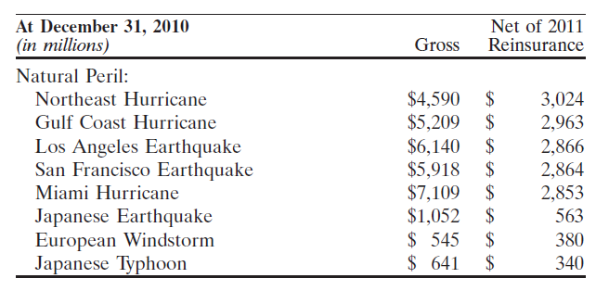
Property and Casualty Insurance Risks
Modelling of Real Disaster Scenarios:
Notes:
Tommy
Single-event modeled property and workers’ compensation losses to AIG’s worldwide portfolio of risk for key geographic areas are set forth below. Gross values represent AIG’s liability after the application of policy limits and deductibles and net values represent losses after reinsurance is applied. The net losses also include
reinsurance reinstatement premiums. Both gross and net losses include loss adjustment expenses.
Total gross: 31204 , Total Net: 15,853.

Slide 98
Managing Risks with Reinsurance
AIG uses reinsurance programs for its insurance risks as follow:
Facultative agreements to cover large individual exposures
Quota share treaties to cover specific books of business
Excess-of-loss treaties to cover large losses
Notes:
Tommy
Reinsurance
AIG monitors its exposures to natural catastrophes and takes corrective actions to limit its exposure with
respect to particular geographic areas, companies, or perils.
The RSD conducts periodic detailed assessments of the financial status and condition of current and potential
reinsurers, both foreign and domestic. The RSD monitors both the nature of the risks ceded to the reinsurers and
the aggregation of total reinsurance recoverables ceded to reinsurers. Such assessments may include, but are not
limited to, identifying whether a reinsurer is appropriately licensed and has sufficient financial capacity and
evaluating the local economic environment in which a foreign reinsurer operates.

Slide 99
Managing Risks with Reinsurance cont.
AIG uses reinsurance programs for its insurance risks as follow:
Excess or surplus automatic treaties to cover individual life risks in excess of stated per-life retention limits
Catastrophe treaties to cover specific catastrophes, including earthquake, windstorm and flood
Notes:
Tommy
Reinsurance
AIG monitors its exposures to natural catastrophes and takes corrective actions to limit its exposure with
respect to particular geographic areas, companies, or perils.
The RSD conducts periodic detailed assessments of the financial status and condition of current and potential
reinsurers, both foreign and domestic. The RSD monitors both the nature of the risks ceded to the reinsurers and
the aggregation of total reinsurance recoverables ceded to reinsurers. Such assessments may include, but are not
limited to, identifying whether a reinsurer is appropriately licensed and has sufficient financial capacity and
evaluating the local economic environment in which a foreign reinsurer operates.

Slide 100
Risk Management Recommendations

Slide 101
Risk Management Recommendations
Credit Risk
Market Risk
Operation Risk
Insurance Risk

Slide 102
Questions?

