Slide 1
Agriculture
The Andersons and ADM
Mengying Chen (Carol), Ho Cheung Chak (Eric), Jia Xu

Slide 2
Outline
Industry Analysis
  Economic
  Market
The Andersons
  Company Overview
  Financial Statement Analysis
  Risk Management
ADM
  Company Overview
  Financial Statements Analysis
  Risk Management

Slide 3
Industry overview

Slide 4
Industrial Agriculture
Livestock
Poultry
Fish
Crops
Notes:
http://www.admc.hct.ac.ae/hd1/english/graphs/line_read_industrial_farms.pdf

Slide 5
History
Agricultural production across the world doubled four times between 1820 and 1975 to feed a global population of one billion human beings in 1800 and 6.5 billion in 2002.
Meanwhile, the number of people involved in farming dropped as the process became more automated, as well as the number of farms has also decreased in terms of more concentrated ownership.
In the 1930s, 24 percent of the American population worked in agriculture compared to 1.5 percent in 2002; in 1940, each farm worker supplied 11 consumers, whereas in 2002, each worker supplied 90 consumers.
In the U.S., four companies kill 81 percent of cows, 73 percent of sheep, 57 percent of pigs, and produce 50 percent of chickens, cited as an example of "vertical integration" by the president of the U.S. NatioFarmers' Union
Notes:
http://www.newworldencyclopedia.org/entry/Industrial_agriculture

Slide 6
Trend
Massive Growth in food demand
A continuing ramp up in efficiency
Innovation defines success
Convenience and health take center stage
Notes:
https://www.jimcarroll.com/2005/12/10-big-trends-for-agriculture/#.VaTGqJNVikr

Slide 7
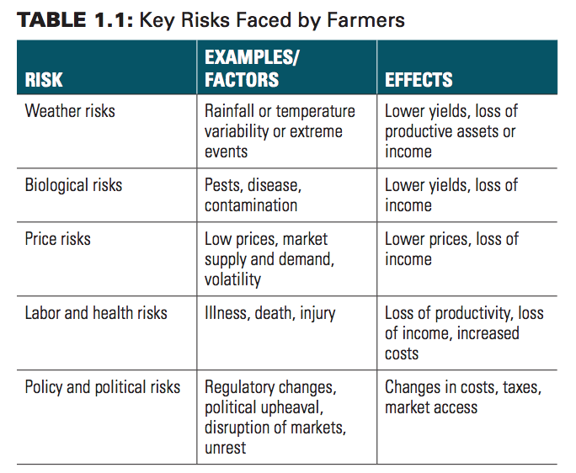
Risk Factors in Agriculture
Production Risk
Price Risk
Casualty Risk
Legal Uncertainty
Personal Uncertainty

Slide 8
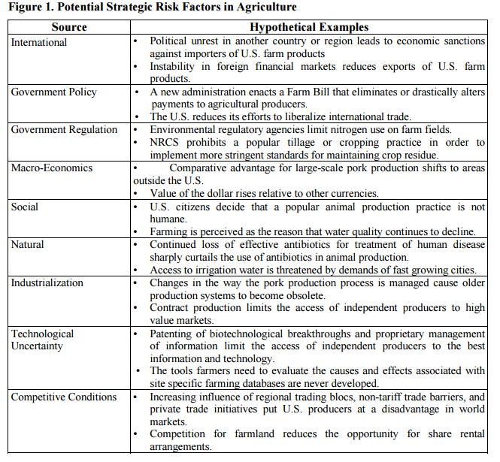

Slide 9
Risk Management
Avoidance
Reduction
Assumption/retention
Transfer
Notes:
http://www.oecd.org/agriculture/agricultural-policies/49003833.pdf
http://core.ac.uk/download/pdf/7089262.pdf
http://www.ictsd.org/downloads/2011/12/risk-management-in-agriculture-and-the-future-of-the-eus-common-agricultural-policy.pdf

Slide 10
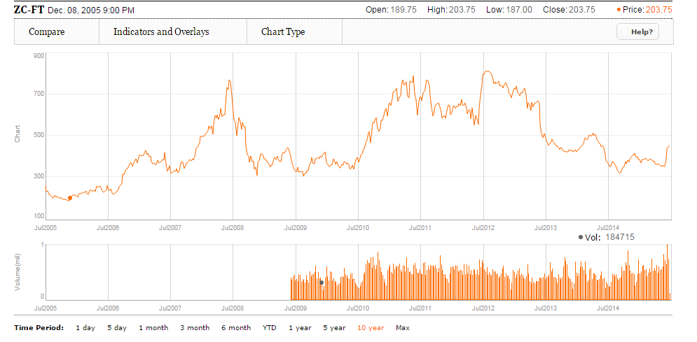
Corn
Notes:
http://www.theglobeandmail.com/globe-investor/markets/indexes/chart/?q=ZC-FT

Slide 11
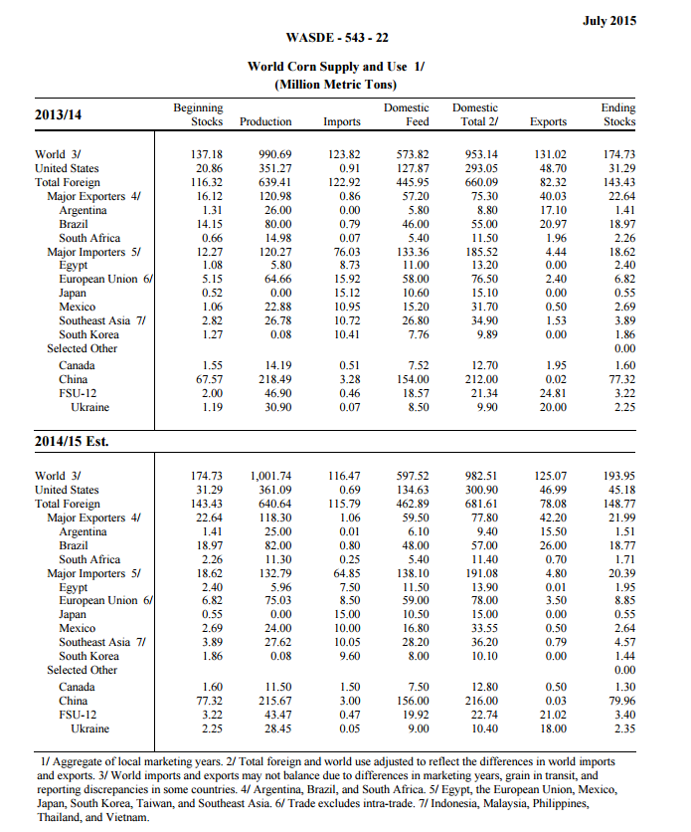
Notes:
http://usda.mannlib.cornell.edu/usda/current/wasde/wasde-07-10-2015.pdf

Slide 12
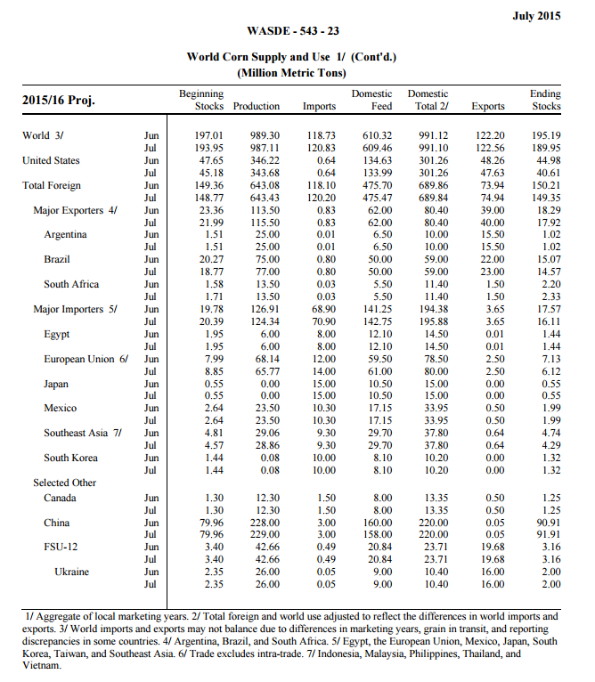

Slide 13
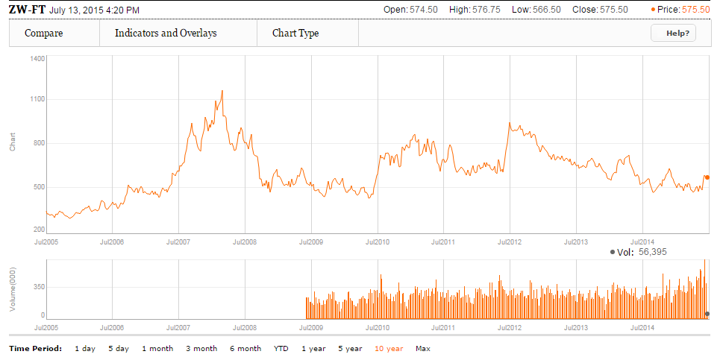
Wheat

Slide 14
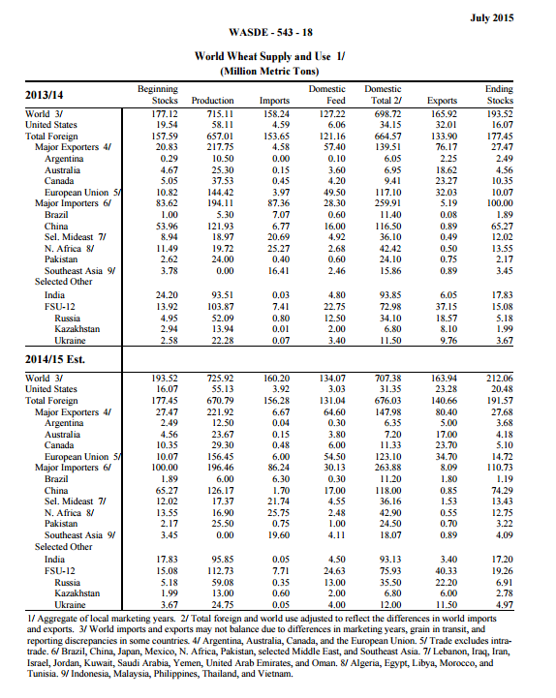

Slide 15
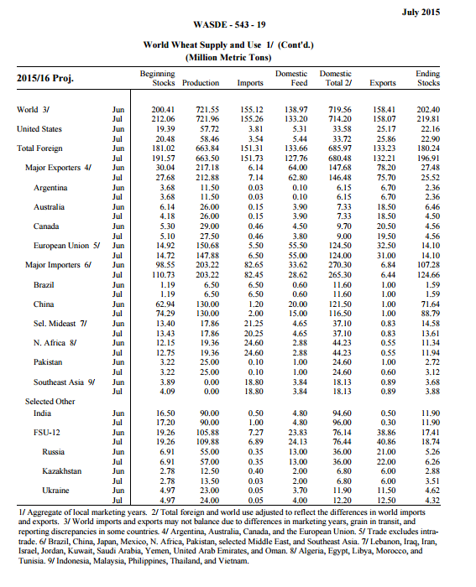

Slide 16
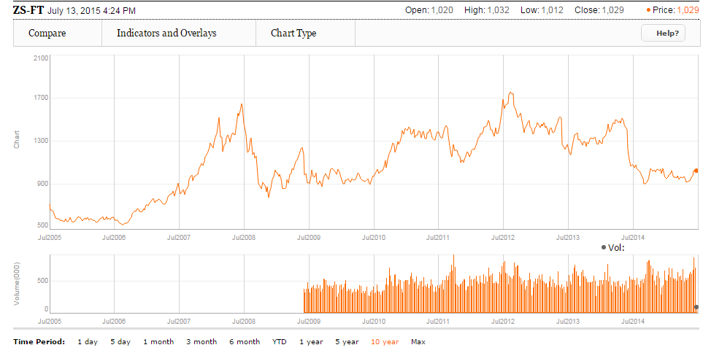
Soybean

Slide 17
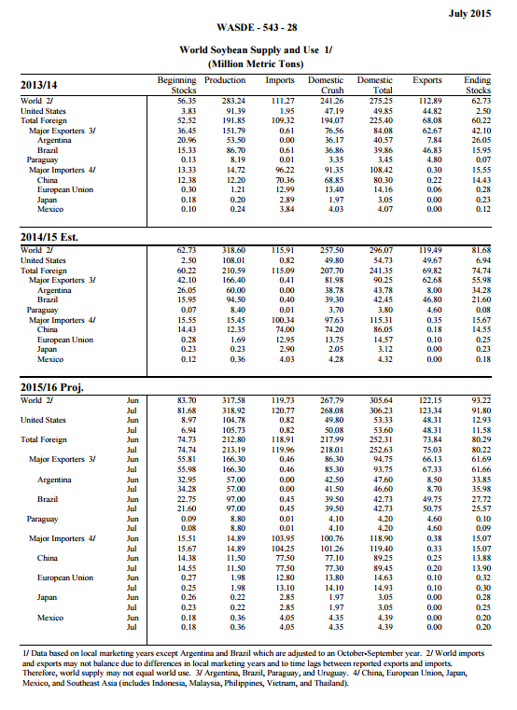

Slide 18
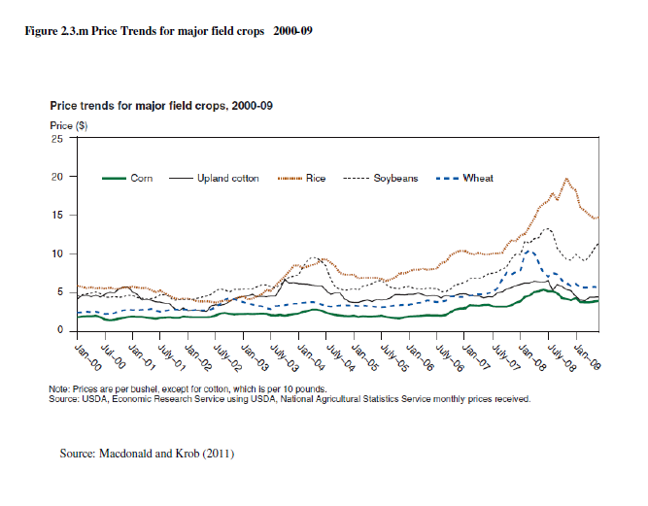

Slide 19
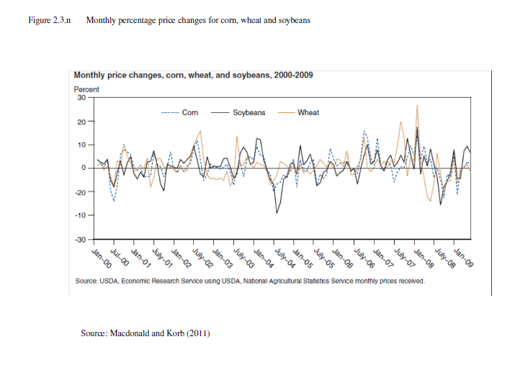

Slide 20
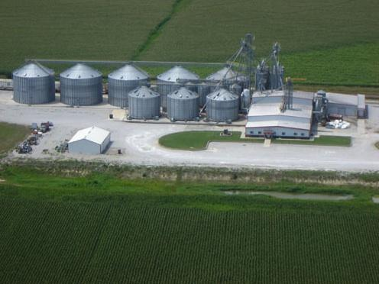
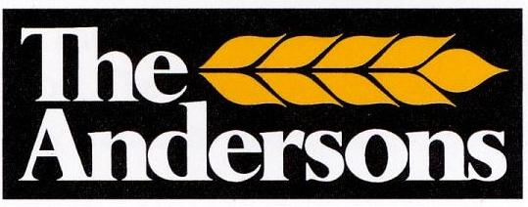

Slide 21
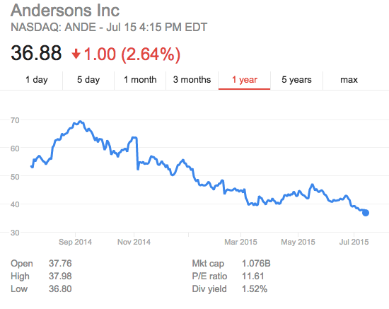
Stock price

Slide 22
Company Overview
Traded in NasdaqGS
Focuses mainly on grain related services e.g., risk management, marketing, crop insurance and grain transportation
Provides merchandising, production and distribution of products and services to the agribusiness community.

Slide 23
Primary Market Segments
Grain
Ethanol
Rail
Plant Nutrient
Turf & Specialty
Retail

Slide 24
Grain Group
Corn, soybeans and wheat
Operates grain elevators in various states in the U.S. Corn Belt
Earns income by:
  Buying and selling (mostly using forward)
  Conditioning for resale
  Space income (“appreciation or depreciation in the basis value of grain held”)

Slide 25
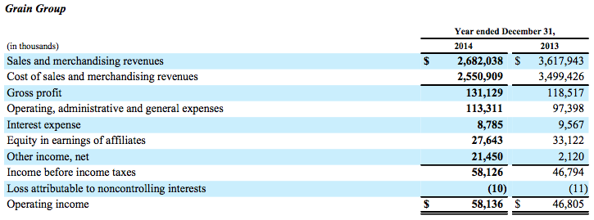
Grain Group (Operating Results)
Notes:
Sales and merchandising revenues decreased over 2013 and are almost entirely a result of a decrease in commodity prices.
Operating expenses were higher than 2013. Approximately half of the increase in operating expenses relates to labor and benefit costs, including growth and incentive compensation expense.

Slide 26
Ethanol Group
Part ownership of 3 LLC’s, each of which owns an ethanol plant operated by The Andersons
Grain group has exclusive rights to provide all corn to each plant
The company buys from 50-100% of the ethanol from each plant for resale
Ethanol group provides operations and administration of each plant

Slide 27
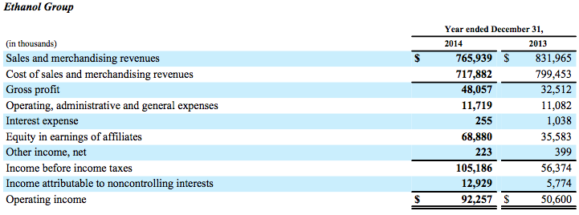
Ethanol Group (Operating Results)
Notes:
Throughout the year, the ethanol facilities' performance improved due to higher margins resulting from the decreased corn costs and higher demand for ethanol.

Slide 28
Plant Nutrient Group
Manufactures and distributes agricultural plant nutrients
Operates 27 manufacturing/distribution locations
Manufactures, stores, distributes agricultural nutrients, lime and gypsum pellets
Also manufactures and distributes industrial products (de-icers for plane runways, water treatment products)

Slide 29
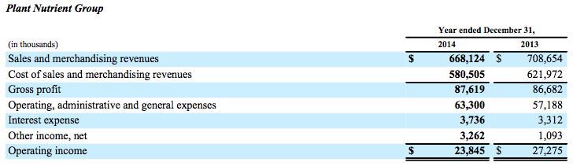
Plant Nutrient Group (Operating Results)
Notes:
Sales and merchandising revenues decreased due to a nine percent decrease in the average price, which followed the price of nutrients in the market.

Slide 30
Rail Group
Repairs, sells, leases locomotives, railcars, containers
Fleet management services offered to private railcar owners
Invested in Iowa Northern Railway Company

Slide 31
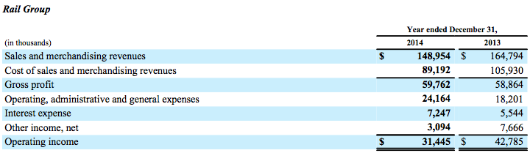
Rail Group (Operating Results)
Notes:
Rail gross profit increased only slightly over the prior year. Operating expenses increased from last year mainly due to higher labor and benefits costs, depreciation, and maintenance expense from recent expansion in the repair business.

Slide 32
Turf & Specialty Group
Turf Products
  Golf courses, turf care markets
  Also sells fertilizer
Cob Products
  Processes corncob based products for animal litter, among other things

Slide 33
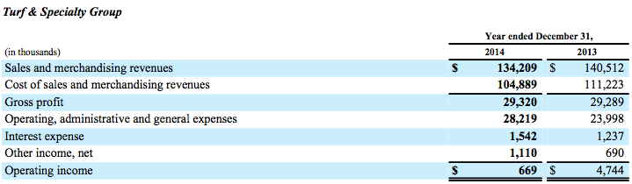
Turf & Specialty Group (Operating Results)
Notes:
Despite the decreases in volume and price, gross profit remained flat due to favorable product mix. Operating expenses increased also due to an increase in labor and benefit costs, and depreciation expense due to the impact of a full year of activity from the December 2013 acquisition.

Slide 34
Retail Group
  Retail stores “The Andersons”
  Specialty foods
  Home improvement products

Slide 35

Retail Group (Operating Results)

Slide 36
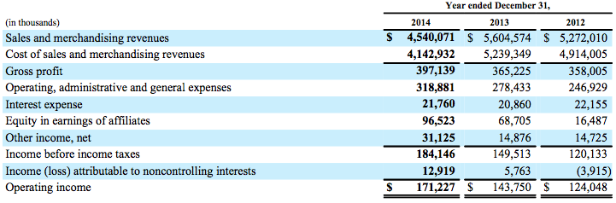
Total operating results

Slide 37
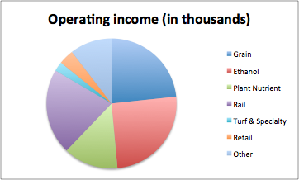
Composition of income before tax 2013
Group type | Operating income (in thousands)
Grain | 46805
Ethanol | 50600
Plant Nutrient | 27275
Rail | 42785
Turf & Specialty | 4744
Retail | -7534
Other | -20925

Slide 38
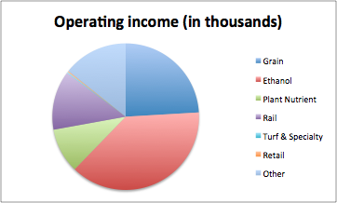
Composition of income before tax 2014
Group type | Operating income (in thousands)
Grain | 58136
Ethanol | 92257
Plant Nutrient | 23845
Rail | 31445
Turf & Specialty | 669
Retail | -620
Other | -34505

Slide 39
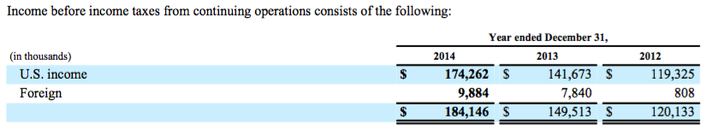
Geographical distribution

Slide 40

Financial Statements

Slide 41
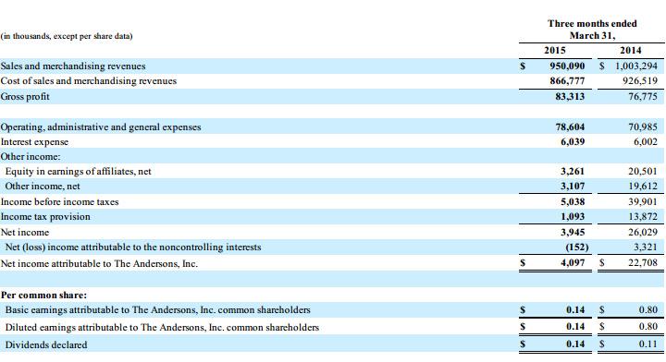
Consolidated Statement of Income

Slide 42
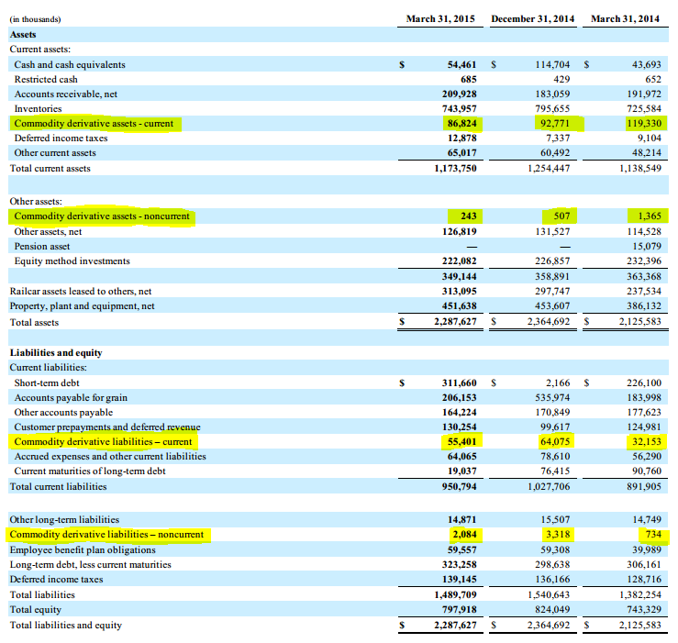
Consolidated Balance Sheet

Slide 43
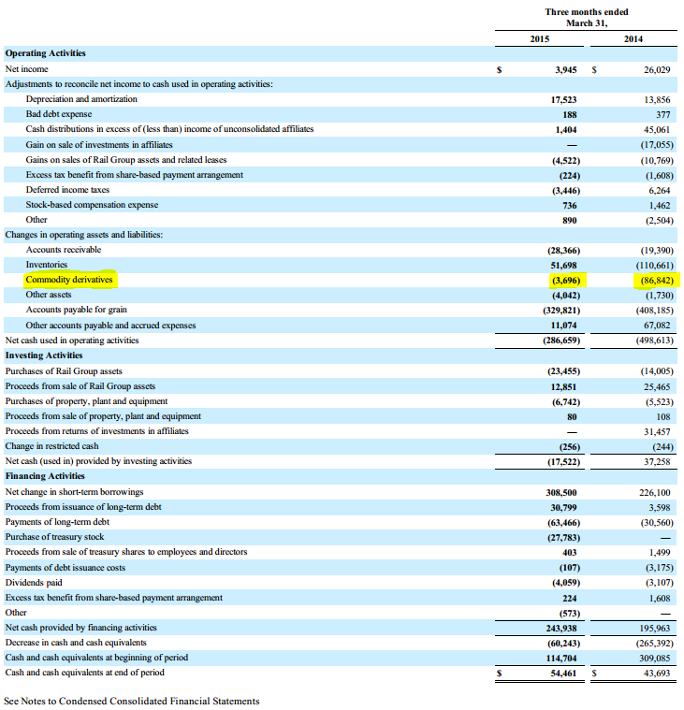
Consolidated Statement of Cash Flows

Slide 44
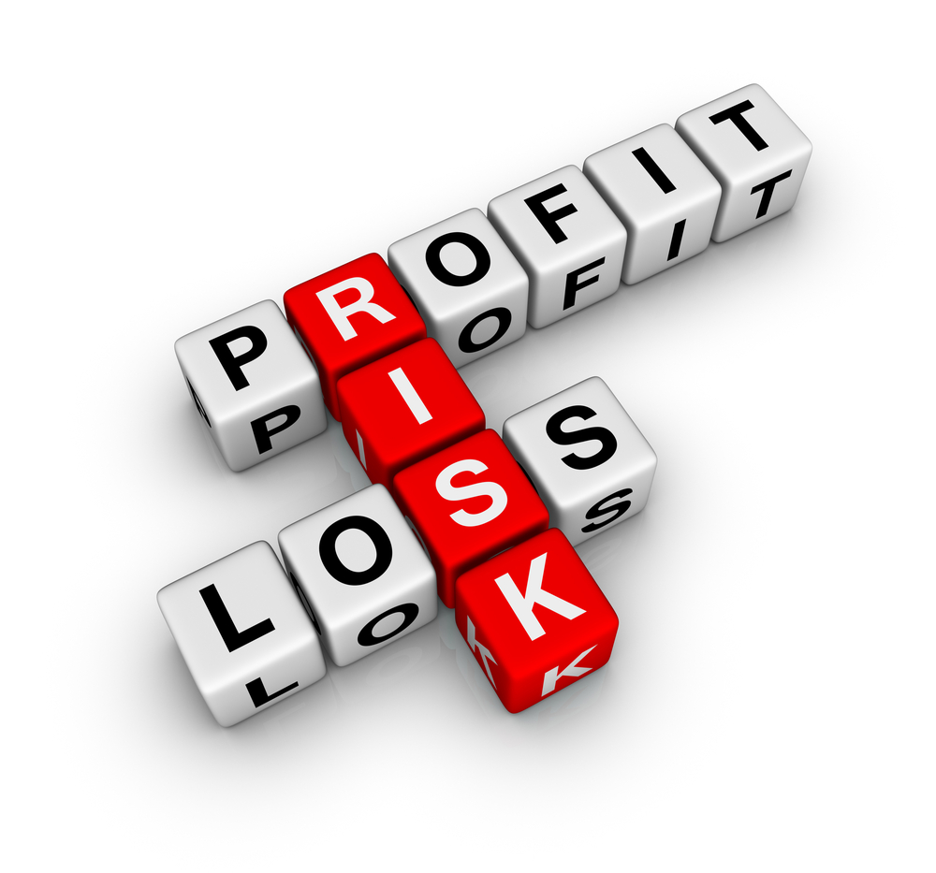
Risk Management

Slide 45
The closest thing to a hedging philosophy available
The Company's grain risk management practices are designed to reduce the risk of changing commodity prices. In that regard, such practices also limit potential gains from further changes in market prices.

Slide 46
Risk Factors
Affected by the supply and demand of commodities, and are sensitive to factors outside of our control. Adverse price movements could negatively affect our profitability and results of operations.
Changes in government regulations or trade association policies could adversely affect our results of operations.
Significant amounts of inventory: If a substantial portion of our inventory becomes damaged or obsolete, its value would decrease and our profit margins would suffer.
Notes:
Certain of our business segments are affected by the supply and demand of commodities, and are sensitive to factors outside of our control. Adverse price movements could negatively affect our profitability and results of operations.
Some of our business segments operate in highly regulated industries. Changes in government regulations or trade association policies could adversely affect our results of operations.
We are required to carry significant amounts of inventory across all of our businesses. If a substantial portion of our inventory becomes damaged or obsolete, its value would decrease and our profit margins would suffer.

Slide 47
Risk Factors (Cont’d)
Substantial indebtedness: decrease liquidity and impair the ability to operate the business.
Increasing competition and pricing pressure from other companies in this industries. If unable to compete effectively with them, sales and profit margins would decrease, in addition earnings and cash flows would be adversely affected.
Non-performance by the counter-parties to the direvative contracts being used
Notes:
Our substantial indebtedness could negatively affect our financial condition, decrease our liquidity and impair our ability to operate the business.
We face increasing competition and pricing pressure from other companies in our industries. If we are unable to compete effectively with these companies, our sales and profit margins would decrease, and our earnings and cash flows would be adversely affected.
Our grain and ethanol businesses use derivative contracts to reduce volatility in the commodity markets. Non-performance by the counter-parties to those contracts could adversely affect our future results of operations and financial position.

Slide 48
Method of Risk Management
Commodity Prices:
  Uses Futures, Options, and OTC contracts
Interest Rate
  Short-term:
    Interest Cap
  Long-term
    Interest Swap, Cap and Collar
FX rate
  Foreign exchange forward rate agreements

Slide 49
Market risk overview
The agricultural commodity-based business is one in which changes in selling prices generally move in relationship to changes in purchase prices. Therefore, changes in prices of the agricultural commodities that will have a relatively equal impact on sales revenue and cost. So we don’t need to worry this too much.
The market risk inherent in the Company's market risk-sensitive instruments and positions is the potential loss arising from adverse changes in commodity prices and interest rates

Slide 50
Commodity
The Company's daily net commodity position consists of inventories, related purchase and sale contracts and exchange-traded futures and over-the-counter contracts. The fair value of the position is a summation of the fair values calculated for each commodity by valuing each net position at quoted futures market prices. The Company has established controls to manage and limit risk exposure, which consists of daily review of position limits and effects of potential market prices moves on those positions.

Slide 51
Commodity (Cont’d)
The forward contracts are for physical delivery of the commodity in a future period. These forward contracts generally relate to the current or following marketing year for delivery periods quoted by regulated commodity exchanges. The terms of the forward contracts are consistent with industry standards.

Slide 52
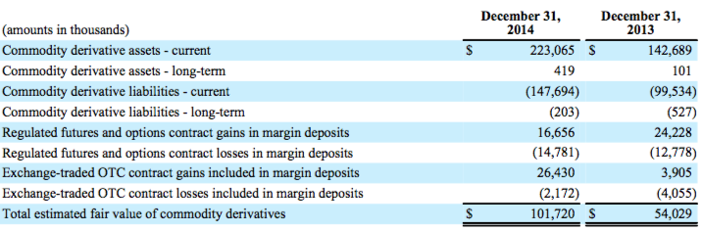
Commodity (Cont’d)

Slide 53
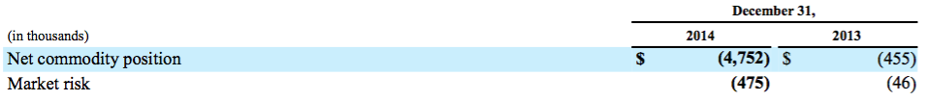
Sensitivity Analysis (commodity)
Market risk is estimated as the potential loss in fair value resulting from a hypothetical 10% adverse change in quoted market prices.

Slide 54
Problems on risk management
Our grain and ethanol businesses use derivative contracts to reduce volatility in the commodity markets. Non-performance by the counter-parties to those contracts could adversely affect our future results of operations and financial position.
The initial and maintenance margin deposit sent to CME could influence the company’s cash liquidity.
There is no assurance that the efforts we have taken to mitigate the impact of the volatility of the prices of commodities upon which we rely will be successful and any sudden change in the price of these commodities could have an adverse effect on our business and results of operations.
Notes:
“Our futures, options and over-the-counter contracts are subject to margin calls. If there is a significant movement in the commodities market, we could be required to post significant levels of margin, which would impact our liquidity.”

Slide 55
Interest Rate
The fair value of the Company's long-term debt is estimated using quoted market prices or discounted future cash flows based on the Company's current incremental borrowing rates and credit ratings for similar types of borrowing arrangements.
The company is exposed to interest rate risk through their borrowing and financing. To mitigate this, they use long term interest rate swaps

Slide 56
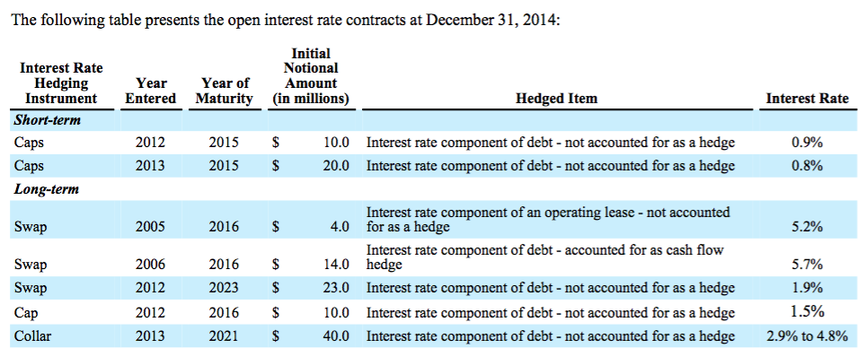
Interest Rate (Cont’d)

Slide 57
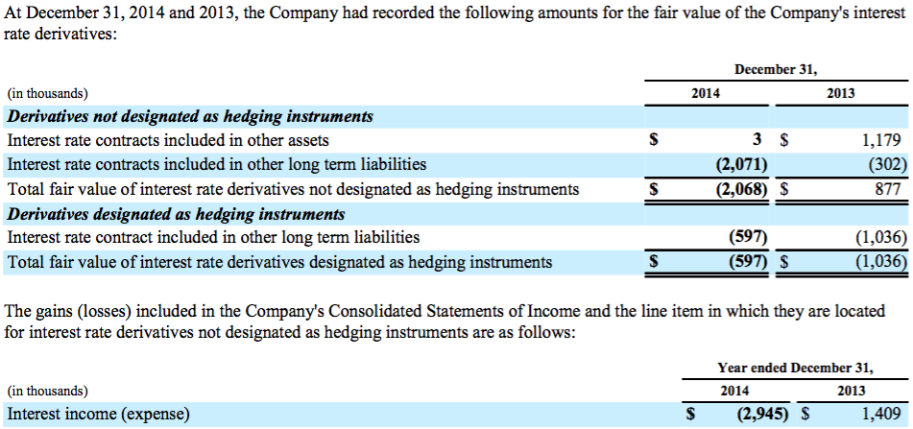
Interest Rate (Cont’d)

Slide 58
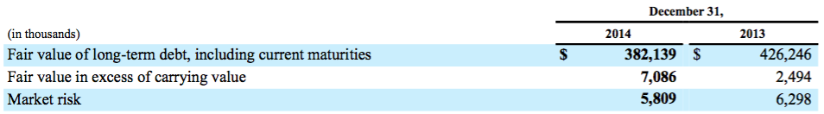
Sensitivity Analysis (Interest Rate)
Market risk, which is estimated as the potential increase in fair value resulting from a hypothetical one-half percent decrease in interest rates

Slide 59
Foreign Currency Risk
The Company uses foreign exchange forward rate agreements in certain operations to mitigate the risk from exchange rate fluctuations in connection with anticipated transactions denominated in foreign currencies.
To reduce the exposure to foreign currency exchange risk on foreign currency-denominated forward purchase and sale contracts, the Company may enter into regulated commodity futures that are not denominated in a foreign currency. The net gain and loss on these hedging activities offset the foreign currency transaction net gain and loss and are included in cost of goods sold.

Slide 60
Foreign Currency Risk (Cont’d)
The fair value of the Company's foreign exchange forward rate agreements was a net loss of $2,354,929 and $922,651 at December 31, 2014 and 2013, respectively, and was included in margin deposits.
Notes:
This is all the data we can find from their 10-K. And it seems they do not pay too much attention on this.

Slide 61
Special accounting policy
Market-to-market
While the Company considers its commodity contracts to be effective economic hedges, the Company does not designate or account for its commodity contracts as hedges. Realized and unrealized gains and losses in the value of commodity contracts and grain inventories are included in sales and merchandising revenues in the Consolidated Statements of Income.

Slide 62
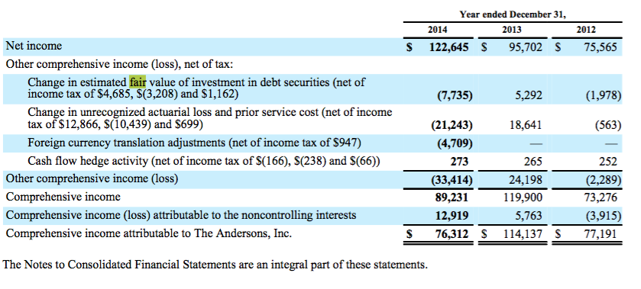
Consolidated Statements of Comprehensive Income

Slide 63
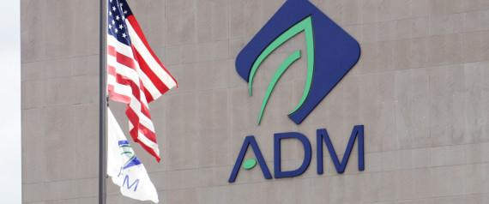

Slide 64
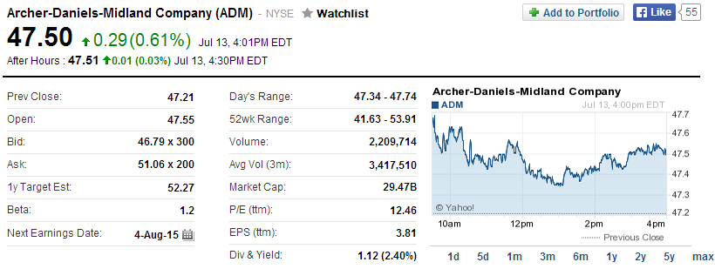

Slide 65
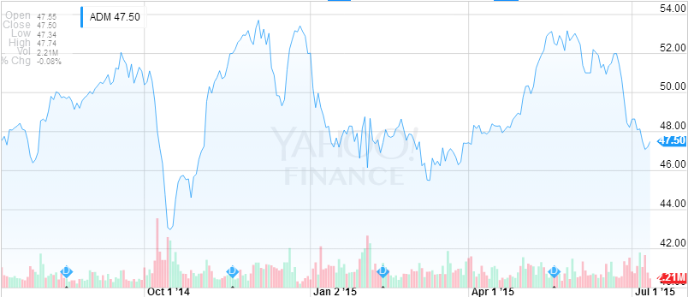
Notes:
high price 47.74 low price 47.34

Slide 66
Company Overview
The Archer Daniels Midland Company (ADM) is an American global food-processing and commodities-trading corporation, headquartered in Chicago, Illinois.
In 1923, the Archer-Daniels-Midland Company was formed.
One of the world’s largest processors of agricultural commodities
Leading manufacturer of value-added food and feed ingredients; an extensive grain elevator and transportation network to procure, store, clean, and transport agricultural commodities.
The Company has significant investments in joint ventures.
Notes:
The Archer Daniels Midland Company (ADM) is an American global food-processing and commodities-trading corporation, headquartered in Chicago, Illinois.[2][3][4]
it is One of the world’s largest processors of agricultural commodities
The company operates more than 270 plants and 420 crop procurement facilities worldwide, where cereal grains and oilseeds are processed into products used in food, beverage, nutraceutical, industrial, and animal feed markets worldwide.

Slide 67
Company Overview
Vision: is to be the most admired global agribusiness while creating value and growing responsibly.
Strategy: involves expanding the volume and diversity of crops that it merchandises and processes, expanding the global reach of its core model, and expanding its value-added product portfolio.
The Company seeks to serve vital needs by connecting the harvest to the home and transforming crops into food and energy products.

Slide 68
Segments
The Company’s operations are classified into three reportable business segments:
  Oilseeds Processing
  Corn Processing
  Agricultural Services
Each of these segments is organized based upon the nature of products and services offered.
The Company’s remaining operations:
Wheat processing
Cocoa processing
Financial business units

Slide 69
Oilseeds Processing
Operates in North America, Europe, and South America
100% ownership in Golden Peanut
  Major supplier of peanuts and peanut-derived ingredients to both the U.S. and export markets and operator of one peanut shelling facility in Argentina
Partial Ownerships in Wilmar (Singapore), Edible Oils Limited (UK), Stratas Foods LLC (U.S.), several other joint ventures

Slide 70
Corn Processing
50% interest in Almidones Mexicanos S.A., operates wet corn milling plant in Mexico
50% in Eaststarch C.V. (Netherlands)
50% interest in Telles, LLC
40% interest in Red Star Yeast Company, LLC which sells in the U.S. and Canada

Slide 71
Agricultural Services
Agricultural Services’ transportation network capabilities include truck, rail, barge, port, and ocean-going vessel handling and freight services
The Agricultural Services segment also includes the activities related to the processing and distributing of formula feeds and animal health and nutrition products, and the procuring, processing, and distributing of edible beans.
80% in Toepfer, 36 sales offices worldwide
45% interest in Kalama Export Company, grain export elevator in Washington

Slide 72
Other
activities related to processing agricultural commodities into food ingredient products such as wheat into wheat flour, and cocoa into chocolate and cocoa products. Other also includes financial activities related to banking, captive insurance, futures commission merchant activities, and private equity fund investments.
23.2% interest in Gruma, operates in U.S. Central America, South America, and Europe
Wholly owned Bank and Trust Copmany
Wholly owned Captive insurance (crop insurance for farmers in the U.S. and South America
Wholly owned ADM Investor Services, Inc., commodities exchange and broker services

Slide 73

Financial Statement

Slide 74
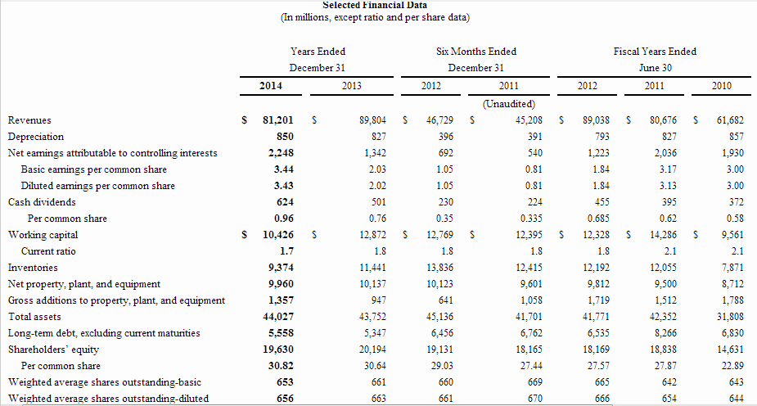

Slide 75
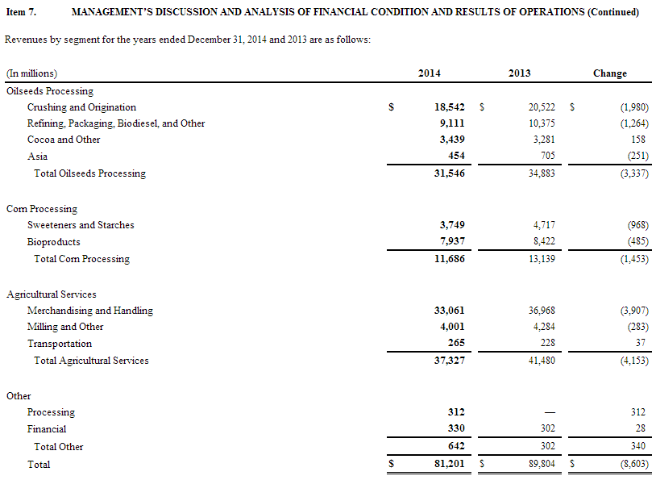

Slide 76
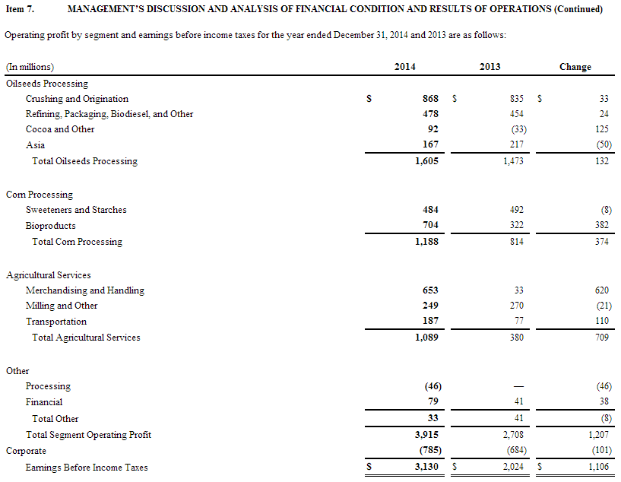

Slide 77
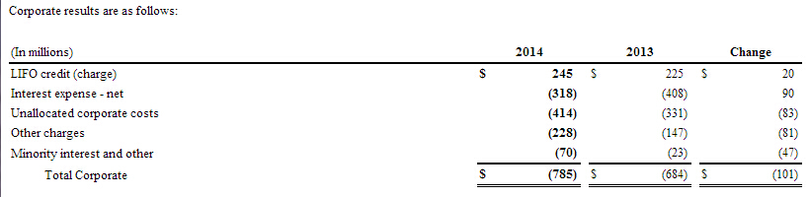
Corporate Results

Slide 78
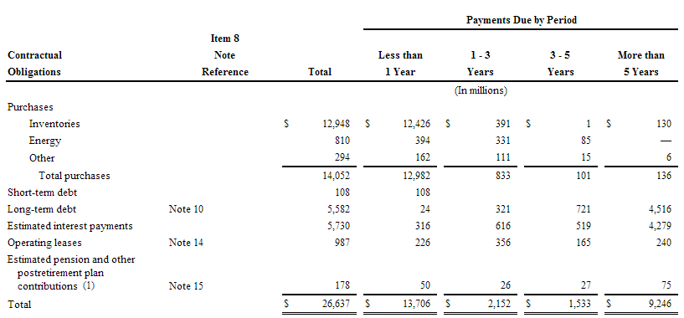

Slide 79
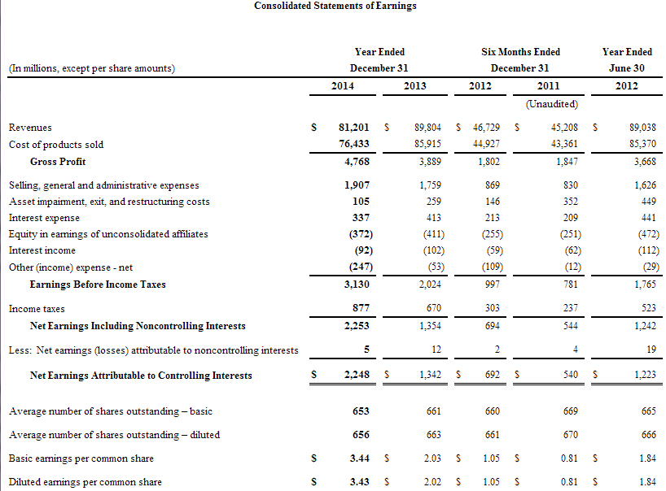

Slide 80
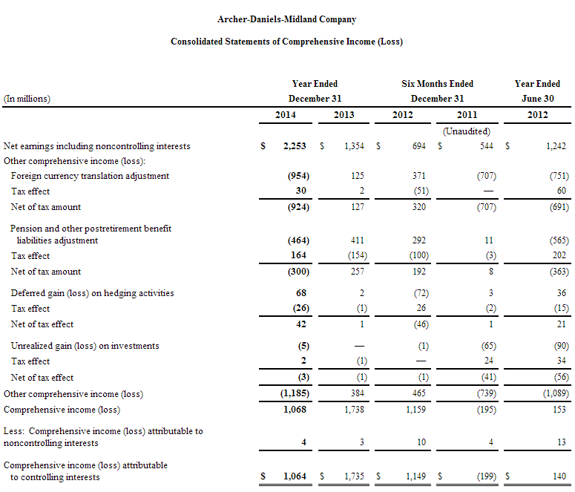

Slide 81
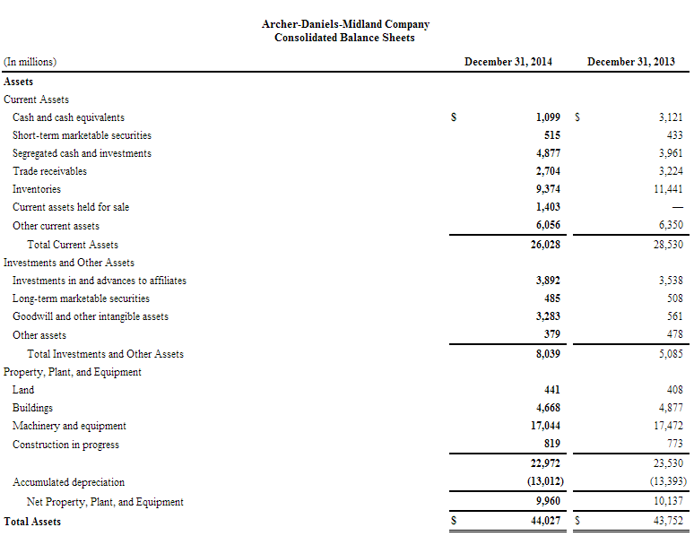

Slide 82
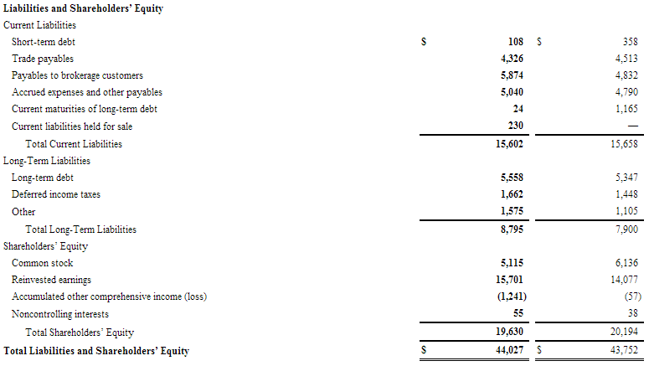

Slide 83
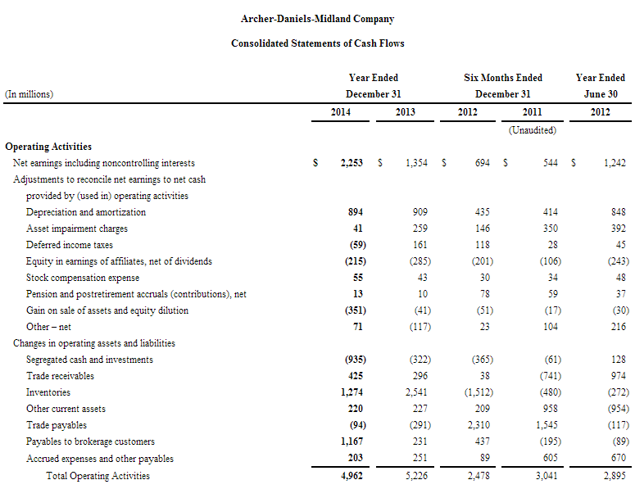

Slide 84
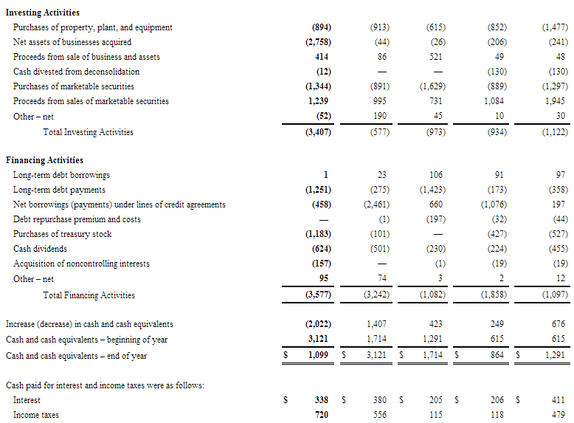

Slide 85
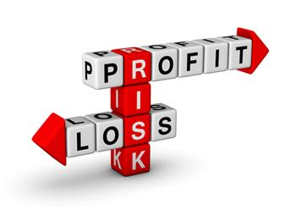

Slide 86
Risk Factors
Weather risk
Commodity price risk
Interest rate risk
Regulation risk
Foreign exchange rate risk
Competition

Slide 87
Hedging Philosophy
The Company enters into derivative and non-derivative contracts with the primary objective of managing the Company’s exposure tadverse price movements in the agricultural commodities used for, and produced in, our business operations.

Slide 88
Hedging Philosophy
“The Company will also use exchange-traded futures and exchange-traded and over-the-counter option contracts as components of merchandising strategies designed to enhance margins.”

Slide 89
Hedging Philosophy
The Company’s position consists of:
energy and freight contracts
exchange-traded futures
exchange-traded and OTC options
contracts used to hedge portions of production

Slide 90
Risk Management (Competition)
operates based principally on price, quality, and alternative products
Given the commodity-based nature of its businesses, the Company focuses on managing unit costs and improving efficiency through technology improvements, productivity enhancements, and regular evaluation of the Company’s asset portfolio

Slide 91
Risk Management (Competition)
Secured demand from subsidiaries and affiliates
  Major supplier of agricultural commodity raw materials to Wilmar, Edible Oils Limited, and Stratas Foods LLC

Slide 92
Risk Management (Commodity)
The Company’s commodity position consists
  merchandisable agricultural commodity inventories
  purchase and sales contracts
  energy and freight contracts
  exchange-traded futures and exchange-traded and over-the-counter option contracts including contracts used to hedge portions of production requirements, net of sales

Slide 93
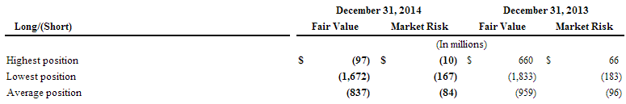
VaR 10% adverse price change

Slide 94
Risk Management (Currencies)
Currency exchange contracts
  Euro, British Pound, Canadian Dollar, and Brazilian Real
Contracts Used
  forward contracts
  swaps with banks
  exchange-traded futures contracts
  and over-the-counter options

Slide 95
Risk Management (Interest)
The Company does not use any derivative instruments to hedge against interest rate risks
Market risk is estimated as the potential increase in fair value resulting from a hypothetical 50 basis points decreases in interest rates

Slide 96

Risk Management (Interest)
Notes:
The fair value of the Company’s long-term debt is estimated using quoted market prices, where available, and discounted future cash flows based on the Company’s current incremental borrowing rates for similar types of borrowing arrangements. Such fair value exceeded the long-term debt carrying value. Market risk is estimated as the potential increase in fair value resulting from a hypothetical 50 basis points decrease in interest rates. Actual results may differ.
The increase in fair value of long-term debt at December 31, 2014 is primarily due to decreased interest rates.

Slide 97
Fair Value Measurements
The Company determines the fair value of certain of its inventories of agricultural commodities, derivative contracts, and marketable securities based on the fair value definition and hierarchy levels

Slide 98
Fair Value Measurement (Cont’d)
Three levels are established within the hierarchy that may be used to measure fair value:
  Level 1: Quoted prices (unadjusted) in active markets for identical assets or liabilities.
  Level 2: Observable inputs, including Level 1 prices that have been adjusted
  Level 3: Unobservable inputs that are supported by little or no market activity and that are a significant component of the fair value of the assets

Slide 99

Fair Value Measurement
Notes:
The following tables set forth, by level, the Company’s assets and liabilities that were accounted for at fair value on a recurring basis as of December 31, 2014 and 2013.

Slide 100
Fair Value Measurement
Except for derivatives designated as cash flow hedges, changes in fair value of commodity-related derivatives are recognized in the consolidated statements of earnings as a component of cost of products sold
Changes of fair value of Foreign currency-related derivatives are recognized in the earnings as a component of net sales and other operating income, cost of products sold, and other (income) expense net
Changes in the fair value of derivatives designated as cash flow hedges are recognized as a component of accumulated other comprehensive income

Slide 101

Fair Value Measurement (not hedge)
Notes:
The following is the fair values of derivatives not designated as hedging instruments

Slide 102

Impact on Financials

Slide 103
Impact on Financials
Derivatives Designated as Cash Flow or Fair Value Hedging Strategies
The Company uses interest rate swaps designated as fair value hedges to protect the fair value of fixed-rate debt due to changes in interest rates.
The Company uses futures or options contracts to fix the purchase price of anticipated volumes of corn to be purchased and processed in a future month.
The Company, from time to time, also uses futures, options, and swaps to fix the sales price of certain ethanol sales contracts.
Notes:
2）As of December 31, 2014 and 2013, the Company has certain derivatives designated as cash flow hedges and fair value hedges

Slide 104


Impact on Financials

Slide 105


