Slide 1
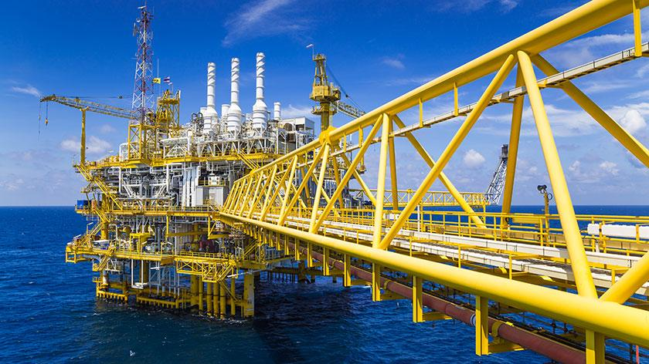
Oil and Gas Industry
Shenxue Shi, MinZhang Si
Yeung Tim Ching, Wing Yin Poon

Slide 2




Agenda
Industry Overview
Company 1 – Husky Energy
Company 2 – Crescent Point
Company 3 – Canadian Natural Resources

Slide 3
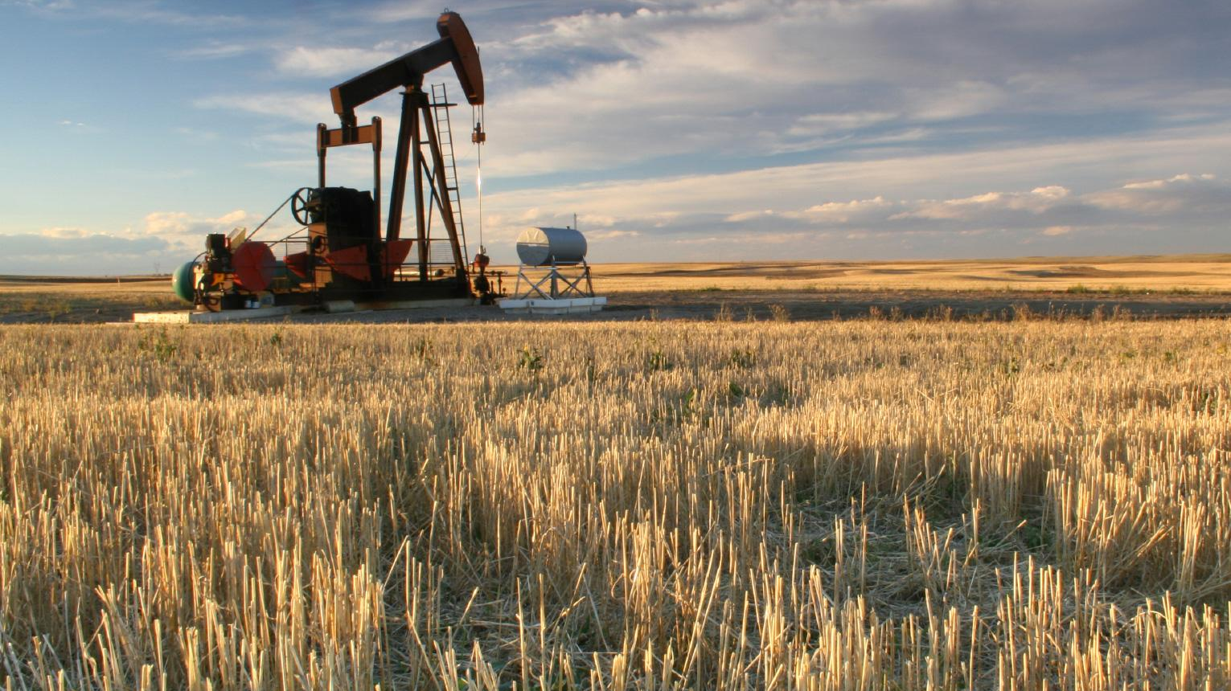
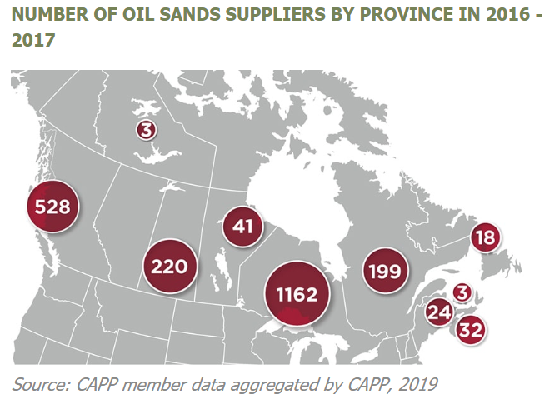
Industry Interview
Natural gas meets 30 per cent of the country’s entire energy needs
The world’s third-largest oil with more than 170 billion barrels of oil that can be recovered economically with today’s technology, and 165 billion barrels (or 96 per cent) of Canada’s oil reserves are located in the oil sands.
Canada is the fifth-largest producer of natural gas and the sixth-largest producer of crude oil in the world with extensive oil and natural gas reserves across the country.

Slide 4
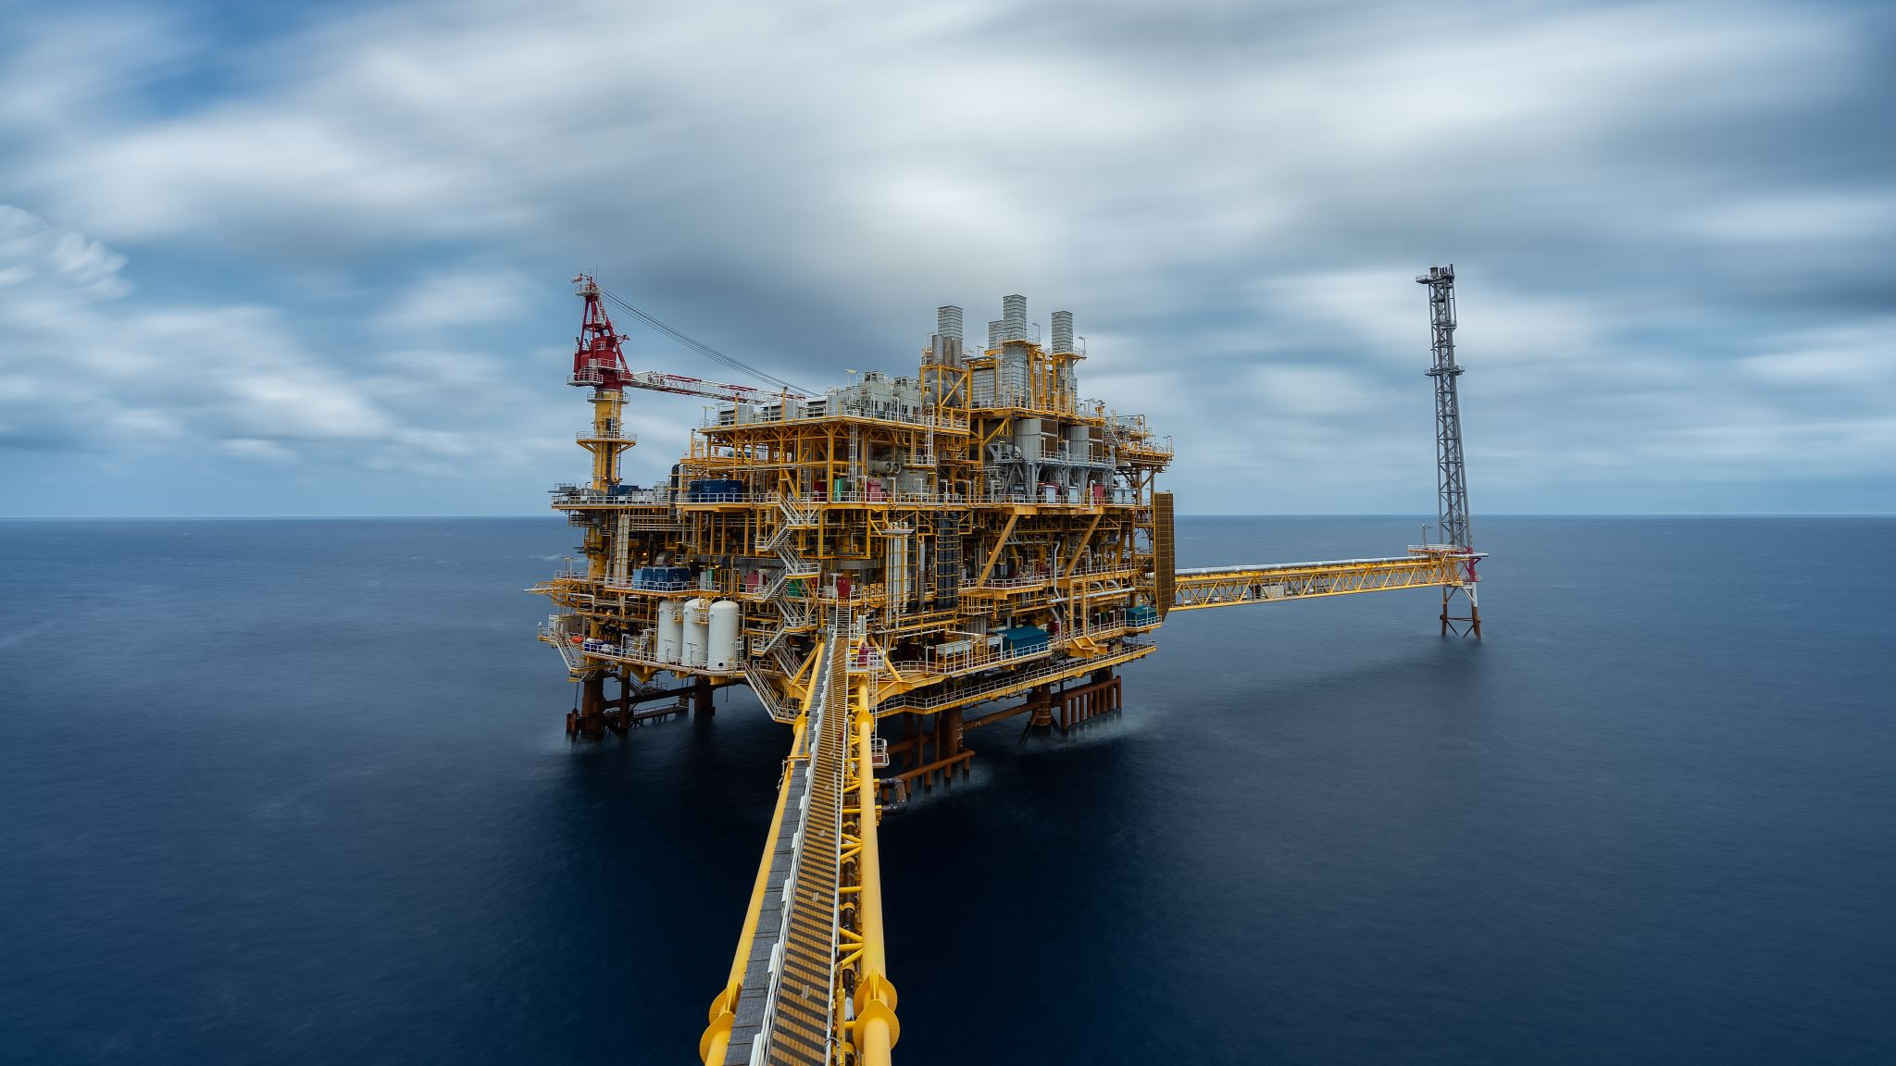
OIL INDUSTRY

Slide 5
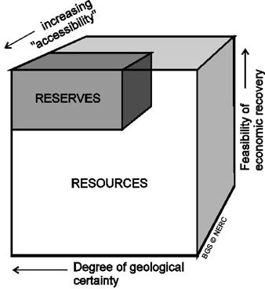
Resources and Reserves
Resources: include all oil that can be technically recovered at any price
Contingent resources: have been discovered but are not yet economically viable
Prospective resources: are potentially recoverable but not yet subject to drilling activity

Slide 6
Resources and Reserves
Reserves: the amount of crude oil that can be technically recovered at a cost that is financially feasible at the present price of oil
Proved reserves: have reasonable certainty of economic recoverability
Probable reserve: less certain, but are more likely than not to be economically recoverable
Possible reserves: associated with insufficient data about the specific reservoir

Slide 7
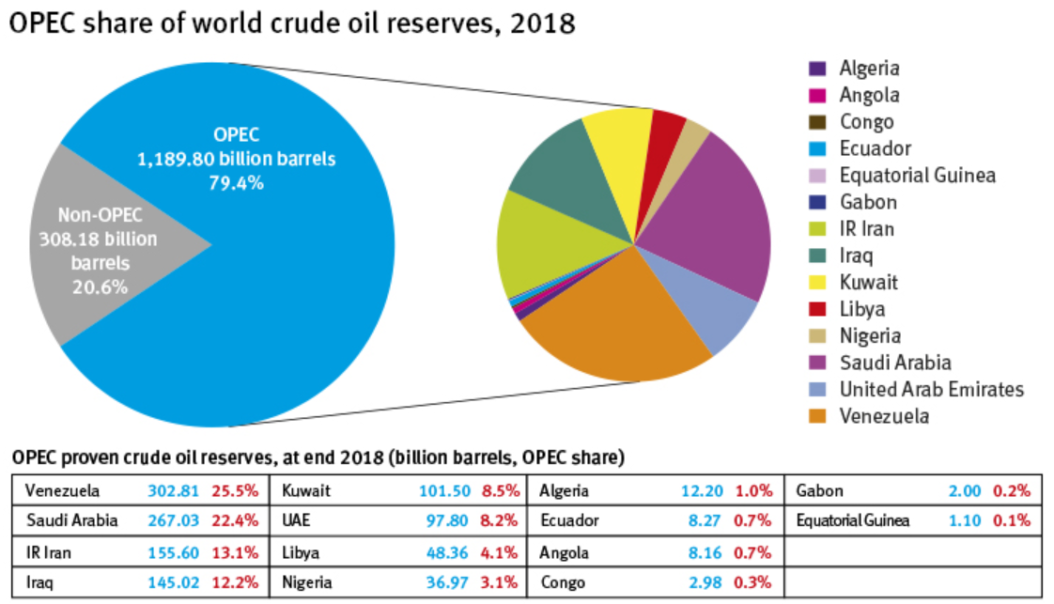
Organization of Petroleum Exporting Countries (OPEC)

Slide 8
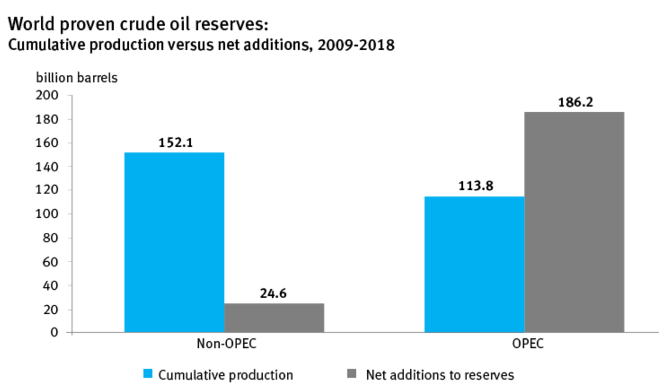
Organization of Petroleum Exporting Countries (OPEC)

Slide 9
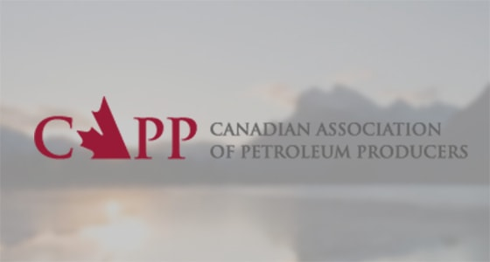
CANADIAN ASSOCIATION OF PETROLEUM PRODUCERS (CAPP)
Directed by a Board of Governors that sets priorities for the Executive Team, staff and committees
Mission: To enhance the economic well-being and sustainability of the Canadian upstream petroleum industry in a socially, environmentally and technically responsible manner
The board includes a full-time president, a volunteer chairman and 30 volunteer governors (drawn from the large, medium, and small member companies. )
Canadian Regulation on the Industry

Slide 10
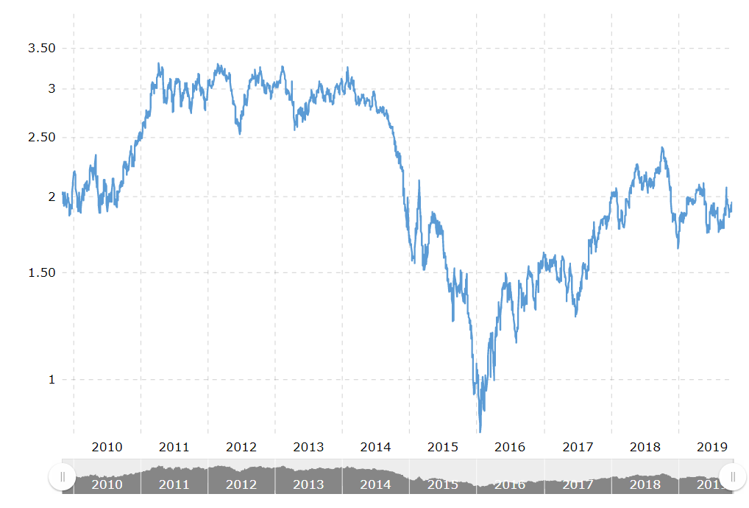
10 years Oil Prices

Slide 11
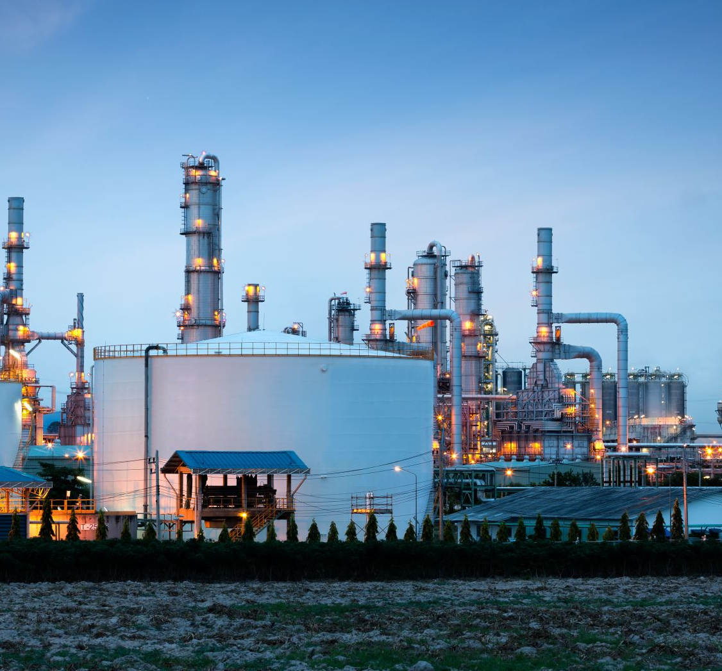
NATURAL GAS INDUSTRY

Slide 12
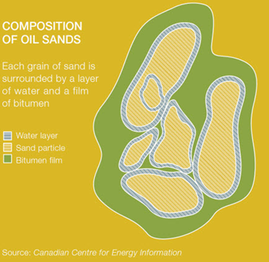
NATURAL GAS INDUSTRY
Upstream Gas industry
Engages in activities such as exploration,drilling and raw production of natural gas
Midstream natural gas industry
operates natural gas processing plants, remove impurities and natural gas liquids (NGL), natural gas storage facilities, gathering pipelines, and NGL facilities.
Downstream natural gas industry
receive gas from pipelines and then distribute it to consumers via extensive networks of local distribution pipelines.

Slide 13
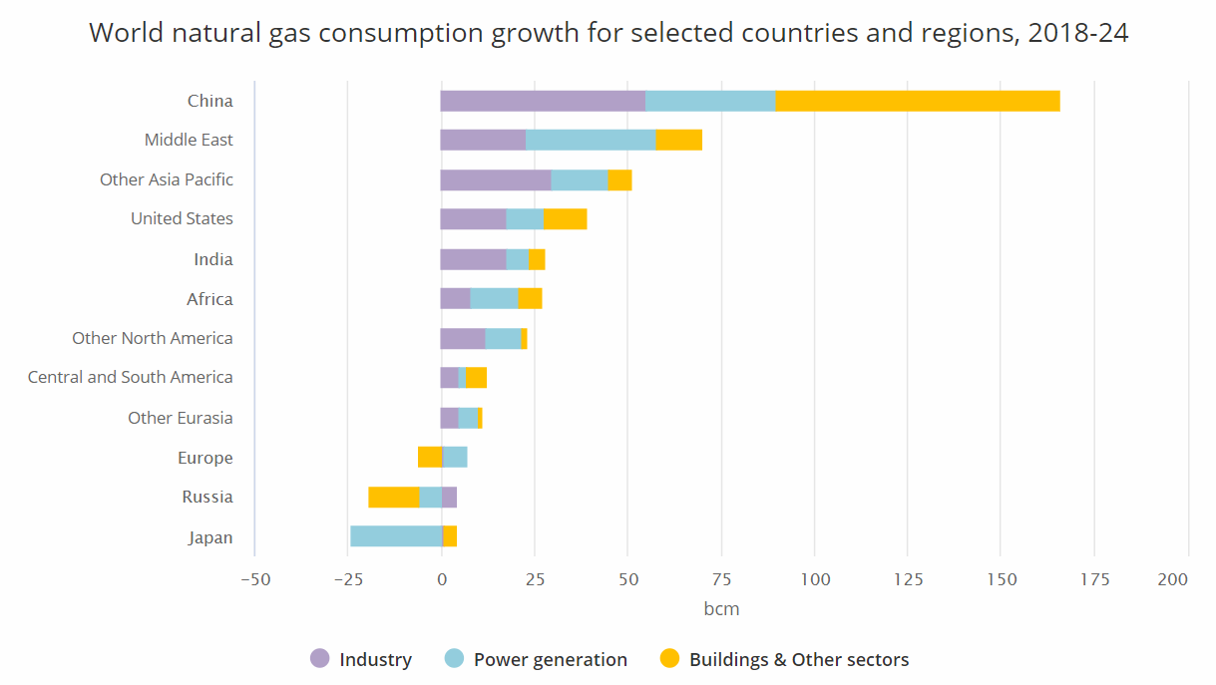

Slide 14
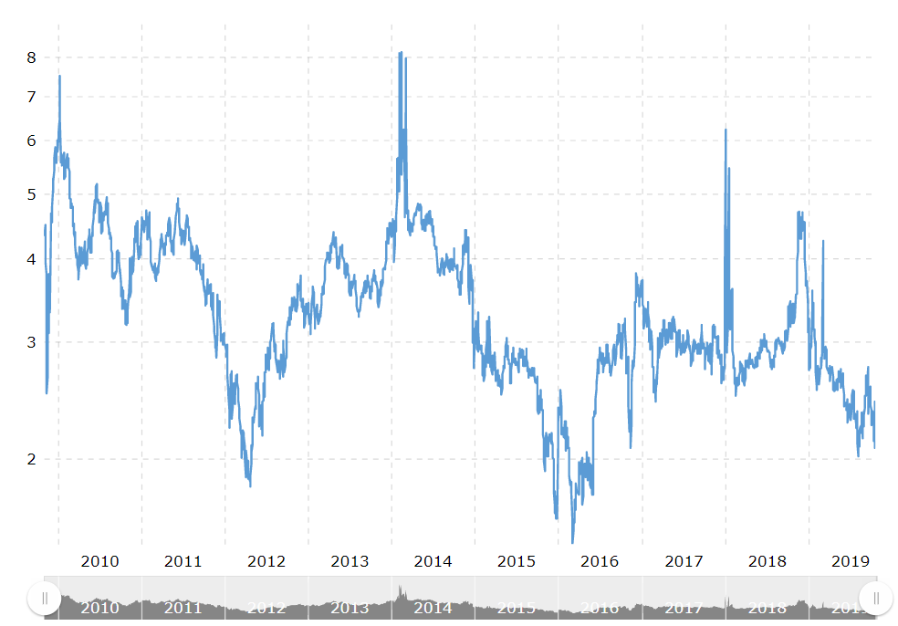
10 years Natural Gas Prices

Slide 15
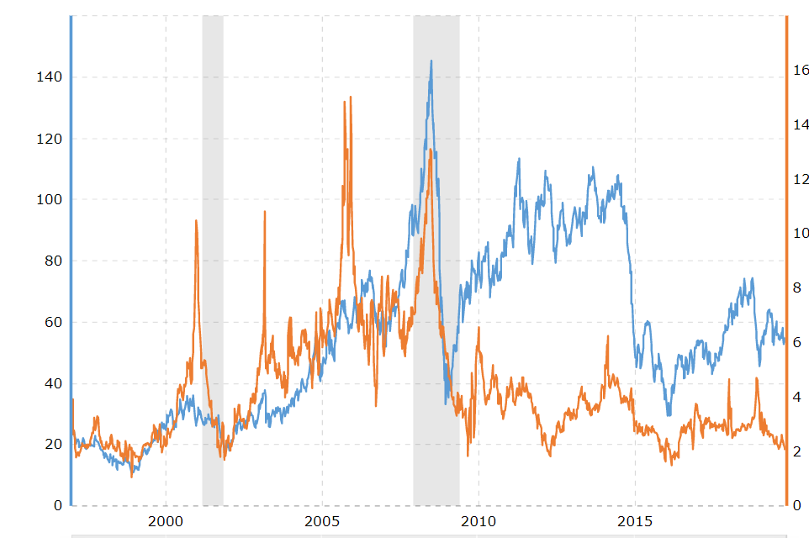
Crude Oil vs Natural Gas - 10 Year Daily Chart

Slide 16
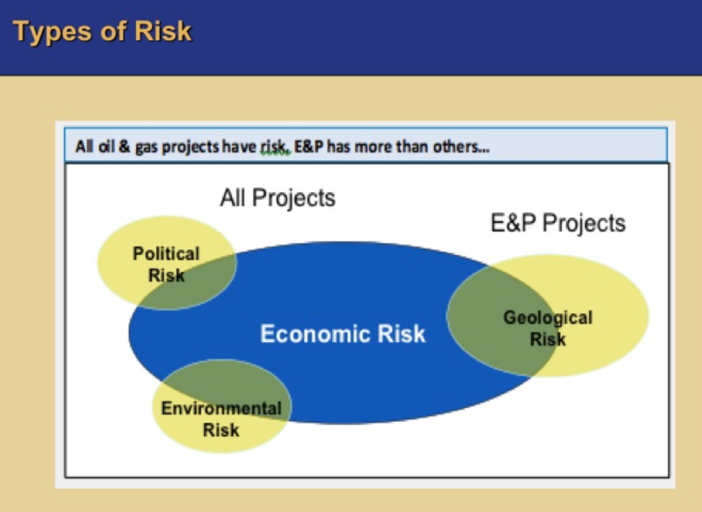
Major Risks
Political Risk
Environment Risk
Economic Risk
Geological Risk

Slide 17

Political Risk
Tax rate
Revisions to production shares
Regulations
Changing governmental policies

Slide 18
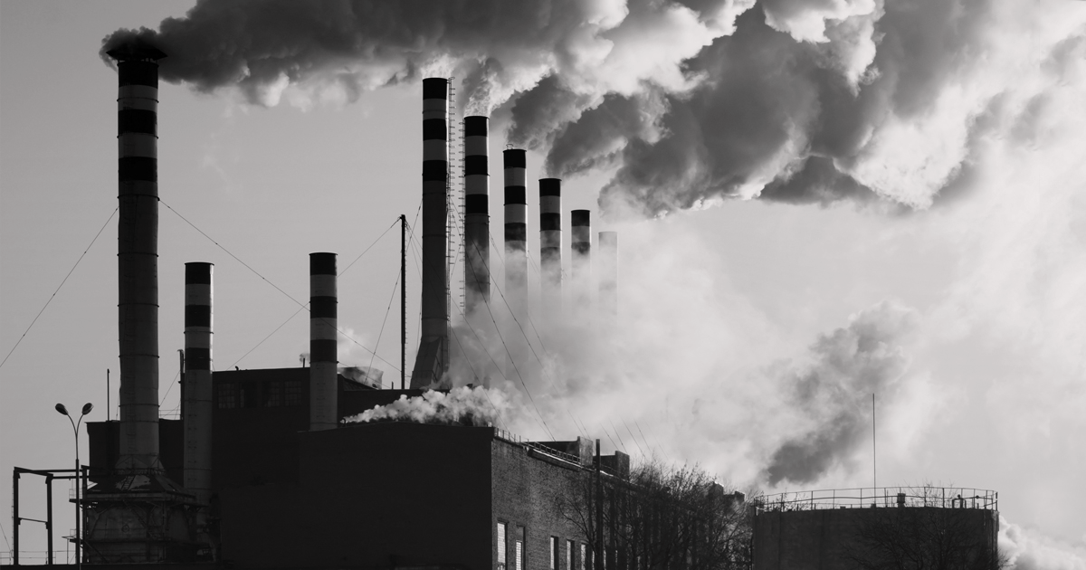




Environmental and Safety Risk
pollution or inattention to the ecological surroundings
personnel safety
damage to equipment
fire, flood, and disaster

Slide 19


Economic Risk
Oil prices
Interest rate
Currency exchange rate
High operating costs
Loss of demand from the facility

Slide 20

Risk Management
Sensitivity analysis
On cash flows sensitive to:
Oil and gas prices
Interest rates
FX changes
Further developed with
Probability calculations for movements in prices, interest rates and FX

Slide 21

Commodity derivatives
Objective: mitigate or remove oil or gas price uncertainty
Energy Futures traded din COMEX
FX futures traded in CME
OTX Forward contracts (oil, gas, etc.)
Interest rate and FX SWAPS

Slide 22



Hazards from risk management activities
DECREASED EARNINGS
LIQUIDITY PRESSURE
POTENTIAL LOSES FROM HEDGING

Slide 23


Slide 24
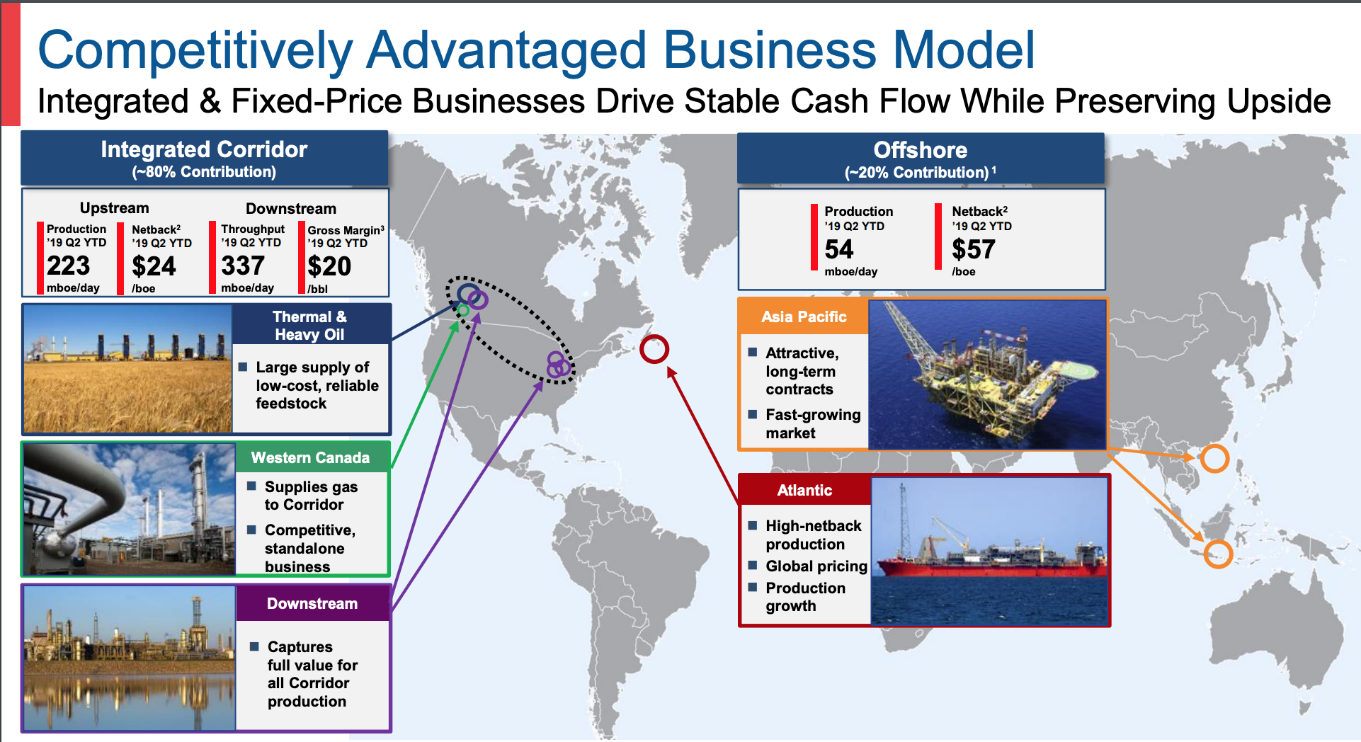
Company Overview
Founded in1938
Headquarters located in Calgary, Alberta
One of largest oil company in Canada
Own oil sands worldwide

Slide 25
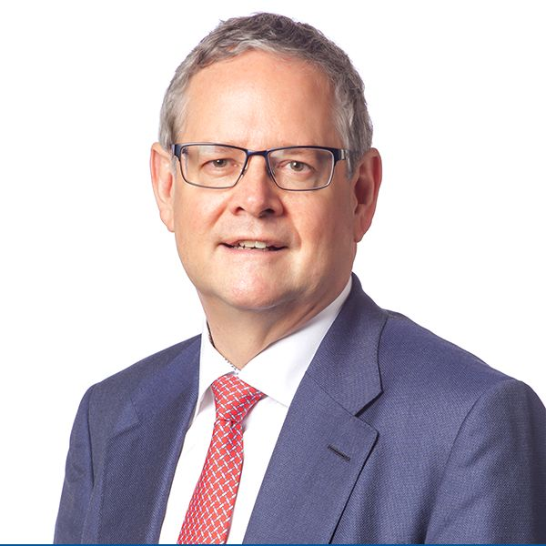

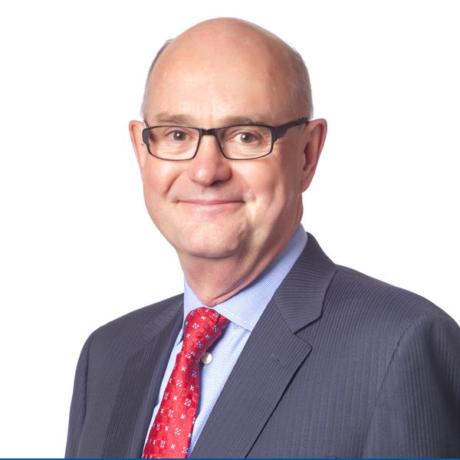
Management
Robert J. Peabody
President & Chief Executive Officer
Jeff Hart
Chief Financial Officer
Robert W.P. Symonds
Chief Operating Officer

Slide 26
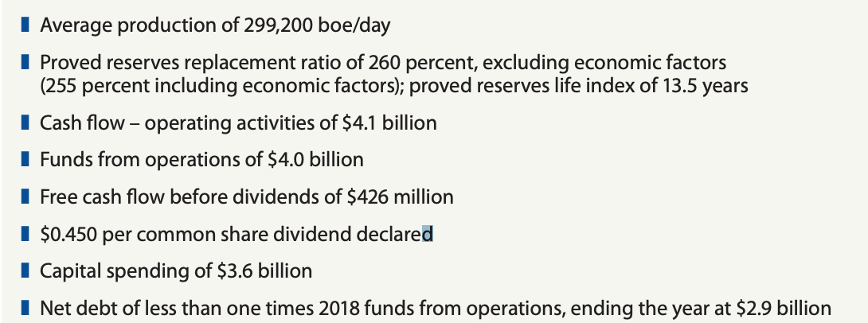
2018 HIGHLIGHTS

Slide 27
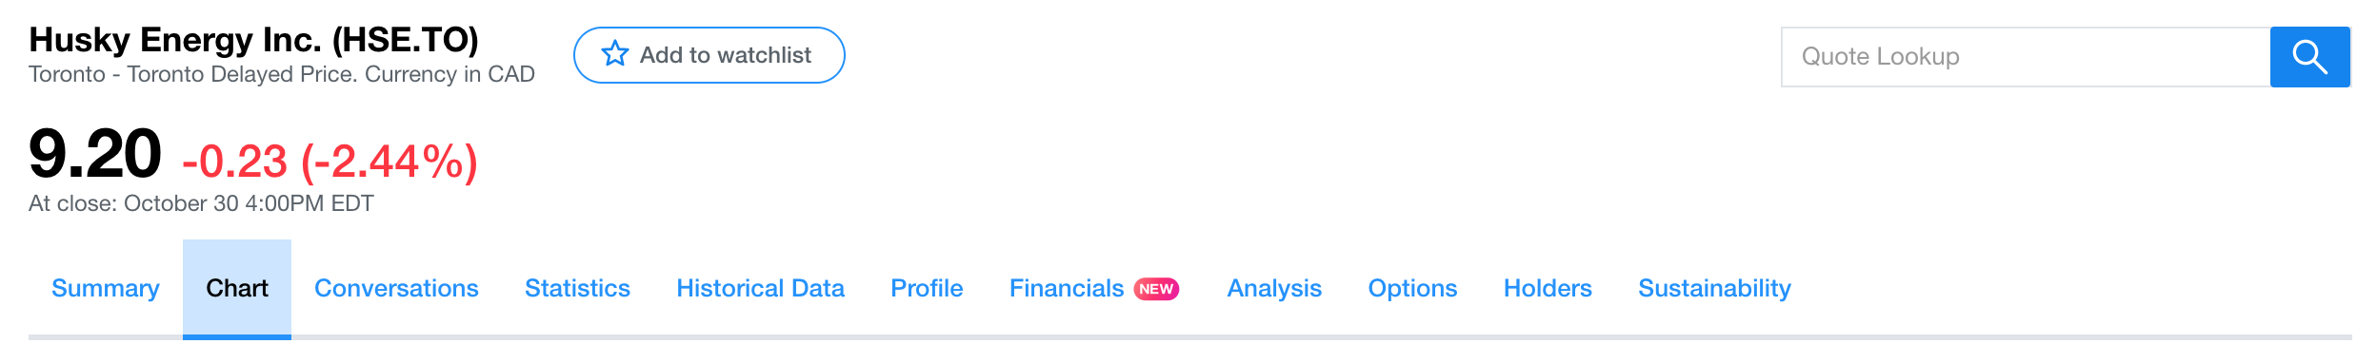
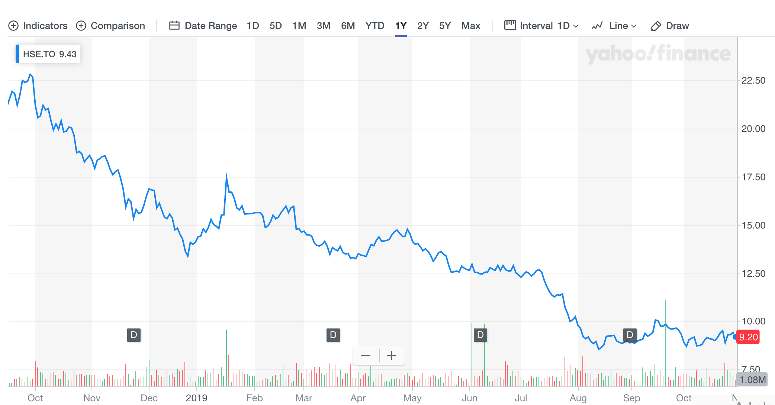
Historical Stock Price in TSX

Slide 28
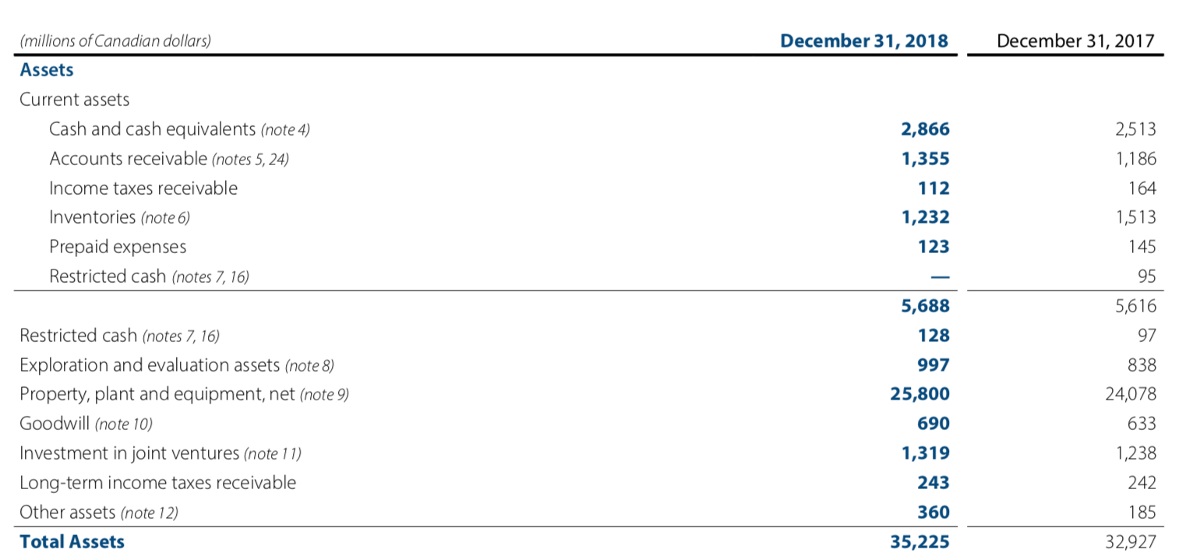
Balance Sheet(Assets)

Slide 29
Balance Sheet(Liabilities and equities)

Slide 30
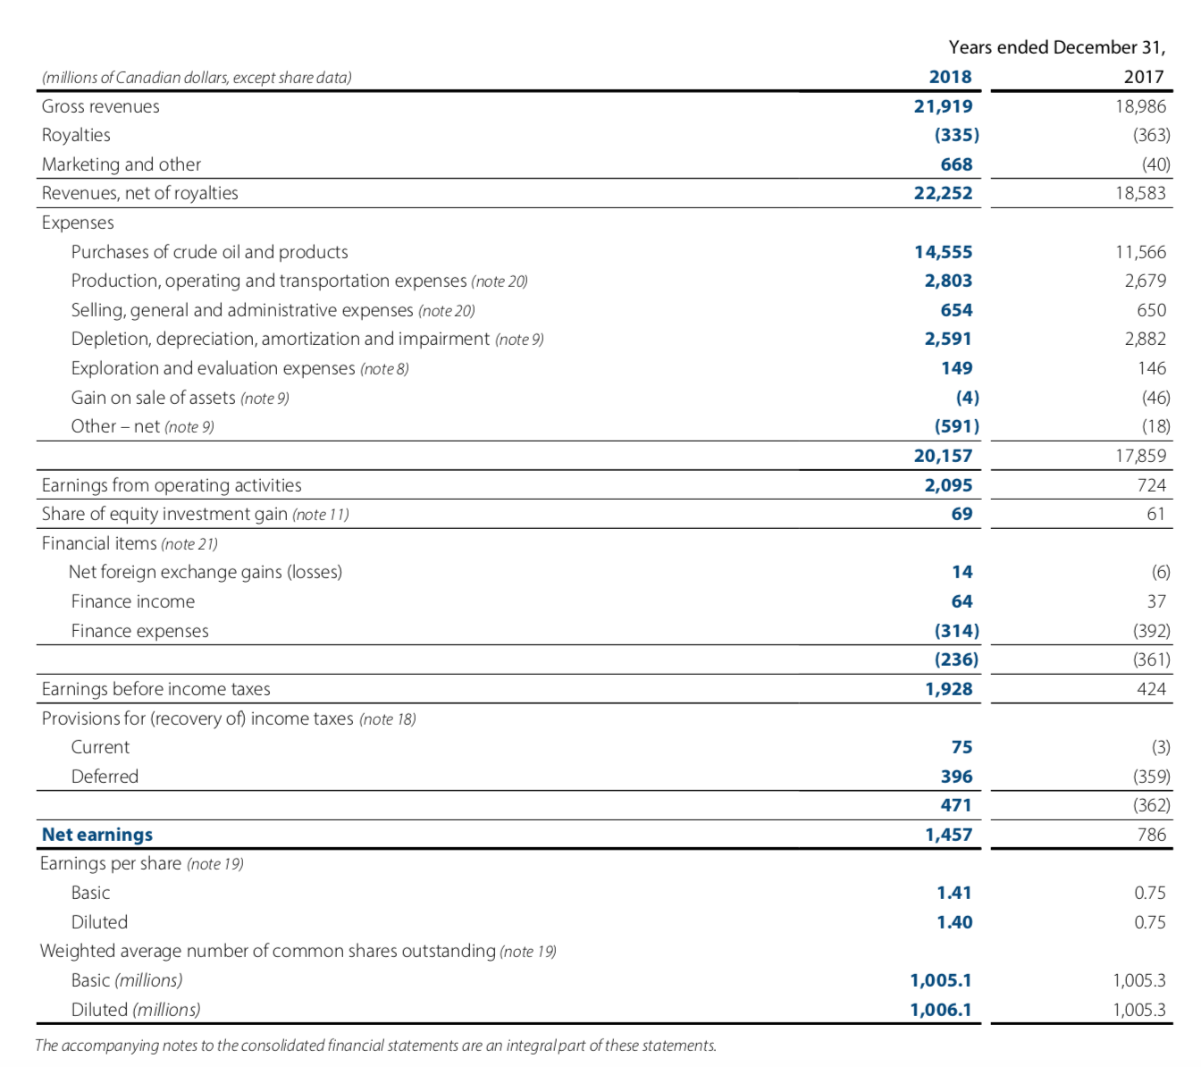
Earnings

Slide 31
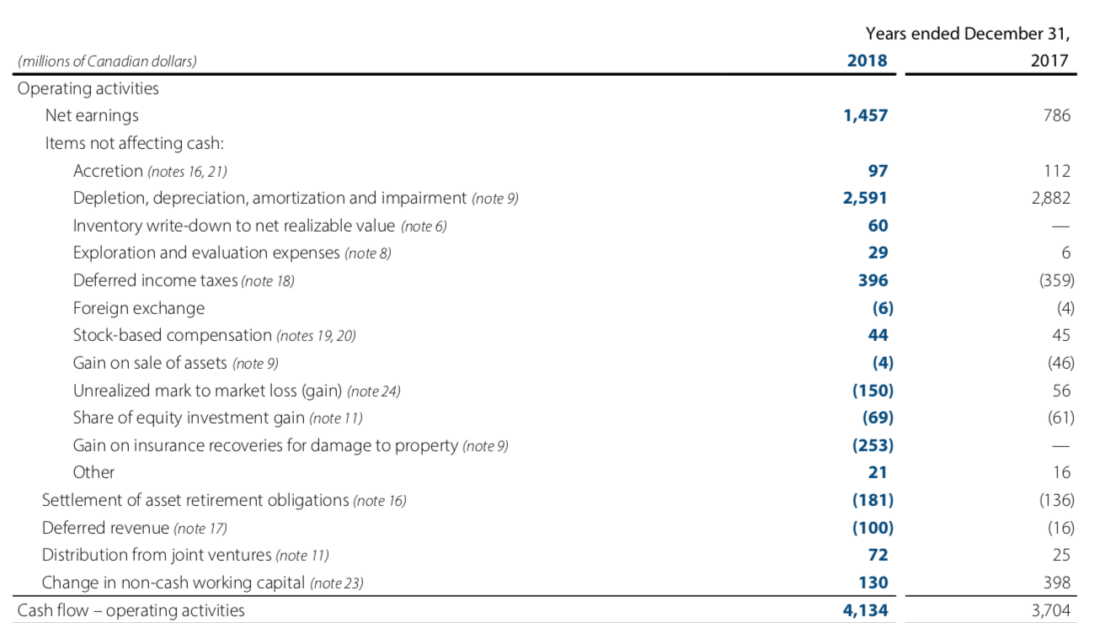
CASH FLOW STATEMENT

Slide 32
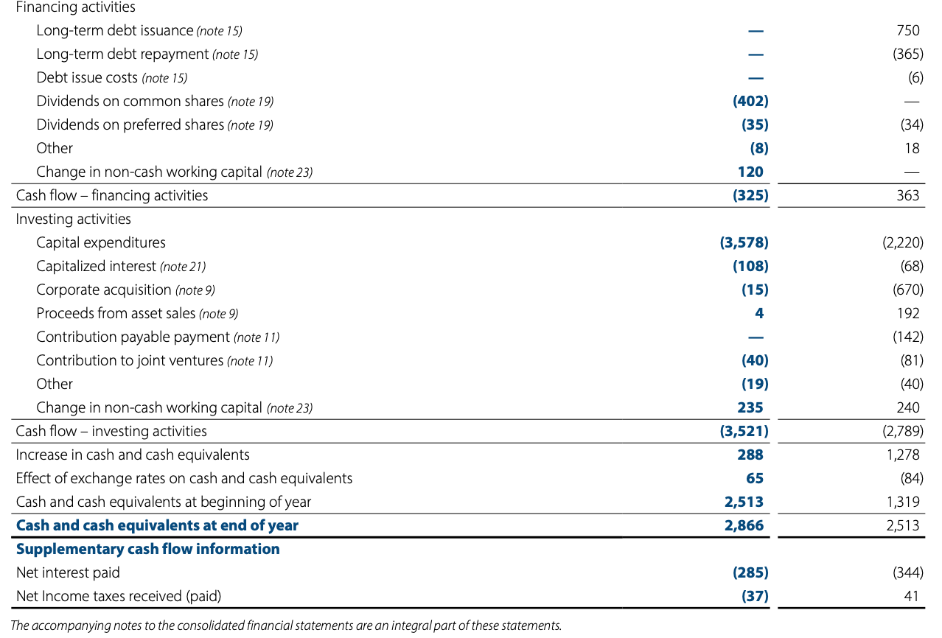
CASH FLOW STATEMENT

Slide 33





Significant Risk Factors
Commodity Price Risk Management
Foreign Exchange Risk Management
Interest Rate Risk Management
Credit and contract risk management
Liquidity Risk

Slide 34
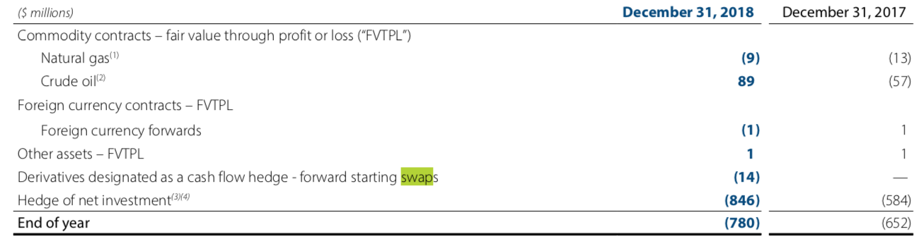
Commodity Price Risk Management
The Company’s results of operations and financial condition are dependent on the prices received for its refined products, crude oil, NGL and natural gas production.

Slide 35
Foreign Exchange Risk Management
December 31, 2018 – US$2.7 billion The US dollar denominated debt .
December 31, 2018, the unrealized loss arising from the translation of the debt was $262 million December 31, 2017 – unrealized gain of $243 million
net of tax recovery of $41 million

Slide 36
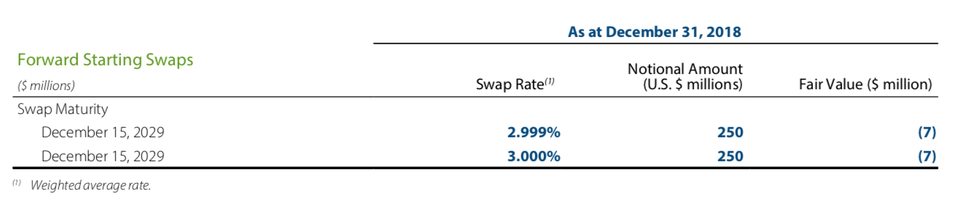
Interest Rate Risk Management
The Company is exposed to fluctuations in short-term interest rates as the Company maintains a portion of its debt capacity in revolving and floating rate bank facilities and commercial paper and invests surplus cash in short-term debt instruments and money market instruments. The Company is also exposed to interest rate risk when fixed rate debt instruments are maturing and require refinancing or when new debt capital needs to be raised.

Slide 37
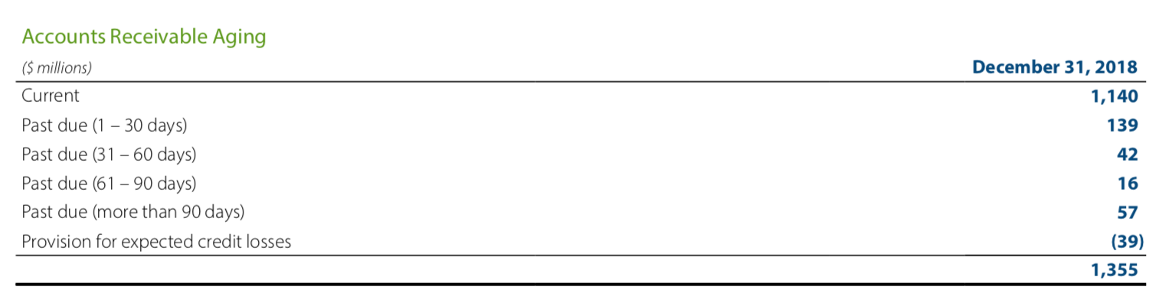
Credit and contract risk management
Credit and contract risk represent the financial loss that the Company would suffer if a counterparty in a transaction fails to meet its obligations in accordance with the agreed terms.

Slide 38
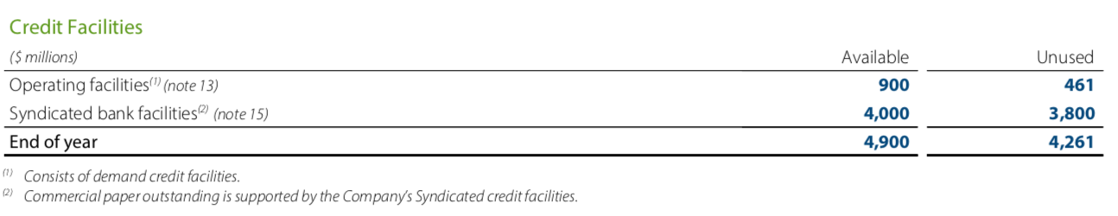
Liquidity Risk Management
Liquidity risk is the risk that the Company will not be able to meet its financial obligations as they become due.

Slide 39
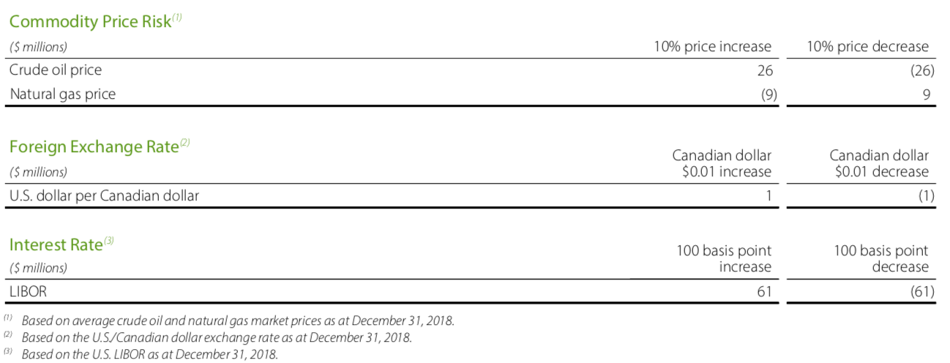
SENSITIVITY ANALYSIS

Slide 40
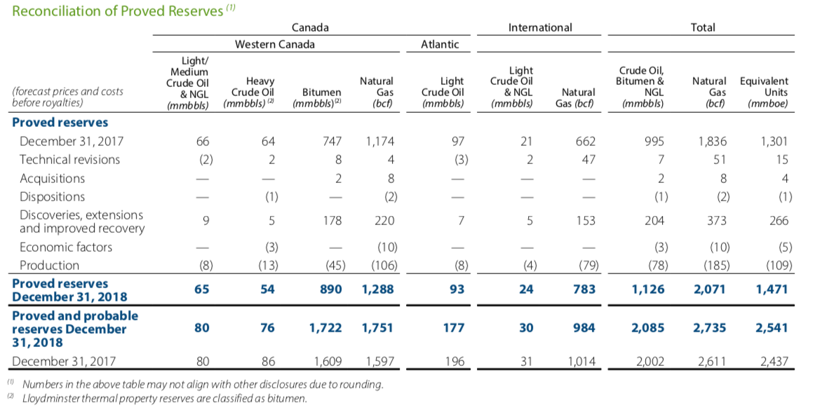

Slide 41


Slide 42
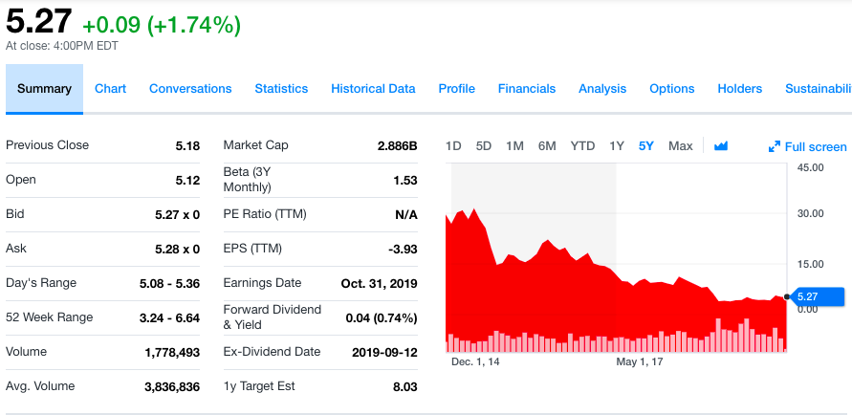
Stock

Slide 43
Company Overview
Crescent Point Energy is found in 2001
Based in Calgary, Alberta, Canada and United States
Leading North American oil producer
Significant asset based in the Viewfield Bakken, Shaunavon, Flat Lake and East Shale Duvernay

Slide 44



Management
President, Chief Executive Officer and Director
Craig Bryksa
Chief Operating Officer
Ryan Gritzfeldt
Chief Financial Officer
Ken Lamont

Slide 45
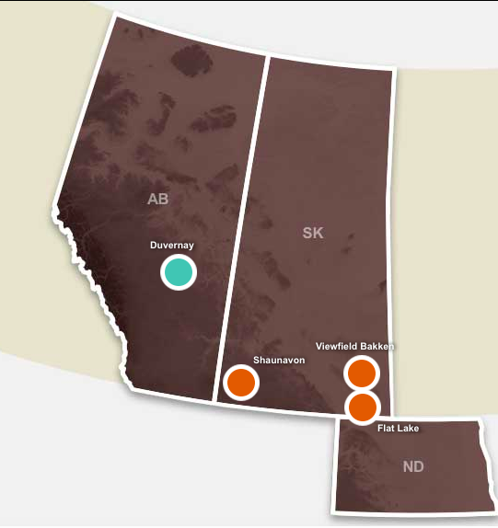
Operation
Key Focus Areas:
Viewfield Bakken light oil pool is the largest and longest producing resource play
Shaunavon resource play provides low-risk growth and free cash flow
Flat Lake play is a multi-zone resource play provides an increasing free cash flow profile and is further enhanced through waterflood development.
Early Stage Growth Play:
Duvernay play has high-quality lands within the oil window based on thickness, depth and pressure.

Slide 46

Operation
Exploration and Production Company
Mainly produces light and medium oil
Acquiring, developing, holding interests in petroleum and natural gas

Slide 47
Most Recent Financial Results
 | Q2 2019 | Q2 2018 | Change
WTI (US$/bbl) | 59.83 | 67.90 | Lower
Operating Netback ($/boe) | 36.59 | 40.74 | Lower
Adj. Funds Flow ($MM/$ per share) | 503.8 | 400.3 | Higher
Capital Expenditures ($MM) | 121.6 | 57.6 | Higher
Adj. Net Earnings ($MM/$ per share) | $146/0.27 | $102.7/0.19 | Higher
Net Debt ($ billion) | 3.6 | 4.0 | Lower
D/CF (trailing) | 1.9x | 2.3x | Lower

Slide 48
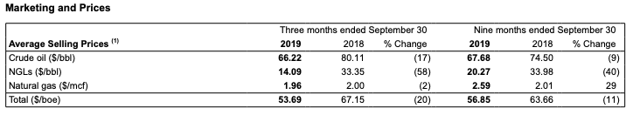

Slide 49
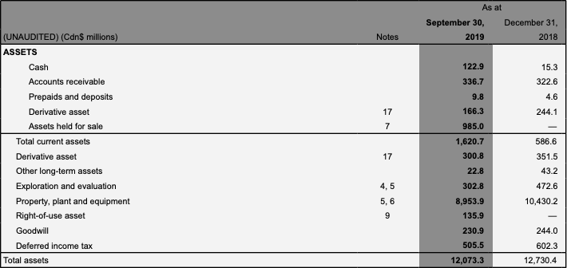
Balance Sheet

Slide 50
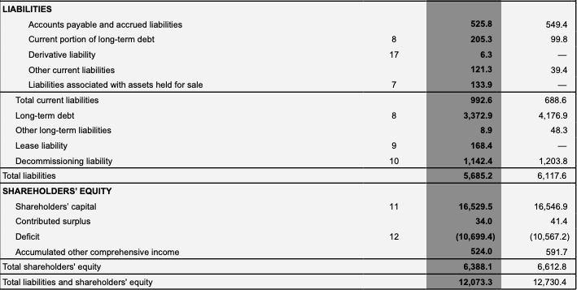
Balance Sheet

Slide 51
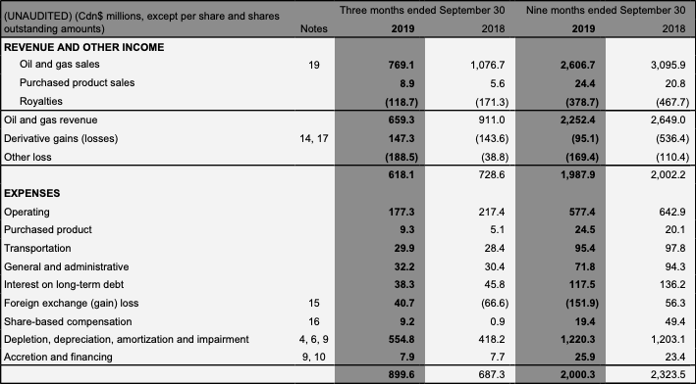
Income Statement

Slide 52
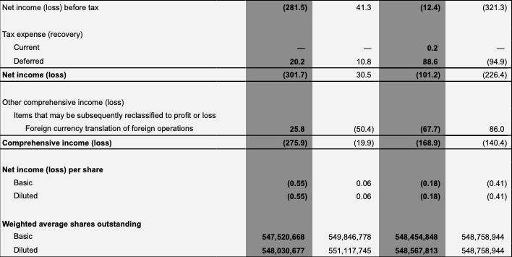
Income Statement

Slide 53
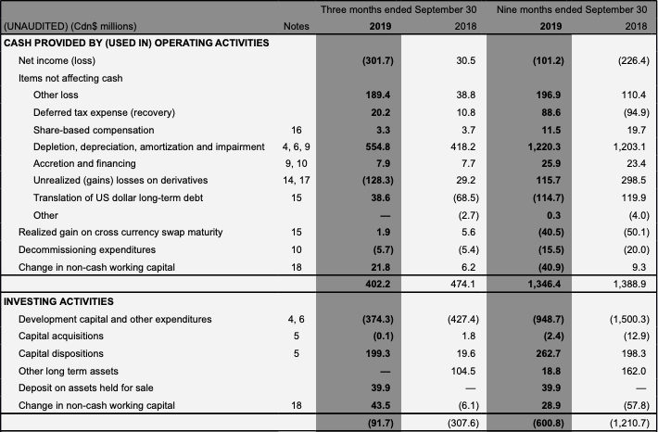
Cash Flow Statement

Slide 54
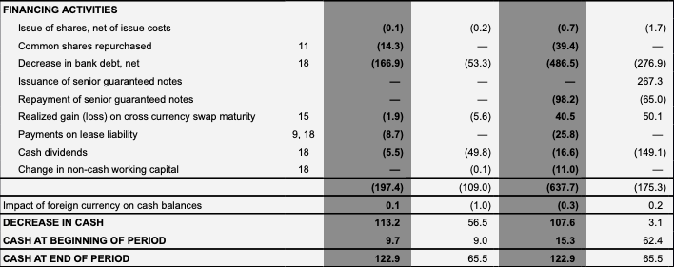
Cash Flow Statement

Slide 55
Major Risk Factors
Pricing
Market Risk
Foreign exchange rates
Credit
Interest rate
Liquidity

Slide 56
Hedges
Crescent Point strives to manage the risks associated with the oil and gas industry and to provide long-term stability to its cash flow. To accomplish this, we maintain a strong balance sheet with significant unutilized lines of credit.
We actively hedge commodity prices using a portfolio of swaps, collars and put option instruments. Our risk management program allows for hedging a forward profile of up to 3½ years out and up to 50 percent of net royalty interest production, increasing to 65 percent including the volume of purchased put options.

Slide 57
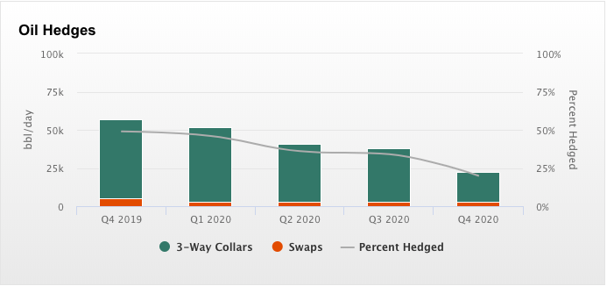
Hedging

Slide 58
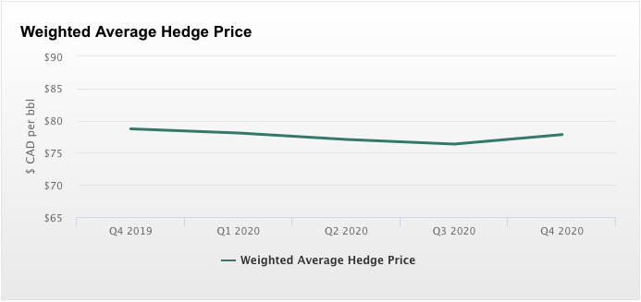
Hedging

Slide 59
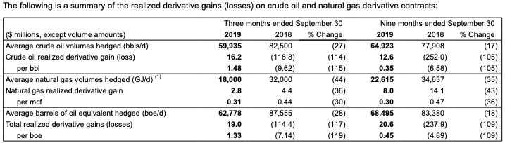
Hedging

Slide 60
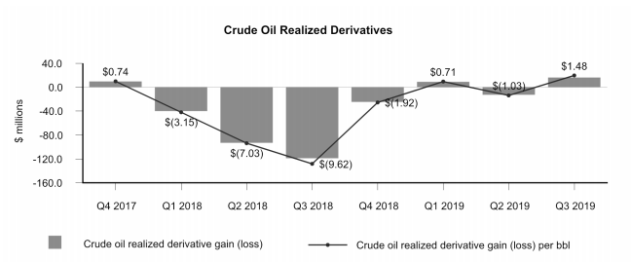
Hedging

Slide 61
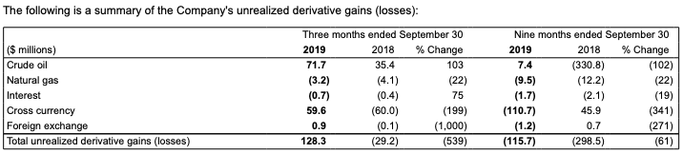
Hedging

Slide 62
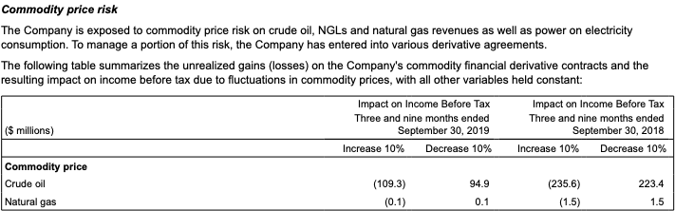
Commodity Sensitivity Analysis

Slide 63
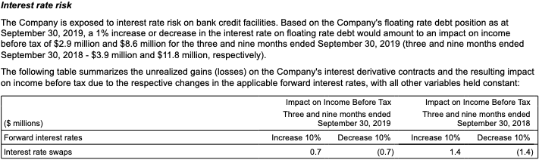
Interest Rate Sensitivity Analysis

Slide 64
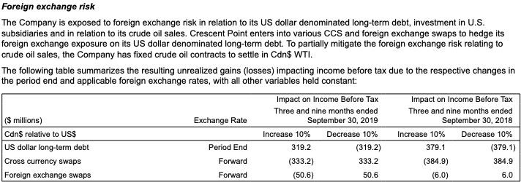
Currency Sensitivity Analysis

Slide 65
Credit Risk Analysis
The Company is exposed to credit risk in relation to its physical oil and gas sales, financial counterparty and joint venture receivables. A substantial portion of the Company's accounts receivable are with customers in the oil and gas industry and are subject to normal industry credit risks. To mitigate credit risk associated with its physical sales portfolio, Crescent Point obtains financial assurances such as parental guarantees, letters of credit and third party credit insurance. Including these assurances, approximately 95% of the Company's oil and gas sales are with entities considered investment grade.
At September 30, 2019, approximately 6 percent (December 31, 2018 - 5 percent) of the Company's accounts receivable balance was outstanding for more than 90 days and the Company's average expected credit loss was 3.24 percent (December 31, 2018 - 2.95 percent) on a portion of the Company’s accounts receivable balance relating to joint venture receivables.

Slide 66
Liquidity Risk
The Company manages its liquidity risk through managing its capital structure and continuously monitoring forecast cash flows and available credit under existing banking arrangements as well as other potential sources of capital.
At September 30, 2019, prior to the renewal of the credit facilities, the Company had available unused borrowing capacity on bank credit facilities of approximately $2.27 billion, including $8.5 million outstanding letters of credit and cash of $122.9 million.

Slide 67
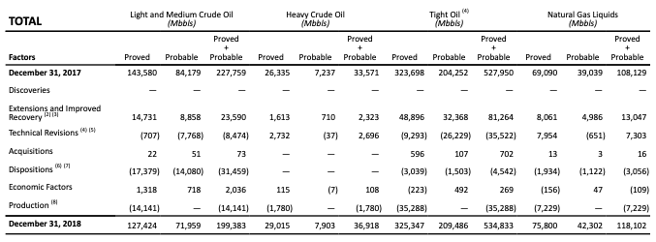
Reconciliations of Changes in Reserve

Slide 68

Reconciliations of Changes in Reserve

Slide 69

Canadian Natural Resources

Slide 70

Overview
Found in 1973
Head Office in Calgary, AB
Operates in North America, North Sea off Scotland, and Offshore Africa

Slide 71

Overview
Mission
To develop people to work together to create value for the Company’s shareholders by doing it right with fun and integrity
Strategy
To execute on our projects and maximize value for our shareholder

Slide 72

Overview (Management)

Slide 73


Historical Stock Price in TSX and NYSE
TSX
NYSE

Slide 74
Operation
Natural Gas
Largest independent natural gas producer in Canada
Largest undeveloped land base
North America Crude Oil and NGLs
Significant heavy oil producer in Canada
Horizon Oil Sands
oil sands mining with 14.4 billion barrels of bitumen initially-in-place
International Crude Oil
North Sea and Offshore Africa

Slide 75

PRODUCT MIX

Slide 76

Reserves

Slide 77

Reserves ( Proved Reserves)

Slide 78

Reserves (Proved Plus Probable Reserves)

Slide 79

Financial Performance

Slide 80

Consolidated Balance Sheet (Assets)

Slide 81

Consolidated Balance Sheet (Liabilities and Equity)

Slide 82

Consolidated Statements of Earnings (Loss)

Slide 83

Consolidated Statements of Cash Flows

Slide 84

Key Risk Factors
Market Risk
Commodity Price Risk
Interest Rate Risk
Foreign Currency Exchange Risk
Credit Risk
Liquidity Risk
Operation Risk
Environment Risk

Slide 85


Market Risk
Fluctuations due to the determination of fair market value
Manage its commodity, foreign currency, and interest rate exposures
Solely for hedging purposes

Slide 86

Commodity Price Risk
Risk associated with sale of future crude oil and natural gas production and with natural gas purchases
Settle monthly based on applicable index pricing

Slide 87
Interest Rate Risk
Interest rate price risk on fixed rate long-term debt
Interest rate cash flow risk on floating rate long-term debt
Interest rate swap
Periodic exchange of payment without exchange of the notional principal amount
No interest rate swap contracts outstanding at June 30, 2019

Slide 88

Foreign Currency Exchange Risk
US dollar denominated long-term debt, commercial paper and working capital.
transactions conducted in other currencies and in the carrying value of its foreign subsidiaries.
Cross Currency Swap Contract
the periodic exchange of payments with the exchange at maturity of notional principal amounts.

Slide 89

Credit Risk
Risk related to non-payment for sales contracts or non-performance by counterparties to contracts,
Normal industry credit risk
Review exposure to individual companies on regular basis
Agreement with counterparties that are substantially all investment grade financial institutions
Net Risk Management Assets of $361 millions at December 31,2018

Slide 90

Liquidity Risk
difficulty in meeting obligations associated with financial liabilities.
maintain sufficient cash and cash equivalents, along with other sources of capital

Slide 91



Operation Risk
Actions result in cost of restriction in jurisdictions where company has operation
The risk of failure of the Company's information technology systems and related data and control systems or a significant breach
cyber security protocols and procedures designed to reduce the risk and related data and control systems.

Slide 92

Sensitivity Analysis

Slide 93

Financial Instrument Sensitivities

