Slide 1
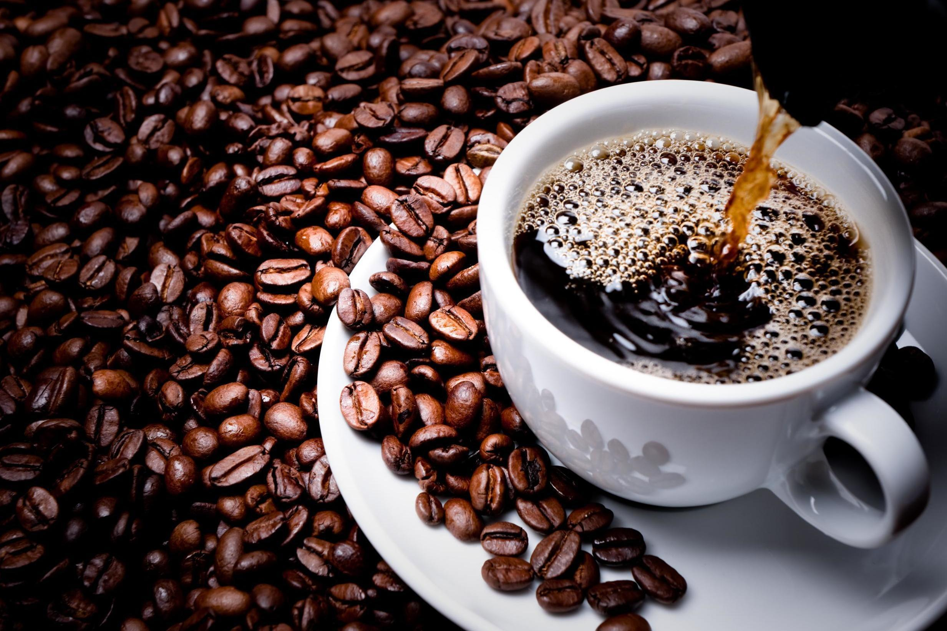
Coffee
Presented by Group #5

Slide 2




Our Team:
Youwei Hao
Hansika Chawla
Forrest Zhu
Chris Chen

Slide 3
Presentation Overview
➢Industry Overview
➢Starbucks
➢J.M. Smucker
➢Dunkin' Brands

Slide 4
Coffee Industry Description
Coffee exports is a $20 billion dollar industry making it the second-most-traded commodity, mostly consumed by industrialized nations while being produced by less developed nations. It has a long and overarching commodity chain that involves production, exporting, importing, roasting, distribution and retail. After harvest, coffee is either purchased from farmers by middlemen, or directly exported by large coffee estates and plantations. Coffee industry is vital to the politics, survival and economies for many developing countries. It is an industry monopolized by large transnational corporations and chains.

Slide 5
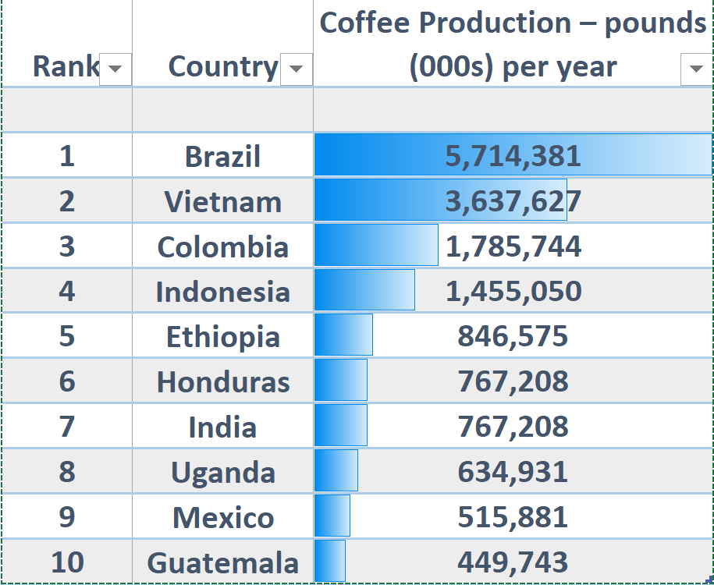
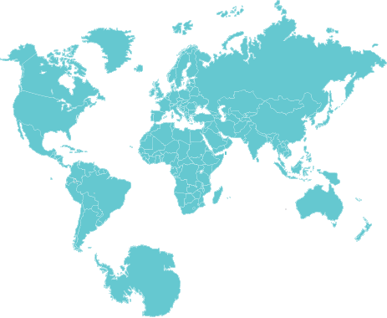
Top 10 Coffee Producing Countries (2020)

Slide 6
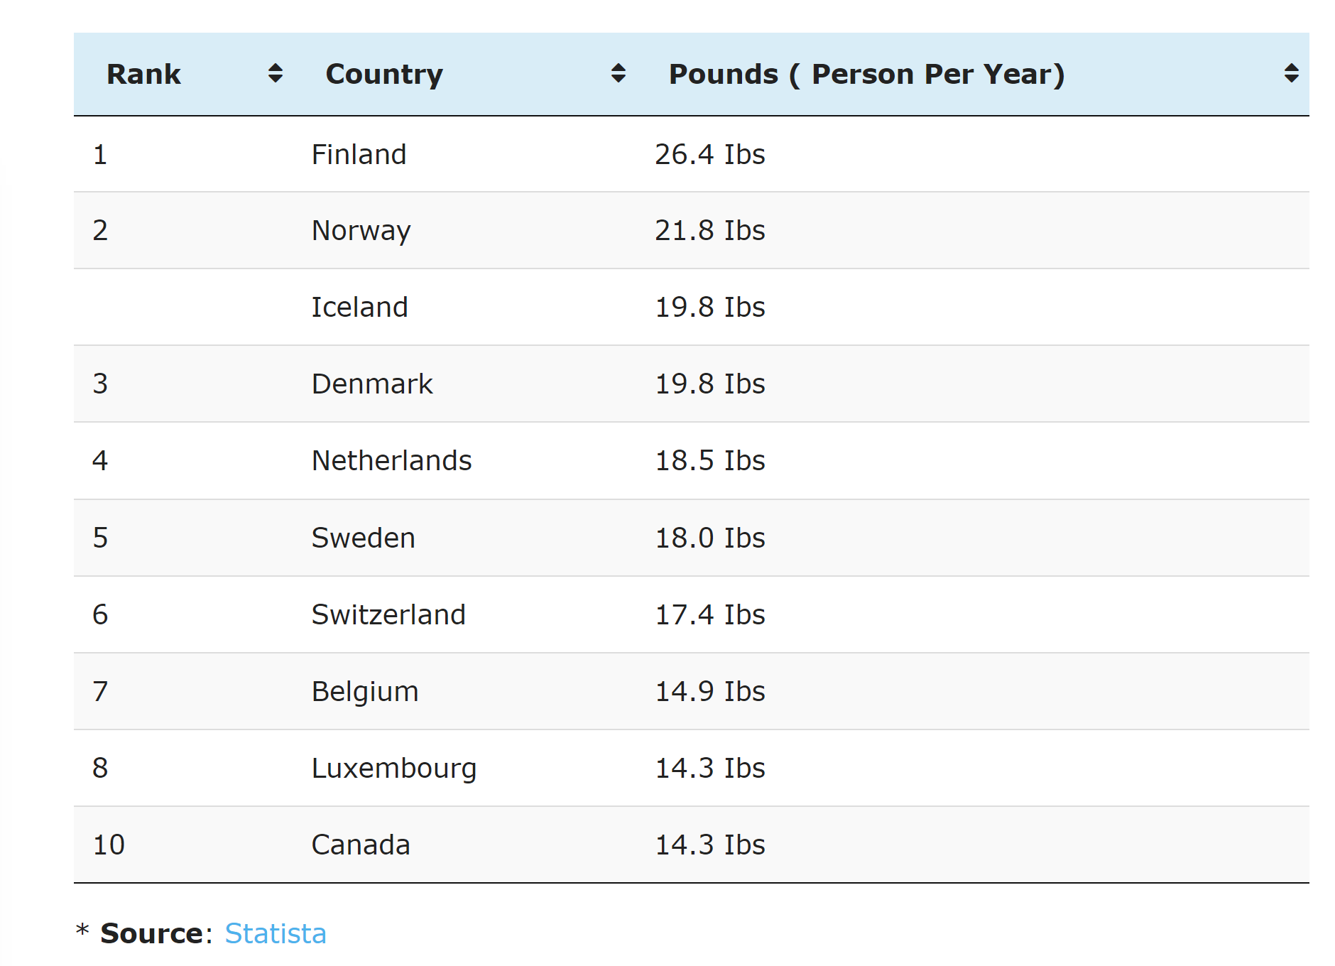
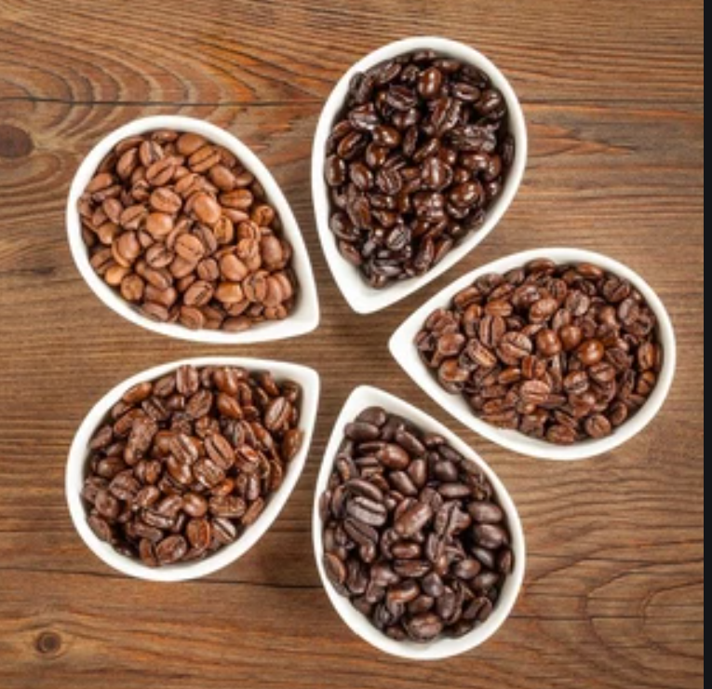
Top 10 Coffee Consumption Countries

Slide 7
History of Coffee
The coffee industry has a long history that can be traced as far as 15th century, when Ethiopia, the origin of coffee, exported coffee to Yemen. The coffee trade soon expanded to Egypt and the Ottoman Empire. With the growing of trade between the Republic of Venice and the Ottoman Empire, coffee was introduced to Europe, spreading to England, France, Germany, Austria and the Netherlands. With European colonial expansion, coffee was introduced to the Americas and Asia, and soon became an important industry in various colonies, especially in South America and India

Slide 8
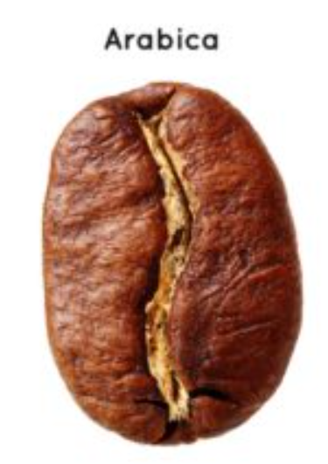
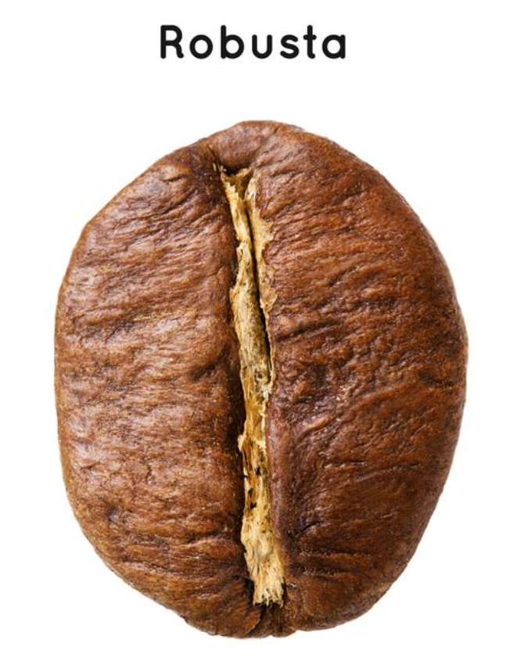
Two types of coffee bean
Arabica Coffee Beans
•Arabica is a special variety, because it has four chromosome.
•More than 65% of world coffee cultures are of Arabica.
•The taste of Arabica can be different, according to the location
Robusta Coffee Beans
•Robusta has more fruit, a lower cost, grows well at lower altitudes and is more resistant to diseases.
•Robusta can be sometimes comparable to Arabica.
•The caffeine content is much higher than the one found in Arabica.

Slide 9
Regulation of Coffee
The coffee industry has caused many environmental and ethical problems and international regulations have been set up to oversee the industry. Historically, the industry was notorious for being responsible for the expansion of slavery. Today, because coffee is mostly produced in developing countries where working conditions are unregulated, child labour abuses and exploitations of farmers in the process of trading is still very common. Moreover, the mechanization of coffee farming has caused deforestation, soil and water degradation, and habitat destruction.

Slide 10
Headline: Coffee Industry Economic Impact
According to Business Insider, coffee is the second most sought-after commodity in the entire world, with an industry that is worth over $100 billion across the globe. In terms of exporting alone, the industry is valued at $20 billion and continues to be on the rise—on average, 500 billion cups of coffee are consumed on Earth every year.
The coffee industry is growing at a significantly large compound annual growth rate of 5.5%. The major consumer demographics of this industry represent people ages 19 to 34, and a large reason the coffee market is expanding can be acquainted with the rise of demand from millennials as their consumption has increased almost ten percent.

Slide 11
Coffee Market in Canada
Canadians consume more coffee than tap water, according to the Coffee Association of Canada (CAC). There are several thousand coffee franchise locations throughout Canada artfully brewing the Canadian drink of choice.
$6.2 billion industry
$4.8 billion sales in Foodservice
$1.4 billion sales in Grocery / Retail Sales
160,000+ jobs in Cafes and Coffee Shops
5,000+ jobs in Manufacturing and Roasting
5,000+ independent café and coffee shop owners and several thousand franchise owner-operators

Slide 12
Coffee Market in United States
The total economic impact of the coffee industry in the United States in 2015 was $225.2 billion
Coffee-related economic activity comprises approximately 1.6% of the total U.S. gross domestic product
Consumers spent $74.2 billion on coffee in 2015
The coffee industry generates nearly $28 billion in taxes
The industry provides the country with approximate 1.7 million jobs

Slide 13
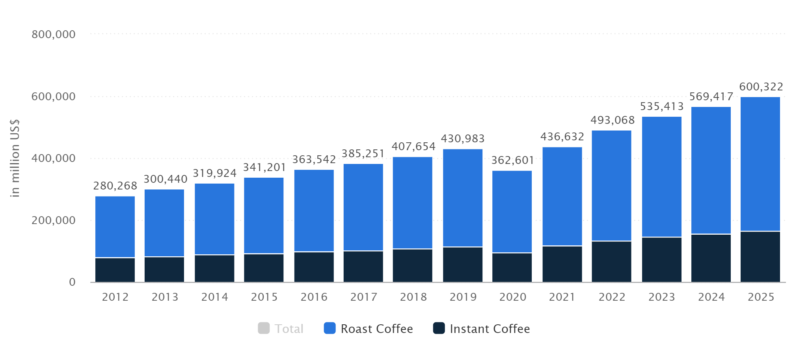
Global Coffee Markets’ Sales

Slide 14
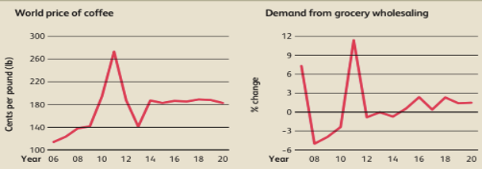
Key External Factors
Demand from grocery wholesaling
The Coffee Production industry is highly dependent on demand from downstream suppliers, such as grocery wholesalers, which provide coffee products to supermarkets.

Slide 15
Key External Factors
●World price of coffee：
The world price of coffee determines coffee producers’ costs and profitability because coffee beans are a key input commodity in coffee production

Slide 16
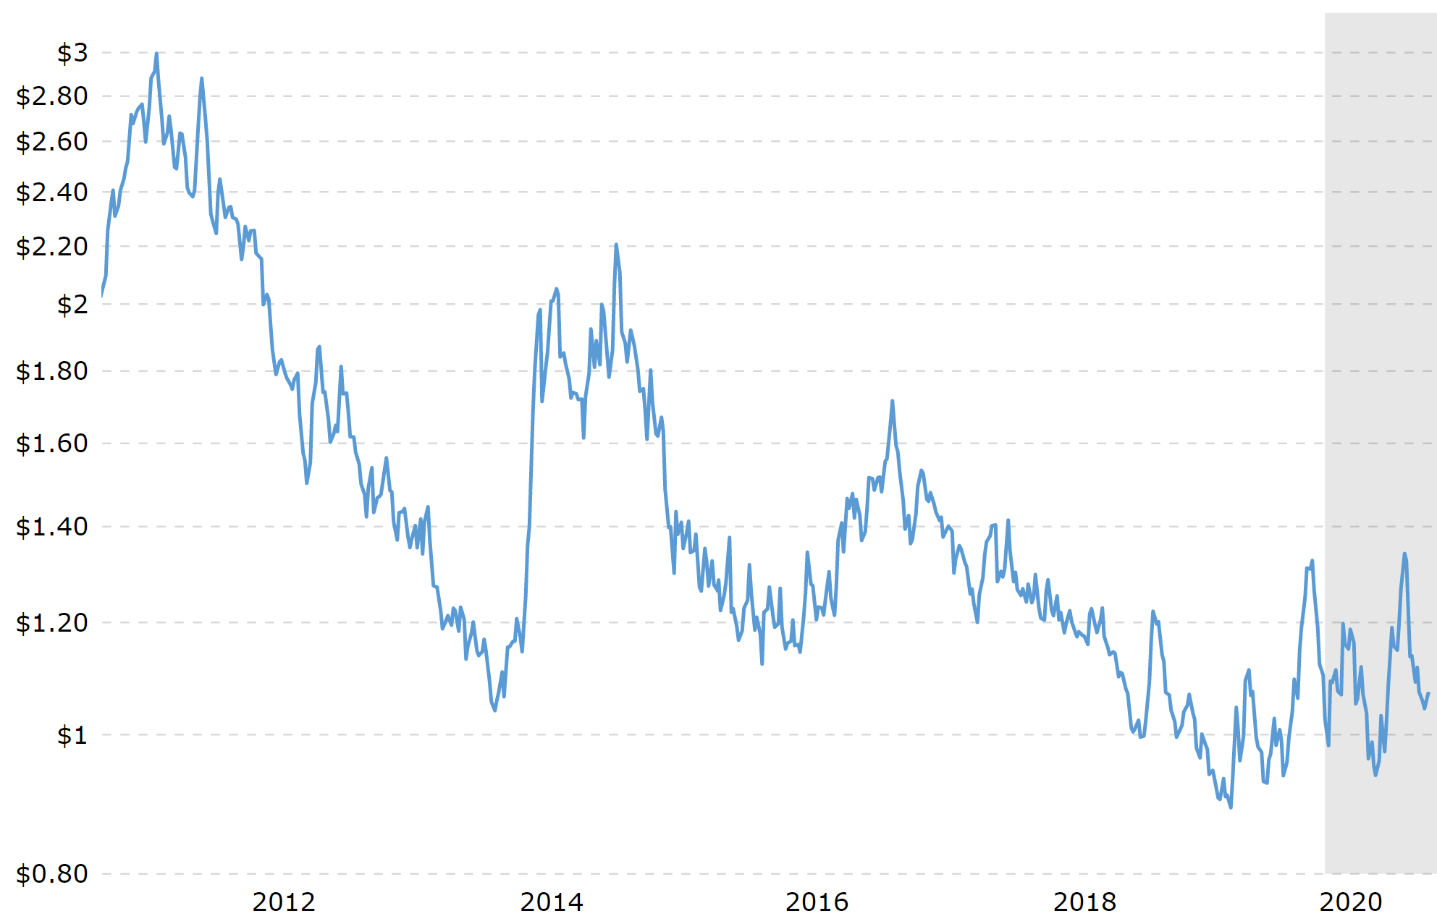
Arabica Price

Slide 17
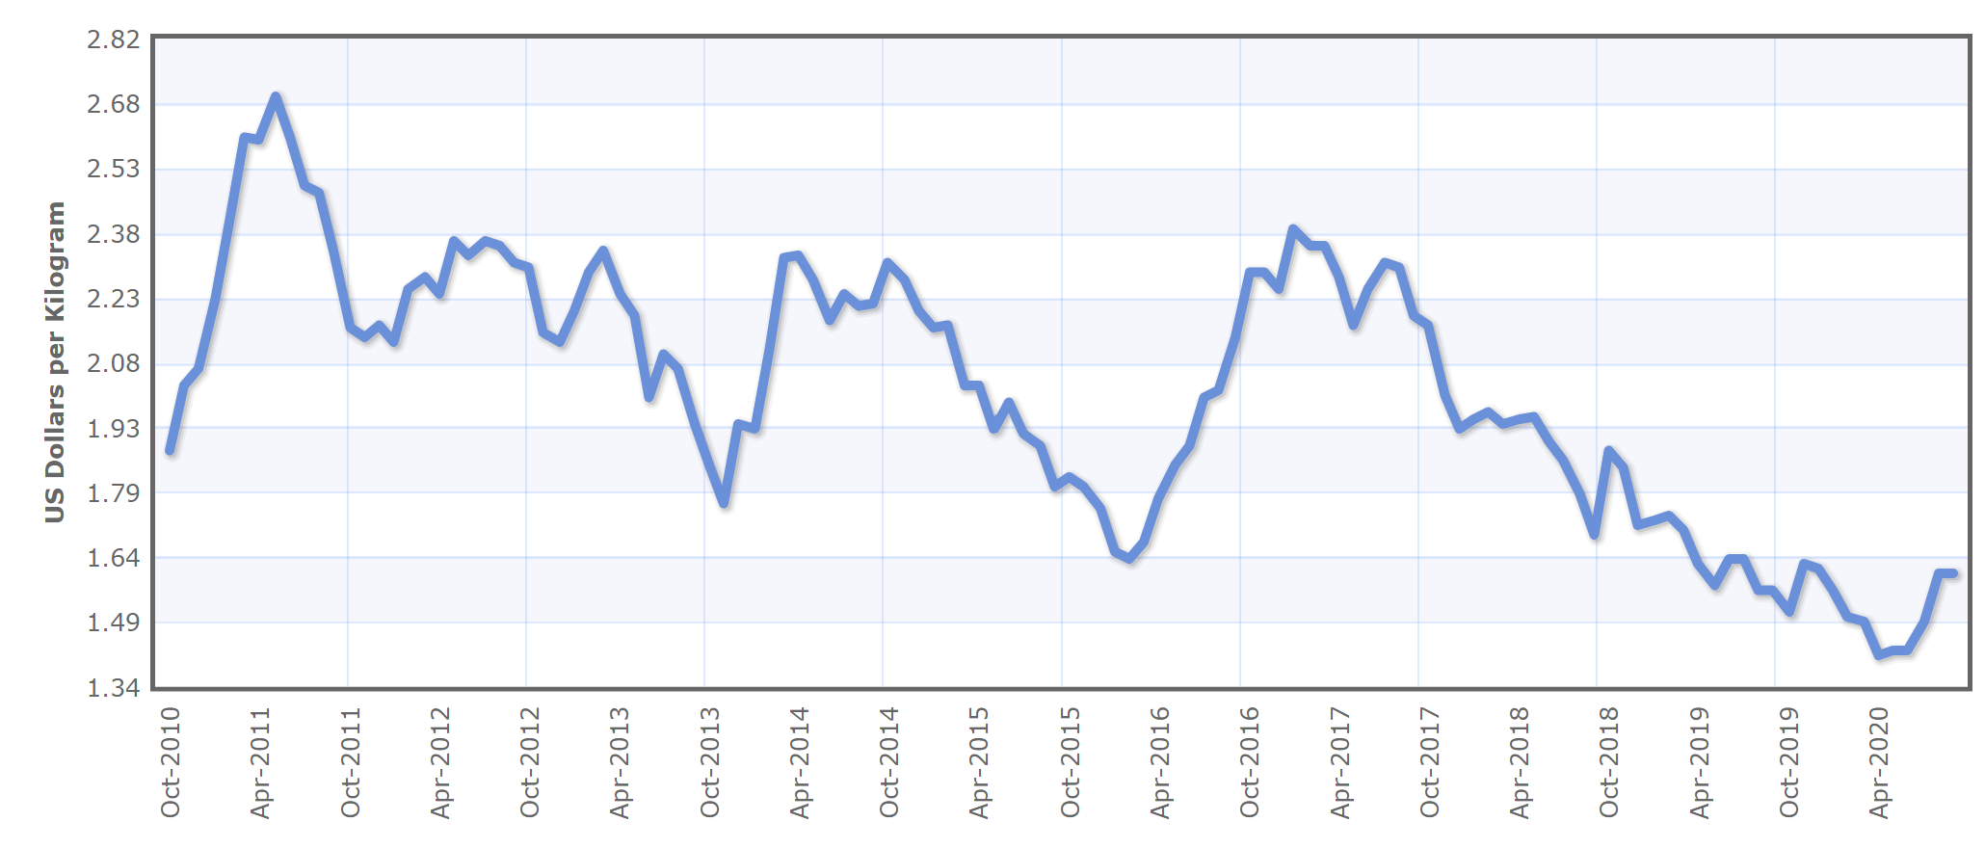
Robusta Price

Slide 18
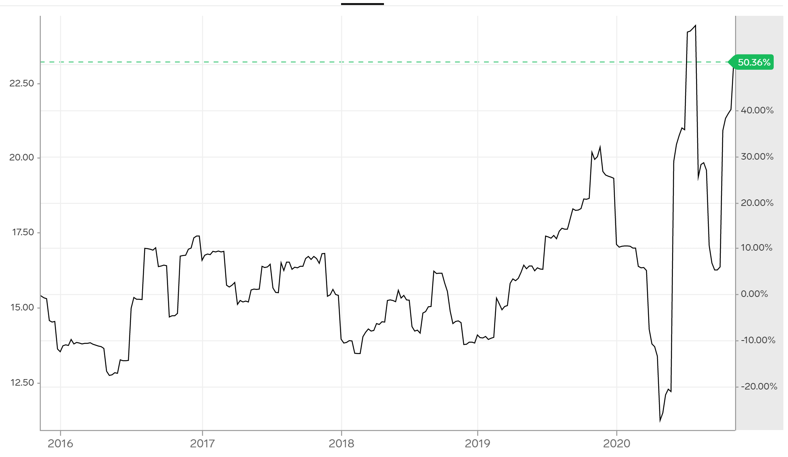
Milk Price

Slide 19
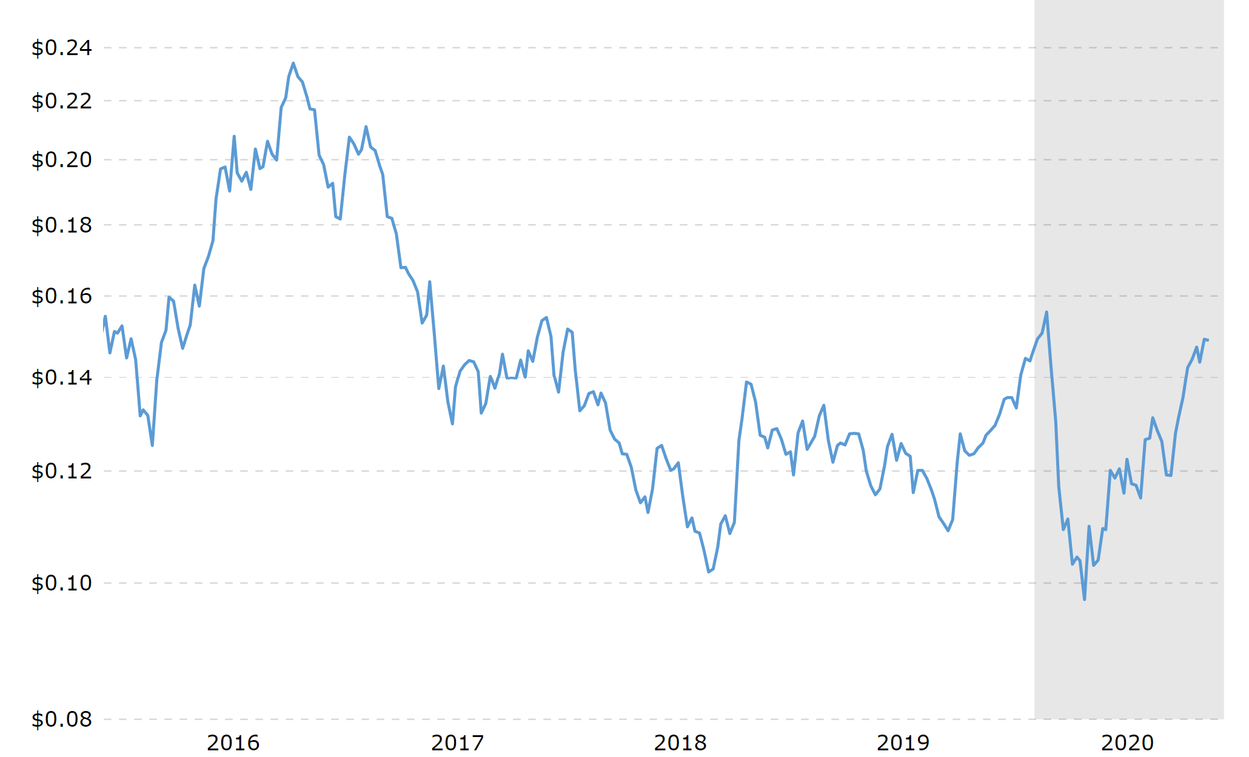
Sugar Price

Slide 20
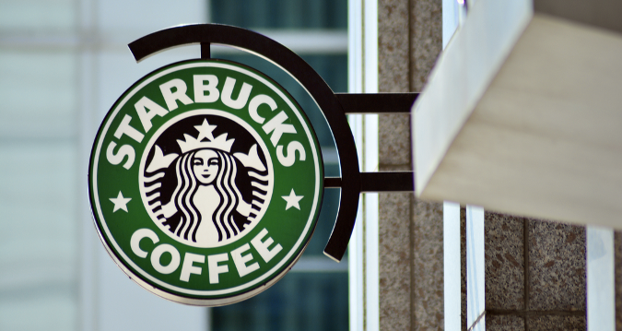

Slide 21

Company Overview
-Founded in March 1971
-The premier roaster, marketer and retailer of specialty coffee in the world
-Object: to maintain Starbucks standing as one of the most recognized and respected brands in the world
-Regulation environment
-Stricter customs and trade regulation
-Licensing regulations related to the industry
-Tax policy
-Employment law

Slide 22
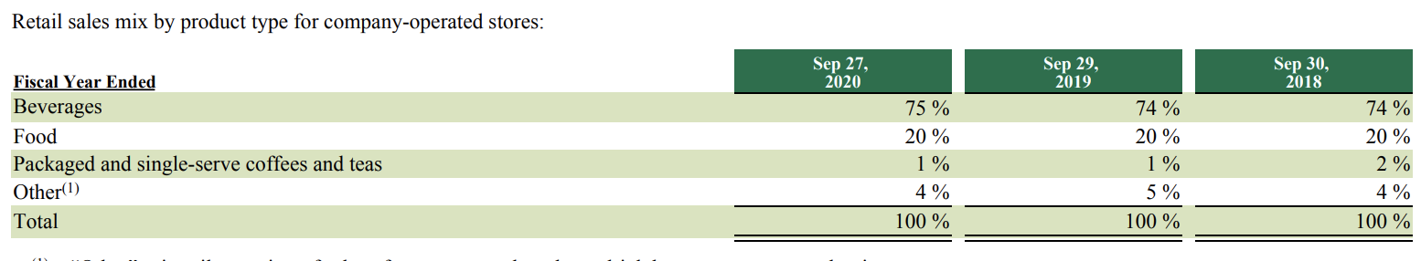
Product Segment
Main products: high-quality coffee, handcrafted coffee, tea and other beverages and a variety of high-quality food items

Slide 23
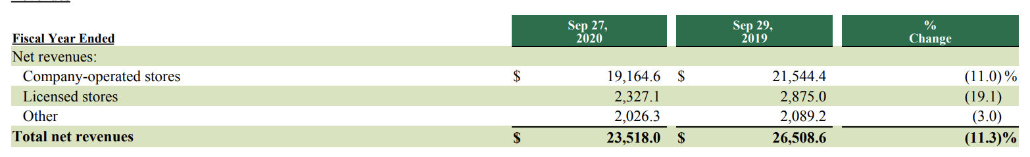
Revenue Segments
Majority of the revenues are generated through company-owned or licensed stores
Notes:
Total net revenues decreased $3.0 billion, or 11%, over fiscal 2019, primarily due to lower revenues from company-operated stores ($2.4 billion). The decline in company-operated store revenue was due to a 14% decrease in comparable store sales ($2.9 billion), attributable to a 22% decrease in comparable transactions, partially offset by a 10% increase in average ticket

Slide 24
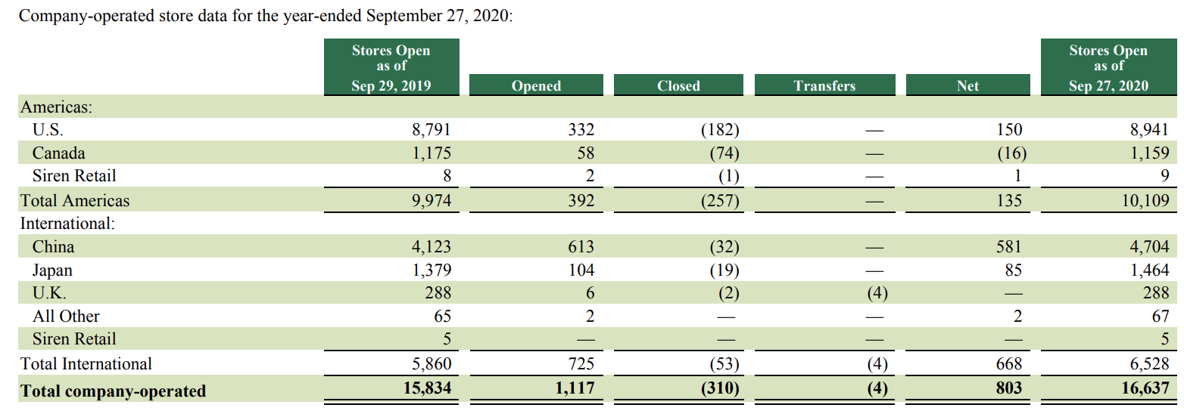
Company Operated Stores
Revenue from company-operated stores accounted for 81% of total revenues during fiscal 2020.
Notes:
Our strategy for expanding our global retail business is to increase our category share in a disciplined manner, by selectively opening additional stores in new and existing markets, as well as increasing sales in existing stores, to support our long-term strategic objective to maintain Starbucks standing as one of the most recognized and respected brands in the world. Store growth in specific existing markets will vary due to many factors, including expected financial returns, the maturity of the market, economic conditions, consumer behavior and local business practices.

Slide 25
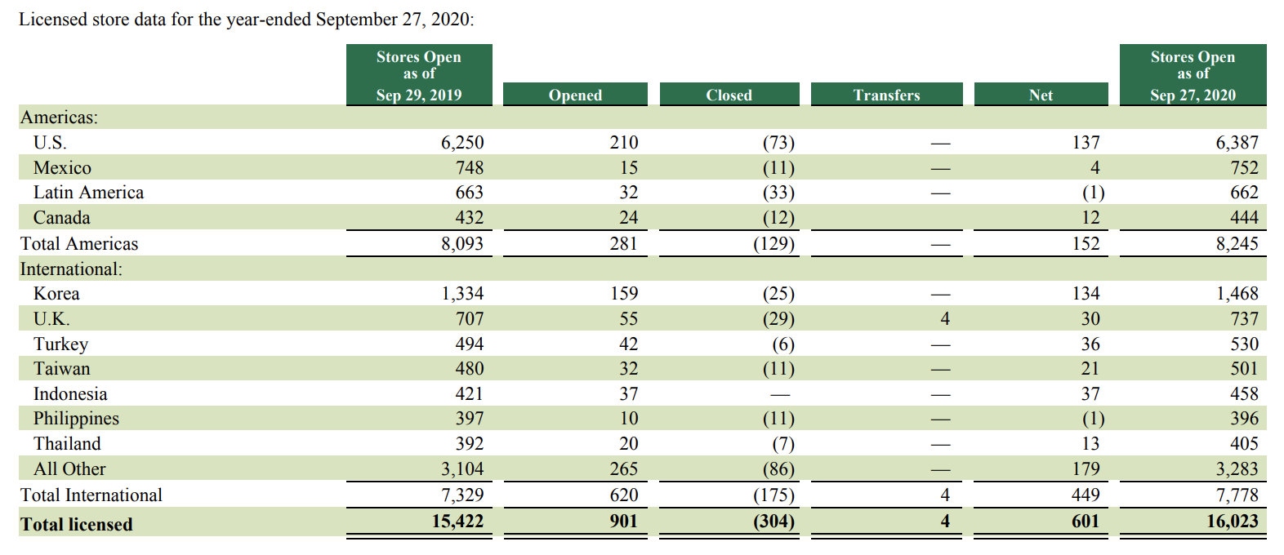
Licensed Stores
Revenue from licensed stores accounted for 11% of total revenues during fiscal 2020.

Slide 26
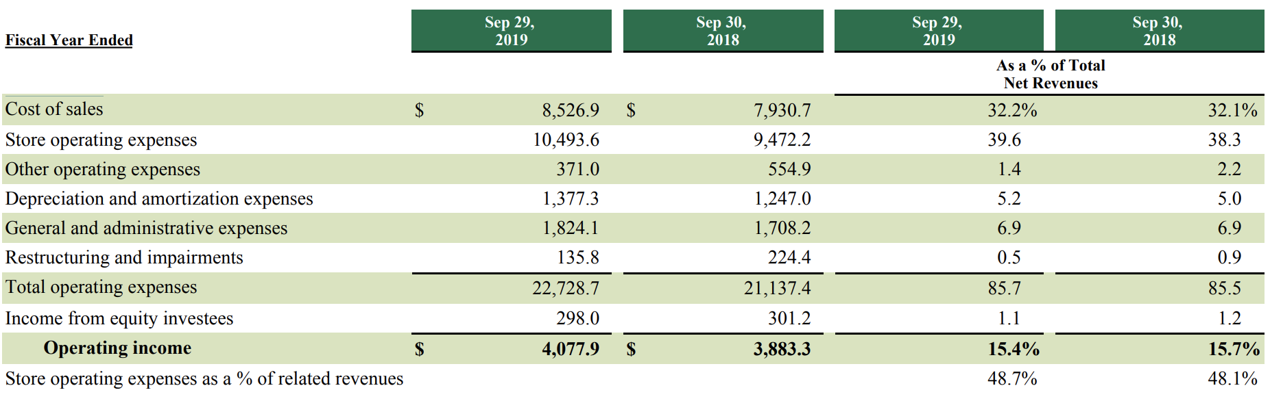
Cost Structure

Slide 27
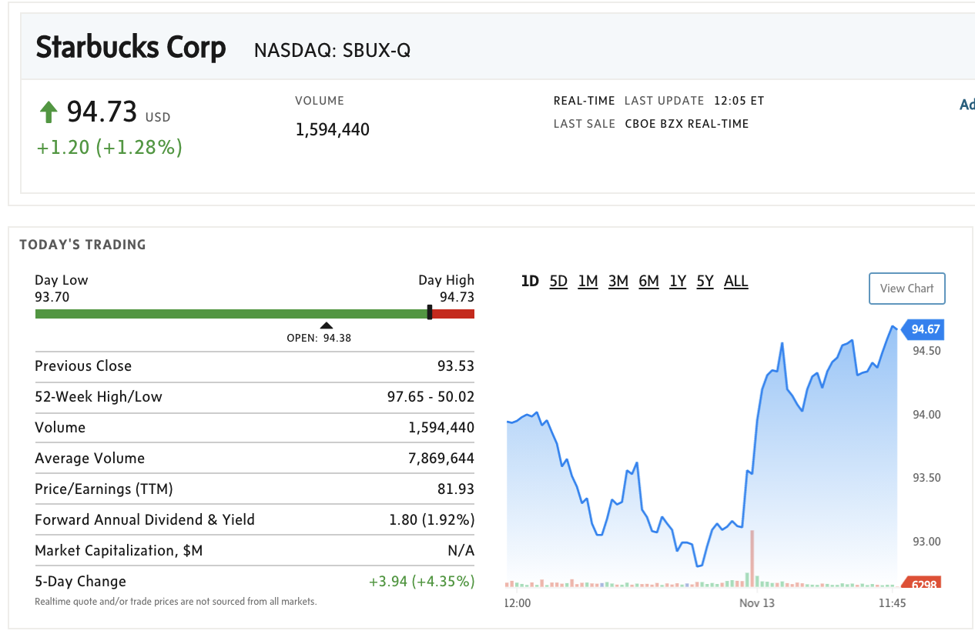
Stock Information - Current

Slide 28
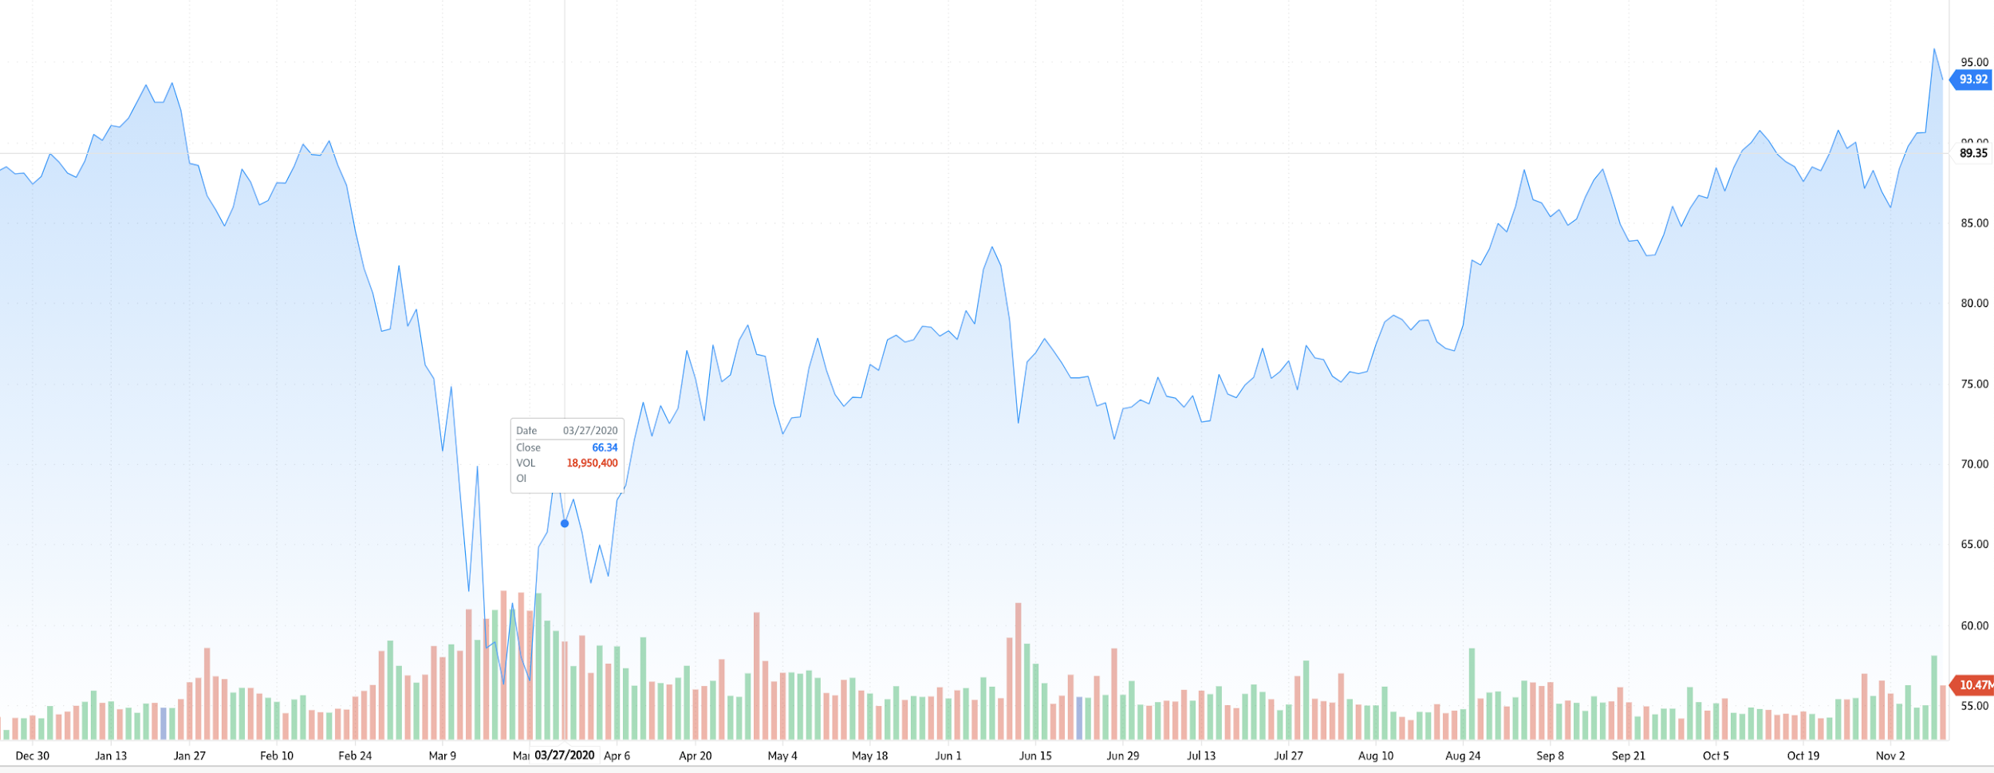
Stock Information - 1 year

Slide 29
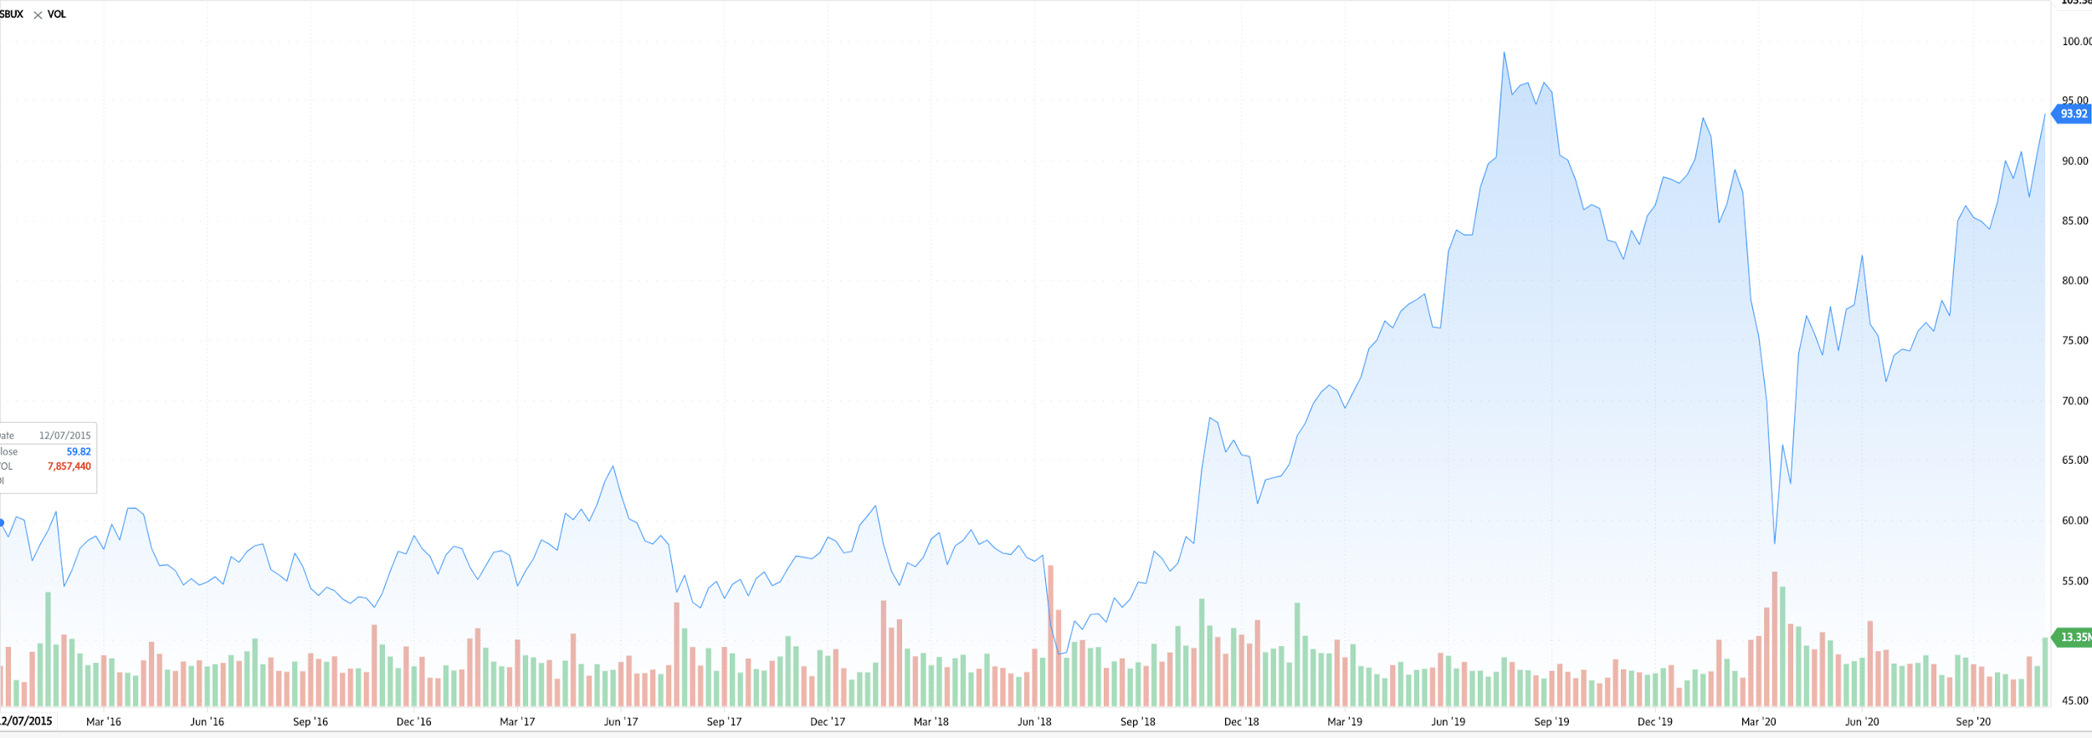
Stock Information - 5 year

Slide 30
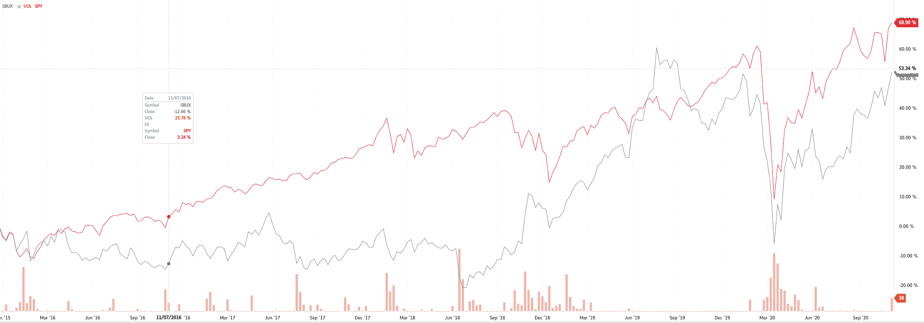
Stock comparison to S&P 500

Slide 31
Financial Statements
-Income Statement
-Balance Sheet
-Statement of Cash Flow

Slide 32
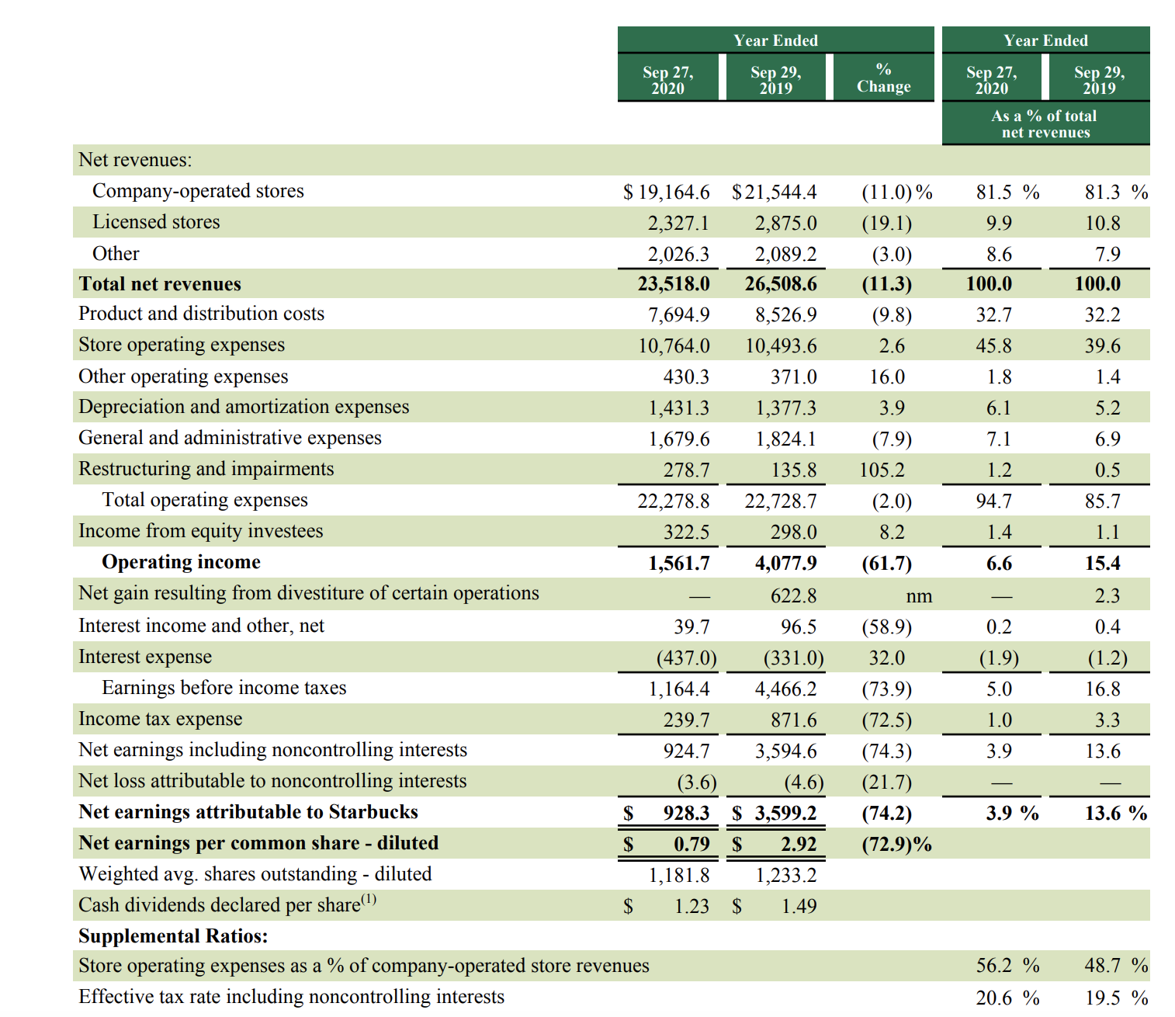
Income Statement

Slide 33
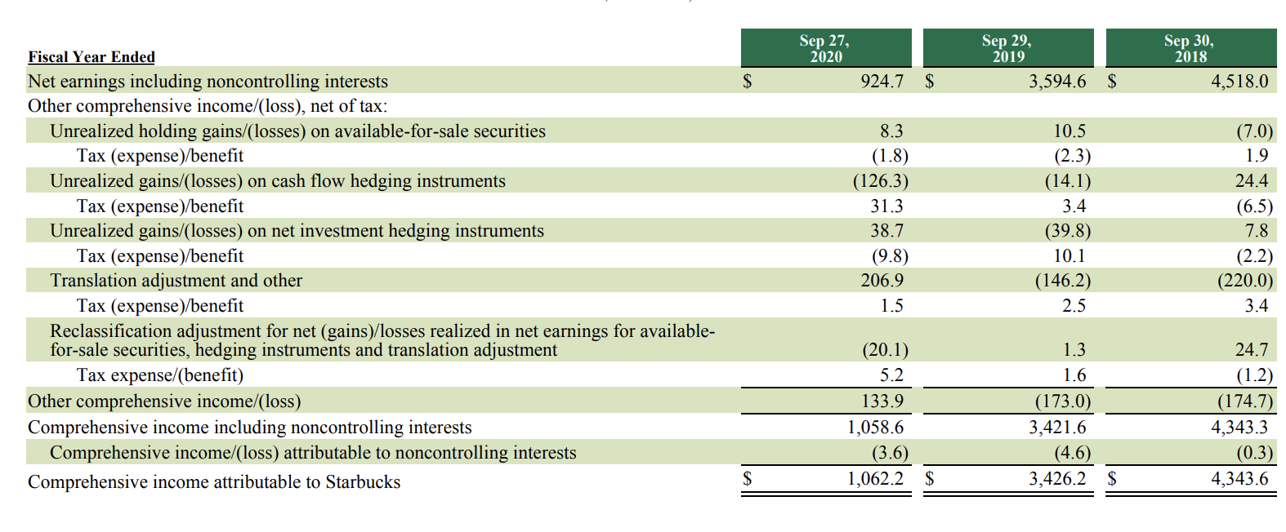
Statement of Comprehensive Income

Slide 34
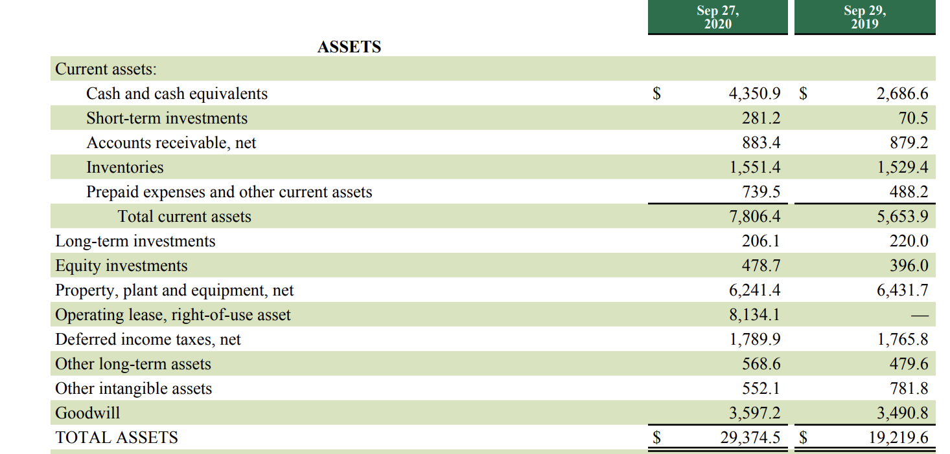
Balance Sheet - Assets

Slide 35
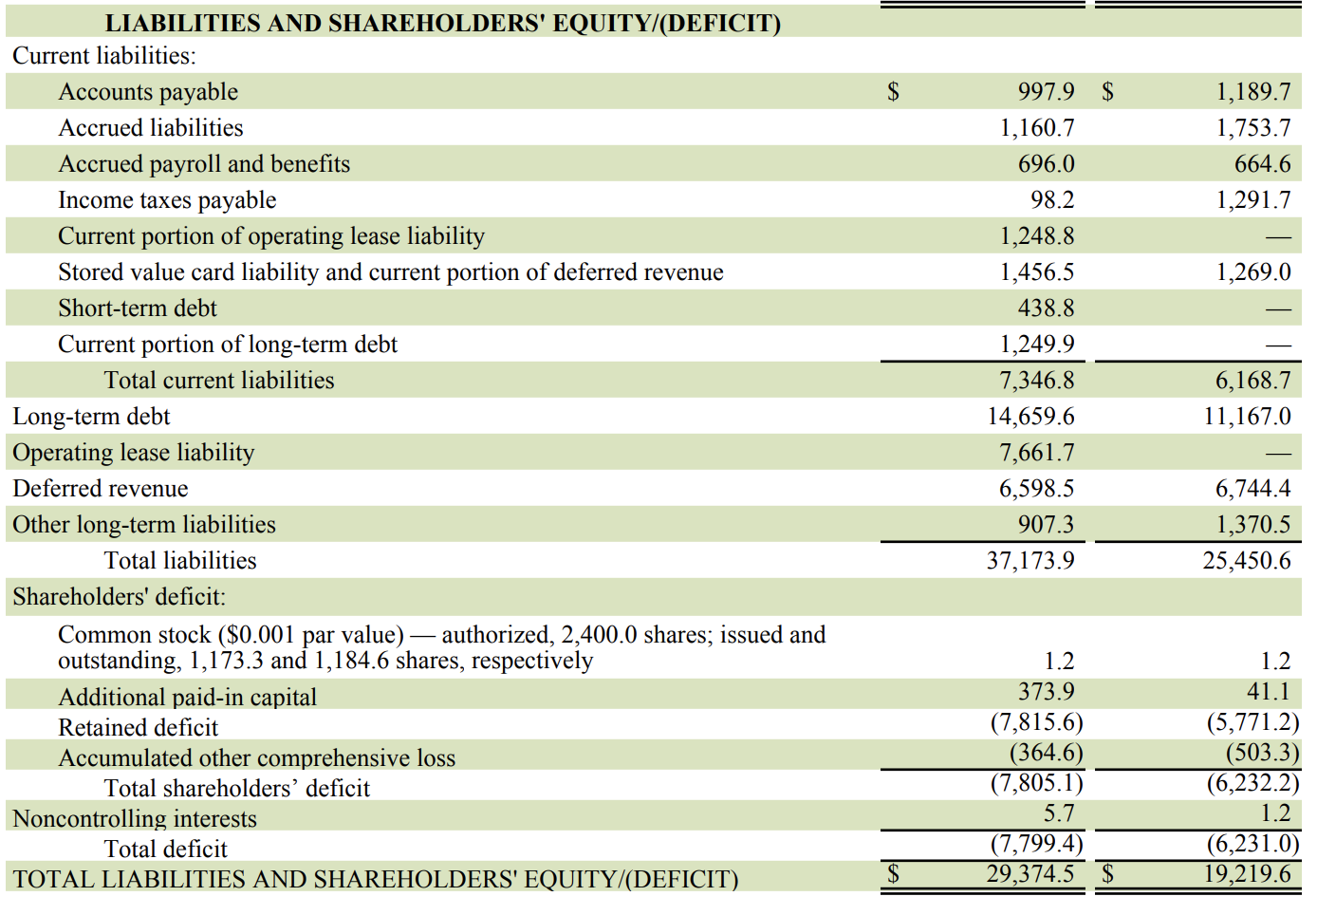
Balance Sheet - Liabilities

Slide 36
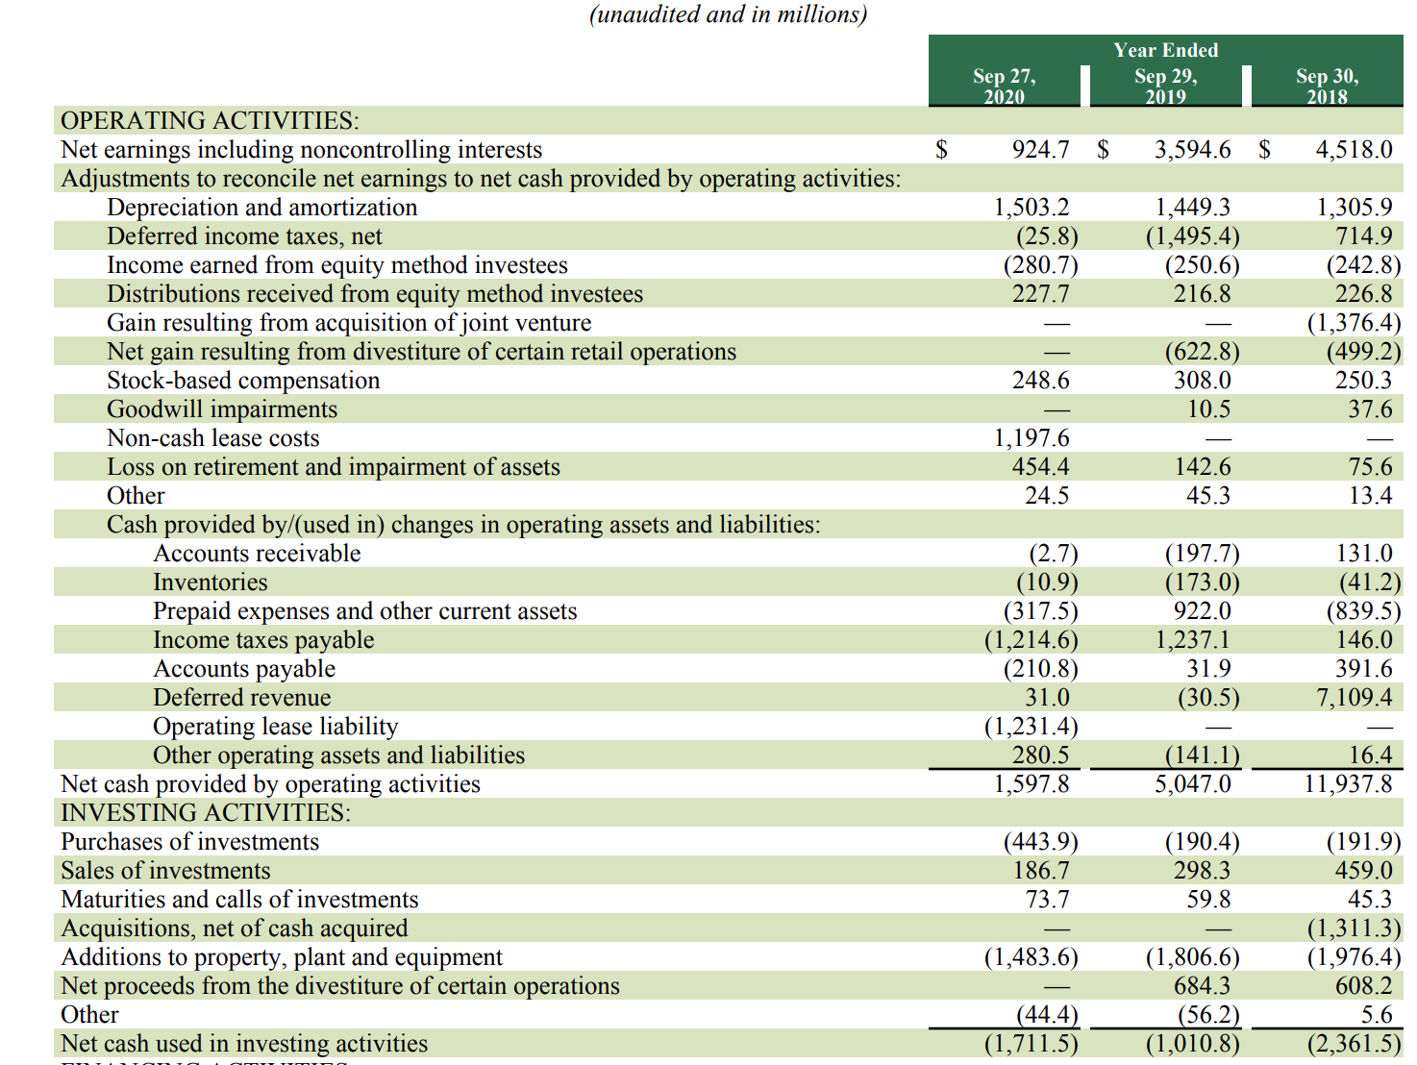
Statement of Cash Flows

Slide 37
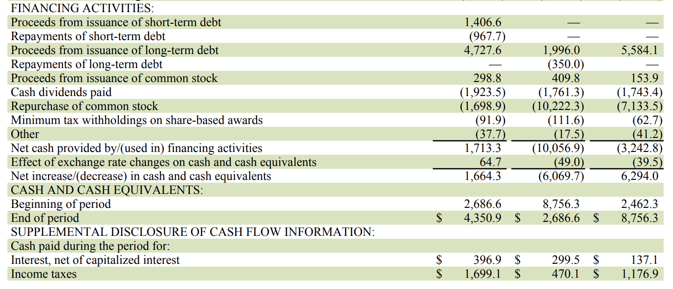
Statement of Cash Flows

Slide 38
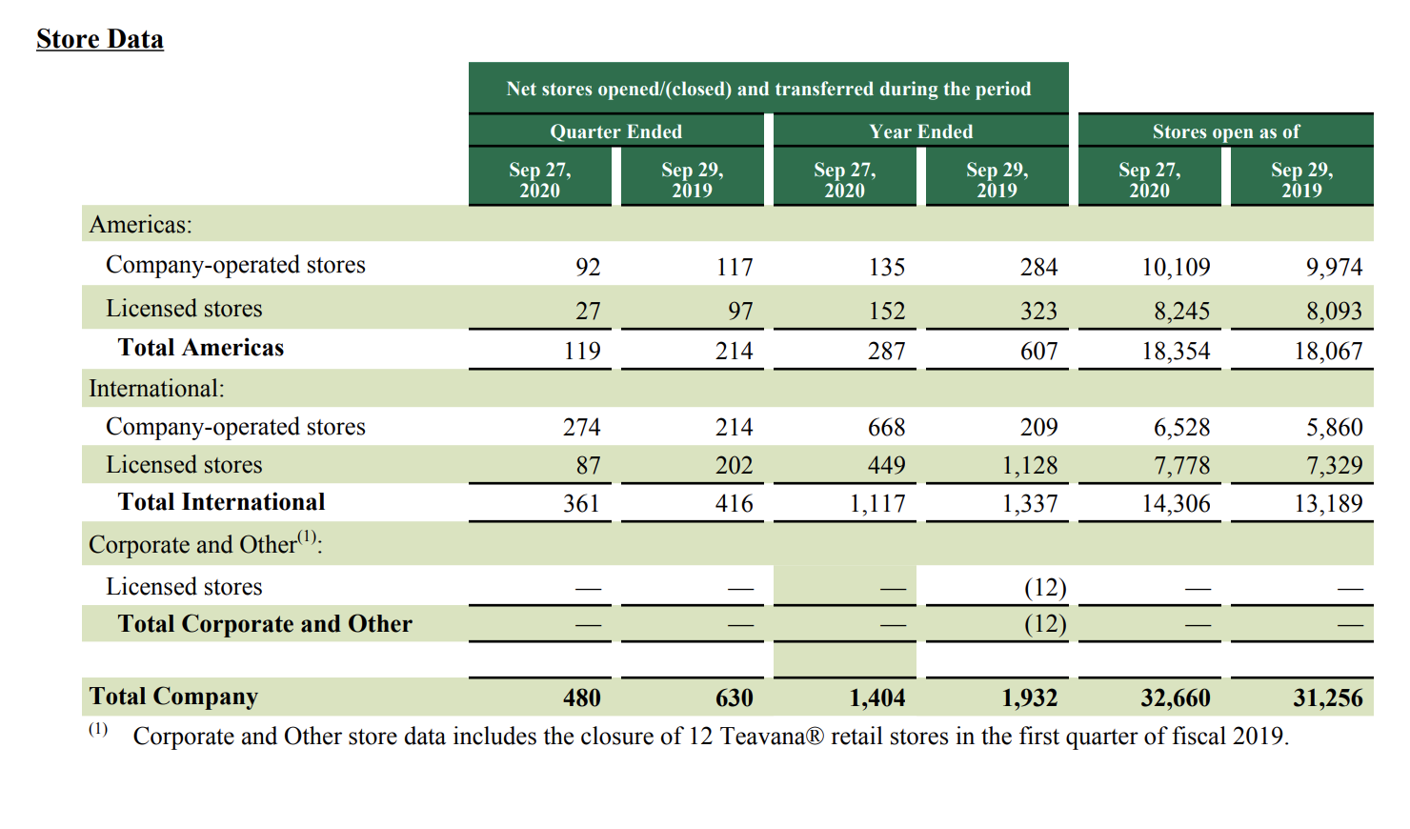
Stores Closed & Opened

Slide 39
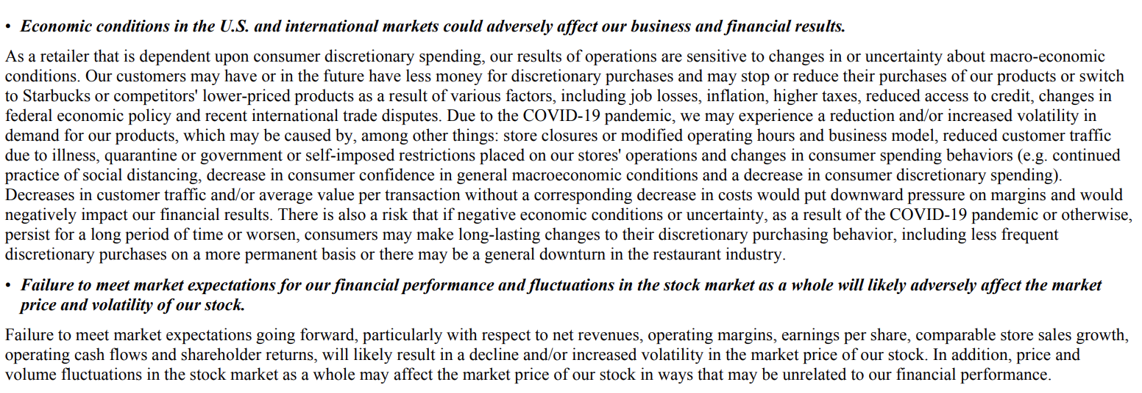
Risk Factors

Slide 40
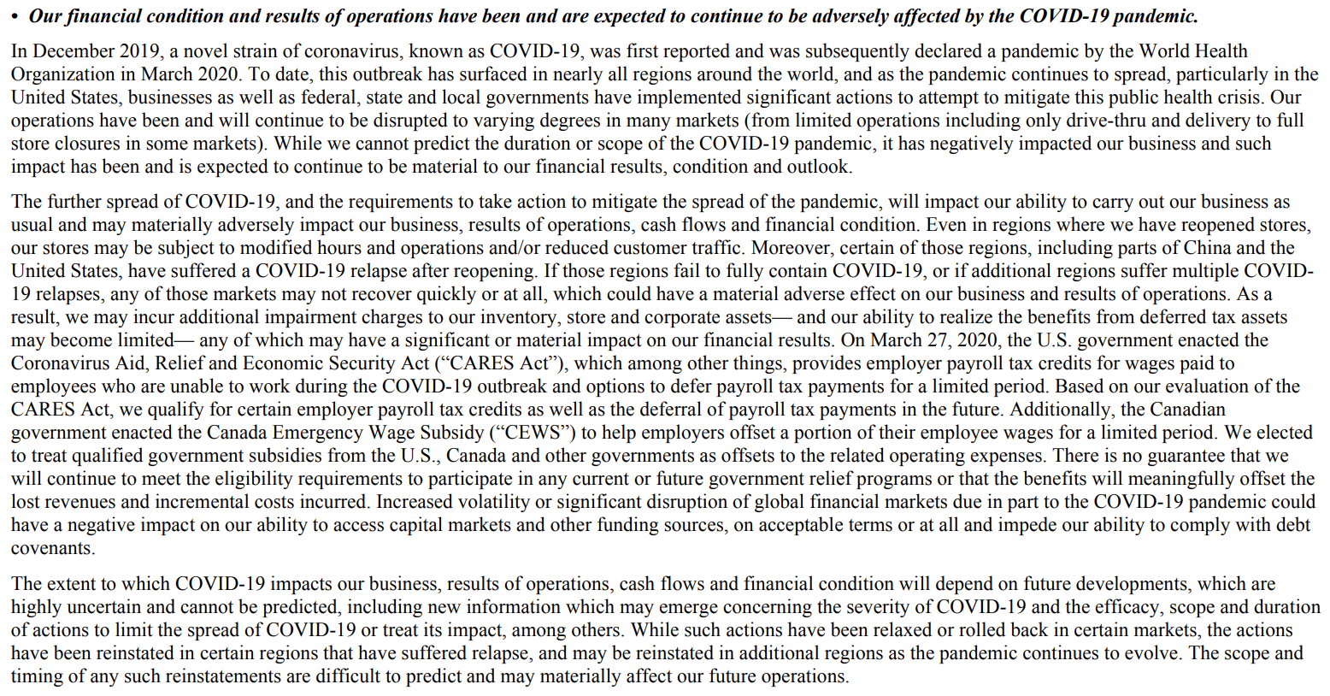
Risk of COVID-19

Slide 41
Financial Risk Management
➢Commodity price risk
➢Foreign currency exchange risk
➢Equity price risk
➢Interest rate risk

Slide 42
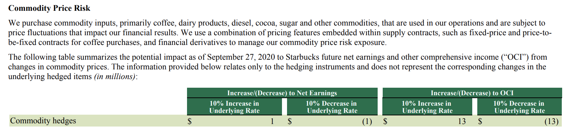
Commodity Price Risk

Slide 43
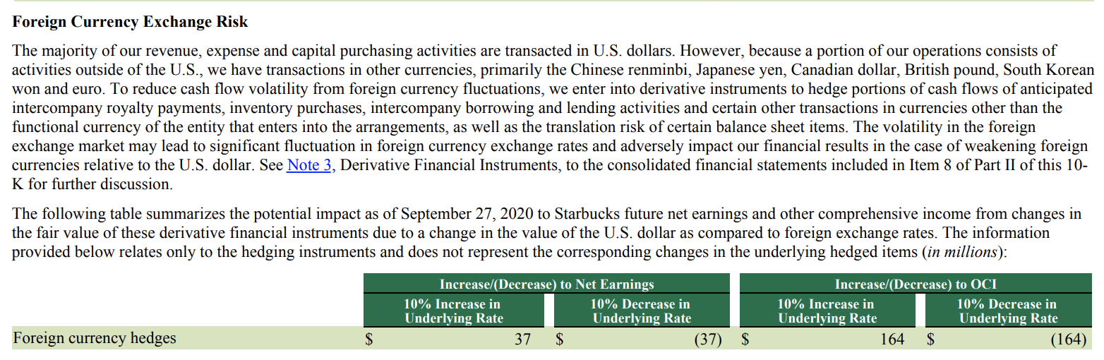
Foreign Currency Exchange Risk

Slide 44
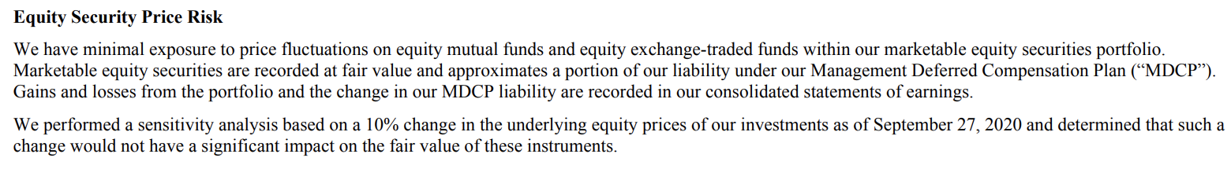
Equity Price Risk

Slide 45
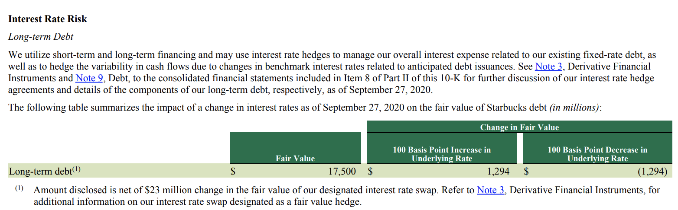
Interest Rate Risk

Slide 46
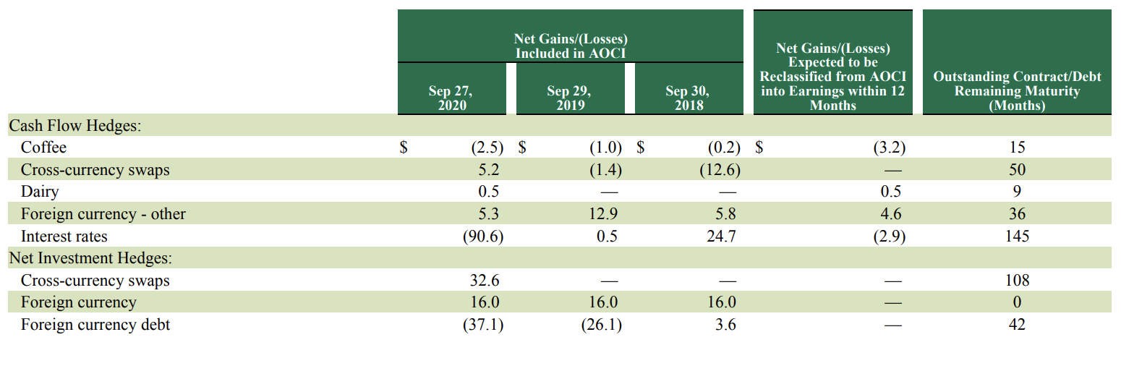
Financial Instrument
Gains and losses on derivative contracts and foreign currency-denominated debt designated as hedging instruments included in AOCI and expected to be reclassified into earning within 12 months, net of tax (in million):

Slide 47
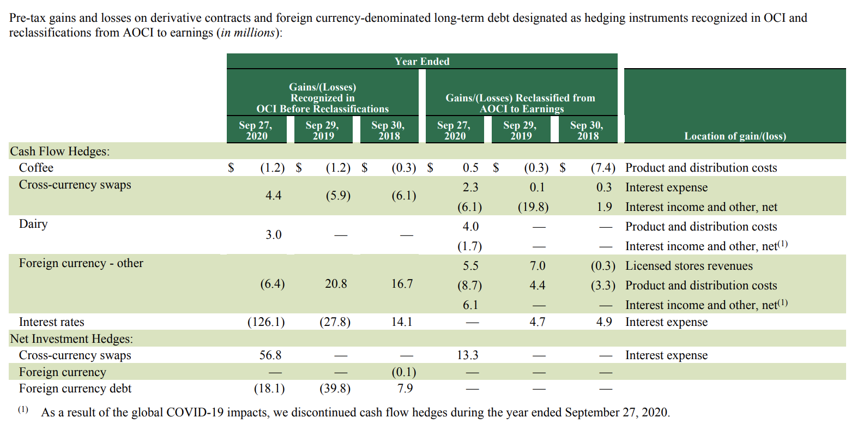

Slide 48
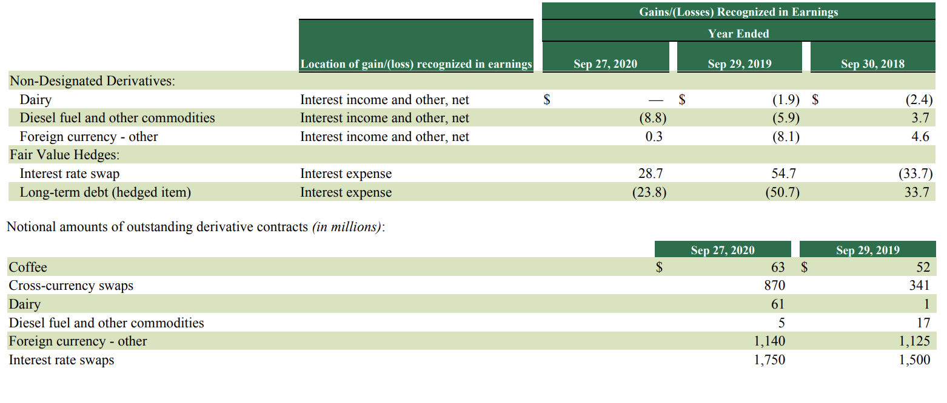
Other Derivative Instruments

Slide 49
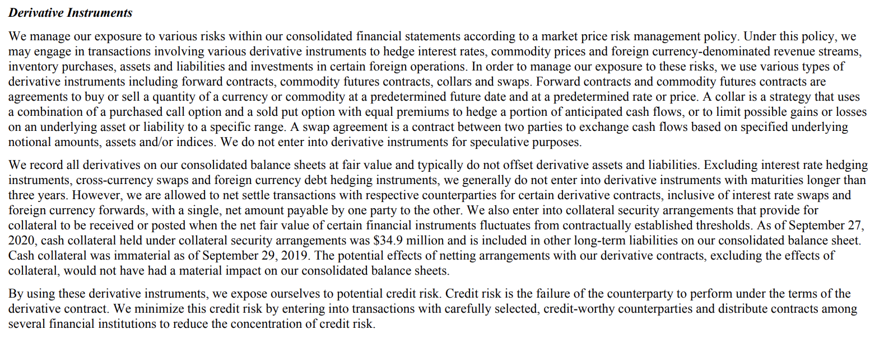
Accounting Method - Derivatives

Slide 50
Recommendation
1.Commodity price
a.Commodity future contracts such as coffee and dairy, to hedge anticipated cash flow
b.Swaps contracts, futures and collars to mitigate the price uncertainty of a portion of future purchases
2.Foreign currency exchange
a.Forward and swaps contracts to mitigate foreign exchange risk
3.Interest rate
a.Interest rate swaps to hedge the changes in the fair value of their fixed-rate debt
b.Designated cash flow hedges to manage the variability of cash flow

Slide 51
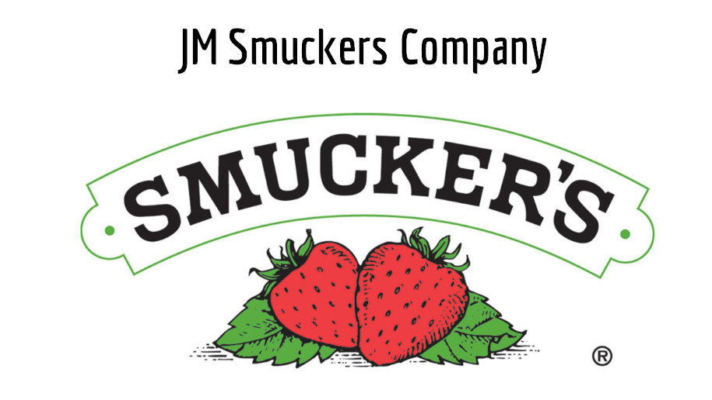

Slide 52
Company Overview
The J.M. Smucker Company is a leading manufacturer of fruit spreads, retail packaged coffee, peanut butter, sweetened condensed milk and other products in North America
Founded by Jerome Monroe Smucker in Orrville, Ohio, in 1897
Traded on: “NYSE” under the symbol “SJM”
Led by CEO Mark Smucker

Slide 53
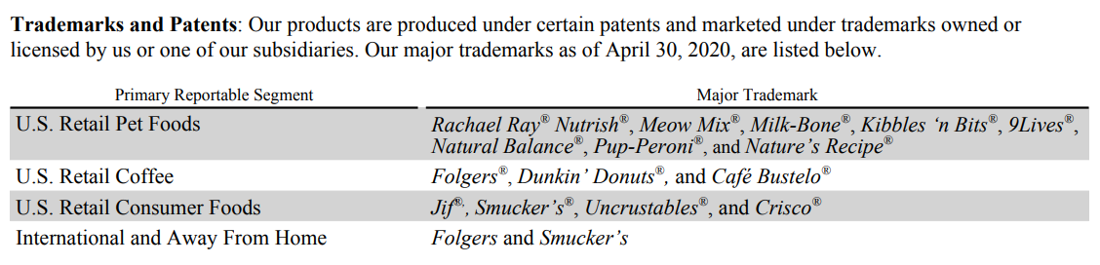
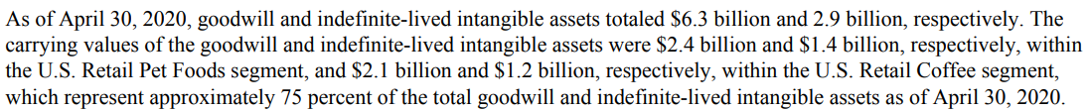
Company Segment

Slide 54
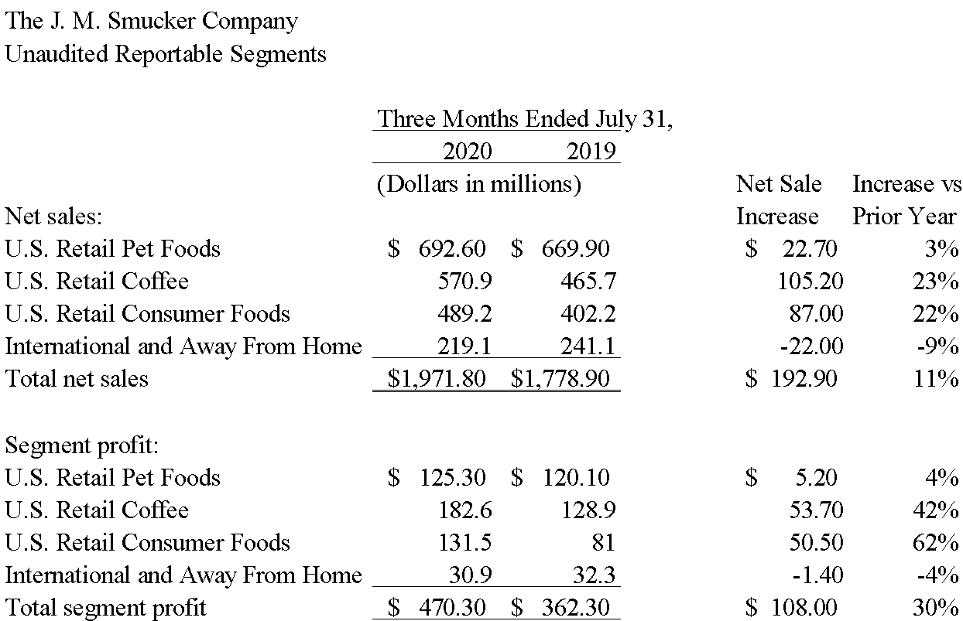
Company Segment Breakdown

Slide 55
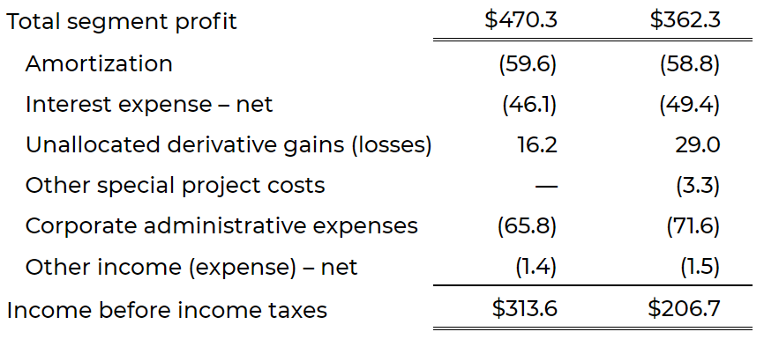
Cost Structure
The following table presents Unaudited Reportable Segments (Dollars in millions)

Slide 56
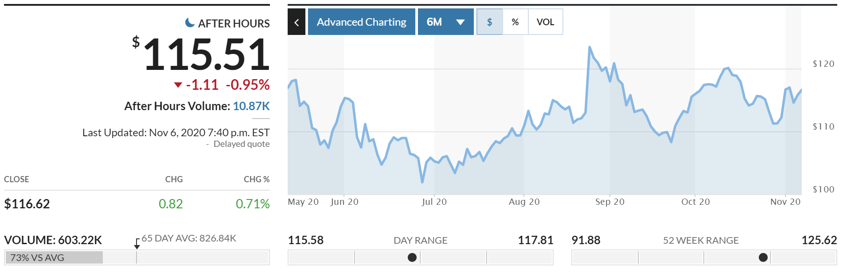
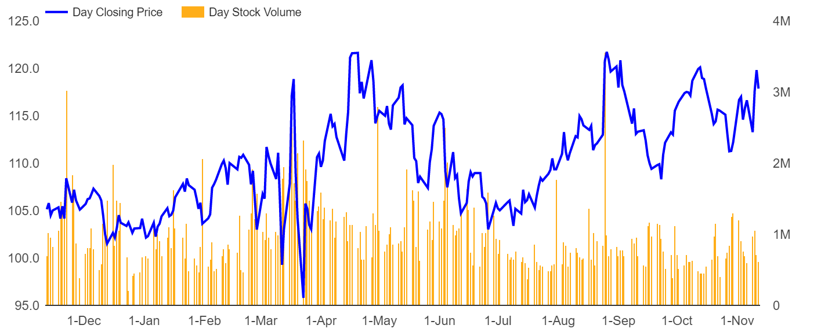

Current Stock Price
J.M. Smuckers Co.

Slide 57
Financial Statements
Consolidated Statements of Comprehensive Income
Consolidated Balance Sheets
Consolidated Statements of Cash Flows

Slide 58
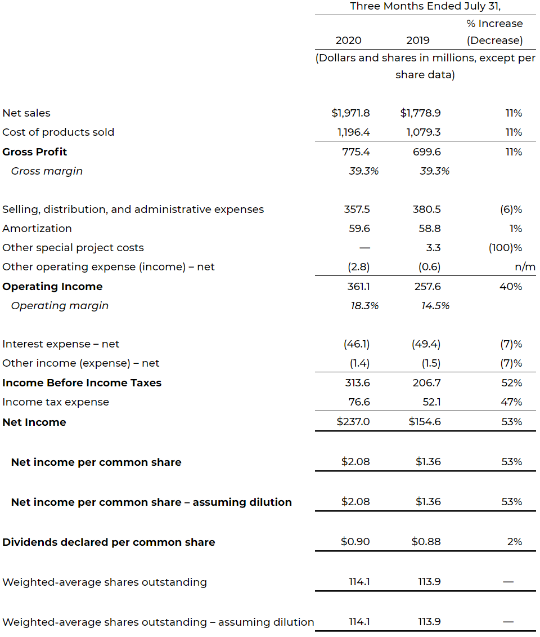
Consolidated Statements of Comprehensive Income

Slide 59
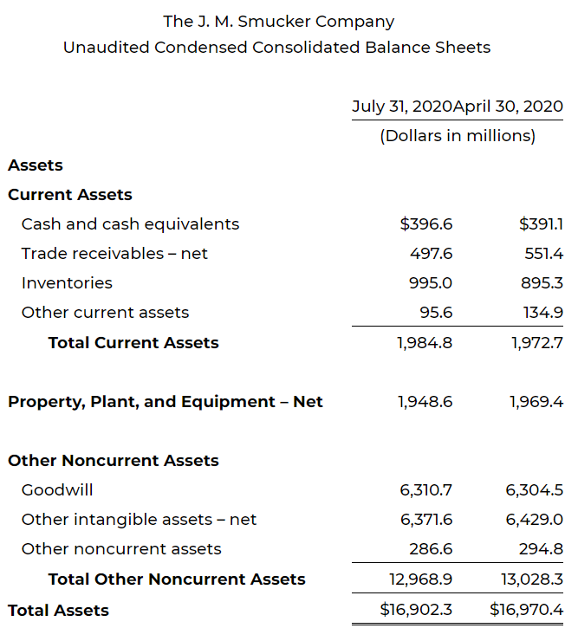
Consolidated Statements of Comprehensive Income
Balance Sheet - Asset

Slide 60
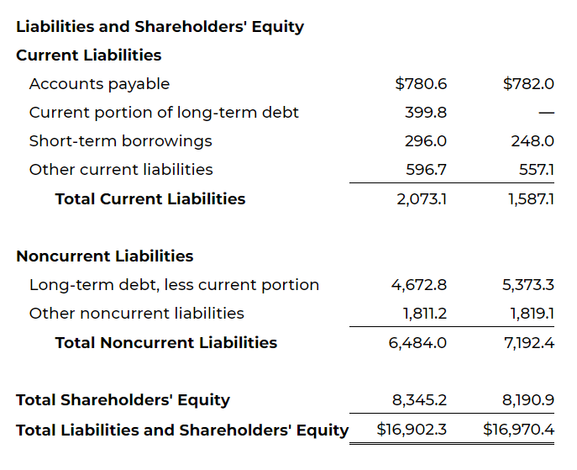
Balance Sheet – Liability and Equity

Slide 61

Cash Flow – Operating activities

Slide 62

Cash Flow – Investing and Financing

Slide 63
Derivative Financial Instruments and Market Risk
JM Smucker is exposed to market risk related to changes in
Interest rates
Foreign currency exchange rates
Commodity prices

Slide 64

Risk Factor - Interest Rate Risk

Slide 65

Risk Factor – Foreign Currency Exchange Risk

Slide 66
Risk Factor – Commodity Price Risk
Commodity Price Risk:
Raw materials including green coffee, certain oils, and certain protein meals are traded on active regulated exchanges, and commodities price fluctuation is based on market conditions, including
- The supply and demand conditions
- Political and economic variables
- Weather
- Investor speculation
- Other unpredictable factors

Slide 67

Risk Management - Interest Rate Risk

Slide 68

Risk Management – Foreign Exchange Risk

Slide 69

Risk Management - Commodity Price Risk
To manage the volatility related to anticipated commodity purchases, we use derivatives with maturities of generally
less than one year. We do not qualify commodity derivatives for hedge accounting treatment. As a result, the gains and losses on all commodity derivatives are immediately recognized in cost of products sold.

Slide 70
Other Risk Factors
The outbreak of the novel coronavirus (“COVID-19”) could negatively impact our business and results of operations.
Their proprietary brands, packaging designs, and manufacturing methods are essential to the value of their business, and the inability to protect these could affect sales and profitability
Loss or interruption of supply from single-source suppliers of raw materials and finished goods could have a disruptive effect

Slide 71
Other Risk Factors
Substantially all of their coffee are produced at single manufacturing sites.
Their efforts to manage commodity, foreign currency exchange, and other price volatility through derivative instruments could adversely affect the results of operations and financial condition.

Slide 72
Summary
Interest rates hedging
Use Interest rate contract for cash flow hedge & fair value hedge to to hedge against unfavorable interest rate movement of their long term debt
Foreign currency exchange hedging
Use foreign currency derivatives to manage the effect of foreign currency fluctuations on future cash payments
Commodities price hedging:
Use commodity derivatives that are generally less than one year to actively adjust hedging strategies as appropriate

Slide 73


Slide 74



Slide 75


Slide 76


Slide 77

Changes in System-wide (2018 ~ 2019)
Changes in systemwide sales are impacted by changes in the number of points of distribution. Points of distribution and net openings (closings) as of and for the fiscal years ended December 28, 2019, 2018:

Slide 78


Franchisee relationships and model
Franchising is a business arrangement - a service organization, the franchisor, grants an operator, the franchisee, a license to sell the franchisor's products and services - use its system and trademarks in a given area
Seek to maximize the alignment of interests with those of franchisees and do not guarantee franchisees' financing obligations - offer voluntary financing to existing franchisees
Franchise agreement covering a standard set of terms and conditions (typical 20-year term in the U.S.)
Master franchise agreements are the most prevalent international relationships for both brands - limited basis domestically but widely internationally
Master franchise required - upfront market entry fee and upfront initial franchise fee

Slide 79

Franchise fees
Franchisees pay an initial franchise fee for the right to operate a restaurant for one or more franchised brands and fees vary by brand, type of development agreement and geographic area of development:

Slide 80





Other franchise related fees (2019)
Net rental fees: 9.0%, or $122.7 million of total revenue
License fee: 0.7%, or $9.8 million of total revenue
Sales revenue to franchisees: 6.7%, or $91.4 million of total revenue
Other sources: 3.1%, or $42.7 million of total revenue

Slide 81

International Operations
Key markets for both brands are predominantly in Asia and the Middle East - approximately 68% and 19%, respectively, of international systemwide sales for fiscal year 2019:

Slide 82



Supply Chain
Main franchisees’ suppliers include Dean Foods, Rich Products Corp., The Coca-Cola Company, and KGM.
Coffee roasters suppliers:
Massimo Zanetti Beverage USA, Inc., Mother Parkers Tea & Coffee Inc., S&D Coffee, Inc., and Reily Foods Company, Inc.
Primary donut mix suppliers: Continental Mills and Pennant Ingredients Inc.

Slide 83

Supply Chain
Manufacturing of Dunkin' bakery goods
Purchasing
Purchasing for the Dunkin’ brand is facilitated by National DCP, LLC (the “NDCP”), which is a Delaware limited liability company operated as a cooperative owned by its franchisee members
Do not control the NDCP and only limited rights associated with franchisee-owned purchasing and distribution cooperative
Centralized manufacturing locations (“CMLs”) are franchisee-owned and -operated facilities for the centralized production of donuts and bakery goods
Outsource the manufacturing and distribution of ice cream products - strengthens relationships with franchisees and allows to focus on core franchising operations

Slide 84

Properties
Company's owned and leased office and training facilities, including the approximate square footage of each facility:

Slide 85


Earning per share
Earning per share of common stock and diluted adjusted earnings per share of common stock were as follows:
The following table sets forth the computation of diluted adjusted earnings per share:

Slide 86

Financial Statements
Consolidated Statements of Operations
Consolidated Balance Sheet
Adjusted Operating Income
Consolidated Statements of Cash Flows

Slide 87


Consolidated Statements of Operations

Slide 88


Consolidated Balance Sheet

Slide 89


Adjusted Operating Income

Slide 90


Consolidated Statements of Cash Flows

Slide 91

Risk Factors
- Risks related to business and industry

Slide 92

Financial results are affected by operating results of franchisees
Receive a substantial majority of revenues in the form of royalties
Financial results are to a large extent dependent upon the operational and financial success of franchisees
Royalty revenues may decrease if franchisees fail to renew their franchise agreements

Slide 93


2. Franchisees could take actions that could harm Dunkin' business
Franchisees are independent third parties - they have sole control over all employee and other workforce conduct and decisions
franchise fees, royalty and advertising fee income could be adversely affected and brand image and reputation could be harmed

Slide 94

3. Success depends substantially on the value of our brands
Success dependent upon- ability to maintain and enhance the value of our brands, customers' connection, and positive relationship with franchisees
Receive considerable negative publicity or result in litigation - brand value damaged
Incidents or other matters erode consumer confidence in company or products - lower sales and lower royalty income

Slide 95

4. Quick service restaurant segment is highly competitive
QSR segment of the restaurants industry is intensely competitive
Major market players in non-competing industries may choose to enter the restaurant industry
Some of competitors have substantially greater financial and other resources than us
Hard to guarantee the retention of any

Slide 96

5. Potential risk of international markets changes
Recessionary or expansive trends in international markets
Changes in foreign currency exchange rates and hyperinflation or deflation
Availability of credit for our franchisees, licensees, and our international joint ventures to finance the development of new restaurants
Legal and regulatory changes and the burdens and the political and economic instability

Slide 97
Market Risk
- Foreign exchange risk
Most of revenues, costs, and debts are denominated in U.S. dollars
Royalty income from our international franchisees is payable in U.S. dollars, and is generally based on gross sales denominated in the foreign currency of the country in which the point of distribution is located, and is therefore subject to foreign currency fluctuations.
Investments in, and equity income from, joint ventures are denominated in foreign currencies, and are therefore also subject to foreign currency fluctuations.
In the future, forward contracts will be used to manage foreign currency exchange rate risks.

Slide 98
Summary
Forward (or swaps) contracts to hedge foreign exchange risk
Diversify licensed suppliers and specify supply contracts
Transfer risks to franchisees
Interest rate swaps contracts to hedge potential interest risk

Slide 99
Thank you

