Slide 1
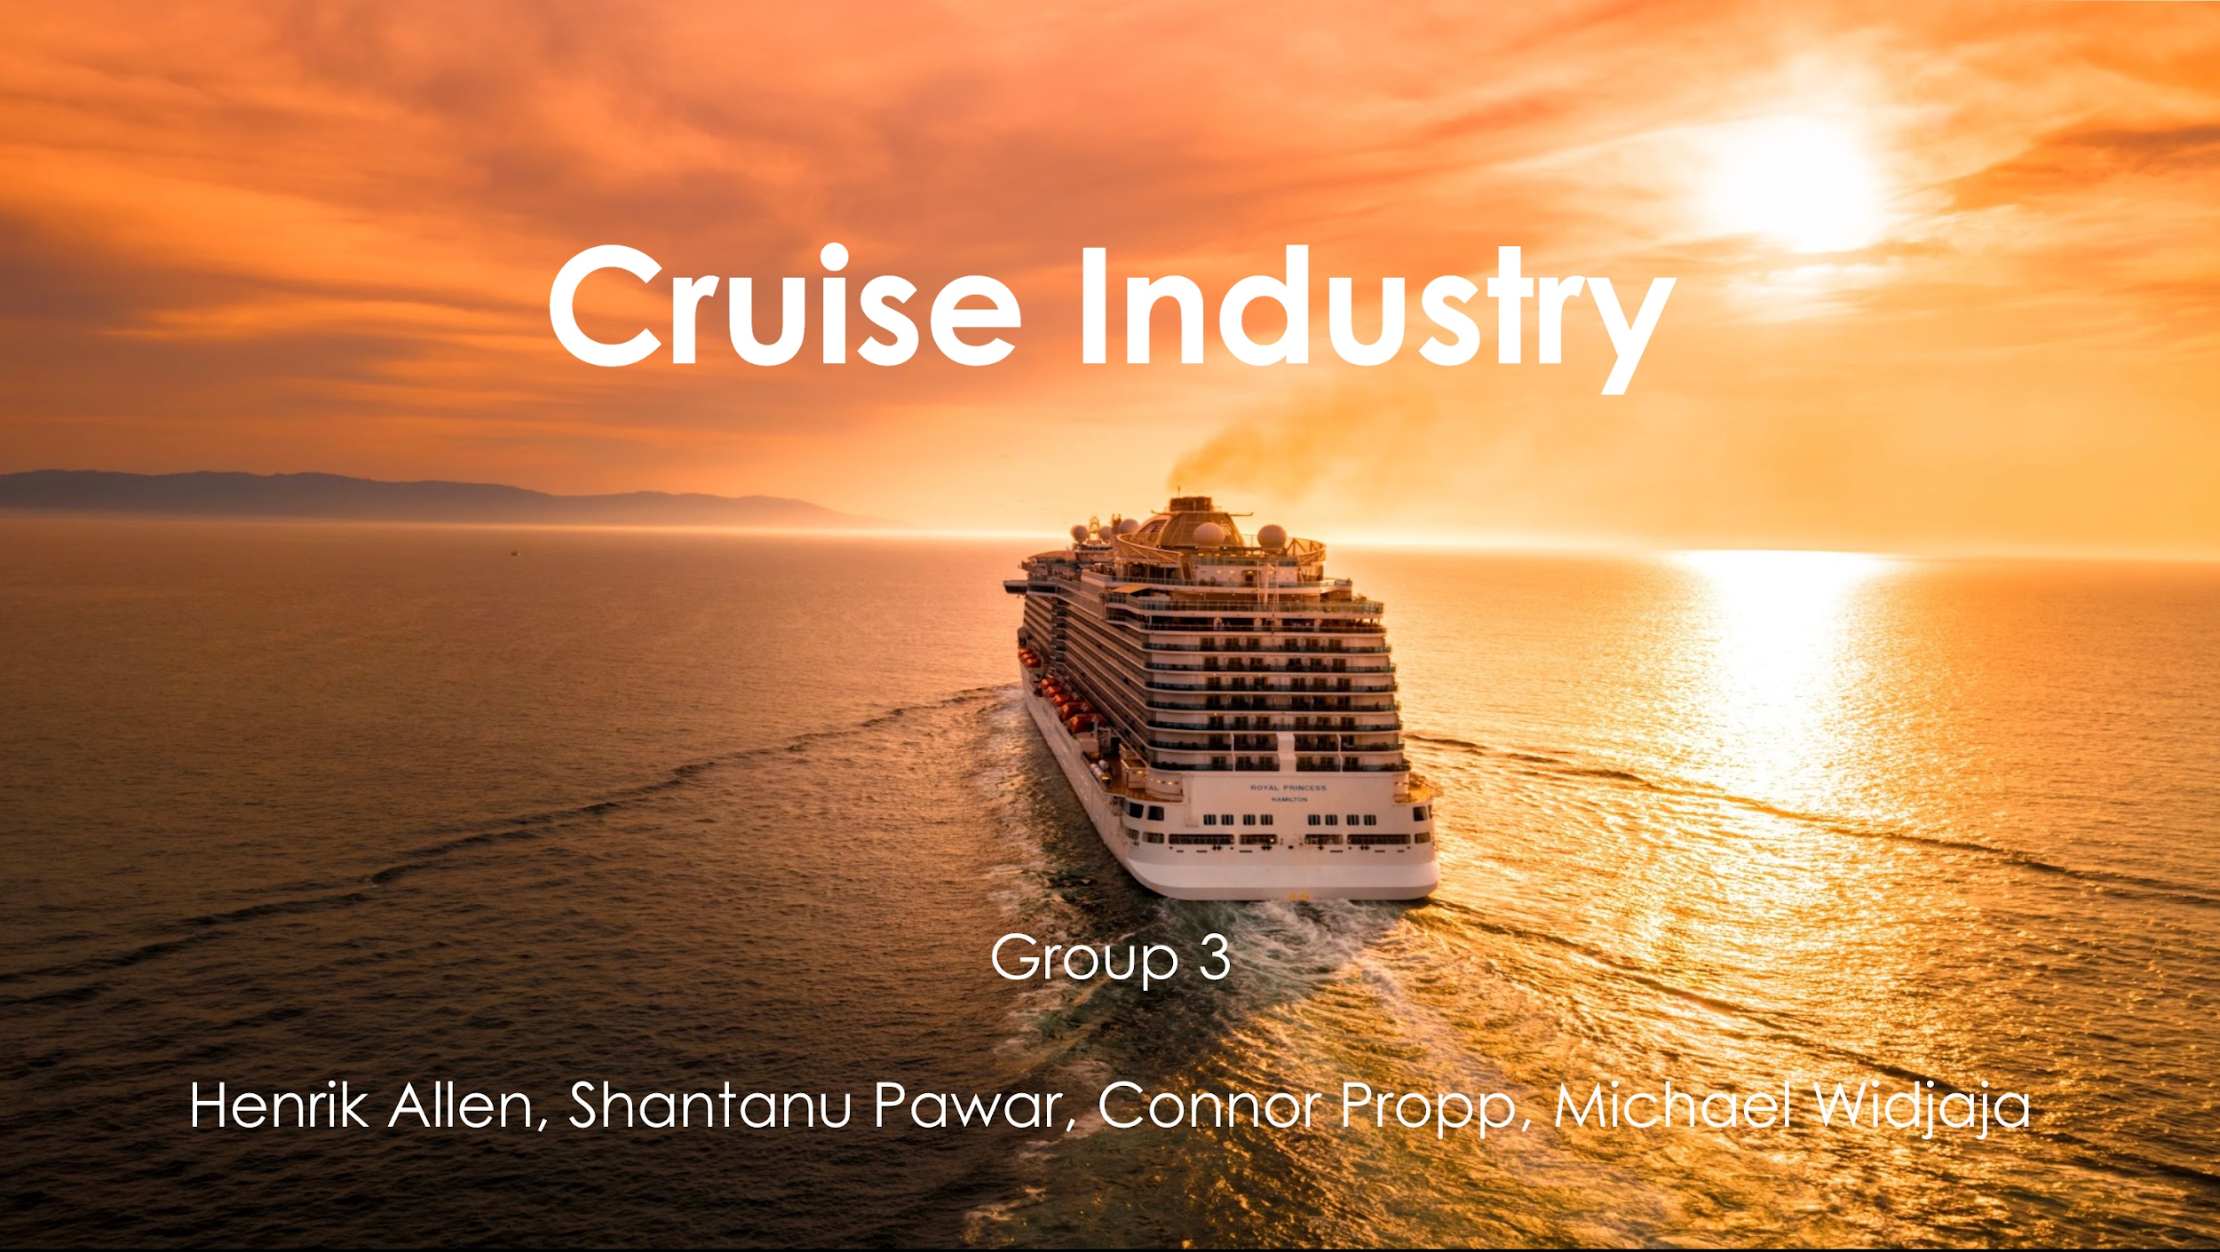
Cruise Industry
Group 3
Henrik Allen, Shantanu Pawar, Connor Propp, Michael Widjaja

Slide 2
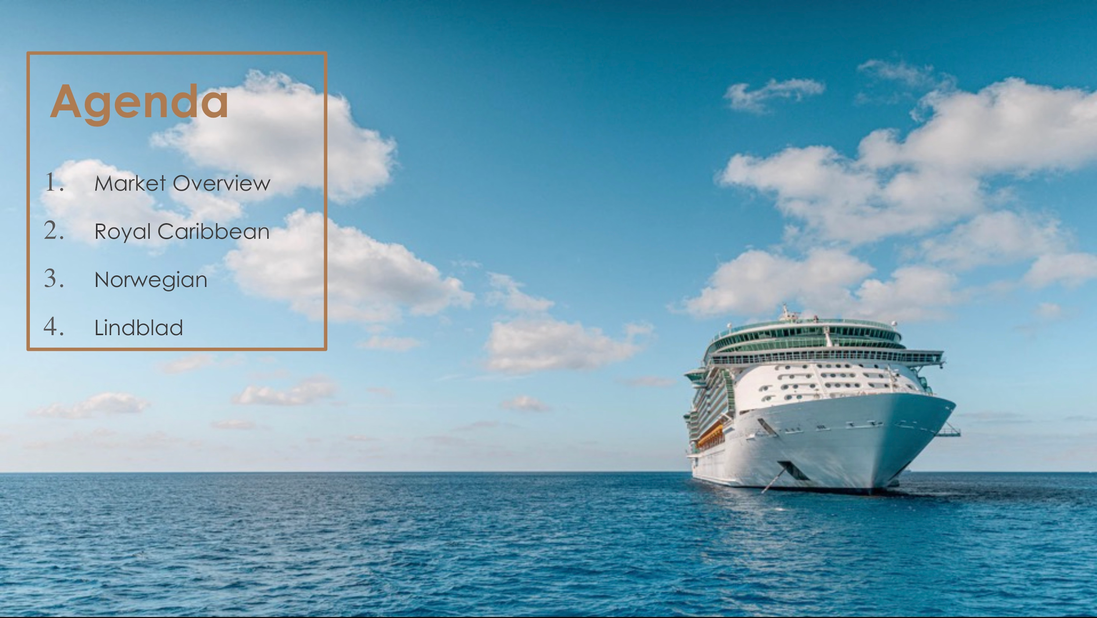
Agenda
Market Overview
Royal Caribbean
Norwegian
Lindblad

Slide 3
Market Overview
Organized by entities like the Cruise Line International Association (CLIA).
Market Size:
Estimated global industry market value: $7.9 billion USD (2022)
Set to reach approximately $22.8 billion USD in 2032
Market Drivers:
Consumer Demand
Innovation
Growth of Offerings

Slide 4
Market Overview
Market Restraints:
External Disruptions
Cost and Competition
Environmental Impact
Contagious Disease Outbreaks
Seasonality and Occupancy
Media Coverage
Market Opportunities:
Emerging Markets
Technological Advancements
Specialized Cruises
Upselling Opportunities
Partnerships

Slide 5
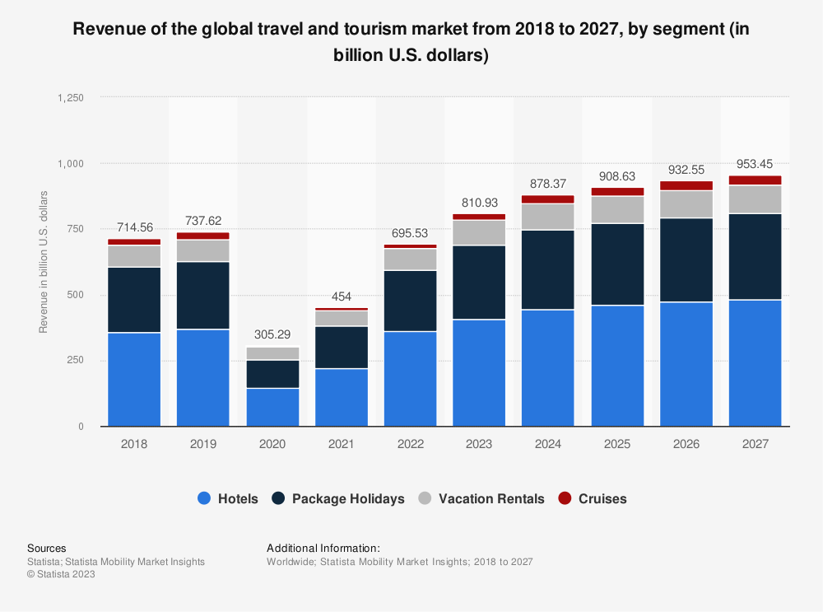

Slide 6
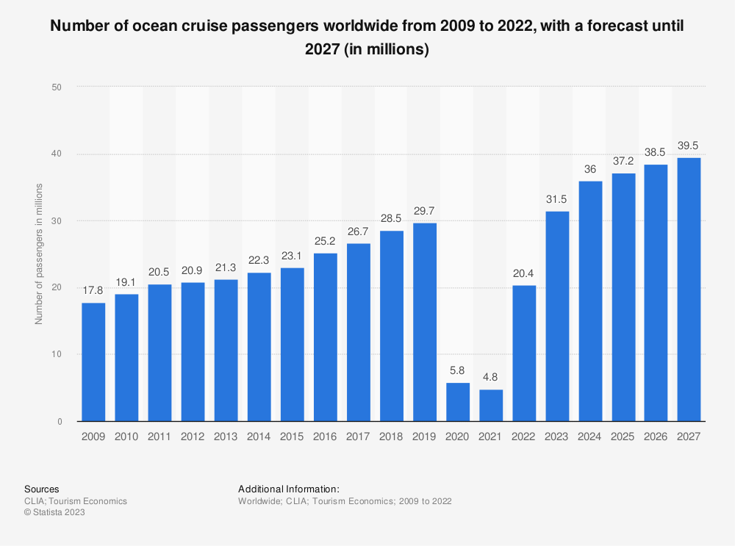

Slide 7
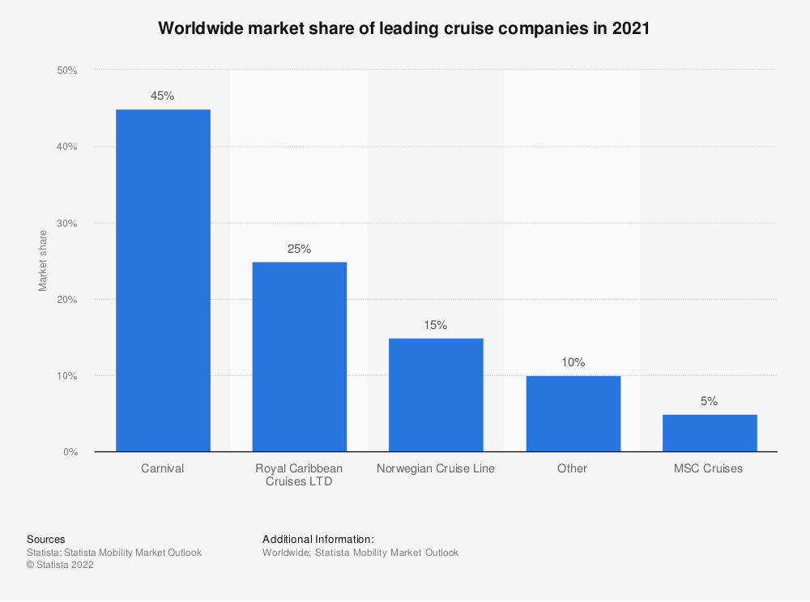

Slide 8
Operating Costs
Commissions, transportation, and other: The cost for things like travel agent commissions and the cost of credit/debit card fees
Onboard and other cruise costs: The costs for things sold on the ship, including alcohol and beverages, and gift shop items
Payroll and related costs: Includes the cost of payroll for all shipboard employees like waiters, entertainers, and staff. Those working on shore aren’t included here
Fuel
Food: Includes both costs for guests and crew
Other ship operating expenses: Includes things like maintenance, insurance premiums for ships, and dry-dock expenses

Slide 9
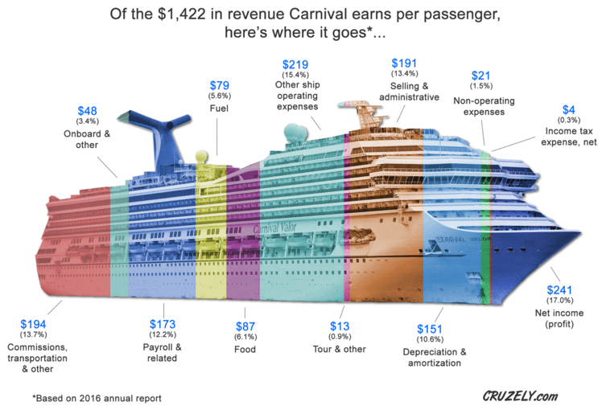

Slide 10
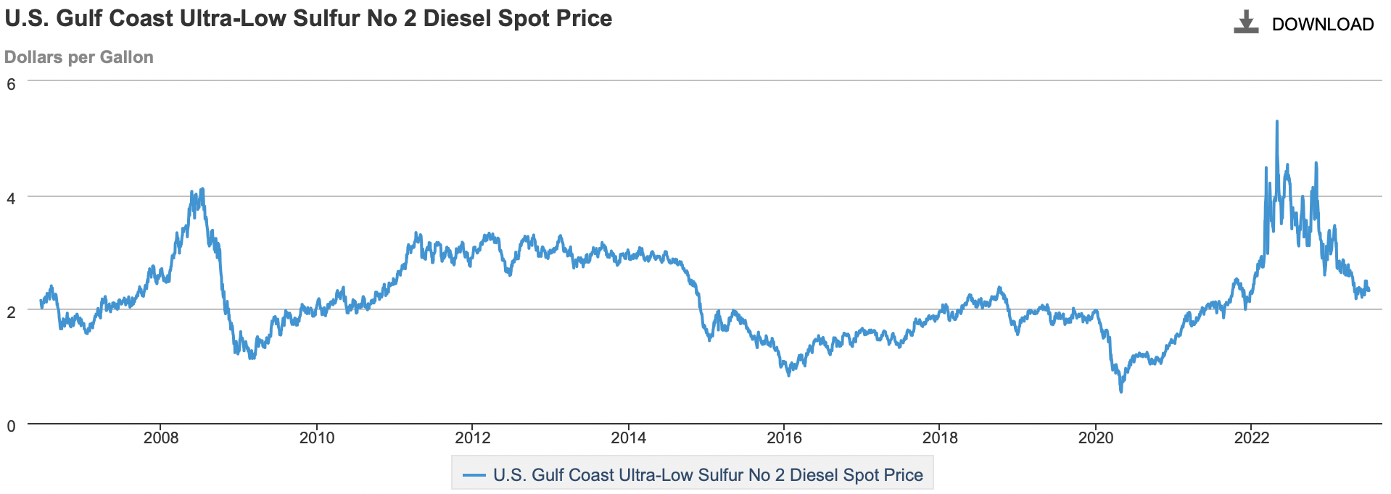
Fuel Costs

Slide 11
Fuel Costs: Cruises vs. Airlines
Cruise liners incur lower fuel costs as a percentage of their total operating costs compared to airlines.
Royal Caribbean’s fuel cost is ~13% of its operating cost, Carnival Corporation’s (CCL) is ~16%, and Norwegian’s (NCLH) is ~14%.
For US airlines, fuel costs comprise ~30% of total operating costs.

Slide 12
Sector Trends
There is more interest than ever before among Millennials and Gen-X travelers to take their first cruise
To attract more first-time cruisers and meet the needs of repeat cruisers, cruise lines are offering both shorter and longer cruise itineraries
Solo cruise travel is on the rise
Cruise lines are responding by increasing the number of single-cabins in new ships and retrofitting some of their existing ships to include additional cabins designed for those traveling alone
More cruise travelers plan to book longer cruises for their next holiday
With 43% saying they plan to book a longer cruise and 43% saying they plan to book a similar-length cruise

Slide 13
Sector Trends cont.
Cruise holidays appeal to those looking for multi-generational travel options
Today 73% of cruise travelers are sailing with family members that represent at least two generations.
Traveler interest in booking an expedition cruise is higher than ever
Travelers seek more immersive, responsible, bucket-list travel experiences. The trend is evident across all age groups. Search results for expedition cruise travel to Antarctica increased 51% in 2022 compared to 2019
There is an acceleration of environmental technologies and practices present on cruise ships
With 50% of current and potential cruise travelers saying they are more committed to making travel decisions based on environmental impacts than they were three years ago

Slide 14
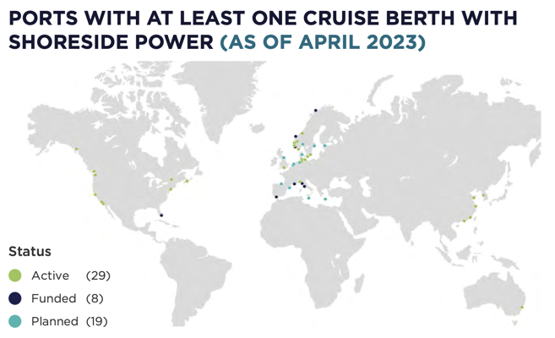
Environmental Technology
Every CLIA-member ship built now until 2028 (except expedition) will be fitted with shoreside power capabilities
30% of ships currently
Reduces emissions by up to 99%

Slide 15
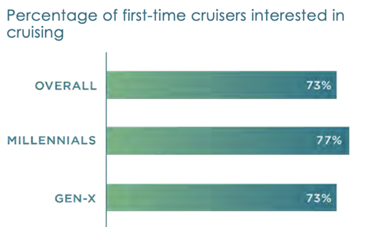
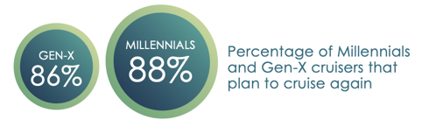
Millennials and Gen X

Slide 16
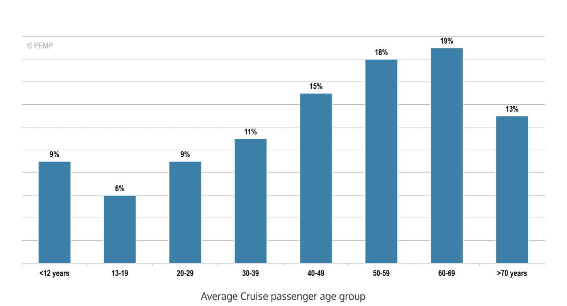

Slide 17
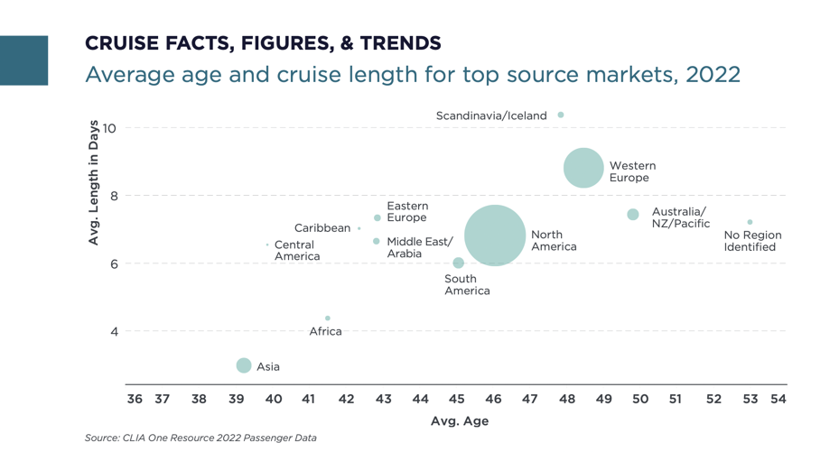

Slide 18
Risk Factors
Black Swan Risk (e.g., COVID-19)
Foreign Exchange Rate Risk
Fuel Price Risk
Interest Rate Risk
Human Risk
Political Risk
Regulation Risk
Credit Risk
Environmental Risk
Health Risk

Slide 19
COVID-19 impact on cruise passenger volume worldwide 2020-2022, by source region
 | 2020 vs. 2019 | 2021 vs. 2019 | 2022 vs. 2019
Asia | -86.7% | -83.3% | -78.8%
Australia, New Zealand, Pacific | -74.8% | -99.5% | -65.2%
Central America | -71.3% | -100% | -59.2%
South America | -51% | -90.5% | -54.4%
Africa | -59.6% | -100% | -47.6%
Caribbean | -87.7% | -100% | -47.4%
Scandinavia, Iceland | -76.2% | -79.4% | -39.9%
Eastern Europe | -72.6% | -87.8% | -38.8%
Middle East | -92.3% | -79.6% | -38%
Western Europe | -83.1% | -76.9% | -24.8%
North America | -80.5% | -85.6% | -18.3%
Notes:
COVID-19 impact on cruise passenger volume worldwide 2020-2022, by source region

Slide 20
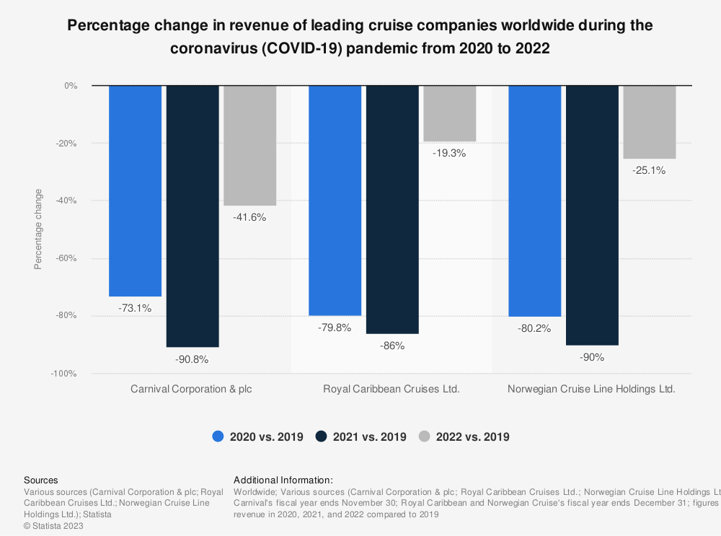

Slide 21
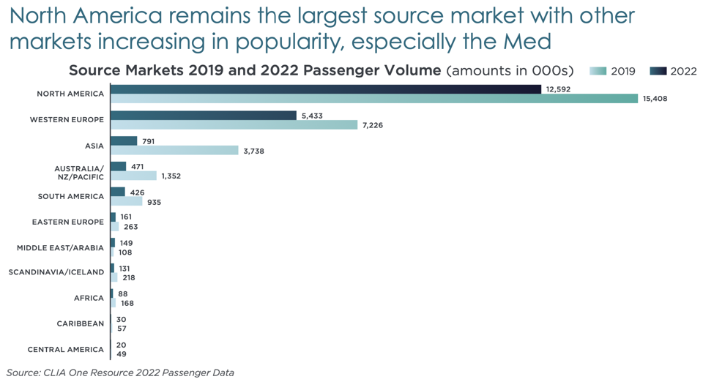

Slide 22
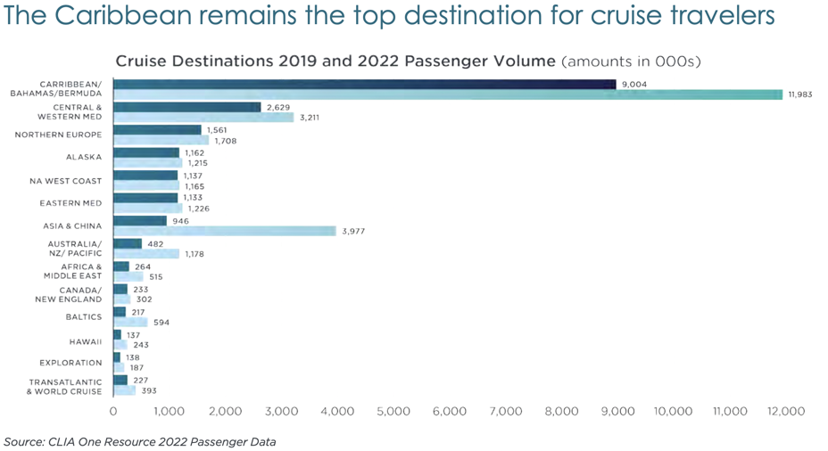

Slide 23
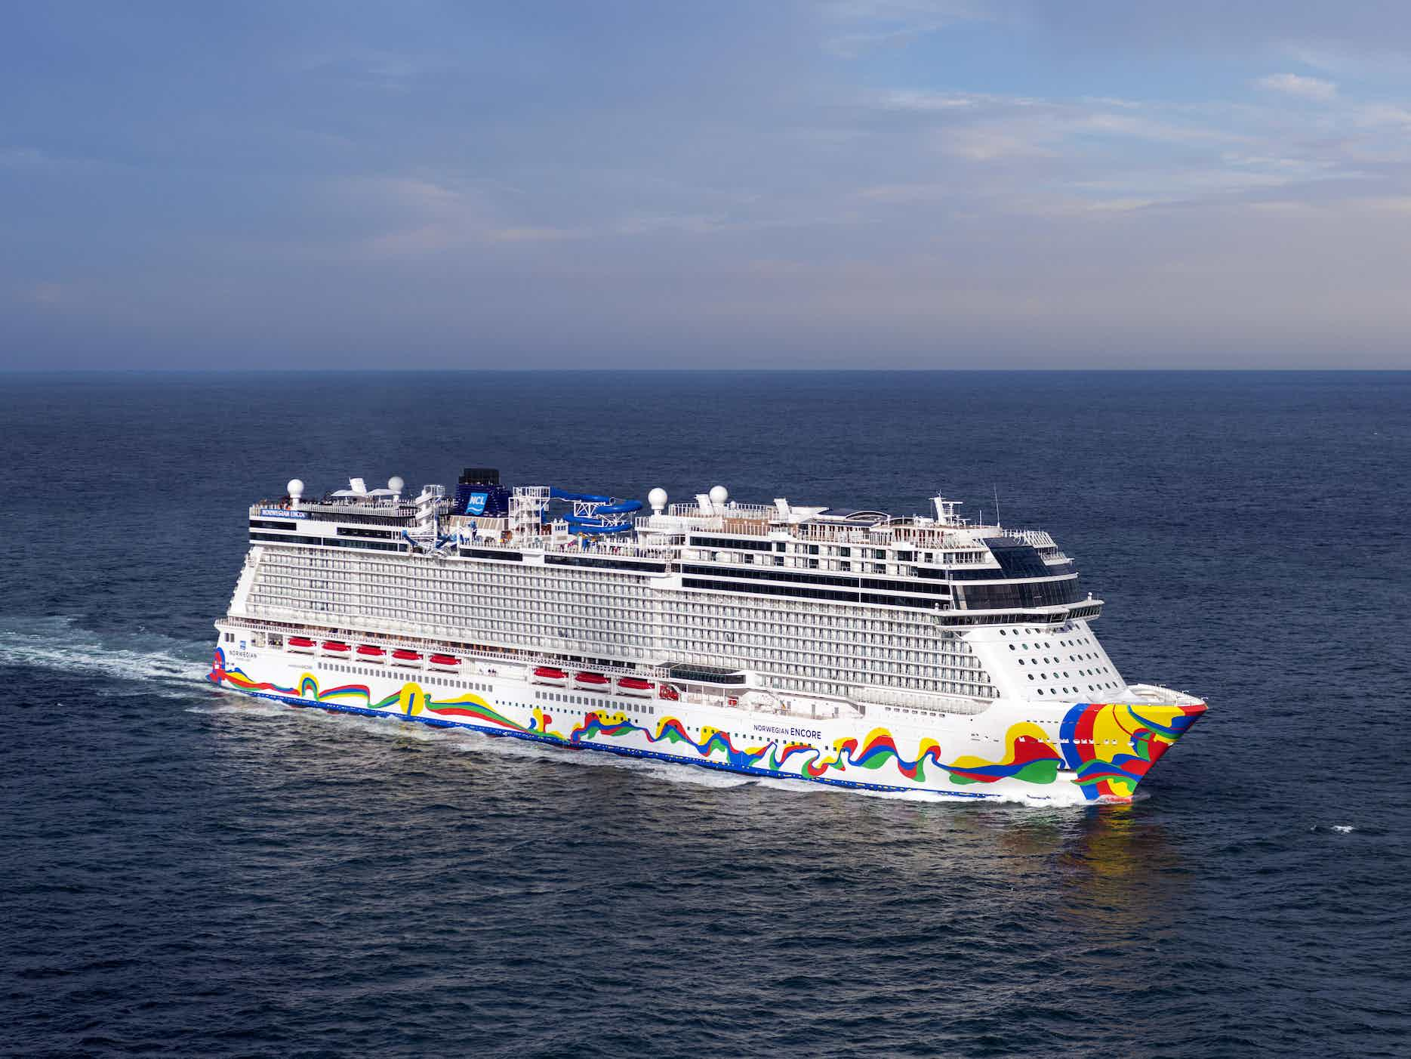
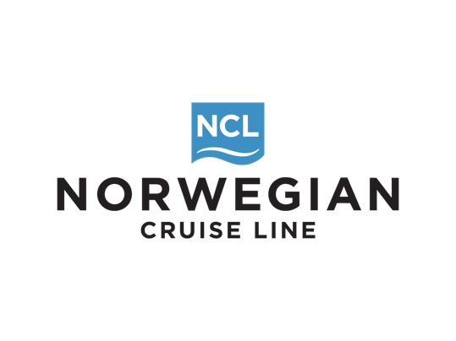

Slide 24
Company Overview
1966: Commenced operations as Norwegian Caribbean Lines and offered weekly departures from Miami to the Caribbeans
1984: Purchased Royal Viking Line and changed name to Norwegian Cruise Line (NCL)
2013: Completed IPO and listed on NASDAQ stock exchange, trading under the ticker symbol “NCLH”
2014: Acquired Prestige Cruises International Inc., the parent company of Oceania Cruises and Regent Seven Seas Cruises.

Slide 25
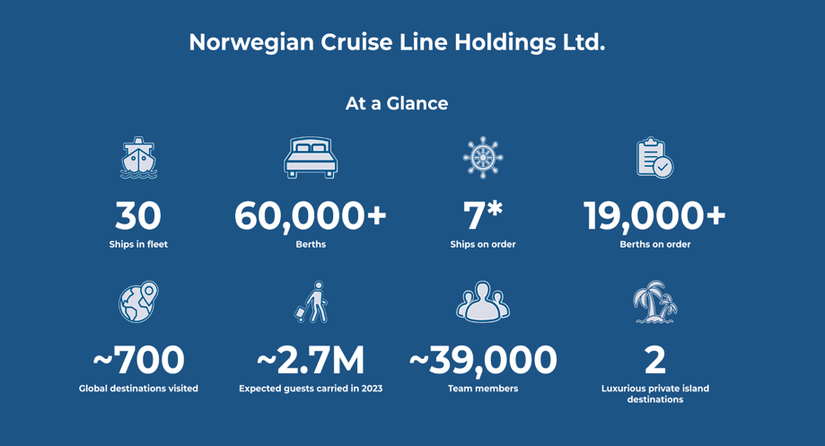
Notes:
Today, they are a leading global cruise company that operate 3 world-renowned cruise brands: Norwegian Cruise Lines, Oceania Cruises and Regent Seven Seas Cruises. They have a combined fleet of 30 across the 3 brands, with approx. 62,000 berths. They have 700 global destinations and 39,000 employees

Slide 26


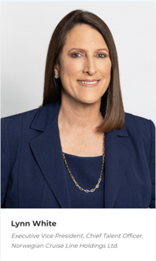
Executives

Slide 27
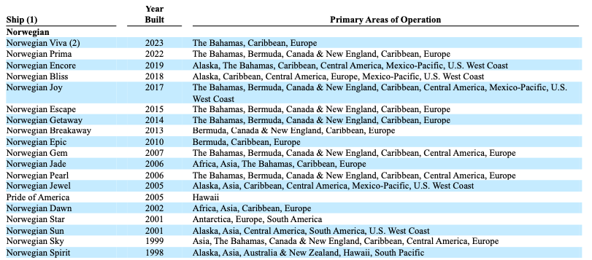
Fleet

Slide 28
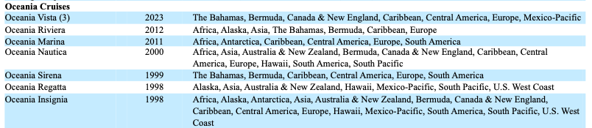
Fleet cont.

Slide 29
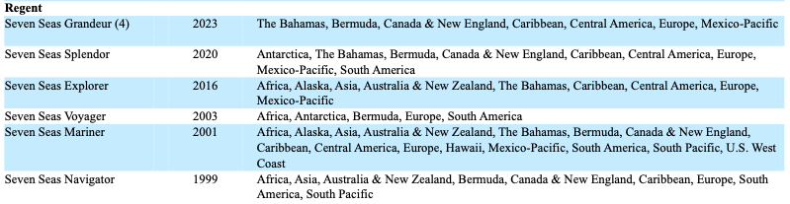
Fleet cont.

Slide 30
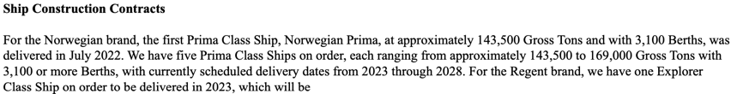
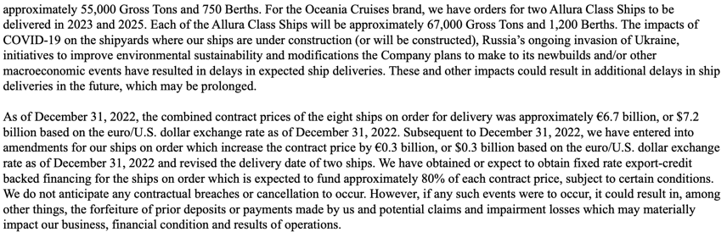
Ship Construction Contracts
Notes:
For the Norwegian Brand they have 5 Prima Class Ships on order, with scheduled deliveries from 2023 through 2028
For the Regent Brand, they have 1 Explorer Class Ships on order due for delivery in 2023
For the Oceania Cruises Brand, they have orders for 2 Allura Class Ships to be delivered in 2023 and 2025
As of Dec 32, 2022 the combined contract prices of the 8 ships on order for delivery was approximately 6.7 billion EUROS or 7.2 billion USD

Slide 31
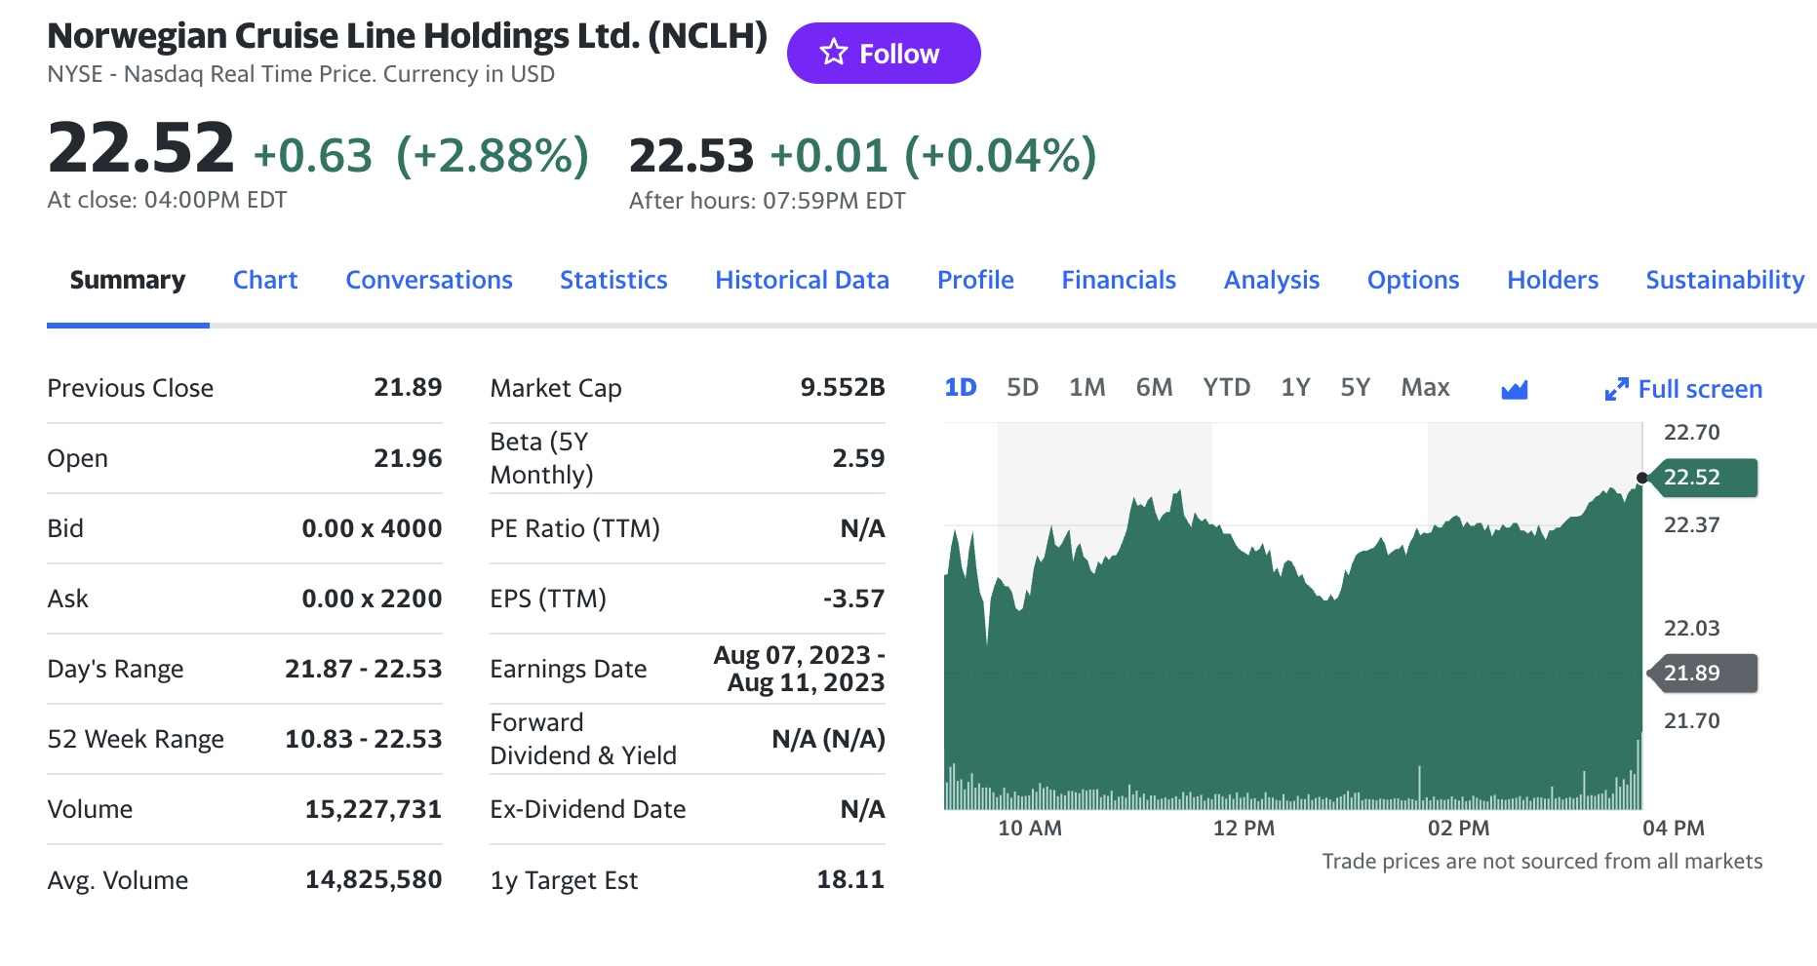
NCLH Share Price
Notes:
Found under Item 5

Slide 32
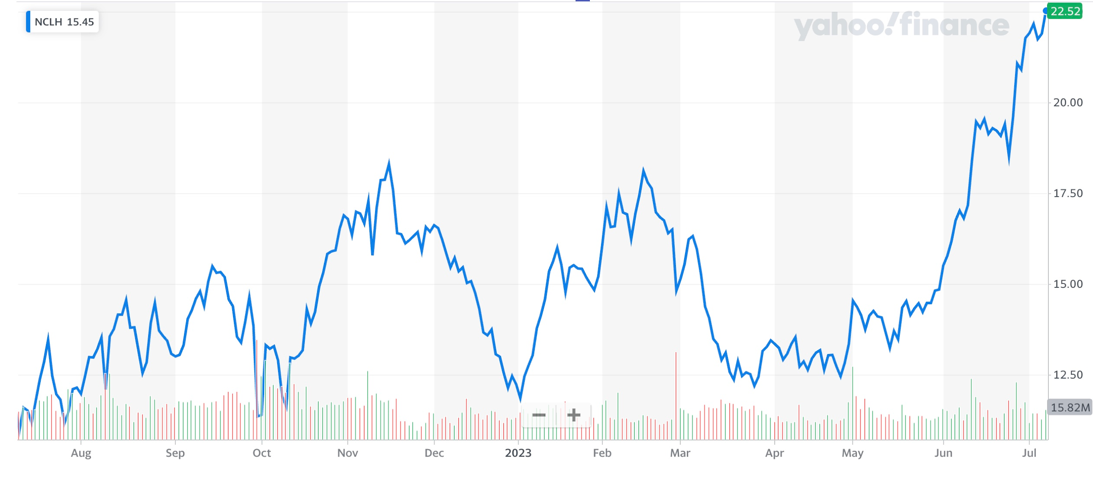
Stock Performance (1Y)
Notes:
Found under Item 5

Slide 33
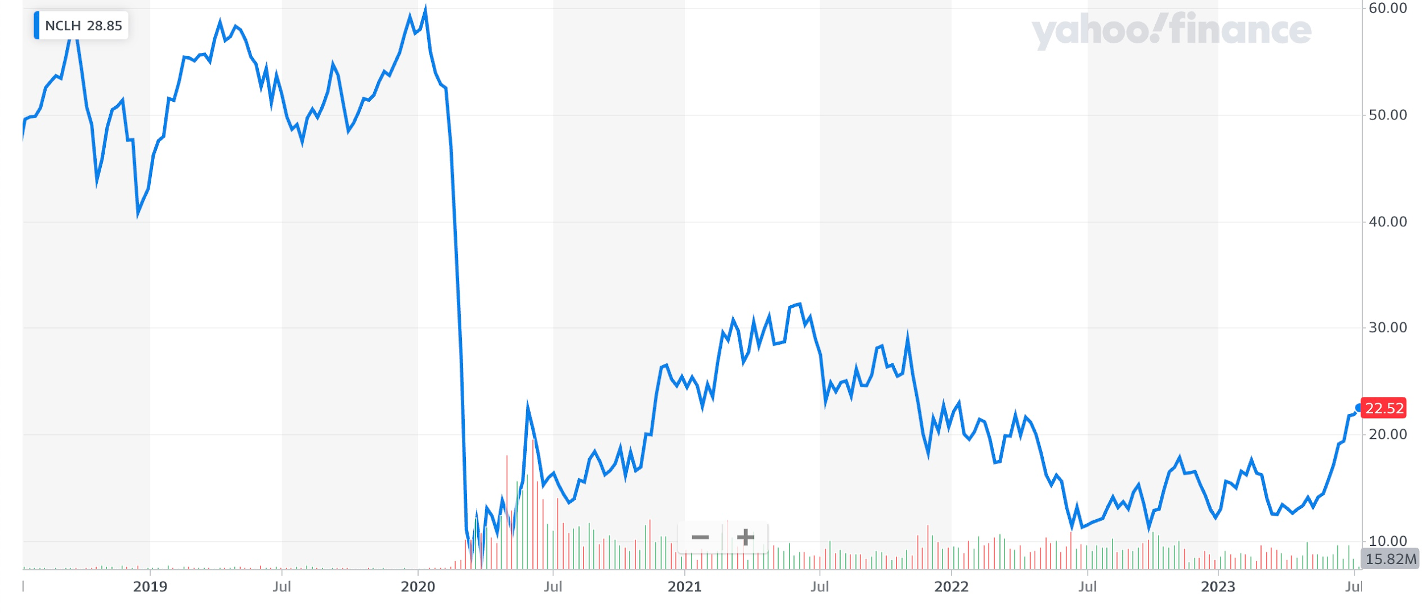
Stock Performance (5Y)
Notes:
Found under Item 5

Slide 34
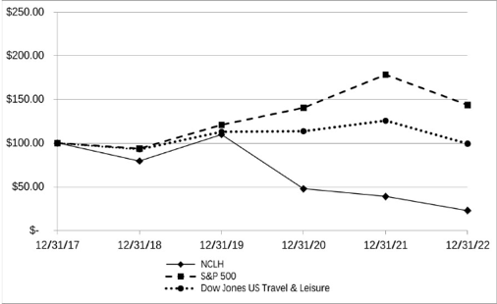
Stock Performance against Indices (5Y)
Comparison of the cumulative total return for NCLH ordinary shares, the S&P 500 Composite Stock Index and the Dow Jones US Travel & Leisure Index
Notes:
Found under Item 5

Slide 35
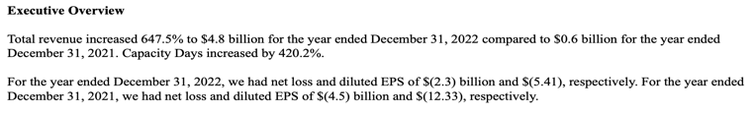
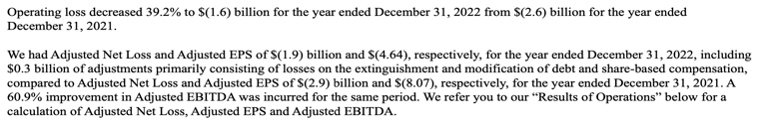
Overview of MD&A
Notes:
Overview of the company’s performance, that will be seen in detail later in the statement of operations and consolidated statement of income

Slide 36
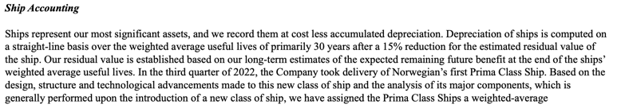

Ship Accounting
Notes:
Talks about how ships values are recorded: their cost minus the accumulated depreciation
Depreciation of ships is computed on a straight-line basis

Slide 37
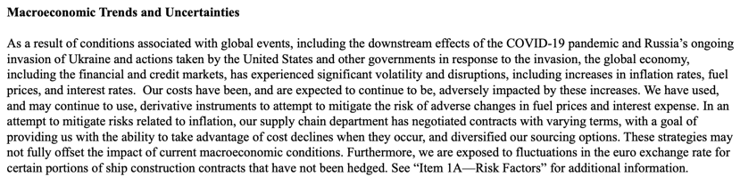
Macroeconomic Trends and Uncertainties
Notes:
Talks about how their costs will be adversely impacted by macroeconomic trends and uncertainties

Slide 38
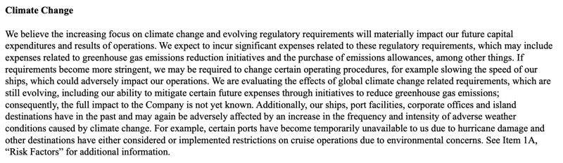
Climate Change and Operations
Notes:
Talks about how climate change laws may impact future capital expenditures and results of operations

Slide 39
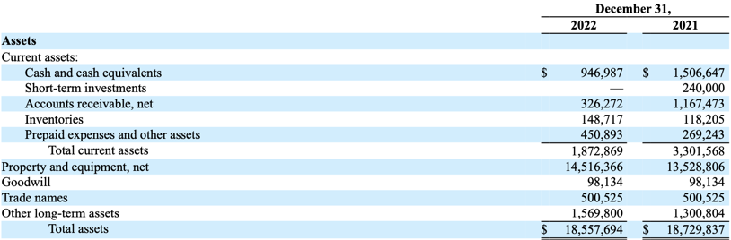
Balance Sheet: Assets (10K)
Notes:
Derivatives fall under the prepaid expenses and other assets, this will be broken down further later

Slide 40
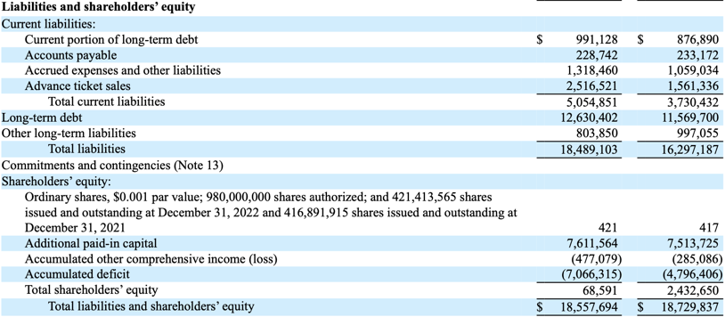
Balance Sheet: Liabilities & S.E. (10K)

Slide 41
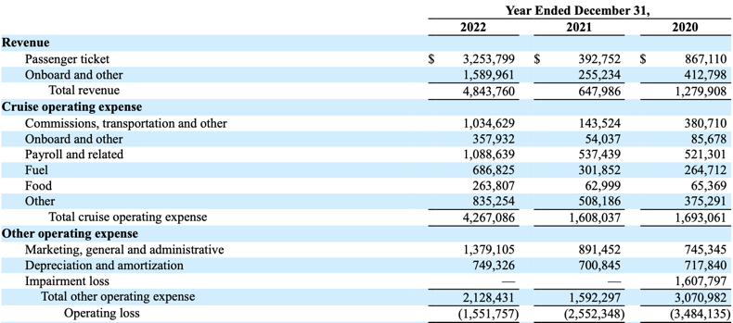
Statement of Operations (10K)
Notes:
Statement of operations

Slide 42
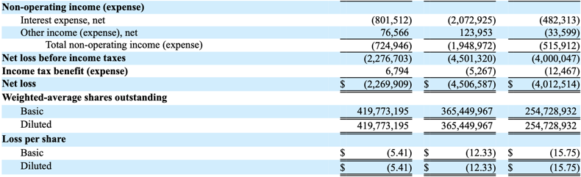
Statement of Operations (10K) cont.

Slide 43
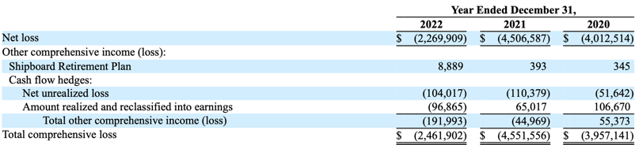
Statement of Comprehensive Income (10K)
Notes:
In the consolidated statement of comprehensive income, the derivatives fall under cash flow hedges

Slide 44
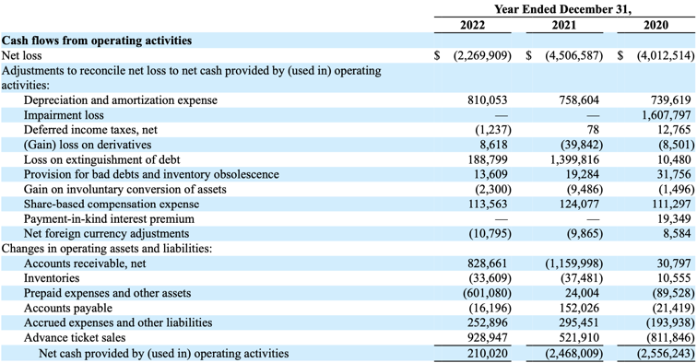
Statement of Cash Flows (10K)
Notes:
Consolidated statement of cash flows

Slide 45
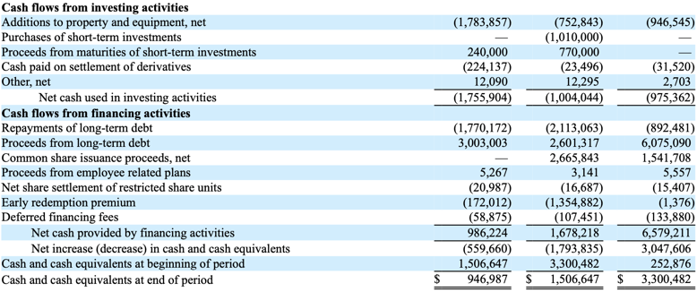
Statement of Cash Flows (10K) cont.

Slide 46
Risk Factors
COVID-19 and Debt/Liquidity Related Risk Factors
Operational Risks
Risks Related to the Regulatory Environment
Market Risks
Notes:
Risk factors that they identify are classified into 4 groups:
covid -19 and debt/liquidity related risk factors
Operational risk
Risks related to the regulatory environment that they operate in
Market risks

Slide 47
COVID-19 and Debt/Liquidity Related Risk Factors
Public health crises, including the COVID-19 pandemic, have had, and may in the future have, a significant impact on our financial condition, results, operations, outlook, plans, goals, growth, reputation, cash flows, liquidity, demand for voyages, and share price
If our results of operations and financial performance do not recover as planned, we may not be in compliance with maintenance covenants in certain of our debt facilities
Additional financing required in the future may not be available on favorable terms, or at all
Our indebtedness, and the agreements governing our indebtedness, may limit our flexibility in operating our business and a substantial majority of our assets are collateral under our debt agreements
The impact of volatility and disruptions in the global credit and financial markets
Notes:
Includes public health crises
Impact of volatility and disruptions in the global credit and financial markets
Additional financing required in the future may not be available on favorable terms, or even at all

Slide 48
Operational Risks
Unavailability of ports of call
We rely on scheduled commercial airline services for passenger and crew connections. Changes and disruptions in commercial airline service has, and could in the future, disrupt our operations
Global events and conditions, including terrorist acts, armed conflicts, acts of piracy, and other international events impacting the security of travel or the economy
Adverse incidents involving cruise ships
Breaches in data security or other disturbances to our information technology or our actual or perceived failure to comply with requirements regarding data privacy and protection
Mechanical malfunctions and repairs, delays in our shipbuilding program, maintenance and refurbishments
Conducting business internationally may result in increased costs and risks
Notes:
Operational risks include:
Unavailability of ports of call
That they rely on scheduled commercial airline services for passenger and crew connections, so disruptions or changes in the commercial airline service can disrupt them
Global events and conditions including terrorist acts, armed conflicts and others that impact the security of travel or the economy
Breaches in data security
Mechanical malfunctions

Slide 49
Operational Risks cont.
Failure or inability to recruit or retain qualified personnel or the loss of key personnel or employee relations issues
Impacts related to climate change
Inability to obtain adequate insurance coverage
Litigation, enforcement actions, fines or penalties
We rely on third parties to provide hotel management services for certain ships and certain other services
Expansion into new markets and investments in new markets and land-based destination projects may not be successful
Overcapacity in key markets
Notes:
Continuing the operational risks:
Failure or inability to recruit or retain qualified personnel
Impacts related to climate change
Inadequate insurance coverage

Slide 50
Risks Related to the Regulatory Environment
Changes to or introduction of new complex laws and regulations, including environmental, health and safety, labor, data privacy and protection and maritime laws and regulations
Future changes in applicable tax laws, or our inability to take advantage of favorable tax regimes
Our ability to comply with economic substance requirements in certain jurisdictions
Notes:
Risks related to the regulatory environment:
Changes to or introduction of new complex laws and regulations
Future changes in applicable tax laws
Their ability to comply with economic substance requirements in certain jurisdictions

Slide 51
Market Risk
Interest Rate Risk
Foreign Currency Exchange Rate Risk
Fuel Price Risk
Notes:
Under Item 7A, market risks are identified which include:
Interest rate risk
Foreign Exchange rate risk
Fuel Price risk

Slide 52
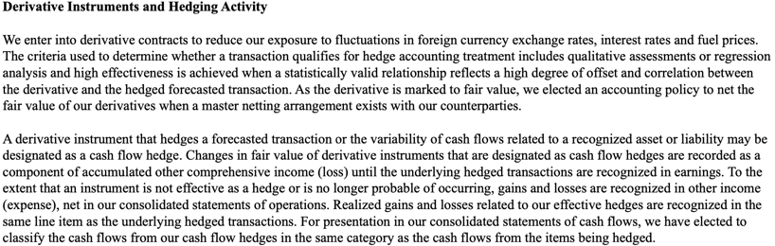
Summary of Significant Accounting Policies
Notes:
Talks about why they enter into derivative contracts, which is to reduce their exposure to fluctuations in foreign currency exchange rates, interest rates and fuel prices
The criteria they use to determine whether a transaction qualifies for hedge accounting treatment includes qualitative assessments or regression analysis

Slide 53
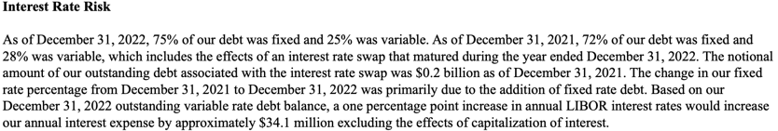
Interest Rate Hedging Strategy
Notes:
As of december 31, 2022, 75% of their debt was fixed and 25% was variable
Based on their 2022 outstanding variable rate debt balance, a one percentage point increase in annual LIBOR interest rates would increase their annual interest expense by approx. $34.1 million

Slide 54
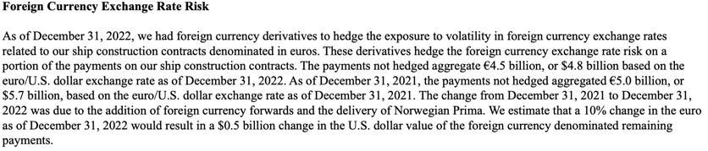
Foreign Exchange Rate Hedging Strategy
Notes:
Foreign currency derivatives are used to hedge the exposure to volatility in foreign currency exchange rates related to their ship construction contracts which are denominated in euros
The derivatives used, hedge the foreign currency exchange rate risk on a portion of the payments on their ship construction contracts
The payments that are not hedged accumulate to 4.5 billion EUROS or 4.8 billion USD in december 31, 2022
10% change in the euro would result in a $0.5 billion change in the USD value of the foreign currency denominated remaining payments

Slide 55
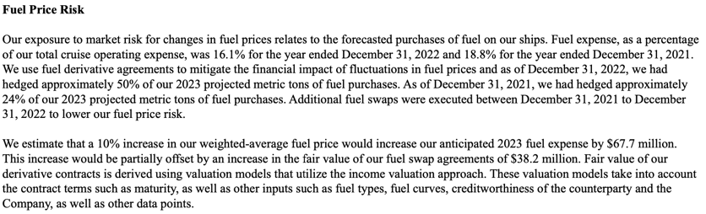
Fuel Price Hedging Strategy
Notes:
Fuel Expense was 16.1% of their total cruise operating expense
As of December 31, 2022, they had hedged approx. 50% of their 2023 projected metric tons of fuel purchases
It is estimated that a 10% increase in their weighted-average fuel price would increase their anticipated 2023 fuel expense by $67.7 million

Slide 56

Contract Positions
Notes:
Summary of the hedging strategies:
As of december 31, 2022, they had fuel swaps pertaining to approx. 455 thousand metric tons of their projected fuel purchases, maturing through December 31, 2023
As of december 31, 2022, they had fuel swaps pertaining to approx. 14 thousand metric tons of their projected fuel purchases which were not designated as cash flow hedges
As of december 31, 2022, they had foreign currency forward contracts, matured foreign currency options and matured foreign currency collars. The notional amount of their foreign currency forward contracts was 1.6 billion EUROS or 1.7 billion USD

Slide 57
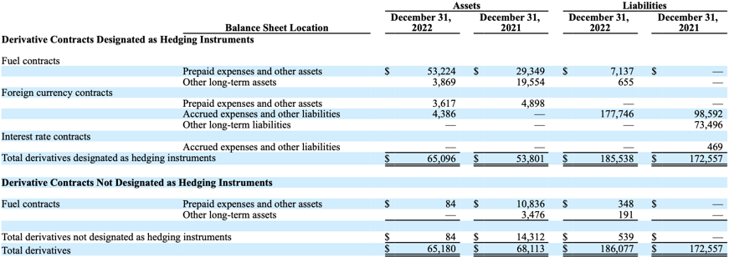
Overview of Derivatives Positions
Notes:
The derivative contracts as shown in the consolidated balance sheet of the company
Earlier in the balance sheet, there was prepaid expenses and other assets, this will be part of that

Slide 58
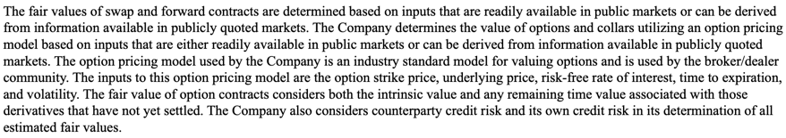
Overview of Derivatives Positions cont.
Notes:
An important note regarding the valuation of swap and forward contracts, they are determined based on inputs that are readily available in public markets

Slide 59
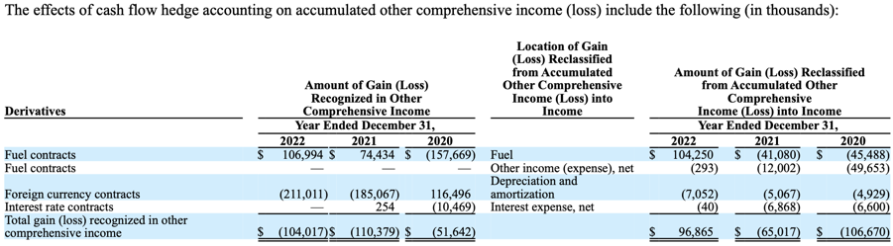
Overview of Derivatives Positions cont.
Notes:
This is a break down of the “cash flow hedges” in the consolidated statement of comprehensive income

Slide 60
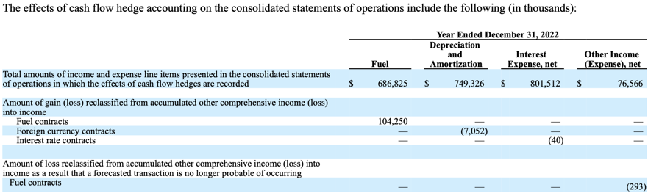
Overview of Derivatives Positions cont.
Notes:
The effects of cash flow hedge accounting on the consolidated statements of operations

Slide 61
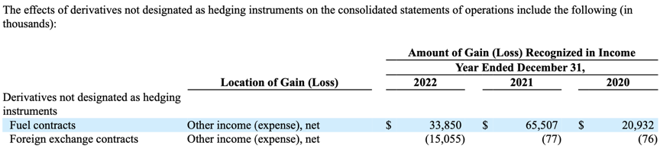
Overview of Derivatives Positions cont.
Notes:
This is the effects of derivatives not designated as hedging instruments on the consolidated statements of operations

Slide 62
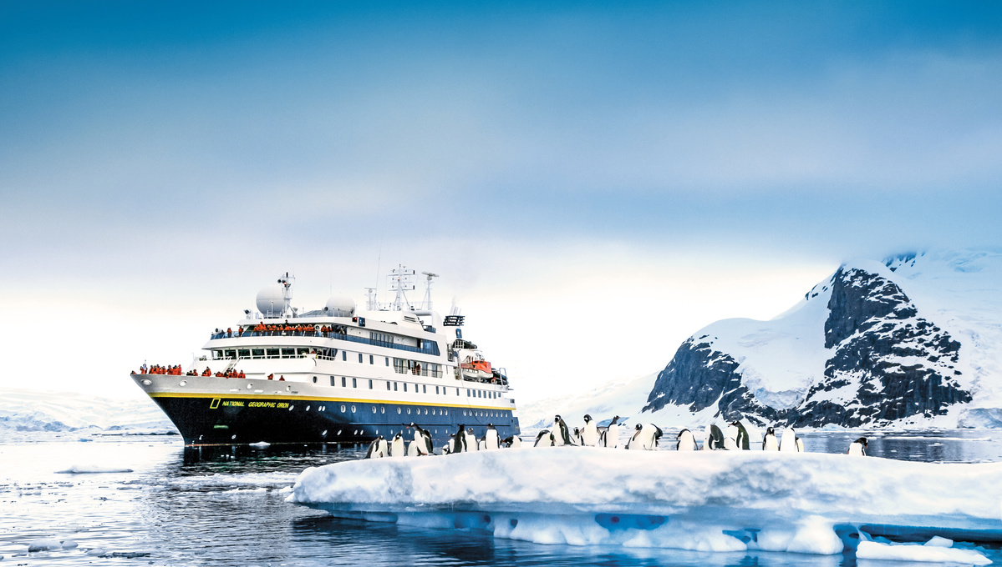


Slide 63

Company Overview
Luxury Adventure Cruises to exotic places:
Antarctica
The Arctic
Galápagos
Pacific Islands
Established by Sven-Olof Lindblad in 1979, carrying on his father, Lars Lindblad’s legacy of bringing private citizens to epic wildernesses
Vessels are built small and nimble to access remote places and for easy disembarking

Slide 64

Company Overview

Slide 65

Exclusive Alliance with National Geographic
Partnership established in 2004 based on shared heritage and passion for exploration
Exclusive provider for all National Geographic Expeditions ocean-going small ship voyages in all of the Americas
Expeditions feature Nat Geo photographers, writers, researchers and film crews

Slide 66


Exclusive Alliance with National Geographic

Slide 67


Slide 68


Slide 69



Executives
Dolf Berle
Chief Executive Officer
Noah Brodsky
Chief Commercial Officer
Tyler Skarda
SVP, Marine Operations

Slide 70



Executives
Craig Felenstein
Chief Financial Officer
Trey Byus
Chief Expedition Officer
Leo Chang
SVP, Strategy, Corporate Development and M&A

Slide 71

LIND Share Price

Slide 72

Stock Performance (1Y)

Slide 73

Stock Performance (5Y)

Slide 74


Cruise Line Resurgence

Slide 75

Financial Statements

Slide 76

Balance Sheet: Assets (10K)

Slide 77

Balance Sheet: Liabilities (10K)

Slide 78

Balance Sheet: Stockholders’ Deficit (10K)

Slide 79

Statement of Operations (10K)

Slide 80

Statement of Operations (10K) cont.

Slide 81

Statement of Consolidated (Loss) Income (10K)

Slide 82

Statement of Cash Flows (10K)

Slide 83

Statement of Cash Flows (10K) cont.

Slide 84


Exchange Rate and Interest Rate Risk (10K)

Slide 85
Additional Risks
Acts of terrorism/sabotage
Economic conditions that reduce the demand for cruises
Change in US Foreign travel policy
Incidents on ships/at port that receive negative media coverage
Rise in the costs of airfare
Natural disasters
Disease outbreaks

Slide 86
Additional Risks cont.
Increase in ship capacity exceeding market demand
Unavailability of ports
Over reliance on dockyards and subcontractors
Growing anti tourism sentiments
Losing business to a competitor
Unable to keep up with technological advancements
Loss of key personnel

Slide 87



Overview of Derivatives Usage (10K)

Slide 88

Overview of Derivatives Usage (10K)

Slide 89

Overview of Derivatives Positions (10Q)

Slide 90

Overview of Derivatives Positions (10Q) cont.

Slide 91



Slide 92
Company Overview
Parent company of three global cruise brands: Royal Caribbean International, Celebrity Cruises and Silversea Cruises
50% share in joint venture interest in TUI Cruises GmbH ("TUIC"), which operates the German brands TUI Cruises
Fleet of 64 ships as of March 31, 2023
Offer a selection of worldwide itineraries that call on more than 1,000 destinations in over 120 countries on all seven continents

Slide 93

Partner Brands

Slide 94

Operating Strategies

Slide 95

Fleet

Slide 96

Fleet cont.

Slide 97

Fleet cont.

Slide 98

Future Purchase Obligations
Notes:
For the Norwegian Brand they have 5 Prima Class Ships on order, with scheduled deliveries from 2023 through 2028
For the Regent Brand, they have 1 Explorer Class Ships on order due for delivery in 2023
For the Oceania Cruises Brand, they have orders for 2 Allura Class Ships to be delivered in 2023 and 2025
As of Dec 32, 2022 the combined contract prices of the 8 ships on order for delivery was approximately 6.7 billion EUROS or 7.2 billion USD

Slide 99

RCL Share Price
Notes:
NCLH 5 year stock

Slide 100

Stock Performance (1Y)
Notes:
Found under Item 5

Slide 101

Stock Performance (5Y)
Notes:
Found under Item 5

Slide 102

Stock Performance against Indices (5Y)
Notes:
Found under Item 5

Slide 103

Company Leadership

Slide 104

Balance Sheet: Assets (10K)
Notes:
Derivatives fall under the prepaid expenses and other assets, this will be broken down further later

Slide 105

Balance Sheet: Liabilities & S.E. (10K)

Slide 106

Statement of Comprehensive Income (10K)
Notes:
In the consolidated statement of comprehensive income, the derivatives fall under cash flow hedges

Slide 107

Statement of Comprehensive Income (10K) cont.
Notes:
In the consolidated statement of comprehensive income, the derivatives fall under cash flow hedges

Slide 108

Statement of Cash Flows (10K)
Notes:
Consolidated statement of cash flows

Slide 109
Statement of Cash Flows (10K) cont.

Slide 110

Statement of Cash Flows (10K) cont.

Slide 111
Risk Factors
COVID-19 and Debt/Liquidity Related Risk Factors
Operational Risks due to high Degree of operational leverage
Terrorist attack, disease outbreak and other Geopolitical risks
Compliance and regulatory risks
Market risks: FOREX, fuel prices and interest rate risks
Notes:
Risk factors that they identify are classified into 4 groups:
covid -19 and debt/liquidity related risk factors
Operational risk
Risks related to the regulatory environment that they operate in
Market risks

Slide 112

Management comment on COVID liquidity risk
Notes:
Management comment on COVID liquidity risk

Slide 113


Summary of Derivative Hedging to Manage Risk
Notes:
Summary of Derivative hedging to manage risk
Talks about why they enter into derivative contracts, which is to reduce their exposure to fluctuations in foreign currency exchange rates, interest rates and fuel prices
The criteria they use to determine whether a transaction qualifies for hedge accounting treatment includes qualitative assessments or regression analysis

Slide 114

Summary of Derivative Hedging to Manage Risk cont.
Notes:
Talks about why they enter into derivative contracts, which is to reduce their exposure to fluctuations in foreign currency exchange rates, interest rates and fuel prices
The criteria they use to determine whether a transaction qualifies for hedge accounting treatment includes qualitative assessments or regression analysis

Slide 115


Interest Rate Hedging Strategy
Notes:
As of december 31, 2022, 75% of their debt was fixed and 25% was variable
Based on their 2022 outstanding variable rate debt balance, a one percentage point increase in annual LIBOR interest rates would increase their annual interest expense by approx. $34.1 million

Slide 116


Foreign Exchange Rate Hedging Strategy
Notes:
Foreign currency derivatives are used to hedge the exposure to volatility in foreign currency exchange rates related to their ship construction contracts which are denominated in euros
The derivatives used, hedge the foreign currency exchange rate risk on a portion of the payments on their ship construction contracts
The payments that are not hedged accumulate to 4.5 billion EUROS or 4.8 billion USD in december 31, 2022
10% change in the euro would result in a $0.5 billion change in the USD value of the foreign currency denominated remaining payments

Slide 117
Foreign Exchange Rate Hedging Strategy
(Non-Derivative Instruments)
Notes:
Foreign currency derivatives are used to hedge the exposure to volatility in foreign currency exchange rates related to their ship construction contracts which are denominated in euros
The derivatives used, hedge the foreign currency exchange rate risk on a portion of the payments on their ship construction contracts
The payments that are not hedged accumulate to 4.5 billion EUROS or 4.8 billion USD in december 31, 2022
10% change in the euro would result in a $0.5 billion change in the USD value of the foreign currency denominated remaining payments

Slide 118


Fuel Price Hedging Strategy
Notes:
Fuel Expense was 16.1% of their total cruise operating expense
As of December 31, 2022, they had hedged approx. 50% of their 2023 projected metric tons of fuel purchases
It is estimated that a 10% increase in their weighted-average fuel price would increase their anticipated 2023 fuel expense by $67.7 million

Slide 119

Overview of Derivatives Positions
Notes:
The derivative contracts as shown in the consolidated balance sheet of the company
Earlier in the balance sheet, there was prepaid expenses and other assets, this will be part of that

Slide 120


Overview of Derivatives Positions cont.
Notes:
The derivative contracts as shown in the consolidated balance sheet of the company
Earlier in the balance sheet, there was prepaid expenses and other assets, this will be part of that

Slide 121
Thank you for listening
Notes:
The derivative contracts as shown in the consolidated balance sheet of the company
Earlier in the balance sheet, there was prepaid expenses and other assets, this will be part of that

