Slide 1
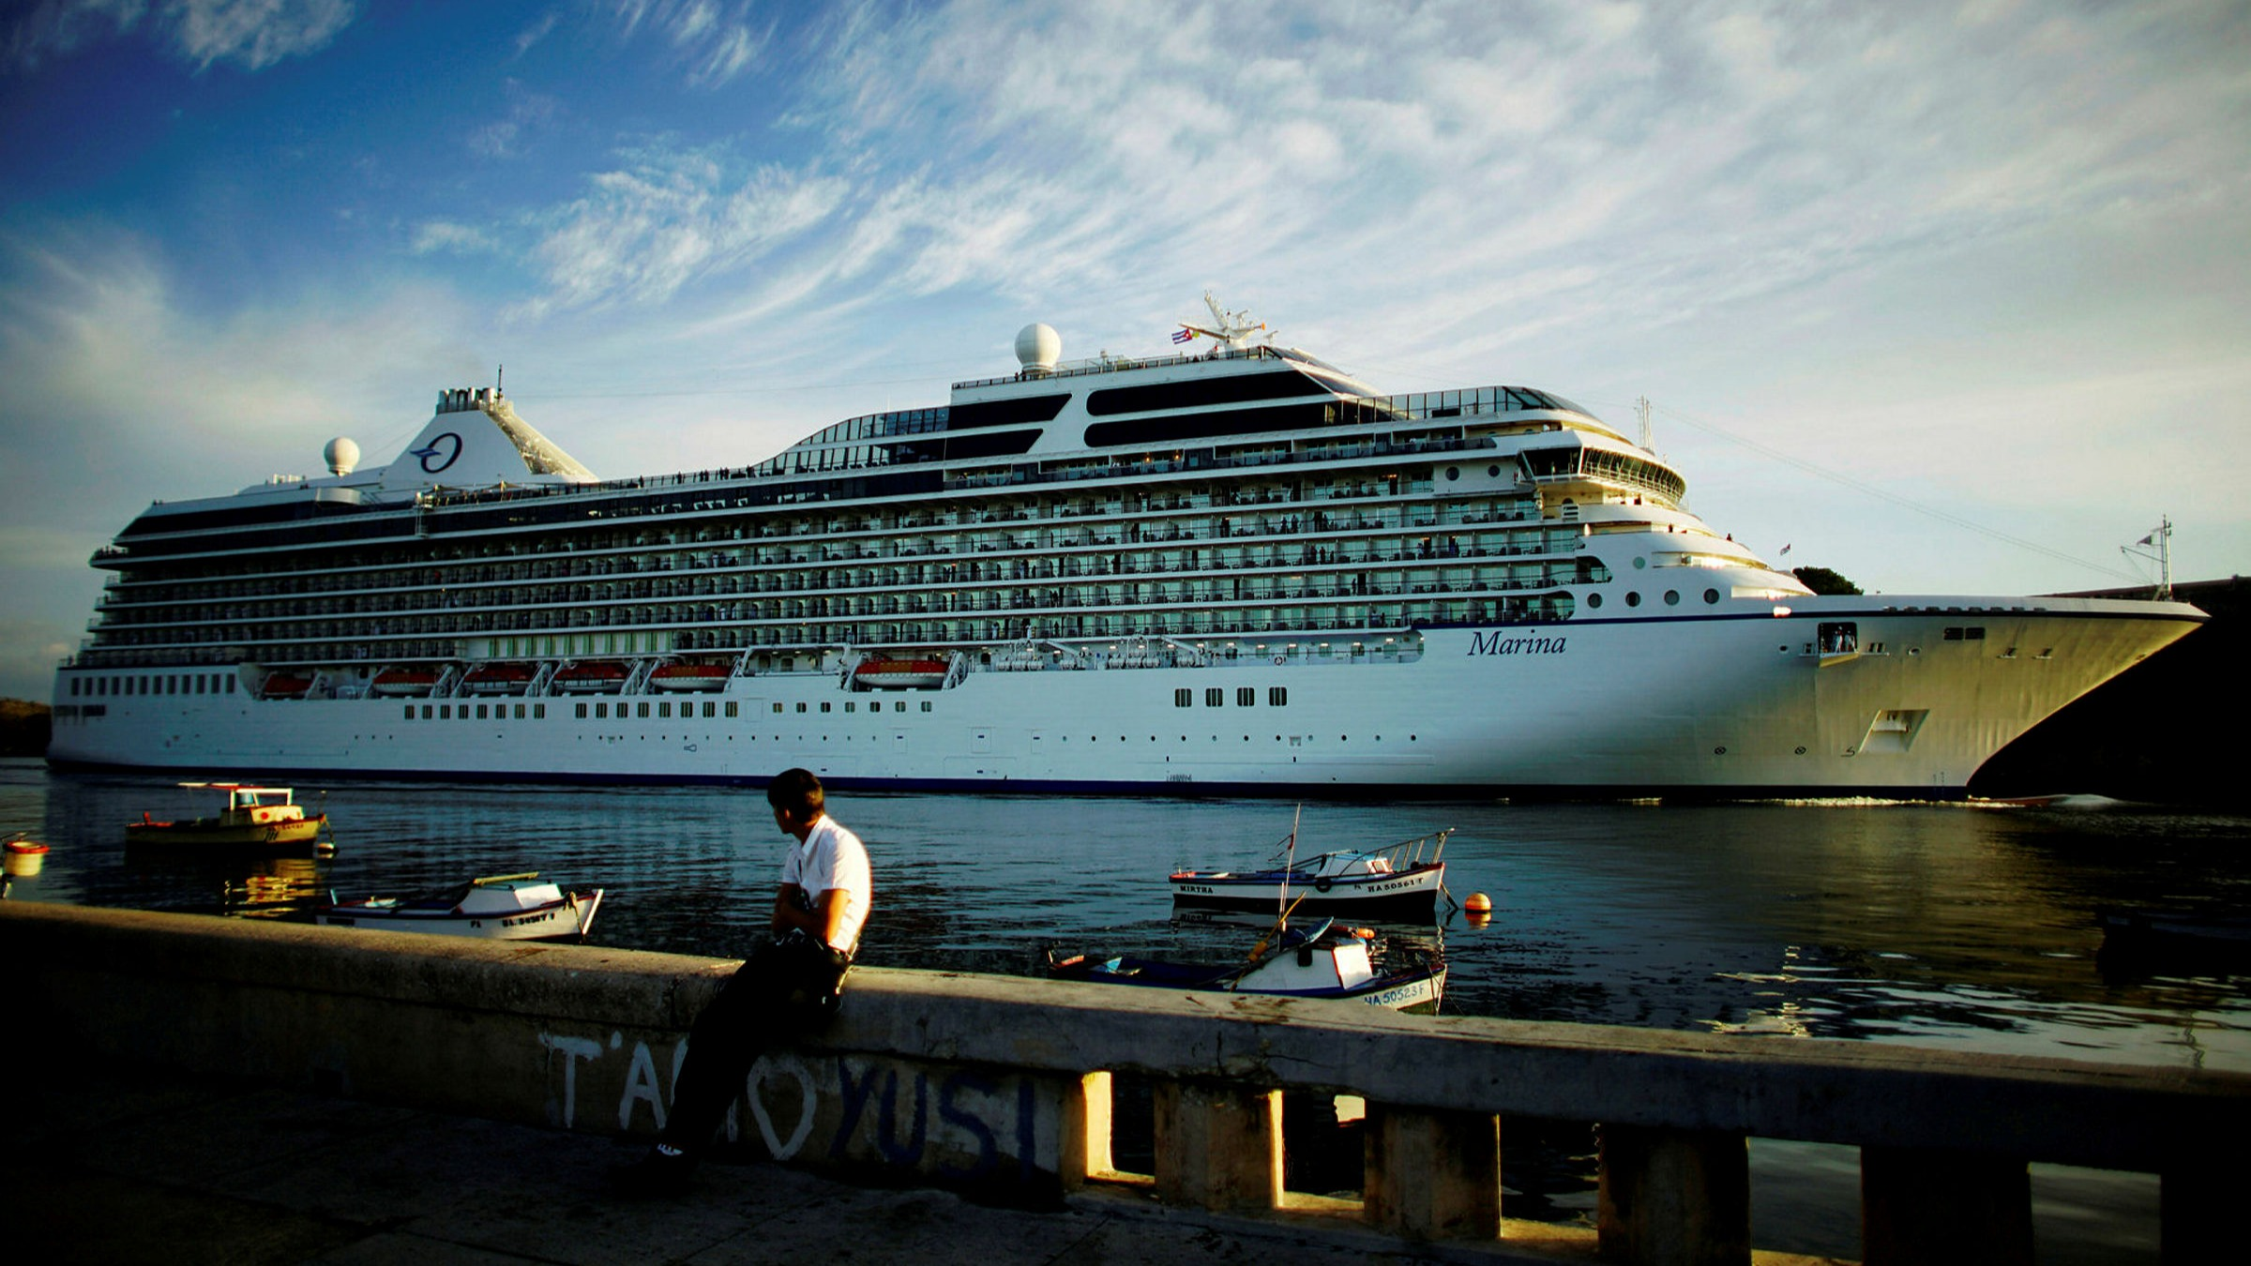
The Cruise Line Industry
BUS419

Slide 2





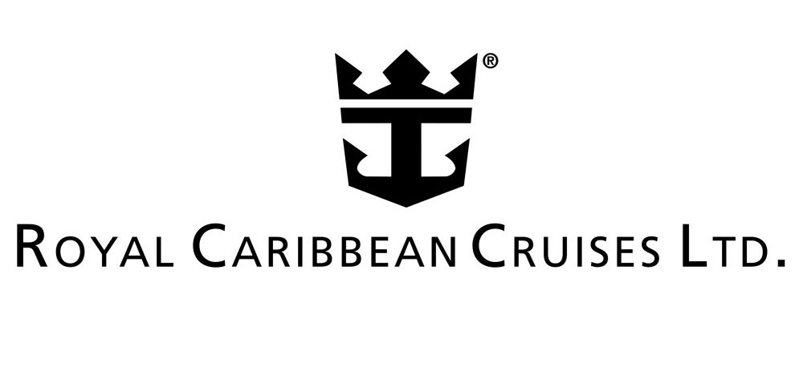
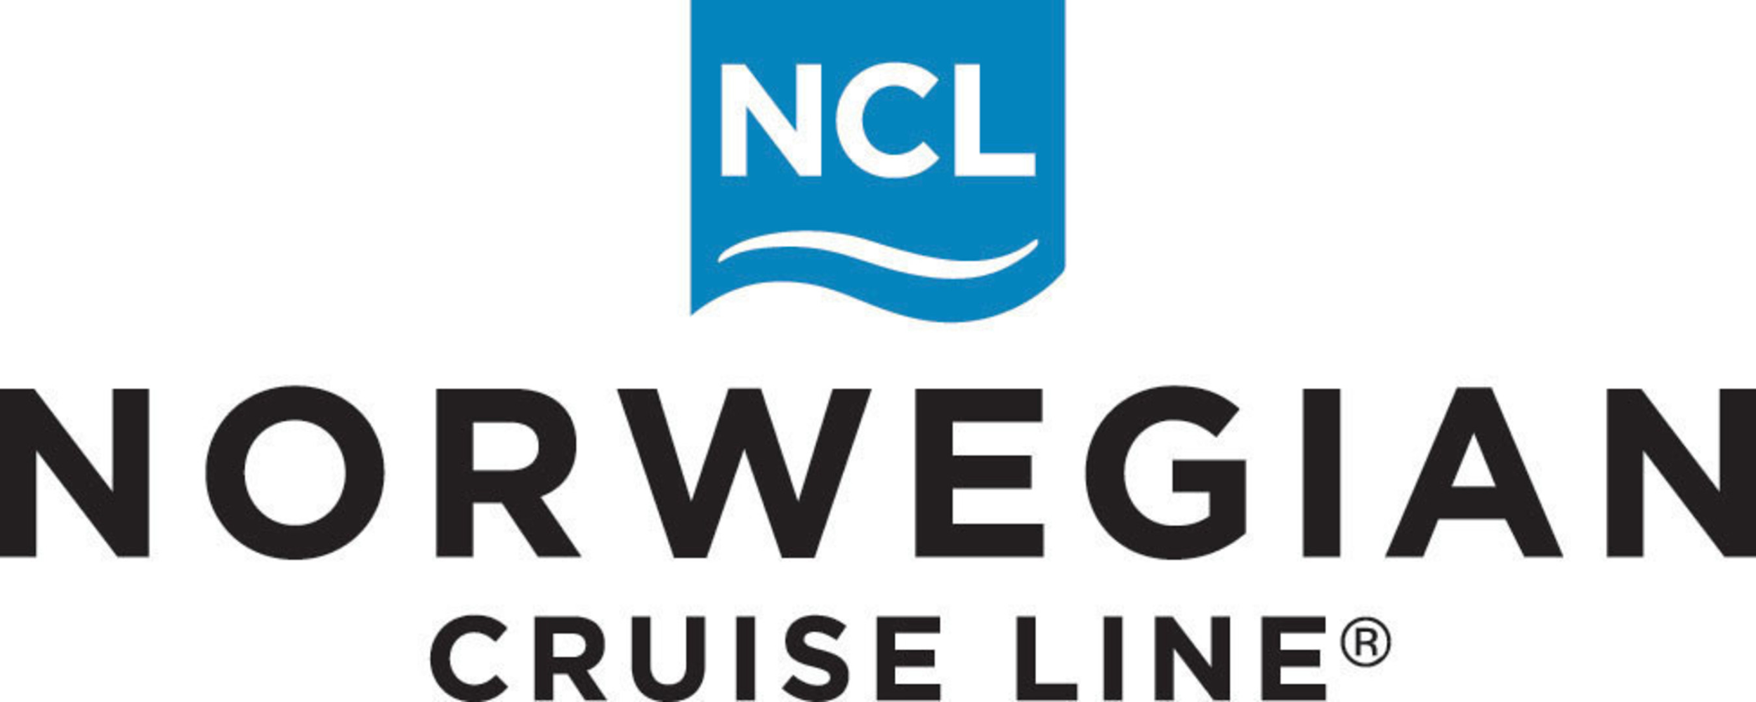
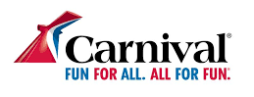
Order of Presentation
Order of Presentation
1
2
3
4
Chris
Zach
Ben
Kale
Market Overview

Slide 3
Agenda
Market Overview
Royal Caribbean Cruises
Norwegian Cruise Lines
Carnival Cruise Lines

Slide 4
Market Overview

Slide 5
Sector Stats + Growth
The cruise line sector is organized by several entities, with the Cruise Line International Association (CLIA) being one of the most important
According to the CLIA, the cruise industry was set towards fast growth:
32 million passengers are set to travel on cruise ships in 2020, up from 30 million in 2019. Since 2009, cruise ship passengers have grown from 17.8 million to 30 million, an annual growth rate of 5.4%.
Cruise industry revenues have grown even faster, from approximately 15.7 billion in 2010 to an estimated 31.5 billion in 2020, a compounded rate of growth of 7.2%.
This industry is highly influenced by macro-economic and human conditions: it is likely that these numbers are hindered due to COVID-19 (all have cancellations)
Notes:
https://cruising.org/news-and-research/-/media/CLIA/Research/CLIA-2019-State-of-the-Industry.pdf
https://www.forbes.com/sites/joemicallef/2020/01/20/state-of-the-cruise-industry-smooth-sailing-into-the-2020s/#70227b6065fa

Slide 6
Sector Trends
Environmental Sustainability: development and identification of new technologies for cleaner fuels is a top priority
Destination Stewardship: exploring new and creative ways to manage the flow of visitors and implement the highest standards of responsible tourism
Cruise and Stay: more travellers are spending time in and near cruise ports
Reduce Single-Use Plastic: travelers value sustainability and more than 8/10 passengers recycle plastics or forego plastic straws
Generation Gruise Positive: there is a increasing positive attitude towards cruising compared to two years ago (probably changed by now)
Lone Cruisers: marriage rates are declining → cruise lines offering studio cabin
Micro Travel: travelers preferring quick short trips (3~5 days)
Notes:
https://cruising.org/news-and-research/-/media/CLIA/Research/CLIA-2019-State-of-the-Industry.pdf
https://www.forbes.com/sites/joemicallef/2020/01/20/state-of-the-cruise-industry-smooth-sailing-into-the-2020s/#70227b6065fa
https://cruising.org/news-and-research/press-room/2019/december/clia-releases-2020-state-of-the-cruise-industry-outlook-report#:~:text=To%20meet%20ongoing%20demand%2C%20CLIA,in%20communities%20around%20the%20world.

Slide 7
Risk Factors
Environmental Risk
Regulation Risk
Fuel Price Risk
Political Risk
Human Risk
Health Risk
Black Swan Risk e.g., COVID

Slide 8

Unprecedented Times!
Norwegian and Royal Caribbean have created a joint task force to develop and improve safety standards amid the COVID-19 pandemic
The group, which is called the “Healthy Sail Panel,” aims to develop public-health recommendations that will enable cruise lines to restart operations while keeping passengers and crew safe from COVID
They have been working for close to a month, and plan to release their initial recommendations and findings by the end of August
The panel is headed by Mike Leavitt, former governor of Utah and Secretary of the US Health and Human Services, and
Dr. Scott Gottlieb, Commissioner of the FDA from 2017-2019
Notes:
https://www.businessinsider.com/norwegian-royal-caribbean-create-coronavirus-covid-19-safety-panel-cruise-2020-7

Slide 9
Major Cruise Companies - Carnival
Carnival Corporation | Ships | Market Share
Carnival | 26 | 4.6%
Princess | 17 | 8.9%
AIDA | 13 | 4.8%
Costa Cruises | 12 | 1.8%
Holland America | 15 | 5.6%
P&O Cruises | 8 | 2.2%
P&O Cruises Australia | 5 | 1.2%
Cunard | 3 | 9.1%
Seabourn | 4 | 1.2%
Total | 103 | 39.4%
Notes:
https://cruisemarketwatch.com/capacity/

Slide 10
Major Cruise Companies - RCL & NCL
Royal Caribbean | Ships | Market Share
Royal Caribbean | 26 | 14%
Celebrity | 13 | 5.3%
Azamara | 3 | 0.9%
Total | 42 | 20.2%
Norwegian
Norwegian | 16 | 8.4%
Oceania Cruises | 6 | 2.3%
Regent (Radisson) | 4 | 1.9%
Total | 26 | 12.6%
Notes:
https://cruisemarketwatch.com/capacity/

Slide 11
Market Share of The Main Players
Company | Ships | Market Share
Carnival | 103 | 39.4%
Royal Caribbean | 42 | 20.2%
Norwegian | 26 | 12.6%
Total | 171 | 72.2%

Slide 12
Major Cruise Companies - Other
 | Ships | Market Share
All other companies | 143 | 27.8%
Notes:
https://cruisemarketwatch.com/capacity/

Slide 13
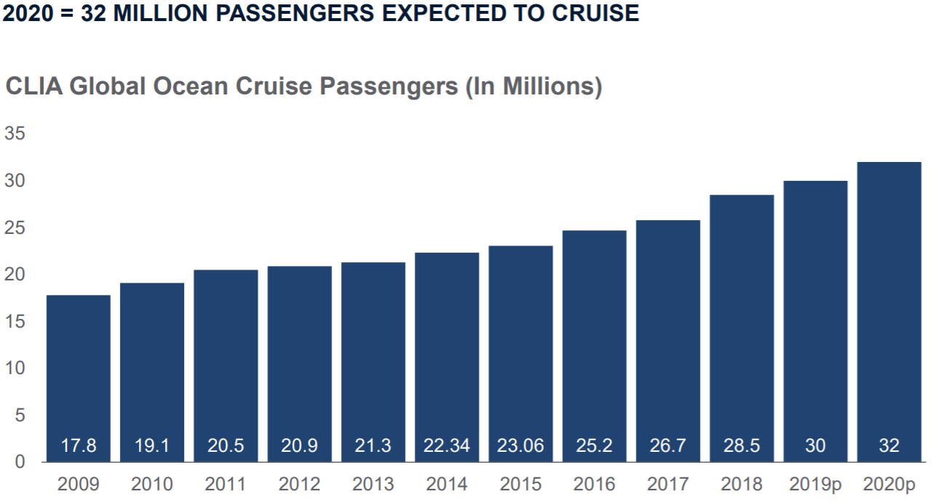
Overall Passenger Growth

Slide 14
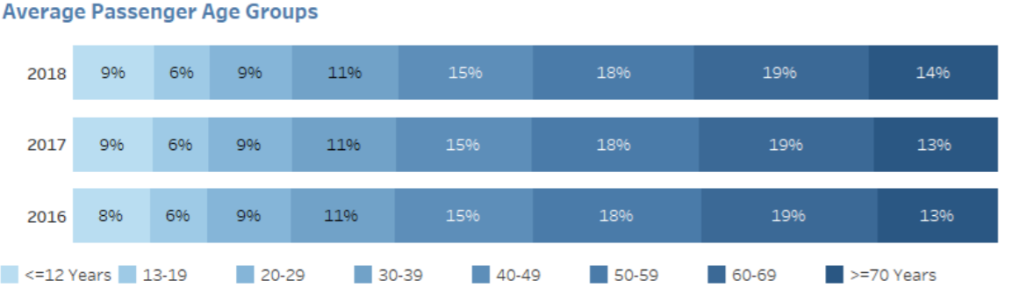
Age Profile of Passengers

Slide 15
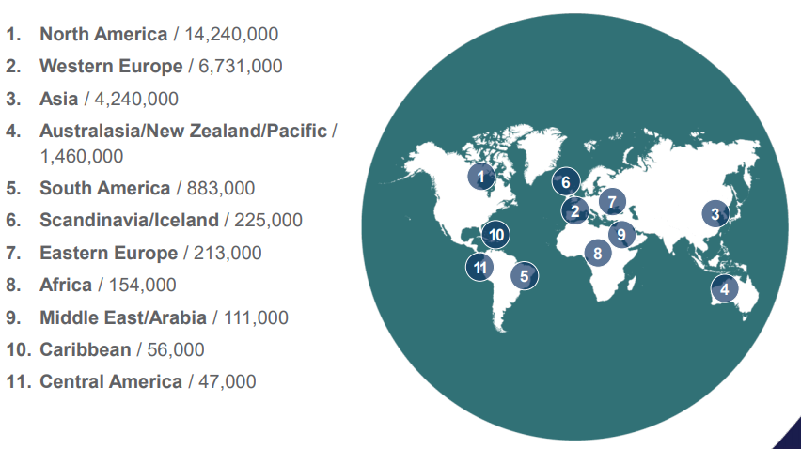
Passenger Geographical Origins

Slide 16
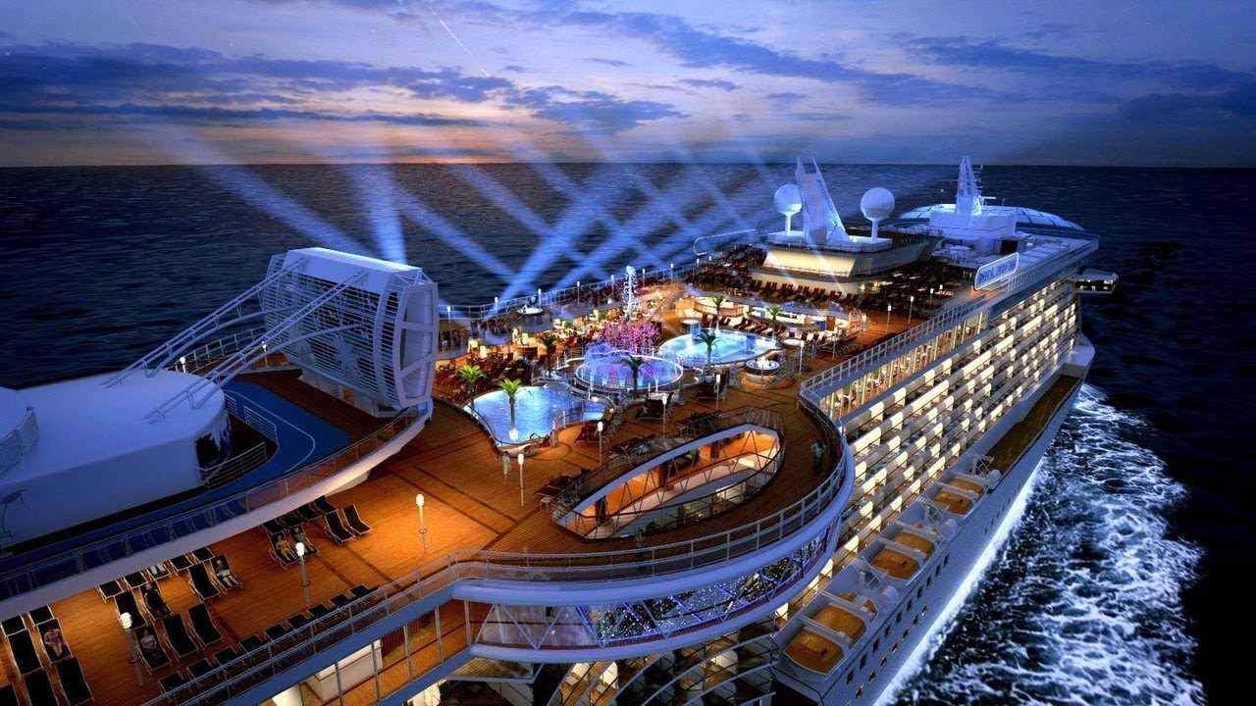
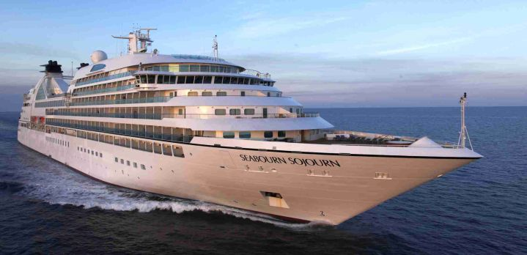
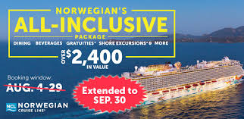
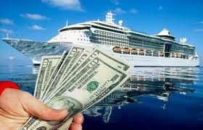
Market Differentiation
Four Main Sectors
Luxury
Premium
All-inclusive
Budget
Two Main Geographical Areas:
North America
Europe

Slide 17
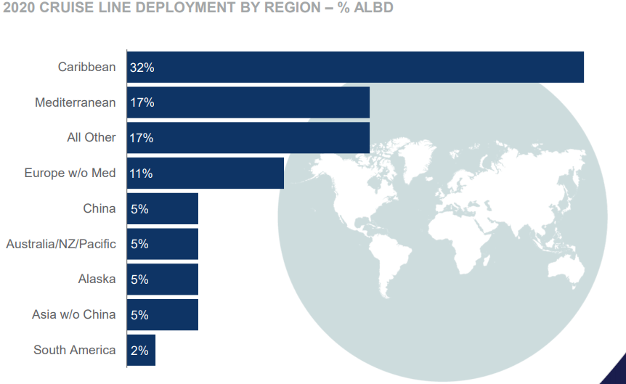
Regional Segmentation

Slide 18
North American Market
Dominated by a few key players
Carnival
Royal Caribbean
Norwegian

Slide 19
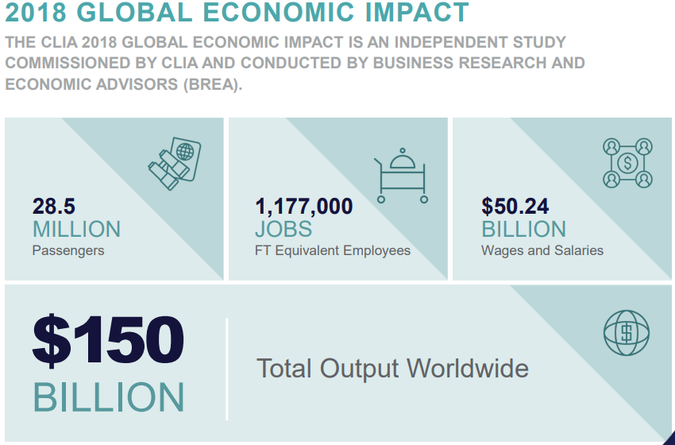
Economic Contribution for North America

Slide 20
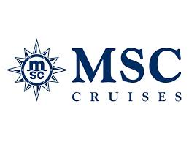
European Market
Dominated by
Carnival
MSC

Slide 21
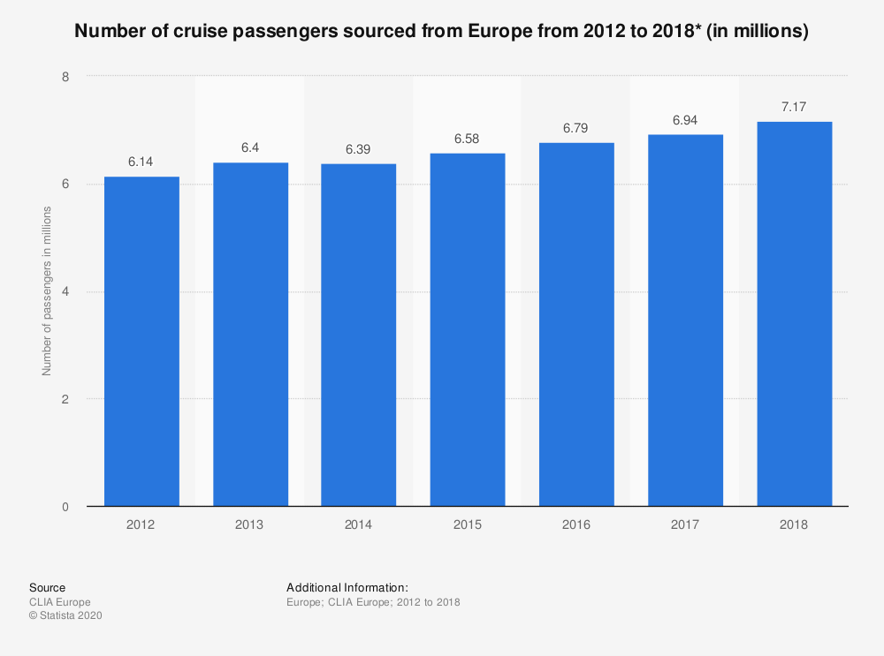
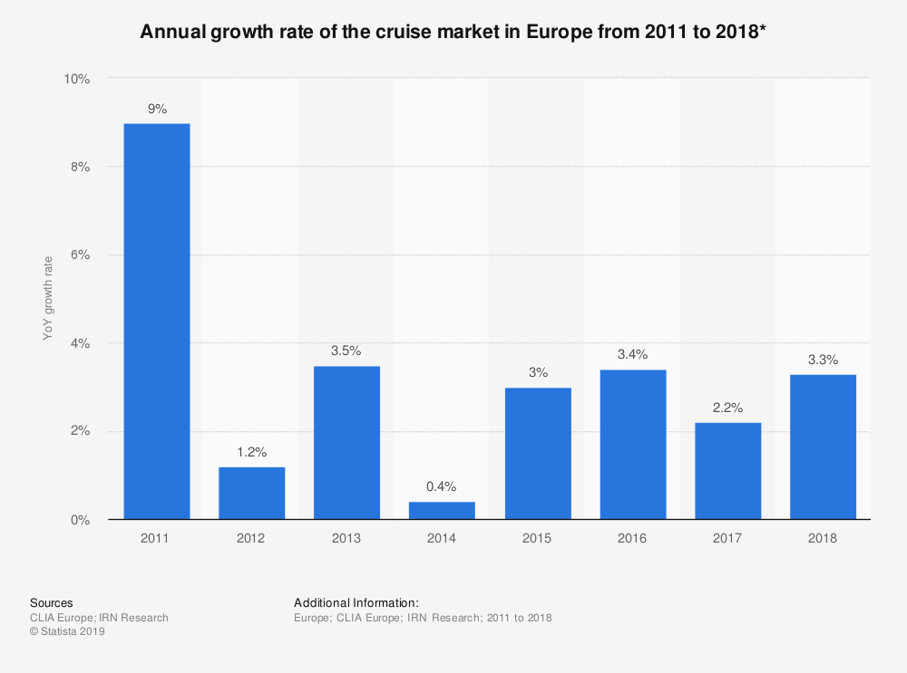
Market Overview

Slide 22
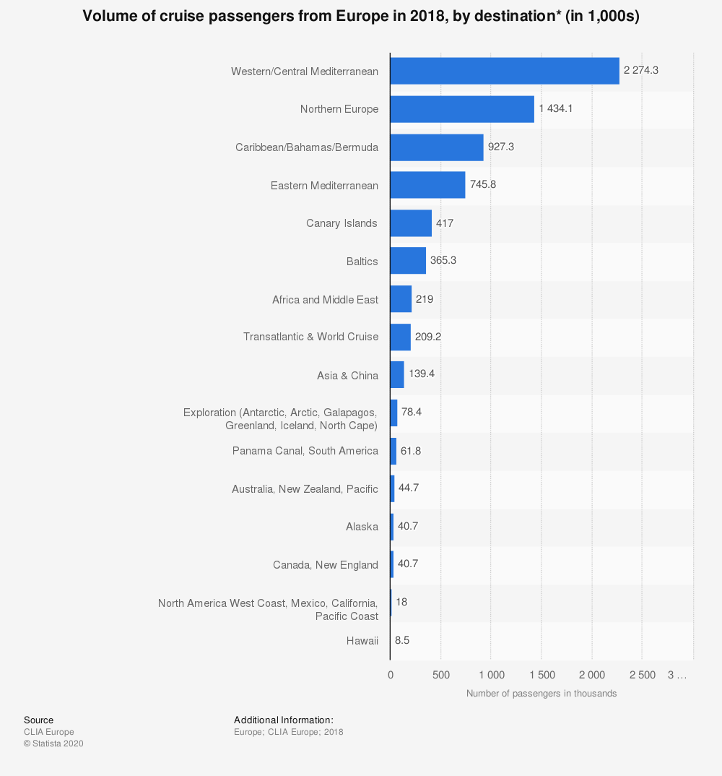
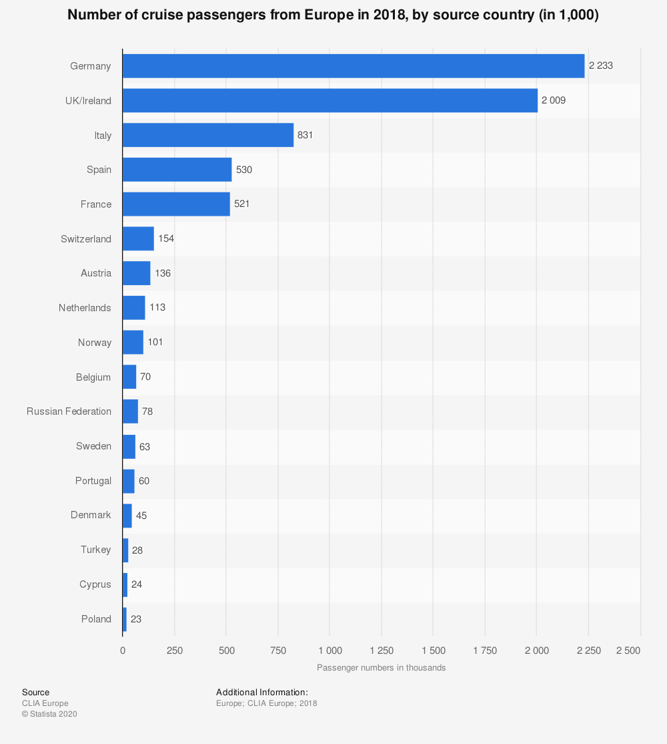
Market Overview

Slide 23
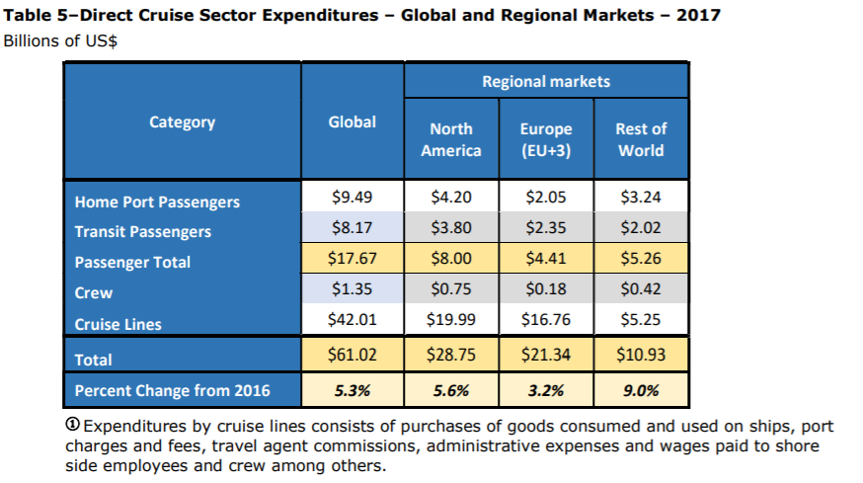
Cruise Line Expenditures
Notes:
https://cruising.org/-/media/CLIA/Research/Global%202018%20EIS

Slide 24
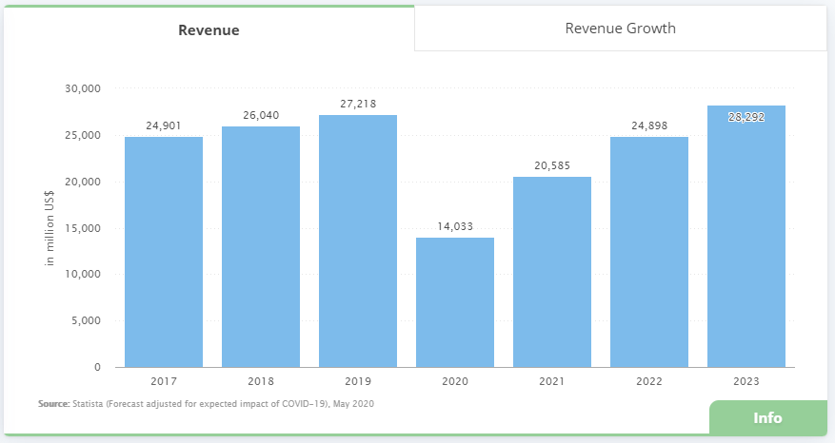
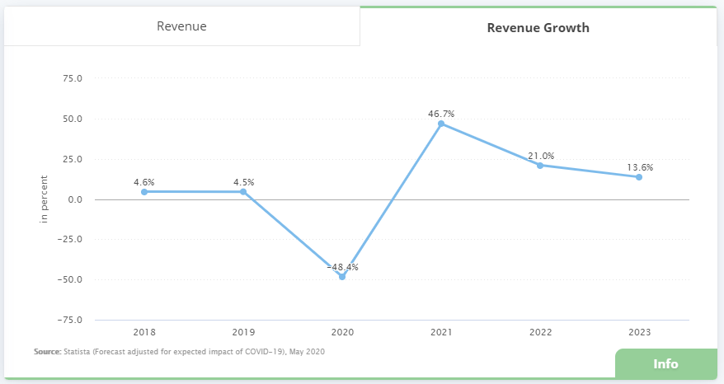
Market Projections

Slide 26

Company Overview
Founded in Norway in 1968 under the name Royal Caribbean Cruise Line
Merged with Celebrity Cruises in 1997, become Royal Caribbean International
Holding company Royal Caribbean Cruises LTD was then formed to oversee both brands
Incorporated in Liberia and operates out of Miami, Florida

Slide 27
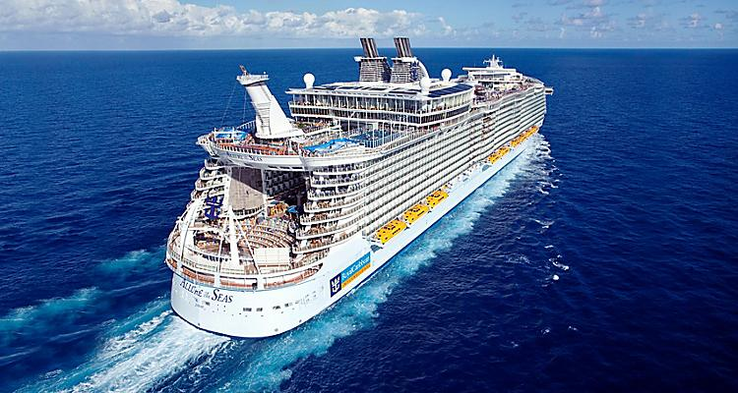
Subsidiaries and Brands
Royal Caribbean International
Celebrity Cruises
Azamara Cruises
Tui Cruises
Silversea Cruises
Pallmantur Cruceros

Slide 28
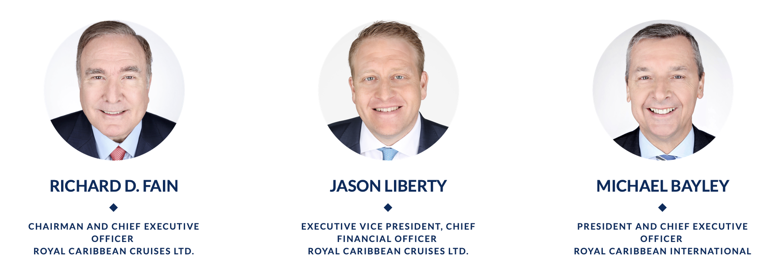
Company Leadership

Slide 29
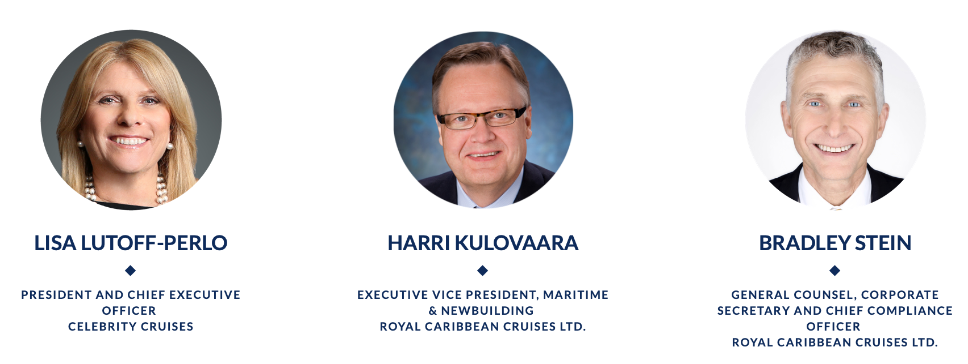
Company Leadership

Slide 30
Board of Directors
John F Brock
Richard D Fain
Stephen R Howe JR
William L Kimsey
Maritza G Montel
Ann S Moore
Eyel Ofer
William K Reilly
Vagn O Sorenson
Donald Thompson

Slide 31
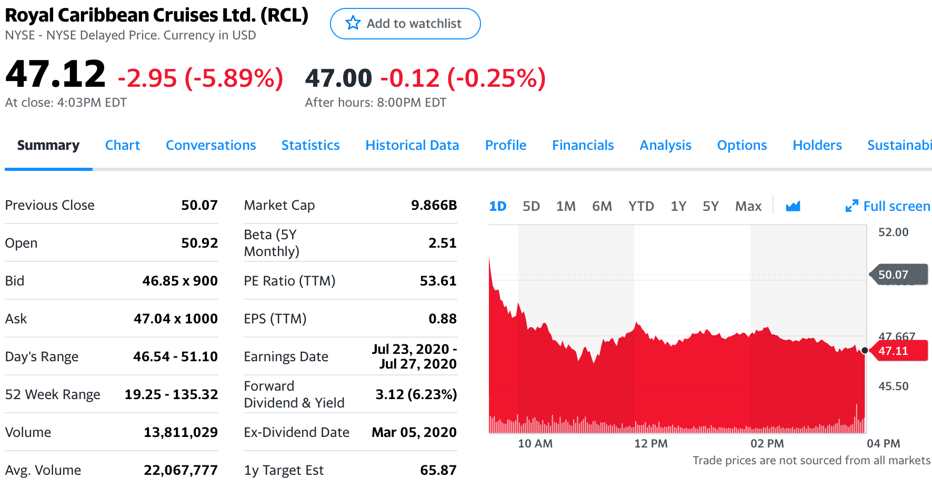
Share Price

Slide 32
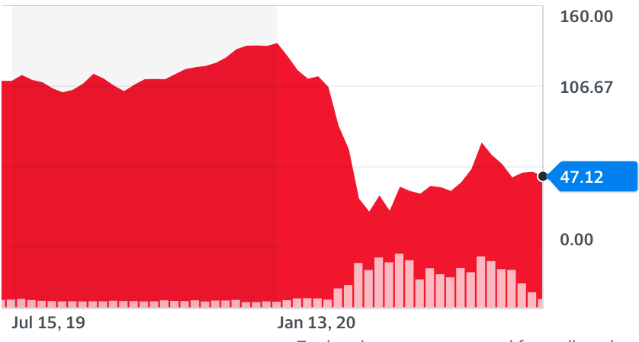
Share Price 1 Year History

Slide 33
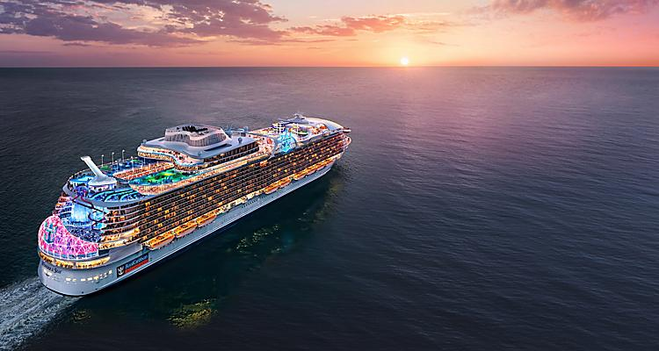
Financials

Slide 34
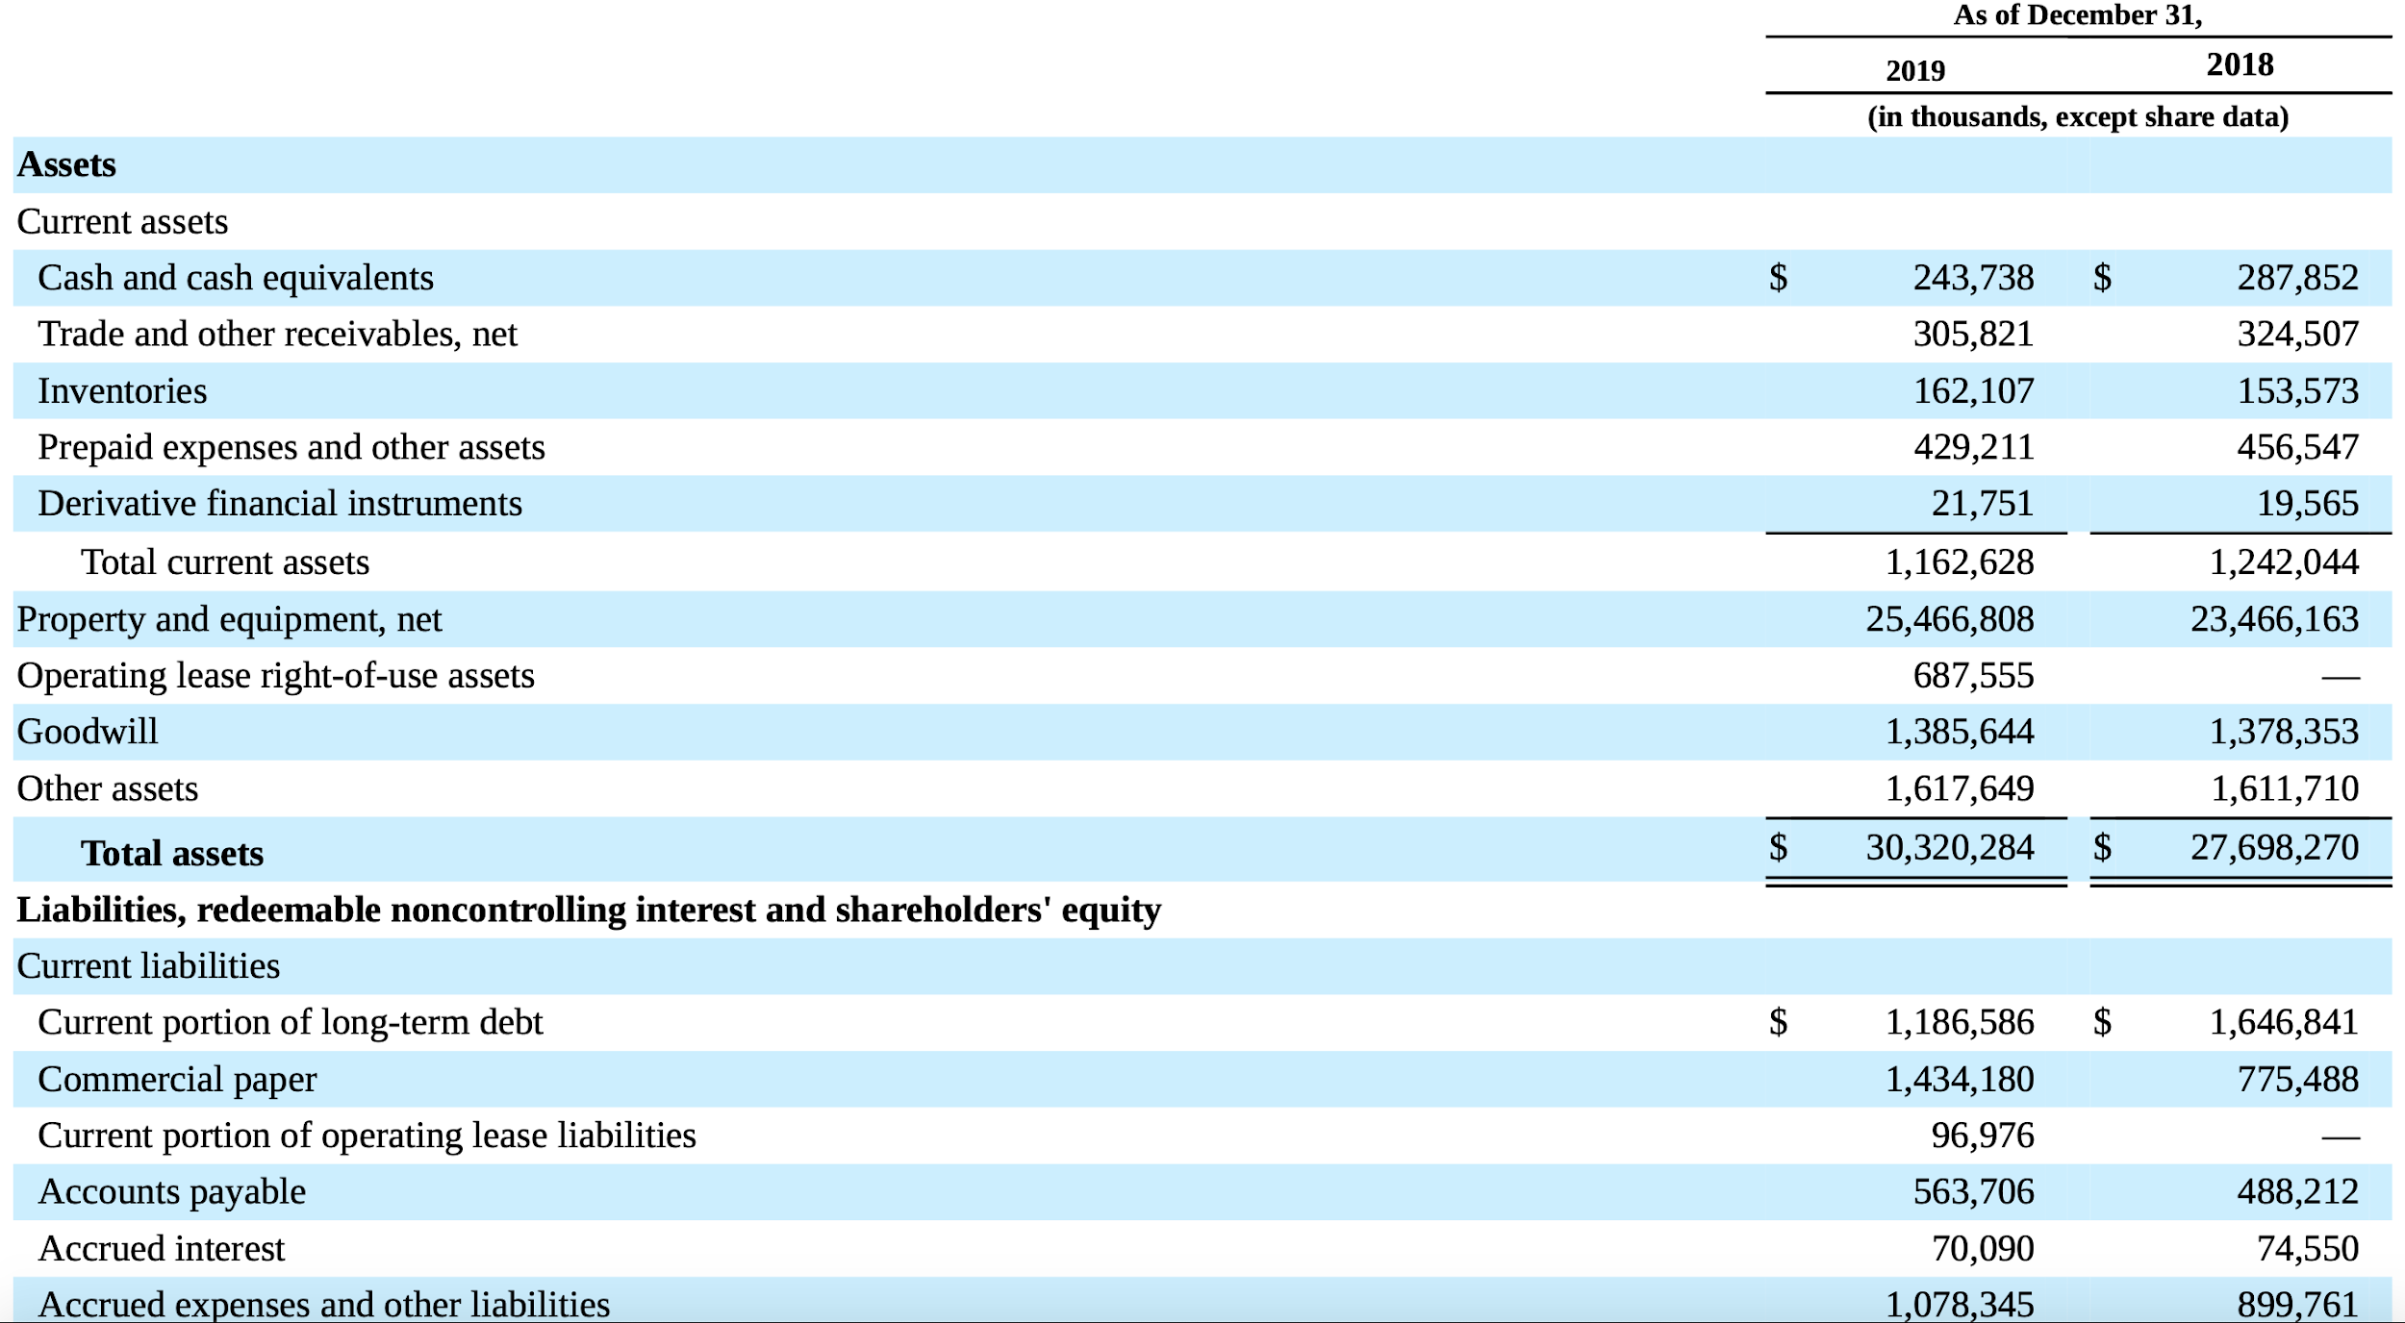
Balance Sheet

Slide 35
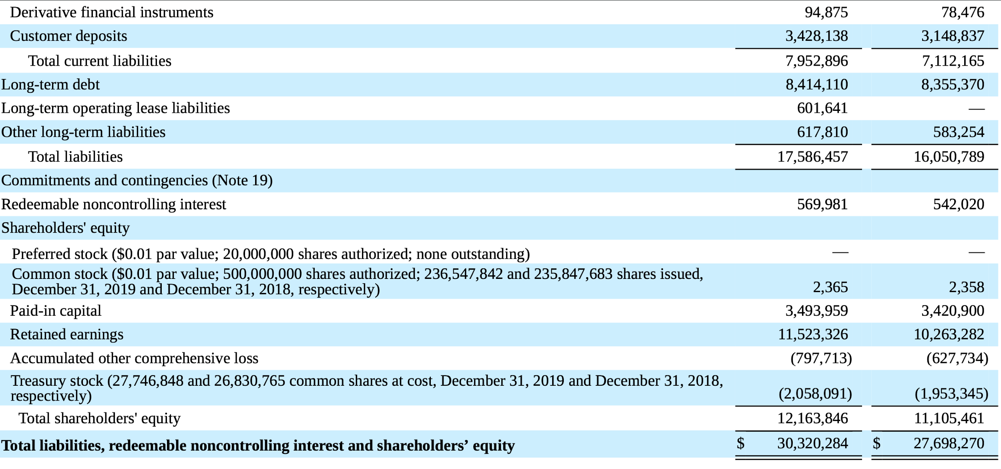
Balance Sheet Cont.

Slide 36
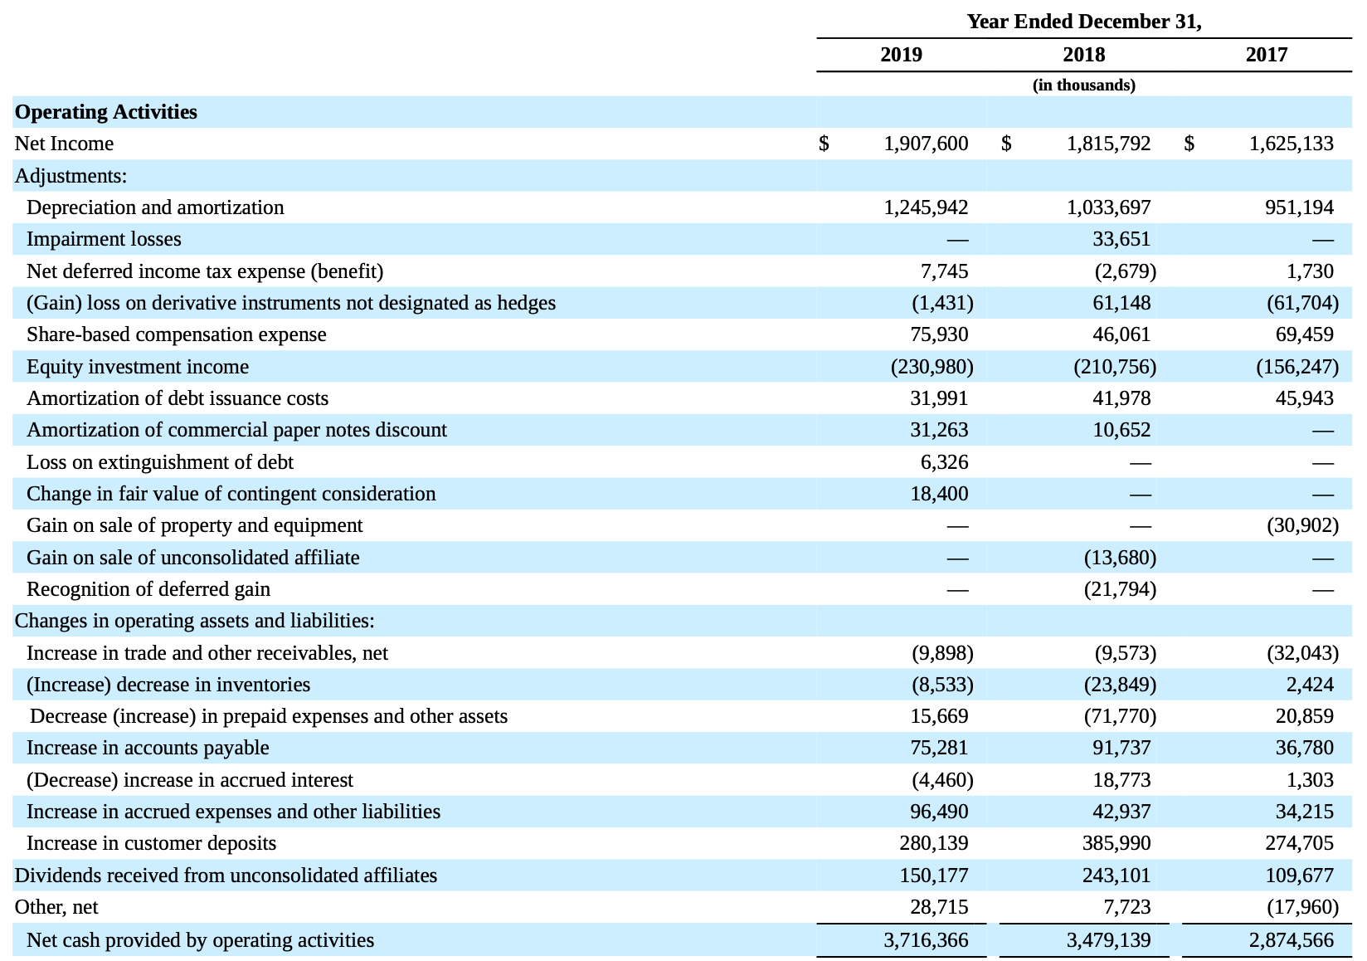
Cash Flow Statement

Slide 37
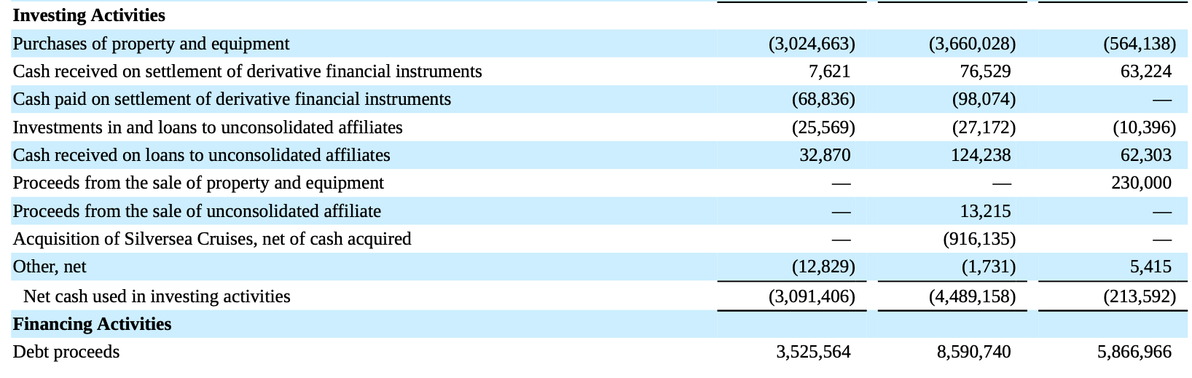
Cash Flow Statement Continued

Slide 38
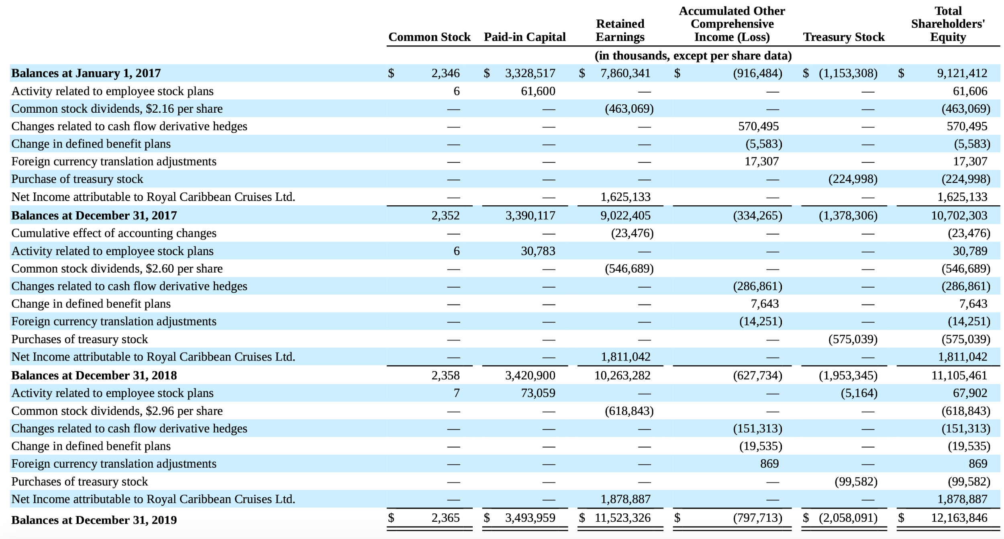
Consolidated Statement of Shareholders Equity

Slide 39
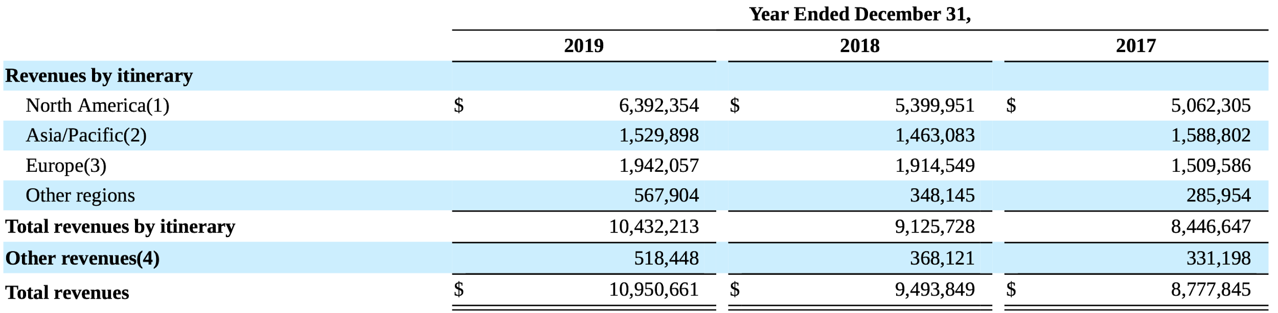
Disaggregated Revenues

Slide 40

Risks

Slide 41

Price/Availability of Fuel
A rise in fuel prices not only impacts fuel costs, but also other aspects of business like crew travel, freight expenses and commodity prices.
The International Maritime Organization 2020 Low Sulphur Regulation creates uncertainty to the future price and availability of certain fuel types.

Slide 42
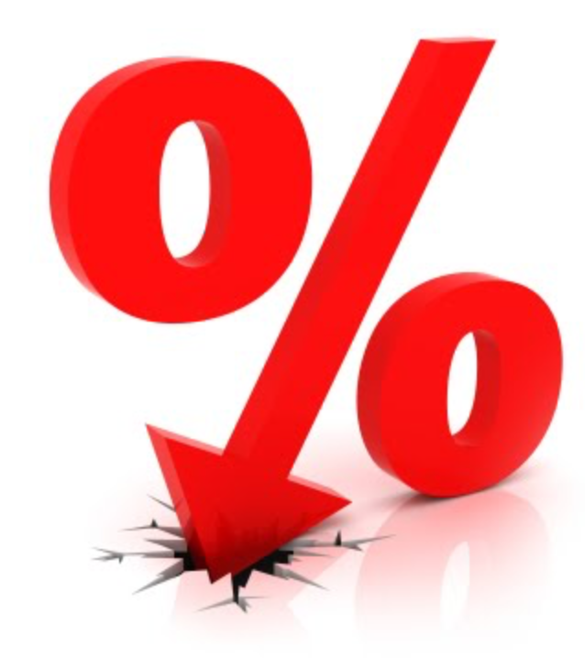
Change in Interest Rate
A rise in interest rates would negatively impact the cost of Royal Caribbean's floating rate debt
Also the UK’s announcement to alter LIBOR by 2021 could negatively impact Royal Caribbean's portfolio of debt instruments and derivatives

Slide 43
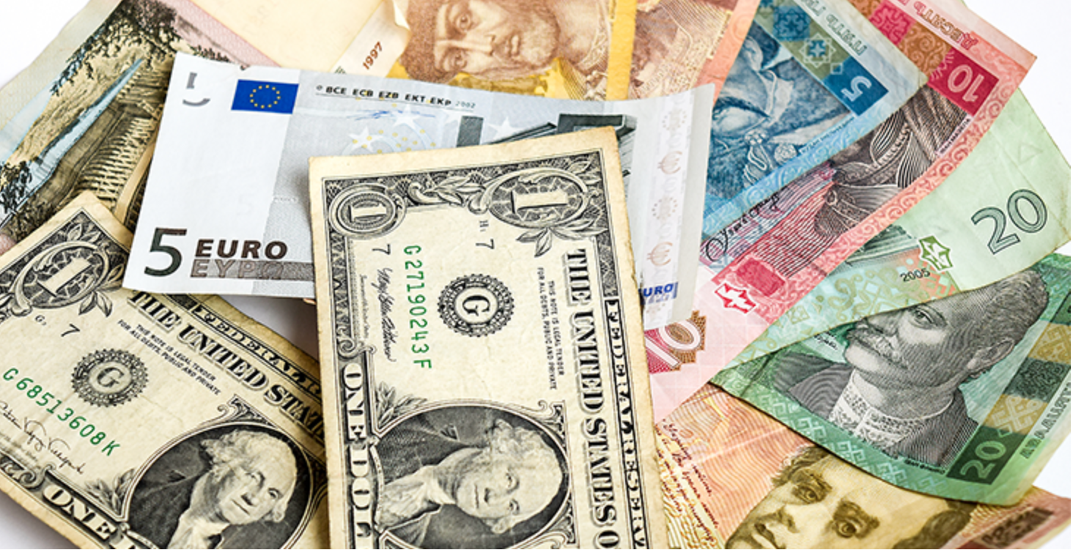
Fluctuations in Exchange Rate
Much of Royal Caribbean's earnings in foreign currencies can adversely be affected by a high US$
Another key currency for the company is the Euro as ship contracts are predominately in that currency.

Slide 44
Other Risks
Acts of terrorism/sabotage
Economic conditions that reduce the demand for cruises
Change in US Foreign travel policy
Incidents on ships/at port that receive negative media coverage
Rise in the costs of airfare
Natural disasters
Disease outbreaks

Slide 45
Other Risks Continued
Increase in ship capacity exceeding market demand
Unavailability of ports
Over reliance on dockyards and subcontractors
Growing anti tourism sentiments
Losing business to a competitor
Unable to keep up with technological advancements
Loss of key personnel

Slide 46

Hedging Strategies

Slide 47
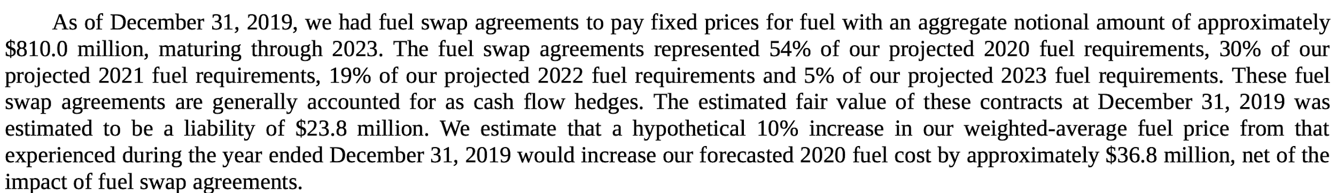
Price of Fuel Hedge

Slide 48
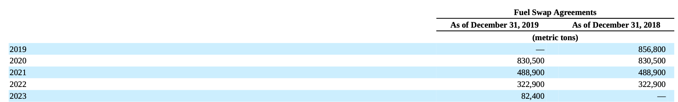
Amount of Fuel Swap Agreements

Slide 49
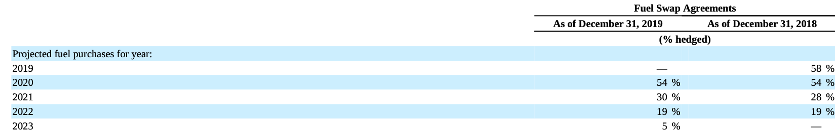
% of Fuel Hedged (Estimated Usage)

Slide 50
Exchange Rate Hedge

Slide 51
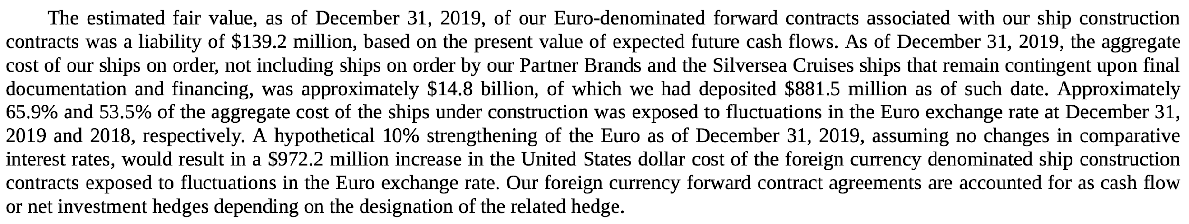
Exchange Rate Hedge Details

Slide 52
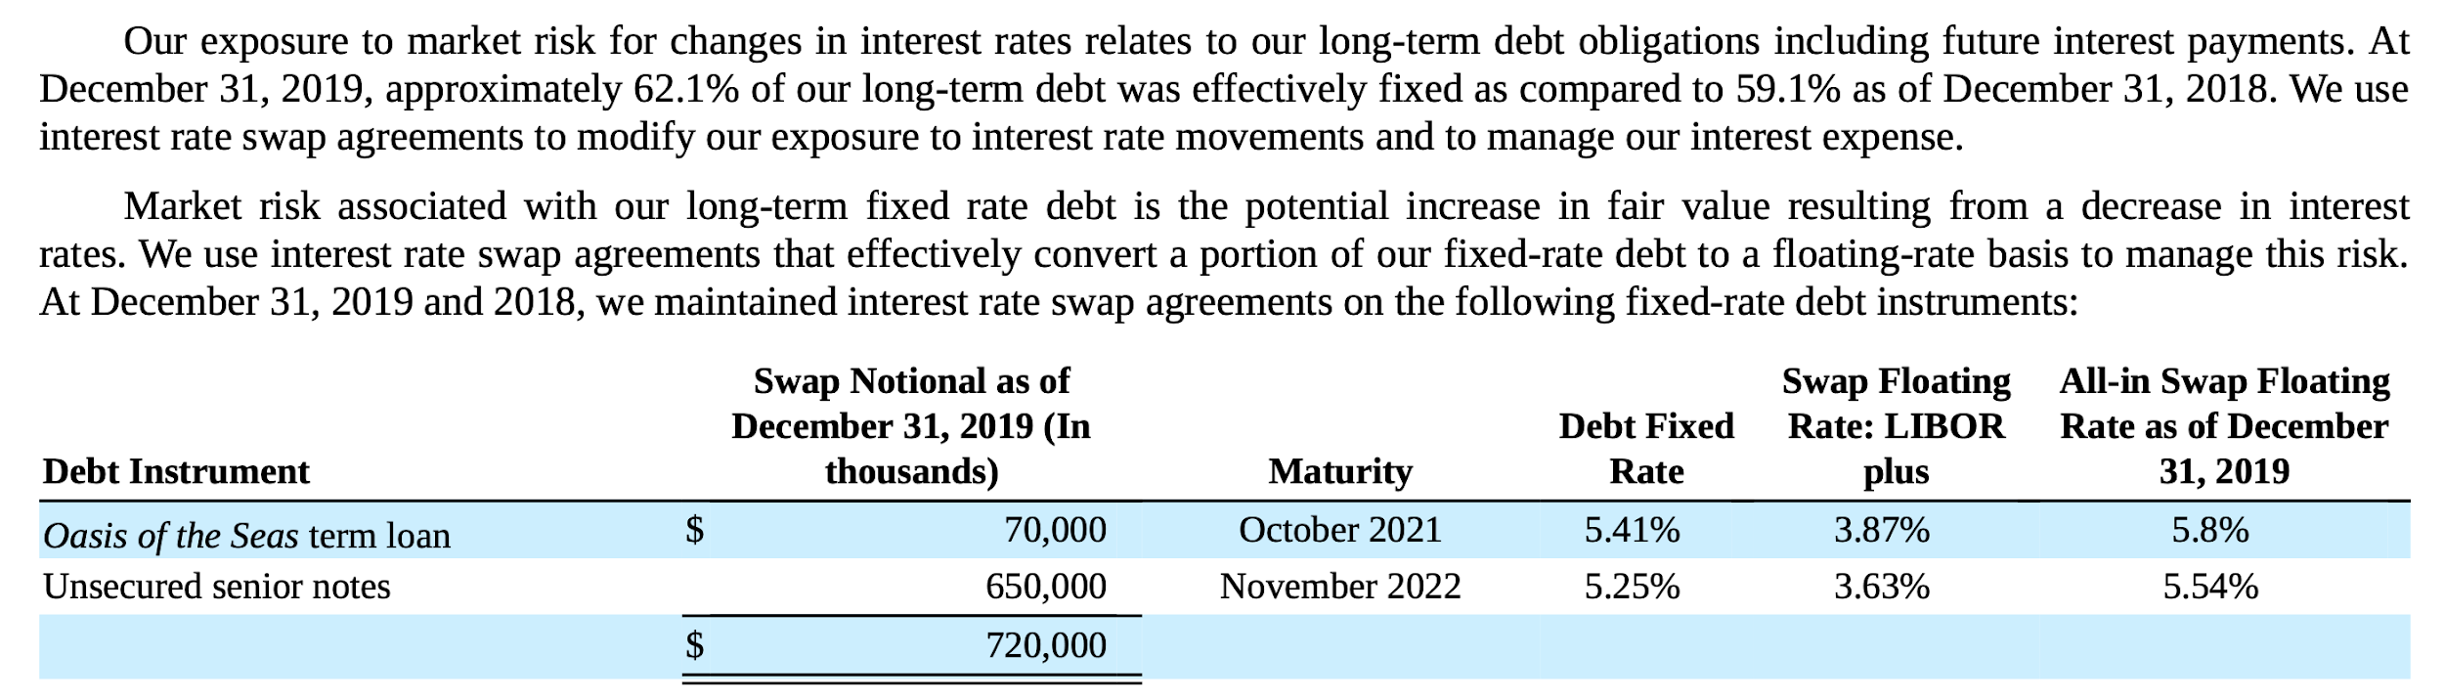
Change in Interest Rate Hedge

Slide 53
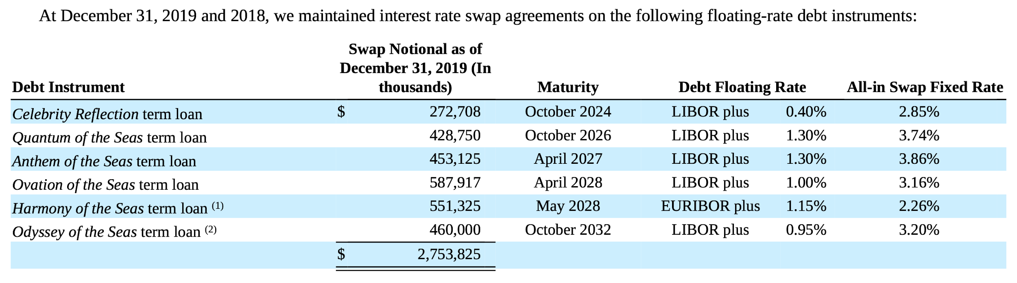
Change in Interest Rate Hedge Continued

Slide 54
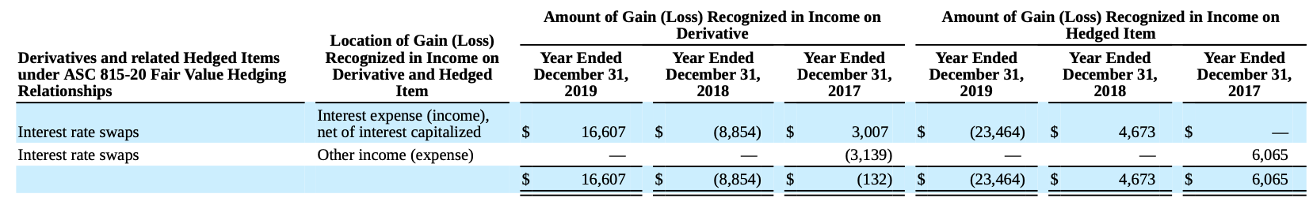
Gain or Loss on Interest Rate Derivatives

Slide 55
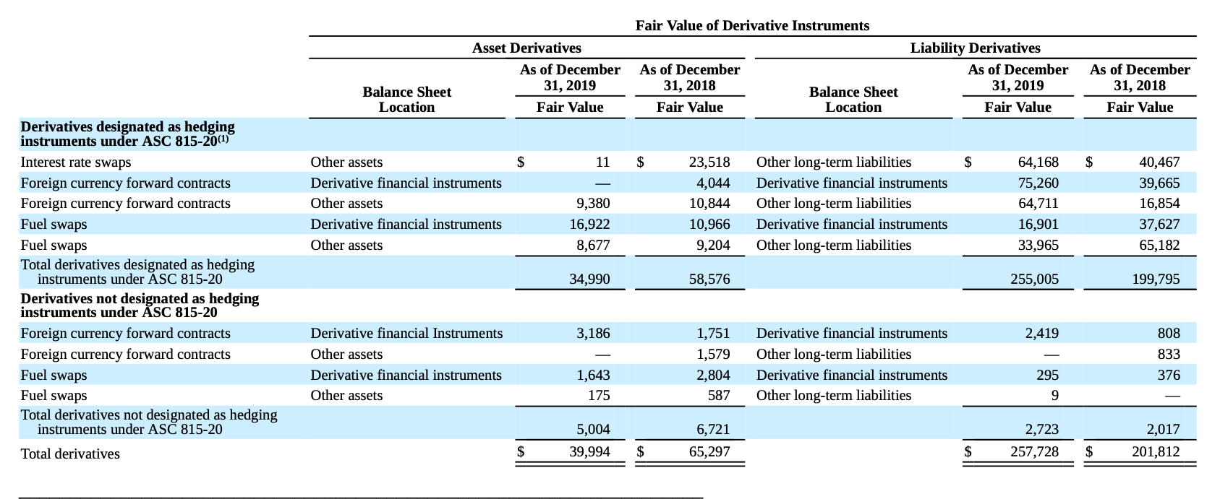
Fair Value of Derivatives

Slide 56
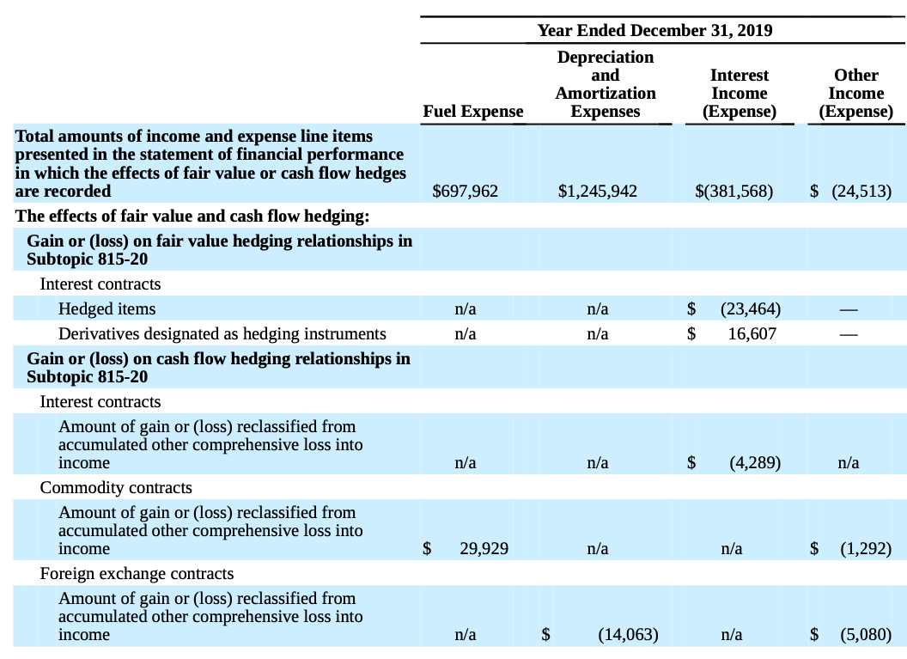
Gain or (Loss) on Hedging Instruments

Slide 57
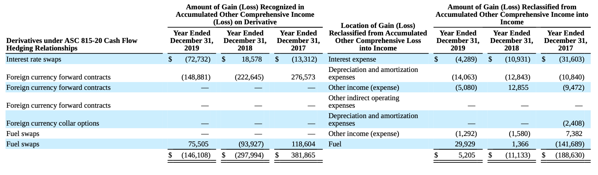
Effect of Hedging Instruments on The Consolidated Financial Statements

Slide 58
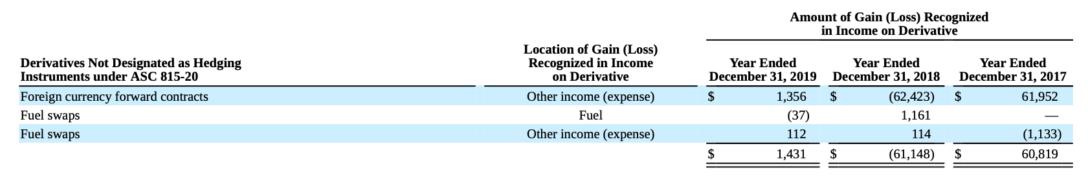
Effect of Non-Hedging Derivatives on The Consolidated Financial Statements

Slide 60
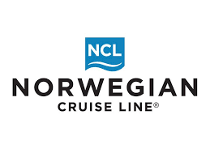
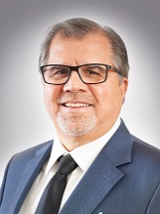

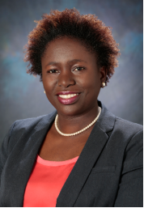
Company Leadership
Frank J. Del Rio President and Chief Executive Officer, Norwegian Cruise Line Holdings Ltd.
Mark A. Kempa Executive Vice President and Chief Financial Officer, Norwegian Cruise Line Holdings Ltd.
Faye L. Ashby Senior Vice President & Chief Accounting Officer, Norwegian Cruise Line Holdings Ltd.

Slide 61



Subsidiary Company Leadership
Harry Sommer Norwegian Cruise Line Chief Executive Officer
Robert J. Binder
Oceania Cruises Chief Executive Officer
Jason Montague
Regent Seven Seas Cruises Chief Executive Officer

Slide 62
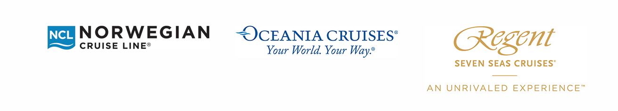
Board of Directors
Russell W. Galbut
Frank J. Del Rio
David M. Abrams
Adam M. Aron
John W. Chidsey
Stella David
Mary E. Landry
Chad A. Leat
Steve Martinez
Pamela Thomas Graham

Slide 63
NCLH Mission & Vision Statement
Mission Statement: To provide exceptional vacation experiences, delivered by passionate team members committed to world-class hospitality and innovation
Vision Statement: To be the vacation of choice for everyone around the world

Slide 64
NCLH Company Facts
Founded in 1966, incorporated in Bermuda and headquartered in Miami.
The third-largest cruise line in the world by passengers.
Acuirred Prestige Cruise Holdings in September 2014.
Operates Norwegian Cruise Line, Oceania Cruises, and Regent Seven Seas.
IPO on January 18, 2013 at $19 per share, traded on the NASDAQ.

Slide 65
NCLH Company Facts
Fleet of 28 ships with 59,150 berths and 9 addition ships on order
More than 490 destinations worldwide
$6.5 billion in revenue for 2019
In 2019, repurchased 19 million shares costing $1 billion dollars (9% of outstanding shares)

Slide 66
NCLH Mission Statement & Vision
Mission Statement: To provide exceptional vacation experiences, delivered by passionate team members committed to world-class hospitality and innovation.
Vision: To be the vacation of choice for everyone around the world.

Slide 67



NCLH Stock Price

Slide 68
Financial Reports

Slide 69

Select Financial Data (item 6)

Slide 70

Statements of Balance Sheet

Slide 71



Statements of Cash Flows

Slide 72

Statements of Operations

Slide 73

Statements of Comprehensive Income

Slide 74

Changes in Shareholders’ Equity

Slide 75
Risk & Derivative Hedging Strategies

Slide 76

Item 1A & 7A: Risks to Consider
Increases in Fuel Prices
Interest Rate Risk
The International Laws and Political Climate
Volatility in Foreign Currency
Terrorist and Pirate Attacks
Changes in environmental and economic conditions
Weather conditions and maritime disasters

Slide 77
Insurance for Risks
We maintain insurance on the hull and machinery of our ships, which are maintained in amounts related to the estimated market value of each ship. The coverage for each of the hull and machinery policies is maintained with syndicates of insurance underwriters from the European and U.S. insurance markets.
In addition to the insurance coverage on the hull and machinery of our ships, we seek to maintain comprehensive insurance coverage and believe that our current coverage is at appropriate levels to protect against most of the accident-related risks involved in the conduct of our business. The insurance we carry includes:
Protection and indemnity insurance (coverage for passenger, crew and third-party liabilities)
Insurance against pollution liabilities
War risk insurance, including terrorist risk insurance.
Insurance for shoreside property, cybersecurity, directors and officers, general liability risks and other
Our insurance coverage, including those noted above, is subject to certain limitations, exclusions and deductible levels.

Slide 78

Risk & Derivative Hedging Strategies

Slide 79
Fuel Derivative Hedging Strategies
As of December 31, 2019, we had fuel swaps, which are used to mitigate the financial impact of volatility of fuel prices pertaining to approximately 1.1 million metric tons of our projected fuel purchases, maturing through December 31, 2022.
Our exposure to market risk for changes in fuel prices relates to the forecasted purchases of fuel on our ships. Fuel expense, as a percentage of our total cruise operating expense, was 11.2% for the year ended December 31, 2019 and 11.6% for the year ended December 31, 2018. We use fuel derivative agreements to mitigate the financial impact of fluctuations in fuel prices and as of December 31, 2019, we had hedged approximately 56%, 50% and 18% of our 2020, 2021 and 2022 projected metric tons of fuel purchases, respectively. As of December 31, 2018, we had hedged approximately 57%, 53% and 33% of our 2019, 2020 and 2021 projected metric tons of fuel purchases, respectively. The change in fuel price risk from December 31, 2018 to December 31, 2019 was due to additional fuel hedges executed.
We estimate that a 10% increase in our weighted-average fuel price would increase our anticipated 2020 fuel expense by $50.0 million. This increase would be partially offset by an increase in the fair value of our fuel swap agreements of $23.0 million. Fair value of our derivative contracts is derived using valuation models that utilize the income valuation approach. These valuation models take into account the contract terms such as maturity, as well as other inputs such as fuel types, fuel curves, creditworthiness of the counterparty and the Company, as well as other data points.

Slide 80
Foreign Currency Hedging Strategies
As of December 31, 2019, we had foreign currency forward contracts, matured foreign currency options and matured foreign currency collars which are used to mitigate the financial impact of volatility in foreign currency exchange rates related to our ship construction contracts denominated in euros. The notional amount of our foreign currency forward contracts was €1.8 billion, or $2.0 billion based on the euro/U.S. dollar exchange rate as of December 31, 2019.
As of December 31, 2019, we had foreign currency derivatives to hedge the exposure to volatility in foreign currency exchange rates related to our ship construction contracts denominated in euros. These derivatives hedge the foreign currency exchange rate risk on a portion of the payments on our ship construction contracts. The payments not hedged aggregate €3.0 billion, or $3.4 billion based on the euro/U.S. dollar exchange rate as of December 31, 2019. As of December 31, 2018, the payments not hedged aggregated €2.2 billion, or $2.5 billion, based on the euro/U.S. dollar exchange rate as of December 31, 2018. The change from December 31, 2018 to December 31, 2019 was due to the delivery of a ship in October 2019 and additional foreign exchange derivatives executed. We estimate that a 10% change in the euro as of December 31, 2019 would result in a $0.3 billion change in the U.S. dollar value of the foreign currency denominated remaining payments.

Slide 81
Interest Derivative Hedging Strategies
As of December 31, 2019, we had interest rate swaps and collars, which are used to hedge our exposure to interest rate movements and manage our interest expense. The notional amount of our outstanding debt associated with the interest rate swaps and collars was $1.7 billion as of December 31, 2019.
As of December 31, 2019, we had interest rate swap and collar agreements to hedge our exposure to interest rate movements and to manage our interest expense. As of December 31, 2019, 78% of our debt was fixed and 22% was variable, which includes the effects of the interest rate swaps and collars. The notional amount of outstanding debt associated with the interest rate swaps and collars was $1.7 billion as of December 31, 2019. As of December 31, 2018, 72% of our debt was fixed and 28% was variable, which includes the effects of the interest rate swaps. The notional amount of outstanding debt associated with the interest rate swap agreements was $1.0 billion as of December 31, 2018. The change in our fixed rate percentage from December 31, 2018 to December 31, 2019 was primarily due to higher outstanding fixed rate debt and additional interest rate swaps and collars executed.
Based on our December 31, 2019 outstanding variable rate debt balance, and adding as variable debt the principle amount of debt associated with interest rate swap agreements that matured on January 2, 2020, a one percentage point increase in annual LIBOR interest rates would increase our annual interest expense by approximately $20.9 million excluding the effects of capitalization of interest.

Slide 83
Company History
1972: Carnival Cruise lines formed by Ted Arison
1987: Carnival releases IPO of 20% of Common stock
1994: Carnival Corporation formed
2003: Carnival Corporation merges with Princess Cruises, creating one of the world’s largest leisure travel companies

Slide 84
Company Overview
Company Cruise line portfolio includes: Carnival Cruise Line, Princess Cruises, Holland America Line, Seabourn, P&O Cruises (Australia), Costa Cruises, AIDA Cruises, P&O Cruises (UK), Cunard and Holland America Princess Alaska Tours.
Collectively, these lines account for over 100 ships visiting over 700 ports around the world and totaling 254,000 lower berths
Carnival Corportation’s 2019 revenue totalled $20.8 billion USD
Notes:
Pretty big company in the leisure travel industry

Slide 85



Company Leadership
Micky Arison
Chairman of the Board
Arnold W. Donald
President and CEO
David Bernstein
CFO and Chief Accounting Officer
Notes:
David bernstein is the person that signed off on the financial statements I’ll be going into later

Slide 86



Subsidiary Company Leadership
Felix Eichhorn
President - Aida Cruises
Christine Duffy
President - Carnival Cruise Line
Ann Sherry
Executive Chairman - Carnival Australia

Slide 87

Stock Information
Notes:
Can be attributed to the coronavirus and the oil price war

Slide 88

Notes:
Revenue is highest ever recorded but net income is slightly lower than 2018, which is probably a more accurate indicator as to why the company’s stock price is lower than in 2018.

Slide 89

Notes:
Total assets = 45 Billion, which also equals liabilities + shareholders
Most of liabilities are from Customer deposits, so there’s not much of a concern there, unless they had to issue refunds due to COVID.
Most of their shareholder equity comes in the form of retained earnings, which is good, the higher percentage of retained earnings, the better

Slide 90

Notes:
Cash and Cash equivalents at the end of 2019 totals $530 million, which is import to showing how liquid the company is.
$530 million shows they aren’t very liquid, especially considering their total assets are $45 billion, and considering in 2018, Carnival’s cash and equivalents was nearly double

Slide 91

Liquidity
Notes:
What’s important is in the box at the bottom, saying that in the event of bankrupcy and liquidation, Carnival can take any action their board of directors deems fit, including prioritizing payments to Carnival Plc

Slide 92

Notes:
Shareholder equity totals to $25 Billion, up almost $1 billion from 2018

Slide 93
Hedging Strategies

Slide 94

Overview
Notes:
They use foreign currency forwards to manage fx rates, they use interest rate swaps to manage interest rates, and they state that they don’t use any derivatives for speculative purposes
The rest of this is basically how they valuate their derivatives, which is based on observable inputs, like commodity price curves, interest rates, maturity dates, etc...

Slide 95

Mitigating Currency Risk
Notes:
Partially mitigate currency exposure by designating a portion of foreign currency debt and derivatives as hedges.
For example, they Designated $854 million of sterling-denominated debt as hedge as of 2019 and recognized $6 million in losses on these, but it’s recognized as a non-derivative net investment hedge

Slide 96

Mitigating Credit Risk During Trade
Notes:
They are primarily looking to mitigate exposure to counterparty non-performance, which is the failure of other parties to pay Carnival what they’re owed.
They list 4 ways of mitigating this risk: by only conducting business with well-established companies, diversifying counterparties, having strict guidelines to follow to ensure liquidity in Carnival, and requiring collateral from other firms for large or long term contracts

Slide 97

Mitigating Newbuild ship risks
Notes:
Shipbuilding contracts are usually in euros
The decision to hedge currency risks on newbuild contracts is made on case by case basis depending on exposure, market volatility, etc…
They use foreign currency forward contracts to manage the currency exchange rate risks for ship construction payments

Slide 98

Managing Fuel Price Risks
Notes:
They don’t really talk about how they manage the fuel price risk through derivatives in this paragraph, essentially saying the company Manages fuel consumption through ship maintenaince practices.
Also add new, more fuel efficient ships to the fleet so they are less exposed to fuel price changes.
But they do have derivatives which hedge the price of fuel in the event that the price goes up and the company’s costs increase. As we can see in 2018, the price of fuel increased, so Carnival realized $59 million in gains off their fuel derivatives to offset the increase in fuel price.

Slide 99

Fuel Derivatives
Notes:
Again, this screenshot shows their fuel price derivatives shown as Non-operating income, and then a small paragraph about an increase to their operating income

Slide 100

Insurance
Notes:
Basically the company also uses insurance to cover risks such as illness, injury to crew or guests, pollution, third party claims, etc….
But they also state that these policies are subject to coverage limits and exclusions, so it’s not necisarily all-encompassing

Slide 101
Thank you for listening

