Slide 1
Cruise Lines
BUS419 Group 3

Slide 2
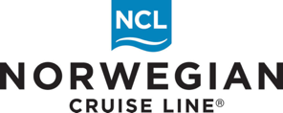
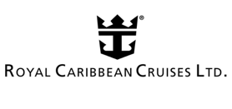
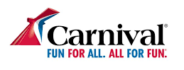




Presenters
Market Overview
Shubh Thind
Gurmehar Gill
Rajan Sohal
Aytan Isgandarli
Shubh Thind

Slide 3
Agenda
Market Overview
Norwegian Cruise Lines
Carnival Cruise Lines
Royal Caribbean Cruises

Slide 4
Market Overview

Slide 5
Sector Overview
●The cruise line sector is organized by several entities, with the Cruise Line International Association (CLIA) being one of the most important.
●According to the CLIA, the cruise industry was set towards fast growth:
○32 million passengers are set to travel on cruise ships in 2020, up from 30 million in 2019. Since 2009, cruise ship passengers have grown from 17.8 million to 30 million, an annual growth rate of 5.4%.
○Cruise industry revenues have grown even faster, from approximately 15.7 billion in 2010 to an estimated 31.5 billion in 2020, a compounded rate of growth of 7.2%.
●This industry is highly influenced by macro-economic and human conditions: it is likely that these numbers are hindered due to COVID-19 (all have cancellations)

Slide 6
Continued
●Norwegian and Royal Caribbean have created a joint task force to develop and improve safety standards amid the COVID-19 pandemic
●The group, which is called the “Healthy Sail Panel,” aims to develop public-health recommendations that will enable cruise lines to restart operations while keeping passengers and crew safe from COVID
●They have been working for close to a month, and plan to release their initial recommendations and findings by the end of August
●The panel is headed by Mike Leavitt, former governor of Utah and Secretary of the US Health and Human Services, and
●Dr. Scott Gottlieb, Commissioner of the FDA from 2017-2019

Slide 7
Sector Trends
1.Environmental Sustainability: development and identification of new technologies for cleaner fuels is a top priority
2.Destination Stewardship: exploring new and creative ways to manage the flow of visitors and implement the highest standards of responsible tourism
3.Cruise and Stay: more travellers are spending time in and near cruise ports
4.Reduce Single-Use Plastic: travelers value sustainability and more than 8/10 passengers recycle plastics or forego plastic straws
5.Generation Gruise Positive: there is a increasing positive attitude towards cruising compared to two years ago (probably changed by now)
6.Lone Cruisers: marriage rates are declining → cruise lines offering studio cabin
Micro Travel: travelers preferring quick short trips (3~5 days)

Slide 8
Risk Factors
●Environmental Risk
●Regulation Risk
●Fuel Price Risk
●Political Risk
●Human Risk
●Health Risk
●Black Swan Risk e.g., COVID

Slide 9
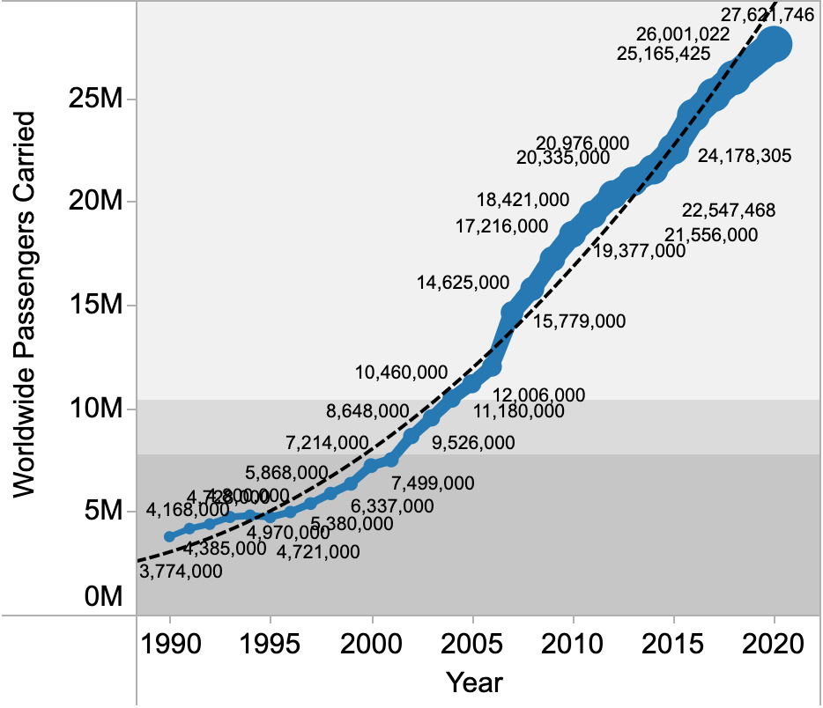
Growth of Worldwide Passengers
Notes:
https://cruisemarketwatch.com/growth/

Slide 10
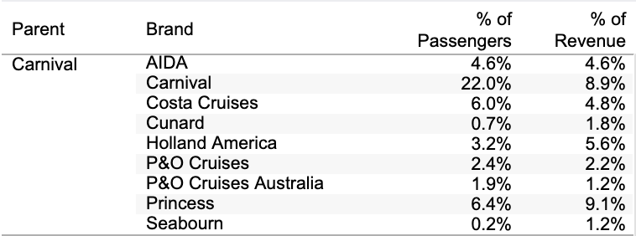
Market Share

Slide 11

Market Share

Slide 12
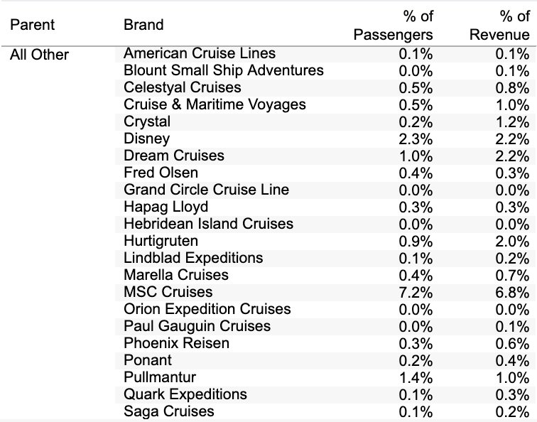
Market Share- Others

Slide 13
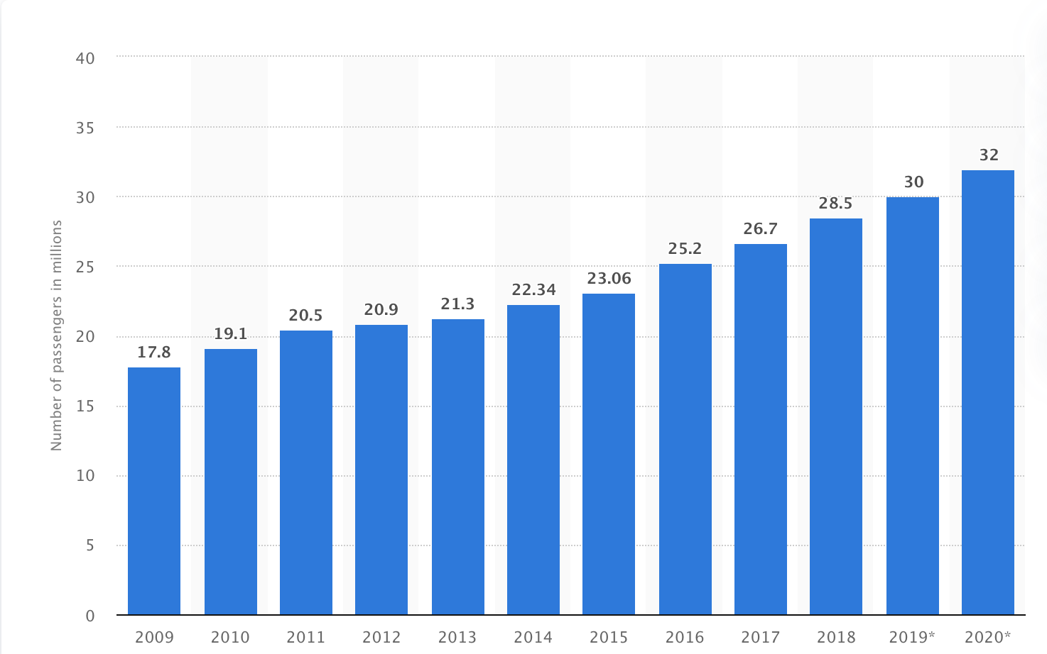
Number of ocean cruise passengers worldwide
Notes:
https://www.statista.com/statistics/385445/number-of-passengers-of-the-cruise-industry-worldwide/

Slide 14
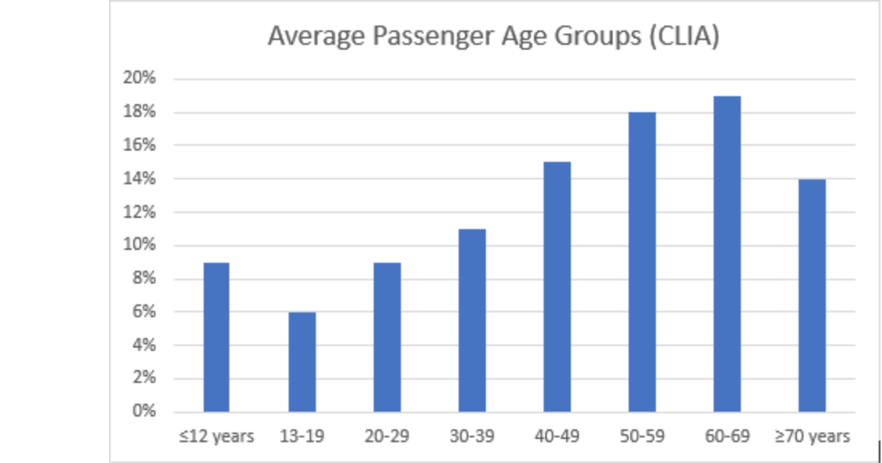
How Old is the Average Cruise Passenger?
Notes:
https://www.cruise1st.co.uk/blog/cruise-holidays/how-old-is-the-average-cruise-passenger/

Slide 15
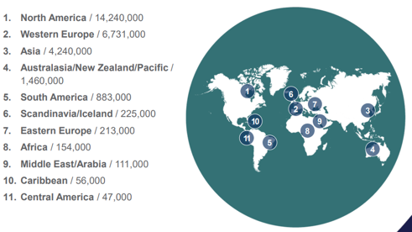
Passenger Geographical Locations

Slide 16
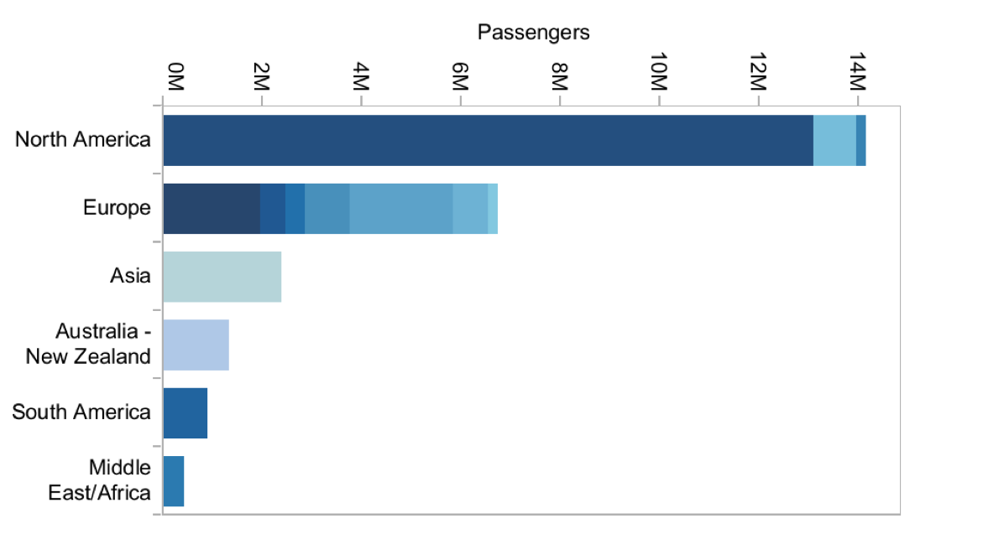
Cruise Passengers Worldwide (2018)

Slide 17
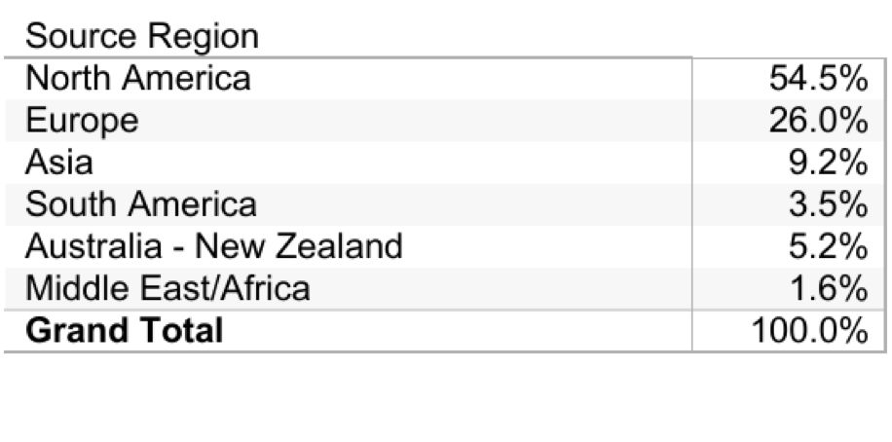
Cruise Passengers Worldwide (2018)

Slide 18
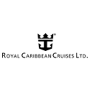


North American Market
The North American Market is dominated by the following:-
1.
2.
3.

Slide 19
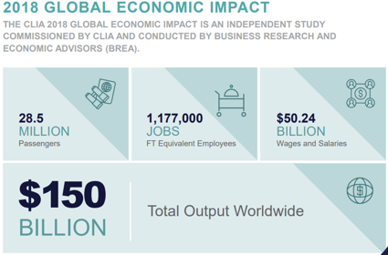

Slide 20

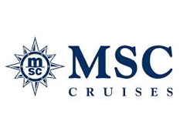
European Market
The European market on the other hand, is dominated by the following:-
1.
2.

Slide 21
European Market
After North America, Europe is the largest cruise market in the world, where it is the fastest growing tourism submarket.
From 2016 to 2018, passenger volume of cruises in Europe increased from 6.79 million to 7.17 million, of which 6.96 million were European residents.
The global cruise tourism market is expected to grow incrementally between 2018 and 2022 by 6%.
According to the 2018 Cruise Industry News Annual Report, the biggest growth in passenger numbers will come from Europe.
By 2027, 51% of cruise passengers will probably be coming from North America (14% in 2019), 31.5% from Europe (7.17% in 2019) and 17.5% from Asia-Pacific (5.7% in 2019). That means that the growth rate of cruise tourism in Europe is anticipated to be bigger than in the US and Canada, but the absolute number of cruise passengers in Europe will not exceed the number in North America.
Notes:
https://www.cbi.eu/market-information/tourism/cruise-tourism/market-potential#:~:text=From%202016%20to%202018%2C%20passenger,2018%20and%202022%20by%206%25.&text=The%20growth%20of%20cruise%20ship%20capacity.

Slide 22
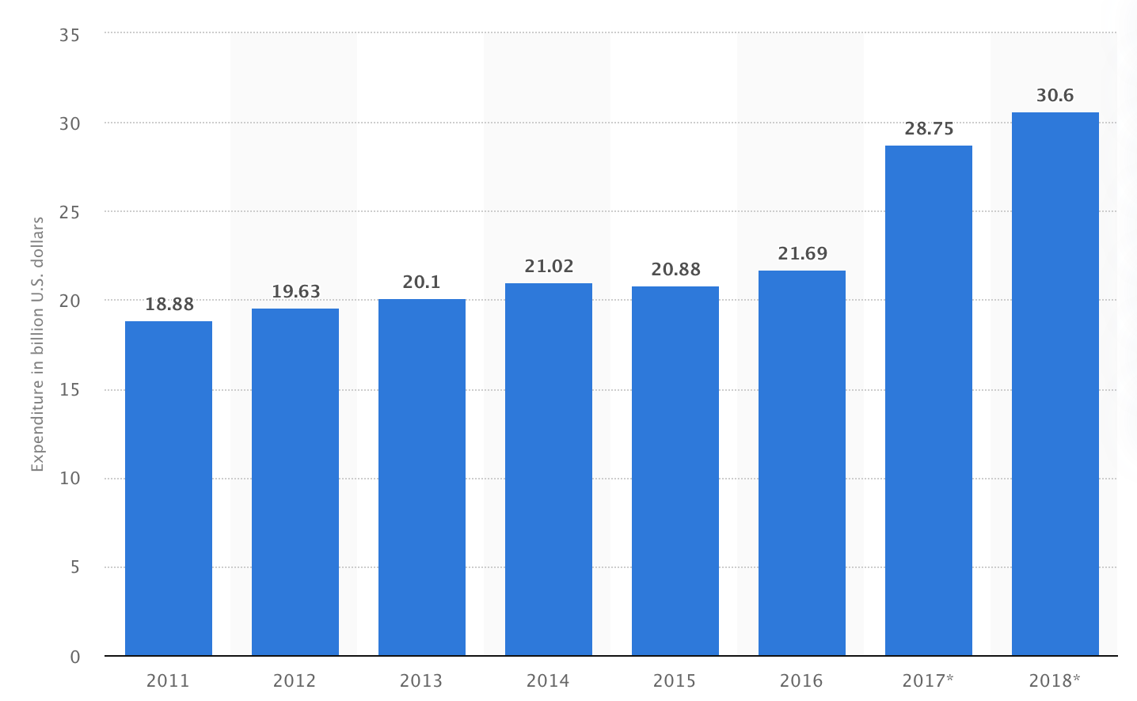
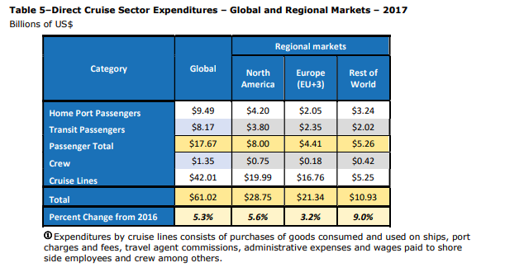
Cruise line industry Expenditure
Notes:
https://cruising.org/-/media/CLIA/Research/Global%202018%20EIS

Slide 23
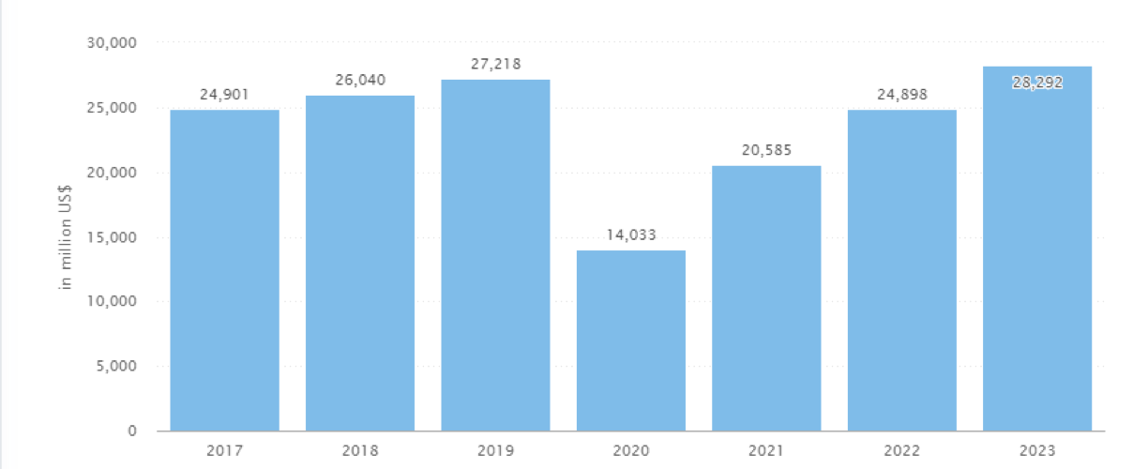
Market Projection - Revenue
Notes:
https://www.statista.com/statistics/204572/revenue-of-the-cruise-line-industry-worldwide-since-2008/

Slide 24
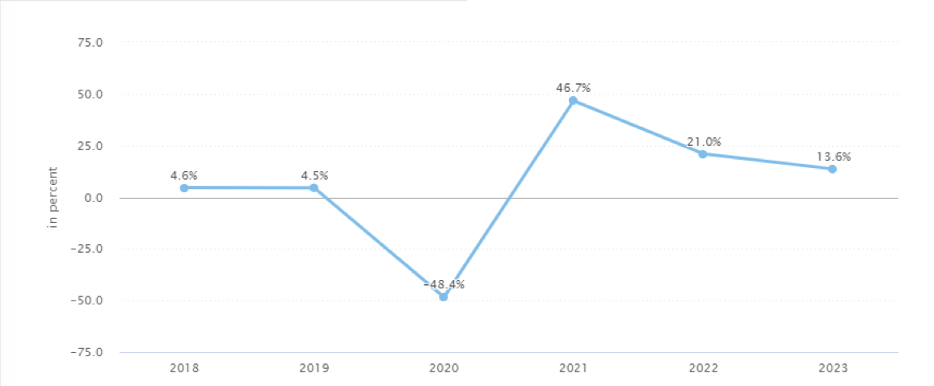
Market Projection - Revenue Growth

Slide 25

Norwegian Cruise Lines

Slide 26
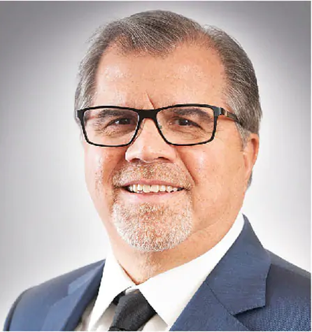
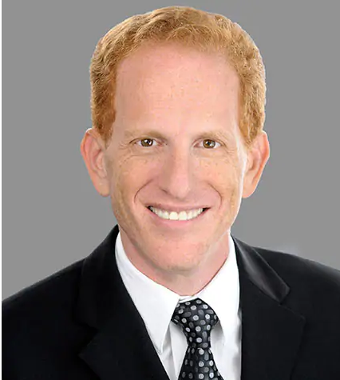
Company Leadership
Frank J. Del Rio, President and CEO of Norwegian Cruise Line Holdings Ltd.
Harry Sommer, President and CEO of Norwegian Cruise Line

Slide 27
Mission & Vision Statement
Mission Statement: Provide exceptional vacation experiences, delivered by passionate team members committed to world-class hospitality and innovation
Vision Statement: To be the vacation of choice for everyone around the world

Slide 28
About the Company
Founded in 1966, originally called Norwegian Caribbean Line
Began with just one ship known as Sunward
Known for being the first cruise line to allow dining on their ships at any time
Now have a fleet of 28 ships that contain approximately 59,150 berths

Slide 29
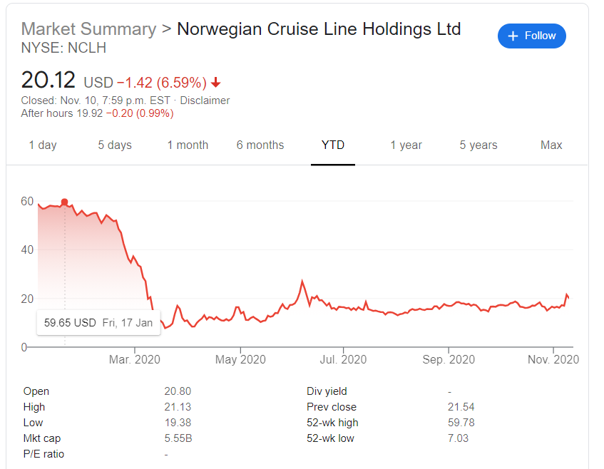
Stock Price

Slide 30
Company Financials

Slide 31
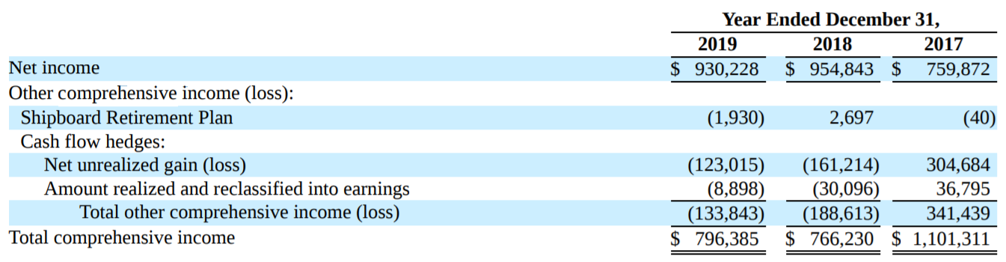
Statement of Comprehensive Income 10K

Slide 32
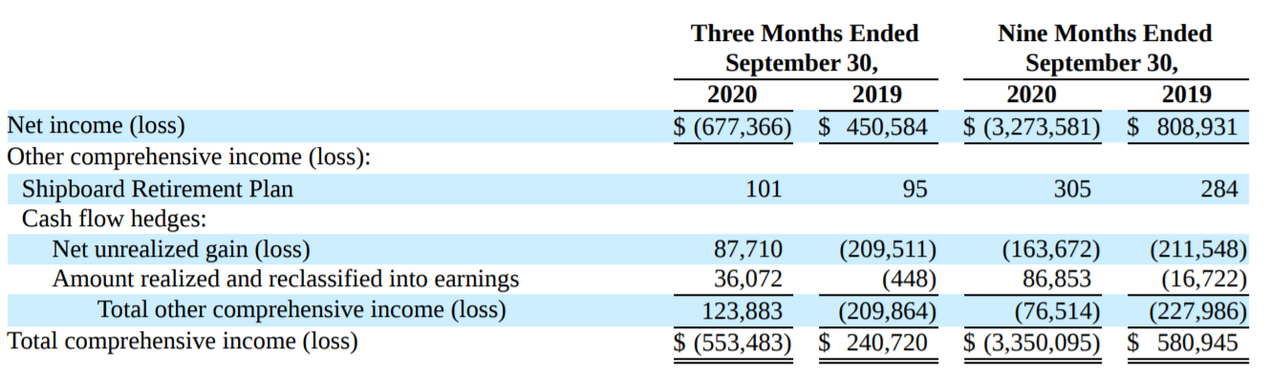
Statement of Comprehensive Income 10Q

Slide 33
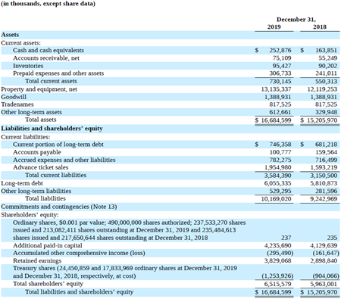
Balance Sheet 10K

Slide 34
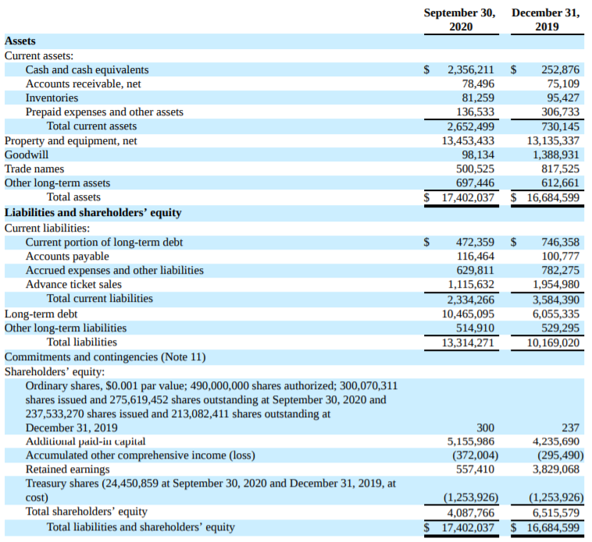
Balance Sheet 10Q

Slide 35
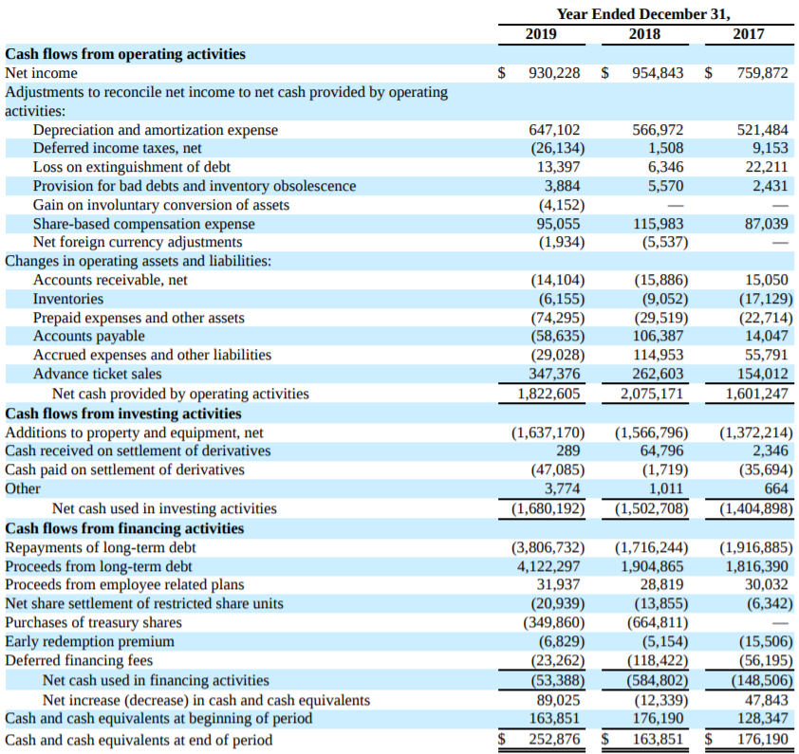
Consolidated Cash Flow Statement 10K

Slide 36
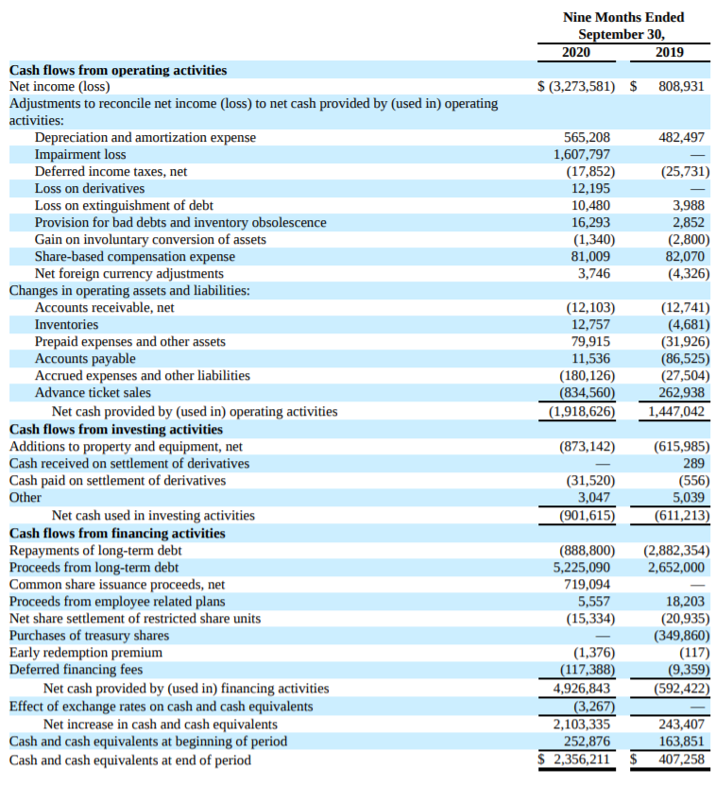
Consolidated Cash Flow Statement 10Q

Slide 37
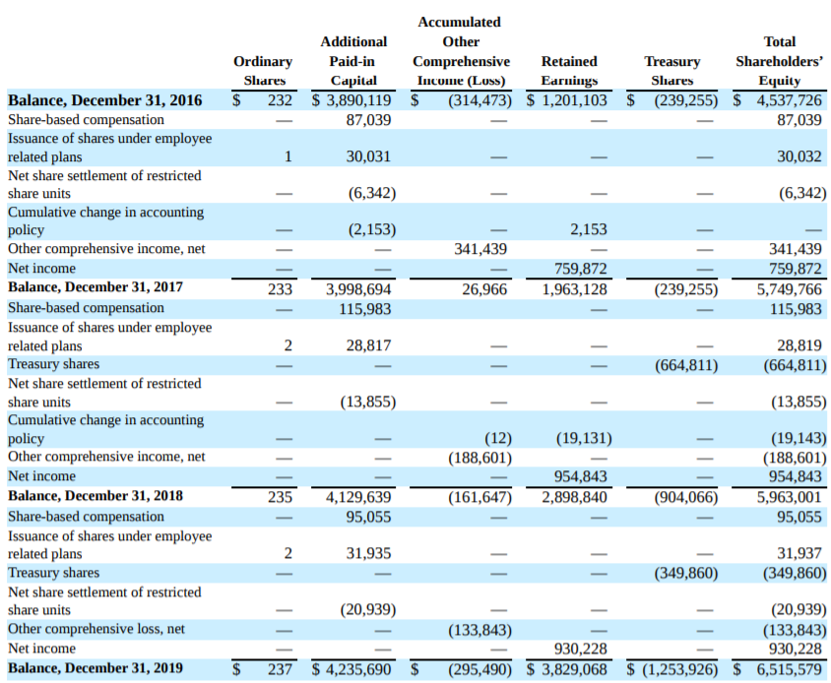
Consolidated Statement of Shareholder’s Equity (10K)

Slide 38
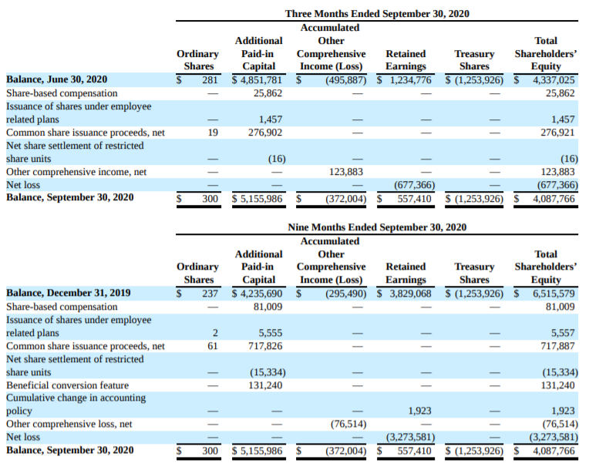
Consolidated Statement of Shareholder’s Equity (10Q)

Slide 39
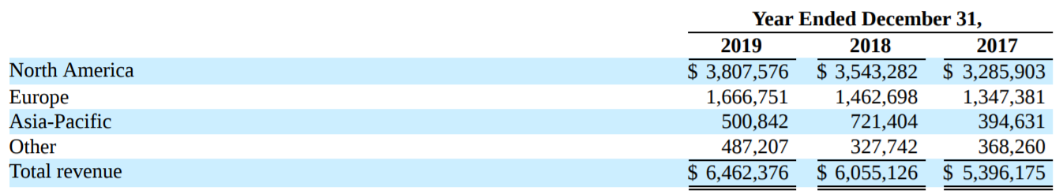
Disaggregated Revenues 10K

Slide 40
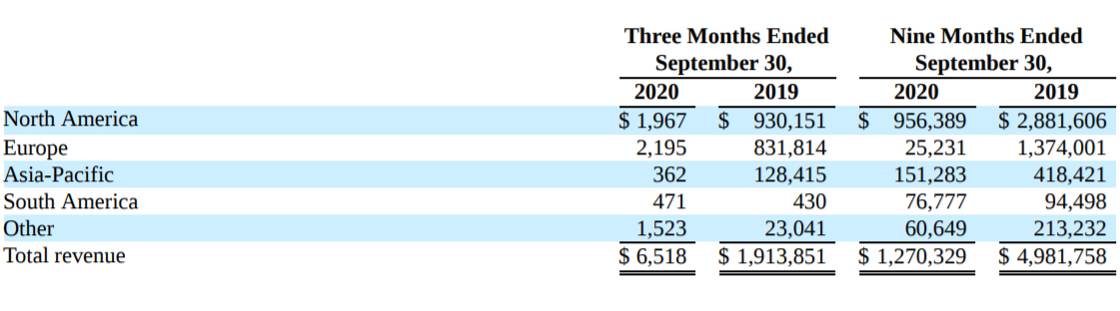
Disaggregated Revenues 10Q

Slide 41
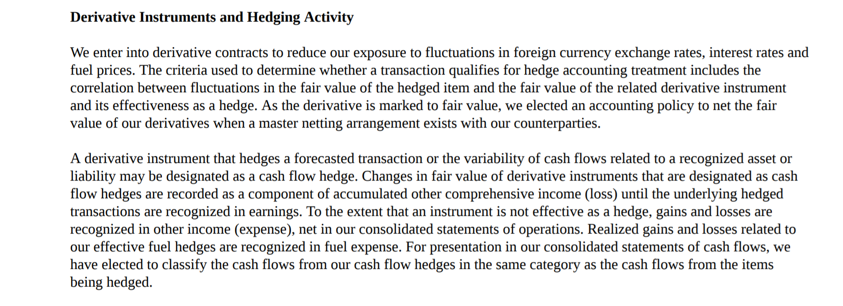
Accounting Methods

Slide 42
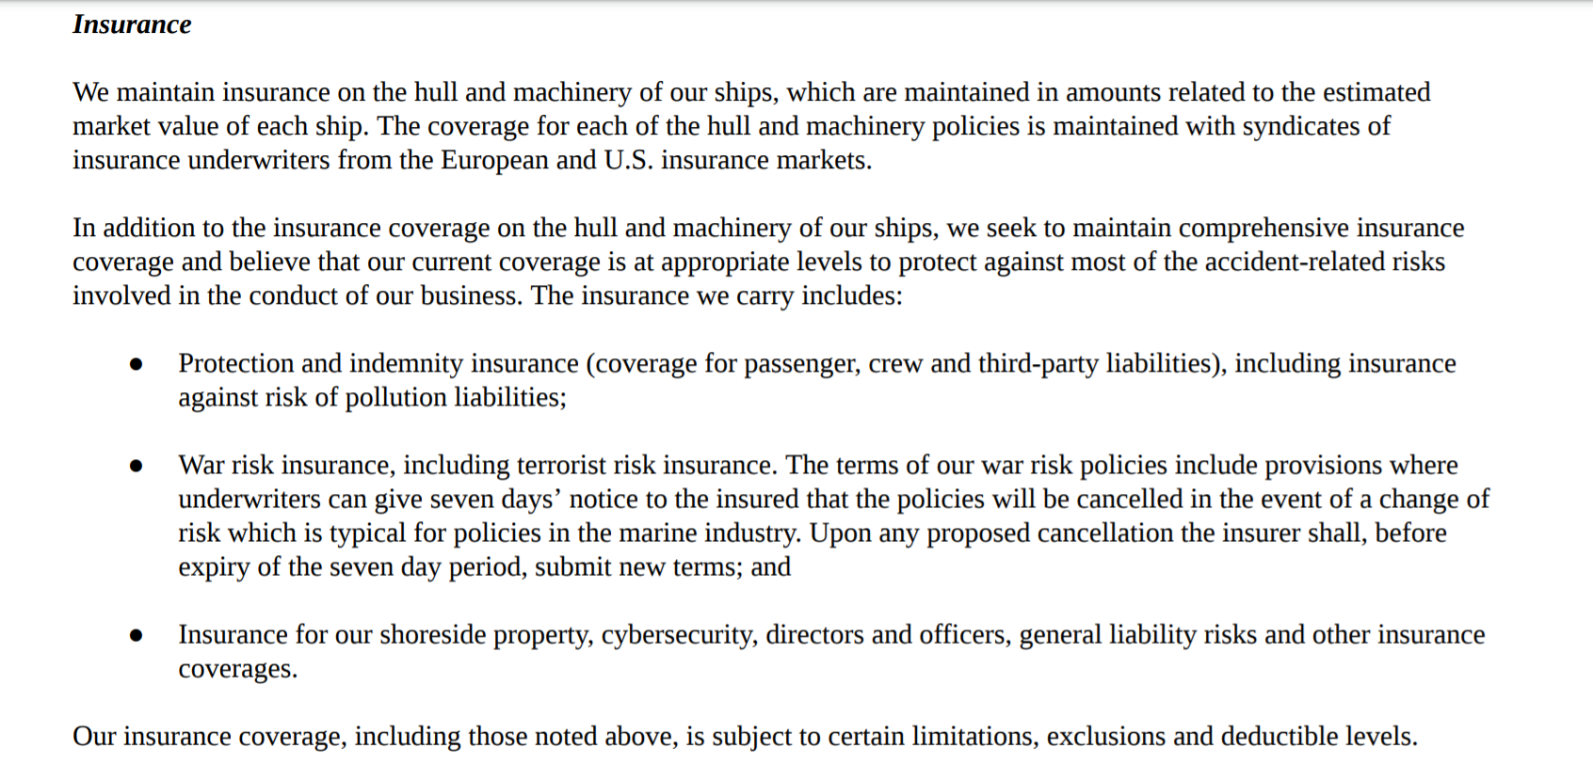
Insurance

Slide 43
Risks Related to the Company (Item 1A)
Acts of Piracy and Terrorism
Adverse Incidents involving Ships
  i.e. Shipwreck in adverse weather conditions
Epidemics and Viral Outbreaks
Changes in Foreign Currency Rates
Changes in Fuel Price
Mechanical Malfunctions and Repair

Slide 44
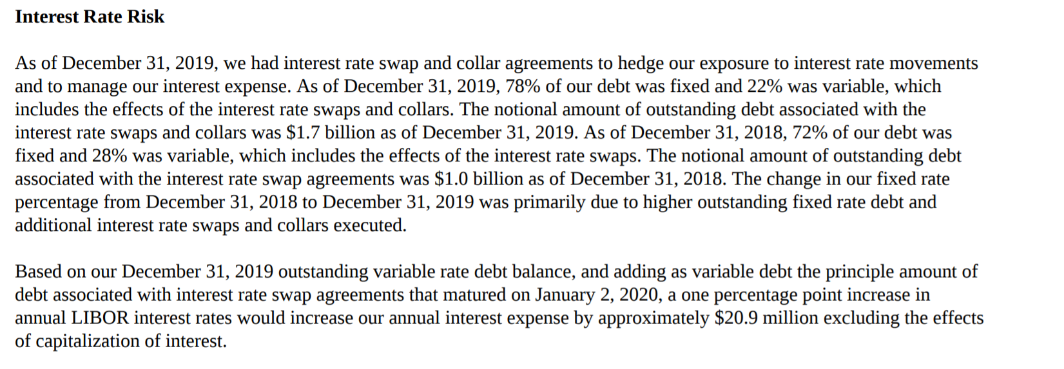
Market Risks (Item 7A): Interest Rate Risk

Slide 45
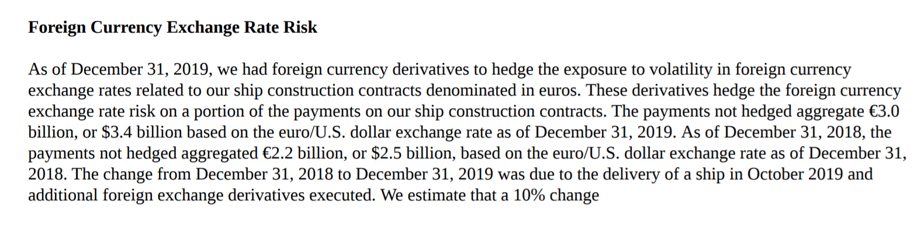
Foreign Currency Exchange Rate Risk

Slide 46
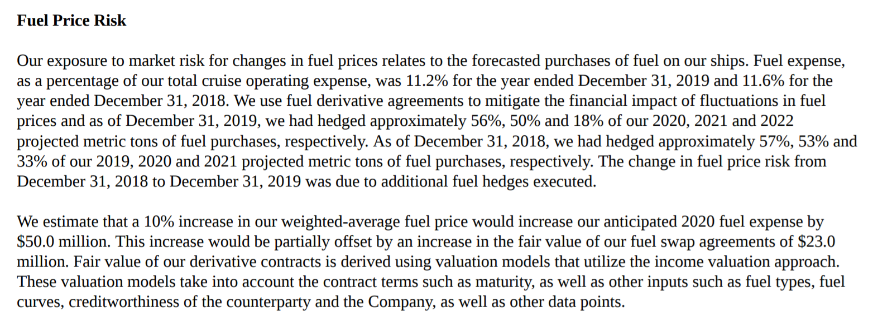
Market Risks (Item 7A): Fuel Price Risk

Slide 47
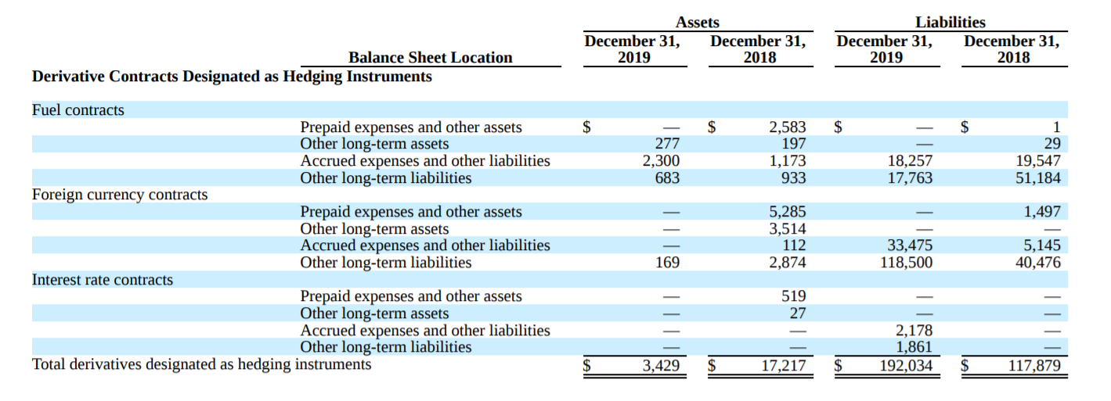
Hedging Strategy with Derivatives

Slide 48
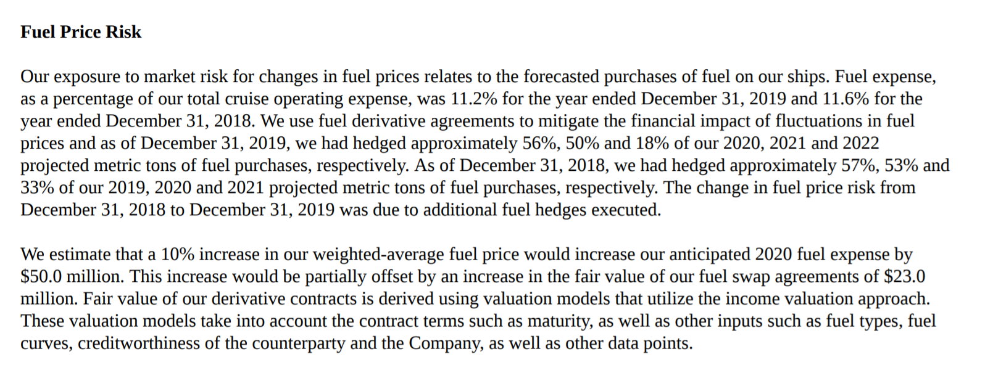
Fuel Contracts

Slide 49
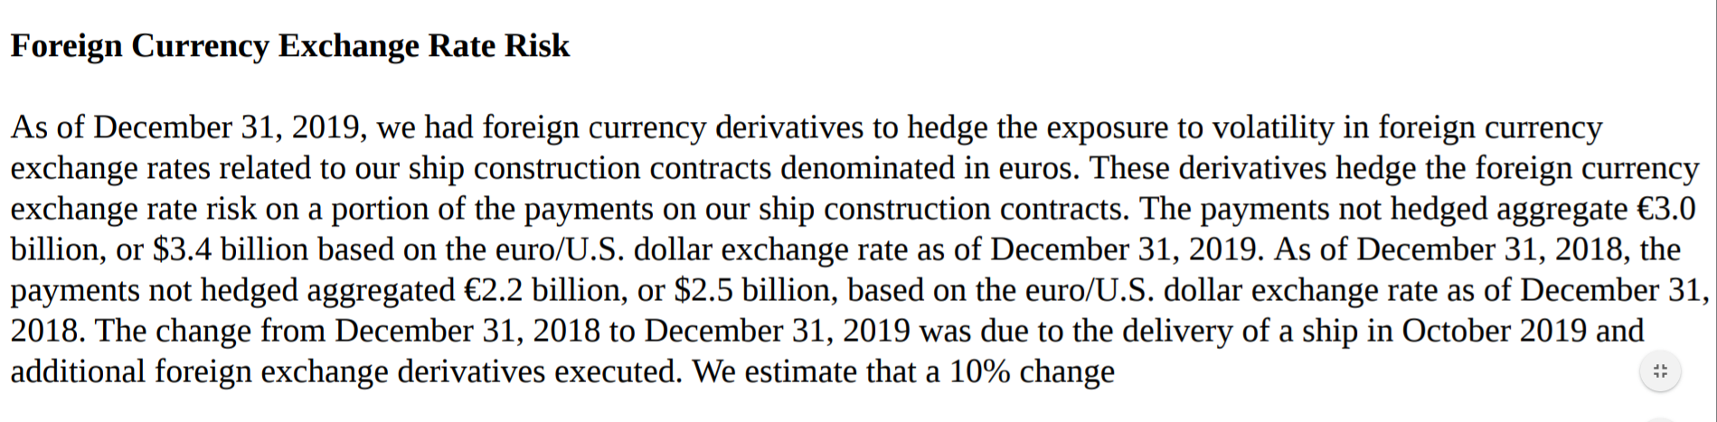
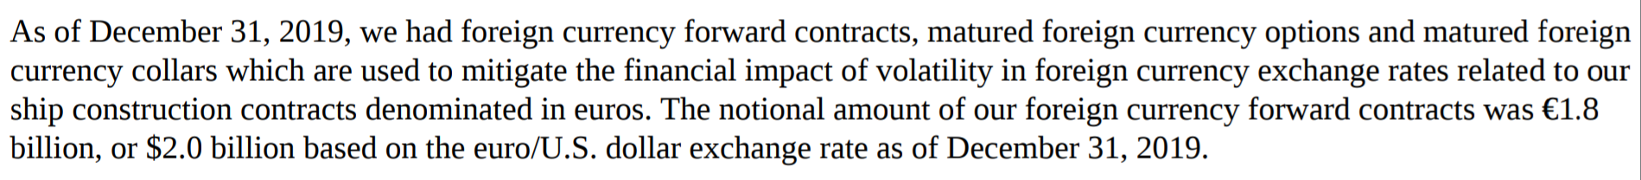
Foreign Currency Contracts

Slide 50
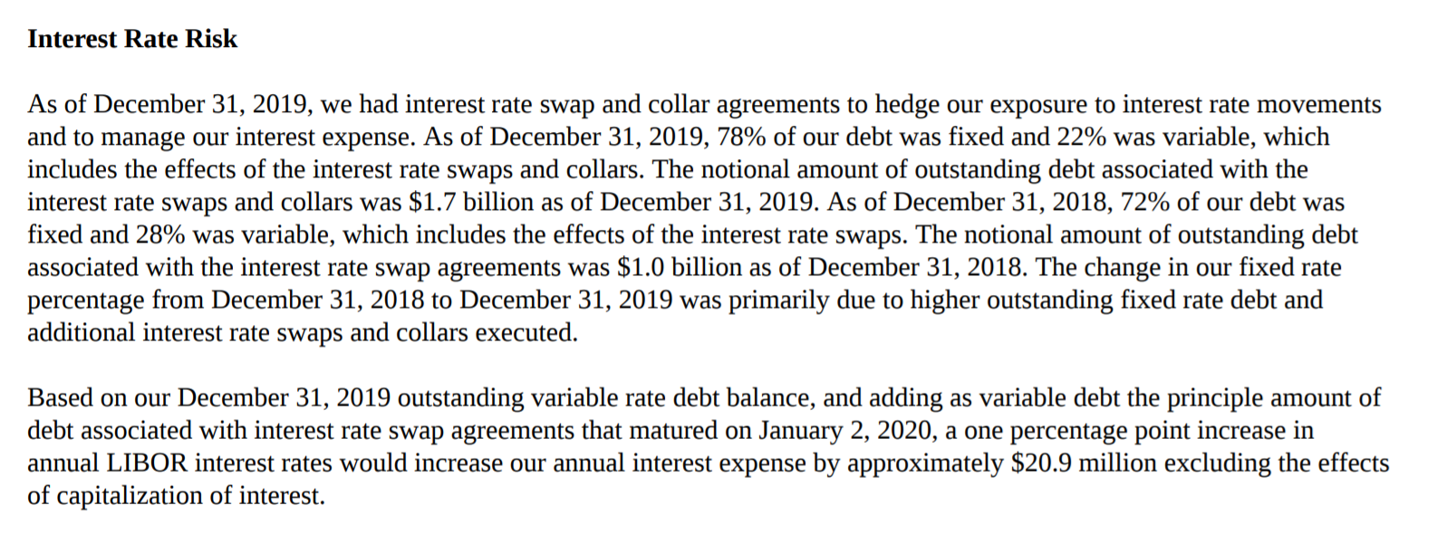
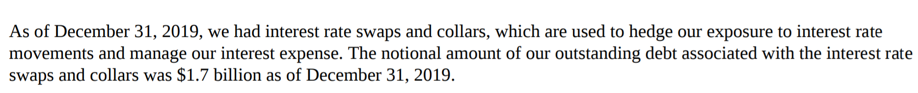
Interest Rate Contracts

Slide 51


Slide 52
Brief History
1972: Carnival Cruise lines formed by Ted Arison
1987: Carnival releases IPO of 20% of Common stock
1994: Carnival Corporation formed
2003: Carnival Corporation merges with Princess Cruises, creating one of the world’s largest leisure travel companies

Slide 53
Company Overview
Carnival Cruise Line is an international cruise line with headquarters in Doral, Florida.
It is a subsidiary of Carnival Corporation & plc.
Carnival is ranked first on the list of largest cruise lines based on passengers carried annually and total number of ships in fleet.
Company Cruise line portfolio includes: Carnival Cruise Line, Princess Cruises, Holland America Line, Seabourn, P&O Cruises (Australia), Costa Cruises, AIDA Cruises, P&O Cruises (UK), Cunard and Holland America Princess Alaska Tours.

Slide 54

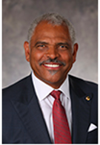
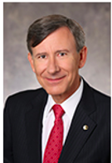
Company Leadership
Micky Arison
Chairman of the Board
Arnold W. Donald
President and CEO
David Bernstein
CFO and Chief Accounting Officer

Slide 55
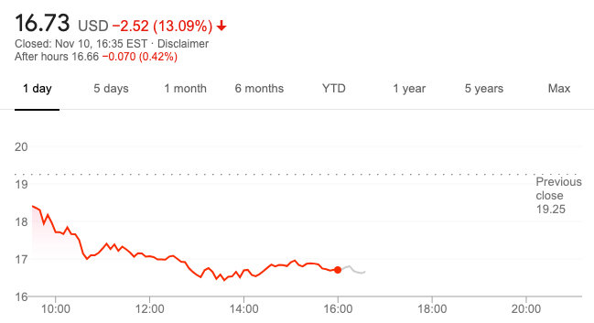
Stock Information

Slide 56
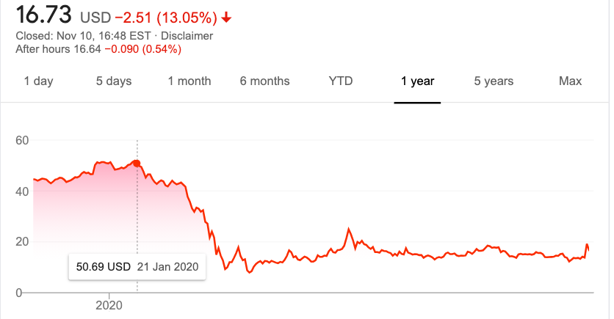
Diamond Princess - Covid Outbreak on January
Notes:
Diamond Princess - Coronavirus
On 20 January 2020, an 80-year-old passenger from Hong Kong embarked in Yokohama, sailed one segment of the itinerary, and disembarked in Hong Kong on 25 January. He visited a local Hong Kong hospital, six days after leaving the ship, where he later tested positive for COVID-19 on 1 February.On its next voyage, 4 February, the ship was in Japanese waters when 10 passengers were diagnosed with COVID-19 during the early stages of the COVID-19 pandemic.
The ship was quarantined on 4 February in the Port of Yokohama in Japan. The infected included at least 138 from India (including 132 crew and 6 passengers), 35 Filipinos, 32 Canadians, 24 Australians, 13 Americans, 4 Indonesians, 4 Malaysians, and 2 Britons.Home countries arranged to evacuate their citizens and quarantine them further in their own countries. As of 1 March, all on board including the crew and the captain had disembarked.
As of 16 March, at least 712 out of the 3,711 passengers and crew had tested positive for the virus.As of 14 April, fourteen of those who were on board have died from the disease.On 30 March, the ship was cleared to sail again after the ship was cleaned and disinfected
On 16 May, Diamond Princess departed from the Port of Yokohama. The ship was said to be going to Malaysia.

Slide 57
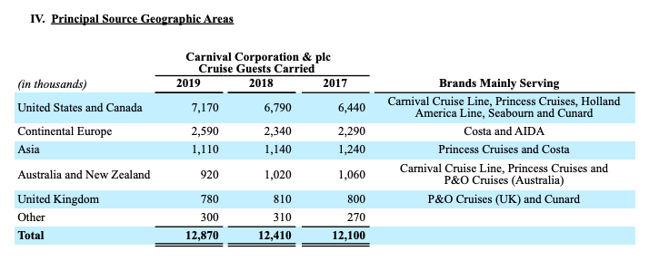
Operations

Slide 58
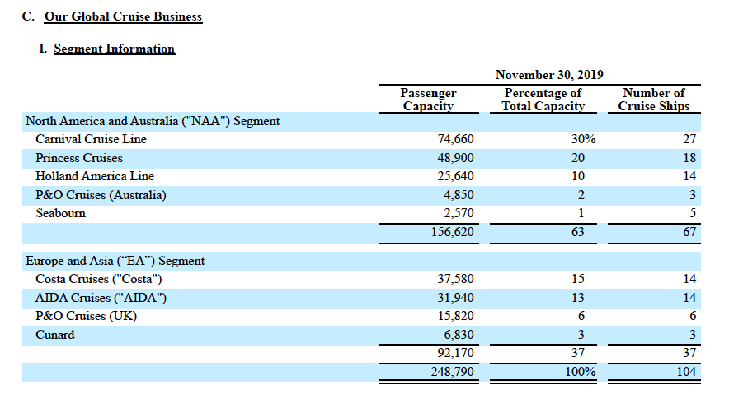

Slide 59
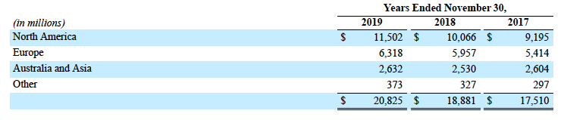
Revenues by Geographic Areas

Slide 60
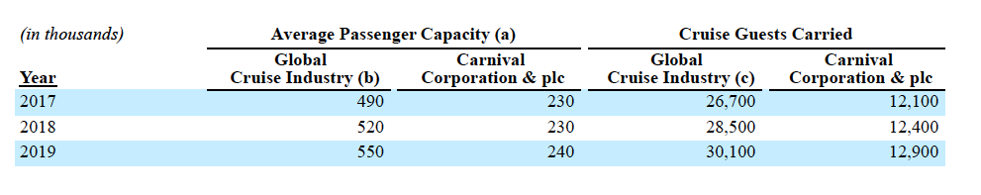
Passenger Capacity and Cruise Guests Carried

Slide 61

Property and Equipment

Slide 62


Growth Capital Commitments
Notes:
Federal and non-U.S. governmental agencies and officials are investigating or otherwise seeking information, testimony and/or documents, regarding COVID-19 incidents and related matters, including, but not limited to, those noted below. We are investigating these matters internally and are cooperating with all requests. The investigations could result in the imposition of civil and criminal penalties in the future. As previously disclosed, in March and April, 2020, there were several inquiries or investigations initiated by foreign governmental authorities related to Ruby Princess, including authorities in Australia and New Zealand. The New South Wales Commission of Inquiry Report dated August 14, 2020, concluded that no recommendations were directed towards Princess Cruises or Carnival Australia. At this time, we continue to believe we have a meritorious defense to the aforementioned claims and while we are unable to estimate a potential range of damages, we do not believe that the ultimate outcome of these proceedings will have any material impact on our consolidated financial statements.

Slide 63

Consolidated Statements of Income- 10K

Slide 64

Consolidated Statements of Income(Loss) - Unaudited 10Q

Slide 65


Consolidated Statements Of Comprehensive Income
10 K
10 Q

Slide 66

Consolidated Balance Sheet - 10K

Slide 67

Consolidated Balance Sheets - Unaudited 10Q

Slide 68

Consolidated Statements of Cash Flow - 10K

Slide 69

Consolidated Statement of Cash Flows - Unaudited 10Q

Slide 70

Consolidated Statements of Shareholders Equity - 10K

Slide 71

Consolidated Statements of Shareholders Equity - Unaudited 10Q

Slide 72

Consolidated Statements of Shareholders Equity - Unaudited 10Q

Slide 73

Notes:
ASC 606 is a recent change in standardized accounting principles for revenue recognition. In a nutshell, Topic 606 covers revenue from contracts with customers and identifies performance and licensing obligations. The document explains, step-by-step, how to account for revenue earned from your business operations.

Slide 74
Carnival Risk Factors
Covid 19 Risk
Economic Risk
Ship or the Cruise Vacation Industry Incidents
Natural Disasters and Adverse Weather Conditions
Changes in and Non Compliance with Laws and Regulations
Data security/Data Privacy
Lack of Qualified shipboard personnel
Overcapacity and Competition
Geographic Regions
Ship Repairs
Newbuild Currency Risk
Foreign Currency Exchange Risk
Fuel price and Availability Risk
Interest Rate Risk
Credit Risk During Trade

Slide 75
Covid- 19
Carnival implemented a pause on cruise operations in mid-MArch 2020 across all brands,
Limited operations were resumed in September 2020, but the pause might be prolonged.
Covid 19 expected to continue to have a significant impact on the company’s financial condition. Operations.and all aspects of the business.
Heightened government regulations and travel advisories have a significant impact on global guest sourcing and access to various ports.
The company has incurred significant costs due to Covid-19 (including sanitation costs)
The company has received, and may continue to receive, lawsuits, other governmental investigations and other actions stemming from COVID-19.

Slide 76
Economic Risk
The company may be impacted by the public’s concerns regarding the health, safety and security of travel, including government travel advisories and travel restrictions, political instability and civil unrest, and other general concerns.
It may be impacted by heightened regulations around customs and border control, travel bans to and from certain geographical areas government policies increasing the difficulty of travel and limitations on issuing international travel visas.
Adverse changes in the perceived or actual economic climate, such as global or regional recessions, higher unemployment and underemployment rates and declines in income levels may have a significant impact on profits.
Uncertainties resulting from the UK’s expected exit from the European Union may impact the operations

Slide 77
Ship or the Cruise Vacation Industry Incidents.
Operations involve the risk of incidents and media coverage thereof. Such incidents include, but are not limited to, the improper operation or maintenance of ships, motorcoaches and trains; guest and crew illnesses; mechanical failures, fires and collisions; repair delays, groundings and navigational errors; oil spills and other maritime and environmental issues as well as the incidents at sea or while in port or on land which may cause guest and crew discomfort, injury, or death.
The company’s ships have been involved in accidents and other incidents in the past and similar or other incidents may happen in the future. Carnival’s ability to attract and retain guests and crew, depends in part, upon the perception and reputation of the company.

Slide 78
Natural Disasters and Adverse Weather Conditions
The cruise ships, hotels, land tours, port and related commercial facilities and shore excursions may be impacted by adverse weather patterns or other natural disasters, such as hurricanes, earthquakes, floods, fires, tornadoes, tsunamis, typhoons and volcanic eruptions. The company could be forced to alter itineraries or cancel a cruise or a series of cruises or tours due to these or other types of disruptions.
Changes in climate may increase the frequency and intensity of adverse weather patterns, make certain destinations less desirable or impact our business in other ways. In addition, these and any other events which impact the travel industry more generally may negatively impact guests’ or crew’s ability or desire to travel to or from our ships and/or interrupt the supply of critical goods and services.

Slide 79
Changes in and Non Compliance with Laws and Regulations
The company is subject to numerous international, national, state and local laws, regulations, treaties and other legal requirements that govern health, environmental, safety and security matters in relation to our guests, crew and ships.
These requirements change regularly, sometimes on a daily basis, depending on the itineraries of our ships and the ports and countries visited.
Failure to comply with any of these laws, regulations, treaties and other requirements have previously been fined or otherwise sanctioned by regulators and this may happen in the future.
There is increased global focus on climate change, which may lead to additional regulatory requirements. Failure to comply with the requirements of this environmental compliance plan or other special conditions of probation could result in fines, which the court has imposed in the past, and restrictions on operations.
Notes:
Court-ordered environmental compliance plan supervised by the U.S. District Court for the Southern District of Florida, which is operative until at least April 2022 and subjects the operations to additional review and other obligations.

Slide 80
Data security/Data Privacy
The company may be impacted by breaches in data security and lapses in data privacy, which occur from time to time.
These can vary in scope and intent from economically driven attacks to malicious attacks targeting key operating systems with the intent to disrupt or compromise shoreside and shipboard operations.
The company has been and continue to be subject to unauthorized access or use of digital systems and networks through human error or for purposes of misappropriating assets or obtaining sensitive financial, medical or other personal or business information.

Slide 81
Lack of Qualified Shipboard Personnel
Carnival hires a significant number of qualified shipboard personnel each year and, thus, ability to adequately recruit, develop and retain these individuals is critical to company’s success.
Incidents involving cruise ships and the related adverse media publicity, adverse economic conditions that negatively affect profitability and increasing demand and the industry’s projected growth could negatively impact the ability to recruit, develop and retain sufficient qualified shipboard personnel.

Slide 82
Overcapacity and Competition
Carnival may be impacted by increases in capacity in the cruise and land-based vacation industry, which may result in capacity growth beyond demand, either globally or for a region, or for a particular itinerary.
The company faces competition from other cruise brands on the basis of overall experience, destinations, types and sizes of ships and cabins, travel agent preferences and value.
In addition the company competes with land-based vacation alternatives ( ex: airlines) throughout the world on the basis of overall experience, destinations and value.

Slide 83
Geographic Regions
The company has been expanding its global presence,but this requires, among other things, significant levels of management resources, capital and other investments. For example, the company may be required to localize cruise products and services to conform to local cultures, standards, policies and regulations.
As a result, it may be more difficult to replicate successful core business models and the company may not be able to recover investments in these markets. In addition, some developing markets such as China might not develop as expected and may cause losses for the company

Slide 84
Ship Repairs
Carnival may be impacted by unforeseen events, such as work stoppages, insolvencies, “force majeure” events or other financial difficulties experienced by shipyards, their subcontractors and suppliers.
This may result in less shipyard availability resulting in delays or preventing the delivery of our ships under construction and/or the completion of the repair, maintenance, or refurbishment of existing ships. This may lead to potential delays or cancellations of cruises.
The prices of various commodities that are used in the construction of ships and for repair, maintenance and refurbishment of existing ships, such as steel, are subject to volatility.

Slide 85
Insurance
A combination of insurance and self-insurance is used to cover a number of risks including illness and injury to crew, guest injuries, pollution, other third-party claims in connection with our cruise activities, damage to hull and machinery for each of our ships, war risks, workers’ compensation, directors’ and officers’ liability, property damage and general liability for shoreside third-party claims.
Insurance recoverables from third-party insurers up to the amount of recorded losses at the time the recovery is probable and upon settlement for amounts in excess of the recorded losses. All of the company’s insurance policies are subject to coverage limits, exclusions and deductible levels.

Slide 86

Newbuild Currency Risk
Shipbuilding contracts are typically denominated in euros. Decision to hedge a non-functional currency ship commitment for cruise brands is made on a case-by-case basis, considering the amount and duration of the exposure, market volatility, economic trends, our overall expected net cash flows by currency and other offsetting risks. Foreign currency derivative contracts are used to manage foreign currency exchange rate risk for some ship construction payments. Shipbuilding contracts are typically denominated in euros.

Slide 87


Slide 88
Foreign Currency Exchange Risk
The company earns revenues, pays expenses, purchases and owns assets and incurs liabilities in currencies other than the U.S. dollar. Movements in foreign currency exchange rates will affect the company’s financial results.
Exposure to fluctuations in foreign currency exchange rates are managed through normal operating and financing activities, including netting certain exposures to take advantage of any natural offsets and, when considered appropriate, through the use of derivative and non-derivative financial instruments. The primary focus is to monitor the company's exposure exposure to, and manage, the economic foreign currency exchange risks faced by company operations and realized if the company should exchange one currency for another. Carnival currently only hedges certain of its ship commitments and net investments in foreign operations.
Notes:
The financial impacts of the hedging instruments we do employ generally offset the changes in the underlying exposures being hedged.

Slide 89
Foreign Currency Exchange Risk Hedge
Operational Currency Risks
Operations primarily utilize the U.S. dollar, Australian dollar, euro or sterling as their functional currencies. Company operations also have revenue and expenses denominated in non-functional currencies. Movements in foreign currency exchange rates will affect company’s financial statements.
Investment Currency Risks
Investments in foreign operations are denominated in stable currencies and are of a long-term nature. The currency exposure of company investments in foreign operations are partially mitigated by designating a portion of foreign currency debt and derivatives as hedges of these investments.
Notes:
As of November 30, 2019, we have designated $854 million of our sterling-denominated debt as non-derivative hedges of our net investments in foreign operations and in 2019, we recognized $6 million of losses on these non-derivative net investment hedges in the cumulative translation adjustment section of other comprehensive income. We also have $7.5 billion of euro-denominated debt, including the effect of cross currency swaps, which provides an economic offset for our operations with euro functional currency.

Slide 90
Fuel price and Availability Risk
The company may be impacted, and have been impacted in the past, by economic, market and political conditions around the world, such as fuel demand, regulatory requirements, supply disruptions and related infrastructure needs, which make it difficult to predict the future price and availability of fuel.
Future increases in the global price of fuel would increase the cost of cruise ship operations as well as some of other expenses, such as crew travel, freight and commodity prices. Increases in airfares, which could result from increases in the price of fuel, would increase guests’ overall vacation costs as many of company’s guests depend on airlines to transport them to or from the airports near the ports where company cruises embark and disembark.
As a result of changes in regulations, the company expects to consume a larger percentage of low sulfur fuel in 2020, which will likely increase fuel costs. Additionally, certain ships are designed to use LNG as their primary fuel source. At this time, the marine LNG distribution infrastructure is in the early stages of development with a limited number of suppliers.

Slide 91

Fuel Price Hedge
Exposure to fuel price risk is managed by managing consumption of fuel. Substantially all of the company’s exposure to market risk for changes in fuel prices relates to the consumption of fuel on company’s ships. Fuel consumption is managed through ship maintenance practices, modifying itineraries and implementing innovative technologies. The company is also adding new, more fuel efficient ships to fleet and are strategically disposing of smaller, less fuel efficient ships.
Notes:
Company has derivatives which hedge the price of fuel in the event that the price goes up and the company’s costs increase. As we can see in 2018, the price of fuel increased, so Carnival realized $59 million in gains off their fuel derivatives to offset the increase in fuel price.
.

Slide 92
Interest Rate Risks Hedge
The exposure to fluctuations in interest rates are hedged through debt portfolio management and investment strategies. The company evaluates debt portfolio to determine whether to make periodic adjustments to the mix of fixed and floating rate debt through the use of:
interest rate swaps
issuance of new debt
amendment of existing debt
early retirement of existing debt.

Slide 93

Credit Risk During Trade

Slide 94

Derivative Instruments and Hedging Activities

Slide 95


Slide 96

Company Overview
Founded in Norway in 1968 under the name Royal Caribbean Cruise Line
Merged with Celebrity Cruises in 1997, become Royal Caribbean International
Holding company Royal Caribbean Cruises LTD was then formed to oversee both brands
Incorporated in Liberia and operates out of Miami, Florida

Slide 97

Subsidiaries and Brands
Royal Caribbean International
Celebrity Cruises
Azamara Cruises
Tui Cruises
Silversea Cruises
Pallmantur Cruceros

Slide 98

Company Leadership

Slide 99

Company Leadership

Slide 100
Board of Directors
John F Brock
Richard D Fain
Stephen R Howe JR
William L Kimsey
Maritza G Montel
Ann S Moore
Eyal Ofer
William K Reilly
Vagn O Sorenson
Donald Thompson
Arne Alexander Wilhelmsen

Slide 101

Share Price

Slide 102

Share Price 1 Year History

Slide 103

Financials

Slide 104

Income Statement - Yearly

Slide 105

Income Statement - Quarterly

Slide 106

Balance Sheet - Yearly

Slide 107

Balance Sheet - Yearly

Slide 108

Balance Sheet - Quarterly

Slide 109

Cash Flow Statement - Yearly

Slide 110

Cash Flow Statement - Yearly

Slide 111

Cash Flow Statement - Quarterly

Slide 112

Cash Flow Statement - Quarterly

Slide 113

Consolidated Statement of Shareholders
Equity - Yearly

Slide 114

Consolidated Statement of Shareholders
Equity - Quarterly

Slide 115

Disaggregated Revenues

Slide 116

Disaggregated Revenues - Quarterly

Slide 117

Risks

Slide 118

Price/Availability of Fuel
A rise in fuel prices not only impacts fuel costs, but also other aspects of business like crew travel, freight expenses and commodity prices.
The International Maritime Organization 2020 Low Sulphur Regulation creates uncertainty to the future price and availability of certain fuel types.

Slide 119

Change in Interest Rate
A rise in interest rates would negatively impact the cost of Royal Caribbean's floating rate debt
Also the UK’s announcement to alter LIBOR by 2021 could negatively impact Royal Caribbean's portfolio of debt instruments and derivatives

Slide 120

Fluctuations in Exchange Rate
Much of Royal Caribbean's earnings in foreign currencies can adversely be affected by a high US$
Another key currency for the company is the Euro as ship contracts are predominately in that currency.

Slide 121
Other Risks
Acts of terrorism/sabotage
Economic conditions that reduce the demand for cruises
Change in US Foreign travel policy
Incidents on ships/at port that receive negative media coverage
Rise in the costs of airfare
Natural disasters
Disease outbreaks

Slide 122
Other Risks Continued
Increase in ship capacity exceeding market demand
Unavailability of ports
Over reliance on dockyards and subcontractors
Growing anti tourism sentiments
Losing business to a competitor
Unable to keep up with technological advancements
Loss of key personnel

Slide 123

Hedging Strategies

Slide 124
A. Non-Derivative Instruments
As of December 30, 2020, designated debt as a hedge of our net investments primarily in TUI Cruises of €284.0 million, or approximately $333.1 million.
As of December 31, 2019, designated debt as a hedge of our net investments primarily in TUI Cruises of €319.0 million, or approximately $358.1 million

Slide 125
B. Fuel Price Risk
The exposure to market risk for changes in fuel prices relates primarily to the consumption of fuel on our ships.
Use of fuel swap agreements to mitigate the financial impact of fluctuations in fuel prices.
As of September 30, 2020, the company discounted cash flow hedge accounting on 0.5 million metric tons of our fuel swap agreements maturing in 2020 and 2021.

Slide 126

Price of Fuel Hedge

Slide 127

Amount of Fuel Swap Agreements - Yearly

Slide 128

Amount of Fuel Swap Agreements -
Quarterly

Slide 129

% of Fuel Hedged (Estimated Usage) - Yearly

Slide 130

% of Fuel Hedged (Estimated Usage) -
Quarterly

Slide 131
Exchange Rate Hedge

Slide 132

Exchange Rate Hedge Details - Quarterly

Slide 133

Exchange Rate Hedge Details - Yearly

Slide 134

Change in Interest Rate Hedge - Yearly

Slide 135

Change in Interest Rate Hedge Continued -
Yearly

Slide 136


Change in Interest Rate Hedge - Quarterly

Slide 137

Change in Interest Rate Hedge Continue -
Quarterly

Slide 138

Gain or Loss on Interest Rate Derivatives -
Yearly

Slide 139

Gain or Loss on Interest Rate Derivatives -
Quarterly

Slide 140

Fair Value of Derivatives - Yearly

Slide 141

Fair Value of Derivatives - Quarterly

Slide 142

Gain or (Loss) on Hedging Instruments -
Yearly

Slide 143

Gain or (Loss) on Hedging Instruments -
Quarterly

Slide 144

Effect of Hedging Instruments on The Consolidated Financial Statements -
Yearly

Slide 145

Effect of Hedging Instruments on The Consolidated Financial Statements -
Quarterly

Slide 146

Effect of Non-Hedging Derivatives on the Consolidated Financial Statements -
Yearly

Slide 147

Effect of Non-Hedging Derivatives on the Consolidated Financial Statements -
Quarterly

