Slide 1


Goldman Sachs
Rajan Dhot
Alex Lawrie
Derek Qiao
Harsh Walia

Slide 2

Agenda
Economic Analysis
Risk Management Overview
Financial Statements
Recommendation About Risk Management

Slide 3

Company Overview
More than just your average bank.
Founded in 1869 and headquartered in New York city while maintaining offices in major financial centers across the globe
Leader in investment banking, lending and management for a variety of clients including private entities, governments and individuals

Slide 4
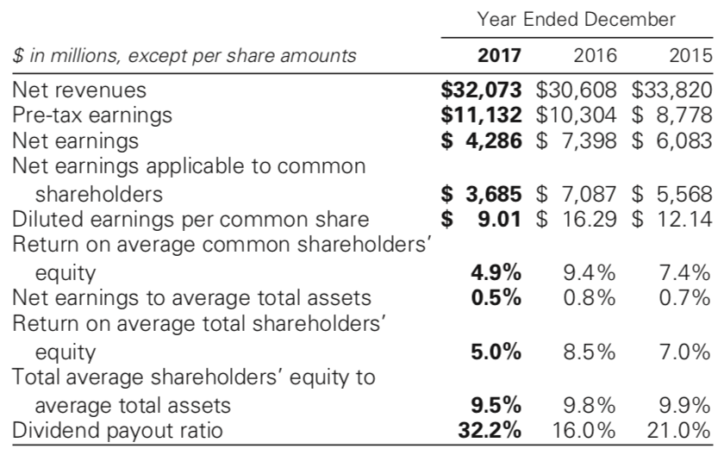
Financial Overview

Slide 5
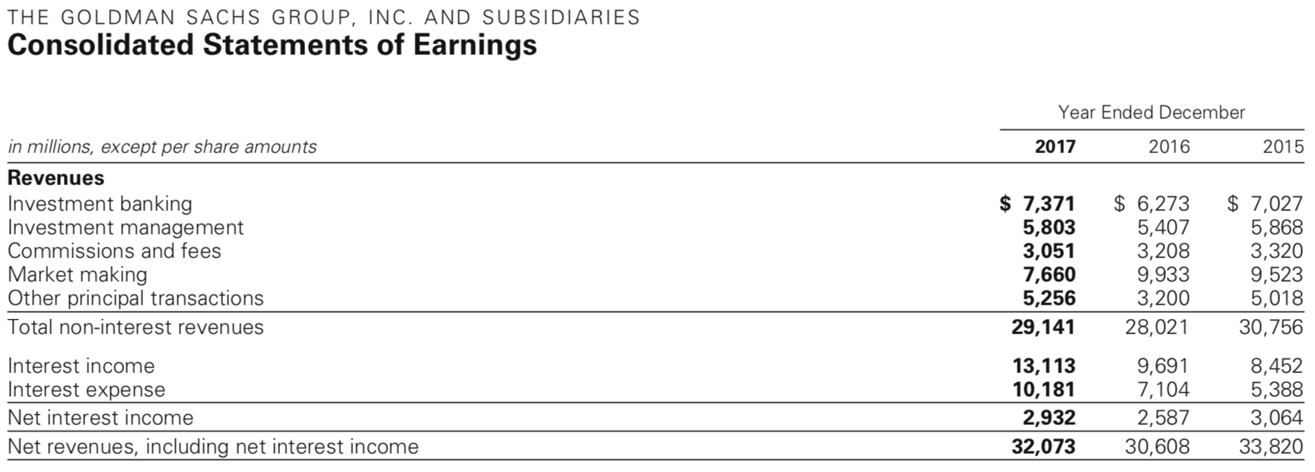
Income Sheet

Slide 6
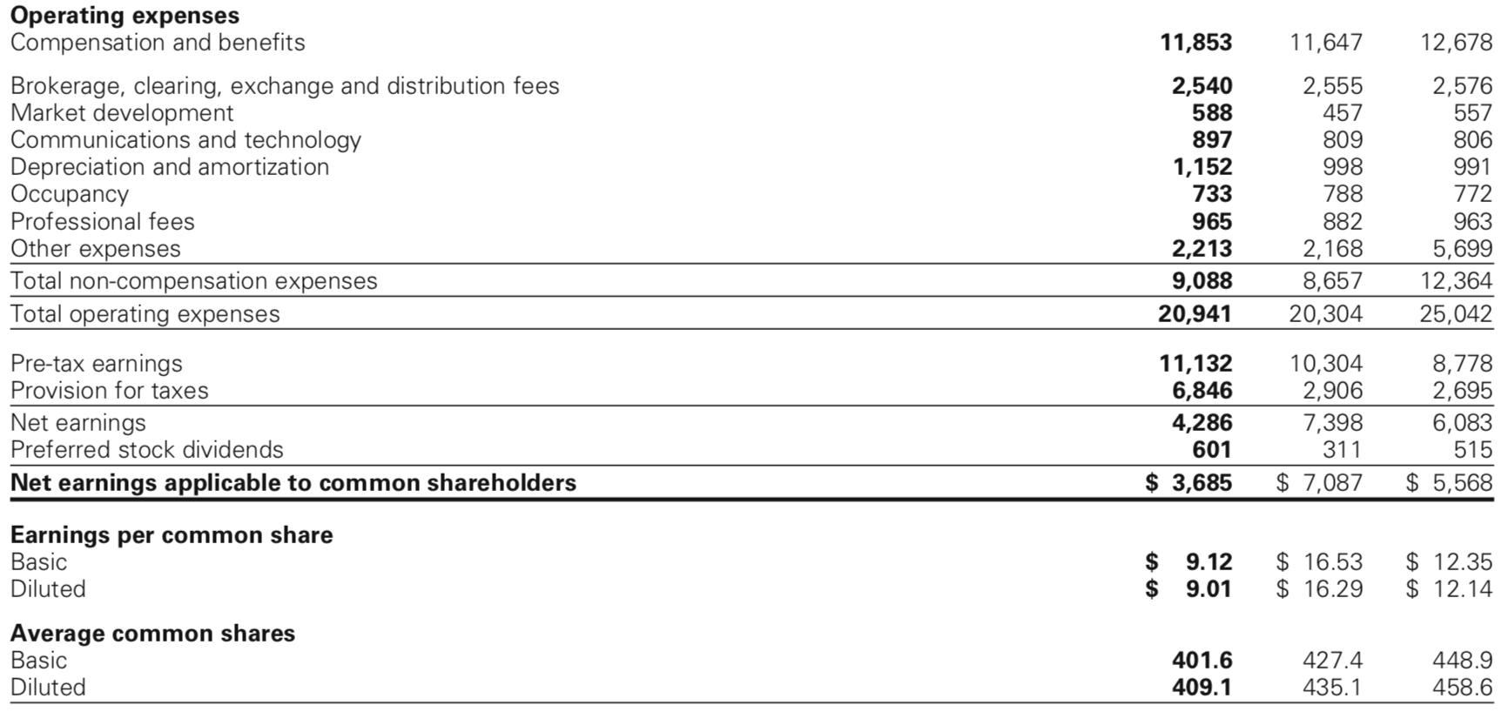

Slide 7
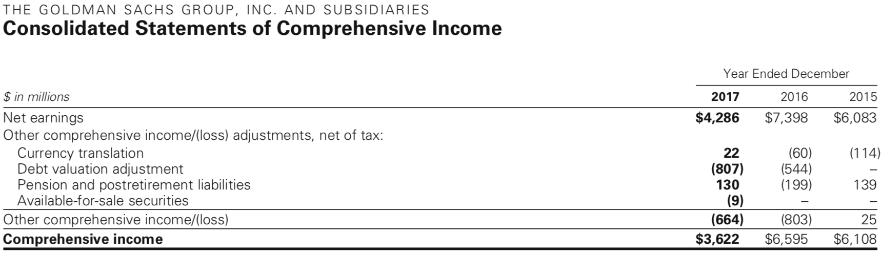

Slide 8
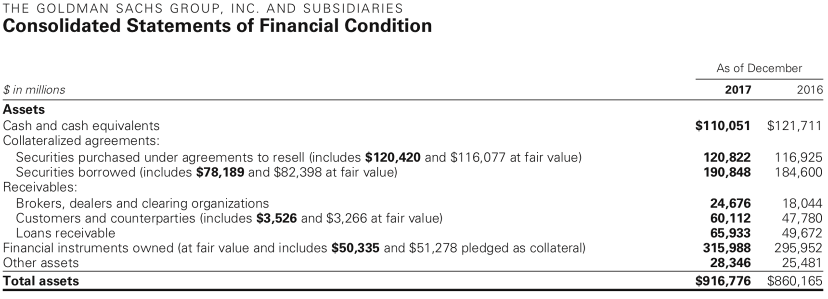

Slide 9
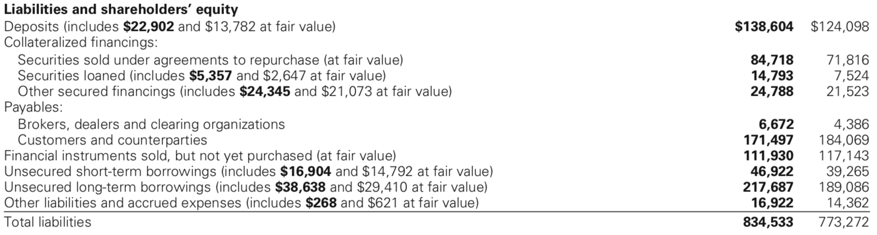

Slide 10
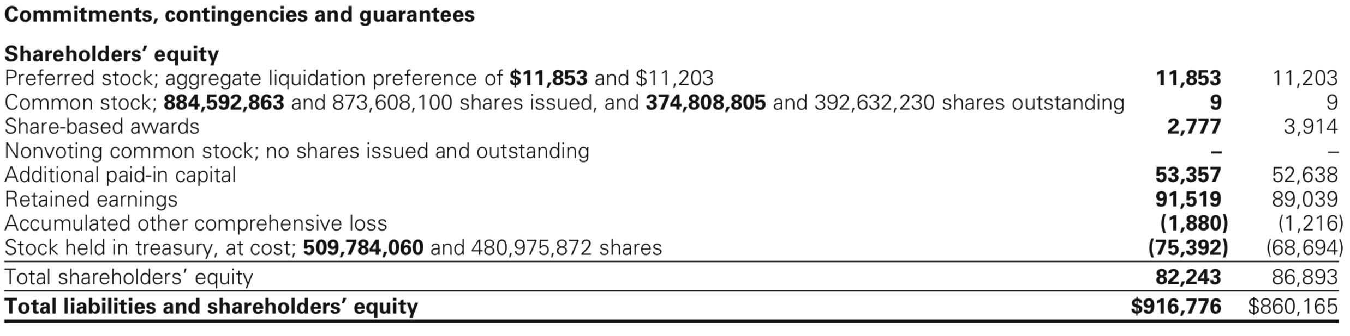

Slide 11
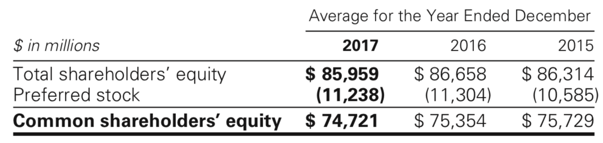

Slide 12
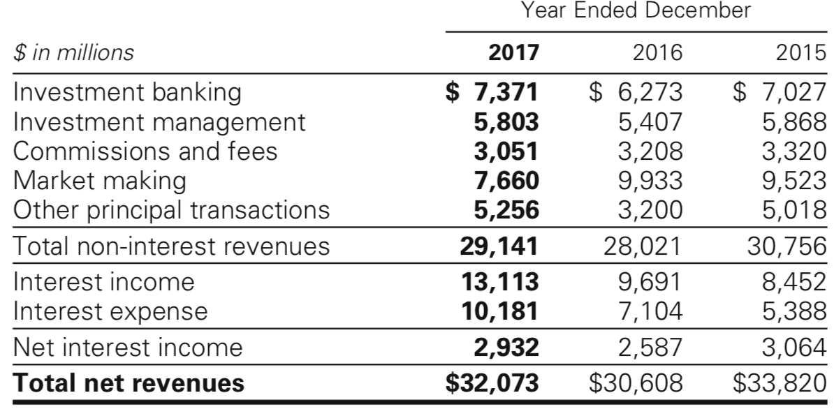
Net Revenues

Slide 13
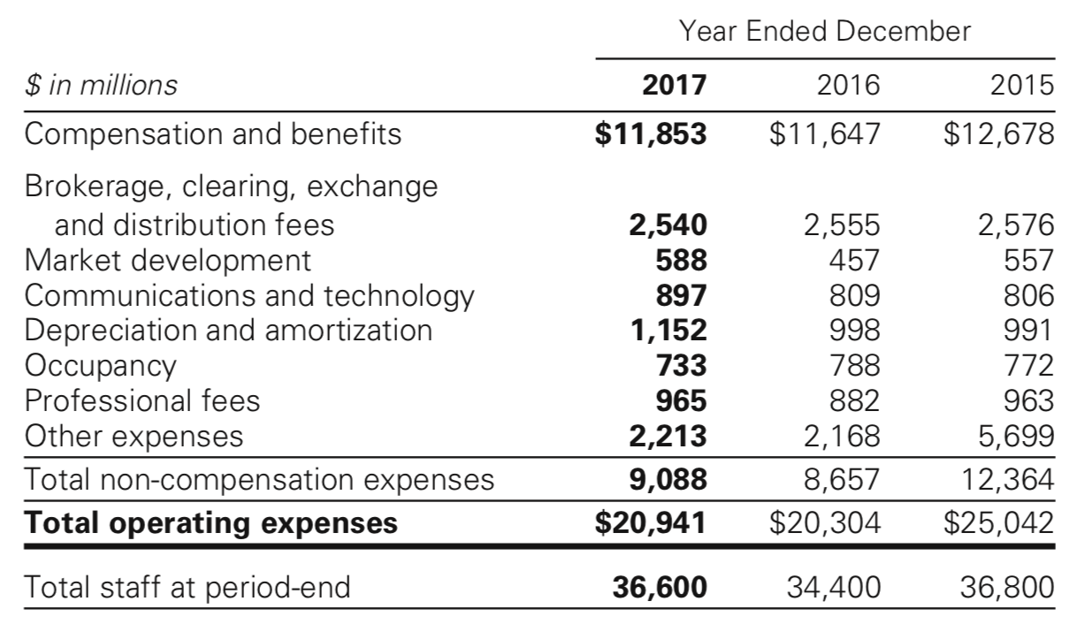
Operating Expenses

Slide 14
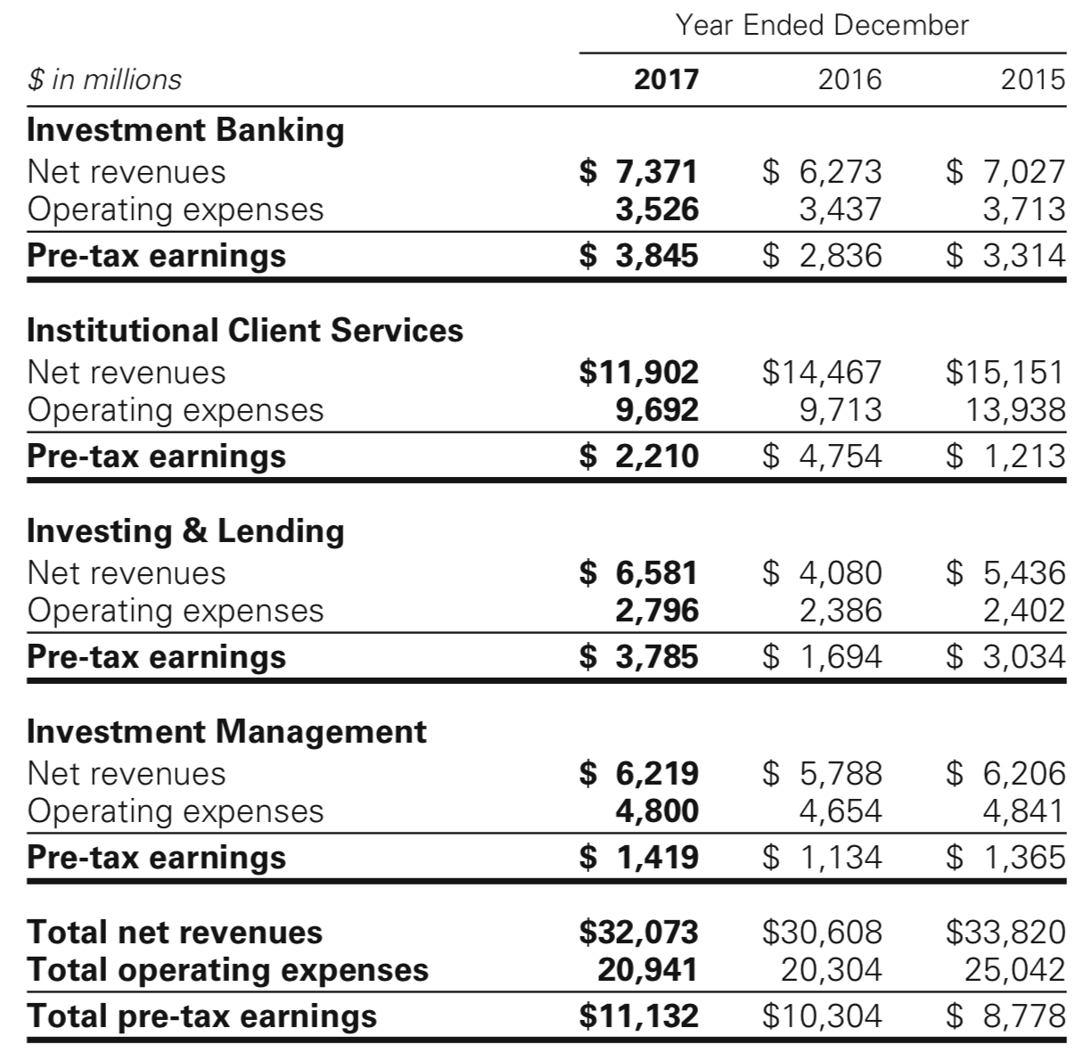
Segment Operating Results

Slide 15

Geographic Info
Due to the highly integrated nature of international financial markets, the firm manages its businesses based on the profitability of the enterprise as a whole
The method for allocating profitability to geographic regions is dependent on estimates and management judgement because a large portion of the firm’s activities require cross-border coordination to meet client needs

Slide 16
Firmwide Services
What does the company offer?
Goldman Sachs
Investment Banking
Investing & Lending
Investment Management
Institutional Client Services
Financial Advisory
Underwriting
Equity Underwriting
Debt Underwriting
Fixed Income, Currency and Commodities Client Execution
Equities
Equities Client Execution
Commissions and Fees
Securities Services
Equity Securities
Debt Securities and Loans
Other
Management and Other Fees
Incentive Fees
Transaction Revenues

Slide 17

Investment Banking
Overview
Serve corporate and government clients around the world
Provide financial advisory services
Help companies raise capital
Try to develop and maintain long term relationships
Goal is to deliver all resources of the firm to benefit clients

Slide 18
Investment Banking
Financial Advisory
Strategic advisory assignments
Help clients execute large, complex transactions
Revenue from derivative transactions
Assist the clients in managing their exposure to loss of capital
Provide lending commitments and bank/bridge loan facilities

Slide 19
Investment Banking
Underwriting (Equity and Debt)
Helping companies raise capital to fund their businesses
Match client capital with needs
IPOs and private placements (worldwide)
Revenue from derivative transactions

Slide 20

Institutional Clients
Managing Client Risk
Assist clients with buying and selling financial products, raise funding, and managing risk
Offers market expertise by acting as a market maker
Facilitates client transactions in fixed income, equity, currency, and commodities

Slide 21
Institutional Clients
How revenue is generated
Large, highly liquid markets: high volume of transactions for modest spread and fees
Large, less liquid markets: low volume of transactions for higher spread and fees
Highly custom markets: address client’s exposure to risk
Financing for clients

Slide 22
Institutional Clients
How revenue is generated
Activities are organized by asset classes, primarily:
Cash instruments: trading the underlying instrument
Derivatives: including futures and options trading

Slide 23

Fixed Income, Currency, and Commodities Execution
Facilitates client transactions by providing liquidity with large blocks of stocks or options
Engagement in insurance activities
Structure and execute derivatives on indices, industry groups, financial measures and individual company stocks
Developing of strategies and portfolio hedging and restructuring
Asset allocation transactions
Creation of tailored instruments to establish or undertake hedging strategies

Slide 24
Fixed Income, Currency, and Commodities Execution
Commissions and Fees
Generated from executing and clearing institutional client transactions on major stock, options and futures exchanges
Access to electronic “low touch” equity trading platforms
Most of the revenues continued to be derived from the “high-touch” handling

Slide 25
Fixed Income, Currency, and Commodities Execution
Securities Services
Financial services: through margin loans collateralized by securities and cash or collateral
Securities lending services: borrowing and lending securities
Other prime brokerage services: provide clearing, settlement and custody services, technology platform is provided

Slide 26
Investing and Lending
Long-term activities
Investing directly in publicly and privately traded securities and loans
Managing diversified global portfolio of investments in equity securities and debt
Provide financing to clients through bank loans, personal loans and mortgages
Equity-related investments

Slide 27
Investment Management
Provides investment and wealth advisory services to help clients preserve and grow their financial assets
Managing client assets
Income and liability management
Trust and estate planning
Philanthropic giving and tax planning
Use global securities and derivative market-making capabilities to address the clients' needs

Slide 28
Management and Other Fees
Fees vary by asset class and affected by investment performance, asset inflows and redemptions
Assets under supervision: earn a fee for managing assets on a discretionary basis
Incentive Fees: when a return exceeds a specific benchmark

Slide 29

Business Continuity Program
Business continuity and information security are high priorities
Key elements of the program:
Crisis planning and management
People recovery
Business recovery
System and data recovery
Process improvement

Slide 30
Employees and Competition
Strive to maintain a work environment of professionalism, excellence, diversity and cooperation among employees
Competitors are other entities that provide investment banking, securities and investment management services (brokers, dealers, investment advisors)
Advantages are taken from competing successfully with larger financial institutions (which have more capital and stronger local presence)
Competition in attracting and retaining qualified employees

Slide 31
Regulation
Dodd-Frank Act: enacted in July 2010, provides extension on the rules adopted by the Federal Reserve Board
Supervision and examination by the Federal Reserve Board
BHC Act restricts bank holding companies from engaging in business activities
Fed board has the authority to limit the ability to conduct activities and it is necessary its approval before engaging in financial activities
The Volcker Rule prohibits “proprietary trading”, sponsorship of “covered funds” and investment in hedge funds

Slide 32
Regulation
The Dodd-Frank Act, and the rules thereunder, significantly altered the financial regulatory regime within which GS operates
The capital, liquidity and leverage ratios based on the Basel Committee’s final capital framework for strengthening international capital standards (Basel III), as implemented by the Federal Reserve, the PRA and FCA and other national regulators have also had a significant impact on GS businesses
The implications of such regulations for our businesses continue to depend largely on their implementation by the relevant regulators globally, as well as the development of market practices and structures under the regime established by such regulations
Other reforms have been adopted or are being considered by regulators and policy makers worldwide
The Basel Committee is the primary global standard setter for prudential bank regulation

Slide 33
The Volcker Rule
Is expected to limit certain kind of transactions with the sponsored funds
Many aspects remain unclear and very complex
In October 2011 the rules to implement the Volcker Rule were issued
The Volcker Rule limitation on investments in hedge funds and private equity funds required to reduce investments to 3% or less

Slide 34
Capital and Liquidity Requirements
As a bank holding company, Goldman Sachs is subject to consolidated regulatory capital requirements by fed board
In January 2016, the Basel Committee finalized a revised framework for calculating minimum capital requirements for market risk

Slide 35

Payments of Dividends and Stock Repurchases
Subject to the oversight of the fed board based on capital plans and stress tests to judge the capital planning processes
The amount of dividends that may be paid by GS is limited to the lesser of the amounts calculated under a “recent earnings” test and an “undivided profits” test

Slide 36
Compensation Practices
Oversight by the fed board
Risk must be taken in account
Incentives that balance risk and financial results
Review of the incentive compensation policies
Enforcement actions taken against the risk of the organization's safety caused by related risk management
If the regulations are adopted the flexibility will be restricted

Slide 37
Regulation of GS Bank USA
Undertake stress test is required, according to Dodd-frank act and conducted by the fed board
“Derivative push-out” will prevent GS from conducting certain swaps-related activities
Transactions between GS bank USA and its subsidiaries are regulated by the fed board

Slide 38
Prompt Corrective Actions & Capital Ratios
The US Federal Deposit Insurance Corporation Improvement Act of 1991 (FDCIA) establishes 5 capital categories:
Well-capitalized depositary institution: if it has a tier 1 capital ratio of at least 6%, a total capital ratio of at least 10% and a tier 1 leverage ratio of at least 5%
Adequately capitalized
Undercapitalized
Significantly undercapitalized
Critically undercapitalized

Slide 39
Insolvency of an Insured Institution
Transfer the depository institution's assets and liabilities to a new obligor
Enforce the terms of the depository institution's contracts
Repudiation of any contracts to which the institution is a Party

Slide 40
Broker-Dealer and Securities Regulation
Broker-dealer subsidiaries are subject to regulations that cover all aspects of the securities business
It is required to maintain orderly markets in the securities assigned
According to the Dodd-Frank Act, any person who organizes an asset-backed security transaction to retain a portion of any credit risk that the person conveys with a third party

Slide 41
Swap, Derivatives & Commodities Regulations
Subject to regulation of the US Commodity Exchange Act
The Dodd-Frank Act provides increased regulation, imposing the following requirements:
Real time public and regulatory reporting of trade information for swaps
Registration of swap dealers
Position limits the cap exposure to derivatives on certain physical commodities
Mandated clearing through central counterparties for certain swaps
New business conduct standards for swap dealers
Margin requirements for trades that are not cleared
Entity level capital requirements for swap dealers

Slide 42
Other Regulations
Insurance subsidiaries: subject to state insurance regulation in the states in which they are domiciled
Investment management: subject to significant regulation in numerous jurisdictions around the world

Slide 43

The Basel Capital Accord
The Basel Capital Accord is a Framework set at the Basel Committee in 1988 and subsequently revised.
The primary objectives are to promote the soundness of the international banking system and to provide an equitable basis for international cooperation among banks

Slide 44
The Basel Capital Accord
Basel 1
Basel I is the round of deliberations by central bankers from around the world, and in 1988, by the Basel Committee on Banking Supervision in Basel, Switzerland, published a set of minimum capital requirements for banks.
This was also known as the 1988 Basel Accord, and was enforced by law in the Group of Ten (G-10) countries in 1992
Primarily focused on credit risk and appropriate risk-weighting of assets.

Slide 45
The Basel Capital Accord
Basel 1A
Basel IA was proposed as an intermediate between the current Basel I accord and the Basel II accord that is being implemented. Basel IA would have been more risk sensitive than Basel I but would not be as complex as the advanced approach under Basel II.
It was decided to drop the proposed Basel 1A and allow Basel II standardized in its place.

Slide 46
The Basel Capital Accord
Basel 2
Basel II was published in June 2004 and intended to amend international standards that controlled how much capital banks need to hold to guard against the financial and operational risks banks face. These rules sought to ensure that the greater the risk to which a bank is exposed, the greater the amount of capital the banks needs to hold to safeguard its solvency and economic stability.
Basel II uses a “three pillars” concept
Minimum capital requirements
Supervisory review
Market discipline

Slide 47
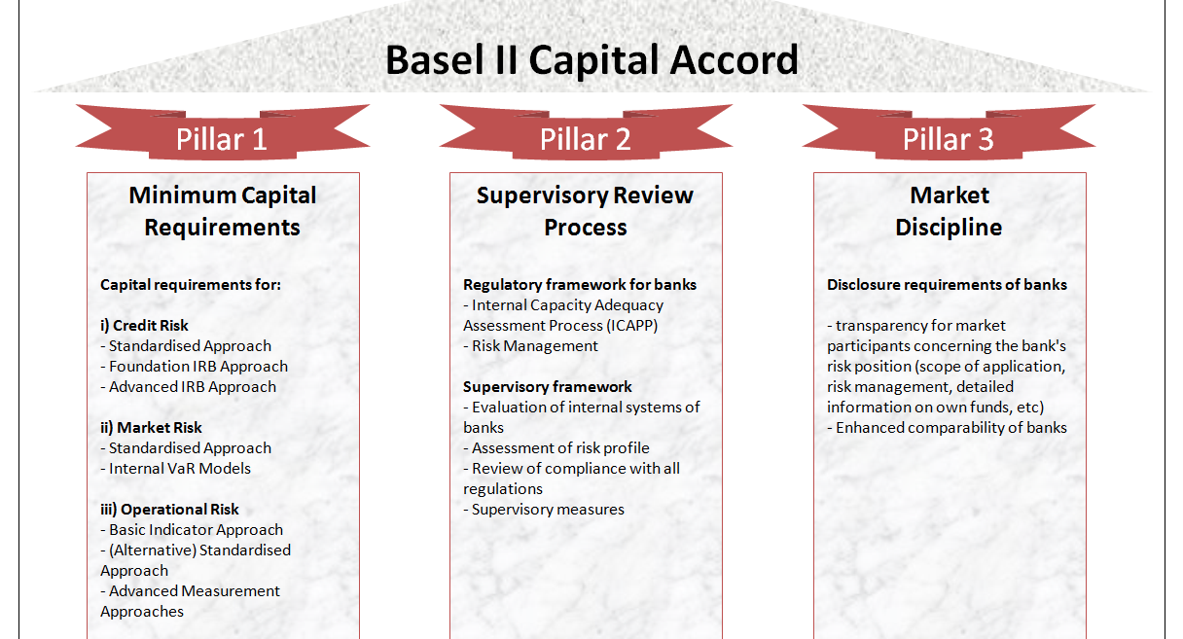

Slide 48
The Basel Capital Accord
Basel 3
The third installment of the Basel Accords was developed in response to the deficiencies in financial regulation revealed by the financial crisis of 2007-08. Basel III is intended to strengthen bank capital requirements by increasing liquidity and decreasing bank leverage.
Tier 1 capital requirements increases from 4% in Basel II to 6%
In July 2014, the U.S. Federal Reserve announced that the minimum Basel III leverage ratio would be 6% for 8 systemically important financial institution (SIFI) banks and 5% for their uninsured bank holding companies

Slide 49
The Risk Management Environment

Slide 50
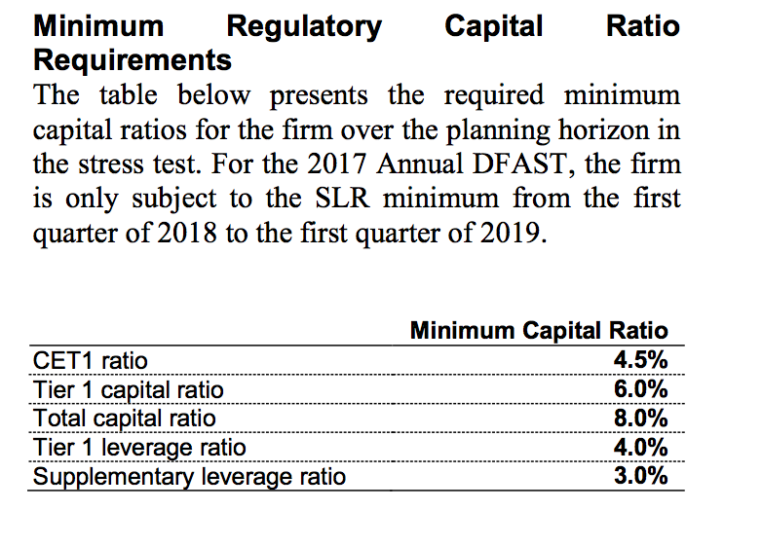

Slide 51
The Dodd-Frank Stress Test Disclosure
These results incorporate the following capital allocation assumptions, as prescribed by the Federal Reserve Board’s DFAST rules:
Common stock dividends equal to the quarterly average dollar amount of common stock dividends that were paid in the second quarter of 2016 through and including the first quarter of 2017
Payments on any other instrument that is eligible for inclusion in the numerator of a regulatory capital ratio equal to the stated dividend, interest, or principal due on such instrument during the quarter

Slide 52
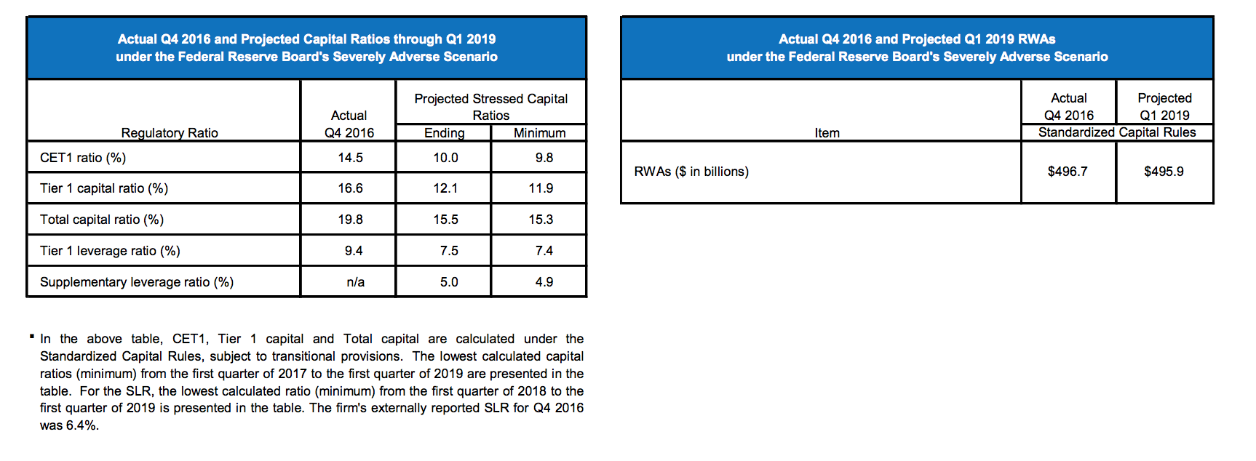

Slide 53
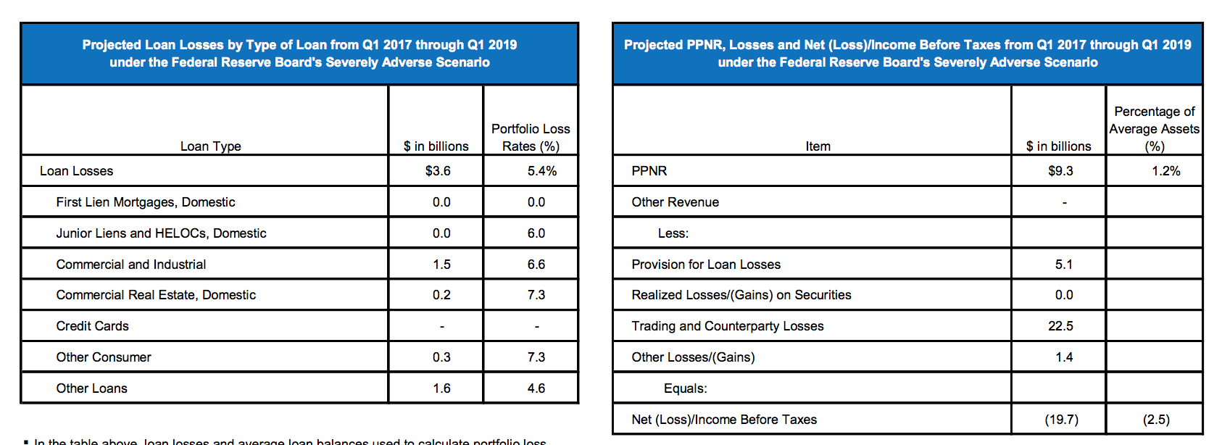

Slide 54
Broker-Dealer & Securities Regulation
Our broker-dealer subsidiaries are subject to regulations that cover all aspects of the securities business, including sales methods, trade practices, use and safekeeping of clients’ funds and securities, capital structure, recordkeeping, the financing of clients’ purchases, and the conduct of directors, officers and employees. In the United States, the SEC is the federal agency responsible for the administration of the federal securities laws. GS&Co. is registered as a broker-dealer, a municipal advisor and an investment adviser with the SEC and as a broker-dealer in all 50 states and the District of Columbia. Self-regulatory organizations, such as FINRA and the NYSE, adopt rules that apply to, and examine, broker-dealers such as GS&Co.

Slide 55
Broker-Dealer & Securities Regulation
Our broker-dealer and other subsidiaries are also subject to rules adopted by federal agencies pursuant to the Dodd-Frank Act that require any person who organizes or initiates an asset-backed security transaction to retain a portion (generally, at least five percent) of any credit risk that the person conveys to a third party. Securitizations would also be affected by rules proposed by the SEC to implement the Dodd-Frank Act’s prohibition against securitization participants engaging in any transaction that would involve or result in any material conflict of interest with an investor in a securitization transaction. The proposed rules would exempt bona fide market-making activities and risk-mitigating hedging activities in connection with securitization activities from the general prohibition.

Slide 56
Major Industry Risks
Liquidity | Market | Credit | Operational
Model | Legal | Regulatory | Reputational

Slide 57

Risk Factors
Goldman Sachs may have been and may continue to be adversely affected by conditions in the global financial markets and economic conditions
Clients are subject to extensive and pervasive regulation around the world
Market-making activities may have been and may be affected by changes in levels of market volatility

Slide 58
Risk Factors
May be adversely affected by market uncertainty or lack of confidence among investors and CEOs due to general declines in economic activity and other unfavorable market conditions
May be adversely affected by declining asset values, especially for those businesses in which the company has net long positions, or in businesses where Goldman Sachs receives fees based on value of assets manage

Slide 59
Risk Factors
Liquidity and profitability may be adversely affected by inability to access debt capital markets or to sell assets by a reduction in credit ratings or an increase in credit spreads
Goldman Sachs may be adversely affected by disruptions in the credit markets, including reduced access to credit and higher costs of servicing debt
Reduction in credit quality or increase in default risks of assets may also adversely impact the bank

Slide 60
Risk Factors
Failure in operational systems or infrastructure, including human error, could impair our liquidity or disrupt business practices, which may ultimately impact the bank’s reputation
Poor investment management may reduce client confidence in the bank
Failure to safeguard digital assets and information could impair ability to conduct business and result in the theft or destruction of private IP
Inability to hire and retain qualified employees may adversely impact the business

Slide 61
Risk Factors
Excessive exposure to derivative transactions or delayed settlements may expose the bank to unexpected risk and potential losses
Concentration of risk increases the potential for more significant losses in market-making, underwriting, investing, and lending activities
New innovations in trading technology may render some banking services obsolete, which could affect ongoing business
Unforeseen catastrophic events, including natural disasters, acts of terrorism, and extreme weather events could harm business

Slide 62
Risk Management Framework
The board
Independent control and support functions
Marking inventory to current market level
Approving risk limits
Training
Evaluating
rewarding
Governance
Process
People

Slide 63
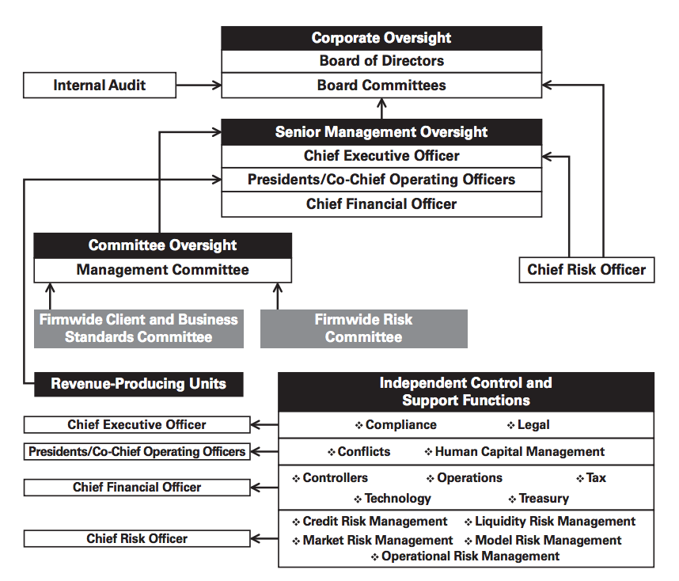

Slide 64

Liquidity Risk
GOLA: meet liquidity needs and fund the firm in the event of firm-specific, broader industry or market liquidity stress events
Treasury: assessing monitoring and managing liquidity (CFO)
Liquidity Risk Management: independent, responsible for control and oversight (CRO)

Slide 65
Liquidity Risk
Three Principles
Hold excess liquidity with Global Core Liquid Assets (GCLA) to cover outflow
Maintain asset-liability management
Maintain a viable contingency funding plan

Slide 66
Asset-Liability Management
Three Approaches
Goal: Long dated and diversified funding
Conservatively managing the overall funding book, and focus on long-term diversified sources of funding
Actively manage asset base
Raising secured and unsecured financing with longer tenure than the liquidity profile of assets

Slide 67
Contingency Funding Plan
Provide framework for analyzing liquidity risks
Outline list of potential risk factors
Identify key groups of individuals to foster effective coordination control and distribution of information

Slide 68
Liquidity Stress Test
Modelled liquidity risks: captures and quantifies liquidity risks and conducts multiple scenarios that include market/firm wide risks
Intraday liquidity model: assess the risk of increased intraday liquidity requirements when access to sources of intraday may become constrained

Slide 69
Liquidity Stress Test
Modelled Liquidity Risk Parameters
Liquidity needs over 30-day scenario
Two-notch downgrade of long-term unsecured credit ratings
Combination of contractual outflows and contingent inflows
No issuance of equity or unsecured debt
No support from additional government funding
No asset liquidation other than GCLA

Slide 70
Liquidity Stress Test
Intraday Liquidity Model Parameters
Liquidity needs over a one-day settlement period
Delays in receipt of counterparty cash payments
Reduction in the availability of intraday credit lines at third-party clearing agents
Higher settlement volumes due to an increase in activity

Slide 71
Limits
Use liquidity limits at various levels and across liquidity risk types to manage the size of liquidity exposures
Approved by risk committee of the board and the firm wide finance committee
Monitored by treasury and liquidity risk management
Minimum liquidity standards approved by the US Federal Bank regulatory agencies call for a liquidity coverage ratio (LCR)

Slide 72
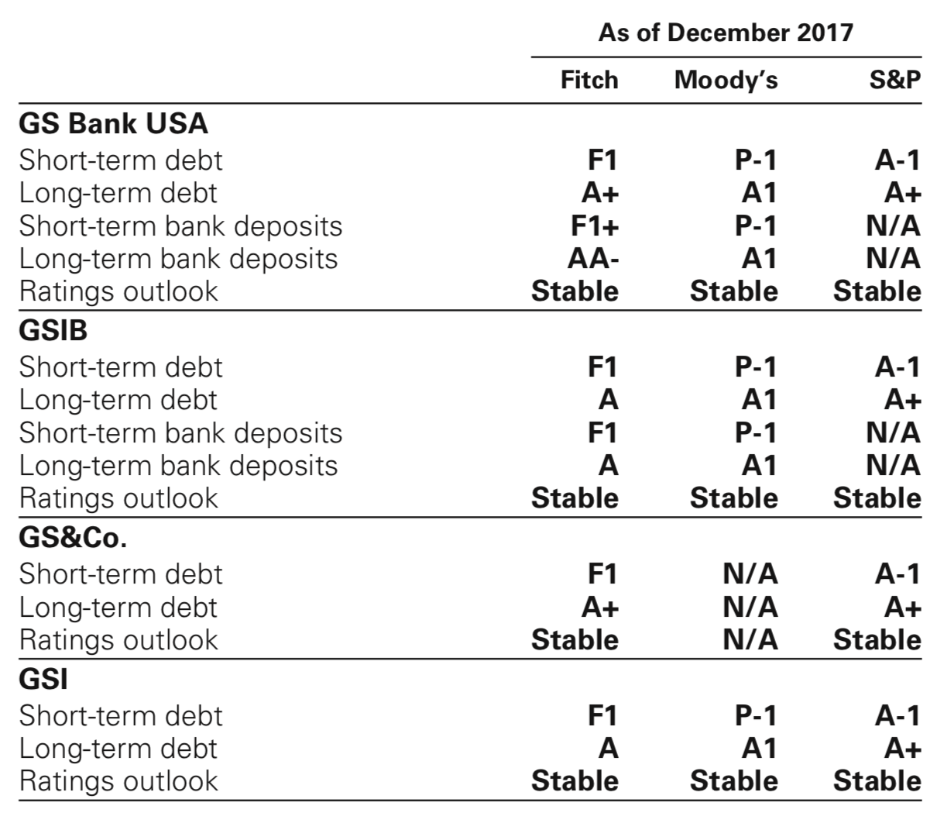
Credit Ratings

Slide 73
Market Risk Management
Risk of loss in the value of inventory and certain other financial assets/liabilities due to change in market conditions
Inventory changed based on client demands and investment opportunities which is accounted for at fair value and fluctuates on a daily basis

Slide 74
Market Risk Management
Categories
Interest Rate Risk
Equity Price Risk
Currency Rate Risk
Commodity Price Risk

Slide 75
Market Risk Management
Process
Accurate and timely exposure information incorporating multiple risk metrics
Set a dynamic limit setting framework
Constant communication among revenue-producing units, risk managers and senior management

Slide 76
Value at Risk (VaR)
Primary short-term risk measure
Potential loss in value due to adverse market movements over a defined period
Use a single VaR model which captures risk (including interest rates, equity prices, currency rate, and commodity prices)
Captures the diversification of aggregated risk at the firm-wide level
Full valuation of approximately 70,000 market factors
Sample from 5 years of historical data to generate scenarios
Daly backtesting of VaR models

Slide 77
Value at Risk (VaR)
Limitations
VaR does not estimate potential losses over longer time horizons where moves may not be extreme
VaR does not take account of the relative liquidity of different risk positions
Previous moves in market risk factors may not produce accurate predictions of all future market moves

Slide 78
Value at Risk (VaR)
Limitations of Tests
Set based on VaR and on a range of stress relevant to exposure
Risk committee of the board and risk governance committee approves market risk limits on firm-wide basis
Market risk management to monitor the limit each day. If excessive, senior management or risk committee reviews

Slide 79
Stress Testing
Alternative Tests
Firm-wide stress test
Sensitivity analysis
Scenario analysis

Slide 80
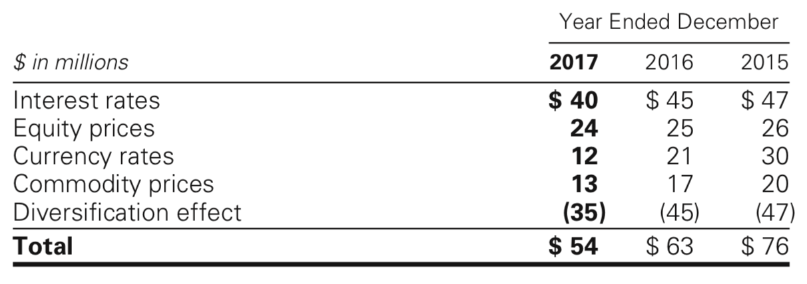
VaR Metrics – Daily Average

Slide 81
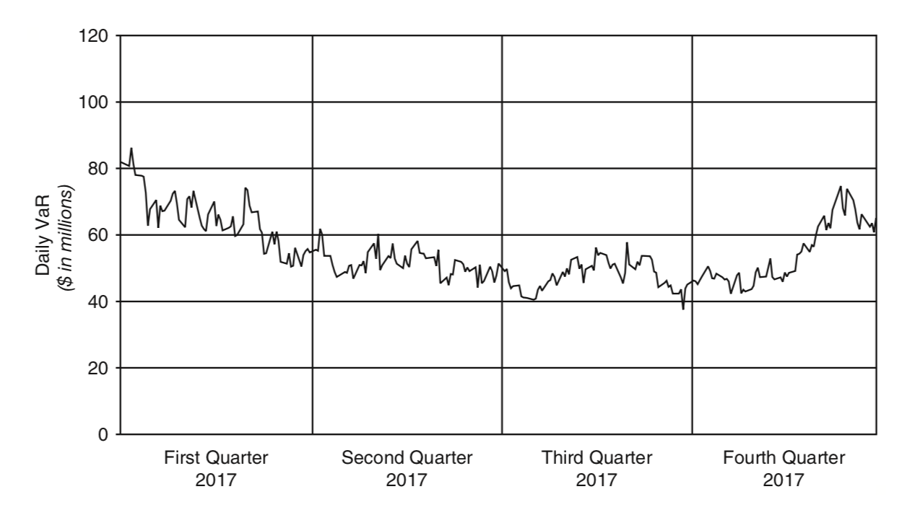

Slide 82
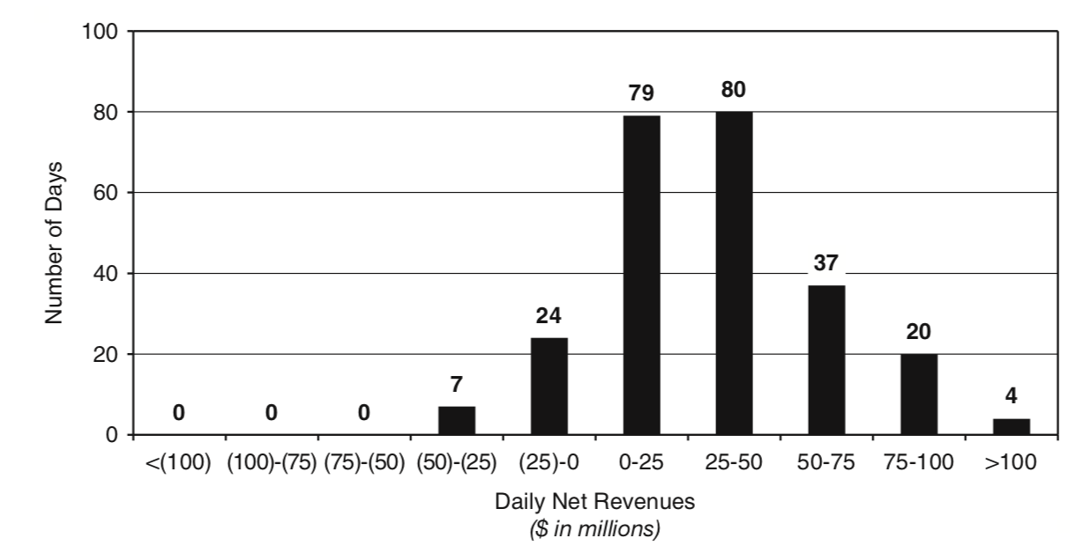

Slide 83
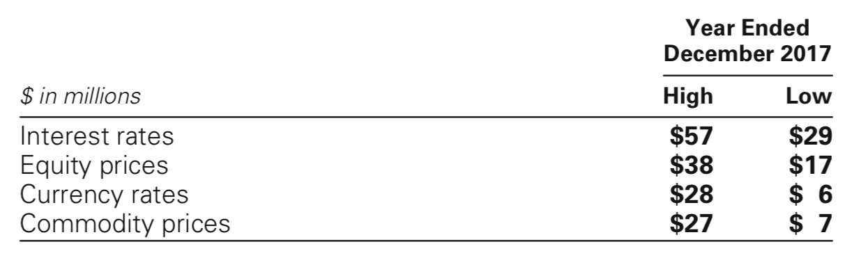
VaR Metrics – Year End

Slide 84
Sensitivity Measures
VaR is not always the most appropriate measure of risk
10% sensitivity measure
Credit spread sensitivity on derivatives and financial liabilities
Interest rate sensitivity

Slide 85
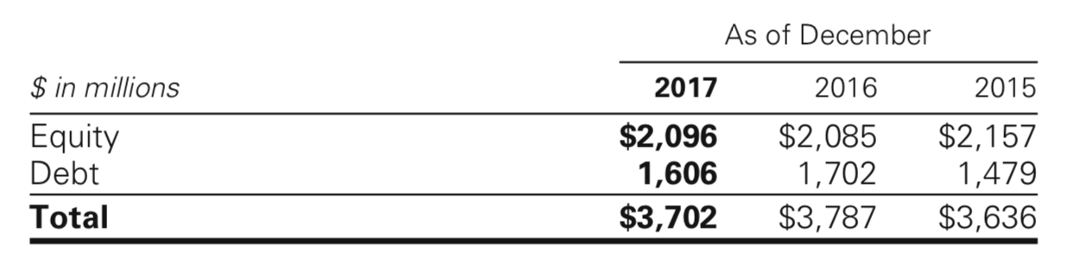
10% Sensitivity Analysis

Slide 86
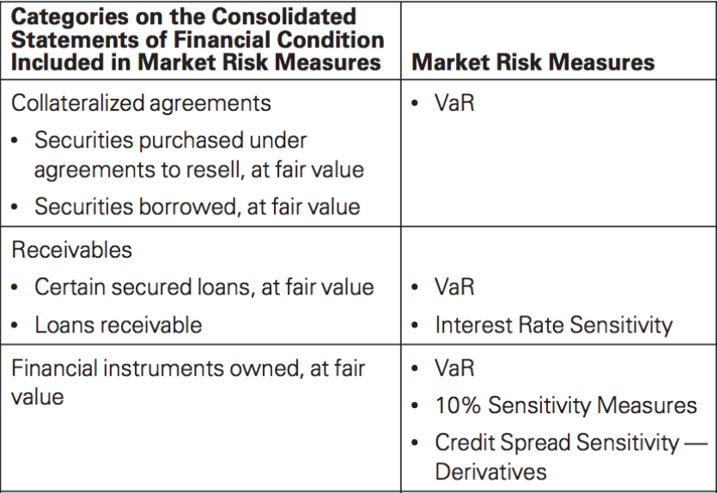
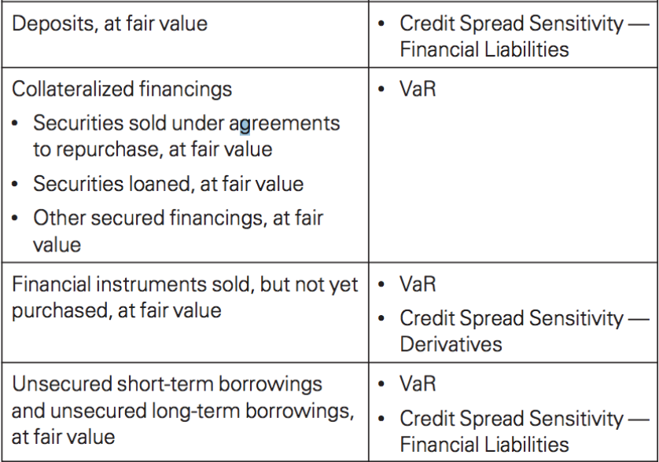
Financial Statement Linkage to Risk Measures

Slide 87
Credit Risk Management
Process
Approving transactions and setting up credit exposure limits
Establishing underwriting standards
Monitoring compliance with established credit exposure limits
Assessing likelihood that a counter-party will default on payment obligations
Measuring current and potential credit exposure and losses
Reporting credit exposures to senior management, the board and regulators

Slide 88
Credit Risk Management
Limits
For derivatives and securities financing transactions, the primary measure is potential exposure
For loans and lending commitments, the primary measure is a function of the position
The firm uses credit limits at various levels to control the size of credit exposures

Slide 89
Credit Risk Management
Stress Test
Use regular stress tests to calculate credit exposures
Apply shocks to counter-party credit ratings or credit risk factors (currency rates, interest rates, etc.)
Some of the stress tests include shocks to multiple risk factors
Run stress tests on a regular basis as part of routine risk management processes, conducted jointly with the market and liquidity risk functions

Slide 90
Credit Risk Management
Mitigants
For derivatives and securities: netting agreements to offset receivables and payables to obtain collateral on an upfront or contingent basis and/or to terminate transactions that fall below acceptable credit rating
For loans/lending: collateral provisions, guarantees, covenants, lending commitments, pricing structure, and other terms

Slide 91
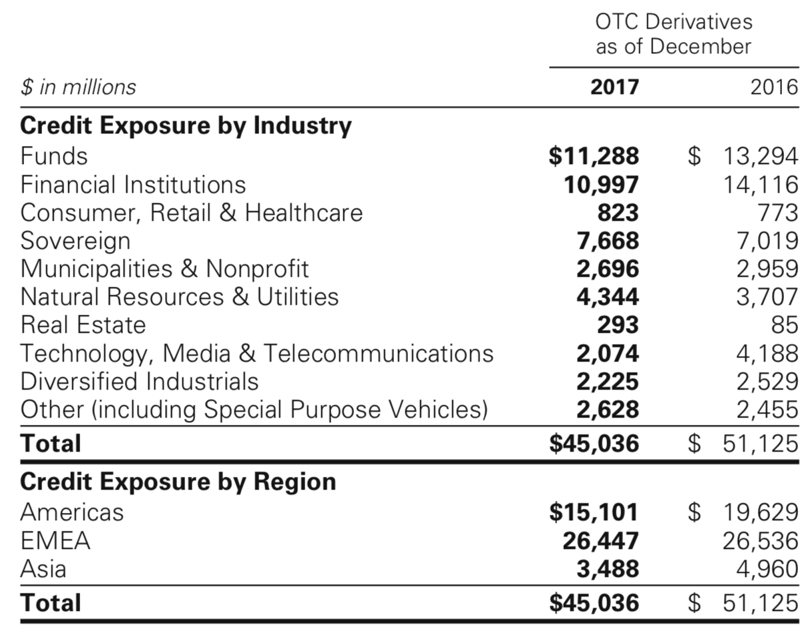
Credit Risk Management: Credit Exposures

Slide 92
Operational Risk Management
Risk of loss resulting from inadequate or failed internal processes, people and/or systems from external events
Arises from routine processing errors as well as extraordinary incidents such as major systems failures or legal and regulatory matters

Slide 93
Operational Risk Management
Types
Clients, products and business practices
Execution, delivery and process management
Business disruption and system failures
Employment practices and workplace safety
Damage to physical assets
Internal fraud
External fraud

Slide 94
Operational Risk Management
Perspectives
Top-down perspective: senior management assesses firm-wide and business level operational risk profiles
Bottom-up perspective: revenue-producing units, independent control and support functions are responsible for risk management on a day-to-day basis

Slide 95
Operational Risk Management
Types
Designed to comply with operational risk measurement rules under Basel 3
The framework comprises of:
Risk identification and reporting
Risk measurement
Risk monitoring

Slide 96
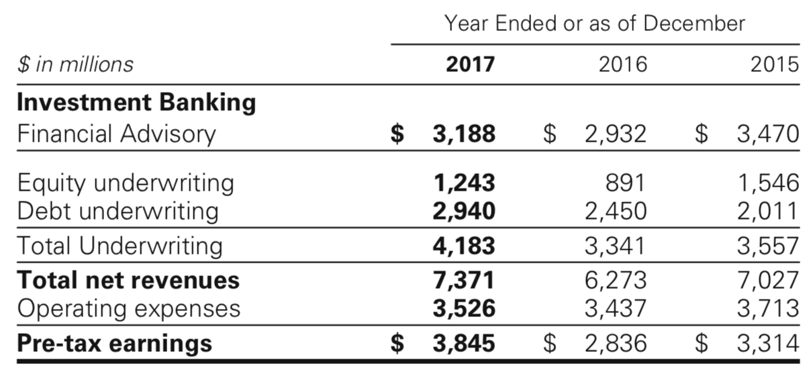
Investment Banking Operational Results

Slide 97
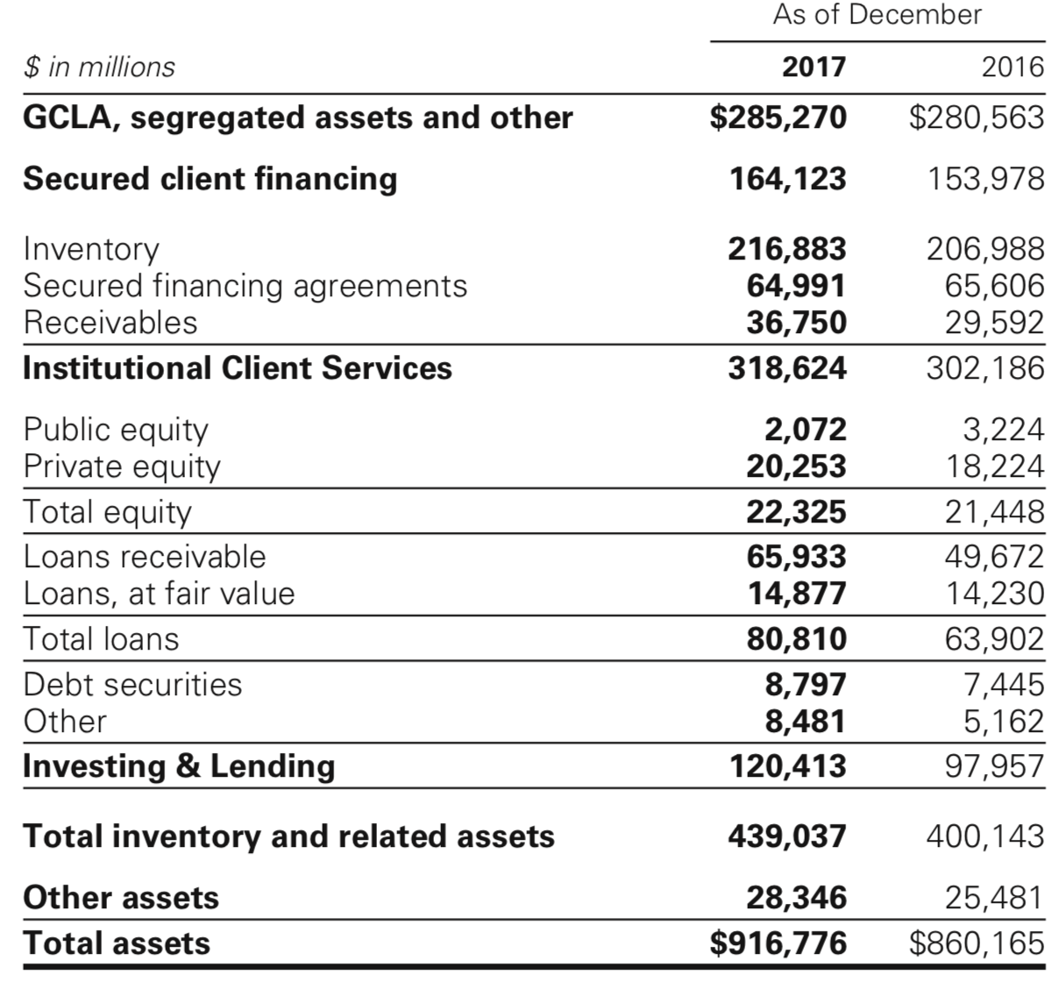
Balance Sheet Allocation
Risk management discipline to manage the size and composition of the balance sheet
Used to reflect factors of overall risk tolerance, amount of equity capital held, funding profiles

Slide 98
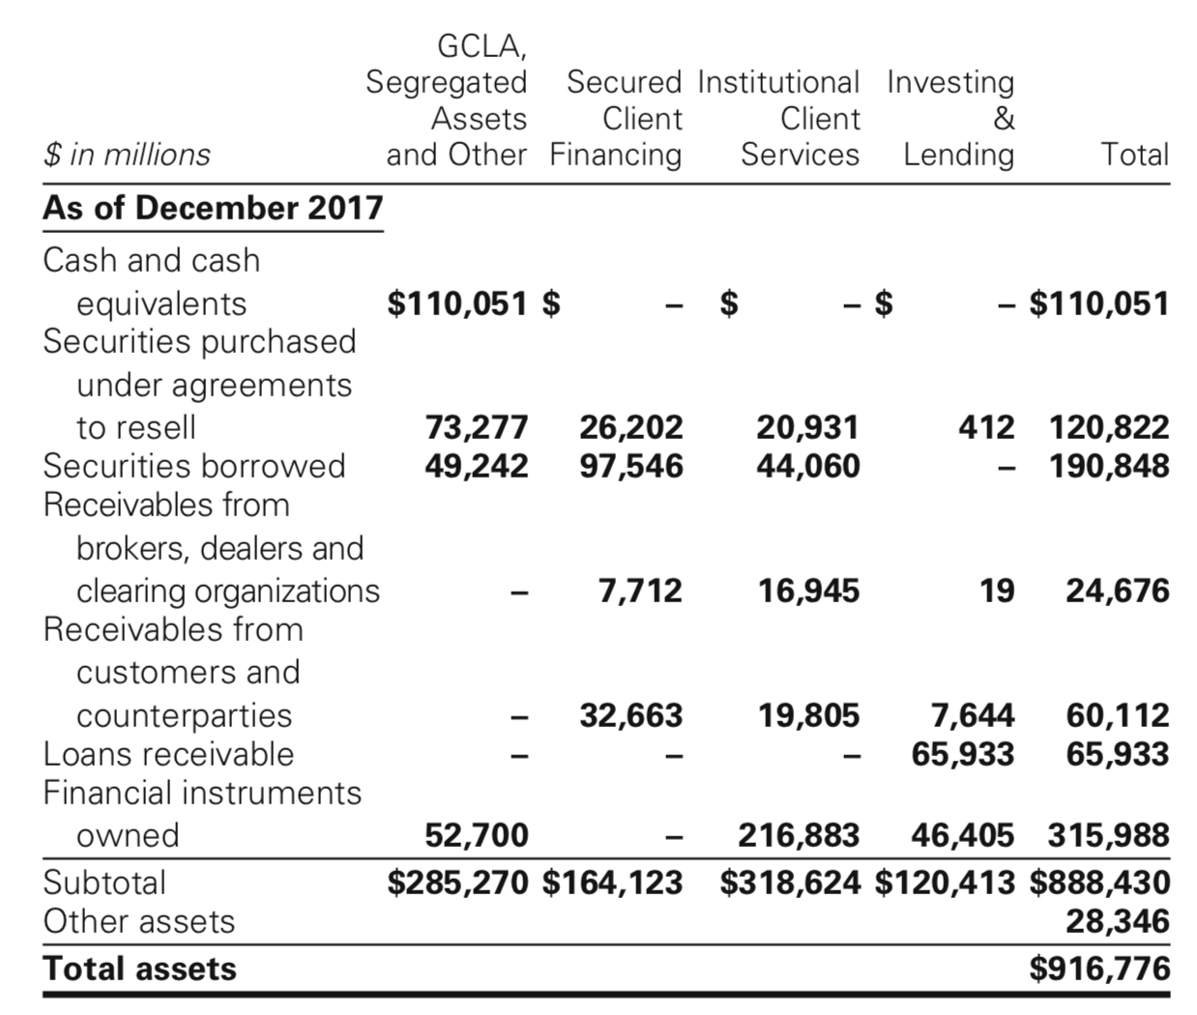
Cash Flow Statement

Slide 99
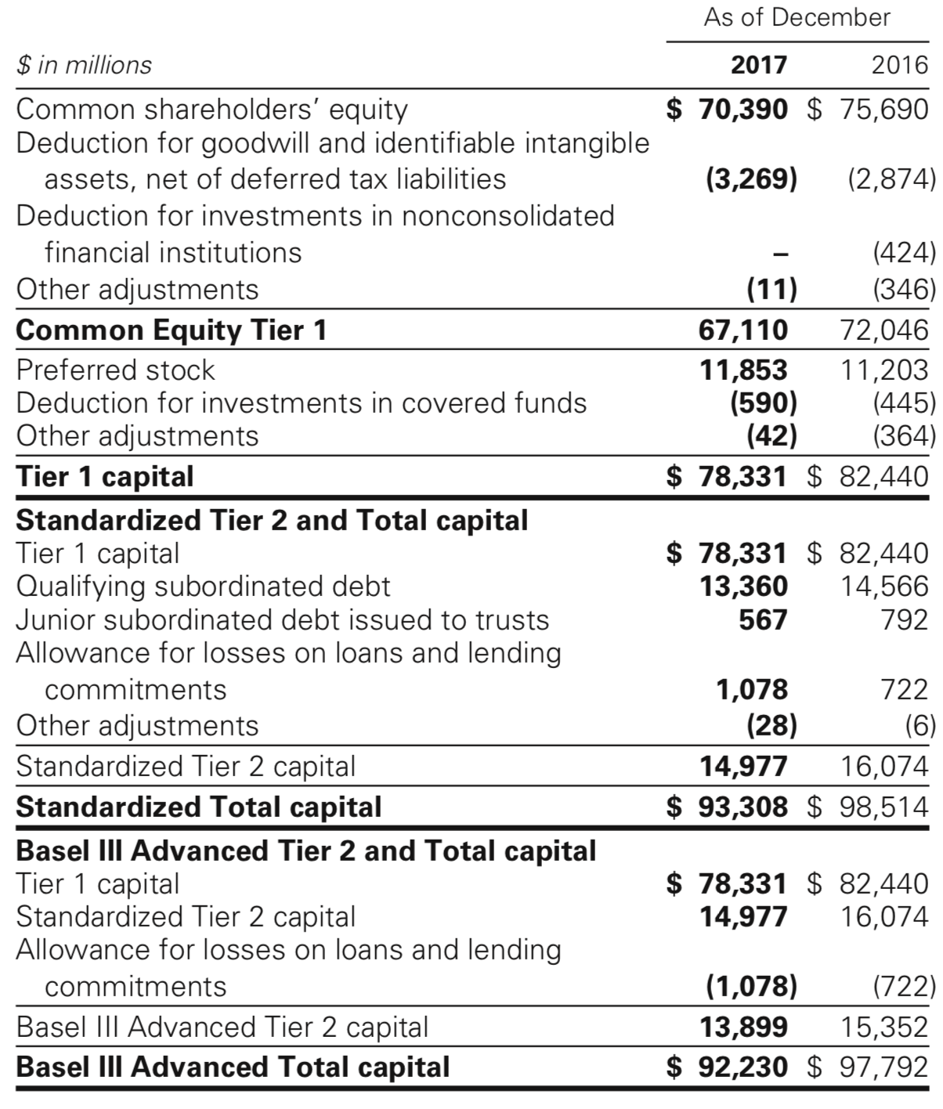
Fully Phased-In Capital Ratios

Slide 100
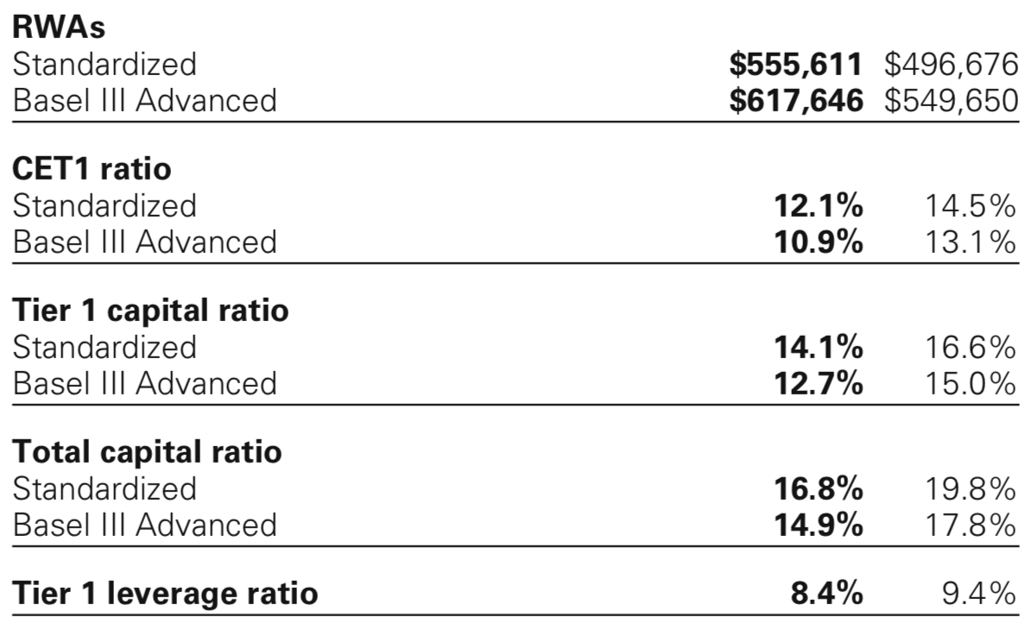

Slide 101
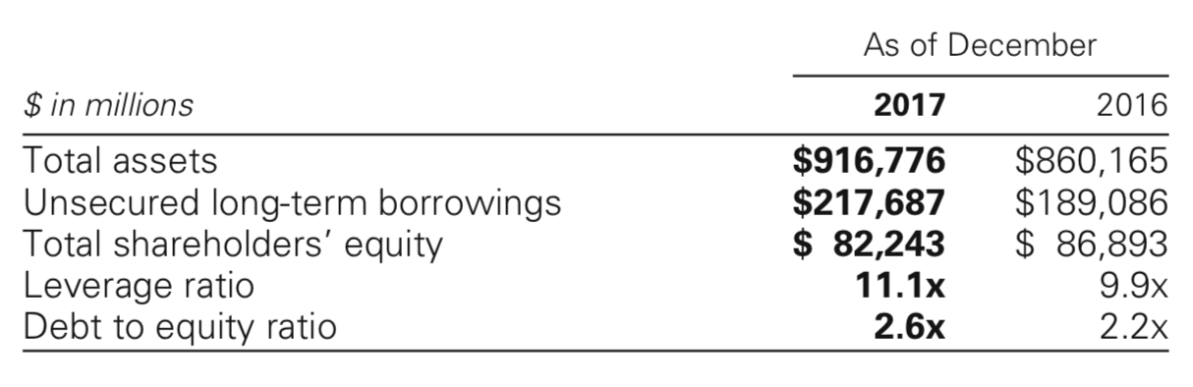

Slide 102
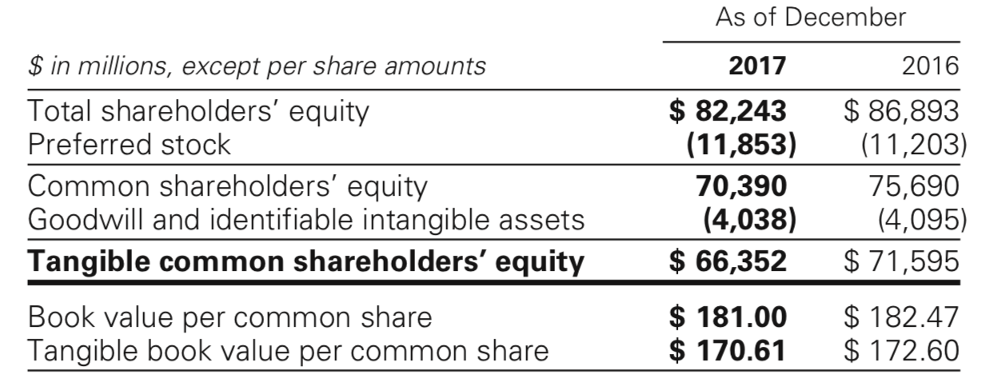
Shareholders Equity

Slide 103
Funding Sources
Primary sources of funding are:
Secured financings
Unsecured long-term financing
Short-term borrowings
Deposits

Slide 104
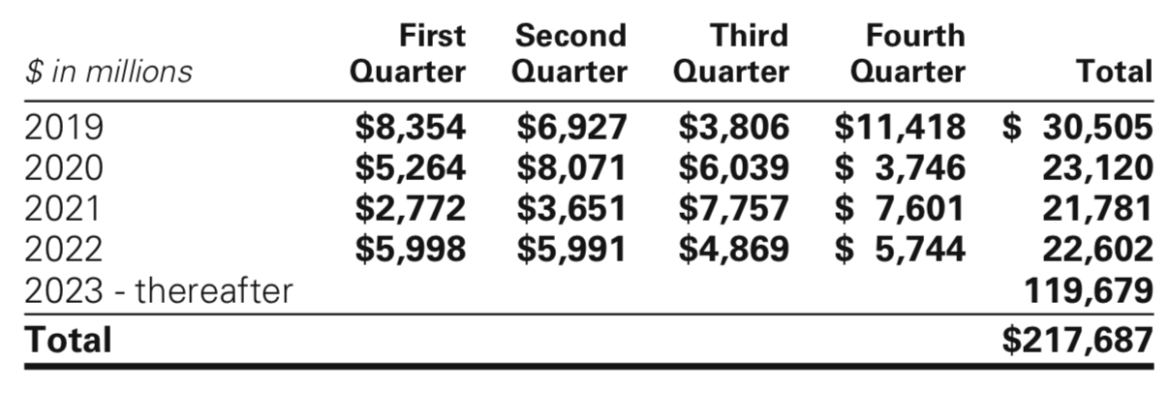
Unsecured Long-Term Borrowing

Slide 105
Minimum Capital Ratios and Buffers
Minimum ratios required under Basel 3 and Revised Capital Framework
The ratio requirement increases incrementally every year, including the addition of new capital buffers
Common equity tier 1 (CET 1) is a measurement of firm’s core equity capital compared with its total risk-weighted assets

Slide 106
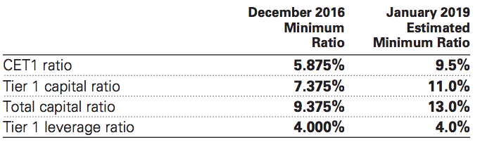
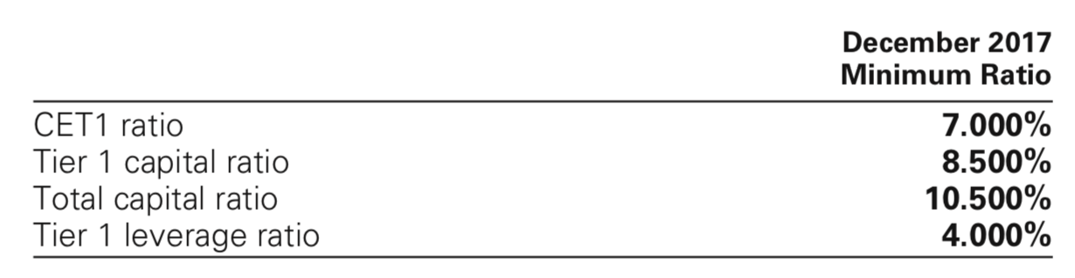
Capital Ratios

Slide 107
Thank You.

