Slide 1


BUS419 Group Presentation Group 2: Goldman Sachs

Slide 2






Presenters
Ruiting Na Harchetan Bhatti Vicky Duan Hebe Wang Will Song

Slide 3

Agenda
Company Overview
Financial Statement Analysis
Basel and Regulations
Risk Management Overview
Risk Management Analysis

Slide 4

Company Overview
The Goldman Sachs Group, Inc. was founded in 1869, the firm is headquartered in New York and maintains offices in all major financial centers around the world.
It is a leading global investment banking, securities and investment management firm that provides a wide range of financial services to a substantial and diversified client base that includes corporations, financial institutions, governments and individuals.

Slide 5
Financial Statement Analysis

Slide 6
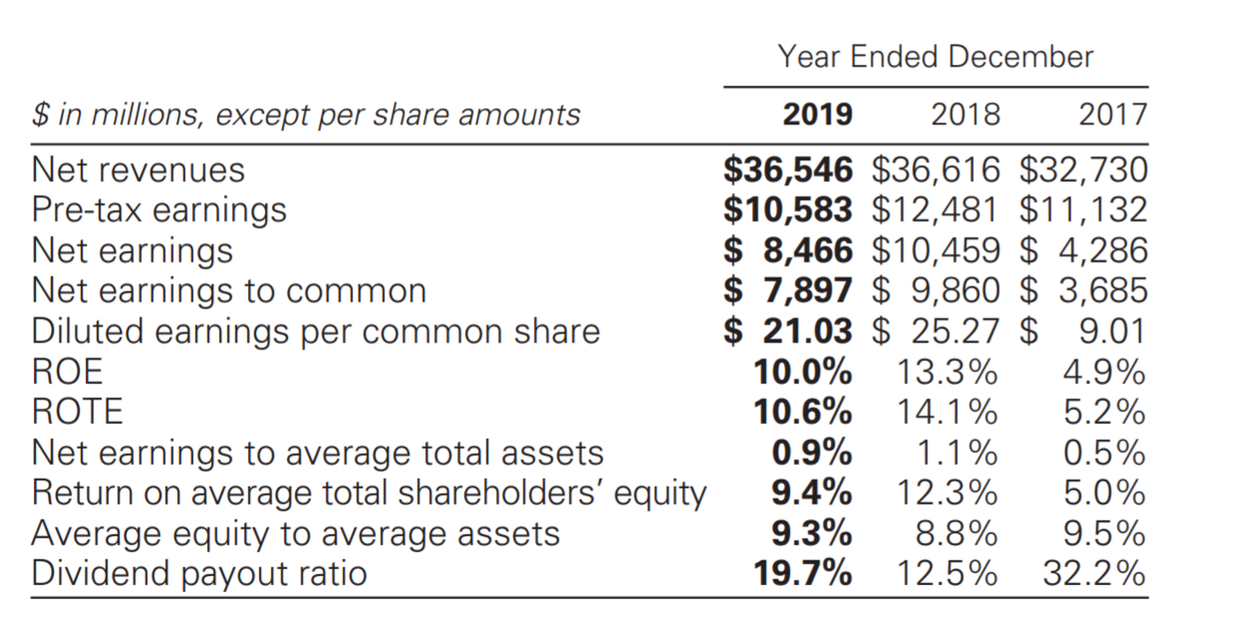
Financial Overview (Page 50 in Financial Report)

Slide 7
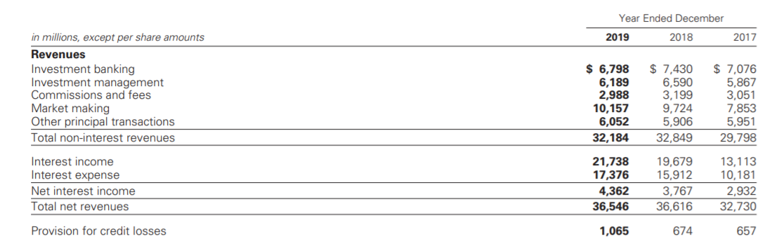
Income Statement (Page 105 in Financial Report)

Slide 8
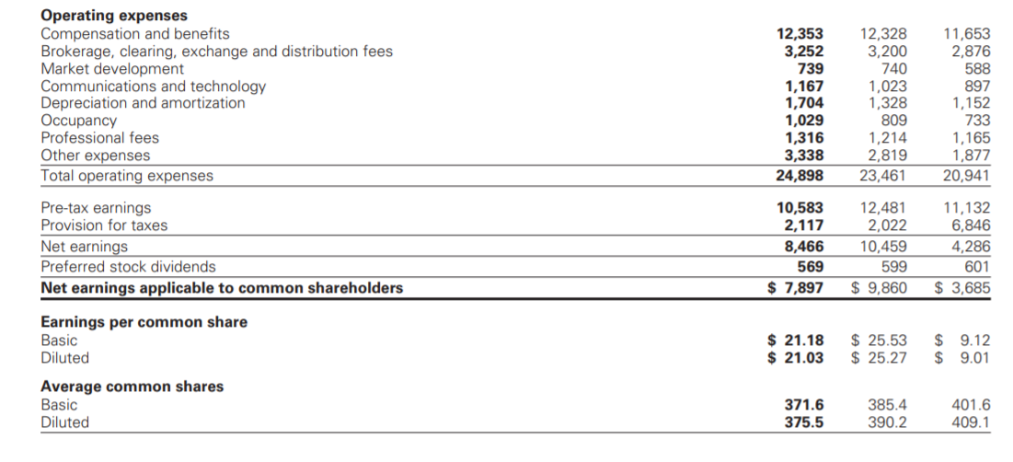
Income Statement (Page 105 in Financial Report)

Slide 9
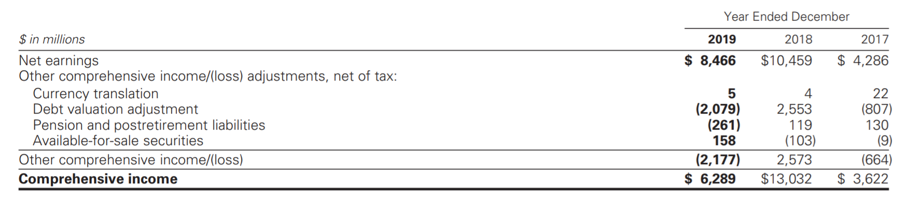
Consolidated Statements (Page 105 in Financial Report)

Slide 10
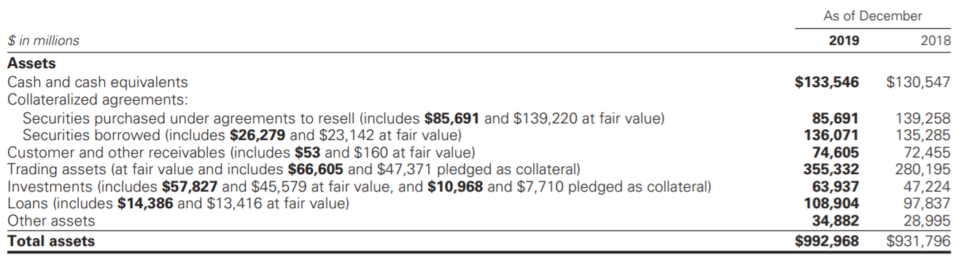
Balance Sheet (Page 106 in Financial Report)

Slide 11
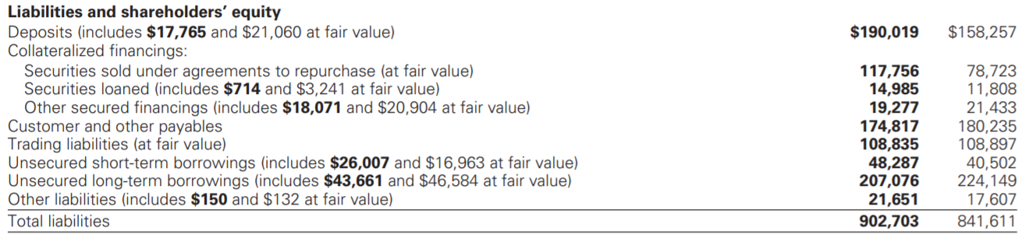
Balance Sheet (Page 106 in Financial Report)

Slide 12
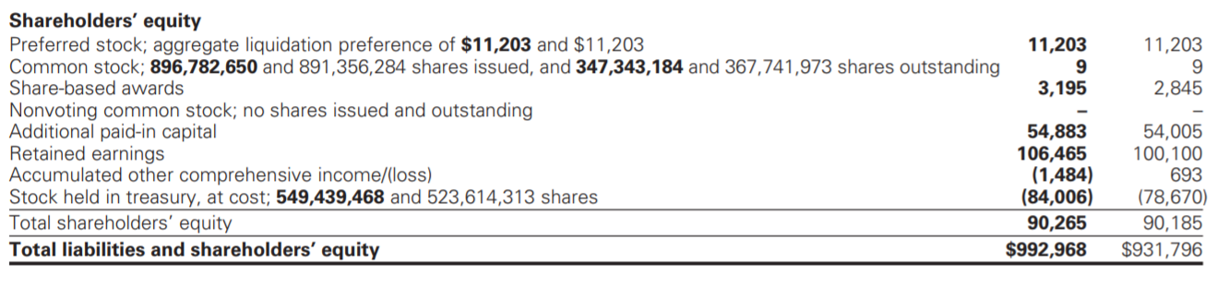
Balance Sheet (Page 106 in Financial Report)

Slide 13
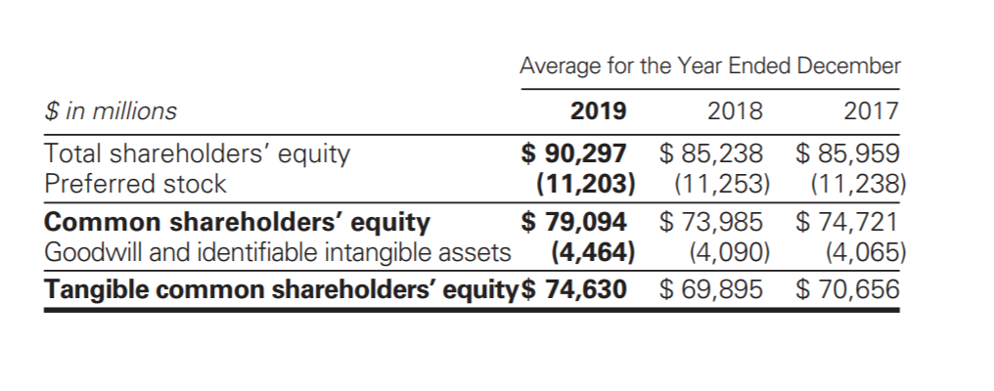
Average Equity (Page 50 in Financial Report)

Slide 14
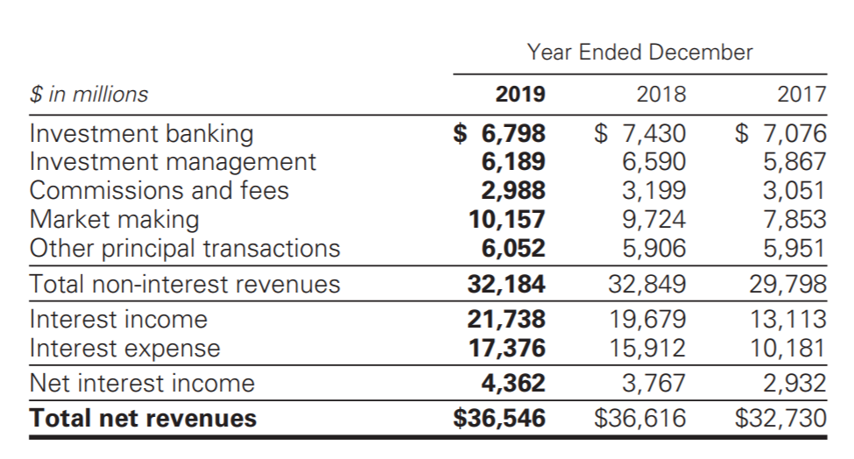
Net Revenue (Page 51 in Financial Report)

Slide 15
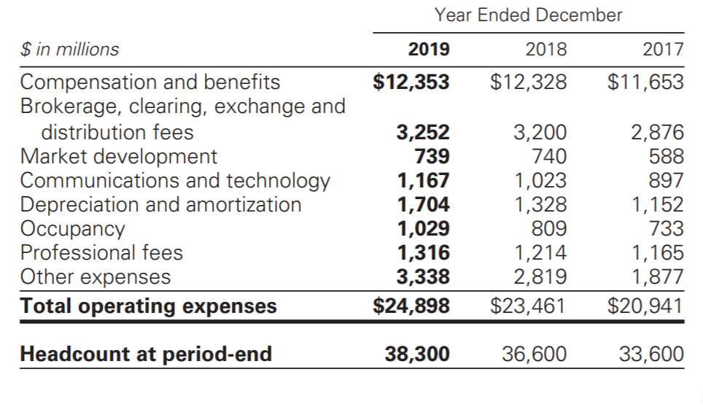
Operating Expense (Page 53 in Financial Report)

Slide 16
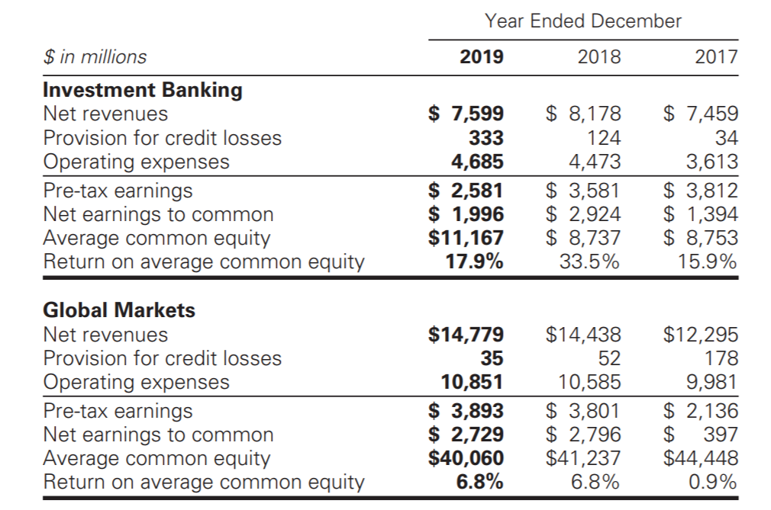
Segment Operating Result (Page 55 in Financial Report)

Slide 17
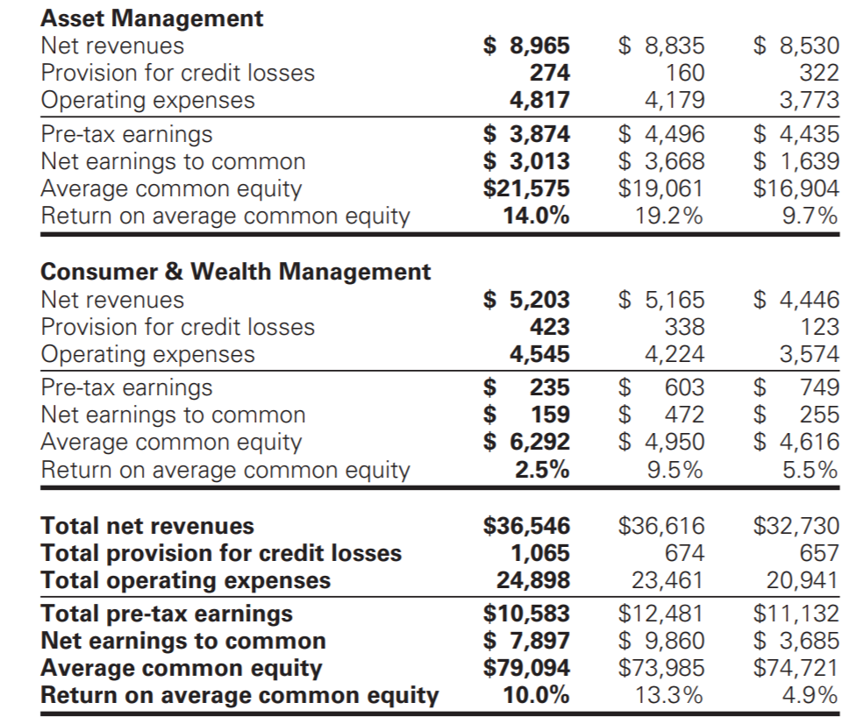
Segment Operating Result (Page 55 in Financial Report)

Slide 18
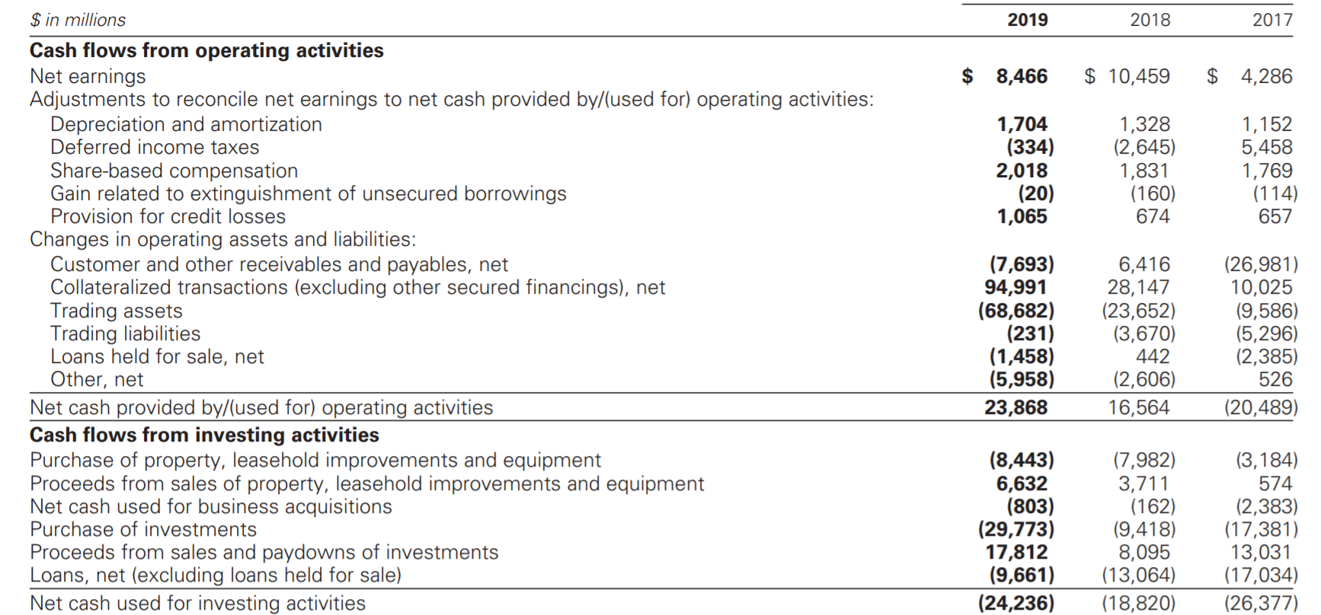
Cash Flow Statement (Page 108 in Financial Report)

Slide 19
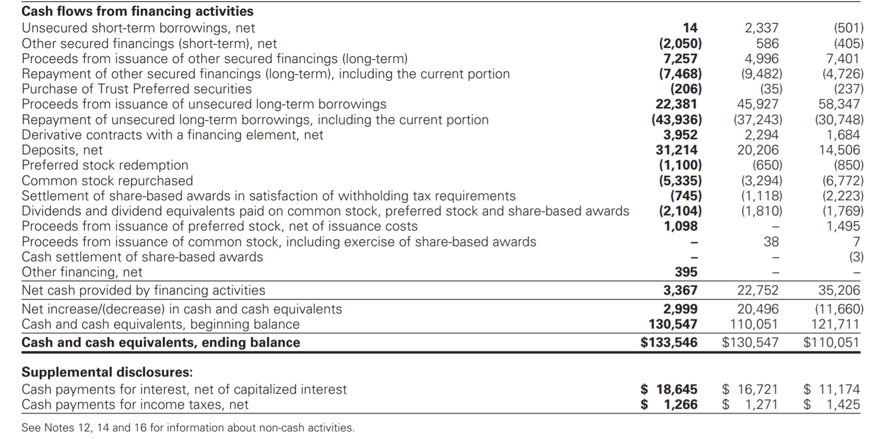
Cash Flow Statement (Page 108 in Financial Report)

Slide 20
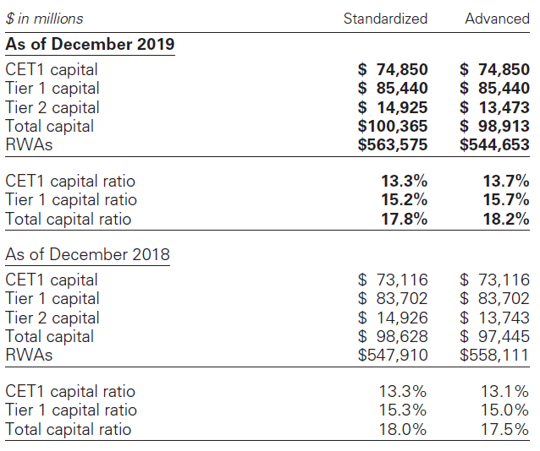
Risk-based Capital Ratios

Slide 21
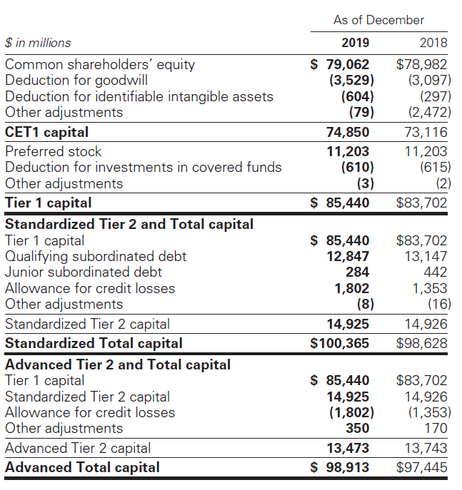
Risk-based Capital

Slide 22
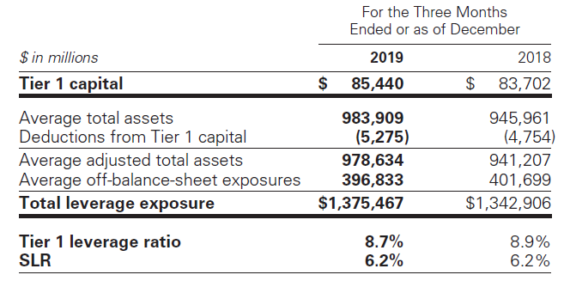
Leverage Ratios

Slide 23
Significant Accounting Policies (Page 110 in Financial Report)
Policies on fair value measurements
Policies on the allowance for credit losses
Policies on consolidation accounting

Slide 24
Geographic Info
Because of the highly integrated nature of international financial markets, the firm manages its businesses based on the entire profitability of the enterprise.
Allocating profitability to geographic regions is dependent on estimates and management judgement, because most of the firm’s activities require cross-border coordination to meet the client needs

Slide 25
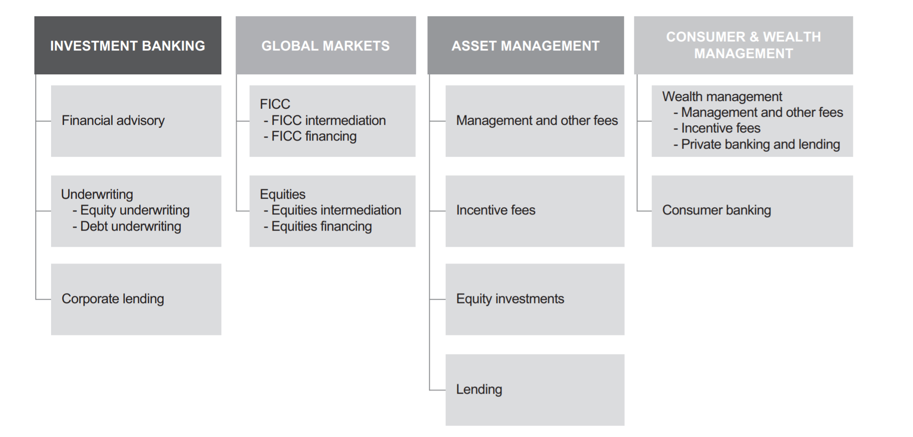
Business Segments (Page 1 in Financial Report)

Slide 26
Investment Banking (Page 2 in Financial Report)
Investment Banking serves public and private sector clients around the world.
We provide financial advisory services, help companies raise capital to strengthen and grow their businesses and provide financing to corporate clients.
We seek to develop and maintain long-term relationships with a diverse global group of institutional clients.
Our goal is to deliver to our institutional clients all of our resources in a seamless fashion, with investment banking serving as the main initial point of contact.

Slide 27
Global Markets (FICC and Equities) (Page 3 in Financial Report)
Global Markets serves our clients who buy and sell financial products, raise funding and manage risk.
We do this by acting as a market maker and offering market expertise on a global basis.
Global Markets makes markets and facilitates client transactions in fixed income, equity, currency and commodity products.

Slide 28
Asset Management (Page 4 in Financial Report)
Asset Management provides investment services to help clients preserve and grow their financial assets.
We provide these services to our institutional clients
As well as investors who primarily access our products through a network of third-party distributors around the world.

Slide 29
Consumer & Wealth Management
Consumer & Wealth Management helps clients achieve their individual financial goals by providing a broad range of wealth advisory and banking services
Including financial planning, investment management, deposit taking, and lending.
Services are offered through our global network of advisors and our digital platforms.

Slide 30
Regulations

Slide 31
Regulations
Dodd-Frank Act: enacted in July 2010, provides extension on the rules adopted by the Federal Reserve Board
Supervision and examination by the Federal Reserve Board
BHC Act restricts bank holding companies from engaging in business activities
Fed board has the authority to limit the ability to conduct activities and it is necessary its approval before engaging in financial activities
The Volcker Rule prohibits “proprietary trading”, sponsorship of “covered funds” and investment in hedge funds

Slide 32
Basel 1
Basel I is the round of deliberations by central bankers from around the world, and in 1988, by the Basel Committee on Banking Supervision in Basel, Switzerland, published a set of minimum capital requirements for banks.
This was also known as the 1988 Basel Accord, and was enforced by law in the Group of Ten (G-10) countries in 1992
Primarily focused on credit risk and appropriate risk-weighting of assets.

Slide 33
Basel 1A
Basel IA was proposed as an intermediate between the current Basel I accord and the Basel II accord that is being implemented. Basel IA would have been more risk sensitive than Basel I but would not be as complex as the advanced approach under Basel II.
It was decided to drop the proposed Basel 1A and allow Basel II standardized in its place.

Slide 34
Basel 2
Basel II was published in June 2004 and intended to amend international standards that controlled how much capital banks need to hold to guard against the financial and operational risks banks face. These rules sought to ensure that the greater the risk to which a bank is exposed, the greater the amount of capital the banks needs to hold to safeguard its solvency and economic stability.
Basel II uses a “three pillars” concept
Minimum capital requirements
Supervisory review
Market discipline

Slide 35
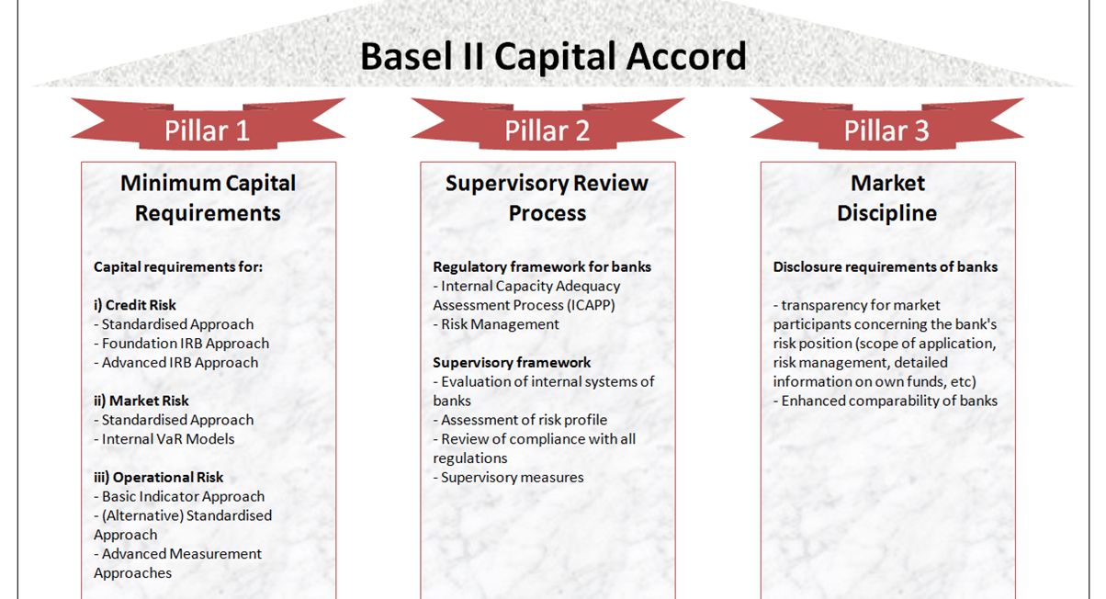

Slide 36
Basel 3
The third instalment of the Basel Accords was developed in response to the deficiencies in financial regulation revealed by the financial crisis of 2007-08. Basel III is intended to strengthen bank capital requirements by increasing liquidity and decreasing bank leverage.
Tier 1 capital requirements increases from 4% in Basel II to 6%
In July 2014, the U.S. Federal Reserve announced that the minimum Basel III leverage ratio would be 6% for 8 systemically important financial institution (SIFI) banks and 5% for their uninsured bank holding companies

Slide 37
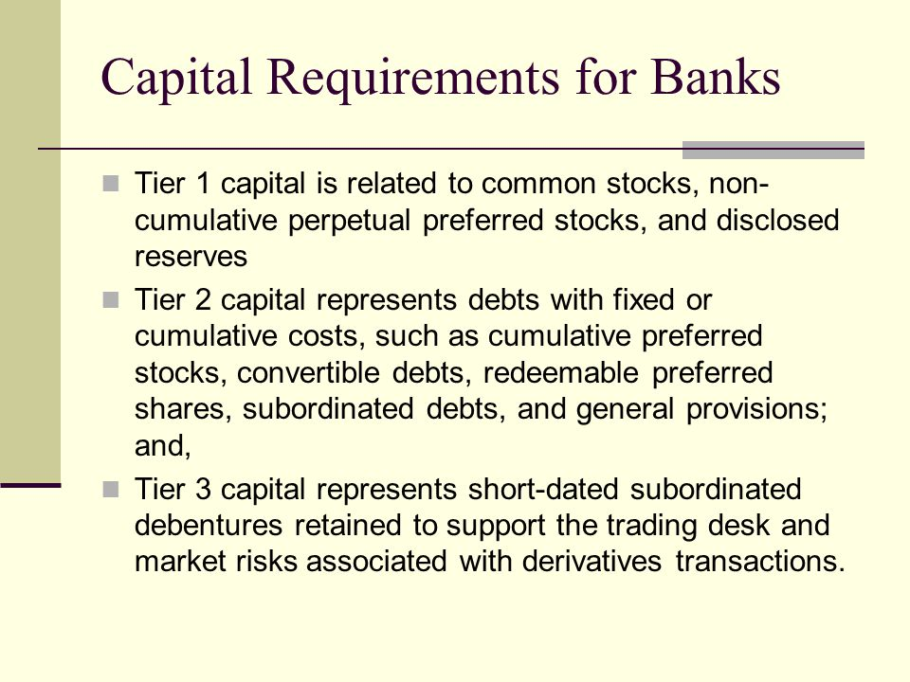

Slide 38
The Volker Rule
The Volcker Rule
Expected to limit certain kind of transactions with the sponsored funds
Prohibits proprietary trading
The Volcker Rule limitation on investments in hedge funds and private equity funds required to reduce investments to 3% or less of Tier 1 Capital
FRB, OCC, FDIC, CFTC and SEC finalized amendments in October 2019
These amendments became effective on January 1, 2020 but with a required compliance date of January 1, 2021.

Slide 39
Capital and Liquidity Requirements
As a bank holding company, Goldman Sachs is subject to consolidated regulatory capital requirements by fed board
In January 2016, the Basel Committee finalized a revised framework for calculating minimum capital requirements for market risk

Slide 40
Changes in Capital Requirements (1)
Changes to the market risk capital rules became effective on January 1, 2013 and these required the addition of new model based capital requirements
Basel 2 revises the regulatory capital framework for credit risk and equity investments and will be adopted once the regulators will approve GS to do so
Under the tailoring rules adopted by the U.S. federal bank regulatory agencies in October 2019, subject to “Category I” standards because they have been designated as a global systemically important bank (G-SIB).

Slide 41
Changes in Capital Requirements (2)
“The Collins Amendment” of the Dodd-Frank Act requires advanced approach banking organization to continue upon adoption of Basel 2 to calculate risk-based capital ratios under both Basel 2 and the fed reserve board's risk-based capital requirements

Slide 42
Changes in Capital Requirements (3)
More stringent capital standards:
New Basel 3 requirements include
The capital conservation buffer
Countercyclical capital buffer
G-SIB surcharge
All of these must consist entirely of capital that qualifies as Common Equity Tier 1 (CET1) capital.

Slide 43
Broker-Dealer & Securities Regulation
Their broker-dealer subsidiaries are subject to regulations that cover all aspects of the securities business, including sales methods, trade practices, use and safekeeping of clients’ funds and securities, capital structure, recordkeeping, the financing of clients’ purchases, and the conduct of directors, officers and employees.
In the United States, the SEC is the federal agency responsible for the administration of the federal securities laws.
GS&Co. is registered as a broker-dealer, a municipal advisor and an investment adviser with the SEC and as a broker-dealer in all 50 states and the District of Columbia.
Self-regulatory organizations, such as FINRA and the NYSE, adopt rules that apply to, and examine, broker-dealers such as GS&Co.

Slide 44
Broker-Dealer & Securities Regulation
Their broker-dealer and other subsidiaries are also subject to rules adopted by federal agencies pursuant to the Dodd-Frank Act that require any person who organizes or initiates an asset-backed security transaction to retain a portion (generally, at least five percent) of any credit risk that the person conveys to a third party.
Securitizations would also be affected by rules proposed by the SEC to implement the Dodd-Frank Act’s prohibition against securitization participants engaging in any transaction that would involve or result in any material conflict of interest with an investor in a securitization transaction. The proposed rules would exempt bona fide market-making activities and risk-mitigating hedging activities in connection with securitization activities from the general prohibition.

Slide 45
Payment of Dividends and Stock Repurchases
Subject to the oversight of the fed board based on capital plans and stress tests to judge the capital planning processes
The applicable U.S. banking regulators have authority to prohibit or limit the payment of dividends if, in the banking regulator’s opinion, payment of a dividend would constitute an unsafe or unsound practice in light of the financial condition of the banking organization.

Slide 46
Compensation Practices
Oversight by the fed board
Risk must be taken in account
Incentives that balance risk and financial results
Review of the incentive compensation policies
Enforcement actions taken against the risk of the organization's safety caused by related risk management
If the regulations are adopted the flexibility will be restricted

Slide 47
Regulation of GS Bank USA
Undertake stress test is required, according to Dodd-frank act and submit them to the fed board
“Derivative push-out” will prevent GS from conducting certain swaps-related activities
Transactions between GS bank USA and its subsidiaries are regulated by the fed board

Slide 48
Prompt Corrective Actions and Capital Ratios
The US Federal Deposit Insurance Corporation Improvement Act of 1991 (FDCIA) establishes 5 capital categories:
Well-capitalized depositary institution: if it has a tier 1 capital ratio of at least 6%, a total capital ratio of at least 10% and a tier 1 leverage ratio of at least 5%
Adequately capitalized
Undercapitalized
Significantly undercapitalized
Critically undercapitalized

Slide 49
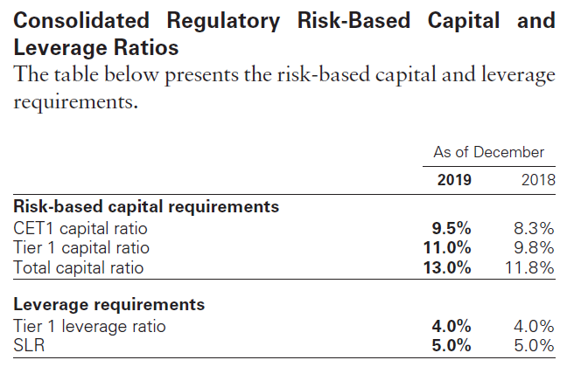

Slide 50
Insolvency of an Insured Depository Institution
Transfer the depository institution's assets and liabilities to a new obligor
Enforce the terms of the depository institution's contracts
Repudiation of any contracts to which the institution is a Party
Resolution plan: submitted to the regulators on June 29, 2012, which established GS bank USA is protected from risks

Slide 51
Broker-Dealer and Securities Regulation
It is required to maintain orderly markets in the securities assigned
According to the Dodd-Frank Act, any person who organizes an asset-backed security transaction to retain a portion of any credit risk that the person conveys with a third party

Slide 52
Swap, Derivatives and Commodities Regulations
Subject to regulation of us commodity exchange act
The Dodd-frank act provides increased regulation, imposing the following requirements:
Real time public and regulatory reporting of trade information for swaps Registration of swap dealers
Position limits the cap exposure to derivatives on certain physical commodities
Mandated clearing through central counterparties for certain swaps
New business conduct standards for swap dealers
Margin requirements for trades that are not cleared
Entity level capital requirements for swap dealers

Slide 53
Brexit and Future Regulations
GS expects considerable change in the regulatory framework that will govern transactions and business undertaken by their U.K. subsidiaries.
Withdrawal agreement- became effective on January 31, 2020 when the U.K. ceased to be an E.U. member state.
After the end of the transition period, the U.K. will not be required to continue to apply E.U. financial services legislation and may not adopt rules that correspond to E.U. legislation not already operative in the U.K.

Slide 54
Other Regulations
Some examples...
Insurance subsidiaries: subject to state insurance regulation in the states in which they are domiciled
Investment management: subject to significant regulation in numerous jurisdictions around the world

Slide 55
Risk Management

Slide 56
Components of Risk Management
Governance: review and approve by the board, followed by a risk-oriented committees run by senior managers. This structure provides the protocol for decision-making.
Processes: discipline the inventory to current market level to provide transparency. Apply a framework of limits to control risk. Using active management to ensure high quality information.
People: by proper training and rewarding experienced professionals to ensure their high risk management and reputational performance.
risk identification and assessment
risk appetite, limit and threshold setting
risk reporting and monitoring
risk decision-making

Slide 57
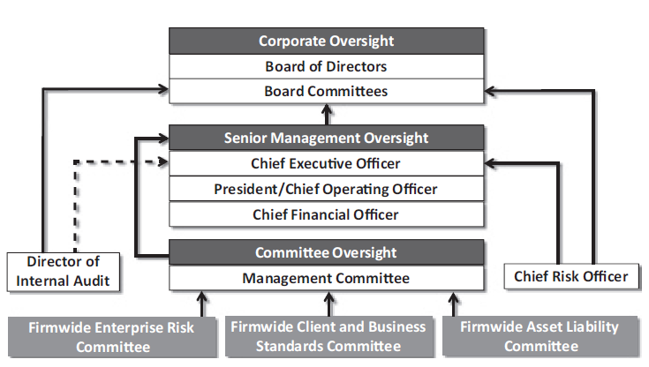
Structure of Risk Management

Slide 58
Risk Management Governance Structure
1. Start with the Risk Committee to oversee the risk management policy and practice implemented through the enterprise risk management framework.
The Board Risk Committee is also responsible for the annual review and approval of risk appetite statement
The risk appetite describes the level and and types of risk, which are willing to accept or avoid.
2. Independent risk oversight and control function by management team are second line of defense.
Include Compliance, Enterprise Risk, Legal, Liquidity Risk, Market Risk, Model Risk, Operational Risk and Tax
3. The third lane of defense is Internal Audit, which is accountable to the Audit Committee of the Board.
Internal Audit is responsible for the independently assessing and validating the effectiveness of key controls.
Providing timely reporting to the Audit Committee, senior management and regulators.

Slide 59
Risk Factors
Goldman Sachs may have been and may continue to be adversely affected by conditions in the global financial markets and economic conditions
Clients are subject to extensive and pervasive regulation around the world
GS may be adversely affected by declining asset values, especially for those businesses in which the company has net long positions, or in businesses where Goldman Sachs receives fees based on value of assets manage
Goldman Sachs may be adversely affected by disruptions in the credit markets, including reduced access to credit and higher costs of servicing debt
Market-making activities may have been and may be affected by changes in levels of market volatility
May be adversely affected by market uncertainty or lack of confidence among investors and CEOs due to general declines in economic activity and other unfavorable market conditions
The poor investment performance of investment products or a client preference may affected asset management and wealth management businesses

Slide 60
Risk Factors
GS may incur losses as a result of ineffective risk management processes and strategies.
Liquidity and profitability may be adversely affected by inability to access debt capital markets or to sell assets by a reduction in credit ratings or an increase in credit spreads
GS faces enhanced risks as new business initiatives and acquisitions lead us to engage in new activities, transact with a broader array of clients and counterparties and expose us to new asset classes and new markets.
Failure in operational systems or infrastructure, including human error, could impair our liquidity or disrupt business practices, which may ultimately impact the bank’s reputation
Failure to safeguard digital assets and information could impair ability to conduct business and result in the theft or destruction of private IP
Brexit may affect the businesses, profitability and liquidity.
Deterioration in the credit quality of, or defaults by, third parties who owe the money, securities or other assets or whose securities or obligations GS hold may affect GS.
Concentration of risk increases the potential for more significant losses in market-making, underwriting, investing, and lending activities

Slide 61
Risk Factors
The financial services industry is both highly competitive and interrelated.
A failure to appropriately identify and address potential conflicts of interest could adversely affect our businesses.
Derivative transactions and delayed settlements may expose us to unexpected risk and potential losses.
May be adversely affected by changes in or the discontinuance of Interbank Offered Rates (IBORs), in particular LIBOR, or changes in other reference rates, currencies, indexes, baskets or ETFs
Inability to hire and retain qualified employees may adversely impact the business
Increased governmental and regulatory scrutiny or negative publicity adversely affect the business.
Substantial civil or criminal liability or significant regulatory action could have material adverse financial effects or cause significant reputational harm

Slide 62
Risk Factors
Group Inc. is dependent for liquidity on payments from its subsidiaries; the application of regulatory strategies and requirements in the U.S. and non-U.S. jurisdictions to facilitate the orderly resolution of large financial institutions could create greater risk of loss for Group Inc.’s security holders.
The growth of electronic trading and the introduction of new trading technology may adversely affect business and may increase competition.
GS is subject to different political, economic, legal, operational and other risks that are inherent in operating in many countries.
Commodities activities, particularly our physical commodities activities, subject to extensive regulation and involve certain potential risks
Unforeseen catastrophic events or climate changes, including natural disasters, acts of terrorism, and extreme weather events could harm business

Slide 63

Major Risk Factors
Market risk
Operational risk
Liquidity risk
Credit risk
Model risk

Slide 64
GS – Market Risk

Slide 65
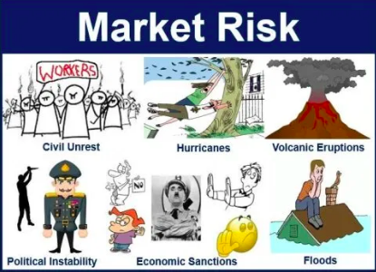
Market Risk
Definition:
Market risk is the possibility of an investor experiencing losses due to factors that affect the overall performance of the financial markets in which he or she is involved.
Sources of market risk include recessions, political turmoil, changes in interest rates, natural disasters and terrorist attacks. Systematic, or market risk tends to influence the entire market at the same time.

Slide 66
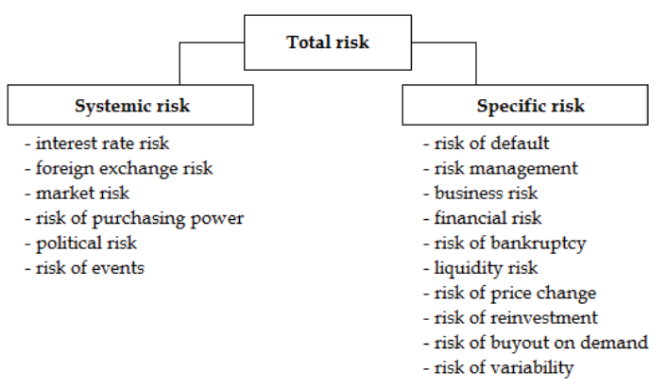
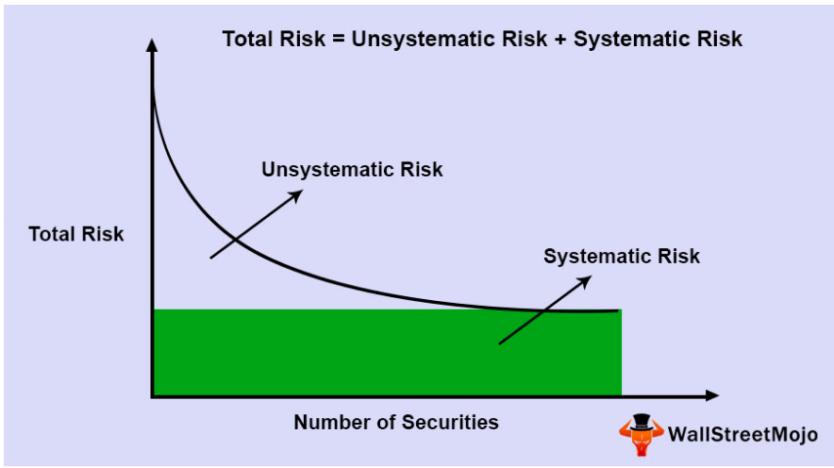
Market Risk
Definition:
Market risk, also called "systematic risk," cannot be eliminated through diversification, though it can be hedged against in other ways.

Slide 67
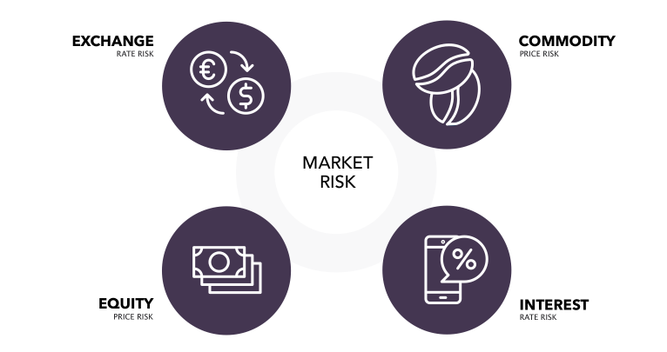
Market Risk - Sources
Interest rate risk: results from exposures to changes in the level, slope and curvature of yield curves, the volatilities of interest rates, prepayment speeds and credit spreads;
Equity price risk: results from exposures to changes in prices and volatilities of individual equities, baskets of equities and equity indices;
Currency rate risk: results from exposures to changes in spot prices, forward prices and volatilities of currency rates;
Commodity price risk: results from exposures to changes in spot prices, forward prices and volatilities of commodities, such as crude oil, petroleum products, natural gas, electricity, and precious and base metals.
Market risk depends on the type of security being traded, as well as the geographical boundaries of the trade.

Slide 68
Market Risk Management Process
Monitoring compliance with established market risk limits and reporting our exposures
Diversifying exposures
Controlling position sizes
Evaluating mitigants, such as economic hedges in related securities or derivatives.

Slide 69
Market Risk - Measurement Tool
VaR (Value at Risk)
VaR modeling is a statistical risk management method that quantifies a stock or portfolio's potential loss as well as the probability of that potential loss occurring.
Assumption:
1. Stationarity. A 1% fluctuation in returns is equally likely to occur at any point in time.
2. Random walk of intertemporal unpredictability. Day-to-day fluctuations in returns are independent.
3. Nonnegativity. Financial assets with limited liability cannot attain negative values.
4. Time consistency. All single-period assumptions hold over the multiperiod time horizon.
5. Distributional. Daily return fluctuations follow a normal distribution with a mean of zero and a standard deviation of 100 bp

Slide 70
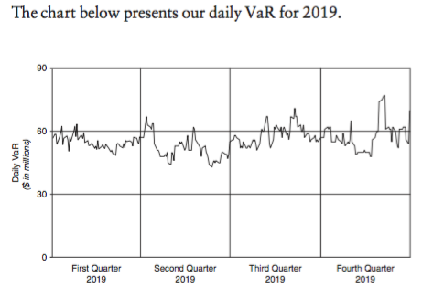
GS daily VaR for 2019:
Market Risk - Measurement Tool
VaR (Value at Risk)
Eg. if a portfolio of stocks has a one-day 5% VaR of $1 million, that means that there is a 0.05 probability that the portfolio will fall in value by more than $1 million over a one-day period if there is no trading. Informally, a loss of $1 million or more on this portfolio is expected on 1 day out of 20 days (because of 5% probability).More formally, p VaR is defined such that the probability of a loss greater than VaR is (at most) p while the probability of a loss less than VaR is (at least) 1−p. A loss which exceeds the VaR threshold is termed a "VaR breach".

Slide 71
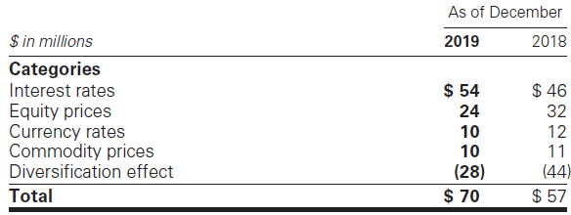
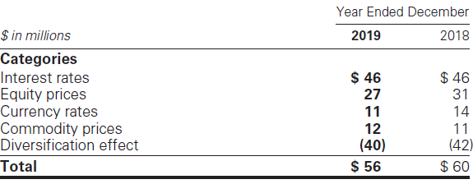
Market Risk - Measurement Tool
VaR (Value at Risk)
GS’s average daily VaR:
GS’s average daily VaR decreased to $56 million in 2019 from $60 million in 2018, primarily due to decreases in the equity prices and currency rates categories, partially offset by a decrease in the diversification effect. The overall decrease was primarily due to reduced exposures.
GS’s period- end VaR:
GS’s period-end VaR:
GS’s period-end VaR increased to $70 million as of December 2019 from $57 million as of December 2018, primarily due to a decrease in the diversification effect and an increase in the interest rates category, partially offset by decreases in the equity prices and currency rates categories. The overall increase was due to higher levels of volatility and increased exposures.

Slide 72
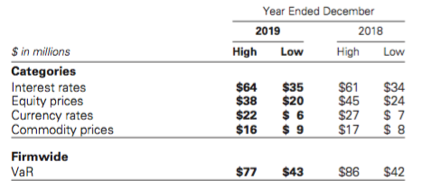
Market Risk - Measurement Tool
VaR (Value at Risk)
GS’s high and low VaR:
During 2019 and 2018, the firmwide VaR risk limit was not exceeded, raised or reduced.

Slide 73
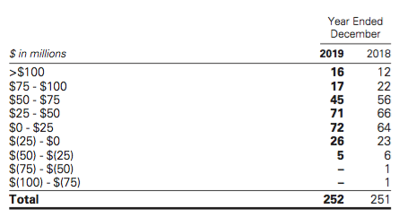
Market Risk - Measurement Tool
VaR (Value at Risk)
The table below presents, by number of business days, the frequency distribution of GS daily net revenues for positions included in VaR:

Slide 74
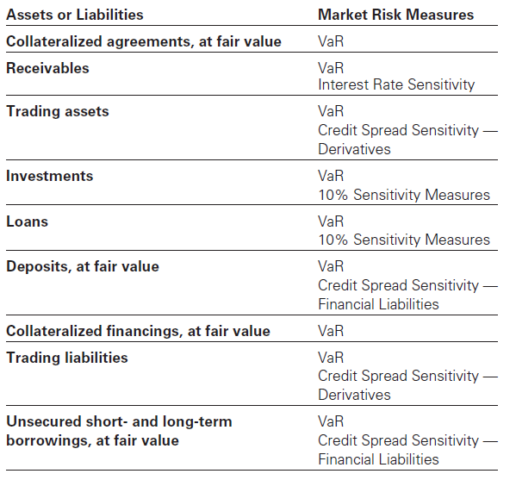
Measurement Tool & Balance Sheet

Slide 75
Limits of VaR:
VaR does not estimate potential losses over longer time horizons where moves may be extreme;
VaR does not take account of the relative liquidity of different risk positions;
Previous moves in market risk factors may not produce accurate predictions of all future market moves.

Slide 76
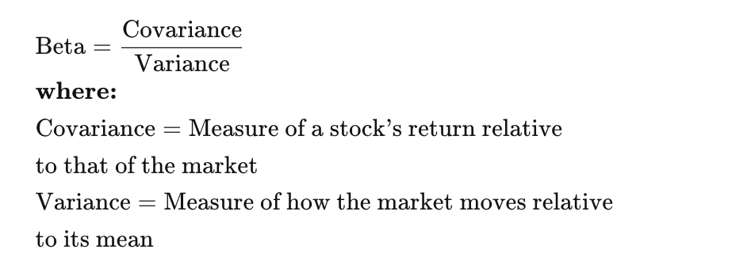
Market Risk - Measurement Tool
2. Beta
Beta is another relevant risk metric, as it measures the volatility or market risk of a security or portfolio in comparison to the market as a whole; it is used in the capital asset pricing model (CAPM) to calculate the expected return of an asset.

Slide 77
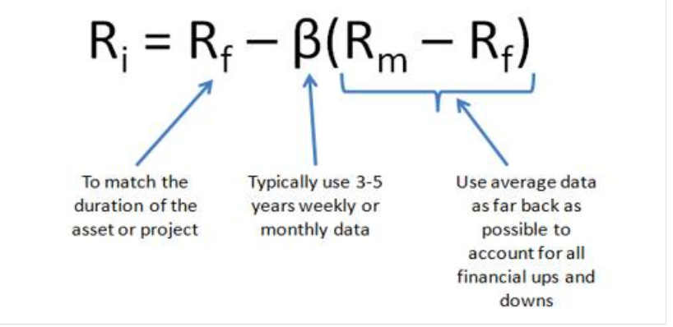
Market Risk - Measurement Tool
2. Beta Continues...
*Note: in CAPM model, a high beta means the stock price is more sensitive to news and information, and will move faster than a stock with low beta. In general, high beta means high risk, but also offers the possibility of high returns if the stock turns out to be a good investment.

Slide 78
Market Risk - Measurement Tool
Other Measurements (rarely use than VaR):
*Certain portfolios and individual positions are not included in VaR because VaR is not the most appropriate risk measure.
Covariance
Correlation
Stress Testing
Designed to ensure a comprehensive analysis of our vulnerabilities and idiosyncratic risks combining financial and nonfinancial risks
Including, but not limited to, market, credit, liquidity and funding, operational and compliance, strategic, systemic and emerging risks into a single combined scenario
Sensitivity analysis
10% sensitivity measure
Credit spread sensitivity on derivatives and financial liabilities
Interest rate sensitivity
Scenario analysis
Comprehensive Capital Analysis and Review (CCAR)
Dodd-Frank Act Stress Tests (DFAST)

Slide 79
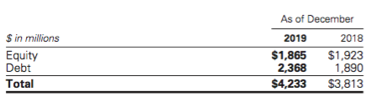
Market Risk - Measurement Tool
Sensitivity analysis - 10% sensitivity measures
The table below presents GS market risk by asset category for positions accounted for at fair value, that are not included in VaR.:
*The market risk of these positions is determined by estimating the potential reduction in net revenues of a 10% decline in the value of these positions.

Slide 80
GS - Operational Risk

Slide 81
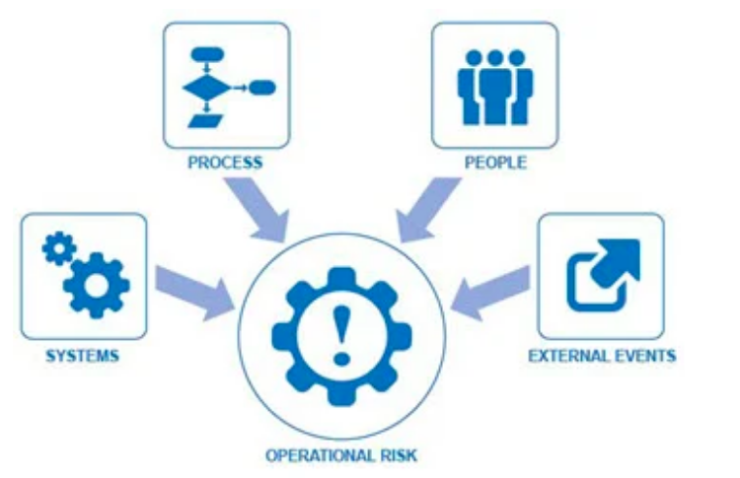
Operational Risk
Overview:
Operational risk is the risk of an adverse outcome resulting from inadequate or failed internal processes, people, systems or from external events. GS exposure to operational risk arises from routine processing errors, as well as extraordinary incidents, such as major systems failures or legal and regulatory matters.

Slide 82
Operational Risk
Potential types of loss events related to internal and external operational risk include:
Clients,products and business practices;
Execution,delivery and process management;
Business disruption and system failures
Employment practices and workplace safety;
Damage to physical assets;
Internal fraud
External fraud.

Slide 83
Operational Risk Measurement
GS measure their operational risk exposure using both statistical modeling and scenario analyses, which involve qualitative and quantitative assessments of internal and external operational risk event data and internal control factors for each of their businesses. Operational risk measurement also incorporates an assessment of business environment factors, including:
Evaluations of the complexity of business activities;
Degree of automation in processes;
New activity information;
Legal and regulatory environment;
Changes in the markets for products and services,
Diversity and sophistication of customers and counterparties.

Slide 84
Operational Risk Management Process
Combine top-down and bottom-up approaches to manage and measure operational risk.
Maintain a comprehensive control framework designed to provide a well-controlled environment to minimize operational risks.
Establish policies that require all employees to report and escalate operational risk events.
Use operational risk management applications to capture and organize operational risk event data and key metrics.

Slide 85
Operational Risk Management
- According to Types of Operational Risks
Information and Cyber Security Risk.
minimize the occurrence and impact of unauthorized access, disruption or use of information and/or information systems.
Third Party Risk
identify, manage and report key third-party risks and conduct due diligence across multiple risk domains, including information security and cyber security, resilience and additional third- party dependencies.
Business Resilience Risk.
monitor threats and assess risks and seek to ensure our state of readiness in the event of a significant operational disruption to the normal operations of our critical functions or their dependencies, such as, critical facilities, systems, third parties, data and/or personnel.

Slide 86
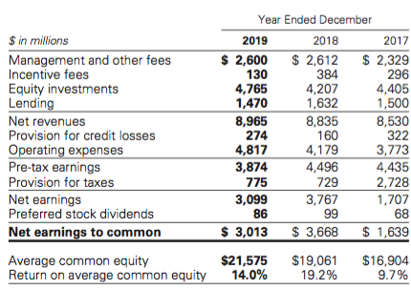
The table below presents the operating results of GS Asset Management segment:

Slide 87
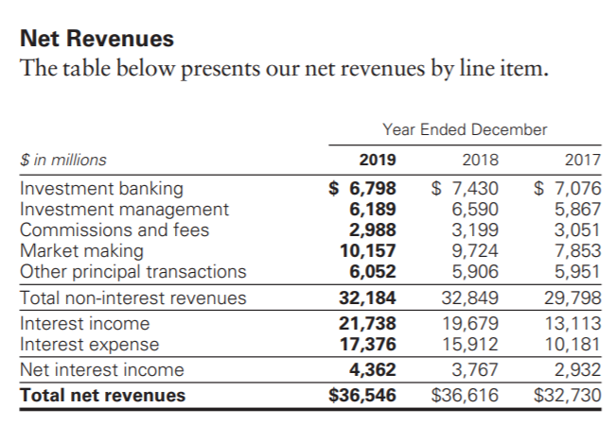

Slide 88
GS - Liquidity Risk

Slide 89
Liquidity Risk Management
Liquidity risk is the risk that will be unable to fund the firm or meet the liquidity needs in the event of firm-specific, broader industry or market liquidity stress events.
The objective of liquidity risk management is to be able to offer fund and to enable core businesses to continue to serve clients and generate revenues, even under adverse circumstances.
GS’s liquidity risk management is independent of revenue producing units and Treasury, and reports to the chief risk officer.

Slide 90
Liquidity Risk Management Principles
Hold sufficient excess liquidity in the form of GCLA to cover outflows during a stressed period
Maintain appropriate Asset-Liability Management
Maintain a viable Contingency Funding Plan

Slide 91
Liquidity Risk Management - GCLA
GCLA is the liquidity maintained to meet a broad range of potential cash outflows and collateral needs in a stressed environment
A primary principle is to pre-fund the estimated potential cash and collateral needs during a liquidity crisis and hold this liquidity in the form of unencumbered, highly liquid securities and cash
Potential hazards: During a liquidity crisis, credit-sensitive funding may change and certain deposits may be withdrawn. To mitigate the risk, GS pre-fund the liquidity that larger than the businesses would otherwise require including unencumbered securities and funding.

Slide 92
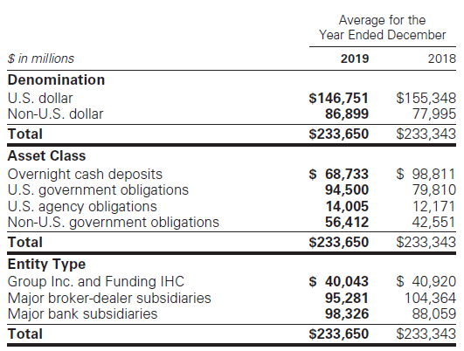
Liquidity Risk Management - GCLA

Slide 93
Liquidity Risk Management - Asset-Liability Management
The goal is to maintain sufficient liquidity to fund assets and meet contractual and contingent obligations.
To manage the overall funding book conservatively and to focus on long-term diversified sources of funding;
To actively manage and monitor the asset base, focusing on liquidity;
To raise secured or unsecured financing with longer tenure than the liquidity profile of assets.

Slide 94
Liquidity Risk Management - Contingency Funding Plan
Aim to provide framework for analyzing liquidity risks and responding market stress:
Outline a list of risk factors, key reports and metrics
Describe details of responses in potential risk crisis
Identifies key groups of individuals to foster effective coordination control and distribution of information

Slide 95
Liquidity Risk Management - Stress Test
Modeled Liquidity Outflow:
Capture and quantifies liquidity risk over a 30-days scenario
Conduct multiple scenarios that include market-wide and firm-wide specific stress
Intraday Liquidity Model:
Access the risk of increased intraday liquidity requirement when access to sources of intraday may become constrained
Long-term Stress Testing:
Take a forward view on liquidity position through prolong

Slide 96
Liquidity Risk Management - Stress Test
Ensure conservative asset-liability management to prepare for a prolonged period of potential stress, maintain a diversified funding profile
Resolution Liquidity Model:
Establish Resolution Liquidity Adequacy and Positioning framework to estimate liquidity needs of major subsidiaries
Establish Resolution Liquidity Execution Need framework to stabilize and wind-down following a Group Inc. bankruptcy filing
Establish a triggers and alerts framework to provide the Board with information to make a decision on commence bankruptcy
Limits: measure relative to acceptable levels of risk given liquidity risk tolerance.

Slide 97
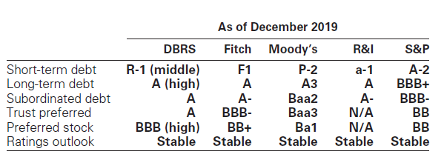
Liquidity Risk Management - Credit Rating
To fund a significant portion of GS’s day-to-day operations relies on the short- and long-term debt capital markets, and the debt financing is influenced by credit ratings.
GS manages GCLA to ensure to make the additional collateral or termination payments that may be required in the event of a two-notch reduction in the long-term credit ratings, as well as collateral that has not been called by counterparties, but is available to them.

Slide 98
GS - Credit Risk

Slide 99
Source of Credit Risk
OTC derivatives
Loans and lending commitments
Securities financing transactions (e.g. resale and repurchase agreements and securities borrowing and lending activities.)
Cash and cash equivalents.

Slide 100
Measuring Credit Risk
The measure of credit risk based on the potential loss in the event of non-payment by a counterparty using current and potential exposure.
Potential Exposure to credit risk
Estimate credit exposure within a given confidence level, during the life of the transaction and market movement
Changes in Credit Spread (VaR)
Scenario analysis / Stress Test
Applying shocks to counterparty credit ratings or credit risk factors.

Slide 101
Mitigating Credit Risk
To Reduce credit exposures on derivatives and securities financing transactions:
Enter into netting agreements with counterparties that allow to offset receivables and payables
Obtain collateral or contingent basis
Ability to terminate transactions if counterparty credit rating falls below a specified level

Slide 102
Mitigating Credit Risk continue...
For loans and lending commitments
Obtain upfront or contingent collaterals
Have 3rd party as guarantor for the counterparties’ obligations
Transfer credit risk through hedging with available derivatives
Covenants/ Guarantees
For cash and cash equivalent
All deposits with highly rated banks and central banks
For OTC Derivatives
Enter into OTC derivatives transactions under bilateral collateral arrangements that require the daily exchange of collateral.
GS includes a credit value adjustment (CVA) in the fair value of derivatives to reflect the counterparty credit risk.
CVA is a function of the present value of expected exposure, the probability of the counterparty default and the assumed recovery upon default.

Slide 103
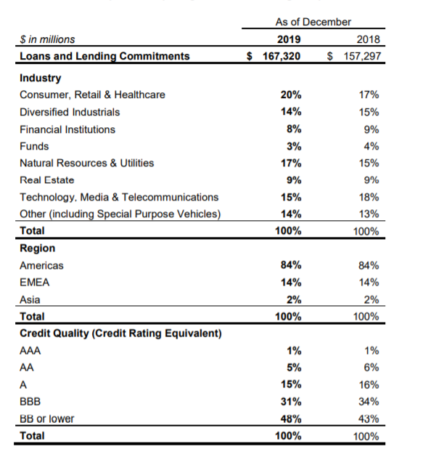
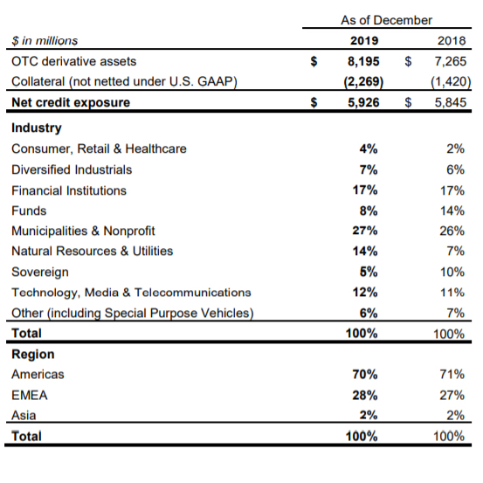
Table represents GS credit exposure from commercial loans and lending commitment and the concentration by industry and credit quality.
The table below presents GS credit exposure from OTC derivatives and the concentration by industry and region.

Slide 104
GS - Model Risk

Slide 105
Model Risk Management
Model risk is the potential for adverse consequences from decisions made based on model outputs that may be incorrect or used inappropriately
Managed through a governance structure and risk management controls
The Firmwide Model Risk Control Committee oversees the model risk management framework.

Slide 106
Model Risk Management Process
The model’s conceptual soundness, including the reasonableness of model assumptions, and suitability for intended use;
The testing strategy utilized by the model developers to ensure that the models function as intended;
The suitability of the calculation techniques incorporated in the model;
The model’s accuracy in reflecting the characteristics of the related product and its significant risks;
The model’s consistency with models for similar products; and
The model’s sensitivity to input parameters and assumptions.

