Slide 1
LIQUOR
Simar Sandhu
Ella
Zhengyu Huang
Ernest Chan

Slide 2
AGENDA
History & Industry Overview
Industry Risk Management
ABInvBev
Daigeo Inc
Molson Coors

Slide 3
HISTORY - Production
Was first discovered in 7000 – 6600 BCE from Jiahu, a Neolithic village in the Yellow River Valley in China. Was mostly absorbed and preserved in pottery jars. It was discovered accidently by fermenting rice, honey and hawthorn fruit/grape by chemical analysists. These were flavored with herbs, flowers and resins.
Followed by resinated wine discovered in Iran through tartaric acid in ceramic vessels
By the 4th Millennium BCE, wine and beer was produced in many locations in Mesopotamia, Assyria and Anatolia.
In 3400 – 2500 BCE, the Hierakonpolis in Egypt had a large number of barley and wheat-based brewery installations.

Slide 4
INDUSTRY TRENDS
Increase in low – ABV drinks in 2022. There is a shift from heavy drinking to drinks that have low alcoholic content or no alcohol content at all. Sales increased 33% in 2022 and will expand by 35% in 2023 (2022 Alcohol Trends: What Consumers are Drinking Now, 2021).
Cock-tails to go – During the pandemic, many retailers and restaurants offered this service to ensure sales were not harmed. This trend picked up and will continue as it promotes sustainability (2022 Alcohol Trends: What Consumers are Drinking Now, 2021).
Alcohol delivery drives sales – Due to the pandemic, delivery sales for alcohol significantly increased because of the convenience and restaurants have seen an increase in profit margins ((2022 Alcohol Trends: What Consumers are Drinking Now, 2021).
Notes:
https://get.doordash.com/en-ca/blog/alcohol-trends

Slide 5
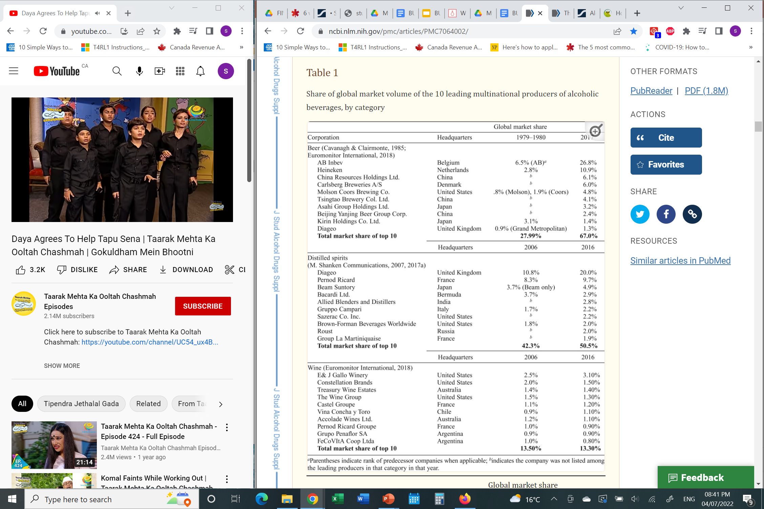
TOP PRODUCERS IN THE INDUSTRY
Notes:
Jernigan, D. & Ross, C.S. (March 2020). The Alcohol Marketing Landscape: Alcohol Industry Size, Structure, Strategies, and Public Health Responses. National Library of Medicine. Retrieved from:
https://www.ncbi.nlm.nih.gov/pmc/articles/PMC7064002/

Slide 6
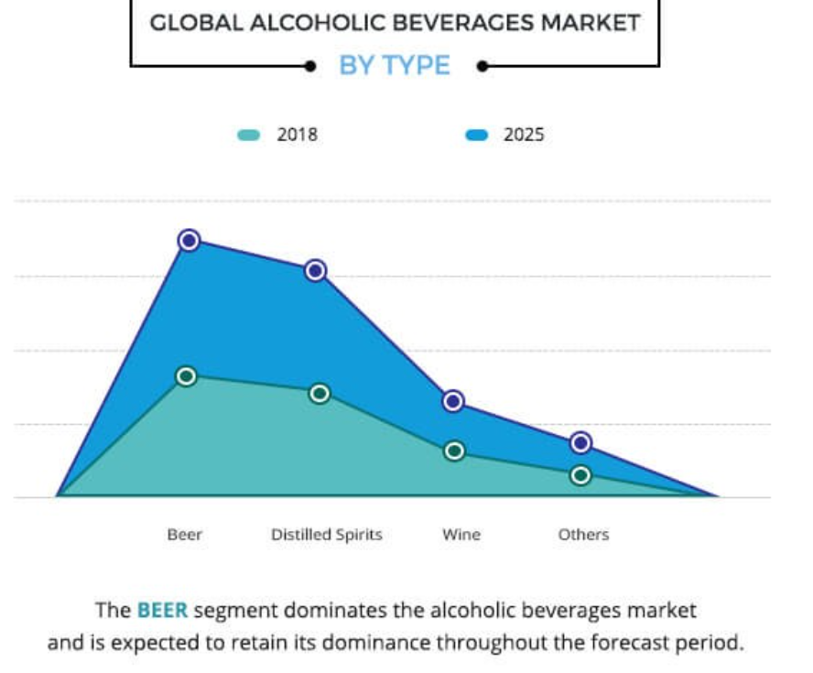
TYPES OF LIQUOR
Beer
Distilled Spirits
Wine
Other liquors

Slide 7
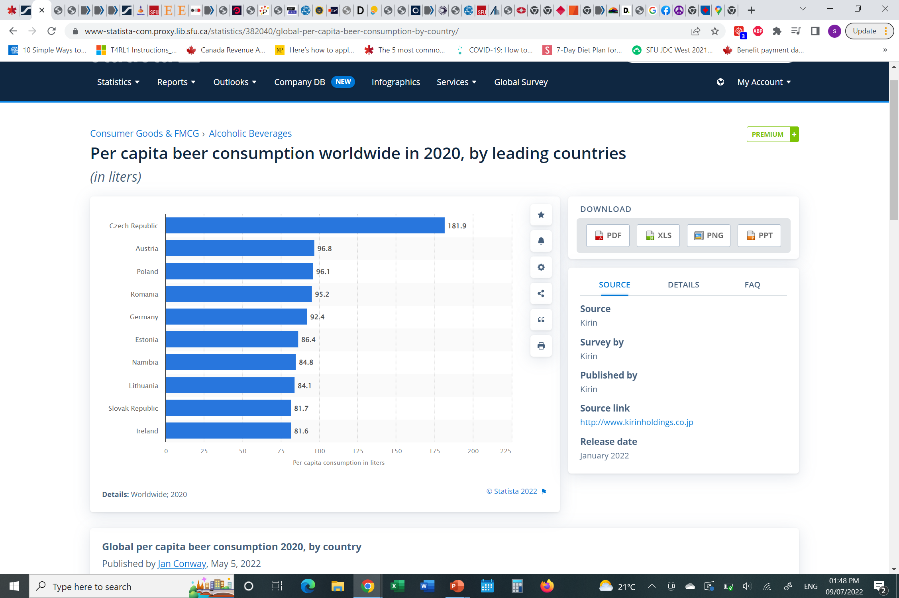
Beer Production
Produced using extraction of raw materials with water and is boiled with hops and fermented. Raw materials can be malt, yeast along with hops.
Before 6000 BCE, beer was made from barley in Sumer and Babylonia. Barley was crushed, mixed with water and later dried in cakes. This process provided an extract that was fermented by microorganisms that appeared on surfaces of the vessels (Young, 2021).
The brewing process involves malting, milling, mashing, extraction, separation, hop addition and boiling, removal of hops and precipitation, cooling and aeration, fermentation, separation from yeast from young beer, aging, maturing and packaging.
The main purpose of the process is to convert grain starches to sugar, extract it with water and then ferment it with yeast to produce the alcoholic carbonated beverage.
Notes:
https://www.britannica.com/topic/beer

Slide 8
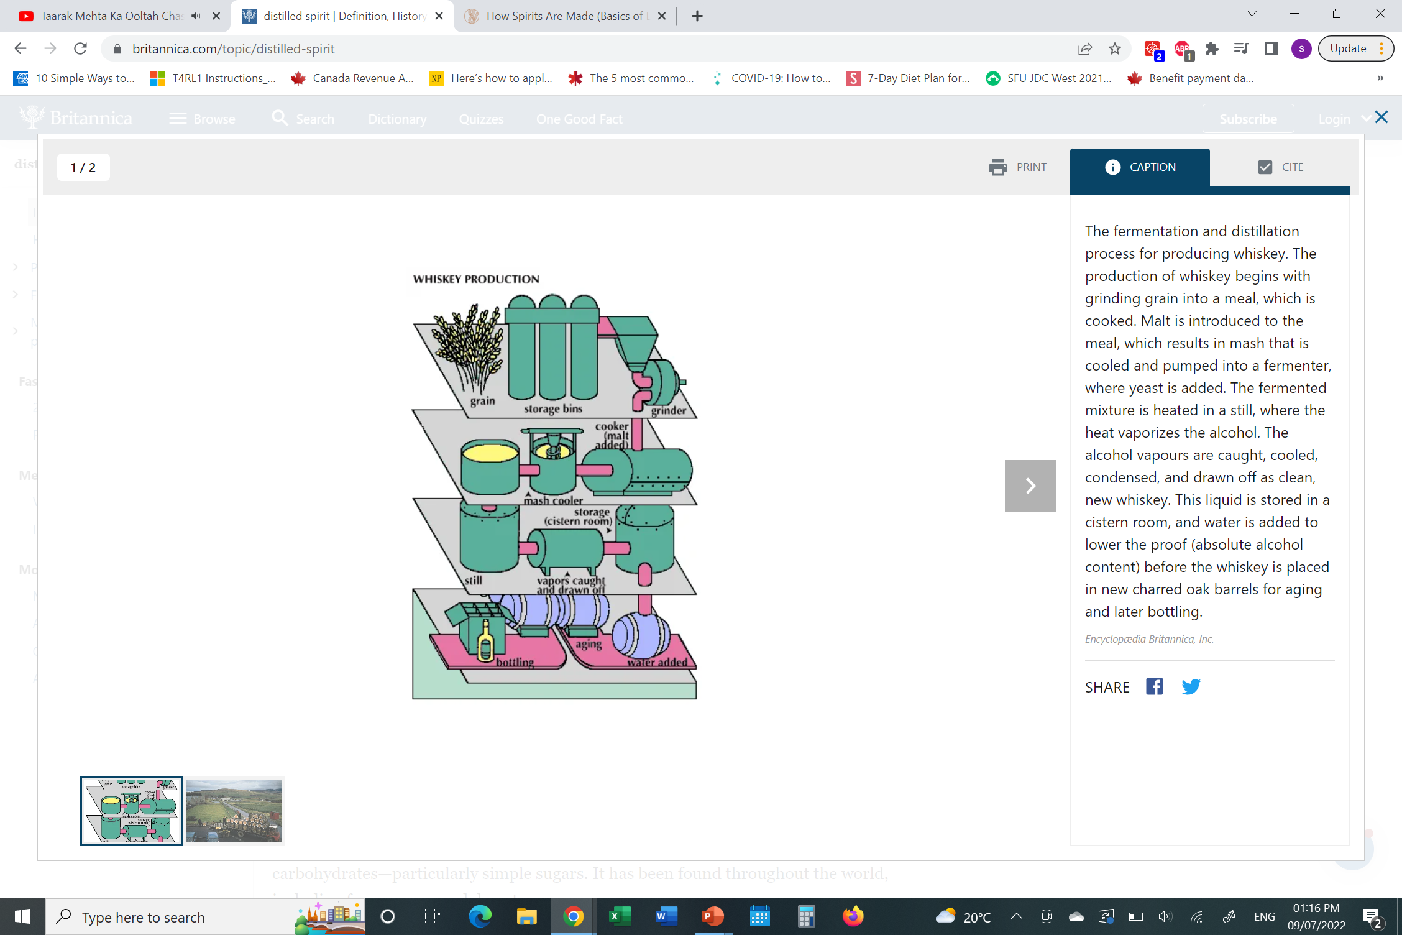
Distilled Spirit Production
Obtained by distillation from wine or other fermented fruit or plant juice or from starchy materials (grains) that has first been brewed. The alcoholic content of liquor is higher than beer and wine.
It is produced using fermentation and occurs when two necessary ingredients; yeast and carbohydrates are available. The carbohydrates can be simple sugars.
The alcoholic distillation is based upon the different boiling points of alcohol. If ethyl alcohol is heated to temperatures above 78 and below 100 then the alcoholic content is higher.
By 800 BCE, the Chinese distilled spirits from rice beer and East Indies used sugarcane and rice. The first distilled spirit was made from sugar-based materials like grapes and honey to make brandy and mead.
The process involves producing the mash from raw materials, sugary materials and starchy materials. After the mash is produced, the mash is milled and pressed and finally mashed in a vessel. Once mashing is complete the yeast is fermented to produce ethyl alcohol. Distillation can be done through a pot still, continuous still or rectification still.
The last process is maturation, blending and packaging.
Examples of Distilled Spirit production are Rum, Vodka, Gin, Whiskey and many more.
Notes:
https://spiritofyork.com/how-spirits-are-made/#
https://www.britannica.com/topic/distilled-spirit

Slide 9
RAW MATERIALS USED FOR PRODUCTION
BEER | DISTILLED SPIRITS
Grains – Corn, Rye, Wheat | Natural sugars – Grapes, apples, peaches, sugarcane, sugar beets, etc.
Hops | Sprouting Grains – Barley, Corn, Rye, Rice, Wheat
Water | Yeast
Yeast | Ethyl Alcohol
Malt (Kiln-dried germinated Barley) | In some cases, Potatoes

Slide 10
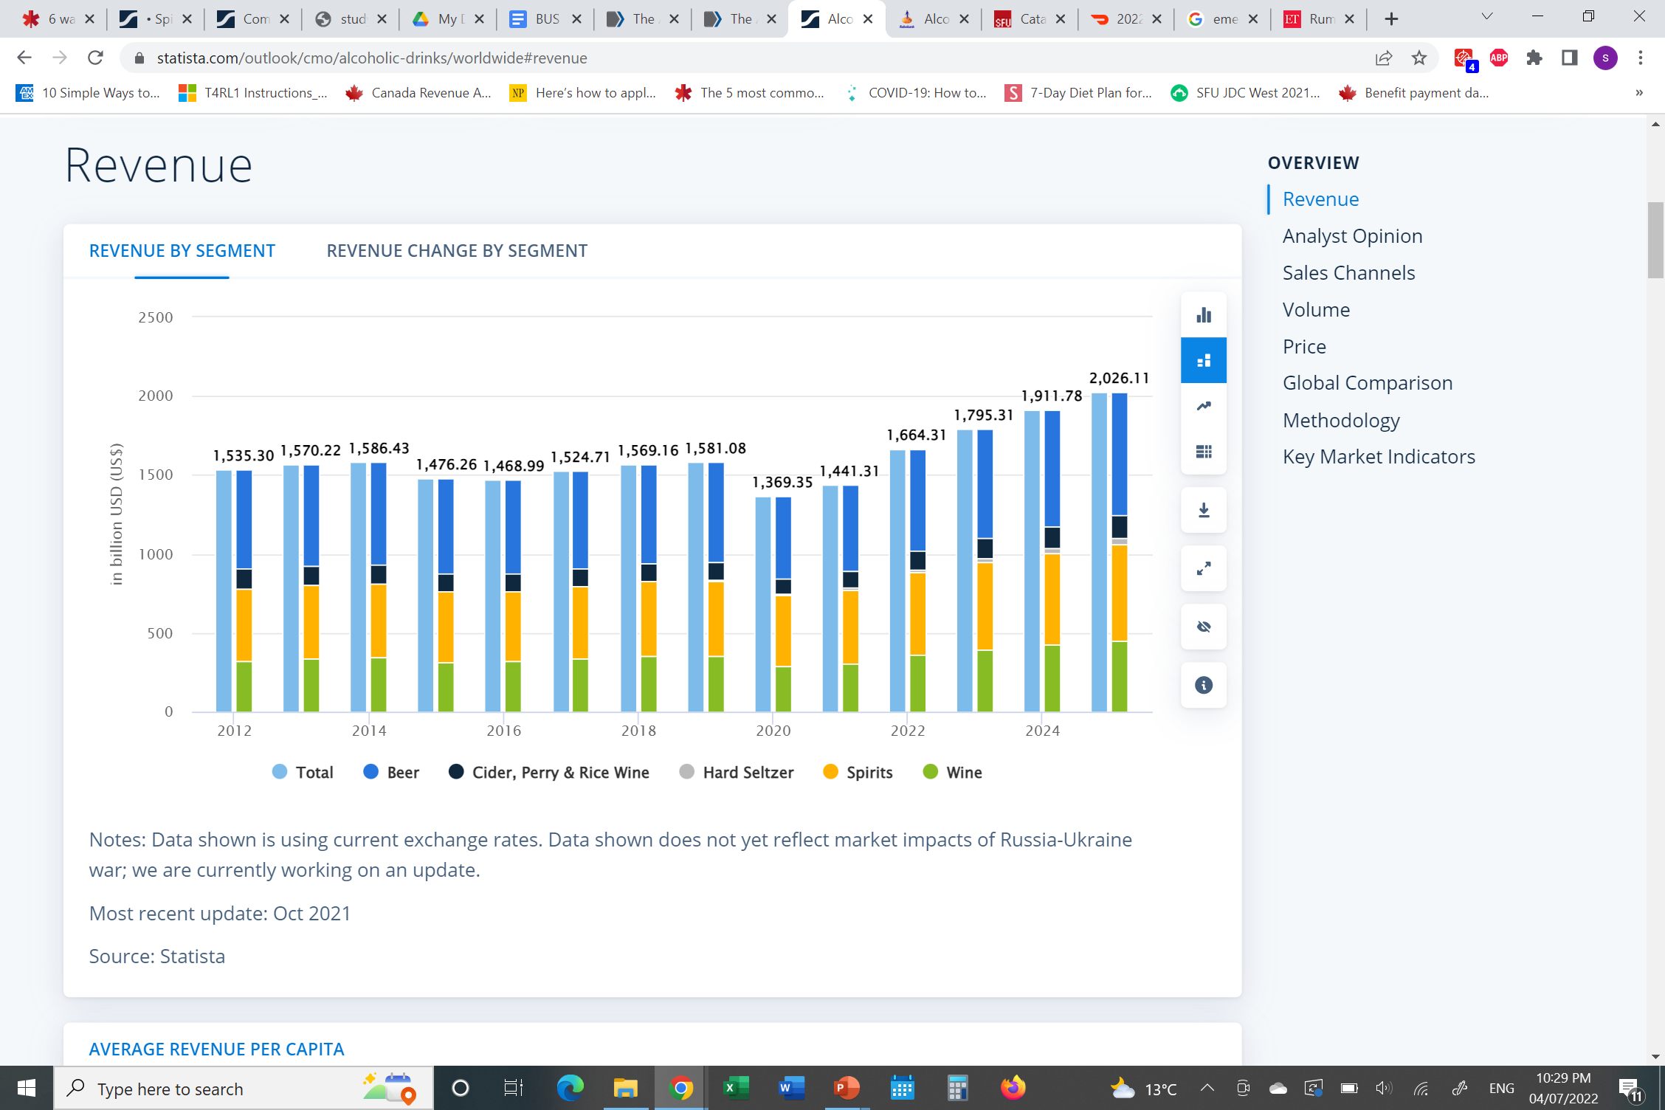
WORLDWIDE PRODUCT REVENUE
Notes:
https://www.statista.com/outlook/cmo/alcoholic-drinks/worldwide

Slide 11
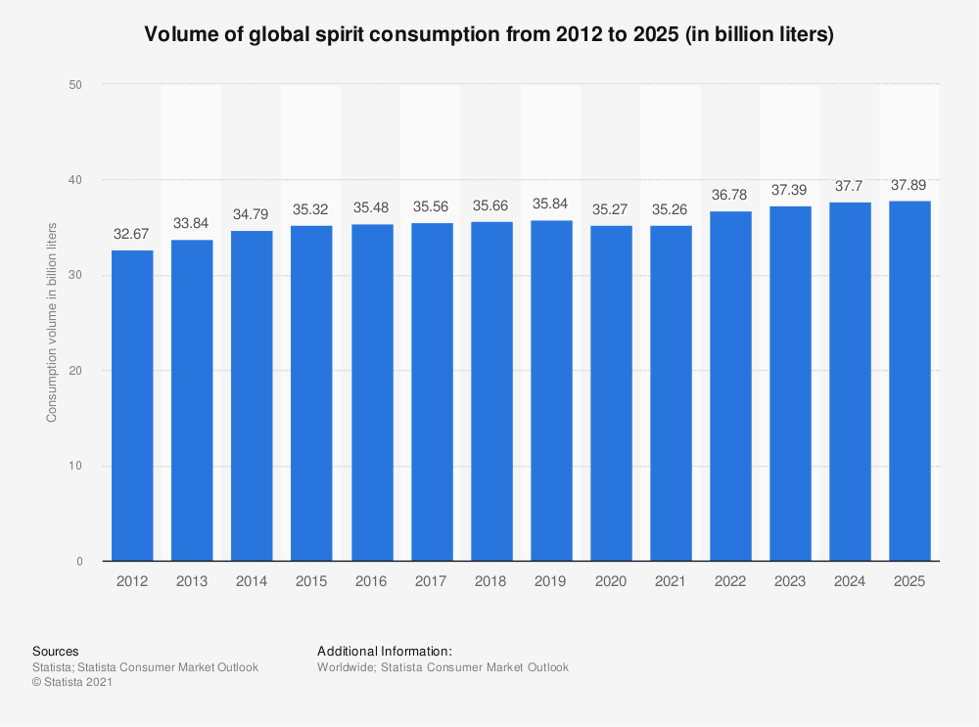
WORLDWIDE CONSUMPTION OF SPIRITS

Slide 12
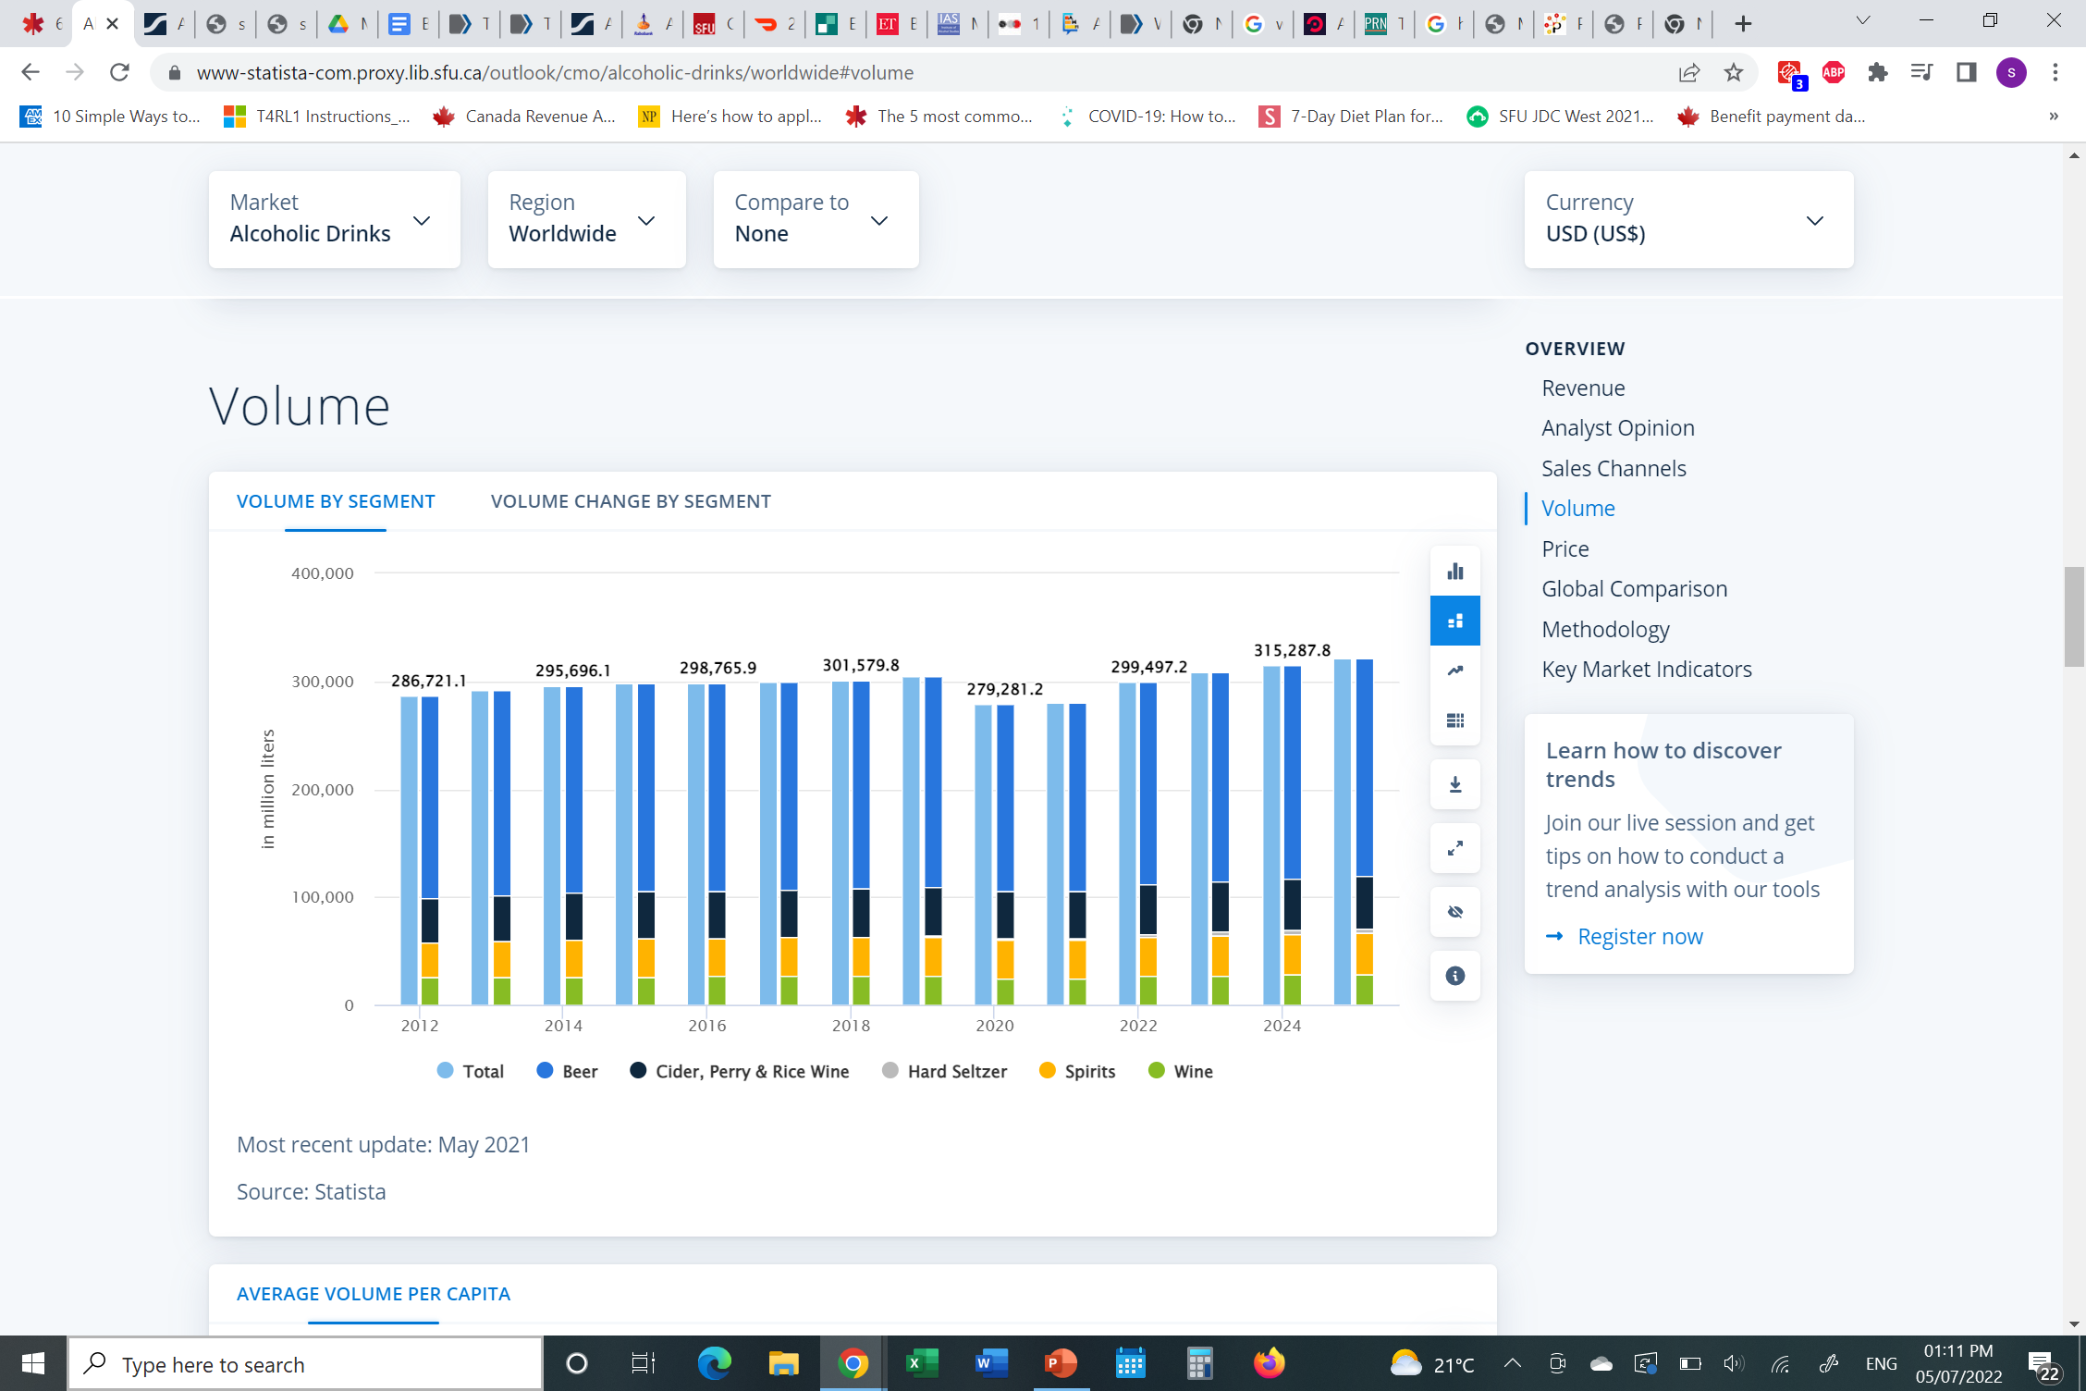
VOLUME
Notes:
https://www-statista-com.proxy.lib.sfu.ca/outlook/cmo/alcoholic-drinks/worldwide#volume

Slide 13
SALES GROWTH
During COVID-19, sale of liquor has dropped significantly due to the closure of many bars, restaurants and other gathering spots.
According to the Brewers Association the sales volume was down -9% in 2020 (Lindenberger, 2022). However, during 2021 the sales jumped up as 24.5 million barrels were produced and led to a 7.9% growth in volume. This led increase outpaced the entire American crafts beer market growth.
Notes:
https://www.ncbi.nlm.nih.gov/books/NBK531660/
https://www.forbes.com/sites/hudsonlindenberger/2022/05/25/the-craft-beer-industry-has-reason-to-celebrate-according-to-the-latest-data/?sh=1ff131902837
https://onlinelibrary-wiley-com.proxy.lib.sfu.ca/doi/full/10.1002/soej.12025

Slide 14
COST STRUCTURE
MAJOR EXPENSES | % OF TOTAL EXPENSES
MATERIAL USE (W/O ENERGY) | 32.9%
TAXES CHARGEABLE AS EXPENSE | 30.6%
TEMPORARY WORKER WAGES | 13.2%
GROSS WAGES AND SALARIES | 5.1%
USE OF COMMODITIES | 3.9%
OTHER EXPENSES (Amortizations, social costs, rents, leases, borrowing costs, energy costs, industrial and manual services) | 14.3%
Notes:
- https://www.statista.com/statistics/515891/spirits-industry-cost-structure-germany/
Took reference from German spirit industry in 2018

Slide 15
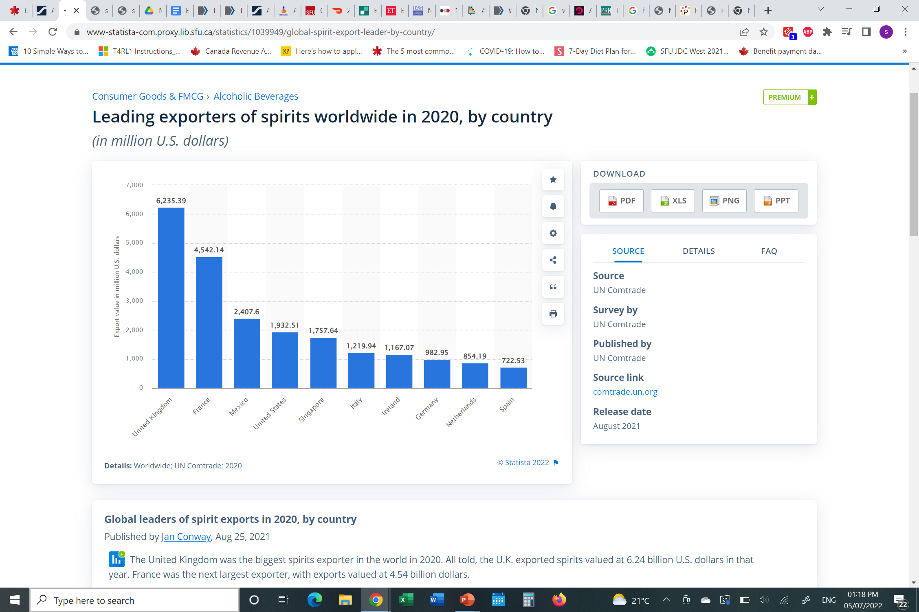
INTERNATIONAL TRADE
United Kingdom is the world leading exporter
    Exported approx. US$6 million worth of liquor (Statista, 2020)
The global alcoholic - beverages market is expected to grow from $499.74 billion in 2020 to $546.15 billion in 2021 at a compound annual growth rate (CAGR) of 9.3%. The market is expected to reach $735.83 billion in 2025 at a CAGR of 8% (Alcoholic-Beverages Global Market Report 2021: COVID-19 Impacts and Forecasts to 2030 - ResearchAndMarkets.com, 2021)
Notes:
https://www-statista-com.proxy.lib.sfu.ca/statistics/1039949/global-spirit-export-leader-by-country/

Slide 16
RISK MANAGEMENT

Slide 17
MAJOR RISKS: GENERAL BUSINESS
CLIMATE CHANGE RISKS
Physical and transition climate change risks including water stress and increased regulation, as well as inability to meet sustainability goals, could reduce revenues and profits.
IMPACT OF CLIMATE CHANGE
- These risks could also impact trust and reputation amongst consumers, investors and other stakeholders.

Slide 18
MEASURING CLIMATE CHANGE RISK
Use water stress index to measure water levels
- Evaluates total water use relative to annual available flow on a catchment level across the globe, enabling users to assess inherent water stress in a particular business location (Verisk Maplecroft).
Notes:
https://www.maplecroft.com/risk-indices/water-stress-index/

Slide 19
MANAGING CLIMATE CHANGE RISK
Use water blueprints
Designed to effect substantial, sustainable and measurable change (Diageo Water Blueprint, 2018).
Helps layout the areas that need a reduction of water use – For instance, reducing 50% water use by ensuring efficient equipment is deployed at water sources.
Develop Cross functional risk management
Developing teams in different locations to monitor change in climate change in particular areas and discuss the potential risks (Carter, 2019)
Notes:
https://www.alvarezandmarsal.com/insights/identifying-cross-functional-risk-global-environment

Slide 20
MAJOR RISKS: GENERAL BUSINESS
Commodity Risk (Price & Supply Changes)
Higher excise taxes on liquor to lower alcohol consumption. Export and import taxes on liquor increase the prices (Albers et al., 2015)
Smaller barley yields has caused an increase in prices of malted barley which is causing increased prices of liquor (CBC, 2021).
Supply chain disruptions due to the pandemic increased the prices of liquor in 2021 (Gilbert, 2021).
Notes:
https://www.ncbi.nlm.nih.gov/pmc/articles/PMC4192130/
https://www.cbc.ca/radio/costofliving/taxing-the-rich-where-has-it-happened-and-why-1.6189413/this-year-s-extreme-drought-could-mean-higher-beer-prices-1.6203372

Slide 21
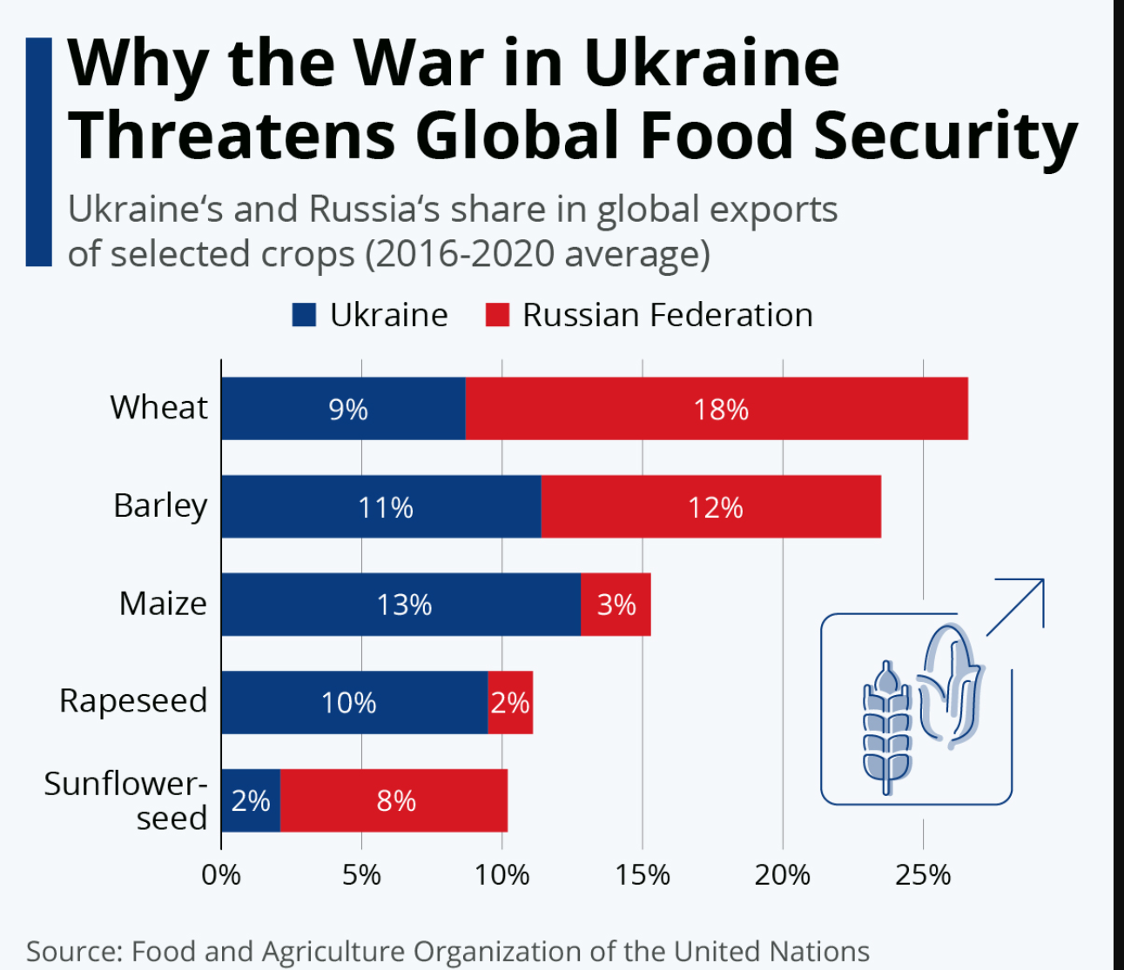
UKRAINE AND RUSSIA WAR IMPACT
Ukraine and Russia are major producers of wheat, barley and maize, accounting for an average (combined) share of 27, 23 and 15 percent of global exports between 2016 and 2020, respectively (Statista, 2022).
This has caused dramatic cost increases in its efforts to combat food emergencies around the world. This therefore heavily affects the prices that many liquor companies may pay for grains to produce liquor.
Notes:
https://www-statista-com.proxy.lib.sfu.ca/chart/27225/russian-and-ukrainian-share-of-global-crop-exports/

Slide 22
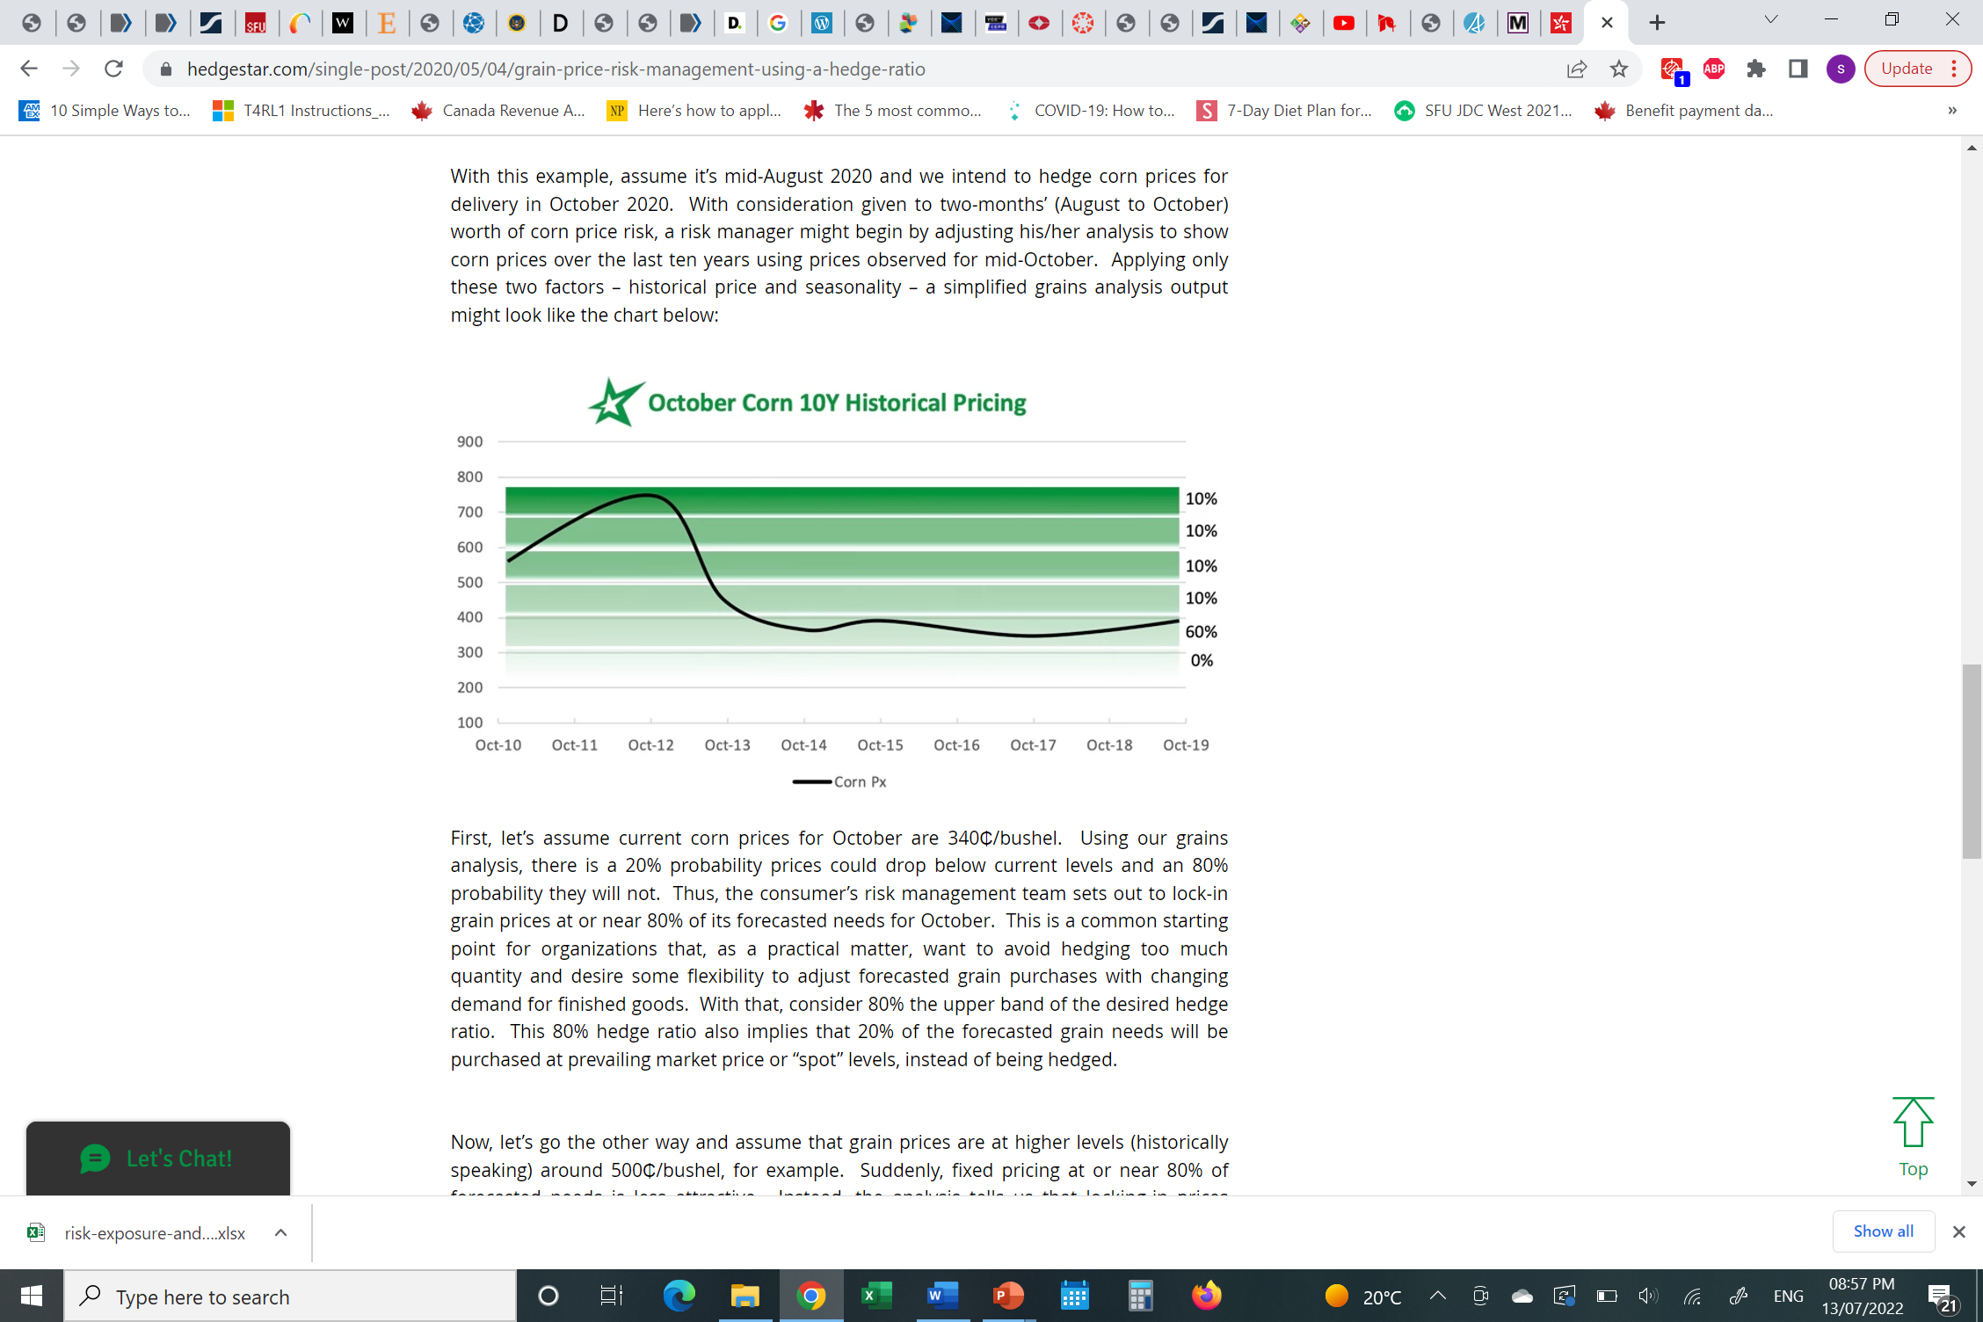
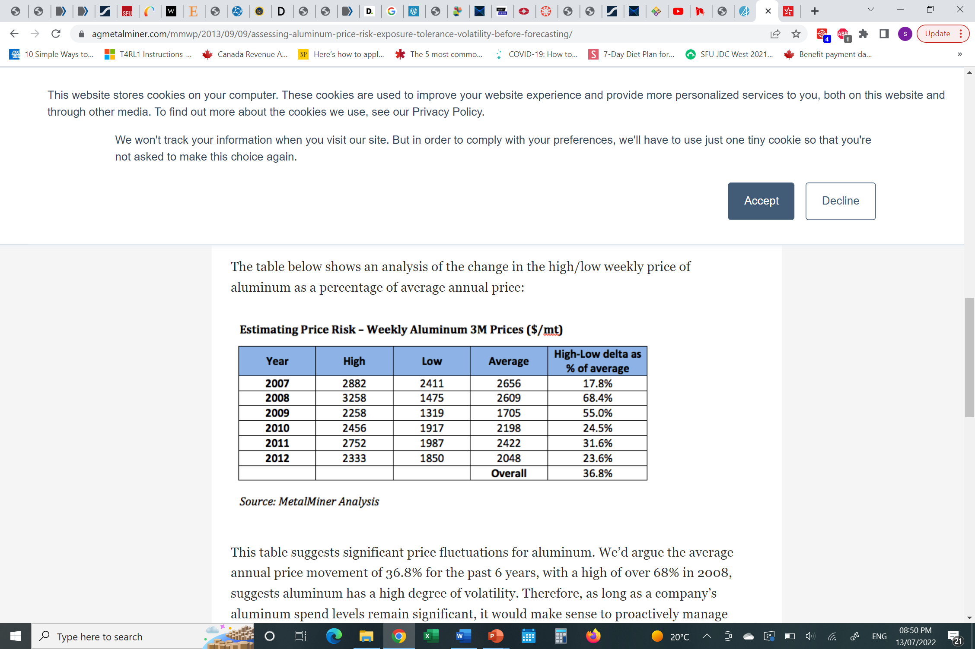
MEASURING COMMODITY RISK
Use sensitivity analysis
Notes:
https://agmetalminer.com/mmwp/2013/09/09/assessing-aluminum-price-risk-exposure-tolerance-volatility-before-forecasting/
This table suggests significant price fluctuations for aluminum. We’d argue the average annual price movement of 36.8% for the past 6 years, with a high of over 68% in 2008, suggests aluminum has a high degree of volatility. Therefore, as long as a company’s aluminum spend levels remain significant, it would make sense to proactively manage aluminum price volatility.
https://www.hedgestar.com/single-post/2020/05/04/grain-price-risk-management-using-a-hedge-ratio

Slide 23
TECHNIQUES AND PRODUCTS TO MANAGE COMMODITY RISKS
Fixed price swaps
Future contracts – Grain option market traders bid price uncertainty into the prices of options on grain futures in the form of implied volatility
Basis Swaps
Notes:
https://www2.deloitte.com/content/dam/Deloitte/in/Documents/risk/in-risk-overview-of-commodity-noexp.PDF
https://www1.agric.gov.ab.ca/$department/deptdocs.nsf/ba3468a2a8681f69872569d60073fde1/e347afab1a7cc5ec8725732b007469dc/$FILE/understanding_barley_contract_june11_2015.pdf

Slide 24
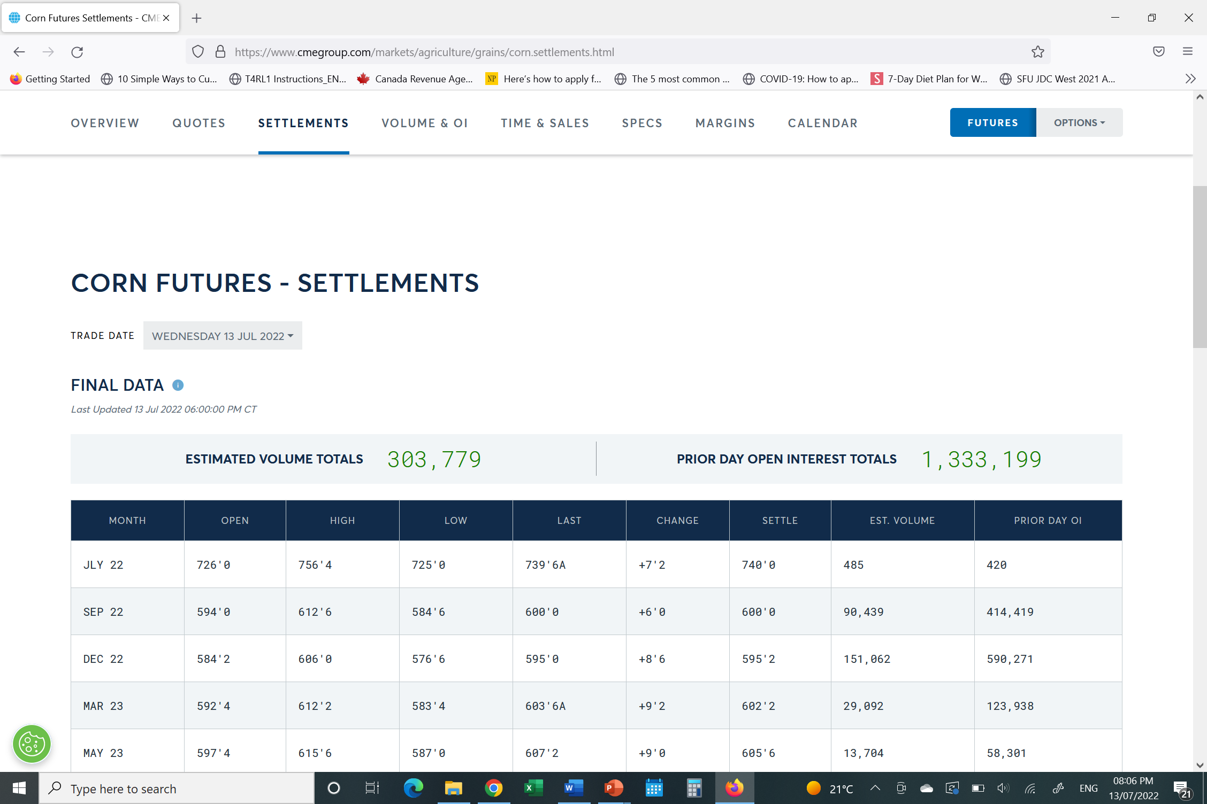
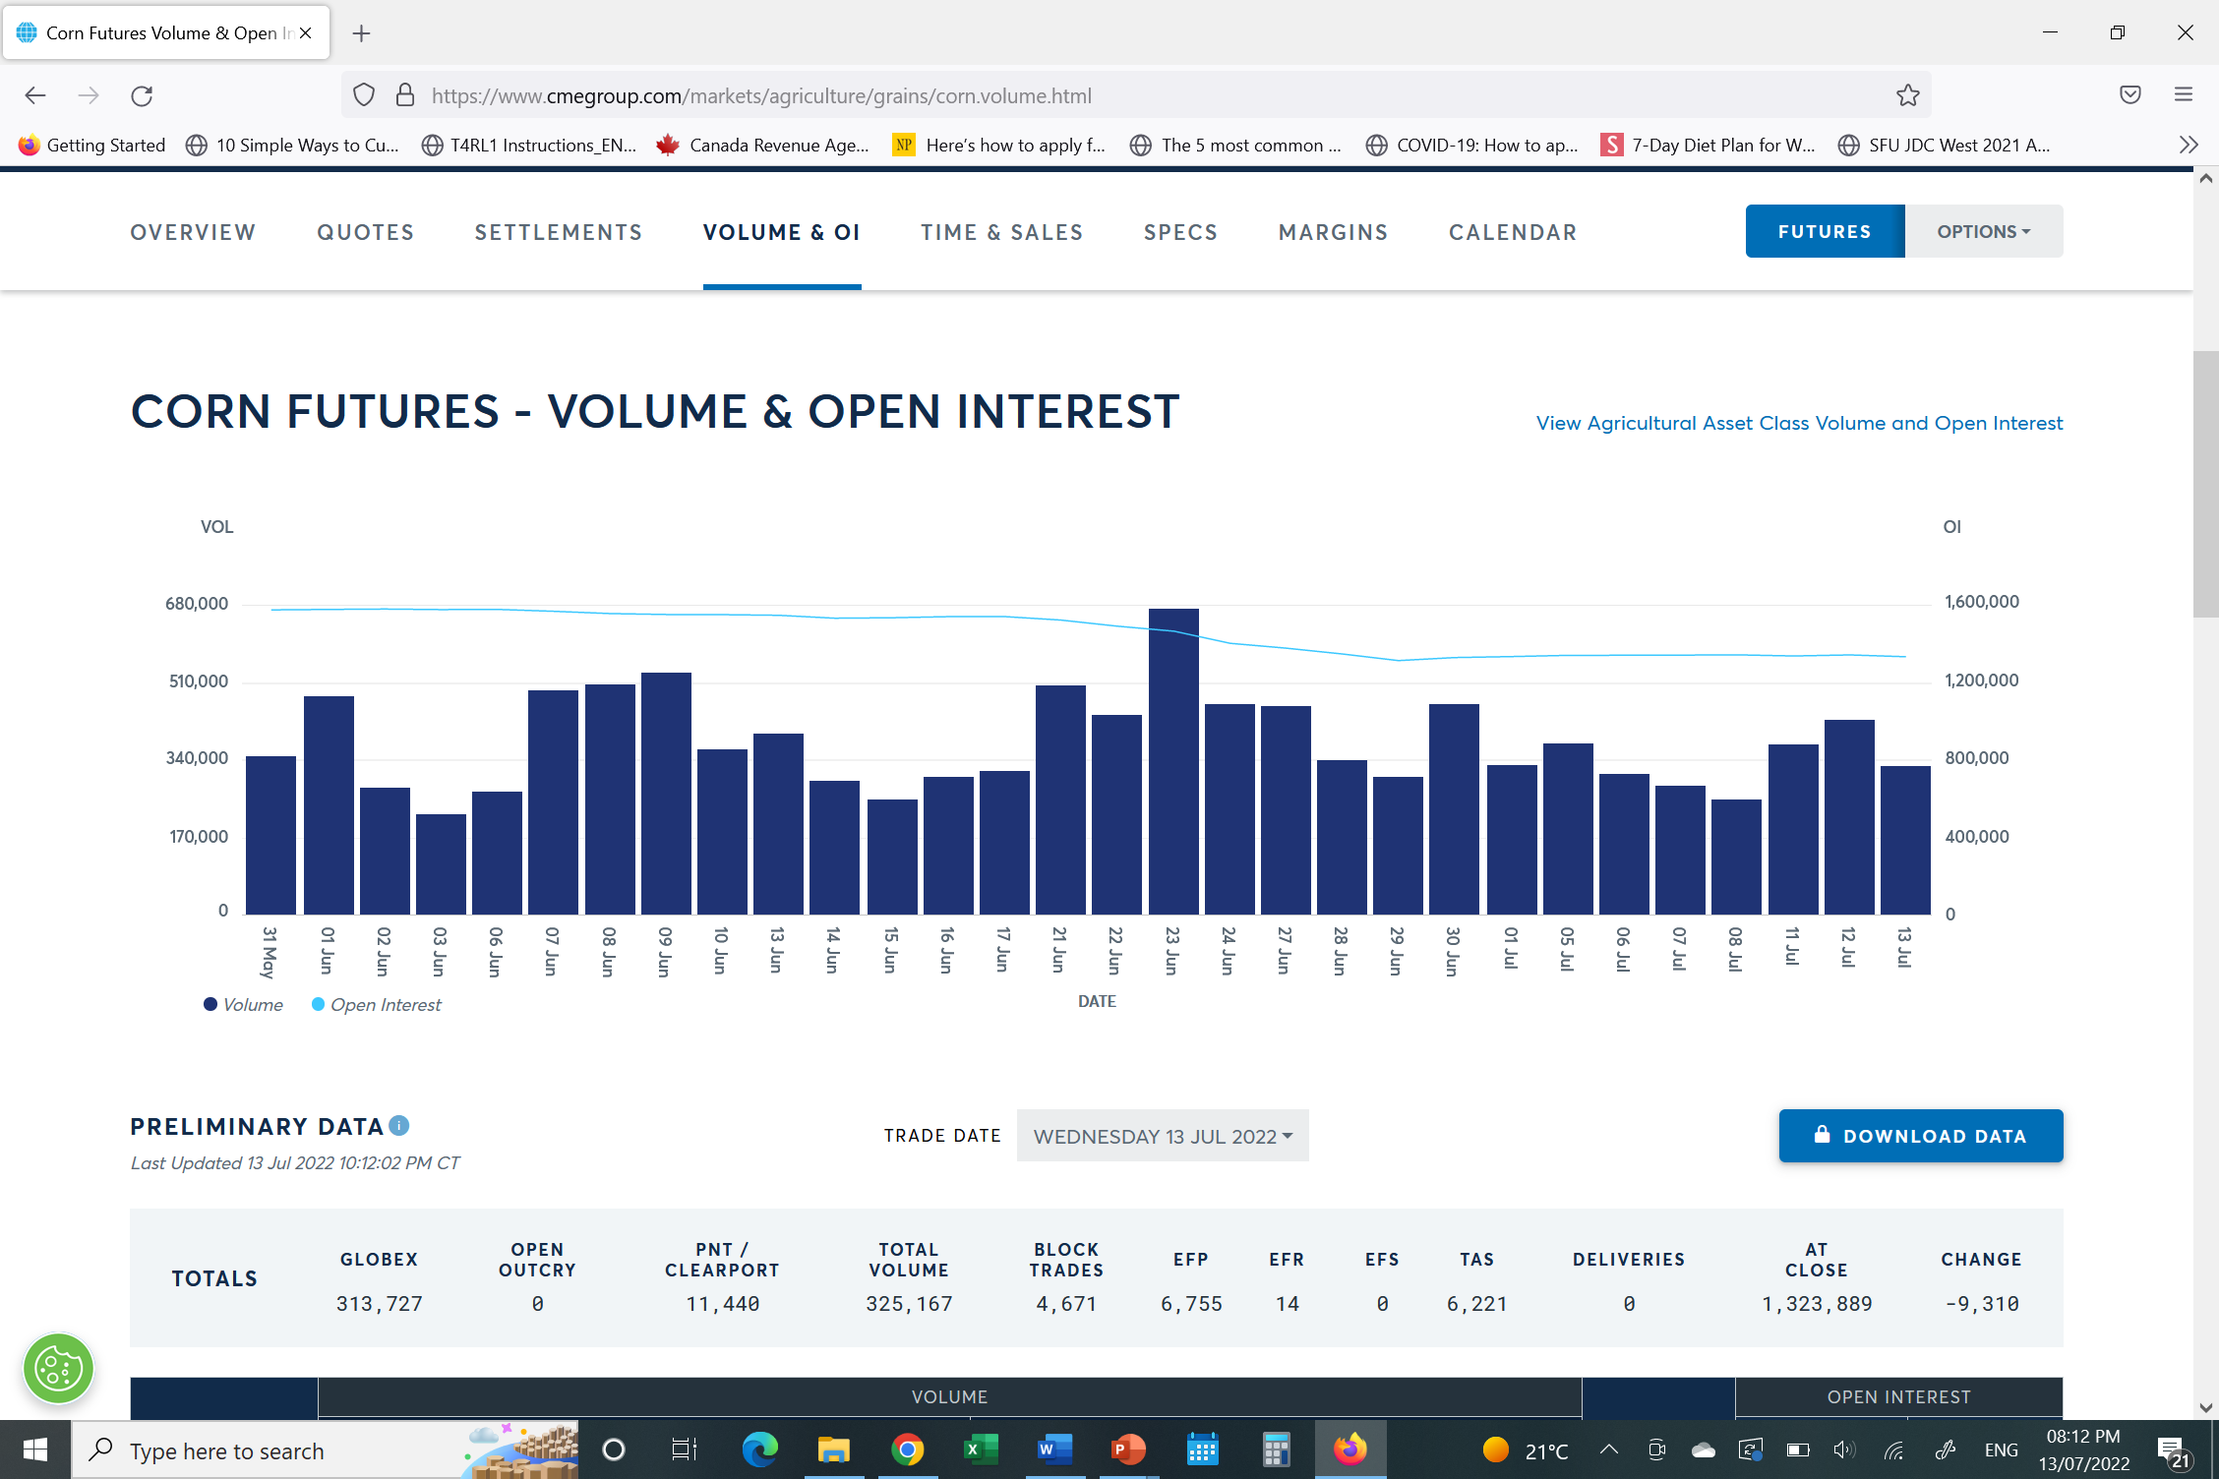

Slide 25
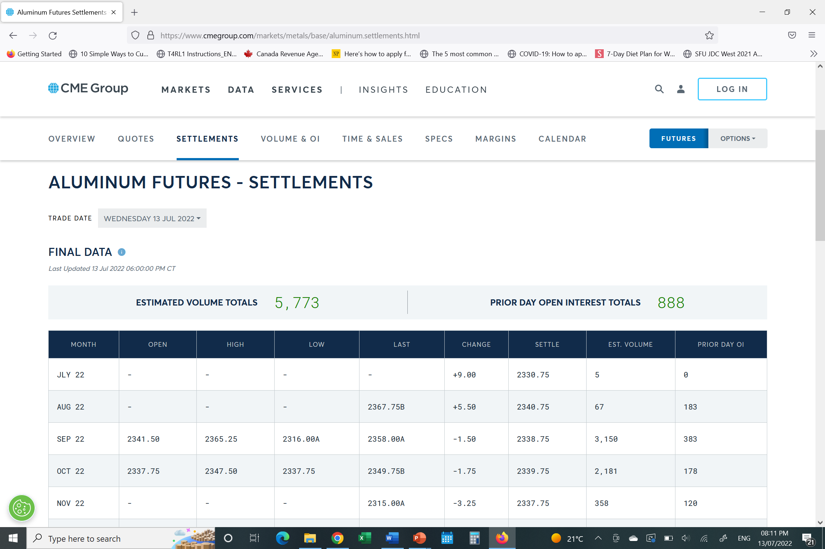
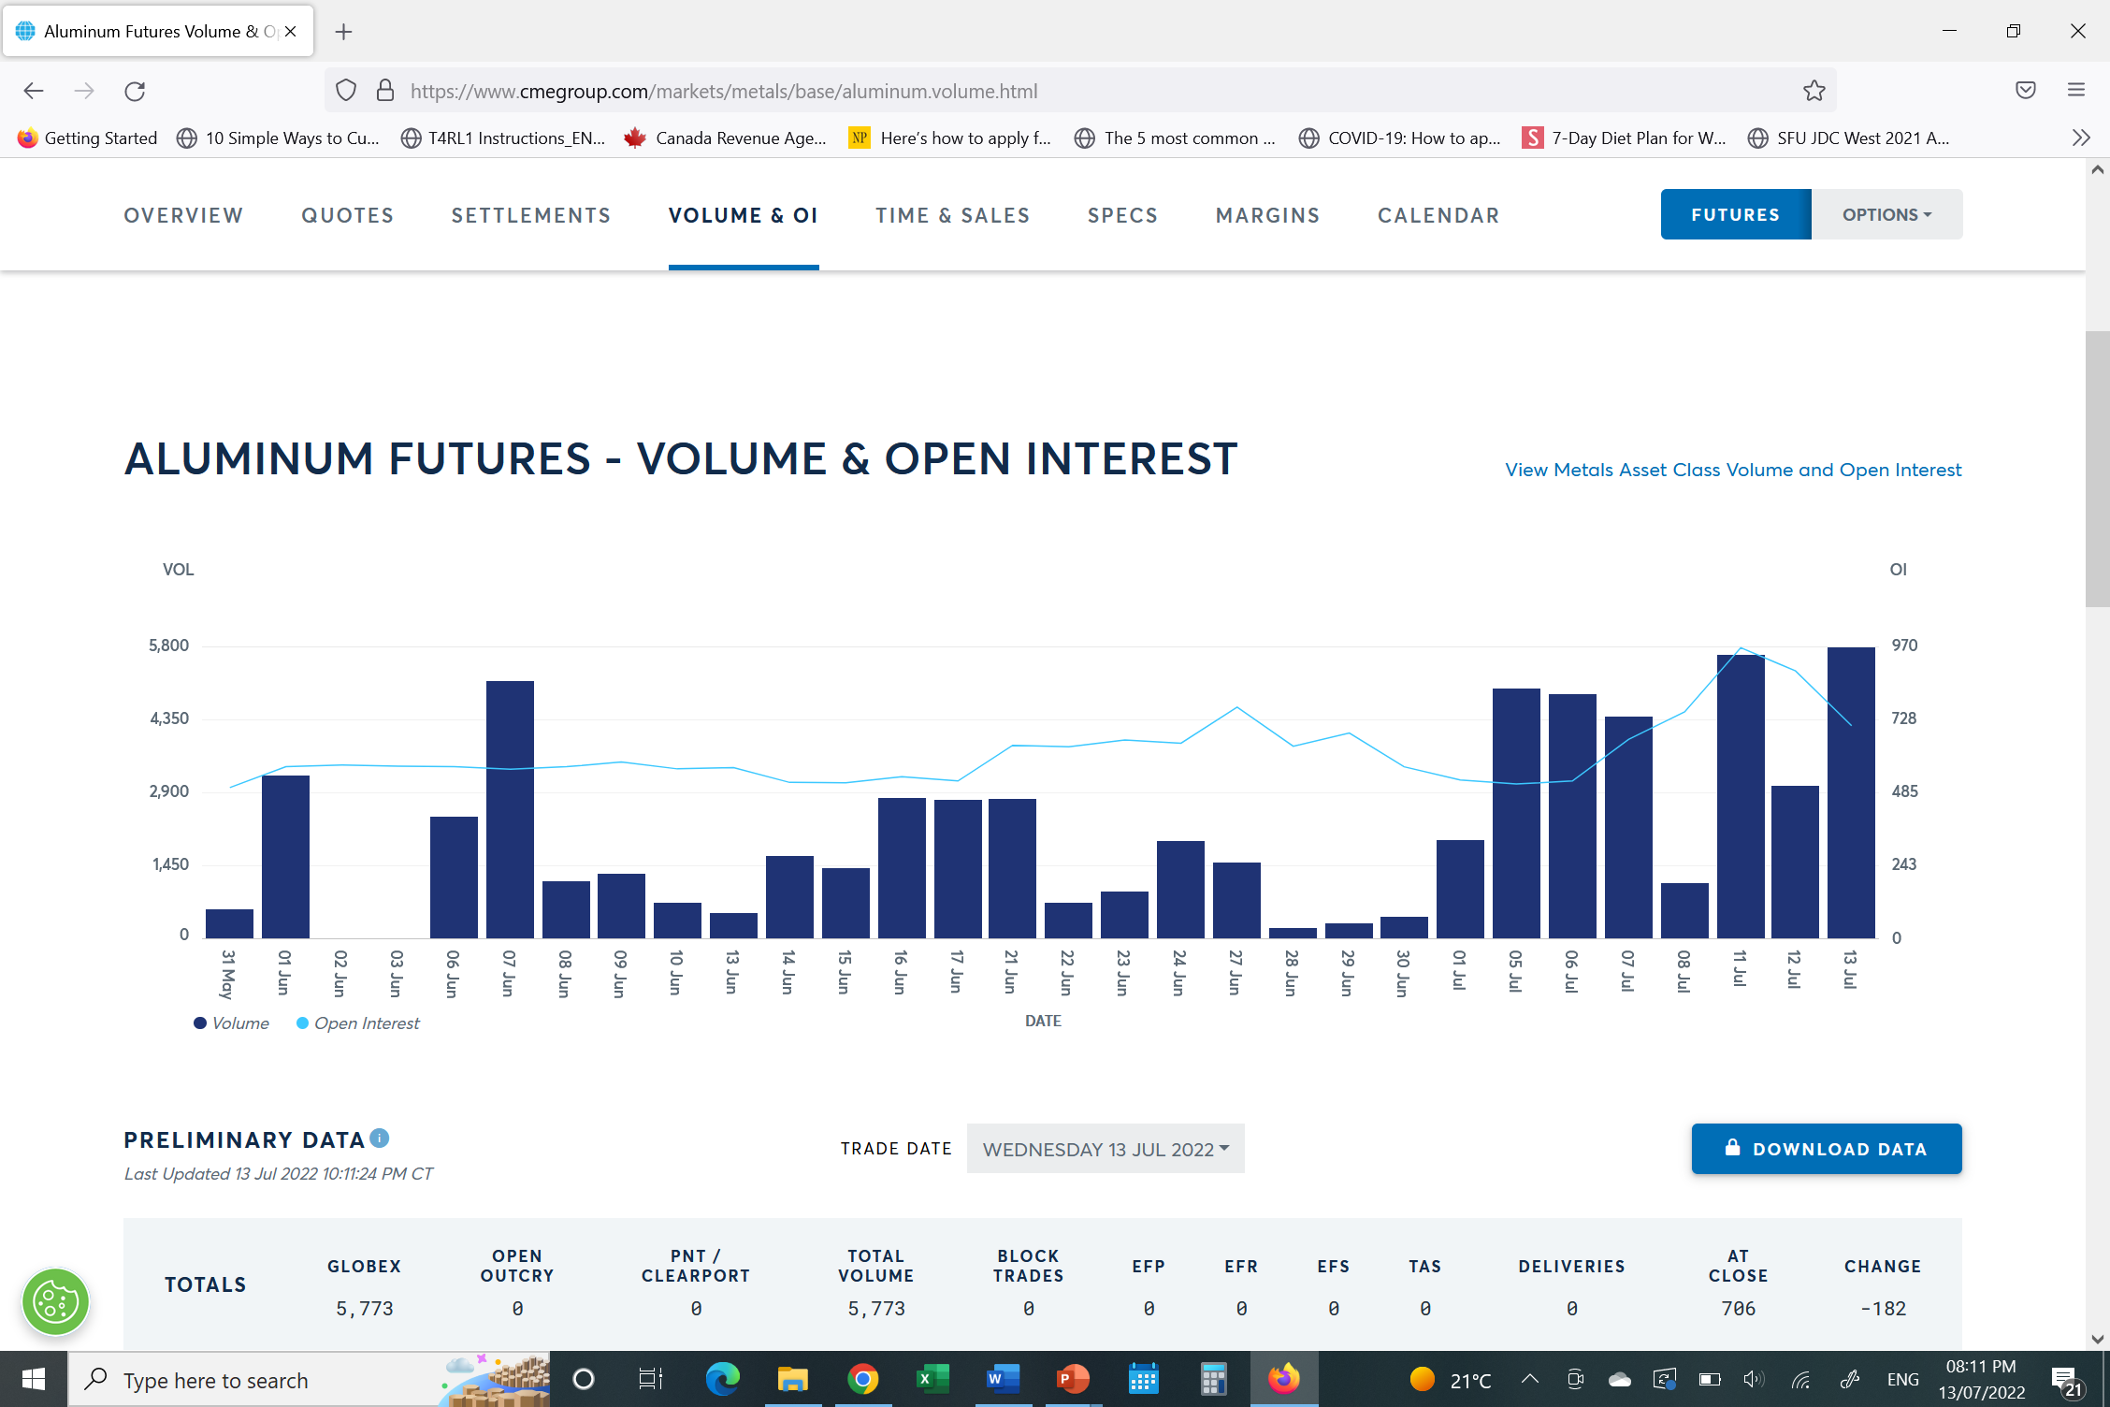

Slide 26
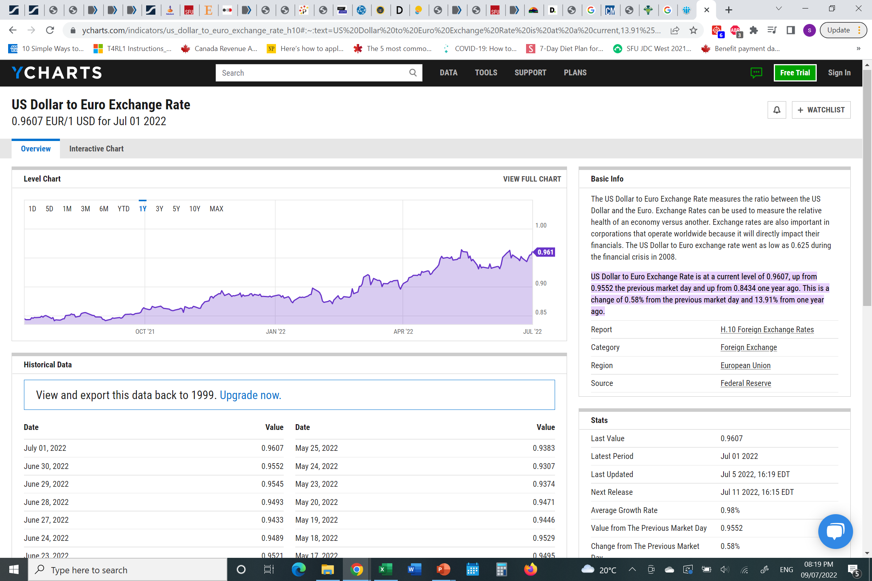
MAJOR RISKS: FINANCIAL RISKS
Currency Risk
The exchange rate market is volatile and subject to multiple fluctuations in a day.
Affects transactions of assets and liabilities on financial statements
Affects the purchase and sale of liquor in different countries.
Relevant to most liquor companies that export and import heavily and have location in various countries.
Notes:
https://ycharts.com/indicators/us_dollar_to_euro_exchange_rate_h10#:~:text=US%20Dollar%20to%20Euro%20Exchange%20Rate%20is%20at%20a%20current,13.91%25%20from%20one%20year%20ago.
- Nominal exchange rates are more volatile.
http://fmwww.bc.edu/repec/esNASM04/up.5121.1075605540.pdf

Slide 27
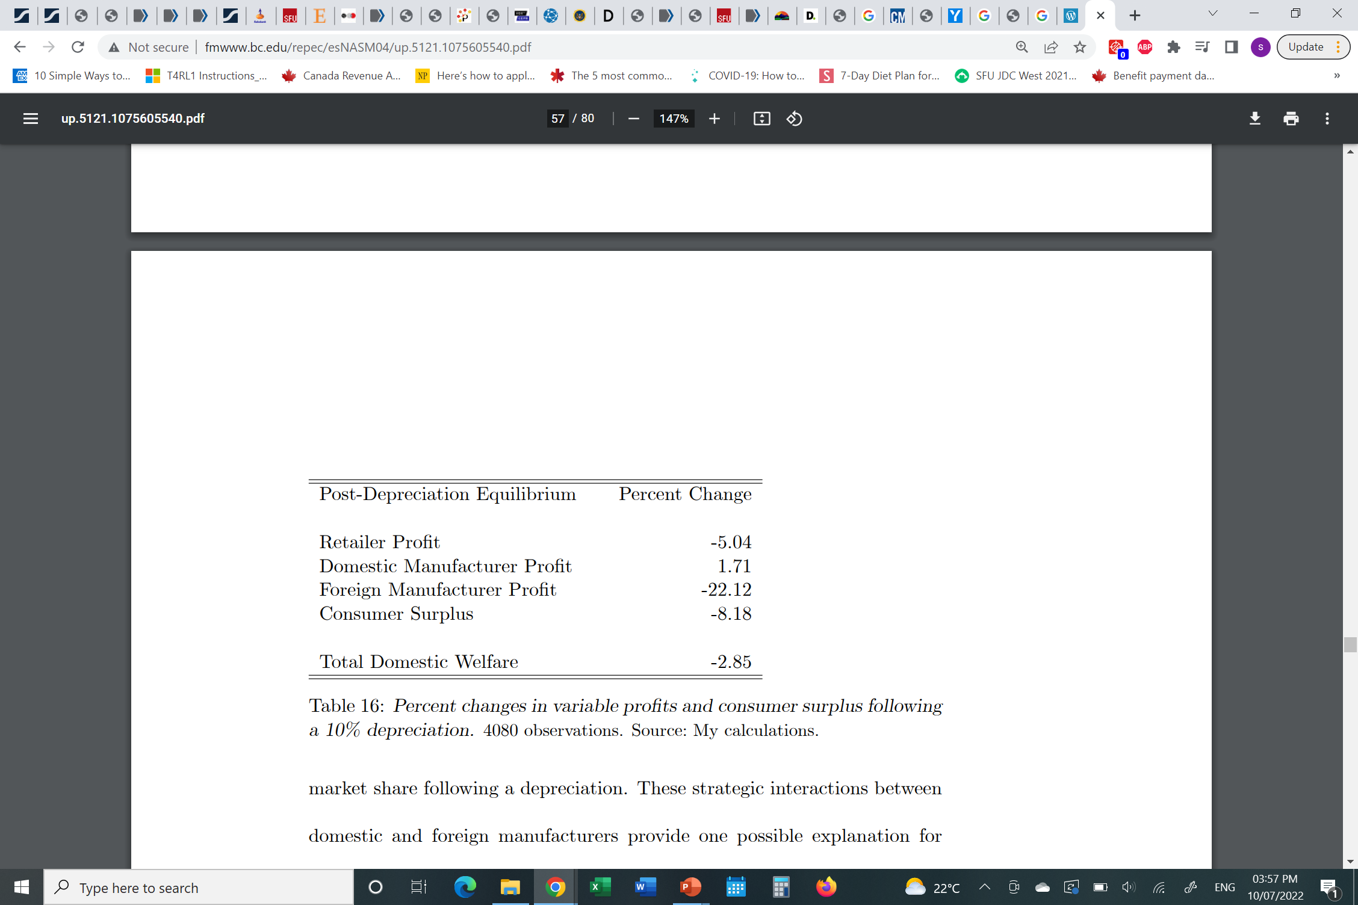
MEASURING CURRENCY RISK
Sensitivity Analysis
A 10-percent domestic currency depreciation, foreign manufacturers’ profits decline by 22 percent, domestic consumer surplus falls by 8 percent, the retailer’s profits fall by 5 percent, and domestic manufacturers’ profits increase by 1.7 percent. (Hellerstein, 2004)
Notes:
http://fmwww.bc.edu/repec/esNASM04/up.5121.1075605540.pdf

Slide 28
MANAGING CURRENCY RISK
Hedging through:
Foreign currency spots
Foreign currency forwards
Foreign currency swaps
Other hedging techniques:
a. Cross currency interest rate swaps
b. Transaction exposure hedging

Slide 29
MAJOR RISKS: FINANCIAL RISK
Interest Rate risks
Changes in US dollar, Euro and Sterling pound interest rates that can affect borrowing
The Russian-Ukraine war has affected the interest rates significantly leading to abnormal interest rates worldwide especially the Euro (Russia-Ukraine war increases financial stability risks, ECB Financial Stability Review finds, 2022).
Notes:
https://www.frontiersin.org/articles/10.3389/fpubh.2020.627001/full#B10
https://www.mckinsey.com/business-functions/strategy-and-corporate-finance/our-insights/the-coronavirus-effect-on-global-economic-sentiment

Slide 30
MANAGING INTEREST RATE RISKS
Use interest rate swaps
Issuing fixed and floating rate borrowings and commercial paper
Interest rate futures and forward rate agreements
Notes:
https://guichet.public.lu/en/entreprises/gestion-juridique-comptabilite/risques/taux-interet/forward-rate-agreement.html

Slide 31
MAJOR RISKS: BUSINESS RISKS
Credit risks
Possibility of default on contractual obligations resulting in losses.
Arises on cash balances including outstanding loans, trade and other receivables and committed transactions.
Company sets internal credit ratings to measure credit risks
Liquidity risks
Difficulties in meeting financial obligations associated with liabilities that are settled by cash or other assets.
Uses short-term commercial paper to finance day-to-day operations

Slide 32
MANAGING CREDIT AND LIQUIDITY RISKS
Operating sound granting process by maintaining credit monitoring processes
Credit Insurance
Letters of credit
Requirements of minimum cash reserves
Use short term commercial paper to finance day-to-day operations

Slide 33
FACTORS PROMOTING ACTIVE RISK MANAGEMENT
Use different hedging options for different risks:
Interest rate risk and currency risks
Many liquor companies are large public companies with a diverse product portfolio
Maintain stable cash flow from operating activities
Cash flows and balance of payments are determined in different currencies
Large volumes of revenue and costs are at stake

Slide 34
PROBLEMS OF ACTIVE RISK MANAGEMENT
There is increased uncertainty in hedging certain risks due to changing market conditions, such as, the Russia Ukraine war and the pandemic. This can lead to potential losses for liquor companies.
High costs associated with purchasing financial derivatives. This can cause liquidity problems.

Slide 35
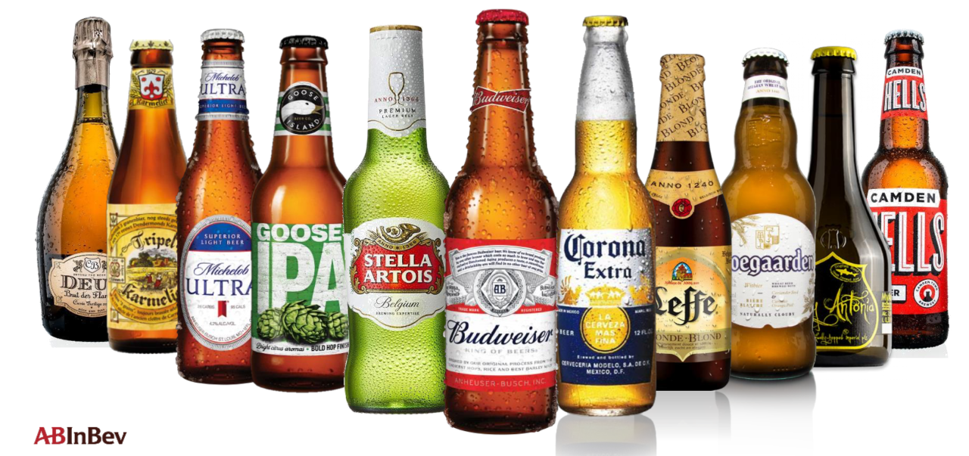

Slide 36
Company Overview - Anheuser-Busch InBev
Commonly known as AB Inbev, is the world's largest beer brewer
Formed by the merge of Interbrew(Belgium) and Ambev(Brazil), which were also individually formed by merges of other beer brewer companies
Purpose: Dream Big to Create a Future With More Cheers
Over 19,000 employees are directly employed by AB Inbev globally, created over 169,000 job opportunities
Well known product brand names include Budweiser, Corona, and Stella Artois

Slide 37
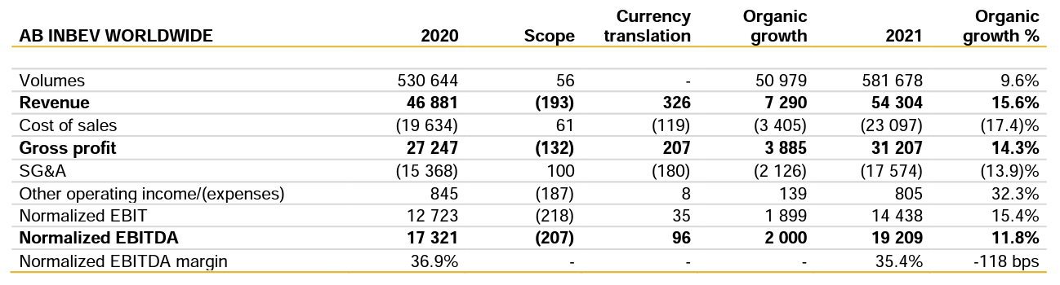
Revenue

Slide 38
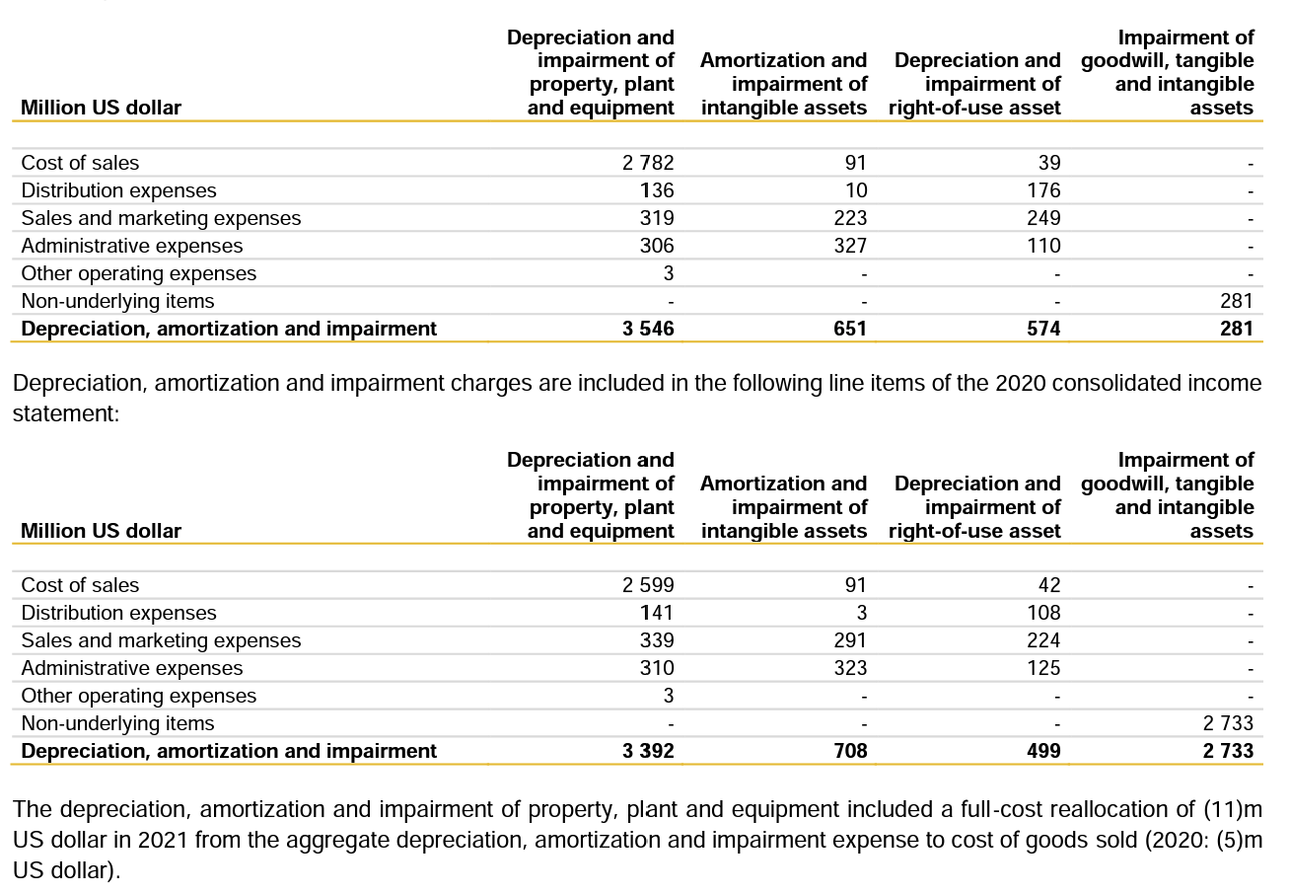
Cost Comparison

Slide 39
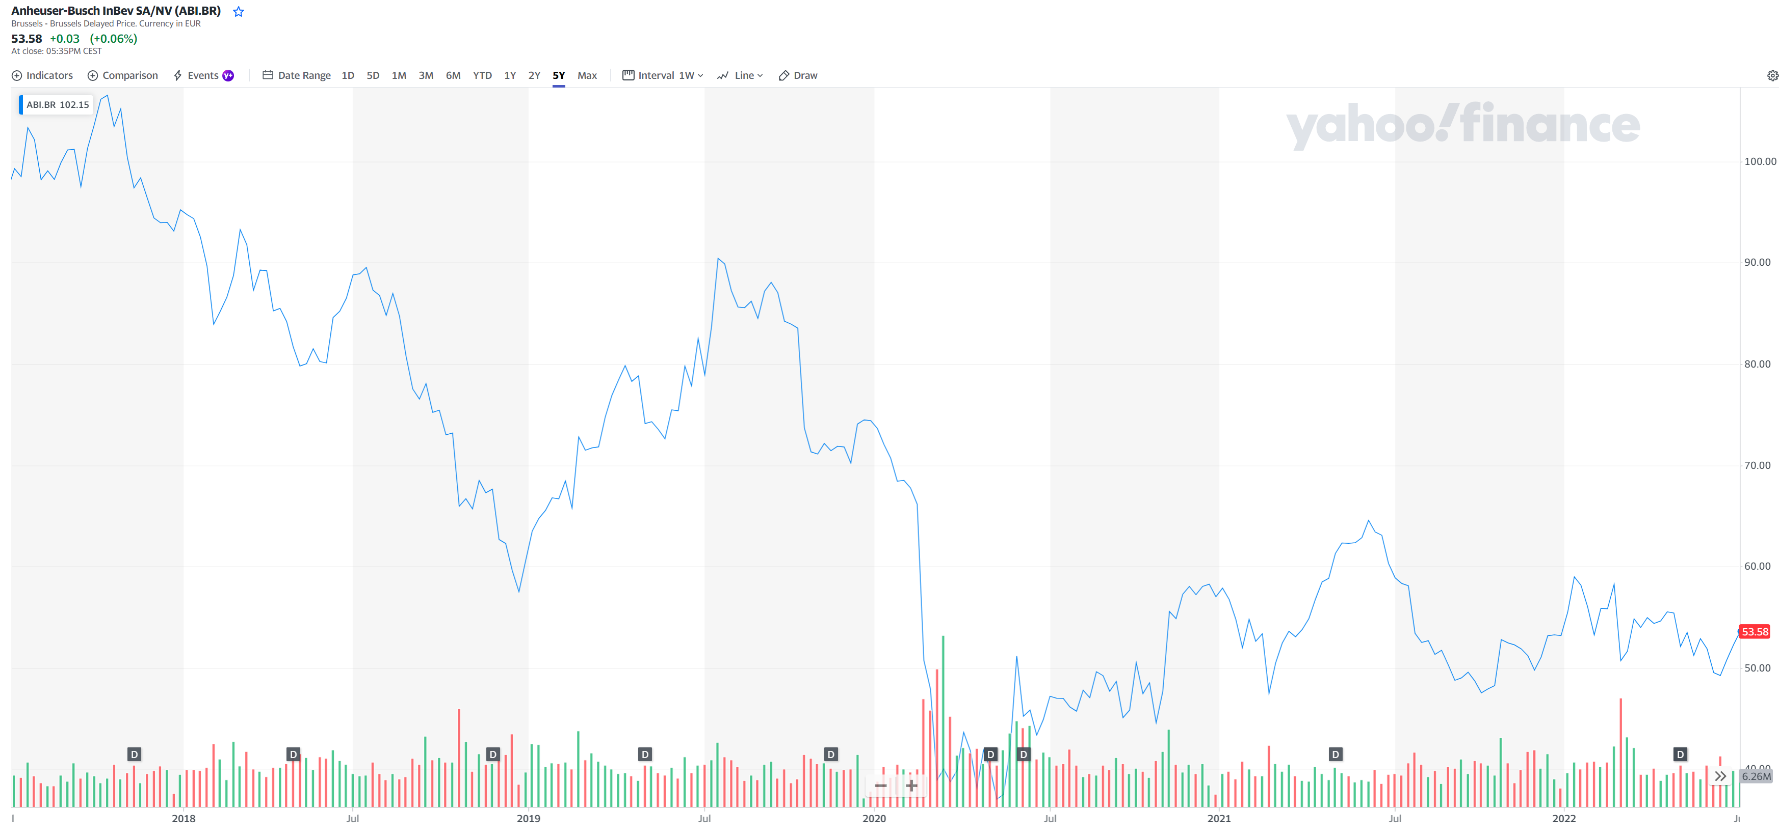
Stock Performance 5 years

Slide 40
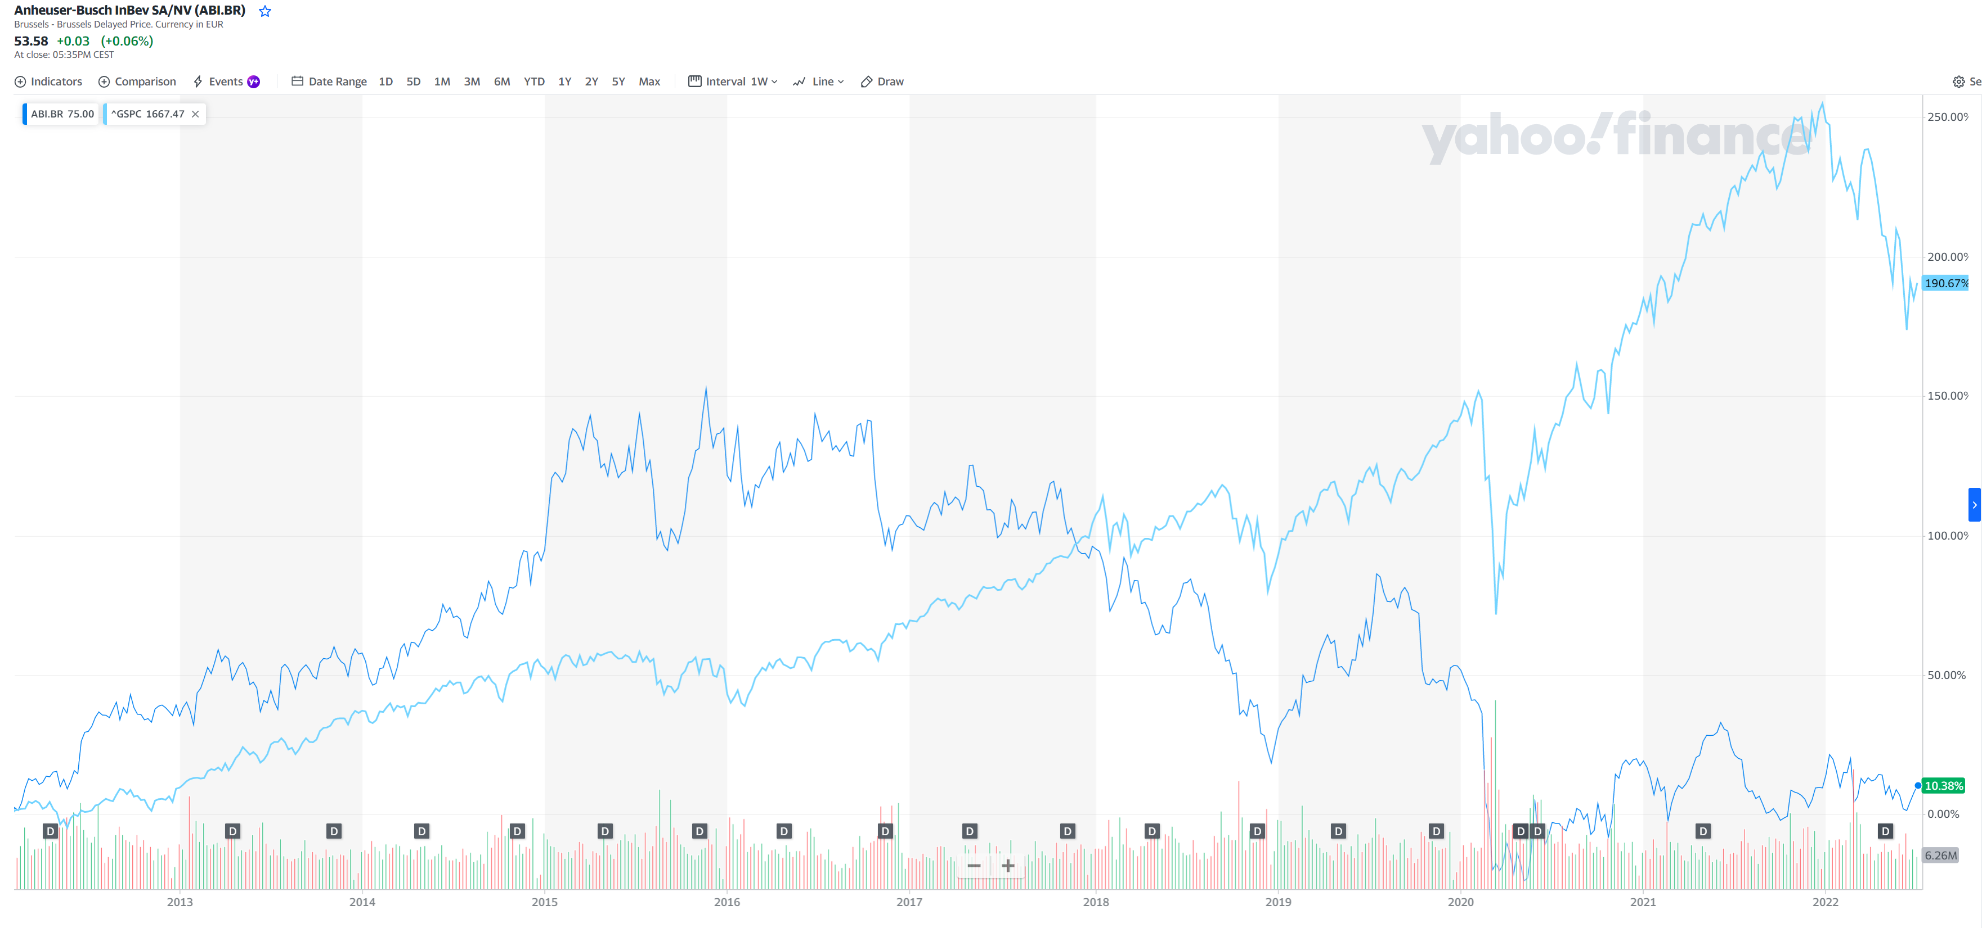
Stock Performance – Compare to S&P 500

Slide 41
Financial statements
Consolidated income statements
Consolidated statement of comprehensive income
Consolidated balance sheet
Consolidated statement of cash flows

Slide 42
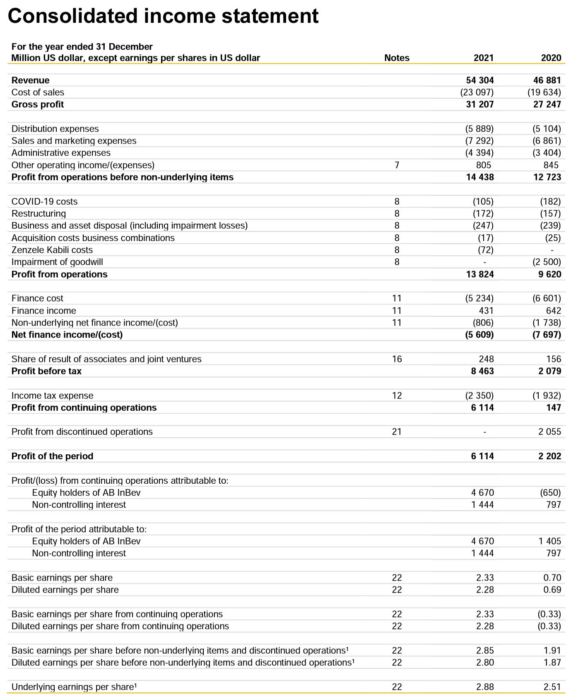
Income statement

Slide 43
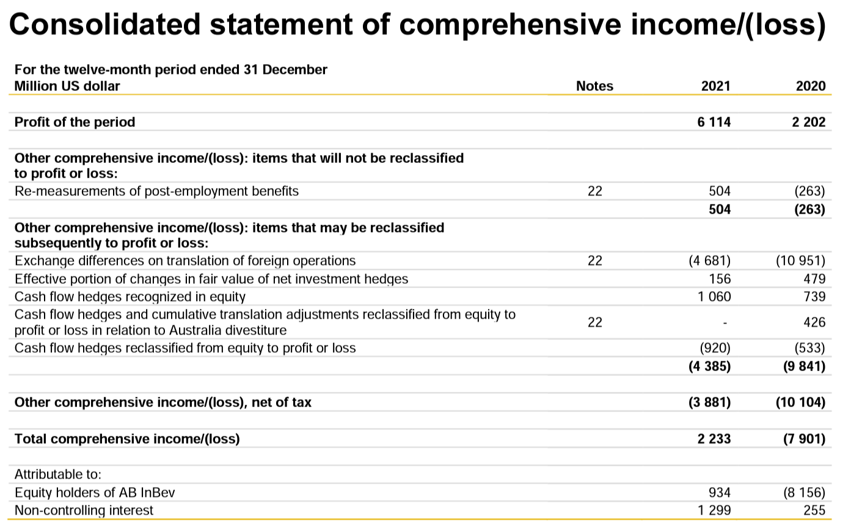
Comprehensive income

Slide 44
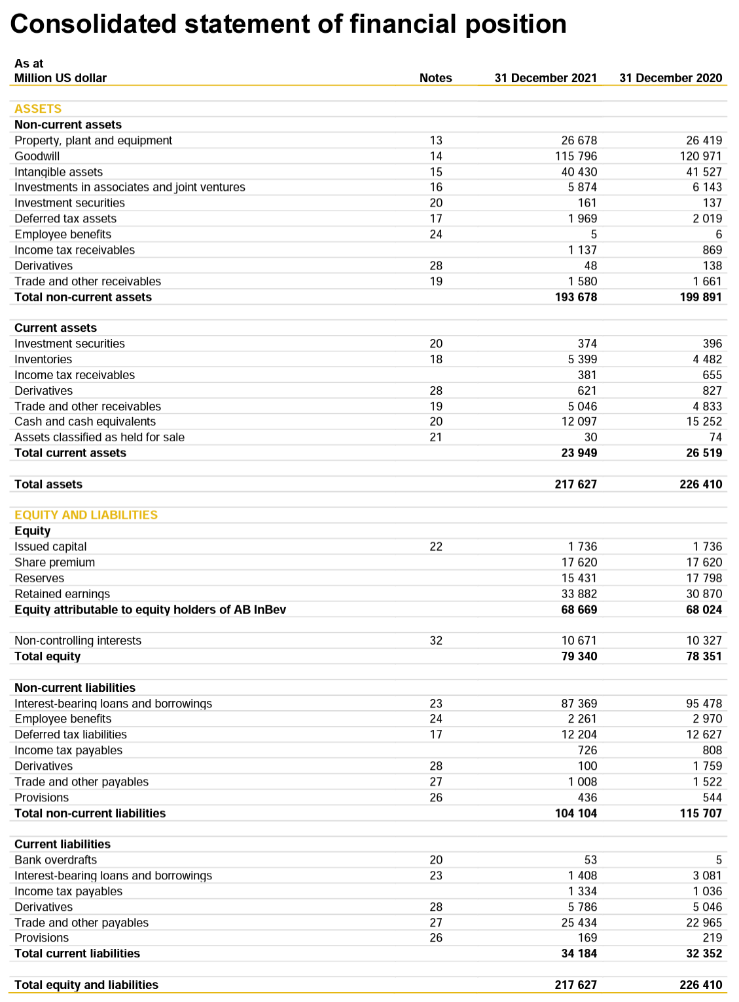
Balance sheet

Slide 45
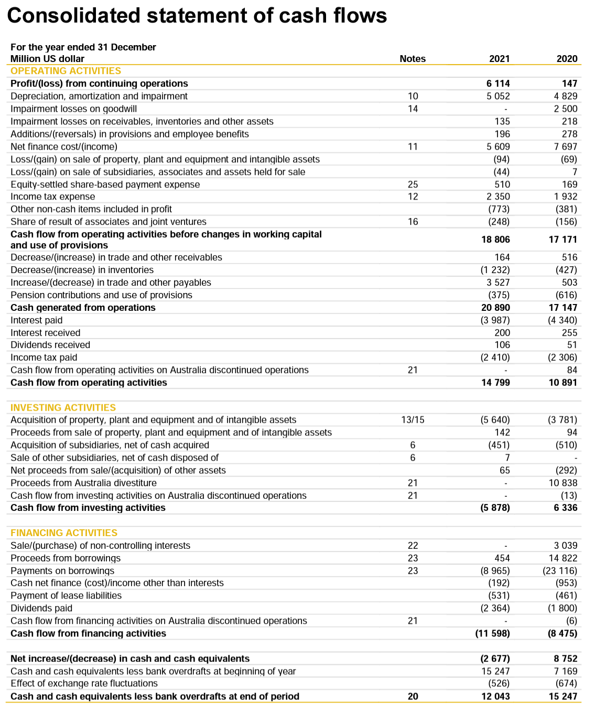
Statement of Cash Flows

Slide 46
Risk factors
Market Risk
  Currency
  Fair Value Interest Rate
  Cash Flow Interest
  Commodity
  Equity
Credit Risk
Liquidity Risk
Other Risks

Slide 47
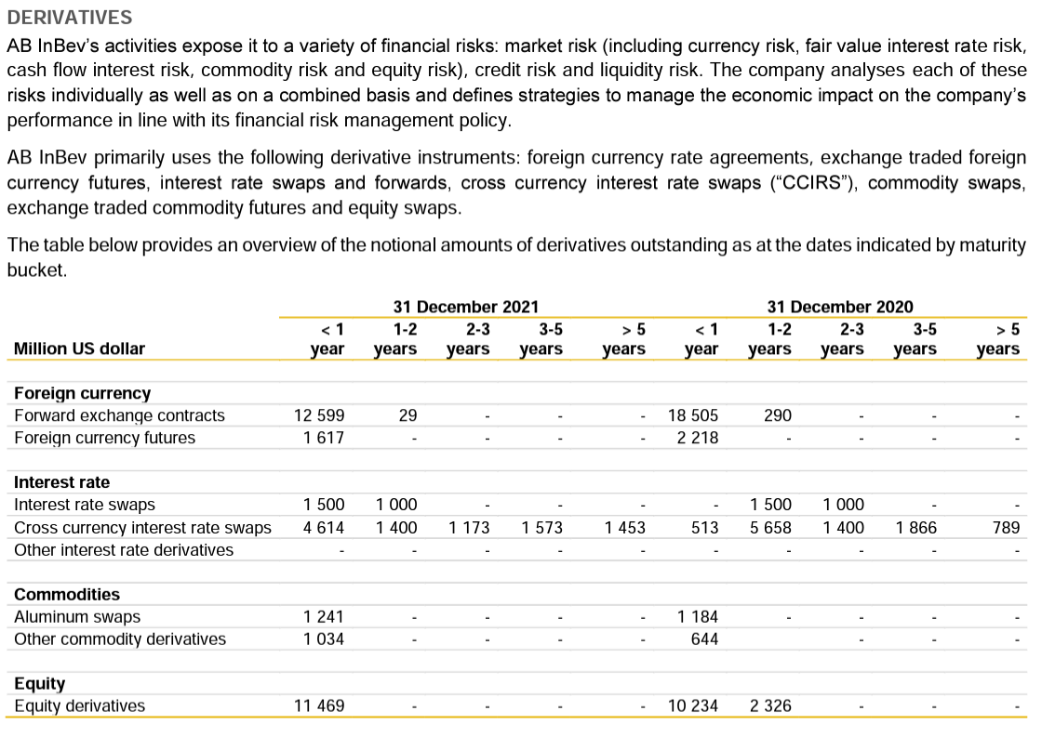

Slide 48
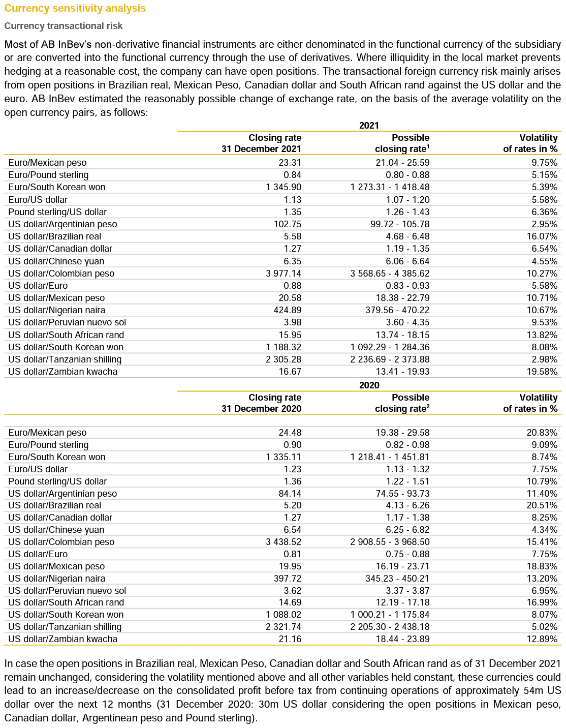
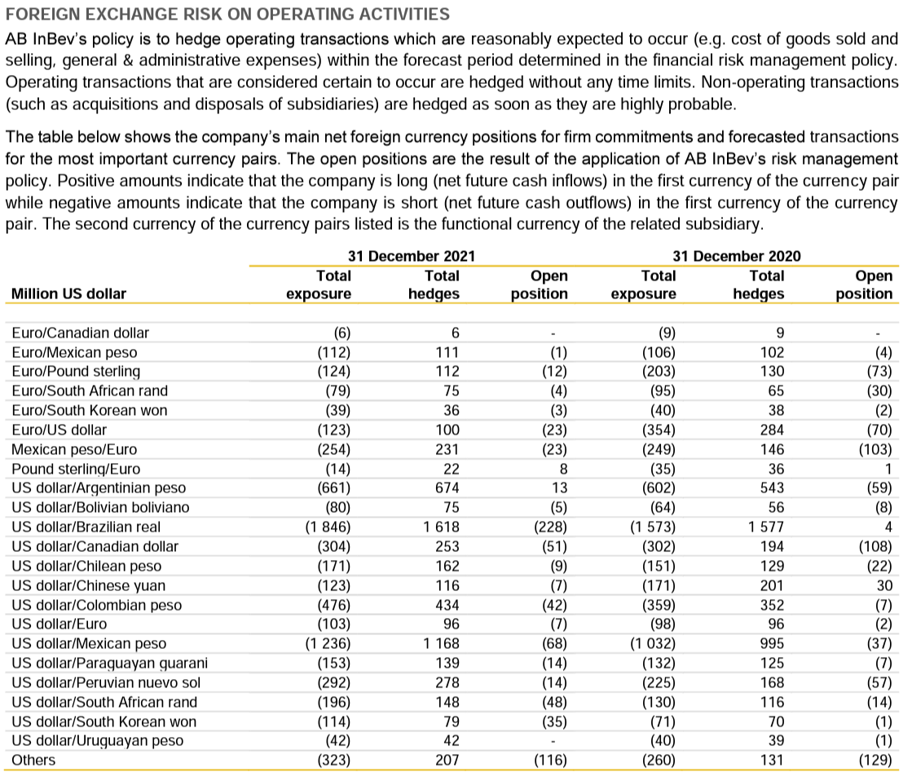
Currency risk

Slide 49
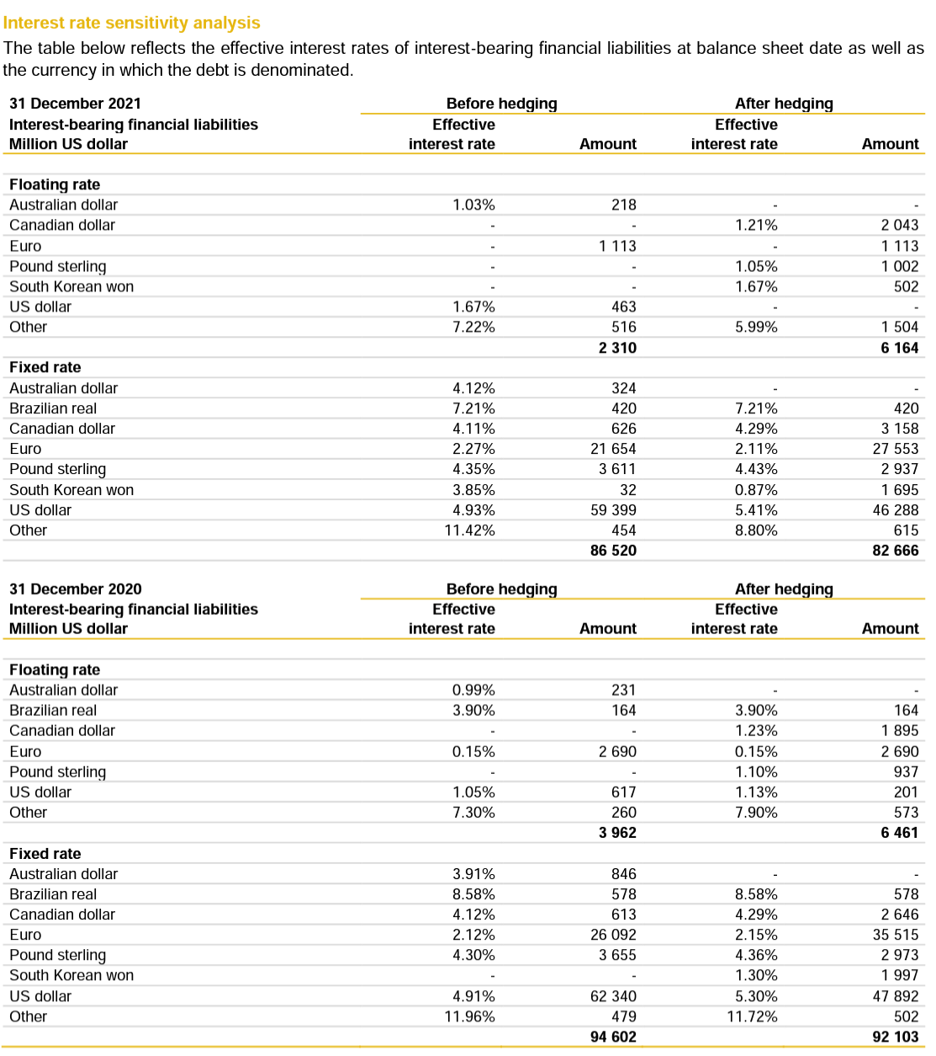
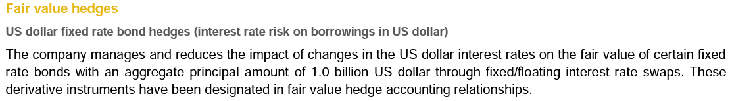
Interest Rate risk

Slide 50
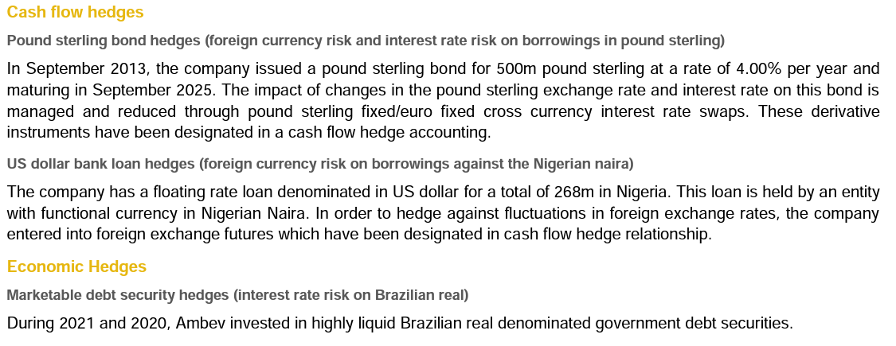
Cash Flow Interest

Slide 51
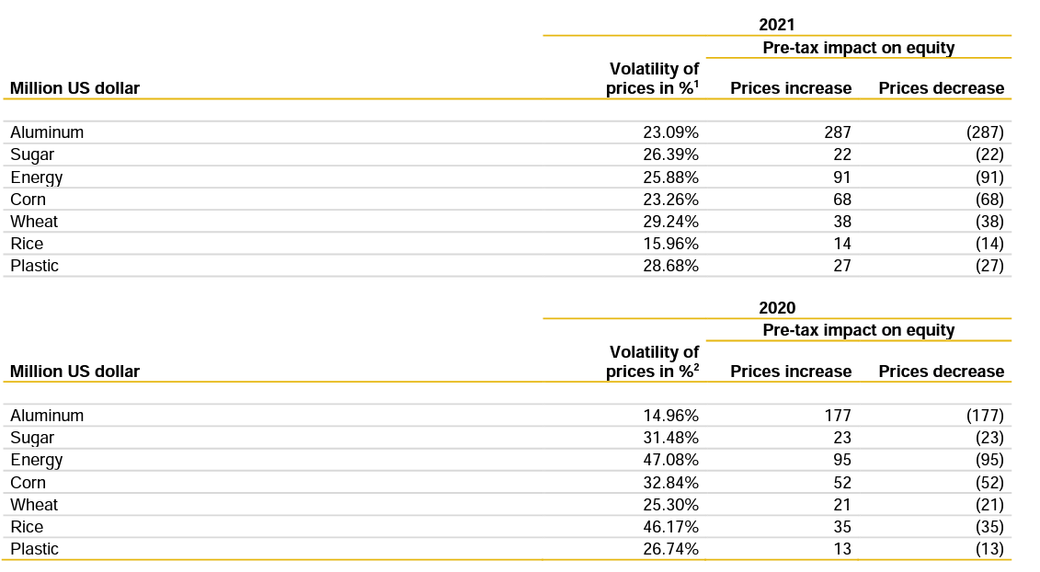
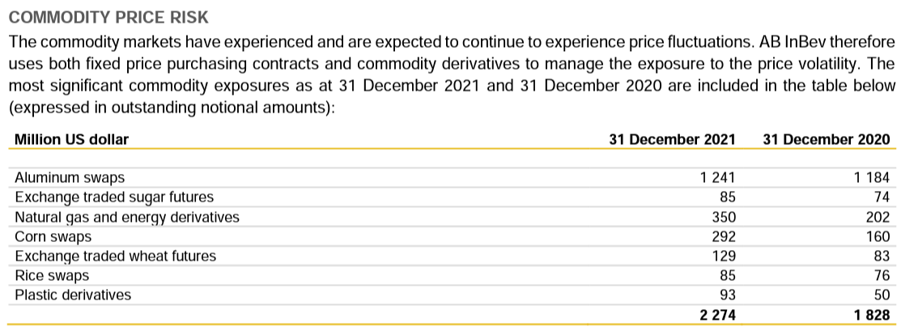
Commodity price risk

Slide 52
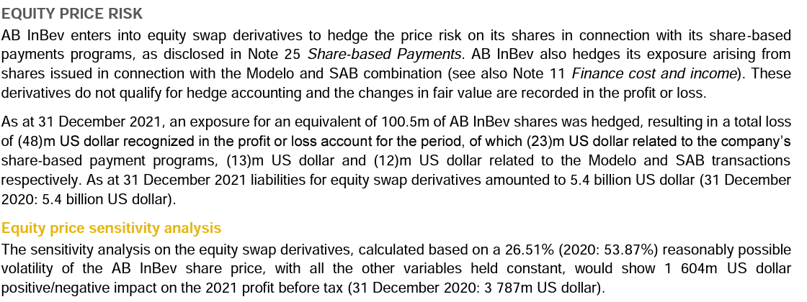
Equity price risk

Slide 53
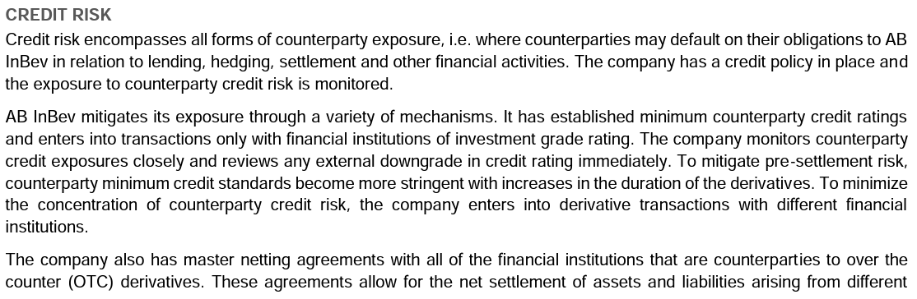
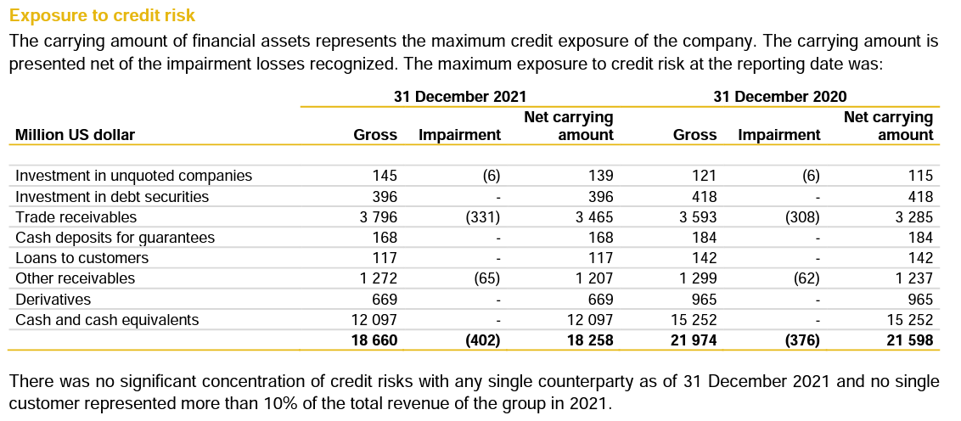
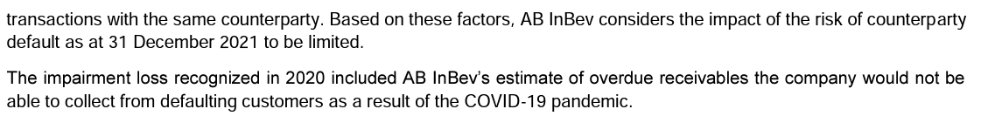
Credit risk

Slide 54
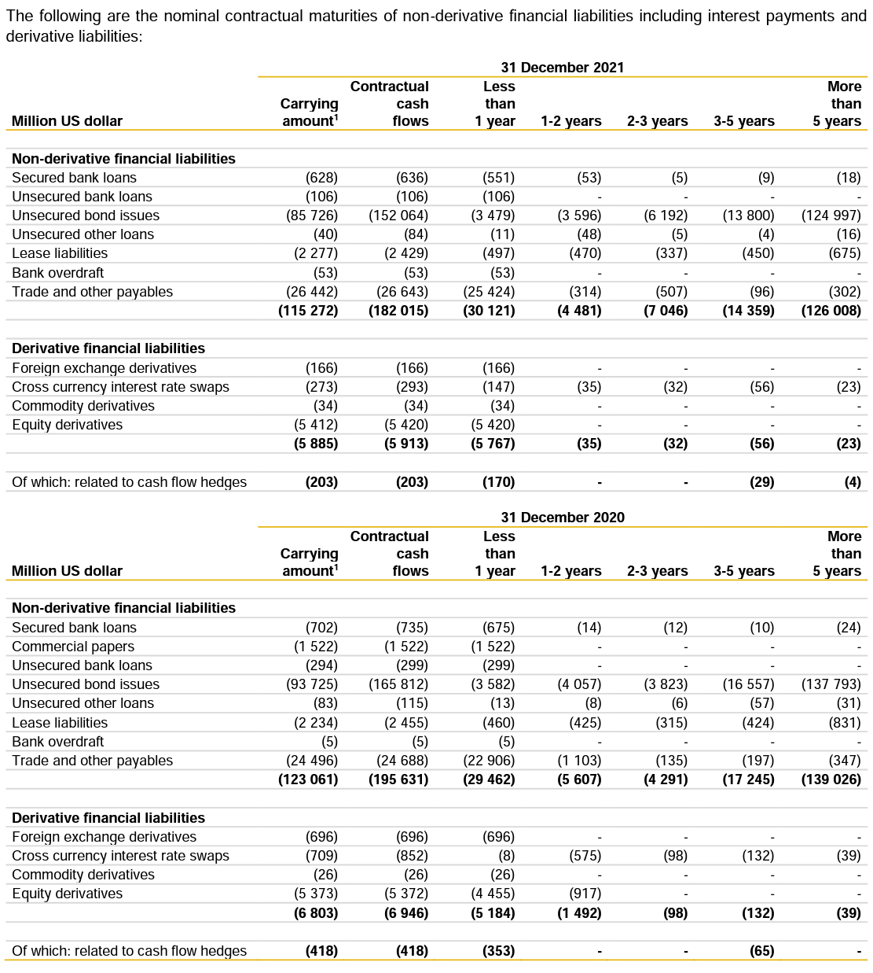
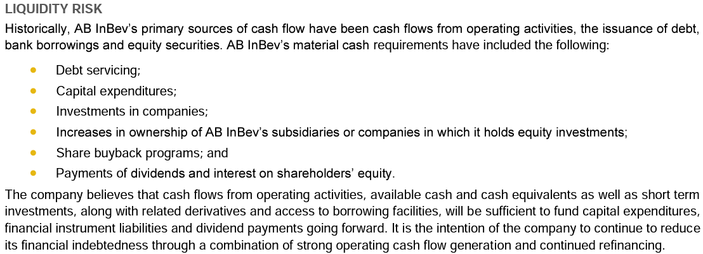
Liquidity risk

Slide 55
Other Risks
COVID-19
Recession
Customary Risk (Political Instability, Economic Instability, Human Rights, Change in Relation Between Countries, etc)
Damage to Brand Image
Tax Changes
Labour Strikes

Slide 56
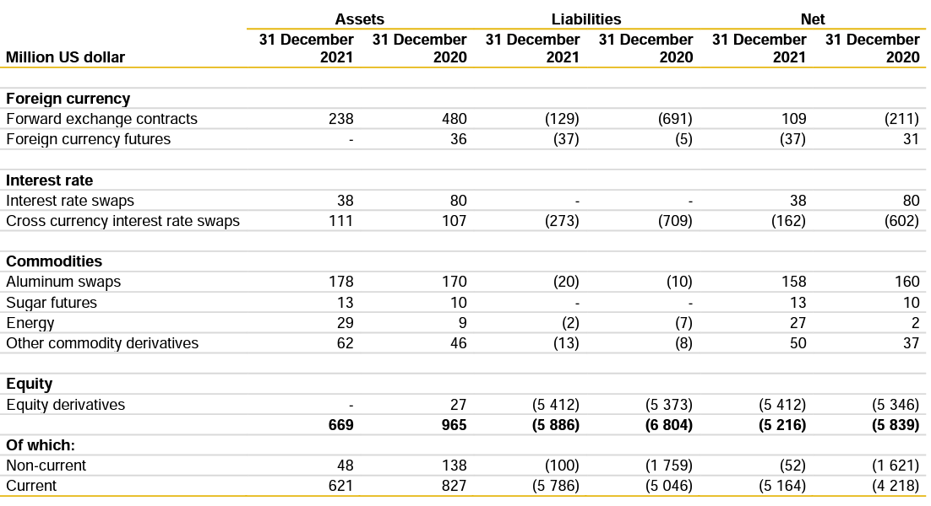
Summary

Slide 57
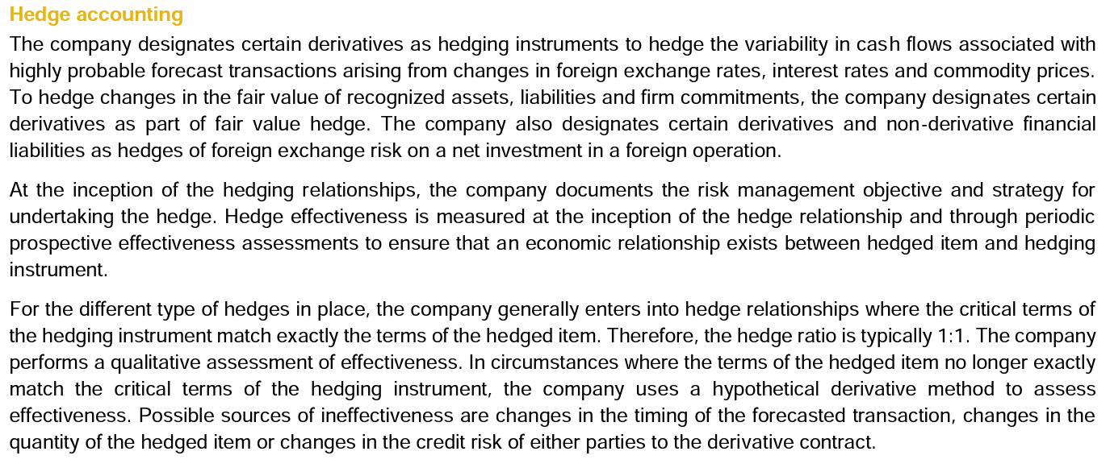
Accounting method

Slide 58
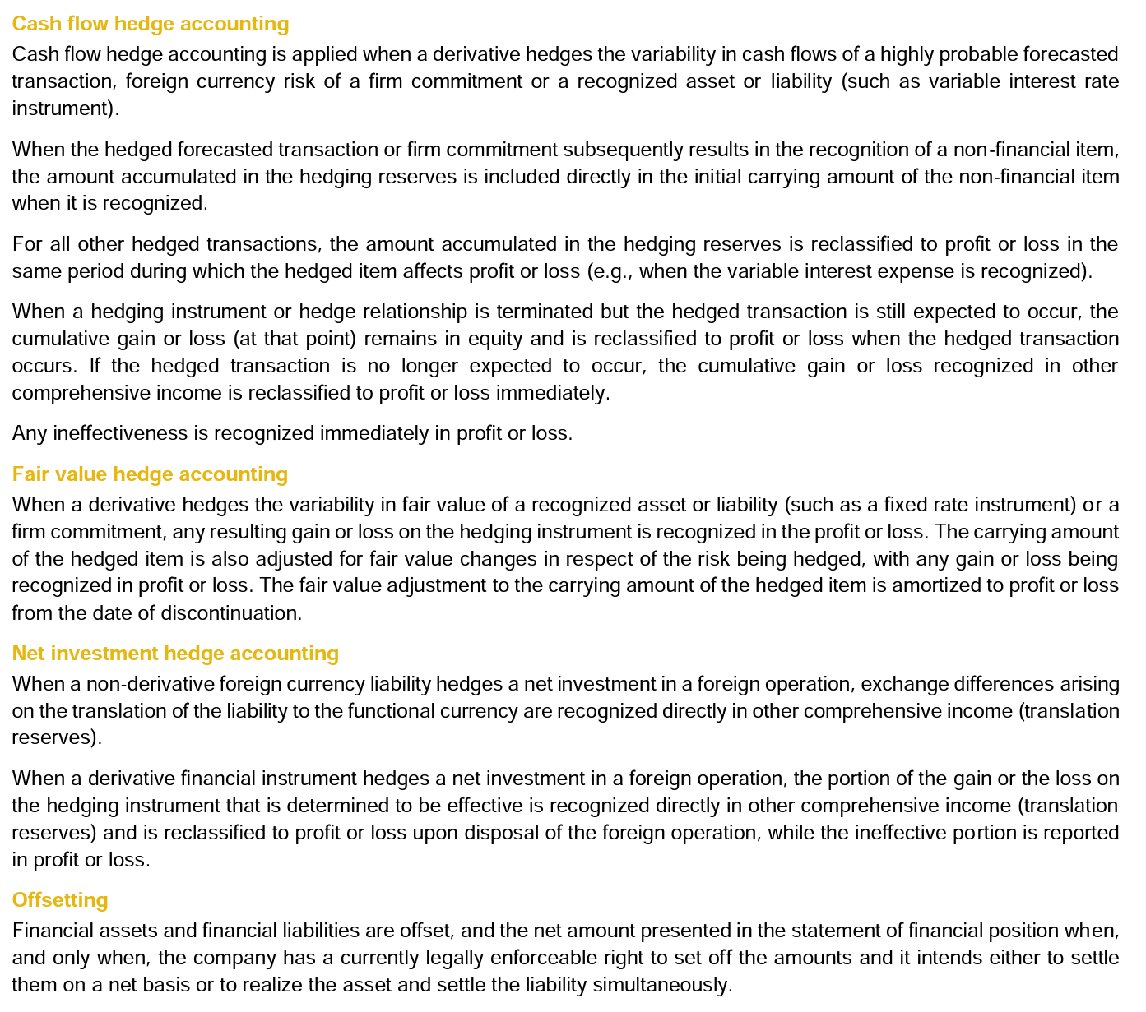

Slide 59
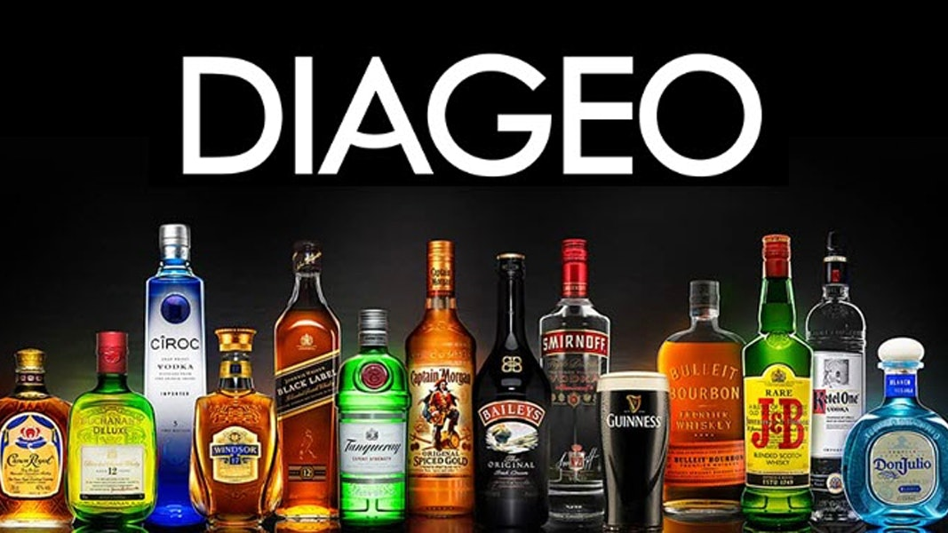

Slide 60

Company overview
Formed in 1997 from merger of Guinness Brewery and Grand Metropolitan
The world's second largest spirit distiller and biggest producer of Scotch whiskey
Objective: To be one of the best performing, most trusted and respected consumer products companies in the world
Operates in more than 180 countries and creates 27,775 job opportunities
One major consitituent of FTSE 100 Index

Slide 61
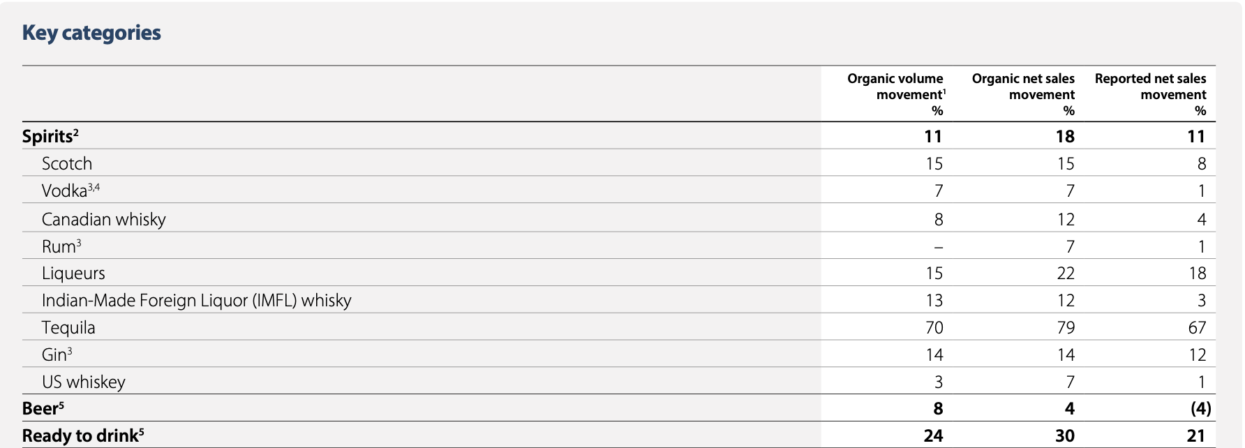
Products

Slide 62
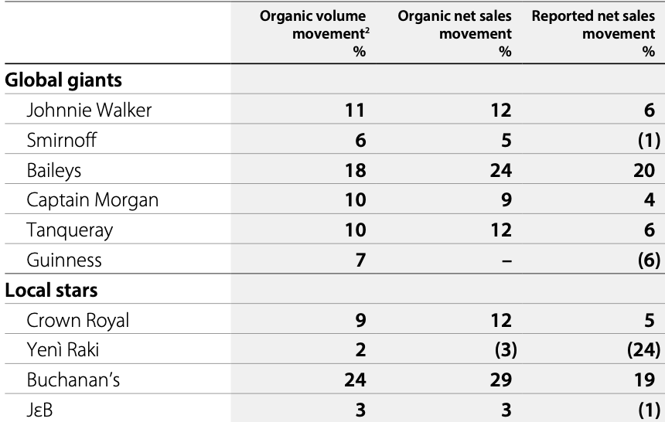
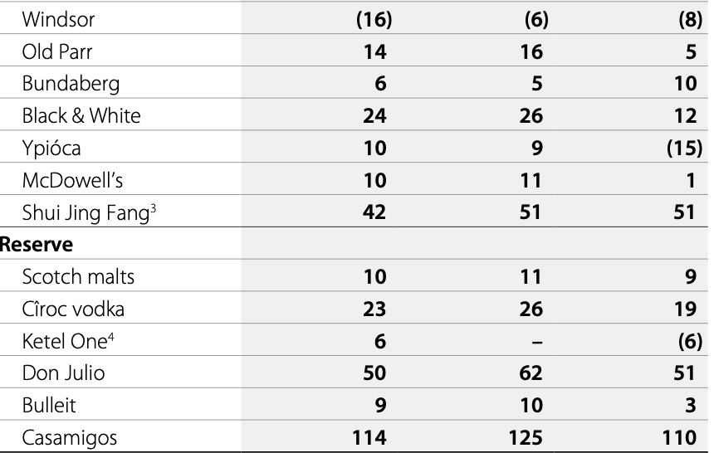
Brands

Slide 63
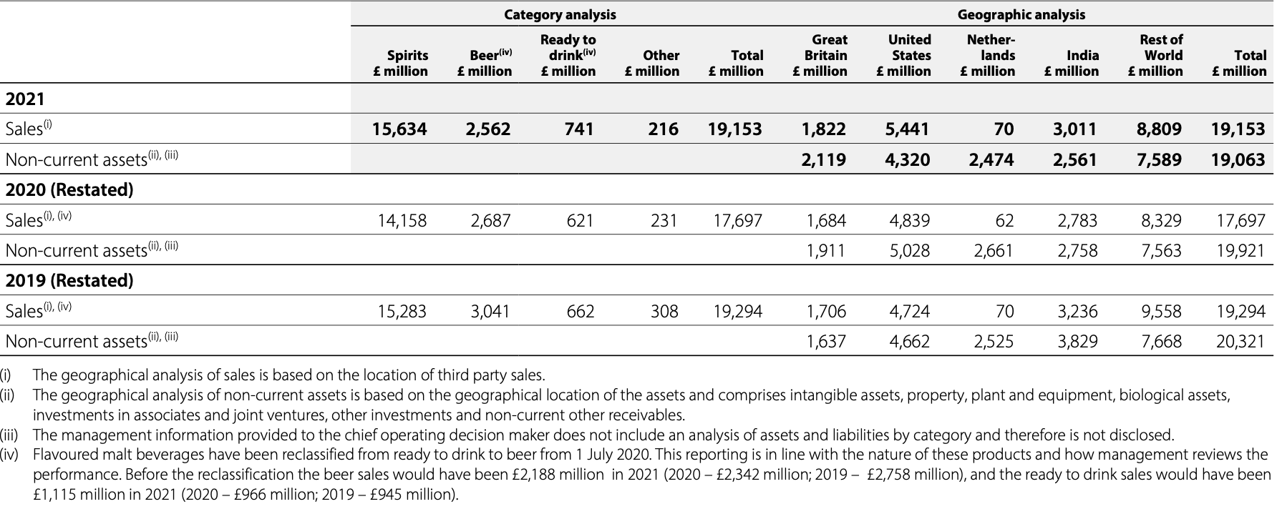
Revenue

Slide 64
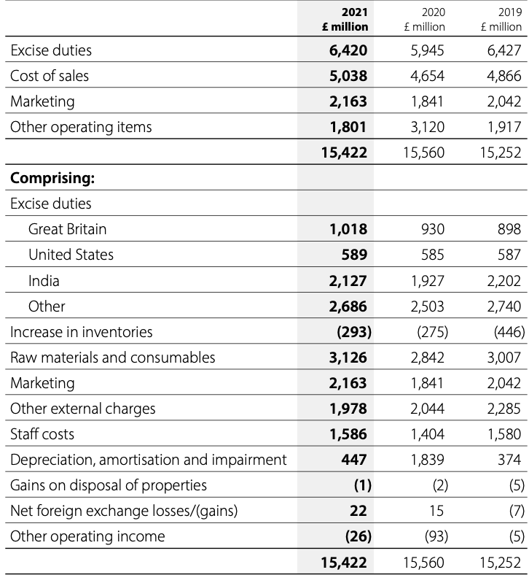
Cost structure

Slide 65
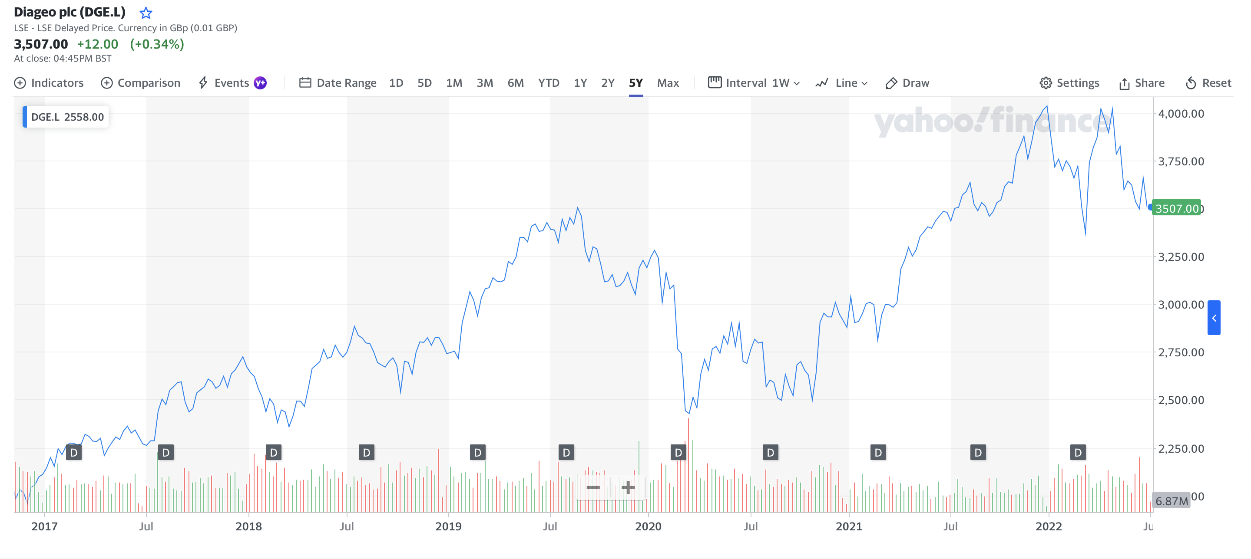
Stock Performance 5 years

Slide 66

Stock Performance – Compare to S&P 500

Slide 67
Financial statements
Consolidated income statements
Consolidated statement of comprehensive income
Consolidated balance sheet
Consolidated statement of cash flows
Performance comparison

Slide 68

Consolidated income statement

Slide 69

Consolidated statement of comprehensive income

Slide 70

Consolidated balance sheet

Slide 71

Consolidated balance sheet

Slide 72

Consolidated statement of cash flows

Slide 73

Consolidated statement of cash flows

Slide 74

Performance comparison

Slide 75
Risk management - Diageo
Currency risk
Interest rate risk
Commodity price risk
Market risk sensitivity analysis
Credit risk
Liquidity risk

Slide 76
Curreny risk
The group presents its consolidated financial statements in sterling and conducts business in many currencies. As a result, it is subject to foreign currency risk due to exchange rate movements, which will affect the group’s transactions and the translation of the results and underlying net assets of its operations. To manage the currency risk the group uses certain financial instruments. Where hedge accounting is applied, hedges are documented and tested for effectiveness on an ongoing basis. The impact of the Covid-19 pandemic on the group's cash flow hedges has been considered to determine if the hedged forecast cash flows remain ‘highly probable’, in relation to forecasted sales transactions on the net US dollar exposure of the group and other hedged currency pairs. In making this assessment, the potential financial impact of the Covid-19 pandemic has been modelled in the group's cash flow projections and stress tested.

Slide 77


Interest rate risk

Slide 78

Commodity price risk

Slide 79


Market risk sensitivity analysis

Slide 80
Credit risk
Credit risk refers to the risk that a counterparty will default on its contractual obligations resulting in financial loss to the group. Credit risk arises on cash balances (including bank deposits and cash and cash equivalents), derivative financial instruments and credit exposures to customers, including outstanding loans, trade and other receivables, financial guarantees and committed transactions. The carrying amount of financial assets of £5,360 million (2020 – £5,989 million) represents the group’s exposure to credit risk at the balance sheet, excluding the impact of any collateral held or other credit enhancements. Credit risk is managed separately for financial and business related credit exposures.

Slide 81


Credit risk

Slide 82

Liquidity risk
Liquidity risk is the risk that Diageo may encounter difficulties in meeting its obligations associated with financial liabilities that are settled by delivering cash or other financial assets. The group uses short-term commercial paper to finance its day-to-day operations. The group’s policy with regard to the expected maturity profile of borrowings is to limit the amount of such borrowings maturing within 12 months to 50% of gross borrowings less money market demand deposits, and the level of commercial paper to 30% of gross borrowings less money market demand deposits. In addition, the group’s policy is to maintain backstop facilities with relationship banks to support commercial paper obligations.

Slide 83

Financial intruments overview

Slide 84


Other risks

Slide 85


Other risks

Slide 86


Other risks

Slide 87

Accounting method

Slide 88

Accounting method

Slide 89


Slide 90
Company Overview – Molson Coors Beverage Company
Molson and Coors were founded in 1786 and 1873.
In October 2003, Coors merged with and into Adolph Coors Company, a Delaware corporation.
In February 2005, Adolph Coors Company merged with Molson Inc.("the Merger").
Upon completion of the Merger, Adolph Coors Company changed its name to Molson Coors Brewing Company.
Producing the highest quality beers and appealing to a wide range of consumer tastes, style and price preference.
Object: To be the first choice for our people, our consumers and our customers, and our success depends on our ability to make our products available to meet a wide range of consumer segments and occasions.

Slide 91

Americas Segments

Slide 92


EMEA&APAC Segments

Slide 93

Stock Performance – 5 Years

Slide 94

Stock Performance – Compare to S&P 500

Slide 95
Financial Statements
Statement of Operations
Statement of Comprehensive Income (Loss)
Balance Sheet
Statement of Cash Flow

Slide 96

Statement of Operations

Slide 97

Statement of Comprehensive Income (Loss)

Slide 98

Balance Sheet – Assets

Slide 99

Balance Sheet – Liabilities and Equity

Slide 100

Statement of Cash Flow

Slide 101
Risk Factors
Risk Related to Campany and Operations
Risks Related to Indebtedness, Capital Structure and Financial Condition
Risks Related to Dependence on Third Parties
Risks Related to Legal Matters, Governmental Regulations and International Operations
Risk Related to Acquisitions and Joint Ventures
Additional Risks Related to Americas Segment
Additional Risks Related to EMEA&APAC Segment
Risks Related to Ownership for our Class B Common Stock

Slide 102
Risk Related to Company and Operations
The coronavirus pandemic, efforts to mitigate or disrupt the coronavirus pandemic and related weak, or weaking of, economic or other negative conditions, have disrupted, and may continue our business, which has had and could continue to have a material adverse effect on our operations, liquidity, financial condition and financial results.
The global beer industry and the broader alcohol industry are constantly evolving, and our position within the global beer industry and markets in which we operate may fundamentally change. If we do not successfully transform along with evolving industry and market dynamics, then the result could have a material adverse effect on our business and financial results.
Competition in our markets could require us to reduce prices or increase capital and other expenditures or cause us to lose sales volume, any of which could have a material adverse effect on our business and financial results.
Our success as an enterprise currently depends largely on the success of relatively few products in several mature markets specific to the beer industry; if consumer preferences shift away from our products, consumption of our products decline or we are unable to successfully and timely innovate beyond beer, our business and financial results could be materially adversely affected.

Slide 103
Risk Related to Campany and Operations
The success of our business relies heavily on brand image, reputation, product quality and protection of intellectual property.
Changes in the social acceptability, perceptions and the political view of the beverage categories in which we operate, including alcohol and cannabis, could adversely affect our business.
Weak, or weaking of, economic or other negative conditions in the markets in which we do business, including reductions in discretionary consumer spending, could have a material adverse effect on our business and financial results.
EGS issues, including those related to climate change and sustainability, may have an adverse effect on our business, financial condition and results of operations and damage our reputation.
Climate change and other weather events may negatively affect our business and financial results.
An inadequate supply or availability of quality water could have a material adverse effect on, among other things, our sales, production processes, other cost and, in turn, profitability.

Slide 104
Risk Related to Campany and Operations
Loss, operational disruptions or closure of a major brewery or other key facility, including those of our suppliers, due to unforeseen or catastrophic events or otherwise, could have a material adverse effect on our business and financial results.
Due to a high concentration of workers represented by unions or trade councils in our Americas and EMEA&APAC segments, we could be significantly affected by labor strikes, work stoppages or other employee-related issues.
Because of our reliance on third-party service providers and internal and outsourced systems for our information technology and certain other administrative functions, we could experience a disruption to our business.
A breach of our information systems could cause material financial or reputational harm
Poor investment performance of pension plan holdings and other factors impacting pension plan cost could unfavorably affect our business, liquidity and our financial results.
We depend on key personnel, the loss of whim could harm our business.

Slide 105
Risks Related to Indebtedness, Capital Structure and Financial Condition
Our significant debt level subjects us to financial and operating risks, and agreements governing such debt subject us to financial and operating covenants and restrictions.
A deterioration in our credit rating could increase our borrowing rates or have an adverse effect on our ability to obtain future financing or refinance current debt.
Default by, or failure of, one or more of our counterparty financial institutions could cause us to incur significant losses.
Our operations face significant exposure to changes in commodity and other input prices, which could materially and adversely affect our business and financial results.
Our operations are dependent on the global supply chain and impacts of supply chain constraints and inflationary pressure could adversely impact our operating results.
We may incur impairments of the carrying value of our goodwill and other intangible assets which could have a material adverse effect on our business and financial results.
The estimates and assumptions on which our financial projections are based may prove to be inaccurate, which may cause our actual results to materially differ from such projections, which may adversely affect our future profitability, cash flows and stock price.

Slide 106
Risks Related to Dependence on Third Parties
Termination of one or more manufacturer/distribution/production agreements, or issues caused by our dependence on the parties to these agreements, could have a material adverse effect on our business and financial results.
Changes in various supply chain standards or agreements could have a material adverse effect on our buiness and financial results.
We rely on a small number of suppliers to obtain the packaging materials we need to operate our business. The inability to obtain materials or disruptions at the facilities of our suppliers could unfavorably affect our ability to produce our products which could have a material adverse effect on our business and financial results.

Slide 107
Risks Related to Legal Matters, Governmental Regulations and International Operations
Unfavorable outcomes of legal or regulatory matters may adversely affect our business and financial condition and damage our reputation.
Our operations in developing and emerging markets expose us to additional risks which could harm our business and financial results
Changes to the regulation of the distribution systems for our products could adversely affect our busniess and financial results.
Our consolidated financial statements are subject to fluctuations in foreign exchange rates, most significantly the Canadian dollar and the European operating currencies such as, Euro, British Pound, Czech Koruna, Croatian Kuna, Serbian Dinar, New Romanian Leu, Bulgarian Lev and Hungarian Forint.
Changes in tax, environmental, trade or other regulations or failure to comply with existing licensing, trade and other regulations could cause volatility or have a material adverse effect on our business and financial results.
Coronavirus pandemic vaccination mandates adopted by federal, state and local governments, as well as by certain healthcare systems, could have a material adverse impact on our business and results of operations.

Slide 108
Risk Related to Acquisitions and Joint Ventures
Risks associated with operating our joint ventures may materially adversely affect our business and financial results.
Failure to successfully identify, complete or integrate attractive acquisitions and joint ventures into our existing operations could have an adverse effect on our business and financial results.

Slide 109
Additional Risks Related to Americas Segment
Our U.S. business is highly dependents on independent distributors to sell our products, with no assurance that these distributors will effectively sell our products, and distributor consolidation in the U.S. could harm our business performance.
Government mandated changes to the retail distribution model resulting from new regulations may have a material adverse effect on our Canada business.
Our Americas business faces numerous risks relating to its joint ventures in the Canadian cannabis industry and the U.S. CBD beverage industry.
If we are required to move away from the industry standard returnable bottle we use today in Canada, we may incur unexpected losses.
Indemnities provided to the purchaser of our previous interest in the Cervejarias Kaiser Brazil S.A. ("Kaiser") business in Brazil could result in future cash outflows and statement of operations charges.

Slide 110
Additional Risks Related to EMEA&APAC Segment
Economic trends and intense competition in European markets could unfavorably affect our profitability.

Slide 111
Risks Related to Ownership for our Class B Common Stock
If pentland and the Coors Trust do not agree on a matter submitted to our stockholders or if a super-majority of our board of directors do not agree on certain actions, generally the matter will not be approved, even if beneficial to us or favored by other stockholders or a majority of our board of directors
The interests of the controlling stockholders may differ from those of other stockholders and could prevent our company from making certain decisions or taking certain actions that would be in the best interest of the other stockholders.

Slide 112
Financial Risk Management
Commodity Price Risk
Foreign Currency Exchange Risk
Interest Rate Risk

Slide 113

Commodity Price Risk
We are exposed to the volatility in commodity prices as we use commodities in the production and distribution of our products. We specifically hedge our exposure to fluctuations in the price of natural gas, aluminum, barley and wheat. We utilize market-based derivatives and long-term supplier-based contracts, specifically a combination of purchase orders, long-term supply contracts and over-the-counter instruments to mitigate our commodity price risk by establishing price certainty for commodities that are used in our supply chain.

Slide 114

Foreign Currency Exchange Risk
Foreign currency exchange risk is inherent in our operations primarily due to operating results that are denominated in currencies other that the USD. We closely monitor our operations in each country and seek to adopt appropriate strategies that are responsive to foreign currency fluctuations. Our finanical risk management policy is intended to offset a portion of the potentially unfavorable impact of exchange rates on our earnings and cash flows
Changes in foreign currency exchange rate affect the translation of local currency balances of foreign subsidiaries, transaction gains and losses associated with intercompany loans with foreign subsidiaries, royalty agreements and transactions denominated in currencies other than the USD, and their related cash flows specifically related to the purchase of production inputs and imports, as well as our foreign currency – denominated debt.

Slide 115

Interest Rate Risk
We are exposed to volatility in interest rates with regard to our current and future debt offerings. Specifically, we are exposed to U.S. Department of Treasury rates, Canadian government rates and LIBOR, or any such LIBOR alternative like SONIA, SOFR or EURIBO, for example. We may from time to time enter into interest rate swaps on our current debt obligations as our hedging strategy is to achieve our desired fixed-to-floating rate debt profile such that we manage the volatility in earning as well as the cost of funding our operations. Further, we may enter into forward starting interest rate swaps to manager our exposure to the volatility of interest rates associated with further interest payments on a forecasted debt issuance.

Slide 116

Financial Instrument
Following table summarize derivative assets and liabilities that were measured at fair value as December 31, 2021 and December 31, 2020

Slide 117

Financial Instrument
Fair Value of Derivative Intruments in the Consolidated Balance Sheet (in millions)

Slide 118

Financial Instrument
The Pretac Effect of Cash Flow Hedge Accounting on Other Comprehensive Income, Accumulated Other Comprehensive Income (Loss), and income (in millions)

Slide 119

Financial Instrument
The Pretax Effect of Net Investment Hedge Accounting on Other Comprehensive Income, Accumulated Other Comprehensive Income (Loss) and income (in millions)

Slide 120

Financial Instrument
The Effect of Derivatives Not Designated as Hedging Instruments on the Consolidated Statements of Operations (in millions)

Slide 121

Accounting Method - Derivatives

