Slide 1
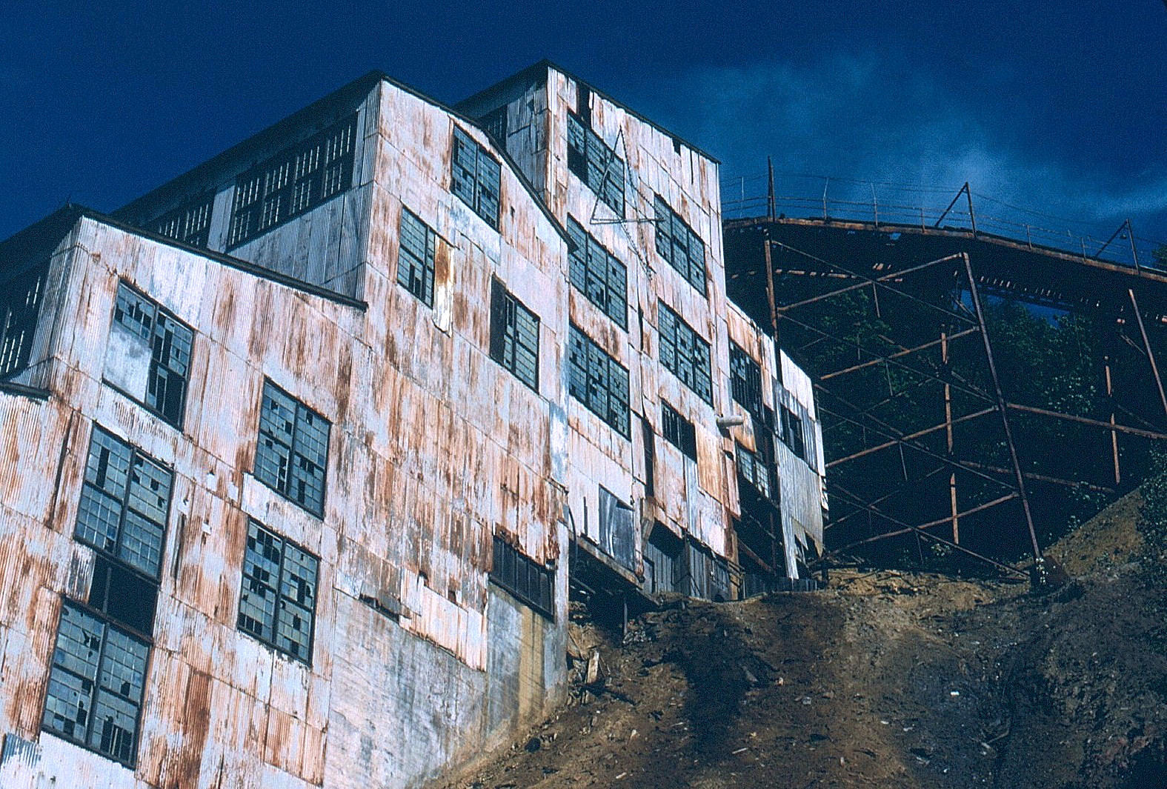
Minerals & Materials
Mike Chow, Jeremy Grewal, Reid McGregor, Nick Morneau

Slide 2

Mining Industry
CAPITAL INTENSIVE
EXPLORATION
MINE CONSTRUCTION
EQUIPMENT
CLEAN UP
SENSITIVE TO BUSINESS CYCLES
REVENUES DRIVEN BY MARKET VOLATILITY
COMMODITY PRICES
EXCHANGE RATES
OPERATING COSTS
MAINTENENCE
FUEL
ENERGY
LABOUR

Slide 3
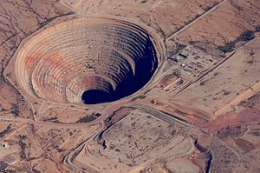
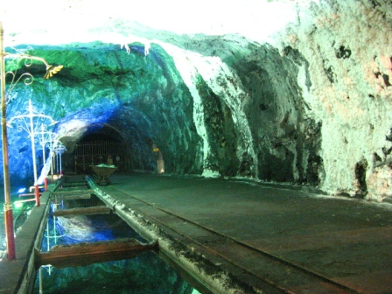
Types of Mines
OPEN PIT MINE
UNDERGROUND MINE
- Used when commercially useful mineral or rock deposits are found near the surface.
- Method used when the overburden is thick or when the mineral or rock occurs in veins that are better accessed by tunnel.

Slide 4
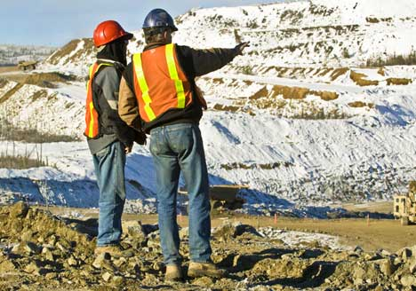
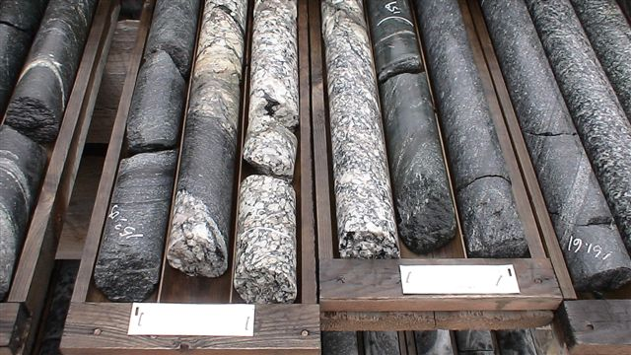
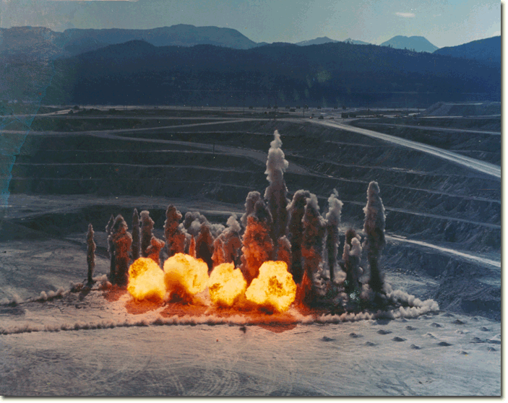
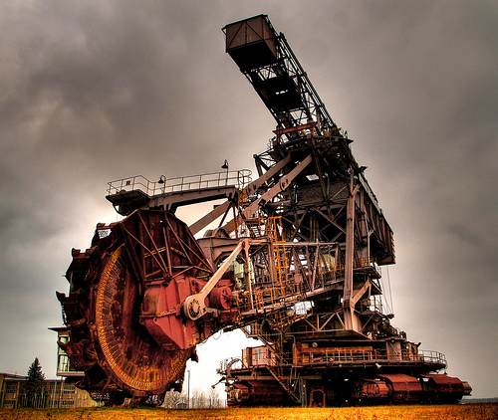
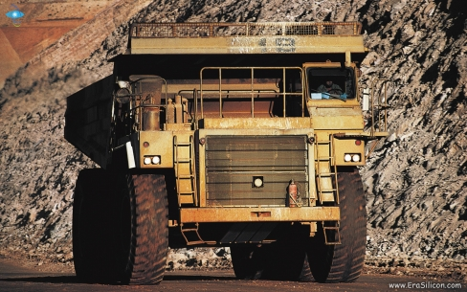
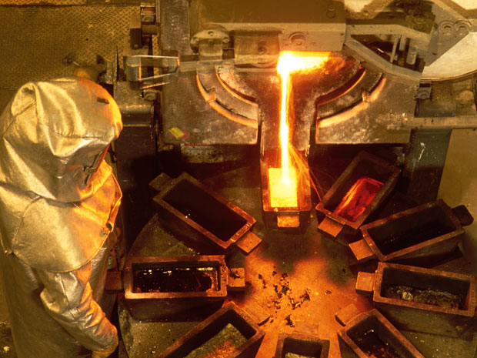
From Ore to Store
EXPLORATION
CORE SAMPLES
BLASTING
MINING
HAULING
REFINING

Slide 5


Slide 6
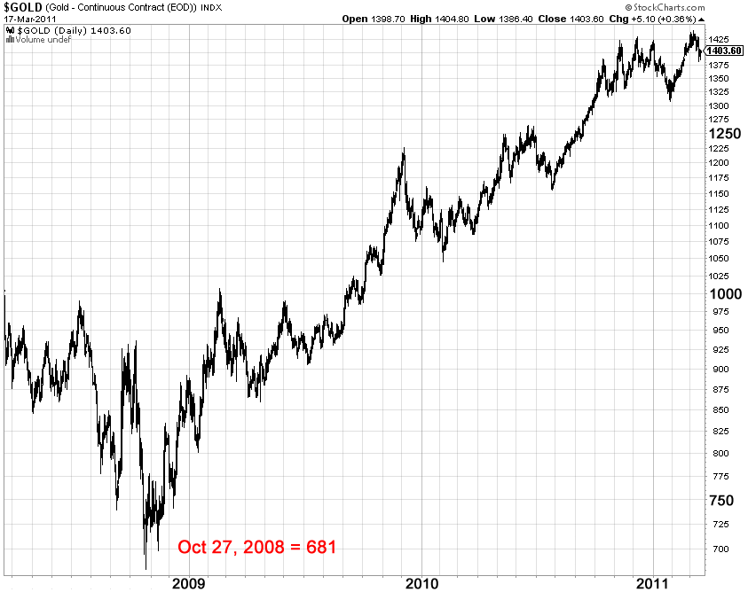
Price of Gold
Cost to mine (avg.)
$655/oz in 2008
$281/oz in 2001

Slide 7
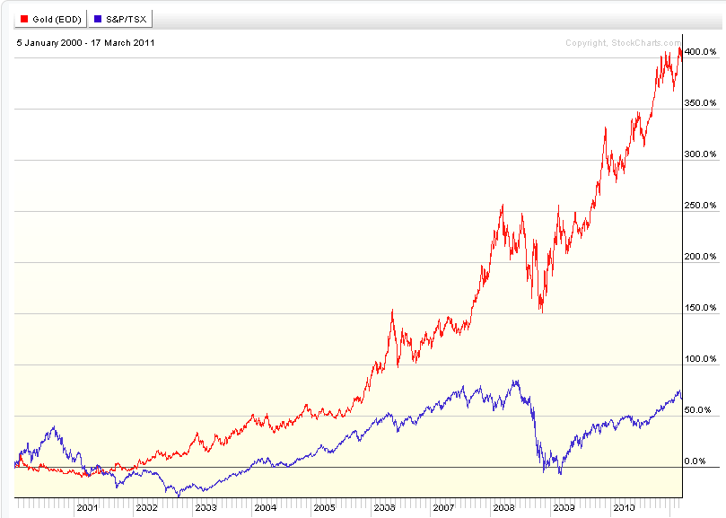
Gold vs. TSX Comp

Slide 8
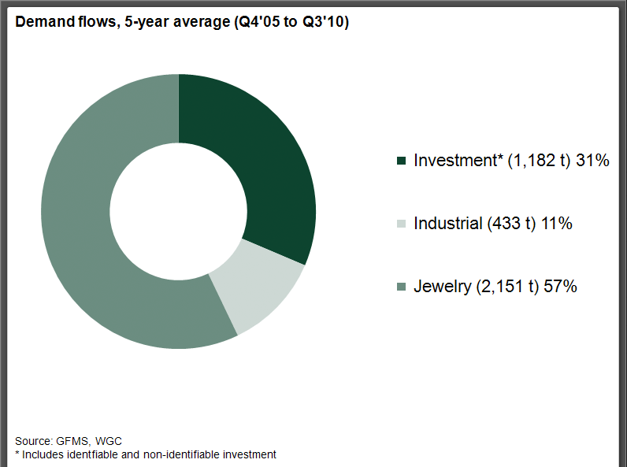
Gold Demand
Notes:
Demand for gold is widely dispersed around the world. East Asia, the Indian sub-continent and the Middle East accounted for approximately 70% of world demand in 2009. India, Greater China (China and Hong Kong), US, Turkey and Saudi Arabia represented over half of world demand. A different set of socio-economic and cultural incentives drives each market, creating a diverse range of factors influencing demand.
Jewellery demand
Jewellery consistently accounts for over two-thirds of gold demand. In the 12 months to December 2009, appetite for jewellery amounted to around US$55 billion, making it one of the world's largest categories of consumer goods. India is the largest consumer in volume terms, accounting for 27% of demand in 2009. Indian gold demand is supported by cultural and religious traditions which are not directly linked to global economic trends.
A significant portion of investment demand is transacted in the over-the-counter market, therefore not easily measurable. However, there’s no doubt that investment demand in gold has increased considerably in recent years. Since 2003, investment has represented the strongest source of growth in demand. The last five years to the end of 2009 saw an increase in value terms of around 119%. In 2009 alone, investment attracted net inflows of approximately US$41bn.
Numerous factors motivate people and institutions to seek gold investments. The positive price outlook is underpinned by expectations that growth in demand will continue to outstrip that of supply. Of the key drivers behind investor demand, one common thread emerges: all are rooted in gold's abilities to insure against instability and protect against risk.
The growth in investment demand has sparked numerous innovations in gold investment, ranging from online bullion sales to gold ETFs. There are now a wide variety of investment products to suit both the private and institutional investor\
Technological demand
Industrial, medical and dental technology accounts for around 12% of gold demand (an annual average of over 434 tonnes from 2005 to 2009).
Gold offers high thermal and electrical conductivity, along with outstanding resistance to corrosion. This explains why over half of all industrial demand arises from its use in electrical components.

Slide 9
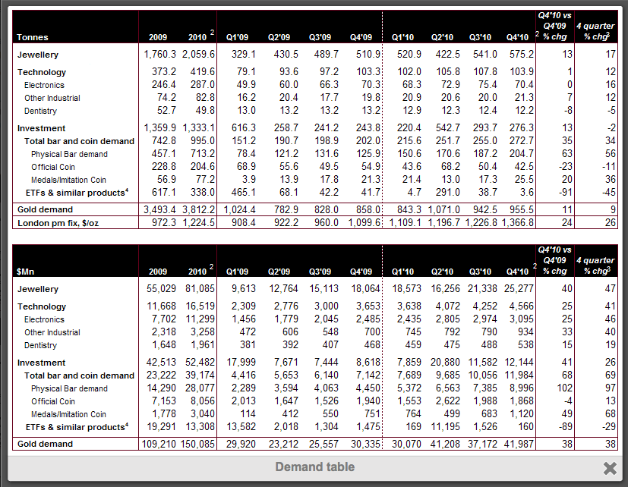
Gold Demand in depth

Slide 10
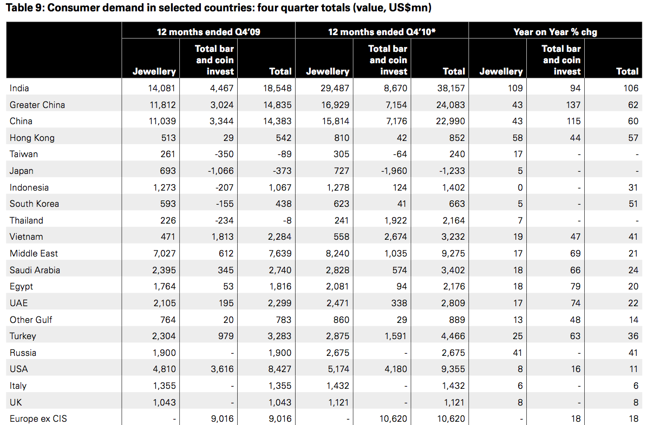
Gold Demand by Country

Slide 11
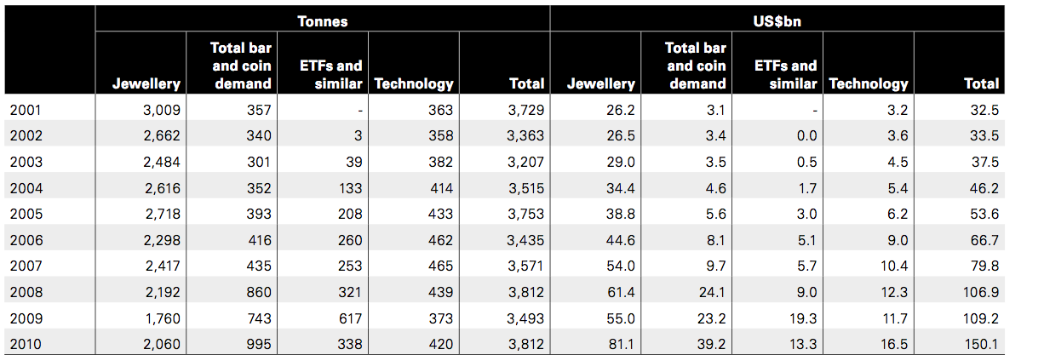
Historical Demand

Slide 12
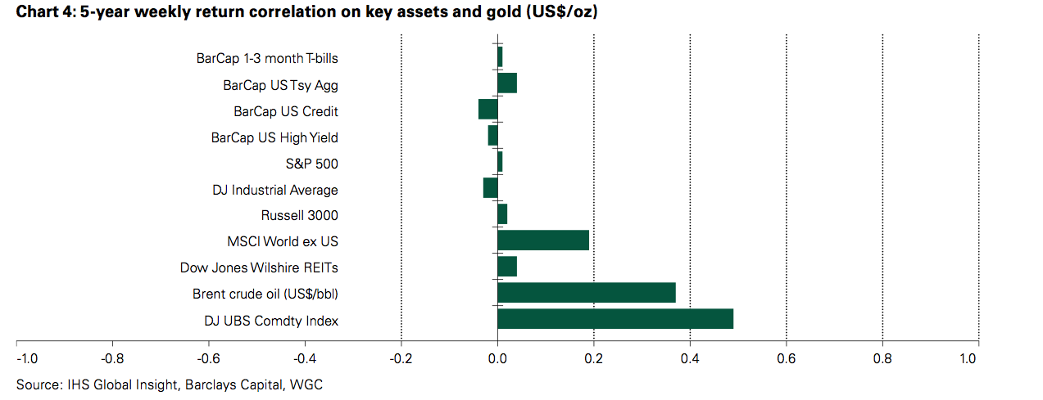
Gold as a Hedge
Inflation Hedge, store of value ???

Slide 13
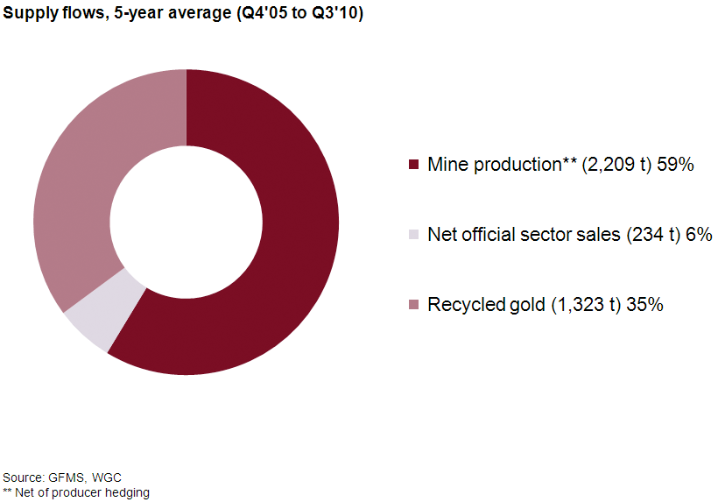
Gold Supply

Slide 14
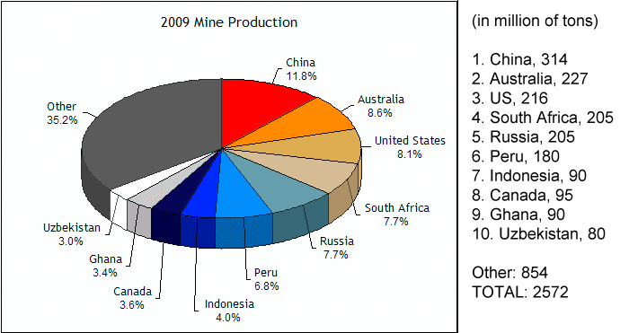
Gold Production

Slide 15
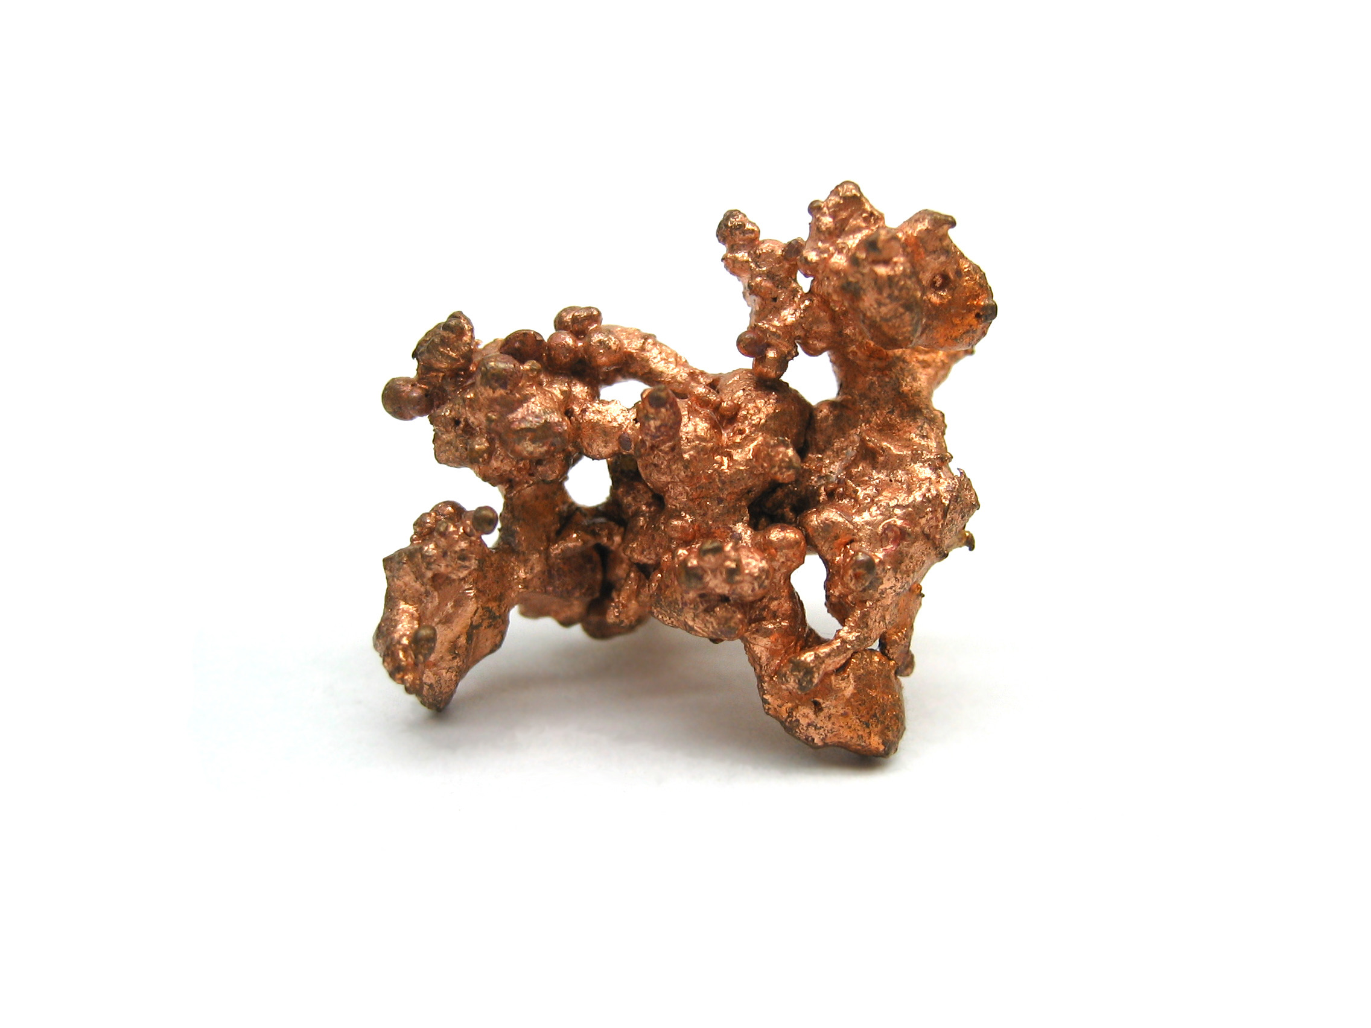

Slide 16
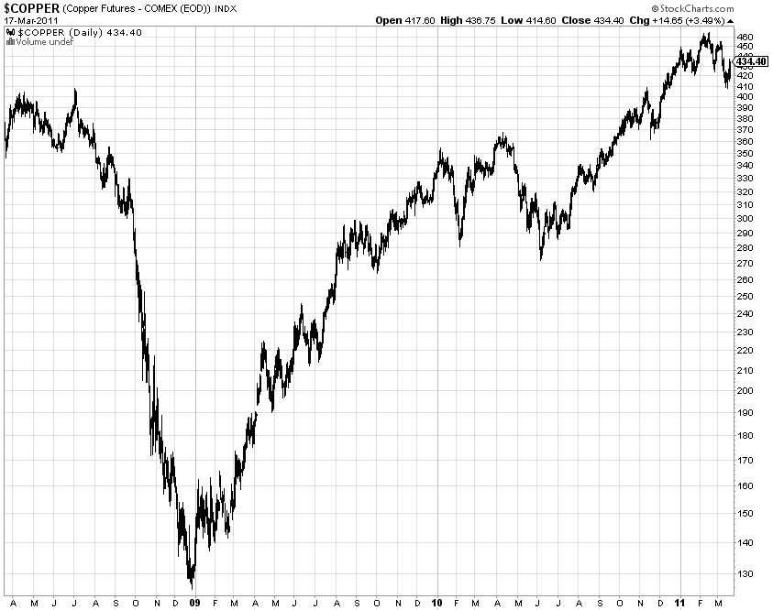
Price of Copper

Slide 17
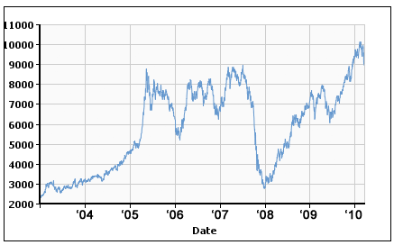
Price of Copper
1 ton = 2,204.62 pounds
2009 Weighted Average Copper Mine Costs: $2,320/t or $1.05/lb

Slide 18
Price of Copper
VOLATILE AND CYCLICAL PRICING
TRADED ON THREE LARGE EXCHANGES
LONDON MERCANTILE EXCHANGE (LME)
COMEX
SHANGHAI FUTURES EXCHANGE

Slide 19
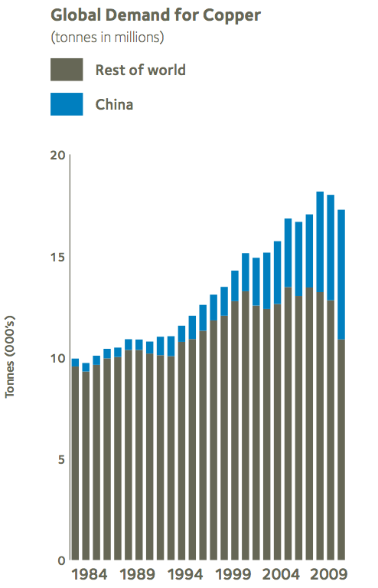
Copper Demand
ELECTRICAL EQUIPMENT
AUTOMOTIVE RADIATORS
ORDNANCE
SMALL ARMS AMMUNITION
JEWELLERY
TELECOMMUNICATIONS

Slide 20
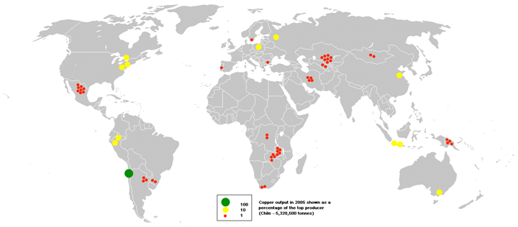
Copper Production

Slide 21
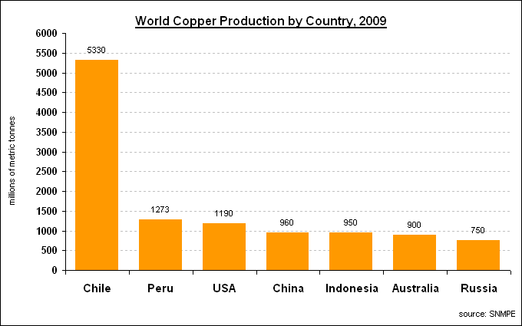
Copper Production

Slide 22
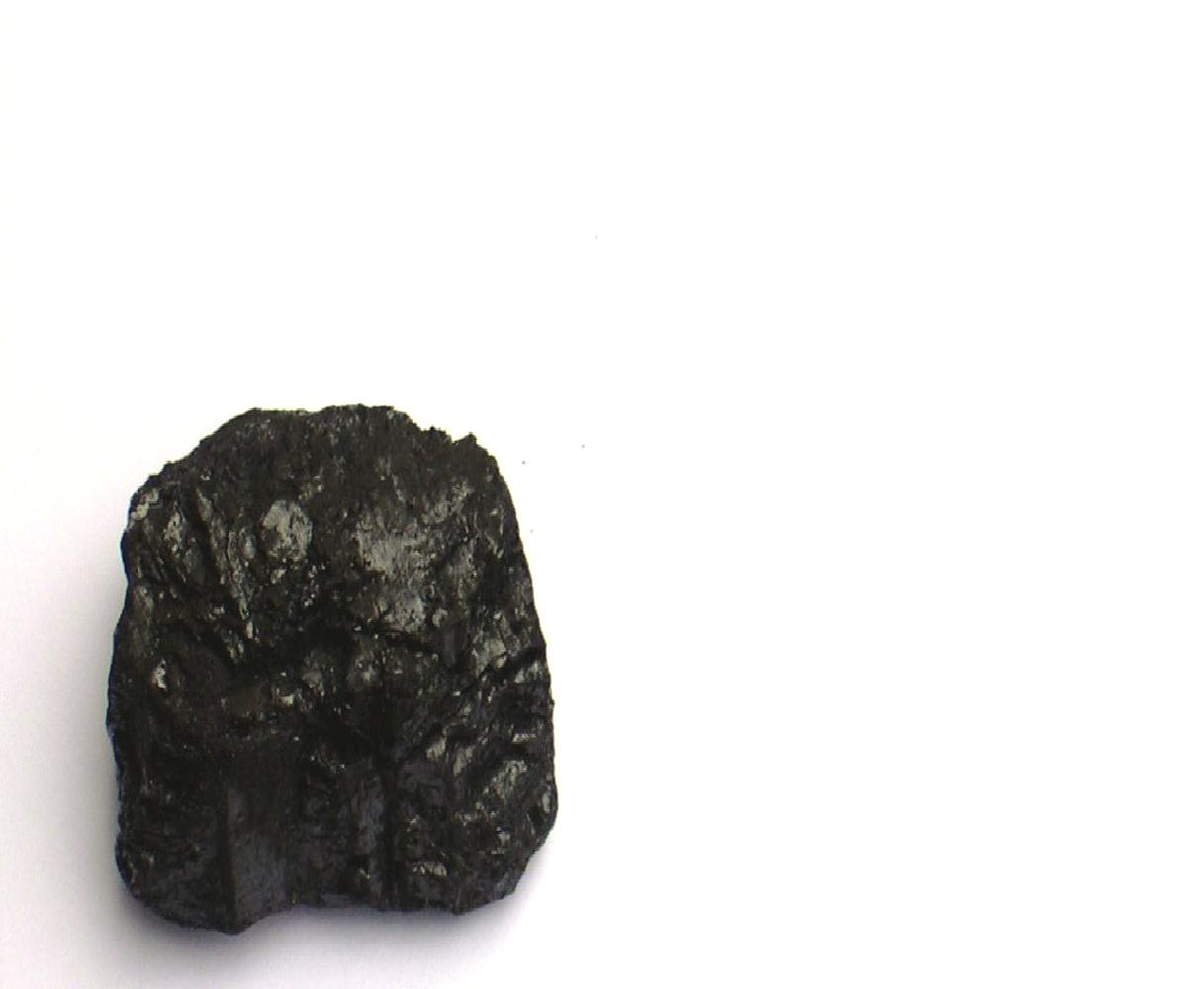

Slide 23
Coal
LARGEST SOURCE OF ENERGY FOR ELECTRICITY GENERATION WORLDWIDE
VARIOUS TYPES OF COAL BASED ON PRESSURE
USED FOR
POWER GENERATION (THERMAL COAL)
STEEL PRODUCTION (COKING COAL)
CEMENT MANUFACTURING
AS A LIQUID FUEL

Slide 24
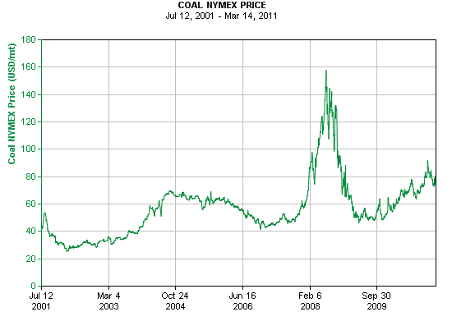
Price of Coal
Source: Infomine.com

Slide 25
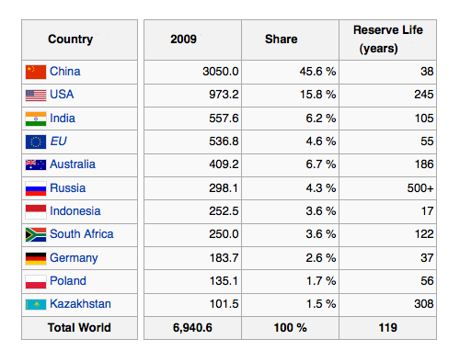
Coal Supply
Wikipedia.org

Slide 26
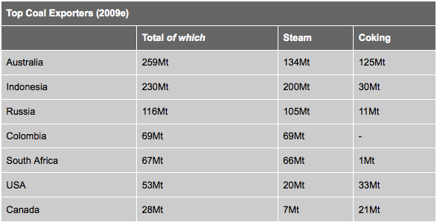
Coal Exports

Slide 27
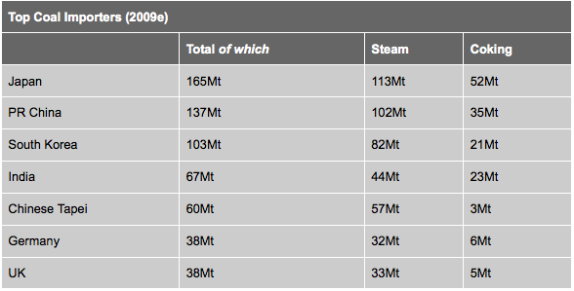
Coal Imports

Slide 28
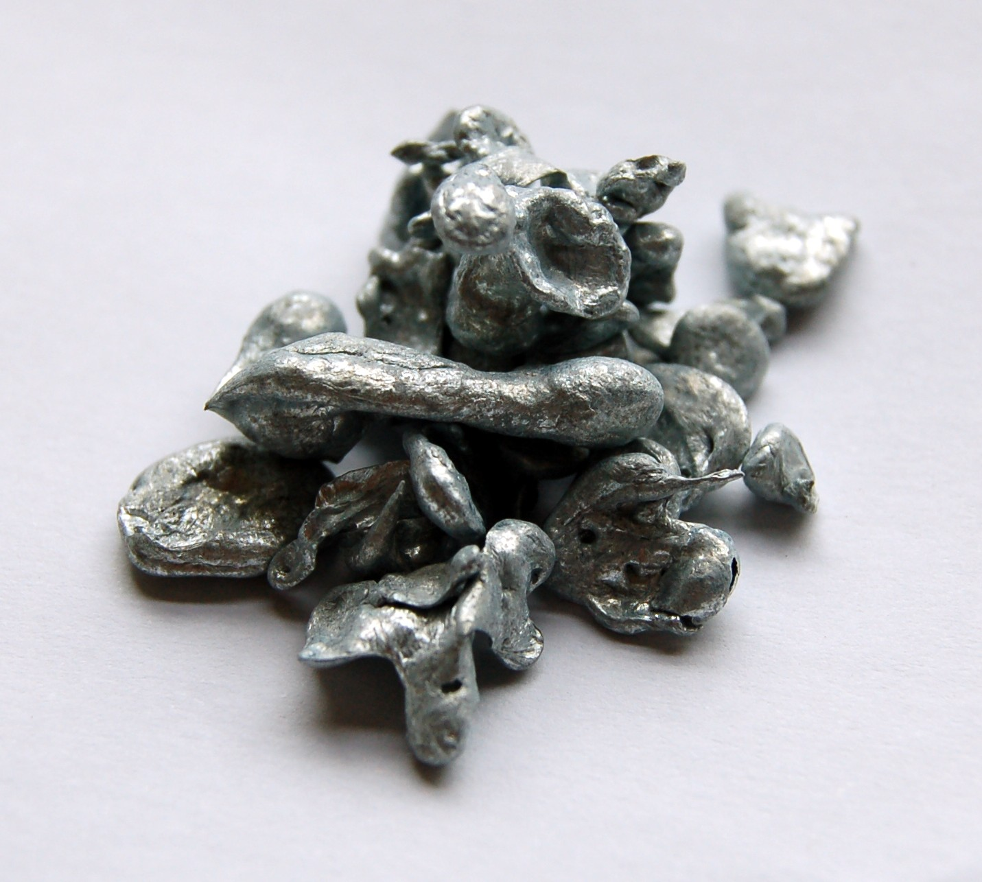

Slide 29
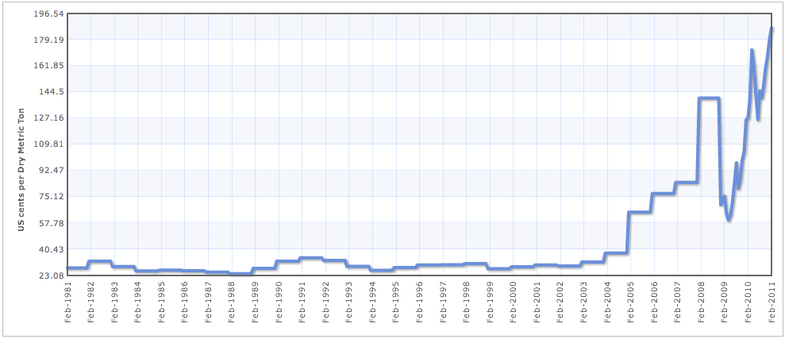
Iron Ore
Most widely used metal
Steel contains 95% iron ore
Prices determined through closed-door negotiations between miners and steelmakers

Slide 30
Iron Ore Production
COUNTRY | PRODUCTION (2009 mmT)
China | 880
Australia | 394
Brazil | 300
India | 245
Russia | 92
Ukraine | 66
South Africa | 55
Iran | 33
Canada | 32
US | 27

Slide 31
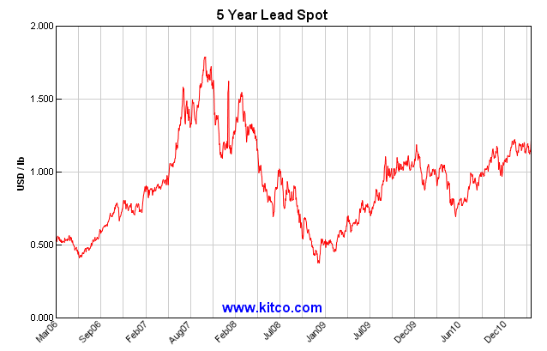
Lead

Slide 32
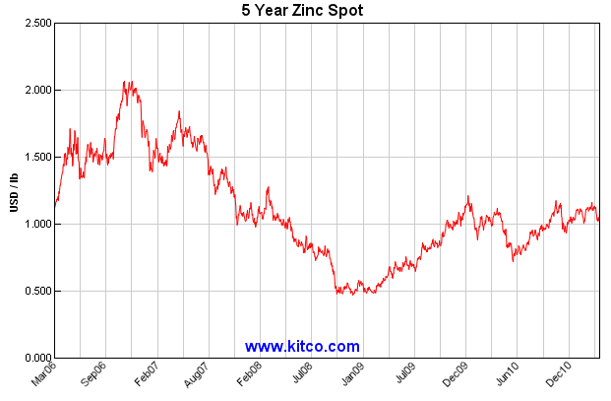
Zinc

Slide 33


Slide 34

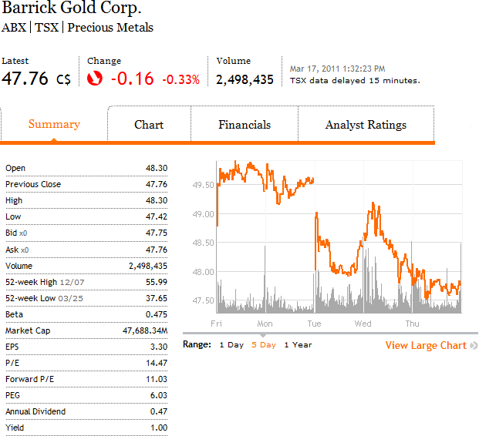

Slide 35
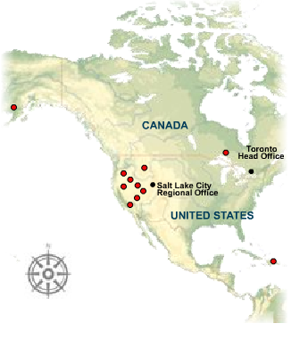
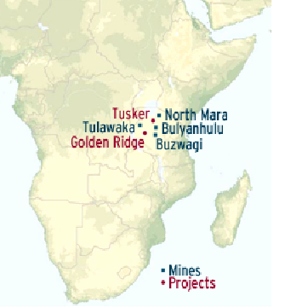
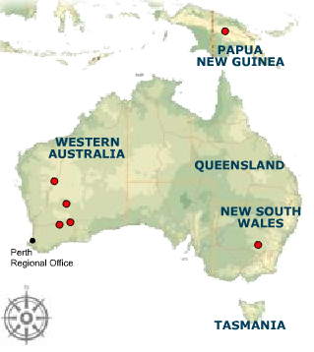
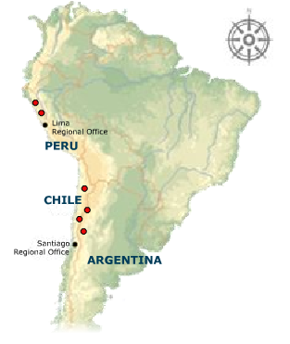
Operations
Notes:
-Barrick does gold primarily
-the Zaldivar mine in Chile is specifically for copper
-both its copper and silver productions can be found in N.A., S.A., and African mines.
-We also produce significant amounts of copper and have significant silver reserves contained within our gold reserves at our Pascua-Lama project.

Slide 36
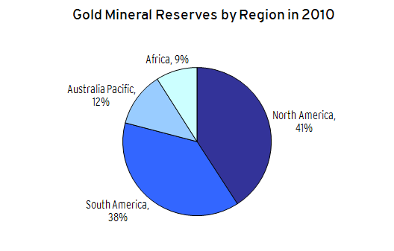

Slide 37
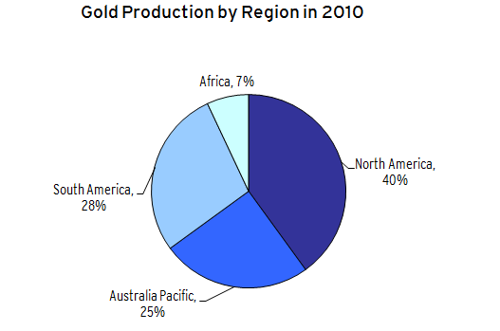

Slide 38
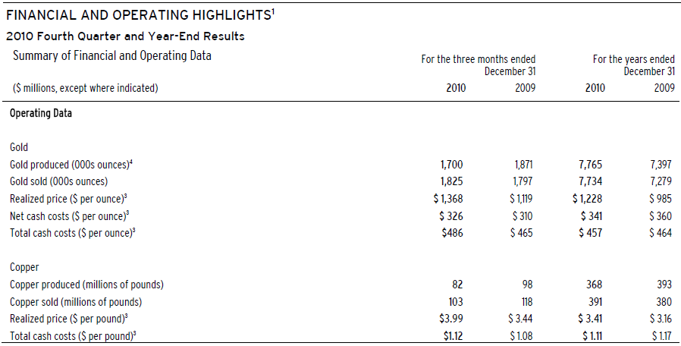
Notes:
-They are a gold corp., but you will usually get other minerals when mining for gold
-Silver Sale Agreement
On September 22, 2009, we entered into an agreement with Silver Wheaton Corp. to sell the equivalent of 25% of the life-of-mine silver production from the Pascua-Lama project and 100% of silver production from the Lagunas Norte, Pierina and Veladero mines until project completion at Pascua-Lama. In return, we were entitled to an upfront cash payment of $625 million payable over three years from the date of the agreement, as well as ongoing payments in cash of the lesser of $3.90 (subject to an annual inflation adjustment of 1% starting three years after project completion at Pascua-Lama) and the
prevailing market price for

Slide 39

OBJECTIVES
FINANCIAL STRENGTH
• Optimize realized gold and copper prices;
• Contain and/or reduce production costs;
• Optimize return on capital expenditures;
• Maintain a strong financial position and good liquidity;
GOLD LEVERAGE
• Meet annual production targets;
• Grow reserve/resource base;
• Unhedged on all future gold production;
GROWTH
• Develop advanced projects on time and on budget;
• Identify and develop growth opportunities at
operating mines
• Selectively acquire future accretive growth
opportunities;
RESPONSIBLE MINING
• Improve safety and environmental performance; and
• Maintain our social license to operate

Slide 40
WHAT IS “GOLD LEVERAGE”?
For a producer who is unhedged against spot gold prices, its gross margin per ounce is said to be leveraged.
For example:
- if producer has a cost of $300 per ounce and the spot gold price is $600 then their gross margin is $300.
-If spot gold price rises by 10%, then gross margin will rise by 20%; if it decreases by 10% then gross margin will decrease by 20%

Slide 41
WHAT DOES BARRICK
PERCEIVE AS RISK?
Gold price volatility
Re-licensing risk
Compliance with environmental laws and regulations
Community relations and human rights issues
Health and safety of employees
Project risk

Slide 42
WHAT DOES BARRICK
PERCEIVE AS RISK? (CONT.)
Economic risk
Foreign exchange risk
Input price risk
Credit risk

Slide 43
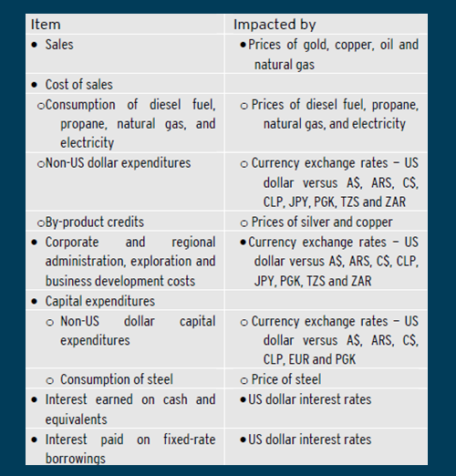
RISK EXPOSURES: CHART
REPRESENTATION

Slide 44
WHAT BARRICK DOES TO HEDGE AGAINST THESE RISKS
Interest rate swaps
Foreign currency contracts for non-US expenditures
Commodity hedging for inputs such as diesel, electricity, propane and natural gas, as well as its production outputs for both copper and silver

Slide 45
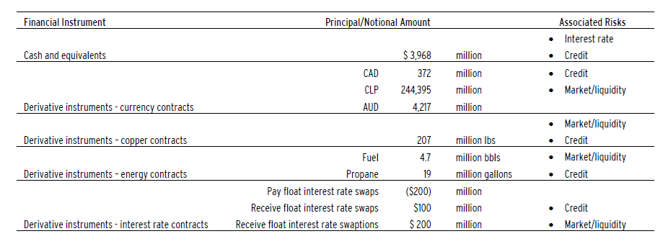

Slide 46
HEDGE AGAINST INTEREST RATE RISK
$300 M USD receive-fixed interest rate swaps outstanding
Not all swaps are utilized for hedging:
Gain of $2 M USD off of premiums for pay-fixed interest rate swaptions, but a $1 M USD loss off of the swaptions itself

Slide 47
HEDGE AGAINST FOREIGN CURRENCY RISK

Slide 48
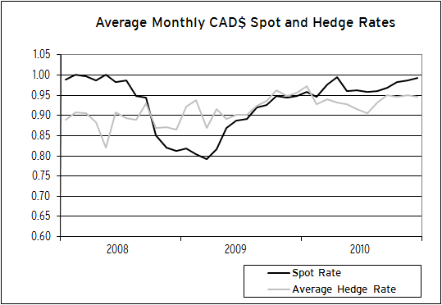

Slide 49
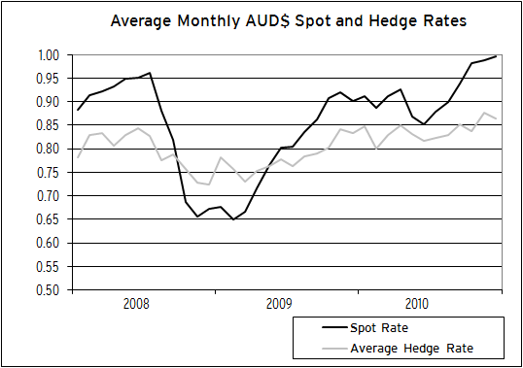

Slide 50
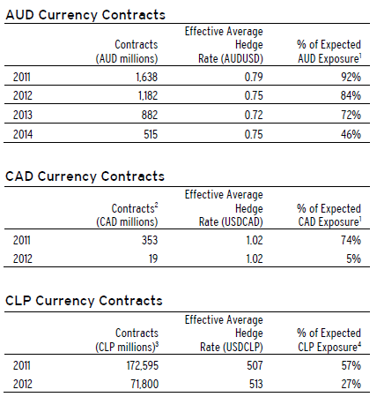

Slide 51
HEDGE AGAINST COMMODITY PRICE RISK
480K bls of WTI/ULSD crack spreads, 1,222K bls of MOPS forwards, 228K bls of WTB forwards, 228K bls of JET forwards, and 19M gallons of propane
185M lbs of copper collars
15M oz. of silver collars

Slide 52
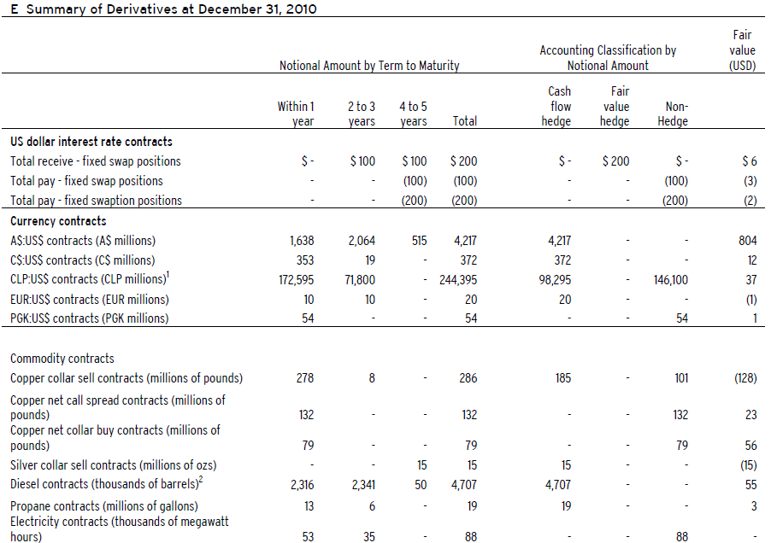
Notes:
-$146 M worth of CLP contracts are considered non-hedge because they are considered economic hedging, and not accounting hedging; they are pre-production capex hedging
-1 Chilean peso / U.S. dollar = 0.002057

Slide 53
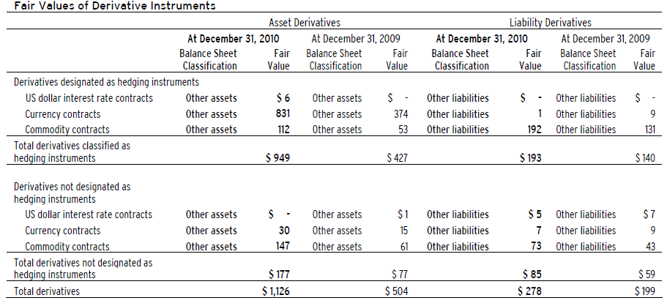
Notes:
Fair Value is the price with which you receive to sell off an asset or to pay for a transfer of a liability between market participants at the quoted at the measurement date. So, basically, market value at the time.

Slide 54
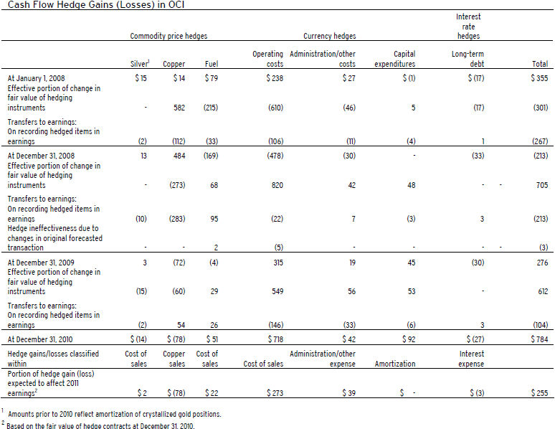

Slide 55
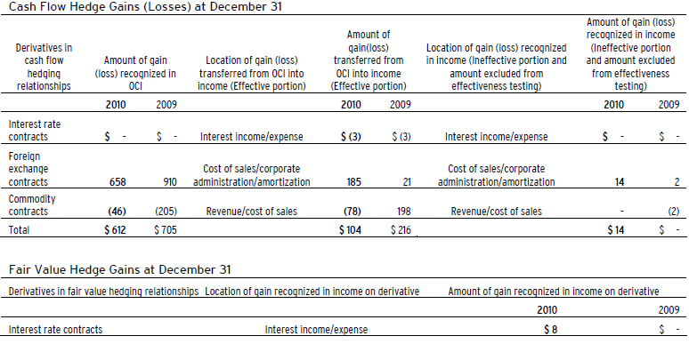
Notes:
So comprehensive income is your normal, net, accounting income, whereas OCI, other comprehensive income, includes economic gains.

Slide 56

Notes:
-derivatives are considered non-hedge because they are for speculative reasons.
-We enter into purchased and written contracts with the primary objective of increasing the realized price on our gold and copper sales. During 2010, we wrote gold put and call options with an average outstanding notional volume of 0.3 million and 0.3 million ounces, respectively,on a net basis. We also held other net purchased gold long positions during the year with an average outstanding notional of 0.1 million ounces. During the year, we wrote copper call options averaging 5 million pounds and purchased other net long copper positions averaging 7 million pounds.
-As a result of these activities, we recorded realized gains in revenue of $26 million on gold contracts and realized gains of $7 million on copper contracts in 2010. There are no outstanding gold or copper positions at December 31, 2010.

Slide 57


Slide 58

INCOME STATEMENT
Notes:
-The gold hedges contractually obligate Barrick to sell its production at an average of about $396 per ounce, guaranteeing certainty in cash flow for the company from 2011 to 2019.
-Barrick issued a $3 billion dollar equity offering, which was increased the following day to $3.5 billion in response to market demand.^{[35]} Revenue from the offering was used to eliminate the company’s gold hedges, which locked in the sale price of future production, rather than selling it at market prices.^{[36]}

Slide 59

BALANCE SHEET: ASSETS

Slide 60

BALANCE SHEET: LIABILITIES & EQUITY

Slide 61

STATEMENT OF CASH FLOW
Notes:
Settlement Obligation to Close Out Gold Sales Contracts
In September 2009, we announced a plan to eliminate our “Gold Hedges” and a significant portion of our “Floating Contracts”. Our “Gold Hedges” were fixed price contracts which did not participate in gold price movements. Our “Floating Contracts” were essentially Gold Hedges that had been offset against future movements in the gold price but not yet settled. As at December 31, 2009, the obligation relating to the Floating Contracts had been reduced to $0.6 billion. During 2010 the $0.6 billion obligation relating to the Floating Contracts was repaid.

Slide 62

STATEMENT OF CASH FLOW (CONT.)

Slide 63


Slide 64




General Information

Slide 65
It formed from a merger between BHP and Billiton
The world’s largest diversified natural resources company.
The world’s third largest producer of copper, and a leading producer of lead and zinc.
Manage risk using Portfolio Risk Management Strategy and within the overall CFaR limits.

Slide 66

Segmented Reporting

Slide 67
Risk Exposure
Commodity price risk
Political uncertainty
Lack of opportunity
China slowdown
Inadequate human resource talent pool
Currency risk
Integrating acquired operations
Lose of development costs.
Non-compliance of non-controlled assets
Liquidity Risks
Unexpected natural and operational catastrophes
Climate change and greenhouse effects
Interest Rate Risk
Breaches in information technology
Breaches in governance processes
Impact of health, safety and environmental exposures regulations
Credit risk
Cost and schedule overruns
Group seeks to achieve financing costs, currency impacts, input costs
and commodity prices on a floating or index basis.

Slide 68

“In executing the strategy, financial instruments are potentially employed”
CFaR - Cashflow at Risk
Defined as the worst expected loss relative to projected business plan cash flows over a one-year horizon under normal market conditions at a confidence level of 95 per cent
Useful for identifying risk associated with commodity price changes.

Slide 69

Governance

Slide 70

Commodity Price Risk
“Contracts for the sale and physical delivery of commodities are executed whenever possible
on a pricing basis intended to achieve a relevant index target”.
“Derivative commodity contracts are used when available to return realized prices to the index”.

Slide 71

• Economic hedging of prices realized on commodity contracts
• Proprietary trading
• Purchases and sales of physical contracts that can be cash-settled
• Cashflow hedging of revenues
• Derivatives embedded within other supply contracts

Slide 72


Slide 73


Sensitivity Analysis
Does not include cashflow hedges or embedded derivatives.

Slide 74

Positive Effects

Slide 75

Currency Risk
Functional Currency: US $
Translational exposure in respect of non-functional currency monetary items
Transactional exposure in respect of non-functional currency expenditure and revenue

Slide 76

Exchange Rate Volatility

Slide 77
Transactional Exposure
Arise from operating and capital expenditures in non-functional currency.
May also be a result of revenues denominated in non-functional currency.
The fair value of forward exchange contracts outstanding is an asset of US$22 million (2009: a liability of US$5 million).

Slide 78

Sensitivity Analysis
Major non-functional Currencies
Effect of weakening US $.

Slide 79

Translational Exposure
⇒ Monetary items denominated in non-functional currency are periodically restated to
US dollar equivalents, and the associated gain or loss is taken to the income statement.

Slide 80
Interest Rate Risk
The Group has entered into interest rate swaps and cross currency interest rate swaps to convert most of the centrally raised debt into US dollar floating rate exposures.
It is estimated that a one percentage point increase in US LIBOR will decrease the Group profit after taxation and equity by US$2 million (2009: increase of US$23 million).

Slide 81


Slide 82

Liquidity Risk
Arises from the possibility that it may not be able to settle or meet its obligations as they fall due.
Strong credit profile, diversified funding sources and committed credit facilities
Long-term credit rating of A+
Short-term credit rating is A-1
Operational, capital and regulatory requirements are considered in conjunction with short- and long-term forecast information.
The Group only uses derivatives in highly liquid markets.

Slide 83

Debt Maturity Profile
The Group holds derivatives related to net debt, commodities and currencies that are classified as other financial assets when they are expected to generate cash inflows.

Slide 84
Credit Risk
Arises from the non-performance by counterparties of their contractual financial obligations towards the Group.
The BHP Billiton Group maintains group-wide procedures for:
credit approvals
granting and renewal of counterparty limits
daily monitoring of exposures against these limits
The maximum exposure is limited to the total carrying value of relevant financial assets on the balance sheet.
Significant exposure in South Africa, Australia, US, Japan and China.
Secured payment mechanisms and other risk mitigation instruments are used to protect revenues from credit risk losses.

Slide 85
Counterparties
Receivables counterparties
the majority of sales to the Group’s customers are made on open terms.
Payment guarantee counterparties
A proportion of sales to Group customers occur via secured payment mechanisms.
Derivative counterparties
Counterparties to derivative contracts consist of a diverse number of financial institutions and industrial counterparties in the relevant markets.
Cash investment counterparties
The Group holds short-term cash investments with a range of approved financial institutions.
No significant concentration of credit risk with any single counterparty or group of counterparties.

Slide 86

Industry Credit Risk
Sells to diverse set of industries.
Credit quality is monitored on an ongoing basis and assessed for impairment.
Solvency of each debtor and their ability to repay is considered in assessment.
May seek collateral as security for the receivable.
Actively seeks to recover the amounts in question and enforce compliance with credit terms.

Slide 87

Fair Value Risks
Derivatives are initially recognized at fair value on the date the contract is entered into and are subsequently remeasured at their fair value.

Slide 88


Slide 89


Slide 90


Slide 91


Slide 92

About Teck
Canada’s largest diversified mining, mineral processing and metallurgical company
Headquartered in Vancouver, Canada
Produce copper, metallurgical coal, zinc, molybdenum and specialty metals
13 mines in Canada, the USA, Chile and Peru
Coal, copper and zinc sales represent 95% of revenue in 2010

Slide 93

Worldwide Production

Slide 94


Productions and Sales

Slide 95


Share Data

Slide 96

Revenue & Profit

Slide 97

Revenues
Mineral | % change from 2009
Copper | 21%
Coal | 24.1%
Zinc | 18.5%

Slide 98
Risks
Risk | Financial Instruments Used
Commodity Price Risk | Forward purchase and forward sale agreements
Input price risk | None
Exchange rate risk | Currency swap agreements
Yield Risk | None
Interest rate risk | Interest rate swaps , Prepayment rights
Liquidity risk | Cash flow hedges: Currency swaps, Interest rate swaps

Slide 99
Commodity Price Hedging Strategies
Forward price contracts
Established quarterly
Price depend on prevailing market prices and future spot prices
Individual mine production sold separately

Slide 100
Examples of uses
“Other expenses included a $100 million gain on derivative positions – Primarily related to an increased value attributed to the embedded call options on our high-yield notes.”
Coal – expected average price range for 2011
US$206 – US$211 per tonne
Matching C$ expenses with US$ revenues and debts

Slide 101
Production Inputs
Natural Gas
Oil
“Our general policy is not to hedge our exposure to changes in the prices of the commodities we use in our business”
Electricity
Diesel

Slide 102

Outstanding Derivative Positions

Slide 103

Effect of Hedging Activities

Slide 104


Sensitivity Analysis

Slide 105

Sensitivity Analysis

Slide 106

Key Financial Statements

Slide 107

Statement of Cash Flows - Operating Activities

Slide 108

Statement of Earnings

Slide 109

Balance Sheet

Slide 110

Balance Sheet

Slide 111

Comprehensive Income

Slide 112


Slide 113



Stock Data

Slide 114

Sales

Slide 115

Forward Sales Contracts

Slide 116
Hedging Policies
Sells forward production on a mine by mine basis
Loan agreements force Capstone to hedge price risk
Will continue to hedge despite rising commodity prices.
Forward sales contracts up to 5 yrs out.

Slide 117
Results of Hedging Program
Production hedged for Q4 2010
Copper- 55% @ 2.10$/lb
Zinc – 27% @ 0.94$/lb
Lead – 66% @ 1.05$/lb

Slide 118

THANK YOU! AND HAPPY TRADING.

