Slide 1
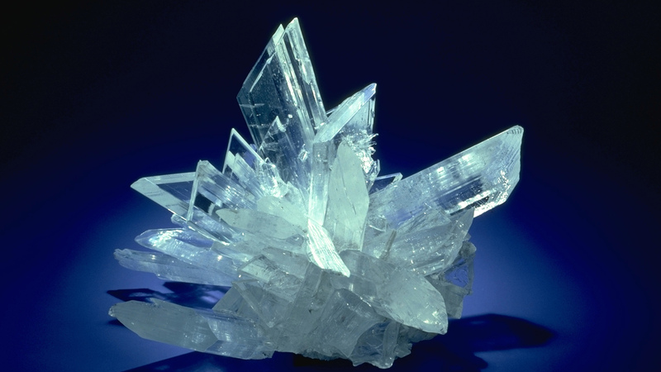
Minerals and Materials
Presented by: Diamond, Fred, Jocelyn, Josephine

Slide 2
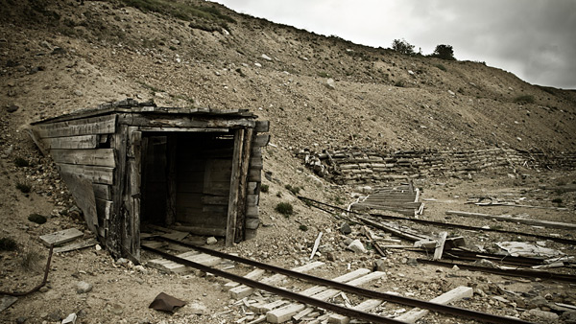
Agenda
1
Industry Overview Gold, Copper, Crude Oil, and Coal
2
Teck Resources Limited Introduction, Financial Statements, Risk Factors, Risk Management
3
Freeport – McMoRan Inc. (FCX) Introduction, Financial Statements, Risk Factors, Risk Management
4
Barrick Gold Introduction, Financial Statements, Risk Factors, Risk Management

Slide 3
Industry Overview

Slide 4
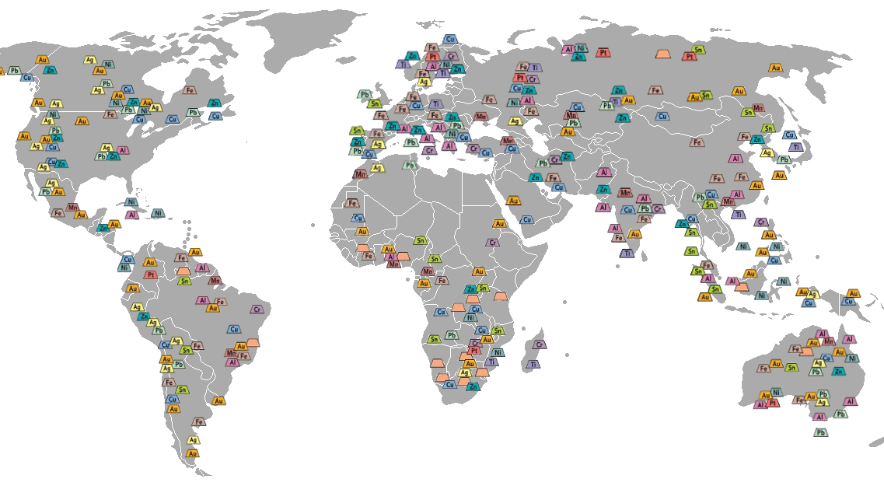
Industry Overview
What is mining industry
Exploration
Extraction
Refining
Industry Use
Notes:
First, mining industry can be divided into four parts, the exploration, extraction, refining and industry use.

Slide 5
The Process of Mining
Exploration
Refining
Core Samples
Hauling
Blasting
Mining
Notes:
This is the mining process.

Slide 6
Industry Overview
The market value of top 12 global mining companies all declined in the past year.
Gross mining revenues for the BC mining industry were $ 8.2 billion in 2014.
In 2014, the top 40 mining companies generated a total profit of approximately 45 billion US dollars.
Notes:
The market value of top 12 global mining companies all declined in the past year. Gross mining revenues for the BC mining industry were $ 8.2 billion in 2014.In 2014, the top 40 mining companies generated a total profit of approximately 45 billion US dollars.
http://www.miningaustralia.com.au/Features/In-retrospect-The-top-100-companies-of-2014
http://www.mining.bc.ca/mining-facts
http://www.statista.com/statistics/208725/net-profit-margin-of-the-top-mining-companies/

Slide 7
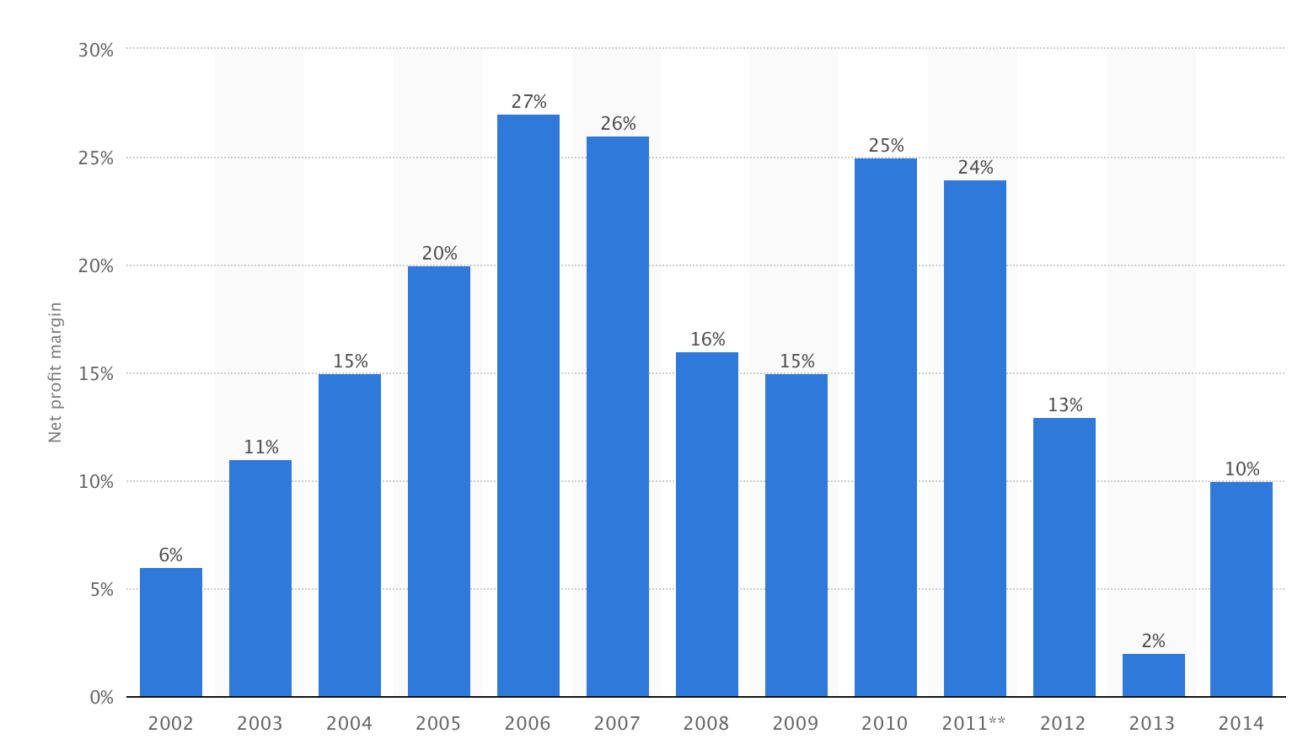
Industry Overview
The trend of the average net profit margin of Top 40 mining companies between 2002 and 2014.
Notes:
This chart describes the distribution of net profit in each year from 2002- 2014. As you can see, there is a huge increase in early 2000s until economic crisis which happened around 2008. Although it bounced back a little bit time after economic crisis, there is a decline after 2011.
http://www.statista.com/statistics/208725/net-profit-margin-of-the-top-mining-companies/

Slide 8
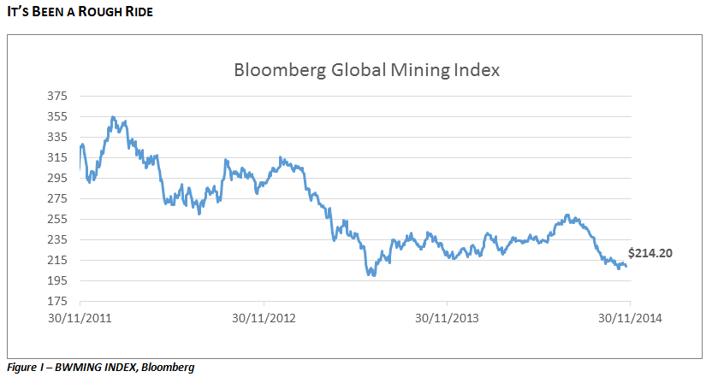
Industry Overview
Notes:
This is the global mining industry index. It also reflects a decline trend since 2011.
Source: http://www.rotmanassetmanagement.com/pulse-check-the-global-mining-industry/

Slide 9
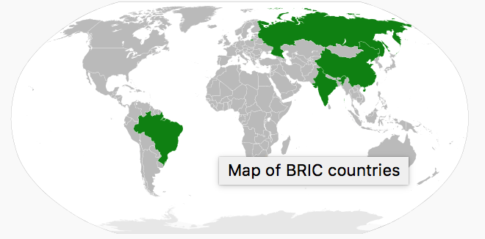
BRIC: Brazil, Russia, India and China
Notes:
The boom of early 2000s is due to the demand from emerging markets which are mainly BRIC, Brazil, Russia, India and China. The slowdown of China’s economy is believed to be an important factor that determines the decline of global mining industry since China is the largest raw material consumer in the world.

Slide 10
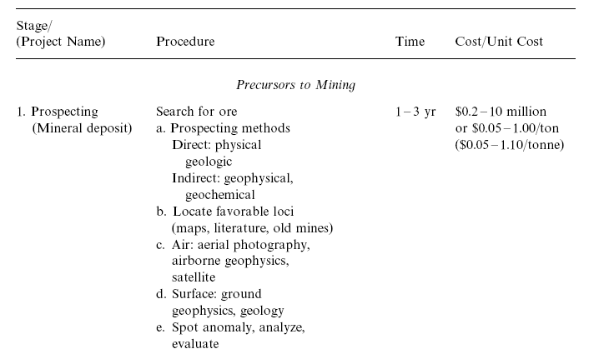
Industry Overview (Operating Cycle)
1. Prospecting 1-3 yr
Notes:
This is the the operating cycle that mining companies explore a new location. In the first 1 to 3 years, they will search for ores.

Slide 11

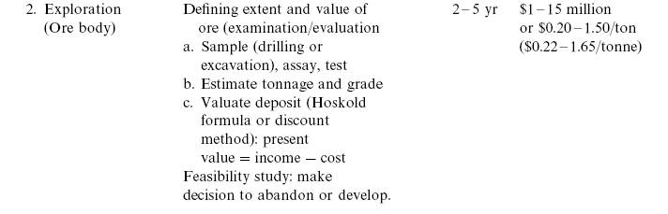
Industry Overview (Operating Cycle)
2. Exploration 2-5 yr
Notes:
Once they found it, it takes 2-5 years to test if location is worthy to explore.

Slide 12
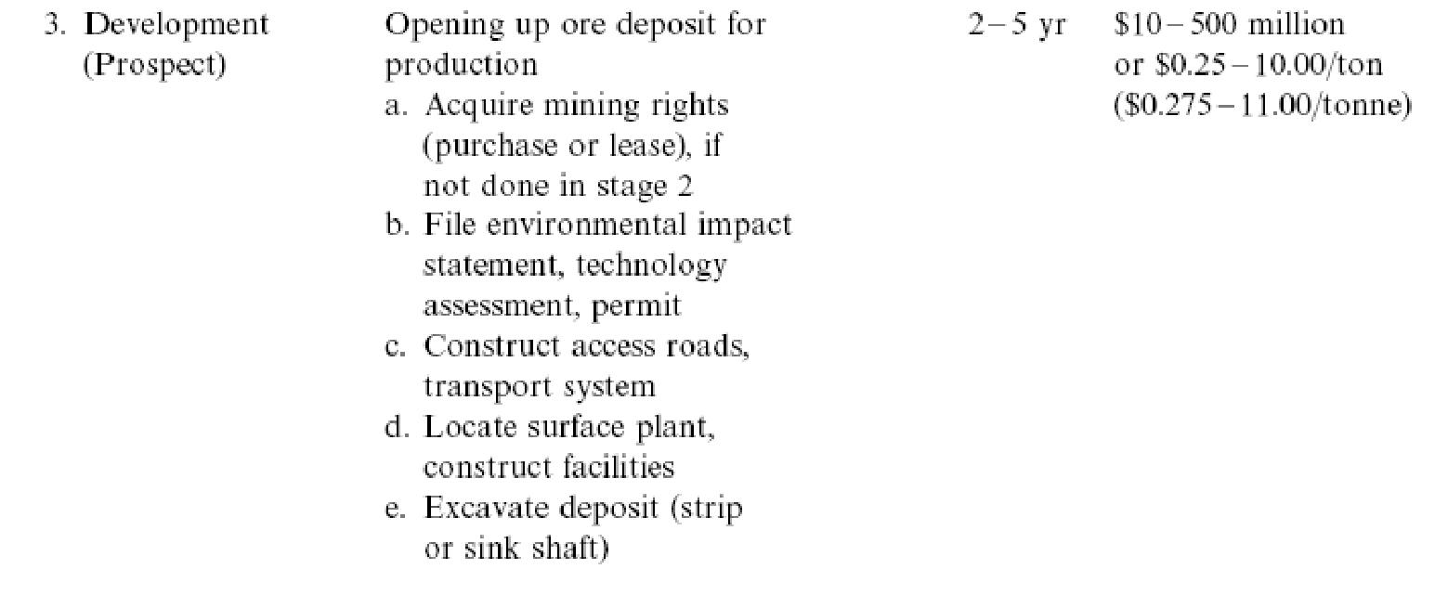
Industry Overview (Operating Cycle)
3. Development 2-5 yr
Notes:
If the answer is yes, they spend another 2-5 years to set up for further exploration.

Slide 13
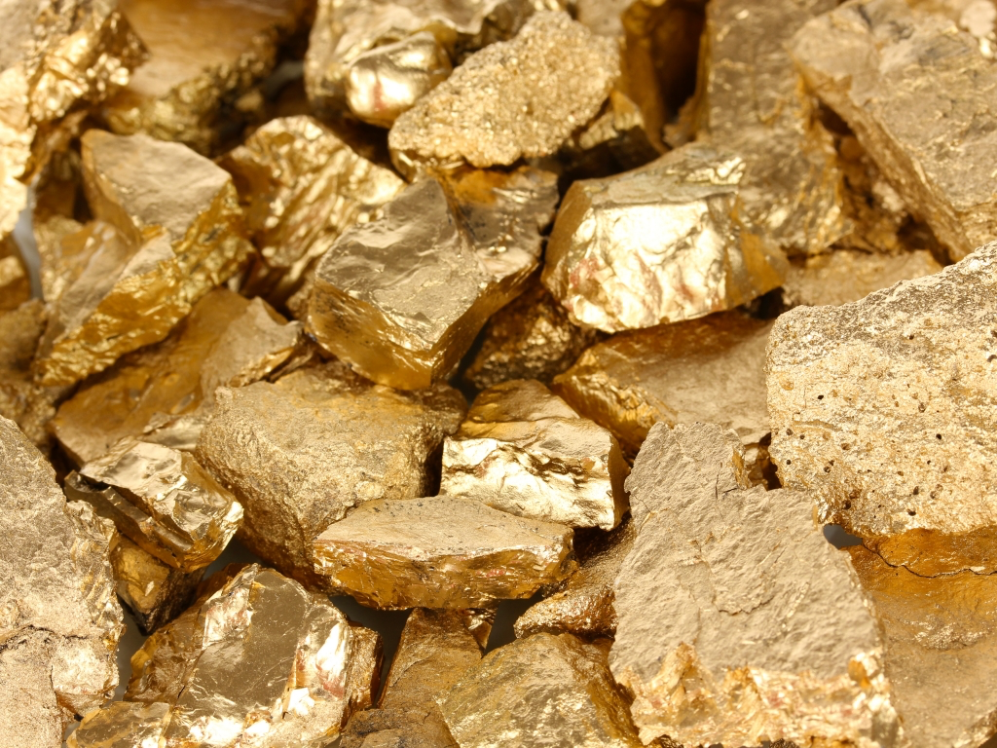
Main Product: Gold
Total Demand in 2014: 3,923.7t
Total Supply in 2014: 4,278.2t
United States currently holds 8,133.5 tons of gold, representing approximately 72% of its foreign reserves.
Notes:
One of our main products is gold. You can see the supply is surplus in 2014 which is an indicator of price declining. We also need notice that US holds approximately 72% gold reserve.

Slide 14
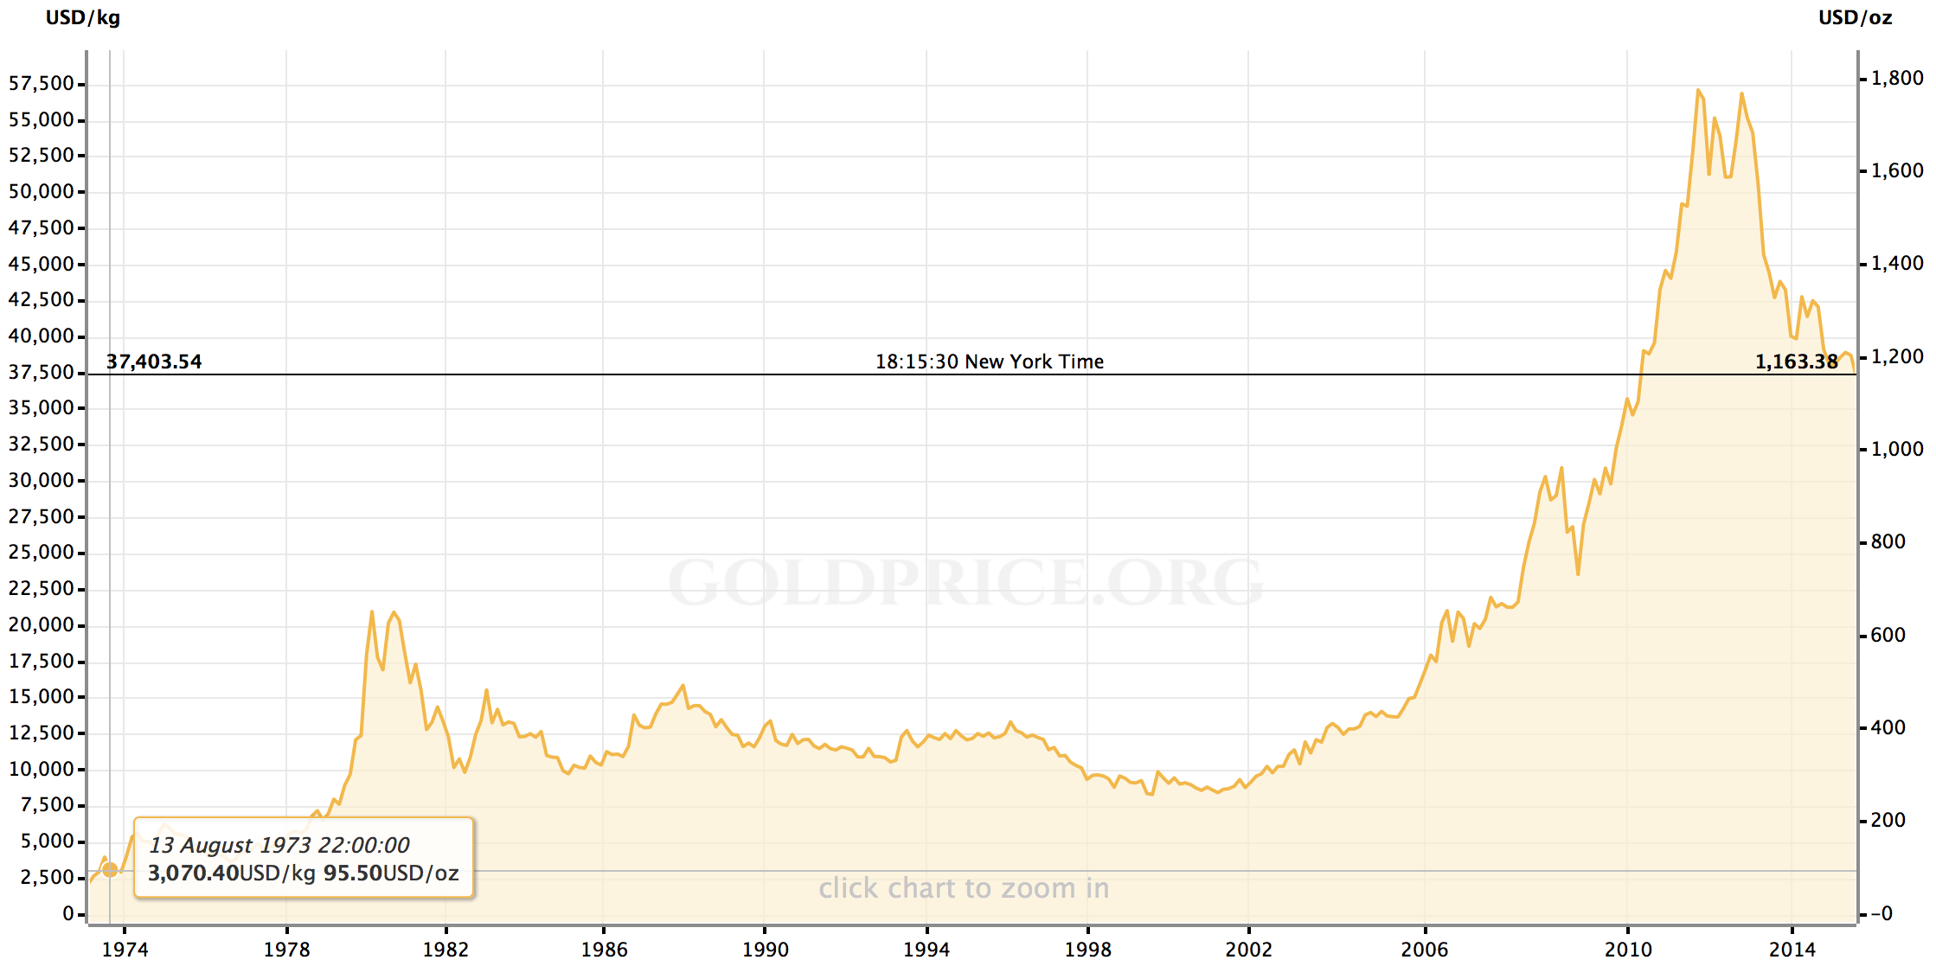
Historical Gold Price
Notes:
http://goldprice.org/gold-price-history.html

Slide 15
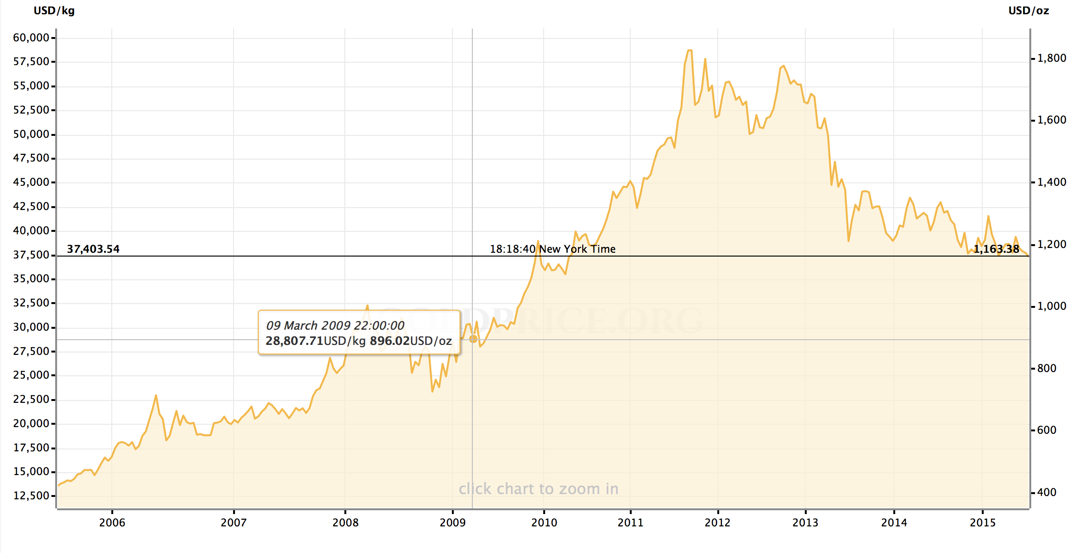
10 Years Gold Price

Slide 16
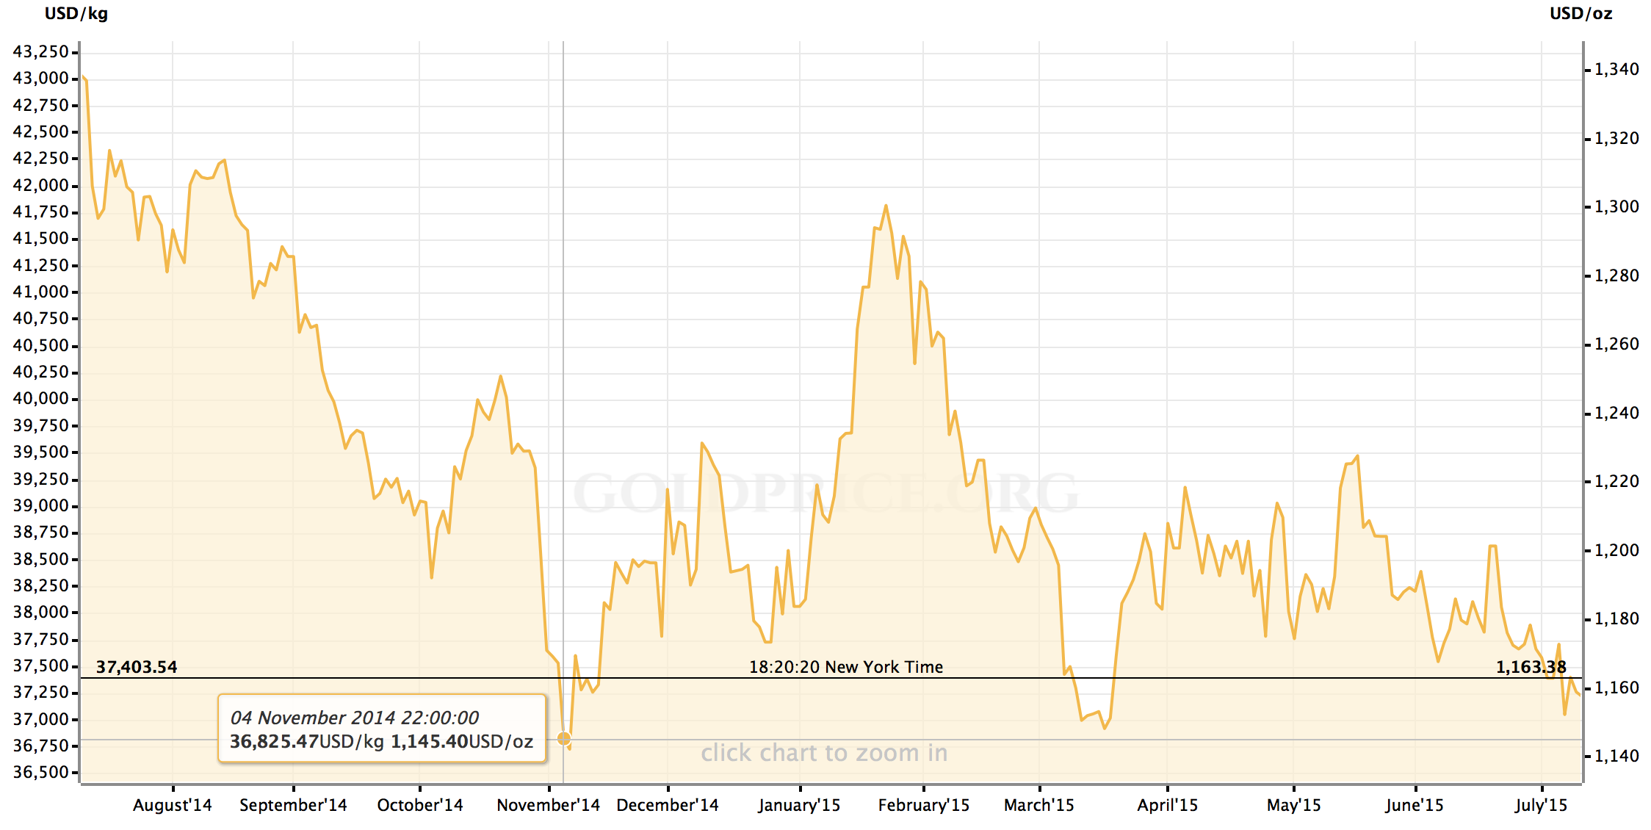
1 Year Gold Price

Slide 17
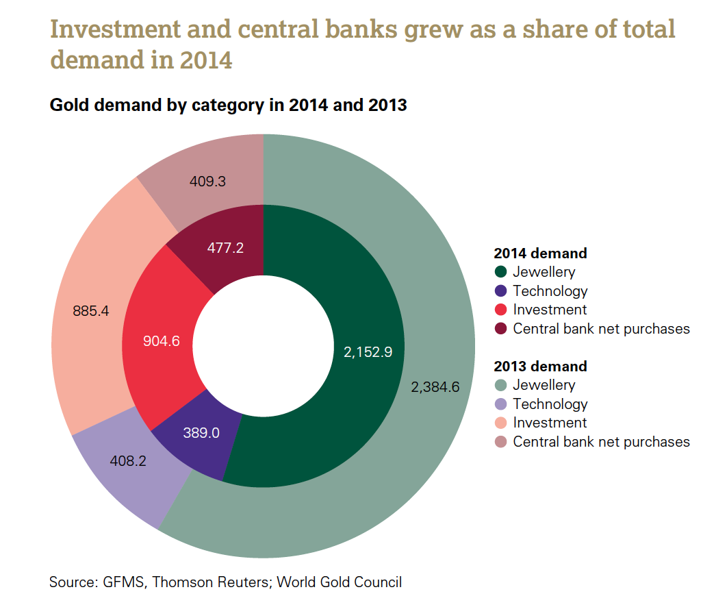
Distribution of Gold Demand
Although jewellery demand declines by 10% to 2,152.9t, it is still 5% above the 5-year average.
Central banks bought 477.2t, close to a 50-year high.
Investment rose 2% to 904.6t, although bar and coin fell from the 2013 record.
Continued substitution pushed technology to an 11-year low of 389t.
Notes:
As you can see from pie chart, the total demand in 2014 is less than that in 2013.

Slide 18
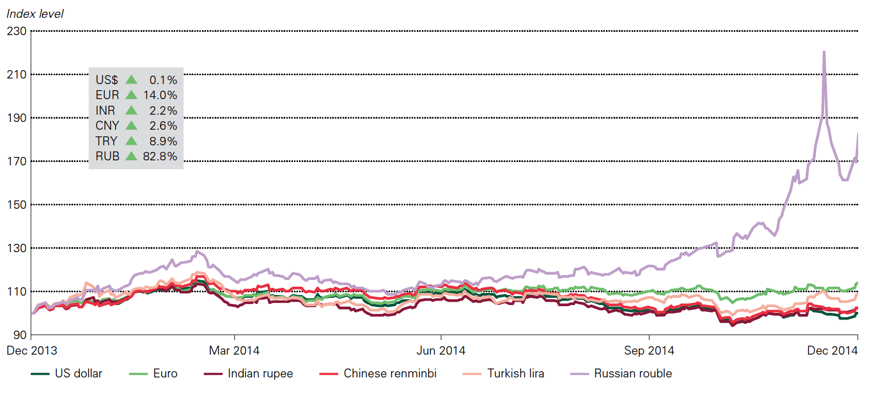
Divergent Gold Prices Caused by Currencies
Notes:
Different currencies can cause divergent gold prices. As a result of high level rouble depreciation, the gold price index in Russia is an outlier for global index.

Slide 19
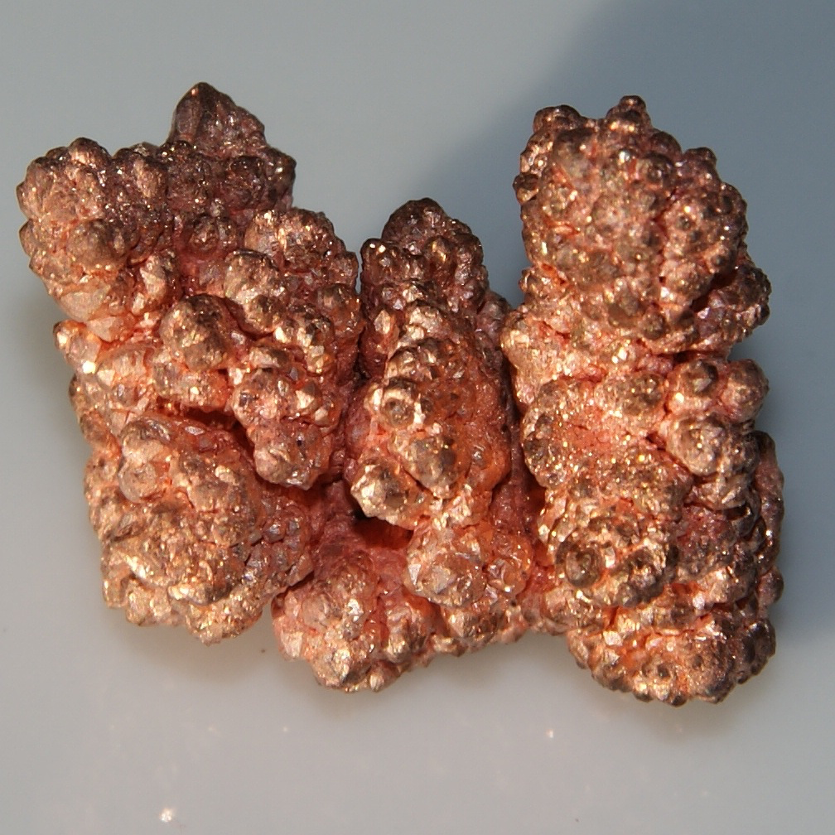
Main Product: Copper
The first time in 5 years, copper production is surplus.
China (42%) is the largest copper consumer in the world.
Notes:
Copper supply will be surplus in 2015, which is the first time in recent 5 years. China which takes up 42% consumption is the largest copper consumer in the world

Slide 20
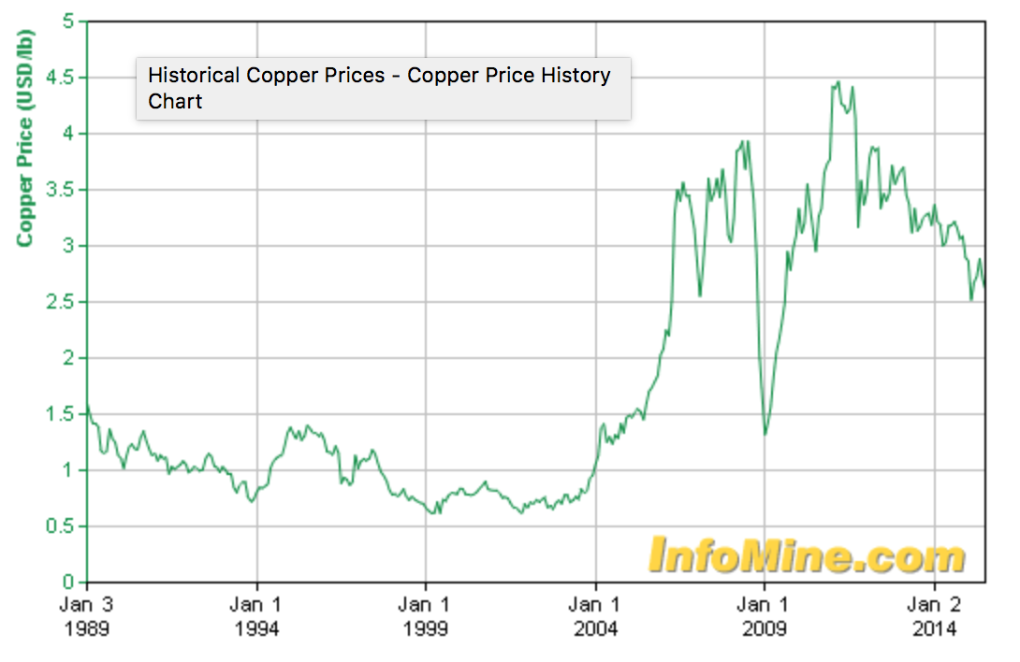
Historical Copper Price
Notes:
http://www.infomine.com/investment/metal-prices/copper/all/

Slide 21
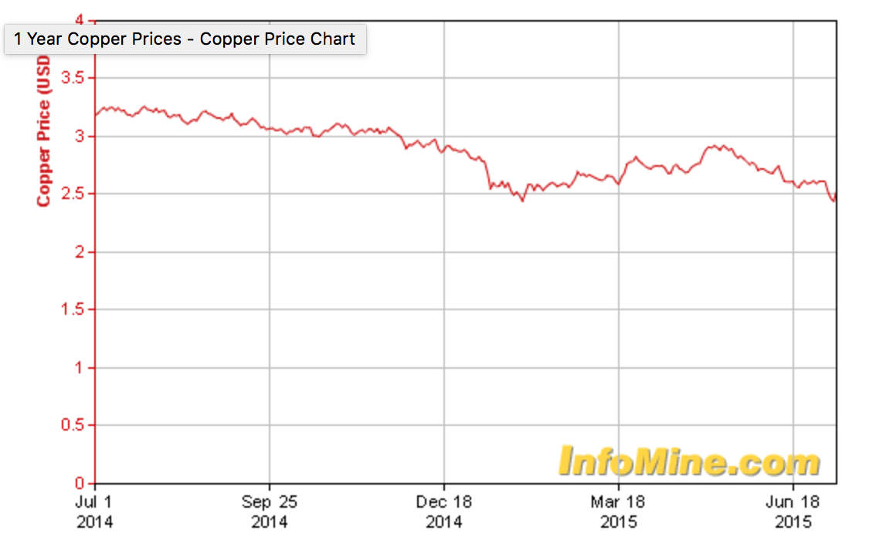
1 Year Copper Price

Slide 22
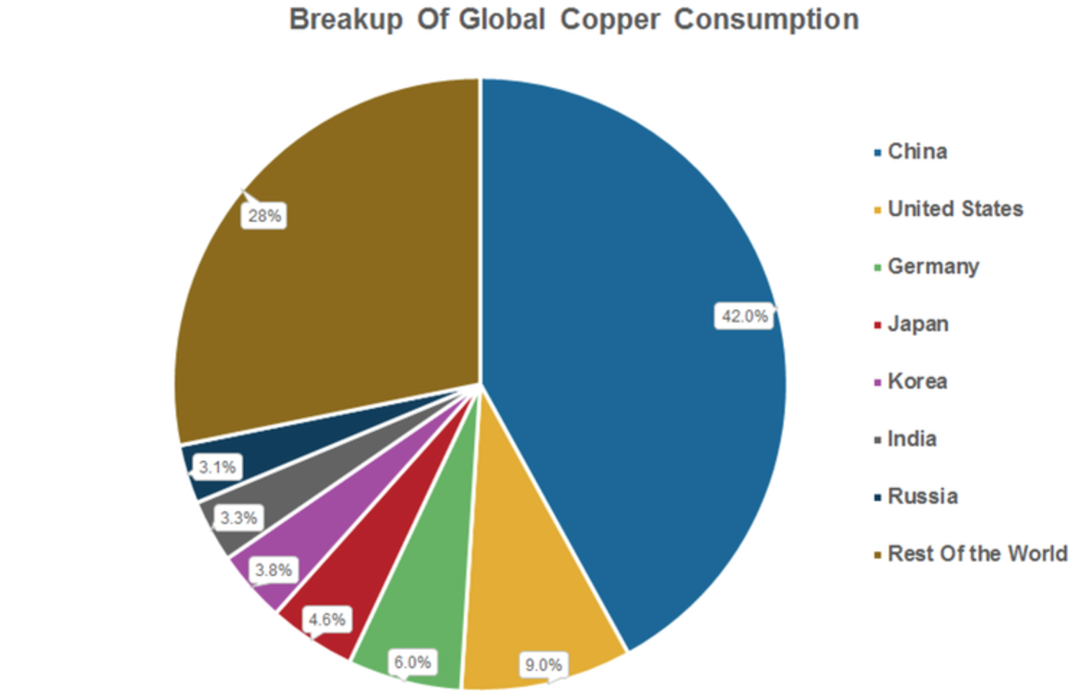
Copper Consumption
Notes:
As mentioned earlier, China is the largest consumer. Its economic slowdown results a decline in global demand.

Slide 23
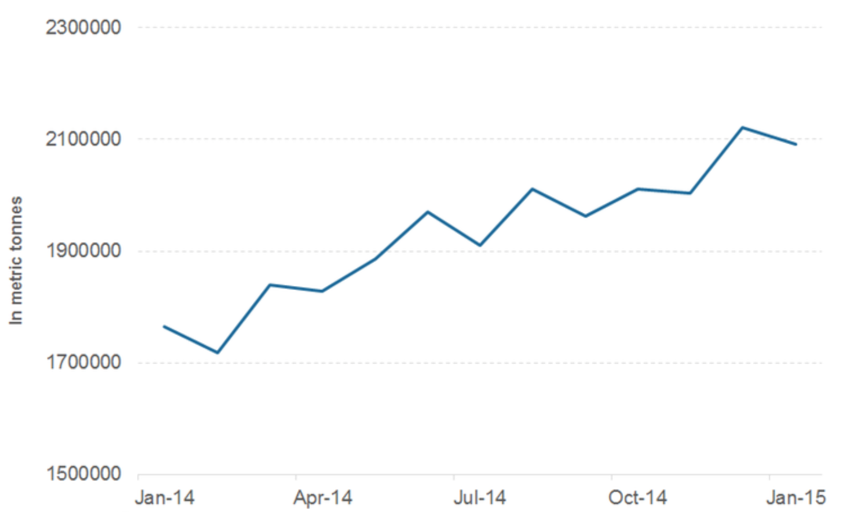
Copper Production in 2014
Notes:
Also you can see the production is growing up, so the price is declining.

Slide 24
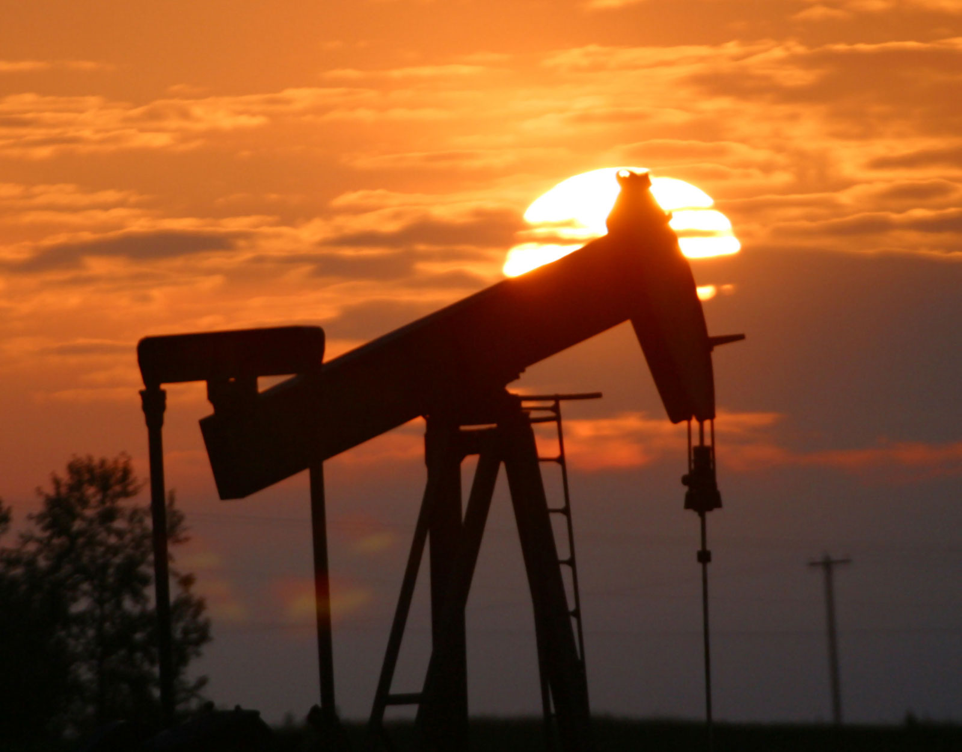
Main Product: Crude Oil
Crude oil is the most important natural resource in the industrialized nations.
Consumption: 92.4m barrels per day.
Notes:
http://www.eia.gov/forecasts/steo/report/global_oil.cfm

Slide 25
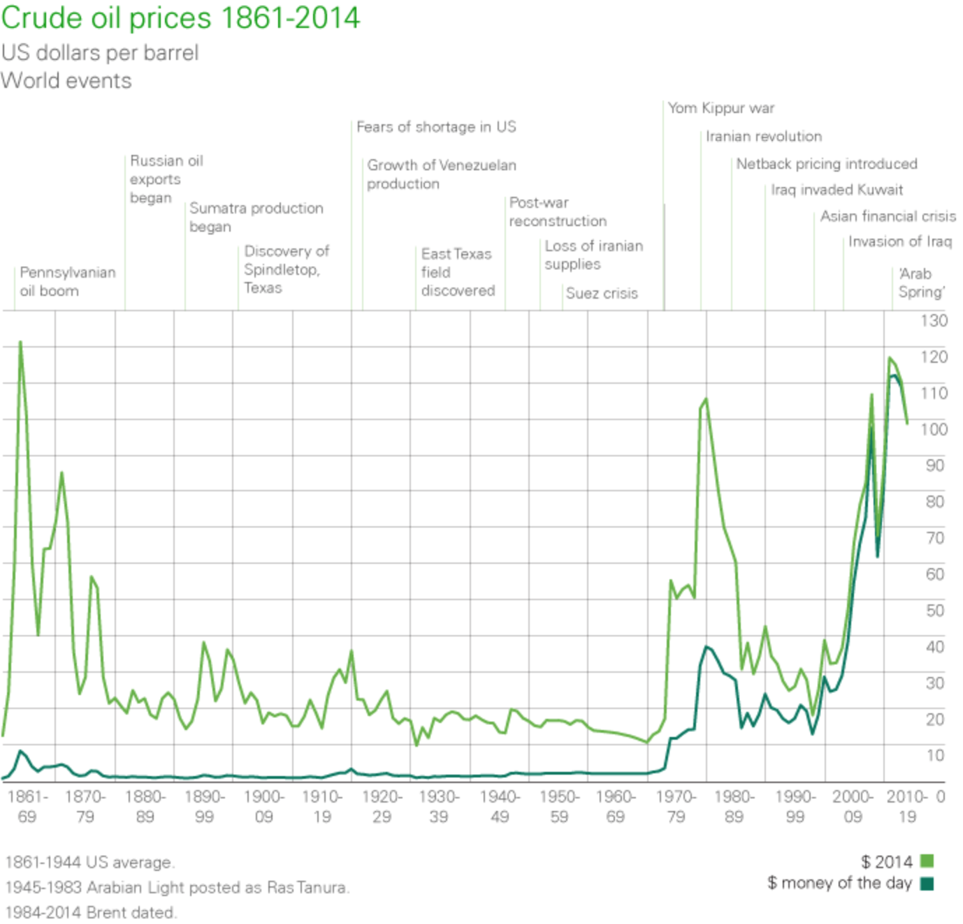
Historical Crude Oil Price
Notes:
This is the historical price of crude oil. You can see what happened to the change of each period. The dark green line is used to describe the original price and the light green line is used to describe the price converted to today’s money.

Slide 26
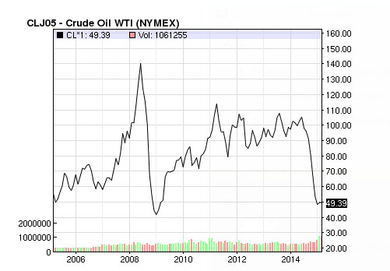
10 Years Crude Oil Price

Slide 27
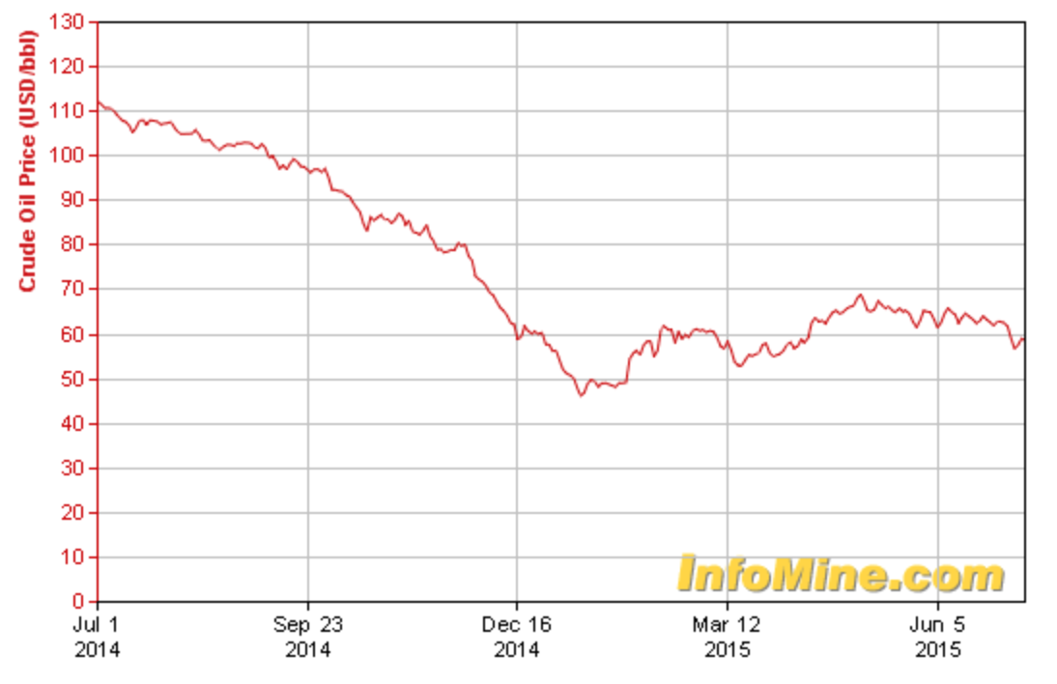
1 Year Crude Oil Price
Notes:
http://www.infomine.com/investment/metal-prices/crude-oil/1-year/

Slide 28
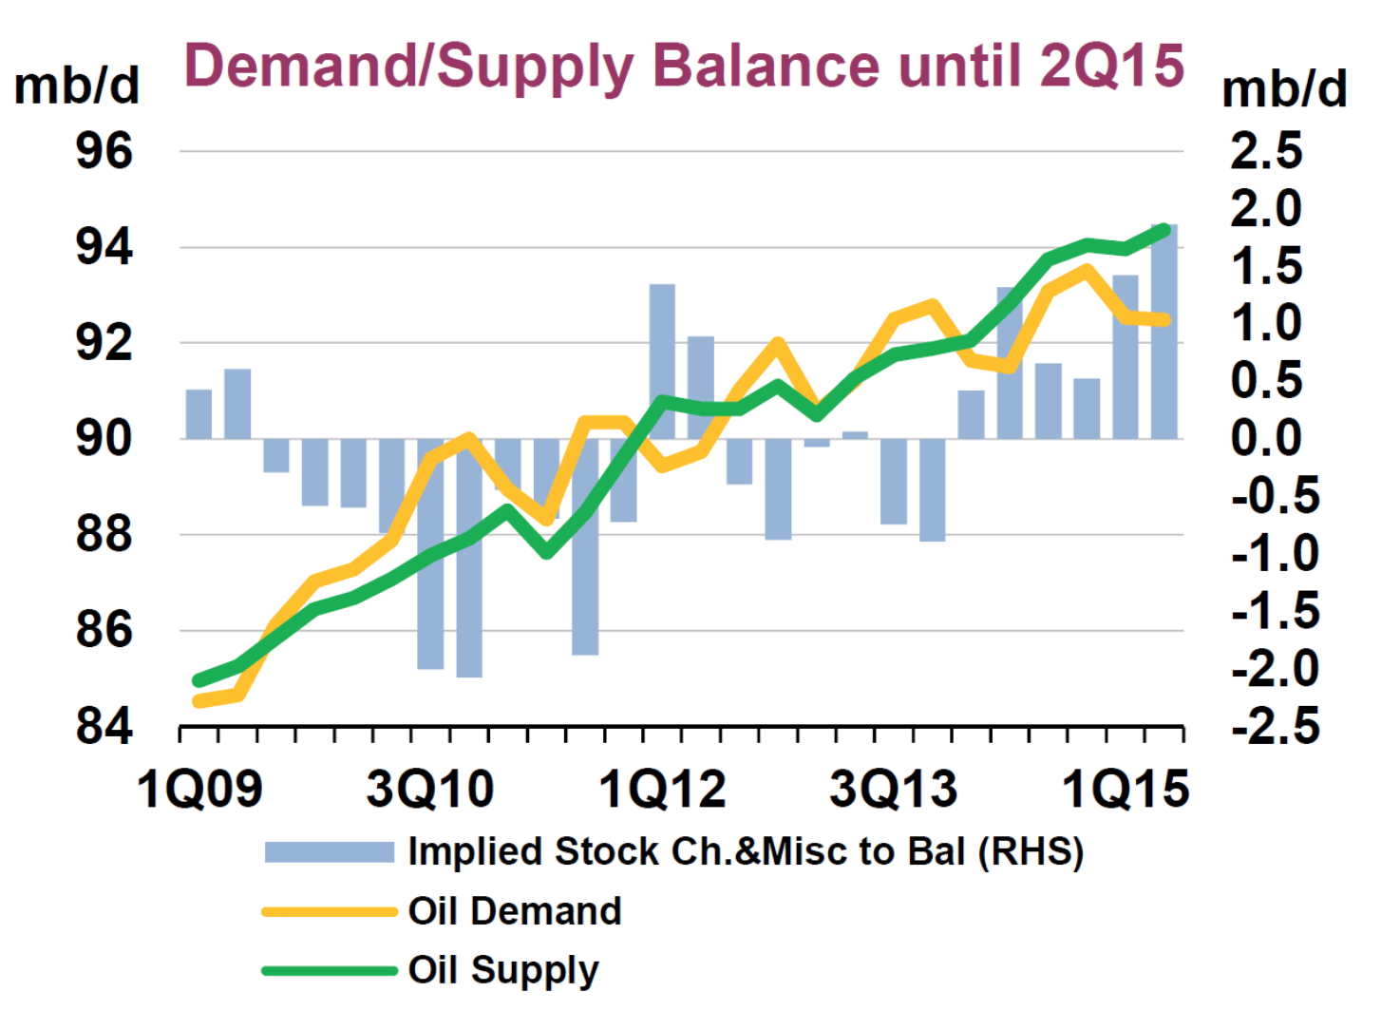
Demand/Supply change
The increasing gap between supply and Demand explains why crude oil price drops a lot recently.

Slide 29
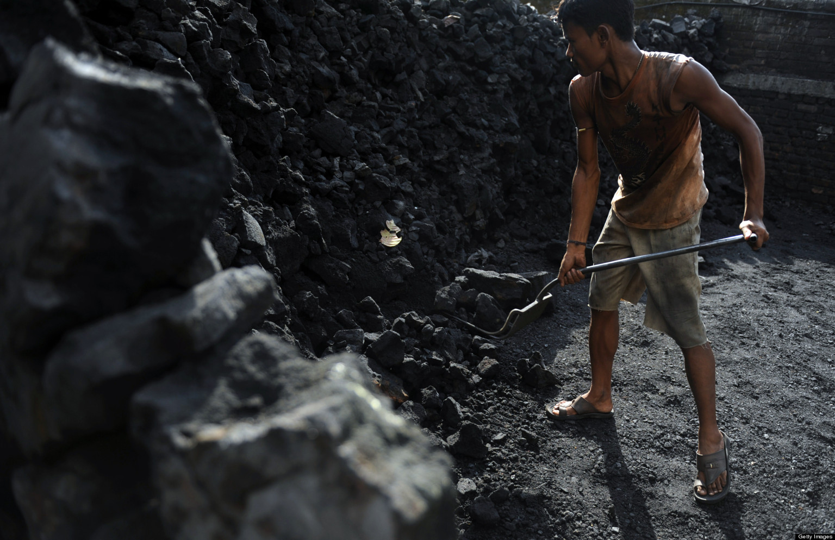
Main Product: Coal
Consumption: 6.6 billion tons in 2014
Functions:
Electricity generation
Steel production
Cement Manufacturing
Liquid Fuel
Notes:
http://www.worldcoal.org/coal/uses-of-coal/

Slide 30
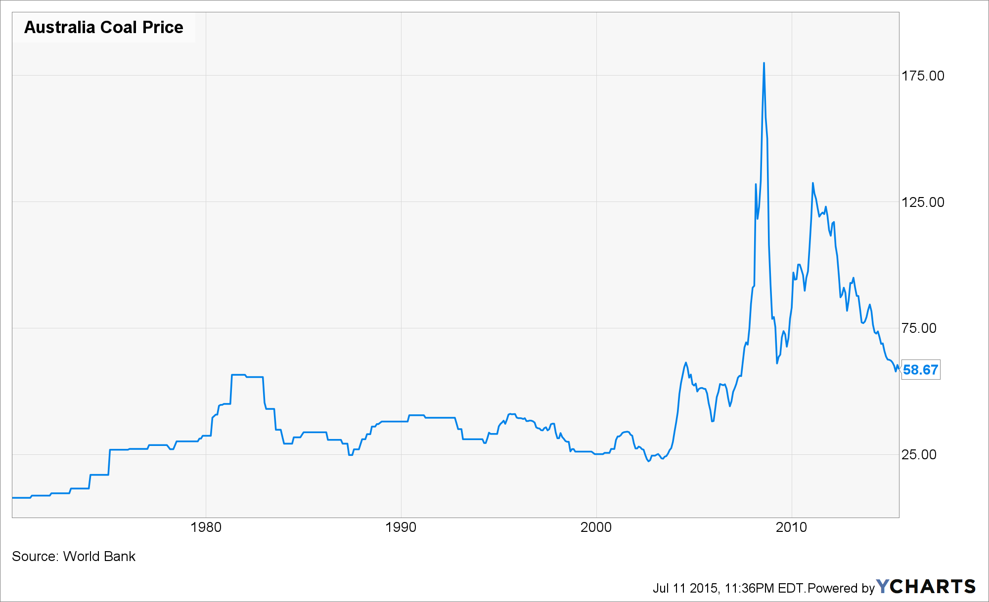
Historical Coal Price

Slide 31
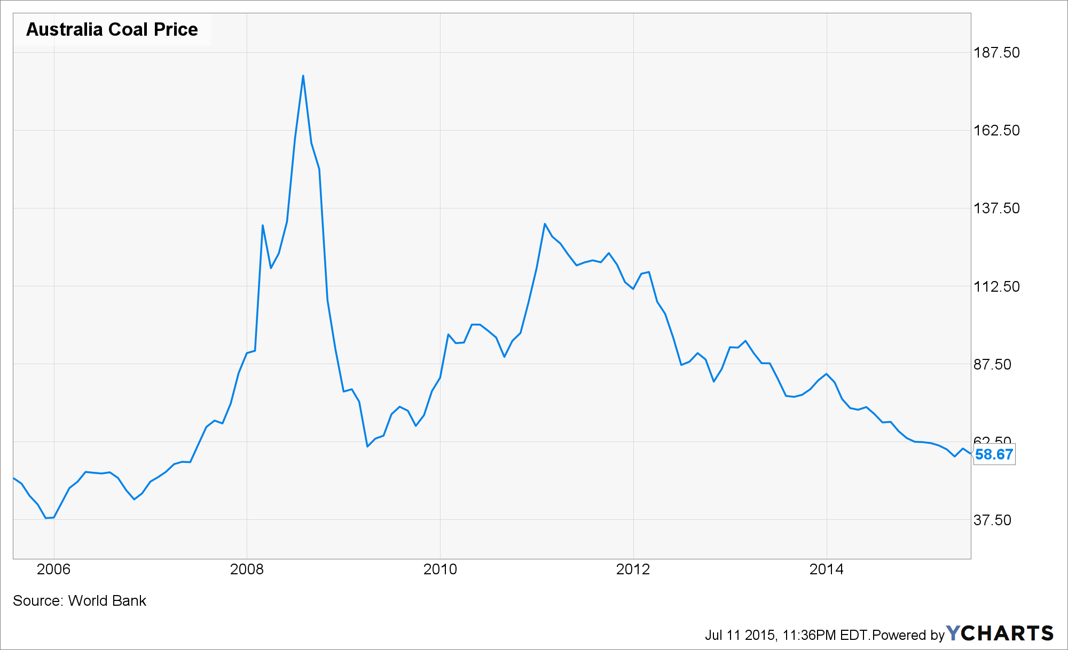
10 Years Coal Price

Slide 32
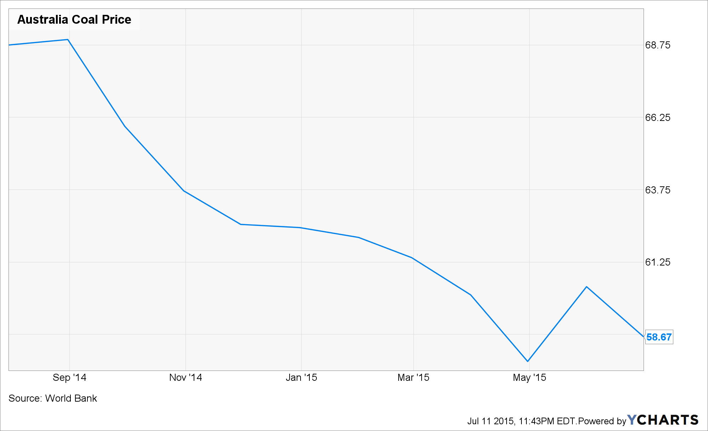
1 Year Coal price

Slide 33
Teck Resources Limited

Slide 34
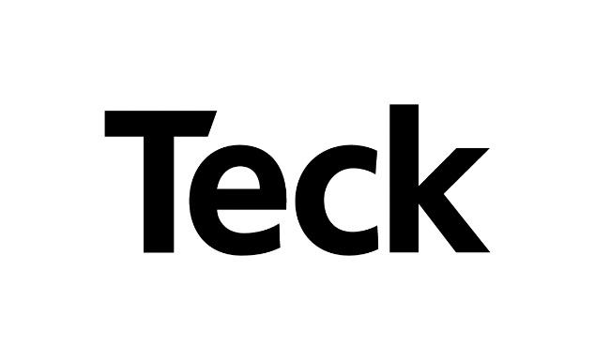
Introduction: Overview
Canada’s largest diversified mining company
Headquartered in Vancouver
Their business is exploring for, developing and producing natural resources

Slide 35
Introduction: Overview
Principal Products:
Coal
Copper
Zinc
Energy
Other products:
Lead
Molybdenum
Silver

Slide 36
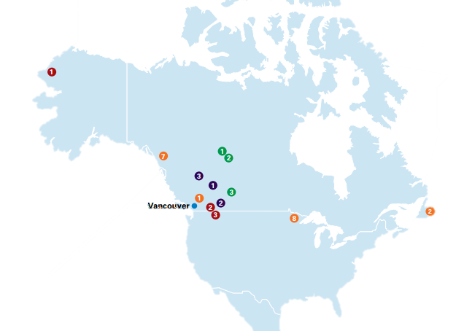
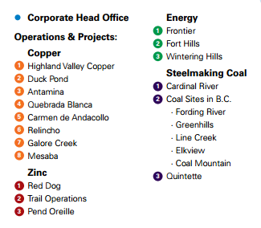
Operations in North America

Slide 37
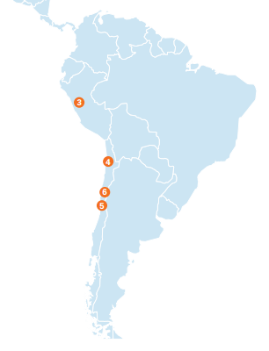
Operations in South America

Slide 38
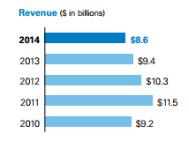
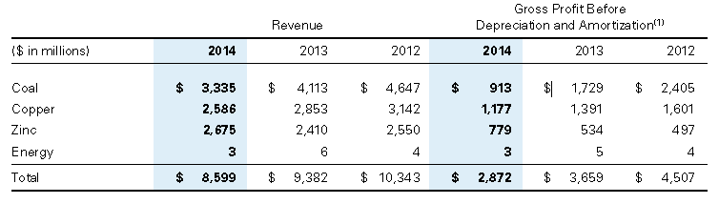
Introduction: Financial Highlights
Had a revenue of $8.6 billion and a gross profit before depreciation of $2.9 billion. This is close to a 9% decrease from the previous year.

Slide 39

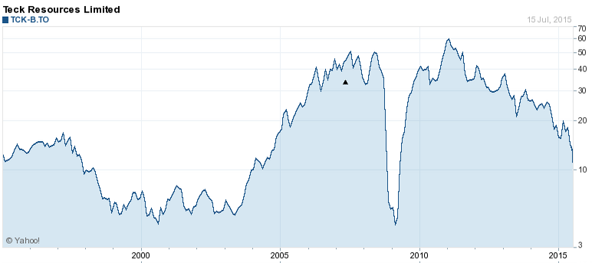
Stock Price

Slide 40
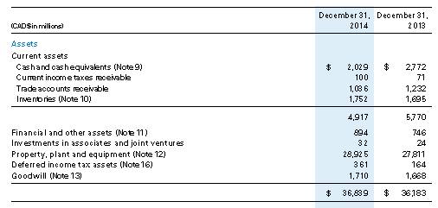
Financial Statements: Consolidated Balance Sheet

Slide 41
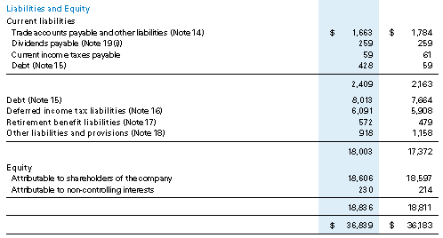
Financial Statements: Consolidated Balance Sheet

Slide 42
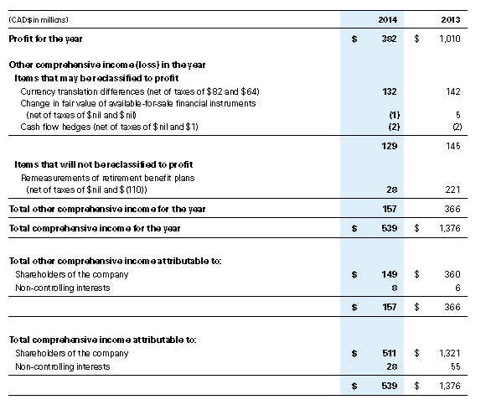
Financial Statements: Consolidated Statements of Income

Slide 43
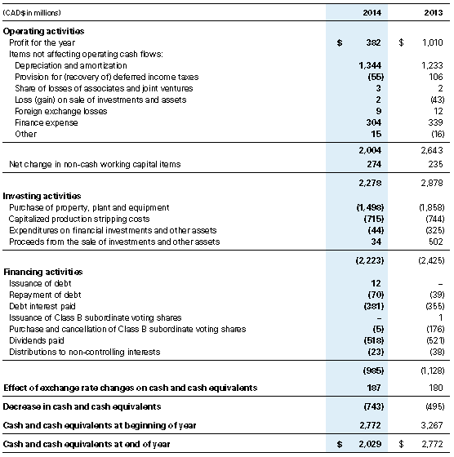
Financial Statements: Consolidated Statements of Cash Flows

Slide 44
Risk Factors
Commodity Price Risk
Foreign Exchange Risk
Interest Rate Risk
Liquidity Risk
Credit Risk

Slide 45
Commodity Price Risk
Future changes in market price of natural resources may significantly adversely affect the result of operations
General policy has been not to hedge changes in prices of our mineral production
Don’t want to risk the opportunity losses in the event of an increase in the world price of the commodity

Slide 46
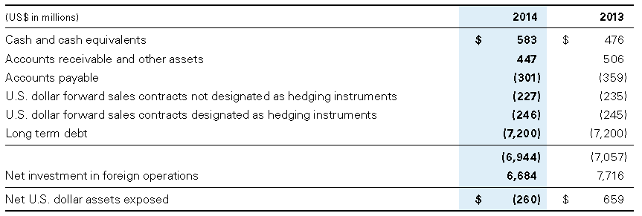
Foreign Exchange Risk
It operate on an international basis and therefore, foreign exchange risk exposures arise from transactions denominated in a foreign currency. Its foreign exchange risk arises primarily with respect to the US dollar

Slide 47
Interest Rate Risk
Interest rate risk mainly arises from our cash and cash equivalents
Interest rate management policy is generally to borrow at fixed rates
Floating rate funding may be used to fund short term operating cash flow requirements or, in conjunction with fixed to floating interest rate swaps, be used to offset interest rate risk from our cash.

Slide 48
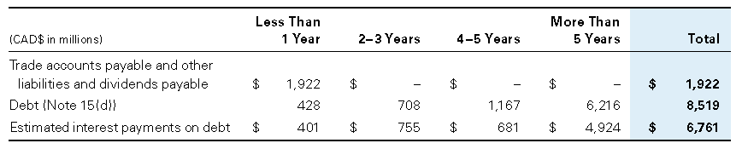
Liquidity Risk
Liquidity risk arises from general and capital financing needs. It has planning, budgeting and forecasting processes to help determine funding requirements to meet various contractual and other obligations.

Slide 49
Credit Risk
Credit risk arises from the non‑performance by counterparties of contractual financial obligations.
Manage credit risk for trade and other receivables through established credit monitoring activities
Maximum exposure: carrying value of our cash and cash equivalents, receivables and derivative assets

Slide 50
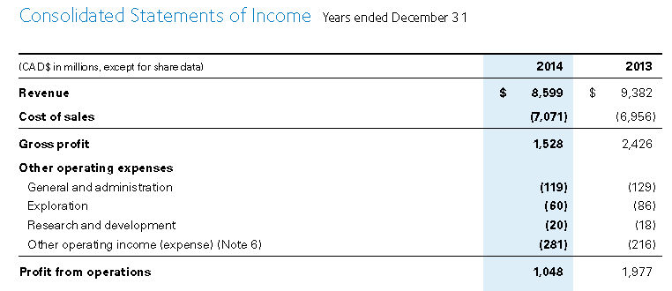
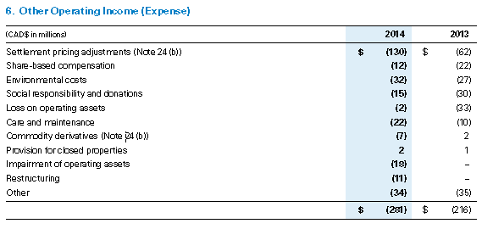
Risk Management: Sales and Purchase Contracts
Settlement pricing adjustments result in gains (losses from purchases) in a rising price environment and losses (gains from purchases) in a declining price environment are recorded as other operating income

Slide 51
Financial Risk Management: Economic Hedge Contracts
They entered into commodity forward sales and purchase contracts to mitigate the risk of price changes for a portion of their concentrate purchases and refined metal sales
These contracts effectively lock in prices for a portion of their smelter sales
They do not apply hedge accounting to these commodity forward sales contracts.
Certain customers purchase concentrate and refined metal products at fixed forward prices from operations.
Forward purchase commitments for these metal products are matched to specific fixed price sales commitments to customers

Slide 52
Financial Risk Management: Zinc Swaps
Due to ice conditions, the port serving the Red Dog Mine is only able to ship concentrates from July to October each year.
As a result, zinc and lead concentrate sales volumes are generally higher in the third and fourth quarter of each year than in the first and second quarter.
During 2014 - purchased and sold zinc swaps to match economic exposure to the average zinc price over our shipping year, which is from July of one year to June of the following year.
They did not apply hedging accounting to zinc swaps

Slide 53
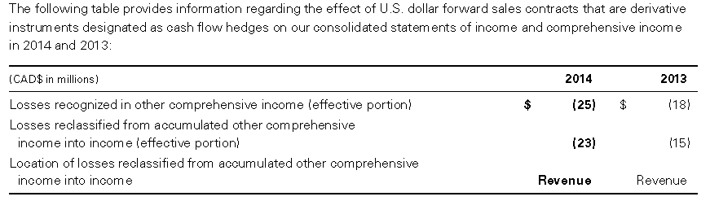
Financial Risk Management: Cash Flow Hedges
At December 31, 2014, U.S. dollar forward sales contracts with a notional amount of US$246 million remained outstanding. The contracts matured in early 2015. These contracts have been designated as cash flow hedges of a portion of our future cash flows from anticipated U.S. dollar coal sales

Slide 54
Recall: Consolidated Statements of Income

Slide 55
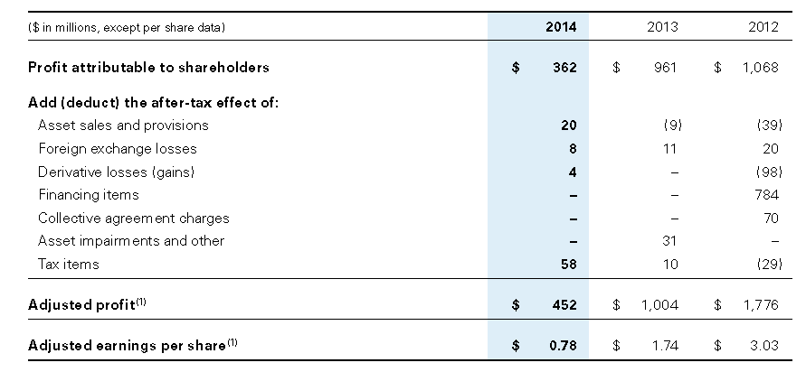
Effects of Hedging Activities

Slide 56
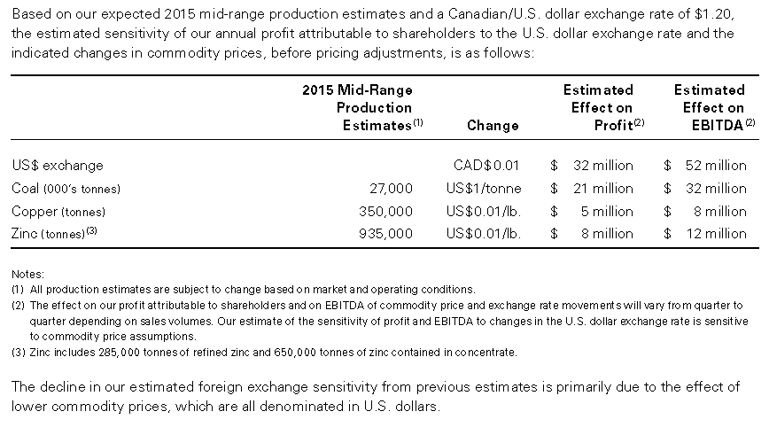
Sensitivity Analysis

Slide 57
Freeport - McMoRan Inc. (FCX)

Slide 58
Background
headquarters in Phoenix, Arizona
the world’s largest publicly traded copper producer
the world’s largest producer of molybdenum
a significant gold, oil and natural gas producer
trades on NYSE: FCX
changes the name from Freeport-McMoRan Copper & Gold Inc. to Freeport-McMoRan Inc. in 2014
Notes:
Freeport-McMoRan Inc. is a premier international natural resources company with headquarters in Phoenix, Arizona. FCX is the world’s largest publically traded copper producer, the world’s largest producer of molybdenum and a significant gold, oil and natural gas producer. Their stock trades on the New York Stock Exchange under the ticker symbol “FCX”. Freeport-McMoRan Copper & Gold Inc. changes name to Freeport-McMoRan Inc. to simplify the company’s existing name and reflect the Company’s expanded portfolio of assets.

Slide 59
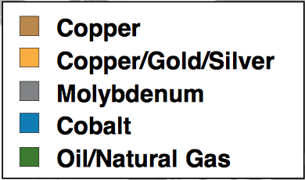
FCX’s Products
Notes:
FCX operates large and diverse assets with significant proven and probable reserves of copper, gold, molybdenum, cobalt, oil and natural gas.

Slide 60
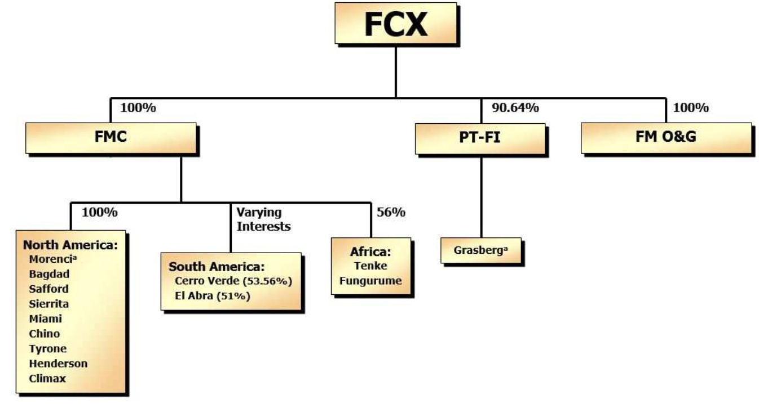
Corporate Structure:
Notes:
These are three subsidiaries of FCX. It operates mines through its subsidiaries Freeport Minerals Corporation (FMC) and PT Freeport Indonesia (PT-FI), and in its oil and gas business through subsidiary, FCX Oil & Gas Inc. (FM O&G)

Slide 61
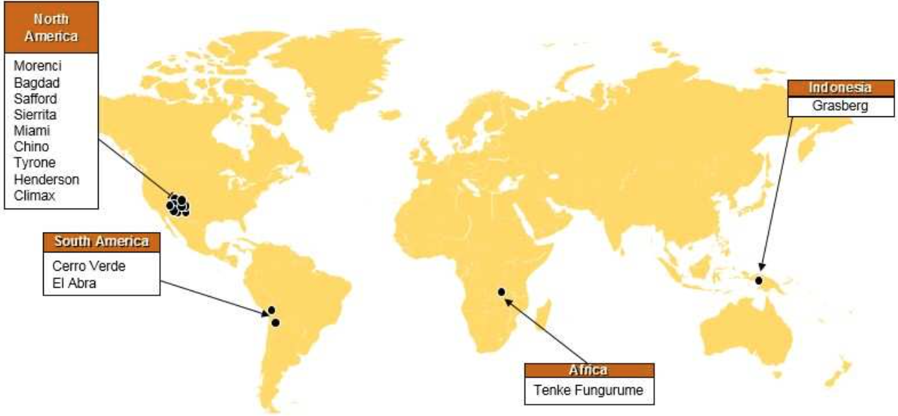
Operating Mine Locations
Notes:
FCX’s portfolio of minerals assets includes the Grasberg minerals district in Indonesia, one of the world’s largest copper and gold deposits; significant mining operations in the Americas, including the large-scale Morenci minerals district in North America and the Cerro Verde operation in South America; and the Tenke Fungurume minerals district in the Democratic Republic of Congo.

Slide 62

Global Footprint
Notes:
These are the reserves and sales of each location. FCX got approximately eight percent of total worldwide estimated mined copper production.

Slide 63


Notes:
Stock prices of Freeport. You can see the price drops a lot since the middle of last year.

Slide 64


Slide 65


Slide 66


Slide 67


Slide 68

Consolidated Statements of Operation

Slide 69

Consolidated Statements of Comprehensive (Loss) Income

Slide 70

Consolidated Statement of Cash Flows

Slide 71

Statement of Cash Flows (cont’d)

Slide 72

Consolidated Balance Sheets

Slide 73

Consolidated Balance Sheets (cont’d)

Slide 74

Risk Factors
Financial Risks
International Risks
Operational Risks
Environmental Risks
Other Risks

Slide 75
Financial Risks
Declines or fluctuations in the market prices of copper, gold and/or oil could adversely affect earnings, cash flows and asset values and, if sustained, could adversely affect ability to repay debt. It can also cause significant volatility in financial performance and adversely affect the trading prices of debt and common stock.
Debt and other financial commitments may limit the financial and operating flexibility.
Mine closure and reclamation regulations impose substantial cost on operations, and include requirements that provide financial assurance(e.g. Bonds) supporting those obligations. Changes in or the failure to comply with these requirements could have a material adverse effect

Slide 76
International Risks
International operations are subject to political, social and geographic risks of doing business in countries outside the U.S.
Because our Grasberg minerals district is the most significant operating asset, their business may continued to be adversely affected by political, economic and social uncertainties and security risk in Indonesia.
The Tenke Fungurume (Tenke) minerals district is located in the Katanga province of the DRC, and may be adversely affected by security risks and political, economic and social instability in the DRC.

Slide 77
Operational Risks
Mining and oil and gas operation are subject to operational risks that could adversely affect the business.
Labor unrest and activism could disrupt the operations.
Our mining production depends on the availability of sufficient water supplies.
Indonesia and Africa mining operations involve additional risks because they are located in very remote areas and, in Indonesia, unusually difficult terrain.
Operations are subject to extensive regulations, some of which require permits and other approval.

Slide 78
Environmental Risks
Operations are subject to complex and evolving environmental laws and regulations.(e.g. CERCLA)
Incur significant costs for remediating environmental conditions on mining properties that have not been operated in many years.
Unexpected environmental impacts from Indonesia mining operation could incur increased costs.
Regulation of greenhouse gas emissions and climate change issues may increase costs and adversely affect the operations.
Notes:
Comprehensive Environmental Response, Compensation and Liability Act

Slide 79
Other Risks
Its holding company structure may impact their ability to service debt and their stockholders’ ability to receive dividends.
Anti-takeover provisions in their charter documents and Delaware law may make an acquisition of the company more difficult.

Slide 80

Market Risks
Commodity Price Risk
Foreign Currency Exchange Risk
Interest Rate Risk

Slide 81
Commodity Price Risk
FCX is acutely aware of the exposure of company operations to price of copper and, to a lesser extent, gold and molybdenum.
Because the prices of these commodities are beyond control, the key measures that management focuses on in operating their business are sales volumes, unit net cash costs operating cash flow.

Slide 82

LME Copper Price and Exchange Stocks
Notes:
You can see the LME copper price fluctuated a lot. 86-87. Thus the financial result can vary significantly as a result.

Slide 83

FCX Consolidated Mining Operation Data

Slide 84

Consolidated Mining Operation Data(cont’d)
Notes:
There is a big difference between 2013 and 2014 of operating income.

Slide 85
Risk Management Philosophy
“FCX does not purchase, hold or sell derivative financial instruments unless there is an existing asset or obligation, or it anticipates a future activity that is likely to occur and will result in exposure to market risks, which FCX intends to offset or mitigate. FCX does not enter into any derivative financial instruments for speculative purposes, but has entered into derivative financial instruments in limited instances to achieve specific objectives. These objectives principally relate to managing risks associated with commodity price changes, foreign currency exchange rates and interest rates.”

Slide 86
However
FCX dose make substantive use of forward contracting provisions in purchase and sale contracts associated with “an existing obligation”.
FCX had no outstanding positions or credit exposure in financial derivative securities for either foreign exchange or interest rates.

Slide 87

Embedded Derivatives
at Dec.31,2014
Notes:
The actual amount of metal production covered by such embedded derivative contracts is indicated in
this Table.

Slide 88
Foreign Currency Exchange Risk
The functional currency for most of operations is the U.S. dollar. All of revenues and a significant portion of our costs are denominated in U.S. dollars
Some costs and certain asset and liability accounts are denominated in local currencies, including the Indonesian rupiah, Australian dollar, Chilean peso, Peruvian nuevo sol and euro

Slide 89

Estimated Annual Payment and Changes on Annual Operating Costs
Notes:
is a summary of estimated annual payment and the impact of changes in foreign currency rates on annual operating cost. Assuming a 10% increase or decrease in the exchange rate based on December 31, 2014.

Slide 90
Interest Rate Risk
At December 31, 2014 , FCX had total debt maturities based on the principal amounts of $18.8 billion , of which approximately 22 percent was variable-rate debt with interest rates based on the LIBOR or the Euro Interbank Offered Rate.

Slide 91

Average Interest Rate & Related Fair Values
Notes:
This table presents average interest rates for the scheduled maturities of principal for outstanding debt and the related fair values at December 31, 2014.

Slide 92
Barrick Gold

Slide 93
Company Overview
Barrick Gold is the largest gold producer in the world
Founded in 1983 by Peter Munk, CC
Headquartered in Toronto, Canada
undertaking mining projects in Argentina, Australia, Canada, Chile, the Dominican Republic, Papua New Guinea, Peru, Saudi Arabia, the United States and Zambia
Notes:
And its stock are trading in both Canada and U.S. Stock market

Slide 94
Mines and Reserves
At the end of 2014, 26 operating mines in Saudi Arabia, Papua New Guinea, the United States, Canada, Dominican Republic, Australia, Peru, Chile, Russia, South Africa, Pakistan, Colombia, Argentina and Tanzania (under African Barrick Gold) .
Largest reserves in the industry:
Reserves:
Gold: 93.0 million ounces; Copper: 9.6 billion pounds
Measured and indicated resources:
Gold: 94.3 million ounces; Copper: 4.6 billion pounds

Slide 95
Production of Gold

Slide 96
Copper Production
Notes:
Similarly, the produciton of copper is continiously decrease to about 310m to 340m in 2015

Slide 97
Notes:
Barrik is operating projects in all of these countries. It shows U.S. Is the largest location has the most non-curren asses and highest revenue until 2014

Slide 98
Notes:
We can see a decling trend for both reveunue and units sold for both gold and copper over the last 3 years

Slide 99
Financial Statement of Barrick

Slide 100
Notes:
Both Cost of sales and total production costs decrease because of the decling sales

Slide 101
Notes:
Cash costs, in mining, are the costs of production, at site level, per unit of output.
All-in sustaining costs is an extension “cash cost” and incorporates costs related to sustaining production.
All in costs is also dropped sinificantly from 2013, in correspondence of the sales decline. All-in costs is total variable cost of producing gold over the lifecycle of a mine.

Slide 102
Notes:
2014’s revenue decreased around 2.3 million from last year, is probably caused by the decreasing sales.
However, the net loss in 2014 is much less than 2013, because of the less expense on impairment

Slide 103
Notes:
After adusting income by the gain/loss by the financial securities, derivative investment and currrency translation adjustments,the total comprehensive loss is 3 thousand 1 hundred and 5 million

Slide 104
Notes:
In 2014,Barrick generate 2thousand 5hundred and 18 million cash inflow in operating activity and 1t 9h 50 million cash outflow in investing activities

Slide 105
Notes:
It also had 60million cash outflow in the financing activities .
At the end of 2014, Barrick has 2thousand 6h 99 million cash and equivalents

Slide 106
Notes:
At the end of 2014, Barrick has 33thousand 8h and 79 million asset on hand, decrease about 3.5 million from last year

Slide 107
Notes:
Its total liabilities and total equity are 21thousand 17 million and 12,862 million respectively

Slide 108
Notes:
The top three locations generated the most revenue for Barrick , only one location called Pascua-Lama generated segment loss

Slide 109
Performance in Stock Market

Slide 110

Notes:
The stock price dropped sinificantly from 2011 to 2015, espceially in 2013, showed a 50% decrease in

Slide 111
Notes:
This table shows the change of Barrick’s stock price at 2014 in Canada and U.S stock market.
The stock price was stable before August, but dropped dramtically afterward.

Slide 112
In the past
Notes:
The following slides show the Barricks’s hedgeing strategy in the past

Slide 113
In the past
Barrick’s has engaged in heavy hedging activities previously (No.1 hedger in Gold industry)
The following slides are presented in Sep 2002 by Ammar Al-Joundi, VP and Treasurer who noted that: “Nobody is buying gold for $345/oz.”
Notes:
Although Barrick is no doing a lot of hedge especially for the commodity price today, it used to be the NO.1 hedger in the Gold indusry

Slide 114

In the past

Slide 115

In the past

Slide 116

In the past

Slide 117
Back to Today

Slide 118
Risk of Metal Price Volatility
The average market price of gold in 2014 was $1,266 per ounce, a 10% decrease compared to the 2013 average. Based on current estimates of Barrick’s 2015 gold production and sales, a $50 per ounce increase or decrease in the market gold price will result in an approximately $310 to $325 million increase or decrease in the Company’s EBITDA
Notes:
One of the most sinificant risk is the metal price volatility
Historically, the gold price decreased 10% from 2013. If the gold price increase or decrease $50 per ounce, Barrick EBITDA will approximately increas or decrease $310 to $325 million in 2015

Slide 119
Risk of Metal Price Volatility
Factors tending to affect the price of gold include:
• industrial and jewelry demand;
• the level of demand for gold as an investment;
• central bank lending, sales and purchases of gold;
• the volume of recycled material available in the market;
• speculative trading; and
Notes:
Industrial and jewelry, which generate the largest demand for gold

Slide 120
Risk of Metal Price Volatility
Gold prices may also be affected by macroeconomic factors, including:
• expectations of the future rate of inflation;
• the strength of, and confidence in, the U.S. dollar, the currency in which the price of gold is generally quoted, and other currencies;
• interest rates; and
• global or regional, political or economic uncertainties.

Slide 121
Currency Risk
Gold and copper are sold U.S. dollar price, but a portion of Barrick’s operating expenses are incurred in local currencies,(such as the Australian dollar, Canadian dollar, Chilean peso)
Appreciation of certain non-U.S. dollar currencies against the U.S. dollar would increase the costs of production at Barrick’s mines, making such mines less profitable.
Barrick enters into currency hedging contracts to mitigate the impact on operating costs of the appreciation of certain non-U.S. dollar currencies against the U.S. dollar.

Slide 122
Risk of Foreign Investments and Operations
• expropriation or nationalization of property;
• changes in laws or policies or increasing legal and regulatory requirements of particular countries, including those relating to taxation, royalties, imports, exports, duties, currency, or other claims by government entities, including retroactive claims and/or changes in the administration of laws, policies and practices (see “Legal Matters – Government Controls and Regulations”);
• uncertain political and economic environments, war, terrorism, sabotage and civil disturbances;
• delays in obtaining or the inability to obtain or maintain necessary governmental permits or to operate in accordance with such permits or regulatory requirements;
• currency fluctuations;
Notes:
Which is related to the uncertian political and economic environments, war, terrorism, sabotage and civil disturbance
It also related to the currency fluctualtion and government regualtion, which will be discuss later.

Slide 123
Risk of Foreign Investments and Operations
• restrictions on the ability of local operating companies to sell gold, copper or other minerals offshore for U.S. dollars, and on the ability of such companies to hold U.S. dollars or other foreign currencies in offshore bank accounts;
• import and export regulations, including restrictions on the export of gold, copper or other minerals;
• limitations on the repatriation of earnings;
• reliance on advisors and consultants in foreign jurisdictions in connection with regulatory, permitting or other governmental requirements; and
• increased financing costs.

Slide 124
Political Risk
The Company’s business is subject to various levels of government controls and regulations, which are supplemented and revised from time to time. The changes of regulations could require increased capital and operating expenditures and could prevent or delay certain operations by the Company. The failure with any applicable regulation, whether in the future or in the past, the Company may be unable to continue to operate successfully at a particular location.
Notes:
The company’s business is subject to various levels of government controls and regulations, which revised from time to time. The changes of regulations could require increased capital and operating expenditures and could prevent or delay certain operations by the Company.
The failure with any applicable regulation ,Barrick may be unable to continuely operate successfully at a particular location

Slide 125
Political Risk
Environmental, health and safety regulations: failure to comply with applicable environmental and health and safety laws and regulations could result in injunctions, fines, suspension or revocation of permits and other penalties.
Permit: failure to obtain required permits and/or to maintain compliance with permits once obtained could result in injunctions, fines, suspension or revocation of permits and other penalties.
Notes:
Barrick’s mining operations are subject to extensive laws and regulations including the enviromental, health and safety regulations, and cenrtain permittion.

Slide 126
Other Risks (external)
Price volatility and availability of other commodities(e.g.: silver)
Mineral reserves and resources
Global financial conditions
Interest rate risk
Inflation
Climate change risk
Mining risk and insurance risk

Slide 127
Other Risks (internal)
Liquidity and level of indebtedness
Use of derivatives(credit risk, market liquidity risk, unrealized mark-to-market risk)
Acquisition and integration
Security and human rights
Production and cost estimations
Community relations and license to operate

Slide 128
Enterprise Risk Management(ERM)
Enterprise risk management process identifies, evaluates and manages company-wide risks
“All risks and associated mitigation plans are reported through our business units and corporate functional leaders. These risks are reviewed, consolidated, ranked and prioritized by senior management. An analysis is performed to ensure there is proper assessment of risks that may interfere with achieving our strategic objectives. “
Notes:
Based on the existing risks, Barrick introduce Enterprise risk management process to identify, evaluate and manage company-wide risks

Slide 129
Enterprise Risk Management(ERM)
Human resource: Our ability to attract and retain staff with critical mining skills affects our ability to deliver on our strategic objectives, move on opportunities and provide resources for our projects.
Reserve depletion: We must continually replace reserves depleted by production to maintain production levels over the long-term.
Project delay risk: Our significant capital projects represent a key driver to our plans for future growth and the process to bring these projects into operation may be subject to unexpected delays that could increase the cost of development and the ultimate operating cost of the relevant project.
Notes:
To manage the human resource risk, we should attract and retain staff with critical mining skills affects our ability to deliver on our strategic objectives, move on opportunities and provide resources for our projects.

Slide 130
Enterprise Risk Management(ERM)
License risk: In order to maintain our license to operate, it is essential that we:
Ensure every person goes home safe and healthy every day;
Actively review talent and develop people for the future;
Manage our reputation proactively;
Are a partner welcomed in the communities where we operate;
Protect the environment;
Maintain good relations with governments and other stakeholders;
Comply with all regulatory standards; and
Conduct our business in an ethical manner.
Notes:
In order to manage the license risk,the company should do the following step

Slide 131
Financial Risk Management (currency)
Barrick’s currency hedge gain within operating cost when exchange rates are compared to prevailing market exchange rates : 2014 - $93 million; 2013 - $268 million; and 2012 - $336 million.
Hedge gains as an offset to corporate administration costs : 2014 - $4 million; 2013 - $11 million; and 2012 – $20 million.
Notes:
For the financial risk management, Barrick is not doing any more to hedge the commodity price risk, but still hedge the currency risk

Slide 132
Financial Risk Management (currency)
As of December 31,
hedged $240 million of Canadian dollar collar contracts with an average range of C$1.03to C$1.15
hedged CLP102 billion of Chilean peso collar contracts with an average range of CLP521 to CLP601.
has $4 million losses related to its previously closed out 2015 $377 million of Australian dollar positions.

Slide 133
Financial Risk Management (currency)
Barrick expects to record losses of approximately $65 million against operating, administrative and capital costs in 2015.
Beyond 2015, Barrick has hedge protection in place for A$85 million at an average rate of A$0.91, and has losses of $19 million related to its previously closed out 2016 Australian dollar positions.

