Slide 1

Bus 419
Morgan Stanley
Group #2
Timothy Yau - 301343248
Lucy Tsoi - 301362421
John Wei - 301308039
Jinyi (Alex) Zhou - 301385129
July 14, 2022

Slide 2
Company Overview

Slide 3
Company Overview
Established in 1935
A global financial services firm specializes in market analysis and in advisory and capital-raising services for corporations
Provides investment banking products and services to its clients and customers including corporations, governments, financial institutions, and individuals
Offices in more than 41 countries, 74.81k employees in 2021
Shareholders:
  Mutual fund holders - 36.13%
  Other institutional - 28.14%
  Individual stakeholders - 25.30%
Top Executives:
  Chairman & Chief Executive Officer - James Patrick Gorman
  Co-President & Head-Wealth Management - Andy Saperstein
  Co-President - Edward N. Pick
  Chief Operating Officer - Jonathan M. Pruzan
  Chief Financial Officer - Sharon Yeshaya

Slide 4
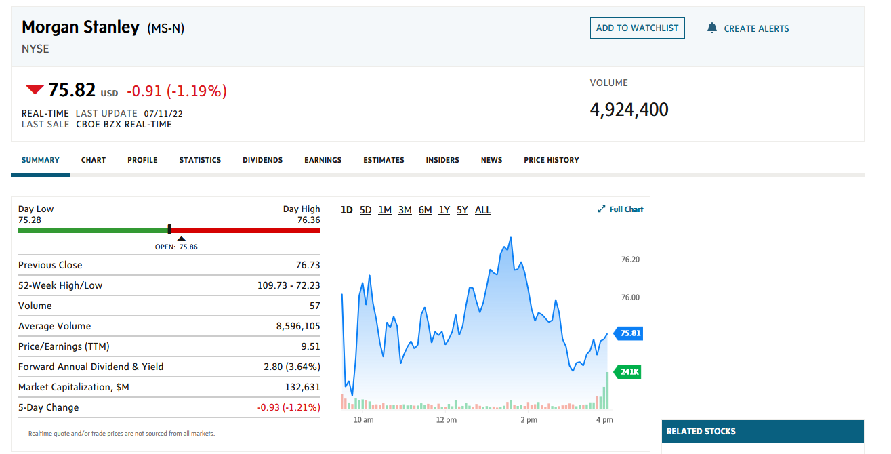

Slide 5
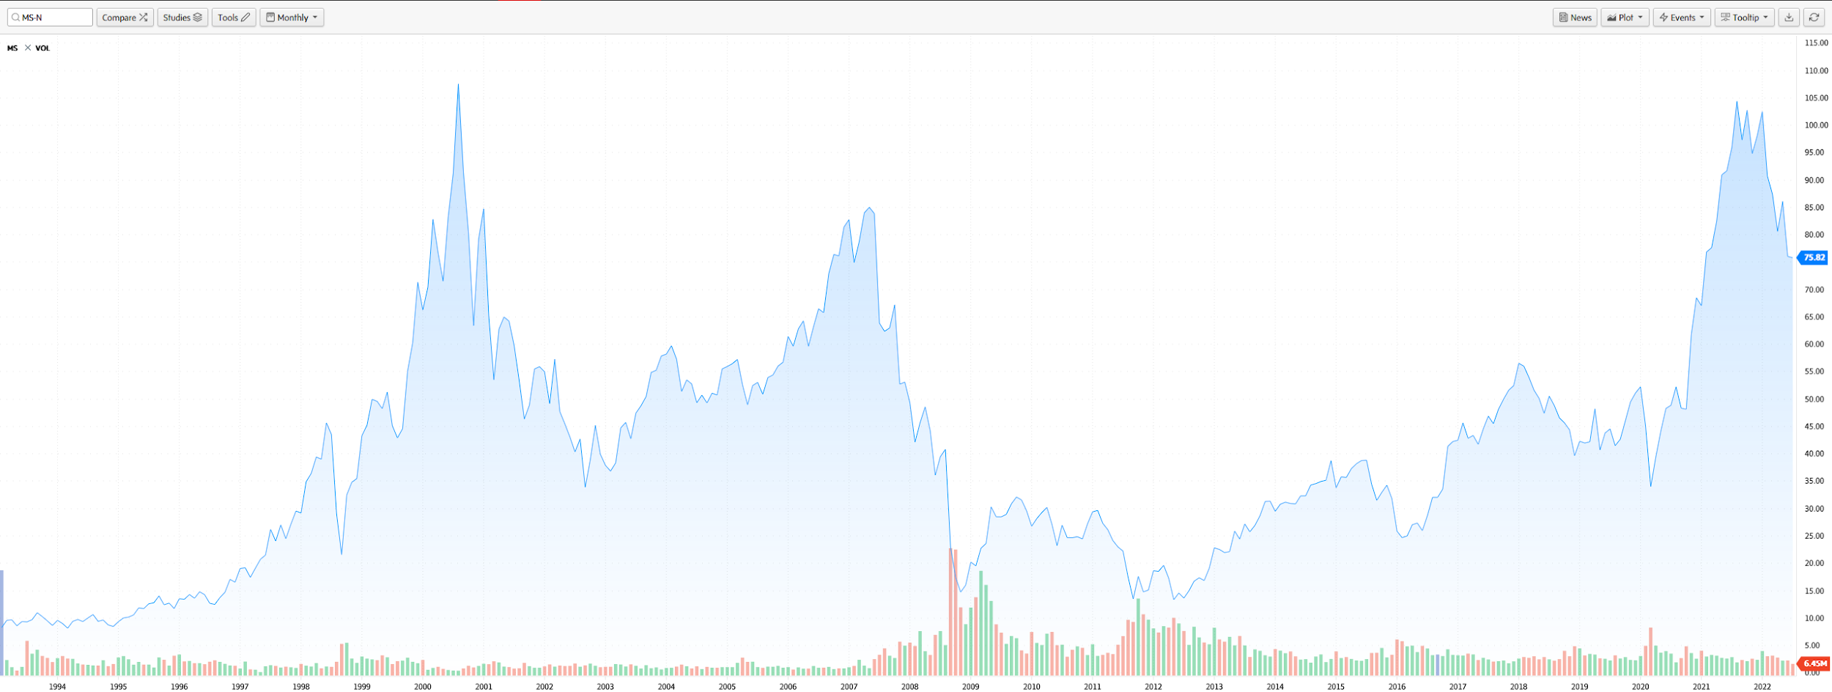

Slide 6
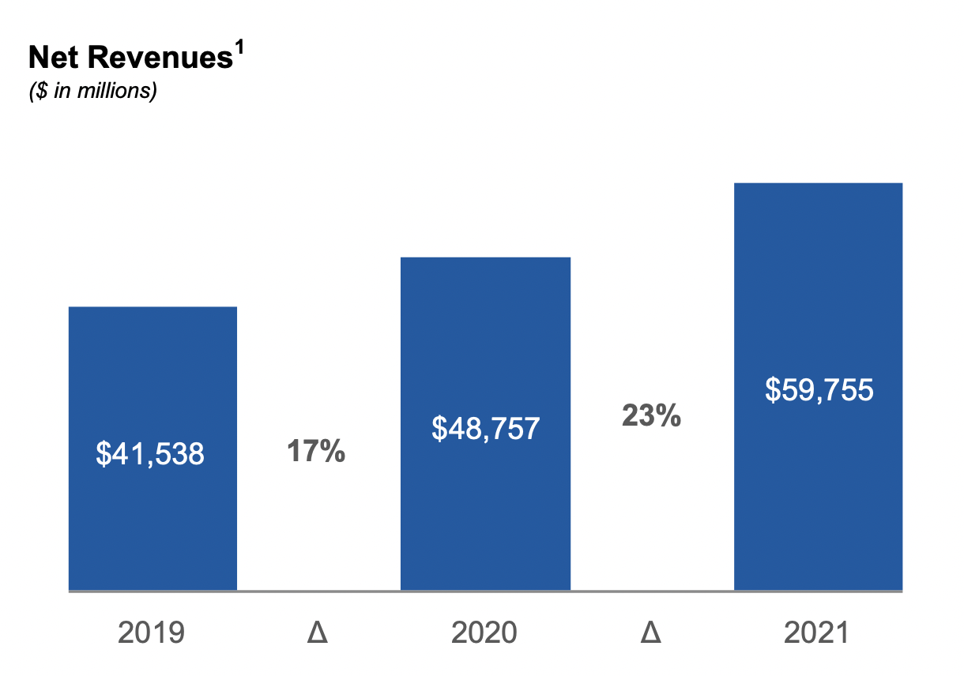

Slide 7
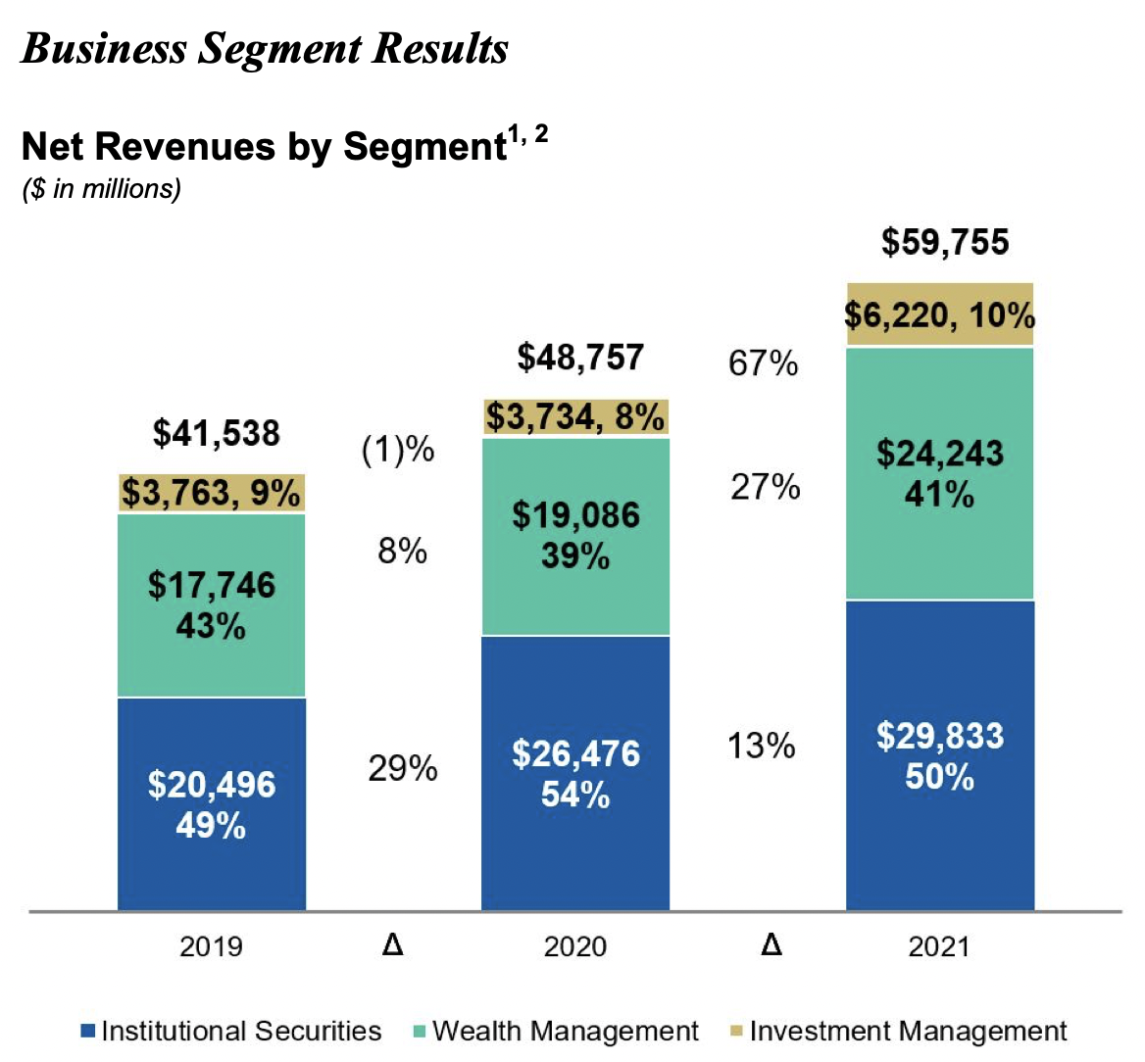
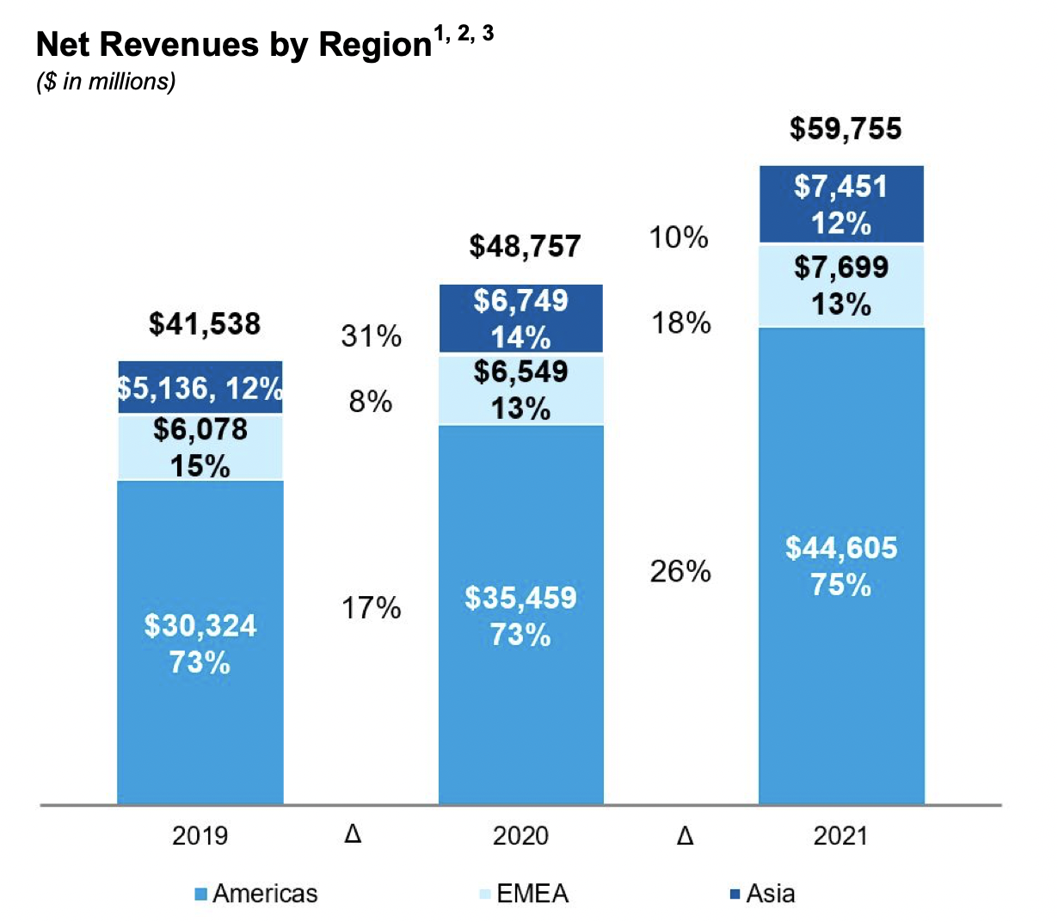

Slide 8
Operating Revenues & Expenses
Updates to Financial Presentation & Documents
Provision for Credit Losses
Investment Management
Investment Banking
Trading
Commissions and Fees
Asset Management
Net Interest
Other Revenue

Slide 9
Consolidated Income Statement

Slide 10
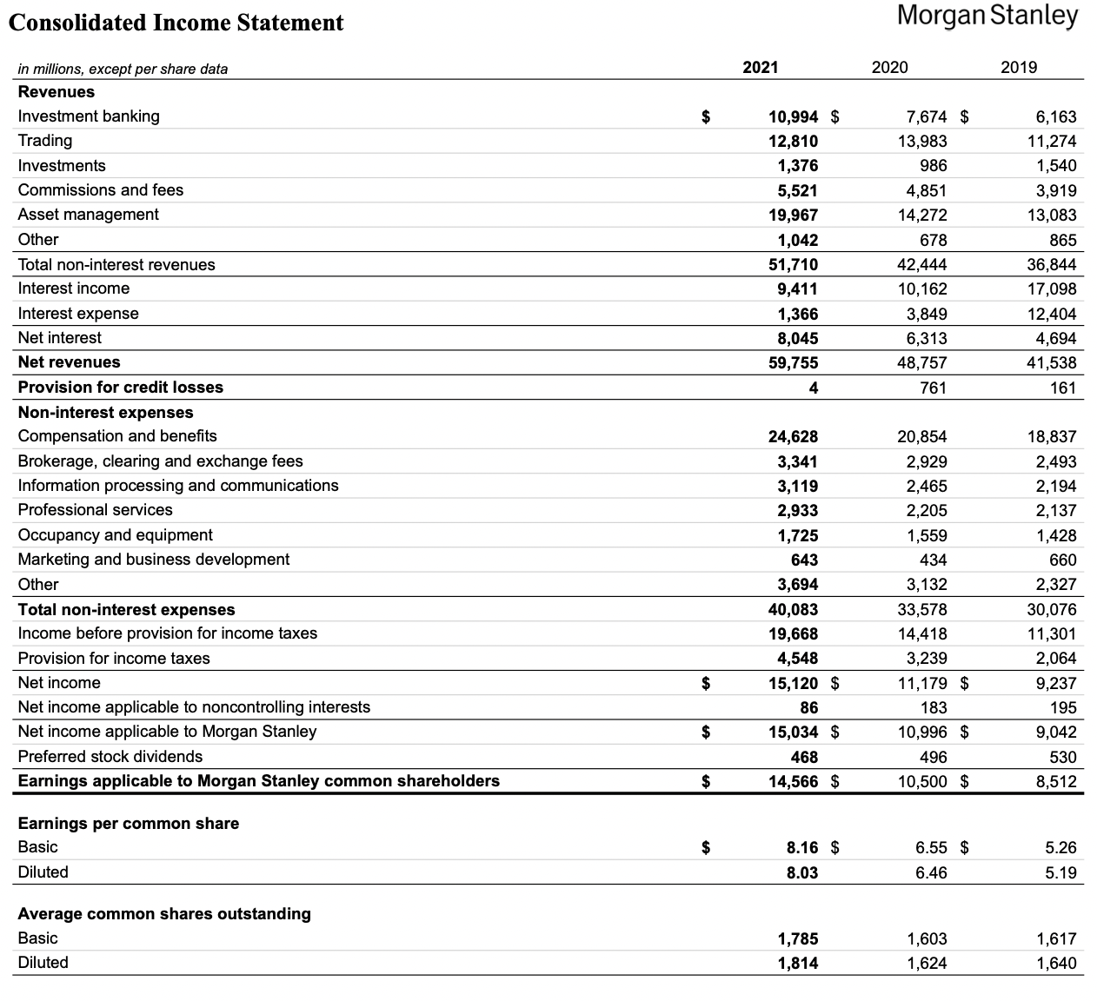

Slide 11
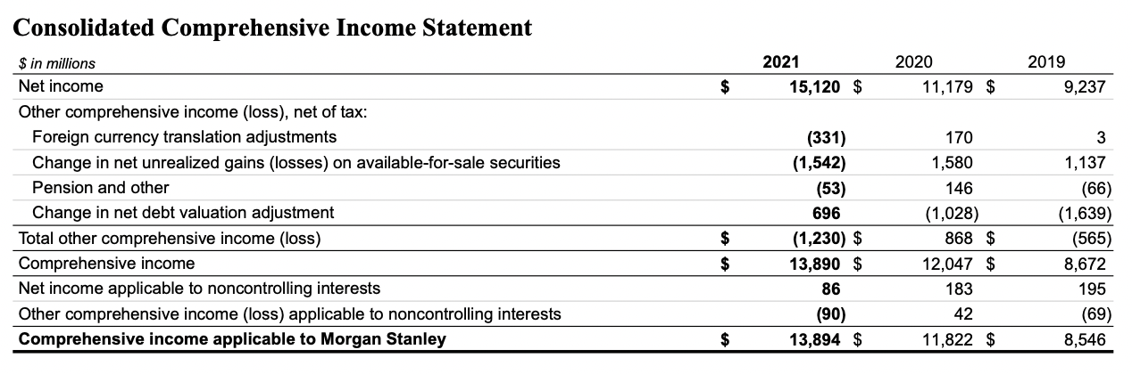

Slide 12
Consolidated Cash Flow Statement

Slide 13
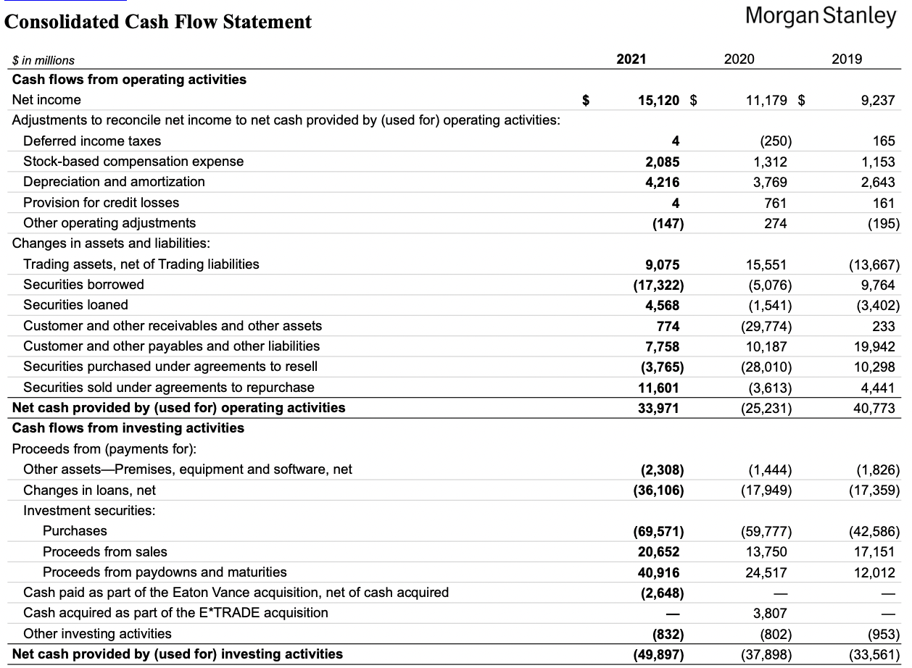

Slide 14
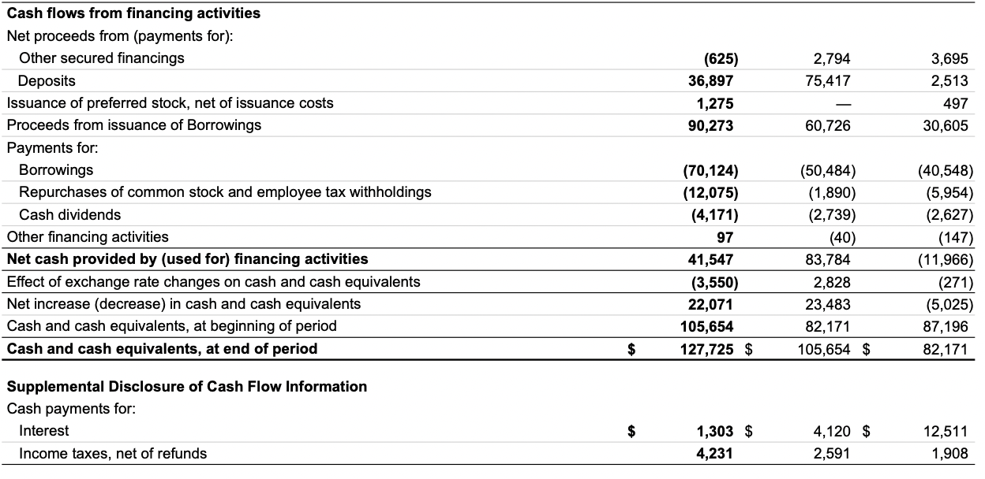

Slide 15
Consolidated Statement of Changes in Total Equity

Slide 16
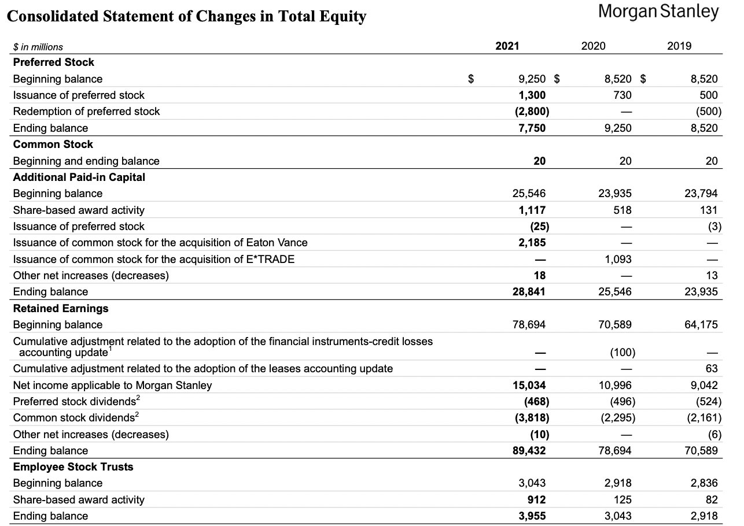

Slide 17
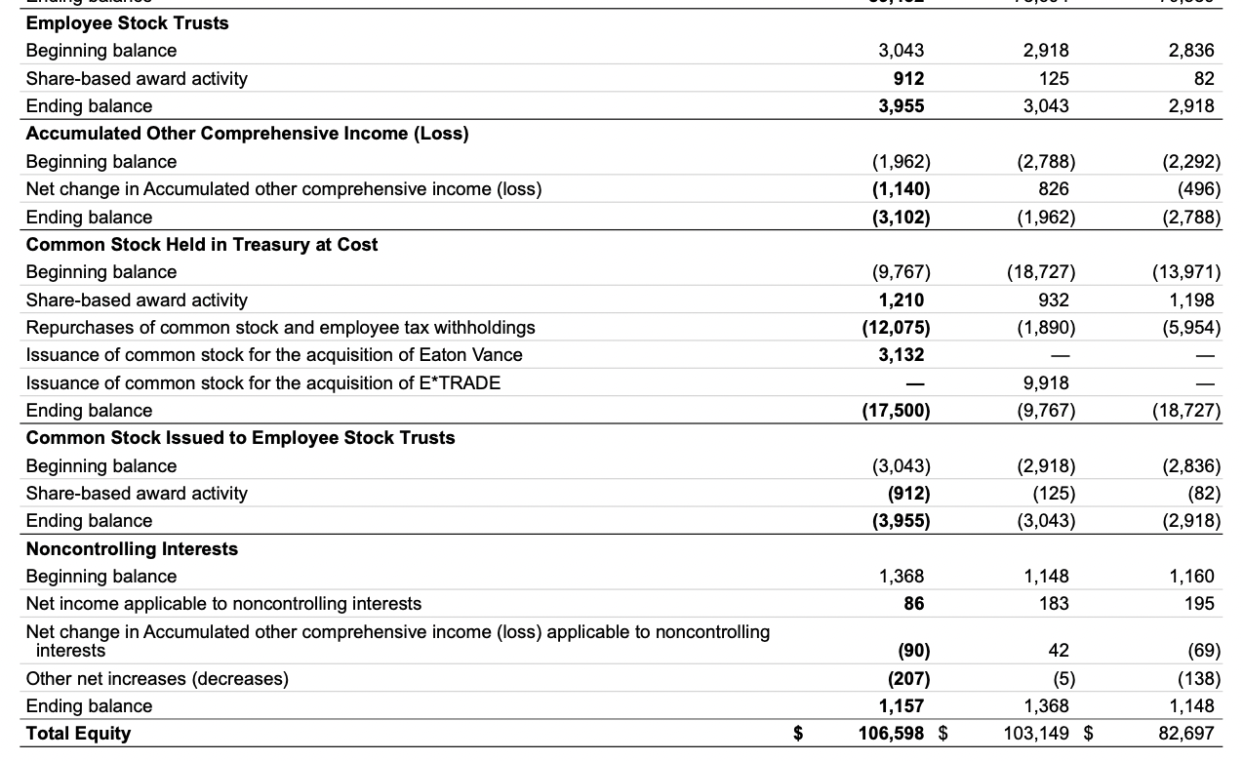

Slide 18
Consolidated Balance Sheet

Slide 19
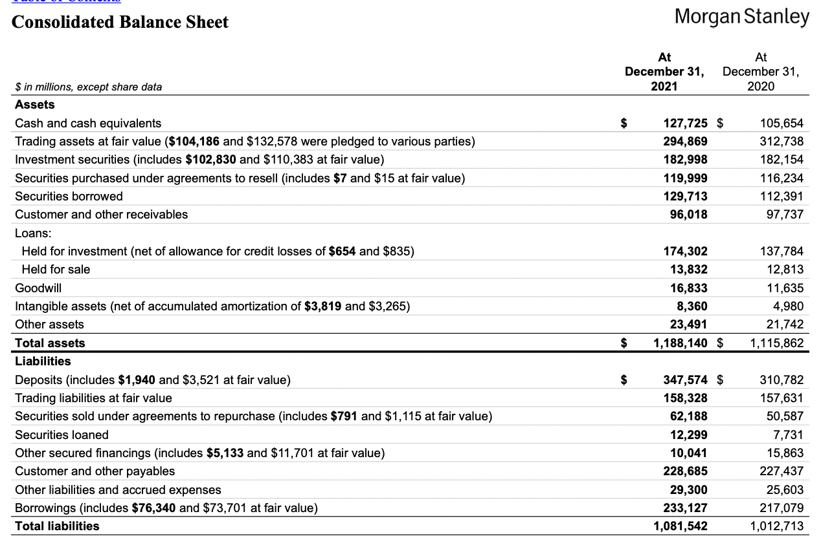

Slide 20
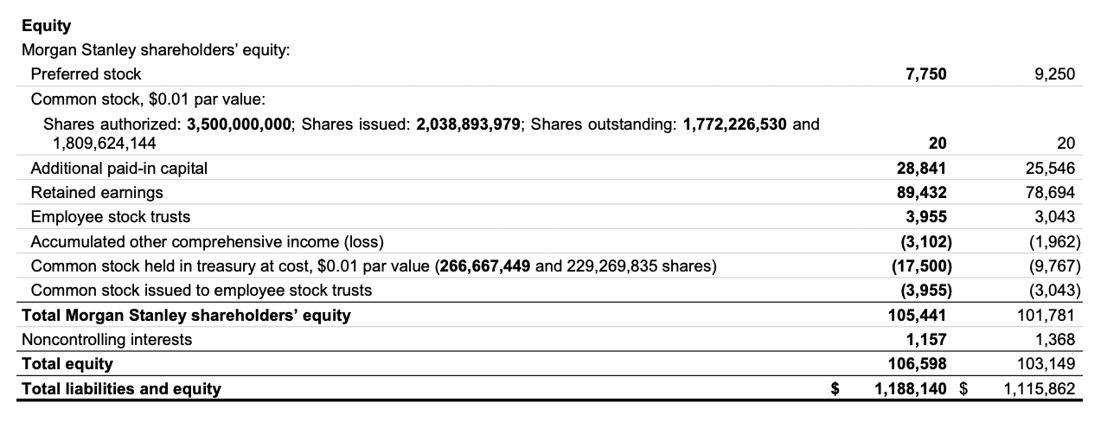

Slide 21
MD&A

Slide 22
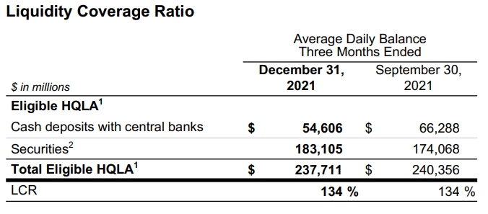
Liquidity Coverage Ratio

Slide 23
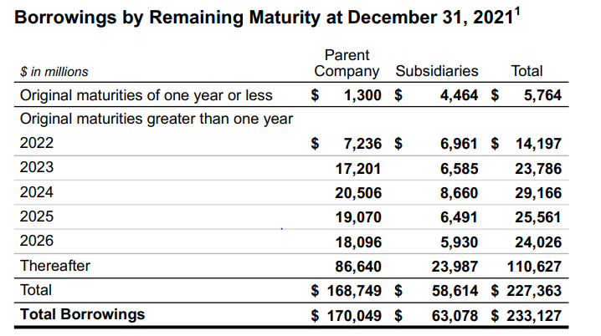
Borrowing by Remaining Maturity on December 31, 2021

Slide 24
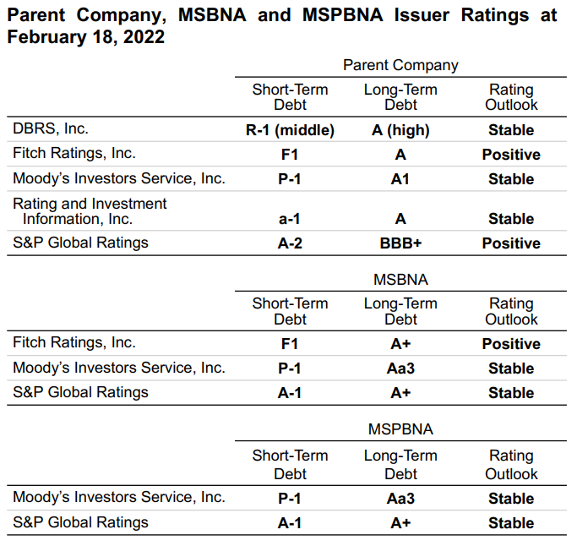
Parent Company and U.S. Bank Subsidiaries Issuer Ratings

Slide 25
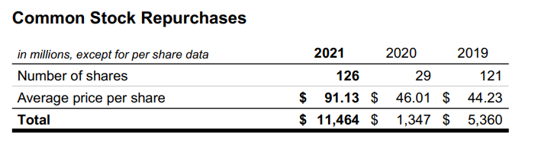
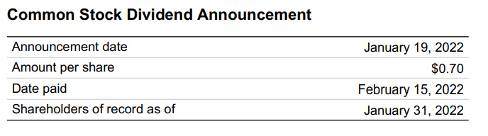
Common Stock

Slide 26
Replacement of LIBOR
Central banks around the world, including the Federal Reserve, have commissioned committees and working groups of market participants and official sector representatives to replace LIBOR and replace or reform other interest rate benchmarks (collectively, the “IBORs”). A transition away from use of the IBORs to alternative rates and other potential interest rate benchmark reforms is underway and will continue over the course of the next few years
As of December 31, 2021, the firm’s LIBOR-referenced contracts were primarily concentrated in derivative contracts and to a lesser extent, loans, floating rate notes, preferred shares, securitizations and mortgages. A significant majority of the firm’s derivative contracts, and a majority of the firm’s non-derivative contracts contain fallback provisions or otherwise have an expected path that will allow for the transition to an alternative reference rate upon the cessation of the applicable LIBOR rate

Slide 27
Basel Accord - l,ll, and lll

Slide 28
What is Basel l
It is a set of international banking regulations established by the Basel Committee on Banking Supervision (BCBS) which sets the minimum capital requirements for financial institutions, with the goal of minimizing credit risk. Compared to other three, Base l introduced guidelines for how much capital banks must keep in reserve based on the risk level of their assets
Banks that operate internationally were required to maintain at least a minimum amount of capital (8%) based on their risk-weighted assets
With the advent of Basel I, bank assets were classified into five level of risk: 0%, 10%, 20%, 50%, and 100%, and banks are required to maintain emergency capital based on that classification
Basel l is the earliest Basel Accords and is now considered too limited in scope, but it laid the framework for the subsequent Basel Accords

Slide 29
What is Basel ll
Also called as the Revised Capital Framework. It is an update of Basel l
Building upon Basel l. Basel ll focused on three main areas: minimum capital requirements, supervisory review of an institution's capital adequacy and internal assessment process, and the effective use of disclosure as a lever to strengthen market discipline and encourage sound banking practices including supervisory review
Further divide bank into three tiers: Tier 1, 2, and 3. The higher the tier, the more secure and liquid its assets
Provided guidelines for the calculation of minimum regulatory capital ratios and confirmed the requirement that banks maintain a capital reserve equal to at least 8% of their risk-weighted assets.
Refined the definition of risk-weighted assets, used in calculating whether a bank meets its capital reserve requirements
However, Basel II underestimated the risks involved in current banking practices and that the financial system was overleveraged and undercapitalized

Slide 30
What is Basel lll
An internationally agreed set of measures developed by the Basel Committee on Banking Supervision in response to the financial crisis of 2007-09
It builds on the Basel I and Basel II accords in an effort to improve the banking system’s ability to deal with financial stress, improve risk management, and promote transparency
Aim to strengthen the regulation, supervision, and risk management of bank
It is a minimum requirement applied to all internationally active banks
Increased the portion of that capital that must be in the form of Tier 1 assets, from 4% to 6%.Basel III also eliminated an even riskier tier of capital, Tier 3, from the calculation
Introduced new leverage and liquidity requirements aimed at safeguarding against excessive and risky lending, while ensuring that banks have sufficient liquidity during periods of financial stress
Introduced new rules requiring that banks maintain additional reserves known as countercyclical capital buffers—essentially a rainy day fund for banks

Slide 31
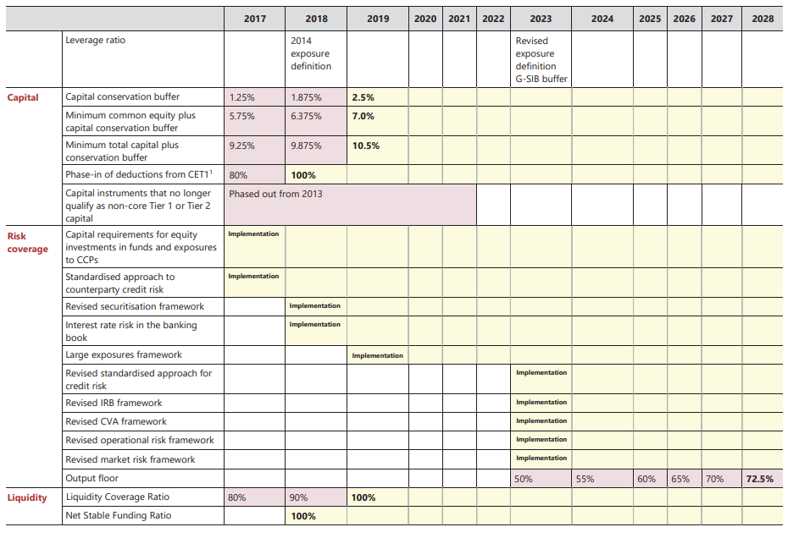
Basel lll Transitional Arrangements 2017-2028

Slide 32
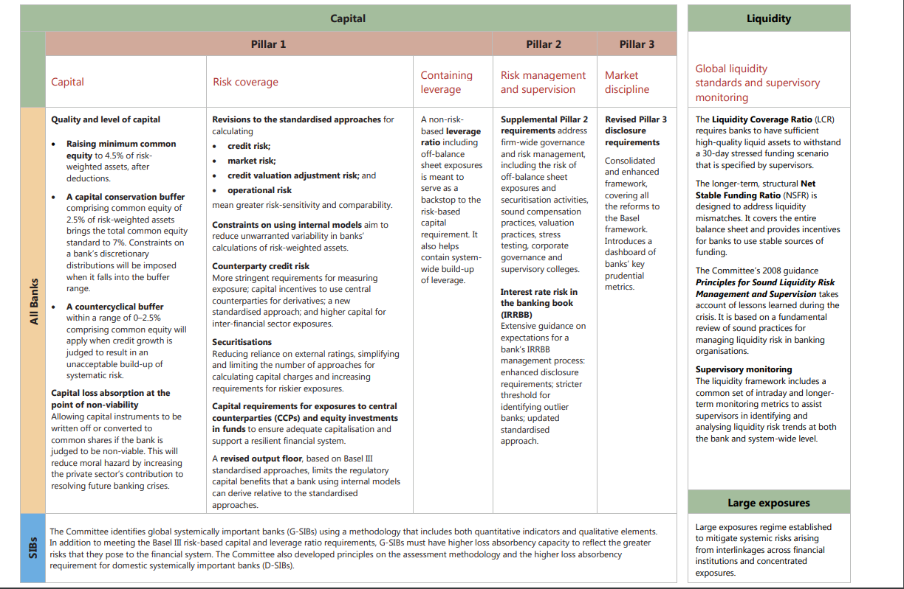
Basel lll Summary Table

Slide 33
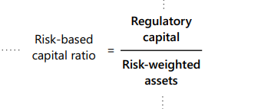
Basel lll Implications
Regulatory Capital:
Common Equity Tier 1 -> Common Shares, retained earnings, other revenue
Additional Tier 1 ->Capital Instruments with no fixed maturity
Tier 2 -> Subordinated debt and general loan-loss reserves
Capital Ratio:
Amount of regulatory capital divided by the amount of risk-weighted assets
Risk-weighted assets:
A risk weight is assigned to each type of asset, as an indication of how risky it is for the bank to hold the asset

Slide 34
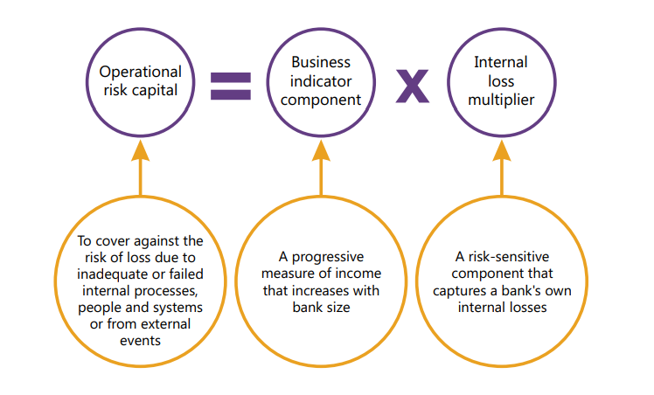
Basel lll 2017 Reform
Replacing the four current approaches with a single standardized approach

Slide 35
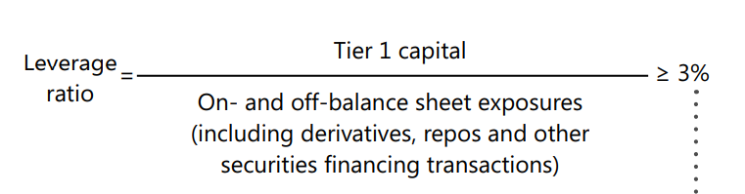
Basel lll 2017 Reform
Introduced a leverage rate buffer for G-SIBs.

Slide 36
Basel lll and Morgan Stanley
Morgan Stanley following Basel lll requirement by:
Using an advanced internal rating-based approach for calculating credit risk-weighted assets (RWAs) and advanced measurement approach for calculating operation RWAs
Supplement of the market RWAs
Make quantitative and qualitative disclosure regarding capital and RWAs on a quarterly basis
Effectively after the quarter ended September 2014, Morgan Stanley’s Basel lll disclosure report includes its credit, market, and operation risk

Slide 37
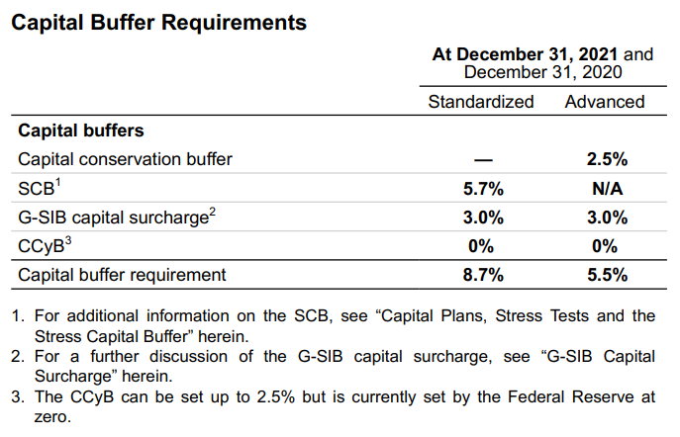
Capital Buffers in Morgan Stanley

Slide 38
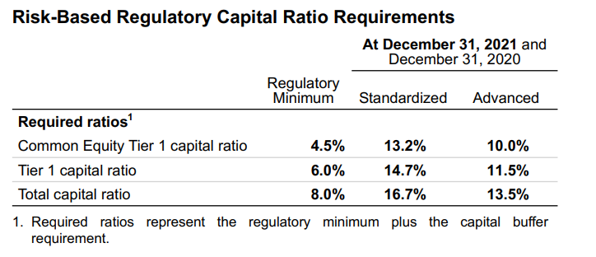
Capital Ratios

Slide 39
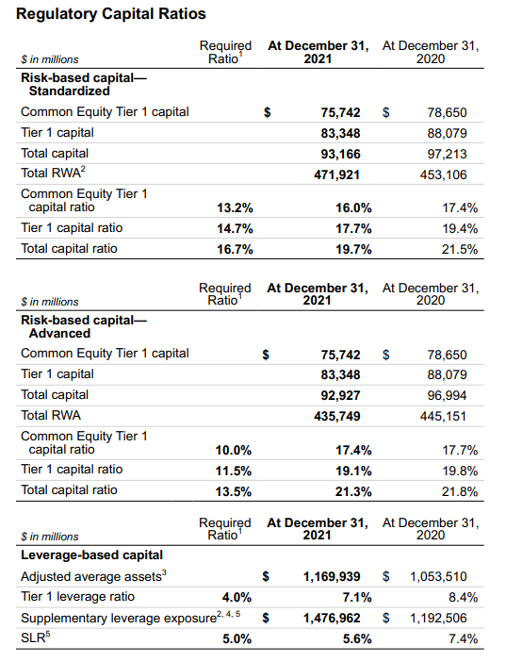
Capital Ratios

Slide 40
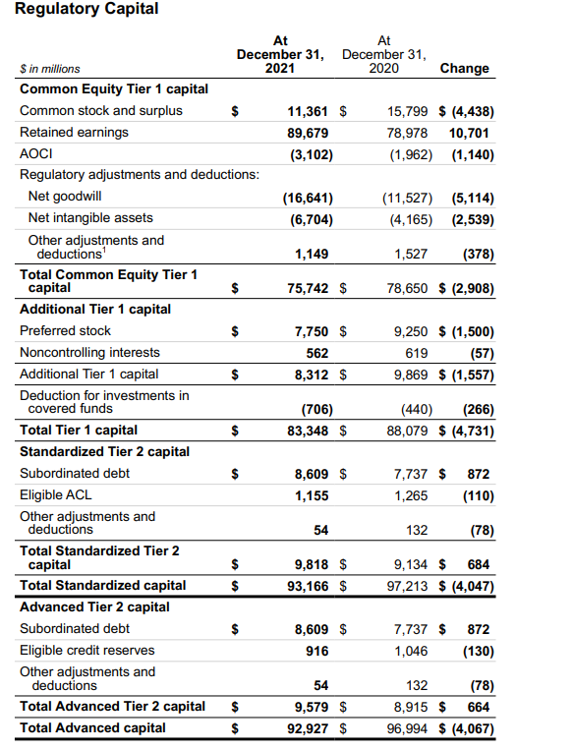
Capital Ratios

Slide 41
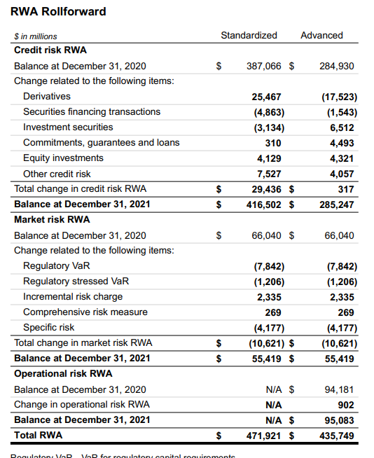
Capital Ratios

Slide 42
Risk Disclosure

Slide 43
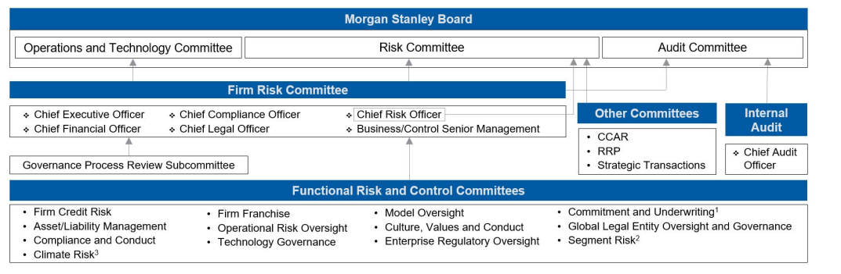
Risk Management Structure

Slide 44
Risk Management
Morgan Stanley Board of Directors
Risk Committee of the Board
Audit Committee of the Board
Operations and Technology Committee of the Board
Firm Risk Committee
Functional Risk and Control Committees
Chief Risk Officer
Independent Risk Management Functions
Support and Control Groups
Internal Audit Department
Culture, Values and Conduct of Employees

Slide 45
Risk Factors

Slide 46
Liquidity Risk
Incur from trading, lending, investing, and client facilitation activities
Loss of access to the capital markets or difficulty in liquidating assets
Liquidity Risk Management Framework:
  Maintain sufficient liquidity reserves and durable funding sources to meet daily obligations and withstand unanticipated stress events
  Ensures transparency of material liquidity funding risks
  Identities and analyzes emerging liquidity and funding risks to such risks are appropriately mitigated, monitors and reports risk exposures against metrics and limits

Slide 47
Liquidity Risk Management Framework
The primary goal of the Liquidity Risk Management Framework is to ensure that the company has access to adequate funding across a wide range of market conditions and time horizons. The framework is designed to fulfill financial obligations and support the execution of business strategies. The following principles guide the Liquidity Risk:
  Sufficient Liquidity Resources should be maintained to cover maturing liabilities and other planned and contingent outflows
  Maturity profile of assets and liabilities should be aligned, with limited reliance on short-term funding
  Source, counterparty, currency, region and term of funding should be diversified
  Liquidity Stress Tests should anticipate, and account for, periods of limited access to funding
The core components of the Liquidity Risk Management Framework are the Required Liquidity Framework, Liquidity Stress Tests and Liquidity Resources, which support their target liquidity profile

Slide 48
Required Liquidity Framework
Required Liquidity Framework establishes the amount of liquidity that must hold in both normal and stressed environments to ensure that the company’s financial condition and overall soundness are not adversely affected by an inability (or perceived inability) to meet financial obligations in a timely manner. The Required Liquidity Framework considers the most constraining liquidity requirement to satisfy all regulatory and internal limits at a consolidated and legal entity level

Slide 49
Liquidity Stress Tests
Use of Liquidity Stress Tests to model external and intercompany liquidity flows across multiple scenarios and a range of time horizons. These scenarios contain various combinations of idiosyncratic and systemic stress events of different severity and duration. The methodology, implementation, production and analysis of Liquidity Stress Tests are important components of the Required Liquidity Framework. The assumptions used in various Liquidity Stress Test scenarios include, but are not limited to, the following:
  No government support;
  No access to equity and limited access to unsecured debt markets;
  Repayment of all unsecured debt maturing within the stress horizon;
  Higher haircuts for and significantly lower availability of secured funding;
  Additional collateral that would be required by trading counterparties, certain exchanges and clearing organizations related to credit rating downgrades;
  Additional collateral that would be required due to collateral substitutions, collateral disputes and uncalled collateral;
  Discretionary unsecured debt buybacks;
  Drawdowns on lending commitments provided to third parties; and
  Client cash withdrawals and reduction in customer short positions that fund long positions
Liquidity Stress Tests are produced and results are reported at different levels, including major operating subsidiaries and major currencies, to capture specific cash requirements and cash availability across the Firm, including a limited number of asset sales in a stressed environment. The Liquidity Stress Tests assume that subsidiaries will use their own liquidity first to fund their obligations before drawing liquidity from the Parent Company and that the Parent Company will support its subsidiaries and will not have access to subsidiaries’ liquidity reserves. In addition to the assumptions underpinning the Liquidity Stress Tests, Morgan Stanley takes into consideration settlement risk related to intraday settlement and clearing of securities and financing activities

Slide 50
Liquidity Resources
Morgan Stanley maintains sufficient liquidity resources, which consist of HQLA and cash deposits with banks (“Liquidity Resources”) to cover daily funding needs and to meet strategic liquidity targets sized by the Required Liquidity Framework and Liquidity Stress Tests. Morgan Stanley actively manage the amount of Liquidity Resources considering the following components:
  unsecured debt maturity profile; balance sheet size and composition;
  funding needs in a stressed environment, inclusive of contingent cash outflows;
  legal entity, regional and segment liquidity requirements
  regulatory requirements;
  collateral requirements
The amount of Liquidity Resources the company hold is based on risk tolerance and is subject to change depending on market and Firm-specific events. The Liquidity Resources are primarily held within the Parent Company and its major operating subsidiaries. The Total HQLA values in the tables immediately following are different from Eligible HQLA, which, in accordance with the LCR rule, also takes into account certain regulatory weightings and other operational considerations

Slide 51
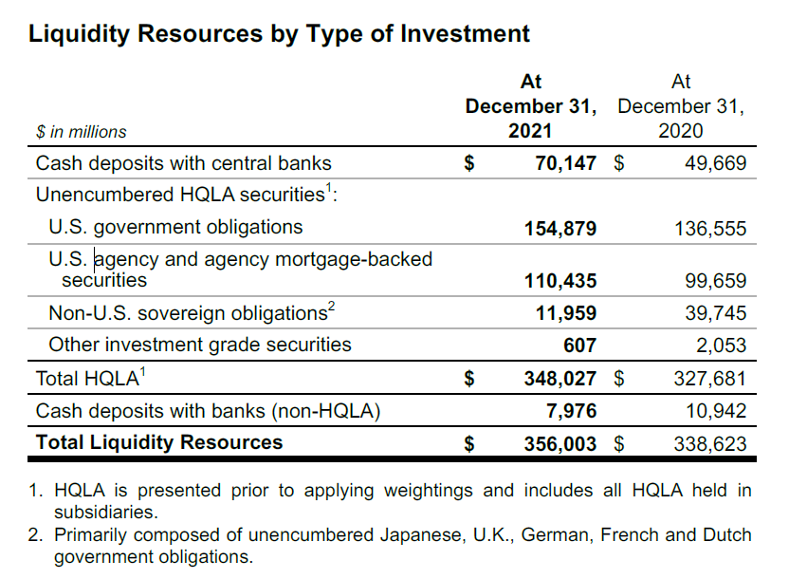

Slide 52
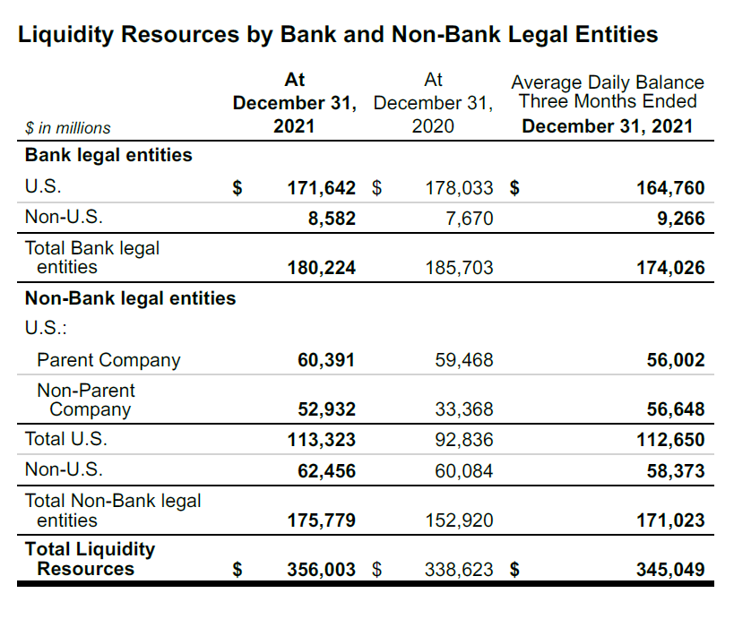

Slide 53
Credit Risk
Incur from extending credit to clients through loans, entering into swap or other derivative contracts, providing short/long-term funding that is secured by physical/financial collateral whose value may be insufficient to fully cover repayment amount, etc
Loss arises when borrower, counterparty, issuer does not meet its financial obligation.
Credit Risk Management:
  The Credit Risk Management Department (CRM) evaluates the creditworthiness of counterparties/borrowers, ensures that credit exposure is actively monitored and managed
  Actively managed by credit professionals and committees within CRM
  A comprehensive and global Credit Limits Framework is utilized and stress tests are performed to identify, analyze and control credit risk concentration.
  Perform credit evaluation to assess an obligor’s probability of default and loss
  Mitigate credit risk by collateral provisions, guarantees and hedges. Hedge lending and derivatives exposures and enter into master netting agreements with collateral arrangement with counterparties

Slide 54
Legal & Compliance Risk
Incur from failure to comply with laws, regulations, rules, related self-regulatory organization standards and codes of conduct
Includes risk of legal or regulatory sanctions, material financial loss, including fines, penalties, judgments, damages and/or settlements, limitations on the company’s business, or loss to reputation
Legal & Compliance Risk Management:
  established procedures based on legal and regulatory requirements on a worldwide basis designed to facilitate compliance with applicable statutory and regulatory requirements
  established procedures to mitigate the risk that a counterparty’s performance obligations will be unenforceable, including consideration of counterparty legal authority and capacity, adequacy of legal documentation, etc

Slide 55
Trading Risk
Exposed to:
Interest risk and credit spread risk
Equity price and implied volatility risk
Foreign exchange rate and implied volatility risk
Commodity price and implied volatility risk

Slide 56
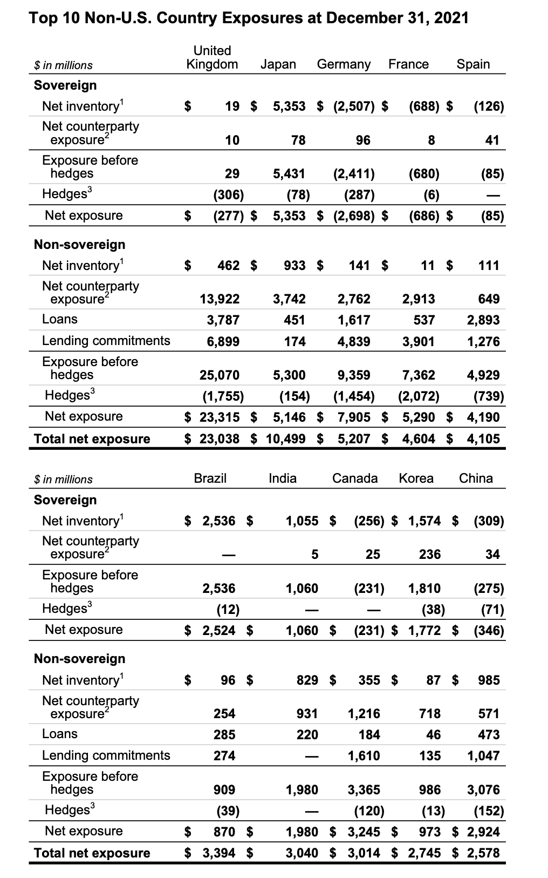
Country Risk

Slide 57
Operational Risk
Cybersecurity
The firm’s cybersecurity and information security policies, procedures and technologies are designed to protect their own, their client and their employee data against unauthorized disclosure, modification or misuse and are also designed to address regulatory requirements. These policies and procedures cover a broad range of areas, including: identification of internal and external threats, access control, data security, protective controls, detection of malicious or unauthorized activity, incident response and recovery planning

Slide 58
Operational Risk
Business Continuity Management and Disaster Recovery
The Firm’s business continuity and disaster recovery programs are designed to provide assurance of business continuity in the event of disruptions impacting people, technology, facilities and third parties, and to comply with regulatory requirements. The key elements of these programs include crisis management, business continuity planning, disaster recovery, testing and verification, and process improvement

Slide 59
Operational Risk
Third-Party Risk Management
In connection with the ongoing operations, the firm utilize the services of third-party suppliers, which they anticipate will continue and may increase in the future. These services include, for example, outsourced processing and support functions and other professional services. Their risk-based approach to managing exposure to these services includes the performance of due diligence, implementation of service level and other contractual agreements, consideration of operational risks and ongoing monitoring of third-party suppliers’ performance. They maintain and continue to enhance their thirdparty risk management program, which is designed to align with their risk tolerance and meet regulatory requirements. The program includes appropriate governance, policies, procedures and enabling technology. The third-party risk management program includes the adoption of appropriate risk management controls and practices throughout the thirdparty management life cycle to manage risk of service failure, risk of data loss and reputational risk, among others

Slide 60
VaR
Designed to evaluate, track, and evaluate the market risk exposures of its trading portfolios
A methodology based on historical simulation for the main market risk components and Monte Carlo simulation for name-specific risk in corporate shares, bonds, loans, and associated derivatives was used to estimate VaR
Based on two sets of inputs, historical simulation creates a distribution of fictitious daily changes in the value of trading portfolios
Historical tracking of daily fluctuations in important market indexes or other market risk variables
Information on the portfolio values' susceptibility to changes in various market risk factors
The company's VaR model analyses four years of historical data to calculate its 95% one-day VaR, which equates to the unrealized loss in portfolio value that would have been surpassed with a frequency of 5% or 5 times in every 100 trading days if the portfolio were held unchanged for one day

Slide 61
VaR Benefits and Limitation
Benefits:
Permits estimation of portfolio’s aggregate market risk exposure
Reflects risk reduction due to portfolio diversification or hedging activities
Limitations:
Past changes in market risk factors may not yield accurate predictions
Changes in portfolio value may differ from responses calculated by a VaR model
Doesn’t fully capture market risk of positions that cannot be liquidated or hedged within one day using a one day time frame
Limited insight into losses that could occur in unusual market conditions
Understates risk associated with severe events

Slide 62
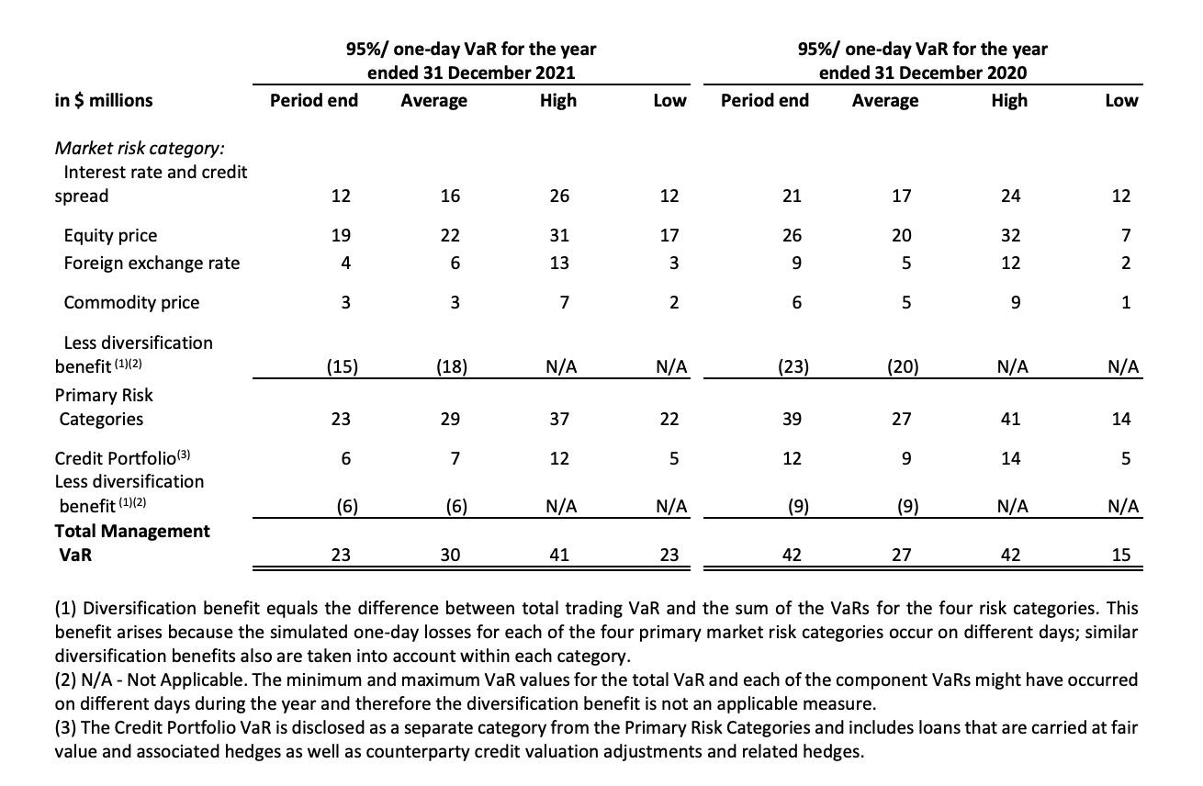
2021 95%/One-day VaR

Slide 63
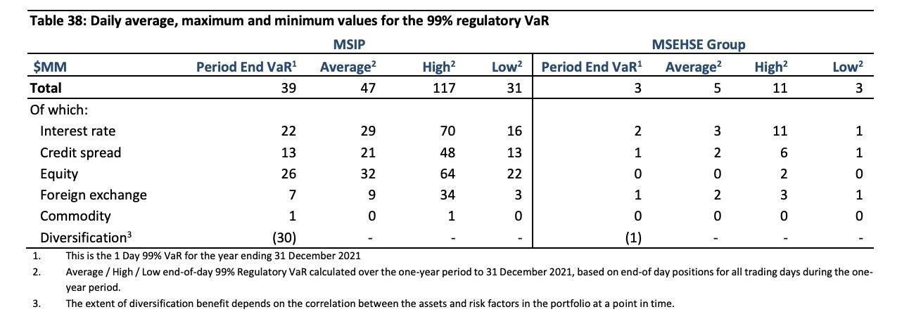
An analysis of the 99% Regulatory VaR over 2021

Slide 64
Credit Risk
The risk of default from borrowers
Refers to the possibility of suffering a loss as a result of a borrower or counterparty defaulting on a debt or other commitment
Third parties indebted to us not perform obligation
Incur through Institutional Securities business segment
Incur in traded securities and loan pools
Incur in Global Wealth Management Group business segment
Continued difficult economic conditions may further negatively impart clients and firm’s current credit exposures

Slide 65
Credit Risk: Institutional Securities business segment
Entering into swap or other derivative contract which counterparties have obligations to make payment
Extending credit to clients through various lending commitments
Providing short or long-term funding secured by physical or financial collateral whose value may at times be insufficient to fully cover the loan repayment amount
Posting margin or collateral to clearing houses, clearing agencies, exchanges, banks, securities firms and other financial counterparties

Slide 66
Credit Risk: Institutional Securities Activities
Corporate lending
  Relationship-driven
    expand business relationships
  Event driven
    lending commitments for events such as acquisition and mergers by clients
Securitized products
  Structuring, underwriting, and trading collateralized securities
  Risk borrower not performing according to agreement and devaluation of collateral
Derivative Contracts
  Represent future commitments to swap interest payment streams, exchange currencies on specific terms at specified future days
  Morgan Stanley as a dealer of OTC derivatives

Slide 67
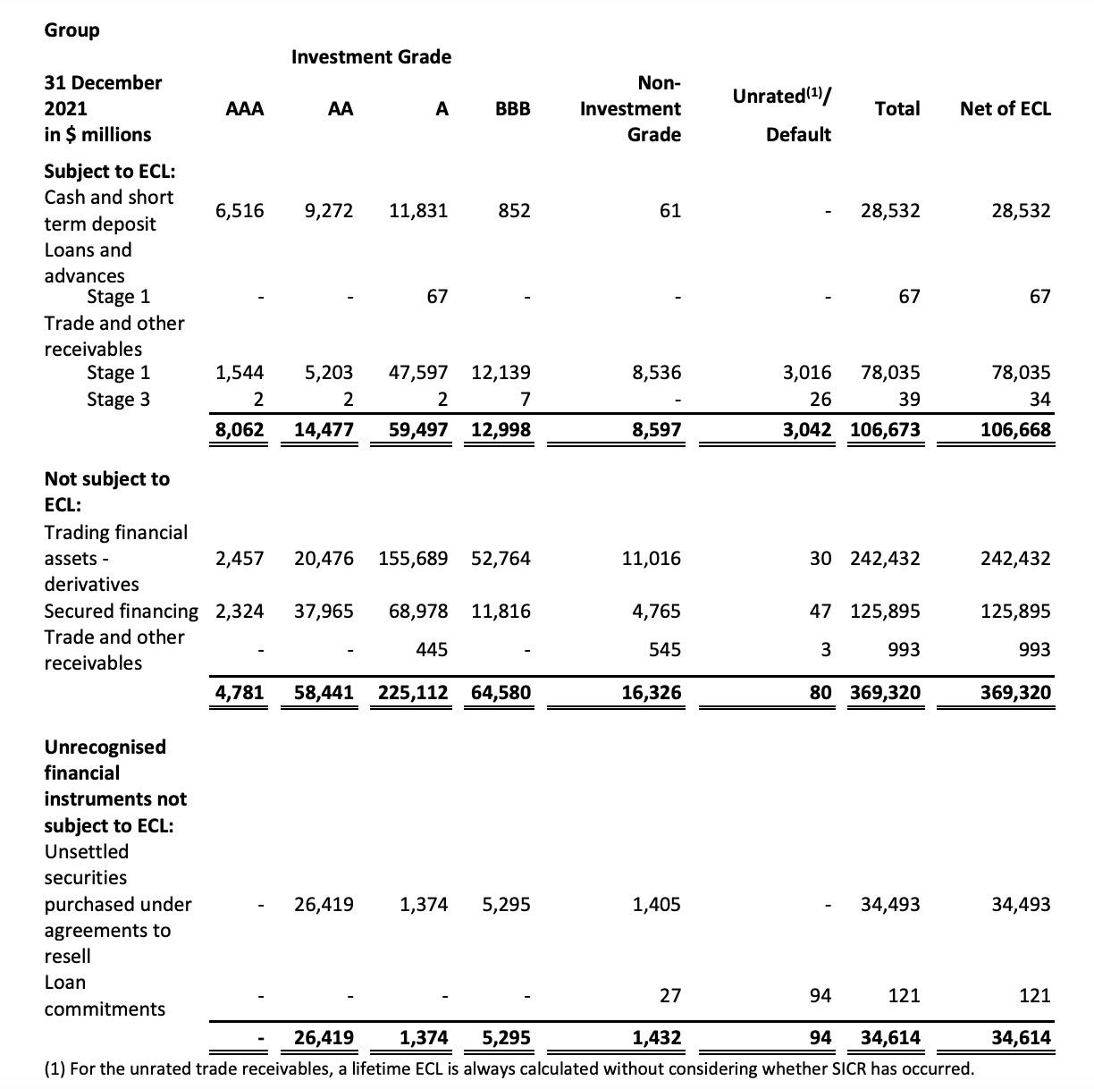
Gross Carrying/Nominal Amount by Internal Rating Grade

Slide 68
Credit Risk Management
Credit Risk Management Department
Credit Limits Framework

Slide 69
Analyzing Credit Risk
Credit Risk Management Department
  Ensure lending transactions and derivative exposure are analyzed
  Review Creditworthiness of counterparties and borrowers regularly
  Actively monitor and manage credit exposure
  Assigns obligor credit ratings to counterparties and borrowers
  Evaluate relative position of particular obligation in borrower’s capital structure and recovery prospects

Slide 70
Risk Mitigation
Through management of key risks elements such as size, financial covenants and collateral
Sell, assign or sub-participate funded loans to other financial institutions
Enter master netting agreements and collateral arrangements with counterparties to offset obligations, request collateral or liquidate collateral

Slide 71
Credit Risk: Global Wealth Management Group Business Segment
Lending to individual investors, margin and non-purpose loans collateralized by securities, residential mortgage loans and home equity lines of credit

Slide 72
Credit Risk: Global Wealth Management Group Activities
Margin lending
  monitors margin levels, establishes credit limits
  reviews amount of margin loans, intended purpose and degree of leverage
Non-purpose securities-based lending (Consumer lending)
  allows clients borrow money against the value of qualifying securities for purposes other than trading or refinancing margin debt
  Establishes approved lines and advance rates against qualifying securities

Slide 73
Credit Risk: Global Wealth Management Group Activities
Commercial lending
  provides structured credit facilities to high net worth individuals and their small and medium-sized domestic businesses
  with working capital lines of credit, revolving lines of credit, standby letters of credit, term loans and commercial real estate mortgages
Residential mortgage lending
  Regards mortgages, HELOC loans, a loan evaluation process is adopted within a framework of credit underwriting policies and collateral valuation
  ensure that all borrowers pass an assessment of capacity and willingness to pay
    loan-to-value ratio, a FICO score, home price index, and delinquency status

Slide 74
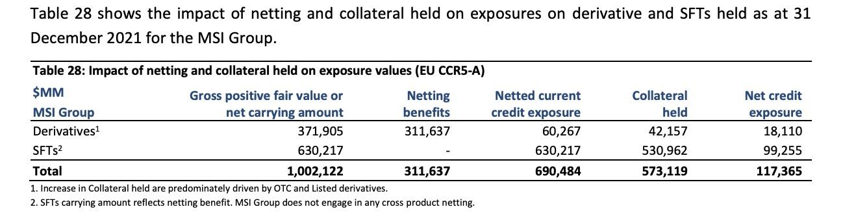
Credit Exposure: Global Wealth Management Group Activities

Slide 75
Credit Risk: Default risk
Firm as a clearing member firm
Responsible for the defaults or misconduct of customers
Although regular review, may arise from event or circumstance that difficult to detect or foresee

Slide 76
Credit Risk: Systemic risk
Defaults by another large financial institution could adversely affect financial market generally
  commercial soundness of financial institution closely interrelated as a result of credit, trading, clearing and other relationships between the institutions
  concerns, default or threatened default by, one institution could lead to significant market-wide liquidity and credit problems, losses or defaults by other institutions

Slide 77
Impact of Covid 19
Sectors Currently in Focus due to COVID-19. The economic effects of COVID-19 have impacted borrowers in many sectors and industries, though certain sectors remain more sensitive to the current economic environment and are continuing to receive heightened focus. The sectors currently in focus are retail, air travel, lodging and leisure, upstream energy, and healthcare services and systems. As of December 31, 2021, exposures to these sectors are included across the Industrials, Financials, Real estate, Consumer discretionary, Energy and Healthcare industries in the previous table, and in aggregate represent less than 10% of total Institutional Securities business segment lending exposure. Further, as of December 31, 2021, over 90% of these exposures are either investment grade and/or secured by collateral. The future developments of COVID-19 and its effect on the economic environment remain uncertain; therefore, the sectors impacted may change over time

Slide 78
Financial Instruments Measured at Fair Value
A significant number of Morgan Stanley’s financial instruments are carried at fair value. Morgan Stanley makes estimates regarding the valuation of assets and liabilities measured at fair value in preparing the financial statements. These assets and liabilities include, but are not limited to:
  Trading assets and Trading liabilities
  Investment Securities—AFS
  Certain Securities purchased under agreements to resell
  Certain Deposits, primarily certificates of deposit
  Certain Securities sold under agreements to repurchase
  Certain Other secured financings
  Certain Borrowings

Slide 79
Fair Value Measurement—Definition and Hierarchy
Fair value is defined as the price that would be received to sell an asset or paid to transfer a liability (i.e., the exit price) in an orderly transaction between market participants at the measurement date
Fair value is a market-based measure considered from the perspective of a market participant rather than an entity-specific measure. Therefore, even when market assumptions are not readily available, assumptions are set to reflect those that the Firm believes market participants would use in pricing the asset or liability at the measurement date. Where the Firm manages a group of financial assets, financial liabilities, and nonfinancial items accounted for as derivatives on the basis of its net exposure to either market risks or credit risk, the Firm measures the fair value of that group of financial instruments consistently with how market participants would price the net risk exposure at the measurement date

Slide 80
Fair Value Measurement—Definition and Hierarchy
In determining fair value, the company uses various valuation approaches. A hierarchy for inputs is used in measuring fair value that maximizes the use of observable prices and inputs and minimizes the use of unobservable prices and inputs by requiring that the relevant observable inputs be used when available. The hierarchy is broken down into three levels:
Level 1. Valuations based on quoted prices in active markets that the Firm has the ability to access for identical assets or liabilities. Valuation adjustments, block discounts and discounts for entity-specific restrictions that would not transfer to market participants are not applied to Level 1 instruments. Since valuations are based on quoted prices that are readily and regularly available in an active market, valuation of these products does not entail a significant degree of judgment
Level 2. Valuations based on one or more quoted prices in markets that are not active or for which all significant inputs are observable, either directly or indirectly
Level 3. Valuations based on inputs that are unobservable and significant to the overall fair value measurement

Slide 81
Fair Value Measurement—Definition and Hierarchy
In periods of market disruption, the observability of prices and inputs may be reduced for many instruments, which could cause an instrument to be recategorized from Level 1 to Level 2 or from Level 2 to Level 3. In addition, a downturn in market conditions could lead to declines in the valuation of many instruments. For further information on the definition of fair value, Level 1, Level 2, Level 3 and related valuation techniques, and quantitative information about and sensitivity of significant unobservable inputs used in Level 3 fair value measurements. Where appropriate, valuation adjustments are made to account for various factors such as liquidity risk (bid-ask adjustments), credit quality, model uncertainty, concentration risk and funding in order to arrive at fair value

Slide 82
Valuation Techniques
Fair value for many cash instruments and OTC derivative contracts is derived using pricing models. Pricing models take into account the contract terms, as well as multiple inputs, including, where applicable, commodity prices, equity prices, interest rate yield curves, credit curves, correlation, creditworthiness of the counterparty, creditworthiness of the Firm, option volatility and currency rates
The Firm applies credit-related valuation adjustments to its Borrowings for which the fair value option was elected and to OTC derivatives. The Firm considers the impact of changes in its own credit spreads based upon observations of the secondary bond market spreads when measuring the fair value for Borrowings
For OTC derivatives, the impact of changes in both the Firm’s and the counterparty’s credit rating is considered when measuring fair value. In determining the expected exposure, the Firm simulates the distribution of the future exposure to a counterparty, then applies market-based default probabilities to the future exposure, leveraging external third-party CDS spread data. Where CDS spread data are unavailable for a specific counterparty, bond market spreads, CDS spread data based on the counterparty’s credit rating or CDS spread data that reference a comparable counterparty may be utilized. The Firm also considers collateral held and legally enforceable master netting agreements that mitigate its exposure to each counterparty

Slide 83
Derivative Instruments and Hedging Activities
The Firm trades and makes markets globally in listed futures, OTC swaps, forwards, options and other derivatives referencing, among other things, interest rates, equities, currencies, investment grade and non-investment grade corporate credits, loans, bonds, U.S. and other sovereign securities, emerging market bonds and loans, credit indices, ABS indices, property indices, mortgage-related and other ABS, and real estate loan products. The Firm uses these instruments for market-making, managing foreign currency and credit exposure, and asset/liability management
The Firm manages its market-making positions by employing a variety of risk mitigation strategies. These strategies include diversification of risk exposures and hedging. Hedging activities consist of the purchase or sale of positions in related securities and financial instruments, including a variety of derivative products (e.g., futures, forwards, swaps and options). The Firm manages the market risk associated with its market-making activities on a Firmwide basis, on a worldwide trading division level and on an individual product basis

Slide 84
Offsetting of Derivative Instruments
In connection with its derivative activities, the Firm generally enters into master netting agreements and collateral agreements with its counterparties. These agreements provide the Firm with the right, in the event of a default by the counterparty, to net a counterparty’s rights and obligations under the agreement and to liquidate and set off cash collateral against any net amount owed by the counterparty. Derivatives with enforceable master netting agreements are reported net of cash collateral received and posted
However, in certain circumstances, the Firm may not have such an agreement in place; the relevant insolvency regime may not support the enforceability of the master netting agreement or collateral agreement; or the Firm may not have sought legal advice to support the enforceability of the agreement. In cases where the Firm has not determined an agreement to be enforceable, the related amounts are not offset
The Firm’s policy is generally to receive cash and/or securities posted as collateral (with rights of rehypothecation), irrespective of the enforceability determination regarding the master netting and collateral agreement. In certain cases, the Firm may agree for such collateral to be posted to a third-party custodian under a control agreement that enables it to take control of such collateral in the event of a counterparty default. The enforceability of the master netting agreement is taken into account in the Firm’s risk management practices and application of counterparty credit limits

Slide 85
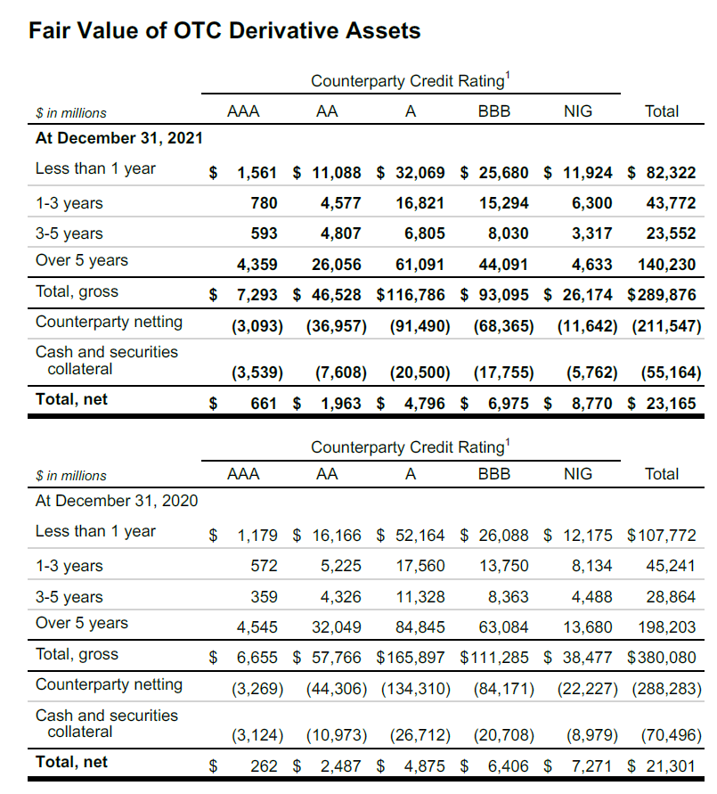

Slide 86
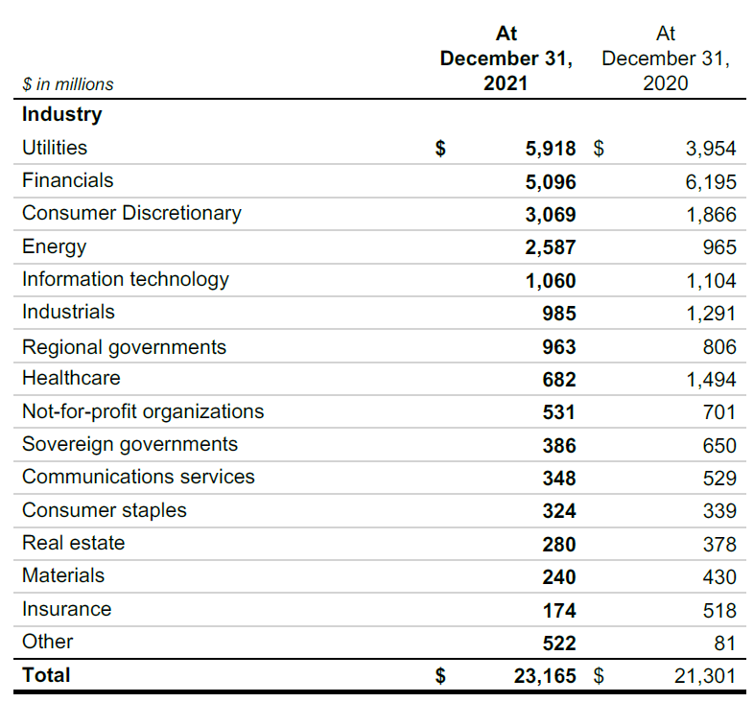

Slide 87
Credit Derivatives
A credit derivative is a contract between a seller and buyer of protection against the risk of a credit event occurring on one or more debt obligations issued by a specified reference entity. The buyer typically pays a periodic premium over the life of the contract and is protected for the period. If a credit event occurs, the seller is required to make payment to the beneficiary based on the terms of the credit derivative contract. Credit events, as defined in the contract, may be one or more of the following defined events: bankruptcy, dissolution or insolvency of the referenced entity, failure to pay, obligation acceleration, repudiation, payment moratorium and restructuring
Morgan Stanley trade in a variety of credit derivatives and may either purchase or write protection on a single name or portfolio of referenced entities. In transactions referencing a portfolio of entities or securities, protection may be limited to a tranche of exposure or a single name within the portfolio. Morgan Stanley is an active market maker in the credit derivatives markets. As a market maker, Morgan Stanley works to earn a bid-offer spread on client flow business and manage any residual credit or correlation risk on a portfolio basis. Further, Morgan Stanley uses credit derivatives to manage exposure to residential and commercial mortgage loans and corporate lending exposures. The effectiveness of CDS protection as a hedge of exposures may vary depending upon a number of factors, including the contractual terms of the CDS
Morgan Stanley actively monitor counterparty credit risk related to credit derivatives. A majority of their counterparties are composed of banks, broker-dealers, insurance and other financial institutions. Contracts with these counterparties may include provisions related to counterparty rating downgrades, which may result in the counterparty posting additional collateral to us. As with all derivative contracts, Morgan Stanley consider counterparty credit risk in the valuation of their positions and recognize CVAs as appropriate within Trading revenues in the income statement

Slide 88
Hedge Accounting
The Firm applies hedge accounting using various derivative financial instruments for the following types of hedges:
hedges of changes in the fair value of assets and liabilities due to the risk being hedged (fair value hedges)
hedges of net investments in foreign operations whose functional currency is different from the reporting currency of the Parent Company (net investment hedges)
These financial instruments are included within Trading assets—Derivative and other contracts or Trading liabilities—Derivative and other contracts in the balance sheet. For hedges where hedge accounting is being applied, the Firm performs effectiveness testing and other procedures

Slide 89
Fair Value Hedges—Interest Rate Risk
The Firm’s designated fair value hedges consist of interest rate swaps designated as hedges of changes in the benchmark interest rate of certain fixed rate AFS securities and senior borrowings. The Firm also designates interest rate swaps as fair value hedges of changes in the benchmark interest rate of certain fixed rate deposits. The Firm is permitted to hedge the full, or part of the, contractual term of the hedged instrument. The Firm uses regression analysis to perform an ongoing prospective and retrospective assessment of the effectiveness of these hedging relationships. A hedging relationship is deemed effective if the change in fair value of the hedging instrument (derivative) and the change in fair value of the hedged item (AFS security, deposit liability or borrowing), due to changes in the benchmark interest rate, offset within a range of 80% to 125%. The Firm considers the impact of valuation adjustments related to counterparty credit spreads and its own credit spreads to determine whether they would cause the hedging relationship to be ineffective. For qualifying fair value hedges of benchmark interest rates, the change in the fair value of the derivative, offset by the change in the fair value attributable to the change in the benchmark interest rate risk of the hedged asset (liability), is recognized in earnings each period as a component of Interest income (expense). For AFS securities, the change in fair value of the hedged item due to changes other than the risk being hedged will continue to be reported in OCI. When a derivative is de-designated as a hedge, any basis adjustment remaining on the hedged asset (liability) is amortized to Interest income (expense) over the remaining life of the asset (liability) using the effective interest method

Slide 90
Net Investment Hedges
The Firm uses forward foreign exchange contracts to manage a portion of the currency exposure relating to its net investments in foreign operations. To the extent that the notional amounts of the hedging instruments equal the portion of the investments being hedged and the underlying exchange rate of the derivative hedging instrument is the same as the exchange rate between the functional currency of the investee and the intermediate parent entity’s functional currency, it is considered to be perfectly effective, with no income statement recognition. The gain or loss from revaluing hedges of net investments in foreign operations at the spot rate is reported within AOCI. The forward points on the hedging instruments are excluded from hedge effectiveness testing and changes in the fair value of this excluded component are recorded currently in Interest income

Slide 91
Other Hedges
In addition to hedges that are designated and qualify for hedge accounting, the Firm uses derivatives to economically hedge credit risk associated with certain held-for-sale and held-for-investment corporate loans and lending commitments, and the related gains and losses are reported within Other revenues in the income statement

Slide 92
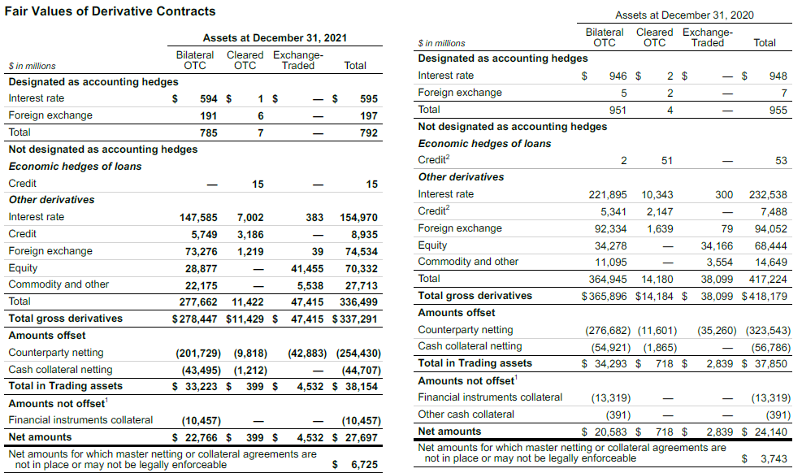

Slide 93
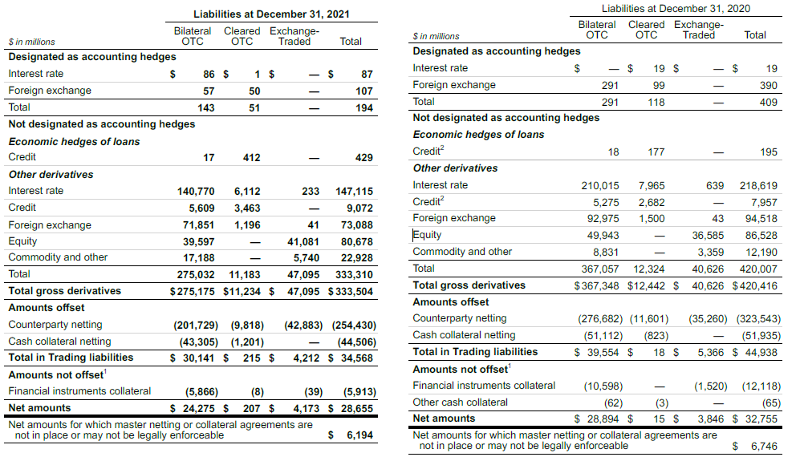

Slide 94
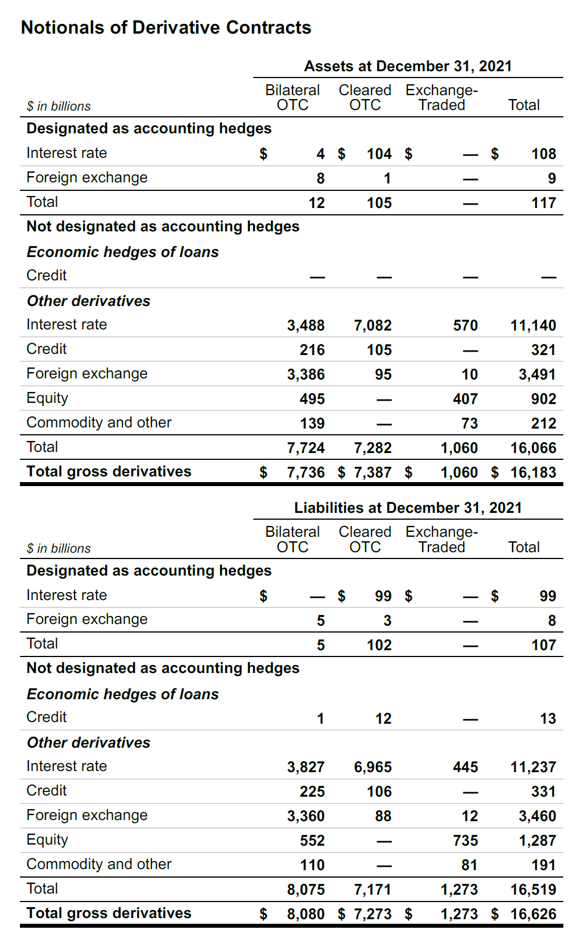
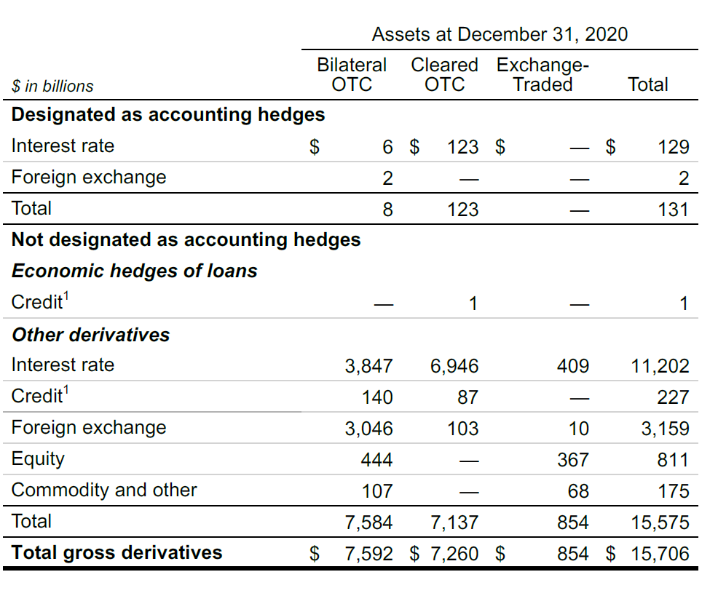
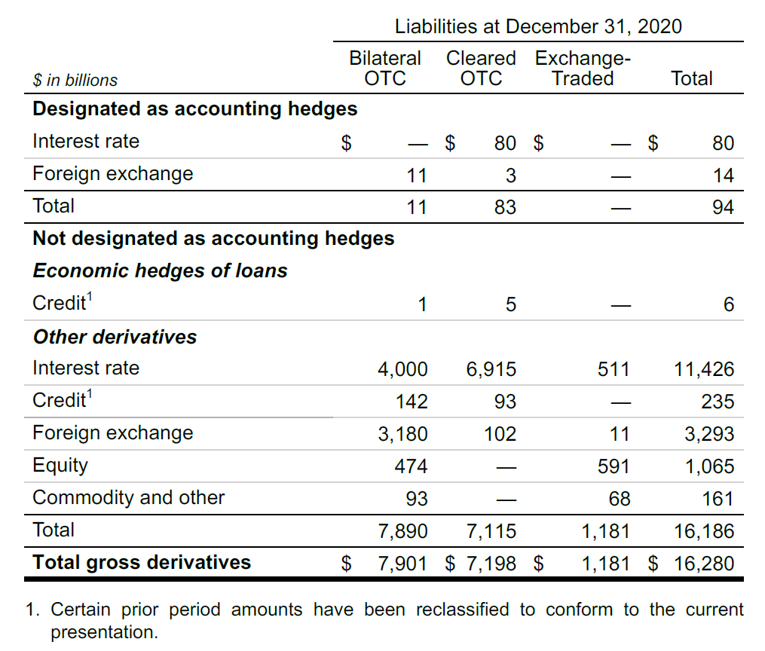

Slide 95
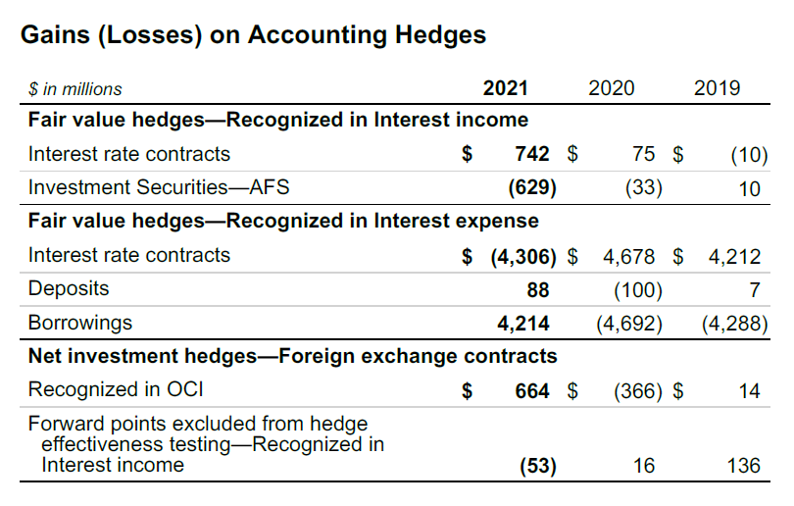

Slide 96
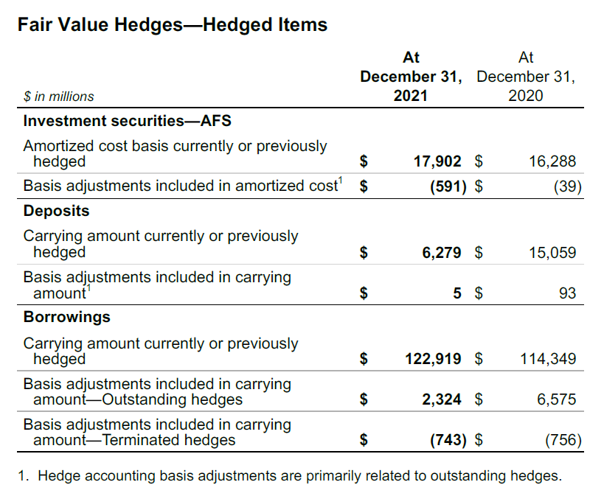

Slide 97
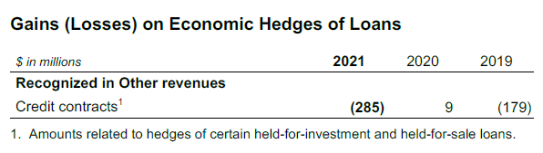

Slide 98
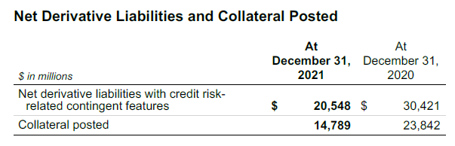
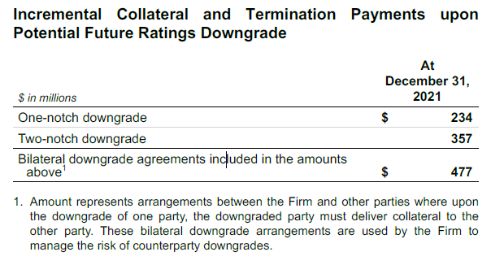

Slide 99
Protection Purchased with CDS
The Firm enters into credit derivatives, principally CDS, under which it receives or provides protection against the risk of default on a set of debt obligations issued by a specified reference entity or entities. A majority of the Firm’s counterparties for these derivatives are banks, broker-dealers, and insurance and other financial institutions
The purchase of credit protection does not represent the sole manner in which the Firm risk manages its exposure to credit derivatives. The Firm manages its exposure to these derivative contracts through a variety of risk mitigation strategies, which include managing the credit and correlation risk across single-name, non-tranched indices and baskets, tranched indices and baskets, and cash positions. Aggregate market risk limits have been established for credit derivatives, and market risk measures are routinely monitored against these limits. The Firm may also recover amounts on the underlying reference obligation delivered to the Firm under CDS where credit protection was sold

Slide 100
Protection Purchased with CDS
Single-Name CDS – A CDS protects the buyer against the loss of principal on a bond or loan in case of a default by the issuer. The protection buyer pays a periodic premium (generally quarterly) over the life of the contract and is protected for the period. The Firm, in turn, performs under a CDS if a credit event as defined under the contract occurs. Typical credit events include bankruptcy, dissolution or insolvency of the referenced entity, failure to pay and restructuring of the obligations of the referenced entity
Index and Basket CDS – Index and basket CDS are products where credit protection is provided on a portfolio of single-name CDS. Generally, in the event of a default on one of the underlying names, the Firm pays a pro rata portion of the total notional amount of the CDS
The Firm also enters into tranched index and basket CDS where credit protection is provided on a particular portion of the portfolio loss distribution. The most junior tranches cover initial defaults, and once losses exceed the notional of the tranche, they are passed on to the next most senior tranche in the capital structure
Other Credit Contracts – The Firm has invested in CLNs and CDOs, which are hybrid instruments containing embedded derivatives, in which credit protection has been sold to the issuer of the note. If there is a credit event of a reference entity underlying the instrument, the principal balance of the note may not be repaid in full to the Firm

Slide 101
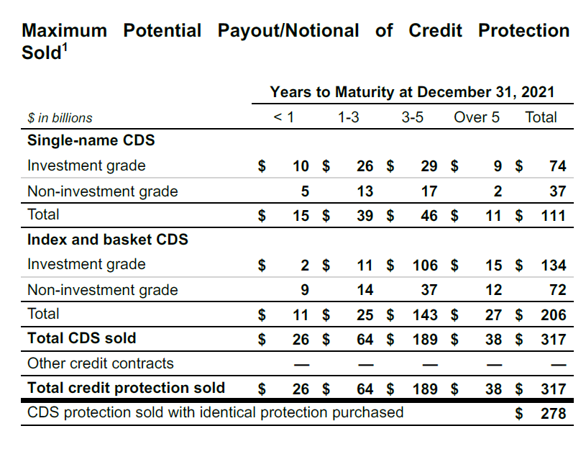
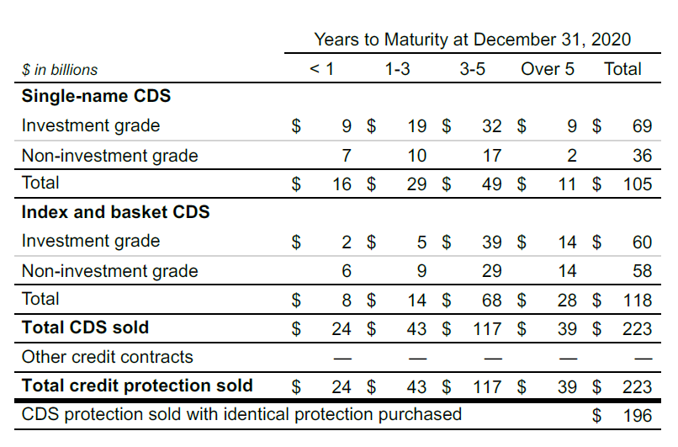

Slide 102


Slide 103


Slide 104
​Thank You

