Slide 1
Canadian Natural Resources Ltd.
Oil and Gas Industry
Presented by:
Chris Siu
Joanne Tong

Slide 2
Agenda
Industry Overview
Global and Canadian Oil and Gas Industry
Risk Management
Forecasting Industry
Canadian Natural Gas
Canadian Oil Sands

Slide 3
Industry Overview
Stages of Operations
Upstream
Exploration
Midstream
Refining
Downstream
Distribution and Sales

Slide 4
Organization of Petroleum Exporting Countries
“The mission of the Organization of the Petroleum Exporting Countries (OPEC) is to coordinate and unify the petroleum policies of its Member Countries and ensure the stabilization of oil markets in order to secure an efficient, economic and regular supply of petroleum to consumers, a steady income to producers and a fair return on capital for those investing in the petroleum industry”
OPEC
Notes:
http://www.opec.org/opec_web/en/about_us/23.htm

Slide 5
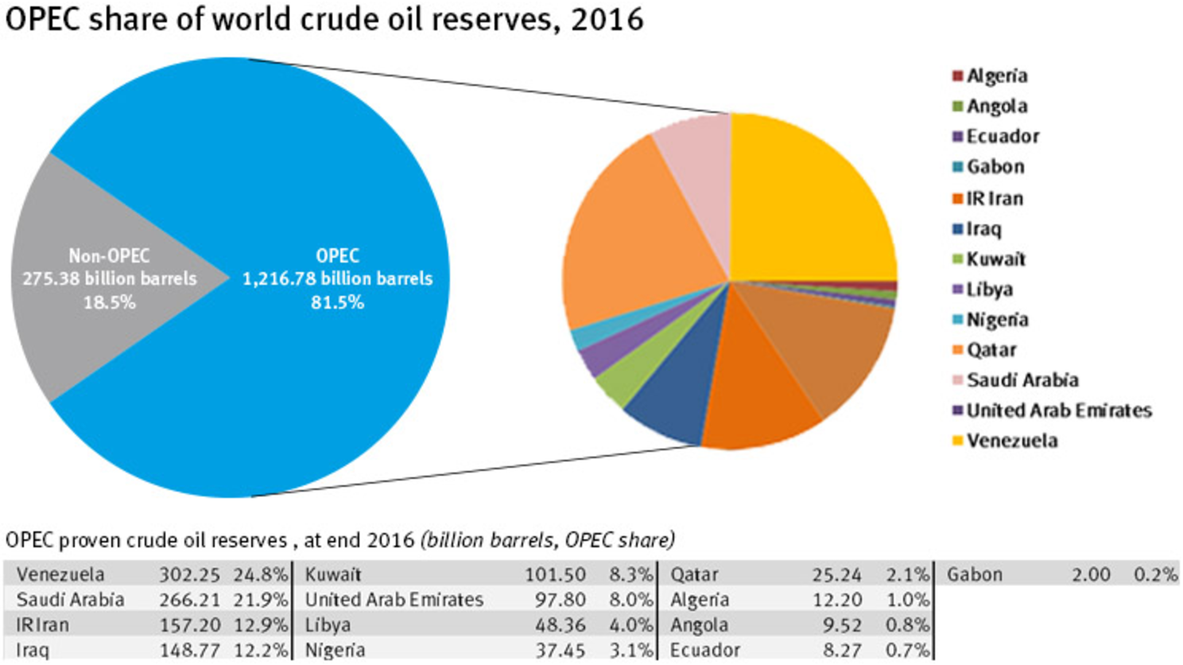
Organization of Petroleum Exporting Countries
Notes:
http://www.opec.org/opec_web/en/data_graphs/330.htm

Slide 6
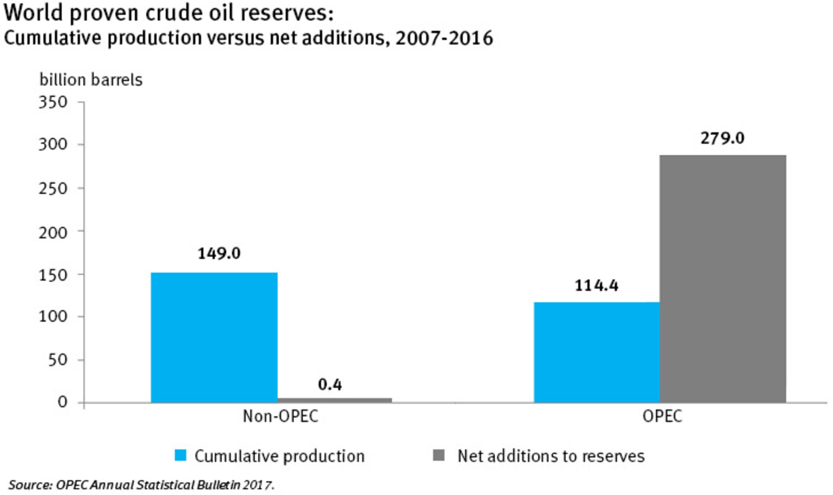
Organization of Petroleum Exporting Countries
From 2007-2016, OPEC member countries have added 279 billion barrels to their total proven crude oil reserves
Notes:
http://www.opec.org/opec_web/en/data_graphs/331.htm

Slide 7
Canadian Association of Petroleum Producers
The CAPP is directed by a Board of Governors that sets priorities for the Executive Team, staff and committees. The board includes a full-time president, a volunteer chairman and 30 volunteer governors. Each represents member companies at the chief executive officer level.
The Board of Governors is balanced with governors drawn from the large, medium, and small member companies. Ten governors are selected from our 15 largest members, 10 from the next 30 member companies, and 10 from the smaller companies. A new chairman is nominated each year.

Slide 8
Canadian Association of Petroleum Producers
“CAPP’s vision is to enhance Canada’s prosperity by enabling responsible growth of Canada’s upstream oil and natural gas industry”
“CAPP’s mission, on behalf of the Canadian upstream oil and natural gas industry, is to advocate for and enable economic competitiveness and safe, environmentally and socially responsible performance”
- CAPP
Notes:
CAPP represents companies, large and small, that explore for, develop and produce natural gas and crude oil throughout Canada. CAPP’s member companies produce about 80 per cent of Canada’s natural gas and crude oil.
Together CAPP's members and associate members are an important part of a national industry with revenues from crude oil and natural gas production of about $120 billion a year.
http://www.capp.ca/about-us/our-mission

Slide 9
Canadian Energy Pipeline Association
Vision
“A safe, socially and environmentally sustainable energy pipeline industry for Canadians”
Mission
“Continually enhance the operating excellence, business environment and recognized responsibility of the Canadian energy transmission pipeline industry through leadership and credible engagement between member companies, governments, the public and stakeholders”
CEPA
Notes:
Values:
Accountability: Accountable to Canadians, we dedicate ourselves to the safety and operating excellence of member operations, and to understanding and meeting expectations for social responsibility.
Respect: Every stakeholder is treated with respect, heard without judgment, and asked to share, question and challenge in the advancement of positive change.
Transparency: Open and responsive, we’re focused on achieving success through credible, trustworthy leadership and open communications.
Leadership: Approachable and balanced, we’re committed to the relentless pursuit of a better future through improved performance, and by embracing science, innovation, progressive regulatory policy and engagement to enhance sustainability.
http://cepa.com/en/about-us/what-we-do-and-why/

Slide 10
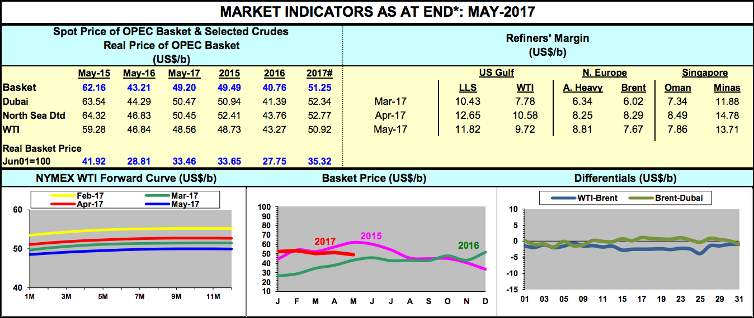
Market Indicators
Notes:
http://www.opec.org/opec_web/static_files_project/media/downloads/data_graphs/MI052017.pdf

Slide 11
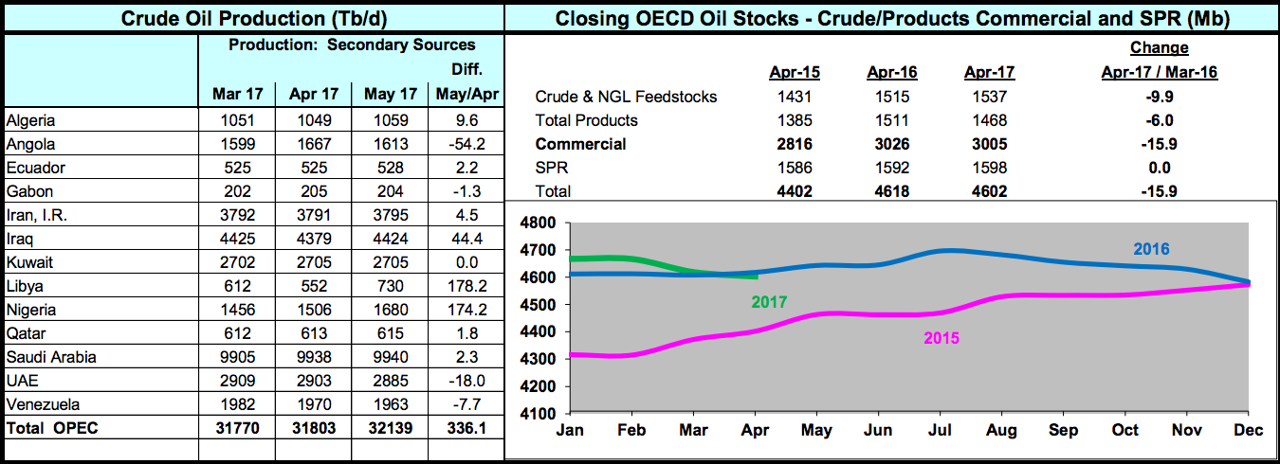
Market Indicators

Slide 12
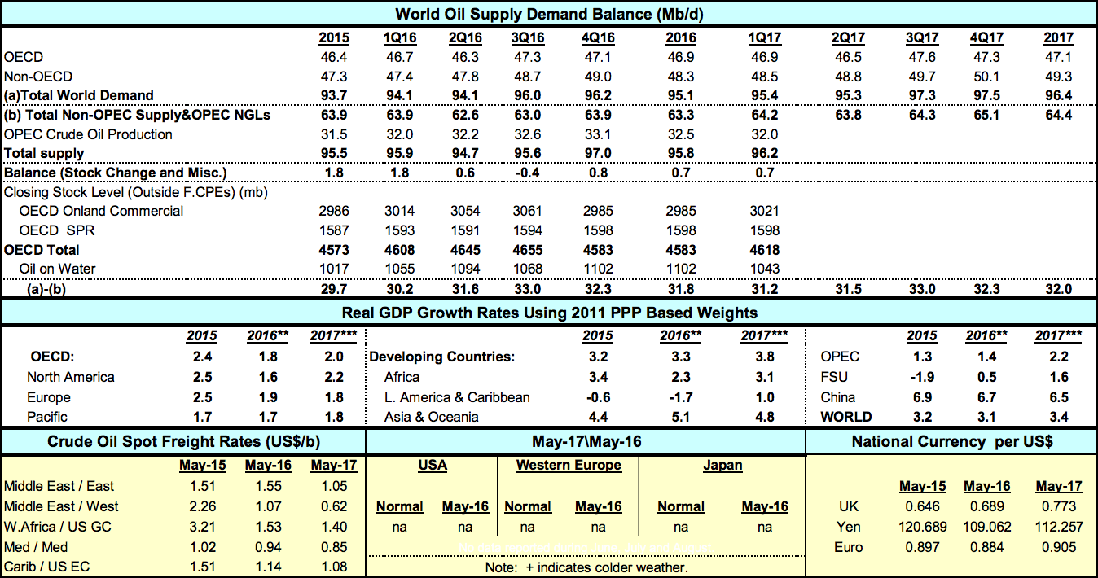
Market Indicators

Slide 13
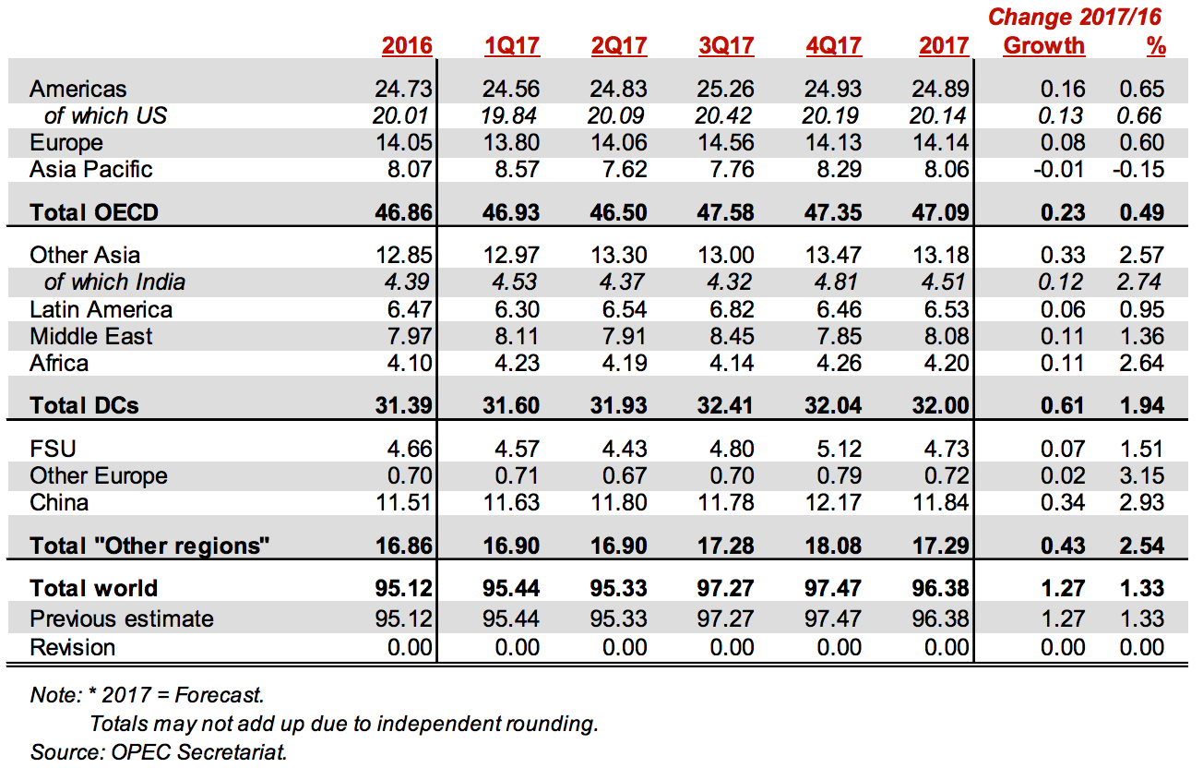
World Demand in Oil

Slide 14
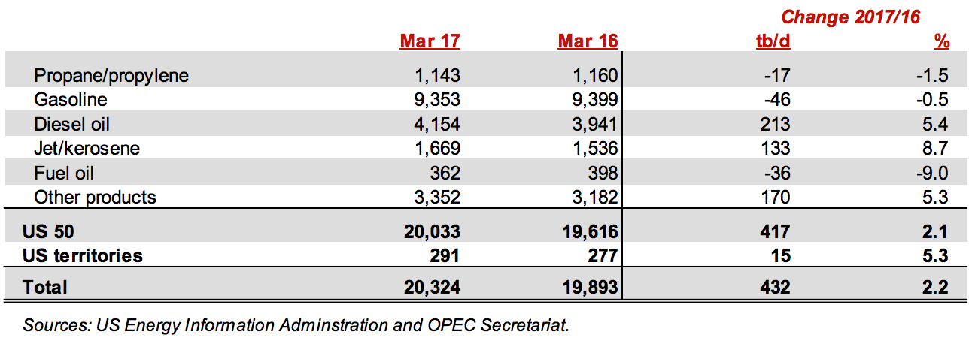
US Demand in Oil
Notes:
The latest Canadian data for March 2017 showed an overall increase in oil demand, with gains for diesel oil, fuel oil and gasoline, although these have been slightly offset by declines in demand for LPG and naphtha. Projections for Canadian oil demand in 2017remain unchanged from those reported last month, with positive growth foreseen compared to 2016.

Slide 15
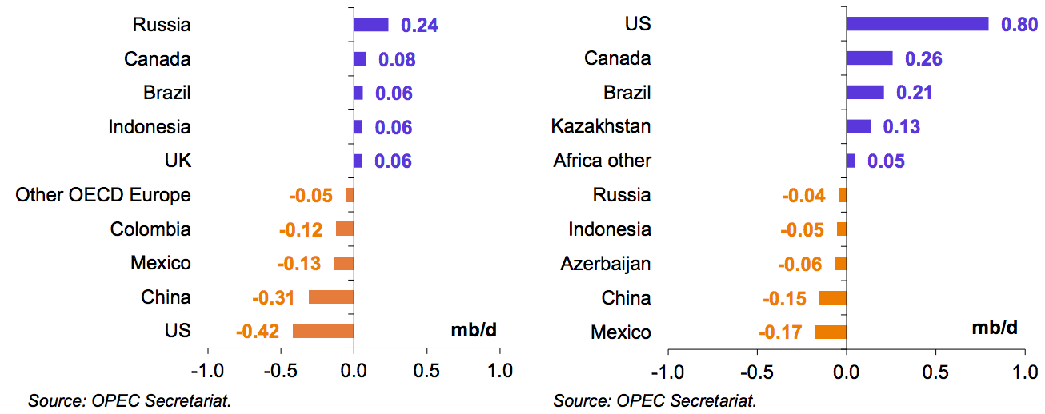
Non-OPEC Oil Supply
Notes:
Non-OPEC oil supply: the graph on the left is the data from 2016; the graph on the right is data forecasted for 2017. On a country-by-country basis, the main contributors to growth in 2017 are expected to be the US with 0.80 mb/d, Canada with 0.26 mb/d, Brazil with 0.21 mb/d and Kazakhstan with 0.13 mb/d. In contrast, Mexico and China, as per 2016, remain the countries that see the largest contractions.

Slide 16
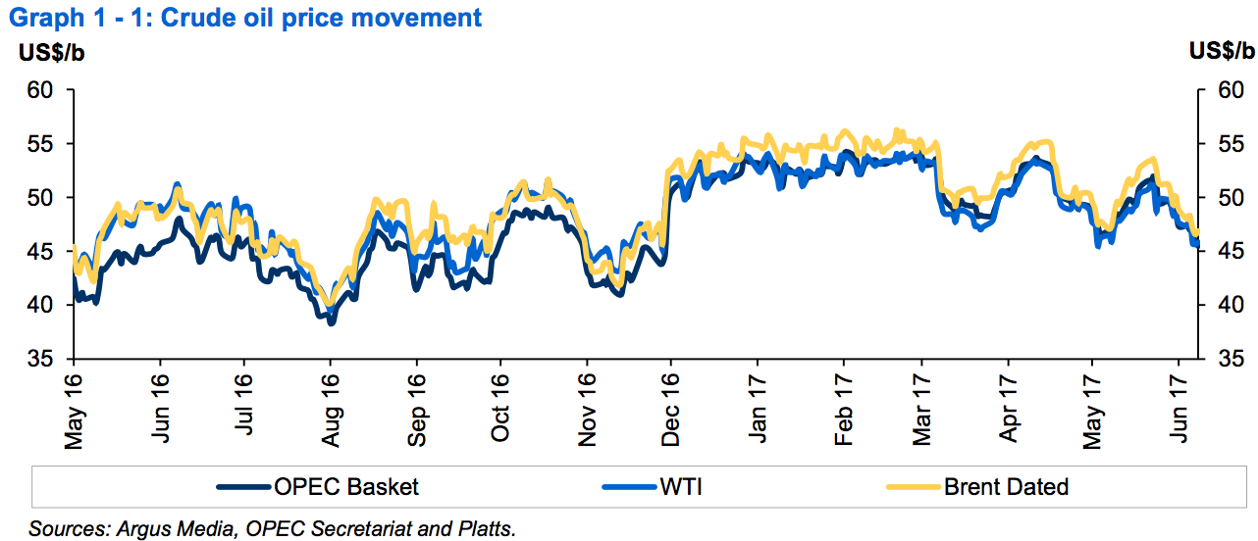
Movements in Crude Oil
Notes:
M-o-m, the ORB value declined $2.17 to settle at $49.20/b on a monthly average, down 4.2%. Compared to the previous year, the ORB value, y-t-d was 49.2% higher or $16.90, at $51.25/b.

Slide 17
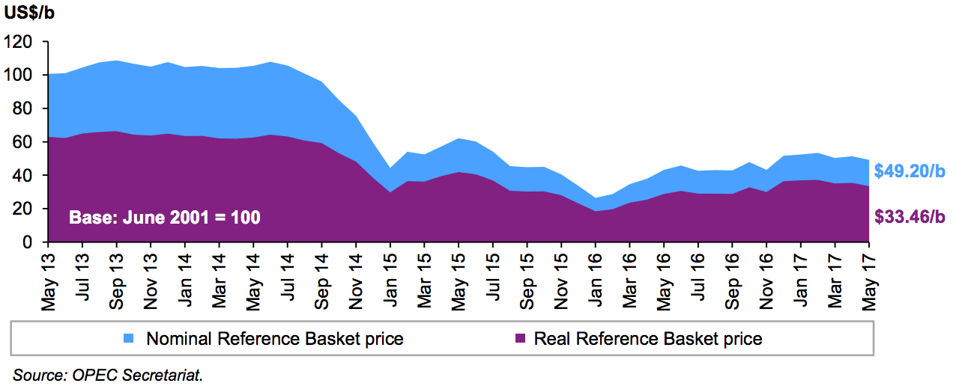
Impact of Inflation and Currency Fluctuations
Notes:
Based on the OPEC reference basket

Slide 18
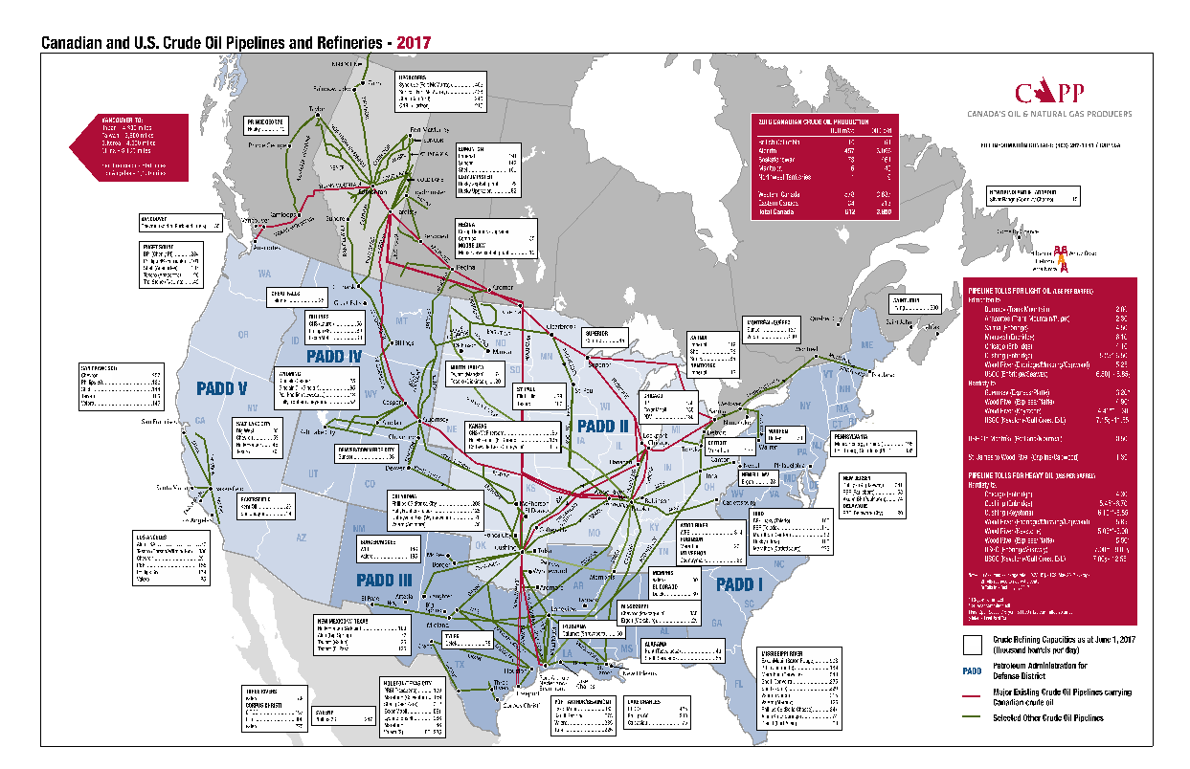

Slide 19
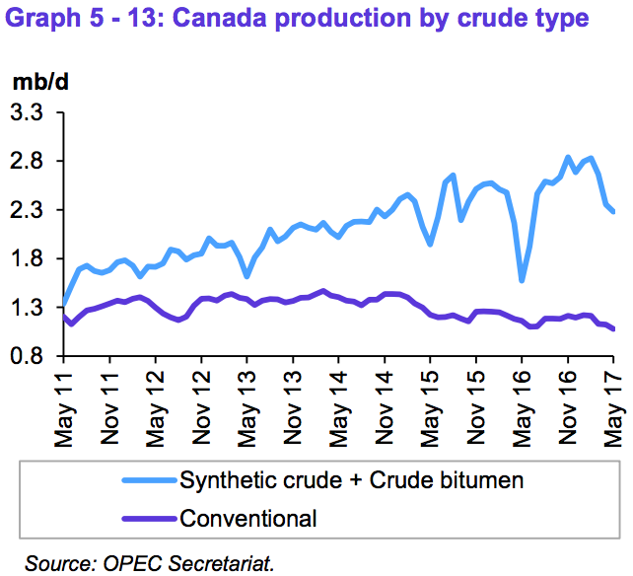
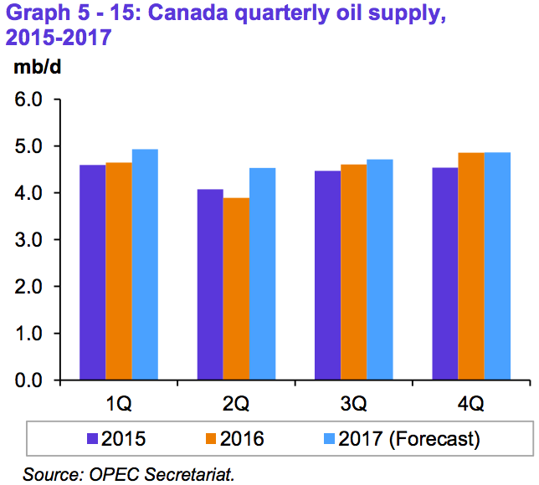
Canadian Oil Supply

Slide 20
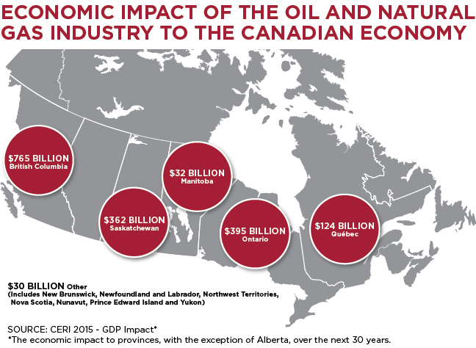
Economic Impact of Oil and Gas Industry
Canada's oil and natural gas industry is the single largest private sector investor in the country, forecast to invest $44 billion in 2017, which is down from a peak $81 billion in capital projects in 2014.
Notes:
Canada is the world’s fifth-largest natural gas producer and natural gas meets 30 per cent of the country’s entire energy needs. Canada’s natural gas is affordable, abundant, versatile, and is the cleanest-burning hydrocarbon.
http://www.capp.ca/canadian-oil-and-natural-gas/canadian-economic-contribution

Slide 21
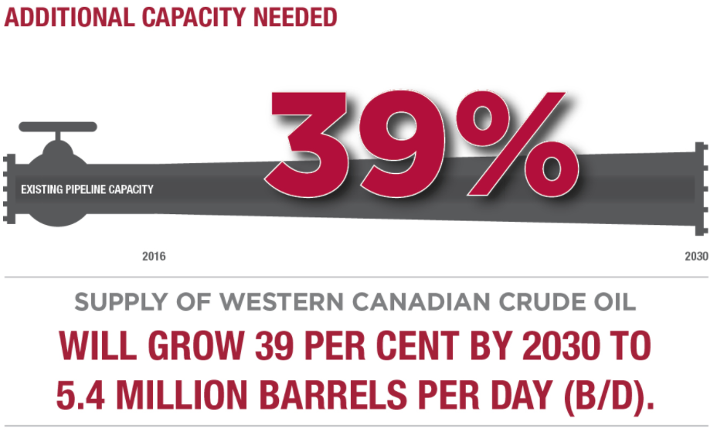
Canadian Crude Oil Forecast
Overall Canadian oil production will grow to 5.1 million b/d in 2030, up from 3.85 million b/d in 2016. This 1.2 million b/d growth will be driven by a 53–per-cent increase in forecasted oil sands production of up to 3.7 million b/d in 2030 from 2.4 million b/d in 2016.
Today, the pipeline network can transport 4 million b/d of oil and oil products but by 2030 it will need to move more than 5.5 million b/d. Increased pipeline capacity to reach more Canadians and new, growing markets around the world will ensure Canada remains globally competitive.

Slide 22
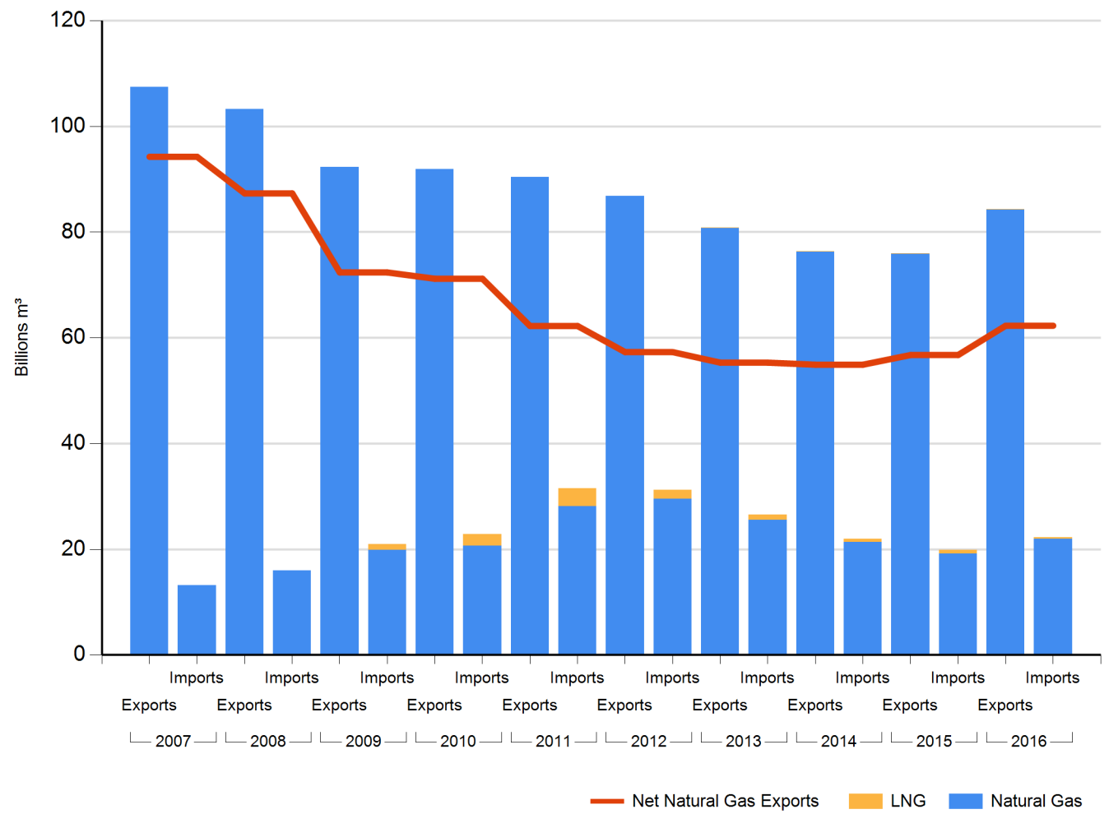
Natural Gas & LNG – Historical Canadian Import and Export Data
Notes:
Canada is the world’s fifth largest producer of natural gas and accounts for around five per cent of global production. Natural gas production in Canada is predominantly from the Western Canadian Sedimentary Basin in British Columbia, Alberta, and Saskatchewan, although other gas is produced from offshore Nova Scotia and smaller amounts are produced in Ontario, New Brunswick, and Nunavut. While Canadian production of conventional natural gas has been declining, production of Canadian unconventional natural gas has been rising. Development of unconventional resources like tight gas is technologically challenging and companies are increasingly using horizontal drilling and hydraulic fracturing to create economically viable wells.
https://apps.neb-one.gc.ca/CommodityStatistics/ViewReport.aspx

Slide 23
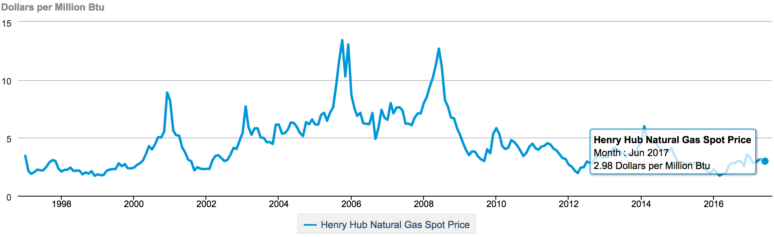
Henry Hub Natural Gas Spot Prices
Notes:
https://www.eia.gov/dnav/ng/hist/rngwhhdm.htm

Slide 24
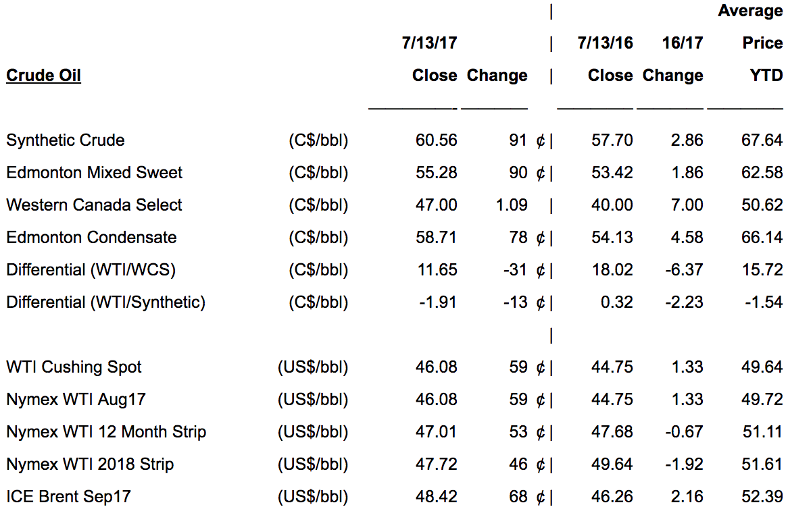
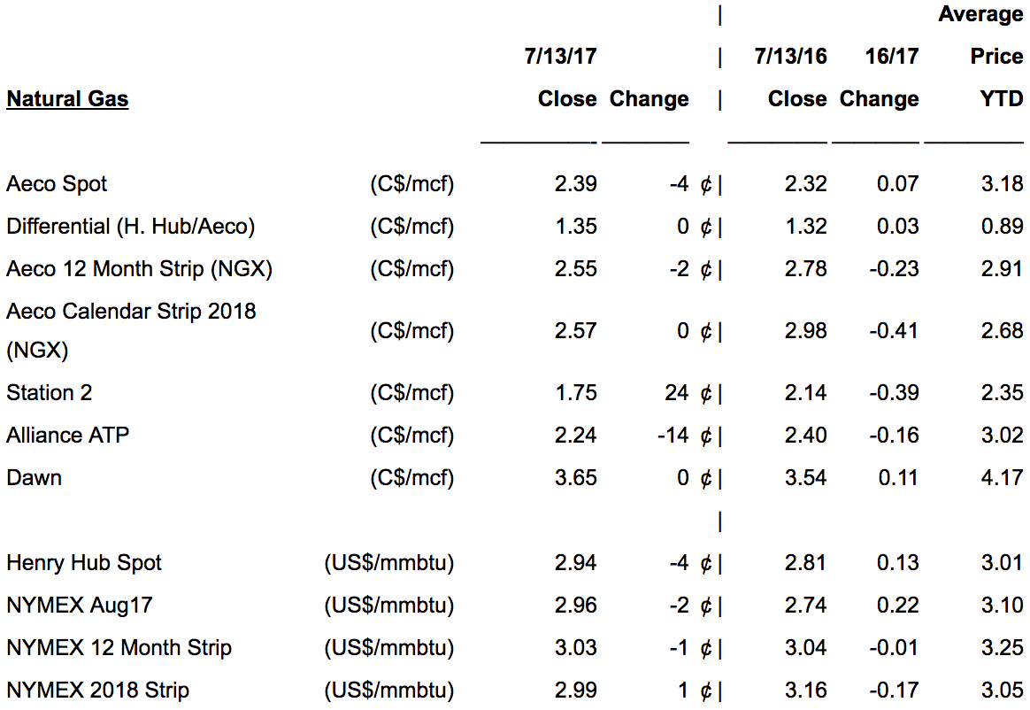
Oil & Natural Gas
Notes:
http://www.psac.ca/business/gmpfirstenergy/

Slide 25
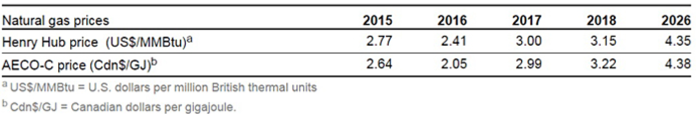
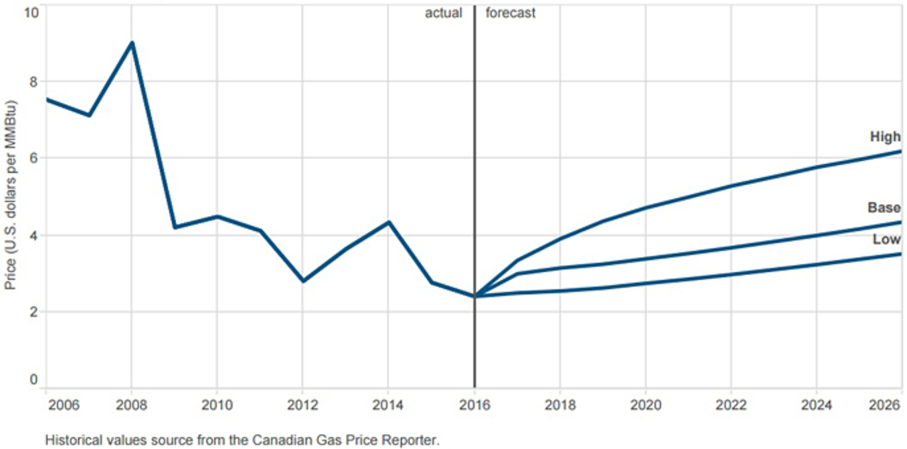
AECO-C/Henry Hub Natural Gas Spot Prices
Notes:
The Henry Hub price continued to weaken, decreasing by an estimated 13 per cent in 2016 compared with 2015. As indicated in the above tabke, the Henry Hub price is expected to rise in 2017 and increase for the remainder of the forecast period.
The forecast assumes that although gas production in the United States declined in 2016 by an estimated 1.4 billion cubic feet per day (Bcf/d) and will increase in 2017, growing U.S. natural gas consumption combined with higher U.S. pipeline exports to Mexico and U.S. liquefied natural gas (LNG) exports will result in stronger prices, albeit not to levels seen historically.
The AECO-C price (referred to as the Alberta Market Price (AMP) in 2015) decreased even more than the Henry Hub price, by 22 per cent in 2016 relative to 2015. The AECO-C price was affected by the Fort McMurray wildfires, which lowered the consumption of natural gas, and by high storage levels as a result of a mild winter. The AECO-C price is projected to increase for the remainder of the forecast period in step with the Henry Hub price forecast.
The Henry Hub natural gas price is forecast to gradually strengthen to US$4.35/MMBtu by 2026 in the base price scenario, reflecting increased international demand through a combination of U.S. LNG exports and U.S. exports to Mexico and increased U.S. demand, primarily in the power sector. In the low and high price scenarios, the price will reach US$3.52/MMBtu and US$6.20/MMBtu, respectively.
https://www.aer.ca/data-and-publications/statistical-reports/natural-gas-prices

Slide 26
Major Risk Factors
Credit Risk
Financial Risk
Market Risk
Interest Risk
Foreign Exchange Risk
Licensing Risk
Liquidity Risk
Commodity Risk
Operational Risks
Notes:
http://www.northseaenergy.ca/risk-factors.html

Slide 27
Risk Instruments
Instruments for risk management:
Futures
Forwards
Currency Swaps
Interest Rate Swaps

Slide 28
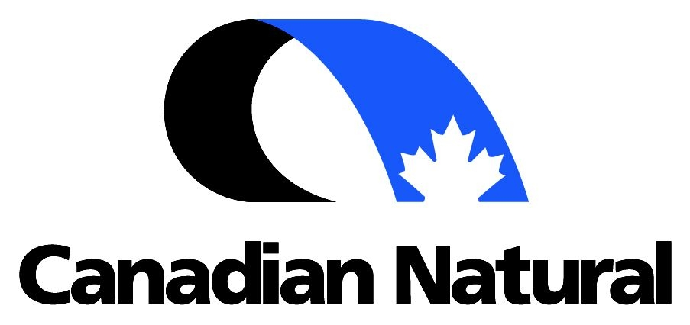

Slide 29
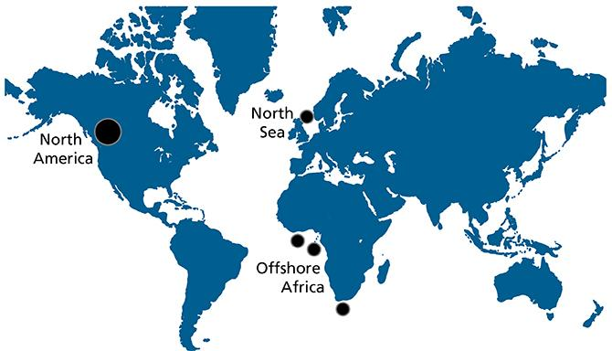
Company Overview
Found in 1973
Corporate head office in Calgary, Alberta
One of the largest crude oil and natural gas producers
Operates in North America, North Sea off Scotland, and Offshore Africa

Slide 30
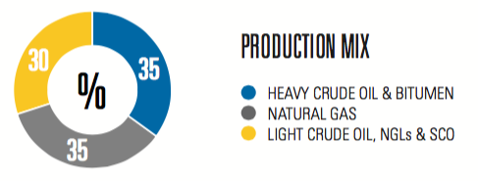
Company Overview
7.99 million barrels of oil reserve
Bulk of production located in north America, with 35% in natural gas, 35% in heavy oil bitumen, and 30% light crude oil, NGLs & SCO

Slide 31
What CNQ Operate
Natural Gas
Largest independent natural gas producer in Canada
Largest undeveloped land base
North America Crude Oil and NGLs
Significant heavy oil producer in Canada
Horizon Oil Sands
World class opportunity for oil sands mining with 14.4 billion barrels of bitumen initially-in-place (BIP
International Crude Oil
Exploration and expansion opportunities in North Sea and Offshore Africa

Slide 32
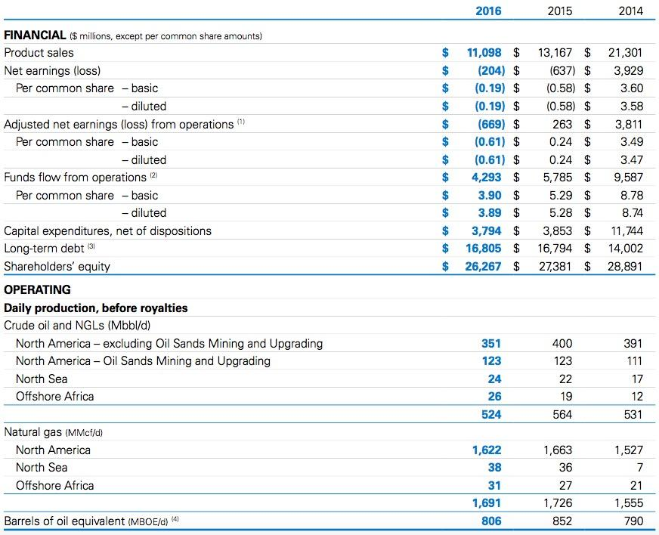
Highlighted Performance

Slide 33
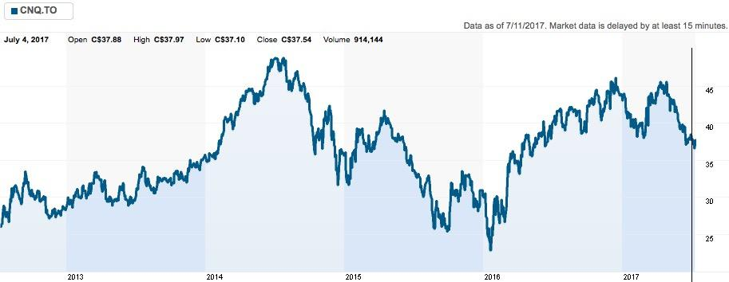
Historical Stock Price in TSX

Slide 34
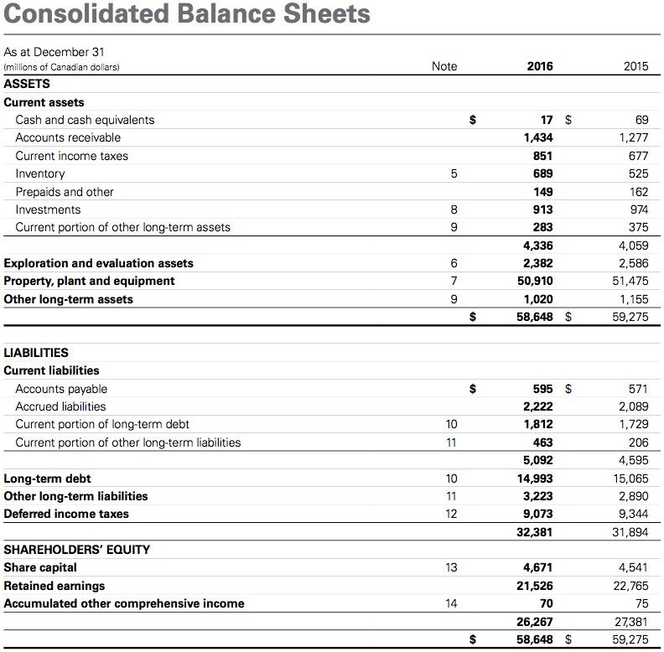

Slide 35
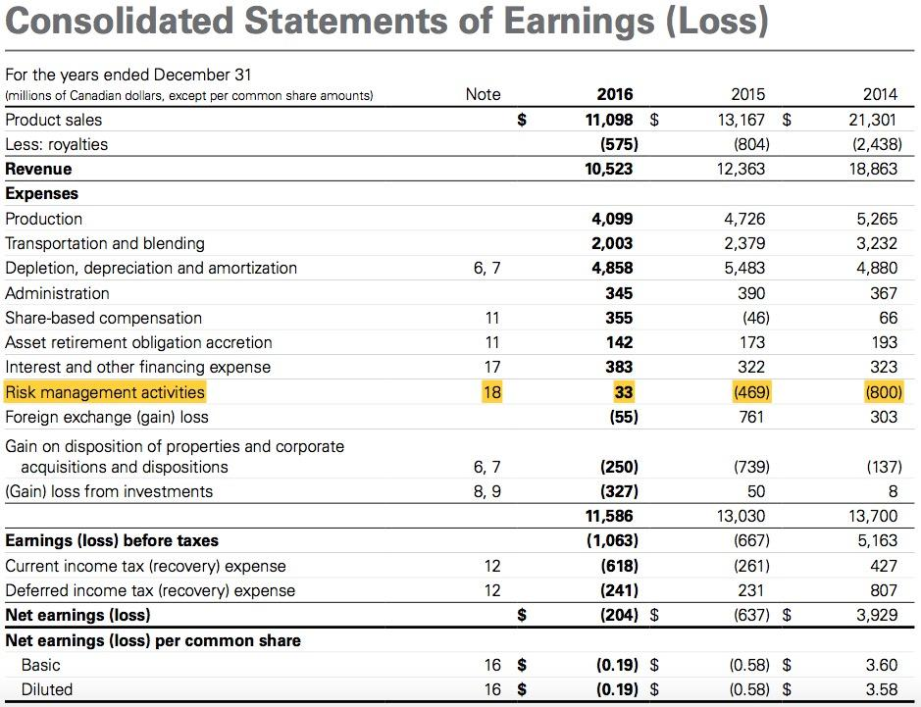

Slide 36
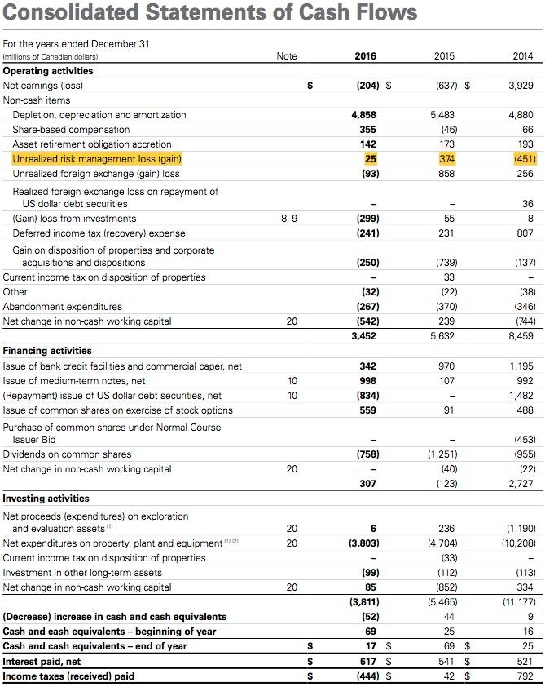

Slide 37


Management
Murray Edwards
Executive Chairman
Launched CNQ
14th wealthiest person in Canada
Steve Laut
President
Joined CNQ in 1991

Slide 38


Management
Tim McKay
Chief Operating Officer
Since 2003
Corey Bieber
Chief Financial Officer
Senior VP
SInce 2013

Slide 39
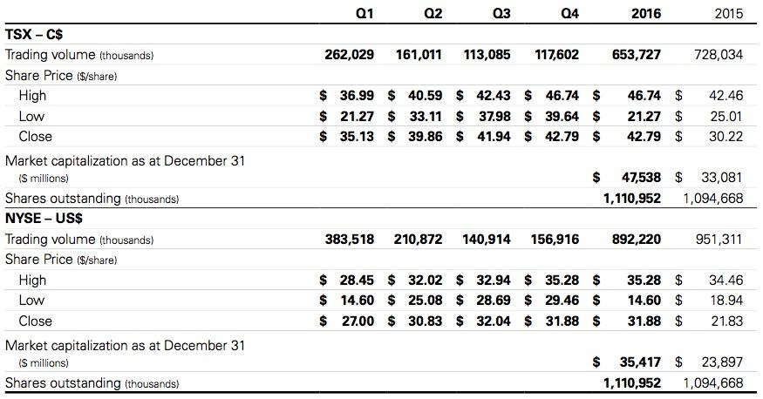
Trading and Share Statistics

Slide 40
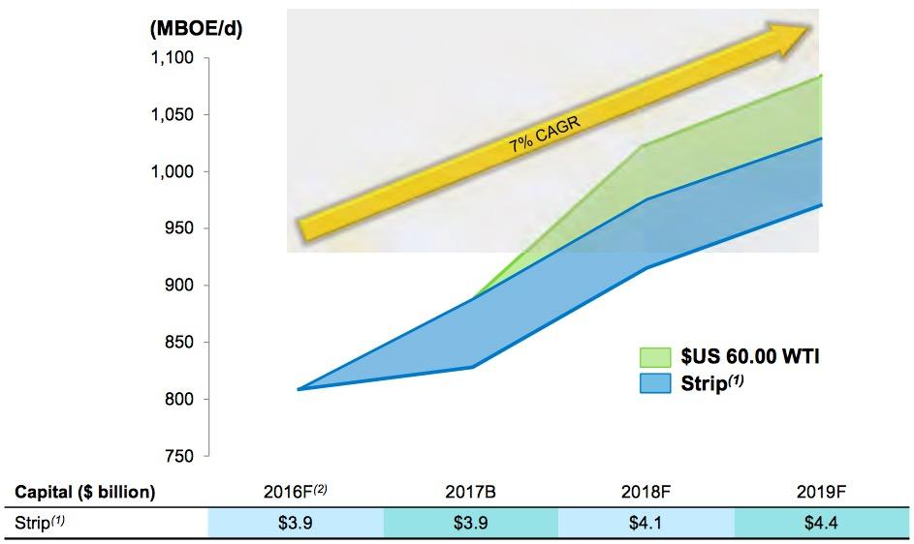
Growth and Development
The growth target is increasing at 7% per year
Expected growth lead to sustainable cash flow for future years

Slide 41
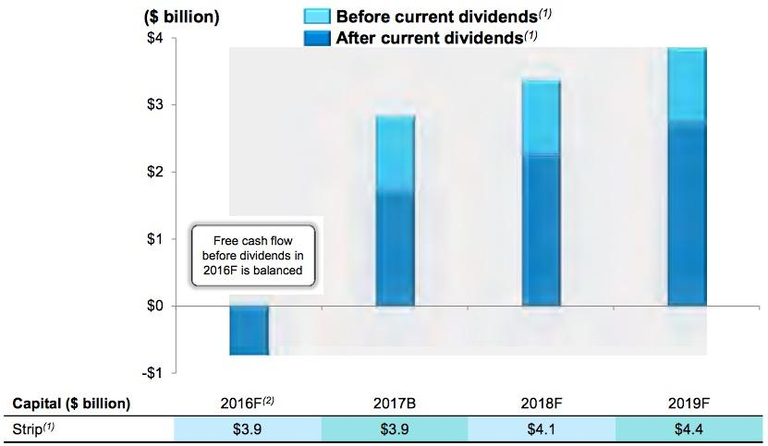
Growth and Development
Sustainable FCF allow CNQ to develop future growth plan
Reduce greenhouse gas emission
Horizon Phase 3 targeted start-up in Q4/2017
Incremental 80,000 bbl/d of SCO production

Slide 42
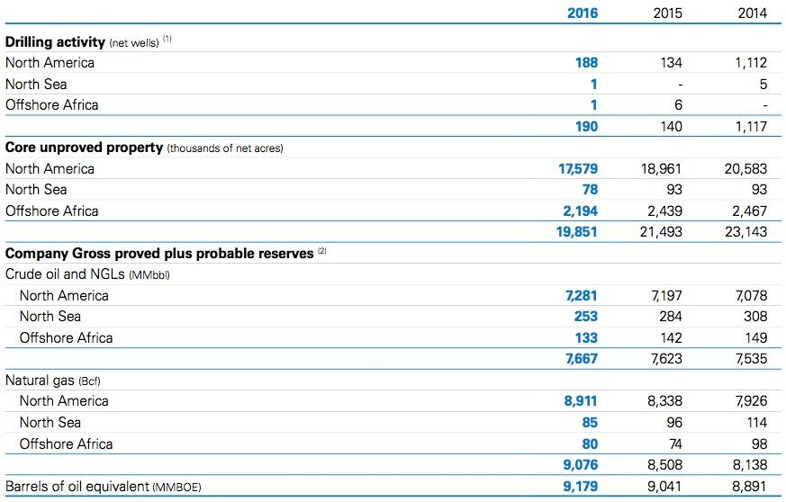
Reserves

Slide 43

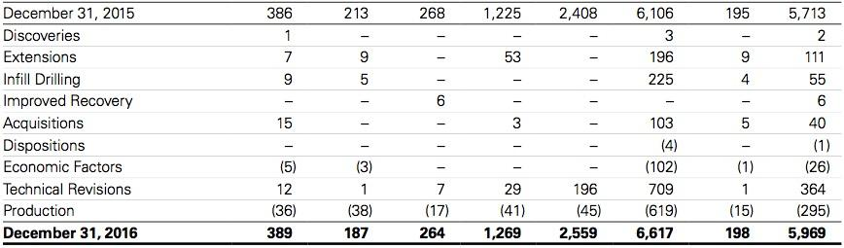
Reserves

Slide 44
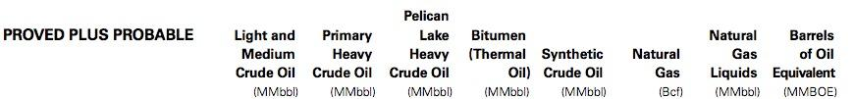
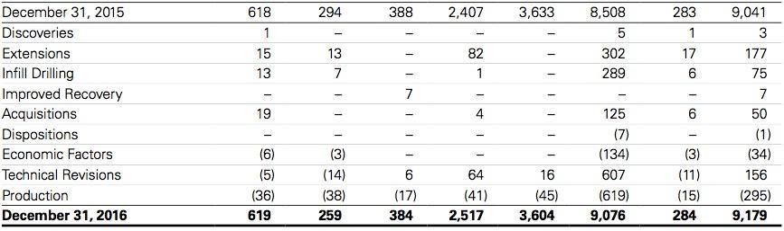
Reserves

Slide 45
Key Risk Factors
Market risk
Commodity price risk
Interest rate risk
Foreign currency exchange risk
Credit risk
Liquidity risk

Slide 46
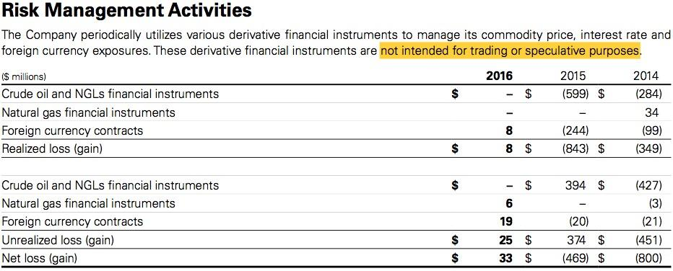
Risk Management Activities
Derivatives financial instruments help manage risks CNQ is facing
Not for trading and speculative purposes
Notes:
The Company’s commodity hedge policy reduces the risk of volatility in commodity prices and supports the Company’s cash ow for its capital expenditure programs
During 2016, net realized risk management losses were related to the settlement of foreign currency contracts. The Company recorded a net unrealized loss of $25 million ($21 million after-tax) on its risk management activities for 2016 (2015 – $374 million unrealized loss, $275 million after-tax; 2014 – $451 million unrealized gain, $339 million after-tax).

Slide 47
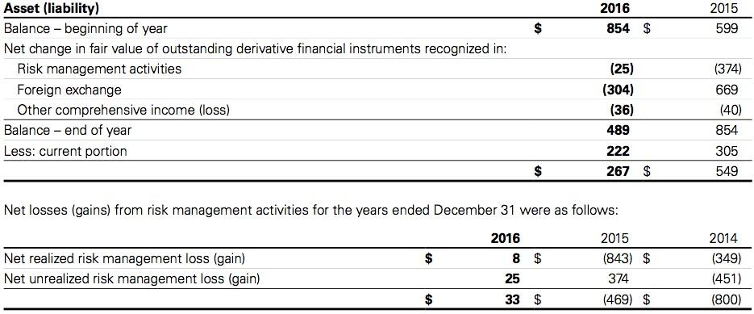
Market Risk
Notes:
Market risk is the risk that the fair value or future cash ows of a nancial instrument will uctuate because of changes in market prices. The Company’s market risk is comprised of commodity price risk, interest rate risk, and foreign currency exchange risk.

Slide 48
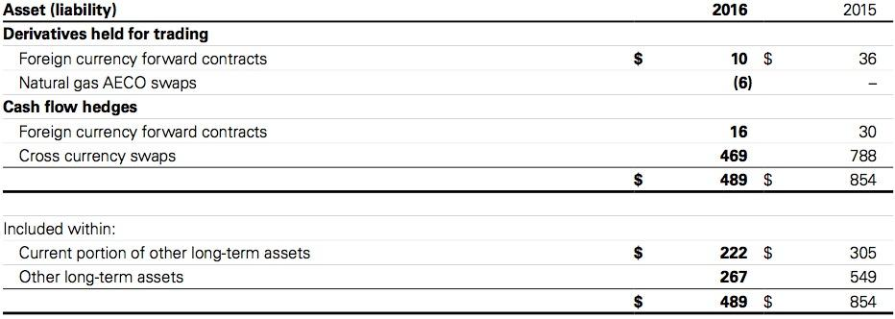
Market Risk

Slide 49
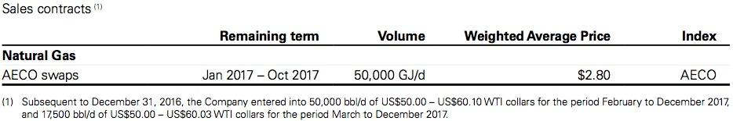
Commodity Price Risk
Uses swaps to control commodity price risk
Also used collars and put options in previous years
Reduce price volatility and maintain cash flow
Notes:
The Company periodically uses commodity derivative nancial instruments to manage its exposure to commodity price risk associated with the sale of its future crude oil and natural gas production and with natural gas purchases. At December 31, 2016, the Company had the following derivative nancial instruments outstanding to manage its commodity price risk:

Slide 50
Interest Rate Risk
Risk on long-term fixed interest debt and floating rate long-term debt
Enter interest rate swap contracts periodically
Require periodic exchange of payment without exchange of notional principal amount
No interest rate swap contract outstanding at December 31, 2016

Slide 51
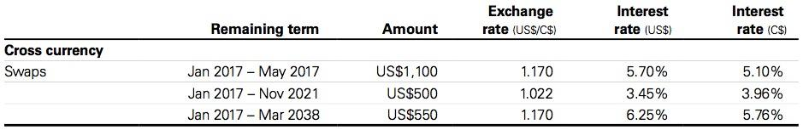
Foreign Currency Exchange Risk
Relates to US$ denominated long-term debt, commercial paper, and working capital
Transaction conducted in foreign currencies and carrying value of foreign subsidiaries
US$1,928 million foreign currency forward contract outstanding
Notes:
The Company is exposed to foreign currency exchange rate risk in Canada primarily related to its US dollar denominated long-term debt, commercial paper and working capital. The Company is also exposed to foreign currency exchange rate risk on transactions conducted in other currencies and in the carrying value of its foreign subsidiaries. The Company periodically enters into cross currency swap contracts and foreign currency forward contracts to manage known currency exposure on US dollar denominated long-term debt, commercial paper and working capital. The cross currency swap contracts require the periodic exchange of payments with the exchange at maturity of notional principal amounts on which the payments are based.

Slide 52
Credit Risk
Financial loss to company by failing to discharge an obligation
A/R mainly with customers in natural gas and crude oil industries
Normal industry credit risk
Ensure parental guarantee and letter of credit are in place
Agreement with counterparties that are substantially all investment grade financial institutions
Net risk management asset of $489 million
Notes:
The Company’s accounts receivable are mainly with customers in the crude oil and natural gas industry and are subject to normal industry credit risks. The Company manages these risks by reviewing its exposure to individual companies on a regular basis and where appropriate, ensures that parental guarantees or letters of credit are in place to minimize the impact in the event of default. At December 31, 2016, substantially all of the Company’s accounts receivable were due within normal trade terms.
The Company is also exposed to possible losses in the event of nonperformance by counterparties to derivative nancial instruments; however, the Company manages this credit risk by entering into agreements with counterparties that are substantially all investment grade nancial institutions. At December 31, 2016, the Company had net risk management assets of $489 million with specific counterparties related to derivative nancial instruments (December 31, 2015 – $854 million).

Slide 53
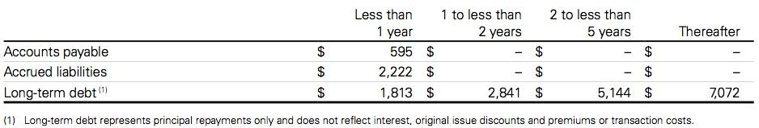
Liquidity Risk
Risk the company may unable to meet its financial obligations
Maintain sufficient cash, cash equivalent, and cash flow from operating activities
Adequate bank credit facilities to provide liquidity
Notes:
Liquidity risk is the risk that the Company will encounter dif culty in meeting obligations associated with nancial liabilities.
Management of liquidity risk requires the Company to maintain suf cient cash and cash equivalents, along with other sources of capital, consisting primarily of cash ow from operating activities, available credit facilities, commercial paper and access to debt capital markets, to meet obligations as they become due. The Company believes it has adequate bank credit facilities to provide liquidity to manage uctuations in the timing of the receipt and/or disbursement of operating cash ows.

Slide 54
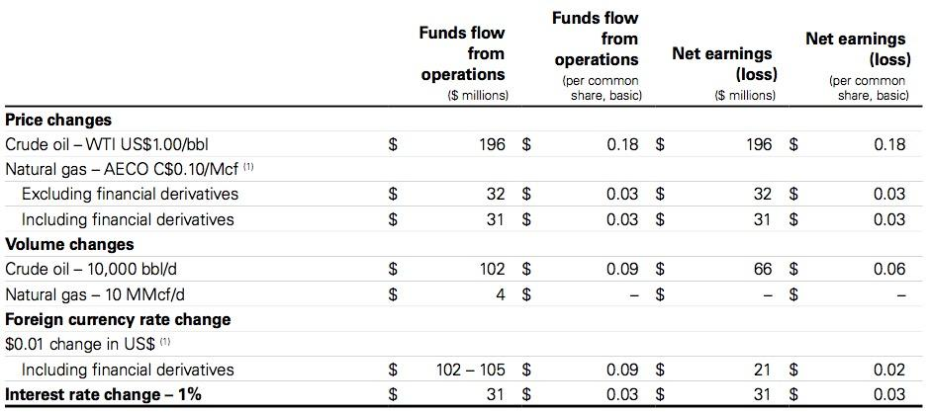
Sensitivity Analysis

