Slide 1
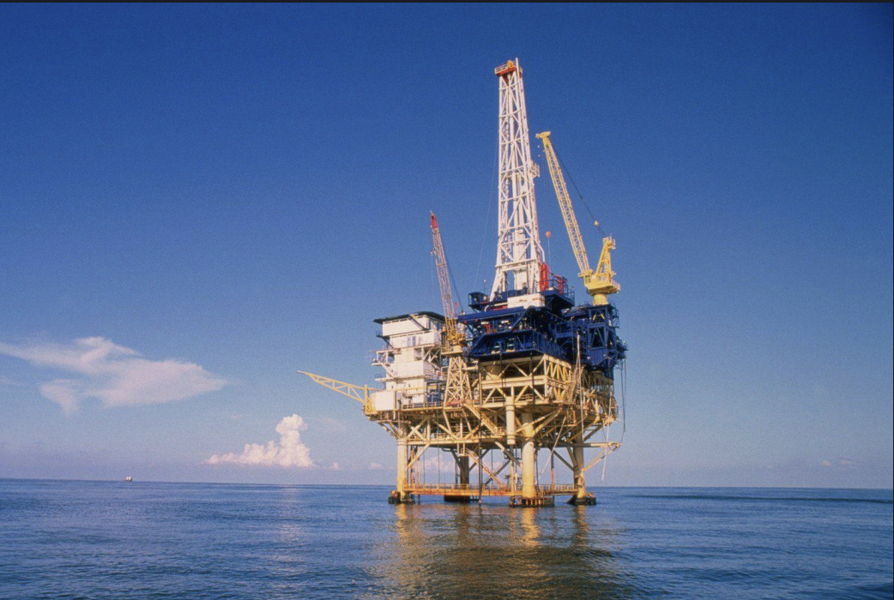
Oil and Gas Industry
Bus 419 - Group 1
Bryn Morgan
Lily Li
Hansey Li

Slide 2
General:
Industry Risks
Oil and Gas Price Comparisons
Methanol Price Comparison
Focus:
Oil Drilling and Gas Extraction in the US
Oil Drilling and Extraction in Canada
Organic Chemical Manufacturing in Canada
INDUSTRY OVERVIEW

Slide 3
Majors Risks
►Commodity Price Volatility
►Geopolitical and Regulatory Risks
►Operational and Technical Risks
►Environmental and Social Risks
►Supply and Demand Risk
Industry Risk

Slide 4
►Commodity Price Volatility
One of the primary risks in the oil and gas industry is the volatility of commodity prices, particularly crude oil and natural gas.
Fluctuations in prices can significantly impact a company's revenue, profitability, and investment decisions.
Companies in this industry must effectively manage and mitigate the risks arising from price volatility through hedging strategies, long-term contracts, and efficient cost structures.
Industry Risk

Slide 5
►Geopolitical and Regulatory Risks
Political instability, geopolitical conflicts, and changes in regulatory frameworks can have a significant impact on the oil and gas industry.
These risks can include trade disputes, changes in taxation policies, government regulations, and environmental regulations.
Companies must navigate these challenges by closely monitoring political developments, maintaining strong relationships with governments, and complying with regulatory requirements.
Industry Risk

Slide 6
►Operational and Technical Risks
The oil and gas industry involves complex and high-risk operations such as exploration, drilling, production, and transportation.
Operational risks can arise from accidents, equipment failures, natural disasters, and safety hazards. Managing operational risks requires stringent safety protocols, regular maintenance, and continuous improvement in operational efficiency.
Industry Risk

Slide 7
►Environmental and Social Risks
The oil and gas industry is under increasing scrutiny due to its impact on the environment and communities. Environmental risks include spills, emissions, and the carbon footprint associated with fossil fuel extraction and combustion.
Social risks involve issues such as community relations, stakeholder engagement, and the transition to cleaner energy sources.
Companies need to address these risks by adopting sustainable practices, reducing their environmental footprint, and engaging with local communities and stakeholders.
Industry Risk

Slide 8
►Supply and Demand Risk
Supply risk is influenced by geopolitical factors, infrastructure constraints, and disruptions in global supply chains.
Demand risk is influenced by economic conditions, the energy transition towards cleaner alternatives, and transportation and logistics challenges.
Industry Risk

Slide 9
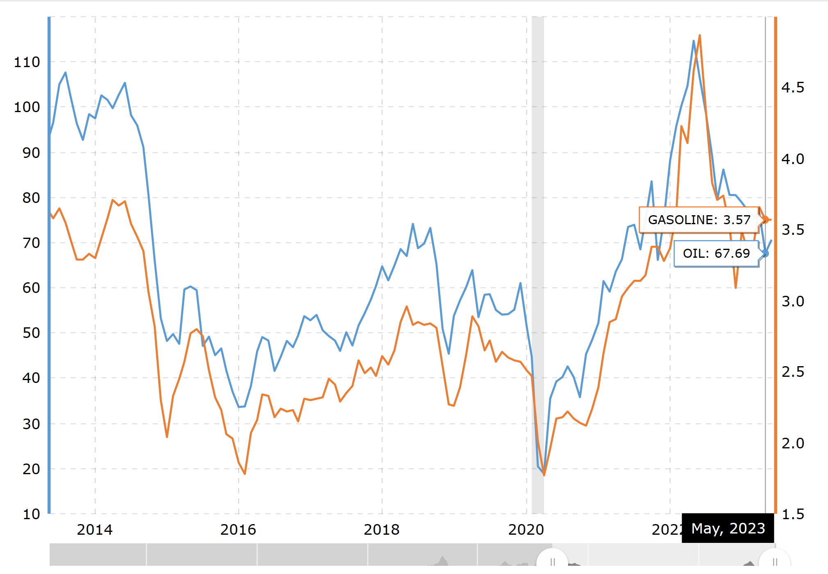
Oil vs Gas Prices - 10 Year Daily Chart (U.S.)

Slide 10
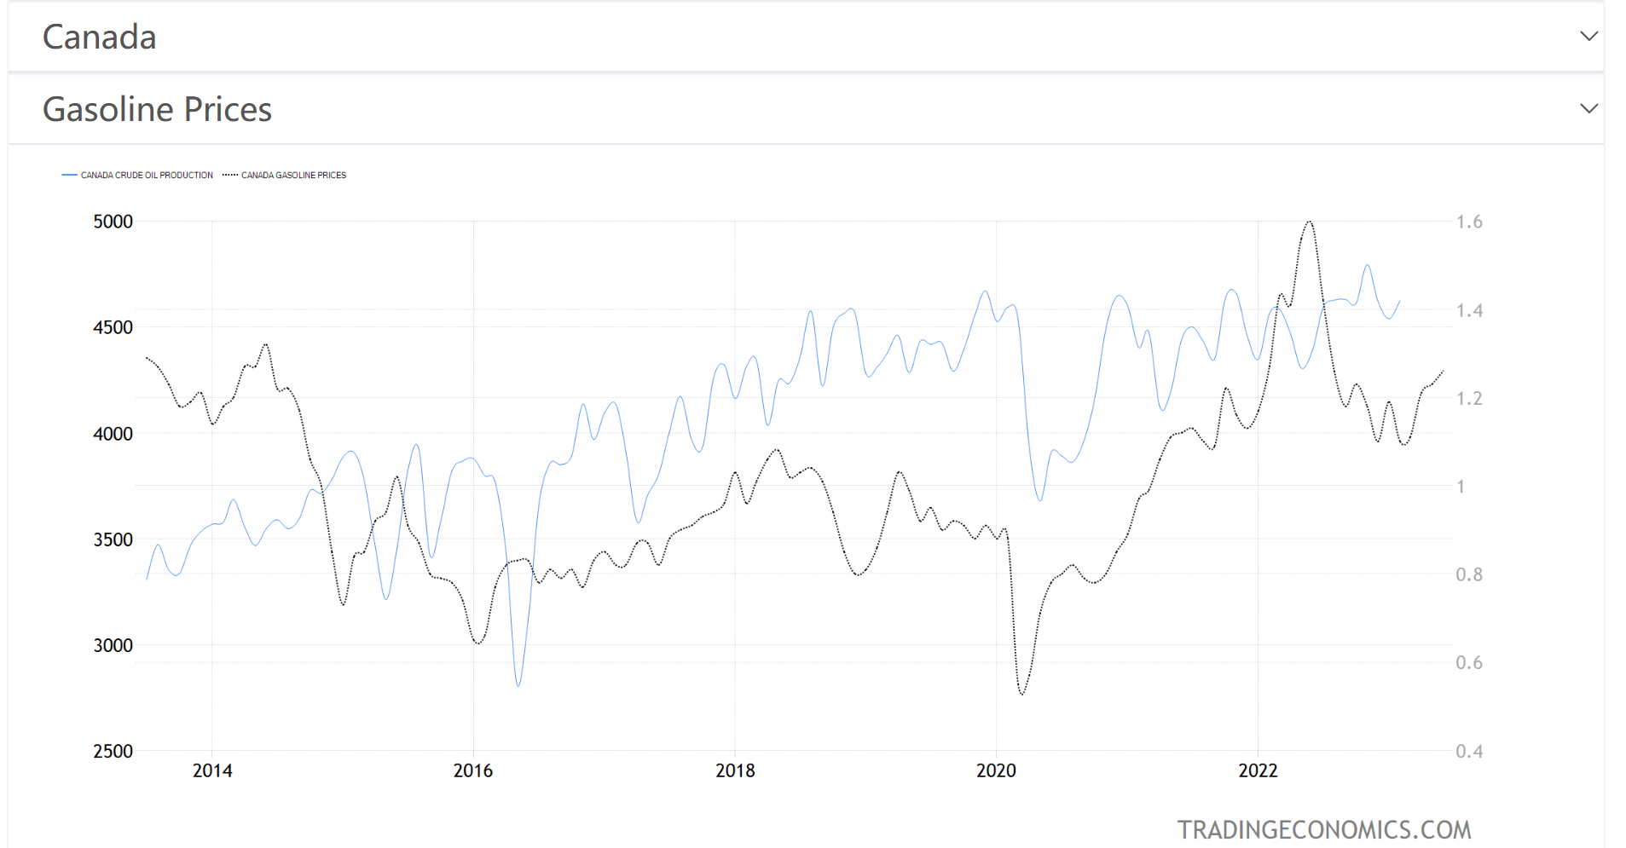
Oil vs Gas Prices - 10 Year Daily Chart (Canada)

Slide 11
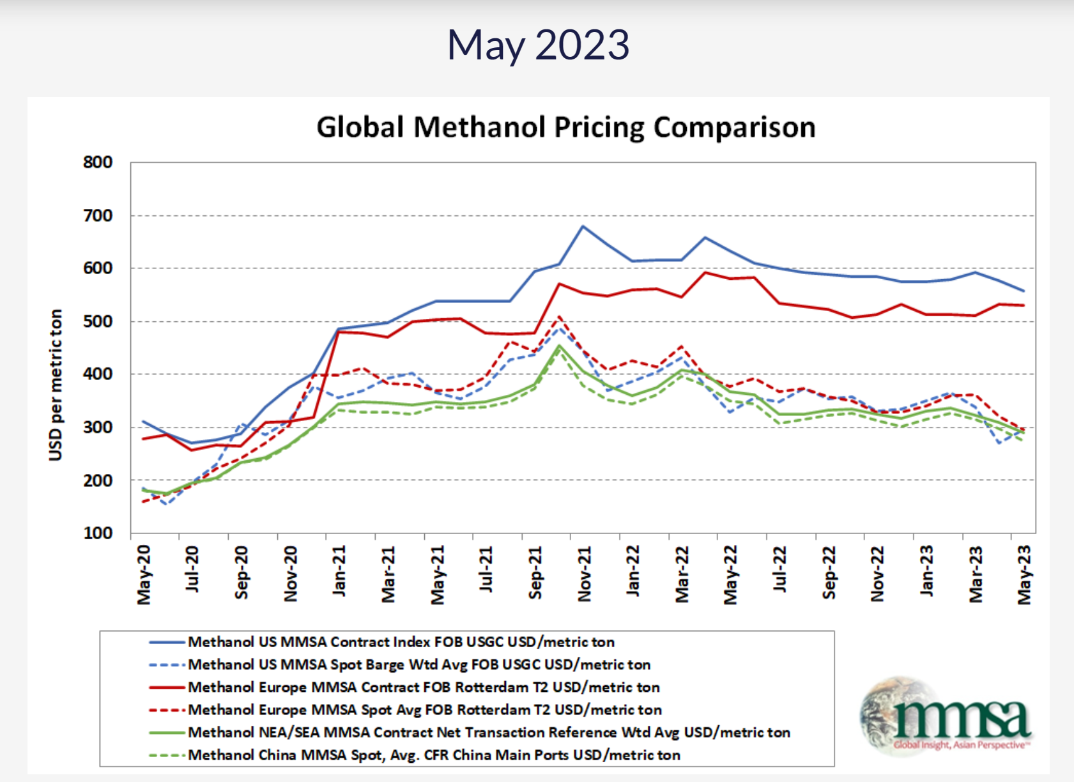
Global Methanol Pricing Comparison

Slide 12
Oil Drilling and Gas
Extraction in the US

Slide 13
“Companies in this industry operate and develop oil and gas field properties. Activities include: the exploration and production of crude petroleum; the mining and extraction of oil from oil shale and oil sands; the exploration and production of natural gas; sulfur recovery from natural gas; and recovery of hydrocarbon liquids. Companies may operate oil and gas wells on their own account or for others on a contract or fee basis.” – (IBIS, 2020)
Oil Drilling and Gas Extraction in the US
- Definition

Slide 14
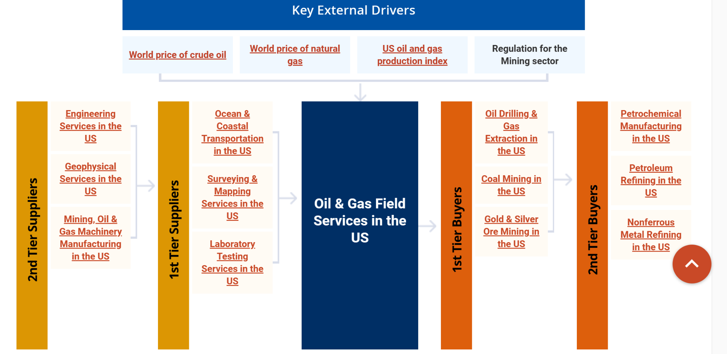
Oil Drilling and Gas Extraction in the US
–Supply Chain

Slide 15
The primary activities of this industry are
►Extracting crude petroleum and natural gas
►Extracting natural gas liquid
►Exploring for crude petroleum and natural gas
►Drilling, completing and equipping wells
►Operating separators, emulsion breakers, desilting equipment and field gathering lines for crude petroleum
The major products and services in this industry are
►Crude oil and lease condensate
►Natural gas liquids
►Dry natural gas
Oil Drilling and Gas Extraction in the US
– Main Actvities

Slide 16
►Industry revenue has fluctuated in lockstep with unstable commodity prices
► In addition to commodity prices, intensifying competition has pressured industry operators’ profit
►IBISWorld estimates that the value of exports has increased over the past five years
►Consumers are expected to increase consumption of petroleum-based products
►New producing fields will likely continue fueling supply growth over the next five years
►While biofuels are expected to grow in importance, output levels are likely to remain low
►Revenue has been extremely volatile, despite rising domestic oil and gas production
Oil Drilling and Gas Extraction in the US –Key Trends

Slide 17
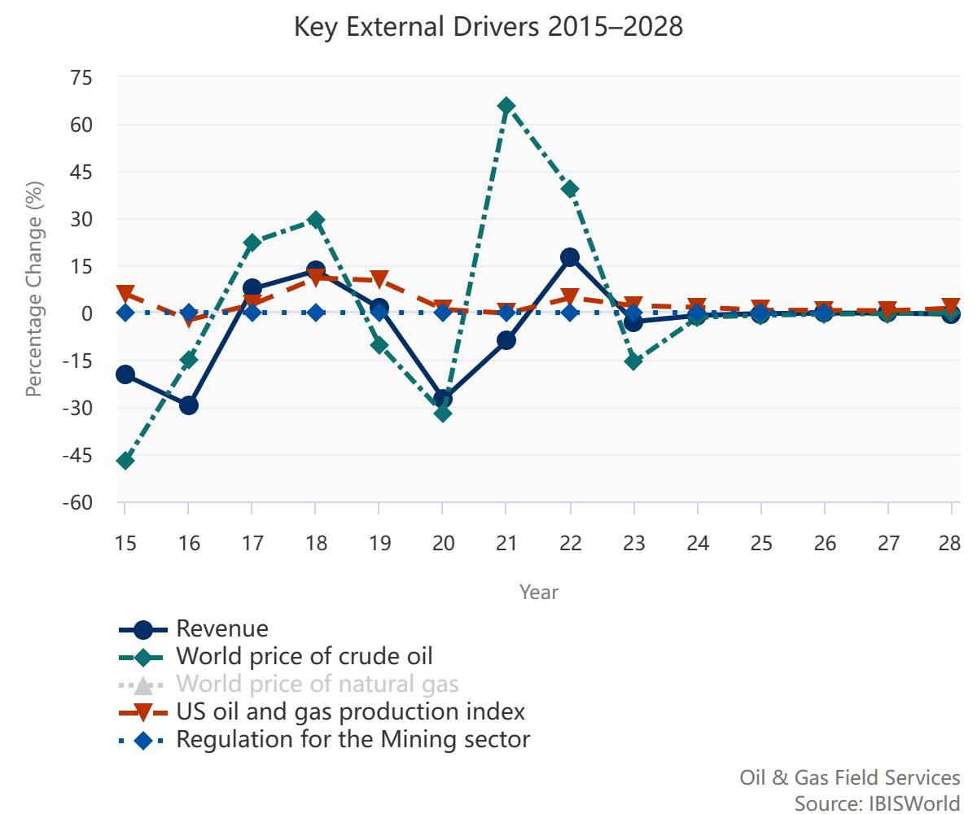
Oil Drilling and Gas Extraction in the US – External Drivers

Slide 18
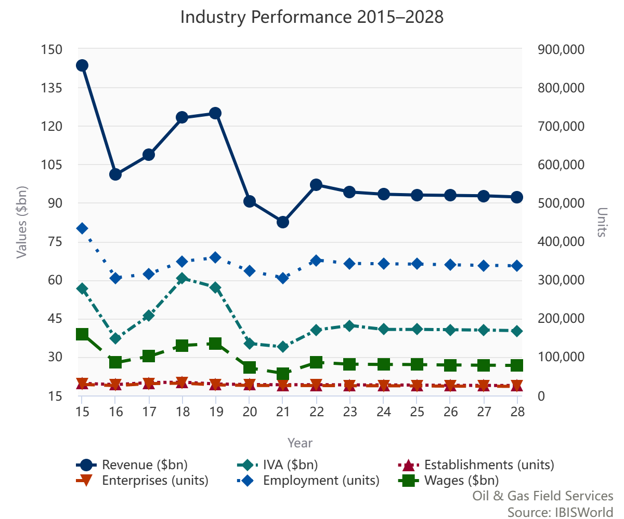
Oil Drilling and Gas Extraction in the US – Industry Performance

Slide 19
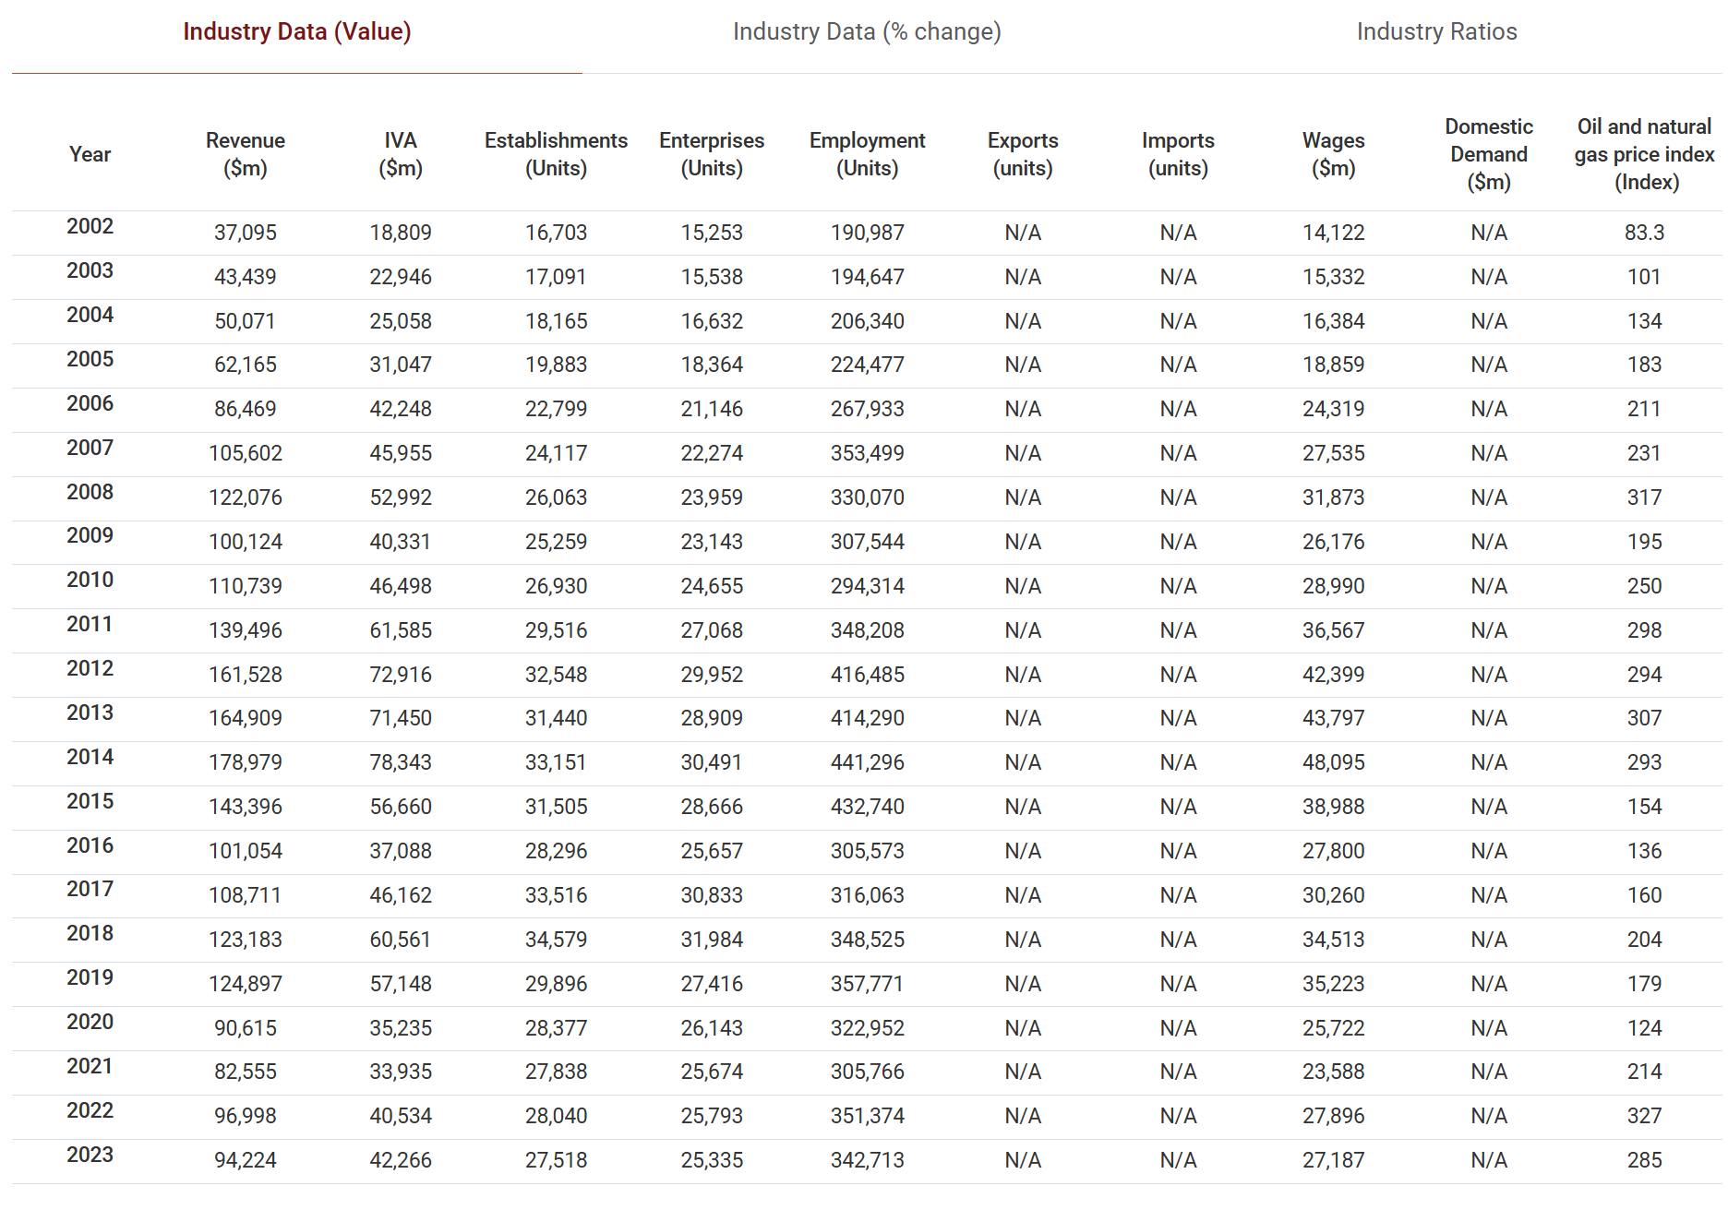
Oil Drilling and Gas Extraction in the US – Industry Performance

Slide 20
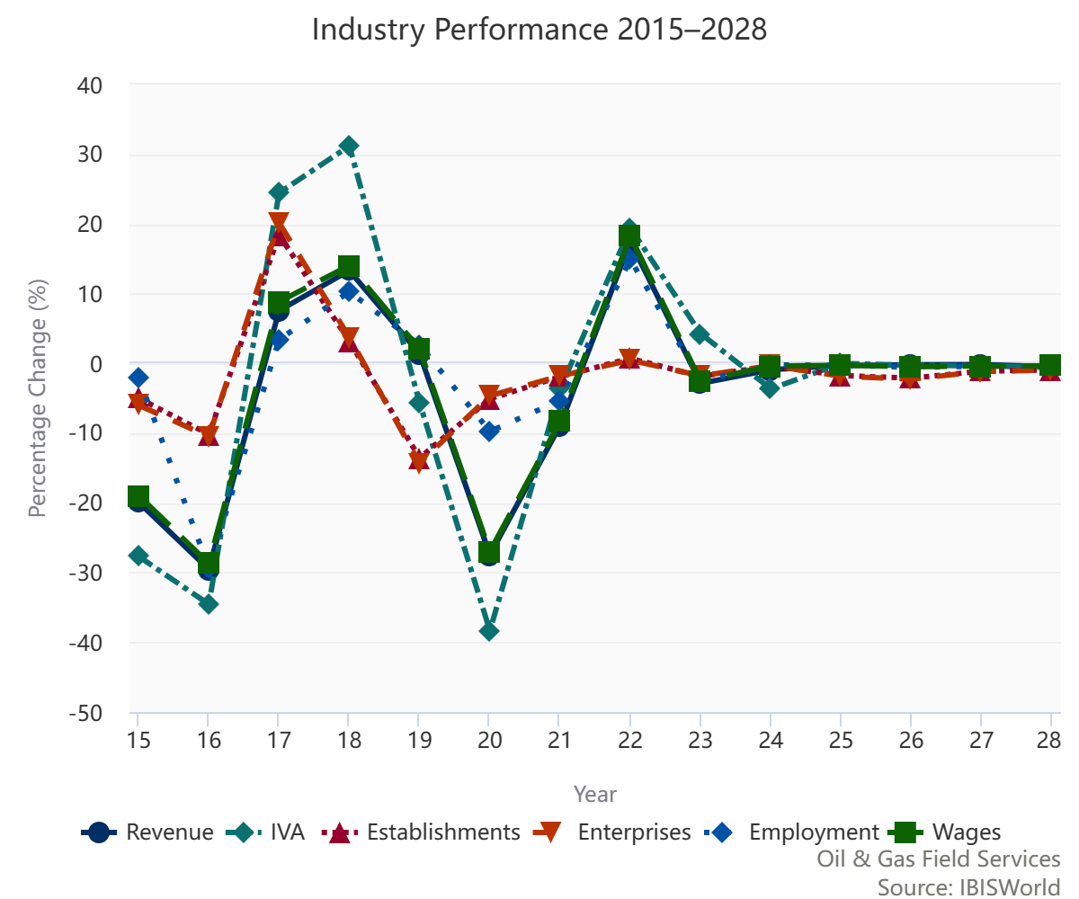
Oil Drilling and Gas Extraction in the US – Annual Change

Slide 21
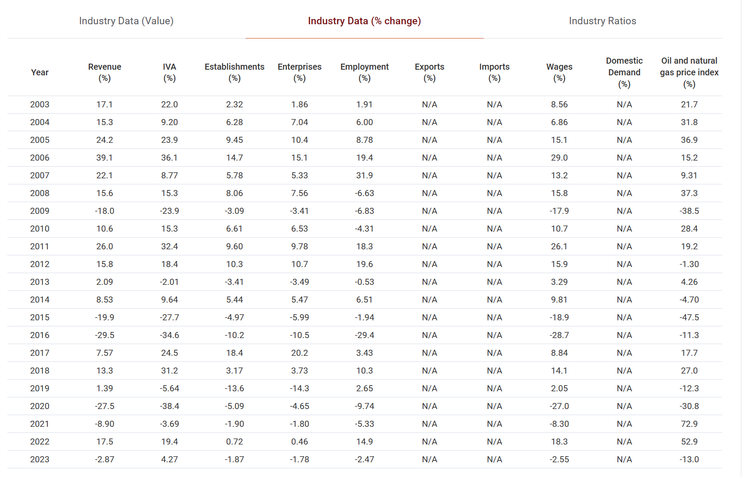
Oil Drilling and Gas Extraction in the US
– Annual Change

Slide 22
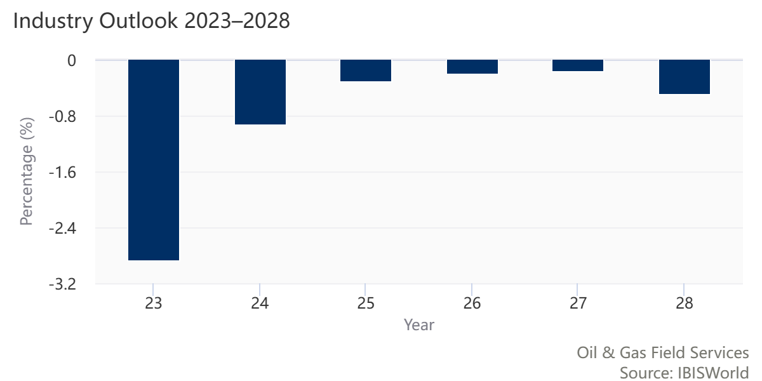
Oil Drilling and Gas Extraction in the US – Industry Growth Outlook

Slide 23
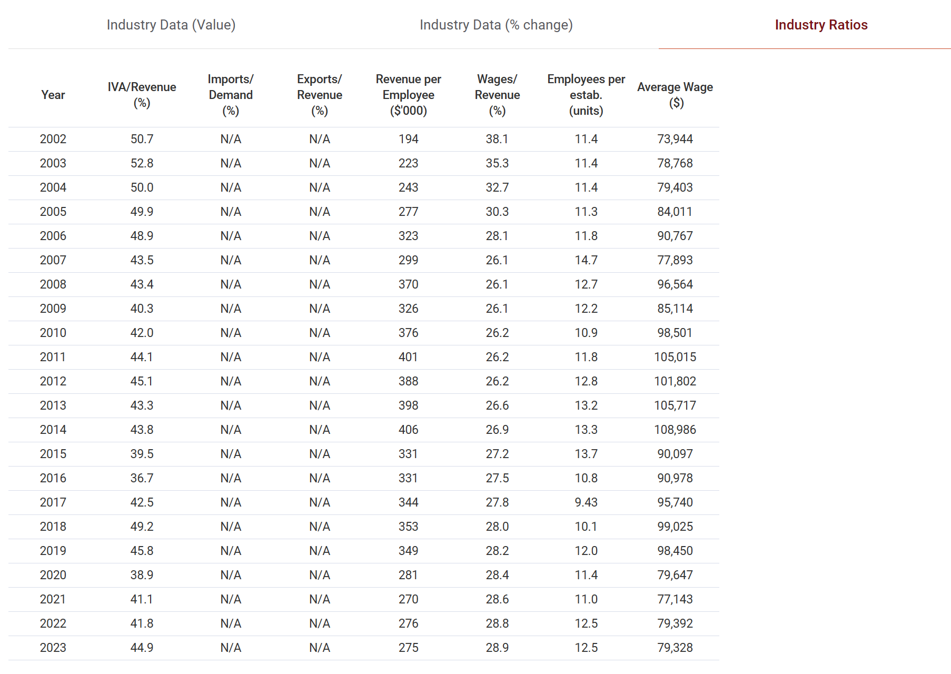
Oil Drilling and Gas Extraction in the US
– Industry Ratios

Slide 24
Oil Drilling and Extraction in Canada

Slide 25
“Companies in the Canadian Oil Drilling and Gas Extraction industry operate and develop oil and gas field properties. Activities include the exploration and production of crude petroleum, the mining and extraction of oil from oil shale and oil sands, the exploration and production of natural gas, sulphur recovery from natural gas and recovery of hydrocarbon liquids. Companies may operate oil and gas wells on their own account or for others on a contract or fee basis.” – (IBIS, 2020)
Oil Drilling and Extraction in Canada -
Definition

Slide 26
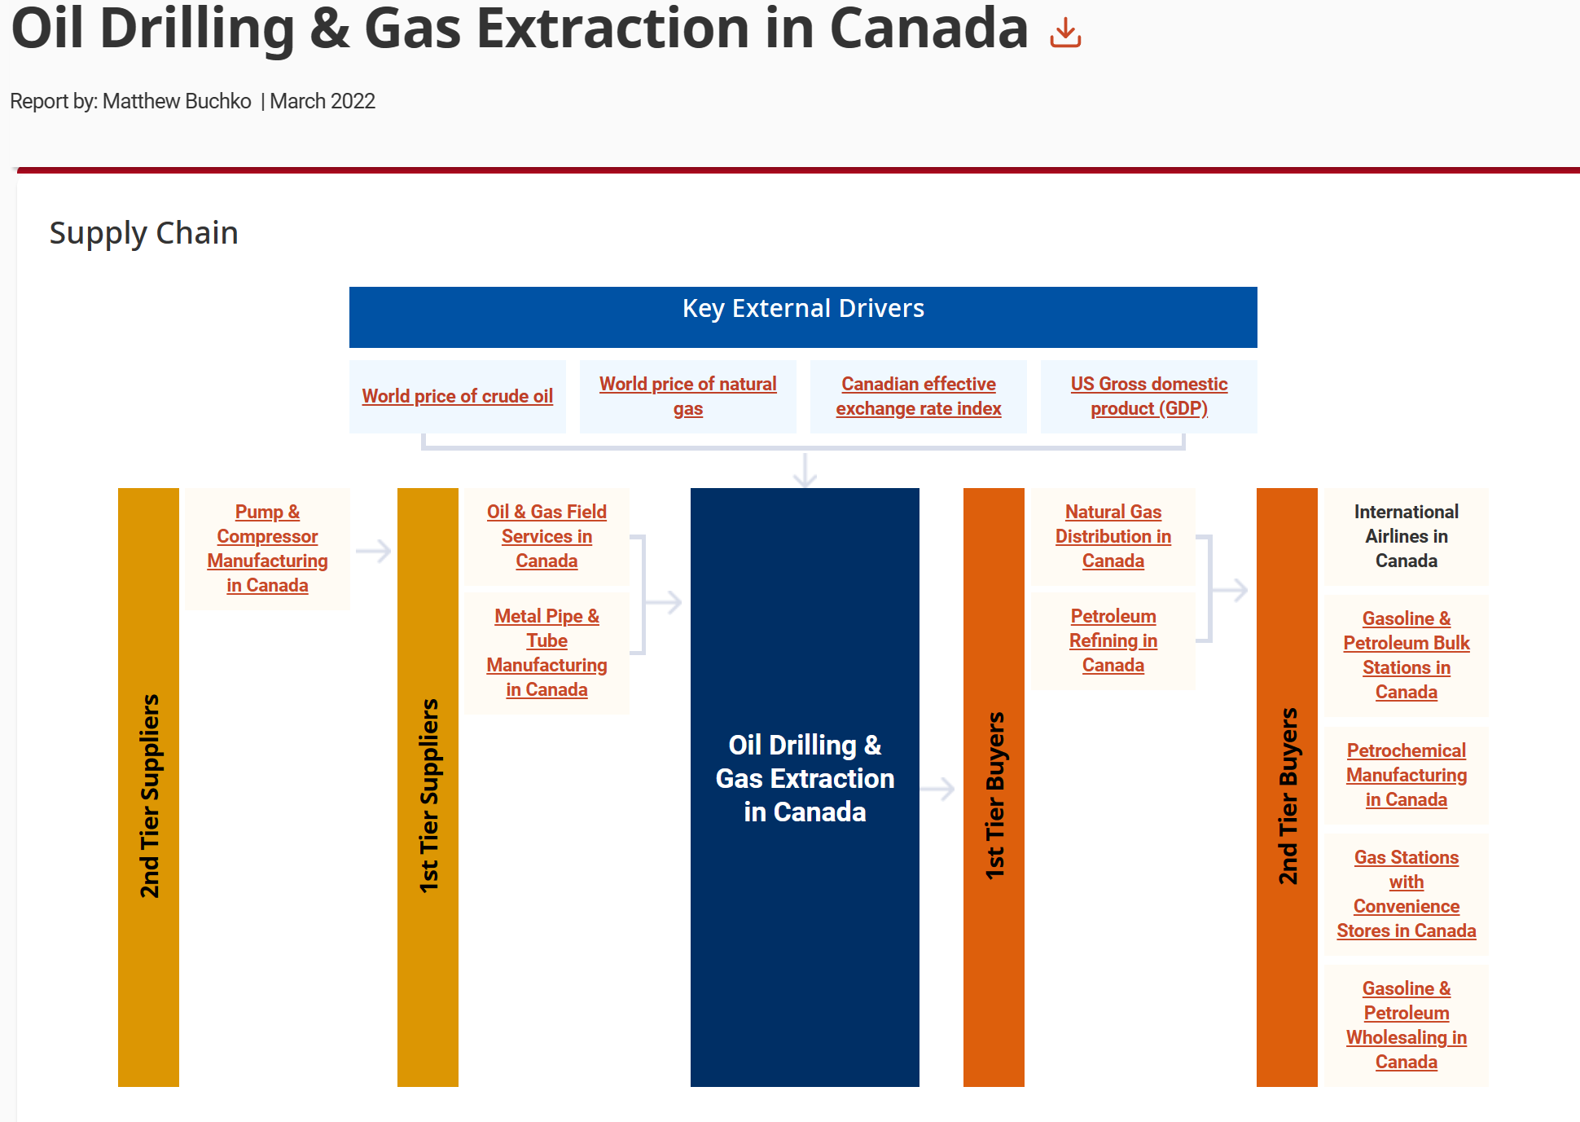
Oil Drilling and Extraction in Canada – Supply Chain

Slide 27
The primary activities of this industry are
►Oil extraction
►Natural gas extraction
►Exploration of crude oil and natural gas
The major products and services in this industry are
►Crude oil
►Natural gas
Oil Drilling and Extraction in Canada –
Main Activities

Slide 28
►Lower industry prices will likely result in the number of estabilshments declining
►Industry production has fared well over the past five years
►The industry is highly reliant on global markets
►Demand for industry products is expected to recover
►With production rising, the number of establishments will also likely increase
Oil Drilling and Extraction in Canada
–Key Trends

Slide 29
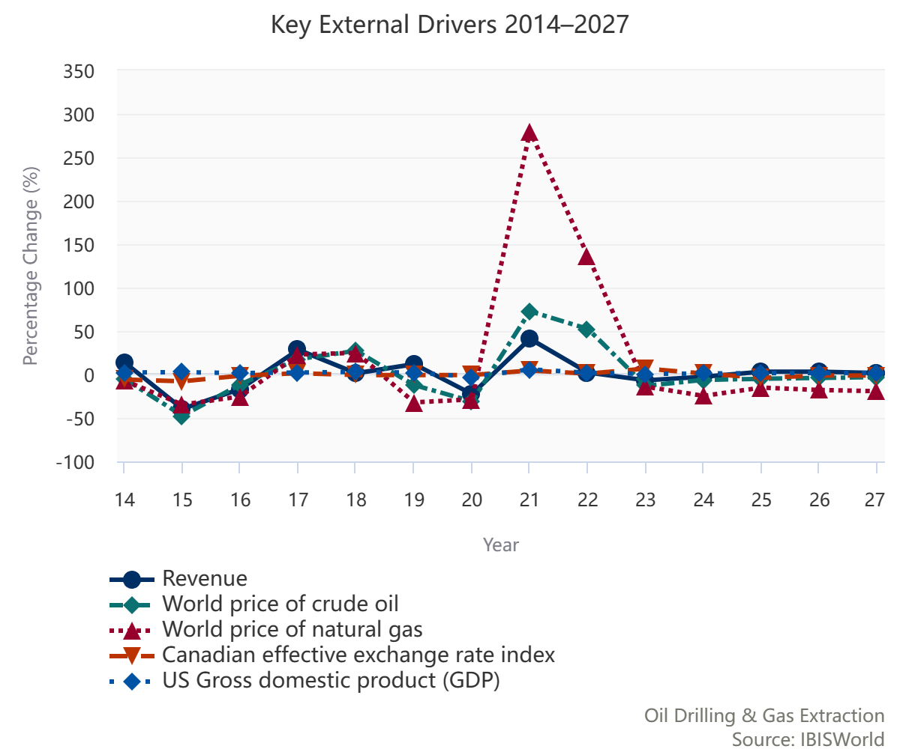
Oil Drilling and Extraction in Canada – External Drivers

Slide 30
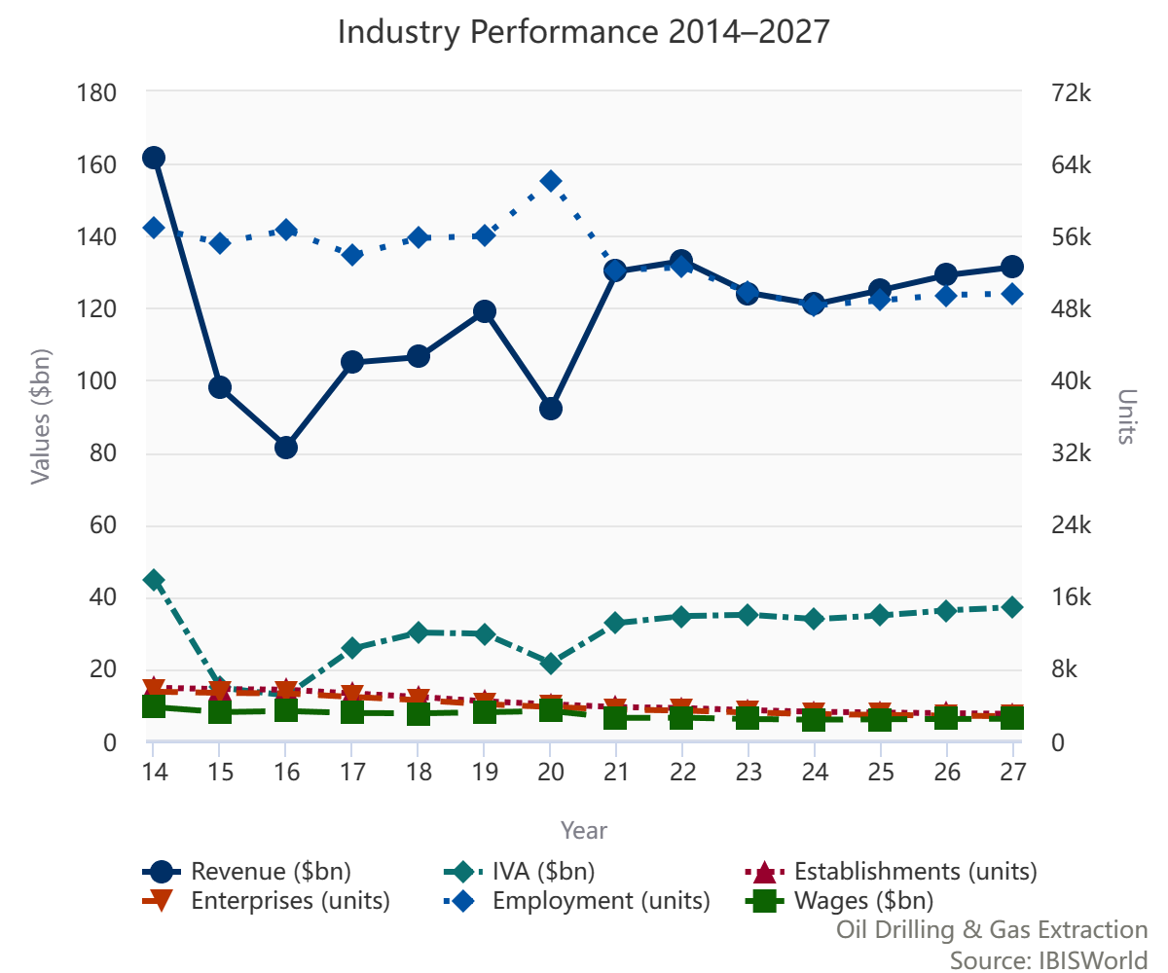
Oil Drilling and Extraction in Canada – Industry Performance

Slide 31
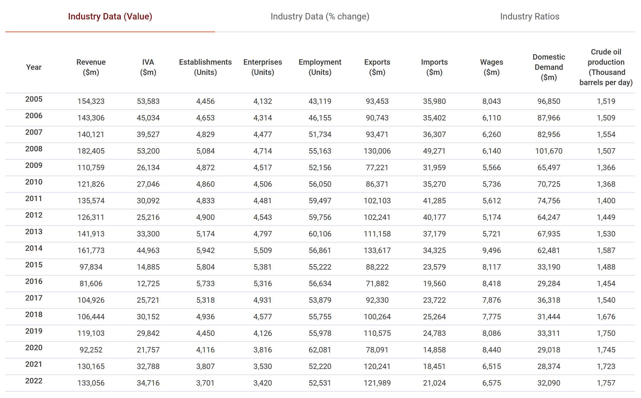
Oil Drilling and Extraction in Canada – Industry Performance

Slide 32
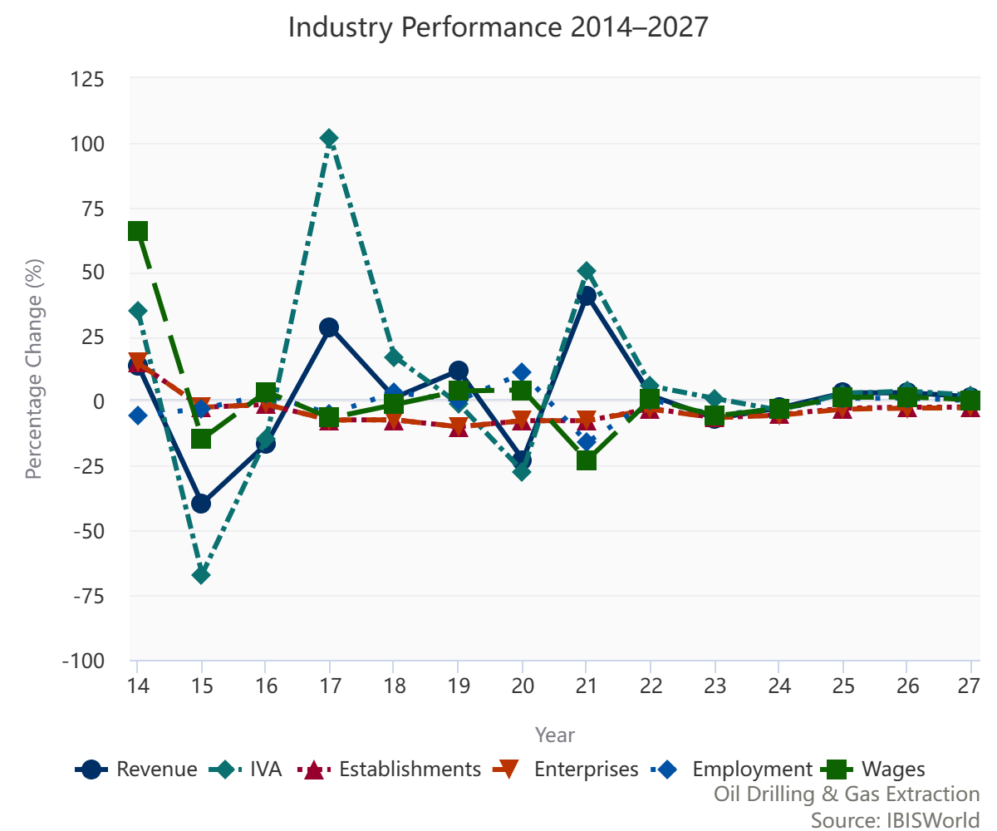
Oil Drilling and Extraction in Canada –Annual Change

Slide 33
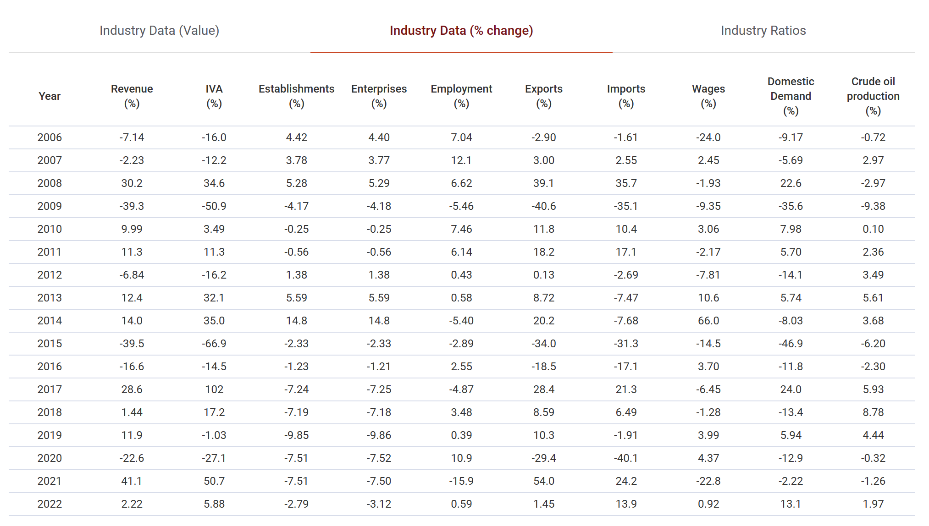
Oil Drilling and Extraction in Canada –Annual Change

Slide 34
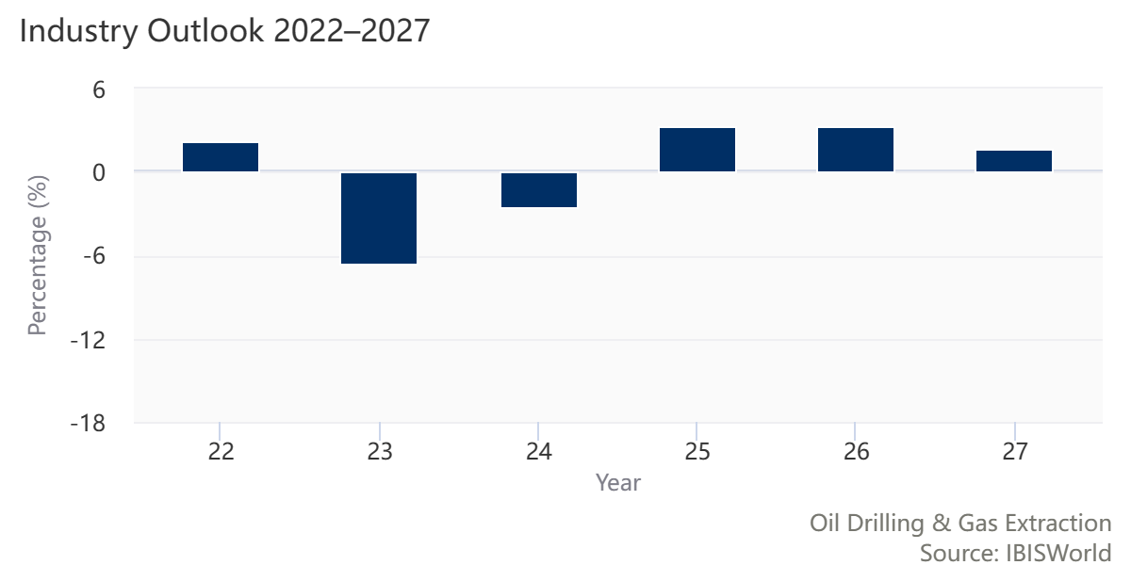
Oil Drilling and Extraction in Canada – Industry Growth Outlook

Slide 35
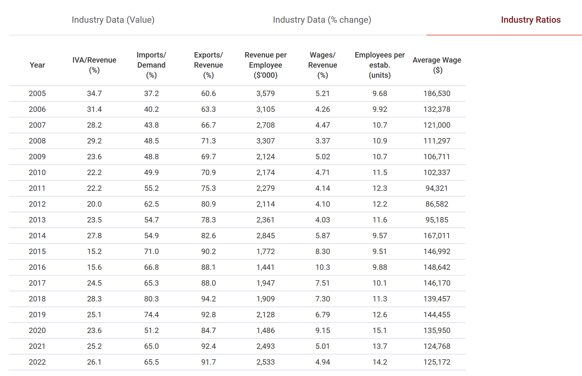
Oil Drilling and Extraction in Canada –Industry Ratios

Slide 36
Organic Chemical
Manufacturing in
Canada

Slide 37
“Operators in this industry manufacture basic organic chemicals (excluding petrochemicals), industrial gases and synthetic dyes and pigments. Key product groups include gum and wood products, cyclic crudes and intermediates and ethyl alcohol, along with other basic organic chemicals. These products are predominantly intermediates that are used as raw material inputs by other manufacturing industries in the production of downstream products.” – (IBIS, 2020)
Organic Chemical Manufacturing in Canada - Definition

Slide 38
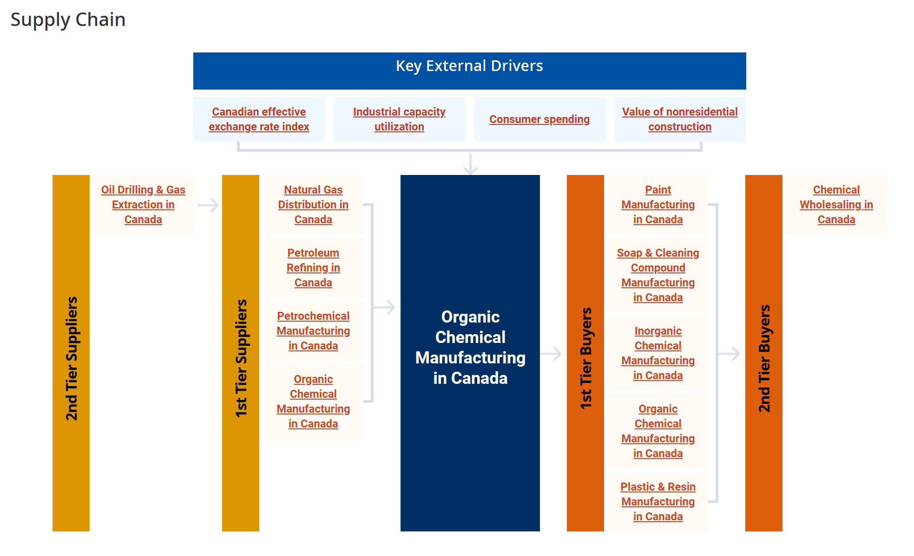
Organic Chemical Manufacturing in
Canada–Supply Chain

Slide 39
The primary activities of this industry are
►Manufacture ethyl alcohol
►Manufacture methanol
►Manufacture wood and gum chemicals
►Manufacture fatty acids
►Manufacture cyclic crudes and other chemical intermediates
►Manufacture all other organic chemical products
The major products and services in this industry are
►Ethyl alcohol
►Cyclic crudes, intermediate products, gum and wood
►Fatty acids
►Other organic chemicals
Organic Chemical Manufacturing in Canada– Main Activities

Slide 40
►The value of exports has declined despite stable export conditions
►High profitability encouraged an increase in the number of operators
►The industry has benefited from favourable government regulation
►Export markets are expected to remain vital for industry operators
►Operators will likely benefit from a greater emphasis on renewable fuels
►Increasing demand for organic chemicals will likely entice new industry participants
►The industry is dependent on global trade, with the majority of trade occurring between Canada and the US
Organic Chemical Manufacturing in
Canada - Key Trends

Slide 41
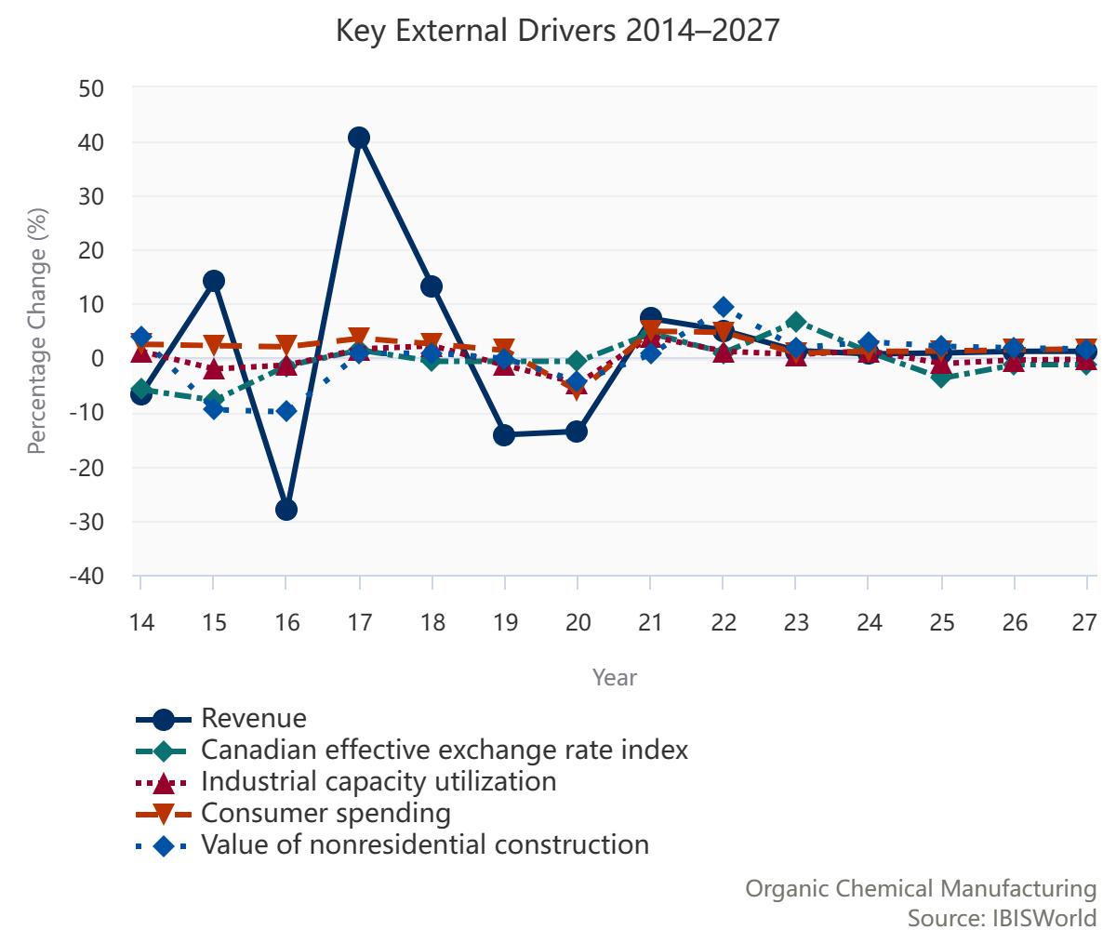
Organic Chemical Manufacturing in Canada– External Drivers

Slide 42
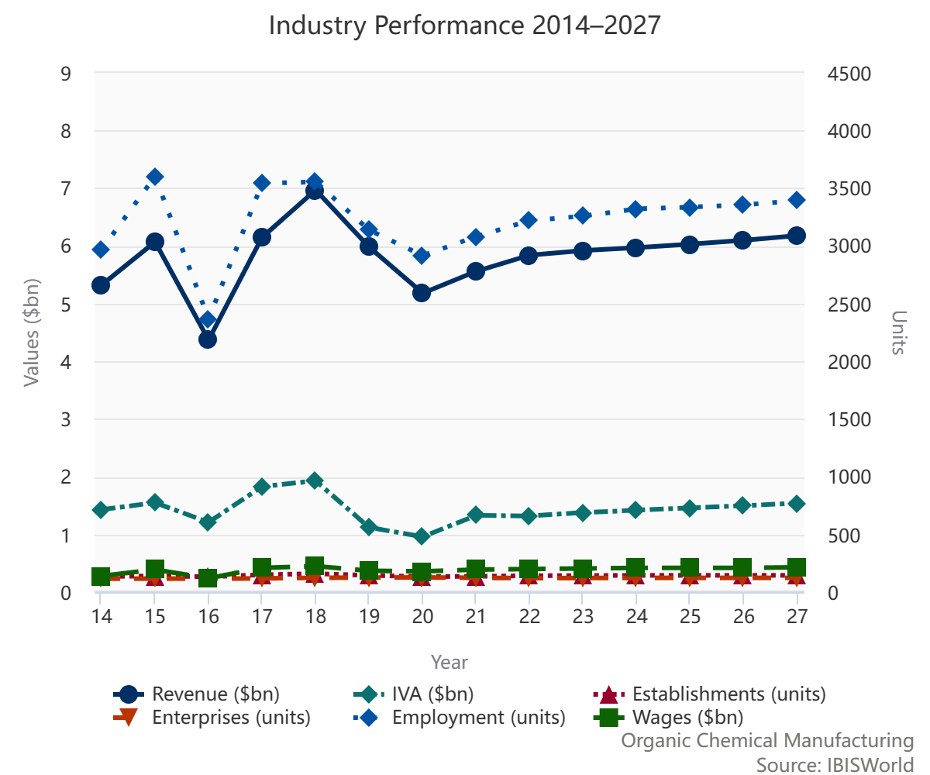
Organic Chemical Manufacturing in Canada – Industry Performance

Slide 43
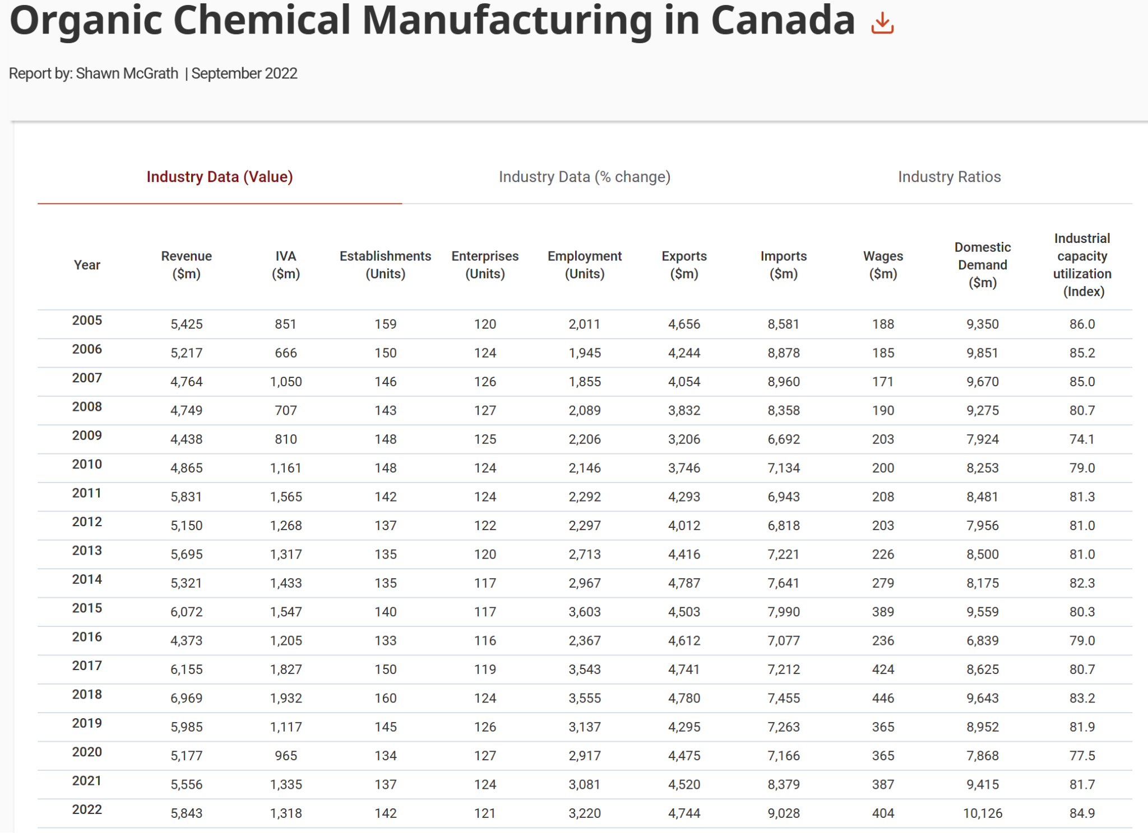
Organic Chemical Manufacturing in Canada– Industry Performance

Slide 44
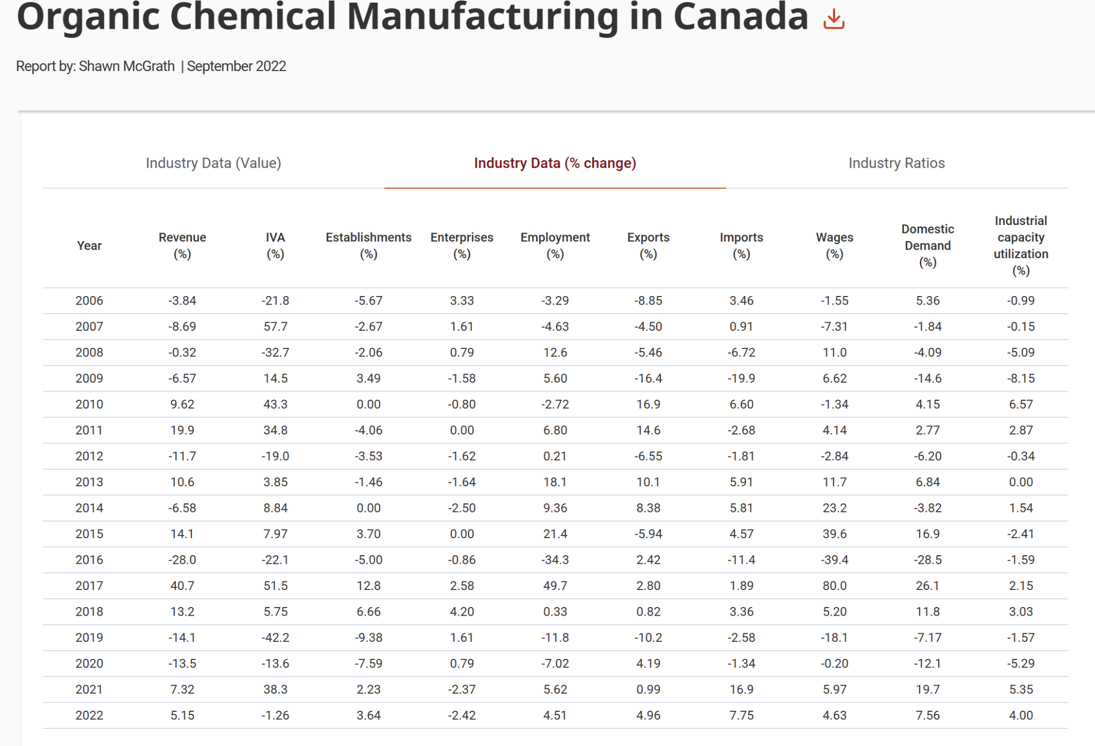
Organic Chemical Manufacturing in Canada – Annual Change

Slide 45
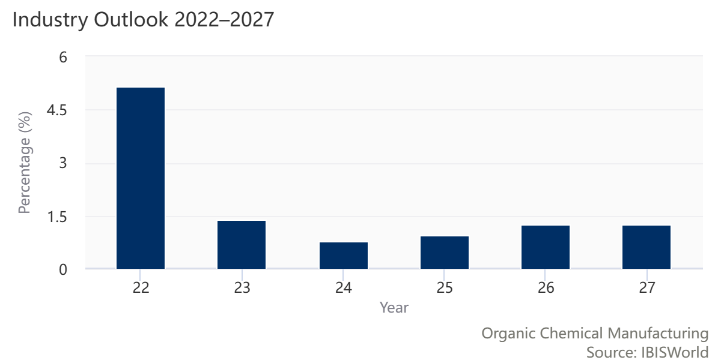
Organic Chemical Manufacturing in Canada– Industry Growth Outlook

Slide 46
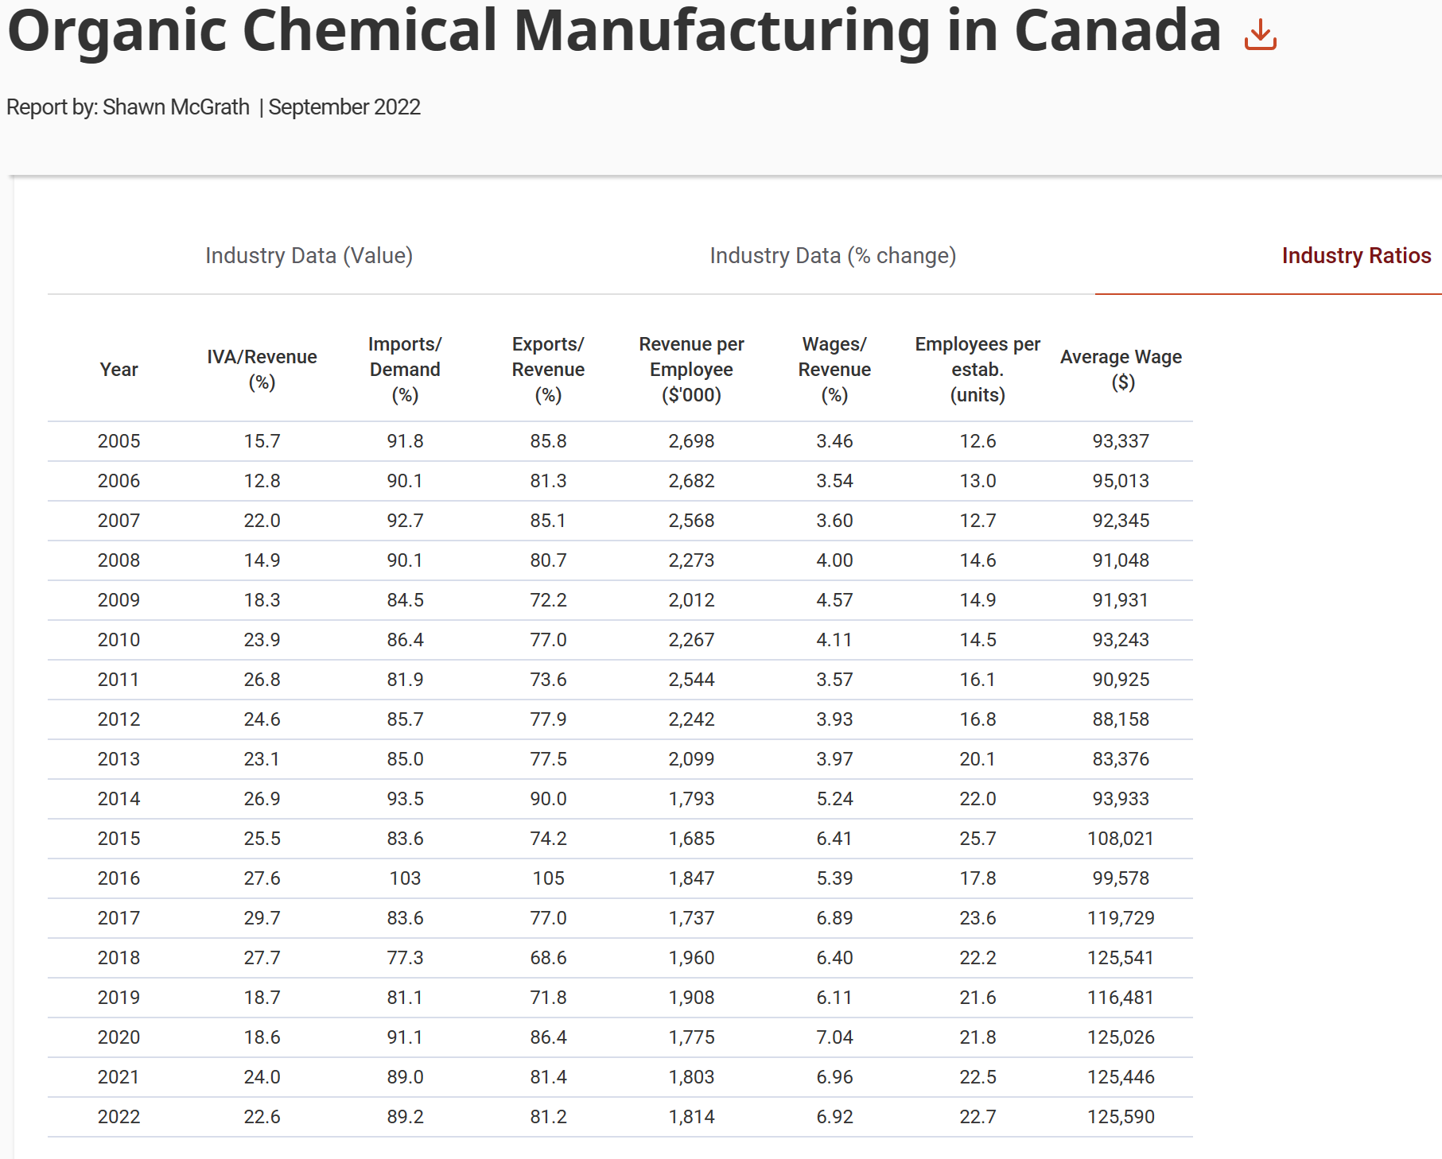
Organic Chemical Manufacturing in Canada – Industry Ratios

Slide 47


Slide 48




Company Overview
A leading North American oil producer
Focused on the development of high-return resource plays.
Established in 2001.
Based in Calgary, Alberta, Canada and United States

Slide 49



Management Team
President, Chief Executive Officer and Director
Craig Bryksa
Chief Operating Officer
Ryan Gritzfeldt
Chief Financial Officer
Ken Lamont

Slide 50
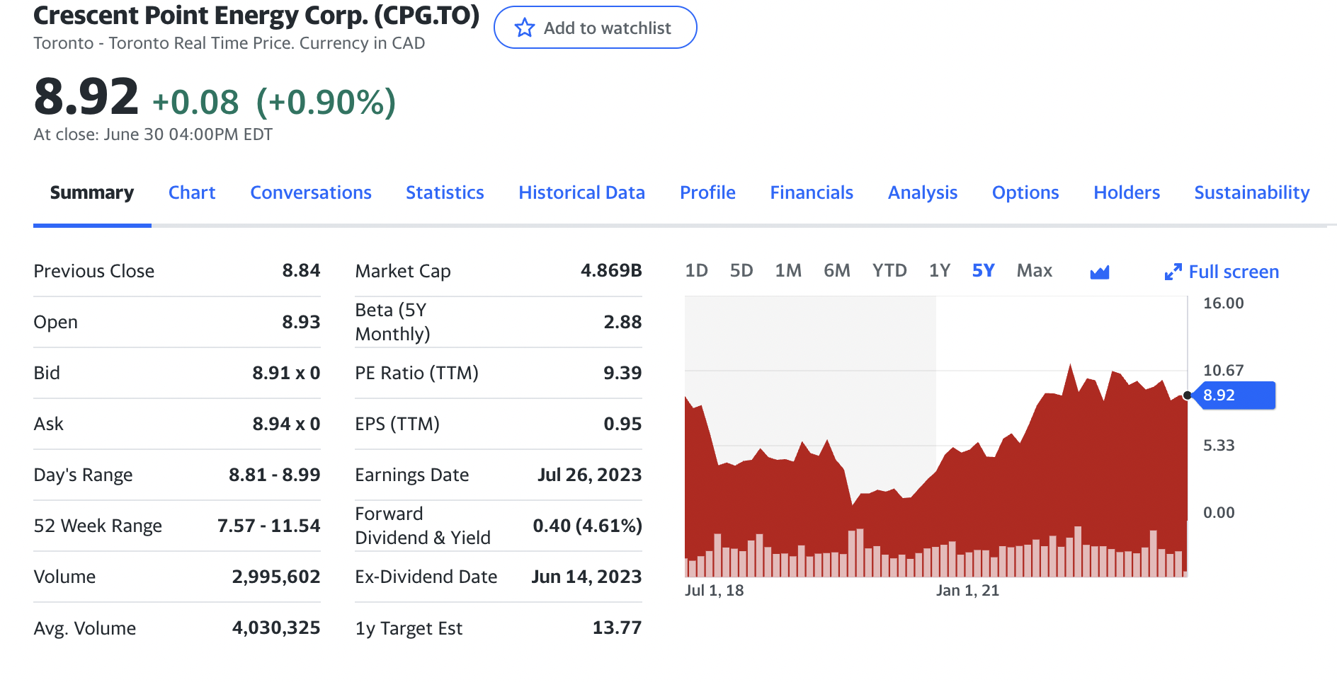
STOCK

Slide 51
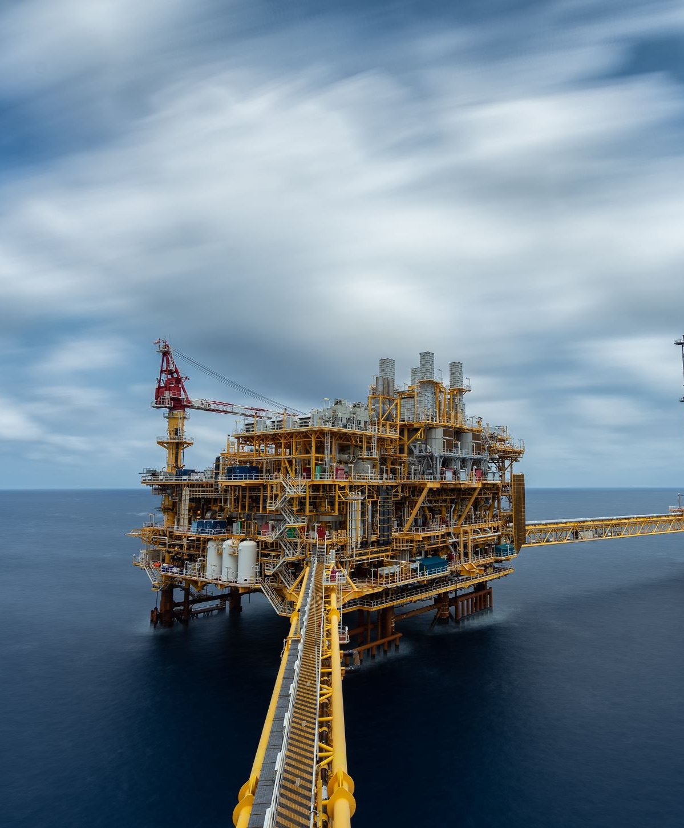
Operation
• Exploration and Production Company
• Mainly produces light and medium oil
• Acquiring, developing and holding interests in petroleum and natural gas

Slide 52
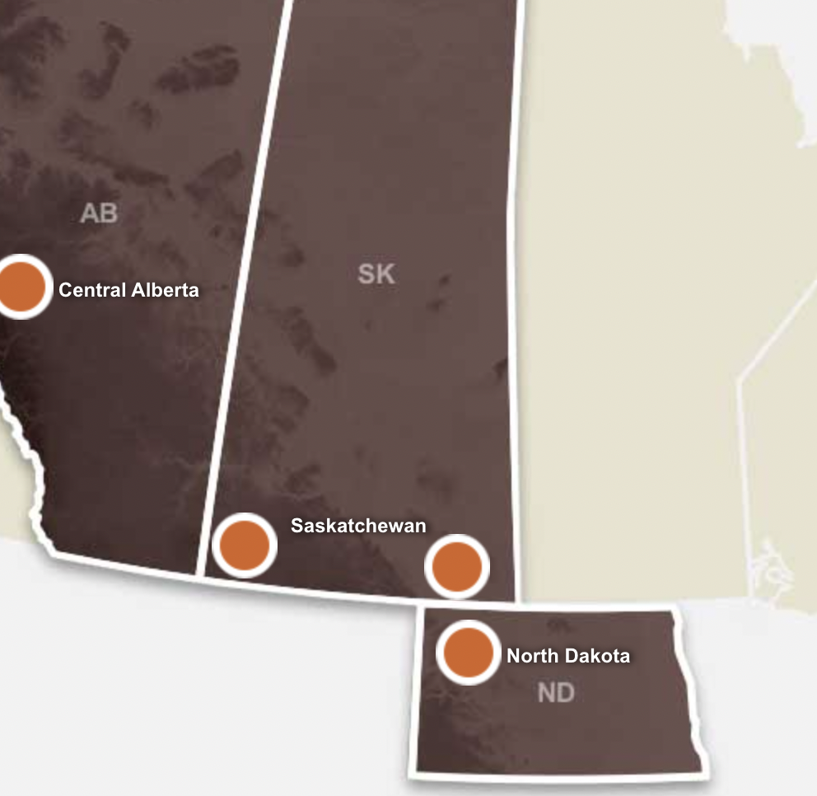
Key Focused Area
Central Alberta
Kaybob Duvernay-Situated in the heart of the condensate rich fairway and providing significant low risk drilling inventory with attractive economics, we entered the Kaybob Duvernay play in 2021.
Montney-possessing similar resource characteristics including pay thickness and permeability in the volatile oil fairway of the reservoir.
Saskatchewan
Viewfield Bakken​-light oil pool in Saskatchewan is our largest and longest producing resource play
Flat Lake-play is a multi-zone resource play located in southeast Saskatchewan and is an extension of our North Dakota properties
Shaunavon-own a significant portion of this oil pool, which provides low-risk growth and free cash flow.
North Dakota
Bakken​-primarily located in Williams County focused on the development of the formation.

Slide 53
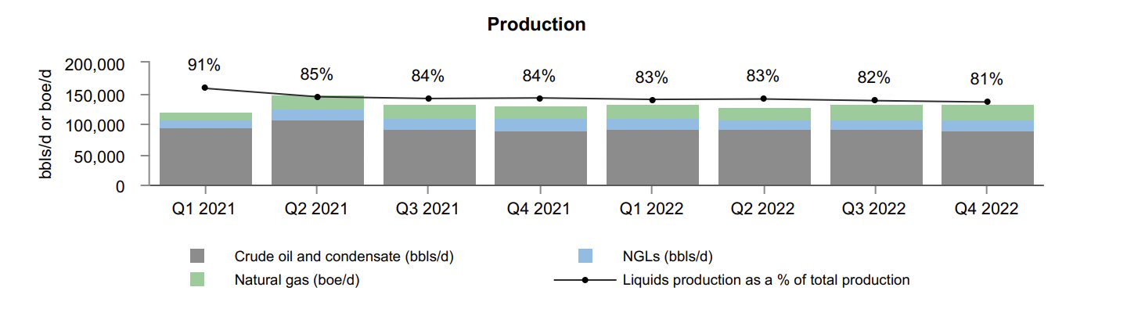
OIL PRODUCTION LEVEL
Notes:
Total production averaged 132,282 boe/d during 2022 compared to 132,683 boe/d in 2021. The Company's production by area has varied as production growth in the Kaybob Duvernay area was offset by non-core asset dispositions in Saskatchewan. The Company's weighting to crude oil and liquids production in 2022 decreased by 4 percent. The decrease was primarily due to higher natural gas production as a result of production growth in the Kaybob Duvernay area and the dispositions of non core oilweighted conventional assets in Southeast Saskatchewan as well as in the Saskatchewan Viking resource play.

Slide 54
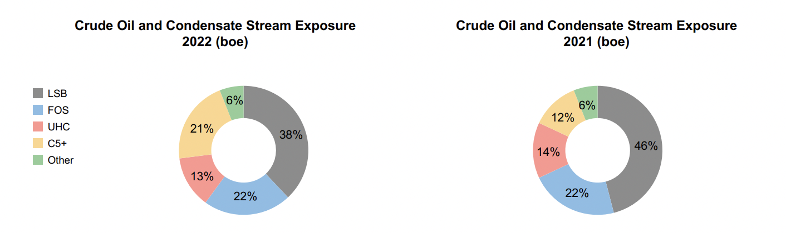
CRUDE OIL AND CONDENSATE STREAM EXPOSURE

Slide 55
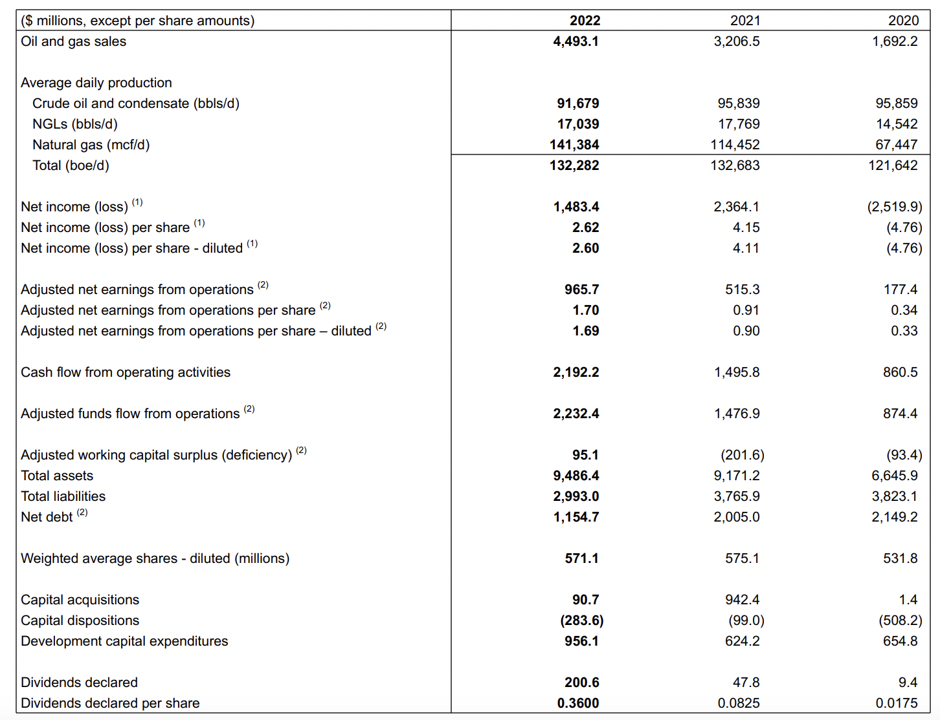
MOST RECENT FINANCIAL RESULT
Notes:
Sales变多，生产量没有跟上，net income减少，可能有潜在的问题，net income减少可能是因为demand多但supply不够

Slide 56
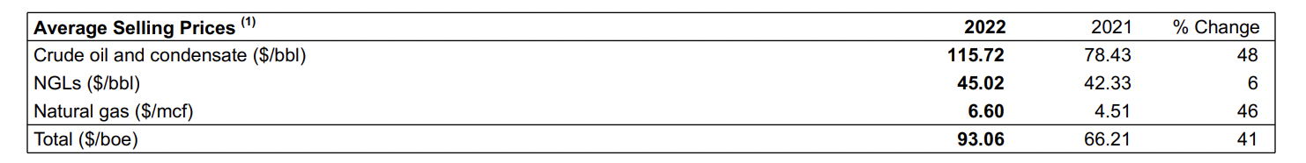
AVERAGE OIL SELLING PRICE

Slide 57
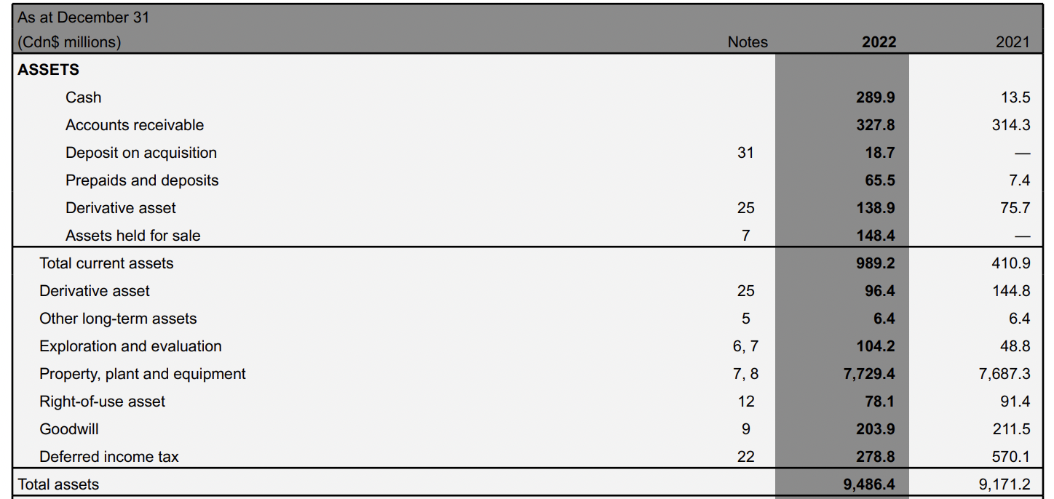
BALANCE SHEET-ASSET
Notes:
用了更多短期derivative 用了更少长期的，所以公司更着重短期risk hedging有derivative 才能来hedge，

Slide 58
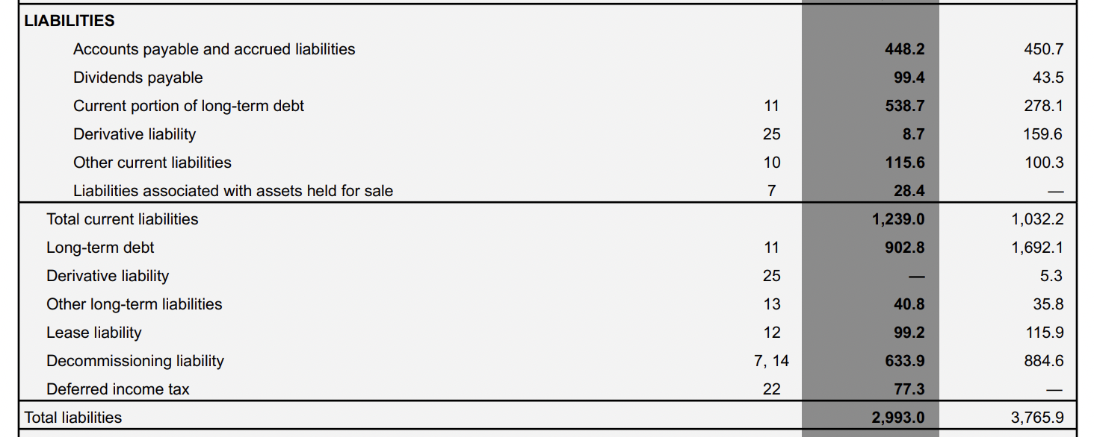
BALANCE SHEET-LIABILITY

Slide 59
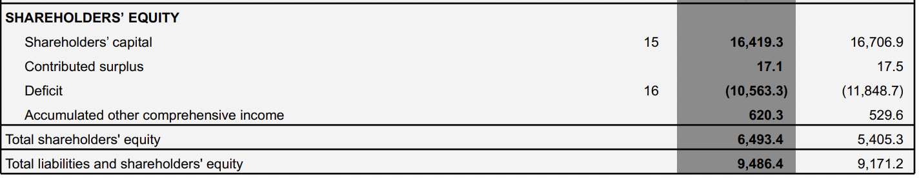
BALANCE SHEET-SHAREHOLDERS EQUITY

Slide 60

Balance Sheet Analysis
Current ratio=Current Asset/Current liability.
Current ratio 2021=410.9/1032.2=0.3981
Current ratio 2022=989.2/1239=0.7984

Slide 61
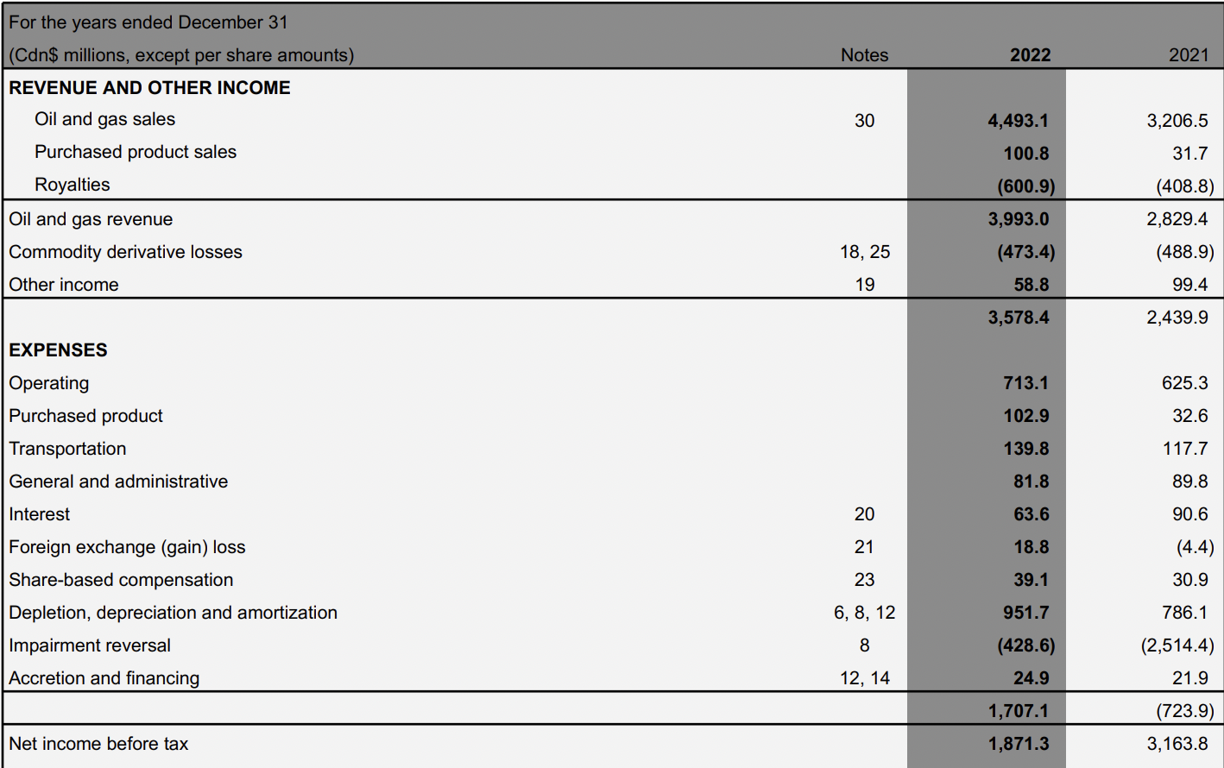
INCOME STATEMENT

Slide 62
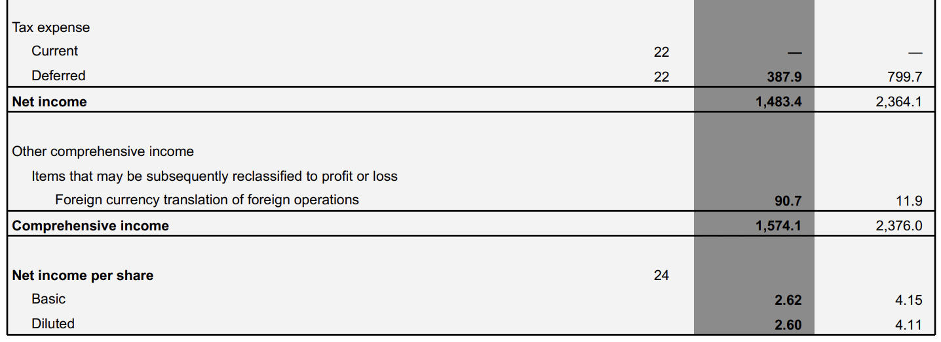
INCOME STATEMENT CONTINUES…

Slide 63
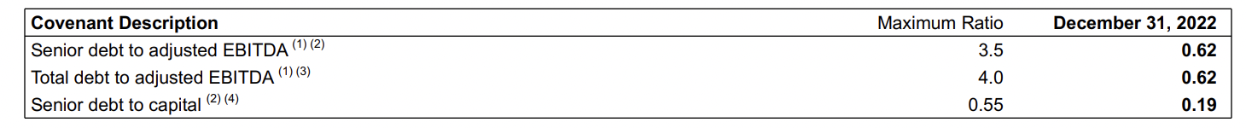
EBITDA
Notes:
通过上面数据，我们能得到公司的ratio，公司健康，我们可以看到debt ratio离maximum ratio较远，证明公司有足够的偿还debt 的能力

Slide 64

STATEMENTS OF CASH FLOWS

Slide 65
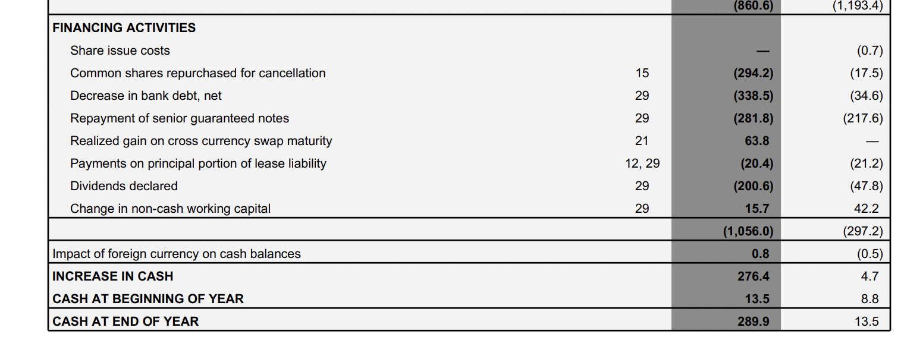
STATEMENTS OF CASH FLOWS CONTINUES..

Slide 66
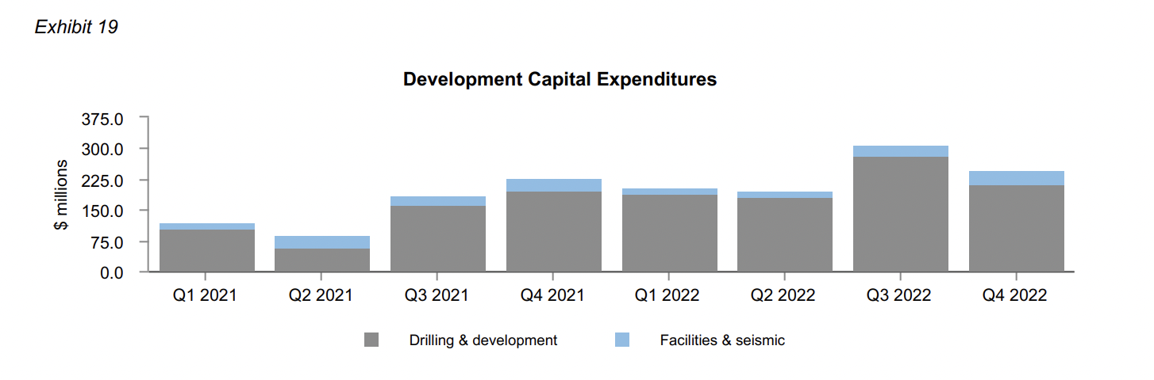
Notes:
The Company's development capital expenditures for the year ended December 31, 2022 were $956.1 million, compared to $624.2 million in 2021. Spending in 2022 was focused on the Company's core assets with $279.2 million of spending in Alberta, $258.2 million in Northern U.S., $237.0 million in Southeast Saskatchewan and $181.7 million in Southwest Saskatchewan. The high inflationary environment resulted in higher unit costs in 2022 and contributed to the increase in spending levels over 2021. During 2022, 219 (206.6 net) wells were drilled and $90.4 million was spent on facilities and seismic.

Slide 67
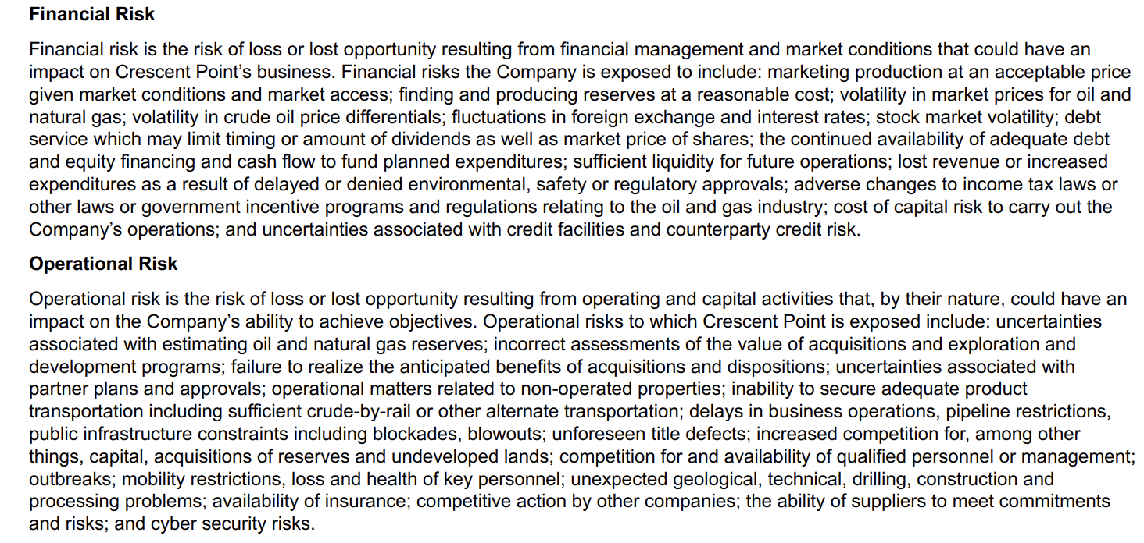
RISK FACTORS

Slide 68
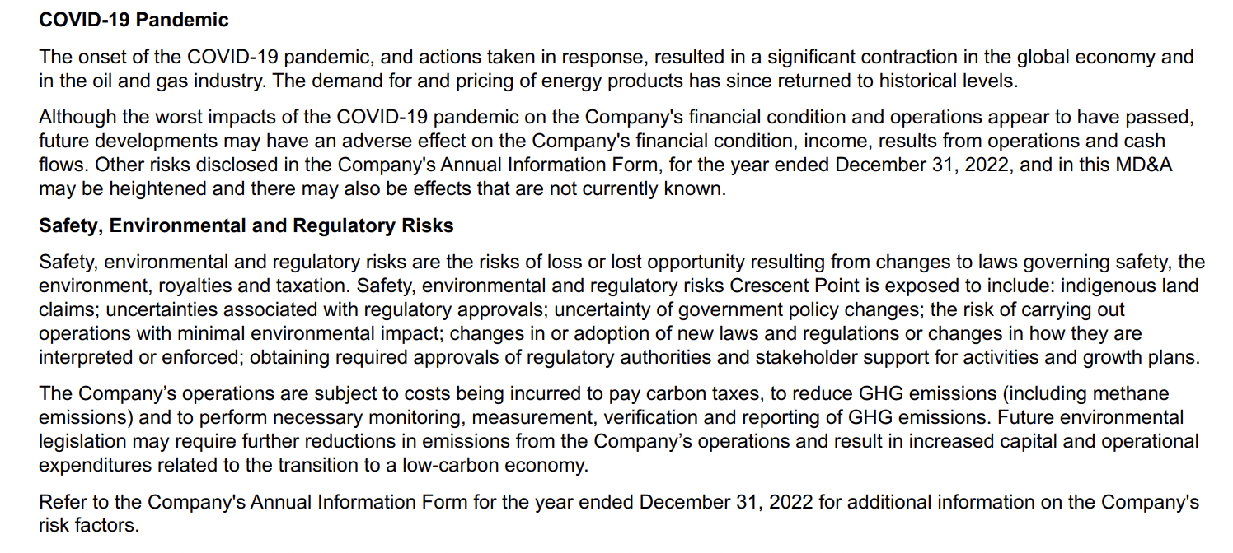
RISK FACTORS

Slide 69
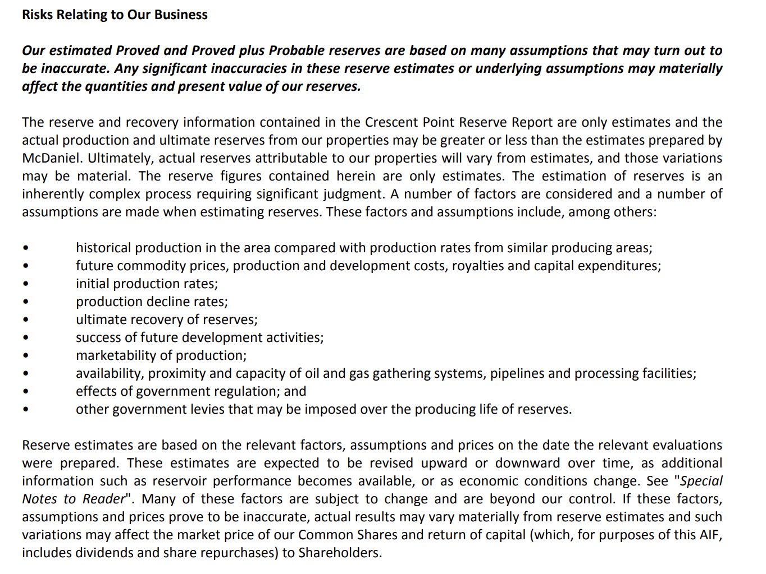

Slide 70








Risk Management
employing qualified professional and technical staff
concentrating in a limited number of areas with lower risk development projects
utilizing market proven technology for finding and developing reserves
constructing quality, environmentally sensitive and safe production facilities; adopting and communicating sound policies governing all areas of our business;
maximizing operational control of drilling and production operations;
strategic hedging program including commodity prices, interest and foreign exchange rates;
adhering to conservative borrowing guidelines and maintaining significant liquidity;
monitoring counterparty creditworthiness and obtaining supplementary credit protection when warranted.

Slide 71
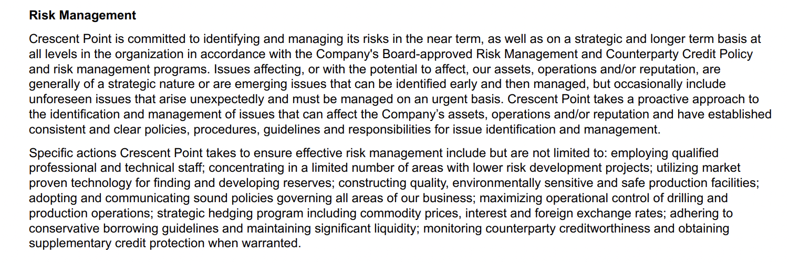

Slide 72
DERIVATIVES
Management of cash flow variability is an integral component of Crescent Point's business strategy. Crescent Point regularly monitors changing business and market conditions while executing its strategic risk management program. Crescent Point proactively manages the risk exposure inherent in movements in the price of crude oil, propane, natural gas, interest rates, the Company's share price and the US/Cdn dollar exchange rate through the use of derivatives with investment-grade counterparties.
The Company's crude oil and NGL derivatives are referenced to WTI and Conway C3, respectively. The Company's natural gas derivatives are referenced to NYMEX and the AECO monthly index. Crescent Point utilizes a variety of derivatives, including swaps, collars and put options, to protect against downward commodity price movements while also providing the opportunity for some upside participation during periods of rising prices. This reduces the volatility of the selling price of crude oil and natural gas production and provides a measure of stability to the Company's cash flow. See Note 25 – "Financial Instruments and Derivatives" in the audited consolidated financial statements for the period ended December 31, 2022 for additional information on the Company's derivatives.

Slide 73
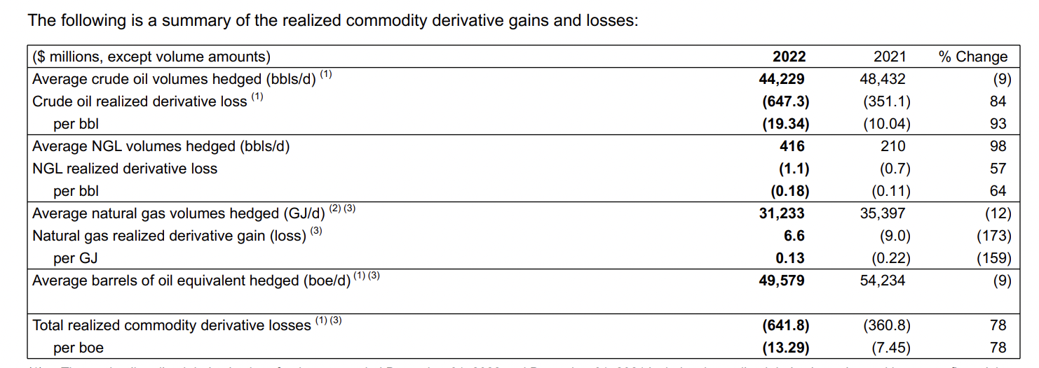
HEDGING
Notes:
Derivative正对的类型，hedge哪部分的underlying asset，三种产品

Slide 74
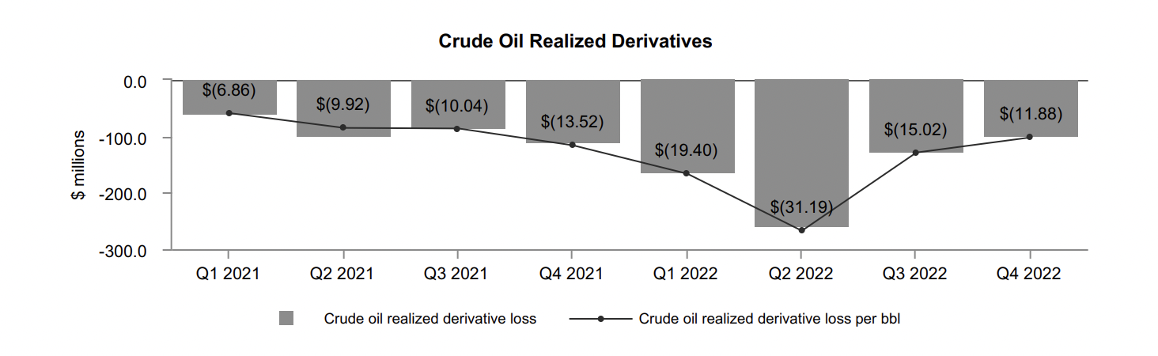
HEDGING
Notes:
近期derivative还是亏，但是我们公司不是靠derivative，我们用derivative hedging，所以这个公司income statement不significant，前面的income statement对比，不算太大的问题。

Slide 75
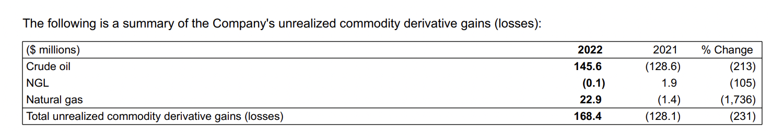
HEDGING
Notes:
For the year ended December 31, 2022, the Company recognized a total unrealized derivative gain of $168.4 million on its commodity contracts compared to a total unrealized derivative loss of $128.1 million in 2021.证明这部分derivative可以hedge风险，发现2022高风险，可以赚钱，risk高公司亏损可以用部分derivative 的profit去弥补

Slide 76
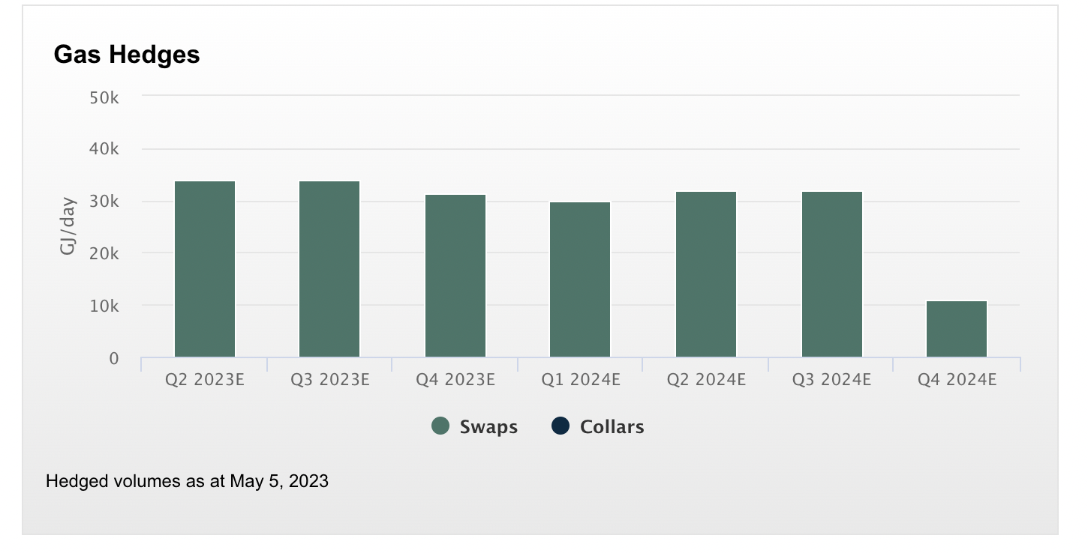

OIL & LIQUID & GAS HEDGE
Notes:
这是derivative的combination去hedgeCrescent Point strives to manage the risks associated with the oil and gas industry and to provide long-term stability to its cash flow. To accomplish this, we maintain a strong balance sheet with significant unutilized lines of credit.
We actively hedge commodity prices using a portfolio of swaps, collars and put option instruments.

Slide 77


Slide 78

Notes:
The Company's operating netback for the year ended December 31, 2022 increased significantly to $62.94 per boe from $42.43 per boe in 2021. The increase in the Company's operating netback was primarily due to the increase in average selling price, partially offset by higher royalties and the increases in operating and transportation expenses. The increase in the Company's netback was a result of the increase in the operating netback, partially offset by an increased realized loss on commodity derivatives

Slide 79

FINANCIAL INSTRUMENTS

Slide 80

FINANCIAL INSTRUMENTS

Slide 81

Critical Accounting Estimates

Slide 82

Critical Accounting Estimates

Slide 83

COMMODITY SENSITIVITY ANALYSIS
Notes:
Crude oil会受到commodity price影响大，受影响比较大，所以公司会放更多derivative在这部分，主营业务是oil

Slide 84

CURRENCY SENSITIVITY ANALYSIS
Notes:
说明加拿大base公司，也会在美国运油，也会看到加币和美元变化对这些产生大影响，发现currency swap可以很好规避风险，可以看到currency swap可以很好规避，net一下等于0

Slide 85

EQUITY RISK

Slide 86
INTEREST RATE RISK ANALYSIS
Notes:
固定利率，没有floating rate debt，公司在这部分没有任何风险

Slide 87

CREDIT RISK ANALYSIS

Slide 88

LIQUIDITY RISK

Slide 89


Slide 90



Methanex Key People

Slide 91

Current Stock Price

Slide 92

Operation
Canada, USA, Egypt, Trinidad and Tobago, New Zealand and Chile

Slide 93

Demand and Supply Dynamics

Slide 94

Demand

Slide 95

Supply

Slide 96

Financial Instruments

Slide 97

Fair Value

Slide 98

Production

Slide 99

Revenue per Location

Slide 100

Methanol Production

Slide 101

Cost Structure

Slide 102

Methanol Value chain

Slide 103

Financial Highlights

Slide 104

Balance Sheet Assets

Slide 105

Balance Sheet Liabilities

Slide 106

Note 10

Slide 107

Note 19
The Company uses derivatives as part of its risk management program to mitigate variability associated with changing market values. Changes in the fair value of derivative financial instruments are recorded in earnings unless the instruments are designated as cash flow hedges, in which case the changes in fair value are recorded in other comprehensive income and are reclassified to profit or loss or accumulated other comprehensive income (loss) when the underlying hedged transaction is recognized in earnings or inventory. The Company designates as cash flow hedges certain derivative financial instruments to hedge its risk exposure to fluctuations in natural gas prices and to hedge its risk exposure to fluctuations on certain foreigncurrency-denominated transactions.

Slide 108

Balance Sheet Equity

Slide 109

Income Statement

Slide 110

Cash Flows from Operating Activities

Slide 111

Cash Flows from Financing Activities

Slide 112

Cash Flows from Investing Activities

Slide 113


Derivative Usage

Slide 114

Natural Gas Forward Contracts

Slide 115

Forward Exchange Contracts

Slide 116

Cash Outflows for Derivative Hedging

Slide 117

Level 3 instrument sensitivities

Slide 118


Methanol and Natural Gas Price Risk

Slide 119

Foreign Currency Risk

Slide 120


Liquidity Risk

Slide 121

Trade Credit Risk

Slide 122

Production Risk

Slide 123

Technological Risk

Slide 124

Reputational Risk

Slide 125

Thank you for watching!

