Slide 1

ROYAL BANK OF CANADA
Tiantian (Sara) Wang
Xinyue (Maggie) Zou
Yiting (Tina) Zhou
Yihua (Fiora) Liu
Notes:
Hello everyone. Our group is going to talk about royal bank of Canada. Here are my teammates, Sara, Maggie and Fiora.

Slide 2
AGENDA
Industry Overview
Overview of RBC
Analysis of financial statements
Major risks of RBC (Micro, Macro….
Risk management structure of RBC
Risk management strategy
Notes:
Here is our agenda for this presentation. First, we will talk about the industry overview and overview of RBC. And then we will analysis its financial statements and start to discuss what are major risks of RBC. Lastly, we will discuss its risk management and structure.

Slide 3
INDUSTRY OVERVIEW
Notes:
So, Let’s have an overview of Canadian banks industry.

Slide 4

INDUSTRY OVERVIEW
Structure of the Industry. Banks Operating in Canada
30 Domestic Banks
24 Foreign Bank Subsidiaries
28 foreign bank branches
4 Lending Banks
Notes:
This slide provides a brief overview of the industry. We can see how many banks operate in Canada so that we can better understand the position of RBC among them. As you can see, there are 30 domestic banks that operate in Canada, 24 foreign bank subsidiaries, 28 foreign bank branches, and 4 lending banks. Now we will proceed to discussing who the leaders of the industry are and what share of the market they hold.

Slide 5
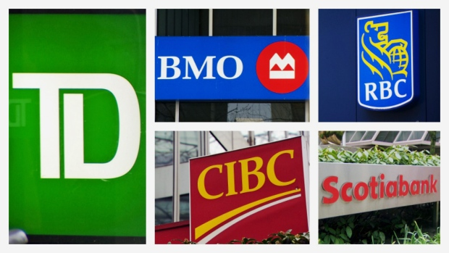
INDUSTRY OVERVIEW
Structure of the Industry
Top Five Banks in Canada
by Market Capitalization (March 15, 2018)
Royal Bank of Canada(RBC)-$147.63B
Toronto-Dominion Bank(TD Bank)-$140.32B
Bank of Nova Scotia(Scotiabank)-$98.36B
Bank of Montreal(BMO)-$63.65B
Canadian Imperial Bank of Commerce(CIBC)-$52.10B
Notes:
This slide shows what the top five banks in Canada by Market Capitalization are. RBC is on top of the list with the over hundred and forty seven billion dollars capitalization. It is followed by TD, Toronto dominion bank with hundred and forty billion dollars capitalization, Bank of Nova Scotia, Scotiabank with ninety-eight billion dollars capitalization, Bank of Montreal, BMO, and CIBC, Canadian Imperial Bank of Commerce with sixty-three and fifty-two billion dollars capitalization accordingly. The bank that our group will be discussing today, RBC is the top Canadian bank by market capitalization.

Slide 6

INDUSTRY OVERVIEW
Structure of the Industry :Major Players
Royal Bank of Canada – 20.6%
Toronto-Dominion (TD) Bank – 21.9%
Canadian Imperial Bank of Commerce (CIBC) – 16.4%
Scotiabank – 14.1%
Bank of Montreal – 13.4%
Notes:
On this slide we can see the share of the market held by each of the leaders of the industry. Royal Bank of Canada has over twenty per cent of market for banking and financial services. TD is the leader of the sector with almost twenty-two percent share; CIBC holds sixteen per cent of the market; Scotiabank and BMO hold fourteen and thirteen per cent accordingly. As we can see, RBC is not the most popular bank in Canada, but its market share is very close to that of the leader of the industry, TD. I will further show the market dynamics so that we can see trends in the growth of banks.

Slide 7
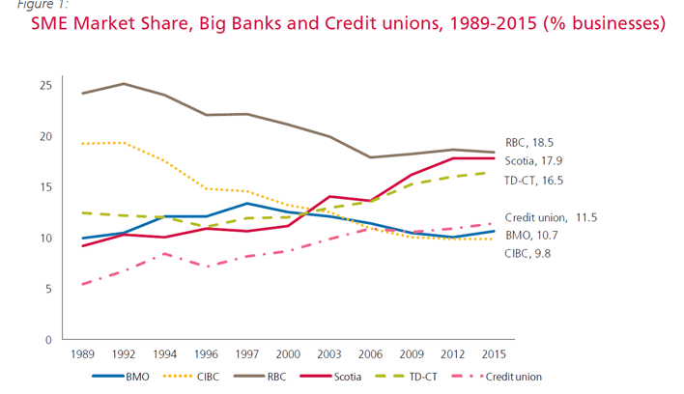
INDUSTRY OVERVIEW
Structure of the Industry. Market Dynamics.
Canadian Banks Market Shares
RBC earned the highest revenue in the industry
Notes:
This slide shows the market trends in the banking industry from nineteen eighty nine to twenty fifteen. As you can see, RBC used to be a non-negotiable leader of the industry in nineteen eighty nine and gradually gave up its share of the market to Scotiabank, Credit unions and TD, who together have an accumulated growth of over eighteen percent of the market. BMO has experienced an increase of their market share in the nineties, but overall preserved the share of ten percent. CIBC lost about half of their share during this period. If we remember the previous slide, RBC now has over twenty percent of the market share, which is two percent more than in twenty fifteen. Thus, we can say, that the bank is gradually restoring their position on the market.
I will further discuss what exactly brings profits to banks, and what they get their revenue from.

Slide 8
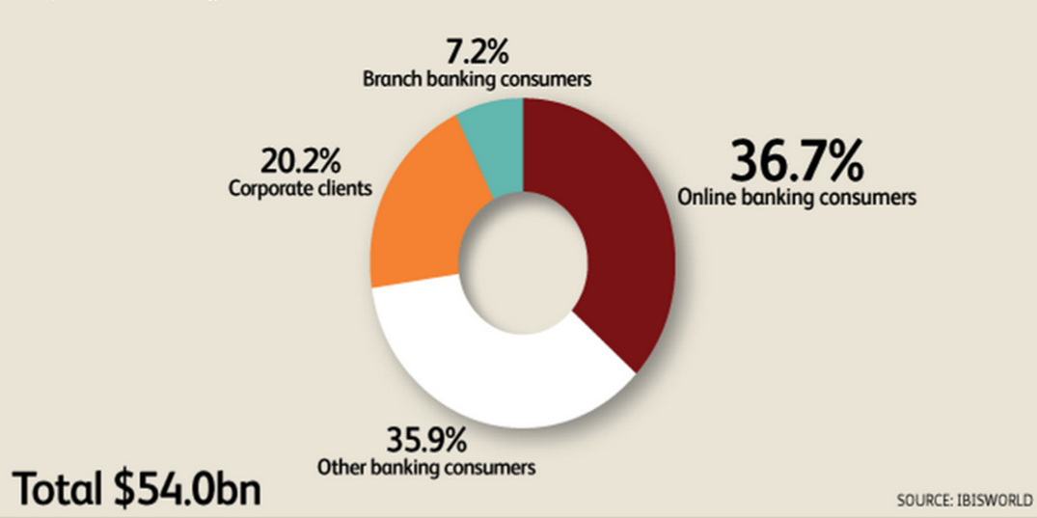
INDUSTRY OVERVIEW
Major Market Segmentation
Notes:
This slide provides insights into who the main clients of the banks are. Here we can see that banks currently get most profits from online banking consumers. Their contribution to banks’ profits constitutes over thirty six per cent. Corporate clients provide twenty per cent of the profits, and consumers in branches bring seven per cent of profits. Other banking consumers provide almost thirty six per cent of profits to banks. Unfortunately it is not specified who they are exactly. I will further go into detail about the structure of the banks’ revenue with respect to the products they produce.

Slide 9
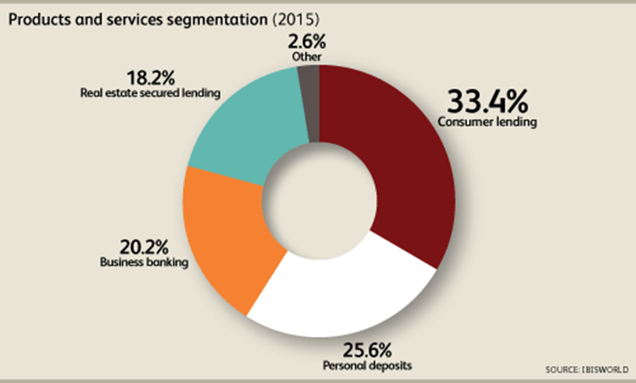
INDUSTRY OVERVIEW
Products and Services Segmentation:
Notes:
This slide shows how much revenue banks get from the services they provide and the products they produce. As this chart shows, banks get most of the profits by lending money to their customers. The second strand of their revenues is personal deposits from which they acquire more than twenty five percent of their profits. Besides, business banking brings them twenty per cent of profits, and real estate secure lending constitutes eighteen percent f their profits. Banks gain about three percent of their profits by providing other services and selling other products. We can remember this structure of revenues for the future when we look at the structure of revenue of RBC so that we can compare the two.

Slide 10
OVERVIEW OF RBC
Notes:
And now we will look more closely at RBC

Slide 11
OVERVIEW
Company Background
The largest bank in Canada, based on market capitalization
Operation in Canada, US and other 44 countries
Has over 80,000 employees Serving over 17.0 million clients
Notes:
Let’s start with some background information about RBC. As we have seen earlier, it is the largest bank in Canada, based on market capitalization. It operates in Canada, US and other 44 countries. RBC employs over 80,000 people and serves over 17.0 million clients.

Slide 12
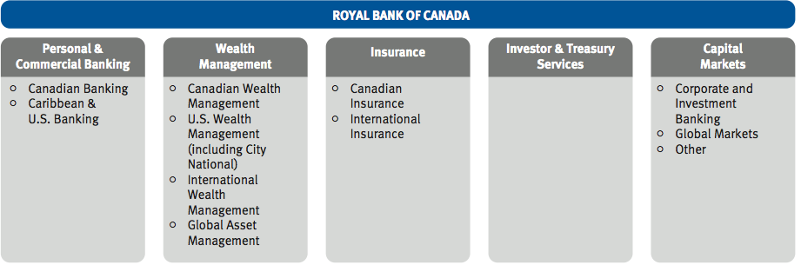
OVERVIEW
Products Being Produced. Major Products and Services. Locations
5 profit segment:
Personal & Commercial Banking
Wealth Management
Insurance
Investors and treasury services
Capital markets
Notes:
On this slide we can see the breakdown of the products and services the company provides by location. RBC gets profit from Personal & Commercial Banking in Canada, Caribbean and U.S.; from Wealth Management in Canada, U.S. and internationally; from Insurance in Canada and internationally; and from Capital markets internationally.

Slide 13
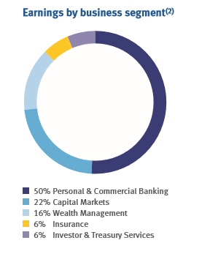
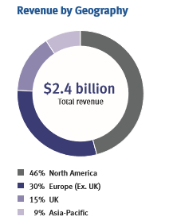
OVERVIEW
Firm Revenue Composition. Earnings
Notes:
On this slide we can see a breakdown of the profits by the segment and by location. Personal and commercial banking constitutes 50 % of the RBC revenue; Capital markets bring twenty two percent of the profits; RBC acquires sixteen percent from Wealth management; and si per cent from both insurance and investor and treasury services.
As for the revenue by location, the most profitable region for RBC is North America with forty six per cent of profits it brings to the bank; Europe without UK brings thirty percent of the profits, UK – fifteen; 9 percent come from the Asia-Pacific region.

Slide 14
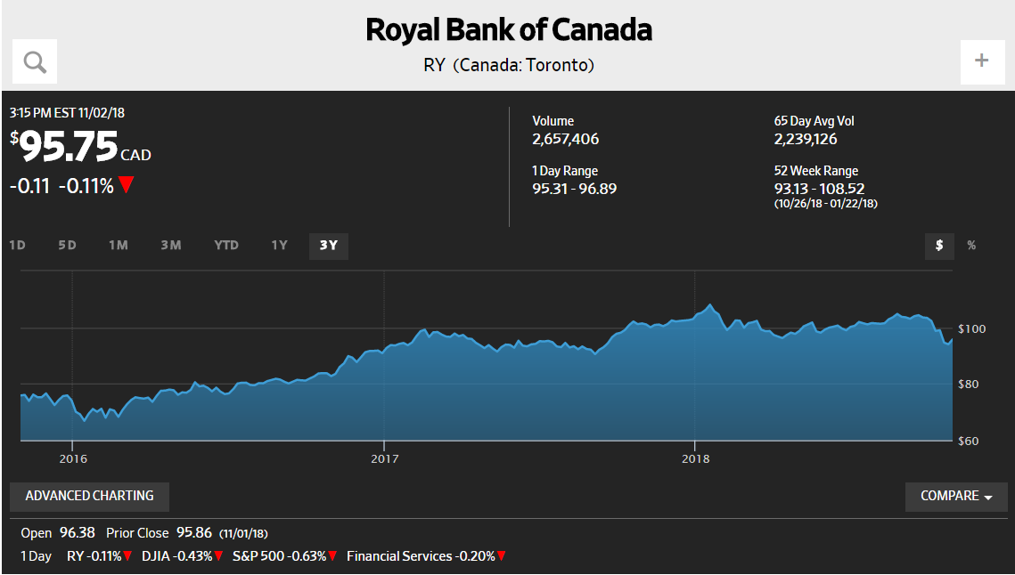
OVERVIEW
Stock Trend
Notes:
This slide addresses the price trend of the RBC stocks. On Nov 2, 2018, one share cost ninety five dollars and seventy-five cents.

Slide 15
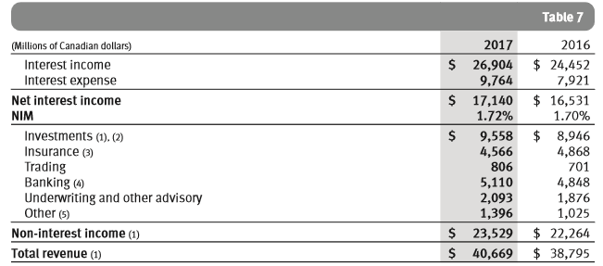
OVERVIEW
Firm Revenue Structure. Total revenue
Notes:
This graph shows a more detailed revenue structure of RBC. Here we can see the exact profits that the company makes from each of the sectors. Total revenues from interest and non-interest income amount to forty thousand six hundred sixty nine millions of Canadian dollars dollars in 2017 which is 5 percent more than in 2016. Net interest income is composed from income from investments, insurance, trading, banking, advisory, and other. As we can see all of the sectors experienced growth in 2017 as compared to 2016.

Slide 16
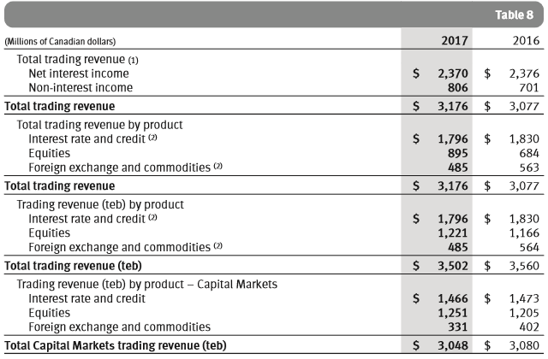
OVERVIEW
Additional trading information
Notes:
p20

Slide 17
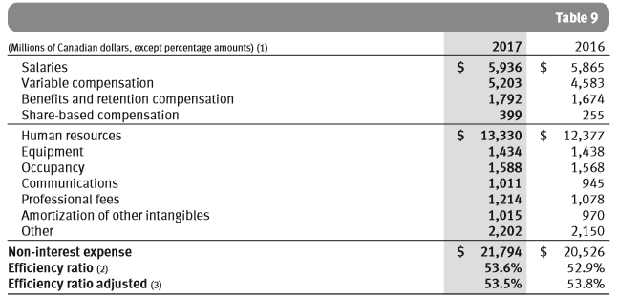
OVERVIEW
Non-interest expense
Notes:
Now we will see the breakdown of the expenses of the company. RBC spent around twenty two thousand millions for such operation related costs as salaries, human resources, equipment, variable compensations, benefits, etc. These expenses increased in 2017 as compared to 2016 due to the increase in severance pay. At the same time the company decreased its efficiency ratio which is explained by the increase in staff related costs.

Slide 18
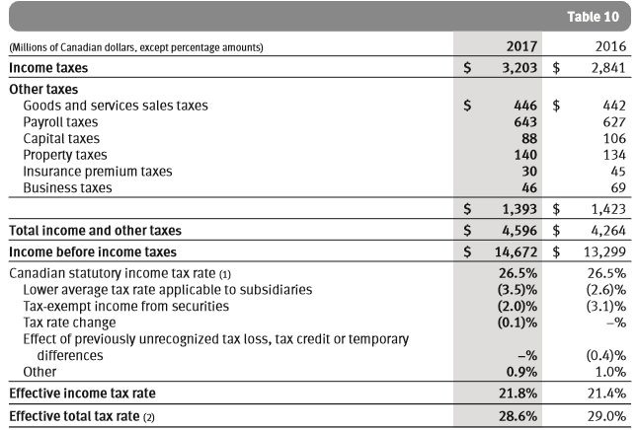
OVERVIEW
Income and other taxes

Slide 19



OVERVIEW
Firm Strategy. Mission, Goals & Objectives
To be among the world’s most trusted and successful financial institutions
 | Goals | Objectives
In Canada: | To be the undisputed leader in financial services | Maintain position as market leader and grow by targeting key client segments
In the U.S.: | To be the preferred partner to corporate, institutional and high net worth clients and their businesses | Use City National Bank (acquired 2015) as a platform for long-term growth and opportunity to build deeper client relationships
In select global financial centers: | To be a leading financial services partner | Focus on key operational hubs in Asia, the U.K., Europe, and the Caribbean
Mission
Notes:
This slide demonstrates the overarching goals that RBC strives to accomplish. The bank plans to developing to such an extent that they can secure their position among the world’s most trusted and successful financial institutions. They plan to become leaders in the industry in Canada, a reliable and preferred partner in the U.S. and to be a leading financial services partner in select global financial centers. I will further discuss in detail how exactly they plan to reach their goals.

Slide 20
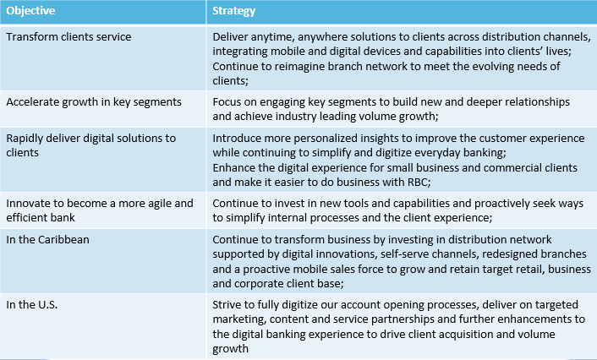
OVERVIEW
Stated Objectives for Future Growth
Notes:
On this slide I want to go in more detail about the growth goals stated by RBC and the strategies they are planning to implement to reach them. RBC stated growth objectives for 2018 based on the progress made in 2017. The bank mostly relies on the enhancement of the quality of the services they provide to grow. They intend to become a more desirable bank for clients to choose because of the easiness and convenience of working with them. They intend to do so by investing in technology. For example, the main goal they stated is transforming clients service. You can see it on top of the table on this slide. Their strategy for reaching this objective is to integrate more digital and mobile devices to meet the evolving needs of clients. This can be pointed out as their overarching goal because it repeats in other goals they state for themselves. For example, in their goals to rapidly deliver digital solutions to clients and to innovate to become a more agile and efficient bank. They plan to simplify and to digitize everyday banking to reach these goals and to continue to invest in new tools and capabilities to simplify internal processes and client experience.
Their strategies for reaching growth goals abroad also rely on innovation. For example, in order to increase sales in the Caribbean they will be targeting clients with mobile sales. In the U.S. they also plan to digitize their sales processes to make their marketing more targeted. They also plan to invest in further enhancement of digital banking.
The only goal that is not technology oriented is the goal to accelerate growth in key segments by building deeper relationships.
Overall, it can be said that RBC will continue to invest in technological innovation to support their growth and retain the existing client base by enhancing their experience with bank products.
In the concluding part I will deal with the regulatory structure of the company.

Slide 21
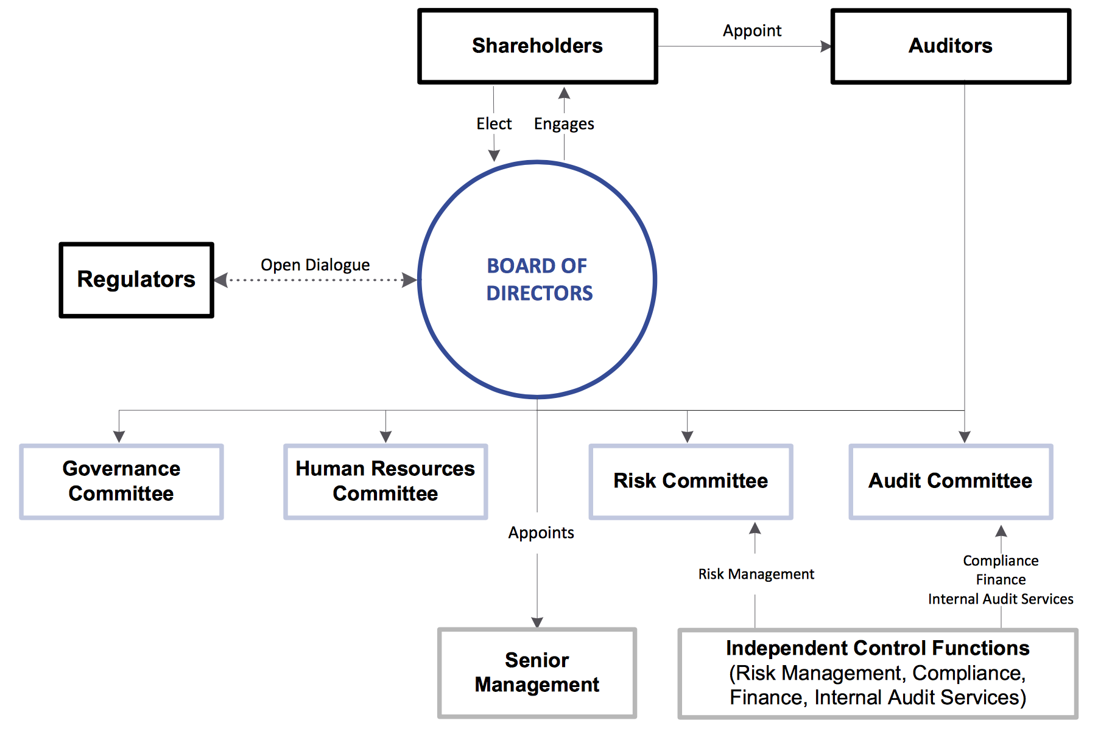
OVERVIEW
Corporate Governance Structure
Notes:
In order to understand the regulatory structure, let’s look at the graph describing the corporate governance structure of RBC. It is governed by the board of directors elected by shareholders.
Board of directors composes governance committee, human resources committee, risk committee, and audit committee. The latter is also composed of the auditors appointed by shareholders.
In order to secure open operation of the company board of directors engages in open dialogue with regulators. We will look at them more closely in the following slides.

Slide 22


OVERVIEW
Management Team
David McKay
President & Chief Executive Officer
Appointed president on Feb. 16, 2014 and CEO on Aug. 1, 2014
Responsible for banking business in Canada, the US and the Caribbean
MBA from the University of Waterloo and honorary Doctor of Laws degree from Ryerson University
Rod Bolger
Chief Finance Officer
Joint RBC in 2011
Responsible for setting the overall strategic direction of RBC
Graduate of Georgetown University in Washington D.C. and MBA from Columbia University
Notes:
Here we can see the president and the chief finance officer of RBC. They are responsible for banking business in Canada, the US and the Caribbean and for for setting the overall strategic direction of RBC accordingly.

Slide 23


OVERVIEW
Management Team
Graeme Hepworth
Chief Risk Officer
Joint RBC in 1997 and appointed CRO in 2018
Responsible for overseeing the strategic management of risk on an enterprise-wide basis
Qualified Chartered Financial Analyst and has a Masters in Mathematics from the University of Waterloo.
Jennifer Tory
Chief Administrative Officer
Providing leadership and oversight of transformational initiatives and focus on how the enterprise works together to further RBC’s success
ICD.D designation at Rotman School of Management
Notes:
Chief risk officer and chief administrative officer we can see on this slide are responsible for overseeing the strategic management of risk on an enterprise-wide basis and for providing leadership and oversight of transformational initiatives and focus on how the enterprise works together to further RBC’s success accordingly.

Slide 24
OVERVIEW
Regulatory Environment
RBC assesses the regulatory environment as favorable although, at the same time encourages to bear the risks imposed by the possibility of new laws in mind.
Overall, regulatory environment is more favorable in Canada than in the U. S.
It allows Canadian banks to generate high profits due to entry restrictions.
Complex overseeing organs prevent Canadian banks from engaging in high risks which makes it desirable for clients to work with these banks
RBC monitors laws and prepares for the possible effects of new legislature in case it is adopted.

Slide 25
FINANCIAL STATEMENT ANALYSIS

Slide 26
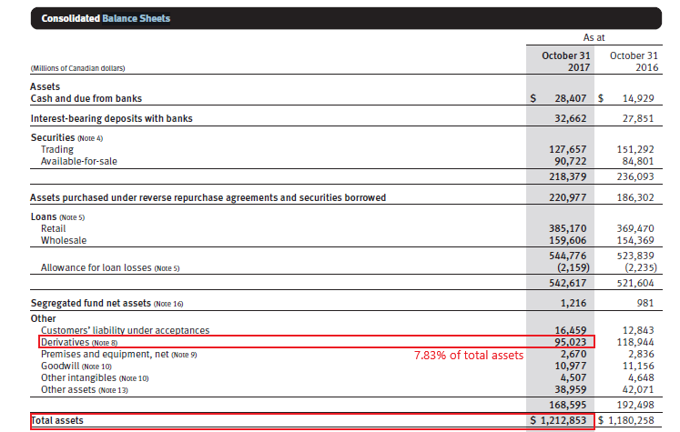
FINANCIAL ANALYSIS
Balance Sheet

Slide 27
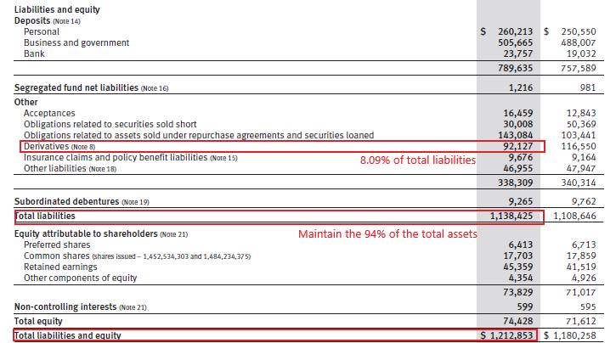
FINANCIAL ANALYSIS
Balance Sheet Cont.

Slide 28
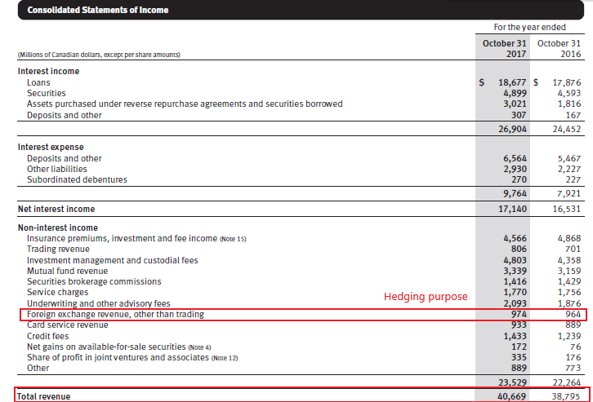
FINANCIAL ANALYSIS
Income Statement

Slide 29
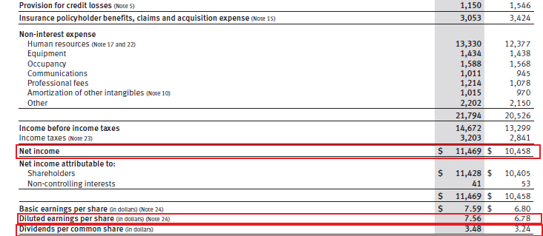
FINANCIAL ANALYSIS
Income Statement Cont.

Slide 30
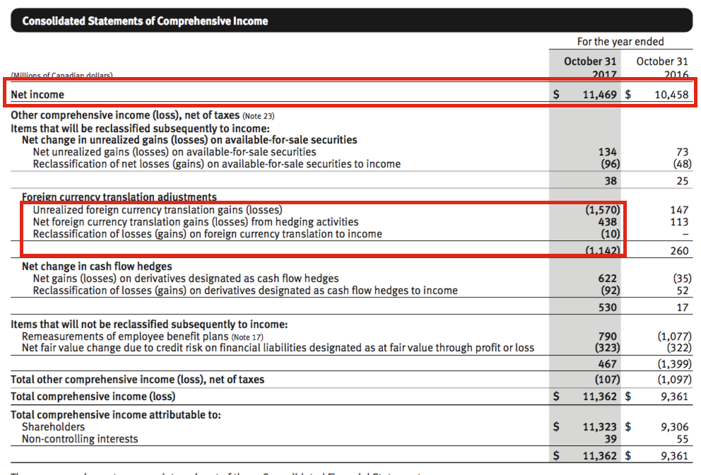
FINANCIAL ANALYSIS
Comprehensive Income

Slide 31
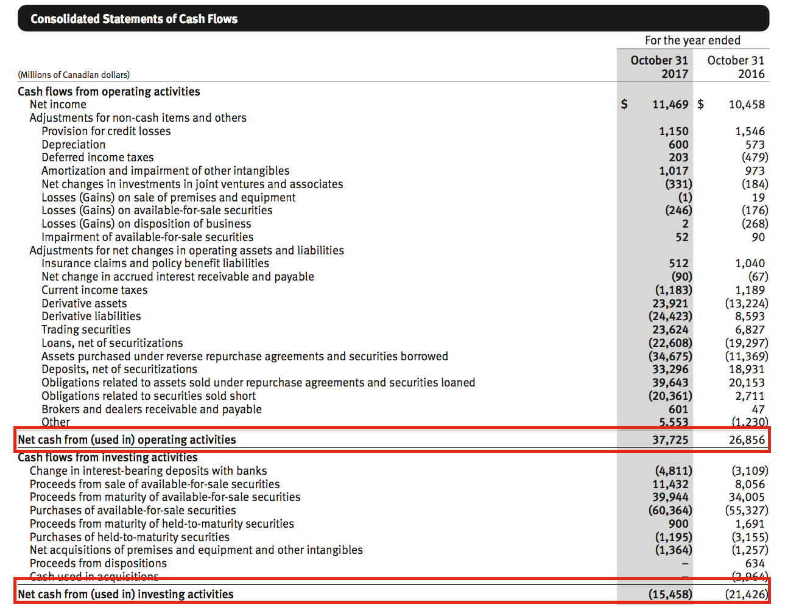
FINANCIAL ANALYSIS
Cash Flows

Slide 32
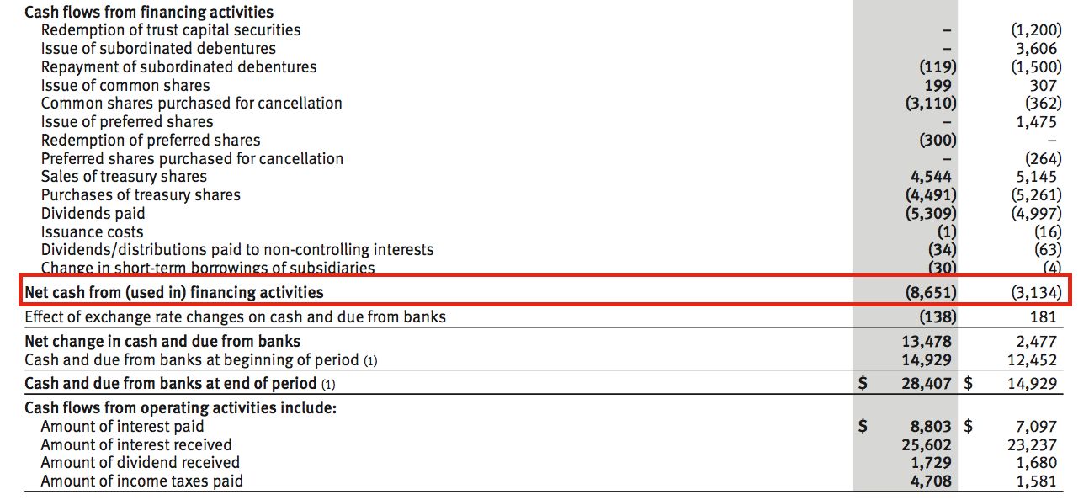
FINANCIAL ANALYSIS
Cash Flows Cont.
Net cash flow $13,616

Slide 33
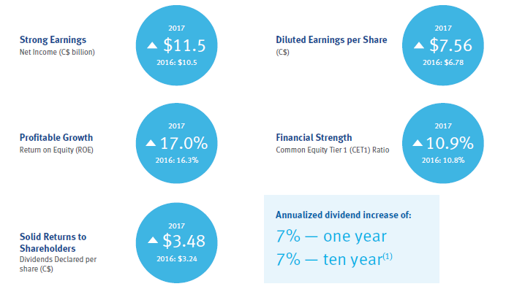
FINANCIAL ANALYSIS
Growth and Strength

Slide 34
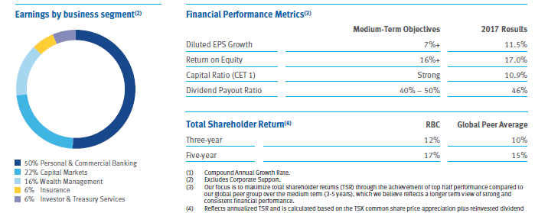
Notes:
For shareholders, this number indicates that RBC is a good investment.

Slide 35
Major Risks of RBC

Slide 36

Major Risks and Control
Main Risks of RBC
Credit Risks
Market Risks
Liquidity and Funding Risks
Insurance Risks
Operational Risks

Slide 37
Major Risks and Control
GEMENT STRUCTURE
Credit Risks: Managed by 3 Lines of Defence
Risk of loss associated with an obligor’s potential inability or unwillingness to fulfill its contractual obligations on a timely basis.
Primary Obligors (Direct)
Issuer
Debtor
Counterparty
Borrower
Policyholder
Secondary Obligors (Indirect)
Guarantor
Reinsurer

Slide 38
Major Risks and Control
Credit Risks Measurement
Quantifies obligors’ and portfolio’s credit risks to help control expected losses and minimize losses that are unexpected
2 Principal Approaches
Internal Ratings Based Approach (IRB) – mostly used
Standardized Approach
3 Key Parameters
Probability of default (PD) – Chances that an obligor of a specific rating would default over a specific time horizon
Exposure at default (EAD) – amount obligor is expected to owe at time of default
Loss given default (LGD) – estimate of amount of EAD that is unrecoverable

Slide 39
Major Risks and Control
Credit Risks – Wholesale Risk
Wholesale Credit Rating System
measure the credit risk inherent in wholesale credit activities.
How to work?
Borrower Risk Rating (BRR)
PD

Slide 40
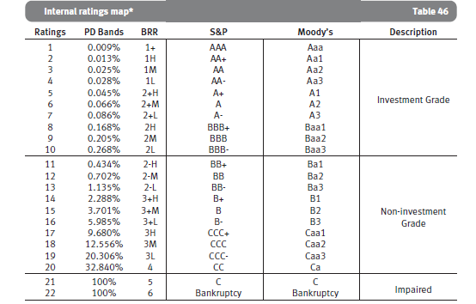
Major Risks and Control
Credit Risks – Wholesale Risk

Slide 41

Major Risks and Control
Credit Risks – Counterparty Risk & Wrong-way Risk
Counterparty Risk
Risk that the bank undertakes because of the possibility that the “other” party who had agreed to a contract with the bank defaults on their contractual obligations
Normally occurs during the trading of financial (options, forwards, swaps, futures and non-financial (commodities) derivative securities
Wrong-way Risk
“Risk that exposure to a counterparty or obligor is adversely correlated with the credit quality of that counterparty”
2 Types
Specific Wrong-way Risk
General Wrong-way Risk

Slide 42
Major Risks and Control
Credit Risks – Retail Risk
Credit Scoring is the primary risk rating system used when acquiring new clients and managing existing clients.
Retail Exposure risk is quantified on a pooled basis using following criteria:
Behavioural Score,
Product Type (Mortgages, Credit Cards)
Collateral Type (Liquid Assets And Real Estate),
Loan-to-value
Utilization Rate
The Delinquency Status of the Exposure

Slide 43
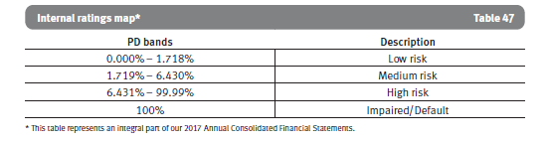
Major Risks and Control
Credit Risks – Retail Risk
Our retail risk rating system is two-dimensional, whereby assessment of internal ratings is based both on PD, which is a borrower risk dimension, and on LGD, which is a facility-specific risk dimension.

Slide 44

Major Risks and Control
Framework for Controlling Credit Risk
Credit Risk Approval
Product approval
Credit limits
Credit Risk Mitigation
Structuring of Transactions
Collateral
Credit Risk Administration
Credit provisioning and allowances
Loan forbearance

Slide 45
Major Risks and Control
Gross Credit Risk Exposure
Gross credit risk exposure is calculated based on the definitions provided under the Basel III framework.
Trading-related credit
Repo-style transactions
Repurchase and Reverse Repurchase
Securities Lending and Borrowing transactions
Derivative amount
Replacement Cost plus Add-on
Lending-related and other
Loans and acceptances outstanding
Undrawn Commitments
Contingent Liabilities (letters of credit and guarantees)
Available-for-sale (AFS) debt securities and deposits
Notes:
credit assessment 之前

Slide 46
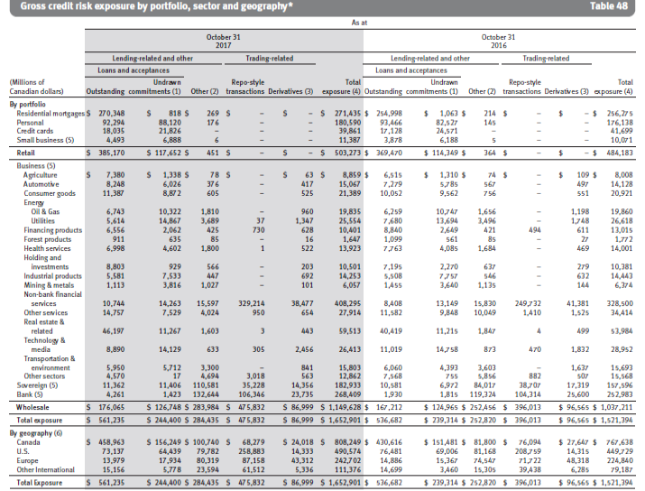
Major Risks and Control

Slide 47
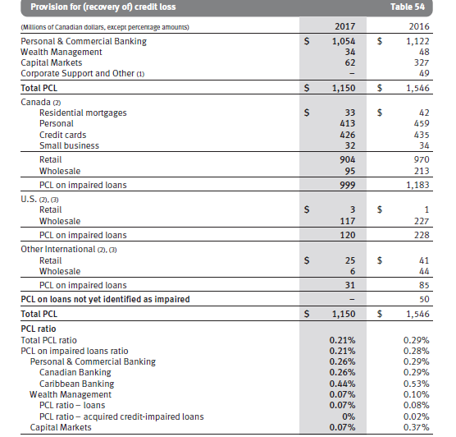
Major Risks and Control
Provision for Recovery of Credit Loss (PCL)
2017 vs 2016
Total PCL increased by 26% ($396 mil)
PCL in Personal & Commercial Banking decreased $68 million or 6%
PCL in Wealth Management decreased $14 million
PCL in Capital Markets decreased $265 million
PCL in Corporate Support and Other decreased $49 million

Slide 48
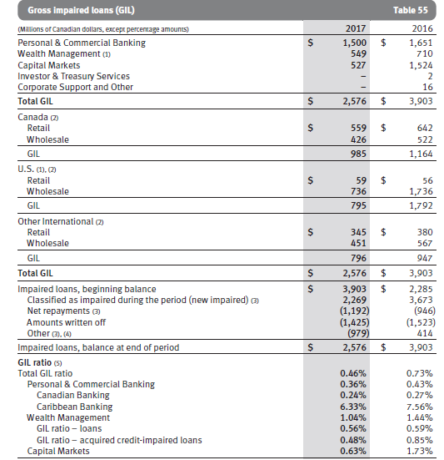
Major Risks and Control
Gross Impaired Loans (GIL)
2017 vs 2016
Total GIL decreased by 34% ($1,327 million)
GIL in Personal & Commercial Banking decreased $151 million or 9%
GIL in Wealth Management decreased $161 million
GIL in Capital Markets decreased $997 million

Slide 49
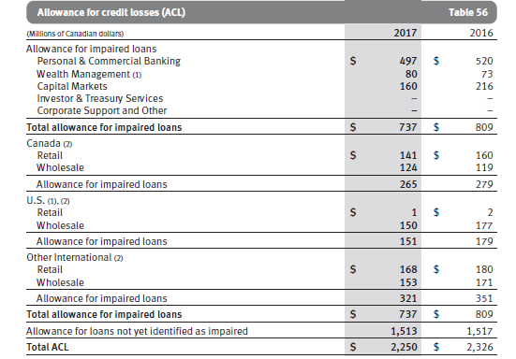
Major Risks and Control
Allowance for Credit Losses (ACL)
2017 vs 2016
Total ACL decreased by 3% ($76million)
Personal & Commercial Banking ACL decreased by $23 million
Total Allowance for Impaired Loans decreased by $72million

Slide 50

Major Risks and Control
Market Risk – What’s it?
Defined as the degree that changes in market prices can affect potential gains or losses
These changes in market price can be associated with changes in
Interest Rates
Credit Spreads
Equity Prices
Commodity Prices
Foreign Exchange Rates
Implied Volatilities
Notes:
p68 market risk definition

Slide 51
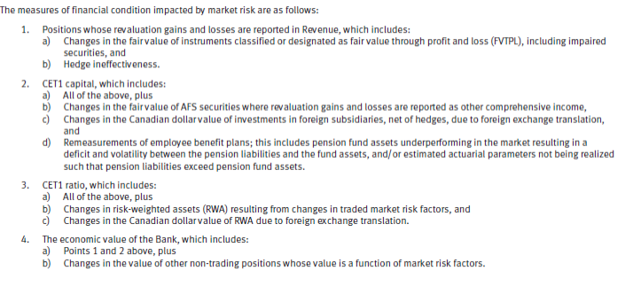
Major Risks and Control
Market Risk – How to Measure?

Slide 52
Major Risks and Control
Market Risk Controls
Value-at-Risk (VaR) for RBC
Statistical measure: quantifies the financial risk of individual and portfolio of potential loss for a financial portfolio computed at a given level of confidence and over a defined holding period
Measured at 99% confidence level
Updated daily with current risk positions
Stressed Value-at-Risk (SVaR)
Same as VaR, but it is measured over a fixed historical one year period
Stress Tests

Slide 53
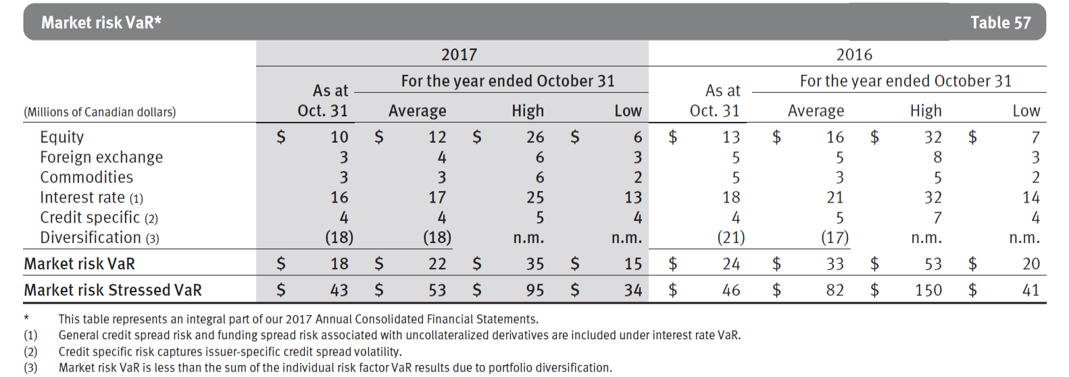
Major Risks and Control
VaR and SVaR

Slide 54
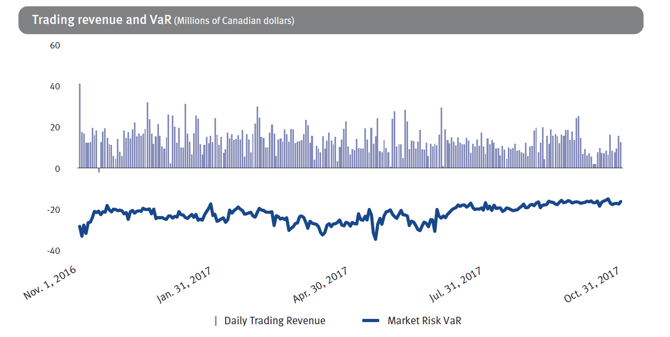
Major Risks and Control
Trading Revenue and VaR (CAD Millions)

Slide 55
Major Risks and Control
Liquidity and Funding Risk
Definition:
Risk of the inability to timely and cost-effectively generate cash and cash equivalents to meet financial commitments as they come due
Risk Control
Review and update objectives, policies, and strategies regularly
Ensure that Liquidity Risk is within the limits of the risk appetite statements
Stress Testing
Notes:
75

Slide 56
Major Risks and Control
Liquidity and Funding Risk
Measured based on the following 3 categories:
Structural Liquidity Risk (Long term)
Internal metric to focus on structure alignment
Tactical Liquidity Risk (Shorter term)
Use short-term net cash flow limits and stress testing
LCR
Contingency Liquidity Risk
Arising from sudden stressful events.
Liquidity contingency plan & Liquidity Crisis Team
Stress tests: elements of scenario & sensitivity analyses

Slide 57
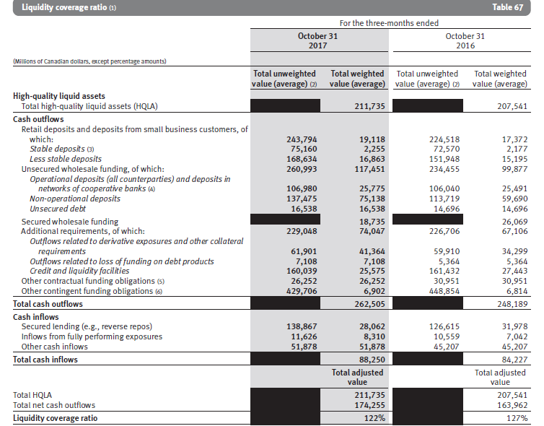
Major Risks and Control
Liquidity Coverage Ratio (LCR)
”LCR is a Basel III metric that measures the sufficiency of High Quality Liquid Assets available to meet liquidity needs over a 30-day period”

Slide 58

Major Risks and Control
Insurance Risk
Definition:
“potential financial loss that may arise where the amount, timing and frequency of benefit payments under insurance and reinsurance contracts are different than expected”
Insurance Risk Framework is used to identify, assess, manage and report on the various insurance risks that the organization faces
4 Insurance sub-risk: Morbidity, Mortality, Longevity,
Travel risk

Slide 59
Major Risks and Control
Operational Risk
Definition:
“Risk of loss or harm resulting from people, inadequate or failed internal processes and systems or from external events”
Operational Risk Framework
Internal Events
External Events
Business Environment and Internal Control Factors (BEICF) Assessments
Scenario analysis
BEICF monitoring

Slide 60
Major Risks and Control
Operational Risk
Factors That Can Significantly Impact Results:
Information Technology and Cyber Risk
Third-party Risk
Processing And Execution Risk
Fraud Risk
Model Risk

Slide 61

Major Risks and Control
Other Risks
Regulatory Compliance Risk
Strategic Risk
Reputation risk
Legal and regulatory environment risk
Competitive Risk
Macroeconomic risk drivers
Systemic Risk

Slide 62
RISK MANAGEMENT STRUCTURE

Slide 63
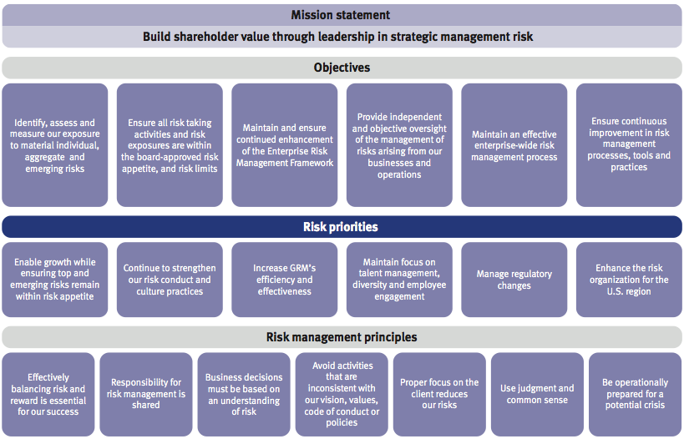
RISK MANAGEMENT STRUCTURE

Slide 64
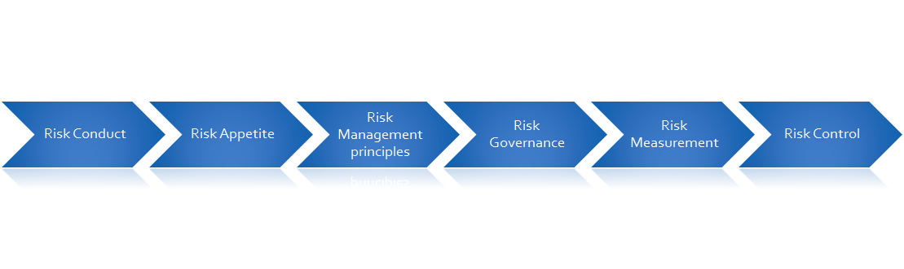
RISK MANAGEMENT STRUCTURE
Enterprise Risk Management Framework
Risk Governance
Risk Appetite
Risk Conduct and Culture
Risk Measurement
Risk Control

Slide 65
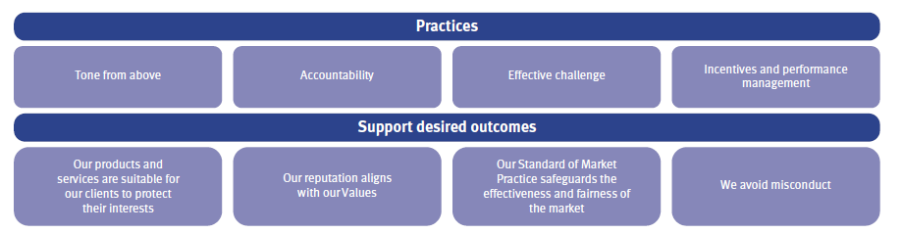
RISK MANAGEMENT STRUCTURE
Risk conduct and culture
RBC defines risk conduct and culture as a shared set of behavioural norms that sustain their core values and enables them to proactively identify,understand and act upon risks, thereby protecting clients, safeguarding shareholders’ value, and supporting the integrity, soundness and resilience of financial markets.
Established core set of policies and values that must followed to control corporate risk and help achieve favourable results:

Slide 66
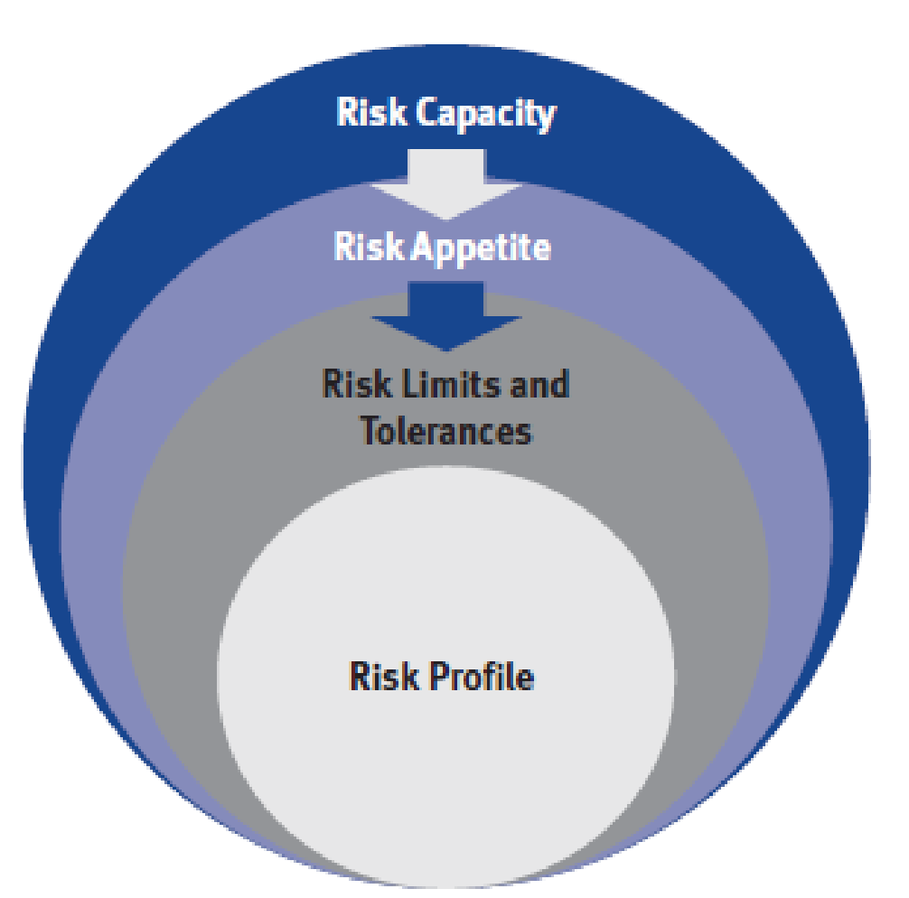
RISK MANAGEMENT STRUCTURE
Risk Appetite
Risk appetite is the amount and type of risk that RBC is able and willing to accept in the pursuit of their business objectives.

Slide 67
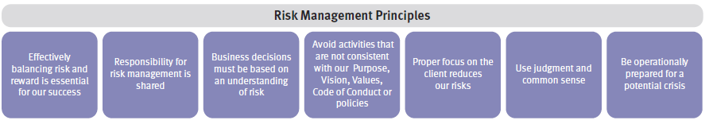
RISK MANAGEMENT STRUCTURE
Risk Management Principles

Slide 68
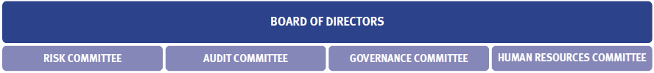
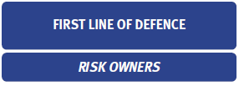
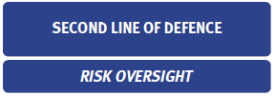
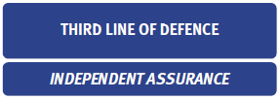
RISK MANAGEMENT STRUCTURE
Risk Governance

Slide 69
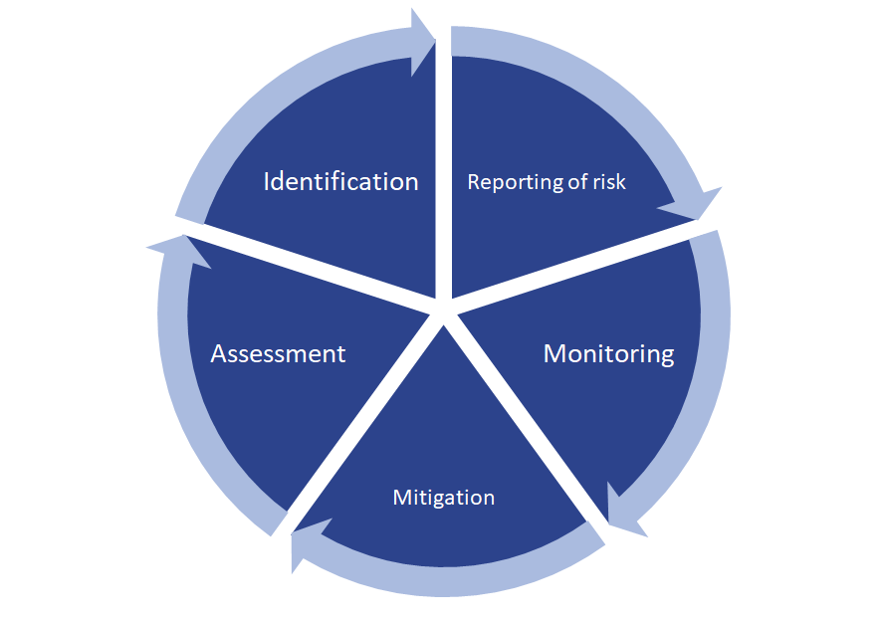
•
RISK MANAGEMENT STRUCTURE
Risk Governance

Slide 70
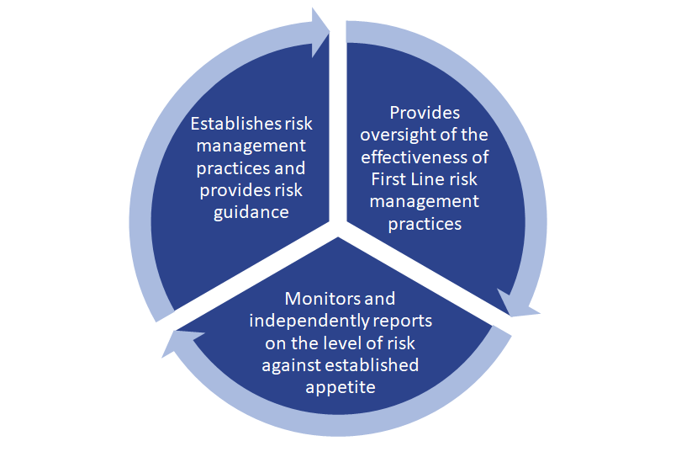
RISK MANAGEMENT STRUCTURE
Risk Governance

Slide 71
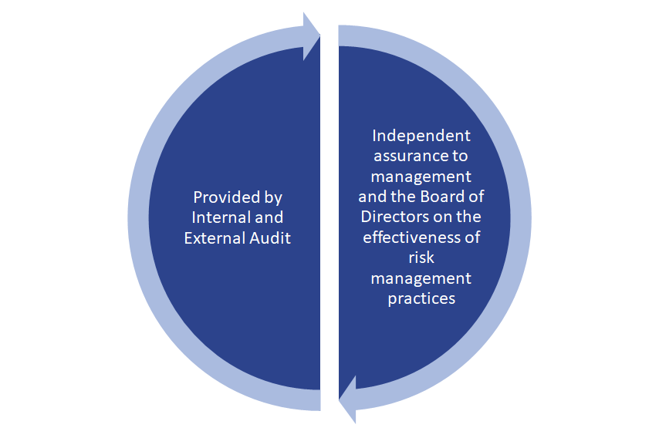
RISK MANAGEMENT STRUCTURE
Risk Governance

Slide 72
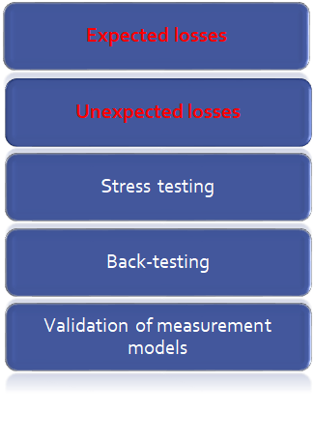
RISK MANAGEMENT STRUCTURE
Risk Measurement
•Expected losses: Losses that are statistically expected to occur in the normal course of business in a given period of time. (Earning at risk)
•Unexpected losses: Losses that are statically estimated of the amount by which actual losses
can exceed expected losses. (Capital at risk)
•Unexpected = Actual - Expected

Slide 73
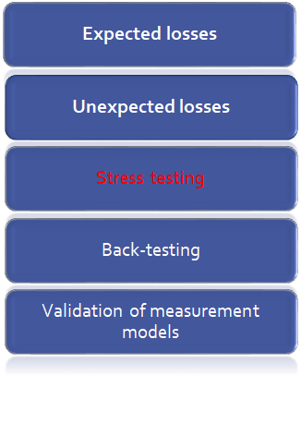
RISK MANAGEMENT STRUCTURE
Risk Measurement
Stress testing: Examines potential impacts arising from adverse events.
•Ongoing enterprise-wide stress tests
•Risk specific stress testing programs
•Ad-hoc stress tests
•Reverse stress tests

Slide 74
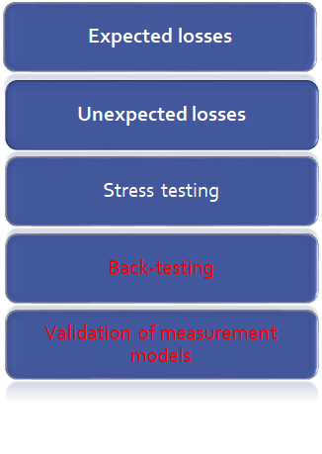
RISK MANAGEMENT STRUCTURE
Risk Measurement
Back-testing: Ensure the credit risk parameters remain appropriate for use in capital calculations
•Preformed by comparing the realized value to beginning estimates
Validation of measurement models:
•Ensure the model incorporate current market developments and industry trends
•Ensure that all material underlying model
risk are identified and mitigated

Slide 75
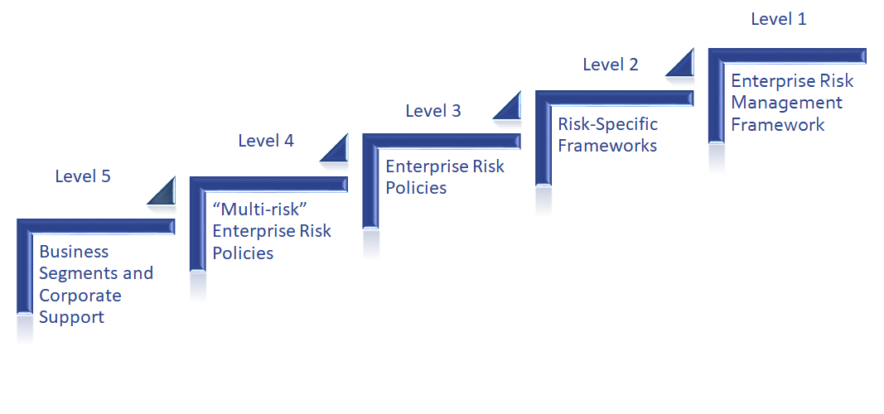
RISK MANAGEMENT STRUCTURE
Risk Control: Optimize Risk and Return
The enterprise-wide risk management approach is supported by a comprehensive set of risk controls. The risk management frameworks and policies are organized into the following five levels:

Slide 76
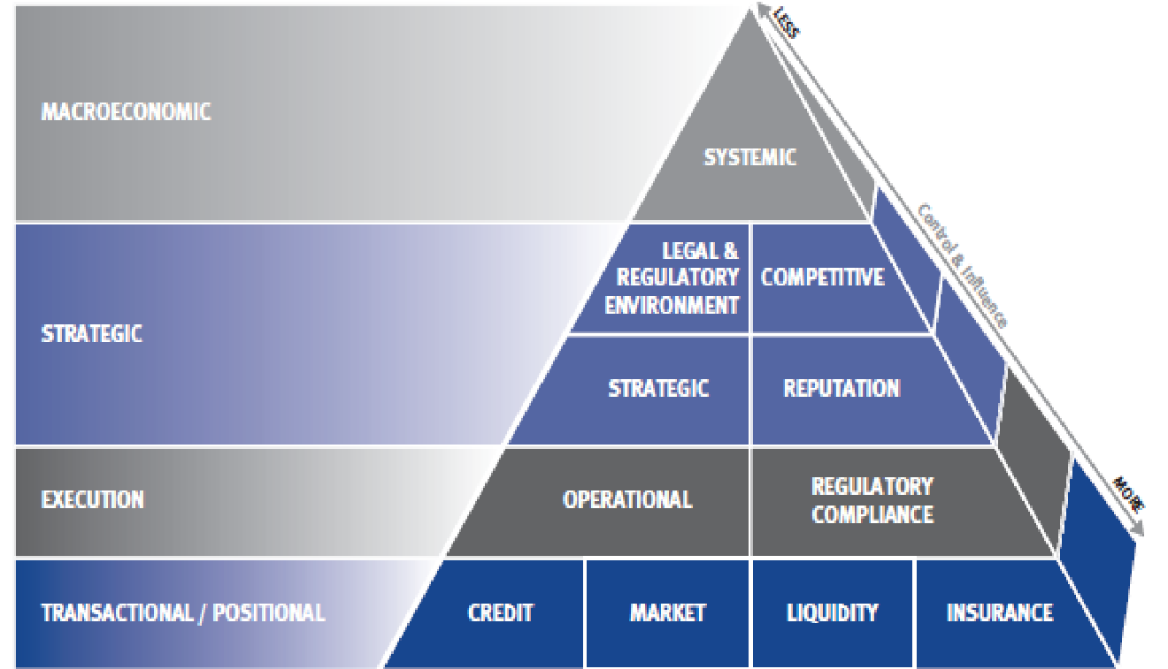
RISK MANAGEMENT STRUCTURE
Risk Pyramid: Identifies and Categorizes Risks

Slide 77
RISK MANAGEMENT STRATEGIES

Slide 78
RISK MANAGEMENT STRATEGIES
Derivatives Instrument
Financial Derivatives: Financial contracts whose value is derived from an underlying interest rate, foreign exchange rate, credit risk, and equity.
Non-financial Derivatives: Contracts whose value is derived from precious metal and commodity derivative contracts in both OTC and exchange markets.

Slide 79
RISK MANAGEMENT STRATEGIES
Derivatives Issued for Trading Purposes
Sales Activities: include the structuring and marketing of derivative products to clients to enable them to transfer, modify or reduce current or expected risks.
Trading Activities
Market-making
Positioning
Arbitrage activities

Slide 80

RISK MANAGEMENT STRATEGIES
Derivatives Issued for Hedging
Interest rate swaps
Cross currency swaps
Foreign exchange forward contracts
Credit derivatives

Slide 81

RISK MANAGEMENT STRATEGIES

Slide 82

RISK MANAGEMENT STRATEGIES
Derivatives – Related to Credit Risk
Generated by the potential for the counterparty to default on its contractual obligations when the transactions have a positive market value
Represented by the positive fair value of the instrument
Normally a small fraction of the contract’s notional amount

Slide 83
Thank You !

