Slide 1

Royal Bank of Canada
Notes:
,

Slide 2


Agenda
Industry Overview
Regulations
Overview of RBC
Financial Statement Analysis
Risk Management Structure
Major Risks of RBC
Risk Management Strategies

Slide 3
Industry Overview

Slide 4

Industry Overview: Canadian Banking System
Chartered banks
Trust and loan companies
Cooperative credit movement
Life insurance companies
Securities dealers
Notes:
The banking system in Canada groups financial institutions into five main categories: chartered banks, trust and loan companies, the cooperative credit movement, life insurance companies, and securities dealers. There are approximately 29 domestic banks, 24 foreign bank subsidiaries, 27 full service foreign bank branches, and three foreign bank lending branches. Combined, these institutions manage more than C$4.6 trillion in assets. Banks account for more than 70 percent of the total assets of the Canadian financial services sector, with the 5 largest domestic banks accounting for more than 90 percent of the banking industry’s assets. The 5major banks have a significant presence outside Canada in areas such as the United States, Latin America, the Caribbean, and Asia.

Slide 5
Industry Overview
29 Domestic Banks
24 Foreign Bank Subsidiaries
27 Full Service Foreign Banks Branches
3 Foreign Bank lending Branches

Slide 6

Industry Structure
Top Five Bank in Canada (Market Cap)
Royal Bank of Canada $150.261B
Toronto-Dominion Bank $140.625B
Bank of Nova Scotia $83.82B
Bank of Montreal $63.046B
Canadian Imperial Bank of Commerce $47.549B

Slide 7
Industry Structure : Major Player

Slide 8
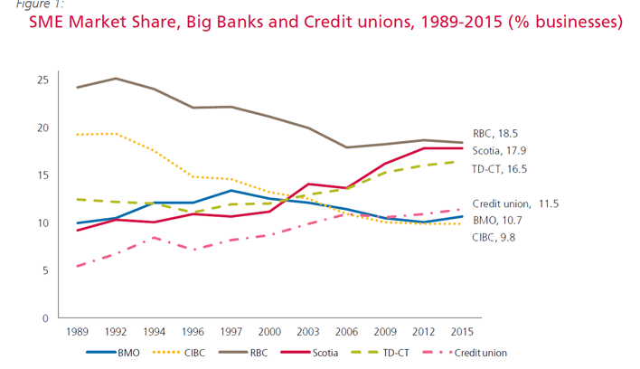
Dynamic Change of Market Shares
Notes:
CFIB has been tracking small- and mid-sized entrerprises (SME) bank market share over the last few decades. While there are differing definitions of market share, CFIB offers a unique perspective on the relative dominance of the financial institutions in the SME segment, namely by the number of businesses.
Although Royal Bank still retains its first place position, it has lost significant ground over the last few decades. Bank of has also been on the decline since 1997 but gained slightly in market share from 2012 to 2015. In contrast, Scotiabank and TD Canada Trust have crept up to second and third place as market share leaders over the last few decades. Credit unions have slowly gained market share over the years, growing from 5.5% in 1989 to 11.5% of total SME bank market share (see Figure 1). From 2000 to 2015 (see Table 1), significant declines occurred across select banks, namely CIBC (-3.5 percentage points), Royal Bank (-2.7 percentage points), and Bank of Montreal (-1.9 percentage points). Since 2000, Scotiabank boosted its market share by 6.7 percentage points while TD Canada Trust increased its market share by 4.4 percentage points. Credit unions gained 2.8 percentage points in market share

Slide 9
Regulation

Slide 10




Basel
3 series of banking regulation
Basel I, II & III
Basel Committee on Bank Supervision (BCBS)
Banking Regulation – Capital Risk, Market Risk & Operational Risk
Ensure enough capital on account
Developed in the beginning 1980s
Notes:
The Basel Accords are three series of banking regulations (Basel I, II, and III) set by the Basel Committee on Bank Supervision (BCBS). The committee provides recommendations on banking regulations, specifically, concerning capital risk, market risk, and operational risk. The accords ensure that financial institutions have enough capital on account to absorb unexpected losses. The Basel Accords were developed over several years beginning in the 1980s.

Slide 11
Basel I - Basel Accord
Issued in 1988
Capital adequacy of financial institutions
five risk categories (0%, 10%, 20%, 50% and 100%)
Risk weight of 8% or less.
Notes:
The first Basel Accord, known as Basel I, was issued in 1988 and focused on the capital adequacy of financial institutions. The capital adequacy risk (the risk that an unexpected loss with hurt a financial institution), categorizes the assets of financial institutions into five risk categories (0%, 10%, 20%, 50% and 100%). Under Basel I, banks that operate internationally are required to have a risk weight of 8% or less.

Slide 12
Basel II - Revised Capital Framework
Update of the original accord
Initially published in 2004 – built on the work of Basel I, especially in the areas of risk and capital
Improve the way regulatory capital requirements reflect underlying risks
Address the financial innovation that had occurred in recent years
Aimed at rewarding and encouraging continued improvements in risk measurement and control
Focus on:
Minimum capital requirements,
Supervisory review of an institution's capital adequacy,
Internal assessment process,
Effective use of disclosure as a lever to strengthen market discipline,
Encourage sound banking practices including supervisory review
Notes:
The second Basel Accord, called the Revised Capital Framework but better known as Basel II, served as an update of the original accord. It focused on three main areas: minimum capital requirements, supervisory review of an institution's capital adequacy and internal assessment process, and the effective use of disclosure as a lever to strengthen market discipline and encourage sound banking practices including supervisory review. Together, these areas of focus are known as the three pillars.
It initial publish in 2004 – Built on the work of basel !, especially in the areas of risk and capital. I tis designed to improve the way regulatory capital requirements reflect underlying risks and to Address the financial innovation that had occurred in recent years

Slide 13
Basel III - Continuation
Originally published in December 2010 in response to the global financial crisis and is expected to be phased in between 2013 and 2019
To strengthen the regulation, supervision and risk management of the banking sector
Raises both the quality and quantity of required regulatory capital bases
Improve the banking sector's ability to absorb shocks arising from financial and economic stress
Enhances the risk coverage of the Basel II capital framework to capture on- and off-balance sheet risks
Also strengthens the consistency and transparency of the capital base for commercial banks by defining and limiting the types of capital instruments they use
Notes:
In the wake of the Lehman Brothers collapse of 2008 and the ensuing financial crisis, the BCBS decided to update and strengthen the Accords. The BCBS considered poor governance and risk management, inappropriate incentive structures, and an overleveraged banking industry as reasons for the collapse. In November 2010, an agreement was reached regarding the overall design of the capital and liquidity reform package. This agreement is now known as Basel III.
Basel III is a continuation of the three pillars along with additional requirements and safeguards. For example, Basel III requires banks to have a minimum amount of common equity and a minimum liquidity ratio. Basel III also includes additional requirements for what the Accord calls "systemically important banks" or those financial institutions that are considered "too big to fail.”
It is use to to strengthen the regulation, supervision and risk management of the banking sector. Raises both the quality and quantity of required regulatory capital bases
Improve the banking sector's ability to absorb shocks arising from financial and economic stress
Enhances the risk coverage of the Basel II capital framework to capture on- and off-balance sheet risks
Also strengthens the consistency and transparency of the capital base for commercial banks by defining and limiting the types of capital instruments they use
The Basel Committee on Banking Supervision greed on the terms of Basel III in November 2010, and it was scheduled to be introduced from 2013 until 2015. Basel III implementation has been extended repeatedly, and the latest completion date is expected to be January 2022.

Slide 14
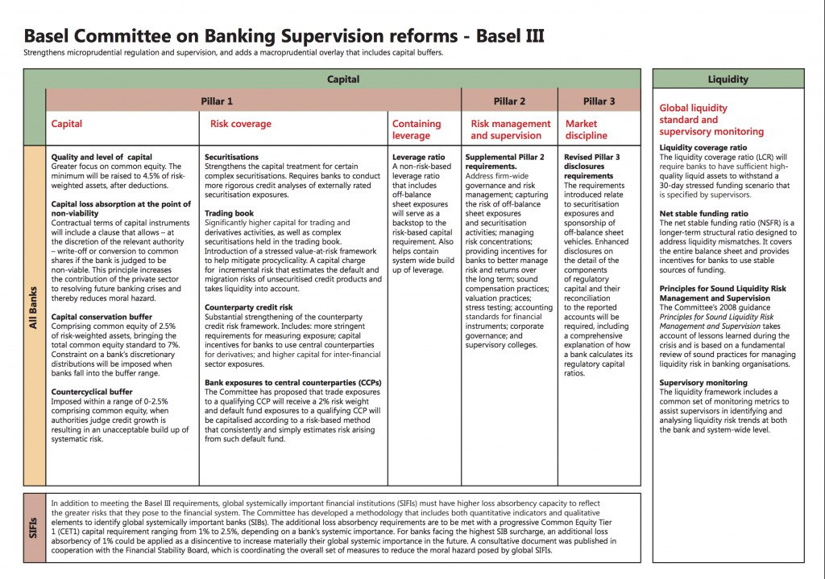

Slide 15
Tier 1 Capital
Refer to capital adequacy of a bank and refers to core capital that includes equity capital and disclosed reserves.
Equity capital is inclusive of instruments that cannot be redeemed at the option of the holder.
Common shares and non-cumulative, perpetual preferred shares would be compliant with the new rules
Used to calculation of the Tier 1 capital ratio => rate a financial institution’s capital adequacy.
Tier 1 Capital Ratio compares bank’s equity capital with its total risk-weighted assets (RWAS)
Notes:
Teir 1 capital is Used to calculation of the Tier 1 capital ratio which is use to rate a financial institution’s capital adequacy.
Core capital is composed primarily of disclosed reserves (also known as retained earnings) and common stock. It can also include noncumulative, nonredeemable preferred stock. Under the Basel Committee on Banking Supervision, which issued the Basel Accord, it was observed that banks utilize inventive instruments to accumulate tier 1 capital as well.
The Tier 1 Capital Ratio compares a bank’s equity capital with its total risk-weighted assets (RWAs). RWAs are all assets held by a bank that is weighted by credit risk. Most central banks set formulas for asset risk weights according to the Basel Committee’s guidelines.
The Tier 1 Capital Ratio compares a bank’s equity capital with its total risk-weighted assets (RWAs). RWAs are all assets held by a bank that is weighted by credit risk. Most central banks set formulas for asset risk weights according to the Basel Committee’s guidelines.

Slide 16
Tier 2 Capital
Includes hybrid capital instruments, loan-loss and revaluation reserves as well as undisclosed reserves.
The secondary component of bank capital
Will need to meet the minimum standard of being subordinated to depositors and general creditors and have an original maturity of at least five years
Subordinated debt issuances will not be compliant where they contain a step-up feature, other incentives to redeem, or provide for redemption in the first five years
Tier 1 capital + Tier 2 capital = reserve requirement 8% (6% Tier 1 Capital)
Notes:
Tier 2 capital is the secondary component of bank capital, in addition to Tier 1 capital, that makes up a bank's required reserves. Tier 2 capital is designated as supplementary capital and is composed of items such as revaluation reserves, undisclosed reserves, hybrid instruments, and subordinated term debt. In the calculation of a bank's reserve requirements,
Banks will need to meet the minimum standard of being subordinated to depositors and general creditors and have an original maturity of at least five years
Subordinated debt issuances will not be compliant where they contain a step-up feature, other incentives to redeem, or provide for redemption in the first five years
How Tier 2 Capital Works
Under the Basel Accords, a bank's capital is divided into Tier 1 core capital and Tier 2 supplementary capital. The minimum capital ratio reserve requirement for a bank is set at 8%; 6% must be provided by Tier 1 capital. A bank's capital ratio is calculated by dividing its capital by its total risk-based assets.

Slide 17
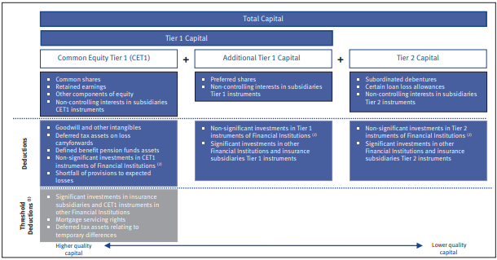
Tier 1 + Tier 2 Capital

Slide 18
Risk-Weighted Assets
Minimum amount of capital that must be held by banks and other institutions to reduce the risk of insolvency.
Capital requirement is based on a risk assessment for each type of bank asset.
For example, a loan that is secured by a letter of credit is considered to be riskier and requires more capital than a mortgage loan that is secured with collateral.
Banks Vs Regulatory
Bank assets are loans, regulators consider both the source of loan repayment and the underlying value of the collateral. A loan for a commercial building, for example, generates interest and principal payments based on lease income from tenants. If the building is not fully leased, the property may not generate sufficient income to repay the loan. Since the building serves as collateral for the loan, bank regulators also consider the value of the building itself.
Notes:
Risk-weighted assets are used to determine the minimum amount of capital that must be held by banks and other institutions to reduce the risk of insolvency. The capital requirement is based on a risk assessment for each type of bank asset. For example, a loan that is secured by a letter of credit is considered to be riskier and requires more capital than a mortgage loan that is secured with collateral.
Regulators consider several tools to assess the risk of a particular asset category. Since a large percentage of bank assets are loans, regulators consider both the source of loan repayment and the underlying value of the collateral. A loan for a commercial building, for example, generates interest and principal payments based on lease income from tenants. If the building is not fully leased, the property may not generate sufficient income to repay the loan. Since the building serves as collateral for the loan, bank regulators also consider the value of the building itself.

Slide 19
Risk-Adjusted Capital Ratio
Used to gauge a financial institution’s ability to continue functioning in the event of an economic downturn.
Measures the resilience of a financial institution's balance sheet, with an emphasis on capital resources, to endure a given economic risk or recession. The greater the institution's capital, the higher its capital ratio, which should translate to a higher probability that the entity will remain stable in the event of a severe economic downturn.
The higher the risk-adjusted capital ratio, the better the ability of the financial institution to withstand an economic downturn
Notes:
Risk-adjusted capital ratio is used to gauge a financial institution’s ability to continue functioning in the event of an economic downturn.
A risk-adjusted capital ratio measures the resilience of a financial institution's balance sheet, with an emphasis on capital resources, to endure a given economic risk or recession. The greater the institution's capital, the higher its capital ratio, which should translate to a higher probability that the entity will remain stable in the event of a severe economic downturn.
The higher the risk-adjusted capital ratio, the better the ability of the financial institution to withstand an economic downturn

Slide 20
Calculating Risk-Adjusted Capital Ratio
Figuring out the risk-adjusted capital ratio. Total adjusted capital is the sum of equity and near-equity instruments adjusted by their equity content.
Value of risk-weighted assets (RWA) is measured. The value of RWA is the sum of each asset multiplied by its assigned individual risk. This number is stated as a percentage and reflects the odds that the asset will retain its value, i.e., not become worthless.
It is calculated by dividing a financial institution's total adjusted capital by its risk-weighted assets (RWA).
Notes:
Determining the total adjusted capital is the first step in figuring out the risk-adjusted capital ratio. Total adjusted capital is the sum of equity and near-equity instruments adjusted by their equity content.
Next, the value of risk-weighted assets (RWA) is measured. The value of RWA is the sum of each asset multiplied by its assigned individual risk. This number is stated as a percentage and reflects the odds that the asset will retain its value, i.e., not become worthless.
It is calculated by dividing a financial institution's total adjusted capital by its risk-weighted assets (RWA).

Slide 21
RBC Overview

Slide 22


Overview
Founded in 1864 in Halifax, Nova Scotia
Largest Bank in Canada, Based on Market Capitalization ~ $150.261B
Operate In Canada, United States and other 44 courtiers.
Serve over 16 million clients
80,000 employee worldwide.
2011 – Largest Canadian Company by revenue and market Capitalization
Rank 50 in the 2013 Forbes Global 2000 Listing
Had US $673.2 Billion of Asset
Notes:
The Royal Bank of Canada is a Canadian multinational financial services company and the largest bank in Canada by market capitalization. The bank serves over 16 million clients and has 80,000 employees worldwide.^{[4]} The bank was founded in 1864 in Halifax, Nova Scotia
In 2011, RBC was the largest Canadian company by revenue and market capitalization.^{[7]} and was ranked at No. 50 in the 2013 Forbes Global 2000listing,^{[8]} The company has operations in Canada, and 40 other countries^{[9]}and had US$673.2 billion of assets under management in 2014.^{[10]}

Slide 23
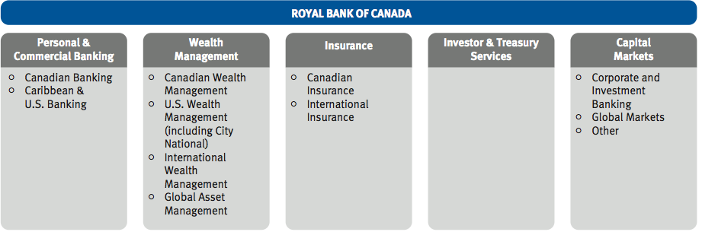
Financial Product & Services
Five profit segment:
Personal & Commercial Banking
Wealth Management
Insurance
Investors and treasury services
Capital markets

Slide 24
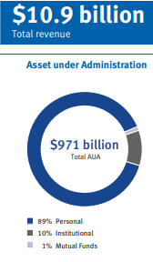
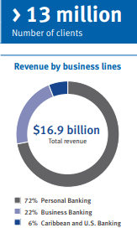
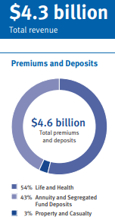
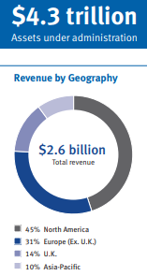
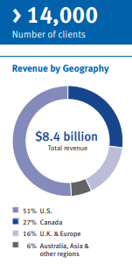
Wealth Management
Personal & Commercial Banking
Insurance
Investor & Treasury Services
Capital Market

Slide 25
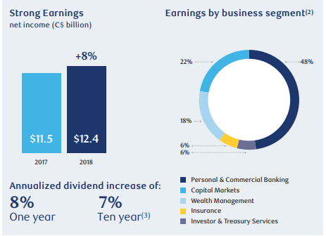
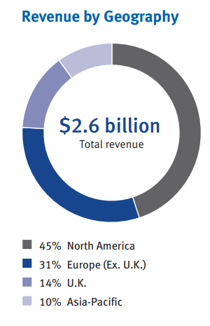

Slide 26

Management Team
Dave Mckay - CEO and President
Joined RBC in 1988
Education:
Bachelor of Mathematics from the University of Waterloo
MBA from the Richard Ivey School of Business at University of Western Ontario

Slide 27

Management Team
Rod Bolger – Chief Financial Officer
Joined RBC in 2011
Education:
Bachelor of Business Administration (Accounting) from Georgetown University in Washington, D.C.
MBA from the Columbia University in New York City

Slide 28

Management Team
Graeme Hepworth – Chief Risk Officer
Joined RBC in 1997
Education:
Certified Chartered Financial Analyst (CFA)
Masters in Mathematics from the University of Waterloo.

Slide 29

Management Team
A. Douglas McGregor – Group Head, RBC Capital Markets and RBC Investor & Treasury Services Chairman and CEO, RBC Capital Markets
Joined RBC in 1990
Education:
Bachelor of Business Administration from University of Western Ontario
MBA from the University of Western Ontario

Slide 30
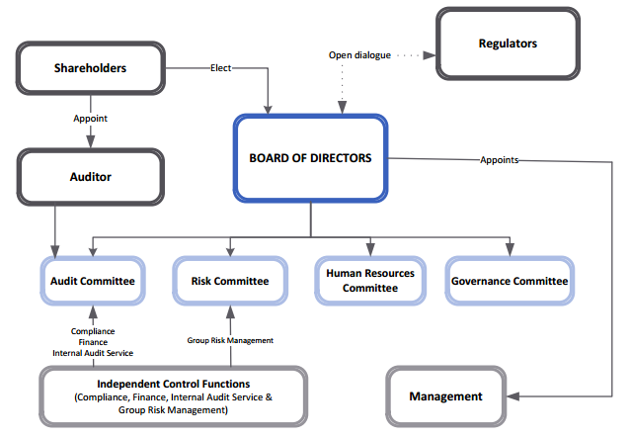

Corporate Governance Structure
Risk Committee’s Responsibilities
Oversee Risk management
Balance risk and rewards
Make recommendation to the board

Slide 31
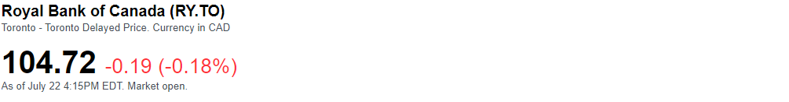
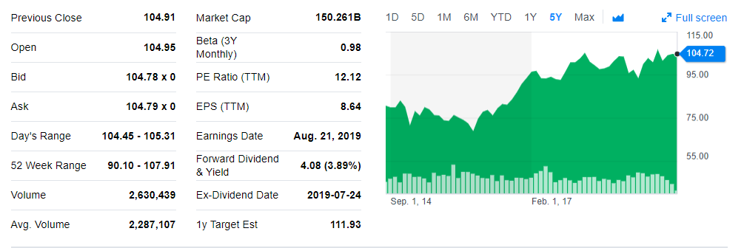
Stock Trend

Slide 32
Financial Analysis

Slide 33
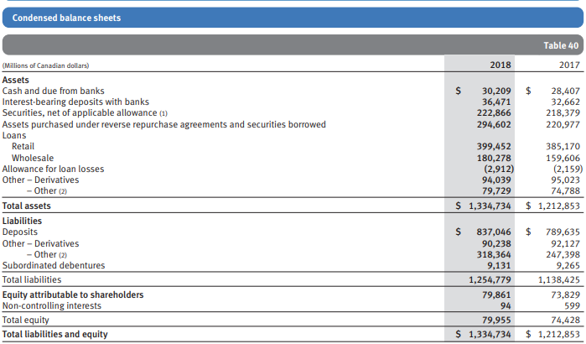
Balance Sheet
Notes:
Derivaties was decrease by -984 millions dollars. However, Total asset was increase by 121,881 million mostly because RBC has increae its over all Cash holding, security, assets purchased under reverse repurchase agreement etc

Slide 34
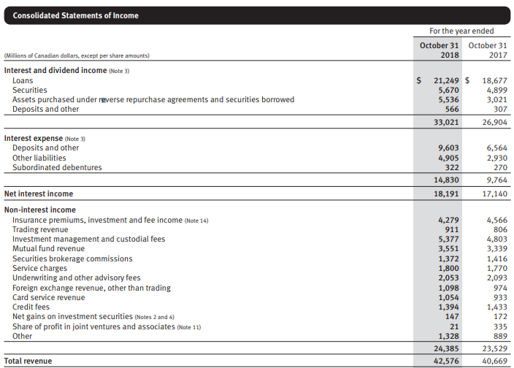
Income Statement
Hedging Purpose
Notes:
This graph shows a more detailed revenue structure of RBC. Here we can see the exact profits that the company makes from each of the sectors. Total revenues from interest and non-interest income amount to 42,576millions of Canadian dollars dollars in 2018 which is 5 percent more than in 2017. Net interest income is composed from income from investments, insurance, trading, banking, advisory, and other. As we can see all of the sectors experienced growth in 2018 as compared to 2017.

Slide 35
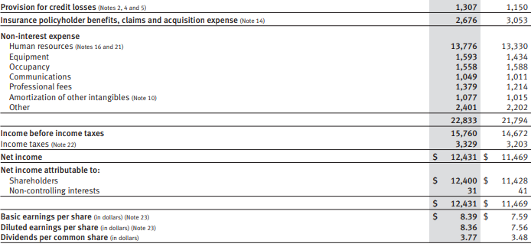
Income Statement Cont.

Slide 36
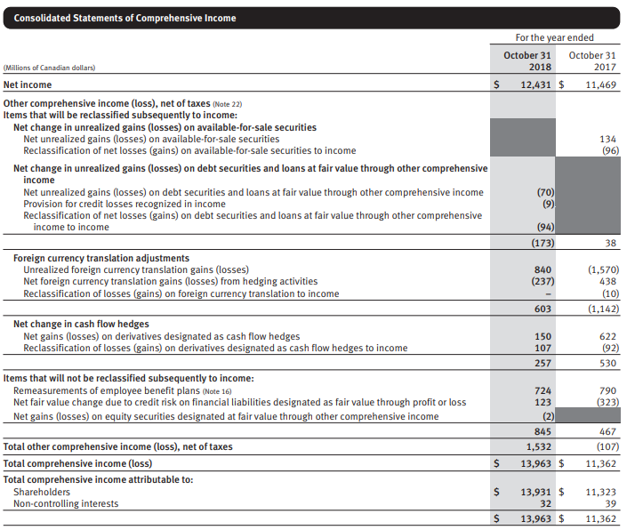
Comprehensive Income

Slide 37
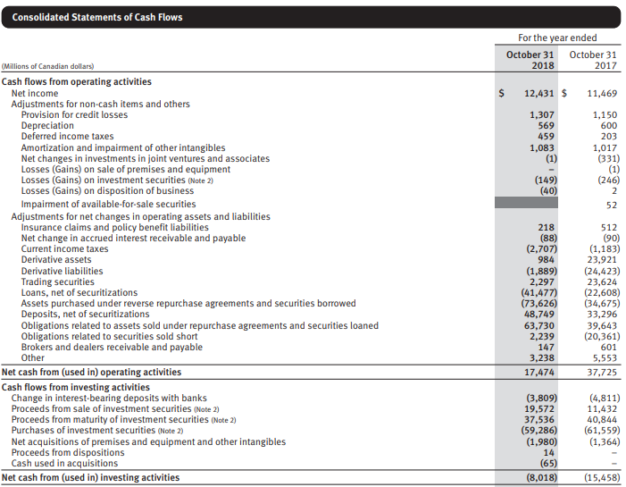
Cash Flows

Slide 38
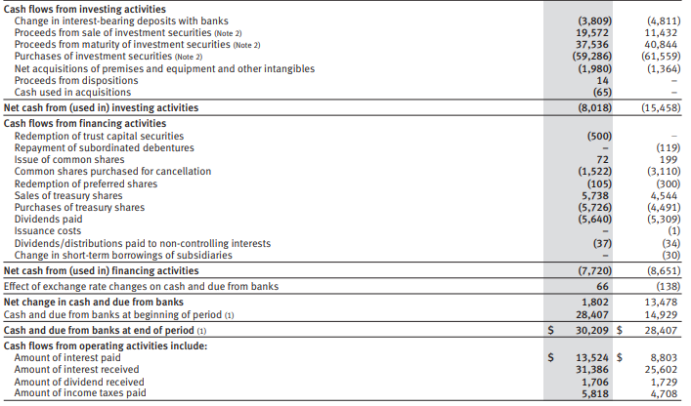
Cash Flows Cont.

Slide 39
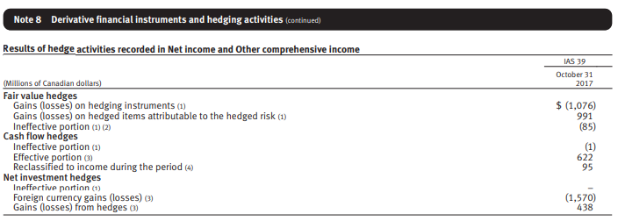
Derivative Income

Slide 40
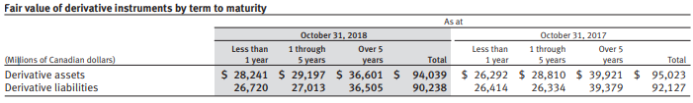
Fair Value of Derivative Instrument

Slide 41
Major Risks of RBC

Slide 42
Major Risks and Control
Major Principal Risks of RBC
Credit Risks
Market Risks
Liquidity and Funding Risks
Insurance Risks
Operational Risks
Regulatory Compliance Risks
Strategic Risks
Reputation Risks
Legal and Regulatory Environment Risks
Competitive Risks
Systemic Risks

Slide 43
Major Risks and Control
GEMENT STRUCTURE
Credit Risks: Managed by 3 Lines of Defense
Risk of loss associated with an obligor’s potential inability or unwillingness to fulfill its contractual obligations on a timely basis.
Primary Obligors (Direct)
Issuer
Debtor
Counterparty
Borrower
Policyholder
Secondary Obligors (Indirect)
Guarantor
Reinsurer
Notes:
. Credit risk may arise directly from the risk of default of a primary obligor (e.g., issuer, debtor, counterparty, borrower or policyholder), indirectly from a secondary obligor (e.g., guarantor or reinsurer), through off-balance sheet exposures, contingent credit risk and/or transactional risk. Credit risk includes counterparty credit risk from both trading and non-trading activities.

Slide 44
Major Risks and Control
Credit Risks Measurement
Quantifies obligors’ and portfolio’s credit risks to help control expected losses and minimize losses that are unexpected
Two Principal Approaches
Internal Ratings Based Approach (IRB) – mostly used
Standardized Approach
Three Key Parameters
Probability of default (PD) – Chances that an obligor of a specific rating would default over a specific time horizon
Exposure at default (EAD) – amount obligor is expected to owe at time of default
Loss given default (LGD) – estimate of amount of EAD that is unrecoverable

Slide 45
Major Risks and Control
Credit Risks – Wholesale Risk
Wholesale Credit Rating System
measure the credit risk inherent in wholesale credit activities.
How to work?
Borrower Risk Rating (BRR)
PD
Notes:
The wholesale credit risk rating system is designed to measure the credit risk inherent in our wholesale credit activities.

Slide 46
Major Risks and Control
Credit Risks – Wholesale Risk
Notes:
Each obligor is assigned a borrower risk rating (BRR), reflecting an assessment of the credit quality of the obligor. The BRR differentiates the riskiness of obligors and represents our evaluation of the obligor’s ability and willingness to meet its contractual obligations on time over a three year time horizon.
PD estimates are designed to be a conservative reflection of our experience across the economic cycle including periods of economic downturn

Slide 47
Major Risks and Control
Credit Risks – Counterparty Risk & Wrong-way Risk
Counterparty Risk
Risk that the bank undertakes because of the possibility that the “other” party who had agreed to a contract with the bank defaults on their contractual obligations
Normally occurs during the trading of financial (options, forwards, swaps, futures and non-financial (commodities) derivative securities
Wrong-way Risk
“Risk that exposure to a counterparty or obligor is adversely correlated with the credit quality of that counterparty”
2 Types
Specific Wrong-way Risk
General Wrong-way Risk

Slide 48
Major Risks and Control
Credit Risks – Retail Risk
Credit Scoring is the primary risk rating system used when acquiring new clients and managing existing clients.
Retail Exposure risk is quantified on a pooled basis using following criteria:
Behavioural Score,
Product Type (Mortgages, Credit Cards)
Collateral Type (Liquid Assets And Real Estate),
Loan-to-value
Utilization Rate
The Delinquency Status of the Exposure

Slide 49
Major Risks and Control
Credit Risks – Retail Risk
Our retail risk rating system is two-dimensional, whereby assessment of internal ratings is based both on PD, which is a borrower risk dimension, and on LGD, which is a facility-specific risk dimension.

Slide 50
Major Risks and Control
Framework for Controlling Credit Risk
Credit Risk Approval
Product approval
Credit limits
Credit Risk Mitigation
Structuring of Transactions
Collateral
Credit Risk Administration
Credit provisioning and allowances
Loan forbearance

Slide 51
Major Risks and Control
Gross Credit Risk Exposure
Gross credit risk exposure is calculated based on the definitions provided under the Basel III framework.
Trading-related credit
Repo-style transactions
Repurchase and Reverse Repurchase
Securities Lending and Borrowing transactions
Derivative amount
Replacement Cost plus Add-on
Lending-related and other
Loans and acceptances outstanding
Undrawn Commitments
Contingent Liabilities (letters of credit and guarantees)
Available-for-sale (AFS) debt securities and deposits
Notes:
credit assessment 之前

Slide 52
Major Risks and Control
Credit Risk Administration
Adoption of IFRS 9
Effective on November 1, 2017
An expected loss accounting model for credit losses (early recognition)
Significantly different from incurred loss model under IAS 39
Credit loss allowances
IAS 39: loans, acceptances, and commitments
IFRS 9: ALL FINANCIAL ASSETS (exceptions: FVTPL and FVOCI equity securities)

Slide 53
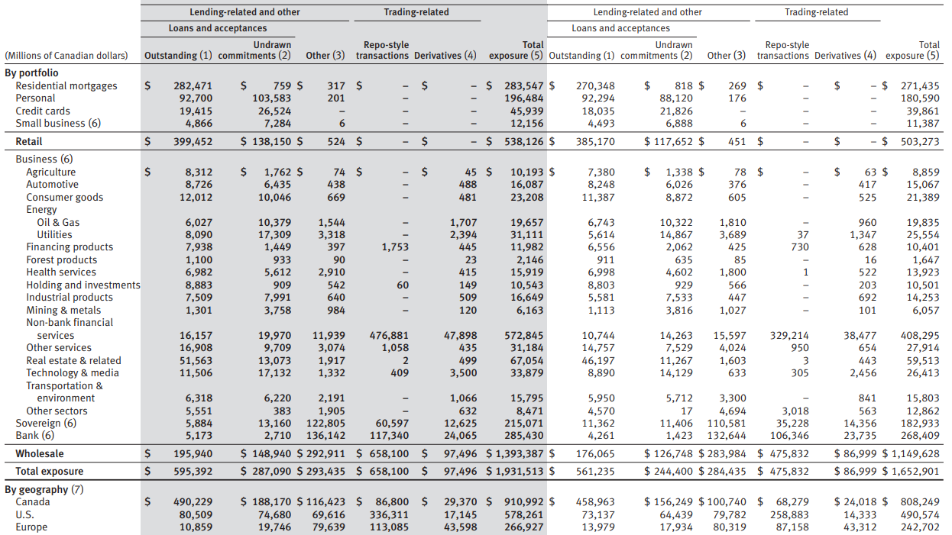
Major Risks and Control

Slide 54
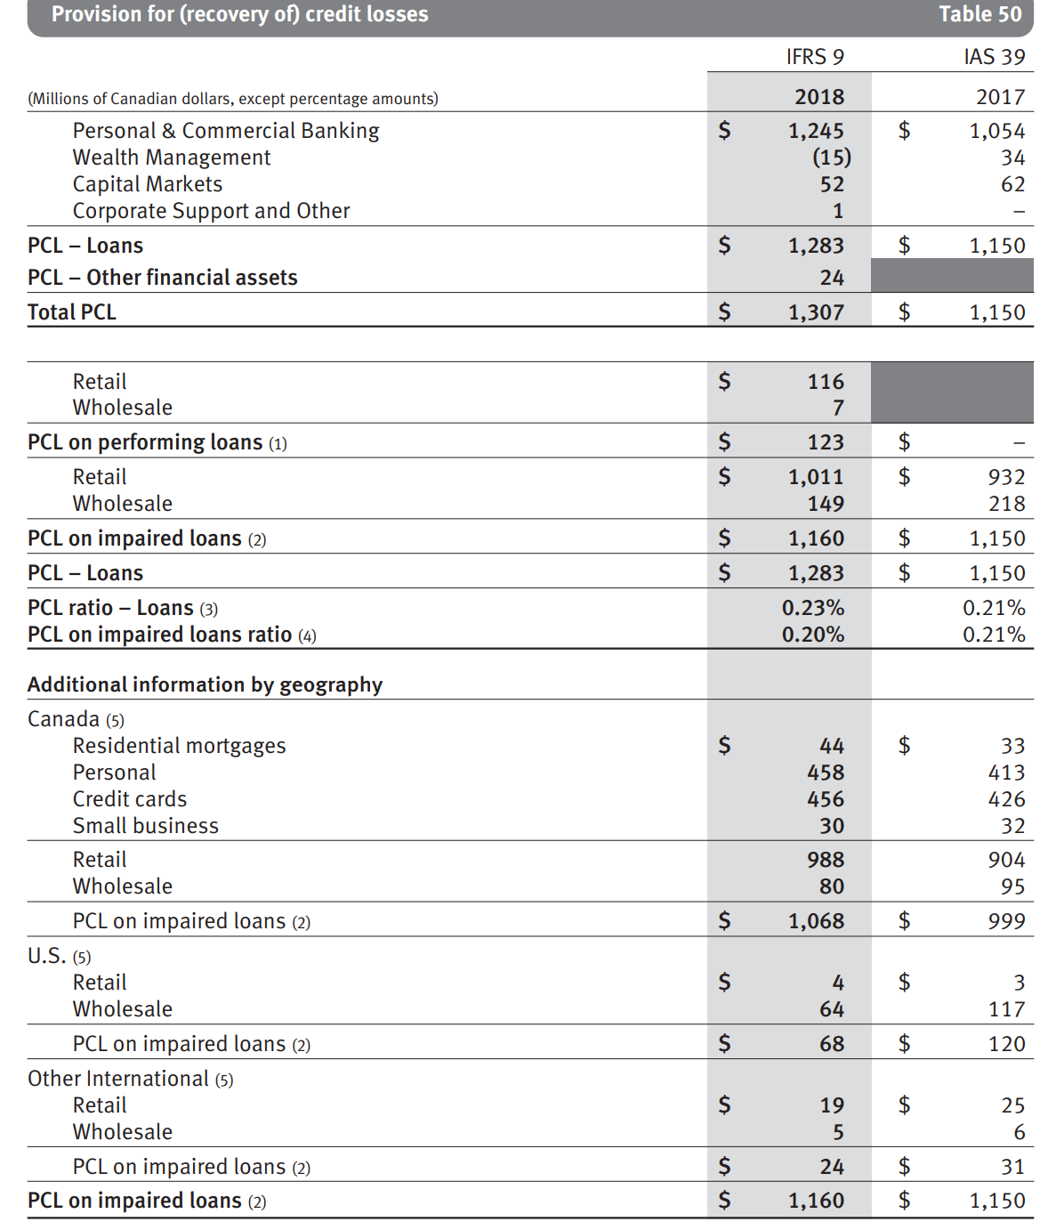
Major Risks and Control
Provision for Recovery of Credit Loss (PCL)
2018 vs 2017
Total PCL increased by 14% ($157 mil)
PCL on loans increased by 12%, due to adoption of IFRS 9
PCL Ratio on loans increased 2 bps
PCL in Personal & Commercial Banking increased $191 million
PCL in Wealth Management decreased $49 million
PCL in Capital Markets decreased $10 million

Slide 55
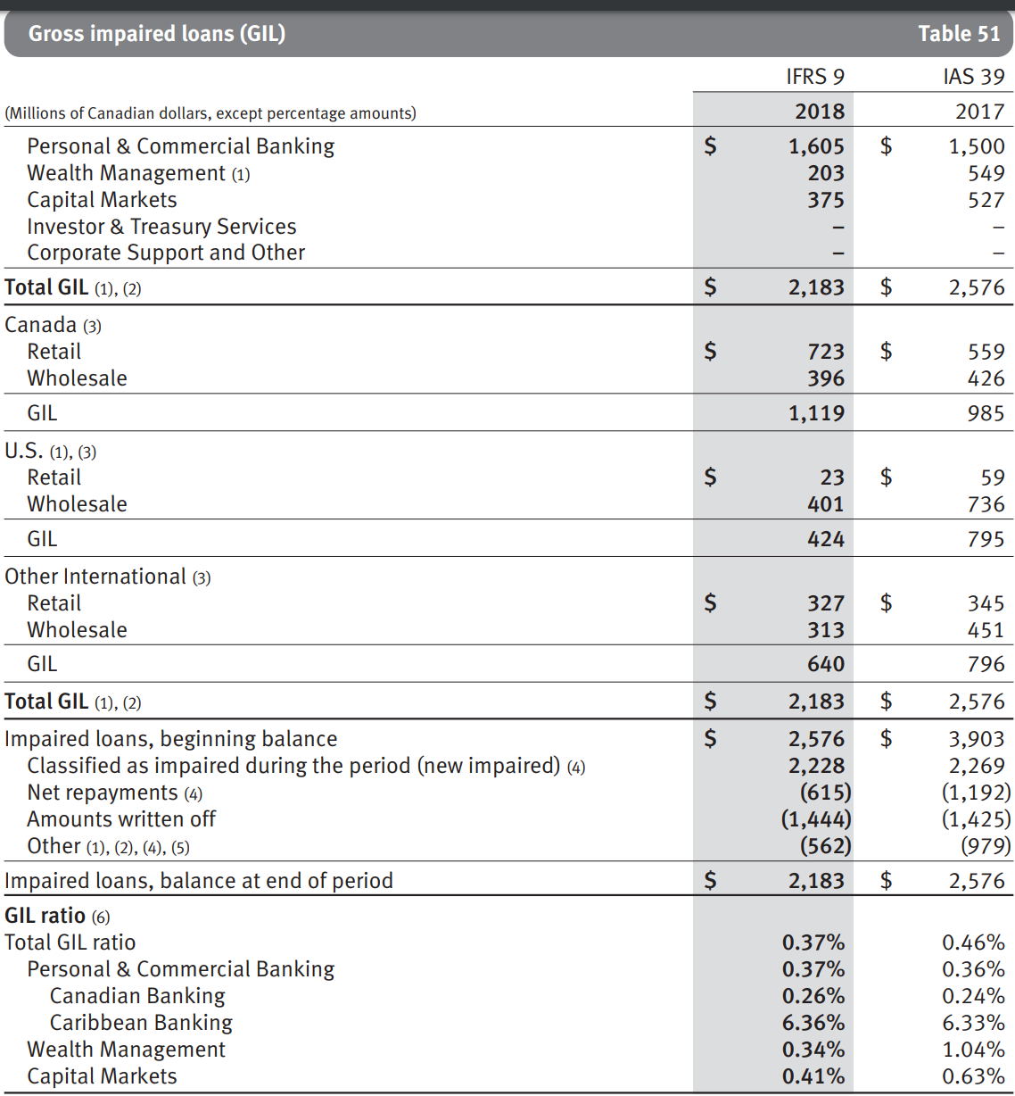
Major Risks and Control
Gross Impaired Loans (GIL)
2018 vs 2017
Total GIL decreased by 15% ($392 mil)
GIL in Personal & Commercial Banking increased $105 million or 7%
GIL in Wealth Management decreased $346 million
GIL in Capital Markets decreased $152 million

Slide 56
Major Risks and Control
Allowance for Credit Losses (ACL)
2018 vs 2017
Total ACL increased by $909 million
ACL on loans increase by $838 million
ACL on performing loans increased by $875 million
Due to adoption of IFRS 9

Slide 57
Major Risks and Control
Market Risk – What’s it?
Defined as the degree that changes in market prices can affect potential gains or losses
These changes in market price can be associated with changes in
Interest Rates
Credit Spreads
Equity Prices
Commodity Prices
Foreign Exchange Rates
Implied Volatilities
Notes:
p68 market risk definition

Slide 58
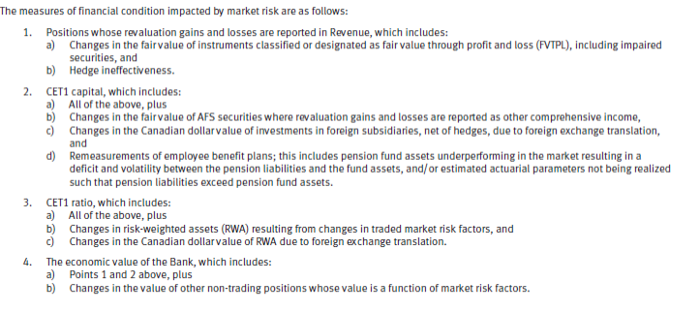
Major Risks and Control
Market Risk – How to Measure?

Slide 59
RISK MANAGEMENT STRUCTURE
Market Risk Controls – TVTPL positions
Value-at-Risk (VaR) for RBC
Statistical measure that quantifies the financial risk of individual and portfolio investments over a period of one day
Measured at 99% confidence level
Updated Daily
Stressed Value-at-Risk (SVaR)
Same as VaR, but it is measured over a fixed historical one year period
a fixed historical one-year period of extreme volatility

Slide 60
Major Risks and Control
VaR and SVaR
2018 vs 2017
Average VaR increased by $3 million
Average SVaR increased by $26 million
Notes:
2018 vs. 2017
Average market risk VaR of $25 million increased $3 million from the prior year, largely due to the change in classification of certain portfolios from AFS to FVTPL as a result of adopting IFRS 9. Client-driven activity in volatile equity derivative markets also contributed to larger volatility in this metric during the year.
Average SVaR of $79 million increased $26 million from the prior year, largely driven by the adoption of IFRS 9 as mentioned above, and the impact of foreign exchange translation. Expiries and repurchases of certain hedging instruments in our equity derivatives trading portfolio also contributed to volatility in this metric during the year.

Slide 61
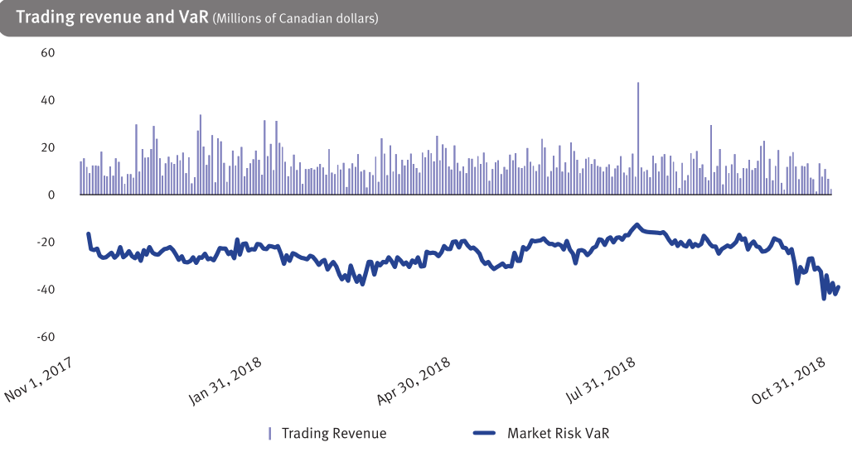
Major Risks and Control
Trading Revenue and VaR (CAD Millions)
Notes:
no net losses in 2018 compared to 1 day of losses totaling $2 million in 2017, which did not exceed VaR on that day.

Slide 62
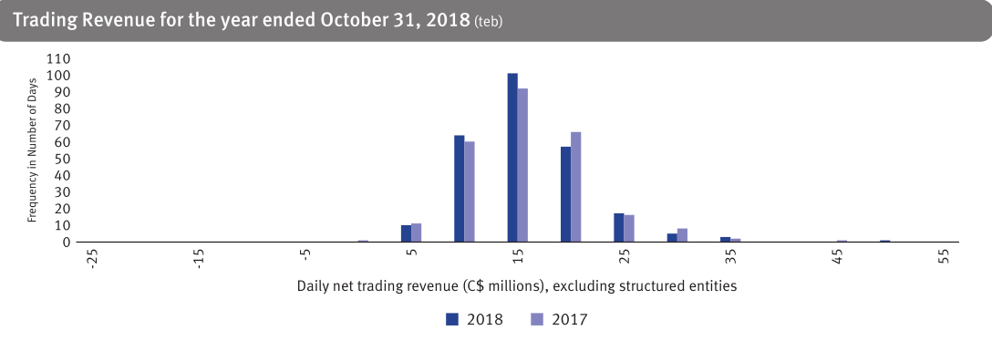
Notes:
displays the distribution of daily trading profit and loss in 2018 and 2017. There were no daily reported losses in 2018. The largest reported profit was $47 million with an average daily profit of $13 million.

Slide 63
Major Risks and Control
Liquidity and Funding Risk
Definition:
Risk of the inability to timely and cost-effectively generate cash and cash equivalents to meet financial commitments as they come due
Risk Control
Review and update objectives, policies, and strategies regularly
Ensure that Liquidity Risk is within the limits of the risk appetite statements
Stress Testing
Notes:
75

Slide 64
Major Risks and Control
Liquidity and Funding Risk
Measured based on the following 3 categories:
Structural Liquidity Risk (Long term)
Internal metric to focus on structure alignment
Tactical Liquidity Risk (Shorter term)
use net cash flow limits to control risk of material units, subsidiaries, currencies
net cash flow positions are determined by applying internally-derived risk assumptions and parameters
Contingency Liquidity Risk
Arising from sudden stressful events.
Liquidity contingency plan & Liquidity Crisis Team
Stress tests: elements of scenario & sensitivity analyses

Slide 65
Funding strategy
The foundation of RBC’s structural liquidity position:
Core funding, comprising capital, longer-term wholesale liabilities, a diversified pool of personal and commercial and institutional deposits.
Competitive credit rating is critical to cost-effective funding

Slide 66
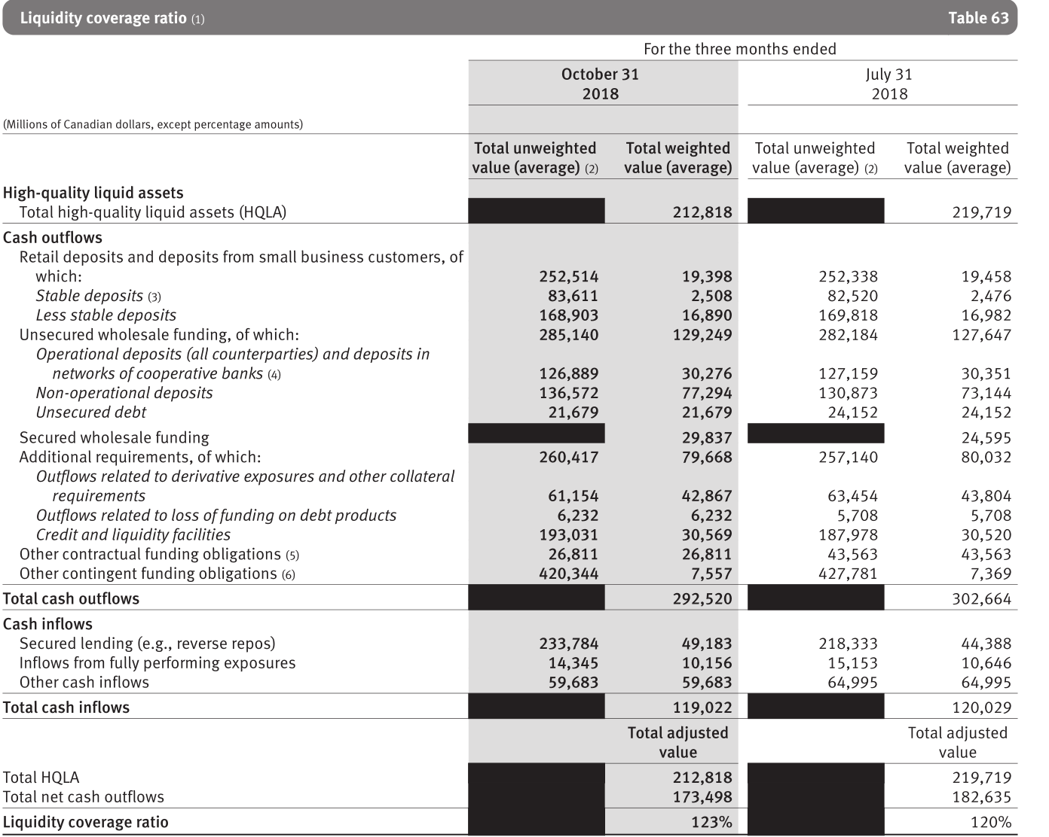
Major Risks and Control
Liquidity Coverage Ratio (LCR)
”LCR is a Basel III metric that measures the sufficiency of High Quality Liquid Assets available to meet liquidity needs over a 30-day period”
The Basel Committee on Banking Supervision (BCBS) and OSFI regulatory minimum coverage level for LCR is currently 100%.
Notes:
Q4 2018 vs. Q3 2018
The average LCR for the quarter ended October 31, 2018 was 123%, which translates into a surplus of approximately $39 billion, compared to 120% in the prior quarter. The improvement in the LCR surplus from the previous quarter reflects a decline in net cash outflows resulting from a change in the composition and term profile of the assets and liabilities.

Slide 67
Major Risks and Control
Insurance Risk
Definition:
“potential financial loss that may arise where the amount, timing and frequency of benefit payments under insurance and reinsurance contracts are different than expected”
Insurance Risk Framework is used to identify, assess, manage and report on the various insurance risks that the organization faces
4 Insurance sub-risk: Morbidity, Mortality, Longevity, Travel risk

Slide 68
Major Risks and Control
Operational Risk
Definition:
“Risk of loss or harm resulting from people, inadequate or failed internal processes and systems or from external events”
Operational Risk Framework
Internal Events
External Events
Business Environment and Internal Control Factors (BEICF) Assessments
Scenario analysis
BEICF monitoring
Notes:
Internal events: Internal events are specific instances where operational risk leads to or could have led to an unintended, identifiable impact.
External events: External events are operational risk events that affect institutions other than us.

Slide 69
Major Risks and Control
Operational Risk
Factors That Can Significantly Impact Results:
Information Technology and Cyber Risk
Third-party Risk
Processing And Execution Risk
Fraud Risk
Model Risk

Slide 70
Major Risks and Control
Other Risks
Regulatory Compliance Risk
Strategic Risk
Reputation risk
Legal and regulatory environment risk
Competitive Risk
Macroeconomic risk drivers
Systemic Risk

Slide 71
Strategic risk
the risk that the enterprise or particular business areas will make inappropriate strategic choices, or will be unable to successfully implement selected strategies or related plans and decisions

Slide 72
Reputation risk
the risk of an adverse impact on stakeholders’ perception of the banks, its representatives, service providers (third parties and intra-group), or clients, or ii) public sentiment towards a global or industry issue

Slide 73
Legal and regulatory environment risk
Global Trade Agreements
Consumer Protection
Privacy
Canadian Housing Market and Consumer Debt
Payments Issues
London Interbank Offered Rate (LIBOR)
Other Regulatory Initiatives Impacting Financial Services in Canada
United States Regulatory Initiatives
U.K. and European Regulatory Reform

Slide 74
Competitive risk
the risk of an inability to build or maintain a sustainable competitive advantage in a given market or markets and includes the potential for loss of market share due to competitors offering superior products and services.

Slide 75
Macroeconomic risk drivers
Systemic risk:
the financial system as a whole is in real & immediate danger of collapse with the material damage to the economy
Result in financial, reputation, legal or other risks for RBC
The least controllable risk

Slide 76
Risk measurement
Diversification: diversified business model, portfolios, products, activities, funding sources
- helps mitigate the potential impacts
- establishes risk limits to ensure well-diversified portfolios
Stress testing: consideration of the movements in risk factors
- ensures RBC’s business strategies and capital planning are robust
- evaluates the potential effects of specified changes in risk factors

Slide 77
RISK MANAGEMENT STRUCTURE

Slide 78
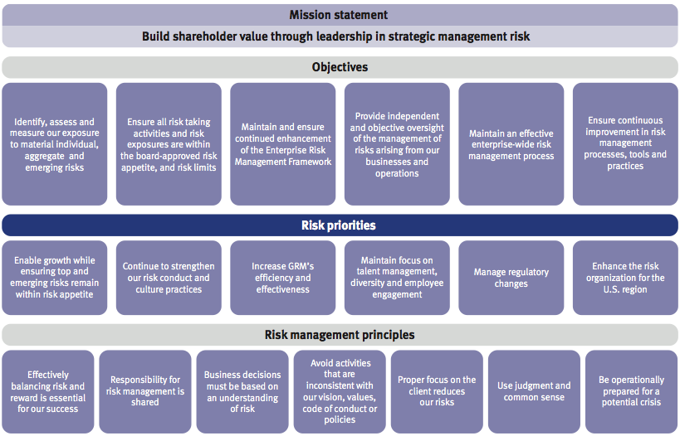
RISK MANAGEMENT STRUCTURE

Slide 79
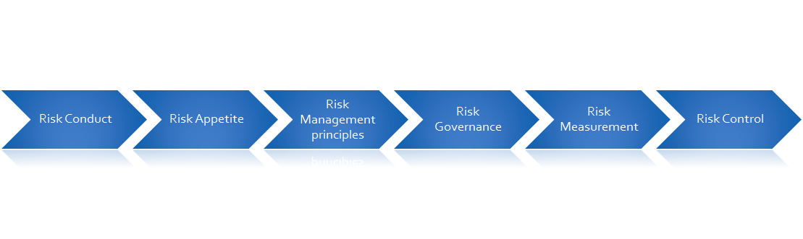
RISK MANAGEMENT STRUCTURE
Enterprise Risk Management Framework
Risk Governance
Risk Appetite
Risk Conduct and Culture
Risk Measurement
Risk Control

Slide 80
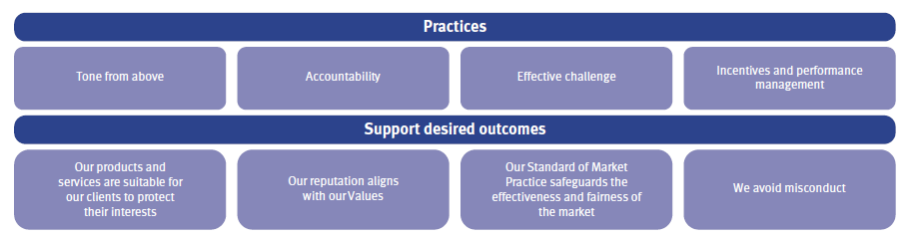
RISK MANAGEMENT STRUCTURE
Risk conduct and culture
RBC defines risk conduct and culture as a shared set of behavioural norms that sustain their core values and enables them to proactively identify,understand and act upon risks, thereby protecting clients, safeguarding shareholders’ value, and supporting the integrity, soundness and resilience of financial markets.
Established core set of policies and values that must followed to control corporate risk and help achieve favourable results:

Slide 81
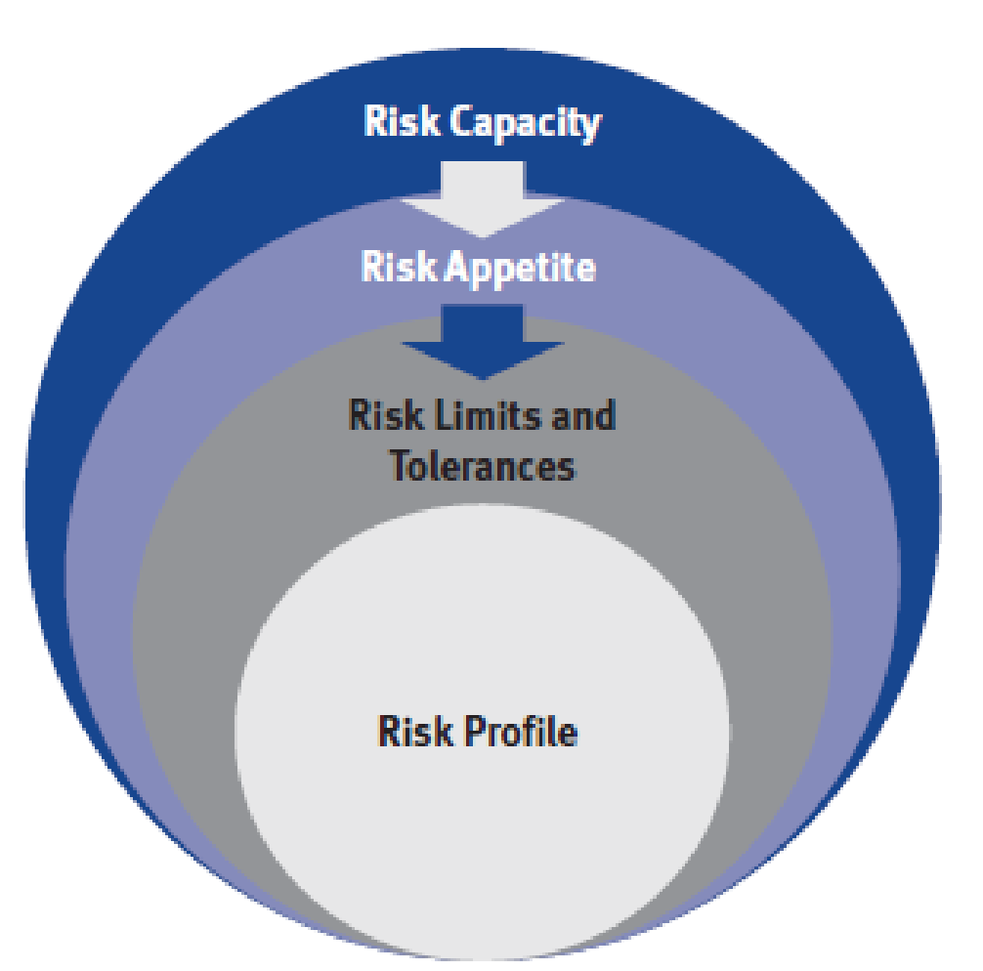
RISK MANAGEMENT STRUCTURE
Risk Appetite
Risk appetite is the amount and type of risk that RBC is able and willing to accept in the pursuit of their business objectives.

Slide 82
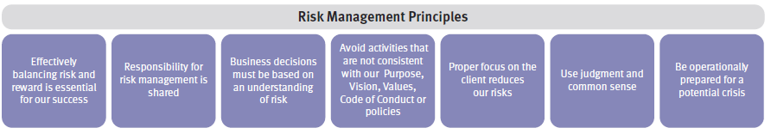
RISK MANAGEMENT STRUCTURE
Risk Management Principles

Slide 83
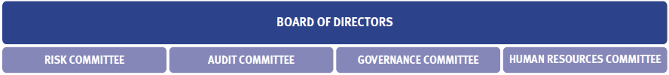
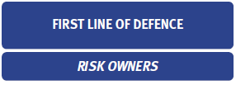
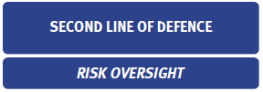
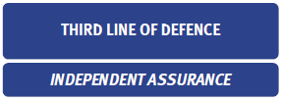
RISK MANAGEMENT STRUCTURE
Risk Governance

Slide 84
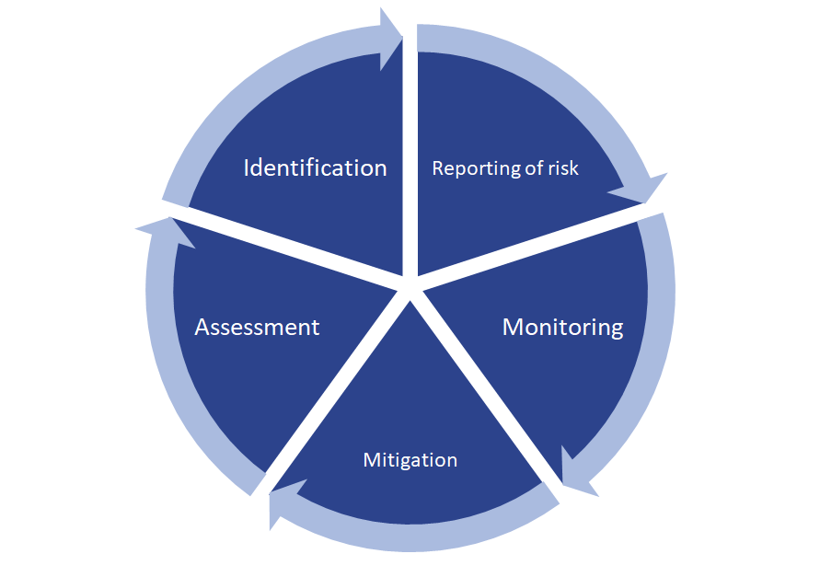
•
RISK MANAGEMENT STRUCTURE
Risk Governance

Slide 85
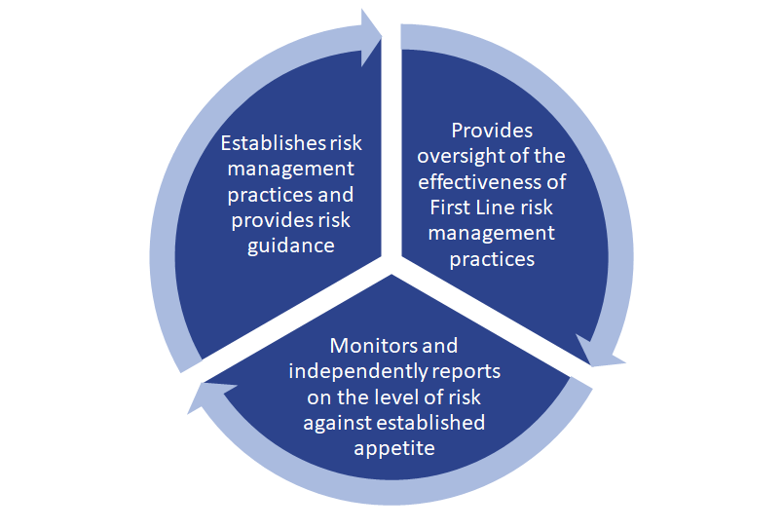
RISK MANAGEMENT STRUCTURE
Risk Governance

Slide 86
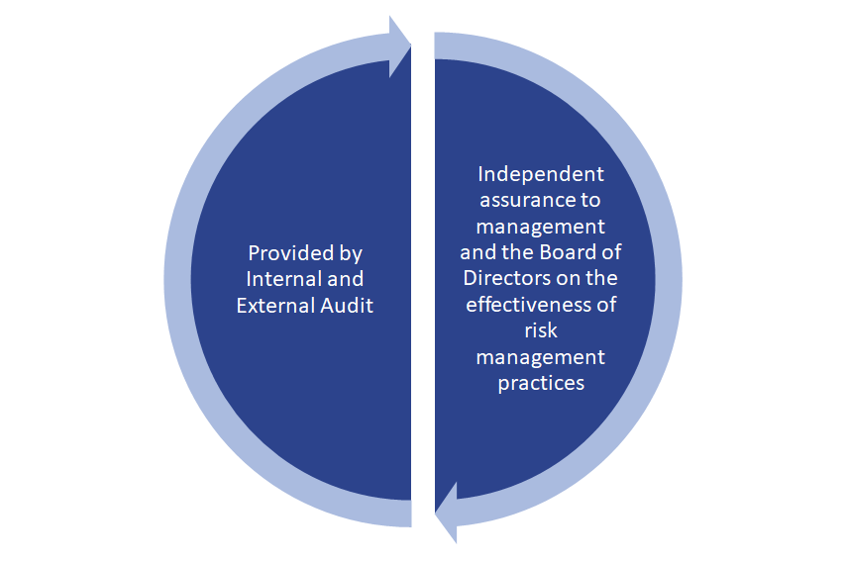
RISK MANAGEMENT STRUCTURE
Risk Governance

Slide 87
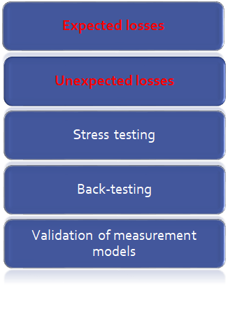
RISK MANAGEMENT STRUCTURE
Risk Measurement
Expected losses: Losses that are statistically expected to occur in the normal course of business in a given period of time. (Earning at risk)
Unexpected losses: Losses that are statically estimated of the amount by which actual losses
can exceed expected losses. (Capital at risk)
Unexpected = Actual - Expected

Slide 88
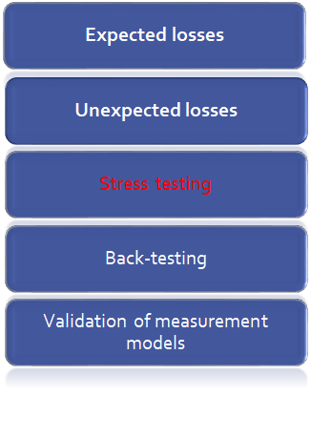
RISK MANAGEMENT STRUCTURE
Risk Measurement
Stress testing: Examines potential impacts arising from adverse events.
•Ongoing enterprise-wide stress tests
•Risk specific stress testing programs
•Ad-hoc stress tests
•Reverse stress tests

Slide 89
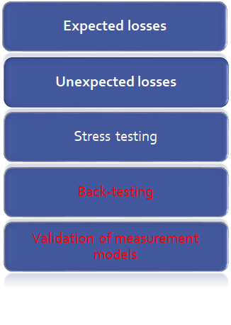
RISK MANAGEMENT STRUCTURE
Risk Measurement
Back-testing: Ensure the credit risk parameters remain appropriate for use in capital calculations
•Preformed by comparing the realized value to beginning estimates
Validation of measurement models:
•Ensure the model incorporate current market developments and industry trends
•Ensure that all material underlying model
risk are identified and mitigated

Slide 90
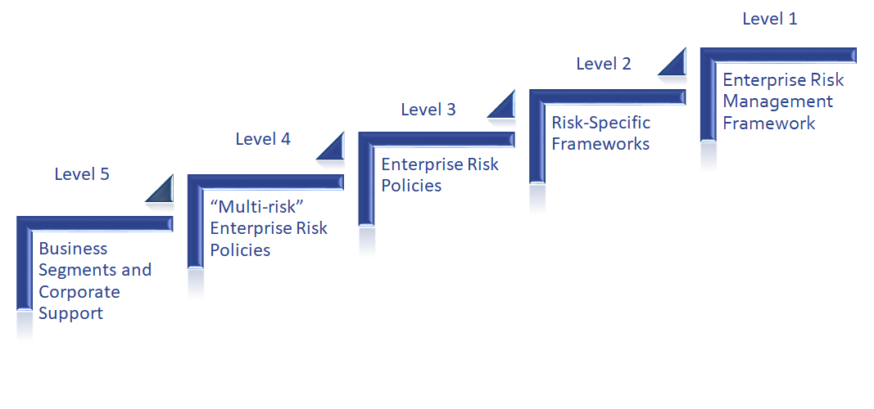
RISK MANAGEMENT STRUCTURE
Risk Control: Optimize Risk and Return
The enterprise-wide risk management approach is supported by a comprehensive set of risk controls. The risk management frameworks and policies are organized into the following five levels:

Slide 91
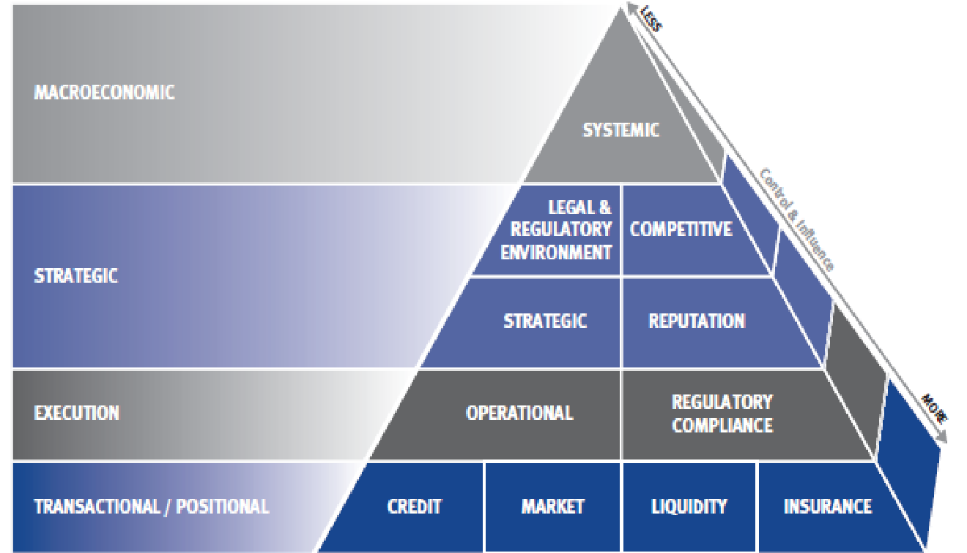
RISK MANAGEMENT STRUCTURE
Risk Pyramid: Identifies and Categorizes Risks

Slide 92
RISK MANAGEMENT STRATEGIES

Slide 93
RISK MANAGEMENT STRATEGIES
Derivatives Instrument
Financial Derivatives: Financial contracts whose value is derived from an underlying interest rate, foreign exchange rate, credit risk, and equity.
Non-financial Derivatives: Contracts whose value is derived from precious metal and commodity derivative contracts in both OTC and exchange markets.

Slide 94
RISK MANAGEMENT STRATEGIES
Derivatives Issued for Trading Purposes
Sales Activities: include the structuring and marketing of derivative products to clients to enable them to transfer, modify or reduce current or expected risks.
Trading Activities
Market-making
Positioning
Arbitrage activities

Slide 95
RISK MANAGEMENT STRATEGIES
Derivatives Issued for Hedging
Interest rate swaps
Cross currency swaps
Foreign exchange forward contracts
Credit derivatives

Slide 96
RISK MANAGEMENT STRATEGIES

Slide 97
RISK MANAGEMENT STRATEGIES
Derivatives – Related to Credit Risk
Generated by the potential for the counterparty to default on its contractual obligations when the transactions have a positive market value
Represented by the positive fair value of the instrument
Normally a small fraction of the contract’s notional amount

