Slide 1

Royal Bank of Canada
Yuling Dai 301451298
Sarah Pham 301470457
Feng Zuo 301386616

Slide 2
AGENDA
01
02
03
04
05
06
Industry Overview
Overview of RBC
Analysis of Financial Statement
Major of Risk
Risk management Structure
Risk management Strategy

Slide 3
01
Industry Overview

Slide 4
Banks Operating in Canada
21 Domestic Banks
26 Foreign Bank Subsidiaries
19 Full-services foreign bank branches
3 Lending Banks

Slide 5

Industry Overview
Royal Bank of Canada(RBC)- $174.3B
Toronto-Dominion Bank(TD Bank)- $ 117.90B
Bank of Montreal(BMO)- $ 63.71 B
Bank of Nova Scotia(Scotiabank)- $58.35 B
Canadian Imperial Bank of Commerce(CIBC)-$36.65 B

Slide 6
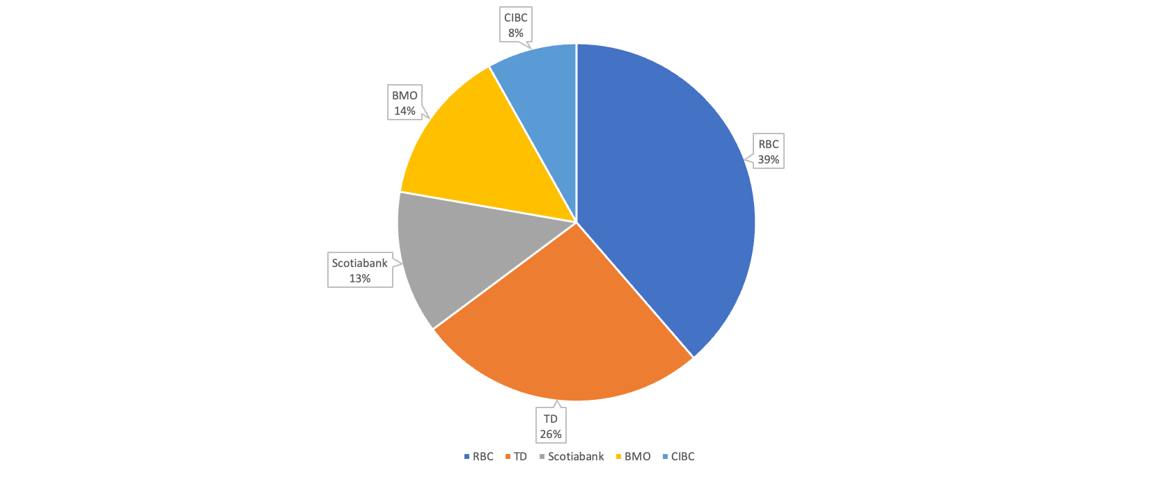
The market share of the Top 5 Canada Bank

Slide 7
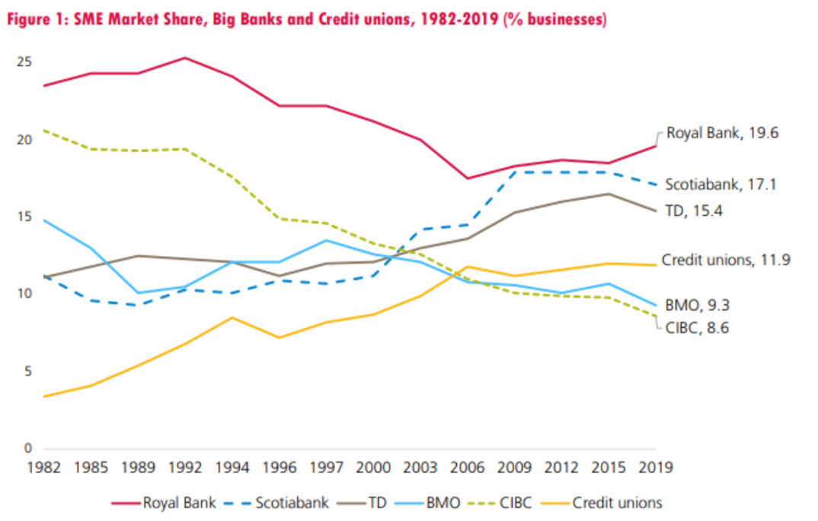
Dynamic Change of Market Share

Slide 8
Regulation

Slide 9
Basel I: Basel Capital Accord
●It is a set of international banking regulations established by the Basel Committee on Banking Supervision (BCBS) which sets the minimum capital requirements for financial institutions, with the goal of minimizing credit risk. Compared to other three, Base l introduced guidelines for how much capital banks must keep in reserve based on the risk level of their assets
●Banks that operate internationally were required to maintain at least a minimum amount of capital (8%) based on their risk-weighted assets
●With the advent of Basel I, bank assets were classified into five level of risk: 0%, 10%, 20%, 50%, and 100%, and banks are required to maintain emergency capital based on that classification
●Basel I is the earliest Basel Accords and is now considered too limited in scope, but it laid the framework for the subsequent Basel Accords

Slide 10

Highlight: Weight Risk Categories
Low risk
0% - Risk-free Assets: Cash, Treasury Bonds
20% - Loans to other banks or securities with highest credit rating
50% - Residential Mortgage
100% - Corporate Debt
High Risk

Slide 11
Basel II : Revised Capital Framework
● Building upon Basel I. Basel II focused on three main areas: minimum capital requirements, supervisory review of an institution's capital adequacy and internal assessment process, and the effective use of disclosure as a lever to strengthen market discipline and encourage sound banking practices including supervisory review
● Further divide bank into three tiers: Tier 1, 2, and 3. The higher the tier, the more secure and liquid its assets
● Provided guidelines for the calculation of minimum regulatory capital ratios and confirmed the requirement that banks maintain a capital reserve equal to at least 8% of their risk-weighted assets.
● Refined the definition of risk-weighted assets, used in calculating whether a bank meets its capital reserve requirements
● However, Basel II underestimated the risks involved in current banking practices and that the financial system was overleveraged and undercapitalized

Slide 12
Basel III: Continuation
● An internationally agreed set of measures developed by the Basel Committee on Banking Supervision in response to the financial crisis of 2007-09
● It builds on the Basel I and Basel II accords in an effort to improve the banking system’s ability to deal with financial stress, improve risk management, and promote transparency
● Aim to strengthen the regulation, supervision, and risk management of bank
● It is a minimum requirement applied to all internationally active banks
● Increased the portion of that capital that must be in the form of Tier 1 assets, from 4% to 6%.Basel III also eliminated an even riskier tier of capital, Tier 3, from the calculation
● Introduced new leverage and liquidity requirements aimed at safeguarding against excessive and risky lending, while ensuring that banks have sufficient liquidity during periods of financial stress
● Introduced new rules requiring that banks maintain additional reserves known as countercyclical capital buffers—essentially a rainy day fund for banks

Slide 13
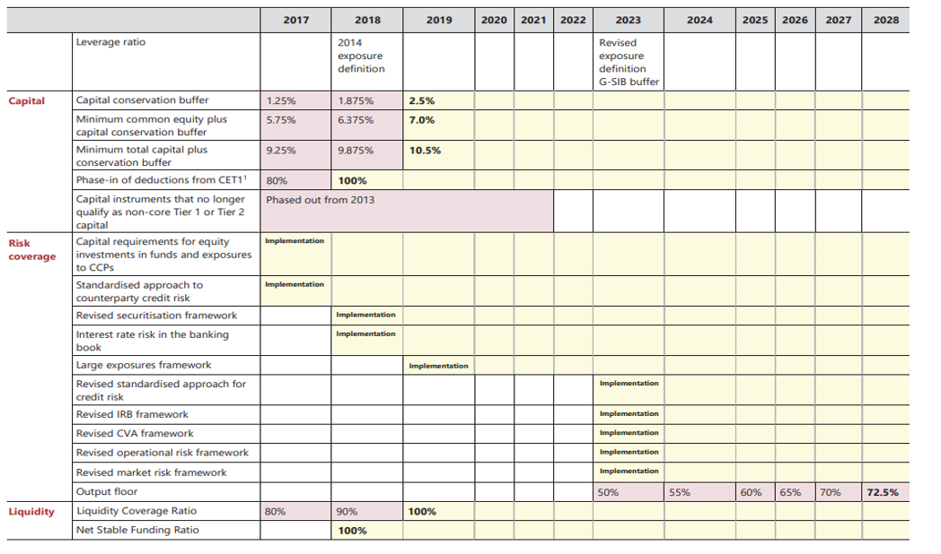
Basel III Transitional Arrangements 2017-2028

Slide 14
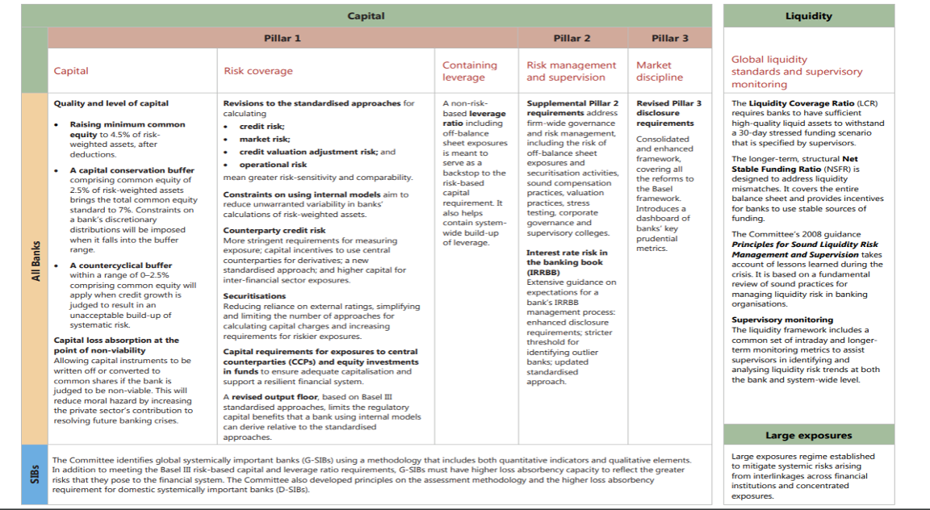
Basel III Summary Table

Slide 15
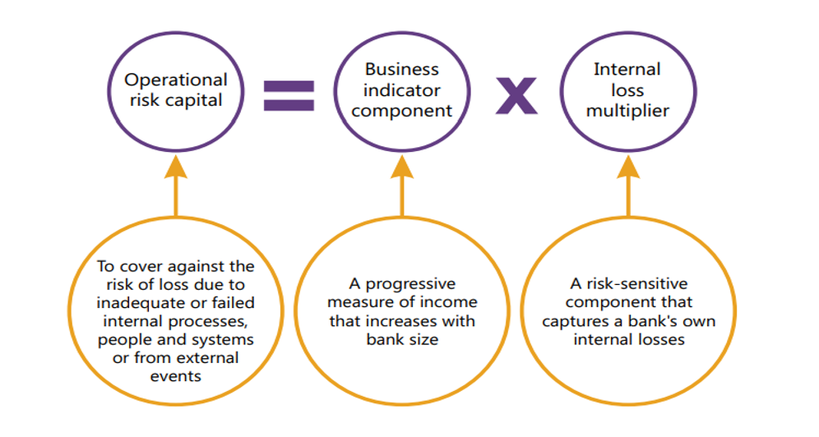
Basel III 2017 Reform
Replacing the four current approaches with a single standardized approach

Slide 16
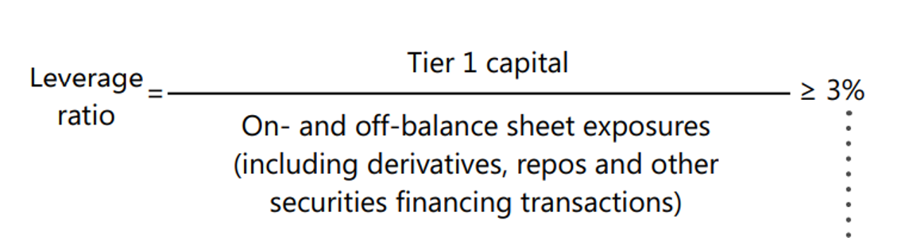
Basel III 2017 Reform
Introduced a leverage rate buffer for G-SIBs.

Slide 17
02
Overview of RBC

Slide 18
Overview
Founded in 1864 in Halifax, Nova Scotia
Largest Bank in Canada, Based on Market Capitalization ~ $174.3B in 2022
Operate In Canada, United States and other 53 courtiers.
Serve over 18 million personal, business, public sector and institutional clients
80,000 employee worldwide
Rank 38 in the 2023 Forbes Global 2000 Listing

Slide 19
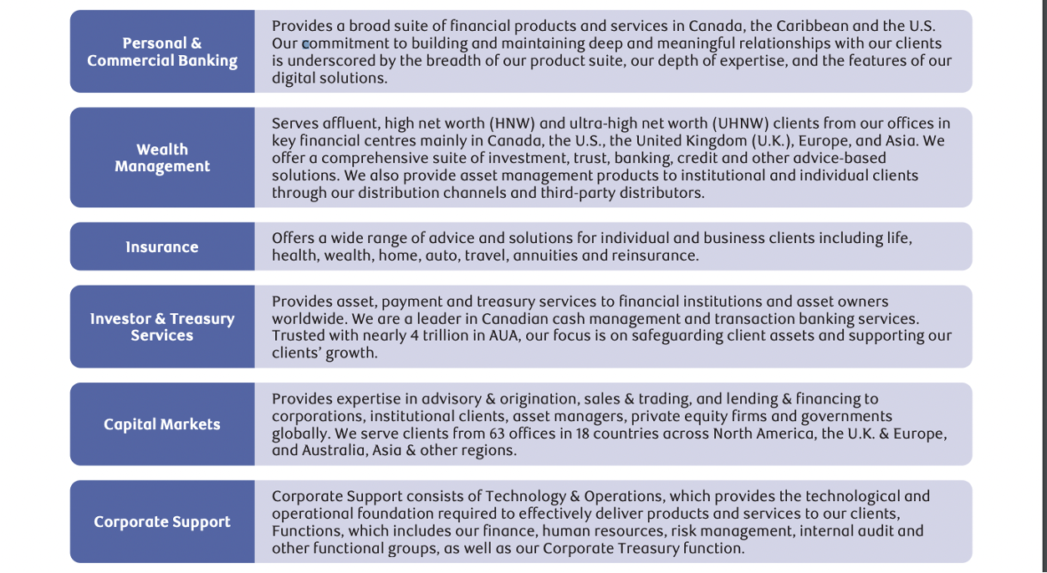
Financial Product & Services

Slide 20
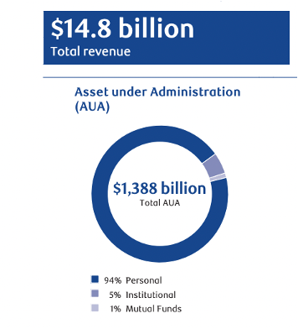
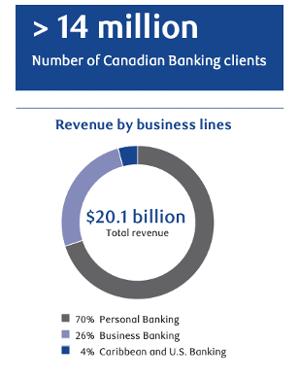
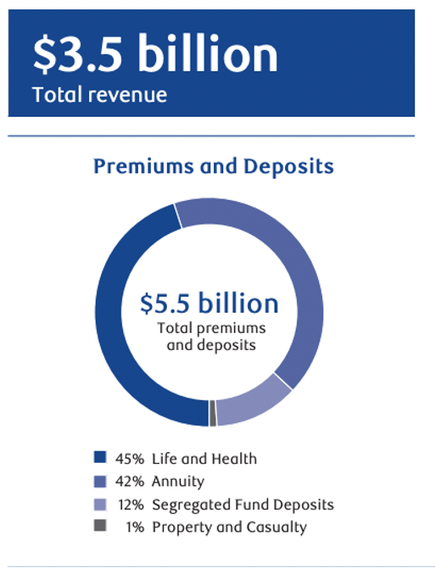
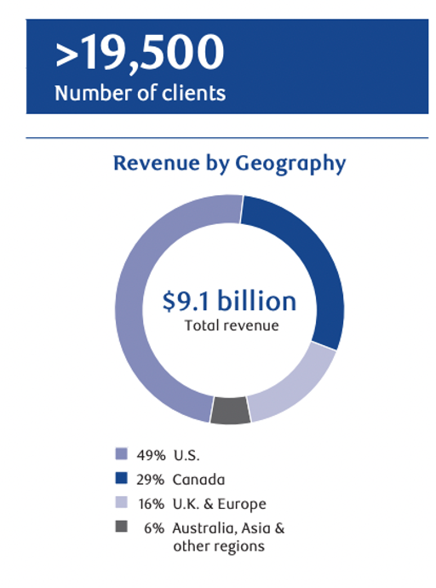

Slide 21
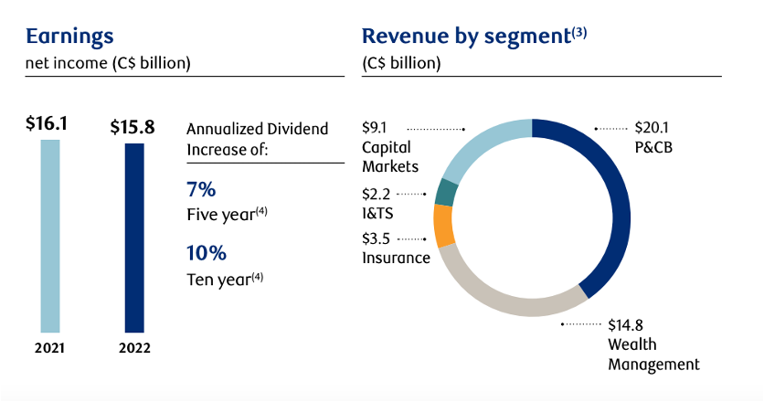
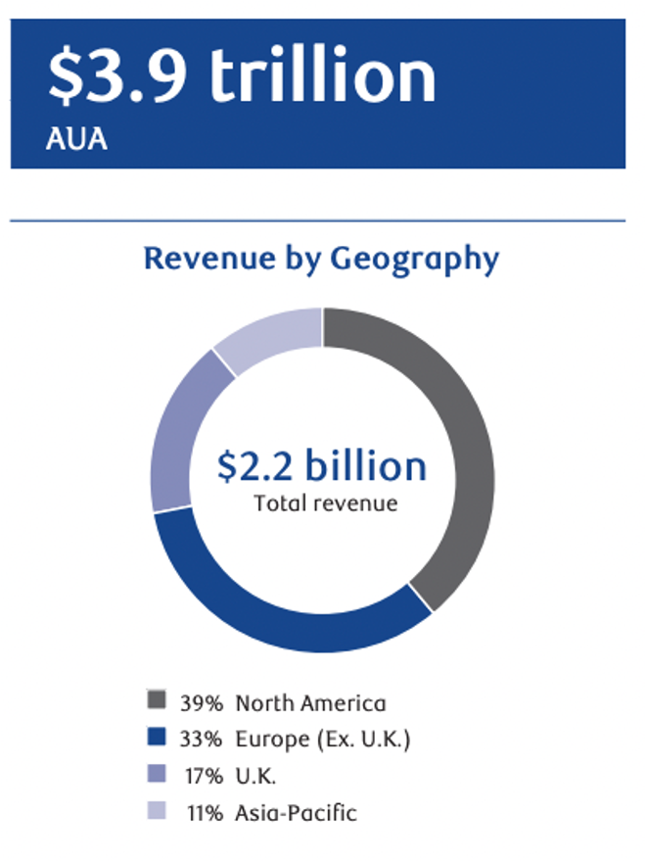

Slide 22

Management Team
Dave Mckay - CEO and President
•Joined RBC in 1988
Education:
•Bachelor of Mathematics from the University of Waterloo
•MBA from the Richard Ivey School of Business at University of Western Ontario

Slide 23

Management Team
Nadine Ahn - Chief Financial Officer
• Joined RBC more than 20 years ago
Education:
• Bachelor of Commerce from the University of Toronto.

Slide 24

Management Team
Graeme Hepworth – Chief Risk Officer
•Joined RBC in 1997
Education:
•Certified Chartered Financial Analyst (CFA)
•Masters in Mathematics from the University of Waterloo.

Slide 25

Management Team
Derek Neldner – CEO and Group Head, RBC Capital Markets
• Joined RBC in 1995
Education:
• Bachelor of Commerce from University of Alberta

Slide 26
03
Analysis of Financial Statement

Slide 27
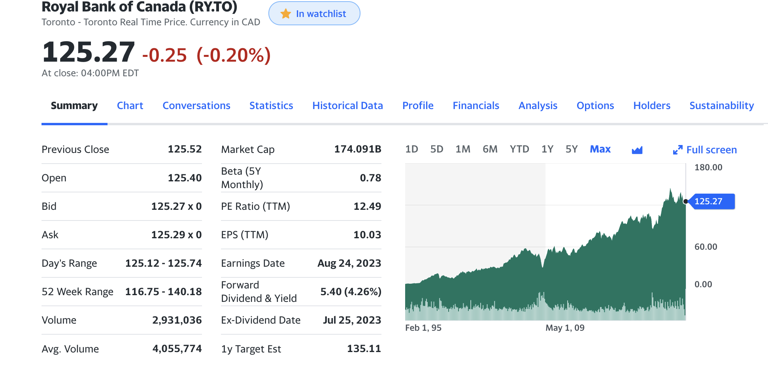
Stock Trend

Slide 28
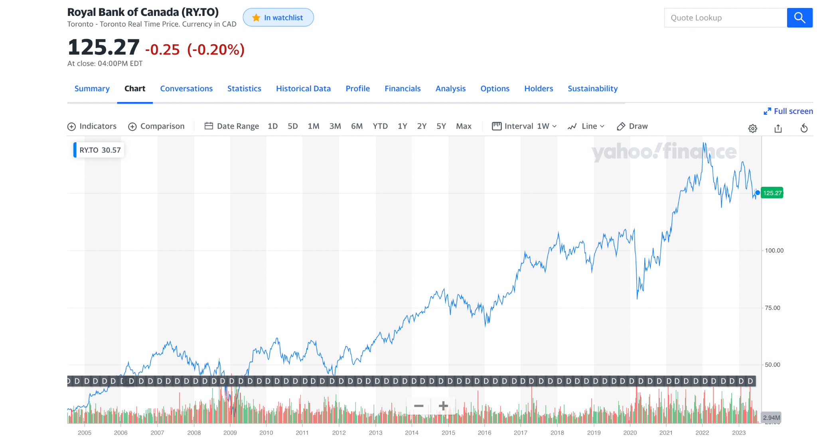

Slide 29
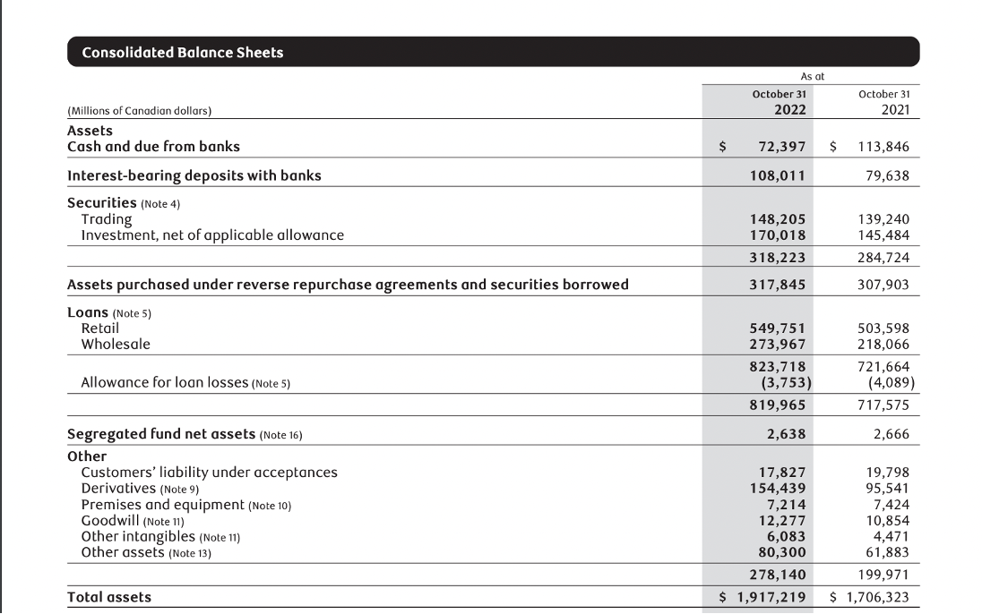
Balance Sheet
8% of the total assets

Slide 30
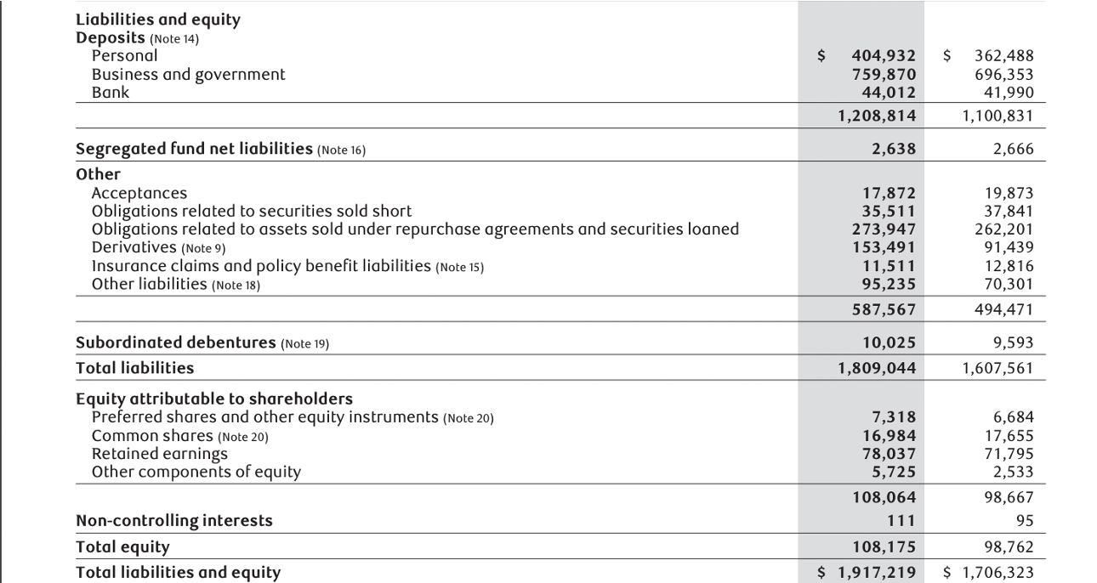
Balance Sheet Con’t
8.5 % of the total liabilities
Maintain 94% of the total assets

Slide 31
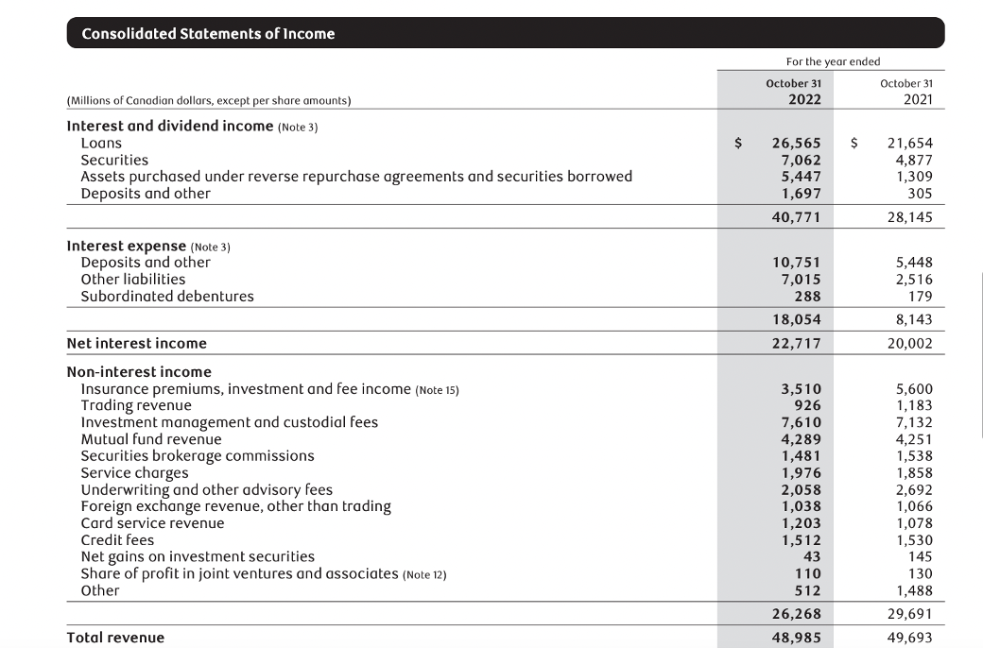
Income Statement
Hedging Purpose

Slide 32
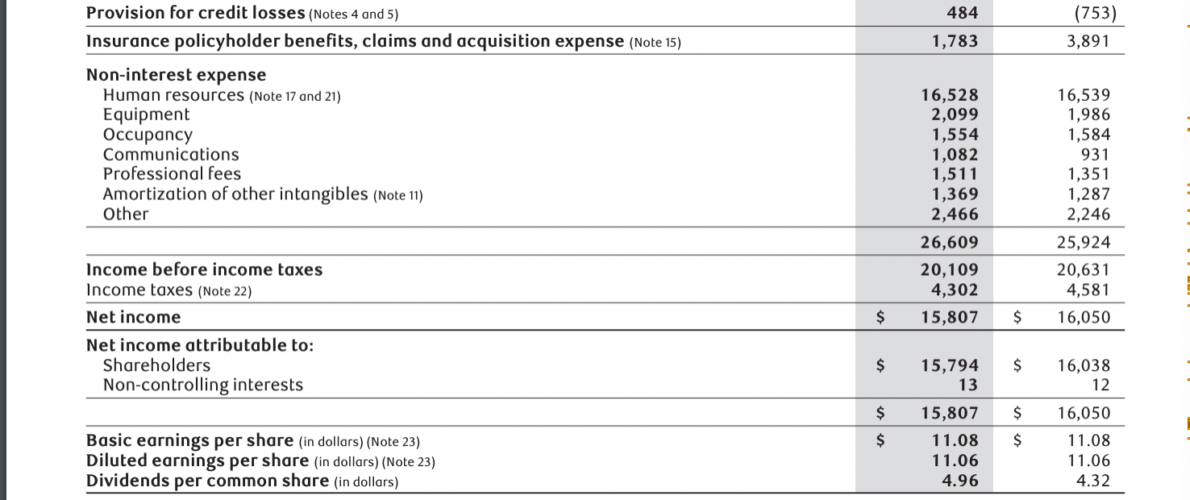
Income Statement Con’t

Slide 33
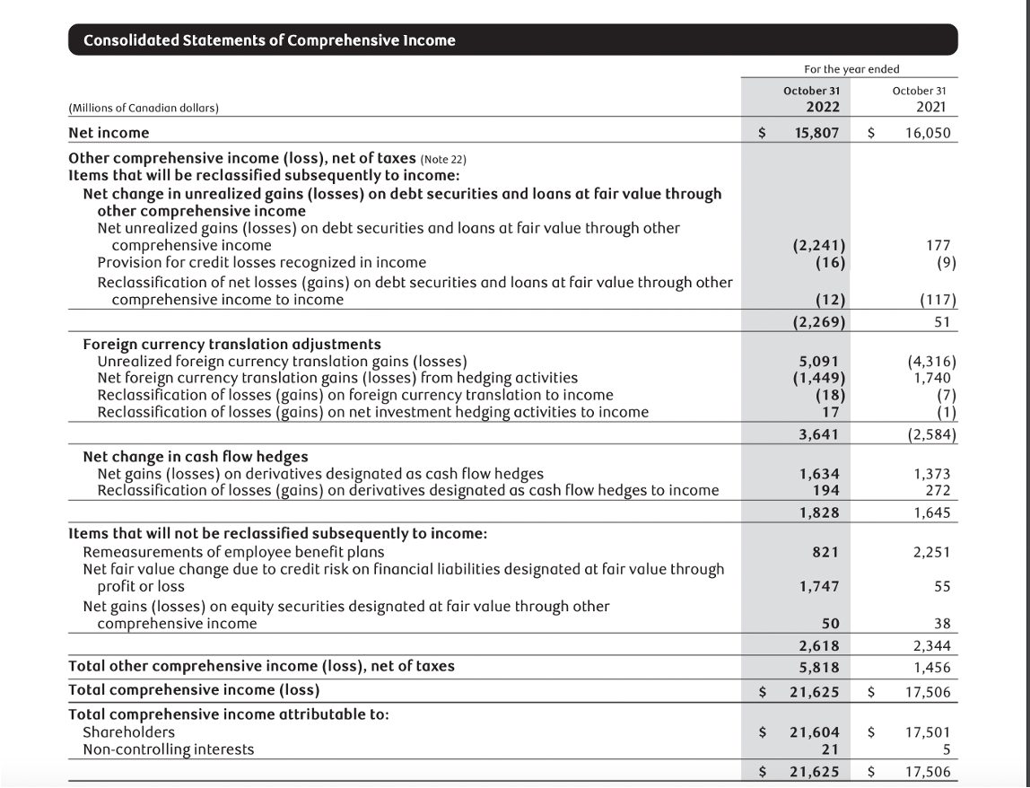
Comprehensive Income

Slide 34
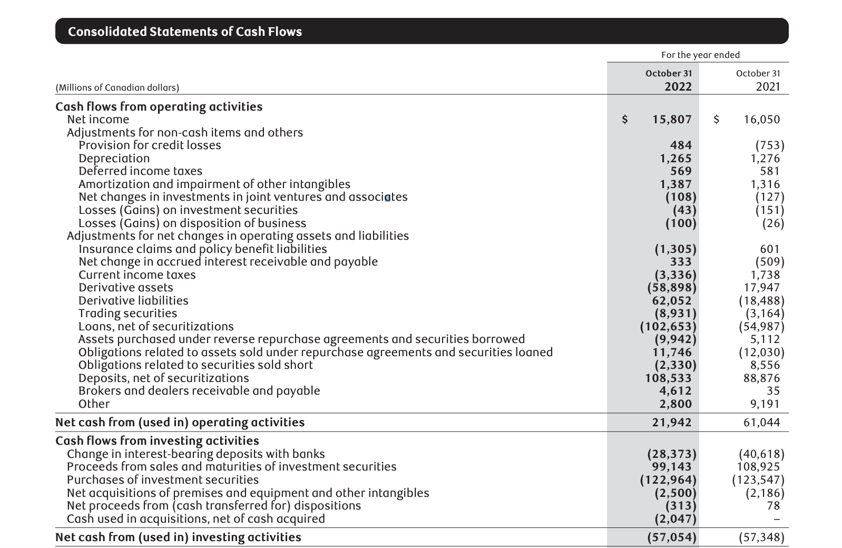
Cash Flow

Slide 35
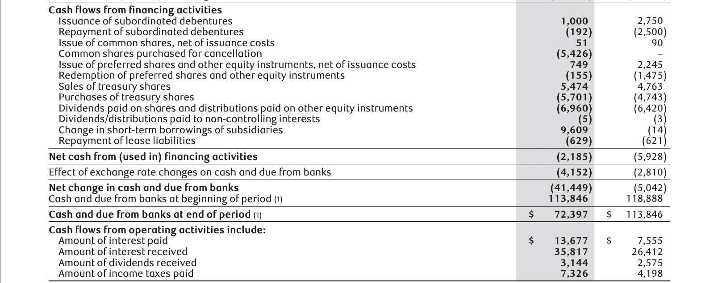
Cash Flow Cont

Slide 36
04
Major of Risk

Slide 37
Major Risks
Competitive Risk
Systemic Risk
Credit Risk
Market Risk
Liquidity and Funding Risk
Insurance Risk
Operational Risk
Regulatory Compliance Risk
Strategic Risk
Reputation Risk
Legal and Regulatory Environment Risk

Slide 38
Credit Risk
Credit risk is the risk of loss associated with an obligor’s potential inability or unwillingness to fulfill its contractual obligations on a timely basis.
Credit risk includes counterparty credit risk arising from both trading and non-trading activities.
Default risk: directly from primary obligor
issuer, debtor,
counterparty,
borrower
policyholder
Off-balance sheet exposures, contingent credit risk, associated credit risk/ transactional risk: indirectly from a secondary obligor
guarantor
reinsurer

Slide 39
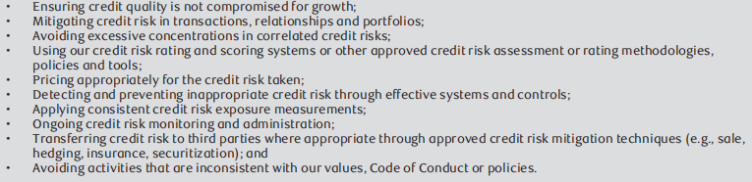
Credit Risk
Balance credit risk and return:

Slide 40
Credit Risk Measurement
Quantify credit risk at both the individual obligor and portfolio levels to manage expected credit losses and minimize unexpected losses to limit earnings volatility
Two Principal Approaches:
Internal Ratings Based Approach (IRB) - mostly used
Standardized Approach
Three Key IRB Parameters :
Probability of default (PD): the likelihood of default with a period of time.
Exposure at default (EAD): an expected amount owed by the obligor.
Loss given default (LGD): an estimated amount not expected to be recovered during the collections and recovery process.

Slide 41
Credit Risk Measurement
Gross credit risk exposure：
refers to the overall magnitude of all credit risks faced by a financial institution or company. It measures the institution's risk exposure in its credit-related activities, including the risk of credit default associated with borrowers or debtors.
categorized as:
lending-related and other credit risk
Loans and acceptances outstanding, undrawn commitments, and other exposures
trading-related credit risk
Repo-style transactions, which include repurchase and reverse repurchase agreements and securities lending and borrowing transactions
Derivative amounts which represent the credit equivalent amount

Slide 42
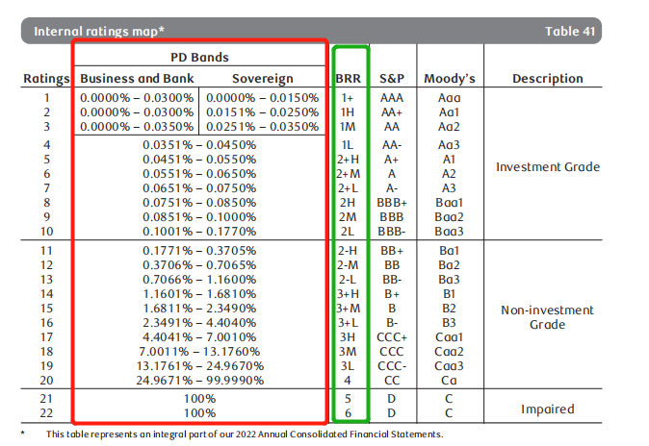
Credit Risk Assessment
Wholesale credit risk：measure the credit risk inherent in our wholesale credit activities.
PD
Each BRR has a PD calibrated against it.
a long-run average of our experience across the economic cycle in accordance with regulatory guidelines.
borrower risk rating (BRR)：
reflecting an assessment of the credit quality of the obligor
differentiates the riskiness of an obligor

Slide 43
Counterparty Credit Risk
Counterparty credit risk is the risk that a party with whom the bank has entered into a financial or non-financial contract will fail to fulfill its contractual agreement and default on its obligation.
primary risk mitigation techniques:
Close-out netting: Considering the net value of contractual obligations then reducing overall credit exposure
Collateralization: The borrower pledges assets as security, which provides recourse to the lender in the event of default.

Slide 44
Credit Risk-Wrong-way risk
Wrong-way risk is the risk that exposure to a counterparty is adversely correlated with the credit quality of that counterparty.
two types of wrong-way risk:
Specific wrong-way risk, which exists when our exposure to a particular counterparty is positively correlated with the PD of the counterparty due to the nature of our transactions with them
General wrong-way risk, which exists when there is a positive correlation between the PD of the counterparties and general macroeconomic or market factors

Slide 45
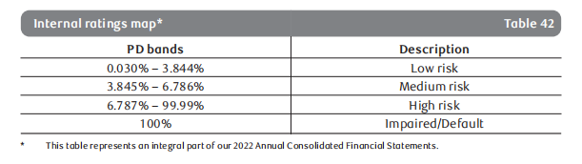
Credit Risk- Retail credit risk
Retail credit risk refers to the potential risk faced by lenders or financial institutions when extending credit to individual consumers or retail customers.
Credit scoring is the primary risk rating system for assessing obligor and transaction risk for retail exposures.
The following table maps PD bands to various summarized risk levels for retail exposures:

Slide 46
Credit Risk Mitigation
We seek to reduce our exposure to credit risk through a variety of means, including the structuring of transactions and the use of collateral.
Structuring of transactions :
Specific credit policies and procedures set out the requirements for structuring transactions including the use of guarantees, collateral, seniority, LTV requirements and covenants.
Collateral:
The extent of risk mitigation provided by collateral depends on the amount, type and quality of the collateral taken.

Slide 47
Credit Risk Approval
The Board, GE, GRC and other senior management committees work together to ensure the ECRMF and supporting policies, processes and procedures exist to manage credit risk and approve related credit risk limits.
Transaction approval :
Credit transactions are governed by our RBC Enterprise Policy on Risk Limits and Risk Approval Authorities that captures the limits delegated to management and the credit rules policy, which outlines the minimum standards for managing credit risk at the individual client relationship and/or transaction level.
Product approval
Proposals for credit products and services are comprehensively reviewed and approved under a risk assessment framework and are subject to risk approval authorities which increase as the level of risk increases.
Credit risk limits:
Single name limits, geographic limits, industry sector limits, product and portfolio limits, and underwriting and distribution risk limits.

Slide 48
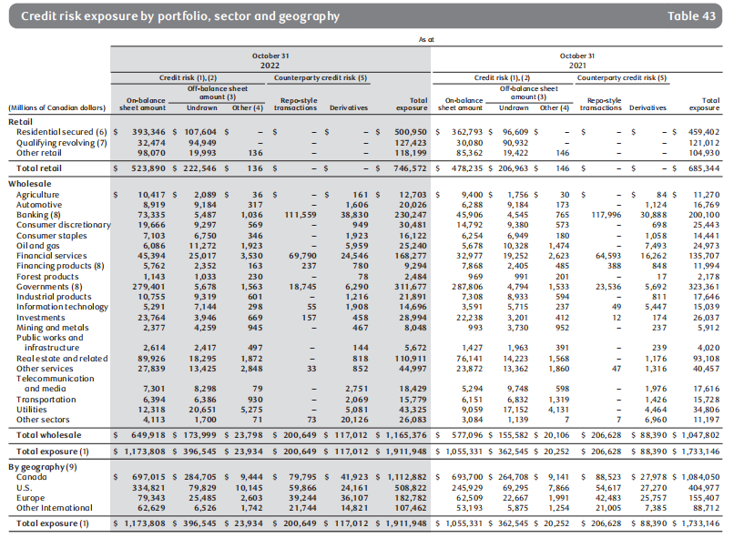
Credit Risk Exposure

Slide 49
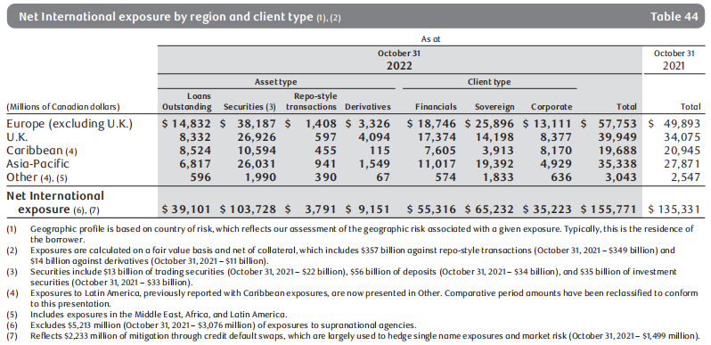
Net International Exposure

Slide 50
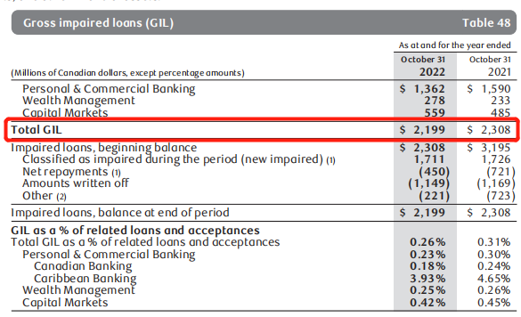
Gross Impaired Loans(GIL)
2022 vs. 2021
Total GIL of $2,199 million decreased $109 million or 5%
GIL in Personal & Commercial Banking decreased $228 million or 14%
GIL in Wealth Management increased $45 million or 19%
GIL in Capital Markets increased $74 million or 15%

Slide 51
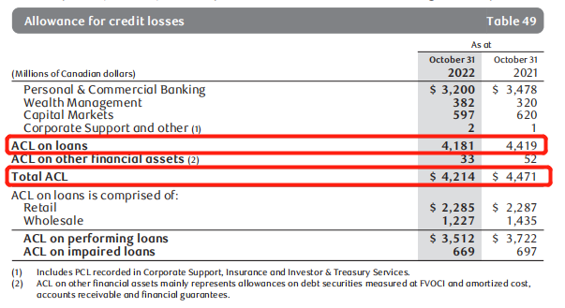
Allowance for Credit Losses
2022 vs. 2021
Total ACL of $4,214 million decreased $257 million or 6%
ACL on performing loans of $3,512 million decreased $210 million or 6%
ACL on impaired loans of $669 million decreased $28 million or 4%

Slide 52
Market Risk
Market risk: the impact of market prices upon our financial condition.
This includes potential gains or losses due to changes in market determined variables such as:
interest rates
credit spreads
equity prices
commodity prices
foreign
exchange rates
implied volatilities

Slide 53
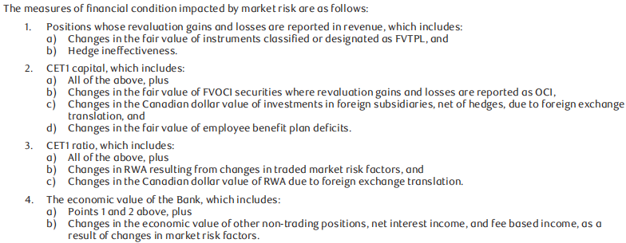
Market Risk Measure

Slide 54
Market Risk Controls
Value-at-Risk (VaR) is a statistical measure of potential loss for a financial portfolio computed at a given level of confidence and over a defined holding period.
We measure VaR at the 99th percentile confidence level for price movements over a one-day holding period using historic simulation of the last two years of equally weighted historic market data.
Stressed Value-at-Risk (SVaR) is calculated in an identical manner as VaR with the exception that it is computed using a fixed historical one-year period of extreme volatility and its inverse

Slide 55
Market Risk Controls
Market Risk measurement limitations:
VaR and SVaR will not be predictive of future losses if the realized market movements differ significantly from the historical periods used to compute them.
VaR and SVaR project potential losses over a one-day holding period and do not project potential losses for risk positions held over longer time periods.
VaR and SVaR are measured using positions at close of business and do not include the impact of trading and hedging activity over the course of a day.

Slide 56
Market Risk Controls
Incremental Risk Charge (IRC) captures the risk of losses under default or rating changes for issuers of certain traded fixed income instruments.
IRC is measured over a one year horizon at a 99.9% confidence level
captures different liquidity horizons for instruments and concentrations in issuers under a constant level of risk assumption.
Stress tests: identify and control risk due to large changes in market prices and rates.

Slide 57
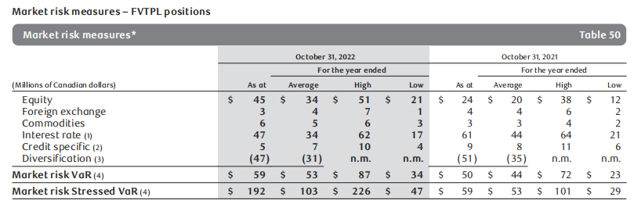
Market Risk Measures
2022 vs. 2021
Average market risk VaR of $53 million increased $9 million from last year.
Average SVaR of $103 million increased $50 million.

Slide 58
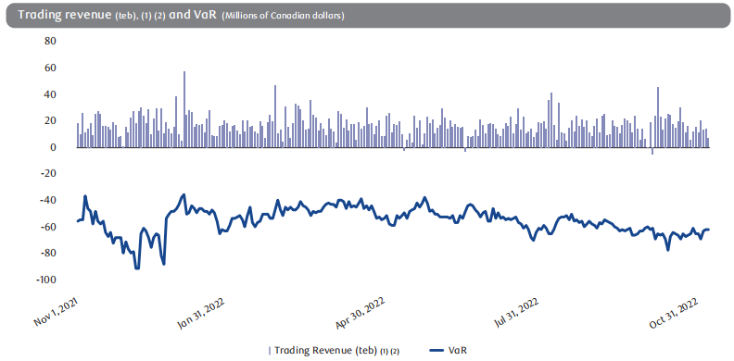
Trading Revenue
This chart displays a bar graph of our daily trading profit and loss and a line graph of our daily market risk VaR. We incurred 4 days of net trading losses in 2022.

Slide 59
Market Risk Control
IRRBB arises primarily from traditional customer-originated banking products such as deposits and loans, and includes related hedges and interest rate risk from securities held for liquidity management purposes
IRRBB measurement:
two primary metrics, Net Interest Income (NII) risk and Economic Value of Equity (EVE) risk, under a range of market shocks, scenarios, and time horizons.
NII and EVE risks are measured for a range of market risk stress scenarios which include extreme but plausible changes in market rates and volatilities.
A number of assumptions affecting cash flows, product re-pricing and the administration of rates underlie the models used to measure NII and EVE risk.

Slide 60
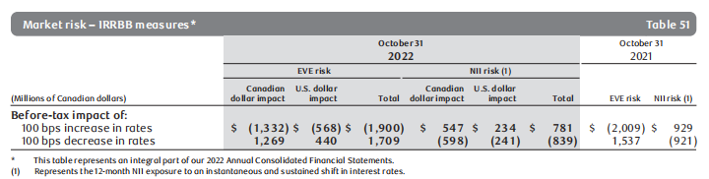
Market Risk Control
Market risk measures – IRRBB Sensitivities:
table shows the potential before-tax impact of an immediate and sustained 100 bps increase or decrease in interest rates on projected 12-month NII and EVE, assuming no subsequent hedging.

Slide 61
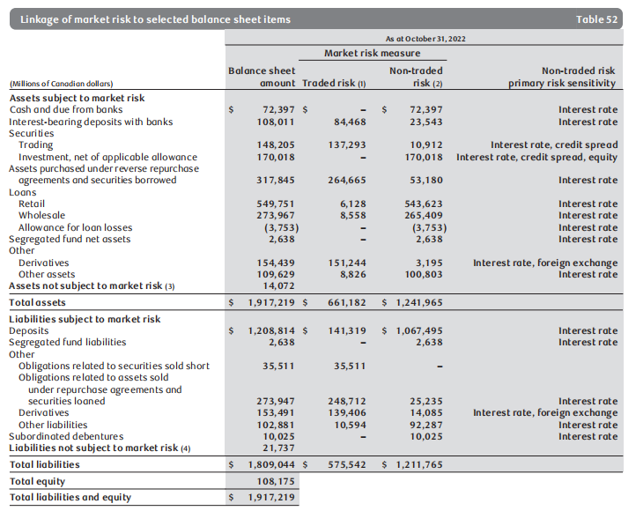
Linkage of market risk to selected balance sheet items:
The following tables provide the linkages between selected balance sheet items with positions included in our trading market risk and non-trading market risk disclosures, which illustrates how we manage market risk for our assets and liabilities through different risk measures:

Slide 62
Liquidity and Funding Risk
Liquidity and funding risk (liquidity risk) is the risk that we may be unable to generate sufficient cash or its equivalents in a timely and cost-effective manner to meet our commitments. Liquidity risk arises from mismatches in the timing and value of on-balance sheet and off-balance sheet cash flows.
Our liquidity profile is structured to ensure that we have sufficient liquidity to satisfy current and prospective commitments in both normal and stressed conditions
we operate under a comprehensive Liquidity Risk Management Framework (LRMF) and Pledging Policy.

Slide 63
Liquidity and Funding Risk
several liquidity risk mitigation strategies
Achieving an appropriate balance between the level of exposure allowed under risk appetite and the cost of risk mitigation
Maintaining broad funding access, including preserving and promoting a reliable base of core client deposits and ongoing access to diversified wholesale funding sources
A comprehensive liquidity stress testing program, contingency, recovery and resolution planning and status monitoring to ensure sufficiency of liquidity
Governance of pledging activity through limits and liquid asset buffers for potential pledging activity
Timely and granular risk measurement information
Transparent liquidity transfer pricing and cost allocation
RBC’s three lines of defense governance model
:

Slide 64
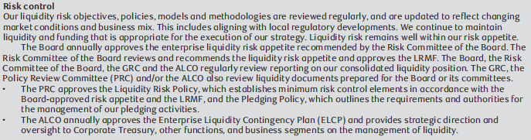
Liquidity and Funding Risk
Risk Control：

Slide 65
Liquidity and Funding Risk
Risk Measurement:
To manage liquidity risk within our liquidity risk appetite, we set limits on various metrics reflecting a range of time horizons and severity of stress conditions and develop contingency, recovery and resolution plans.
three categories：
Structural (longer-term) liquidity risk：
To guide our secured and unsecured wholesale term funding activities, we employ both internal and regulatory metrics to manage and control the structural alignment between long-term illiquid assets and longer-term funding sourced from wholesale investors and core relationship deposits.

Slide 66
Liquidity and Funding Risk
Tactical (shorter-term) liquidity risk ：
To address potential immediate cash flow risks in times of stress, we use short-term net cash flow limits to control risk of material units, subsidiaries and currencies, and perform stress testing assessments. Net cash flow positions are determined by applying internally-derived risk assumptions and parameters to known and anticipated cash flows for all material unencumbered assets, liabilities and off-balance sheet activities. Encumbered assets are not considered a source of available liquidity. We also control tactical liquidity by adhering to relevant regulatory standards, such as LCR.

Slide 67
Liquidity and Funding Risk
Contingency liquidity risk ：
Contingency liquidity risk planning assesses the impact of sudden stress events and our planned responses. Our ELCP, maintained and administered by Corporate Treasury, has been developed to guide our potential responses to liquidity crises. Under leadership of Corporate Treasury, both enterprise and regional Liquidity Crisis Teams (LCT) meet regularly to assess our liquidity status, approve the ELCP, and in times of stress provide valuable linkages to front line and risk functions to support the crisis management process. LCT’s include members from key business segments, GRM, Finance, Operations, and Communications with relevant subject matter expertise.

Slide 68
Liquidity and Funding Risk
Liquidity Reserve
Liquidity reserve consists of available unencumbered liquid assets.
Uncommitted and undrawn central bank borrowing facilities that could be accessed subject to satisfying certain preconditions as set by various central banks (e.g., BoC, the Fed, Bank of England, and Bank of France) are excluded in the liquidity reserve.
Amounts that qualify as eligible collateral at the Federal Reserve Bank of New York (FRBNY) and Federal Home Loan Bank (FHLB) are also excluded from the determination of the liquidity reserve.

Slide 69
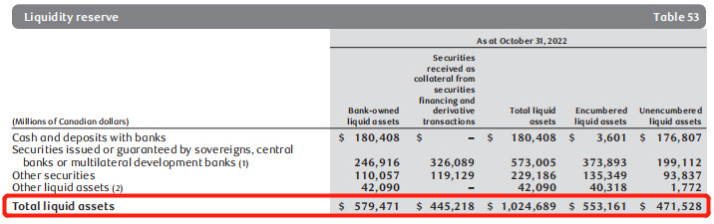
Liquidity and Funding Risk

Slide 70
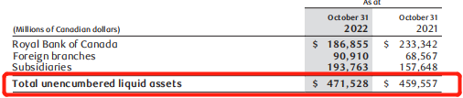
Liquidity and Funding Risk
Total unencumbered liquid assets increased $12 billion or 3% from last year, mainly due to an increase in on-balance sheet securities reflecting higher wholesale funding and client deposit levels.

Slide 71
Liquidity and Funding Risk
Asset Encumbrance
Bank-owned liquid assets that are either pledged as collateral (e.g., repo financing and derivative pledging) or not freely available due to regulatory or internal policy requirements (e.g., earmarked to satisfy mandatory reserve or regional capital adequacy requirements and to maintain continuous access to payment and settlement systems)
Securities received as collateral from securities financing and derivative transactions which have either been re-hypothecated where permissible (e.g., to obtain financing through repos or to cover securities sold short) or have no liquidity value since re-hypothecation is prohibited
Illiquid assets that have been securitized and sold into the market or that have been pledged as collateral in support of structured term funding vehicles. As per liquidity management framework and practice, encumbered assets are not considered a source of liquidity

Slide 72
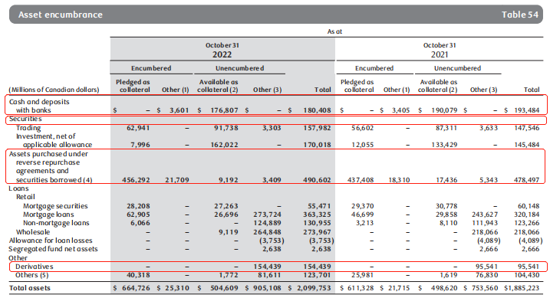
Liquidity and Funding Risk

Slide 73
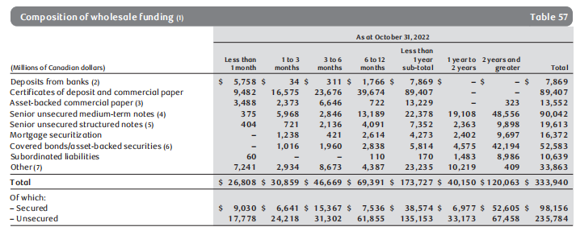
Liquidity and Funding Risk
Funding:
Funding for highly liquid assets consists primarily of short-term wholesale funding that reflects the monetization period of those assets.
Long-term wholesale funding is used mostly to fund less liquid wholesale assets and to support liquid asset buffers.

Slide 74
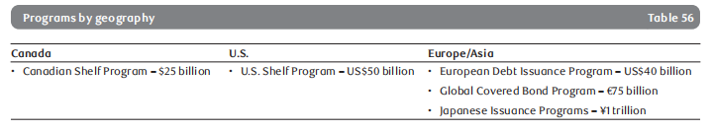
Liquidity and Funding Risk
wholesale funding activities:
RBC wholesale funding activities are well-diversified by geography, investor segment, instrument, currency, structure and maturity.
RBC maintain an ongoing presence in different funding markets which allows us to continuously monitor market developments and trends, identify opportunities and risks, and take appropriate and timely actions.

Slide 75
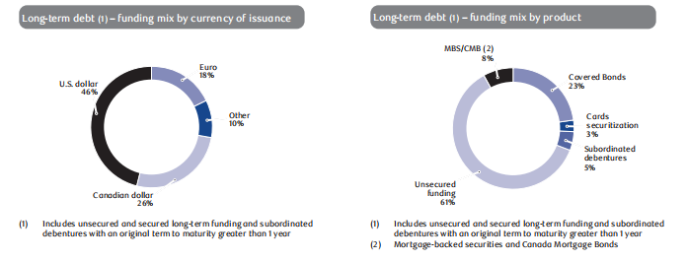
Liquidity and Funding Risk
RBC also raise long-term funding using Canadian Senior Notes, Canadian National Housing Act MBS, Canada Mortgage Bonds, credit card receivable-backed securities, Kangaroo Bonds (issued in the Australian domestic market by foreign firms) and Yankee Certificates of Deposit (issued in the U.S. domestic market by foreign firms).

Slide 76
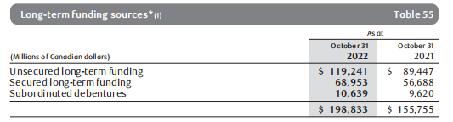
Liquidity and Funding Risk
During 2022, RBC continued to experience favourable unsecured wholesale funding access and pricing. RBC issued, either directly or through RBC subsidiaries, unsecured long-term funding of $43 billion in various currencies and markets.
Compared to 2021, RBC outstanding MBS sold decreased $190 million. RBC covered bonds and securitized credit card receivables increased $10 billion and $3 billion, respectively.

Slide 77
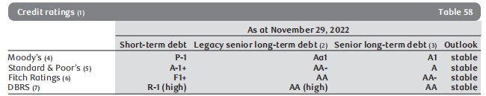
Liquidity and Funding Risk
Credit ratings
Rbc’s ability to access unsecured funding markets and to engage in certain collateralized business activities on a cost-effective basis are primarily dependent upon maintaining competitive credit ratings. Credit ratings and outlooks provided by rating agencies reflect their views and methodologies. Ratings are subject to change, based on a number of factors including, but not limited to, our financial strength, competitive position, liquidity and other factors not completely within our control.

Slide 78
Liquidity and Funding Risk
Liquidity Coverage Ratio (LCR)
The LCR is a Basel III metric that measures the sufficiency of high-quality liquid assets (HQLA) available to meet liquidity needs over a 30-day period in an acute stress scenario. The BCBS and OSFI regulatory minimum coverage level for LCR is 100%.
OSFI requires Canadian banks to disclose the LCR using the standard Basel disclosure template and calculated using the average of daily LCR positions during the quarter.

Slide 79
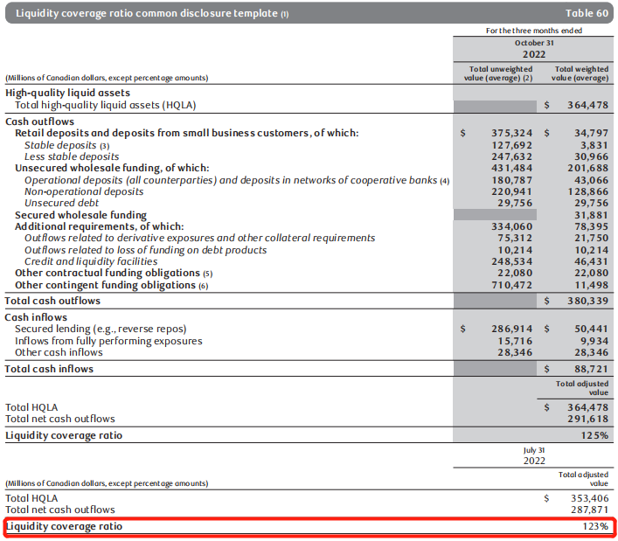
Liquidity and Funding Risk

Slide 80
Liquidity and Funding Risk
Net Stable Funding Ratio (NSFR)
NSFR is a Basel III metric that measures the sufficiency of available stable funding relative to the amount of required stable funding. The BCBS and OSFI regulatory minimum coverage level for NSFR is 100%.
Available stable funding is defined as the portion of capital and liabilities expected to be reliable over the time horizon considered by the NSFR, which extends to one year. Required stable funding is a function of the liquidity characteristics and residual maturities of the various assets held by the bank as well as those of its off-balance sheet exposures.

Slide 81
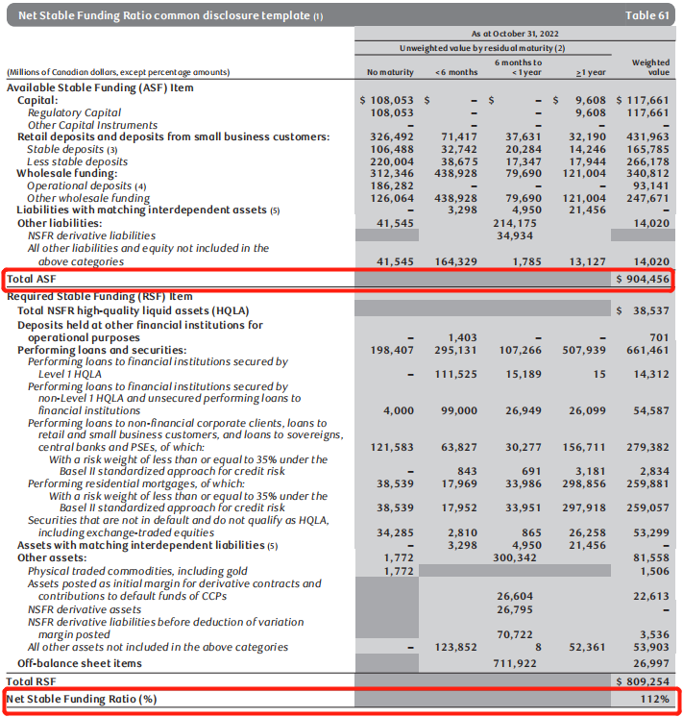
Liquidity and Funding Risk

Slide 82
Insurance Risk
Insurance risk refers to the potential financial loss that may arise where the amount, timing and/or frequency of benefit and/or premium payments under insurance and reinsurance contracts are different than expected.
Insurance risk is distinct from those risks covered by other parts of our risk management framework (e.g., credit, market and operational risk) where those risks areancillary to, or accompany, the risk transfer.
The five insurance sub-risks are:
Morbidity risk
Mortality risk
Longevity risk
Policyholder behaviour (lapse) risk
Travel risk

Slide 83
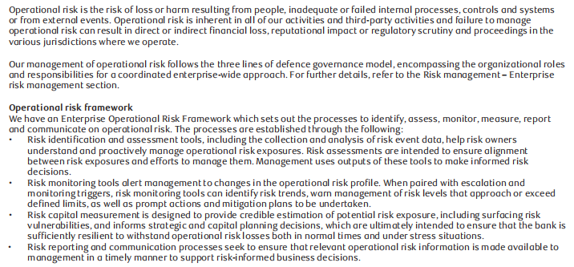
Operational Risk

Slide 84
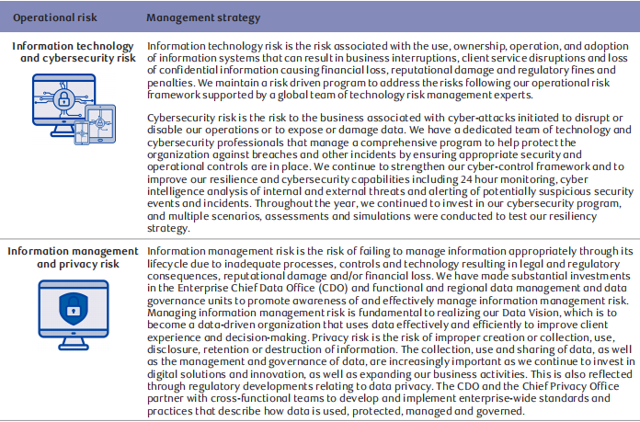
Operational Risk

Slide 85
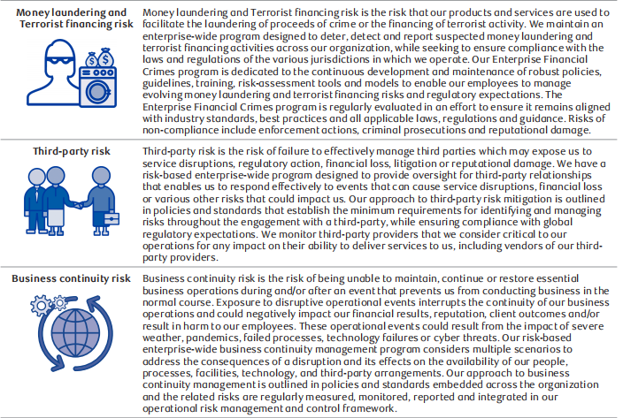

Slide 86
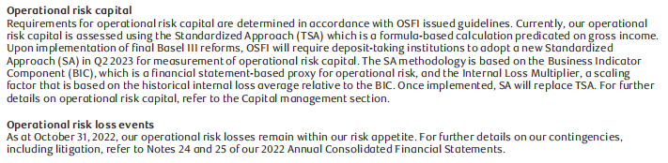
Operational Risk

Slide 87

Regulatory Compliance Risk

Slide 88
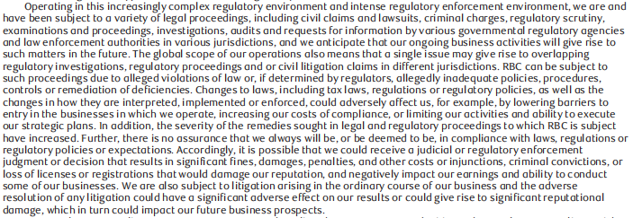

Regulatory Compliance Risk

Slide 89
Strategic Risk
Strategic risk is the risk that the enterprise or particular business areas will make inappropriate strategic choices, or will be unable to successfully implement selected strategies or achieve the expected benefits.
Responsibility for selecting and successfully implementing business strategies is mandated to the individual heads of each business segment. Oversight of strategic risk is the responsibility of the heads of the business segments and their operating committees, the Enterprise Strategy & Transformation group, the GE, and the Board. The Enterprise Strategy & Transformation group supports the management of strategic risk through the strategic planning process, articulated within our Enterprise Strategic Planning Policy, ensuring alignment across our business, financial, capital and risk planning

Slide 90
Reputation Risk
Reputation risk is the risk of an adverse impact on stakeholders’ perception of the bank due to:
the actions or inactions of the bank, its employees, third-party service providers, or clients
the perceived misalignment of these actions or inactions with stakeholder expectations of the bank,
negative public sentiment towards a global or industry issue.

Slide 91
Reputation Risk
damage to reputation can result:
Reduced share price and market capitalization,
Increased cost of capital
loss of strategic flexibility
Inability to enter or expand into markets
loss of client loyalty and business
Regulatory fines and penalties
Restrictive agreements with regulators or prosecutors
Managing our reputation risk is an integral part of our organizational culture and our overall enterprise risk management approach, as well as a priority for employees and our Board.

Slide 92

Legal and Regulatory Environment Risk

Slide 93

Legal and Regulatory Environment Risk

Slide 94

Legal and Regulatory Environment Risk

Slide 95


Legal and Regulatory Environment Risk

Slide 96

Legal and Regulatory Environment Risk

Slide 97
Competitive Risk
The risk of an inability to build or maintain a sustainable competitive advantage in a given market
Includes the potential for loss of the market share due to competitors offering superior products and services
Arised within or outside the financial sectors , from traditional or non traditional competitors, domestically or globally.
Reduced the revenue which adversely affected company results

Slide 98
Systemic Risk
The risk that the financial system as a whole, or a major part of it either in an individual country, a region, or globally
refers to the potential collapse or severe damage of the entire financial system or a significant portion of it due to an unforeseen event
Threat to the economy and can lead to various financial, reputation, legal, and other risks.
The two most significant measures in mitigating the impact of systemic risk are diversification and stress testing.
RBC diversified business model, portfolios, products, activities and funding sources help mitigate the potential impacts from systemic risk.

Slide 99
05
Risk management Structure

Slide 100

Risk management principal

Slide 101
Three Lines of Defense - First Line of Defence
Risk Owner
03
All employees across businesses and functional areas
Maintaining effective internal controls and for executing risk and control procedures on a day-to-day basis
Accountable for：
Identification
Measurement
Mitigation
Monitoring
Reporting of risk against approved policies and appetite

Slide 102
Three Lines of Defense - Second Line of Defence
Risk Oversight
03
Management to help ensure risk and controls are effectively managed
Establishes risk management practices and provides risk guidance
Provides oversight of the effectiveness of First Line risk management practices
Monitors and independently reports on the level of risk against established risk appetite

Slide 103
Three Lines of Defense - Third Line of Defence
Independent Assurance
03
Internal Audit
Independent assurance to management and the Board on the effectiveness of risk management practices

Slide 104
Risk Governance - Board of Director
Risk Committee
01
03
Governance Committee
Risk management Function
Independent from the business
Oversee the risk management program
Ensuring Management policies, processes and procedure
manage significant risks and monitor risk posture and risk profile
Developing and recommending governance frameworks, principles and policies to the Board
Overseeing and coordinating ESG matters at the Board and its committees
Monitoring developments in corporate governance and adapting best practices
Reviewing shareholder proposals and recommending responses to the Board.

Slide 105
Risk Governance - Board of Director
Audit Committee
02
04
Human Resources Committee
Assists the Board in its oversight of
The integrity of financial statements
The qualifications, performance and independence of external auditors
The performance of internal audit function,
Internal controls
Compliance with legal and regulatory requirements.
Assists the Board in its oversight of:
Compensation policies and programs
Compensation risk, management
Compensation for the CEO and Group Executives (GE)
Oversees pension plans, key talent management and human resources strategies and practices

Slide 106

Risk Management

Slide 107
Risk Appetite Statement
Quantitative Statement
01
02
Qualitative Statement
Manage earnings volatility and exposure to future losses under normal and stressed conditions.
Avoid excessive concentrations of risk.
Ensure capital adequacy and sound management of liquidity and funding risk.
Ensure sound management of operational and regulatory compliance risk.
Maintain strong credit ratings and a risk profile in the top half of our peer group.
Always uphold our Purpose and vision and consistently abide by our values and Code of Conduct to maintain our reputation and the trust of our clients, colleagues, and communities.
Undertake only risk we understand. Make thoughtful and future-focused risk decisions, taking environmental and social considerations into account.
Effectively balance risk and reward to enable sustainable growth.
Maintain a healthy and robust control environment to protect our stakeholders.
Always be operationally prepared and financially resilient for a potential crisis

Slide 108
Function of Risk Appetite
Protection
01
02
Clear Articulation
Unacceptable losses or undesirable outcomes with respect to earnings volatility, capital adequacy or liquidity, reputation risk or other risks while supporting and enabling our overall business strategy.
The amount and type of risk that we are able and willing to accept in the pursuit of our business objectives
It reflects our self-imposed upper bound to risk-taking, set at levels inside of regulatory limits and constraints, and influences our risk management philosophy, Code of Conduct, business practices and resource allocation.
Articulates our quantitative and qualitative risk appetite statements and their supporting measures and associated constraints, which can be applied at the enterprise, business segment, business unit and legal entity level
Describes our requirements and expectations to embed effective risk appetite practices throughout the organization.

Slide 109
Risk Measurement
01
Risk Measurement
02
Activities
Risk measurement and planning processes are integrated across the enterprise
Regards to forward-looking projections and analyses, including but not limited to, stress testing, recovery and resolution planning, and credit provisioning
Quantifying expected loss: losses that are statistically expected to occur as a result of conducting business in a given time period
Quantifying unexpected loss: an estimate of the deviation of actual earnings from expected earnings, over a specified time horizon
Stress testing: evaluates, from a forward looking perspective, the potential effects of a set of specified changes in risk factors, corresponding to exceptional but plausible adverse economic and financial market events
Back-testing: the realized values are compared to the parameter estimates that are currently used in an effort to ensure the parameters remain appropriate for regulatory and economic capital calculations

Slide 110
Risk Measurement- Stress test
Stress testing is an important component of risk management framework. Stress testing results are used for:
Assessing the viability of long-term business plans and strategies
Monitoring risk profile relative to risk appetite in terms of earnings and capital at risk
Setting limits of acceptable risk
Identifying key risks to, and potential shifts in, capital and liquidity levels, as well as financial position
Enhancing understanding of available mitigating actions in response to potential adverse events
Assessing the adequacy of capital and liquidity levels

Slide 111
06
Risk management Strategy

Slide 112
Derivative Instrument
01
Financial Derivatives
02
Non-financial Derivative
Financial contracts whose value is derived from an underlying interest rate, foreign exchange rate, credit risk, and equity or equity index
Forwards and Future
Swaps
Options
Credit Derivatives
Contracts also include non-financial derivative products such as precious metal and commodity derivative contracts in both the OTC and exchange markets.

Slide 113
Risk Management Strategies - Issued for Trading Purposes
01
Sales Activities
02
Trading Activities
Structuring and marketing derivative products to client
Modify or reduce risk
Market-making
Positioning
Arbitrage Activity

Slide 114
Risk Management Strategies - Issued for other-than-trading purposes
01
Risk management
02
Activities
Management of interest rate, credit, equity and foreign exchange risk related to funding, lending, investment activities and asset/liability management
Interest rate swap-Manage exposure to interest rate risk
Cross currency swaps - Managed exposure to foreign currency risk
Foreign exchange forward contracts
Certain derivatives-Designated and qualify for hedge accounting

Slide 115
Risk Management Strategies - Fair value hedge
01
Fair Value hedge
Carrying value of the hedged item is adjusted for changes in fair value attributable to the hedged risk and recognized in Non-interest income
Changes in the fair value of the hedged item, to the extent that the hedging relationship is effective, are offset by changes in the fair value of the hedging derivative, which are also recognized in Non-interest income.
When hedge accounting is discontinued, the carrying value of the hedged item is no longer adjusted and the cumulative fair value adjustments to the carrying value of the hedged items are amortized to Net income over the expected remaining life of the hedged items

Slide 116

Fair Value Hedges- --- assets and liabilities designated as hedged items

Slide 117

Fair Value Hedges

Slide 118
Risk Management Strategies - Cash Flow Hedge
01
Cash Flow Hedge
The effective portion of the change in the fair value of the hedging derivative, net of taxes, is recognized in OCI and reclassified to profit or loss as the associated hedged forecast transaction occurs, while the ineffective portion is recognized in Non-interest income
When hedge accounting is discontinued, the cumulative amounts previously recognized in OCI are reclassified to Net interest income during the periods when the variability in the cash flows of the hedged item affects Net interest income
Unrealized gains and losses on derivatives are reclassified immediately to Net income when the hedged item is sold or terminated early, or when the forecast transaction is no longer expected to occur

Slide 119

Cash Flow Hedges

Slide 120
Risk Management Strategies - Net Investment Hedge
01
Net Investment Hedge
Foreign currency exposure to a net investment in a foreign operation, the effective portion of foreign exchange gains and losses on the hedging instruments, net of applicable taxes, is recognized in OCI and the ineffective portion is recognized in Non-interest income
The amounts, or a portion thereof, previously recognized in Other components of equity are recognized in Net income on the disposal, or partial disposal, of the foreign operation
Foreign exchange contracts and foreign currency-denominated liabilities to manage foreign currency exposures to net investments in foreign operations having a functional currency other than the Canadian dollar

Slide 121

Cash Flow & Net Investment Hedges

Slide 122

Trading Revenue

Slide 123


Slide 124

Derivative-Related Credit Risk

Slide 125

Derivatives and Non-derivative Instruments

Slide 126

Net Investment Hedges

Slide 127

Effectiveness of Designated Hedging Relationships (2022)

Slide 128

Effectiveness of Designated Hedging Relationships (2021)

Slide 129
Thank You !

