Slide 1
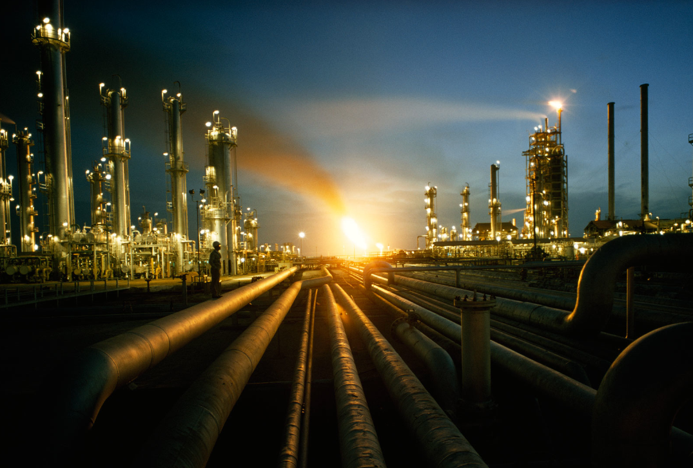
PETROLEUM REFINING

Slide 2
AGENDA
Introduction
Industry Overview
Risk Analysis
Company Analysis
  Valero Energy Corporation
  Provident
  Inter Pipeline
Conclusion
  Recommendations

Slide 3
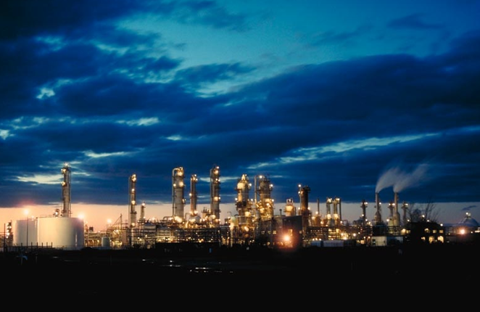
INDUSTRY OVERVIEW

Slide 4
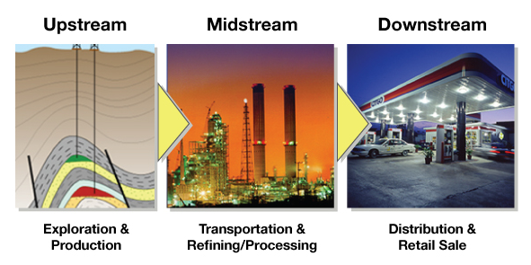
Main Sector in Oil and Gas Industry

Slide 5
Petroleum Refining
A refinery takes a raw material (crude oil) and transforms it into petrol and hundreds of other useful products.
What refining does:
  Adjusts and reshapes molecules
  Standardizes product
  Removes contaminants to meet requirements for:
    end-user performance
    environmental regulations

Slide 6
Major Products
Light distillates
LPG
Gasoline
Naphtha
Middle distillates
Kerosene
Diesel
Heavy distillates and residuum
Heavy fuel oil
Lubricating oils
Wax
Asphalt

Slide 7
Main Processes
All refineries perform three basic steps:
  Separation: fractional distillation)
  Conversion: cracking and rearranging the molecules
  Treatment: blending, purifying, fine-tuning and improving products to meet specific requirements

Slide 8
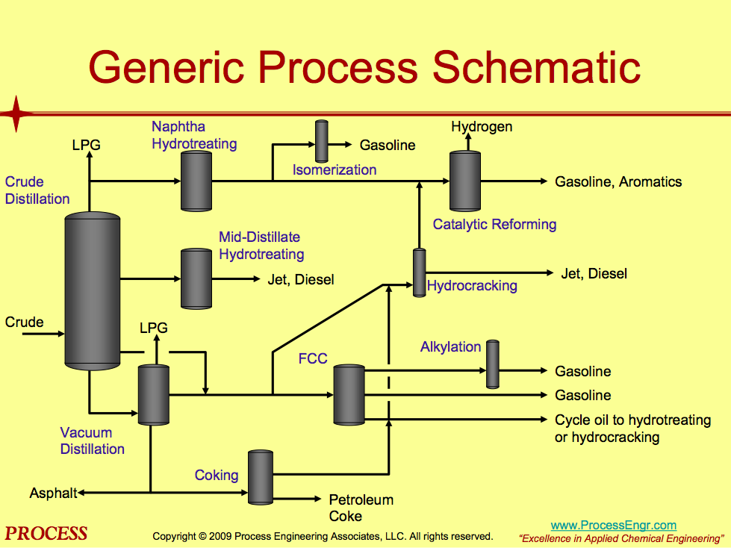

Slide 9
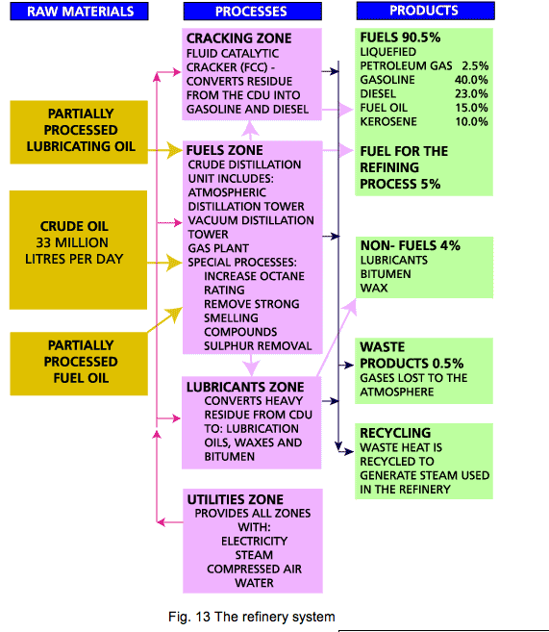
Refinery System

Slide 10
World’s Top Refineries Companies in 2011

Slide 11
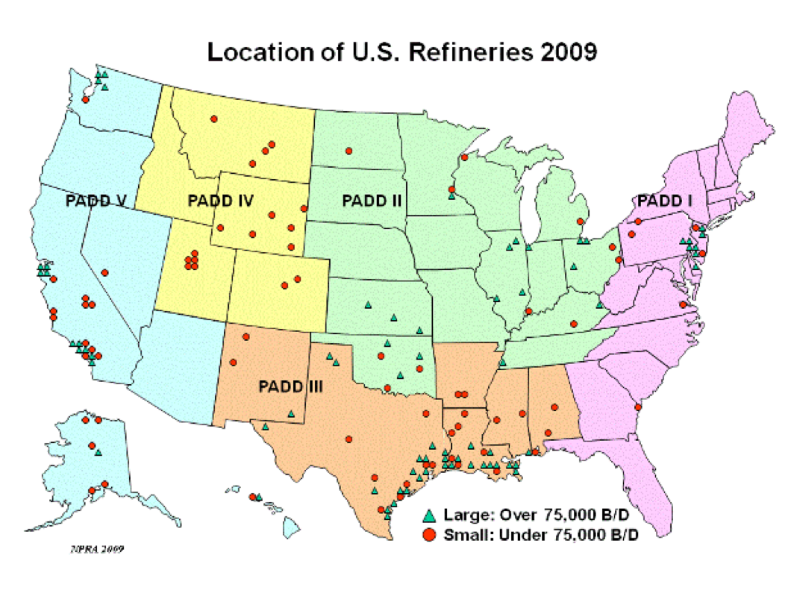
Geographic distribution in U.S.

Slide 12
U.S. Top Refineries Companies in 2011

Slide 13
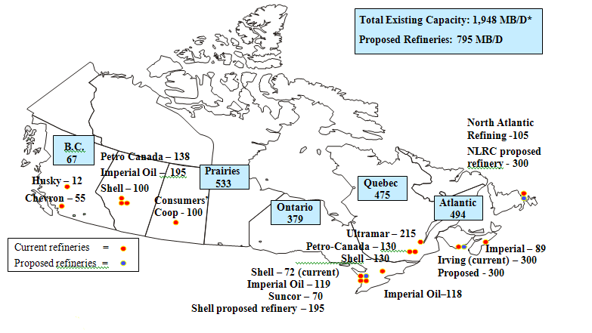
Refineries in Canada
Thousand of Cube Meters per day in 2007

Slide 14
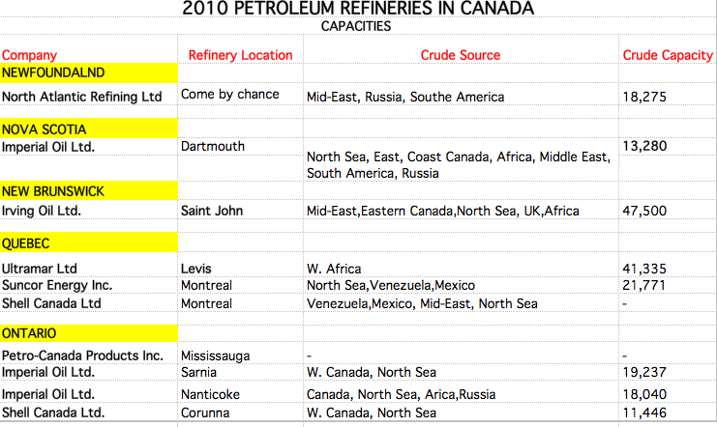
Canada Top Refineries Companies 2010

Slide 15
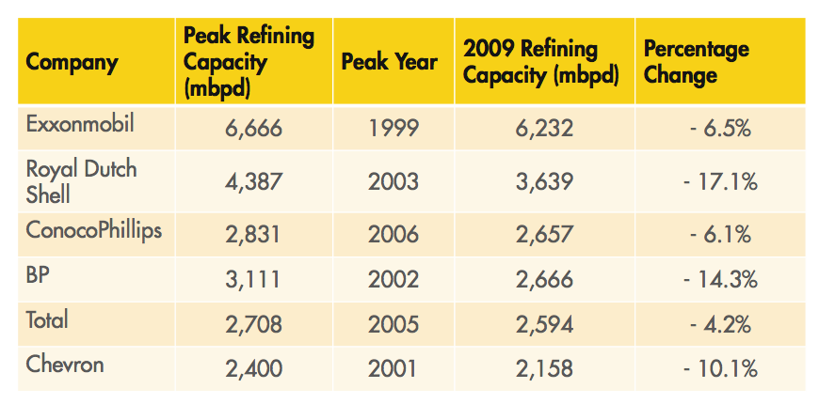
Refining Capacity Changes for Integrated Majors

Slide 16
Refining Capacity Changes for Integrated Majors
IMPLICATIONS:DOWNSTREAM DIVESTMENTS
Integrated majors continuing to exit refining business – some through divestment of refining assets and some through spinning off of Downstream business as a separate corporate entity.
Result is that refinery ownership is moving away from integrated majors towards non-integrated companies.
To remain viable, refining businesses will need to be able to generate sufficient cash to provide an adequate return to their owners

Slide 17
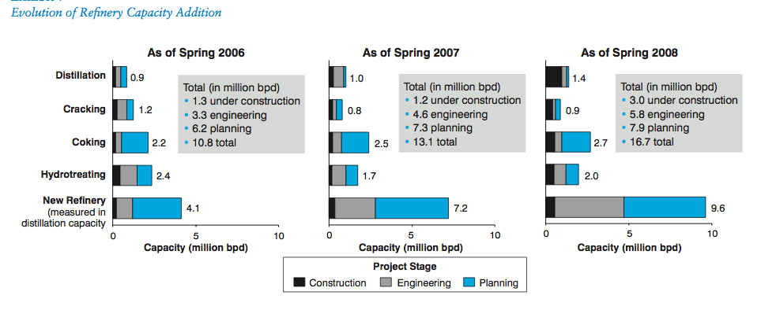
Evaluation of Refinery Capacity

Slide 18
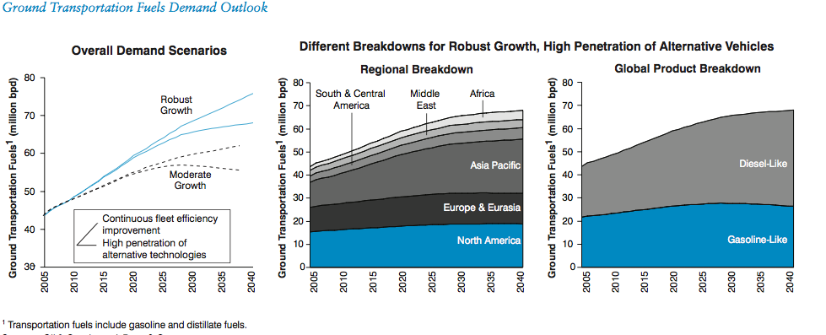
Future Capacity Forecast

Slide 19
Factors Determining Gas Price
Notes:
40 - 55 per cent is crude oil costs (the raw material for making gasoline and diesel fuel)
25 - 35 per cent is federal, provincial and municipal taxes and the GST
10 - 25 per cent is the refiner's margin (the difference between what it costs to buy crude oil and the price refined gasoline sells for in the wholesale market which, in turn, is influenced by supply and demand)
4 - 6 per cent is the marketing (or retail) margin that covers retail stations’ expenses and profits.

Slide 20
Refinery Margin and Major Costs
Refining margin = total value of petroleum products - the price of the raw material-other costs
Major Costs
  Fixed operating costs: labour, maintenance, taxes and overhead costs
  Variable operating costs: feed-dependent costs for power, water, chemicals, additives, catalyst and refinery fuels beyond own production
  Transport costs
  Marginal crude freight
  Insurance and ocean loss
  Applicable fees and duties

Slide 21
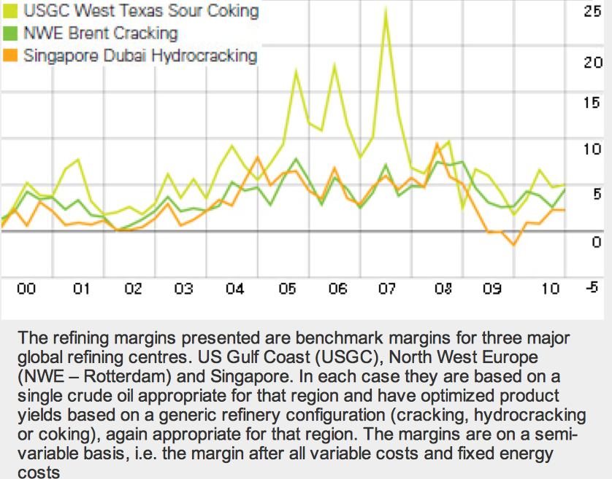
Regional Refining Margins
$/barrel

Slide 22
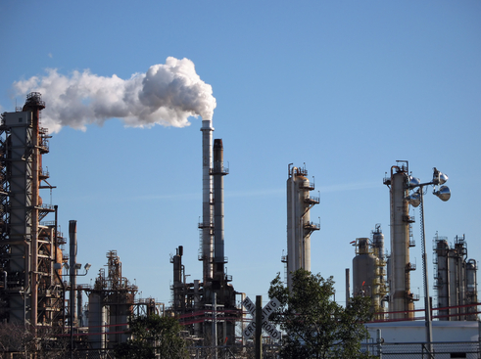
REGULATION ENVIRONMENT

Slide 23
Green House Gas Regulation
EPA has started to propose regulation of GHG’s under existing CAA programs such as Vehicle Emissions standards rule, Prevention of Significant Deterioration, and New Source Performance Standards
Under these regulations, permits will be required for projects that emit threshold levels of CO2 (regardless of emissions of other criteria pollutants such as SOx, NOx, etc.

Slide 24
Implications
Significantly more permits will be required for refinery modifications
Require installation of BACT (Best Available Control Technology) for managing CO2 emissions. BACT to be determined on case-by-case basis.
EPA is currently working on approach for refinery GHG measures: Energy management
Command and control (source specific emission limits) Benchmarking
In any case, greater focus on energy reduction projects will likely be required.

Slide 25
Reformulated Fuel Standard (RFS2)
  RFS program was created under the Energy Policy Act of 2005. Established first renewable fuel mandate – 7.5 billion gallons by 2012
  Established new categories of renewable fuel and mandates for each, and increased volumes of renewable fuel (9 billion gallons in 2008 to 36 billion gallons by 2022)

Slide 26
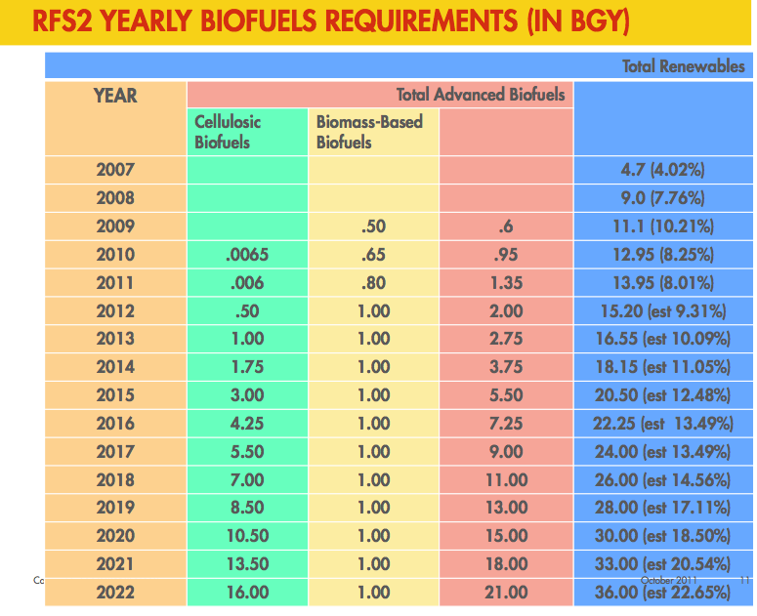
Reformulated Fuel Standard (RFS2)

Slide 27
Implications
Growth in biofuels exceeds overall growth in transportation fuels – increased pressure on refining
Significant expansion in facilities required to manufacture, store, transport, and blend biofuels
Impact of increasing biofuels volumes will result in changes to mix of fuel blending components – refinery configuration and/or new technologies

Slide 28
Other Regulations
Clean Air Act
  Dominant regulatory effect on refinery operations
Reformulated gasoline (RFG) standards
  Affects operations indirectly through restrictions on product mix
Clean Water Act
RCRA
State regulations
Corporate Average Fuel Economy (CAFE) standards
  Indirect effect through performance requirements on products

Slide 29
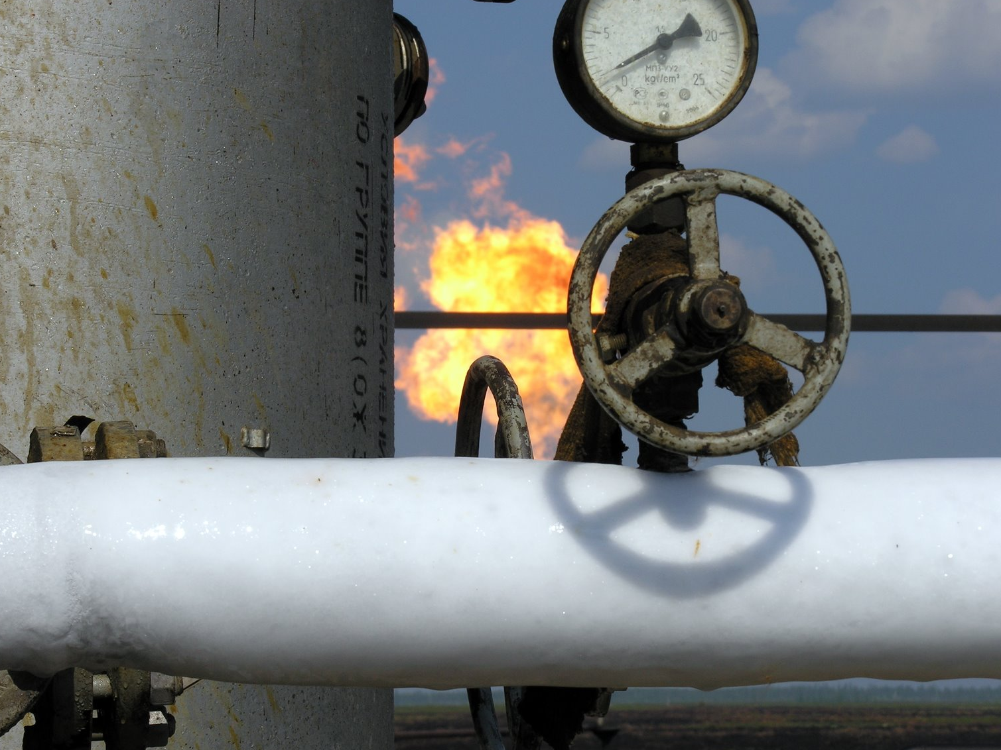
Risk Analysis

Slide 30
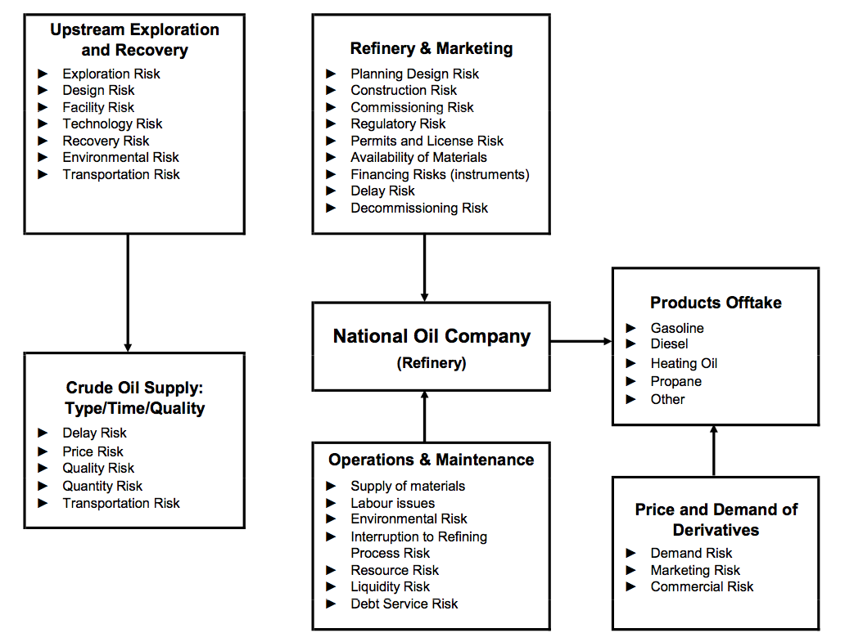
Typical Risks in the Oil and Gas Industry

Slide 31
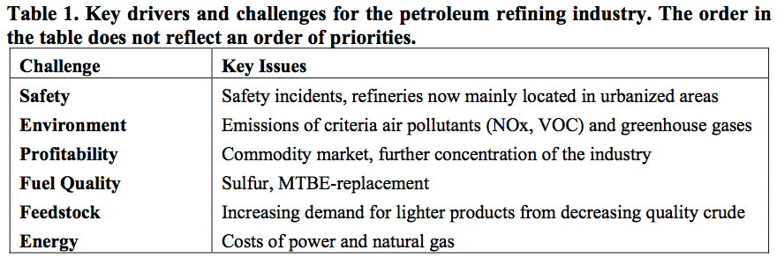
Key drivers and Challenges in Refinery

Slide 32
Risk Exposure
Operational Risk
Environmental Consideration
Economic and Political Risk
Commodity Risk
Financial Risk
Regulatory Limitations
Limitation on Capacity

Slide 33
Environmental Impacts and Risks
Air
  Refinery emissions contain several major ozone precursors. The associated impacts would be most significant near and downwind of a given facility.
Water and soil
  Potential for contamination from leaks and spills
Carcinogens
  Benzene is a significant component of refinery air emissions
Global warming

Slide 34
Future Regulation: Waxman-Markey Legislation
Market Environment Characterized by Rising Regulatory Costs and Excess Capacity Abroad
  Rising costs of production from recently enacted environmental and regulatory requirements.
  Rising competition from foreign competitors – 7.6 – 8.8 million barrels per day (mb/d) of new refining capacity is expected to come online by 2015 – 80% of which will be built outside of the OECD. Flat or declining demand for transportation fuels in the U.S. market.
  Rising taxes, and biofuel mandates will further shrink margins and place 2.5 mb/d of the current 17.5 mb/d of domestic operable capacity at high risk of permanent closure early in the 2015-2030 forecast period.

Slide 35
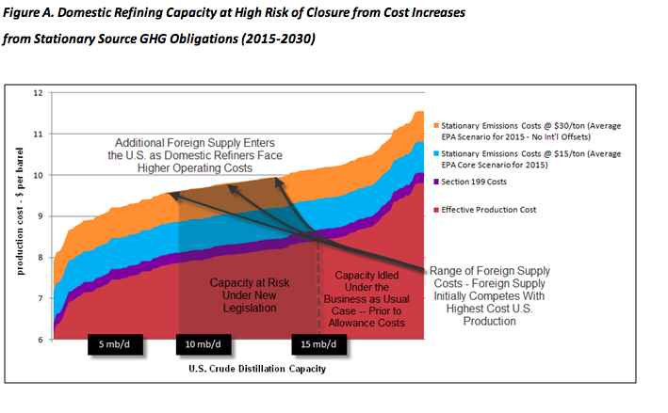
Future Regulation: Waxman-Markey Legislation

Slide 36
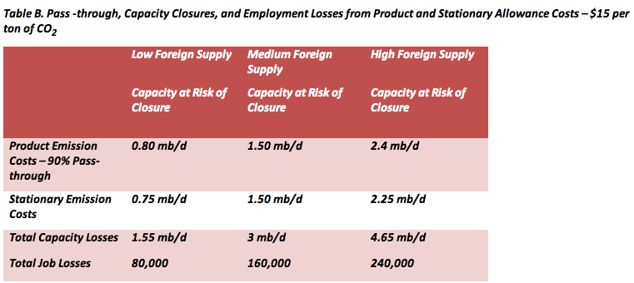
Future Regulation: Waxman-Markey Legislation

Slide 37
Implications
Gasoline Prices
In the 2015-2030 gasoline prices could rise by an average of $0.20 to $0.40 per gallon under the carbon costs calculated by the U.S. Environmental Protection Agency (EPA).
Gasoline, and all other petroleum based transportation fuels, could rise by over $1/gallon under some CO₂ allowance cost forecasts by the U.S. Energy Information Administration (EIA).

Slide 38
Risk Measurement
Sensitivity analysis
Simulation Analysis
Probability Estimation
Value at Risk (VaR)

Slide 39
Risk Management
Diversification and Insurance
OTC Forward Contracts
Exchange-Traded Energy Futures
Foreign Exchange Futures
Hedging through Options

Slide 40

Valero Energy Corporation
Notes:
UPDATE EVERYTHING TO 2011 10-K
40

Slide 41
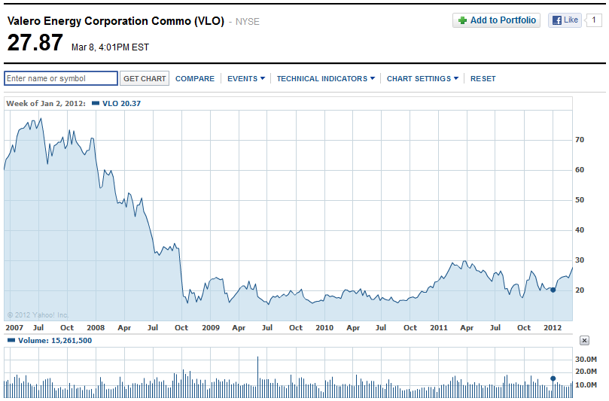
VLO - NYSE
Notes:
41

Slide 42
Overview
Fortune 500 company based in San Antonio, Texas
Incorporated in 1981 – Valero Refining & Marketing Company
Changed name in 1997 to Valero Energy Corporation
22,000 employees
Notes:
42

Slide 43




Executives
Bill Klesse
Chairman of the Board, CEO and President
Started out as chemical engineer
BSci Chem Eng
MBA in Finance
Mike Ciskowski
Executive Vice President and Chief Financial Officer
Responsible for Treasury, Finance, Accounting, Internal Audit, Trading Controls and Insurance
BBA & MBA in Finance
Jay Browning
Senior Vice President-Corporate Law and Secretary
Responsible for Corporate Governance, Finance, Securities and Exchange Commission, and Information Systems Support.
BBA & MBA in Finance
Donna Titzman
Vice President and Treasurer
Responsible for the company’s banking, cash management, customer credit and investment management areas.
BBA Accounting, CPA
Notes:
CPA certified public accountant.
43

Slide 44
Segments
Refining
Refining operations, wholesale marketing, product supply and distribution, and transportation operations
Ethanol
Sales of internally produced ethanol and distillers grains
Our ethanol operations are geographically located in the central plains region of the U.S.
Retail
Company-operated convenience stores, Canadian dealers/jobbers, truckstop facilities, cardlock facilities, and home heating oil operations.
Segregated into Retail-US and Retail-Canada
Notes:
Refining -Gulf Coast, Mid-Continent, West Coast, Northeast regions
Joint venture agreement with Darling Green Energy LLC to construct and operate biomass-based diesel plant with feed capacity of 10,000 barrels per day that will process animal fats, used cooking oils, and other vegetable oils into renewable green diesel. $368 million cost
44

Slide 45
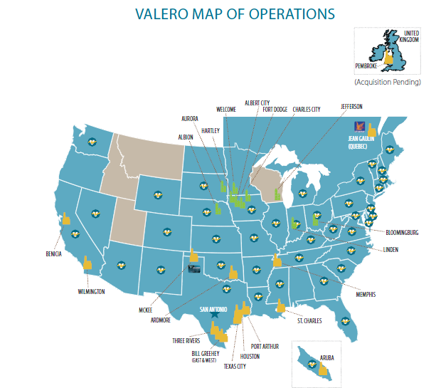
Notes:
From 2010 annual report – need updated 2011 map of operations
Yellow – refinery
Green – ethanol
Teal states – have retail presence
Also 1 in Aruba in Caribbean, just north of Venezuela, South America.
45

Slide 46
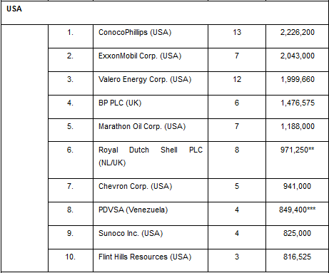
Competitors
2010 Refining Capacity in USA
Notes:
Doesn’t include 3 refineries in Canada, Aruba, UK plus 1 more bought in 2011.
46

Slide 47
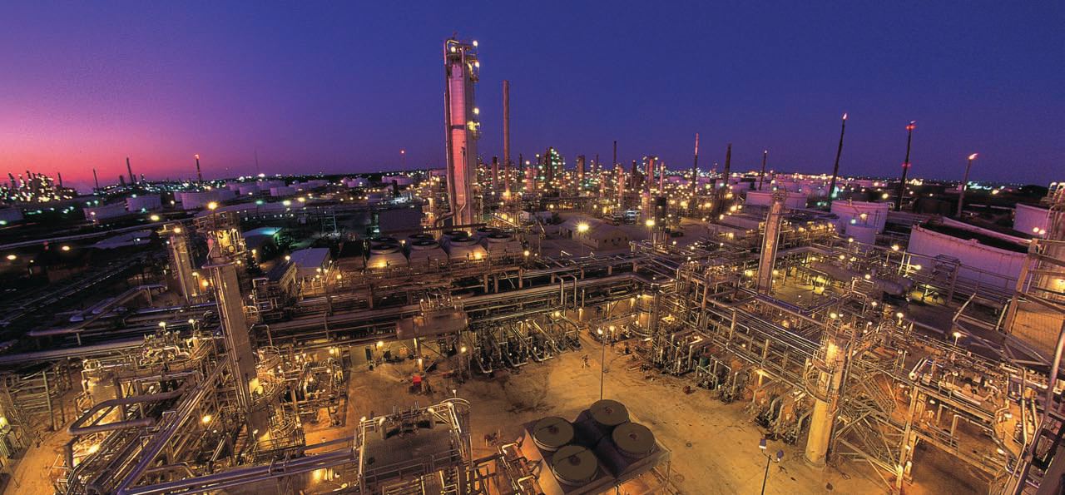
Financial Statements
Notes:
47

Slide 48
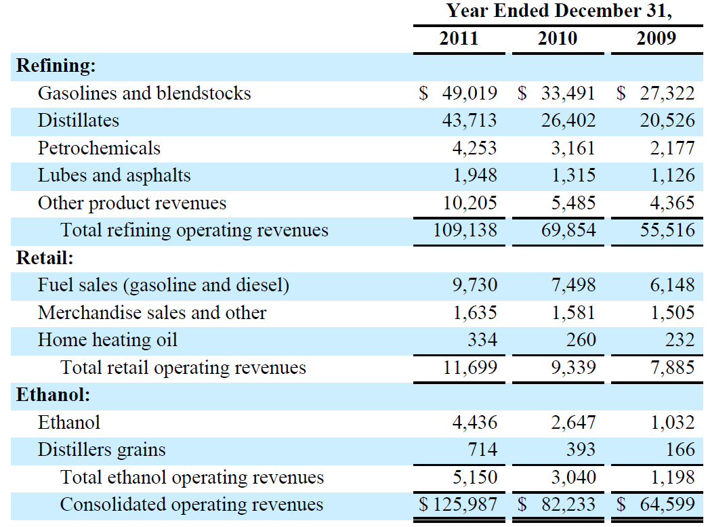
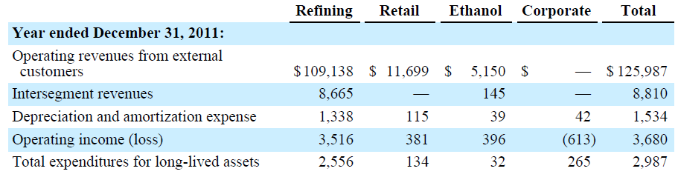
Segment Revenues
Notes:
86% refining, 10% retail, 4% ethanol
48

Slide 49
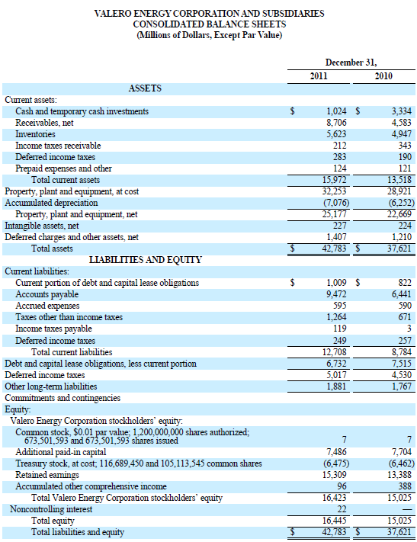
Notes:
In millions
49

Slide 50
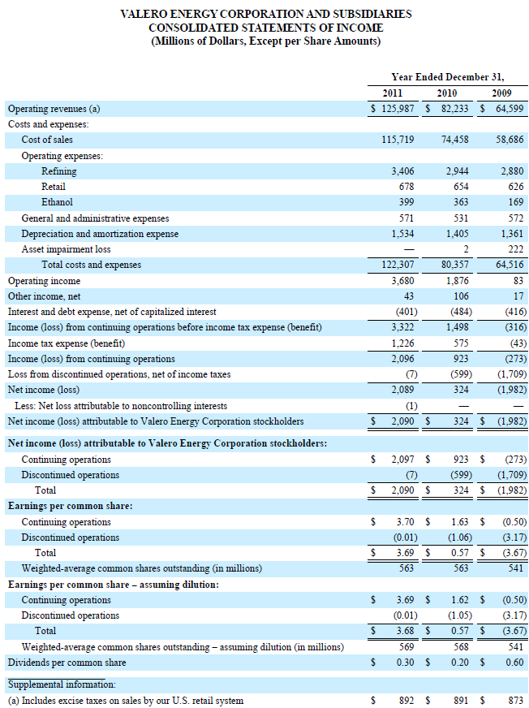
Gross margin: 9.2%
Operating margin: 3%
Notes:
operating revenue 126 billion
COGS 116 billion
50

Slide 51
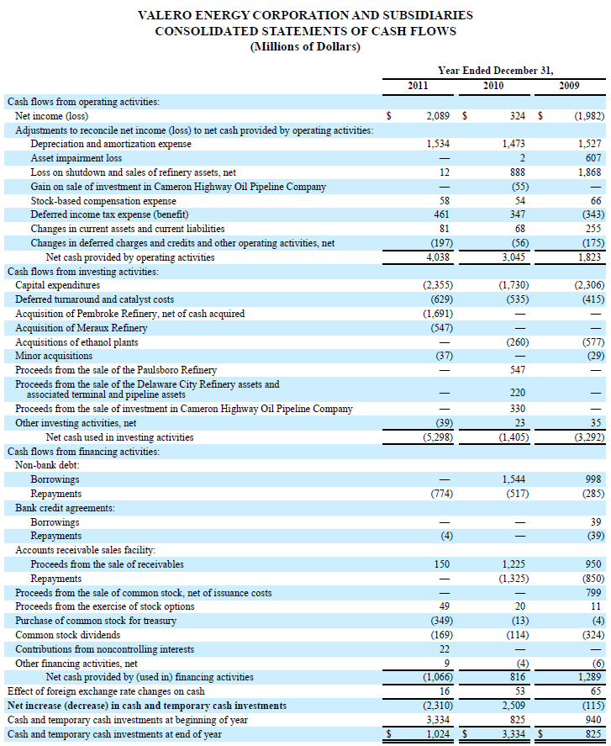
Notes:
51

Slide 52
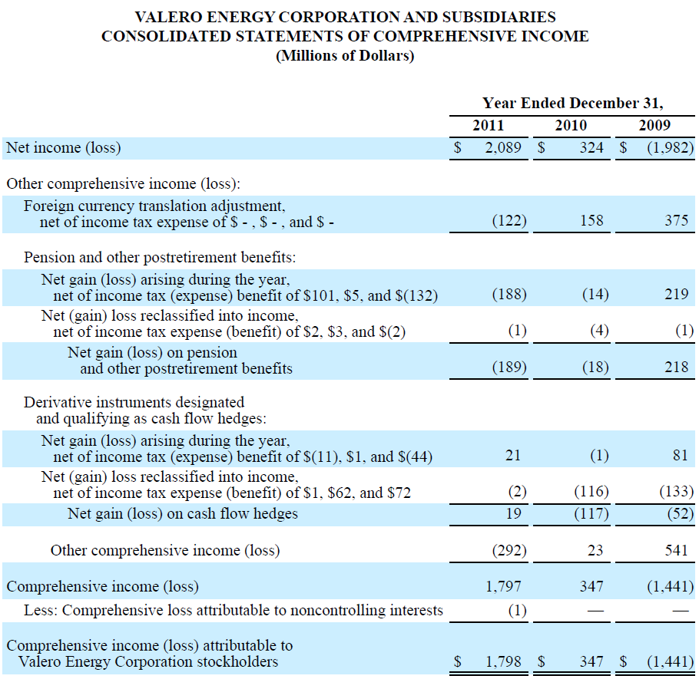
Notes:
52

Slide 53
Operations - Petroleum
16 petroleum refineries are located in the United States (U.S.), Canada, the United Kingdom (U.K.), and Aruba
Conventional gasolines
Distillates
Jet fuel
Asphalt
Petrochemicals
Lubricants
Premium products including CBOB and RBOB1
Gasoline meeting the specifications of the California Air Resources Board (CARB)
CARB diesel fuel
Low−sulfur and ultra−low−sulfur diesel fuel
Notes:
Most of our refineries have access to marine
transportation facilities and interconnect with common-carrier pipeline systems, allowing us to sell products
in the U.S., Canada, the U.K., and other countries. No customer accounted for more than 10 percent of our
total operating revenues in 2011.
They sell a significant portion of our gasoline and distillate production through bulk sales channels in U.S.
and international markets
53

Slide 54
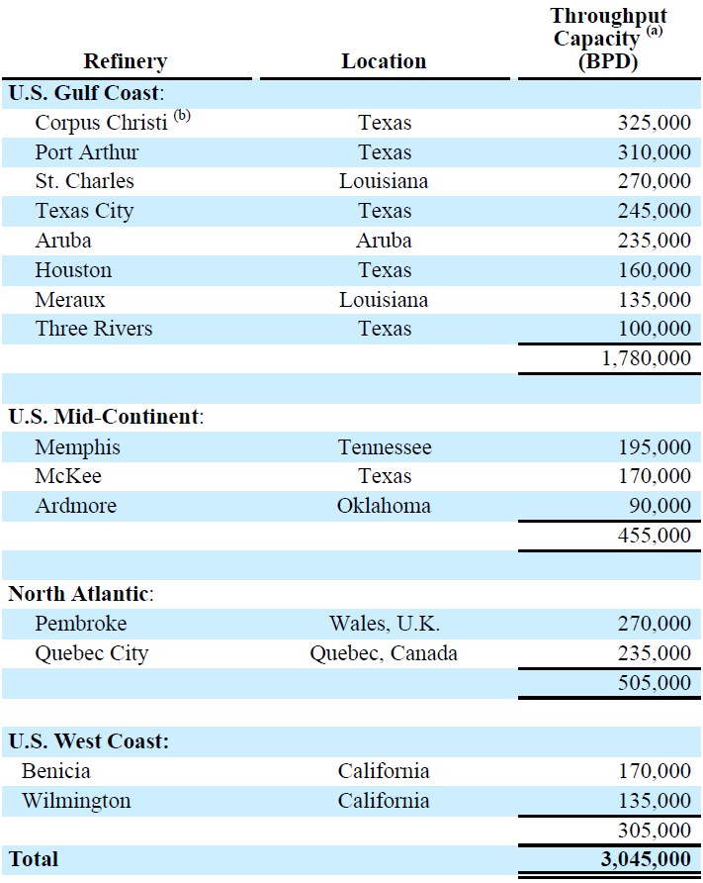
Refining Capacity
Notes:
Total capacity of 3 million barrels per day
54

Slide 55
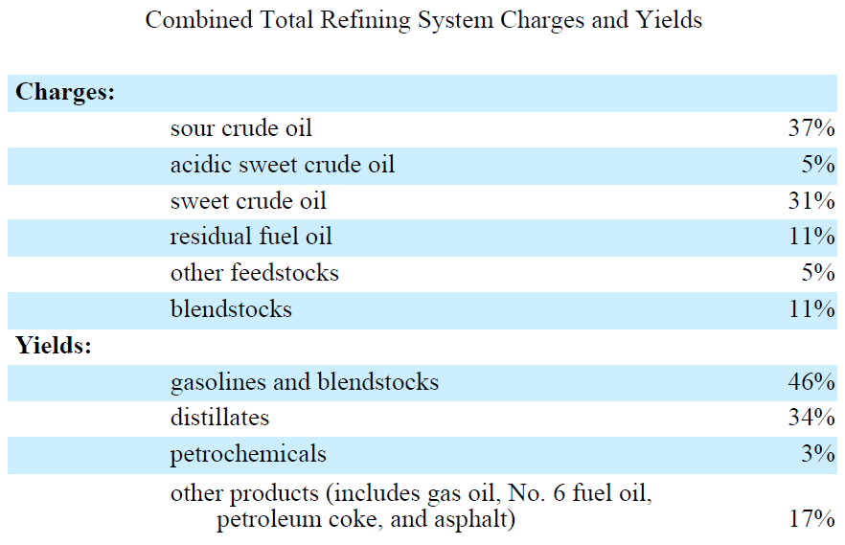
Refining Yields
Notes:
Average combined throughput 2.4 million bpd. = 80% of capacity
We are a large producer of sulfur with sales primarily to customers in the agricultural sector. Sulfur
is used in manufacturing fertilizer.
55

Slide 56
Feedstock Supply
Approximately 63 percent of our current crude oil feedstock requirements are purchased through term contracts while the remaining requirements are generally purchased on the spot market.
The majority of the crude oil purchased under our term contracts is purchased at the producer’s official stated price (i.e., the “market” price established by the seller for all purchasers) and not at a negotiated price specific to us.
Notes:
56

Slide 57
Feedstock Supply
Approximately 63 percent of our current crude oil feedstock requirements are purchased through term contracts while the remaining requirements are generally purchased on the spot market.
The majority of the crude oil purchased under our term contracts is purchased at the producer’s official stated price (i.e., the “market” price established by the seller for all purchasers) and not at a negotiated price specific to us.
Notes:
57

Slide 58
Marketing
We market our refined products through an extensive bulk and rack marketing network and we sell refined products through a network of approximately 6,800 retail and wholesale branded outlets in the United States (U.S.), Canada, the United Kingdom (U.K.), Aruba, and Ireland under various brand names including Valero®, Diamond Shamrock®, Shamrock®, Ultramar®, Beacon®, and Texaco®
Notes:
58

Slide 59
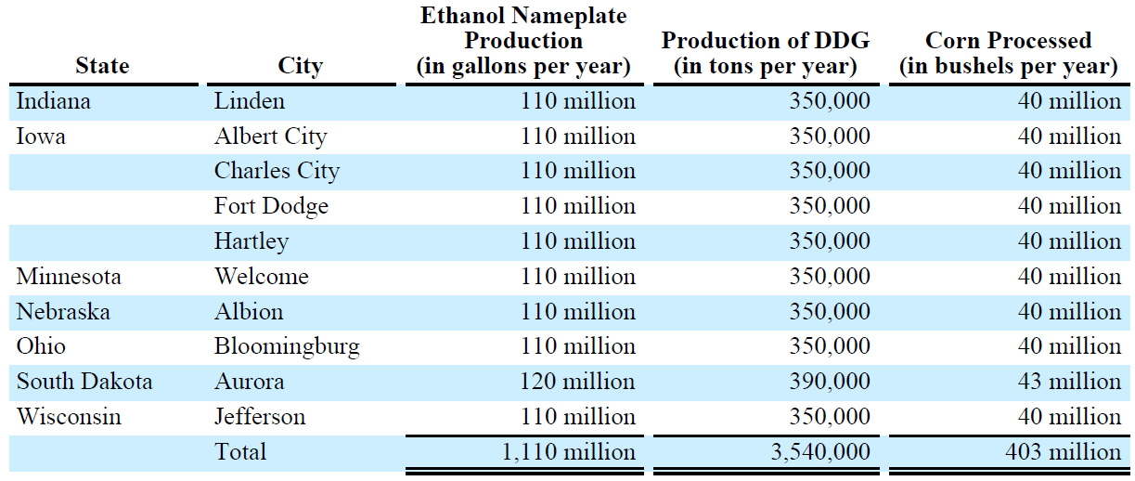
Operations - Ethanol
10 ethanol plants in the Midwest
Notes:
Our ethanol plants are dry mill facilities that process corn to produce ethanol and distillers grains.2
We source our corn supply from local farmers and commercial elevators. Our facilities receive corn by rail
and truck. We publish on our website a corn bid for local farmers and cooperative dealers to use to facilitate
corn supply transactions.
Bought 7 from the VeraSun Energy bankruptcy in second quarter 2009.
59

Slide 60
Operations - Retail
Retail – U.S.
Sales of transportation fuels
  Average 119,780 BPD
  Fuels sold under Valero brand
Convenience store merchandise and services
998 company-operated sites under Corner Store brand name
Retail – Canada
Sales of transportation fuels
  Average 76,100 BPD
  Fuels sold under Ultramar brand
791 outlets
  381 owned
  410 independent dealers and jobbers
Sales of home heating oil to residential customers

Slide 61
Growth Strategy
“leads in shareholder value growth through innovative, efficient upgrading of low cost feedstocks into high value, high quality products.”
Aggressive “growth through acquisitions” strategy
Since 1997
  1,000 to 22,000 employees
  1 to 16 refineries
  0.2 to 3 million BPD capacity
Notes:
61

Slide 62
Risk Oversight
The Board considers oversight of Valero’s risk management efforts to be a responsibility of the full board
Risk management is an integral part of Valero’s annual strategic planning process, which addresses, among other things, the risks and opportunities facing Valero
Notes:
62

Slide 63
Risk Management Policies
“The Board had a Finance Committee in 2010. The Finance Committee reviewed and monitored the investment policies and performance of our Thrift Plan and pension plans, insurance and risk management policies and programs, and finance matters and policies as needed. During 2010, the members of the Finance Committee were Irl F. Engelhardt (Chairman), Ruben M. Escobedo, Bob Marbut, Susan Kaufman Purcell, and Stephen M. Waters. The Finance Committee met three times in 2010. The Board has determined that it will not have a separately appointed Finance Committee in 2011.”
Notes:
All on Board of Directors. 11 board of directors, 5 involved with risk. Engelhardt left board in 2010.
63

Slide 64
Risk Factors
1. Volatility of refining margins & global economic activity
  Primarily affected by the relationship, or margin, between refined product prices and the prices for crude oil and other feedstocks
  Affected by regional/global supply & demand for crude oil and refined products, US & global economies, US relationships with foreign governments, governmental regulation
Notes:
Production levels of foreign & domestic suppliers
Economic turmoil, threat of terrorist attacks, recessions – decline in energy consumption
Refining capacity expansions
A significant portion of our profitability is derived from the ability to purchase and process crude oil feedstocks
that historically have been cheaper than benchmark crude oils, such as Louisiana Light Sweet (LLS) and
Brent crude oils.
Historically, refining margins have been volatile, and we believe they will
continue to be volatile in the future.
64

Slide 65
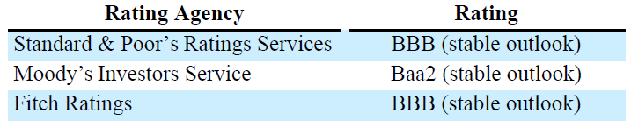
Risk Factors
2. Uncertainty and illiquidity in credit and capital markets
  Can impair our ability to obtain credit and financing on acceptable terms, and can adversely affect the financial strength of our business partners
Notes:
S&P, Moody's, Fitch’s could downgrade our rating of investment grade rating -> lead to increased borrowing costs
A/R, A/P, rely on counter-parties to our derivative instruments to fund their obligations.
65

Slide 66
Risk Factors
3. Compliance with and changes in environmental laws
  Emissions into the air and releases into the soil, surface water, or groundwater
  Level of expenditures required for environmental matters could increase in the future due to more stringent and new environment laws and regulations
Notes:
Because environmental laws and regulations
are becoming more stringent and new environmental laws and regulations are continuously being enacted
or proposed, such as those relating to greenhouse gas emissions and climate changePermit costs
66

Slide 67
Risk Factors
4. Disruption of our ability to obtain crude oil could adversely affect our operations
  Supplies originating in Middle East, Africa, Asia, North America & South America
    Political, geographic and economic risks
  Possibility for unavailability of alternative sources or volumes at unfavourable prices
Notes:
67

Slide 68
Risk Factors
5. Reliance on third-party transportation of crude oil and refined products
  Subject to interruptions in supply and increased costs
    Weather events, accidents, governmental regulations, or third-party actions
Notes:
68

Slide 69
Risk Factors
6. Competitors that produce their own supply of feedstocks, have more extensive retail outlets, or have greater financial resources may have a competitive advantage
  Do not produce any of our crude oil feedstocks
    Many competitors obtain significant portion of feedstocks from company-owned production

Slide 70
Risk Factors
7. A significant interruption in one or more of our refineries could adversely affect our business
  Refineries are principal operating assets
  Interruption: lost production and repair costs
Notes:
experience a major accident or mechanical failure,
encounter work stoppages relating to organized labor issues, be damaged by severe weather or other natural
or man-made disaster, such as an act of terrorism, or otherwise be forced to shut down
70

Slide 71
Risk Factors
8. Insurance may not cover all potential losses from operating hazards
  We maintain insurance against many, but not all, potential losses arising from operating hazards
    For example, coverage for hurricane damage is very limited, and coverage for terrorism risks includes very broad exclusions
  Failure by one or more insurers to honor its coverage commitments for an insured event
Notes:
71

Slide 72
Risk Factors
9. Compliance with and changes in tax laws could adversely affect our performance
Extensive tax liabilities imposed by multiple jurisdictions, including
  income taxes,
  transactional taxes (excise/duty, sales/use, and value-added taxes),
  payroll taxes,
  franchise taxes,
  withholdingtaxes, and
  ad valorem taxes.
Notes:
72

Slide 73
Risk Factors
10. Losses as a result of our forward-contract activities and derivative transactions
  Currently use derivative instruments
  Expect to continue their use in the future
  If these instruments we use to hedge are not effective, we may incur losses
Notes:
73

Slide 74
Item 7A
Commodity Price Risk
Interest Rate Risk
Foreign Currency Risk
Compliance Program Price Risk

Slide 75
Commodity Price Risk
Future markets for liquidity
Swaps for price exposure
Certain commodity derivative instruments for trading purposes to take advantage of existing market conditions related to future results of operations and cash flows
Notes:
We are exposed to market risks related to the price of crude oil, refined products (primarily gasoline and
distillate), grain (primarily corn), and natural gas used in our refining operations. To reduce the impact of
price volatility on our results of operations and cash flows, we enter into commodity derivative instruments,
including swaps, futures, and options to hedge:
• inventories and firm commitments to purchase inventories generally for amounts by which our
current year LIFO inventory levels differ from our previous year-end LIFO inventory levels and
• forecasted feedstock and refined product purchases, refined product sales, natural gas purchases,
and corn purchases to lock in the price of those forecasted transactions at existing market prices that
we deem favorable.
75

Slide 76
Commodity Price Risk
“Our positions in commodity derivative instruments are monitored and managed on a daily basis by a risk control group to ensure compliance with our stated risk management policy that has been approved by our board of directors.”

Slide 77
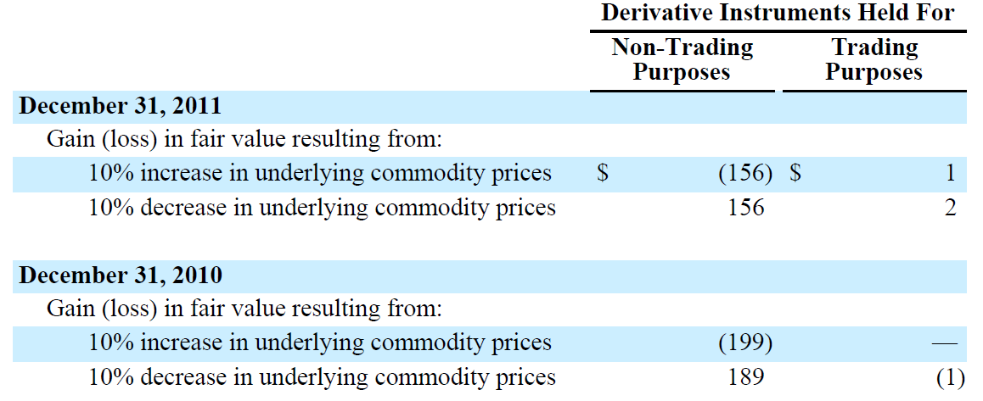
Commodity Price Risk
Sensitivity Analysis
Notes:
In millions
77

Slide 78
Commodity Price Risk
For risk management, we use:
  Fair Value Hedges
  Cash Flow Hedges
  Economic Hedges
  Trading Derivatives
Notes:
78

Slide 79
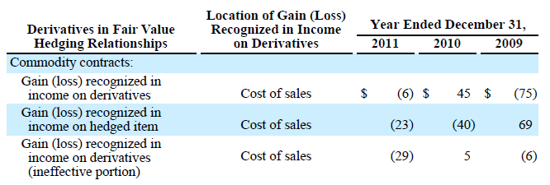
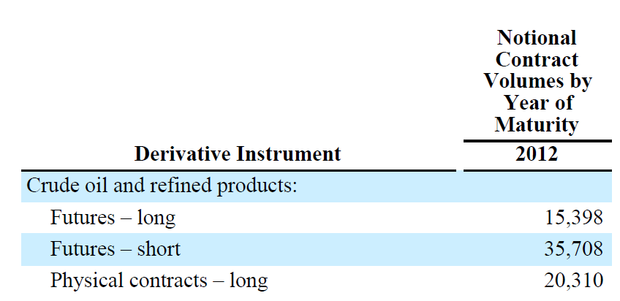
Commodity Price Risk
Fair Value Hedges
  Hedge price volatility in certain refining inventories and firm commitments to purchase inventories
  Level of activity for our fair value hedges is based on the level of our operating inventories, and generally represents the amount by which our inventories differ from our previous year-end LIFO inventory levels
Notes:
Volumes In thousands, gains/losses in millions
only hedging 35 million barrels per year
79

Slide 80
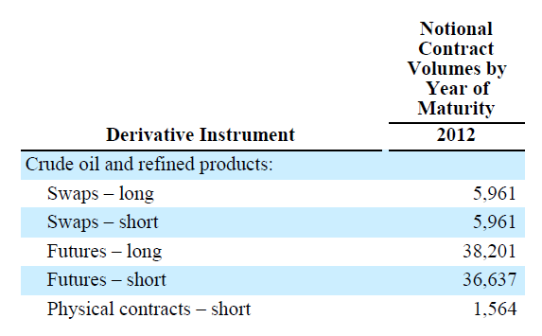
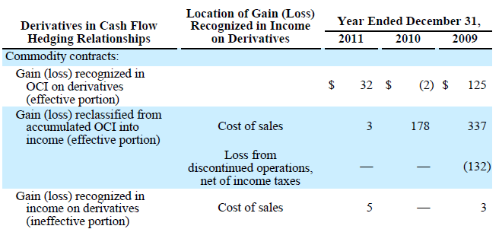
Commodity Price Risk
  Cash Flow Hedges
    Price volatility in certain forecasted feedstock, refined product purchases, refined product sales & natural gas purchases
Notes:
Objective is to lock in price of forecasted feedstock, product or natural gas purchases or refined product sales at existing market prices we deem favourable
Volumes In thousands, gains/losses in millions
80

Slide 81
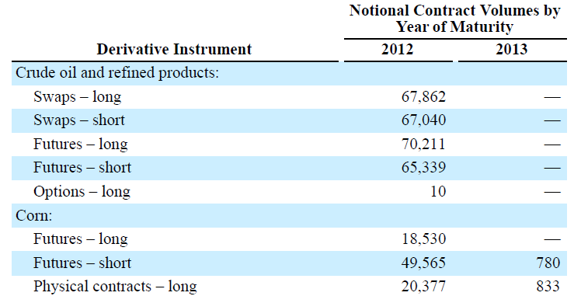
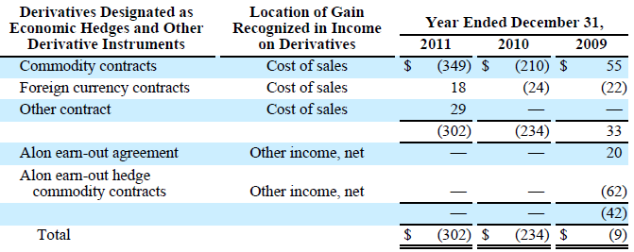
Commodity Price Risk
Economic Hedges
  Manage price volatility in certain (i) refinery feedstock, refined product, and corn inventories, (ii) forecasted refinery feedstock, refined product, and corn purchases, and refined product sales, and (iii) fixed-price corn purchase contracts
Notes:
Volumes In thousands, gains/losses in millions. Not designated as hedging instruments for accounting purposes
used to manage price volatility in certain (i) refinery feedstock, refined product, and
corn inventories, (ii) forecasted refinery feedstock, refined product, and corn purchases, and refined product
sales, and (iii) fixed-price corn purchase contracts. Our objective in entering into economic hedges is
consistent with the objectives discussed above for fair value hedges and cash flow hedges. However, the
economic hedges are not designated as a fair value hedge or a cash flow hedge for accounting purposes,
usually due to the difficulty of establishing the required documentation at the date that the derivative
instrument is entered into that would allow us to achieve “hedge deferral accounting.”
The loss of $349 million on
commodity contracts for the year ended December 31, 2011 includes a $542 million loss related to forward
sales of refined products.
81

Slide 82

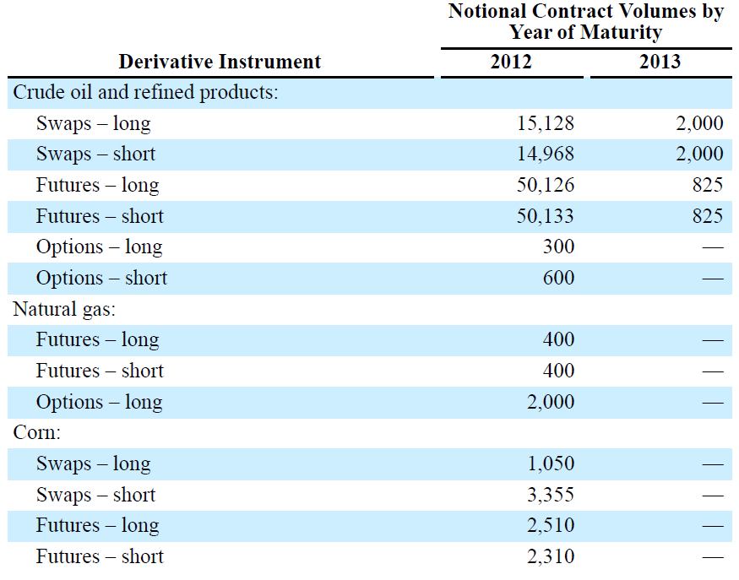
Commodity Price Risk
Trading Derivatives
  Take advantage of existing market conditions related to future results of operations and cash flows
Notes:
Oil – thousands of barrels, natural gas – billions BTUs, corn – thousands of bushels
82

Slide 83
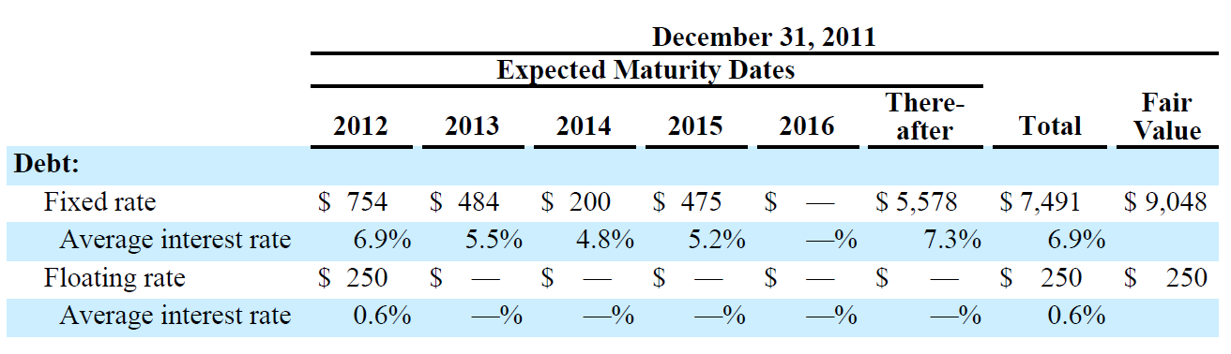
Interest Rate Risk
No outstanding interest rate derivatives as of Dec 31, 2011 & 2010
Notes:
Our primary market risk exposure for changes in interest rates relates to our debt obligations. We manage
our exposure to changing interest rates through the use of a combination of fixed-rate and floating-rate debt.
In addition, at times we have used interest rate swap agreements to manage our fixed to floating interest rate
position by converting certain fixed-rate debt to floating-rate debt.
millions
83

Slide 84
Foreign Currency Risk
As of December 31, 2011, we had commitments to purchase $751 million of U.S. dollars
Our market risk was minimal on the contracts, as they matured on or before January 26, 2012, resulting in a $3 million loss
Notes:
We are exposed to exchange rate fluctuations on transactions entered into by our Canadian and European
operations that are denominated in currencies other than the local (functional) currencies of those operations.
To manage our exposure to these exchange rate fluctuations, we use foreign currency exchange and purchase
contracts. These contracts are not designated as hedging instruments for accounting purposes, and therefore
they are classified as economic hedges.
84

Slide 85
Compliance Program Price Risk
Exposed to volatility in the price of financial instruments associated with various governmental and regulatory compliance programs that we must purchase in the open market to comply with these programs.
As of December 31, 2011, we had purchased futures contracts – long for 68,000 metric tons of EU emission allowances that were entered into as economic hedges.
Notes:
Namely blending biofuels
In the U.K., we are required to maintain a minimum quantity of refined products as a reserve against shortages
or interruptions in the supply of these products
Our Pembroke Refinery is subject to a maximum amount of carbon dioxide that it can emit each year under
the EU Emissions Trading Scheme. $2 million
Immaterial fair value
85

Slide 86
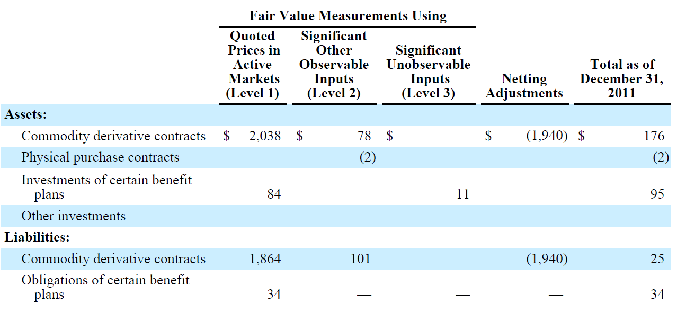
Fair Value Measurements
Notes:
In millions
Level 1 – exchange traded futures and swaps
Level 2 – third party broker quotes, contractual terms that are different from level 1.
86

Slide 87
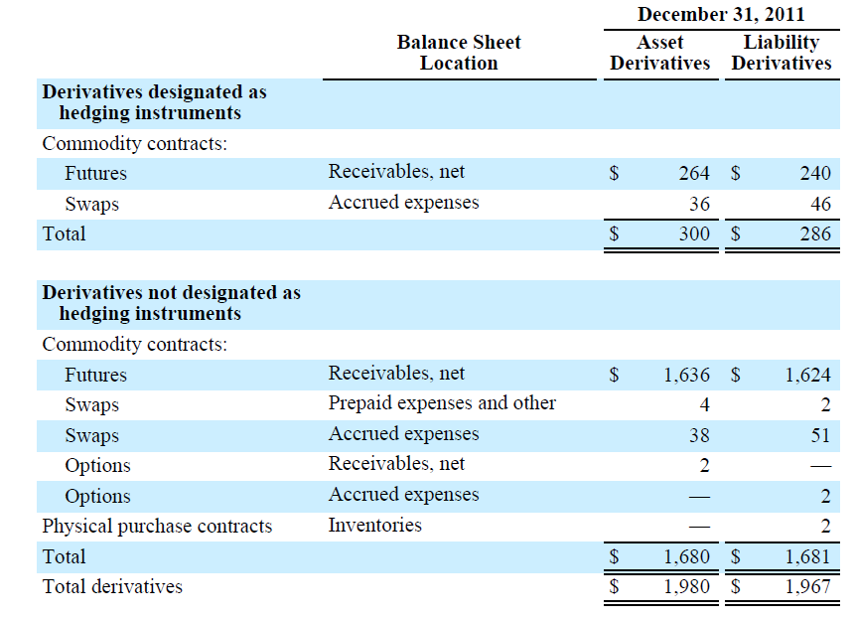
Fair Values of Derivative Instruments
Notes:
Millions
Economic hedges Not designated as hedging instruments for accounting purposes
87

Slide 88
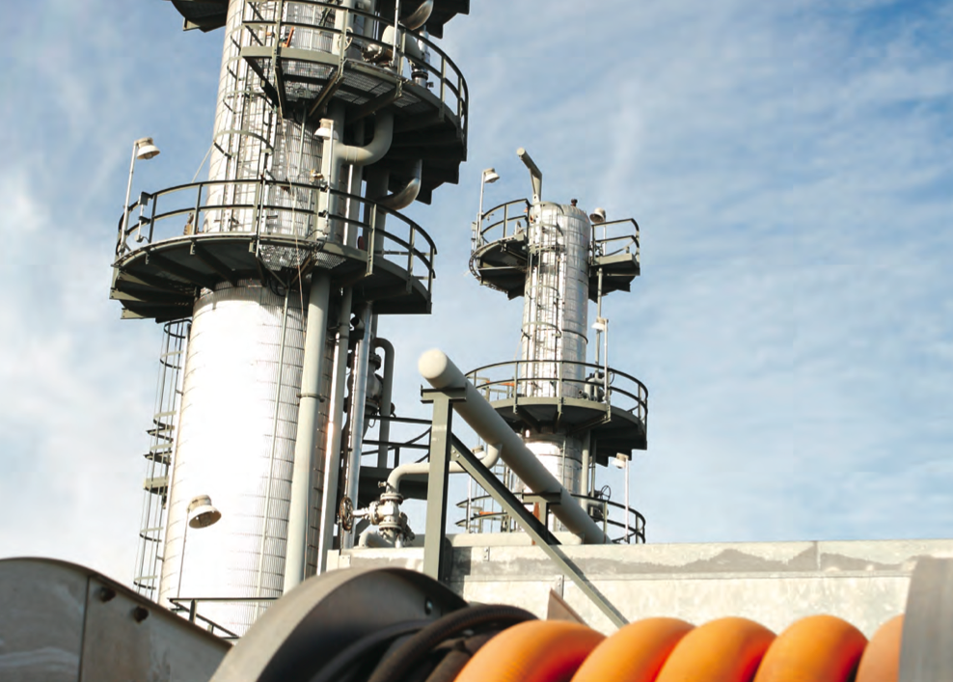


Slide 89
Corporate Overview
Calgary based corporation that owns and operates NGL midstream services
  Provides natural gas liquids midstream processing and marketing in western and central Canada and the United States
  4th largest integrated oil and gas company in Canada
  Energy products include: ethane, butane, propane, condensate
  Non energy products: storage, processing, terminalling and transportation

Slide 90
Corporate Overview
The Midstream business unit extracts, processes, stores, transports and markets natural gas liquids (NGLs) for Provident and offers these services to third party customers
Three operations:
  Empress East
  Redwater West
  Commercial Services

Slide 91
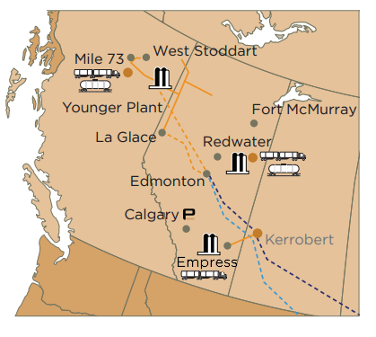
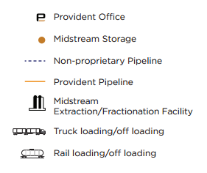
Map of Operations

Slide 92
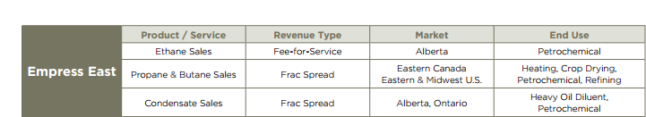
Empress East
Extracts NGLs from natural gas at the Empress straddle plants and sells finished products into markets in central Canada and the eastern United States.
The margin in this business is determined primarily by the “frac spread ratio”, which is the ratio between crude oil prices and natural gas prices
Demand for propane is seasonal and results in inventory that generally builds over the second and third quarters of the year and is sold in the fourth quarter and the first quarter of the following year
.

Slide 93
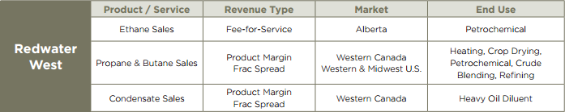
Redwater West
Purchases an NGL mix from various producers and fractionates it into finished products at the Redwater fractionation facility, the feedstock for this business line is primarily NGL mix rather than natural gas, the frac spread ratio has a smaller impact on margin than in the Empress East business line
Captures supply from northeast British Columbia and northwest Alberta and generates revenues through extraction, gathering, transportation, storage and fractionation of NGL into finished products
Has several significant competitive advantages including the ability to process sour NGL and is one of only two fractionation facilities in the Fort Saskatchewan area capable of processing ethane-plus
Located at the Redwater facility is rail-based condensate terminal, which serves the heavy oil industry and its need for diluent

Slide 94
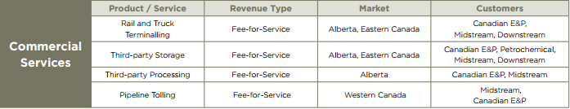
Commercial services
Commercial Services - generates income from relatively stable fee-for-service contracts to provide fractionation, storage, loading, and marketing services to upstream producers. Income from pipeline tariffs from Provident's ownership in NGL pipelines is also included in this business line
Redwater facility has a rail unloading capacity of 110 rail cars per day or 75,000 bpd
Storage facilities at both Empress East and Redwater West facilities
  seven million gross barrels at Empress East
  50% ownership of 2.5 mm-bbl storage cavern and 100% ownership of 1000 acre 12 million barrel storage cavern at Redwater West

Slide 95


Stock Details

Slide 96

Financial Statements

Slide 97


Slide 98


Slide 99

Notes:
Funds flow from continuing operations includes the impact of the Midstream financial derivative contract buyout, as well as strategic review and restructuring costs associated with the separation and divestment of Provident's Upstream business and the corporate conversion. Adjusted funds flow from continuing operations is presented as a measure to evaluate the performance of Provident's pure-play Midstream infrastructure business and to provide additional information to assess future funds flow generating capability.
For the year ended December 31, 2011, adjusted funds flow from continuing operations was $252.6 million, 23 percent above the $206.1 million in 2010. The increase is attributed to a significant increase in gross operating margin partially offset by higher realized losses on financial derivative instruments and a current income tax recovery in 2010.
Declared dividends in 2011 totaled $146.3 million, 63 percent of adjusted funds flow from continuing operations, net of sustaining capital spending. This compares to $191.6 million of declared distributions in the comparable period of 2010, 96 percent of adjusted funds flow from continuing operations, net of sustaining capital spendin

Slide 100

Provident Midstream business performance
Notes:
Midstream gross operating margin was $381.4 million for the year ended December 31, 2011 compared to $313.0 million in 2010. The 22 percent increase was the result of a higher contribution from both Redwater West and Empress East by 33 percent and 23 percent, respectively, partially offset by an eight percent decrease in operating margin from Commercial Services.
The operating margin for Redwater West in 2011 was $213.3 million, an increase of 33 percent compared to $160.2 million in 2010. Stronger 2011 results when compared to 2010 were primarily due to stronger market prices for all NGL products as well as higher frac spreads at Younger. Overall, Redwater West NGL sales volumes averaged 58,969 barrels per day in 2011, a six percent decrease compared to 2010. Lower NGL sales volumes can be largely attributed to a decrease in sales volumes for condensate in 2011 compared to 2010. Condensate sale volumes decreased compared to the prior year as Provident imported less condensate via railcar from the U.S. Gulf Coast for sale into the western Canadian market. Margins on imported condensate supply tend to be lower than product supplied through western Canadian NGL mix or product extracted at Younger due to the significant transportation costs incurred on imported product. Decreases in sales volumes were more than offset by significant improvements in condensate market pricing, resulting in a higher product operating margin despite the decrease in sales volumes.
Provident extracts NGLs from natural gas at the Empress straddle plants and sells ethane and condensate in the western Canadian marketplace while transporting propane and butane to Sarnia, Ontario for fractionation and sale into markets in central Canada and the eastern United States. The margin in the business is determined primarily by frac spreads. Demand for propane is seasonal and results in inventory that generally builds over the second and third quarters of the year and is sold in the fourth quarter and the first quarter of the following year.
Empress East gross operating margin in 2011 was $109.4 million compared to $89.0 million in 2010. The 23 percent increase was due to increased sales volumes primarily driven by strong demand for propane in 2011 when compared to 2010 as well as strong refinery demand for butane in 2011. While condensate sales volumes were lower in 2011 compared to 2010 the decrease was more than offset by the significant increase in condensate market prices, primarily driven by the 20 percent increase in WTI. Overall, Empress East NGL sales volumes averaged 45,790 barrels per day, a six percent increase compared to 2010. Stronger market prices for propane-plus products and consistently low gas prices resulted in higher frac spreads which was also beneficial to gross operating margin. The positive impacts of strong demand, higher NGL sales prices and a lower AECO natural gas price were partially offset by increased extraction premiums paid to purchase natural gas in the Empress market.
Provident also utilizes its assets to generate income from fee-for-service contracts to provide fractionation, storage, NGL terminalling, loading and offloading services. Income from pipeline tariffs from Provident's ownership in NGL pipelines is also included in this activity. During the third quarter of 2011, Provident announced long-term storage agreements at both the Redwater facility and Provident's Corunna facility. In the fourth quarter, Provident announced a long-term storage agreement for crude oil storage at the Redwater facility. In addition, in the fourth quarter of 2011 Provident completed the acquisition of a two-thirds interest in Three Star, a Saskatchewan based oilfield hauling company serving Bakken area crude oil producers.
The gross operating margin for commercial services in 2011 was $58.7 million, a decrease of eight percent compared to $63.8 million in 2010. The decrease in margin was primarily associated with decreased condensate terminalling revenues partly as a result of the termination of a multi-year condensate storage and terminalling services agreement in 2010 as well as the completion in mid-2010 of the Enbridge Southern Lights pipeline, which transports condensate from the United States to the Edmonton area. This decrease was partially offset by increases in margin related to third party storage as well as due to the acquisition of Three Star.

Slide 101
Risk Factors
1. Frac Spread and Commodity Price
Exposed to possible price declines between the time Provident purchases NGL feedstock and sells NGL products, and to narrowing frac spreads
Also a differential between NGL product prices and crude oil prices which can change prices received and margins realized for midstream products separate from frac spread ratio changes

Slide 102
Risk Factors
2.Facilities Throughput and Product Demand
Volumes of natural gas processed through Provident's natural gas liquids midstream processing and marketing business and of NGLs and other products transported in the pipelines depend on production of natural gas in the areas serviced by the business and pipelines
Without reserve additions, production will decline over time as reserves are depleted and production costs may rise
Producers may shut in production at lower product prices or higher production costs
Producers in the areas serviced by the business may not be successful in exploring for and developing additional reserves, and the gas plants and the pipelines may not be able to maintain existing volumes of throughput

Slide 103
Risk Factors
3.Operating and Capital Costs
Operating and Capital Costs may vary considerably from current and forecast values and rates and represent significant components of the cost of providing service

Slide 104
Risk Factors
4.Reliance on Principal Customers and Operators
Rely on several significant customers to purchase product from the Midstream Business
If for any reason these parties were unable to perform their obligations under the various agreements with Provident, the revenue and dividends of Provident, and the operations of the Midstream Business could be negatively impacted

Slide 105
Risk Factors
5.Operational Matters and Hazards
Subject to common hazards of the natural gas processing and pipeline transportation business
The operation of Provident's natural gas liquids midstream processing and marketing business could be disrupted by natural disasters or other events beyond the control of Provident

Slide 106
Risk Factors
6.Competition
Subject to competition from other gas processing plants which are either in the general vicinity of the gas plants or have gathering systems that are or could potentially extend into areas served by the gas plants
Producers in Western Canada compete with producers in other regions to supply natural gas and gas products to customers in North America and the natural gas and gas products industry also competes with other industries to supply the fuel, feedstock and other needs of consumers

Slide 107
Risk Factors
7.Regulatory Intervention
Pipelines and facilities can be subject to common carrier and common processor applications and to rate setting by regulatory authorities in the event agreement on fees or tariffs cannot be reached with producers

Slide 108
Risk Factors
8.Environmental Considerations
Major equipment failure, release of toxic substances or pipeline rupture could result in damage to the environment and Provident's natural gas liquids midstream processing and marketing business, death or injury and substantial costs and liabilities to third parties
The gas processing and gathering industry is regulated by federal and provincial environmental legislation

Slide 109
Risk Factors
9.Variations in Interest Rates and Foreign Exchange Rates
Variations in interest rates could result in a significant change in the amount Provident pays to service debt, potentially impacting dividends to Shareholders.
Variations in the exchange rate for the Canadian dollar versus the U.S. dollar could affect future dividends

Slide 110
Risk Management Philosophy
Provident has an Enterprise Risk Management program that is designed to identify and manage risks that could negatively impact the business, operations, or results
Utilizes a hedging program that protects a portion of the company's cash flow and supports continued unitholder distributions, capital programs, and bank financing
Has an insurance program in place to mitigate the economic costs associated with risks to the business, its assets, and its people
Manages counterparty exposure with a credit policy that establishes limits by counterparty based on an analysis of financial information and other business factors

Slide 111
Risk Management overview
Enterprise Risk Management program that is designed to identify and manage risks that could negatively affect its business, operations or results. The program’s activities include risk identification, assessment, response, control, monitoring and communication of derivative instruments
Provident uses include put and call options, costless collars, participating swaps, and fixed price products that settle against indexed referenced pricing
Provident’s commodity price risk management program utilizes derivative instruments to provide for protection against lower commodity prices and product margins, as well as fluctuating interest and foreign exchange rates.
Provident may also use derivative instruments to protect acquisition economics. The program is designed to stabilize cash flows in order to support cash distributions, capital programs and bank financing
Notes:
The purchase of put option contracts effectively create a floor price for the commodity, while allowing for full participation if prices increase. The purchase of call options allow for a commodity to be purchased at a fixed price at the option of the contract holder. Costless collars are contracts that provide a floor and a ceiling price and allowing participation within a set range. Participating swaps are contracts that provide a floor and also provide a ceiling for a certain percentage of the volume of the contract. Fixed price swaps are contracts that specify a fixed price at which a certain volume of product will be bought or sold at in the future.
.

Slide 112
Fair Values
Fair value measurement of assets and liabilities recognized on the consolidated statement of financial position are categorized into levels within a fair value hierarchy based on the nature of valuation inputs
Level 1 – Unadjusted quoted prices in active markets for identical assets or liabilities;
Level 2 – Inputs other than quoted prices that are observable for the asset or liability either directly or indirectly; and
Level 3 – Inputs that are not based on observable market data
Provident’s financial derivative instruments have been classified as Level 2 instruments

Slide 113

Financial Derivative Sensitivity Analysis

Slide 114

Market Environment
Notes:
The pricing environment for NGLs in 2011 was significantly stronger than in 2010. The average 2011 WTI crude oil price was US$95.12 per barrel, representing an increase of 20 percent compared to US$79.53 per barrel in 2010. The impact of higher WTI crude oil prices was partially offset by the strengthening of the Canadian dollar relative to the U.S. dollar in 2011 compared to 2010. Propane prices were also stronger than in the comparative period, reflecting the increase in crude oil prices combined with lower North American propane supply for much of 2011 resulting from above average exports and stronger demand from the petrochemical sector. The Mont Belvieu propane price averaged US$1.47 per U.S. gallon (65 percent of WTI) in 2011, compared to US$1.17 per U.S. gallon (62 percent of WTI) in 2010. Butane and condensate sales prices were also much improved in 2011, also reflective of higher crude oil prices and steady petrochemical and oilsands demand for these products.
The margins generated from Provident's extraction operations at Empress, Alberta and Younger, British Columbia are determined primarily by "frac spreads", which represent the difference between the selling prices for propane-plus and the input cost of the natural gas required to produce the respective NGL products. Frac spreads can change significantly from period to period depending on the relationship between crude oil and natural gas prices (the "frac spread ratio"), absolute commodity prices, and changes in the Canadian to U.S. dollar foreign exchange rate. Traditionally, a higher frac spread ratio and higher crude oil prices will result in stronger extraction margins. Differentials between propane-plus and crude oil prices, as well as location price differentials will also impact frac spreads. Natural gas extraction premiums and costs relating to transportation, fractionation, storage and marketing are not included within frac spreads, however these costs are included when determining operating margin.Market frac spreads averaged $54.67 per barrel in 2011, representing a 36 percent increase from $40.30 per barrel in 2010. Higher frac spreads were a result of higher NGL prices combined with a lower AECO natural gas price. While Provident benefits directly from higher frac spreads at its Younger facility, the benefit of higher market frac spreads in 2011 was offset at Empress by continued high costs for natural gas supply in the form of extraction premiums. Empress extraction premiums in 2011 increased approximately 30 percent when compared to 2010 and, are primarily a result of low volumes of natural gas flowing past the Empress straddle plants and increased competition for NGLs as a result of higher frac spreads
Industry propane inventories in the United States were approximately 55.2 million barrels at the end of 2011, which is approximately 1.5 million barrels above the five year historical average. Inventory levels are above the five year historical average primarily due to the mild winter temperatures across the United States in the fourth quarter of 2011 that has reduced demand for propane. Year end 2011 Canadian industry propane inventories were approximately 7.5 million barrels, 1.8 million barrels higher than the historic five year average. Propane inventories in Canada are at high levels primarily due to mild winter temperatures in central Canada in the fourth quarter of 2011 that has reduced demand for propane..

Slide 115
Market Risk
Market risk is the risk that the fair value of a financial instrument will fluctuate because of changes in market prices
Price risk
Currency risk
Interest risk
Notes:
Commodity price volatility and market location differentials affect the Midstream business. In addition, Midstream is exposed to possible price declines between the time Provident purchases natural gas liquid (NGL) feedstock and sells NGL products, and to narrowing frac spread ratios. Frac spread ratio is the ratio between crude oil prices and natural gas prices. There is also a differential between NGL product prices (propane, butane and condensate) and crude oil prices.
Provident responds to these risks using a risk management program that protects a margin or floor level of operating income on a portion of its NGL inventory and production, while retaining some ability to participate in a widening margin environment. Subject to market conditions, Provident’s intention is to hedge approximately 50 percent of its natural gas and natural gas liquids (NGL) volumes on a rolling 12 month basis. Also, subject to market conditions, Provident may add additional hedges as appropriate for up to 24 months.
Provident’s commodity sales are exposed to both positive and negative effects of fluctuations in the
Canadian/U.S. exchange rate. Provident manages this exposure by matching a significant portion of the cash costs that it expects with revenues in the same currency. As well, Provident uses derivative instruments to manage the U.S. cash requirements of its business. Provident regularly sells or purchases forward a portion of expected U.S. cashflows. Provident’s strategy also manages the exposure it has to fluctuations in the U.S./Canadian dollar exchange rate when the underlying commodity price is based upon a U.S. index price. Provident may also use derivative products that provide for protection against a stronger Canadian dollar, while allowing it to participate if the currency weakens relative to the U.S. dollar.
Provident’s revolving term credit facilities bear interest at a floating rate. Using debt levels as at December
31, 2010, an increase/decrease of 50 basis points in the lender’s base rate would result in an
increase/decrease of annual interest expense of approximately $0.4 million (2009 - $1.3 million). Provident
has mitigated this risk by entering into interest rate financial derivative contracts for a portion of the
outstanding long term debt. The contracts settle against Canadian Bankers Acceptance CDOR rates.

Slide 116
Market Risk Management Program
Utilizes financial derivative instruments to provide protection against commodity price volatility and protect a base level of operating cash flow
Protect the relationship between the purchase cost of natural gas and the sales price of propane, butane and condensate and to protect the relationship between NGLs and crude oil in physical sales contracts
Reduces foreign exchange risk due to the exposure arising from the conversion of U.S. dollars into Canadian dollars, interest rate risk and fixes a portion of Provident’s input costs
Notes:
In April, 2010, Provident completed the buyout of all fixed price crude oil and natural gas swaps associated with the
Midstream business for a total cost of $199.1 million. The buyout of Provident’s forward mark to market positions
allows Provident to refocus its Commodity Price Risk Management Program on forward selling a portion of actual
produced NGL products and inventory to protect margins for terms of up to two years.
Management continues to actively monitor commodity price risk and continues to mitigate its impact through
financial risk management activities. Subject to market conditions, Provident’s intention is to hedge approximately
50 percent of its natural gas and NGL volumes on a rolling 12 month basis. Also, subject to market conditions,
Provident may add additional positions as appropriate for up to 24 months.

Slide 117


Risk Management Contracts

Slide 118

Settlement of Contracts
Notes:
The realized loss for the fourth quarter of 2011 was $11.4 million compared to $16.4 million in the comparable 2010
quarter. The majority of the realized loss in the fourth quarter of 2011 was driven by natural gas purchase derivative
contracts settling at a contracted price higher than the market natural gas prices, foreign exchange contracts settling
at a contracted rate lower than the average market rates, as well as crude oil derivative sales contracts settling at
contracted crude oil prices lower than the crude oil market prices during the settlement period. The comparable
2010 realized loss was driven mostly by NGL derivative sales contracts settling at a contracted price lower than the
market NGL prices during the settlement period, natural gas purchase derivative contracts in the Midstream business
settling at a contracted price higher than the market natural gas prices during the settlement period as well as crude
oil derivative sales contracts settling at contracted crude oil prices lower than the crude oil market prices during the
settlement period.

Slide 119

Liquidity Risk
Notes:
Liquidity Risk
Liquidity risk is the risk Provident will not be able to meet its financial obligations as they come due.
Provident’s approach to managing liquidity risk is to ensure that it always has sufficient cash and credit
facilities to meet its obligations when due, without incurring unacceptable losses or damage to Provident’s
reputation.
Provident Energy AR 2010 69Management typically forecasts cash flows for a period of twelve months to identify financing requirements.
These requirements are then addressed through a combination of committed and demand credit facilities and
access to capital markets

Slide 120

Credit Risk
Notes:
Substantially all of Provident’s accounts receivable are due from customers and joint venture partners in the oil
and gas and midstream services and marketing industries and are subject to credit risk. Provident partially
mitigates associated credit risk by limiting transactions with certain counterparties to limits imposed by
Provident based on management’s assessment of the creditworthiness of such counterparties. The carrying
value of accounts receivable reflects management's assessment of the associated credit risks.

Slide 121

Net Financial Derivative Instruments
Notes:
The net liability in both periods represents unrealized “mark-to-market” opportunity costs related to financial
derivative instruments with contract settlements ranging from January 1, 2011 through September 30, 2014 (with the
exception of the conversion feature of convertible debentures, which is associated with long-term debt maturing in
2017 and 2018). The balances are required to be recognized in the financial statements under generally accepted
accounting principles. These financial derivative instruments were generally entered into in order to manage
commodity prices and protect future Midstream product margins. Fluctuations in the market value of these
instruments impact earnings prior to their settlement dates but have no impact on funds flow from operations until
the instruments are actually settled.
For convertible debentures containing a cash conversion option, the conversion feature is measured at fair value
through profit and loss at each reporting date, with any unrealized gains or losses arising from fair value changes
reported in the consolidated statement of operations. This resulted in Provident recording a loss of approximately
$19.0 million (2010 – nil) on the revaluation of the conversion feature of convertible debentures on the consolidated
statement of operations.

Slide 122
Commodity Price Risk Program
Provident's commodity price risk management program utilizes commodity hedges to protect against adverse price movements
Provident's intention is to routinely hedge approximately 50 percent of its natural gas and NGL volumes on a rolling 12 month basis. Subject to market conditions, Provident may add additional hedges as appropriate for up to 24 months

Slide 123

Frac Spread Volumes

Slide 124

Contracts In Place

Slide 125

Contracts In Place

Slide 126



Slide 127

Historical Stock Price

Slide 128
Corporate Profile – IPL
Petroleum transportation, storage and natural gas liquids extraction business
Operating approximately 6,100 kilometres of petroleum pipelines and 4.8 million barrels of storage in western Canada
Made the 100 Venture’s list

Slide 129

Executives
CEO: David W. Fesyk
  President since 1997
  Senior executive and general partner at Koch from 1991 to 2002
  Director of South Saskatchewan Pipeline Company

Slide 130
Operation Overview
Conventional Pipelines
Oil Sands Transportation
NGL Extraction
Bulk Liquid Storage

Slide 131

Operation Overview

Slide 132
Conventional Pipelines
Through a total of approximately 3,700 kilometres (almost 2,300 miles) of pipeline and over 975,000 barrels of storage, the conventional gathering business transported approximately 170,000 b/d of crude in 2011
Crude for the conventional systems is gathered from approximately 160 producer owned batteries and 20 truck terminals throughout southern Alberta and southwest Saskatchewan for delivery to key market hubs in Alberta and Saskatchewan.

Slide 133

Conventional Pipelines

Slide 134
Oil Sands Transportation
The Oil Sands Transportation business is the largest oil sands gathering business in Canada - transporting in 2011 roughly 786,000 b/d of bitumen blend or approximately 35% of Canada’s oil sands production
Consisting of the Cold Lake, Corridor and Polaris pipeline systems, this business segment has nearly 2,500 km of pipeline and 3.8 million barrels of storage

Slide 135

Oil Sands Transportation

Slide 136
NGL Extraction
Facilities process pipeline quality natural gas to remove natural gas liquids (NGL) comprised of ethane, propane, butanes and pentanes-plus
The NGL stream is then partially fractionated to produce a specification ethane product and a mix of propane, butane, and pentanes-plus
Notes:
nter Pipeline's extraction business consists of 100% ownership interests in the Cochrane and Empress II plants and a 50% ownership interest in the Empress V plant. The Empress II and V plants are located on the eastern leg and the Cochrane plant is located on the western leg of the TransCanada Alberta System near the natural gas export points from the province of Alberta. These facilities process pipeline quality natural gas to remove natural gas liquids (NGL) comprised of ethane, propane, butanes and pentanes-plus. The NGL stream is then partially fractionated to produce a specification ethane product and a mix of propane, butane, and pentanes-plus.

Slide 137

NGL Extraction
Notes:
In 2011 these facilities processed an average of 2.6 bcf/d of natural gas producing an average of 107,000 b/d of natural gas liquids. NGL are generally used directly as an energy product and as a feedstock for the petrochemical and crude oil refining industries.

Slide 138
Bulk Liquid Storage
Inter Pipeline's bulk liquid storage business segment is the fourth largest independent storage business in Europe
Operating under two wholly owned entities, the bulk liquid storage business operates 12 deep-water terminals and approximately 19 million barrels of storage

Slide 139

Bulk Liquid Storage

Slide 140

Financial Statements

Slide 141


Slide 142


Slide 143


Slide 144
Performance Overview
Fourth quarter FFO* increased to $90 million, 12% higher than fourth quarter 2010 levels
Payout ratio before sustaining capital* of 72% for the quarter
Cash distributions to unitholders were $65 million or $0.2475 per unit
Inter Pipeline’s oil sands and conventional oil pipelines systems transported 945,100 b/d

Slide 145

Performance Overview

Slide 146

Performance Overview Cont’

Slide 147
Risk Factors
1. Demand risk
Inter Pipeline’s business will depend, in part, on the level of demand for petroleum in the geographic areas in which deliveries are made by the pipelines and the ability and willingness of shippers having access or rights to utilize the pipelines to supply such demand

Slide 148
Risk Factors
2. Supply Risk
Future throughput on the pipelines and replacement of petroleum reserves in the pipelines’ service areas is dependent upon the success of producers operating in those areas in exploiting their existing reserve bases and exploring for and developing additional reserves
Reserve bases necessary to maintain long term supply cannot be assured, and petroleum price declines, without corresponding reductions in costs of production, may reduce or eliminate the profitability of production and therefore the supply of petroleum for the pipelines

Slide 149
Risk Factors
3. Competition and Contracts
While Inter Pipeline attempts to renew contracts on the same or similar terms and conditions, there can be no assurance that such contracts will continue to be renewed or, if renewed, will be renewed upon favourable terms to Inter Pipeline
Inter Pipeline's supply contracts with producers in the areas serviced by the conventional oil pipelines business are based on market-based toll structures negotiated from time to time with individual producers
The pipelines are subject to competition for volumes transported by trucking or by other pipelines near the areas serviced by the pipelines

Slide 150
Risk Factors
4. Operational Factors
The pipelines are connected to various third party mainline systems such as the Enbridge system, Express pipeline, the Trans Mountain pipeline, and the Plains Milk River system, as well as refineries in the Edmonton area
Operational disruptions or apportionment on third party systems or refineries may prevent the full utilization of the pipelines

Slide 151
Risk Factors
5. Multi-Jurisdictional Regulation
The pipelines are subject to intra-provincial and multi-jurisdictional regulation, including regulation by the Energy Resources Conservation Board in Alberta, and the Ministry of Energy and Resources in Saskatchewan

Slide 152
Risk Factors
6. Natural Gas Availability and Composition
The volumes of natural gas processed by the NGL extraction business depend on the throughput of the Foothills and TransCanada Alberta systems from which the NGL extraction facilities source their natural gas supply
The production of NGL from the NGL extraction facilities is largely dependent on the quantity and composition of the NGL within the natural gas streams that supply the NGL extraction business

Slide 153
Risk Factors
7. Competition
The NGL extraction facilities are subject to natural gas markets and, as such, are subject to competition for gas supply from all natural gas markets served by the TransCanada Alberta System or the Foothills System
The NGL extraction facilities are subject to competition from other extraction plants that are in the general vicinity of the NGL extraction facilities or that may be constructed upstream of or in parallel to the NGL extraction facilities

Slide 154
Risk Factors
8. Execution Risk and Reputational Risk
Inter Pipeline’s ability to successfully execute the development of its growth projects may be influenced by capital constraints, third party opposition, changes in customer support over time, delays in or changes to government and regulatory approvals, cost escalations, construction delays, shortages and in-service delays
Reputational risk is the potential for negative impacts that could result from the deterioration of Inter Pipeline’s reputation with key stakeholders. The potential for harming Inter Pipeline’s reputation exists in every business decision and all risks can have an impact on reputation

Slide 155
Hedging Philosophy
Inter Pipeline utilizes derivative financial instruments to manage liquidity and market risk exposure to changes in commodity prices, foreign currencies and interest rates
Risk management policies are intended to minimize the volatility of Inter Pipeline’s exposure to commodity price, foreign exchange and interest rate risk to assist with stabilizing FFO*
Derivative financial instruments:
commodity price swap agreements
foreign currency exchange contracts
power price hedges
heat rate and interest rate swap agreements

Slide 156

Frac-Spread Risk Management
Frac-spread risk : The difference between the weighted average propane-plus price and the Monthly index price of AECO natural gas
Notes:
Inter Pipeline is exposed to frac-spread risk which is the difference between the weighted average
propane-plus price at Mont Belvieu, Texas and the monthly index price of AECO natural gas purchased for
shrinkage calculated in USD/USG. Derivative financial instruments are utilized to manage frac-spread risk.
Inter Pipeline transacts with third party counterparties to sell a notional portion of its NGL products and
purchase related notional quantities of natural gas at fixed prices. NGL price swap agreements are
transacted in US currency, therefore Inter Pipeline also enters into foreign exchange contracts to sell US
dollars to convert notional US dollar amounts in the NGL swaps.
156

Slide 157

Frac-Spread Risk Management
Notes:
157

Slide 158
Power Price Risk Management
Inter Pipeline uses derivative financial instruments to manage power price risk in its NGL extraction and conventional oil pipelines business segments
Inter Pipeline enters into financial heat rate swap and power price swap contracts to manage power price risk exposure in these businesses.

Slide 159
Foreign Exchange Risk Management
Inter Pipeline uses derivative financial instruments to manage power price risk in its NGL extraction and conventional oil pipelines business segments. Inter Pipeline enters into financial heat rate swap and power price swap contracts to manage power price risk exposure in these businesses.

Slide 160
Interest Rate Risk Management
Based on the variable rate obligations outstanding at December 31, 2011, a 1% change in interest rates at this date could affect interest expense on credit facilities by approximately $14.7 million, assuming all other variables remain constant
The entire $14.7 million relates to the $1.55 billion Corridor credit facility and is recoverable through the terms of the Corridor FSA, therefore there would be no after-tax income impact

Slide 161

Fair Value Through Profit or Loss

Slide 162

Fair Value Through Profit or Loss

Slide 163
Credit Risk
Inter Pipeline’s credit risk exposure relates primarily to customers and financial counter-parties holding cash and derivative financial instruments, with a maximum exposure equal to the carrying amount of these instruments
Credit risk is managed through credit approval and monitoring procedures
Notes:
163

