Slide 1

Global Airlines
Cathy Bai
Nelson Leung
Pinky Leung
Yin Wu
Notes:
Yin

Slide 2
Agenda
Global Airline Industry
General Information
Singapore Airlines
Company Overview
Financial Statement
Risk Management
Risk Management
Financial Statement
Company Overview
Southwest Airlines
Notes:
Yin

Slide 3
Terminology
ASK – Available Seat Kilometers
The number of seats available for sale multiplied by the distance flown
ATK – Available Tonne Kilometres
The number of tonnes of capacity available for the carriage of revenue load (passenger and cargo) multiplied by the distance flown
RPK – Revenue Passenger Kilometer
The number of revenue passengers carried multiplied by the distance flown
Revenue per RPK:
Passenger revenue from airline scheduled operations divided by airline scheduled RPK
CTK – Cargo Tonne Kilometers
The number of revenue tonnes of cargo (freight and mail) carried multiplied by the distance flown
Notes:
Yin

Slide 4
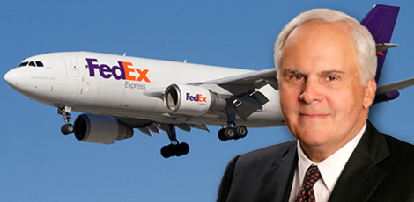
Airline Industry
The secret of this business is you've got to have a defensive strategy, as well as an offensive strategy.
— Fred Smith, FedEx founder and CEO
The Wall Street Journal, 14 July 2010
Notes:
Yin

Slide 5
Airline Industry
The airline industry is characterized by:
High competition
High overhead costs
Low profit margins
Sensitive to external factors
Social influences
Technological influences
Political influences
Legal influences
Economic influences
Notes:
Yin

Slide 6
Airline Industry
Definition:
Airline industry is a system of transportation
Part of Aviation industry
Moving people and goods
Utilizing the airways
One of the only true global businesses
Notes:
Yin

Slide 7
Business Models
Notes:
Yin

Slide 8
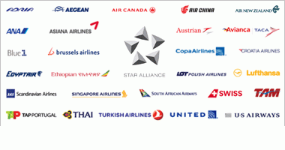
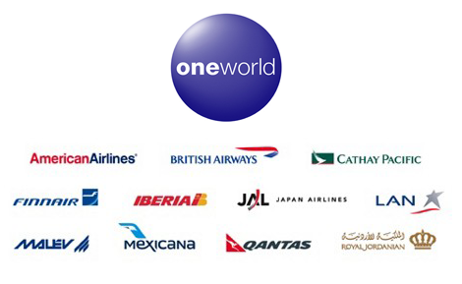
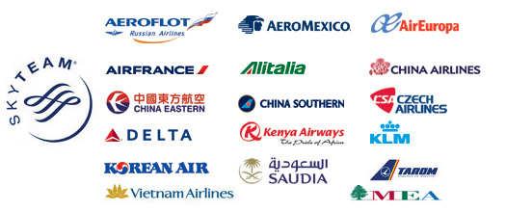
Airline Alliance
An agreement between two or more airlines to cooperate on a substantial level. Most of the largest passenger airlines worldwide are members of the three major alliances: the Star Alliance, Oneworld, or SkyTeam
Notes:
YIn

Slide 9
Airline Alliance
Pros
Extended Network through codeshare agreements
Cost reductions and traveler benefits
Cons
Less competition can cause higher prices
Less frequent flights
Notes:
Yin

Slide 10



Passenger Airline Alliances
Oneworld
American Airlines
SkyTeam
Aeroflot
StarAlliance
Adria Airways
British Airways
Cathay Pacific
Finnair
Iberia
Japan Airlines
LAN
Malev
Mexicana
Qantas
Royal Jordanian
S7 Airlines
AeroMexico
AirEuropa
Air France
Alitalia
China Airlines
China Eastern
China Southern
Czech Airlines
Delta Airlines
Kenya Airlines
KLM
Korean Air
TAROM
Vietnam Airlines
Aegean Airlines
Air Canada
Air China
Air New Zealand
ANA
Asiana Airlines
Austrian
Blue1
bmi
Brussels Airlines
Croatia Airlines
EGYPTAIR
Ethiopian Airlines
LOT Polish Airlines
Lufthansa
Scandinavian Airlines
Singapore Airlines
South African Airways
Notes:
Yin

Slide 11
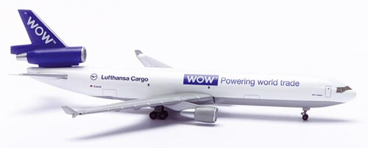

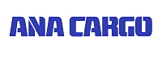

Cargo Alliance
WOW Alliances
SkyTeam Cargo
ANA/UPS Alliances
Notes:
Yin

Slide 12
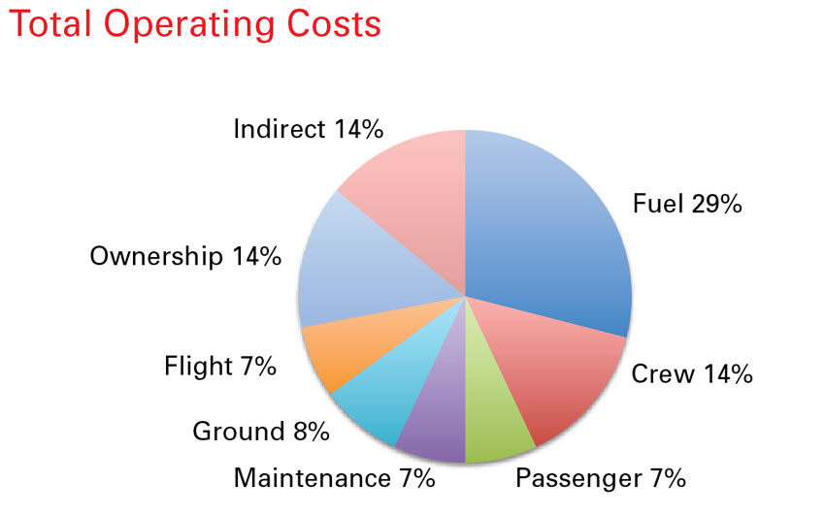
Cost Structure

Slide 13
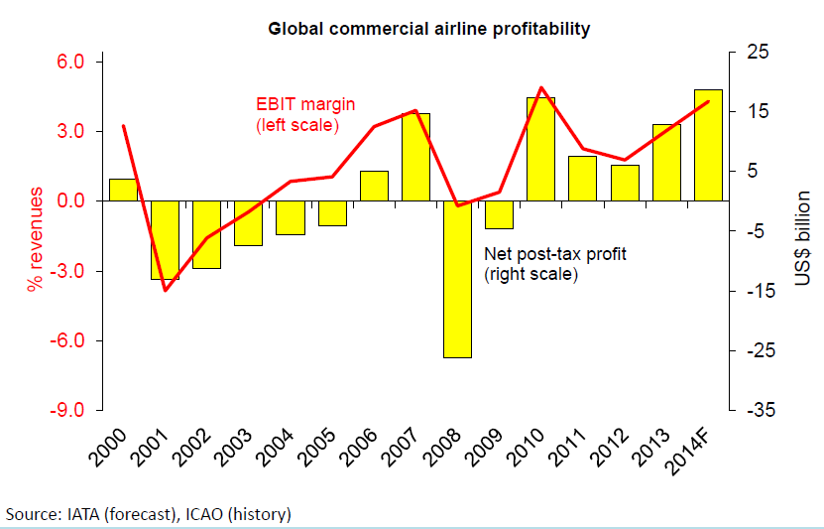
Industry Profitability

Slide 14
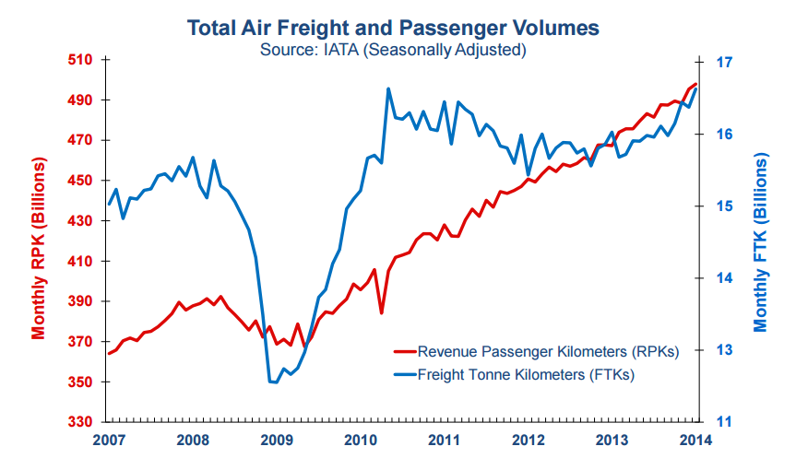
Passenger and Freight Volume

Slide 15
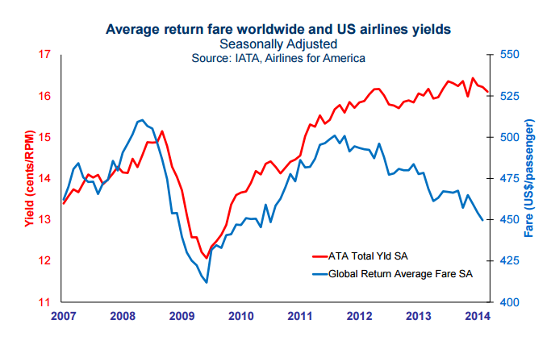
Airfares

Slide 16
Small vs. Large Airlines
Larger Airlines
More active hedgers of fuel costs
Highest costs of financial distress
Smaller Airlines
Lacked sufficient resources
Lacked strategic foresight

Slide 17
Types of Risks
Basis Risk
Exchange rate Risk
Counterparty Risk
Liquidity Risk
Credit Risk
Interest Rate Risk
Other Risks
Fuel Risk

Slide 18
Basis Risk
Basis Risk describes the relation (correlation factor) between the value of the commodity being hedged and the value of the derivative contract used to hedge the price risk.
Basis risks can be divided into 3 for airline companies:
Product basis risk
Time basis risk
Locational basis risk

Slide 19

Currency Exchange Risks
Revenues and expenses in multiple currencies for international airlines
Debt may be denominated in foreign currency
Contracts used:
Forward contracts
Currency swaps
Currency options

Slide 20
Counterpart Risk
The risk to each party of a contract that the counterparty will not live up to its contractual obligations. Counterparty risk as a risk to both parties and should be considered when evaluating a contract.

Slide 21
Liquidity Risk
Liquidity risk is realted to the generated cash flows of the airline companies if we examine the financial instruments we can see company is a sufficient to pay off the next fiscal year’s expense.
Market Price determine the competitiveness of company.

Slide 22
Credit Risk
Limit exposure to individual counterparties and sometimes create provisions that require counterparties to provide security if their credit falls.

Slide 23
Interest Risk
Change in interest rates impact interest income and expenses from short-term deposits and other interest-bearing financial assets and liabilities.
Use interest rate swaps, forward rate agreements, interest rate caps, and options can be used to manage interest risk

Slide 24
Other Risks
Terrorist Attacks (911)
Economic Instability (Financial Crisis)
Political Instability (Government Policy)
Natural Disaster (Storm)

Slide 25
Fuel Risk
Jet Fuel has been one of the largest expense categories for domestic airlines
Airlines are inherently dependent upon jet fuel to operate
Unpredictable price movements
Cannot easily compensate for these increases with increases in fare prices due to competitive nature of airline industry
Fuel usually makes up at least 1/3 of operating expenses

Slide 26
Use of Derivatives by Airliners
Jet fuel hedging activities
Currency exchange risk management
Interest rate risk management
The use of derivatives does not guarantee profitability or reduction in risks

Slide 27
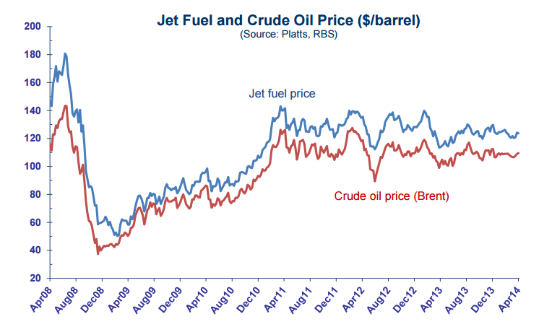
Jet Fuel Prices

Slide 28
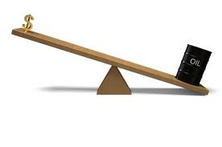
“Does hedging add value to corporations?”
Hedging stabilize fuel prices and therefore overall costs, cash flows, and profits.
Advantage of investment opportunities arises when fuel prices are high and airline operating cash flows and values are down.
The value premium associated with hedging increases with the level of the firm’s capital investment.

Slide 29
Jet Fuel Hedging
Fuel price risk can be managed in a number of ways:
Forward contracts
Futures contracts
Options, collars, swaps

Slide 30
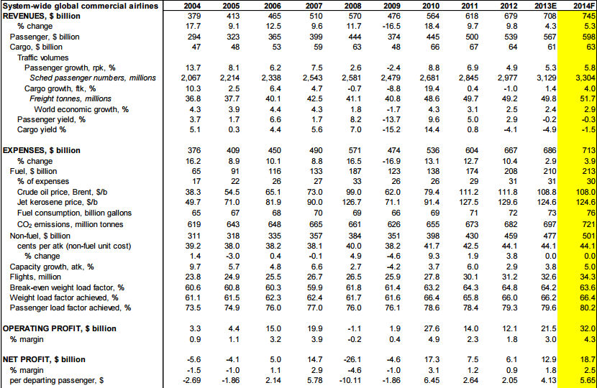
Financial Highlights and Outlook

Slide 31
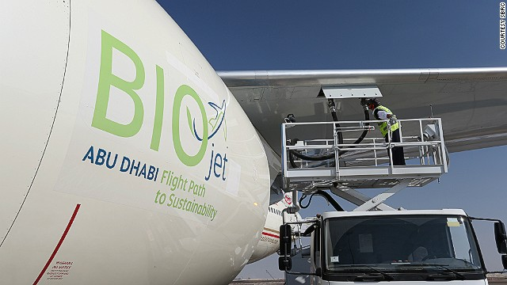
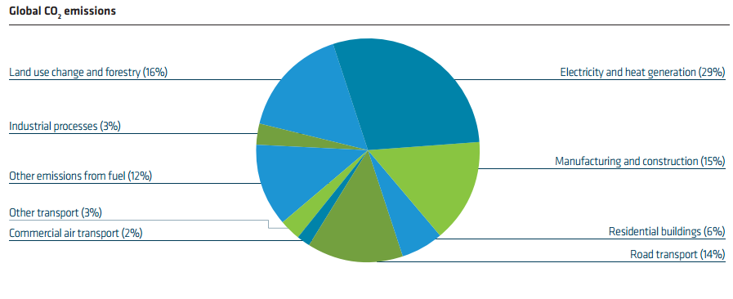
Biofuel
Providing environmental benefits
Providing diversified supply
Providing economic and social benefits
Notes:
https://www.iaa.ie/media/Beginners_guide_to_aviation11.pdf

Slide 32
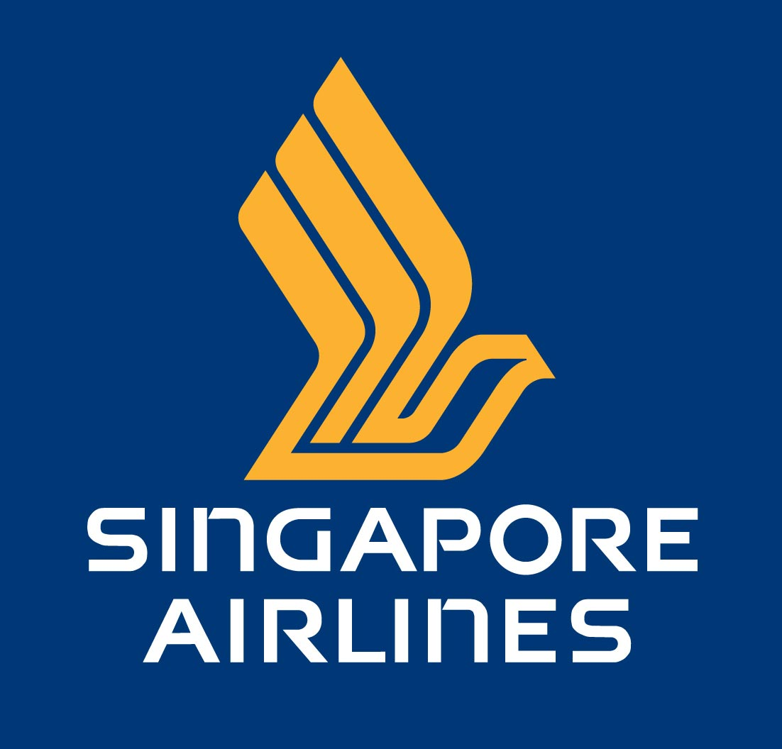
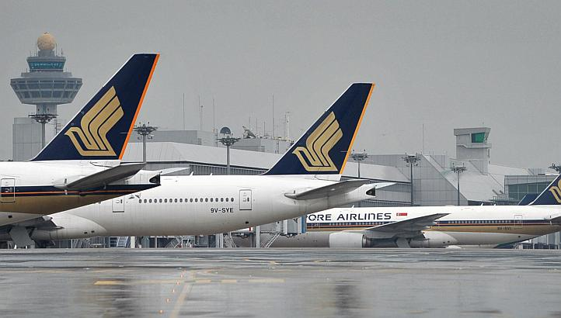
Singapore Airlines
Notes:
Yin

Slide 33

Singapore Airlines is a global company dedicated to providing air transportation services of the highest quality and to maximizing returns for the benefit of its shareholders and employees.“
--Singapore Airlines' Mission Statement
Notes:
Yin

Slide 34
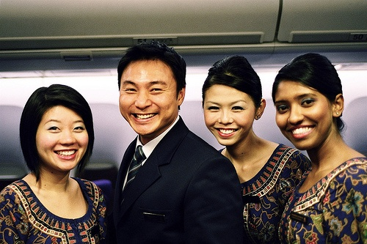
History & Background
Founded 1972
Current employee: 21534
Covers 103 destinations in 39 countries
Significant subsidiaries include SIA Cargo, SIA Engineering Company (SIAEC), and SilkAir
Notes:
Yin

Slide 35

History & Background
1950s-1960s: more new aircrafts were added to the fleet
1970s: Malaysia-Singapore Airlines (MSA) split to become two new entities—Singapore Airlines and Malaysian Airline System
1990: Singapore Airlines commenced operations from the new Terminal 2 at Singapore Changi
2008: Singapore Airlines was the first carrier to operate an all-Business Class service between Asia and the U.S.
Notes:
Yin

Slide 36
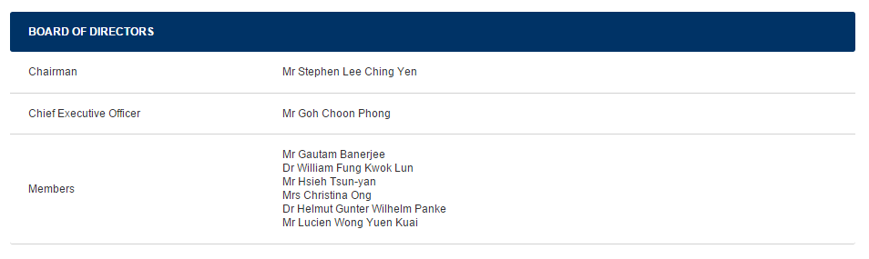
Singapore Airline Board of Director
Notes:
Yin

Slide 37

Singapore Airline Board of Director
Chairman: Mr. Stephen Lee Ching Yen
Singapore Airlines Ltd, SIA Engineering Company Ltd, and NTUC Income Insurance Co-operative Limited.
Managing director of Shanghai Commercial & Savings Bank Ltd (Taipei) and GMT Investments Pte Ltd.
Awards
The Beijing’s Friendship Awards to Foreign Experts in 2007
The Singapore Distinguished Service Order in 2006
The Singapore Public Service Star 1998
Notes:
Yin

Slide 38
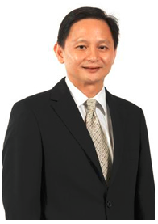
Singapore Airline Board of Director
Director & Chief Executive Officer:
Goh Choon Phong
Appointed Director on 1 October 2010 and Chief Executive Officer on 1 January 2011
Joined the company in 1990 and has held senior management positions in various divisions in Singapore and overseas
2004-2006: Senior Vice President Finance
2006-2010: President of Singapore Airlines Cargo Pte Ltd
Notes:
Yin

Slide 39
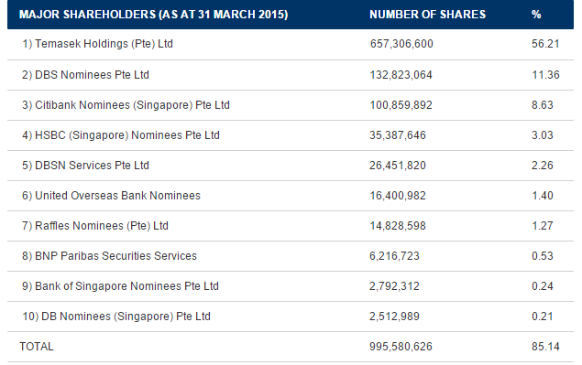
SIA Composition(Shareholder)
Notes:
Yin

Slide 40
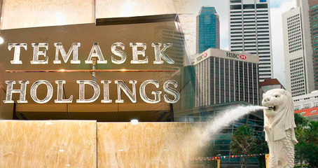
Significance
Temasek Holdings:
Government owned investment company
Portfolio asset of over S$266 Billion ($177 billion USD)
Also hold other major Singaporean companies
Chairman Stephen Lee Ching Yen
Member of Advisory Panel of Temasek Holdings
Notes:
Yin

Slide 41
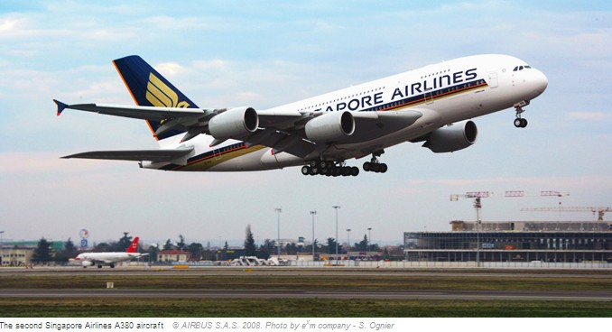
SIA Characteristic
Relatively higher cost carrier compare to domestic airlines due to various models.
Uses young fleet (average age of 7 years)
Businesses spread across the industry, providing engineering services, cargo and airline operation

Slide 42
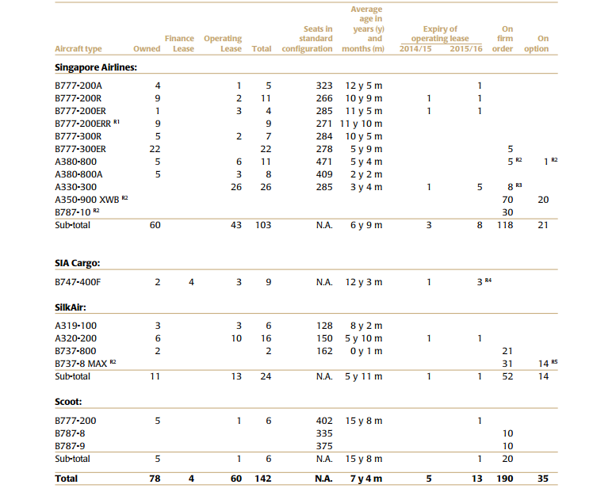
The Group Fleet Profile

Slide 43
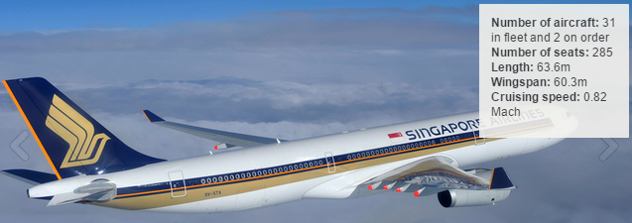
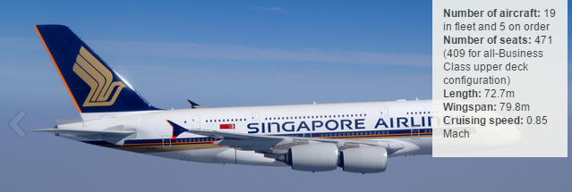
SIA’s Fleets

Slide 44
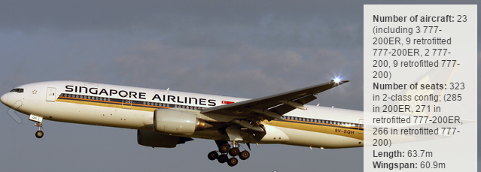
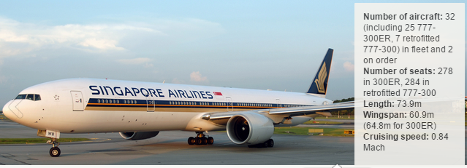
SIA’s Fleets

Slide 45
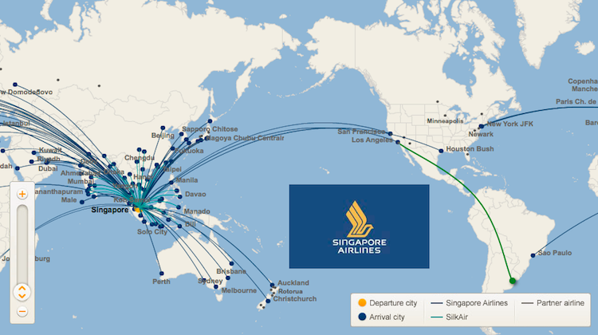
Singapore Airline Route Map

Slide 46
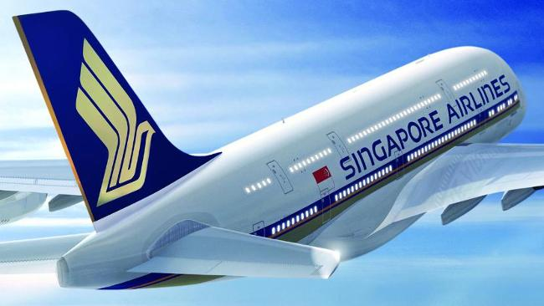
Financial Analysis & Risk Management

Slide 47
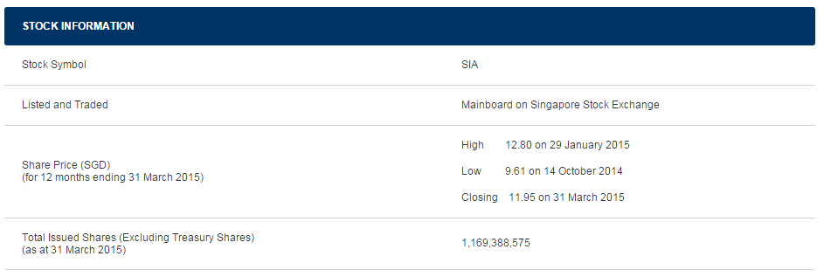
Singapore Airline Stock Info

Slide 48
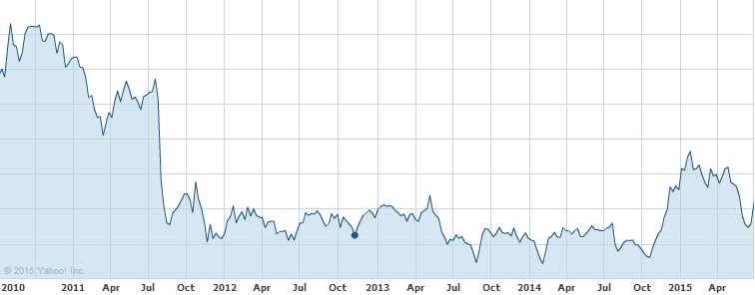
Singapore Airline Stock Performance (5 Years)

Slide 49
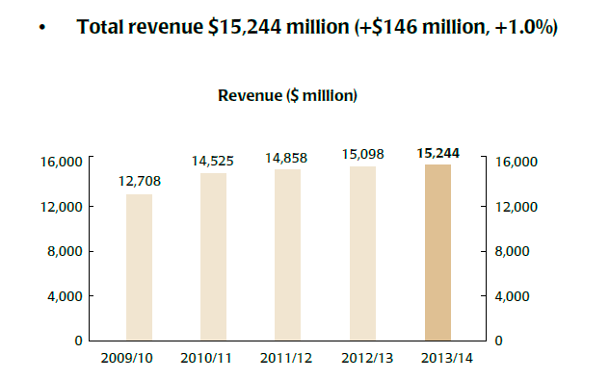
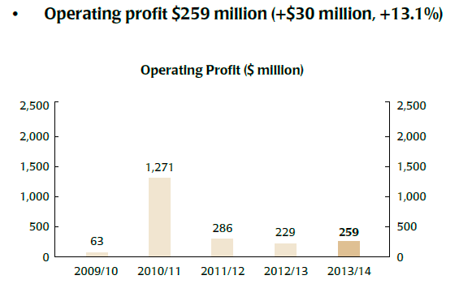
Financial Review
5 Years Revenue/Profit Performance

Slide 50
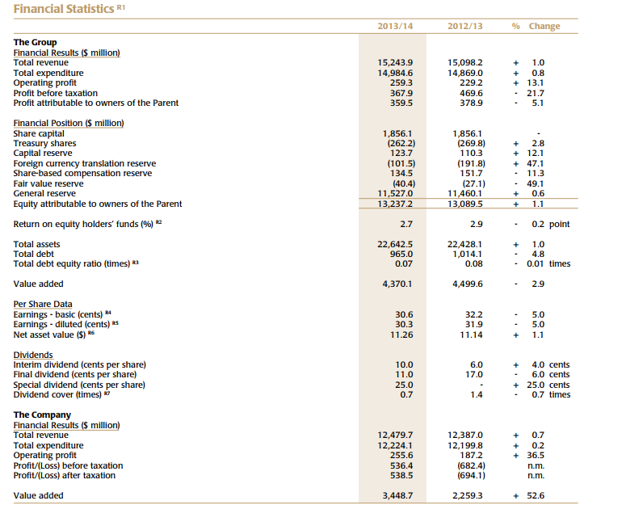

Slide 51
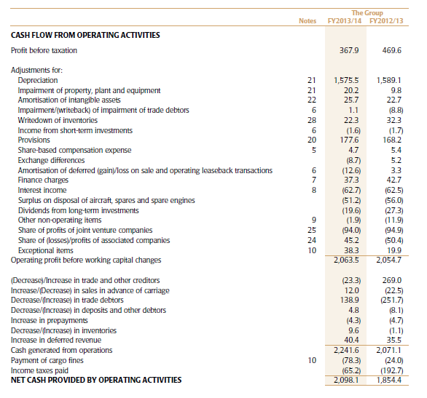
Cash Flow

Slide 52
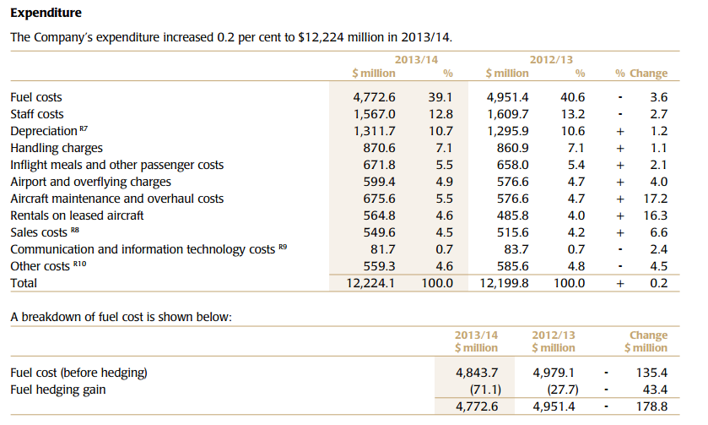
Cost Structure

Slide 53
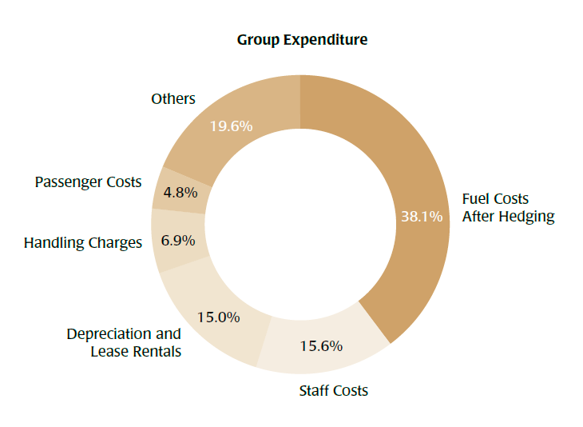
Cost Structure (Visual)

Slide 54
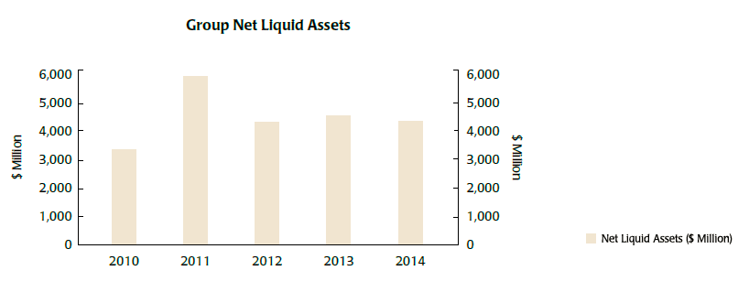
SIA Liquid Asset

Slide 55
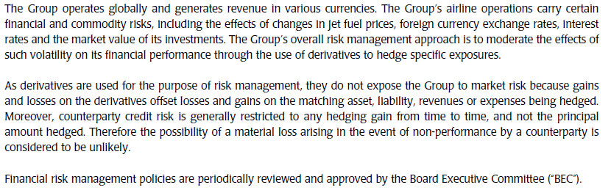
Financial Risk Management Objectives and Policies

Slide 56

Risk Management
For the last decade, failure to manage the risks within the airline industry resulted in the evaporation of $46 billion US$ in shareholder value
Aviation encompasses a full spectrum of risk factors:
International airline is exposed
General entrepreneurial risks and
Industry-specific risks
Key area of exposure are:
Capacity and utilization risks
Strategy-related risks
Political risks
Operational risks
Procurement risks
Labor agreement risks
Financial and treasury management risks

Slide 57
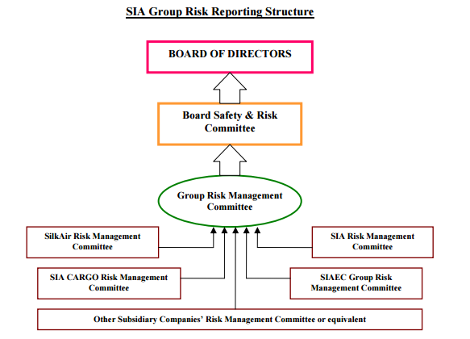
SIA Risk Management

Slide 58
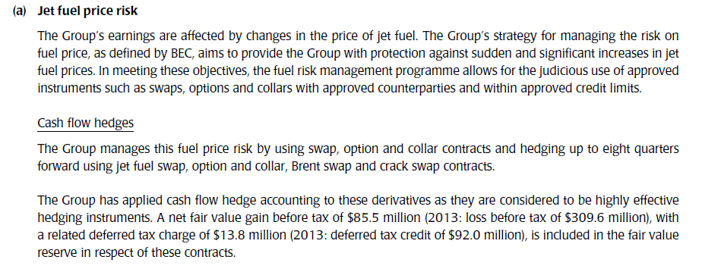
Jet Fuel Price Risk

Slide 59
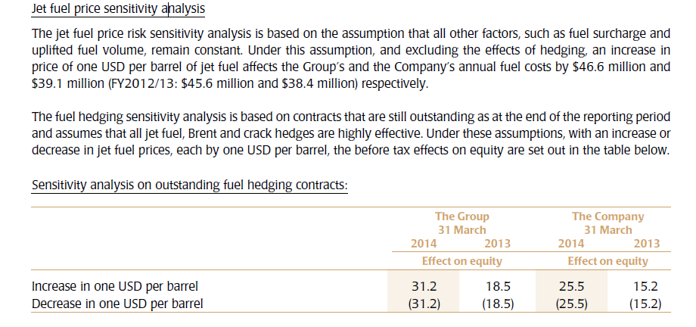
Jet Fuel Price Risk

Slide 60
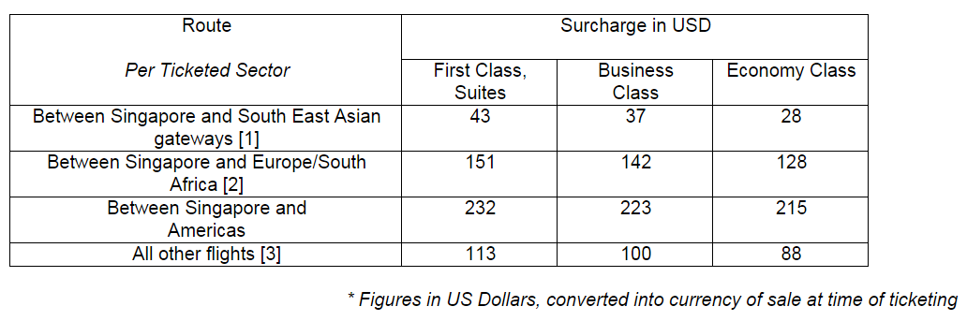
Singapore Airlines to Increase Fuel Surcharges

Slide 61
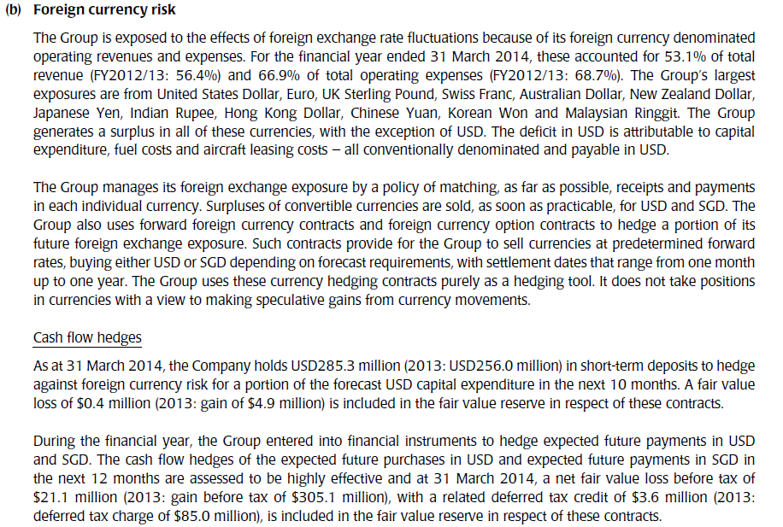
Foreign Currency Risk

Slide 62
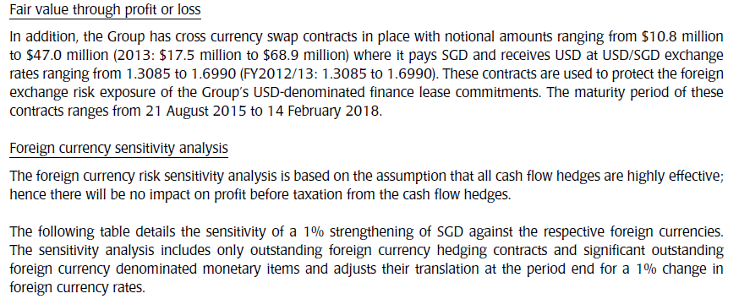
Foreign Currency Risk

Slide 63
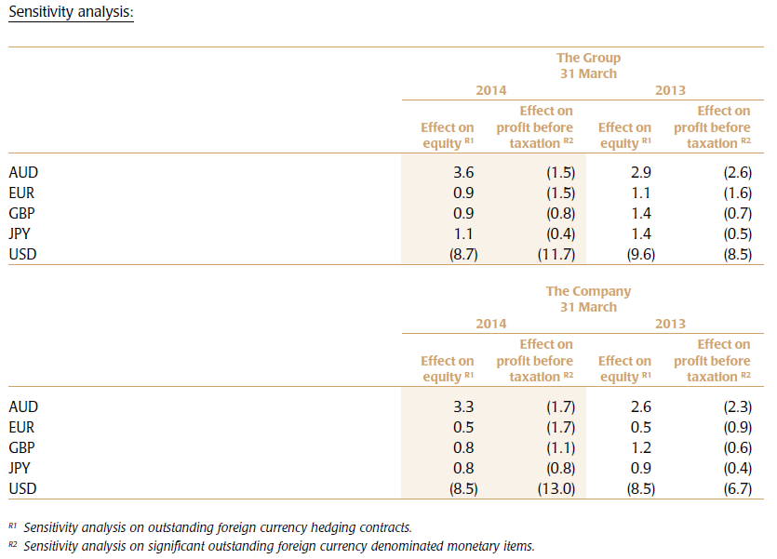
Foreign Currency Risk

Slide 64
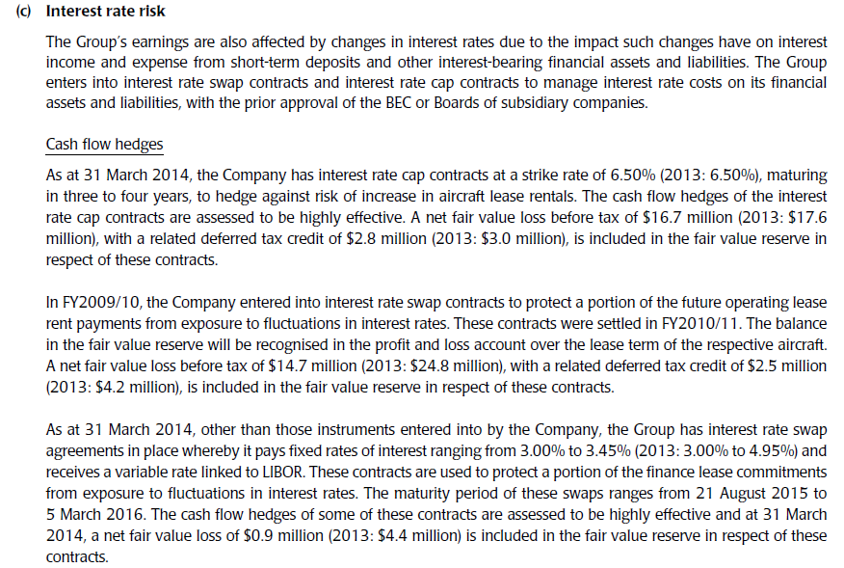
Interest Rate Risk

Slide 65
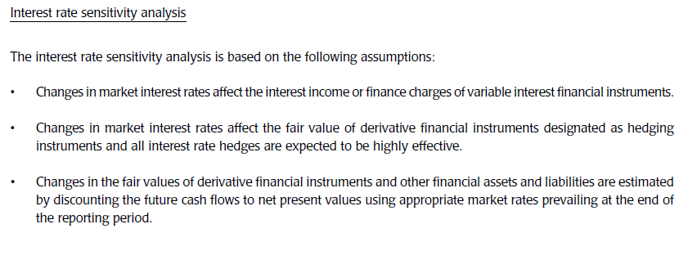
Interest Rate Risk

Slide 66
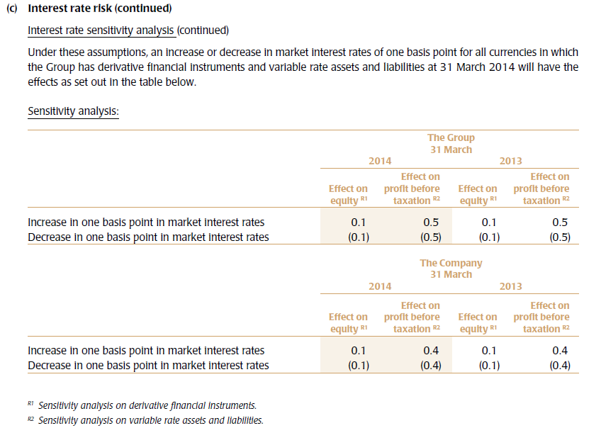
Interest Rate Risk

Slide 67

Liquidity Risk

Slide 68

Liquidity Risk

Slide 69
Southwest Airlines

Slide 70

Mission

Slide 71
Company Overview
Largest domestic air carriers in the United States
Currently operates primarily in the United States
More than 100 million passengers annually
More than 47000 Employees
Provides Point-to- Point service instead of traditional “hub-and-spoke” service
Low cost structure

Slide 72
History
1971 – Foundation of the company
1973 – First profitable year
1977 – Listed on NYSE
1990 – First time Annual Revenue exceeds $1Billion
2013 – Complete connection between Southwest & AirTran
2014 – 42nd consecutive year of profits
Successful Integration of AirTran into Southwest
Notes:
New York Stock Exchange

Slide 73

Broad of Director

Slide 74

Chairman of the board
Gary C. Kelly
Chairman of the board,
President & Chief Executive Officer (CEO)
Education:
BBA from University of Texas
served as a CPA for a public auditing firm in 1986 Before joining Southwest
- Qualifications:
Executive leadership & management experience,
Able to provide insights into Operational, Regulatory and Governance matters
Substantial expertise in finance, Accounting and Financial Reporting.
Notes:
He got his BBA degree from University of Texas
He is qualified as lots of skills, that’s why he is able to lead the company in the right track

Slide 75

Destinations
Notes:
Here is the map of destinations of Southwest, The Company serving 93 destinations in 40 states,

Slide 76

Acquisition of AirTran
Transaction valued at $1.4 billion
Cost synergies of approximately $400 million annually
Increase the Company’s fleet size

Slide 77
Acquisition of AirTran
Southwest extent its operating scale
Access to International Markets and US’s Key Markets
Expected efficiency with operating single aircraft type- Boeing 737
Remove AirTran 66 Boeing 717
Completed the integration of AirTranin 2014

Slide 78
5 Strategic initiatives in 2014
Integration of Southwest’s and AirTran’s network and operations
Fleet Modernization
Continued incorporation of the larger Boeing 737-800 aircraft into the Southwest fleet
International Capabilities & New Reservation System
The continued Growth of the Southwest’s Rapid Rewards Frequent Flyer Program
Notes:
During 2014, the company effectively completed the process of integrating AirTran into Southwest’s operations and accomplished the a bench of integration.
2., the Company has multiple efforts underway to replace its older aircraft with newer aircraft that are less
maintenance intensive and more fuel efficient and that also have a greater range.
3. The Company expects the 737-800 will continue to enable it to (i) more economically
serve long-haul routes; (ii) improve scheduling flexibility and more economically serve high-demand, slot-controlled, and gaterestricted
airports by adding seats to such markets without increasing the number of flights; and (iii) boost fuel efficiency to reduce
overall unit costs.
4. In January 2014, the Company launched an international reservation system and, as discussed above under “Company
Operations - International Service,” began selling its inaugural international daily nonstop service to be flown by Southwest aircraft
beginning July 1, 2014. The Company worked with Amadeus IT Group to launch Amadeus’ Altéa reservations solution to support the
Company’s international service.
5. Southwest’s Rapid Rewards frequent flyer program enables members to earn points for every dollar spent.
The amount of points earned under the program is based on the fare and fare class purchased, with higher fare products (e.g., Business Select) earning more
points than lower fare products (e.g., Wanna Get Away).
Under the program (i) members are able to redeem their points for every available seat, every day, on every flight, with no blackout dates; and (ii) points do not expire so long as the Rapid Rewards Member has points-earning activity during the most recent 24 months.

Slide 79




Competitors
‘Southwest Airlines has the reputation of being able to force a competitor into bankruptcy!’
Cost competitive
“Bags fly free”
Fewer fees
MAIN COMPETITORS:
American Airlines
Delta Airlines
Jetblue Airways
Spirit Airlines

Slide 80
Performance 2014
Net Income $1.1 billion. $1.64 per diluted share
Recording earning $1.4 billion. $2.01 per diluted share
73% more than 2013
Stock increases 125 % to $42.32 per share
Double amount of the 2001 record

Slide 81

Fleet

Slide 82

Fleet
Notes:
December 31, 2014, the Company had firm deliveries and options for Boeing 737-700, 737-800, 737 MAX 7, and 737
MAX 8 aircraft as follows:

Slide 83


Scheduled Passenger Carried- Kilometers Flown

Slide 84

Top Served Cities
Notes:
Southwest Top Ten Airports By Departures
http://swamedia.com/channels/Corporate-Fact-Sheet/pages/corporate-fact-sheet#cities

Slide 85

Stock

Slide 86


Slide 87
Southwest Airlines Financial Analysis

Slide 88

Balance Sheet 2014

Slide 89

Balance Sheet 2014

Slide 90

Income Statement 2014

Slide 91

Income Statement 2014

Slide 92

Income Statement 2014

Slide 93

Cash Flow 2014

Slide 94
Risk Management
“If we don’t hedge jet fuel price risk, we are speculating. It is our fiduciary duty to try and
hedge this risk.”
Scott Topping, Director of Corporate Finance for Southwest Airlines

Slide 95
Types of Risk
Jet Fuel Price Risk
Interest Rate Risk
Credit Risk
Foreign Currency Risk
Economic Risk
Labour Relations

Slide 96
Jet Fuel Price Risk
Airlines are inherently dependent upon jet fuel to operate
Unpredictable price movements
Increase the fares to address the increased fuel price
Reduce Demand & create Great Loss (LOW COST STRUCTURE)
Cannot easily compensate for these increases with increases in fare prices due to competitive nature of airline industry
Fuel usually makes up at least 1/3 of operating expenses

Slide 97

Average Cost of Jet Fuel Oil
Notes:
jet fuel and oil represented
approximately 32 percent of the Company’s operating expenses for 2014.

Slide 98

Hedging Strategy- Jet Fuel Price Risk
Notes:
P101

Slide 99


Hedging Strategy- Jet Fuel Price Risk

Slide 100

Hedging Strategy- Jet Fuel Price Risk

Slide 101

Hedging Strategy- Jet Fuel Price Risk

Slide 102


Slide 103



Slide 104

Interest Rate Risk
Long-Term Debt

Slide 105
Interest Rate Risk
Floating-rate will affect the Company’s Long-term Debt Obligations
Lease Payment of small number of Aircrafts will fluctuate
Can potentially have impact on the firm’s liquidity position
Notes:
Interest rate swap
Interest Rate Swaps
switch between fixed and floating rates on debt instruments where they deem appropriate
usually to better match the value of their assets and liabilities

Slide 106

Hedging Strategy – Interest rate swaps
Notes:
Interest rate swaps
for as either fair value hedges or cash flowhedges,
as defined in the applicable accounting guidance for derivative instruments and hedging.
Several of the Company's interest rate swap agreements qualify for the “shortcut” method of accounting for hedges, which dictates that
the hedges are assumed to be perfectly effective, and, thus, there is no ineffectiveness to be recorded in earnings.
For the Company’s interest rate swap agreements that do not qualify for the "shortcut" method of accounting, ineffectiveness is required to be measured at each reporting period. The ineffectiveness associated with all of the Company’s, including AirTran’s, interest rate swap agreements for all periods presented was not material.
The Company has floating-to-fixed interest rate swap agreements associated with its $600 million floating-rate term loan
agreement due 2020 and its $332 million term loan agreement due 2019 that are accounted for as cash flow hedges.
As a result of the fixed-to-floating interest rate swap agreement in place, the average floating rate recognized during 2014 for
the Company’s $300 million 5.75% Notes due 2016 was approximately 2.51 percent, based on actual and forward rates as of
December 31, 2014.

Slide 107
Credit Risk
Represented by the Fair Value of Contracts that are an asset to the Company at the Reporting Date
The Company has NOT experienced any significant Credit Loss as a result of the counterparties nonperformance in the past

Slide 108
Risk Management – Credit Risk
Select & periodically reveals counterparties based on Credit Ratings limit is exposure with respect to Each Counterparty
Monitors the Market Position of the Fuel Hedging Program & is Relative Market Position with Each Counterparty

Slide 109


Slide 110


Slide 111
Foreign Currency Risk
Transact in Currencies other than US Dollar
NOT an issue for Southwest
Small Airport Point-to-Point Strategy
Restricts Luggage Transfer & Security Clearance Activities
Almost exclusively a US Domestic Carrier
No Direct Transactions Exposure to other Currencies

Slide 112
Economic Risk
particularly sensitive to changes in economic conditions
Unfavorable economic conditions or uncertainty
hampered the ability of airlines to raise fares to counteract increased fuel, labor, and other costs
Customers Change Spending Patterns
High Fixed cost & Highly Variable and Unpredictable Demand

Slide 113
Labour Relations
Labour Intensive
Financial Security – help employees plan for the future
ProfitSharing Plan
Employee Stoke Purchase Plan

Slide 114


