Slide 1
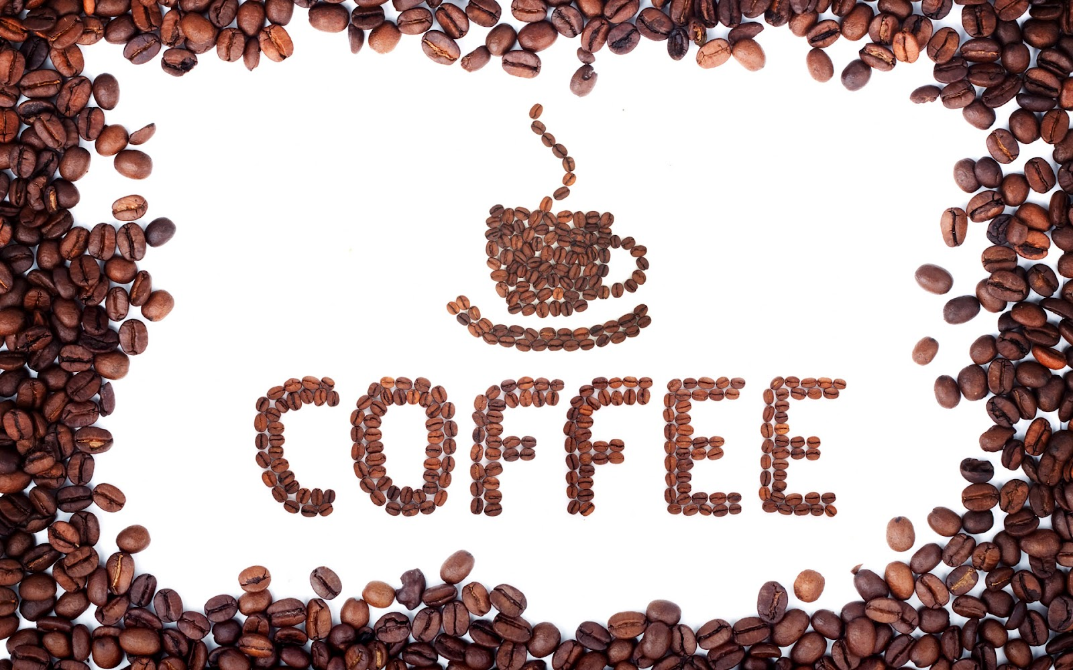
Ruby Tian
301215793
Menglong Lu
301186836
Siesta Jin
301131697
Michelle Chen
301149381
Notes:
Today, we are going to talk about the coffee industry.

Slide 2
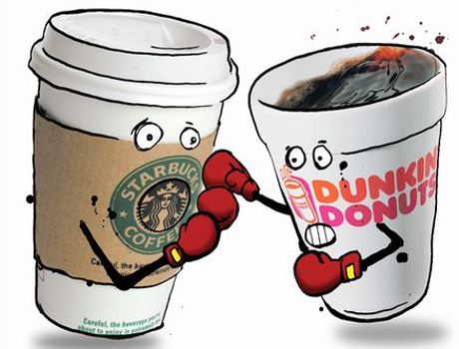
Table of Content
The coffee industry
Starbucks
Dunkin’ Donuts
Green Mountain
Notes:
First of all, I will introduce you guys some information of the coffee market. And then go through three major coffee companies which are Starbucks, Dunkin’s Donuts and Green Mountain.

Slide 3
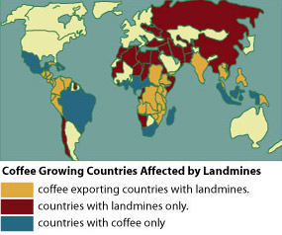
Top 10 Coffee Producing Countries (2014)
1 – Brazil
2 – Vietnam
3 – Colombia
4 – Indonesia
5 – Ethiopia
6 – India
7 – Honduras
8 – Mexiaco
9 – Uganda
10 - Guatemala
Description
Headlines
Key External Drivers
Industry Performance
Notes:
This is top 10 coffee producing countries. Brazil is the biggest coffee producing countries.

Slide 4
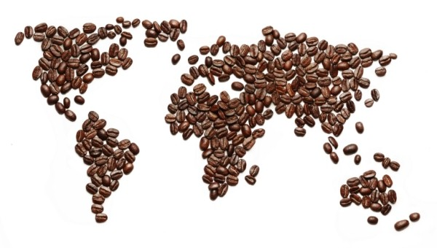
Coffee Industry Description
Coffee is more than popular: it's ubiquitous. No other beverage is as revered or respected. It can be seen in offices, during commutes, and on kitchen counter tops worldwide.
Coffee exporting alone is a $20 billion dollar industry, mostly consumed by industrialized nations while being produced by the world's underclass. It's so beloved today, you would never know drinking coffee once carried the death penalty.
Description
Headlines
Key External Drivers
Industry Performance
Notes:
Coffee is more popular today. No other beverage is as revered or respected. It can be seen in offices, during commutes, and on kitchen counter tops worldwide.

Slide 5

Coffee Industry Description
After crude oil, coffee is the most sought commodity in the world There’s no shame in coming in second place to oil. Coffee is worth over $100 billion worldwide.
Worldwide, we drink over 500 billion cups of coffee every year
And of that number, 14 billion are Italian espresso coffees.
Coffee farms are the economic livelihood of over 25 million people.
Coffee is grown in over 50 countries in Asia, Africa, South America, Central America and the Caribbean. And 67 percent of the world’s coffee is grown in the Americas alone.
Description
Headlines
Key External Drivers
Industry Performance

Slide 6
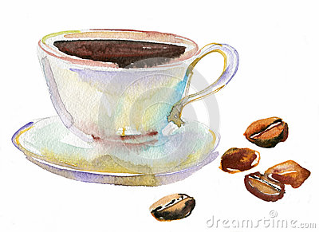
Coffee Industry Description
Over half of Americans over the age of 18 drink coffee daily.
American coffee drinkers average 3 and a half cups of coffee every day.
Coffee is the source of 75 percent of America’s caffeine.
Substantially more than any tea, soda or energy drink.
Coffee shops are the fastest growing niche in the restaurant business
Starbucks, by far America’s coffee giant, is the third largest restaurant chain in the U.S.
Description
Headlines
Key External Drivers
Industry Performance

Slide 7
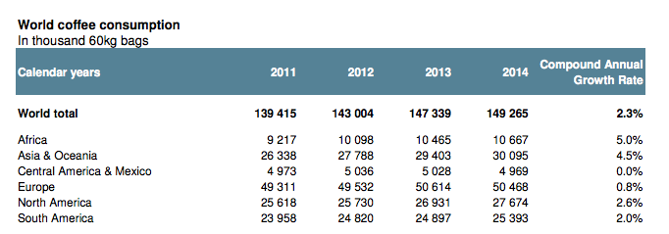
Coffee Industry Description
Description
Headlines
Key External Drivers
Industry Performance
Notes:
This is the world coffee consumption table.

Slide 8
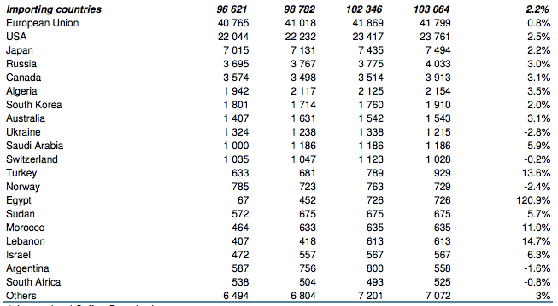
Coffee Industry Description
Description
Headlines
Key External Drivers
Industry Performance
Notes:
Also following the coffee importing countries.

Slide 9
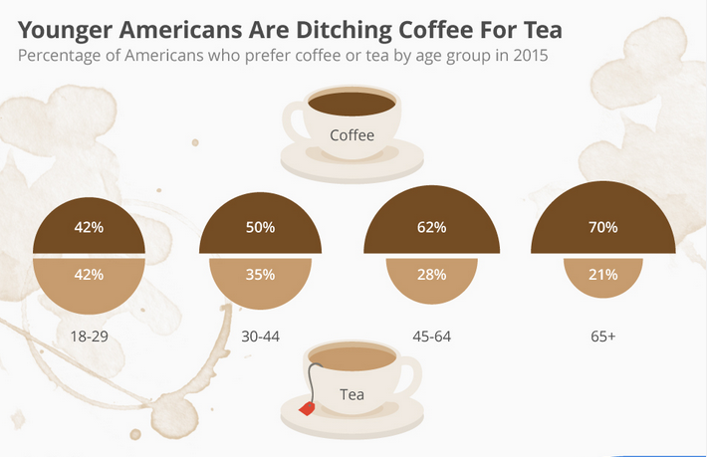
Coffee Industry Description
Description
Headlines
Key External Drivers
Industry Performance
Notes:
However, there is a unusual trend that younger Amercians are ditching coffee for tea.

Slide 10
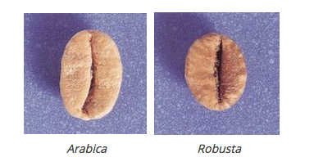
Coffee Industry Description
Two types of coffee beans
There are basically two types of coffee beans that are commonly used: Arabica and Robusta. There are numerous varieties of plants that are coffee species, but these two are the most important from a commercial point of view.
Description
Headlines
Key External Drivers
Industry Performance
Notes:
Coffee beans are the seeds of a cherry-like fruit. The seeds are covered by different layers of skin, which all have their specific roles. Before the roasting process, all these skins have to be eliminated. Sometimes, there are skins that remain.

Slide 11

Coffee Industry Description
Arabica Coffee Beans
Arabica is a special variety, because it has four chromosome.
More than sixty five percent of world coffee cultures are of Arabica.
The taste of Arabica can be different, according to the location
Description
Headlines
Key External Drivers
Industry Performance

Slide 12
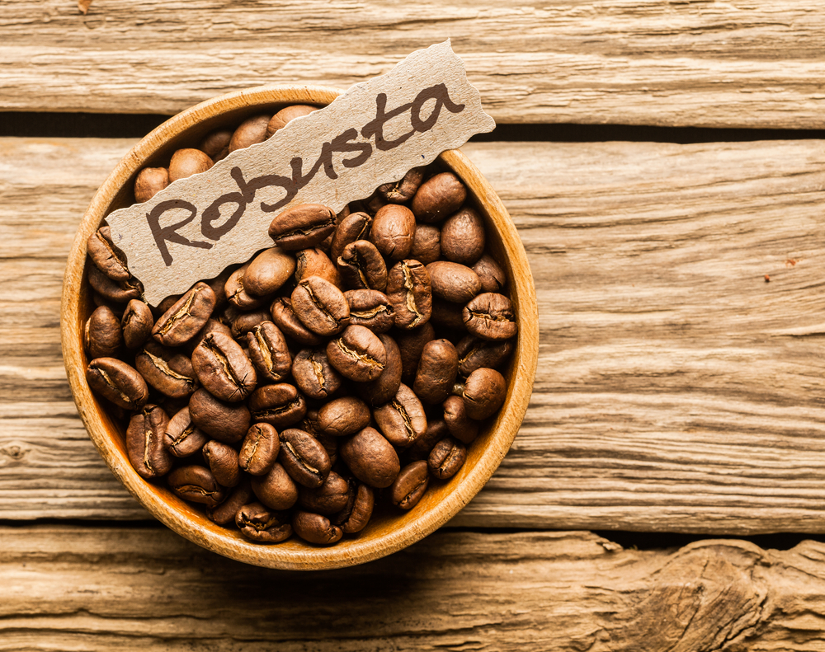
Coffee Industry Description
Robusta Coffee Beans
Robusta has more fruit, a lower cost, grows well at lower altitudes and is more resistant to diseases.
Robusta can be sometimes comparable to Arabica.
The caffeine content is much higher than the one found in Arabica.
Description
Headlines
Key External Drivers
Industry Performance

Slide 13
Headlines
In U.S.
Looking at market size and growth, coffee sales will top $48 billion in 2014, with $11.2 billion to come from retail sales and $37 billion to come from foodservice sales. Retail sales are predicted to grow at just over 5% a year in the next couple of years while foodservice sales are expected to grow slightly faster.
In Canada
More than 2.1 billion cups of coffee is served up at Canada’s restaurants each year.
In 2014 retail sales grow by 19% in current value terms and 4% in volume terms to reach C$2.3 billion and 81,000 tonnes
Fresh ground coffee pods posts the fastest retail current value sales growth of 47% in 2014
Description
Headlines
Key External Drivers
Industry Performance

Slide 14
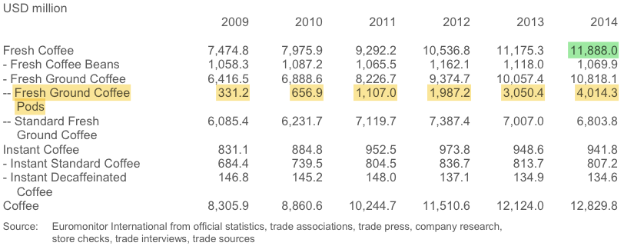
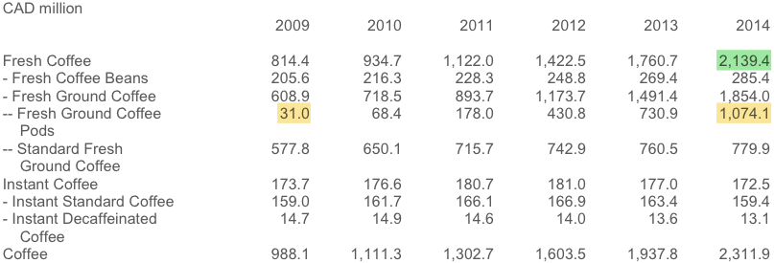
Table 1: Retail Sales of Coffee by Category: Value 2009-2014
Description
Headlines
Key External Drivers
Industry Performance
Notes:
There is a significant change from 2010 to 2011. We can also see this change from world price of coffee later.

Slide 15
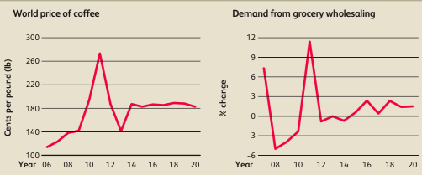
Key External Drivers
Demand from grocery wholesaling
The Coffee Production industry is highly dependent on demand from downstream suppliers, such as grocery wholesalers, which provide coffee products to supermarkets.
World price of coffee
The world price of coffee determines coffee producers’ costs and profitability because coffee beans are a key input commodity in coffee production
Description
Headlines
Key External Drivers
Industry Performance

Slide 16
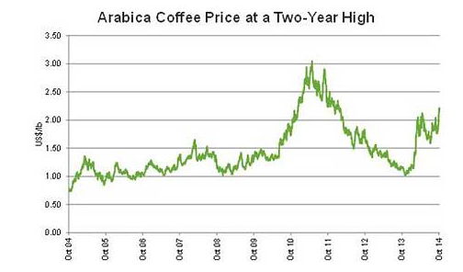
Key External Drivers
Coffee bean price
Description
Headlines
Key External Drivers
Industry Performance

Slide 17
Key External Drivers
Demand from supermarkets and grocery stores Coffee producers rely on favorable supply-side contracts with downstream markets, such as supermarkets and grocery stores.
Lifestyles changing The increasing emphasis on healthy lifestyles and reducing caffeine intake for people with certain health conditions is a potential threat to coffee house companies. The secret will be finding suitable alternatives for those consumers who cannot or choose not to drink caffeinated coffee. A quality decaffeinated alternative will provide access to this sub-segment of the market.
Climate changing Climate change may well represent a threat to coffee production and hence make the raw materials more expensive.
Description
Headlines
Key External Drivers
Industry Performance

Slide 18
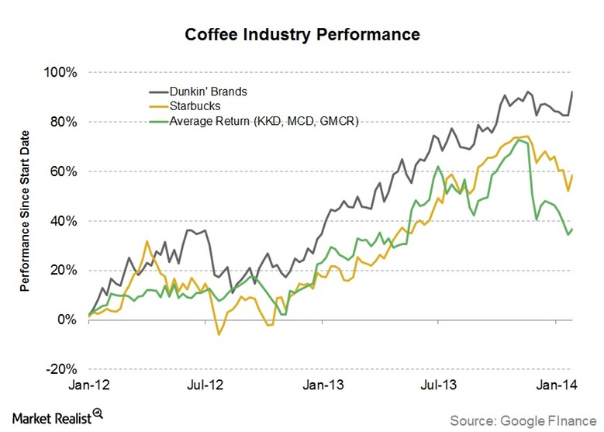
Coffee Industry performance
Description
Headlines
Key External Drivers
Industry Performance
Notes:
This is the coffee industry performance for Dunkin Donuts , Starbucks and other coffee companies.

Slide 19
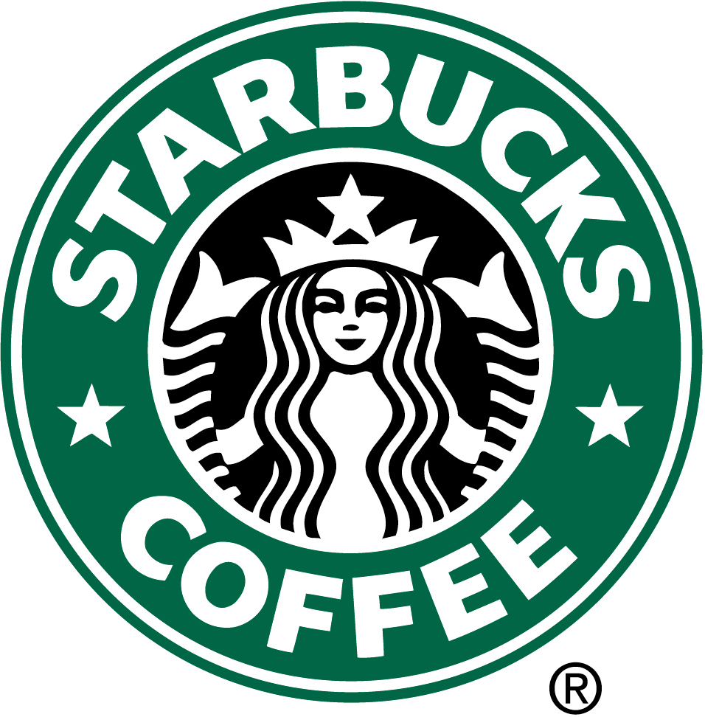

Slide 20
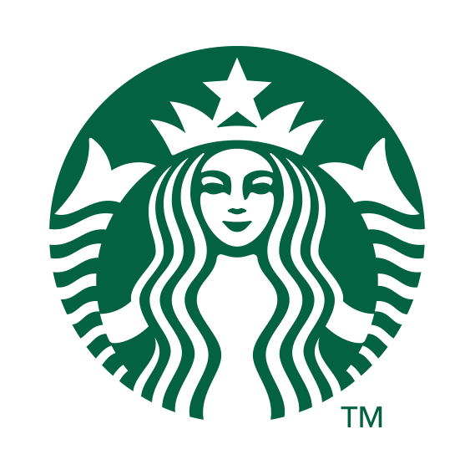
Introduction
The largest coffeehouse company with 21,536 stores in 65 countries
Traded on NASDAQ as SBUX
Core product: coffee, tea, other beverages and fresh food items
Objective: maintain Starbucks standing as one of the most recognized and respected brands in the world
Introduction
Financial Statement
Risk Factors
Market Risk
Notes:
Starbucks is the largest coffeehouse company and operated around the world. The main products are coffee, tee and other beverages and fresh food items.

Slide 21
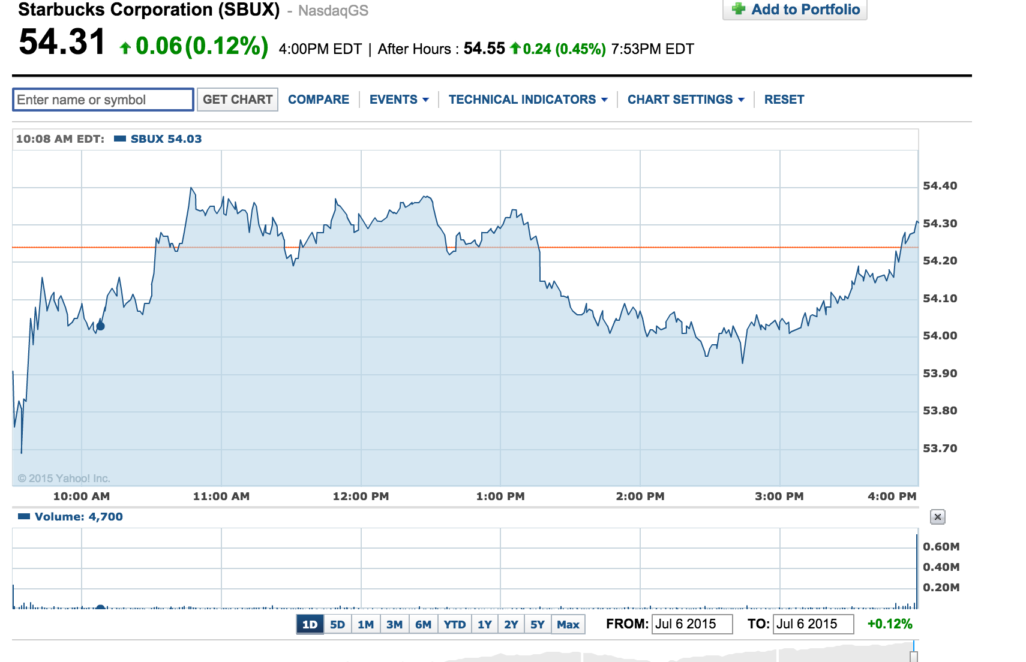
Introduction
Introduction
Financial Statement
Risk Factors
Market Risk
Summary
Notes:
Stock information

Slide 22
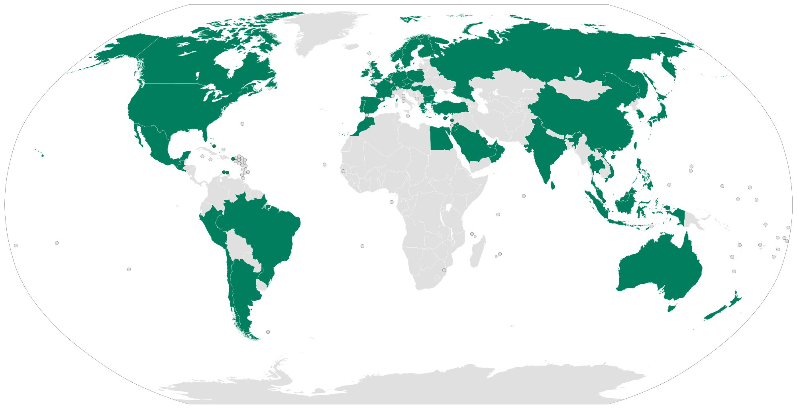
Business Segment
US( U.S. ,Canada, Latin America)
EMEA ( Europe, Middle East, Africa)
CAP (China/ Asia Pacific)
Introduction
Financial Statement
Risk Factors
Market Risk
Summary
Notes:
There are 3 business segments around the world

Slide 23
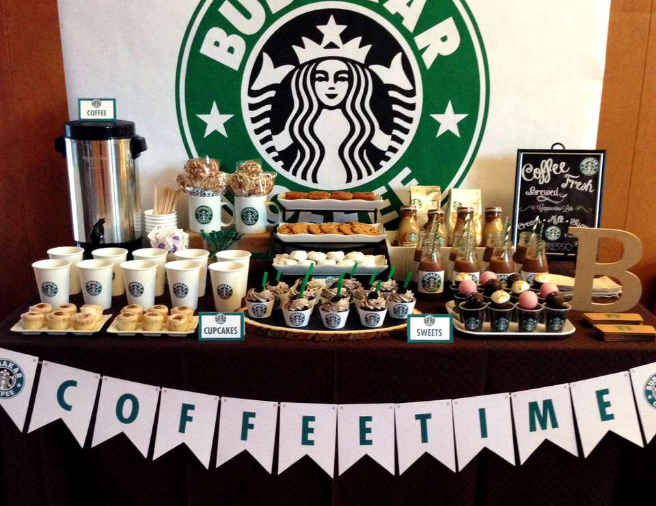
Revenue Component
Company-operated retail stores
Licensed Stores
Consumer packaged goods & foodservice operations
Introduction
Financial Statement
Risk Factors
Market Risk
Summary
Notes:
We generate our revenues though company-operated retail stores and our specialty operations. Specialty operations include retail stores licensed by local business partners, packaged coffee and tea sold through licensees in grocery and warehouse club stores, license arrangements with business partners

Slide 24
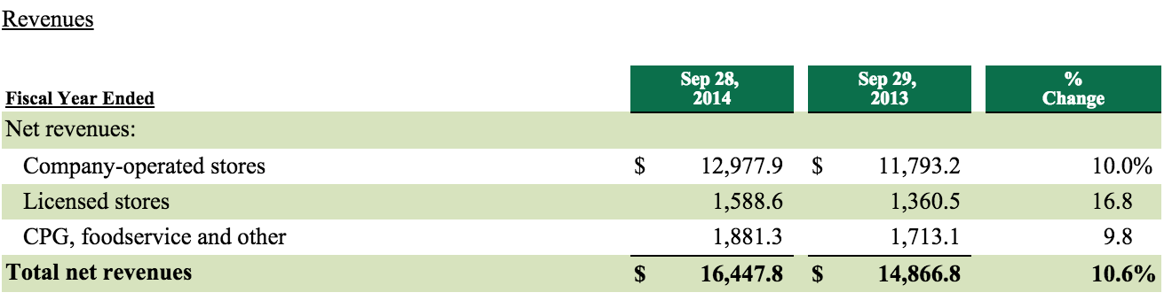
Revenue
Introduction
Financial Statement
Risk Factors
Market Risk
Summary

Slide 25
Financial Statement
Consolidated Statements of Comprehensive Income
Consolidated Balance Sheets
Consolidated Statements of Cash Flows
Introduction
Financial Statement
Risk Factors
Market Risk
Summary

Slide 26
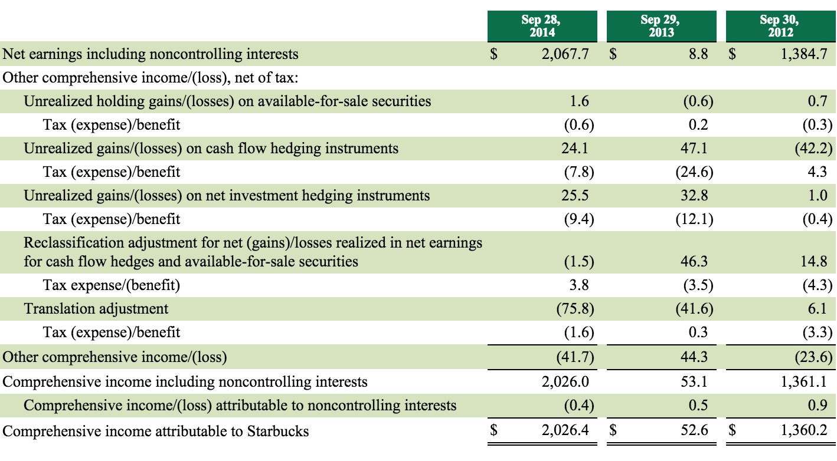
Consolidated Statements of Comprehensive Income(in millions)
Introduction
Financial Statement
Risk Factors
Market Risk
Summary
Notes:
Pretax gains and losses on derivative contracts designated as hedging instruments recognized in other comprehensive income.

Slide 27
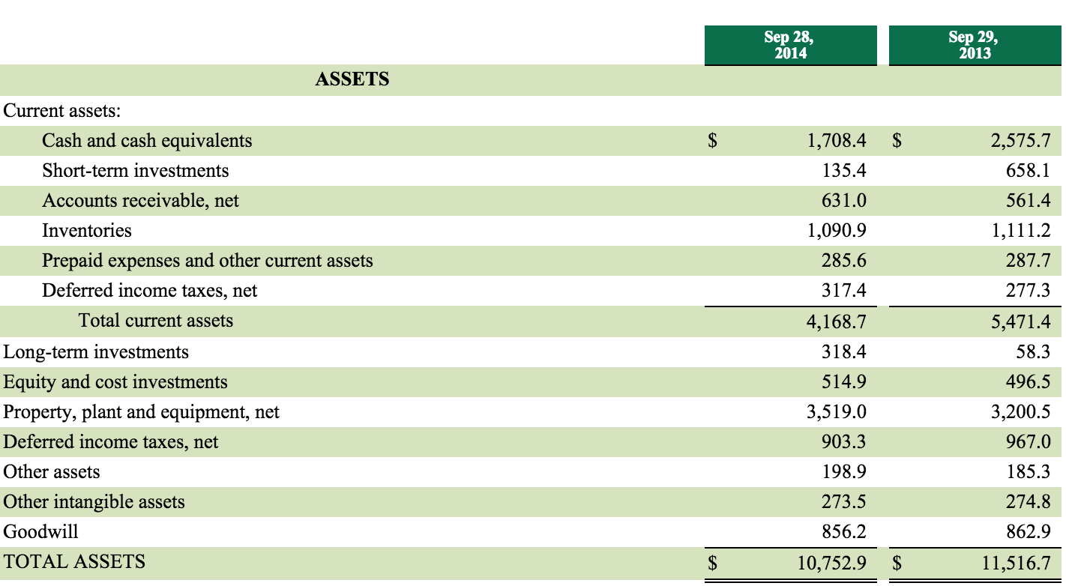
Consolidated Balance Sheet (in millions, expect per share data )
Introduction
Financial Statement
Risk Factors
Market Risk
Summary

Slide 28
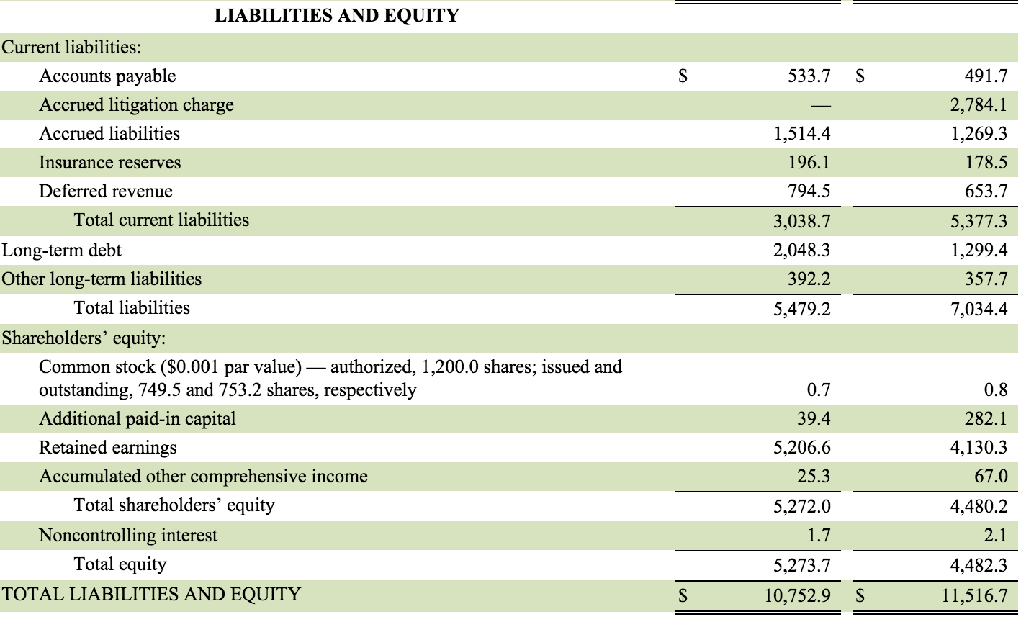
Consolidated Balance Sheet (in millions, expect per share data )
Introduction
Financial Statement
Risk Factors
Market Risk
Summary

Slide 29
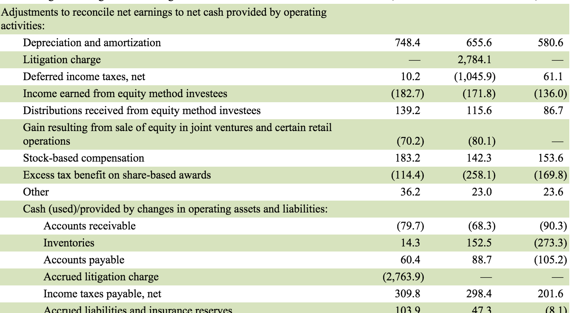
Consolidated Statements of Cash Flows (in millions)
Introduction
Financial Statement
Risk Factors
Market Risk
Summary

Slide 30
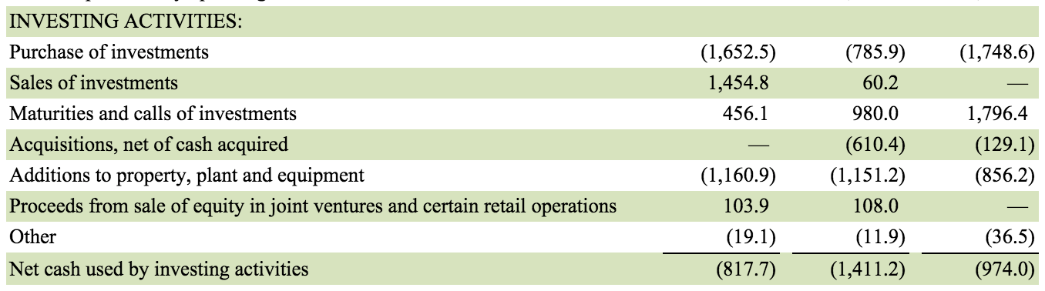
Consolidated Statements of Cash Flows (in millions)
Introduction
Financial Statement
Risk Factors
Market Risk
Summary

Slide 31
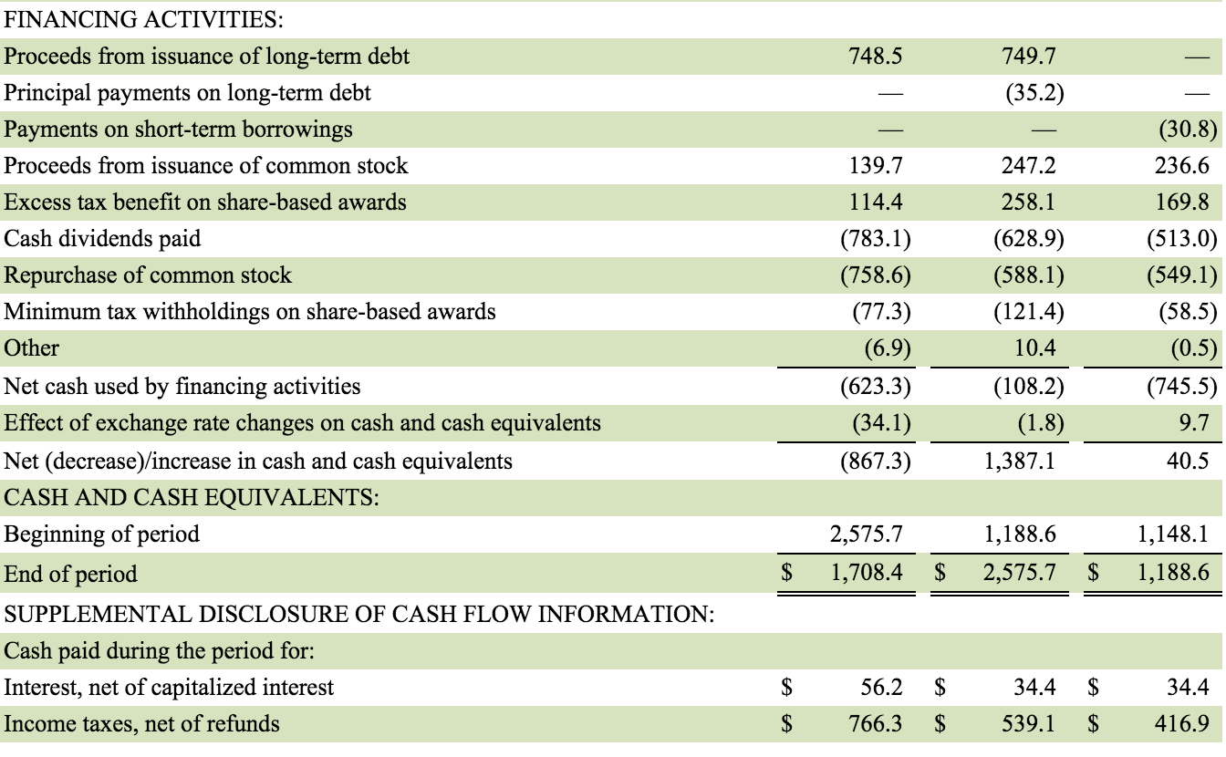
Consolidated Statements of Cash Flows (in millions)
Introduction
Financial Statement
Risk Factors
Market Risk
Summary

Slide 32
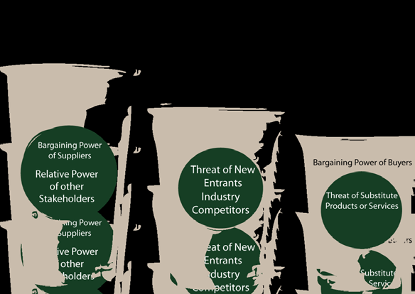
Risk Factors
Economic conditions in the US and certain international markets
Success depends substantially on the value of brands to preserve value
Introduction
Financial Statement
Risk Factors
Market Risk
Summary
Notes:
There are risk factors that might affect their business environment.

Slide 33
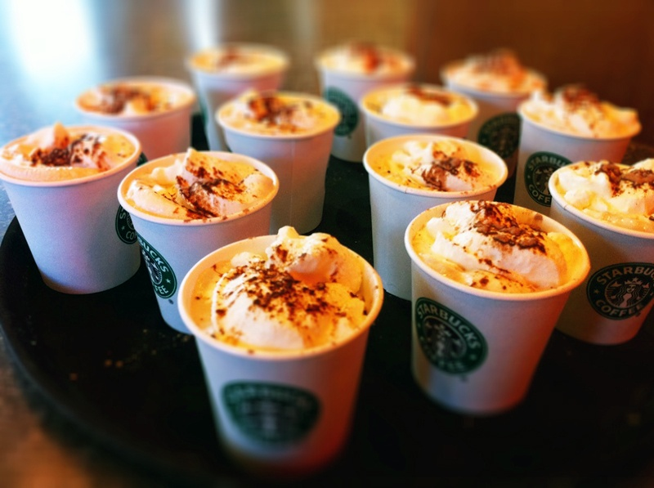
Risk Factors
The unauthorized access, theft and destruction of company and customer information
Incidents involving food-borne illnesses, food tempering, or mislabeling
Introduction
Financial Statement
Risk Factors
Market Risk
Summary

Slide 34

Risk Factors
Unsuccessful in implementing important strategic initiatives have impact on business and financial results
Intense competition in each of channels and markets could lead to reduced profitability
Introduction
Financial Statement
Risk Factors
Market Risk
Summary

Slide 35
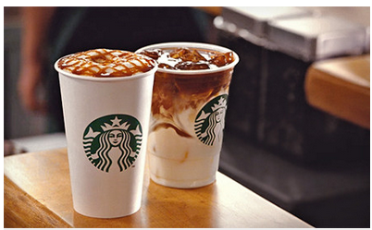
Risk Factors
Highly dependent on the financial performance of Americas operating segment
Financial conditions and results of operations are sensitive by many factors which are outside control
Introduction
Financial Statement
Risk Factors
Market Risk
Summary

Slide 36
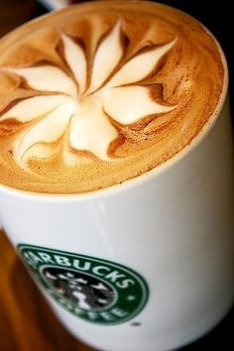
Risk Factors
Interruption of supply chain could affect ability to produce or deliver products
The loss of key personnel or difficulties recruiting and retaining qualified personnel
Failure to meet market expectations for financial performance
Introduction
Financial Statement
Risk Factors
Market Risk
Summary

Slide 37
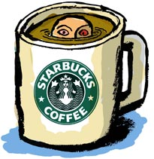
General Risk Conditions
Commodity Price Risk
Foreign Currency Exchange Risk
Equity Security Price Risk
Interest Rate Risk
Introduction
Financial Statement
Risk Factors
Market Risk
Summary
Notes:
According to those risks, Starbucks classify their general risk conditions. There are

Slide 38
Commodity Price Risk
Presents company primary market risk
Generated by purchase of commodity inputs, including coffee, dairy products and diesel
Use a combination of pricing features embedded with supply contracts and financial derivatives to manage. ( Fixed-price and price-to-be-fixed contracts for coffee purchase)
Introduction
Financial Statement
Risk Factors
Market Risk
Summary
Notes:
Price to be fixed contracts are purchase commitments whereby the quality, quantity, delivery period and other negotiated terms are agreed upon prior to the delivery date, but the price is not set.

Slide 39
Foreign Currency Exchange Risk
For transaction in other currencies, need reduce cash flow volatility from foreign currency fluctuations
Enter into derivative instruments to hedge portions of cash flows of anticipated revenue streams and inventory purchases in other than functional currency, the US dollar
Introduction
Financial Statement
Risk Factors
Market Risk
Summary
Notes:
Although their majority revenue is US dollar, but still consist operation activities outside of U.S

Slide 40
Equity Security Price Risk
Have minimal exposure to price fluctuations on equity mutual funds and equity exchange-traded within trading securities portfolio
Perform a sensitivity analysis based on a 10% change in the underlying equity prices of investments, determined that such a change would not have a significant impact
Introduction
Financial Statement
Risk Factors
Market Risk
Summary
Notes:
Trading securities are recorded at fair value with unrealized holding gains and losses recorded in net interest income and other in the consolidated statements of earnings.

Slide 41
Interest Rate Risk
Utilize short-term and long-term financing and use interest rate hedges to manage overall interest expense related to existing fixed-rate debt
Hedge the variability in cash flows due to changes in the benchmark interest rate related to anticipated debt issuances
Introduction
Financial Statement
Risk Factors
Market Risk
Summary

Slide 42
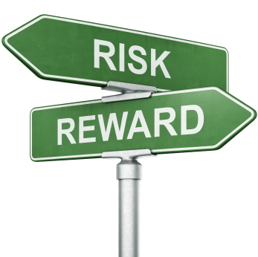
Market price risk management policy
Market-based risks are quantified and evaluated for potential mitigation strategies, such as entering into hedging transactions
Governs how hedging instruments may be used to mitigate risk not for revenue
Risk limits are set annually
Monitor and limit the amount of associated counterparty credit risk
Introduction
Financial Statement
Risk Factors
Market Risk
Summary
Notes:
Starbucks manage various market-based risks according to a market price risk management policy. Under this policy,

Slide 43
Summary
Interest rate swap agreements to hedge the variability in cash flows
Forward and swap contracts to hedge position of cash flow
Futures contracts and collars to hedge the risk of commodity price
Introduction
Financial Statement
Risk Factors
Market Risk
Summary
Notes:
There are several strategies Starbucks use in hedge position.
Collars: the combination of a purchased call option and a sold put option

Slide 44
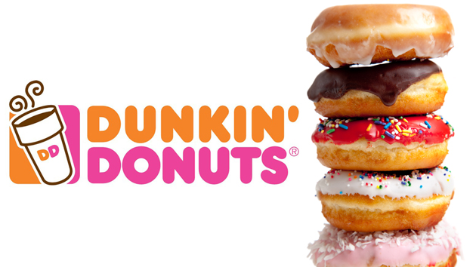

Slide 45
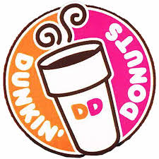
Company Snapshot
Founded In 1950, Bill Rosenberg opened the first Dunkin' Donuts shop in Quincy, Massachusetts. Dunkin' Donuts licensed the first of many franchises in 1955.
One of the world's leading franchisors of quick service restaurants (“QSRs”) serving hot and cold coffee and baked goods, as well as hard serve ice cream.
With over 3,100 stores in 30 countries outside of the U.S., Dunkin' Donuts has been serving loyal customers internationally for over 40 years.
Plans to expand its number of American locations to 15,000 by 2020.
Introduction
Financial Statement
Risk Factor
Market Risk
Summary

Slide 46
Global Presence
There are more than 11,300 Dunkin’ Donuts restaurants worldwide.
More than 8,000 Dunkin’ Donuts restaurants in 41 states in the U.S. plus the District of Columbia.
Over 3,200 international restaurants in 36 countries.
Returned in European market in 2014.
Introduction
Financial Statement
Risk Factor
Market Risk
Summary
Notes:
Open stores in England, Denmark, Sweden, Finland and Austria one after the other in 2014.
From Asia to Latin America and everywhere in between, you can count on Dunkin' Donuts for delicious coffee and espresso, cool Coolatta®, frozen beverages, delectable donuts, sandwiches and more

Slide 47
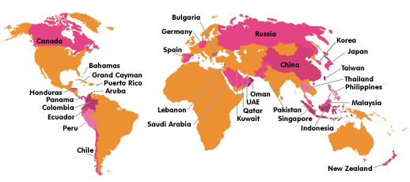
Global Presence
Introduction
Financial Statement
Risk Factor
Market Risk
Summary

Slide 48
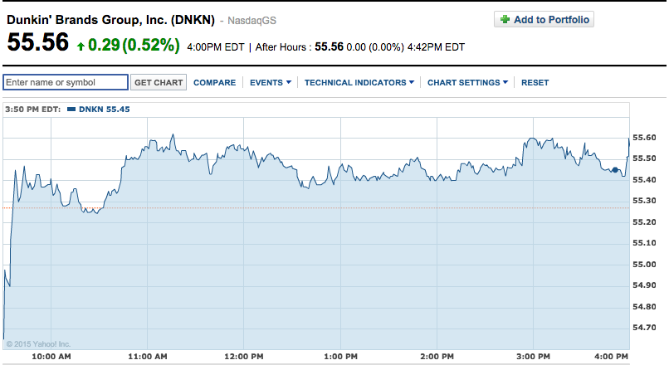
Price Stock
Introduction
Financial Statement
Risk Factor
Market Risk
Summary

Slide 49
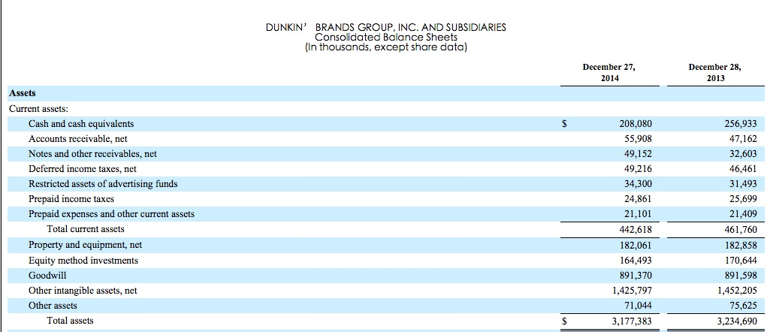
Consolidated Balance Sheet
Introduction
Financial Statement
Risk Factor
Market Risk
Summary

Slide 50
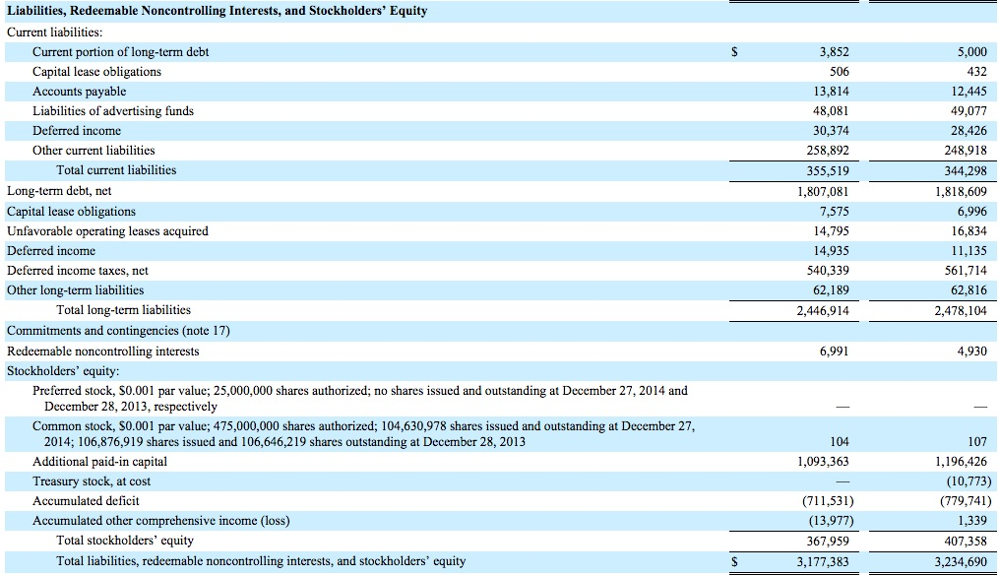
Consolidated Balance Sheet
Introduction
Financial Statement
Risk Factor
Market Risk
Summary

Slide 51
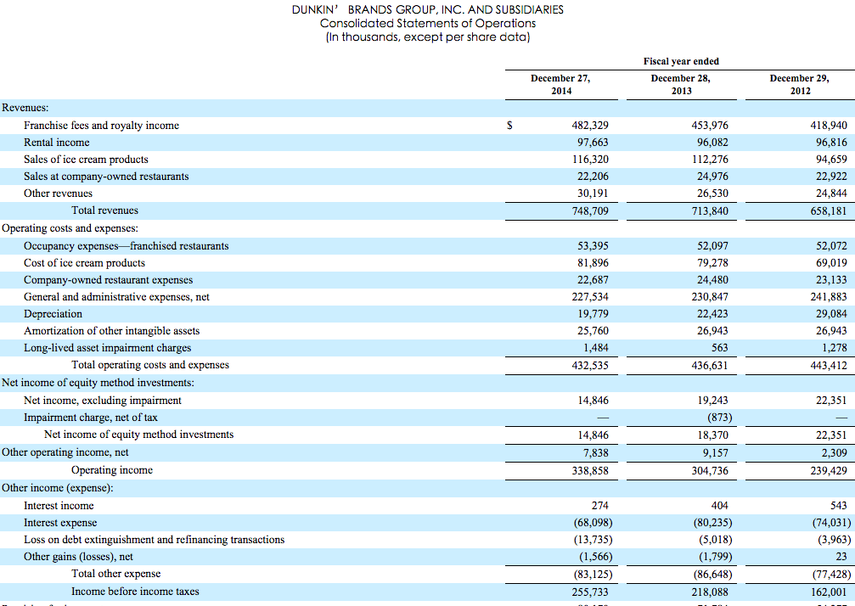
Consolidated Statement of Operation
Introduction
Financial Statement
Risk Factor
Market Risk
Summary

Slide 52
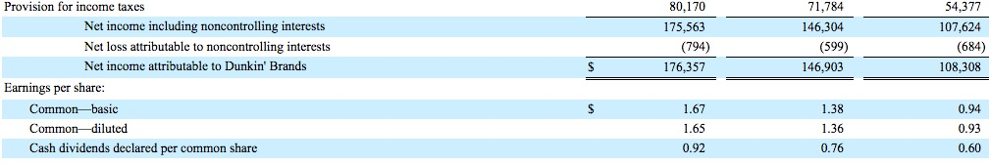
Consolidated Statement of Operation
Introduction
Financial Statement
Risk Factor
Market Risk
Summary

Slide 53
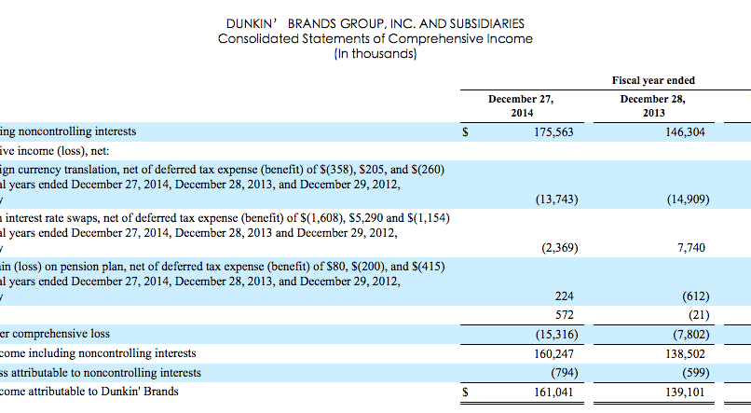
Consolidated Statement of Comprehensive Income
Introduction
Financial Statement
Risk Factor
Summary
Market Risk

Slide 54
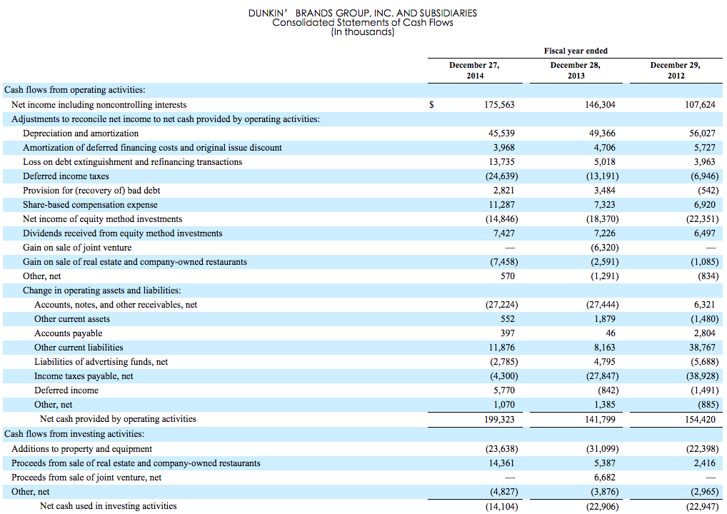
Consolidated Statement of Cash Flows
Introduction
Financial Statement
Risk Factor
Market Risk
Summary

Slide 55
Consolidated Statement of Cash Flows
Introduction
Financial Statement
Risk Factor
Market Risk
Summary

Slide 56
Risk Factor
Our business is subject to various laws and regulations and changes in such laws and regulations, and/or failure to comply with existing or future laws and regulations, could adversely affect us.
The restaurant industry is affected by consumer preferences and perceptions. Changes in these preferences and perceptions may lessen the demand for our products, which could reduce sales by our franchisees and reduce our royalty revenues.
Shortages of coffee or mild could adversely affect our revenues.
Economic conditions adversely affecting consumer discretionary spending may negatively impact our business and operating results.
Introduction
Financial Statement
Risk Factor
Market Risk
Summary
Notes:
Law & regulations➔ failure to comply
Change in consumer preferences and perceptions will lessen demand and reduce revenue.
Coffee & milk shortage
Economic conditions

Slide 57
Risk Factor
The quick service restaurant segment is highly competitive, and competition could lower our revenues.
We are and may become subject to third-party infringement claims or challenges to the validity of our Intellectual Property.
Increases in commodity prices may negatively affect payment from our franchisees and licensees
Coffee price fluctuation
Our business activities subject us to litigation risk that could affect us adversely by subjecting us to significant money damages and other remedies or by increasing our litigation expense.
We may be unable to generate sufficient cash flow to satisfy our significant debt service obligations, which would adversely affect our financial condition and results of operations
Introduction
Financial Statement
Risk Factor
Market Risk
Summary
Notes:
Competitor
Increases in commodity prices negatively
Litigation risk➔ remedies, litigation expense
Not enough cash flow to satisfy debt

Slide 58
Risk Factor
We cannot predict the impact that the following may have on our business: (i) new or improved technologies, (ii) alternative methods of delivery, or (iii) changes in consumer behavior facilitated by these technologies and alternative methods of delivery.
The indenture governing the securitized debt will restrict the cash flow from the entities subject to the securitization to any of our other entities and upon the occurrence of certain events, cash flow would be further restricted.
Interruptions in the supply of product to franchisees and licensees could adversely affect our revenues.
Our substantial indebtedness could adversely affect our financial condition.
Introduction
Financial Statement
Risk Factor
Market Risk
Summary
Notes:
Unpredictable factors➔ tech delivery consumer behavior
Interruptions in supply of product to franchisees
Debt condition

Slide 59
Risk Factor
If the international markets in which we compete are affected by changes in political, social, legal, economic, or other factors, our business and operation results may be materially and adversely affected.
Adverse public or medical options about the health effects of consuming our products, as well as reports of incidents involving food-borne, illnesses or food tempering, whether or not accurate, could harm our brands and our business.
Our financial results are affected by the operating results of our franchisees.
Our success depends substantially on the value of our brands.
Introduction
Financial Statement
Risk Factor
Market Risk
Summary
Notes:
Political, social, legal, economic factor
Public/medical options abt health effect
Their Financial result
Value of brands

Slide 60
Market Risk
Foreign exchange risk: subject to operating in a global economy because the company has investments and equity income from joint ventures that are denominated in foreign currency.
Interest rate risk: in connection with long-term debt.
Introduction
Financial Statement
Risk Factor
Market Risk
Summary
Notes:
Global economy➔investments and equity denominated in foreign currency
Long-term debt

Slide 61
Risk Management
The Company used derivative instruments to hedge interest rate risks
For derivative instruments that were designated and qualified as a cash flow hedge
These derivative contracts were entered into with financial institutions.
Introduction
Financial Statement
Risk Factor
Market Risk
Summary
Notes:
Derivative instruments for interest rate risks
Designated and qualified as a cash flow hedge
Entered into with financial institutions

Slide 62
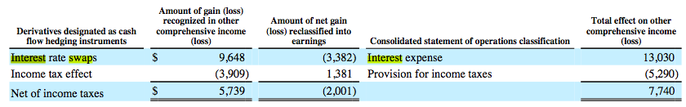
Risk Management
Introduction
Financial Statement
Risk Factor
Market Risk
Summary
Notes:
Use Interest rate swap to hedge interest rate risk

Slide 63
Risk Management
The company may consider the use of derivative financial instruments, such as forward contracts, to manage foreign currency exchange rate risks.
After refinancing transaction completed in January 26, 2015 the company’s long-term debt bear fixed interest rate so no longer exposed to interest rate volatility with long-term debt.
Introduction
Financial Statement
Risk Factor
Market Risk
Summary
Notes:
Derivative financial instrument: forward contract
Refinancing➔ fixed interest rate➔ no interest rate volatility

Slide 64
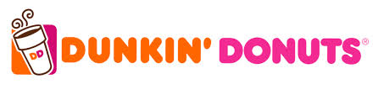
Summary
Forward contracts to hedge foreign exchange rate risks
Use variable-to-fixed interest rate swap agreements to hedge interest rate risks
Introduction
Financial Statement
Risk Factor
Market Risk
Summary
Notes:
Forward contracts➔ foreign exchange rate risks
Variable-to-fixed interest rate swap agreements➔ interest rate risks

Slide 65
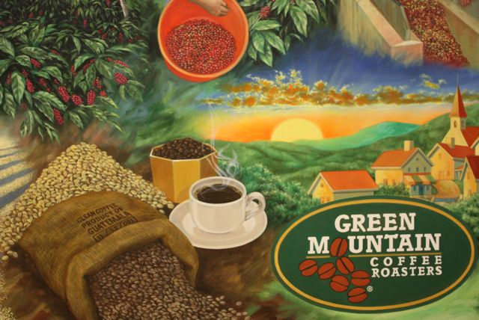

Slide 66
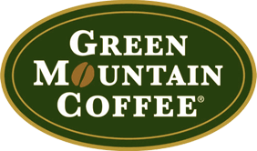

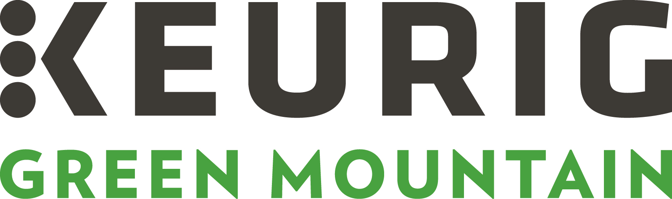
Keurig Green Mountain (Green Mountain Coffee )

Slide 67
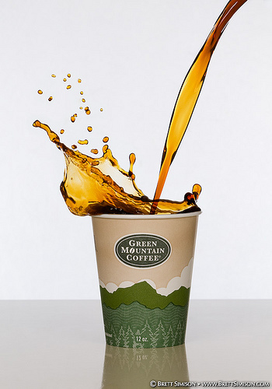
History
Beginning:
Started as a small specialty coffee roasting company in Waitsfield, Vermont in 1981.
Sold beans, grounds, and coffee
Expansion:
1991: GMCR had seven retail outlets, 1,000 wholesale clients, $11 million in sales, and $200,000 in profits.
1993: the company had sales of about $10 million and the Green Mountain Coffee Roasters Inc. started trading publicly under the sticker “GMCR”.
Introduction
Financial Statement
Risk Factor
Market Risk
Summary

Slide 68
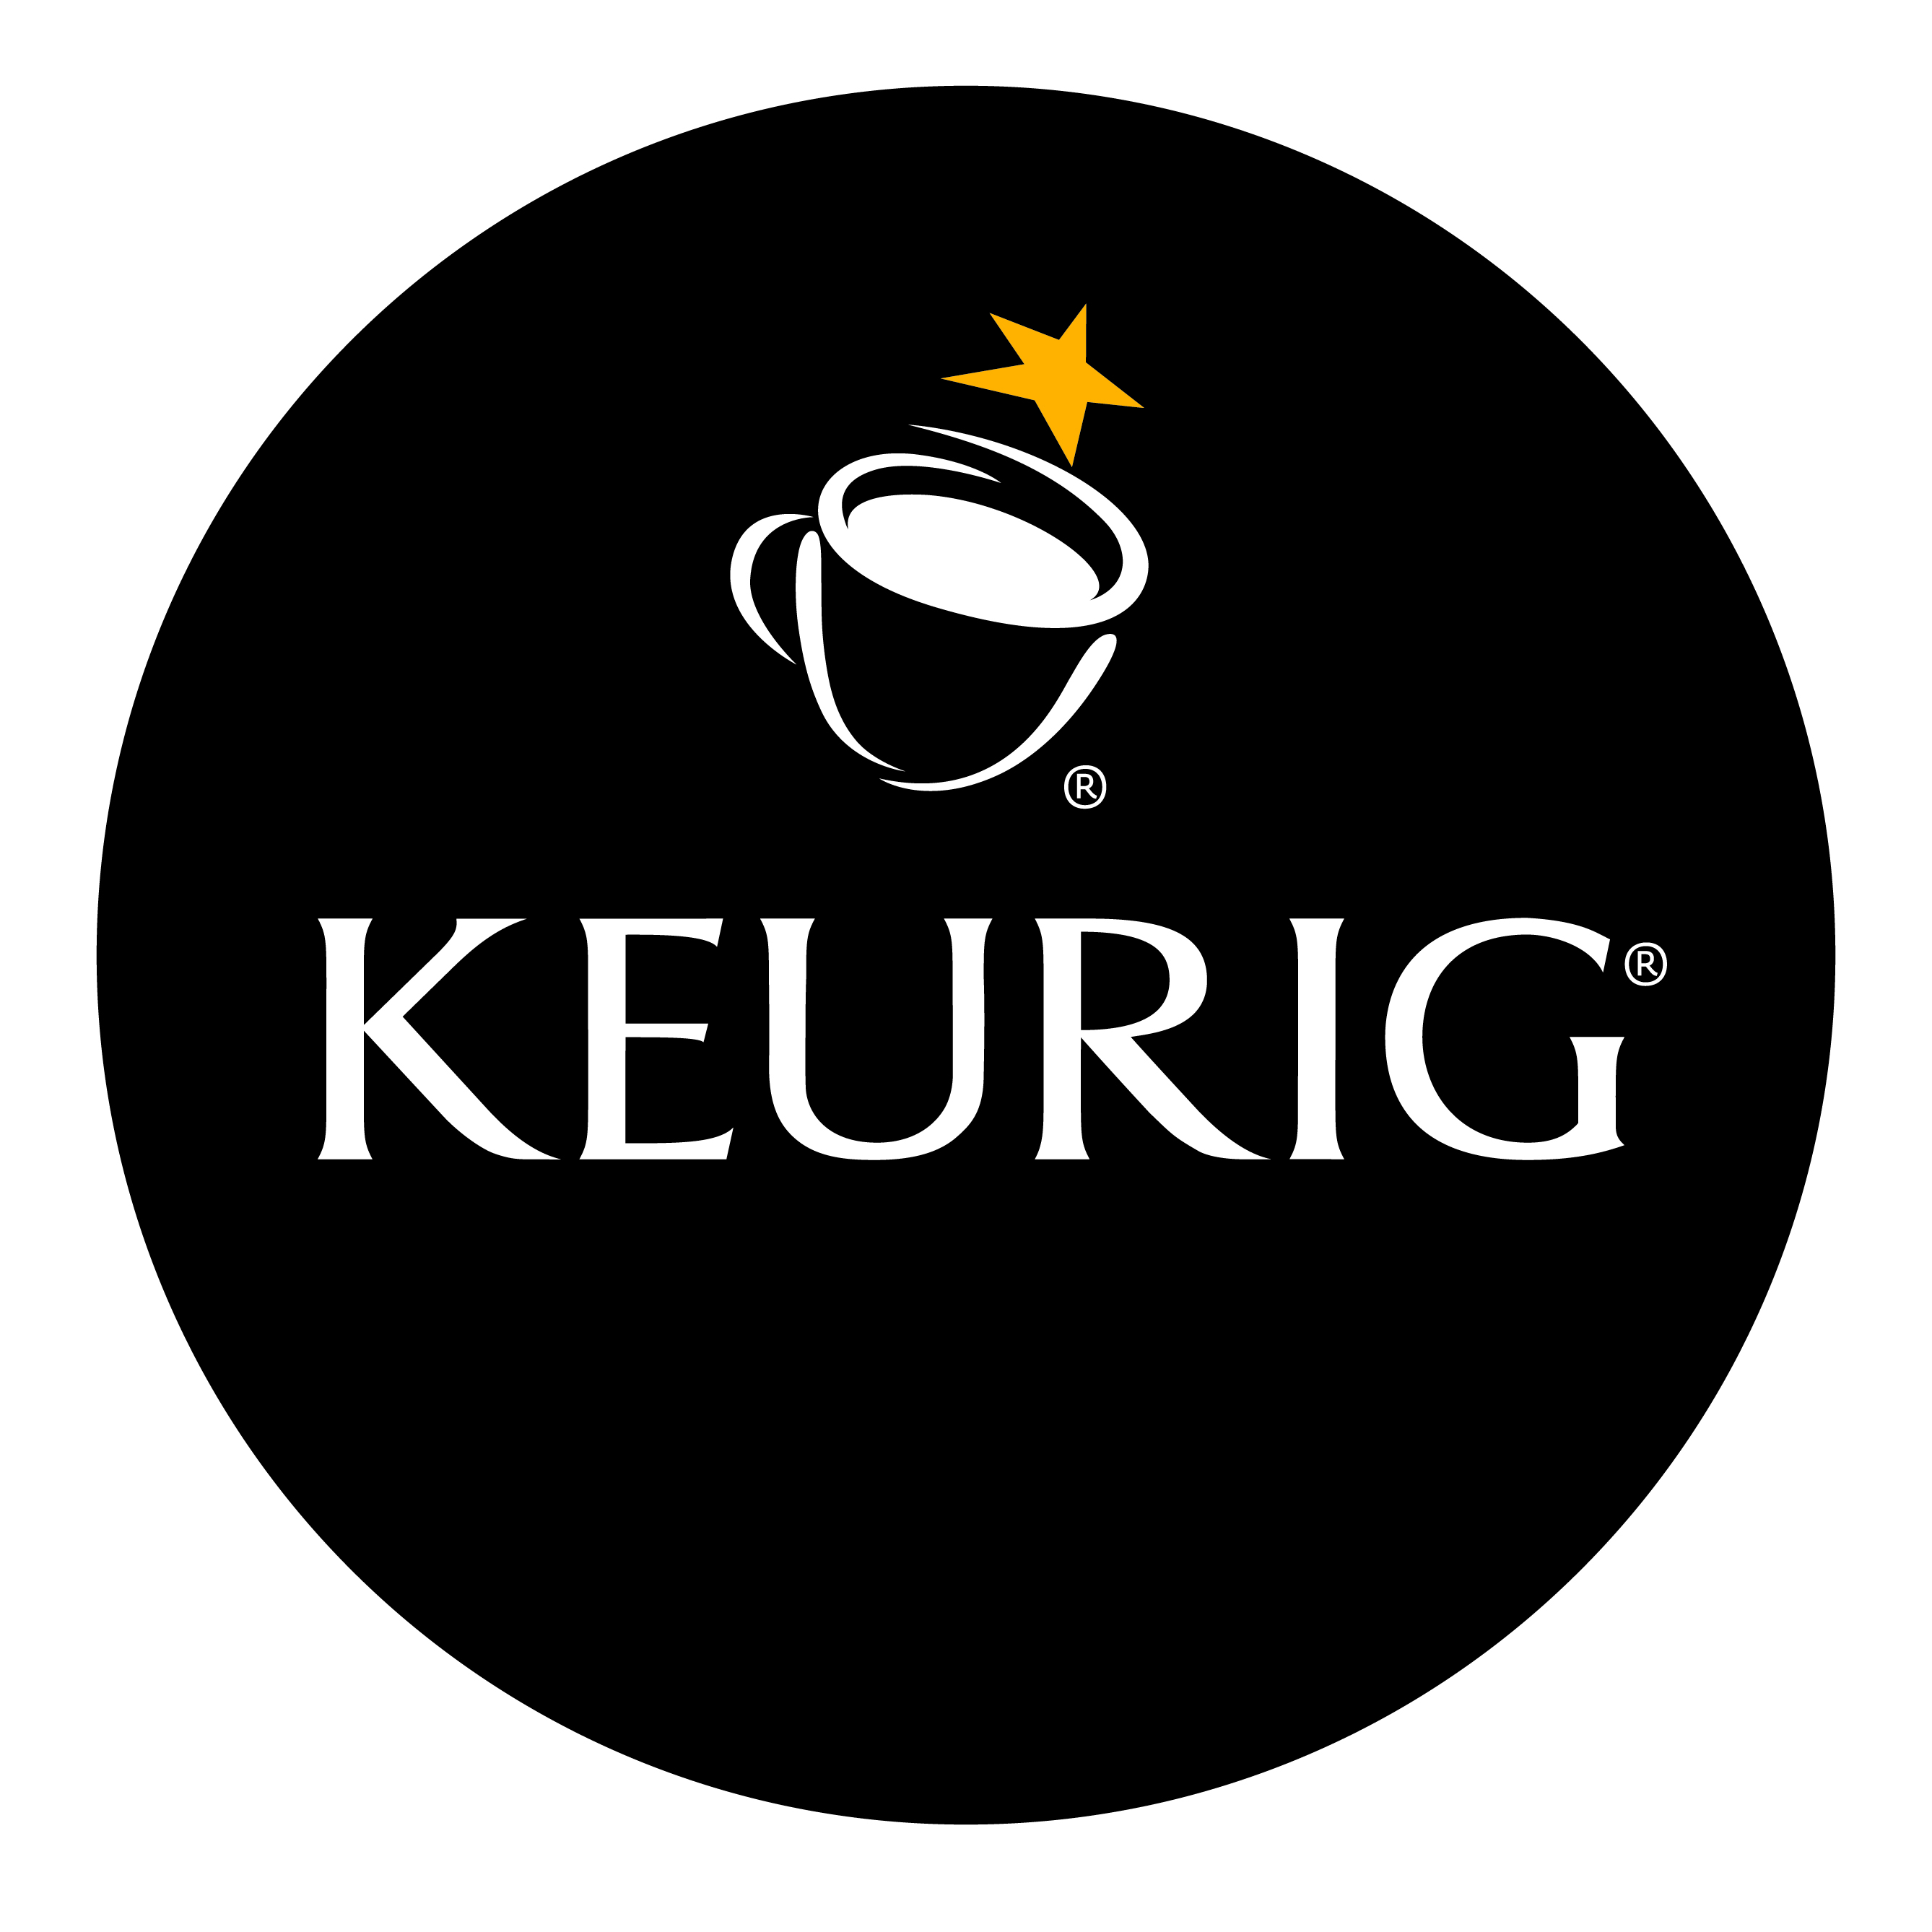

History
Acquisition of Keurig, Inc.
1993: Keurig, a start up company, approached GMCR to develop a single-cup coffee brewing system
1997: Green Mountain Coffee Roasters became the first roaster to offer coffee in a K-Cup pod for the Keurig Single-Cup Brewing System.
2006: Green Mountain completed its full acquisition of Keurig, by investing in a 43% ownership over time.
Introduction
Financial Statement
Risk Factor
Market Risk
Summary

Slide 69

Transition
Transition: transitioned fully by deriving 95% of its revenue from its low-margin wholesale coffee business in the late 1990s (approximately $65 million), to deriving 95% of its revenue from high-margin sales of K-Cups as of 2014 (more than $4.3 billion).
Introduction
Financial Statement
Risk Factor
Market Risk
Summary
Notes:
Transition: transitioned fully by deriving 95% of its revenue from its low-margin wholesale coffee business in the late 1990s (approximately $65 million), to deriving 95% of its revenue from high-margin sales of K-Cups as of 2014 (more than $4.3 billion).

Slide 70

Keurig Green Mountain
In March 2014, GMCR changed its name to Keurig Green Mountain to reflect its business of selling Keurig coffee makers (stock-market symbol remains GMCR)
Introduction
Financial Statement
Risk Factor
Market Risk
Summary
Notes:
In March 2014, GMCR changed its name to Keurig Green Mountain to reflect its business of selling Keurig coffee makers (stock-market symbol remains GMCR)

Slide 71
Introduction of Keurig Green Mountain
Products
Keurig® Brewers
specialty coffee and other beverages in portion packs
traditional whole bean and ground coffee in bags and fractional packages
Differentiation
partner with other beverage brand companies to bring consumers significant beverage and brand choice in Keurig® Brewing systems
Growth Strategy
using consumer insights to develop innovative new brewing systems and beverages, continually improving and refining current systems and beverages.
Introduction
Financial Statement
Risk Factor
Market Risk
Summary

Slide 72

Business Segments
USA (domestic)
Design hot beverage system brewers
Produce coffee, hot cocoa, teas and other beverages under a variety of brands in portion packs and coffee in more traditional packaging
Sell to retailers including supermarkets, department stores, coffee distributors, and to consumers through a consumer-facing website
Canada
Sell hot beverage system brewers, coffee and other beverages in portion packs and coffee in more traditional packaging to retailers including supermarkets, department stores, coffee distributors, and to consumers through a consumer-facing website
Introduction
Financial Statement
Risk Factor
Market Risk
Summary

Slide 73

Financial Statements
Consolidated Balance Sheets
Consolidated Statement of Operations
Consolidated Statements of Comprehensive Income
Consolidated Statements of Cash Flows
Introduction
Financial Statement
Risk Factor
Market Risk
Summary

Slide 74

Balance Sheets Assets (2013 & 2014)
Introduction
Financial Statement
Risk Factor
Market Risk
Summary

Slide 75

Balance Sheets Liabilities (2013 & 2014)
Introduction
Financial Statement
Risk Factor
Market Risk
Summary

Slide 76

Statement of Operations
Introduction
Financial Statement
Risk Factor
Market Risk
Summary

Slide 77

Statement of Comprehensive Income
Introduction
Financial Statement
Risk Factor
Market Risk
Summary

Slide 78

Statement of Cash Flows (Part I)
Introduction
Financial Statement
Risk Factor
Market Risk
Summary

Slide 79

Statement of Cash Flows (Part II)
Introduction
Financial Statement
Risk Factor
Market Risk
Summary

Slide 80

Risk Factors
Increase in the cost of high-quality Arabica coffee beans or other commodities or decreases in the availability of high quality Arabica coffee beans could have an adverse impact on the business and financial results
Price increases may not be sufficient to offset cost increases and maintain profitability or may result in sales volume declines.
Introduction
Financial Statement
Risk Factor
Market Risk
Summary
Notes:
Increase in the cost of high-quality Arabica coffee beans or other commodities or decreases in the availability of high quality Arabica coffee beans could have an adverse impact on the business and financial results
Price increases may not be sufficient to offset cost increases and maintain profitability or may result in sales volume declines.

Slide 81

Risk Factors
Exposure to foreign currency risk and related hedging activities may result in significant losses and fluctuations to their periodic income statements.
Increased competition could hurt our business.
Introduction
Financial Statement
Risk Factor
Market Risk
Summary
Notes:
Exposure to foreign currency risk and related hedging activities may result in significant losses and fluctuations to their periodic income statements

Slide 82

Risk Factors
If the company is not able to achieve the overall long-term goals, the value of an investment in the company could be negatively affected.
If the company is unable to expand the operations in new countries, the long-term growth rate could be negatively affected.
Introduction
Financial Statement
Risk Factor
Market Risk
Summary
Notes:
How their achievements in long term goals and expansion operations will affect Keurig’s growth

Slide 83

Risk Factors
The financial performance is highly dependent upon the sales of Keurig Brewing systems and portion packs
Continued innovation and the successful development and timely launch of new platforms, products and product extensions are critical to financial results and achievement of our growth strategy
Failure to meet expectations for our financial performance will likely adversely affect the price and volatility of our stock.
Introduction
Financial Statement
Risk Factor
Market Risk
Summary
Notes:
The financial performance is highly dependent upon the sales of Keurig Brewing systems and portion packs

Slide 84

Market risks
Interest rate risks
Commodity price risks
Foreign Currency Exchange Rate Risk
Introduction
Financial Statement
Risk Factor
Market Risk
Summary

Slide 85

Interest Rate Risks
Market risks relating to the company’s operations result primarily from changes in interest rates
Uses interest rate swap agreements, the effect of which is to limit the interest rate exposure on a portion of the loans to a fixed rate versus the 30-day Libor rate
Designate the swap agreements as cash flow hedges and the changes in the fair value of these derivatives are classified in accumulated other comprehensive income (loss) (a component of equity)
Introduction
Financial Statement
Risk Factor
Market Risk
Summary
Notes:
Because the company uses debt to leverage the company, keurig is exposed to interest rate risks
Uses interest rate swap agreements, the effect of which is to limit the interest rate exposure on a portion of the loans to a fixed rate versus the 30-day Libor rate
Designate the swap agreements as cash flow hedges and the changes in the fair value of these derivatives are classified in accumulated other comprehensive income (loss) (a component of equity)

Slide 86

Commodity Price Risk
The company enters into over-the-counter derivative contracts based on coffee futures to hedge against price increase in price-to-be-coffee purchase commitments and anticipated
Coffee future contracts outstanding 2014 (in thousands)
Introduction
Financial Statement
Risk Factor
Market Risk
Summary
Notes:
The price of coffee is subject to significant volatility and recently the price of coffee has been increasing, and may continue to increase significantly.
The company enters into over-the-counter derivative contracts based on coffee futures to hedge against price increase in price-to-be-coffee purchase commitments and anticipated
Coffee future contracts outstanding 2014 (in thousands)

Slide 87

Commodity Price Risk
High quality Arabica coffee tends to trade on negotiated basis at premium above the price of coffee, which is dependent on the supply and demand at the time of purchase
Price-to-be-fixed contracts: quality, quantity and delivery period are agreed upon, but the price and date are not yet established at the time of entering the supply contracts.
Introduction
Financial Statement
Risk Factor
Market Risk
Summary
Notes:
The Arabica coffee of the quality that Keurig seeks tends to trade on a negotiated basis at a premium above the price of coffee. This premium depends upon the supply and demand at the time of purchase and the amount of the premium can vary significantly.
Price-to-be-fixed contracts: quality, quantity and delivery period are agreed upon, but the price and date are not yet established at the time of entering the supply contracts.
Because of the significance of coffee beans to the company’s operations, combined with their ability to only partially mitigate future price risk through hedging activities, increases in the cost of high-quality Arabica coffee beans could have an adverse impact on their profitability.

Slide 88
Foreign Currency Exchange Rate Risk
Engage in transactions involving various derivative instruments to mitigate our foreign currency rate exposures
More specifically, hedging foreign currency exposure of a portion of the company’s assets and liabilities that are denominated Canadian Dollars on a net basis
Cross-currency swaps
Foreign currency forward contracts
Introduction
Financial Statement
Risk Factor
Market Risk
Summary
Notes:
Keurig hedge foreign currency exposure of a portion of the company’s assets and liabilities that are denominated in Canadian dollars on a net basis
Cross-currency swaps
Foreign currency forward contracts
These contracts will effectively protect us from fluctuation

Slide 89

Summary: Derivative Instruments
Cash flow hedges:
Interest rate swap agreements to hedge interest rate risks
Price-to-be-fixed contracts and coffee futures to hedge commodity price risks
Cross-currency swaps and foreign currency forward contracts to hedge foreign currency risks
Introduction
Financial Statement
Risk Factor
Market Risk
Summary
Notes:
Keurig Green mountain is exposed to certain risks relating to ongoing business operations. The primary risks that are mitigated by financial instruments are interest rate risk, commodity price risk and foreign currency exchange rate risk. The Company uses interest rate swaps to mitigate interest rate risk associated with the Company's variable-rate borrowings, enters into coffee futures contracts to hedge future coffee purchase commitments to minimize cost risk due to market fluctuations, and uses foreign currency forward contracts to hedge the purchases.

Slide 90

Summary: Derivative Instruments
The company does not engage in speculative transactions, nor hold derivative instruments for trading purposes
Introduction
Financial Statement
Risk Factor
Market Risk
Summary

Slide 91

Summary: Derivative Instruments
Fair value of the company’s derivatives
Introduction
Financial Statement
Risk Factor
Market Risk
Summary

