Slide 1
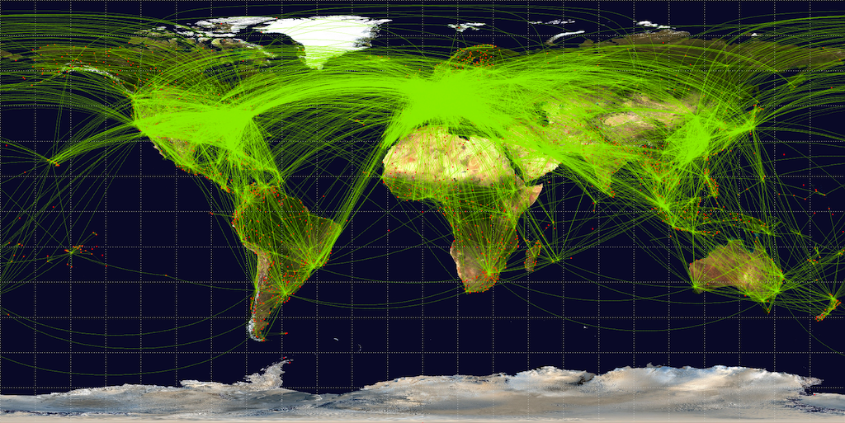
Global Airlines
Yue Shi
Bryan Smyth
Sviatoslav Moldavanov

Slide 2
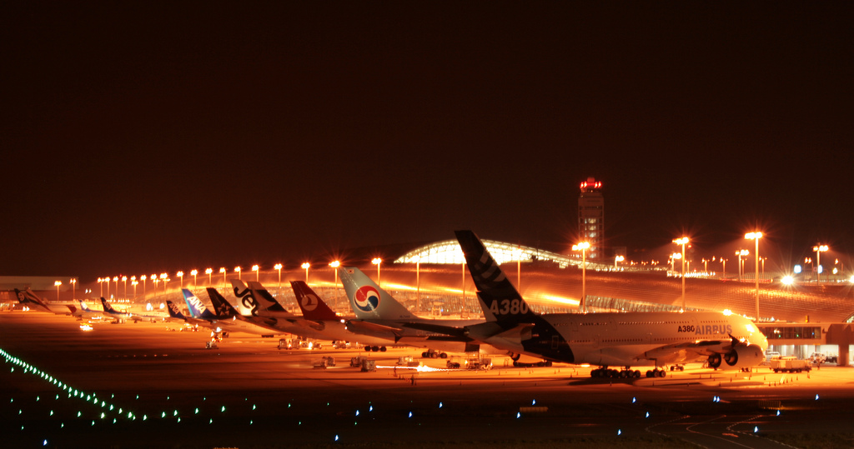
Schedule:
Industry Overview
Singapore Airlines
Southwest Airlines

Slide 3
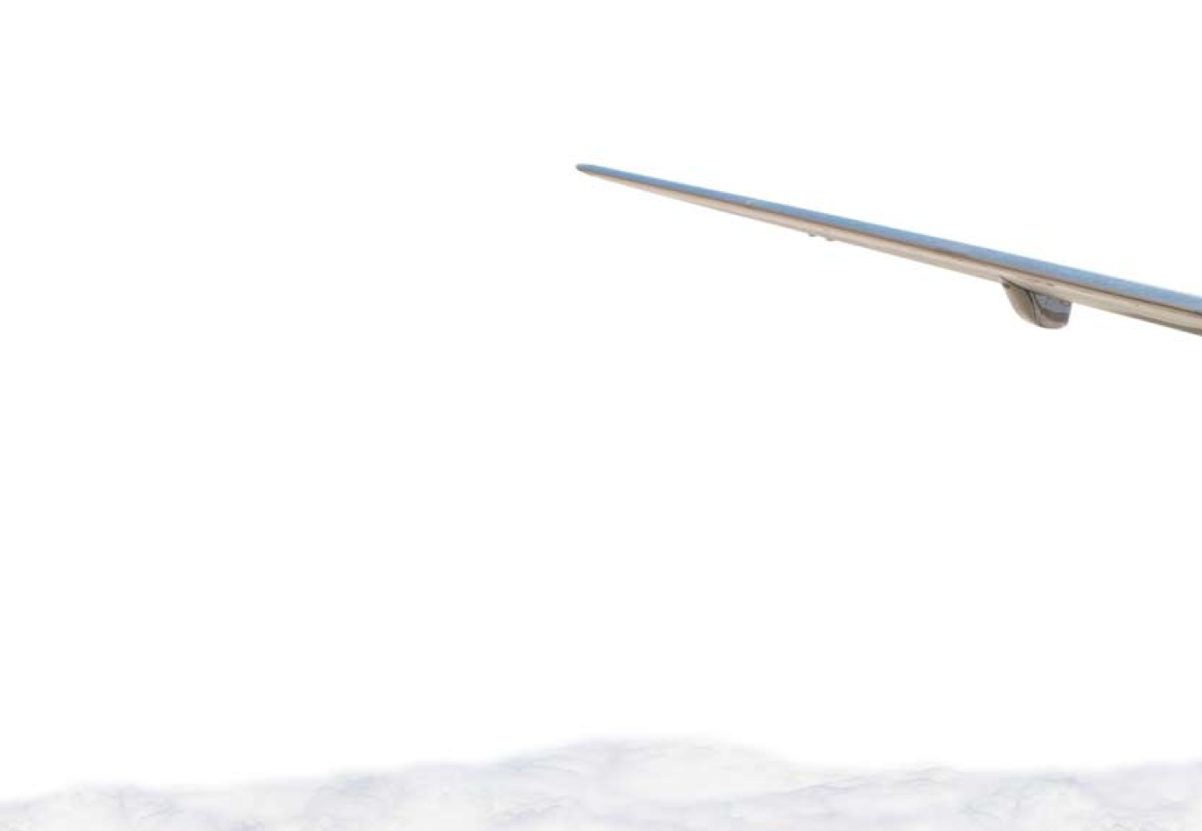
The Global Airlines Industry
The global airlines industry provides:
Air transportation of passengers, mail, and cargo over regular routes and on schedules;
Services include any flights that either end or originate internationally

Slide 4
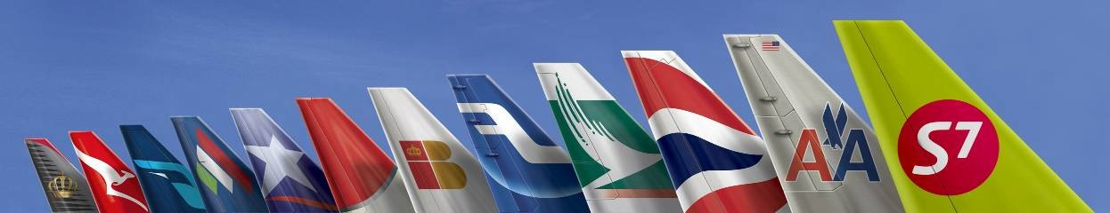
Types of Airlines & Models

Slide 5


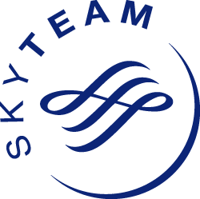
Airline Alliances
Passenger alliances: Star Alliance, Sky Team, Oneworld.
Cargo alliances: WOW Alliance, Sky Team Cargo, ANA/UPS Alliances.
Advantage:
Cost reduction; Traveler benefits
Disadvantage:
Less competition will cause higher prices

Slide 6
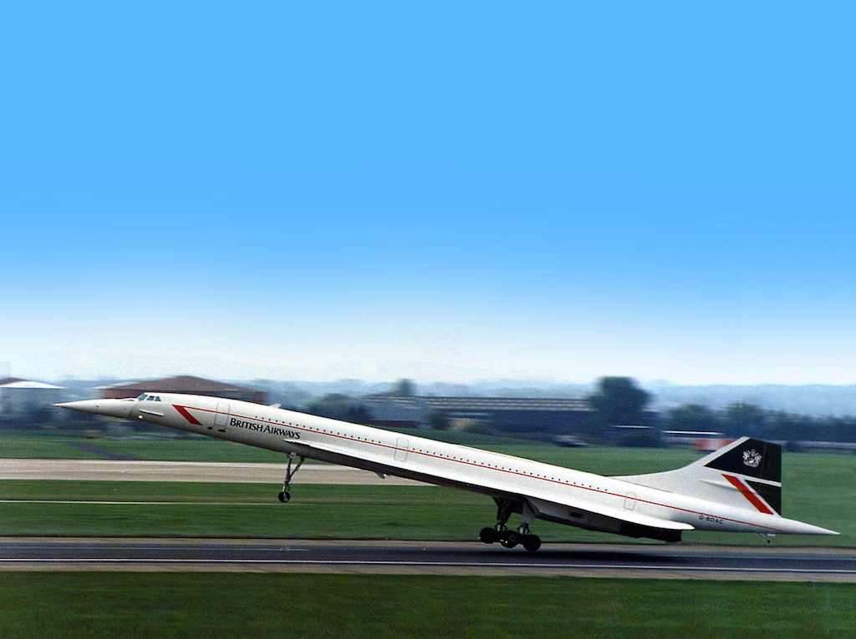
The Global Airlines Industry
High levels of risk
Low levels of profit
High overhead costs
Extremely sensitive

Slide 7
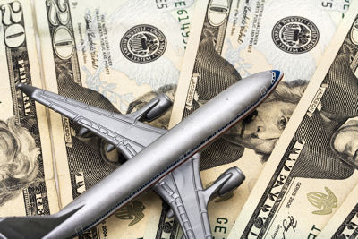
Costs
Fuel (28.2%)
Wages (25.7%)
Aircrafts (7.8%)
Depreciation and Amortization (7.5%)
Landing fees (6.0%)
Purchased services (5.8%)
Sales costs (3.5%)
Other (13.2%)

Slide 8
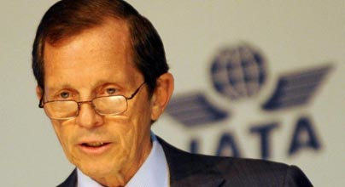
Giovanni Bisignani: Director General and Chief Executive Officer of the International Air Transport Association (IATA)
“Today we are downgrading our profit forecast to $8.6 billion from the $9.1 billion that we predicted in December. That means that the 2.7% margin of 2010 will shrink to 1.5% this year.”
“We are constantly walking on a tight rope of very thin margins. And there is no buffer against shocks. So everything that hits us has the potential to knock us over. ”
--- Financial Outlook Announcement, Geneva, March 03, 2011

Slide 9
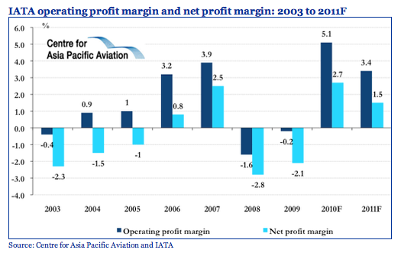
Industry Profitability

Slide 10
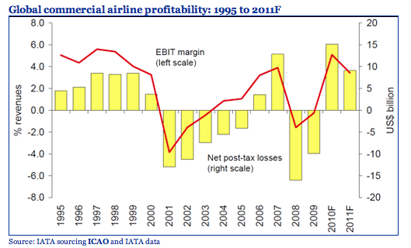
Industry Profitability
Total losses from 2001 to 2009: $51 billion

Slide 11
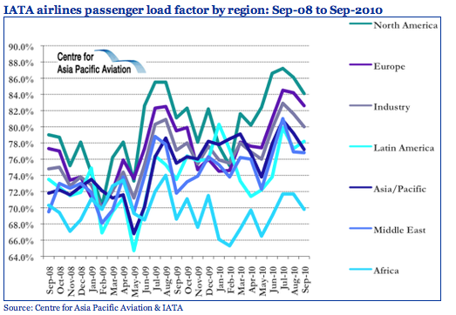
Load factor
Breakeven: 60% - 65%

Slide 12
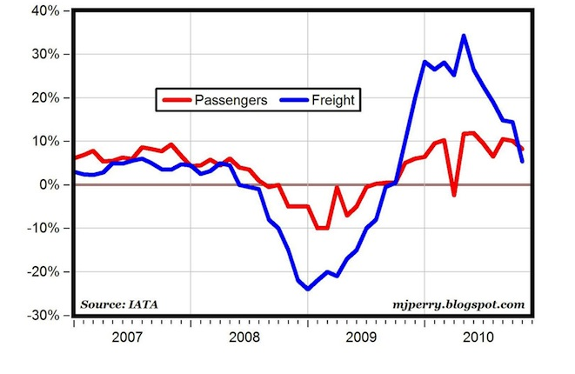
International Air Travel % changes

Slide 13
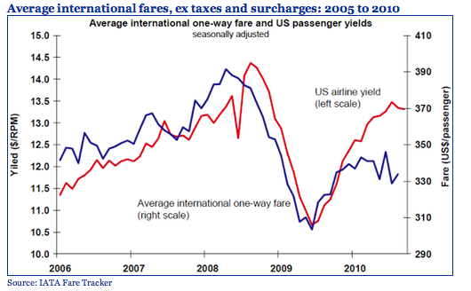
Airfares

Slide 14
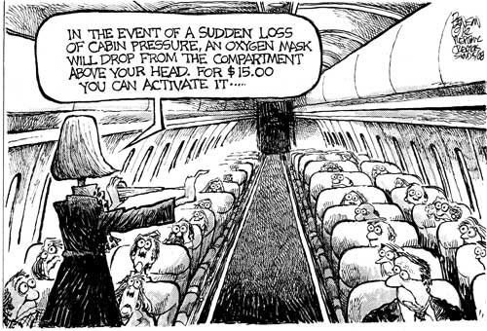

Slide 15

Use of Derivatives
Jet fuel hedging activities
Currency exchange risk management
Interest rate risk management
The use of derivatives does not guarantee profitability or reduction in risks

Slide 16
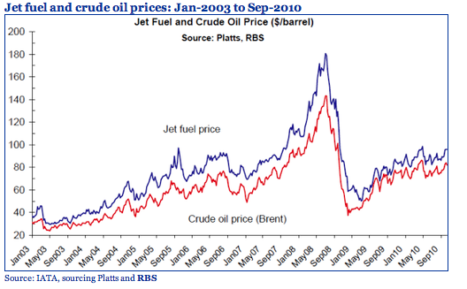
Jet Fuel Prices
Predicted future price of fuel
Crude oil prices
Difficulties regarding refinery capacity

Slide 17
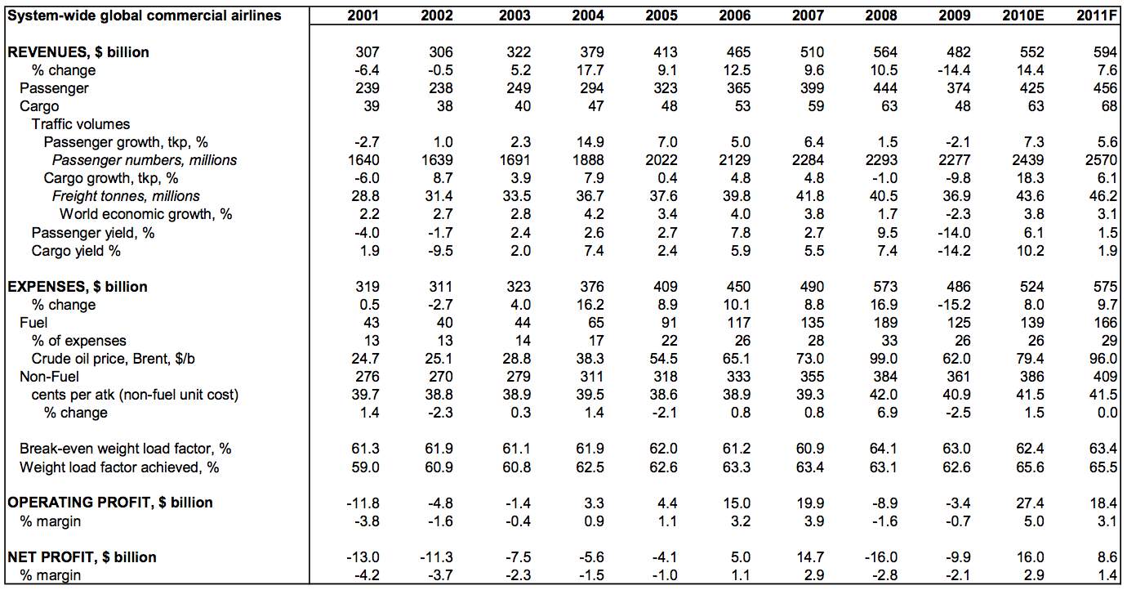
Financial highlights and outlook:2001 to 2011F
Source: IATA . ICAO data to 2008. IATA 2009 estimates and 2010-11 forecasts. Excludes exceptional accounting items and
mark-to-market fuel hedging losses from net profits

Slide 18
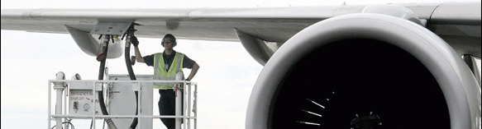
Jet Fuel Hedging
They enter into hedging contracts to mitigate their exposure to future fuel prices that may be higher than current prices and to establish a known fuel cost for budgeting purposes.
A fuel hedge contract allows those airlines to establish a fixed or capped cost by using a commodity swap or option.

Slide 19
Airlines Without Fuel Hedging
The company has the ability to pass on any and all increases in fuel prices to their customers, without a negative impact on their profit margins.
The company is confident that fuel prices are going to fall and is comfortable paying a higher price for fuel if their analysis proves to be incorrect.

Slide 20
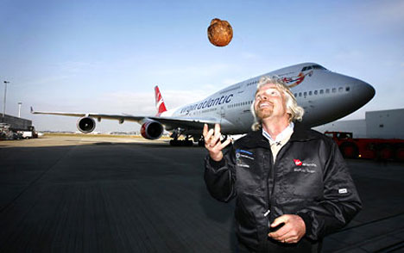
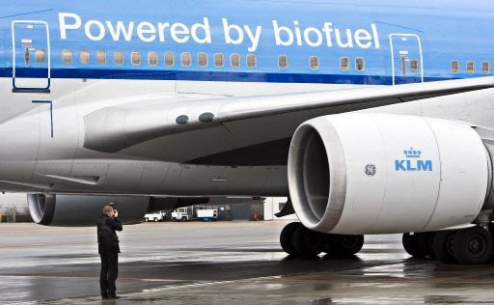
Biofuel
reduce flight-related greenhouse-gas emissions by 60 to 80 percent
50:50 "drop-in" mixtures of biofuel and traditional aviation kerosene
First flight: Feb 24, 2008. Virgin’s Boeing 747
a mixture of Brazilian babassu nuts and coconuts

Slide 21
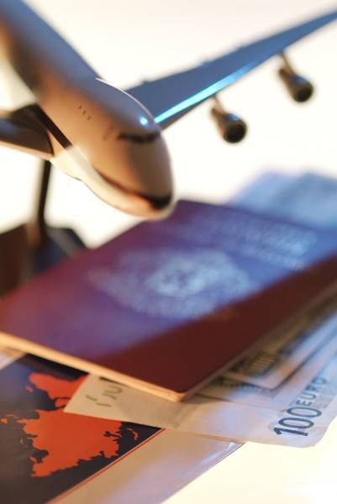
Interest Rate Risk
High leverage, high debt ($200 billion)
Interest rate fluctuations on interest income generating assets and interest expense incurred on interest bearing liabilities impact the earnings of the company.
Interest rate swaps
Forward rate agreements
Options
Interest rate caps

Slide 22

Currency Exchange Risk
Revenues and expenses
Borrowings
Tourism demand
Forward contracts
Currency options
Currency swaps

Slide 23
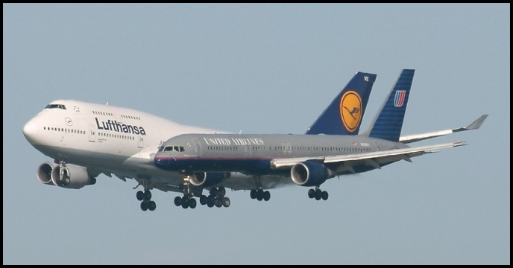
Other Risks
Threat of terrorist attacks
Economical instability
Political instability
Natural disasters
Credit risk
Tourism

Slide 24
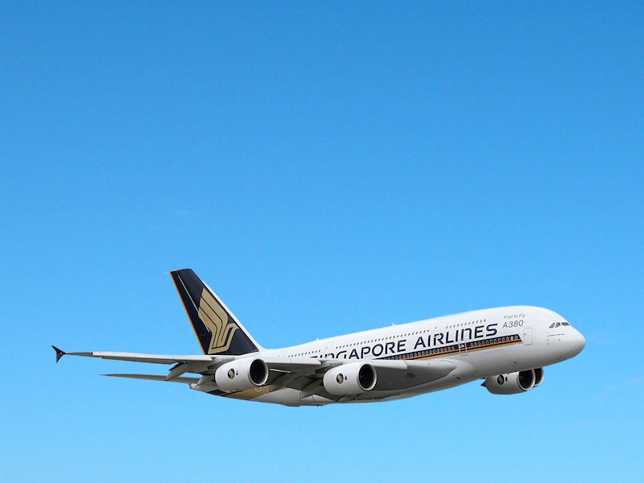
Singapore Airlines
Risk Management and Derivatives use

Slide 25
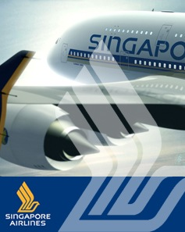
Agenda
Company Overview
Major Risk Factors
Financials
Hedging Strategy

Slide 26
History
Singapore Airlines Mission Statement "Singapore Airlines is a global company dedicated to providing air transportation services of the highest quality and to maximising returns for the benefit of its shareholders and employees"

Slide 27
Singapore Business Model
Not a low cost carrier
Extensive First Class
Extensive Business Class
“Young Fleet”
Fares will go up from October 1 by as much as $200 for an economy seat and up to $1,000 more for a premium ticket.

Slide 28
From Inception to Today
1 May 1947, Malayan Airways first flight.
Over the next two decades, the Airline steadily acquired more planes.
16 September 1963, the Federation of Malaysia was born and the Airline became known as Malaysian Airways.
In May 1966, it became Malaysia-Singapore Airlines.
1972, Malaysia-Singapore Airlines split up to become two entities - Singapore Airlines and Malaysian Airline System

Slide 29

The Singapore Girl
1968,
The sarong kebaya uniform designed by French couturier Pierre Balmain was introduced and the internationally recognized image of the Singapore Girl debuted.

Slide 30
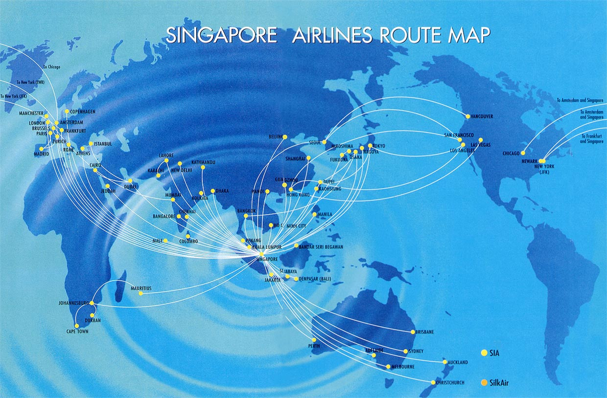

Slide 31
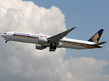
Singapore Airlines' Passenger Fleet

Slide 32
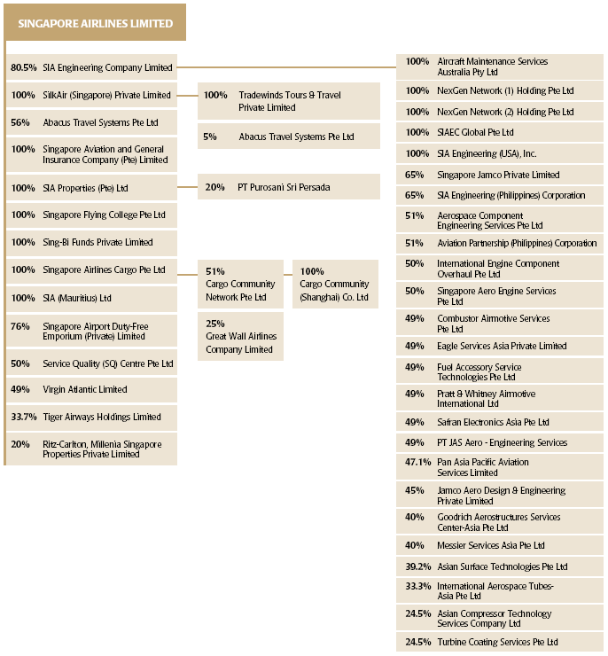
SIA Group of Companies As At Mar 31 2010

Slide 33
SIA Group
Suffice it to say, SIA has many Subsidiaries
22 Active
Many more Associated Companies
3 Joint Ventures
In last fiscal year SIA disposed of a major group of companies: SATS. Non core activities (food prep).

Slide 34
Stock Info

Slide 35



The Directors

Slide 36
List of Major Shareholders

Slide 37
Temasek Holdings
Temasek Holdings is an investment company owned by the Government of Singapore
International staff of 380 people,
Portfolio of S$186 billion (US$142 billion),
Golden Share

Slide 38

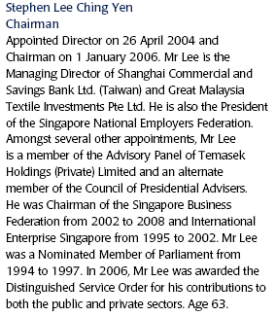

Slide 39

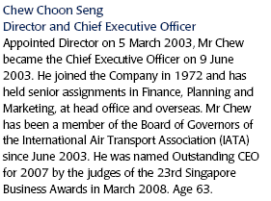

Slide 40
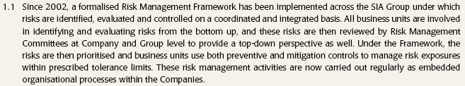
Statement of Risk Management

Slide 41
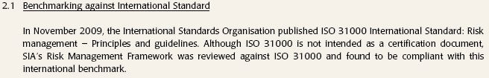

Highlights

Slide 42
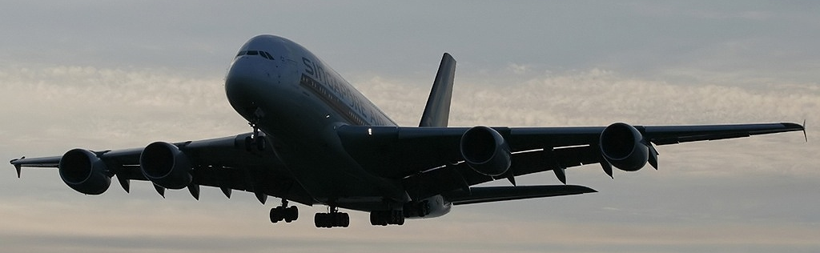
Board Safety and Risk Committee
James Koh Cher Siang (Chairman)
Dr Helmut Gunter Wilhelm Panke
Christina Ong

Slide 43

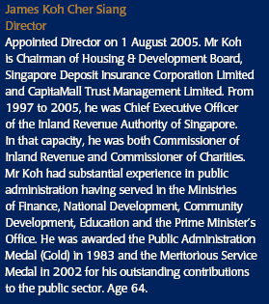
Risk Management Team

Slide 44
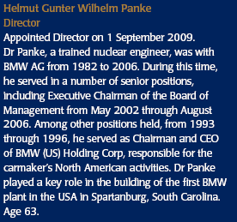

Risk Management Team

Slide 45

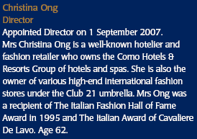
Risk Management Team

Slide 46
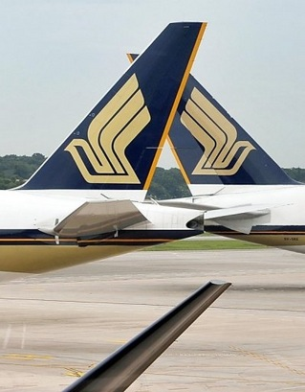
Identified Risks
Fuel
FX
Employee (Marginal)
Interest Rates
Anti-Trust

Slide 47
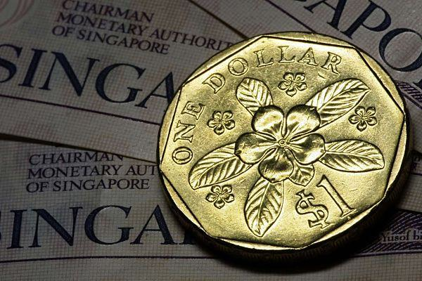
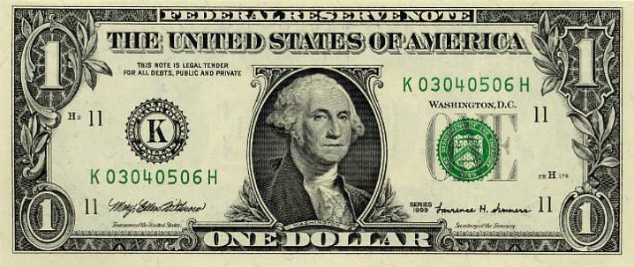
Financials
1 Singapore dollar = 0.785484 U.S. dollars

Slide 48
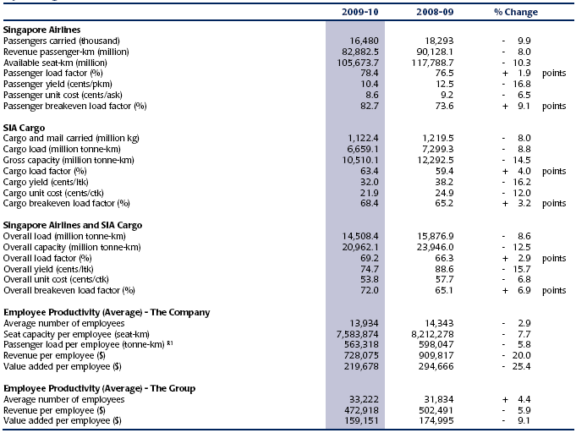
Operating Statics

Slide 49
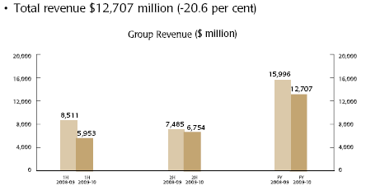
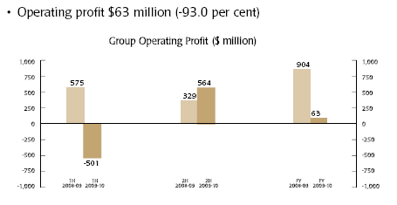
Highlights

Slide 50
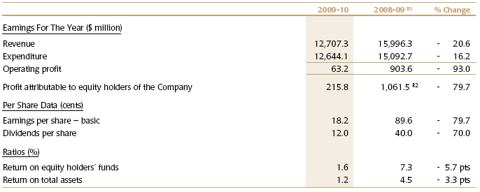
Highlights

Slide 51
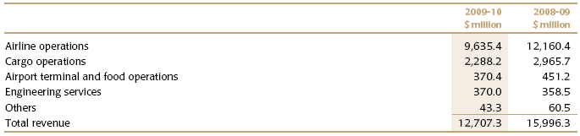
Scale and Scope

Slide 52
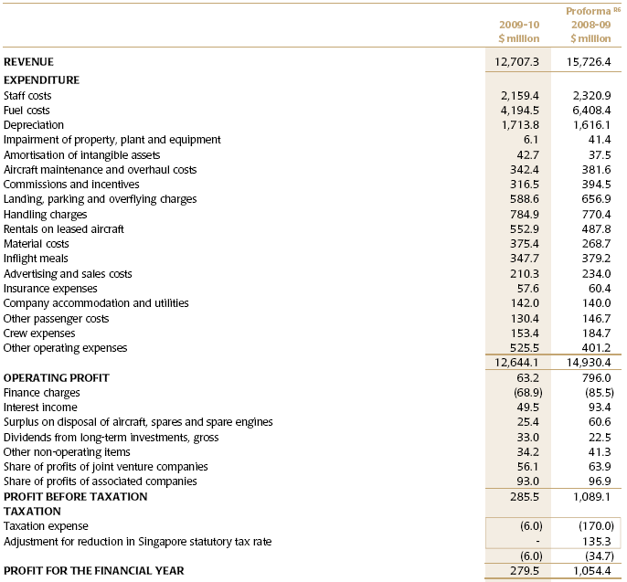
Profit and Loss

Slide 53
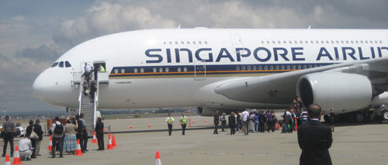
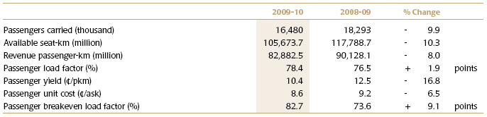
Operating Performance

Slide 54
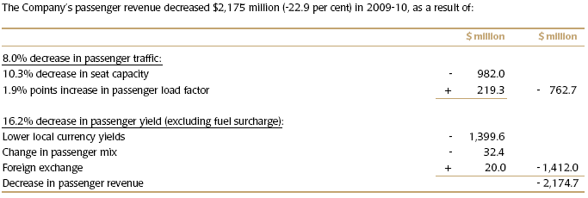
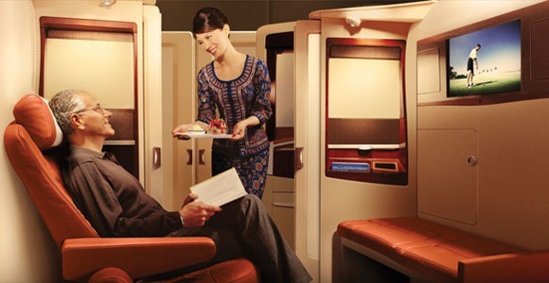
Revenue per Passenger

Slide 55
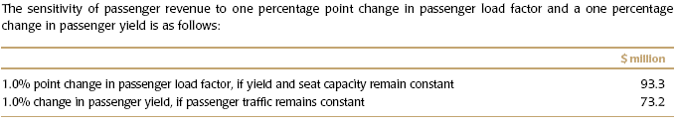
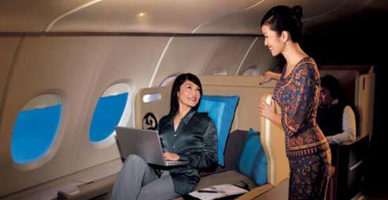
Passenger sensitivity

Slide 56
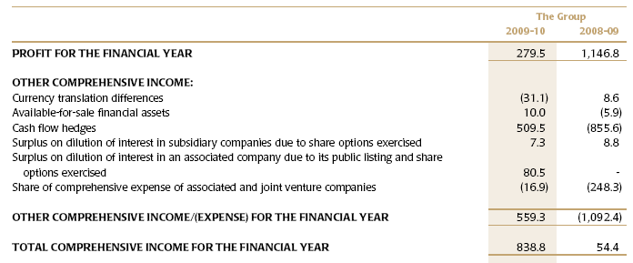
Income

Slide 57

Expenses

Slide 58

Cash Flow

Slide 59


Slide 60

Hedging
Direct Hedges
Using Hedging Accounting
Jet Kerosene, Currency and Interest Rates

Slide 61

Accounting of Hedging Strategy

Slide 62


Fair Value Determination

Slide 63
MOPS and PLATTS
Mean of PLATTS Singapore
Direct Market for Commodities
Jet Kerosene
Following is a sample Platts Order form
Market price for MOPS is then the average of the Sum of Platts orders for the day

Slide 64


Slide 65

Fuel Impact

Slide 66


Jet Fuel Sensitivity Analysis

Slide 67

Jet Kerosene
Net Fuel Costs
08-09 4277M
09-10 3077M
Fuel Hedge Outcomes
08-09 -306.25M
09-10 -460
Average BBL price $120.
Bought options – call options at below $10 for a strike price of $80

Slide 68
Quote from our Sponsor
The intention is to continue hedging, but at a minimum of 1/5th, 20%, of our projected volume uplift of 33 million barrels of jet fuel, jet fuel. Our hedging is on direct jet fuel which means our hedges are, what in accounting terms, are called effective hedges and therefore are not subject to flowing through our P&L until they are materialized, although we do take in mark-to-market adjustments as a reserve, to the reserve on our balance sheet.

Slide 69
Summary on Jet Kero Hedging
…So we will stay with our policy of using hedging as a tool to mitigate the volatility of our input price of jet fuel.
We deem it worthwhile still to keep some hedges in place to protect us against the swings that can come around. But we are doing it very judiciously, and the high end of the mandate that we have from the Board is up to 60%.
But right now, given the very unpredictable direction and movements of jet fuel prices and the fact that they remain at historically high levels, we deem it prudent not to hedge too much.

Slide 70

Share Based Compensation
Total Shares Outstanding 1.196B

Slide 71

Currency

Slide 72


Slide 73


Covering Aircraft Purchases FX

Slide 74


Slide 75

Foreign Currency Sensitivity Analysis

Slide 76

Interest Rate Hedging

Slide 77

Interest Rate Sensitivity Analysis

Slide 78
Anti- Trust AKA Price Fixing
USA Plea Deal 199M USD
EU 74.8M €
Korea 3.6M SGD
Australia Undeterminable
New Zealand Undeterminable

Slide 79

Note to Risk Managers:
In related cases, the cartel described has seen 17 Executives sent to prison for price fixing
None from SIA

Slide 80

Southwest Airlines

Slide 81


Agenda
General Information
Financial Statements
Risks and Risk Management

Slide 82
Company Overview
Dallas, Texas based low cost carrier airline
Founded in 1967
Grown since then to be the largest airline in the United States, based on domestic passengers carried
Southwest is the most successful low-fare, high frequency, point-to-point carrier in the United States with more than 3,200 flights a day
As of January 2011 operates more than 3,200 flights a day, with a fleet of 549 Boeing 737 aircraft with service to 72 destinations in 37 states

Slide 83
Company History
1967: Incorporated as Air Southwest Co.
1971:
Change name to Southwest Airlines Co.
Begin service to Dallas, San Antonio and Houston with fleet of three Boeing 737s
1973: First Yearly Profit
1977: Carries its 5 millionth passenger and is listed on the NYSE
1978: Flight to New Orleans (First flight outside Texas)
1990: Yearly revenue exceeds $1 Billion
2010: 38th consecutive year of profit

Slide 84



Management
Herbert D. Kelleher - Founder and Chairman Emeritus
Gary C. Kelly: Chairman, President, CEO
Scott E. Topping: Vice President Treasurer
Responsible for fuel hedging program and interest rate risk management
Background: B.S. in Agriculture/Economics and an MBA.

Slide 85


Size of Southwest Airlines
Passengers Carried Fleet Size

Slide 86

Route Map

Slide 87
Business Model
Lowest cost producer (average ticket price of $114)
Point to point service
Secondary Airports
Employee empowerment and respect
Use only one type of aircraft
No first class
No in flight video/audio programming

Slide 88

Customer Satisfaction

Slide 89
Financial Overview
2010
Net income: $459 million
Profitable for the 38th consecutive year
Net income, excluding special items: $550 million
Total passengers carried: 88 million
Total RPMs: 78 billion
Average passenger load factor: 79.3 percent
Total operating revenue: $12.1 billion

Slide 90

Stock Information (NYSE:LUV)
Last Trade: 11.85 (march 17th)
Change: 0.17 (1.41%)
Prev Close: 12.02
1y Target Est: 16.36
Day's Range: 11.81 - 12.25
52wk Range: 10.42 - 14.32
Avg Vol (3m): 7,611,840
Market Cap: 8.86B
P/E (ttm): 19.43
EPS (ttm): 0.61
Div & Yield: 0.02 (0.10%)

Slide 91

5 Year Stock Performance

Slide 92

Competitor Comparison
JetBlue (JBLU)
American Airlines (AMR)
United Airlines (UAL)

Slide 93


Slide 94

Financial Statements

Slide 95


Operating Data
Notes:
Note: Load Factor, Fuel Costs

Slide 96


Slide 97


Slide 98



Slide 99
Fair Value
The majority of their financial derivative instruments are not traded on a market exchange so they must estimate their fair values.
The values are determined based on assumptions about commodity prices observed in underlying markets.
Forward jet fuel prices are estimated through the observation of similar commodity futures prices (such as crude oil, heating oil, and unleaded gasoline) and adjusted based on variations of those commodities to the ultimate expected price to be paid for jet fuel at the specific locations in which they hedge.

Slide 100

Fair Value of Derivatives
Notes:
100
Level 1, defined as observable inputs such as quoted prices in active markets; Level 2, defined as inputs other than quoted prices
in active markets that are either directly or indirectly observable; and Level 3, defined as unobservable inputs in which little or no market data exists,
therefore requiring an entity to develop its own assumptions.

Slide 101

Risks
Notes:
101

Slide 102
General Risk Factors
Fuel prices
Economic condition
Company’s low cost structure
Labour intensive business
Security concerns
Dependency on one supplier (Boeing)
Global Conditions

Slide 103
1) Jet Fuel Risks
Airlines are inherently dependent upon energy to operate
Unpredictable price movements
Cannot easily compensate for these increases with increases in fare prices due to competitive nature of airline industry
Southwest expects to consume 1.5 Billion gallons of jet fuel in 2011
Therefore a 1 cent increase in fuel price per gallon would increase their fuel and oil expense by $15 million
Notes:
103

Slide 104
2) Economic Condition
Airline industry is particularly sensitive to changes in economic conditions
Affects customer travel patterns and related revenues. In harsh economic times customers will cut back on both leisure and business travel
Hampers the ability of airlines to raise fares to counteract increased fuel, labor, and other costs
Notes:
104

Slide 105
3) Company’s low cost structure
Their low cost structure is Southwest's main competitive advantage. It enables them to offer low fares and drive traffic volume.
However, if oil, fuel, and labor costs increase, the company can loose its competitive advantage.
Notes:
105

Slide 106
4) Labour Intensive Business
Salaries, wages, and benefits represented approximately 33 percent of operating expenses in 2010.
Approximately 82 percent of their employees were represented for collective bargaining purposes by labor unions
Therefore, they are particularly exposed in the event of labor-related job actions (strikes)
Notes:
106

Slide 107
5) Security Concerns
Terrorist attacks or the threat of terrorist attacks
Reduced demand for air travel
Increased safety and security costs for airline and industry in general
Notes:
107

Slide 108
6) Dependency on one supplier (Boeing)
Boeing is the only aircraft supplier for Southwest.
Therefore, if they are unable to acquire additional aircraft from Boeing, or Boeing were unable or unwilling to provide adequate support for its products, the Company's operations would be materially adversely affected.
Southwest believes their years of experience with this one type of aircraft and the efficiencies they are able to achieve outweigh this risk.
Notes:
108

Slide 109
7) Global Conditions
Adverse weather and natural disasters
Outbreaks of disease
Government regulations
Changes in consumer preferences, perceptions, spending patterns, or demographic trends.
Actual and potential disruptions in the air traffic control system
Changes in the competitive environment due to industry consolidation, industry bankruptcies, and other factors.

Slide 110

Risk Management
Notes:
110

Slide 111
Risk Management Policy
“The Company utilizes various derivative instruments to attempt to reduce the risk of its exposure to jet fuel price increases.”
“The Company endeavors to acquire jet fuel at the lowest possible cost and to reduce volatility in operating expenses through its fuel hedging program.”
Notes:
111

Slide 112
Hedging Governance Structure
(i) create and maintain a comprehensive risk management policy
(ii) provide for proper authorization by the appropriate levels of management
(iii) provide for proper segregation of duties
(iv) maintain an appropriate level of knowledge regarding the execution of and the accounting for derivative instruments
(v) have key performance indicators in place in order to adequately measure the performance of its hedging activities.
Notes:
112

Slide 113
Risk Management Committee?
A part of Southwest’s Audit Committee charter deals with risk management
“discuss the Company’s major financial risk exposures and its policies with respect to risk assessment and risk management and the steps management has taken to monitor and control or mitigate such exposures”
Scott E. Topping: Vice President Treasurer
Responsible for fuel hedging program and interest rate risk management

Slide 114

Types of Risks
Market Risk
Commodity price risk (Jet Fuel)
Financial Market Risk
Interest Rate Risk
Credit Risk
Liquidity Risk

Slide 115

Risk Factor: Jet Fuel Expense
For the sixth consecutive year, Fuel and oil expense represented the Company's largest or second largest cost
Notes:
115

Slide 116

Jet Fuel Hedging
“Jet fuel is not widely traded on an organized futures exchange, therefore there are limited opportunities to hedge directly in jet fuel”
Instead Southwest cross-hedges in the OTC market using:
Crude oil
Heating oil
Unleaded gasoline
Notes:
116

Slide 117

Derivatives Used
Call Options
Collars (buy call option, write put option)
Call Spreads (buy call option and write call option)
Swaps
Notes:
117

Slide 118
Fuel Hedging Policy
When Southwest perceives that prices are lower than historical or expected future levels, they prefer to use fixed price swap agreements and purchased call options.
However, at times when they perceive that purchased call options have become too expensive, they choose to use more collar structures and call spreads.
Notes:
118

Slide 119


Fuel Hedging
Notes:
119

Slide 120


Fuel Hedging for 2011
Notes:
120

Slide 121
Interest Rate Risk
Fluctuations of interest rates affect the firm’s interest obligation on their long term debt
-Can potentially have impact on the firm’s liquidity position
Southwest's strategy is to reduce the volatility of net interest income by better matching the repricing of its assets and liabilities
Methods:
-Prepayment, redemption or termination for floating-rate debt -Interest rate Swaps

Slide 122

Contractual Obligations

Slide 123

Interest Rate Hedging
Fixed to Floating:
The company also has floating-to-fixed interest rate swap agreements associated with its $600 million floating-rate term loan agreement and its $332million term loan agreement that are accounted for as cash flow hedges.
Fixed the interest rate on the $600 million floating rate term loan agreement at 5.223 percent until maturity, and for the $332 million term loan agreement at 6.64 percent until maturity.
Notes:
123

Slide 124
Credit Risk
To manage credit risk, the company selects and will periodically review counterparties based on credit ratings
They also try to limit their exposure to a single counterparty with collateral support agreements, and monitor the market position of the program and its relative market position with each counterparty.
The Company had agreements with several counterparties containing early termination rights and/or bilateral collateral provisions whereby security is required if market risk exposure exceeds a specified threshold amount or credit ratings fall below certain levels
Notes:
124

Slide 125
Liquidity Risk
Liquidity and Financing
Agreements with financial institutions
Outstanding debt agreements
Potential to reduce availability of cash or increase costs to maintain agreements
Southwest strategy goals
Maintain minimum credit ratings, asset fair values and covenant ratios for outstanding debt agreements
Results: Company has met or exceeded standards set forth in all their agreements
Notes:
125

Slide 126
Stock Options
Two classes of employee stock plans:
1) Collective bargaining plans
Subjective to collective bargaining agreements
Granted at or above pair value
Terms ranging from 6 to 12 years
No executive nor member of the Board of Directors are eligible to participate in this plan
Not required to be approved by Shareholders

Slide 127
Two Types of Plans
2) Other employee plans
Not subjective to collective bargaining agreements
Granted at fair market value
Have 10-year terms and become fully exercisable after three, five or ten years
Need to be approved by shareholders

Slide 128

Stock Options
Shares Outstanding: 747.56M

Slide 129

Thank You !!!

