Slide 1
COMPANY OVERVIEW AND RISKS MANAGEMENT ANALYSIS
GOLDMAN SACHS
Sahil Ali
Tianhan Xia
Yihong Lu

Slide 2
Agenda
Economic and Market Analysis
Risk Management Environment
Financial Statements for Each Firm
Recommendation about Risk Management

Slide 3
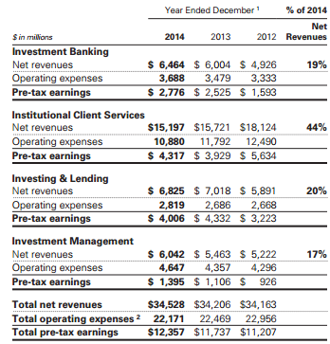
Definition
Leading global investment banking securities and investment management firm
Provides a wide range of financial services
As of December 2014,had offices in over 30 countries
49% of their total staff was based outside the Americas
42% of their net revenues outside the Americas.

Slide 4
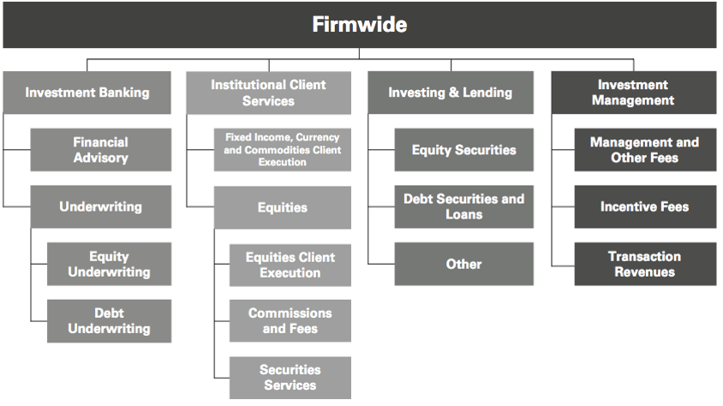

Slide 5
Investment Banking
Serve corporate and government clients around the world
Provide financial advisory services
Help companies raise capital
Try to develop and maintain long term relationships
Goal: deliver to the clients the entire resources of the firm

Slide 6
Investment banking; financial advisory
Strategic advisory assignments
Help clients execute large, complex transactions
Revenues from derivative transactions
Assist the clients in managing their asset and liability exposure and their capital
Provide lending commitments and bank loan
Bridge loan facilities
Notes:
Labels

Slide 7
Investment banking; underwriting
Helping companies raise capital to fund their businesses
Match the capital of the investing clients with the needs of the clients
Public offerings and private placements
Revenues from derivative transactions
Notes:
Slide for email

Slide 8
Investment Banking: equity underwriting
Leading position in
    Worldwide public common stock offerings
    Worldwide initial public offerings

Slide 9
Investment banking: debt underwriting
Investment-grade
High yield debt
Bank loans
Bridge loans
Emerging and growth-market debt
Structured securities (mortgage-related securities)
Notes:
Labels: Excel

Slide 10
Institutional client services
Helps clients to buy and sell financial products, raise funding and manage risk
Acts as a market maker
Offers market expertise
Makes markets and facilitates client transactions in
        Fixed income
        Equity
        Currency
        Commodity products
Notes:
Labels Outlook

Slide 11
Institutional client services…(2)
Clear client transactions
Provides liquidity
Play a critical role in price discovery (efficiency of the capital markets)
Willingness to make markets is crucial
Relationships with clients are maintained
Prices to clients globally are provided
Notes:
Labels/new list

Slide 12
Institutional client services…(3)
4 ways to generate revenues:
In large, highly liquid markets: high volume of transactions for modest spread and fees
In less liquid markets: transactions for spread and fees somewhat larger
Customized or tailor-made products that address the client's risk exposures
Financing to the clients is provided

Slide 13
Institutional client services…(4)
The activities are organized by asset class including:
  Cash instruments: trading the underlying instrument
  Derivative: instruments that derive their value
Notes:
Excel-Email

Slide 14
Fixed Income, Currency And Commodities Client Execution
  Interest rate products: government bonds, money market instruments, IRS, options
  Credit products: investment-grade corporate securities, credit derivatives, bank and bridge loans
  Mortgages: commercial mortgage-related securities, loans and derivatives
  Currencies: including growth-market currencies
  Commodities: oil and natural gas, base, precious and other metals
Notes:
Outlook Email

Slide 15
Fixed Income, Currency And Commodities Client Execution…(2)
Equities: equity client execution, commissions and fees, securities services
Notes:
CSV Email

Slide 16
Fixed Income, Currency And Commodities Client Execution…(3)
Equities client execution:
Facilitates client transactions by providing liquidity with large blocks of stocks or options
Engagement in insurance activities
Structure and execute derivatives on indices, industry groups, financial measures and individual company stocks
Developing of strategies and portfolio hedging and restructuring
Asset allocation transactions
Creation of tailored instruments to establish or undertake hedging strategies
Notes:
Email Type

Slide 17
Fixed Income, Currency And Commodities Client Execution…(4)
Commissions and fees:
Generated from executing and clearing institutional client transactions on major stock, options and futures
Access to electronic “low touch” equity trading platforms
Most of the revenues continued to be derived from the “high-touch” handling

Slide 18
Fixed Income, Currency And Commodities Client Execution…(5)
Securities services:
  Financial services: through margin loans collateralized by securities and cash or collateral
  Securities lending services: borrowing and lending securities
  Other prime brokerage services: technology platform is provided, custody services

Slide 19

Investing and Lending
  Long-term activities
  Investing directly in publicly and privately traded securities and loans
  Managing diversified global portfolio of investments in equity securities and debt
  Investment in the ordinary shares of ICBC
  Equity-related investments

Slide 20
Investing and Lending…(2)
  Corporate, infrastructure debt investments
  Credit to corporate clients through loan facilities
  Investment entities with a defined exit strategy not related to the principal businesses
  Invest in distressed assets

Slide 21
Investment management
  Provides investment and wealth advisory services to help clients preserve and grow their financial assets
  Managing client assets
  Income and liability management
  Trust and estate planning
  Philanthropic giving and tax planning
  Use of global securities to address the clients' needs

Slide 22
Management and other fees
  Fees vary by asset class and affected by investment performance, asset inflows and redemptions
  Assets under management
  Incentive fees (when a return exceeds a specific benchmark)

Slide 23
Business continuity program
Business continuity and information security are high priorities
Key elements of the program:
Crisis planning and management
People recovery
Business recovery
System and data recovery
Process improvement

Slide 24
Employees and competition
Quality, commitment, professionalism, excellence, diversity, cooperation are the keys of success
Competitors are other entities that provide investment banking, securities and investment management services (brokers, dealers, investment advisors)
Advantages are taken from competing successfully with larger financial institutions (which have more capital and stronger local presence).

Slide 25
Competition and regulation
Price competition
Competition in attracting and retaining qualified employees
Dodd-frank act: enacted in July 2010 which provides extension on the rules adopted by the fed board
Supervision and examination by the fed board

Slide 26
Regulation
BHC act restricts bank holding companies from engaging in business activities
Fed board has the authority to limit the ability to conduct activities and it is necessary its approval before engaging in financial activities
The Volker rule prohibits “proprietary trading” sponsorship and investment in hedge funds

Slide 27
The Volker rule
Is expected to limit certain kind of transactions with the sponsored funds
Many aspects remain unclear and very complex
In October 2011 the rules to implement the Volker rule were issued
The Volker rule limitation on investments in hedge funds and private equity funds required to reduce investments to 3% or less

Slide 28
Liquidity Ratios Under Basel III
Basel III, which is subject to implementation by national regulators, requires banks and bank holding companies to measure their liquidity against two specific liquidity tests
liquidity coverage ratio (LCR)
the net stable funding ratio (NSFR)
These requirements may incentivize banking entities to increase their holdings of securities that qualify as high-quality liquid assets and increase the use of long-term debt as a funding source.

Slide 29
Liquidity Ratios Under Basel III
During 2014, the U.S. federal bank regulatory agencies approved final rules implementing the LCR for Advanced approach banking organizations
the LCR became effective in the United States on January 1, 2015, with a phase-in period whereby firms must meet an 80% minimum ratio in 2015, which will increase 10% per year until 2017

Slide 30
Liquidity Ratios Under Basel III
During 2014, the Basel Committee issued its final framework for calculation of the NSFR. Under the Basel Committee framework, the NSFR will be effective on January 1, 2018. The U.S. federal bank regulatory agencies have not yet proposed rules implementing the NSFR for U.S. banking organizations

Slide 31
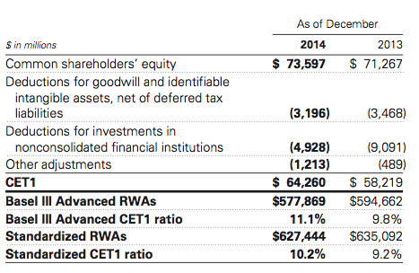
Fully Phased-in Capital Ratios
The table below presents the estimated ratio of CET1 to RWAs calculated under the Basel III Advanced Rules and the Standardized Capital Rules on a fully phased-in basis.

Slide 32
Payment of dividends and stock repurchases
Subject to the oversight of the fed board based on capital plans and stress tests to judge the capital planning processes
GS not object to its capital actions through the first quarter of 2013

Slide 33
Compensation Practices
Oversight by the fed board
Risk must be taken in account
Incentives that balance risk and financial results
Review of the incentive compensation policies
Enforcement actions taken against the risk of the organization's safety caused by related risk management
If the regulations are adopted the flexibility will be restricted

Slide 34
Regulation Of GS Bank USA
Undertake stress test is required, according to Dodd-frank act and submit them to the fed board
“Derivative push-out” will prevent GS from conducting certain swaps-related activities
Transactions between GS bank USA and its subsidiaries are regulated by the fed board.

Slide 35
Prompt Corrective Actions and Capital Ratios
The US Federal Deposit Insurance Corporation Improvement Act of 1991 (FDCIA) establishes 5 capital categories:
Well-capitalized depositary institution: if it has a tier 1 capital ratio of at least 6%, a total capital ratio of at least 10% and a tier 1 leverage ratio of at least 5%
Adequately capitalized
Undercapitalized
Significantly undercapitalized
Critically undercapitalized

Slide 36
Insolvency Of An Insured Depository Institution
Transfer the depository institution's assets and liabilities to a new obligor
Enforce the terms of the depository institution's contracts
Repudiation of any contracts to which the institution is a Party
Resolution plan: submitted to the regulators on June 29, 2012, which established GS bank USA is protected from risks

Slide 37
Broker-Dealer and Securities Regulation
It is required to maintain orderly markets in the securities assigned
According to the Dodd-Frank Act, any person who organizes an asset-backed security transaction to retain a portion of any credit risk that the person conveys with a third party

Slide 38
Swap, Derivatives and Commodities Regulations
Subject to regulation of us commodity exchange act
The Dodd-frank act provides increased regulation, imposing the following requirements:
Real time public and regulatory reporting of trade information for swaps Registration of swap dealers
Position limits the cap exposure to derivatives on certain physical commodities
Mandated clearing through central counterparties for certain swaps
New business conduct standards for swap dealers
Margin requirements for trades that are not cleared
Entity level capital requirements for swap dealers

Slide 39
Other Regulations
Some examples...
Insurance subsidiaries: subject to state insurance regulation in the states in which they are domiciled
Investment management: subject to significant regulation in numerous jurisdictions around the world

Slide 40
More on Basel
The Basel Committee on Banking Supervision, established at the Bank for International Settlements, is a forum whose objective is to enhance the understanding of key supervisory issues and improve the quality of banking supervision worldwide

Slide 41
The Basel Capital Accord
The Basel Capital Accord is a Framework set at the Basel Committee in 1988 and subsequently revised.
The primary objectives are to promote the soundness of the international banking system and to provide an equitable basis for international cooperation among banks

Slide 42
Timeline of the Basel Capital Accord
1988 Basel I
Not adapt for big banks in concentrated markets
Not in line with RM Evolutions
2003 Basel II
Didn’t avoid the financial crisis to happen
Procyclical
No Standard for Liquidity
2010 Basel III
Currently Implementing

Slide 43
Global Relations
The firm faces the risk of significant intervention by regulatory and taxing authorities in all jurisdictions in which they conduct business.
The firm could be:
fined;
prohibited from engaging in business activities, subject to limitations or conditions
subjected to new or substantially higher taxes or other governmental charges
etc.

Slide 44
FINANCIAL STATEMENTS AND ANALYSIS

Slide 45
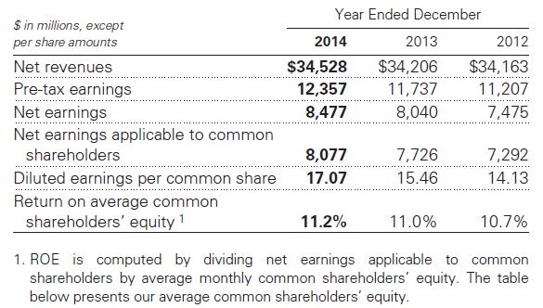
Financial Overview

Slide 46
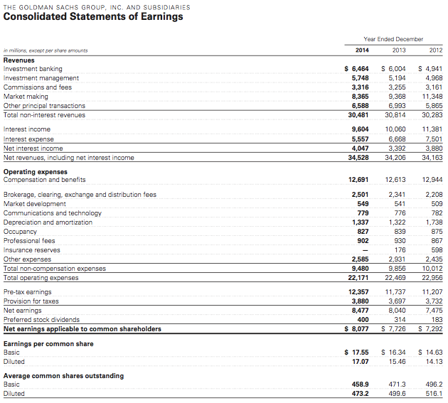

Slide 47
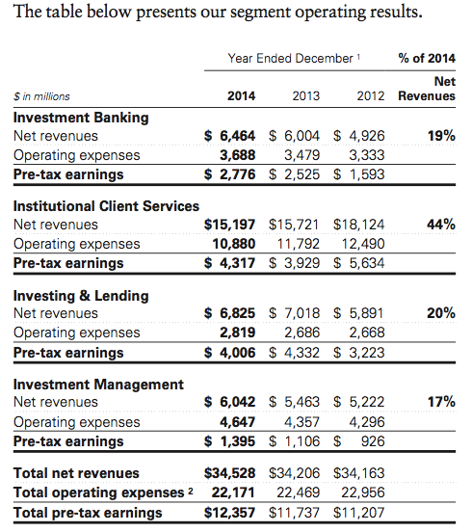
Operating Income By Segment

Slide 48
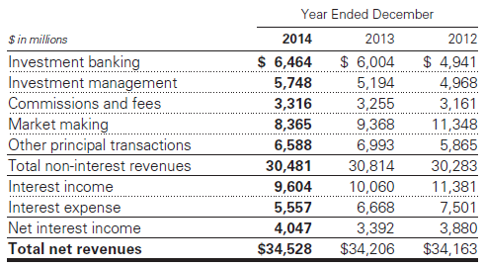
Net Revenues From Operations

Slide 49
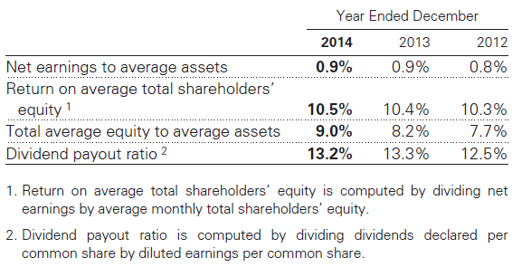
Financial Overview (Ratios)

Slide 50
Balance Sheet Management
One of the most important risk management disciplines is the firm’s ability to manage the size and composition of their balance sheet.
The size and composition of the balance sheet reflects:
the firm’s overall risk tolerance,
the firm’s ability to access stable funding sources and
the amount of equity capital the firm holds.

Slide 51
Balance Sheet Management…(2)
During 2014, the firm undertook an initiative to reduce their balance sheet in response to regulatory developments, to improve the overall efficiency of the balance sheet and to position the firm to provide additional risk capacity to clients.

Slide 52
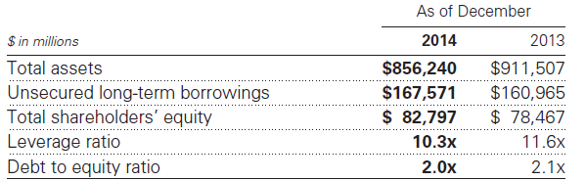
Balance Sheet Management…(2)

Slide 53


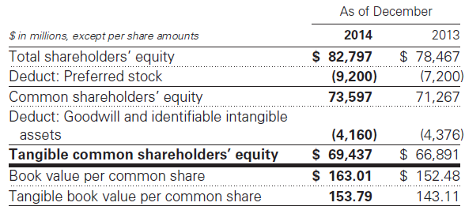
Balance Sheet Management…(3)

Slide 54
Funding Sources
The firm’s primary sources of funding are :
  secured financings
  unsecured long-term
  short-term borrowings
  deposits

Slide 55
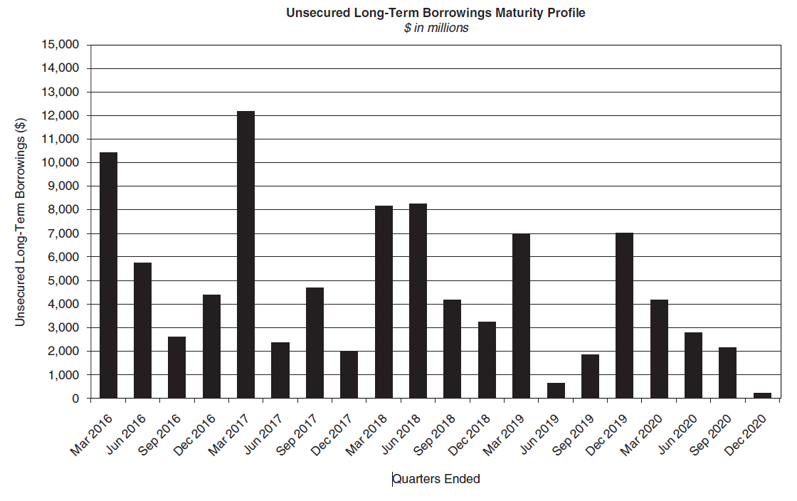
Unsecured Long-term Borrowing

Slide 56
Capital Adequacy
Objective: conservatively capitalized in terms of the amount and composition of their equity base, both relative to their risk exposures and compared to external requirements and benchmarks.

Slide 57
Capital Framework
As of January 1, 2014, the firm became subject to the Federal Reserve Board’s revised risk-based capital and leverage regulations, known as the Revised Capital Framework (RCF)
  Regulatory capital to be calculated under the Revised Capital Framework
Risk weighted assets (RWAs) are required to be calculated under Basel III advanced rules

Slide 58
Capital Framework…(2)
As a result of the change in framework during 2014, the capital ratios calculated as of December 2014 and December 2013 are not directly comparable

Slide 59
Risk weighted assets (RWAs)
Calculated under both Basel III Advanced Rules and Hybrid Capital Rules
  Under both, certain amounts not required to be deducted from CET1 under the transitional provisions are either deducted from Tier 1 capital or are risk weighted

Slide 60
Capital Conservation Buffer
Mandatory capital that Goldman Sachs is required to hold
  The amount is to increase in increments of 0.625% per year, starting on January 1, 2016, until it reaches 2.5% of all RWAs
  This has been mandated due to the 2008 financial crisis where banks held insufficient capital on hand

Slide 61
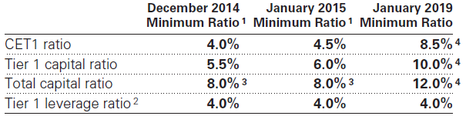
Minimum Capital Ratios Buffer
Minimum ratios required under Basel III and Revised Capital Framework
  The ratio requirement increases incrementally every year, including the addition of new capital buffers
  Common equity tier 1, or CET1, is a measurement of a firm’s core equity capital compared with its total risk-weighted assets

Slide 62
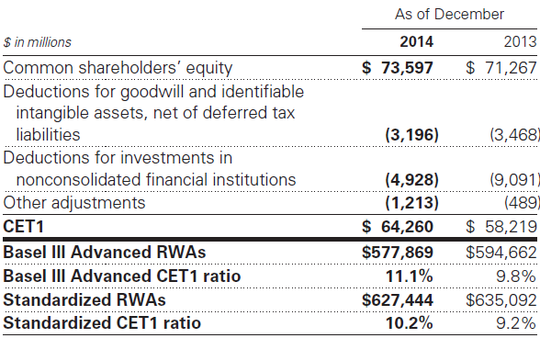
Phased In Capital Ratios
Comparing CET1 ratio of 2013 & 2014, displaying old standardized methods and new Basel III methods.
  These ratios are based on current interpretation, expectations, and understanding of the RCF

Slide 63
RISK MANAGEMENT/FACTORS & ENVIRONMENT

Slide 64
Risk Environment
GS faces a variety of risks in the operation of their business, such as:
Market uncertainty and global financial markets conditions
Regulation in jurisdictions around the world
Declining asset values particularly those assets with long position.
Credit spreads and declines in the availability of credit will affected our ability to borrow on a secured and unsecured basis
Poor investment performance and ineffective risk management
Failure to appropriately identify and address potential conflicts of interest
Catastrophic events such as terrorist attacks

Slide 65
Risk Factors
The four main risk categories that Goldman Sachs faces in their operations are:
  Liquidity Risk
  Market Risk
  Credit Risk
  Operational Risk
Goldman Sachs also faces risk which have uncertain outcomes and have the potential to materially impact their financial results, liquidity and reputation.

Slide 66
Risk Management Framework
Three Components:
Governance: review and approve by the board, followed by a risk-oriented committees run by senior managers. This structure provides the protocol for decision-making
Processes: discipline the inventory to current market level to provide transparency. Apply a framework of limits to control risk. Using active management to ensure high quality information
People: by proper training and rewarding our experienced professionals to ensure their high risk management and reputational performance.

Slide 67
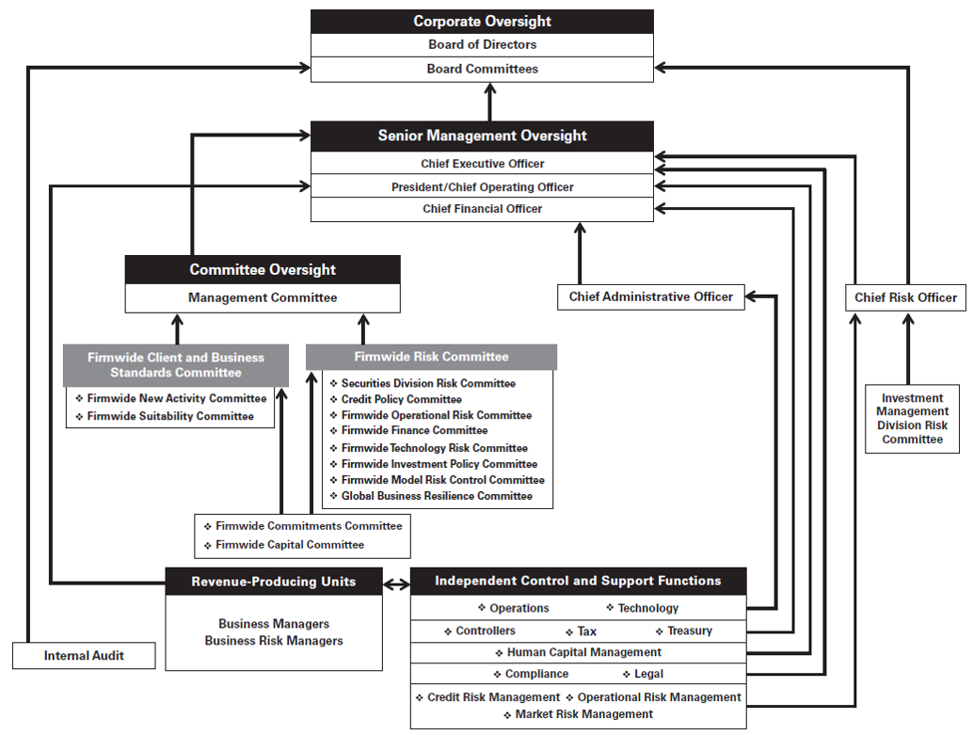
Governance Structure

Slide 68
Processes
Apply a rigorous framework of limits to control risk across multiple transactions, products, businesses, and markets
Includes setting credit and market risk limits at numerous levels and monitoring limits on a daily basis
Limits are set at levels that will be periodically exceeded, rather than levels which reflect their maximum appetite
Proactive mitigation of market and credit exposure minimizes the risk that they will be required to take outsized actions during periods of stress
Goal of risk management technology is to get the right information to the right people at the right time

Slide 69
People
Effective risk management requires people to interpret risk data on an ongoing and timely basis
Adjusting positions accordingly
Reinforce a culture of effective risk management
“Review and reward” processes
○Reinforces the link between behaviours and how people are recognized, and the need to focus on clients and reputation

Slide 70
Liquidity Risk Management
Objective: to be able to fund the firm and to enable Goldman Sachs core businesses to continue to serve clients and generate revenues, even under adverse circumstances.
Global Core Liquid Assets: maintain substantial liquidity to meet a broad range of potential cash outflows and collateral needs in a stressed environment.

Slide 71
Liquidity Risk Management…(2)
Asset-Liability Management: manage the maturities and diversity of funding across markets, products and counterparties, and seek to maintain liabilities of appropriate tenor relative to the asset base.
Contingency Funding Plan: maintain a contingency funding plan to provide a framework for analyzing and responding to a liquidity crisis situation or periods of market stress.

Slide 72
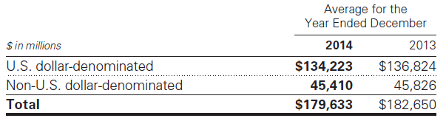
Global Core Liquid Assets
Global Core Liquid Assets (GCLA): pre-fund their estimated potential cash and collateral needs during a liquidity crisis and hold this liquidity in the form of unencumbered, highly liquid securities and cash.
The fair value of the securities and certain overnight cash deposits that are included in the GCLA.

Slide 73
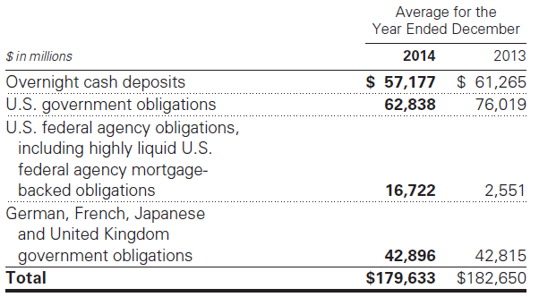
Fair Market Value of GCLA

Slide 74
Liquidity Risk Models
Modeled Liquidity Outflow: conducting multiple scenarios that include combinations of market-wide and firm-specific stress.
Intraday Liquidity Model: assesses the risk of increased intraday liquidity requirements during a scenario where access to sources of intraday liquidity may become constrained.
Asset-Liability Management: ensures the firm have a sufficient amount of financing, even when funding markets experience persistent stress.

Slide 75
Liquidity Risk Models…(2)
Contingency Funding Plan: sets out the plan of action the firm would use to fund business activity in crisis situations and periods of market stress.
Liquidity Regulatory Framework: ensure that banks and bank holding companies maintain an adequate level of high-quality liquid assets.
Credit Ratings: GS relies on the credit rating to fund a significant portion of day-to-day operations, and the availability of debt financing.

Slide 76
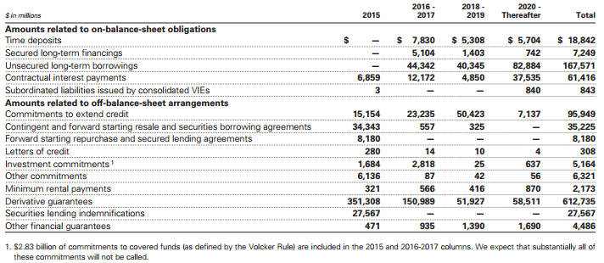

Slide 77
Market Risk Management
Market risk is the risk of loss in the value of the firm’s inventory, as well as certain other financial assets and financial liabilities, due to changes in market conditions.
The firm holds inventory primarily for market making for their clients and for their investing and lending activities.
inventory is accounted for at fair value and therefore fluctuates on a daily basis.

Slide 78
Market Risks
Interest rate risk: results from exposures to changes in the level, slope and curvature of yield curves, the volatilities of interest rates, mortgage prepayment speeds and credit spread.
Equity price risk: results from exposures to changes in prices and volatilities of individual equities, baskets of equities and equity indices.
Currency rate risk: results from exposures to changes in spot prices, forward prices and volatilities of currency rates
Commodity price risk: results from exposures to changes in spot prices, forward prices and volatilities of commodities.

Slide 79
Market Risk Management
The firm manages market risk by diversifying exposures, controlling position sizes and establishing economic hedges in related securities or derivatives.
Risk measures are used to estimate the size of potential losses for both moderate and more extreme market moves over both short-term and long-term time horizons.

Slide 80
Value at Risk (VaR) and Stress Tests
VaR is the potential loss in value due to adverse market movements over a defined time horizon with a specified confidence level.
Stress testing is a method of determining the effect of various hypothetical stress scenarios.
The primary risk measures are VaR, which is used for shorter-term periods, and stress tests.

Slide 81
Stress Tests
Stress test include:
Sensitivity analysis is used to quantify the impact of a market move in a single risk factor across all positions by using market shocks
Scenario analysis is used to quantify the impact of a specified event, including how the event impacts multiple risk factors simultaneously
Firm wide stress testing combines market, credit, operational and liquidity risks into a single combined scenario

Slide 82
Value at Risk (VaR)
Limitations to VaR:
VaR does not estimate potential losses over longer time horizons where moves may be extreme;
VaR does not take account of the relative liquidity of different risk positions;
Previous moves in market risk factors may not produce accurate predictions of all future market moves.
Either take on additional risk or to incur losses in order to decrease the VaR. But increases in volatility increase the level of RWAs.

Slide 83
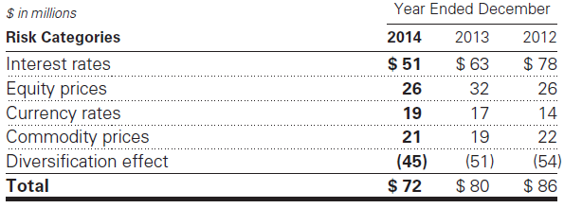
In 2014, the average daily VaR decreased reflecting a decrease in the the interest rates category due to decreased exposures and lower levels of volatility, and a decrease in the equity prices category principally due to lower levels of volatility.

Slide 84
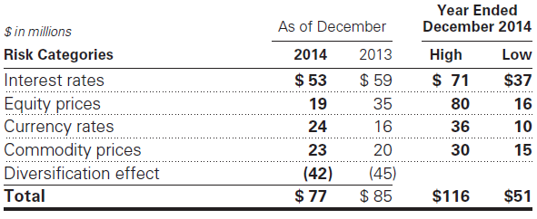
Year End VaR and High and Low VaR

Slide 85
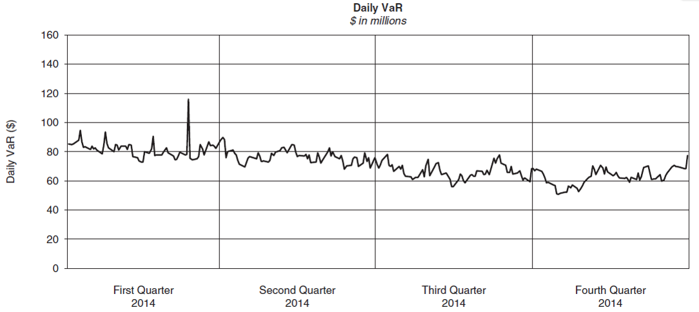
Daily VaR Over Four Quarters

Slide 86
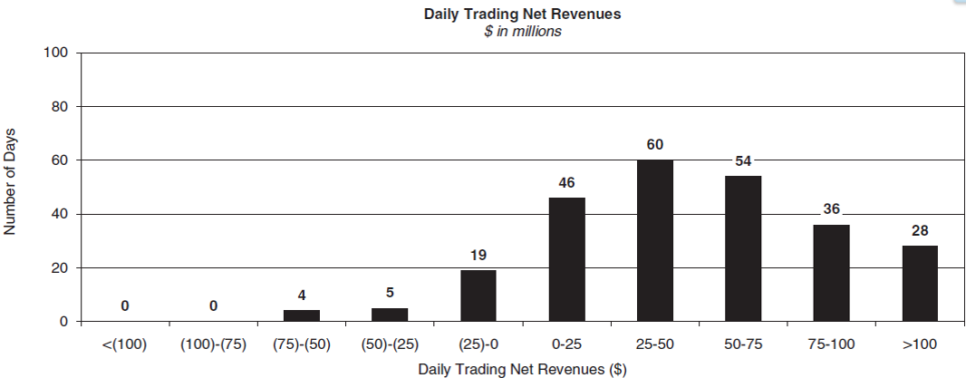
Market Risk Management
Daily trading net revenues for substantially all positions included in VaR for 2014.

Slide 87
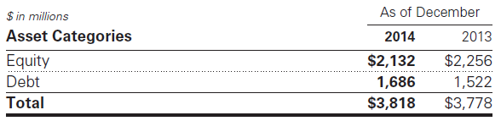
Market Risk Management…(2)
Certain portfolios and individual positions are not included in VaR because VaR is not the most appropriate risk measure
10% Sensitivity Measures: estimating the potential reduction in net revenues of a 10% decline in the underlying asset value

Slide 88
Credit Risk Management
Credit risk represents the potential for loss due to the default or deterioration in credit quality of a counterparty or an issuer of securities or other instruments GS holds.
Goldman Sachs’ exposure to credit risk comes mostly from client transactions in OTC derivatives and loans and lending commitments.
The firm also enters into derivatives to manage market risk exposures. Such derivatives also give rise to credit risk.

Slide 89
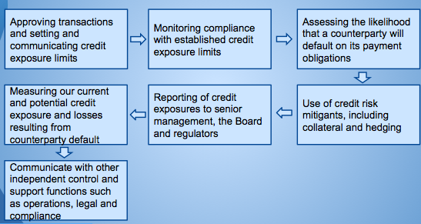
Credit Risk Process

Slide 90
Risk Measures and Limits
The firm measures credit risk based on the potential loss in an event of non-payment by a counterparty.
For derivatives and securities financing transactions, the primary measure is potential exposure.
For loans and lending commitments, the primary measure is a function of the notional amount of the position.
The firm uses credit limits at various levels (counterparty, economic group, industry, country) to control the size of our credit exposures.

Slide 91
Stress Tests
Use regular stress tests to calculate the credit exposures
Applying shocks to counterparty credit ratings or credit risk factors: currency rates, interest rates, equity prices, etc
Some of the stress tests include shocks to multiple risk factors
They run stress tests on a regular basis as part of their routine risk management processes
Stress tests are regularly conducted jointly with the market and liquidity risk functions

Slide 92
Risk Mitigants
For Derivatives and Securities:
getting agreements to offset receivables and payables agreements to obtain collateral on an upfront or contingent basis and/or to terminate transactions the credit rating falls below a specified level
For loans and lending commitments:
collateral provisions, guarantees, covenants, structural seniority of the bank loan claims, certain lending commitments, provisions in the legal documentation to adjust loan amounts, pricing, structure and other terms

Slide 93
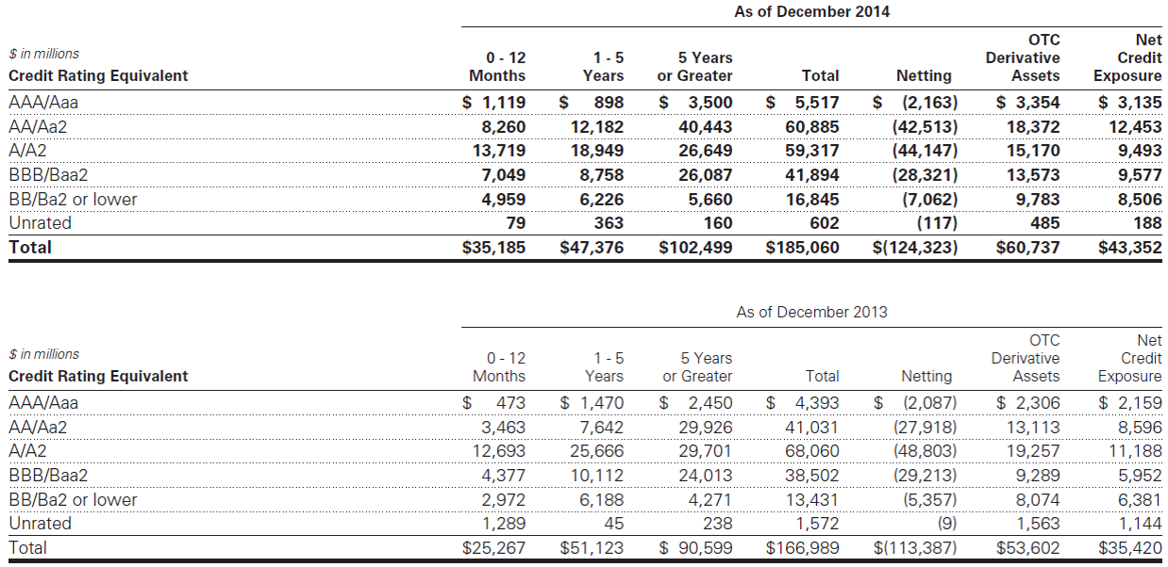
Borrowings By Credit Rating

Slide 94
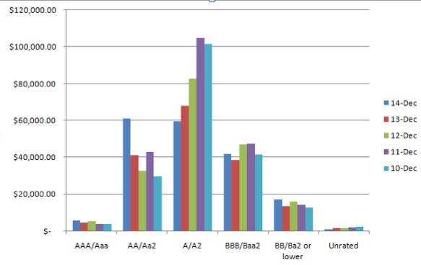
Borrowings By Credit Rating

Slide 95
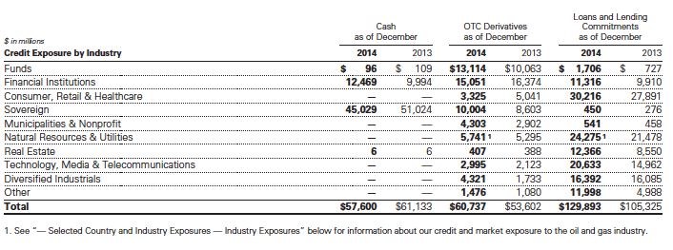
Credit Exposure

Slide 96
Operational Risk Management
Operational risk is the risk of loss resulting from inadequate or failed internal processes, people and systems or from external events.
Results from routine processing errors as well as extraordinary incidents, such as major systems failures

Slide 97
Operational Risk Perspectives
Top Down Perspective:
senior management assesses firmwide and business level operational risk profiles.
Bottom Up Perspective:
revenue-producing units and independent control and support functions are responsible for risk management on a day-to-day basis

Slide 98
Operational Framework
The firm’s operational risk framework is designed to comply with operational risk measurement rules under Basel III
The framework comprises of:
Risk identification and reporting
Risk measurement
Risk monitoring.

Slide 99
Operational Risk Management
Country Exposures: During 2014, the political situations in Iraq, Russia and Ukraine have negatively affected market sentiment toward those countries
Industry Exposures: Significant declines in the price of oil have led to market concerns regarding the creditworthiness of certain companies in the oil and gas industry

Slide 100
Recommendations
Credit risk
Supplementary evaluations of the firm’s current/potential credit exposure/losses from counterparty default
Increasing the use of credit risk mitigants, including collateral and hedging
Liquidity Risk
Maintain substantial excess liquidity to meet a broad range of potential cash outflows
Maintain contingency funding plan to provide a framework for responding to a liquidity crisis situation
Manage maturities and diversity of funding across markets and counterparties; to maintain liabilities of appropriate tenor relative to asset

