Slide 1
Goldman Sachs
Fall 2019
Presented by:
Aidariya Kairosheva
Branko Bajetic
Mark Vu
Zihua Song

Slide 2

Agenda
Overview of Goldman Sachs
Financial Statement Analysis
Regulations
Risk Management Structure
Major Risks of GS
Risk Management Strategies

Slide 3
Goldman Sachs Overview

Slide 4
Company Overview
Founded in 1869 by Marcus Goldman
A leading global multinational investment bank and financial services with company headquartered in New York City, and other international financial centers.
One of the largest investment banks with revenue of USD $37 billion as of 2018.

Slide 5
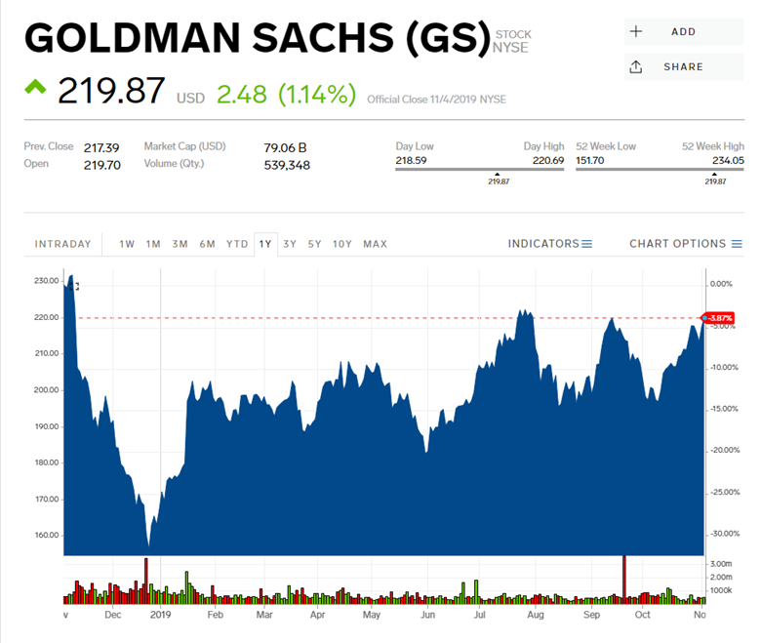

Slide 6
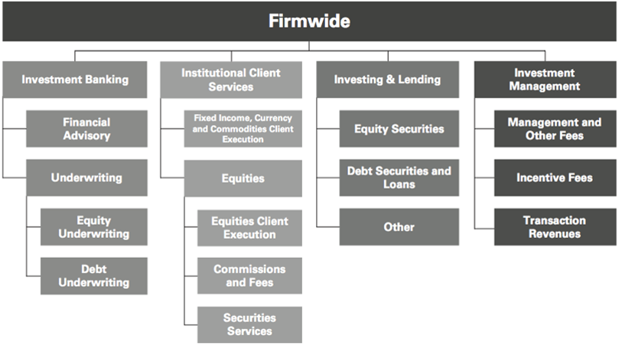
Business Segments

Slide 7
Financial Statement Analysis

Slide 8
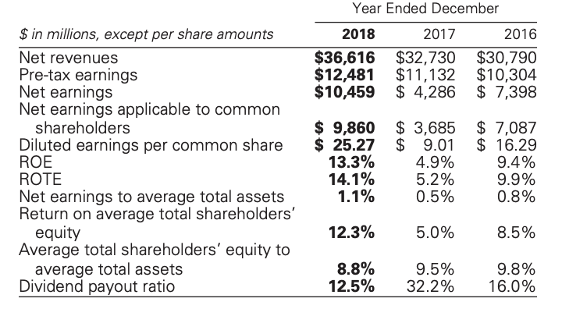
Financial Key Stats

Slide 9
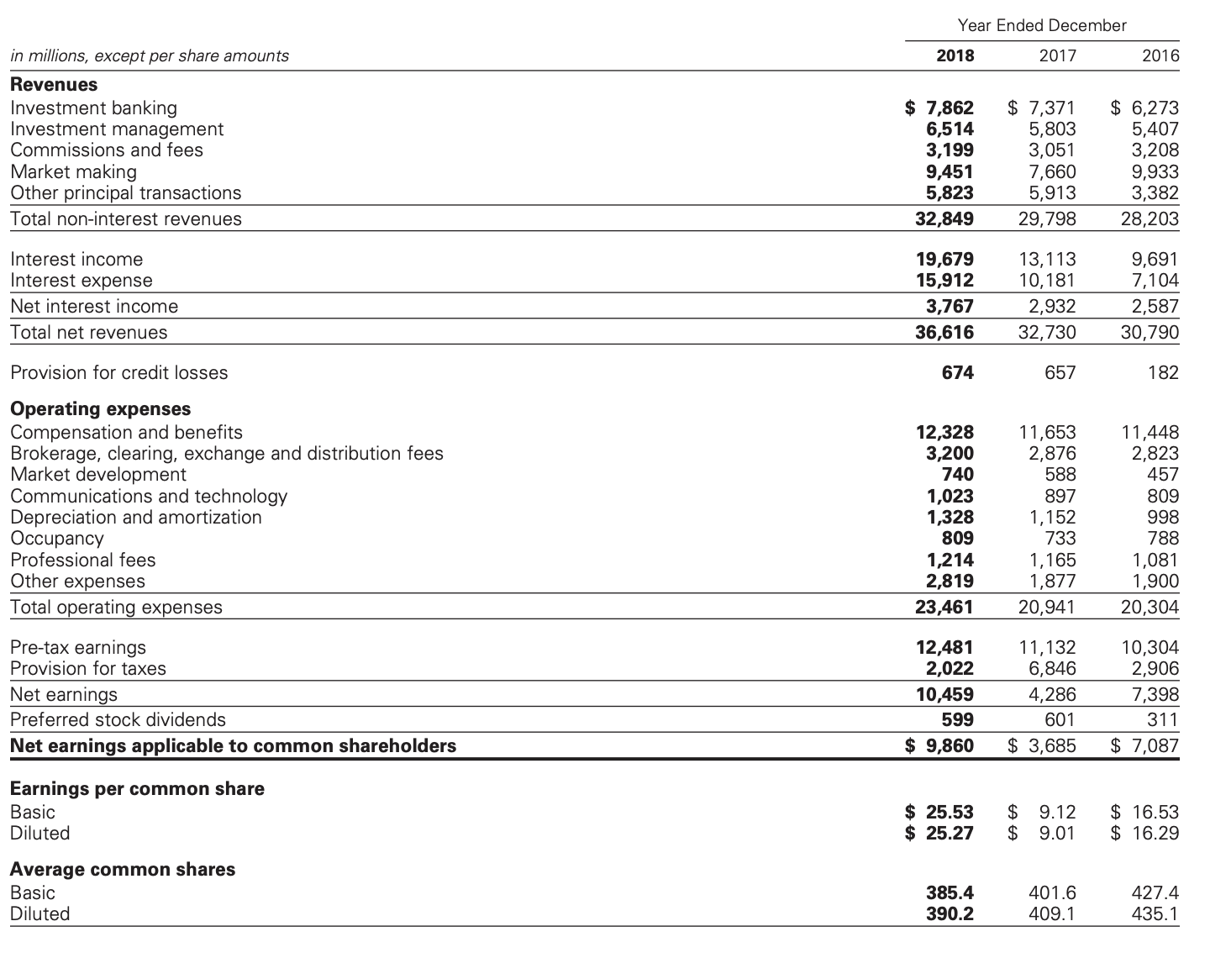
Income Statement

Slide 10
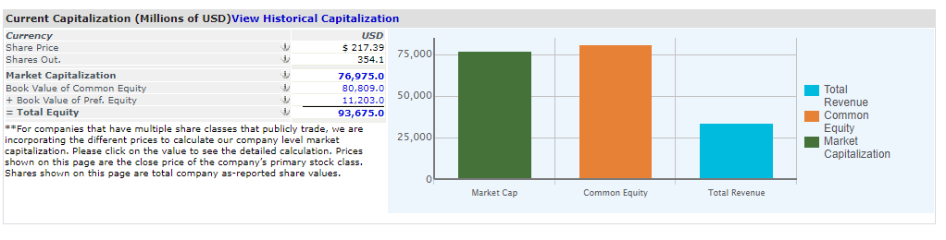
Current Capitalization

Slide 11
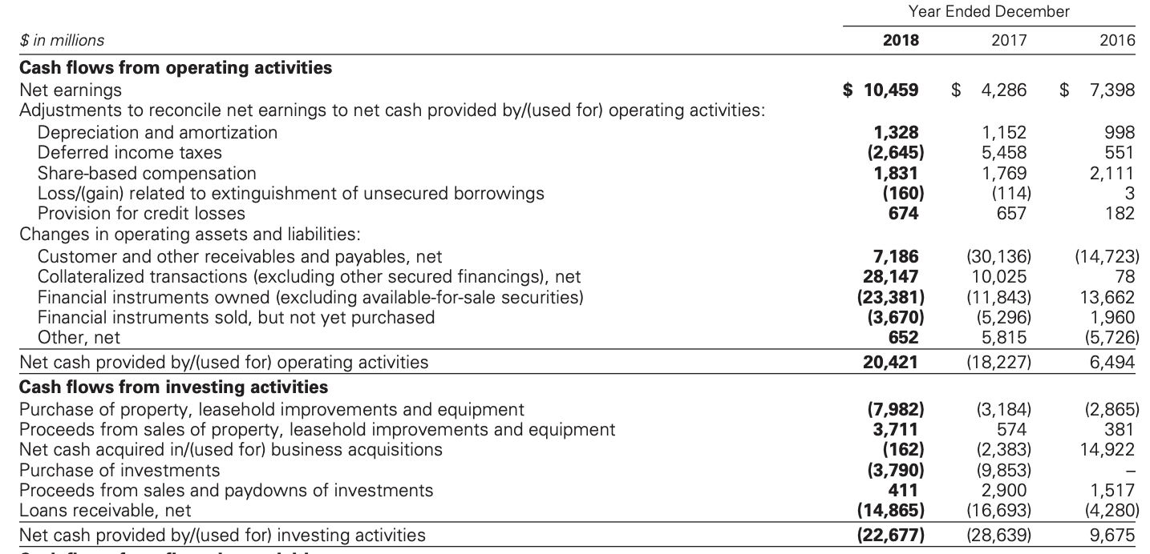
Cash Flow Statement

Slide 12
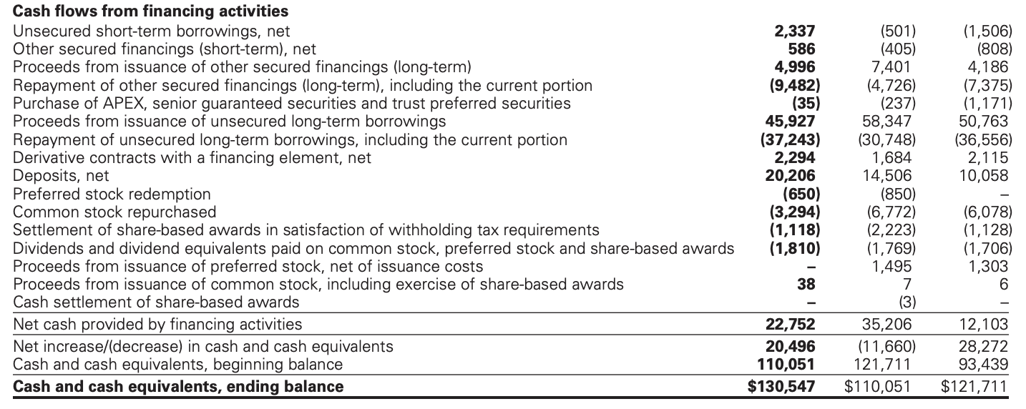
Cash Flow Statement: Con’t

Slide 13
Critical Accounting Policies
Fair Value
Controls Over Valuation of Financial Instruments
Price Verification
Review of Net Revenues
Review of Valuation Models
Goodwill
Identifiable Intangible Assets

Slide 14
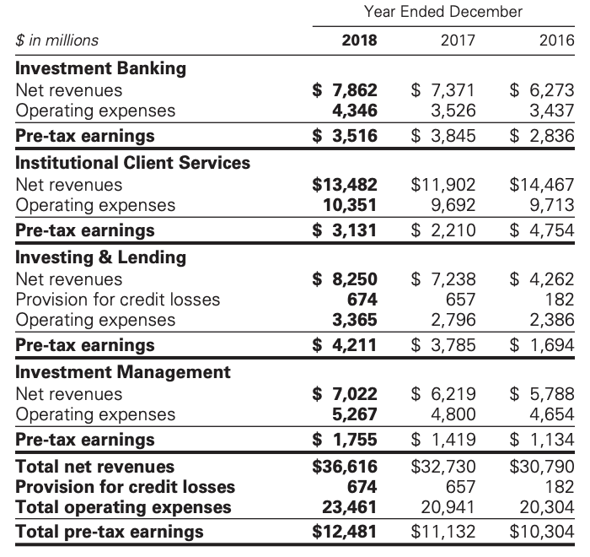
Segment Operating Results

Slide 15
Geographic Info
Highly integrated nature of international financial markets, which leads the firm manages its business based on the profitability of enterprise.
Allocating profitability to geographic regions is dependent on estimates and management judgement since large portions of firm’s activities require cross-border coordination to meet client’s needs.

Slide 16
[1] Investment Banking:
Overview:
Corporate and government clients are around the world
Financial advisory services are provided
Assist companies raise capital
Develop and maintain long term relationships
Goal: to deliver clients the entire resources of the firm

Slide 17
Investment Banking: Cont’d
Underwriting (Equity and Debt):
Assisting companies raise capital to fund businesses
Match capital for client’s need
Public offerings and private placements
Revenues from derivate transactions

Slide 18
Investment Banking: Cont’d
Financial Advisory:
Bridge loan facilities
Strategic advisory assignments
Revenue from derivative transactions
Provide lending commitments and bank loan
Help clients with managing their asset and liability exposure and capital

Slide 19
[2] Institutional Client:
Risk Management:
Assist clients with purchasing & selling financial products, raise funding, risk management
Offers market expertise by acting as a market maker
Facilitates client transactions in fixed income, equity, currency, and commodities

Slide 20
[2] Institutional Client: Cont’d
Revenues:
Large, highly liquid market: high volume of transactions for modest spread and fees
Less liquid market: transactions for spread and fees are larger.
Highly custom market: address client’s exposure to risk
Financing for clients
Assets Debt (Activities):
Cash instruments: trading the underlying instrument
Derivative: including features and options trading

Slide 21
[2] Institutional Client: Cont’d
Fixed Income/Currency/Commodities:
Interest rate products: government bonds, money market instruments, IRS, options
Credit products: investment-grade corporate securities, credit derivatives, bank and bridge loans
Mortgages: commercial mortgage-related securities, loans and derivatives
Currencies: including growth-market currencies
Commodities: oil and natural gas, base, precious and other metals

Slide 22
[3] Investing and Lending:
Long-term activities
Investing directly in publicly and privately traded securities and loans
Managing diversified global portfolio of investments in equity securities and debt
Provide financing to clients through bank loans, personal loans and mortgages
Equity-related investments

Slide 23
[4] Investment Management:
Provides investment and wealth advisory services to help clients preserve and grow their financial assets
Managing client assets
Income and liability management
Trust and estate planning
Philanthropic giving and tax planning
Use global securities and derivative market-making capabilities to address the clients' needs

Slide 24
Commission and Fees
Generated from executing and clearing institutional client transactions on major stock, options and futures
Access to electronic “low touch” equity trading platforms
Most of the revenues continued to be derived from the “high-touch” handling

Slide 25
Business Continuity Program
Key elements of the program:
Crisis planning and management
People recovery
Business recovery
System and data recovery
Process improvement
Business continuity and information security are high priorities

Slide 26
Employees and Competition
Quality, commitment, professionalism, excellence, diversity, Cooperation—Key success
Competitors are other entities that provide investment banking, securities and investment management services(brokers, dealers, investment advisors)
Advantages are taken from competing successfully with larger financial institutions

Slide 27
Regulations

Slide 28
Banking Regulations (1)
Dodd-Frank Act:
  Enacted in July 2010, provides extension on the rules adopted by the Federal Reserve Board.
  The Volcker Rule prohibits “proprietary trading”, sponsorship of “covered funds” and investment in hedge funds
Federal Reserve Board:
  Primary regulator of bank holding company (BHC) under BHC Act
  BHC Act restricts bank holding companies from engaging in certain business activities
  Authority to limit the ability to conduct activities and need its approval before engaging in financial activities

Slide 29
Banking Regulations (2)
The Dodd-Frank Act, and the rules thereunder, significantly altered the financial regulatory regime within which GS operates
The capital, liquidity and leverage ratios based on the Basel Committee’s final capital framework for strengthening international capital standards (Basel III), as implemented by the Federal Reserve, the PRA and FCA and other national regulators have also had a significant impact on GS businesses
The implications of such regulations for the businesses continue to depend largely on their implementation by the relevant regulators globally, as well as the development of market practices and structures under the regime established by such regulations
Other reforms have been adopted or are being considered by regulators and policy makers worldwide
The Basel Committee is the primary global standard setter for prudential bank regulation

Slide 30
The Volcker Rule
The provision of the ‘’Dodd-Frank Act’’ referred to as ‘’Volcker Rule’’’ became effective in Year 2015.
Prohibits ‘’proprietary trading,’’ but permits other activities with extensive compliance requirements.
Expected to limit certain kind of transactions with the sponsored funds and investment in ‘’covered funds,’’ such as hedge funds and private equity funds (reduced investment to 3% or less).
Many aspects remain unclear and very complex

Slide 31
Capital and Liquidity Requirements
As a BHC, Goldman Sachs are subject to consolidated regulatory capital requirements, which are calculated in accordance with regulations of the FRB (Capital Framework).
In January 2016, the Basel Committee finalized a revised framework for calculating minimum capital requirements for market risk

Slide 32
Payments of Dividends and Stock Repurchases
Subject to the oversight of the Fed Board based on capital plans and stress tests to judge the capital planning processes.
The amount of dividends that may be paid by GS is limited to the lesser of the amounts calculated under a “recent earnings” test and an “undivided profits” test.

Slide 33
Compensation Practices
Oversight by the Fed Board
Proper incentives to balance risk and financial results.
Compatible with effective controls and risk management
Supported by strong corporate governance
Review of the incentive compensation policies will affect GS’s ability to perform acquisitions and other activities.
Enforcement actions taken against GS: incentive compensation, risk management or corporate governance pose risks safety of the company.

Slide 34
Regulation of GS Bank USA
Stress tests required to be undertaken, according to Dodd-Frank Act and to be conducted by the Fed Board.
“Derivative push-out” will prevent GS from conducting certain swaps-related activities.
Transactions between GS Bank USA and its subsidiaries are regulated by the Fed Board.

Slide 35
Prompt Corrective Actions & Capital Ratios
The US Federal Deposit Insurance Corporation Improvement Act of 1991 (FDCIA) establishes 5 capital categories:
Well-capitalized depositary institution:
  If it has a tier 1 capital ratio of at least 6%, a total capital ratio of at least 10% and a tier 1 leverage ratio of at least 5%
Adequately capitalized
Undercapitalized
Significantly undercapitalized
Critically undercapitalized

Slide 36
Insolvency of a Bank Holding Company
Under FDIA (Federal Deposit Insurance Corporation):
Transfer the depository institution’s assets and liabilities to a new obligor without approval of the creditors.
Enforce the terms of the depository institution's contracts without regards to any provisions.
Repudiate any contracts to which the institution is a party.
Notes:
In case there is an insolvency happening for a bank holding company such as US GS Bank, the FDIA has powers to

Slide 37
Broker-Dealer and Securities Regulation
Broker-dealer subsidiaries are subject to regulations that cover all aspects of the securities business.
It is required to maintain orderly markets in the securities assigned
According to the Dodd-Frank Act, any person who organizes an asset-backed security transaction to retain a portion of any credit risk that the person conveys with a third party.

Slide 38
Swap, Derivatives & Commodities
Regulation
Subject to regulation of the US Commodity Exchange Act
The Dodd-Frank Act strengthened regulations by imposing the following requirements:
  Real time public and regulatory reporting of trade information for swaps
  Registration of swap dealers
  Position limits the cap exposure to derivatives on certain physical commodities
  Mandated clearing through central counterparties for certain swaps
  New business conduct standards for swap dealers
  Margin requirements for trades that are not cleared
  Entity level capital requirements for swap dealers

Slide 39
Other Regulations
Insurance subsidiaries: subject to state insurance regulation in the states in which they are domiciled
Investment management: subject to significant regulation in numerous jurisdictions around the world

Slide 40
The Basel Capital Accord
The Basel Capital Accord is a Framework set at the Basel Committee in 1988 and subsequently revised.
Three series of banking regulation
  Basel I (1988)
  Basel II (2004)
  Basel III (2018)
Basel Committee on Bank Supervision (BCBS)
  Banking Regulation – Capital Risk, Market Risk & Operational Risk
  Ensure sufficient capital on account
Notes:
The primary objectives are to promote the soundness of the international banking system and to provide an equitable basis for international cooperation among banks

Slide 41
Basel I – The First Basel Accord
Basel I (1988) ~ Basel Committee on Banking Supervision in Basel, Switzerland, published a set of minimum capital requirements for banks.
Primarily focused on credit risk and appropriate risk-weighting of assets.
Capital Adequacy Risk: (0%, 10%, 20%, 50% and 100%)
Basel 1A
Notes:
Basel I is the round of deliberations by central bankers from around the world, and in 1988, by the Basel Committee on Banking Supervision in Basel, Switzerland, published a set of minimum capital requirements for banks.

Slide 42
Basel II – Revised Capital Framework
Published in 2004 – update of the original accord (Basel I), especially in the areas of Risk & Capital.
  Improve the way regulatory capital requirements reflect underlying risks
  Address the financial innovation that had occurred in recent years
  Aimed at rewarding and encouraging continued improvements in risk measurement and control
Basel II uses a “three pillars” concept
  Minimum Capital Requirements
  Supervisory Review Process
  Market Discipline

Slide 43
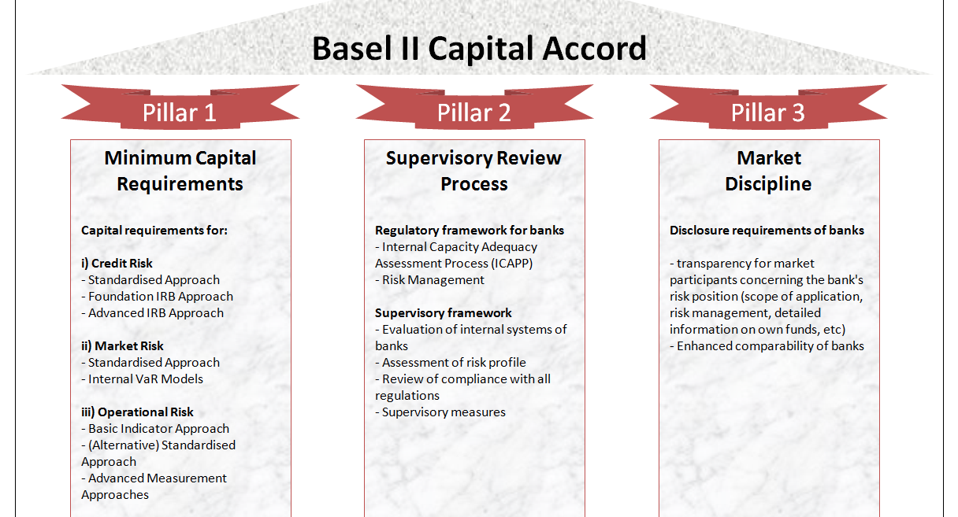

Slide 44
Basel III - Continuation
Basel III is intended to strengthen bank capital requirements by increasing liquidity and decreasing bank leverage.
Changes:
Tier 1 capital requirements increases from 4% in Basel II to 6%
In July 2014, the U.S. Federal Reserve announced that the minimum Basel III leverage ratio would be 6% for 8 systemically important financial institution (SIFI) banks and 5% for their uninsured bank holding companies

Slide 45
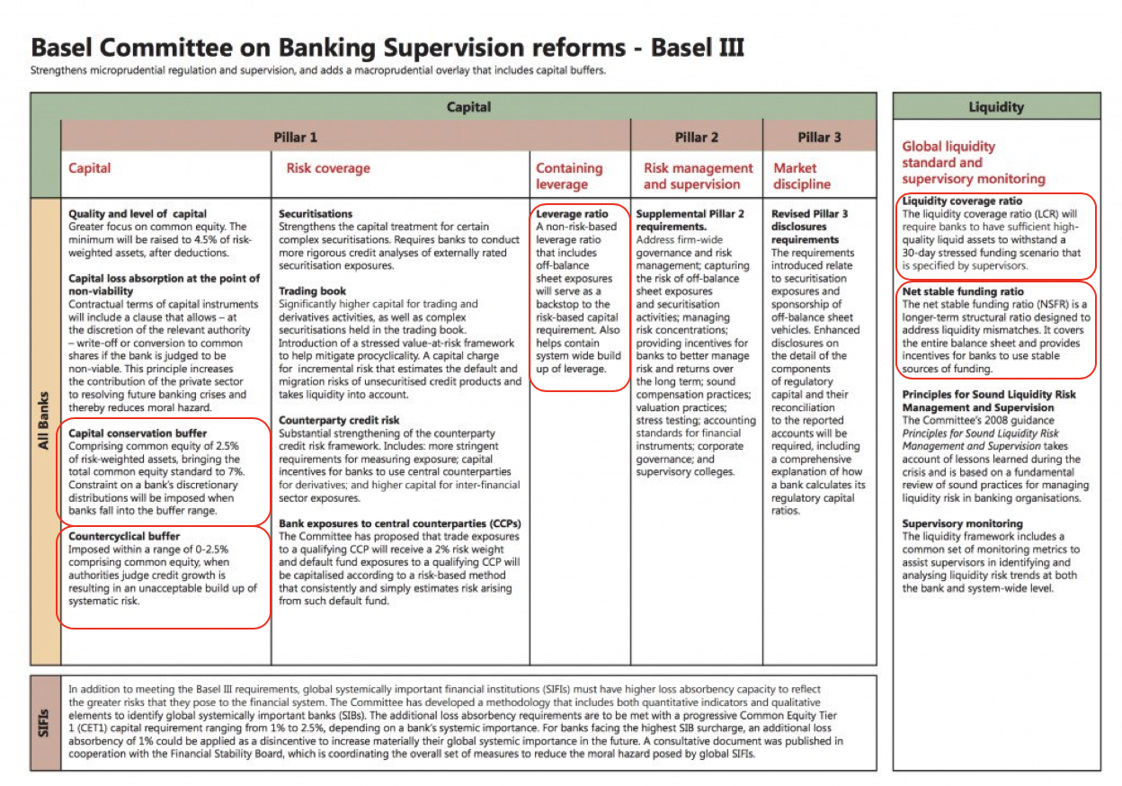

Slide 46
Tier 1 Capital
T1 refers to the capital adequacy (financial strength) of the bank from the regulator’s perspective.
T1 is composed of core capital (primarily C/S, disclosed reserves, and non-redeemable or non-cumulative preferred stock)
Equity capital is inclusive of instruments that cannot be redeemed at the option of the holder.
T1 Capital Ratio compares bank’s equity capital with its total risk-weighted assets (RWAS)

Slide 47
Tier 2 Capital (Supplementary Capital)
T2 is composed of hybrid capital instruments, loan-loss, revaluation reserves and undisclosed reserves.
T2 need to meet the minimum standard of being subordinated to depositors and general creditors and have an original maturity of at least five years.
Tier 1 capital + Tier 2 capital = reserve requirement 8% (6% Tier 1 Capital)

Slide 48
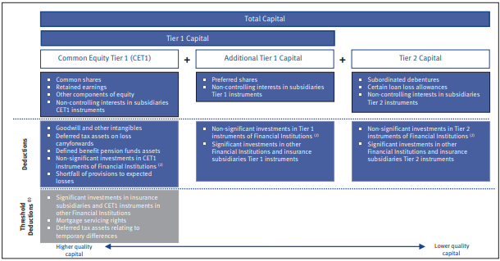
Tier 1 + Tier 2 Capital

Slide 49
Risk Management Structure

Slide 50
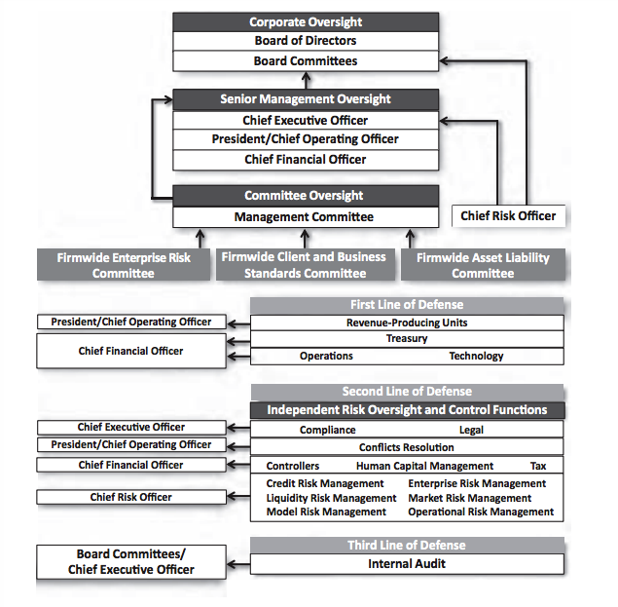
Risk Management Structure

Slide 51
Risk Management Structure
Risk Management Governance Structure:
Management Committee
Firmwide Enterprise Risk Committee
Firmwide Client and Business Standards Committee
Firmwide Asset Liability Committee
Conflicts Management

Slide 52
Major Risks of Goldman Sachs

Slide 53
Risk Management
Liquidity Risk
Market Risk
Credit Risk
Operational Risk
Model Risk

Slide 54
Liquidity Risk Management (LRM)

Slide 55
Liquidity Risk Management (LRM)
Three Principles:
Hold sufficient excess liquidity in the form of GCLA to cover outflows during a stressed period
Maintain appropriate Asset-Liability Management
Maintain a viable Contingency Funding Plan

Slide 56
Liquidity - GCLA
GCLA:
Liquidity maintained to meet a broad range of potential cash outflows and collateral needs in a stressed environment
A primary principle is to pre-fund the estimated potential cash and collateral needs during a liquidity crisis and hold this liquidity in the form of unencumbered, highly liquid securities and cash

Slide 57
Liquidity - Asset-Liability Management
Goal: Maintain sufficient liquidity to fund assets and meet contractual and contingent obligations.
To manage the overall funding book conservatively and to focus on long-term diversified sources of funding
To actively manage the asset base
To raise secured/unsecured financing with longer tenure than the liquidity profile of assets.

Slide 58
Liquidity - Contingency Funding Plan
Provide framework for analyzing liquidity risks and market stress
Outline list of potential risk factors
Identifies key groups of individuals to foster effective coordination control and distribution of information

Slide 59
Liquidity Stress Test: Modeled Liquidity Risks
HOW:
Capture and quantifies liquidity risk
Conduct multiple scenarios that include market-wide and firm-wide specific stress
Parameters:
Liquidity needs over 30-day scenario
Two-notch downgrade of long-term senior unsecured credit ratings
Combination of contractual outflows and contingent outflows
No issuance of equity /unsecured deb
No support from additional government funding
No asset liquidation other than GCLA

Slide 60
Liquidity Stress Test: Intraday Liquidity Model
How:
Access the risk of increased intraday liquidity requirement when access to sources of intraday may become constrained
Parameters:
Liquidity needs over a one-day settlement period
Delays in receipt of counterparty cash payments
A reduction in the availability of intraday credit lines at our third-party clearing agents
Higher settlement volumes due to and increase in activity

Slide 61
Liquidity Limits
Measured relative to acceptable levels of risk given our liquidity risk tolerance
The purpose: to assist senior management in monitoring and controlling the overall liquidity risk profile
Approved by Risk Committee of the Board and the Firmwide Finance Committee
Monitored by Treasury and Liquidity Risk Management

Slide 62
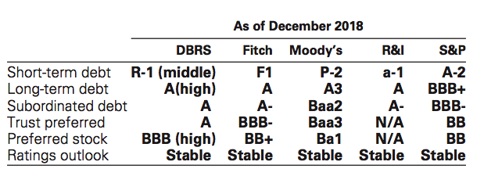
Credit Ratings

Slide 63
Market Risk Management (MRM)

Slide 64
Market Risk Management (MRM)
Risk of loss in the value of inventory and certain other financial assets and liabilities due to change in market conditions.
Inventory changed based on client demands and investment opportunities, and accounted for at fair value and fluctuates on a daily basis.

Slide 65
Market Risk - Categories
Interest rate risk
Equity price risk
Currency rate risk
Commodity price risk

Slide 66
Market Risk - Process
Collecting complete, accurate and timely information
A dynamic limit-setting framework
Monitoring compliance with established market risk limits and reporting our exposures
Diversifying exposures
Controlling position sizes
Evaluating mitigants, such as economic hedges in related securities or derivatives
Proactive communication between our revenue producing units and independent risk oversight and control functions

Slide 67
Risk Measure: Value-at-Risk (VaR)
Potential loss in value due to adverse market movements over a defined time horizon with a specified confidence level
Company uses a single VaR model which capture risks including interest rates, equity prices, currency rate and commodity prices
Typically employ a one-day time horizon with a 95% confidence level
VaR facilitates comparison across portfolios of different risk characteristics
Captures the diversification of aggregated risk at the firm wide level

Slide 68
VaR Limitations
VaR does not estimate potential losses over longer time horizons where moves may be extreme.
VaR does not take account of the relative liquidity of different risk positions.
Previous moves in market risk factors may not produce accurate predictions of all future market moves.

Slide 69
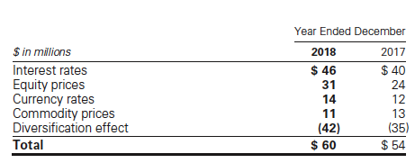
Average Daily VaR: Risk Category

Slide 70
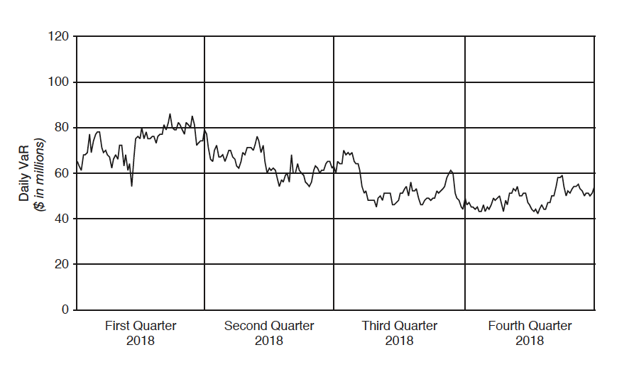
Daily VaR: Year 2018

Slide 71
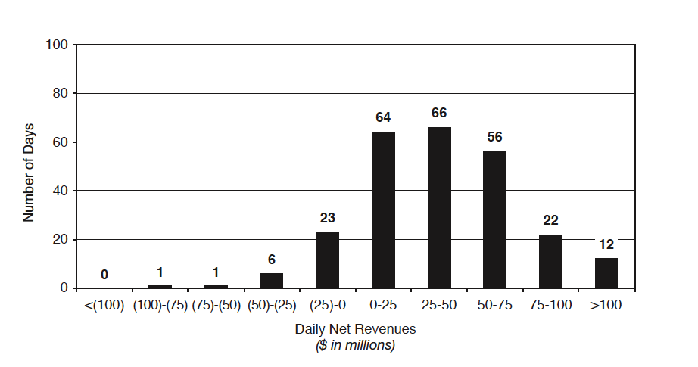

Slide 72
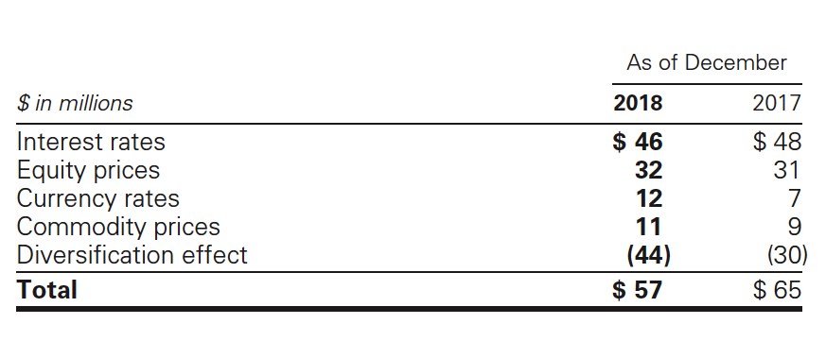
Period End VaR: Risk Category

Slide 73
Offsetting: Assets and Liabilities
To reduce credit exposures on derivatives and securities financing transactions, the firm may enter into master Netting agreements:
Netting agreement is a contract with a counterparty that permits net settlement of multiple transactions with that counterparty, including upon the exercise of termination rights by a non-defaulting party

Slide 74
Netting Agreements: Execution
Upon exercise of such termination rights, all transactions governed by the netting agreement are terminated and a net settlement amount is calculated
In order to assess enforceability of the firm’s right of setoff under netting and credit support agreements, the firm evaluates various factors, including applicable bankruptcy laws, local statutes and regulatory provisions in the jurisdiction of the parties to the agreement.

Slide 75
Netting Agreements: Derivatives
Derivatives are reported on a net-by-counterparty basis (i.e., the net payable or receivable for derivative assets and liabilities for a given counterparty):
  Agreements to resell (resale agreements)
  Repurchase (repurchase agreements)
  Securities borrowed and loaned transactions with the same term and currency are presented on a net-by-counterparty basis
In the consolidated statements of financial condition, resale and repurchase agreements, and securities borrowed and loaned, are not reported net of the related cash and securities received or posted as collateral.

Slide 76
Foreign Currency Translation
Assets and liabilities denominated in non-U.S. currencies are translated at rates of exchange prevailing on the date of the consolidated statements of financial condition and revenues and expenses are translated at average rates of exchange for the period
Gains or losses on translation of the financial statements of a non-U.S. operation, when the functional currency is other than the U.S. dollar, are included, net of hedges and taxes, in the consolidated statements of comprehensive income.

Slide 77
Stress Testing
Stress testing is a method of determining the effect of various hypothetical stress scenarios
Use to examine risks of specific portfolios, as well as the potential impact of our significant risk exposures.
Stress tests
Sensitivity analysis
Scenario analysis

Slide 78
[1] Stress Testing:
Designed to ensure a comprehensive analysis of our vulnerabilities and idiosyncratic risks combining financial and nonfinancial risks
  Including, but not limited to, market, credit, liquidity and funding, operational and compliance, strategic, systemic and emerging risks into a single combined scenario
Primarily used to assess capital adequacy as part of our capital planning and stress testing process
Selecting appropriate scenarios to use for our capital planning and stress testing process

Slide 79
[2] Sensitivity Analysis
Used to quantify the impact of a market move in a single risk factor across all positions
Quantify the impact of the default of any single entity, which captures the risk of large or concentrated exposures
Certain portfolios and individual positions are not included in VaR because VaR is not the most appropriate risk measure
  10% sensitivity measure
  Credit spread sensitivity on derivatives and financial liabilities
  Interest rate sensitivity

Slide 80
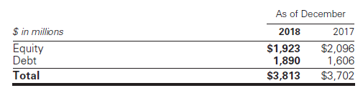
Sensitivity Measures: 10%
Market risk by asset category for positions accounted for at fair value, that are not included in VaR
Market risk of these positions is determined by estimating the potential reduction in net revenues of a 10% decline in the value of these positions
Equity positions
Debt positions

Slide 81
Credit Spread Sensitivity & Interest Rate Sensitivity
Credit Spread Sensitivity on Derivatives and Financial Liabilities:
  VaR excludes the impact of changes in counterparty and the credit spreads on derivatives, as well as changes in the credit spreads (debt valuation adjustment) on financial liabilities for which the fair value option was elected.
Interest Rate Sensitivity:
  The estimated sensitivity to a 100 basis point increase in interest rates on such loans was $607 million as of December 2018 and $527 million as of December 2017

Slide 82
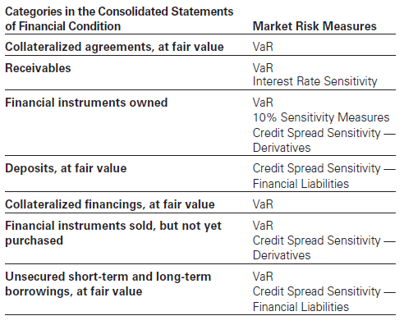
Financial Statement Linkages to Market Risk Measures

Slide 83
[3] Scenario Analysis
Comprehensive Capital Analysis and Review (CCAR)
Dodd-Frank Act Stress Tests (DFAST)
Used to quantify the impact of a specified event, including how the event impacts multiple risk factors simultaneously
Conducted on a regular basis as part of our routine risk management process and on an ad hoc basis in response to market events or concerns

Slide 84
Credit Risk Management (CRM)

Slide 85
Credit Risk Management (CRM): Process
Collecting complete, accurate and timely information
Approving transactions and setting and communicating credit exposure limits;
Monitoring compliance with established credit risk limits and reporting our exposure
Establishing or approving underwriting standards
Assessing the likelihood that a counterparty will default on its payment obligations
Measuring our current and potential credit exposure and losses resulting from counterparty default;
Using credit risk mitigants, including collateral and hedging
Maximizing recovery through active workout and restructuring of claims

Slide 86
CRM - Measures & Limits
Based on potential loss in the event of non-payment by a counterparty using current and potential exposure
For loans and lending commitments, the primary measure is a function of the notional amount of the position
The firm uses credit limits at various levels to control the size of credit exposures

Slide 87
CRM - Stress Test
Regular stress tests to calculate the credit exposures including potential concentrations that would result from applying shocks to counterparty credit ratings or credit risk factors
Shocks include multiple risk factors, consistent with the occurrence of a severe market or economic event
Perform stress tests on a regular basis as part of our routine risk management processes and conduct tailored stress tests on an ad hoc basis in response to market developments

Slide 88
CRM - Mitigants
Mitigate credit exposures by netting agreements with counterparties that permit us to offset receivables and payables with such counterparties.
For loans and lending commitments: collateral provisions, guarantees, covenants, structural seniority of the bank loan claims, provisions in legal documentation that allow us to adjust loan amounts, pricing, structure and other terms as market conditions change.

Slide 89
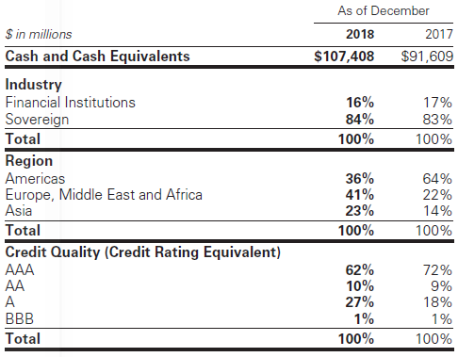
Credit Risk Management: Credit Exposures

Slide 90
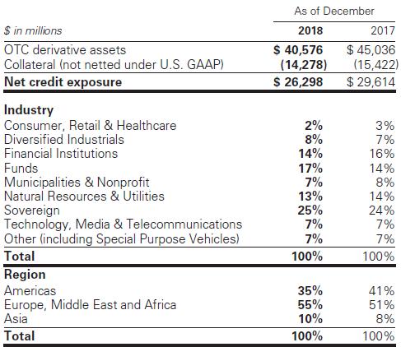
Credit Risk Management: OTC Derivatives

Slide 91
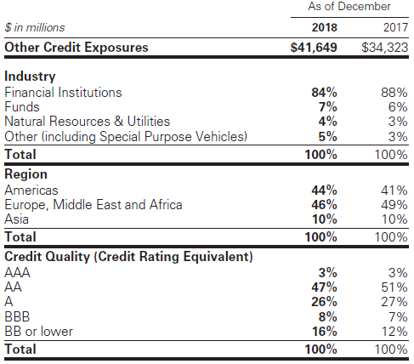
Credit Risk Management: Other Credit Exposures

Slide 92
Operational Risk Management (ORM)

Slide 93
Operational Risk Management (ORM)
Operational risk is the risk of an adverse outcome resulting from inadequate or failed internal processes, people, systems or from external events.
Arises from routine processing errors, as well as extraordinary incidents, such as major systems failures or legal and regulatory matters.
Management framework is in part designed to comply with the operational risk measurement rules under the Capital Framework.
Consists of the following practices:
  Risk identification and assessment
  Risk measurement
  Risk monitoring and reporting

Slide 94
ORM - Process
Collecting complete, accurate and timely information;
Training, supervision and development of our people;
Active participation of senior management in identifying and mitigating our key operational risks;
Independent risk oversight and control functions that monitor operational risk, and implementation of policies and procedures, and controls designed to prevent the occurrence of operational risk events; and
Proactive communication between our revenue producing units and our independent risk oversight and control functions.

Slide 95
ORM – Risk Identification and Assessment
The core of our operational risk management framework is risk identification and assessment
When operational risk events are identified, our policies require that the events be documented and analyzed to determine whether changes are required in our systems and/or processes to further mitigate the risk of future events
Key tool: The Operational Risk and Control self-assessment process, which is performed by our managers. This process consists of the identification and rating of operational risks, on a forward looking basis, and the related controls

Slide 96
ORM – Risk Measurement
We measure our operational risk exposure using both statistical modeling and scenario analyses
  Involve qualitative and quantitative assessments of internal and external operational risk event data and internal control factors for each of our businesses

Slide 97
ORM – Risk Monitoring and Reporting
Changes in business mix or jurisdictions in which we operate, by monitoring the factors noted above at a firmwide level
  Preventive and detective internal controls, which are designed to reduce the frequency and severity of operational risk losses and the probability of operational risk events.
  Established limits and thresholds consistent with our risk appetite statement that are approved by the Risk Committee of the Board, as well as escalation protocols

Slide 98
ORM – Type of Losses
Clients, products and business practices;
Execution, delivery and process management;
Business disruption and system failures;
Employment practices and workplace safety;
Damage to physical assets;
Internal fraud; and
External fraud

Slide 99
Model Risk Management (MRM)

Slide 100
Model Risk Management (MRM)
Model risk is the potential for adverse consequences from decisions made based on model outputs that may be incorrect or used inappropriately
Managed through a governance structure and risk management controls
The Firmwide Model Risk Control Committee oversees the model risk management framework.

Slide 101
MRM - Process
The model’s conceptual soundness, including the reasonableness of model assumptions, and suitability for intended use;
The testing strategy utilized by the model developers to ensure that the models function as intended;
The suitability of the calculation techniques incorporated in the model;
The model’s accuracy in reflecting the characteristics of the related product and its significant risks;
The model’s consistency with models for similar products; and
The model’s sensitivity to input parameters and assumptions.

Slide 102
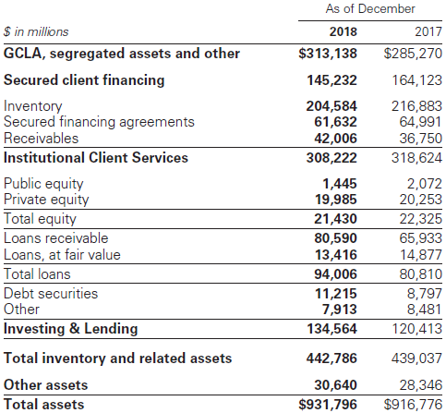
Balance Sheet Allocation
Risk management discipline to manage the size and composition of the balance sheet.
Used to reflect factors of overall risk tolerance, amount of equity capital held, funding profiles

Slide 103
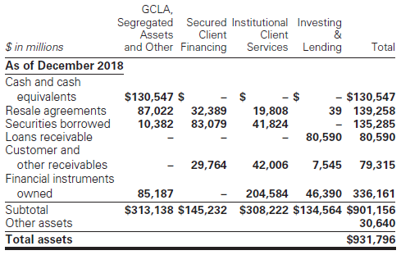
Cash Flow Statement

Slide 104
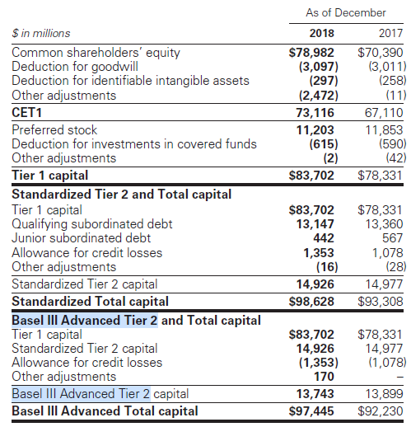
Risk-based Capital

Slide 105
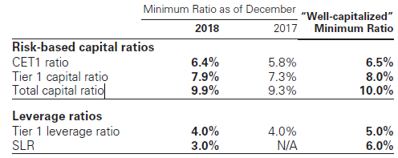
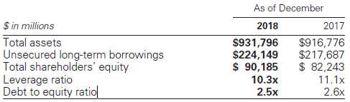
Minimum risk-based capital and leverage ratios and “well-capitalized” minimum ratios
Balance sheet and the leverage ratios.

Slide 106
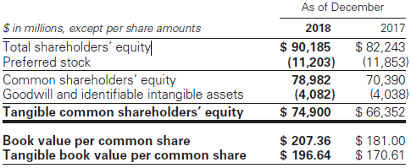
Shareholder’s Equity

Slide 107
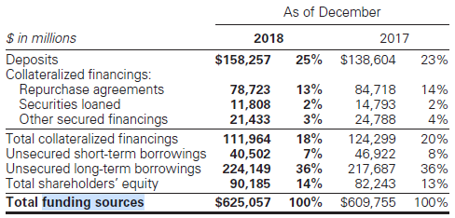
Funding Sources
Primary sources of funding are deposits, collateralized financings, unsecured short-term and long-term borrowings, and shareholders’ equity.

Slide 108
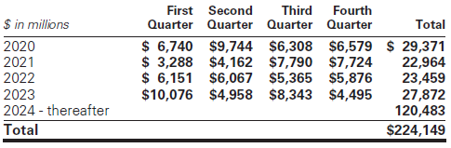
Unsecured Long-Term Borrowings Maturity Profile

Slide 109
Minimum Capital Ratios and Buffers
Subject to regulatory risk-based capital and leverage requirements that are calculated in accordance with the regulations of the FRB (Capital Framework)
Based on Basel III and also implements certain provisions of the Dodd-Frank Act
Meet specific regulatory capital requirements that involve quantitative measures of assets, liabilities and certain off-balance-sheet items
The Capital Framework provides for an additional capital ratio requirement that consists of three components:
  For capital conservation (capital conservation buffer)
  For countercyclicality (countercyclical capital buffer)
  As a consequence of our designation as a G-SIB (G-SIB buffer)

Slide 110
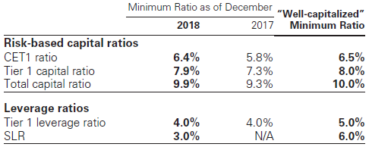
Capital Ratio

