Slide 1
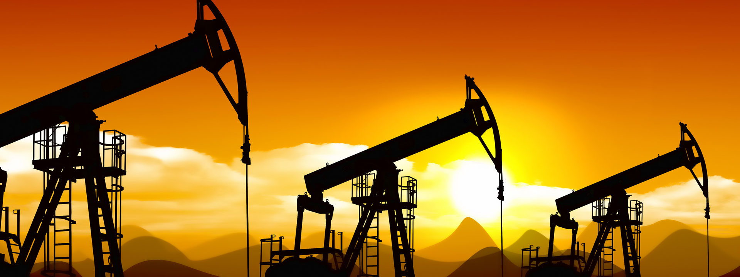
Canadian Oil and Gas
Yimeng Sun
Jiawei Zhu
Yujia Fu

Slide 2
Agenda
Industry overview
Global oil & Canadian oil industry
Global natural gas & Canadian natural gas industry
Risk Management
Forecasting Industry
Canadian Natural Resources
Canadian Oil Sands
Encana Corporation

Slide 3
Industry Overview
Oil And Gas Components
Upstream Operation (Exploration)
Midstream Operation (Refining)
Downstream Operations (Distribution And Sales)
Canada Is 5th Largest Production Of Natural Gas, Crude Oil Producer In the World
20% Of Value On TSX

Slide 4
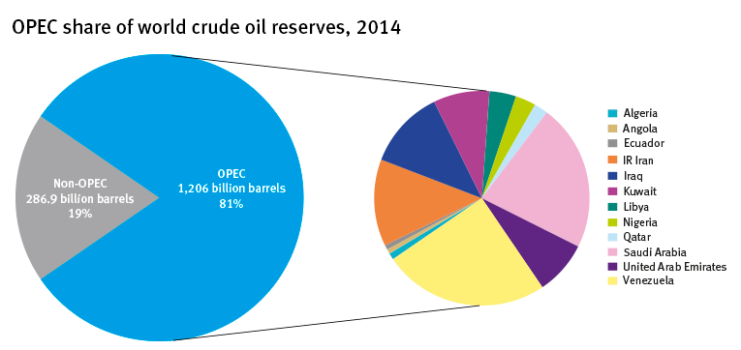

Regulation on the Industry
OPEC: Organization of the Petroleum Exporting Countries
Industry Overview
Canadian Natural Resources
Canadian Oil Sands
Encana
Notes:
OPEC
OPEC's objective is to co-ordinate and unify petroleum policies among Member Countries, in order to secure fair and stable prices for petroleum producers; an efficient, economic and regular supply of petroleum to consuming nations; and a fair return on capital to those investing in the industry.
According to current estimates, more than 80% of the world's proven oil reserves are located in OPEC Member Countries, with the bulk of OPEC oil reserves in the Middle East, amounting to around 66% of the OPEC total.

Slide 5
OPEC
The OPEC's objective is to co-ordinate and unify petroleum policies among member countries, in order to secure fair and stable prices for petroleum producers; an efficient, economic and regular supply of petroleum to consuming nations; and a fair return on capital to those investing in the industry.
According to current estimates, more than 80% of the world's proven oil reserves are located in OPEC member countries, with the bulk of OPEC oil reserves in the middle east, amounting to around 66% of the OPEC total.
Industry Overview
Canadian Natural Resources
Canadian Oil Sands
Encana

Slide 6

Canadian Regulation on the Industry
Canadian Association Of Petroleum Producers (CAPP)
CAAP’s mission is to Enhance the economic well-being and sustainability of the Canadian upstream petroleum industry in a socially, environmentally and technically responsible manner
CAPP members produce "90% of Canada's natural gas and crude oil
It represents large and small producer member companies
An important part of a national industry with revenues of about $100 billion-a-year
Industry Overview
Canadian Natural Resources
Canadian Oil Sands
Encana
Notes:
Natural Resources Canada

Slide 7
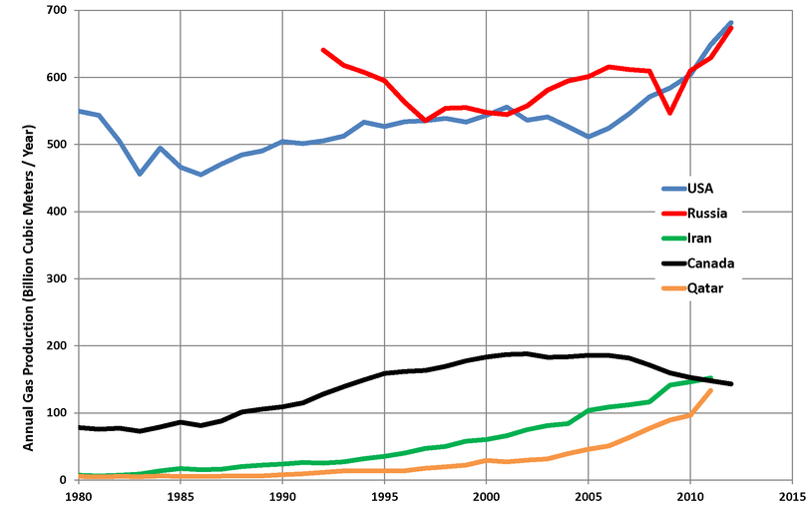
Global Natural Gas Supply
Notes:
As Jacob said, Canada is the fifth gas producer in the world, Canada is the only country decrease the natural gas supply in the last ten years. Moreover, If we keep the same consumption of the 2014, the Canada gas can be comsumed 300 yrs
So we can easily conclude that Canada natural gas have huge potentials.

Slide 8
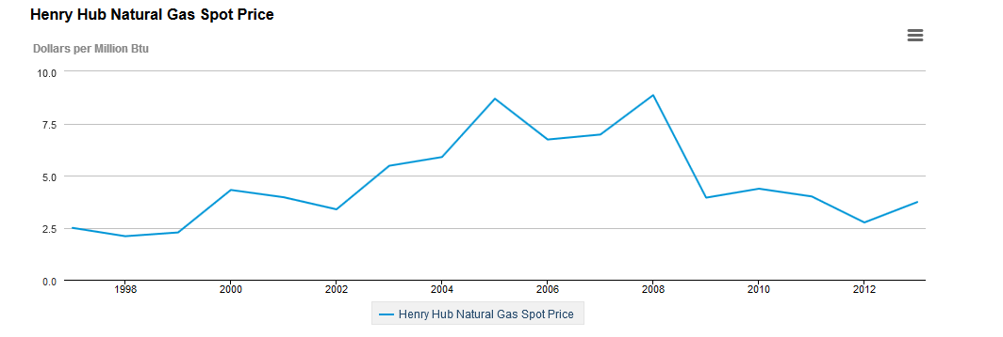
Natural Gas Historical Price
Jun 2015 $2.78 per Million Btu
Notes:
No expected huge changes on the price

Slide 9

Canadian Natural Gas
Today about 30 per cent of Canada's entire energy needs are met by natural gas. It is abundant, relatively easy to transport through pipelines and burns more cleanly than other hydrocarbons
Reserve: 1,093 trillion cubic feet (tcf). This equates to more than 300 years of Canadian natural gas consumption at current levels.
Supply: Total annual production reached 5.1 trillion cubic feet (tcf) in 2013 and could reach 7.1 trillion cubic feet by 2020.
Industry Overview
Canadian Natural Resources
Canadian Oil Sands
Encana
Notes:
Natural gas accounts for about half of the energy used in the industrial sector. Industrial customers prefer natural gas because it is readily available and provides heat for industrial processes, like manufacturing steel. It is also a key raw material for the chemical and fertilizer industries.
Natural gas is the single-largest form of energy used in Canadian homes. Over six million homeowners use natural gas to heat their houses and their water. Canadian homes are also enjoying the benefits of increasingly efficient natural gas furnaces and appliances.

Slide 10
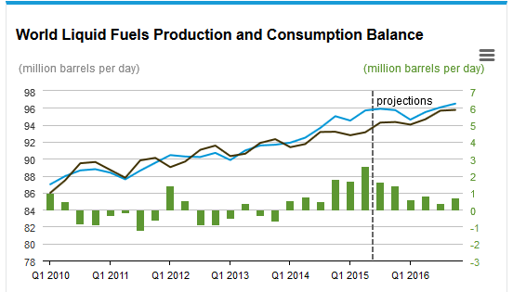
Global Oil Forecasting
Global liquids production continues to exceed consumption
The slowing increases in inventory reflect rising demand and slowing production growth outside of the OPEC, particularly in the U.S
Grew 1.4 million b/d in 2014, projected to grow by 0.8 million b/d in 2015 and by 1.1 million b/d in 2016
Industry Overview
Canadian Natural Resources
Canadian Oil Sands
Encana
Notes:
resulting in inventory builds. Global oil inventory builds are estimated to have averaged 2.2 million b/d through the first half of 2015 and are projected to average 1.5 million b/d during the second half of the year
The expected inventory builds in 2015 are on top of an estimated 0.9 million b/d increase in 2014. By 2016, inventory builds are expected to moderate to 0.6 million b/d.

Slide 11
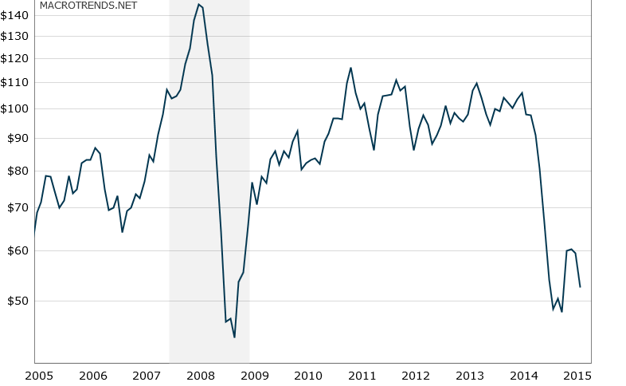
Oil Historical Price
June 2008: $145.58
Crud Oil Futures-Aug 2015 $51.97
Feb 2009: $43.9

Slide 12
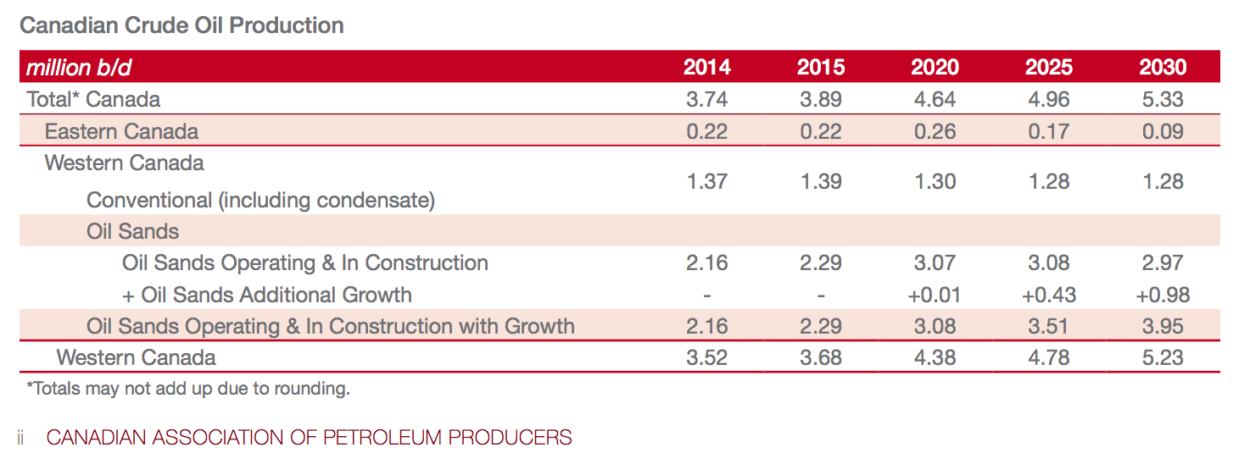
Canadian Oil
Capp’s Forecast
Notes:
The global trend and the candian trend is maintain similar, which is keep increasing at low speed.
As you have a brief idea of trend in the global oil and gas industry, we are now focusing on the Canadian oil and gas industry.
According to CAPP’s forecast:
It shows that:
Total oil production continues to grow but at a slower pace than previously anticipated.
Total Canadian production grows from 3.7 million b/d in 2014 up to 5.3 million b/d in 2030, which is 1.1 million b/d lower than last year’s forecast.

Slide 13
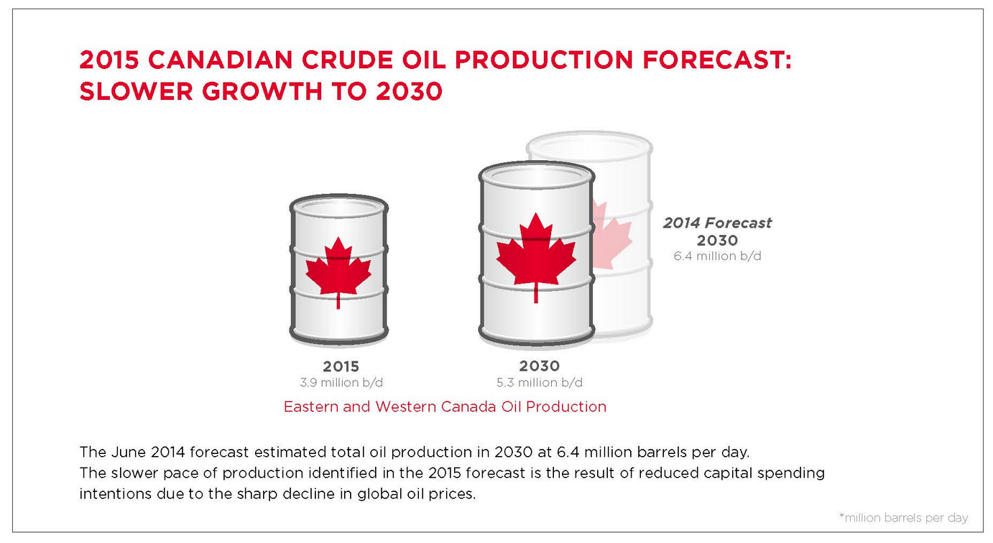
Canadian Oil
Notes:
CAPP estimates production of Canadian oil will increase 43 per cent over 16 years, growing to 5.3 million barrels per day by 2030, up from 3.7 million barrels per day in 2014. Increased transportation capacity, in all forms, is therefore needed to meet growing domestic and international demand for Canadian oil.
CAPP’s June 2014 forecast estimated total oil production in 2030 at 6.4 million barrels per day. While the two forecasts are similar during the early years of the forecast period, the slower pace of production in the latter years is the result of reduced capital spending intentions due to the sharp decline in global oil prices.

Slide 14
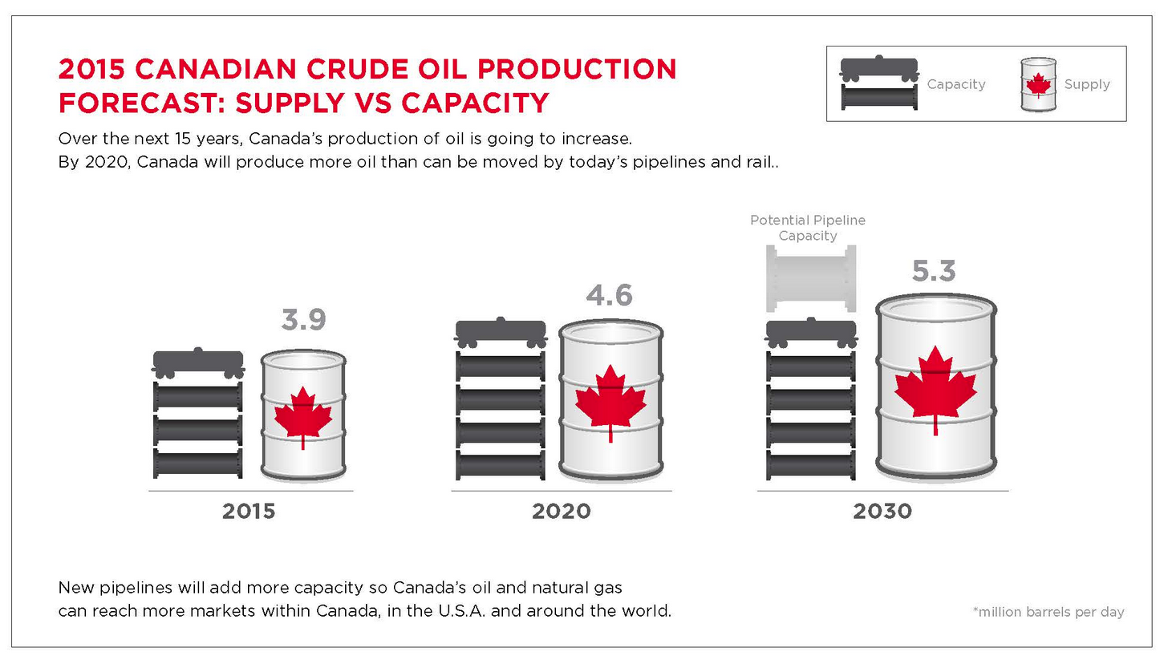
Supply VS Capacity

Slide 15
Major Risk Factors
Operational risk: arising from execution of company business function
Environmental, regulatory, reputational and safety risk
Economy and Price volatility
Reserve Replacement risk: feasibility of extraction and production, contingent resources
Competition from new alternative energies.
Industry Overview
Canadian Natural Resources
Canadian Oil Sands
Encana
Notes:
Arising from execution of company business function

Slide 16
Major Risk Factors
We will analysis each of these risk factors by illustrating three major oil and gas produce in Canada:
Credit/Liquidity risk
Commodity risk
Exchange risk
Interest risk
Industry Overview
Canadian Natural Resources
Canadian Oil Sands
Encana

Slide 17
Risk Instruments
Objective: Hedge risk of adverse price changes
Methods:
Commodity hedging
Interest rate swaps
Cross currency swaps
Bank credit facilities
Foreign exchange contracts
Future contracts
Forward contracts
Industry Overview
Canadian Natural Resources
Canadian Oil Sands
Encana

Slide 18
2015 Oil & Natural Gas Market Outlook
Oil
Oil is expected to be the slowest growing of the major fuels to 2035, with demand growing at an average of just 0.8% a year.
Gas
Natural gas is expected to be the fastest growing of the fossil fuels – with demand rising at an average of 1.9% a year.
Industry Overview
Canadian Natural Resources
Canadian Oil Sands
Encana
Notes:
According to the forecast conducted BP Global, it believes that….
The reasons for this result are too complicated. Coz it involves many dimensions such as global economics, government policy, environment policy, and various legislation in different regions.
So I briefly summarize some common factors that we can easily understand in this stage.

Slide 19
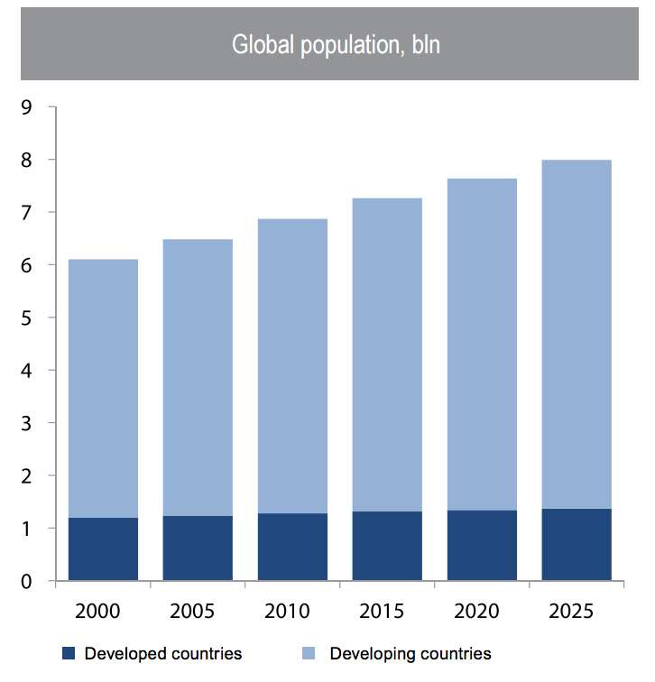
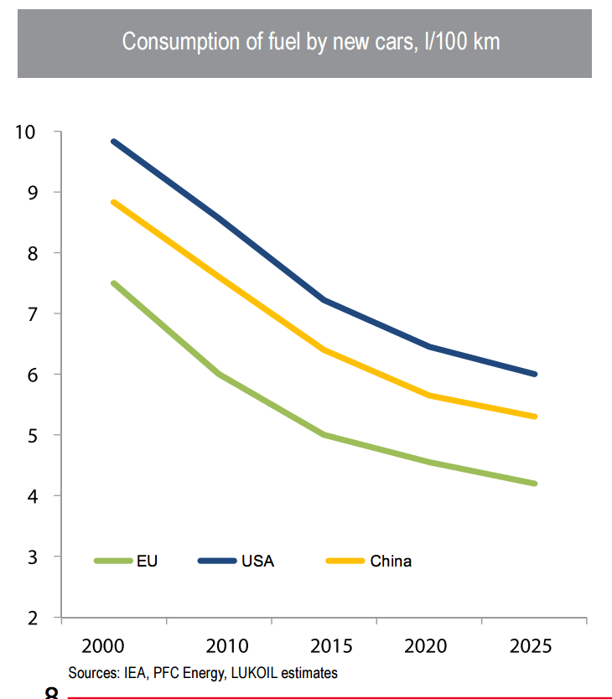
Oil Forecasting
Notes:
Take a look at two chart.
BP global believes that oil consumption will increase slowly due to two main reasons
One is the population growth rate and the other is technology improvement in the next decade.
So the oil consumption will still increase in the next 10 years but with a pretty slight increasing rate.

Slide 20
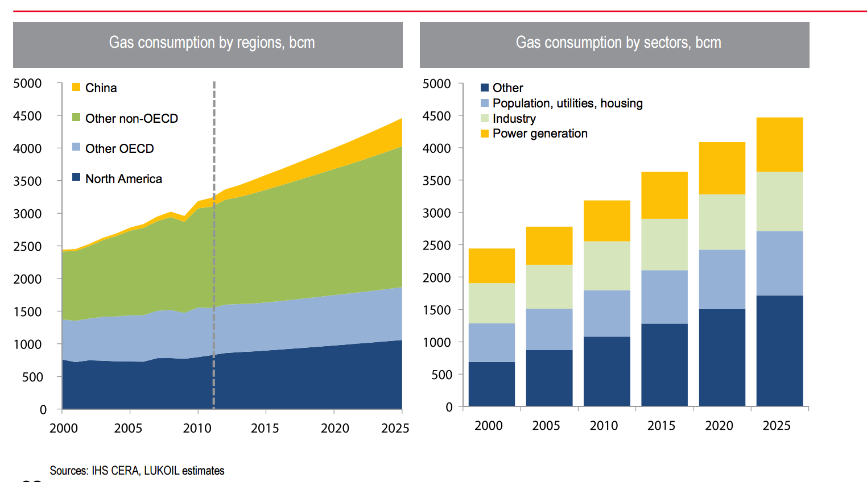
Natural Gas Forecasting
Notes:
While in the gas industry, the consumption will have a faster increasing rate in the next 10 yrs

Slide 21
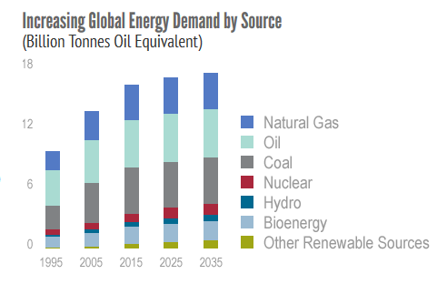
Natural Gas Forecasting
Global demand for energy is expected to increase 33 per cent by 2035 as economies in both developed and emerging countries
Natural gas will be an important part of that growth and is expected to increase 48% by 2035.
Industry Overview
Canadian Natural Resources
Canadian Oil Sands
Encana

Slide 22
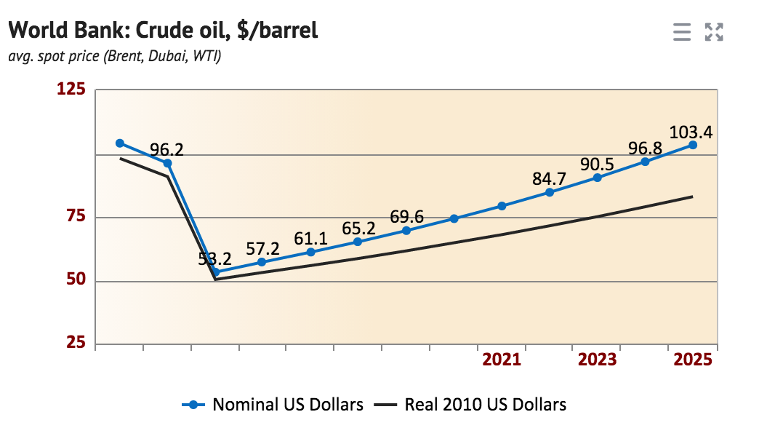
Oil Price Forecast:
Notes:
As

Slide 23

Canadian Natural Resource

Slide 24
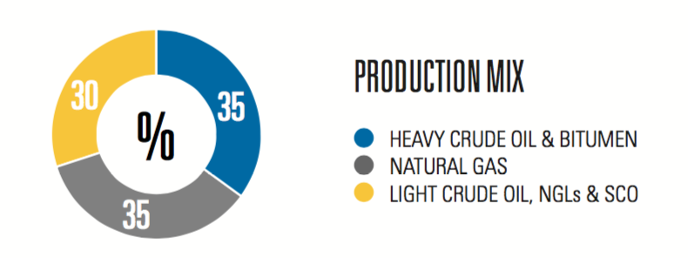
Corporate Profile
Founded in Calgary, Alberta (1973)
Strive to efficient and effective producer
One of the largest independent crude oil and natural gas producers in the world
Bulk of production located in north America, with 35% in natural gas, 35% in heavy oil bitumen, and 30% light crude oil, NGLs & SCO.
Balanced mix of natural gas, heavy oil, bitumen and synthetic crude oil represents one of the strongest and most diverse portfolios of energy producer in the world
Industry Overview
Canadian Natural Resources
Canadian Oil Sands
Encana

Slide 25


Management
N. Murray Edwards
Chairman
Launched canadian natural resources
Bachelor of commerce
Doctor of law
Steve w. Laut
President & director
Bachelor of science in mechanical engineering
Joined CNR ltd. In 1991
President since april 2005
Compensation for 2013: $9,248,828
Industry Overview
Canadian Natural Resources
Canadian Oil Sands
Encana

Slide 26


Management
Tim S. McKay
Coo
Since january 2003
Compensation: $4,053,568
Corey B. Bieber
CFO (since 2013)
Senior vice-president of finance
Bachelor of commerce
Salary: $2,000,010
Industry Overview
Canadian Natural Resources
Canadian Oil Sands
Encana

Slide 27
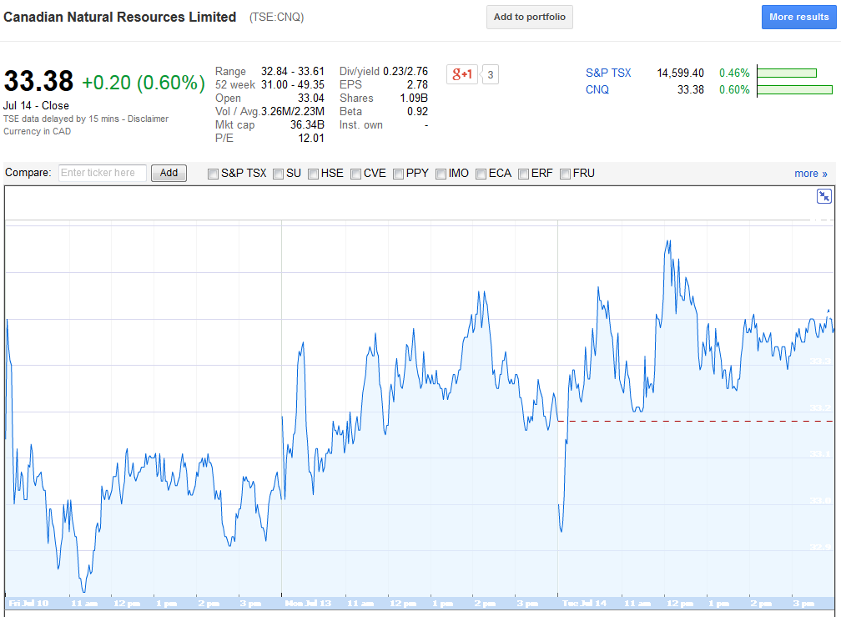
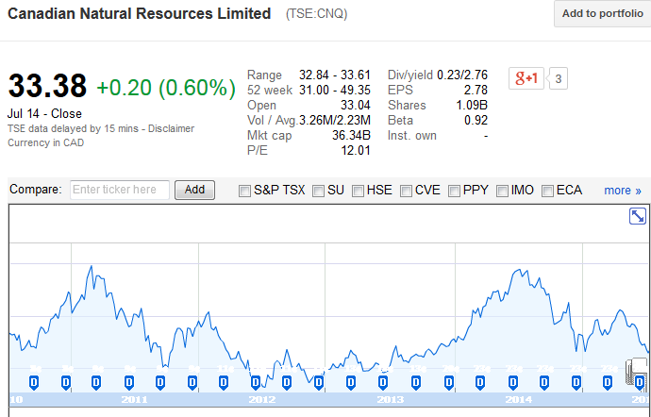
Historical Stock Price in TSX

Slide 28
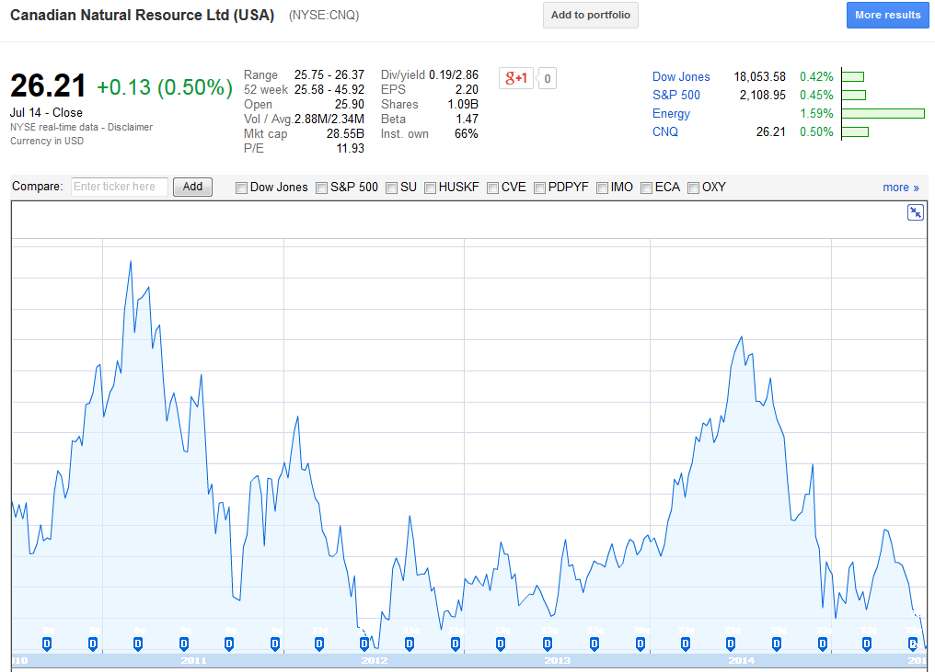
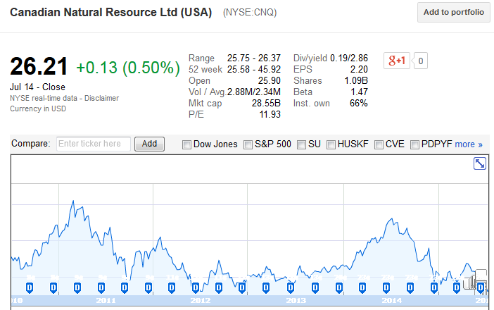
Historical Stock Price in NYSE

Slide 29
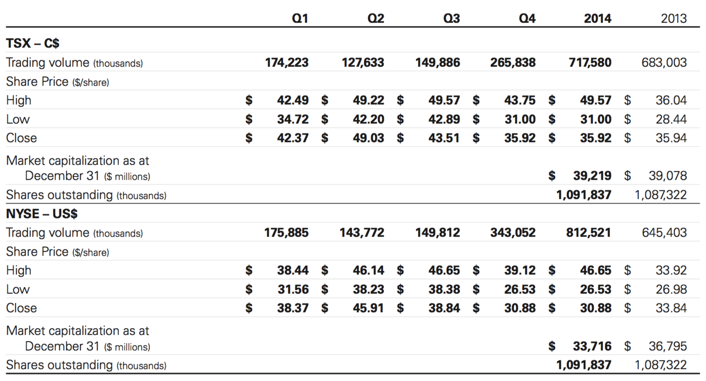
Trading and Share Statistics

Slide 30
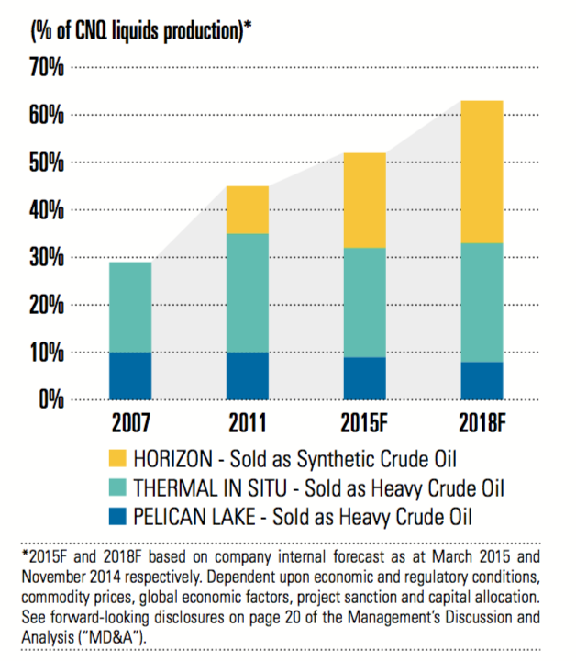
Growth and Development
Transition to a longer life, low decline asset base
In 2015, over 50% of our crude oil and NGL production came from longer-life assets
By 2018, longer-life, low decline production will constitute more than 60% of overall crude oil and NGL production
Transition will result in increasing, sustainable free cash flow generation for years to come
Industry Overview
Canadian Natural Resources
Canadian Oil Sands
Encana

Slide 31
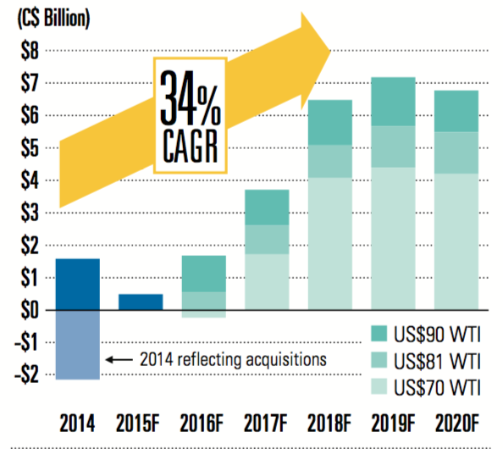
Growth and Development
Sustainable free cash flow will increase substantially
Enable us to execute on our defined growth plan
A key to unlocking the value of our large reserve and resource base
Industry Overview
Canadian Natural Resources
Canadian Oil Sands
Encana

Slide 32
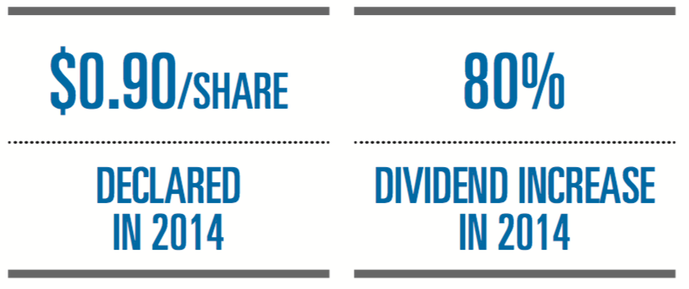
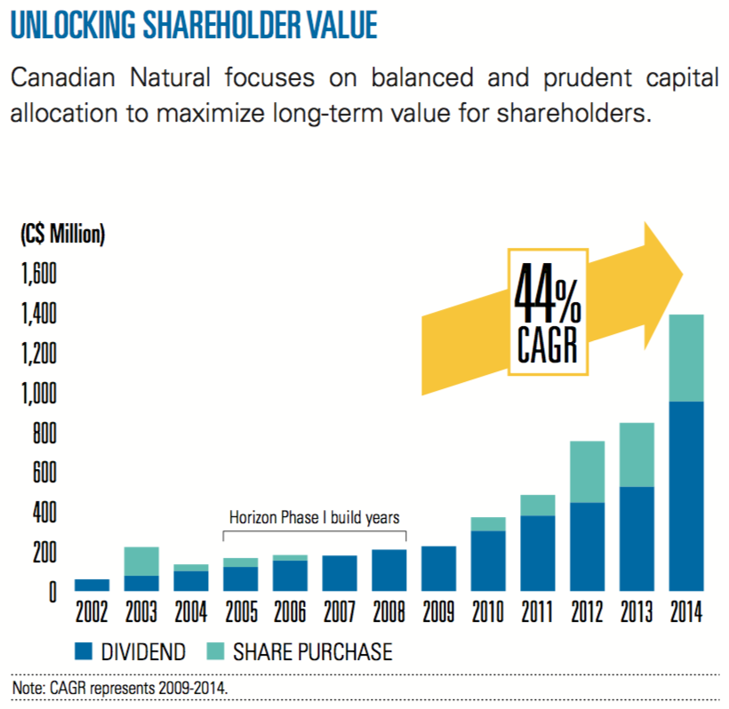
Growth and Development
Continue to execute its strategies and unlock significant value for shareholders
Industry Overview
Canadian Natural Resources
Canadian Oil Sands
Encana

Slide 33
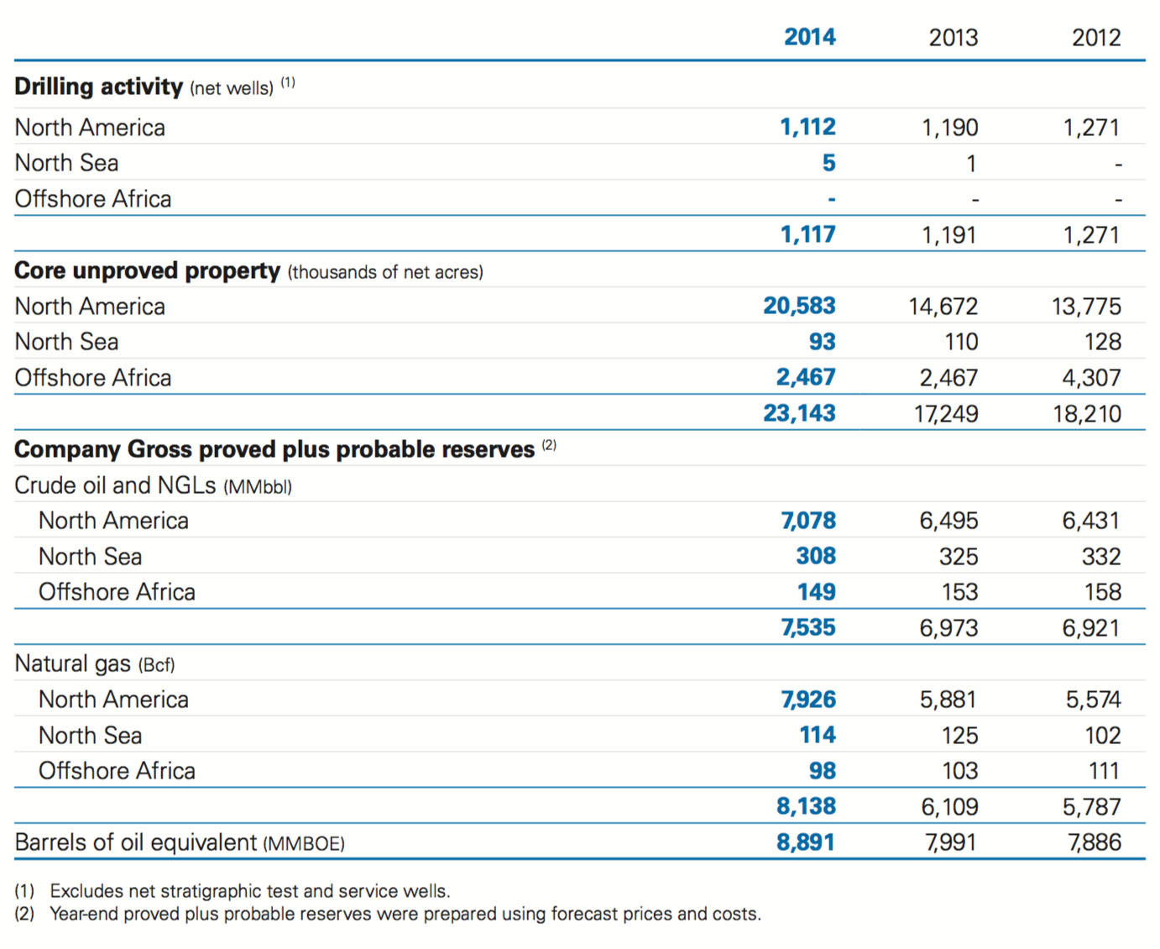
Reserves

Slide 34
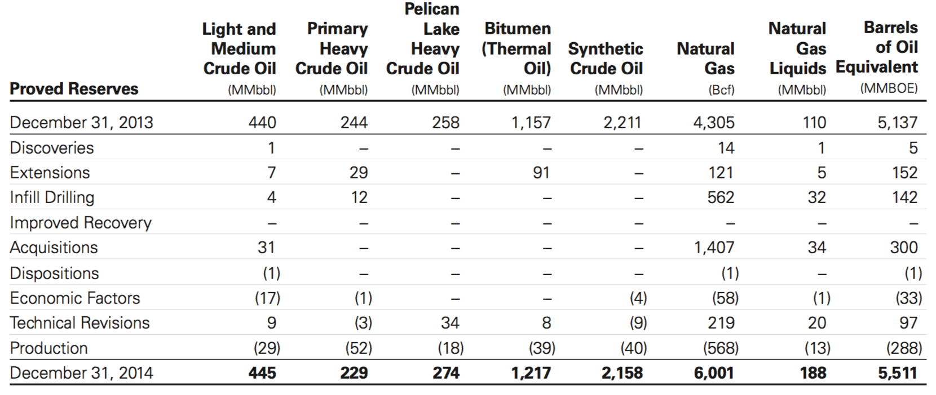
Reserves
Notes:
At December 31, 2014, the company gross proved crude oil, bitumen (thermal oil), SCO and NGLs reserves totaled
4,511 MMbbl, and gross proved plus probable crude oil, bitumen (thermal oil), SCO and NGLs reserves totaled 7,535 MMbbl.
Proved reserve additions and revisions replaced 148% of 2014 production. Additions to proved reserves resulting from
exploration and development activities, acquisitions and future offset additions amounted to 246 MMbbl, and additions to
proved plus probable reserves amounted to 709MMbbl. Net positive revisions amounted to 36 MMbbl for proved reserves and
44 MMbbl for proved plus probable reserves, primarily due to technical revisions to prior estimates.

Slide 35
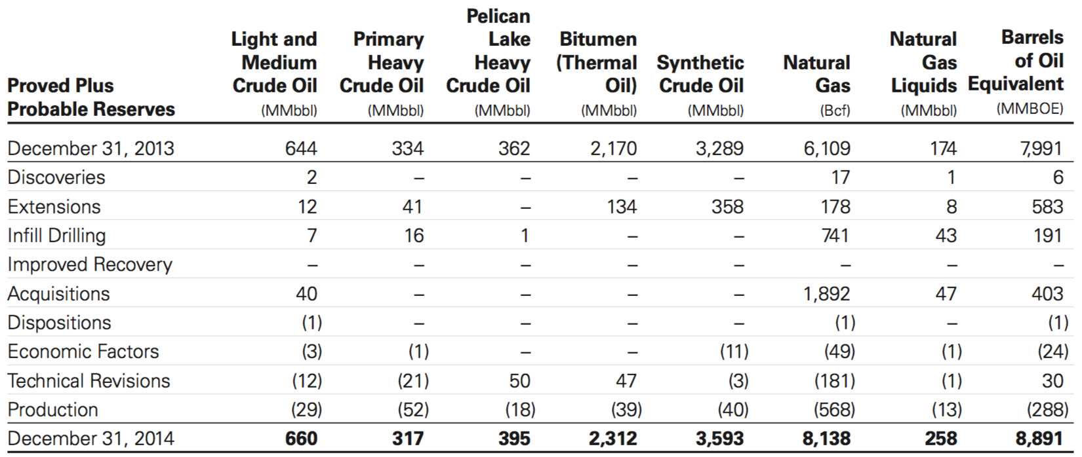
Reserves
Notes:
At December 31, 2014, the company gross proved natural gas reserves totaled 6,001 Bcf, and gross proved plus probable
natural gas reserves totaled 8,138 Bcf. Proved reserve additions and revisions replaced 399% of 2014 production. Additions to
proved reserves resulting from exploration and development activities, acquisitions and future offset additions amounted to
2,103 Bcf, and additions to proved plus probable reserves amounted to 2,827 Bcf. Net positive revisions amounted to 161 Bcf
for proved reserves and net negative revisions amounted to 230 Bcf for proved plus probable reserves, primarily due to
technical revisions to prior estimates.

Slide 36
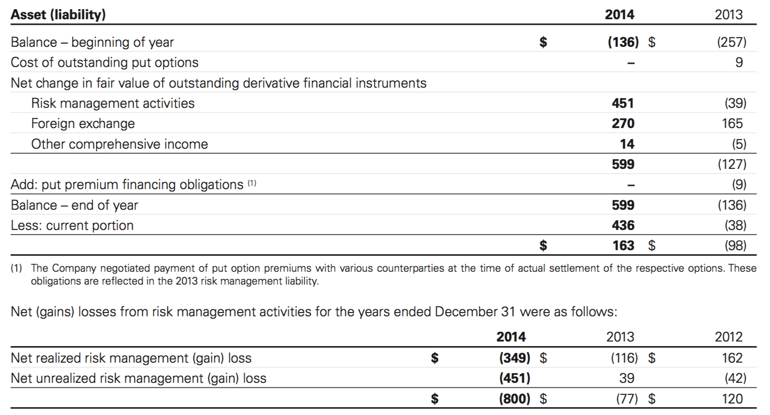
Risk Management
The company uses derivative financial instruments to manage its commodity price, interest rate and foreign currency exposures. These financial instruments are entered into solely for hedging purposes and are not used for speculative purposes.
The changes in estimated fair values of derivative financial instruments included in the risk management asset (liability) were recognized in the financial statements
Industry Overview
Canadian Natural Resources
Canadian Oil Sands
Encana

Slide 37
Risk Factors
Market risk-risk that the fair value or future cash flows of a financial instrument will fluctuate because of changes in market prices, comprised of commodity price risk, interest rate risk, and foreign currency exchange risk
Credit risk-is a party to a financial instrument will cause a financial loss to the company by failing to discharge an obligation.
Liquidity risk – risk that the company will have difficulties meeting its financial liabilities
Industry Overview
Canadian Natural Resources
Canadian Oil Sands
Encana

Slide 38
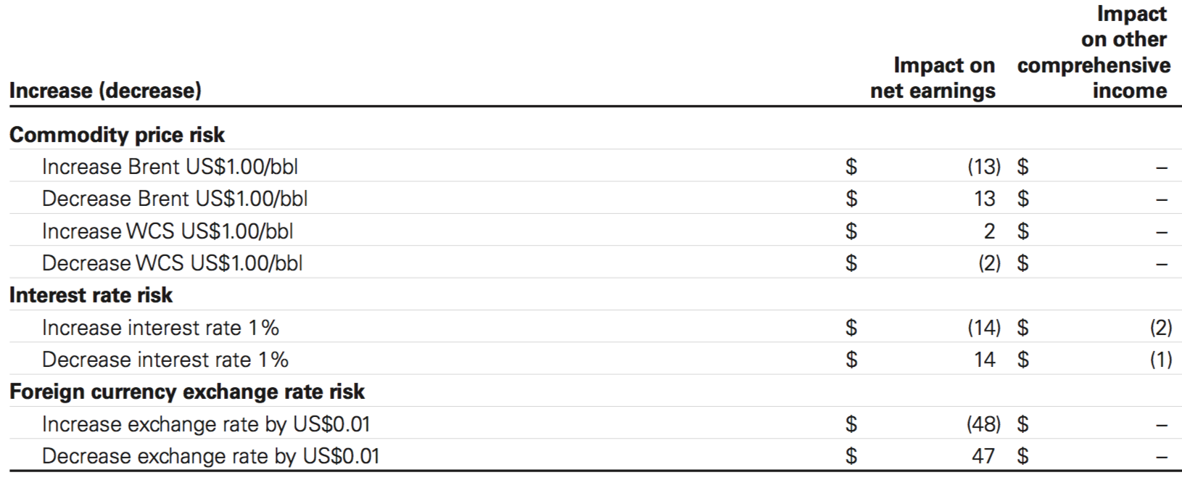
Derivatives Instruments for Hedging Market Risk
Commodity risk
Commodity hedging
Interest rate risk
Interest rate swaps
Foreign exchange risk
Cross currency swaps
Industry Overview
Canadian Natural Resources
Canadian Oil Sands
Encana

Slide 39
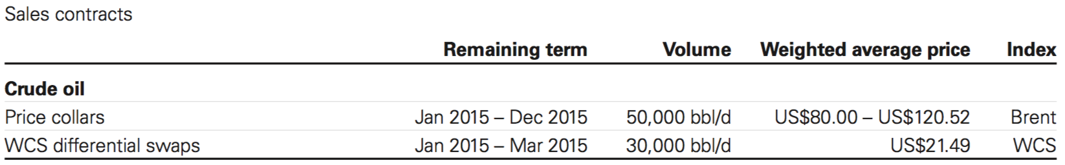
Commodity Price Risk Management
Commodity derivative instruments are used to hedge exposure to commodity price risk associated with the sale of future crude oil and natural gas production, and with natural gas purchases.
Industry Overview
Canadian Natural Resources
Canadian Oil Sands
Encana

Slide 40
Interest Rate Risk Management
The company is exposed to interest rate price risk on its fixed rate long-term debt and to interest rate cash flow risk on its floating rate long-term debt
Periodically enters into interest rate swap contracts to manage its fixed to floating interest rate mix on long-term debt
The interest rate swap contracts require the periodic exchange of payments without the exchange of the notional principal amounts on which the payments are based
At December 31, 2014, the company had no interest rate swap contracts outstanding
Industry Overview
Canadian Natural Resources
Canadian Oil Sands
Encana

Slide 41
Foreign Currency Exchange Rate Risk Management
The company is exposed to foreign currency exchange rate risk in Canada primarily related to its US dollar denominated long-term debt, commercial paper and working capital
Also exposed to foreign currency exchange ate risk on transactions conducted in other currencies and in the carrying value of its foreign subsidiaries
The company had US$1,766 million of foreign currency forward contracts outstanding, with terms of approximately 30 days or less, including US$500 million designated as cash flow hedges
The cross currency swap contracts require the periodic exchange of payments with the exchange at maturity of notional principal amounts on which the payments are based
Industry Overview
Canadian Natural Resources
Canadian Oil Sands
Encana

Slide 42
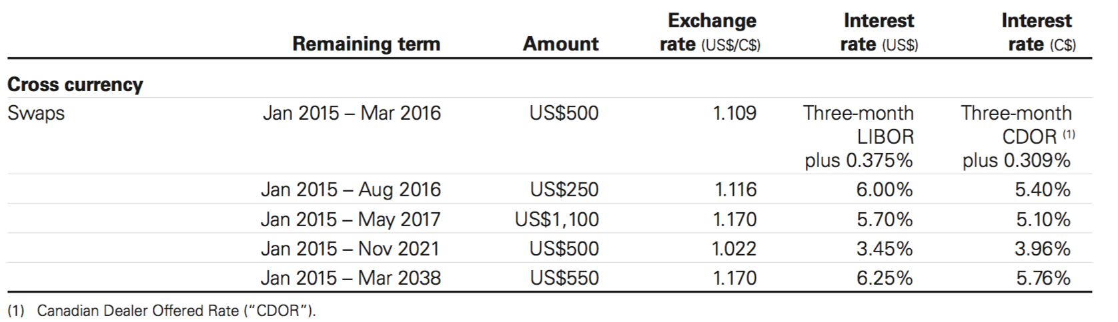
Cross Currency Swaps
Notes:
All cross currency swap derivative financial instruments were designated as hedges at December 31, 2014 and were classified
as cash flow hedges.
In addition to the cross currency swap contracts noted above, at December 31, 2014, the Company had US$1,766 million of
foreign currency forward contracts outstanding, with terms of approximately 30 days or less, including US$500 million
designated as cash flow hedges.

Slide 43
Credit Risk
The company’s accounts receivable are mainly with customers in the crude oil and natural gas industry and are subject to normal industry credit risks
Managing risk by review individual companies, like parental guarantees or letters of credit
Managing risk by entering into agreements with counterparties that are substantially all investment grade financial institutions and other entities
At December 31, 2014, the company had net risk management assets of $622 million with specific counterparties related to derivative financial instruments
Industry Overview
Canadian Natural Resources
Canadian Oil Sands
Encana

Slide 44
Liquidity Risk
Requires the company to maintain sufficient cash and cash equivalents, along with other sources of capital, consisting primarily of cash flow from operating activities, available credit facilities, commercial paper and access to debt capital markets.
Adequate bank credit facilities to provide liquidity to manage fluctuations in the timing of the receipt and/or disbursement of operating cash flows
Industry Overview
Canadian Natural Resources
Canadian Oil Sands
Encana

Slide 45
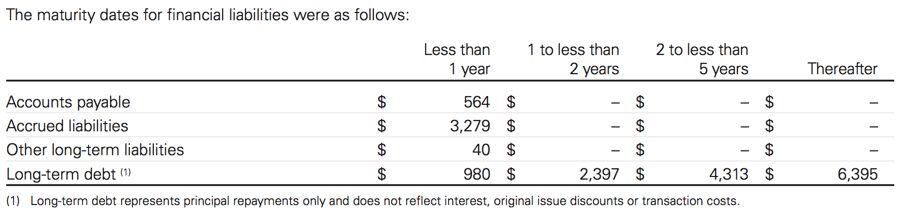
Liquidity Risk

Slide 46
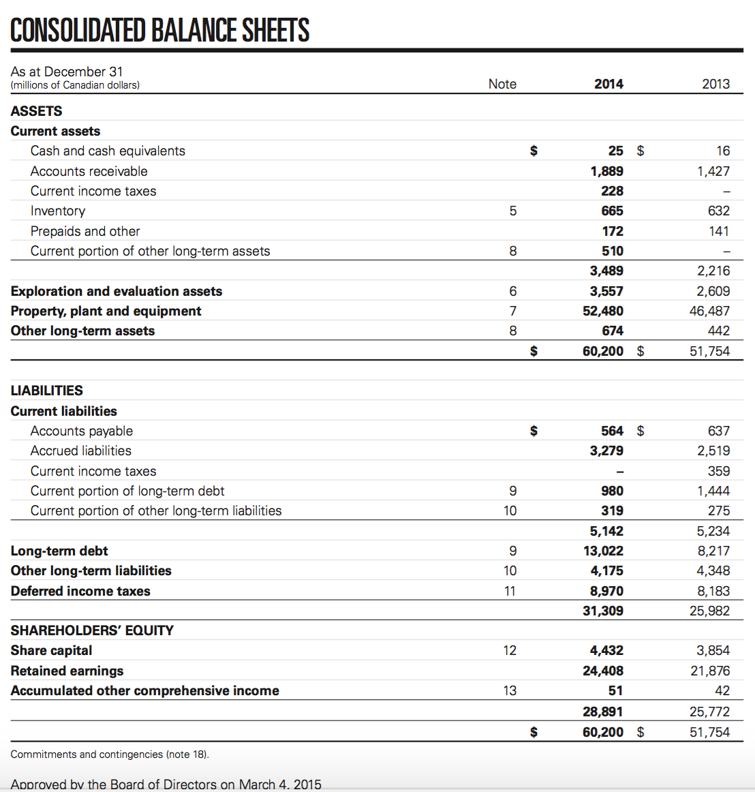
Consolidated Balance Sheets

Slide 47
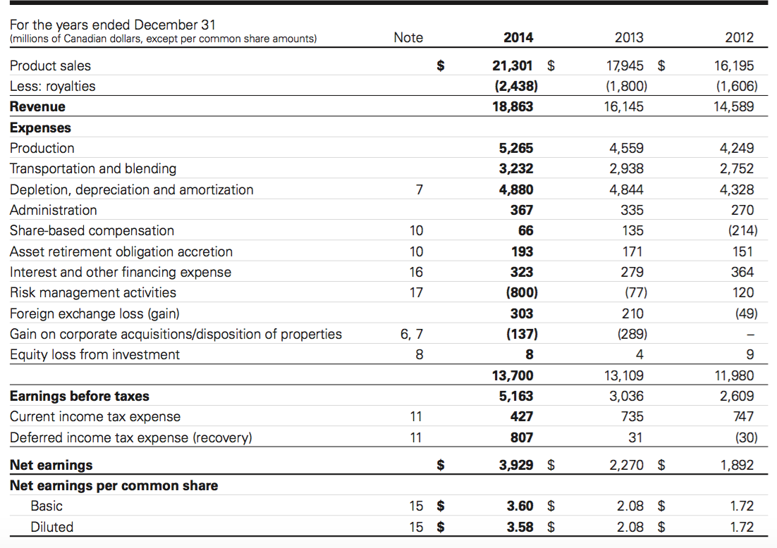
Consolidated Income Statements

Slide 48
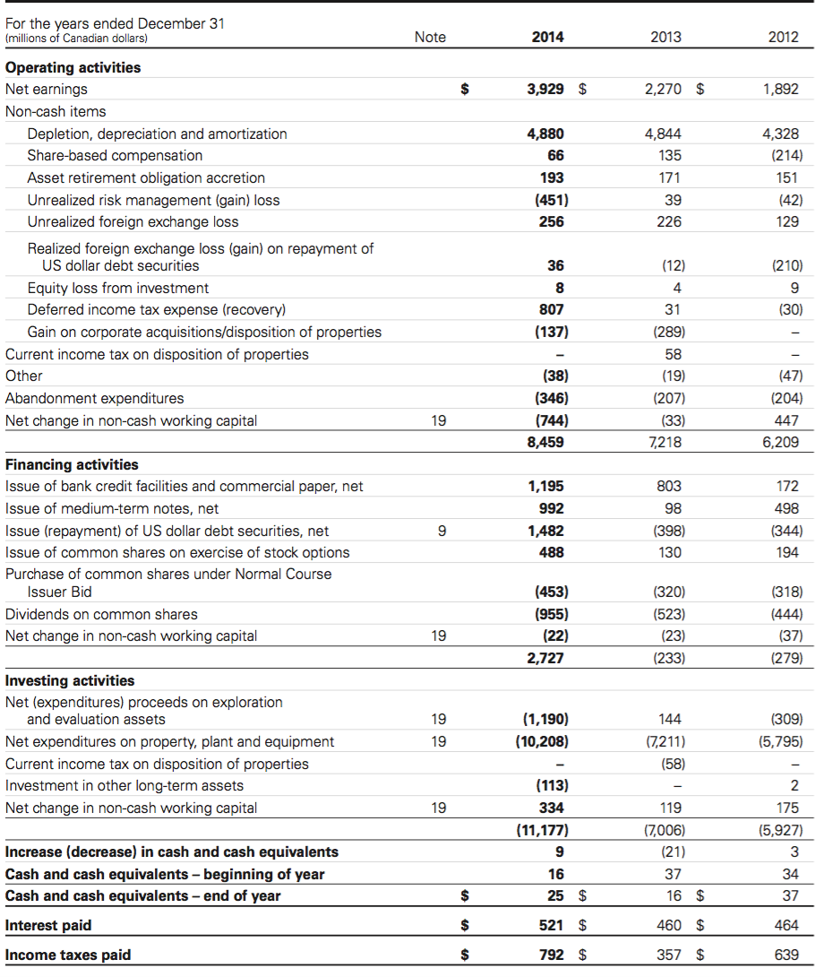
Consolidated Statements Of Cash Flows

Slide 49


Slide 50
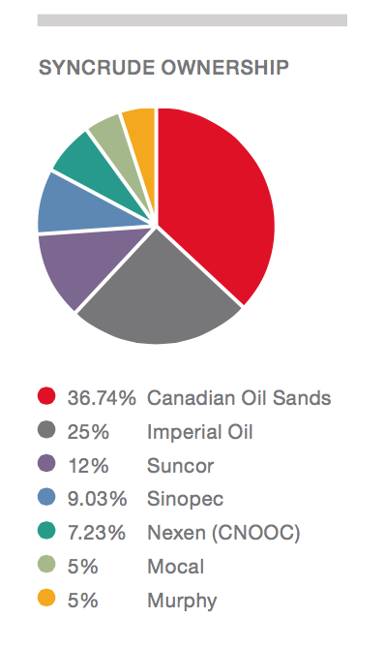
Overview
Canadian Oil Sands (COS):
A limited liability, publicly traded Canadian corporation
The largest owner of the sync rude joint venture
A major producer of high quality, low Sulphur, light, synthetic crude oil
Industry Overview
Canadian Natural Resources
Canadian Oil Sands
Encana
Notes:
And it is a major producer of high quality, low sulphur, light, synthetic crude oil (“SCO”).
Canadian Oil Sands is the largest owner of the Syncrude Joint 􏰹enture (“Syncrude”),
Take a look at this par chat.
Canadian Oil Sands’ only producing asset is its 36.74 per cent working interest in Syncrude, generating revenue from its share of production. COS represents the only public opportunity for undiversified investment directly in Syncrude.

Slide 51


Shareholder Information
Donald J. Lowry
Chairman of the Board
Joined the COS in 2007
Bachelor of Commerce (Hons) degree & MBA
Harvard Advanced Management Program
Ian A. Bourne
Corporate Director
Joined the COS board in 2007
Bachelor of Commerce degree
Director Education Program
Notes:
COS’s board of director contains many intelligent people.
They are still working for COS right now.

Slide 52
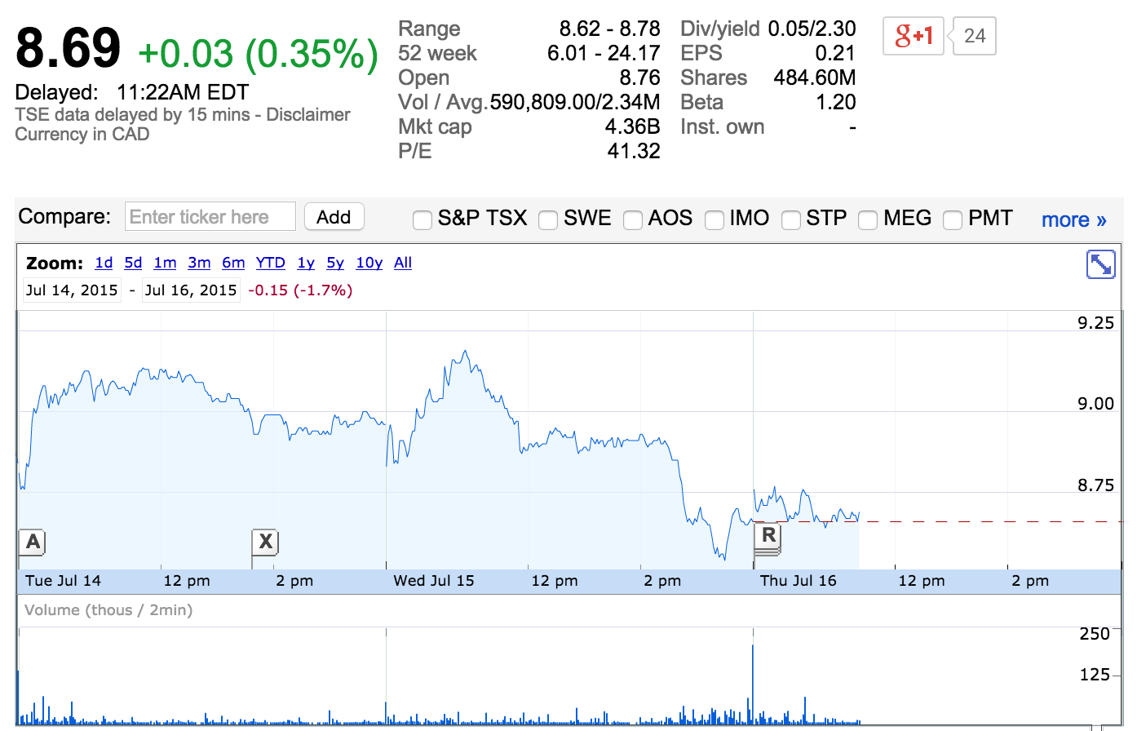
Stock Price
Notes:
As of today, the stock price of COS is $8.69.
Although in this chart, you can easily identify a fluctuant trend, comparing to the stock price in previous period, it shows a decreasing trend.

Slide 53
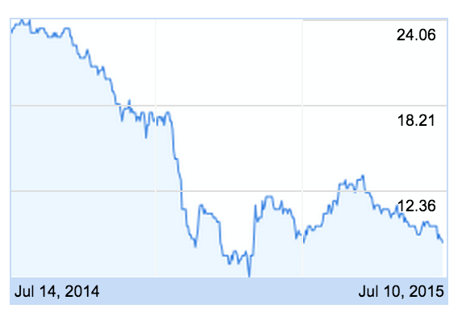
Historical Stock Price
Notes:
This chart illustrates the trends of COS’s stock price better.
From July 2014 to July 2015, in this one year period, the stock price of COS drops from nearly $24 to only nearly $9.

Slide 54
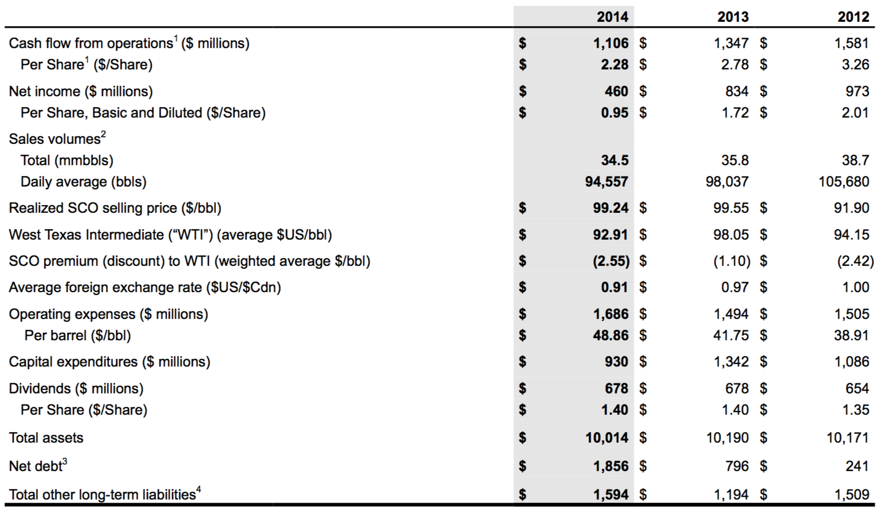
Highlights
Notes:
Why does the stock price of COS drops a lot in this recent years?
Let’s analysis the firm’s performance first.
From COS’s financial report in 2014:
Canadian Oil Sands Limited (􏰻COS􏰻) generated cash flow from operations of 􏱅1,106 million (􏱅2.28 per Share) in 2014 compared with 􏱅1,347 million (􏱅2.78 per Share) in 2013.
And the sales volume underwent a slight decrease in 2014 which is 34.5 while in 2013 the sales volume is 35.8
Meanwhile, COS generated nearly $200 million more in operating expense in 2014 comparing to the number in 2013.
And we can conclude the decrease of 􏱅241 million in its cash inflow largely reflects higher operating expenses and lower sales volumes, partially offset by lower current taxes.

Slide 55
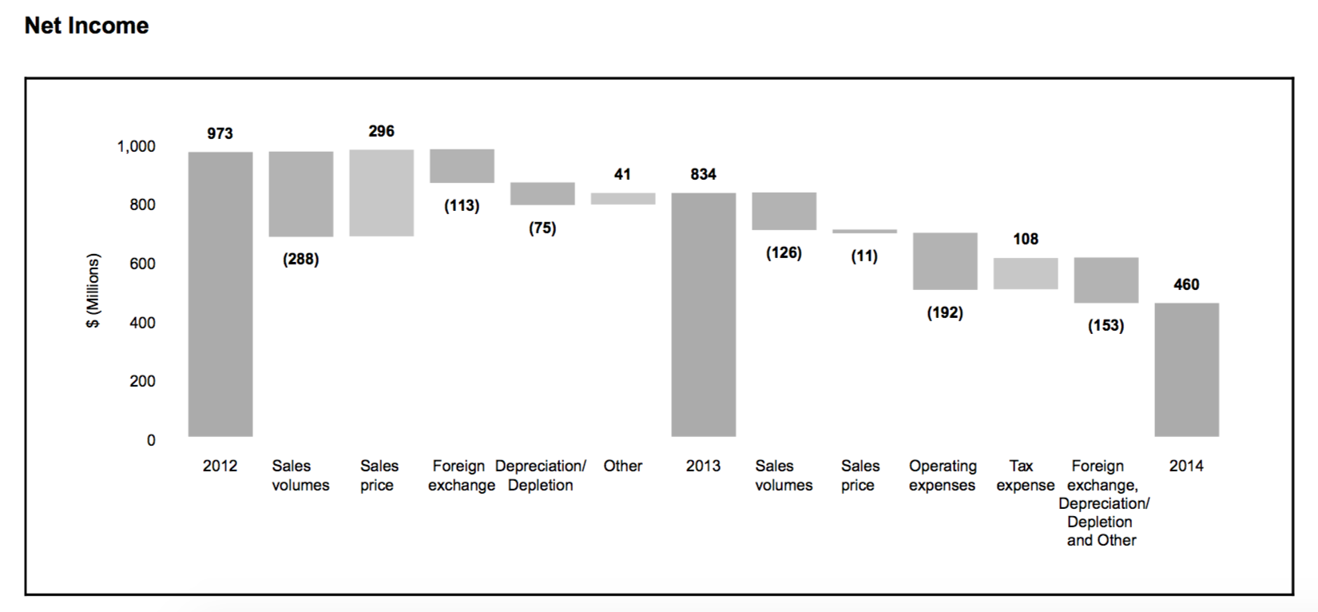
Highlights
Industry Overview
Canadian Natural Resources
Canadian Oil Sands
Encana
Notes:
Canadian Oil Sands reported net income of 􏱅􏱅􏱅460 million in 2014 compared with 􏱅􏱅􏱅834 million in 2013, primarily reflecting the same factors that impacted cash flow from operations.
Additionally, foreign exchange losses and depreciation and depletion expense were higher in 2014 compared with 2013.
Net income decreased to 􏱅􏱅􏱅834 million, or 􏱅􏱅􏱅1.72 per Share, in 2013 from 􏱅􏱅􏱅973 million, or 􏱅􏱅􏱅2.01 per Share,, in 2012.. Lower sales volumes were largely offset by a higher realized selling price in 2013. 􏰼􏰼􏰼however, the Corporation recorded a foreign exchange loss in 2013 as opposed to a foreign exchange gain in 2012 and recorded a higher depreciation and depletion expense in 2013.

Slide 56
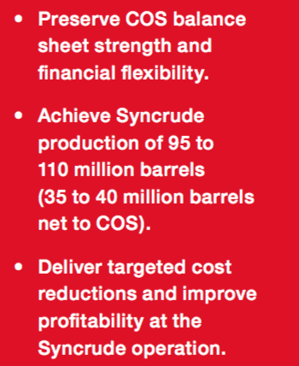
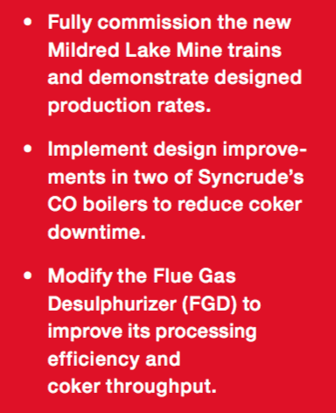
2015 Strategy
Notes:
In response to COS’s lower cash inflow with a higher operation expense, COS provides several strategies to restore investor’s confidence in COS.
Namely….

Slide 57
Risk Management
Canadian oil sands approaches the management of risk systematically through a process designed to identify, categorize and assess risks.
Risks are categorized based on their probability of occurrence and their potential impact on Canadian oil sands’ financial results, financial condition, corporate reputation and EH&S performance.
Risk Management
Crude Oil Price Risk
Operational
Risk
Competition
Risk
Market&
Trans Risk
Environmental
Risk
Ownership Risk
Financial Market Risk
Industry Overview
Canadian Natural Resources
Canadian Oil Sands
Encana
Notes:
And this chart briefly summarize the main 7 risks that COS may face with. And I will through each of these 7 in details.

Slide 58
Crude Oil Price Risk
The financial results and financial condition of Canadian oil sands are significantly impacted by crude oil prices.
Price is subject to large fluctuations in response to changes in the global and regional supply and demand for oil
A prolonged period of low crude oil prices could affect the value of COS’s interest in the syncrude project, the level of capital investment and could ultimately result in deduction of production.
A prolonged period of low crude oil prices could also result in the impairment of Canadian oil sands’ assets, which would likely have a negative impact on COS’s financial condition.
COS response:
it will manage its exposure to crude oil price risk by
maintaining a strong balance sheet and ensuring adequate sources of
financing are available.
Industry Overview
Canadian Natural Resources
Canadian Oil Sands
Encana

Slide 59
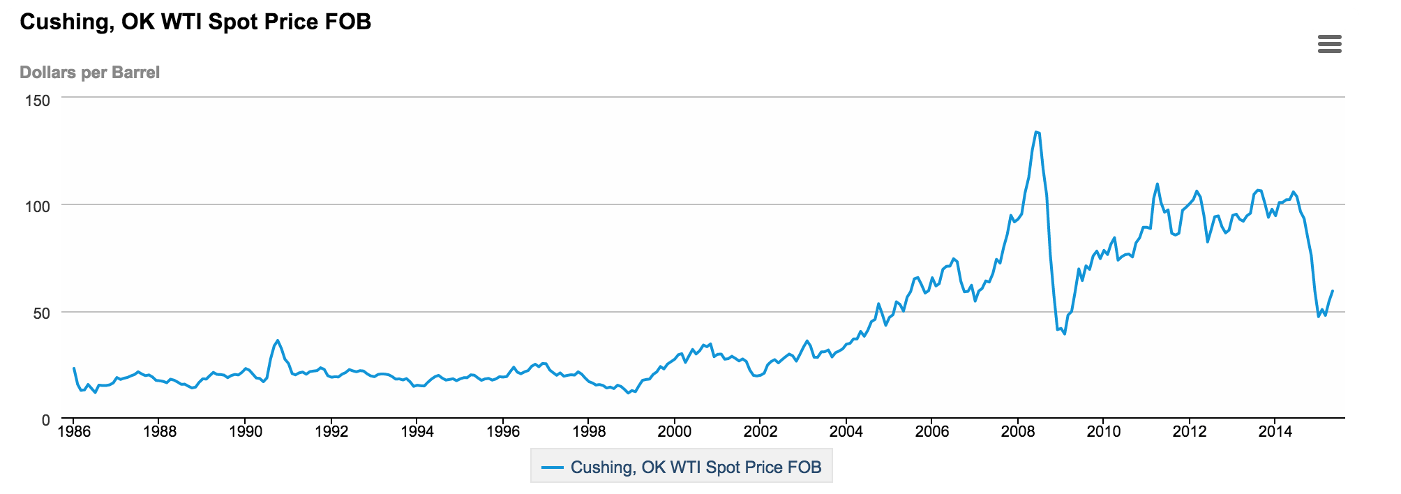

Slide 60
Operational Risk
Operational outages:
COS’s investment in syncrude is its only producing asset and COS’s results depend on syncrude’s operations.
The shutdown of any part of syncrude’s operation could significantly impact the production of COS.
COS response:
It will reduce exposure to some operational risks by maintaining appropriate levels of insurance, primarily business interruption (“BI”) and property insurance.
Industry Overview
Canadian Natural Resources
Canadian Oil Sands
Encana

Slide 61
Operational Risk
Project execution:
Risks associated with the execution of syncrude’s major projects and future growth and development projects
COS response:
Syncrude’s strategic planning function, whose mandate includes the identification and evaluation of capital projects, helps manage these risks with support from imperial oil􏰓/exxonmobil
Industry Overview
Canadian Natural Resources
Canadian Oil Sands
Encana

Slide 62
Competition Risk
Syncrude faces risks associated with competition amongst other oil sands producers for limited resources, in particular skilled labor
The demand for these resources creates cost pressure on products and services to operate, maintain and grow syncrude’s facilities
In addition, the competition for skilled labor has put pressure on recruiting, training and retaining the necessary personnel to operate syncrude’s facilities effectively and efficiently
COS response:
Syncrude formed a cost analysis and strategy taskforce in 2014 to identify more efficient and effective ways to conduct its business. The aim is to reduce the cost structure at syncrude and improve profitability.
Industry Overview
Canadian Natural Resources
Canadian Oil Sands
Encana

Slide 63
Environmental Risk
Tailings management
While syncrude continues to develop tailings and fluid fine tailings reclamation technologies, there is a risk of increased costs to develop and implement various measures
Water access and emissions
Legislation significantly restricts or penalizes water use and/or emissions
COS Response:
Collaborating will other oil sands producers to enable responsible and sustainable growth while delivering accelerated improvement
Industry Overview
Canadian Natural Resources
Canadian Oil Sands
Encana

Slide 64
Marketing And Transportation Risk
Lack of sufficient pipeline capacity or interruptions in pipeline operations could result in apportionment of volumes and therefore adversely impact COS’s crude oil production, sales volumes and􏰓/or the prices received for SCO.
COS response:
Canadian oil sands has committed capacity on a number of proposed pipelines to help secure future market access for product and enhance its marketing flexibility.
Industry Overview
Canadian Natural Resources
Canadian Oil Sands
Encana

Slide 65
Financial Market Risk
Foreign currency risk
Canadian oil sands’ results are affected by fluctuations in the U.S. & Canadian currency exchange rates
Sales are based in part on a WTI benchmark price in U.S. Dollars, while operating expenses and capital expenditures are primarily in Canadian dollars
Industry Overview
Canadian Natural Resources
Canadian Oil Sands
Encana

Slide 66
Financial Market Risk
Interest rate risk:
Changes in market interest rates may affect the corporation’s financial results and financial condition
Impact both long-term debt and short-term investments
Industry Overview
Canadian Natural Resources
Canadian Oil Sands
Encana

Slide 67
Financial Market Risk
Credit risk:
Canadian oil sands is exposed to credit risk primarily through customer accounts receivable balances, financial counterparties with whom the corporation has invested its cash and cash equivalents and with its insurance providers in the event of an outstanding claim
COS response:
It ensures a credit policy that limits exposure based on credit ratings
Industry Overview
Canadian Natural Resources
Canadian Oil Sands
Encana

Slide 68
Financial Market Risk
Liquidity risk:
Liquidity risk is the risk that Canadian oil sands will not be able to meet its financial obligations
The amount and timing of operating commitments
Future capital expenditure requirements
Debt repayments
Adequacy of financing available
COS response:
Canadian oil sands actively manages its liquidity through cash, debt and equity management strategies
Industry Overview
Canadian Natural Resources
Canadian Oil Sands
Encana

Slide 69
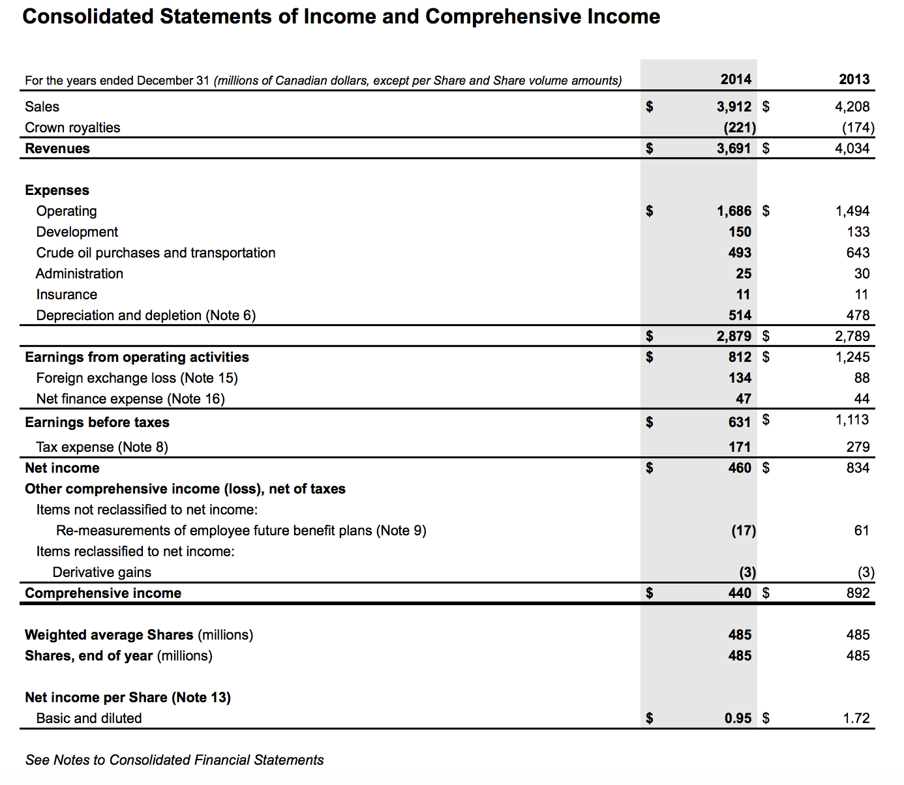

Slide 70
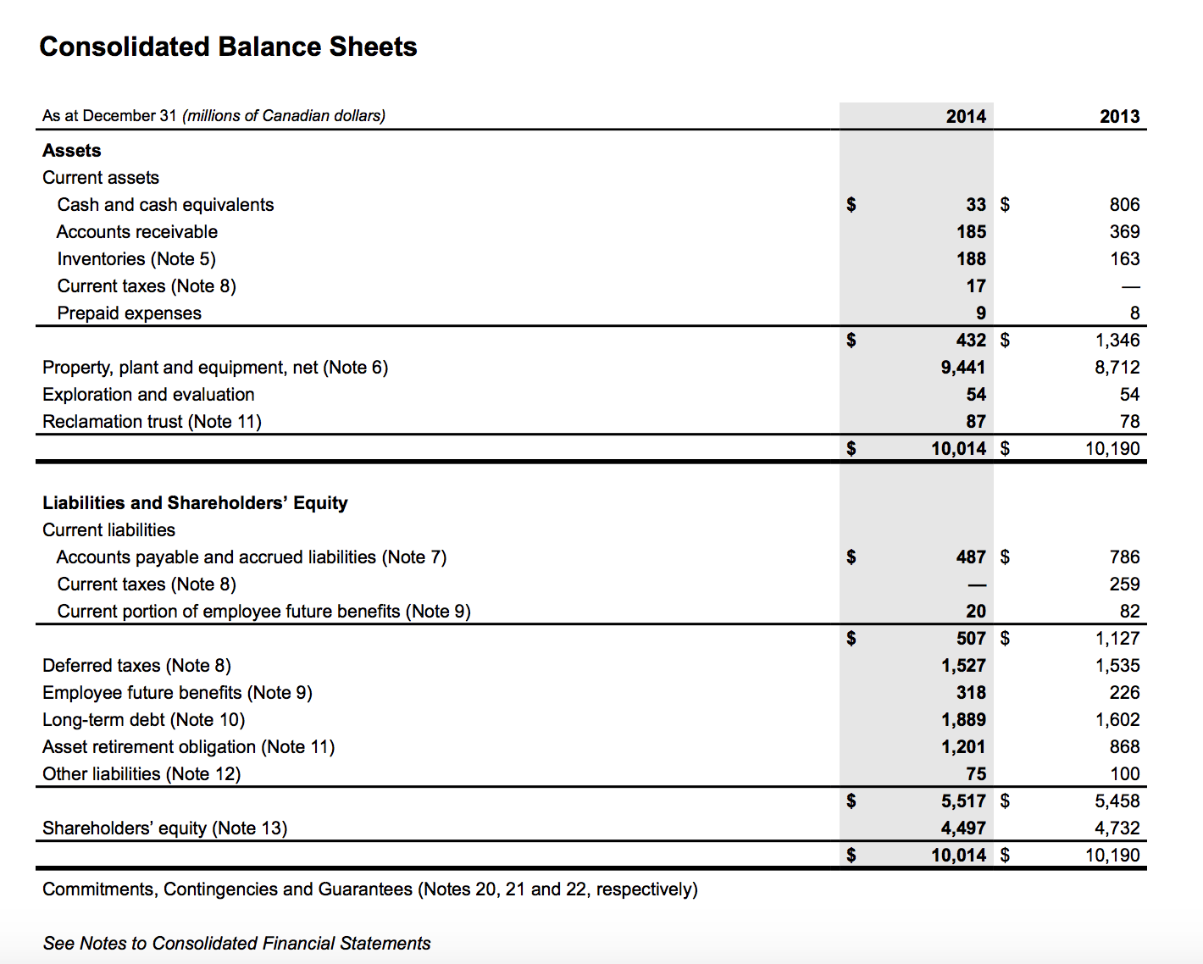

Slide 71

Encana Cooperation
Notes:
Ok, next ill talk about the Encana cooperation

Slide 72

Encana Cooperation
Encana is Canada's largest natural gas producer with a large land position in western Canada of 7.0 million net acres, of which about 3.2 million net acres are undeveloped.
On February 25, 2015 Encana cut $700 million from this year budget after reporting an 85 percent drop in operating profits
Industry Overview
Canadian Natural Resources
Canadian Oil Sands
Encana
Notes:
Encana is a leading North American energy producer that is focused on growing its strong portfolio of diverse resource plays producing natural gas, oil and natural gas liquids.

Slide 73



Management
Doug Suttles
President & Chief Executive Officer
Doug joined Encana in June 2013 as President & CEO. With 30 years of experience in the oil and gas industry in various engineering and leadership roles, he is responsible for the overall success of Encana and for creating, planning, implementing and integrating the strategic direction of the organization.
Sherri Brillon
Executive Vice-President & Chief Financial Officer
Sherri directs the financial operations of the company and ensures Encana has the financial resources in place to enable the execution of its strategy
Joanne Alexander
Executive Vice-President & General Counsel
Joanne is responsible for the overall legal affairs of Encana and its subsidiaries, and overseeing the company’s corporate compliance program
Industry Overview
Canadian Natural Resources
Canadian Oil Sands
Encana

Slide 74
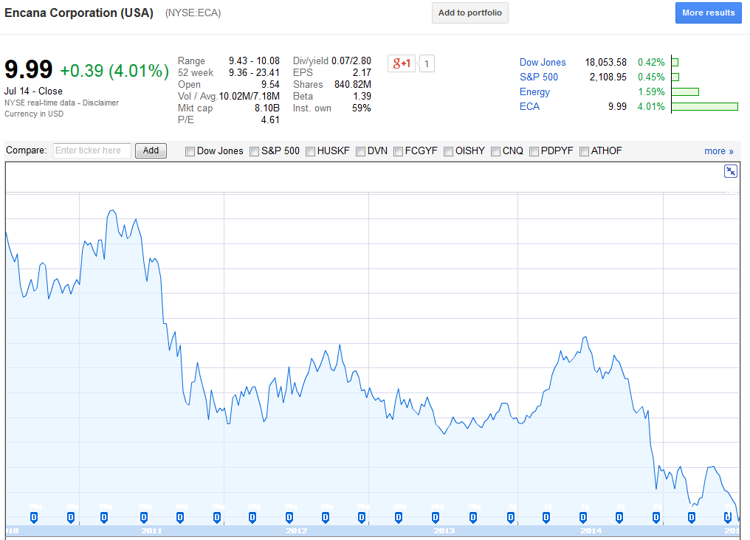
Stock Price
Notes:
The Encana stock price is at one of the lowest point in the history
In 2013, the dividends were 20cents
The highest price is $98.7

Slide 75
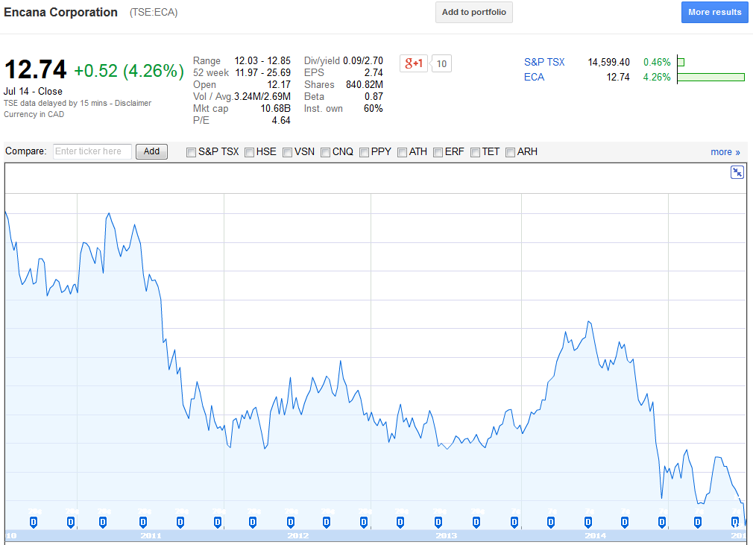

Slide 76
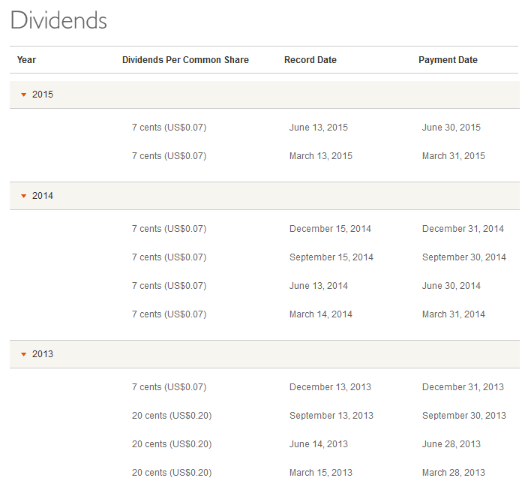
Dividends

Slide 77
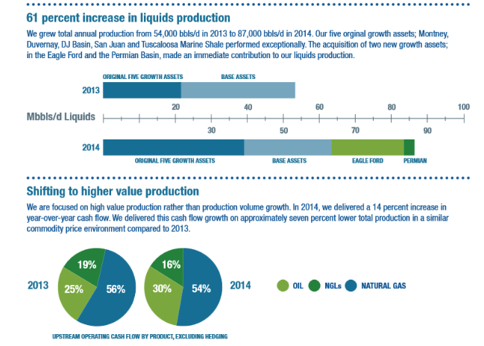
Production Volume

Slide 78
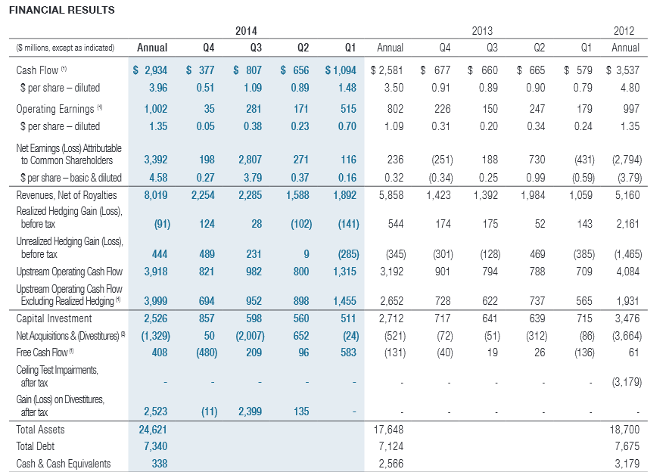
Financial Result
Notes:
By focusing on value over production volume, Encana is focusing 75 percent of its capital program on core growth assets and the remaining 25 percent of capital investments to existing and option value assets.

Slide 79

Operation Ranges
Notes:
Growth Assets
These liquids rich and oil assets offer high returns, are comprised of high quality rocks, have significant running room and scale and create portfolio optionality. In 2014, Encana is targeting an estimated 90 percent liquids production growth in these assets.
Base Asset
In addition to our core growth assets, Encana holds a significant collection of base and option value assets located throughout North America. Optimizing base production is another critical component of our strategy.

Slide 80

Canadian

Slide 81

US

Slide 82
Hedging Philosophy
Partially mitigates its exposure to financial risks through the use of various financial instruments and physical contracts
The use of these derivative instruments is governed under formal policies and is subject to limits established by the board. The company’s policy is to not use derivative financial instruments for speculative purposes
Industry Overview
Canadian Natural Resources
Canadian Oil Sands
Encana

Slide 83
Financial Risk Factors
Market risk
Pricing of natural gas and liquids(commodity price risk)
Foreign exchange rates
Interest rates
Credit
Liquidity
Industry Overview
Canadian Natural Resources
Canadian Oil Sands
Encana
Notes:
Financial
The use of derivative financial instruments is governed under formal policies and is subject to limits established by the Board. All derivative financial agreements are with major global financial institutions or with corporate counterparties having investment grade credit ratings.
Encana has in place policies and procedures with respect to the required documentation and approvals for the use of derivative financial instruments and specifically ties their use to the mitigation of financial risk to achieve investment returns and growth objectives, while maintaining prescribed financial metrics

Slide 84

Commodity Price Risk
Notes:
Commodity
To partially mitigate commodity price risk, the Company may enter into transactions that fix or set a floor and cap on prices. To help protect against regional price differentials, Encana executes transactions to manage the price differentials between its production areas and various sales points.

Slide 85

Sensitivity Analysis
Notes:
The table below summarizes the sensitivity of the fair value of the Company’s risk management positions to fluctuations in commodity prices, with all other variables held constant. The Company has used a 10 percent variability to assess the potential impact of commodity price changes. Fluctuations in commodity prices could have resulted in unrealized gains (losses) impacting pre-tax net earnings as at December 31 as follows:

Slide 86
Foreign Exchange Rates
To mitigate the exposure to fluctuations in the US/CAD, Encana may enter into foreign exchange contracts. By maintaining U.S. And Canadian operations, Encana has a natural hedge to some foreign exchange exposure.
Directly issuance of U.S. Dollar denominated debt, the company may enter into cross currency swaps on a portion of its debt as a means of managing the U.S./Canadian dollar debt mix.
As at December 31, 2014, Encana had $6.7 billion in U.S. Dollar debt issued from Canada that was subject to foreign exchange exposure (2013 – $5.4 billion) and $0.6 billion in debt that was not subject to foreign exchange exposure (2013 – $1.7billion).
Industry Overview
Canadian Natural Resources
Canadian Oil Sands
Encana
Notes:
Foreign exchange risk arises from changes in foreign exchange rates that may affect the fair value or future cash flows of the
Company’s financial assets or liabilities.
Credit and liquidity risk
The Company has access to cash equivalents and a range of funding alternatives
at competitive rates through committed revolving bank credit facilities and debt and equity capital markets. Encana closely monitors the Company’s ability to access cost-effective credit and ensures that sufficient liquidity is in place to fund capital expenditures and dividend payments. The Company minimizes its liquidity risk by managing its capital structure which may include adjusting capital spending, adjusting dividends paid to shareholders, issuing new shares, issuing new debt or repaying existing debt.
Encana may enter into interest rate
swap transactions from time to time as an additional means of managing the fixed/floating rate debt portfolio mix.

Slide 87
Interest Risk
Arise from changes in market interest rates that may affect the fair value or future cash flows from the financial asset or liabilities
Mitigate exposure by managing the portfolio mix of both fixed and floating rate debt
Industry Overview
Canadian Natural Resources
Canadian Oil Sands
Encana

Slide 88
Credit Risk
This credit risk exposure is mitigated through the use of board-approved credit policies governing the company’s credit portfolio including credit practices that limit transactions according to counterparties’ credit quality
Mitigation strategies may include master netting arrangements, requesting collateral and/or transacting credit derivatives
Industry Overview
Canadian Natural Resources
Canadian Oil Sands
Encana
Notes:
To partially mitigate commodity price risk, the Company may enter into transactions that fix, set a floor or set a floor and cap on prices. To help protect against regional price differentials, Encana executes transactions to manage the price differentials between its production areas and various sales points

Slide 89

Liquidity Risk
Arise from the potential difficulties in meeting a demand to fund its financial liabilities as they come due. Encana manages liquidity risk by using cash and debt management programs.
Access to cash equivalents and a range of funding alternatives at competitive rates through committed revolving bank credit facilities and debt and equity capital markets.
Timing of cash outflows relating to financial liabilities:
Industry Overview
Canadian Natural Resources
Canadian Oil Sands
Encana

Slide 90
Other Risks
Operational risks: the risk of loss or lost opportunity resulting from
Operating activities
Capital activities
Reserves & resources replacement
To mitigate risks, projects evaluated on fully risked basis, including engineering risk and geological. Also, encana mitigates risks through a number of other policies, systems and processes as well as by maintaining a comprehensive insurance program
Industry Overview
Canadian Natural Resources
Canadian Oil Sands
Encana

Slide 91
Other Risks
Environmental, regulatory, reputational and safety risks:
When assessing the materiality of environmental risk factors, encana takes into account a number of qualitative and quantitative factors the financial, operational, reputational and regulatory aspects of each identified risk factor. These risks are managed by executing policies and standards that are designed to comply with or exceed government regulations and industry standards. In addition, encana maintains a system that identifies, assesses and controls safety, security and environmental risk.
Industry Overview
Canadian Natural Resources
Canadian Oil Sands
Encana

Slide 92

Risk Management Assets & Liabilities

Slide 93

Risk Management Assets & Liabilities

Slide 94


Slide 95


Slide 96


Slide 97

THANKS FOR YOUR ATTENTAION

